Slide 1
WARM-UP · THINK • TRY • CHECK
Turn and talk: compare strategies, then defend one.
Warm-Up
Lesson 4-1 · Understand Percent | Warm-Up · about 4 minutes
Try each on your own. Mark an unsure answer; explain and revise when we check.
QUESTION 1
QUESTION 2
Write 53 out of 100 as a fraction: ______
9 of the 100 squares are shaded. As a percent: ______
QUESTION 3
QUESTION 4
Write 71 hundredths as a decimal: ______
Write 25/100 in simplest form: ______
TALK IT OVER: “I got ______ because ______.” • Compare with a partner before we check as a class.
1 / 40
Notes:
TEACH IN PRACTICE | Embedded facilitation | Lesson 4.1, slide 1 | WARMUP
Focus on the existing task: Warm-Up WARM-UP · THINK • TRY • CHECK Do these four on your own. We…
GATHER EVIDENCE (T4/6): Keep the original items. Students try independently, mark an uncertain item, and explain one method before checking. Use the existing key when present.
RESPOND: Distinguish a calculation slip from a reasoning gap. Give one next step on the same item; have students revise in a second color. Use the responses to choose flexible support for today’s lesson.
PARTICIPATION (T5/6/7): Think time before volunteers; accept a written, drawn or rehearsed entry. Students ask for evidence respectfully. Recognize a specific contribution or revision and check that both partners participate.
Source: BCPS Updated Instructional Framework Rubric (June 2020), TEACH 1–7. Earlier notes and answer keys are retained below.
EARLIER NOTES / EXISTING ANSWER KEY
Warm-Up answers (teacher only): 1) 53/100 2) 9% 3) 0.71 4) 1/4
UIFR FULL | Lesson-specific facilitation
PREPARE 1-2 | Before teaching (UIFR PDF pp. 6-7).
Plan to gather evidence that students can identify the whole; represent a rate per 100; interpret values above 100 percent. Review recent work and today’s warm-up to choose flexible groups and access supports; do not infer needs from identity or perceived ability. Use the existing lesson tasks and stated standards.
Anticipate: assuming a percent must be less than or equal to 100. If observed, label 100 percent on the existing grid or tape diagram before locating the part. Offer oral rehearsal, drawing, pointing, or home-language processing as needed; retain the original mathematical demand. Ask students which support helps and fade it as evidence improves.
TEACH 6-7 | Before the first transition, agree on materials, partner roles, and how to request help. Invite students to restate the routine. Normalize revising an idea, recognize a specific contribution, and check privately when frustration blocks participation. Source: UIFR PDF pp. 13-14.

Slide 2
Vocabulary: Understand Percent
Lesson 4-1 • Copy each word and its meaning
percent
A ratio per 100. The symbol is %.
por ciento
whole
The entire amount. One complete group is 100%.
todo / entero
compare
Describe how a part relates to a whole.
comparar
equivalent
Different names for the same value or ratio.
equivalente
decimal grid
A 10 × 10 grid with 100 equal squares.
cuadrícula decimal

Slide 3
Tell a partner the goal and why it matters.
Today’s Objectives
Lesson 4-1 · Understand Percent
Understand Percent
Maryland Standard 6.AT.4
CONTENT OBJECTIVE
LANGUAGE OBJECTIVE
Restate the goal in your words
Use these words to explain why
I can explain a percent as a rate per 100, model it on a decimal grid or tape diagram, and interpret percents greater than 100%.
I can explain what a percent means using the words per hundred, part, whole, and equivalent ratio.
eduwonderlab.com · Neft Teacher
3 / 40
Notes:
TEACH IN PRACTICE | Embedded facilitation | Lesson 4.1, slide 3 | GOAL
Focus on the existing task: Today’s Objectives Understand Percent Maryland Standard 6.AT.4 CONTENT…
CONNECT (T1/4): Ask students to restate the displayed goal or key idea and connect it to earlier work. Relevant lesson evidence: identify the whole; represent a rate per 100; interpret values above 100 percent. Use only the criterion that matches the current session.
SHOW PROGRESS: Students point to their own existing work, explain what improved after feedback, and name a next step. Pair confidence ratings with actual evidence.
PARTICIPATION (T5/6/7): Think time before volunteers; accept a written, drawn or rehearsed entry. Students ask for evidence respectfully. Recognize a specific contribution or revision and check that both partners participate.
Source: BCPS Updated Instructional Framework Rubric (June 2020), TEACH 1–7. Earlier notes and answer keys are retained below.
EARLIER NOTES / EXISTING ANSWER KEY
UIFR TEACH — Level 4 student move: Tell a partner the goal and why it matters.
Student move: Tell a partner the goal and why it matters.
UIFR FULL | Lesson-specific facilitation
TEACH 1 | Session 1 purpose and evidence (UIFR PDF p. 8).
Have students restate the displayed session goal in their own words and connect it to the existing context or a familiar experience they choose to share. Use the current session goal to select from these lesson-wide evidence criteria; do not frontload a later-session procedure.
Look for: identify the whole; represent a rate per 100; interpret values above 100 percent. Ask: “Which part of your work would show this?” Revisit that evidence after the task; a confidence rating alone is not evidence of understanding.

Slide 4


Ask a partner a question; choose a model together.
Middle School Mascot
Middle school students voted on a new mascot for their school. The results show that four out of every ten voters selected the tiger as the new mascot.
How many students out of every 100 voted for the tiger?
Using Representations
14 / 40
Notes:
TEACH IN PRACTICE | Embedded facilitation | Lesson 4.1, slide 14 | TASK
Focus on the existing task: Middle school students voted on a new mascot for their school. The results show that four out of every ten voters selected the tiger as the new mascot. How many students out of every 100 voted for the tiger?
LAUNCH (T2/3/5): Use the displayed question. Give private thinking time; then A explains while B asks for evidence. Switch roles. Each student records their own reasoning.
LOOK FOR (T4): Where this task addresses it, students can identify the whole. Ask which feature of their work supports the claim.
RESPOND: If this task shows the lesson misconception—assuming a percent must be less than or equal to 100—label 100 percent on the existing grid or tape diagram before locating the part. Have the student revise and explain the change. Use this support only where the concept occurs in the current task; otherwise respond to the displayed question.
RECHECK: If a gap is shared, revisit the existing representation together. If it is limited, give targeted support while others compare valid methods on the same task. Check the revision before moving on.
PARTICIPATION (T5/6/7): Think time before volunteers; accept a written, drawn or rehearsed entry. Students ask for evidence respectfully. Recognize a specific contribution or revision and check that both partners participate.
Source: BCPS Updated Instructional Framework Rubric (June 2020), TEACH 1–7. Earlier notes and answer keys are retained below.
EARLIER NOTES / EXISTING ANSWER KEY
UIFR TEACH — Level 4 student move: Ask a partner a question; choose a model together.
Student move: Ask a partner a question; choose a model together.
UIFR FULL | Lesson-specific facilitation
TEACH 2-3 | Session 1 task launch (UIFR PDF pp. 9-10).
Use the problem exactly as displayed. Give individual thinking time before discussion or advancing to the explanation. If the answer is already visible, ask students to reconstruct and justify it. Invite a choice of suitable representations and have students explain why their choice helps.
At the point where this concept appears, ask: “What is one whole in this model, and how would more than one whole appear?” Wait for evidence, invite another pathway, and have a student ask a follow-up question. Do not replace students’ reasoning with a sequence of leading steps.

Slide 5
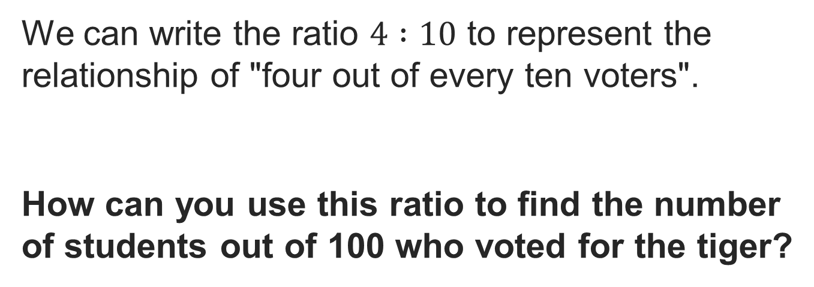
Partner press: ask ‘Why?’ and answer with evidence.
Middle School Mascot
Reveal:
We can create an equivalent ratio by multiplying each term by 10 so that the second term in the equivalent ratio is 100.
15 / 40
Notes:
TEACH IN PRACTICE | Embedded facilitation | Lesson 4.1, slide 15 | REVEAL
Focus on the existing task: Reveal: We can create an equivalent ratio by multiplying each term by 10 so that the second term in the equivalent ratio is 100. Middle School Mascot Partner press: ask ‘Why?
LAUNCH (T2/3/5): If an existing answer cover is present, gather an attempt before revealing. If the explanation is already visible, ask students to reconstruct and justify it. Compare reasoning and explain a revision; preserve the reveal sequence.
LOOK FOR (T4): Where this task addresses it, students can identify the whole. Ask which feature of their work supports the claim.
RESPOND: If this task shows the lesson misconception—assuming a percent must be less than or equal to 100—label 100 percent on the existing grid or tape diagram before locating the part. Have the student revise and explain the change. Use this support only where the concept occurs in the current task; otherwise respond to the displayed question.
RECHECK: If a gap is shared, revisit the existing representation together. If it is limited, give targeted support while others compare valid methods on the same task. Check the revision before moving on.
PARTICIPATION (T5/6/7): Think time before volunteers; accept a written, drawn or rehearsed entry. Students ask for evidence respectfully. Recognize a specific contribution or revision and check that both partners participate.
Source: BCPS Updated Instructional Framework Rubric (June 2020), TEACH 1–7. Earlier notes and answer keys are retained below.
EARLIER NOTES / EXISTING ANSWER KEY
UIFR TEACH — Level 4 student move: Partner press: ask ‘Why?’ and answer with evidence.
Student move: Partner press: ask ‘Why?’ and answer with evidence.

Slide 6
Middle School Mascot
A percent is a ratio or rate that compares a number to 100. Percent means per hundred. It can also be expressed as a fraction with a denominator of 100.
Explain how the information shown supports your reasoning.
Think About It:
16 / 40
Notes:
TEACH IN PRACTICE | Embedded facilitation | Lesson 4.1, slide 16 | WORKED
Focus on the existing task: A percent is a ratio or rate that compares a number to 100. Percent means per hundred. It can also be expressed as a fraction with a…
LAUNCH (T2/3/5): Ask students to explain the displayed idea or example and point to evidence. When a calculation step is shown, ask why it is valid. Have a partner restate the explanation; copying is not the check.
LOOK FOR (T4): Where this task addresses it, students can represent a rate per 100. Ask which feature of their work supports the claim.
RESPOND: If this task shows the lesson misconception—assuming a percent must be less than or equal to 100—label 100 percent on the existing grid or tape diagram before locating the part. Have the student revise and explain the change. Use this support only where the concept occurs in the current task; otherwise respond to the displayed question.
RECHECK: If a gap is shared, revisit the existing representation together. If it is limited, give targeted support while others compare valid methods on the same task. Check the revision before moving on.
PARTICIPATION (T5/6/7): Think time before volunteers; accept a written, drawn or rehearsed entry. Students ask for evidence respectfully. Recognize a specific contribution or revision and check that both partners participate.
Source: BCPS Updated Instructional Framework Rubric (June 2020), TEACH 1–7. Earlier notes and answer keys are retained below.
EARLIER NOTES / EXISTING ANSWER KEY
Read the definition together, then ask: what does the word percent literally tell us? Draw out per hundred. Listen for students connecting percent to the ratios and rates they already know. A common mix-up is treating a percent as an amount instead of a comparison to 100, so ask what the 100 refers to here.

Slide 7
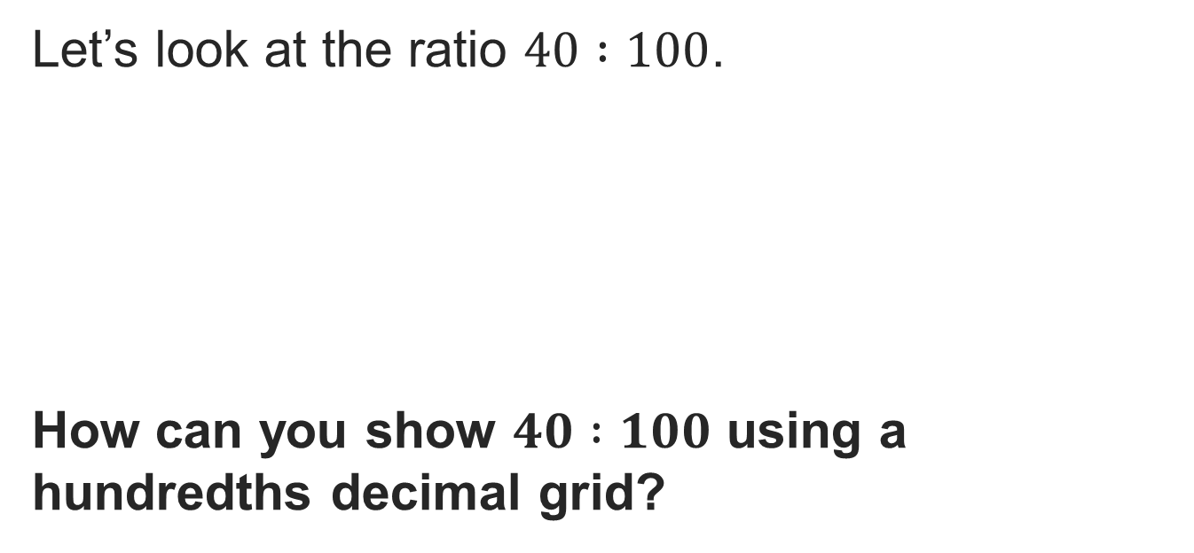
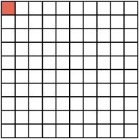
Middle School Mascot
PICK YOUR STRATEGY · Choose your path — picture, table, number line, or equation — and be ready to say why you chose it.
Reveal:
We can shade in 40 out of 100 squares.
17 / 40
Notes:
TEACH IN PRACTICE | Embedded facilitation | Lesson 4.1, slide 17 | REVEAL
Focus on the existing task: Reveal: We can shade in 40 out of 100 squares. Middle School Mascot
LAUNCH (T2/3/5): If an existing answer cover is present, gather an attempt before revealing. If the explanation is already visible, ask students to reconstruct and justify it. Compare reasoning and explain a revision; preserve the reveal sequence.
LOOK FOR (T4): Where this task addresses it, students can identify the whole. Ask which feature of their work supports the claim.
RESPOND: If this task shows the lesson misconception—assuming a percent must be less than or equal to 100—label 100 percent on the existing grid or tape diagram before locating the part. Have the student revise and explain the change. Use this support only where the concept occurs in the current task; otherwise respond to the displayed question.
RECHECK: If a gap is shared, revisit the existing representation together. If it is limited, give targeted support while others compare valid methods on the same task. Check the revision before moving on.
PARTICIPATION (T5/6/7): Think time before volunteers; accept a written, drawn or rehearsed entry. Students ask for evidence respectfully. Recognize a specific contribution or revision and check that both partners participate.
Source: BCPS Updated Instructional Framework Rubric (June 2020), TEACH 1–7. Earlier notes and answer keys are retained below.
EARLIER NOTES / EXISTING ANSWER KEY
Before showing the shading, ask how many of the 100 squares should be shaded for 40 percent and why. Listen for the reasoning that 40 percent means 40 out of every 100. Some students shade 40 without connecting it to the total; ask what the whole grid represents.

Slide 8
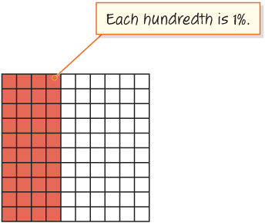
Middle School Mascot
Let’s shade 40 out of 100 squares to represent the number of students who voted for the tiger out of 100 students.
What percent of students voted for the tiger?
TRY IT BEFORE YOU’RE SURE · Start even if you are not sure. A revised answer counts as much as a first-try answer.
Reveal:
We can see that 40 out of 100 squares are shaded so 40% of the students voted for the tiger.
18 / 40
Notes:
TEACH IN PRACTICE | Embedded facilitation | Lesson 4.1, slide 18 | REVEAL
Focus on the existing task: Let’s shade 40 out of 100 squares to represent the number of students who voted for the tiger out of 100 students. What percent of students voted for the tiger?
LAUNCH (T2/3/5): If an existing answer cover is present, gather an attempt before revealing. If the explanation is already visible, ask students to reconstruct and justify it. Compare reasoning and explain a revision; preserve the reveal sequence.
LOOK FOR (T4): Where this task addresses it, students can represent a rate per 100. Ask which feature of their work supports the claim.
RESPOND: If this task shows the lesson misconception—assuming a percent must be less than or equal to 100—label 100 percent on the existing grid or tape diagram before locating the part. Have the student revise and explain the change. Use this support only where the concept occurs in the current task; otherwise respond to the displayed question.
RECHECK: If a gap is shared, revisit the existing representation together. If it is limited, give targeted support while others compare valid methods on the same task. Check the revision before moving on.
PARTICIPATION (T5/6/7): Think time before volunteers; accept a written, drawn or rehearsed entry. Students ask for evidence respectfully. Recognize a specific contribution or revision and check that both partners participate.
Source: BCPS Updated Instructional Framework Rubric (June 2020), TEACH 1–7. Earlier notes and answer keys are retained below.
EARLIER NOTES / EXISTING ANSWER KEY
Have students shade or picture 40 of the 100 squares, then ask what fraction and what decimal name the same amount. Listen for 40 out of 100, 40 hundredths, and 0.40 named as the same number. Watch for students who think 40 percent and 0.4 are different amounts; the grid settles it.

Slide 9

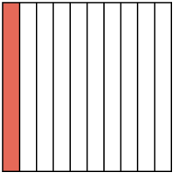
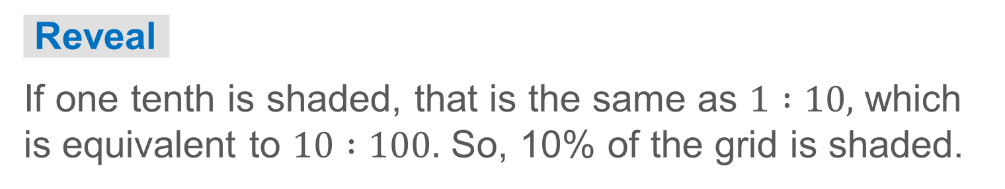
COLLABORATE · TALK IT THROUGH • AGREE ON A MODEL
Student-led talk: paraphrase, agree or disagree, add on.
Collaborate and Connect
We can also use a tenths decimal grid to show a percent.
If we shade one tenth of the decimal grid, what percent of the grid is shaded?
19 / 40
Notes:
TEACH IN PRACTICE | Embedded facilitation | Lesson 4.1, slide 19 | COLLABORATE
Focus on the existing task: We can also use a tenths decimal grid to show a percent. If we shade one tenth of the decimal grid, what percent of the grid is shaded?
LAUNCH (T2/3/5): Use the displayed question. Give private thinking time; then A explains while B asks for evidence. Switch roles. Each student records their own reasoning.
LOOK FOR (T4): Where this task addresses it, students can interpret values above 100 percent. Ask which feature of their work supports the claim.
RESPOND: If this task shows the lesson misconception—assuming a percent must be less than or equal to 100—label 100 percent on the existing grid or tape diagram before locating the part. Have the student revise and explain the change. Use this support only where the concept occurs in the current task; otherwise respond to the displayed question.
RECHECK: If a gap is shared, revisit the existing representation together. If it is limited, give targeted support while others compare valid methods on the same task. Check the revision before moving on.
PARTICIPATION (T5/6/7): Think time before volunteers; accept a written, drawn or rehearsed entry. Students ask for evidence respectfully. Recognize a specific contribution or revision and check that both partners participate.
Source: BCPS Updated Instructional Framework Rubric (June 2020), TEACH 1–7. Earlier notes and answer keys are retained below.
EARLIER NOTES / EXISTING ANSWER KEY
UIFR TEACH — Level 4 student move: Student-led talk: paraphrase, agree or disagree, add on.
Student move: Student-led talk: paraphrase, agree or disagree, add on.
Routine: COLLABORATE · TALK IT THROUGH • AGREE ON A MODEL
UIFR FULL | Lesson-specific facilitation
TEACH 4-5 | Session 1 discussion and checkpoint (UIFR PDF pp. 11-12).
Collect a brief response from every student to the existing prompt before hearing volunteers. Partners take turns explaining and asking for evidence: “I understand ___; what supports ___?” Offer rehearsal or an annotated model for students who need language support. Each student records their own reasoning.
Look specifically for: assuming a percent must be less than or equal to 100. If it appears, label 100 percent on the existing grid or tape diagram before locating the part; then ask the student to revise the same response and explain the change. If evidence is secure, have students compare a second valid pathway or state why their approach works. Choose the next step from the responses, not a preset pace.

Slide 10
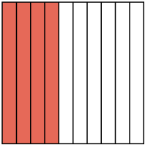
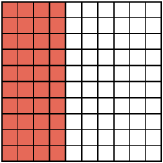
Compare strategies; persist, revise, and try again.
Let’s Explore More
What percent of the decimal grids are not shaded?
The results also showed that 23 out of every 100 voters selected the eagle. Which representation would you use to show 23 out of 100 voters?
20 / 40
Notes:
TEACH IN PRACTICE | Embedded facilitation | Lesson 4.1, slide 20 | PRACTICE
Focus on the existing task: What percent of the decimal grids are not shaded?
LAUNCH (T2/3/5): Use the displayed question. Give private thinking time; then A explains while B asks for evidence. Switch roles. Each student records their own reasoning.
LOOK FOR (T4): Where this task addresses it, students can interpret values above 100 percent. Ask which feature of their work supports the claim.
RESPOND: If this task shows the lesson misconception—assuming a percent must be less than or equal to 100—label 100 percent on the existing grid or tape diagram before locating the part. Have the student revise and explain the change. Use this support only where the concept occurs in the current task; otherwise respond to the displayed question.
RECHECK: If a gap is shared, revisit the existing representation together. If it is limited, give targeted support while others compare valid methods on the same task. Check the revision before moving on.
PARTICIPATION (T5/6/7): Think time before volunteers; accept a written, drawn or rehearsed entry. Students ask for evidence respectfully. Recognize a specific contribution or revision and check that both partners participate.
Source: BCPS Updated Instructional Framework Rubric (June 2020), TEACH 1–7. Earlier notes and answer keys are retained below.
EARLIER NOTES / EXISTING ANSWER KEY
UIFR TEACH — Level 4 student move: Compare strategies; persist, revise, and try again.
Student move: Compare strategies; persist, revise, and try again.

Slide 11
LESSON 4.1 / DISCUSS THE TASK
Explain and compare
Use the task you just explored.
TAKE TURNS
What is one whole in this model, and how would more than one whole appear?
Explain
“I know this because…”
Ask
“Where does your work show that?”
Point to evidence in your work.
Then compare your approach with a partner’s.
JUSTIFY IT · Say it like this: “I know ______ because ______.”
Listen to understand. Ask for evidence. Make room for every voice.
Notes:
TEACH IN PRACTICE | Embedded facilitation | Lesson 4.1, slide 21 | PRIOR_INSERT
Focus on the existing task: Point to evidence in your work. Then compare your approach with a partner’s. TAKE TURNS Explain “I know this because…” Ask “Where does your work show that?
CONNECT (T1/4): Ask students to restate the displayed goal or key idea and connect it to earlier work. Relevant lesson evidence: identify the whole; represent a rate per 100; interpret values above 100 percent. Use only the criterion that matches the current session.
SHOW PROGRESS: Students point to their own existing work, explain what improved after feedback, and name a next step. Pair confidence ratings with actual evidence.
PARTICIPATION (T5/6/7): Think time before volunteers; accept a written, drawn or rehearsed entry. Students ask for evidence respectfully. Recognize a specific contribution or revision and check that both partners participate.
Source: BCPS Updated Instructional Framework Rubric (June 2020), TEACH 1–7.

Slide 12
Middle School Mascot
We know that four out of every ten voters selected the tiger as the new mascot.
What type of relationship is “four out of every ten voters”?
Compare your reasoning with the explanation. Explain any revision you make.
Reveal:
It is a ratio relationship.
22 / 40
Notes:
TEACH IN PRACTICE | Embedded facilitation | Lesson 4.1, slide 22 | REVEAL
Focus on the existing task: We know that four out of every ten voters selected the tiger as the new mascot. What type of relationship is “four out of every ten voters”?
LAUNCH (T2/3/5): If an existing answer cover is present, gather an attempt before revealing. If the explanation is already visible, ask students to reconstruct and justify it. Compare reasoning and explain a revision; preserve the reveal sequence.
LOOK FOR (T4): Where this task addresses it, students can identify the whole. Ask which feature of their work supports the claim.
RESPOND: If this task shows the lesson misconception—assuming a percent must be less than or equal to 100—label 100 percent on the existing grid or tape diagram before locating the part. Have the student revise and explain the change. Use this support only where the concept occurs in the current task; otherwise respond to the displayed question.
RECHECK: If a gap is shared, revisit the existing representation together. If it is limited, give targeted support while others compare valid methods on the same task. Check the revision before moving on.
PARTICIPATION (T5/6/7): Think time before volunteers; accept a written, drawn or rehearsed entry. Students ask for evidence respectfully. Recognize a specific contribution or revision and check that both partners participate.
Source: BCPS Updated Instructional Framework Rubric (June 2020), TEACH 1–7.

Slide 13
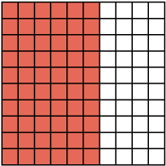

Be Curious
How are they the same?
How are they different?
Think first. Share a notice and a question; build on a classmate’s idea.
Mindset
How is a new perspective helping you with your work in math?
23 / 40
Notes:
TEACH IN PRACTICE | Embedded facilitation | Lesson 4.1, slide 23 | CURIOUS
Focus on the existing task: How are they the same?
LAUNCH (T2/3/5): Allow quiet observation first. Separate a notice from an inference, invite students’ own questions, and follow the existing launch before teaching a procedure.
LOOK FOR (T4): Where this task addresses it, students can identify the whole. Ask which feature of their work supports the claim.
RESPOND: If this task shows the lesson misconception—assuming a percent must be less than or equal to 100—label 100 percent on the existing grid or tape diagram before locating the part. Have the student revise and explain the change. Use this support only where the concept occurs in the current task; otherwise respond to the displayed question.
RECHECK: If a gap is shared, revisit the existing representation together. If it is limited, give targeted support while others compare valid methods on the same task. Check the revision before moving on.
PARTICIPATION (T5/6/7): Think time before volunteers; accept a written, drawn or rehearsed entry. Students ask for evidence respectfully. Recognize a specific contribution or revision and check that both partners participate.
Source: BCPS Updated Instructional Framework Rubric (June 2020), TEACH 1–7.

Slide 14
Session 2 Warm-Up
Lesson 4-1 · Understand Percent
Session 2 Warm-Up
Quick review from Session 1 · about 4 minutes
1
A percent is a ratio that compares a number to:
2
What percent is represented by 40 out of 100?
A
10
A
4%
B
100
B
40%
C
1,000
C
400%
D
1
D
0.4%
3
On a 10 × 10 grid, 1.5 whole grids shaded equals:
4
The symbol % literally means:
A
15%
A
Times ten
B
150%
B
Per hundred
C
1.5%
C
Plus fifty
D
1500%
D
Divided by zero
eduwonderlab.com · Neft Teacher
24 / 40
Notes:
TEACH IN PRACTICE | Embedded facilitation | Lesson 4.1, slide 24 | WARMUP
Focus on the existing task: Session 2 Warm-Up Session 2 Warm-Up Quick review from Session 1 · about…
GATHER EVIDENCE (T4/6): Keep the original items. Students try independently, mark an uncertain item, and explain one method before checking. Use the existing key when present.
RESPOND: Distinguish a calculation slip from a reasoning gap. Give one next step on the same item; have students revise in a second color. Use the responses to choose flexible support for today’s lesson.
PARTICIPATION (T5/6/7): Think time before volunteers; accept a written, drawn or rehearsed entry. Students ask for evidence respectfully. Recognize a specific contribution or revision and check that both partners participate.
Source: BCPS Updated Instructional Framework Rubric (June 2020), TEACH 1–7. Earlier notes and answer keys are retained below.
EARLIER NOTES / EXISTING ANSWER KEY
Warm-up routine: students start silently on entry; keep it to about 4 minutes.
Circulate and note who is stuck — use what you see to choose who you check on first today.
Go over answers quickly; ask one student to explain a step, not just say the answer.
UIFR: TEACH 4 · TEACH 6.
UIFR FULL | Lesson-specific facilitation
TEACH 1 | Session 2 purpose and evidence (UIFR PDF p. 8).
Have students restate the displayed session goal in their own words and connect it to the existing context or a familiar experience they choose to share. Use the current session goal to select from these lesson-wide evidence criteria; do not frontload a later-session procedure.
Look for: identify the whole; represent a rate per 100; interpret values above 100 percent. Ask: “Which part of your work would show this?” Revisit that evidence after the task; a confidence rating alone is not evidence of understanding.

Slide 15
STUDENT MOVES
Lesson 4-1
Your move
YOU KNOW THE ROUTINE · Read → plan → solve → check. Do all four, in that order.
25 / 40

Slide 16
Review Notes
Lesson 4-1 · Understand Percent
Review Notes — Session 2
Copy. Explain. Check.
CONNECT IT · What earlier lesson does this build on? Tell a partner in one sentence.
Percent as Ratio
1
A percent is a special ratio comparing a quantity to a base of 100.
Grid Models
2
A full 10 × 10 hundredths grid equals 100%. More than one grid represents over 100%.
Equivalent Rates
3
Scale parts to 100 to quickly convert common ratios to percentages.
eduwonderlab.com · Neft Teacher
26 / 40
Notes:
TEACH IN PRACTICE | Embedded facilitation | Lesson 4.1, slide 25 | NOTES
Focus on the existing task: Review Notes Review Notes — Session 2 Copy into your notebook: 1 Percent…
ROUTINE (T1/2/4): Read or copy the original notes, cover one line, and explain it using the displayed example. Reopen and correct. Copying alone is not evidence of understanding.
LOOK FOR: A link between a symbol, quantity or feature and the explanation. If missing, point back to that feature and have the student try again; fade the prompt once they can explain.
PARTICIPATION (T5/6/7): Think time before volunteers; accept a written, drawn or rehearsed entry. Students ask for evidence respectfully. Recognize a specific contribution or revision and check that both partners participate.
Source: BCPS Updated Instructional Framework Rubric (June 2020), TEACH 1–7. Earlier notes and answer keys are retained below.
EARLIER NOTES / EXISTING ANSWER KEY
Copy routine: read one line at a time; students copy, then explain that line to a partner.
Keep it brisk — the understanding work happens in the examples, not the copying.
UIFR: TEACH 1 · TEACH 6.

Slide 17
Session 2
Understand Percent
TAKE TURNS · One explains, one asks a question. Then switch, so both of you talk.
27 / 40
Notes:
TEACH IN PRACTICE | Embedded facilitation | Lesson 4.1, slide 26 | DIVIDER
Focus on the existing task: Understand Percent Session 2
TRANSITION (T6/7): Students confirm materials, roles, how to request help, and the next response routine. Ask a student to restate it. Keep teacher-only slides hidden.
PARTICIPATION (T5/6/7): Think time before volunteers; accept a written, drawn or rehearsed entry. Students ask for evidence respectfully. Recognize a specific contribution or revision and check that both partners participate.
Source: BCPS Updated Instructional Framework Rubric (June 2020), TEACH 1–7. Earlier notes and answer keys are retained below.
EARLIER NOTES / EXISTING ANSWER KEY
Transition cue: state what materials are out and what success looks like this session.
Keep the changeover under a minute.
UIFR: TEACH 6.

Slide 18
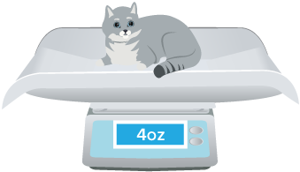
Shanice’s Kittens
Shanice’s cat had two kittens, a gray kitten and an orange kitten. The orange kitten weighs 1.5 times as much as the gray kitten.
What percent of the gray kitten’s weight does the orange kitten weigh?
Think and record first. Which part of your work supports your answer?
28 / 40
Notes:
TEACH IN PRACTICE | Embedded facilitation | Lesson 4.1, slide 27 | TASK
Focus on the existing task: Shanice’s cat had two kittens, a gray kitten and an orange kitten. The orange kitten weighs 1.5 times as much as the gray kitten. What percent of the gray kitten’s weight does the orange kitten weigh?
LAUNCH (T2/3/5): Use the displayed question. Give private thinking time; then A explains while B asks for evidence. Switch roles. Each student records their own reasoning.
LOOK FOR (T4): Where this task addresses it, students can interpret values above 100 percent. Ask which feature of their work supports the claim.
RESPOND: If this task shows the lesson misconception—assuming a percent must be less than or equal to 100—label 100 percent on the existing grid or tape diagram before locating the part. Have the student revise and explain the change. Use this support only where the concept occurs in the current task; otherwise respond to the displayed question.
RECHECK: If a gap is shared, revisit the existing representation together. If it is limited, give targeted support while others compare valid methods on the same task. Check the revision before moving on.
PARTICIPATION (T5/6/7): Think time before volunteers; accept a written, drawn or rehearsed entry. Students ask for evidence respectfully. Recognize a specific contribution or revision and check that both partners participate.
Source: BCPS Updated Instructional Framework Rubric (June 2020), TEACH 1–7. Earlier notes and answer keys are retained below.
EARLIER NOTES / EXISTING ANSWER KEY
Ask students what is being compared in this kitten situation before any numbers are used. Have partners restate the setup in their own words. Listen for whether they see the comparison as one weight measured against the other, which is what makes a percent over 100 possible.
UIFR FULL | Lesson-specific facilitation
TEACH 2-3 | Session 2 task launch (UIFR PDF pp. 9-10).
Use the problem exactly as displayed. Give individual thinking time before discussion or advancing to the explanation. If the answer is already visible, ask students to reconstruct and justify it. Invite a choice of suitable representations and have students explain why their choice helps.
At the point where this concept appears, ask: “What is one whole in this model, and how would more than one whole appear?” Wait for evidence, invite another pathway, and have a student ask a follow-up question. Do not replace students’ reasoning with a sequence of leading steps.

Slide 19
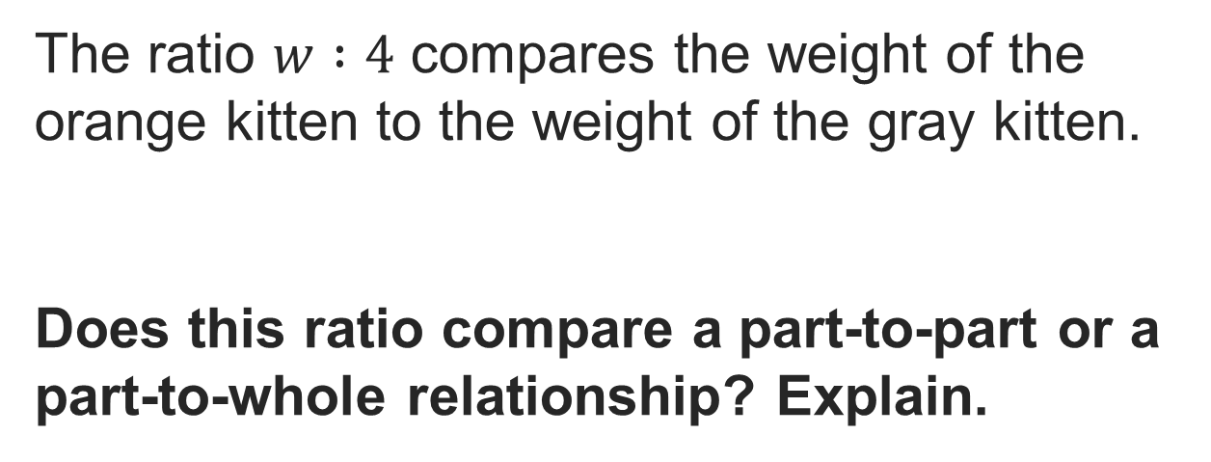
Share a connection to prior learning or lived experience.
Shanice’s Kittens
Record your reasoning before the reveal. Compare, then explain any revision.
Reveal:
The gray kitten’s weight is the whole (100%). We want to know what percent of the gray kitten’s weight the orange kitten weighs.
29 / 40
Notes:
TEACH IN PRACTICE | Embedded facilitation | Lesson 4.1, slide 28 | REVEAL
Focus on the existing task: Reveal: The gray kitten’s weight is the whole (100%). We want to know what percent of the gray kitten’s weight the orange kitten weighs. Shanice’s…
LAUNCH (T2/3/5): If an existing answer cover is present, gather an attempt before revealing. If the explanation is already visible, ask students to reconstruct and justify it. Compare reasoning and explain a revision; preserve the reveal sequence.
LOOK FOR (T4): Where this task addresses it, students can identify the whole. Ask which feature of their work supports the claim.
RESPOND: If this task shows the lesson misconception—assuming a percent must be less than or equal to 100—label 100 percent on the existing grid or tape diagram before locating the part. Have the student revise and explain the change. Use this support only where the concept occurs in the current task; otherwise respond to the displayed question.
RECHECK: If a gap is shared, revisit the existing representation together. If it is limited, give targeted support while others compare valid methods on the same task. Check the revision before moving on.
PARTICIPATION (T5/6/7): Think time before volunteers; accept a written, drawn or rehearsed entry. Students ask for evidence respectfully. Recognize a specific contribution or revision and check that both partners participate.
Source: BCPS Updated Instructional Framework Rubric (June 2020), TEACH 1–7. Earlier notes and answer keys are retained below.
EARLIER NOTES / EXISTING ANSWER KEY
UIFR TEACH — Level 4 student move: Share a connection to prior learning or lived experience.
Student move: Share a connection to prior learning or lived experience.
UIFR FULL | Lesson-specific facilitation
TEACH 4-5 | Session 2 discussion and checkpoint (UIFR PDF pp. 11-12).
Collect a brief response from every student to the existing prompt before hearing volunteers. Partners take turns explaining and asking for evidence: “I understand ___; what supports ___?” Offer rehearsal or an annotated model for students who need language support. Each student records their own reasoning.
Look specifically for: assuming a percent must be less than or equal to 100. If it appears, label 100 percent on the existing grid or tape diagram before locating the part; then ask the student to revise the same response and explain the change. If evidence is secure, have students compare a second valid pathway or state why their approach works. Choose the next step from the responses, not a preset pace.

Slide 20
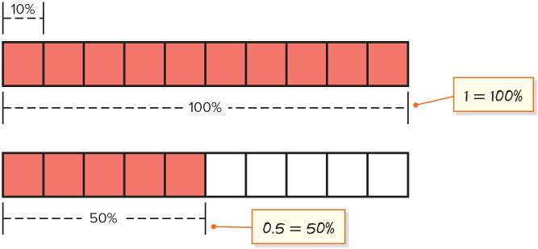
Shanice’s Kittens
The orange kitten weighs 1.5 times as much as the gray kitten. We can break this up into 1 and 0.5.
Shade one whole tape diagram and 0.5, or half, of the other.
How can we determine the weight of the orange kitten as a percent of the gray kitten using the tape diagrams?
SELF-CHECK · Mark it: ✓ got it · ~ almost · ? stuck. Then fix one thing before we move on.
Reveal:
We can add the percentages together to find the weight of the orange kitten, which is 150% of the weight of the gray kitten.
30 / 40
Notes:
TEACH IN PRACTICE | Embedded facilitation | Lesson 4.1, slide 29 | REVEAL
Focus on the existing task: The orange kitten weighs 1.5 times as much as the gray kitten. We can break this up into 1 and 0.5. Reveal: We can add the percentages…
LAUNCH (T2/3/5): If an existing answer cover is present, gather an attempt before revealing. If the explanation is already visible, ask students to reconstruct and justify it. Compare reasoning and explain a revision; preserve the reveal sequence.
LOOK FOR (T4): Where this task addresses it, students can identify the whole. Ask which feature of their work supports the claim.
RESPOND: If this task shows the lesson misconception—assuming a percent must be less than or equal to 100—label 100 percent on the existing grid or tape diagram before locating the part. Have the student revise and explain the change. Use this support only where the concept occurs in the current task; otherwise respond to the displayed question.
RECHECK: If a gap is shared, revisit the existing representation together. If it is limited, give targeted support while others compare valid methods on the same task. Check the revision before moving on.
PARTICIPATION (T5/6/7): Think time before volunteers; accept a written, drawn or rehearsed entry. Students ask for evidence respectfully. Recognize a specific contribution or revision and check that both partners participate.
Source: BCPS Updated Instructional Framework Rubric (June 2020), TEACH 1–7. Earlier notes and answer keys are retained below.
EARLIER NOTES / EXISTING ANSWER KEY
Ask why it makes sense to add the percentages here, and what whole each percent is measured against. Listen for students naming the gray kitten’s weight as the reference. A common error is averaging the percents instead of adding the parts; ask what question the sum answers.

Slide 21
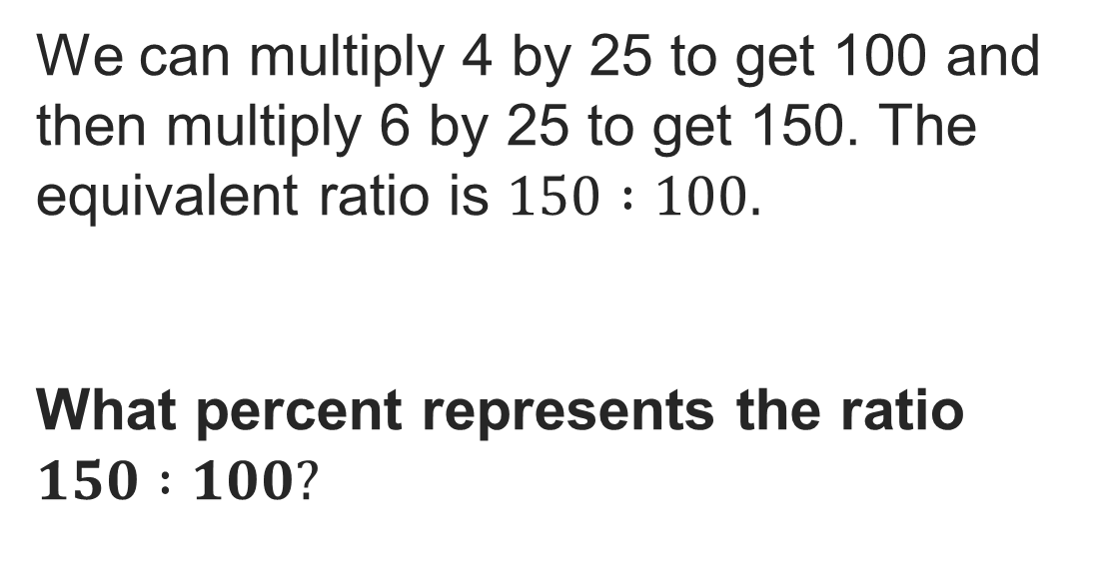
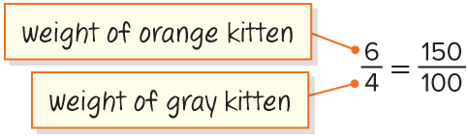
Shanice’s Kittens
Record your reasoning before the
reveal. Compare, then explain
any revision.
Reveal:
We can write this ratio as 150%.
31 / 40
Notes:
TEACH IN PRACTICE | Embedded facilitation | Lesson 4.1, slide 30 | REVEAL
Focus on the existing task: Reveal: We can write this ratio as 150%. Shanice’s Kittens
LAUNCH (T2/3/5): If an existing answer cover is present, gather an attempt before revealing. If the explanation is already visible, ask students to reconstruct and justify it. Compare reasoning and explain a revision; preserve the reveal sequence.
LOOK FOR (T4): Where this task addresses it, students can identify the whole. Ask which feature of their work supports the claim.
RESPOND: If this task shows the lesson misconception—assuming a percent must be less than or equal to 100—label 100 percent on the existing grid or tape diagram before locating the part. Have the student revise and explain the change. Use this support only where the concept occurs in the current task; otherwise respond to the displayed question.
RECHECK: If a gap is shared, revisit the existing representation together. If it is limited, give targeted support while others compare valid methods on the same task. Check the revision before moving on.
PARTICIPATION (T5/6/7): Think time before volunteers; accept a written, drawn or rehearsed entry. Students ask for evidence respectfully. Recognize a specific contribution or revision and check that both partners participate.
Source: BCPS Updated Instructional Framework Rubric (June 2020), TEACH 1–7. Earlier notes and answer keys are retained below.
EARLIER NOTES / EXISTING ANSWER KEY
Ask what a percent greater than 100 means in this situation. Listen for the idea that 150 percent is one and a half times the reference weight. Students often believe percents stop at 100; have them restate 150 percent as a ratio to 100 to break that.

Slide 22
Compare pathways with a partner; name one revision.
Shanice’s Kittens
Shanice’s cat had two kittens, a gray kitten and an orange kitten. The orange kitten weighs 1.5 times as much as the gray kitten.
What percent of the gray kitten’s weight does the orange kitten weigh?
The weight of the orange kitten is 150% of the weight of the gray kitten at birth.
Using Representations
What are some other representations you could use?
32 / 40
Notes:
TEACH IN PRACTICE | Embedded facilitation | Lesson 4.1, slide 31 | TASK
Focus on the existing task: Shanice’s cat had two kittens, a gray kitten and an orange kitten. The orange kitten weighs 1.5 times as much as the gray kitten. What percent of the gray kitten’s weight does the orange kitten weigh?
LAUNCH (T2/3/5): Use the displayed question. Give private thinking time; then A explains while B asks for evidence. Switch roles. Each student records their own reasoning.
LOOK FOR (T4): Where this task addresses it, students can interpret values above 100 percent. Ask which feature of their work supports the claim.
RESPOND: If this task shows the lesson misconception—assuming a percent must be less than or equal to 100—label 100 percent on the existing grid or tape diagram before locating the part. Have the student revise and explain the change. Use this support only where the concept occurs in the current task; otherwise respond to the displayed question.
RECHECK: If a gap is shared, revisit the existing representation together. If it is limited, give targeted support while others compare valid methods on the same task. Check the revision before moving on.
PARTICIPATION (T5/6/7): Think time before volunteers; accept a written, drawn or rehearsed entry. Students ask for evidence respectfully. Recognize a specific contribution or revision and check that both partners participate.
Source: BCPS Updated Instructional Framework Rubric (June 2020), TEACH 1–7. Earlier notes and answer keys are retained below.
EARLIER NOTES / EXISTING ANSWER KEY
UIFR TEACH — Level 4 student move: Compare pathways with a partner; name one revision.
Student move: Compare pathways with a partner; name one revision.

Slide 23
Shanice’s Kittens
We can use a variable such as w to represent the unknown weight of the orange kitten.
How could you compare the weights of the kittens?
Compare your reasoning with the explanation. Explain any revision you make.
Reveal:
We can use a ratio to compare the weights.
33 / 40
Notes:
TEACH IN PRACTICE | Embedded facilitation | Lesson 4.1, slide 32 | REVEAL
Focus on the existing task: We can use a variable such as w to represent the unknown weight of the orange kitten. How could you compare the weights of the kittens?
LAUNCH (T2/3/5): If an existing answer cover is present, gather an attempt before revealing. If the explanation is already visible, ask students to reconstruct and justify it. Compare reasoning and explain a revision; preserve the reveal sequence.
LOOK FOR (T4): Where this task addresses it, students can represent a rate per 100. Ask which feature of their work supports the claim.
RESPOND: If this task shows the lesson misconception—assuming a percent must be less than or equal to 100—label 100 percent on the existing grid or tape diagram before locating the part. Have the student revise and explain the change. Use this support only where the concept occurs in the current task; otherwise respond to the displayed question.
RECHECK: If a gap is shared, revisit the existing representation together. If it is limited, give targeted support while others compare valid methods on the same task. Check the revision before moving on.
PARTICIPATION (T5/6/7): Think time before volunteers; accept a written, drawn or rehearsed entry. Students ask for evidence respectfully. Recognize a specific contribution or revision and check that both partners participate.
Source: BCPS Updated Instructional Framework Rubric (June 2020), TEACH 1–7.

Slide 24
Shanice’s Kittens
The gray kitten’s weight at birth can be described as 100%.
What tool can be used to represent the weight of the gray kitten?
Compare your reasoning with the explanation. Explain any revision you make.
Reveal:
One tool we could use is a tape diagram.
34 / 40
Notes:
TEACH IN PRACTICE | Embedded facilitation | Lesson 4.1, slide 33 | REVEAL
Focus on the existing task: The gray kitten’s weight at birth can be described as 100%. What tool can be used to represent the weight of the gray kitten?
LAUNCH (T2/3/5): If an existing answer cover is present, gather an attempt before revealing. If the explanation is already visible, ask students to reconstruct and justify it. Compare reasoning and explain a revision; preserve the reveal sequence.
LOOK FOR (T4): Where this task addresses it, students can represent a rate per 100. Ask which feature of their work supports the claim.
RESPOND: If this task shows the lesson misconception—assuming a percent must be less than or equal to 100—label 100 percent on the existing grid or tape diagram before locating the part. Have the student revise and explain the change. Use this support only where the concept occurs in the current task; otherwise respond to the displayed question.
RECHECK: If a gap is shared, revisit the existing representation together. If it is limited, give targeted support while others compare valid methods on the same task. Check the revision before moving on.
PARTICIPATION (T5/6/7): Think time before volunteers; accept a written, drawn or rehearsed entry. Students ask for evidence respectfully. Recognize a specific contribution or revision and check that both partners participate.
Source: BCPS Updated Instructional Framework Rubric (June 2020), TEACH 1–7.

Slide 25
Shanice’s Kittens
The orange kitten weighs 1.5 times as much as the gray kitten. We can break this up into 1 and 0.5.
Shade one whole tape diagram and 0.5, or half, of the other.
How can we determine the weight of the orange kitten as a percent of the gray kitten using the tape diagrams?
Reveal:
We can add the percentages together to find the weight of the orange kitten, which is 150% of the weight of the gray kitten.
35 / 40
Notes:
TEACH IN PRACTICE | Embedded facilitation | Lesson 4.1, slide 34 | REVEAL
Focus on the existing task: The orange kitten weighs 1.5 times as much as the gray kitten. We can break this up into 1 and 0.5. Reveal: We can add the percentages…
LAUNCH (T2/3/5): If an existing answer cover is present, gather an attempt before revealing. If the explanation is already visible, ask students to reconstruct and justify it. Compare reasoning and explain a revision; preserve the reveal sequence.
LOOK FOR (T4): Where this task addresses it, students can identify the whole. Ask which feature of their work supports the claim.
RESPOND: If this task shows the lesson misconception—assuming a percent must be less than or equal to 100—label 100 percent on the existing grid or tape diagram before locating the part. Have the student revise and explain the change. Use this support only where the concept occurs in the current task; otherwise respond to the displayed question.
RECHECK: If a gap is shared, revisit the existing representation together. If it is limited, give targeted support while others compare valid methods on the same task. Check the revision before moving on.
PARTICIPATION (T5/6/7): Think time before volunteers; accept a written, drawn or rehearsed entry. Students ask for evidence respectfully. Recognize a specific contribution or revision and check that both partners participate.
Source: BCPS Updated Instructional Framework Rubric (June 2020), TEACH 1–7.

Slide 26
STUDENT MOVES
Lesson 4-1
Your move
USE YOUR TOOLS · Reach for your notes, a model, or a manipulative before you reach for an answer.
36 / 40

Slide 27
LESSON 4.1 / CHECK YOUR WORK
Pause. Check. Improve.
CHECK
A mistake to watch for: assuming a percent must be less than or equal to 100.
TRY
Label 100 percent on the given grid or tape diagram before locating the part.
REVISE
Use that check on the task you just completed. Correct or strengthen one part, and explain why.
REVISE NOW · Change one answer and write why you changed it. A revision is evidence of learning.
Listen to understand. Ask for evidence. Make room for every voice.
Notes:
TEACH IN PRACTICE | Embedded facilitation | Lesson 4.1, slide 35 | PRIOR_INSERT
Focus on the existing task: LESSON 4.1 / CHECK YOUR WORK Pause. Check. Improve. Listen to understand. Ask for evidence. Make room for every voice. CHECK A mistake…
CONNECT (T1/4): Ask students to restate the displayed goal or key idea and connect it to earlier work. Relevant lesson evidence: identify the whole; represent a rate per 100; interpret values above 100 percent. Use only the criterion that matches the current session.
SHOW PROGRESS: Students point to their own existing work, explain what improved after feedback, and name a next step. Pair confidence ratings with actual evidence.
PARTICIPATION (T5/6/7): Think time before volunteers; accept a written, drawn or rehearsed entry. Students ask for evidence respectfully. Recognize a specific contribution or revision and check that both partners participate.
Source: BCPS Updated Instructional Framework Rubric (June 2020), TEACH 1–7.

Slide 28




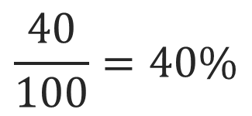
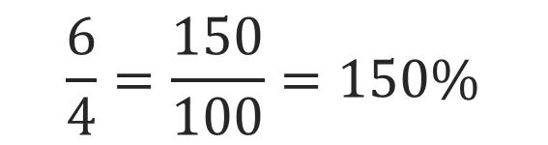
SUMMARIZE · SAY IT IN YOUR OWN WORDS
Summarize: Understand Percent
A percent is a ratio or rate that compares a number to 100.
A percent can be written with a percent symbol, %.
A percent can be greater than 100%.
STRUGGLE FIRST · Work on your own first. Stuck is allowed — try a second strategy before you ask.
38 / 40
Notes:
TEACH IN PRACTICE | Embedded facilitation | Lesson 4.1, slide 36 | SUMMARIZE
Focus on the existing task: A percent is a ratio or rate that compares a number to 100. A percent can be written with a percent symbol, %. A percent can be greater…
CONNECT (T1/4): Ask students to restate the displayed goal or key idea and connect it to earlier work. Relevant lesson evidence: identify the whole; represent a rate per 100; interpret values above 100 percent. Use only the criterion that matches the current session.
SHOW PROGRESS: Students point to their own existing work, explain what improved after feedback, and name a next step. Pair confidence ratings with actual evidence.
PARTICIPATION (T5/6/7): Think time before volunteers; accept a written, drawn or rehearsed entry. Students ask for evidence respectfully. Recognize a specific contribution or revision and check that both partners participate.
Source: BCPS Updated Instructional Framework Rubric (June 2020), TEACH 1–7. Earlier notes and answer keys are retained below.
EARLIER NOTES / EXISTING ANSWER KEY
Routine: SUMMARIZE · SAY IT IN YOUR OWN WORDS

Slide 29
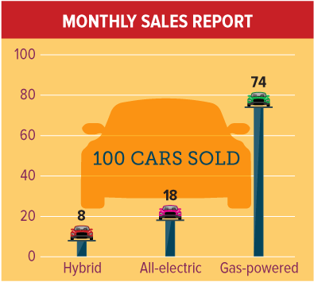
APPLY · PLAN IT • SOLVE IT • PROVE IT
Defend your method; partner gives one specific next step.
Apply: Car Sales
A car dealership’s sales for one month are shown. The owner of the car dealership needs to order 50 cars from the factory.
Question: Based upon the sales shown, how many of each type of car do you recommend that the owner order?
39 / 40
Notes:
TEACH IN PRACTICE | Embedded facilitation | Lesson 4.1, slide 37 | APPLY
Focus on the existing task: A car dealership’s sales for one month are shown. The owner of the car dealership needs to order 50 cars from the factory. Question…
LAUNCH (T2/3/5): Use the exact application task independently first. Ask students to justify their choice of method. Collect evidence before a partner discussion or correction.
LOOK FOR (T4): Where this task addresses it, students can identify the whole. Ask which feature of their work supports the claim.
RESPOND: If this task shows the lesson misconception—assuming a percent must be less than or equal to 100—label 100 percent on the existing grid or tape diagram before locating the part. Have the student revise and explain the change. Use this support only where the concept occurs in the current task; otherwise respond to the displayed question.
RECHECK: If a gap is shared, revisit the existing representation together. If it is limited, give targeted support while others compare valid methods on the same task. Check the revision before moving on.
PARTICIPATION (T5/6/7): Think time before volunteers; accept a written, drawn or rehearsed entry. Students ask for evidence respectfully. Recognize a specific contribution or revision and check that both partners participate.
Source: BCPS Updated Instructional Framework Rubric (June 2020), TEACH 1–7. Earlier notes and answer keys are retained below.
EARLIER NOTES / EXISTING ANSWER KEY
UIFR TEACH — Level 4 student move: Defend your method; partner gives one specific next step.
Student move: Defend your method; partner gives one specific next step.
Routine: APPLY · PLAN IT • SOLVE IT • PROVE IT
UIFR FULL | Lesson-specific facilitation
TEACH 4 | Independent evidence and revision (UIFR PDF p. 11).
Use the existing application/exit problem as the independent check. If this is a learning-target slide, have students point to and explain their work on the preceding task. Separate initial independent evidence from the revision after feedback.
Check the relevant criteria: identify the whole; represent a rate per 100; interpret values above 100 percent. Respond with one specific next step tied to the work. Students revise and annotate what changed, then identify a criterion they can now demonstrate and one they still need to practice.
REFLECT & ADJUST 1-2 | After the lesson (UIFR PDF pp. 15-16).
Sort the existing work by demonstrated reasoning, partial understanding, and the specific misconception: assuming a percent must be less than or equal to 100. Compare the initial response with the revision. Record which teaching move plausibly helped, which did not, and whose participation or access needs a different approach; do not record sensitive student details in this shared deck.
Plan the next lesson from that evidence: if the misconception persists, label 100 percent on the existing grid or tape diagram before locating the part using the current example before returning to the next grade-level task; if understanding is secure, use an existing extension or ask for a general explanation. Check the targeted idea again at the next warm-up.
Ask students what supported their thinking and what would help next time. Identify one change to try and one successful practice to retain. Seek colleague feedback on anonymized work when useful; these prompts support reflection and do not establish an evaluation rating. Source: Baltimore City Public Schools, Updated Instructional Framework Rubric, June 2020 (UIFR_Full.pdf).

Slide 30
LESSON 4.1 / REFLECT ON YOUR LEARNING
Show your progress
1 SHOW EVIDENCE
2 CHOOSE A NEXT STEP
Choose one response. Point to the part that shows your reasoning.
Name a change you made after feedback—or a question you still have.
“My work shows ___ because ___.”
“Next time, I will ___ to help me ___.”
Today’s focus: Identify the whole.
CREDIT A CLASSMATE · Name one classmate whose idea helped you today, and say what they said.
Listen to understand. Ask for evidence. Make room for every voice.
Notes:
TEACH IN PRACTICE | Embedded facilitation | Lesson 4.1, slide 38 | PRIOR_INSERT
Focus on the existing task: LESSON 4.1 / REFLECT ON YOUR LEARNING Show your progress Listen to understand. Ask for evidence. Make room for every voice. 1 SHOW…
CONNECT (T1/4): Ask students to restate the displayed goal or key idea and connect it to earlier work. Relevant lesson evidence: identify the whole; represent a rate per 100; interpret values above 100 percent. Use only the criterion that matches the current session.
SHOW PROGRESS: Students point to their own existing work, explain what improved after feedback, and name a next step. Pair confidence ratings with actual evidence.
PARTICIPATION (T5/6/7): Think time before volunteers; accept a written, drawn or rehearsed entry. Students ask for evidence respectfully. Recognize a specific contribution or revision and check that both partners participate.
Source: BCPS Updated Instructional Framework Rubric (June 2020), TEACH 1–7.

