Slide 1
WARM-UP · THINK • TRY • CHECK
Turn and talk: compare strategies, then defend one.
Warm-Up
Lesson 4-2 · Relate Fractions, Decimals, and Percentages | Warm-Up · about 4 minutes
Try each on your own. Mark an unsure answer; explain and revise when we check.
QUESTION 1
QUESTION 2
0.62 × 100 = ______
Write 3/5 as a decimal: ______
QUESTION 3
QUESTION 4
Write 3/4 as a percent: ______
Which is greater, 0.48 or 0.5? ______
TALK IT OVER: “I got ______ because ______.” • Compare with a partner before we check as a class.
1 / 38
Notes:
TEACH IN PRACTICE | Embedded facilitation | Lesson 4.2, slide 1 | WARMUP
Focus on the existing task: Warm-Up WARM-UP · THINK • TRY • CHECK Do these…
GATHER EVIDENCE (T4/6): Keep the original items. Students try independently, mark an uncertain item, and explain one method before checking. Use the existing key when present.
RESPOND: Distinguish a calculation slip from a reasoning gap. Give one next step on the same item; have students revise in a second color. Use the responses to choose flexible support for today’s lesson.
PARTICIPATION (T5/6/7): Think time before volunteers; accept a written, drawn or rehearsed entry. Students ask for evidence respectfully. Recognize a specific contribution or revision and check that both partners participate.
Source: BCPS Updated Instructional Framework Rubric (June 2020), TEACH 1–7. Earlier notes and answer keys are retained below.
EARLIER NOTES / EXISTING ANSWER KEY
Warm-Up answers (teacher only): 1) 62 2) 0.6 3) 75% 4) 0.5
UIFR FULL | Lesson-specific facilitation
PREPARE 1-2 | Before teaching (UIFR PDF pp. 6-7).
Plan to gather evidence that students can express the same value as fraction, decimal and percent; check against a benchmark. Review recent work and today’s warm-up to choose flexible groups and access supports; do not infer needs from identity or perceived ability. Use the existing lesson tasks and stated standards.
Anticipate: confusing a decimal with the same numeral followed by a percent sign. If observed, connect the original value to a hundred grid or a known benchmark. Offer oral rehearsal, drawing, pointing, or home-language processing as needed; retain the original mathematical demand. Ask students which support helps and fade it as evidence improves.
TEACH 6-7 | Before the first transition, agree on materials, partner roles, and how to request help. Invite students to restate the routine. Normalize revising an idea, recognize a specific contribution, and check privately when frustration blocks participation. Source: UIFR PDF pp. 13-14.

Slide 2
Partner talk: connect today’s idea to prior learning.
Today’s Math Notes
Lesson 4-2 · Relate Fractions, Decimals, and Percentages
Section 2: Today’s Math
Copy. Explain. Check.
Fraction, Decimal & Percent Equivalence
Percent to Decimal: Divide by 100 (move decimal point 2 places left)
1
Decimal to Percent: Multiply by 100 (move decimal point 2 places right)
2
Fraction to Percent: Divide numerator by denominator, then convert decimal to percent
3
eduwonderlab.com · Neft Teacher
2 / 38
Notes:
TEACH IN PRACTICE | Embedded facilitation | Lesson 4.2, slide 2 | NOTES
Focus on the existing task: Today’s Math Notes Section 2: Today’s Math Copy…
ROUTINE (T1/2/4): Read or copy the original notes, cover one line, and explain it using the displayed example. Reopen and correct. Copying alone is not evidence of understanding.
LOOK FOR: A link between a symbol, quantity or feature and the explanation. If missing, point back to that feature and have the student try again; fade the prompt once they can explain.
PARTICIPATION (T5/6/7): Think time before volunteers; accept a written, drawn or rehearsed entry. Students ask for evidence respectfully. Recognize a specific contribution or revision and check that both partners participate.
Source: BCPS Updated Instructional Framework Rubric (June 2020), TEACH 1–7. Earlier notes and answer keys are retained below.
EARLIER NOTES / EXISTING ANSWER KEY
UIFR TEACH — Level 4 student move: Partner talk: connect today’s idea to prior learning.
Student move: Partner talk: connect today’s idea to prior learning.

Slide 3
Tell a partner the goal and why it matters.
Today’s Objectives
Lesson 4-2 · Relate Fractions, Decimals, and Percentages
Relate Fractions, Decimals, and Percentages
Maryland Standard 6.AT.4
CONTENT OBJECTIVE
LANGUAGE OBJECTIVE
Restate the goal in your words
Use these words to explain why
I can write equivalent fractions, decimals, and percents for the same value.
I can explain my conversions using the words percent, decimal, equivalent, and benchmark.
eduwonderlab.com · Neft Teacher
3 / 38
Notes:
TEACH IN PRACTICE | Embedded facilitation | Lesson 4.2, slide 3 | GOAL
Focus on the existing task: Today’s Objectives Relate Fractions, Decimals…
CONNECT (T1/4): Ask students to restate the displayed goal or key idea and connect it to earlier work. Relevant lesson evidence: express the same value as fraction, decimal and percent; check against a benchmark. Use only the criterion that matches the current session.
SHOW PROGRESS: Students point to their own existing work, explain what improved after feedback, and name a next step. Pair confidence ratings with actual evidence.
PARTICIPATION (T5/6/7): Think time before volunteers; accept a written, drawn or rehearsed entry. Students ask for evidence respectfully. Recognize a specific contribution or revision and check that both partners participate.
Source: BCPS Updated Instructional Framework Rubric (June 2020), TEACH 1–7. Earlier notes and answer keys are retained below.
EARLIER NOTES / EXISTING ANSWER KEY
UIFR TEACH — Level 4 student move: Tell a partner the goal and why it matters.
Student move: Tell a partner the goal and why it matters.
UIFR FULL | Lesson-specific facilitation
TEACH 1 | Session 1 purpose and evidence (UIFR PDF p. 8).
Have students restate the displayed session goal in their own words and connect it to the existing context or a familiar experience they choose to share. Use the current session goal to select from these lesson-wide evidence criteria; do not frontload a later-session procedure.
Look for: express the same value as fraction, decimal and percent; check against a benchmark. Ask: “Which part of your work would show this?” Revisit that evidence after the task; a confidence rating alone is not evidence of understanding.

Slide 4
LESSON 4.2 / OUR LEARNING
What will show your learning?
1
Express the same value as fraction, decimal and percent.
2
Check against a benchmark.
Tell a partner: Which skill connects to something you already know?
SAY THE GOAL · Say today’s goal in your own words, then name one place this shows up outside math class.
Listen to understand. Ask for evidence. Make room for every voice.
Notes:
TEACH IN PRACTICE | Embedded facilitation | Lesson 4.2, slide 4 | PRIOR_INSERT
Focus on the existing task: LESSON 4.2 / OUR LEARNING What will show your learning?
CONNECT (T1/4): Ask students to restate the displayed goal or key idea and connect it to earlier work. Relevant lesson evidence: express the same value as fraction, decimal and percent; check against a benchmark. Use only the criterion that matches the current session.
SHOW PROGRESS: Students point to their own existing work, explain what improved after feedback, and name a next step. Pair confidence ratings with actual evidence.
PARTICIPATION (T5/6/7): Think time before volunteers; accept a written, drawn or rehearsed entry. Students ask for evidence respectfully. Recognize a specific contribution or revision and check that both partners participate.
Source: BCPS Updated Instructional Framework Rubric (June 2020), TEACH 1–7.

Slide 5
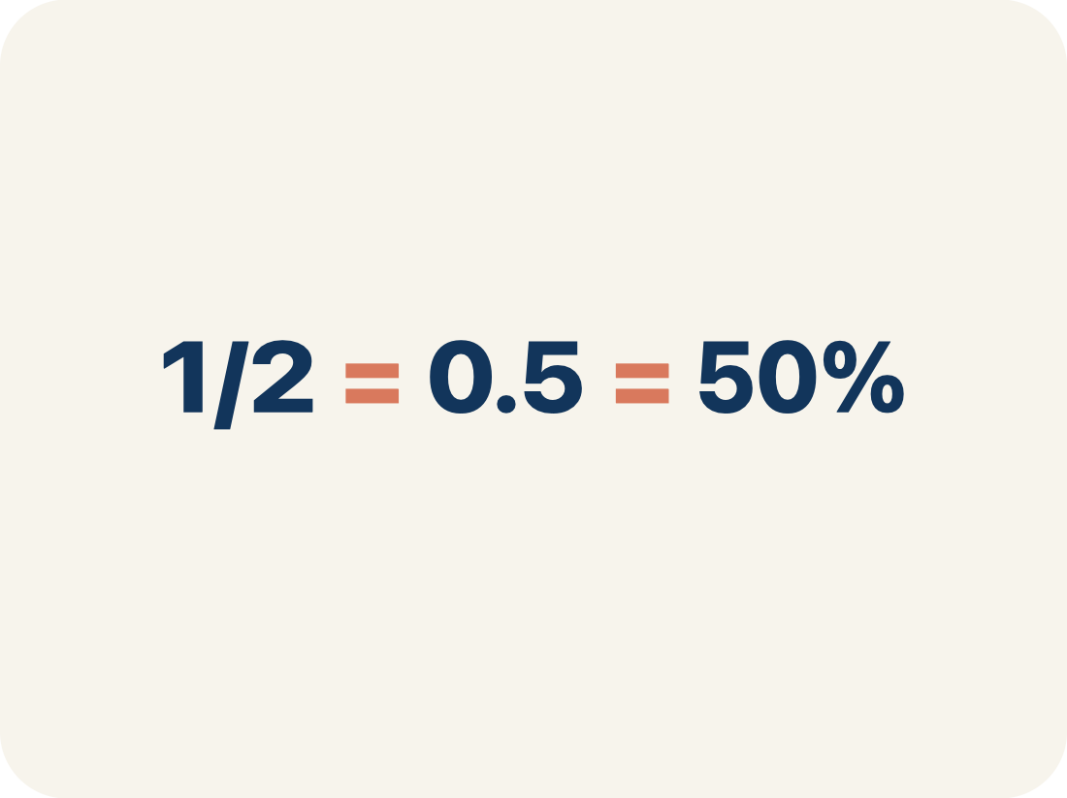
Vocabulary 1 of 6
Lesson 4-2 · Relate Fractions, Decimals, and Percentages
Fractions, Decimals, and Percents
Three equivalent ways to name the same part of a whole.
EXAMPLE · EXPLAIN WHY IT FITS
1/2 = 0.5 = 50%
USE THE MATH WORDS · Use today’s math words in your explanation — not “it” and “that thing.”
eduwonderlab.com · Neft Teacher
5 / 38
Notes:
TEACH IN PRACTICE | Embedded facilitation | Lesson 4.2, slide 5 | VOCAB
Focus on the existing task: Vocabulary 1 of 6 Fractions, Decimals, and…
ASK (T1/3/5): Where does “Fractions, Decimals, and Percents” appear in the example? Explain the meaning without reading the definition. Partner: restate the idea and ask a clarifying question.
LOOK FOR: A correct connection between the word and a feature of the example. If the student only repeats the definition, invite pointing, sketching or oral rehearsal, then ask for another explanation of this same example.
PARTICIPATION (T5/6/7): Think time before volunteers; accept a written, drawn or rehearsed entry. Students ask for evidence respectfully. Recognize a specific contribution or revision and check that both partners participate.
Source: BCPS Updated Instructional Framework Rubric (June 2020), TEACH 1–7.

Slide 6
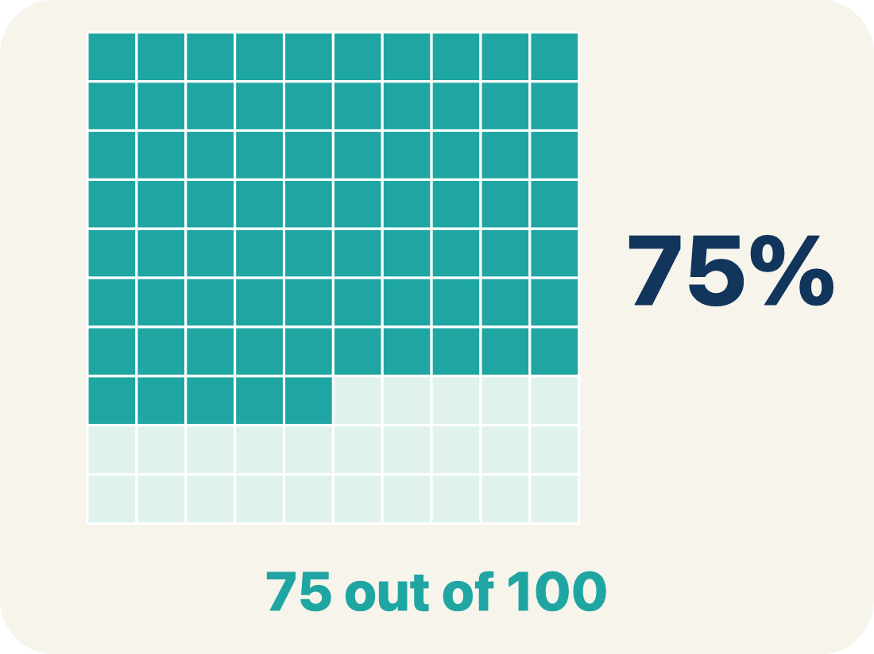
Vocabulary 2 of 6
Lesson 4-2 · Relate Fractions, Decimals, and Percentages
Percent
A way to compare a number to 100, shown with the % sign.
EXAMPLE · EXPLAIN WHY IT FITS
25% means 25 out of 100
Use “Percent” to explain the example. Point to evidence.
eduwonderlab.com · Neft Teacher
6 / 38
Notes:
TEACH IN PRACTICE | Embedded facilitation | Lesson 4.2, slide 6 | VOCAB
Focus on the existing task: Vocabulary 2 of 6 Percent A way to compare a…
ASK (T1/3/5): Where does “Percent” appear in the example? Explain the meaning without reading the definition. Partner: restate the idea and ask a clarifying question.
LOOK FOR: A correct connection between the word and a feature of the example. If the student only repeats the definition, invite pointing, sketching or oral rehearsal, then ask for another explanation of this same example.
PARTICIPATION (T5/6/7): Think time before volunteers; accept a written, drawn or rehearsed entry. Students ask for evidence respectfully. Recognize a specific contribution or revision and check that both partners participate.
Source: BCPS Updated Instructional Framework Rubric (June 2020), TEACH 1–7.

Slide 7
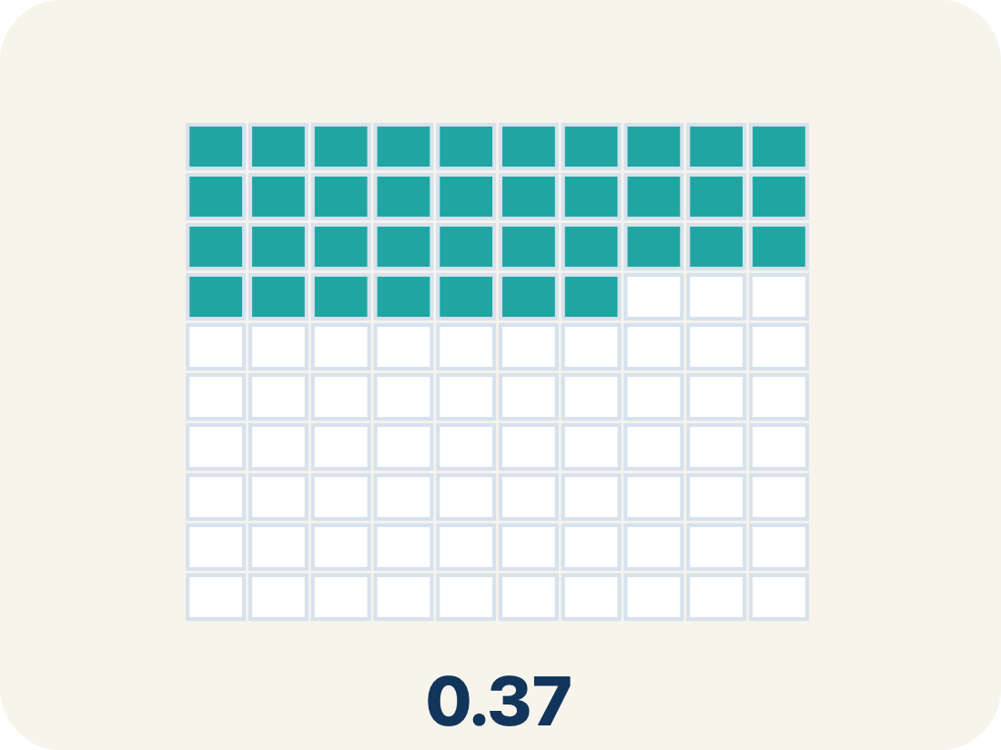
Vocabulary 3 of 6
Lesson 4-2 · Relate Fractions, Decimals, and Percentages
Decimal
A number with a dot, like 0.5 or 1.3, that uses place value to show tenths and hundredths.
EXAMPLE · EXPLAIN WHY IT FITS
0.75 means seventy-five hundredths
Use “Decimal” to explain the example. Point to evidence.
eduwonderlab.com · Neft Teacher
7 / 38
Notes:
TEACH IN PRACTICE | Embedded facilitation | Lesson 4.2, slide 7 | VOCAB
Focus on the existing task: Vocabulary 3 of 6 Decimal A number with a dot…
ASK (T1/3/5): Where does “Decimal” appear in the example? Explain the meaning without reading the definition. Partner: restate the idea and ask a clarifying question.
LOOK FOR: A correct connection between the word and a feature of the example. If the student only repeats the definition, invite pointing, sketching or oral rehearsal, then ask for another explanation of this same example.
PARTICIPATION (T5/6/7): Think time before volunteers; accept a written, drawn or rehearsed entry. Students ask for evidence respectfully. Recognize a specific contribution or revision and check that both partners participate.
Source: BCPS Updated Instructional Framework Rubric (June 2020), TEACH 1–7.

Slide 8
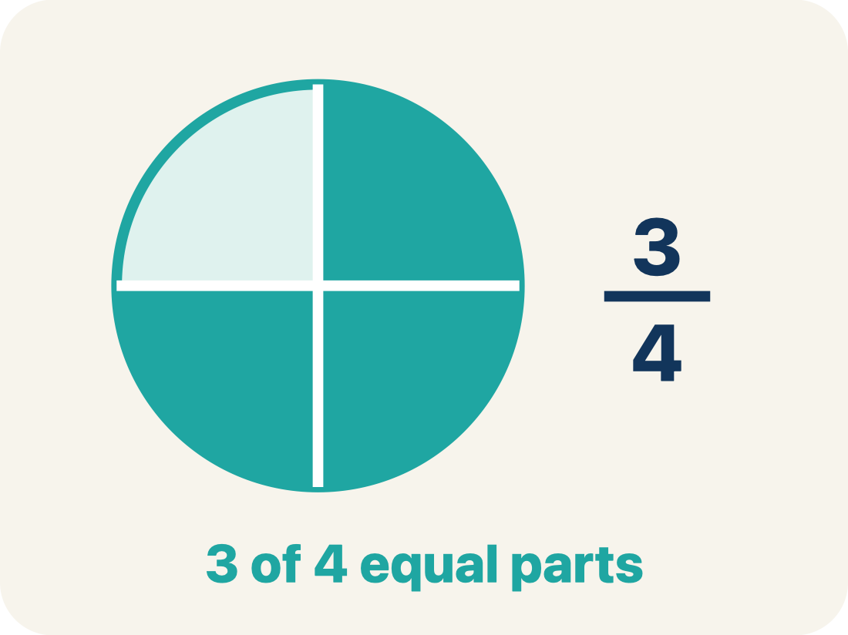
Vocabulary 4 of 6
Lesson 4-2 · Relate Fractions, Decimals, and Percentages
Equivalent
Having the same value, just written a different way.
EXAMPLE · EXPLAIN WHY IT FITS
1/2 = 0.5 = 50%
Use “Equivalent” to explain the example. Point to evidence.
eduwonderlab.com · Neft Teacher
8 / 38
Notes:
TEACH IN PRACTICE | Embedded facilitation | Lesson 4.2, slide 8 | VOCAB
Focus on the existing task: Vocabulary 4 of 6 Equivalent Having the same…
ASK (T1/3/5): Where does “Equivalent” appear in the example? Explain the meaning without reading the definition. Partner: restate the idea and ask a clarifying question.
LOOK FOR: A correct connection between the word and a feature of the example. If the student only repeats the definition, invite pointing, sketching or oral rehearsal, then ask for another explanation of this same example.
PARTICIPATION (T5/6/7): Think time before volunteers; accept a written, drawn or rehearsed entry. Students ask for evidence respectfully. Recognize a specific contribution or revision and check that both partners participate.
Source: BCPS Updated Instructional Framework Rubric (June 2020), TEACH 1–7.

Slide 9
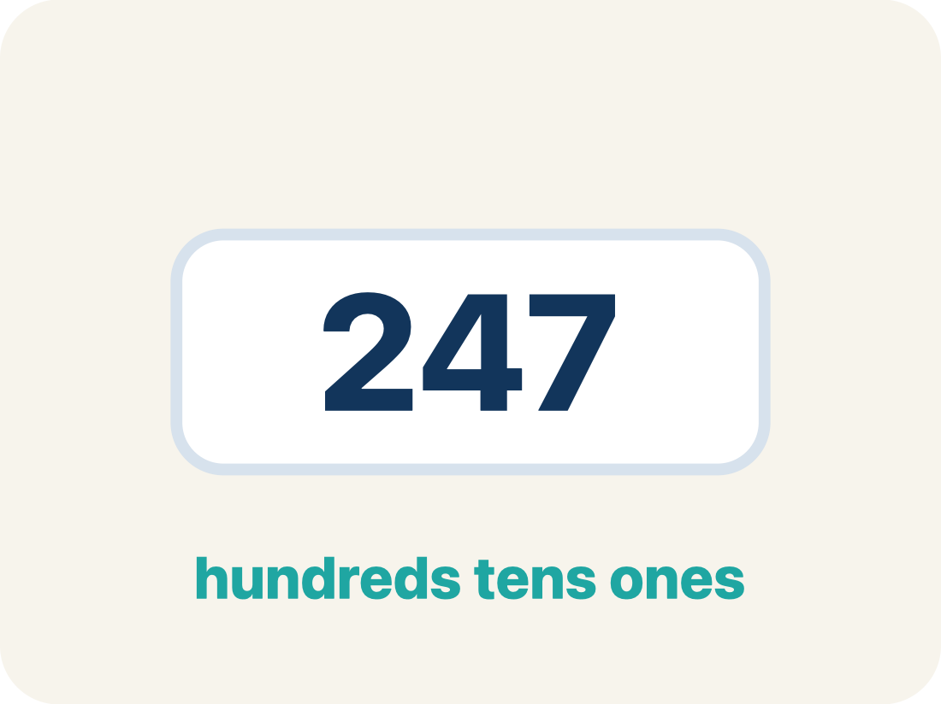
Vocabulary 5 of 6
Lesson 4-2 · Relate Fractions, Decimals, and Percentages
Benchmark
A familiar number you use to guess, like 50% or 1/2.
EXAMPLE · EXPLAIN WHY IT FITS
Common benchmarks: 25%, 50%, 75%
Use “Benchmark” to explain the example. Point to evidence.
eduwonderlab.com · Neft Teacher
9 / 38
Notes:
TEACH IN PRACTICE | Embedded facilitation | Lesson 4.2, slide 9 | VOCAB
Focus on the existing task: Vocabulary 5 of 6 Benchmark A familiar number…
ASK (T1/3/5): Where does “Benchmark” appear in the example? Explain the meaning without reading the definition. Partner: restate the idea and ask a clarifying question.
LOOK FOR: A correct connection between the word and a feature of the example. If the student only repeats the definition, invite pointing, sketching or oral rehearsal, then ask for another explanation of this same example.
PARTICIPATION (T5/6/7): Think time before volunteers; accept a written, drawn or rehearsed entry. Students ask for evidence respectfully. Recognize a specific contribution or revision and check that both partners participate.
Source: BCPS Updated Instructional Framework Rubric (June 2020), TEACH 1–7.

Slide 10
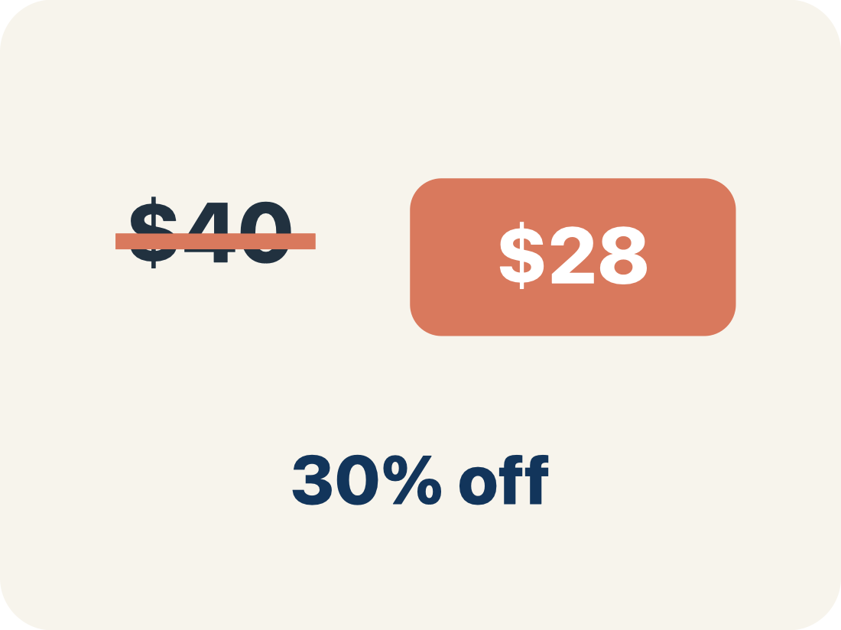
Vocabulary 6 of 6
Lesson 4-2 · Relate Fractions, Decimals, and Percentages
Discount
Money taken off the first price to make it cheaper.
EXAMPLE · EXPLAIN WHY IT FITS
$40 shirt at 25% off: discount = $10
Use “Discount” to explain the example. Point to evidence.
eduwonderlab.com · Neft Teacher
10 / 38
Notes:
TEACH IN PRACTICE | Embedded facilitation | Lesson 4.2, slide 10 | VOCAB
Focus on the existing task: Vocabulary 6 of 6 Discount Money taken off the…
ASK (T1/3/5): Where does “Discount” appear in the example? Explain the meaning without reading the definition. Partner: restate the idea and ask a clarifying question.
LOOK FOR: A correct connection between the word and a feature of the example. If the student only repeats the definition, invite pointing, sketching or oral rehearsal, then ask for another explanation of this same example.
PARTICIPATION (T5/6/7): Think time before volunteers; accept a written, drawn or rehearsed entry. Students ask for evidence respectfully. Recognize a specific contribution or revision and check that both partners participate.
Source: BCPS Updated Instructional Framework Rubric (June 2020), TEACH 1–7.

Slide 11





Be Curious
Which doesn’t belong?
Think first. Share a notice and a question;
build on a classmate’s idea.
Mindset
What helps you work productively with your classmates?
11 / 38
Notes:
TEACH IN PRACTICE | Embedded facilitation | Lesson 4.2, slide 11 | CURIOUS
Focus on the existing task: Which doesn’t belong?
LAUNCH (T2/3/5): Allow quiet observation first. Separate a notice from an inference, invite students’ own questions, and follow the existing launch before teaching a procedure.
LOOK FOR (T4): Where this task addresses it, students can express the same value as fraction, decimal and percent. Ask which feature of their work supports the claim.
RESPOND: If this task shows the lesson misconception—confusing a decimal with the same numeral followed by a percent sign—connect the original value to a hundred grid or a known benchmark. Have the student revise and explain the change. Use this support only where the concept occurs in the current task; otherwise respond to the displayed question.
RECHECK: If a gap is shared, revisit the existing representation together. If it is limited, give targeted support while others compare valid methods on the same task. Check the revision before moving on.
PARTICIPATION (T5/6/7): Think time before volunteers; accept a written, drawn or rehearsed entry. Students ask for evidence respectfully. Recognize a specific contribution or revision and check that both partners participate.
Source: BCPS Updated Instructional Framework Rubric (June 2020), TEACH 1–7.

Slide 12
Explain with today’s vocabulary; partner paraphrases.
Vocabulary
Lesson 4-2 · Relate Fractions, Decimals, and Percentages
Today’s Math Words
We learn every word — what it means and what it looks like — before we use it.
Fractions, Decimals, and Percents
Percent
Three equivalent ways to name the same part of a whole
A way to compare a number to 100, shown with the % sign
Decimal
Equivalent
A number with a dot, like 0.5 or 1.3, that uses place value to show tenths and hundredths
Having the same value, just written a different way
Benchmark
Discount
A familiar number you use to guess, like 50% or 1/2
Money taken off the first price to make it cheaper
eduwonderlab.com · Neft Teacher
12 / 38
Notes:
TEACH IN PRACTICE | Embedded facilitation | Lesson 4.2, slide 12 | VOCAB
Focus on the existing task: Vocabulary Today’s Math Words We learn every…
ASK (T1/3/5): Where does “the displayed term” appear in the example? Explain the meaning without reading the definition. Partner: restate the idea and ask a clarifying question.
LOOK FOR: A correct connection between the word and a feature of the example. If the student only repeats the definition, invite pointing, sketching or oral rehearsal, then ask for another explanation of this same example.
PARTICIPATION (T5/6/7): Think time before volunteers; accept a written, drawn or rehearsed entry. Students ask for evidence respectfully. Recognize a specific contribution or revision and check that both partners participate.
Source: BCPS Updated Instructional Framework Rubric (June 2020), TEACH 1–7. Earlier notes and answer keys are retained below.
EARLIER NOTES / EXISTING ANSWER KEY
UIFR TEACH — Level 4 student move: Explain with today’s vocabulary; partner paraphrases.
Student move: Explain with today’s vocabulary; partner paraphrases.

Slide 13
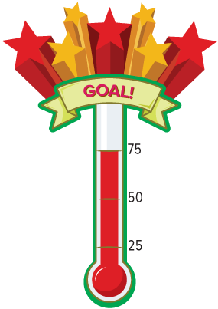
Ask a partner a question; choose a model together.
Food Drive
Some middle school students are organizing a canned food drive. Their goal is to collect 100 cans each week for the local food pantry. So far this week, students have brought in 75 cans.
How can the students represent the part of the goal that they have achieved so far this week?
13 / 38
Notes:
TEACH IN PRACTICE | Embedded facilitation | Lesson 4.2, slide 13 | TASK
Focus on the existing task: Some middle school students are organizing a canned food drive. Their goal is to collect 100 cans each week for the local food pantry. So…
LAUNCH (T2/3/5): Use the displayed question. Give private thinking time; then A explains while B asks for evidence. Switch roles. Each student records their own reasoning.
LOOK FOR (T4): Where this task addresses it, students can express the same value as fraction, decimal and percent. Ask which feature of their work supports the claim.
RESPOND: If this task shows the lesson misconception—confusing a decimal with the same numeral followed by a percent sign—connect the original value to a hundred grid or a known benchmark. Have the student revise and explain the change. Use this support only where the concept occurs in the current task; otherwise respond to the displayed question.
RECHECK: If a gap is shared, revisit the existing representation together. If it is limited, give targeted support while others compare valid methods on the same task. Check the revision before moving on.
PARTICIPATION (T5/6/7): Think time before volunteers; accept a written, drawn or rehearsed entry. Students ask for evidence respectfully. Recognize a specific contribution or revision and check that both partners participate.
Source: BCPS Updated Instructional Framework Rubric (June 2020), TEACH 1–7. Earlier notes and answer keys are retained below.
EARLIER NOTES / EXISTING ANSWER KEY
UIFR TEACH — Level 4 student move: Ask a partner a question; choose a model together.
Student move: Ask a partner a question; choose a model together.
UIFR FULL | Lesson-specific facilitation
TEACH 2-3 | Session 1 task launch (UIFR PDF pp. 9-10).
Use the problem exactly as displayed. Give individual thinking time before discussion or advancing to the explanation. If the answer is already visible, ask students to reconstruct and justify it. Invite a choice of suitable representations and have students explain why their choice helps.
At the point where this concept appears, ask: “How do all three forms represent the same amount of the same whole?” Wait for evidence, invite another pathway, and have a student ask a follow-up question. Do not replace students’ reasoning with a sequence of leading steps.

Slide 14
Food Drive
Some middle school students are organizing a canned food drive. Their goal is to collect 100 cans each week for the local food pantry. So far this week, students have brought in 75 cans. How can the students represent the part of the goal that they have achieved so far this week?
How can you represent the part of the goal they have achieved?
Reveal:
One way is to use a fraction.
14 / 38
Notes:
TEACH IN PRACTICE | Embedded facilitation | Lesson 4.2, slide 14 | REVEAL
Focus on the existing task: How can you represent the part of the goal they have achieved?
LAUNCH (T2/3/5): If an existing answer cover is present, gather an attempt before revealing. If the explanation is already visible, ask students to reconstruct and justify it. Compare reasoning and explain a revision; preserve the reveal sequence.
LOOK FOR (T4): Where this task addresses it, students can express the same value as fraction, decimal and percent. Ask which feature of their work supports the claim.
RESPOND: If this task shows the lesson misconception—confusing a decimal with the same numeral followed by a percent sign—connect the original value to a hundred grid or a known benchmark. Have the student revise and explain the change. Use this support only where the concept occurs in the current task; otherwise respond to the displayed question.
RECHECK: If a gap is shared, revisit the existing representation together. If it is limited, give targeted support while others compare valid methods on the same task. Check the revision before moving on.
PARTICIPATION (T5/6/7): Think time before volunteers; accept a written, drawn or rehearsed entry. Students ask for evidence respectfully. Recognize a specific contribution or revision and check that both partners participate.
Source: BCPS Updated Instructional Framework Rubric (June 2020), TEACH 1–7. Earlier notes and answer keys are retained below.
EARLIER NOTES / EXISTING ANSWER KEY
Ask students to describe the food-drive relationship in their own words before writing anything. Then ask: why is a fraction a reasonable first way to show it? Listen for who the whole is in the fraction; naming the wrong whole is the most common slip here.

Slide 15
STUDENT MOVES
Lesson 4-2
Your move
STRUGGLE FIRST · Work on your own first. Stuck is allowed — try a second strategy before you ask.
15 / 38

Slide 16
Partner press: ask ‘Why?’ and answer with evidence.
Food Drive
A fraction can represent the 75 out of 100 cans that the students have collected.
How does a fraction use a number to represent part of a whole?
Record your reasoning before the reveal. Compare, then
explain any revision.
Reveal:
The denominator of the fraction represents the whole and the numerator represents the part being discussed.
16 / 38
Notes:
TEACH IN PRACTICE | Embedded facilitation | Lesson 4.2, slide 15 | REVEAL
Focus on the existing task: A fraction can represent the 75 out of 100 cans that the students have collected. How does a fraction use a number to represent part of a whole?
LAUNCH (T2/3/5): If an existing answer cover is present, gather an attempt before revealing. If the explanation is already visible, ask students to reconstruct and justify it. Compare reasoning and explain a revision; preserve the reveal sequence.
LOOK FOR (T4): Where this task addresses it, students can express the same value as fraction, decimal and percent. Ask which feature of their work supports the claim.
RESPOND: If this task shows the lesson misconception—confusing a decimal with the same numeral followed by a percent sign—connect the original value to a hundred grid or a known benchmark. Have the student revise and explain the change. Use this support only where the concept occurs in the current task; otherwise respond to the displayed question.
RECHECK: If a gap is shared, revisit the existing representation together. If it is limited, give targeted support while others compare valid methods on the same task. Check the revision before moving on.
PARTICIPATION (T5/6/7): Think time before volunteers; accept a written, drawn or rehearsed entry. Students ask for evidence respectfully. Recognize a specific contribution or revision and check that both partners participate.
Source: BCPS Updated Instructional Framework Rubric (June 2020), TEACH 1–7. Earlier notes and answer keys are retained below.
EARLIER NOTES / EXISTING ANSWER KEY
UIFR TEACH — Level 4 student move: Partner press: ask ‘Why?’ and answer with evidence.
Student move: Partner press: ask ‘Why?’ and answer with evidence.

Slide 17
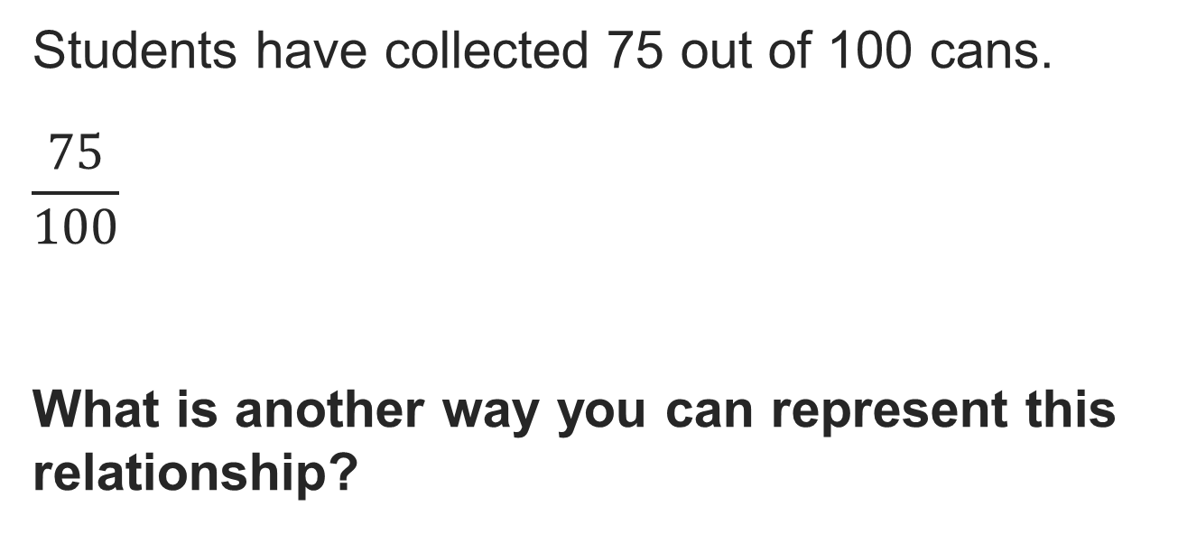
Food Drive
PICK YOUR STRATEGY · Choose your path — picture, table, number line, or equation — and be ready to say why you chose it.
Reveal:
We can express the relationship as a percent.
17 / 38
Notes:
TEACH IN PRACTICE | Embedded facilitation | Lesson 4.2, slide 16 | REVEAL
Focus on the existing task: Reveal: We can express the relationship as a percent. Food Drive
LAUNCH (T2/3/5): If an existing answer cover is present, gather an attempt before revealing. If the explanation is already visible, ask students to reconstruct and justify it. Compare reasoning and explain a revision; preserve the reveal sequence.
LOOK FOR (T4): Where this task addresses it, students can express the same value as fraction, decimal and percent. Ask which feature of their work supports the claim.
RESPOND: If this task shows the lesson misconception—confusing a decimal with the same numeral followed by a percent sign—connect the original value to a hundred grid or a known benchmark. Have the student revise and explain the change. Use this support only where the concept occurs in the current task; otherwise respond to the displayed question.
RECHECK: If a gap is shared, revisit the existing representation together. If it is limited, give targeted support while others compare valid methods on the same task. Check the revision before moving on.
PARTICIPATION (T5/6/7): Think time before volunteers; accept a written, drawn or rehearsed entry. Students ask for evidence respectfully. Recognize a specific contribution or revision and check that both partners participate.
Source: BCPS Updated Instructional Framework Rubric (June 2020), TEACH 1–7. Earlier notes and answer keys are retained below.
EARLIER NOTES / EXISTING ANSWER KEY
Ask what changes and what stays the same when the fraction becomes a percent. Listen for equivalent out of 100 reasoning rather than a memorized shortcut. If students jump straight to a rule, press for why the rule works.

Slide 18
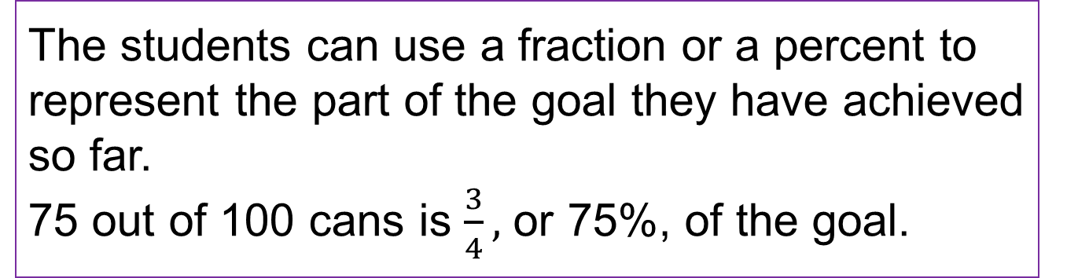
Compare strategies; persist, revise, and try again.
Food Drive
Some middle school students are organizing a canned food drive. Their goal is to collect 100 cans each week for the local food pantry. So far this week, students have brought in 75 cans.
How can the students represent the part of the goal that they have achieved so far this week?
18 / 38
Notes:
TEACH IN PRACTICE | Embedded facilitation | Lesson 4.2, slide 17 | TASK
Focus on the existing task: Some middle school students are organizing a canned food drive. Their goal is to collect 100 cans each week for the local food pantry. So…
LAUNCH (T2/3/5): Use the displayed question. Give private thinking time; then A explains while B asks for evidence. Switch roles. Each student records their own reasoning.
LOOK FOR (T4): Where this task addresses it, students can express the same value as fraction, decimal and percent. Ask which feature of their work supports the claim.
RESPOND: If this task shows the lesson misconception—confusing a decimal with the same numeral followed by a percent sign—connect the original value to a hundred grid or a known benchmark. Have the student revise and explain the change. Use this support only where the concept occurs in the current task; otherwise respond to the displayed question.
RECHECK: If a gap is shared, revisit the existing representation together. If it is limited, give targeted support while others compare valid methods on the same task. Check the revision before moving on.
PARTICIPATION (T5/6/7): Think time before volunteers; accept a written, drawn or rehearsed entry. Students ask for evidence respectfully. Recognize a specific contribution or revision and check that both partners participate.
Source: BCPS Updated Instructional Framework Rubric (June 2020), TEACH 1–7. Earlier notes and answer keys are retained below.
EARLIER NOTES / EXISTING ANSWER KEY
UIFR TEACH — Level 4 student move: Compare strategies; persist, revise, and try again.
Student move: Compare strategies; persist, revise, and try again.

Slide 19
Let’s Explore More
How could you represent 75% using decimal notation?
Workspace
Which representation is more meaningful for you? Explain why.
Try it yourself. Compare your
work with a partner; explain one
choice and revise.
Workspace
19 / 38
Notes:
TEACH IN PRACTICE | Embedded facilitation | Lesson 4.2, slide 18 | PRACTICE
Focus on the existing task: How could you represent 75% using decimal notation?
LAUNCH (T2/3/5): Use the displayed question. Give private thinking time; then A explains while B asks for evidence. Switch roles. Each student records their own reasoning.
LOOK FOR (T4): Where this task addresses it, students can express the same value as fraction, decimal and percent. Ask which feature of their work supports the claim.
RESPOND: If this task shows the lesson misconception—confusing a decimal with the same numeral followed by a percent sign—connect the original value to a hundred grid or a known benchmark. Have the student revise and explain the change. Use this support only where the concept occurs in the current task; otherwise respond to the displayed question.
RECHECK: If a gap is shared, revisit the existing representation together. If it is limited, give targeted support while others compare valid methods on the same task. Check the revision before moving on.
PARTICIPATION (T5/6/7): Think time before volunteers; accept a written, drawn or rehearsed entry. Students ask for evidence respectfully. Recognize a specific contribution or revision and check that both partners participate.
Source: BCPS Updated Instructional Framework Rubric (June 2020), TEACH 1–7. Earlier notes and answer keys are retained below.
EARLIER NOTES / EXISTING ANSWER KEY
Give a quiet minute to write 75 percent as a decimal, then have partners compare. Listen for 75 hundredths as the bridge between the forms. Watch for the classic 0.75 versus 7.5 error and ask what place value the percent digits land in.
UIFR FULL | Lesson-specific facilitation
TEACH 4-5 | Session 1 discussion and checkpoint (UIFR PDF pp. 11-12).
Collect a brief response from every student to the existing prompt before hearing volunteers. Partners take turns explaining and asking for evidence: “I understand ___; what supports ___?” Offer rehearsal or an annotated model for students who need language support. Each student records their own reasoning.
Look specifically for: confusing a decimal with the same numeral followed by a percent sign. If it appears, connect the original value to a hundred grid or a known benchmark; then ask the student to revise the same response and explain the change. If evidence is secure, have students compare a second valid pathway or state why their approach works. Choose the next step from the responses, not a preset pace.

Slide 20
LESSON 4.2 / DISCUSS THE TASK
Explain and compare
Use the task you just explored.
TAKE TURNS
How do all three forms represent the same amount of the same whole?
Explain
“I know this because…”
Ask
“Where does your work show that?”
Point to evidence in your work.
Then compare your approach with a partner’s.
HOW DO YOU KNOW? · Ask your partner “How do you know?” Answer by pointing to your own work.
Listen to understand. Ask for evidence. Make room for every voice.
Notes:
TEACH IN PRACTICE | Embedded facilitation | Lesson 4.2, slide 19 | PRIOR_INSERT
Focus on the existing task: Point to evidence in your work. Then compare your approach with a partner’s. TAKE TURNS Explain “I know this because…” Ask “Where does your work show that?
CONNECT (T1/4): Ask students to restate the displayed goal or key idea and connect it to earlier work. Relevant lesson evidence: express the same value as fraction, decimal and percent; check against a benchmark. Use only the criterion that matches the current session.
SHOW PROGRESS: Students point to their own existing work, explain what improved after feedback, and name a next step. Pair confidence ratings with actual evidence.
PARTICIPATION (T5/6/7): Think time before volunteers; accept a written, drawn or rehearsed entry. Students ask for evidence respectfully. Recognize a specific contribution or revision and check that both partners participate.
Source: BCPS Updated Instructional Framework Rubric (June 2020), TEACH 1–7.

Slide 21
Be Curious
What math do you see in this problem?
When blue whales feed, they can take in more than their body weight in food and water in one single gulp. What percent of their body weight do they take in when feeding?
Mindset
JUSTIFY IT · Say it like this: “I know ______ because ______.”
What are some ways you are connecting with your classmates during math class?
21 / 38
Notes:
TEACH IN PRACTICE | Embedded facilitation | Lesson 4.2, slide 20 | CURIOUS
Focus on the existing task: What math do you see in this problem?
LAUNCH (T2/3/5): Allow quiet observation first. Separate a notice from an inference, invite students’ own questions, and follow the existing launch before teaching a procedure.
LOOK FOR (T4): Where this task addresses it, students can express the same value as fraction, decimal and percent. Ask which feature of their work supports the claim.
RESPOND: If this task shows the lesson misconception—confusing a decimal with the same numeral followed by a percent sign—connect the original value to a hundred grid or a known benchmark. Have the student revise and explain the change. Use this support only where the concept occurs in the current task; otherwise respond to the displayed question.
RECHECK: If a gap is shared, revisit the existing representation together. If it is limited, give targeted support while others compare valid methods on the same task. Check the revision before moving on.
PARTICIPATION (T5/6/7): Think time before volunteers; accept a written, drawn or rehearsed entry. Students ask for evidence respectfully. Recognize a specific contribution or revision and check that both partners participate.
Source: BCPS Updated Instructional Framework Rubric (June 2020), TEACH 1–7.

Slide 22
Session 2 Warm-Up
Lesson 4-2 · Relate Fractions, Decimals, and Percentages
Session 2 Warm-Up
Quick review from Session 1 · about 4 minutes
1
What is 3/4 written as a percentage?
2
What is 0.65 written as a percentage?
A
34%
A
6.5%
B
75%
B
65%
C
7.5%
C
0.65%
D
25%
D
650%
3
What is 20% written as a simplified fraction?
4
To convert a decimal to a percent, multiply by:
A
1 / 20
A
10
B
1 / 5
B
100
C
2 / 10
C
1,000
D
20 / 1
D
0.1
eduwonderlab.com · Neft Teacher
22 / 38
Notes:
TEACH IN PRACTICE | Embedded facilitation | Lesson 4.2, slide 21 | WARMUP
Focus on the existing task: A 34% B 75% C 7.5% D 25% 2 What is 0.65 written as a percentage?
GATHER EVIDENCE (T4/6): Keep the original items. Students try independently, mark an uncertain item, and explain one method before checking. Use the existing key when present.
RESPOND: Distinguish a calculation slip from a reasoning gap. Give one next step on the same item; have students revise in a second color. Use the responses to choose flexible support for today’s lesson.
PARTICIPATION (T5/6/7): Think time before volunteers; accept a written, drawn or rehearsed entry. Students ask for evidence respectfully. Recognize a specific contribution or revision and check that both partners participate.
Source: BCPS Updated Instructional Framework Rubric (June 2020), TEACH 1–7. Earlier notes and answer keys are retained below.
EARLIER NOTES / EXISTING ANSWER KEY
Warm-up routine: students start silently on entry; keep it to about 4 minutes.
Circulate and note who is stuck — use what you see to choose who you check on first today.
Go over answers quickly; ask one student to explain a step, not just say the answer.
UIFR: TEACH 4 · TEACH 6.
UIFR FULL | Lesson-specific facilitation
TEACH 1 | Session 2 purpose and evidence (UIFR PDF p. 8).
Have students restate the displayed session goal in their own words and connect it to the existing context or a familiar experience they choose to share. Use the current session goal to select from these lesson-wide evidence criteria; do not frontload a later-session procedure.
Look for: express the same value as fraction, decimal and percent; check against a benchmark. Ask: “Which part of your work would show this?” Revisit that evidence after the task; a confidence rating alone is not evidence of understanding.

Slide 23
STUDENT MOVES
Lesson 4-2
Your move
YOU KNOW THE ROUTINE · Read → plan → solve → check. Do all four, in that order.
23 / 38

Slide 24
Review Notes
Lesson 4-2 · Relate Fractions, Decimals, and Percentages
Review Notes — Session 2
Copy. Explain. Check.
CONNECT IT · What earlier lesson does this build on? Tell a partner in one sentence.
Fractions to Percents
1
Convert denominator to 100 or divide numerator by denominator and multiply by 100.
Decimals to Percents
2
Shift the decimal point two places right (multiply by 100) and append the % symbol.
Percents to Fractions
3
Write the percent over 100 and simplify by dividing out common factors.
eduwonderlab.com · Neft Teacher
24 / 38
Notes:
TEACH IN PRACTICE | Embedded facilitation | Lesson 4.2, slide 22 | NOTES
Focus on the existing task: Review Notes Review Notes — Session 2 Copy into…
ROUTINE (T1/2/4): Read or copy the original notes, cover one line, and explain it using the displayed example. Reopen and correct. Copying alone is not evidence of understanding.
LOOK FOR: A link between a symbol, quantity or feature and the explanation. If missing, point back to that feature and have the student try again; fade the prompt once they can explain.
PARTICIPATION (T5/6/7): Think time before volunteers; accept a written, drawn or rehearsed entry. Students ask for evidence respectfully. Recognize a specific contribution or revision and check that both partners participate.
Source: BCPS Updated Instructional Framework Rubric (June 2020), TEACH 1–7. Earlier notes and answer keys are retained below.
EARLIER NOTES / EXISTING ANSWER KEY
Copy routine: read one line at a time; students copy, then explain that line to a partner.
Keep it brisk — the understanding work happens in the examples, not the copying.
UIFR: TEACH 1 · TEACH 6.

Slide 25
Session 2
Relate Fractions, Decimals, and Percentages
TRY IT BEFORE YOU’RE SURE · Start even if you are not sure. A revised answer counts as much as a first-try answer.
25 / 38
Notes:
TEACH IN PRACTICE | Embedded facilitation | Lesson 4.2, slide 23 | DIVIDER
Focus on the existing task: Relate Fractions, Decimals, and Percentages Session 2
TRANSITION (T6/7): Students confirm materials, roles, how to request help, and the next response routine. Ask a student to restate it. Keep teacher-only slides hidden.
PARTICIPATION (T5/6/7): Think time before volunteers; accept a written, drawn or rehearsed entry. Students ask for evidence respectfully. Recognize a specific contribution or revision and check that both partners participate.
Source: BCPS Updated Instructional Framework Rubric (June 2020), TEACH 1–7. Earlier notes and answer keys are retained below.
EARLIER NOTES / EXISTING ANSWER KEY
Session divider. Frame the goal: today we move between fractions, decimals, and percents and use one form to compare numbers. Ask students to predict when a percent might be easier to use than a fraction.

Slide 26

Number Reorganization
How can you order the following numbers from least to greatest?
Think and record first. Which part of your work supports your answer?
Planning
26 / 38
Notes:
TEACH IN PRACTICE | Embedded facilitation | Lesson 4.2, slide 24 | TASK
Focus on the existing task: How can you order the following numbers from least to greatest?
LAUNCH (T2/3/5): Use the displayed question. Give private thinking time; then A explains while B asks for evidence. Switch roles. Each student records their own reasoning.
LOOK FOR (T4): Where this task addresses it, students can express the same value as fraction, decimal and percent. Ask which feature of their work supports the claim.
RESPOND: If this task shows the lesson misconception—confusing a decimal with the same numeral followed by a percent sign—connect the original value to a hundred grid or a known benchmark. Have the student revise and explain the change. Use this support only where the concept occurs in the current task; otherwise respond to the displayed question.
RECHECK: If a gap is shared, revisit the existing representation together. If it is limited, give targeted support while others compare valid methods on the same task. Check the revision before moving on.
PARTICIPATION (T5/6/7): Think time before volunteers; accept a written, drawn or rehearsed entry. Students ask for evidence respectfully. Recognize a specific contribution or revision and check that both partners participate.
Source: BCPS Updated Instructional Framework Rubric (June 2020), TEACH 1–7. Earlier notes and answer keys are retained below.
EARLIER NOTES / EXISTING ANSWER KEY
Have students attempt an order before any converting, and keep the first guesses visible. Listen for which numbers students find hard to place and why. The point of the reveal is that mixed forms are hard to compare directly, so let that difficulty surface.
UIFR FULL | Lesson-specific facilitation
TEACH 2-3 | Session 2 task launch (UIFR PDF pp. 9-10).
Use the problem exactly as displayed. Give individual thinking time before discussion or advancing to the explanation. If the answer is already visible, ask students to reconstruct and justify it. Invite a choice of suitable representations and have students explain why their choice helps.
At the point where this concept appears, ask: “How do all three forms represent the same amount of the same whole?” Wait for evidence, invite another pathway, and have a student ask a follow-up question. Do not replace students’ reasoning with a sequence of leading steps.

Slide 27
Number Reorganization
How can you make it easier to compare and order the numbers?
Record your reasoning before the reveal. Compare, then explain any revision.
Reveal:
We can express all the numbers using the same notation.
27 / 38
Notes:
TEACH IN PRACTICE | Embedded facilitation | Lesson 4.2, slide 25 | REVEAL
Focus on the existing task: How can you make it easier to compare and order the numbers?
LAUNCH (T2/3/5): If an existing answer cover is present, gather an attempt before revealing. If the explanation is already visible, ask students to reconstruct and justify it. Compare reasoning and explain a revision; preserve the reveal sequence.
LOOK FOR (T4): Where this task addresses it, students can express the same value as fraction, decimal and percent. Ask which feature of their work supports the claim.
RESPOND: If this task shows the lesson misconception—confusing a decimal with the same numeral followed by a percent sign—connect the original value to a hundred grid or a known benchmark. Have the student revise and explain the change. Use this support only where the concept occurs in the current task; otherwise respond to the displayed question.
RECHECK: If a gap is shared, revisit the existing representation together. If it is limited, give targeted support while others compare valid methods on the same task. Check the revision before moving on.
PARTICIPATION (T5/6/7): Think time before volunteers; accept a written, drawn or rehearsed entry. Students ask for evidence respectfully. Recognize a specific contribution or revision and check that both partners participate.
Source: BCPS Updated Instructional Framework Rubric (June 2020), TEACH 1–7. Earlier notes and answer keys are retained below.
EARLIER NOTES / EXISTING ANSWER KEY
Ask why putting every number in the same form makes comparing easier. Listen for students choosing a form on purpose and defending the choice. Some students convert only some of the numbers and compare across forms anyway; ask them to check that every number is in the chosen form.

Slide 28
COLLABORATE · TALK IT THROUGH • AGREE ON A MODEL
Student-led talk: paraphrase, agree or disagree, add on.
Collaborate and Connect
How can you express all the numbers
as fractions with the same denominator?
as decimals? as percentages?
Reveal:
Fractions:
Decimals:
Percentages:
28 / 38
Notes:
TEACH IN PRACTICE | Embedded facilitation | Lesson 4.2, slide 26 | COLLABORATE
Focus on the existing task: How can you express all the numbers as fractions with the same denominator?
LAUNCH (T2/3/5): Use the displayed question. Give private thinking time; then A explains while B asks for evidence. Switch roles. Each student records their own reasoning.
LOOK FOR (T4): Where this task addresses it, students can express the same value as fraction, decimal and percent. Ask which feature of their work supports the claim.
RESPOND: If this task shows the lesson misconception—confusing a decimal with the same numeral followed by a percent sign—connect the original value to a hundred grid or a known benchmark. Have the student revise and explain the change. Use this support only where the concept occurs in the current task; otherwise respond to the displayed question.
RECHECK: If a gap is shared, revisit the existing representation together. If it is limited, give targeted support while others compare valid methods on the same task. Check the revision before moving on.
PARTICIPATION (T5/6/7): Think time before volunteers; accept a written, drawn or rehearsed entry. Students ask for evidence respectfully. Recognize a specific contribution or revision and check that both partners participate.
Source: BCPS Updated Instructional Framework Rubric (June 2020), TEACH 1–7. Earlier notes and answer keys are retained below.
EARLIER NOTES / EXISTING ANSWER KEY
UIFR TEACH — Level 4 student move: Student-led talk: paraphrase, agree or disagree, add on.
Student move: Student-led talk: paraphrase, agree or disagree, add on.
Routine: COLLABORATE · TALK IT THROUGH • AGREE ON A MODEL
UIFR FULL | Lesson-specific facilitation
TEACH 4-5 | Session 2 discussion and checkpoint (UIFR PDF pp. 11-12).
Collect a brief response from every student to the existing prompt before hearing volunteers. Partners take turns explaining and asking for evidence: “I understand ___; what supports ___?” Offer rehearsal or an annotated model for students who need language support. Each student records their own reasoning.
Look specifically for: confusing a decimal with the same numeral followed by a percent sign. If it appears, connect the original value to a hundred grid or a known benchmark; then ask the student to revise the same response and explain the change. If evidence is secure, have students compare a second valid pathway or state why their approach works. Choose the next step from the responses, not a preset pace.

Slide 29
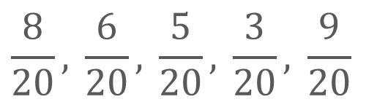
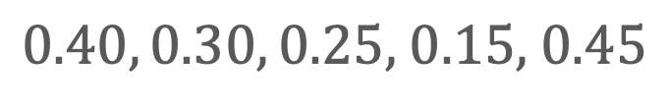

Number Reorganization
How can you compare the numbers once they are all written as fractions with the same denominator? as decimals? as percentages?
Fractions:
Decimals:
Percentages:
Reveal:
ADD ON · Add on: “I agree because ______.” or “I see it differently because ______.”
29 / 38
Notes:
TEACH IN PRACTICE | Embedded facilitation | Lesson 4.2, slide 27 | REVEAL
Focus on the existing task: How can you compare the numbers once they are all written as fractions with the same denominator?
LAUNCH (T2/3/5): If an existing answer cover is present, gather an attempt before revealing. If the explanation is already visible, ask students to reconstruct and justify it. Compare reasoning and explain a revision; preserve the reveal sequence.
LOOK FOR (T4): Where this task addresses it, students can express the same value as fraction, decimal and percent. Ask which feature of their work supports the claim.
RESPOND: If this task shows the lesson misconception—confusing a decimal with the same numeral followed by a percent sign—connect the original value to a hundred grid or a known benchmark. Have the student revise and explain the change. Use this support only where the concept occurs in the current task; otherwise respond to the displayed question.
RECHECK: If a gap is shared, revisit the existing representation together. If it is limited, give targeted support while others compare valid methods on the same task. Check the revision before moving on.
PARTICIPATION (T5/6/7): Think time before volunteers; accept a written, drawn or rehearsed entry. Students ask for evidence respectfully. Recognize a specific contribution or revision and check that both partners participate.
Source: BCPS Updated Instructional Framework Rubric (June 2020), TEACH 1–7. Earlier notes and answer keys are retained below.
EARLIER NOTES / EXISTING ANSWER KEY
Have partners compare the numbers now that they share a form, then rebuild the order from least to greatest. Listen for place-value talk when decimals are compared. Watch for students ranking by digit count instead of value, for example calling 0.125 greater than 0.4.

Slide 30
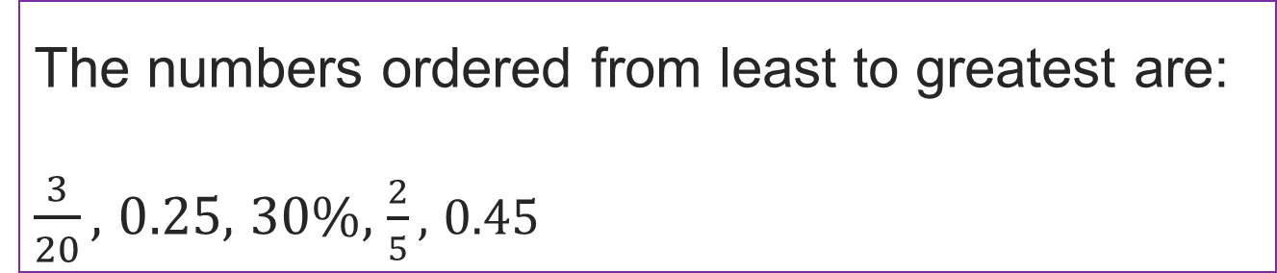
Number Reorganization
How can you order these numbers from least to greatest?
Think and record first. Which part of your work supports your answer?
30 / 38
Notes:
TEACH IN PRACTICE | Embedded facilitation | Lesson 4.2, slide 28 | TASK
Focus on the existing task: How can you order these numbers from least to greatest?
LAUNCH (T2/3/5): Use the displayed question. Give private thinking time; then A explains while B asks for evidence. Switch roles. Each student records their own reasoning.
LOOK FOR (T4): Where this task addresses it, students can express the same value as fraction, decimal and percent. Ask which feature of their work supports the claim.
RESPOND: If this task shows the lesson misconception—confusing a decimal with the same numeral followed by a percent sign—connect the original value to a hundred grid or a known benchmark. Have the student revise and explain the change. Use this support only where the concept occurs in the current task; otherwise respond to the displayed question.
RECHECK: If a gap is shared, revisit the existing representation together. If it is limited, give targeted support while others compare valid methods on the same task. Check the revision before moving on.
PARTICIPATION (T5/6/7): Think time before volunteers; accept a written, drawn or rehearsed entry. Students ask for evidence respectfully. Recognize a specific contribution or revision and check that both partners participate.
Source: BCPS Updated Instructional Framework Rubric (June 2020), TEACH 1–7. Earlier notes and answer keys are retained below.
EARLIER NOTES / EXISTING ANSWER KEY
Have students finish the ordering independently, then defend one placement to a partner. Listen for a clear reason tied to the shared form, not just answer-matching. Ask the class which conversion felt hardest and collect one strategy for it.

Slide 31
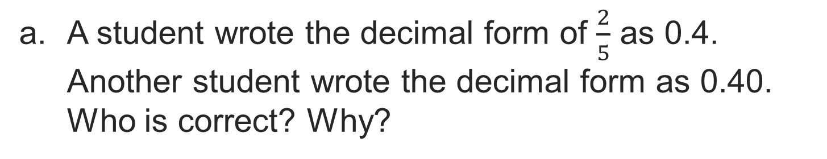
Compare pathways with a partner; name one revision.
Let’s Explore More
Workspace
When writing a fraction as a percent, why do you find an equivalent ratio with a denominator of 100?
Workspace
31 / 38
Notes:
TEACH IN PRACTICE | Embedded facilitation | Lesson 4.2, slide 29 | PRACTICE
Focus on the existing task: Let’s Explore More When writing a fraction as a percent, why do you find an equivalent ratio with a denominator of 100?
LAUNCH (T2/3/5): Use the displayed question. Give private thinking time; then A explains while B asks for evidence. Switch roles. Each student records their own reasoning.
LOOK FOR (T4): Where this task addresses it, students can express the same value as fraction, decimal and percent. Ask which feature of their work supports the claim.
RESPOND: If this task shows the lesson misconception—confusing a decimal with the same numeral followed by a percent sign—connect the original value to a hundred grid or a known benchmark. Have the student revise and explain the change. Use this support only where the concept occurs in the current task; otherwise respond to the displayed question.
RECHECK: If a gap is shared, revisit the existing representation together. If it is limited, give targeted support while others compare valid methods on the same task. Check the revision before moving on.
PARTICIPATION (T5/6/7): Think time before volunteers; accept a written, drawn or rehearsed entry. Students ask for evidence respectfully. Recognize a specific contribution or revision and check that both partners participate.
Source: BCPS Updated Instructional Framework Rubric (June 2020), TEACH 1–7. Earlier notes and answer keys are retained below.
EARLIER NOTES / EXISTING ANSWER KEY
UIFR TEACH — Level 4 student move: Compare pathways with a partner; name one revision.
Student move: Compare pathways with a partner; name one revision.

Slide 32
LESSON 4.2 / CHECK YOUR WORK
Pause. Check. Improve.
CHECK
A mistake to watch for: confusing a decimal with the same numeral followed by a percent sign.
TRY
Connect the given value to a hundred grid or a known benchmark.
REVISE
Use that check on the task you just completed. Correct or strengthen one part, and explain why.
SELF-CHECK · Mark it: ✓ got it · ~ almost · ? stuck. Then fix one thing before we move on.
Listen to understand. Ask for evidence. Make room for every voice.
Notes:
TEACH IN PRACTICE | Embedded facilitation | Lesson 4.2, slide 30 | PRIOR_INSERT
Focus on the existing task: LESSON 4.2 / CHECK YOUR WORK Pause. Check. Improve. Listen to understand. Ask for evidence. Make room for every voice. CHECK A mistake…
CONNECT (T1/4): Ask students to restate the displayed goal or key idea and connect it to earlier work. Relevant lesson evidence: express the same value as fraction, decimal and percent; check against a benchmark. Use only the criterion that matches the current session.
SHOW PROGRESS: Students point to their own existing work, explain what improved after feedback, and name a next step. Pair confidence ratings with actual evidence.
PARTICIPATION (T5/6/7): Think time before volunteers; accept a written, drawn or rehearsed entry. Students ask for evidence respectfully. Recognize a specific contribution or revision and check that both partners participate.
Source: BCPS Updated Instructional Framework Rubric (June 2020), TEACH 1–7.

Slide 33
Number Reorganization
What do you notice about what each number represents?
Compare your reasoning with the explanation. Explain any revision you make.
Reveal:
Each of these numbers represents part of a whole.
33 / 38
Notes:
TEACH IN PRACTICE | Embedded facilitation | Lesson 4.2, slide 31 | REVEAL
Focus on the existing task: What do you notice about what each number represents?
LAUNCH (T2/3/5): If an existing answer cover is present, gather an attempt before revealing. If the explanation is already visible, ask students to reconstruct and justify it. Compare reasoning and explain a revision; preserve the reveal sequence.
LOOK FOR (T4): Where this task addresses it, students can express the same value as fraction, decimal and percent. Ask which feature of their work supports the claim.
RESPOND: If this task shows the lesson misconception—confusing a decimal with the same numeral followed by a percent sign—connect the original value to a hundred grid or a known benchmark. Have the student revise and explain the change. Use this support only where the concept occurs in the current task; otherwise respond to the displayed question.
RECHECK: If a gap is shared, revisit the existing representation together. If it is limited, give targeted support while others compare valid methods on the same task. Check the revision before moving on.
PARTICIPATION (T5/6/7): Think time before volunteers; accept a written, drawn or rehearsed entry. Students ask for evidence respectfully. Recognize a specific contribution or revision and check that both partners participate.
Source: BCPS Updated Instructional Framework Rubric (June 2020), TEACH 1–7.

Slide 34
Number Reorganization
What do you notice about how these numbers are written?
Compare your reasoning with the explanation. Explain any revision you make.
Reveal:
Each part of a whole is written in a different notation.
34 / 38
Notes:
TEACH IN PRACTICE | Embedded facilitation | Lesson 4.2, slide 32 | REVEAL
Focus on the existing task: What do you notice about how these numbers are written?
LAUNCH (T2/3/5): If an existing answer cover is present, gather an attempt before revealing. If the explanation is already visible, ask students to reconstruct and justify it. Compare reasoning and explain a revision; preserve the reveal sequence.
LOOK FOR (T4): Where this task addresses it, students can express the same value as fraction, decimal and percent. Ask which feature of their work supports the claim.
RESPOND: If this task shows the lesson misconception—confusing a decimal with the same numeral followed by a percent sign—connect the original value to a hundred grid or a known benchmark. Have the student revise and explain the change. Use this support only where the concept occurs in the current task; otherwise respond to the displayed question.
RECHECK: If a gap is shared, revisit the existing representation together. If it is limited, give targeted support while others compare valid methods on the same task. Check the revision before moving on.
PARTICIPATION (T5/6/7): Think time before volunteers; accept a written, drawn or rehearsed entry. Students ask for evidence respectfully. Recognize a specific contribution or revision and check that both partners participate.
Source: BCPS Updated Instructional Framework Rubric (June 2020), TEACH 1–7.

Slide 35
Number Reorganization
How can you make it easier to compare and order the numbers?
Compare your reasoning with the explanation. Explain any revision you make.
Reveal:
We can express all the numbers using the same notation.
35 / 38
Notes:
TEACH IN PRACTICE | Embedded facilitation | Lesson 4.2, slide 33 | REVEAL
Focus on the existing task: How can you make it easier to compare and order the numbers?
LAUNCH (T2/3/5): If an existing answer cover is present, gather an attempt before revealing. If the explanation is already visible, ask students to reconstruct and justify it. Compare reasoning and explain a revision; preserve the reveal sequence.
LOOK FOR (T4): Where this task addresses it, students can express the same value as fraction, decimal and percent. Ask which feature of their work supports the claim.
RESPOND: If this task shows the lesson misconception—confusing a decimal with the same numeral followed by a percent sign—connect the original value to a hundred grid or a known benchmark. Have the student revise and explain the change. Use this support only where the concept occurs in the current task; otherwise respond to the displayed question.
RECHECK: If a gap is shared, revisit the existing representation together. If it is limited, give targeted support while others compare valid methods on the same task. Check the revision before moving on.
PARTICIPATION (T5/6/7): Think time before volunteers; accept a written, drawn or rehearsed entry. Students ask for evidence respectfully. Recognize a specific contribution or revision and check that both partners participate.
Source: BCPS Updated Instructional Framework Rubric (June 2020), TEACH 1–7.

Slide 36
SUMMARIZE · SAY IT IN YOUR OWN WORDS
Share a connection to prior learning or lived experience.
Summarize: Relate Fractions, Decimals, and Percentages
You can express percentages in percent, fraction, or decimal forms.
A percent expressed in fraction form always has a denominator of 100.
Percent | Fraction | Decimal
37% |  | 0.37
Explain the key idea without reading. Use today’s example as
evidence.
36 / 38
Notes:
TEACH IN PRACTICE | Embedded facilitation | Lesson 4.2, slide 34 | SUMMARIZE
Focus on the existing task: You can express percentages in percent, fraction, or decimal forms. A percent expressed in fraction form always has a denominator of 100.…
CONNECT (T1/4): Ask students to restate the displayed goal or key idea and connect it to earlier work. Relevant lesson evidence: express the same value as fraction, decimal and percent; check against a benchmark. Use only the criterion that matches the current session.
SHOW PROGRESS: Students point to their own existing work, explain what improved after feedback, and name a next step. Pair confidence ratings with actual evidence.
PARTICIPATION (T5/6/7): Think time before volunteers; accept a written, drawn or rehearsed entry. Students ask for evidence respectfully. Recognize a specific contribution or revision and check that both partners participate.
Source: BCPS Updated Instructional Framework Rubric (June 2020), TEACH 1–7. Earlier notes and answer keys are retained below.
EARLIER NOTES / EXISTING ANSWER KEY
UIFR TEACH — Level 4 student move: Share a connection to prior learning or lived experience.
Student move: Share a connection to prior learning or lived experience.
Routine: SUMMARIZE · SAY IT IN YOUR OWN WORDS

Slide 37
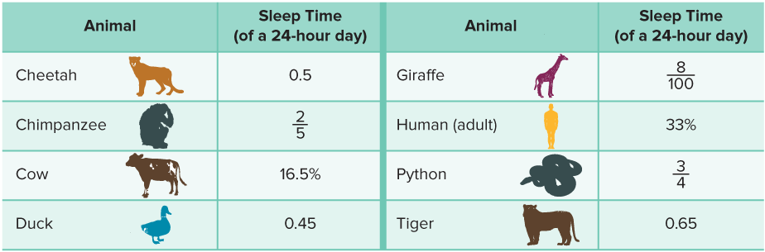
APPLY · PLAN IT • SOLVE IT • PROVE IT
Defend your method; partner gives one specific next step.
Apply: Sleepy Animals
The table shows the average total sleep times for different animals.
Question: How do the sleep times of the different animals compare? Order the animals from those that sleep the most to the least. Which animals’ sleep times surprised you? Explain why.
37 / 38
Notes:
TEACH IN PRACTICE | Embedded facilitation | Lesson 4.2, slide 35 | APPLY
Focus on the existing task: The table shows the average total sleep times for different animals. Apply: Sleepy Animals Question: How do the sleep times of the different animals compare?
LAUNCH (T2/3/5): Use the exact application task independently first. Ask students to justify their choice of method. Collect evidence before a partner discussion or correction.
LOOK FOR (T4): Where this task addresses it, students can express the same value as fraction, decimal and percent. Ask which feature of their work supports the claim.
RESPOND: If this task shows the lesson misconception—confusing a decimal with the same numeral followed by a percent sign—connect the original value to a hundred grid or a known benchmark. Have the student revise and explain the change. Use this support only where the concept occurs in the current task; otherwise respond to the displayed question.
RECHECK: If a gap is shared, revisit the existing representation together. If it is limited, give targeted support while others compare valid methods on the same task. Check the revision before moving on.
PARTICIPATION (T5/6/7): Think time before volunteers; accept a written, drawn or rehearsed entry. Students ask for evidence respectfully. Recognize a specific contribution or revision and check that both partners participate.
Source: BCPS Updated Instructional Framework Rubric (June 2020), TEACH 1–7. Earlier notes and answer keys are retained below.
EARLIER NOTES / EXISTING ANSWER KEY
UIFR TEACH — Level 4 student move: Defend your method; partner gives one specific next step.
Student move: Defend your method; partner gives one specific next step.
Routine: APPLY · PLAN IT • SOLVE IT • PROVE IT
UIFR FULL | Lesson-specific facilitation
TEACH 4 | Independent evidence and revision (UIFR PDF p. 11).
Use the existing application/exit problem as the independent check. If this is a learning-target slide, have students point to and explain their work on the preceding task. Separate initial independent evidence from the revision after feedback.
Check the relevant criteria: express the same value as fraction, decimal and percent; check against a benchmark. Respond with one specific next step tied to the work. Students revise and annotate what changed, then identify a criterion they can now demonstrate and one they still need to practice.
REFLECT & ADJUST 1-2 | After the lesson (UIFR PDF pp. 15-16).
Sort the existing work by demonstrated reasoning, partial understanding, and the specific misconception: confusing a decimal with the same numeral followed by a percent sign. Compare the initial response with the revision. Record which teaching move plausibly helped, which did not, and whose participation or access needs a different approach; do not record sensitive student details in this shared deck.
Plan the next lesson from that evidence: if the misconception persists, connect the original value to a hundred grid or a known benchmark using the current example before returning to the next grade-level task; if understanding is secure, use an existing extension or ask for a general explanation. Check the targeted idea again at the next warm-up.
Ask students what supported their thinking and what would help next time. Identify one change to try and one successful practice to retain. Seek colleague feedback on anonymized work when useful; these prompts support reflection and do not establish an evaluation rating. Source: Baltimore City Public Schools, Updated Instructional Framework Rubric, June 2020 (UIFR_Full.pdf).

Slide 38
LESSON 4.2 / REFLECT ON YOUR LEARNING
Show your progress
1 SHOW EVIDENCE
2 CHOOSE A NEXT STEP
Choose one response. Point to the part that shows your reasoning.
Name a change you made after feedback—or a question you still have.
“My work shows ___ because ___.”
“Next time, I will ___ to help me ___.”
Today’s focus: Express the same value as fraction, decimal and percent.
CREDIT A CLASSMATE · Name one classmate whose idea helped you today, and say what they said.
Listen to understand. Ask for evidence. Make room for every voice.
Notes:
TEACH IN PRACTICE | Embedded facilitation | Lesson 4.2, slide 36 | PRIOR_INSERT
Focus on the existing task: LESSON 4.2 / REFLECT ON YOUR LEARNING Show your progress Listen to understand. Ask for evidence. Make room for every voice. 1 SHOW…
CONNECT (T1/4): Ask students to restate the displayed goal or key idea and connect it to earlier work. Relevant lesson evidence: express the same value as fraction, decimal and percent; check against a benchmark. Use only the criterion that matches the current session.
SHOW PROGRESS: Students point to their own existing work, explain what improved after feedback, and name a next step. Pair confidence ratings with actual evidence.
PARTICIPATION (T5/6/7): Think time before volunteers; accept a written, drawn or rehearsed entry. Students ask for evidence respectfully. Recognize a specific contribution or revision and check that both partners participate.
Source: BCPS Updated Instructional Framework Rubric (June 2020), TEACH 1–7.

