Slide 1
WARM-UP · THINK • TRY • CHECK
Turn and talk: compare strategies, then defend one.
Warm-Up
Lesson 4-3 · Estimate the Percent of a Number | Warm-Up · about 4 minutes
Try each on your own. Mark an unsure answer; explain and revise when we check.
QUESTION 1
QUESTION 2
10% of 320 = ______
1% of 320 = ______
QUESTION 3
QUESTION 4
Half of 32 = ______
Round 78 to the nearest ten: ______
TALK IT OVER: “I got ______ because ______.” • Compare with a partner before we check as a class.
1 / 44
Notes:
TEACH IN PRACTICE | Embedded facilitation | Lesson 4.3, slide 1 | WARMUP
Focus on the existing task: Warm-Up WARM-UP · THINK • TRY • CHECK Do these four on…
GATHER EVIDENCE (T4/6): Keep the original items. Students try independently, mark an uncertain item, and explain one method before checking. Use the existing key when present.
RESPOND: Distinguish a calculation slip from a reasoning gap. Give one next step on the same item; have students revise in a second color. Use the responses to choose flexible support for today’s lesson.
PARTICIPATION (T5/6/7): Think time before volunteers; accept a written, drawn or rehearsed entry. Students ask for evidence respectfully. Recognize a specific contribution or revision and check that both partners participate.
Source: BCPS Updated Instructional Framework Rubric (June 2020), TEACH 1–7. Earlier notes and answer keys are retained below.
EARLIER NOTES / EXISTING ANSWER KEY
Warm-Up answers (teacher only): 1) 32 2) 3.2 3) 16 4) 80
UIFR FULL | Lesson-specific facilitation
PREPARE 1-2 | Before teaching (UIFR PDF pp. 6-7).
Plan to gather evidence that students can choose a useful benchmark or compatible number; label an estimate; justify its size. Review recent work and today’s warm-up to choose flexible groups and access supports; do not infer needs from identity or perceived ability. Use the existing lesson tasks and stated standards.
Anticipate: presenting an estimate as an exact answer. If observed, locate the given percent or amount between familiar benchmarks. Offer oral rehearsal, drawing, pointing, or home-language processing as needed; retain the original mathematical demand. Ask students which support helps and fade it as evidence improves.
TEACH 6-7 | Before the first transition, agree on materials, partner roles, and how to request help. Invite students to restate the routine. Normalize revising an idea, recognize a specific contribution, and check privately when frustration blocks participation. Source: UIFR PDF pp. 13-14.

Slide 2
Partner talk: connect today’s idea to prior learning.
Today’s Math Notes
Lesson 4-3 · Estimate the Percent of a Number
Section 2: Today’s Math
Copy. Explain. Check.
Estimating Percents of Numbers
Use benchmark percents: 10% (move decimal left 1), 1% (move left 2), 50% (half), 25% (quarter)
1
Combine benchmarks (e.g. 15% = 10% + 5%; 75% = 50% + 25%)
2
Round numbers to compatible values for quick mental estimates
3
eduwonderlab.com · Neft Teacher
2 / 44
Notes:
TEACH IN PRACTICE | Embedded facilitation | Lesson 4.3, slide 2 | NOTES
Focus on the existing task: Today’s Math Notes Section 2: Today’s Math Copy into your…
ROUTINE (T1/2/4): Read or copy the original notes, cover one line, and explain it using the displayed example. Reopen and correct. Copying alone is not evidence of understanding.
LOOK FOR: A link between a symbol, quantity or feature and the explanation. If missing, point back to that feature and have the student try again; fade the prompt once they can explain.
PARTICIPATION (T5/6/7): Think time before volunteers; accept a written, drawn or rehearsed entry. Students ask for evidence respectfully. Recognize a specific contribution or revision and check that both partners participate.
Source: BCPS Updated Instructional Framework Rubric (June 2020), TEACH 1–7. Earlier notes and answer keys are retained below.
EARLIER NOTES / EXISTING ANSWER KEY
UIFR TEACH — Level 4 student move: Partner talk: connect today’s idea to prior learning.
Student move: Partner talk: connect today’s idea to prior learning.

Slide 3
Tell a partner the goal and why it matters.
Today’s Objectives
Lesson 4-3 · Estimate the Percent of a Number
Estimate the Percent of a Number
Maryland Standard 6.AT.4
CONTENT OBJECTIVE
LANGUAGE OBJECTIVE
Restate the goal in your words
Use these words to explain why
I can estimate the percent of a number using benchmark percents, rounding, and compatible numbers.
I can explain an estimate using the words about, benchmark, and compatible numbers.
eduwonderlab.com · Neft Teacher
3 / 44
Notes:
TEACH IN PRACTICE | Embedded facilitation | Lesson 4.3, slide 3 | GOAL
Focus on the existing task: Today’s Objectives Estimate the Percent of a Number…
CONNECT (T1/4): Ask students to restate the displayed goal or key idea and connect it to earlier work. Relevant lesson evidence: choose a useful benchmark or compatible number; label an estimate; justify its size. Use only the criterion that matches the current session.
SHOW PROGRESS: Students point to their own existing work, explain what improved after feedback, and name a next step. Pair confidence ratings with actual evidence.
PARTICIPATION (T5/6/7): Think time before volunteers; accept a written, drawn or rehearsed entry. Students ask for evidence respectfully. Recognize a specific contribution or revision and check that both partners participate.
Source: BCPS Updated Instructional Framework Rubric (June 2020), TEACH 1–7. Earlier notes and answer keys are retained below.
EARLIER NOTES / EXISTING ANSWER KEY
UIFR TEACH — Level 4 student move: Tell a partner the goal and why it matters.
Student move: Tell a partner the goal and why it matters.
UIFR FULL | Lesson-specific facilitation
TEACH 1 | Session 1 purpose and evidence (UIFR PDF p. 8).
Have students restate the displayed session goal in their own words and connect it to the existing context or a familiar experience they choose to share. Use the current session goal to select from these lesson-wide evidence criteria; do not frontload a later-session procedure.
Look for: choose a useful benchmark or compatible number; label an estimate; justify its size. Ask: “Which part of your work would show this?” Revisit that evidence after the task; a confidence rating alone is not evidence of understanding.

Slide 4
LESSON 4.3 / OUR LEARNING
What will show your learning?
1
Choose a useful benchmark or compatible number.
2
Label an estimate.
3
Justify its size.
Tell a partner: Which skill connects to something you already know?
SAY THE GOAL · Say today’s goal in your own words, then name one place this shows up outside math class.
Listen to understand. Ask for evidence. Make room for every voice.
Notes:
TEACH IN PRACTICE | Embedded facilitation | Lesson 4.3, slide 4 | PRIOR_INSERT
Focus on the existing task: LESSON 4.3 / OUR LEARNING What will show your learning?
CONNECT (T1/4): Ask students to restate the displayed goal or key idea and connect it to earlier work. Relevant lesson evidence: choose a useful benchmark or compatible number; label an estimate; justify its size. Use only the criterion that matches the current session.
SHOW PROGRESS: Students point to their own existing work, explain what improved after feedback, and name a next step. Pair confidence ratings with actual evidence.
PARTICIPATION (T5/6/7): Think time before volunteers; accept a written, drawn or rehearsed entry. Students ask for evidence respectfully. Recognize a specific contribution or revision and check that both partners participate.
Source: BCPS Updated Instructional Framework Rubric (June 2020), TEACH 1–7.

Slide 5
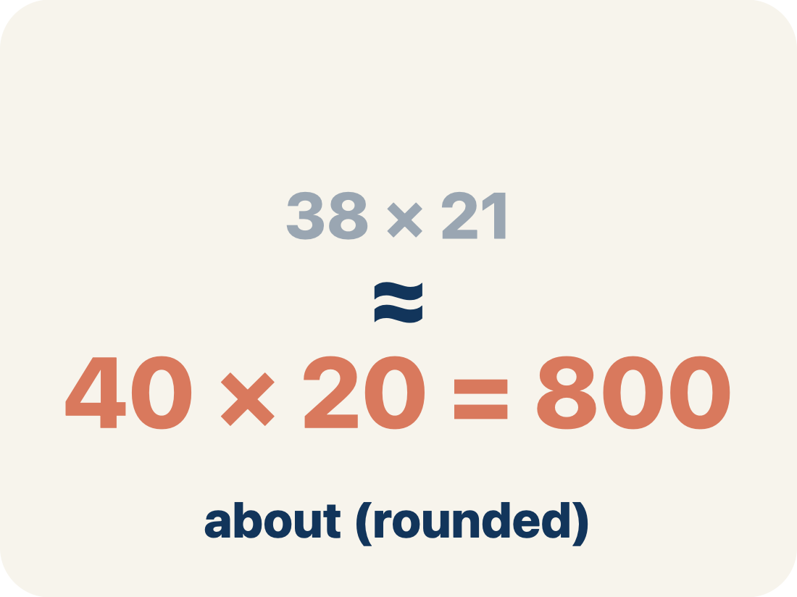
Vocabulary 1 of 5
Lesson 4-3 · Estimate the Percent of a Number
estimate
4 / 34
A reasoned answer that is close enough to be useful, found without exact computation.
EXAMPLE · EXPLAIN WHY IT FITS
8.6% of 216 ≈ 10% of 200 = 20 pounds of metal.
Use “estimate” to explain the example. Point to evidence.
eduwonderlab.com · Neft Teacher
Notes:
TEACH IN PRACTICE | Embedded facilitation | Lesson 4.3, slide 5 | VOCAB
Focus on the existing task: Vocabulary 1 of 5 estimate A reasoned answer that is…
ASK (T1/3/5): Where does “estimate” appear in the example? Explain the meaning without reading the definition. Partner: restate the idea and ask a clarifying question.
LOOK FOR: A correct connection between the word and a feature of the example. If the student only repeats the definition, invite pointing, sketching or oral rehearsal, then ask for another explanation of this same example.
PARTICIPATION (T5/6/7): Think time before volunteers; accept a written, drawn or rehearsed entry. Students ask for evidence respectfully. Recognize a specific contribution or revision and check that both partners participate.
Source: BCPS Updated Instructional Framework Rubric (June 2020), TEACH 1–7.

Slide 6
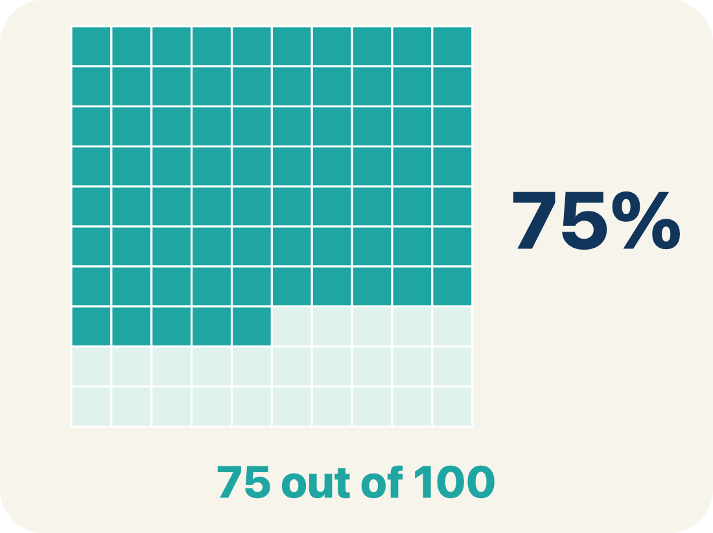
Vocabulary 2 of 5
Lesson 4-3 · Estimate the Percent of a Number
benchmark percent
5 / 34
A friendly percent — 1%, 10%, 25%, 50%, 75%, 100% — used as a landmark for estimating.
EXAMPLE · EXPLAIN WHY IT FITS
1% · 10% · 25% · 50% · 75% · 100% — the landmarks you can find mentally.
USE THE MATH WORDS · Use today’s math words in your explanation — not “it” and “that thing.”
eduwonderlab.com · Neft Teacher
Notes:
TEACH IN PRACTICE | Embedded facilitation | Lesson 4.3, slide 6 | VOCAB
Focus on the existing task: Vocabulary 2 of 5 benchmark percent A friendly percent…
ASK (T1/3/5): Where does “benchmark percent” appear in the example? Explain the meaning without reading the definition. Partner: restate the idea and ask a clarifying question.
LOOK FOR: A correct connection between the word and a feature of the example. If the student only repeats the definition, invite pointing, sketching or oral rehearsal, then ask for another explanation of this same example.
PARTICIPATION (T5/6/7): Think time before volunteers; accept a written, drawn or rehearsed entry. Students ask for evidence respectfully. Recognize a specific contribution or revision and check that both partners participate.
Source: BCPS Updated Instructional Framework Rubric (June 2020), TEACH 1–7.

Slide 7
Vocabulary 3 of 5
Lesson 4-3 · Estimate the Percent of a Number
compatible numbers
6 / 34
Numbers close to the originals that are easy to compute with mentally.
EXAMPLE · EXPLAIN WHY IT FITS
8.6% of 216 → 10% of 220: both nudged to numbers that divide nicely.
Use “compatible numbers” to explain the example. Point to
evidence.
eduwonderlab.com · Neft Teacher
Notes:
TEACH IN PRACTICE | Embedded facilitation | Lesson 4.3, slide 7 | VOCAB
Focus on the existing task: Vocabulary 3 of 5 compatible numbers Numbers close to the…
ASK (T1/3/5): Where does “compatible numbers” appear in the example? Explain the meaning without reading the definition. Partner: restate the idea and ask a clarifying question.
LOOK FOR: A correct connection between the word and a feature of the example. If the student only repeats the definition, invite pointing, sketching or oral rehearsal, then ask for another explanation of this same example.
PARTICIPATION (T5/6/7): Think time before volunteers; accept a written, drawn or rehearsed entry. Students ask for evidence respectfully. Recognize a specific contribution or revision and check that both partners participate.
Source: BCPS Updated Instructional Framework Rubric (June 2020), TEACH 1–7.

Slide 8

Vocabulary 4 of 5
Lesson 4-3 · Estimate the Percent of a Number
double number line
7 / 34
Two parallel number lines that pair amounts with their percents at the same positions.
EXAMPLE · EXPLAIN WHY IT FITS
0 · 25% · 50% · 75% · 100% above; 0 · 1.5 · 3 · 4.5 · 6 GB below.
Use “double number line” to explain the example. Point to
evidence.
eduwonderlab.com · Neft Teacher
Notes:
TEACH IN PRACTICE | Embedded facilitation | Lesson 4.3, slide 8 | VOCAB
Focus on the existing task: Vocabulary 4 of 5 double number line Two parallel number…
ASK (T1/3/5): Where does “double number line” appear in the example? Explain the meaning without reading the definition. Partner: restate the idea and ask a clarifying question.
LOOK FOR: A correct connection between the word and a feature of the example. If the student only repeats the definition, invite pointing, sketching or oral rehearsal, then ask for another explanation of this same example.
PARTICIPATION (T5/6/7): Think time before volunteers; accept a written, drawn or rehearsed entry. Students ask for evidence respectfully. Recognize a specific contribution or revision and check that both partners participate.
Source: BCPS Updated Instructional Framework Rubric (June 2020), TEACH 1–7.

Slide 9
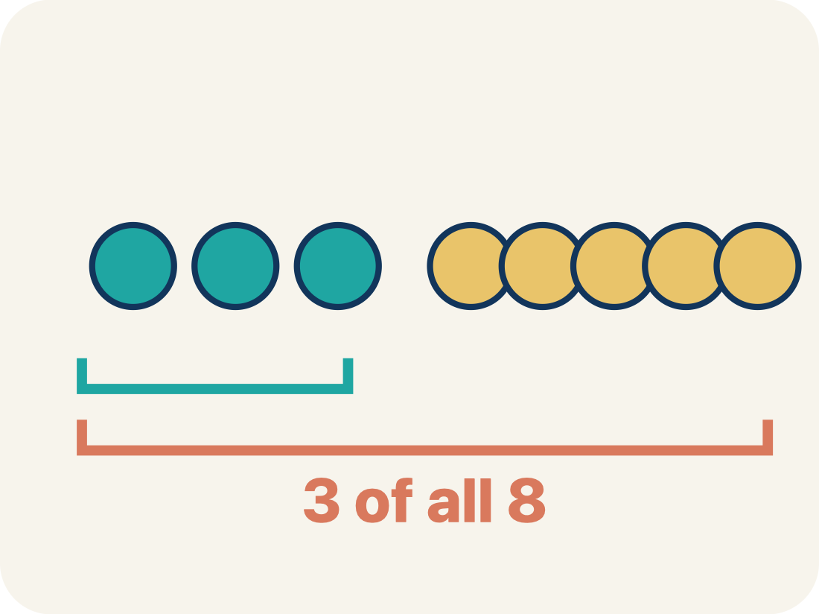
Vocabulary 5 of 5
Lesson 4-3 · Estimate the Percent of a Number
the whole
8 / 34
The quantity that counts as 100% in a problem — and it can change between questions.
EXAMPLE · EXPLAIN WHY IT FITS
“Of the USED storage” makes 4 GB the whole — not the 6 GB total.
Use “the whole” to explain the example. Point to evidence.
eduwonderlab.com · Neft Teacher
Notes:
TEACH IN PRACTICE | Embedded facilitation | Lesson 4.3, slide 9 | VOCAB
Focus on the existing task: Vocabulary 5 of 5 the whole The quantity that counts as…
ASK (T1/3/5): Where does “the whole” appear in the example? Explain the meaning without reading the definition. Partner: restate the idea and ask a clarifying question.
LOOK FOR: A correct connection between the word and a feature of the example. If the student only repeats the definition, invite pointing, sketching or oral rehearsal, then ask for another explanation of this same example.
PARTICIPATION (T5/6/7): Think time before volunteers; accept a written, drawn or rehearsed entry. Students ask for evidence respectfully. Recognize a specific contribution or revision and check that both partners participate.
Source: BCPS Updated Instructional Framework Rubric (June 2020), TEACH 1–7.

Slide 10
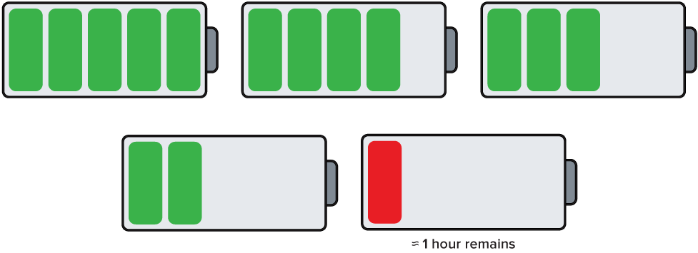

Be Curious
What do you notice?
What do you wonder?
9 / 34
Think first. Share a notice and a question; build on a classmate’s idea.
Mindset
How can you know that you have made a good decision in math class?
Notes:
TEACH IN PRACTICE | Embedded facilitation | Lesson 4.3, slide 10 | CURIOUS
Focus on the existing task: What do you notice?
LAUNCH (T2/3/5): Allow quiet observation first. Separate a notice from an inference, invite students’ own questions, and follow the existing launch before teaching a procedure.
LOOK FOR (T4): Where this task addresses it, students can choose a useful benchmark or compatible number. Ask which feature of their work supports the claim.
RESPOND: If this task shows the lesson misconception—presenting an estimate as an exact answer—locate the given percent or amount between familiar benchmarks. Have the student revise and explain the change. Use this support only where the concept occurs in the current task; otherwise respond to the displayed question.
RECHECK: If a gap is shared, revisit the existing representation together. If it is limited, give targeted support while others compare valid methods on the same task. Check the revision before moving on.
PARTICIPATION (T5/6/7): Think time before volunteers; accept a written, drawn or rehearsed entry. Students ask for evidence respectfully. Recognize a specific contribution or revision and check that both partners participate.
Source: BCPS Updated Instructional Framework Rubric (June 2020), TEACH 1–7.

Slide 11
Explain with today’s vocabulary; partner paraphrases.
Vocabulary
Lesson 4-3 · Estimate the Percent of a Number
Today’s Math Words
We learn every word — what it means and what it looks like — before we use it.
estimate
benchmark percent
A reasoned answer that is close enough to be useful, found without exact computation
A friendly percent — 1%, 10%, 25%, 50%, 75%, 100% — used as a landmark for estimating
compatible numbers
double number line
Numbers close to the originals that are easy to compute with mentally
Two parallel number lines that pair amounts with their percents at the same positions
the whole
The quantity that counts as 100% in a problem — and it can change between questions
Explain one math word using the example.
Partner: point to evidence.
eduwonderlab.com · Neft Teacher
11 / 44
Notes:
TEACH IN PRACTICE | Embedded facilitation | Lesson 4.3, slide 11 | VOCAB
Focus on the existing task: Vocabulary Today’s Math Words We learn every word — what…
ASK (T1/3/5): Where does “the displayed term” appear in the example? Explain the meaning without reading the definition. Partner: restate the idea and ask a clarifying question.
LOOK FOR: A correct connection between the word and a feature of the example. If the student only repeats the definition, invite pointing, sketching or oral rehearsal, then ask for another explanation of this same example.
PARTICIPATION (T5/6/7): Think time before volunteers; accept a written, drawn or rehearsed entry. Students ask for evidence respectfully. Recognize a specific contribution or revision and check that both partners participate.
Source: BCPS Updated Instructional Framework Rubric (June 2020), TEACH 1–7. Earlier notes and answer keys are retained below.
EARLIER NOTES / EXISTING ANSWER KEY
UIFR TEACH — Level 4 student move: Explain with today’s vocabulary; partner paraphrases.
Student move: Explain with today’s vocabulary; partner paraphrases.

Slide 12
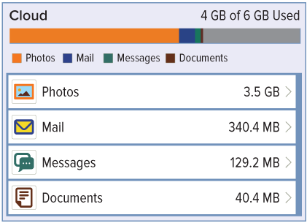
Ask a partner a question; choose a model together.
Cloud Storage
Margaret checked the cloud storage for her cell phone.
Approximately what percent of her storage is used?
Of the used storage, approximately what percent are photos?
Think About It:
12 / 44
Notes:
TEACH IN PRACTICE | Embedded facilitation | Lesson 4.3, slide 12 | TASK
Focus on the existing task: Margaret checked the cloud storage for her cell phone. Approximately what percent of her storage is used?
LAUNCH (T2/3/5): Use the displayed question. Give private thinking time; then A explains while B asks for evidence. Switch roles. Each student records their own reasoning.
LOOK FOR (T4): Where this task addresses it, students can choose a useful benchmark or compatible number. Ask which feature of their work supports the claim.
RESPOND: If this task shows the lesson misconception—presenting an estimate as an exact answer—locate the given percent or amount between familiar benchmarks. Have the student revise and explain the change. Use this support only where the concept occurs in the current task; otherwise respond to the displayed question.
RECHECK: If a gap is shared, revisit the existing representation together. If it is limited, give targeted support while others compare valid methods on the same task. Check the revision before moving on.
PARTICIPATION (T5/6/7): Think time before volunteers; accept a written, drawn or rehearsed entry. Students ask for evidence respectfully. Recognize a specific contribution or revision and check that both partners participate.
Source: BCPS Updated Instructional Framework Rubric (June 2020), TEACH 1–7. Earlier notes and answer keys are retained below.
EARLIER NOTES / EXISTING ANSWER KEY
UIFR TEACH — Level 4 student move: Ask a partner a question; choose a model together.
Student move: Ask a partner a question; choose a model together.
UIFR FULL | Lesson-specific facilitation
TEACH 2-3 | Session 1 task launch (UIFR PDF pp. 9-10).
Use the problem exactly as displayed. Give individual thinking time before discussion or advancing to the explanation. If the answer is already visible, ask students to reconstruct and justify it. Invite a choice of suitable representations and have students explain why their choice helps.
At the point where this concept appears, ask: “Which rounding choice made your estimate easier, and does it likely make the result larger or smaller?” Wait for evidence, invite another pathway, and have a student ask a follow-up question. Do not replace students’ reasoning with a sequence of leading steps.

Slide 13
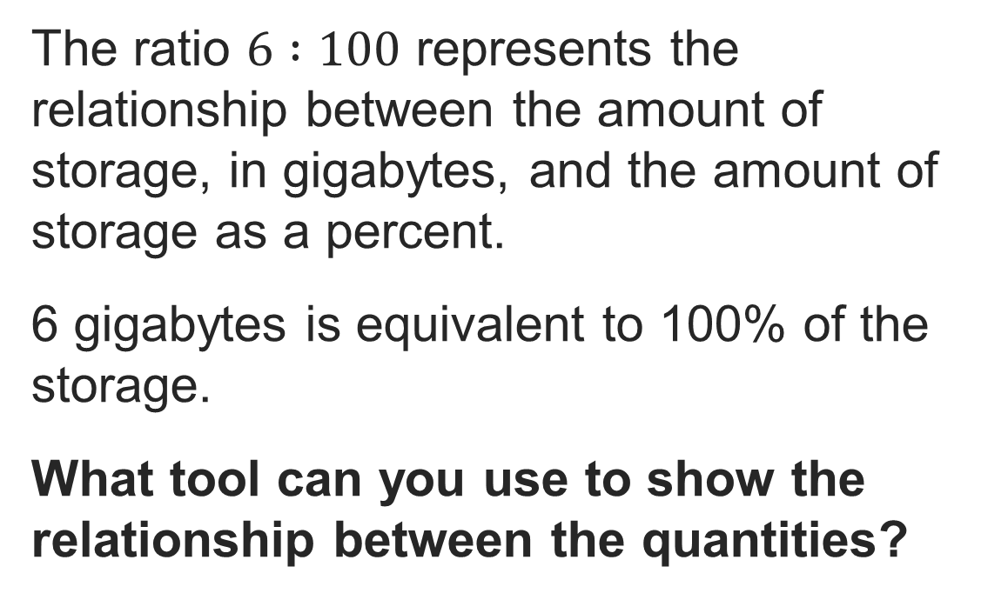
Cloud Storage
Reveal:
One tool is a double number line.
13 / 44
Notes:
TEACH IN PRACTICE | Embedded facilitation | Lesson 4.3, slide 13 | REVEAL
Focus on the existing task: Reveal: One tool is a double number line. Cloud Storage
LAUNCH (T2/3/5): If an existing answer cover is present, gather an attempt before revealing. If the explanation is already visible, ask students to reconstruct and justify it. Compare reasoning and explain a revision; preserve the reveal sequence.
LOOK FOR (T4): Where this task addresses it, students can choose a useful benchmark or compatible number. Ask which feature of their work supports the claim.
RESPOND: If this task shows the lesson misconception—presenting an estimate as an exact answer—locate the given percent or amount between familiar benchmarks. Have the student revise and explain the change. Use this support only where the concept occurs in the current task; otherwise respond to the displayed question.
RECHECK: If a gap is shared, revisit the existing representation together. If it is limited, give targeted support while others compare valid methods on the same task. Check the revision before moving on.
PARTICIPATION (T5/6/7): Think time before volunteers; accept a written, drawn or rehearsed entry. Students ask for evidence respectfully. Recognize a specific contribution or revision and check that both partners participate.
Source: BCPS Updated Instructional Framework Rubric (June 2020), TEACH 1–7. Earlier notes and answer keys are retained below.
EARLIER NOTES / EXISTING ANSWER KEY
Ask what tool could show a quantity and its percent at the same time, then introduce the double number line. Listen for students connecting the two lines: one carries the amounts, one carries the percents. Watch for lines whose labels do not stay aligned; that alignment is the whole tool.

Slide 14
STUDENT MOVES
Lesson 4-3
Your move
USE YOUR TOOLS · Reach for your notes, a model, or a manipulative before you reach for an answer.
14 / 44

Slide 15
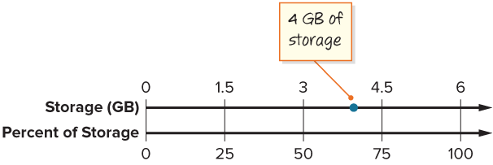
Cloud Storage
How can you represent the corresponding percent of storage used on the number line?
PICK YOUR STRATEGY · Choose your path — picture, table, number line, or equation — and be ready to say why you chose it.
Reveal:
We can plot a point on the bottom number line that is at the same location as the point on the top number line.
15 / 44
Notes:
TEACH IN PRACTICE | Embedded facilitation | Lesson 4.3, slide 14 | REVEAL
Focus on the existing task: How can you represent the corresponding percent of storage used on the number line?
LAUNCH (T2/3/5): If an existing answer cover is present, gather an attempt before revealing. If the explanation is already visible, ask students to reconstruct and justify it. Compare reasoning and explain a revision; preserve the reveal sequence.
LOOK FOR (T4): Where this task addresses it, students can choose a useful benchmark or compatible number. Ask which feature of their work supports the claim.
RESPOND: If this task shows the lesson misconception—presenting an estimate as an exact answer—locate the given percent or amount between familiar benchmarks. Have the student revise and explain the change. Use this support only where the concept occurs in the current task; otherwise respond to the displayed question.
RECHECK: If a gap is shared, revisit the existing representation together. If it is limited, give targeted support while others compare valid methods on the same task. Check the revision before moving on.
PARTICIPATION (T5/6/7): Think time before volunteers; accept a written, drawn or rehearsed entry. Students ask for evidence respectfully. Recognize a specific contribution or revision and check that both partners participate.
Source: BCPS Updated Instructional Framework Rubric (June 2020), TEACH 1–7. Earlier notes and answer keys are retained below.
EARLIER NOTES / EXISTING ANSWER KEY
Ask where the given amount lives on the top line and what percent must sit directly below it. Listen for reasoning that keeps the two lines locked together. A common error is spacing marks unevenly; ask whether equal jumps on one line stay equal on the other.

Slide 16

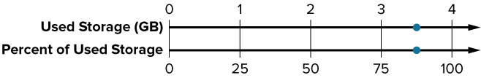
COLLABORATE · TALK IT THROUGH • AGREE ON A MODEL
Student-led talk: paraphrase, agree or disagree, add on.
Collaborate and Connect
How can you complete the double number line to show the amount of storage used for photos, in gigabytes, and the corresponding percentage?
Think first. A explains; B asks for evidence. Switch roles; both revise.
16 / 44
Notes:
TEACH IN PRACTICE | Embedded facilitation | Lesson 4.3, slide 15 | COLLABORATE
Focus on the existing task: How can you complete the double number line to show the amount of storage used for photos, in gigabytes, and the corresponding percentage?
LAUNCH (T2/3/5): Use the displayed question. Give private thinking time; then A explains while B asks for evidence. Switch roles. Each student records their own reasoning.
LOOK FOR (T4): Where this task addresses it, students can choose a useful benchmark or compatible number. Ask which feature of their work supports the claim.
RESPOND: If this task shows the lesson misconception—presenting an estimate as an exact answer—locate the given percent or amount between familiar benchmarks. Have the student revise and explain the change. Use this support only where the concept occurs in the current task; otherwise respond to the displayed question.
RECHECK: If a gap is shared, revisit the existing representation together. If it is limited, give targeted support while others compare valid methods on the same task. Check the revision before moving on.
PARTICIPATION (T5/6/7): Think time before volunteers; accept a written, drawn or rehearsed entry. Students ask for evidence respectfully. Recognize a specific contribution or revision and check that both partners participate.
Source: BCPS Updated Instructional Framework Rubric (June 2020), TEACH 1–7. Earlier notes and answer keys are retained below.
EARLIER NOTES / EXISTING ANSWER KEY
UIFR TEACH — Level 4 student move: Student-led talk: paraphrase, agree or disagree, add on.
Student move: Student-led talk: paraphrase, agree or disagree, add on.
Routine: COLLABORATE · TALK IT THROUGH • AGREE ON A MODEL
UIFR FULL | Lesson-specific facilitation
TEACH 4-5 | Session 1 discussion and checkpoint (UIFR PDF pp. 11-12).
Collect a brief response from every student to the existing prompt before hearing volunteers. Partners take turns explaining and asking for evidence: “I understand ___; what supports ___?” Offer rehearsal or an annotated model for students who need language support. Each student records their own reasoning.
Look specifically for: presenting an estimate as an exact answer. If it appears, locate the given percent or amount between familiar benchmarks; then ask the student to revise the same response and explain the change. If evidence is secure, have students compare a second valid pathway or state why their approach works. Choose the next step from the responses, not a preset pace.

Slide 17
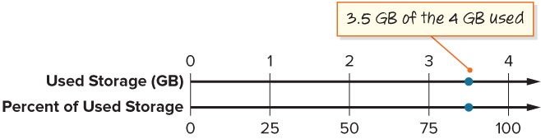
Cloud Storage
How can you estimate the percent of the used storage that is used for photos?
TRY IT BEFORE YOU’RE SURE · Start even if you are not sure. A revised answer counts as much as a first-try answer.
Reveal:
We can use the benchmark values to estimate what percentage is between 75% and 100%.
17 / 44
Notes:
TEACH IN PRACTICE | Embedded facilitation | Lesson 4.3, slide 16 | REVEAL
Focus on the existing task: How can you estimate the percent of the used storage that is used for photos?
LAUNCH (T2/3/5): If an existing answer cover is present, gather an attempt before revealing. If the explanation is already visible, ask students to reconstruct and justify it. Compare reasoning and explain a revision; preserve the reveal sequence.
LOOK FOR (T4): Where this task addresses it, students can choose a useful benchmark or compatible number. Ask which feature of their work supports the claim.
RESPOND: If this task shows the lesson misconception—presenting an estimate as an exact answer—locate the given percent or amount between familiar benchmarks. Have the student revise and explain the change. Use this support only where the concept occurs in the current task; otherwise respond to the displayed question.
RECHECK: If a gap is shared, revisit the existing representation together. If it is limited, give targeted support while others compare valid methods on the same task. Check the revision before moving on.
PARTICIPATION (T5/6/7): Think time before volunteers; accept a written, drawn or rehearsed entry. Students ask for evidence respectfully. Recognize a specific contribution or revision and check that both partners participate.
Source: BCPS Updated Instructional Framework Rubric (June 2020), TEACH 1–7. Earlier notes and answer keys are retained below.
EARLIER NOTES / EXISTING ANSWER KEY
Ask students to estimate using benchmarks like 25, 50, and 75 percent before calculating anything. Listen for comparisons to a nearby benchmark rather than exact arithmetic. If a student computes precisely, ask them whether the estimate would have caught a wrong answer.

Slide 18
Cloud Storage
Margaret checked the cloud storage for her cell phone.
Approximately what percent of her storage is used?
About 70% of the cloud storage is used.
Of the used storage, approximately what percent are photos?
About 87% of the used storage is used for photos.
18 / 44
Notes:
TEACH IN PRACTICE | Embedded facilitation | Lesson 4.3, slide 17 | TASK
Focus on the existing task: Margaret checked the cloud storage for her cell phone. Approximately what percent of her storage is used?
LAUNCH (T2/3/5): Use the displayed question. Give private thinking time; then A explains while B asks for evidence. Switch roles. Each student records their own reasoning.
LOOK FOR (T4): Where this task addresses it, students can choose a useful benchmark or compatible number. Ask which feature of their work supports the claim.
RESPOND: If this task shows the lesson misconception—presenting an estimate as an exact answer—locate the given percent or amount between familiar benchmarks. Have the student revise and explain the change. Use this support only where the concept occurs in the current task; otherwise respond to the displayed question.
RECHECK: If a gap is shared, revisit the existing representation together. If it is limited, give targeted support while others compare valid methods on the same task. Check the revision before moving on.
PARTICIPATION (T5/6/7): Think time before volunteers; accept a written, drawn or rehearsed entry. Students ask for evidence respectfully. Recognize a specific contribution or revision and check that both partners participate.
Source: BCPS Updated Instructional Framework Rubric (June 2020), TEACH 1–7. Earlier notes and answer keys are retained below.
EARLIER NOTES / EXISTING ANSWER KEY
Ask: 87 percent of what? Getting the whole right is the entire question here, since it is 87 percent of the used storage, not of all storage. Listen for students naming the correct whole before estimating. This changing-whole idea is the most common trap in the lesson.

Slide 19
STUDENT MOVES
Lesson 4-3
Your move
ANOTHER PATHWAY · Did anyone get there a different way? Put both pathways side by side and compare.
19 / 44

Slide 20
Compare strategies; persist, revise, and try again.
Let’s Explore More
What is a good estimate of the percent of the total storage that is used for photos?
What strategy might you use to determine the approximate percent of the cloud storage that is used for mail, messages, and documents? Note: 1 MB is equal to 0.001 GB.
Try it yourself. Compare your work with a partner; explain one choice and revise.
20 / 44
Notes:
TEACH IN PRACTICE | Embedded facilitation | Lesson 4.3, slide 18 | PRACTICE
Focus on the existing task: What is a good estimate of the percent of the total storage that is used for photos?
LAUNCH (T2/3/5): Use the displayed question. Give private thinking time; then A explains while B asks for evidence. Switch roles. Each student records their own reasoning.
LOOK FOR (T4): Where this task addresses it, students can label an estimate. Ask which feature of their work supports the claim.
RESPOND: If this task shows the lesson misconception—presenting an estimate as an exact answer—locate the given percent or amount between familiar benchmarks. Have the student revise and explain the change. Use this support only where the concept occurs in the current task; otherwise respond to the displayed question.
RECHECK: If a gap is shared, revisit the existing representation together. If it is limited, give targeted support while others compare valid methods on the same task. Check the revision before moving on.
PARTICIPATION (T5/6/7): Think time before volunteers; accept a written, drawn or rehearsed entry. Students ask for evidence respectfully. Recognize a specific contribution or revision and check that both partners participate.
Source: BCPS Updated Instructional Framework Rubric (June 2020), TEACH 1–7. Earlier notes and answer keys are retained below.
EARLIER NOTES / EXISTING ANSWER KEY
UIFR TEACH — Level 4 student move: Compare strategies; persist, revise, and try again.
Student move: Compare strategies; persist, revise, and try again.

Slide 21
LESSON 4.3 / DISCUSS THE TASK
Explain and compare
Use the task you just explored.
TAKE TURNS
Which rounding choice made your estimate easier, and does it likely make the result larger or smaller?
Explain
“I know this because…”
Ask
“Where does your work show that?”
Point to evidence in your work.
Then compare your approach with a partner’s.
HOW DO YOU KNOW? · Ask your partner “How do you know?” Answer by pointing to your own work.
Listen to understand. Ask for evidence. Make room for every voice.
Notes:
TEACH IN PRACTICE | Embedded facilitation | Lesson 4.3, slide 19 | PRIOR_INSERT
Focus on the existing task: Point to evidence in your work. Then compare your approach with a partner’s. TAKE TURNS Explain “I know this because…” Ask “Where does your work show that?
CONNECT (T1/4): Ask students to restate the displayed goal or key idea and connect it to earlier work. Relevant lesson evidence: choose a useful benchmark or compatible number; label an estimate; justify its size. Use only the criterion that matches the current session.
SHOW PROGRESS: Students point to their own existing work, explain what improved after feedback, and name a next step. Pair confidence ratings with actual evidence.
PARTICIPATION (T5/6/7): Think time before volunteers; accept a written, drawn or rehearsed entry. Students ask for evidence respectfully. Recognize a specific contribution or revision and check that both partners participate.
Source: BCPS Updated Instructional Framework Rubric (June 2020), TEACH 1–7.

Slide 22
Cloud Storage
Let’s look at the first question.
Approximately what percent of her storage is used?
What is the total cloud storage capacity? What percentage represents this whole?
18 / 34
ADD ON · Add on: “I agree because ______.” or “I see it differently because ______.”
Reveal:
6 gigabytes (GB), which represents 100% of the storage
Notes:
TEACH IN PRACTICE | Embedded facilitation | Lesson 4.3, slide 20 | REVEAL
Focus on the existing task: Let’s look at the first question. Approximately what percent of her storage is used?
LAUNCH (T2/3/5): If an existing answer cover is present, gather an attempt before revealing. If the explanation is already visible, ask students to reconstruct and justify it. Compare reasoning and explain a revision; preserve the reveal sequence.
LOOK FOR (T4): Where this task addresses it, students can choose a useful benchmark or compatible number. Ask which feature of their work supports the claim.
RESPOND: If this task shows the lesson misconception—presenting an estimate as an exact answer—locate the given percent or amount between familiar benchmarks. Have the student revise and explain the change. Use this support only where the concept occurs in the current task; otherwise respond to the displayed question.
RECHECK: If a gap is shared, revisit the existing representation together. If it is limited, give targeted support while others compare valid methods on the same task. Check the revision before moving on.
PARTICIPATION (T5/6/7): Think time before volunteers; accept a written, drawn or rehearsed entry. Students ask for evidence respectfully. Recognize a specific contribution or revision and check that both partners participate.
Source: BCPS Updated Instructional Framework Rubric (June 2020), TEACH 1–7.

Slide 23
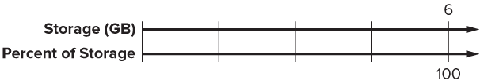
Cloud Storage
Let’s use intervals of 25 on the bottom number line.
How can you determine the corresponding labels for the number line that represents the amount of storage in gigabytes?
19 / 34
SELF-CHECK · Mark it: ✓ got it · ~ almost · ? stuck. Then fix one thing before we move on.
Reveal:
We can use multiplication or division to find values that result in equivalent ratios.
Notes:
TEACH IN PRACTICE | Embedded facilitation | Lesson 4.3, slide 21 | REVEAL
Focus on the existing task: Let’s use intervals of 25 on the bottom number line. How can you determine the corresponding labels for the number line that represents the amount of storage in gigabytes?
LAUNCH (T2/3/5): If an existing answer cover is present, gather an attempt before revealing. If the explanation is already visible, ask students to reconstruct and justify it. Compare reasoning and explain a revision; preserve the reveal sequence.
LOOK FOR (T4): Where this task addresses it, students can choose a useful benchmark or compatible number. Ask which feature of their work supports the claim.
RESPOND: If this task shows the lesson misconception—presenting an estimate as an exact answer—locate the given percent or amount between familiar benchmarks. Have the student revise and explain the change. Use this support only where the concept occurs in the current task; otherwise respond to the displayed question.
RECHECK: If a gap is shared, revisit the existing representation together. If it is limited, give targeted support while others compare valid methods on the same task. Check the revision before moving on.
PARTICIPATION (T5/6/7): Think time before volunteers; accept a written, drawn or rehearsed entry. Students ask for evidence respectfully. Recognize a specific contribution or revision and check that both partners participate.
Source: BCPS Updated Instructional Framework Rubric (June 2020), TEACH 1–7.

Slide 24
Cloud Storage
How can you represent the corresponding percent of storage used on the number line?
20 / 34
STRUGGLE FIRST · Work on your own first. Stuck is allowed — try a second strategy before you ask.
Reveal:
We can plot a point on the bottom number line that is at the same location as the point on the top number line.
Notes:
TEACH IN PRACTICE | Embedded facilitation | Lesson 4.3, slide 22 | REVEAL
Focus on the existing task: How can you represent the corresponding percent of storage used on the number line?
LAUNCH (T2/3/5): If an existing answer cover is present, gather an attempt before revealing. If the explanation is already visible, ask students to reconstruct and justify it. Compare reasoning and explain a revision; preserve the reveal sequence.
LOOK FOR (T4): Where this task addresses it, students can choose a useful benchmark or compatible number. Ask which feature of their work supports the claim.
RESPOND: If this task shows the lesson misconception—presenting an estimate as an exact answer—locate the given percent or amount between familiar benchmarks. Have the student revise and explain the change. Use this support only where the concept occurs in the current task; otherwise respond to the displayed question.
RECHECK: If a gap is shared, revisit the existing representation together. If it is limited, give targeted support while others compare valid methods on the same task. Check the revision before moving on.
PARTICIPATION (T5/6/7): Think time before volunteers; accept a written, drawn or rehearsed entry. Students ask for evidence respectfully. Recognize a specific contribution or revision and check that both partners participate.
Source: BCPS Updated Instructional Framework Rubric (June 2020), TEACH 1–7.

Slide 25
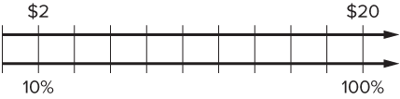
Be Curious
How are they the same?
How are they different?
10% of $20 is $2
21 / 34
Think first. Share a notice and a question; build on a classmate’s idea.
Mindset
How do you know that you are making a good decision in math class?
Notes:
TEACH IN PRACTICE | Embedded facilitation | Lesson 4.3, slide 23 | CURIOUS
Focus on the existing task: How are they the same?
LAUNCH (T2/3/5): Allow quiet observation first. Separate a notice from an inference, invite students’ own questions, and follow the existing launch before teaching a procedure.
LOOK FOR (T4): Where this task addresses it, students can choose a useful benchmark or compatible number. Ask which feature of their work supports the claim.
RESPOND: If this task shows the lesson misconception—presenting an estimate as an exact answer—locate the given percent or amount between familiar benchmarks. Have the student revise and explain the change. Use this support only where the concept occurs in the current task; otherwise respond to the displayed question.
RECHECK: If a gap is shared, revisit the existing representation together. If it is limited, give targeted support while others compare valid methods on the same task. Check the revision before moving on.
PARTICIPATION (T5/6/7): Think time before volunteers; accept a written, drawn or rehearsed entry. Students ask for evidence respectfully. Recognize a specific contribution or revision and check that both partners participate.
Source: BCPS Updated Instructional Framework Rubric (June 2020), TEACH 1–7.

Slide 26
Session 2 Warm-Up
Lesson 4-3 · Estimate the Percent of a Number
Session 2 Warm-Up
Quick review from Session 1 · about 4 minutes
1
Which benchmark percent equals one half?
2
To estimate 10% of 240, divide 240 by:
A
25%
A
2
B
50%
B
10
C
75%
C
100
D
10%
D
4
3
What is 10% of 240?
4
Which compatible percent best estimates 48%?
A
12
A
10%
B
24
B
50%
C
2.4
C
100%
D
48
D
25%
eduwonderlab.com · Neft Teacher
26 / 44
Notes:
TEACH IN PRACTICE | Embedded facilitation | Lesson 4.3, slide 24 | WARMUP
Focus on the existing task: Session 2 Warm-Up Session 2 Warm-Up Quick review from Session 1 · about 4 minutes 1 Which benchmark percent equals one half?
GATHER EVIDENCE (T4/6): Keep the original items. Students try independently, mark an uncertain item, and explain one method before checking. Use the existing key when present.
RESPOND: Distinguish a calculation slip from a reasoning gap. Give one next step on the same item; have students revise in a second color. Use the responses to choose flexible support for today’s lesson.
PARTICIPATION (T5/6/7): Think time before volunteers; accept a written, drawn or rehearsed entry. Students ask for evidence respectfully. Recognize a specific contribution or revision and check that both partners participate.
Source: BCPS Updated Instructional Framework Rubric (June 2020), TEACH 1–7. Earlier notes and answer keys are retained below.
EARLIER NOTES / EXISTING ANSWER KEY
Warm-up routine: students start silently on entry; keep it to about 4 minutes.
Circulate and note who is stuck — use what you see to choose who you check on first today.
Go over answers quickly; ask one student to explain a step, not just say the answer.
UIFR: TEACH 4 · TEACH 6.
UIFR FULL | Lesson-specific facilitation
TEACH 1 | Session 2 purpose and evidence (UIFR PDF p. 8).
Have students restate the displayed session goal in their own words and connect it to the existing context or a familiar experience they choose to share. Use the current session goal to select from these lesson-wide evidence criteria; do not frontload a later-session procedure.
Look for: choose a useful benchmark or compatible number; label an estimate; justify its size. Ask: “Which part of your work would show this?” Revisit that evidence after the task; a confidence rating alone is not evidence of understanding.

Slide 27
STUDENT MOVES
Lesson 4-3
Your move
YOU KNOW THE ROUTINE · Read → plan → solve → check. Do all four, in that order.
27 / 44

Slide 28
Review Notes
Lesson 4-3 · Estimate the Percent of a Number
Review Notes — Session 2
Copy. Explain. Check.
CONNECT IT · What earlier lesson does this build on? Tell a partner in one sentence.
Benchmark Percents
1
Use familiar benchmarks like 10% (÷10), 25% (÷4), 50% (÷2), and 1% (÷100).
Compatible Numbers
2
Round percents and totals to friendly numbers that divide easily mentally.
Double Number Lines
3
Map percent benchmarks on top and real quantities on bottom to check reasonableness.
eduwonderlab.com · Neft Teacher
28 / 44
Notes:
TEACH IN PRACTICE | Embedded facilitation | Lesson 4.3, slide 25 | NOTES
Focus on the existing task: Review Notes Review Notes — Session 2 Copy into your…
ROUTINE (T1/2/4): Read or copy the original notes, cover one line, and explain it using the displayed example. Reopen and correct. Copying alone is not evidence of understanding.
LOOK FOR: A link between a symbol, quantity or feature and the explanation. If missing, point back to that feature and have the student try again; fade the prompt once they can explain.
PARTICIPATION (T5/6/7): Think time before volunteers; accept a written, drawn or rehearsed entry. Students ask for evidence respectfully. Recognize a specific contribution or revision and check that both partners participate.
Source: BCPS Updated Instructional Framework Rubric (June 2020), TEACH 1–7. Earlier notes and answer keys are retained below.
EARLIER NOTES / EXISTING ANSWER KEY
Copy routine: read one line at a time; students copy, then explain that line to a partner.
Keep it brisk — the understanding work happens in the examples, not the copying.
UIFR: TEACH 1 · TEACH 6.

Slide 29
Session 2
Estimate the Percent of a Number
JUSTIFY IT · Say it like this: “I know ______ because ______.”
29 / 44
Notes:
TEACH IN PRACTICE | Embedded facilitation | Lesson 4.3, slide 26 | DIVIDER
Focus on the existing task: Estimate the Percent of a Number Session 2
TRANSITION (T6/7): Students confirm materials, roles, how to request help, and the next response routine. Ask a student to restate it. Keep teacher-only slides hidden.
PARTICIPATION (T5/6/7): Think time before volunteers; accept a written, drawn or rehearsed entry. Students ask for evidence respectfully. Recognize a specific contribution or revision and check that both partners participate.
Source: BCPS Updated Instructional Framework Rubric (June 2020), TEACH 1–7. Earlier notes and answer keys are retained below.
EARLIER NOTES / EXISTING ANSWER KEY
Transition cue: state what materials are out and what success looks like this session.
Keep the changeover under a minute.
UIFR: TEACH 6.

Slide 30
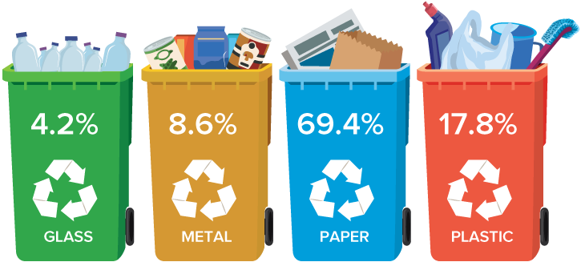
School Recycling
A local middle school has organized a Green-Team to set up and manage recycling at the school. The team decided to collect paper, metal, glass, and plastic to recycle. In one month, the team collected 216 total pounds of recycled materials, in the percents shown.
About how many pounds of metal were recycled that month?
30 / 44
Notes:
TEACH IN PRACTICE | Embedded facilitation | Lesson 4.3, slide 27 | TASK
Focus on the existing task: A local middle school has organized a Green-Team to set up and manage recycling at the school. The team decided to collect paper, metal…
LAUNCH (T2/3/5): Use the displayed question. Give private thinking time; then A explains while B asks for evidence. Switch roles. Each student records their own reasoning.
LOOK FOR (T4): Where this task addresses it, students can choose a useful benchmark or compatible number. Ask which feature of their work supports the claim.
RESPOND: If this task shows the lesson misconception—presenting an estimate as an exact answer—locate the given percent or amount between familiar benchmarks. Have the student revise and explain the change. Use this support only where the concept occurs in the current task; otherwise respond to the displayed question.
RECHECK: If a gap is shared, revisit the existing representation together. If it is limited, give targeted support while others compare valid methods on the same task. Check the revision before moving on.
PARTICIPATION (T5/6/7): Think time before volunteers; accept a written, drawn or rehearsed entry. Students ask for evidence respectfully. Recognize a specific contribution or revision and check that both partners participate.
Source: BCPS Updated Instructional Framework Rubric (June 2020), TEACH 1–7. Earlier notes and answer keys are retained below.
EARLIER NOTES / EXISTING ANSWER KEY
Read the recycling situation and have students restate what is known and what is asked. Listen for the quantities students choose to track. Ask what an estimate would look like before any exact work is attempted.
UIFR FULL | Lesson-specific facilitation
TEACH 2-3 | Session 2 task launch (UIFR PDF pp. 9-10).
Use the problem exactly as displayed. Give individual thinking time before discussion or advancing to the explanation. If the answer is already visible, ask students to reconstruct and justify it. Invite a choice of suitable representations and have students explain why their choice helps.
At the point where this concept appears, ask: “Which rounding choice made your estimate easier, and does it likely make the result larger or smaller?” Wait for evidence, invite another pathway, and have a student ask a follow-up question. Do not replace students’ reasoning with a sequence of leading steps.

Slide 31
STUDENT MOVES
Lesson 4-3
Your move
TAKE TURNS · One explains, one asks a question. Then switch, so both of you talk.
31 / 44

Slide 32
Partner press: ask ‘Why?’ and answer with evidence.
School Recycling
Of the 216 pounds of recycled materials, 8.6% was metal. About how many pounds of metal were recycled that month?
We need to estimate 8.6% of 216.
What strategies have you used before to estimate?
Reveal:
We can use rounding or compatible numbers to estimate.
32 / 44
Notes:
TEACH IN PRACTICE | Embedded facilitation | Lesson 4.3, slide 28 | REVEAL
Focus on the existing task: Of the 216 pounds of recycled materials, 8.6% was metal. About how many pounds of metal were recycled that month?
LAUNCH (T2/3/5): If an existing answer cover is present, gather an attempt before revealing. If the explanation is already visible, ask students to reconstruct and justify it. Compare reasoning and explain a revision; preserve the reveal sequence.
LOOK FOR (T4): Where this task addresses it, students can choose a useful benchmark or compatible number. Ask which feature of their work supports the claim.
RESPOND: If this task shows the lesson misconception—presenting an estimate as an exact answer—locate the given percent or amount between familiar benchmarks. Have the student revise and explain the change. Use this support only where the concept occurs in the current task; otherwise respond to the displayed question.
RECHECK: If a gap is shared, revisit the existing representation together. If it is limited, give targeted support while others compare valid methods on the same task. Check the revision before moving on.
PARTICIPATION (T5/6/7): Think time before volunteers; accept a written, drawn or rehearsed entry. Students ask for evidence respectfully. Recognize a specific contribution or revision and check that both partners participate.
Source: BCPS Updated Instructional Framework Rubric (June 2020), TEACH 1–7. Earlier notes and answer keys are retained below.
EARLIER NOTES / EXISTING ANSWER KEY
UIFR TEACH — Level 4 student move: Partner press: ask ‘Why?’ and answer with evidence.
Student move: Partner press: ask ‘Why?’ and answer with evidence.

Slide 33
School Recycling
Let’s use rounding to estimate 8.6% of 216.
8.6% of the recycling collected was metal. This is about 10%.
216 pounds of material were recycled. This is about 220.
So, we can estimate using 10% of 220.
How can you write 10% as a decimal?
Reveal:
We can write 10% as 0.10 or 0.1.
33 / 44
Notes:
TEACH IN PRACTICE | Embedded facilitation | Lesson 4.3, slide 29 | REVEAL
Focus on the existing task: Let’s use rounding to estimate 8.6% of 216. 8.6% of the recycling collected was metal. This is about 10%. 216 pounds of material were…
LAUNCH (T2/3/5): If an existing answer cover is present, gather an attempt before revealing. If the explanation is already visible, ask students to reconstruct and justify it. Compare reasoning and explain a revision; preserve the reveal sequence.
LOOK FOR (T4): Where this task addresses it, students can label an estimate. Ask which feature of their work supports the claim.
RESPOND: If this task shows the lesson misconception—presenting an estimate as an exact answer—locate the given percent or amount between familiar benchmarks. Have the student revise and explain the change. Use this support only where the concept occurs in the current task; otherwise respond to the displayed question.
RECHECK: If a gap is shared, revisit the existing representation together. If it is limited, give targeted support while others compare valid methods on the same task. Check the revision before moving on.
PARTICIPATION (T5/6/7): Think time before volunteers; accept a written, drawn or rehearsed entry. Students ask for evidence respectfully. Recognize a specific contribution or revision and check that both partners participate.
Source: BCPS Updated Instructional Framework Rubric (June 2020), TEACH 1–7. Earlier notes and answer keys are retained below.
EARLIER NOTES / EXISTING ANSWER KEY
Ask why 10 percent is a friendly stepping stone for estimating 8.6 percent. Listen for students rounding the percent and defending whether the estimate runs high or low. Watch for students moving the decimal the wrong way when writing 10 percent as 0.1.

Slide 34
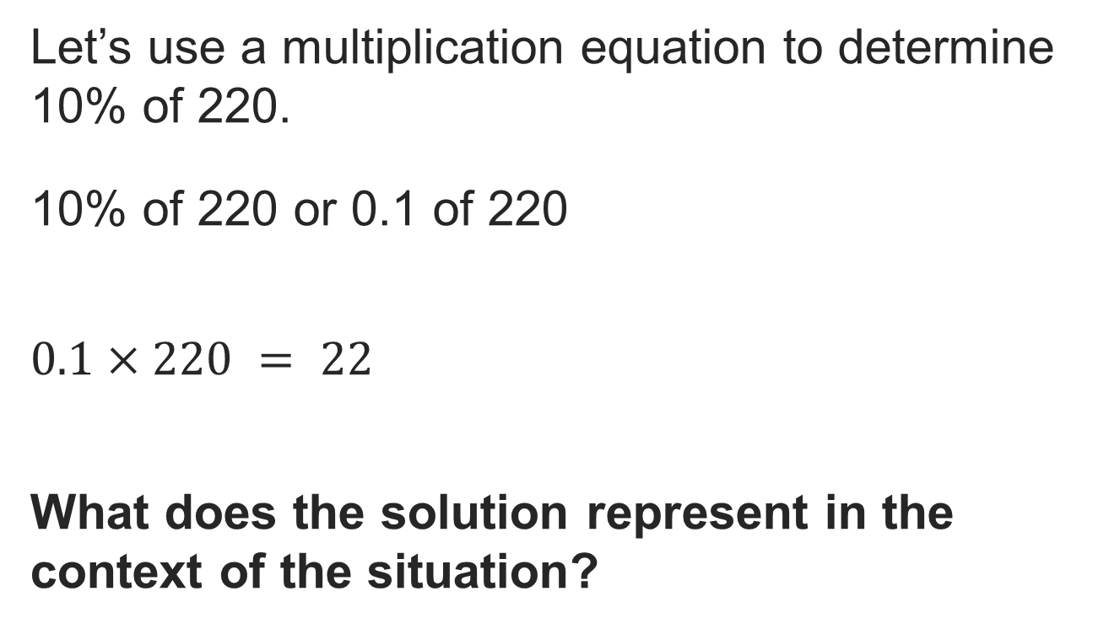
School Recycling
Reveal:
About 22 pounds of metal were recycled that month.
34 / 44
Notes:
TEACH IN PRACTICE | Embedded facilitation | Lesson 4.3, slide 30 | REVEAL
Focus on the existing task: Reveal: About 22 pounds of metal were recycled that month. School Recycling
LAUNCH (T2/3/5): If an existing answer cover is present, gather an attempt before revealing. If the explanation is already visible, ask students to reconstruct and justify it. Compare reasoning and explain a revision; preserve the reveal sequence.
LOOK FOR (T4): Where this task addresses it, students can choose a useful benchmark or compatible number. Ask which feature of their work supports the claim.
RESPOND: If this task shows the lesson misconception—presenting an estimate as an exact answer—locate the given percent or amount between familiar benchmarks. Have the student revise and explain the change. Use this support only where the concept occurs in the current task; otherwise respond to the displayed question.
RECHECK: If a gap is shared, revisit the existing representation together. If it is limited, give targeted support while others compare valid methods on the same task. Check the revision before moving on.
PARTICIPATION (T5/6/7): Think time before volunteers; accept a written, drawn or rehearsed entry. Students ask for evidence respectfully. Recognize a specific contribution or revision and check that both partners participate.
Source: BCPS Updated Instructional Framework Rubric (June 2020), TEACH 1–7. Earlier notes and answer keys are retained below.
EARLIER NOTES / EXISTING ANSWER KEY
Have students check the estimate against the situation: does about 22 pounds make sense for this percent of this total? Listen for reasonableness talk, not just the number. Ask what would signal that an answer was way off.

Slide 35
STUDENT MOVES
Lesson 4-3
Your moves
SPECIFIC FEEDBACK · Trade work. Give one specific comment: “This part is clear because ______.”
TWO MINUTES SOLO · Two minutes on your own, then compare. Bring one thing you tried, even if it did not work.
35 / 44

Slide 36
COLLABORATE · TALK IT THROUGH • AGREE ON A MODEL
Student-led talk: assign roles and monitor group progress.
Collaborate and Connect
We can also use compatible numbers to estimate.
8.6% of the recycling collected was metal.
216 pounds of material were recycled.
What compatible numbers can you use for 8.6% and 216 pounds?
Reveal:
We can use 10% and 200 pounds.
36 / 44
Notes:
TEACH IN PRACTICE | Embedded facilitation | Lesson 4.3, slide 31 | COLLABORATE
Focus on the existing task: We can also use compatible numbers to estimate. 8.6% of the recycling collected was metal. 216 pounds of material were recycled. What compatible numbers can you use for 8.6% and 216 pounds?
LAUNCH (T2/3/5): Use the displayed question. Give private thinking time; then A explains while B asks for evidence. Switch roles. Each student records their own reasoning.
LOOK FOR (T4): Where this task addresses it, students can choose a useful benchmark or compatible number. Ask which feature of their work supports the claim.
RESPOND: If this task shows the lesson misconception—presenting an estimate as an exact answer—locate the given percent or amount between familiar benchmarks. Have the student revise and explain the change. Use this support only where the concept occurs in the current task; otherwise respond to the displayed question.
RECHECK: If a gap is shared, revisit the existing representation together. If it is limited, give targeted support while others compare valid methods on the same task. Check the revision before moving on.
PARTICIPATION (T5/6/7): Think time before volunteers; accept a written, drawn or rehearsed entry. Students ask for evidence respectfully. Recognize a specific contribution or revision and check that both partners participate.
Source: BCPS Updated Instructional Framework Rubric (June 2020), TEACH 1–7. Earlier notes and answer keys are retained below.
EARLIER NOTES / EXISTING ANSWER KEY
UIFR TEACH — Level 4 student move: Student-led talk: assign roles and monitor group progress.
Student move: Student-led talk: assign roles and monitor group progress.
Routine: COLLABORATE · TALK IT THROUGH • AGREE ON A MODEL
UIFR FULL | Lesson-specific facilitation
TEACH 4-5 | Session 2 discussion and checkpoint (UIFR PDF pp. 11-12).
Collect a brief response from every student to the existing prompt before hearing volunteers. Partners take turns explaining and asking for evidence: “I understand ___; what supports ___?” Offer rehearsal or an annotated model for students who need language support. Each student records their own reasoning.
Look specifically for: presenting an estimate as an exact answer. If it appears, locate the given percent or amount between familiar benchmarks; then ask the student to revise the same response and explain the change. If evidence is secure, have students compare a second valid pathway or state why their approach works. Choose the next step from the responses, not a preset pace.

Slide 37
School Recycling
A local middle school has organized a Green-Team to set up and manage recycling at the school. The team decided to collect paper, metal, glass, and plastic to recycle. In one month, the team collected 216 total pounds of recycled materials, in the percents shown.
About how many pounds of metal were recycled that month?
Using rounding, about 22 pounds of metal were recycled that month.
Using compatible numbers, about 20 pounds of metal were recycled that month.
37 / 44
Notes:
TEACH IN PRACTICE | Embedded facilitation | Lesson 4.3, slide 32 | TASK
Focus on the existing task: A local middle school has organized a Green-Team to set up and manage recycling at the school. The team decided to collect paper, metal…
LAUNCH (T2/3/5): Use the displayed question. Give private thinking time; then A explains while B asks for evidence. Switch roles. Each student records their own reasoning.
LOOK FOR (T4): Where this task addresses it, students can choose a useful benchmark or compatible number. Ask which feature of their work supports the claim.
RESPOND: If this task shows the lesson misconception—presenting an estimate as an exact answer—locate the given percent or amount between familiar benchmarks. Have the student revise and explain the change. Use this support only where the concept occurs in the current task; otherwise respond to the displayed question.
RECHECK: If a gap is shared, revisit the existing representation together. If it is limited, give targeted support while others compare valid methods on the same task. Check the revision before moving on.
PARTICIPATION (T5/6/7): Think time before volunteers; accept a written, drawn or rehearsed entry. Students ask for evidence respectfully. Recognize a specific contribution or revision and check that both partners participate.
Source: BCPS Updated Instructional Framework Rubric (June 2020), TEACH 1–7. Earlier notes and answer keys are retained below.
EARLIER NOTES / EXISTING ANSWER KEY
Closing pass on the recycling problem. Have students explain the full estimation chain from percent to pounds in their own words. Listen for the correct whole and a benchmark-based estimate. Ask one pair to present, and one other student to add a check on reasonableness.

Slide 38
STUDENT MOVES
Lesson 4-3
Your move
ASK THE CLASS · Write one question about this that you could ask the class.
38 / 44

Slide 39
Compare pathways with a partner; name one revision.
Let’s Explore More
For each method, how would you expect the actual amount of metal recycled to compare to the estimate? Explain.
You can use compatible numbers to estimate the amount of plastic that was recycled. For example, 20% of 200 pounds. How can you decompose 20% to find the estimate of the number of pounds of plastic recycled?
Try it yourself. Compare your work with a partner; explain one choice and revise.
39 / 44
Notes:
TEACH IN PRACTICE | Embedded facilitation | Lesson 4.3, slide 33 | PRACTICE
Focus on the existing task: For each method, how would you expect the actual amount of metal recycled to compare to the estimate?
LAUNCH (T2/3/5): Use the displayed question. Give private thinking time; then A explains while B asks for evidence. Switch roles. Each student records their own reasoning.
LOOK FOR (T4): Where this task addresses it, students can choose a useful benchmark or compatible number. Ask which feature of their work supports the claim.
RESPOND: If this task shows the lesson misconception—presenting an estimate as an exact answer—locate the given percent or amount between familiar benchmarks. Have the student revise and explain the change. Use this support only where the concept occurs in the current task; otherwise respond to the displayed question.
RECHECK: If a gap is shared, revisit the existing representation together. If it is limited, give targeted support while others compare valid methods on the same task. Check the revision before moving on.
PARTICIPATION (T5/6/7): Think time before volunteers; accept a written, drawn or rehearsed entry. Students ask for evidence respectfully. Recognize a specific contribution or revision and check that both partners participate.
Source: BCPS Updated Instructional Framework Rubric (June 2020), TEACH 1–7. Earlier notes and answer keys are retained below.
EARLIER NOTES / EXISTING ANSWER KEY
UIFR TEACH — Level 4 student move: Compare pathways with a partner; name one revision.
Student move: Compare pathways with a partner; name one revision.

Slide 40
LESSON 4.3 / CHECK YOUR WORK
Pause. Check. Improve.
CHECK
A mistake to watch for: presenting an estimate as an exact answer.
TRY
Locate the given percent or amount between familiar benchmarks.
REVISE
Use that check on the task you just completed. Correct or strengthen one part, and explain why.
REVISE NOW · Change one answer and write why you changed it. A revision is evidence of learning.
Listen to understand. Ask for evidence. Make room for every voice.
Notes:
TEACH IN PRACTICE | Embedded facilitation | Lesson 4.3, slide 34 | PRIOR_INSERT
Focus on the existing task: LESSON 4.3 / CHECK YOUR WORK Pause. Check. Improve. Listen to understand. Ask for evidence. Make room for every voice. CHECK A mistake…
CONNECT (T1/4): Ask students to restate the displayed goal or key idea and connect it to earlier work. Relevant lesson evidence: choose a useful benchmark or compatible number; label an estimate; justify its size. Use only the criterion that matches the current session.
SHOW PROGRESS: Students point to their own existing work, explain what improved after feedback, and name a next step. Pair confidence ratings with actual evidence.
PARTICIPATION (T5/6/7): Think time before volunteers; accept a written, drawn or rehearsed entry. Students ask for evidence respectfully. Recognize a specific contribution or revision and check that both partners participate.
Source: BCPS Updated Instructional Framework Rubric (June 2020), TEACH 1–7.

Slide 41
School Recycling
Let’s represent the percentage as a decimal.
10% of 220 or 0.1 of 220
How can you find 0.1 of 220?
32 / 34
Compare your reasoning with the explanation. Explain any revision you make.
Reveal:
We can use a multiplication equation.
Notes:
TEACH IN PRACTICE | Embedded facilitation | Lesson 4.3, slide 35 | REVEAL
Focus on the existing task: Let’s represent the percentage as a decimal. 10% of 220 or 0.1 of 220 How can you find 0.1 of 220?
LAUNCH (T2/3/5): If an existing answer cover is present, gather an attempt before revealing. If the explanation is already visible, ask students to reconstruct and justify it. Compare reasoning and explain a revision; preserve the reveal sequence.
LOOK FOR (T4): Where this task addresses it, students can choose a useful benchmark or compatible number. Ask which feature of their work supports the claim.
RESPOND: If this task shows the lesson misconception—presenting an estimate as an exact answer—locate the given percent or amount between familiar benchmarks. Have the student revise and explain the change. Use this support only where the concept occurs in the current task; otherwise respond to the displayed question.
RECHECK: If a gap is shared, revisit the existing representation together. If it is limited, give targeted support while others compare valid methods on the same task. Check the revision before moving on.
PARTICIPATION (T5/6/7): Think time before volunteers; accept a written, drawn or rehearsed entry. Students ask for evidence respectfully. Recognize a specific contribution or revision and check that both partners participate.
Source: BCPS Updated Instructional Framework Rubric (June 2020), TEACH 1–7.

Slide 42
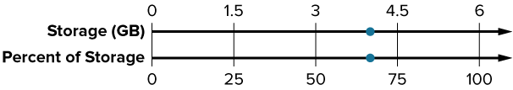
SUMMARIZE · SAY IT IN YOUR OWN WORDS
Summarize: Estimate the Percent of a Number
You can use benchmarks or rounding strategies to estimate the percent of a number.
Estimate 4 out of 6 as a percentage.
4 out of 6 is about 70%
Explain the key idea without reading. Use today’s example as evidence.
42 / 44
Notes:
TEACH IN PRACTICE | Embedded facilitation | Lesson 4.3, slide 36 | SUMMARIZE
Focus on the existing task: Estimate 4 out of 6 as a percentage. 4 out of 6 is about 70% You can use benchmarks or rounding strategies to estimate the percent of a…
CONNECT (T1/4): Ask students to restate the displayed goal or key idea and connect it to earlier work. Relevant lesson evidence: choose a useful benchmark or compatible number; label an estimate; justify its size. Use only the criterion that matches the current session.
SHOW PROGRESS: Students point to their own existing work, explain what improved after feedback, and name a next step. Pair confidence ratings with actual evidence.
PARTICIPATION (T5/6/7): Think time before volunteers; accept a written, drawn or rehearsed entry. Students ask for evidence respectfully. Recognize a specific contribution or revision and check that both partners participate.
Source: BCPS Updated Instructional Framework Rubric (June 2020), TEACH 1–7. Earlier notes and answer keys are retained below.
EARLIER NOTES / EXISTING ANSWER KEY
Routine: SUMMARIZE · SAY IT IN YOUR OWN WORDS

Slide 43
APPLY · PLAN IT • SOLVE IT • PROVE IT
Defend your method; partner gives one specific next step.
Apply: The Food Drive
The organizers of a food drive set a new goal for a second food drive. They hope to collect 140% as many cans as they did for the last food drive in which they collected 145 cans.
Question: About how many cans can the organizers expect to collect? Explain your reasoning.
Choose a method. Solve independently, justify your answer, then check the goal.
43 / 44
Notes:
TEACH IN PRACTICE | Embedded facilitation | Lesson 4.3, slide 37 | APPLY
Focus on the existing task: The organizers of a food drive set a new goal for a second food drive. They hope to collect 140% as many cans as they did for the last…
LAUNCH (T2/3/5): Use the exact application task independently first. Ask students to justify their choice of method. Collect evidence before a partner discussion or correction.
LOOK FOR (T4): Where this task addresses it, students can choose a useful benchmark or compatible number. Ask which feature of their work supports the claim.
RESPOND: If this task shows the lesson misconception—presenting an estimate as an exact answer—locate the given percent or amount between familiar benchmarks. Have the student revise and explain the change. Use this support only where the concept occurs in the current task; otherwise respond to the displayed question.
RECHECK: If a gap is shared, revisit the existing representation together. If it is limited, give targeted support while others compare valid methods on the same task. Check the revision before moving on.
PARTICIPATION (T5/6/7): Think time before volunteers; accept a written, drawn or rehearsed entry. Students ask for evidence respectfully. Recognize a specific contribution or revision and check that both partners participate.
Source: BCPS Updated Instructional Framework Rubric (June 2020), TEACH 1–7. Earlier notes and answer keys are retained below.
EARLIER NOTES / EXISTING ANSWER KEY
UIFR TEACH — Level 4 student move: Defend your method; partner gives one specific next step.
Student move: Defend your method; partner gives one specific next step.
Routine: APPLY · PLAN IT • SOLVE IT • PROVE IT
UIFR FULL | Lesson-specific facilitation
TEACH 4 | Independent evidence and revision (UIFR PDF p. 11).
Use the existing application/exit problem as the independent check. If this is a learning-target slide, have students point to and explain their work on the preceding task. Separate initial independent evidence from the revision after feedback.
Check the relevant criteria: choose a useful benchmark or compatible number; label an estimate; justify its size. Respond with one specific next step tied to the work. Students revise and annotate what changed, then identify a criterion they can now demonstrate and one they still need to practice.
REFLECT & ADJUST 1-2 | After the lesson (UIFR PDF pp. 15-16).
Sort the existing work by demonstrated reasoning, partial understanding, and the specific misconception: presenting an estimate as an exact answer. Compare the initial response with the revision. Record which teaching move plausibly helped, which did not, and whose participation or access needs a different approach; do not record sensitive student details in this shared deck.
Plan the next lesson from that evidence: if the misconception persists, locate the given percent or amount between familiar benchmarks using the current example before returning to the next grade-level task; if understanding is secure, use an existing extension or ask for a general explanation. Check the targeted idea again at the next warm-up.
Ask students what supported their thinking and what would help next time. Identify one change to try and one successful practice to retain. Seek colleague feedback on anonymized work when useful; these prompts support reflection and do not establish an evaluation rating. Source: Baltimore City Public Schools, Updated Instructional Framework Rubric, June 2020 (UIFR_Full.pdf).

Slide 44
LESSON 4.3 / REFLECT ON YOUR LEARNING
Show your progress
1 SHOW EVIDENCE
2 CHOOSE A NEXT STEP
Choose one response. Point to the part that shows your reasoning.
Name a change you made after feedback—or a question you still have.
“My work shows ___ because ___.”
“Next time, I will ___ to help me ___.”
Today’s focus: Choose a useful benchmark or compatible number.
CREDIT A CLASSMATE · Name one classmate whose idea helped you today, and say what they said.
Listen to understand. Ask for evidence. Make room for every voice.
Notes:
TEACH IN PRACTICE | Embedded facilitation | Lesson 4.3, slide 38 | PRIOR_INSERT
Focus on the existing task: LESSON 4.3 / REFLECT ON YOUR LEARNING Show your progress Listen to understand. Ask for evidence. Make room for every voice. 1 SHOW…
CONNECT (T1/4): Ask students to restate the displayed goal or key idea and connect it to earlier work. Relevant lesson evidence: choose a useful benchmark or compatible number; label an estimate; justify its size. Use only the criterion that matches the current session.
SHOW PROGRESS: Students point to their own existing work, explain what improved after feedback, and name a next step. Pair confidence ratings with actual evidence.
PARTICIPATION (T5/6/7): Think time before volunteers; accept a written, drawn or rehearsed entry. Students ask for evidence respectfully. Recognize a specific contribution or revision and check that both partners participate.
Source: BCPS Updated Instructional Framework Rubric (June 2020), TEACH 1–7.

