Slide 1
WARM-UP · THINK • TRY • CHECK
Turn and talk: compare strategies, then defend one.
Warm-Up
Lesson 4-4 · Find and Compare with Percentages | Warm-Up · about 4 minutes
Try each on your own. Mark an unsure answer; explain and revise when we check.
QUESTION 1
QUESTION 2
Write 35% as a decimal: ______
0.25 × 80 = ______
QUESTION 3
QUESTION 4
3/4 of 80 = ______
Which is more, 20% of 50 or 30% of 40? ______
TALK IT OVER: “I got ______ because ______.” • Compare with a partner before we check as a class.
1 / 44
Notes:
TEACH IN PRACTICE | Embedded facilitation | Lesson 4.4, slide 1 | WARMUP
Focus on the existing task: Warm-Up WARM-UP · THINK • TRY • CHECK Do these four on…
GATHER EVIDENCE (T4/6): Keep the original items. Students try independently, mark an uncertain item, and explain one method before checking. Use the existing key when present.
RESPOND: Distinguish a calculation slip from a reasoning gap. Give one next step on the same item; have students revise in a second color. Use the responses to choose flexible support for today’s lesson.
PARTICIPATION (T5/6/7): Think time before volunteers; accept a written, drawn or rehearsed entry. Students ask for evidence respectfully. Recognize a specific contribution or revision and check that both partners participate.
Source: BCPS Updated Instructional Framework Rubric (June 2020), TEACH 1–7. Earlier notes and answer keys are retained below.
EARLIER NOTES / EXISTING ANSWER KEY
Warm-Up answers (teacher only): 1) 0.35 2) 20 3) 60 4) 30% of 40
UIFR FULL | Lesson-specific facilitation
PREPARE 1-2 | Before teaching (UIFR PDF pp. 6-7).
Plan to gather evidence that students can identify part, whole and percent; use a matching model or equation; check reasonableness. Review recent work and today’s warm-up to choose flexible groups and access supports; do not infer needs from identity or perceived ability. Use the existing lesson tasks and stated standards.
Anticipate: using the part as the whole or confusing percent with a decimal multiplier. If observed, label the three quantities in the original problem before selecting an operation. Offer oral rehearsal, drawing, pointing, or home-language processing as needed; retain the original mathematical demand. Ask students which support helps and fade it as evidence improves.
TEACH 6-7 | Before the first transition, agree on materials, partner roles, and how to request help. Invite students to restate the routine. Normalize revising an idea, recognize a specific contribution, and check privately when frustration blocks participation. Source: UIFR PDF pp. 13-14.

Slide 2
Partner talk: connect today’s idea to prior learning.
Today’s Math Notes
Lesson 4-4 · Find and Compare with Percentages
Section 2: Today’s Math
Copy. Explain. Check.
Finding the Percent of a Number
Part = Percent × Whole
Read, cover, explain. Reopen your notes to
check and improve your explanation.
1
Identify the percent and the whole (base amount)
2
Convert the percent to a decimal or simplified fraction
3
Multiply the decimal/fraction by the whole to calculate the part
eduwonderlab.com · Neft Teacher
2 / 44
Notes:
TEACH IN PRACTICE | Embedded facilitation | Lesson 4.4, slide 2 | NOTES
Focus on the existing task: Today’s Math Notes Section 2: Today’s Math Copy into your…
ROUTINE (T1/2/4): Read or copy the original notes, cover one line, and explain it using the displayed example. Reopen and correct. Copying alone is not evidence of understanding.
LOOK FOR: A link between a symbol, quantity or feature and the explanation. If missing, point back to that feature and have the student try again; fade the prompt once they can explain.
PARTICIPATION (T5/6/7): Think time before volunteers; accept a written, drawn or rehearsed entry. Students ask for evidence respectfully. Recognize a specific contribution or revision and check that both partners participate.
Source: BCPS Updated Instructional Framework Rubric (June 2020), TEACH 1–7. Earlier notes and answer keys are retained below.
EARLIER NOTES / EXISTING ANSWER KEY
UIFR TEACH — Level 4 student move: Partner talk: connect today’s idea to prior learning.
Student move: Partner talk: connect today’s idea to prior learning.

Slide 3
Tell a partner the goal and why it matters.
Today’s Objectives
Lesson 4-4 · Find and Compare with Percentages
Find and Compare with Percentages
Maryland Standard 6.AT.4
CONTENT OBJECTIVE
LANGUAGE OBJECTIVE
Restate the goal in your words
Use these words to explain why
I can find the percent of a number using an equation or a model.
I can explain my steps using the words percent, base, part, and equation.
eduwonderlab.com · Neft Teacher
3 / 44
Notes:
TEACH IN PRACTICE | Embedded facilitation | Lesson 4.4, slide 3 | GOAL
Focus on the existing task: Today’s Objectives Find and Compare with Percentages…
CONNECT (T1/4): Ask students to restate the displayed goal or key idea and connect it to earlier work. Relevant lesson evidence: identify part, whole and percent; use a matching model or equation; check reasonableness. Use only the criterion that matches the current session.
SHOW PROGRESS: Students point to their own existing work, explain what improved after feedback, and name a next step. Pair confidence ratings with actual evidence.
PARTICIPATION (T5/6/7): Think time before volunteers; accept a written, drawn or rehearsed entry. Students ask for evidence respectfully. Recognize a specific contribution or revision and check that both partners participate.
Source: BCPS Updated Instructional Framework Rubric (June 2020), TEACH 1–7. Earlier notes and answer keys are retained below.
EARLIER NOTES / EXISTING ANSWER KEY
UIFR TEACH — Level 4 student move: Tell a partner the goal and why it matters.
Student move: Tell a partner the goal and why it matters.
UIFR FULL | Lesson-specific facilitation
TEACH 1 | Session 1 purpose and evidence (UIFR PDF p. 8).
Have students restate the displayed session goal in their own words and connect it to the existing context or a familiar experience they choose to share. Use the current session goal to select from these lesson-wide evidence criteria; do not frontload a later-session procedure.
Look for: identify part, whole and percent; use a matching model or equation; check reasonableness. Ask: “Which part of your work would show this?” Revisit that evidence after the task; a confidence rating alone is not evidence of understanding.

Slide 4
LESSON 4.4 / OUR LEARNING
What will show your learning?
1
Identify part, whole and percent.
2
Use a matching model or equation.
3
Check reasonableness.
Tell a partner: Which skill connects to something you already know?
SAY THE GOAL · Say today’s goal in your own words, then name one place this shows up outside math class.
Listen to understand. Ask for evidence. Make room for every voice.
Notes:
TEACH IN PRACTICE | Embedded facilitation | Lesson 4.4, slide 4 | PRIOR_INSERT
Focus on the existing task: LESSON 4.4 / OUR LEARNING What will show your learning?
CONNECT (T1/4): Ask students to restate the displayed goal or key idea and connect it to earlier work. Relevant lesson evidence: identify part, whole and percent; use a matching model or equation; check reasonableness. Use only the criterion that matches the current session.
SHOW PROGRESS: Students point to their own existing work, explain what improved after feedback, and name a next step. Pair confidence ratings with actual evidence.
PARTICIPATION (T5/6/7): Think time before volunteers; accept a written, drawn or rehearsed entry. Students ask for evidence respectfully. Recognize a specific contribution or revision and check that both partners participate.
Source: BCPS Updated Instructional Framework Rubric (June 2020), TEACH 1–7.

Slide 5
Vocabulary 1 of 6
Lesson 4-4 · Find and Compare with Percentages
Percent of a Number
A part of a number found by multiplying the number by the percent written as a decimal.
EXAMPLE · EXPLAIN WHY IT FITS
25% of 80 = 0.25 × 80 = 20
USE THE MATH WORDS · Use today’s math words in your explanation — not “it” and “that thing.”
eduwonderlab.com · Neft Teacher
5 / 44
Notes:
TEACH IN PRACTICE | Embedded facilitation | Lesson 4.4, slide 5 | VOCAB
Focus on the existing task: Vocabulary 1 of 6 Percent of a Number A part of a number…
ASK (T1/3/5): Where does “Percent of a Number” appear in the example? Explain the meaning without reading the definition. Partner: restate the idea and ask a clarifying question.
LOOK FOR: A correct connection between the word and a feature of the example. If the student only repeats the definition, invite pointing, sketching or oral rehearsal, then ask for another explanation of this same example.
PARTICIPATION (T5/6/7): Think time before volunteers; accept a written, drawn or rehearsed entry. Students ask for evidence respectfully. Recognize a specific contribution or revision and check that both partners participate.
Source: BCPS Updated Instructional Framework Rubric (June 2020), TEACH 1–7.

Slide 6
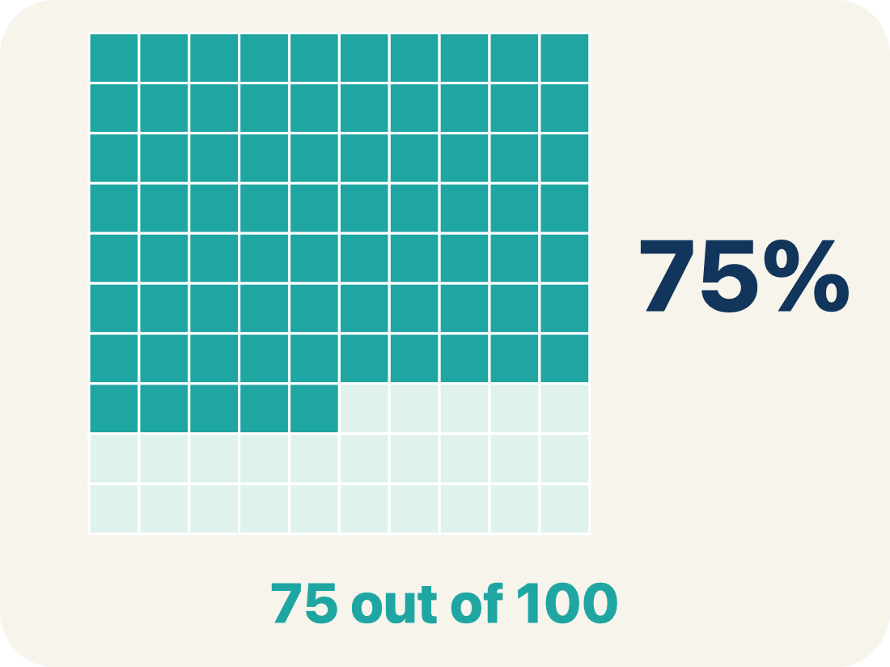
Vocabulary 2 of 6
Lesson 4-4 · Find and Compare with Percentages
Percent
A way to compare a number to 100, shown with the % sign.
EXAMPLE · EXPLAIN WHY IT FITS
30% means 30 out of 100
Use “Percent” to explain the example. Point to evidence.
eduwonderlab.com · Neft Teacher
6 / 44
Notes:
TEACH IN PRACTICE | Embedded facilitation | Lesson 4.4, slide 6 | VOCAB
Focus on the existing task: Vocabulary 2 of 6 Percent A way to compare a number to…
ASK (T1/3/5): Where does “Percent” appear in the example? Explain the meaning without reading the definition. Partner: restate the idea and ask a clarifying question.
LOOK FOR: A correct connection between the word and a feature of the example. If the student only repeats the definition, invite pointing, sketching or oral rehearsal, then ask for another explanation of this same example.
PARTICIPATION (T5/6/7): Think time before volunteers; accept a written, drawn or rehearsed entry. Students ask for evidence respectfully. Recognize a specific contribution or revision and check that both partners participate.
Source: BCPS Updated Instructional Framework Rubric (June 2020), TEACH 1–7.

Slide 7
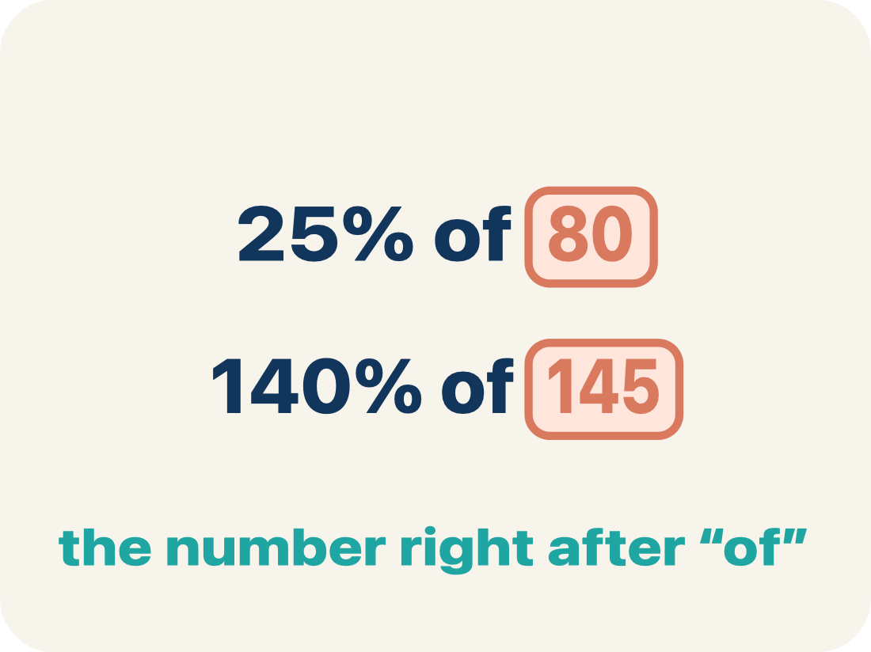
Vocabulary 3 of 6
Lesson 4-4 · Find and Compare with Percentages
Base
The whole amount you start with — the number right after the word “of.”
EXAMPLE · EXPLAIN WHY IT FITS
25% of 80 → the whole is 80.
Use “Base” to explain the example. Point to evidence.
eduwonderlab.com · Neft Teacher
7 / 44
Notes:
TEACH IN PRACTICE | Embedded facilitation | Lesson 4.4, slide 7 | VOCAB
Focus on the existing task: Vocabulary 3 of 6 Base The whole amount you start with…
ASK (T1/3/5): Where does “Base” appear in the example? Explain the meaning without reading the definition. Partner: restate the idea and ask a clarifying question.
LOOK FOR: A correct connection between the word and a feature of the example. If the student only repeats the definition, invite pointing, sketching or oral rehearsal, then ask for another explanation of this same example.
PARTICIPATION (T5/6/7): Think time before volunteers; accept a written, drawn or rehearsed entry. Students ask for evidence respectfully. Recognize a specific contribution or revision and check that both partners participate.
Source: BCPS Updated Instructional Framework Rubric (June 2020), TEACH 1–7.

Slide 8
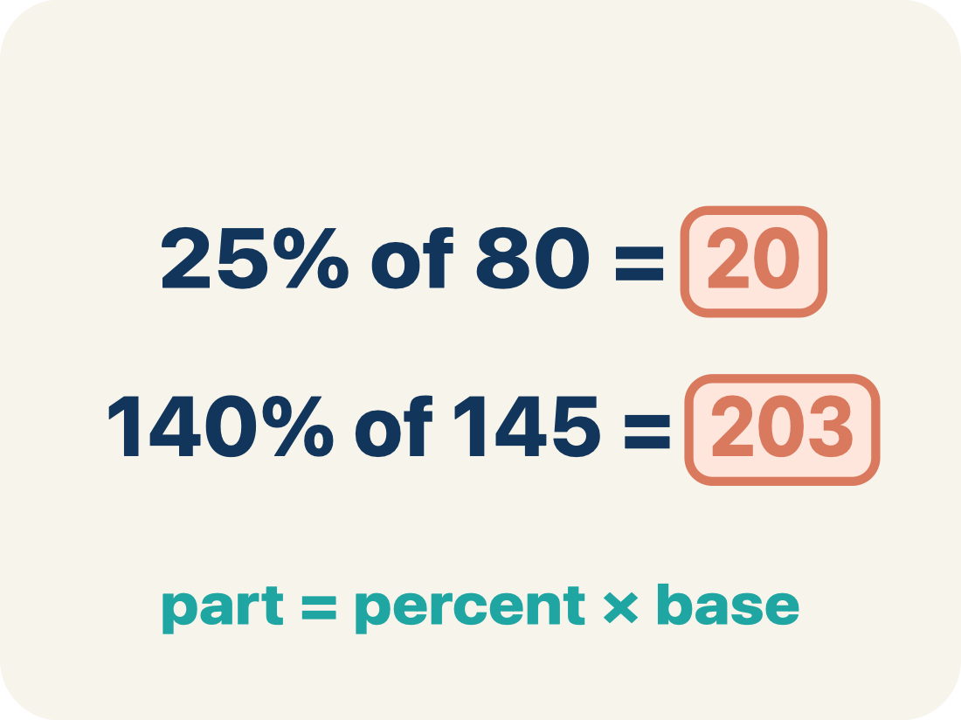
Vocabulary 4 of 6
Lesson 4-4 · Find and Compare with Percentages
Part
How much of the base (the whole) you get. It is your answer.
EXAMPLE · EXPLAIN WHY IT FITS
25% of 80 = 20 → the part is 20 (20 out of the 80).
Use “Part” to explain the example. Point to evidence.
eduwonderlab.com · Neft Teacher
8 / 44
Notes:
TEACH IN PRACTICE | Embedded facilitation | Lesson 4.4, slide 8 | VOCAB
Focus on the existing task: Vocabulary 4 of 6 Part How much of the base (the whole)…
ASK (T1/3/5): Where does “Part” appear in the example? Explain the meaning without reading the definition. Partner: restate the idea and ask a clarifying question.
LOOK FOR: A correct connection between the word and a feature of the example. If the student only repeats the definition, invite pointing, sketching or oral rehearsal, then ask for another explanation of this same example.
PARTICIPATION (T5/6/7): Think time before volunteers; accept a written, drawn or rehearsed entry. Students ask for evidence respectfully. Recognize a specific contribution or revision and check that both partners participate.
Source: BCPS Updated Instructional Framework Rubric (June 2020), TEACH 1–7.

Slide 9
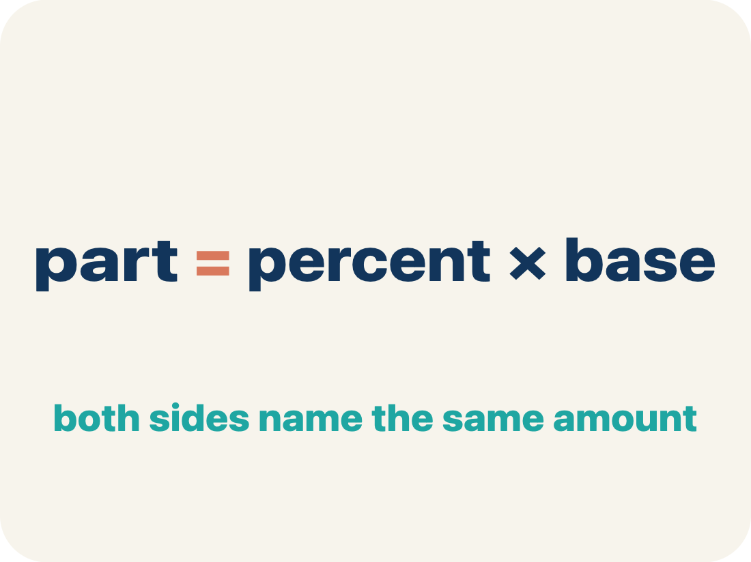
Vocabulary 5 of 6
Lesson 4-4 · Find and Compare with Percentages
Equation
A number sentence with an equal sign. The percent one is: part = percent × base.
EXAMPLE · EXPLAIN WHY IT FITS
part = percent × base — like 20 = 0.25 × 80.
Use “Equation” to explain the example. Point to evidence.
eduwonderlab.com · Neft Teacher
9 / 44
Notes:
TEACH IN PRACTICE | Embedded facilitation | Lesson 4.4, slide 9 | VOCAB
Focus on the existing task: Vocabulary 5 of 6 Equation A number sentence with an…
ASK (T1/3/5): Where does “Equation” appear in the example? Explain the meaning without reading the definition. Partner: restate the idea and ask a clarifying question.
LOOK FOR: A correct connection between the word and a feature of the example. If the student only repeats the definition, invite pointing, sketching or oral rehearsal, then ask for another explanation of this same example.
PARTICIPATION (T5/6/7): Think time before volunteers; accept a written, drawn or rehearsed entry. Students ask for evidence respectfully. Recognize a specific contribution or revision and check that both partners participate.
Source: BCPS Updated Instructional Framework Rubric (June 2020), TEACH 1–7.

Slide 10
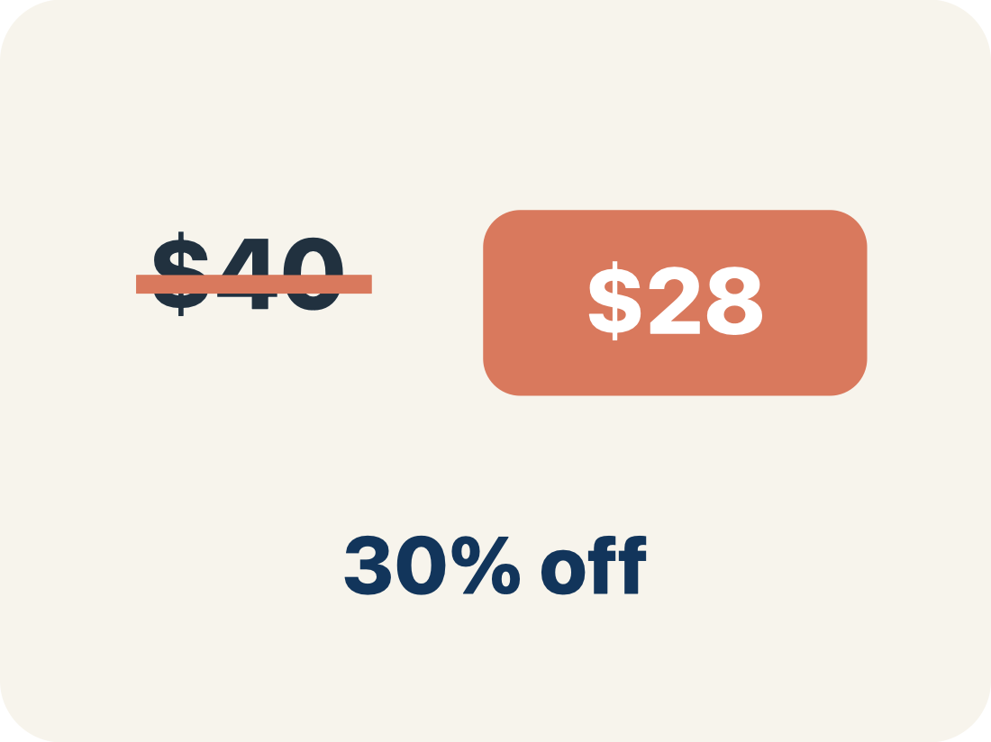
Vocabulary 6 of 6
Lesson 4-4 · Find and Compare with Percentages
Discount
Money taken off the first price to make it cheaper.
EXAMPLE · EXPLAIN WHY IT FITS
$40 shirt at 25% off: discount = $10
Use “Discount” to explain the example. Point to evidence.
eduwonderlab.com · Neft Teacher
10 / 44
Notes:
TEACH IN PRACTICE | Embedded facilitation | Lesson 4.4, slide 10 | VOCAB
Focus on the existing task: Vocabulary 6 of 6 Discount Money taken off the first…
ASK (T1/3/5): Where does “Discount” appear in the example? Explain the meaning without reading the definition. Partner: restate the idea and ask a clarifying question.
LOOK FOR: A correct connection between the word and a feature of the example. If the student only repeats the definition, invite pointing, sketching or oral rehearsal, then ask for another explanation of this same example.
PARTICIPATION (T5/6/7): Think time before volunteers; accept a written, drawn or rehearsed entry. Students ask for evidence respectfully. Recognize a specific contribution or revision and check that both partners participate.
Source: BCPS Updated Instructional Framework Rubric (June 2020), TEACH 1–7.

Slide 11
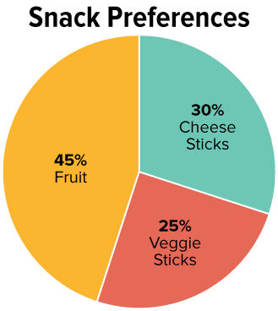

Be Curious
What do you notice?
What do you wonder?
Snack Preferences
Snack | Number of Students
Cheese Sticks
Fruit
Veggie Sticks
Mindset
HOW DO YOU KNOW? · Ask your partner “How do you know?” Answer by pointing to your own work.
What are your strengths as a problem solver?
11 / 44
Notes:
TEACH IN PRACTICE | Embedded facilitation | Lesson 4.4, slide 11 | CURIOUS
Focus on the existing task: What do you notice?
LAUNCH (T2/3/5): Allow quiet observation first. Separate a notice from an inference, invite students’ own questions, and follow the existing launch before teaching a procedure.
LOOK FOR (T4): Where this task addresses it, students can identify part, whole and percent. Ask which feature of their work supports the claim.
RESPOND: If this task shows the lesson misconception—using the part as the whole or confusing percent with a decimal multiplier—label the three quantities in the original problem before selecting an operation. Have the student revise and explain the change. Use this support only where the concept occurs in the current task; otherwise respond to the displayed question.
RECHECK: If a gap is shared, revisit the existing representation together. If it is limited, give targeted support while others compare valid methods on the same task. Check the revision before moving on.
PARTICIPATION (T5/6/7): Think time before volunteers; accept a written, drawn or rehearsed entry. Students ask for evidence respectfully. Recognize a specific contribution or revision and check that both partners participate.
Source: BCPS Updated Instructional Framework Rubric (June 2020), TEACH 1–7.

Slide 12
Explain with today’s vocabulary; partner paraphrases.
Vocabulary
Lesson 4-4 · Find and Compare with Percentages
Today’s Math Words
We learn every word — what it means and what it looks like — before we use it.
Percent of a Number
Percent
A part of a number found by multiplying the number by the percent written as a decimal
A way to compare a number to 100, shown with the % sign
Base
Part
The whole amount you start with — the number right after the word “of.”
How much of the base (the whole) you get
Equation
Discount
A number sentence with an equal sign
Money taken off the first price to make it cheaper
eduwonderlab.com · Neft Teacher
12 / 44
Notes:
TEACH IN PRACTICE | Embedded facilitation | Lesson 4.4, slide 12 | VOCAB
Focus on the existing task: Vocabulary Today’s Math Words We learn every word — what…
ASK (T1/3/5): Where does “the displayed term” appear in the example? Explain the meaning without reading the definition. Partner: restate the idea and ask a clarifying question.
LOOK FOR: A correct connection between the word and a feature of the example. If the student only repeats the definition, invite pointing, sketching or oral rehearsal, then ask for another explanation of this same example.
PARTICIPATION (T5/6/7): Think time before volunteers; accept a written, drawn or rehearsed entry. Students ask for evidence respectfully. Recognize a specific contribution or revision and check that both partners participate.
Source: BCPS Updated Instructional Framework Rubric (June 2020), TEACH 1–7. Earlier notes and answer keys are retained below.
EARLIER NOTES / EXISTING ANSWER KEY
UIFR TEACH — Level 4 student move: Explain with today’s vocabulary; partner paraphrases.
Student move: Explain with today’s vocabulary; partner paraphrases.

Slide 13

Ask a partner a question; choose a model together.
School Snacks
Three hundred middle school students voted for one of three snacks to add to the school cafeteria menu. The graph shows the percentage of students who voted for each snack.
How many students voted for fruit?
Describing Quantities
13 / 44
Notes:
TEACH IN PRACTICE | Embedded facilitation | Lesson 4.4, slide 13 | TASK
Focus on the existing task: Three hundred middle school students voted for one of three snacks to add to the school cafeteria menu. The graph shows the percentage of students who voted for each snack. How many students voted for fruit?
LAUNCH (T2/3/5): Use the displayed question. Give private thinking time; then A explains while B asks for evidence. Switch roles. Each student records their own reasoning.
LOOK FOR (T4): Where this task addresses it, students can use a matching model or equation. Ask which feature of their work supports the claim.
RESPOND: If this task shows the lesson misconception—using the part as the whole or confusing percent with a decimal multiplier—label the three quantities in the original problem before selecting an operation. Have the student revise and explain the change. Use this support only where the concept occurs in the current task; otherwise respond to the displayed question.
RECHECK: If a gap is shared, revisit the existing representation together. If it is limited, give targeted support while others compare valid methods on the same task. Check the revision before moving on.
PARTICIPATION (T5/6/7): Think time before volunteers; accept a written, drawn or rehearsed entry. Students ask for evidence respectfully. Recognize a specific contribution or revision and check that both partners participate.
Source: BCPS Updated Instructional Framework Rubric (June 2020), TEACH 1–7. Earlier notes and answer keys are retained below.
EARLIER NOTES / EXISTING ANSWER KEY
UIFR TEACH — Level 4 student move: Ask a partner a question; choose a model together.
Student move: Ask a partner a question; choose a model together.
UIFR FULL | Lesson-specific facilitation
TEACH 2-3 | Session 1 task launch (UIFR PDF pp. 9-10).
Use the problem exactly as displayed. Give individual thinking time before discussion or advancing to the explanation. If the answer is already visible, ask students to reconstruct and justify it. Invite a choice of suitable representations and have students explain why their choice helps.
At the point where this concept appears, ask: “Which quantity is the whole, and how does your equation or model represent the requested unknown?” Wait for evidence, invite another pathway, and have a student ask a follow-up question. Do not replace students’ reasoning with a sequence of leading steps.

Slide 14
School Snacks
45% of the 300 students voted for fruit.
What is the whole in this situation?
What percentage represents the whole?
Record your reasoning before the reveal. Compare, then explain any revision.
Reveal:
The number of students who voted, 300, is the whole. This is 100% of the students who voted.
14 / 44
Notes:
TEACH IN PRACTICE | Embedded facilitation | Lesson 4.4, slide 14 | REVEAL
Focus on the existing task: 45% of the 300 students voted for fruit. What is the whole in this situation?
LAUNCH (T2/3/5): If an existing answer cover is present, gather an attempt before revealing. If the explanation is already visible, ask students to reconstruct and justify it. Compare reasoning and explain a revision; preserve the reveal sequence.
LOOK FOR (T4): Where this task addresses it, students can identify part, whole and percent. Ask which feature of their work supports the claim.
RESPOND: If this task shows the lesson misconception—using the part as the whole or confusing percent with a decimal multiplier—label the three quantities in the original problem before selecting an operation. Have the student revise and explain the change. Use this support only where the concept occurs in the current task; otherwise respond to the displayed question.
RECHECK: If a gap is shared, revisit the existing representation together. If it is limited, give targeted support while others compare valid methods on the same task. Check the revision before moving on.
PARTICIPATION (T5/6/7): Think time before volunteers; accept a written, drawn or rehearsed entry. Students ask for evidence respectfully. Recognize a specific contribution or revision and check that both partners participate.
Source: BCPS Updated Instructional Framework Rubric (June 2020), TEACH 1–7. Earlier notes and answer keys are retained below.
EARLIER NOTES / EXISTING ANSWER KEY
Ask students to name the whole, the percent, and the unknown part before computing: 45 percent of 300 students. Listen for correct identification of 300 as the whole. The frequent error is treating 45 as the count of students rather than a rate per 100.

Slide 15
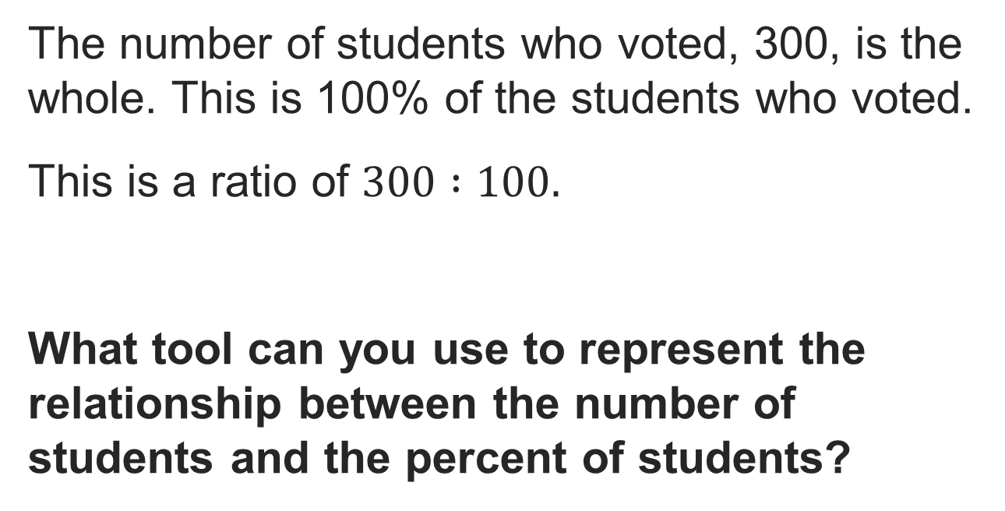
School Snacks
Reveal:
We can use a double number line.
15 / 44
Notes:
TEACH IN PRACTICE | Embedded facilitation | Lesson 4.4, slide 15 | REVEAL
Focus on the existing task: Reveal: We can use a double number line. School Snacks
LAUNCH (T2/3/5): If an existing answer cover is present, gather an attempt before revealing. If the explanation is already visible, ask students to reconstruct and justify it. Compare reasoning and explain a revision; preserve the reveal sequence.
LOOK FOR (T4): Where this task addresses it, students can identify part, whole and percent. Ask which feature of their work supports the claim.
RESPOND: If this task shows the lesson misconception—using the part as the whole or confusing percent with a decimal multiplier—label the three quantities in the original problem before selecting an operation. Have the student revise and explain the change. Use this support only where the concept occurs in the current task; otherwise respond to the displayed question.
RECHECK: If a gap is shared, revisit the existing representation together. If it is limited, give targeted support while others compare valid methods on the same task. Check the revision before moving on.
PARTICIPATION (T5/6/7): Think time before volunteers; accept a written, drawn or rehearsed entry. Students ask for evidence respectfully. Recognize a specific contribution or revision and check that both partners participate.
Source: BCPS Updated Instructional Framework Rubric (June 2020), TEACH 1–7. Earlier notes and answer keys are retained below.
EARLIER NOTES / EXISTING ANSWER KEY
Ask how a double number line could organize this vote problem, and what belongs on each line. Listen for percents on one line and student counts on the other, aligned at 0 and at 100 percent above 300. Watch for students placing 45 percent without scaling the count line to match.

Slide 16
STUDENT MOVES
Lesson 4-4
Your move
TWO MINUTES SOLO · Two minutes on your own, then compare. Bring one thing you tried, even if it did not work.
16 / 44

Slide 17
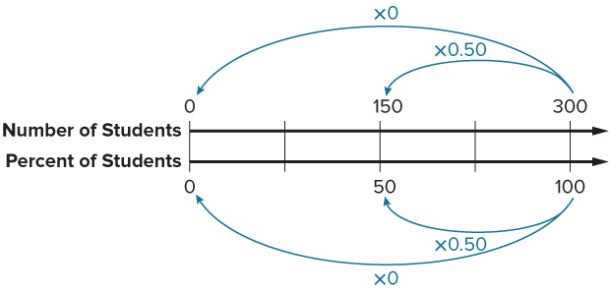
Partner press: ask ‘Why?’ and answer with evidence.
School Snacks
In general, how do you think you can generate an equivalent ratio that represents a given percentage of students?
Reveal:
We can multiply each term in the original ratio by the given percentage, written as a decimal.
17 / 44
Notes:
TEACH IN PRACTICE | Embedded facilitation | Lesson 4.4, slide 16 | REVEAL
Focus on the existing task: School Snacks Partner press: ask ‘Why?
LAUNCH (T2/3/5): If an existing answer cover is present, gather an attempt before revealing. If the explanation is already visible, ask students to reconstruct and justify it. Compare reasoning and explain a revision; preserve the reveal sequence.
LOOK FOR (T4): Where this task addresses it, students can identify part, whole and percent. Ask which feature of their work supports the claim.
RESPOND: If this task shows the lesson misconception—using the part as the whole or confusing percent with a decimal multiplier—label the three quantities in the original problem before selecting an operation. Have the student revise and explain the change. Use this support only where the concept occurs in the current task; otherwise respond to the displayed question.
RECHECK: If a gap is shared, revisit the existing representation together. If it is limited, give targeted support while others compare valid methods on the same task. Check the revision before moving on.
PARTICIPATION (T5/6/7): Think time before volunteers; accept a written, drawn or rehearsed entry. Students ask for evidence respectfully. Recognize a specific contribution or revision and check that both partners participate.
Source: BCPS Updated Instructional Framework Rubric (June 2020), TEACH 1–7. Earlier notes and answer keys are retained below.
EARLIER NOTES / EXISTING ANSWER KEY
UIFR TEACH — Level 4 student move: Partner press: ask ‘Why?’ and answer with evidence.
Student move: Partner press: ask ‘Why?’ and answer with evidence.

Slide 18
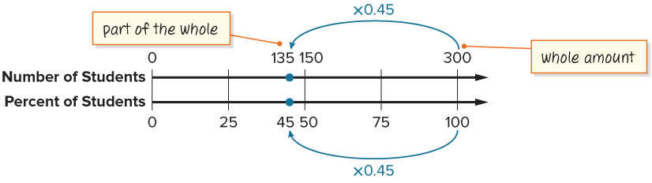
School Snacks
135 of the 300 students voted for fruit.
What is another way you can represent the multiplication used to find the percent of a whole?
Reveal:
We can use an equation.
18 / 44
Notes:
TEACH IN PRACTICE | Embedded facilitation | Lesson 4.4, slide 17 | REVEAL
Focus on the existing task: 135 of the 300 students voted for fruit. What is another way you can represent the multiplication used to find the percent of a whole?
LAUNCH (T2/3/5): If an existing answer cover is present, gather an attempt before revealing. If the explanation is already visible, ask students to reconstruct and justify it. Compare reasoning and explain a revision; preserve the reveal sequence.
LOOK FOR (T4): Where this task addresses it, students can identify part, whole and percent. Ask which feature of their work supports the claim.
RESPOND: If this task shows the lesson misconception—using the part as the whole or confusing percent with a decimal multiplier—label the three quantities in the original problem before selecting an operation. Have the student revise and explain the change. Use this support only where the concept occurs in the current task; otherwise respond to the displayed question.
RECHECK: If a gap is shared, revisit the existing representation together. If it is limited, give targeted support while others compare valid methods on the same task. Check the revision before moving on.
PARTICIPATION (T5/6/7): Think time before volunteers; accept a written, drawn or rehearsed entry. Students ask for evidence respectfully. Recognize a specific contribution or revision and check that both partners participate.
Source: BCPS Updated Instructional Framework Rubric (June 2020), TEACH 1–7. Earlier notes and answer keys are retained below.
EARLIER NOTES / EXISTING ANSWER KEY
Now the part is known and the percent is the unknown. Ask what stays the same in the setup and what switches roles. Listen for students writing the relationship 135 out of 300 before converting to a percent. Ask why an equation is a reasonable tool once the relationship is written.

Slide 19
STUDENT MOVES
Lesson 4-4
Your move
PROVE IT · Find the evidence in the problem that makes your answer right — not just the answer.
19 / 44

Slide 20
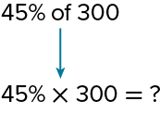
School Snacks
Let’s use an equation to determine how many students voted for fruit.
How can you multiply a percent by a whole number?
PICK YOUR STRATEGY · Choose your path — picture, table, number line, or equation — and be ready to say why you chose it.
Reveal:
I can use the decimal form of the percent to multiply.
20 / 44
Notes:
TEACH IN PRACTICE | Embedded facilitation | Lesson 4.4, slide 18 | REVEAL
Focus on the existing task: Let’s use an equation to determine how many students voted for fruit. How can you multiply a percent by a whole number?
LAUNCH (T2/3/5): If an existing answer cover is present, gather an attempt before revealing. If the explanation is already visible, ask students to reconstruct and justify it. Compare reasoning and explain a revision; preserve the reveal sequence.
LOOK FOR (T4): Where this task addresses it, students can identify part, whole and percent. Ask which feature of their work supports the claim.
RESPOND: If this task shows the lesson misconception—using the part as the whole or confusing percent with a decimal multiplier—label the three quantities in the original problem before selecting an operation. Have the student revise and explain the change. Use this support only where the concept occurs in the current task; otherwise respond to the displayed question.
RECHECK: If a gap is shared, revisit the existing representation together. If it is limited, give targeted support while others compare valid methods on the same task. Check the revision before moving on.
PARTICIPATION (T5/6/7): Think time before volunteers; accept a written, drawn or rehearsed entry. Students ask for evidence respectfully. Recognize a specific contribution or revision and check that both partners participate.
Source: BCPS Updated Instructional Framework Rubric (June 2020), TEACH 1–7. Earlier notes and answer keys are retained below.
EARLIER NOTES / EXISTING ANSWER KEY
Ask why the decimal form of the percent is useful inside an equation. Listen for students translating the percent to hundredths on purpose. Watch for equations that multiply by 45 instead of 0.45; have students test their equation with an easy percent like 50.

Slide 21
School Snacks
Three hundred middle school students voted for one of three snacks to add to the school cafeteria menu. The graph shows the percentage of students who voted for each snack.
How many students voted for fruit?
135 students voted for fruit.
TRY IT BEFORE YOU’RE SURE · Start even if you are not sure. A revised answer counts as much as a first-try answer.
21 / 44
Notes:
TEACH IN PRACTICE | Embedded facilitation | Lesson 4.4, slide 19 | TASK
Focus on the existing task: Three hundred middle school students voted for one of three snacks to add to the school cafeteria menu. The graph shows the percentage of students who voted for each snack. How many students voted for fruit?
LAUNCH (T2/3/5): Use the displayed question. Give private thinking time; then A explains while B asks for evidence. Switch roles. Each student records their own reasoning.
LOOK FOR (T4): Where this task addresses it, students can identify part, whole and percent. Ask which feature of their work supports the claim.
RESPOND: If this task shows the lesson misconception—using the part as the whole or confusing percent with a decimal multiplier—label the three quantities in the original problem before selecting an operation. Have the student revise and explain the change. Use this support only where the concept occurs in the current task; otherwise respond to the displayed question.
RECHECK: If a gap is shared, revisit the existing representation together. If it is limited, give targeted support while others compare valid methods on the same task. Check the revision before moving on.
PARTICIPATION (T5/6/7): Think time before volunteers; accept a written, drawn or rehearsed entry. Students ask for evidence respectfully. Recognize a specific contribution or revision and check that both partners participate.
Source: BCPS Updated Instructional Framework Rubric (June 2020), TEACH 1–7. Earlier notes and answer keys are retained below.
EARLIER NOTES / EXISTING ANSWER KEY
Summary moment: 135 students voted for fruit. Have students trace how each representation, the number line and the equation, produced the same answer. Listen for connections between the two methods rather than a preference vote. Ask which method they would pick for a messier percent and why.

Slide 22

COLLABORATE · TALK IT THROUGH • AGREE ON A MODEL
Student-led talk: paraphrase, agree or disagree, add on.
Collaborate and Connect
Let’s try a similar problem.
How many of the 300 students voted for veggie snacks?
Think first. A explains; B asks for evidence. Switch roles;
both revise.
Reveal:
75 students
22 / 44
Notes:
TEACH IN PRACTICE | Embedded facilitation | Lesson 4.4, slide 20 | COLLABORATE
Focus on the existing task: Let’s try a similar problem. How many of the 300 students voted for veggie snacks?
LAUNCH (T2/3/5): Use the displayed question. Give private thinking time; then A explains while B asks for evidence. Switch roles. Each student records their own reasoning.
LOOK FOR (T4): Where this task addresses it, students can use a matching model or equation. Ask which feature of their work supports the claim.
RESPOND: If this task shows the lesson misconception—using the part as the whole or confusing percent with a decimal multiplier—label the three quantities in the original problem before selecting an operation. Have the student revise and explain the change. Use this support only where the concept occurs in the current task; otherwise respond to the displayed question.
RECHECK: If a gap is shared, revisit the existing representation together. If it is limited, give targeted support while others compare valid methods on the same task. Check the revision before moving on.
PARTICIPATION (T5/6/7): Think time before volunteers; accept a written, drawn or rehearsed entry. Students ask for evidence respectfully. Recognize a specific contribution or revision and check that both partners participate.
Source: BCPS Updated Instructional Framework Rubric (June 2020), TEACH 1–7. Earlier notes and answer keys are retained below.
EARLIER NOTES / EXISTING ANSWER KEY
UIFR TEACH — Level 4 student move: Student-led talk: paraphrase, agree or disagree, add on.
Student move: Student-led talk: paraphrase, agree or disagree, add on.
Routine: COLLABORATE · TALK IT THROUGH • AGREE ON A MODEL
UIFR FULL | Lesson-specific facilitation
TEACH 4-5 | Session 1 discussion and checkpoint (UIFR PDF pp. 11-12).
Collect a brief response from every student to the existing prompt before hearing volunteers. Partners take turns explaining and asking for evidence: “I understand ___; what supports ___?” Offer rehearsal or an annotated model for students who need language support. Each student records their own reasoning.
Look specifically for: using the part as the whole or confusing percent with a decimal multiplier. If it appears, label the three quantities in the original problem before selecting an operation; then ask the student to revise the same response and explain the change. If evidence is secure, have students compare a second valid pathway or state why their approach works. Choose the next step from the responses, not a preset pace.

Slide 23
Compare strategies; persist, revise, and try again.
Let’s Explore More
What is a reasonable estimate for the number of students who voted for cheese sticks?
What does it mean to find the percent of a number?
Try it yourself. Compare your work with a partner; explain one choice and revise.
23 / 44
Notes:
TEACH IN PRACTICE | Embedded facilitation | Lesson 4.4, slide 21 | PRACTICE
Focus on the existing task: What is a reasonable estimate for the number of students who voted for cheese sticks?
LAUNCH (T2/3/5): Use the displayed question. Give private thinking time; then A explains while B asks for evidence. Switch roles. Each student records their own reasoning.
LOOK FOR (T4): Where this task addresses it, students can identify part, whole and percent. Ask which feature of their work supports the claim.
RESPOND: If this task shows the lesson misconception—using the part as the whole or confusing percent with a decimal multiplier—label the three quantities in the original problem before selecting an operation. Have the student revise and explain the change. Use this support only where the concept occurs in the current task; otherwise respond to the displayed question.
RECHECK: If a gap is shared, revisit the existing representation together. If it is limited, give targeted support while others compare valid methods on the same task. Check the revision before moving on.
PARTICIPATION (T5/6/7): Think time before volunteers; accept a written, drawn or rehearsed entry. Students ask for evidence respectfully. Recognize a specific contribution or revision and check that both partners participate.
Source: BCPS Updated Instructional Framework Rubric (June 2020), TEACH 1–7. Earlier notes and answer keys are retained below.
EARLIER NOTES / EXISTING ANSWER KEY
UIFR TEACH — Level 4 student move: Compare strategies; persist, revise, and try again.
Student move: Compare strategies; persist, revise, and try again.

Slide 24
LESSON 4.4 / DISCUSS THE TASK
Explain and compare
Use the task you just explored.
TAKE TURNS
Which quantity is the whole, and how does your equation or model represent the requested unknown?
Explain
“I know this because…”
Ask
“Where does your work show that?”
Point to evidence in your work.
Then compare your approach with a partner’s.
JUSTIFY IT · Say it like this: “I know ______ because ______.”
Listen to understand. Ask for evidence. Make room for every voice.
Notes:
TEACH IN PRACTICE | Embedded facilitation | Lesson 4.4, slide 22 | PRIOR_INSERT
Focus on the existing task: Point to evidence in your work. Then compare your approach with a partner’s. TAKE TURNS Explain “I know this because…” Ask “Where does your work show that?
CONNECT (T1/4): Ask students to restate the displayed goal or key idea and connect it to earlier work. Relevant lesson evidence: identify part, whole and percent; use a matching model or equation; check reasonableness. Use only the criterion that matches the current session.
SHOW PROGRESS: Students point to their own existing work, explain what improved after feedback, and name a next step. Pair confidence ratings with actual evidence.
PARTICIPATION (T5/6/7): Think time before volunteers; accept a written, drawn or rehearsed entry. Students ask for evidence respectfully. Recognize a specific contribution or revision and check that both partners participate.
Source: BCPS Updated Instructional Framework Rubric (June 2020), TEACH 1–7.

Slide 25
School Snacks
45% of the 300 students voted for fruit.
What is the whole in this situation?
What percentage represents the whole?
Compare your reasoning with the explanation. Explain any revision you make.
Reveal:
The number of students who voted, 300, is the whole. This is 100% of the students who voted.
25 / 44
Notes:
TEACH IN PRACTICE | Embedded facilitation | Lesson 4.4, slide 23 | REVEAL
Focus on the existing task: 45% of the 300 students voted for fruit. What is the whole in this situation?
LAUNCH (T2/3/5): If an existing answer cover is present, gather an attempt before revealing. If the explanation is already visible, ask students to reconstruct and justify it. Compare reasoning and explain a revision; preserve the reveal sequence.
LOOK FOR (T4): Where this task addresses it, students can identify part, whole and percent. Ask which feature of their work supports the claim.
RESPOND: If this task shows the lesson misconception—using the part as the whole or confusing percent with a decimal multiplier—label the three quantities in the original problem before selecting an operation. Have the student revise and explain the change. Use this support only where the concept occurs in the current task; otherwise respond to the displayed question.
RECHECK: If a gap is shared, revisit the existing representation together. If it is limited, give targeted support while others compare valid methods on the same task. Check the revision before moving on.
PARTICIPATION (T5/6/7): Think time before volunteers; accept a written, drawn or rehearsed entry. Students ask for evidence respectfully. Recognize a specific contribution or revision and check that both partners participate.
Source: BCPS Updated Instructional Framework Rubric (June 2020), TEACH 1–7.

Slide 26
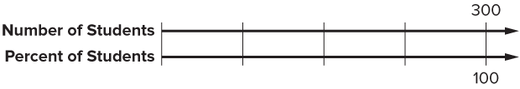
School Snacks
Let’s use a double number line to represent the relationship between the quantities.
How can you determine equivalent ratios to label the double number line?
ADD ON · Add on: “I agree because ______.” or “I see it differently because ______.”
Reveal:
We can multiply the number of students and percent of students by the same number to generate equivalent ratios.
26 / 44
Notes:
TEACH IN PRACTICE | Embedded facilitation | Lesson 4.4, slide 24 | REVEAL
Focus on the existing task: Let’s use a double number line to represent the relationship between the quantities. How can you determine equivalent ratios to label the double number line?
LAUNCH (T2/3/5): If an existing answer cover is present, gather an attempt before revealing. If the explanation is already visible, ask students to reconstruct and justify it. Compare reasoning and explain a revision; preserve the reveal sequence.
LOOK FOR (T4): Where this task addresses it, students can identify part, whole and percent. Ask which feature of their work supports the claim.
RESPOND: If this task shows the lesson misconception—using the part as the whole or confusing percent with a decimal multiplier—label the three quantities in the original problem before selecting an operation. Have the student revise and explain the change. Use this support only where the concept occurs in the current task; otherwise respond to the displayed question.
RECHECK: If a gap is shared, revisit the existing representation together. If it is limited, give targeted support while others compare valid methods on the same task. Check the revision before moving on.
PARTICIPATION (T5/6/7): Think time before volunteers; accept a written, drawn or rehearsed entry. Students ask for evidence respectfully. Recognize a specific contribution or revision and check that both partners participate.
Source: BCPS Updated Instructional Framework Rubric (June 2020), TEACH 1–7.

Slide 27
School Snacks
Let’s multiply the number of students and percent of students by the same number to generate equivalent ratios.
What do you notice about the calculations and the percentages?
ANOTHER PATHWAY · Did anyone get there a different way? Put both pathways side by side and compare.
Reveal:
To find an equivalent ratio with a term of 50%, we multiply each term by the decimal equivalent of 50%, 0.50.
27 / 44
Notes:
TEACH IN PRACTICE | Embedded facilitation | Lesson 4.4, slide 25 | REVEAL
Focus on the existing task: Reveal: To find an equivalent ratio with a term of 50%, we multiply each term by the decimal equivalent of 50%, 0.50. Let’s multiply…
LAUNCH (T2/3/5): If an existing answer cover is present, gather an attempt before revealing. If the explanation is already visible, ask students to reconstruct and justify it. Compare reasoning and explain a revision; preserve the reveal sequence.
LOOK FOR (T4): Where this task addresses it, students can identify part, whole and percent. Ask which feature of their work supports the claim.
RESPOND: If this task shows the lesson misconception—using the part as the whole or confusing percent with a decimal multiplier—label the three quantities in the original problem before selecting an operation. Have the student revise and explain the change. Use this support only where the concept occurs in the current task; otherwise respond to the displayed question.
RECHECK: If a gap is shared, revisit the existing representation together. If it is limited, give targeted support while others compare valid methods on the same task. Check the revision before moving on.
PARTICIPATION (T5/6/7): Think time before volunteers; accept a written, drawn or rehearsed entry. Students ask for evidence respectfully. Recognize a specific contribution or revision and check that both partners participate.
Source: BCPS Updated Instructional Framework Rubric (June 2020), TEACH 1–7.

Slide 28
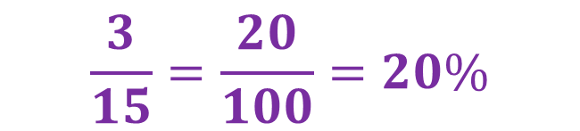
Be Curious
What do you notice?
What do you wonder?
Think first. Share a notice and a question;
build on a classmate’s idea.
Mindset
How are you using your strengths as a problem solver in math class?
28 / 44
Notes:
TEACH IN PRACTICE | Embedded facilitation | Lesson 4.4, slide 26 | CURIOUS
Focus on the existing task: What do you notice?
LAUNCH (T2/3/5): Allow quiet observation first. Separate a notice from an inference, invite students’ own questions, and follow the existing launch before teaching a procedure.
LOOK FOR (T4): Where this task addresses it, students can identify part, whole and percent. Ask which feature of their work supports the claim.
RESPOND: If this task shows the lesson misconception—using the part as the whole or confusing percent with a decimal multiplier—label the three quantities in the original problem before selecting an operation. Have the student revise and explain the change. Use this support only where the concept occurs in the current task; otherwise respond to the displayed question.
RECHECK: If a gap is shared, revisit the existing representation together. If it is limited, give targeted support while others compare valid methods on the same task. Check the revision before moving on.
PARTICIPATION (T5/6/7): Think time before volunteers; accept a written, drawn or rehearsed entry. Students ask for evidence respectfully. Recognize a specific contribution or revision and check that both partners participate.
Source: BCPS Updated Instructional Framework Rubric (June 2020), TEACH 1–7.

Slide 29
Session 2 Warm-Up
Lesson 4-4 · Find and Compare with Percentages
Session 2 Warm-Up
Quick review from Session 1 · about 4 minutes
1
What is 45% of 300?
2
Which equation finds p, the percent 18 is of 24?
A
45
A
p = 24 ÷ 18
B
135
B
18/24 = p/100
C
150
C
p = 18 × 24
D
180
D
p = 24 + 18
3
To find 15% of 80, calculate:
4
18 out of 24 simplified is 3/4, which equals:
A
0.15 × 80
A
34%
B
15 × 80
B
75%
C
80 ÷ 15
C
80%
D
0.015 × 80
D
60%
eduwonderlab.com · Neft Teacher
29 / 44
Notes:
TEACH IN PRACTICE | Embedded facilitation | Lesson 4.4, slide 27 | WARMUP
Focus on the existing task: Session 2 Warm-Up Session 2 Warm-Up Quick review from Session 1 · about 4 minutes 1 What is 45% of 300?
GATHER EVIDENCE (T4/6): Keep the original items. Students try independently, mark an uncertain item, and explain one method before checking. Use the existing key when present.
RESPOND: Distinguish a calculation slip from a reasoning gap. Give one next step on the same item; have students revise in a second color. Use the responses to choose flexible support for today’s lesson.
PARTICIPATION (T5/6/7): Think time before volunteers; accept a written, drawn or rehearsed entry. Students ask for evidence respectfully. Recognize a specific contribution or revision and check that both partners participate.
Source: BCPS Updated Instructional Framework Rubric (June 2020), TEACH 1–7. Earlier notes and answer keys are retained below.
EARLIER NOTES / EXISTING ANSWER KEY
Warm-up routine: students start silently on entry; keep it to about 4 minutes.
Circulate and note who is stuck — use what you see to choose who you check on first today.
Go over answers quickly; ask one student to explain a step, not just say the answer.
UIFR: TEACH 4 · TEACH 6.
UIFR FULL | Lesson-specific facilitation
TEACH 1 | Session 2 purpose and evidence (UIFR PDF p. 8).
Have students restate the displayed session goal in their own words and connect it to the existing context or a familiar experience they choose to share. Use the current session goal to select from these lesson-wide evidence criteria; do not frontload a later-session procedure.
Look for: identify part, whole and percent; use a matching model or equation; check reasonableness. Ask: “Which part of your work would show this?” Revisit that evidence after the task; a confidence rating alone is not evidence of understanding.

Slide 30
STUDENT MOVES
Lesson 4-4
Your move
YOU KNOW THE ROUTINE · Read → plan → solve → check. Do all four, in that order.
30 / 44

Slide 31
Review Notes
Lesson 4-4 · Find and Compare with Percentages
Review Notes — Session 2
Copy. Explain. Check.
CONNECT IT · What earlier lesson does this build on? Tell a partner in one sentence.
Percent of a Number
1
Multiply the decimal form of the percent by the whole: Part = Percent × Whole.
Ratio Equation
2
Set up proportions: (Part / Whole) = (Percent / 100) to find missing values.
Double Number Line
3
Verify results visually by scaling equivalent ratios along a dual number line.
eduwonderlab.com · Neft Teacher
31 / 44
Notes:
TEACH IN PRACTICE | Embedded facilitation | Lesson 4.4, slide 28 | NOTES
Focus on the existing task: Review Notes Review Notes — Session 2 Copy into your…
ROUTINE (T1/2/4): Read or copy the original notes, cover one line, and explain it using the displayed example. Reopen and correct. Copying alone is not evidence of understanding.
LOOK FOR: A link between a symbol, quantity or feature and the explanation. If missing, point back to that feature and have the student try again; fade the prompt once they can explain.
PARTICIPATION (T5/6/7): Think time before volunteers; accept a written, drawn or rehearsed entry. Students ask for evidence respectfully. Recognize a specific contribution or revision and check that both partners participate.
Source: BCPS Updated Instructional Framework Rubric (June 2020), TEACH 1–7. Earlier notes and answer keys are retained below.
EARLIER NOTES / EXISTING ANSWER KEY
Copy routine: read one line at a time; students copy, then explain that line to a partner.
Keep it brisk — the understanding work happens in the examples, not the copying.
UIFR: TEACH 1 · TEACH 6.

Slide 32
Session 2
Find and Compare with Percentages
SELF-CHECK · Mark it: ✓ got it · ~ almost · ? stuck. Then fix one thing before we move on.
32 / 44
Notes:
TEACH IN PRACTICE | Embedded facilitation | Lesson 4.4, slide 29 | DIVIDER
Focus on the existing task: Find and Compare with Percentages Session 2
TRANSITION (T6/7): Students confirm materials, roles, how to request help, and the next response routine. Ask a student to restate it. Keep teacher-only slides hidden.
PARTICIPATION (T5/6/7): Think time before volunteers; accept a written, drawn or rehearsed entry. Students ask for evidence respectfully. Recognize a specific contribution or revision and check that both partners participate.
Source: BCPS Updated Instructional Framework Rubric (June 2020), TEACH 1–7. Earlier notes and answer keys are retained below.
EARLIER NOTES / EXISTING ANSWER KEY
Transition cue: state what materials are out and what success looks like this session.
Keep the changeover under a minute.
UIFR: TEACH 6.

Slide 33
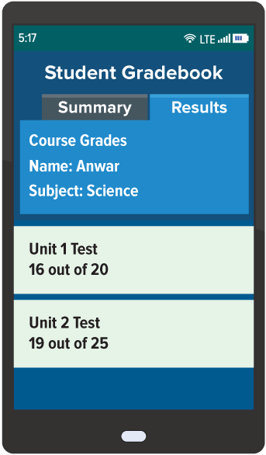
Test Scores
On two recent science tests, Anwar earned the scores shown.
On which test did Anwar earn a higher score?
Making Connections
STRUGGLE FIRST · Work on your own first. Stuck is allowed — try a second strategy before you ask.
33 / 44
Notes:
TEACH IN PRACTICE | Embedded facilitation | Lesson 4.4, slide 30 | TASK
Focus on the existing task: On two recent science tests, Anwar earned the scores shown. On which test did Anwar earn a higher score?
LAUNCH (T2/3/5): Use the displayed question. Give private thinking time; then A explains while B asks for evidence. Switch roles. Each student records their own reasoning.
LOOK FOR (T4): Where this task addresses it, students can identify part, whole and percent. Ask which feature of their work supports the claim.
RESPOND: If this task shows the lesson misconception—using the part as the whole or confusing percent with a decimal multiplier—label the three quantities in the original problem before selecting an operation. Have the student revise and explain the change. Use this support only where the concept occurs in the current task; otherwise respond to the displayed question.
RECHECK: If a gap is shared, revisit the existing representation together. If it is limited, give targeted support while others compare valid methods on the same task. Check the revision before moving on.
PARTICIPATION (T5/6/7): Think time before volunteers; accept a written, drawn or rehearsed entry. Students ask for evidence respectfully. Recognize a specific contribution or revision and check that both partners participate.
Source: BCPS Updated Instructional Framework Rubric (June 2020), TEACH 1–7. Earlier notes and answer keys are retained below.
EARLIER NOTES / EXISTING ANSWER KEY
Read Anwar’s two test scores and ask what makes comparing them tricky as given. Listen for students noticing the scores are not in the same form. Ask for a prediction of which score is better before any conversion.
UIFR FULL | Lesson-specific facilitation
TEACH 2-3 | Session 2 task launch (UIFR PDF pp. 9-10).
Use the problem exactly as displayed. Give individual thinking time before discussion or advancing to the explanation. If the answer is already visible, ask students to reconstruct and justify it. Invite a choice of suitable representations and have students explain why their choice helps.
At the point where this concept appears, ask: “Which quantity is the whole, and how does your equation or model represent the requested unknown?” Wait for evidence, invite another pathway, and have a student ask a follow-up question. Do not replace students’ reasoning with a sequence of leading steps.

Slide 34
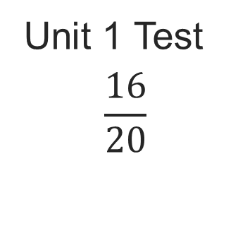
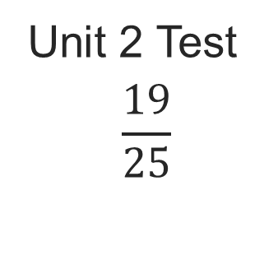
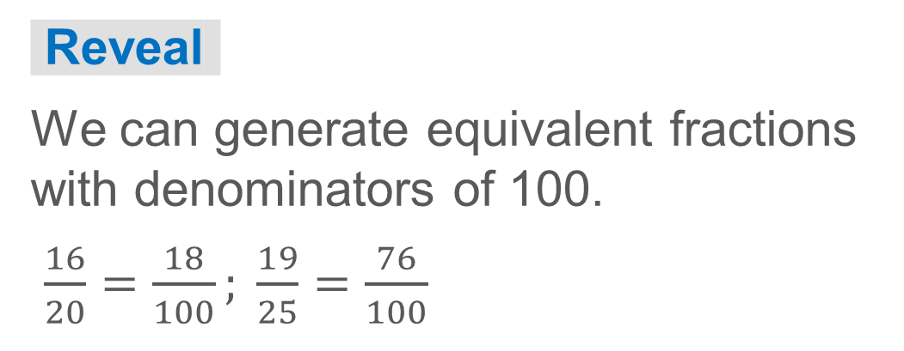
COLLABORATE · TALK IT THROUGH • AGREE ON A MODEL
Student-led talk: assign roles and monitor group progress.
Collaborate and Connect
We can write each test score as a part-to-whole ratio.
Think first. A explains; B asks for evidence.
Switch roles; both revise.
How can you convert the test scores to percentages?
34 / 44
Notes:
TEACH IN PRACTICE | Embedded facilitation | Lesson 4.4, slide 31 | COLLABORATE
Focus on the existing task: How can you convert the test scores to percentages?
LAUNCH (T2/3/5): Use the displayed question. Give private thinking time; then A explains while B asks for evidence. Switch roles. Each student records their own reasoning.
LOOK FOR (T4): Where this task addresses it, students can identify part, whole and percent. Ask which feature of their work supports the claim.
RESPOND: If this task shows the lesson misconception—using the part as the whole or confusing percent with a decimal multiplier—label the three quantities in the original problem before selecting an operation. Have the student revise and explain the change. Use this support only where the concept occurs in the current task; otherwise respond to the displayed question.
RECHECK: If a gap is shared, revisit the existing representation together. If it is limited, give targeted support while others compare valid methods on the same task. Check the revision before moving on.
PARTICIPATION (T5/6/7): Think time before volunteers; accept a written, drawn or rehearsed entry. Students ask for evidence respectfully. Recognize a specific contribution or revision and check that both partners participate.
Source: BCPS Updated Instructional Framework Rubric (June 2020), TEACH 1–7. Earlier notes and answer keys are retained below.
EARLIER NOTES / EXISTING ANSWER KEY
UIFR TEACH — Level 4 student move: Student-led talk: assign roles and monitor group progress.
Student move: Student-led talk: assign roles and monitor group progress.
Routine: COLLABORATE · TALK IT THROUGH • AGREE ON A MODEL
UIFR FULL | Lesson-specific facilitation
TEACH 4-5 | Session 2 discussion and checkpoint (UIFR PDF pp. 11-12).
Collect a brief response from every student to the existing prompt before hearing volunteers. Partners take turns explaining and asking for evidence: “I understand ___; what supports ___?” Offer rehearsal or an annotated model for students who need language support. Each student records their own reasoning.
Look specifically for: using the part as the whole or confusing percent with a decimal multiplier. If it appears, label the three quantities in the original problem before selecting an operation; then ask the student to revise the same response and explain the change. If evidence is secure, have students compare a second valid pathway or state why their approach works. Choose the next step from the responses, not a preset pace.

Slide 35


Test Scores
We can generate equivalent fractions with denominators of 100 to convert to percentages.
Unit 1 Test
Unit 2 Test
Record your reasoning before the reveal.
Compare, then explain any revision.
How can you compare the test scores?
Reveal:
We can compare the numerators or write the scores as percentages.
35 / 44
Notes:
TEACH IN PRACTICE | Embedded facilitation | Lesson 4.4, slide 32 | REVEAL
Focus on the existing task: How can you compare the test scores?
LAUNCH (T2/3/5): If an existing answer cover is present, gather an attempt before revealing. If the explanation is already visible, ask students to reconstruct and justify it. Compare reasoning and explain a revision; preserve the reveal sequence.
LOOK FOR (T4): Where this task addresses it, students can identify part, whole and percent. Ask which feature of their work supports the claim.
RESPOND: If this task shows the lesson misconception—using the part as the whole or confusing percent with a decimal multiplier—label the three quantities in the original problem before selecting an operation. Have the student revise and explain the change. Use this support only where the concept occurs in the current task; otherwise respond to the displayed question.
RECHECK: If a gap is shared, revisit the existing representation together. If it is limited, give targeted support while others compare valid methods on the same task. Check the revision before moving on.
PARTICIPATION (T5/6/7): Think time before volunteers; accept a written, drawn or rehearsed entry. Students ask for evidence respectfully. Recognize a specific contribution or revision and check that both partners participate.
Source: BCPS Updated Instructional Framework Rubric (June 2020), TEACH 1–7. Earlier notes and answer keys are retained below.
EARLIER NOTES / EXISTING ANSWER KEY
Ask why denominators of 100 make the comparison fair. Listen for equivalent-fraction reasoning, both numerator and denominator scaled together. Watch for students scaling only the denominator; press with what happened to the top number.

Slide 36
Test Scores
On two recent science tests, Anwar earned the scores shown.
On which test did Anwar earn a higher score?
Anwar scored an 80% on the unit 1 test
and 76% on the unit 2 test.
Anwar earned a higher score on the
unit 1 test.
36 / 44
Notes:
TEACH IN PRACTICE | Embedded facilitation | Lesson 4.4, slide 33 | TASK
Focus on the existing task: On two recent science tests, Anwar earned the scores shown. On which test did Anwar earn a higher score?
LAUNCH (T2/3/5): Use the displayed question. Give private thinking time; then A explains while B asks for evidence. Switch roles. Each student records their own reasoning.
LOOK FOR (T4): Where this task addresses it, students can identify part, whole and percent. Ask which feature of their work supports the claim.
RESPOND: If this task shows the lesson misconception—using the part as the whole or confusing percent with a decimal multiplier—label the three quantities in the original problem before selecting an operation. Have the student revise and explain the change. Use this support only where the concept occurs in the current task; otherwise respond to the displayed question.
RECHECK: If a gap is shared, revisit the existing representation together. If it is limited, give targeted support while others compare valid methods on the same task. Check the revision before moving on.
PARTICIPATION (T5/6/7): Think time before volunteers; accept a written, drawn or rehearsed entry. Students ask for evidence respectfully. Recognize a specific contribution or revision and check that both partners participate.
Source: BCPS Updated Instructional Framework Rubric (June 2020), TEACH 1–7. Earlier notes and answer keys are retained below.
EARLIER NOTES / EXISTING ANSWER KEY
Wrap the comparison: 80 percent versus 76 percent. Ask students to state the conclusion in a full sentence about the tests, not just the numbers. Listen for the claim tied back to the original scores. Ask what the percent form made visible that the raw scores hid.

Slide 37
STUDENT MOVES
Lesson 4-4
Your move
TAKE TURNS · One explains, one asks a question. Then switch, so both of you talk.
37 / 44

Slide 38
Compare pathways with a partner; name one revision.
Let’s Explore More
Anwar answered 47 out of 50 questions correctly on the unit 3 test. Is this score better than his scores on the previous two tests? Explain.
How does finding the percent of a quantity help you compare two or more amounts?
Try it yourself. Compare your work with a partner; explain
one choice and revise.
38 / 44
Notes:
TEACH IN PRACTICE | Embedded facilitation | Lesson 4.4, slide 34 | PRACTICE
Focus on the existing task: Anwar answered 47 out of 50 questions correctly on the unit 3 test. Is this score better than his scores on the previous two tests?
LAUNCH (T2/3/5): Use the displayed question. Give private thinking time; then A explains while B asks for evidence. Switch roles. Each student records their own reasoning.
LOOK FOR (T4): Where this task addresses it, students can identify part, whole and percent. Ask which feature of their work supports the claim.
RESPOND: If this task shows the lesson misconception—using the part as the whole or confusing percent with a decimal multiplier—label the three quantities in the original problem before selecting an operation. Have the student revise and explain the change. Use this support only where the concept occurs in the current task; otherwise respond to the displayed question.
RECHECK: If a gap is shared, revisit the existing representation together. If it is limited, give targeted support while others compare valid methods on the same task. Check the revision before moving on.
PARTICIPATION (T5/6/7): Think time before volunteers; accept a written, drawn or rehearsed entry. Students ask for evidence respectfully. Recognize a specific contribution or revision and check that both partners participate.
Source: BCPS Updated Instructional Framework Rubric (June 2020), TEACH 1–7. Earlier notes and answer keys are retained below.
EARLIER NOTES / EXISTING ANSWER KEY
UIFR TEACH — Level 4 student move: Compare pathways with a partner; name one revision.
Student move: Compare pathways with a partner; name one revision.

Slide 39
LESSON 4.4 / CHECK YOUR WORK
Pause. Check. Improve.
CHECK
A mistake to watch for: using the part as the whole or confusing percent with a decimal multiplier.
TRY
Label the three quantities in the given problem before selecting an operation.
REVISE
Use that check on the task you just completed. Correct or strengthen one part, and explain why.
REVISE NOW · Change one answer and write why you changed it. A revision is evidence of learning.
Listen to understand. Ask for evidence. Make room for every voice.
Notes:
TEACH IN PRACTICE | Embedded facilitation | Lesson 4.4, slide 35 | PRIOR_INSERT
Focus on the existing task: LESSON 4.4 / CHECK YOUR WORK Pause. Check. Improve. Listen to understand. Ask for evidence. Make room for every voice. CHECK A mistake…
CONNECT (T1/4): Ask students to restate the displayed goal or key idea and connect it to earlier work. Relevant lesson evidence: identify part, whole and percent; use a matching model or equation; check reasonableness. Use only the criterion that matches the current session.
SHOW PROGRESS: Students point to their own existing work, explain what improved after feedback, and name a next step. Pair confidence ratings with actual evidence.
PARTICIPATION (T5/6/7): Think time before volunteers; accept a written, drawn or rehearsed entry. Students ask for evidence respectfully. Recognize a specific contribution or revision and check that both partners participate.
Source: BCPS Updated Instructional Framework Rubric (June 2020), TEACH 1–7.

Slide 40
Test Scores
On two recent science tests, Anwar earned the scores shown. On which test did Anwar earn a higher score?
How can you represent the relationship between the number of points earned and the number of points possible?
ASK THE CLASS · Write one question about this that you could ask the class.
Reveal:
We can write each test score as a part-to-whole ratio.
40 / 44
Notes:
TEACH IN PRACTICE | Embedded facilitation | Lesson 4.4, slide 36 | REVEAL
Focus on the existing task: On two recent science tests, Anwar earned the scores shown. On which test did Anwar earn a higher score?
LAUNCH (T2/3/5): If an existing answer cover is present, gather an attempt before revealing. If the explanation is already visible, ask students to reconstruct and justify it. Compare reasoning and explain a revision; preserve the reveal sequence.
LOOK FOR (T4): Where this task addresses it, students can identify part, whole and percent. Ask which feature of their work supports the claim.
RESPOND: If this task shows the lesson misconception—using the part as the whole or confusing percent with a decimal multiplier—label the three quantities in the original problem before selecting an operation. Have the student revise and explain the change. Use this support only where the concept occurs in the current task; otherwise respond to the displayed question.
RECHECK: If a gap is shared, revisit the existing representation together. If it is limited, give targeted support while others compare valid methods on the same task. Check the revision before moving on.
PARTICIPATION (T5/6/7): Think time before volunteers; accept a written, drawn or rehearsed entry. Students ask for evidence respectfully. Recognize a specific contribution or revision and check that both partners participate.
Source: BCPS Updated Instructional Framework Rubric (June 2020), TEACH 1–7.

Slide 41
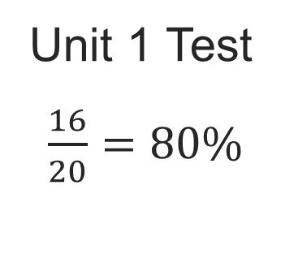
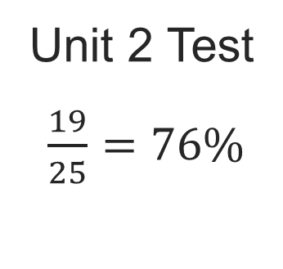
Test Scores
Let’s write the scores as percentages.
Compare your reasoning with the
explanation. Explain any revision you make.
Which score is higher?
Reveal:
Unit 1 Test
41 / 44
Notes:
TEACH IN PRACTICE | Embedded facilitation | Lesson 4.4, slide 37 | REVEAL
Focus on the existing task: Which score is higher?
LAUNCH (T2/3/5): If an existing answer cover is present, gather an attempt before revealing. If the explanation is already visible, ask students to reconstruct and justify it. Compare reasoning and explain a revision; preserve the reveal sequence.
LOOK FOR (T4): Where this task addresses it, students can identify part, whole and percent. Ask which feature of their work supports the claim.
RESPOND: If this task shows the lesson misconception—using the part as the whole or confusing percent with a decimal multiplier—label the three quantities in the original problem before selecting an operation. Have the student revise and explain the change. Use this support only where the concept occurs in the current task; otherwise respond to the displayed question.
RECHECK: If a gap is shared, revisit the existing representation together. If it is limited, give targeted support while others compare valid methods on the same task. Check the revision before moving on.
PARTICIPATION (T5/6/7): Think time before volunteers; accept a written, drawn or rehearsed entry. Students ask for evidence respectfully. Recognize a specific contribution or revision and check that both partners participate.
Source: BCPS Updated Instructional Framework Rubric (June 2020), TEACH 1–7.

Slide 42
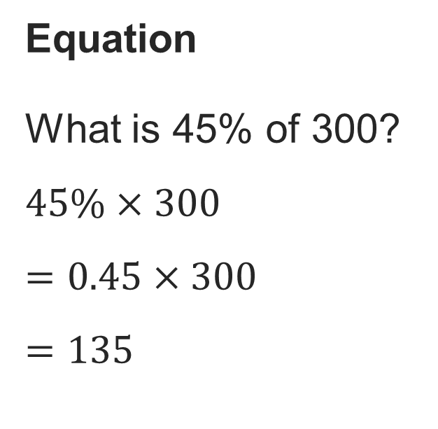
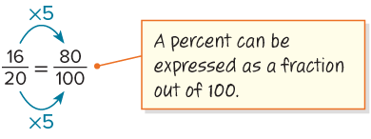
SUMMARIZE · SAY IT IN YOUR OWN WORDS
Summarize: Determine the Percent of a Number
You can use equations and ratio reasoning to determine the percent of a number.
Ratio Reasoning
What percent of 20 is 16?
16 is 80% of 20.
42 / 44
Notes:
TEACH IN PRACTICE | Embedded facilitation | Lesson 4.4, slide 38 | SUMMARIZE
Focus on the existing task: You can use equations and ratio reasoning to determine the percent of a number. Summarize: Determine the Percent of a Number Ratio Reasoning What percent of 20 is 16?
CONNECT (T1/4): Ask students to restate the displayed goal or key idea and connect it to earlier work. Relevant lesson evidence: identify part, whole and percent; use a matching model or equation; check reasonableness. Use only the criterion that matches the current session.
SHOW PROGRESS: Students point to their own existing work, explain what improved after feedback, and name a next step. Pair confidence ratings with actual evidence.
PARTICIPATION (T5/6/7): Think time before volunteers; accept a written, drawn or rehearsed entry. Students ask for evidence respectfully. Recognize a specific contribution or revision and check that both partners participate.
Source: BCPS Updated Instructional Framework Rubric (June 2020), TEACH 1–7. Earlier notes and answer keys are retained below.
EARLIER NOTES / EXISTING ANSWER KEY
Routine: SUMMARIZE · SAY IT IN YOUR OWN WORDS

Slide 43
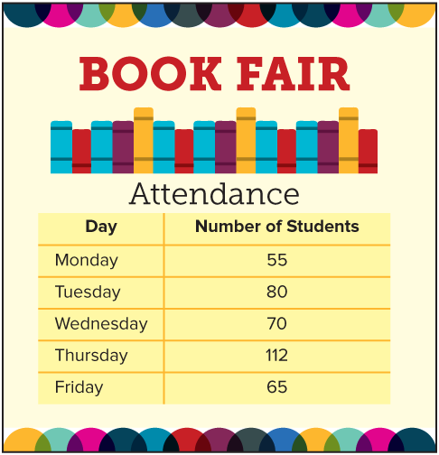
APPLY · PLAN IT • SOLVE IT • PROVE IT
Defend your method; partner gives one specific next step.
Apply: Book Fair​
Students were asked which night of the book fair they planned to attend. The results of the survey are shown. Twenty percent of the students who planned to attend on Wednesday attended on Thursday instead. Twenty-five percent of the students who planned to attend on Thursday attended on Friday instead.
Question: Which day, Thursday or Friday, had a greater actual attendance? How many more students attended that day?
43 / 44
Notes:
TEACH IN PRACTICE | Embedded facilitation | Lesson 4.4, slide 39 | APPLY
Focus on the existing task: How many more students attended that day?
LAUNCH (T2/3/5): Use the exact application task independently first. Ask students to justify their choice of method. Collect evidence before a partner discussion or correction.
LOOK FOR (T4): Where this task addresses it, students can identify part, whole and percent. Ask which feature of their work supports the claim.
RESPOND: If this task shows the lesson misconception—using the part as the whole or confusing percent with a decimal multiplier—label the three quantities in the original problem before selecting an operation. Have the student revise and explain the change. Use this support only where the concept occurs in the current task; otherwise respond to the displayed question.
RECHECK: If a gap is shared, revisit the existing representation together. If it is limited, give targeted support while others compare valid methods on the same task. Check the revision before moving on.
PARTICIPATION (T5/6/7): Think time before volunteers; accept a written, drawn or rehearsed entry. Students ask for evidence respectfully. Recognize a specific contribution or revision and check that both partners participate.
Source: BCPS Updated Instructional Framework Rubric (June 2020), TEACH 1–7. Earlier notes and answer keys are retained below.
EARLIER NOTES / EXISTING ANSWER KEY
UIFR TEACH — Level 4 student move: Defend your method; partner gives one specific next step.
Student move: Defend your method; partner gives one specific next step.
Routine: APPLY · PLAN IT • SOLVE IT • PROVE IT
UIFR FULL | Lesson-specific facilitation
TEACH 4 | Independent evidence and revision (UIFR PDF p. 11).
Use the existing application/exit problem as the independent check. If this is a learning-target slide, have students point to and explain their work on the preceding task. Separate initial independent evidence from the revision after feedback.
Check the relevant criteria: identify part, whole and percent; use a matching model or equation; check reasonableness. Respond with one specific next step tied to the work. Students revise and annotate what changed, then identify a criterion they can now demonstrate and one they still need to practice.
REFLECT & ADJUST 1-2 | After the lesson (UIFR PDF pp. 15-16).
Sort the existing work by demonstrated reasoning, partial understanding, and the specific misconception: using the part as the whole or confusing percent with a decimal multiplier. Compare the initial response with the revision. Record which teaching move plausibly helped, which did not, and whose participation or access needs a different approach; do not record sensitive student details in this shared deck.
Plan the next lesson from that evidence: if the misconception persists, label the three quantities in the original problem before selecting an operation using the current example before returning to the next grade-level task; if understanding is secure, use an existing extension or ask for a general explanation. Check the targeted idea again at the next warm-up.
Ask students what supported their thinking and what would help next time. Identify one change to try and one successful practice to retain. Seek colleague feedback on anonymized work when useful; these prompts support reflection and do not establish an evaluation rating. Source: Baltimore City Public Schools, Updated Instructional Framework Rubric, June 2020 (UIFR_Full.pdf).

Slide 44
LESSON 4.4 / REFLECT ON YOUR LEARNING
Show your progress
1 SHOW EVIDENCE
2 CHOOSE A NEXT STEP
Choose one response. Point to the part that shows your reasoning.
Name a change you made after feedback—or a question you still have.
“My work shows ___ because ___.”
“Next time, I will ___ to help me ___.”
Today’s focus: Identify part, whole and percent.
CREDIT A CLASSMATE · Name one classmate whose idea helped you today, and say what they said.
Listen to understand. Ask for evidence. Make room for every voice.
Notes:
TEACH IN PRACTICE | Embedded facilitation | Lesson 4.4, slide 40 | PRIOR_INSERT
Focus on the existing task: LESSON 4.4 / REFLECT ON YOUR LEARNING Show your progress Listen to understand. Ask for evidence. Make room for every voice. 1 SHOW…
CONNECT (T1/4): Ask students to restate the displayed goal or key idea and connect it to earlier work. Relevant lesson evidence: identify part, whole and percent; use a matching model or equation; check reasonableness. Use only the criterion that matches the current session.
SHOW PROGRESS: Students point to their own existing work, explain what improved after feedback, and name a next step. Pair confidence ratings with actual evidence.
PARTICIPATION (T5/6/7): Think time before volunteers; accept a written, drawn or rehearsed entry. Students ask for evidence respectfully. Recognize a specific contribution or revision and check that both partners participate.
Source: BCPS Updated Instructional Framework Rubric (June 2020), TEACH 1–7.

