Slide 1
WARM-UP · THINK • TRY • CHECK
Turn and talk: compare strategies, then defend one.
Warm-Up
Lesson 4-5 · Determine the Whole Given the Part and Percent | Warm-Up · about 4 minutes
Try each on your own. Mark an unsure answer; explain and revise when we check.
QUESTION 1
QUESTION 2
12 ÷ 0.25 = ______
8 is 40% of 20. Which number is the whole? ______
QUESTION 3
QUESTION 4
6 ÷ 1/2 = ______
Check it: 25% of 48 = ______
TALK IT OVER: “I got ______ because ______.” • Compare with a partner before we check as a class.
1 / 44
Notes:
TEACH IN PRACTICE | Embedded facilitation | Lesson 4.5, slide 1 | WARMUP
Focus on the existing task: Warm-Up WARM-UP · THINK • TRY • CHECK Do…
GATHER EVIDENCE (T4/6): Keep the original items. Students try independently, mark an uncertain item, and explain one method before checking. Use the existing key when present.
RESPOND: Distinguish a calculation slip from a reasoning gap. Give one next step on the same item; have students revise in a second color. Use the responses to choose flexible support for today’s lesson.
PARTICIPATION (T5/6/7): Think time before volunteers; accept a written, drawn or rehearsed entry. Students ask for evidence respectfully. Recognize a specific contribution or revision and check that both partners participate.
Source: BCPS Updated Instructional Framework Rubric (June 2020), TEACH 1–7. Earlier notes and answer keys are retained below.
EARLIER NOTES / EXISTING ANSWER KEY
Warm-Up answers (teacher only): 1) 48 2) 20 3) 12 4) 12
UIFR FULL | Lesson-specific facilitation
PREPARE 1-2 | Before teaching (UIFR PDF pp. 6-7).
Plan to gather evidence that students can identify the known part and percent; recover the whole; verify by taking the stated percent. Review recent work and today’s warm-up to choose flexible groups and access supports; do not infer needs from identity or perceived ability. Use the existing lesson tasks and stated standards.
Anticipate: multiplying the part by the percent when solving for the whole. If observed, label the known part and the 100-percent position on the existing model. Offer oral rehearsal, drawing, pointing, or home-language processing as needed; retain the original mathematical demand. Ask students which support helps and fade it as evidence improves.
TEACH 6-7 | Before the first transition, agree on materials, partner roles, and how to request help. Invite students to restate the routine. Normalize revising an idea, recognize a specific contribution, and check privately when frustration blocks participation. Source: UIFR PDF pp. 13-14.

Slide 2
Partner talk: connect today’s idea to prior learning.
Today’s Math Notes
Lesson 4-5 · Determine the Whole Given the Part and Percent
Section 2: Today’s Math
Copy. Explain. Check.
Finding the Whole Given Part & Percent
Whole = Part ÷ Percent
Read, cover, explain. Reopen your notes to
check and improve your explanation.
1
Identify the given part and the percentage it represents
2
Convert the percent to a decimal or fraction
3
Divide the part by the percent decimal to find the total whole (100%)
eduwonderlab.com · Neft Teacher
2 / 44
Notes:
TEACH IN PRACTICE | Embedded facilitation | Lesson 4.5, slide 2 | NOTES
Focus on the existing task: Today’s Math Notes Section 2: Today’s Math…
ROUTINE (T1/2/4): Read or copy the original notes, cover one line, and explain it using the displayed example. Reopen and correct. Copying alone is not evidence of understanding.
LOOK FOR: A link between a symbol, quantity or feature and the explanation. If missing, point back to that feature and have the student try again; fade the prompt once they can explain.
PARTICIPATION (T5/6/7): Think time before volunteers; accept a written, drawn or rehearsed entry. Students ask for evidence respectfully. Recognize a specific contribution or revision and check that both partners participate.
Source: BCPS Updated Instructional Framework Rubric (June 2020), TEACH 1–7. Earlier notes and answer keys are retained below.
EARLIER NOTES / EXISTING ANSWER KEY
UIFR TEACH — Level 4 student move: Partner talk: connect today’s idea to prior learning.
Student move: Partner talk: connect today’s idea to prior learning.

Slide 3
Tell a partner the goal and why it matters.
Today’s Objectives
Lesson 4-5 · Determine the Whole Given the Part and Percent
Determine the Whole Given the Part and Percent
Maryland Standard 6.AT.4
CONTENT OBJECTIVE
LANGUAGE OBJECTIVE
Restate the goal in your words
Use these words to explain why
I can determine the whole when I know a part and the percent that part represents.
I can explain how I found the whole using the words part, whole, percent, and equation.
eduwonderlab.com · Neft Teacher
3 / 44
Notes:
TEACH IN PRACTICE | Embedded facilitation | Lesson 4.5, slide 3 | GOAL
Focus on the existing task: Today’s Objectives Determine the Whole Given…
CONNECT (T1/4): Ask students to restate the displayed goal or key idea and connect it to earlier work. Relevant lesson evidence: identify the known part and percent; recover the whole; verify by taking the stated percent. Use only the criterion that matches the current session.
SHOW PROGRESS: Students point to their own existing work, explain what improved after feedback, and name a next step. Pair confidence ratings with actual evidence.
PARTICIPATION (T5/6/7): Think time before volunteers; accept a written, drawn or rehearsed entry. Students ask for evidence respectfully. Recognize a specific contribution or revision and check that both partners participate.
Source: BCPS Updated Instructional Framework Rubric (June 2020), TEACH 1–7. Earlier notes and answer keys are retained below.
EARLIER NOTES / EXISTING ANSWER KEY
UIFR TEACH — Level 4 student move: Tell a partner the goal and why it matters.
Student move: Tell a partner the goal and why it matters.
UIFR FULL | Lesson-specific facilitation
TEACH 1 | Session 1 purpose and evidence (UIFR PDF p. 8).
Have students restate the displayed session goal in their own words and connect it to the existing context or a familiar experience they choose to share. Use the current session goal to select from these lesson-wide evidence criteria; do not frontload a later-session procedure.
Look for: identify the known part and percent; recover the whole; verify by taking the stated percent. Ask: “Which part of your work would show this?” Revisit that evidence after the task; a confidence rating alone is not evidence of understanding.

Slide 4
LESSON 4.5 / OUR LEARNING
What will show your learning?
1
Identify the known part and percent.
2
Recover the whole.
3
Verify by taking the stated percent.
Tell a partner: Which skill connects to something you already know?
SAY THE GOAL · Say today’s goal in your own words, then name one place this shows up outside math class.
Listen to understand. Ask for evidence. Make room for every voice.
Notes:
TEACH IN PRACTICE | Embedded facilitation | Lesson 4.5, slide 4 | PRIOR_INSERT
Focus on the existing task: LESSON 4.5 / OUR LEARNING What will show your learning?
CONNECT (T1/4): Ask students to restate the displayed goal or key idea and connect it to earlier work. Relevant lesson evidence: identify the known part and percent; recover the whole; verify by taking the stated percent. Use only the criterion that matches the current session.
SHOW PROGRESS: Students point to their own existing work, explain what improved after feedback, and name a next step. Pair confidence ratings with actual evidence.
PARTICIPATION (T5/6/7): Think time before volunteers; accept a written, drawn or rehearsed entry. Students ask for evidence respectfully. Recognize a specific contribution or revision and check that both partners participate.
Source: BCPS Updated Instructional Framework Rubric (June 2020), TEACH 1–7.

Slide 5
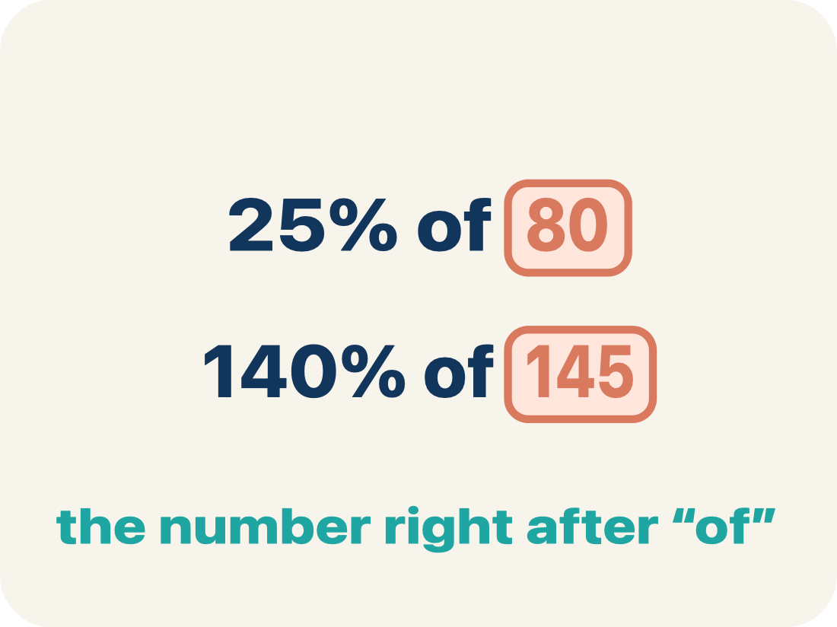
Vocabulary 1 of 6
Lesson 4-5 · Determine the Whole Given the Part and Percent
Determine the Whole Given the Part and Percent
Working backwards from a part and its percent to find the whole amount it came from.
EXAMPLE · EXPLAIN WHY IT FITS
$42 is 60% of what? → $70
USE THE MATH WORDS · Use today’s math words in your explanation — not “it” and “that thing.”
eduwonderlab.com · Neft Teacher
5 / 44
Notes:
TEACH IN PRACTICE | Embedded facilitation | Lesson 4.5, slide 5 | VOCAB
Focus on the existing task: Vocabulary 1 of 6 Determine the Whole Given…
ASK (T1/3/5): Where does “Determine the Whole Given the Part and Percent” appear in the example? Explain the meaning without reading the definition. Partner: restate the idea and ask a clarifying question.
LOOK FOR: A correct connection between the word and a feature of the example. If the student only repeats the definition, invite pointing, sketching or oral rehearsal, then ask for another explanation of this same example.
PARTICIPATION (T5/6/7): Think time before volunteers; accept a written, drawn or rehearsed entry. Students ask for evidence respectfully. Recognize a specific contribution or revision and check that both partners participate.
Source: BCPS Updated Instructional Framework Rubric (June 2020), TEACH 1–7.

Slide 6
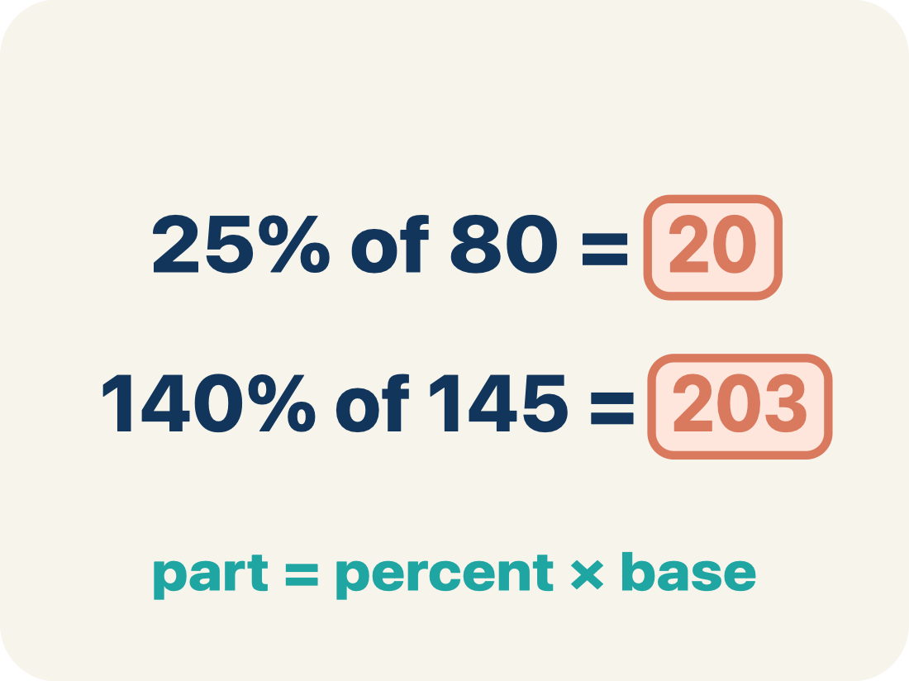
Vocabulary 2 of 6
Lesson 4-5 · Determine the Whole Given the Part and Percent
Part
The amount you already know — the piece of the whole that the percent describes.
EXAMPLE · EXPLAIN WHY IT FITS
The $42 sale price is the part
Use “Part” to explain the example. Point to evidence.
eduwonderlab.com · Neft Teacher
6 / 44
Notes:
TEACH IN PRACTICE | Embedded facilitation | Lesson 4.5, slide 6 | VOCAB
Focus on the existing task: Vocabulary 2 of 6 Part The amount you…
ASK (T1/3/5): Where does “Part” appear in the example? Explain the meaning without reading the definition. Partner: restate the idea and ask a clarifying question.
LOOK FOR: A correct connection between the word and a feature of the example. If the student only repeats the definition, invite pointing, sketching or oral rehearsal, then ask for another explanation of this same example.
PARTICIPATION (T5/6/7): Think time before volunteers; accept a written, drawn or rehearsed entry. Students ask for evidence respectfully. Recognize a specific contribution or revision and check that both partners participate.
Source: BCPS Updated Instructional Framework Rubric (June 2020), TEACH 1–7.

Slide 7
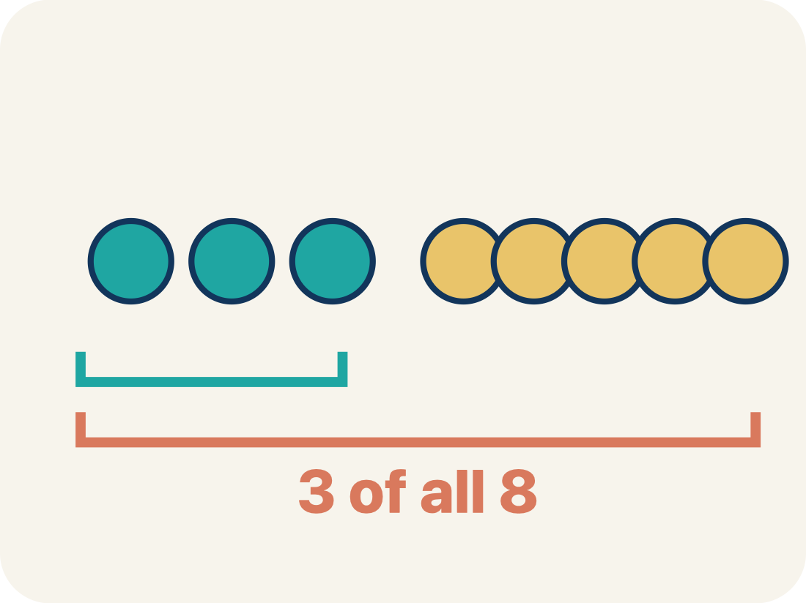
Vocabulary 3 of 6
Lesson 4-5 · Determine the Whole Given the Part and Percent
Whole
The full amount the percent is measured against. The whole is always 100%.
EXAMPLE · EXPLAIN WHY IT FITS
The original price is the whole = 100%
Use “Whole” to explain the example. Point to evidence.
eduwonderlab.com · Neft Teacher
7 / 44
Notes:
TEACH IN PRACTICE | Embedded facilitation | Lesson 4.5, slide 7 | VOCAB
Focus on the existing task: Vocabulary 3 of 6 Whole The full amount the…
ASK (T1/3/5): Where does “Whole” appear in the example? Explain the meaning without reading the definition. Partner: restate the idea and ask a clarifying question.
LOOK FOR: A correct connection between the word and a feature of the example. If the student only repeats the definition, invite pointing, sketching or oral rehearsal, then ask for another explanation of this same example.
PARTICIPATION (T5/6/7): Think time before volunteers; accept a written, drawn or rehearsed entry. Students ask for evidence respectfully. Recognize a specific contribution or revision and check that both partners participate.
Source: BCPS Updated Instructional Framework Rubric (June 2020), TEACH 1–7.

Slide 8

Vocabulary 4 of 6
Lesson 4-5 · Determine the Whole Given the Part and Percent
Double number line
Two lines lined up — dollars on one, percents on the other — so matching marks show the same amount two ways.
EXAMPLE · EXPLAIN WHY IT FITS
$0, $7, $42, $70 above 0%, 10%, 60%, 100%
ADD ON · Add on: “I agree because ______.” or “I see it differently because ______.”
eduwonderlab.com · Neft Teacher
8 / 44
Notes:
TEACH IN PRACTICE | Embedded facilitation | Lesson 4.5, slide 8 | VOCAB
Focus on the existing task: Vocabulary 4 of 6 Double number line Two…
ASK (T1/3/5): Where does “Double number line” appear in the example? Explain the meaning without reading the definition. Partner: restate the idea and ask a clarifying question.
LOOK FOR: A correct connection between the word and a feature of the example. If the student only repeats the definition, invite pointing, sketching or oral rehearsal, then ask for another explanation of this same example.
PARTICIPATION (T5/6/7): Think time before volunteers; accept a written, drawn or rehearsed entry. Students ask for evidence respectfully. Recognize a specific contribution or revision and check that both partners participate.
Source: BCPS Updated Instructional Framework Rubric (June 2020), TEACH 1–7.

Slide 9
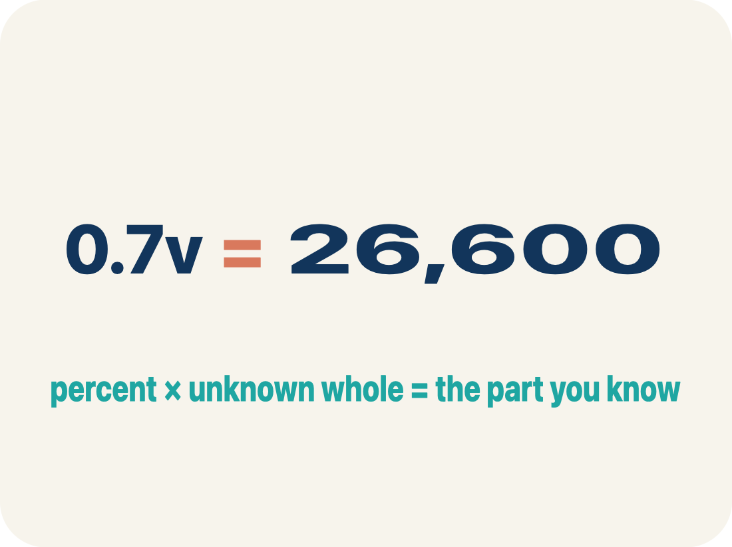
Vocabulary 5 of 6
Lesson 4-5 · Determine the Whole Given the Part and Percent
Equation
A math sentence with an equal sign. Here it says percent × whole = part, with the whole unknown.
EXAMPLE · EXPLAIN WHY IT FITS
0.7v = 26,600 — the percent times the unknown whole equals the part
Use “Equation” to explain the example. Point to evidence.
eduwonderlab.com · Neft Teacher
9 / 44
Notes:
TEACH IN PRACTICE | Embedded facilitation | Lesson 4.5, slide 9 | VOCAB
Focus on the existing task: Vocabulary 5 of 6 Equation A math sentence…
ASK (T1/3/5): Where does “Equation” appear in the example? Explain the meaning without reading the definition. Partner: restate the idea and ask a clarifying question.
LOOK FOR: A correct connection between the word and a feature of the example. If the student only repeats the definition, invite pointing, sketching or oral rehearsal, then ask for another explanation of this same example.
PARTICIPATION (T5/6/7): Think time before volunteers; accept a written, drawn or rehearsed entry. Students ask for evidence respectfully. Recognize a specific contribution or revision and check that both partners participate.
Source: BCPS Updated Instructional Framework Rubric (June 2020), TEACH 1–7.

Slide 10
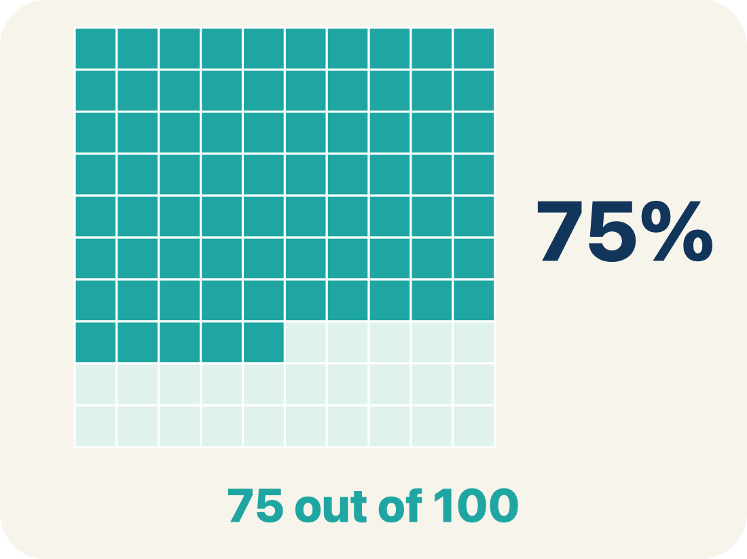
Vocabulary 6 of 6
Lesson 4-5 · Determine the Whole Given the Part and Percent
Percent
A ratio comparing a number to 100. To compute with it, write it in decimal form: 60% = 0.6.
EXAMPLE · EXPLAIN WHY IT FITS
60% = 0.6 · 70% = 0.7
Use “Percent” to explain the example. Point to evidence.
eduwonderlab.com · Neft Teacher
10 / 44
Notes:
TEACH IN PRACTICE | Embedded facilitation | Lesson 4.5, slide 10 | VOCAB
Focus on the existing task: Vocabulary 6 of 6 Percent A ratio comparing…
ASK (T1/3/5): Where does “Percent” appear in the example? Explain the meaning without reading the definition. Partner: restate the idea and ask a clarifying question.
LOOK FOR: A correct connection between the word and a feature of the example. If the student only repeats the definition, invite pointing, sketching or oral rehearsal, then ask for another explanation of this same example.
PARTICIPATION (T5/6/7): Think time before volunteers; accept a written, drawn or rehearsed entry. Students ask for evidence respectfully. Recognize a specific contribution or revision and check that both partners participate.
Source: BCPS Updated Instructional Framework Rubric (June 2020), TEACH 1–7.

Slide 11
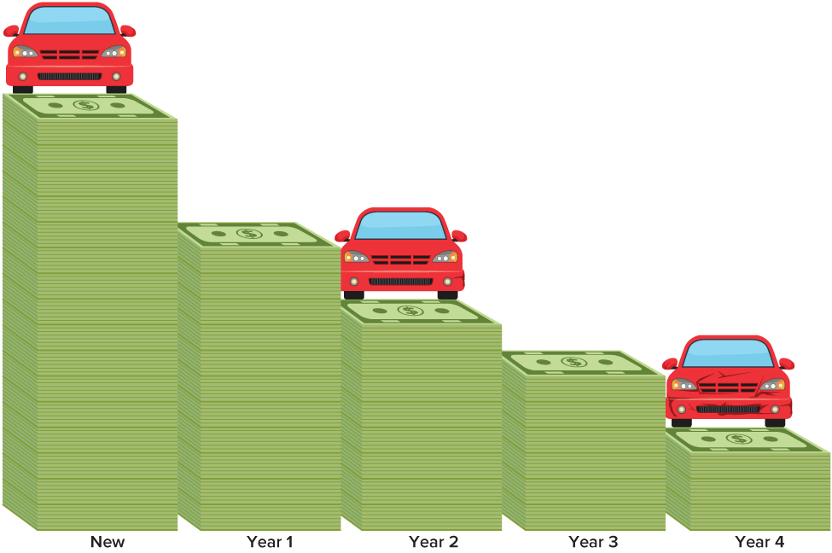

Be Curious
What do you notice?
What do you wonder?
Mindset
What helps you be organized in math class?
11 / 44
Notes:
TEACH IN PRACTICE | Embedded facilitation | Lesson 4.5, slide 11 | CURIOUS
Focus on the existing task: What do you notice?
LAUNCH (T2/3/5): Allow quiet observation first. Separate a notice from an inference, invite students’ own questions, and follow the existing launch before teaching a procedure.
LOOK FOR (T4): Where this task addresses it, students can identify the known part and percent. Ask which feature of their work supports the claim.
RESPOND: If this task shows the lesson misconception—multiplying the part by the percent when solving for the whole—label the known part and the 100-percent position on the existing model. Have the student revise and explain the change. Use this support only where the concept occurs in the current task; otherwise respond to the displayed question.
RECHECK: If a gap is shared, revisit the existing representation together. If it is limited, give targeted support while others compare valid methods on the same task. Check the revision before moving on.
PARTICIPATION (T5/6/7): Think time before volunteers; accept a written, drawn or rehearsed entry. Students ask for evidence respectfully. Recognize a specific contribution or revision and check that both partners participate.
Source: BCPS Updated Instructional Framework Rubric (June 2020), TEACH 1–7.

Slide 12
STUDENT MOVES
Lesson 4-5
Your move
ANOTHER PATHWAY · Did anyone get there a different way? Put both pathways side by side and compare.
12 / 44

Slide 13
Explain with today’s vocabulary; partner paraphrases.
Vocabulary
Lesson 4-5 · Determine the Whole Given the Part and Percent
Today’s Math Words
We learn every word — what it means and what it looks like — before we use it.
Determine the Whole Given the Part and Percent
Part
Working backwards from a part and its percent to find the whole amount it came from
The amount you already know — the piece of the whole that the percent describes
Whole
Double number line
The full amount the percent is measured against
Two lines lined up — dollars on one, percents on the other — so matching marks show the same amount two ways
Equation
Percent
A math sentence with an equal sign
A ratio comparing a number to 100
eduwonderlab.com · Neft Teacher
13 / 44
Notes:
TEACH IN PRACTICE | Embedded facilitation | Lesson 4.5, slide 12 | VOCAB
Focus on the existing task: Vocabulary Today’s Math Words We learn every…
ASK (T1/3/5): Where does “the displayed term” appear in the example? Explain the meaning without reading the definition. Partner: restate the idea and ask a clarifying question.
LOOK FOR: A correct connection between the word and a feature of the example. If the student only repeats the definition, invite pointing, sketching or oral rehearsal, then ask for another explanation of this same example.
PARTICIPATION (T5/6/7): Think time before volunteers; accept a written, drawn or rehearsed entry. Students ask for evidence respectfully. Recognize a specific contribution or revision and check that both partners participate.
Source: BCPS Updated Instructional Framework Rubric (June 2020), TEACH 1–7. Earlier notes and answer keys are retained below.
EARLIER NOTES / EXISTING ANSWER KEY
UIFR TEACH — Level 4 student move: Explain with today’s vocabulary; partner paraphrases.
Student move: Explain with today’s vocabulary; partner paraphrases.

Slide 14
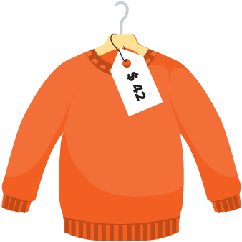

Ask a partner a question; choose a model together.
Sweater Sale
Akela bought a sweater on sale for the price shown. He paid 60% of the original price.
What was the original price of the sweater?
Try first. Connect a feature of the model to a step in your
reasoning.
Making Sense
14 / 44
Notes:
TEACH IN PRACTICE | Embedded facilitation | Lesson 4.5, slide 13 | TASK
Focus on the existing task: Akela bought a sweater on sale for the price shown. He paid 60% of the original price. What was the original price of the sweater?
LAUNCH (T2/3/5): Use the displayed question. Give private thinking time; then A explains while B asks for evidence. Switch roles. Each student records their own reasoning.
LOOK FOR (T4): Where this task addresses it, students can identify the known part and percent. Ask which feature of their work supports the claim.
RESPOND: If this task shows the lesson misconception—multiplying the part by the percent when solving for the whole—label the known part and the 100-percent position on the existing model. Have the student revise and explain the change. Use this support only where the concept occurs in the current task; otherwise respond to the displayed question.
RECHECK: If a gap is shared, revisit the existing representation together. If it is limited, give targeted support while others compare valid methods on the same task. Check the revision before moving on.
PARTICIPATION (T5/6/7): Think time before volunteers; accept a written, drawn or rehearsed entry. Students ask for evidence respectfully. Recognize a specific contribution or revision and check that both partners participate.
Source: BCPS Updated Instructional Framework Rubric (June 2020), TEACH 1–7. Earlier notes and answer keys are retained below.
EARLIER NOTES / EXISTING ANSWER KEY
UIFR TEACH — Level 4 student move: Ask a partner a question; choose a model together.
Student move: Ask a partner a question; choose a model together.
UIFR FULL | Lesson-specific facilitation
TEACH 2-3 | Session 1 task launch (UIFR PDF pp. 9-10).
Use the problem exactly as displayed. Give individual thinking time before discussion or advancing to the explanation. If the answer is already visible, ask students to reconstruct and justify it. Invite a choice of suitable representations and have students explain why their choice helps.
At the point where this concept appears, ask: “How can you use your proposed whole to recover the known part?” Wait for evidence, invite another pathway, and have a student ask a follow-up question. Do not replace students’ reasoning with a sequence of leading steps.

Slide 15
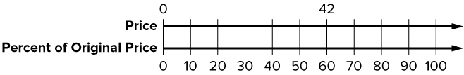
Sweater Sale
Let’s use a double number line to represent the relationship.
$42 represents is 60% of the original price.
How can you determine the scale of the top number line?
Reveal:
We can generate an equivalent ratio to find what 10% of the original price is. That dollar amount will be the scale for the top number line.
15 / 44
Notes:
TEACH IN PRACTICE | Embedded facilitation | Lesson 4.5, slide 14 | REVEAL
Focus on the existing task: Let’s use a double number line to represent the relationship. $42 represents is 60% of the original price. How can you determine the scale of the top number line?
LAUNCH (T2/3/5): If an existing answer cover is present, gather an attempt before revealing. If the explanation is already visible, ask students to reconstruct and justify it. Compare reasoning and explain a revision; preserve the reveal sequence.
LOOK FOR (T4): Where this task addresses it, students can identify the known part and percent. Ask which feature of their work supports the claim.
RESPOND: If this task shows the lesson misconception—multiplying the part by the percent when solving for the whole—label the known part and the 100-percent position on the existing model. Have the student revise and explain the change. Use this support only where the concept occurs in the current task; otherwise respond to the displayed question.
RECHECK: If a gap is shared, revisit the existing representation together. If it is limited, give targeted support while others compare valid methods on the same task. Check the revision before moving on.
PARTICIPATION (T5/6/7): Think time before volunteers; accept a written, drawn or rehearsed entry. Students ask for evidence respectfully. Recognize a specific contribution or revision and check that both partners participate.
Source: BCPS Updated Instructional Framework Rubric (June 2020), TEACH 1–7. Earlier notes and answer keys are retained below.
EARLIER NOTES / EXISTING ANSWER KEY
Ask what is known and what is unknown in this sale situation; here the part and percent are known and the whole is missing. Listen for students noticing this is the reverse of finding a part. Set up the double number line and ask where the unknown whole must sit, above 100 percent.

Slide 16
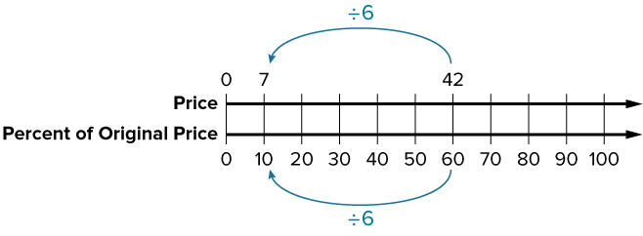
Sweater Sale
Let’s generate an equivalent ratio to find what 10% of the original price is.
What percent represents the original price of the sweater? Explain.
Reveal:
100% because the original price is the whole.
16 / 44
Notes:
TEACH IN PRACTICE | Embedded facilitation | Lesson 4.5, slide 15 | REVEAL
Focus on the existing task: Let’s generate an equivalent ratio to find what 10% of the original price is. What percent represents the original price of the sweater?
LAUNCH (T2/3/5): If an existing answer cover is present, gather an attempt before revealing. If the explanation is already visible, ask students to reconstruct and justify it. Compare reasoning and explain a revision; preserve the reveal sequence.
LOOK FOR (T4): Where this task addresses it, students can identify the known part and percent. Ask which feature of their work supports the claim.
RESPOND: If this task shows the lesson misconception—multiplying the part by the percent when solving for the whole—label the known part and the 100-percent position on the existing model. Have the student revise and explain the change. Use this support only where the concept occurs in the current task; otherwise respond to the displayed question.
RECHECK: If a gap is shared, revisit the existing representation together. If it is limited, give targeted support while others compare valid methods on the same task. Check the revision before moving on.
PARTICIPATION (T5/6/7): Think time before volunteers; accept a written, drawn or rehearsed entry. Students ask for evidence respectfully. Recognize a specific contribution or revision and check that both partners participate.
Source: BCPS Updated Instructional Framework Rubric (June 2020), TEACH 1–7. Earlier notes and answer keys are retained below.
EARLIER NOTES / EXISTING ANSWER KEY
Ask what percent of the original price the sale price represents and how an equivalent ratio can walk back to 100 percent. Listen for scaling reasoning: what factor connects the given percent to 100. Watch for students scaling the money line without scaling the percent line by the same factor.

Slide 17
STUDENT MOVES
Lesson 4-5
Your moves
USE YOUR TOOLS · Reach for your notes, a model, or a manipulative before you reach for an answer.
ASK THE CLASS · Write one question about this that you could ask the class.
17 / 44

Slide 18

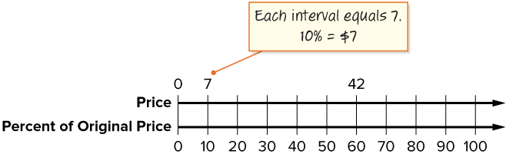
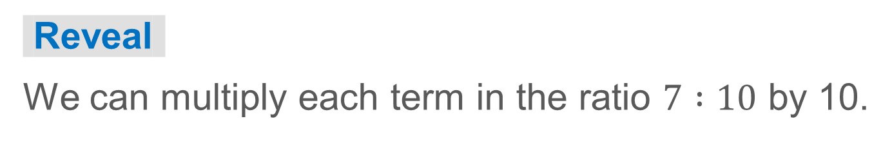
COLLABORATE · TALK IT THROUGH • AGREE ON A MODEL
Student-led talk: paraphrase, agree or disagree, add on.
Collaborate and Connect
The original price of the sweater is represented by 100%.
How can you use the double number line to generate an equivalent ratio that represents the original price? Explain your reasoning.
18 / 44
Notes:
TEACH IN PRACTICE | Embedded facilitation | Lesson 4.5, slide 16 | COLLABORATE
Focus on the existing task: The original price of the sweater is represented by 100%. How can you use the double number line to generate an equivalent ratio that represents the original price?
LAUNCH (T2/3/5): Use the displayed question. Give private thinking time; then A explains while B asks for evidence. Switch roles. Each student records their own reasoning.
LOOK FOR (T4): Where this task addresses it, students can identify the known part and percent. Ask which feature of their work supports the claim.
RESPOND: If this task shows the lesson misconception—multiplying the part by the percent when solving for the whole—label the known part and the 100-percent position on the existing model. Have the student revise and explain the change. Use this support only where the concept occurs in the current task; otherwise respond to the displayed question.
RECHECK: If a gap is shared, revisit the existing representation together. If it is limited, give targeted support while others compare valid methods on the same task. Check the revision before moving on.
PARTICIPATION (T5/6/7): Think time before volunteers; accept a written, drawn or rehearsed entry. Students ask for evidence respectfully. Recognize a specific contribution or revision and check that both partners participate.
Source: BCPS Updated Instructional Framework Rubric (June 2020), TEACH 1–7. Earlier notes and answer keys are retained below.
EARLIER NOTES / EXISTING ANSWER KEY
UIFR TEACH — Level 4 student move: Student-led talk: paraphrase, agree or disagree, add on.
Student move: Student-led talk: paraphrase, agree or disagree, add on.
Routine: COLLABORATE · TALK IT THROUGH • AGREE ON A MODEL
UIFR FULL | Lesson-specific facilitation
TEACH 4-5 | Session 1 discussion and checkpoint (UIFR PDF pp. 11-12).
Collect a brief response from every student to the existing prompt before hearing volunteers. Partners take turns explaining and asking for evidence: “I understand ___; what supports ___?” Offer rehearsal or an annotated model for students who need language support. Each student records their own reasoning.
Look specifically for: multiplying the part by the percent when solving for the whole. If it appears, label the known part and the 100-percent position on the existing model; then ask the student to revise the same response and explain the change. If evidence is secure, have students compare a second valid pathway or state why their approach works. Choose the next step from the responses, not a preset pace.

Slide 19

Partner press: ask ‘Why?’ and answer with evidence.
Sweater Sale
Let’s use a table of equivalent ratios to find the original price.
60% of the original price is $42.
How can you generate an equivalent ratio to find the original price? Explain.
Reveal:
We can multiply or divide each term of the ratio by the same number to find the price compared to 100%.
19 / 44
Notes:
TEACH IN PRACTICE | Embedded facilitation | Lesson 4.5, slide 17 | REVEAL
Focus on the existing task: Explain. Sweater Sale Partner press: ask ‘Why?
LAUNCH (T2/3/5): If an existing answer cover is present, gather an attempt before revealing. If the explanation is already visible, ask students to reconstruct and justify it. Compare reasoning and explain a revision; preserve the reveal sequence.
LOOK FOR (T4): Where this task addresses it, students can identify the known part and percent. Ask which feature of their work supports the claim.
RESPOND: If this task shows the lesson misconception—multiplying the part by the percent when solving for the whole—label the known part and the 100-percent position on the existing model. Have the student revise and explain the change. Use this support only where the concept occurs in the current task; otherwise respond to the displayed question.
RECHECK: If a gap is shared, revisit the existing representation together. If it is limited, give targeted support while others compare valid methods on the same task. Check the revision before moving on.
PARTICIPATION (T5/6/7): Think time before volunteers; accept a written, drawn or rehearsed entry. Students ask for evidence respectfully. Recognize a specific contribution or revision and check that both partners participate.
Source: BCPS Updated Instructional Framework Rubric (June 2020), TEACH 1–7. Earlier notes and answer keys are retained below.
EARLIER NOTES / EXISTING ANSWER KEY
UIFR TEACH — Level 4 student move: Partner press: ask ‘Why?’ and answer with evidence.
Student move: Partner press: ask ‘Why?’ and answer with evidence.

Slide 20
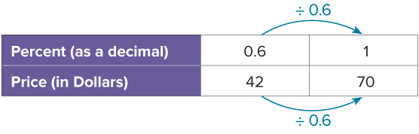
Sweater Sale
To keep equivalent ratios, divide the bottom row by the same number, 0.6.
Explain how the information shown supports your reasoning.
20 / 44
Notes:
TEACH IN PRACTICE | Embedded facilitation | Lesson 4.5, slide 18 | WORKED
Focus on the existing task: To keep equivalent ratios, divide the bottom row by the same number, 0.6. Sweater Sale
LAUNCH (T2/3/5): Ask students to explain the displayed idea or example and point to evidence. When a calculation step is shown, ask why it is valid. Have a partner restate the explanation; copying is not the check.
LOOK FOR (T4): Where this task addresses it, students can identify the known part and percent. Ask which feature of their work supports the claim.
RESPOND: If this task shows the lesson misconception—multiplying the part by the percent when solving for the whole—label the known part and the 100-percent position on the existing model. Have the student revise and explain the change. Use this support only where the concept occurs in the current task; otherwise respond to the displayed question.
RECHECK: If a gap is shared, revisit the existing representation together. If it is limited, give targeted support while others compare valid methods on the same task. Check the revision before moving on.
PARTICIPATION (T5/6/7): Think time before volunteers; accept a written, drawn or rehearsed entry. Students ask for evidence respectfully. Recognize a specific contribution or revision and check that both partners participate.
Source: BCPS Updated Instructional Framework Rubric (June 2020), TEACH 1–7. Earlier notes and answer keys are retained below.
EARLIER NOTES / EXISTING ANSWER KEY
Ask why dividing the bottom row keeps the ratio equivalent, and what the matching move on the top row must be. Listen for both rows changed by the same factor. A common slip is dividing one row only; have partners check each other’s tables row against row.

Slide 21
LESSON 4.5 / DISCUSS THE TASK
Explain and compare
Use the task you just explored.
TAKE TURNS
How can you use your proposed whole to recover the known part?
Explain
“I know this because…”
Ask
“Where does your work show that?”
Point to evidence in your work.
Then compare your approach with a partner’s.
HOW DO YOU KNOW? · Ask your partner “How do you know?” Answer by pointing to your own work.
Listen to understand. Ask for evidence. Make room for every voice.
Notes:
TEACH IN PRACTICE | Embedded facilitation | Lesson 4.5, slide 19 | PRIOR_INSERT
Focus on the existing task: Point to evidence in your work. Then compare your approach with a partner’s. TAKE TURNS Explain “I know this because…” Ask “Where does your work show that?
CONNECT (T1/4): Ask students to restate the displayed goal or key idea and connect it to earlier work. Relevant lesson evidence: identify the known part and percent; recover the whole; verify by taking the stated percent. Use only the criterion that matches the current session.
SHOW PROGRESS: Students point to their own existing work, explain what improved after feedback, and name a next step. Pair confidence ratings with actual evidence.
PARTICIPATION (T5/6/7): Think time before volunteers; accept a written, drawn or rehearsed entry. Students ask for evidence respectfully. Recognize a specific contribution or revision and check that both partners participate.
Source: BCPS Updated Instructional Framework Rubric (June 2020), TEACH 1–7.

Slide 22
Sweater Sale
Akela bought a sweater on sale for the price shown. He paid 60% of the original price.
What was the original price of the sweater?
The original price of the sweater was $70.
Think and record first. Which part of your work supports your answer?
22 / 44
Notes:
TEACH IN PRACTICE | Embedded facilitation | Lesson 4.5, slide 20 | TASK
Focus on the existing task: Akela bought a sweater on sale for the price shown. He paid 60% of the original price. What was the original price of the sweater?
LAUNCH (T2/3/5): Use the displayed question. Give private thinking time; then A explains while B asks for evidence. Switch roles. Each student records their own reasoning.
LOOK FOR (T4): Where this task addresses it, students can identify the known part and percent. Ask which feature of their work supports the claim.
RESPOND: If this task shows the lesson misconception—multiplying the part by the percent when solving for the whole—label the known part and the 100-percent position on the existing model. Have the student revise and explain the change. Use this support only where the concept occurs in the current task; otherwise respond to the displayed question.
RECHECK: If a gap is shared, revisit the existing representation together. If it is limited, give targeted support while others compare valid methods on the same task. Check the revision before moving on.
PARTICIPATION (T5/6/7): Think time before volunteers; accept a written, drawn or rehearsed entry. Students ask for evidence respectfully. Recognize a specific contribution or revision and check that both partners participate.
Source: BCPS Updated Instructional Framework Rubric (June 2020), TEACH 1–7. Earlier notes and answer keys are retained below.
EARLIER NOTES / EXISTING ANSWER KEY
The reveal names the original price as 70 dollars. Have students verify it forward: does taking the sale percent of 70 return the sale price? Listen for students closing the loop with a check. Ask why checking forward catches mistakes that the backward work hides.

Slide 23
Sweater Sale
$42 represents 60% of the original price.
What tool can you use to display the relationship between the price, in dollars, and the percent of the original price?
Compare your reasoning with the explanation. Explain any revision you make.
Reveal:
We can use a double number line.
23 / 44
Notes:
TEACH IN PRACTICE | Embedded facilitation | Lesson 4.5, slide 21 | REVEAL
Focus on the existing task: $42 represents 60% of the original price. What tool can you use to display the relationship between the price, in dollars, and the percent of the original price?
LAUNCH (T2/3/5): If an existing answer cover is present, gather an attempt before revealing. If the explanation is already visible, ask students to reconstruct and justify it. Compare reasoning and explain a revision; preserve the reveal sequence.
LOOK FOR (T4): Where this task addresses it, students can identify the known part and percent. Ask which feature of their work supports the claim.
RESPOND: If this task shows the lesson misconception—multiplying the part by the percent when solving for the whole—label the known part and the 100-percent position on the existing model. Have the student revise and explain the change. Use this support only where the concept occurs in the current task; otherwise respond to the displayed question.
RECHECK: If a gap is shared, revisit the existing representation together. If it is limited, give targeted support while others compare valid methods on the same task. Check the revision before moving on.
PARTICIPATION (T5/6/7): Think time before volunteers; accept a written, drawn or rehearsed entry. Students ask for evidence respectfully. Recognize a specific contribution or revision and check that both partners participate.
Source: BCPS Updated Instructional Framework Rubric (June 2020), TEACH 1–7.

Slide 24
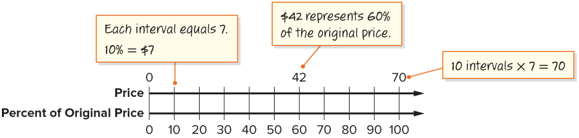
Sweater Sale
What is another way you can generate equivalent ratios?
Reveal:
One way is to use a table.
Compare your reasoning with the
explanation. Explain any revision you make.
24 / 44
Notes:
TEACH IN PRACTICE | Embedded facilitation | Lesson 4.5, slide 22 | REVEAL
Focus on the existing task: What is another way you can generate equivalent ratios?
LAUNCH (T2/3/5): If an existing answer cover is present, gather an attempt before revealing. If the explanation is already visible, ask students to reconstruct and justify it. Compare reasoning and explain a revision; preserve the reveal sequence.
LOOK FOR (T4): Where this task addresses it, students can identify the known part and percent. Ask which feature of their work supports the claim.
RESPOND: If this task shows the lesson misconception—multiplying the part by the percent when solving for the whole—label the known part and the 100-percent position on the existing model. Have the student revise and explain the change. Use this support only where the concept occurs in the current task; otherwise respond to the displayed question.
RECHECK: If a gap is shared, revisit the existing representation together. If it is limited, give targeted support while others compare valid methods on the same task. Check the revision before moving on.
PARTICIPATION (T5/6/7): Think time before volunteers; accept a written, drawn or rehearsed entry. Students ask for evidence respectfully. Recognize a specific contribution or revision and check that both partners participate.
Source: BCPS Updated Instructional Framework Rubric (June 2020), TEACH 1–7.

Slide 25
Sweater Sale
Let’s use a table of equivalent ratios to find the original price.
60% of the original price is $42.
How can you generate an equivalent ratio to find the original price? Explain.
Reveal:
We can multiply or divide each term of the ratio by the same number to find the price compared to 100%.
25 / 44
Notes:
TEACH IN PRACTICE | Embedded facilitation | Lesson 4.5, slide 23 | REVEAL
Focus on the existing task: Let’s use a table of equivalent ratios to find the original price. 60% of the original price is $42. Reveal: We can multiply or…
LAUNCH (T2/3/5): If an existing answer cover is present, gather an attempt before revealing. If the explanation is already visible, ask students to reconstruct and justify it. Compare reasoning and explain a revision; preserve the reveal sequence.
LOOK FOR (T4): Where this task addresses it, students can identify the known part and percent. Ask which feature of their work supports the claim.
RESPOND: If this task shows the lesson misconception—multiplying the part by the percent when solving for the whole—label the known part and the 100-percent position on the existing model. Have the student revise and explain the change. Use this support only where the concept occurs in the current task; otherwise respond to the displayed question.
RECHECK: If a gap is shared, revisit the existing representation together. If it is limited, give targeted support while others compare valid methods on the same task. Check the revision before moving on.
PARTICIPATION (T5/6/7): Think time before volunteers; accept a written, drawn or rehearsed entry. Students ask for evidence respectfully. Recognize a specific contribution or revision and check that both partners participate.
Source: BCPS Updated Instructional Framework Rubric (June 2020), TEACH 1–7.

Slide 26
STUDENT MOVES
Lesson 4-5
Your move
TAKE TURNS · One explains, one asks a question. Then switch, so both of you talk.
26 / 44

Slide 27
Be Curious
What could the question be?
A student calculates that he spends 15% of the school day in science class. He spends 75 minutes in science class.
Think first. Share a notice and a question;
build on a classmate’s idea.
Mindset
What is helping you be organized in math class?
27 / 44
Notes:
TEACH IN PRACTICE | Embedded facilitation | Lesson 4.5, slide 24 | CURIOUS
Focus on the existing task: What could the question be?
LAUNCH (T2/3/5): Allow quiet observation first. Separate a notice from an inference, invite students’ own questions, and follow the existing launch before teaching a procedure.
LOOK FOR (T4): Where this task addresses it, students can identify the known part and percent. Ask which feature of their work supports the claim.
RESPOND: If this task shows the lesson misconception—multiplying the part by the percent when solving for the whole—label the known part and the 100-percent position on the existing model. Have the student revise and explain the change. Use this support only where the concept occurs in the current task; otherwise respond to the displayed question.
RECHECK: If a gap is shared, revisit the existing representation together. If it is limited, give targeted support while others compare valid methods on the same task. Check the revision before moving on.
PARTICIPATION (T5/6/7): Think time before volunteers; accept a written, drawn or rehearsed entry. Students ask for evidence respectfully. Recognize a specific contribution or revision and check that both partners participate.
Source: BCPS Updated Instructional Framework Rubric (June 2020), TEACH 1–7.

Slide 28
Session 2 Warm-Up
Lesson 4-5 · Determine the Whole Given the Part and Percent
Session 2 Warm-Up
Quick review from Session 1 · about 4 minutes
1
If 20% of a number is 14, what is 100%?
2
To find the whole given the part and percent, calculate:
A
28
A
Part × Percent
B
70
B
Part ÷ (Percent as decimal)
C
140
C
Whole − Part
D
280
D
Percent ÷ Part
3
If 50% of x is 45, what is x?
4
30 is 25% of what whole number?
A
22.5
A
60
B
90
B
120
C
100
C
150
D
450
D
300
eduwonderlab.com · Neft Teacher
28 / 44
Notes:
TEACH IN PRACTICE | Embedded facilitation | Lesson 4.5, slide 25 | WARMUP
Focus on the existing task: A 28 B 70 C 140 D 280 2 To find the whole given the part and percent, calculate: A Part × Percent B Part ÷ (Percent as decimal) C Whole − Part D Percent ÷ Part 3 If 50% of x is 45, what is x?
GATHER EVIDENCE (T4/6): Keep the original items. Students try independently, mark an uncertain item, and explain one method before checking. Use the existing key when present.
RESPOND: Distinguish a calculation slip from a reasoning gap. Give one next step on the same item; have students revise in a second color. Use the responses to choose flexible support for today’s lesson.
PARTICIPATION (T5/6/7): Think time before volunteers; accept a written, drawn or rehearsed entry. Students ask for evidence respectfully. Recognize a specific contribution or revision and check that both partners participate.
Source: BCPS Updated Instructional Framework Rubric (June 2020), TEACH 1–7. Earlier notes and answer keys are retained below.
EARLIER NOTES / EXISTING ANSWER KEY
Warm-up routine: students start silently on entry; keep it to about 4 minutes.
Circulate and note who is stuck — use what you see to choose who you check on first today.
Go over answers quickly; ask one student to explain a step, not just say the answer.
UIFR: TEACH 4 · TEACH 6.
UIFR FULL | Lesson-specific facilitation
TEACH 1 | Session 2 purpose and evidence (UIFR PDF p. 8).
Have students restate the displayed session goal in their own words and connect it to the existing context or a familiar experience they choose to share. Use the current session goal to select from these lesson-wide evidence criteria; do not frontload a later-session procedure.
Look for: identify the known part and percent; recover the whole; verify by taking the stated percent. Ask: “Which part of your work would show this?” Revisit that evidence after the task; a confidence rating alone is not evidence of understanding.

Slide 29
STUDENT MOVES
Lesson 4-5
Your move
YOU KNOW THE ROUTINE · Read → plan → solve → check. Do all four, in that order.
29 / 44

Slide 30
Review Notes
Lesson 4-5 · Determine the Whole Given the Part and Percent
Review Notes — Session 2
Copy. Explain. Check.
CONNECT IT · What earlier lesson does this build on? Tell a partner in one sentence.
Finding the Whole
1
When part and percent are known: Whole = Part ÷ (Percent in decimal form).
Unit Rate Strategy
2
Find 1% first by dividing the part by the percent, then multiply by 100 to get the whole.
Tape Diagrams
3
Divide a bar into equal percent segments (e.g. 5 boxes of 20%) to solve visually.
eduwonderlab.com · Neft Teacher
30 / 44
Notes:
TEACH IN PRACTICE | Embedded facilitation | Lesson 4.5, slide 26 | NOTES
Focus on the existing task: Review Notes Review Notes — Session 2 Copy…
ROUTINE (T1/2/4): Read or copy the original notes, cover one line, and explain it using the displayed example. Reopen and correct. Copying alone is not evidence of understanding.
LOOK FOR: A link between a symbol, quantity or feature and the explanation. If missing, point back to that feature and have the student try again; fade the prompt once they can explain.
PARTICIPATION (T5/6/7): Think time before volunteers; accept a written, drawn or rehearsed entry. Students ask for evidence respectfully. Recognize a specific contribution or revision and check that both partners participate.
Source: BCPS Updated Instructional Framework Rubric (June 2020), TEACH 1–7. Earlier notes and answer keys are retained below.
EARLIER NOTES / EXISTING ANSWER KEY
Copy routine: read one line at a time; students copy, then explain that line to a partner.
Keep it brisk — the understanding work happens in the examples, not the copying.
UIFR: TEACH 1 · TEACH 6.

Slide 31
Session 2
Determine the Whole Given the Part and Percent​
PICK YOUR STRATEGY · Choose your path — picture, table, number line, or equation — and be ready to say why you chose it.
31 / 44
Notes:
TEACH IN PRACTICE | Embedded facilitation | Lesson 4.5, slide 27 | DIVIDER
Focus on the existing task: Determine the Whole Given the Part and Percent Session 2
TRANSITION (T6/7): Students confirm materials, roles, how to request help, and the next response routine. Ask a student to restate it. Keep teacher-only slides hidden.
PARTICIPATION (T5/6/7): Think time before volunteers; accept a written, drawn or rehearsed entry. Students ask for evidence respectfully. Recognize a specific contribution or revision and check that both partners participate.
Source: BCPS Updated Instructional Framework Rubric (June 2020), TEACH 1–7. Earlier notes and answer keys are retained below.
EARLIER NOTES / EXISTING ANSWER KEY
Session divider. Frame the goal: determine the whole when the part and percent are known. Ask students to name one situation from yesterday where they found a part, and predict how today’s problems flip that.

Slide 32
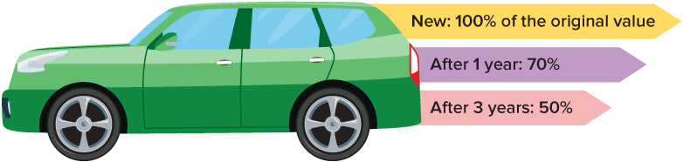
Share a connection to prior learning or lived experience.
Car Value
Sheng’s parents bought a new car last year. Sheng looked up the car value online and saw that the value of their car is now $26,600.
What was the value
of the car when they
bought it?
Think and record first. Which part of your work supports your answer?
Analyzing
32 / 44
Notes:
TEACH IN PRACTICE | Embedded facilitation | Lesson 4.5, slide 28 | TASK
Focus on the existing task: Sheng’s parents bought a new car last year. Sheng looked up the car value online and saw that the value of their car is now $26,600. What was the value of the car when they bought it?
LAUNCH (T2/3/5): Use the displayed question. Give private thinking time; then A explains while B asks for evidence. Switch roles. Each student records their own reasoning.
LOOK FOR (T4): Where this task addresses it, students can identify the known part and percent. Ask which feature of their work supports the claim.
RESPOND: If this task shows the lesson misconception—multiplying the part by the percent when solving for the whole—label the known part and the 100-percent position on the existing model. Have the student revise and explain the change. Use this support only where the concept occurs in the current task; otherwise respond to the displayed question.
RECHECK: If a gap is shared, revisit the existing representation together. If it is limited, give targeted support while others compare valid methods on the same task. Check the revision before moving on.
PARTICIPATION (T5/6/7): Think time before volunteers; accept a written, drawn or rehearsed entry. Students ask for evidence respectfully. Recognize a specific contribution or revision and check that both partners participate.
Source: BCPS Updated Instructional Framework Rubric (June 2020), TEACH 1–7. Earlier notes and answer keys are retained below.
EARLIER NOTES / EXISTING ANSWER KEY
UIFR TEACH — Level 4 student move: Share a connection to prior learning or lived experience.
Student move: Share a connection to prior learning or lived experience.
UIFR FULL | Lesson-specific facilitation
TEACH 2-3 | Session 2 task launch (UIFR PDF pp. 9-10).
Use the problem exactly as displayed. Give individual thinking time before discussion or advancing to the explanation. If the answer is already visible, ask students to reconstruct and justify it. Invite a choice of suitable representations and have students explain why their choice helps.
At the point where this concept appears, ask: “How can you use your proposed whole to recover the known part?” Wait for evidence, invite another pathway, and have a student ask a follow-up question. Do not replace students’ reasoning with a sequence of leading steps.

Slide 33
Car Value
70% of some number is $26,600.
How can you find the unknown number?
Record your reasoning before the reveal. Compare, then explain any revision.
Reveal:
We can write and solve an equation.
33 / 44
Notes:
TEACH IN PRACTICE | Embedded facilitation | Lesson 4.5, slide 29 | REVEAL
Focus on the existing task: 70% of some number is $26,600. How can you find the unknown number?
LAUNCH (T2/3/5): If an existing answer cover is present, gather an attempt before revealing. If the explanation is already visible, ask students to reconstruct and justify it. Compare reasoning and explain a revision; preserve the reveal sequence.
LOOK FOR (T4): Where this task addresses it, students can identify the known part and percent. Ask which feature of their work supports the claim.
RESPOND: If this task shows the lesson misconception—multiplying the part by the percent when solving for the whole—label the known part and the 100-percent position on the existing model. Have the student revise and explain the change. Use this support only where the concept occurs in the current task; otherwise respond to the displayed question.
RECHECK: If a gap is shared, revisit the existing representation together. If it is limited, give targeted support while others compare valid methods on the same task. Check the revision before moving on.
PARTICIPATION (T5/6/7): Think time before volunteers; accept a written, drawn or rehearsed entry. Students ask for evidence respectfully. Recognize a specific contribution or revision and check that both partners participate.
Source: BCPS Updated Instructional Framework Rubric (June 2020), TEACH 1–7. Earlier notes and answer keys are retained below.
EARLIER NOTES / EXISTING ANSWER KEY
Ask students to translate the sentence into an equation before solving: 70 percent of what number is 26,600. Listen for 0.70 times the unknown equals 26,600. Watch for students multiplying 26,600 by 0.70, which answers a different question; ask them what their expression finds.

Slide 34
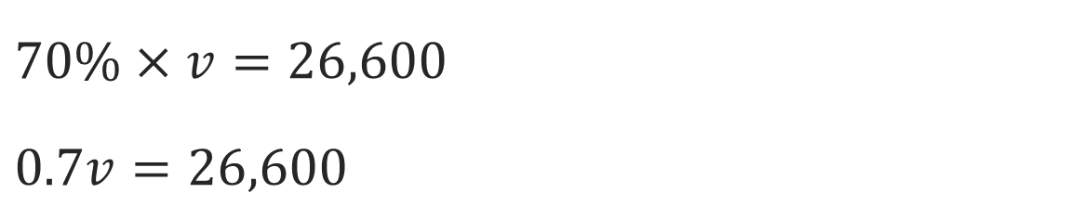
Car Value
How can you solve a multiplication equation with an unknown?
JUSTIFY IT · Say it like this: “I know ______ because ______.”
Reveal:
We can divide.
34 / 44
Notes:
TEACH IN PRACTICE | Embedded facilitation | Lesson 4.5, slide 30 | REVEAL
Focus on the existing task: How can you solve a multiplication equation with an unknown?
LAUNCH (T2/3/5): If an existing answer cover is present, gather an attempt before revealing. If the explanation is already visible, ask students to reconstruct and justify it. Compare reasoning and explain a revision; preserve the reveal sequence.
LOOK FOR (T4): Where this task addresses it, students can identify the known part and percent. Ask which feature of their work supports the claim.
RESPOND: If this task shows the lesson misconception—multiplying the part by the percent when solving for the whole—label the known part and the 100-percent position on the existing model. Have the student revise and explain the change. Use this support only where the concept occurs in the current task; otherwise respond to the displayed question.
RECHECK: If a gap is shared, revisit the existing representation together. If it is limited, give targeted support while others compare valid methods on the same task. Check the revision before moving on.
PARTICIPATION (T5/6/7): Think time before volunteers; accept a written, drawn or rehearsed entry. Students ask for evidence respectfully. Recognize a specific contribution or revision and check that both partners participate.
Source: BCPS Updated Instructional Framework Rubric (June 2020), TEACH 1–7. Earlier notes and answer keys are retained below.
EARLIER NOTES / EXISTING ANSWER KEY
Ask why division undoes the multiplication in this equation. Listen for inverse-operation language, not just a move-the-number rule. Have students estimate first: the answer must be bigger than 26,600 since 26,600 is only 70 percent of it.

Slide 35
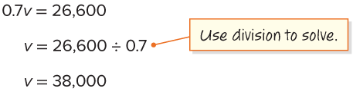
Car Value
Let’s divide to solve for the unknown.
70% of what number is $26,600?
What does the solution represent?
TRY IT BEFORE YOU’RE SURE · Start even if you are not sure. A revised answer counts as much as a first-try answer.
Reveal:
The solution, 38,000, represents the price of the car when it was purchased.
35 / 44
Notes:
TEACH IN PRACTICE | Embedded facilitation | Lesson 4.5, slide 31 | REVEAL
Focus on the existing task: Let’s divide to solve for the unknown. 70% of what number is $26,600?
LAUNCH (T2/3/5): If an existing answer cover is present, gather an attempt before revealing. If the explanation is already visible, ask students to reconstruct and justify it. Compare reasoning and explain a revision; preserve the reveal sequence.
LOOK FOR (T4): Where this task addresses it, students can identify the known part and percent. Ask which feature of their work supports the claim.
RESPOND: If this task shows the lesson misconception—multiplying the part by the percent when solving for the whole—label the known part and the 100-percent position on the existing model. Have the student revise and explain the change. Use this support only where the concept occurs in the current task; otherwise respond to the displayed question.
RECHECK: If a gap is shared, revisit the existing representation together. If it is limited, give targeted support while others compare valid methods on the same task. Check the revision before moving on.
PARTICIPATION (T5/6/7): Think time before volunteers; accept a written, drawn or rehearsed entry. Students ask for evidence respectfully. Recognize a specific contribution or revision and check that both partners participate.
Source: BCPS Updated Instructional Framework Rubric (June 2020), TEACH 1–7. Earlier notes and answer keys are retained below.
EARLIER NOTES / EXISTING ANSWER KEY
The reveal interprets 38,000 as the original price of the car. Ask students to say what the number means in context, not just state it. Listen for the connection back to 70 percent: 70 percent of 38,000 is 26,600. Ask why the whole being larger than the part makes sense here.

Slide 36
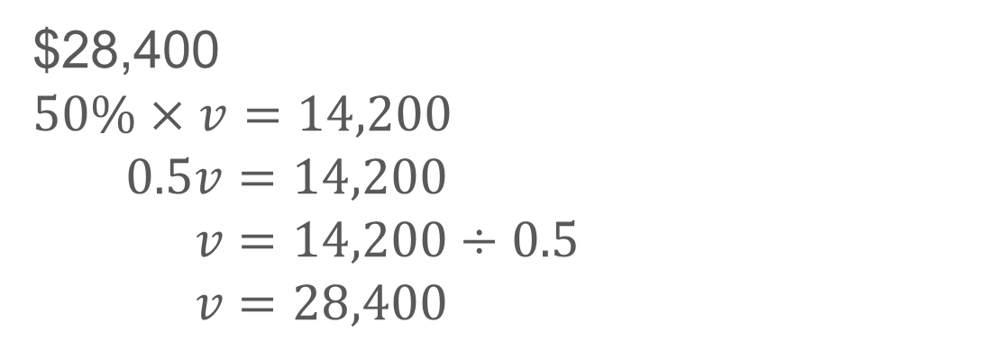
COLLABORATE · TALK IT THROUGH • AGREE ON A MODEL
Student-led talk: assign roles and monitor group progress.
Collaborate and Connect
Let’s try a similar problem.
Yelina’s parents bought a new car three years ago. The value of their car is now $14,200.
What was the value of the car when they bought it?
Reveal:
Think first. A explains; B asks for
evidence. Switch roles; both
revise.
36 / 44
Notes:
TEACH IN PRACTICE | Embedded facilitation | Lesson 4.5, slide 32 | COLLABORATE
Focus on the existing task: Let’s try a similar problem. Yelina’s parents bought a new car three years ago. The value of their car is now $14,200. What was the value of the car when they bought it?
LAUNCH (T2/3/5): Use the displayed question. Give private thinking time; then A explains while B asks for evidence. Switch roles. Each student records their own reasoning.
LOOK FOR (T4): Where this task addresses it, students can identify the known part and percent. Ask which feature of their work supports the claim.
RESPOND: If this task shows the lesson misconception—multiplying the part by the percent when solving for the whole—label the known part and the 100-percent position on the existing model. Have the student revise and explain the change. Use this support only where the concept occurs in the current task; otherwise respond to the displayed question.
RECHECK: If a gap is shared, revisit the existing representation together. If it is limited, give targeted support while others compare valid methods on the same task. Check the revision before moving on.
PARTICIPATION (T5/6/7): Think time before volunteers; accept a written, drawn or rehearsed entry. Students ask for evidence respectfully. Recognize a specific contribution or revision and check that both partners participate.
Source: BCPS Updated Instructional Framework Rubric (June 2020), TEACH 1–7. Earlier notes and answer keys are retained below.
EARLIER NOTES / EXISTING ANSWER KEY
UIFR TEACH — Level 4 student move: Student-led talk: assign roles and monitor group progress.
Student move: Student-led talk: assign roles and monitor group progress.
Routine: COLLABORATE · TALK IT THROUGH • AGREE ON A MODEL
UIFR FULL | Lesson-specific facilitation
TEACH 4-5 | Session 2 discussion and checkpoint (UIFR PDF pp. 11-12).
Collect a brief response from every student to the existing prompt before hearing volunteers. Partners take turns explaining and asking for evidence: “I understand ___; what supports ___?” Offer rehearsal or an annotated model for students who need language support. Each student records their own reasoning.
Look specifically for: multiplying the part by the percent when solving for the whole. If it appears, label the known part and the 100-percent position on the existing model; then ask the student to revise the same response and explain the change. If evidence is secure, have students compare a second valid pathway or state why their approach works. Choose the next step from the responses, not a preset pace.

Slide 37
Compare strategies; persist, revise, and try again.
Let’s Explore More
Is Sheng’s parents’ car worth more now or when they bought it? By how much did the price change?
New price: $38,000
Current value: $26,600
What could be an example of a real-world problem where you use equivalent ratios to find the whole? Write and solve
Try it yourself. Compare your work with a partner; explain one choice and revise.
37 / 44
Notes:
TEACH IN PRACTICE | Embedded facilitation | Lesson 4.5, slide 33 | PRACTICE
Focus on the existing task: Is Sheng’s parents’ car worth more now or when they bought it?
LAUNCH (T2/3/5): Use the displayed question. Give private thinking time; then A explains while B asks for evidence. Switch roles. Each student records their own reasoning.
LOOK FOR (T4): Where this task addresses it, students can recover the whole. Ask which feature of their work supports the claim.
RESPOND: If this task shows the lesson misconception—multiplying the part by the percent when solving for the whole—label the known part and the 100-percent position on the existing model. Have the student revise and explain the change. Use this support only where the concept occurs in the current task; otherwise respond to the displayed question.
RECHECK: If a gap is shared, revisit the existing representation together. If it is limited, give targeted support while others compare valid methods on the same task. Check the revision before moving on.
PARTICIPATION (T5/6/7): Think time before volunteers; accept a written, drawn or rehearsed entry. Students ask for evidence respectfully. Recognize a specific contribution or revision and check that both partners participate.
Source: BCPS Updated Instructional Framework Rubric (June 2020), TEACH 1–7. Earlier notes and answer keys are retained below.
EARLIER NOTES / EXISTING ANSWER KEY
UIFR TEACH — Level 4 student move: Compare strategies; persist, revise, and try again.
Student move: Compare strategies; persist, revise, and try again.

Slide 38
LESSON 4.5 / CHECK YOUR WORK
Pause. Check. Improve.
CHECK
A mistake to watch for: multiplying the part by the percent when solving for the whole.
TRY
Label the known part and the 100-percent position on the given model.
REVISE
Use that check on the task you just completed. Correct or strengthen one part, and explain why.
SELF-CHECK · Mark it: ✓ got it · ~ almost · ? stuck. Then fix one thing before we move on.
Listen to understand. Ask for evidence. Make room for every voice.
Notes:
TEACH IN PRACTICE | Embedded facilitation | Lesson 4.5, slide 34 | PRIOR_INSERT
Focus on the existing task: LESSON 4.5 / CHECK YOUR WORK Pause. Check. Improve. Listen to understand. Ask for evidence. Make room for every voice. CHECK A mistake…
CONNECT (T1/4): Ask students to restate the displayed goal or key idea and connect it to earlier work. Relevant lesson evidence: identify the known part and percent; recover the whole; verify by taking the stated percent. Use only the criterion that matches the current session.
SHOW PROGRESS: Students point to their own existing work, explain what improved after feedback, and name a next step. Pair confidence ratings with actual evidence.
PARTICIPATION (T5/6/7): Think time before volunteers; accept a written, drawn or rehearsed entry. Students ask for evidence respectfully. Recognize a specific contribution or revision and check that both partners participate.
Source: BCPS Updated Instructional Framework Rubric (June 2020), TEACH 1–7.

Slide 39
Car Value
70% of some number is $26,600.
How can you find the unknown number?
Compare your reasoning with the explanation. Explain any revision you make.
Reveal:
We can write and solve an equation.
39 / 44
Notes:
TEACH IN PRACTICE | Embedded facilitation | Lesson 4.5, slide 35 | REVEAL
Focus on the existing task: 70% of some number is $26,600. How can you find the unknown number?
LAUNCH (T2/3/5): If an existing answer cover is present, gather an attempt before revealing. If the explanation is already visible, ask students to reconstruct and justify it. Compare reasoning and explain a revision; preserve the reveal sequence.
LOOK FOR (T4): Where this task addresses it, students can identify the known part and percent. Ask which feature of their work supports the claim.
RESPOND: If this task shows the lesson misconception—multiplying the part by the percent when solving for the whole—label the known part and the 100-percent position on the existing model. Have the student revise and explain the change. Use this support only where the concept occurs in the current task; otherwise respond to the displayed question.
RECHECK: If a gap is shared, revisit the existing representation together. If it is limited, give targeted support while others compare valid methods on the same task. Check the revision before moving on.
PARTICIPATION (T5/6/7): Think time before volunteers; accept a written, drawn or rehearsed entry. Students ask for evidence respectfully. Recognize a specific contribution or revision and check that both partners participate.
Source: BCPS Updated Instructional Framework Rubric (June 2020), TEACH 1–7.

Slide 40
Car Value
How can you solve a multiplication equation with an unknown?
REVISE NOW · Change one answer and write why you changed it. A revision is evidence of learning.
Reveal:
We can divide.
40 / 44
Notes:
TEACH IN PRACTICE | Embedded facilitation | Lesson 4.5, slide 36 | REVEAL
Focus on the existing task: How can you solve a multiplication equation with an unknown?
LAUNCH (T2/3/5): If an existing answer cover is present, gather an attempt before revealing. If the explanation is already visible, ask students to reconstruct and justify it. Compare reasoning and explain a revision; preserve the reveal sequence.
LOOK FOR (T4): Where this task addresses it, students can identify the known part and percent. Ask which feature of their work supports the claim.
RESPOND: If this task shows the lesson misconception—multiplying the part by the percent when solving for the whole—label the known part and the 100-percent position on the existing model. Have the student revise and explain the change. Use this support only where the concept occurs in the current task; otherwise respond to the displayed question.
RECHECK: If a gap is shared, revisit the existing representation together. If it is limited, give targeted support while others compare valid methods on the same task. Check the revision before moving on.
PARTICIPATION (T5/6/7): Think time before volunteers; accept a written, drawn or rehearsed entry. Students ask for evidence respectfully. Recognize a specific contribution or revision and check that both partners participate.
Source: BCPS Updated Instructional Framework Rubric (June 2020), TEACH 1–7.

Slide 41
Car Value
Let’s divide to solve for the unknown.
70% of what number is $26,600?
What does the solution represent?
STRUGGLE FIRST · Work on your own first. Stuck is allowed — try a second strategy before you ask.
Reveal:
The solution, 38,000, represents the price of the car when it was purchased.
41 / 44
Notes:
TEACH IN PRACTICE | Embedded facilitation | Lesson 4.5, slide 37 | REVEAL
Focus on the existing task: Let’s divide to solve for the unknown. 70% of what number is $26,600?
LAUNCH (T2/3/5): If an existing answer cover is present, gather an attempt before revealing. If the explanation is already visible, ask students to reconstruct and justify it. Compare reasoning and explain a revision; preserve the reveal sequence.
LOOK FOR (T4): Where this task addresses it, students can identify the known part and percent. Ask which feature of their work supports the claim.
RESPOND: If this task shows the lesson misconception—multiplying the part by the percent when solving for the whole—label the known part and the 100-percent position on the existing model. Have the student revise and explain the change. Use this support only where the concept occurs in the current task; otherwise respond to the displayed question.
RECHECK: If a gap is shared, revisit the existing representation together. If it is limited, give targeted support while others compare valid methods on the same task. Check the revision before moving on.
PARTICIPATION (T5/6/7): Think time before volunteers; accept a written, drawn or rehearsed entry. Students ask for evidence respectfully. Recognize a specific contribution or revision and check that both partners participate.
Source: BCPS Updated Instructional Framework Rubric (June 2020), TEACH 1–7.

Slide 42
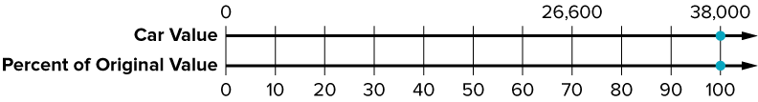
SUMMARIZE · SAY IT IN YOUR OWN WORDS
Compare pathways with a partner; name one revision.
Summarize: Determine the Whole Given the Part and Percent​
You can use a double number line, a table, or an equation to determine the whole given the part and percent.
70% of what number is $26,600?
Explain the key idea without reading. Use today’s example as evidence.
42 / 44
Notes:
TEACH IN PRACTICE | Embedded facilitation | Lesson 4.5, slide 38 | SUMMARIZE
Focus on the existing task: You can use a double number line, a table, or an equation to determine the whole given the part and percent. 70% of what number is $26,600?
CONNECT (T1/4): Ask students to restate the displayed goal or key idea and connect it to earlier work. Relevant lesson evidence: identify the known part and percent; recover the whole; verify by taking the stated percent. Use only the criterion that matches the current session.
SHOW PROGRESS: Students point to their own existing work, explain what improved after feedback, and name a next step. Pair confidence ratings with actual evidence.
PARTICIPATION (T5/6/7): Think time before volunteers; accept a written, drawn or rehearsed entry. Students ask for evidence respectfully. Recognize a specific contribution or revision and check that both partners participate.
Source: BCPS Updated Instructional Framework Rubric (June 2020), TEACH 1–7. Earlier notes and answer keys are retained below.
EARLIER NOTES / EXISTING ANSWER KEY
UIFR TEACH — Level 4 student move: Compare pathways with a partner; name one revision.
Student move: Compare pathways with a partner; name one revision.
Routine: SUMMARIZE · SAY IT IN YOUR OWN WORDS

Slide 43
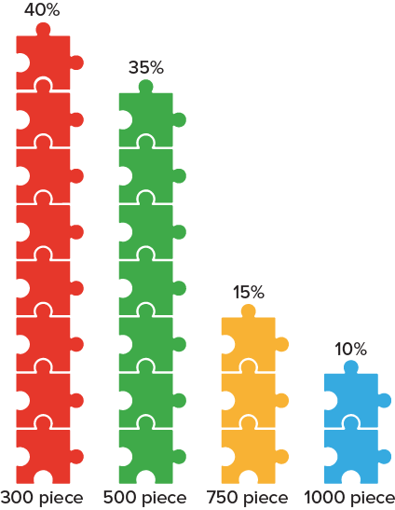
APPLY · PLAN IT • SOLVE IT • PROVE IT
Apply: Puzzle Problem​
The percentage of each type of puzzle in a toy store before a sale is shown. During the sale, the store sold all of the 300-piece and 500-piece puzzles. They sold 120 puzzles.
Question: How many of each type of puzzle did the store have before the sale?
Choose a method. Solve independently,
justify your answer, then check the goal.
43 / 44
Notes:
TEACH IN PRACTICE | Embedded facilitation | Lesson 4.5, slide 39 | APPLY
Focus on the existing task: The percentage of each type of puzzle in a toy store before a sale is shown. During the sale, the store sold all of the 300-piece and…
LAUNCH (T2/3/5): Use the exact application task independently first. Ask students to justify their choice of method. Collect evidence before a partner discussion or correction.
LOOK FOR (T4): Where this task addresses it, students can identify the known part and percent. Ask which feature of their work supports the claim.
RESPOND: If this task shows the lesson misconception—multiplying the part by the percent when solving for the whole—label the known part and the 100-percent position on the existing model. Have the student revise and explain the change. Use this support only where the concept occurs in the current task; otherwise respond to the displayed question.
RECHECK: If a gap is shared, revisit the existing representation together. If it is limited, give targeted support while others compare valid methods on the same task. Check the revision before moving on.
PARTICIPATION (T5/6/7): Think time before volunteers; accept a written, drawn or rehearsed entry. Students ask for evidence respectfully. Recognize a specific contribution or revision and check that both partners participate.
Source: BCPS Updated Instructional Framework Rubric (June 2020), TEACH 1–7. Earlier notes and answer keys are retained below.
EARLIER NOTES / EXISTING ANSWER KEY
Routine: APPLY · PLAN IT • SOLVE IT • PROVE IT
UIFR FULL | Lesson-specific facilitation
TEACH 4 | Independent evidence and revision (UIFR PDF p. 11).
Use the existing application/exit problem as the independent check. If this is a learning-target slide, have students point to and explain their work on the preceding task. Separate initial independent evidence from the revision after feedback.
Check the relevant criteria: identify the known part and percent; recover the whole; verify by taking the stated percent. Respond with one specific next step tied to the work. Students revise and annotate what changed, then identify a criterion they can now demonstrate and one they still need to practice.
REFLECT & ADJUST 1-2 | After the lesson (UIFR PDF pp. 15-16).
Sort the existing work by demonstrated reasoning, partial understanding, and the specific misconception: multiplying the part by the percent when solving for the whole. Compare the initial response with the revision. Record which teaching move plausibly helped, which did not, and whose participation or access needs a different approach; do not record sensitive student details in this shared deck.
Plan the next lesson from that evidence: if the misconception persists, label the known part and the 100-percent position on the existing model using the current example before returning to the next grade-level task; if understanding is secure, use an existing extension or ask for a general explanation. Check the targeted idea again at the next warm-up.
Ask students what supported their thinking and what would help next time. Identify one change to try and one successful practice to retain. Seek colleague feedback on anonymized work when useful; these prompts support reflection and do not establish an evaluation rating. Source: Baltimore City Public Schools, Updated Instructional Framework Rubric, June 2020 (UIFR_Full.pdf).

Slide 44
LESSON 4.5 / REFLECT ON YOUR LEARNING
Show your progress
1 SHOW EVIDENCE
2 CHOOSE A NEXT STEP
Choose one response. Point to the part that shows your reasoning.
Name a change you made after feedback—or a question you still have.
“My work shows ___ because ___.”
“Next time, I will ___ to help me ___.”
Today’s focus: Identify the known part and percent.
CREDIT A CLASSMATE · Name one classmate whose idea helped you today, and say what they said.
Listen to understand. Ask for evidence. Make room for every voice.
Notes:
TEACH IN PRACTICE | Embedded facilitation | Lesson 4.5, slide 40 | PRIOR_INSERT
Focus on the existing task: LESSON 4.5 / REFLECT ON YOUR LEARNING Show your progress Listen to understand. Ask for evidence. Make room for every voice. 1 SHOW…
CONNECT (T1/4): Ask students to restate the displayed goal or key idea and connect it to earlier work. Relevant lesson evidence: identify the known part and percent; recover the whole; verify by taking the stated percent. Use only the criterion that matches the current session.
SHOW PROGRESS: Students point to their own existing work, explain what improved after feedback, and name a next step. Pair confidence ratings with actual evidence.
PARTICIPATION (T5/6/7): Think time before volunteers; accept a written, drawn or rehearsed entry. Students ask for evidence respectfully. Recognize a specific contribution or revision and check that both partners participate.
Source: BCPS Updated Instructional Framework Rubric (June 2020), TEACH 1–7.

