Slide 1
WARM-UP · THINK • TRY • CHECK
Turn and talk: compare strategies, then defend one.
Warm-Up
Lesson 5-1 · Determine the Area of Parallelograms and Rhombuses | Warm-Up · about 4 minutes
Try each on your own. Mark an unsure answer; explain and revise when we check.
QUESTION 1
QUESTION 2
14 × 25 = ______
A rectangle is 8 cm long and 5 cm wide. Area = ______
QUESTION 3
QUESTION 4
Parallelogram: base 10 in, slanted side 6 in, height 4 in.
The height is ______
Area of a 7 m by 3 m rectangle = 21 ______
TALK IT OVER: “I got ______ because ______.” • Compare with a partner before we check as a class.
1 / 66
Notes:
TEACH IN PRACTICE | Embedded facilitation | Lesson 5.1, slide 1 | WARMUP
Focus on the existing task: Warm-Up WARM-UP · THINK • TRY • CHECK…
GATHER EVIDENCE (T4/6): Keep the original items. Students try independently, mark an uncertain item, and explain one method before checking. Use the existing key when present.
RESPOND: Distinguish a calculation slip from a reasoning gap. Give one next step on the same item; have students revise in a second color. Use the responses to choose flexible support for today’s lesson.
PARTICIPATION (T5/6/7): Think time before volunteers; accept a written, drawn or rehearsed entry. Students ask for evidence respectfully. Recognize a specific contribution or revision and check that both partners participate.
Source: BCPS Updated Instructional Framework Rubric (June 2020), TEACH 1–7. Earlier notes and answer keys are retained below.
EARLIER NOTES / EXISTING ANSWER KEY
Warm-Up answers (teacher only): 1) 350 2) 40 square centimeters 3) 4 inches 4) square meters
UIFR FULL | Lesson-specific facilitation
PREPARE 1-2 | Before teaching (UIFR PDF pp. 6-7).
Plan to gather evidence that students can identify base and perpendicular height; connect rearrangement to base times height; label square units. Review recent work and today’s warm-up to choose flexible groups and access supports; do not infer needs from identity or perceived ability. Use the existing lesson tasks and stated standards.
Anticipate: using a slanted side as the height. If observed, mark a right angle between the selected base and height on the original diagram. Offer oral rehearsal, drawing, pointing, or home-language processing as needed; retain the original mathematical demand. Ask students which support helps and fade it as evidence improves.
TEACH 6-7 | Before the first transition, agree on materials, partner roles, and how to request help. Invite students to restate the routine. Normalize revising an idea, recognize a specific contribution, and check privately when frustration blocks participation. Source: UIFR PDF pp. 13-14.

Slide 2
Today’s Math Notes
Lesson 5-1 · Determine the Area of Parallelograms and Rhombuses
Section 1: Math Words
Copy. Explain. Check.
SAY THE GOAL · Say today’s goal in your own words, then name one place this shows up outside math class.
Area of Parallelograms
1
The space inside a parallelogram
Slanted side
2
A side that leans instead of going straight up and down
Parallelogram
3
A four-sided shape with two pairs of parallel sides
eduwonderlab.com · Neft Teacher
2 / 66
Notes:
TEACH IN PRACTICE | Embedded facilitation | Lesson 5.1, slide 2 | NOTES
Focus on the existing task: Today’s Math Notes Section 1: Math Words…
ROUTINE (T1/2/4): Read or copy the original notes, cover one line, and explain it using the displayed example. Reopen and correct. Copying alone is not evidence of understanding.
LOOK FOR: A link between a symbol, quantity or feature and the explanation. If missing, point back to that feature and have the student try again; fade the prompt once they can explain.
PARTICIPATION (T5/6/7): Think time before volunteers; accept a written, drawn or rehearsed entry. Students ask for evidence respectfully. Recognize a specific contribution or revision and check that both partners participate.
Source: BCPS Updated Instructional Framework Rubric (June 2020), TEACH 1–7. Earlier notes and answer keys are retained below.
EARLIER NOTES / EXISTING ANSWER KEY
Copy routine: read one line at a time; students copy, then explain that line to a partner.
Keep it brisk — the understanding work happens in the examples, not the copying.
UIFR: TEACH 1 · TEACH 6.

Slide 3
Today’s Math Notes
Lesson 5-1 · Determine the Area of Parallelograms and Rhombuses
Section 2: Today’s Math
Copy. Explain. Check.
Area of Parallelograms & Rhombuses
Area = Base × Height (A = b · h)
Read, cover, explain. Reopen your notes to
check and improve your explanation.
1
Identify the base (any side)
2
Identify the perpendicular height (height must be perpendicular to base, not slanted)
3
Multiply base times height; label with square units (e.g. cm², in²)
eduwonderlab.com · Neft Teacher
3 / 66
Notes:
TEACH IN PRACTICE | Embedded facilitation | Lesson 5.1, slide 3 | NOTES
Focus on the existing task: Today’s Math Notes Section 2: Today’s…
ROUTINE (T1/2/4): Read or copy the original notes, cover one line, and explain it using the displayed example. Reopen and correct. Copying alone is not evidence of understanding.
LOOK FOR: A link between a symbol, quantity or feature and the explanation. If missing, point back to that feature and have the student try again; fade the prompt once they can explain.
PARTICIPATION (T5/6/7): Think time before volunteers; accept a written, drawn or rehearsed entry. Students ask for evidence respectfully. Recognize a specific contribution or revision and check that both partners participate.
Source: BCPS Updated Instructional Framework Rubric (June 2020), TEACH 1–7. Earlier notes and answer keys are retained below.
EARLIER NOTES / EXISTING ANSWER KEY
Copy routine: read one line at a time; students copy, then explain that line to a partner.
Keep it brisk — the understanding work happens in the examples, not the copying.
UIFR: TEACH 1 · TEACH 6.

Slide 4
Session 1
Determine the Area of
Parallelograms and Rhombuses​
PICK YOUR STRATEGY · Choose your path — picture, table, number line, or equation — and be ready to say why you chose it.
4 / 66
Notes:
TEACH IN PRACTICE | Embedded facilitation | Lesson 5.1, slide 4 | DIVIDER
Focus on the existing task: Determine the Area of Parallelograms and Rhombuses Session 1
TRANSITION (T6/7): Students confirm materials, roles, how to request help, and the next response routine. Ask a student to restate it. Keep teacher-only slides hidden.
PARTICIPATION (T5/6/7): Think time before volunteers; accept a written, drawn or rehearsed entry. Students ask for evidence respectfully. Recognize a specific contribution or revision and check that both partners participate.
Source: BCPS Updated Instructional Framework Rubric (June 2020), TEACH 1–7. Earlier notes and answer keys are retained below.
EARLIER NOTES / EXISTING ANSWER KEY
Transition cue: state what materials are out and what success looks like this session.
Keep the changeover under a minute.
UIFR: TEACH 6.

Slide 5
This or That
Would you rather have THIS or THAT hours of recess?
Hours of Recess
THIS | THAT
Think and record first. Which part of your work supports your answer?
5 / 66
Notes:
TEACH IN PRACTICE | Embedded facilitation | Lesson 5.1, slide 5 | TASK
Focus on the existing task: This or That Would you rather have THIS or THAT hours of recess?
LAUNCH (T2/3/5): Use the displayed question. Give private thinking time; then A explains while B asks for evidence. Switch roles. Each student records their own reasoning.
LOOK FOR (T4): Where this task addresses it, students can identify base and perpendicular height. Ask which feature of their work supports the claim.
RESPOND: If this task shows the lesson misconception—using a slanted side as the height—mark a right angle between the selected base and height on the original diagram. Have the student revise and explain the change. Use this support only where the concept occurs in the current task; otherwise respond to the displayed question.
RECHECK: If a gap is shared, revisit the existing representation together. If it is limited, give targeted support while others compare valid methods on the same task. Check the revision before moving on.
PARTICIPATION (T5/6/7): Think time before volunteers; accept a written, drawn or rehearsed entry. Students ask for evidence respectfully. Recognize a specific contribution or revision and check that both partners participate.
Source: BCPS Updated Instructional Framework Rubric (June 2020), TEACH 1–7. Earlier notes and answer keys are retained below.
EARLIER NOTES / EXISTING ANSWER KEY
Number-sense routine — every voice in. Give quiet think time, then hear from at least three students.
Always follow with “How do you know?” — the reasoning is the point, not the answer.
There is more than one path; name and celebrate different strategies.
UIFR: TEACH 3 · TEACH 5 · TEACH 6.

Slide 6
Today’s Objectives
Lesson 5-1 · Determine the Area of Parallelograms and Rhombuses
Determine the Area of Parallelograms and Rhombuses
Maryland Standard 6.GR.1
CONNECT IT · What earlier lesson does this build on? Tell a partner in one sentence.
CONTENT OBJECTIVE
LANGUAGE OBJECTIVE
Restate the goal in your words
Use these words to explain why
I can find the area of a parallelogram using base × height.
I can explain how I found the area using the words base, height, area, and formula.
eduwonderlab.com · Neft Teacher
6 / 66
Notes:
TEACH IN PRACTICE | Embedded facilitation | Lesson 5.1, slide 6 | GOAL
Focus on the existing task: Today’s Objectives Determine the Area of…
CONNECT (T1/4): Ask students to restate the displayed goal or key idea and connect it to earlier work. Relevant lesson evidence: identify base and perpendicular height; connect rearrangement to base times height; label square units. Use only the criterion that matches the current session.
SHOW PROGRESS: Students point to their own existing work, explain what improved after feedback, and name a next step. Pair confidence ratings with actual evidence.
PARTICIPATION (T5/6/7): Think time before volunteers; accept a written, drawn or rehearsed entry. Students ask for evidence respectfully. Recognize a specific contribution or revision and check that both partners participate.
Source: BCPS Updated Instructional Framework Rubric (June 2020), TEACH 1–7. Earlier notes and answer keys are retained below.
EARLIER NOTES / EXISTING ANSWER KEY
Read the objective together, then have one or two students restate today’s goal in their own words.
Connect it to what the class learned last lesson.
Return to this goal at the end of class to check it was met.
UIFR: TEACH 1.
UIFR FULL | Lesson-specific facilitation
TEACH 1 | Session 1 purpose and evidence (UIFR PDF p. 8).
Have students restate the displayed session goal in their own words and connect it to the existing context or a familiar experience they choose to share. Use the current session goal to select from these lesson-wide evidence criteria; do not frontload a later-session procedure.
Look for: identify base and perpendicular height; connect rearrangement to base times height; label square units. Ask: “Which part of your work would show this?” Revisit that evidence after the task; a confidence rating alone is not evidence of understanding.

Slide 7
LESSON 5.1 / OUR LEARNING
What will show your learning?
1
Identify base and perpendicular height.
2
Connect rearrangement to base times height.
3
Label square units.
Tell a partner: Which skill connects to something you already know?
SHOW YOUR THINKING · Show what you know — write it, draw it, or build it. A picture counts as an explanation.
Listen to understand. Ask for evidence. Make room for every voice.
Notes:
TEACH IN PRACTICE | Embedded facilitation | Lesson 5.1, slide 7 | PRIOR_INSERT
Focus on the existing task: LESSON 5.1 / OUR LEARNING What will show your learning?
CONNECT (T1/4): Ask students to restate the displayed goal or key idea and connect it to earlier work. Relevant lesson evidence: identify base and perpendicular height; connect rearrangement to base times height; label square units. Use only the criterion that matches the current session.
SHOW PROGRESS: Students point to their own existing work, explain what improved after feedback, and name a next step. Pair confidence ratings with actual evidence.
PARTICIPATION (T5/6/7): Think time before volunteers; accept a written, drawn or rehearsed entry. Students ask for evidence respectfully. Recognize a specific contribution or revision and check that both partners participate.
Source: BCPS Updated Instructional Framework Rubric (June 2020), TEACH 1–7.

Slide 8
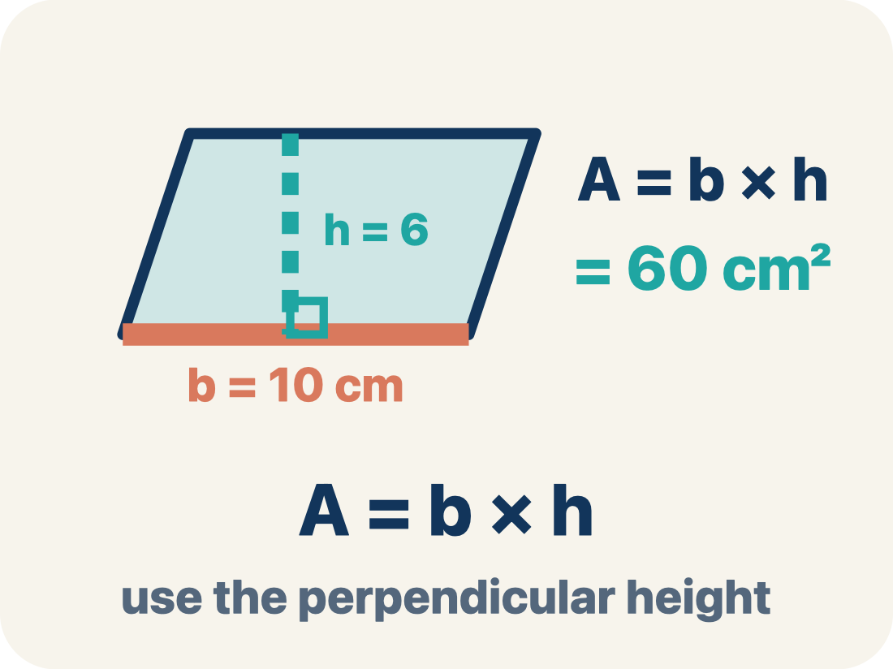
Vocabulary 1 of 10
Lesson 5-1 · Determine the Area of Parallelograms and Rhombuses
Area of Parallelograms
The space inside a parallelogram. Formula: A = b × h, using the perpendicular height.
EXAMPLE · EXPLAIN WHY IT FITS
A = b × h; if b = 10 cm and h = 6 cm, A = 60 cm².
Use “Area of Parallelograms” to explain the example. Point to
evidence.
eduwonderlab.com · Neft Teacher
8 / 66
Notes:
TEACH IN PRACTICE | Embedded facilitation | Lesson 5.1, slide 8 | VOCAB
Focus on the existing task: Vocabulary 1 of 10 Area of…
ASK (T1/3/5): Where does “Area of Parallelograms” appear in the example? Explain the meaning without reading the definition. Partner: restate the idea and ask a clarifying question.
LOOK FOR: A correct connection between the word and a feature of the example. If the student only repeats the definition, invite pointing, sketching or oral rehearsal, then ask for another explanation of this same example.
PARTICIPATION (T5/6/7): Think time before volunteers; accept a written, drawn or rehearsed entry. Students ask for evidence respectfully. Recognize a specific contribution or revision and check that both partners participate.
Source: BCPS Updated Instructional Framework Rubric (June 2020), TEACH 1–7.

Slide 9
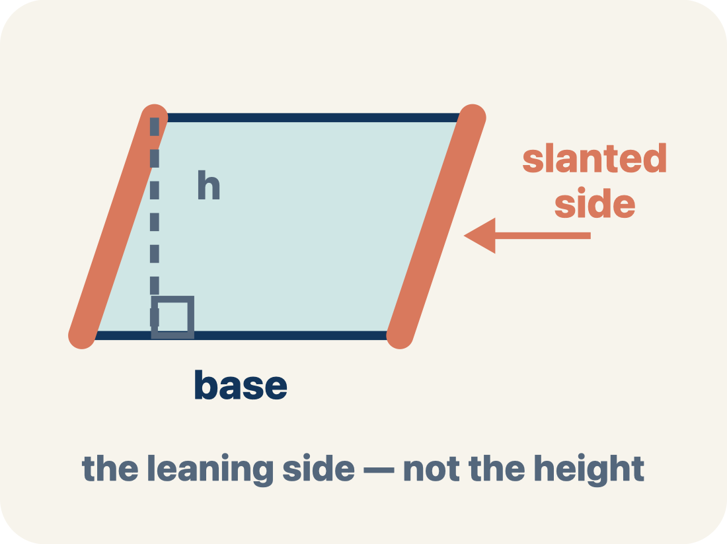
Vocabulary 2 of 10
Lesson 5-1 · Determine the Area of Parallelograms and Rhombuses
Slanted side
A side that leans instead of going straight up and down. It is not the perpendicular height.
EXAMPLE · EXPLAIN WHY IT FITS
In a leaning parallelogram, use the dashed 90° height—not the slanted side—in A = b × h.
Use “Slanted side” to explain the example. Point to evidence.
eduwonderlab.com · Neft Teacher
9 / 66
Notes:
TEACH IN PRACTICE | Embedded facilitation | Lesson 5.1, slide 9 | VOCAB
Focus on the existing task: Vocabulary 2 of 10 Slanted side A side…
ASK (T1/3/5): Where does “Slanted side” appear in the example? Explain the meaning without reading the definition. Partner: restate the idea and ask a clarifying question.
LOOK FOR: A correct connection between the word and a feature of the example. If the student only repeats the definition, invite pointing, sketching or oral rehearsal, then ask for another explanation of this same example.
PARTICIPATION (T5/6/7): Think time before volunteers; accept a written, drawn or rehearsed entry. Students ask for evidence respectfully. Recognize a specific contribution or revision and check that both partners participate.
Source: BCPS Updated Instructional Framework Rubric (June 2020), TEACH 1–7.

Slide 10
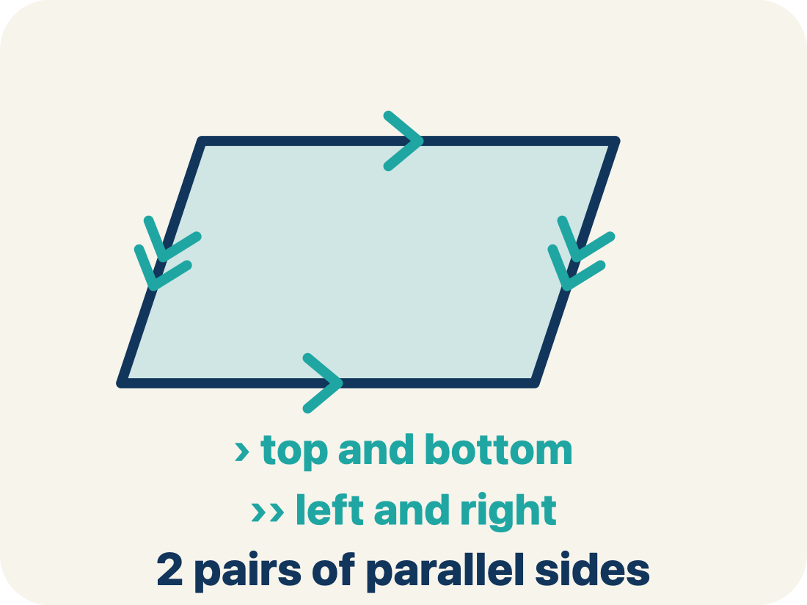
Vocabulary 3 of 10
Lesson 5-1 · Determine the Area of Parallelograms and Rhombuses
Parallelogram
A four-sided shape with two pairs of parallel sides.
EXAMPLE · EXPLAIN WHY IT FITS
Think of a leaning door — the top and bottom are parallel, and the two sides are parallel, like a slanted rectangle
Use “Parallelogram” to explain
the example. Point to evidence.
eduwonderlab.com · Neft Teacher
10 / 66
Notes:
TEACH IN PRACTICE | Embedded facilitation | Lesson 5.1, slide 10 | VOCAB
Focus on the existing task: Vocabulary 3 of 10 Parallelogram A…
ASK (T1/3/5): Where does “Parallelogram” appear in the example? Explain the meaning without reading the definition. Partner: restate the idea and ask a clarifying question.
LOOK FOR: A correct connection between the word and a feature of the example. If the student only repeats the definition, invite pointing, sketching or oral rehearsal, then ask for another explanation of this same example.
PARTICIPATION (T5/6/7): Think time before volunteers; accept a written, drawn or rehearsed entry. Students ask for evidence respectfully. Recognize a specific contribution or revision and check that both partners participate.
Source: BCPS Updated Instructional Framework Rubric (June 2020), TEACH 1–7.

Slide 11
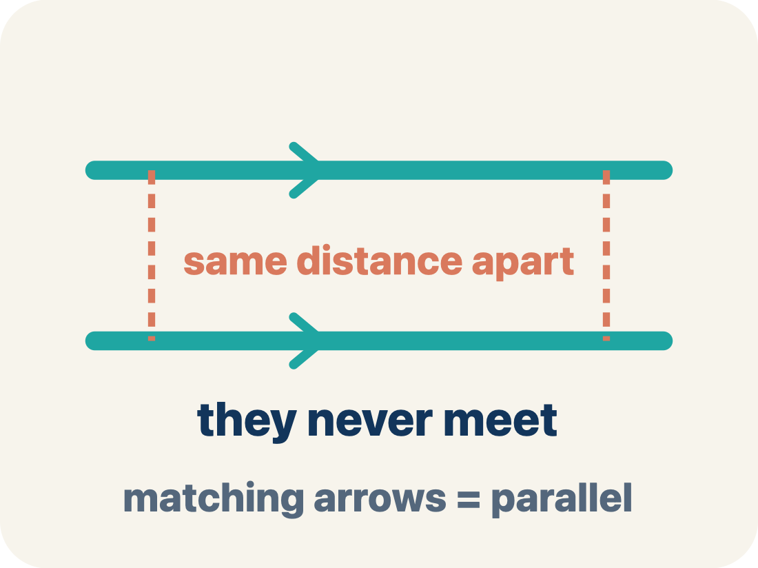
Vocabulary 4 of 10
Lesson 5-1 · Determine the Area of Parallelograms and Rhombuses
Parallel
Two lines or sides that stay the same distance apart and never meet.
EXAMPLE · EXPLAIN WHY IT FITS
The top and bottom of a parallelogram never get closer together — matching arrowheads (›) mark one parallel pair, double arrowheads (››) mark the other.
Use “Parallel” to explain the example. Point to evidence.
eduwonderlab.com · Neft Teacher
11 / 66
Notes:
TEACH IN PRACTICE | Embedded facilitation | Lesson 5.1, slide 11 | VOCAB
Focus on the existing task: Vocabulary 4 of 10 Parallel Two lines…
ASK (T1/3/5): Where does “Parallel” appear in the example? Explain the meaning without reading the definition. Partner: restate the idea and ask a clarifying question.
LOOK FOR: A correct connection between the word and a feature of the example. If the student only repeats the definition, invite pointing, sketching or oral rehearsal, then ask for another explanation of this same example.
PARTICIPATION (T5/6/7): Think time before volunteers; accept a written, drawn or rehearsed entry. Students ask for evidence respectfully. Recognize a specific contribution or revision and check that both partners participate.
Source: BCPS Updated Instructional Framework Rubric (June 2020), TEACH 1–7.

Slide 12
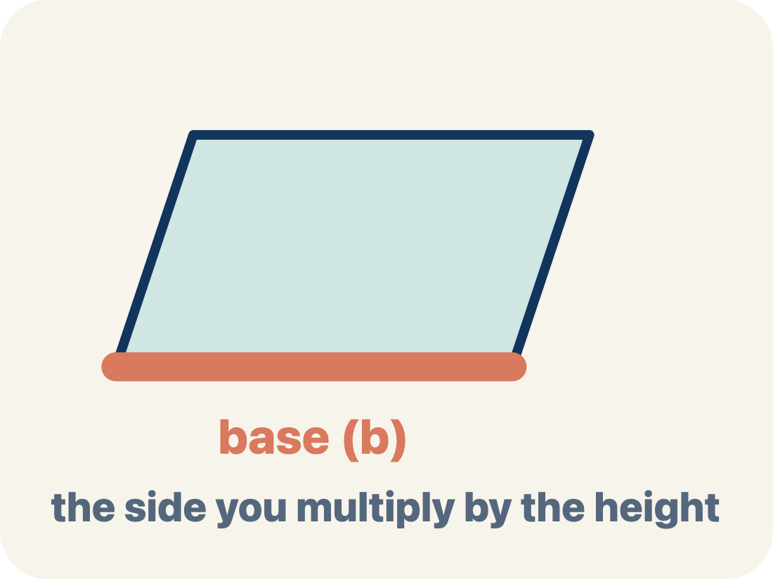
Vocabulary 5 of 10
Lesson 5-1 · Determine the Area of Parallelograms and Rhombuses
Base
Any side of a parallelogram can be the base. Once you pick a base, the height must be measured perpendicular (at a 90° angle) to it.
EXAMPLE · EXPLAIN WHY IT FITS
Any side can be the base: choose the 10 cm side and b = 10 cm, then draw the height at 90° to that side in A = b × h
Use “Base” to explain the example. Point to evidence.
eduwonderlab.com · Neft Teacher
12 / 66
Notes:
TEACH IN PRACTICE | Embedded facilitation | Lesson 5.1, slide 12 | VOCAB
Focus on the existing task: Vocabulary 5 of 10 Base Any side of a…
ASK (T1/3/5): Where does “Base” appear in the example? Explain the meaning without reading the definition. Partner: restate the idea and ask a clarifying question.
LOOK FOR: A correct connection between the word and a feature of the example. If the student only repeats the definition, invite pointing, sketching or oral rehearsal, then ask for another explanation of this same example.
PARTICIPATION (T5/6/7): Think time before volunteers; accept a written, drawn or rehearsed entry. Students ask for evidence respectfully. Recognize a specific contribution or revision and check that both partners participate.
Source: BCPS Updated Instructional Framework Rubric (June 2020), TEACH 1–7.

Slide 13
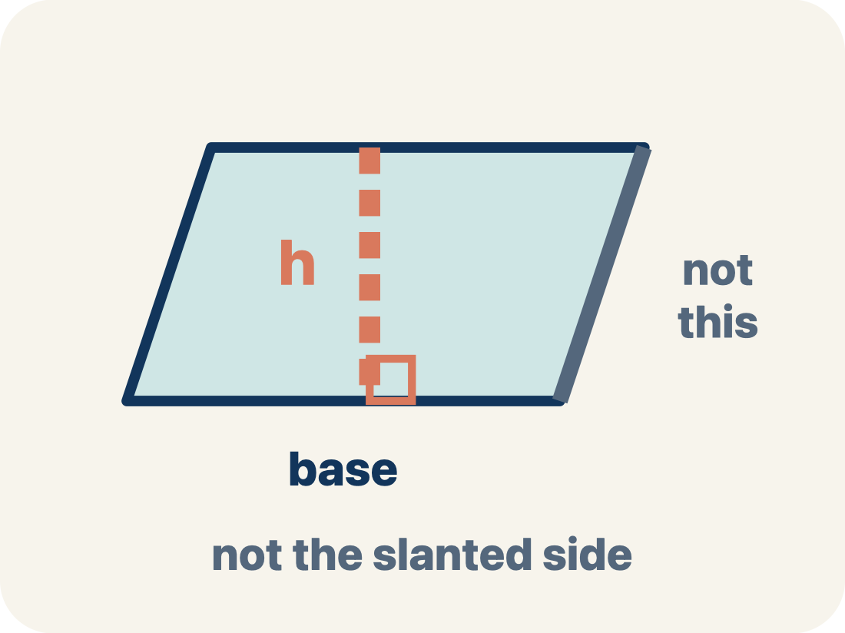
Vocabulary 6 of 10
Lesson 5-1 · Determine the Area of Parallelograms and Rhombuses
Height
The straight-up distance from the base to the top.
EXAMPLE · EXPLAIN WHY IT FITS
A dashed vertical line from the top side straight down to the base, forming a 90° angle — NOT the slanted side
Use “Height” to explain the example. Point to evidence.
eduwonderlab.com · Neft Teacher
13 / 66
Notes:
TEACH IN PRACTICE | Embedded facilitation | Lesson 5.1, slide 13 | VOCAB
Focus on the existing task: Vocabulary 6 of 10 Height The…
ASK (T1/3/5): Where does “Height” appear in the example? Explain the meaning without reading the definition. Partner: restate the idea and ask a clarifying question.
LOOK FOR: A correct connection between the word and a feature of the example. If the student only repeats the definition, invite pointing, sketching or oral rehearsal, then ask for another explanation of this same example.
PARTICIPATION (T5/6/7): Think time before volunteers; accept a written, drawn or rehearsed entry. Students ask for evidence respectfully. Recognize a specific contribution or revision and check that both partners participate.
Source: BCPS Updated Instructional Framework Rubric (June 2020), TEACH 1–7.

Slide 14
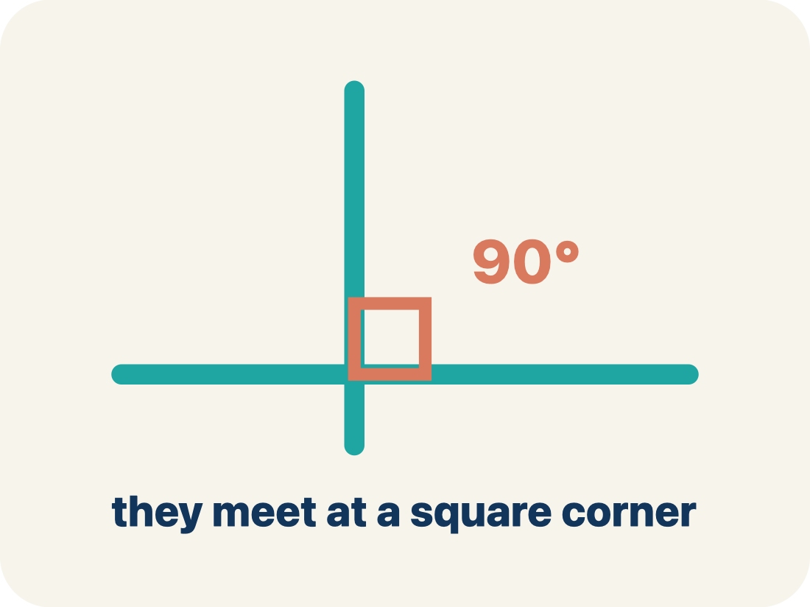
Vocabulary 7 of 10
Lesson 5-1 · Determine the Area of Parallelograms and Rhombuses
Perpendicular
Two lines that meet to make a square corner (90 degrees).
EXAMPLE · EXPLAIN WHY IT FITS
The dashed height meets the base at a square corner — the small 90° box is what makes it perpendicular, not slanted.
Use “Perpendicular” to explain
the example. Point to evidence.
eduwonderlab.com · Neft Teacher
14 / 66
Notes:
TEACH IN PRACTICE | Embedded facilitation | Lesson 5.1, slide 14 | VOCAB
Focus on the existing task: Vocabulary 7 of 10 Perpendicular Two…
ASK (T1/3/5): Where does “Perpendicular” appear in the example? Explain the meaning without reading the definition. Partner: restate the idea and ask a clarifying question.
LOOK FOR: A correct connection between the word and a feature of the example. If the student only repeats the definition, invite pointing, sketching or oral rehearsal, then ask for another explanation of this same example.
PARTICIPATION (T5/6/7): Think time before volunteers; accept a written, drawn or rehearsed entry. Students ask for evidence respectfully. Recognize a specific contribution or revision and check that both partners participate.
Source: BCPS Updated Instructional Framework Rubric (June 2020), TEACH 1–7.

Slide 15
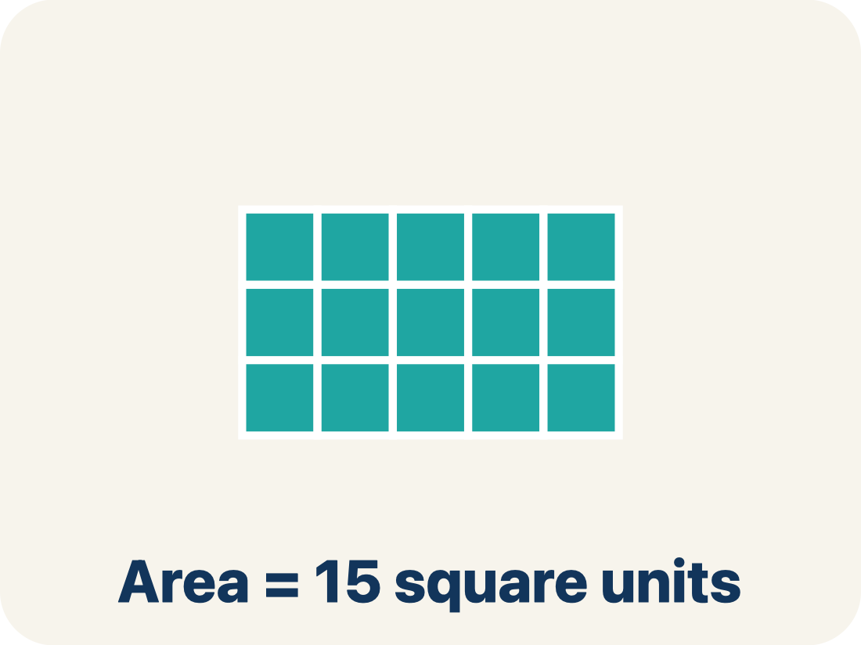
Vocabulary 8 of 10
Lesson 5-1 · Determine the Area of Parallelograms and Rhombuses
Area
How much space is inside a flat shape.
EXAMPLE · EXPLAIN WHY IT FITS
A 3 cm × 4 cm rectangle covers 12 square centimeters — imagine 12 tiny 1×1 squares inside it
Use “Area” to explain the example. Point to evidence.
eduwonderlab.com · Neft Teacher
15 / 66
Notes:
TEACH IN PRACTICE | Embedded facilitation | Lesson 5.1, slide 15 | VOCAB
Focus on the existing task: Vocabulary 8 of 10 Area How much space…
ASK (T1/3/5): Where does “Area” appear in the example? Explain the meaning without reading the definition. Partner: restate the idea and ask a clarifying question.
LOOK FOR: A correct connection between the word and a feature of the example. If the student only repeats the definition, invite pointing, sketching or oral rehearsal, then ask for another explanation of this same example.
PARTICIPATION (T5/6/7): Think time before volunteers; accept a written, drawn or rehearsed entry. Students ask for evidence respectfully. Recognize a specific contribution or revision and check that both partners participate.
Source: BCPS Updated Instructional Framework Rubric (June 2020), TEACH 1–7.

Slide 16
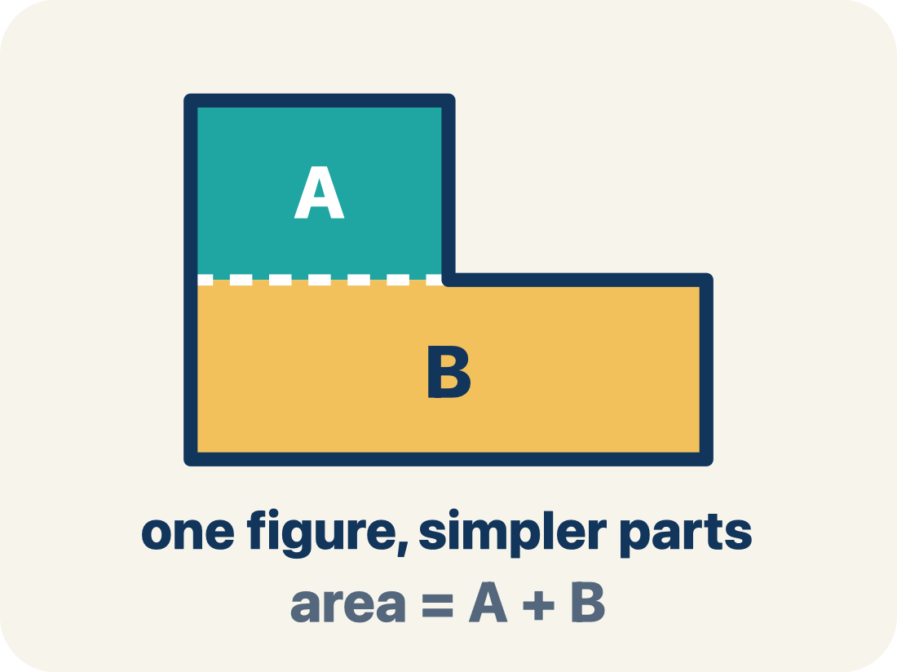
Vocabulary 9 of 10
Lesson 5-1 · Determine the Area of Parallelograms and Rhombuses
Composite figure
A shape made by putting two or more simple shapes together.
EXAMPLE · EXPLAIN WHY IT FITS
An L-shaped room = a 10×8 rectangle joined to a 4×5 rectangle; total area = 80 + 20 = 100 sq ft
Use “Composite figure” to explain the example. Point to
evidence.
eduwonderlab.com · Neft Teacher
16 / 66
Notes:
TEACH IN PRACTICE | Embedded facilitation | Lesson 5.1, slide 16 | VOCAB
Focus on the existing task: Vocabulary 9 of 10 Composite figure A…
ASK (T1/3/5): Where does “Composite figure” appear in the example? Explain the meaning without reading the definition. Partner: restate the idea and ask a clarifying question.
LOOK FOR: A correct connection between the word and a feature of the example. If the student only repeats the definition, invite pointing, sketching or oral rehearsal, then ask for another explanation of this same example.
PARTICIPATION (T5/6/7): Think time before volunteers; accept a written, drawn or rehearsed entry. Students ask for evidence respectfully. Recognize a specific contribution or revision and check that both partners participate.
Source: BCPS Updated Instructional Framework Rubric (June 2020), TEACH 1–7.

Slide 17
Vocabulary 10 of 10
Lesson 5-1 · Determine the Area of Parallelograms and Rhombuses
Formula
A math rule written with symbols.
EXAMPLE · EXPLAIN WHY IT FITS
A = b × h means Area equals base times height; for a parallelogram with b = 6 and h = 4, A = 24
Use “Formula” to explain the example. Point to evidence.
eduwonderlab.com · Neft Teacher
17 / 66
Notes:
TEACH IN PRACTICE | Embedded facilitation | Lesson 5.1, slide 17 | VOCAB
Focus on the existing task: Vocabulary 10 of 10 Formula A math rule…
ASK (T1/3/5): Where does “Formula” appear in the example? Explain the meaning without reading the definition. Partner: restate the idea and ask a clarifying question.
LOOK FOR: A correct connection between the word and a feature of the example. If the student only repeats the definition, invite pointing, sketching or oral rehearsal, then ask for another explanation of this same example.
PARTICIPATION (T5/6/7): Think time before volunteers; accept a written, drawn or rehearsed entry. Students ask for evidence respectfully. Recognize a specific contribution or revision and check that both partners participate.
Source: BCPS Updated Instructional Framework Rubric (June 2020), TEACH 1–7.

Slide 18
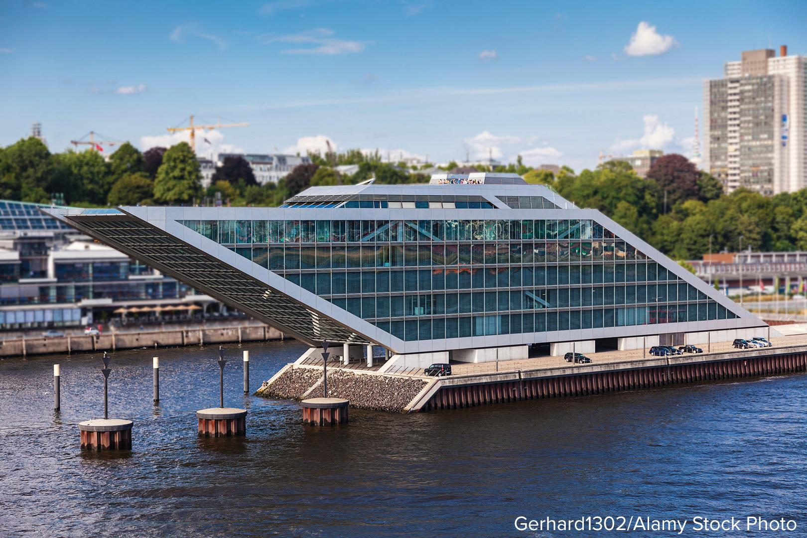

Be Curious
HOW DO YOU KNOW? · Ask your partner “How do you know?” Answer by pointing to your own work.
What do you notice?
What do you wonder?
Mindset
How can different ideas and viewpoints help you understand math better?
18 / 66
Notes:
TEACH IN PRACTICE | Embedded facilitation | Lesson 5.1, slide 18 | CURIOUS
Focus on the existing task: How can different ideas and viewpoints help you understand math better?
LAUNCH (T2/3/5): Allow quiet observation first. Separate a notice from an inference, invite students’ own questions, and follow the existing launch before teaching a procedure.
LOOK FOR (T4): Where this task addresses it, students can identify base and perpendicular height. Ask which feature of their work supports the claim.
RESPOND: If this task shows the lesson misconception—using a slanted side as the height—mark a right angle between the selected base and height on the original diagram. Have the student revise and explain the change. Use this support only where the concept occurs in the current task; otherwise respond to the displayed question.
RECHECK: If a gap is shared, revisit the existing representation together. If it is limited, give targeted support while others compare valid methods on the same task. Check the revision before moving on.
PARTICIPATION (T5/6/7): Think time before volunteers; accept a written, drawn or rehearsed entry. Students ask for evidence respectfully. Recognize a specific contribution or revision and check that both partners participate.
Source: BCPS Updated Instructional Framework Rubric (June 2020), TEACH 1–7.

Slide 19
Vocabulary
Lesson 5-1 · Determine the Area of Parallelograms and Rhombuses
Today’s Math Words
We learn every word — what it means and what it looks like — before we use it.
Area of Parallelograms
Slanted side
Parallelogram
The space inside a parallelogram
A side that leans instead of going straight up and down
A four-sided shape with two pairs of parallel sides
Parallel
Base
Height
Two lines or sides that stay the same distance apart and never meet
Any side of a parallelogram can be the base
The straight-up distance from the base to the top
Perpendicular
Area
Composite figure
Two lines that meet to make a square corner (90 degrees)
How much space is inside a flat shape
A shape made by putting two or more simple shapes together
Formula
Explain one math word using the example.
Partner: point to evidence.
A math rule written with symbols
eduwonderlab.com · Neft Teacher
19 / 66
Notes:
TEACH IN PRACTICE | Embedded facilitation | Lesson 5.1, slide 19 | VOCAB
Focus on the existing task: Vocabulary Today’s Math Words We learn…
ASK (T1/3/5): Where does “the displayed term” appear in the example? Explain the meaning without reading the definition. Partner: restate the idea and ask a clarifying question.
LOOK FOR: A correct connection between the word and a feature of the example. If the student only repeats the definition, invite pointing, sketching or oral rehearsal, then ask for another explanation of this same example.
PARTICIPATION (T5/6/7): Think time before volunteers; accept a written, drawn or rehearsed entry. Students ask for evidence respectfully. Recognize a specific contribution or revision and check that both partners participate.
Source: BCPS Updated Instructional Framework Rubric (June 2020), TEACH 1–7. Earlier notes and answer keys are retained below.
EARLIER NOTES / EXISTING ANSWER KEY
Choral-read each word, its meaning, and what it looks like.
Students should use these words out loud today — listen for them in partner talk and revoice student ideas with the academic term.
UIFR: TEACH 1 · TEACH 5.

Slide 20
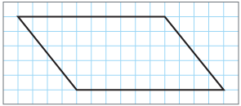
Parallelograms​
What is the area of the parallelogram shown?​
Think and record first. Which part of your work supports your answer?
20 / 66
Notes:
TEACH IN PRACTICE | Embedded facilitation | Lesson 5.1, slide 20 | TASK
Focus on the existing task: What is the area of the parallelogram shown?
LAUNCH (T2/3/5): Use the displayed question. Give private thinking time; then A explains while B asks for evidence. Switch roles. Each student records their own reasoning.
LOOK FOR (T4): Where this task addresses it, students can identify base and perpendicular height. Ask which feature of their work supports the claim.
RESPOND: If this task shows the lesson misconception—using a slanted side as the height—mark a right angle between the selected base and height on the original diagram. Have the student revise and explain the change. Use this support only where the concept occurs in the current task; otherwise respond to the displayed question.
RECHECK: If a gap is shared, revisit the existing representation together. If it is limited, give targeted support while others compare valid methods on the same task. Check the revision before moving on.
PARTICIPATION (T5/6/7): Think time before volunteers; accept a written, drawn or rehearsed entry. Students ask for evidence respectfully. Recognize a specific contribution or revision and check that both partners participate.
Source: BCPS Updated Instructional Framework Rubric (June 2020), TEACH 1–7. Earlier notes and answer keys are retained below.
EARLIER NOTES / EXISTING ANSWER KEY
Model briefly, then hand the thinking back: ask “Why does this step work?” before showing the next one.
Quick check before moving on — thumbs or whiteboards from everyone, not volunteers.
UIFR: TEACH 2 · TEACH 3 · TEACH 4.
UIFR FULL | Lesson-specific facilitation
TEACH 2-3 | Session 1 task launch (UIFR PDF pp. 9-10).
Use the problem exactly as displayed. Give individual thinking time before discussion or advancing to the explanation. If the answer is already visible, ask students to reconstruct and justify it. Invite a choice of suitable representations and have students explain why their choice helps.
At the point where this concept appears, ask: “Why does rearranging this parallelogram preserve area, and which segment is its height?” Wait for evidence, invite another pathway, and have a student ask a follow-up question. Do not replace students’ reasoning with a sequence of leading steps.

Slide 21
Parallelograms​
How can you use the grid to help you estimate the area?
Record your reasoning before the reveal.
Compare, then explain any revision.
Reveal:
We can count the whole squares inside the shape. We can approximate the number of whole squares that can be created from the partial squares. And then add the two amounts together.
21 / 66
Notes:
TEACH IN PRACTICE | Embedded facilitation | Lesson 5.1, slide 21 | REVEAL
Focus on the existing task: How can you use the grid to help you estimate the area?
LAUNCH (T2/3/5): If an existing answer cover is present, gather an attempt before revealing. If the explanation is already visible, ask students to reconstruct and justify it. Compare reasoning and explain a revision; preserve the reveal sequence.
LOOK FOR (T4): Where this task addresses it, students can identify base and perpendicular height. Ask which feature of their work supports the claim.
RESPOND: If this task shows the lesson misconception—using a slanted side as the height—mark a right angle between the selected base and height on the original diagram. Have the student revise and explain the change. Use this support only where the concept occurs in the current task; otherwise respond to the displayed question.
RECHECK: If a gap is shared, revisit the existing representation together. If it is limited, give targeted support while others compare valid methods on the same task. Check the revision before moving on.
PARTICIPATION (T5/6/7): Think time before volunteers; accept a written, drawn or rehearsed entry. Students ask for evidence respectfully. Recognize a specific contribution or revision and check that both partners participate.
Source: BCPS Updated Instructional Framework Rubric (June 2020), TEACH 1–7. Earlier notes and answer keys are retained below.
EARLIER NOTES / EXISTING ANSWER KEY
Do not click yet: collect 2–3 student answers with reasons first.
Then click to remove the cover and have students compare their thinking to the reveal — “Is this what we said? Where is it different?”
Behind the cover: We can count the whole squares inside the shape. We can approximate the number of whole squares that can be created from the partial squares. And then add the two amounts together.
UIFR: TEACH 3 · TEACH 4.

Slide 22
Parallelograms​
How can you decompose the parallelogram into other shapes that you know?
Record your reasoning before the reveal. Compare, then explain any revision.
Reveal:
We can decompose the parallelogram into a rectangle and two triangles.
22 / 66
Notes:
TEACH IN PRACTICE | Embedded facilitation | Lesson 5.1, slide 22 | REVEAL
Focus on the existing task: How can you decompose the parallelogram into other shapes that you know?
LAUNCH (T2/3/5): If an existing answer cover is present, gather an attempt before revealing. If the explanation is already visible, ask students to reconstruct and justify it. Compare reasoning and explain a revision; preserve the reveal sequence.
LOOK FOR (T4): Where this task addresses it, students can identify base and perpendicular height. Ask which feature of their work supports the claim.
RESPOND: If this task shows the lesson misconception—using a slanted side as the height—mark a right angle between the selected base and height on the original diagram. Have the student revise and explain the change. Use this support only where the concept occurs in the current task; otherwise respond to the displayed question.
RECHECK: If a gap is shared, revisit the existing representation together. If it is limited, give targeted support while others compare valid methods on the same task. Check the revision before moving on.
PARTICIPATION (T5/6/7): Think time before volunteers; accept a written, drawn or rehearsed entry. Students ask for evidence respectfully. Recognize a specific contribution or revision and check that both partners participate.
Source: BCPS Updated Instructional Framework Rubric (June 2020), TEACH 1–7. Earlier notes and answer keys are retained below.
EARLIER NOTES / EXISTING ANSWER KEY
Do not click yet: collect 2–3 student answers with reasons first.
Then click to remove the cover and have students compare their thinking to the reveal — “Is this what we said? Where is it different?”
Behind the cover: We can decompose the parallelogram into a rectangle and two triangles.
UIFR: TEACH 3 · TEACH 4.

Slide 23
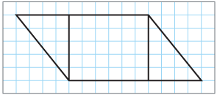
Parallelograms​
We can decompose the parallelogram into a rectangle and two triangles.
Try first. Point to a base and its matching height. Explain how your method uses them.
Think About It:
How have you determined the area of composite shapes in the past?
23 / 66
Notes:
TEACH IN PRACTICE | Embedded facilitation | Lesson 5.1, slide 23 | TASK
Focus on the existing task: Think About It: How have you determined the area of composite shapes in the past?
LAUNCH (T2/3/5): Use the displayed question. Give private thinking time; then A explains while B asks for evidence. Switch roles. Each student records their own reasoning.
LOOK FOR (T4): Where this task addresses it, students can identify base and perpendicular height. Ask which feature of their work supports the claim.
RESPOND: If this task shows the lesson misconception—using a slanted side as the height—mark a right angle between the selected base and height on the original diagram. Have the student revise and explain the change. Use this support only where the concept occurs in the current task; otherwise respond to the displayed question.
RECHECK: If a gap is shared, revisit the existing representation together. If it is limited, give targeted support while others compare valid methods on the same task. Check the revision before moving on.
PARTICIPATION (T5/6/7): Think time before volunteers; accept a written, drawn or rehearsed entry. Students ask for evidence respectfully. Recognize a specific contribution or revision and check that both partners participate.
Source: BCPS Updated Instructional Framework Rubric (June 2020), TEACH 1–7. Earlier notes and answer keys are retained below.
EARLIER NOTES / EXISTING ANSWER KEY
Ask the question, then hold the silence — students think or jot before anyone answers.
Take two or three responses and press with “Why?” or “How do you know?” before moving on.
UIFR: TEACH 3.

Slide 24
Parallelograms​
We can decompose the parallelogram into a rectangle and two triangles.
How can you use the shapes to compose a single shape that you know how to find the area of?
Record your reasoning before the reveal. Compare, then explain any revision.
Reveal:
We can compose the shapes into a rectangle. We can move the triangle on the left to the other side.
24 / 66
Notes:
TEACH IN PRACTICE | Embedded facilitation | Lesson 5.1, slide 24 | REVEAL
Focus on the existing task: Reveal: We can compose the shapes into a rectangle. We can move the triangle on the left to the other side. We can decompose the…
LAUNCH (T2/3/5): If an existing answer cover is present, gather an attempt before revealing. If the explanation is already visible, ask students to reconstruct and justify it. Compare reasoning and explain a revision; preserve the reveal sequence.
LOOK FOR (T4): Where this task addresses it, students can identify base and perpendicular height. Ask which feature of their work supports the claim.
RESPOND: If this task shows the lesson misconception—using a slanted side as the height—mark a right angle between the selected base and height on the original diagram. Have the student revise and explain the change. Use this support only where the concept occurs in the current task; otherwise respond to the displayed question.
RECHECK: If a gap is shared, revisit the existing representation together. If it is limited, give targeted support while others compare valid methods on the same task. Check the revision before moving on.
PARTICIPATION (T5/6/7): Think time before volunteers; accept a written, drawn or rehearsed entry. Students ask for evidence respectfully. Recognize a specific contribution or revision and check that both partners participate.
Source: BCPS Updated Instructional Framework Rubric (June 2020), TEACH 1–7. Earlier notes and answer keys are retained below.
EARLIER NOTES / EXISTING ANSWER KEY
Do not click yet: collect 2–3 student answers with reasons first.
Then click to remove the cover and have students compare their thinking to the reveal — “Is this what we said? Where is it different?”
Behind the cover: We can compose the shapes into a rectangle. We can move the triangle on the left to the other side.
UIFR: TEACH 3 · TEACH 4.

Slide 25
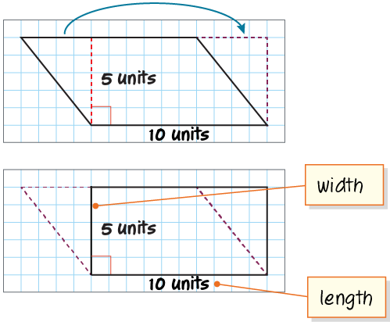
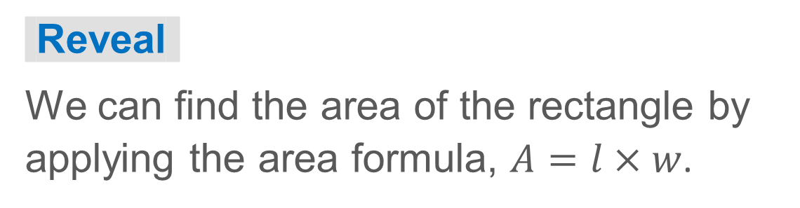
Parallelograms​
Let’s compose the parallelogram into a rectangle.
How can you find the area of the rectangle?
TRY IT BEFORE YOU’RE SURE · Start even if you are not sure. A revised answer counts as much as a first-try answer.
25 / 66
Notes:
TEACH IN PRACTICE | Embedded facilitation | Lesson 5.1, slide 25 | TASK
Focus on the existing task: Let’s compose the parallelogram into a rectangle. How can you find the area of the rectangle?
LAUNCH (T2/3/5): Use the displayed question. Give private thinking time; then A explains while B asks for evidence. Switch roles. Each student records their own reasoning.
LOOK FOR (T4): Where this task addresses it, students can identify base and perpendicular height. Ask which feature of their work supports the claim.
RESPOND: If this task shows the lesson misconception—using a slanted side as the height—mark a right angle between the selected base and height on the original diagram. Have the student revise and explain the change. Use this support only where the concept occurs in the current task; otherwise respond to the displayed question.
RECHECK: If a gap is shared, revisit the existing representation together. If it is limited, give targeted support while others compare valid methods on the same task. Check the revision before moving on.
PARTICIPATION (T5/6/7): Think time before volunteers; accept a written, drawn or rehearsed entry. Students ask for evidence respectfully. Recognize a specific contribution or revision and check that both partners participate.
Source: BCPS Updated Instructional Framework Rubric (June 2020), TEACH 1–7. Earlier notes and answer keys are retained below.
EARLIER NOTES / EXISTING ANSWER KEY
Model briefly, then hand the thinking back: ask “Why does this step work?” before showing the next one.
Quick check before moving on — thumbs or whiteboards from everyone, not volunteers.
UIFR: TEACH 2 · TEACH 3 · TEACH 4.

Slide 26
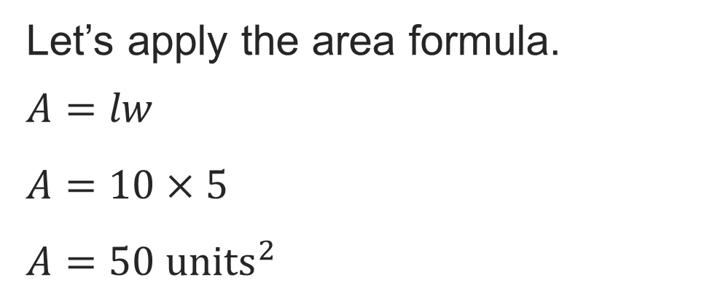
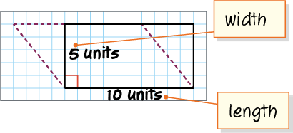
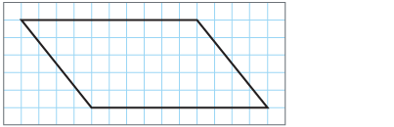
Parallelograms​
How does the area of the rectangle relate to the area of the original parallelogram?
Reveal:
The areas are the same because we did not change the size of the figure, just its shape.
26 / 66
Notes:
TEACH IN PRACTICE | Embedded facilitation | Lesson 5.1, slide 26 | REVEAL
Focus on the existing task: Reveal: The areas are the same because we did not change the size of the figure, just its shape. How does the area of the rectangle relate to the area of the original parallelogram?
LAUNCH (T2/3/5): If an existing answer cover is present, gather an attempt before revealing. If the explanation is already visible, ask students to reconstruct and justify it. Compare reasoning and explain a revision; preserve the reveal sequence.
LOOK FOR (T4): Where this task addresses it, students can identify base and perpendicular height. Ask which feature of their work supports the claim.
RESPOND: If this task shows the lesson misconception—using a slanted side as the height—mark a right angle between the selected base and height on the original diagram. Have the student revise and explain the change. Use this support only where the concept occurs in the current task; otherwise respond to the displayed question.
RECHECK: If a gap is shared, revisit the existing representation together. If it is limited, give targeted support while others compare valid methods on the same task. Check the revision before moving on.
PARTICIPATION (T5/6/7): Think time before volunteers; accept a written, drawn or rehearsed entry. Students ask for evidence respectfully. Recognize a specific contribution or revision and check that both partners participate.
Source: BCPS Updated Instructional Framework Rubric (June 2020), TEACH 1–7. Earlier notes and answer keys are retained below.
EARLIER NOTES / EXISTING ANSWER KEY
Do not click yet: collect 2–3 student answers with reasons first.
Then click to remove the cover and have students compare their thinking to the reveal — “Is this what we said? Where is it different?”
Behind the cover: The areas are the same because we did not change the size of the figure, just its shape.
UIFR: TEACH 3 · TEACH 4.

Slide 27
STUDENT MOVES
Lesson 5-1
Your move
TWO MINUTES SOLO · Two minutes on your own, then compare. Bring one thing you tried, even if it did not work.
27 / 66

Slide 28
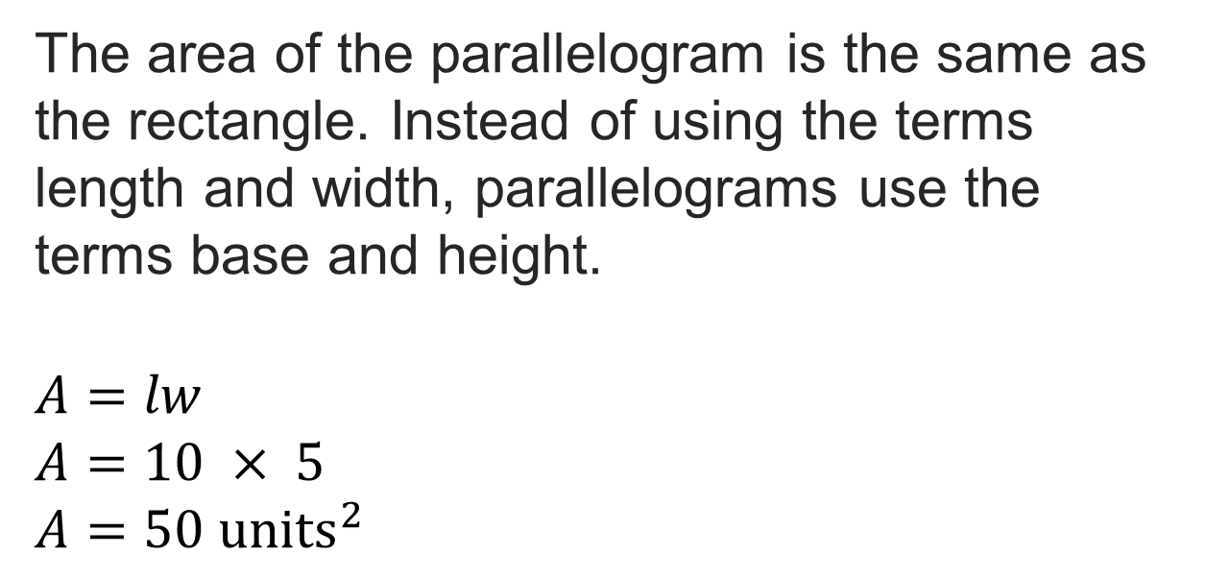
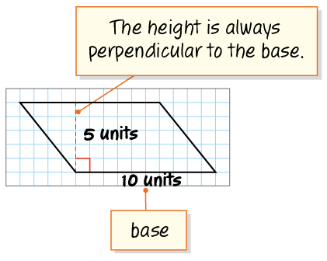
Parallelograms​
USE THE MATH WORDS · Use today’s math words in your explanation — not “it” and “that thing.”
Persevering
How could you check your answer?
28 / 66
Notes:
TEACH IN PRACTICE | Embedded facilitation | Lesson 5.1, slide 27 | TASK
Focus on the existing task: How could you check your answer?
LAUNCH (T2/3/5): Use the displayed question. Give private thinking time; then A explains while B asks for evidence. Switch roles. Each student records their own reasoning.
LOOK FOR (T4): Where this task addresses it, students can identify base and perpendicular height. Ask which feature of their work supports the claim.
RESPOND: If this task shows the lesson misconception—using a slanted side as the height—mark a right angle between the selected base and height on the original diagram. Have the student revise and explain the change. Use this support only where the concept occurs in the current task; otherwise respond to the displayed question.
RECHECK: If a gap is shared, revisit the existing representation together. If it is limited, give targeted support while others compare valid methods on the same task. Check the revision before moving on.
PARTICIPATION (T5/6/7): Think time before volunteers; accept a written, drawn or rehearsed entry. Students ask for evidence respectfully. Recognize a specific contribution or revision and check that both partners participate.
Source: BCPS Updated Instructional Framework Rubric (June 2020), TEACH 1–7. Earlier notes and answer keys are retained below.
EARLIER NOTES / EXISTING ANSWER KEY
Model briefly, then hand the thinking back: ask “Why does this step work?” before showing the next one.
Quick check before moving on — thumbs or whiteboards from everyone, not volunteers.
UIFR: TEACH 2 · TEACH 3 · TEACH 4.

Slide 29

Parallelograms​
How can you use this information to determine a formula for the area of a parallelogram?
29 / 66
Notes:
TEACH IN PRACTICE | Embedded facilitation | Lesson 5.1, slide 28 | TASK
Focus on the existing task: How can you use this information to determine a formula for the area of a parallelogram?
LAUNCH (T2/3/5): Use the displayed question. Give private thinking time; then A explains while B asks for evidence. Switch roles. Each student records their own reasoning.
LOOK FOR (T4): Where this task addresses it, students can identify base and perpendicular height. Ask which feature of their work supports the claim.
RESPOND: If this task shows the lesson misconception—using a slanted side as the height—mark a right angle between the selected base and height on the original diagram. Have the student revise and explain the change. Use this support only where the concept occurs in the current task; otherwise respond to the displayed question.
RECHECK: If a gap is shared, revisit the existing representation together. If it is limited, give targeted support while others compare valid methods on the same task. Check the revision before moving on.
PARTICIPATION (T5/6/7): Think time before volunteers; accept a written, drawn or rehearsed entry. Students ask for evidence respectfully. Recognize a specific contribution or revision and check that both partners participate.
Source: BCPS Updated Instructional Framework Rubric (June 2020), TEACH 1–7. Earlier notes and answer keys are retained below.
EARLIER NOTES / EXISTING ANSWER KEY
Model briefly, then hand the thinking back: ask “Why does this step work?” before showing the next one.
Quick check before moving on — thumbs or whiteboards from everyone, not volunteers.
UIFR: TEACH 2 · TEACH 3 · TEACH 4.

Slide 30
STUDENT MOVES
Lesson 5-1
Your move
HOW DO YOU KNOW? · Ask your partner “How do you know?” Answer by pointing to your own work.
30 / 66

Slide 31
Parallelograms​
We can use the relationship between the length of the rectangle and the base of the parallelogram, and the relationship between the width of the rectangle and the height of the rectangle to derive a formula for the area of a parallelogram.
Explain how the information shown supports your reasoning.
31 / 66
Notes:
TEACH IN PRACTICE | Embedded facilitation | Lesson 5.1, slide 29 | WORKED
Focus on the existing task: We can use the relationship between the length of the rectangle and the base of the parallelogram, and the relationship between the width…
LAUNCH (T2/3/5): Ask students to explain the displayed idea or example and point to evidence. When a calculation step is shown, ask why it is valid. Have a partner restate the explanation; copying is not the check.
LOOK FOR (T4): Where this task addresses it, students can identify base and perpendicular height. Ask which feature of their work supports the claim.
RESPOND: If this task shows the lesson misconception—using a slanted side as the height—mark a right angle between the selected base and height on the original diagram. Have the student revise and explain the change. Use this support only where the concept occurs in the current task; otherwise respond to the displayed question.
RECHECK: If a gap is shared, revisit the existing representation together. If it is limited, give targeted support while others compare valid methods on the same task. Check the revision before moving on.
PARTICIPATION (T5/6/7): Think time before volunteers; accept a written, drawn or rehearsed entry. Students ask for evidence respectfully. Recognize a specific contribution or revision and check that both partners participate.
Source: BCPS Updated Instructional Framework Rubric (June 2020), TEACH 1–7. Earlier notes and answer keys are retained below.
EARLIER NOTES / EXISTING ANSWER KEY
Model briefly, then hand the thinking back: ask “Why does this step work?” before showing the next one.
Quick check before moving on — thumbs or whiteboards from everyone, not volunteers.
UIFR: TEACH 2 · TEACH 3 · TEACH 4.

Slide 32

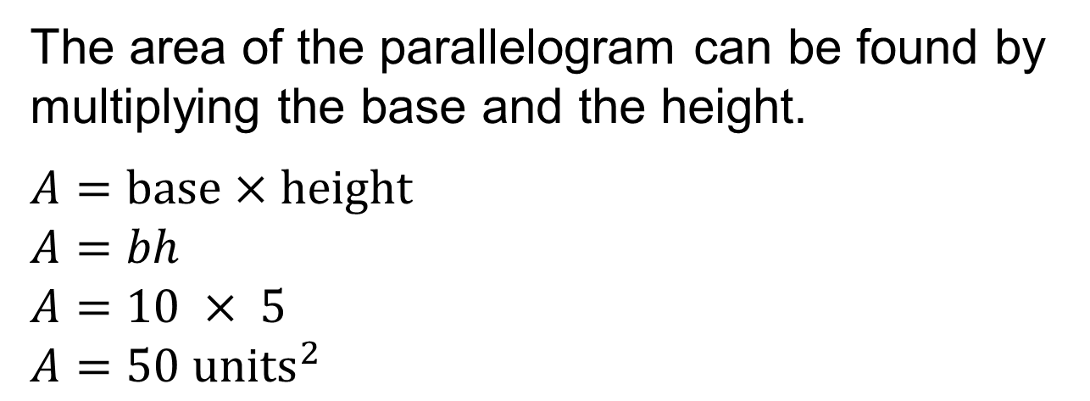
COLLABORATE · TALK IT THROUGH • AGREE ON A MODEL
Collaborate and Connect
How can you use grid paper to confirm the area of the parallelogram found using the formula?
Reveal:
When we made the parallelogram into a rectangle, it resulted in 50 whole squares, or 50 square units, which matches the formula.
32 / 66
Notes:
TEACH IN PRACTICE | Embedded facilitation | Lesson 5.1, slide 30 | COLLABORATE
Focus on the existing task: Collaborate and Connect How can you use grid paper to confirm the area of the parallelogram found using the formula?
LAUNCH (T2/3/5): Use the displayed question. Give private thinking time; then A explains while B asks for evidence. Switch roles. Each student records their own reasoning.
LOOK FOR (T4): Where this task addresses it, students can label square units. Ask which feature of their work supports the claim.
RESPOND: If this task shows the lesson misconception—using a slanted side as the height—mark a right angle between the selected base and height on the original diagram. Have the student revise and explain the change. Use this support only where the concept occurs in the current task; otherwise respond to the displayed question.
RECHECK: If a gap is shared, revisit the existing representation together. If it is limited, give targeted support while others compare valid methods on the same task. Check the revision before moving on.
PARTICIPATION (T5/6/7): Think time before volunteers; accept a written, drawn or rehearsed entry. Students ask for evidence respectfully. Recognize a specific contribution or revision and check that both partners participate.
Source: BCPS Updated Instructional Framework Rubric (June 2020), TEACH 1–7. Earlier notes and answer keys are retained below.
EARLIER NOTES / EXISTING ANSWER KEY
Routine: COLLABORATE · TALK IT THROUGH • AGREE ON A MODEL
UIFR FULL | Lesson-specific facilitation
TEACH 4-5 | Session 1 discussion and checkpoint (UIFR PDF pp. 11-12).
Collect a brief response from every student to the existing prompt before hearing volunteers. Partners take turns explaining and asking for evidence: “I understand ___; what supports ___?” Offer rehearsal or an annotated model for students who need language support. Each student records their own reasoning.
Look specifically for: using a slanted side as the height. If it appears, mark a right angle between the selected base and height on the original diagram; then ask the student to revise the same response and explain the change. If evidence is secure, have students compare a second valid pathway or state why their approach works. Choose the next step from the responses, not a preset pace.

Slide 33
STUDENT MOVES
Lesson 5-1
Your move
ADD ON · Add on: “I agree because ______.” or “I see it differently because ______.”
33 / 66

Slide 34
Parallelograms​
What is the area of the parallelogram shown?
The area of the parallelogram is 50 square units.
Think and record first. Which part of your work supports your answer?
34 / 66
Notes:
TEACH IN PRACTICE | Embedded facilitation | Lesson 5.1, slide 31 | TASK
Focus on the existing task: What is the area of the parallelogram shown?
LAUNCH (T2/3/5): Use the displayed question. Give private thinking time; then A explains while B asks for evidence. Switch roles. Each student records their own reasoning.
LOOK FOR (T4): Where this task addresses it, students can label square units. Ask which feature of their work supports the claim.
RESPOND: If this task shows the lesson misconception—using a slanted side as the height—mark a right angle between the selected base and height on the original diagram. Have the student revise and explain the change. Use this support only where the concept occurs in the current task; otherwise respond to the displayed question.
RECHECK: If a gap is shared, revisit the existing representation together. If it is limited, give targeted support while others compare valid methods on the same task. Check the revision before moving on.
PARTICIPATION (T5/6/7): Think time before volunteers; accept a written, drawn or rehearsed entry. Students ask for evidence respectfully. Recognize a specific contribution or revision and check that both partners participate.
Source: BCPS Updated Instructional Framework Rubric (June 2020), TEACH 1–7. Earlier notes and answer keys are retained below.
EARLIER NOTES / EXISTING ANSWER KEY
Model briefly, then hand the thinking back: ask “Why does this step work?” before showing the next one.
Quick check before moving on — thumbs or whiteboards from everyone, not volunteers.
UIFR: TEACH 2 · TEACH 3 · TEACH 4.

Slide 35
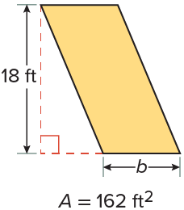
Let’s Explore More
How can you use the given area to find the unknown dimension of the parallelogram?
Workspace
35 / 66
Notes:
TEACH IN PRACTICE | Embedded facilitation | Lesson 5.1, slide 32 | PRACTICE
Focus on the existing task: Workspace How can you use the given area to find the unknown dimension of the parallelogram?
LAUNCH (T2/3/5): Use the displayed question. Give private thinking time; then A explains while B asks for evidence. Switch roles. Each student records their own reasoning.
LOOK FOR (T4): Where this task addresses it, students can identify base and perpendicular height. Ask which feature of their work supports the claim.
RESPOND: If this task shows the lesson misconception—using a slanted side as the height—mark a right angle between the selected base and height on the original diagram. Have the student revise and explain the change. Use this support only where the concept occurs in the current task; otherwise respond to the displayed question.
RECHECK: If a gap is shared, revisit the existing representation together. If it is limited, give targeted support while others compare valid methods on the same task. Check the revision before moving on.
PARTICIPATION (T5/6/7): Think time before volunteers; accept a written, drawn or rehearsed entry. Students ask for evidence respectfully. Recognize a specific contribution or revision and check that both partners participate.
Source: BCPS Updated Instructional Framework Rubric (June 2020), TEACH 1–7. Earlier notes and answer keys are retained below.
EARLIER NOTES / EXISTING ANSWER KEY
Extension for partners or table groups — students choose their approach and use the workspace to show thinking.
Push with “Convince me,” and have two groups with different approaches share.
This is where students stretch past the worked example.
UIFR: TEACH 2 · TEACH 5.

Slide 36
STUDENT MOVES
Lesson 5-1
Your move
YOUR CHOICE · You choose how to show this — numbers, words, or a diagram. Make your reasoning visible.
36 / 66

Slide 37
LESSON 5.1 / DISCUSS THE TASK
Explain and compare
Use the task you just explored.
TAKE TURNS
Why does rearranging this parallelogram preserve area, and which segment is its height?
Explain
“I know this because…”
Ask
“Where does your work show that?”
Point to evidence in your work.
Then compare your approach with a partner’s.
JUSTIFY IT · Say it like this: “I know ______ because ______.”
Listen to understand. Ask for evidence. Make room for every voice.
Notes:
TEACH IN PRACTICE | Embedded facilitation | Lesson 5.1, slide 33 | PRIOR_INSERT
Focus on the existing task: Point to evidence in your work. Then compare your approach with a partner’s. TAKE TURNS Explain “I know this because…” Ask “Where does your work show that?
CONNECT (T1/4): Ask students to restate the displayed goal or key idea and connect it to earlier work. Relevant lesson evidence: identify base and perpendicular height; connect rearrangement to base times height; label square units. Use only the criterion that matches the current session.
SHOW PROGRESS: Students point to their own existing work, explain what improved after feedback, and name a next step. Pair confidence ratings with actual evidence.
PARTICIPATION (T5/6/7): Think time before volunteers; accept a written, drawn or rehearsed entry. Students ask for evidence respectfully. Recognize a specific contribution or revision and check that both partners participate.
Source: BCPS Updated Instructional Framework Rubric (June 2020), TEACH 1–7.

Slide 38
Parallelograms​
How can you use the grid to help you estimate the area?
Compare your reasoning with the
explanation. Explain any revision you make.
Reveal:
We can count the whole squares inside the shape. We can approximate the number of whole squares that can be created from the partial squares. And then add the two amounts together.
38 / 66
Notes:
TEACH IN PRACTICE | Embedded facilitation | Lesson 5.1, slide 34 | REVEAL
Focus on the existing task: How can you use the grid to help you estimate the area?
LAUNCH (T2/3/5): If an existing answer cover is present, gather an attempt before revealing. If the explanation is already visible, ask students to reconstruct and justify it. Compare reasoning and explain a revision; preserve the reveal sequence.
LOOK FOR (T4): Where this task addresses it, students can identify base and perpendicular height. Ask which feature of their work supports the claim.
RESPOND: If this task shows the lesson misconception—using a slanted side as the height—mark a right angle between the selected base and height on the original diagram. Have the student revise and explain the change. Use this support only where the concept occurs in the current task; otherwise respond to the displayed question.
RECHECK: If a gap is shared, revisit the existing representation together. If it is limited, give targeted support while others compare valid methods on the same task. Check the revision before moving on.
PARTICIPATION (T5/6/7): Think time before volunteers; accept a written, drawn or rehearsed entry. Students ask for evidence respectfully. Recognize a specific contribution or revision and check that both partners participate.
Source: BCPS Updated Instructional Framework Rubric (June 2020), TEACH 1–7.

Slide 39
Parallelograms​
How can you decompose the parallelogram into other shapes that you know?
Compare your reasoning with the explanation. Explain any revision you make.
Reveal:
We can decompose the parallelogram into a rectangle and two triangles.
39 / 66
Notes:
TEACH IN PRACTICE | Embedded facilitation | Lesson 5.1, slide 35 | REVEAL
Focus on the existing task: How can you decompose the parallelogram into other shapes that you know?
LAUNCH (T2/3/5): If an existing answer cover is present, gather an attempt before revealing. If the explanation is already visible, ask students to reconstruct and justify it. Compare reasoning and explain a revision; preserve the reveal sequence.
LOOK FOR (T4): Where this task addresses it, students can identify base and perpendicular height. Ask which feature of their work supports the claim.
RESPOND: If this task shows the lesson misconception—using a slanted side as the height—mark a right angle between the selected base and height on the original diagram. Have the student revise and explain the change. Use this support only where the concept occurs in the current task; otherwise respond to the displayed question.
RECHECK: If a gap is shared, revisit the existing representation together. If it is limited, give targeted support while others compare valid methods on the same task. Check the revision before moving on.
PARTICIPATION (T5/6/7): Think time before volunteers; accept a written, drawn or rehearsed entry. Students ask for evidence respectfully. Recognize a specific contribution or revision and check that both partners participate.
Source: BCPS Updated Instructional Framework Rubric (June 2020), TEACH 1–7.

Slide 40

Be Curious
ANOTHER PATHWAY · Did anyone get there a different way? Put both pathways side by side and compare.
What do you notice?
What do you wonder?
Mindset
How are different ideas and viewpoints helping you understand math better?
40 / 66
Notes:
TEACH IN PRACTICE | Embedded facilitation | Lesson 5.1, slide 36 | CURIOUS
Focus on the existing task: How are different ideas and viewpoints helping you understand math better?
LAUNCH (T2/3/5): Allow quiet observation first. Separate a notice from an inference, invite students’ own questions, and follow the existing launch before teaching a procedure.
LOOK FOR (T4): Where this task addresses it, students can identify base and perpendicular height. Ask which feature of their work supports the claim.
RESPOND: If this task shows the lesson misconception—using a slanted side as the height—mark a right angle between the selected base and height on the original diagram. Have the student revise and explain the change. Use this support only where the concept occurs in the current task; otherwise respond to the displayed question.
RECHECK: If a gap is shared, revisit the existing representation together. If it is limited, give targeted support while others compare valid methods on the same task. Check the revision before moving on.
PARTICIPATION (T5/6/7): Think time before volunteers; accept a written, drawn or rehearsed entry. Students ask for evidence respectfully. Recognize a specific contribution or revision and check that both partners participate.
Source: BCPS Updated Instructional Framework Rubric (June 2020), TEACH 1–7.

Slide 41
Warm-Up
Lesson 5-1 · Determine the Area of Parallelograms and Rhombuses
Session 2 Warm-Up
Try alone. Explain one. Then revise.
1
Which formula gives the area of a parallelogram?
2
A parallelogram has base 8 cm and height 5 cm. What is its area?
A
A = b + h
B
A = b × h
A
13 cm²
B
26 cm²
C
A = ½ b × h
D
A = 2(b + h)
C
40 cm²
D
40 cm³
3
Which height is used in A = b × h?
4
A parallelogram has base 12 in and height 3 in. Its area is:
A
Slanted side
B
Perpendicular
A
15 in²
B
36 in²
C
Longest side
D
Any side
C
36 in³
D
18 in²
eduwonderlab.com · Neft Teacher
41 / 66
Notes:
TEACH IN PRACTICE | Embedded facilitation | Lesson 5.1, slide 37 | WARMUP
Focus on the existing task: A A = b + h B A = b × h C A = ½ b × h D A = 2(b + h) 2 A parallelogram has base 8 cm and height 5 cm. What is its area?
GATHER EVIDENCE (T4/6): Keep the original items. Students try independently, mark an uncertain item, and explain one method before checking. Use the existing key when present.
RESPOND: Distinguish a calculation slip from a reasoning gap. Give one next step on the same item; have students revise in a second color. Use the responses to choose flexible support for today’s lesson.
PARTICIPATION (T5/6/7): Think time before volunteers; accept a written, drawn or rehearsed entry. Students ask for evidence respectfully. Recognize a specific contribution or revision and check that both partners participate.
Source: BCPS Updated Instructional Framework Rubric (June 2020), TEACH 1–7. Earlier notes and answer keys are retained below.
EARLIER NOTES / EXISTING ANSWER KEY
Warm-up routine: students start silently on entry; keep it to about 4 minutes.
Circulate and note who is stuck — use what you see to choose who you check on first today.
Go over answers quickly; ask one student to explain a step, not just say the answer.
UIFR: TEACH 4 · TEACH 6.

Slide 42
STUDENT MOVES
Lesson 5-1
Your move
YOU KNOW THE ROUTINE · Read → plan → solve → check. Do all four, in that order.
42 / 66

Slide 43
Review Notes — Session 2
Lesson 5-1 · Determine the Area of Parallelograms and Rhombuses
Session 2: Review Notes
Copy. Explain. Check.
WHY IT MATTERS · Finish this: “This is worth knowing because ______.”
Parallelogram Area
1
Area = base × height (A = bh). Decomposing and rearranging forms a rectangle.
Perpendicular Height
2
Height must always form a 90° right angle with the chosen base, not the slanted side.
Rhombus Attributes
3
A rhombus is a parallelogram with 4 congruent sides; area is also base × height.
eduwonderlab.com · Neft Teacher
43 / 66
Notes:
TEACH IN PRACTICE | Embedded facilitation | Lesson 5.1, slide 38 | NOTES
Focus on the existing task: Review Notes — Session 2 Session 2…
ROUTINE (T1/2/4): Read or copy the original notes, cover one line, and explain it using the displayed example. Reopen and correct. Copying alone is not evidence of understanding.
LOOK FOR: A link between a symbol, quantity or feature and the explanation. If missing, point back to that feature and have the student try again; fade the prompt once they can explain.
PARTICIPATION (T5/6/7): Think time before volunteers; accept a written, drawn or rehearsed entry. Students ask for evidence respectfully. Recognize a specific contribution or revision and check that both partners participate.
Source: BCPS Updated Instructional Framework Rubric (June 2020), TEACH 1–7. Earlier notes and answer keys are retained below.
EARLIER NOTES / EXISTING ANSWER KEY
Copy routine: read one line at a time; students copy, then explain that line to a partner.
Keep it brisk — the understanding work happens in the examples, not the copying.
UIFR: TEACH 1 · TEACH 6.

Slide 44
Session 2
Determine the Area of
Parallelograms and Rhombuses​
SELF-CHECK · Mark it: ✓ got it · ~ almost · ? stuck. Then fix one thing before we move on.
44 / 66
Notes:
TEACH IN PRACTICE | Embedded facilitation | Lesson 5.1, slide 39 | DIVIDER
Focus on the existing task: Session 2 Determine the Area of Parallelograms and Rhombuses
TRANSITION (T6/7): Students confirm materials, roles, how to request help, and the next response routine. Ask a student to restate it. Keep teacher-only slides hidden.
PARTICIPATION (T5/6/7): Think time before volunteers; accept a written, drawn or rehearsed entry. Students ask for evidence respectfully. Recognize a specific contribution or revision and check that both partners participate.
Source: BCPS Updated Instructional Framework Rubric (June 2020), TEACH 1–7. Earlier notes and answer keys are retained below.
EARLIER NOTES / EXISTING ANSWER KEY
Transition cue: state what materials are out and what success looks like this session.
Keep the changeover under a minute.
UIFR: TEACH 6.

Slide 45
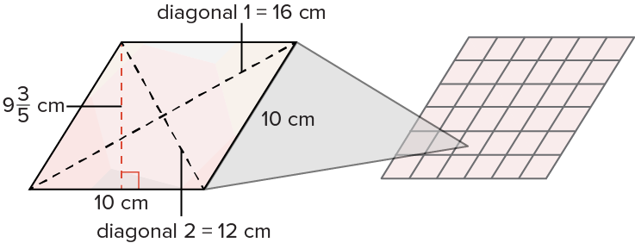
Tiling a Backsplash
The wall tile shown has the shape of a rhombus, a parallelogram with four equal sides. The dimensions of the tile are shown.
What is the area of the tile?
Think and record first. Which part of your work supports your answer?
Think About It:
45 / 66
Notes:
TEACH IN PRACTICE | Embedded facilitation | Lesson 5.1, slide 40 | TASK
Focus on the existing task: The wall tile shown has the shape of a rhombus, a parallelogram with four equal sides. The dimensions of the tile are shown. What is the area of the tile?
LAUNCH (T2/3/5): Use the displayed question. Give private thinking time; then A explains while B asks for evidence. Switch roles. Each student records their own reasoning.
LOOK FOR (T4): Where this task addresses it, students can identify base and perpendicular height. Ask which feature of their work supports the claim.
RESPOND: If this task shows the lesson misconception—using a slanted side as the height—mark a right angle between the selected base and height on the original diagram. Have the student revise and explain the change. Use this support only where the concept occurs in the current task; otherwise respond to the displayed question.
RECHECK: If a gap is shared, revisit the existing representation together. If it is limited, give targeted support while others compare valid methods on the same task. Check the revision before moving on.
PARTICIPATION (T5/6/7): Think time before volunteers; accept a written, drawn or rehearsed entry. Students ask for evidence respectfully. Recognize a specific contribution or revision and check that both partners participate.
Source: BCPS Updated Instructional Framework Rubric (June 2020), TEACH 1–7. Earlier notes and answer keys are retained below.
EARLIER NOTES / EXISTING ANSWER KEY
Ask the question, then hold the silence — students think or jot before anyone answers.
Take two or three responses and press with “Why?” or “How do you know?” before moving on.
UIFR: TEACH 3.

Slide 46
Tiling a Backsplash
The wall tile shown has the shape of a rhombus, a parallelogram with four equal sides. The dimensions of the tile are shown.
What is the area of the tile?
STRUGGLE FIRST · Work on your own first. Stuck is allowed — try a second strategy before you ask.
Think About It:
What attributes do a parallelogram and rhombus share?
46 / 66
Notes:
TEACH IN PRACTICE | Embedded facilitation | Lesson 5.1, slide 41 | TASK
Focus on the existing task: Think About It: What attributes do a parallelogram and rhombus share?
LAUNCH (T2/3/5): Use the displayed question. Give private thinking time; then A explains while B asks for evidence. Switch roles. Each student records their own reasoning.
LOOK FOR (T4): Where this task addresses it, students can identify base and perpendicular height. Ask which feature of their work supports the claim.
RESPOND: If this task shows the lesson misconception—using a slanted side as the height—mark a right angle between the selected base and height on the original diagram. Have the student revise and explain the change. Use this support only where the concept occurs in the current task; otherwise respond to the displayed question.
RECHECK: If a gap is shared, revisit the existing representation together. If it is limited, give targeted support while others compare valid methods on the same task. Check the revision before moving on.
PARTICIPATION (T5/6/7): Think time before volunteers; accept a written, drawn or rehearsed entry. Students ask for evidence respectfully. Recognize a specific contribution or revision and check that both partners participate.
Source: BCPS Updated Instructional Framework Rubric (June 2020), TEACH 1–7. Earlier notes and answer keys are retained below.
EARLIER NOTES / EXISTING ANSWER KEY
Ask the question, then hold the silence — students think or jot before anyone answers.
Take two or three responses and press with “Why?” or “How do you know?” before moving on.
UIFR: TEACH 3.

Slide 47
Tiling a Backsplash
What do you notice about the line segments that are labeled as diagonals in the figure?
Record your reasoning before the reveal. Compare, then explain any revision.
Reveal:
They connect two non-adjacent vertices of the rhombus.
47 / 66
Notes:
TEACH IN PRACTICE | Embedded facilitation | Lesson 5.1, slide 42 | REVEAL
Focus on the existing task: What do you notice about the line segments that are labeled as diagonals in the figure?
LAUNCH (T2/3/5): If an existing answer cover is present, gather an attempt before revealing. If the explanation is already visible, ask students to reconstruct and justify it. Compare reasoning and explain a revision; preserve the reveal sequence.
LOOK FOR (T4): Where this task addresses it, students can connect rearrangement to base times height. Ask which feature of their work supports the claim.
RESPOND: If this task shows the lesson misconception—using a slanted side as the height—mark a right angle between the selected base and height on the original diagram. Have the student revise and explain the change. Use this support only where the concept occurs in the current task; otherwise respond to the displayed question.
RECHECK: If a gap is shared, revisit the existing representation together. If it is limited, give targeted support while others compare valid methods on the same task. Check the revision before moving on.
PARTICIPATION (T5/6/7): Think time before volunteers; accept a written, drawn or rehearsed entry. Students ask for evidence respectfully. Recognize a specific contribution or revision and check that both partners participate.
Source: BCPS Updated Instructional Framework Rubric (June 2020), TEACH 1–7. Earlier notes and answer keys are retained below.
EARLIER NOTES / EXISTING ANSWER KEY
Do not click yet: collect 2–3 student answers with reasons first.
Then click to remove the cover and have students compare their thinking to the reveal — “Is this what we said? Where is it different?”
Behind the cover: They connect two non-adjacent vertices of the rhombus.
UIFR: TEACH 3 · TEACH 4.

Slide 48
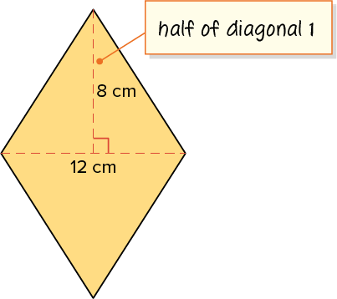
Tiling a Backsplash
A diagonal is a line segment that connects two nonconsecutive vertices of a polygon.
The diagonals of a rhombus divide one another into two equal parts and are perpendicular to each other.
Explain how the information shown supports your reasoning.
48 / 66
Notes:
TEACH IN PRACTICE | Embedded facilitation | Lesson 5.1, slide 43 | WORKED
Focus on the existing task: A diagonal is a line segment that connects two nonconsecutive vertices of a polygon. The diagonals of a rhombus divide one another into…
LAUNCH (T2/3/5): Ask students to explain the displayed idea or example and point to evidence. When a calculation step is shown, ask why it is valid. Have a partner restate the explanation; copying is not the check.
LOOK FOR (T4): Where this task addresses it, students can identify base and perpendicular height. Ask which feature of their work supports the claim.
RESPOND: If this task shows the lesson misconception—using a slanted side as the height—mark a right angle between the selected base and height on the original diagram. Have the student revise and explain the change. Use this support only where the concept occurs in the current task; otherwise respond to the displayed question.
RECHECK: If a gap is shared, revisit the existing representation together. If it is limited, give targeted support while others compare valid methods on the same task. Check the revision before moving on.
PARTICIPATION (T5/6/7): Think time before volunteers; accept a written, drawn or rehearsed entry. Students ask for evidence respectfully. Recognize a specific contribution or revision and check that both partners participate.
Source: BCPS Updated Instructional Framework Rubric (June 2020), TEACH 1–7. Earlier notes and answer keys are retained below.
EARLIER NOTES / EXISTING ANSWER KEY
Model briefly, then hand the thinking back: ask “Why does this step work?” before showing the next one.
Quick check before moving on — thumbs or whiteboards from everyone, not volunteers.
UIFR: TEACH 2 · TEACH 3 · TEACH 4.

Slide 49
COLLABORATE · TALK IT THROUGH • AGREE ON A MODEL
Collaborate and Connect
How can you use the diagonals to compose the rhombus into a rectangle?
Think first. A explains; B asks for evidence.
Switch roles; both revise.
Reveal:
The diagonals make 4 congruent right triangles. I can combine them to create an 8-centimeter by 12-centimeter rectangle.
49 / 66
Notes:
TEACH IN PRACTICE | Embedded facilitation | Lesson 5.1, slide 44 | COLLABORATE
Focus on the existing task: Reveal: The diagonals make 4 congruent right triangles. I can combine them to create an 8-centimeter by 12-centimeter rectangle.…
LAUNCH (T2/3/5): Use the displayed question. Give private thinking time; then A explains while B asks for evidence. Switch roles. Each student records their own reasoning.
LOOK FOR (T4): Where this task addresses it, students can connect rearrangement to base times height. Ask which feature of their work supports the claim.
RESPOND: If this task shows the lesson misconception—using a slanted side as the height—mark a right angle between the selected base and height on the original diagram. Have the student revise and explain the change. Use this support only where the concept occurs in the current task; otherwise respond to the displayed question.
RECHECK: If a gap is shared, revisit the existing representation together. If it is limited, give targeted support while others compare valid methods on the same task. Check the revision before moving on.
PARTICIPATION (T5/6/7): Think time before volunteers; accept a written, drawn or rehearsed entry. Students ask for evidence respectfully. Recognize a specific contribution or revision and check that both partners participate.
Source: BCPS Updated Instructional Framework Rubric (June 2020), TEACH 1–7. Earlier notes and answer keys are retained below.
EARLIER NOTES / EXISTING ANSWER KEY
Routine: COLLABORATE · TALK IT THROUGH • AGREE ON A MODEL

Slide 50
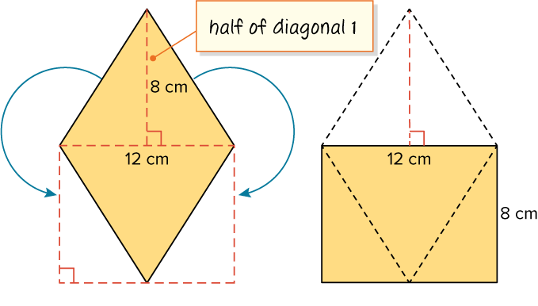
Tiling a Backsplash
The diagonals make 4 congruent right triangles. Combine them to create an 8-centimeter by 12-centimeter rectangle.
How can you find the area of the resulting rectangle?
ASK THE CLASS · Write one question about this that you could ask the class.
Reveal:
We can apply the area formula for rectangles.
50 / 66
Notes:
TEACH IN PRACTICE | Embedded facilitation | Lesson 5.1, slide 45 | REVEAL
Focus on the existing task: Reveal: We can apply the area formula for rectangles. The diagonals make 4 congruent right triangles. Combine them to create an…
LAUNCH (T2/3/5): If an existing answer cover is present, gather an attempt before revealing. If the explanation is already visible, ask students to reconstruct and justify it. Compare reasoning and explain a revision; preserve the reveal sequence.
LOOK FOR (T4): Where this task addresses it, students can identify base and perpendicular height. Ask which feature of their work supports the claim.
RESPOND: If this task shows the lesson misconception—using a slanted side as the height—mark a right angle between the selected base and height on the original diagram. Have the student revise and explain the change. Use this support only where the concept occurs in the current task; otherwise respond to the displayed question.
RECHECK: If a gap is shared, revisit the existing representation together. If it is limited, give targeted support while others compare valid methods on the same task. Check the revision before moving on.
PARTICIPATION (T5/6/7): Think time before volunteers; accept a written, drawn or rehearsed entry. Students ask for evidence respectfully. Recognize a specific contribution or revision and check that both partners participate.
Source: BCPS Updated Instructional Framework Rubric (June 2020), TEACH 1–7. Earlier notes and answer keys are retained below.
EARLIER NOTES / EXISTING ANSWER KEY
Do not click yet: collect 2–3 student answers with reasons first.
Then click to remove the cover and have students compare their thinking to the reveal — “Is this what we said? Where is it different?”
Behind the cover: We can apply the area formula for rectangles.
UIFR: TEACH 3 · TEACH 4.

Slide 51
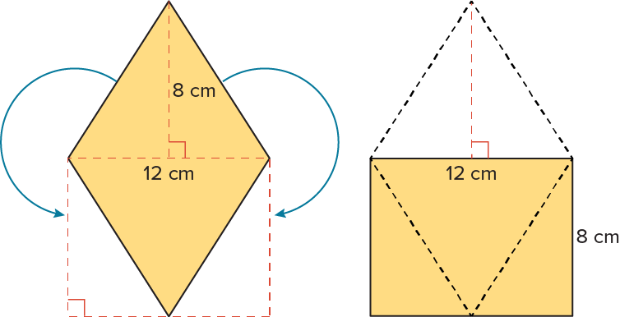



Tiling a Backsplash
We can use the area formula for rectangles.
How does the area of the rectangle relate to the area of the original rhombus?
Reveal:
The areas are the same because we did not change the size of the figure, just its shape.
51 / 66
Notes:
TEACH IN PRACTICE | Embedded facilitation | Lesson 5.1, slide 46 | REVEAL
Focus on the existing task: We can use the area formula for rectangles. Reveal: The areas are the same because we did not change the size of the figure…
LAUNCH (T2/3/5): If an existing answer cover is present, gather an attempt before revealing. If the explanation is already visible, ask students to reconstruct and justify it. Compare reasoning and explain a revision; preserve the reveal sequence.
LOOK FOR (T4): Where this task addresses it, students can identify base and perpendicular height. Ask which feature of their work supports the claim.
RESPOND: If this task shows the lesson misconception—using a slanted side as the height—mark a right angle between the selected base and height on the original diagram. Have the student revise and explain the change. Use this support only where the concept occurs in the current task; otherwise respond to the displayed question.
RECHECK: If a gap is shared, revisit the existing representation together. If it is limited, give targeted support while others compare valid methods on the same task. Check the revision before moving on.
PARTICIPATION (T5/6/7): Think time before volunteers; accept a written, drawn or rehearsed entry. Students ask for evidence respectfully. Recognize a specific contribution or revision and check that both partners participate.
Source: BCPS Updated Instructional Framework Rubric (June 2020), TEACH 1–7. Earlier notes and answer keys are retained below.
EARLIER NOTES / EXISTING ANSWER KEY
Do not click yet: collect 2–3 student answers with reasons first.
Then click to remove the cover and have students compare their thinking to the reveal — “Is this what we said? Where is it different?”
Behind the cover: The areas are the same because we did not change the size of the figure, just its shape.
UIFR: TEACH 3 · TEACH 4.

Slide 52
STUDENT MOVES
Lesson 5-1
Your move
TAKE TURNS · One explains, one asks a question. Then switch, so both of you talk.
52 / 66

Slide 53
Tiling a Backsplash
What is another way we can find the area of the rhombus?
Think About It:
Think and record first. Which part of your work supports your answer?
53 / 66
Notes:
TEACH IN PRACTICE | Embedded facilitation | Lesson 5.1, slide 47 | TASK
Focus on the existing task: What is another way we can find the area of the rhombus?
LAUNCH (T2/3/5): Use the displayed question. Give private thinking time; then A explains while B asks for evidence. Switch roles. Each student records their own reasoning.
LOOK FOR (T4): Where this task addresses it, students can identify base and perpendicular height. Ask which feature of their work supports the claim.
RESPOND: If this task shows the lesson misconception—using a slanted side as the height—mark a right angle between the selected base and height on the original diagram. Have the student revise and explain the change. Use this support only where the concept occurs in the current task; otherwise respond to the displayed question.
RECHECK: If a gap is shared, revisit the existing representation together. If it is limited, give targeted support while others compare valid methods on the same task. Check the revision before moving on.
PARTICIPATION (T5/6/7): Think time before volunteers; accept a written, drawn or rehearsed entry. Students ask for evidence respectfully. Recognize a specific contribution or revision and check that both partners participate.
Source: BCPS Updated Instructional Framework Rubric (June 2020), TEACH 1–7. Earlier notes and answer keys are retained below.
EARLIER NOTES / EXISTING ANSWER KEY
Ask the question, then hold the silence — students think or jot before anyone answers.
Take two or three responses and press with “Why?” or “How do you know?” before moving on.
UIFR: TEACH 3.

Slide 54
Tiling a Backsplash
What is another way we can find the area of the rhombus?
Record your reasoning before the
reveal. Compare, then explain
any revision.
Reveal:
We can use the area formula for parallelograms to find the area of the rhombus.​
54 / 66
Notes:
TEACH IN PRACTICE | Embedded facilitation | Lesson 5.1, slide 48 | REVEAL
Focus on the existing task: Reveal: We can use the area formula for parallelograms to find the area of the rhombus. What is another way we can find the area of the rhombus?
LAUNCH (T2/3/5): If an existing answer cover is present, gather an attempt before revealing. If the explanation is already visible, ask students to reconstruct and justify it. Compare reasoning and explain a revision; preserve the reveal sequence.
LOOK FOR (T4): Where this task addresses it, students can identify base and perpendicular height. Ask which feature of their work supports the claim.
RESPOND: If this task shows the lesson misconception—using a slanted side as the height—mark a right angle between the selected base and height on the original diagram. Have the student revise and explain the change. Use this support only where the concept occurs in the current task; otherwise respond to the displayed question.
RECHECK: If a gap is shared, revisit the existing representation together. If it is limited, give targeted support while others compare valid methods on the same task. Check the revision before moving on.
PARTICIPATION (T5/6/7): Think time before volunteers; accept a written, drawn or rehearsed entry. Students ask for evidence respectfully. Recognize a specific contribution or revision and check that both partners participate.
Source: BCPS Updated Instructional Framework Rubric (June 2020), TEACH 1–7. Earlier notes and answer keys are retained below.
EARLIER NOTES / EXISTING ANSWER KEY
Do not click yet: collect 2–3 student answers with reasons first.
Then click to remove the cover and have students compare their thinking to the reveal — “Is this what we said? Where is it different?”
Behind the cover: We can use the area formula for parallelograms to find the area of the rhombus.​
UIFR: TEACH 3 · TEACH 4.

Slide 55
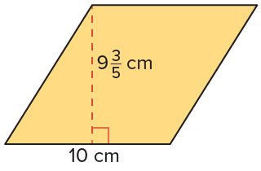



Tiling a Backsplash
Let’s use a formula. Rhombuses are parallelograms, so we can use the area formula for parallelograms to find the area of the rhombus.
USE YOUR TOOLS · Reach for your notes, a model, or a manipulative before you reach for an answer.
Planning
What is another approach to solving this problem?
55 / 66
Notes:
TEACH IN PRACTICE | Embedded facilitation | Lesson 5.1, slide 49 | TASK
Focus on the existing task: What is another approach to solving this problem?
LAUNCH (T2/3/5): Use the displayed question. Give private thinking time; then A explains while B asks for evidence. Switch roles. Each student records their own reasoning.
LOOK FOR (T4): Where this task addresses it, students can identify base and perpendicular height. Ask which feature of their work supports the claim.
RESPOND: If this task shows the lesson misconception—using a slanted side as the height—mark a right angle between the selected base and height on the original diagram. Have the student revise and explain the change. Use this support only where the concept occurs in the current task; otherwise respond to the displayed question.
RECHECK: If a gap is shared, revisit the existing representation together. If it is limited, give targeted support while others compare valid methods on the same task. Check the revision before moving on.
PARTICIPATION (T5/6/7): Think time before volunteers; accept a written, drawn or rehearsed entry. Students ask for evidence respectfully. Recognize a specific contribution or revision and check that both partners participate.
Source: BCPS Updated Instructional Framework Rubric (June 2020), TEACH 1–7. Earlier notes and answer keys are retained below.
EARLIER NOTES / EXISTING ANSWER KEY
Read the context aloud (or have a student read it).
Before any math, students restate the situation and what is being asked in their own words.
Ask: What is another approach to solving this problem?
UIFR: TEACH 1 · TEACH 3.

Slide 56
Tiling a Backsplash
The wall tile shown has the shape of a rhombus, a parallelogram with four equal sides. The dimensions of the tile are shown.
What is the area of the tile?
The area of the tile is 96 square centimeters.
Think and record first. Which part of your work supports your answer?
56 / 66
Notes:
TEACH IN PRACTICE | Embedded facilitation | Lesson 5.1, slide 50 | TASK
Focus on the existing task: The wall tile shown has the shape of a rhombus, a parallelogram with four equal sides. The dimensions of the tile are shown. What is the area of the tile?
LAUNCH (T2/3/5): Use the displayed question. Give private thinking time; then A explains while B asks for evidence. Switch roles. Each student records their own reasoning.
LOOK FOR (T4): Where this task addresses it, students can label square units. Ask which feature of their work supports the claim.
RESPOND: If this task shows the lesson misconception—using a slanted side as the height—mark a right angle between the selected base and height on the original diagram. Have the student revise and explain the change. Use this support only where the concept occurs in the current task; otherwise respond to the displayed question.
RECHECK: If a gap is shared, revisit the existing representation together. If it is limited, give targeted support while others compare valid methods on the same task. Check the revision before moving on.
PARTICIPATION (T5/6/7): Think time before volunteers; accept a written, drawn or rehearsed entry. Students ask for evidence respectfully. Recognize a specific contribution or revision and check that both partners participate.
Source: BCPS Updated Instructional Framework Rubric (June 2020), TEACH 1–7. Earlier notes and answer keys are retained below.
EARLIER NOTES / EXISTING ANSWER KEY
Apply task — students try it independently first, then partners compare answers and reasoning.
Collect a quick pulse (thumbs or whiteboards) before the close; this tells you who needs a second look tomorrow.
UIFR: TEACH 2 · TEACH 4.

Slide 57
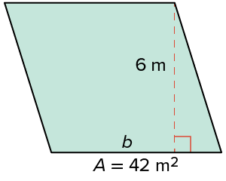
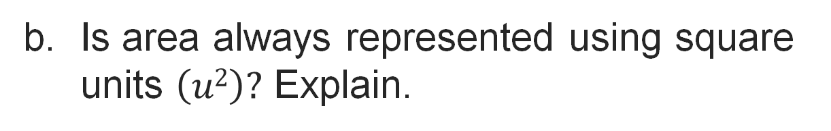
Let’s Explore More
What are the side lengths of the rhombus shown?​
Try it yourself. Compare your work with a partner; explain one choice and revise.
57 / 66
Notes:
TEACH IN PRACTICE | Embedded facilitation | Lesson 5.1, slide 51 | PRACTICE
Focus on the existing task: What are the side lengths of the rhombus shown?
LAUNCH (T2/3/5): Use the displayed question. Give private thinking time; then A explains while B asks for evidence. Switch roles. Each student records their own reasoning.
LOOK FOR (T4): Where this task addresses it, students can identify base and perpendicular height. Ask which feature of their work supports the claim.
RESPOND: If this task shows the lesson misconception—using a slanted side as the height—mark a right angle between the selected base and height on the original diagram. Have the student revise and explain the change. Use this support only where the concept occurs in the current task; otherwise respond to the displayed question.
RECHECK: If a gap is shared, revisit the existing representation together. If it is limited, give targeted support while others compare valid methods on the same task. Check the revision before moving on.
PARTICIPATION (T5/6/7): Think time before volunteers; accept a written, drawn or rehearsed entry. Students ask for evidence respectfully. Recognize a specific contribution or revision and check that both partners participate.
Source: BCPS Updated Instructional Framework Rubric (June 2020), TEACH 1–7. Earlier notes and answer keys are retained below.
EARLIER NOTES / EXISTING ANSWER KEY
Extension for partners or table groups — students choose their approach and use the workspace to show thinking.
Push with “Convince me,” and have two groups with different approaches share.
This is where students stretch past the worked example.
UIFR: TEACH 2 · TEACH 5.

Slide 58
LESSON 5.1 / CHECK YOUR WORK
Pause. Check. Improve.
CHECK
A mistake to watch for: using a slanted side as the height.
TRY
Mark a right angle between the selected base and height on the given diagram.
REVISE
Use that check on the task you just completed. Correct or strengthen one part, and explain why.
REVISE NOW · Change one answer and write why you changed it. A revision is evidence of learning.
Listen to understand. Ask for evidence. Make room for every voice.
Notes:
TEACH IN PRACTICE | Embedded facilitation | Lesson 5.1, slide 52 | PRIOR_INSERT
Focus on the existing task: LESSON 5.1 / CHECK YOUR WORK Pause. Check. Improve. Listen to understand. Ask for evidence. Make room for every voice. CHECK A mistake…
CONNECT (T1/4): Ask students to restate the displayed goal or key idea and connect it to earlier work. Relevant lesson evidence: identify base and perpendicular height; connect rearrangement to base times height; label square units. Use only the criterion that matches the current session.
SHOW PROGRESS: Students point to their own existing work, explain what improved after feedback, and name a next step. Pair confidence ratings with actual evidence.
PARTICIPATION (T5/6/7): Think time before volunteers; accept a written, drawn or rehearsed entry. Students ask for evidence respectfully. Recognize a specific contribution or revision and check that both partners participate.
Source: BCPS Updated Instructional Framework Rubric (June 2020), TEACH 1–7.

Slide 59
Tiling a Backsplash
What do you notice about the line segments that are labeled as diagonals in the figure?
Compare your reasoning with the explanation. Explain any revision you make.
Reveal:
They connect two non-adjacent vertices of the rhombus.
59 / 66
Notes:
TEACH IN PRACTICE | Embedded facilitation | Lesson 5.1, slide 53 | REVEAL
Focus on the existing task: What do you notice about the line segments that are labeled as diagonals in the figure?
LAUNCH (T2/3/5): If an existing answer cover is present, gather an attempt before revealing. If the explanation is already visible, ask students to reconstruct and justify it. Compare reasoning and explain a revision; preserve the reveal sequence.
LOOK FOR (T4): Where this task addresses it, students can connect rearrangement to base times height. Ask which feature of their work supports the claim.
RESPOND: If this task shows the lesson misconception—using a slanted side as the height—mark a right angle between the selected base and height on the original diagram. Have the student revise and explain the change. Use this support only where the concept occurs in the current task; otherwise respond to the displayed question.
RECHECK: If a gap is shared, revisit the existing representation together. If it is limited, give targeted support while others compare valid methods on the same task. Check the revision before moving on.
PARTICIPATION (T5/6/7): Think time before volunteers; accept a written, drawn or rehearsed entry. Students ask for evidence respectfully. Recognize a specific contribution or revision and check that both partners participate.
Source: BCPS Updated Instructional Framework Rubric (June 2020), TEACH 1–7.

Slide 60
Tiling a Backsplash
We can use the area formula for rectangles.
How does the area of the rectangle relate to the area of the original rhombus?
Reveal:
The areas are the same because we did not change the size of the figure, just its shape.
60 / 66
Notes:
TEACH IN PRACTICE | Embedded facilitation | Lesson 5.1, slide 54 | REVEAL
Focus on the existing task: We can use the area formula for rectangles. Reveal: The areas are the same because we did not change the size of the figure…
LAUNCH (T2/3/5): If an existing answer cover is present, gather an attempt before revealing. If the explanation is already visible, ask students to reconstruct and justify it. Compare reasoning and explain a revision; preserve the reveal sequence.
LOOK FOR (T4): Where this task addresses it, students can identify base and perpendicular height. Ask which feature of their work supports the claim.
RESPOND: If this task shows the lesson misconception—using a slanted side as the height—mark a right angle between the selected base and height on the original diagram. Have the student revise and explain the change. Use this support only where the concept occurs in the current task; otherwise respond to the displayed question.
RECHECK: If a gap is shared, revisit the existing representation together. If it is limited, give targeted support while others compare valid methods on the same task. Check the revision before moving on.
PARTICIPATION (T5/6/7): Think time before volunteers; accept a written, drawn or rehearsed entry. Students ask for evidence respectfully. Recognize a specific contribution or revision and check that both partners participate.
Source: BCPS Updated Instructional Framework Rubric (June 2020), TEACH 1–7.

Slide 61
STUDENT MOVES
Lesson 5-1
Your move
SPECIFIC FEEDBACK · Trade work. Give one specific comment: “This part is clear because ______.”
61 / 66

Slide 62
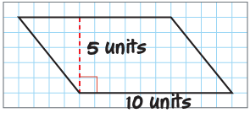
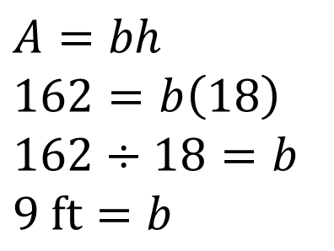
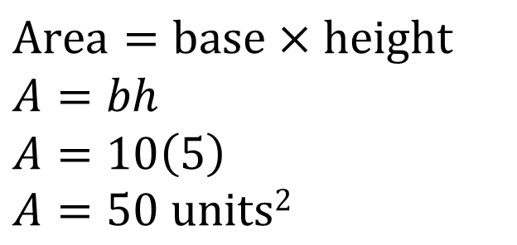
SUMMARIZE · SAY IT IN YOUR OWN WORDS
Summarize: Determine the Area of Parallelograms and Rhombuses
You can find the areas of parallelograms and rhombuses by composing them into rectangles or by using a formula. | You can find an unknown dimension of a parallelogram when given one dimension and the area by using the area formula.
PROVE IT · Find the evidence in the problem that makes your answer right — not just the answer.
62 / 66
Notes:
TEACH IN PRACTICE | Embedded facilitation | Lesson 5.1, slide 55 | SUMMARIZE
Focus on the existing task: Summarize: Determine the Area of Parallelograms and Rhombuses You can find the areas of parallelograms and rhombuses by composing them…
CONNECT (T1/4): Ask students to restate the displayed goal or key idea and connect it to earlier work. Relevant lesson evidence: identify base and perpendicular height; connect rearrangement to base times height; label square units. Use only the criterion that matches the current session.
SHOW PROGRESS: Students point to their own existing work, explain what improved after feedback, and name a next step. Pair confidence ratings with actual evidence.
PARTICIPATION (T5/6/7): Think time before volunteers; accept a written, drawn or rehearsed entry. Students ask for evidence respectfully. Recognize a specific contribution or revision and check that both partners participate.
Source: BCPS Updated Instructional Framework Rubric (June 2020), TEACH 1–7. Earlier notes and answer keys are retained below.
EARLIER NOTES / EXISTING ANSWER KEY
Routine: SUMMARIZE · SAY IT IN YOUR OWN WORDS

Slide 63
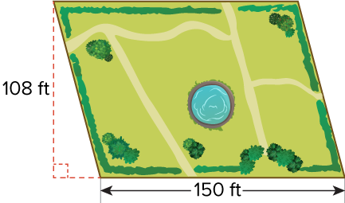
APPLY · PLAN IT • SOLVE IT • PROVE IT
Apply: A New Park
Claire, a city horticulturist, is developing a new park to replace an old city lot. The center of the park will feature a koi pond that will cover 1,245 square feet. Eighty-five percent of the remaining space will be covered with grass seed. A 50-pound bag of grass seed covers up to 7,500 square feet. Straw is also needed to cover the grass seed. One bale of straw will cover about 500 square feet.
Choose a question to answer.​
Question 1: How many bags of grass seed should be used to seed the park?
Question 2: How many bales of straw should be used to cover the grass seed?
63 / 66
Notes:
TEACH IN PRACTICE | Embedded facilitation | Lesson 5.1, slide 56 | APPLY
Focus on the existing task: Question 2: How many bales of straw should be used to cover the grass seed?
LAUNCH (T2/3/5): Use the exact application task independently first. Ask students to justify their choice of method. Collect evidence before a partner discussion or correction.
LOOK FOR (T4): Where this task addresses it, students can label square units. Ask which feature of their work supports the claim.
RESPOND: If this task shows the lesson misconception—using a slanted side as the height—mark a right angle between the selected base and height on the original diagram. Have the student revise and explain the change. Use this support only where the concept occurs in the current task; otherwise respond to the displayed question.
RECHECK: If a gap is shared, revisit the existing representation together. If it is limited, give targeted support while others compare valid methods on the same task. Check the revision before moving on.
PARTICIPATION (T5/6/7): Think time before volunteers; accept a written, drawn or rehearsed entry. Students ask for evidence respectfully. Recognize a specific contribution or revision and check that both partners participate.
Source: BCPS Updated Instructional Framework Rubric (June 2020), TEACH 1–7. Earlier notes and answer keys are retained below.
EARLIER NOTES / EXISTING ANSWER KEY
Routine: APPLY · PLAN IT • SOLVE IT • PROVE IT
UIFR FULL | Lesson-specific facilitation
TEACH 4 | Independent evidence and revision (UIFR PDF p. 11).
Use the existing application/exit problem as the independent check. If this is a learning-target slide, have students point to and explain their work on the preceding task. Separate initial independent evidence from the revision after feedback.
Check the relevant criteria: identify base and perpendicular height; connect rearrangement to base times height; label square units. Respond with one specific next step tied to the work. Students revise and annotate what changed, then identify a criterion they can now demonstrate and one they still need to practice.

Slide 64
STUDENT MOVES
Lesson 5-1
Your move
PICK YOUR STRATEGY · Choose your path — picture, table, number line, or equation — and be ready to say why you chose it.
64 / 66

Slide 65
Learning Targets
I can find the area of parallelograms and rhombuses by composing them into rectangles.
I can find the area of parallelograms and rhombuses by using a formula.
I can attend to precision to find a missing dimension by using the area formula.
Point to evidence in your work. Name what improved and your next step.
65 / 66
Notes:
TEACH IN PRACTICE | Embedded facilitation | Lesson 5.1, slide 57 | REFLECTION
Focus on the existing task: Learning Targets I can find the area of parallelograms and rhombuses by composing them into rectangles. I can find the area of…
CONNECT (T1/4): Ask students to restate the displayed goal or key idea and connect it to earlier work. Relevant lesson evidence: identify base and perpendicular height; connect rearrangement to base times height; label square units. Use only the criterion that matches the current session.
SHOW PROGRESS: Students point to their own existing work, explain what improved after feedback, and name a next step. Pair confidence ratings with actual evidence.
PARTICIPATION (T5/6/7): Think time before volunteers; accept a written, drawn or rehearsed entry. Students ask for evidence respectfully. Recognize a specific contribution or revision and check that both partners participate.
Source: BCPS Updated Instructional Framework Rubric (June 2020), TEACH 1–7. Earlier notes and answer keys are retained below.
EARLIER NOTES / EXISTING ANSWER KEY
UIFR FULL | Lesson-specific facilitation
REFLECT & ADJUST 1-2 | After the lesson (UIFR PDF pp. 15-16).
Sort the existing work by demonstrated reasoning, partial understanding, and the specific misconception: using a slanted side as the height. Compare the initial response with the revision. Record which teaching move plausibly helped, which did not, and whose participation or access needs a different approach; do not record sensitive student details in this shared deck.
Plan the next lesson from that evidence: if the misconception persists, mark a right angle between the selected base and height on the original diagram using the current example before returning to the next grade-level task; if understanding is secure, use an existing extension or ask for a general explanation. Check the targeted idea again at the next warm-up.
Ask students what supported their thinking and what would help next time. Identify one change to try and one successful practice to retain. Seek colleague feedback on anonymized work when useful; these prompts support reflection and do not establish an evaluation rating. Source: Baltimore City Public Schools, Updated Instructional Framework Rubric, June 2020 (UIFR_Full.pdf).

Slide 66
LESSON 5.1 / REFLECT ON YOUR LEARNING
Show your progress
1 SHOW EVIDENCE
2 CHOOSE A NEXT STEP
Choose one response. Point to the part that shows your reasoning.
Name a change you made after feedback—or a question you still have.
“My work shows ___ because ___.”
“Next time, I will ___ to help me ___.”
Today’s focus: Identify base and perpendicular height.
CREDIT A CLASSMATE · Name one classmate whose idea helped you today, and say what they said.
Listen to understand. Ask for evidence. Make room for every voice.
Notes:
TEACH IN PRACTICE | Embedded facilitation | Lesson 5.1, slide 58 | PRIOR_INSERT
Focus on the existing task: LESSON 5.1 / REFLECT ON YOUR LEARNING Show your progress Listen to understand. Ask for evidence. Make room for every voice. 1 SHOW…
CONNECT (T1/4): Ask students to restate the displayed goal or key idea and connect it to earlier work. Relevant lesson evidence: identify base and perpendicular height; connect rearrangement to base times height; label square units. Use only the criterion that matches the current session.
SHOW PROGRESS: Students point to their own existing work, explain what improved after feedback, and name a next step. Pair confidence ratings with actual evidence.
PARTICIPATION (T5/6/7): Think time before volunteers; accept a written, drawn or rehearsed entry. Students ask for evidence respectfully. Recognize a specific contribution or revision and check that both partners participate.
Source: BCPS Updated Instructional Framework Rubric (June 2020), TEACH 1–7.

