Slide 1
WARM-UP · THINK • TRY • CHECK
Turn and talk: compare strategies, then defend one.
Warm-Up
Lesson 5-2 · Determine the Area of Triangles | Warm-Up · about 4 minutes
Try each on your own. Mark an unsure answer; explain and revise when we check.
QUESTION 1
QUESTION 2
7 × 4 = ______, and half of that is ______
1/2 × 18 = ______
QUESTION 3
QUESTION 4
A parallelogram has base 9 m and height 6 m. Area = ______
Triangle: base 10 cm, slanted side 7 cm, height 4 cm.
The height is ______
TALK IT OVER: “I got ______ because ______.” • Compare with a partner before we check as a class.
1 / 50
Notes:
TEACH IN PRACTICE | Embedded facilitation | Lesson 5.2, slide 1 | WARMUP
Focus on the existing task: Warm-Up WARM-UP · THINK • TRY • CHECK Do these four on…
GATHER EVIDENCE (T4/6): Keep the original items. Students try independently, mark an uncertain item, and explain one method before checking. Use the existing key when present.
RESPOND: Distinguish a calculation slip from a reasoning gap. Give one next step on the same item; have students revise in a second color. Use the responses to choose flexible support for today’s lesson.
PARTICIPATION (T5/6/7): Think time before volunteers; accept a written, drawn or rehearsed entry. Students ask for evidence respectfully. Recognize a specific contribution or revision and check that both partners participate.
Source: BCPS Updated Instructional Framework Rubric (June 2020), TEACH 1–7. Earlier notes and answer keys are retained below.
EARLIER NOTES / EXISTING ANSWER KEY
Warm-Up answers (teacher only): 1) 28, then 14 2) 9 3) 54 square meters 4) 4 centimeters
UIFR FULL | Lesson-specific facilitation
PREPARE 1-2 | Before teaching (UIFR PDF pp. 6-7).
Plan to gather evidence that students can identify a matching base and height; explain the factor one-half; use square units. Review recent work and today’s warm-up to choose flexible groups and access supports; do not infer needs from identity or perceived ability. Use the existing lesson tasks and stated standards.
Anticipate: omitting the half or using a nonperpendicular side. If observed, trace the base and perpendicular height and relate the figure to the shown parallelogram. Offer oral rehearsal, drawing, pointing, or home-language processing as needed; retain the original mathematical demand. Ask students which support helps and fade it as evidence improves.
TEACH 6-7 | Before the first transition, agree on materials, partner roles, and how to request help. Invite students to restate the routine. Normalize revising an idea, recognize a specific contribution, and check privately when frustration blocks participation. Source: UIFR PDF pp. 13-14.

Slide 2
Today’s Math Notes
Lesson 5-2 · Determine the Area of Triangles
Section 1: Math Words
Copy. Explain. Check.
SAY THE GOAL · Say today’s goal in your own words, then name one place this shows up outside math class.
Area of a Triangle
1
The space inside a triangle
Base
2
Any side of a triangle can be the base
Height
3
The straight-up distance from the base to the top corner
eduwonderlab.com · Neft Teacher
2 / 50
Notes:
TEACH IN PRACTICE | Embedded facilitation | Lesson 5.2, slide 2 | NOTES
Focus on the existing task: Today’s Math Notes Section 1: Math Words Copy into your…
ROUTINE (T1/2/4): Read or copy the original notes, cover one line, and explain it using the displayed example. Reopen and correct. Copying alone is not evidence of understanding.
LOOK FOR: A link between a symbol, quantity or feature and the explanation. If missing, point back to that feature and have the student try again; fade the prompt once they can explain.
PARTICIPATION (T5/6/7): Think time before volunteers; accept a written, drawn or rehearsed entry. Students ask for evidence respectfully. Recognize a specific contribution or revision and check that both partners participate.
Source: BCPS Updated Instructional Framework Rubric (June 2020), TEACH 1–7. Earlier notes and answer keys are retained below.
EARLIER NOTES / EXISTING ANSWER KEY
Copy routine: read one line at a time; students copy, then explain that line to a partner.
Keep it brisk — the understanding work happens in the examples, not the copying.
UIFR: TEACH 1 · TEACH 6.

Slide 3
Today’s Math Notes
Lesson 5-2 · Determine the Area of Triangles
Section 2: Today’s Math
Copy. Explain. Check.
Area of Triangles
Area = ½ × Base × Height (A = ½ b · h)
Read, cover, explain. Reopen your notes to
check and improve your explanation.
1
Identify the base and the perpendicular height to that base
2
A triangle is exactly half of a rectangle with the same base and height
3
Multiply base by height, then divide by 2
eduwonderlab.com · Neft Teacher
3 / 50
Notes:
TEACH IN PRACTICE | Embedded facilitation | Lesson 5.2, slide 3 | NOTES
Focus on the existing task: Today’s Math Notes Section 2: Today’s Math Copy into your…
ROUTINE (T1/2/4): Read or copy the original notes, cover one line, and explain it using the displayed example. Reopen and correct. Copying alone is not evidence of understanding.
LOOK FOR: A link between a symbol, quantity or feature and the explanation. If missing, point back to that feature and have the student try again; fade the prompt once they can explain.
PARTICIPATION (T5/6/7): Think time before volunteers; accept a written, drawn or rehearsed entry. Students ask for evidence respectfully. Recognize a specific contribution or revision and check that both partners participate.
Source: BCPS Updated Instructional Framework Rubric (June 2020), TEACH 1–7. Earlier notes and answer keys are retained below.
EARLIER NOTES / EXISTING ANSWER KEY
Copy routine: read one line at a time; students copy, then explain that line to a partner.
Keep it brisk — the understanding work happens in the examples, not the copying.
UIFR: TEACH 1 · TEACH 6.

Slide 4
Session 1
Determine the Area of Triangles
PICK YOUR STRATEGY · Choose your path — picture, table, number line, or equation — and be ready to say why you chose it.
4 / 50
Notes:
TEACH IN PRACTICE | Embedded facilitation | Lesson 5.2, slide 4 | DIVIDER
Focus on the existing task: Determine the Area of Triangles Session 1
TRANSITION (T6/7): Students confirm materials, roles, how to request help, and the next response routine. Ask a student to restate it. Keep teacher-only slides hidden.
PARTICIPATION (T5/6/7): Think time before volunteers; accept a written, drawn or rehearsed entry. Students ask for evidence respectfully. Recognize a specific contribution or revision and check that both partners participate.
Source: BCPS Updated Instructional Framework Rubric (June 2020), TEACH 1–7. Earlier notes and answer keys are retained below.
EARLIER NOTES / EXISTING ANSWER KEY
Transition cue: state what materials are out and what success looks like this session.
Keep the changeover under a minute.
UIFR: TEACH 6.

Slide 5
This or That
Would you rather have THIS or THAT box of gold coins?
Box of Gold Coins
THIS | THAT
Think and record first. Which part of your work supports your answer?
5 / 50
Notes:
TEACH IN PRACTICE | Embedded facilitation | Lesson 5.2, slide 5 | TASK
Focus on the existing task: This or That Would you rather have THIS or THAT box of gold coins?
LAUNCH (T2/3/5): Use the displayed question. Give private thinking time; then A explains while B asks for evidence. Switch roles. Each student records their own reasoning.
LOOK FOR (T4): Where this task addresses it, students can identify a matching base and height. Ask which feature of their work supports the claim.
RESPOND: If this task shows the lesson misconception—omitting the half or using a nonperpendicular side—trace the base and perpendicular height and relate the figure to the shown parallelogram. Have the student revise and explain the change. Use this support only where the concept occurs in the current task; otherwise respond to the displayed question.
RECHECK: If a gap is shared, revisit the existing representation together. If it is limited, give targeted support while others compare valid methods on the same task. Check the revision before moving on.
PARTICIPATION (T5/6/7): Think time before volunteers; accept a written, drawn or rehearsed entry. Students ask for evidence respectfully. Recognize a specific contribution or revision and check that both partners participate.
Source: BCPS Updated Instructional Framework Rubric (June 2020), TEACH 1–7. Earlier notes and answer keys are retained below.
EARLIER NOTES / EXISTING ANSWER KEY
Number-sense routine — every voice in. Give quiet think time, then hear from at least three students.
Always follow with “How do you know?” — the reasoning is the point, not the answer.
There is more than one path; name and celebrate different strategies.
UIFR: TEACH 3 · TEACH 5 · TEACH 6.

Slide 6
Today’s Objectives
Lesson 5-2 · Determine the Area of Triangles
Determine the Area of Triangles
Maryland Standard 6.GR.1
CONNECT IT · What earlier lesson does this build on? Tell a partner in one sentence.
CONTENT OBJECTIVE
LANGUAGE OBJECTIVE
Restate the goal in your words
Use these words to explain why
I can find the area of a triangle using the formula A = ½ × base × height.
I can explain my steps using the words base, height, area, and perpendicular.
eduwonderlab.com · Neft Teacher
6 / 50
Notes:
TEACH IN PRACTICE | Embedded facilitation | Lesson 5.2, slide 6 | GOAL
Focus on the existing task: Today’s Objectives Determine the Area of Triangles Maryland…
CONNECT (T1/4): Ask students to restate the displayed goal or key idea and connect it to earlier work. Relevant lesson evidence: identify a matching base and height; explain the factor one-half; use square units. Use only the criterion that matches the current session.
SHOW PROGRESS: Students point to their own existing work, explain what improved after feedback, and name a next step. Pair confidence ratings with actual evidence.
PARTICIPATION (T5/6/7): Think time before volunteers; accept a written, drawn or rehearsed entry. Students ask for evidence respectfully. Recognize a specific contribution or revision and check that both partners participate.
Source: BCPS Updated Instructional Framework Rubric (June 2020), TEACH 1–7. Earlier notes and answer keys are retained below.
EARLIER NOTES / EXISTING ANSWER KEY
Read the objective together, then have one or two students restate today’s goal in their own words.
Connect it to what the class learned last lesson.
Return to this goal at the end of class to check it was met.
UIFR: TEACH 1.
UIFR FULL | Lesson-specific facilitation
TEACH 1 | Session 1 purpose and evidence (UIFR PDF p. 8).
Have students restate the displayed session goal in their own words and connect it to the existing context or a familiar experience they choose to share. Use the current session goal to select from these lesson-wide evidence criteria; do not frontload a later-session procedure.
Look for: identify a matching base and height; explain the factor one-half; use square units. Ask: “Which part of your work would show this?” Revisit that evidence after the task; a confidence rating alone is not evidence of understanding.

Slide 7
LESSON 5.2 / OUR LEARNING
What will show your learning?
1
Identify a matching base and height.
2
Explain the factor one-half.
3
Use square units.
Tell a partner: Which skill connects to something you already know?
SHOW YOUR THINKING · Show what you know — write it, draw it, or build it. A picture counts as an explanation.
Listen to understand. Ask for evidence. Make room for every voice.
Notes:
TEACH IN PRACTICE | Embedded facilitation | Lesson 5.2, slide 7 | PRIOR_INSERT
Focus on the existing task: LESSON 5.2 / OUR LEARNING What will show your learning?
CONNECT (T1/4): Ask students to restate the displayed goal or key idea and connect it to earlier work. Relevant lesson evidence: identify a matching base and height; explain the factor one-half; use square units. Use only the criterion that matches the current session.
SHOW PROGRESS: Students point to their own existing work, explain what improved after feedback, and name a next step. Pair confidence ratings with actual evidence.
PARTICIPATION (T5/6/7): Think time before volunteers; accept a written, drawn or rehearsed entry. Students ask for evidence respectfully. Recognize a specific contribution or revision and check that both partners participate.
Source: BCPS Updated Instructional Framework Rubric (June 2020), TEACH 1–7.

Slide 8
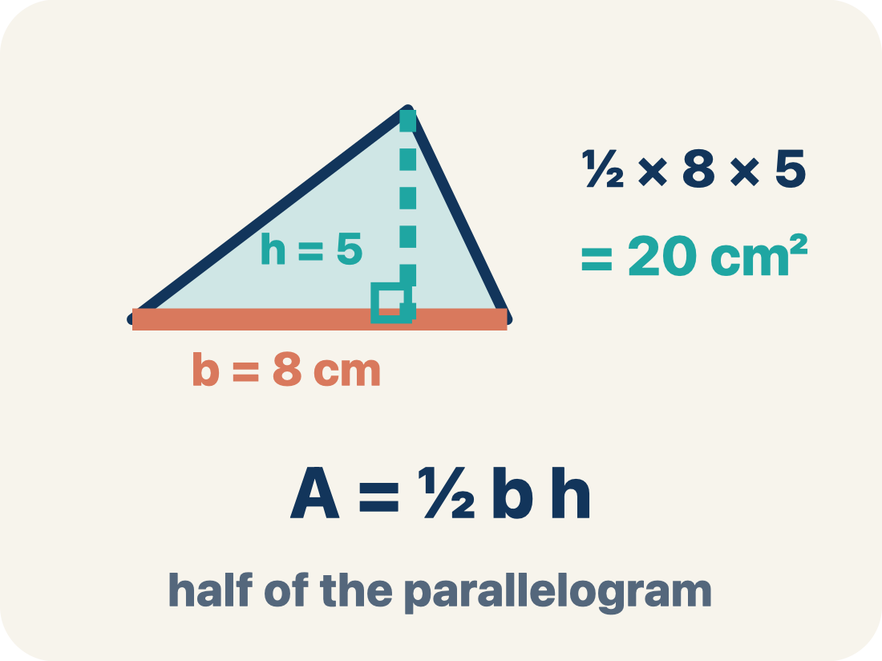
Vocabulary 1 of 8
Lesson 5-2 · Determine the Area of Triangles
Area of a Triangle
The space inside a triangle. A triangle is half of a rectangle with the same base and height, so A = ½ × b × h.
EXAMPLE · EXPLAIN WHY IT FITS
A = ½ × b × h; if b = 8 and h = 5, then A = ½ × 8 × 5 = 20 square units
USE THE MATH WORDS · Use today’s math words in your explanation — not “it” and “that thing.”
eduwonderlab.com · Neft Teacher
8 / 50
Notes:
TEACH IN PRACTICE | Embedded facilitation | Lesson 5.2, slide 8 | VOCAB
Focus on the existing task: Vocabulary 1 of 8 Area of a Triangle The space inside a…
ASK (T1/3/5): Where does “Area of a Triangle” appear in the example? Explain the meaning without reading the definition. Partner: restate the idea and ask a clarifying question.
LOOK FOR: A correct connection between the word and a feature of the example. If the student only repeats the definition, invite pointing, sketching or oral rehearsal, then ask for another explanation of this same example.
PARTICIPATION (T5/6/7): Think time before volunteers; accept a written, drawn or rehearsed entry. Students ask for evidence respectfully. Recognize a specific contribution or revision and check that both partners participate.
Source: BCPS Updated Instructional Framework Rubric (June 2020), TEACH 1–7.

Slide 9
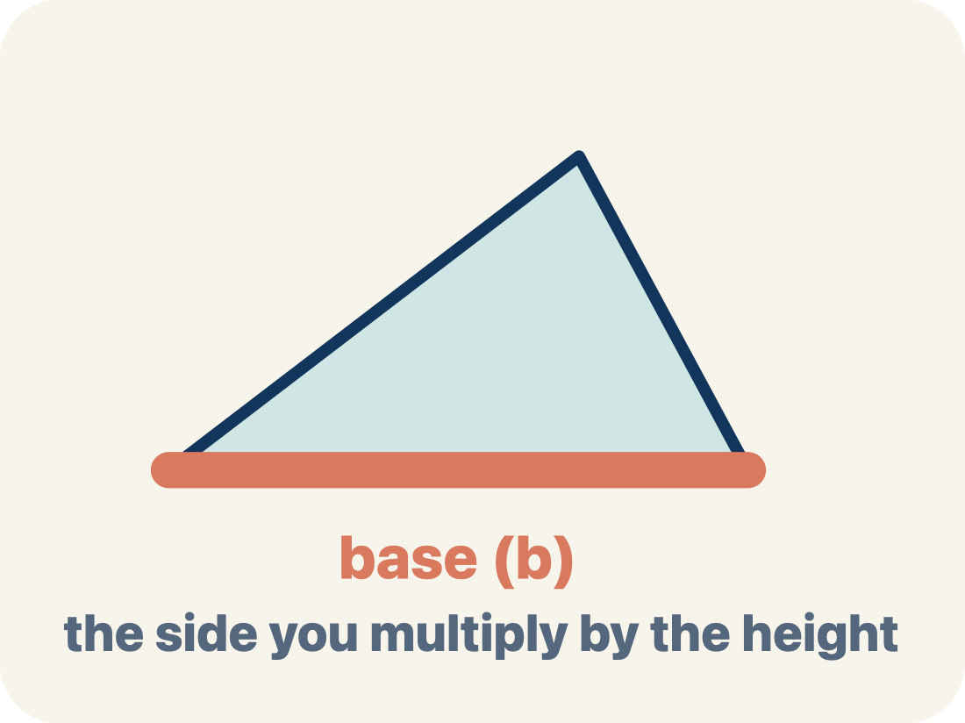
Vocabulary 2 of 8
Lesson 5-2 · Determine the Area of Triangles
Base
Any side of a triangle can be the base. Once you pick a base, the height must be measured perpendicular (at a 90° angle) to it.
EXAMPLE · EXPLAIN WHY IT FITS
Any side can be the base: choose the 10 cm side and b = 10 cm, then draw the height from the opposite vertex at 90° to that side in A = ½ × b × h
Use “Base” to explain the example. Point to evidence.
eduwonderlab.com · Neft Teacher
9 / 50
Notes:
TEACH IN PRACTICE | Embedded facilitation | Lesson 5.2, slide 9 | VOCAB
Focus on the existing task: Vocabulary 2 of 8 Base Any side of a triangle can be the…
ASK (T1/3/5): Where does “Base” appear in the example? Explain the meaning without reading the definition. Partner: restate the idea and ask a clarifying question.
LOOK FOR: A correct connection between the word and a feature of the example. If the student only repeats the definition, invite pointing, sketching or oral rehearsal, then ask for another explanation of this same example.
PARTICIPATION (T5/6/7): Think time before volunteers; accept a written, drawn or rehearsed entry. Students ask for evidence respectfully. Recognize a specific contribution or revision and check that both partners participate.
Source: BCPS Updated Instructional Framework Rubric (June 2020), TEACH 1–7.

Slide 10
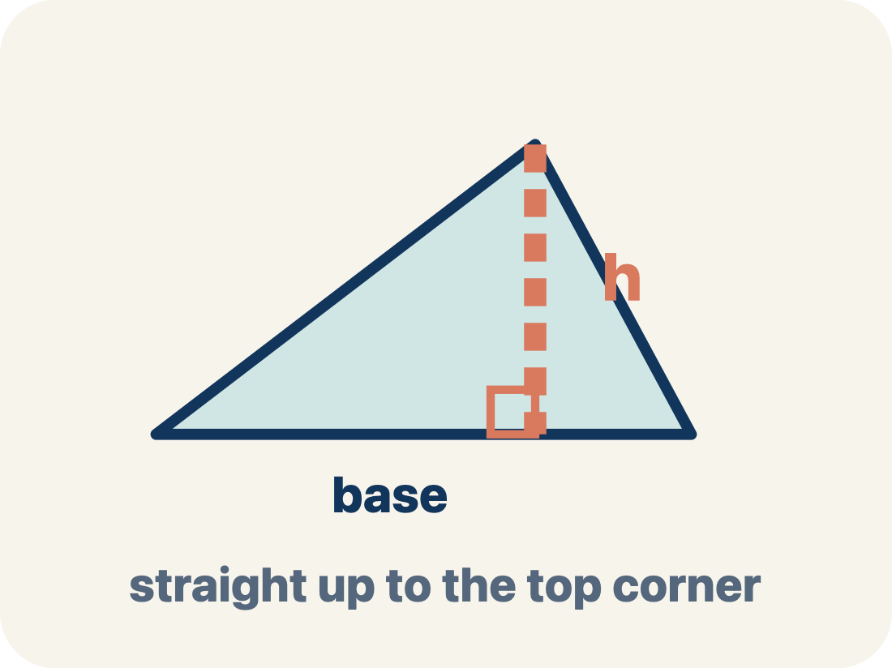
Vocabulary 3 of 8
Lesson 5-2 · Determine the Area of Triangles
Height
The straight-up distance from the base to the top corner.
EXAMPLE · EXPLAIN WHY IT FITS
A dashed vertical line from the top point straight down to the base at a 90° angle — like dropping a plumb line
Use “Height” to explain the example. Point to evidence.
eduwonderlab.com · Neft Teacher
10 / 50
Notes:
TEACH IN PRACTICE | Embedded facilitation | Lesson 5.2, slide 10 | VOCAB
Focus on the existing task: Vocabulary 3 of 8 Height The straight-up distance from the…
ASK (T1/3/5): Where does “Height” appear in the example? Explain the meaning without reading the definition. Partner: restate the idea and ask a clarifying question.
LOOK FOR: A correct connection between the word and a feature of the example. If the student only repeats the definition, invite pointing, sketching or oral rehearsal, then ask for another explanation of this same example.
PARTICIPATION (T5/6/7): Think time before volunteers; accept a written, drawn or rehearsed entry. Students ask for evidence respectfully. Recognize a specific contribution or revision and check that both partners participate.
Source: BCPS Updated Instructional Framework Rubric (June 2020), TEACH 1–7.

Slide 11
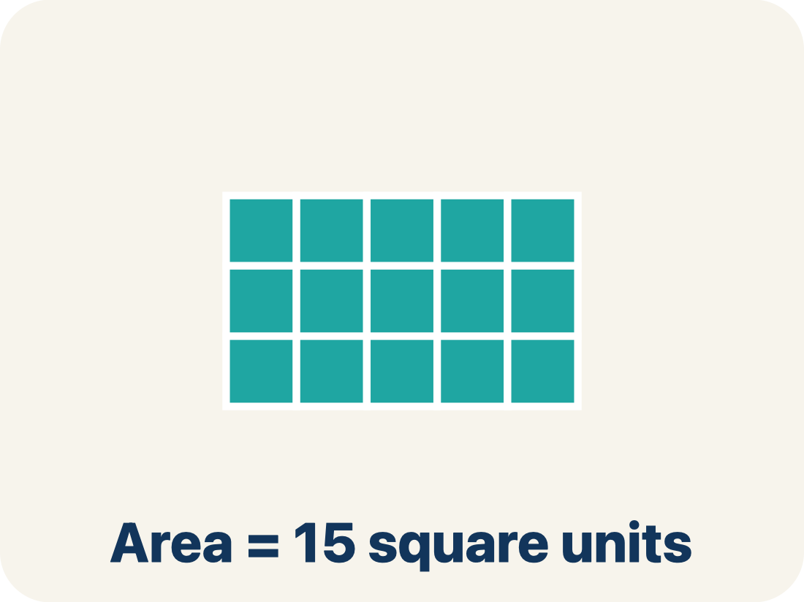
Vocabulary 4 of 8
Lesson 5-2 · Determine the Area of Triangles
Area
How much space is inside a flat shape.
EXAMPLE · EXPLAIN WHY IT FITS
A triangle with b = 8 and h = 6 has area = ½ × 8 × 6 = 24 sq units — exactly half the rectangle around it
Use “Area” to explain the example. Point to evidence.
eduwonderlab.com · Neft Teacher
11 / 50
Notes:
TEACH IN PRACTICE | Embedded facilitation | Lesson 5.2, slide 11 | VOCAB
Focus on the existing task: Vocabulary 4 of 8 Area How much space is inside a flat…
ASK (T1/3/5): Where does “Area” appear in the example? Explain the meaning without reading the definition. Partner: restate the idea and ask a clarifying question.
LOOK FOR: A correct connection between the word and a feature of the example. If the student only repeats the definition, invite pointing, sketching or oral rehearsal, then ask for another explanation of this same example.
PARTICIPATION (T5/6/7): Think time before volunteers; accept a written, drawn or rehearsed entry. Students ask for evidence respectfully. Recognize a specific contribution or revision and check that both partners participate.
Source: BCPS Updated Instructional Framework Rubric (June 2020), TEACH 1–7.

Slide 12
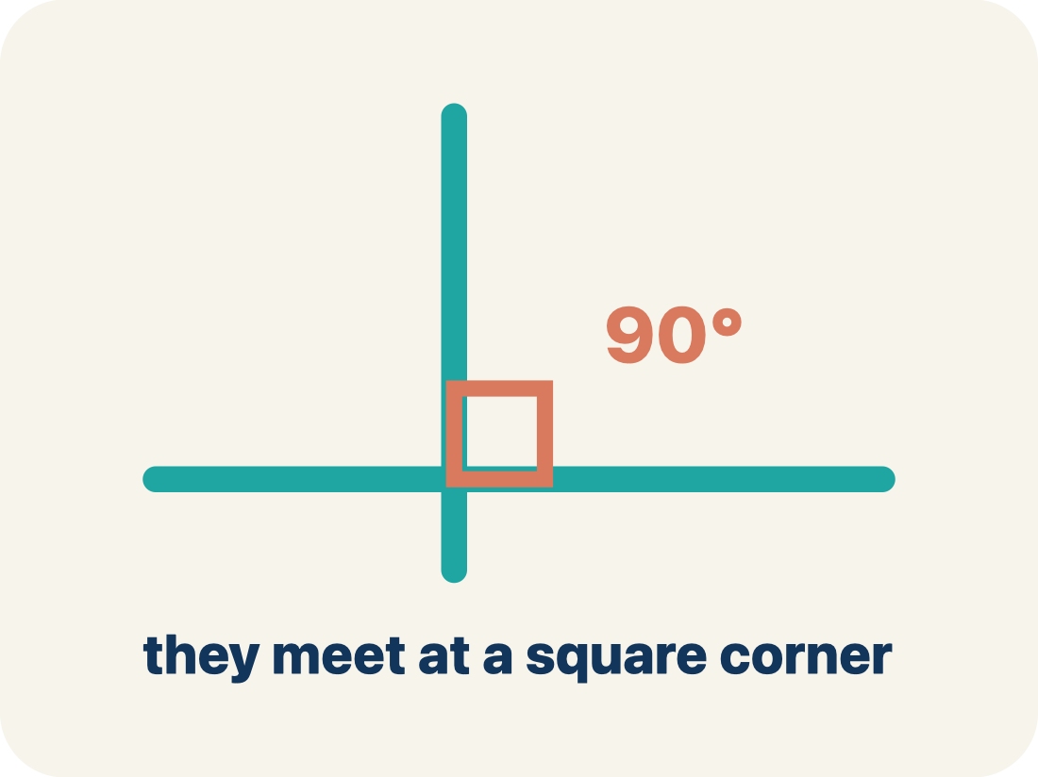
Vocabulary 5 of 8
Lesson 5-2 · Determine the Area of Triangles
Perpendicular
Two lines that meet to make a square corner (90 degrees).
EXAMPLE · EXPLAIN WHY IT FITS
The corner of a book or a door frame — the edges meet at exactly 90°, shown by a small square symbol
Use “Perpendicular” to explain the example. Point to
evidence.
eduwonderlab.com · Neft Teacher
12 / 50
Notes:
TEACH IN PRACTICE | Embedded facilitation | Lesson 5.2, slide 12 | VOCAB
Focus on the existing task: Vocabulary 5 of 8 Perpendicular Two lines that meet to…
ASK (T1/3/5): Where does “Perpendicular” appear in the example? Explain the meaning without reading the definition. Partner: restate the idea and ask a clarifying question.
LOOK FOR: A correct connection between the word and a feature of the example. If the student only repeats the definition, invite pointing, sketching or oral rehearsal, then ask for another explanation of this same example.
PARTICIPATION (T5/6/7): Think time before volunteers; accept a written, drawn or rehearsed entry. Students ask for evidence respectfully. Recognize a specific contribution or revision and check that both partners participate.
Source: BCPS Updated Instructional Framework Rubric (June 2020), TEACH 1–7.

Slide 13
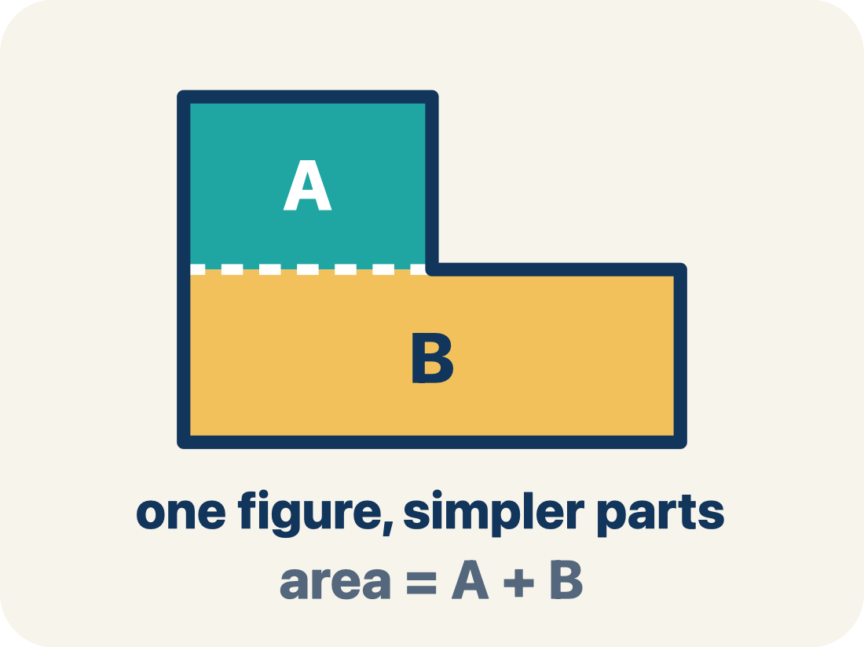
Vocabulary 6 of 8
Lesson 5-2 · Determine the Area of Triangles
Composite figure
A shape made by putting two or more simple shapes together.
EXAMPLE · EXPLAIN WHY IT FITS
A house shape = a rectangle (the walls) + a triangle (the roof); total area = rectangle area + triangle area
Use “Composite figure” to explain the example. Point to
evidence.
eduwonderlab.com · Neft Teacher
13 / 50
Notes:
TEACH IN PRACTICE | Embedded facilitation | Lesson 5.2, slide 13 | VOCAB
Focus on the existing task: Vocabulary 6 of 8 Composite figure A shape made by putting…
ASK (T1/3/5): Where does “Composite figure” appear in the example? Explain the meaning without reading the definition. Partner: restate the idea and ask a clarifying question.
LOOK FOR: A correct connection between the word and a feature of the example. If the student only repeats the definition, invite pointing, sketching or oral rehearsal, then ask for another explanation of this same example.
PARTICIPATION (T5/6/7): Think time before volunteers; accept a written, drawn or rehearsed entry. Students ask for evidence respectfully. Recognize a specific contribution or revision and check that both partners participate.
Source: BCPS Updated Instructional Framework Rubric (June 2020), TEACH 1–7.

Slide 14
Vocabulary 7 of 8
Lesson 5-2 · Determine the Area of Triangles
Formula
A math rule written with symbols.
EXAMPLE · EXPLAIN WHY IT FITS
A = ½ × b × h means Area equals one-half times base times height; for b = 12 and h = 8, A = 48
Use “Formula” to explain the example. Point to evidence.
eduwonderlab.com · Neft Teacher
14 / 50
Notes:
TEACH IN PRACTICE | Embedded facilitation | Lesson 5.2, slide 14 | VOCAB
Focus on the existing task: Vocabulary 7 of 8 Formula A math rule written with symbols.
ASK (T1/3/5): Where does “Formula” appear in the example? Explain the meaning without reading the definition. Partner: restate the idea and ask a clarifying question.
LOOK FOR: A correct connection between the word and a feature of the example. If the student only repeats the definition, invite pointing, sketching or oral rehearsal, then ask for another explanation of this same example.
PARTICIPATION (T5/6/7): Think time before volunteers; accept a written, drawn or rehearsed entry. Students ask for evidence respectfully. Recognize a specific contribution or revision and check that both partners participate.
Source: BCPS Updated Instructional Framework Rubric (June 2020), TEACH 1–7.

Slide 15
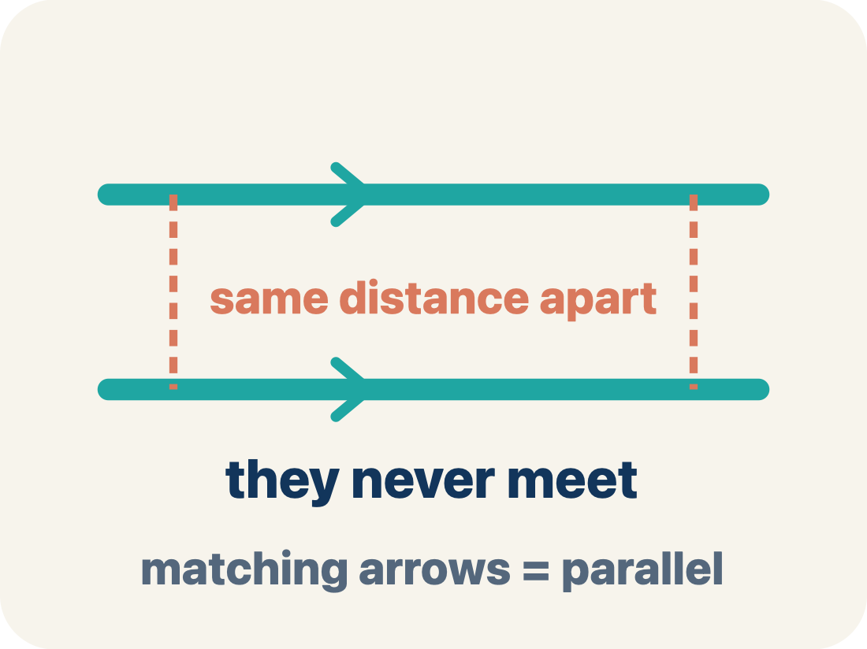
Vocabulary 8 of 8
Lesson 5-2 · Determine the Area of Triangles
Parallel
Two lines or sides that stay the same distance apart and never meet.
EXAMPLE · EXPLAIN WHY IT FITS
The top and bottom of a parallelogram never get closer together — matching arrowheads (›) mark one parallel pair, double arrowheads (››) mark the other.
Use “Parallel” to explain the example. Point to evidence.
eduwonderlab.com · Neft Teacher
15 / 50
Notes:
TEACH IN PRACTICE | Embedded facilitation | Lesson 5.2, slide 15 | VOCAB
Focus on the existing task: Vocabulary 8 of 8 Parallel Two lines or sides that stay…
ASK (T1/3/5): Where does “Parallel” appear in the example? Explain the meaning without reading the definition. Partner: restate the idea and ask a clarifying question.
LOOK FOR: A correct connection between the word and a feature of the example. If the student only repeats the definition, invite pointing, sketching or oral rehearsal, then ask for another explanation of this same example.
PARTICIPATION (T5/6/7): Think time before volunteers; accept a written, drawn or rehearsed entry. Students ask for evidence respectfully. Recognize a specific contribution or revision and check that both partners participate.
Source: BCPS Updated Instructional Framework Rubric (June 2020), TEACH 1–7.

Slide 16
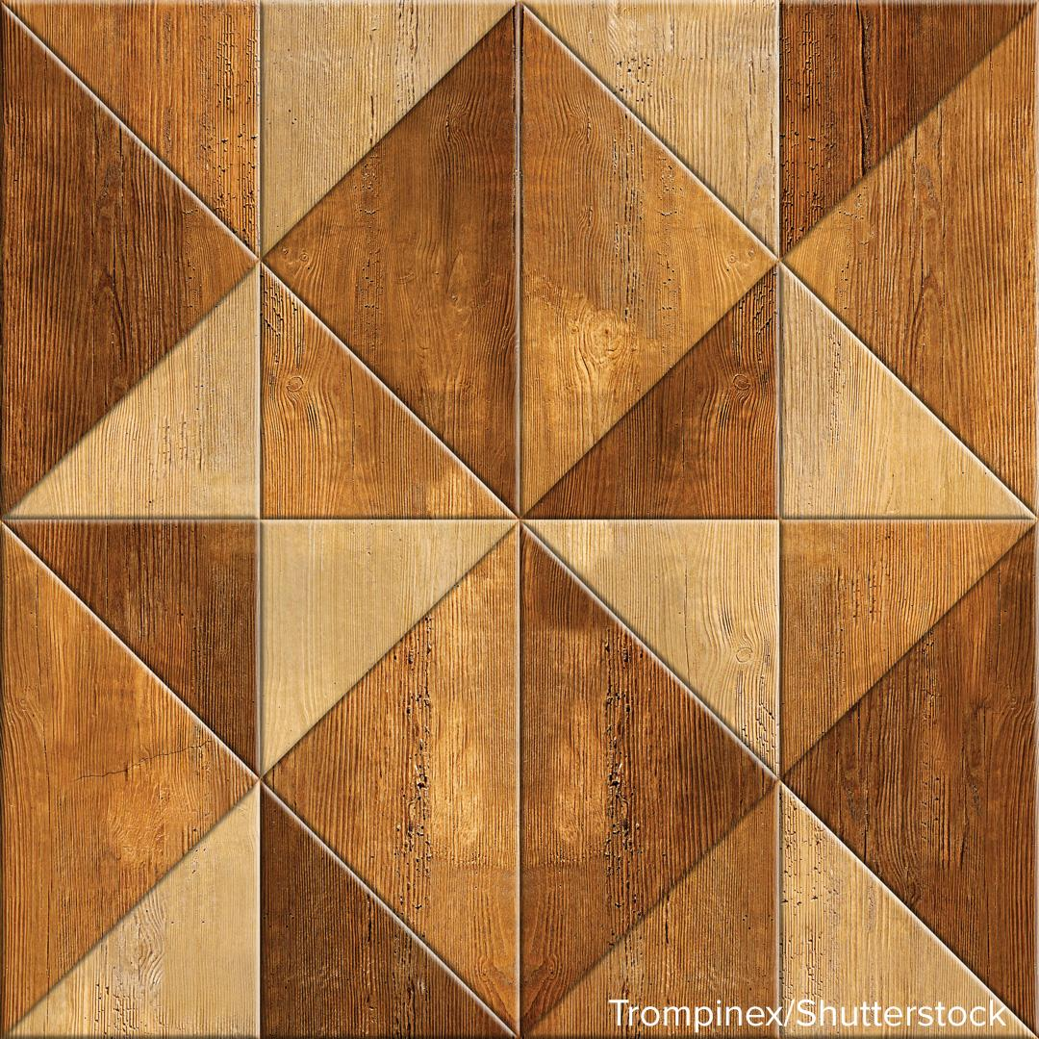

Be Curious
What do you notice?
What do you wonder?
Think first. Share a notice and a question;
build on a classmate’s idea.
Mindset
How do you establish a positive relationship with a classmate in math class?
16 / 50
Notes:
TEACH IN PRACTICE | Embedded facilitation | Lesson 5.2, slide 16 | CURIOUS
Focus on the existing task: Be Curious What do you notice?
LAUNCH (T2/3/5): Allow quiet observation first. Separate a notice from an inference, invite students’ own questions, and follow the existing launch before teaching a procedure.
LOOK FOR (T4): Where this task addresses it, students can identify a matching base and height. Ask which feature of their work supports the claim.
RESPOND: If this task shows the lesson misconception—omitting the half or using a nonperpendicular side—trace the base and perpendicular height and relate the figure to the shown parallelogram. Have the student revise and explain the change. Use this support only where the concept occurs in the current task; otherwise respond to the displayed question.
RECHECK: If a gap is shared, revisit the existing representation together. If it is limited, give targeted support while others compare valid methods on the same task. Check the revision before moving on.
PARTICIPATION (T5/6/7): Think time before volunteers; accept a written, drawn or rehearsed entry. Students ask for evidence respectfully. Recognize a specific contribution or revision and check that both partners participate.
Source: BCPS Updated Instructional Framework Rubric (June 2020), TEACH 1–7.

Slide 17
Vocabulary
Lesson 5-2 · Determine the Area of Triangles
ADD ON · Add on: “I agree because ______.” or “I see it differently because ______.”
Today’s Math Words
We learn every word — what it means and what it looks like — before we use it.
Area of a Triangle
Base
The space inside a triangle
Any side of a triangle can be the base
Height
Area
The straight-up distance from the base to the top corner
How much space is inside a flat shape
Perpendicular
Composite figure
Two lines that meet to make a square corner (90 degrees)
A shape made by putting two or more simple shapes together
Formula
Parallel
A math rule written with symbols
Two lines or sides that stay the same distance apart and never meet
eduwonderlab.com · Neft Teacher
17 / 50
Notes:
TEACH IN PRACTICE | Embedded facilitation | Lesson 5.2, slide 17 | VOCAB
Focus on the existing task: Vocabulary Today’s Math Words We learn every word — what it…
ASK (T1/3/5): Where does “the displayed term” appear in the example? Explain the meaning without reading the definition. Partner: restate the idea and ask a clarifying question.
LOOK FOR: A correct connection between the word and a feature of the example. If the student only repeats the definition, invite pointing, sketching or oral rehearsal, then ask for another explanation of this same example.
PARTICIPATION (T5/6/7): Think time before volunteers; accept a written, drawn or rehearsed entry. Students ask for evidence respectfully. Recognize a specific contribution or revision and check that both partners participate.
Source: BCPS Updated Instructional Framework Rubric (June 2020), TEACH 1–7. Earlier notes and answer keys are retained below.
EARLIER NOTES / EXISTING ANSWER KEY
Choral-read each word, its meaning, and what it looks like.
Students should use these words out loud today — listen for them in partner talk and revoice student ideas with the academic term.
UIFR: TEACH 1 · TEACH 5.

Slide 18
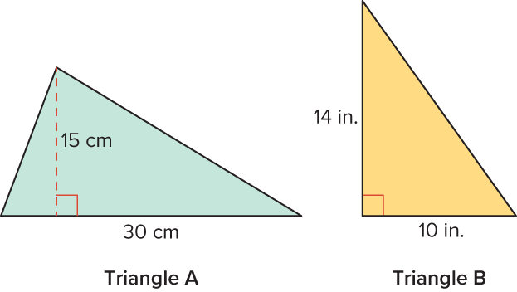
Triangles
What is the area of each of the triangles shown?
Try first. Point to a base and its matching height. Explain how your method uses them.
18 / 50
Notes:
TEACH IN PRACTICE | Embedded facilitation | Lesson 5.2, slide 18 | TASK
Focus on the existing task: What is the area of each of the triangles shown?
LAUNCH (T2/3/5): Use the displayed question. Give private thinking time; then A explains while B asks for evidence. Switch roles. Each student records their own reasoning.
LOOK FOR (T4): Where this task addresses it, students can identify a matching base and height. Ask which feature of their work supports the claim.
RESPOND: If this task shows the lesson misconception—omitting the half or using a nonperpendicular side—trace the base and perpendicular height and relate the figure to the shown parallelogram. Have the student revise and explain the change. Use this support only where the concept occurs in the current task; otherwise respond to the displayed question.
RECHECK: If a gap is shared, revisit the existing representation together. If it is limited, give targeted support while others compare valid methods on the same task. Check the revision before moving on.
PARTICIPATION (T5/6/7): Think time before volunteers; accept a written, drawn or rehearsed entry. Students ask for evidence respectfully. Recognize a specific contribution or revision and check that both partners participate.
Source: BCPS Updated Instructional Framework Rubric (June 2020), TEACH 1–7. Earlier notes and answer keys are retained below.
EARLIER NOTES / EXISTING ANSWER KEY
Model briefly, then hand the thinking back: ask “Why does this step work?” before showing the next one.
Quick check before moving on — thumbs or whiteboards from everyone, not volunteers.
UIFR: TEACH 2 · TEACH 3 · TEACH 4.
UIFR FULL | Lesson-specific facilitation
TEACH 2-3 | Session 1 task launch (UIFR PDF pp. 9-10).
Use the problem exactly as displayed. Give individual thinking time before discussion or advancing to the explanation. If the answer is already visible, ask students to reconstruct and justify it. Invite a choice of suitable representations and have students explain why their choice helps.
At the point where this concept appears, ask: “How do two copies of this triangle explain the area formula?” Wait for evidence, invite another pathway, and have a student ask a follow-up question. Do not replace students’ reasoning with a sequence of leading steps.

Slide 19
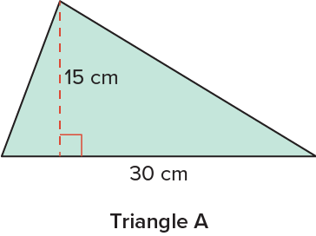
Triangles
How can you use what you know about finding the area of a parallelogram to find the area of Triangle A?
Record your reasoning before the reveal.
Compare, then explain any revision.
Reveal:
We can compose the triangle into a parallelogram to determine the area.
19 / 50
Notes:
TEACH IN PRACTICE | Embedded facilitation | Lesson 5.2, slide 19 | REVEAL
Focus on the existing task: Reveal: We can compose the triangle into a parallelogram to determine the area. How can you use what you know about finding the area of a parallelogram to find the area of Triangle A?
LAUNCH (T2/3/5): If an existing answer cover is present, gather an attempt before revealing. If the explanation is already visible, ask students to reconstruct and justify it. Compare reasoning and explain a revision; preserve the reveal sequence.
LOOK FOR (T4): Where this task addresses it, students can identify a matching base and height. Ask which feature of their work supports the claim.
RESPOND: If this task shows the lesson misconception—omitting the half or using a nonperpendicular side—trace the base and perpendicular height and relate the figure to the shown parallelogram. Have the student revise and explain the change. Use this support only where the concept occurs in the current task; otherwise respond to the displayed question.
RECHECK: If a gap is shared, revisit the existing representation together. If it is limited, give targeted support while others compare valid methods on the same task. Check the revision before moving on.
PARTICIPATION (T5/6/7): Think time before volunteers; accept a written, drawn or rehearsed entry. Students ask for evidence respectfully. Recognize a specific contribution or revision and check that both partners participate.
Source: BCPS Updated Instructional Framework Rubric (June 2020), TEACH 1–7. Earlier notes and answer keys are retained below.
EARLIER NOTES / EXISTING ANSWER KEY
Do not click yet: collect 2–3 student answers with reasons first.
Then click to remove the cover and have students compare their thinking to the reveal — “Is this what we said? Where is it different?”
Behind the cover: We can compose the triangle into a parallelogram to determine the area .
UIFR: TEACH 3 · TEACH 4.

Slide 20

COLLABORATE · TALK IT THROUGH • AGREE ON A MODEL
Collaborate and Connect
How can you compose the triangle into a parallelogram?
Think first. A explains; B asks for evidence.
Switch roles; both revise.
Reveal:
We can compose the triangle into a parallelogram by copying and rotating the triangle.
20 / 50
Notes:
TEACH IN PRACTICE | Embedded facilitation | Lesson 5.2, slide 20 | COLLABORATE
Focus on the existing task: Reveal: We can compose the triangle into a parallelogram by copying and rotating the triangle. How can you compose the triangle into a parallelogram?
LAUNCH (T2/3/5): Use the displayed question. Give private thinking time; then A explains while B asks for evidence. Switch roles. Each student records their own reasoning.
LOOK FOR (T4): Where this task addresses it, students can identify a matching base and height. Ask which feature of their work supports the claim.
RESPOND: If this task shows the lesson misconception—omitting the half or using a nonperpendicular side—trace the base and perpendicular height and relate the figure to the shown parallelogram. Have the student revise and explain the change. Use this support only where the concept occurs in the current task; otherwise respond to the displayed question.
RECHECK: If a gap is shared, revisit the existing representation together. If it is limited, give targeted support while others compare valid methods on the same task. Check the revision before moving on.
PARTICIPATION (T5/6/7): Think time before volunteers; accept a written, drawn or rehearsed entry. Students ask for evidence respectfully. Recognize a specific contribution or revision and check that both partners participate.
Source: BCPS Updated Instructional Framework Rubric (June 2020), TEACH 1–7. Earlier notes and answer keys are retained below.
EARLIER NOTES / EXISTING ANSWER KEY
Routine: COLLABORATE · TALK IT THROUGH • AGREE ON A MODEL
UIFR FULL | Lesson-specific facilitation
TEACH 4-5 | Session 1 discussion and checkpoint (UIFR PDF pp. 11-12).
Collect a brief response from every student to the existing prompt before hearing volunteers. Partners take turns explaining and asking for evidence: “I understand ___; what supports ___?” Offer rehearsal or an annotated model for students who need language support. Each student records their own reasoning.
Look specifically for: omitting the half or using a nonperpendicular side. If it appears, trace the base and perpendicular height and relate the figure to the shown parallelogram; then ask the student to revise the same response and explain the change. If evidence is secure, have students compare a second valid pathway or state why their approach works. Choose the next step from the responses, not a preset pace.

Slide 21
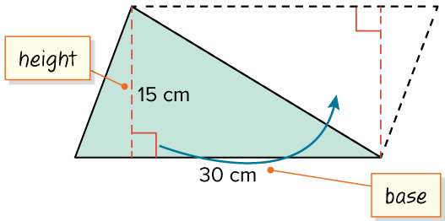
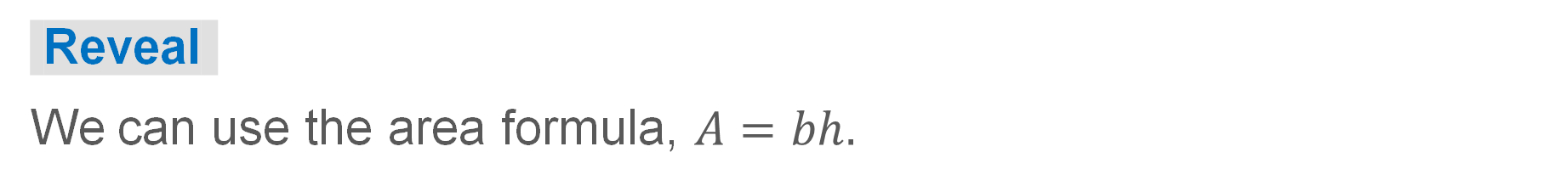
Triangles
Let’s compose the triangle into a parallelogram by copying and combining the triangle.​
How can you find the area of the resulting parallelogram?
Try first. Point to a base and its matching
height. Explain how your method uses them.
21 / 50
Notes:
TEACH IN PRACTICE | Embedded facilitation | Lesson 5.2, slide 21 | TASK
Focus on the existing task: Let’s compose the triangle into a parallelogram by copying and combining the triangle. How can you find the area of the resulting parallelogram?
LAUNCH (T2/3/5): Use the displayed question. Give private thinking time; then A explains while B asks for evidence. Switch roles. Each student records their own reasoning.
LOOK FOR (T4): Where this task addresses it, students can identify a matching base and height. Ask which feature of their work supports the claim.
RESPOND: If this task shows the lesson misconception—omitting the half or using a nonperpendicular side—trace the base and perpendicular height and relate the figure to the shown parallelogram. Have the student revise and explain the change. Use this support only where the concept occurs in the current task; otherwise respond to the displayed question.
RECHECK: If a gap is shared, revisit the existing representation together. If it is limited, give targeted support while others compare valid methods on the same task. Check the revision before moving on.
PARTICIPATION (T5/6/7): Think time before volunteers; accept a written, drawn or rehearsed entry. Students ask for evidence respectfully. Recognize a specific contribution or revision and check that both partners participate.
Source: BCPS Updated Instructional Framework Rubric (June 2020), TEACH 1–7. Earlier notes and answer keys are retained below.
EARLIER NOTES / EXISTING ANSWER KEY
Model briefly, then hand the thinking back: ask “Why does this step work?” before showing the next one.
Quick check before moving on — thumbs or whiteboards from everyone, not volunteers.
UIFR: TEACH 2 · TEACH 3 · TEACH 4.

Slide 22



Triangles
Area of the parallelogram:
Record your reasoning before the reveal. Compare, then
explain any revision.
What relationship do you notice between the area of the triangle and the area of the parallelogram? Explain.
Reveal:
We used two copies of the triangle to compose the parallelogram. So, the area of the triangle is half the area of the parallelogram.
22 / 50
Notes:
TEACH IN PRACTICE | Embedded facilitation | Lesson 5.2, slide 22 | REVEAL
Focus on the existing task: Reveal: We used two copies of the triangle to compose the parallelogram. So, the area of the triangle is half the area of the…
LAUNCH (T2/3/5): If an existing answer cover is present, gather an attempt before revealing. If the explanation is already visible, ask students to reconstruct and justify it. Compare reasoning and explain a revision; preserve the reveal sequence.
LOOK FOR (T4): Where this task addresses it, students can explain the factor one-half. Ask which feature of their work supports the claim.
RESPOND: If this task shows the lesson misconception—omitting the half or using a nonperpendicular side—trace the base and perpendicular height and relate the figure to the shown parallelogram. Have the student revise and explain the change. Use this support only where the concept occurs in the current task; otherwise respond to the displayed question.
RECHECK: If a gap is shared, revisit the existing representation together. If it is limited, give targeted support while others compare valid methods on the same task. Check the revision before moving on.
PARTICIPATION (T5/6/7): Think time before volunteers; accept a written, drawn or rehearsed entry. Students ask for evidence respectfully. Recognize a specific contribution or revision and check that both partners participate.
Source: BCPS Updated Instructional Framework Rubric (June 2020), TEACH 1–7. Earlier notes and answer keys are retained below.
EARLIER NOTES / EXISTING ANSWER KEY
Do not click yet: collect 2–3 student answers with reasons first.
Then click to remove the cover and have students compare their thinking to the reveal — “Is this what we said? Where is it different?”
Behind the cover: We used two copies of the triangle to compose the parallelogram. So, the area of the triangle is half the area of the parallelogram.
UIFR: TEACH 3 · TEACH 4.

Slide 23
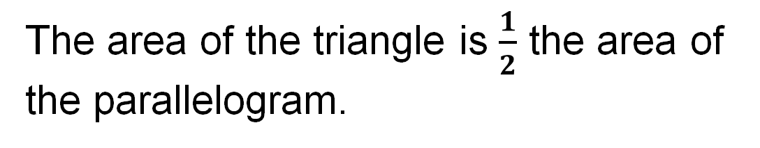

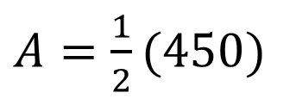



Triangles
Area of the parallelogram:
Area of the triangle:
How can you use this information to help you develop a formula for the area of a triangle?
23 / 50
Notes:
TEACH IN PRACTICE | Embedded facilitation | Lesson 5.2, slide 23 | TASK
Focus on the existing task: Area of the parallelogram: Area of the triangle: How can you use this information to help you develop a formula for the area of a triangle?
LAUNCH (T2/3/5): Use the displayed question. Give private thinking time; then A explains while B asks for evidence. Switch roles. Each student records their own reasoning.
LOOK FOR (T4): Where this task addresses it, students can identify a matching base and height. Ask which feature of their work supports the claim.
RESPOND: If this task shows the lesson misconception—omitting the half or using a nonperpendicular side—trace the base and perpendicular height and relate the figure to the shown parallelogram. Have the student revise and explain the change. Use this support only where the concept occurs in the current task; otherwise respond to the displayed question.
RECHECK: If a gap is shared, revisit the existing representation together. If it is limited, give targeted support while others compare valid methods on the same task. Check the revision before moving on.
PARTICIPATION (T5/6/7): Think time before volunteers; accept a written, drawn or rehearsed entry. Students ask for evidence respectfully. Recognize a specific contribution or revision and check that both partners participate.
Source: BCPS Updated Instructional Framework Rubric (June 2020), TEACH 1–7. Earlier notes and answer keys are retained below.
EARLIER NOTES / EXISTING ANSWER KEY
Model briefly, then hand the thinking back: ask “Why does this step work?” before showing the next one.
Quick check before moving on — thumbs or whiteboards from everyone, not volunteers.
UIFR: TEACH 2 · TEACH 3 · TEACH 4.

Slide 24
STUDENT MOVES
Lesson 5-2
Your move
USE YOUR TOOLS · Reach for your notes, a model, or a manipulative before you reach for an answer.
24 / 50

Slide 25

Triangles
We can write the formula that reflects half the area of a parallelogram.
Area of the parallelogram:
Area of the triangle:
Point to a base and its matching height. Explain how your method uses them.
25 / 50
Notes:
TEACH IN PRACTICE | Embedded facilitation | Lesson 5.2, slide 24 | WORKED
Focus on the existing task: We can write the formula that reflects half the area of a parallelogram. Area of the parallelogram: Area of the triangle: Triangles
LAUNCH (T2/3/5): Ask students to explain the displayed idea or example and point to evidence. When a calculation step is shown, ask why it is valid. Have a partner restate the explanation; copying is not the check.
LOOK FOR (T4): Where this task addresses it, students can explain the factor one-half. Ask which feature of their work supports the claim.
RESPOND: If this task shows the lesson misconception—omitting the half or using a nonperpendicular side—trace the base and perpendicular height and relate the figure to the shown parallelogram. Have the student revise and explain the change. Use this support only where the concept occurs in the current task; otherwise respond to the displayed question.
RECHECK: If a gap is shared, revisit the existing representation together. If it is limited, give targeted support while others compare valid methods on the same task. Check the revision before moving on.
PARTICIPATION (T5/6/7): Think time before volunteers; accept a written, drawn or rehearsed entry. Students ask for evidence respectfully. Recognize a specific contribution or revision and check that both partners participate.
Source: BCPS Updated Instructional Framework Rubric (June 2020), TEACH 1–7. Earlier notes and answer keys are retained below.
EARLIER NOTES / EXISTING ANSWER KEY
Model briefly, then hand the thinking back: ask “Why does this step work?” before showing the next one.
Quick check before moving on — thumbs or whiteboards from everyone, not volunteers.
UIFR: TEACH 2 · TEACH 3 · TEACH 4.

Slide 26
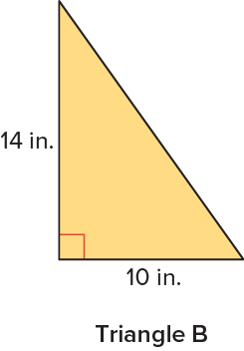
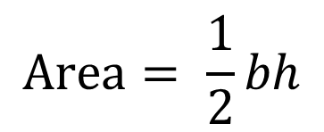
Triangles
Let’s determine the area of Triangle B using the area formula for triangles.
HOW DO YOU KNOW? · Ask your partner “How do you know?” Answer by pointing to your own work.
What type of triangle is Triangle B? What does this tell you about the height of the triangle?
Reveal:
It is a right triangle, so the height of the triangle is the same as the vertical side connecting the base to the opposite vertex.
26 / 50
Notes:
TEACH IN PRACTICE | Embedded facilitation | Lesson 5.2, slide 25 | REVEAL
Focus on the existing task: What type of triangle is Triangle B?
LAUNCH (T2/3/5): If an existing answer cover is present, gather an attempt before revealing. If the explanation is already visible, ask students to reconstruct and justify it. Compare reasoning and explain a revision; preserve the reveal sequence.
LOOK FOR (T4): Where this task addresses it, students can identify a matching base and height. Ask which feature of their work supports the claim.
RESPOND: If this task shows the lesson misconception—omitting the half or using a nonperpendicular side—trace the base and perpendicular height and relate the figure to the shown parallelogram. Have the student revise and explain the change. Use this support only where the concept occurs in the current task; otherwise respond to the displayed question.
RECHECK: If a gap is shared, revisit the existing representation together. If it is limited, give targeted support while others compare valid methods on the same task. Check the revision before moving on.
PARTICIPATION (T5/6/7): Think time before volunteers; accept a written, drawn or rehearsed entry. Students ask for evidence respectfully. Recognize a specific contribution or revision and check that both partners participate.
Source: BCPS Updated Instructional Framework Rubric (June 2020), TEACH 1–7. Earlier notes and answer keys are retained below.
EARLIER NOTES / EXISTING ANSWER KEY
Do not click yet: collect 2–3 student answers with reasons first.
Then click to remove the cover and have students compare their thinking to the reveal — “Is this what we said? Where is it different?”
Behind the cover: It is a right triangle, so the height of the triangle is the same as the vertical side connecting the base to the opposite vertex.
UIFR: TEACH 3 · TEACH 4.

Slide 27
Triangles
What is the area of each of the triangles shown?
The area of Triangle A is 225 square centimeters. The area of Triangle B is 70 square inches.
TRY IT BEFORE YOU’RE SURE · Start even if you are not sure. A revised answer counts as much as a first-try answer.
Using Symbols Appropriately
What units of measure are needed to be precise?
27 / 50
Notes:
TEACH IN PRACTICE | Embedded facilitation | Lesson 5.2, slide 26 | TASK
Focus on the existing task: Using Symbols Appropriately What units of measure are needed to be precise?
LAUNCH (T2/3/5): Use the displayed question. Give private thinking time; then A explains while B asks for evidence. Switch roles. Each student records their own reasoning.
LOOK FOR (T4): Where this task addresses it, students can use square units. Ask which feature of their work supports the claim.
RESPOND: If this task shows the lesson misconception—omitting the half or using a nonperpendicular side—trace the base and perpendicular height and relate the figure to the shown parallelogram. Have the student revise and explain the change. Use this support only where the concept occurs in the current task; otherwise respond to the displayed question.
RECHECK: If a gap is shared, revisit the existing representation together. If it is limited, give targeted support while others compare valid methods on the same task. Check the revision before moving on.
PARTICIPATION (T5/6/7): Think time before volunteers; accept a written, drawn or rehearsed entry. Students ask for evidence respectfully. Recognize a specific contribution or revision and check that both partners participate.
Source: BCPS Updated Instructional Framework Rubric (June 2020), TEACH 1–7. Earlier notes and answer keys are retained below.
EARLIER NOTES / EXISTING ANSWER KEY
Model briefly, then hand the thinking back: ask “Why does this step work?” before showing the next one.
Quick check before moving on — thumbs or whiteboards from everyone, not volunteers.
UIFR: TEACH 2 · TEACH 3 · TEACH 4.

Slide 28
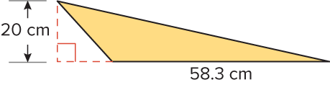
Let’s Explore More
Lucy found the area of the triangle shown by first taking half of the height and then multiplying the result by the base. Is this an acceptable way to find the area of a triangle? Explain. ​
Workspace
28 / 50
Notes:
TEACH IN PRACTICE | Embedded facilitation | Lesson 5.2, slide 27 | PRACTICE
Focus on the existing task: Workspace Lucy found the area of the triangle shown by first taking half of the height and then multiplying the result by the base. Is this an acceptable way to find the area of a triangle?
LAUNCH (T2/3/5): Use the displayed question. Give private thinking time; then A explains while B asks for evidence. Switch roles. Each student records their own reasoning.
LOOK FOR (T4): Where this task addresses it, students can identify a matching base and height. Ask which feature of their work supports the claim.
RESPOND: If this task shows the lesson misconception—omitting the half or using a nonperpendicular side—trace the base and perpendicular height and relate the figure to the shown parallelogram. Have the student revise and explain the change. Use this support only where the concept occurs in the current task; otherwise respond to the displayed question.
RECHECK: If a gap is shared, revisit the existing representation together. If it is limited, give targeted support while others compare valid methods on the same task. Check the revision before moving on.
PARTICIPATION (T5/6/7): Think time before volunteers; accept a written, drawn or rehearsed entry. Students ask for evidence respectfully. Recognize a specific contribution or revision and check that both partners participate.
Source: BCPS Updated Instructional Framework Rubric (June 2020), TEACH 1–7. Earlier notes and answer keys are retained below.
EARLIER NOTES / EXISTING ANSWER KEY
Extension for partners or table groups — students choose their approach and use the workspace to show thinking.
Push with “Convince me,” and have two groups with different approaches share.
This is where students stretch past the worked example.
UIFR: TEACH 2 · TEACH 5.

Slide 29
STUDENT MOVES
Lesson 5-2
Your move
TWO MINUTES SOLO · Two minutes on your own, then compare. Bring one thing you tried, even if it did not work.
29 / 50

Slide 30
LESSON 5.2 / DISCUSS THE TASK
Explain and compare
Use the task you just explored.
TAKE TURNS
How do two copies of this triangle explain the area formula?
Explain
“I know this because…”
Ask
“Where does your work show that?”
Point to evidence in your work.
Then compare your approach with a partner’s.
JUSTIFY IT · Say it like this: “I know ______ because ______.”
Listen to understand. Ask for evidence. Make room for every voice.
Notes:
TEACH IN PRACTICE | Embedded facilitation | Lesson 5.2, slide 28 | PRIOR_INSERT
Focus on the existing task: Point to evidence in your work. Then compare your approach with a partner’s. TAKE TURNS Explain “I know this because…” Ask “Where does your work show that?
CONNECT (T1/4): Ask students to restate the displayed goal or key idea and connect it to earlier work. Relevant lesson evidence: identify a matching base and height; explain the factor one-half; use square units. Use only the criterion that matches the current session.
SHOW PROGRESS: Students point to their own existing work, explain what improved after feedback, and name a next step. Pair confidence ratings with actual evidence.
PARTICIPATION (T5/6/7): Think time before volunteers; accept a written, drawn or rehearsed entry. Students ask for evidence respectfully. Recognize a specific contribution or revision and check that both partners participate.
Source: BCPS Updated Instructional Framework Rubric (June 2020), TEACH 1–7.

Slide 31
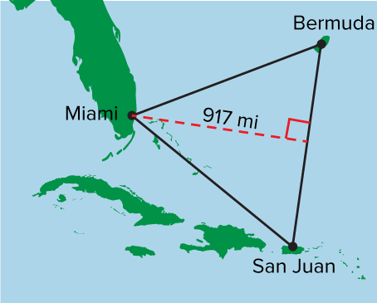
Be Curious
What could the question be?
Think first. Share a notice and a
question; build on a classmate’s
idea.
Mindset
How are you establishing a positive relationship with a classmate in math class?
31 / 50
Notes:
TEACH IN PRACTICE | Embedded facilitation | Lesson 5.2, slide 29 | CURIOUS
Focus on the existing task: How are you establishing a positive relationship with a classmate in math class?
LAUNCH (T2/3/5): Allow quiet observation first. Separate a notice from an inference, invite students’ own questions, and follow the existing launch before teaching a procedure.
LOOK FOR (T4): Where this task addresses it, students can identify a matching base and height. Ask which feature of their work supports the claim.
RESPOND: If this task shows the lesson misconception—omitting the half or using a nonperpendicular side—trace the base and perpendicular height and relate the figure to the shown parallelogram. Have the student revise and explain the change. Use this support only where the concept occurs in the current task; otherwise respond to the displayed question.
RECHECK: If a gap is shared, revisit the existing representation together. If it is limited, give targeted support while others compare valid methods on the same task. Check the revision before moving on.
PARTICIPATION (T5/6/7): Think time before volunteers; accept a written, drawn or rehearsed entry. Students ask for evidence respectfully. Recognize a specific contribution or revision and check that both partners participate.
Source: BCPS Updated Instructional Framework Rubric (June 2020), TEACH 1–7.

Slide 32
Warm-Up
Lesson 5-2 · Determine the Area of Triangles
Session 2 Warm-Up
Try alone. Explain one. Then revise.
1
Which formula gives the area of a triangle?
2
Why does the triangle formula include 1/2?
A
A = b × h
A
Triangles have 3 sides
B
A = ½(b × h)
B
A triangle is half a parallelogram
C
A = b + h
C
To make numbers smaller
D
A = 2(b × h)
D
Only for right triangles
3
A triangle has base 10 m and height 6 m. What is its area?
4
A right triangle has legs 4 ft and 7 ft. Its area is:
A
16 m²
A
11 ft²
B
30 m²
B
14 ft²
C
60 m²
C
28 ft²
D
30 m³
D
22 ft²
eduwonderlab.com · Neft Teacher
32 / 50
Notes:
TEACH IN PRACTICE | Embedded facilitation | Lesson 5.2, slide 30 | WARMUP
Focus on the existing task: Warm-Up Session 2 Warm-Up Check what you remember from Session 1 1 Which formula gives the area of a triangle?
GATHER EVIDENCE (T4/6): Keep the original items. Students try independently, mark an uncertain item, and explain one method before checking. Use the existing key when present.
RESPOND: Distinguish a calculation slip from a reasoning gap. Give one next step on the same item; have students revise in a second color. Use the responses to choose flexible support for today’s lesson.
PARTICIPATION (T5/6/7): Think time before volunteers; accept a written, drawn or rehearsed entry. Students ask for evidence respectfully. Recognize a specific contribution or revision and check that both partners participate.
Source: BCPS Updated Instructional Framework Rubric (June 2020), TEACH 1–7. Earlier notes and answer keys are retained below.
EARLIER NOTES / EXISTING ANSWER KEY
Warm-up routine: students start silently on entry; keep it to about 4 minutes.
Circulate and note who is stuck — use what you see to choose who you check on first today.
Go over answers quickly; ask one student to explain a step, not just say the answer.
UIFR: TEACH 4 · TEACH 6.

Slide 33
STUDENT MOVES
Lesson 5-2
Your move
YOU KNOW THE ROUTINE · Read → plan → solve → check. Do all four, in that order.
33 / 50

Slide 34
Review Notes — Session 2
Lesson 5-2 · Determine the Area of Triangles
Session 2: Review Notes
Copy. Explain. Check.
WHY IT MATTERS · Finish this: “This is worth knowing because ______.”
Triangle Area Formula
1
Area = ½ × base × height (A = ½bh). Any triangle is exactly half of a parallelogram with the same base and height.
Identifying Base & Height
2
The base can be any side; the height is the perpendicular segment from the opposite vertex to that base.
Right Triangles
3
In a right triangle, the two perpendicular legs serve directly as base and height.
eduwonderlab.com · Neft Teacher
34 / 50
Notes:
TEACH IN PRACTICE | Embedded facilitation | Lesson 5.2, slide 31 | NOTES
Focus on the existing task: Review Notes — Session 2 Session 2: Review Notes Copy into…
ROUTINE (T1/2/4): Read or copy the original notes, cover one line, and explain it using the displayed example. Reopen and correct. Copying alone is not evidence of understanding.
LOOK FOR: A link between a symbol, quantity or feature and the explanation. If missing, point back to that feature and have the student try again; fade the prompt once they can explain.
PARTICIPATION (T5/6/7): Think time before volunteers; accept a written, drawn or rehearsed entry. Students ask for evidence respectfully. Recognize a specific contribution or revision and check that both partners participate.
Source: BCPS Updated Instructional Framework Rubric (June 2020), TEACH 1–7. Earlier notes and answer keys are retained below.
EARLIER NOTES / EXISTING ANSWER KEY
Copy routine: read one line at a time; students copy, then explain that line to a partner.
Keep it brisk — the understanding work happens in the examples, not the copying.
UIFR: TEACH 1 · TEACH 6.

Slide 35
Session 2
Determine the Area of Triangles
SELF-CHECK · Mark it: ✓ got it · ~ almost · ? stuck. Then fix one thing before we move on.
35 / 50
Notes:
TEACH IN PRACTICE | Embedded facilitation | Lesson 5.2, slide 32 | DIVIDER
Focus on the existing task: Determine the Area of Triangles Session 2
TRANSITION (T6/7): Students confirm materials, roles, how to request help, and the next response routine. Ask a student to restate it. Keep teacher-only slides hidden.
PARTICIPATION (T5/6/7): Think time before volunteers; accept a written, drawn or rehearsed entry. Students ask for evidence respectfully. Recognize a specific contribution or revision and check that both partners participate.
Source: BCPS Updated Instructional Framework Rubric (June 2020), TEACH 1–7. Earlier notes and answer keys are retained below.
EARLIER NOTES / EXISTING ANSWER KEY
Transition cue: state what materials are out and what success looks like this session.
Keep the changeover under a minute.
UIFR: TEACH 6.

Slide 36
The Bermuda Triangle
The Bermuda Triangle is an area in the Atlantic Ocean between Miami, Florida, the island of Bermuda, and San Juan, Puerto Rico. It covers an area of about 437,409 square miles.
What is the approximate distance from Bermuda to San Juan?
Precision
STRUGGLE FIRST · Work on your own first. Stuck is allowed — try a second strategy before you ask.
Does the problem call for an estimate or an exact solution?
36 / 50
Notes:
TEACH IN PRACTICE | Embedded facilitation | Lesson 5.2, slide 33 | TASK
Focus on the existing task: Does the problem call for an estimate or an exact solution?
LAUNCH (T2/3/5): Use the displayed question. Give private thinking time; then A explains while B asks for evidence. Switch roles. Each student records their own reasoning.
LOOK FOR (T4): Where this task addresses it, students can use square units. Ask which feature of their work supports the claim.
RESPOND: If this task shows the lesson misconception—omitting the half or using a nonperpendicular side—trace the base and perpendicular height and relate the figure to the shown parallelogram. Have the student revise and explain the change. Use this support only where the concept occurs in the current task; otherwise respond to the displayed question.
RECHECK: If a gap is shared, revisit the existing representation together. If it is limited, give targeted support while others compare valid methods on the same task. Check the revision before moving on.
PARTICIPATION (T5/6/7): Think time before volunteers; accept a written, drawn or rehearsed entry. Students ask for evidence respectfully. Recognize a specific contribution or revision and check that both partners participate.
Source: BCPS Updated Instructional Framework Rubric (June 2020), TEACH 1–7. Earlier notes and answer keys are retained below.
EARLIER NOTES / EXISTING ANSWER KEY
Read the context aloud (or have a student read it).
Before any math, students restate the situation and what is being asked in their own words.
Ask: What is the approximate distance from Bermuda to San Juan?
UIFR: TEACH 1 · TEACH 3.

Slide 37
The Bermuda Triangle
The Bermuda Triangle is an area in the Atlantic Ocean between Miami, Florida, the island of Bermuda, and San Juan, Puerto Rico. It covers an area of about 437,409 square miles. What is the approximate distance from Bermuda to San Juan? ​
What tool can you use to represent the problem?
Reveal:
We can use a visual representation.
37 / 50
Notes:
TEACH IN PRACTICE | Embedded facilitation | Lesson 5.2, slide 34 | REVEAL
Focus on the existing task: What tool can you use to represent the problem?
LAUNCH (T2/3/5): If an existing answer cover is present, gather an attempt before revealing. If the explanation is already visible, ask students to reconstruct and justify it. Compare reasoning and explain a revision; preserve the reveal sequence.
LOOK FOR (T4): Where this task addresses it, students can use square units. Ask which feature of their work supports the claim.
RESPOND: If this task shows the lesson misconception—omitting the half or using a nonperpendicular side—trace the base and perpendicular height and relate the figure to the shown parallelogram. Have the student revise and explain the change. Use this support only where the concept occurs in the current task; otherwise respond to the displayed question.
RECHECK: If a gap is shared, revisit the existing representation together. If it is limited, give targeted support while others compare valid methods on the same task. Check the revision before moving on.
PARTICIPATION (T5/6/7): Think time before volunteers; accept a written, drawn or rehearsed entry. Students ask for evidence respectfully. Recognize a specific contribution or revision and check that both partners participate.
Source: BCPS Updated Instructional Framework Rubric (June 2020), TEACH 1–7. Earlier notes and answer keys are retained below.
EARLIER NOTES / EXISTING ANSWER KEY
Do not click yet: collect 2–3 student answers with reasons first.
Then click to remove the cover and have students compare their thinking to the reveal — “Is this what we said? Where is it different?”
Behind the cover: We can use a visual representation.
UIFR: TEACH 3 · TEACH 4.

Slide 38
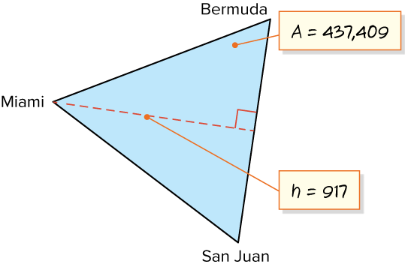
The Bermuda Triangle
Step 1 Let’s create a visual representation of the problem.
The Bermuda Triangle covers an area of about 437,409 square miles. What is the approximate distance from Bermuda to San Juan?
What is the problem asking you to find? How does this relate to the visual representation?
Reveal:
We need to find the distance from Bermuda to San Juan, which is the base of the triangle.
38 / 50
Notes:
TEACH IN PRACTICE | Embedded facilitation | Lesson 5.2, slide 35 | REVEAL
Focus on the existing task: Step 1 Let’s create a visual representation of the problem. The Bermuda Triangle covers an area of about 437,409 square miles. What is the approximate distance from Bermuda to San Juan?
LAUNCH (T2/3/5): If an existing answer cover is present, gather an attempt before revealing. If the explanation is already visible, ask students to reconstruct and justify it. Compare reasoning and explain a revision; preserve the reveal sequence.
LOOK FOR (T4): Where this task addresses it, students can identify a matching base and height. Ask which feature of their work supports the claim.
RESPOND: If this task shows the lesson misconception—omitting the half or using a nonperpendicular side—trace the base and perpendicular height and relate the figure to the shown parallelogram. Have the student revise and explain the change. Use this support only where the concept occurs in the current task; otherwise respond to the displayed question.
RECHECK: If a gap is shared, revisit the existing representation together. If it is limited, give targeted support while others compare valid methods on the same task. Check the revision before moving on.
PARTICIPATION (T5/6/7): Think time before volunteers; accept a written, drawn or rehearsed entry. Students ask for evidence respectfully. Recognize a specific contribution or revision and check that both partners participate.
Source: BCPS Updated Instructional Framework Rubric (June 2020), TEACH 1–7. Earlier notes and answer keys are retained below.
EARLIER NOTES / EXISTING ANSWER KEY
Do not click yet: collect 2–3 student answers with reasons first.
Then click to remove the cover and have students compare their thinking to the reveal — “Is this what we said? Where is it different?”
Behind the cover: We need to find the distance from Bermuda to San Juan, which is the base of the triangle.
UIFR: TEACH 3 · TEACH 4.

Slide 39
STUDENT MOVES
Lesson 5-2
Your moves
ANOTHER PATHWAY · Did anyone get there a different way? Put both pathways side by side and compare.
TAKE TURNS · One explains, one asks a question. Then switch, so both of you talk.
39 / 50

Slide 40
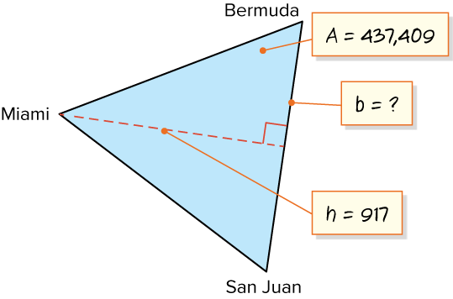
The Bermuda Triangle
We need to find the distance from Bermuda to San Juan, which is the base of the triangle.​
Record your reasoning before the reveal.
Compare, then explain any revision.
How can you relate the base, height, and area to find the missing measure?
Reveal:
We can use the area formula for triangles.
40 / 50
Notes:
TEACH IN PRACTICE | Embedded facilitation | Lesson 5.2, slide 36 | REVEAL
Focus on the existing task: Reveal: We can use the area formula for triangles. We need to find the distance from Bermuda to San Juan, which is the base of the…
LAUNCH (T2/3/5): If an existing answer cover is present, gather an attempt before revealing. If the explanation is already visible, ask students to reconstruct and justify it. Compare reasoning and explain a revision; preserve the reveal sequence.
LOOK FOR (T4): Where this task addresses it, students can identify a matching base and height. Ask which feature of their work supports the claim.
RESPOND: If this task shows the lesson misconception—omitting the half or using a nonperpendicular side—trace the base and perpendicular height and relate the figure to the shown parallelogram. Have the student revise and explain the change. Use this support only where the concept occurs in the current task; otherwise respond to the displayed question.
RECHECK: If a gap is shared, revisit the existing representation together. If it is limited, give targeted support while others compare valid methods on the same task. Check the revision before moving on.
PARTICIPATION (T5/6/7): Think time before volunteers; accept a written, drawn or rehearsed entry. Students ask for evidence respectfully. Recognize a specific contribution or revision and check that both partners participate.
Source: BCPS Updated Instructional Framework Rubric (June 2020), TEACH 1–7. Earlier notes and answer keys are retained below.
EARLIER NOTES / EXISTING ANSWER KEY
Do not click yet: collect 2–3 student answers with reasons first.
Then click to remove the cover and have students compare their thinking to the reveal — “Is this what we said? Where is it different?”
Behind the cover: We can use the area formula for triangles.
UIFR: TEACH 3 · TEACH 4.

Slide 41
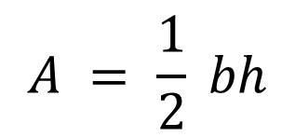
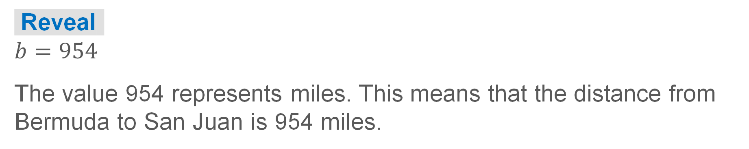
COLLABORATE · TALK IT THROUGH • AGREE ON A MODEL
Collaborate and Connect
Let’s use an area formula for triangles to find the base.
What is the missing measure? What does this value represent?​
41 / 50
Notes:
TEACH IN PRACTICE | Embedded facilitation | Lesson 5.2, slide 37 | COLLABORATE
Focus on the existing task: Collaborate and Connect Let’s use an area formula for triangles to find the base. What is the missing measure?
LAUNCH (T2/3/5): Use the displayed question. Give private thinking time; then A explains while B asks for evidence. Switch roles. Each student records their own reasoning.
LOOK FOR (T4): Where this task addresses it, students can identify a matching base and height. Ask which feature of their work supports the claim.
RESPOND: If this task shows the lesson misconception—omitting the half or using a nonperpendicular side—trace the base and perpendicular height and relate the figure to the shown parallelogram. Have the student revise and explain the change. Use this support only where the concept occurs in the current task; otherwise respond to the displayed question.
RECHECK: If a gap is shared, revisit the existing representation together. If it is limited, give targeted support while others compare valid methods on the same task. Check the revision before moving on.
PARTICIPATION (T5/6/7): Think time before volunteers; accept a written, drawn or rehearsed entry. Students ask for evidence respectfully. Recognize a specific contribution or revision and check that both partners participate.
Source: BCPS Updated Instructional Framework Rubric (June 2020), TEACH 1–7. Earlier notes and answer keys are retained below.
EARLIER NOTES / EXISTING ANSWER KEY
Routine: COLLABORATE · TALK IT THROUGH • AGREE ON A MODEL

Slide 42
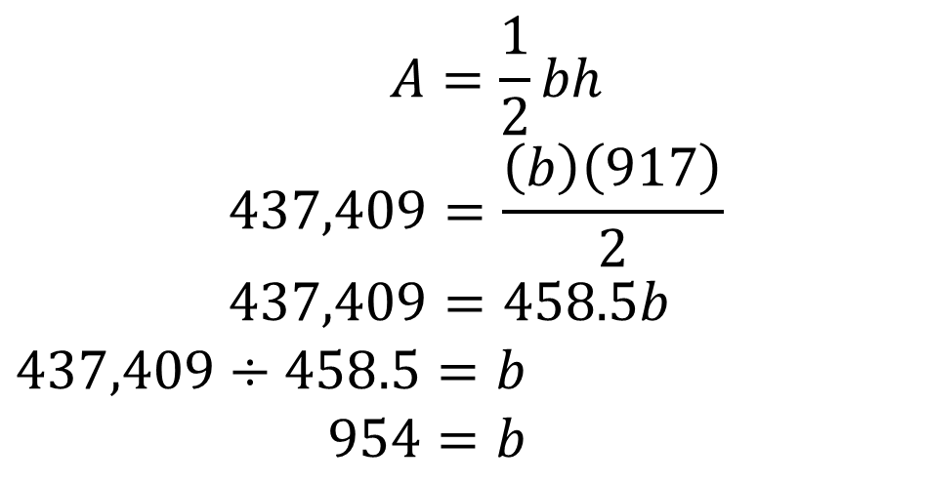
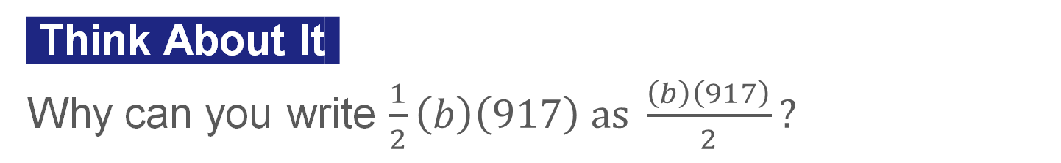
The Bermuda Triangle
Let’s substitute the given values for the area and the height for A and h in the formula, then solve for b.
42 / 50
Notes:
TEACH IN PRACTICE | Embedded facilitation | Lesson 5.2, slide 38 | WORKED
Focus on the existing task: Let’s substitute the given values for the area and the height for A and h in the formula, then solve for b. The Bermuda Triangle…
LAUNCH (T2/3/5): Ask students to explain the displayed idea or example and point to evidence. When a calculation step is shown, ask why it is valid. Have a partner restate the explanation; copying is not the check.
LOOK FOR (T4): Where this task addresses it, students can identify a matching base and height. Ask which feature of their work supports the claim.
RESPOND: If this task shows the lesson misconception—omitting the half or using a nonperpendicular side—trace the base and perpendicular height and relate the figure to the shown parallelogram. Have the student revise and explain the change. Use this support only where the concept occurs in the current task; otherwise respond to the displayed question.
RECHECK: If a gap is shared, revisit the existing representation together. If it is limited, give targeted support while others compare valid methods on the same task. Check the revision before moving on.
PARTICIPATION (T5/6/7): Think time before volunteers; accept a written, drawn or rehearsed entry. Students ask for evidence respectfully. Recognize a specific contribution or revision and check that both partners participate.
Source: BCPS Updated Instructional Framework Rubric (June 2020), TEACH 1–7. Earlier notes and answer keys are retained below.
EARLIER NOTES / EXISTING ANSWER KEY
Model briefly, then hand the thinking back: ask “Why does this step work?” before showing the next one.
Quick check before moving on — thumbs or whiteboards from everyone, not volunteers.
UIFR: TEACH 2 · TEACH 3 · TEACH 4.

Slide 43
STUDENT MOVES
Lesson 5-2
Your moves
RESTATE FIRST · Restate your partner’s idea in your own words before you give yours.
SPECIFIC FEEDBACK · Trade work. Give one specific comment: “This part is clear because ______.”
43 / 50

Slide 44
The Bermuda Triangle
The Bermuda Triangle is an area in the Atlantic Ocean between Miami, Florida, the island of Bermuda, and San Juan, Puerto Rico. It covers an area of about 437,409 square miles.
What is the approximate distance from Bermuda to San Juan?
The approximate distance from Bermuda to San Juan, Puerto Rico, is 954 miles.
Try first. Point to a base and its matching height. Explain how your method uses them.
44 / 50
Notes:
TEACH IN PRACTICE | Embedded facilitation | Lesson 5.2, slide 39 | TASK
Focus on the existing task: The approximate distance from Bermuda to San Juan, Puerto Rico, is 954 miles. The Bermuda Triangle is an area in the Atlantic Ocean…
LAUNCH (T2/3/5): Use the displayed question. Give private thinking time; then A explains while B asks for evidence. Switch roles. Each student records their own reasoning.
LOOK FOR (T4): Where this task addresses it, students can use square units. Ask which feature of their work supports the claim.
RESPOND: If this task shows the lesson misconception—omitting the half or using a nonperpendicular side—trace the base and perpendicular height and relate the figure to the shown parallelogram. Have the student revise and explain the change. Use this support only where the concept occurs in the current task; otherwise respond to the displayed question.
RECHECK: If a gap is shared, revisit the existing representation together. If it is limited, give targeted support while others compare valid methods on the same task. Check the revision before moving on.
PARTICIPATION (T5/6/7): Think time before volunteers; accept a written, drawn or rehearsed entry. Students ask for evidence respectfully. Recognize a specific contribution or revision and check that both partners participate.
Source: BCPS Updated Instructional Framework Rubric (June 2020), TEACH 1–7. Earlier notes and answer keys are retained below.
EARLIER NOTES / EXISTING ANSWER KEY
Apply task — students try it independently first, then partners compare answers and reasoning.
Collect a quick pulse (thumbs or whiteboards) before the close; this tells you who needs a second look tomorrow.
UIFR: TEACH 2 · TEACH 4.

Slide 45
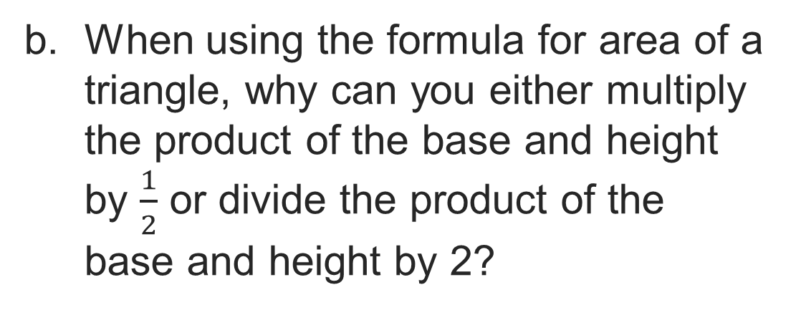
Let’s Explore More
What other information would you need to calculate the distance from San Juan to Miami using the area formula?​
Try it yourself. Compare your
work with a partner; explain one
choice and revise.
45 / 50
Notes:
TEACH IN PRACTICE | Embedded facilitation | Lesson 5.2, slide 40 | PRACTICE
Focus on the existing task: What other information would you need to calculate the distance from San Juan to Miami using the area formula?
LAUNCH (T2/3/5): Use the displayed question. Give private thinking time; then A explains while B asks for evidence. Switch roles. Each student records their own reasoning.
LOOK FOR (T4): Where this task addresses it, students can identify a matching base and height. Ask which feature of their work supports the claim.
RESPOND: If this task shows the lesson misconception—omitting the half or using a nonperpendicular side—trace the base and perpendicular height and relate the figure to the shown parallelogram. Have the student revise and explain the change. Use this support only where the concept occurs in the current task; otherwise respond to the displayed question.
RECHECK: If a gap is shared, revisit the existing representation together. If it is limited, give targeted support while others compare valid methods on the same task. Check the revision before moving on.
PARTICIPATION (T5/6/7): Think time before volunteers; accept a written, drawn or rehearsed entry. Students ask for evidence respectfully. Recognize a specific contribution or revision and check that both partners participate.
Source: BCPS Updated Instructional Framework Rubric (June 2020), TEACH 1–7. Earlier notes and answer keys are retained below.
EARLIER NOTES / EXISTING ANSWER KEY
Extension for partners or table groups — students choose their approach and use the workspace to show thinking.
Push with “Convince me,” and have two groups with different approaches share.
This is where students stretch past the worked example.
UIFR: TEACH 2 · TEACH 5.

Slide 46
LESSON 5.2 / CHECK YOUR WORK
Pause. Check. Improve.
CHECK
A mistake to watch for: omitting the half or using a nonperpendicular side.
TRY
Trace the base and perpendicular height and relate the figure to the shown parallelogram.
REVISE
Use that check on the task you just completed. Correct or strengthen one part, and explain why.
REVISE NOW · Change one answer and write why you changed it. A revision is evidence of learning.
Listen to understand. Ask for evidence. Make room for every voice.
Notes:
TEACH IN PRACTICE | Embedded facilitation | Lesson 5.2, slide 41 | PRIOR_INSERT
Focus on the existing task: LESSON 5.2 / CHECK YOUR WORK Pause. Check. Improve. Listen to understand. Ask for evidence. Make room for every voice. CHECK A mistake…
CONNECT (T1/4): Ask students to restate the displayed goal or key idea and connect it to earlier work. Relevant lesson evidence: identify a matching base and height; explain the factor one-half; use square units. Use only the criterion that matches the current session.
SHOW PROGRESS: Students point to their own existing work, explain what improved after feedback, and name a next step. Pair confidence ratings with actual evidence.
PARTICIPATION (T5/6/7): Think time before volunteers; accept a written, drawn or rehearsed entry. Students ask for evidence respectfully. Recognize a specific contribution or revision and check that both partners participate.
Source: BCPS Updated Instructional Framework Rubric (June 2020), TEACH 1–7.

Slide 47
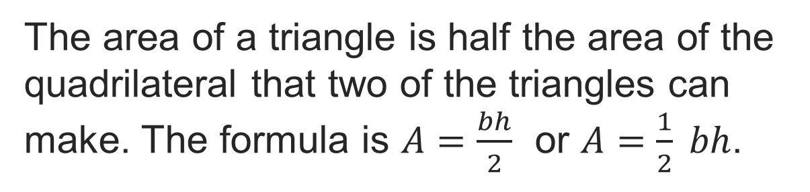
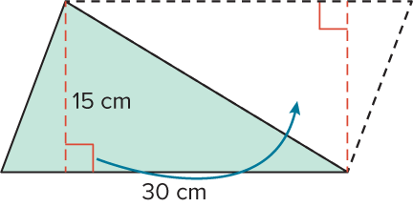
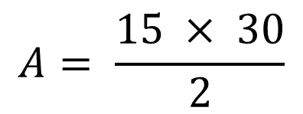

SUMMARIZE · SAY IT IN YOUR OWN WORDS
Summarize: Determine the Area of Triangles
Explain the key idea without reading. Use today’s example as evidence.
47 / 50
Notes:
TEACH IN PRACTICE | Embedded facilitation | Lesson 5.2, slide 42 | SUMMARIZE
Focus on the existing task: Summarize: Determine the Area of Triangles SUMMARIZE · SAY IT IN YOUR OWN WORDS
CONNECT (T1/4): Ask students to restate the displayed goal or key idea and connect it to earlier work. Relevant lesson evidence: identify a matching base and height; explain the factor one-half; use square units. Use only the criterion that matches the current session.
SHOW PROGRESS: Students point to their own existing work, explain what improved after feedback, and name a next step. Pair confidence ratings with actual evidence.
PARTICIPATION (T5/6/7): Think time before volunteers; accept a written, drawn or rehearsed entry. Students ask for evidence respectfully. Recognize a specific contribution or revision and check that both partners participate.
Source: BCPS Updated Instructional Framework Rubric (June 2020), TEACH 1–7. Earlier notes and answer keys are retained below.
EARLIER NOTES / EXISTING ANSWER KEY
Routine: SUMMARIZE · SAY IT IN YOUR OWN WORDS

Slide 48
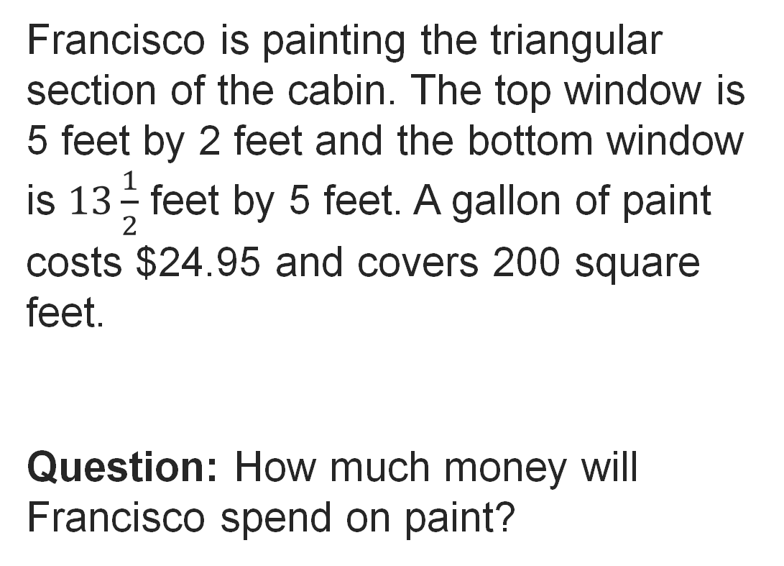
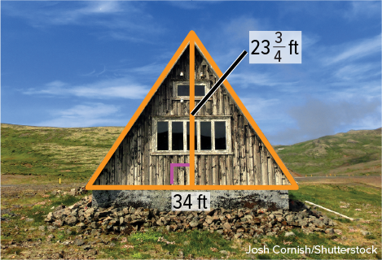
APPLY · PLAN IT • SOLVE IT • PROVE IT
Apply: Painting a Cabin
Choose a method. Solve independently, justify your answer, then check the goal.
48 / 50
Notes:
TEACH IN PRACTICE | Embedded facilitation | Lesson 5.2, slide 43 | APPLY
Focus on the existing task: Apply: Painting a Cabin APPLY · PLAN IT • SOLVE IT • PROVE IT
LAUNCH (T2/3/5): Use the exact application task independently first. Ask students to justify their choice of method. Collect evidence before a partner discussion or correction.
LOOK FOR (T4): Where this task addresses it, students can identify a matching base and height. Ask which feature of their work supports the claim.
RESPOND: If this task shows the lesson misconception—omitting the half or using a nonperpendicular side—trace the base and perpendicular height and relate the figure to the shown parallelogram. Have the student revise and explain the change. Use this support only where the concept occurs in the current task; otherwise respond to the displayed question.
RECHECK: If a gap is shared, revisit the existing representation together. If it is limited, give targeted support while others compare valid methods on the same task. Check the revision before moving on.
PARTICIPATION (T5/6/7): Think time before volunteers; accept a written, drawn or rehearsed entry. Students ask for evidence respectfully. Recognize a specific contribution or revision and check that both partners participate.
Source: BCPS Updated Instructional Framework Rubric (June 2020), TEACH 1–7. Earlier notes and answer keys are retained below.
EARLIER NOTES / EXISTING ANSWER KEY
Routine: APPLY · PLAN IT • SOLVE IT • PROVE IT
UIFR FULL | Lesson-specific facilitation
TEACH 4 | Independent evidence and revision (UIFR PDF p. 11).
Use the existing application/exit problem as the independent check. If this is a learning-target slide, have students point to and explain their work on the preceding task. Separate initial independent evidence from the revision after feedback.
Check the relevant criteria: identify a matching base and height; explain the factor one-half; use square units. Respond with one specific next step tied to the work. Students revise and annotate what changed, then identify a criterion they can now demonstrate and one they still need to practice.

Slide 49
Learning Targets
I can find the area of a triangle by composing it into a parallelogram and by using a formula.
I can attend to precision to find the missing dimension of a triangle by using the area formula.
NAME THE MATH · Point to the part of this that is new today, and say what it changes.
49 / 50
Notes:
TEACH IN PRACTICE | Embedded facilitation | Lesson 5.2, slide 44 | REFLECTION
Focus on the existing task: Learning Targets I can find the area of a triangle by composing it into a parallelogram and by using a formula. I can attend to precision…
CONNECT (T1/4): Ask students to restate the displayed goal or key idea and connect it to earlier work. Relevant lesson evidence: identify a matching base and height; explain the factor one-half; use square units. Use only the criterion that matches the current session.
SHOW PROGRESS: Students point to their own existing work, explain what improved after feedback, and name a next step. Pair confidence ratings with actual evidence.
PARTICIPATION (T5/6/7): Think time before volunteers; accept a written, drawn or rehearsed entry. Students ask for evidence respectfully. Recognize a specific contribution or revision and check that both partners participate.
Source: BCPS Updated Instructional Framework Rubric (June 2020), TEACH 1–7. Earlier notes and answer keys are retained below.
EARLIER NOTES / EXISTING ANSWER KEY
UIFR FULL | Lesson-specific facilitation
REFLECT & ADJUST 1-2 | After the lesson (UIFR PDF pp. 15-16).
Sort the existing work by demonstrated reasoning, partial understanding, and the specific misconception: omitting the half or using a nonperpendicular side. Compare the initial response with the revision. Record which teaching move plausibly helped, which did not, and whose participation or access needs a different approach; do not record sensitive student details in this shared deck.
Plan the next lesson from that evidence: if the misconception persists, trace the base and perpendicular height and relate the figure to the shown parallelogram using the current example before returning to the next grade-level task; if understanding is secure, use an existing extension or ask for a general explanation. Check the targeted idea again at the next warm-up.
Ask students what supported their thinking and what would help next time. Identify one change to try and one successful practice to retain. Seek colleague feedback on anonymized work when useful; these prompts support reflection and do not establish an evaluation rating. Source: Baltimore City Public Schools, Updated Instructional Framework Rubric, June 2020 (UIFR_Full.pdf).

Slide 50
LESSON 5.2 / REFLECT ON YOUR LEARNING
Show your progress
1 SHOW EVIDENCE
2 CHOOSE A NEXT STEP
Choose one response. Point to the part that shows your reasoning.
Name a change you made after feedback—or a question you still have.
“My work shows ___ because ___.”
“Next time, I will ___ to help me ___.”
Today’s focus: Identify a matching base and height.
CREDIT A CLASSMATE · Name one classmate whose idea helped you today, and say what they said.
Listen to understand. Ask for evidence. Make room for every voice.
Notes:
TEACH IN PRACTICE | Embedded facilitation | Lesson 5.2, slide 45 | PRIOR_INSERT
Focus on the existing task: LESSON 5.2 / REFLECT ON YOUR LEARNING Show your progress Listen to understand. Ask for evidence. Make room for every voice. 1 SHOW…
CONNECT (T1/4): Ask students to restate the displayed goal or key idea and connect it to earlier work. Relevant lesson evidence: identify a matching base and height; explain the factor one-half; use square units. Use only the criterion that matches the current session.
SHOW PROGRESS: Students point to their own existing work, explain what improved after feedback, and name a next step. Pair confidence ratings with actual evidence.
PARTICIPATION (T5/6/7): Think time before volunteers; accept a written, drawn or rehearsed entry. Students ask for evidence respectfully. Recognize a specific contribution or revision and check that both partners participate.
Source: BCPS Updated Instructional Framework Rubric (June 2020), TEACH 1–7.

