Slide 1
WARM-UP · THINK • TRY • CHECK
Turn and talk: compare strategies, then defend one.
Warm-Up
Lesson 5-3 · Determine the Area of Trapezoids | Warm-Up · about 4 minutes
Try each on your own. Mark an unsure answer; explain and revise when we check.
QUESTION 1
QUESTION 2
(6 + 10) × 4 = ______
1/2 × 32 = ______
QUESTION 3
QUESTION 4
1/2 × (6 + 10) × 4 = ______
A rectangle of 20 square cm sits beside a triangle of 6 square cm.
Together = ______
TALK IT OVER: “I got ______ because ______.” • Compare with a partner before we check as a class.
1 / 62
Notes:
TEACH IN PRACTICE | Embedded facilitation | Lesson 5.3, slide 1 | WARMUP
Focus on the existing task: Warm-Up WARM-UP · THINK • TRY • CHECK Do these four on…
GATHER EVIDENCE (T4/6): Keep the original items. Students try independently, mark an uncertain item, and explain one method before checking. Use the existing key when present.
RESPOND: Distinguish a calculation slip from a reasoning gap. Give one next step on the same item; have students revise in a second color. Use the responses to choose flexible support for today’s lesson.
PARTICIPATION (T5/6/7): Think time before volunteers; accept a written, drawn or rehearsed entry. Students ask for evidence respectfully. Recognize a specific contribution or revision and check that both partners participate.
Source: BCPS Updated Instructional Framework Rubric (June 2020), TEACH 1–7. Earlier notes and answer keys are retained below.
EARLIER NOTES / EXISTING ANSWER KEY
Warm-Up answers (teacher only): 1) 64 2) 16 3) 32 4) 26 square centimeters
UIFR FULL | Lesson-specific facilitation
PREPARE 1-2 | Before teaching (UIFR PDF pp. 6-7).
Plan to gather evidence that students can identify the parallel bases and height; explain the half-sum formula; check area units. Review recent work and today’s warm-up to choose flexible groups and access supports; do not infer needs from identity or perceived ability. Use the existing lesson tasks and stated standards.
Anticipate: using one base twice or a slanted side as height. If observed, mark the two parallel bases and perpendicular height before substituting. Offer oral rehearsal, drawing, pointing, or home-language processing as needed; retain the original mathematical demand. Ask students which support helps and fade it as evidence improves.
TEACH 6-7 | Before the first transition, agree on materials, partner roles, and how to request help. Invite students to restate the routine. Normalize revising an idea, recognize a specific contribution, and check privately when frustration blocks participation. Source: UIFR PDF pp. 13-14.

Slide 2
Today’s Math Notes
Lesson 5-3 · Determine the Area of Trapezoids
Section 1: Math Words
Copy. Explain. Check.
SAY THE GOAL · Say today’s goal in your own words, then name one place this shows up outside math class.
Area of Trapezoids
1
The space inside a trapezoid
Trapezoid
2
A four-sided shape with just one pair of parallel sides
Parallel
3
Two lines or sides
eduwonderlab.com · Neft Teacher
2 / 62
Notes:
TEACH IN PRACTICE | Embedded facilitation | Lesson 5.3, slide 2 | NOTES
Focus on the existing task: Today’s Math Notes Section 1: Math Words Copy into your…
ROUTINE (T1/2/4): Read or copy the original notes, cover one line, and explain it using the displayed example. Reopen and correct. Copying alone is not evidence of understanding.
LOOK FOR: A link between a symbol, quantity or feature and the explanation. If missing, point back to that feature and have the student try again; fade the prompt once they can explain.
PARTICIPATION (T5/6/7): Think time before volunteers; accept a written, drawn or rehearsed entry. Students ask for evidence respectfully. Recognize a specific contribution or revision and check that both partners participate.
Source: BCPS Updated Instructional Framework Rubric (June 2020), TEACH 1–7. Earlier notes and answer keys are retained below.
EARLIER NOTES / EXISTING ANSWER KEY
Copy routine: read one line at a time; students copy, then explain that line to a partner.
Keep it brisk — the understanding work happens in the examples, not the copying.
UIFR: TEACH 1 · TEACH 6.

Slide 3
Today’s Math Notes
Lesson 5-3 · Determine the Area of Trapezoids
Section 2: Today’s Math
Copy. Explain. Check.
Area of Trapezoids
Area = ½ × (b1 + b2) × h
Read, cover, explain. Reopen your notes to
check and improve your explanation.
1
A trapezoid is a four-sided shape with one pair of parallel bases
2
Add the two bases together: (b1 + b2)
3
Multiply by the perpendicular height, then take half
eduwonderlab.com · Neft Teacher
3 / 62
Notes:
TEACH IN PRACTICE | Embedded facilitation | Lesson 5.3, slide 3 | NOTES
Focus on the existing task: Today’s Math Notes Section 2: Today’s Math Copy into your…
ROUTINE (T1/2/4): Read or copy the original notes, cover one line, and explain it using the displayed example. Reopen and correct. Copying alone is not evidence of understanding.
LOOK FOR: A link between a symbol, quantity or feature and the explanation. If missing, point back to that feature and have the student try again; fade the prompt once they can explain.
PARTICIPATION (T5/6/7): Think time before volunteers; accept a written, drawn or rehearsed entry. Students ask for evidence respectfully. Recognize a specific contribution or revision and check that both partners participate.
Source: BCPS Updated Instructional Framework Rubric (June 2020), TEACH 1–7. Earlier notes and answer keys are retained below.
EARLIER NOTES / EXISTING ANSWER KEY
Copy routine: read one line at a time; students copy, then explain that line to a partner.
Keep it brisk — the understanding work happens in the examples, not the copying.
UIFR: TEACH 1 · TEACH 6.

Slide 4
Session 1
Determine the Area of Trapezoids​
PICK YOUR STRATEGY · Choose your path — picture, table, number line, or equation — and be ready to say why you chose it.
4 / 62
Notes:
TEACH IN PRACTICE | Embedded facilitation | Lesson 5.3, slide 4 | DIVIDER
Focus on the existing task: Determine the Area of Trapezoids Session 1
TRANSITION (T6/7): Students confirm materials, roles, how to request help, and the next response routine. Ask a student to restate it. Keep teacher-only slides hidden.
PARTICIPATION (T5/6/7): Think time before volunteers; accept a written, drawn or rehearsed entry. Students ask for evidence respectfully. Recognize a specific contribution or revision and check that both partners participate.
Source: BCPS Updated Instructional Framework Rubric (June 2020), TEACH 1–7. Earlier notes and answer keys are retained below.
EARLIER NOTES / EXISTING ANSWER KEY
Transition cue: state what materials are out and what success looks like this session.
Keep the changeover under a minute.
UIFR: TEACH 6.

Slide 5
This or That
Would you rather have THIS or THAT ice cream sandwiches?
Ice Cream Sandwiches
THIS | THAT
Think and record first. Which part of your work supports your
answer?
5 / 62
Notes:
TEACH IN PRACTICE | Embedded facilitation | Lesson 5.3, slide 5 | TASK
Focus on the existing task: This or That Would you rather have THIS or THAT ice cream sandwiches?
LAUNCH (T2/3/5): Use the displayed question. Give private thinking time; then A explains while B asks for evidence. Switch roles. Each student records their own reasoning.
LOOK FOR (T4): Where this task addresses it, students can identify the parallel bases and height. Ask which feature of their work supports the claim.
RESPOND: If this task shows the lesson misconception—using one base twice or a slanted side as height—mark the two parallel bases and perpendicular height before substituting. Have the student revise and explain the change. Use this support only where the concept occurs in the current task; otherwise respond to the displayed question.
RECHECK: If a gap is shared, revisit the existing representation together. If it is limited, give targeted support while others compare valid methods on the same task. Check the revision before moving on.
PARTICIPATION (T5/6/7): Think time before volunteers; accept a written, drawn or rehearsed entry. Students ask for evidence respectfully. Recognize a specific contribution or revision and check that both partners participate.
Source: BCPS Updated Instructional Framework Rubric (June 2020), TEACH 1–7. Earlier notes and answer keys are retained below.
EARLIER NOTES / EXISTING ANSWER KEY
Number-sense routine — every voice in. Give quiet think time, then hear from at least three students.
Always follow with “How do you know?” — the reasoning is the point, not the answer.
There is more than one path; name and celebrate different strategies.
UIFR: TEACH 3 · TEACH 5 · TEACH 6.

Slide 6
Today’s Objectives
Lesson 5-3 · Determine the Area of Trapezoids
Determine the Area of Trapezoids
Maryland Standard 6.GR.1
CONNECT IT · What earlier lesson does this build on? Tell a partner in one sentence.
CONTENT OBJECTIVE
LANGUAGE OBJECTIVE
Restate the goal in your words
Use these words to explain why
I can find the area of a trapezoid using the formula A = ½(b1 + b2) × h.
I can explain my steps using the words trapezoid, base, height, and area.
eduwonderlab.com · Neft Teacher
6 / 62
Notes:
TEACH IN PRACTICE | Embedded facilitation | Lesson 5.3, slide 6 | GOAL
Focus on the existing task: Today’s Objectives Determine the Area of Trapezoids…
CONNECT (T1/4): Ask students to restate the displayed goal or key idea and connect it to earlier work. Relevant lesson evidence: identify the parallel bases and height; explain the half-sum formula; check area units. Use only the criterion that matches the current session.
SHOW PROGRESS: Students point to their own existing work, explain what improved after feedback, and name a next step. Pair confidence ratings with actual evidence.
PARTICIPATION (T5/6/7): Think time before volunteers; accept a written, drawn or rehearsed entry. Students ask for evidence respectfully. Recognize a specific contribution or revision and check that both partners participate.
Source: BCPS Updated Instructional Framework Rubric (June 2020), TEACH 1–7. Earlier notes and answer keys are retained below.
EARLIER NOTES / EXISTING ANSWER KEY
Read the objective together, then have one or two students restate today’s goal in their own words.
Connect it to what the class learned last lesson.
Return to this goal at the end of class to check it was met.
UIFR: TEACH 1.
UIFR FULL | Lesson-specific facilitation
TEACH 1 | Session 1 purpose and evidence (UIFR PDF p. 8).
Have students restate the displayed session goal in their own words and connect it to the existing context or a familiar experience they choose to share. Use the current session goal to select from these lesson-wide evidence criteria; do not frontload a later-session procedure.
Look for: identify the parallel bases and height; explain the half-sum formula; check area units. Ask: “Which part of your work would show this?” Revisit that evidence after the task; a confidence rating alone is not evidence of understanding.

Slide 7
LESSON 5.3 / OUR LEARNING
What will show your learning?
1
Identify the parallel bases and height.
2
Explain the half-sum formula.
3
Check area units.
Tell a partner: Which skill connects to something you already know?
SHOW YOUR THINKING · Show what you know — write it, draw it, or build it. A picture counts as an explanation.
Listen to understand. Ask for evidence. Make room for every voice.
Notes:
TEACH IN PRACTICE | Embedded facilitation | Lesson 5.3, slide 7 | PRIOR_INSERT
Focus on the existing task: LESSON 5.3 / OUR LEARNING What will show your learning?
CONNECT (T1/4): Ask students to restate the displayed goal or key idea and connect it to earlier work. Relevant lesson evidence: identify the parallel bases and height; explain the half-sum formula; check area units. Use only the criterion that matches the current session.
SHOW PROGRESS: Students point to their own existing work, explain what improved after feedback, and name a next step. Pair confidence ratings with actual evidence.
PARTICIPATION (T5/6/7): Think time before volunteers; accept a written, drawn or rehearsed entry. Students ask for evidence respectfully. Recognize a specific contribution or revision and check that both partners participate.
Source: BCPS Updated Instructional Framework Rubric (June 2020), TEACH 1–7.

Slide 8
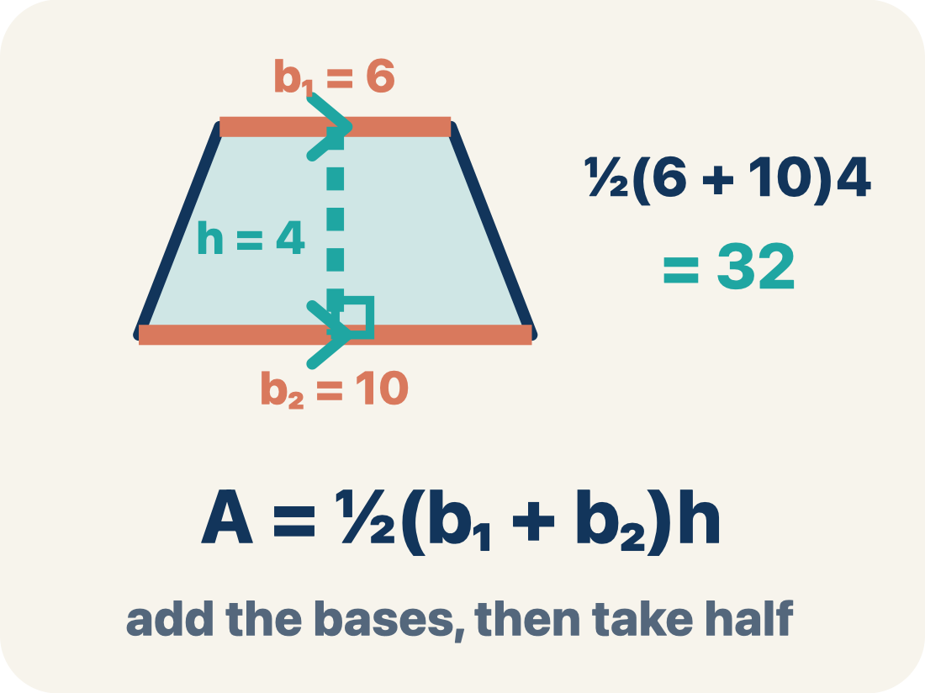
Vocabulary 1 of 8
Lesson 5-3 · Determine the Area of Trapezoids
Area of Trapezoids
The space inside a trapezoid. Formula: A = 1/2(b₁ + b₂)h.
EXAMPLE · EXPLAIN WHY IT FITS
A = 1/2(b₁ + b₂)h
Use “Area of Trapezoids” to explain the example. Point to
evidence.
eduwonderlab.com · Neft Teacher
8 / 62
Notes:
TEACH IN PRACTICE | Embedded facilitation | Lesson 5.3, slide 8 | VOCAB
Focus on the existing task: Vocabulary 1 of 8 Area of Trapezoids The space inside a…
ASK (T1/3/5): Where does “Area of Trapezoids” appear in the example? Explain the meaning without reading the definition. Partner: restate the idea and ask a clarifying question.
LOOK FOR: A correct connection between the word and a feature of the example. If the student only repeats the definition, invite pointing, sketching or oral rehearsal, then ask for another explanation of this same example.
PARTICIPATION (T5/6/7): Think time before volunteers; accept a written, drawn or rehearsed entry. Students ask for evidence respectfully. Recognize a specific contribution or revision and check that both partners participate.
Source: BCPS Updated Instructional Framework Rubric (June 2020), TEACH 1–7.

Slide 9
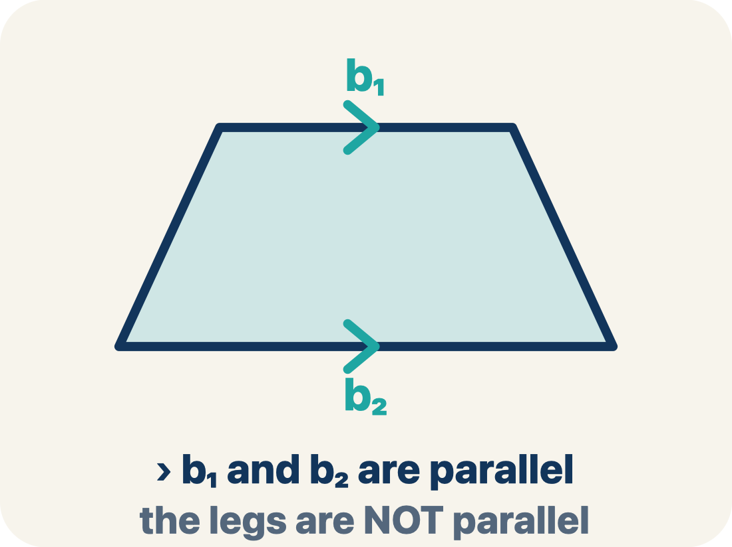
Vocabulary 2 of 8
Lesson 5-3 · Determine the Area of Trapezoids
Trapezoid
A four-sided shape with just one pair of parallel sides.
EXAMPLE · EXPLAIN WHY IT FITS
A table top wider than the bottom shelf — the top and bottom edges are parallel, the two sides slant inward
Use “Trapezoid” to explain the example. Point to evidence.
eduwonderlab.com · Neft Teacher
9 / 62
Notes:
TEACH IN PRACTICE | Embedded facilitation | Lesson 5.3, slide 9 | VOCAB
Focus on the existing task: Vocabulary 2 of 8 Trapezoid A four-sided shape with just…
ASK (T1/3/5): Where does “Trapezoid” appear in the example? Explain the meaning without reading the definition. Partner: restate the idea and ask a clarifying question.
LOOK FOR: A correct connection between the word and a feature of the example. If the student only repeats the definition, invite pointing, sketching or oral rehearsal, then ask for another explanation of this same example.
PARTICIPATION (T5/6/7): Think time before volunteers; accept a written, drawn or rehearsed entry. Students ask for evidence respectfully. Recognize a specific contribution or revision and check that both partners participate.
Source: BCPS Updated Instructional Framework Rubric (June 2020), TEACH 1–7.

Slide 10
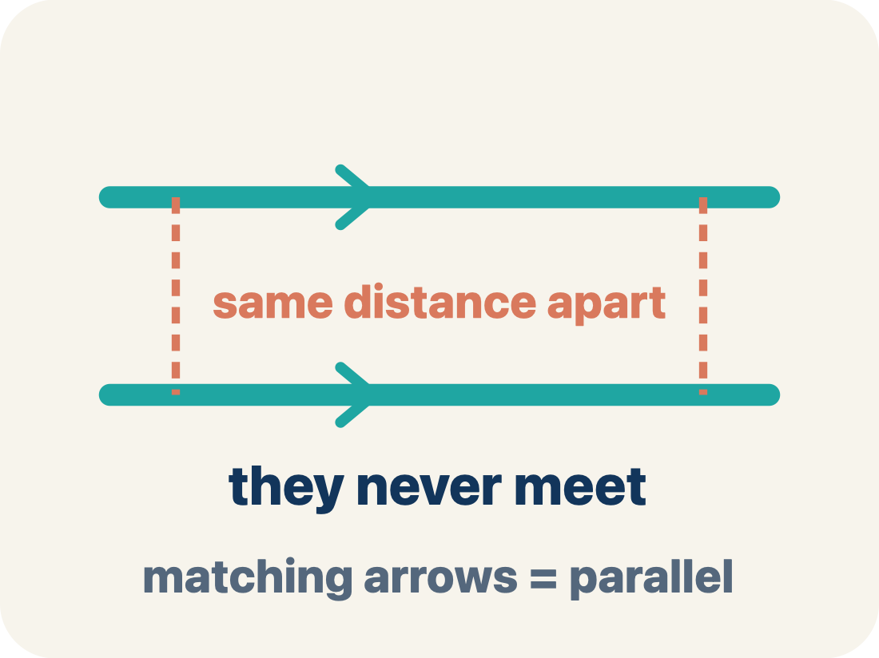
Vocabulary 3 of 8
Lesson 5-3 · Determine the Area of Trapezoids
Parallel
Two lines or sides that stay the same distance apart and never meet.
EXAMPLE · EXPLAIN WHY IT FITS
The top and bottom of a parallelogram never get closer together — matching arrowheads (›) mark one parallel pair, double arrowheads (››) mark the other.
Use “Parallel” to explain the example. Point to evidence.
eduwonderlab.com · Neft Teacher
10 / 62
Notes:
TEACH IN PRACTICE | Embedded facilitation | Lesson 5.3, slide 10 | VOCAB
Focus on the existing task: Vocabulary 3 of 8 Parallel Two lines or sides that stay…
ASK (T1/3/5): Where does “Parallel” appear in the example? Explain the meaning without reading the definition. Partner: restate the idea and ask a clarifying question.
LOOK FOR: A correct connection between the word and a feature of the example. If the student only repeats the definition, invite pointing, sketching or oral rehearsal, then ask for another explanation of this same example.
PARTICIPATION (T5/6/7): Think time before volunteers; accept a written, drawn or rehearsed entry. Students ask for evidence respectfully. Recognize a specific contribution or revision and check that both partners participate.
Source: BCPS Updated Instructional Framework Rubric (June 2020), TEACH 1–7.

Slide 11
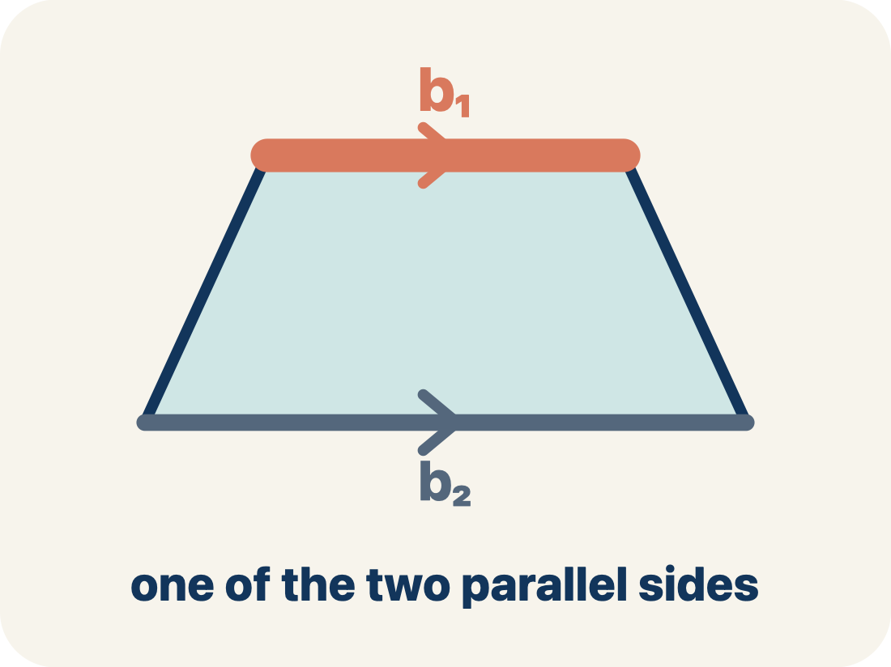
Vocabulary 4 of 8
Lesson 5-3 · Determine the Area of Trapezoids
Base 1 (b1)
One of the two parallel sides of a trapezoid.
EXAMPLE · EXPLAIN WHY IT FITS
If the bottom of the trapezoid is 10 ft, then b₁ = 10 ft in the formula A = ½(b₁ + b₂) × h
Use “Base 1 (b1)” to explain the example. Point to evidence.
eduwonderlab.com · Neft Teacher
11 / 62
Notes:
TEACH IN PRACTICE | Embedded facilitation | Lesson 5.3, slide 11 | VOCAB
Focus on the existing task: Vocabulary 4 of 8 Base 1 (b1) One of the two parallel…
ASK (T1/3/5): Where does “Base 1 (b1)” appear in the example? Explain the meaning without reading the definition. Partner: restate the idea and ask a clarifying question.
LOOK FOR: A correct connection between the word and a feature of the example. If the student only repeats the definition, invite pointing, sketching or oral rehearsal, then ask for another explanation of this same example.
PARTICIPATION (T5/6/7): Think time before volunteers; accept a written, drawn or rehearsed entry. Students ask for evidence respectfully. Recognize a specific contribution or revision and check that both partners participate.
Source: BCPS Updated Instructional Framework Rubric (June 2020), TEACH 1–7.

Slide 12
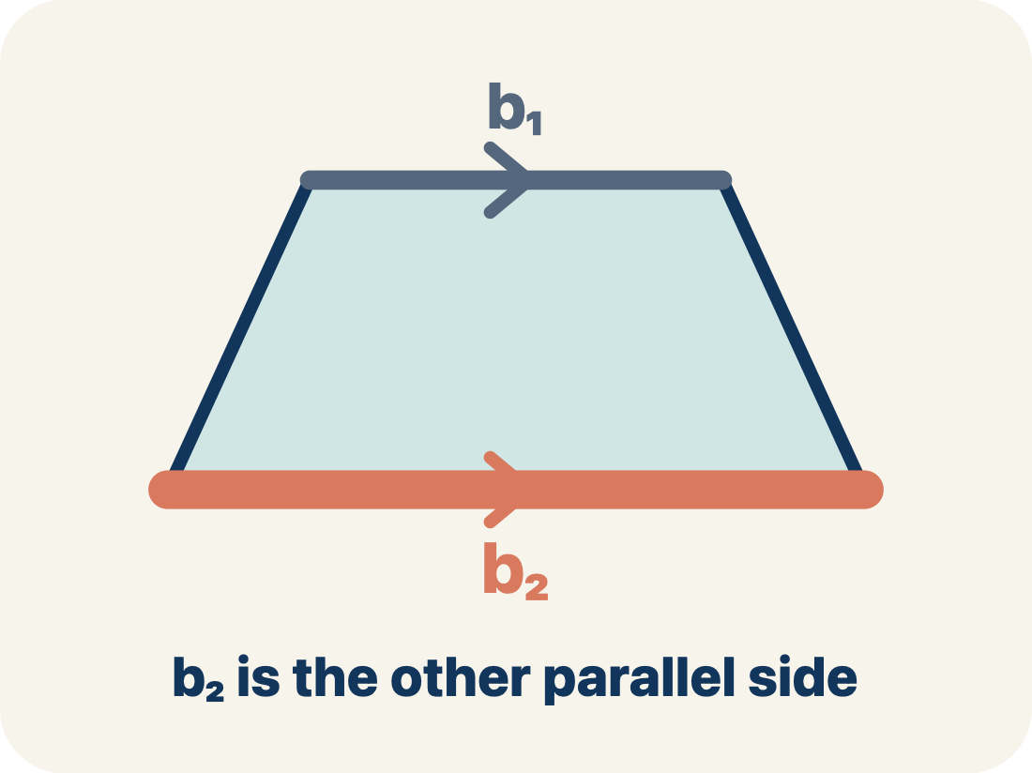
Vocabulary 5 of 8
Lesson 5-3 · Determine the Area of Trapezoids
Base 2 (b2)
The other parallel side of a trapezoid.
EXAMPLE · EXPLAIN WHY IT FITS
If the top of the trapezoid is 6 ft, then b₂ = 6 ft; both bases are parallel to each other
Use “Base 2 (b2)” to explain the example. Point to evidence.
eduwonderlab.com · Neft Teacher
12 / 62
Notes:
TEACH IN PRACTICE | Embedded facilitation | Lesson 5.3, slide 12 | VOCAB
Focus on the existing task: Vocabulary 5 of 8 Base 2 (b2) The other parallel side of…
ASK (T1/3/5): Where does “Base 2 (b2)” appear in the example? Explain the meaning without reading the definition. Partner: restate the idea and ask a clarifying question.
LOOK FOR: A correct connection between the word and a feature of the example. If the student only repeats the definition, invite pointing, sketching or oral rehearsal, then ask for another explanation of this same example.
PARTICIPATION (T5/6/7): Think time before volunteers; accept a written, drawn or rehearsed entry. Students ask for evidence respectfully. Recognize a specific contribution or revision and check that both partners participate.
Source: BCPS Updated Instructional Framework Rubric (June 2020), TEACH 1–7.

Slide 13
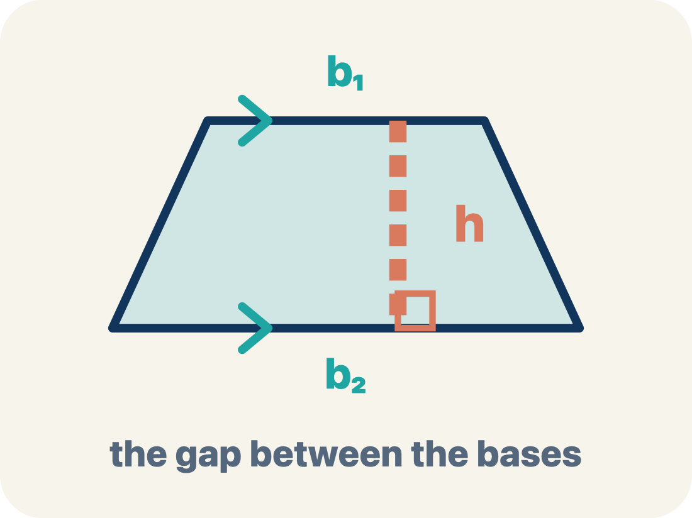
Vocabulary 6 of 8
Lesson 5-3 · Determine the Area of Trapezoids
Height
The straight-up distance between the two parallel sides.
EXAMPLE · EXPLAIN WHY IT FITS
A dashed vertical line from the top base straight down to the bottom base at a 90° angle — NOT the slanted side
Use “Height” to explain the example. Point to evidence.
eduwonderlab.com · Neft Teacher
13 / 62
Notes:
TEACH IN PRACTICE | Embedded facilitation | Lesson 5.3, slide 13 | VOCAB
Focus on the existing task: Vocabulary 6 of 8 Height The straight-up distance between…
ASK (T1/3/5): Where does “Height” appear in the example? Explain the meaning without reading the definition. Partner: restate the idea and ask a clarifying question.
LOOK FOR: A correct connection between the word and a feature of the example. If the student only repeats the definition, invite pointing, sketching or oral rehearsal, then ask for another explanation of this same example.
PARTICIPATION (T5/6/7): Think time before volunteers; accept a written, drawn or rehearsed entry. Students ask for evidence respectfully. Recognize a specific contribution or revision and check that both partners participate.
Source: BCPS Updated Instructional Framework Rubric (June 2020), TEACH 1–7.

Slide 14
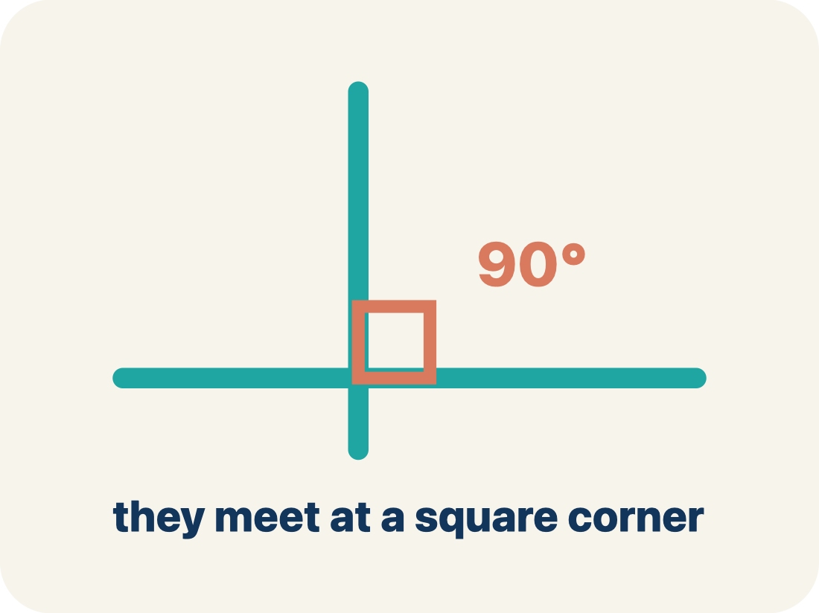
Vocabulary 7 of 8
Lesson 5-3 · Determine the Area of Trapezoids
Perpendicular
Two lines that meet to make a square corner (90 degrees).
EXAMPLE · EXPLAIN WHY IT FITS
The dashed height meets the base at a square corner — the small 90° box is what makes it perpendicular, not slanted.
Use “Perpendicular” to explain
the example. Point to evidence.
eduwonderlab.com · Neft Teacher
14 / 62
Notes:
TEACH IN PRACTICE | Embedded facilitation | Lesson 5.3, slide 14 | VOCAB
Focus on the existing task: Vocabulary 7 of 8 Perpendicular Two lines that meet to…
ASK (T1/3/5): Where does “Perpendicular” appear in the example? Explain the meaning without reading the definition. Partner: restate the idea and ask a clarifying question.
LOOK FOR: A correct connection between the word and a feature of the example. If the student only repeats the definition, invite pointing, sketching or oral rehearsal, then ask for another explanation of this same example.
PARTICIPATION (T5/6/7): Think time before volunteers; accept a written, drawn or rehearsed entry. Students ask for evidence respectfully. Recognize a specific contribution or revision and check that both partners participate.
Source: BCPS Updated Instructional Framework Rubric (June 2020), TEACH 1–7.

Slide 15
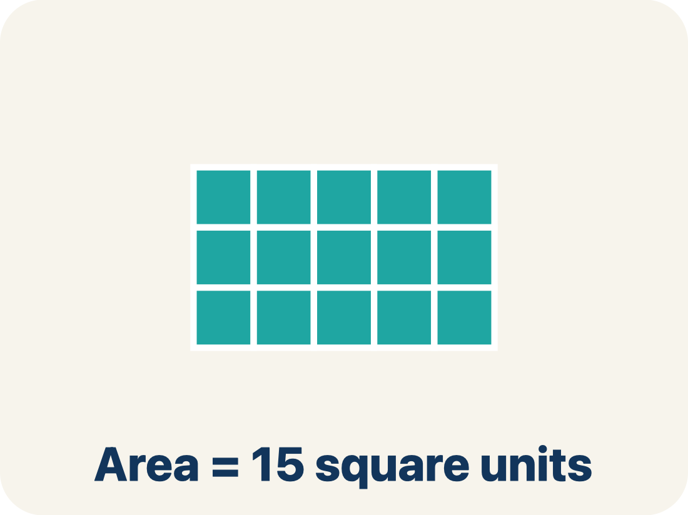
Vocabulary 8 of 8
Lesson 5-3 · Determine the Area of Trapezoids
Area
How much space is inside a flat shape.
EXAMPLE · EXPLAIN WHY IT FITS
A trapezoid with b₁ = 10, b₂ = 6, h = 4 has area = ½(10 + 6) × 4 = 32 sq units
Use “Area” to explain the example. Point to evidence.
eduwonderlab.com · Neft Teacher
15 / 62
Notes:
TEACH IN PRACTICE | Embedded facilitation | Lesson 5.3, slide 15 | VOCAB
Focus on the existing task: Vocabulary 8 of 8 Area How much space is inside a flat…
ASK (T1/3/5): Where does “Area” appear in the example? Explain the meaning without reading the definition. Partner: restate the idea and ask a clarifying question.
LOOK FOR: A correct connection between the word and a feature of the example. If the student only repeats the definition, invite pointing, sketching or oral rehearsal, then ask for another explanation of this same example.
PARTICIPATION (T5/6/7): Think time before volunteers; accept a written, drawn or rehearsed entry. Students ask for evidence respectfully. Recognize a specific contribution or revision and check that both partners participate.
Source: BCPS Updated Instructional Framework Rubric (June 2020), TEACH 1–7.

Slide 16
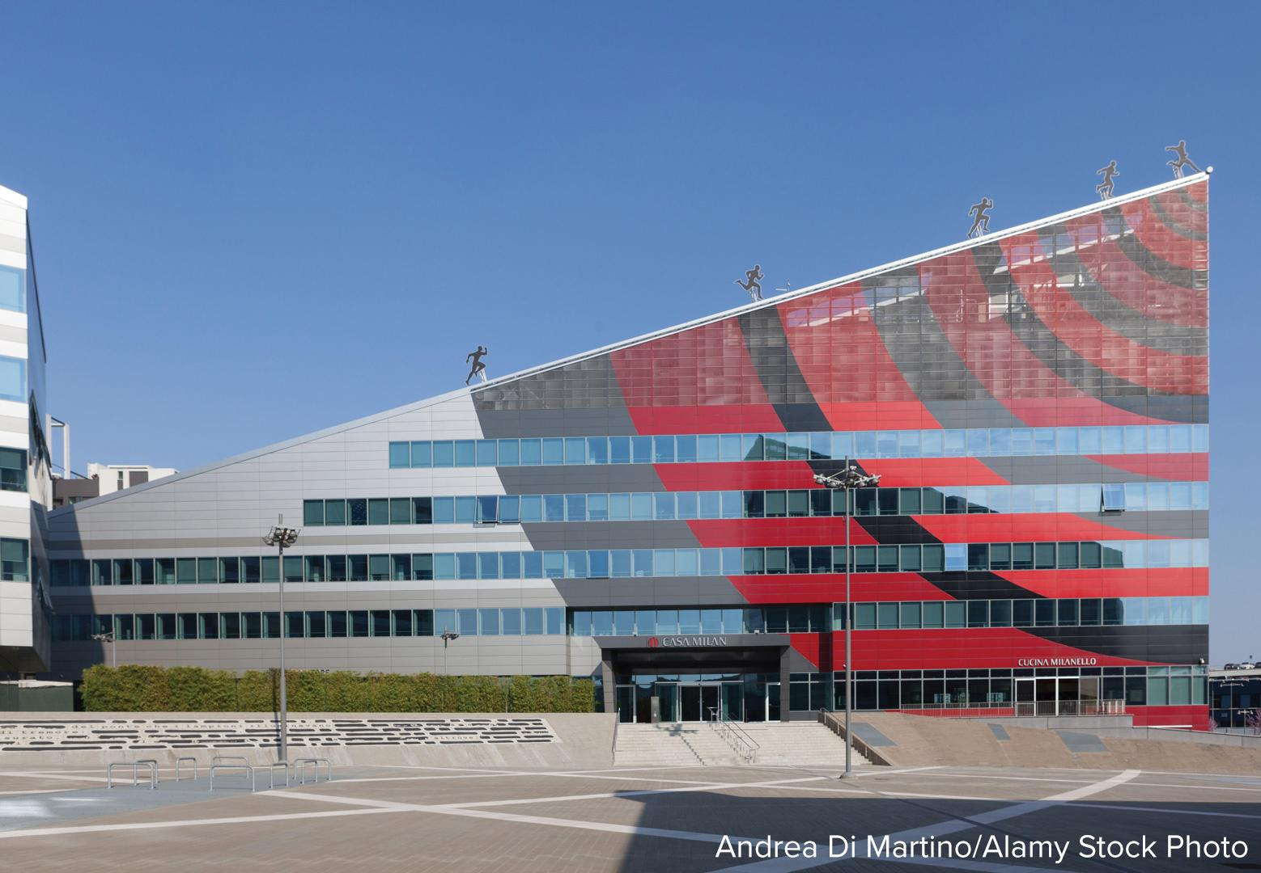

Be Curious
What do you notice?
What do you wonder?
Mindset
HOW DO YOU KNOW? · Ask your partner “How do you know?” Answer by pointing to your own work.
How can you use math to help identify a problem in your class or community?
16 / 62
Notes:
TEACH IN PRACTICE | Embedded facilitation | Lesson 5.3, slide 16 | CURIOUS
Focus on the existing task: How can you use math to help identify a problem in your class or community?
LAUNCH (T2/3/5): Allow quiet observation first. Separate a notice from an inference, invite students’ own questions, and follow the existing launch before teaching a procedure.
LOOK FOR (T4): Where this task addresses it, students can identify the parallel bases and height. Ask which feature of their work supports the claim.
RESPOND: If this task shows the lesson misconception—using one base twice or a slanted side as height—mark the two parallel bases and perpendicular height before substituting. Have the student revise and explain the change. Use this support only where the concept occurs in the current task; otherwise respond to the displayed question.
RECHECK: If a gap is shared, revisit the existing representation together. If it is limited, give targeted support while others compare valid methods on the same task. Check the revision before moving on.
PARTICIPATION (T5/6/7): Think time before volunteers; accept a written, drawn or rehearsed entry. Students ask for evidence respectfully. Recognize a specific contribution or revision and check that both partners participate.
Source: BCPS Updated Instructional Framework Rubric (June 2020), TEACH 1–7.

Slide 17
Vocabulary
Lesson 5-3 · Determine the Area of Trapezoids
USE THE MATH WORDS · Use today’s math words in your explanation — not “it” and “that thing.”
Today’s Math Words
We learn every word — what it means and what it looks like — before we use it.
Area of Trapezoids
Trapezoid
The space inside a trapezoid
A four-sided shape with just one pair of parallel sides
Parallel
Base 1 (b1)
Two lines or sides that stay the same distance apart and never meet
One of the two parallel sides of a trapezoid
Base 2 (b2)
Height
The other parallel side of a trapezoid
The straight-up distance between the two parallel sides
Perpendicular
Area
Two lines that meet to make a square corner (90 degrees)
How much space is inside a flat shape
eduwonderlab.com · Neft Teacher
17 / 62
Notes:
TEACH IN PRACTICE | Embedded facilitation | Lesson 5.3, slide 17 | VOCAB
Focus on the existing task: Vocabulary Today’s Math Words We learn every word — what…
ASK (T1/3/5): Where does “the displayed term” appear in the example? Explain the meaning without reading the definition. Partner: restate the idea and ask a clarifying question.
LOOK FOR: A correct connection between the word and a feature of the example. If the student only repeats the definition, invite pointing, sketching or oral rehearsal, then ask for another explanation of this same example.
PARTICIPATION (T5/6/7): Think time before volunteers; accept a written, drawn or rehearsed entry. Students ask for evidence respectfully. Recognize a specific contribution or revision and check that both partners participate.
Source: BCPS Updated Instructional Framework Rubric (June 2020), TEACH 1–7. Earlier notes and answer keys are retained below.
EARLIER NOTES / EXISTING ANSWER KEY
Choral-read each word, its meaning, and what it looks like.
Students should use these words out loud today — listen for them in partner talk and revoice student ideas with the academic term.
UIFR: TEACH 1 · TEACH 5.

Slide 18
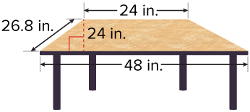

Odd-Shaped Furniture
The top of a table is in the shape of an isosceles trapezoid.
What is the area of the tabletop?​
Try first. Explain what a row or column represents. Use it as evidence for your answer.
Describing Quantities
What are the important quantities in the problem?
18 / 62
Notes:
TEACH IN PRACTICE | Embedded facilitation | Lesson 5.3, slide 18 | TASK
Focus on the existing task: What are the important quantities in the problem?
LAUNCH (T2/3/5): Use the displayed question. Give private thinking time; then A explains while B asks for evidence. Switch roles. Each student records their own reasoning.
LOOK FOR (T4): Where this task addresses it, students can check area units. Ask which feature of their work supports the claim.
RESPOND: If this task shows the lesson misconception—using one base twice or a slanted side as height—mark the two parallel bases and perpendicular height before substituting. Have the student revise and explain the change. Use this support only where the concept occurs in the current task; otherwise respond to the displayed question.
RECHECK: If a gap is shared, revisit the existing representation together. If it is limited, give targeted support while others compare valid methods on the same task. Check the revision before moving on.
PARTICIPATION (T5/6/7): Think time before volunteers; accept a written, drawn or rehearsed entry. Students ask for evidence respectfully. Recognize a specific contribution or revision and check that both partners participate.
Source: BCPS Updated Instructional Framework Rubric (June 2020), TEACH 1–7. Earlier notes and answer keys are retained below.
EARLIER NOTES / EXISTING ANSWER KEY
Model briefly, then hand the thinking back: ask “Why does this step work?” before showing the next one.
Quick check before moving on — thumbs or whiteboards from everyone, not volunteers.
UIFR: TEACH 2 · TEACH 3 · TEACH 4.
UIFR FULL | Lesson-specific facilitation
TEACH 2-3 | Session 1 task launch (UIFR PDF pp. 9-10).
Use the problem exactly as displayed. Give individual thinking time before discussion or advancing to the explanation. If the answer is already visible, ask students to reconstruct and justify it. Invite a choice of suitable representations and have students explain why their choice helps.
At the point where this concept appears, ask: “How does combining two copies of the trapezoid explain the sum of the bases?” Wait for evidence, invite another pathway, and have a student ask a follow-up question. Do not replace students’ reasoning with a sequence of leading steps.

Slide 19
Odd-Shaped Furniture
The top of a table is in the shape of an isosceles trapezoid.
What is the area of the tabletop?
Try first. Explain what a row or column represents. Use it as evidence for your answer.
Think About It:
What do you know about trapezoids?
19 / 62
Notes:
TEACH IN PRACTICE | Embedded facilitation | Lesson 5.3, slide 19 | TASK
Focus on the existing task: The top of a table is in the shape of an isosceles trapezoid. What is the area of the tabletop?
LAUNCH (T2/3/5): Use the displayed question. Give private thinking time; then A explains while B asks for evidence. Switch roles. Each student records their own reasoning.
LOOK FOR (T4): Where this task addresses it, students can check area units. Ask which feature of their work supports the claim.
RESPOND: If this task shows the lesson misconception—using one base twice or a slanted side as height—mark the two parallel bases and perpendicular height before substituting. Have the student revise and explain the change. Use this support only where the concept occurs in the current task; otherwise respond to the displayed question.
RECHECK: If a gap is shared, revisit the existing representation together. If it is limited, give targeted support while others compare valid methods on the same task. Check the revision before moving on.
PARTICIPATION (T5/6/7): Think time before volunteers; accept a written, drawn or rehearsed entry. Students ask for evidence respectfully. Recognize a specific contribution or revision and check that both partners participate.
Source: BCPS Updated Instructional Framework Rubric (June 2020), TEACH 1–7. Earlier notes and answer keys are retained below.
EARLIER NOTES / EXISTING ANSWER KEY
Ask the question, then hold the silence — students think or jot before anyone answers.
Take two or three responses and press with “Why?” or “How do you know?” before moving on.
UIFR: TEACH 3.

Slide 20
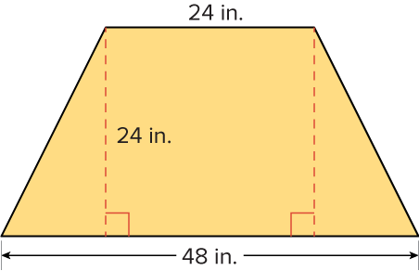
Odd-Shaped Furniture
This type of trapezoid is called an isosceles trapezoid.
Using what you know about isosceles triangles, what do you think it means for a trapezoid to be isosceles?
Record your reasoning before the reveal. Compare, then explain any revision.
Reveal:
The opposite non-parallel sides of the trapezoid are the same length.
20 / 62
Notes:
TEACH IN PRACTICE | Embedded facilitation | Lesson 5.3, slide 20 | REVEAL
Focus on the existing task: This type of trapezoid is called an isosceles trapezoid. Using what you know about isosceles triangles, what do you think it means for a trapezoid to be isosceles?
LAUNCH (T2/3/5): If an existing answer cover is present, gather an attempt before revealing. If the explanation is already visible, ask students to reconstruct and justify it. Compare reasoning and explain a revision; preserve the reveal sequence.
LOOK FOR (T4): Where this task addresses it, students can identify the parallel bases and height. Ask which feature of their work supports the claim.
RESPOND: If this task shows the lesson misconception—using one base twice or a slanted side as height—mark the two parallel bases and perpendicular height before substituting. Have the student revise and explain the change. Use this support only where the concept occurs in the current task; otherwise respond to the displayed question.
RECHECK: If a gap is shared, revisit the existing representation together. If it is limited, give targeted support while others compare valid methods on the same task. Check the revision before moving on.
PARTICIPATION (T5/6/7): Think time before volunteers; accept a written, drawn or rehearsed entry. Students ask for evidence respectfully. Recognize a specific contribution or revision and check that both partners participate.
Source: BCPS Updated Instructional Framework Rubric (June 2020), TEACH 1–7. Earlier notes and answer keys are retained below.
EARLIER NOTES / EXISTING ANSWER KEY
Do not click yet: collect 2–3 student answers with reasons first.
Then click to remove the cover and have students compare their thinking to the reveal — “Is this what we said? Where is it different?”
Behind the cover: The opposite non-parallel sides of the trapezoid are the same length.
UIFR: TEACH 3 · TEACH 4.

Slide 21
Odd-Shaped Furniture
The opposite non-parallel sides of an isosceles trapezoid are the same length.
What other shapes do you see when you look at the trapezoid?
Record your reasoning before the reveal. Compare, then explain any revision.
Reveal:
two triangles and a square
21 / 62
Notes:
TEACH IN PRACTICE | Embedded facilitation | Lesson 5.3, slide 21 | REVEAL
Focus on the existing task: Reveal: two triangles and a square The opposite non-parallel sides of an isosceles trapezoid are the same length. What other shapes do you see when you look at the trapezoid?
LAUNCH (T2/3/5): If an existing answer cover is present, gather an attempt before revealing. If the explanation is already visible, ask students to reconstruct and justify it. Compare reasoning and explain a revision; preserve the reveal sequence.
LOOK FOR (T4): Where this task addresses it, students can identify the parallel bases and height. Ask which feature of their work supports the claim.
RESPOND: If this task shows the lesson misconception—using one base twice or a slanted side as height—mark the two parallel bases and perpendicular height before substituting. Have the student revise and explain the change. Use this support only where the concept occurs in the current task; otherwise respond to the displayed question.
RECHECK: If a gap is shared, revisit the existing representation together. If it is limited, give targeted support while others compare valid methods on the same task. Check the revision before moving on.
PARTICIPATION (T5/6/7): Think time before volunteers; accept a written, drawn or rehearsed entry. Students ask for evidence respectfully. Recognize a specific contribution or revision and check that both partners participate.
Source: BCPS Updated Instructional Framework Rubric (June 2020), TEACH 1–7. Earlier notes and answer keys are retained below.
EARLIER NOTES / EXISTING ANSWER KEY
Do not click yet: collect 2–3 student answers with reasons first.
Then click to remove the cover and have students compare their thinking to the reveal — “Is this what we said? Where is it different?”
Behind the cover: two triangles and a square
UIFR: TEACH 3 · TEACH 4.

Slide 22
Odd-Shaped Furniture
This trapezoid can be decomposed into two congruent triangles and a square.
How can you determine the lengths of the bases of the two triangles?
Record your reasoning before the reveal.
Compare, then explain any revision.
Reveal:
We can use the length of the square and the total length of the bottom base of the trapezoid to calculate each length.
22 / 62
Notes:
TEACH IN PRACTICE | Embedded facilitation | Lesson 5.3, slide 22 | REVEAL
Focus on the existing task: Reveal: We can use the length of the square and the total length of the bottom base of the trapezoid to calculate each length. This…
LAUNCH (T2/3/5): If an existing answer cover is present, gather an attempt before revealing. If the explanation is already visible, ask students to reconstruct and justify it. Compare reasoning and explain a revision; preserve the reveal sequence.
LOOK FOR (T4): Where this task addresses it, students can identify the parallel bases and height. Ask which feature of their work supports the claim.
RESPOND: If this task shows the lesson misconception—using one base twice or a slanted side as height—mark the two parallel bases and perpendicular height before substituting. Have the student revise and explain the change. Use this support only where the concept occurs in the current task; otherwise respond to the displayed question.
RECHECK: If a gap is shared, revisit the existing representation together. If it is limited, give targeted support while others compare valid methods on the same task. Check the revision before moving on.
PARTICIPATION (T5/6/7): Think time before volunteers; accept a written, drawn or rehearsed entry. Students ask for evidence respectfully. Recognize a specific contribution or revision and check that both partners participate.
Source: BCPS Updated Instructional Framework Rubric (June 2020), TEACH 1–7. Earlier notes and answer keys are retained below.
EARLIER NOTES / EXISTING ANSWER KEY
Do not click yet: collect 2–3 student answers with reasons first.
Then click to remove the cover and have students compare their thinking to the reveal — “Is this what we said? Where is it different?”
Behind the cover: We can use the length of the square and the total length of the bottom base of the trapezoid to calculate each length.
UIFR: TEACH 3 · TEACH 4.

Slide 23
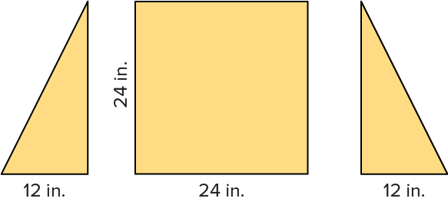
Odd-Shaped Furniture
Let’s use the length of the square to determine the base lengths of the triangles.
How can you use the triangles and the square to find the area of the trapezoid?
TRY IT BEFORE YOU’RE SURE · Start even if you are not sure. A revised answer counts as much as a first-try answer.
Reveal:
We can find the sum of the areas of the triangles and the square.
23 / 62
Notes:
TEACH IN PRACTICE | Embedded facilitation | Lesson 5.3, slide 23 | REVEAL
Focus on the existing task: Reveal: We can find the sum of the areas of the triangles and the square. Let’s use the length of the square to determine the base…
LAUNCH (T2/3/5): If an existing answer cover is present, gather an attempt before revealing. If the explanation is already visible, ask students to reconstruct and justify it. Compare reasoning and explain a revision; preserve the reveal sequence.
LOOK FOR (T4): Where this task addresses it, students can check area units. Ask which feature of their work supports the claim.
RESPOND: If this task shows the lesson misconception—using one base twice or a slanted side as height—mark the two parallel bases and perpendicular height before substituting. Have the student revise and explain the change. Use this support only where the concept occurs in the current task; otherwise respond to the displayed question.
RECHECK: If a gap is shared, revisit the existing representation together. If it is limited, give targeted support while others compare valid methods on the same task. Check the revision before moving on.
PARTICIPATION (T5/6/7): Think time before volunteers; accept a written, drawn or rehearsed entry. Students ask for evidence respectfully. Recognize a specific contribution or revision and check that both partners participate.
Source: BCPS Updated Instructional Framework Rubric (June 2020), TEACH 1–7. Earlier notes and answer keys are retained below.
EARLIER NOTES / EXISTING ANSWER KEY
Do not click yet: collect 2–3 student answers with reasons first.
Then click to remove the cover and have students compare their thinking to the reveal — “Is this what we said? Where is it different?”
Behind the cover: We can find the sum of the areas of the triangles and the square.
UIFR: TEACH 3 · TEACH 4.

Slide 24

COLLABORATE · TALK IT THROUGH • AGREE ON A MODEL
Collaborate and Connect
The area of the trapezoid is the sum of the areas of the triangles and the square.
What is the area of the trapezoid?
Think first. A explains; B asks for evidence. Switch roles; both revise.
Reveal:
864 square inches
24 / 62
Notes:
TEACH IN PRACTICE | Embedded facilitation | Lesson 5.3, slide 24 | COLLABORATE
Focus on the existing task: Reveal: 864 square inches The area of the trapezoid is the sum of the areas of the triangles and the square. What is the area of the trapezoid?
LAUNCH (T2/3/5): Use the displayed question. Give private thinking time; then A explains while B asks for evidence. Switch roles. Each student records their own reasoning.
LOOK FOR (T4): Where this task addresses it, students can check area units. Ask which feature of their work supports the claim.
RESPOND: If this task shows the lesson misconception—using one base twice or a slanted side as height—mark the two parallel bases and perpendicular height before substituting. Have the student revise and explain the change. Use this support only where the concept occurs in the current task; otherwise respond to the displayed question.
RECHECK: If a gap is shared, revisit the existing representation together. If it is limited, give targeted support while others compare valid methods on the same task. Check the revision before moving on.
PARTICIPATION (T5/6/7): Think time before volunteers; accept a written, drawn or rehearsed entry. Students ask for evidence respectfully. Recognize a specific contribution or revision and check that both partners participate.
Source: BCPS Updated Instructional Framework Rubric (June 2020), TEACH 1–7. Earlier notes and answer keys are retained below.
EARLIER NOTES / EXISTING ANSWER KEY
Routine: COLLABORATE · TALK IT THROUGH • AGREE ON A MODEL
UIFR FULL | Lesson-specific facilitation
TEACH 4-5 | Session 1 discussion and checkpoint (UIFR PDF pp. 11-12).
Collect a brief response from every student to the existing prompt before hearing volunteers. Partners take turns explaining and asking for evidence: “I understand ___; what supports ___?” Offer rehearsal or an annotated model for students who need language support. Each student records their own reasoning.
Look specifically for: using one base twice or a slanted side as height. If it appears, mark the two parallel bases and perpendicular height before substituting; then ask the student to revise the same response and explain the change. If evidence is secure, have students compare a second valid pathway or state why their approach works. Choose the next step from the responses, not a preset pace.

Slide 25
Odd-Shaped Furniture
Let’s find the area of the trapezoid.
Find the area of the triangular sections.
Area of one Triangle: | There are two congruent triangles:
Try first. Point to a base and its matching height. Explain how
your method uses them.
25 / 62
Notes:
TEACH IN PRACTICE | Embedded facilitation | Lesson 5.3, slide 25 | TASK
Focus on the existing task: Let’s find the area of the trapezoid. Find the area of the triangular sections. Area of one Triangle: There are two congruent triangles…
LAUNCH (T2/3/5): Use the displayed question. Give private thinking time; then A explains while B asks for evidence. Switch roles. Each student records their own reasoning.
LOOK FOR (T4): Where this task addresses it, students can check area units. Ask which feature of their work supports the claim.
RESPOND: If this task shows the lesson misconception—using one base twice or a slanted side as height—mark the two parallel bases and perpendicular height before substituting. Have the student revise and explain the change. Use this support only where the concept occurs in the current task; otherwise respond to the displayed question.
RECHECK: If a gap is shared, revisit the existing representation together. If it is limited, give targeted support while others compare valid methods on the same task. Check the revision before moving on.
PARTICIPATION (T5/6/7): Think time before volunteers; accept a written, drawn or rehearsed entry. Students ask for evidence respectfully. Recognize a specific contribution or revision and check that both partners participate.
Source: BCPS Updated Instructional Framework Rubric (June 2020), TEACH 1–7. Earlier notes and answer keys are retained below.
EARLIER NOTES / EXISTING ANSWER KEY
Model briefly, then hand the thinking back: ask “Why does this step work?” before showing the next one.
Quick check before moving on — thumbs or whiteboards from everyone, not volunteers.
UIFR: TEACH 2 · TEACH 3 · TEACH 4.

Slide 26

Odd-Shaped Furniture
Find the area of the square:
Add the areas of the triangles and square to find the area of the trapezoid.
Try first. Point to a base and its
matching height. Explain how
your method uses them.
26 / 62
Notes:
TEACH IN PRACTICE | Embedded facilitation | Lesson 5.3, slide 26 | TASK
Focus on the existing task: Find the area of the square: Add the areas of the triangles and square to find the area of the trapezoid. Odd-Shaped Furniture
LAUNCH (T2/3/5): Use the displayed question. Give private thinking time; then A explains while B asks for evidence. Switch roles. Each student records their own reasoning.
LOOK FOR (T4): Where this task addresses it, students can check area units. Ask which feature of their work supports the claim.
RESPOND: If this task shows the lesson misconception—using one base twice or a slanted side as height—mark the two parallel bases and perpendicular height before substituting. Have the student revise and explain the change. Use this support only where the concept occurs in the current task; otherwise respond to the displayed question.
RECHECK: If a gap is shared, revisit the existing representation together. If it is limited, give targeted support while others compare valid methods on the same task. Check the revision before moving on.
PARTICIPATION (T5/6/7): Think time before volunteers; accept a written, drawn or rehearsed entry. Students ask for evidence respectfully. Recognize a specific contribution or revision and check that both partners participate.
Source: BCPS Updated Instructional Framework Rubric (June 2020), TEACH 1–7. Earlier notes and answer keys are retained below.
EARLIER NOTES / EXISTING ANSWER KEY
Model briefly, then hand the thinking back: ask “Why does this step work?” before showing the next one.
Quick check before moving on — thumbs or whiteboards from everyone, not volunteers.
UIFR: TEACH 2 · TEACH 3 · TEACH 4.

Slide 27
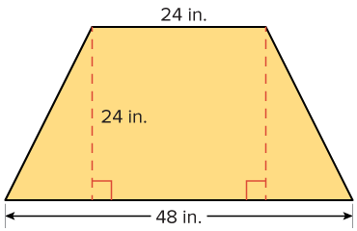
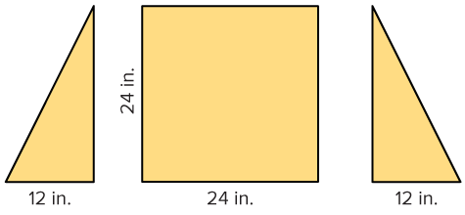
Odd-Shaped Furniture
What is another method you can use to find the area of the isosceles trapezoid?
Record your reasoning before the reveal.
Compare, then explain any revision.
Reveal:
We can compose it into a rectangle.
27 / 62
Notes:
TEACH IN PRACTICE | Embedded facilitation | Lesson 5.3, slide 27 | REVEAL
Focus on the existing task: Reveal: We can compose it into a rectangle. What is another method you can use to find the area of the isosceles trapezoid?
LAUNCH (T2/3/5): If an existing answer cover is present, gather an attempt before revealing. If the explanation is already visible, ask students to reconstruct and justify it. Compare reasoning and explain a revision; preserve the reveal sequence.
LOOK FOR (T4): Where this task addresses it, students can check area units. Ask which feature of their work supports the claim.
RESPOND: If this task shows the lesson misconception—using one base twice or a slanted side as height—mark the two parallel bases and perpendicular height before substituting. Have the student revise and explain the change. Use this support only where the concept occurs in the current task; otherwise respond to the displayed question.
RECHECK: If a gap is shared, revisit the existing representation together. If it is limited, give targeted support while others compare valid methods on the same task. Check the revision before moving on.
PARTICIPATION (T5/6/7): Think time before volunteers; accept a written, drawn or rehearsed entry. Students ask for evidence respectfully. Recognize a specific contribution or revision and check that both partners participate.
Source: BCPS Updated Instructional Framework Rubric (June 2020), TEACH 1–7. Earlier notes and answer keys are retained below.
EARLIER NOTES / EXISTING ANSWER KEY
Do not click yet: collect 2–3 student answers with reasons first.
Then click to remove the cover and have students compare their thinking to the reveal — “Is this what we said? Where is it different?”
Behind the cover: We can compose it into a rectangle.
UIFR: TEACH 3 · TEACH 4.

Slide 28
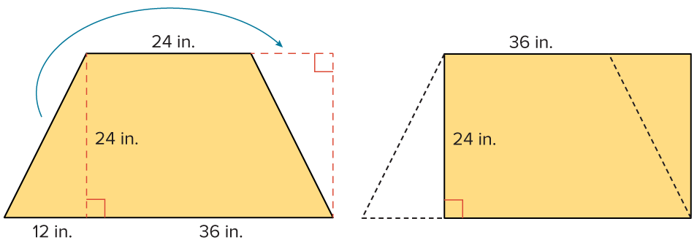
Odd-Shaped Furniture
ADD ON · Add on: “I agree because ______.” or “I see it differently because ______.”
Let’s find the area of an isosceles trapezoid by composing it into a rectangle.
How can you use what you know about the area of a rectangle to find the area of the trapezoid?
Reveal:
We can use the area formula for rectangles.
28 / 62
Notes:
TEACH IN PRACTICE | Embedded facilitation | Lesson 5.3, slide 28 | REVEAL
Focus on the existing task: Reveal: We can use the area formula for rectangles. Let’s find the area of an isosceles trapezoid by composing it into a rectangle.…
LAUNCH (T2/3/5): If an existing answer cover is present, gather an attempt before revealing. If the explanation is already visible, ask students to reconstruct and justify it. Compare reasoning and explain a revision; preserve the reveal sequence.
LOOK FOR (T4): Where this task addresses it, students can explain the half-sum formula. Ask which feature of their work supports the claim.
RESPOND: If this task shows the lesson misconception—using one base twice or a slanted side as height—mark the two parallel bases and perpendicular height before substituting. Have the student revise and explain the change. Use this support only where the concept occurs in the current task; otherwise respond to the displayed question.
RECHECK: If a gap is shared, revisit the existing representation together. If it is limited, give targeted support while others compare valid methods on the same task. Check the revision before moving on.
PARTICIPATION (T5/6/7): Think time before volunteers; accept a written, drawn or rehearsed entry. Students ask for evidence respectfully. Recognize a specific contribution or revision and check that both partners participate.
Source: BCPS Updated Instructional Framework Rubric (June 2020), TEACH 1–7. Earlier notes and answer keys are retained below.
EARLIER NOTES / EXISTING ANSWER KEY
Do not click yet: collect 2–3 student answers with reasons first.
Then click to remove the cover and have students compare their thinking to the reveal — “Is this what we said? Where is it different?”
Behind the cover: We can use the area formula for rectangles .
UIFR: TEACH 3 · TEACH 4.

Slide 29
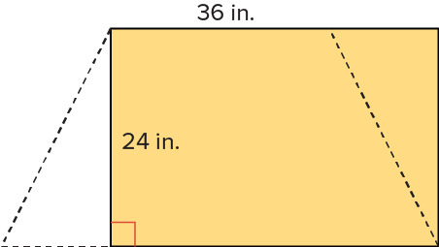



Odd-Shaped Furniture
Let’s use the area formula for rectangles to find the area.
SELF-CHECK · Mark it: ✓ got it · ~ almost · ? stuck. Then fix one thing before we move on.
Think About It:
29 / 62
Notes:
TEACH IN PRACTICE | Embedded facilitation | Lesson 5.3, slide 29 | WORKED
Focus on the existing task: Let’s use the area formula for rectangles to find the area. Think About It: Odd-Shaped Furniture
LAUNCH (T2/3/5): Ask students to explain the displayed idea or example and point to evidence. When a calculation step is shown, ask why it is valid. Have a partner restate the explanation; copying is not the check.
LOOK FOR (T4): Where this task addresses it, students can explain the half-sum formula. Ask which feature of their work supports the claim.
RESPOND: If this task shows the lesson misconception—using one base twice or a slanted side as height—mark the two parallel bases and perpendicular height before substituting. Have the student revise and explain the change. Use this support only where the concept occurs in the current task; otherwise respond to the displayed question.
RECHECK: If a gap is shared, revisit the existing representation together. If it is limited, give targeted support while others compare valid methods on the same task. Check the revision before moving on.
PARTICIPATION (T5/6/7): Think time before volunteers; accept a written, drawn or rehearsed entry. Students ask for evidence respectfully. Recognize a specific contribution or revision and check that both partners participate.
Source: BCPS Updated Instructional Framework Rubric (June 2020), TEACH 1–7. Earlier notes and answer keys are retained below.
EARLIER NOTES / EXISTING ANSWER KEY
Ask the question, then hold the silence — students think or jot before anyone answers.
Take two or three responses and press with “Why?” or “How do you know?” before moving on.
UIFR: TEACH 3.

Slide 30
Odd-Shaped Furniture
Let’s use the area formula for rectangles to find the area.
STRUGGLE FIRST · Work on your own first. Stuck is allowed — try a second strategy before you ask.
Think About It:
Why is the length of the rectangle 36 inches?
30 / 62
Notes:
TEACH IN PRACTICE | Embedded facilitation | Lesson 5.3, slide 30 | TASK
Focus on the existing task: Let’s use the area formula for rectangles to find the area. Think About It: Why is the length of the rectangle 36 inches?
LAUNCH (T2/3/5): Use the displayed question. Give private thinking time; then A explains while B asks for evidence. Switch roles. Each student records their own reasoning.
LOOK FOR (T4): Where this task addresses it, students can explain the half-sum formula. Ask which feature of their work supports the claim.
RESPOND: If this task shows the lesson misconception—using one base twice or a slanted side as height—mark the two parallel bases and perpendicular height before substituting. Have the student revise and explain the change. Use this support only where the concept occurs in the current task; otherwise respond to the displayed question.
RECHECK: If a gap is shared, revisit the existing representation together. If it is limited, give targeted support while others compare valid methods on the same task. Check the revision before moving on.
PARTICIPATION (T5/6/7): Think time before volunteers; accept a written, drawn or rehearsed entry. Students ask for evidence respectfully. Recognize a specific contribution or revision and check that both partners participate.
Source: BCPS Updated Instructional Framework Rubric (June 2020), TEACH 1–7. Earlier notes and answer keys are retained below.
EARLIER NOTES / EXISTING ANSWER KEY
Ask the question, then hold the silence — students think or jot before anyone answers.
Take two or three responses and press with “Why?” or “How do you know?” before moving on.
UIFR: TEACH 3.

Slide 31
The top of a table is in the shape of an isosceles trapezoid.
What is the area of the tabletop?
Try first. Explain what a row or column represents. Use it as evidence for your answer.
The area of the tabletop is 864 square inches.
31 / 62
Notes:
TEACH IN PRACTICE | Embedded facilitation | Lesson 5.3, slide 31 | TASK
Focus on the existing task: The top of a table is in the shape of an isosceles trapezoid. What is the area of the tabletop?
LAUNCH (T2/3/5): Use the displayed question. Give private thinking time; then A explains while B asks for evidence. Switch roles. Each student records their own reasoning.
LOOK FOR (T4): Where this task addresses it, students can check area units. Ask which feature of their work supports the claim.
RESPOND: If this task shows the lesson misconception—using one base twice or a slanted side as height—mark the two parallel bases and perpendicular height before substituting. Have the student revise and explain the change. Use this support only where the concept occurs in the current task; otherwise respond to the displayed question.
RECHECK: If a gap is shared, revisit the existing representation together. If it is limited, give targeted support while others compare valid methods on the same task. Check the revision before moving on.
PARTICIPATION (T5/6/7): Think time before volunteers; accept a written, drawn or rehearsed entry. Students ask for evidence respectfully. Recognize a specific contribution or revision and check that both partners participate.
Source: BCPS Updated Instructional Framework Rubric (June 2020), TEACH 1–7. Earlier notes and answer keys are retained below.
EARLIER NOTES / EXISTING ANSWER KEY
Model briefly, then hand the thinking back: ask “Why does this step work?” before showing the next one.
Quick check before moving on — thumbs or whiteboards from everyone, not volunteers.
UIFR: TEACH 2 · TEACH 3 · TEACH 4.

Slide 32
Let’s Explore More
What statement can you make about the lengths of the parallel sides of the trapezoid when composing the trapezoid into a rectangle?
Is there another way you could decompose the trapezoid to find the area? Explain.
32 / 62
Notes:
TEACH IN PRACTICE | Embedded facilitation | Lesson 5.3, slide 32 | PRACTICE
Focus on the existing task: What statement can you make about the lengths of the parallel sides of the trapezoid when composing the trapezoid into a rectangle?
LAUNCH (T2/3/5): Use the displayed question. Give private thinking time; then A explains while B asks for evidence. Switch roles. Each student records their own reasoning.
LOOK FOR (T4): Where this task addresses it, students can identify the parallel bases and height. Ask which feature of their work supports the claim.
RESPOND: If this task shows the lesson misconception—using one base twice or a slanted side as height—mark the two parallel bases and perpendicular height before substituting. Have the student revise and explain the change. Use this support only where the concept occurs in the current task; otherwise respond to the displayed question.
RECHECK: If a gap is shared, revisit the existing representation together. If it is limited, give targeted support while others compare valid methods on the same task. Check the revision before moving on.
PARTICIPATION (T5/6/7): Think time before volunteers; accept a written, drawn or rehearsed entry. Students ask for evidence respectfully. Recognize a specific contribution or revision and check that both partners participate.
Source: BCPS Updated Instructional Framework Rubric (June 2020), TEACH 1–7. Earlier notes and answer keys are retained below.
EARLIER NOTES / EXISTING ANSWER KEY
Extension for partners or table groups — students choose their approach and use the workspace to show thinking.
Push with “Convince me,” and have two groups with different approaches share.
This is where students stretch past the worked example.
UIFR: TEACH 2 · TEACH 5.

Slide 33
STUDENT MOVES
Lesson 5-3
Your move
TWO MINUTES SOLO · Two minutes on your own, then compare. Bring one thing you tried, even if it did not work.
33 / 62

Slide 34
LESSON 5.3 / DISCUSS THE TASK
Explain and compare
Use the task you just explored.
TAKE TURNS
How does combining two copies of the trapezoid explain the sum of the bases?
Explain
“I know this because…”
Ask
“Where does your work show that?”
Point to evidence in your work.
Then compare your approach with a partner’s.
JUSTIFY IT · Say it like this: “I know ______ because ______.”
Listen to understand. Ask for evidence. Make room for every voice.
Notes:
TEACH IN PRACTICE | Embedded facilitation | Lesson 5.3, slide 33 | PRIOR_INSERT
Focus on the existing task: Point to evidence in your work. Then compare your approach with a partner’s. TAKE TURNS Explain “I know this because…” Ask “Where does your work show that?
CONNECT (T1/4): Ask students to restate the displayed goal or key idea and connect it to earlier work. Relevant lesson evidence: identify the parallel bases and height; explain the half-sum formula; check area units. Use only the criterion that matches the current session.
SHOW PROGRESS: Students point to their own existing work, explain what improved after feedback, and name a next step. Pair confidence ratings with actual evidence.
PARTICIPATION (T5/6/7): Think time before volunteers; accept a written, drawn or rehearsed entry. Students ask for evidence respectfully. Recognize a specific contribution or revision and check that both partners participate.
Source: BCPS Updated Instructional Framework Rubric (June 2020), TEACH 1–7.

Slide 35
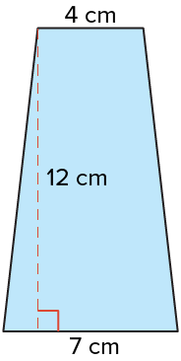
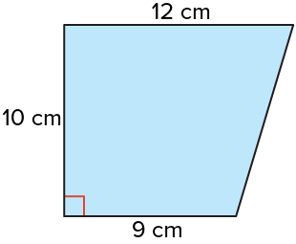
Be Curious
What do you notice?
What do you wonder?
Think first. Share a notice and a
question; build on a classmate’s
idea.
Mindset
How are you using math to help identify a problem in your class or community?
35 / 62
Notes:
TEACH IN PRACTICE | Embedded facilitation | Lesson 5.3, slide 34 | CURIOUS
Focus on the existing task: How are you using math to help identify a problem in your class or community?
LAUNCH (T2/3/5): Allow quiet observation first. Separate a notice from an inference, invite students’ own questions, and follow the existing launch before teaching a procedure.
LOOK FOR (T4): Where this task addresses it, students can identify the parallel bases and height. Ask which feature of their work supports the claim.
RESPOND: If this task shows the lesson misconception—using one base twice or a slanted side as height—mark the two parallel bases and perpendicular height before substituting. Have the student revise and explain the change. Use this support only where the concept occurs in the current task; otherwise respond to the displayed question.
RECHECK: If a gap is shared, revisit the existing representation together. If it is limited, give targeted support while others compare valid methods on the same task. Check the revision before moving on.
PARTICIPATION (T5/6/7): Think time before volunteers; accept a written, drawn or rehearsed entry. Students ask for evidence respectfully. Recognize a specific contribution or revision and check that both partners participate.
Source: BCPS Updated Instructional Framework Rubric (June 2020), TEACH 1–7.

Slide 36
Warm-Up
Lesson 5-3 · Determine the Area of Trapezoids
Session 2 Warm-Up
Try alone. Explain one. Then revise.
1
Which formula gives the area of a trapezoid?
2
In a trapezoid, what are b1 and b2?
A
A = b × h
A
The slanted sides
B
A = ½(b1 + b2)h
B
The two parallel bases
C
A = b1 + b2 + h
C
The diagonal lines
D
A = (b1 × b2) ÷ h
D
The corners
3
A trapezoid has bases 6 cm and 10 cm, height 4 cm. Area is:
4
Two identical trapezoids placed together form a:
A
16 cm²
A
Circle
B
32 cm²
B
Parallelogram with base (b1 + b2)
C
64 cm²
C
Right triangle
D
24 cm²
D
Cube
eduwonderlab.com · Neft Teacher
36 / 62
Notes:
TEACH IN PRACTICE | Embedded facilitation | Lesson 5.3, slide 35 | WARMUP
Focus on the existing task: Warm-Up Session 2 Warm-Up Check what you remember from Session 1 1 Which formula gives the area of a trapezoid?
GATHER EVIDENCE (T4/6): Keep the original items. Students try independently, mark an uncertain item, and explain one method before checking. Use the existing key when present.
RESPOND: Distinguish a calculation slip from a reasoning gap. Give one next step on the same item; have students revise in a second color. Use the responses to choose flexible support for today’s lesson.
PARTICIPATION (T5/6/7): Think time before volunteers; accept a written, drawn or rehearsed entry. Students ask for evidence respectfully. Recognize a specific contribution or revision and check that both partners participate.
Source: BCPS Updated Instructional Framework Rubric (June 2020), TEACH 1–7. Earlier notes and answer keys are retained below.
EARLIER NOTES / EXISTING ANSWER KEY
Warm-up routine: students start silently on entry; keep it to about 4 minutes.
Circulate and note who is stuck — use what you see to choose who you check on first today.
Go over answers quickly; ask one student to explain a step, not just say the answer.
UIFR: TEACH 4 · TEACH 6.

Slide 37
STUDENT MOVES
Lesson 5-3
Your move
YOU KNOW THE ROUTINE · Read → plan → solve → check. Do all four, in that order.
37 / 62

Slide 38
Review Notes — Session 2
Lesson 5-3 · Determine the Area of Trapezoids
Session 2: Review Notes
Copy. Explain. Check.
WHY IT MATTERS · Finish this: “This is worth knowing because ______.”
Trapezoid Area Formula
1
Area = ½ × (b1 + b2) × h. Average the two parallel bases and multiply by perpendicular height.
Composite Decomposition
2
Trapezoids can also be decomposed into a central rectangle and one or two right triangles.
Parallel Bases
3
Always identify the two parallel sides as bases; distance between them is height.
eduwonderlab.com · Neft Teacher
38 / 62
Notes:
TEACH IN PRACTICE | Embedded facilitation | Lesson 5.3, slide 36 | NOTES
Focus on the existing task: Review Notes — Session 2 Session 2: Review Notes Copy into…
ROUTINE (T1/2/4): Read or copy the original notes, cover one line, and explain it using the displayed example. Reopen and correct. Copying alone is not evidence of understanding.
LOOK FOR: A link between a symbol, quantity or feature and the explanation. If missing, point back to that feature and have the student try again; fade the prompt once they can explain.
PARTICIPATION (T5/6/7): Think time before volunteers; accept a written, drawn or rehearsed entry. Students ask for evidence respectfully. Recognize a specific contribution or revision and check that both partners participate.
Source: BCPS Updated Instructional Framework Rubric (June 2020), TEACH 1–7. Earlier notes and answer keys are retained below.
EARLIER NOTES / EXISTING ANSWER KEY
Copy routine: read one line at a time; students copy, then explain that line to a partner.
Keep it brisk — the understanding work happens in the examples, not the copying.
UIFR: TEACH 1 · TEACH 6.

Slide 39
Session 2
Determine the Area of Trapezoids​
ANOTHER PATHWAY · Did anyone get there a different way? Put both pathways side by side and compare.
39 / 62
Notes:
TEACH IN PRACTICE | Embedded facilitation | Lesson 5.3, slide 37 | DIVIDER
Focus on the existing task: Session 2 Determine the Area of Trapezoids
TRANSITION (T6/7): Students confirm materials, roles, how to request help, and the next response routine. Ask a student to restate it. Keep teacher-only slides hidden.
PARTICIPATION (T5/6/7): Think time before volunteers; accept a written, drawn or rehearsed entry. Students ask for evidence respectfully. Recognize a specific contribution or revision and check that both partners participate.
Source: BCPS Updated Instructional Framework Rubric (June 2020), TEACH 1–7. Earlier notes and answer keys are retained below.
EARLIER NOTES / EXISTING ANSWER KEY
Transition cue: state what materials are out and what success looks like this session.
Keep the changeover under a minute.
UIFR: TEACH 6.

Slide 40
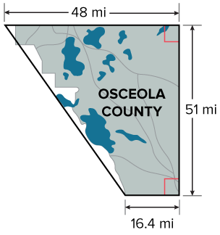
Land Area
The shape of Osceola County, Florida resembles a trapezoid.
What is the approximate area of the county?
USE YOUR TOOLS · Reach for your notes, a model, or a manipulative before you reach for an answer.
Making Connections​
How can you connect the problem to math that you already know?
40 / 62
Notes:
TEACH IN PRACTICE | Embedded facilitation | Lesson 5.3, slide 38 | TASK
Focus on the existing task: The shape of Osceola County, Florida resembles a trapezoid. What is the approximate area of the county?
LAUNCH (T2/3/5): Use the displayed question. Give private thinking time; then A explains while B asks for evidence. Switch roles. Each student records their own reasoning.
LOOK FOR (T4): Where this task addresses it, students can check area units. Ask which feature of their work supports the claim.
RESPOND: If this task shows the lesson misconception—using one base twice or a slanted side as height—mark the two parallel bases and perpendicular height before substituting. Have the student revise and explain the change. Use this support only where the concept occurs in the current task; otherwise respond to the displayed question.
RECHECK: If a gap is shared, revisit the existing representation together. If it is limited, give targeted support while others compare valid methods on the same task. Check the revision before moving on.
PARTICIPATION (T5/6/7): Think time before volunteers; accept a written, drawn or rehearsed entry. Students ask for evidence respectfully. Recognize a specific contribution or revision and check that both partners participate.
Source: BCPS Updated Instructional Framework Rubric (June 2020), TEACH 1–7. Earlier notes and answer keys are retained below.
EARLIER NOTES / EXISTING ANSWER KEY
Model briefly, then hand the thinking back: ask “Why does this step work?” before showing the next one.
Quick check before moving on — thumbs or whiteboards from everyone, not volunteers.
UIFR: TEACH 2 · TEACH 3 · TEACH 4.

Slide 41
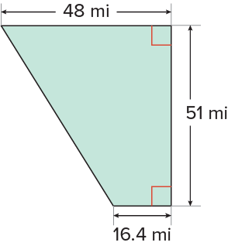
Land Area
What do you notice about the angles in the trapezoid?​
Record your reasoning before the reveal. Compare, then
explain any revision.
Reveal:
Two of the angles are right angles.
41 / 62
Notes:
TEACH IN PRACTICE | Embedded facilitation | Lesson 5.3, slide 39 | REVEAL
Focus on the existing task: What do you notice about the angles in the trapezoid?
LAUNCH (T2/3/5): If an existing answer cover is present, gather an attempt before revealing. If the explanation is already visible, ask students to reconstruct and justify it. Compare reasoning and explain a revision; preserve the reveal sequence.
LOOK FOR (T4): Where this task addresses it, students can check area units. Ask which feature of their work supports the claim.
RESPOND: If this task shows the lesson misconception—using one base twice or a slanted side as height—mark the two parallel bases and perpendicular height before substituting. Have the student revise and explain the change. Use this support only where the concept occurs in the current task; otherwise respond to the displayed question.
RECHECK: If a gap is shared, revisit the existing representation together. If it is limited, give targeted support while others compare valid methods on the same task. Check the revision before moving on.
PARTICIPATION (T5/6/7): Think time before volunteers; accept a written, drawn or rehearsed entry. Students ask for evidence respectfully. Recognize a specific contribution or revision and check that both partners participate.
Source: BCPS Updated Instructional Framework Rubric (June 2020), TEACH 1–7. Earlier notes and answer keys are retained below.
EARLIER NOTES / EXISTING ANSWER KEY
Do not click yet: collect 2–3 student answers with reasons first.
Then click to remove the cover and have students compare their thinking to the reveal — “Is this what we said? Where is it different?”
Behind the cover: Two of the angles are right angles.
UIFR: TEACH 3 · TEACH 4.

Slide 42
Land Area
A trapezoid with two right angles is called a right trapezoid.
Try first. Point to a base and its matching height. Explain how
your method uses them.
Think About It:
How is a right trapezoid similar to a right triangle?
42 / 62
Notes:
TEACH IN PRACTICE | Embedded facilitation | Lesson 5.3, slide 40 | TASK
Focus on the existing task: A trapezoid with two right angles is called a right trapezoid. Think About It: How is a right trapezoid similar to a right triangle?
LAUNCH (T2/3/5): Use the displayed question. Give private thinking time; then A explains while B asks for evidence. Switch roles. Each student records their own reasoning.
LOOK FOR (T4): Where this task addresses it, students can check area units. Ask which feature of their work supports the claim.
RESPOND: If this task shows the lesson misconception—using one base twice or a slanted side as height—mark the two parallel bases and perpendicular height before substituting. Have the student revise and explain the change. Use this support only where the concept occurs in the current task; otherwise respond to the displayed question.
RECHECK: If a gap is shared, revisit the existing representation together. If it is limited, give targeted support while others compare valid methods on the same task. Check the revision before moving on.
PARTICIPATION (T5/6/7): Think time before volunteers; accept a written, drawn or rehearsed entry. Students ask for evidence respectfully. Recognize a specific contribution or revision and check that both partners participate.
Source: BCPS Updated Instructional Framework Rubric (June 2020), TEACH 1–7. Earlier notes and answer keys are retained below.
EARLIER NOTES / EXISTING ANSWER KEY
Ask the question, then hold the silence — students think or jot before anyone answers.
Take two or three responses and press with “Why?” or “How do you know?” before moving on.
UIFR: TEACH 3.

Slide 43
Land Area
What is one method you could use to find the area of the right trapezoid?
Record your reasoning before the reveal. Compare, then
explain any revision.
Reveal:
We could compose the trapezoid into another shape.
43 / 62
Notes:
TEACH IN PRACTICE | Embedded facilitation | Lesson 5.3, slide 41 | REVEAL
Focus on the existing task: What is one method you could use to find the area of the right trapezoid?
LAUNCH (T2/3/5): If an existing answer cover is present, gather an attempt before revealing. If the explanation is already visible, ask students to reconstruct and justify it. Compare reasoning and explain a revision; preserve the reveal sequence.
LOOK FOR (T4): Where this task addresses it, students can check area units. Ask which feature of their work supports the claim.
RESPOND: If this task shows the lesson misconception—using one base twice or a slanted side as height—mark the two parallel bases and perpendicular height before substituting. Have the student revise and explain the change. Use this support only where the concept occurs in the current task; otherwise respond to the displayed question.
RECHECK: If a gap is shared, revisit the existing representation together. If it is limited, give targeted support while others compare valid methods on the same task. Check the revision before moving on.
PARTICIPATION (T5/6/7): Think time before volunteers; accept a written, drawn or rehearsed entry. Students ask for evidence respectfully. Recognize a specific contribution or revision and check that both partners participate.
Source: BCPS Updated Instructional Framework Rubric (June 2020), TEACH 1–7. Earlier notes and answer keys are retained below.
EARLIER NOTES / EXISTING ANSWER KEY
Do not click yet: collect 2–3 student answers with reasons first.
Then click to remove the cover and have students compare their thinking to the reveal — “Is this what we said? Where is it different?”
Behind the cover: We could compose the trapezoid into another shape.
UIFR: TEACH 3 · TEACH 4.

Slide 44
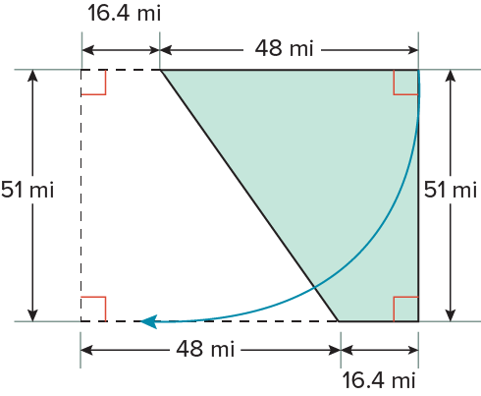
Land Area
Let’s compose the trapezoid into a rectangle by copying and combining the trapezoid.
How can you find the area of the resulting rectangle?
Record your reasoning before the reveal.
Compare, then explain any revision.
Reveal:
We can use the area formula for rectangles.
44 / 62
Notes:
TEACH IN PRACTICE | Embedded facilitation | Lesson 5.3, slide 42 | REVEAL
Focus on the existing task: Reveal: We can use the area formula for rectangles. Let’s compose the trapezoid into a rectangle by copying and combining the trapezoid. How can you find the area of the resulting rectangle?
LAUNCH (T2/3/5): If an existing answer cover is present, gather an attempt before revealing. If the explanation is already visible, ask students to reconstruct and justify it. Compare reasoning and explain a revision; preserve the reveal sequence.
LOOK FOR (T4): Where this task addresses it, students can explain the half-sum formula. Ask which feature of their work supports the claim.
RESPOND: If this task shows the lesson misconception—using one base twice or a slanted side as height—mark the two parallel bases and perpendicular height before substituting. Have the student revise and explain the change. Use this support only where the concept occurs in the current task; otherwise respond to the displayed question.
RECHECK: If a gap is shared, revisit the existing representation together. If it is limited, give targeted support while others compare valid methods on the same task. Check the revision before moving on.
PARTICIPATION (T5/6/7): Think time before volunteers; accept a written, drawn or rehearsed entry. Students ask for evidence respectfully. Recognize a specific contribution or revision and check that both partners participate.
Source: BCPS Updated Instructional Framework Rubric (June 2020), TEACH 1–7. Earlier notes and answer keys are retained below.
EARLIER NOTES / EXISTING ANSWER KEY
Do not click yet: collect 2–3 student answers with reasons first.
Then click to remove the cover and have students compare their thinking to the reveal — “Is this what we said? Where is it different?”
Behind the cover: We can use the area formula for rectangles .
UIFR: TEACH 3 · TEACH 4.

Slide 45




Land Area
Let’s use the area formula for rectangles.
What do you notice about the length of the rectangle?
Reveal:
It is equivalent to the sum of the bases of the original trapezoid.
45 / 62
Notes:
TEACH IN PRACTICE | Embedded facilitation | Lesson 5.3, slide 43 | REVEAL
Focus on the existing task: Reveal: It is equivalent to the sum of the bases of the original trapezoid. Let’s use the area formula for rectangles. What do you notice about the length of the rectangle?
LAUNCH (T2/3/5): If an existing answer cover is present, gather an attempt before revealing. If the explanation is already visible, ask students to reconstruct and justify it. Compare reasoning and explain a revision; preserve the reveal sequence.
LOOK FOR (T4): Where this task addresses it, students can identify the parallel bases and height. Ask which feature of their work supports the claim.
RESPOND: If this task shows the lesson misconception—using one base twice or a slanted side as height—mark the two parallel bases and perpendicular height before substituting. Have the student revise and explain the change. Use this support only where the concept occurs in the current task; otherwise respond to the displayed question.
RECHECK: If a gap is shared, revisit the existing representation together. If it is limited, give targeted support while others compare valid methods on the same task. Check the revision before moving on.
PARTICIPATION (T5/6/7): Think time before volunteers; accept a written, drawn or rehearsed entry. Students ask for evidence respectfully. Recognize a specific contribution or revision and check that both partners participate.
Source: BCPS Updated Instructional Framework Rubric (June 2020), TEACH 1–7. Earlier notes and answer keys are retained below.
EARLIER NOTES / EXISTING ANSWER KEY
Do not click yet: collect 2–3 student answers with reasons first.
Then click to remove the cover and have students compare their thinking to the reveal — “Is this what we said? Where is it different?”
Behind the cover: It is equivalent to the sum of the bases of the original trapezoid .
UIFR: TEACH 3 · TEACH 4.

Slide 46
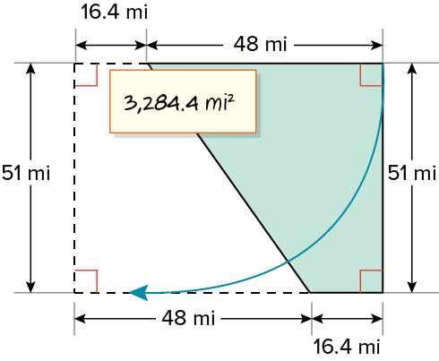
Land Area
The area of the rectangle is 3,284.4 square miles.
The length of the rectangle is equal to the sum of the bases of the trapezoid.
How can you use the area of the rectangle to find the area of the trapezoid?
Reveal:
There are two identical trapezoids that form the rectangle. The area of one trapezoid is half the area of the rectangle.
46 / 62
Notes:
TEACH IN PRACTICE | Embedded facilitation | Lesson 5.3, slide 44 | REVEAL
Focus on the existing task: Reveal: There are two identical trapezoids that form the rectangle. The area of one trapezoid is half the area of the rectangle. Land…
LAUNCH (T2/3/5): If an existing answer cover is present, gather an attempt before revealing. If the explanation is already visible, ask students to reconstruct and justify it. Compare reasoning and explain a revision; preserve the reveal sequence.
LOOK FOR (T4): Where this task addresses it, students can identify the parallel bases and height. Ask which feature of their work supports the claim.
RESPOND: If this task shows the lesson misconception—using one base twice or a slanted side as height—mark the two parallel bases and perpendicular height before substituting. Have the student revise and explain the change. Use this support only where the concept occurs in the current task; otherwise respond to the displayed question.
RECHECK: If a gap is shared, revisit the existing representation together. If it is limited, give targeted support while others compare valid methods on the same task. Check the revision before moving on.
PARTICIPATION (T5/6/7): Think time before volunteers; accept a written, drawn or rehearsed entry. Students ask for evidence respectfully. Recognize a specific contribution or revision and check that both partners participate.
Source: BCPS Updated Instructional Framework Rubric (June 2020), TEACH 1–7. Earlier notes and answer keys are retained below.
EARLIER NOTES / EXISTING ANSWER KEY
Do not click yet: collect 2–3 student answers with reasons first.
Then click to remove the cover and have students compare their thinking to the reveal — “Is this what we said? Where is it different?”
Behind the cover: There are two identical trapezoids that form the rectangle. The area of one trapezoid is half the area of the rectangle.
UIFR: TEACH 3 · TEACH 4.

Slide 47
STUDENT MOVES
Lesson 5-3
Your moves
PROVE IT · Find the evidence in the problem that makes your answer right — not just the answer.
YOUR CHOICE · You choose how to show this — numbers, words, or a diagram. Make your reasoning visible.
47 / 62

Slide 48
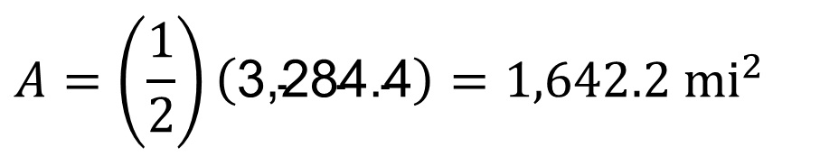
Land Area
The area of the trapezoid is half of the area of the rectangle.
Explain how the information shown supports your reasoning.
48 / 62
Notes:
TEACH IN PRACTICE | Embedded facilitation | Lesson 5.3, slide 45 | WORKED
Focus on the existing task: The area of the trapezoid is half of the area of the rectangle. Land Area
LAUNCH (T2/3/5): Ask students to explain the displayed idea or example and point to evidence. When a calculation step is shown, ask why it is valid. Have a partner restate the explanation; copying is not the check.
LOOK FOR (T4): Where this task addresses it, students can explain the half-sum formula. Ask which feature of their work supports the claim.
RESPOND: If this task shows the lesson misconception—using one base twice or a slanted side as height—mark the two parallel bases and perpendicular height before substituting. Have the student revise and explain the change. Use this support only where the concept occurs in the current task; otherwise respond to the displayed question.
RECHECK: If a gap is shared, revisit the existing representation together. If it is limited, give targeted support while others compare valid methods on the same task. Check the revision before moving on.
PARTICIPATION (T5/6/7): Think time before volunteers; accept a written, drawn or rehearsed entry. Students ask for evidence respectfully. Recognize a specific contribution or revision and check that both partners participate.
Source: BCPS Updated Instructional Framework Rubric (June 2020), TEACH 1–7. Earlier notes and answer keys are retained below.
EARLIER NOTES / EXISTING ANSWER KEY
Model briefly, then hand the thinking back: ask “Why does this step work?” before showing the next one.
Quick check before moving on — thumbs or whiteboards from everyone, not volunteers.
UIFR: TEACH 2 · TEACH 3 · TEACH 4.

Slide 49
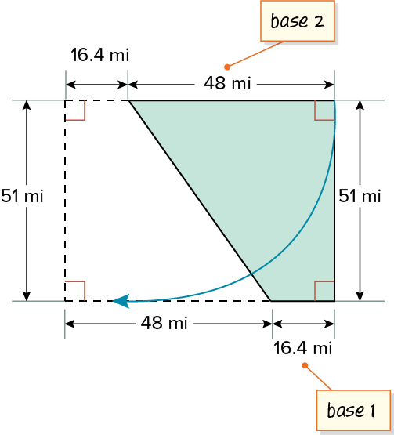
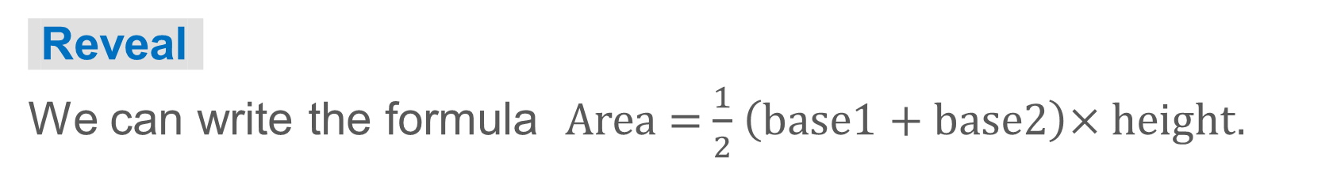
COLLABORATE · TALK IT THROUGH • AGREE ON A MODEL
Collaborate and Connect
You can find the area of the trapezoid by finding half the area of the rectangle formed by copying and combining the trapezoid.
The length of the rectangle is equal to the sum of the bases of the trapezoid.
How can you use this information to help you develop a formula for the area of a trapezoid?
49 / 62
Notes:
TEACH IN PRACTICE | Embedded facilitation | Lesson 5.3, slide 46 | COLLABORATE
Focus on the existing task: Collaborate and Connect You can find the area of the trapezoid by finding half the area of the rectangle formed by copying and combining…
LAUNCH (T2/3/5): Use the displayed question. Give private thinking time; then A explains while B asks for evidence. Switch roles. Each student records their own reasoning.
LOOK FOR (T4): Where this task addresses it, students can explain the half-sum formula. Ask which feature of their work supports the claim.
RESPOND: If this task shows the lesson misconception—using one base twice or a slanted side as height—mark the two parallel bases and perpendicular height before substituting. Have the student revise and explain the change. Use this support only where the concept occurs in the current task; otherwise respond to the displayed question.
RECHECK: If a gap is shared, revisit the existing representation together. If it is limited, give targeted support while others compare valid methods on the same task. Check the revision before moving on.
PARTICIPATION (T5/6/7): Think time before volunteers; accept a written, drawn or rehearsed entry. Students ask for evidence respectfully. Recognize a specific contribution or revision and check that both partners participate.
Source: BCPS Updated Instructional Framework Rubric (June 2020), TEACH 1–7. Earlier notes and answer keys are retained below.
EARLIER NOTES / EXISTING ANSWER KEY
Routine: COLLABORATE · TALK IT THROUGH • AGREE ON A MODEL

Slide 50
STUDENT MOVES
Lesson 5-3
Your move
TAKE TURNS · One explains, one asks a question. Then switch, so both of you talk.
50 / 62

Slide 51
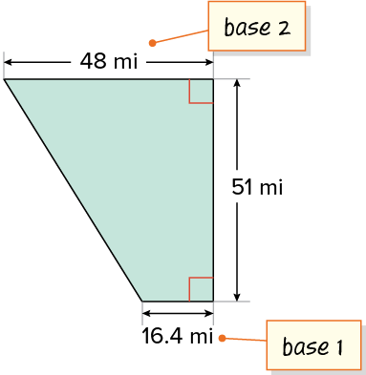
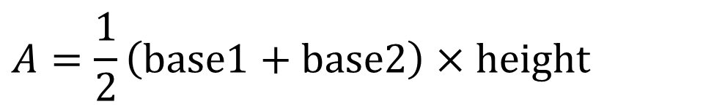
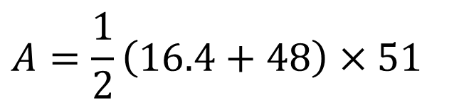

Land Area
Let’s find the area of the trapezoid using an area formula.​
Explain how the information shown supports your reasoning.
51 / 62
Notes:
TEACH IN PRACTICE | Embedded facilitation | Lesson 5.3, slide 47 | WORKED
Focus on the existing task: Let’s find the area of the trapezoid using an area formula. Land Area
LAUNCH (T2/3/5): Ask students to explain the displayed idea or example and point to evidence. When a calculation step is shown, ask why it is valid. Have a partner restate the explanation; copying is not the check.
LOOK FOR (T4): Where this task addresses it, students can explain the half-sum formula. Ask which feature of their work supports the claim.
RESPOND: If this task shows the lesson misconception—using one base twice or a slanted side as height—mark the two parallel bases and perpendicular height before substituting. Have the student revise and explain the change. Use this support only where the concept occurs in the current task; otherwise respond to the displayed question.
RECHECK: If a gap is shared, revisit the existing representation together. If it is limited, give targeted support while others compare valid methods on the same task. Check the revision before moving on.
PARTICIPATION (T5/6/7): Think time before volunteers; accept a written, drawn or rehearsed entry. Students ask for evidence respectfully. Recognize a specific contribution or revision and check that both partners participate.
Source: BCPS Updated Instructional Framework Rubric (June 2020), TEACH 1–7. Earlier notes and answer keys are retained below.
EARLIER NOTES / EXISTING ANSWER KEY
Model briefly, then hand the thinking back: ask “Why does this step work?” before showing the next one.
Quick check before moving on — thumbs or whiteboards from everyone, not volunteers.
UIFR: TEACH 2 · TEACH 3 · TEACH 4.

Slide 52
Land Area
The shape of Osceola County, Florida resembles a trapezoid.
What is the approximate area of the county?
The area of Osceola County is about 1,642.2 square miles.
Think and record first. Which part of your work supports your answer?
52 / 62
Notes:
TEACH IN PRACTICE | Embedded facilitation | Lesson 5.3, slide 48 | TASK
Focus on the existing task: The shape of Osceola County, Florida resembles a trapezoid. What is the approximate area of the county?
LAUNCH (T2/3/5): Use the displayed question. Give private thinking time; then A explains while B asks for evidence. Switch roles. Each student records their own reasoning.
LOOK FOR (T4): Where this task addresses it, students can check area units. Ask which feature of their work supports the claim.
RESPOND: If this task shows the lesson misconception—using one base twice or a slanted side as height—mark the two parallel bases and perpendicular height before substituting. Have the student revise and explain the change. Use this support only where the concept occurs in the current task; otherwise respond to the displayed question.
RECHECK: If a gap is shared, revisit the existing representation together. If it is limited, give targeted support while others compare valid methods on the same task. Check the revision before moving on.
PARTICIPATION (T5/6/7): Think time before volunteers; accept a written, drawn or rehearsed entry. Students ask for evidence respectfully. Recognize a specific contribution or revision and check that both partners participate.
Source: BCPS Updated Instructional Framework Rubric (June 2020), TEACH 1–7. Earlier notes and answer keys are retained below.
EARLIER NOTES / EXISTING ANSWER KEY
Model briefly, then hand the thinking back: ask “Why does this step work?” before showing the next one.
Quick check before moving on — thumbs or whiteboards from everyone, not volunteers.
UIFR: TEACH 2 · TEACH 3 · TEACH 4.

Slide 53
Let’s Explore More
How do the area formulas for a trapezoid and a parallelogram relate?
Workspace
53 / 62
Notes:
TEACH IN PRACTICE | Embedded facilitation | Lesson 5.3, slide 49 | PRACTICE
Focus on the existing task: Workspace How do the area formulas for a trapezoid and a parallelogram relate?
LAUNCH (T2/3/5): Use the displayed question. Give private thinking time; then A explains while B asks for evidence. Switch roles. Each student records their own reasoning.
LOOK FOR (T4): Where this task addresses it, students can check area units. Ask which feature of their work supports the claim.
RESPOND: If this task shows the lesson misconception—using one base twice or a slanted side as height—mark the two parallel bases and perpendicular height before substituting. Have the student revise and explain the change. Use this support only where the concept occurs in the current task; otherwise respond to the displayed question.
RECHECK: If a gap is shared, revisit the existing representation together. If it is limited, give targeted support while others compare valid methods on the same task. Check the revision before moving on.
PARTICIPATION (T5/6/7): Think time before volunteers; accept a written, drawn or rehearsed entry. Students ask for evidence respectfully. Recognize a specific contribution or revision and check that both partners participate.
Source: BCPS Updated Instructional Framework Rubric (June 2020), TEACH 1–7. Earlier notes and answer keys are retained below.
EARLIER NOTES / EXISTING ANSWER KEY
Extension for partners or table groups — students choose their approach and use the workspace to show thinking.
Push with “Convince me,” and have two groups with different approaches share.
This is where students stretch past the worked example.
UIFR: TEACH 2 · TEACH 5.

Slide 54
STUDENT MOVES
Lesson 5-3
Your move
PICK YOUR STRATEGY · Choose your path — picture, table, number line, or equation — and be ready to say why you chose it.
54 / 62

Slide 55
LESSON 5.3 / CHECK YOUR WORK
Pause. Check. Improve.
CHECK
A mistake to watch for: using one base twice or a slanted side as height.
TRY
Mark the two parallel bases and perpendicular height before substituting.
REVISE
Use that check on the task you just completed. Correct or strengthen one part, and explain why.
REVISE NOW · Change one answer and write why you changed it. A revision is evidence of learning.
Listen to understand. Ask for evidence. Make room for every voice.
Notes:
TEACH IN PRACTICE | Embedded facilitation | Lesson 5.3, slide 50 | PRIOR_INSERT
Focus on the existing task: LESSON 5.3 / CHECK YOUR WORK Pause. Check. Improve. Listen to understand. Ask for evidence. Make room for every voice. CHECK A mistake…
CONNECT (T1/4): Ask students to restate the displayed goal or key idea and connect it to earlier work. Relevant lesson evidence: identify the parallel bases and height; explain the half-sum formula; check area units. Use only the criterion that matches the current session.
SHOW PROGRESS: Students point to their own existing work, explain what improved after feedback, and name a next step. Pair confidence ratings with actual evidence.
PARTICIPATION (T5/6/7): Think time before volunteers; accept a written, drawn or rehearsed entry. Students ask for evidence respectfully. Recognize a specific contribution or revision and check that both partners participate.
Source: BCPS Updated Instructional Framework Rubric (June 2020), TEACH 1–7.

Slide 56
Land Area
What do you notice about the angles in the trapezoid?​
Compare your reasoning with the explanation. Explain any
revision you make.
Reveal:
Two of the angles are right angles.
56 / 62
Notes:
TEACH IN PRACTICE | Embedded facilitation | Lesson 5.3, slide 51 | REVEAL
Focus on the existing task: What do you notice about the angles in the trapezoid?
LAUNCH (T2/3/5): If an existing answer cover is present, gather an attempt before revealing. If the explanation is already visible, ask students to reconstruct and justify it. Compare reasoning and explain a revision; preserve the reveal sequence.
LOOK FOR (T4): Where this task addresses it, students can check area units. Ask which feature of their work supports the claim.
RESPOND: If this task shows the lesson misconception—using one base twice or a slanted side as height—mark the two parallel bases and perpendicular height before substituting. Have the student revise and explain the change. Use this support only where the concept occurs in the current task; otherwise respond to the displayed question.
RECHECK: If a gap is shared, revisit the existing representation together. If it is limited, give targeted support while others compare valid methods on the same task. Check the revision before moving on.
PARTICIPATION (T5/6/7): Think time before volunteers; accept a written, drawn or rehearsed entry. Students ask for evidence respectfully. Recognize a specific contribution or revision and check that both partners participate.
Source: BCPS Updated Instructional Framework Rubric (June 2020), TEACH 1–7.

Slide 57
Land Area
What is one method you could use to find the area of the right trapezoid?
Compare your reasoning with the explanation. Explain any
revision you make.
Reveal:
We could compose the trapezoid into another shape.
57 / 62
Notes:
TEACH IN PRACTICE | Embedded facilitation | Lesson 5.3, slide 52 | REVEAL
Focus on the existing task: What is one method you could use to find the area of the right trapezoid?
LAUNCH (T2/3/5): If an existing answer cover is present, gather an attempt before revealing. If the explanation is already visible, ask students to reconstruct and justify it. Compare reasoning and explain a revision; preserve the reveal sequence.
LOOK FOR (T4): Where this task addresses it, students can check area units. Ask which feature of their work supports the claim.
RESPOND: If this task shows the lesson misconception—using one base twice or a slanted side as height—mark the two parallel bases and perpendicular height before substituting. Have the student revise and explain the change. Use this support only where the concept occurs in the current task; otherwise respond to the displayed question.
RECHECK: If a gap is shared, revisit the existing representation together. If it is limited, give targeted support while others compare valid methods on the same task. Check the revision before moving on.
PARTICIPATION (T5/6/7): Think time before volunteers; accept a written, drawn or rehearsed entry. Students ask for evidence respectfully. Recognize a specific contribution or revision and check that both partners participate.
Source: BCPS Updated Instructional Framework Rubric (June 2020), TEACH 1–7.

Slide 58
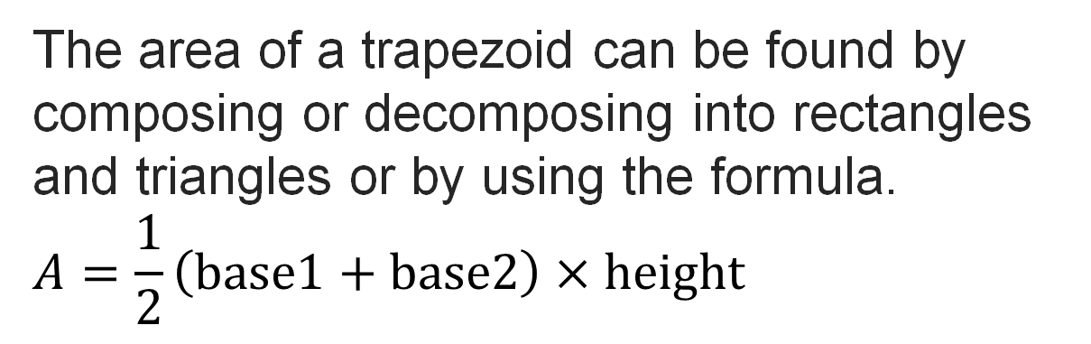
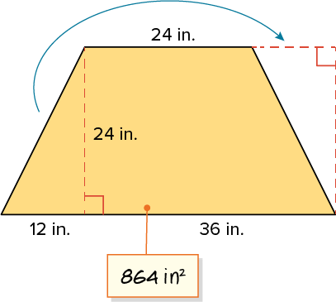
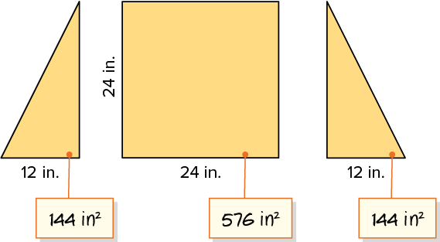
SUMMARIZE · SAY IT IN YOUR OWN WORDS
Summarize: Area of a Trapezoid
58 / 62
Notes:
TEACH IN PRACTICE | Embedded facilitation | Lesson 5.3, slide 53 | SUMMARIZE
Focus on the existing task: Summarize: Area of a Trapezoid SUMMARIZE · SAY IT IN YOUR OWN WORDS
CONNECT (T1/4): Ask students to restate the displayed goal or key idea and connect it to earlier work. Relevant lesson evidence: identify the parallel bases and height; explain the half-sum formula; check area units. Use only the criterion that matches the current session.
SHOW PROGRESS: Students point to their own existing work, explain what improved after feedback, and name a next step. Pair confidence ratings with actual evidence.
PARTICIPATION (T5/6/7): Think time before volunteers; accept a written, drawn or rehearsed entry. Students ask for evidence respectfully. Recognize a specific contribution or revision and check that both partners participate.
Source: BCPS Updated Instructional Framework Rubric (June 2020), TEACH 1–7. Earlier notes and answer keys are retained below.
EARLIER NOTES / EXISTING ANSWER KEY
Routine: SUMMARIZE · SAY IT IN YOUR OWN WORDS

Slide 59
STUDENT MOVES
Lesson 5-3
Your move
HOW DO YOU KNOW? · Ask your partner “How do you know?” Answer by pointing to your own work.
59 / 62

Slide 60
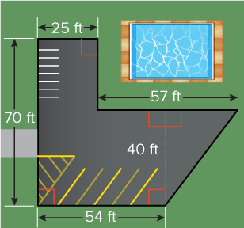
APPLY · PLAN IT • SOLVE IT • PROVE IT
Apply: Budgets
The parking lot shown is being repaved. Asphalt for the parking lot costs $3.95 per square foot, while the cost of labor is about $3 per square foot. The project manager also budgets for the use of equipment, including fuel and potential repairs.
Question: How much money would you recommend the project manager budget to complete the project?
ASK THE CLASS · Write one question about this that you could ask the class.
60 / 62
Notes:
TEACH IN PRACTICE | Embedded facilitation | Lesson 5.3, slide 54 | APPLY
Focus on the existing task: The parking lot shown is being repaved. Asphalt for the parking lot costs $3.95 per square foot, while the cost of labor is about $3 per…
LAUNCH (T2/3/5): Use the exact application task independently first. Ask students to justify their choice of method. Collect evidence before a partner discussion or correction.
LOOK FOR (T4): Where this task addresses it, students can identify the parallel bases and height. Ask which feature of their work supports the claim.
RESPOND: If this task shows the lesson misconception—using one base twice or a slanted side as height—mark the two parallel bases and perpendicular height before substituting. Have the student revise and explain the change. Use this support only where the concept occurs in the current task; otherwise respond to the displayed question.
RECHECK: If a gap is shared, revisit the existing representation together. If it is limited, give targeted support while others compare valid methods on the same task. Check the revision before moving on.
PARTICIPATION (T5/6/7): Think time before volunteers; accept a written, drawn or rehearsed entry. Students ask for evidence respectfully. Recognize a specific contribution or revision and check that both partners participate.
Source: BCPS Updated Instructional Framework Rubric (June 2020), TEACH 1–7. Earlier notes and answer keys are retained below.
EARLIER NOTES / EXISTING ANSWER KEY
Routine: APPLY · PLAN IT • SOLVE IT • PROVE IT
UIFR FULL | Lesson-specific facilitation
TEACH 4 | Independent evidence and revision (UIFR PDF p. 11).
Use the existing application/exit problem as the independent check. If this is a learning-target slide, have students point to and explain their work on the preceding task. Separate initial independent evidence from the revision after feedback.
Check the relevant criteria: identify the parallel bases and height; explain the half-sum formula; check area units. Respond with one specific next step tied to the work. Students revise and annotate what changed, then identify a criterion they can now demonstrate and one they still need to practice.

Slide 61
Learning Targets
I can find the area of a trapezoid by decomposing into triangles or composing into a rectangle.
I can make use of structure to find the area of a trapezoid by composing it into a rectangle or by using a formula.
NAME THE MATH · Point to the part of this that is new today, and say what it changes.
61 / 62
Notes:
TEACH IN PRACTICE | Embedded facilitation | Lesson 5.3, slide 55 | REFLECTION
Focus on the existing task: Learning Targets I can find the area of a trapezoid by decomposing into triangles or composing into a rectangle. I can make use of…
CONNECT (T1/4): Ask students to restate the displayed goal or key idea and connect it to earlier work. Relevant lesson evidence: identify the parallel bases and height; explain the half-sum formula; check area units. Use only the criterion that matches the current session.
SHOW PROGRESS: Students point to their own existing work, explain what improved after feedback, and name a next step. Pair confidence ratings with actual evidence.
PARTICIPATION (T5/6/7): Think time before volunteers; accept a written, drawn or rehearsed entry. Students ask for evidence respectfully. Recognize a specific contribution or revision and check that both partners participate.
Source: BCPS Updated Instructional Framework Rubric (June 2020), TEACH 1–7. Earlier notes and answer keys are retained below.
EARLIER NOTES / EXISTING ANSWER KEY
UIFR FULL | Lesson-specific facilitation
REFLECT & ADJUST 1-2 | After the lesson (UIFR PDF pp. 15-16).
Sort the existing work by demonstrated reasoning, partial understanding, and the specific misconception: using one base twice or a slanted side as height. Compare the initial response with the revision. Record which teaching move plausibly helped, which did not, and whose participation or access needs a different approach; do not record sensitive student details in this shared deck.
Plan the next lesson from that evidence: if the misconception persists, mark the two parallel bases and perpendicular height before substituting using the current example before returning to the next grade-level task; if understanding is secure, use an existing extension or ask for a general explanation. Check the targeted idea again at the next warm-up.
Ask students what supported their thinking and what would help next time. Identify one change to try and one successful practice to retain. Seek colleague feedback on anonymized work when useful; these prompts support reflection and do not establish an evaluation rating. Source: Baltimore City Public Schools, Updated Instructional Framework Rubric, June 2020 (UIFR_Full.pdf).

Slide 62
LESSON 5.3 / REFLECT ON YOUR LEARNING
Show your progress
1 SHOW EVIDENCE
2 CHOOSE A NEXT STEP
Choose one response. Point to the part that shows your reasoning.
Name a change you made after feedback—or a question you still have.
“My work shows ___ because ___.”
“Next time, I will ___ to help me ___.”
Today’s focus: Identify the parallel bases and height.
CREDIT A CLASSMATE · Name one classmate whose idea helped you today, and say what they said.
Listen to understand. Ask for evidence. Make room for every voice.
Notes:
TEACH IN PRACTICE | Embedded facilitation | Lesson 5.3, slide 56 | PRIOR_INSERT
Focus on the existing task: LESSON 5.3 / REFLECT ON YOUR LEARNING Show your progress Listen to understand. Ask for evidence. Make room for every voice. 1 SHOW…
CONNECT (T1/4): Ask students to restate the displayed goal or key idea and connect it to earlier work. Relevant lesson evidence: identify the parallel bases and height; explain the half-sum formula; check area units. Use only the criterion that matches the current session.
SHOW PROGRESS: Students point to their own existing work, explain what improved after feedback, and name a next step. Pair confidence ratings with actual evidence.
PARTICIPATION (T5/6/7): Think time before volunteers; accept a written, drawn or rehearsed entry. Students ask for evidence respectfully. Recognize a specific contribution or revision and check that both partners participate.
Source: BCPS Updated Instructional Framework Rubric (June 2020), TEACH 1–7.

