Slide 1
WARM-UP · THINK • TRY • CHECK
Turn and talk: compare strategies, then defend one.
Warm-Up
Lesson 5-4 · Apply Area Concepts to Solve Problems | Warm-Up · about 4 minutes
Try each on your own. Mark an unsure answer; explain and revise when we check.
QUESTION 1
QUESTION 2
A triangle has base 8 m and height 5 m. Area = ______
A 10 by 6 rectangle has a 3 by 2 square cut out.
The area left = ______
QUESTION 3
QUESTION 4
A 15 ft side splits into a 9 ft piece and one more piece.
The other piece is ______
One identical triangle is 12 square in. Six of them cover ______
TALK IT OVER: “I got ______ because ______.” • Compare with a partner before we check as a class.
1 / 47
Notes:
TEACH IN PRACTICE | Embedded facilitation | Lesson 5.4, slide 1 | WARMUP
Focus on the existing task: Warm-Up WARM-UP · THINK • TRY • CHECK Do these four…
GATHER EVIDENCE (T4/6): Keep the original items. Students try independently, mark an uncertain item, and explain one method before checking. Use the existing key when present.
RESPOND: Distinguish a calculation slip from a reasoning gap. Give one next step on the same item; have students revise in a second color. Use the responses to choose flexible support for today’s lesson.
PARTICIPATION (T5/6/7): Think time before volunteers; accept a written, drawn or rehearsed entry. Students ask for evidence respectfully. Recognize a specific contribution or revision and check that both partners participate.
Source: BCPS Updated Instructional Framework Rubric (June 2020), TEACH 1–7. Earlier notes and answer keys are retained below.
EARLIER NOTES / EXISTING ANSWER KEY
Warm-Up answers (teacher only): 1) 20 square meters 2) 54 square units 3) 6 feet 4) 72 square inches
UIFR FULL | Lesson-specific facilitation
PREPARE 1-2 | Before teaching (UIFR PDF pp. 6-7).
Plan to gather evidence that students can decompose or enclose the figure; account for every region once; add or subtract areas. Review recent work and today’s warm-up to choose flexible groups and access supports; do not infer needs from identity or perceived ability. Use the existing lesson tasks and stated standards.
Anticipate: counting an overlapping region twice or retaining a cutout. If observed, outline a proposed partition on the original diagram and label each included region. Offer oral rehearsal, drawing, pointing, or home-language processing as needed; retain the original mathematical demand. Ask students which support helps and fade it as evidence improves.
TEACH 6-7 | Before the first transition, agree on materials, partner roles, and how to request help. Invite students to restate the routine. Normalize revising an idea, recognize a specific contribution, and check privately when frustration blocks participation. Source: UIFR PDF pp. 13-14.

Slide 2
Today’s Math Notes
Lesson 5-4 · Apply Area Concepts to Solve Problems
Section 1: Math Words
Copy. Explain. Check.
SAY THE GOAL · Say today’s goal in your own words, then name one place this shows up outside math class.
Area of Composite Figures
1
The total space inside a figure made of basic shapes
Composite Figure
2
A shape made by putting two or more simple shapes together
Decompose
3
To break a shape into smaller, simpler shapes
eduwonderlab.com · Neft Teacher
2 / 47
Notes:
TEACH IN PRACTICE | Embedded facilitation | Lesson 5.4, slide 2 | NOTES
Focus on the existing task: Today’s Math Notes Section 1: Math Words Copy into…
ROUTINE (T1/2/4): Read or copy the original notes, cover one line, and explain it using the displayed example. Reopen and correct. Copying alone is not evidence of understanding.
LOOK FOR: A link between a symbol, quantity or feature and the explanation. If missing, point back to that feature and have the student try again; fade the prompt once they can explain.
PARTICIPATION (T5/6/7): Think time before volunteers; accept a written, drawn or rehearsed entry. Students ask for evidence respectfully. Recognize a specific contribution or revision and check that both partners participate.
Source: BCPS Updated Instructional Framework Rubric (June 2020), TEACH 1–7. Earlier notes and answer keys are retained below.
EARLIER NOTES / EXISTING ANSWER KEY
Copy routine: read one line at a time; students copy, then explain that line to a partner.
Keep it brisk — the understanding work happens in the examples, not the copying.
UIFR: TEACH 1 · TEACH 6.

Slide 3
Today’s Math Notes
Lesson 5-4 · Apply Area Concepts to Solve Problems
Section 2: Today’s Math
Copy. Explain. Check.
Area of Composite Figures
Decompose: Split the irregular shape into basic figures (rectangles, triangles, trapezoids)
1
Calculate: Find the area of each individual sub-figure
2
CONNECT IT · What earlier lesson does this build on? Tell a partner in one sentence.
Combine: Add the areas together (or subtract if a piece is removed/cut out)
3
eduwonderlab.com · Neft Teacher
3 / 47
Notes:
TEACH IN PRACTICE | Embedded facilitation | Lesson 5.4, slide 3 | NOTES
Focus on the existing task: Today’s Math Notes Section 2: Today’s Math Copy into…
ROUTINE (T1/2/4): Read or copy the original notes, cover one line, and explain it using the displayed example. Reopen and correct. Copying alone is not evidence of understanding.
LOOK FOR: A link between a symbol, quantity or feature and the explanation. If missing, point back to that feature and have the student try again; fade the prompt once they can explain.
PARTICIPATION (T5/6/7): Think time before volunteers; accept a written, drawn or rehearsed entry. Students ask for evidence respectfully. Recognize a specific contribution or revision and check that both partners participate.
Source: BCPS Updated Instructional Framework Rubric (June 2020), TEACH 1–7. Earlier notes and answer keys are retained below.
EARLIER NOTES / EXISTING ANSWER KEY
Copy routine: read one line at a time; students copy, then explain that line to a partner.
Keep it brisk — the understanding work happens in the examples, not the copying.
UIFR: TEACH 1 · TEACH 6.

Slide 4
Session 1
Apply Area Concepts to Solve Problems
PICK YOUR STRATEGY · Choose your path — picture, table, number line, or equation — and be ready to say why you chose it.
4 / 47
Notes:
TEACH IN PRACTICE | Embedded facilitation | Lesson 5.4, slide 4 | DIVIDER
Focus on the existing task: Apply Area Concepts to Solve Problems Session 1
TRANSITION (T6/7): Students confirm materials, roles, how to request help, and the next response routine. Ask a student to restate it. Keep teacher-only slides hidden.
PARTICIPATION (T5/6/7): Think time before volunteers; accept a written, drawn or rehearsed entry. Students ask for evidence respectfully. Recognize a specific contribution or revision and check that both partners participate.
Source: BCPS Updated Instructional Framework Rubric (June 2020), TEACH 1–7. Earlier notes and answer keys are retained below.
EARLIER NOTES / EXISTING ANSWER KEY
Transition cue: state what materials are out and what success looks like this session.
Keep the changeover under a minute.
UIFR: TEACH 6.

Slide 5
This or That
Would you rather have THIS or THAT tokens for prizes?
Tokens For Prizes
THIS | THAT
Think and record first. Which part of your work supports your
answer?
5 / 47
Notes:
TEACH IN PRACTICE | Embedded facilitation | Lesson 5.4, slide 5 | TASK
Focus on the existing task: This or That Would you rather have THIS or THAT tokens for prizes?
LAUNCH (T2/3/5): Use the displayed question. Give private thinking time; then A explains while B asks for evidence. Switch roles. Each student records their own reasoning.
LOOK FOR (T4): Where this task addresses it, students can decompose or enclose the figure. Ask which feature of their work supports the claim.
RESPOND: If this task shows the lesson misconception—counting an overlapping region twice or retaining a cutout—outline a proposed partition on the original diagram and label each included region. Have the student revise and explain the change. Use this support only where the concept occurs in the current task; otherwise respond to the displayed question.
RECHECK: If a gap is shared, revisit the existing representation together. If it is limited, give targeted support while others compare valid methods on the same task. Check the revision before moving on.
PARTICIPATION (T5/6/7): Think time before volunteers; accept a written, drawn or rehearsed entry. Students ask for evidence respectfully. Recognize a specific contribution or revision and check that both partners participate.
Source: BCPS Updated Instructional Framework Rubric (June 2020), TEACH 1–7. Earlier notes and answer keys are retained below.
EARLIER NOTES / EXISTING ANSWER KEY
Number-sense routine — every voice in. Give quiet think time, then hear from at least three students.
Always follow with “How do you know?” — the reasoning is the point, not the answer.
There is more than one path; name and celebrate different strategies.
UIFR: TEACH 3 · TEACH 5 · TEACH 6.

Slide 6
Today’s Objectives
Lesson 5-4 · Apply Area Concepts to Solve Problems
Apply Area Concepts to Solve Problems
Maryland Standard 6.GR.1
SHOW YOUR THINKING · Show what you know — write it, draw it, or build it. A picture counts as an explanation.
CONTENT OBJECTIVE
LANGUAGE OBJECTIVE
Restate the goal in your words
Use these words to explain why
I can find the area of a composite figure by decomposing it into basic shapes, including a regular polygon split into triangles, and adding or subtracting the areas.
I can explain my steps using the words composite figure, decompose, add, and subtract.
eduwonderlab.com · Neft Teacher
6 / 47
Notes:
TEACH IN PRACTICE | Embedded facilitation | Lesson 5.4, slide 6 | GOAL
Focus on the existing task: Today’s Objectives Apply Area Concepts to Solve…
CONNECT (T1/4): Ask students to restate the displayed goal or key idea and connect it to earlier work. Relevant lesson evidence: decompose or enclose the figure; account for every region once; add or subtract areas. Use only the criterion that matches the current session.
SHOW PROGRESS: Students point to their own existing work, explain what improved after feedback, and name a next step. Pair confidence ratings with actual evidence.
PARTICIPATION (T5/6/7): Think time before volunteers; accept a written, drawn or rehearsed entry. Students ask for evidence respectfully. Recognize a specific contribution or revision and check that both partners participate.
Source: BCPS Updated Instructional Framework Rubric (June 2020), TEACH 1–7. Earlier notes and answer keys are retained below.
EARLIER NOTES / EXISTING ANSWER KEY
Read the objective together, then have one or two students restate today’s goal in their own words.
Connect it to what the class learned last lesson.
Return to this goal at the end of class to check it was met.
UIFR: TEACH 1.
UIFR FULL | Lesson-specific facilitation
TEACH 1 | Session 1 purpose and evidence (UIFR PDF p. 8).
Have students restate the displayed session goal in their own words and connect it to the existing context or a familiar experience they choose to share. Use the current session goal to select from these lesson-wide evidence criteria; do not frontload a later-session procedure.
Look for: decompose or enclose the figure; account for every region once; add or subtract areas. Ask: “Which part of your work would show this?” Revisit that evidence after the task; a confidence rating alone is not evidence of understanding.

Slide 7
LESSON 5.4 / OUR LEARNING
What will show your learning?
1
Decompose or enclose the figure.
2
Account for every region once.
3
Add or subtract areas.
Tell a partner: Which skill connects to something you already know?
WHY IT MATTERS · Finish this: “This is worth knowing because ______.”
Listen to understand. Ask for evidence. Make room for every voice.
Notes:
TEACH IN PRACTICE | Embedded facilitation | Lesson 5.4, slide 7 | PRIOR_INSERT
Focus on the existing task: LESSON 5.4 / OUR LEARNING What will show your learning?
CONNECT (T1/4): Ask students to restate the displayed goal or key idea and connect it to earlier work. Relevant lesson evidence: decompose or enclose the figure; account for every region once; add or subtract areas. Use only the criterion that matches the current session.
SHOW PROGRESS: Students point to their own existing work, explain what improved after feedback, and name a next step. Pair confidence ratings with actual evidence.
PARTICIPATION (T5/6/7): Think time before volunteers; accept a written, drawn or rehearsed entry. Students ask for evidence respectfully. Recognize a specific contribution or revision and check that both partners participate.
Source: BCPS Updated Instructional Framework Rubric (June 2020), TEACH 1–7.

Slide 8
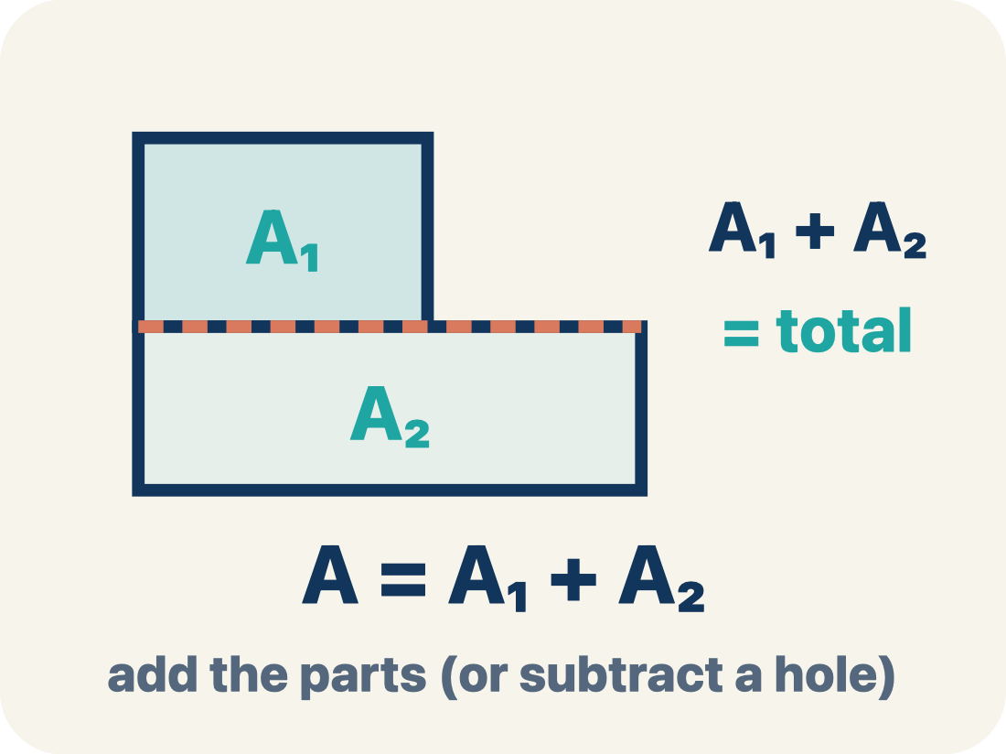
Vocabulary 1 of 6
Lesson 5-4 · Apply Area Concepts to Solve Problems
Area of Composite Figures
The total space inside a figure made of basic shapes. Formula: A = A₁ + A₂ — add the parts (or subtract a missing piece).
EXAMPLE · EXPLAIN WHY IT FITS
Total area = area of rectangle 1 + area of rectangle 2.
USE THE MATH WORDS · Use today’s math words in your explanation — not “it” and “that thing.”
eduwonderlab.com · Neft Teacher
8 / 47
Notes:
TEACH IN PRACTICE | Embedded facilitation | Lesson 5.4, slide 8 | VOCAB
Focus on the existing task: Vocabulary 1 of 6 Area of Composite Figures The…
ASK (T1/3/5): Where does “Area of Composite Figures” appear in the example? Explain the meaning without reading the definition. Partner: restate the idea and ask a clarifying question.
LOOK FOR: A correct connection between the word and a feature of the example. If the student only repeats the definition, invite pointing, sketching or oral rehearsal, then ask for another explanation of this same example.
PARTICIPATION (T5/6/7): Think time before volunteers; accept a written, drawn or rehearsed entry. Students ask for evidence respectfully. Recognize a specific contribution or revision and check that both partners participate.
Source: BCPS Updated Instructional Framework Rubric (June 2020), TEACH 1–7.

Slide 9
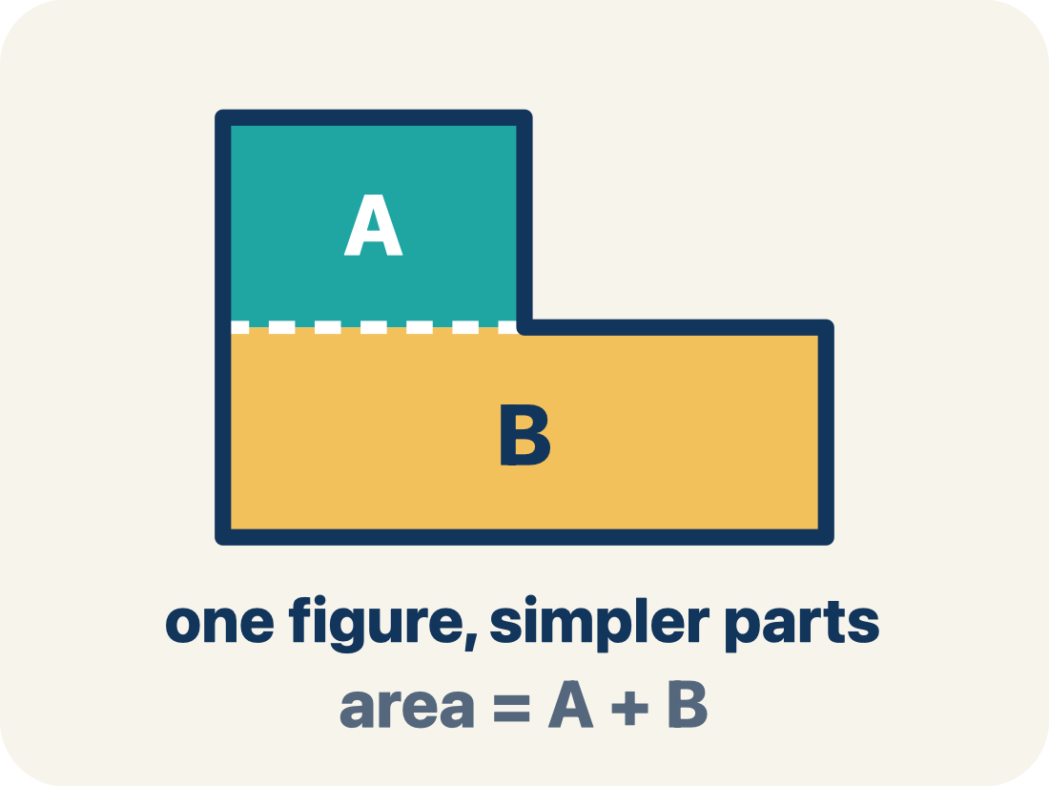
Vocabulary 2 of 6
Lesson 5-4 · Apply Area Concepts to Solve Problems
Composite Figure
A shape made by putting two or more simple shapes together.
EXAMPLE · EXPLAIN WHY IT FITS
An L-shaped room = a 12×8 rectangle joined to a 6×5 rectangle; total area = 96 + 30 = 126 sq ft
Use “Composite Figure” to explain the example. Point to
evidence.
eduwonderlab.com · Neft Teacher
9 / 47
Notes:
TEACH IN PRACTICE | Embedded facilitation | Lesson 5.4, slide 9 | VOCAB
Focus on the existing task: Vocabulary 2 of 6 Composite Figure A shape made by…
ASK (T1/3/5): Where does “Composite Figure” appear in the example? Explain the meaning without reading the definition. Partner: restate the idea and ask a clarifying question.
LOOK FOR: A correct connection between the word and a feature of the example. If the student only repeats the definition, invite pointing, sketching or oral rehearsal, then ask for another explanation of this same example.
PARTICIPATION (T5/6/7): Think time before volunteers; accept a written, drawn or rehearsed entry. Students ask for evidence respectfully. Recognize a specific contribution or revision and check that both partners participate.
Source: BCPS Updated Instructional Framework Rubric (June 2020), TEACH 1–7.

Slide 10
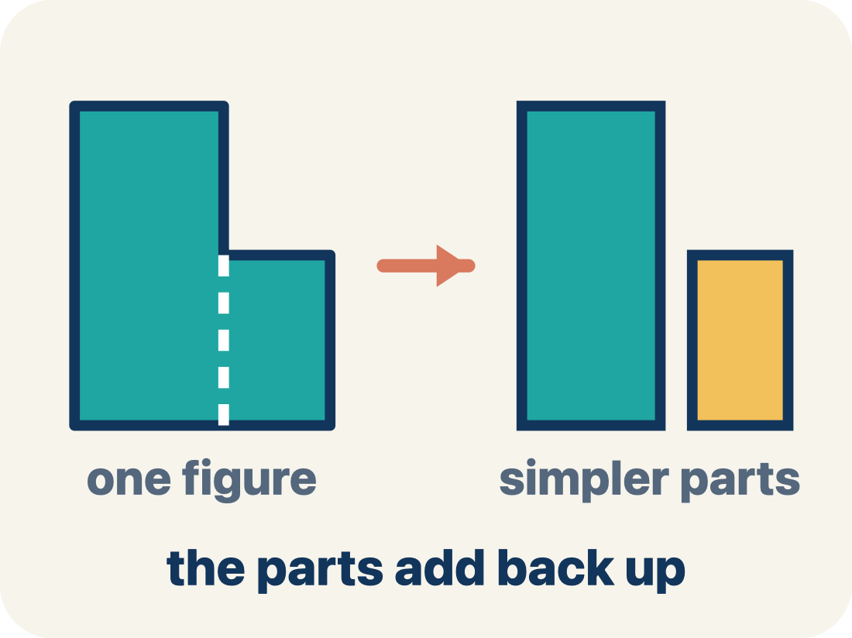
Vocabulary 3 of 6
Lesson 5-4 · Apply Area Concepts to Solve Problems
Decompose
To break a shape into smaller, simpler shapes.
EXAMPLE · EXPLAIN WHY IT FITS
Draw a dashed line across the L-shape to split it into two rectangles — now you can find each area separately
Use “Decompose” to explain the example. Point to evidence.
eduwonderlab.com · Neft Teacher
10 / 47
Notes:
TEACH IN PRACTICE | Embedded facilitation | Lesson 5.4, slide 10 | VOCAB
Focus on the existing task: Vocabulary 3 of 6 Decompose To break a shape into…
ASK (T1/3/5): Where does “Decompose” appear in the example? Explain the meaning without reading the definition. Partner: restate the idea and ask a clarifying question.
LOOK FOR: A correct connection between the word and a feature of the example. If the student only repeats the definition, invite pointing, sketching or oral rehearsal, then ask for another explanation of this same example.
PARTICIPATION (T5/6/7): Think time before volunteers; accept a written, drawn or rehearsed entry. Students ask for evidence respectfully. Recognize a specific contribution or revision and check that both partners participate.
Source: BCPS Updated Instructional Framework Rubric (June 2020), TEACH 1–7.

Slide 11
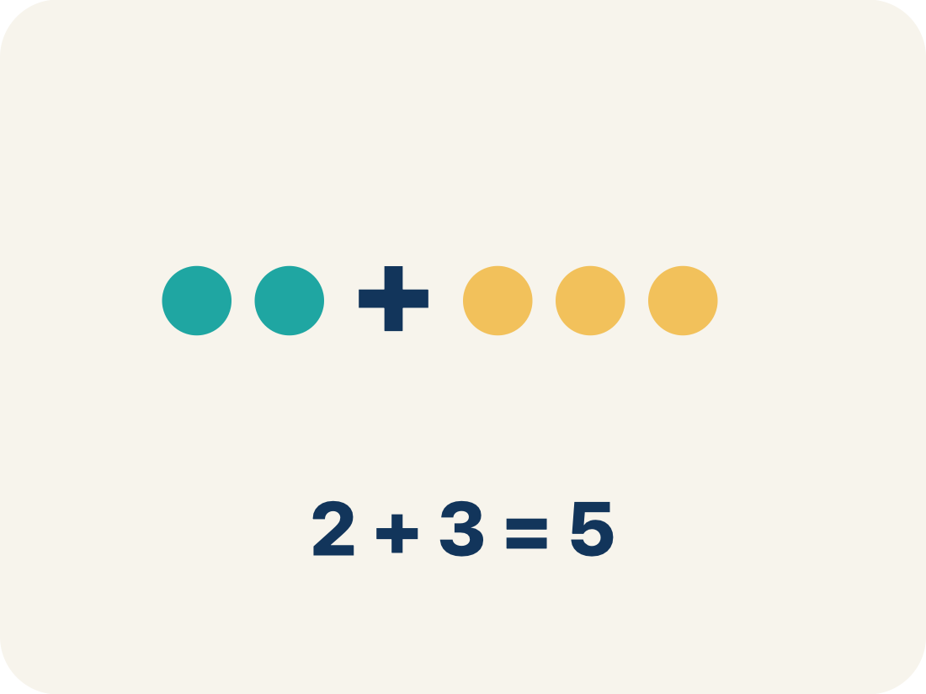
Vocabulary 4 of 6
Lesson 5-4 · Apply Area Concepts to Solve Problems
Add
Add up the areas of the smaller shapes to get the total.
EXAMPLE · EXPLAIN WHY IT FITS
T-shaped hallway: top rectangle = 30 sq ft, bottom rectangle = 28 sq ft → total = 30 + 28 = 58 sq ft
Use “Add” to explain the example. Point to evidence.
eduwonderlab.com · Neft Teacher
11 / 47
Notes:
TEACH IN PRACTICE | Embedded facilitation | Lesson 5.4, slide 11 | VOCAB
Focus on the existing task: Vocabulary 4 of 6 Add Add up the areas of the…
ASK (T1/3/5): Where does “Add” appear in the example? Explain the meaning without reading the definition. Partner: restate the idea and ask a clarifying question.
LOOK FOR: A correct connection between the word and a feature of the example. If the student only repeats the definition, invite pointing, sketching or oral rehearsal, then ask for another explanation of this same example.
PARTICIPATION (T5/6/7): Think time before volunteers; accept a written, drawn or rehearsed entry. Students ask for evidence respectfully. Recognize a specific contribution or revision and check that both partners participate.
Source: BCPS Updated Instructional Framework Rubric (June 2020), TEACH 1–7.

Slide 12
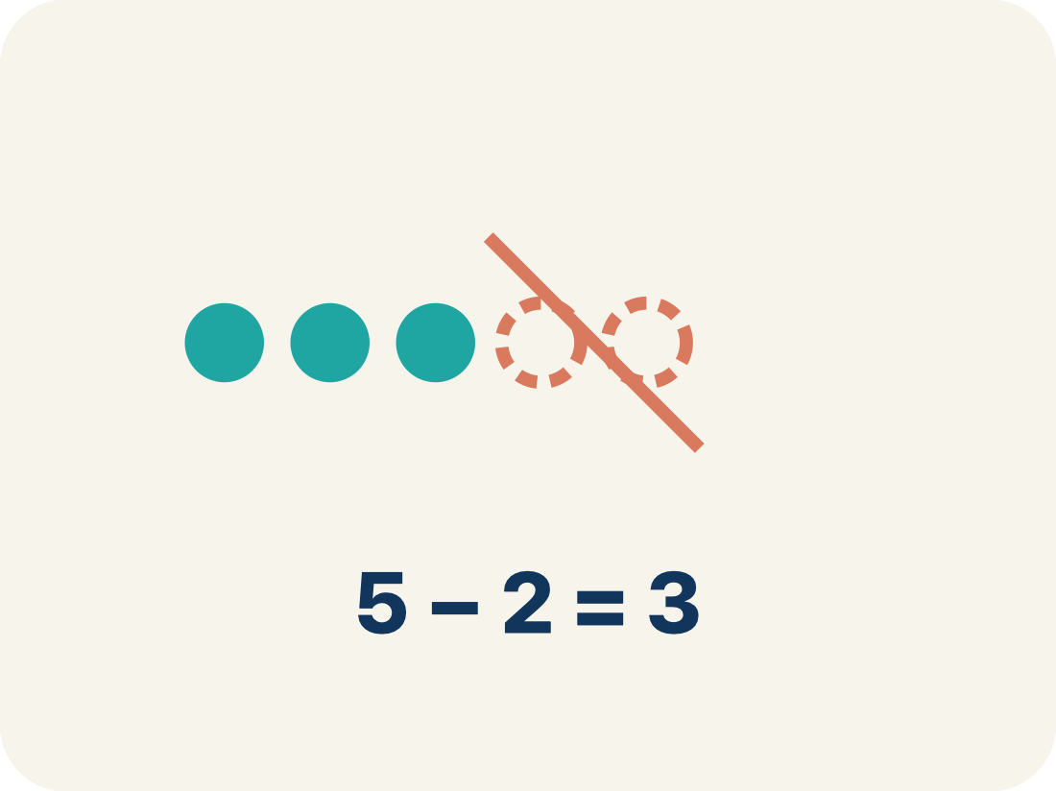
Vocabulary 5 of 6
Lesson 5-4 · Apply Area Concepts to Solve Problems
Subtract
Take away the area of a missing piece from a bigger shape.
EXAMPLE · EXPLAIN WHY IT FITS
A 14×10 pool with a 6×4 cutout: 140 − 24 = 116 sq ft of water surface
Use “Subtract” to explain the example. Point to evidence.
eduwonderlab.com · Neft Teacher
12 / 47
Notes:
TEACH IN PRACTICE | Embedded facilitation | Lesson 5.4, slide 12 | VOCAB
Focus on the existing task: Vocabulary 5 of 6 Subtract Take away the area of a…
ASK (T1/3/5): Where does “Subtract” appear in the example? Explain the meaning without reading the definition. Partner: restate the idea and ask a clarifying question.
LOOK FOR: A correct connection between the word and a feature of the example. If the student only repeats the definition, invite pointing, sketching or oral rehearsal, then ask for another explanation of this same example.
PARTICIPATION (T5/6/7): Think time before volunteers; accept a written, drawn or rehearsed entry. Students ask for evidence respectfully. Recognize a specific contribution or revision and check that both partners participate.
Source: BCPS Updated Instructional Framework Rubric (June 2020), TEACH 1–7.

Slide 13
Vocabulary 6 of 6
Lesson 5-4 · Apply Area Concepts to Solve Problems
Formula
A math rule written with symbols.
EXAMPLE · EXPLAIN WHY IT FITS
Rectangle: A = l × w; Triangle: A = ½ × b × h; use the right formula for each piece of a composite figure
Use “Formula” to explain the example. Point to evidence.
eduwonderlab.com · Neft Teacher
13 / 47
Notes:
TEACH IN PRACTICE | Embedded facilitation | Lesson 5.4, slide 13 | VOCAB
Focus on the existing task: Vocabulary 6 of 6 Formula A math rule written with…
ASK (T1/3/5): Where does “Formula” appear in the example? Explain the meaning without reading the definition. Partner: restate the idea and ask a clarifying question.
LOOK FOR: A correct connection between the word and a feature of the example. If the student only repeats the definition, invite pointing, sketching or oral rehearsal, then ask for another explanation of this same example.
PARTICIPATION (T5/6/7): Think time before volunteers; accept a written, drawn or rehearsed entry. Students ask for evidence respectfully. Recognize a specific contribution or revision and check that both partners participate.
Source: BCPS Updated Instructional Framework Rubric (June 2020), TEACH 1–7.

Slide 14
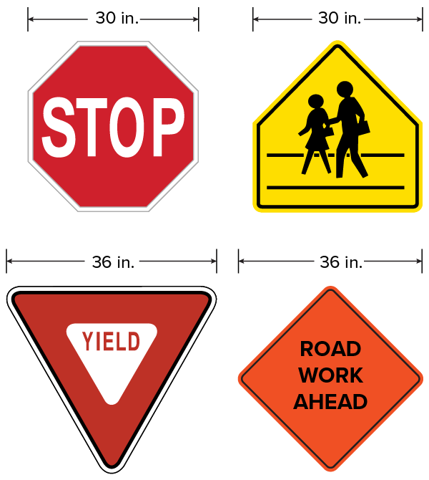

Be Curious
What do you notice?
What do you wonder?
Think first. Share a notice and a question;
build on a classmate’s idea.
Mindset
Why does confidence in yourself and your abilities help you be successful in math?
14 / 47
Notes:
TEACH IN PRACTICE | Embedded facilitation | Lesson 5.4, slide 14 | CURIOUS
Focus on the existing task: Why does confidence in yourself and your abilities help you be successful in math?
LAUNCH (T2/3/5): Allow quiet observation first. Separate a notice from an inference, invite students’ own questions, and follow the existing launch before teaching a procedure.
LOOK FOR (T4): Where this task addresses it, students can decompose or enclose the figure. Ask which feature of their work supports the claim.
RESPOND: If this task shows the lesson misconception—counting an overlapping region twice or retaining a cutout—outline a proposed partition on the original diagram and label each included region. Have the student revise and explain the change. Use this support only where the concept occurs in the current task; otherwise respond to the displayed question.
RECHECK: If a gap is shared, revisit the existing representation together. If it is limited, give targeted support while others compare valid methods on the same task. Check the revision before moving on.
PARTICIPATION (T5/6/7): Think time before volunteers; accept a written, drawn or rehearsed entry. Students ask for evidence respectfully. Recognize a specific contribution or revision and check that both partners participate.
Source: BCPS Updated Instructional Framework Rubric (June 2020), TEACH 1–7.

Slide 15
Vocabulary
Lesson 5-4 · Apply Area Concepts to Solve Problems
Today’s Math Words
We learn every word — what it means and what it looks like — before we use it.
Area of Composite Figures
Composite Figure
The total space inside a figure made of basic shapes
A shape made by putting two or more simple shapes together
Decompose
Add
To break a shape into smaller, simpler shapes
Add up the areas of the smaller shapes to get the total
Subtract
Formula
Take away the area of a missing piece from a bigger shape
A math rule written with symbols
ADD ON · Add on: “I agree because ______.” or “I see it differently because ______.”
eduwonderlab.com · Neft Teacher
15 / 47
Notes:
TEACH IN PRACTICE | Embedded facilitation | Lesson 5.4, slide 15 | VOCAB
Focus on the existing task: Vocabulary Today’s Math Words We learn every word…
ASK (T1/3/5): Where does “the displayed term” appear in the example? Explain the meaning without reading the definition. Partner: restate the idea and ask a clarifying question.
LOOK FOR: A correct connection between the word and a feature of the example. If the student only repeats the definition, invite pointing, sketching or oral rehearsal, then ask for another explanation of this same example.
PARTICIPATION (T5/6/7): Think time before volunteers; accept a written, drawn or rehearsed entry. Students ask for evidence respectfully. Recognize a specific contribution or revision and check that both partners participate.
Source: BCPS Updated Instructional Framework Rubric (June 2020), TEACH 1–7. Earlier notes and answer keys are retained below.
EARLIER NOTES / EXISTING ANSWER KEY
Choral-read each word, its meaning, and what it looks like.
Students should use these words out loud today — listen for them in partner talk and revoice student ideas with the academic term.
UIFR: TEACH 1 · TEACH 5.

Slide 16
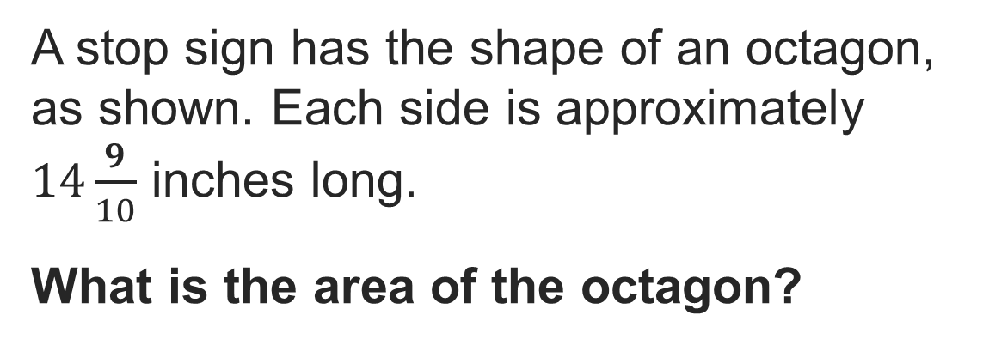

Stop Sign
Think and record first. Which part of your work supports your
answer?
Analyzing
What do you already know about the problem?
16 / 47
Notes:
TEACH IN PRACTICE | Embedded facilitation | Lesson 5.4, slide 16 | TASK
Focus on the existing task: What do you already know about the problem?
LAUNCH (T2/3/5): Use the displayed question. Give private thinking time; then A explains while B asks for evidence. Switch roles. Each student records their own reasoning.
LOOK FOR (T4): Where this task addresses it, students can decompose or enclose the figure. Ask which feature of their work supports the claim.
RESPOND: If this task shows the lesson misconception—counting an overlapping region twice or retaining a cutout—outline a proposed partition on the original diagram and label each included region. Have the student revise and explain the change. Use this support only where the concept occurs in the current task; otherwise respond to the displayed question.
RECHECK: If a gap is shared, revisit the existing representation together. If it is limited, give targeted support while others compare valid methods on the same task. Check the revision before moving on.
PARTICIPATION (T5/6/7): Think time before volunteers; accept a written, drawn or rehearsed entry. Students ask for evidence respectfully. Recognize a specific contribution or revision and check that both partners participate.
Source: BCPS Updated Instructional Framework Rubric (June 2020), TEACH 1–7. Earlier notes and answer keys are retained below.
EARLIER NOTES / EXISTING ANSWER KEY
Model briefly, then hand the thinking back: ask “Why does this step work?” before showing the next one.
Quick check before moving on — thumbs or whiteboards from everyone, not volunteers.
UIFR: TEACH 2 · TEACH 3 · TEACH 4.
UIFR FULL | Lesson-specific facilitation
TEACH 2-3 | Session 1 task launch (UIFR PDF pp. 9-10).
Use the problem exactly as displayed. Give individual thinking time before discussion or advancing to the explanation. If the answer is already visible, ask students to reconstruct and justify it. Invite a choice of suitable representations and have students explain why their choice helps.
At the point where this concept appears, ask: “How can you show that your pieces cover exactly the original figure?” Wait for evidence, invite another pathway, and have a student ask a follow-up question. Do not replace students’ reasoning with a sequence of leading steps.

Slide 17

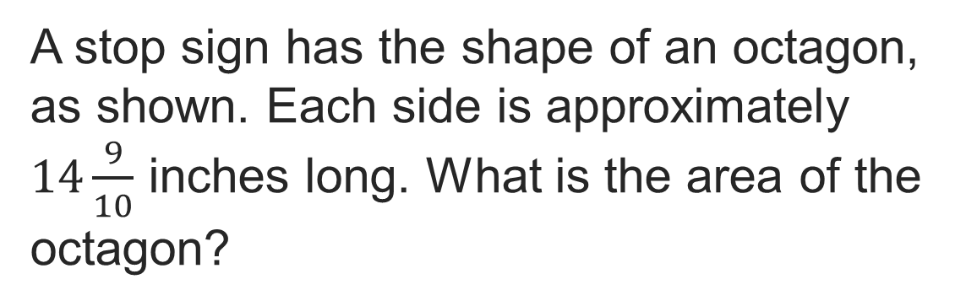
COLLABORATE · TALK IT THROUGH • AGREE ON A MODEL
Collaborate and Connect
How can you decompose the octagon into shapes that you can find the area of?
Think first. A explains; B asks for evidence. Switch roles; both revise.
Reveal:
We can decompose it into 8 triangles.
17 / 47
Notes:
TEACH IN PRACTICE | Embedded facilitation | Lesson 5.4, slide 17 | COLLABORATE
Focus on the existing task: Collaborate and Connect Reveal: We can decompose it into 8 triangles. How can you decompose the octagon into shapes that you can find the area of?
LAUNCH (T2/3/5): Use the displayed question. Give private thinking time; then A explains while B asks for evidence. Switch roles. Each student records their own reasoning.
LOOK FOR (T4): Where this task addresses it, students can decompose or enclose the figure. Ask which feature of their work supports the claim.
RESPOND: If this task shows the lesson misconception—counting an overlapping region twice or retaining a cutout—outline a proposed partition on the original diagram and label each included region. Have the student revise and explain the change. Use this support only where the concept occurs in the current task; otherwise respond to the displayed question.
RECHECK: If a gap is shared, revisit the existing representation together. If it is limited, give targeted support while others compare valid methods on the same task. Check the revision before moving on.
PARTICIPATION (T5/6/7): Think time before volunteers; accept a written, drawn or rehearsed entry. Students ask for evidence respectfully. Recognize a specific contribution or revision and check that both partners participate.
Source: BCPS Updated Instructional Framework Rubric (June 2020), TEACH 1–7. Earlier notes and answer keys are retained below.
EARLIER NOTES / EXISTING ANSWER KEY
Routine: COLLABORATE · TALK IT THROUGH • AGREE ON A MODEL
UIFR FULL | Lesson-specific facilitation
TEACH 4-5 | Session 1 discussion and checkpoint (UIFR PDF pp. 11-12).
Collect a brief response from every student to the existing prompt before hearing volunteers. Partners take turns explaining and asking for evidence: “I understand ___; what supports ___?” Offer rehearsal or an annotated model for students who need language support. Each student records their own reasoning.
Look specifically for: counting an overlapping region twice or retaining a cutout. If it appears, outline a proposed partition on the original diagram and label each included region; then ask the student to revise the same response and explain the change. If evidence is secure, have students compare a second valid pathway or state why their approach works. Choose the next step from the responses, not a preset pace.

Slide 18
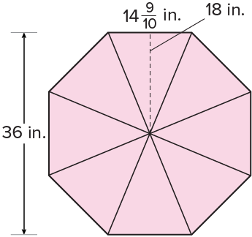
Stop Sign
Let’s decompose the octagon into 8 congruent triangles.
Because each side has the same length, the octagon is a regular polygon. You can decompose a regular polygon into triangles to determine the area.
Try first. Point to a base and its matching
height. Explain how your method uses them.
Think About It:
Why is the height of one triangle 18 inches?
18 / 47
Notes:
TEACH IN PRACTICE | Embedded facilitation | Lesson 5.4, slide 18 | TASK
Focus on the existing task: Think About It: Why is the height of one triangle 18 inches?
LAUNCH (T2/3/5): Use the displayed question. Give private thinking time; then A explains while B asks for evidence. Switch roles. Each student records their own reasoning.
LOOK FOR (T4): Where this task addresses it, students can decompose or enclose the figure. Ask which feature of their work supports the claim.
RESPOND: If this task shows the lesson misconception—counting an overlapping region twice or retaining a cutout—outline a proposed partition on the original diagram and label each included region. Have the student revise and explain the change. Use this support only where the concept occurs in the current task; otherwise respond to the displayed question.
RECHECK: If a gap is shared, revisit the existing representation together. If it is limited, give targeted support while others compare valid methods on the same task. Check the revision before moving on.
PARTICIPATION (T5/6/7): Think time before volunteers; accept a written, drawn or rehearsed entry. Students ask for evidence respectfully. Recognize a specific contribution or revision and check that both partners participate.
Source: BCPS Updated Instructional Framework Rubric (June 2020), TEACH 1–7. Earlier notes and answer keys are retained below.
EARLIER NOTES / EXISTING ANSWER KEY
Ask the question, then hold the silence — students think or jot before anyone answers.
Take two or three responses and press with “Why?” or “How do you know?” before moving on.
UIFR: TEACH 3.

Slide 19
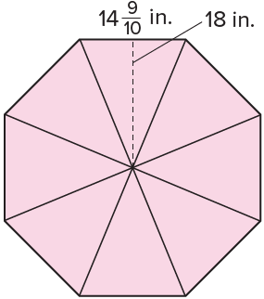
Stop Sign
The octagon can be decomposed into 8 congruent triangles.
What do you notice about the number of congruent triangles and the number of sides of the original polygon? Why do you think this is?
Record your reasoning before the reveal. Compare, then
explain any revision.
Reveal:
They are the same because each side is the base of one triangle.
19 / 47
Notes:
TEACH IN PRACTICE | Embedded facilitation | Lesson 5.4, slide 19 | REVEAL
Focus on the existing task: Why do you think this is?
LAUNCH (T2/3/5): If an existing answer cover is present, gather an attempt before revealing. If the explanation is already visible, ask students to reconstruct and justify it. Compare reasoning and explain a revision; preserve the reveal sequence.
LOOK FOR (T4): Where this task addresses it, students can decompose or enclose the figure. Ask which feature of their work supports the claim.
RESPOND: If this task shows the lesson misconception—counting an overlapping region twice or retaining a cutout—outline a proposed partition on the original diagram and label each included region. Have the student revise and explain the change. Use this support only where the concept occurs in the current task; otherwise respond to the displayed question.
RECHECK: If a gap is shared, revisit the existing representation together. If it is limited, give targeted support while others compare valid methods on the same task. Check the revision before moving on.
PARTICIPATION (T5/6/7): Think time before volunteers; accept a written, drawn or rehearsed entry. Students ask for evidence respectfully. Recognize a specific contribution or revision and check that both partners participate.
Source: BCPS Updated Instructional Framework Rubric (June 2020), TEACH 1–7. Earlier notes and answer keys are retained below.
EARLIER NOTES / EXISTING ANSWER KEY
Do not click yet: collect 2–3 student answers with reasons first.
Then click to remove the cover and have students compare their thinking to the reveal — “Is this what we said? Where is it different?”
Behind the cover: They are the same because each side is the base of one triangle.
UIFR: TEACH 3 · TEACH 4.

Slide 20
Stop Sign
The octagon can be decomposed into 8 congruent triangles. Each side is the base of a triangle.
How can you determine the area of the octagon using the triangles?
Record your reasoning before the reveal. Compare, then
explain any revision.
Reveal:
We can find the area of one triangle and then multiply the area by 8, or the number of triangles.
20 / 47
Notes:
TEACH IN PRACTICE | Embedded facilitation | Lesson 5.4, slide 20 | REVEAL
Focus on the existing task: Reveal: We can find the area of one triangle and then multiply the area by 8, or the number of triangles. The octagon can be decomposed…
LAUNCH (T2/3/5): If an existing answer cover is present, gather an attempt before revealing. If the explanation is already visible, ask students to reconstruct and justify it. Compare reasoning and explain a revision; preserve the reveal sequence.
LOOK FOR (T4): Where this task addresses it, students can decompose or enclose the figure. Ask which feature of their work supports the claim.
RESPOND: If this task shows the lesson misconception—counting an overlapping region twice or retaining a cutout—outline a proposed partition on the original diagram and label each included region. Have the student revise and explain the change. Use this support only where the concept occurs in the current task; otherwise respond to the displayed question.
RECHECK: If a gap is shared, revisit the existing representation together. If it is limited, give targeted support while others compare valid methods on the same task. Check the revision before moving on.
PARTICIPATION (T5/6/7): Think time before volunteers; accept a written, drawn or rehearsed entry. Students ask for evidence respectfully. Recognize a specific contribution or revision and check that both partners participate.
Source: BCPS Updated Instructional Framework Rubric (June 2020), TEACH 1–7. Earlier notes and answer keys are retained below.
EARLIER NOTES / EXISTING ANSWER KEY
Do not click yet: collect 2–3 student answers with reasons first.
Then click to remove the cover and have students compare their thinking to the reveal — “Is this what we said? Where is it different?”
Behind the cover: We can find the area of one triangle and then multiply the area by 8, or the number of triangles.
UIFR: TEACH 3 · TEACH 4.

Slide 21
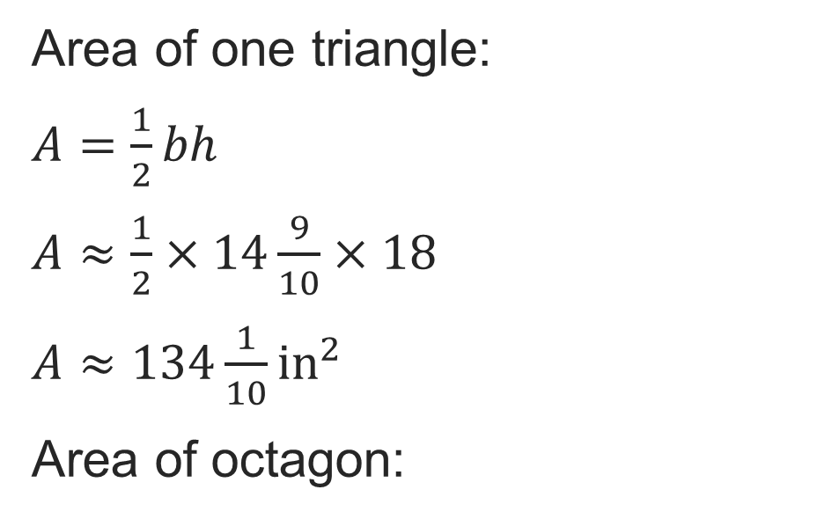
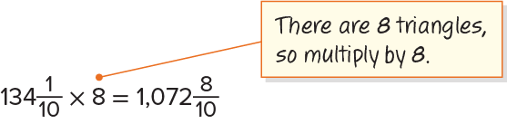
Stop Sign
Let’s use the triangles to find the area of the octagon.
Point to a base and its matching height.
Explain how your method uses them.
21 / 47
Notes:
TEACH IN PRACTICE | Embedded facilitation | Lesson 5.4, slide 21 | WORKED
Focus on the existing task: Let’s use the triangles to find the area of the octagon. Stop Sign
LAUNCH (T2/3/5): Ask students to explain the displayed idea or example and point to evidence. When a calculation step is shown, ask why it is valid. Have a partner restate the explanation; copying is not the check.
LOOK FOR (T4): Where this task addresses it, students can decompose or enclose the figure. Ask which feature of their work supports the claim.
RESPOND: If this task shows the lesson misconception—counting an overlapping region twice or retaining a cutout—outline a proposed partition on the original diagram and label each included region. Have the student revise and explain the change. Use this support only where the concept occurs in the current task; otherwise respond to the displayed question.
RECHECK: If a gap is shared, revisit the existing representation together. If it is limited, give targeted support while others compare valid methods on the same task. Check the revision before moving on.
PARTICIPATION (T5/6/7): Think time before volunteers; accept a written, drawn or rehearsed entry. Students ask for evidence respectfully. Recognize a specific contribution or revision and check that both partners participate.
Source: BCPS Updated Instructional Framework Rubric (June 2020), TEACH 1–7. Earlier notes and answer keys are retained below.
EARLIER NOTES / EXISTING ANSWER KEY
Model briefly, then hand the thinking back: ask “Why does this step work?” before showing the next one.
Quick check before moving on — thumbs or whiteboards from everyone, not volunteers.
UIFR: TEACH 2 · TEACH 3 · TEACH 4.

Slide 22

Stop Sign
The area of the stop sign is approximately 1,073 square inches.
Explain how the information shown supports your reasoning.
22 / 47
Notes:
TEACH IN PRACTICE | Embedded facilitation | Lesson 5.4, slide 22 | WORKED
Focus on the existing task: The area of the stop sign is approximately 1,073 square inches. Stop Sign
LAUNCH (T2/3/5): Ask students to explain the displayed idea or example and point to evidence. When a calculation step is shown, ask why it is valid. Have a partner restate the explanation; copying is not the check.
LOOK FOR (T4): Where this task addresses it, students can decompose or enclose the figure. Ask which feature of their work supports the claim.
RESPOND: If this task shows the lesson misconception—counting an overlapping region twice or retaining a cutout—outline a proposed partition on the original diagram and label each included region. Have the student revise and explain the change. Use this support only where the concept occurs in the current task; otherwise respond to the displayed question.
RECHECK: If a gap is shared, revisit the existing representation together. If it is limited, give targeted support while others compare valid methods on the same task. Check the revision before moving on.
PARTICIPATION (T5/6/7): Think time before volunteers; accept a written, drawn or rehearsed entry. Students ask for evidence respectfully. Recognize a specific contribution or revision and check that both partners participate.
Source: BCPS Updated Instructional Framework Rubric (June 2020), TEACH 1–7. Earlier notes and answer keys are retained below.
EARLIER NOTES / EXISTING ANSWER KEY
Model briefly, then hand the thinking back: ask “Why does this step work?” before showing the next one.
Quick check before moving on — thumbs or whiteboards from everyone, not volunteers.
UIFR: TEACH 2 · TEACH 3 · TEACH 4.

Slide 23
Let’s Explore More
With the given information, can you compose or decompose the octagon into different shapes to find the area? Why or why not?
Workspace
23 / 47
Notes:
TEACH IN PRACTICE | Embedded facilitation | Lesson 5.4, slide 23 | PRACTICE
Focus on the existing task: Workspace With the given information, can you compose or decompose the octagon into different shapes to find the area?
LAUNCH (T2/3/5): Use the displayed question. Give private thinking time; then A explains while B asks for evidence. Switch roles. Each student records their own reasoning.
LOOK FOR (T4): Where this task addresses it, students can decompose or enclose the figure. Ask which feature of their work supports the claim.
RESPOND: If this task shows the lesson misconception—counting an overlapping region twice or retaining a cutout—outline a proposed partition on the original diagram and label each included region. Have the student revise and explain the change. Use this support only where the concept occurs in the current task; otherwise respond to the displayed question.
RECHECK: If a gap is shared, revisit the existing representation together. If it is limited, give targeted support while others compare valid methods on the same task. Check the revision before moving on.
PARTICIPATION (T5/6/7): Think time before volunteers; accept a written, drawn or rehearsed entry. Students ask for evidence respectfully. Recognize a specific contribution or revision and check that both partners participate.
Source: BCPS Updated Instructional Framework Rubric (June 2020), TEACH 1–7. Earlier notes and answer keys are retained below.
EARLIER NOTES / EXISTING ANSWER KEY
Extension for partners or table groups — students choose their approach and use the workspace to show thinking.
Push with “Convince me,” and have two groups with different approaches share.
This is where students stretch past the worked example.
UIFR: TEACH 2 · TEACH 5.

Slide 24
STUDENT MOVES
Lesson 5-4
Your move
STRUGGLE FIRST · Work on your own first. Stuck is allowed — try a second strategy before you ask.
24 / 47

Slide 25
LESSON 5.4 / DISCUSS THE TASK
Explain and compare
Use the task you just explored.
TAKE TURNS
How can you show that your pieces cover exactly the original figure?
Explain
“I know this because…”
Ask
“Where does your work show that?”
Point to evidence in your work.
Then compare your approach with a partner’s.
HOW DO YOU KNOW? · Ask your partner “How do you know?” Answer by pointing to your own work.
Listen to understand. Ask for evidence. Make room for every voice.
Notes:
TEACH IN PRACTICE | Embedded facilitation | Lesson 5.4, slide 24 | PRIOR_INSERT
Focus on the existing task: Point to evidence in your work. Then compare your approach with a partner’s. TAKE TURNS Explain “I know this because…” Ask “Where does your work show that?
CONNECT (T1/4): Ask students to restate the displayed goal or key idea and connect it to earlier work. Relevant lesson evidence: decompose or enclose the figure; account for every region once; add or subtract areas. Use only the criterion that matches the current session.
SHOW PROGRESS: Students point to their own existing work, explain what improved after feedback, and name a next step. Pair confidence ratings with actual evidence.
PARTICIPATION (T5/6/7): Think time before volunteers; accept a written, drawn or rehearsed entry. Students ask for evidence respectfully. Recognize a specific contribution or revision and check that both partners participate.
Source: BCPS Updated Instructional Framework Rubric (June 2020), TEACH 1–7.

Slide 26
Collaborate and Connect
How can you decompose the octagon into shapes that you can find the area of?
Think first. A explains; B asks for evidence. Switch roles; both revise.
Reveal:
We can decompose it into 8 triangles.
26 / 47
Notes:
TEACH IN PRACTICE | Embedded facilitation | Lesson 5.4, slide 25 | COLLABORATE
Focus on the existing task: Collaborate and Connect Reveal: We can decompose it into 8 triangles. How can you decompose the octagon into shapes that you can find the area of?
LAUNCH (T2/3/5): Use the displayed question. Give private thinking time; then A explains while B asks for evidence. Switch roles. Each student records their own reasoning.
LOOK FOR (T4): Where this task addresses it, students can decompose or enclose the figure. Ask which feature of their work supports the claim.
RESPOND: If this task shows the lesson misconception—counting an overlapping region twice or retaining a cutout—outline a proposed partition on the original diagram and label each included region. Have the student revise and explain the change. Use this support only where the concept occurs in the current task; otherwise respond to the displayed question.
RECHECK: If a gap is shared, revisit the existing representation together. If it is limited, give targeted support while others compare valid methods on the same task. Check the revision before moving on.
PARTICIPATION (T5/6/7): Think time before volunteers; accept a written, drawn or rehearsed entry. Students ask for evidence respectfully. Recognize a specific contribution or revision and check that both partners participate.
Source: BCPS Updated Instructional Framework Rubric (June 2020), TEACH 1–7.

Slide 27
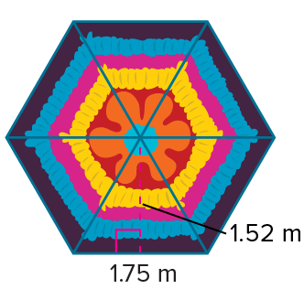
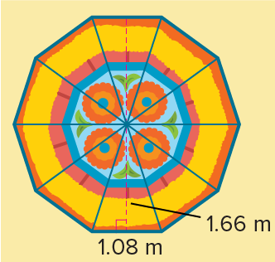
Be Curious
How are they the same?
How are they different?
Think first. Share a notice and a question;
build on a classmate’s idea.
Mindset
Why is confidence in yourself and your abilities helping you be successful in math?
27 / 47
Notes:
TEACH IN PRACTICE | Embedded facilitation | Lesson 5.4, slide 26 | CURIOUS
Focus on the existing task: Why is confidence in yourself and your abilities helping you be successful in math?
LAUNCH (T2/3/5): Allow quiet observation first. Separate a notice from an inference, invite students’ own questions, and follow the existing launch before teaching a procedure.
LOOK FOR (T4): Where this task addresses it, students can decompose or enclose the figure. Ask which feature of their work supports the claim.
RESPOND: If this task shows the lesson misconception—counting an overlapping region twice or retaining a cutout—outline a proposed partition on the original diagram and label each included region. Have the student revise and explain the change. Use this support only where the concept occurs in the current task; otherwise respond to the displayed question.
RECHECK: If a gap is shared, revisit the existing representation together. If it is limited, give targeted support while others compare valid methods on the same task. Check the revision before moving on.
PARTICIPATION (T5/6/7): Think time before volunteers; accept a written, drawn or rehearsed entry. Students ask for evidence respectfully. Recognize a specific contribution or revision and check that both partners participate.
Source: BCPS Updated Instructional Framework Rubric (June 2020), TEACH 1–7.

Slide 28
Warm-Up
Lesson 5-4 · Apply Area Concepts to Solve Problems
Session 2 Warm-Up
Try alone. Explain one. Then revise.
1
A composite figure is a shape made up of:
2
To find the area of a composite figure, you can:
A
Only circles
A
Multiply all side lengths
B
Two or more simpler geometric shapes
B
Decompose into rectangles and triangles, then add
C
Straight lines only
C
Only measure perimeter
D
3D blocks
D
Guess the center
3
An L-shaped room is split into 4 × 5 and 3 × 2 rectangles. Total area is:
4
When subtracting an unshaded hole from a shape:
A
14
A
Add the areas
B
26
B
Subtract the hole area from the total area
C
40
C
Multiply areas
D
60
D
Divide by 2
eduwonderlab.com · Neft Teacher
28 / 47
Notes:
TEACH IN PRACTICE | Embedded facilitation | Lesson 5.4, slide 27 | WARMUP
Focus on the existing task: Warm-Up Session 2 Warm-Up Check what you remember…
GATHER EVIDENCE (T4/6): Keep the original items. Students try independently, mark an uncertain item, and explain one method before checking. Use the existing key when present.
RESPOND: Distinguish a calculation slip from a reasoning gap. Give one next step on the same item; have students revise in a second color. Use the responses to choose flexible support for today’s lesson.
PARTICIPATION (T5/6/7): Think time before volunteers; accept a written, drawn or rehearsed entry. Students ask for evidence respectfully. Recognize a specific contribution or revision and check that both partners participate.
Source: BCPS Updated Instructional Framework Rubric (June 2020), TEACH 1–7. Earlier notes and answer keys are retained below.
EARLIER NOTES / EXISTING ANSWER KEY
Warm-up routine: students start silently on entry; keep it to about 4 minutes.
Circulate and note who is stuck — use what you see to choose who you check on first today.
Go over answers quickly; ask one student to explain a step, not just say the answer.
UIFR: TEACH 4 · TEACH 6.

Slide 29
STUDENT MOVES
Lesson 5-4
Your move
YOU KNOW THE ROUTINE · Read → plan → solve → check. Do all four, in that order.
29 / 47

Slide 30
Review Notes — Session 2
Lesson 5-4 · Apply Area Concepts to Solve Problems
Session 2: Review Notes
Copy. Explain. Check.
NAME THE MATH · Point to the part of this that is new today, and say what it changes.
Decomposition Strategy
1
Break complex irregular polygons into recognizable rectangles, triangles, and parallelograms.
Additive Area
2
Calculate the area of each individual region and sum them to obtain total figure area.
Subtractive Area
3
Find the area of the outer bounding figure and subtract any interior cutout spaces.
eduwonderlab.com · Neft Teacher
30 / 47
Notes:
TEACH IN PRACTICE | Embedded facilitation | Lesson 5.4, slide 28 | NOTES
Focus on the existing task: Review Notes — Session 2 Session 2: Review Notes Copy…
ROUTINE (T1/2/4): Read or copy the original notes, cover one line, and explain it using the displayed example. Reopen and correct. Copying alone is not evidence of understanding.
LOOK FOR: A link between a symbol, quantity or feature and the explanation. If missing, point back to that feature and have the student try again; fade the prompt once they can explain.
PARTICIPATION (T5/6/7): Think time before volunteers; accept a written, drawn or rehearsed entry. Students ask for evidence respectfully. Recognize a specific contribution or revision and check that both partners participate.
Source: BCPS Updated Instructional Framework Rubric (June 2020), TEACH 1–7. Earlier notes and answer keys are retained below.
EARLIER NOTES / EXISTING ANSWER KEY
Copy routine: read one line at a time; students copy, then explain that line to a partner.
Keep it brisk — the understanding work happens in the examples, not the copying.
UIFR: TEACH 1 · TEACH 6.

Slide 31
Session 2
Apply Area Concepts to Solve Problems
JUSTIFY IT · Say it like this: “I know ______ because ______.”
31 / 47
Notes:
TEACH IN PRACTICE | Embedded facilitation | Lesson 5.4, slide 29 | DIVIDER
Focus on the existing task: Apply Area Concepts to Solve Problems Session 2
TRANSITION (T6/7): Students confirm materials, roles, how to request help, and the next response routine. Ask a student to restate it. Keep teacher-only slides hidden.
PARTICIPATION (T5/6/7): Think time before volunteers; accept a written, drawn or rehearsed entry. Students ask for evidence respectfully. Recognize a specific contribution or revision and check that both partners participate.
Source: BCPS Updated Instructional Framework Rubric (June 2020), TEACH 1–7. Earlier notes and answer keys are retained below.
EARLIER NOTES / EXISTING ANSWER KEY
Transition cue: state what materials are out and what success looks like this session.
Keep the changeover under a minute.
UIFR: TEACH 6.

Slide 32
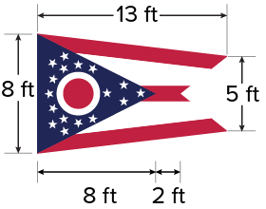
Flags
The Ohio Burgee, the official flag of Ohio, is a swallowtail flag. It is the only non-rectangular U.S. state flag. The dimensions of a flag are shown.
What is the area of the flag?
Think and record first. Which part of your work supports your answer?
32 / 47
Notes:
TEACH IN PRACTICE | Embedded facilitation | Lesson 5.4, slide 30 | TASK
Focus on the existing task: The Ohio Burgee, the official flag of Ohio, is a swallowtail flag. It is the only non-rectangular U.S. state flag. The dimensions of a flag are shown. What is the area of the flag?
LAUNCH (T2/3/5): Use the displayed question. Give private thinking time; then A explains while B asks for evidence. Switch roles. Each student records their own reasoning.
LOOK FOR (T4): Where this task addresses it, students can decompose or enclose the figure. Ask which feature of their work supports the claim.
RESPOND: If this task shows the lesson misconception—counting an overlapping region twice or retaining a cutout—outline a proposed partition on the original diagram and label each included region. Have the student revise and explain the change. Use this support only where the concept occurs in the current task; otherwise respond to the displayed question.
RECHECK: If a gap is shared, revisit the existing representation together. If it is limited, give targeted support while others compare valid methods on the same task. Check the revision before moving on.
PARTICIPATION (T5/6/7): Think time before volunteers; accept a written, drawn or rehearsed entry. Students ask for evidence respectfully. Recognize a specific contribution or revision and check that both partners participate.
Source: BCPS Updated Instructional Framework Rubric (June 2020), TEACH 1–7. Earlier notes and answer keys are retained below.
EARLIER NOTES / EXISTING ANSWER KEY
Read the context aloud (or have a student read it).
Before any math, students restate the situation and what is being asked in their own words.
Ask: What is the area of the flag?
UIFR: TEACH 1 · TEACH 3.

Slide 33
COLLABORATE · TALK IT THROUGH • AGREE ON A MODEL
Collaborate and Connect
The Ohio Burgee, the official flag of Ohio, is a swallowtail flag. It is the only non-rectangular U.S. state flag. The dimensions of a flag are shown. What is the area of the flag?
How can you use your prior knowledge of area to help you determine the area of the irregular shape?
Reveal:
We can compose or decompose the figure into known shapes and use those areas to determine the area of the flag.
33 / 47
Notes:
TEACH IN PRACTICE | Embedded facilitation | Lesson 5.4, slide 31 | COLLABORATE
Focus on the existing task: How can you use your prior knowledge of area to help you determine the area of the irregular shape?
LAUNCH (T2/3/5): Use the displayed question. Give private thinking time; then A explains while B asks for evidence. Switch roles. Each student records their own reasoning.
LOOK FOR (T4): Where this task addresses it, students can decompose or enclose the figure. Ask which feature of their work supports the claim.
RESPOND: If this task shows the lesson misconception—counting an overlapping region twice or retaining a cutout—outline a proposed partition on the original diagram and label each included region. Have the student revise and explain the change. Use this support only where the concept occurs in the current task; otherwise respond to the displayed question.
RECHECK: If a gap is shared, revisit the existing representation together. If it is limited, give targeted support while others compare valid methods on the same task. Check the revision before moving on.
PARTICIPATION (T5/6/7): Think time before volunteers; accept a written, drawn or rehearsed entry. Students ask for evidence respectfully. Recognize a specific contribution or revision and check that both partners participate.
Source: BCPS Updated Instructional Framework Rubric (June 2020), TEACH 1–7. Earlier notes and answer keys are retained below.
EARLIER NOTES / EXISTING ANSWER KEY
Routine: COLLABORATE · TALK IT THROUGH • AGREE ON A MODEL

Slide 34
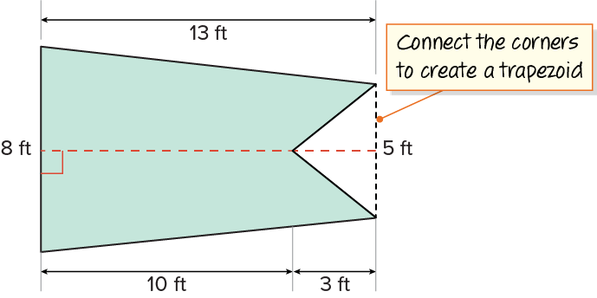
Flags
Let’s compose the shape into a trapezoid.
Think About It:
How were the dimensions 10 feet and 3 feet determined?
34 / 47
Notes:
TEACH IN PRACTICE | Embedded facilitation | Lesson 5.4, slide 32 | TASK
Focus on the existing task: Let’s compose the shape into a trapezoid. Think About It: How were the dimensions 10 feet and 3 feet determined?
LAUNCH (T2/3/5): Use the displayed question. Give private thinking time; then A explains while B asks for evidence. Switch roles. Each student records their own reasoning.
LOOK FOR (T4): Where this task addresses it, students can decompose or enclose the figure. Ask which feature of their work supports the claim.
RESPOND: If this task shows the lesson misconception—counting an overlapping region twice or retaining a cutout—outline a proposed partition on the original diagram and label each included region. Have the student revise and explain the change. Use this support only where the concept occurs in the current task; otherwise respond to the displayed question.
RECHECK: If a gap is shared, revisit the existing representation together. If it is limited, give targeted support while others compare valid methods on the same task. Check the revision before moving on.
PARTICIPATION (T5/6/7): Think time before volunteers; accept a written, drawn or rehearsed entry. Students ask for evidence respectfully. Recognize a specific contribution or revision and check that both partners participate.
Source: BCPS Updated Instructional Framework Rubric (June 2020), TEACH 1–7. Earlier notes and answer keys are retained below.
EARLIER NOTES / EXISTING ANSWER KEY
Ask the question, then hold the silence — students think or jot before anyone answers.
Take two or three responses and press with “Why?” or “How do you know?” before moving on.
UIFR: TEACH 3.

Slide 35
STUDENT MOVES
Lesson 5-4
Your moves
TAKE TURNS · One explains, one asks a question. Then switch, so both of you talk.
USE YOUR TOOLS · Reach for your notes, a model, or a manipulative before you reach for an answer.
35 / 47

Slide 36
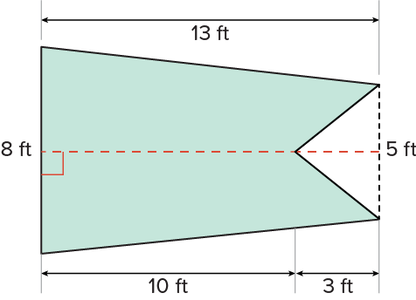
Flags
What do you notice about the trapezoid?
Record your reasoning before the reveal.
Compare, then explain any revision.
Reveal:
It is a trapezoid with a triangle cut-out.
36 / 47
Notes:
TEACH IN PRACTICE | Embedded facilitation | Lesson 5.4, slide 33 | REVEAL
Focus on the existing task: What do you notice about the trapezoid?
LAUNCH (T2/3/5): If an existing answer cover is present, gather an attempt before revealing. If the explanation is already visible, ask students to reconstruct and justify it. Compare reasoning and explain a revision; preserve the reveal sequence.
LOOK FOR (T4): Where this task addresses it, students can decompose or enclose the figure. Ask which feature of their work supports the claim.
RESPOND: If this task shows the lesson misconception—counting an overlapping region twice or retaining a cutout—outline a proposed partition on the original diagram and label each included region. Have the student revise and explain the change. Use this support only where the concept occurs in the current task; otherwise respond to the displayed question.
RECHECK: If a gap is shared, revisit the existing representation together. If it is limited, give targeted support while others compare valid methods on the same task. Check the revision before moving on.
PARTICIPATION (T5/6/7): Think time before volunteers; accept a written, drawn or rehearsed entry. Students ask for evidence respectfully. Recognize a specific contribution or revision and check that both partners participate.
Source: BCPS Updated Instructional Framework Rubric (June 2020), TEACH 1–7. Earlier notes and answer keys are retained below.
EARLIER NOTES / EXISTING ANSWER KEY
Do not click yet: collect 2–3 student answers with reasons first.
Then click to remove the cover and have students compare their thinking to the reveal — “Is this what we said? Where is it different?”
Behind the cover: It is a trapezoid with a triangle cut-out .
UIFR: TEACH 3 · TEACH 4.

Slide 37
Flags
The flag is a trapezoid with a triangular cut-out.
How can you use the trapezoid and triangle to find the area of the flag?
TRY IT BEFORE YOU’RE SURE · Start even if you are not sure. A revised answer counts as much as a first-try answer.
Reveal:
We can find the area of each shape and subtract the area of the triangular cut-out from the area of the trapezoid.
37 / 47
Notes:
TEACH IN PRACTICE | Embedded facilitation | Lesson 5.4, slide 34 | REVEAL
Focus on the existing task: The flag is a trapezoid with a triangular cut-out. How can you use the trapezoid and triangle to find the area of the flag?
LAUNCH (T2/3/5): If an existing answer cover is present, gather an attempt before revealing. If the explanation is already visible, ask students to reconstruct and justify it. Compare reasoning and explain a revision; preserve the reveal sequence.
LOOK FOR (T4): Where this task addresses it, students can add or subtract areas. Ask which feature of their work supports the claim.
RESPOND: If this task shows the lesson misconception—counting an overlapping region twice or retaining a cutout—outline a proposed partition on the original diagram and label each included region. Have the student revise and explain the change. Use this support only where the concept occurs in the current task; otherwise respond to the displayed question.
RECHECK: If a gap is shared, revisit the existing representation together. If it is limited, give targeted support while others compare valid methods on the same task. Check the revision before moving on.
PARTICIPATION (T5/6/7): Think time before volunteers; accept a written, drawn or rehearsed entry. Students ask for evidence respectfully. Recognize a specific contribution or revision and check that both partners participate.
Source: BCPS Updated Instructional Framework Rubric (June 2020), TEACH 1–7. Earlier notes and answer keys are retained below.
EARLIER NOTES / EXISTING ANSWER KEY
Do not click yet: collect 2–3 student answers with reasons first.
Then click to remove the cover and have students compare their thinking to the reveal — “Is this what we said? Where is it different?”
Behind the cover: We can find the area of each shape and subtract the area of the triangular cut-out from the area of the trapezoid.
UIFR: TEACH 3 · TEACH 4.

Slide 38
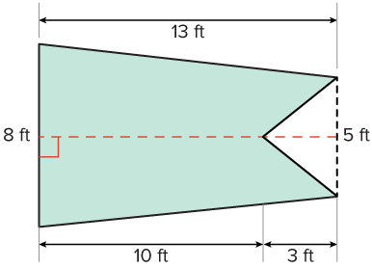
Flags
Think and record first. Which part of your work supports your answer?
Persevering
How would you check your answer?
38 / 47
Notes:
TEACH IN PRACTICE | Embedded facilitation | Lesson 5.4, slide 35 | TASK
Focus on the existing task: How would you check your answer?
LAUNCH (T2/3/5): Use the displayed question. Give private thinking time; then A explains while B asks for evidence. Switch roles. Each student records their own reasoning.
LOOK FOR (T4): Where this task addresses it, students can decompose or enclose the figure. Ask which feature of their work supports the claim.
RESPOND: If this task shows the lesson misconception—counting an overlapping region twice or retaining a cutout—outline a proposed partition on the original diagram and label each included region. Have the student revise and explain the change. Use this support only where the concept occurs in the current task; otherwise respond to the displayed question.
RECHECK: If a gap is shared, revisit the existing representation together. If it is limited, give targeted support while others compare valid methods on the same task. Check the revision before moving on.
PARTICIPATION (T5/6/7): Think time before volunteers; accept a written, drawn or rehearsed entry. Students ask for evidence respectfully. Recognize a specific contribution or revision and check that both partners participate.
Source: BCPS Updated Instructional Framework Rubric (June 2020), TEACH 1–7. Earlier notes and answer keys are retained below.
EARLIER NOTES / EXISTING ANSWER KEY
Model briefly, then hand the thinking back: ask “Why does this step work?” before showing the next one.
Quick check before moving on — thumbs or whiteboards from everyone, not volunteers.
UIFR: TEACH 2 · TEACH 3 · TEACH 4.

Slide 39
Flags
The Ohio Burgee, the official flag of Ohio, is a swallowtail flag. It is the only non-rectangular U.S. state flag. The dimensions of a flag are shown.
What is the area of the flag?
The area of the flag is 77 square feet.
Think and record first. Which part of your work supports your answer?
39 / 47
Notes:
TEACH IN PRACTICE | Embedded facilitation | Lesson 5.4, slide 36 | TASK
Focus on the existing task: The Ohio Burgee, the official flag of Ohio, is a swallowtail flag. It is the only non-rectangular U.S. state flag. The dimensions of a flag are shown. What is the area of the flag?
LAUNCH (T2/3/5): Use the displayed question. Give private thinking time; then A explains while B asks for evidence. Switch roles. Each student records their own reasoning.
LOOK FOR (T4): Where this task addresses it, students can decompose or enclose the figure. Ask which feature of their work supports the claim.
RESPOND: If this task shows the lesson misconception—counting an overlapping region twice or retaining a cutout—outline a proposed partition on the original diagram and label each included region. Have the student revise and explain the change. Use this support only where the concept occurs in the current task; otherwise respond to the displayed question.
RECHECK: If a gap is shared, revisit the existing representation together. If it is limited, give targeted support while others compare valid methods on the same task. Check the revision before moving on.
PARTICIPATION (T5/6/7): Think time before volunteers; accept a written, drawn or rehearsed entry. Students ask for evidence respectfully. Recognize a specific contribution or revision and check that both partners participate.
Source: BCPS Updated Instructional Framework Rubric (June 2020), TEACH 1–7. Earlier notes and answer keys are retained below.
EARLIER NOTES / EXISTING ANSWER KEY
Read the context aloud (or have a student read it).
Before any math, students restate the situation and what is being asked in their own words.
Ask: What is the area of the flag?
UIFR: TEACH 1 · TEACH 3.

Slide 40
Let’s Explore More
What is another way you could determine the area of the flag?
What method do you prefer for finding the area of the flag? Explain.
Try it yourself. Compare your work with a partner; explain one choice and revise.
40 / 47
Notes:
TEACH IN PRACTICE | Embedded facilitation | Lesson 5.4, slide 37 | PRACTICE
Focus on the existing task: What is another way you could determine the area of the flag?
LAUNCH (T2/3/5): Use the displayed question. Give private thinking time; then A explains while B asks for evidence. Switch roles. Each student records their own reasoning.
LOOK FOR (T4): Where this task addresses it, students can decompose or enclose the figure. Ask which feature of their work supports the claim.
RESPOND: If this task shows the lesson misconception—counting an overlapping region twice or retaining a cutout—outline a proposed partition on the original diagram and label each included region. Have the student revise and explain the change. Use this support only where the concept occurs in the current task; otherwise respond to the displayed question.
RECHECK: If a gap is shared, revisit the existing representation together. If it is limited, give targeted support while others compare valid methods on the same task. Check the revision before moving on.
PARTICIPATION (T5/6/7): Think time before volunteers; accept a written, drawn or rehearsed entry. Students ask for evidence respectfully. Recognize a specific contribution or revision and check that both partners participate.
Source: BCPS Updated Instructional Framework Rubric (June 2020), TEACH 1–7. Earlier notes and answer keys are retained below.
EARLIER NOTES / EXISTING ANSWER KEY
Extension for partners or table groups — students choose their approach and use the workspace to show thinking.
Push with “Convince me,” and have two groups with different approaches share.
This is where students stretch past the worked example.
UIFR: TEACH 2 · TEACH 5.

Slide 41
LESSON 5.4 / CHECK YOUR WORK
Pause. Check. Improve.
CHECK
A mistake to watch for: counting an overlapping region twice or retaining a cutout.
TRY
Outline a proposed partition on the given diagram and label each included region.
REVISE
Use that check on the task you just completed. Correct or strengthen one part, and explain why.
SELF-CHECK · Mark it: ✓ got it · ~ almost · ? stuck. Then fix one thing before we move on.
Listen to understand. Ask for evidence. Make room for every voice.
Notes:
TEACH IN PRACTICE | Embedded facilitation | Lesson 5.4, slide 38 | PRIOR_INSERT
Focus on the existing task: LESSON 5.4 / CHECK YOUR WORK Pause. Check. Improve. Listen to understand. Ask for evidence. Make room for every voice. CHECK A mistake…
CONNECT (T1/4): Ask students to restate the displayed goal or key idea and connect it to earlier work. Relevant lesson evidence: decompose or enclose the figure; account for every region once; add or subtract areas. Use only the criterion that matches the current session.
SHOW PROGRESS: Students point to their own existing work, explain what improved after feedback, and name a next step. Pair confidence ratings with actual evidence.
PARTICIPATION (T5/6/7): Think time before volunteers; accept a written, drawn or rehearsed entry. Students ask for evidence respectfully. Recognize a specific contribution or revision and check that both partners participate.
Source: BCPS Updated Instructional Framework Rubric (June 2020), TEACH 1–7.

Slide 42
Flags
What do you notice about the trapezoid?
Compare your reasoning with the
explanation. Explain any revision you make.
Reveal:
It is a trapezoid with a triangle cut-out.
42 / 47
Notes:
TEACH IN PRACTICE | Embedded facilitation | Lesson 5.4, slide 39 | REVEAL
Focus on the existing task: What do you notice about the trapezoid?
LAUNCH (T2/3/5): If an existing answer cover is present, gather an attempt before revealing. If the explanation is already visible, ask students to reconstruct and justify it. Compare reasoning and explain a revision; preserve the reveal sequence.
LOOK FOR (T4): Where this task addresses it, students can decompose or enclose the figure. Ask which feature of their work supports the claim.
RESPOND: If this task shows the lesson misconception—counting an overlapping region twice or retaining a cutout—outline a proposed partition on the original diagram and label each included region. Have the student revise and explain the change. Use this support only where the concept occurs in the current task; otherwise respond to the displayed question.
RECHECK: If a gap is shared, revisit the existing representation together. If it is limited, give targeted support while others compare valid methods on the same task. Check the revision before moving on.
PARTICIPATION (T5/6/7): Think time before volunteers; accept a written, drawn or rehearsed entry. Students ask for evidence respectfully. Recognize a specific contribution or revision and check that both partners participate.
Source: BCPS Updated Instructional Framework Rubric (June 2020), TEACH 1–7.

Slide 43
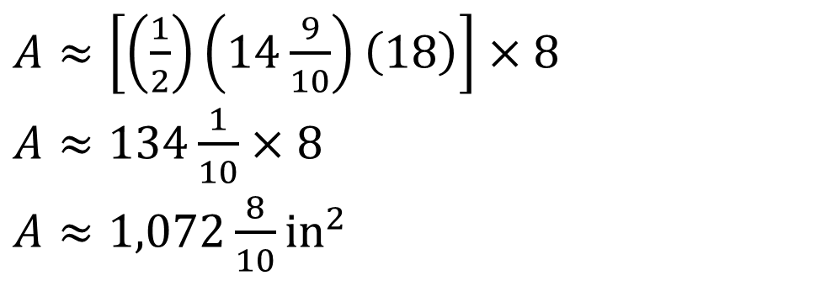
SUMMARIZE · SAY IT IN YOUR OWN WORDS
Summarize: Area of Polygons
The area of polygons can be found by decomposing them into triangles or quadrilaterals, or by composing them into rectangles.
REVISE NOW · Change one answer and write why you changed it. A revision is evidence of learning.
43 / 47
Notes:
TEACH IN PRACTICE | Embedded facilitation | Lesson 5.4, slide 40 | SUMMARIZE
Focus on the existing task: Summarize: Area of Polygons The area of polygons can be found by decomposing them into triangles or quadrilaterals, or by composing…
CONNECT (T1/4): Ask students to restate the displayed goal or key idea and connect it to earlier work. Relevant lesson evidence: decompose or enclose the figure; account for every region once; add or subtract areas. Use only the criterion that matches the current session.
SHOW PROGRESS: Students point to their own existing work, explain what improved after feedback, and name a next step. Pair confidence ratings with actual evidence.
PARTICIPATION (T5/6/7): Think time before volunteers; accept a written, drawn or rehearsed entry. Students ask for evidence respectfully. Recognize a specific contribution or revision and check that both partners participate.
Source: BCPS Updated Instructional Framework Rubric (June 2020), TEACH 1–7. Earlier notes and answer keys are retained below.
EARLIER NOTES / EXISTING ANSWER KEY
Routine: SUMMARIZE · SAY IT IN YOUR OWN WORDS

Slide 44
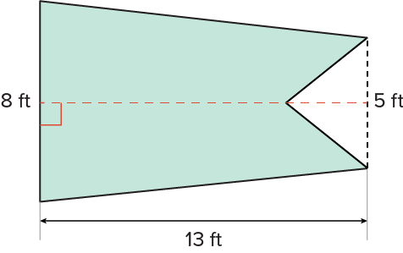
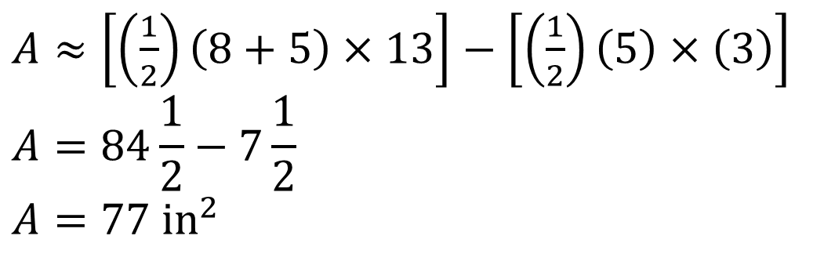
SUMMARIZE · SAY IT IN YOUR OWN WORDS
Summarize: Area of Polygons
The area of polygons can be found by decomposing them into triangles or quadrilaterals, or by composing them into rectangles.
Explain the key idea without reading. Use
today’s example as evidence.
44 / 47
Notes:
TEACH IN PRACTICE | Embedded facilitation | Lesson 5.4, slide 41 | SUMMARIZE
Focus on the existing task: Summarize: Area of Polygons The area of polygons can be found by decomposing them into triangles or quadrilaterals, or by composing them…
CONNECT (T1/4): Ask students to restate the displayed goal or key idea and connect it to earlier work. Relevant lesson evidence: decompose or enclose the figure; account for every region once; add or subtract areas. Use only the criterion that matches the current session.
SHOW PROGRESS: Students point to their own existing work, explain what improved after feedback, and name a next step. Pair confidence ratings with actual evidence.
PARTICIPATION (T5/6/7): Think time before volunteers; accept a written, drawn or rehearsed entry. Students ask for evidence respectfully. Recognize a specific contribution or revision and check that both partners participate.
Source: BCPS Updated Instructional Framework Rubric (June 2020), TEACH 1–7. Earlier notes and answer keys are retained below.
EARLIER NOTES / EXISTING ANSWER KEY
Routine: SUMMARIZE · SAY IT IN YOUR OWN WORDS

Slide 45
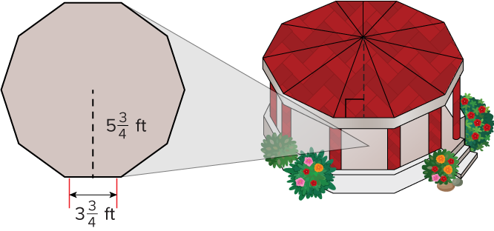
APPLY · PLAN IT • SOLVE IT • PROVE IT
Apply: Flooring
A garden designer wants to cover a gazebo floor with tiles. The gazebo is shaped like a decagon with equal sides.
Question: If floor tiles cost $2.89 per square foot, what budget do you recommend the designer have for the tiles?
Choose a method. Solve
independently, justify your
answer, then check the goal.
45 / 47
Notes:
TEACH IN PRACTICE | Embedded facilitation | Lesson 5.4, slide 42 | APPLY
Focus on the existing task: A garden designer wants to cover a gazebo floor with tiles. The gazebo is shaped like a decagon with equal sides. Question: If floor…
LAUNCH (T2/3/5): Use the exact application task independently first. Ask students to justify their choice of method. Collect evidence before a partner discussion or correction.
LOOK FOR (T4): Where this task addresses it, students can decompose or enclose the figure. Ask which feature of their work supports the claim.
RESPOND: If this task shows the lesson misconception—counting an overlapping region twice or retaining a cutout—outline a proposed partition on the original diagram and label each included region. Have the student revise and explain the change. Use this support only where the concept occurs in the current task; otherwise respond to the displayed question.
RECHECK: If a gap is shared, revisit the existing representation together. If it is limited, give targeted support while others compare valid methods on the same task. Check the revision before moving on.
PARTICIPATION (T5/6/7): Think time before volunteers; accept a written, drawn or rehearsed entry. Students ask for evidence respectfully. Recognize a specific contribution or revision and check that both partners participate.
Source: BCPS Updated Instructional Framework Rubric (June 2020), TEACH 1–7. Earlier notes and answer keys are retained below.
EARLIER NOTES / EXISTING ANSWER KEY
Routine: APPLY · PLAN IT • SOLVE IT • PROVE IT
UIFR FULL | Lesson-specific facilitation
TEACH 4 | Independent evidence and revision (UIFR PDF p. 11).
Use the existing application/exit problem as the independent check. If this is a learning-target slide, have students point to and explain their work on the preceding task. Separate initial independent evidence from the revision after feedback.
Check the relevant criteria: decompose or enclose the figure; account for every region once; add or subtract areas. Respond with one specific next step tied to the work. Students revise and annotate what changed, then identify a criterion they can now demonstrate and one they still need to practice.

Slide 46
Learning Targets
I can find the area of a regular polygon by decomposing the figure into triangles.
I can make use of structure to find the area of a composite figure by decomposing the figure into other shapes.
SAY THE GOAL · Say today’s goal in your own words, then name one place this shows up outside math class.
46 / 47
Notes:
TEACH IN PRACTICE | Embedded facilitation | Lesson 5.4, slide 43 | REFLECTION
Focus on the existing task: Learning Targets I can find the area of a regular polygon by decomposing the figure into triangles. I can make use of structure to find…
CONNECT (T1/4): Ask students to restate the displayed goal or key idea and connect it to earlier work. Relevant lesson evidence: decompose or enclose the figure; account for every region once; add or subtract areas. Use only the criterion that matches the current session.
SHOW PROGRESS: Students point to their own existing work, explain what improved after feedback, and name a next step. Pair confidence ratings with actual evidence.
PARTICIPATION (T5/6/7): Think time before volunteers; accept a written, drawn or rehearsed entry. Students ask for evidence respectfully. Recognize a specific contribution or revision and check that both partners participate.
Source: BCPS Updated Instructional Framework Rubric (June 2020), TEACH 1–7. Earlier notes and answer keys are retained below.
EARLIER NOTES / EXISTING ANSWER KEY
UIFR FULL | Lesson-specific facilitation
REFLECT & ADJUST 1-2 | After the lesson (UIFR PDF pp. 15-16).
Sort the existing work by demonstrated reasoning, partial understanding, and the specific misconception: counting an overlapping region twice or retaining a cutout. Compare the initial response with the revision. Record which teaching move plausibly helped, which did not, and whose participation or access needs a different approach; do not record sensitive student details in this shared deck.
Plan the next lesson from that evidence: if the misconception persists, outline a proposed partition on the original diagram and label each included region using the current example before returning to the next grade-level task; if understanding is secure, use an existing extension or ask for a general explanation. Check the targeted idea again at the next warm-up.
Ask students what supported their thinking and what would help next time. Identify one change to try and one successful practice to retain. Seek colleague feedback on anonymized work when useful; these prompts support reflection and do not establish an evaluation rating. Source: Baltimore City Public Schools, Updated Instructional Framework Rubric, June 2020 (UIFR_Full.pdf).

Slide 47
LESSON 5.4 / REFLECT ON YOUR LEARNING
Show your progress
1 SHOW EVIDENCE
2 CHOOSE A NEXT STEP
Choose one response. Point to the part that shows your reasoning.
Name a change you made after feedback—or a question you still have.
“My work shows ___ because ___.”
“Next time, I will ___ to help me ___.”
Today’s focus: Decompose or enclose the figure.
CREDIT A CLASSMATE · Name one classmate whose idea helped you today, and say what they said.
Listen to understand. Ask for evidence. Make room for every voice.
Notes:
TEACH IN PRACTICE | Embedded facilitation | Lesson 5.4, slide 44 | PRIOR_INSERT
Focus on the existing task: LESSON 5.4 / REFLECT ON YOUR LEARNING Show your progress Listen to understand. Ask for evidence. Make room for every voice. 1 SHOW…
CONNECT (T1/4): Ask students to restate the displayed goal or key idea and connect it to earlier work. Relevant lesson evidence: decompose or enclose the figure; account for every region once; add or subtract areas. Use only the criterion that matches the current session.
SHOW PROGRESS: Students point to their own existing work, explain what improved after feedback, and name a next step. Pair confidence ratings with actual evidence.
PARTICIPATION (T5/6/7): Think time before volunteers; accept a written, drawn or rehearsed entry. Students ask for evidence respectfully. Recognize a specific contribution or revision and check that both partners participate.
Source: BCPS Updated Instructional Framework Rubric (June 2020), TEACH 1–7.

