Slide 1
WARM-UP · THINK • TRY • CHECK
Turn and talk: compare strategies, then defend one.
Warm-Up
Lesson 5-5 · Determine the Volume of Rectangular Prisms | Warm-Up · about 4 minutes
Try each on your own. Mark an unsure answer; explain and revise when we check.
QUESTION 1
QUESTION 2
4 × 3 × 2 = ______
1/2 × 1/3 = ______
QUESTION 3
QUESTION 4
A rectangular base is 5 cm by 6 cm. Its area = ______
A 4 by 3 by 2 prism has a volume of 24 ______
TALK IT OVER: “I got ______ because ______.” • Compare with a partner before we check as a class.
1 / 51
Notes:
TEACH IN PRACTICE | Embedded facilitation | Lesson 5.5, slide 1 | WARMUP
Focus on the existing task: Warm-Up WARM-UP · THINK • TRY • CHECK Do these…
GATHER EVIDENCE (T4/6): Keep the original items. Students try independently, mark an uncertain item, and explain one method before checking. Use the existing key when present.
RESPOND: Distinguish a calculation slip from a reasoning gap. Give one next step on the same item; have students revise in a second color. Use the responses to choose flexible support for today’s lesson.
PARTICIPATION (T5/6/7): Think time before volunteers; accept a written, drawn or rehearsed entry. Students ask for evidence respectfully. Recognize a specific contribution or revision and check that both partners participate.
Source: BCPS Updated Instructional Framework Rubric (June 2020), TEACH 1–7. Earlier notes and answer keys are retained below.
EARLIER NOTES / EXISTING ANSWER KEY
Warm-Up answers (teacher only): 1) 24 2) 1/6 3) 30 square centimeters 4) cubic units
UIFR FULL | Lesson-specific facilitation
PREPARE 1-2 | Before teaching (UIFR PDF pp. 6-7).
Plan to gather evidence that students can connect unit-cube layers to volume; use fractional edges when present; recover a missing dimension. Review recent work and today’s warm-up to choose flexible groups and access supports; do not infer needs from identity or perceived ability. Use the existing lesson tasks and stated standards.
Anticipate: confusing square and cubic units or assuming fractional edges cannot have volume. If observed, label edge units and one layer of the original prism before connecting it to the formula. Offer oral rehearsal, drawing, pointing, or home-language processing as needed; retain the original mathematical demand. Ask students which support helps and fade it as evidence improves.
TEACH 6-7 | Before the first transition, agree on materials, partner roles, and how to request help. Invite students to restate the routine. Normalize revising an idea, recognize a specific contribution, and check privately when frustration blocks participation. Source: UIFR PDF pp. 13-14.

Slide 2
Today’s Math Notes
Lesson 5-5 · Determine the Volume of Rectangular Prisms
Section 1: Math Words
Copy. Explain. Check.
SAY THE GOAL · Say today’s goal in your own words, then name one place this shows up outside math class.
Volume with Whole-Number Edges
1
The number of unit cubes inside a rectangular prism
Volume
2
How much space is inside a solid shape
Rectangular prism
3
A solid box shape with six flat rectangle sides
eduwonderlab.com · Neft Teacher
2 / 51
Notes:
TEACH IN PRACTICE | Embedded facilitation | Lesson 5.5, slide 2 | NOTES
Focus on the existing task: Today’s Math Notes Section 1: Math Words Copy…
ROUTINE (T1/2/4): Read or copy the original notes, cover one line, and explain it using the displayed example. Reopen and correct. Copying alone is not evidence of understanding.
LOOK FOR: A link between a symbol, quantity or feature and the explanation. If missing, point back to that feature and have the student try again; fade the prompt once they can explain.
PARTICIPATION (T5/6/7): Think time before volunteers; accept a written, drawn or rehearsed entry. Students ask for evidence respectfully. Recognize a specific contribution or revision and check that both partners participate.
Source: BCPS Updated Instructional Framework Rubric (June 2020), TEACH 1–7. Earlier notes and answer keys are retained below.
EARLIER NOTES / EXISTING ANSWER KEY
Copy routine: read one line at a time; students copy, then explain that line to a partner.
Keep it brisk — the understanding work happens in the examples, not the copying.
UIFR: TEACH 1 · TEACH 6.

Slide 3
Today’s Math Notes
Lesson 5-5 · Determine the Volume of Rectangular Prisms
Section 2: Today’s Math
Copy. Explain. Check.
Volume of Rectangular Prisms (Whole Numbers)
V = Length × Width × Height = Base Area × Height (V = l · w · h = B · h)
Read, cover, explain. Reopen your notes to
check and improve your explanation.
1
Identify the length, width, and height of the box
2
Multiply base area (l × w) by height (h)
3
Label answer in cubic units (e.g. in³, cm³, ft³)
eduwonderlab.com · Neft Teacher
3 / 51
Notes:
TEACH IN PRACTICE | Embedded facilitation | Lesson 5.5, slide 3 | NOTES
Focus on the existing task: Today’s Math Notes Section 2: Today’s Math Copy…
ROUTINE (T1/2/4): Read or copy the original notes, cover one line, and explain it using the displayed example. Reopen and correct. Copying alone is not evidence of understanding.
LOOK FOR: A link between a symbol, quantity or feature and the explanation. If missing, point back to that feature and have the student try again; fade the prompt once they can explain.
PARTICIPATION (T5/6/7): Think time before volunteers; accept a written, drawn or rehearsed entry. Students ask for evidence respectfully. Recognize a specific contribution or revision and check that both partners participate.
Source: BCPS Updated Instructional Framework Rubric (June 2020), TEACH 1–7. Earlier notes and answer keys are retained below.
EARLIER NOTES / EXISTING ANSWER KEY
Copy routine: read one line at a time; students copy, then explain that line to a partner.
Keep it brisk — the understanding work happens in the examples, not the copying.
UIFR: TEACH 1 · TEACH 6.

Slide 4
Session 1
Determine the Volume of a Rectangular Prism​
PICK YOUR STRATEGY · Choose your path — picture, table, number line, or equation — and be ready to say why you chose it.
4 / 51
Notes:
TEACH IN PRACTICE | Embedded facilitation | Lesson 5.5, slide 4 | DIVIDER
Focus on the existing task: Determine the Volume of a Rectangular Prism Session 1
TRANSITION (T6/7): Students confirm materials, roles, how to request help, and the next response routine. Ask a student to restate it. Keep teacher-only slides hidden.
PARTICIPATION (T5/6/7): Think time before volunteers; accept a written, drawn or rehearsed entry. Students ask for evidence respectfully. Recognize a specific contribution or revision and check that both partners participate.
Source: BCPS Updated Instructional Framework Rubric (June 2020), TEACH 1–7. Earlier notes and answer keys are retained below.
EARLIER NOTES / EXISTING ANSWER KEY
Transition cue: state what materials are out and what success looks like this session.
Keep the changeover under a minute.
UIFR: TEACH 6.

Slide 5
This or That
Would you rather have THIS or THAT points?
Points
THIS | THAT
Think and record first. Which part of your work supports your answer?
5 / 51
Notes:
TEACH IN PRACTICE | Embedded facilitation | Lesson 5.5, slide 5 | TASK
Focus on the existing task: This or That Would you rather have THIS or THAT points?
LAUNCH (T2/3/5): Use the displayed question. Give private thinking time; then A explains while B asks for evidence. Switch roles. Each student records their own reasoning.
LOOK FOR (T4): Where this task addresses it, students can connect unit-cube layers to volume. Ask which feature of their work supports the claim.
RESPOND: If this task shows the lesson misconception—confusing square and cubic units or assuming fractional edges cannot have volume—label edge units and one layer of the original prism before connecting it to the formula. Have the student revise and explain the change. Use this support only where the concept occurs in the current task; otherwise respond to the displayed question.
RECHECK: If a gap is shared, revisit the existing representation together. If it is limited, give targeted support while others compare valid methods on the same task. Check the revision before moving on.
PARTICIPATION (T5/6/7): Think time before volunteers; accept a written, drawn or rehearsed entry. Students ask for evidence respectfully. Recognize a specific contribution or revision and check that both partners participate.
Source: BCPS Updated Instructional Framework Rubric (June 2020), TEACH 1–7. Earlier notes and answer keys are retained below.
EARLIER NOTES / EXISTING ANSWER KEY
Number-sense routine — every voice in. Give quiet think time, then hear from at least three students.
Always follow with “How do you know?” — the reasoning is the point, not the answer.
There is more than one path; name and celebrate different strategies.
UIFR: TEACH 3 · TEACH 5 · TEACH 6.

Slide 6
Today’s Objectives
Lesson 5-5 · Determine the Volume of Rectangular Prisms
Determine the Volume of Rectangular Prisms
Maryland Standard 6.GR.2
CONNECT IT · What earlier lesson does this build on? Tell a partner in one sentence.
CONTENT OBJECTIVE
LANGUAGE OBJECTIVE
Restate the goal in your words
Use these words to explain why
I can find the volume of a rectangular prism with whole-number edges using length × width × height.
I can explain my work using the words volume, rectangular prism, cubic units, and edge.
eduwonderlab.com · Neft Teacher
6 / 51
Notes:
TEACH IN PRACTICE | Embedded facilitation | Lesson 5.5, slide 6 | GOAL
Focus on the existing task: Today’s Objectives Determine the Volume of…
CONNECT (T1/4): Ask students to restate the displayed goal or key idea and connect it to earlier work. Relevant lesson evidence: connect unit-cube layers to volume; use fractional edges when present; recover a missing dimension. Use only the criterion that matches the current session.
SHOW PROGRESS: Students point to their own existing work, explain what improved after feedback, and name a next step. Pair confidence ratings with actual evidence.
PARTICIPATION (T5/6/7): Think time before volunteers; accept a written, drawn or rehearsed entry. Students ask for evidence respectfully. Recognize a specific contribution or revision and check that both partners participate.
Source: BCPS Updated Instructional Framework Rubric (June 2020), TEACH 1–7. Earlier notes and answer keys are retained below.
EARLIER NOTES / EXISTING ANSWER KEY
Read the objective together, then have one or two students restate today’s goal in their own words.
Connect it to what the class learned last lesson.
Return to this goal at the end of class to check it was met.
UIFR: TEACH 1.
UIFR FULL | Lesson-specific facilitation
TEACH 1 | Session 1 purpose and evidence (UIFR PDF p. 8).
Have students restate the displayed session goal in their own words and connect it to the existing context or a familiar experience they choose to share. Use the current session goal to select from these lesson-wide evidence criteria; do not frontload a later-session procedure.
Look for: connect unit-cube layers to volume; use fractional edges when present; recover a missing dimension. Ask: “Which part of your work would show this?” Revisit that evidence after the task; a confidence rating alone is not evidence of understanding.

Slide 7
LESSON 5.5 / OUR LEARNING
What will show your learning?
1
Connect unit-cube layers to volume.
2
Use fractional edges when present.
3
Recover a missing dimension.
Tell a partner: Which skill connects to something you already know?
SHOW YOUR THINKING · Show what you know — write it, draw it, or build it. A picture counts as an explanation.
Listen to understand. Ask for evidence. Make room for every voice.
Notes:
TEACH IN PRACTICE | Embedded facilitation | Lesson 5.5, slide 7 | PRIOR_INSERT
Focus on the existing task: LESSON 5.5 / OUR LEARNING What will show your learning?
CONNECT (T1/4): Ask students to restate the displayed goal or key idea and connect it to earlier work. Relevant lesson evidence: connect unit-cube layers to volume; use fractional edges when present; recover a missing dimension. Use only the criterion that matches the current session.
SHOW PROGRESS: Students point to their own existing work, explain what improved after feedback, and name a next step. Pair confidence ratings with actual evidence.
PARTICIPATION (T5/6/7): Think time before volunteers; accept a written, drawn or rehearsed entry. Students ask for evidence respectfully. Recognize a specific contribution or revision and check that both partners participate.
Source: BCPS Updated Instructional Framework Rubric (June 2020), TEACH 1–7.

Slide 8
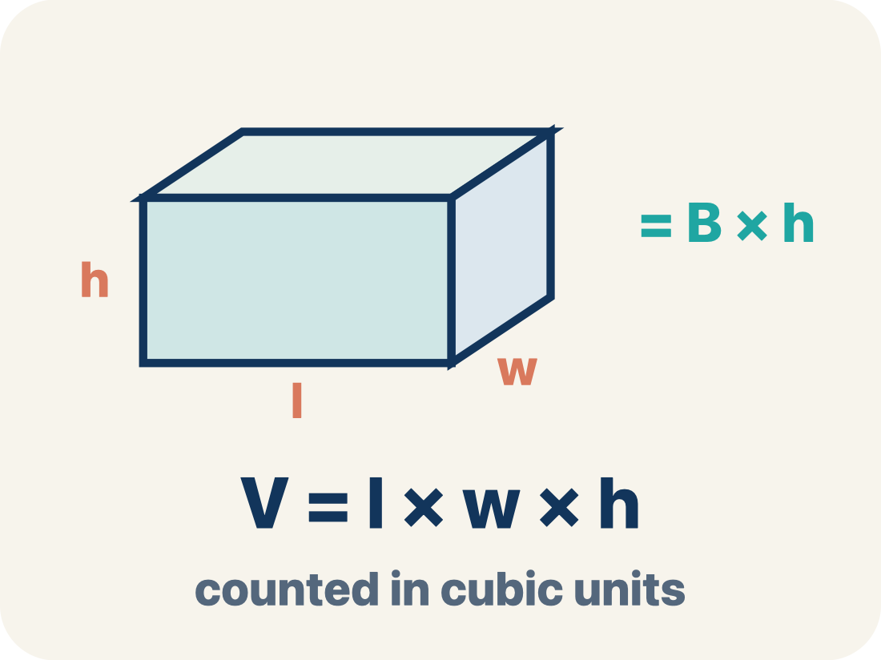
Vocabulary 1 of 7
Lesson 5-5 · Determine the Volume of Rectangular Prisms
Volume with Whole-Number Edges
The number of unit cubes inside a rectangular prism. Formula: V = l × w × h.
EXAMPLE · EXPLAIN WHY IT FITS
V = l × w × h; 3 × 4 × 5 = 60 cubic units.
USE THE MATH WORDS · Use today’s math words in your explanation — not “it” and “that thing.”
eduwonderlab.com · Neft Teacher
8 / 51
Notes:
TEACH IN PRACTICE | Embedded facilitation | Lesson 5.5, slide 8 | VOCAB
Focus on the existing task: Vocabulary 1 of 7 Volume with Whole-Number…
ASK (T1/3/5): Where does “Volume with Whole-Number Edges” appear in the example? Explain the meaning without reading the definition. Partner: restate the idea and ask a clarifying question.
LOOK FOR: A correct connection between the word and a feature of the example. If the student only repeats the definition, invite pointing, sketching or oral rehearsal, then ask for another explanation of this same example.
PARTICIPATION (T5/6/7): Think time before volunteers; accept a written, drawn or rehearsed entry. Students ask for evidence respectfully. Recognize a specific contribution or revision and check that both partners participate.
Source: BCPS Updated Instructional Framework Rubric (June 2020), TEACH 1–7.

Slide 9
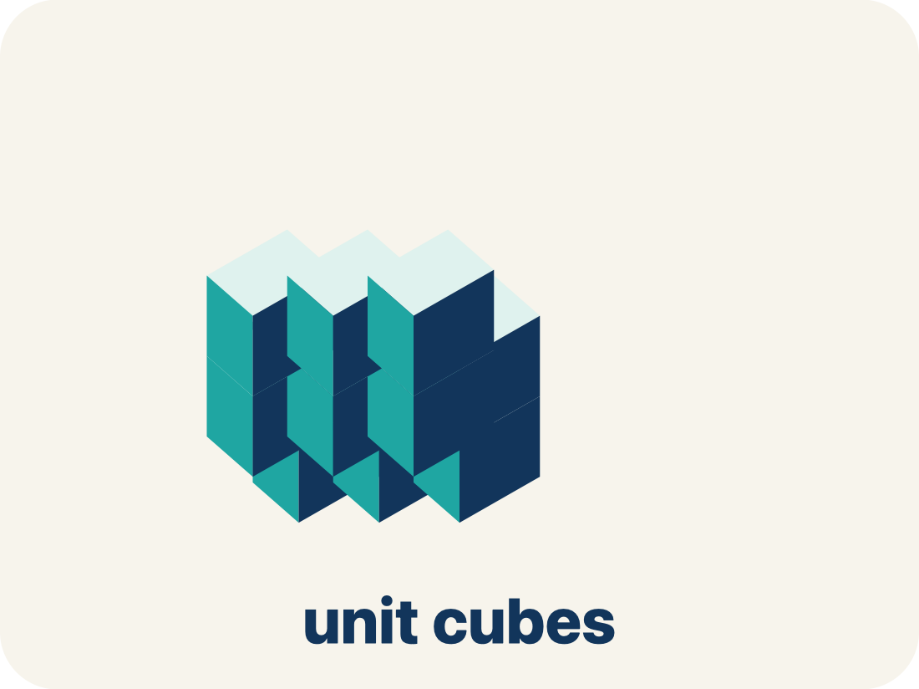
Vocabulary 2 of 7
Lesson 5-5 · Determine the Volume of Rectangular Prisms
Volume
How much space is inside a solid shape.
EXAMPLE · EXPLAIN WHY IT FITS
A box 3 × 2 × 4 holds 24 unit cubes, so V = 24 cubic units
Use “Volume” to explain the example. Point to evidence.
eduwonderlab.com · Neft Teacher
9 / 51
Notes:
TEACH IN PRACTICE | Embedded facilitation | Lesson 5.5, slide 9 | VOCAB
Focus on the existing task: Vocabulary 2 of 7 Volume How much space is…
ASK (T1/3/5): Where does “Volume” appear in the example? Explain the meaning without reading the definition. Partner: restate the idea and ask a clarifying question.
LOOK FOR: A correct connection between the word and a feature of the example. If the student only repeats the definition, invite pointing, sketching or oral rehearsal, then ask for another explanation of this same example.
PARTICIPATION (T5/6/7): Think time before volunteers; accept a written, drawn or rehearsed entry. Students ask for evidence respectfully. Recognize a specific contribution or revision and check that both partners participate.
Source: BCPS Updated Instructional Framework Rubric (June 2020), TEACH 1–7.

Slide 10
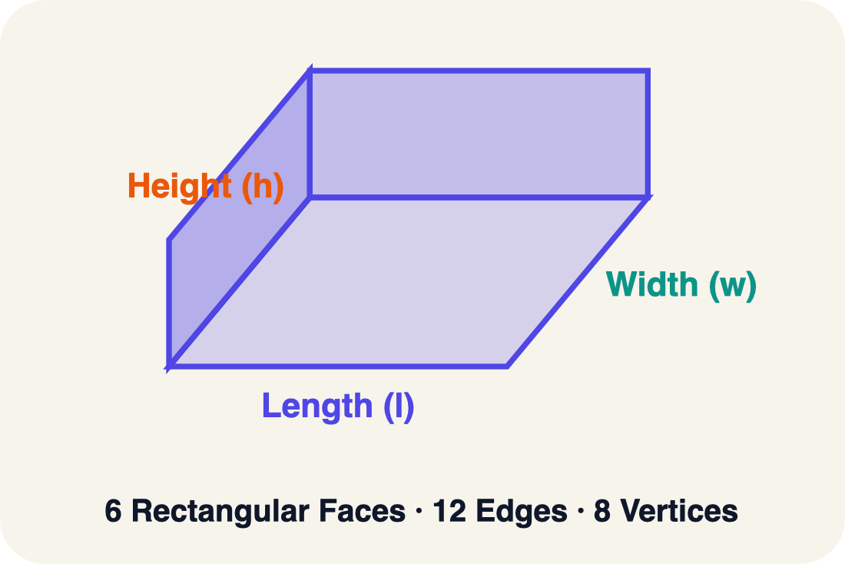
Vocabulary 3 of 7
Lesson 5-5 · Determine the Volume of Rectangular Prisms
Rectangular prism
A solid box shape with six flat rectangle sides.
EXAMPLE · EXPLAIN WHY IT FITS
A cereal box or shoe box — it has length, width, and height
Use “Rectangular prism” to explain the example. Point to
evidence.
eduwonderlab.com · Neft Teacher
10 / 51
Notes:
TEACH IN PRACTICE | Embedded facilitation | Lesson 5.5, slide 10 | VOCAB
Focus on the existing task: Vocabulary 3 of 7 Rectangular prism A solid box…
ASK (T1/3/5): Where does “Rectangular prism” appear in the example? Explain the meaning without reading the definition. Partner: restate the idea and ask a clarifying question.
LOOK FOR: A correct connection between the word and a feature of the example. If the student only repeats the definition, invite pointing, sketching or oral rehearsal, then ask for another explanation of this same example.
PARTICIPATION (T5/6/7): Think time before volunteers; accept a written, drawn or rehearsed entry. Students ask for evidence respectfully. Recognize a specific contribution or revision and check that both partners participate.
Source: BCPS Updated Instructional Framework Rubric (June 2020), TEACH 1–7.

Slide 11
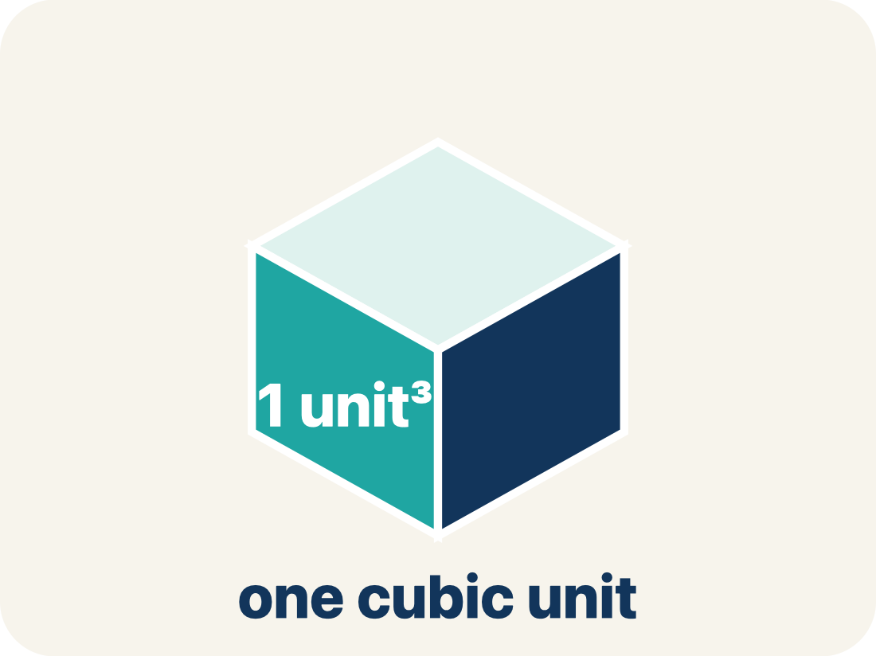
Vocabulary 4 of 7
Lesson 5-5 · Determine the Volume of Rectangular Prisms
Cubic units
The units used to measure space inside, like cubic inches.
EXAMPLE · EXPLAIN WHY IT FITS
A tiny cube that is 1 in × 1 in × 1 in = 1 in³ (one cubic inch)
Use “Cubic units” to explain the example. Point to evidence.
eduwonderlab.com · Neft Teacher
11 / 51
Notes:
TEACH IN PRACTICE | Embedded facilitation | Lesson 5.5, slide 11 | VOCAB
Focus on the existing task: Vocabulary 4 of 7 Cubic units The units used to…
ASK (T1/3/5): Where does “Cubic units” appear in the example? Explain the meaning without reading the definition. Partner: restate the idea and ask a clarifying question.
LOOK FOR: A correct connection between the word and a feature of the example. If the student only repeats the definition, invite pointing, sketching or oral rehearsal, then ask for another explanation of this same example.
PARTICIPATION (T5/6/7): Think time before volunteers; accept a written, drawn or rehearsed entry. Students ask for evidence respectfully. Recognize a specific contribution or revision and check that both partners participate.
Source: BCPS Updated Instructional Framework Rubric (June 2020), TEACH 1–7.

Slide 12
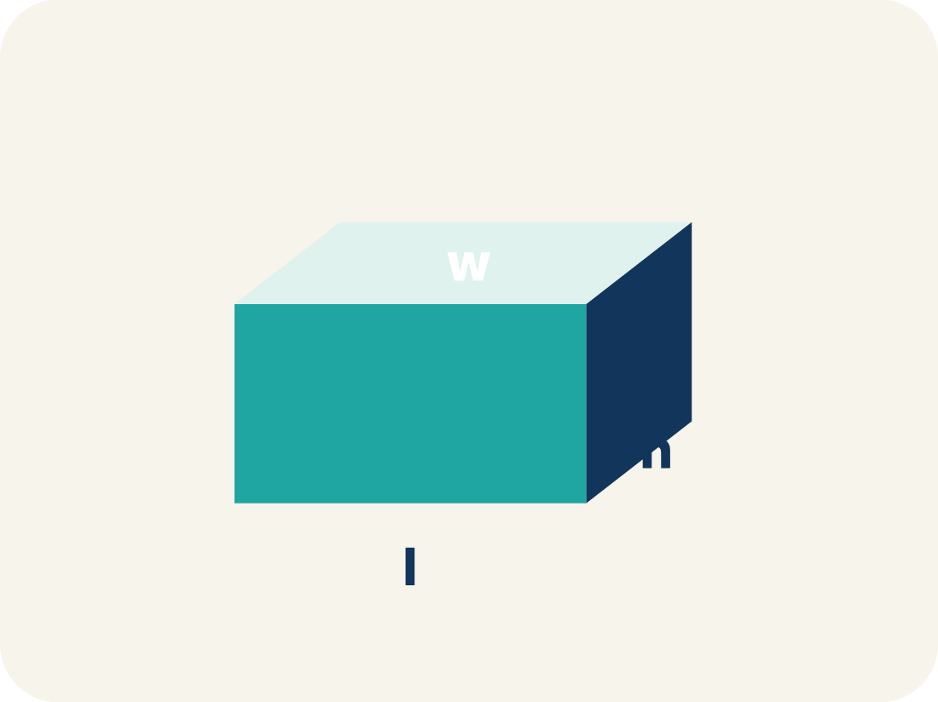
Vocabulary 5 of 7
Lesson 5-5 · Determine the Volume of Rectangular Prisms
Length, width, height
How long, how wide, and how tall a box is.
EXAMPLE · EXPLAIN WHY IT FITS
V = l × w × h: for a box 5 × 3 × 2, volume = 30 cubic units
Use “Length, width, height” to explain the example. Point to
evidence.
eduwonderlab.com · Neft Teacher
12 / 51
Notes:
TEACH IN PRACTICE | Embedded facilitation | Lesson 5.5, slide 12 | VOCAB
Focus on the existing task: Vocabulary 5 of 7 Length, width, height How…
ASK (T1/3/5): Where does “Length, width, height” appear in the example? Explain the meaning without reading the definition. Partner: restate the idea and ask a clarifying question.
LOOK FOR: A correct connection between the word and a feature of the example. If the student only repeats the definition, invite pointing, sketching or oral rehearsal, then ask for another explanation of this same example.
PARTICIPATION (T5/6/7): Think time before volunteers; accept a written, drawn or rehearsed entry. Students ask for evidence respectfully. Recognize a specific contribution or revision and check that both partners participate.
Source: BCPS Updated Instructional Framework Rubric (June 2020), TEACH 1–7.

Slide 13
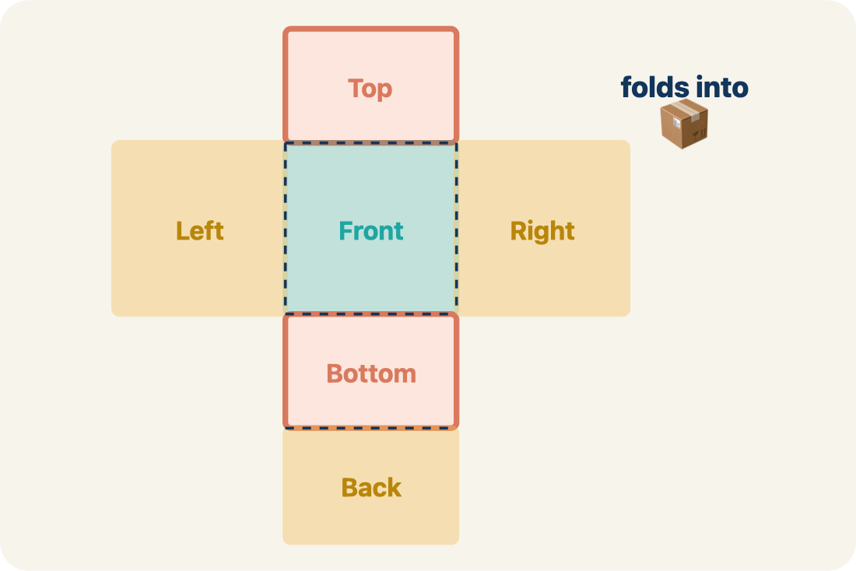
Vocabulary 6 of 7
Lesson 5-5 · Determine the Volume of Rectangular Prisms
Net
A flat shape that folds up into a solid.
EXAMPLE · EXPLAIN WHY IT FITS
A cross-shaped pattern of 6 rectangles folds into a rectangular box
Use “Net” to explain the example. Point to evidence.
eduwonderlab.com · Neft Teacher
13 / 51
Notes:
TEACH IN PRACTICE | Embedded facilitation | Lesson 5.5, slide 13 | VOCAB
Focus on the existing task: Vocabulary 6 of 7 Net A flat shape that folds…
ASK (T1/3/5): Where does “Net” appear in the example? Explain the meaning without reading the definition. Partner: restate the idea and ask a clarifying question.
LOOK FOR: A correct connection between the word and a feature of the example. If the student only repeats the definition, invite pointing, sketching or oral rehearsal, then ask for another explanation of this same example.
PARTICIPATION (T5/6/7): Think time before volunteers; accept a written, drawn or rehearsed entry. Students ask for evidence respectfully. Recognize a specific contribution or revision and check that both partners participate.
Source: BCPS Updated Instructional Framework Rubric (June 2020), TEACH 1–7.

Slide 14
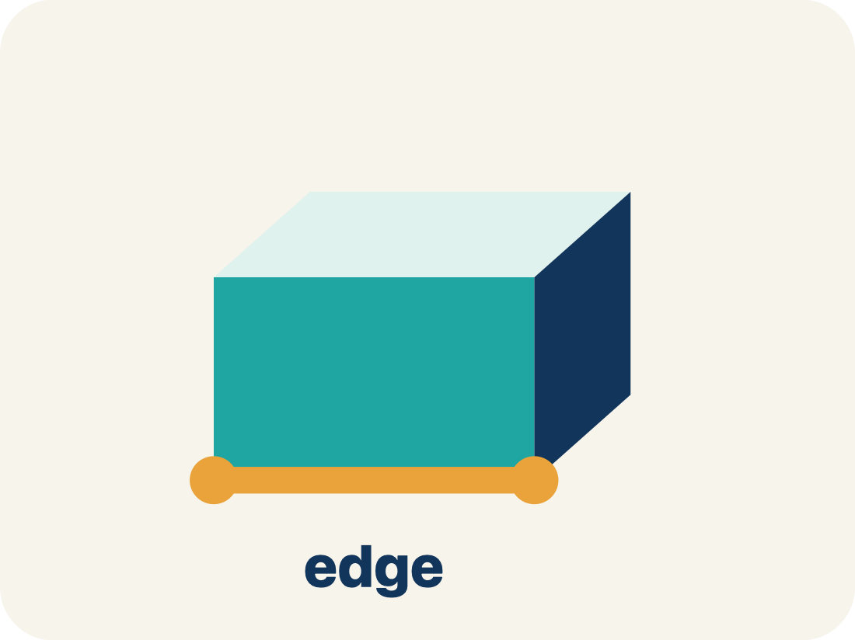
Vocabulary 7 of 7
Lesson 5-5 · Determine the Volume of Rectangular Prisms
Edge
The line where two flat sides of a solid meet.
EXAMPLE · EXPLAIN WHY IT FITS
A cube has 12 edges — 4 along the top, 4 along the bottom, 4 vertical
Use “Edge” to explain the example. Point to evidence.
eduwonderlab.com · Neft Teacher
14 / 51
Notes:
TEACH IN PRACTICE | Embedded facilitation | Lesson 5.5, slide 14 | VOCAB
Focus on the existing task: Vocabulary 7 of 7 Edge The line where two flat…
ASK (T1/3/5): Where does “Edge” appear in the example? Explain the meaning without reading the definition. Partner: restate the idea and ask a clarifying question.
LOOK FOR: A correct connection between the word and a feature of the example. If the student only repeats the definition, invite pointing, sketching or oral rehearsal, then ask for another explanation of this same example.
PARTICIPATION (T5/6/7): Think time before volunteers; accept a written, drawn or rehearsed entry. Students ask for evidence respectfully. Recognize a specific contribution or revision and check that both partners participate.
Source: BCPS Updated Instructional Framework Rubric (June 2020), TEACH 1–7.

Slide 15

Be Curious
Is it always true?​
A cube is a rectangular prism.
Think first. Share a notice and a question;
build on a classmate’s idea.
Mindset
How can you organize yourself to be successful in math?
15 / 51
Notes:
TEACH IN PRACTICE | Embedded facilitation | Lesson 5.5, slide 15 | CURIOUS
Focus on the existing task: How can you organize yourself to be successful in math?
LAUNCH (T2/3/5): Allow quiet observation first. Separate a notice from an inference, invite students’ own questions, and follow the existing launch before teaching a procedure.
LOOK FOR (T4): Where this task addresses it, students can connect unit-cube layers to volume. Ask which feature of their work supports the claim.
RESPOND: If this task shows the lesson misconception—confusing square and cubic units or assuming fractional edges cannot have volume—label edge units and one layer of the original prism before connecting it to the formula. Have the student revise and explain the change. Use this support only where the concept occurs in the current task; otherwise respond to the displayed question.
RECHECK: If a gap is shared, revisit the existing representation together. If it is limited, give targeted support while others compare valid methods on the same task. Check the revision before moving on.
PARTICIPATION (T5/6/7): Think time before volunteers; accept a written, drawn or rehearsed entry. Students ask for evidence respectfully. Recognize a specific contribution or revision and check that both partners participate.
Source: BCPS Updated Instructional Framework Rubric (June 2020), TEACH 1–7.

Slide 16
Vocabulary
Lesson 5-5 · Determine the Volume of Rectangular Prisms
Today’s Math Words
We learn every word — what it means and what it looks like — before we use it.
Volume with Whole-Number Edges
Volume
The number of unit cubes inside a rectangular prism
How much space is inside a solid shape
Rectangular prism
Cubic units
A solid box shape with six flat rectangle sides
The units used to measure space inside, like cubic inches
Length, width, height
Net
How long, how wide, and how tall a box is
A flat shape that folds up into a solid
Edge
Explain one math word using the example.
Partner: point to evidence.
The line where two flat sides of a solid meet
eduwonderlab.com · Neft Teacher
16 / 51
Notes:
TEACH IN PRACTICE | Embedded facilitation | Lesson 5.5, slide 16 | VOCAB
Focus on the existing task: Vocabulary Today’s Math Words We learn every…
ASK (T1/3/5): Where does “the displayed term” appear in the example? Explain the meaning without reading the definition. Partner: restate the idea and ask a clarifying question.
LOOK FOR: A correct connection between the word and a feature of the example. If the student only repeats the definition, invite pointing, sketching or oral rehearsal, then ask for another explanation of this same example.
PARTICIPATION (T5/6/7): Think time before volunteers; accept a written, drawn or rehearsed entry. Students ask for evidence respectfully. Recognize a specific contribution or revision and check that both partners participate.
Source: BCPS Updated Instructional Framework Rubric (June 2020), TEACH 1–7. Earlier notes and answer keys are retained below.
EARLIER NOTES / EXISTING ANSWER KEY
Choral-read each word, its meaning, and what it looks like.
Students should use these words out loud today — listen for them in partner talk and revoice student ideas with the academic term.
UIFR: TEACH 1 · TEACH 5.

Slide 17
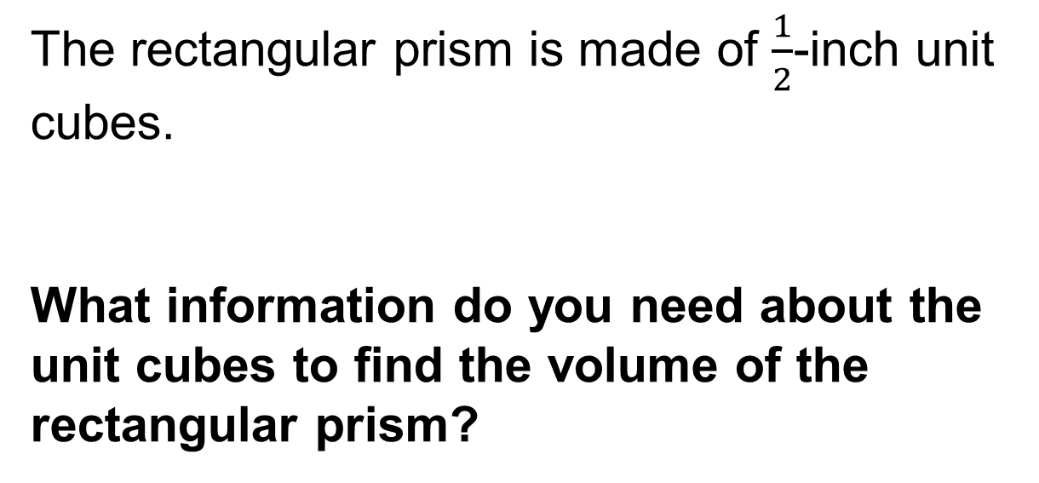
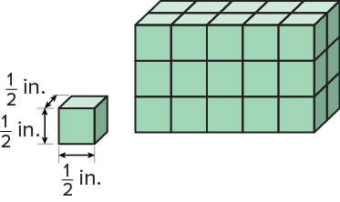
Volume of a Rectangular Prism
Explain how the information shown supports your reasoning.
Think About It:
17 / 51
Notes:
TEACH IN PRACTICE | Embedded facilitation | Lesson 5.5, slide 17 | WORKED
Focus on the existing task: Think About It: Volume of a Rectangular Prism
LAUNCH (T2/3/5): Ask students to explain the displayed idea or example and point to evidence. When a calculation step is shown, ask why it is valid. Have a partner restate the explanation; copying is not the check.
LOOK FOR (T4): Where this task addresses it, students can connect unit-cube layers to volume. Ask which feature of their work supports the claim.
RESPOND: If this task shows the lesson misconception—confusing square and cubic units or assuming fractional edges cannot have volume—label edge units and one layer of the original prism before connecting it to the formula. Have the student revise and explain the change. Use this support only where the concept occurs in the current task; otherwise respond to the displayed question.
RECHECK: If a gap is shared, revisit the existing representation together. If it is limited, give targeted support while others compare valid methods on the same task. Check the revision before moving on.
PARTICIPATION (T5/6/7): Think time before volunteers; accept a written, drawn or rehearsed entry. Students ask for evidence respectfully. Recognize a specific contribution or revision and check that both partners participate.
Source: BCPS Updated Instructional Framework Rubric (June 2020), TEACH 1–7. Earlier notes and answer keys are retained below.
EARLIER NOTES / EXISTING ANSWER KEY
Ask the question, then hold the silence — students think or jot before anyone answers.
Take two or three responses and press with “Why?” or “How do you know?” before moving on.
UIFR: TEACH 3.

Slide 18
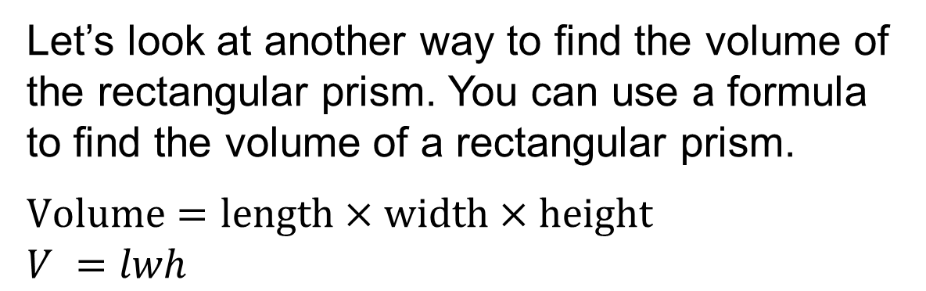
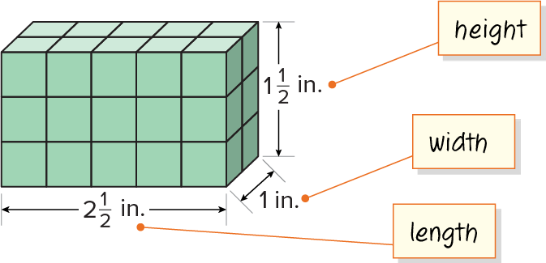
Volume of a Rectangular Prism
How does the volume formula relate to area formulas you have used before?
Reveal:
To find the area of some two-dimensional figures, like rectangles, you multiply the two dimensions: length and width. To find the volume of a three-dimensional rectangular prism, you multiply the three dimensions: length, width, and height.
18 / 51
Notes:
TEACH IN PRACTICE | Embedded facilitation | Lesson 5.5, slide 18 | REVEAL
Focus on the existing task: Reveal: To find the area of some two-dimensional figures, like rectangles, you multiply the two dimensions: length and width. To find…
LAUNCH (T2/3/5): If an existing answer cover is present, gather an attempt before revealing. If the explanation is already visible, ask students to reconstruct and justify it. Compare reasoning and explain a revision; preserve the reveal sequence.
LOOK FOR (T4): Where this task addresses it, students can connect unit-cube layers to volume. Ask which feature of their work supports the claim.
RESPOND: If this task shows the lesson misconception—confusing square and cubic units or assuming fractional edges cannot have volume—label edge units and one layer of the original prism before connecting it to the formula. Have the student revise and explain the change. Use this support only where the concept occurs in the current task; otherwise respond to the displayed question.
RECHECK: If a gap is shared, revisit the existing representation together. If it is limited, give targeted support while others compare valid methods on the same task. Check the revision before moving on.
PARTICIPATION (T5/6/7): Think time before volunteers; accept a written, drawn or rehearsed entry. Students ask for evidence respectfully. Recognize a specific contribution or revision and check that both partners participate.
Source: BCPS Updated Instructional Framework Rubric (June 2020), TEACH 1–7. Earlier notes and answer keys are retained below.
EARLIER NOTES / EXISTING ANSWER KEY
Do not click yet: collect 2–3 student answers with reasons first.
Then click to remove the cover and have students compare their thinking to the reveal — “Is this what we said? Where is it different?”
Behind the cover: To find the area of some two-dimensional figures, like rectangles, you multiply the two dimensions: length and width. To find the volume of a three-dimensional rectangular prism, you multiply the three dimensions: len…
UIFR: TEACH 3 · TEACH 4.
UIFR FULL | Lesson-specific facilitation
TEACH 2-3 | Session 1 task launch (UIFR PDF pp. 9-10).
Use the problem exactly as displayed. Give individual thinking time before discussion or advancing to the explanation. If the answer is already visible, ask students to reconstruct and justify it. Invite a choice of suitable representations and have students explain why their choice helps.
At the point where this concept appears, ask: “How do the layers explain the product of the dimensions, including a fractional edge?” Wait for evidence, invite another pathway, and have a student ask a follow-up question. Do not replace students’ reasoning with a sequence of leading steps.

Slide 19
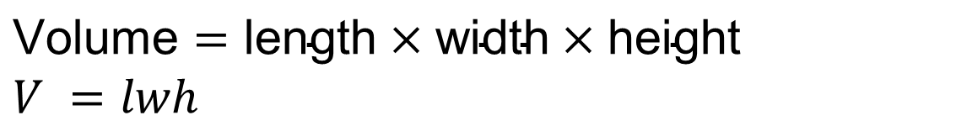
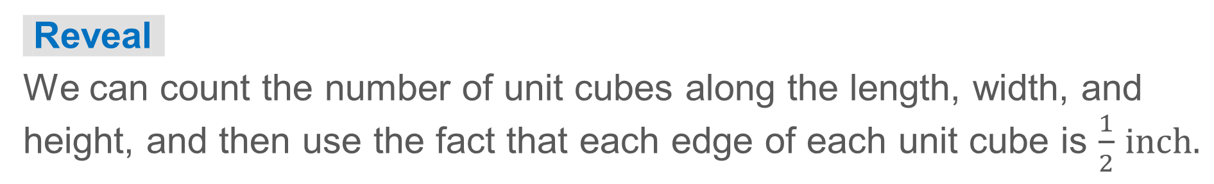
Volume of a Rectangular Prism
To find the volume of a three-dimensional rectangular prism, you multiply the three dimensions: length, width, and height.
How can you determine the length, width, and height of the prism?
19 / 51
Notes:
TEACH IN PRACTICE | Embedded facilitation | Lesson 5.5, slide 19 | TASK
Focus on the existing task: To find the volume of a three-dimensional rectangular prism, you multiply the three dimensions: length, width, and height. How can you determine the length, width, and height of the prism?
LAUNCH (T2/3/5): Use the displayed question. Give private thinking time; then A explains while B asks for evidence. Switch roles. Each student records their own reasoning.
LOOK FOR (T4): Where this task addresses it, students can connect unit-cube layers to volume. Ask which feature of their work supports the claim.
RESPOND: If this task shows the lesson misconception—confusing square and cubic units or assuming fractional edges cannot have volume—label edge units and one layer of the original prism before connecting it to the formula. Have the student revise and explain the change. Use this support only where the concept occurs in the current task; otherwise respond to the displayed question.
RECHECK: If a gap is shared, revisit the existing representation together. If it is limited, give targeted support while others compare valid methods on the same task. Check the revision before moving on.
PARTICIPATION (T5/6/7): Think time before volunteers; accept a written, drawn or rehearsed entry. Students ask for evidence respectfully. Recognize a specific contribution or revision and check that both partners participate.
Source: BCPS Updated Instructional Framework Rubric (June 2020), TEACH 1–7. Earlier notes and answer keys are retained below.
EARLIER NOTES / EXISTING ANSWER KEY
Read the context aloud (or have a student read it).
Before any math, students restate the situation and what is being asked in their own words.
Ask: How can you determine the length, width, and height of the prism?
UIFR: TEACH 1 · TEACH 3.

Slide 20
STUDENT MOVES
Lesson 5-5
Your moves
USE YOUR TOOLS · Reach for your notes, a model, or a manipulative before you reach for an answer.
ANOTHER PATHWAY · Did anyone get there a different way? Put both pathways side by side and compare.
20 / 51

Slide 21
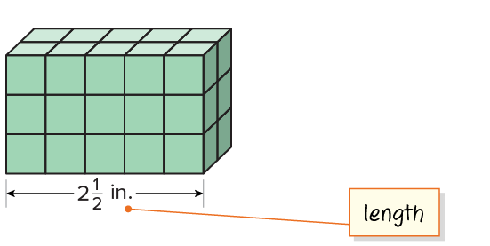
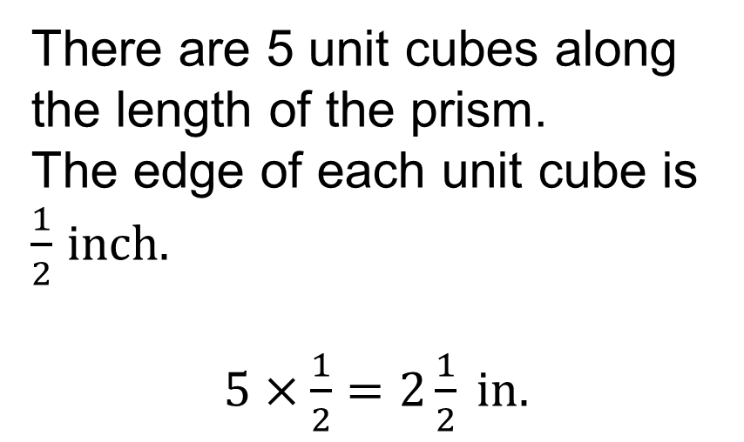
Volume of a Rectangular Prism
Let’s use the dimensions of the unit cube to determine the dimensions of the rectangular prism.​
Explain how the information shown supports your reasoning.
21 / 51
Notes:
TEACH IN PRACTICE | Embedded facilitation | Lesson 5.5, slide 20 | WORKED
Focus on the existing task: Let’s use the dimensions of the unit cube to determine the dimensions of the rectangular prism. Volume of a Rectangular Prism
LAUNCH (T2/3/5): Ask students to explain the displayed idea or example and point to evidence. When a calculation step is shown, ask why it is valid. Have a partner restate the explanation; copying is not the check.
LOOK FOR (T4): Where this task addresses it, students can connect unit-cube layers to volume. Ask which feature of their work supports the claim.
RESPOND: If this task shows the lesson misconception—confusing square and cubic units or assuming fractional edges cannot have volume—label edge units and one layer of the original prism before connecting it to the formula. Have the student revise and explain the change. Use this support only where the concept occurs in the current task; otherwise respond to the displayed question.
RECHECK: If a gap is shared, revisit the existing representation together. If it is limited, give targeted support while others compare valid methods on the same task. Check the revision before moving on.
PARTICIPATION (T5/6/7): Think time before volunteers; accept a written, drawn or rehearsed entry. Students ask for evidence respectfully. Recognize a specific contribution or revision and check that both partners participate.
Source: BCPS Updated Instructional Framework Rubric (June 2020), TEACH 1–7. Earlier notes and answer keys are retained below.
EARLIER NOTES / EXISTING ANSWER KEY
Model briefly, then hand the thinking back: ask “Why does this step work?” before showing the next one.
Quick check before moving on — thumbs or whiteboards from everyone, not volunteers.
UIFR: TEACH 2 · TEACH 3 · TEACH 4.

Slide 22
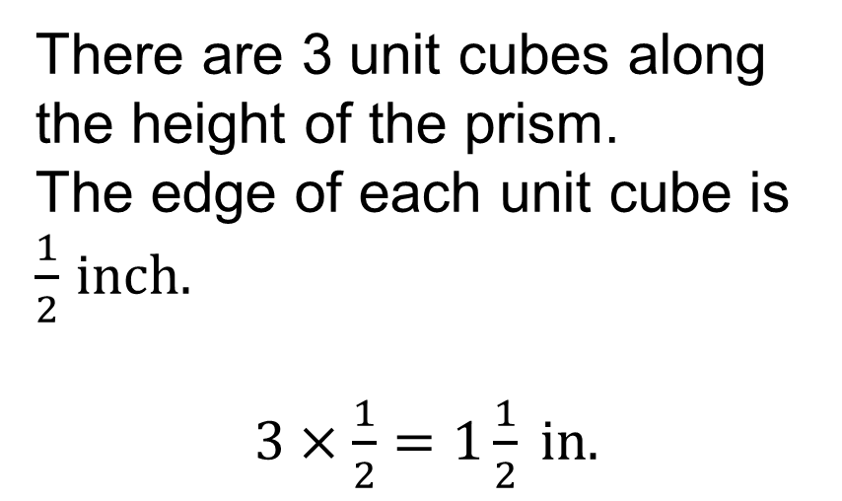
Volume of a Rectangular Prism
There are 3 unit cubes along the height of the prism.
Explain how the information shown supports your reasoning.
22 / 51
Notes:
TEACH IN PRACTICE | Embedded facilitation | Lesson 5.5, slide 21 | WORKED
Focus on the existing task: There are 3 unit cubes along the height of the prism. Volume of a Rectangular Prism
LAUNCH (T2/3/5): Ask students to explain the displayed idea or example and point to evidence. When a calculation step is shown, ask why it is valid. Have a partner restate the explanation; copying is not the check.
LOOK FOR (T4): Where this task addresses it, students can connect unit-cube layers to volume. Ask which feature of their work supports the claim.
RESPOND: If this task shows the lesson misconception—confusing square and cubic units or assuming fractional edges cannot have volume—label edge units and one layer of the original prism before connecting it to the formula. Have the student revise and explain the change. Use this support only where the concept occurs in the current task; otherwise respond to the displayed question.
RECHECK: If a gap is shared, revisit the existing representation together. If it is limited, give targeted support while others compare valid methods on the same task. Check the revision before moving on.
PARTICIPATION (T5/6/7): Think time before volunteers; accept a written, drawn or rehearsed entry. Students ask for evidence respectfully. Recognize a specific contribution or revision and check that both partners participate.
Source: BCPS Updated Instructional Framework Rubric (June 2020), TEACH 1–7. Earlier notes and answer keys are retained below.
EARLIER NOTES / EXISTING ANSWER KEY
Model briefly, then hand the thinking back: ask “Why does this step work?” before showing the next one.
Quick check before moving on — thumbs or whiteboards from everyone, not volunteers.
UIFR: TEACH 2 · TEACH 3 · TEACH 4.

Slide 23
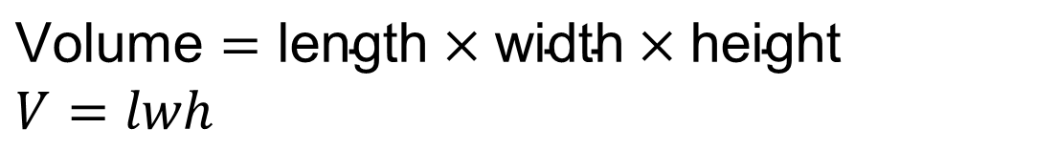
Volume of a Rectangular Prism
How do you use the formula to find the volume of the prism?
Record your reasoning before the reveal.
Compare, then explain any revision.
Reveal:
We substitute the dimensions of the prism for the corresponding variables in the formula.
23 / 51
Notes:
TEACH IN PRACTICE | Embedded facilitation | Lesson 5.5, slide 22 | REVEAL
Focus on the existing task: Reveal: We substitute the dimensions of the prism for the corresponding variables in the formula. How do you use the formula to find the volume of the prism?
LAUNCH (T2/3/5): If an existing answer cover is present, gather an attempt before revealing. If the explanation is already visible, ask students to reconstruct and justify it. Compare reasoning and explain a revision; preserve the reveal sequence.
LOOK FOR (T4): Where this task addresses it, students can connect unit-cube layers to volume. Ask which feature of their work supports the claim.
RESPOND: If this task shows the lesson misconception—confusing square and cubic units or assuming fractional edges cannot have volume—label edge units and one layer of the original prism before connecting it to the formula. Have the student revise and explain the change. Use this support only where the concept occurs in the current task; otherwise respond to the displayed question.
RECHECK: If a gap is shared, revisit the existing representation together. If it is limited, give targeted support while others compare valid methods on the same task. Check the revision before moving on.
PARTICIPATION (T5/6/7): Think time before volunteers; accept a written, drawn or rehearsed entry. Students ask for evidence respectfully. Recognize a specific contribution or revision and check that both partners participate.
Source: BCPS Updated Instructional Framework Rubric (June 2020), TEACH 1–7. Earlier notes and answer keys are retained below.
EARLIER NOTES / EXISTING ANSWER KEY
Do not click yet: collect 2–3 student answers with reasons first.
Then click to remove the cover and have students compare their thinking to the reveal — “Is this what we said? Where is it different?”
Behind the cover: We substitute the dimensions of the prism for the corresponding variables in the formula.
UIFR: TEACH 3 · TEACH 4.

Slide 24
Volume of a Rectangular Prism
How do you use the formula to find the volume of the prism?
Think and record first. Which part of your
work supports your answer?
Using Symbols Appropriately
What units of measure are needed to be precise?
24 / 51
Notes:
TEACH IN PRACTICE | Embedded facilitation | Lesson 5.5, slide 23 | TASK
Focus on the existing task: Using Symbols Appropriately What units of measure are needed to be precise?
LAUNCH (T2/3/5): Use the displayed question. Give private thinking time; then A explains while B asks for evidence. Switch roles. Each student records their own reasoning.
LOOK FOR (T4): Where this task addresses it, students can connect unit-cube layers to volume. Ask which feature of their work supports the claim.
RESPOND: If this task shows the lesson misconception—confusing square and cubic units or assuming fractional edges cannot have volume—label edge units and one layer of the original prism before connecting it to the formula. Have the student revise and explain the change. Use this support only where the concept occurs in the current task; otherwise respond to the displayed question.
RECHECK: If a gap is shared, revisit the existing representation together. If it is limited, give targeted support while others compare valid methods on the same task. Check the revision before moving on.
PARTICIPATION (T5/6/7): Think time before volunteers; accept a written, drawn or rehearsed entry. Students ask for evidence respectfully. Recognize a specific contribution or revision and check that both partners participate.
Source: BCPS Updated Instructional Framework Rubric (June 2020), TEACH 1–7. Earlier notes and answer keys are retained below.
EARLIER NOTES / EXISTING ANSWER KEY
Model briefly, then hand the thinking back: ask “Why does this step work?” before showing the next one.
Quick check before moving on — thumbs or whiteboards from everyone, not volunteers.
UIFR: TEACH 2 · TEACH 3 · TEACH 4.

Slide 25
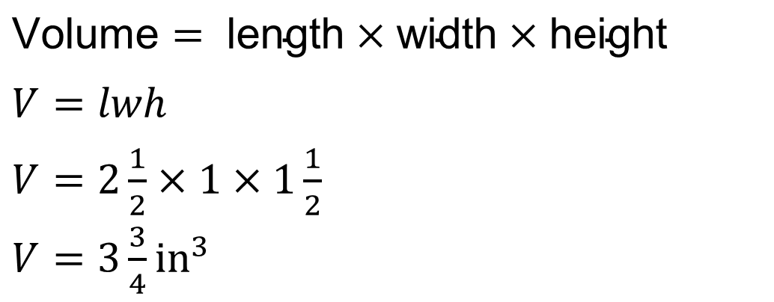
Volume of a Rectangular Prism
Let’s substitute the dimensions of the prism into the formula.​
Explain how the information shown supports your reasoning.
25 / 51
Notes:
TEACH IN PRACTICE | Embedded facilitation | Lesson 5.5, slide 24 | WORKED
Focus on the existing task: Let’s substitute the dimensions of the prism into the formula. Volume of a Rectangular Prism
LAUNCH (T2/3/5): Ask students to explain the displayed idea or example and point to evidence. When a calculation step is shown, ask why it is valid. Have a partner restate the explanation; copying is not the check.
LOOK FOR (T4): Where this task addresses it, students can connect unit-cube layers to volume. Ask which feature of their work supports the claim.
RESPOND: If this task shows the lesson misconception—confusing square and cubic units or assuming fractional edges cannot have volume—label edge units and one layer of the original prism before connecting it to the formula. Have the student revise and explain the change. Use this support only where the concept occurs in the current task; otherwise respond to the displayed question.
RECHECK: If a gap is shared, revisit the existing representation together. If it is limited, give targeted support while others compare valid methods on the same task. Check the revision before moving on.
PARTICIPATION (T5/6/7): Think time before volunteers; accept a written, drawn or rehearsed entry. Students ask for evidence respectfully. Recognize a specific contribution or revision and check that both partners participate.
Source: BCPS Updated Instructional Framework Rubric (June 2020), TEACH 1–7. Earlier notes and answer keys are retained below.
EARLIER NOTES / EXISTING ANSWER KEY
Model briefly, then hand the thinking back: ask “Why does this step work?” before showing the next one.
Quick check before moving on — thumbs or whiteboards from everyone, not volunteers.
UIFR: TEACH 2 · TEACH 3 · TEACH 4.

Slide 26
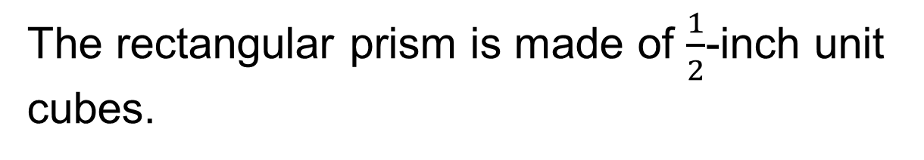
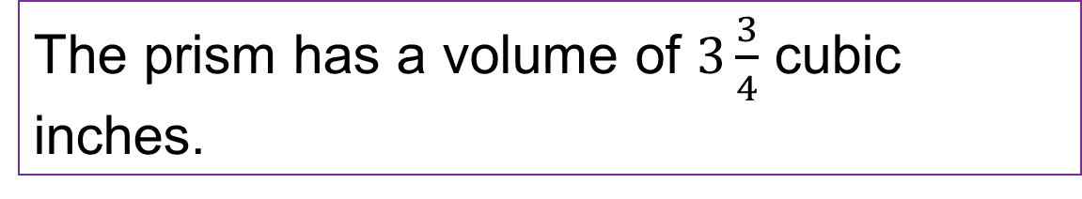
Volume of a Rectangular Prism
What is the volume of the prism?
Think and record first. Which part of your work supports your answer?
26 / 51
Notes:
TEACH IN PRACTICE | Embedded facilitation | Lesson 5.5, slide 25 | TASK
Focus on the existing task: What is the volume of the prism?
LAUNCH (T2/3/5): Use the displayed question. Give private thinking time; then A explains while B asks for evidence. Switch roles. Each student records their own reasoning.
LOOK FOR (T4): Where this task addresses it, students can connect unit-cube layers to volume. Ask which feature of their work supports the claim.
RESPOND: If this task shows the lesson misconception—confusing square and cubic units or assuming fractional edges cannot have volume—label edge units and one layer of the original prism before connecting it to the formula. Have the student revise and explain the change. Use this support only where the concept occurs in the current task; otherwise respond to the displayed question.
RECHECK: If a gap is shared, revisit the existing representation together. If it is limited, give targeted support while others compare valid methods on the same task. Check the revision before moving on.
PARTICIPATION (T5/6/7): Think time before volunteers; accept a written, drawn or rehearsed entry. Students ask for evidence respectfully. Recognize a specific contribution or revision and check that both partners participate.
Source: BCPS Updated Instructional Framework Rubric (June 2020), TEACH 1–7. Earlier notes and answer keys are retained below.
EARLIER NOTES / EXISTING ANSWER KEY
Model briefly, then hand the thinking back: ask “Why does this step work?” before showing the next one.
Quick check before moving on — thumbs or whiteboards from everyone, not volunteers.
UIFR: TEACH 2 · TEACH 3 · TEACH 4.

Slide 27
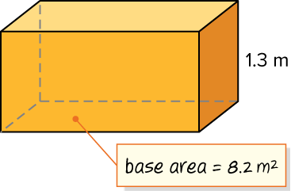
Let’s Explore More
How is finding area related to finding volume?
Try it yourself. Compare your work with a partner; explain one choice and revise.
What is the volume of the rectangular prism shown? Explain.
27 / 51
Notes:
TEACH IN PRACTICE | Embedded facilitation | Lesson 5.5, slide 26 | PRACTICE
Focus on the existing task: How is finding area related to finding volume?
LAUNCH (T2/3/5): Use the displayed question. Give private thinking time; then A explains while B asks for evidence. Switch roles. Each student records their own reasoning.
LOOK FOR (T4): Where this task addresses it, students can connect unit-cube layers to volume. Ask which feature of their work supports the claim.
RESPOND: If this task shows the lesson misconception—confusing square and cubic units or assuming fractional edges cannot have volume—label edge units and one layer of the original prism before connecting it to the formula. Have the student revise and explain the change. Use this support only where the concept occurs in the current task; otherwise respond to the displayed question.
RECHECK: If a gap is shared, revisit the existing representation together. If it is limited, give targeted support while others compare valid methods on the same task. Check the revision before moving on.
PARTICIPATION (T5/6/7): Think time before volunteers; accept a written, drawn or rehearsed entry. Students ask for evidence respectfully. Recognize a specific contribution or revision and check that both partners participate.
Source: BCPS Updated Instructional Framework Rubric (June 2020), TEACH 1–7. Earlier notes and answer keys are retained below.
EARLIER NOTES / EXISTING ANSWER KEY
Extension for partners or table groups — students choose their approach and use the workspace to show thinking.
Push with “Convince me,” and have two groups with different approaches share.
This is where students stretch past the worked example.
UIFR: TEACH 2 · TEACH 5.
UIFR FULL | Lesson-specific facilitation
TEACH 4-5 | Session 1 discussion and checkpoint (UIFR PDF pp. 11-12).
Collect a brief response from every student to the existing prompt before hearing volunteers. Partners take turns explaining and asking for evidence: “I understand ___; what supports ___?” Offer rehearsal or an annotated model for students who need language support. Each student records their own reasoning.
Look specifically for: confusing square and cubic units or assuming fractional edges cannot have volume. If it appears, label edge units and one layer of the original prism before connecting it to the formula; then ask the student to revise the same response and explain the change. If evidence is secure, have students compare a second valid pathway or state why their approach works. Choose the next step from the responses, not a preset pace.

Slide 28
LESSON 5.5 / DISCUSS THE TASK
Explain and compare
Use the task you just explored.
TAKE TURNS
How do the layers explain the product of the dimensions, including a fractional edge?
Explain
“I know this because…”
Ask
“Where does your work show that?”
Point to evidence in your work.
Then compare your approach with a partner’s.
HOW DO YOU KNOW? · Ask your partner “How do you know?” Answer by pointing to your own work.
Listen to understand. Ask for evidence. Make room for every voice.
Notes:
TEACH IN PRACTICE | Embedded facilitation | Lesson 5.5, slide 27 | PRIOR_INSERT
Focus on the existing task: Point to evidence in your work. Then compare your approach with a partner’s. TAKE TURNS Explain “I know this because…” Ask “Where does your work show that?
CONNECT (T1/4): Ask students to restate the displayed goal or key idea and connect it to earlier work. Relevant lesson evidence: connect unit-cube layers to volume; use fractional edges when present; recover a missing dimension. Use only the criterion that matches the current session.
SHOW PROGRESS: Students point to their own existing work, explain what improved after feedback, and name a next step. Pair confidence ratings with actual evidence.
PARTICIPATION (T5/6/7): Think time before volunteers; accept a written, drawn or rehearsed entry. Students ask for evidence respectfully. Recognize a specific contribution or revision and check that both partners participate.
Source: BCPS Updated Instructional Framework Rubric (June 2020), TEACH 1–7.

Slide 29
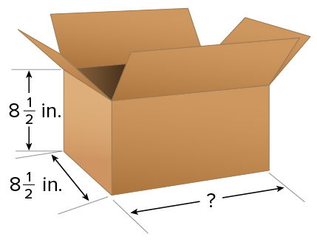
Be Curious
What do you notice?
What do you wonder?
Think first. Share a notice and a question;
build on a classmate’s idea.
Mindset
How are you organizing yourself to be successful in math?
29 / 51
Notes:
TEACH IN PRACTICE | Embedded facilitation | Lesson 5.5, slide 28 | CURIOUS
Focus on the existing task: How are you organizing yourself to be successful in math?
LAUNCH (T2/3/5): Allow quiet observation first. Separate a notice from an inference, invite students’ own questions, and follow the existing launch before teaching a procedure.
LOOK FOR (T4): Where this task addresses it, students can connect unit-cube layers to volume. Ask which feature of their work supports the claim.
RESPOND: If this task shows the lesson misconception—confusing square and cubic units or assuming fractional edges cannot have volume—label edge units and one layer of the original prism before connecting it to the formula. Have the student revise and explain the change. Use this support only where the concept occurs in the current task; otherwise respond to the displayed question.
RECHECK: If a gap is shared, revisit the existing representation together. If it is limited, give targeted support while others compare valid methods on the same task. Check the revision before moving on.
PARTICIPATION (T5/6/7): Think time before volunteers; accept a written, drawn or rehearsed entry. Students ask for evidence respectfully. Recognize a specific contribution or revision and check that both partners participate.
Source: BCPS Updated Instructional Framework Rubric (June 2020), TEACH 1–7.

Slide 30
Warm-Up
Lesson 5-5 · Determine the Volume of Rectangular Prisms
Session 2 Warm-Up
Try alone. Explain one. Then revise.
1
Which formula gives the volume of a rectangular prism?
2
In V = Bh, what does capital B represent?
A
V = l + w + h
A
Bottom line
B
V = l × w × h or V = B × h
B
Area of the base (l × w)
C
V = 2(lw + lh)
C
Perimeter
D
V = ½ lwh
D
Box weight
3
A prism measures 4 cm by 3 cm by 5 cm. What is its volume?
4
Volume is always measured in:
A
12 cm³
A
Linear units
B
60 cm³
B
Square units
C
30 cm³
C
Cubic units
D
60 cm²
D
Grams
eduwonderlab.com · Neft Teacher
30 / 51
Notes:
TEACH IN PRACTICE | Embedded facilitation | Lesson 5.5, slide 29 | WARMUP
Focus on the existing task: A V = l + w + h B V = l × w × h or V = B × h C V = 2(lw + lh) D V = ½ lwh 2 In V = Bh, what does capital B represent?
GATHER EVIDENCE (T4/6): Keep the original items. Students try independently, mark an uncertain item, and explain one method before checking. Use the existing key when present.
RESPOND: Distinguish a calculation slip from a reasoning gap. Give one next step on the same item; have students revise in a second color. Use the responses to choose flexible support for today’s lesson.
PARTICIPATION (T5/6/7): Think time before volunteers; accept a written, drawn or rehearsed entry. Students ask for evidence respectfully. Recognize a specific contribution or revision and check that both partners participate.
Source: BCPS Updated Instructional Framework Rubric (June 2020), TEACH 1–7. Earlier notes and answer keys are retained below.
EARLIER NOTES / EXISTING ANSWER KEY
Warm-up routine: students start silently on entry; keep it to about 4 minutes.
Circulate and note who is stuck — use what you see to choose who you check on first today.
Go over answers quickly; ask one student to explain a step, not just say the answer.
UIFR: TEACH 4 · TEACH 6.

Slide 31
STUDENT MOVES
Lesson 5-5
Your move
YOU KNOW THE ROUTINE · Read → plan → solve → check. Do all four, in that order.
31 / 51

Slide 32
Review Notes — Session 2
Lesson 5-5 · Determine the Volume of Rectangular Prisms
Session 2: Review Notes
Copy. Explain. Check.
WHY IT MATTERS · Finish this: “This is worth knowing because ______.”
Volume Formula
1
Volume = length × width × height (V = lwh) or Base Area × height (V = Bh).
Fractional Edges
2
The formula applies identically when dimensions include fractional unit cubes.
Cubic Measurement
3
Volume measures three-dimensional capacity and is expressed in cubic units (e.g. cm³).
eduwonderlab.com · Neft Teacher
32 / 51
Notes:
TEACH IN PRACTICE | Embedded facilitation | Lesson 5.5, slide 30 | NOTES
Focus on the existing task: Review Notes — Session 2 Session 2: Review Notes…
ROUTINE (T1/2/4): Read or copy the original notes, cover one line, and explain it using the displayed example. Reopen and correct. Copying alone is not evidence of understanding.
LOOK FOR: A link between a symbol, quantity or feature and the explanation. If missing, point back to that feature and have the student try again; fade the prompt once they can explain.
PARTICIPATION (T5/6/7): Think time before volunteers; accept a written, drawn or rehearsed entry. Students ask for evidence respectfully. Recognize a specific contribution or revision and check that both partners participate.
Source: BCPS Updated Instructional Framework Rubric (June 2020), TEACH 1–7. Earlier notes and answer keys are retained below.
EARLIER NOTES / EXISTING ANSWER KEY
Copy routine: read one line at a time; students copy, then explain that line to a partner.
Keep it brisk — the understanding work happens in the examples, not the copying.
UIFR: TEACH 1 · TEACH 6.

Slide 33
Session 2
Determine the Volume of a Rectangular Prism​
TRY IT BEFORE YOU’RE SURE · Start even if you are not sure. A revised answer counts as much as a first-try answer.
33 / 51
Notes:
TEACH IN PRACTICE | Embedded facilitation | Lesson 5.5, slide 31 | DIVIDER
Focus on the existing task: Determine the Volume of a Rectangular Prism Session 2
TRANSITION (T6/7): Students confirm materials, roles, how to request help, and the next response routine. Ask a student to restate it. Keep teacher-only slides hidden.
PARTICIPATION (T5/6/7): Think time before volunteers; accept a written, drawn or rehearsed entry. Students ask for evidence respectfully. Recognize a specific contribution or revision and check that both partners participate.
Source: BCPS Updated Instructional Framework Rubric (June 2020), TEACH 1–7. Earlier notes and answer keys are retained below.
EARLIER NOTES / EXISTING ANSWER KEY
Transition cue: state what materials are out and what success looks like this session.
Keep the changeover under a minute.
UIFR: TEACH 6.

Slide 34
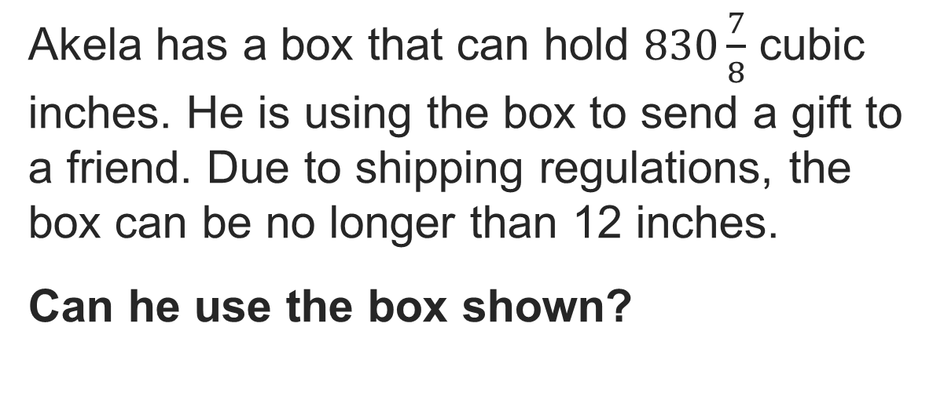
The Right Shipping Box
Precision
ADD ON · Add on: “I agree because ______.” or “I see it differently because ______.”
What level of precision does this solution require?
34 / 51
Notes:
TEACH IN PRACTICE | Embedded facilitation | Lesson 5.5, slide 32 | TASK
Focus on the existing task: The Right Shipping Box What level of precision does this solution require?
LAUNCH (T2/3/5): Use the displayed question. Give private thinking time; then A explains while B asks for evidence. Switch roles. Each student records their own reasoning.
LOOK FOR (T4): Where this task addresses it, students can connect unit-cube layers to volume. Ask which feature of their work supports the claim.
RESPOND: If this task shows the lesson misconception—confusing square and cubic units or assuming fractional edges cannot have volume—label edge units and one layer of the original prism before connecting it to the formula. Have the student revise and explain the change. Use this support only where the concept occurs in the current task; otherwise respond to the displayed question.
RECHECK: If a gap is shared, revisit the existing representation together. If it is limited, give targeted support while others compare valid methods on the same task. Check the revision before moving on.
PARTICIPATION (T5/6/7): Think time before volunteers; accept a written, drawn or rehearsed entry. Students ask for evidence respectfully. Recognize a specific contribution or revision and check that both partners participate.
Source: BCPS Updated Instructional Framework Rubric (June 2020), TEACH 1–7. Earlier notes and answer keys are retained below.
EARLIER NOTES / EXISTING ANSWER KEY
Model briefly, then hand the thinking back: ask “Why does this step work?” before showing the next one.
Quick check before moving on — thumbs or whiteboards from everyone, not volunteers.
UIFR: TEACH 2 · TEACH 3 · TEACH 4.

Slide 35
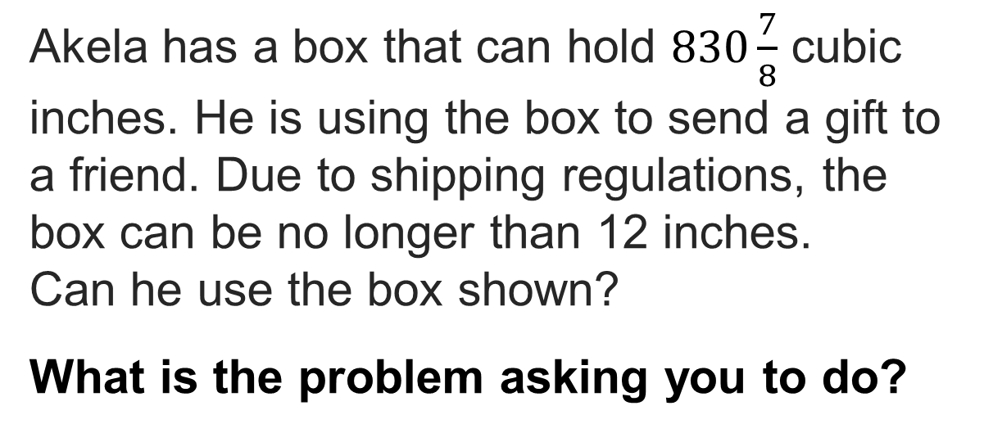
The Right Shipping Box
SELF-CHECK · Mark it: ✓ got it · ~ almost · ? stuck. Then fix one thing before we move on.
Reveal:
We need to find the missing length and determine if it is 12 inches or shorter.
35 / 51
Notes:
TEACH IN PRACTICE | Embedded facilitation | Lesson 5.5, slide 33 | REVEAL
Focus on the existing task: Reveal: We need to find the missing length and determine if it is 12 inches or shorter. The Right Shipping Box
LAUNCH (T2/3/5): If an existing answer cover is present, gather an attempt before revealing. If the explanation is already visible, ask students to reconstruct and justify it. Compare reasoning and explain a revision; preserve the reveal sequence.
LOOK FOR (T4): Where this task addresses it, students can recover a missing dimension. Ask which feature of their work supports the claim.
RESPOND: If this task shows the lesson misconception—confusing square and cubic units or assuming fractional edges cannot have volume—label edge units and one layer of the original prism before connecting it to the formula. Have the student revise and explain the change. Use this support only where the concept occurs in the current task; otherwise respond to the displayed question.
RECHECK: If a gap is shared, revisit the existing representation together. If it is limited, give targeted support while others compare valid methods on the same task. Check the revision before moving on.
PARTICIPATION (T5/6/7): Think time before volunteers; accept a written, drawn or rehearsed entry. Students ask for evidence respectfully. Recognize a specific contribution or revision and check that both partners participate.
Source: BCPS Updated Instructional Framework Rubric (June 2020), TEACH 1–7. Earlier notes and answer keys are retained below.
EARLIER NOTES / EXISTING ANSWER KEY
Do not click yet: collect 2–3 student answers with reasons first.
Then click to remove the cover and have students compare their thinking to the reveal — “Is this what we said? Where is it different?”
Behind the cover: We need to find the missing length and determine if it is 12 inches or shorter.
UIFR: TEACH 3 · TEACH 4.

Slide 36
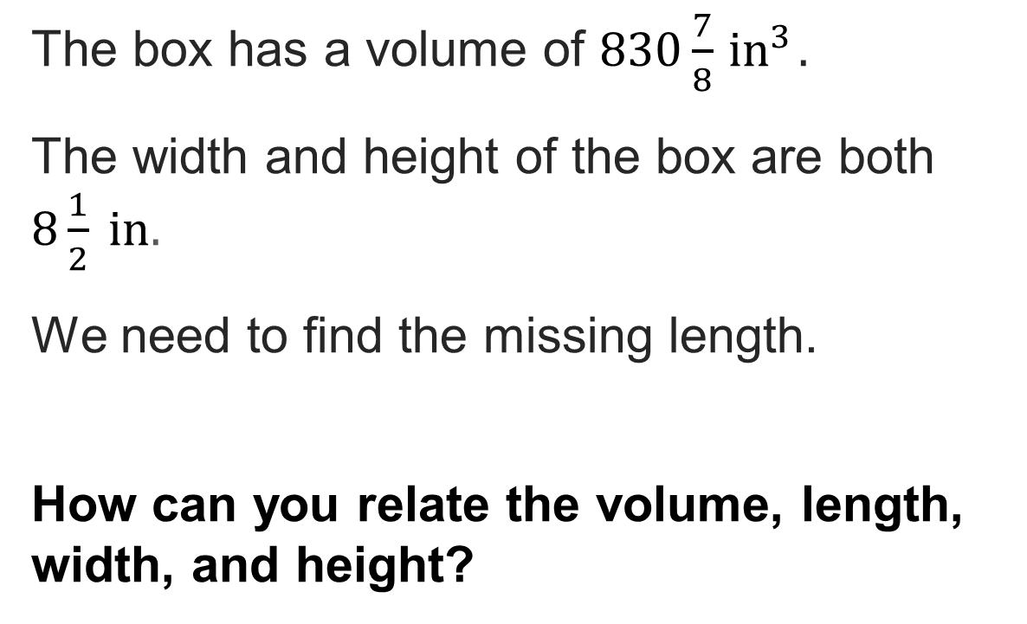
The Right Shipping Box
Reveal:
We can use the formula for the volume of a rectangular prism.
36 / 51
Notes:
TEACH IN PRACTICE | Embedded facilitation | Lesson 5.5, slide 34 | REVEAL
Focus on the existing task: Reveal: We can use the formula for the volume of a rectangular prism. The Right Shipping Box
LAUNCH (T2/3/5): If an existing answer cover is present, gather an attempt before revealing. If the explanation is already visible, ask students to reconstruct and justify it. Compare reasoning and explain a revision; preserve the reveal sequence.
LOOK FOR (T4): Where this task addresses it, students can connect unit-cube layers to volume. Ask which feature of their work supports the claim.
RESPOND: If this task shows the lesson misconception—confusing square and cubic units or assuming fractional edges cannot have volume—label edge units and one layer of the original prism before connecting it to the formula. Have the student revise and explain the change. Use this support only where the concept occurs in the current task; otherwise respond to the displayed question.
RECHECK: If a gap is shared, revisit the existing representation together. If it is limited, give targeted support while others compare valid methods on the same task. Check the revision before moving on.
PARTICIPATION (T5/6/7): Think time before volunteers; accept a written, drawn or rehearsed entry. Students ask for evidence respectfully. Recognize a specific contribution or revision and check that both partners participate.
Source: BCPS Updated Instructional Framework Rubric (June 2020), TEACH 1–7. Earlier notes and answer keys are retained below.
EARLIER NOTES / EXISTING ANSWER KEY
Do not click yet: collect 2–3 student answers with reasons first.
Then click to remove the cover and have students compare their thinking to the reveal — “Is this what we said? Where is it different?”
Behind the cover: We can use the formula for the volume of a rectangular prism.
UIFR: TEACH 3 · TEACH 4.

Slide 37
STUDENT MOVES
Lesson 5-5
Your move
RESTATE FIRST · Restate your partner’s idea in your own words before you give yours.
37 / 51

Slide 38

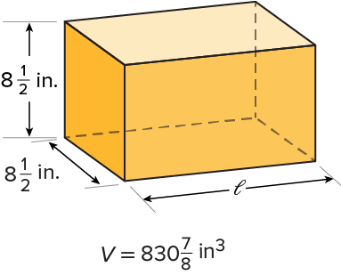

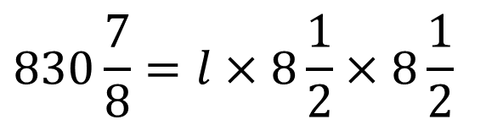
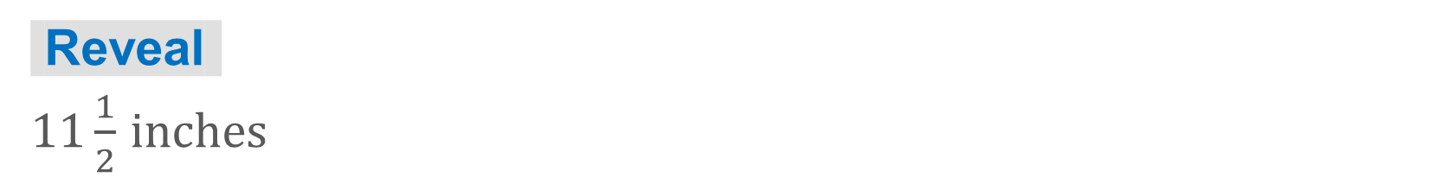
COLLABORATE · TALK IT THROUGH • AGREE ON A MODEL
Collaborate and Connect
Use a formula for volume to relate the volume and dimensions.
TAKE TURNS · One explains, one asks a question. Then switch, so both of you talk.
What is the length of the box?
38 / 51
Notes:
TEACH IN PRACTICE | Embedded facilitation | Lesson 5.5, slide 35 | COLLABORATE
Focus on the existing task: Use a formula for volume to relate the volume and dimensions. What is the length of the box?
LAUNCH (T2/3/5): Use the displayed question. Give private thinking time; then A explains while B asks for evidence. Switch roles. Each student records their own reasoning.
LOOK FOR (T4): Where this task addresses it, students can connect unit-cube layers to volume. Ask which feature of their work supports the claim.
RESPOND: If this task shows the lesson misconception—confusing square and cubic units or assuming fractional edges cannot have volume—label edge units and one layer of the original prism before connecting it to the formula. Have the student revise and explain the change. Use this support only where the concept occurs in the current task; otherwise respond to the displayed question.
RECHECK: If a gap is shared, revisit the existing representation together. If it is limited, give targeted support while others compare valid methods on the same task. Check the revision before moving on.
PARTICIPATION (T5/6/7): Think time before volunteers; accept a written, drawn or rehearsed entry. Students ask for evidence respectfully. Recognize a specific contribution or revision and check that both partners participate.
Source: BCPS Updated Instructional Framework Rubric (June 2020), TEACH 1–7. Earlier notes and answer keys are retained below.
EARLIER NOTES / EXISTING ANSWER KEY
Routine: COLLABORATE · TALK IT THROUGH • AGREE ON A MODEL

Slide 39
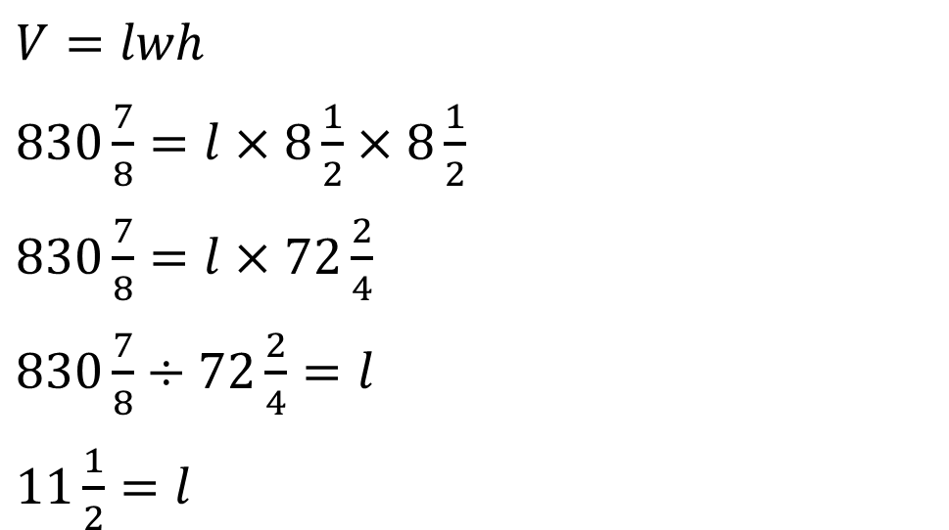

The Right Shipping Box
Divide the volume by the product of the width and height.
Think About It:
STRUGGLE FIRST · Work on your own first. Stuck is allowed — try a second strategy before you ask.
39 / 51
Notes:
TEACH IN PRACTICE | Embedded facilitation | Lesson 5.5, slide 36 | WORKED
Focus on the existing task: Think About It: Divide the volume by the product of the width and height. The Right Shipping Box
LAUNCH (T2/3/5): Ask students to explain the displayed idea or example and point to evidence. When a calculation step is shown, ask why it is valid. Have a partner restate the explanation; copying is not the check.
LOOK FOR (T4): Where this task addresses it, students can connect unit-cube layers to volume. Ask which feature of their work supports the claim.
RESPOND: If this task shows the lesson misconception—confusing square and cubic units or assuming fractional edges cannot have volume—label edge units and one layer of the original prism before connecting it to the formula. Have the student revise and explain the change. Use this support only where the concept occurs in the current task; otherwise respond to the displayed question.
RECHECK: If a gap is shared, revisit the existing representation together. If it is limited, give targeted support while others compare valid methods on the same task. Check the revision before moving on.
PARTICIPATION (T5/6/7): Think time before volunteers; accept a written, drawn or rehearsed entry. Students ask for evidence respectfully. Recognize a specific contribution or revision and check that both partners participate.
Source: BCPS Updated Instructional Framework Rubric (June 2020), TEACH 1–7. Earlier notes and answer keys are retained below.
EARLIER NOTES / EXISTING ANSWER KEY
Ask the question, then hold the silence — students think or jot before anyone answers.
Take two or three responses and press with “Why?” or “How do you know?” before moving on.
UIFR: TEACH 3.

Slide 40
The Right Shipping Box
Divide the volume by the product of the width and height.
Think About It:
When multiplying or dividing with fractions, why is it sometimes better to simplify the product or quotient?
40 / 51
Notes:
TEACH IN PRACTICE | Embedded facilitation | Lesson 5.5, slide 37 | TASK
Focus on the existing task: Think About It: When multiplying or dividing with fractions, why is it sometimes better to simplify the product or quotient?
LAUNCH (T2/3/5): Use the displayed question. Give private thinking time; then A explains while B asks for evidence. Switch roles. Each student records their own reasoning.
LOOK FOR (T4): Where this task addresses it, students can connect unit-cube layers to volume. Ask which feature of their work supports the claim.
RESPOND: If this task shows the lesson misconception—confusing square and cubic units or assuming fractional edges cannot have volume—label edge units and one layer of the original prism before connecting it to the formula. Have the student revise and explain the change. Use this support only where the concept occurs in the current task; otherwise respond to the displayed question.
RECHECK: If a gap is shared, revisit the existing representation together. If it is limited, give targeted support while others compare valid methods on the same task. Check the revision before moving on.
PARTICIPATION (T5/6/7): Think time before volunteers; accept a written, drawn or rehearsed entry. Students ask for evidence respectfully. Recognize a specific contribution or revision and check that both partners participate.
Source: BCPS Updated Instructional Framework Rubric (June 2020), TEACH 1–7. Earlier notes and answer keys are retained below.
EARLIER NOTES / EXISTING ANSWER KEY
Ask the question, then hold the silence — students think or jot before anyone answers.
Take two or three responses and press with “Why?” or “How do you know?” before moving on.
UIFR: TEACH 3.

Slide 41
STUDENT MOVES
Lesson 5-5
Your move
SPECIFIC FEEDBACK · Trade work. Give one specific comment: “This part is clear because ______.”
41 / 51

Slide 42
The Right Shipping Box
Due to shipping regulations, the box can be no longer than 12 inches.
How does the length of the box compare to the shipping regulations?
JUSTIFY IT · Say it like this: “I know ______ because ______.”
Reveal:
The length of the box is shorter than the length set by the shipping regulations.​
42 / 51
Notes:
TEACH IN PRACTICE | Embedded facilitation | Lesson 5.5, slide 38 | REVEAL
Focus on the existing task: Due to shipping regulations, the box can be no longer than 12 inches. How does the length of the box compare to the shipping regulations?
LAUNCH (T2/3/5): If an existing answer cover is present, gather an attempt before revealing. If the explanation is already visible, ask students to reconstruct and justify it. Compare reasoning and explain a revision; preserve the reveal sequence.
LOOK FOR (T4): Where this task addresses it, students can connect unit-cube layers to volume. Ask which feature of their work supports the claim.
RESPOND: If this task shows the lesson misconception—confusing square and cubic units or assuming fractional edges cannot have volume—label edge units and one layer of the original prism before connecting it to the formula. Have the student revise and explain the change. Use this support only where the concept occurs in the current task; otherwise respond to the displayed question.
RECHECK: If a gap is shared, revisit the existing representation together. If it is limited, give targeted support while others compare valid methods on the same task. Check the revision before moving on.
PARTICIPATION (T5/6/7): Think time before volunteers; accept a written, drawn or rehearsed entry. Students ask for evidence respectfully. Recognize a specific contribution or revision and check that both partners participate.
Source: BCPS Updated Instructional Framework Rubric (June 2020), TEACH 1–7. Earlier notes and answer keys are retained below.
EARLIER NOTES / EXISTING ANSWER KEY
Do not click yet: collect 2–3 student answers with reasons first.
Then click to remove the cover and have students compare their thinking to the reveal — “Is this what we said? Where is it different?”
Behind the cover: The length of the box is shorter than the length set by the shipping regulations.​
UIFR: TEACH 3 · TEACH 4.

Slide 43
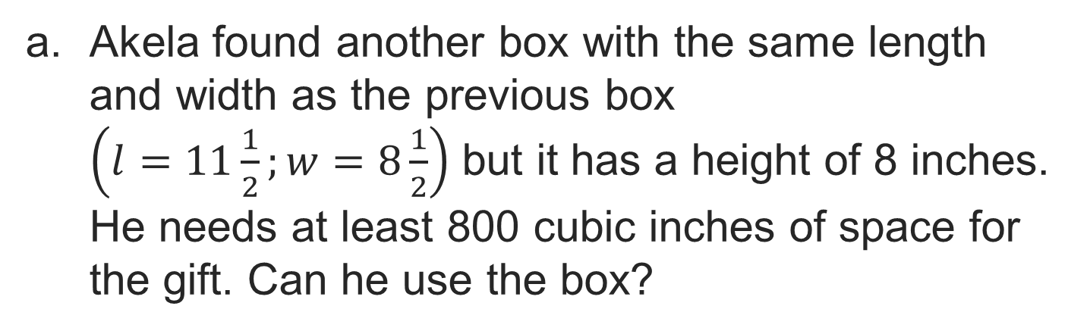
Let’s Explore More
Workspace
43 / 51
Notes:
TEACH IN PRACTICE | Embedded facilitation | Lesson 5.5, slide 39 | PRACTICE
Focus on the existing task: Workspace Let’s Explore More
LAUNCH (T2/3/5): Use the displayed question. Give private thinking time; then A explains while B asks for evidence. Switch roles. Each student records their own reasoning.
LOOK FOR (T4): Where this task addresses it, students can connect unit-cube layers to volume. Ask which feature of their work supports the claim.
RESPOND: If this task shows the lesson misconception—confusing square and cubic units or assuming fractional edges cannot have volume—label edge units and one layer of the original prism before connecting it to the formula. Have the student revise and explain the change. Use this support only where the concept occurs in the current task; otherwise respond to the displayed question.
RECHECK: If a gap is shared, revisit the existing representation together. If it is limited, give targeted support while others compare valid methods on the same task. Check the revision before moving on.
PARTICIPATION (T5/6/7): Think time before volunteers; accept a written, drawn or rehearsed entry. Students ask for evidence respectfully. Recognize a specific contribution or revision and check that both partners participate.
Source: BCPS Updated Instructional Framework Rubric (June 2020), TEACH 1–7. Earlier notes and answer keys are retained below.
EARLIER NOTES / EXISTING ANSWER KEY
Extension for partners or table groups — students choose their approach and use the workspace to show thinking.
Push with “Convince me,” and have two groups with different approaches share.
This is where students stretch past the worked example.
UIFR: TEACH 2 · TEACH 5.

Slide 44
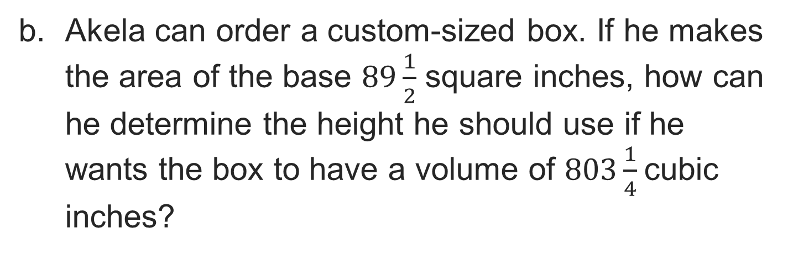
Let’s Explore More
Workspace
44 / 51
Notes:
TEACH IN PRACTICE | Embedded facilitation | Lesson 5.5, slide 40 | PRACTICE
Focus on the existing task: Workspace Let’s Explore More
LAUNCH (T2/3/5): Use the displayed question. Give private thinking time; then A explains while B asks for evidence. Switch roles. Each student records their own reasoning.
LOOK FOR (T4): Where this task addresses it, students can connect unit-cube layers to volume. Ask which feature of their work supports the claim.
RESPOND: If this task shows the lesson misconception—confusing square and cubic units or assuming fractional edges cannot have volume—label edge units and one layer of the original prism before connecting it to the formula. Have the student revise and explain the change. Use this support only where the concept occurs in the current task; otherwise respond to the displayed question.
RECHECK: If a gap is shared, revisit the existing representation together. If it is limited, give targeted support while others compare valid methods on the same task. Check the revision before moving on.
PARTICIPATION (T5/6/7): Think time before volunteers; accept a written, drawn or rehearsed entry. Students ask for evidence respectfully. Recognize a specific contribution or revision and check that both partners participate.
Source: BCPS Updated Instructional Framework Rubric (June 2020), TEACH 1–7. Earlier notes and answer keys are retained below.
EARLIER NOTES / EXISTING ANSWER KEY
Extension for partners or table groups — students choose their approach and use the workspace to show thinking.
Push with “Convince me,” and have two groups with different approaches share.
This is where students stretch past the worked example.
UIFR: TEACH 2 · TEACH 5.

Slide 45
STUDENT MOVES
Lesson 5-5
Your moves
TWO MINUTES SOLO · Two minutes on your own, then compare. Bring one thing you tried, even if it did not work.
YOUR CHOICE · You choose how to show this — numbers, words, or a diagram. Make your reasoning visible.
45 / 51

Slide 46
LESSON 5.5 / CHECK YOUR WORK
Pause. Check. Improve.
CHECK
A mistake to watch for: confusing square and cubic units or assuming fractional edges cannot have volume.
TRY
Label edge units and one layer of the given prism before connecting it to the formula.
REVISE
Use that check on the task you just completed. Correct or strengthen one part, and explain why.
REVISE NOW · Change one answer and write why you changed it. A revision is evidence of learning.
Listen to understand. Ask for evidence. Make room for every voice.
Notes:
TEACH IN PRACTICE | Embedded facilitation | Lesson 5.5, slide 41 | PRIOR_INSERT
Focus on the existing task: LESSON 5.5 / CHECK YOUR WORK Pause. Check. Improve. Listen to understand. Ask for evidence. Make room for every voice. CHECK A mistake…
CONNECT (T1/4): Ask students to restate the displayed goal or key idea and connect it to earlier work. Relevant lesson evidence: connect unit-cube layers to volume; use fractional edges when present; recover a missing dimension. Use only the criterion that matches the current session.
SHOW PROGRESS: Students point to their own existing work, explain what improved after feedback, and name a next step. Pair confidence ratings with actual evidence.
PARTICIPATION (T5/6/7): Think time before volunteers; accept a written, drawn or rehearsed entry. Students ask for evidence respectfully. Recognize a specific contribution or revision and check that both partners participate.
Source: BCPS Updated Instructional Framework Rubric (June 2020), TEACH 1–7.

Slide 47
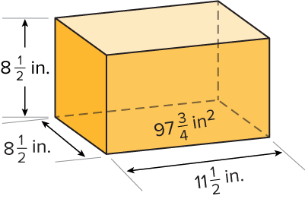


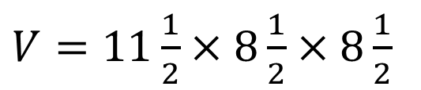
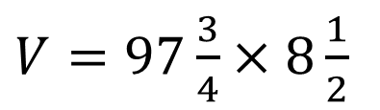
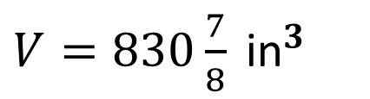
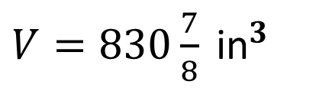
SUMMARIZE · SAY IT IN YOUR OWN WORDS
Summarize: Volume of Rectangular Prisms with Fractional Edge Lengths
You can use the volume formulas you know to determine the volume of rectangular prisms with fractional edge lengths. Volume formulas can be used to find missing dimensions.
47 / 51
Notes:
TEACH IN PRACTICE | Embedded facilitation | Lesson 5.5, slide 42 | SUMMARIZE
Focus on the existing task: You can use the volume formulas you know to determine the volume of rectangular prisms with fractional edge lengths. Volume formulas can…
CONNECT (T1/4): Ask students to restate the displayed goal or key idea and connect it to earlier work. Relevant lesson evidence: connect unit-cube layers to volume; use fractional edges when present; recover a missing dimension. Use only the criterion that matches the current session.
SHOW PROGRESS: Students point to their own existing work, explain what improved after feedback, and name a next step. Pair confidence ratings with actual evidence.
PARTICIPATION (T5/6/7): Think time before volunteers; accept a written, drawn or rehearsed entry. Students ask for evidence respectfully. Recognize a specific contribution or revision and check that both partners participate.
Source: BCPS Updated Instructional Framework Rubric (June 2020), TEACH 1–7. Earlier notes and answer keys are retained below.
EARLIER NOTES / EXISTING ANSWER KEY
Routine: SUMMARIZE · SAY IT IN YOUR OWN WORDS

Slide 48
STUDENT MOVES
Lesson 5-5
Your move
PICK YOUR STRATEGY · Choose your path — picture, table, number line, or equation — and be ready to say why you chose it.
48 / 51

Slide 49
APPLY · PLAN IT • SOLVE IT • PROVE IT
Apply: Buying Popcorn
You go to movie theater with your family. Your family likes to buy popcorn to snack on during the movie. The theater sells three different-sized boxes of popcorn.
Question: Which size and how many boxes would you buy? Explain.
Boxes of Popcorn
Size | Length (in.) | Width (in.) | Height (in.) | Price ($)
Small |  | 4 |  | 4.50
Medium |  | 5 |  | 5.75
Large |  | 6 |  | 7.00
Choose a method. Solve
independently, justify your
answer, then check the goal.
49 / 51
Notes:
TEACH IN PRACTICE | Embedded facilitation | Lesson 5.5, slide 43 | APPLY
Focus on the existing task: You go to movie theater with your family. Your family likes to buy popcorn to snack on during the movie. The theater sells three…
LAUNCH (T2/3/5): Use the exact application task independently first. Ask students to justify their choice of method. Collect evidence before a partner discussion or correction.
LOOK FOR (T4): Where this task addresses it, students can connect unit-cube layers to volume. Ask which feature of their work supports the claim.
RESPOND: If this task shows the lesson misconception—confusing square and cubic units or assuming fractional edges cannot have volume—label edge units and one layer of the original prism before connecting it to the formula. Have the student revise and explain the change. Use this support only where the concept occurs in the current task; otherwise respond to the displayed question.
RECHECK: If a gap is shared, revisit the existing representation together. If it is limited, give targeted support while others compare valid methods on the same task. Check the revision before moving on.
PARTICIPATION (T5/6/7): Think time before volunteers; accept a written, drawn or rehearsed entry. Students ask for evidence respectfully. Recognize a specific contribution or revision and check that both partners participate.
Source: BCPS Updated Instructional Framework Rubric (June 2020), TEACH 1–7. Earlier notes and answer keys are retained below.
EARLIER NOTES / EXISTING ANSWER KEY
Routine: APPLY · PLAN IT • SOLVE IT • PROVE IT
UIFR FULL | Lesson-specific facilitation
TEACH 4 | Independent evidence and revision (UIFR PDF p. 11).
Use the existing application/exit problem as the independent check. If this is a learning-target slide, have students point to and explain their work on the preceding task. Separate initial independent evidence from the revision after feedback.
Check the relevant criteria: connect unit-cube layers to volume; use fractional edges when present; recover a missing dimension. Respond with one specific next step tied to the work. Students revise and annotate what changed, then identify a criterion they can now demonstrate and one they still need to practice.

Slide 50
Learning Targets
I can find the volume of rectangular prisms by filling them with unit cubes.
I can find the volume of a rectangular prism by using a formula.
I can attend to precision to find an unknown dimension of a rectangular prism by using the volume formula.
NAME THE MATH · Point to the part of this that is new today, and say what it changes.
50 / 51
Notes:
TEACH IN PRACTICE | Embedded facilitation | Lesson 5.5, slide 44 | REFLECTION
Focus on the existing task: Learning Targets I can find the volume of rectangular prisms by filling them with unit cubes. I can find the volume of a rectangular prism…
CONNECT (T1/4): Ask students to restate the displayed goal or key idea and connect it to earlier work. Relevant lesson evidence: connect unit-cube layers to volume; use fractional edges when present; recover a missing dimension. Use only the criterion that matches the current session.
SHOW PROGRESS: Students point to their own existing work, explain what improved after feedback, and name a next step. Pair confidence ratings with actual evidence.
PARTICIPATION (T5/6/7): Think time before volunteers; accept a written, drawn or rehearsed entry. Students ask for evidence respectfully. Recognize a specific contribution or revision and check that both partners participate.
Source: BCPS Updated Instructional Framework Rubric (June 2020), TEACH 1–7. Earlier notes and answer keys are retained below.
EARLIER NOTES / EXISTING ANSWER KEY
UIFR FULL | Lesson-specific facilitation
REFLECT & ADJUST 1-2 | After the lesson (UIFR PDF pp. 15-16).
Sort the existing work by demonstrated reasoning, partial understanding, and the specific misconception: confusing square and cubic units or assuming fractional edges cannot have volume. Compare the initial response with the revision. Record which teaching move plausibly helped, which did not, and whose participation or access needs a different approach; do not record sensitive student details in this shared deck.
Plan the next lesson from that evidence: if the misconception persists, label edge units and one layer of the original prism before connecting it to the formula using the current example before returning to the next grade-level task; if understanding is secure, use an existing extension or ask for a general explanation. Check the targeted idea again at the next warm-up.
Ask students what supported their thinking and what would help next time. Identify one change to try and one successful practice to retain. Seek colleague feedback on anonymized work when useful; these prompts support reflection and do not establish an evaluation rating. Source: Baltimore City Public Schools, Updated Instructional Framework Rubric, June 2020 (UIFR_Full.pdf).

Slide 51
LESSON 5.5 / REFLECT ON YOUR LEARNING
Show your progress
1 SHOW EVIDENCE
2 CHOOSE A NEXT STEP
Choose one response. Point to the part that shows your reasoning.
Name a change you made after feedback—or a question you still have.
“My work shows ___ because ___.”
“Next time, I will ___ to help me ___.”
Today’s focus: Connect unit-cube layers to volume.
CREDIT A CLASSMATE · Name one classmate whose idea helped you today, and say what they said.
Listen to understand. Ask for evidence. Make room for every voice.
Notes:
TEACH IN PRACTICE | Embedded facilitation | Lesson 5.5, slide 45 | PRIOR_INSERT
Focus on the existing task: LESSON 5.5 / REFLECT ON YOUR LEARNING Show your progress Listen to understand. Ask for evidence. Make room for every voice. 1 SHOW…
CONNECT (T1/4): Ask students to restate the displayed goal or key idea and connect it to earlier work. Relevant lesson evidence: connect unit-cube layers to volume; use fractional edges when present; recover a missing dimension. Use only the criterion that matches the current session.
SHOW PROGRESS: Students point to their own existing work, explain what improved after feedback, and name a next step. Pair confidence ratings with actual evidence.
PARTICIPATION (T5/6/7): Think time before volunteers; accept a written, drawn or rehearsed entry. Students ask for evidence respectfully. Recognize a specific contribution or revision and check that both partners participate.
Source: BCPS Updated Instructional Framework Rubric (June 2020), TEACH 1–7.

