Slide 1
WARM-UP · THINK • TRY • CHECK
Turn and talk: compare strategies, then defend one.
Warm-Up
Lesson 5-6 · Represent Three-Dimensional Figures in Two Dimensions | Warm-Up · about 4 minutes
Try each on your own. Mark an unsure answer; explain and revise when we check.
QUESTION 1
QUESTION 2
A rectangular prism has ______ faces, ______ edges, and ______ vertices
A square pyramid has ______ faces in all
QUESTION 3
QUESTION 4
One face of a net is a 7 cm by 3 cm rectangle. Its area = ______
The 6 faces of a rectangular prism form ______ matching pairs
TALK IT OVER: “I got ______ because ______.” • Compare with a partner before we check as a class.
1 / 62
Notes:
TEACH IN PRACTICE | Embedded facilitation | Lesson 5.6, slide 1 | WARMUP
Focus on the existing task: Warm-Up WARM-UP · THINK • TRY •…
GATHER EVIDENCE (T4/6): Keep the original items. Students try independently, mark an uncertain item, and explain one method before checking. Use the existing key when present.
RESPOND: Distinguish a calculation slip from a reasoning gap. Give one next step on the same item; have students revise in a second color. Use the responses to choose flexible support for today’s lesson.
PARTICIPATION (T5/6/7): Think time before volunteers; accept a written, drawn or rehearsed entry. Students ask for evidence respectfully. Recognize a specific contribution or revision and check that both partners participate.
Source: BCPS Updated Instructional Framework Rubric (June 2020), TEACH 1–7. Earlier notes and answer keys are retained below.
EARLIER NOTES / EXISTING ANSWER KEY
Warm-Up answers (teacher only): 1) 6 faces, 12 edges, 8 vertices 2) 5 3) 21 square centimeters 4) 3
UIFR FULL | Lesson-specific facilitation
PREPARE 1-2 | Before teaching (UIFR PDF pp. 6-7).
Plan to gather evidence that students can match each face of the solid to a net; justify how the net folds; distinguish edges from faces. Review recent work and today’s warm-up to choose flexible groups and access supports; do not infer needs from identity or perceived ability. Use the existing lesson tasks and stated standards.
Anticipate: accepting a net whose faces overlap or leave an opening. If observed, use a paper trace of the existing net and mark corresponding edges. Offer oral rehearsal, drawing, pointing, or home-language processing as needed; retain the original mathematical demand. Ask students which support helps and fade it as evidence improves.
TEACH 6-7 | Before the first transition, agree on materials, partner roles, and how to request help. Invite students to restate the routine. Normalize revising an idea, recognize a specific contribution, and check privately when frustration blocks participation. Source: UIFR PDF pp. 13-14.

Slide 2
Today’s Math Notes
Lesson 5-6 · Represent Three-Dimensional Figures in Two Dimensions
Section 1: Math Words
Copy. Explain. Check.
SAY THE GOAL · Say today’s goal in your own words, then name one place this shows up outside math class.
Surface Area Using Nets
1
The total area of all the faces of a solid
Surface area
2
The total area of all the flat sides of a solid
Net
3
A flat shape that folds up into a solid
eduwonderlab.com · Neft Teacher
2 / 62
Notes:
TEACH IN PRACTICE | Embedded facilitation | Lesson 5.6, slide 2 | NOTES
Focus on the existing task: Today’s Math Notes Section 1: Math…
ROUTINE (T1/2/4): Read or copy the original notes, cover one line, and explain it using the displayed example. Reopen and correct. Copying alone is not evidence of understanding.
LOOK FOR: A link between a symbol, quantity or feature and the explanation. If missing, point back to that feature and have the student try again; fade the prompt once they can explain.
PARTICIPATION (T5/6/7): Think time before volunteers; accept a written, drawn or rehearsed entry. Students ask for evidence respectfully. Recognize a specific contribution or revision and check that both partners participate.
Source: BCPS Updated Instructional Framework Rubric (June 2020), TEACH 1–7. Earlier notes and answer keys are retained below.
EARLIER NOTES / EXISTING ANSWER KEY
Copy routine: read one line at a time; students copy, then explain that line to a partner.
Keep it brisk — the understanding work happens in the examples, not the copying.
UIFR: TEACH 1 · TEACH 6.

Slide 3
Today’s Math Notes
Lesson 5-6 · Represent Three-Dimensional Figures in Two Dimensions
Section 2: Today’s Math
Copy. Explain. Check.
Representing 3D Solids with Nets
A net is a 2D flat pattern that folds into a 3D solid without overlapping
1
Rectangular prism net has 6 rectangular faces in 3 congruent opposite pairs
2
CONNECT IT · What earlier lesson does this build on? Tell a partner in one sentence.
Surface Area is the total sum of the areas of all flat faces on the net
3
eduwonderlab.com · Neft Teacher
3 / 62
Notes:
TEACH IN PRACTICE | Embedded facilitation | Lesson 5.6, slide 3 | NOTES
Focus on the existing task: Today’s Math Notes Section 2: Today’s…
ROUTINE (T1/2/4): Read or copy the original notes, cover one line, and explain it using the displayed example. Reopen and correct. Copying alone is not evidence of understanding.
LOOK FOR: A link between a symbol, quantity or feature and the explanation. If missing, point back to that feature and have the student try again; fade the prompt once they can explain.
PARTICIPATION (T5/6/7): Think time before volunteers; accept a written, drawn or rehearsed entry. Students ask for evidence respectfully. Recognize a specific contribution or revision and check that both partners participate.
Source: BCPS Updated Instructional Framework Rubric (June 2020), TEACH 1–7. Earlier notes and answer keys are retained below.
EARLIER NOTES / EXISTING ANSWER KEY
Copy routine: read one line at a time; students copy, then explain that line to a partner.
Keep it brisk — the understanding work happens in the examples, not the copying.
UIFR: TEACH 1 · TEACH 6.

Slide 4
Session 1
Represent Three-Dimensional Figures in
Two Dimensions
PICK YOUR STRATEGY · Choose your path — picture, table, number line, or equation — and be ready to say why you chose it.
4 / 62
Notes:
TEACH IN PRACTICE | Embedded facilitation | Lesson 5.6, slide 4 | DIVIDER
Focus on the existing task: Represent Three-Dimensional Figures in Two Dimensions Session 1
TRANSITION (T6/7): Students confirm materials, roles, how to request help, and the next response routine. Ask a student to restate it. Keep teacher-only slides hidden.
PARTICIPATION (T5/6/7): Think time before volunteers; accept a written, drawn or rehearsed entry. Students ask for evidence respectfully. Recognize a specific contribution or revision and check that both partners participate.
Source: BCPS Updated Instructional Framework Rubric (June 2020), TEACH 1–7. Earlier notes and answer keys are retained below.
EARLIER NOTES / EXISTING ANSWER KEY
Transition cue: state what materials are out and what success looks like this session.
Keep the changeover under a minute.
UIFR: TEACH 6.

Slide 5
This or That
Would you rather have THIS or THAT coins?
This | That
Think and record first. Which part of your work supports your answer?
5 / 62
Notes:
TEACH IN PRACTICE | Embedded facilitation | Lesson 5.6, slide 5 | TASK
Focus on the existing task: This or That Would you rather have THIS or THAT coins?
LAUNCH (T2/3/5): Use the displayed question. Give private thinking time; then A explains while B asks for evidence. Switch roles. Each student records their own reasoning.
LOOK FOR (T4): Where this task addresses it, students can match each face of the solid to a net. Ask which feature of their work supports the claim.
RESPOND: If this task shows the lesson misconception—accepting a net whose faces overlap or leave an opening—use a paper trace of the existing net and mark corresponding edges. Have the student revise and explain the change. Use this support only where the concept occurs in the current task; otherwise respond to the displayed question.
RECHECK: If a gap is shared, revisit the existing representation together. If it is limited, give targeted support while others compare valid methods on the same task. Check the revision before moving on.
PARTICIPATION (T5/6/7): Think time before volunteers; accept a written, drawn or rehearsed entry. Students ask for evidence respectfully. Recognize a specific contribution or revision and check that both partners participate.
Source: BCPS Updated Instructional Framework Rubric (June 2020), TEACH 1–7. Earlier notes and answer keys are retained below.
EARLIER NOTES / EXISTING ANSWER KEY
Number-sense routine — every voice in. Give quiet think time, then hear from at least three students.
Always follow with “How do you know?” — the reasoning is the point, not the answer.
There is more than one path; name and celebrate different strategies.
UIFR: TEACH 3 · TEACH 5 · TEACH 6.

Slide 6
Today’s Objectives
Lesson 5-6 · Represent Three-Dimensional Figures in Two Dimensions
Represent Three-Dimensional Figures in Two Dimensions
Maryland Standard 6.GR.4
CONTENT OBJECTIVE
LANGUAGE OBJECTIVE
Restate the goal in your words
Use these words to explain why
I can find the surface area of a solid by using its net.
I can explain my work using the words surface area, net, face, and two-dimensional.
eduwonderlab.com · Neft Teacher
6 / 62
Notes:
TEACH IN PRACTICE | Embedded facilitation | Lesson 5.6, slide 6 | GOAL
Focus on the existing task: Today’s Objectives Represent…
CONNECT (T1/4): Ask students to restate the displayed goal or key idea and connect it to earlier work. Relevant lesson evidence: match each face of the solid to a net; justify how the net folds; distinguish edges from faces. Use only the criterion that matches the current session.
SHOW PROGRESS: Students point to their own existing work, explain what improved after feedback, and name a next step. Pair confidence ratings with actual evidence.
PARTICIPATION (T5/6/7): Think time before volunteers; accept a written, drawn or rehearsed entry. Students ask for evidence respectfully. Recognize a specific contribution or revision and check that both partners participate.
Source: BCPS Updated Instructional Framework Rubric (June 2020), TEACH 1–7. Earlier notes and answer keys are retained below.
EARLIER NOTES / EXISTING ANSWER KEY
Read the objective together, then have one or two students restate today’s goal in their own words.
Connect it to what the class learned last lesson.
Return to this goal at the end of class to check it was met.
UIFR: TEACH 1.
UIFR FULL | Lesson-specific facilitation
TEACH 1 | Session 1 purpose and evidence (UIFR PDF p. 8).
Have students restate the displayed session goal in their own words and connect it to the existing context or a familiar experience they choose to share. Use the current session goal to select from these lesson-wide evidence criteria; do not frontload a later-session procedure.
Look for: match each face of the solid to a net; justify how the net folds; distinguish edges from faces. Ask: “Which part of your work would show this?” Revisit that evidence after the task; a confidence rating alone is not evidence of understanding.

Slide 7
STUDENT MOVES
Lesson 5-6
Your move
SAY THE GOAL · Say today’s goal in your own words, then name one place this shows up outside math class.
7 / 62

Slide 8
LESSON 5.6 / OUR LEARNING
What will show your learning?
1
Match each face of the solid to a net.
2
Justify how the net folds.
3
Distinguish edges from faces.
Tell a partner: Which skill connects to something you already know?
SHOW YOUR THINKING · Show what you know — write it, draw it, or build it. A picture counts as an explanation.
Listen to understand. Ask for evidence. Make room for every voice.
Notes:
TEACH IN PRACTICE | Embedded facilitation | Lesson 5.6, slide 7 | PRIOR_INSERT
Focus on the existing task: LESSON 5.6 / OUR LEARNING What will show your learning?
CONNECT (T1/4): Ask students to restate the displayed goal or key idea and connect it to earlier work. Relevant lesson evidence: match each face of the solid to a net; justify how the net folds; distinguish edges from faces. Use only the criterion that matches the current session.
SHOW PROGRESS: Students point to their own existing work, explain what improved after feedback, and name a next step. Pair confidence ratings with actual evidence.
PARTICIPATION (T5/6/7): Think time before volunteers; accept a written, drawn or rehearsed entry. Students ask for evidence respectfully. Recognize a specific contribution or revision and check that both partners participate.
Source: BCPS Updated Instructional Framework Rubric (June 2020), TEACH 1–7.

Slide 9
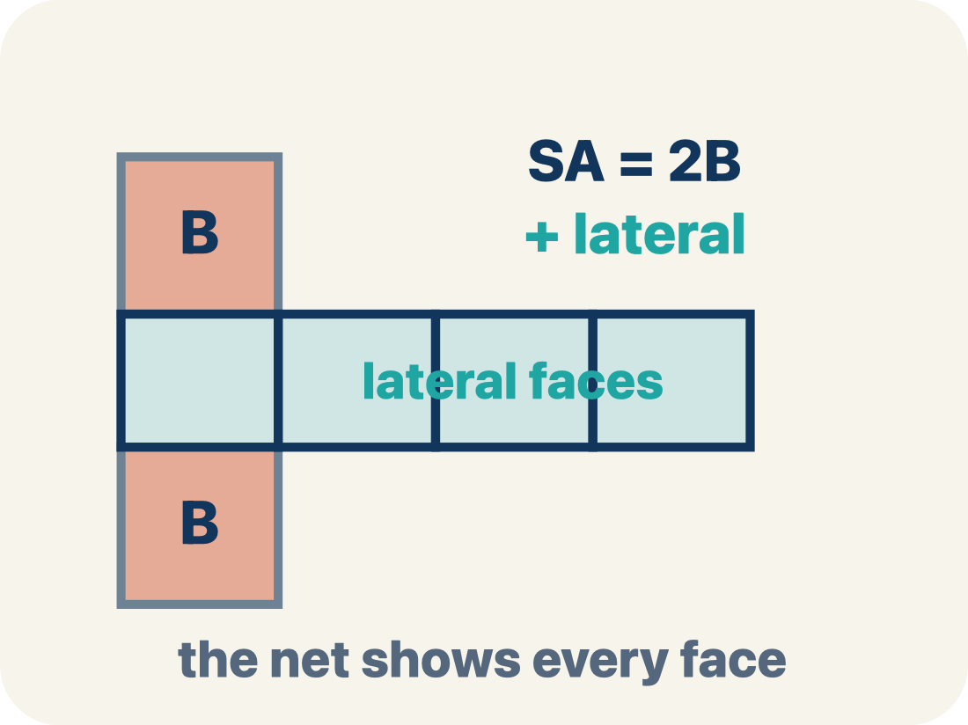
Vocabulary 1 of 6
Lesson 5-6 · Represent Three-Dimensional Figures in Two Dimensions
Surface Area Using Nets
The total area of all the faces of a solid. A net unfolds the solid flat so you can see every face and add their areas.
EXAMPLE · EXPLAIN WHY IT FITS
A box with 6 faces: 2(8×5) + 2(8×3) + 2(5×3) = 158 square units
USE THE MATH WORDS · Use today’s math words in your explanation — not “it” and “that thing.”
eduwonderlab.com · Neft Teacher
9 / 62
Notes:
TEACH IN PRACTICE | Embedded facilitation | Lesson 5.6, slide 8 | VOCAB
Focus on the existing task: Vocabulary 1 of 6 Surface Area Using…
ASK (T1/3/5): Where does “Surface Area Using Nets” appear in the example? Explain the meaning without reading the definition. Partner: restate the idea and ask a clarifying question.
LOOK FOR: A correct connection between the word and a feature of the example. If the student only repeats the definition, invite pointing, sketching or oral rehearsal, then ask for another explanation of this same example.
PARTICIPATION (T5/6/7): Think time before volunteers; accept a written, drawn or rehearsed entry. Students ask for evidence respectfully. Recognize a specific contribution or revision and check that both partners participate.
Source: BCPS Updated Instructional Framework Rubric (June 2020), TEACH 1–7.

Slide 10
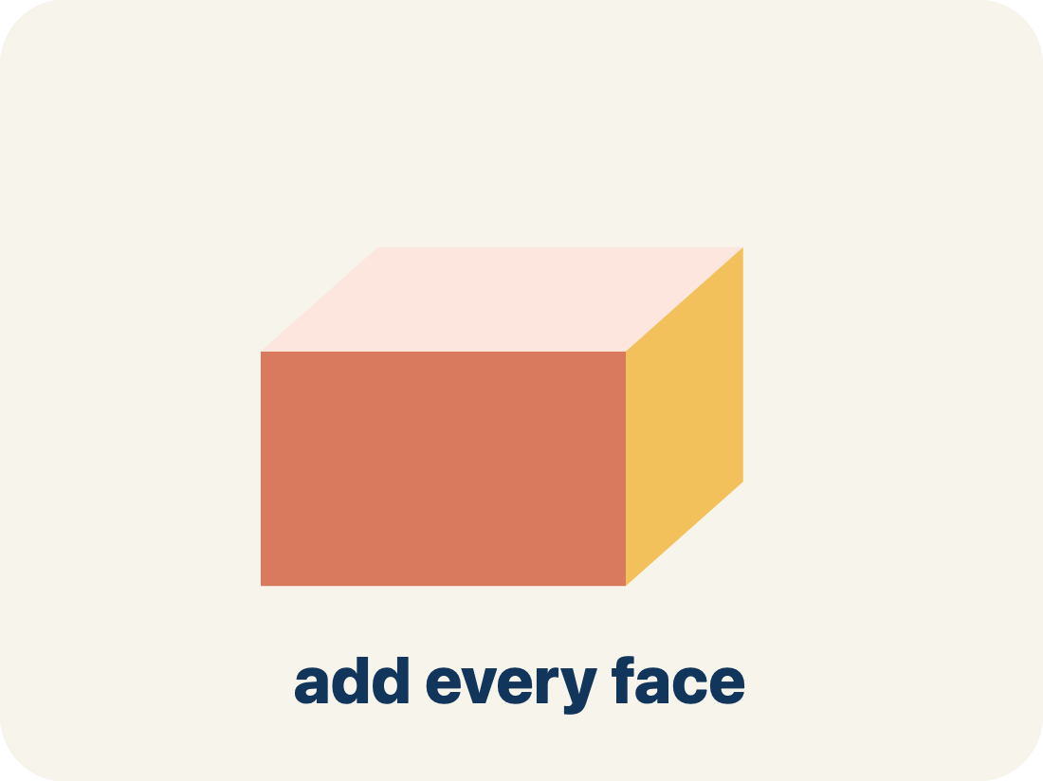
Vocabulary 2 of 6
Lesson 5-6 · Represent Three-Dimensional Figures in Two Dimensions
Surface area
The total area of all the flat sides of a solid.
EXAMPLE · EXPLAIN WHY IT FITS
A box 6 × 4 × 2: SA = 2(24) + 2(12) + 2(8) = 88 in² — like wrapping paper needed
Use “Surface area” to explain the example. Point to
evidence.
eduwonderlab.com · Neft Teacher
10 / 62
Notes:
TEACH IN PRACTICE | Embedded facilitation | Lesson 5.6, slide 9 | VOCAB
Focus on the existing task: Vocabulary 2 of 6 Surface area The…
ASK (T1/3/5): Where does “Surface area” appear in the example? Explain the meaning without reading the definition. Partner: restate the idea and ask a clarifying question.
LOOK FOR: A correct connection between the word and a feature of the example. If the student only repeats the definition, invite pointing, sketching or oral rehearsal, then ask for another explanation of this same example.
PARTICIPATION (T5/6/7): Think time before volunteers; accept a written, drawn or rehearsed entry. Students ask for evidence respectfully. Recognize a specific contribution or revision and check that both partners participate.
Source: BCPS Updated Instructional Framework Rubric (June 2020), TEACH 1–7.

Slide 11
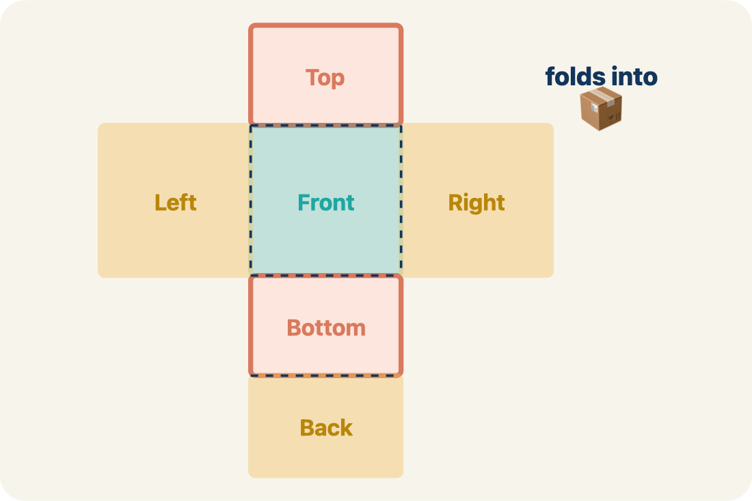
Vocabulary 3 of 6
Lesson 5-6 · Represent Three-Dimensional Figures in Two Dimensions
Net
A flat shape that folds up into a solid.
EXAMPLE · EXPLAIN WHY IT FITS
Cut along the edges of a cereal box and unfold it flat — you see all 6 faces
Use “Net” to explain the example. Point to evidence.
eduwonderlab.com · Neft Teacher
11 / 62
Notes:
TEACH IN PRACTICE | Embedded facilitation | Lesson 5.6, slide 10 | VOCAB
Focus on the existing task: Vocabulary 3 of 6 Net A flat shape…
ASK (T1/3/5): Where does “Net” appear in the example? Explain the meaning without reading the definition. Partner: restate the idea and ask a clarifying question.
LOOK FOR: A correct connection between the word and a feature of the example. If the student only repeats the definition, invite pointing, sketching or oral rehearsal, then ask for another explanation of this same example.
PARTICIPATION (T5/6/7): Think time before volunteers; accept a written, drawn or rehearsed entry. Students ask for evidence respectfully. Recognize a specific contribution or revision and check that both partners participate.
Source: BCPS Updated Instructional Framework Rubric (June 2020), TEACH 1–7.

Slide 12
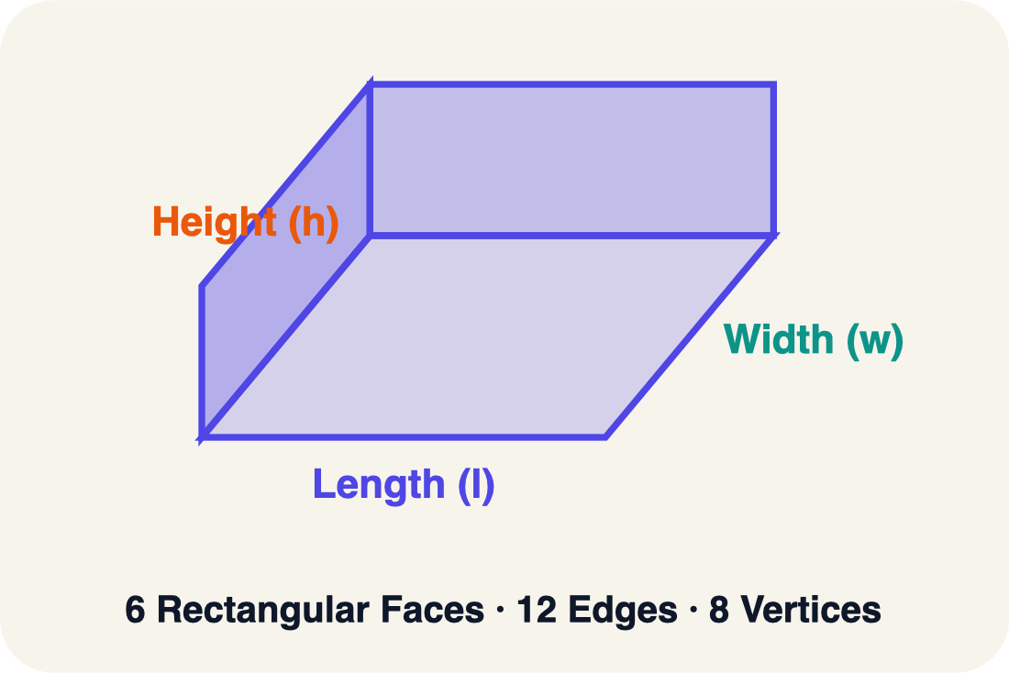
Vocabulary 4 of 6
Lesson 5-6 · Represent Three-Dimensional Figures in Two Dimensions
Face
One flat side of a solid shape.
EXAMPLE · EXPLAIN WHY IT FITS
A rectangular prism has 6 faces: top, bottom, front, back, left, right
Use “Face” to explain the example. Point to evidence.
eduwonderlab.com · Neft Teacher
12 / 62
Notes:
TEACH IN PRACTICE | Embedded facilitation | Lesson 5.6, slide 11 | VOCAB
Focus on the existing task: Vocabulary 4 of 6 Face One flat side…
ASK (T1/3/5): Where does “Face” appear in the example? Explain the meaning without reading the definition. Partner: restate the idea and ask a clarifying question.
LOOK FOR: A correct connection between the word and a feature of the example. If the student only repeats the definition, invite pointing, sketching or oral rehearsal, then ask for another explanation of this same example.
PARTICIPATION (T5/6/7): Think time before volunteers; accept a written, drawn or rehearsed entry. Students ask for evidence respectfully. Recognize a specific contribution or revision and check that both partners participate.
Source: BCPS Updated Instructional Framework Rubric (June 2020), TEACH 1–7.

Slide 13
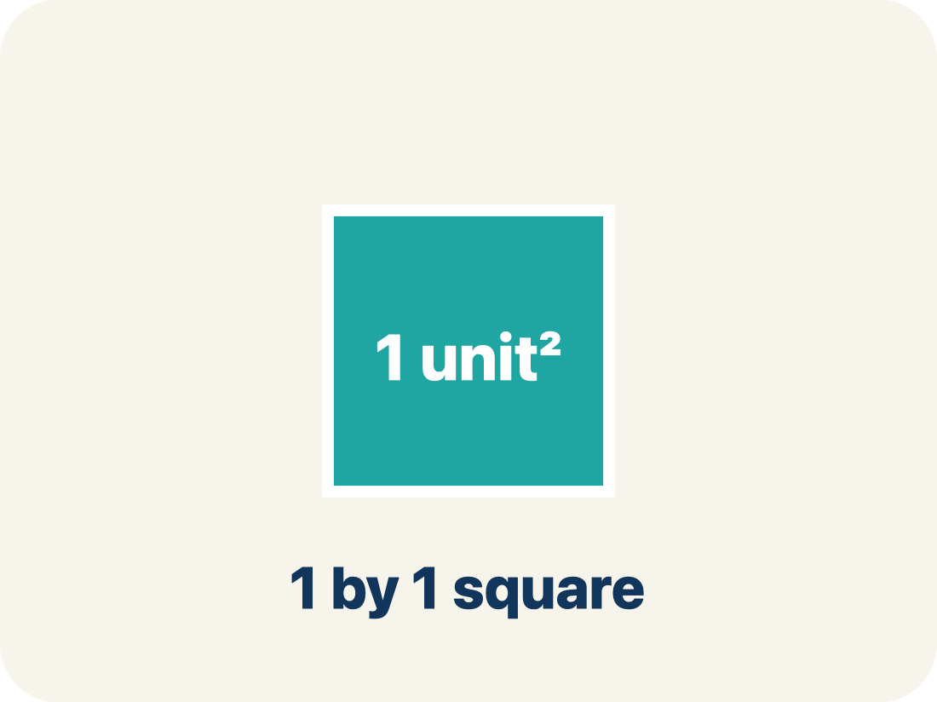
Vocabulary 5 of 6
Lesson 5-6 · Represent Three-Dimensional Figures in Two Dimensions
Two-dimensional
A flat shape with length and width, but no thickness.
EXAMPLE · EXPLAIN WHY IT FITS
A rectangle drawn on paper is 2D — it has length and width but no depth
Use “Two-dimensional” to explain the example. Point to
evidence.
eduwonderlab.com · Neft Teacher
13 / 62
Notes:
TEACH IN PRACTICE | Embedded facilitation | Lesson 5.6, slide 12 | VOCAB
Focus on the existing task: Vocabulary 5 of 6 Two-dimensional A…
ASK (T1/3/5): Where does “Two-dimensional” appear in the example? Explain the meaning without reading the definition. Partner: restate the idea and ask a clarifying question.
LOOK FOR: A correct connection between the word and a feature of the example. If the student only repeats the definition, invite pointing, sketching or oral rehearsal, then ask for another explanation of this same example.
PARTICIPATION (T5/6/7): Think time before volunteers; accept a written, drawn or rehearsed entry. Students ask for evidence respectfully. Recognize a specific contribution or revision and check that both partners participate.
Source: BCPS Updated Instructional Framework Rubric (June 2020), TEACH 1–7.

Slide 14
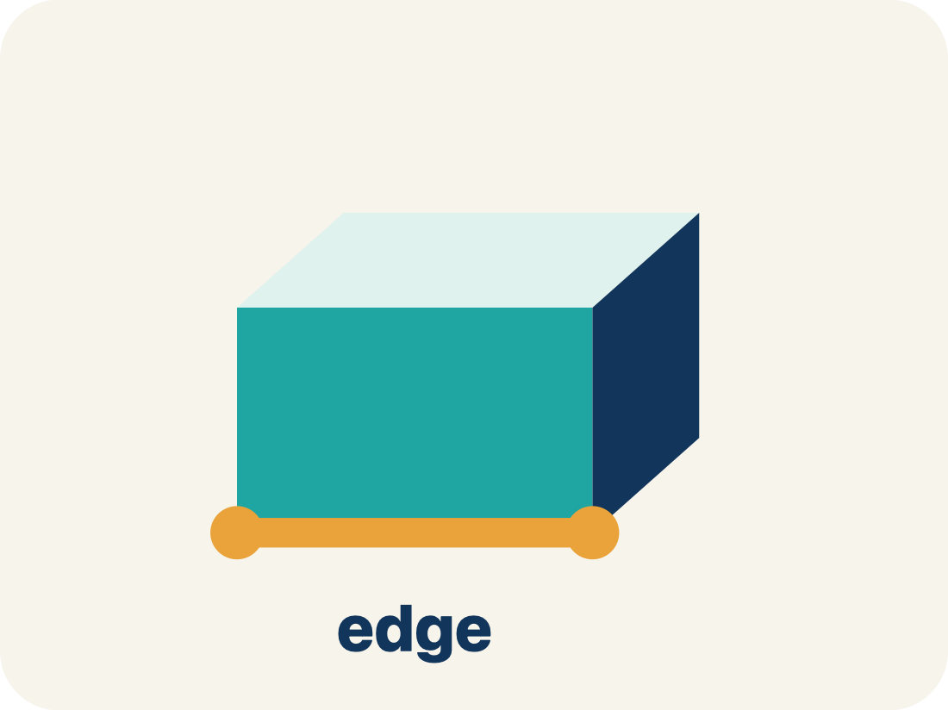
Vocabulary 6 of 6
Lesson 5-6 · Represent Three-Dimensional Figures in Two Dimensions
Edge
The line where two flat sides of a solid meet.
EXAMPLE · EXPLAIN WHY IT FITS
A cube has 12 edges — the lines where two flat faces connect
Use “Edge” to explain the example. Point to evidence.
eduwonderlab.com · Neft Teacher
14 / 62
Notes:
TEACH IN PRACTICE | Embedded facilitation | Lesson 5.6, slide 13 | VOCAB
Focus on the existing task: Vocabulary 6 of 6 Edge The line…
ASK (T1/3/5): Where does “Edge” appear in the example? Explain the meaning without reading the definition. Partner: restate the idea and ask a clarifying question.
LOOK FOR: A correct connection between the word and a feature of the example. If the student only repeats the definition, invite pointing, sketching or oral rehearsal, then ask for another explanation of this same example.
PARTICIPATION (T5/6/7): Think time before volunteers; accept a written, drawn or rehearsed entry. Students ask for evidence respectfully. Recognize a specific contribution or revision and check that both partners participate.
Source: BCPS Updated Instructional Framework Rubric (June 2020), TEACH 1–7.

Slide 15
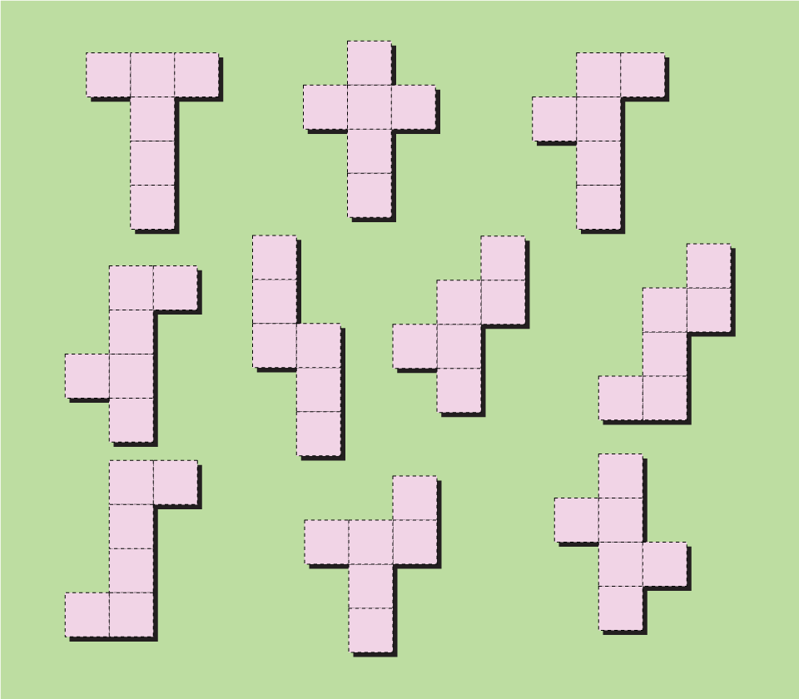

Be Curious
What do you notice?
What do you wonder?
Think first. Share a notice and a question;
build on a classmate’s idea.
Mindset
How can you show others you find their ideas useful?
15 / 62
Notes:
TEACH IN PRACTICE | Embedded facilitation | Lesson 5.6, slide 14 | CURIOUS
Focus on the existing task: How can you show others you find their ideas useful?
LAUNCH (T2/3/5): Allow quiet observation first. Separate a notice from an inference, invite students’ own questions, and follow the existing launch before teaching a procedure.
LOOK FOR (T4): Where this task addresses it, students can match each face of the solid to a net. Ask which feature of their work supports the claim.
RESPOND: If this task shows the lesson misconception—accepting a net whose faces overlap or leave an opening—use a paper trace of the existing net and mark corresponding edges. Have the student revise and explain the change. Use this support only where the concept occurs in the current task; otherwise respond to the displayed question.
RECHECK: If a gap is shared, revisit the existing representation together. If it is limited, give targeted support while others compare valid methods on the same task. Check the revision before moving on.
PARTICIPATION (T5/6/7): Think time before volunteers; accept a written, drawn or rehearsed entry. Students ask for evidence respectfully. Recognize a specific contribution or revision and check that both partners participate.
Source: BCPS Updated Instructional Framework Rubric (June 2020), TEACH 1–7.

Slide 16
Vocabulary
Lesson 5-6 · Represent Three-Dimensional Figures in Two Dimensions
Today’s Math Words
We learn every word — what it means and what it looks like — before we use it.
Surface Area Using Nets
Surface area
The total area of all the faces of a solid
The total area of all the flat sides of a solid
Net
Face
A flat shape that folds up into a solid
One flat side of a solid shape
Two-dimensional
Edge
A flat shape with length and width, but no thickness
The line where two flat sides of a solid meet
ADD ON · Add on: “I agree because ______.” or “I see it differently because ______.”
eduwonderlab.com · Neft Teacher
16 / 62
Notes:
TEACH IN PRACTICE | Embedded facilitation | Lesson 5.6, slide 15 | VOCAB
Focus on the existing task: Vocabulary Today’s Math Words We…
ASK (T1/3/5): Where does “the displayed term” appear in the example? Explain the meaning without reading the definition. Partner: restate the idea and ask a clarifying question.
LOOK FOR: A correct connection between the word and a feature of the example. If the student only repeats the definition, invite pointing, sketching or oral rehearsal, then ask for another explanation of this same example.
PARTICIPATION (T5/6/7): Think time before volunteers; accept a written, drawn or rehearsed entry. Students ask for evidence respectfully. Recognize a specific contribution or revision and check that both partners participate.
Source: BCPS Updated Instructional Framework Rubric (June 2020), TEACH 1–7. Earlier notes and answer keys are retained below.
EARLIER NOTES / EXISTING ANSWER KEY
Choral-read each word, its meaning, and what it looks like.
Students should use these words out loud today — listen for them in partner talk and revoice student ideas with the academic term.
UIFR: TEACH 1 · TEACH 5.

Slide 17
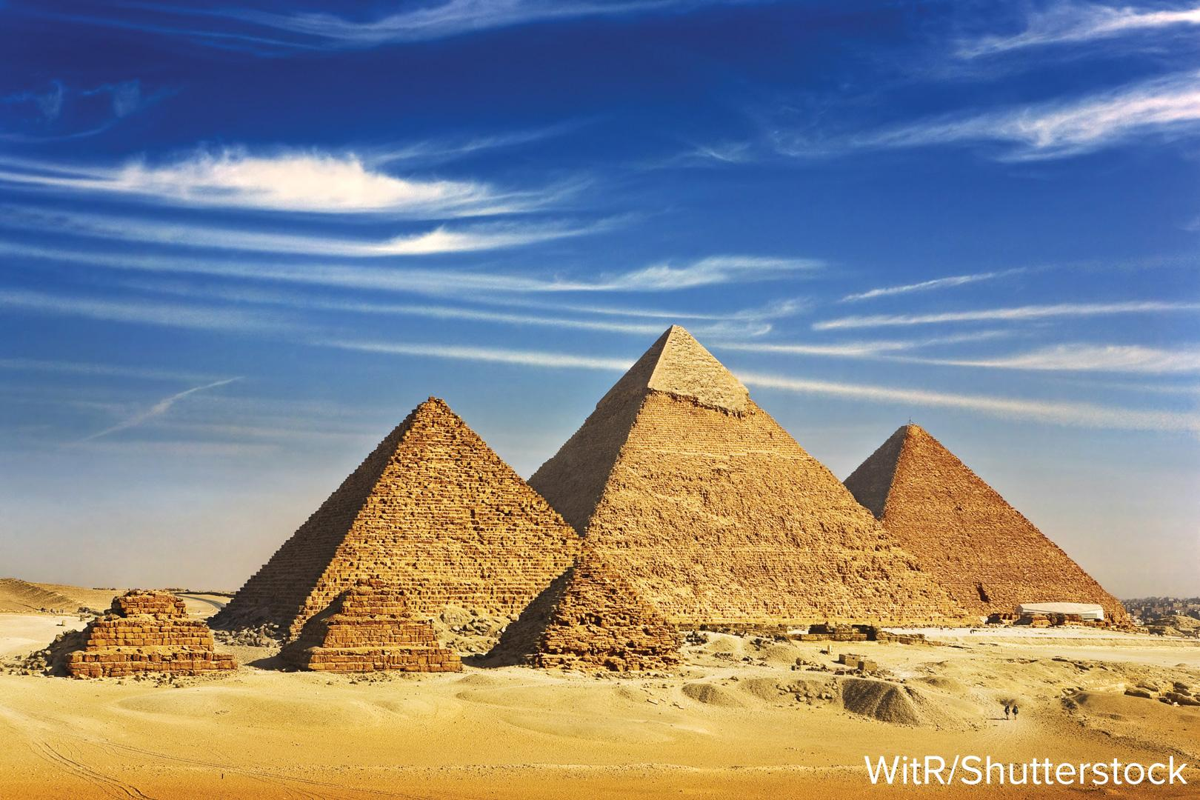

A New Figure
Yuzuki is making a replica of the Pyramids of Giza for a social studies project. She will make the pyramids out of paper.
What can help Yuzuki make her paper pyramids?
HOW DO YOU KNOW? · Ask your partner “How do you know?” Answer by pointing to your own work.
Using Representations
How can you use a picture to model the problem?
17 / 62
Notes:
TEACH IN PRACTICE | Embedded facilitation | Lesson 5.6, slide 16 | TASK
Focus on the existing task: Yuzuki is making a replica of the Pyramids of Giza for a social studies project. She will make the pyramids out of paper. What can help Yuzuki make her paper pyramids?
LAUNCH (T2/3/5): Use the displayed question. Give private thinking time; then A explains while B asks for evidence. Switch roles. Each student records their own reasoning.
LOOK FOR (T4): Where this task addresses it, students can match each face of the solid to a net. Ask which feature of their work supports the claim.
RESPOND: If this task shows the lesson misconception—accepting a net whose faces overlap or leave an opening—use a paper trace of the existing net and mark corresponding edges. Have the student revise and explain the change. Use this support only where the concept occurs in the current task; otherwise respond to the displayed question.
RECHECK: If a gap is shared, revisit the existing representation together. If it is limited, give targeted support while others compare valid methods on the same task. Check the revision before moving on.
PARTICIPATION (T5/6/7): Think time before volunteers; accept a written, drawn or rehearsed entry. Students ask for evidence respectfully. Recognize a specific contribution or revision and check that both partners participate.
Source: BCPS Updated Instructional Framework Rubric (June 2020), TEACH 1–7. Earlier notes and answer keys are retained below.
EARLIER NOTES / EXISTING ANSWER KEY
Read the context aloud (or have a student read it).
Before any math, students restate the situation and what is being asked in their own words.
Ask: What can help Yuzuki make her paper pyramids?
UIFR: TEACH 1 · TEACH 3.
UIFR FULL | Lesson-specific facilitation
TEACH 2-3 | Session 1 task launch (UIFR PDF pp. 9-10).
Use the problem exactly as displayed. Give individual thinking time before discussion or advancing to the explanation. If the answer is already visible, ask students to reconstruct and justify it. Invite a choice of suitable representations and have students explain why their choice helps.
At the point where this concept appears, ask: “Where will each face go when this net folds, and which edges must meet?” Wait for evidence, invite another pathway, and have a student ask a follow-up question. Do not replace students’ reasoning with a sequence of leading steps.

Slide 18
A New Figure
Yuzuki is making a replica of the Pyramids of Giza for a social studies project. She will make the pyramids out of paper. What can help Yuzuki make her paper pyramids? ​
How can you determine if these figures are two- or three-dimensional? Explain.
Reveal:
These figures are three-dimensional, because they have length, width, and height. Two-dimensional figures only have a length and a width.
18 / 62
Notes:
TEACH IN PRACTICE | Embedded facilitation | Lesson 5.6, slide 17 | REVEAL
Focus on the existing task: Yuzuki is making a replica of the Pyramids of Giza for a social studies project. She will make the pyramids out of paper. What can help Yuzuki make her paper pyramids?
LAUNCH (T2/3/5): If an existing answer cover is present, gather an attempt before revealing. If the explanation is already visible, ask students to reconstruct and justify it. Compare reasoning and explain a revision; preserve the reveal sequence.
LOOK FOR (T4): Where this task addresses it, students can match each face of the solid to a net. Ask which feature of their work supports the claim.
RESPOND: If this task shows the lesson misconception—accepting a net whose faces overlap or leave an opening—use a paper trace of the existing net and mark corresponding edges. Have the student revise and explain the change. Use this support only where the concept occurs in the current task; otherwise respond to the displayed question.
RECHECK: If a gap is shared, revisit the existing representation together. If it is limited, give targeted support while others compare valid methods on the same task. Check the revision before moving on.
PARTICIPATION (T5/6/7): Think time before volunteers; accept a written, drawn or rehearsed entry. Students ask for evidence respectfully. Recognize a specific contribution or revision and check that both partners participate.
Source: BCPS Updated Instructional Framework Rubric (June 2020), TEACH 1–7. Earlier notes and answer keys are retained below.
EARLIER NOTES / EXISTING ANSWER KEY
Do not click yet: collect 2–3 student answers with reasons first.
Then click to remove the cover and have students compare their thinking to the reveal — “Is this what we said? Where is it different?”
Behind the cover: These figures are three-dimensional, because they have length, width, and height. Two-dimensional figures only have a length and a width.
UIFR: TEACH 3 · TEACH 4.

Slide 19
A New Figure
A pyramid is a three-dimensional figure that has a polygonal base and triangular sides that meet at a common point.
How can Yuzuki make paper pyramids that look like the three-dimensional figures? Explain.
Reveal:
Yuzuki can create a two-dimensional representation of the three-dimensional figure using paper.
19 / 62
Notes:
TEACH IN PRACTICE | Embedded facilitation | Lesson 5.6, slide 18 | REVEAL
Focus on the existing task: A pyramid is a three-dimensional figure that has a polygonal base and triangular sides that meet at a common point. How can Yuzuki make paper pyramids that look like the three-dimensional figures?
LAUNCH (T2/3/5): If an existing answer cover is present, gather an attempt before revealing. If the explanation is already visible, ask students to reconstruct and justify it. Compare reasoning and explain a revision; preserve the reveal sequence.
LOOK FOR (T4): Where this task addresses it, students can match each face of the solid to a net. Ask which feature of their work supports the claim.
RESPOND: If this task shows the lesson misconception—accepting a net whose faces overlap or leave an opening—use a paper trace of the existing net and mark corresponding edges. Have the student revise and explain the change. Use this support only where the concept occurs in the current task; otherwise respond to the displayed question.
RECHECK: If a gap is shared, revisit the existing representation together. If it is limited, give targeted support while others compare valid methods on the same task. Check the revision before moving on.
PARTICIPATION (T5/6/7): Think time before volunteers; accept a written, drawn or rehearsed entry. Students ask for evidence respectfully. Recognize a specific contribution or revision and check that both partners participate.
Source: BCPS Updated Instructional Framework Rubric (June 2020), TEACH 1–7. Earlier notes and answer keys are retained below.
EARLIER NOTES / EXISTING ANSWER KEY
Do not click yet: collect 2–3 student answers with reasons first.
Then click to remove the cover and have students compare their thinking to the reveal — “Is this what we said? Where is it different?”
Behind the cover: Yuzuki can create a two-dimensional representation of the three-dimensional figure using paper.
UIFR: TEACH 3 · TEACH 4.

Slide 20
STUDENT MOVES
Lesson 5-6
Your moves
YOUR CHOICE · You choose how to show this — numbers, words, or a diagram. Make your reasoning visible.
HOW DO YOU KNOW? · Ask your partner “How do you know?” Answer by pointing to your own work.
20 / 62

Slide 21
A New Figure
To make the pyramids out of paper, Yuzuki can create a net, or two-dimensional representation of a three-dimensional figure.
Think and record first. Which part of your
work supports your answer?
Think About It:
How should the attributes of the three-dimensional figure be reflected in the two-dimensional representation?
21 / 62
Notes:
TEACH IN PRACTICE | Embedded facilitation | Lesson 5.6, slide 19 | TASK
Focus on the existing task: To make the pyramids out of paper, Yuzuki can create a net, or two-dimensional representation of a three-dimensional figure. Think…
LAUNCH (T2/3/5): Use the displayed question. Give private thinking time; then A explains while B asks for evidence. Switch roles. Each student records their own reasoning.
LOOK FOR (T4): Where this task addresses it, students can match each face of the solid to a net. Ask which feature of their work supports the claim.
RESPOND: If this task shows the lesson misconception—accepting a net whose faces overlap or leave an opening—use a paper trace of the existing net and mark corresponding edges. Have the student revise and explain the change. Use this support only where the concept occurs in the current task; otherwise respond to the displayed question.
RECHECK: If a gap is shared, revisit the existing representation together. If it is limited, give targeted support while others compare valid methods on the same task. Check the revision before moving on.
PARTICIPATION (T5/6/7): Think time before volunteers; accept a written, drawn or rehearsed entry. Students ask for evidence respectfully. Recognize a specific contribution or revision and check that both partners participate.
Source: BCPS Updated Instructional Framework Rubric (June 2020), TEACH 1–7. Earlier notes and answer keys are retained below.
EARLIER NOTES / EXISTING ANSWER KEY
Ask the question, then hold the silence — students think or jot before anyone answers.
Take two or three responses and press with “Why?” or “How do you know?” before moving on.
UIFR: TEACH 3.

Slide 22

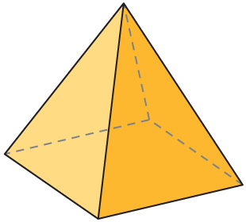
COLLABORATE · TALK IT THROUGH • AGREE ON A MODEL
Collaborate and Connect
Yuzuki can create a net of a pyramid.
What defining attributes does the pyramid have?
TAKE TURNS · One explains, one asks a question. Then switch, so both of you talk.
Reveal:
The pyramid has 4 faces and a base. The figure has a vertex, opposite to the base, that is connected by the faces.
22 / 62
Notes:
TEACH IN PRACTICE | Embedded facilitation | Lesson 5.6, slide 20 | COLLABORATE
Focus on the existing task: Yuzuki can create a net of a pyramid. What defining attributes does the pyramid have?
LAUNCH (T2/3/5): Use the displayed question. Give private thinking time; then A explains while B asks for evidence. Switch roles. Each student records their own reasoning.
LOOK FOR (T4): Where this task addresses it, students can distinguish edges from faces. Ask which feature of their work supports the claim.
RESPOND: If this task shows the lesson misconception—accepting a net whose faces overlap or leave an opening—use a paper trace of the existing net and mark corresponding edges. Have the student revise and explain the change. Use this support only where the concept occurs in the current task; otherwise respond to the displayed question.
RECHECK: If a gap is shared, revisit the existing representation together. If it is limited, give targeted support while others compare valid methods on the same task. Check the revision before moving on.
PARTICIPATION (T5/6/7): Think time before volunteers; accept a written, drawn or rehearsed entry. Students ask for evidence respectfully. Recognize a specific contribution or revision and check that both partners participate.
Source: BCPS Updated Instructional Framework Rubric (June 2020), TEACH 1–7. Earlier notes and answer keys are retained below.
EARLIER NOTES / EXISTING ANSWER KEY
Routine: COLLABORATE · TALK IT THROUGH • AGREE ON A MODEL
UIFR FULL | Lesson-specific facilitation
TEACH 4-5 | Session 1 discussion and checkpoint (UIFR PDF pp. 11-12).
Collect a brief response from every student to the existing prompt before hearing volunteers. Partners take turns explaining and asking for evidence: “I understand ___; what supports ___?” Offer rehearsal or an annotated model for students who need language support. Each student records their own reasoning.
Look specifically for: accepting a net whose faces overlap or leave an opening. If it appears, use a paper trace of the existing net and mark corresponding edges; then ask the student to revise the same response and explain the change. If evidence is secure, have students compare a second valid pathway or state why their approach works. Choose the next step from the responses, not a preset pace.

Slide 23
A New Figure
The pyramid has 4 faces and a base. The figure has a vertex, opposite to the base, that is connected by the faces.
How can you describe the faces and the base of the figure?
TRY IT BEFORE YOU’RE SURE · Start even if you are not sure. A revised answer counts as much as a first-try answer.
Reveal:
The figure has four triangular faces and a square base.
23 / 62
Notes:
TEACH IN PRACTICE | Embedded facilitation | Lesson 5.6, slide 21 | REVEAL
Focus on the existing task: The pyramid has 4 faces and a base. The figure has a vertex, opposite to the base, that is connected by the faces. How can you describe the faces and the base of the figure?
LAUNCH (T2/3/5): If an existing answer cover is present, gather an attempt before revealing. If the explanation is already visible, ask students to reconstruct and justify it. Compare reasoning and explain a revision; preserve the reveal sequence.
LOOK FOR (T4): Where this task addresses it, students can distinguish edges from faces. Ask which feature of their work supports the claim.
RESPOND: If this task shows the lesson misconception—accepting a net whose faces overlap or leave an opening—use a paper trace of the existing net and mark corresponding edges. Have the student revise and explain the change. Use this support only where the concept occurs in the current task; otherwise respond to the displayed question.
RECHECK: If a gap is shared, revisit the existing representation together. If it is limited, give targeted support while others compare valid methods on the same task. Check the revision before moving on.
PARTICIPATION (T5/6/7): Think time before volunteers; accept a written, drawn or rehearsed entry. Students ask for evidence respectfully. Recognize a specific contribution or revision and check that both partners participate.
Source: BCPS Updated Instructional Framework Rubric (June 2020), TEACH 1–7. Earlier notes and answer keys are retained below.
EARLIER NOTES / EXISTING ANSWER KEY
Do not click yet: collect 2–3 student answers with reasons first.
Then click to remove the cover and have students compare their thinking to the reveal — “Is this what we said? Where is it different?”
Behind the cover: The figure has four triangular faces and a square base.
UIFR: TEACH 3 · TEACH 4.

Slide 24
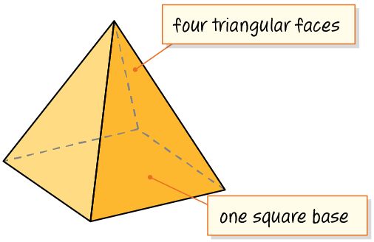
A New Figure
How can you use the defining attributes to draw a net for the pyramid? Explain.
Reveal:
To make the net, the defining attributes tell us the shape and number of faces and the shape and number of bases of the figure. We can use this information to create a net that reflects these attributes.
Record your reasoning before the
reveal. Compare, then explain
any revision.
24 / 62
Notes:
TEACH IN PRACTICE | Embedded facilitation | Lesson 5.6, slide 22 | REVEAL
Focus on the existing task: Reveal: To make the net, the defining attributes tell us the shape and number of faces and the shape and number of bases of the figure.…
LAUNCH (T2/3/5): If an existing answer cover is present, gather an attempt before revealing. If the explanation is already visible, ask students to reconstruct and justify it. Compare reasoning and explain a revision; preserve the reveal sequence.
LOOK FOR (T4): Where this task addresses it, students can distinguish edges from faces. Ask which feature of their work supports the claim.
RESPOND: If this task shows the lesson misconception—accepting a net whose faces overlap or leave an opening—use a paper trace of the existing net and mark corresponding edges. Have the student revise and explain the change. Use this support only where the concept occurs in the current task; otherwise respond to the displayed question.
RECHECK: If a gap is shared, revisit the existing representation together. If it is limited, give targeted support while others compare valid methods on the same task. Check the revision before moving on.
PARTICIPATION (T5/6/7): Think time before volunteers; accept a written, drawn or rehearsed entry. Students ask for evidence respectfully. Recognize a specific contribution or revision and check that both partners participate.
Source: BCPS Updated Instructional Framework Rubric (June 2020), TEACH 1–7. Earlier notes and answer keys are retained below.
EARLIER NOTES / EXISTING ANSWER KEY
Do not click yet: collect 2–3 student answers with reasons first.
Then click to remove the cover and have students compare their thinking to the reveal — “Is this what we said? Where is it different?”
Behind the cover: To make the net, the defining attributes tell us the shape and number of faces and the shape and number of bases of the figure. We can use this information to create a net that reflects these attributes.
UIFR: TEACH 3 · TEACH 4.

Slide 25
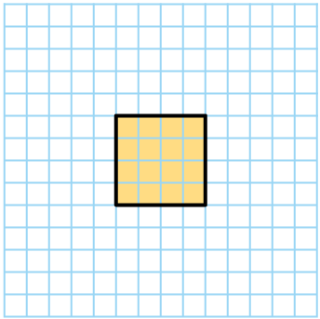
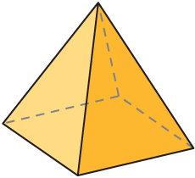
A New Figure
Let’s draw the net of the square pyramid by using its defining attributes.
The base is a square.
SELF-CHECK · Mark it: ✓ got it · ~ almost · ? stuck. Then fix one thing before we move on.
Think About It:
Do you know the number of grid squares that should be used for the base?
25 / 62
Notes:
TEACH IN PRACTICE | Embedded facilitation | Lesson 5.6, slide 23 | TASK
Focus on the existing task: Let’s draw the net of the square pyramid by using its defining attributes. The base is a square. Think About It: Do you know the number of grid squares that should be used for the base?
LAUNCH (T2/3/5): Use the displayed question. Give private thinking time; then A explains while B asks for evidence. Switch roles. Each student records their own reasoning.
LOOK FOR (T4): Where this task addresses it, students can match each face of the solid to a net. Ask which feature of their work supports the claim.
RESPOND: If this task shows the lesson misconception—accepting a net whose faces overlap or leave an opening—use a paper trace of the existing net and mark corresponding edges. Have the student revise and explain the change. Use this support only where the concept occurs in the current task; otherwise respond to the displayed question.
RECHECK: If a gap is shared, revisit the existing representation together. If it is limited, give targeted support while others compare valid methods on the same task. Check the revision before moving on.
PARTICIPATION (T5/6/7): Think time before volunteers; accept a written, drawn or rehearsed entry. Students ask for evidence respectfully. Recognize a specific contribution or revision and check that both partners participate.
Source: BCPS Updated Instructional Framework Rubric (June 2020), TEACH 1–7. Earlier notes and answer keys are retained below.
EARLIER NOTES / EXISTING ANSWER KEY
Ask the question, then hold the silence — students think or jot before anyone answers.
Take two or three responses and press with “Why?” or “How do you know?” before moving on.
UIFR: TEACH 3.

Slide 26
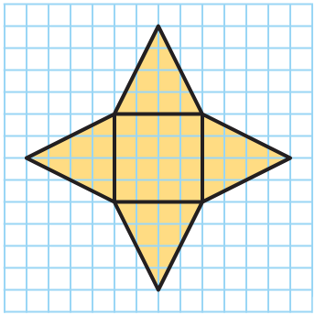
A New Figure
Let’s draw the triangular faces of the pyramid.
Why are the triangular faces drawn this way?
Reveal:
The base of each triangular face connects to one side of the square base.
Record your reasoning before the reveal.
Compare, then explain any revision.
26 / 62
Notes:
TEACH IN PRACTICE | Embedded facilitation | Lesson 5.6, slide 24 | REVEAL
Focus on the existing task: Reveal: The base of each triangular face connects to one side of the square base. Let’s draw the triangular faces of the pyramid. Why are the triangular faces drawn this way?
LAUNCH (T2/3/5): If an existing answer cover is present, gather an attempt before revealing. If the explanation is already visible, ask students to reconstruct and justify it. Compare reasoning and explain a revision; preserve the reveal sequence.
LOOK FOR (T4): Where this task addresses it, students can match each face of the solid to a net. Ask which feature of their work supports the claim.
RESPOND: If this task shows the lesson misconception—accepting a net whose faces overlap or leave an opening—use a paper trace of the existing net and mark corresponding edges. Have the student revise and explain the change. Use this support only where the concept occurs in the current task; otherwise respond to the displayed question.
RECHECK: If a gap is shared, revisit the existing representation together. If it is limited, give targeted support while others compare valid methods on the same task. Check the revision before moving on.
PARTICIPATION (T5/6/7): Think time before volunteers; accept a written, drawn or rehearsed entry. Students ask for evidence respectfully. Recognize a specific contribution or revision and check that both partners participate.
Source: BCPS Updated Instructional Framework Rubric (June 2020), TEACH 1–7. Earlier notes and answer keys are retained below.
EARLIER NOTES / EXISTING ANSWER KEY
Do not click yet: collect 2–3 student answers with reasons first.
Then click to remove the cover and have students compare their thinking to the reveal — “Is this what we said? Where is it different?”
Behind the cover: The base of each triangular face connects to one side of the square base.
UIFR: TEACH 3 · TEACH 4.

Slide 27
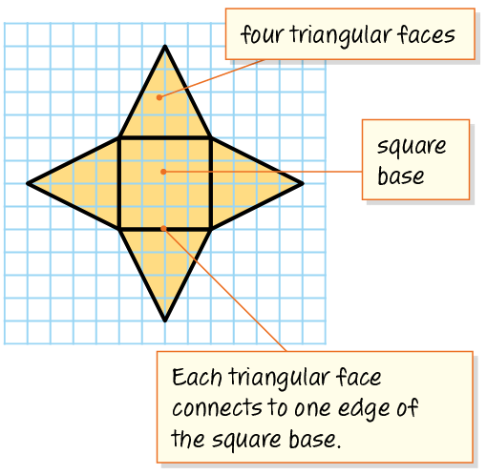
A New Figure
What do we know about the triangular faces on a square pyramid?
Record your reasoning before the reveal.
Compare, then explain any revision.
Reveal:
They are all the same size because their bases are sides of the square base.
27 / 62
Notes:
TEACH IN PRACTICE | Embedded facilitation | Lesson 5.6, slide 25 | REVEAL
Focus on the existing task: Reveal: They are all the same size because their bases are sides of the square base. What do we know about the triangular faces on a square pyramid?
LAUNCH (T2/3/5): If an existing answer cover is present, gather an attempt before revealing. If the explanation is already visible, ask students to reconstruct and justify it. Compare reasoning and explain a revision; preserve the reveal sequence.
LOOK FOR (T4): Where this task addresses it, students can distinguish edges from faces. Ask which feature of their work supports the claim.
RESPOND: If this task shows the lesson misconception—accepting a net whose faces overlap or leave an opening—use a paper trace of the existing net and mark corresponding edges. Have the student revise and explain the change. Use this support only where the concept occurs in the current task; otherwise respond to the displayed question.
RECHECK: If a gap is shared, revisit the existing representation together. If it is limited, give targeted support while others compare valid methods on the same task. Check the revision before moving on.
PARTICIPATION (T5/6/7): Think time before volunteers; accept a written, drawn or rehearsed entry. Students ask for evidence respectfully. Recognize a specific contribution or revision and check that both partners participate.
Source: BCPS Updated Instructional Framework Rubric (June 2020), TEACH 1–7. Earlier notes and answer keys are retained below.
EARLIER NOTES / EXISTING ANSWER KEY
Do not click yet: collect 2–3 student answers with reasons first.
Then click to remove the cover and have students compare their thinking to the reveal — “Is this what we said? Where is it different?”
Behind the cover: They are all the same size because their bases are sides of the square base.
UIFR: TEACH 3 · TEACH 4.

Slide 28
A New Figure
Yuzuki is making a replica of the Pyramids of Giza for a social studies project. She will make the pyramids out of paper.
What can help Yuzuki make her paper pyramids?
Yuzuki can create a net of each pyramid to help her make paper pyramids.
Think and record first. Which part of your work supports your answer?
28 / 62
Notes:
TEACH IN PRACTICE | Embedded facilitation | Lesson 5.6, slide 26 | TASK
Focus on the existing task: Yuzuki is making a replica of the Pyramids of Giza for a social studies project. She will make the pyramids out of paper. What can help Yuzuki make her paper pyramids?
LAUNCH (T2/3/5): Use the displayed question. Give private thinking time; then A explains while B asks for evidence. Switch roles. Each student records their own reasoning.
LOOK FOR (T4): Where this task addresses it, students can match each face of the solid to a net. Ask which feature of their work supports the claim.
RESPOND: If this task shows the lesson misconception—accepting a net whose faces overlap or leave an opening—use a paper trace of the existing net and mark corresponding edges. Have the student revise and explain the change. Use this support only where the concept occurs in the current task; otherwise respond to the displayed question.
RECHECK: If a gap is shared, revisit the existing representation together. If it is limited, give targeted support while others compare valid methods on the same task. Check the revision before moving on.
PARTICIPATION (T5/6/7): Think time before volunteers; accept a written, drawn or rehearsed entry. Students ask for evidence respectfully. Recognize a specific contribution or revision and check that both partners participate.
Source: BCPS Updated Instructional Framework Rubric (June 2020), TEACH 1–7. Earlier notes and answer keys are retained below.
EARLIER NOTES / EXISTING ANSWER KEY
Read the context aloud (or have a student read it).
Before any math, students restate the situation and what is being asked in their own words.
Ask: What can help Yuzuki make her paper pyramids?
UIFR: TEACH 1 · TEACH 3.

Slide 29
Let’s Explore More
Does a square pyramid—a pyramid with a square base—have more edges or vertices? Explain how you know.
How does the net of a pyramid with a square base differ from the net of a pyramid with non-square rectangle base?
Try it yourself. Compare your work with a
partner; explain one choice and revise.
29 / 62
Notes:
TEACH IN PRACTICE | Embedded facilitation | Lesson 5.6, slide 27 | PRACTICE
Focus on the existing task: Does a square pyramid—a pyramid with a square base—have more edges or vertices?
LAUNCH (T2/3/5): Use the displayed question. Give private thinking time; then A explains while B asks for evidence. Switch roles. Each student records their own reasoning.
LOOK FOR (T4): Where this task addresses it, students can distinguish edges from faces. Ask which feature of their work supports the claim.
RESPOND: If this task shows the lesson misconception—accepting a net whose faces overlap or leave an opening—use a paper trace of the existing net and mark corresponding edges. Have the student revise and explain the change. Use this support only where the concept occurs in the current task; otherwise respond to the displayed question.
RECHECK: If a gap is shared, revisit the existing representation together. If it is limited, give targeted support while others compare valid methods on the same task. Check the revision before moving on.
PARTICIPATION (T5/6/7): Think time before volunteers; accept a written, drawn or rehearsed entry. Students ask for evidence respectfully. Recognize a specific contribution or revision and check that both partners participate.
Source: BCPS Updated Instructional Framework Rubric (June 2020), TEACH 1–7. Earlier notes and answer keys are retained below.
EARLIER NOTES / EXISTING ANSWER KEY
Extension for partners or table groups — students choose their approach and use the workspace to show thinking.
Push with “Convince me,” and have two groups with different approaches share.
This is where students stretch past the worked example.
UIFR: TEACH 2 · TEACH 5.

Slide 30
LESSON 5.6 / DISCUSS THE TASK
Explain and compare
Use the task you just explored.
TAKE TURNS
Where will each face go when this net folds, and which edges must meet?
Explain
“I know this because…”
Ask
“Where does your work show that?”
Point to evidence in your work.
Then compare your approach with a partner’s.
JUSTIFY IT · Say it like this: “I know ______ because ______.”
Listen to understand. Ask for evidence. Make room for every voice.
Notes:
TEACH IN PRACTICE | Embedded facilitation | Lesson 5.6, slide 28 | PRIOR_INSERT
Focus on the existing task: Point to evidence in your work. Then compare your approach with a partner’s. TAKE TURNS Explain “I know this because…” Ask “Where does your work show that?
CONNECT (T1/4): Ask students to restate the displayed goal or key idea and connect it to earlier work. Relevant lesson evidence: match each face of the solid to a net; justify how the net folds; distinguish edges from faces. Use only the criterion that matches the current session.
SHOW PROGRESS: Students point to their own existing work, explain what improved after feedback, and name a next step. Pair confidence ratings with actual evidence.
PARTICIPATION (T5/6/7): Think time before volunteers; accept a written, drawn or rehearsed entry. Students ask for evidence respectfully. Recognize a specific contribution or revision and check that both partners participate.
Source: BCPS Updated Instructional Framework Rubric (June 2020), TEACH 1–7.

Slide 31
Collaborate and Connect
Yuzuki can create a net of a pyramid.
What defining attributes does the pyramid have?
RESTATE FIRST · Restate your partner’s idea in your own words before you give yours.
Reveal:
The pyramid has 4 faces and a base. The figure has a vertex, opposite to the base, that is connected by the faces.
31 / 62
Notes:
TEACH IN PRACTICE | Embedded facilitation | Lesson 5.6, slide 29 | COLLABORATE
Focus on the existing task: Yuzuki can create a net of a pyramid. What defining attributes does the pyramid have?
LAUNCH (T2/3/5): Use the displayed question. Give private thinking time; then A explains while B asks for evidence. Switch roles. Each student records their own reasoning.
LOOK FOR (T4): Where this task addresses it, students can distinguish edges from faces. Ask which feature of their work supports the claim.
RESPOND: If this task shows the lesson misconception—accepting a net whose faces overlap or leave an opening—use a paper trace of the existing net and mark corresponding edges. Have the student revise and explain the change. Use this support only where the concept occurs in the current task; otherwise respond to the displayed question.
RECHECK: If a gap is shared, revisit the existing representation together. If it is limited, give targeted support while others compare valid methods on the same task. Check the revision before moving on.
PARTICIPATION (T5/6/7): Think time before volunteers; accept a written, drawn or rehearsed entry. Students ask for evidence respectfully. Recognize a specific contribution or revision and check that both partners participate.
Source: BCPS Updated Instructional Framework Rubric (June 2020), TEACH 1–7.

Slide 32
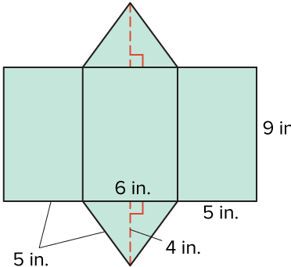
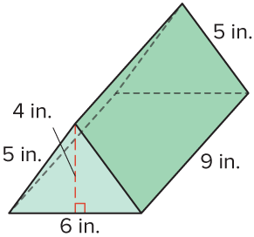
Be Curious
How are they the same?
How are they different?
Mindset
ANOTHER PATHWAY · Did anyone get there a different way? Put both pathways side by side and compare.
How are you showing others that you find their ideas useful?
32 / 62
Notes:
TEACH IN PRACTICE | Embedded facilitation | Lesson 5.6, slide 30 | CURIOUS
Focus on the existing task: How are you showing others that you find their ideas useful?
LAUNCH (T2/3/5): Allow quiet observation first. Separate a notice from an inference, invite students’ own questions, and follow the existing launch before teaching a procedure.
LOOK FOR (T4): Where this task addresses it, students can match each face of the solid to a net. Ask which feature of their work supports the claim.
RESPOND: If this task shows the lesson misconception—accepting a net whose faces overlap or leave an opening—use a paper trace of the existing net and mark corresponding edges. Have the student revise and explain the change. Use this support only where the concept occurs in the current task; otherwise respond to the displayed question.
RECHECK: If a gap is shared, revisit the existing representation together. If it is limited, give targeted support while others compare valid methods on the same task. Check the revision before moving on.
PARTICIPATION (T5/6/7): Think time before volunteers; accept a written, drawn or rehearsed entry. Students ask for evidence respectfully. Recognize a specific contribution or revision and check that both partners participate.
Source: BCPS Updated Instructional Framework Rubric (June 2020), TEACH 1–7.

Slide 33
Warm-Up
Lesson 5-6 · Represent Three-Dimensional Figures in Two Dimensions
Session 2 Warm-Up
Try alone. Explain one. Then revise.
1
What is a 2D pattern that folds into a 3D figure called?
2
How many faces does a rectangular prism have?
A
Perimeter
A
4
B
A net
B
6
C
A scale
C
8
D
A volume box
D
12
3
A triangular prism has:
4
The faces of a net represent the 3D shape’s:
A
2 triangular bases and 3 rectangular faces
A
Volume
B
1 triangle and 4 squares
B
Surface faces
C
6 triangles
C
Internal diagonals
D
No flat faces
D
Angles only
eduwonderlab.com · Neft Teacher
33 / 62
Notes:
TEACH IN PRACTICE | Embedded facilitation | Lesson 5.6, slide 31 | WARMUP
Focus on the existing task: A Perimeter B A net C A scale D A volume box 2 How many faces does a rectangular prism have?
GATHER EVIDENCE (T4/6): Keep the original items. Students try independently, mark an uncertain item, and explain one method before checking. Use the existing key when present.
RESPOND: Distinguish a calculation slip from a reasoning gap. Give one next step on the same item; have students revise in a second color. Use the responses to choose flexible support for today’s lesson.
PARTICIPATION (T5/6/7): Think time before volunteers; accept a written, drawn or rehearsed entry. Students ask for evidence respectfully. Recognize a specific contribution or revision and check that both partners participate.
Source: BCPS Updated Instructional Framework Rubric (June 2020), TEACH 1–7. Earlier notes and answer keys are retained below.
EARLIER NOTES / EXISTING ANSWER KEY
Warm-up routine: students start silently on entry; keep it to about 4 minutes.
Circulate and note who is stuck — use what you see to choose who you check on first today.
Go over answers quickly; ask one student to explain a step, not just say the answer.
UIFR: TEACH 4 · TEACH 6.

Slide 34
STUDENT MOVES
Lesson 5-6
Your move
YOU KNOW THE ROUTINE · Read → plan → solve → check. Do all four, in that order.
34 / 62

Slide 35
Review Notes — Session 2
Lesson 5-6 · Represent Three-Dimensional Figures in Two Dimensions
Session 2: Review Notes
Copy. Explain. Check.
WHY IT MATTERS · Finish this: “This is worth knowing because ______.”
Nets of Polyhedra
1
A net is a flattened, two-dimensional arrangement of polygons that folds to form a 3D solid.
Prism Structure
2
Prisms have two identical parallel bases connected by rectangular lateral faces.
Face Matching
3
Corresponding folding edges on adjacent polygons in a net must have equal lengths.
eduwonderlab.com · Neft Teacher
35 / 62
Notes:
TEACH IN PRACTICE | Embedded facilitation | Lesson 5.6, slide 32 | NOTES
Focus on the existing task: Review Notes — Session 2 Session 2…
ROUTINE (T1/2/4): Read or copy the original notes, cover one line, and explain it using the displayed example. Reopen and correct. Copying alone is not evidence of understanding.
LOOK FOR: A link between a symbol, quantity or feature and the explanation. If missing, point back to that feature and have the student try again; fade the prompt once they can explain.
PARTICIPATION (T5/6/7): Think time before volunteers; accept a written, drawn or rehearsed entry. Students ask for evidence respectfully. Recognize a specific contribution or revision and check that both partners participate.
Source: BCPS Updated Instructional Framework Rubric (June 2020), TEACH 1–7. Earlier notes and answer keys are retained below.
EARLIER NOTES / EXISTING ANSWER KEY
Copy routine: read one line at a time; students copy, then explain that line to a partner.
Keep it brisk — the understanding work happens in the examples, not the copying.
UIFR: TEACH 1 · TEACH 6.

Slide 36
Session 2
Represent Three-Dimensional Figures in
Two Dimensions
STRUGGLE FIRST · Work on your own first. Stuck is allowed — try a second strategy before you ask.
36 / 62
Notes:
TEACH IN PRACTICE | Embedded facilitation | Lesson 5.6, slide 33 | DIVIDER
Focus on the existing task: Represent Three-Dimensional Figures in Two Dimensions Session 2
TRANSITION (T6/7): Students confirm materials, roles, how to request help, and the next response routine. Ask a student to restate it. Keep teacher-only slides hidden.
PARTICIPATION (T5/6/7): Think time before volunteers; accept a written, drawn or rehearsed entry. Students ask for evidence respectfully. Recognize a specific contribution or revision and check that both partners participate.
Source: BCPS Updated Instructional Framework Rubric (June 2020), TEACH 1–7. Earlier notes and answer keys are retained below.
EARLIER NOTES / EXISTING ANSWER KEY
Transition cue: state what materials are out and what success looks like this session.
Keep the changeover under a minute.
UIFR: TEACH 6.

Slide 37
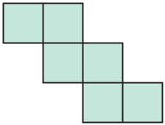
Mystery Shape
What three-dimensional figure can this net make?
Think and record first. Which part of your work supports your answer?
37 / 62
Notes:
TEACH IN PRACTICE | Embedded facilitation | Lesson 5.6, slide 34 | TASK
Focus on the existing task: What three-dimensional figure can this net make?
LAUNCH (T2/3/5): Use the displayed question. Give private thinking time; then A explains while B asks for evidence. Switch roles. Each student records their own reasoning.
LOOK FOR (T4): Where this task addresses it, students can match each face of the solid to a net. Ask which feature of their work supports the claim.
RESPOND: If this task shows the lesson misconception—accepting a net whose faces overlap or leave an opening—use a paper trace of the existing net and mark corresponding edges. Have the student revise and explain the change. Use this support only where the concept occurs in the current task; otherwise respond to the displayed question.
RECHECK: If a gap is shared, revisit the existing representation together. If it is limited, give targeted support while others compare valid methods on the same task. Check the revision before moving on.
PARTICIPATION (T5/6/7): Think time before volunteers; accept a written, drawn or rehearsed entry. Students ask for evidence respectfully. Recognize a specific contribution or revision and check that both partners participate.
Source: BCPS Updated Instructional Framework Rubric (June 2020), TEACH 1–7. Earlier notes and answer keys are retained below.
EARLIER NOTES / EXISTING ANSWER KEY
Model briefly, then hand the thinking back: ask “Why does this step work?” before showing the next one.
Quick check before moving on — thumbs or whiteboards from everyone, not volunteers.
UIFR: TEACH 2 · TEACH 3 · TEACH 4.

Slide 38
Mystery Shape
What is the relationship between the net and the three-dimensional shape that can be made by the net?
Record your reasoning before the reveal. Compare, then
explain any revision.
Reveal:
The net is a two-dimensional representation of the three-dimensional figure it can make.
38 / 62
Notes:
TEACH IN PRACTICE | Embedded facilitation | Lesson 5.6, slide 35 | REVEAL
Focus on the existing task: What is the relationship between the net and the three-dimensional shape that can be made by the net?
LAUNCH (T2/3/5): If an existing answer cover is present, gather an attempt before revealing. If the explanation is already visible, ask students to reconstruct and justify it. Compare reasoning and explain a revision; preserve the reveal sequence.
LOOK FOR (T4): Where this task addresses it, students can match each face of the solid to a net. Ask which feature of their work supports the claim.
RESPOND: If this task shows the lesson misconception—accepting a net whose faces overlap or leave an opening—use a paper trace of the existing net and mark corresponding edges. Have the student revise and explain the change. Use this support only where the concept occurs in the current task; otherwise respond to the displayed question.
RECHECK: If a gap is shared, revisit the existing representation together. If it is limited, give targeted support while others compare valid methods on the same task. Check the revision before moving on.
PARTICIPATION (T5/6/7): Think time before volunteers; accept a written, drawn or rehearsed entry. Students ask for evidence respectfully. Recognize a specific contribution or revision and check that both partners participate.
Source: BCPS Updated Instructional Framework Rubric (June 2020), TEACH 1–7. Earlier notes and answer keys are retained below.
EARLIER NOTES / EXISTING ANSWER KEY
Do not click yet: collect 2–3 student answers with reasons first.
Then click to remove the cover and have students compare their thinking to the reveal — “Is this what we said? Where is it different?”
Behind the cover: The net is a two-dimensional representation of the three-dimensional figure it can make.
UIFR: TEACH 3 · TEACH 4.

Slide 39
Mystery Shape
The net is a two-dimensional representation of the three-dimensional figure it can make.
How can you use this net to form a three-dimensional figure?
ASK THE CLASS · Write one question about this that you could ask the class.
Reveal:
We can fold the net to create a three-dimensional figure.
39 / 62
Notes:
TEACH IN PRACTICE | Embedded facilitation | Lesson 5.6, slide 36 | REVEAL
Focus on the existing task: The net is a two-dimensional representation of the three-dimensional figure it can make. How can you use this net to form a three-dimensional figure?
LAUNCH (T2/3/5): If an existing answer cover is present, gather an attempt before revealing. If the explanation is already visible, ask students to reconstruct and justify it. Compare reasoning and explain a revision; preserve the reveal sequence.
LOOK FOR (T4): Where this task addresses it, students can match each face of the solid to a net. Ask which feature of their work supports the claim.
RESPOND: If this task shows the lesson misconception—accepting a net whose faces overlap or leave an opening—use a paper trace of the existing net and mark corresponding edges. Have the student revise and explain the change. Use this support only where the concept occurs in the current task; otherwise respond to the displayed question.
RECHECK: If a gap is shared, revisit the existing representation together. If it is limited, give targeted support while others compare valid methods on the same task. Check the revision before moving on.
PARTICIPATION (T5/6/7): Think time before volunteers; accept a written, drawn or rehearsed entry. Students ask for evidence respectfully. Recognize a specific contribution or revision and check that both partners participate.
Source: BCPS Updated Instructional Framework Rubric (June 2020), TEACH 1–7. Earlier notes and answer keys are retained below.
EARLIER NOTES / EXISTING ANSWER KEY
Do not click yet: collect 2–3 student answers with reasons first.
Then click to remove the cover and have students compare their thinking to the reveal — “Is this what we said? Where is it different?”
Behind the cover: We can fold the net to create a three-dimensional figure.
UIFR: TEACH 3 · TEACH 4.

Slide 40
Mystery Shape
How can you describe the shapes that appear in the net?
Record your reasoning before the reveal. Compare, then
explain any revision.
Reveal:
The net is made up of 6 squares of the same size.
40 / 62
Notes:
TEACH IN PRACTICE | Embedded facilitation | Lesson 5.6, slide 37 | REVEAL
Focus on the existing task: How can you describe the shapes that appear in the net?
LAUNCH (T2/3/5): If an existing answer cover is present, gather an attempt before revealing. If the explanation is already visible, ask students to reconstruct and justify it. Compare reasoning and explain a revision; preserve the reveal sequence.
LOOK FOR (T4): Where this task addresses it, students can match each face of the solid to a net. Ask which feature of their work supports the claim.
RESPOND: If this task shows the lesson misconception—accepting a net whose faces overlap or leave an opening—use a paper trace of the existing net and mark corresponding edges. Have the student revise and explain the change. Use this support only where the concept occurs in the current task; otherwise respond to the displayed question.
RECHECK: If a gap is shared, revisit the existing representation together. If it is limited, give targeted support while others compare valid methods on the same task. Check the revision before moving on.
PARTICIPATION (T5/6/7): Think time before volunteers; accept a written, drawn or rehearsed entry. Students ask for evidence respectfully. Recognize a specific contribution or revision and check that both partners participate.
Source: BCPS Updated Instructional Framework Rubric (June 2020), TEACH 1–7. Earlier notes and answer keys are retained below.
EARLIER NOTES / EXISTING ANSWER KEY
Do not click yet: collect 2–3 student answers with reasons first.
Then click to remove the cover and have students compare their thinking to the reveal — “Is this what we said? Where is it different?”
Behind the cover: The net is made up of 6 squares of the same size.
UIFR: TEACH 3 · TEACH 4.

Slide 41
Mystery Shape
The net is made up of 6 squares of the same size.
Think and record first. Which part of your work supports your
answer?
Think About It:
What do the shapes in the net tell you about the faces of the three-dimensional figure it will make?
41 / 62
Notes:
TEACH IN PRACTICE | Embedded facilitation | Lesson 5.6, slide 38 | TASK
Focus on the existing task: The net is made up of 6 squares of the same size. Think About It: What do the shapes in the net tell you about the faces of the three-dimensional figure it will make?
LAUNCH (T2/3/5): Use the displayed question. Give private thinking time; then A explains while B asks for evidence. Switch roles. Each student records their own reasoning.
LOOK FOR (T4): Where this task addresses it, students can distinguish edges from faces. Ask which feature of their work supports the claim.
RESPOND: If this task shows the lesson misconception—accepting a net whose faces overlap or leave an opening—use a paper trace of the existing net and mark corresponding edges. Have the student revise and explain the change. Use this support only where the concept occurs in the current task; otherwise respond to the displayed question.
RECHECK: If a gap is shared, revisit the existing representation together. If it is limited, give targeted support while others compare valid methods on the same task. Check the revision before moving on.
PARTICIPATION (T5/6/7): Think time before volunteers; accept a written, drawn or rehearsed entry. Students ask for evidence respectfully. Recognize a specific contribution or revision and check that both partners participate.
Source: BCPS Updated Instructional Framework Rubric (June 2020), TEACH 1–7. Earlier notes and answer keys are retained below.
EARLIER NOTES / EXISTING ANSWER KEY
Ask the question, then hold the silence — students think or jot before anyone answers.
Take two or three responses and press with “Why?” or “How do you know?” before moving on.
UIFR: TEACH 3.

Slide 42
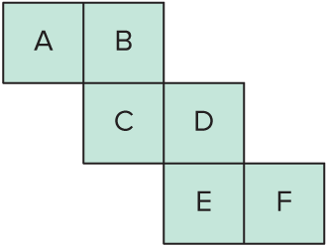
COLLABORATE · TALK IT THROUGH • AGREE ON A MODEL
Collaborate and Connect
To keep track of where each shape in the net will appear when folded into a three-dimensional figure, we can label each shape.
How can you fold the net to create a three-dimensional figure?
TEACH A PARTNER · Teach this to someone who missed it. If you can teach it, you know it.
Reveal:
We can fold the shapes along the connected sides to form a three-dimensional figure.
42 / 62
Notes:
TEACH IN PRACTICE | Embedded facilitation | Lesson 5.6, slide 39 | COLLABORATE
Focus on the existing task: To keep track of where each shape in the net will appear when folded into a three-dimensional figure, we can label each shape. How can you fold the net to create a three-dimensional figure?
LAUNCH (T2/3/5): Use the displayed question. Give private thinking time; then A explains while B asks for evidence. Switch roles. Each student records their own reasoning.
LOOK FOR (T4): Where this task addresses it, students can match each face of the solid to a net. Ask which feature of their work supports the claim.
RESPOND: If this task shows the lesson misconception—accepting a net whose faces overlap or leave an opening—use a paper trace of the existing net and mark corresponding edges. Have the student revise and explain the change. Use this support only where the concept occurs in the current task; otherwise respond to the displayed question.
RECHECK: If a gap is shared, revisit the existing representation together. If it is limited, give targeted support while others compare valid methods on the same task. Check the revision before moving on.
PARTICIPATION (T5/6/7): Think time before volunteers; accept a written, drawn or rehearsed entry. Students ask for evidence respectfully. Recognize a specific contribution or revision and check that both partners participate.
Source: BCPS Updated Instructional Framework Rubric (June 2020), TEACH 1–7. Earlier notes and answer keys are retained below.
EARLIER NOTES / EXISTING ANSWER KEY
Routine: COLLABORATE · TALK IT THROUGH • AGREE ON A MODEL

Slide 43
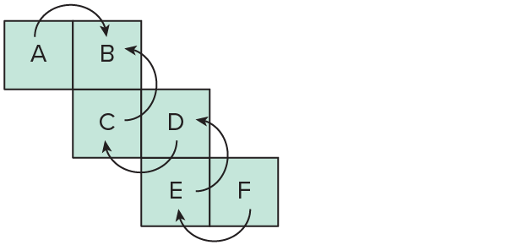
Mystery Shape
Let’s fold along the connected sides to form a three-dimensional figure. One way to fold the net is shown.
Explain how the information shown supports your reasoning.
43 / 62
Notes:
TEACH IN PRACTICE | Embedded facilitation | Lesson 5.6, slide 40 | WORKED
Focus on the existing task: Let’s fold along the connected sides to form a three-dimensional figure. One way to fold the net is shown. Mystery Shape
LAUNCH (T2/3/5): Ask students to explain the displayed idea or example and point to evidence. When a calculation step is shown, ask why it is valid. Have a partner restate the explanation; copying is not the check.
LOOK FOR (T4): Where this task addresses it, students can match each face of the solid to a net. Ask which feature of their work supports the claim.
RESPOND: If this task shows the lesson misconception—accepting a net whose faces overlap or leave an opening—use a paper trace of the existing net and mark corresponding edges. Have the student revise and explain the change. Use this support only where the concept occurs in the current task; otherwise respond to the displayed question.
RECHECK: If a gap is shared, revisit the existing representation together. If it is limited, give targeted support while others compare valid methods on the same task. Check the revision before moving on.
PARTICIPATION (T5/6/7): Think time before volunteers; accept a written, drawn or rehearsed entry. Students ask for evidence respectfully. Recognize a specific contribution or revision and check that both partners participate.
Source: BCPS Updated Instructional Framework Rubric (June 2020), TEACH 1–7. Earlier notes and answer keys are retained below.
EARLIER NOTES / EXISTING ANSWER KEY
Model briefly, then hand the thinking back: ask “Why does this step work?” before showing the next one.
Quick check before moving on — thumbs or whiteboards from everyone, not volunteers.
UIFR: TEACH 2 · TEACH 3 · TEACH 4.

Slide 44
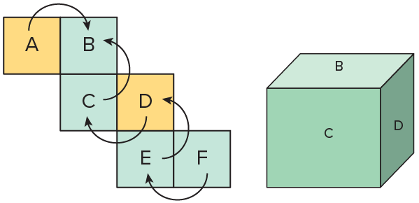
Mystery Shape
Faces A and D are the two side faces. ​
Explain how the information shown supports your reasoning.
44 / 62
Notes:
TEACH IN PRACTICE | Embedded facilitation | Lesson 5.6, slide 41 | WORKED
Focus on the existing task: Faces A and D are the two side faces. Mystery Shape
LAUNCH (T2/3/5): Ask students to explain the displayed idea or example and point to evidence. When a calculation step is shown, ask why it is valid. Have a partner restate the explanation; copying is not the check.
LOOK FOR (T4): Where this task addresses it, students can distinguish edges from faces. Ask which feature of their work supports the claim.
RESPOND: If this task shows the lesson misconception—accepting a net whose faces overlap or leave an opening—use a paper trace of the existing net and mark corresponding edges. Have the student revise and explain the change. Use this support only where the concept occurs in the current task; otherwise respond to the displayed question.
RECHECK: If a gap is shared, revisit the existing representation together. If it is limited, give targeted support while others compare valid methods on the same task. Check the revision before moving on.
PARTICIPATION (T5/6/7): Think time before volunteers; accept a written, drawn or rehearsed entry. Students ask for evidence respectfully. Recognize a specific contribution or revision and check that both partners participate.
Source: BCPS Updated Instructional Framework Rubric (June 2020), TEACH 1–7. Earlier notes and answer keys are retained below.
EARLIER NOTES / EXISTING ANSWER KEY
Model briefly, then hand the thinking back: ask “Why does this step work?” before showing the next one.
Quick check before moving on — thumbs or whiteboards from everyone, not volunteers.
UIFR: TEACH 2 · TEACH 3 · TEACH 4.

Slide 45
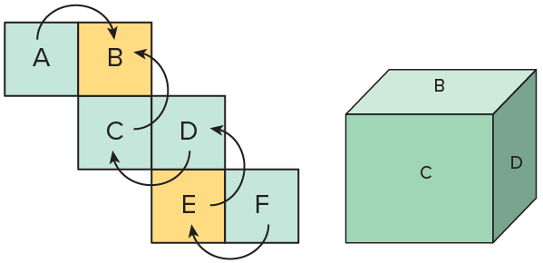
Mystery Shape
Face B is the top face and E is the bottom face.
Explain how the information shown supports your reasoning.
45 / 62
Notes:
TEACH IN PRACTICE | Embedded facilitation | Lesson 5.6, slide 42 | WORKED
Focus on the existing task: Face B is the top face and E is the bottom face. Mystery Shape
LAUNCH (T2/3/5): Ask students to explain the displayed idea or example and point to evidence. When a calculation step is shown, ask why it is valid. Have a partner restate the explanation; copying is not the check.
LOOK FOR (T4): Where this task addresses it, students can match each face of the solid to a net. Ask which feature of their work supports the claim.
RESPOND: If this task shows the lesson misconception—accepting a net whose faces overlap or leave an opening—use a paper trace of the existing net and mark corresponding edges. Have the student revise and explain the change. Use this support only where the concept occurs in the current task; otherwise respond to the displayed question.
RECHECK: If a gap is shared, revisit the existing representation together. If it is limited, give targeted support while others compare valid methods on the same task. Check the revision before moving on.
PARTICIPATION (T5/6/7): Think time before volunteers; accept a written, drawn or rehearsed entry. Students ask for evidence respectfully. Recognize a specific contribution or revision and check that both partners participate.
Source: BCPS Updated Instructional Framework Rubric (June 2020), TEACH 1–7. Earlier notes and answer keys are retained below.
EARLIER NOTES / EXISTING ANSWER KEY
Model briefly, then hand the thinking back: ask “Why does this step work?” before showing the next one.
Quick check before moving on — thumbs or whiteboards from everyone, not volunteers.
UIFR: TEACH 2 · TEACH 3 · TEACH 4.

Slide 46
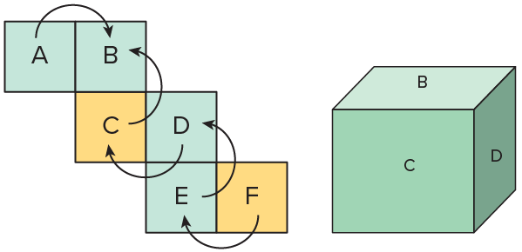
Mystery Shape
Faces C and F are the front and back faces.​
Think About It:
Is there only way to unfold a three-dimensional figure?
46 / 62
Notes:
TEACH IN PRACTICE | Embedded facilitation | Lesson 5.6, slide 43 | TASK
Focus on the existing task: Faces C and F are the front and back faces. Think About It: Is there only way to unfold a three-dimensional figure?
LAUNCH (T2/3/5): Use the displayed question. Give private thinking time; then A explains while B asks for evidence. Switch roles. Each student records their own reasoning.
LOOK FOR (T4): Where this task addresses it, students can distinguish edges from faces. Ask which feature of their work supports the claim.
RESPOND: If this task shows the lesson misconception—accepting a net whose faces overlap or leave an opening—use a paper trace of the existing net and mark corresponding edges. Have the student revise and explain the change. Use this support only where the concept occurs in the current task; otherwise respond to the displayed question.
RECHECK: If a gap is shared, revisit the existing representation together. If it is limited, give targeted support while others compare valid methods on the same task. Check the revision before moving on.
PARTICIPATION (T5/6/7): Think time before volunteers; accept a written, drawn or rehearsed entry. Students ask for evidence respectfully. Recognize a specific contribution or revision and check that both partners participate.
Source: BCPS Updated Instructional Framework Rubric (June 2020), TEACH 1–7. Earlier notes and answer keys are retained below.
EARLIER NOTES / EXISTING ANSWER KEY
Ask the question, then hold the silence — students think or jot before anyone answers.
Take two or three responses and press with “Why?” or “How do you know?” before moving on.
UIFR: TEACH 3.

Slide 47
STUDENT MOVES
Lesson 5-6
Your move
ADD ON · Add on: “I agree because ______.” or “I see it differently because ______.”
47 / 62

Slide 48
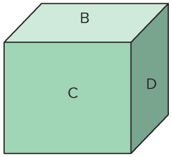
Mystery Shape
USE YOUR TOOLS · Reach for your notes, a model, or a manipulative before you reach for an answer.
How many faces, edges, and vertices does the three-dimensional figure have?
Reveal:
The figure has 6 faces, 12 edges, 8 vertices.
48 / 62
Notes:
TEACH IN PRACTICE | Embedded facilitation | Lesson 5.6, slide 44 | REVEAL
Focus on the existing task: How many faces, edges, and vertices does the three-dimensional figure have?
LAUNCH (T2/3/5): If an existing answer cover is present, gather an attempt before revealing. If the explanation is already visible, ask students to reconstruct and justify it. Compare reasoning and explain a revision; preserve the reveal sequence.
LOOK FOR (T4): Where this task addresses it, students can distinguish edges from faces. Ask which feature of their work supports the claim.
RESPOND: If this task shows the lesson misconception—accepting a net whose faces overlap or leave an opening—use a paper trace of the existing net and mark corresponding edges. Have the student revise and explain the change. Use this support only where the concept occurs in the current task; otherwise respond to the displayed question.
RECHECK: If a gap is shared, revisit the existing representation together. If it is limited, give targeted support while others compare valid methods on the same task. Check the revision before moving on.
PARTICIPATION (T5/6/7): Think time before volunteers; accept a written, drawn or rehearsed entry. Students ask for evidence respectfully. Recognize a specific contribution or revision and check that both partners participate.
Source: BCPS Updated Instructional Framework Rubric (June 2020), TEACH 1–7. Earlier notes and answer keys are retained below.
EARLIER NOTES / EXISTING ANSWER KEY
Do not click yet: collect 2–3 student answers with reasons first.
Then click to remove the cover and have students compare their thinking to the reveal — “Is this what we said? Where is it different?”
Behind the cover: The figure has 6 faces, 12 edges, 8 vertices.
UIFR: TEACH 3 · TEACH 4.

Slide 49
Mystery Shape
PROVE IT · Find the evidence in the problem that makes your answer right — not just the answer.
What three-dimensional figure is made from this net? Explain.
Reveal:
The three-dimensional figure has 6 square faces. So, it is a cube.
49 / 62
Notes:
TEACH IN PRACTICE | Embedded facilitation | Lesson 5.6, slide 45 | REVEAL
Focus on the existing task: What three-dimensional figure is made from this net?
LAUNCH (T2/3/5): If an existing answer cover is present, gather an attempt before revealing. If the explanation is already visible, ask students to reconstruct and justify it. Compare reasoning and explain a revision; preserve the reveal sequence.
LOOK FOR (T4): Where this task addresses it, students can distinguish edges from faces. Ask which feature of their work supports the claim.
RESPOND: If this task shows the lesson misconception—accepting a net whose faces overlap or leave an opening—use a paper trace of the existing net and mark corresponding edges. Have the student revise and explain the change. Use this support only where the concept occurs in the current task; otherwise respond to the displayed question.
RECHECK: If a gap is shared, revisit the existing representation together. If it is limited, give targeted support while others compare valid methods on the same task. Check the revision before moving on.
PARTICIPATION (T5/6/7): Think time before volunteers; accept a written, drawn or rehearsed entry. Students ask for evidence respectfully. Recognize a specific contribution or revision and check that both partners participate.
Source: BCPS Updated Instructional Framework Rubric (June 2020), TEACH 1–7. Earlier notes and answer keys are retained below.
EARLIER NOTES / EXISTING ANSWER KEY
Do not click yet: collect 2–3 student answers with reasons first.
Then click to remove the cover and have students compare their thinking to the reveal — “Is this what we said? Where is it different?”
Behind the cover: The three-dimensional figure has 6 square faces. So, it is a cube.
UIFR: TEACH 3 · TEACH 4.

Slide 50
Mystery Shape
Think and record first. Which part of your work supports your answer?
Using Representations
What are some other representations you could use?
50 / 62
Notes:
TEACH IN PRACTICE | Embedded facilitation | Lesson 5.6, slide 46 | TASK
Focus on the existing task: What are some other representations you could use?
LAUNCH (T2/3/5): Use the displayed question. Give private thinking time; then A explains while B asks for evidence. Switch roles. Each student records their own reasoning.
LOOK FOR (T4): Where this task addresses it, students can match each face of the solid to a net. Ask which feature of their work supports the claim.
RESPOND: If this task shows the lesson misconception—accepting a net whose faces overlap or leave an opening—use a paper trace of the existing net and mark corresponding edges. Have the student revise and explain the change. Use this support only where the concept occurs in the current task; otherwise respond to the displayed question.
RECHECK: If a gap is shared, revisit the existing representation together. If it is limited, give targeted support while others compare valid methods on the same task. Check the revision before moving on.
PARTICIPATION (T5/6/7): Think time before volunteers; accept a written, drawn or rehearsed entry. Students ask for evidence respectfully. Recognize a specific contribution or revision and check that both partners participate.
Source: BCPS Updated Instructional Framework Rubric (June 2020), TEACH 1–7. Earlier notes and answer keys are retained below.
EARLIER NOTES / EXISTING ANSWER KEY
Model briefly, then hand the thinking back: ask “Why does this step work?” before showing the next one.
Quick check before moving on — thumbs or whiteboards from everyone, not volunteers.
UIFR: TEACH 2 · TEACH 3 · TEACH 4.

Slide 51
Mystery Shape
What three-dimensional figure can this net make?
This net makes a cube.
Think and record first. Which part of your work supports your answer?
51 / 62
Notes:
TEACH IN PRACTICE | Embedded facilitation | Lesson 5.6, slide 47 | TASK
Focus on the existing task: What three-dimensional figure can this net make?
LAUNCH (T2/3/5): Use the displayed question. Give private thinking time; then A explains while B asks for evidence. Switch roles. Each student records their own reasoning.
LOOK FOR (T4): Where this task addresses it, students can match each face of the solid to a net. Ask which feature of their work supports the claim.
RESPOND: If this task shows the lesson misconception—accepting a net whose faces overlap or leave an opening—use a paper trace of the existing net and mark corresponding edges. Have the student revise and explain the change. Use this support only where the concept occurs in the current task; otherwise respond to the displayed question.
RECHECK: If a gap is shared, revisit the existing representation together. If it is limited, give targeted support while others compare valid methods on the same task. Check the revision before moving on.
PARTICIPATION (T5/6/7): Think time before volunteers; accept a written, drawn or rehearsed entry. Students ask for evidence respectfully. Recognize a specific contribution or revision and check that both partners participate.
Source: BCPS Updated Instructional Framework Rubric (June 2020), TEACH 1–7. Earlier notes and answer keys are retained below.
EARLIER NOTES / EXISTING ANSWER KEY
Model briefly, then hand the thinking back: ask “Why does this step work?” before showing the next one.
Quick check before moving on — thumbs or whiteboards from everyone, not volunteers.
UIFR: TEACH 2 · TEACH 3 · TEACH 4.

Slide 52
Let’s Explore More
How can you determine if a net forms a cube by just looking at the net?
Where have you seen cubes in real life?
Try it yourself. Compare your work with a partner; explain one choice and revise.
52 / 62
Notes:
TEACH IN PRACTICE | Embedded facilitation | Lesson 5.6, slide 48 | PRACTICE
Focus on the existing task: How can you determine if a net forms a cube by just looking at the net?
LAUNCH (T2/3/5): Use the displayed question. Give private thinking time; then A explains while B asks for evidence. Switch roles. Each student records their own reasoning.
LOOK FOR (T4): Where this task addresses it, students can match each face of the solid to a net. Ask which feature of their work supports the claim.
RESPOND: If this task shows the lesson misconception—accepting a net whose faces overlap or leave an opening—use a paper trace of the existing net and mark corresponding edges. Have the student revise and explain the change. Use this support only where the concept occurs in the current task; otherwise respond to the displayed question.
RECHECK: If a gap is shared, revisit the existing representation together. If it is limited, give targeted support while others compare valid methods on the same task. Check the revision before moving on.
PARTICIPATION (T5/6/7): Think time before volunteers; accept a written, drawn or rehearsed entry. Students ask for evidence respectfully. Recognize a specific contribution or revision and check that both partners participate.
Source: BCPS Updated Instructional Framework Rubric (June 2020), TEACH 1–7. Earlier notes and answer keys are retained below.
EARLIER NOTES / EXISTING ANSWER KEY
Extension for partners or table groups — students choose their approach and use the workspace to show thinking.
Push with “Convince me,” and have two groups with different approaches share.
This is where students stretch past the worked example.
UIFR: TEACH 2 · TEACH 5.

Slide 53
LESSON 5.6 / CHECK YOUR WORK
Pause. Check. Improve.
CHECK
A mistake to watch for: accepting a net whose faces overlap or leave an opening.
TRY
Use a paper trace of the given net and mark corresponding edges.
REVISE
Use that check on the task you just completed. Correct or strengthen one part, and explain why.
REVISE NOW · Change one answer and write why you changed it. A revision is evidence of learning.
Listen to understand. Ask for evidence. Make room for every voice.
Notes:
TEACH IN PRACTICE | Embedded facilitation | Lesson 5.6, slide 49 | PRIOR_INSERT
Focus on the existing task: LESSON 5.6 / CHECK YOUR WORK Pause. Check. Improve. Listen to understand. Ask for evidence. Make room for every voice. CHECK A mistake…
CONNECT (T1/4): Ask students to restate the displayed goal or key idea and connect it to earlier work. Relevant lesson evidence: match each face of the solid to a net; justify how the net folds; distinguish edges from faces. Use only the criterion that matches the current session.
SHOW PROGRESS: Students point to their own existing work, explain what improved after feedback, and name a next step. Pair confidence ratings with actual evidence.
PARTICIPATION (T5/6/7): Think time before volunteers; accept a written, drawn or rehearsed entry. Students ask for evidence respectfully. Recognize a specific contribution or revision and check that both partners participate.
Source: BCPS Updated Instructional Framework Rubric (June 2020), TEACH 1–7.

Slide 54
Mystery Shape
What is the relationship between the net and the three-dimensional shape that can be made by the net?
Compare your reasoning with the explanation. Explain any
revision you make.
Reveal:
The net is a two-dimensional representation of the three-dimensional figure it can make.
54 / 62
Notes:
TEACH IN PRACTICE | Embedded facilitation | Lesson 5.6, slide 50 | REVEAL
Focus on the existing task: What is the relationship between the net and the three-dimensional shape that can be made by the net?
LAUNCH (T2/3/5): If an existing answer cover is present, gather an attempt before revealing. If the explanation is already visible, ask students to reconstruct and justify it. Compare reasoning and explain a revision; preserve the reveal sequence.
LOOK FOR (T4): Where this task addresses it, students can match each face of the solid to a net. Ask which feature of their work supports the claim.
RESPOND: If this task shows the lesson misconception—accepting a net whose faces overlap or leave an opening—use a paper trace of the existing net and mark corresponding edges. Have the student revise and explain the change. Use this support only where the concept occurs in the current task; otherwise respond to the displayed question.
RECHECK: If a gap is shared, revisit the existing representation together. If it is limited, give targeted support while others compare valid methods on the same task. Check the revision before moving on.
PARTICIPATION (T5/6/7): Think time before volunteers; accept a written, drawn or rehearsed entry. Students ask for evidence respectfully. Recognize a specific contribution or revision and check that both partners participate.
Source: BCPS Updated Instructional Framework Rubric (June 2020), TEACH 1–7.

Slide 55
Mystery Shape
How can you describe the shapes that appear in the net?
Compare your reasoning with the explanation. Explain any
revision you make.
Reveal:
The net is made up of 6 squares of the same size.
55 / 62
Notes:
TEACH IN PRACTICE | Embedded facilitation | Lesson 5.6, slide 51 | REVEAL
Focus on the existing task: How can you describe the shapes that appear in the net?
LAUNCH (T2/3/5): If an existing answer cover is present, gather an attempt before revealing. If the explanation is already visible, ask students to reconstruct and justify it. Compare reasoning and explain a revision; preserve the reveal sequence.
LOOK FOR (T4): Where this task addresses it, students can match each face of the solid to a net. Ask which feature of their work supports the claim.
RESPOND: If this task shows the lesson misconception—accepting a net whose faces overlap or leave an opening—use a paper trace of the existing net and mark corresponding edges. Have the student revise and explain the change. Use this support only where the concept occurs in the current task; otherwise respond to the displayed question.
RECHECK: If a gap is shared, revisit the existing representation together. If it is limited, give targeted support while others compare valid methods on the same task. Check the revision before moving on.
PARTICIPATION (T5/6/7): Think time before volunteers; accept a written, drawn or rehearsed entry. Students ask for evidence respectfully. Recognize a specific contribution or revision and check that both partners participate.
Source: BCPS Updated Instructional Framework Rubric (June 2020), TEACH 1–7.

Slide 56
Mystery Shape
USE THE MATH WORDS · Use today’s math words in your explanation — not “it” and “that thing.”
How many faces, edges, and vertices does the three-dimensional figure have?
Reveal:
The figure has 6 faces, 12 edges, 8 vertices.
56 / 62
Notes:
TEACH IN PRACTICE | Embedded facilitation | Lesson 5.6, slide 52 | REVEAL
Focus on the existing task: How many faces, edges, and vertices does the three-dimensional figure have?
LAUNCH (T2/3/5): If an existing answer cover is present, gather an attempt before revealing. If the explanation is already visible, ask students to reconstruct and justify it. Compare reasoning and explain a revision; preserve the reveal sequence.
LOOK FOR (T4): Where this task addresses it, students can distinguish edges from faces. Ask which feature of their work supports the claim.
RESPOND: If this task shows the lesson misconception—accepting a net whose faces overlap or leave an opening—use a paper trace of the existing net and mark corresponding edges. Have the student revise and explain the change. Use this support only where the concept occurs in the current task; otherwise respond to the displayed question.
RECHECK: If a gap is shared, revisit the existing representation together. If it is limited, give targeted support while others compare valid methods on the same task. Check the revision before moving on.
PARTICIPATION (T5/6/7): Think time before volunteers; accept a written, drawn or rehearsed entry. Students ask for evidence respectfully. Recognize a specific contribution or revision and check that both partners participate.
Source: BCPS Updated Instructional Framework Rubric (June 2020), TEACH 1–7.

Slide 57
Mystery Shape
SPECIFIC FEEDBACK · Trade work. Give one specific comment: “This part is clear because ______.”
What three-dimensional figure is made from this net? Explain.
Reveal:
The three-dimensional figure has 6 square faces. So, it is a cube.
57 / 62
Notes:
TEACH IN PRACTICE | Embedded facilitation | Lesson 5.6, slide 53 | REVEAL
Focus on the existing task: What three-dimensional figure is made from this net?
LAUNCH (T2/3/5): If an existing answer cover is present, gather an attempt before revealing. If the explanation is already visible, ask students to reconstruct and justify it. Compare reasoning and explain a revision; preserve the reveal sequence.
LOOK FOR (T4): Where this task addresses it, students can distinguish edges from faces. Ask which feature of their work supports the claim.
RESPOND: If this task shows the lesson misconception—accepting a net whose faces overlap or leave an opening—use a paper trace of the existing net and mark corresponding edges. Have the student revise and explain the change. Use this support only where the concept occurs in the current task; otherwise respond to the displayed question.
RECHECK: If a gap is shared, revisit the existing representation together. If it is limited, give targeted support while others compare valid methods on the same task. Check the revision before moving on.
PARTICIPATION (T5/6/7): Think time before volunteers; accept a written, drawn or rehearsed entry. Students ask for evidence respectfully. Recognize a specific contribution or revision and check that both partners participate.
Source: BCPS Updated Instructional Framework Rubric (June 2020), TEACH 1–7.

Slide 58
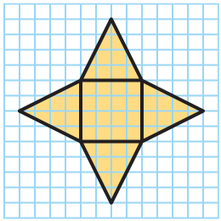
SUMMARIZE · SAY IT IN YOUR OWN WORDS
Summarize: Use Nets to Represent Figures
A net is a two-dimensional representation of a three-dimensional figure. To construct a net, you unfold the three-dimensional figure into its two-dimensional faces.
The net shown represents a square pyramid; it has a square base and four triangular faces. A pyramid is a three-dimensional figure that has one polygonal base and triangular sides that meet at a common vertex. A pyramid is named by the shape of its base.
58 / 62
Notes:
TEACH IN PRACTICE | Embedded facilitation | Lesson 5.6, slide 54 | SUMMARIZE
Focus on the existing task: A net is a two-dimensional representation of a three-dimensional figure. To construct a net, you unfold the three-dimensional figure into…
CONNECT (T1/4): Ask students to restate the displayed goal or key idea and connect it to earlier work. Relevant lesson evidence: match each face of the solid to a net; justify how the net folds; distinguish edges from faces. Use only the criterion that matches the current session.
SHOW PROGRESS: Students point to their own existing work, explain what improved after feedback, and name a next step. Pair confidence ratings with actual evidence.
PARTICIPATION (T5/6/7): Think time before volunteers; accept a written, drawn or rehearsed entry. Students ask for evidence respectfully. Recognize a specific contribution or revision and check that both partners participate.
Source: BCPS Updated Instructional Framework Rubric (June 2020), TEACH 1–7. Earlier notes and answer keys are retained below.
EARLIER NOTES / EXISTING ANSWER KEY
Routine: SUMMARIZE · SAY IT IN YOUR OWN WORDS

Slide 59
STUDENT MOVES
Lesson 5-6
Your move
SHOW THE EVIDENCE · Circle the part of your work that proves you met today’s goal.
59 / 62

Slide 60
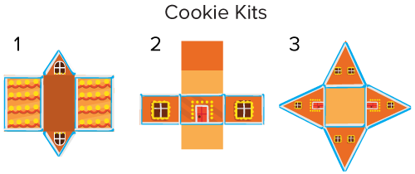
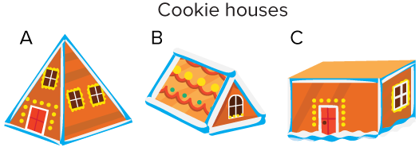
APPLY · PLAN IT • SOLVE IT • PROVE IT
Apply: Cookie Houses
A cookie house building kit contains three different cookie house kits.
Question: Which cookie matches with which cookie house? Explain your reasoning.
TWO MINUTES SOLO · Two minutes on your own, then compare. Bring one thing you tried, even if it did not work.
60 / 62
Notes:
TEACH IN PRACTICE | Embedded facilitation | Lesson 5.6, slide 55 | APPLY
Focus on the existing task: A cookie house building kit contains three different cookie house kits. Question: Which cookie matches with which cookie house?
LAUNCH (T2/3/5): Use the exact application task independently first. Ask students to justify their choice of method. Collect evidence before a partner discussion or correction.
LOOK FOR (T4): Where this task addresses it, students can match each face of the solid to a net. Ask which feature of their work supports the claim.
RESPOND: If this task shows the lesson misconception—accepting a net whose faces overlap or leave an opening—use a paper trace of the existing net and mark corresponding edges. Have the student revise and explain the change. Use this support only where the concept occurs in the current task; otherwise respond to the displayed question.
RECHECK: If a gap is shared, revisit the existing representation together. If it is limited, give targeted support while others compare valid methods on the same task. Check the revision before moving on.
PARTICIPATION (T5/6/7): Think time before volunteers; accept a written, drawn or rehearsed entry. Students ask for evidence respectfully. Recognize a specific contribution or revision and check that both partners participate.
Source: BCPS Updated Instructional Framework Rubric (June 2020), TEACH 1–7. Earlier notes and answer keys are retained below.
EARLIER NOTES / EXISTING ANSWER KEY
Routine: APPLY · PLAN IT • SOLVE IT • PROVE IT
UIFR FULL | Lesson-specific facilitation
TEACH 4 | Independent evidence and revision (UIFR PDF p. 11).
Use the existing application/exit problem as the independent check. If this is a learning-target slide, have students point to and explain their work on the preceding task. Separate initial independent evidence from the revision after feedback.
Check the relevant criteria: match each face of the solid to a net; justify how the net folds; distinguish edges from faces. Respond with one specific next step tied to the work. Students revise and annotate what changed, then identify a criterion they can now demonstrate and one they still need to practice.

Slide 61
Learning Targets
I can use a three-dimensional figure to create a two-dimensional net.
I can look for and make use of structure when using a two-dimensional net to find a three-dimensional figure.
NAME THE MATH · Point to the part of this that is new today, and say what it changes.
61 / 62
Notes:
TEACH IN PRACTICE | Embedded facilitation | Lesson 5.6, slide 56 | REFLECTION
Focus on the existing task: Learning Targets I can use a three-dimensional figure to create a two-dimensional net. I can look for and make use of structure when using…
CONNECT (T1/4): Ask students to restate the displayed goal or key idea and connect it to earlier work. Relevant lesson evidence: match each face of the solid to a net; justify how the net folds; distinguish edges from faces. Use only the criterion that matches the current session.
SHOW PROGRESS: Students point to their own existing work, explain what improved after feedback, and name a next step. Pair confidence ratings with actual evidence.
PARTICIPATION (T5/6/7): Think time before volunteers; accept a written, drawn or rehearsed entry. Students ask for evidence respectfully. Recognize a specific contribution or revision and check that both partners participate.
Source: BCPS Updated Instructional Framework Rubric (June 2020), TEACH 1–7. Earlier notes and answer keys are retained below.
EARLIER NOTES / EXISTING ANSWER KEY
UIFR FULL | Lesson-specific facilitation
REFLECT & ADJUST 1-2 | After the lesson (UIFR PDF pp. 15-16).
Sort the existing work by demonstrated reasoning, partial understanding, and the specific misconception: accepting a net whose faces overlap or leave an opening. Compare the initial response with the revision. Record which teaching move plausibly helped, which did not, and whose participation or access needs a different approach; do not record sensitive student details in this shared deck.
Plan the next lesson from that evidence: if the misconception persists, use a paper trace of the existing net and mark corresponding edges using the current example before returning to the next grade-level task; if understanding is secure, use an existing extension or ask for a general explanation. Check the targeted idea again at the next warm-up.
Ask students what supported their thinking and what would help next time. Identify one change to try and one successful practice to retain. Seek colleague feedback on anonymized work when useful; these prompts support reflection and do not establish an evaluation rating. Source: Baltimore City Public Schools, Updated Instructional Framework Rubric, June 2020 (UIFR_Full.pdf).

Slide 62
LESSON 5.6 / REFLECT ON YOUR LEARNING
Show your progress
1 SHOW EVIDENCE
2 CHOOSE A NEXT STEP
Choose one response. Point to the part that shows your reasoning.
Name a change you made after feedback—or a question you still have.
“My work shows ___ because ___.”
“Next time, I will ___ to help me ___.”
Today’s focus: Match each face of the solid to a net.
CREDIT A CLASSMATE · Name one classmate whose idea helped you today, and say what they said.
Listen to understand. Ask for evidence. Make room for every voice.
Notes:
TEACH IN PRACTICE | Embedded facilitation | Lesson 5.6, slide 57 | PRIOR_INSERT
Focus on the existing task: LESSON 5.6 / REFLECT ON YOUR LEARNING Show your progress Listen to understand. Ask for evidence. Make room for every voice. 1 SHOW…
CONNECT (T1/4): Ask students to restate the displayed goal or key idea and connect it to earlier work. Relevant lesson evidence: match each face of the solid to a net; justify how the net folds; distinguish edges from faces. Use only the criterion that matches the current session.
SHOW PROGRESS: Students point to their own existing work, explain what improved after feedback, and name a next step. Pair confidence ratings with actual evidence.
PARTICIPATION (T5/6/7): Think time before volunteers; accept a written, drawn or rehearsed entry. Students ask for evidence respectfully. Recognize a specific contribution or revision and check that both partners participate.
Source: BCPS Updated Instructional Framework Rubric (June 2020), TEACH 1–7.

