Slide 1
WARM-UP · THINK • TRY • CHECK
Turn and talk: compare strategies, then defend one.
Warm-Up
Lesson 5-7 · Determine Surface Area of Prisms | Warm-Up · about 4 minutes
Try each on your own. Mark an unsure answer; explain and revise when we check.
QUESTION 1
QUESTION 2
12 + 12 + 20 + 20 + 15 + 15 = ______
A face is a 9 cm by 4 cm rectangle. Its area = ______
QUESTION 3
QUESTION 4
The faces of a rectangular prism come in ______ matching pairs
One face is 18 square inches. That face and its match cover ______
TALK IT OVER: “I got ______ because ______.” • Compare with a partner before we check as a class.
1 / 47
Notes:
TEACH IN PRACTICE | Embedded facilitation | Lesson 5.7, slide 1 | WARMUP
Focus on the existing task: Warm-Up WARM-UP · THINK • TRY • CHECK Do these four on…
GATHER EVIDENCE (T4/6): Keep the original items. Students try independently, mark an uncertain item, and explain one method before checking. Use the existing key when present.
RESPOND: Distinguish a calculation slip from a reasoning gap. Give one next step on the same item; have students revise in a second color. Use the responses to choose flexible support for today’s lesson.
PARTICIPATION (T5/6/7): Think time before volunteers; accept a written, drawn or rehearsed entry. Students ask for evidence respectfully. Recognize a specific contribution or revision and check that both partners participate.
Source: BCPS Updated Instructional Framework Rubric (June 2020), TEACH 1–7. Earlier notes and answer keys are retained below.
EARLIER NOTES / EXISTING ANSWER KEY
Warm-Up answers (teacher only): 1) 94 2) 36 square centimeters 3) 3 4) 36 square inches
UIFR FULL | Lesson-specific facilitation
PREPARE 1-2 | Before teaching (UIFR PDF pp. 6-7).
Plan to gather evidence that students can account for every required prism face once; calculate face areas; respect excluded surfaces in context. Review recent work and today’s warm-up to choose flexible groups and access supports; do not infer needs from identity or perceived ability. Use the existing lesson tasks and stated standards.
Anticipate: including openings or forgetting a pair of faces. If observed, label corresponding faces and cross-reference them with the original problem requirements. Offer oral rehearsal, drawing, pointing, or home-language processing as needed; retain the original mathematical demand. Ask students which support helps and fade it as evidence improves.
TEACH 6-7 | Before the first transition, agree on materials, partner roles, and how to request help. Invite students to restate the routine. Normalize revising an idea, recognize a specific contribution, and check privately when frustration blocks participation. Source: UIFR PDF pp. 13-14.

Slide 2
Today’s Math Notes
Lesson 5-7 · Determine Surface Area of Prisms
Section 1: Math Words
Copy. Explain. Check.
SAY THE GOAL · Say today’s goal in your own words, then name one place this shows up outside math class.
Surface Area
1
The total area of all the faces of a 3-D figure
Net
2
A flat pattern that folds up to make a 3-D figure
Face
3
One flat surface of a three-dimensional figure
eduwonderlab.com · Neft Teacher
2 / 47
Notes:
TEACH IN PRACTICE | Embedded facilitation | Lesson 5.7, slide 2 | NOTES
Focus on the existing task: Today’s Math Notes Section 1: Math Words Copy into your…
ROUTINE (T1/2/4): Read or copy the original notes, cover one line, and explain it using the displayed example. Reopen and correct. Copying alone is not evidence of understanding.
LOOK FOR: A link between a symbol, quantity or feature and the explanation. If missing, point back to that feature and have the student try again; fade the prompt once they can explain.
PARTICIPATION (T5/6/7): Think time before volunteers; accept a written, drawn or rehearsed entry. Students ask for evidence respectfully. Recognize a specific contribution or revision and check that both partners participate.
Source: BCPS Updated Instructional Framework Rubric (June 2020), TEACH 1–7. Earlier notes and answer keys are retained below.
EARLIER NOTES / EXISTING ANSWER KEY
Copy routine: read one line at a time; students copy, then explain that line to a partner.
Keep it brisk — the understanding work happens in the examples, not the copying.
UIFR: TEACH 1 · TEACH 6.

Slide 3
Today’s Math Notes
Lesson 5-7 · Determine Surface Area of Prisms
Section 2: Today’s Math
Copy. Explain. Check.
Surface Area of Prisms
Surface Area = Sum of the Areas of All the Faces
Read, cover, explain. Reopen your notes to
check and improve your explanation.
1
Draw a net to unfold the prism into its flat faces
2
Find the area of each face using its own area formula
3
Add all the face areas together to find the surface area
eduwonderlab.com · Neft Teacher
3 / 47
Notes:
TEACH IN PRACTICE | Embedded facilitation | Lesson 5.7, slide 3 | NOTES
Focus on the existing task: Today’s Math Notes Section 2: Today’s Math Copy into your…
ROUTINE (T1/2/4): Read or copy the original notes, cover one line, and explain it using the displayed example. Reopen and correct. Copying alone is not evidence of understanding.
LOOK FOR: A link between a symbol, quantity or feature and the explanation. If missing, point back to that feature and have the student try again; fade the prompt once they can explain.
PARTICIPATION (T5/6/7): Think time before volunteers; accept a written, drawn or rehearsed entry. Students ask for evidence respectfully. Recognize a specific contribution or revision and check that both partners participate.
Source: BCPS Updated Instructional Framework Rubric (June 2020), TEACH 1–7. Earlier notes and answer keys are retained below.
EARLIER NOTES / EXISTING ANSWER KEY
Copy routine: read one line at a time; students copy, then explain that line to a partner.
Keep it brisk — the understanding work happens in the examples, not the copying.
UIFR: TEACH 1 · TEACH 6.

Slide 4
Session 1
Determine Surface Area of Prisms
PICK YOUR STRATEGY · Choose your path — picture, table, number line, or equation — and be ready to say why you chose it.
4 / 47
Notes:
TEACH IN PRACTICE | Embedded facilitation | Lesson 5.7, slide 4 | DIVIDER
Focus on the existing task: Determine Surface Area of Prisms Session 1
TRANSITION (T6/7): Students confirm materials, roles, how to request help, and the next response routine. Ask a student to restate it. Keep teacher-only slides hidden.
PARTICIPATION (T5/6/7): Think time before volunteers; accept a written, drawn or rehearsed entry. Students ask for evidence respectfully. Recognize a specific contribution or revision and check that both partners participate.
Source: BCPS Updated Instructional Framework Rubric (June 2020), TEACH 1–7. Earlier notes and answer keys are retained below.
EARLIER NOTES / EXISTING ANSWER KEY
Transition cue: state what materials are out and what success looks like this session.
Keep the changeover under a minute.
UIFR: TEACH 6.

Slide 5
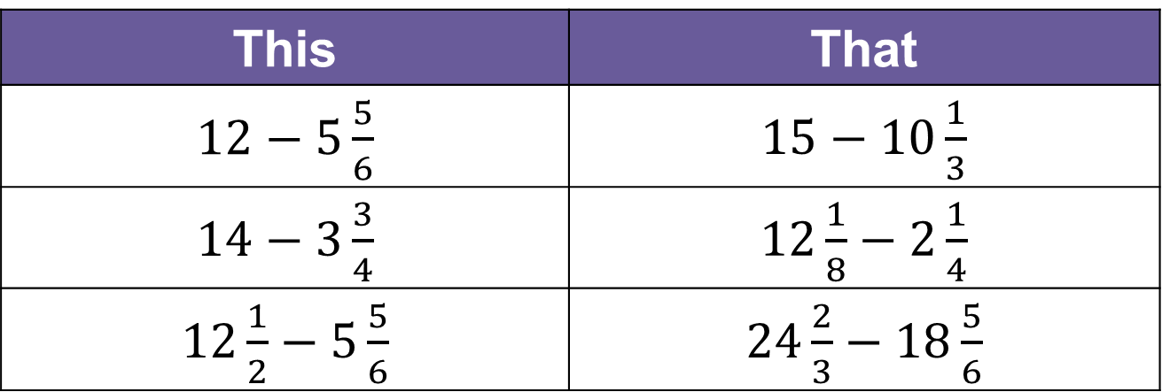
This or That
Would you rather have THIS or THAT fun adventures?
Fun Adventures
This | That
$12−5\frac{5}{6}$ | $15−10\frac{1}{3}$
$14−3\frac{3}{4}$ | $12\frac{1}{8}−2\frac{1}{4}$
$12\frac{1}{2}−5\frac{5}{6}$ | $24\frac{2}{3}−18\frac{5}{6}$
Think and record first. Which part of your work supports your answer?
5 / 47
Notes:
TEACH IN PRACTICE | Embedded facilitation | Lesson 5.7, slide 5 | TASK
Focus on the existing task: This or That Would you rather have THIS or THAT fun adventures?
LAUNCH (T2/3/5): Use the displayed question. Give private thinking time; then A explains while B asks for evidence. Switch roles. Each student records their own reasoning.
LOOK FOR (T4): Where this task addresses it, students can account for every required prism face once. Ask which feature of their work supports the claim.
RESPOND: If this task shows the lesson misconception—including openings or forgetting a pair of faces—label corresponding faces and cross-reference them with the original problem requirements. Have the student revise and explain the change. Use this support only where the concept occurs in the current task; otherwise respond to the displayed question.
RECHECK: If a gap is shared, revisit the existing representation together. If it is limited, give targeted support while others compare valid methods on the same task. Check the revision before moving on.
PARTICIPATION (T5/6/7): Think time before volunteers; accept a written, drawn or rehearsed entry. Students ask for evidence respectfully. Recognize a specific contribution or revision and check that both partners participate.
Source: BCPS Updated Instructional Framework Rubric (June 2020), TEACH 1–7. Earlier notes and answer keys are retained below.
EARLIER NOTES / EXISTING ANSWER KEY
Number-sense routine — every voice in. Give quiet think time, then hear from at least three students.
Always follow with “How do you know?” — the reasoning is the point, not the answer.
There is more than one path; name and celebrate different strategies.
UIFR: TEACH 3 · TEACH 5 · TEACH 6.

Slide 6
Today’s Objectives
Lesson 5-7 · Determine Surface Area of Prisms
Determine Surface Area of Prisms
Maryland Standard 6.GR.4
CONNECT IT · What earlier lesson does this build on? Tell a partner in one sentence.
CONTENT OBJECTIVE
LANGUAGE OBJECTIVE
Restate the goal in your words
Use these words to explain why
I can use a net to find the surface area of a prism by adding the area of every face.
I can explain my work using the words net, face, base, prism, and surface area.
eduwonderlab.com · Neft Teacher
6 / 47
Notes:
TEACH IN PRACTICE | Embedded facilitation | Lesson 5.7, slide 6 | GOAL
Focus on the existing task: Today’s Objectives Determine Surface Area of Prisms…
CONNECT (T1/4): Ask students to restate the displayed goal or key idea and connect it to earlier work. Relevant lesson evidence: account for every required prism face once; calculate face areas; respect excluded surfaces in context. Use only the criterion that matches the current session.
SHOW PROGRESS: Students point to their own existing work, explain what improved after feedback, and name a next step. Pair confidence ratings with actual evidence.
PARTICIPATION (T5/6/7): Think time before volunteers; accept a written, drawn or rehearsed entry. Students ask for evidence respectfully. Recognize a specific contribution or revision and check that both partners participate.
Source: BCPS Updated Instructional Framework Rubric (June 2020), TEACH 1–7. Earlier notes and answer keys are retained below.
EARLIER NOTES / EXISTING ANSWER KEY
Read the objective together, then have one or two students restate today’s goal in their own words.
Connect it to what the class learned last lesson.
Return to this goal at the end of class to check it was met.
UIFR: TEACH 1.
UIFR FULL | Lesson-specific facilitation
TEACH 1 | Session 1 purpose and evidence (UIFR PDF p. 8).
Have students restate the displayed session goal in their own words and connect it to the existing context or a familiar experience they choose to share. Use the current session goal to select from these lesson-wide evidence criteria; do not frontload a later-session procedure.
Look for: account for every required prism face once; calculate face areas; respect excluded surfaces in context. Ask: “Which part of your work would show this?” Revisit that evidence after the task; a confidence rating alone is not evidence of understanding.

Slide 7
LESSON 5.7 / OUR LEARNING
What will show your learning?
1
Account for every required prism face once.
2
Calculate face areas.
3
Respect excluded surfaces in context.
Tell a partner: Which skill connects to something you already know?
SHOW YOUR THINKING · Show what you know — write it, draw it, or build it. A picture counts as an explanation.
Listen to understand. Ask for evidence. Make room for every voice.
Notes:
TEACH IN PRACTICE | Embedded facilitation | Lesson 5.7, slide 7 | PRIOR_INSERT
Focus on the existing task: LESSON 5.7 / OUR LEARNING What will show your learning?
CONNECT (T1/4): Ask students to restate the displayed goal or key idea and connect it to earlier work. Relevant lesson evidence: account for every required prism face once; calculate face areas; respect excluded surfaces in context. Use only the criterion that matches the current session.
SHOW PROGRESS: Students point to their own existing work, explain what improved after feedback, and name a next step. Pair confidence ratings with actual evidence.
PARTICIPATION (T5/6/7): Think time before volunteers; accept a written, drawn or rehearsed entry. Students ask for evidence respectfully. Recognize a specific contribution or revision and check that both partners participate.
Source: BCPS Updated Instructional Framework Rubric (June 2020), TEACH 1–7.

Slide 8
Vocabulary
Lesson 5-7 · Determine Surface Area of Prisms
Today’s Math Words
We learn every word — what it means and what it looks like — before we use it.
Surface area
Net
The total area of all the faces of a three-dimensional figure
A flat pattern that folds up to form a three-dimensional figure
Face
Prism
One flat surface of a three-dimensional figure
A solid with two congruent parallel bases joined by rectangular faces
Rectangular prism
Triangular prism
A prism whose six faces are all rectangles, in three congruent pairs
A prism with two congruent triangular bases and three rectangular faces
Lateral face
Explain one math word using the example.
Partner: point to evidence.
Any face of a prism that is not one of its two bases
eduwonderlab.com · Neft Teacher
8 / 47
Notes:
TEACH IN PRACTICE | Embedded facilitation | Lesson 5.7, slide 8 | VOCAB
Focus on the existing task: Vocabulary Today’s Math Words We learn every word — what…
ASK (T1/3/5): Where does “the displayed term” appear in the example? Explain the meaning without reading the definition. Partner: restate the idea and ask a clarifying question.
LOOK FOR: A correct connection between the word and a feature of the example. If the student only repeats the definition, invite pointing, sketching or oral rehearsal, then ask for another explanation of this same example.
PARTICIPATION (T5/6/7): Think time before volunteers; accept a written, drawn or rehearsed entry. Students ask for evidence respectfully. Recognize a specific contribution or revision and check that both partners participate.
Source: BCPS Updated Instructional Framework Rubric (June 2020), TEACH 1–7. Earlier notes and answer keys are retained below.
EARLIER NOTES / EXISTING ANSWER KEY
Choral-read each word, its meaning, and what it looks like.
Students should use these words out loud today — listen for them in partner talk and revoice student ideas with the academic term.
UIFR: TEACH 1 · TEACH 5.

Slide 9
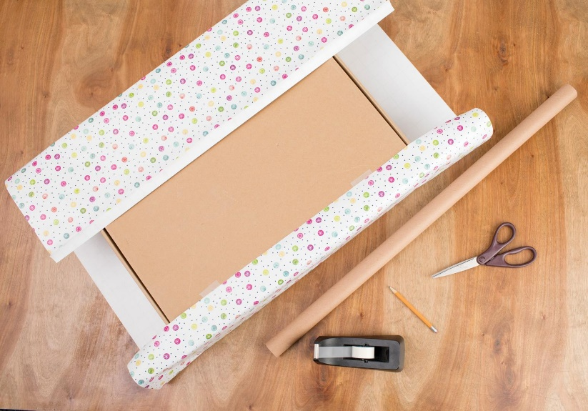

Be Curious
What do you notice?
What do you wonder?
Mindset
HOW DO YOU KNOW? · Ask your partner “How do you know?” Answer by pointing to your own work.
What helps you be a contributor to the math class community?
9 / 47
Notes:
TEACH IN PRACTICE | Embedded facilitation | Lesson 5.7, slide 9 | CURIOUS
Focus on the existing task: What helps you be a contributor to the math class community?
LAUNCH (T2/3/5): Allow quiet observation first. Separate a notice from an inference, invite students’ own questions, and follow the existing launch before teaching a procedure.
LOOK FOR (T4): Where this task addresses it, students can account for every required prism face once. Ask which feature of their work supports the claim.
RESPOND: If this task shows the lesson misconception—including openings or forgetting a pair of faces—label corresponding faces and cross-reference them with the original problem requirements. Have the student revise and explain the change. Use this support only where the concept occurs in the current task; otherwise respond to the displayed question.
RECHECK: If a gap is shared, revisit the existing representation together. If it is limited, give targeted support while others compare valid methods on the same task. Check the revision before moving on.
PARTICIPATION (T5/6/7): Think time before volunteers; accept a written, drawn or rehearsed entry. Students ask for evidence respectfully. Recognize a specific contribution or revision and check that both partners participate.
Source: BCPS Updated Instructional Framework Rubric (June 2020), TEACH 1–7. Earlier notes and answer keys are retained below.
EARLIER NOTES / EXISTING ANSWER KEY
Accept all noticings and wonderings — there are no wrong answers here.
Give 20–30 seconds of quiet think time before taking responses; mix cold and warm calls so it is not always the same voices.
Read the mindset question aloud and let two students respond.
UIFR: TEACH 3 · TEACH 7.

Slide 10
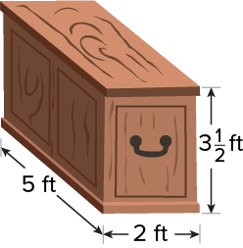
Painting Project
James is putting a special restorative stain on the entire surface of the wooden chest. One can of stain covers about 35 square feet.
How many cans of stain will James need?
​
Think and record first. Which part of your work supports your answer?
10 / 47
Notes:
TEACH IN PRACTICE | Embedded facilitation | Lesson 5.7, slide 10 | TASK
Focus on the existing task: James is putting a special restorative stain on the entire surface of the wooden chest. One can of stain covers about 35 square feet. How many cans of stain will James need?
LAUNCH (T2/3/5): Use the displayed question. Give private thinking time; then A explains while B asks for evidence. Switch roles. Each student records their own reasoning.
LOOK FOR (T4): Where this task addresses it, students can account for every required prism face once. Ask which feature of their work supports the claim.
RESPOND: If this task shows the lesson misconception—including openings or forgetting a pair of faces—label corresponding faces and cross-reference them with the original problem requirements. Have the student revise and explain the change. Use this support only where the concept occurs in the current task; otherwise respond to the displayed question.
RECHECK: If a gap is shared, revisit the existing representation together. If it is limited, give targeted support while others compare valid methods on the same task. Check the revision before moving on.
PARTICIPATION (T5/6/7): Think time before volunteers; accept a written, drawn or rehearsed entry. Students ask for evidence respectfully. Recognize a specific contribution or revision and check that both partners participate.
Source: BCPS Updated Instructional Framework Rubric (June 2020), TEACH 1–7. Earlier notes and answer keys are retained below.
EARLIER NOTES / EXISTING ANSWER KEY
Read the context aloud (or have a student read it).
Before any math, students restate the situation and what is being asked in their own words.
Ask: How many cans of stain will James need?
UIFR: TEACH 1 · TEACH 3.
UIFR FULL | Lesson-specific facilitation
TEACH 2-3 | Session 1 task launch (UIFR PDF pp. 9-10).
Use the problem exactly as displayed. Give individual thinking time before discussion or advancing to the explanation. If the answer is already visible, ask students to reconstruct and justify it. Invite a choice of suitable representations and have students explain why their choice helps.
At the point where this concept appears, ask: “Which surfaces does this situation require, and how can your net prove none are missing or counted twice?” Wait for evidence, invite another pathway, and have a student ask a follow-up question. Do not replace students’ reasoning with a sequence of leading steps.

Slide 11
Painting Project
James is putting a special restorative stain on the entire surface of the wooden chest.
How can you determine the total square feet of the chest?
TRY IT BEFORE YOU’RE SURE · Start even if you are not sure. A revised answer counts as much as a first-try answer.
Reveal:
We can find the area of each surface of the wooden chest.
11 / 47
Notes:
TEACH IN PRACTICE | Embedded facilitation | Lesson 5.7, slide 11 | REVEAL
Focus on the existing task: James is putting a special restorative stain on the entire surface of the wooden chest. How can you determine the total square feet of the chest?
LAUNCH (T2/3/5): If an existing answer cover is present, gather an attempt before revealing. If the explanation is already visible, ask students to reconstruct and justify it. Compare reasoning and explain a revision; preserve the reveal sequence.
LOOK FOR (T4): Where this task addresses it, students can account for every required prism face once. Ask which feature of their work supports the claim.
RESPOND: If this task shows the lesson misconception—including openings or forgetting a pair of faces—label corresponding faces and cross-reference them with the original problem requirements. Have the student revise and explain the change. Use this support only where the concept occurs in the current task; otherwise respond to the displayed question.
RECHECK: If a gap is shared, revisit the existing representation together. If it is limited, give targeted support while others compare valid methods on the same task. Check the revision before moving on.
PARTICIPATION (T5/6/7): Think time before volunteers; accept a written, drawn or rehearsed entry. Students ask for evidence respectfully. Recognize a specific contribution or revision and check that both partners participate.
Source: BCPS Updated Instructional Framework Rubric (June 2020), TEACH 1–7. Earlier notes and answer keys are retained below.
EARLIER NOTES / EXISTING ANSWER KEY
Do not click yet: collect 2–3 student answers with reasons first.
Then click to remove the cover and have students compare their thinking to the reveal — “Is this what we said? Where is it different?”
Behind the cover: We can find the area of each surface of the wooden chest.
UIFR: TEACH 3 · TEACH 4.

Slide 12
Painting Project
We need to find the area of each surface of the wooden chest, or the surface area.
The surface area of a three-dimensional figure is the sum of the areas of the faces.​
Think About It:
How can you apply what you know about finding the area of composite figures to find the surface area of the wooden chest?
12 / 47
Notes:
TEACH IN PRACTICE | Embedded facilitation | Lesson 5.7, slide 12 | TASK
Focus on the existing task: We need to find the area of each surface of the wooden chest, or the surface area. The surface area of a three-dimensional figure is the…
LAUNCH (T2/3/5): Use the displayed question. Give private thinking time; then A explains while B asks for evidence. Switch roles. Each student records their own reasoning.
LOOK FOR (T4): Where this task addresses it, students can calculate face areas. Ask which feature of their work supports the claim.
RESPOND: If this task shows the lesson misconception—including openings or forgetting a pair of faces—label corresponding faces and cross-reference them with the original problem requirements. Have the student revise and explain the change. Use this support only where the concept occurs in the current task; otherwise respond to the displayed question.
RECHECK: If a gap is shared, revisit the existing representation together. If it is limited, give targeted support while others compare valid methods on the same task. Check the revision before moving on.
PARTICIPATION (T5/6/7): Think time before volunteers; accept a written, drawn or rehearsed entry. Students ask for evidence respectfully. Recognize a specific contribution or revision and check that both partners participate.
Source: BCPS Updated Instructional Framework Rubric (June 2020), TEACH 1–7. Earlier notes and answer keys are retained below.
EARLIER NOTES / EXISTING ANSWER KEY
Ask the question, then hold the silence — students think or jot before anyone answers.
Take two or three responses and press with “Why?” or “How do you know?” before moving on.
UIFR: TEACH 3.

Slide 13
STUDENT MOVES
Lesson 5-7
Your move
STRUGGLE FIRST · Work on your own first. Stuck is allowed — try a second strategy before you ask.
13 / 47

Slide 14
Painting Project
What tool you can use to find the area of each surface of the wooden chest?
Record your reasoning before the reveal. Compare, then
explain any revision.
Reveal:
We can use a net.
14 / 47
Notes:
TEACH IN PRACTICE | Embedded facilitation | Lesson 5.7, slide 13 | REVEAL
Focus on the existing task: What tool you can use to find the area of each surface of the wooden chest?
LAUNCH (T2/3/5): If an existing answer cover is present, gather an attempt before revealing. If the explanation is already visible, ask students to reconstruct and justify it. Compare reasoning and explain a revision; preserve the reveal sequence.
LOOK FOR (T4): Where this task addresses it, students can account for every required prism face once. Ask which feature of their work supports the claim.
RESPOND: If this task shows the lesson misconception—including openings or forgetting a pair of faces—label corresponding faces and cross-reference them with the original problem requirements. Have the student revise and explain the change. Use this support only where the concept occurs in the current task; otherwise respond to the displayed question.
RECHECK: If a gap is shared, revisit the existing representation together. If it is limited, give targeted support while others compare valid methods on the same task. Check the revision before moving on.
PARTICIPATION (T5/6/7): Think time before volunteers; accept a written, drawn or rehearsed entry. Students ask for evidence respectfully. Recognize a specific contribution or revision and check that both partners participate.
Source: BCPS Updated Instructional Framework Rubric (June 2020), TEACH 1–7. Earlier notes and answer keys are retained below.
EARLIER NOTES / EXISTING ANSWER KEY
Students should have shared predictions before this reveal.
Have them compare their thinking to what is shown: “Is this the same as what we said? Where is it different?”
Press one student to explain the reveal in their own words.
UIFR: TEACH 3 · TEACH 4.

Slide 15
Painting Project
We can use a net to deconstruct the chest.
What type of three-dimensional figure models the chest? What are the defining attributes of the figure?
Reveal:
The chest is a rectangular prism. It has 6 rectangular faces with 3 pairs of congruent faces.
15 / 47
Notes:
TEACH IN PRACTICE | Embedded facilitation | Lesson 5.7, slide 14 | REVEAL
Focus on the existing task: We can use a net to deconstruct the chest. What type of three-dimensional figure models the chest?
LAUNCH (T2/3/5): If an existing answer cover is present, gather an attempt before revealing. If the explanation is already visible, ask students to reconstruct and justify it. Compare reasoning and explain a revision; preserve the reveal sequence.
LOOK FOR (T4): Where this task addresses it, students can account for every required prism face once. Ask which feature of their work supports the claim.
RESPOND: If this task shows the lesson misconception—including openings or forgetting a pair of faces—label corresponding faces and cross-reference them with the original problem requirements. Have the student revise and explain the change. Use this support only where the concept occurs in the current task; otherwise respond to the displayed question.
RECHECK: If a gap is shared, revisit the existing representation together. If it is limited, give targeted support while others compare valid methods on the same task. Check the revision before moving on.
PARTICIPATION (T5/6/7): Think time before volunteers; accept a written, drawn or rehearsed entry. Students ask for evidence respectfully. Recognize a specific contribution or revision and check that both partners participate.
Source: BCPS Updated Instructional Framework Rubric (June 2020), TEACH 1–7. Earlier notes and answer keys are retained below.
EARLIER NOTES / EXISTING ANSWER KEY
Do not click yet: collect 2–3 student answers with reasons first.
Then click to remove the cover and have students compare their thinking to the reveal — “Is this what we said? Where is it different?”
Behind the cover: The chest is a rectangular prism. It has 6 rectangular faces with 3 pairs of congruent faces .
UIFR: TEACH 3 · TEACH 4.

Slide 16
STUDENT MOVES
Lesson 5-7
Your move
ANOTHER PATHWAY · Did anyone get there a different way? Put both pathways side by side and compare.
16 / 47

Slide 17
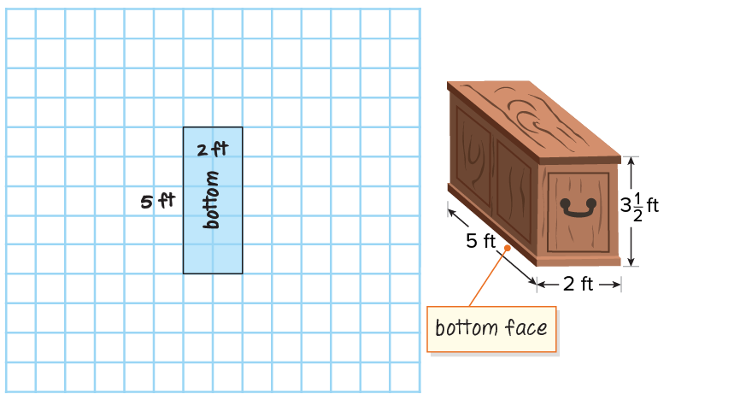
Painting Project
Let’s create a net of the rectangular prism chest.​
A rectangular prism is made up of 3 pairs of congruent faces.​
The bottom face is a 2-foot by 5-foot rectangle.​
​
Explain how the information shown supports your reasoning.
17 / 47
Notes:
TEACH IN PRACTICE | Embedded facilitation | Lesson 5.7, slide 15 | WORKED
Focus on the existing task: Let’s create a net of the rectangular prism chest. A rectangular prism is made up of 3 pairs of congruent faces. The bottom face is a…
LAUNCH (T2/3/5): Ask students to explain the displayed idea or example and point to evidence. When a calculation step is shown, ask why it is valid. Have a partner restate the explanation; copying is not the check.
LOOK FOR (T4): Where this task addresses it, students can account for every required prism face once. Ask which feature of their work supports the claim.
RESPOND: If this task shows the lesson misconception—including openings or forgetting a pair of faces—label corresponding faces and cross-reference them with the original problem requirements. Have the student revise and explain the change. Use this support only where the concept occurs in the current task; otherwise respond to the displayed question.
RECHECK: If a gap is shared, revisit the existing representation together. If it is limited, give targeted support while others compare valid methods on the same task. Check the revision before moving on.
PARTICIPATION (T5/6/7): Think time before volunteers; accept a written, drawn or rehearsed entry. Students ask for evidence respectfully. Recognize a specific contribution or revision and check that both partners participate.
Source: BCPS Updated Instructional Framework Rubric (June 2020), TEACH 1–7. Earlier notes and answer keys are retained below.
EARLIER NOTES / EXISTING ANSWER KEY
Model briefly, then hand the thinking back: ask “Why does this step work?” before showing the next one.
Quick check before moving on — thumbs or whiteboards from everyone, not volunteers.
UIFR: TEACH 2 · TEACH 3 · TEACH 4.

Slide 18
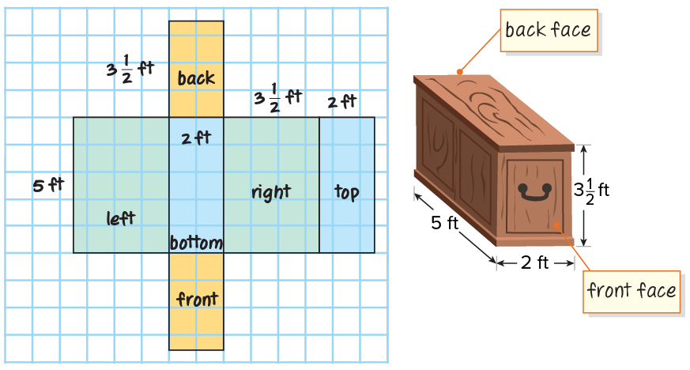
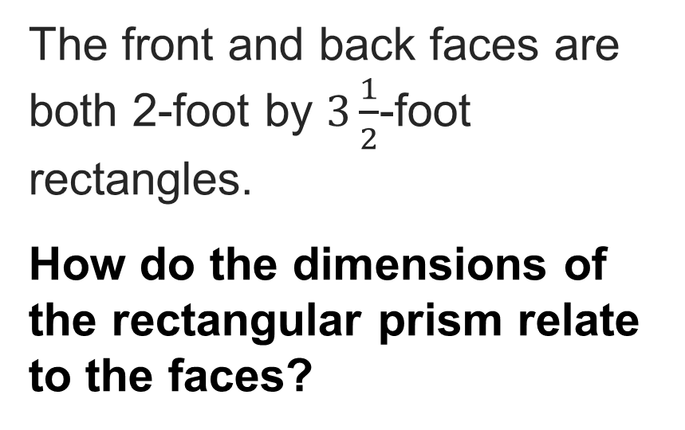
Painting Project
The front and back faces are both 2-foot by $3\frac{1}{2}$-foot rectangles.
How do the dimensions of the rectangular prism relate to the faces?
Record your reasoning before the
reveal. Compare, then explain
any revision.
Reveal:
The dimensions of the rectangular prism correspond to the lengths and widths of the faces.
18 / 47
Notes:
TEACH IN PRACTICE | Embedded facilitation | Lesson 5.7, slide 16 | REVEAL
Focus on the existing task: Reveal: The dimensions of the rectangular prism correspond to the lengths and widths of the faces. The front and back faces are both…
LAUNCH (T2/3/5): If an existing answer cover is present, gather an attempt before revealing. If the explanation is already visible, ask students to reconstruct and justify it. Compare reasoning and explain a revision; preserve the reveal sequence.
LOOK FOR (T4): Where this task addresses it, students can account for every required prism face once. Ask which feature of their work supports the claim.
RESPOND: If this task shows the lesson misconception—including openings or forgetting a pair of faces—label corresponding faces and cross-reference them with the original problem requirements. Have the student revise and explain the change. Use this support only where the concept occurs in the current task; otherwise respond to the displayed question.
RECHECK: If a gap is shared, revisit the existing representation together. If it is limited, give targeted support while others compare valid methods on the same task. Check the revision before moving on.
PARTICIPATION (T5/6/7): Think time before volunteers; accept a written, drawn or rehearsed entry. Students ask for evidence respectfully. Recognize a specific contribution or revision and check that both partners participate.
Source: BCPS Updated Instructional Framework Rubric (June 2020), TEACH 1–7. Earlier notes and answer keys are retained below.
EARLIER NOTES / EXISTING ANSWER KEY
Do not click yet: collect 2–3 student answers with reasons first.
Then click to remove the cover and have students compare their thinking to the reveal — “Is this what we said? Where is it different?”
Behind the cover: The dimensions of the rectangular prism correspond to the lengths and widths of the faces.
UIFR: TEACH 3 · TEACH 4.

Slide 19

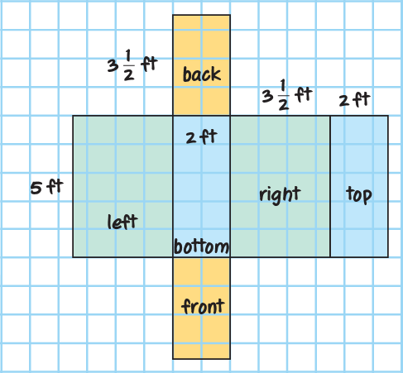
COLLABORATE · TALK IT THROUGH • AGREE ON A MODEL
Collaborate and Connect
What is the area of each face?
Think first. A explains; B asks for evidence.
Switch roles; both revise.
19 / 47
Notes:
TEACH IN PRACTICE | Embedded facilitation | Lesson 5.7, slide 17 | COLLABORATE
Focus on the existing task: What is the area of each face?
LAUNCH (T2/3/5): Use the displayed question. Give private thinking time; then A explains while B asks for evidence. Switch roles. Each student records their own reasoning.
LOOK FOR (T4): Where this task addresses it, students can account for every required prism face once. Ask which feature of their work supports the claim.
RESPOND: If this task shows the lesson misconception—including openings or forgetting a pair of faces—label corresponding faces and cross-reference them with the original problem requirements. Have the student revise and explain the change. Use this support only where the concept occurs in the current task; otherwise respond to the displayed question.
RECHECK: If a gap is shared, revisit the existing representation together. If it is limited, give targeted support while others compare valid methods on the same task. Check the revision before moving on.
PARTICIPATION (T5/6/7): Think time before volunteers; accept a written, drawn or rehearsed entry. Students ask for evidence respectfully. Recognize a specific contribution or revision and check that both partners participate.
Source: BCPS Updated Instructional Framework Rubric (June 2020), TEACH 1–7. Earlier notes and answer keys are retained below.
EARLIER NOTES / EXISTING ANSWER KEY
Partner talk first: talk it through, agree on an answer, be ready to share.
Circulate and listen for today’s vocabulary; choose a pair to share because of their strategy, not just a right answer.
Reveal only after pairs have shared.
UIFR: TEACH 5.
UIFR FULL | Lesson-specific facilitation
TEACH 4-5 | Session 1 discussion and checkpoint (UIFR PDF pp. 11-12).
Collect a brief response from every student to the existing prompt before hearing volunteers. Partners take turns explaining and asking for evidence: “I understand ___; what supports ___?” Offer rehearsal or an annotated model for students who need language support. Each student records their own reasoning.
Look specifically for: including openings or forgetting a pair of faces. If it appears, label corresponding faces and cross-reference them with the original problem requirements; then ask the student to revise the same response and explain the change. If evidence is secure, have students compare a second valid pathway or state why their approach works. Choose the next step from the responses, not a preset pace.

Slide 20
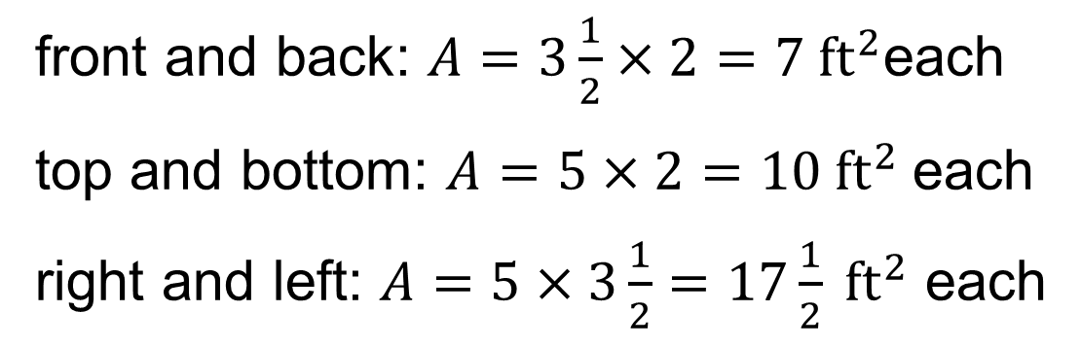
Painting Project
Areas of the faces:
front and back: $A=3\frac{1}{2}×2=7 {ft}^{2}$each
top and bottom: $A=5×2=10 {ft}^{2}$each
right and left: $A=5×3\frac{1}{2}=17\frac{1}{2} {ft}^{2}$ each
Record your reasoning before the reveal.
Compare, then explain any revision.
How can you find the surface area of the rectangular prism?
Reveal:
We can add the areas of all the faces of the rectangular prism to find the surface area.
20 / 47
Notes:
TEACH IN PRACTICE | Embedded facilitation | Lesson 5.7, slide 18 | REVEAL
Focus on the existing task: Areas of the faces: front and back: each top and bottom: each right and left: each How can you find the surface area of the rectangular prism?
LAUNCH (T2/3/5): If an existing answer cover is present, gather an attempt before revealing. If the explanation is already visible, ask students to reconstruct and justify it. Compare reasoning and explain a revision; preserve the reveal sequence.
LOOK FOR (T4): Where this task addresses it, students can account for every required prism face once. Ask which feature of their work supports the claim.
RESPOND: If this task shows the lesson misconception—including openings or forgetting a pair of faces—label corresponding faces and cross-reference them with the original problem requirements. Have the student revise and explain the change. Use this support only where the concept occurs in the current task; otherwise respond to the displayed question.
RECHECK: If a gap is shared, revisit the existing representation together. If it is limited, give targeted support while others compare valid methods on the same task. Check the revision before moving on.
PARTICIPATION (T5/6/7): Think time before volunteers; accept a written, drawn or rehearsed entry. Students ask for evidence respectfully. Recognize a specific contribution or revision and check that both partners participate.
Source: BCPS Updated Instructional Framework Rubric (June 2020), TEACH 1–7. Earlier notes and answer keys are retained below.
EARLIER NOTES / EXISTING ANSWER KEY
Do not click yet: collect 2–3 student answers with reasons first.
Then click to remove the cover and have students compare their thinking to the reveal — “Is this what we said? Where is it different?”
Behind the cover: We can add the areas of all the faces of the rectangular prism to find the surface area.
UIFR: TEACH 3 · TEACH 4.

Slide 21
Painting Project
We can divide the surface area of the chest, 69 square feet, by the amount of paint one can of stain covers, 35 square feet.
$$69÷35≈1.97$$
Record your reasoning before the reveal. Compare, then
explain any revision.
How many cans of stain are needed to cover the chest?
Reveal:
2 cans
21 / 47
Notes:
TEACH IN PRACTICE | Embedded facilitation | Lesson 5.7, slide 19 | REVEAL
Focus on the existing task: We can divide the surface area of the chest, 69 square feet, by the amount of paint one can of stain covers, 35 square feet. How many cans of stain are needed to cover the chest?
LAUNCH (T2/3/5): If an existing answer cover is present, gather an attempt before revealing. If the explanation is already visible, ask students to reconstruct and justify it. Compare reasoning and explain a revision; preserve the reveal sequence.
LOOK FOR (T4): Where this task addresses it, students can account for every required prism face once. Ask which feature of their work supports the claim.
RESPOND: If this task shows the lesson misconception—including openings or forgetting a pair of faces—label corresponding faces and cross-reference them with the original problem requirements. Have the student revise and explain the change. Use this support only where the concept occurs in the current task; otherwise respond to the displayed question.
RECHECK: If a gap is shared, revisit the existing representation together. If it is limited, give targeted support while others compare valid methods on the same task. Check the revision before moving on.
PARTICIPATION (T5/6/7): Think time before volunteers; accept a written, drawn or rehearsed entry. Students ask for evidence respectfully. Recognize a specific contribution or revision and check that both partners participate.
Source: BCPS Updated Instructional Framework Rubric (June 2020), TEACH 1–7. Earlier notes and answer keys are retained below.
EARLIER NOTES / EXISTING ANSWER KEY
Do not click yet: collect 2–3 student answers with reasons first.
Then click to remove the cover and have students compare their thinking to the reveal — “Is this what we said? Where is it different?”
Behind the cover: 2 cans
UIFR: TEACH 3 · TEACH 4.

Slide 22
Let’s Explore More
What is a formula that could be used to find the surface area of a rectangular prism?
Workspace
22 / 47
Notes:
TEACH IN PRACTICE | Embedded facilitation | Lesson 5.7, slide 20 | PRACTICE
Focus on the existing task: Workspace What is a formula that could be used to find the surface area of a rectangular prism?
LAUNCH (T2/3/5): Use the displayed question. Give private thinking time; then A explains while B asks for evidence. Switch roles. Each student records their own reasoning.
LOOK FOR (T4): Where this task addresses it, students can account for every required prism face once. Ask which feature of their work supports the claim.
RESPOND: If this task shows the lesson misconception—including openings or forgetting a pair of faces—label corresponding faces and cross-reference them with the original problem requirements. Have the student revise and explain the change. Use this support only where the concept occurs in the current task; otherwise respond to the displayed question.
RECHECK: If a gap is shared, revisit the existing representation together. If it is limited, give targeted support while others compare valid methods on the same task. Check the revision before moving on.
PARTICIPATION (T5/6/7): Think time before volunteers; accept a written, drawn or rehearsed entry. Students ask for evidence respectfully. Recognize a specific contribution or revision and check that both partners participate.
Source: BCPS Updated Instructional Framework Rubric (June 2020), TEACH 1–7. Earlier notes and answer keys are retained below.
EARLIER NOTES / EXISTING ANSWER KEY
Extension for partners or table groups — students choose their approach and use the workspace to show thinking.
Push with “Convince me,” and have two groups with different approaches share.
This is where students stretch past the worked example.
UIFR: TEACH 2 · TEACH 5.

Slide 23
STUDENT MOVES
Lesson 5-7
Your move
USE YOUR TOOLS · Reach for your notes, a model, or a manipulative before you reach for an answer.
23 / 47

Slide 24
LESSON 5.7 / DISCUSS THE TASK
Explain and compare
Use the task you just explored.
TAKE TURNS
Which surfaces does this situation require, and how can your net prove none are missing or counted twice?
Explain
“I know this because…”
Ask
“Where does your work show that?”
Point to evidence in your work.
Then compare your approach with a partner’s.
JUSTIFY IT · Say it like this: “I know ______ because ______.”
Listen to understand. Ask for evidence. Make room for every voice.
Notes:
TEACH IN PRACTICE | Embedded facilitation | Lesson 5.7, slide 21 | PRIOR_INSERT
Focus on the existing task: Point to evidence in your work. Then compare your approach with a partner’s. TAKE TURNS Explain “I know this because…” Ask “Where does your work show that?
CONNECT (T1/4): Ask students to restate the displayed goal or key idea and connect it to earlier work. Relevant lesson evidence: account for every required prism face once; calculate face areas; respect excluded surfaces in context. Use only the criterion that matches the current session.
SHOW PROGRESS: Students point to their own existing work, explain what improved after feedback, and name a next step. Pair confidence ratings with actual evidence.
PARTICIPATION (T5/6/7): Think time before volunteers; accept a written, drawn or rehearsed entry. Students ask for evidence respectfully. Recognize a specific contribution or revision and check that both partners participate.
Source: BCPS Updated Instructional Framework Rubric (June 2020), TEACH 1–7.

Slide 25
Warm-Up
Lesson 5-7 · Determine Surface Area of Prisms
Session 2 Warm-Up
Try alone. Explain one. Then revise.
1
Surface area is the:
2
A cube has edge length 3 in. Each face has area:
A
Space inside a 3D figure
A
6 in²
B
Total sum of the areas of all outer faces
B
9 in²
C
Length of all edges
C
27 in²
D
Height times width
D
54 in²
3
What is the total surface area of a cube with 3 in edges?
4
Surface area is expressed in:
A
18 in²
A
Linear units
B
54 in²
B
Square units
C
27 in³
C
Cubic units
D
36 in²
D
Pounds
eduwonderlab.com · Neft Teacher
25 / 47
Notes:
TEACH IN PRACTICE | Embedded facilitation | Lesson 5.7, slide 22 | WARMUP
Focus on the existing task: Warm-Up Session 2 Warm-Up Check what you remember from…
GATHER EVIDENCE (T4/6): Keep the original items. Students try independently, mark an uncertain item, and explain one method before checking. Use the existing key when present.
RESPOND: Distinguish a calculation slip from a reasoning gap. Give one next step on the same item; have students revise in a second color. Use the responses to choose flexible support for today’s lesson.
PARTICIPATION (T5/6/7): Think time before volunteers; accept a written, drawn or rehearsed entry. Students ask for evidence respectfully. Recognize a specific contribution or revision and check that both partners participate.
Source: BCPS Updated Instructional Framework Rubric (June 2020), TEACH 1–7. Earlier notes and answer keys are retained below.
EARLIER NOTES / EXISTING ANSWER KEY
Warm-up routine: students start silently on entry; keep it to about 4 minutes.
Circulate and note who is stuck — use what you see to choose who you check on first today.
Go over answers quickly; ask one student to explain a step, not just say the answer.
UIFR: TEACH 4 · TEACH 6.

Slide 26
STUDENT MOVES
Lesson 5-7
Your move
YOU KNOW THE ROUTINE · Read → plan → solve → check. Do all four, in that order.
26 / 47

Slide 27
Review Notes — Session 2
Lesson 5-7 · Determine Surface Area of Prisms
Session 2: Review Notes
Copy. Explain. Check.
WHY IT MATTERS · Finish this: “This is worth knowing because ______.”
Surface Area Concept
1
Surface area equals the total area of all two-dimensional faces combined (measured in units²).
Rectangular Prisms
2
Calculate area of 3 pairs of matching faces: Top/Bottom, Front/Back, Left/Right.
Net Calculation
3
Find the area of each polygon in the unfolded net and calculate their sum.
eduwonderlab.com · Neft Teacher
27 / 47
Notes:
TEACH IN PRACTICE | Embedded facilitation | Lesson 5.7, slide 23 | NOTES
Focus on the existing task: Review Notes — Session 2 Session 2: Review Notes Copy into…
ROUTINE (T1/2/4): Read or copy the original notes, cover one line, and explain it using the displayed example. Reopen and correct. Copying alone is not evidence of understanding.
LOOK FOR: A link between a symbol, quantity or feature and the explanation. If missing, point back to that feature and have the student try again; fade the prompt once they can explain.
PARTICIPATION (T5/6/7): Think time before volunteers; accept a written, drawn or rehearsed entry. Students ask for evidence respectfully. Recognize a specific contribution or revision and check that both partners participate.
Source: BCPS Updated Instructional Framework Rubric (June 2020), TEACH 1–7. Earlier notes and answer keys are retained below.
EARLIER NOTES / EXISTING ANSWER KEY
Copy routine: read one line at a time; students copy, then explain that line to a partner.
Keep it brisk — the understanding work happens in the examples, not the copying.
UIFR: TEACH 1 · TEACH 6.

Slide 28
Session 2
Determine Surface Area of Prisms
USE THE MATH WORDS · Use today’s math words in your explanation — not “it” and “that thing.”
28 / 47
Notes:
TEACH IN PRACTICE | Embedded facilitation | Lesson 5.7, slide 24 | DIVIDER
Focus on the existing task: Determine Surface Area of Prisms Session 2
TRANSITION (T6/7): Students confirm materials, roles, how to request help, and the next response routine. Ask a student to restate it. Keep teacher-only slides hidden.
PARTICIPATION (T5/6/7): Think time before volunteers; accept a written, drawn or rehearsed entry. Students ask for evidence respectfully. Recognize a specific contribution or revision and check that both partners participate.
Source: BCPS Updated Instructional Framework Rubric (June 2020), TEACH 1–7. Earlier notes and answer keys are retained below.
EARLIER NOTES / EXISTING ANSWER KEY
Transition cue: state what materials are out and what success looks like this session.
Keep the changeover under a minute.
UIFR: TEACH 6.

Slide 29
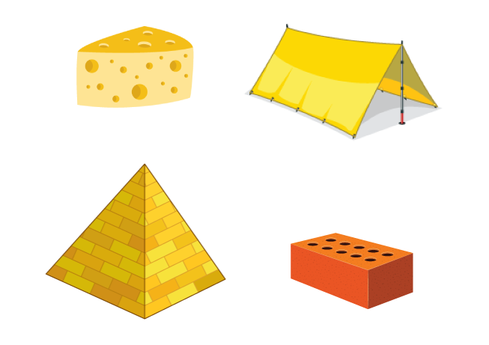
Be Curious
Which doesn’t belong?
Think first. Share a notice and a
question; build on a classmate’s
idea.
Mindset
What is helping you be a contributor to the math class community?
29 / 47
Notes:
TEACH IN PRACTICE | Embedded facilitation | Lesson 5.7, slide 25 | CURIOUS
Focus on the existing task: What is helping you be a contributor to the math class community?
LAUNCH (T2/3/5): Allow quiet observation first. Separate a notice from an inference, invite students’ own questions, and follow the existing launch before teaching a procedure.
LOOK FOR (T4): Where this task addresses it, students can account for every required prism face once. Ask which feature of their work supports the claim.
RESPOND: If this task shows the lesson misconception—including openings or forgetting a pair of faces—label corresponding faces and cross-reference them with the original problem requirements. Have the student revise and explain the change. Use this support only where the concept occurs in the current task; otherwise respond to the displayed question.
RECHECK: If a gap is shared, revisit the existing representation together. If it is limited, give targeted support while others compare valid methods on the same task. Check the revision before moving on.
PARTICIPATION (T5/6/7): Think time before volunteers; accept a written, drawn or rehearsed entry. Students ask for evidence respectfully. Recognize a specific contribution or revision and check that both partners participate.
Source: BCPS Updated Instructional Framework Rubric (June 2020), TEACH 1–7. Earlier notes and answer keys are retained below.
EARLIER NOTES / EXISTING ANSWER KEY
Accept all noticings and wonderings — there are no wrong answers here.
Give 20–30 seconds of quiet think time before taking responses; mix cold and warm calls so it is not always the same voices.
Read the mindset question aloud and let two students respond.
UIFR: TEACH 3 · TEACH 7.

Slide 30
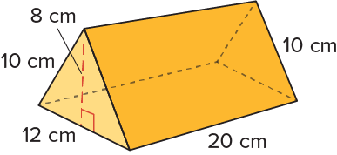

A Different Kind of Prism
What is the surface area of the prism shown?
Think and record first. Which part of your work supports your answer?
Using Structure
How can you organize the problem into pieces that you make sense of and to move forward?
30 / 47
Notes:
TEACH IN PRACTICE | Embedded facilitation | Lesson 5.7, slide 26 | TASK
Focus on the existing task: What is the surface area of the prism shown?
LAUNCH (T2/3/5): Use the displayed question. Give private thinking time; then A explains while B asks for evidence. Switch roles. Each student records their own reasoning.
LOOK FOR (T4): Where this task addresses it, students can account for every required prism face once. Ask which feature of their work supports the claim.
RESPOND: If this task shows the lesson misconception—including openings or forgetting a pair of faces—label corresponding faces and cross-reference them with the original problem requirements. Have the student revise and explain the change. Use this support only where the concept occurs in the current task; otherwise respond to the displayed question.
RECHECK: If a gap is shared, revisit the existing representation together. If it is limited, give targeted support while others compare valid methods on the same task. Check the revision before moving on.
PARTICIPATION (T5/6/7): Think time before volunteers; accept a written, drawn or rehearsed entry. Students ask for evidence respectfully. Recognize a specific contribution or revision and check that both partners participate.
Source: BCPS Updated Instructional Framework Rubric (June 2020), TEACH 1–7. Earlier notes and answer keys are retained below.
EARLIER NOTES / EXISTING ANSWER KEY
Model briefly, then hand the thinking back: ask “Why does this step work?” before showing the next one.
Quick check before moving on — thumbs or whiteboards from everyone, not volunteers.
UIFR: TEACH 2 · TEACH 3 · TEACH 4.

Slide 31
COLLABORATE · TALK IT THROUGH • AGREE ON A MODEL
Collaborate and Connect
What are some defining attributes of the prism that can help you create a net of the figure?
Think first. A explains; B asks for evidence.
Switch roles; both revise.
Reveal:
The prism has two triangular bases that are congruent and parallel to each other, two congruent rectangular faces, and another rectangular face.
31 / 47
Notes:
TEACH IN PRACTICE | Embedded facilitation | Lesson 5.7, slide 27 | COLLABORATE
Focus on the existing task: What are some defining attributes of the prism that can help you create a net of the figure?
LAUNCH (T2/3/5): Use the displayed question. Give private thinking time; then A explains while B asks for evidence. Switch roles. Each student records their own reasoning.
LOOK FOR (T4): Where this task addresses it, students can account for every required prism face once. Ask which feature of their work supports the claim.
RESPOND: If this task shows the lesson misconception—including openings or forgetting a pair of faces—label corresponding faces and cross-reference them with the original problem requirements. Have the student revise and explain the change. Use this support only where the concept occurs in the current task; otherwise respond to the displayed question.
RECHECK: If a gap is shared, revisit the existing representation together. If it is limited, give targeted support while others compare valid methods on the same task. Check the revision before moving on.
PARTICIPATION (T5/6/7): Think time before volunteers; accept a written, drawn or rehearsed entry. Students ask for evidence respectfully. Recognize a specific contribution or revision and check that both partners participate.
Source: BCPS Updated Instructional Framework Rubric (June 2020), TEACH 1–7. Earlier notes and answer keys are retained below.
EARLIER NOTES / EXISTING ANSWER KEY
Partner talk first: talk it through, agree on an answer, be ready to share.
Circulate and listen for today’s vocabulary; choose a pair to share because of their strategy, not just a right answer.
Reveal only after pairs have shared.
UIFR: TEACH 5.

Slide 32
A Different Kind of Prism
This is a triangular prism. It has two triangular bases that are congruent and parallel to each other, two congruent rectangular faces, and another rectangular face.
Think and record first. Which part of your work supports your answer?
Think About It:
Why do you think the prism is called a triangular prism?
32 / 47
Notes:
TEACH IN PRACTICE | Embedded facilitation | Lesson 5.7, slide 28 | TASK
Focus on the existing task: This is a triangular prism. It has two triangular bases that are congruent and parallel to each other, two congruent rectangular faces…
LAUNCH (T2/3/5): Use the displayed question. Give private thinking time; then A explains while B asks for evidence. Switch roles. Each student records their own reasoning.
LOOK FOR (T4): Where this task addresses it, students can account for every required prism face once. Ask which feature of their work supports the claim.
RESPOND: If this task shows the lesson misconception—including openings or forgetting a pair of faces—label corresponding faces and cross-reference them with the original problem requirements. Have the student revise and explain the change. Use this support only where the concept occurs in the current task; otherwise respond to the displayed question.
RECHECK: If a gap is shared, revisit the existing representation together. If it is limited, give targeted support while others compare valid methods on the same task. Check the revision before moving on.
PARTICIPATION (T5/6/7): Think time before volunteers; accept a written, drawn or rehearsed entry. Students ask for evidence respectfully. Recognize a specific contribution or revision and check that both partners participate.
Source: BCPS Updated Instructional Framework Rubric (June 2020), TEACH 1–7. Earlier notes and answer keys are retained below.
EARLIER NOTES / EXISTING ANSWER KEY
Ask the question, then hold the silence — students think or jot before anyone answers.
Take two or three responses and press with “Why?” or “How do you know?” before moving on.
UIFR: TEACH 3.

Slide 33
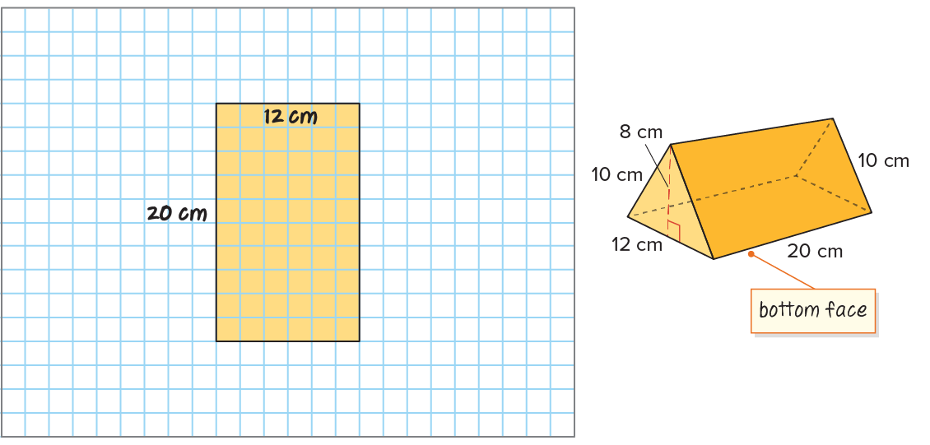
A Different Kind of Prism
The bottom side is a 20-centimeter by 12-centimeter rectangle.
​
33 / 47
Notes:
TEACH IN PRACTICE | Embedded facilitation | Lesson 5.7, slide 29 | WORKED
Focus on the existing task: The bottom side is a 20-centimeter by 12-centimeter rectangle. A Different Kind of Prism
LAUNCH (T2/3/5): Ask students to explain the displayed idea or example and point to evidence. When a calculation step is shown, ask why it is valid. Have a partner restate the explanation; copying is not the check.
LOOK FOR (T4): Where this task addresses it, students can account for every required prism face once. Ask which feature of their work supports the claim.
RESPOND: If this task shows the lesson misconception—including openings or forgetting a pair of faces—label corresponding faces and cross-reference them with the original problem requirements. Have the student revise and explain the change. Use this support only where the concept occurs in the current task; otherwise respond to the displayed question.
RECHECK: If a gap is shared, revisit the existing representation together. If it is limited, give targeted support while others compare valid methods on the same task. Check the revision before moving on.
PARTICIPATION (T5/6/7): Think time before volunteers; accept a written, drawn or rehearsed entry. Students ask for evidence respectfully. Recognize a specific contribution or revision and check that both partners participate.
Source: BCPS Updated Instructional Framework Rubric (June 2020), TEACH 1–7. Earlier notes and answer keys are retained below.
EARLIER NOTES / EXISTING ANSWER KEY
Model briefly, then hand the thinking back: ask “Why does this step work?” before showing the next one.
Quick check before moving on — thumbs or whiteboards from everyone, not volunteers.
UIFR: TEACH 2 · TEACH 3 · TEACH 4.

Slide 34
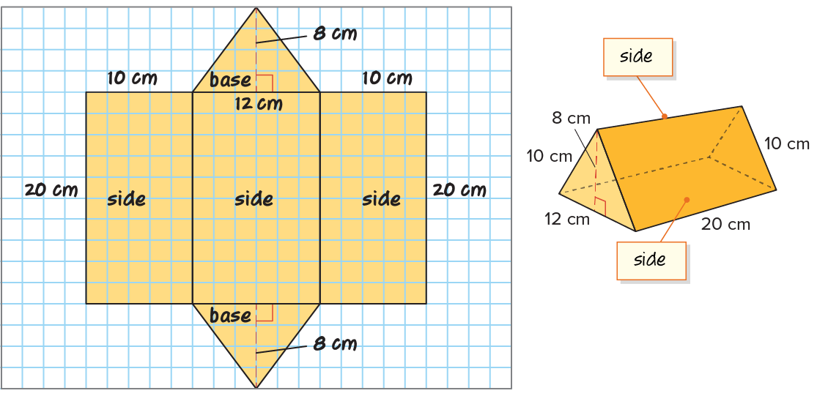
A Different Kind of Prism
The two other sides are 10-centimeter by 20-centimeter rectangles.​​
34 / 47
Notes:
TEACH IN PRACTICE | Embedded facilitation | Lesson 5.7, slide 30 | WORKED
Focus on the existing task: The two other sides are 10-centimeter by 20-centimeter rectangles. A Different Kind of Prism
LAUNCH (T2/3/5): Ask students to explain the displayed idea or example and point to evidence. When a calculation step is shown, ask why it is valid. Have a partner restate the explanation; copying is not the check.
LOOK FOR (T4): Where this task addresses it, students can account for every required prism face once. Ask which feature of their work supports the claim.
RESPOND: If this task shows the lesson misconception—including openings or forgetting a pair of faces—label corresponding faces and cross-reference them with the original problem requirements. Have the student revise and explain the change. Use this support only where the concept occurs in the current task; otherwise respond to the displayed question.
RECHECK: If a gap is shared, revisit the existing representation together. If it is limited, give targeted support while others compare valid methods on the same task. Check the revision before moving on.
PARTICIPATION (T5/6/7): Think time before volunteers; accept a written, drawn or rehearsed entry. Students ask for evidence respectfully. Recognize a specific contribution or revision and check that both partners participate.
Source: BCPS Updated Instructional Framework Rubric (June 2020), TEACH 1–7. Earlier notes and answer keys are retained below.
EARLIER NOTES / EXISTING ANSWER KEY
Model briefly, then hand the thinking back: ask “Why does this step work?” before showing the next one.
Quick check before moving on — thumbs or whiteboards from everyone, not volunteers.
UIFR: TEACH 2 · TEACH 3 · TEACH 4.

Slide 35
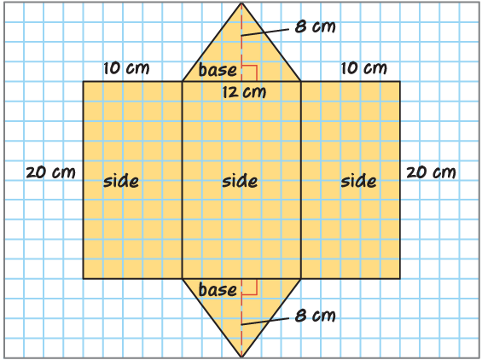
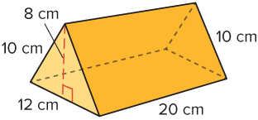
A Different Kind of Prism
We can use the area formulas for triangles and rectangles to find the area of each face.
And then add the areas of each face to find the surface area.
35 / 47
Notes:
TEACH IN PRACTICE | Embedded facilitation | Lesson 5.7, slide 31 | WORKED
Focus on the existing task: We can use the area formulas for triangles and rectangles to find the area of each face. And then add the areas of each face to find the…
LAUNCH (T2/3/5): Ask students to explain the displayed idea or example and point to evidence. When a calculation step is shown, ask why it is valid. Have a partner restate the explanation; copying is not the check.
LOOK FOR (T4): Where this task addresses it, students can account for every required prism face once. Ask which feature of their work supports the claim.
RESPOND: If this task shows the lesson misconception—including openings or forgetting a pair of faces—label corresponding faces and cross-reference them with the original problem requirements. Have the student revise and explain the change. Use this support only where the concept occurs in the current task; otherwise respond to the displayed question.
RECHECK: If a gap is shared, revisit the existing representation together. If it is limited, give targeted support while others compare valid methods on the same task. Check the revision before moving on.
PARTICIPATION (T5/6/7): Think time before volunteers; accept a written, drawn or rehearsed entry. Students ask for evidence respectfully. Recognize a specific contribution or revision and check that both partners participate.
Source: BCPS Updated Instructional Framework Rubric (June 2020), TEACH 1–7. Earlier notes and answer keys are retained below.
EARLIER NOTES / EXISTING ANSWER KEY
Model briefly, then hand the thinking back: ask “Why does this step work?” before showing the next one.
Quick check before moving on — thumbs or whiteboards from everyone, not volunteers.
UIFR: TEACH 2 · TEACH 3 · TEACH 4.

Slide 36
STUDENT MOVES
Lesson 5-7
Your moves
ADD ON · Add on: “I agree because ______.” or “I see it differently because ______.”
SPECIFIC FEEDBACK · Trade work. Give one specific comment: “This part is clear because ______.”
TWO MINUTES SOLO · Two minutes on your own, then compare. Bring one thing you tried, even if it did not work.
36 / 47

Slide 37
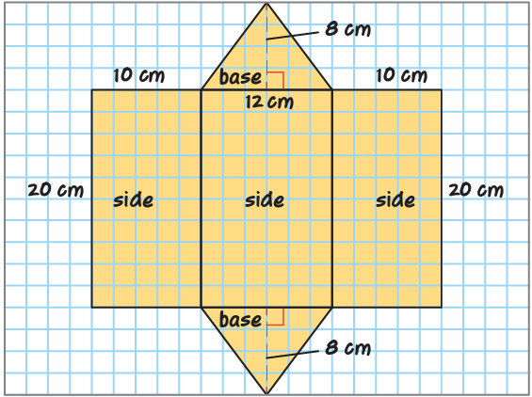
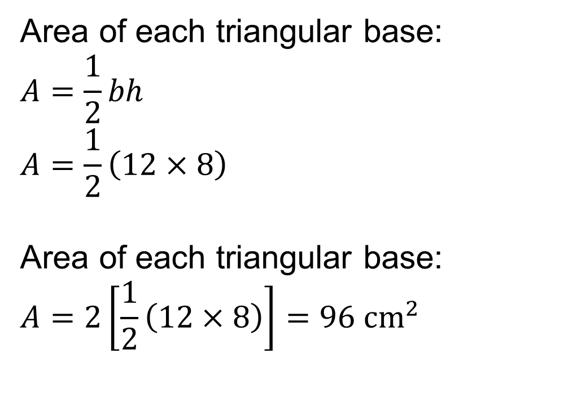
A Different Kind of Prism
Let’s find the area of each face of the triangular prism.
Area of each triangular base:
$$A=\frac{1}{2}bh$$
$$A=\frac{1}{2}\left(12×8\right)$$
Area of each triangular base:
$$A=2\left[\frac{1}{2}\left(12×8\right)\right]=96 {cm}^{2}$$
Explain how the information shown supports
your reasoning.
37 / 47
Notes:
TEACH IN PRACTICE | Embedded facilitation | Lesson 5.7, slide 32 | WORKED
Focus on the existing task: Let’s find the area of each face of the triangular prism. Area of each triangular base: Area of each triangular base: A Different Kind…
LAUNCH (T2/3/5): Ask students to explain the displayed idea or example and point to evidence. When a calculation step is shown, ask why it is valid. Have a partner restate the explanation; copying is not the check.
LOOK FOR (T4): Where this task addresses it, students can account for every required prism face once. Ask which feature of their work supports the claim.
RESPOND: If this task shows the lesson misconception—including openings or forgetting a pair of faces—label corresponding faces and cross-reference them with the original problem requirements. Have the student revise and explain the change. Use this support only where the concept occurs in the current task; otherwise respond to the displayed question.
RECHECK: If a gap is shared, revisit the existing representation together. If it is limited, give targeted support while others compare valid methods on the same task. Check the revision before moving on.
PARTICIPATION (T5/6/7): Think time before volunteers; accept a written, drawn or rehearsed entry. Students ask for evidence respectfully. Recognize a specific contribution or revision and check that both partners participate.
Source: BCPS Updated Instructional Framework Rubric (June 2020), TEACH 1–7. Earlier notes and answer keys are retained below.
EARLIER NOTES / EXISTING ANSWER KEY
Model briefly, then hand the thinking back: ask “Why does this step work?” before showing the next one.
Quick check before moving on — thumbs or whiteboards from everyone, not volunteers.
UIFR: TEACH 2 · TEACH 3 · TEACH 4.

Slide 38
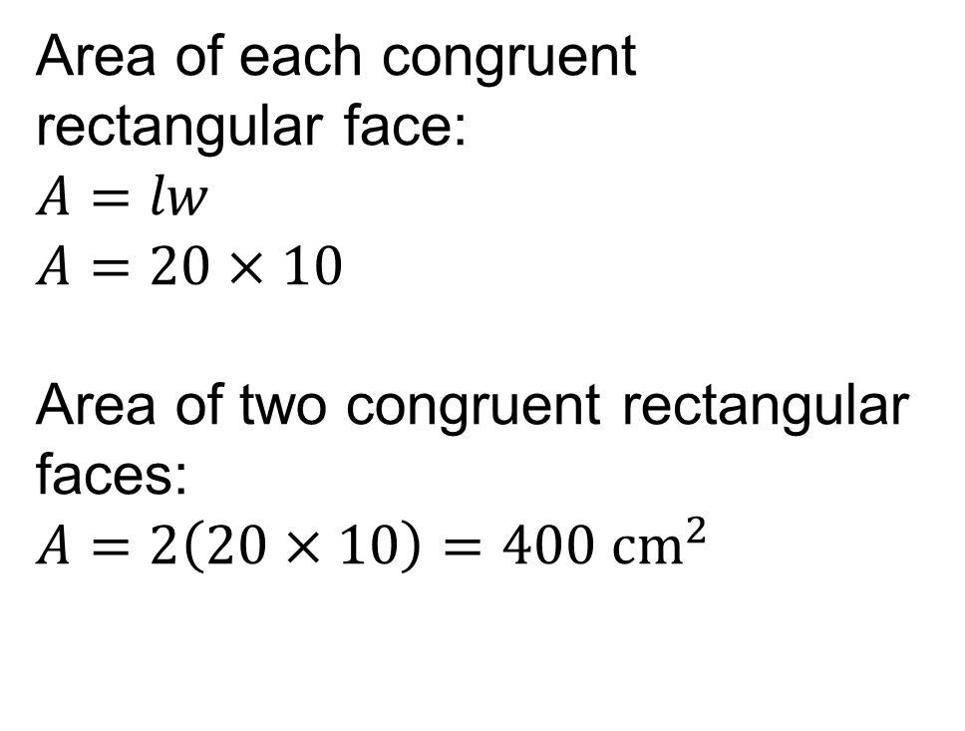
A Different Kind of Prism
Let’s find the area of each face of the triangular prism.
Area of each congruent rectangular face:​
$$A=lw$$
$$A=20×10$$
Area of two congruent rectangular faces:​
$$A=2\left(20×10\right)=400 {cm}^{2}$$
Explain how the information shown supports your reasoning.
38 / 47
Notes:
TEACH IN PRACTICE | Embedded facilitation | Lesson 5.7, slide 33 | WORKED
Focus on the existing task: Let’s find the area of each face of the triangular prism. Area of each congruent rectangular face: Area of two congruent rectangular…
LAUNCH (T2/3/5): Ask students to explain the displayed idea or example and point to evidence. When a calculation step is shown, ask why it is valid. Have a partner restate the explanation; copying is not the check.
LOOK FOR (T4): Where this task addresses it, students can account for every required prism face once. Ask which feature of their work supports the claim.
RESPOND: If this task shows the lesson misconception—including openings or forgetting a pair of faces—label corresponding faces and cross-reference them with the original problem requirements. Have the student revise and explain the change. Use this support only where the concept occurs in the current task; otherwise respond to the displayed question.
RECHECK: If a gap is shared, revisit the existing representation together. If it is limited, give targeted support while others compare valid methods on the same task. Check the revision before moving on.
PARTICIPATION (T5/6/7): Think time before volunteers; accept a written, drawn or rehearsed entry. Students ask for evidence respectfully. Recognize a specific contribution or revision and check that both partners participate.
Source: BCPS Updated Instructional Framework Rubric (June 2020), TEACH 1–7. Earlier notes and answer keys are retained below.
EARLIER NOTES / EXISTING ANSWER KEY
Model briefly, then hand the thinking back: ask “Why does this step work?” before showing the next one.
Quick check before moving on — thumbs or whiteboards from everyone, not volunteers.
UIFR: TEACH 2 · TEACH 3 · TEACH 4.

Slide 39
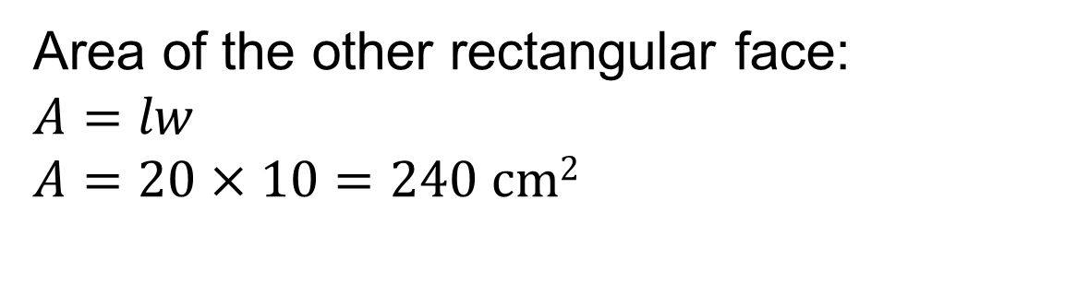
A Different Kind of Prism
Let’s find the area of each face of the triangular prism.
Area of the other rectangular face:
$$A=lw$$
$$A=20×10=240 \text{cm}2$$
Explain how the information shown supports
your reasoning.
39 / 47
Notes:
TEACH IN PRACTICE | Embedded facilitation | Lesson 5.7, slide 34 | WORKED
Focus on the existing task: Area of the other rectangular face: Let’s find the area of each face of the triangular prism. A Different Kind of Prism
LAUNCH (T2/3/5): Ask students to explain the displayed idea or example and point to evidence. When a calculation step is shown, ask why it is valid. Have a partner restate the explanation; copying is not the check.
LOOK FOR (T4): Where this task addresses it, students can account for every required prism face once. Ask which feature of their work supports the claim.
RESPOND: If this task shows the lesson misconception—including openings or forgetting a pair of faces—label corresponding faces and cross-reference them with the original problem requirements. Have the student revise and explain the change. Use this support only where the concept occurs in the current task; otherwise respond to the displayed question.
RECHECK: If a gap is shared, revisit the existing representation together. If it is limited, give targeted support while others compare valid methods on the same task. Check the revision before moving on.
PARTICIPATION (T5/6/7): Think time before volunteers; accept a written, drawn or rehearsed entry. Students ask for evidence respectfully. Recognize a specific contribution or revision and check that both partners participate.
Source: BCPS Updated Instructional Framework Rubric (June 2020), TEACH 1–7. Earlier notes and answer keys are retained below.
EARLIER NOTES / EXISTING ANSWER KEY
Model briefly, then hand the thinking back: ask “Why does this step work?” before showing the next one.
Quick check before moving on — thumbs or whiteboards from everyone, not volunteers.
UIFR: TEACH 2 · TEACH 3 · TEACH 4.

Slide 40
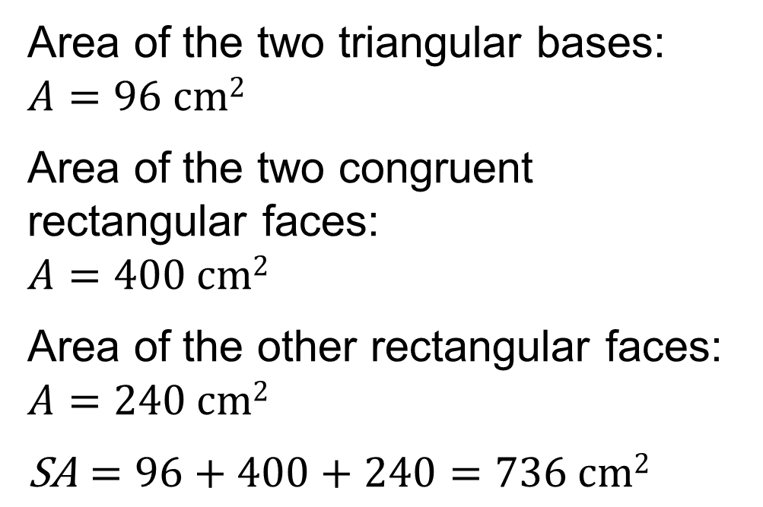
A Different Kind of Prism
Add the areas to find the surface area of the triangular prism.
Area of the two triangular bases: $A=96 \text{cm}2$
Area of the two congruent rectangular faces:
$$A=400 \text{cm}2$$
Area of the other rectangular faces:
$A=240 \text{cm}2$
$$\text{SA}=96+400+240=736 \text{cm}2$$
Explain how the information shown supports
your reasoning.
40 / 47
Notes:
TEACH IN PRACTICE | Embedded facilitation | Lesson 5.7, slide 35 | WORKED
Focus on the existing task: Add the areas to find the surface area of the triangular prism. Area of the two triangular bases: Area of the two congruent rectangular…
LAUNCH (T2/3/5): Ask students to explain the displayed idea or example and point to evidence. When a calculation step is shown, ask why it is valid. Have a partner restate the explanation; copying is not the check.
LOOK FOR (T4): Where this task addresses it, students can account for every required prism face once. Ask which feature of their work supports the claim.
RESPOND: If this task shows the lesson misconception—including openings or forgetting a pair of faces—label corresponding faces and cross-reference them with the original problem requirements. Have the student revise and explain the change. Use this support only where the concept occurs in the current task; otherwise respond to the displayed question.
RECHECK: If a gap is shared, revisit the existing representation together. If it is limited, give targeted support while others compare valid methods on the same task. Check the revision before moving on.
PARTICIPATION (T5/6/7): Think time before volunteers; accept a written, drawn or rehearsed entry. Students ask for evidence respectfully. Recognize a specific contribution or revision and check that both partners participate.
Source: BCPS Updated Instructional Framework Rubric (June 2020), TEACH 1–7. Earlier notes and answer keys are retained below.
EARLIER NOTES / EXISTING ANSWER KEY
Model briefly, then hand the thinking back: ask “Why does this step work?” before showing the next one.
Quick check before moving on — thumbs or whiteboards from everyone, not volunteers.
UIFR: TEACH 2 · TEACH 3 · TEACH 4.

Slide 41
Let’s Explore More
What type of triangles are the bases of this prism? Explain how you know.
Why is the unit of measure for the square centimeters rather than centimeters or cubic centimeters?
Try first. Point to the features of the figure that justify your reasoning.
41 / 47
Notes:
TEACH IN PRACTICE | Embedded facilitation | Lesson 5.7, slide 36 | PRACTICE
Focus on the existing task: What type of triangles are the bases of this prism?
LAUNCH (T2/3/5): Use the displayed question. Give private thinking time; then A explains while B asks for evidence. Switch roles. Each student records their own reasoning.
LOOK FOR (T4): Where this task addresses it, students can account for every required prism face once. Ask which feature of their work supports the claim.
RESPOND: If this task shows the lesson misconception—including openings or forgetting a pair of faces—label corresponding faces and cross-reference them with the original problem requirements. Have the student revise and explain the change. Use this support only where the concept occurs in the current task; otherwise respond to the displayed question.
RECHECK: If a gap is shared, revisit the existing representation together. If it is limited, give targeted support while others compare valid methods on the same task. Check the revision before moving on.
PARTICIPATION (T5/6/7): Think time before volunteers; accept a written, drawn or rehearsed entry. Students ask for evidence respectfully. Recognize a specific contribution or revision and check that both partners participate.
Source: BCPS Updated Instructional Framework Rubric (June 2020), TEACH 1–7. Earlier notes and answer keys are retained below.
EARLIER NOTES / EXISTING ANSWER KEY
Extension for partners or table groups — students choose their approach and use the workspace to show thinking.
Push with “Convince me,” and have two groups with different approaches share.
This is where students stretch past the worked example.
UIFR: TEACH 2 · TEACH 5.

Slide 42
LESSON 5.7 / CHECK YOUR WORK
Pause. Check. Improve.
CHECK
A mistake to watch for: including openings or forgetting a pair of faces.
TRY
Label corresponding faces and cross-reference them with the given problem requirements.
REVISE
Use that check on the task you just completed. Correct or strengthen one part, and explain why.
SELF-CHECK · Mark it: ✓ got it · ~ almost · ? stuck. Then fix one thing before we move on.
Listen to understand. Ask for evidence. Make room for every voice.
Notes:
TEACH IN PRACTICE | Embedded facilitation | Lesson 5.7, slide 37 | PRIOR_INSERT
Focus on the existing task: LESSON 5.7 / CHECK YOUR WORK Pause. Check. Improve. Listen to understand. Ask for evidence. Make room for every voice. CHECK A mistake…
CONNECT (T1/4): Ask students to restate the displayed goal or key idea and connect it to earlier work. Relevant lesson evidence: account for every required prism face once; calculate face areas; respect excluded surfaces in context. Use only the criterion that matches the current session.
SHOW PROGRESS: Students point to their own existing work, explain what improved after feedback, and name a next step. Pair confidence ratings with actual evidence.
PARTICIPATION (T5/6/7): Think time before volunteers; accept a written, drawn or rehearsed entry. Students ask for evidence respectfully. Recognize a specific contribution or revision and check that both partners participate.
Source: BCPS Updated Instructional Framework Rubric (June 2020), TEACH 1–7.

Slide 43
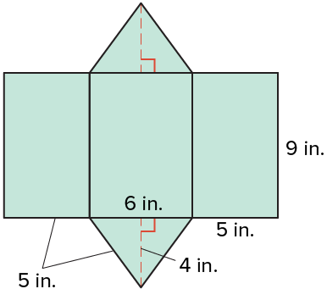
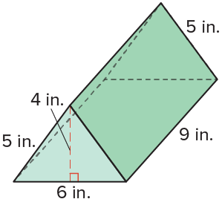
SUMMARIZE · SAY IT IN YOUR OWN WORDS
Summarize: Determine Surface Area of Prisms
The surface area of a three-dimensional figure is the sum of the areas of the faces. A net can help you unfold the prism into two-dimensional shapes so you can find the area of each face. The net below represents a triangular prism, which has triangular bases and rectangular faces.
43 / 47
Notes:
TEACH IN PRACTICE | Embedded facilitation | Lesson 5.7, slide 38 | SUMMARIZE
Focus on the existing task: The surface area of a three-dimensional figure is the sum of the areas of the faces. A net can help you unfold the prism into…
CONNECT (T1/4): Ask students to restate the displayed goal or key idea and connect it to earlier work. Relevant lesson evidence: account for every required prism face once; calculate face areas; respect excluded surfaces in context. Use only the criterion that matches the current session.
SHOW PROGRESS: Students point to their own existing work, explain what improved after feedback, and name a next step. Pair confidence ratings with actual evidence.
PARTICIPATION (T5/6/7): Think time before volunteers; accept a written, drawn or rehearsed entry. Students ask for evidence respectfully. Recognize a specific contribution or revision and check that both partners participate.
Source: BCPS Updated Instructional Framework Rubric (June 2020), TEACH 1–7. Earlier notes and answer keys are retained below.
EARLIER NOTES / EXISTING ANSWER KEY
Model briefly, then hand the thinking back: ask “Why does this step work?” before showing the next one.
Quick check before moving on — thumbs or whiteboards from everyone, not volunteers.
UIFR: TEACH 2 · TEACH 3 · TEACH 4.

Slide 44
STUDENT MOVES
Lesson 5-7
Your move
ASK THE CLASS · Write one question about this that you could ask the class.
44 / 47

Slide 45
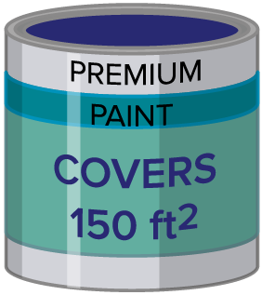
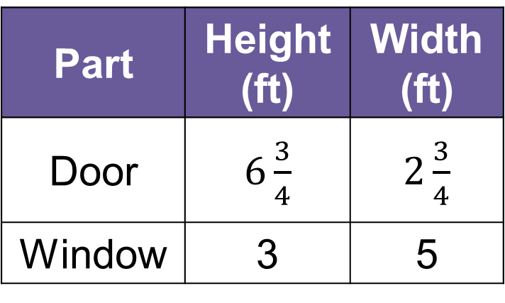
APPLY · PLAN IT • SOLVE IT • PROVE IT
Apply: Painting a Bedroom
Tahira is planning to paint the walls of her bedroom, which is in the shape of a rectangular prism. The bedroom has one window and two doors. The dimensions of the window and doors are shown in the table.
Question: How many gallons of paint are needed to cover the walls of Tahira’s bedroom that is 20 feet long, 15 feet wide, and 8 feet high?
Part | Height (ft) | Width (ft)
Door | $6\frac{3}{4}$ | $2\frac{3}{4}$
Window | 3 | 5
45 / 47
Notes:
TEACH IN PRACTICE | Embedded facilitation | Lesson 5.7, slide 39 | APPLY
Focus on the existing task: Tahira is planning to paint the walls of her bedroom, which is in the shape of a rectangular prism. The bedroom has one window and two…
LAUNCH (T2/3/5): Use the exact application task independently first. Ask students to justify their choice of method. Collect evidence before a partner discussion or correction.
LOOK FOR (T4): Where this task addresses it, students can account for every required prism face once. Ask which feature of their work supports the claim.
RESPOND: If this task shows the lesson misconception—including openings or forgetting a pair of faces—label corresponding faces and cross-reference them with the original problem requirements. Have the student revise and explain the change. Use this support only where the concept occurs in the current task; otherwise respond to the displayed question.
RECHECK: If a gap is shared, revisit the existing representation together. If it is limited, give targeted support while others compare valid methods on the same task. Check the revision before moving on.
PARTICIPATION (T5/6/7): Think time before volunteers; accept a written, drawn or rehearsed entry. Students ask for evidence respectfully. Recognize a specific contribution or revision and check that both partners participate.
Source: BCPS Updated Instructional Framework Rubric (June 2020), TEACH 1–7. Earlier notes and answer keys are retained below.
EARLIER NOTES / EXISTING ANSWER KEY
Apply task — students try it independently first, then partners compare answers and reasoning.
Collect a quick pulse (thumbs or whiteboards) before the close; this tells you who needs a second look tomorrow.
UIFR: TEACH 2 · TEACH 4.
UIFR FULL | Lesson-specific facilitation
TEACH 4 | Independent evidence and revision (UIFR PDF p. 11).
Use the existing application/exit problem as the independent check. If this is a learning-target slide, have students point to and explain their work on the preceding task. Separate initial independent evidence from the revision after feedback.
Check the relevant criteria: account for every required prism face once; calculate face areas; respect excluded surfaces in context. Respond with one specific next step tied to the work. Students revise and annotate what changed, then identify a criterion they can now demonstrate and one they still need to practice.

Slide 46
Learning Targets
I can use nets and a formula to determine the surface area of rectangular prisms.
I can use nets and a formula to determine the surface area of triangular prisms. ​
I can look for and make use of structure to find the surface area of prisms.
NAME THE MATH · Point to the part of this that is new today, and say what it changes.
46 / 47
Notes:
TEACH IN PRACTICE | Embedded facilitation | Lesson 5.7, slide 40 | REFLECTION
Focus on the existing task: Learning Targets I can use nets and a formula to determine the surface area of rectangular prisms. I can use nets and a formula to…
CONNECT (T1/4): Ask students to restate the displayed goal or key idea and connect it to earlier work. Relevant lesson evidence: account for every required prism face once; calculate face areas; respect excluded surfaces in context. Use only the criterion that matches the current session.
SHOW PROGRESS: Students point to their own existing work, explain what improved after feedback, and name a next step. Pair confidence ratings with actual evidence.
PARTICIPATION (T5/6/7): Think time before volunteers; accept a written, drawn or rehearsed entry. Students ask for evidence respectfully. Recognize a specific contribution or revision and check that both partners participate.
Source: BCPS Updated Instructional Framework Rubric (June 2020), TEACH 1–7. Earlier notes and answer keys are retained below.
EARLIER NOTES / EXISTING ANSWER KEY
Read each target; students self-rate with fist-to-five or thumbs.
Tie back to the goal from the start of class: did we get there?
Note any target that rates low — revisit it tomorrow.
UIFR: TEACH 1 · TEACH 4.
UIFR FULL | Lesson-specific facilitation
REFLECT & ADJUST 1-2 | After the lesson (UIFR PDF pp. 15-16).
Sort the existing work by demonstrated reasoning, partial understanding, and the specific misconception: including openings or forgetting a pair of faces. Compare the initial response with the revision. Record which teaching move plausibly helped, which did not, and whose participation or access needs a different approach; do not record sensitive student details in this shared deck.
Plan the next lesson from that evidence: if the misconception persists, label corresponding faces and cross-reference them with the original problem requirements using the current example before returning to the next grade-level task; if understanding is secure, use an existing extension or ask for a general explanation. Check the targeted idea again at the next warm-up.
Ask students what supported their thinking and what would help next time. Identify one change to try and one successful practice to retain. Seek colleague feedback on anonymized work when useful; these prompts support reflection and do not establish an evaluation rating. Source: Baltimore City Public Schools, Updated Instructional Framework Rubric, June 2020 (UIFR_Full.pdf).

Slide 47
LESSON 5.7 / REFLECT ON YOUR LEARNING
Show your progress
1 SHOW EVIDENCE
2 CHOOSE A NEXT STEP
Choose one response. Point to the part that shows your reasoning.
Name a change you made after feedback—or a question you still have.
“My work shows ___ because ___.”
“Next time, I will ___ to help me ___.”
Today’s focus: Account for every required prism face once.
CREDIT A CLASSMATE · Name one classmate whose idea helped you today, and say what they said.
Listen to understand. Ask for evidence. Make room for every voice.
Notes:
TEACH IN PRACTICE | Embedded facilitation | Lesson 5.7, slide 41 | PRIOR_INSERT
Focus on the existing task: LESSON 5.7 / REFLECT ON YOUR LEARNING Show your progress Listen to understand. Ask for evidence. Make room for every voice. 1 SHOW…
CONNECT (T1/4): Ask students to restate the displayed goal or key idea and connect it to earlier work. Relevant lesson evidence: account for every required prism face once; calculate face areas; respect excluded surfaces in context. Use only the criterion that matches the current session.
SHOW PROGRESS: Students point to their own existing work, explain what improved after feedback, and name a next step. Pair confidence ratings with actual evidence.
PARTICIPATION (T5/6/7): Think time before volunteers; accept a written, drawn or rehearsed entry. Students ask for evidence respectfully. Recognize a specific contribution or revision and check that both partners participate.
Source: BCPS Updated Instructional Framework Rubric (June 2020), TEACH 1–7.

