Slide 1
WARM-UP · THINK • TRY • CHECK
Turn and talk: compare strategies, then defend one.
Warm-Up
Lesson 5-8 · Determine Surface Area of Pyramids | Warm-Up · about 4 minutes
Try each on your own. Mark an unsure answer; explain and revise when we check.
QUESTION 1
QUESTION 2
A triangle has base 6 in and height 8 in. Area = ______
A square base has sides of 7 cm. Its area = ______
QUESTION 3
QUESTION 4
One triangular face is 24 square in. Four identical faces cover ______
Pyramid: slant height 10 in, vertical height 8 in.
For one face’s area, use ______
TALK IT OVER: “I got ______ because ______.” • Compare with a partner before we check as a class.
1 / 50
Notes:
TEACH IN PRACTICE | Embedded facilitation | Lesson 5.8, slide 1 | WARMUP
Focus on the existing task: Warm-Up WARM-UP · THINK • TRY • CHECK Do these four on…
GATHER EVIDENCE (T4/6): Keep the original items. Students try independently, mark an uncertain item, and explain one method before checking. Use the existing key when present.
RESPOND: Distinguish a calculation slip from a reasoning gap. Give one next step on the same item; have students revise in a second color. Use the responses to choose flexible support for today’s lesson.
PARTICIPATION (T5/6/7): Think time before volunteers; accept a written, drawn or rehearsed entry. Students ask for evidence respectfully. Recognize a specific contribution or revision and check that both partners participate.
Source: BCPS Updated Instructional Framework Rubric (June 2020), TEACH 1–7. Earlier notes and answer keys are retained below.
EARLIER NOTES / EXISTING ANSWER KEY
Warm-Up answers (teacher only): 1) 24 square inches 2) 49 square centimeters 3) 96 square inches 4) the slant height, 10 inches
UIFR FULL | Lesson-specific facilitation
PREPARE 1-2 | Before teaching (UIFR PDF pp. 6-7).
Plan to gather evidence that students can include the base and each triangular face; use face height correctly; report square units. Review recent work and today’s warm-up to choose flexible groups and access supports; do not infer needs from identity or perceived ability. Use the existing lesson tasks and stated standards.
Anticipate: using vertical pyramid height in place of a triangular face height. If observed, mark the perpendicular height within each triangle on the existing net. Offer oral rehearsal, drawing, pointing, or home-language processing as needed; retain the original mathematical demand. Ask students which support helps and fade it as evidence improves.
TEACH 6-7 | Before the first transition, agree on materials, partner roles, and how to request help. Invite students to restate the routine. Normalize revising an idea, recognize a specific contribution, and check privately when frustration blocks participation. Source: UIFR PDF pp. 13-14.

Slide 2
Today’s Math Notes
Lesson 5-8 · Determine Surface Area of Pyramids
Section 1: Math Words
Copy. Explain. Check.
SAY THE GOAL · Say today’s goal in your own words, then name one place this shows up outside math class.
Surface Area of Pyramids
1
The total area of a pyramid’s base and triangular faces
Pyramid
2
A solid with a flat bottom and triangle sides
Slant height
3
The height of a side triangle, measured along its slanted face
eduwonderlab.com · Neft Teacher
2 / 50
Notes:
TEACH IN PRACTICE | Embedded facilitation | Lesson 5.8, slide 2 | NOTES
Focus on the existing task: Today’s Math Notes Section 1: Math Words Copy into your…
ROUTINE (T1/2/4): Read or copy the original notes, cover one line, and explain it using the displayed example. Reopen and correct. Copying alone is not evidence of understanding.
LOOK FOR: A link between a symbol, quantity or feature and the explanation. If missing, point back to that feature and have the student try again; fade the prompt once they can explain.
PARTICIPATION (T5/6/7): Think time before volunteers; accept a written, drawn or rehearsed entry. Students ask for evidence respectfully. Recognize a specific contribution or revision and check that both partners participate.
Source: BCPS Updated Instructional Framework Rubric (June 2020), TEACH 1–7. Earlier notes and answer keys are retained below.
EARLIER NOTES / EXISTING ANSWER KEY
Copy routine: read one line at a time; students copy, then explain that line to a partner.
Keep it brisk — the understanding work happens in the examples, not the copying.
UIFR: TEACH 1 · TEACH 6.

Slide 3
Today’s Math Notes
Lesson 5-8 · Determine Surface Area of Pyramids
Section 2: Today’s Math
Copy. Explain. Check.
Surface Area of Pyramids
Surface Area = Base Area + Sum of Triangular Lateral Faces
Read, cover, explain. Reopen your notes to
check and improve your explanation.
1
Calculate area of base polygon (square, rectangle, or triangle)
2
Calculate area of each triangular face using ½ × base × slant height
3
Add the base area and all triangular face areas together
eduwonderlab.com · Neft Teacher
3 / 50
Notes:
TEACH IN PRACTICE | Embedded facilitation | Lesson 5.8, slide 3 | NOTES
Focus on the existing task: Today’s Math Notes Section 2: Today’s Math Copy into…
ROUTINE (T1/2/4): Read or copy the original notes, cover one line, and explain it using the displayed example. Reopen and correct. Copying alone is not evidence of understanding.
LOOK FOR: A link between a symbol, quantity or feature and the explanation. If missing, point back to that feature and have the student try again; fade the prompt once they can explain.
PARTICIPATION (T5/6/7): Think time before volunteers; accept a written, drawn or rehearsed entry. Students ask for evidence respectfully. Recognize a specific contribution or revision and check that both partners participate.
Source: BCPS Updated Instructional Framework Rubric (June 2020), TEACH 1–7. Earlier notes and answer keys are retained below.
EARLIER NOTES / EXISTING ANSWER KEY
Copy routine: read one line at a time; students copy, then explain that line to a partner.
Keep it brisk — the understanding work happens in the examples, not the copying.
UIFR: TEACH 1 · TEACH 6.

Slide 4
Session 1
Determine Surface Area of Pyramids
PICK YOUR STRATEGY · Choose your path — picture, table, number line, or equation — and be ready to say why you chose it.
4 / 50
Notes:
TEACH IN PRACTICE | Embedded facilitation | Lesson 5.8, slide 4 | DIVIDER
Focus on the existing task: Determine Surface Area of Pyramids Session 1
TRANSITION (T6/7): Students confirm materials, roles, how to request help, and the next response routine. Ask a student to restate it. Keep teacher-only slides hidden.
PARTICIPATION (T5/6/7): Think time before volunteers; accept a written, drawn or rehearsed entry. Students ask for evidence respectfully. Recognize a specific contribution or revision and check that both partners participate.
Source: BCPS Updated Instructional Framework Rubric (June 2020), TEACH 1–7. Earlier notes and answer keys are retained below.
EARLIER NOTES / EXISTING ANSWER KEY
Transition cue: state what materials are out and what success looks like this session.
Keep the changeover under a minute.
UIFR: TEACH 6.

Slide 5
This or That
Would you rather have THIS or THAT hours of recess?
Hours of Recess
THIS | THAT
Think and record first. Which part of your work supports your
answer?
5 / 50
Notes:
TEACH IN PRACTICE | Embedded facilitation | Lesson 5.8, slide 5 | TASK
Focus on the existing task: This or That Would you rather have THIS or THAT hours of recess?
LAUNCH (T2/3/5): Use the displayed question. Give private thinking time; then A explains while B asks for evidence. Switch roles. Each student records their own reasoning.
LOOK FOR (T4): Where this task addresses it, students can include the base and each triangular face. Ask which feature of their work supports the claim.
RESPOND: If this task shows the lesson misconception—using vertical pyramid height in place of a triangular face height—mark the perpendicular height within each triangle on the existing net. Have the student revise and explain the change. Use this support only where the concept occurs in the current task; otherwise respond to the displayed question.
RECHECK: If a gap is shared, revisit the existing representation together. If it is limited, give targeted support while others compare valid methods on the same task. Check the revision before moving on.
PARTICIPATION (T5/6/7): Think time before volunteers; accept a written, drawn or rehearsed entry. Students ask for evidence respectfully. Recognize a specific contribution or revision and check that both partners participate.
Source: BCPS Updated Instructional Framework Rubric (June 2020), TEACH 1–7. Earlier notes and answer keys are retained below.
EARLIER NOTES / EXISTING ANSWER KEY
Number-sense routine — every voice in. Give quiet think time, then hear from at least three students.
Always follow with “How do you know?” — the reasoning is the point, not the answer.
There is more than one path; name and celebrate different strategies.
UIFR: TEACH 3 · TEACH 5 · TEACH 6.

Slide 6
Today’s Objectives
Lesson 5-8 · Determine Surface Area of Pyramids
Determine Surface Area of Pyramids
Maryland Standard 6.GR.4
CONNECT IT · What earlier lesson does this build on? Tell a partner in one sentence.
CONTENT OBJECTIVE
LANGUAGE OBJECTIVE
Restate the goal in your words
Use these words to explain why
I can find the surface area of a pyramid by adding the base area and the lateral faces.
I can explain my work using the words pyramid, slant height, lateral face, and base.
eduwonderlab.com · Neft Teacher
6 / 50
Notes:
TEACH IN PRACTICE | Embedded facilitation | Lesson 5.8, slide 6 | GOAL
Focus on the existing task: Today’s Objectives Determine Surface Area of Pyramids…
CONNECT (T1/4): Ask students to restate the displayed goal or key idea and connect it to earlier work. Relevant lesson evidence: include the base and each triangular face; use face height correctly; report square units. Use only the criterion that matches the current session.
SHOW PROGRESS: Students point to their own existing work, explain what improved after feedback, and name a next step. Pair confidence ratings with actual evidence.
PARTICIPATION (T5/6/7): Think time before volunteers; accept a written, drawn or rehearsed entry. Students ask for evidence respectfully. Recognize a specific contribution or revision and check that both partners participate.
Source: BCPS Updated Instructional Framework Rubric (June 2020), TEACH 1–7. Earlier notes and answer keys are retained below.
EARLIER NOTES / EXISTING ANSWER KEY
Read the objective together, then have one or two students restate today’s goal in their own words.
Connect it to what the class learned last lesson.
Return to this goal at the end of class to check it was met.
UIFR: TEACH 1.
UIFR FULL | Lesson-specific facilitation
TEACH 1 | Session 1 purpose and evidence (UIFR PDF p. 8).
Have students restate the displayed session goal in their own words and connect it to the existing context or a familiar experience they choose to share. Use the current session goal to select from these lesson-wide evidence criteria; do not frontload a later-session procedure.
Look for: include the base and each triangular face; use face height correctly; report square units. Ask: “Which part of your work would show this?” Revisit that evidence after the task; a confidence rating alone is not evidence of understanding.

Slide 7
LESSON 5.8 / OUR LEARNING
What will show your learning?
1
Include the base and each triangular face.
2
Use face height correctly.
3
Report square units.
Tell a partner: Which skill connects to something you already know?
SHOW YOUR THINKING · Show what you know — write it, draw it, or build it. A picture counts as an explanation.
Listen to understand. Ask for evidence. Make room for every voice.
Notes:
TEACH IN PRACTICE | Embedded facilitation | Lesson 5.8, slide 7 | PRIOR_INSERT
Focus on the existing task: LESSON 5.8 / OUR LEARNING What will show your learning?
CONNECT (T1/4): Ask students to restate the displayed goal or key idea and connect it to earlier work. Relevant lesson evidence: include the base and each triangular face; use face height correctly; report square units. Use only the criterion that matches the current session.
SHOW PROGRESS: Students point to their own existing work, explain what improved after feedback, and name a next step. Pair confidence ratings with actual evidence.
PARTICIPATION (T5/6/7): Think time before volunteers; accept a written, drawn or rehearsed entry. Students ask for evidence respectfully. Recognize a specific contribution or revision and check that both partners participate.
Source: BCPS Updated Instructional Framework Rubric (June 2020), TEACH 1–7.

Slide 8
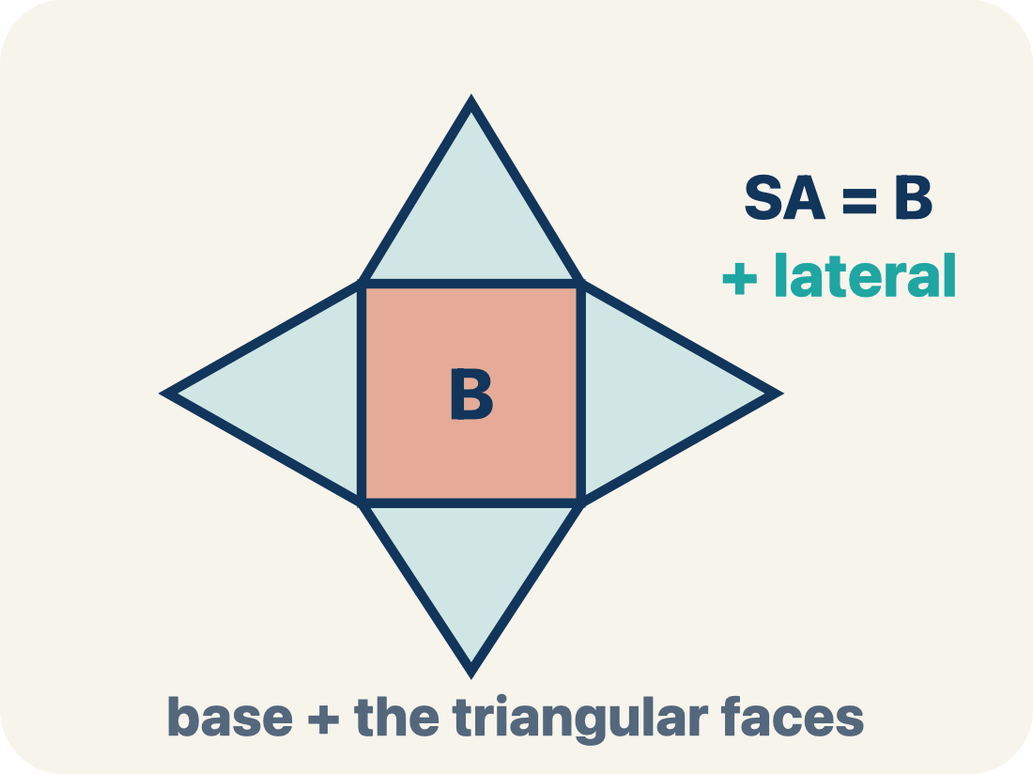
Vocabulary 1 of 7
Lesson 5-8 · Determine Surface Area of Pyramids
USE THE MATH WORDS · Use today’s math words in your explanation — not “it” and “that thing.”
Surface Area of Pyramids
The total area of a pyramid’s base and triangular faces. Formula: SA = B + lateral area.
EXAMPLE · EXPLAIN WHY IT FITS
Square base 6×6 with 4 triangles of ½ × 6 × 5: 36 + 60 = 96 square units
eduwonderlab.com · Neft Teacher
8 / 50
Notes:
TEACH IN PRACTICE | Embedded facilitation | Lesson 5.8, slide 8 | VOCAB
Focus on the existing task: Vocabulary 1 of 7 Surface Area of Pyramids The total…
ASK (T1/3/5): Where does “Surface Area of Pyramids” appear in the example? Explain the meaning without reading the definition. Partner: restate the idea and ask a clarifying question.
LOOK FOR: A correct connection between the word and a feature of the example. If the student only repeats the definition, invite pointing, sketching or oral rehearsal, then ask for another explanation of this same example.
PARTICIPATION (T5/6/7): Think time before volunteers; accept a written, drawn or rehearsed entry. Students ask for evidence respectfully. Recognize a specific contribution or revision and check that both partners participate.
Source: BCPS Updated Instructional Framework Rubric (June 2020), TEACH 1–7.

Slide 9
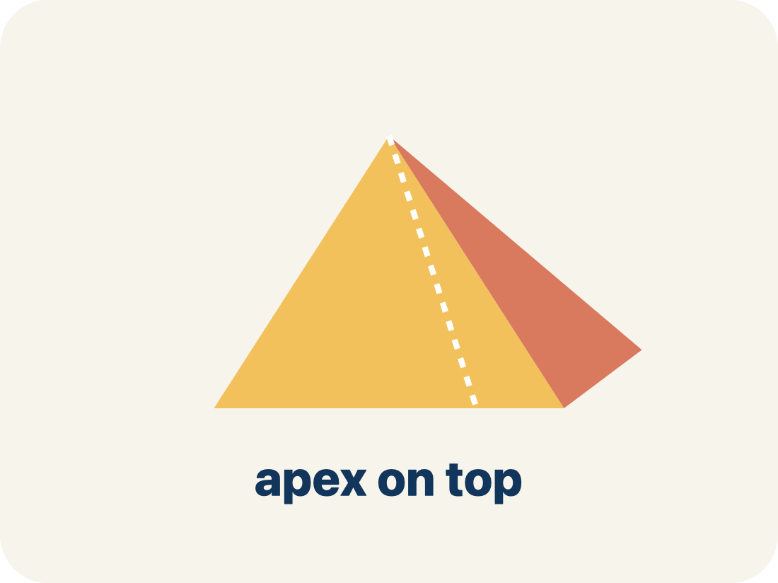
Vocabulary 2 of 7
Lesson 5-8 · Determine Surface Area of Pyramids
Pyramid
A solid with a flat bottom and triangle sides that meet at one point on top.
EXAMPLE · EXPLAIN WHY IT FITS
Like the Great Pyramid of Giza — a square on the bottom, 4 triangles slanting up to a point
Use “Pyramid” to explain the example. Point to evidence.
eduwonderlab.com · Neft Teacher
9 / 50
Notes:
TEACH IN PRACTICE | Embedded facilitation | Lesson 5.8, slide 9 | VOCAB
Focus on the existing task: Vocabulary 2 of 7 Pyramid A solid with a flat bottom…
ASK (T1/3/5): Where does “Pyramid” appear in the example? Explain the meaning without reading the definition. Partner: restate the idea and ask a clarifying question.
LOOK FOR: A correct connection between the word and a feature of the example. If the student only repeats the definition, invite pointing, sketching or oral rehearsal, then ask for another explanation of this same example.
PARTICIPATION (T5/6/7): Think time before volunteers; accept a written, drawn or rehearsed entry. Students ask for evidence respectfully. Recognize a specific contribution or revision and check that both partners participate.
Source: BCPS Updated Instructional Framework Rubric (June 2020), TEACH 1–7.

Slide 10
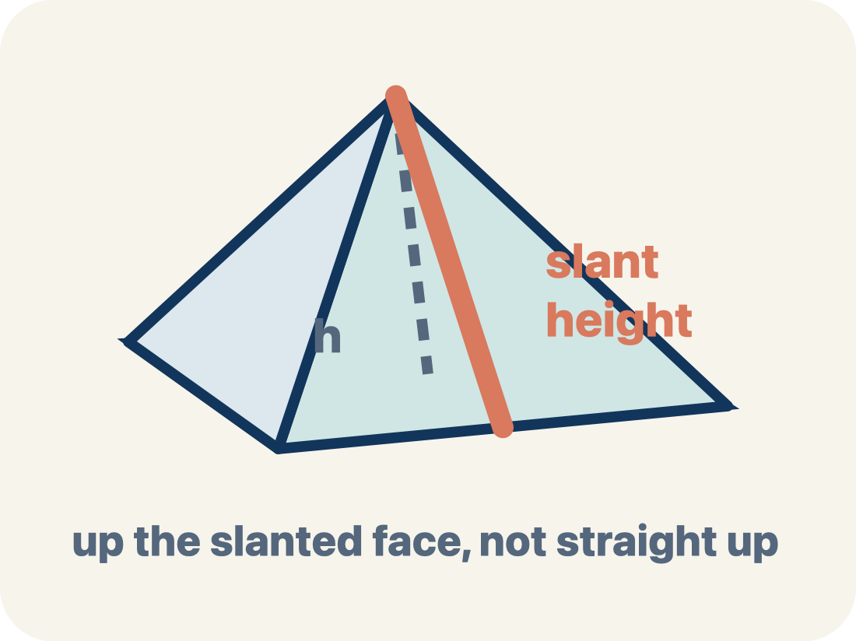
Vocabulary 3 of 7
Lesson 5-8 · Determine Surface Area of Pyramids
Slant height
The height of a side triangle, measured along its slanted face.
EXAMPLE · EXPLAIN WHY IT FITS
If you slide your finger from the bottom edge up the triangle face to the top point — that distance is the slant height
Use “Slant height” to explain the example. Point to evidence.
eduwonderlab.com · Neft Teacher
10 / 50
Notes:
TEACH IN PRACTICE | Embedded facilitation | Lesson 5.8, slide 10 | VOCAB
Focus on the existing task: Vocabulary 3 of 7 Slant height The height of a side…
ASK (T1/3/5): Where does “Slant height” appear in the example? Explain the meaning without reading the definition. Partner: restate the idea and ask a clarifying question.
LOOK FOR: A correct connection between the word and a feature of the example. If the student only repeats the definition, invite pointing, sketching or oral rehearsal, then ask for another explanation of this same example.
PARTICIPATION (T5/6/7): Think time before volunteers; accept a written, drawn or rehearsed entry. Students ask for evidence respectfully. Recognize a specific contribution or revision and check that both partners participate.
Source: BCPS Updated Instructional Framework Rubric (June 2020), TEACH 1–7.

Slide 11
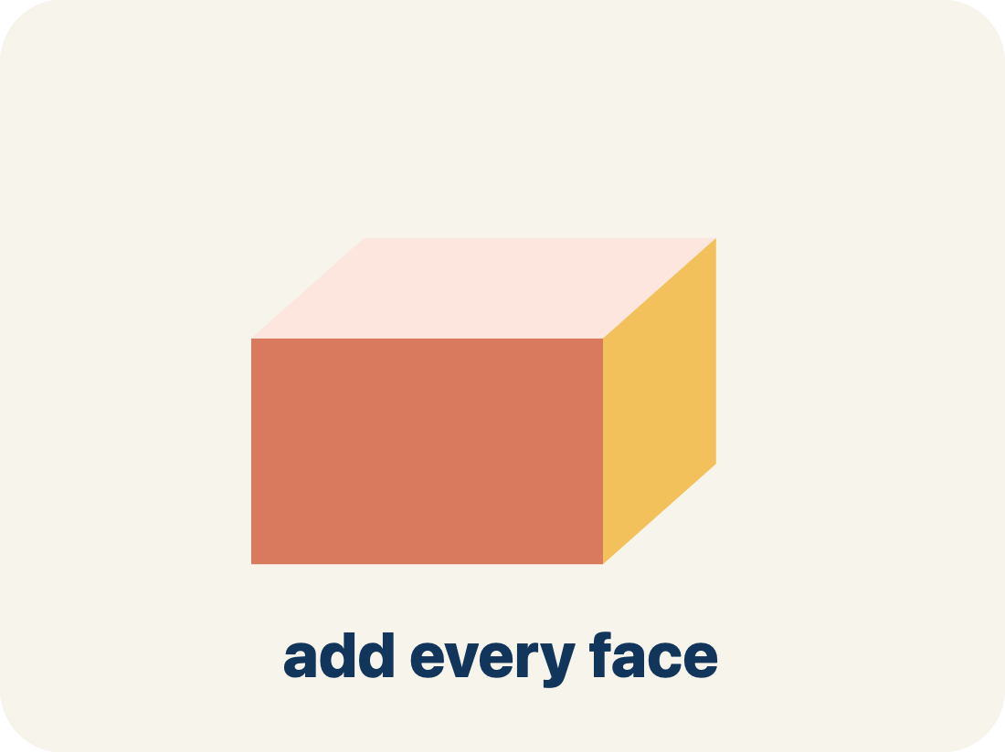
Vocabulary 4 of 7
Lesson 5-8 · Determine Surface Area of Pyramids
Lateral face
A triangle side of a pyramid, not the bottom.
EXAMPLE · EXPLAIN WHY IT FITS
A square pyramid has 4 lateral faces — one triangle for each side of the square base
Use “Lateral face” to explain the example. Point to evidence.
eduwonderlab.com · Neft Teacher
11 / 50
Notes:
TEACH IN PRACTICE | Embedded facilitation | Lesson 5.8, slide 11 | VOCAB
Focus on the existing task: Vocabulary 4 of 7 Lateral face A triangle side of a…
ASK (T1/3/5): Where does “Lateral face” appear in the example? Explain the meaning without reading the definition. Partner: restate the idea and ask a clarifying question.
LOOK FOR: A correct connection between the word and a feature of the example. If the student only repeats the definition, invite pointing, sketching or oral rehearsal, then ask for another explanation of this same example.
PARTICIPATION (T5/6/7): Think time before volunteers; accept a written, drawn or rehearsed entry. Students ask for evidence respectfully. Recognize a specific contribution or revision and check that both partners participate.
Source: BCPS Updated Instructional Framework Rubric (June 2020), TEACH 1–7.

Slide 12
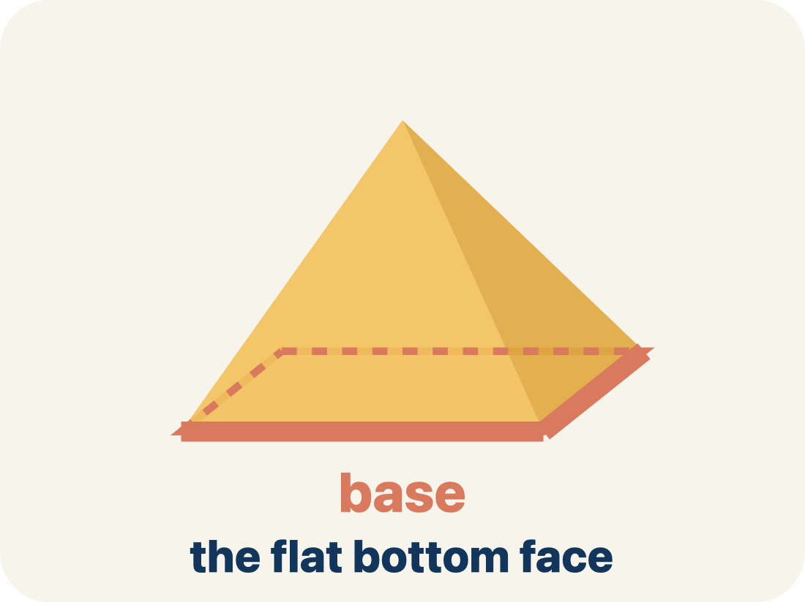
Vocabulary 5 of 7
Lesson 5-8 · Determine Surface Area of Pyramids
Base
The flat bottom of a pyramid.
EXAMPLE · EXPLAIN WHY IT FITS
A square pyramid sits on a square base; base area = side × side
Use “Base” to explain the example. Point to evidence.
eduwonderlab.com · Neft Teacher
12 / 50
Notes:
TEACH IN PRACTICE | Embedded facilitation | Lesson 5.8, slide 12 | VOCAB
Focus on the existing task: Vocabulary 5 of 7 Base The flat bottom of a pyramid.…
ASK (T1/3/5): Where does “Base” appear in the example? Explain the meaning without reading the definition. Partner: restate the idea and ask a clarifying question.
LOOK FOR: A correct connection between the word and a feature of the example. If the student only repeats the definition, invite pointing, sketching or oral rehearsal, then ask for another explanation of this same example.
PARTICIPATION (T5/6/7): Think time before volunteers; accept a written, drawn or rehearsed entry. Students ask for evidence respectfully. Recognize a specific contribution or revision and check that both partners participate.
Source: BCPS Updated Instructional Framework Rubric (June 2020), TEACH 1–7.

Slide 13
Vocabulary 6 of 7
Lesson 5-8 · Determine Surface Area of Pyramids
Apex
The point at the top of a pyramid where the sides meet.
EXAMPLE · EXPLAIN WHY IT FITS
The pointy top of a pyramid — all the slanted edges connect here
Use “Apex” to explain the example. Point to evidence.
eduwonderlab.com · Neft Teacher
13 / 50
Notes:
TEACH IN PRACTICE | Embedded facilitation | Lesson 5.8, slide 13 | VOCAB
Focus on the existing task: Vocabulary 6 of 7 Apex The point at the top of a…
ASK (T1/3/5): Where does “Apex” appear in the example? Explain the meaning without reading the definition. Partner: restate the idea and ask a clarifying question.
LOOK FOR: A correct connection between the word and a feature of the example. If the student only repeats the definition, invite pointing, sketching or oral rehearsal, then ask for another explanation of this same example.
PARTICIPATION (T5/6/7): Think time before volunteers; accept a written, drawn or rehearsed entry. Students ask for evidence respectfully. Recognize a specific contribution or revision and check that both partners participate.
Source: BCPS Updated Instructional Framework Rubric (June 2020), TEACH 1–7.

Slide 14
Vocabulary 7 of 7
Lesson 5-8 · Determine Surface Area of Pyramids
Lateral area
The total area of just the side triangles, not the bottom.
EXAMPLE · EXPLAIN WHY IT FITS
For a square pyramid: lateral area = 4 × (½ × base edge × slant height)
Use “Lateral area” to explain the example. Point to evidence.
eduwonderlab.com · Neft Teacher
14 / 50
Notes:
TEACH IN PRACTICE | Embedded facilitation | Lesson 5.8, slide 14 | VOCAB
Focus on the existing task: Vocabulary 7 of 7 Lateral area The total area of just…
ASK (T1/3/5): Where does “Lateral area” appear in the example? Explain the meaning without reading the definition. Partner: restate the idea and ask a clarifying question.
LOOK FOR: A correct connection between the word and a feature of the example. If the student only repeats the definition, invite pointing, sketching or oral rehearsal, then ask for another explanation of this same example.
PARTICIPATION (T5/6/7): Think time before volunteers; accept a written, drawn or rehearsed entry. Students ask for evidence respectfully. Recognize a specific contribution or revision and check that both partners participate.
Source: BCPS Updated Instructional Framework Rubric (June 2020), TEACH 1–7.

Slide 15
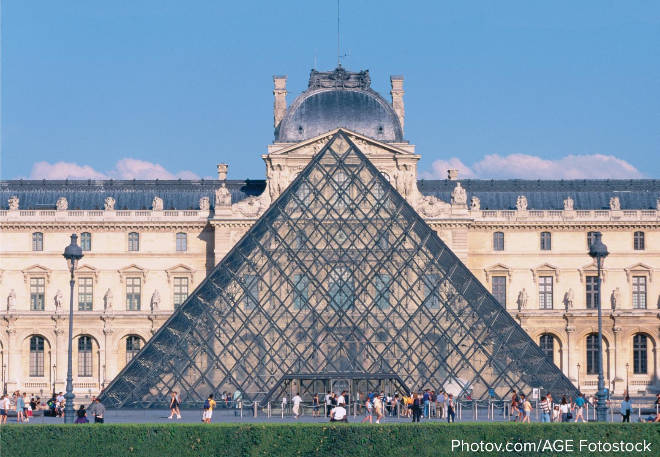

Be Curious
What do you notice?
What do you wonder?
Think first. Share a notice and a
question; build on a classmate’s
idea.
Mindset
What helps you make sense of a math or non-math problem?
15 / 50
Notes:
TEACH IN PRACTICE | Embedded facilitation | Lesson 5.8, slide 15 | CURIOUS
Focus on the existing task: What helps you make sense of a math or non-math problem?
LAUNCH (T2/3/5): Allow quiet observation first. Separate a notice from an inference, invite students’ own questions, and follow the existing launch before teaching a procedure.
LOOK FOR (T4): Where this task addresses it, students can include the base and each triangular face. Ask which feature of their work supports the claim.
RESPOND: If this task shows the lesson misconception—using vertical pyramid height in place of a triangular face height—mark the perpendicular height within each triangle on the existing net. Have the student revise and explain the change. Use this support only where the concept occurs in the current task; otherwise respond to the displayed question.
RECHECK: If a gap is shared, revisit the existing representation together. If it is limited, give targeted support while others compare valid methods on the same task. Check the revision before moving on.
PARTICIPATION (T5/6/7): Think time before volunteers; accept a written, drawn or rehearsed entry. Students ask for evidence respectfully. Recognize a specific contribution or revision and check that both partners participate.
Source: BCPS Updated Instructional Framework Rubric (June 2020), TEACH 1–7.

Slide 16
Vocabulary
Lesson 5-8 · Determine Surface Area of Pyramids
Today’s Math Words
We learn every word — what it means and what it looks like — before we use it.
Surface Area of Pyramids
Pyramid
The total area of a pyramid’s base and triangular faces
A solid with a flat bottom and triangle sides that meet at one point on top
Slant height
Lateral face
The height of a side triangle, measured along its slanted face
A triangle side of a pyramid, not the bottom
Base
Apex
The flat bottom of a pyramid
The point at the top of a pyramid where the sides meet
Lateral area
Explain one math word using the example.
Partner: point to evidence.
The total area of just the side triangles, not the bottom
eduwonderlab.com · Neft Teacher
16 / 50
Notes:
TEACH IN PRACTICE | Embedded facilitation | Lesson 5.8, slide 16 | VOCAB
Focus on the existing task: Vocabulary Today’s Math Words We learn every word — what…
ASK (T1/3/5): Where does “the displayed term” appear in the example? Explain the meaning without reading the definition. Partner: restate the idea and ask a clarifying question.
LOOK FOR: A correct connection between the word and a feature of the example. If the student only repeats the definition, invite pointing, sketching or oral rehearsal, then ask for another explanation of this same example.
PARTICIPATION (T5/6/7): Think time before volunteers; accept a written, drawn or rehearsed entry. Students ask for evidence respectfully. Recognize a specific contribution or revision and check that both partners participate.
Source: BCPS Updated Instructional Framework Rubric (June 2020), TEACH 1–7. Earlier notes and answer keys are retained below.
EARLIER NOTES / EXISTING ANSWER KEY
Choral-read each word, its meaning, and what it looks like.
Students should use these words out loud today — listen for them in partner talk and revoice student ideas with the academic term.
UIFR: TEACH 1 · TEACH 5.

Slide 17
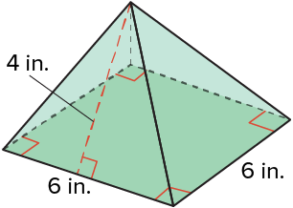
Pyramids
What is the surface area of the right square pyramid shown?
Think and record first. Which part of your work supports your answer?
Think About It:
How is surface area related to area?
17 / 50
Notes:
TEACH IN PRACTICE | Embedded facilitation | Lesson 5.8, slide 17 | TASK
Focus on the existing task: What is the surface area of the right square pyramid shown?
LAUNCH (T2/3/5): Use the displayed question. Give private thinking time; then A explains while B asks for evidence. Switch roles. Each student records their own reasoning.
LOOK FOR (T4): Where this task addresses it, students can report square units. Ask which feature of their work supports the claim.
RESPOND: If this task shows the lesson misconception—using vertical pyramid height in place of a triangular face height—mark the perpendicular height within each triangle on the existing net. Have the student revise and explain the change. Use this support only where the concept occurs in the current task; otherwise respond to the displayed question.
RECHECK: If a gap is shared, revisit the existing representation together. If it is limited, give targeted support while others compare valid methods on the same task. Check the revision before moving on.
PARTICIPATION (T5/6/7): Think time before volunteers; accept a written, drawn or rehearsed entry. Students ask for evidence respectfully. Recognize a specific contribution or revision and check that both partners participate.
Source: BCPS Updated Instructional Framework Rubric (June 2020), TEACH 1–7. Earlier notes and answer keys are retained below.
EARLIER NOTES / EXISTING ANSWER KEY
Ask the question, then hold the silence — students think or jot before anyone answers.
Take two or three responses and press with “Why?” or “How do you know?” before moving on.
UIFR: TEACH 3.
UIFR FULL | Lesson-specific facilitation
TEACH 2-3 | Session 1 task launch (UIFR PDF pp. 9-10).
Use the problem exactly as displayed. Give individual thinking time before discussion or advancing to the explanation. If the answer is already visible, ask students to reconstruct and justify it. Invite a choice of suitable representations and have students explain why their choice helps.
At the point where this concept appears, ask: “Which height belongs to each triangular face, and how does the net help you identify it?” Wait for evidence, invite another pathway, and have a student ask a follow-up question. Do not replace students’ reasoning with a sequence of leading steps.

Slide 18
Pyramids
What is the surface area of the right square pyramid shown?​
Record your reasoning before the reveal. Compare, then
explain any revision.
How can you find the surface area of a three-dimensional figure?
Reveal:
We can find the sum of the areas of all the faces.
18 / 50
Notes:
TEACH IN PRACTICE | Embedded facilitation | Lesson 5.8, slide 18 | REVEAL
Focus on the existing task: What is the surface area of the right square pyramid shown?
LAUNCH (T2/3/5): If an existing answer cover is present, gather an attempt before revealing. If the explanation is already visible, ask students to reconstruct and justify it. Compare reasoning and explain a revision; preserve the reveal sequence.
LOOK FOR (T4): Where this task addresses it, students can report square units. Ask which feature of their work supports the claim.
RESPOND: If this task shows the lesson misconception—using vertical pyramid height in place of a triangular face height—mark the perpendicular height within each triangle on the existing net. Have the student revise and explain the change. Use this support only where the concept occurs in the current task; otherwise respond to the displayed question.
RECHECK: If a gap is shared, revisit the existing representation together. If it is limited, give targeted support while others compare valid methods on the same task. Check the revision before moving on.
PARTICIPATION (T5/6/7): Think time before volunteers; accept a written, drawn or rehearsed entry. Students ask for evidence respectfully. Recognize a specific contribution or revision and check that both partners participate.
Source: BCPS Updated Instructional Framework Rubric (June 2020), TEACH 1–7. Earlier notes and answer keys are retained below.
EARLIER NOTES / EXISTING ANSWER KEY
Do not click yet: collect 2–3 student answers with reasons first.
Then click to remove the cover and have students compare their thinking to the reveal — “Is this what we said? Where is it different?”
Behind the cover: We can find the sum of the areas of all the faces.
UIFR: TEACH 3 · TEACH 4.

Slide 19
Pyramids
To determine the surface area of a three-dimensional figure, find the area of each face and add the areas.
Record your reasoning before the reveal. Compare, then
explain any revision.
What tool or representation can you use to help you determine the surface area of the pyramid?
Reveal:
One tool we can use is a net.
19 / 50
Notes:
TEACH IN PRACTICE | Embedded facilitation | Lesson 5.8, slide 19 | REVEAL
Focus on the existing task: To determine the surface area of a three-dimensional figure, find the area of each face and add the areas. What tool or representation can you use to help you determine the surface area of the pyramid?
LAUNCH (T2/3/5): If an existing answer cover is present, gather an attempt before revealing. If the explanation is already visible, ask students to reconstruct and justify it. Compare reasoning and explain a revision; preserve the reveal sequence.
LOOK FOR (T4): Where this task addresses it, students can include the base and each triangular face. Ask which feature of their work supports the claim.
RESPOND: If this task shows the lesson misconception—using vertical pyramid height in place of a triangular face height—mark the perpendicular height within each triangle on the existing net. Have the student revise and explain the change. Use this support only where the concept occurs in the current task; otherwise respond to the displayed question.
RECHECK: If a gap is shared, revisit the existing representation together. If it is limited, give targeted support while others compare valid methods on the same task. Check the revision before moving on.
PARTICIPATION (T5/6/7): Think time before volunteers; accept a written, drawn or rehearsed entry. Students ask for evidence respectfully. Recognize a specific contribution or revision and check that both partners participate.
Source: BCPS Updated Instructional Framework Rubric (June 2020), TEACH 1–7. Earlier notes and answer keys are retained below.
EARLIER NOTES / EXISTING ANSWER KEY
Do not click yet: collect 2–3 student answers with reasons first.
Then click to remove the cover and have students compare their thinking to the reveal — “Is this what we said? Where is it different?”
Behind the cover: One tool we can use is a net.
UIFR: TEACH 3 · TEACH 4.

Slide 20
Pyramids
How can you create a net of the right square pyramid?
Record your reasoning before the reveal. Compare, then explain any revision.
Reveal:
We can draw a square with four congruent triangles connected to each side of the square.
20 / 50
Notes:
TEACH IN PRACTICE | Embedded facilitation | Lesson 5.8, slide 20 | REVEAL
Focus on the existing task: How can you create a net of the right square pyramid?
LAUNCH (T2/3/5): If an existing answer cover is present, gather an attempt before revealing. If the explanation is already visible, ask students to reconstruct and justify it. Compare reasoning and explain a revision; preserve the reveal sequence.
LOOK FOR (T4): Where this task addresses it, students can include the base and each triangular face. Ask which feature of their work supports the claim.
RESPOND: If this task shows the lesson misconception—using vertical pyramid height in place of a triangular face height—mark the perpendicular height within each triangle on the existing net. Have the student revise and explain the change. Use this support only where the concept occurs in the current task; otherwise respond to the displayed question.
RECHECK: If a gap is shared, revisit the existing representation together. If it is limited, give targeted support while others compare valid methods on the same task. Check the revision before moving on.
PARTICIPATION (T5/6/7): Think time before volunteers; accept a written, drawn or rehearsed entry. Students ask for evidence respectfully. Recognize a specific contribution or revision and check that both partners participate.
Source: BCPS Updated Instructional Framework Rubric (June 2020), TEACH 1–7. Earlier notes and answer keys are retained below.
EARLIER NOTES / EXISTING ANSWER KEY
Do not click yet: collect 2–3 student answers with reasons first.
Then click to remove the cover and have students compare their thinking to the reveal — “Is this what we said? Where is it different?”
Behind the cover: We can draw a square with four congruent triangles connected to each side of the square.
UIFR: TEACH 3 · TEACH 4.

Slide 21

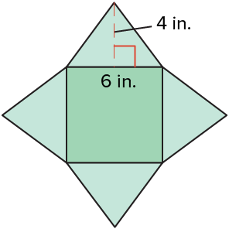
COLLABORATE · TALK IT THROUGH • AGREE ON A MODEL
Collaborate and Connect
The pyramid has 5 faces: a square base and 4 triangular faces. So, the net is a square with four congruent triangles connected to each side.
What is the area of the square base? of the triangular faces?
Think first. A explains; B asks for evidence.
Switch roles; both revise.
21 / 50
Notes:
TEACH IN PRACTICE | Embedded facilitation | Lesson 5.8, slide 21 | COLLABORATE
Focus on the existing task: The pyramid has 5 faces: a square base and 4 triangular faces. So, the net is a square with four congruent triangles connected to each side. What is the area of the square base?
LAUNCH (T2/3/5): Use the displayed question. Give private thinking time; then A explains while B asks for evidence. Switch roles. Each student records their own reasoning.
LOOK FOR (T4): Where this task addresses it, students can include the base and each triangular face. Ask which feature of their work supports the claim.
RESPOND: If this task shows the lesson misconception—using vertical pyramid height in place of a triangular face height—mark the perpendicular height within each triangle on the existing net. Have the student revise and explain the change. Use this support only where the concept occurs in the current task; otherwise respond to the displayed question.
RECHECK: If a gap is shared, revisit the existing representation together. If it is limited, give targeted support while others compare valid methods on the same task. Check the revision before moving on.
PARTICIPATION (T5/6/7): Think time before volunteers; accept a written, drawn or rehearsed entry. Students ask for evidence respectfully. Recognize a specific contribution or revision and check that both partners participate.
Source: BCPS Updated Instructional Framework Rubric (June 2020), TEACH 1–7. Earlier notes and answer keys are retained below.
EARLIER NOTES / EXISTING ANSWER KEY
Routine: COLLABORATE · TALK IT THROUGH • AGREE ON A MODEL
UIFR FULL | Lesson-specific facilitation
TEACH 4-5 | Session 1 discussion and checkpoint (UIFR PDF pp. 11-12).
Collect a brief response from every student to the existing prompt before hearing volunteers. Partners take turns explaining and asking for evidence: “I understand ___; what supports ___?” Offer rehearsal or an annotated model for students who need language support. Each student records their own reasoning.
Look specifically for: using vertical pyramid height in place of a triangular face height. If it appears, mark the perpendicular height within each triangle on the existing net; then ask the student to revise the same response and explain the change. If evidence is secure, have students compare a second valid pathway or state why their approach works. Choose the next step from the responses, not a preset pace.

Slide 22
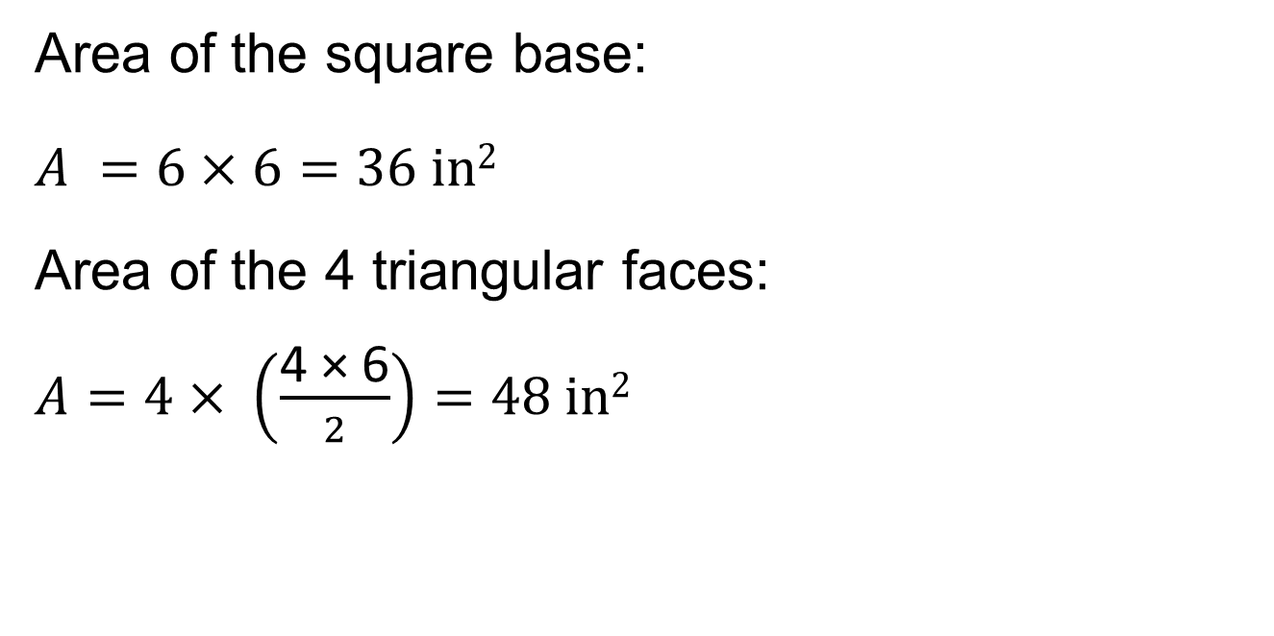
Pyramids
Think About It:
Why is the area of one triangular face multiplied by 4?
22 / 50
Notes:
TEACH IN PRACTICE | Embedded facilitation | Lesson 5.8, slide 22 | TASK
Focus on the existing task: Think About It: Why is the area of one triangular face multiplied by 4?
LAUNCH (T2/3/5): Use the displayed question. Give private thinking time; then A explains while B asks for evidence. Switch roles. Each student records their own reasoning.
LOOK FOR (T4): Where this task addresses it, students can include the base and each triangular face. Ask which feature of their work supports the claim.
RESPOND: If this task shows the lesson misconception—using vertical pyramid height in place of a triangular face height—mark the perpendicular height within each triangle on the existing net. Have the student revise and explain the change. Use this support only where the concept occurs in the current task; otherwise respond to the displayed question.
RECHECK: If a gap is shared, revisit the existing representation together. If it is limited, give targeted support while others compare valid methods on the same task. Check the revision before moving on.
PARTICIPATION (T5/6/7): Think time before volunteers; accept a written, drawn or rehearsed entry. Students ask for evidence respectfully. Recognize a specific contribution or revision and check that both partners participate.
Source: BCPS Updated Instructional Framework Rubric (June 2020), TEACH 1–7. Earlier notes and answer keys are retained below.
EARLIER NOTES / EXISTING ANSWER KEY
Ask the question, then hold the silence — students think or jot before anyone answers.
Take two or three responses and press with “Why?” or “How do you know?” before moving on.
UIFR: TEACH 3.

Slide 23
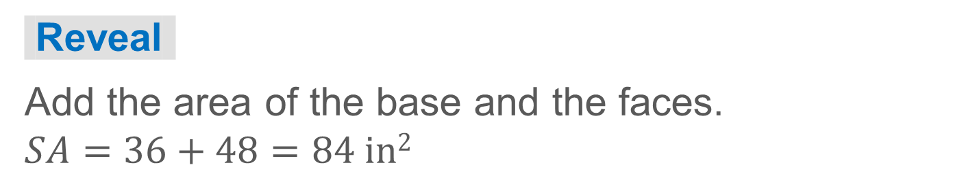
Pyramids
How can you find the surface area?
23 / 50
Notes:
TEACH IN PRACTICE | Embedded facilitation | Lesson 5.8, slide 23 | TASK
Focus on the existing task: How can you find the surface area?
LAUNCH (T2/3/5): Use the displayed question. Give private thinking time; then A explains while B asks for evidence. Switch roles. Each student records their own reasoning.
LOOK FOR (T4): Where this task addresses it, students can include the base and each triangular face. Ask which feature of their work supports the claim.
RESPOND: If this task shows the lesson misconception—using vertical pyramid height in place of a triangular face height—mark the perpendicular height within each triangle on the existing net. Have the student revise and explain the change. Use this support only where the concept occurs in the current task; otherwise respond to the displayed question.
RECHECK: If a gap is shared, revisit the existing representation together. If it is limited, give targeted support while others compare valid methods on the same task. Check the revision before moving on.
PARTICIPATION (T5/6/7): Think time before volunteers; accept a written, drawn or rehearsed entry. Students ask for evidence respectfully. Recognize a specific contribution or revision and check that both partners participate.
Source: BCPS Updated Instructional Framework Rubric (June 2020), TEACH 1–7. Earlier notes and answer keys are retained below.
EARLIER NOTES / EXISTING ANSWER KEY
Model briefly, then hand the thinking back: ask “Why does this step work?” before showing the next one.
Quick check before moving on — thumbs or whiteboards from everyone, not volunteers.
UIFR: TEACH 2 · TEACH 3 · TEACH 4.

Slide 24
STUDENT MOVES
Lesson 5-8
Your moves
STRUGGLE FIRST · Work on your own first. Stuck is allowed — try a second strategy before you ask.
ANOTHER PATHWAY · Did anyone get there a different way? Put both pathways side by side and compare.
24 / 50

Slide 25
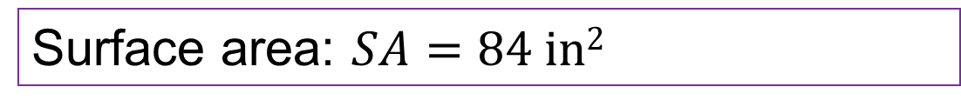
Pyramids
What is the surface area of the right square pyramid shown?
Think and record first. Which part of your work supports your answer?
Justifying ​
How can you use mathematics to justify your process?
25 / 50
Notes:
TEACH IN PRACTICE | Embedded facilitation | Lesson 5.8, slide 24 | TASK
Focus on the existing task: What is the surface area of the right square pyramid shown?
LAUNCH (T2/3/5): Use the displayed question. Give private thinking time; then A explains while B asks for evidence. Switch roles. Each student records their own reasoning.
LOOK FOR (T4): Where this task addresses it, students can report square units. Ask which feature of their work supports the claim.
RESPOND: If this task shows the lesson misconception—using vertical pyramid height in place of a triangular face height—mark the perpendicular height within each triangle on the existing net. Have the student revise and explain the change. Use this support only where the concept occurs in the current task; otherwise respond to the displayed question.
RECHECK: If a gap is shared, revisit the existing representation together. If it is limited, give targeted support while others compare valid methods on the same task. Check the revision before moving on.
PARTICIPATION (T5/6/7): Think time before volunteers; accept a written, drawn or rehearsed entry. Students ask for evidence respectfully. Recognize a specific contribution or revision and check that both partners participate.
Source: BCPS Updated Instructional Framework Rubric (June 2020), TEACH 1–7. Earlier notes and answer keys are retained below.
EARLIER NOTES / EXISTING ANSWER KEY
Model briefly, then hand the thinking back: ask “Why does this step work?” before showing the next one.
Quick check before moving on — thumbs or whiteboards from everyone, not volunteers.
UIFR: TEACH 2 · TEACH 3 · TEACH 4.

Slide 26
Let’s Explore More
Why are the heights of the triangles in a right square pyramid congruent?​
The triangular faces in a right square pyramid are congruent. Is this true for all pyramids?
Try first. Point to a base and its matching height. Explain how your method uses them.
26 / 50
Notes:
TEACH IN PRACTICE | Embedded facilitation | Lesson 5.8, slide 25 | PRACTICE
Focus on the existing task: Why are the heights of the triangles in a right square pyramid congruent?
LAUNCH (T2/3/5): Use the displayed question. Give private thinking time; then A explains while B asks for evidence. Switch roles. Each student records their own reasoning.
LOOK FOR (T4): Where this task addresses it, students can include the base and each triangular face. Ask which feature of their work supports the claim.
RESPOND: If this task shows the lesson misconception—using vertical pyramid height in place of a triangular face height—mark the perpendicular height within each triangle on the existing net. Have the student revise and explain the change. Use this support only where the concept occurs in the current task; otherwise respond to the displayed question.
RECHECK: If a gap is shared, revisit the existing representation together. If it is limited, give targeted support while others compare valid methods on the same task. Check the revision before moving on.
PARTICIPATION (T5/6/7): Think time before volunteers; accept a written, drawn or rehearsed entry. Students ask for evidence respectfully. Recognize a specific contribution or revision and check that both partners participate.
Source: BCPS Updated Instructional Framework Rubric (June 2020), TEACH 1–7. Earlier notes and answer keys are retained below.
EARLIER NOTES / EXISTING ANSWER KEY
Extension for partners or table groups — students choose their approach and use the workspace to show thinking.
Push with “Convince me,” and have two groups with different approaches share.
This is where students stretch past the worked example.
UIFR: TEACH 2 · TEACH 5.

Slide 27
LESSON 5.8 / DISCUSS THE TASK
Explain and compare
Use the task you just explored.
TAKE TURNS
Which height belongs to each triangular face, and how does the net help you identify it?
Explain
“I know this because…”
Ask
“Where does your work show that?”
Point to evidence in your work.
Then compare your approach with a partner’s.
HOW DO YOU KNOW? · Ask your partner “How do you know?” Answer by pointing to your own work.
Listen to understand. Ask for evidence. Make room for every voice.
Notes:
TEACH IN PRACTICE | Embedded facilitation | Lesson 5.8, slide 26 | PRIOR_INSERT
Focus on the existing task: Point to evidence in your work. Then compare your approach with a partner’s. TAKE TURNS Explain “I know this because…” Ask “Where does your work show that?
CONNECT (T1/4): Ask students to restate the displayed goal or key idea and connect it to earlier work. Relevant lesson evidence: include the base and each triangular face; use face height correctly; report square units. Use only the criterion that matches the current session.
SHOW PROGRESS: Students point to their own existing work, explain what improved after feedback, and name a next step. Pair confidence ratings with actual evidence.
PARTICIPATION (T5/6/7): Think time before volunteers; accept a written, drawn or rehearsed entry. Students ask for evidence respectfully. Recognize a specific contribution or revision and check that both partners participate.
Source: BCPS Updated Instructional Framework Rubric (June 2020), TEACH 1–7.

Slide 28
Pyramids
How can you create a net of the right square pyramid?
Compare your reasoning with the explanation. Explain any revision you make.
Reveal:
We can draw a square with four congruent triangles connected to each side of the square.
28 / 50
Notes:
TEACH IN PRACTICE | Embedded facilitation | Lesson 5.8, slide 27 | REVEAL
Focus on the existing task: How can you create a net of the right square pyramid?
LAUNCH (T2/3/5): If an existing answer cover is present, gather an attempt before revealing. If the explanation is already visible, ask students to reconstruct and justify it. Compare reasoning and explain a revision; preserve the reveal sequence.
LOOK FOR (T4): Where this task addresses it, students can include the base and each triangular face. Ask which feature of their work supports the claim.
RESPOND: If this task shows the lesson misconception—using vertical pyramid height in place of a triangular face height—mark the perpendicular height within each triangle on the existing net. Have the student revise and explain the change. Use this support only where the concept occurs in the current task; otherwise respond to the displayed question.
RECHECK: If a gap is shared, revisit the existing representation together. If it is limited, give targeted support while others compare valid methods on the same task. Check the revision before moving on.
PARTICIPATION (T5/6/7): Think time before volunteers; accept a written, drawn or rehearsed entry. Students ask for evidence respectfully. Recognize a specific contribution or revision and check that both partners participate.
Source: BCPS Updated Instructional Framework Rubric (June 2020), TEACH 1–7.

Slide 29
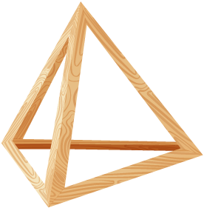
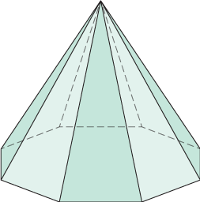
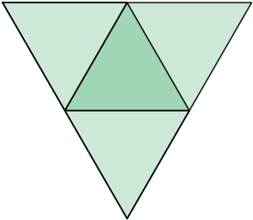
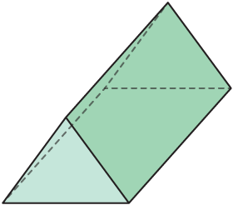
Be Curious
Which doesn’t belong?
Think first. Share a notice and a question;
build on a classmate’s idea.
Mindset
What is helping you make sense of a math or non-math problem?
29 / 50
Notes:
TEACH IN PRACTICE | Embedded facilitation | Lesson 5.8, slide 28 | CURIOUS
Focus on the existing task: What is helping you make sense of a math or non-math problem?
LAUNCH (T2/3/5): Allow quiet observation first. Separate a notice from an inference, invite students’ own questions, and follow the existing launch before teaching a procedure.
LOOK FOR (T4): Where this task addresses it, students can include the base and each triangular face. Ask which feature of their work supports the claim.
RESPOND: If this task shows the lesson misconception—using vertical pyramid height in place of a triangular face height—mark the perpendicular height within each triangle on the existing net. Have the student revise and explain the change. Use this support only where the concept occurs in the current task; otherwise respond to the displayed question.
RECHECK: If a gap is shared, revisit the existing representation together. If it is limited, give targeted support while others compare valid methods on the same task. Check the revision before moving on.
PARTICIPATION (T5/6/7): Think time before volunteers; accept a written, drawn or rehearsed entry. Students ask for evidence respectfully. Recognize a specific contribution or revision and check that both partners participate.
Source: BCPS Updated Instructional Framework Rubric (June 2020), TEACH 1–7.

Slide 30
Warm-Up
Lesson 5-8 · Determine Surface Area of Pyramids
Session 2 Warm-Up
Try alone. Explain one. Then revise.
1
A pyramid has:
2
A square pyramid has a base of 6 × 6 cm and 4 triangles with h=5 cm. Base area is:
A
Two parallel bases
A
12 cm²
B
One polygonal base and triangular faces meeting at an apex
B
36 cm²
C
Only curved surfaces
C
24 cm²
D
Rectangles on all sides
D
30 cm²
3
Each triangular face has base 6 cm and height 5 cm. Area of one face is:
4
Total surface area of this pyramid (base 36 + 4 triangles of 15) is:
A
30 cm²
A
51 cm²
B
15 cm²
B
96 cm²
C
11 cm²
C
66 cm²
D
60 cm²
D
120 cm²
eduwonderlab.com · Neft Teacher
30 / 50
Notes:
TEACH IN PRACTICE | Embedded facilitation | Lesson 5.8, slide 29 | WARMUP
Focus on the existing task: Warm-Up Session 2 Warm-Up Check what you remember from…
GATHER EVIDENCE (T4/6): Keep the original items. Students try independently, mark an uncertain item, and explain one method before checking. Use the existing key when present.
RESPOND: Distinguish a calculation slip from a reasoning gap. Give one next step on the same item; have students revise in a second color. Use the responses to choose flexible support for today’s lesson.
PARTICIPATION (T5/6/7): Think time before volunteers; accept a written, drawn or rehearsed entry. Students ask for evidence respectfully. Recognize a specific contribution or revision and check that both partners participate.
Source: BCPS Updated Instructional Framework Rubric (June 2020), TEACH 1–7. Earlier notes and answer keys are retained below.
EARLIER NOTES / EXISTING ANSWER KEY
Warm-up routine: students start silently on entry; keep it to about 4 minutes.
Circulate and note who is stuck — use what you see to choose who you check on first today.
Go over answers quickly; ask one student to explain a step, not just say the answer.
UIFR: TEACH 4 · TEACH 6.

Slide 31
STUDENT MOVES
Lesson 5-8
Your move
YOU KNOW THE ROUTINE · Read → plan → solve → check. Do all four, in that order.
31 / 50

Slide 32
Review Notes — Session 2
Lesson 5-8 · Determine Surface Area of Pyramids
Session 2: Review Notes
Copy. Explain. Check.
WHY IT MATTERS · Finish this: “This is worth knowing because ______.”
Pyramid Architecture
1
Pyramids have a single base polygon and triangular lateral faces that converge at a point.
Surface Area of Pyramids
2
Total Surface Area = (Area of Base) + (Sum of all triangular lateral faces).
Slant Height
3
Use the triangle’s slant height (from base to apex) when calculating lateral face areas.
eduwonderlab.com · Neft Teacher
32 / 50
Notes:
TEACH IN PRACTICE | Embedded facilitation | Lesson 5.8, slide 30 | NOTES
Focus on the existing task: Review Notes — Session 2 Session 2: Review Notes Copy…
ROUTINE (T1/2/4): Read or copy the original notes, cover one line, and explain it using the displayed example. Reopen and correct. Copying alone is not evidence of understanding.
LOOK FOR: A link between a symbol, quantity or feature and the explanation. If missing, point back to that feature and have the student try again; fade the prompt once they can explain.
PARTICIPATION (T5/6/7): Think time before volunteers; accept a written, drawn or rehearsed entry. Students ask for evidence respectfully. Recognize a specific contribution or revision and check that both partners participate.
Source: BCPS Updated Instructional Framework Rubric (June 2020), TEACH 1–7. Earlier notes and answer keys are retained below.
EARLIER NOTES / EXISTING ANSWER KEY
Copy routine: read one line at a time; students copy, then explain that line to a partner.
Keep it brisk — the understanding work happens in the examples, not the copying.
UIFR: TEACH 1 · TEACH 6.

Slide 33
Session 2
Determine Surface Area of Pyramids
JUSTIFY IT · Say it like this: “I know ______ because ______.”
33 / 50
Notes:
TEACH IN PRACTICE | Embedded facilitation | Lesson 5.8, slide 31 | DIVIDER
Focus on the existing task: Determine Surface Area of Pyramids Session 2
TRANSITION (T6/7): Students confirm materials, roles, how to request help, and the next response routine. Ask a student to restate it. Keep teacher-only slides hidden.
PARTICIPATION (T5/6/7): Think time before volunteers; accept a written, drawn or rehearsed entry. Students ask for evidence respectfully. Recognize a specific contribution or revision and check that both partners participate.
Source: BCPS Updated Instructional Framework Rubric (June 2020), TEACH 1–7. Earlier notes and answer keys are retained below.
EARLIER NOTES / EXISTING ANSWER KEY
Transition cue: state what materials are out and what success looks like this session.
Keep the changeover under a minute.
UIFR: TEACH 6.

Slide 34
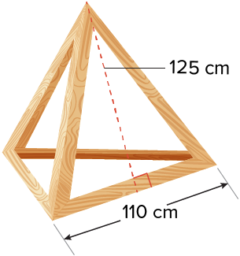
Maria’s Unique Artwork​
Maria will cover each of the faces, but not the base, of the frame with canvas to create a three-dimensional painting. The three faces have the same dimensions.
How much canvas will Maria need?
TRY IT BEFORE YOU’RE SURE · Start even if you are not sure. A revised answer counts as much as a first-try answer.
Explaining
What words, representations, or formulas can you use to explain your thinking to your classmates?
34 / 50
Notes:
TEACH IN PRACTICE | Embedded facilitation | Lesson 5.8, slide 32 | TASK
Focus on the existing task: Explaining What words, representations, or formulas can you use to explain your thinking to your classmates?
LAUNCH (T2/3/5): Use the displayed question. Give private thinking time; then A explains while B asks for evidence. Switch roles. Each student records their own reasoning.
LOOK FOR (T4): Where this task addresses it, students can include the base and each triangular face. Ask which feature of their work supports the claim.
RESPOND: If this task shows the lesson misconception—using vertical pyramid height in place of a triangular face height—mark the perpendicular height within each triangle on the existing net. Have the student revise and explain the change. Use this support only where the concept occurs in the current task; otherwise respond to the displayed question.
RECHECK: If a gap is shared, revisit the existing representation together. If it is limited, give targeted support while others compare valid methods on the same task. Check the revision before moving on.
PARTICIPATION (T5/6/7): Think time before volunteers; accept a written, drawn or rehearsed entry. Students ask for evidence respectfully. Recognize a specific contribution or revision and check that both partners participate.
Source: BCPS Updated Instructional Framework Rubric (June 2020), TEACH 1–7. Earlier notes and answer keys are retained below.
EARLIER NOTES / EXISTING ANSWER KEY
Read the context aloud (or have a student read it).
Before any math, students restate the situation and what is being asked in their own words.
Ask: What words, representations, or formulas can you use to explain your thinking to your classmates?
UIFR: TEACH 1 · TEACH 3.

Slide 35
Maria’s Unique Artwork​
Maria will cover each of the faces, but not the base, of the frame with canvas to create a three-dimensional painting. The three faces have the same dimensions. How much canvas will Maria need?
What is the problem asking you to find?
Reveal:
We need to find the surface area of a pyramid, not including the base.
35 / 50
Notes:
TEACH IN PRACTICE | Embedded facilitation | Lesson 5.8, slide 33 | REVEAL
Focus on the existing task: Maria will cover each of the faces, but not the base, of the frame with canvas to create a three-dimensional painting. The three faces have the same dimensions. How much canvas will Maria need?
LAUNCH (T2/3/5): If an existing answer cover is present, gather an attempt before revealing. If the explanation is already visible, ask students to reconstruct and justify it. Compare reasoning and explain a revision; preserve the reveal sequence.
LOOK FOR (T4): Where this task addresses it, students can include the base and each triangular face. Ask which feature of their work supports the claim.
RESPOND: If this task shows the lesson misconception—using vertical pyramid height in place of a triangular face height—mark the perpendicular height within each triangle on the existing net. Have the student revise and explain the change. Use this support only where the concept occurs in the current task; otherwise respond to the displayed question.
RECHECK: If a gap is shared, revisit the existing representation together. If it is limited, give targeted support while others compare valid methods on the same task. Check the revision before moving on.
PARTICIPATION (T5/6/7): Think time before volunteers; accept a written, drawn or rehearsed entry. Students ask for evidence respectfully. Recognize a specific contribution or revision and check that both partners participate.
Source: BCPS Updated Instructional Framework Rubric (June 2020), TEACH 1–7. Earlier notes and answer keys are retained below.
EARLIER NOTES / EXISTING ANSWER KEY
Do not click yet: collect 2–3 student answers with reasons first.
Then click to remove the cover and have students compare their thinking to the reveal — “Is this what we said? Where is it different?”
Behind the cover: We need to find the surface area of a pyramid, not including the base.
UIFR: TEACH 3 · TEACH 4.

Slide 36
STUDENT MOVES
Lesson 5-8
Your move
TAKE TURNS · One explains, one asks a question. Then switch, so both of you talk.
36 / 50

Slide 37
Maria’s Unique Artwork​
We need to find the surface area of the pyramid, not including the base.
What will the net of the pyramid look like?
Record your reasoning before the reveal. Compare, then
explain any revision.
Reveal:
It will have one triangle in the center with 3 congruent triangles connected to each side.
37 / 50
Notes:
TEACH IN PRACTICE | Embedded facilitation | Lesson 5.8, slide 34 | REVEAL
Focus on the existing task: Reveal: It will have one triangle in the center with 3 congruent triangles connected to each side. We need to find the surface area of…
LAUNCH (T2/3/5): If an existing answer cover is present, gather an attempt before revealing. If the explanation is already visible, ask students to reconstruct and justify it. Compare reasoning and explain a revision; preserve the reveal sequence.
LOOK FOR (T4): Where this task addresses it, students can include the base and each triangular face. Ask which feature of their work supports the claim.
RESPOND: If this task shows the lesson misconception—using vertical pyramid height in place of a triangular face height—mark the perpendicular height within each triangle on the existing net. Have the student revise and explain the change. Use this support only where the concept occurs in the current task; otherwise respond to the displayed question.
RECHECK: If a gap is shared, revisit the existing representation together. If it is limited, give targeted support while others compare valid methods on the same task. Check the revision before moving on.
PARTICIPATION (T5/6/7): Think time before volunteers; accept a written, drawn or rehearsed entry. Students ask for evidence respectfully. Recognize a specific contribution or revision and check that both partners participate.
Source: BCPS Updated Instructional Framework Rubric (June 2020), TEACH 1–7. Earlier notes and answer keys are retained below.
EARLIER NOTES / EXISTING ANSWER KEY
Do not click yet: collect 2–3 student answers with reasons first.
Then click to remove the cover and have students compare their thinking to the reveal — “Is this what we said? Where is it different?”
Behind the cover: It will have one triangle in the center with 3 congruent triangles connected to each side.
UIFR: TEACH 3 · TEACH 4.

Slide 38
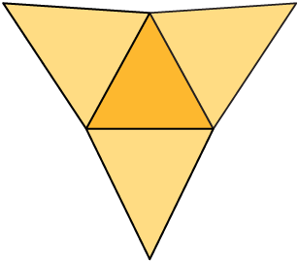
COLLABORATE · TALK IT THROUGH • AGREE ON A MODEL
Collaborate and Connect
Let’s make a net to represent the pyramid. The three faces have the same dimensions.
What will be the dimensions of the triangles that form the net? Explain how you know.
ADD ON · Add on: “I agree because ______.” or “I see it differently because ______.”
Reveal:
Because the three faces have the same dimensions, the base must be an equilateral triangle, and each face has a height of 125 centimeters.
38 / 50
Notes:
TEACH IN PRACTICE | Embedded facilitation | Lesson 5.8, slide 35 | COLLABORATE
Focus on the existing task: Let’s make a net to represent the pyramid. The three faces have the same dimensions. What will be the dimensions of the triangles that form the net?
LAUNCH (T2/3/5): Use the displayed question. Give private thinking time; then A explains while B asks for evidence. Switch roles. Each student records their own reasoning.
LOOK FOR (T4): Where this task addresses it, students can include the base and each triangular face. Ask which feature of their work supports the claim.
RESPOND: If this task shows the lesson misconception—using vertical pyramid height in place of a triangular face height—mark the perpendicular height within each triangle on the existing net. Have the student revise and explain the change. Use this support only where the concept occurs in the current task; otherwise respond to the displayed question.
RECHECK: If a gap is shared, revisit the existing representation together. If it is limited, give targeted support while others compare valid methods on the same task. Check the revision before moving on.
PARTICIPATION (T5/6/7): Think time before volunteers; accept a written, drawn or rehearsed entry. Students ask for evidence respectfully. Recognize a specific contribution or revision and check that both partners participate.
Source: BCPS Updated Instructional Framework Rubric (June 2020), TEACH 1–7. Earlier notes and answer keys are retained below.
EARLIER NOTES / EXISTING ANSWER KEY
Routine: COLLABORATE · TALK IT THROUGH • AGREE ON A MODEL

Slide 39
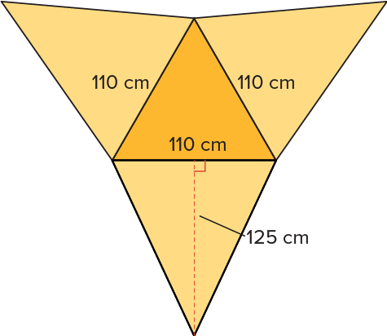
Maria’s Unique Artwork​
The base is an equilateral triangle, and each face has a height of 125 centimeters.
Maria will cover each of the faces, but not the base, of the frame with canvas.
Which triangles in the net will be covered with canvas?
SELF-CHECK · Mark it: ✓ got it · ~ almost · ? stuck. Then fix one thing before we move on.
Reveal:
She will only cover the 3 congruent triangles, not the triangle in the middle.
39 / 50
Notes:
TEACH IN PRACTICE | Embedded facilitation | Lesson 5.8, slide 36 | REVEAL
Focus on the existing task: Reveal: She will only cover the 3 congruent triangles, not the triangle in the middle. The base is an equilateral triangle, and each…
LAUNCH (T2/3/5): If an existing answer cover is present, gather an attempt before revealing. If the explanation is already visible, ask students to reconstruct and justify it. Compare reasoning and explain a revision; preserve the reveal sequence.
LOOK FOR (T4): Where this task addresses it, students can include the base and each triangular face. Ask which feature of their work supports the claim.
RESPOND: If this task shows the lesson misconception—using vertical pyramid height in place of a triangular face height—mark the perpendicular height within each triangle on the existing net. Have the student revise and explain the change. Use this support only where the concept occurs in the current task; otherwise respond to the displayed question.
RECHECK: If a gap is shared, revisit the existing representation together. If it is limited, give targeted support while others compare valid methods on the same task. Check the revision before moving on.
PARTICIPATION (T5/6/7): Think time before volunteers; accept a written, drawn or rehearsed entry. Students ask for evidence respectfully. Recognize a specific contribution or revision and check that both partners participate.
Source: BCPS Updated Instructional Framework Rubric (June 2020), TEACH 1–7. Earlier notes and answer keys are retained below.
EARLIER NOTES / EXISTING ANSWER KEY
Do not click yet: collect 2–3 student answers with reasons first.
Then click to remove the cover and have students compare their thinking to the reveal — “Is this what we said? Where is it different?”
Behind the cover: She will only cover the 3 congruent triangles, not the triangle in the middle.
UIFR: TEACH 3 · TEACH 4.

Slide 40
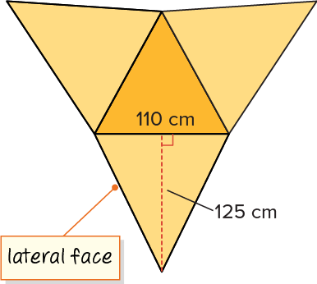
Maria’s Unique Artwork​
Maria will only cover the 3 congruent triangles that represent the lateral faces of the pyramid. The lateral faces are the faces that are not the base.
Try first. Point to a base and its matching
height. Explain how your method uses them.
Think About It:
In general, how many lateral faces does a pyramid have?
40 / 50
Notes:
TEACH IN PRACTICE | Embedded facilitation | Lesson 5.8, slide 37 | TASK
Focus on the existing task: Maria will only cover the 3 congruent triangles that represent the lateral faces of the pyramid. The lateral faces are the faces that are…
LAUNCH (T2/3/5): Use the displayed question. Give private thinking time; then A explains while B asks for evidence. Switch roles. Each student records their own reasoning.
LOOK FOR (T4): Where this task addresses it, students can include the base and each triangular face. Ask which feature of their work supports the claim.
RESPOND: If this task shows the lesson misconception—using vertical pyramid height in place of a triangular face height—mark the perpendicular height within each triangle on the existing net. Have the student revise and explain the change. Use this support only where the concept occurs in the current task; otherwise respond to the displayed question.
RECHECK: If a gap is shared, revisit the existing representation together. If it is limited, give targeted support while others compare valid methods on the same task. Check the revision before moving on.
PARTICIPATION (T5/6/7): Think time before volunteers; accept a written, drawn or rehearsed entry. Students ask for evidence respectfully. Recognize a specific contribution or revision and check that both partners participate.
Source: BCPS Updated Instructional Framework Rubric (June 2020), TEACH 1–7. Earlier notes and answer keys are retained below.
EARLIER NOTES / EXISTING ANSWER KEY
Ask the question, then hold the silence — students think or jot before anyone answers.
Take two or three responses and press with “Why?” or “How do you know?” before moving on.
UIFR: TEACH 3.

Slide 41
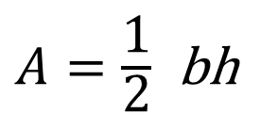
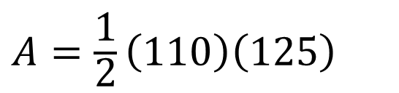

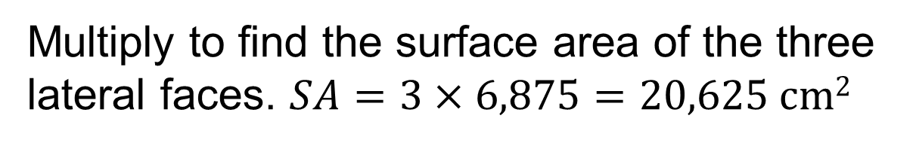
Maria’s Unique Artwork​
Let’s find the area of the lateral faces that will be covered with canvas.
41 / 50
Notes:
TEACH IN PRACTICE | Embedded facilitation | Lesson 5.8, slide 38 | WORKED
Focus on the existing task: Let’s find the area of the lateral faces that will be covered with canvas. Maria’s Unique Artwork
LAUNCH (T2/3/5): Ask students to explain the displayed idea or example and point to evidence. When a calculation step is shown, ask why it is valid. Have a partner restate the explanation; copying is not the check.
LOOK FOR (T4): Where this task addresses it, students can include the base and each triangular face. Ask which feature of their work supports the claim.
RESPOND: If this task shows the lesson misconception—using vertical pyramid height in place of a triangular face height—mark the perpendicular height within each triangle on the existing net. Have the student revise and explain the change. Use this support only where the concept occurs in the current task; otherwise respond to the displayed question.
RECHECK: If a gap is shared, revisit the existing representation together. If it is limited, give targeted support while others compare valid methods on the same task. Check the revision before moving on.
PARTICIPATION (T5/6/7): Think time before volunteers; accept a written, drawn or rehearsed entry. Students ask for evidence respectfully. Recognize a specific contribution or revision and check that both partners participate.
Source: BCPS Updated Instructional Framework Rubric (June 2020), TEACH 1–7. Earlier notes and answer keys are retained below.
EARLIER NOTES / EXISTING ANSWER KEY
Model briefly, then hand the thinking back: ask “Why does this step work?” before showing the next one.
Quick check before moving on — thumbs or whiteboards from everyone, not volunteers.
UIFR: TEACH 2 · TEACH 3 · TEACH 4.

Slide 42
STUDENT MOVES
Lesson 5-8
Your move
SPECIFIC FEEDBACK · Trade work. Give one specific comment: “This part is clear because ______.”
42 / 50

Slide 43
Maria’s Unique Artwork​
Maria will cover each of the faces, but not the base of the frame with canvas to create a three-dimensional painting. The three faces have the same dimensions.
How much canvas will Maria need?
Maria will need 20,625 square centimeters of canvas to cover the three faces.
Think and record first. Which part of your work supports your answer?
43 / 50
Notes:
TEACH IN PRACTICE | Embedded facilitation | Lesson 5.8, slide 39 | TASK
Focus on the existing task: Maria will cover each of the faces, but not the base of the frame with canvas to create a three-dimensional painting. The three faces have the same dimensions. How much canvas will Maria need?
LAUNCH (T2/3/5): Use the displayed question. Give private thinking time; then A explains while B asks for evidence. Switch roles. Each student records their own reasoning.
LOOK FOR (T4): Where this task addresses it, students can include the base and each triangular face. Ask which feature of their work supports the claim.
RESPOND: If this task shows the lesson misconception—using vertical pyramid height in place of a triangular face height—mark the perpendicular height within each triangle on the existing net. Have the student revise and explain the change. Use this support only where the concept occurs in the current task; otherwise respond to the displayed question.
RECHECK: If a gap is shared, revisit the existing representation together. If it is limited, give targeted support while others compare valid methods on the same task. Check the revision before moving on.
PARTICIPATION (T5/6/7): Think time before volunteers; accept a written, drawn or rehearsed entry. Students ask for evidence respectfully. Recognize a specific contribution or revision and check that both partners participate.
Source: BCPS Updated Instructional Framework Rubric (June 2020), TEACH 1–7. Earlier notes and answer keys are retained below.
EARLIER NOTES / EXISTING ANSWER KEY
Apply task — students try it independently first, then partners compare answers and reasoning.
Collect a quick pulse (thumbs or whiteboards) before the close; this tells you who needs a second look tomorrow.
UIFR: TEACH 2 · TEACH 4.

Slide 44
Let’s Explore More
If the base of a pyramid were a regular octagon, how many lateral faces would the pyramid have? Would they all be congruent? Explain.
Can you think of a different type of pyramid where the faces are not all congruent? Describe its characteristics.
Try it yourself. Compare your work with a partner; explain one choice and revise.
44 / 50
Notes:
TEACH IN PRACTICE | Embedded facilitation | Lesson 5.8, slide 40 | PRACTICE
Focus on the existing task: If the base of a pyramid were a regular octagon, how many lateral faces would the pyramid have?
LAUNCH (T2/3/5): Use the displayed question. Give private thinking time; then A explains while B asks for evidence. Switch roles. Each student records their own reasoning.
LOOK FOR (T4): Where this task addresses it, students can include the base and each triangular face. Ask which feature of their work supports the claim.
RESPOND: If this task shows the lesson misconception—using vertical pyramid height in place of a triangular face height—mark the perpendicular height within each triangle on the existing net. Have the student revise and explain the change. Use this support only where the concept occurs in the current task; otherwise respond to the displayed question.
RECHECK: If a gap is shared, revisit the existing representation together. If it is limited, give targeted support while others compare valid methods on the same task. Check the revision before moving on.
PARTICIPATION (T5/6/7): Think time before volunteers; accept a written, drawn or rehearsed entry. Students ask for evidence respectfully. Recognize a specific contribution or revision and check that both partners participate.
Source: BCPS Updated Instructional Framework Rubric (June 2020), TEACH 1–7. Earlier notes and answer keys are retained below.
EARLIER NOTES / EXISTING ANSWER KEY
Extension for partners or table groups — students choose their approach and use the workspace to show thinking.
Push with “Convince me,” and have two groups with different approaches share.
This is where students stretch past the worked example.
UIFR: TEACH 2 · TEACH 5.

Slide 45
LESSON 5.8 / CHECK YOUR WORK
Pause. Check. Improve.
CHECK
A mistake to watch for: using vertical pyramid height in place of a triangular face height.
TRY
Mark the perpendicular height within each triangle on the given net.
REVISE
Use that check on the task you just completed. Correct or strengthen one part, and explain why.
REVISE NOW · Change one answer and write why you changed it. A revision is evidence of learning.
Listen to understand. Ask for evidence. Make room for every voice.
Notes:
TEACH IN PRACTICE | Embedded facilitation | Lesson 5.8, slide 41 | PRIOR_INSERT
Focus on the existing task: LESSON 5.8 / CHECK YOUR WORK Pause. Check. Improve. Listen to understand. Ask for evidence. Make room for every voice. CHECK A mistake…
CONNECT (T1/4): Ask students to restate the displayed goal or key idea and connect it to earlier work. Relevant lesson evidence: include the base and each triangular face; use face height correctly; report square units. Use only the criterion that matches the current session.
SHOW PROGRESS: Students point to their own existing work, explain what improved after feedback, and name a next step. Pair confidence ratings with actual evidence.
PARTICIPATION (T5/6/7): Think time before volunteers; accept a written, drawn or rehearsed entry. Students ask for evidence respectfully. Recognize a specific contribution or revision and check that both partners participate.
Source: BCPS Updated Instructional Framework Rubric (June 2020), TEACH 1–7.

Slide 46
SUMMARIZE · SAY IT IN YOUR OWN WORDS
Summarize: Determine Surface Area of Pyramids
To determine the surface area of a pyramid, find the area of each face and add the areas. A net can help you visualize the faces.
46 / 50
Notes:
TEACH IN PRACTICE | Embedded facilitation | Lesson 5.8, slide 42 | SUMMARIZE
Focus on the existing task: To determine the surface area of a pyramid, find the area of each face and add the areas. A net can help you visualize the faces.…
CONNECT (T1/4): Ask students to restate the displayed goal or key idea and connect it to earlier work. Relevant lesson evidence: include the base and each triangular face; use face height correctly; report square units. Use only the criterion that matches the current session.
SHOW PROGRESS: Students point to their own existing work, explain what improved after feedback, and name a next step. Pair confidence ratings with actual evidence.
PARTICIPATION (T5/6/7): Think time before volunteers; accept a written, drawn or rehearsed entry. Students ask for evidence respectfully. Recognize a specific contribution or revision and check that both partners participate.
Source: BCPS Updated Instructional Framework Rubric (June 2020), TEACH 1–7. Earlier notes and answer keys are retained below.
EARLIER NOTES / EXISTING ANSWER KEY
Routine: SUMMARIZE · SAY IT IN YOUR OWN WORDS

Slide 47
STUDENT MOVES
Lesson 5-8
Your move
USE YOUR TOOLS · Reach for your notes, a model, or a manipulative before you reach for an answer.
47 / 50

Slide 48
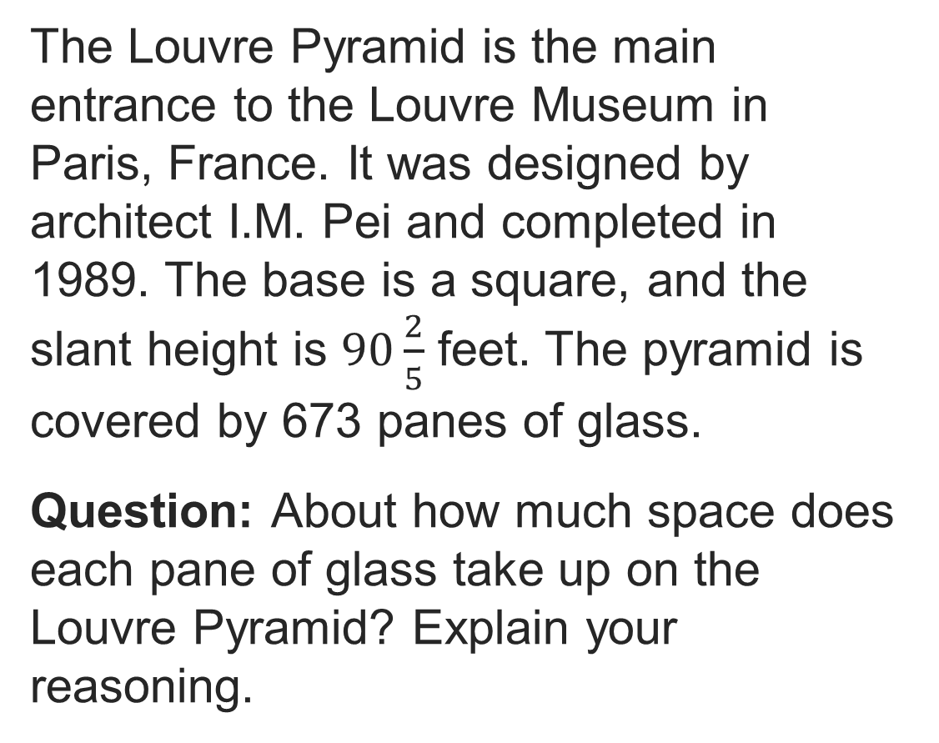
APPLY · PLAN IT • SOLVE IT • PROVE IT
Apply: The Louvre Pyramid
Choose a method. Solve
independently, justify your
answer, then check the goal.
48 / 50
Notes:
TEACH IN PRACTICE | Embedded facilitation | Lesson 5.8, slide 43 | APPLY
Focus on the existing task: Apply: The Louvre Pyramid APPLY · PLAN IT • SOLVE IT • PROVE IT
LAUNCH (T2/3/5): Use the exact application task independently first. Ask students to justify their choice of method. Collect evidence before a partner discussion or correction.
LOOK FOR (T4): Where this task addresses it, students can include the base and each triangular face. Ask which feature of their work supports the claim.
RESPOND: If this task shows the lesson misconception—using vertical pyramid height in place of a triangular face height—mark the perpendicular height within each triangle on the existing net. Have the student revise and explain the change. Use this support only where the concept occurs in the current task; otherwise respond to the displayed question.
RECHECK: If a gap is shared, revisit the existing representation together. If it is limited, give targeted support while others compare valid methods on the same task. Check the revision before moving on.
PARTICIPATION (T5/6/7): Think time before volunteers; accept a written, drawn or rehearsed entry. Students ask for evidence respectfully. Recognize a specific contribution or revision and check that both partners participate.
Source: BCPS Updated Instructional Framework Rubric (June 2020), TEACH 1–7. Earlier notes and answer keys are retained below.
EARLIER NOTES / EXISTING ANSWER KEY
Routine: APPLY · PLAN IT • SOLVE IT • PROVE IT
UIFR FULL | Lesson-specific facilitation
TEACH 4 | Independent evidence and revision (UIFR PDF p. 11).
Use the existing application/exit problem as the independent check. If this is a learning-target slide, have students point to and explain their work on the preceding task. Separate initial independent evidence from the revision after feedback.
Check the relevant criteria: include the base and each triangular face; use face height correctly; report square units. Respond with one specific next step tied to the work. Students revise and annotate what changed, then identify a criterion they can now demonstrate and one they still need to practice.

Slide 49
Learning Targets
I can use nets and formulas to find the surface area of square pyramids.
I can use nets and formulas to find the surface area of triangular pyramids.
I can look for and make use of structure to find the surface area of pyramids.
NAME THE MATH · Point to the part of this that is new today, and say what it changes.
49 / 50
Notes:
TEACH IN PRACTICE | Embedded facilitation | Lesson 5.8, slide 44 | REFLECTION
Focus on the existing task: Learning Targets I can use nets and formulas to find the surface area of square pyramids. I can use nets and formulas to find the surface…
CONNECT (T1/4): Ask students to restate the displayed goal or key idea and connect it to earlier work. Relevant lesson evidence: include the base and each triangular face; use face height correctly; report square units. Use only the criterion that matches the current session.
SHOW PROGRESS: Students point to their own existing work, explain what improved after feedback, and name a next step. Pair confidence ratings with actual evidence.
PARTICIPATION (T5/6/7): Think time before volunteers; accept a written, drawn or rehearsed entry. Students ask for evidence respectfully. Recognize a specific contribution or revision and check that both partners participate.
Source: BCPS Updated Instructional Framework Rubric (June 2020), TEACH 1–7. Earlier notes and answer keys are retained below.
EARLIER NOTES / EXISTING ANSWER KEY
UIFR FULL | Lesson-specific facilitation
REFLECT & ADJUST 1-2 | After the lesson (UIFR PDF pp. 15-16).
Sort the existing work by demonstrated reasoning, partial understanding, and the specific misconception: using vertical pyramid height in place of a triangular face height. Compare the initial response with the revision. Record which teaching move plausibly helped, which did not, and whose participation or access needs a different approach; do not record sensitive student details in this shared deck.
Plan the next lesson from that evidence: if the misconception persists, mark the perpendicular height within each triangle on the existing net using the current example before returning to the next grade-level task; if understanding is secure, use an existing extension or ask for a general explanation. Check the targeted idea again at the next warm-up.
Ask students what supported their thinking and what would help next time. Identify one change to try and one successful practice to retain. Seek colleague feedback on anonymized work when useful; these prompts support reflection and do not establish an evaluation rating. Source: Baltimore City Public Schools, Updated Instructional Framework Rubric, June 2020 (UIFR_Full.pdf).

Slide 50
LESSON 5.8 / REFLECT ON YOUR LEARNING
Show your progress
1 SHOW EVIDENCE
2 CHOOSE A NEXT STEP
Choose one response. Point to the part that shows your reasoning.
Name a change you made after feedback—or a question you still have.
“My work shows ___ because ___.”
“Next time, I will ___ to help me ___.”
Today’s focus: Include the base and each triangular face.
CREDIT A CLASSMATE · Name one classmate whose idea helped you today, and say what they said.
Listen to understand. Ask for evidence. Make room for every voice.
Notes:
TEACH IN PRACTICE | Embedded facilitation | Lesson 5.8, slide 45 | PRIOR_INSERT
Focus on the existing task: LESSON 5.8 / REFLECT ON YOUR LEARNING Show your progress Listen to understand. Ask for evidence. Make room for every voice. 1 SHOW…
CONNECT (T1/4): Ask students to restate the displayed goal or key idea and connect it to earlier work. Relevant lesson evidence: include the base and each triangular face; use face height correctly; report square units. Use only the criterion that matches the current session.
SHOW PROGRESS: Students point to their own existing work, explain what improved after feedback, and name a next step. Pair confidence ratings with actual evidence.
PARTICIPATION (T5/6/7): Think time before volunteers; accept a written, drawn or rehearsed entry. Students ask for evidence respectfully. Recognize a specific contribution or revision and check that both partners participate.
Source: BCPS Updated Instructional Framework Rubric (June 2020), TEACH 1–7.

