Slide 1
WARM-UP · THINK • TRY • CHECK
Turn and talk: compare strategies, then defend one.
Warm-Up
Lesson 6-1 · Division Expressions with Fractions and Whole Numbers | Warm-Up · about 4 minutes
Try each on your own. Mark an unsure answer; explain and revise when we check.
QUESTION 1
QUESTION 2
4.8 ÷ 2 = ______
The reciprocal of 5 is ______
QUESTION 3
QUESTION 4
6 × 1/3 = ______
12/3 means 12 ÷ 3, so 12/3 = ______
TALK IT OVER: “I got ______ because ______.” • Compare with a partner before we check as a class.
1 / 46
Notes:
TEACH IN PRACTICE | Embedded facilitation | Lesson 6.1, slide 1 | WARMUP
Focus on the existing task: Warm-Up WARM-UP · THINK • TRY •…
GATHER EVIDENCE (T4/6): Keep the original items. Students try independently, mark an uncertain item, and explain one method before checking. Use the existing key when present.
RESPOND: Distinguish a calculation slip from a reasoning gap. Give one next step on the same item; have students revise in a second color. Use the responses to choose flexible support for today’s lesson.
PARTICIPATION (T5/6/7): Think time before volunteers; accept a written, drawn or rehearsed entry. Students ask for evidence respectfully. Recognize a specific contribution or revision and check that both partners participate.
Source: BCPS Updated Instructional Framework Rubric (June 2020), TEACH 1–7. Earlier notes and answer keys are retained below.
EARLIER NOTES / EXISTING ANSWER KEY
Warm-Up answers (teacher only): 1) 2.4 2) 1/5 3) 2 4) 4
UIFR FULL | Lesson-specific facilitation
PREPARE 1-2 | Before teaching (UIFR PDF pp. 6-7).
Plan to gather evidence that students can interpret division as groups or sharing; connect the model to the equation; check by multiplication. Review recent work and today’s warm-up to choose flexible groups and access supports; do not infer needs from identity or perceived ability. Use the existing lesson tasks and stated standards.
Anticipate: assuming division always makes a quantity smaller. If observed, label the whole, group size and number of groups on the original fraction model. Offer oral rehearsal, drawing, pointing, or home-language processing as needed; retain the original mathematical demand. Ask students which support helps and fade it as evidence improves.
TEACH 6-7 | Before the first transition, agree on materials, partner roles, and how to request help. Invite students to restate the routine. Normalize revising an idea, recognize a specific contribution, and check privately when frustration blocks participation. Source: UIFR PDF pp. 13-14.

Slide 2
Today’s Math Notes
Lesson 6-1 · Division Expressions with Fractions and Whole Numbers
Section 1: Math Words
Copy. Explain. Check.
SAY THE GOAL · Say today’s goal in your own words, then name one place this shows up outside math class.
Division of Fractions
1
Finding how many groups of one fraction fit inside another amount
Reciprocal
2
A fraction turned upside down
Quotient
3
The answer when you divide
eduwonderlab.com · Neft Teacher
2 / 46
Notes:
TEACH IN PRACTICE | Embedded facilitation | Lesson 6.1, slide 2 | NOTES
Focus on the existing task: Today’s Math Notes Section 1: Math…
ROUTINE (T1/2/4): Read or copy the original notes, cover one line, and explain it using the displayed example. Reopen and correct. Copying alone is not evidence of understanding.
LOOK FOR: A link between a symbol, quantity or feature and the explanation. If missing, point back to that feature and have the student try again; fade the prompt once they can explain.
PARTICIPATION (T5/6/7): Think time before volunteers; accept a written, drawn or rehearsed entry. Students ask for evidence respectfully. Recognize a specific contribution or revision and check that both partners participate.
Source: BCPS Updated Instructional Framework Rubric (June 2020), TEACH 1–7. Earlier notes and answer keys are retained below.
EARLIER NOTES / EXISTING ANSWER KEY
Copy routine: read one line at a time; students copy, then explain that line to a partner.
Keep it brisk — the understanding work happens in the examples, not the copying.
UIFR: TEACH 1 · TEACH 6.

Slide 3
Today’s Math Notes
Lesson 6-1 · Division Expressions with Fractions and Whole Numbers
Section 2: Today’s Math
Copy. Explain. Check.
CONNECT IT · What earlier lesson does this build on? Tell a partner in one sentence.
Dividing Whole Numbers & Fractions
1
Put a 1 under the whole number: 3 ÷ 1/4 = 3/1 ÷ 1/4
2
Keep, Change, Flip: 3/1 ÷ 1/4 = 3/1 × 4/1
3
Multiply across: 3/1 × 4/1 = 12/1 = 12
Example:
mixed number → improper fraction: multiply the bottom by the whole number, add the top, keep the same bottom. 3 1/2 → (2 × 3) + 1 = 7 → 7/2
eduwonderlab.com · Neft Teacher
3 / 46
Notes:
TEACH IN PRACTICE | Embedded facilitation | Lesson 6.1, slide 3 | NOTES
Focus on the existing task: Today’s Math Notes Section 2: Today’s…
ROUTINE (T1/2/4): Read or copy the original notes, cover one line, and explain it using the displayed example. Reopen and correct. Copying alone is not evidence of understanding.
LOOK FOR: A link between a symbol, quantity or feature and the explanation. If missing, point back to that feature and have the student try again; fade the prompt once they can explain.
PARTICIPATION (T5/6/7): Think time before volunteers; accept a written, drawn or rehearsed entry. Students ask for evidence respectfully. Recognize a specific contribution or revision and check that both partners participate.
Source: BCPS Updated Instructional Framework Rubric (June 2020), TEACH 1–7. Earlier notes and answer keys are retained below.
EARLIER NOTES / EXISTING ANSWER KEY
Copy routine: read one line at a time; students copy, then explain that line to a partner.
Keep it brisk — the understanding work happens in the examples, not the copying.
UIFR: TEACH 1 · TEACH 6.

Slide 4
Session 1
Division Expressions with Fractions and Whole Numbers
TRY IT BEFORE YOU’RE SURE · Start even if you are not sure. A revised answer counts as much as a first-try answer.
4 / 46
Notes:
TEACH IN PRACTICE | Embedded facilitation | Lesson 6.1, slide 4 | DIVIDER
Focus on the existing task: Division Expressions with Fractions and Whole Numbers Session 1
TRANSITION (T6/7): Students confirm materials, roles, how to request help, and the next response routine. Ask a student to restate it. Keep teacher-only slides hidden.
PARTICIPATION (T5/6/7): Think time before volunteers; accept a written, drawn or rehearsed entry. Students ask for evidence respectfully. Recognize a specific contribution or revision and check that both partners participate.
Source: BCPS Updated Instructional Framework Rubric (June 2020), TEACH 1–7. Earlier notes and answer keys are retained below.
EARLIER NOTES / EXISTING ANSWER KEY
Transition cue: state what materials are out and what success looks like this session.
Keep the changeover under a minute.
UIFR: TEACH 6.

Slide 5
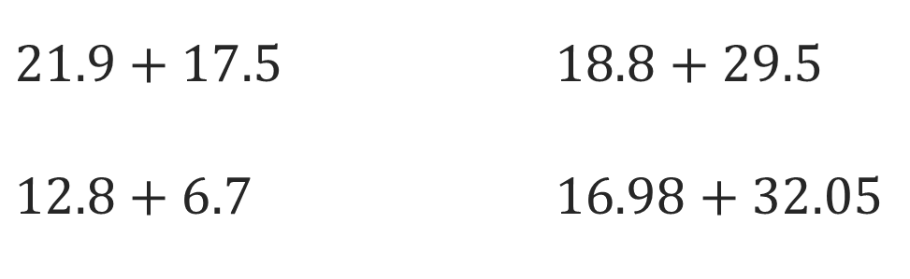
Or You Could
Explain how the information shown supports your reasoning.
5 / 46
Notes:
TEACH IN PRACTICE | Embedded facilitation | Lesson 6.1, slide 5 | WORKED
Focus on the existing task: Or You Could
LAUNCH (T2/3/5): Ask students to explain the displayed idea or example and point to evidence. When a calculation step is shown, ask why it is valid. Have a partner restate the explanation; copying is not the check.
LOOK FOR (T4): Where this task addresses it, students can interpret division as groups or sharing. Ask which feature of their work supports the claim.
RESPOND: If this task shows the lesson misconception—assuming division always makes a quantity smaller—label the whole, group size and number of groups on the original fraction model. Have the student revise and explain the change. Use this support only where the concept occurs in the current task; otherwise respond to the displayed question.
RECHECK: If a gap is shared, revisit the existing representation together. If it is limited, give targeted support while others compare valid methods on the same task. Check the revision before moving on.
PARTICIPATION (T5/6/7): Think time before volunteers; accept a written, drawn or rehearsed entry. Students ask for evidence respectfully. Recognize a specific contribution or revision and check that both partners participate.
Source: BCPS Updated Instructional Framework Rubric (June 2020), TEACH 1–7. Earlier notes and answer keys are retained below.
EARLIER NOTES / EXISTING ANSWER KEY
Model briefly, then hand the thinking back: ask “Why does this step work?” before showing the next one.
Quick check before moving on — thumbs or whiteboards from everyone, not volunteers.
UIFR: TEACH 2 · TEACH 3 · TEACH 4.

Slide 6
Today’s Objectives
Lesson 6-1 · Division Expressions with Fractions and Whole Numbers
Division Expressions with Fractions and Whole Numbers
Maryland Standard 6.NOS.1
CONTENT OBJECTIVE
LANGUAGE OBJECTIVE
Restate the goal in your words
Use these words to explain why
I can divide a whole number by a unit fraction and divide a fraction by a whole number by writing the whole number over 1 and using Keep, Change, Flip.
I can explain each step of Keep, Change, Flip using the words reciprocal, divisor, and quotient.
eduwonderlab.com · Neft Teacher
6 / 46
Notes:
TEACH IN PRACTICE | Embedded facilitation | Lesson 6.1, slide 6 | GOAL
Focus on the existing task: Today’s Objectives Division…
CONNECT (T1/4): Ask students to restate the displayed goal or key idea and connect it to earlier work. Relevant lesson evidence: interpret division as groups or sharing; connect the model to the equation; check by multiplication. Use only the criterion that matches the current session.
SHOW PROGRESS: Students point to their own existing work, explain what improved after feedback, and name a next step. Pair confidence ratings with actual evidence.
PARTICIPATION (T5/6/7): Think time before volunteers; accept a written, drawn or rehearsed entry. Students ask for evidence respectfully. Recognize a specific contribution or revision and check that both partners participate.
Source: BCPS Updated Instructional Framework Rubric (June 2020), TEACH 1–7. Earlier notes and answer keys are retained below.
EARLIER NOTES / EXISTING ANSWER KEY
Read the objective together, then have one or two students restate today’s goal in their own words.
Connect it to what the class learned last lesson.
Return to this goal at the end of class to check it was met.
UIFR: TEACH 1.
UIFR FULL | Lesson-specific facilitation
TEACH 1 | Session 1 purpose and evidence (UIFR PDF p. 8).
Have students restate the displayed session goal in their own words and connect it to the existing context or a familiar experience they choose to share. Use the current session goal to select from these lesson-wide evidence criteria; do not frontload a later-session procedure.
Look for: interpret division as groups or sharing; connect the model to the equation; check by multiplication. Ask: “Which part of your work would show this?” Revisit that evidence after the task; a confidence rating alone is not evidence of understanding.

Slide 7
STUDENT MOVES
Lesson 6-1
Your move
SAY THE GOAL · Say today’s goal in your own words, then name one place this shows up outside math class.
7 / 46

Slide 8
LESSON 6.1 / OUR LEARNING
What will show your learning?
1
Interpret division as groups or sharing.
2
Connect the model to the equation.
3
Check by multiplication.
Tell a partner: Which skill connects to something you already know?
SHOW YOUR THINKING · Show what you know — write it, draw it, or build it. A picture counts as an explanation.
Listen to understand. Ask for evidence. Make room for every voice.
Notes:
TEACH IN PRACTICE | Embedded facilitation | Lesson 6.1, slide 7 | PRIOR_INSERT
Focus on the existing task: LESSON 6.1 / OUR LEARNING What will show your learning?
CONNECT (T1/4): Ask students to restate the displayed goal or key idea and connect it to earlier work. Relevant lesson evidence: interpret division as groups or sharing; connect the model to the equation; check by multiplication. Use only the criterion that matches the current session.
SHOW PROGRESS: Students point to their own existing work, explain what improved after feedback, and name a next step. Pair confidence ratings with actual evidence.
PARTICIPATION (T5/6/7): Think time before volunteers; accept a written, drawn or rehearsed entry. Students ask for evidence respectfully. Recognize a specific contribution or revision and check that both partners participate.
Source: BCPS Updated Instructional Framework Rubric (June 2020), TEACH 1–7.

Slide 9
Vocabulary 1 of 6
Lesson 6-1 · Division Expressions with Fractions and Whole Numbers
Division of Fractions
Finding how many groups of one fraction fit inside another amount.
EXAMPLE · EXPLAIN WHY IT FITS
3 ÷ 1/2 asks how many halves fit in 3; the answer is 6.
Use “Division of Fractions” to explain the example. Point to
evidence.
eduwonderlab.com · Neft Teacher
9 / 46
Notes:
TEACH IN PRACTICE | Embedded facilitation | Lesson 6.1, slide 8 | VOCAB
Focus on the existing task: Vocabulary 1 of 6 Division of…
ASK (T1/3/5): Where does “Division of Fractions” appear in the example? Explain the meaning without reading the definition. Partner: restate the idea and ask a clarifying question.
LOOK FOR: A correct connection between the word and a feature of the example. If the student only repeats the definition, invite pointing, sketching or oral rehearsal, then ask for another explanation of this same example.
PARTICIPATION (T5/6/7): Think time before volunteers; accept a written, drawn or rehearsed entry. Students ask for evidence respectfully. Recognize a specific contribution or revision and check that both partners participate.
Source: BCPS Updated Instructional Framework Rubric (June 2020), TEACH 1–7.

Slide 10
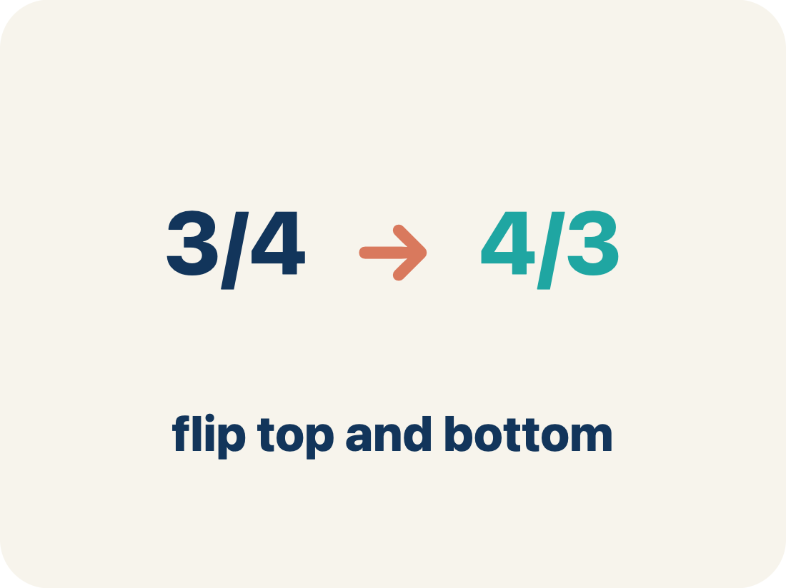
Vocabulary 2 of 6
Lesson 6-1 · Division Expressions with Fractions and Whole Numbers
Reciprocal
A fraction turned upside down.
EXAMPLE · EXPLAIN WHY IT FITS
The reciprocal of 1/4 is 4/1 = 4. A whole number like 3 is 3/1, so its reciprocal is 1/3.
Use “Reciprocal” to explain the example. Point to evidence.
eduwonderlab.com · Neft Teacher
10 / 46
Notes:
TEACH IN PRACTICE | Embedded facilitation | Lesson 6.1, slide 9 | VOCAB
Focus on the existing task: Vocabulary 2 of 6 Reciprocal A…
ASK (T1/3/5): Where does “Reciprocal” appear in the example? Explain the meaning without reading the definition. Partner: restate the idea and ask a clarifying question.
LOOK FOR: A correct connection between the word and a feature of the example. If the student only repeats the definition, invite pointing, sketching or oral rehearsal, then ask for another explanation of this same example.
PARTICIPATION (T5/6/7): Think time before volunteers; accept a written, drawn or rehearsed entry. Students ask for evidence respectfully. Recognize a specific contribution or revision and check that both partners participate.
Source: BCPS Updated Instructional Framework Rubric (June 2020), TEACH 1–7.

Slide 11
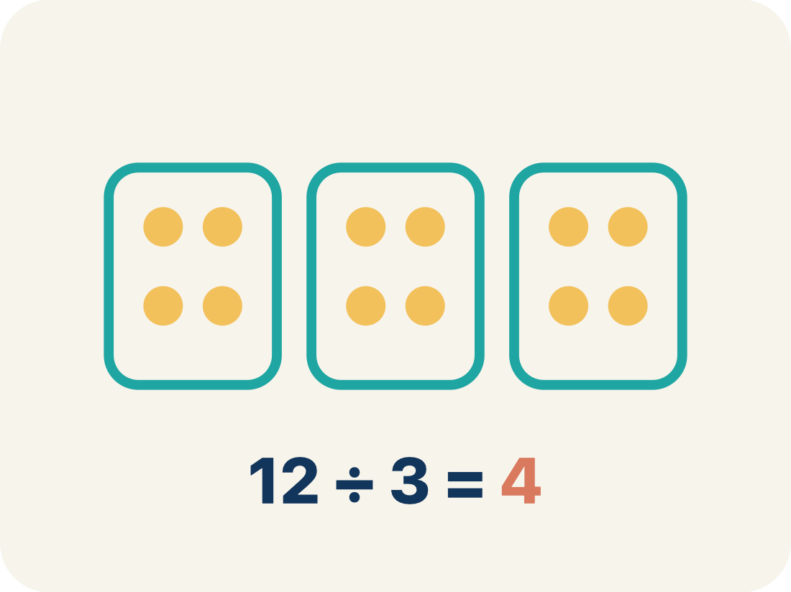
Vocabulary 3 of 6
Lesson 6-1 · Division Expressions with Fractions and Whole Numbers
Quotient
The answer when you divide.
EXAMPLE · EXPLAIN WHY IT FITS
In 3 ÷ 1/4 = 12, the quotient is 12 — there are 12 quarter-size pieces in 3
Use “Quotient” to explain the example. Point to evidence.
eduwonderlab.com · Neft Teacher
11 / 46
Notes:
TEACH IN PRACTICE | Embedded facilitation | Lesson 6.1, slide 10 | VOCAB
Focus on the existing task: Vocabulary 3 of 6 Quotient The…
ASK (T1/3/5): Where does “Quotient” appear in the example? Explain the meaning without reading the definition. Partner: restate the idea and ask a clarifying question.
LOOK FOR: A correct connection between the word and a feature of the example. If the student only repeats the definition, invite pointing, sketching or oral rehearsal, then ask for another explanation of this same example.
PARTICIPATION (T5/6/7): Think time before volunteers; accept a written, drawn or rehearsed entry. Students ask for evidence respectfully. Recognize a specific contribution or revision and check that both partners participate.
Source: BCPS Updated Instructional Framework Rubric (June 2020), TEACH 1–7.

Slide 12
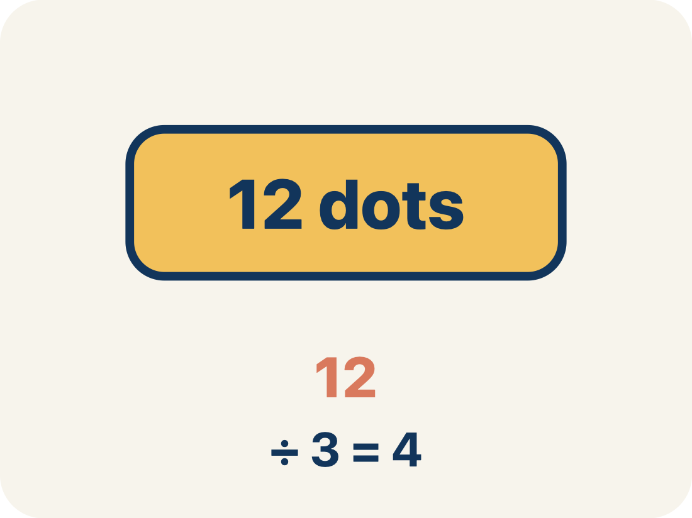
Vocabulary 4 of 6
Lesson 6-1 · Division Expressions with Fractions and Whole Numbers
Dividend
The total number being divided into equal groups (the number inside the division bracket).
EXAMPLE · EXPLAIN WHY IT FITS
In 3 ÷ 1/4 = 12, the dividend is 3 — it is the total being split
Use “Dividend” to explain the example. Point to evidence.
eduwonderlab.com · Neft Teacher
12 / 46
Notes:
TEACH IN PRACTICE | Embedded facilitation | Lesson 6.1, slide 11 | VOCAB
Focus on the existing task: Vocabulary 4 of 6 Dividend The total…
ASK (T1/3/5): Where does “Dividend” appear in the example? Explain the meaning without reading the definition. Partner: restate the idea and ask a clarifying question.
LOOK FOR: A correct connection between the word and a feature of the example. If the student only repeats the definition, invite pointing, sketching or oral rehearsal, then ask for another explanation of this same example.
PARTICIPATION (T5/6/7): Think time before volunteers; accept a written, drawn or rehearsed entry. Students ask for evidence respectfully. Recognize a specific contribution or revision and check that both partners participate.
Source: BCPS Updated Instructional Framework Rubric (June 2020), TEACH 1–7.

Slide 13
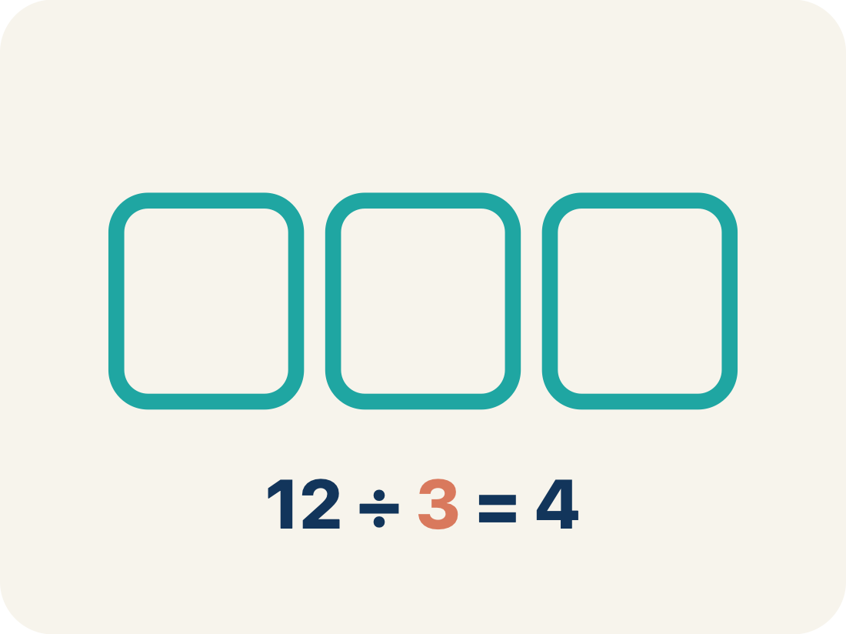
Vocabulary 5 of 6
Lesson 6-1 · Division Expressions with Fractions and Whole Numbers
Divisor
The number of equal groups you are dividing into (the number outside the division bracket).
EXAMPLE · EXPLAIN WHY IT FITS
In 3 ÷ 1/4 = 12, the divisor is 1/4 — it is the size of each piece
Use “Divisor” to explain the example. Point to evidence.
eduwonderlab.com · Neft Teacher
13 / 46
Notes:
TEACH IN PRACTICE | Embedded facilitation | Lesson 6.1, slide 12 | VOCAB
Focus on the existing task: Vocabulary 5 of 6 Divisor The number…
ASK (T1/3/5): Where does “Divisor” appear in the example? Explain the meaning without reading the definition. Partner: restate the idea and ask a clarifying question.
LOOK FOR: A correct connection between the word and a feature of the example. If the student only repeats the definition, invite pointing, sketching or oral rehearsal, then ask for another explanation of this same example.
PARTICIPATION (T5/6/7): Think time before volunteers; accept a written, drawn or rehearsed entry. Students ask for evidence respectfully. Recognize a specific contribution or revision and check that both partners participate.
Source: BCPS Updated Instructional Framework Rubric (June 2020), TEACH 1–7.

Slide 14
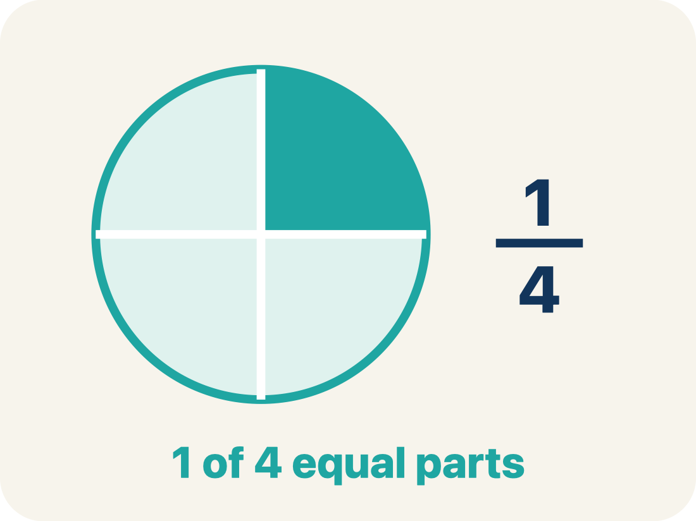
Vocabulary 6 of 6
Lesson 6-1 · Division Expressions with Fractions and Whole Numbers
Unit fraction
A fraction with 1 on top, like 1/4.
EXAMPLE · EXPLAIN WHY IT FITS
1/2, 1/3, 1/4, 1/5 — each represents one equal part of a whole
Use “Unit fraction” to explain the example. Point to evidence.
eduwonderlab.com · Neft Teacher
14 / 46
Notes:
TEACH IN PRACTICE | Embedded facilitation | Lesson 6.1, slide 13 | VOCAB
Focus on the existing task: Vocabulary 6 of 6 Unit fraction A…
ASK (T1/3/5): Where does “Unit fraction” appear in the example? Explain the meaning without reading the definition. Partner: restate the idea and ask a clarifying question.
LOOK FOR: A correct connection between the word and a feature of the example. If the student only repeats the definition, invite pointing, sketching or oral rehearsal, then ask for another explanation of this same example.
PARTICIPATION (T5/6/7): Think time before volunteers; accept a written, drawn or rehearsed entry. Students ask for evidence respectfully. Recognize a specific contribution or revision and check that both partners participate.
Source: BCPS Updated Instructional Framework Rubric (June 2020), TEACH 1–7.

Slide 15
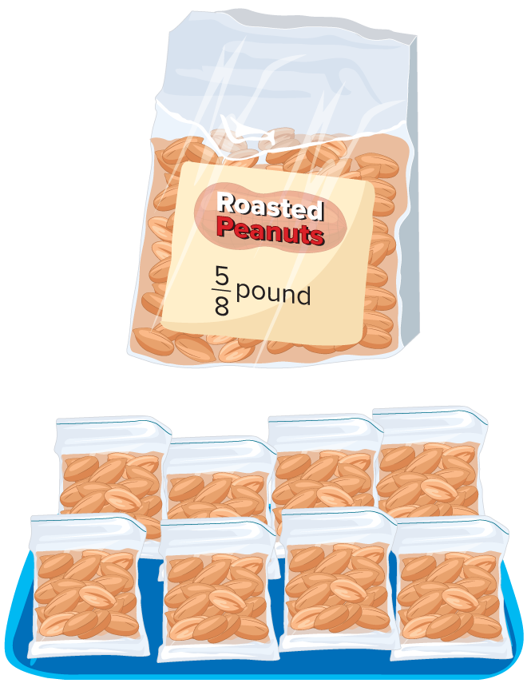

Be Curious
What do you notice?
What do you wonder?
Think first. Share a notice and a question;
build on a classmate’s idea.
Mindset
How can you build your confidence when engaging with math?
15 / 46
Notes:
TEACH IN PRACTICE | Embedded facilitation | Lesson 6.1, slide 14 | CURIOUS
Focus on the existing task: What do you notice?
LAUNCH (T2/3/5): Allow quiet observation first. Separate a notice from an inference, invite students’ own questions, and follow the existing launch before teaching a procedure.
LOOK FOR (T4): Where this task addresses it, students can interpret division as groups or sharing. Ask which feature of their work supports the claim.
RESPOND: If this task shows the lesson misconception—assuming division always makes a quantity smaller—label the whole, group size and number of groups on the original fraction model. Have the student revise and explain the change. Use this support only where the concept occurs in the current task; otherwise respond to the displayed question.
RECHECK: If a gap is shared, revisit the existing representation together. If it is limited, give targeted support while others compare valid methods on the same task. Check the revision before moving on.
PARTICIPATION (T5/6/7): Think time before volunteers; accept a written, drawn or rehearsed entry. Students ask for evidence respectfully. Recognize a specific contribution or revision and check that both partners participate.
Source: BCPS Updated Instructional Framework Rubric (June 2020), TEACH 1–7.

Slide 16
Vocabulary
Lesson 6-1 · Division Expressions with Fractions and Whole Numbers
Today’s Math Words
We learn every word — what it means and what it looks like — before we use it.
Division of Fractions
Reciprocal
Finding how many groups of one fraction fit inside another amount
A fraction turned upside down
Quotient
Dividend
The answer when you divide
The total number being divided into equal groups (the number inside the division bracket)
Divisor
Unit fraction
The number of equal groups you are dividing into (the number outside the division bracket)
A fraction with 1 on top, like 1/4
USE THE MATH WORDS · Use today’s math words in your explanation — not “it” and “that thing.”
eduwonderlab.com · Neft Teacher
16 / 46
Notes:
TEACH IN PRACTICE | Embedded facilitation | Lesson 6.1, slide 15 | VOCAB
Focus on the existing task: Vocabulary Today’s Math Words We…
ASK (T1/3/5): Where does “the displayed term” appear in the example? Explain the meaning without reading the definition. Partner: restate the idea and ask a clarifying question.
LOOK FOR: A correct connection between the word and a feature of the example. If the student only repeats the definition, invite pointing, sketching or oral rehearsal, then ask for another explanation of this same example.
PARTICIPATION (T5/6/7): Think time before volunteers; accept a written, drawn or rehearsed entry. Students ask for evidence respectfully. Recognize a specific contribution or revision and check that both partners participate.
Source: BCPS Updated Instructional Framework Rubric (June 2020), TEACH 1–7. Earlier notes and answer keys are retained below.
EARLIER NOTES / EXISTING ANSWER KEY
Choral-read each word, its meaning, and what it looks like.
Students should use these words out loud today — listen for them in partner talk and revoice student ideas with the academic term.
UIFR: TEACH 1 · TEACH 5.

Slide 17

STEM Camp
A summer science, technology, engineering, and math (STEM) summer camp has a 3-hour-long afternoon session. The campers choose from different afternoon activities that are each 45 minutes long. How many 45-minute activities can the campers complete in the 3-hour afternoon session?
What do you notice about the units of time used for the session and the activities?
Reveal:
HOW DO YOU KNOW? · Ask your partner “How do you know?” Answer by pointing to your own work.
17 / 46
Notes:
TEACH IN PRACTICE | Embedded facilitation | Lesson 6.1, slide 16 | REVEAL
Focus on the existing task: What do you notice about the units of time used for the session and the activities?
LAUNCH (T2/3/5): If an existing answer cover is present, gather an attempt before revealing. If the explanation is already visible, ask students to reconstruct and justify it. Compare reasoning and explain a revision; preserve the reveal sequence.
LOOK FOR (T4): Where this task addresses it, students can interpret division as groups or sharing. Ask which feature of their work supports the claim.
RESPOND: If this task shows the lesson misconception—assuming division always makes a quantity smaller—label the whole, group size and number of groups on the original fraction model. Have the student revise and explain the change. Use this support only where the concept occurs in the current task; otherwise respond to the displayed question.
RECHECK: If a gap is shared, revisit the existing representation together. If it is limited, give targeted support while others compare valid methods on the same task. Check the revision before moving on.
PARTICIPATION (T5/6/7): Think time before volunteers; accept a written, drawn or rehearsed entry. Students ask for evidence respectfully. Recognize a specific contribution or revision and check that both partners participate.
Source: BCPS Updated Instructional Framework Rubric (June 2020), TEACH 1–7. Earlier notes and answer keys are retained below.
EARLIER NOTES / EXISTING ANSWER KEY
Students should have shared predictions before this reveal.
Have them compare their thinking to what is shown: “Is this the same as what we said? Where is it different?”
Press one student to explain the reveal in their own words.
UIFR: TEACH 3 · TEACH 4.
UIFR FULL | Lesson-specific facilitation
TEACH 2-3 | Session 1 task launch (UIFR PDF pp. 9-10).
Use the problem exactly as displayed. Give individual thinking time before discussion or advancing to the explanation. If the answer is already visible, ask students to reconstruct and justify it. Invite a choice of suitable representations and have students explain why their choice helps.
At the point where this concept appears, ask: “What does the quotient count in this situation, and why is its size reasonable?” Wait for evidence, invite another pathway, and have a student ask a follow-up question. Do not replace students’ reasoning with a sequence of leading steps.

Slide 18
STEM Camp
The sessions are 3 hours long. Each activity is 45 minutes long.
The units of time are different. The session is measured in hours, and the activities are measured in minutes.
How can you determine the length of each activity in hours?
JUSTIFY IT · Say it like this: “I know ______ because ______.”
Reveal:
We can divide the length of each activity, in minutes, by the number of minutes in an hour.
18 / 46
Notes:
TEACH IN PRACTICE | Embedded facilitation | Lesson 6.1, slide 17 | REVEAL
Focus on the existing task: The sessions are 3 hours long. Each activity is 45 minutes long. The units of time are different. The session is measured in hours, and…
LAUNCH (T2/3/5): If an existing answer cover is present, gather an attempt before revealing. If the explanation is already visible, ask students to reconstruct and justify it. Compare reasoning and explain a revision; preserve the reveal sequence.
LOOK FOR (T4): Where this task addresses it, students can interpret division as groups or sharing. Ask which feature of their work supports the claim.
RESPOND: If this task shows the lesson misconception—assuming division always makes a quantity smaller—label the whole, group size and number of groups on the original fraction model. Have the student revise and explain the change. Use this support only where the concept occurs in the current task; otherwise respond to the displayed question.
RECHECK: If a gap is shared, revisit the existing representation together. If it is limited, give targeted support while others compare valid methods on the same task. Check the revision before moving on.
PARTICIPATION (T5/6/7): Think time before volunteers; accept a written, drawn or rehearsed entry. Students ask for evidence respectfully. Recognize a specific contribution or revision and check that both partners participate.
Source: BCPS Updated Instructional Framework Rubric (June 2020), TEACH 1–7. Earlier notes and answer keys are retained below.
EARLIER NOTES / EXISTING ANSWER KEY
Do not click yet: collect 2–3 student answers with reasons first.
Then click to remove the cover and have students compare their thinking to the reveal — “Is this what we said? Where is it different?”
Behind the cover: We can divide the length of each activity, in minutes, by the number of minutes in an hour.
UIFR: TEACH 3 · TEACH 4.

Slide 19
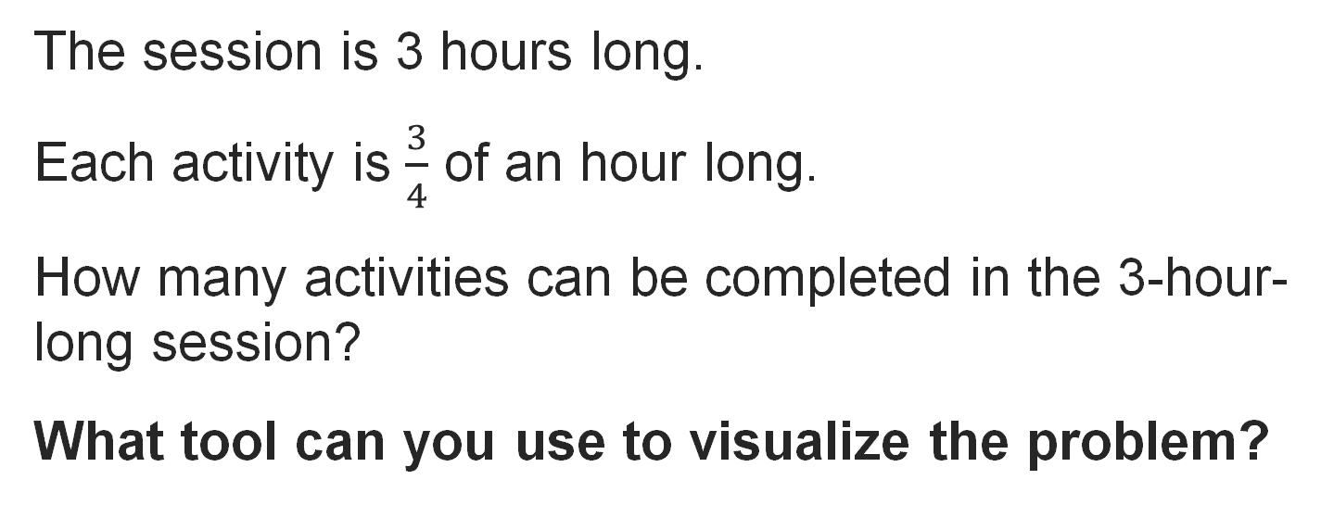
STEM Camp
Record your reasoning before the reveal. Compare, then explain any revision.
Reveal:
One tool is a tape diagram.
19 / 46
Notes:
TEACH IN PRACTICE | Embedded facilitation | Lesson 6.1, slide 18 | REVEAL
Focus on the existing task: Reveal: One tool is a tape diagram. STEM Camp
LAUNCH (T2/3/5): If an existing answer cover is present, gather an attempt before revealing. If the explanation is already visible, ask students to reconstruct and justify it. Compare reasoning and explain a revision; preserve the reveal sequence.
LOOK FOR (T4): Where this task addresses it, students can interpret division as groups or sharing. Ask which feature of their work supports the claim.
RESPOND: If this task shows the lesson misconception—assuming division always makes a quantity smaller—label the whole, group size and number of groups on the original fraction model. Have the student revise and explain the change. Use this support only where the concept occurs in the current task; otherwise respond to the displayed question.
RECHECK: If a gap is shared, revisit the existing representation together. If it is limited, give targeted support while others compare valid methods on the same task. Check the revision before moving on.
PARTICIPATION (T5/6/7): Think time before volunteers; accept a written, drawn or rehearsed entry. Students ask for evidence respectfully. Recognize a specific contribution or revision and check that both partners participate.
Source: BCPS Updated Instructional Framework Rubric (June 2020), TEACH 1–7. Earlier notes and answer keys are retained below.
EARLIER NOTES / EXISTING ANSWER KEY
Do not click yet: collect 2–3 student answers with reasons first.
Then click to remove the cover and have students compare their thinking to the reveal — “Is this what we said? Where is it different?”
Behind the cover: One tool is a tape diagram.
UIFR: TEACH 3 · TEACH 4.

Slide 20
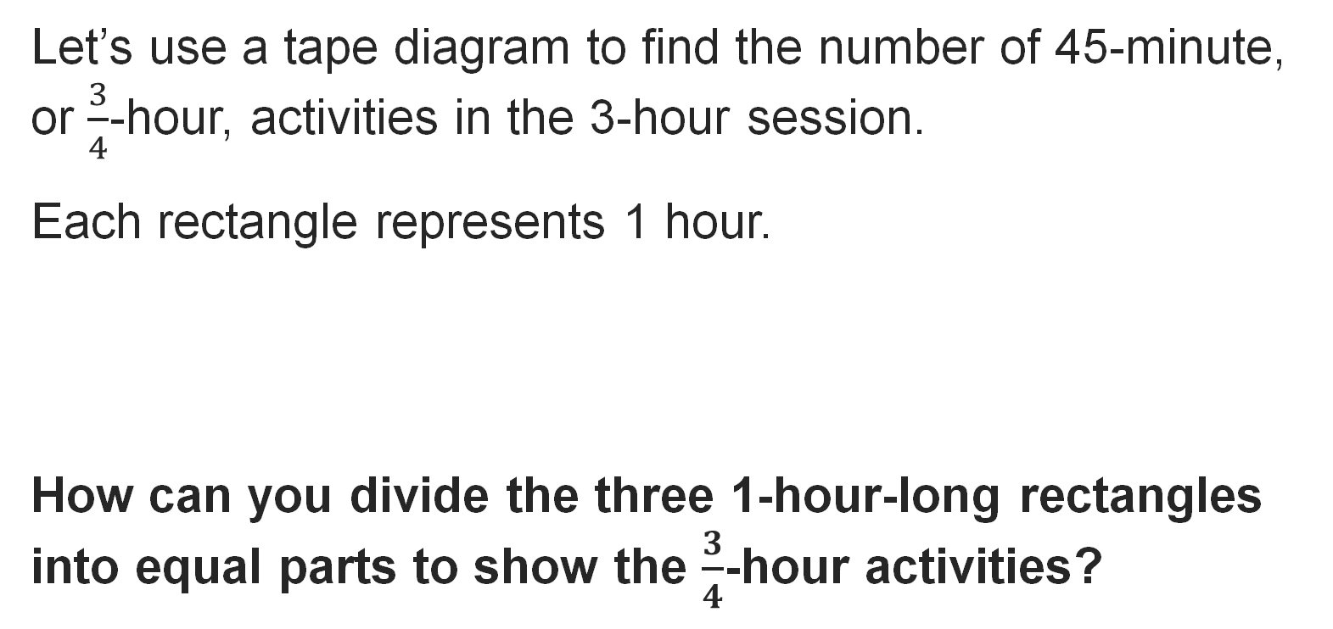

STEM Camp
Reveal:
We can divide the rectangles into fourths.
20 / 46
Notes:
TEACH IN PRACTICE | Embedded facilitation | Lesson 6.1, slide 19 | REVEAL
Focus on the existing task: Reveal: We can divide the rectangles into fourths. STEM Camp
LAUNCH (T2/3/5): If an existing answer cover is present, gather an attempt before revealing. If the explanation is already visible, ask students to reconstruct and justify it. Compare reasoning and explain a revision; preserve the reveal sequence.
LOOK FOR (T4): Where this task addresses it, students can interpret division as groups or sharing. Ask which feature of their work supports the claim.
RESPOND: If this task shows the lesson misconception—assuming division always makes a quantity smaller—label the whole, group size and number of groups on the original fraction model. Have the student revise and explain the change. Use this support only where the concept occurs in the current task; otherwise respond to the displayed question.
RECHECK: If a gap is shared, revisit the existing representation together. If it is limited, give targeted support while others compare valid methods on the same task. Check the revision before moving on.
PARTICIPATION (T5/6/7): Think time before volunteers; accept a written, drawn or rehearsed entry. Students ask for evidence respectfully. Recognize a specific contribution or revision and check that both partners participate.
Source: BCPS Updated Instructional Framework Rubric (June 2020), TEACH 1–7. Earlier notes and answer keys are retained below.
EARLIER NOTES / EXISTING ANSWER KEY
Do not click yet: collect 2–3 student answers with reasons first.
Then click to remove the cover and have students compare their thinking to the reveal — “Is this what we said? Where is it different?”
Behind the cover: We can divide the rectangles into fourths.
UIFR: TEACH 3 · TEACH 4.

Slide 21

STEM Camp
A summer science, technology, engineering, and math (STEM) summer camp has a 3-hour-long afternoon session. The campers choose from different afternoon activities that are each 45 minutes long.
How many 45-minute activities can the campers complete in the 3-hour afternoon session?
They can complete 4 activities in the afternoon session.
21 / 46
Notes:
TEACH IN PRACTICE | Embedded facilitation | Lesson 6.1, slide 20 | TASK
Focus on the existing task: A summer science, technology, engineering, and math (STEM) summer camp has a 3-hour-long afternoon session. The campers choose from…
LAUNCH (T2/3/5): Use the displayed question. Give private thinking time; then A explains while B asks for evidence. Switch roles. Each student records their own reasoning.
LOOK FOR (T4): Where this task addresses it, students can interpret division as groups or sharing. Ask which feature of their work supports the claim.
RESPOND: If this task shows the lesson misconception—assuming division always makes a quantity smaller—label the whole, group size and number of groups on the original fraction model. Have the student revise and explain the change. Use this support only where the concept occurs in the current task; otherwise respond to the displayed question.
RECHECK: If a gap is shared, revisit the existing representation together. If it is limited, give targeted support while others compare valid methods on the same task. Check the revision before moving on.
PARTICIPATION (T5/6/7): Think time before volunteers; accept a written, drawn or rehearsed entry. Students ask for evidence respectfully. Recognize a specific contribution or revision and check that both partners participate.
Source: BCPS Updated Instructional Framework Rubric (June 2020), TEACH 1–7. Earlier notes and answer keys are retained below.
EARLIER NOTES / EXISTING ANSWER KEY
Read the context aloud (or have a student read it).
Before any math, students restate the situation and what is being asked in their own words.
Ask: How many 45-minute activities can the campers complete in the 3-hour afternoon session?
UIFR: TEACH 1 · TEACH 3.

Slide 22
STUDENT MOVES
Lesson 6-1
Your moves
TWO MINUTES SOLO · Two minutes on your own, then compare. Bring one thing you tried, even if it did not work.
PROVE IT · Find the evidence in the problem that makes your answer right — not just the answer.
22 / 46

Slide 23
Let’s Explore More
The afternoon session begins at 1:00 pm. When does each of the 45-minute activities begin and end?
How would the model change if each activity were 30 minutes?
PICK YOUR STRATEGY · Choose your path — picture, table, number line, or equation — and be ready to say why you chose it.
23 / 46
Notes:
TEACH IN PRACTICE | Embedded facilitation | Lesson 6.1, slide 21 | PRACTICE
Focus on the existing task: Let’s Explore More The afternoon session begins at 1:00 pm. When does each of the 45-minute activities begin and end?
LAUNCH (T2/3/5): Use the displayed question. Give private thinking time; then A explains while B asks for evidence. Switch roles. Each student records their own reasoning.
LOOK FOR (T4): Where this task addresses it, students can connect the model to the equation. Ask which feature of their work supports the claim.
RESPOND: If this task shows the lesson misconception—assuming division always makes a quantity smaller—label the whole, group size and number of groups on the original fraction model. Have the student revise and explain the change. Use this support only where the concept occurs in the current task; otherwise respond to the displayed question.
RECHECK: If a gap is shared, revisit the existing representation together. If it is limited, give targeted support while others compare valid methods on the same task. Check the revision before moving on.
PARTICIPATION (T5/6/7): Think time before volunteers; accept a written, drawn or rehearsed entry. Students ask for evidence respectfully. Recognize a specific contribution or revision and check that both partners participate.
Source: BCPS Updated Instructional Framework Rubric (June 2020), TEACH 1–7. Earlier notes and answer keys are retained below.
EARLIER NOTES / EXISTING ANSWER KEY
Extension for partners or table groups — students choose their approach and use the workspace to show thinking.
Push with “Convince me,” and have two groups with different approaches share.
This is where students stretch past the worked example.
UIFR: TEACH 2 · TEACH 5.
UIFR FULL | Lesson-specific facilitation
TEACH 4-5 | Session 1 discussion and checkpoint (UIFR PDF pp. 11-12).
Collect a brief response from every student to the existing prompt before hearing volunteers. Partners take turns explaining and asking for evidence: “I understand ___; what supports ___?” Offer rehearsal or an annotated model for students who need language support. Each student records their own reasoning.
Look specifically for: assuming division always makes a quantity smaller. If it appears, label the whole, group size and number of groups on the original fraction model; then ask the student to revise the same response and explain the change. If evidence is secure, have students compare a second valid pathway or state why their approach works. Choose the next step from the responses, not a preset pace.

Slide 24
LESSON 6.1 / DISCUSS THE TASK
Explain and compare
Use the task you just explored.
TAKE TURNS
What does the quotient count in this situation, and why is its size reasonable?
Explain
“I know this because…”
Ask
“Where does your work show that?”
Point to evidence in your work.
Then compare your approach with a partner’s.
ANOTHER PATHWAY · Did anyone get there a different way? Put both pathways side by side and compare.
Listen to understand. Ask for evidence. Make room for every voice.
Notes:
TEACH IN PRACTICE | Embedded facilitation | Lesson 6.1, slide 22 | PRIOR_INSERT
Focus on the existing task: Point to evidence in your work. Then compare your approach with a partner’s. TAKE TURNS Explain “I know this because…” Ask “Where does your work show that?
CONNECT (T1/4): Ask students to restate the displayed goal or key idea and connect it to earlier work. Relevant lesson evidence: interpret division as groups or sharing; connect the model to the equation; check by multiplication. Use only the criterion that matches the current session.
SHOW PROGRESS: Students point to their own existing work, explain what improved after feedback, and name a next step. Pair confidence ratings with actual evidence.
PARTICIPATION (T5/6/7): Think time before volunteers; accept a written, drawn or rehearsed entry. Students ask for evidence respectfully. Recognize a specific contribution or revision and check that both partners participate.
Source: BCPS Updated Instructional Framework Rubric (June 2020), TEACH 1–7.

Slide 25
Warm-Up
Lesson 6-1 · Division Expressions with Fractions and Whole Numbers
Session 2 Warm-Up
Try alone. Explain one. Then revise.
1
To divide a fraction by a whole number, multiply by its:
2
What is the reciprocal of 4?
A
Opposite
A
−4
B
Reciprocal
B
21 / 37
C
Numerator
C
4
D
Square
D
0.4
3
What is 1/2 ÷ 3?
4
What is 6 ÷ 1/3?
A
21 / 37
A
2
B
21 / 37
B
18
C
21 / 37
C
6
D
21 / 37
D
21 / 37
eduwonderlab.com · Neft Teacher
25 / 46
Notes:
TEACH IN PRACTICE | Embedded facilitation | Lesson 6.1, slide 23 | WARMUP
Focus on the existing task: A −4 B C 4 D 0.4 3 What is ÷ 3?
GATHER EVIDENCE (T4/6): Keep the original items. Students try independently, mark an uncertain item, and explain one method before checking. Use the existing key when present.
RESPOND: Distinguish a calculation slip from a reasoning gap. Give one next step on the same item; have students revise in a second color. Use the responses to choose flexible support for today’s lesson.
PARTICIPATION (T5/6/7): Think time before volunteers; accept a written, drawn or rehearsed entry. Students ask for evidence respectfully. Recognize a specific contribution or revision and check that both partners participate.
Source: BCPS Updated Instructional Framework Rubric (June 2020), TEACH 1–7. Earlier notes and answer keys are retained below.
EARLIER NOTES / EXISTING ANSWER KEY
Warm-up routine: students start silently on entry; keep it to about 4 minutes.
Circulate and note who is stuck — use what you see to choose who you check on first today.
Go over answers quickly; ask one student to explain a step, not just say the answer.
UIFR: TEACH 4 · TEACH 6.

Slide 26
STUDENT MOVES
Lesson 6-1
Your move
YOU KNOW THE ROUTINE · Read → plan → solve → check. Do all four, in that order.
26 / 46

Slide 27
Review Notes — Session 2
Lesson 6-1 · Division Expressions with Fractions and Whole Numbers
Session 2: Review Notes
Copy. Explain. Check.
WHY IT MATTERS · Finish this: “This is worth knowing because ______.”
Fraction Division Rule
1
Dividing by a number is equivalent to multiplying by its multiplicative inverse (reciprocal).
Reciprocal Definition
2
Two numbers whose product equals 1 (e.g. 4 and 1/4, 2/3 and 3/2).
Tape Models
3
Visualize how many divisor groups fit inside the dividend using bar models.
eduwonderlab.com · Neft Teacher
27 / 46
Notes:
TEACH IN PRACTICE | Embedded facilitation | Lesson 6.1, slide 24 | NOTES
Focus on the existing task: Review Notes — Session 2 Session 2…
ROUTINE (T1/2/4): Read or copy the original notes, cover one line, and explain it using the displayed example. Reopen and correct. Copying alone is not evidence of understanding.
LOOK FOR: A link between a symbol, quantity or feature and the explanation. If missing, point back to that feature and have the student try again; fade the prompt once they can explain.
PARTICIPATION (T5/6/7): Think time before volunteers; accept a written, drawn or rehearsed entry. Students ask for evidence respectfully. Recognize a specific contribution or revision and check that both partners participate.
Source: BCPS Updated Instructional Framework Rubric (June 2020), TEACH 1–7. Earlier notes and answer keys are retained below.
EARLIER NOTES / EXISTING ANSWER KEY
Copy routine: read one line at a time; students copy, then explain that line to a partner.
Keep it brisk — the understanding work happens in the examples, not the copying.
UIFR: TEACH 1 · TEACH 6.

Slide 28
Session 2
Division Expressions with Fractions and Whole Numbers
ADD ON · Add on: “I agree because ______.” or “I see it differently because ______.”
28 / 46
Notes:
TEACH IN PRACTICE | Embedded facilitation | Lesson 6.1, slide 25 | DIVIDER
Focus on the existing task: Division Expressions with Fractions and Whole Numbers Session 2
TRANSITION (T6/7): Students confirm materials, roles, how to request help, and the next response routine. Ask a student to restate it. Keep teacher-only slides hidden.
PARTICIPATION (T5/6/7): Think time before volunteers; accept a written, drawn or rehearsed entry. Students ask for evidence respectfully. Recognize a specific contribution or revision and check that both partners participate.
Source: BCPS Updated Instructional Framework Rubric (June 2020), TEACH 1–7. Earlier notes and answer keys are retained below.
EARLIER NOTES / EXISTING ANSWER KEY
Transition cue: state what materials are out and what success looks like this session.
Keep the changeover under a minute.
UIFR: TEACH 6.

Slide 29

Be Curious
What do you notice?
What do you wonder?
Think first. Share a notice and a question; build on a classmate’s idea.
Mindset
How are you building your confidence when engaging with math?
29 / 46
Notes:
TEACH IN PRACTICE | Embedded facilitation | Lesson 6.1, slide 26 | CURIOUS
Focus on the existing task: What do you notice?
LAUNCH (T2/3/5): Allow quiet observation first. Separate a notice from an inference, invite students’ own questions, and follow the existing launch before teaching a procedure.
LOOK FOR (T4): Where this task addresses it, students can interpret division as groups or sharing. Ask which feature of their work supports the claim.
RESPOND: If this task shows the lesson misconception—assuming division always makes a quantity smaller—label the whole, group size and number of groups on the original fraction model. Have the student revise and explain the change. Use this support only where the concept occurs in the current task; otherwise respond to the displayed question.
RECHECK: If a gap is shared, revisit the existing representation together. If it is limited, give targeted support while others compare valid methods on the same task. Check the revision before moving on.
PARTICIPATION (T5/6/7): Think time before volunteers; accept a written, drawn or rehearsed entry. Students ask for evidence respectfully. Recognize a specific contribution or revision and check that both partners participate.
Source: BCPS Updated Instructional Framework Rubric (June 2020), TEACH 1–7. Earlier notes and answer keys are retained below.
EARLIER NOTES / EXISTING ANSWER KEY
Accept all noticings and wonderings — there are no wrong answers here.
Give 20–30 seconds of quiet think time before taking responses; mix cold and warm calls so it is not always the same voices.
Read the mindset question aloud and let two students respond.
UIFR: TEACH 3 · TEACH 7.

Slide 30
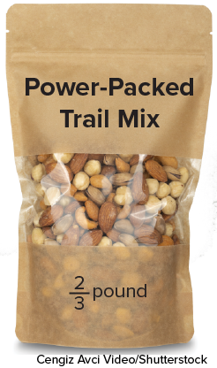

Trail Mix
Tahira bought the package of trail mix shown. She wants to make 3 snack bags of trail mix, each with the same amount of trail mix.
How much trail mix will be in each bag?
Think and record first. Which part of your work supports your
answer?
Asking Questions
What questions can you ask to better define the problem?
30 / 46
Notes:
TEACH IN PRACTICE | Embedded facilitation | Lesson 6.1, slide 27 | TASK
Focus on the existing task: Tahira bought the package of trail mix shown. She wants to make 3 snack bags of trail mix, each with the same amount of trail mix. How much trail mix will be in each bag?
LAUNCH (T2/3/5): Use the displayed question. Give private thinking time; then A explains while B asks for evidence. Switch roles. Each student records their own reasoning.
LOOK FOR (T4): Where this task addresses it, students can interpret division as groups or sharing. Ask which feature of their work supports the claim.
RESPOND: If this task shows the lesson misconception—assuming division always makes a quantity smaller—label the whole, group size and number of groups on the original fraction model. Have the student revise and explain the change. Use this support only where the concept occurs in the current task; otherwise respond to the displayed question.
RECHECK: If a gap is shared, revisit the existing representation together. If it is limited, give targeted support while others compare valid methods on the same task. Check the revision before moving on.
PARTICIPATION (T5/6/7): Think time before volunteers; accept a written, drawn or rehearsed entry. Students ask for evidence respectfully. Recognize a specific contribution or revision and check that both partners participate.
Source: BCPS Updated Instructional Framework Rubric (June 2020), TEACH 1–7. Earlier notes and answer keys are retained below.
EARLIER NOTES / EXISTING ANSWER KEY
Read the context aloud (or have a student read it).
Before any math, students restate the situation and what is being asked in their own words.
Ask: How much trail mix will be in each bag?
UIFR: TEACH 1 · TEACH 3.

Slide 31
Trail Mix
Tahira bought the package of trail mix shown. She wants to make 3 snack bags of trail mix, each with the same amount of trail mix. How much trail mix will be in each bag?
What is the problem asking you to do?
Reveal:
SELF-CHECK · Mark it: ✓ got it · ~ almost · ? stuck. Then fix one thing before we move on.
31 / 46
Notes:
TEACH IN PRACTICE | Embedded facilitation | Lesson 6.1, slide 28 | REVEAL
Focus on the existing task: Tahira bought the package of trail mix shown. She wants to make 3 snack bags of trail mix, each with the same amount of trail mix. How much trail mix will be in each bag?
LAUNCH (T2/3/5): If an existing answer cover is present, gather an attempt before revealing. If the explanation is already visible, ask students to reconstruct and justify it. Compare reasoning and explain a revision; preserve the reveal sequence.
LOOK FOR (T4): Where this task addresses it, students can interpret division as groups or sharing. Ask which feature of their work supports the claim.
RESPOND: If this task shows the lesson misconception—assuming division always makes a quantity smaller—label the whole, group size and number of groups on the original fraction model. Have the student revise and explain the change. Use this support only where the concept occurs in the current task; otherwise respond to the displayed question.
RECHECK: If a gap is shared, revisit the existing representation together. If it is limited, give targeted support while others compare valid methods on the same task. Check the revision before moving on.
PARTICIPATION (T5/6/7): Think time before volunteers; accept a written, drawn or rehearsed entry. Students ask for evidence respectfully. Recognize a specific contribution or revision and check that both partners participate.
Source: BCPS Updated Instructional Framework Rubric (June 2020), TEACH 1–7. Earlier notes and answer keys are retained below.
EARLIER NOTES / EXISTING ANSWER KEY
Students should have shared predictions before this reveal.
Have them compare their thinking to what is shown: “Is this the same as what we said? Where is it different?”
Press one student to explain the reveal in their own words.
UIFR: TEACH 3 · TEACH 4.

Slide 32
Trail Mix
Tahira bought the package of trail mix shown. She wants to make 3 snack bags of trail mix, each with the same amount of trail mix. How much trail mix will be in each bag?
What tool can you use to visualize the problem?
Record your reasoning before the reveal. Compare, then
explain any revision.
Reveal:
One tool is a tape diagram.
32 / 46
Notes:
TEACH IN PRACTICE | Embedded facilitation | Lesson 6.1, slide 29 | REVEAL
Focus on the existing task: Tahira bought the package of trail mix shown. She wants to make 3 snack bags of trail mix, each with the same amount of trail mix. How much trail mix will be in each bag?
LAUNCH (T2/3/5): If an existing answer cover is present, gather an attempt before revealing. If the explanation is already visible, ask students to reconstruct and justify it. Compare reasoning and explain a revision; preserve the reveal sequence.
LOOK FOR (T4): Where this task addresses it, students can interpret division as groups or sharing. Ask which feature of their work supports the claim.
RESPOND: If this task shows the lesson misconception—assuming division always makes a quantity smaller—label the whole, group size and number of groups on the original fraction model. Have the student revise and explain the change. Use this support only where the concept occurs in the current task; otherwise respond to the displayed question.
RECHECK: If a gap is shared, revisit the existing representation together. If it is limited, give targeted support while others compare valid methods on the same task. Check the revision before moving on.
PARTICIPATION (T5/6/7): Think time before volunteers; accept a written, drawn or rehearsed entry. Students ask for evidence respectfully. Recognize a specific contribution or revision and check that both partners participate.
Source: BCPS Updated Instructional Framework Rubric (June 2020), TEACH 1–7. Earlier notes and answer keys are retained below.
EARLIER NOTES / EXISTING ANSWER KEY
Do not click yet: collect 2–3 student answers with reasons first.
Then click to remove the cover and have students compare their thinking to the reveal — “Is this what we said? Where is it different?”
Behind the cover: One tool is a tape diagram.
UIFR: TEACH 3 · TEACH 4.

Slide 33

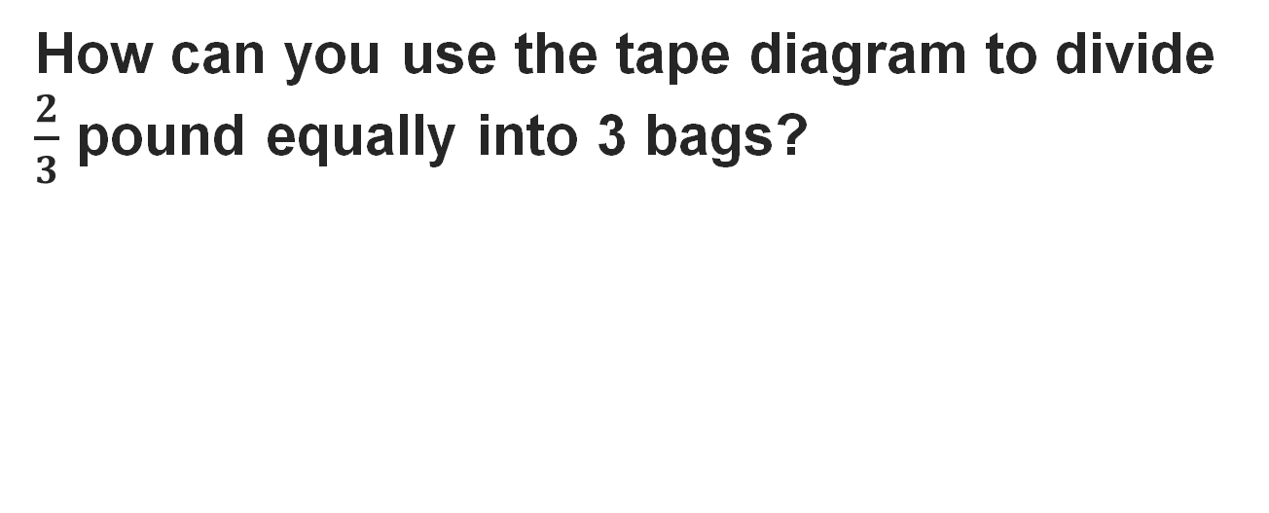
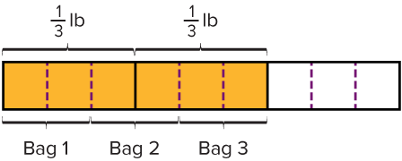
COLLABORATE · TALK IT THROUGH • AGREE ON A MODEL
Collaborate and Connect
TAKE TURNS · One explains, one asks a question. Then switch, so both of you talk.
Reveal:
We can divide each third into 3 equal parts, resulting in 6 shaded parts. Two of the 6 shaded parts will go in each of the 3 bags.
33 / 46
Notes:
TEACH IN PRACTICE | Embedded facilitation | Lesson 6.1, slide 30 | COLLABORATE
Focus on the existing task: Collaborate and Connect Reveal: We can divide each third into 3 equal parts, resulting in 6 shaded parts. Two of the 6 shaded parts…
LAUNCH (T2/3/5): Use the displayed question. Give private thinking time; then A explains while B asks for evidence. Switch roles. Each student records their own reasoning.
LOOK FOR (T4): Where this task addresses it, students can connect the model to the equation. Ask which feature of their work supports the claim.
RESPOND: If this task shows the lesson misconception—assuming division always makes a quantity smaller—label the whole, group size and number of groups on the original fraction model. Have the student revise and explain the change. Use this support only where the concept occurs in the current task; otherwise respond to the displayed question.
RECHECK: If a gap is shared, revisit the existing representation together. If it is limited, give targeted support while others compare valid methods on the same task. Check the revision before moving on.
PARTICIPATION (T5/6/7): Think time before volunteers; accept a written, drawn or rehearsed entry. Students ask for evidence respectfully. Recognize a specific contribution or revision and check that both partners participate.
Source: BCPS Updated Instructional Framework Rubric (June 2020), TEACH 1–7. Earlier notes and answer keys are retained below.
EARLIER NOTES / EXISTING ANSWER KEY
Routine: COLLABORATE · TALK IT THROUGH • AGREE ON A MODEL

Slide 34
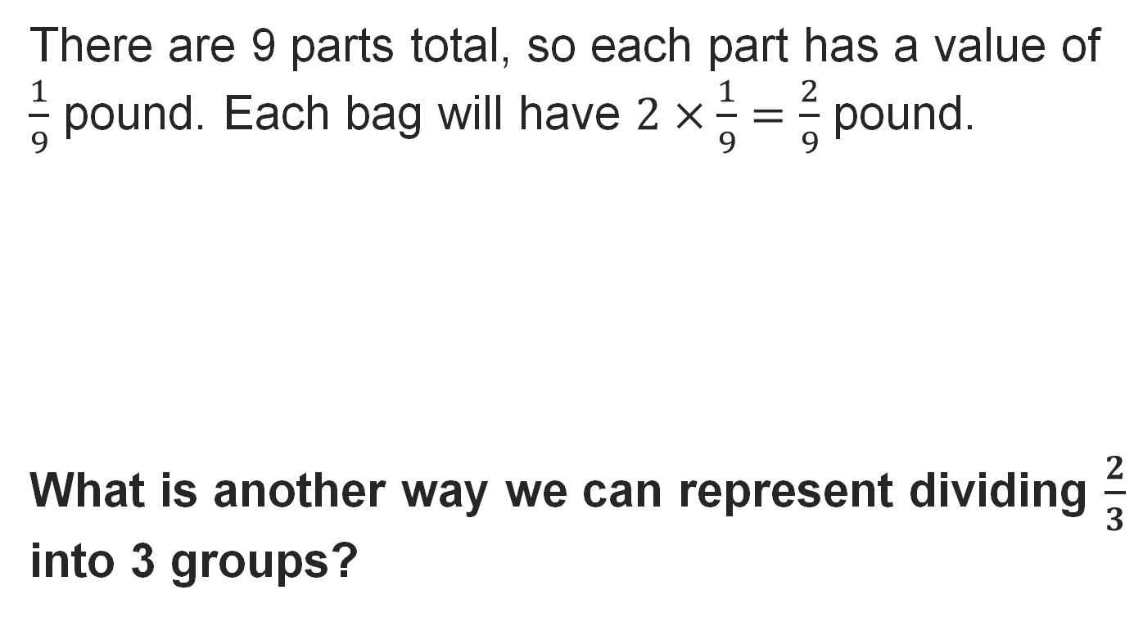
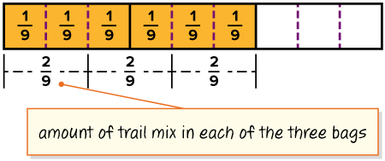
Trail Mix
Reveal:
We can use a division equation.
34 / 46
Notes:
TEACH IN PRACTICE | Embedded facilitation | Lesson 6.1, slide 31 | REVEAL
Focus on the existing task: Reveal: We can use a division equation. Trail Mix
LAUNCH (T2/3/5): If an existing answer cover is present, gather an attempt before revealing. If the explanation is already visible, ask students to reconstruct and justify it. Compare reasoning and explain a revision; preserve the reveal sequence.
LOOK FOR (T4): Where this task addresses it, students can interpret division as groups or sharing. Ask which feature of their work supports the claim.
RESPOND: If this task shows the lesson misconception—assuming division always makes a quantity smaller—label the whole, group size and number of groups on the original fraction model. Have the student revise and explain the change. Use this support only where the concept occurs in the current task; otherwise respond to the displayed question.
RECHECK: If a gap is shared, revisit the existing representation together. If it is limited, give targeted support while others compare valid methods on the same task. Check the revision before moving on.
PARTICIPATION (T5/6/7): Think time before volunteers; accept a written, drawn or rehearsed entry. Students ask for evidence respectfully. Recognize a specific contribution or revision and check that both partners participate.
Source: BCPS Updated Instructional Framework Rubric (June 2020), TEACH 1–7. Earlier notes and answer keys are retained below.
EARLIER NOTES / EXISTING ANSWER KEY
Do not click yet: collect 2–3 student answers with reasons first.
Then click to remove the cover and have students compare their thinking to the reveal — “Is this what we said? Where is it different?”
Behind the cover: We can use a division equation.
UIFR: TEACH 3 · TEACH 4.

Slide 35
STUDENT MOVES
Lesson 6-1
Your move
RESTATE FIRST · Restate your partner’s idea in your own words before you give yours.
35 / 46

Slide 36
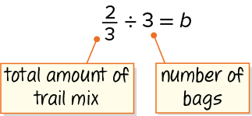
Trail Mix
Let’s use an equation to represent the problem.
How can you determine the unknown value?
STRUGGLE FIRST · Work on your own first. Stuck is allowed — try a second strategy before you ask.
Reveal:
We can use multiplication.
36 / 46
Notes:
TEACH IN PRACTICE | Embedded facilitation | Lesson 6.1, slide 32 | REVEAL
Focus on the existing task: Let’s use an equation to represent the problem. How can you determine the unknown value?
LAUNCH (T2/3/5): If an existing answer cover is present, gather an attempt before revealing. If the explanation is already visible, ask students to reconstruct and justify it. Compare reasoning and explain a revision; preserve the reveal sequence.
LOOK FOR (T4): Where this task addresses it, students can connect the model to the equation. Ask which feature of their work supports the claim.
RESPOND: If this task shows the lesson misconception—assuming division always makes a quantity smaller—label the whole, group size and number of groups on the original fraction model. Have the student revise and explain the change. Use this support only where the concept occurs in the current task; otherwise respond to the displayed question.
RECHECK: If a gap is shared, revisit the existing representation together. If it is limited, give targeted support while others compare valid methods on the same task. Check the revision before moving on.
PARTICIPATION (T5/6/7): Think time before volunteers; accept a written, drawn or rehearsed entry. Students ask for evidence respectfully. Recognize a specific contribution or revision and check that both partners participate.
Source: BCPS Updated Instructional Framework Rubric (June 2020), TEACH 1–7. Earlier notes and answer keys are retained below.
EARLIER NOTES / EXISTING ANSWER KEY
Do not click yet: collect 2–3 student answers with reasons first.
Then click to remove the cover and have students compare their thinking to the reveal — “Is this what we said? Where is it different?”
Behind the cover: We can use multiplication.
UIFR: TEACH 3 · TEACH 4.

Slide 37
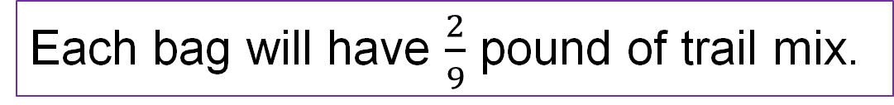
Trail Mix
Tahira bought the package of trail mix shown. She wants to make 3 snack bags of trail mix, each with the same amount of trail mix.
How much trail mix will be in each bag?
Think and record first. Which part of your work supports your answer?
37 / 46
Notes:
TEACH IN PRACTICE | Embedded facilitation | Lesson 6.1, slide 33 | TASK
Focus on the existing task: Tahira bought the package of trail mix shown. She wants to make 3 snack bags of trail mix, each with the same amount of trail mix. How much trail mix will be in each bag?
LAUNCH (T2/3/5): Use the displayed question. Give private thinking time; then A explains while B asks for evidence. Switch roles. Each student records their own reasoning.
LOOK FOR (T4): Where this task addresses it, students can interpret division as groups or sharing. Ask which feature of their work supports the claim.
RESPOND: If this task shows the lesson misconception—assuming division always makes a quantity smaller—label the whole, group size and number of groups on the original fraction model. Have the student revise and explain the change. Use this support only where the concept occurs in the current task; otherwise respond to the displayed question.
RECHECK: If a gap is shared, revisit the existing representation together. If it is limited, give targeted support while others compare valid methods on the same task. Check the revision before moving on.
PARTICIPATION (T5/6/7): Think time before volunteers; accept a written, drawn or rehearsed entry. Students ask for evidence respectfully. Recognize a specific contribution or revision and check that both partners participate.
Source: BCPS Updated Instructional Framework Rubric (June 2020), TEACH 1–7. Earlier notes and answer keys are retained below.
EARLIER NOTES / EXISTING ANSWER KEY
Read the context aloud (or have a student read it).
Before any math, students restate the situation and what is being asked in their own words.
Ask: How much trail mix will be in each bag?
UIFR: TEACH 1 · TEACH 3.

Slide 38

Let’s Explore More
How would the visual model change if Tahira decided to make 4 snack bags?
How much would be in each bag if Tahira decided to make 4 snack bags?
USE YOUR TOOLS · Reach for your notes, a model, or a manipulative before you reach for an answer.
38 / 46
Notes:
TEACH IN PRACTICE | Embedded facilitation | Lesson 6.1, slide 34 | PRACTICE
Focus on the existing task: Let’s Explore More How would the visual model change if Tahira decided to make 4 snack bags?
LAUNCH (T2/3/5): Use the displayed question. Give private thinking time; then A explains while B asks for evidence. Switch roles. Each student records their own reasoning.
LOOK FOR (T4): Where this task addresses it, students can connect the model to the equation. Ask which feature of their work supports the claim.
RESPOND: If this task shows the lesson misconception—assuming division always makes a quantity smaller—label the whole, group size and number of groups on the original fraction model. Have the student revise and explain the change. Use this support only where the concept occurs in the current task; otherwise respond to the displayed question.
RECHECK: If a gap is shared, revisit the existing representation together. If it is limited, give targeted support while others compare valid methods on the same task. Check the revision before moving on.
PARTICIPATION (T5/6/7): Think time before volunteers; accept a written, drawn or rehearsed entry. Students ask for evidence respectfully. Recognize a specific contribution or revision and check that both partners participate.
Source: BCPS Updated Instructional Framework Rubric (June 2020), TEACH 1–7. Earlier notes and answer keys are retained below.
EARLIER NOTES / EXISTING ANSWER KEY
Extension for partners or table groups — students choose their approach and use the workspace to show thinking.
Push with “Convince me,” and have two groups with different approaches share.
This is where students stretch past the worked example.
UIFR: TEACH 2 · TEACH 5.

Slide 39
LESSON 6.1 / CHECK YOUR WORK
Pause. Check. Improve.
CHECK
A mistake to watch for: assuming division always makes a quantity smaller.
TRY
Label the whole, group size and number of groups on the given fraction model.
REVISE
Use that check on the task you just completed. Correct or strengthen one part, and explain why.
REVISE NOW · Change one answer and write why you changed it. A revision is evidence of learning.
Listen to understand. Ask for evidence. Make room for every voice.
Notes:
TEACH IN PRACTICE | Embedded facilitation | Lesson 6.1, slide 35 | PRIOR_INSERT
Focus on the existing task: LESSON 6.1 / CHECK YOUR WORK Pause. Check. Improve. Listen to understand. Ask for evidence. Make room for every voice. CHECK A mistake…
CONNECT (T1/4): Ask students to restate the displayed goal or key idea and connect it to earlier work. Relevant lesson evidence: interpret division as groups or sharing; connect the model to the equation; check by multiplication. Use only the criterion that matches the current session.
SHOW PROGRESS: Students point to their own existing work, explain what improved after feedback, and name a next step. Pair confidence ratings with actual evidence.
PARTICIPATION (T5/6/7): Think time before volunteers; accept a written, drawn or rehearsed entry. Students ask for evidence respectfully. Recognize a specific contribution or revision and check that both partners participate.
Source: BCPS Updated Instructional Framework Rubric (June 2020), TEACH 1–7.

Slide 40
Trail Mix
Let’s use an equation to represent the problem.
How can you determine the unknown value?
ASK THE CLASS · Write one question about this that you could ask the class.
Reveal:
We can use multiplication.
40 / 46
Notes:
TEACH IN PRACTICE | Embedded facilitation | Lesson 6.1, slide 36 | REVEAL
Focus on the existing task: Let’s use an equation to represent the problem. How can you determine the unknown value?
LAUNCH (T2/3/5): If an existing answer cover is present, gather an attempt before revealing. If the explanation is already visible, ask students to reconstruct and justify it. Compare reasoning and explain a revision; preserve the reveal sequence.
LOOK FOR (T4): Where this task addresses it, students can connect the model to the equation. Ask which feature of their work supports the claim.
RESPOND: If this task shows the lesson misconception—assuming division always makes a quantity smaller—label the whole, group size and number of groups on the original fraction model. Have the student revise and explain the change. Use this support only where the concept occurs in the current task; otherwise respond to the displayed question.
RECHECK: If a gap is shared, revisit the existing representation together. If it is limited, give targeted support while others compare valid methods on the same task. Check the revision before moving on.
PARTICIPATION (T5/6/7): Think time before volunteers; accept a written, drawn or rehearsed entry. Students ask for evidence respectfully. Recognize a specific contribution or revision and check that both partners participate.
Source: BCPS Updated Instructional Framework Rubric (June 2020), TEACH 1–7.

Slide 41
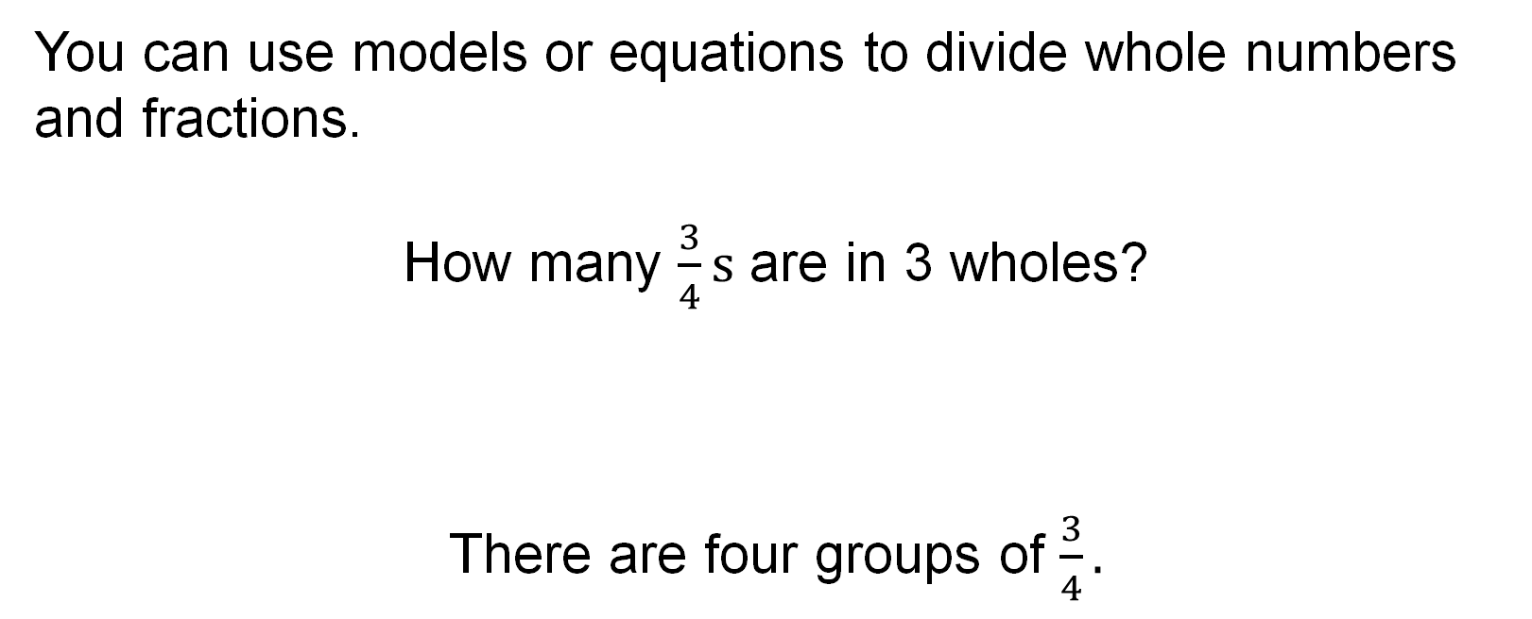
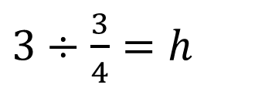
SUMMARIZE · SAY IT IN YOUR OWN WORDS
Summarize: Division Expressions with Fractions and Whole Numbers
Explain the key idea without reading. Use today’s example as evidence.
41 / 46
Notes:
TEACH IN PRACTICE | Embedded facilitation | Lesson 6.1, slide 37 | SUMMARIZE
Focus on the existing task: Summarize: Division Expressions with Fractions and Whole Numbers SUMMARIZE · SAY IT IN YOUR OWN WORDS
CONNECT (T1/4): Ask students to restate the displayed goal or key idea and connect it to earlier work. Relevant lesson evidence: interpret division as groups or sharing; connect the model to the equation; check by multiplication. Use only the criterion that matches the current session.
SHOW PROGRESS: Students point to their own existing work, explain what improved after feedback, and name a next step. Pair confidence ratings with actual evidence.
PARTICIPATION (T5/6/7): Think time before volunteers; accept a written, drawn or rehearsed entry. Students ask for evidence respectfully. Recognize a specific contribution or revision and check that both partners participate.
Source: BCPS Updated Instructional Framework Rubric (June 2020), TEACH 1–7. Earlier notes and answer keys are retained below.
EARLIER NOTES / EXISTING ANSWER KEY
Routine: SUMMARIZE · SAY IT IN YOUR OWN WORDS

Slide 42
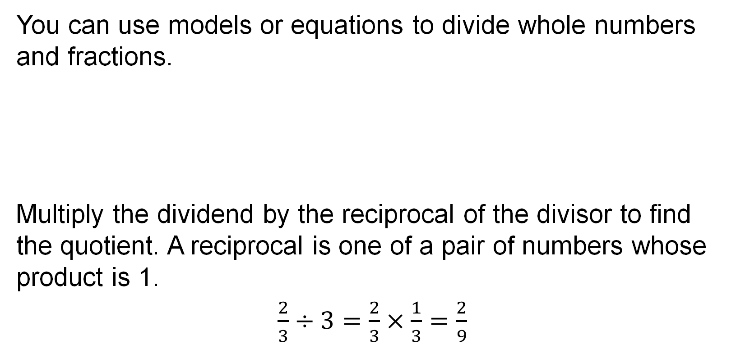
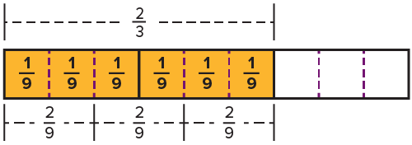
SUMMARIZE · SAY IT IN YOUR OWN WORDS
Summarize: Division Expressions with Fractions and Whole Numbers
42 / 46
Notes:
TEACH IN PRACTICE | Embedded facilitation | Lesson 6.1, slide 38 | SUMMARIZE
Focus on the existing task: Summarize: Division Expressions with Fractions and Whole Numbers SUMMARIZE · SAY IT IN YOUR OWN WORDS
CONNECT (T1/4): Ask students to restate the displayed goal or key idea and connect it to earlier work. Relevant lesson evidence: interpret division as groups or sharing; connect the model to the equation; check by multiplication. Use only the criterion that matches the current session.
SHOW PROGRESS: Students point to their own existing work, explain what improved after feedback, and name a next step. Pair confidence ratings with actual evidence.
PARTICIPATION (T5/6/7): Think time before volunteers; accept a written, drawn or rehearsed entry. Students ask for evidence respectfully. Recognize a specific contribution or revision and check that both partners participate.
Source: BCPS Updated Instructional Framework Rubric (June 2020), TEACH 1–7. Earlier notes and answer keys are retained below.
EARLIER NOTES / EXISTING ANSWER KEY
Routine: SUMMARIZE · SAY IT IN YOUR OWN WORDS

Slide 43
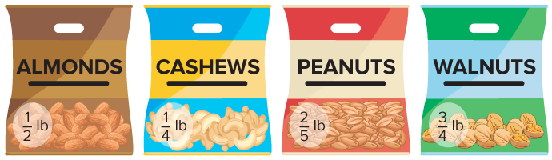
APPLY · PLAN IT • SOLVE IT • PROVE IT
Apply: Snack Bags
Andrew has four types of nuts and a different quantity of each type. He wants to make 4 snack bags for each type of nut and will not mix the nuts in the snack bags.
Question: What will be the weight of the snack bags for each type of nut? Explain your reasoning.
43 / 46
Notes:
TEACH IN PRACTICE | Embedded facilitation | Lesson 6.1, slide 39 | APPLY
Focus on the existing task: Andrew has four types of nuts and a different quantity of each type. He wants to make 4 snack bags for each type of nut and will not mix…
LAUNCH (T2/3/5): Use the exact application task independently first. Ask students to justify their choice of method. Collect evidence before a partner discussion or correction.
LOOK FOR (T4): Where this task addresses it, students can interpret division as groups or sharing. Ask which feature of their work supports the claim.
RESPOND: If this task shows the lesson misconception—assuming division always makes a quantity smaller—label the whole, group size and number of groups on the original fraction model. Have the student revise and explain the change. Use this support only where the concept occurs in the current task; otherwise respond to the displayed question.
RECHECK: If a gap is shared, revisit the existing representation together. If it is limited, give targeted support while others compare valid methods on the same task. Check the revision before moving on.
PARTICIPATION (T5/6/7): Think time before volunteers; accept a written, drawn or rehearsed entry. Students ask for evidence respectfully. Recognize a specific contribution or revision and check that both partners participate.
Source: BCPS Updated Instructional Framework Rubric (June 2020), TEACH 1–7. Earlier notes and answer keys are retained below.
EARLIER NOTES / EXISTING ANSWER KEY
Routine: APPLY · PLAN IT • SOLVE IT • PROVE IT
UIFR FULL | Lesson-specific facilitation
TEACH 4 | Independent evidence and revision (UIFR PDF p. 11).
Use the existing application/exit problem as the independent check. If this is a learning-target slide, have students point to and explain their work on the preceding task. Separate initial independent evidence from the revision after feedback.
Check the relevant criteria: interpret division as groups or sharing; connect the model to the equation; check by multiplication. Respond with one specific next step tied to the work. Students revise and annotate what changed, then identify a criterion they can now demonstrate and one they still need to practice.

Slide 44
STUDENT MOVES
Lesson 6-1
Your moves
SPECIFIC FEEDBACK · Trade work. Give one specific comment: “This part is clear because ______.”
YOUR CHOICE · You choose how to show this — numbers, words, or a diagram. Make your reasoning visible.
44 / 46

Slide 45
Learning Targets
I can use appropriate tools to divide whole numbers by fractions using fraction models.
I can divide fractions by whole numbers using fraction models and equations.
NAME THE MATH · Point to the part of this that is new today, and say what it changes.
45 / 46
Notes:
TEACH IN PRACTICE | Embedded facilitation | Lesson 6.1, slide 40 | REFLECTION
Focus on the existing task: I can use appropriate tools to divide whole numbers by fractions using fraction models. I can divide fractions by whole numbers using…
CONNECT (T1/4): Ask students to restate the displayed goal or key idea and connect it to earlier work. Relevant lesson evidence: interpret division as groups or sharing; connect the model to the equation; check by multiplication. Use only the criterion that matches the current session.
SHOW PROGRESS: Students point to their own existing work, explain what improved after feedback, and name a next step. Pair confidence ratings with actual evidence.
PARTICIPATION (T5/6/7): Think time before volunteers; accept a written, drawn or rehearsed entry. Students ask for evidence respectfully. Recognize a specific contribution or revision and check that both partners participate.
Source: BCPS Updated Instructional Framework Rubric (June 2020), TEACH 1–7. Earlier notes and answer keys are retained below.
EARLIER NOTES / EXISTING ANSWER KEY
Read each target; students self-rate with fist-to-five or thumbs.
Tie back to the goal from the start of class: did we get there?
Note any target that rates low — revisit it tomorrow.
UIFR: TEACH 1 · TEACH 4.
UIFR FULL | Lesson-specific facilitation
REFLECT & ADJUST 1-2 | After the lesson (UIFR PDF pp. 15-16).
Sort the existing work by demonstrated reasoning, partial understanding, and the specific misconception: assuming division always makes a quantity smaller. Compare the initial response with the revision. Record which teaching move plausibly helped, which did not, and whose participation or access needs a different approach; do not record sensitive student details in this shared deck.
Plan the next lesson from that evidence: if the misconception persists, label the whole, group size and number of groups on the original fraction model using the current example before returning to the next grade-level task; if understanding is secure, use an existing extension or ask for a general explanation. Check the targeted idea again at the next warm-up.
Ask students what supported their thinking and what would help next time. Identify one change to try and one successful practice to retain. Seek colleague feedback on anonymized work when useful; these prompts support reflection and do not establish an evaluation rating. Source: Baltimore City Public Schools, Updated Instructional Framework Rubric, June 2020 (UIFR_Full.pdf).

Slide 46
LESSON 6.1 / REFLECT ON YOUR LEARNING
Show your progress
1 SHOW EVIDENCE
2 CHOOSE A NEXT STEP
Choose one response. Point to the part that shows your reasoning.
Name a change you made after feedback—or a question you still have.
“My work shows ___ because ___.”
“Next time, I will ___ to help me ___.”
Today’s focus: Interpret division as groups or sharing.
CREDIT A CLASSMATE · Name one classmate whose idea helped you today, and say what they said.
Listen to understand. Ask for evidence. Make room for every voice.
Notes:
TEACH IN PRACTICE | Embedded facilitation | Lesson 6.1, slide 41 | PRIOR_INSERT
Focus on the existing task: LESSON 6.1 / REFLECT ON YOUR LEARNING Show your progress Listen to understand. Ask for evidence. Make room for every voice. 1 SHOW…
CONNECT (T1/4): Ask students to restate the displayed goal or key idea and connect it to earlier work. Relevant lesson evidence: interpret division as groups or sharing; connect the model to the equation; check by multiplication. Use only the criterion that matches the current session.
SHOW PROGRESS: Students point to their own existing work, explain what improved after feedback, and name a next step. Pair confidence ratings with actual evidence.
PARTICIPATION (T5/6/7): Think time before volunteers; accept a written, drawn or rehearsed entry. Students ask for evidence respectfully. Recognize a specific contribution or revision and check that both partners participate.
Source: BCPS Updated Instructional Framework Rubric (June 2020), TEACH 1–7.

