Slide 1
WARM-UP · THINK • TRY • CHECK
Turn and talk: compare strategies, then defend one.
Warm-Up
Lesson 6-2 · Division Expressions with Fractions and Mixed Numbers | Warm-Up · about 4 minutes
Try each on your own. Mark an unsure answer; explain and revise when we check.
QUESTION 1
QUESTION 2
Write 2 3/4 as an improper fraction: ______
1/3 × 2/5 = ______
QUESTION 3
QUESTION 4
The reciprocal of 3/5 is ______
Write 6/8 in lowest terms: ______
TALK IT OVER: “I got ______ because ______.” • Compare with a partner before we check as a class.
1 / 42
Notes:
TEACH IN PRACTICE | Embedded facilitation | Lesson 6.2, slide 1 | WARMUP
Focus on the existing task: Warm-Up WARM-UP · THINK • TRY •…
GATHER EVIDENCE (T4/6): Keep the original items. Students try independently, mark an uncertain item, and explain one method before checking. Use the existing key when present.
RESPOND: Distinguish a calculation slip from a reasoning gap. Give one next step on the same item; have students revise in a second color. Use the responses to choose flexible support for today’s lesson.
PARTICIPATION (T5/6/7): Think time before volunteers; accept a written, drawn or rehearsed entry. Students ask for evidence respectfully. Recognize a specific contribution or revision and check that both partners participate.
Source: BCPS Updated Instructional Framework Rubric (June 2020), TEACH 1–7. Earlier notes and answer keys are retained below.
EARLIER NOTES / EXISTING ANSWER KEY
Warm-Up answers (teacher only): 1) 11/4 2) 2/15 3) 5/3 4) 3/4
UIFR FULL | Lesson-specific facilitation
PREPARE 1-2 | Before teaching (UIFR PDF pp. 6-7).
Plan to gather evidence that students can represent mixed numbers accurately; connect fraction division to a model and reciprocal; check the result. Review recent work and today’s warm-up to choose flexible groups and access supports; do not infer needs from identity or perceived ability. Use the existing lesson tasks and stated standards.
Anticipate: inverting the dividend or failing to convert a mixed number. If observed, mark equal-size fractional units in the given quantities before writing the equivalent division. Offer oral rehearsal, drawing, pointing, or home-language processing as needed; retain the original mathematical demand. Ask students which support helps and fade it as evidence improves.
TEACH 6-7 | Before the first transition, agree on materials, partner roles, and how to request help. Invite students to restate the routine. Normalize revising an idea, recognize a specific contribution, and check privately when frustration blocks participation. Source: UIFR PDF pp. 13-14.

Slide 2
Today’s Math Notes
Lesson 6-2 · Division Expressions with Fractions and Mixed Numbers
Section 1: Math Words
Copy. Explain. Check.
SAY THE GOAL · Say today’s goal in your own words, then name one place this shows up outside math class.
Divide Fractions
1
Multiply the first fraction by the reciprocal of the second fraction
Dividend
2
The total number being divided into equal groups
Divisor
3
The number of equal groups you are dividing
eduwonderlab.com · Neft Teacher
2 / 42
Notes:
TEACH IN PRACTICE | Embedded facilitation | Lesson 6.2, slide 2 | NOTES
Focus on the existing task: Today’s Math Notes Section 1: Math…
ROUTINE (T1/2/4): Read or copy the original notes, cover one line, and explain it using the displayed example. Reopen and correct. Copying alone is not evidence of understanding.
LOOK FOR: A link between a symbol, quantity or feature and the explanation. If missing, point back to that feature and have the student try again; fade the prompt once they can explain.
PARTICIPATION (T5/6/7): Think time before volunteers; accept a written, drawn or rehearsed entry. Students ask for evidence respectfully. Recognize a specific contribution or revision and check that both partners participate.
Source: BCPS Updated Instructional Framework Rubric (June 2020), TEACH 1–7. Earlier notes and answer keys are retained below.
EARLIER NOTES / EXISTING ANSWER KEY
Copy routine: read one line at a time; students copy, then explain that line to a partner.
Keep it brisk — the understanding work happens in the examples, not the copying.
UIFR: TEACH 1 · TEACH 6.

Slide 3
Today’s Math Notes
Lesson 6-2 · Division Expressions with Fractions and Mixed Numbers
Section 2: Today’s Math
Copy. Explain. Check.
Dividing Fractions Algorithm (Keep, Change, Flip)
a/b ÷ c/d = a/b × d/c
Read, cover, explain. Reopen your notes to
check and improve your explanation.
1
Keep the first fraction unchanged
2
Change the division symbol (÷) to multiplication (×)
3
Flip the second fraction to its reciprocal (d/c), then multiply across and simplify
Example:
mixed number → improper fraction: multiply the bottom by the whole number, add the top, keep the same bottom. 3 1/2 → (2 × 3) + 1 = 7 → 7/2
eduwonderlab.com · Neft Teacher
3 / 42
Notes:
TEACH IN PRACTICE | Embedded facilitation | Lesson 6.2, slide 3 | NOTES
Focus on the existing task: Today’s Math Notes Section 2: Today’s…
ROUTINE (T1/2/4): Read or copy the original notes, cover one line, and explain it using the displayed example. Reopen and correct. Copying alone is not evidence of understanding.
LOOK FOR: A link between a symbol, quantity or feature and the explanation. If missing, point back to that feature and have the student try again; fade the prompt once they can explain.
PARTICIPATION (T5/6/7): Think time before volunteers; accept a written, drawn or rehearsed entry. Students ask for evidence respectfully. Recognize a specific contribution or revision and check that both partners participate.
Source: BCPS Updated Instructional Framework Rubric (June 2020), TEACH 1–7. Earlier notes and answer keys are retained below.
EARLIER NOTES / EXISTING ANSWER KEY
Copy routine: read one line at a time; students copy, then explain that line to a partner.
Keep it brisk — the understanding work happens in the examples, not the copying.
UIFR: TEACH 1 · TEACH 6.

Slide 4
Session 1
Division Expressions with Fractions and
Mixed Numbers
TRY IT BEFORE YOU’RE SURE · Start even if you are not sure. A revised answer counts as much as a first-try answer.
4 / 42
Notes:
TEACH IN PRACTICE | Embedded facilitation | Lesson 6.2, slide 4 | DIVIDER
Focus on the existing task: Division Expressions with Fractions and Mixed Numbers Session 1
TRANSITION (T6/7): Students confirm materials, roles, how to request help, and the next response routine. Ask a student to restate it. Keep teacher-only slides hidden.
PARTICIPATION (T5/6/7): Think time before volunteers; accept a written, drawn or rehearsed entry. Students ask for evidence respectfully. Recognize a specific contribution or revision and check that both partners participate.
Source: BCPS Updated Instructional Framework Rubric (June 2020), TEACH 1–7. Earlier notes and answer keys are retained below.
EARLIER NOTES / EXISTING ANSWER KEY
Transition cue: state what materials are out and what success looks like this session.
Keep the changeover under a minute.
UIFR: TEACH 6.

Slide 5
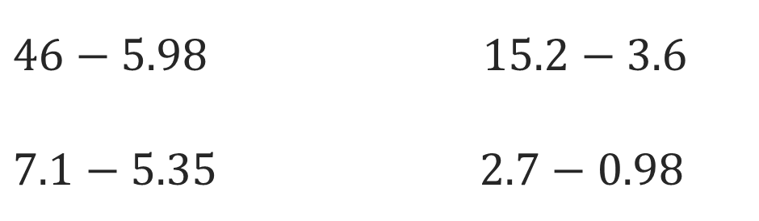
Or You Could
Explain how the information shown supports your reasoning.
5 / 42
Notes:
TEACH IN PRACTICE | Embedded facilitation | Lesson 6.2, slide 5 | WORKED
Focus on the existing task: Or You Could
LAUNCH (T2/3/5): Ask students to explain the displayed idea or example and point to evidence. When a calculation step is shown, ask why it is valid. Have a partner restate the explanation; copying is not the check.
LOOK FOR (T4): Where this task addresses it, students can represent mixed numbers accurately. Ask which feature of their work supports the claim.
RESPOND: If this task shows the lesson misconception—inverting the dividend or failing to convert a mixed number—mark equal-size fractional units in the given quantities before writing the equivalent division. Have the student revise and explain the change. Use this support only where the concept occurs in the current task; otherwise respond to the displayed question.
RECHECK: If a gap is shared, revisit the existing representation together. If it is limited, give targeted support while others compare valid methods on the same task. Check the revision before moving on.
PARTICIPATION (T5/6/7): Think time before volunteers; accept a written, drawn or rehearsed entry. Students ask for evidence respectfully. Recognize a specific contribution or revision and check that both partners participate.
Source: BCPS Updated Instructional Framework Rubric (June 2020), TEACH 1–7. Earlier notes and answer keys are retained below.
EARLIER NOTES / EXISTING ANSWER KEY
Model briefly, then hand the thinking back: ask “Why does this step work?” before showing the next one.
Quick check before moving on — thumbs or whiteboards from everyone, not volunteers.
UIFR: TEACH 2 · TEACH 3 · TEACH 4.

Slide 6
Today’s Objectives
Lesson 6-2 · Division Expressions with Fractions and Mixed Numbers
Division Expressions with Fractions and Mixed Numbers
Maryland Standard 6.NOS.1
CONTENT OBJECTIVE
LANGUAGE OBJECTIVE
Restate the goal in your words
Use these words to explain why
I can divide a fraction by a fraction and divide with mixed numbers by multiplying by the reciprocal.
I can explain the steps using the words reciprocal, improper fraction, mixed number, and simplify.
eduwonderlab.com · Neft Teacher
6 / 42
Notes:
TEACH IN PRACTICE | Embedded facilitation | Lesson 6.2, slide 6 | GOAL
Focus on the existing task: Today’s Objectives Division…
CONNECT (T1/4): Ask students to restate the displayed goal or key idea and connect it to earlier work. Relevant lesson evidence: represent mixed numbers accurately; connect fraction division to a model and reciprocal; check the result. Use only the criterion that matches the current session.
SHOW PROGRESS: Students point to their own existing work, explain what improved after feedback, and name a next step. Pair confidence ratings with actual evidence.
PARTICIPATION (T5/6/7): Think time before volunteers; accept a written, drawn or rehearsed entry. Students ask for evidence respectfully. Recognize a specific contribution or revision and check that both partners participate.
Source: BCPS Updated Instructional Framework Rubric (June 2020), TEACH 1–7. Earlier notes and answer keys are retained below.
EARLIER NOTES / EXISTING ANSWER KEY
Read the objective together, then have one or two students restate today’s goal in their own words.
Connect it to what the class learned last lesson.
Return to this goal at the end of class to check it was met.
UIFR: TEACH 1.
UIFR FULL | Lesson-specific facilitation
TEACH 1 | Session 1 purpose and evidence (UIFR PDF p. 8).
Have students restate the displayed session goal in their own words and connect it to the existing context or a familiar experience they choose to share. Use the current session goal to select from these lesson-wide evidence criteria; do not frontload a later-session procedure.
Look for: represent mixed numbers accurately; connect fraction division to a model and reciprocal; check the result. Ask: “Which part of your work would show this?” Revisit that evidence after the task; a confidence rating alone is not evidence of understanding.

Slide 7
STUDENT MOVES
Lesson 6-2
Your move
NAME THE MATH · Point to the part of this that is new today, and say what it changes.
7 / 42

Slide 8
LESSON 6.2 / OUR LEARNING
What will show your learning?
1
Represent mixed numbers accurately.
2
Connect fraction division to a model and reciprocal.
3
Check the result.
Tell a partner: Which skill connects to something you already know?
CONNECT IT · What earlier lesson does this build on? Tell a partner in one sentence.
Listen to understand. Ask for evidence. Make room for every voice.
Notes:
TEACH IN PRACTICE | Embedded facilitation | Lesson 6.2, slide 7 | PRIOR_INSERT
Focus on the existing task: LESSON 6.2 / OUR LEARNING What will show your learning?
CONNECT (T1/4): Ask students to restate the displayed goal or key idea and connect it to earlier work. Relevant lesson evidence: represent mixed numbers accurately; connect fraction division to a model and reciprocal; check the result. Use only the criterion that matches the current session.
SHOW PROGRESS: Students point to their own existing work, explain what improved after feedback, and name a next step. Pair confidence ratings with actual evidence.
PARTICIPATION (T5/6/7): Think time before volunteers; accept a written, drawn or rehearsed entry. Students ask for evidence respectfully. Recognize a specific contribution or revision and check that both partners participate.
Source: BCPS Updated Instructional Framework Rubric (June 2020), TEACH 1–7.

Slide 9
Vocabulary 1 of 8
Lesson 6-2 · Division Expressions with Fractions and Mixed Numbers
Divide Fractions
7 / 35
Multiply the first fraction by the reciprocal of the second fraction.
EXAMPLE · EXPLAIN WHY IT FITS
2/3 ÷ 1/4 = 2/3 × 4/1 = 8/3
Use “Divide Fractions” to explain the example. Point to
evidence.
eduwonderlab.com · Neft Teacher
Notes:
TEACH IN PRACTICE | Embedded facilitation | Lesson 6.2, slide 8 | VOCAB
Focus on the existing task: Vocabulary 1 of 8 Divide Fractions…
ASK (T1/3/5): Where does “Divide Fractions” appear in the example? Explain the meaning without reading the definition. Partner: restate the idea and ask a clarifying question.
LOOK FOR: A correct connection between the word and a feature of the example. If the student only repeats the definition, invite pointing, sketching or oral rehearsal, then ask for another explanation of this same example.
PARTICIPATION (T5/6/7): Think time before volunteers; accept a written, drawn or rehearsed entry. Students ask for evidence respectfully. Recognize a specific contribution or revision and check that both partners participate.
Source: BCPS Updated Instructional Framework Rubric (June 2020), TEACH 1–7.

Slide 10
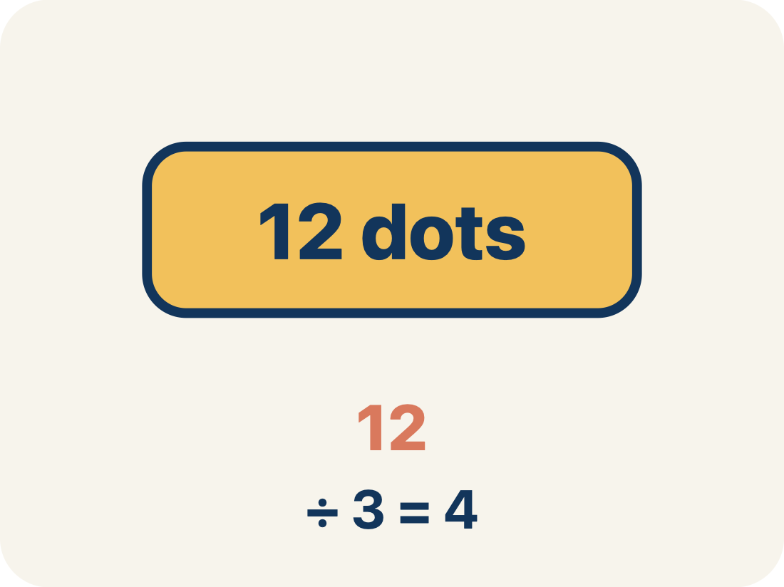
Vocabulary 2 of 8
Lesson 6-2 · Division Expressions with Fractions and Mixed Numbers
Dividend
8 / 35
The total number being divided into equal groups (the number inside the division bracket).
EXAMPLE · EXPLAIN WHY IT FITS
In 3/4 ÷ 1/2, the dividend is 3/4 — the total amount being split
Use “Dividend” to explain the example. Point to evidence.
eduwonderlab.com · Neft Teacher
Notes:
TEACH IN PRACTICE | Embedded facilitation | Lesson 6.2, slide 9 | VOCAB
Focus on the existing task: Vocabulary 2 of 8 Dividend The total…
ASK (T1/3/5): Where does “Dividend” appear in the example? Explain the meaning without reading the definition. Partner: restate the idea and ask a clarifying question.
LOOK FOR: A correct connection between the word and a feature of the example. If the student only repeats the definition, invite pointing, sketching or oral rehearsal, then ask for another explanation of this same example.
PARTICIPATION (T5/6/7): Think time before volunteers; accept a written, drawn or rehearsed entry. Students ask for evidence respectfully. Recognize a specific contribution or revision and check that both partners participate.
Source: BCPS Updated Instructional Framework Rubric (June 2020), TEACH 1–7.

Slide 11
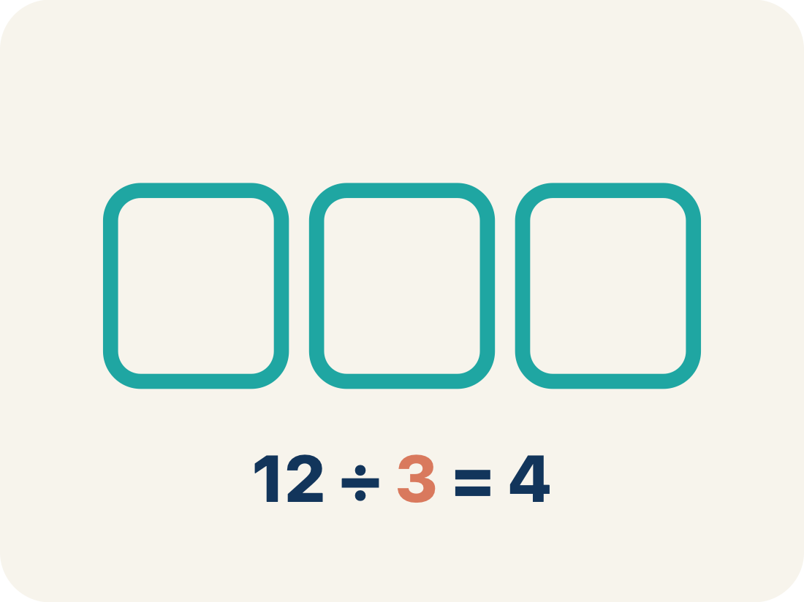
Vocabulary 3 of 8
Lesson 6-2 · Division Expressions with Fractions and Mixed Numbers
Divisor
9 / 35
The number of equal groups you are dividing into (the number outside the division bracket).
EXAMPLE · EXPLAIN WHY IT FITS
In 3/4 ÷ 1/2, the divisor is 1/2 — the size of each group
Use “Divisor” to explain the example. Point to evidence.
eduwonderlab.com · Neft Teacher
Notes:
TEACH IN PRACTICE | Embedded facilitation | Lesson 6.2, slide 10 | VOCAB
Focus on the existing task: Vocabulary 3 of 8 Divisor The number…
ASK (T1/3/5): Where does “Divisor” appear in the example? Explain the meaning without reading the definition. Partner: restate the idea and ask a clarifying question.
LOOK FOR: A correct connection between the word and a feature of the example. If the student only repeats the definition, invite pointing, sketching or oral rehearsal, then ask for another explanation of this same example.
PARTICIPATION (T5/6/7): Think time before volunteers; accept a written, drawn or rehearsed entry. Students ask for evidence respectfully. Recognize a specific contribution or revision and check that both partners participate.
Source: BCPS Updated Instructional Framework Rubric (June 2020), TEACH 1–7.

Slide 12
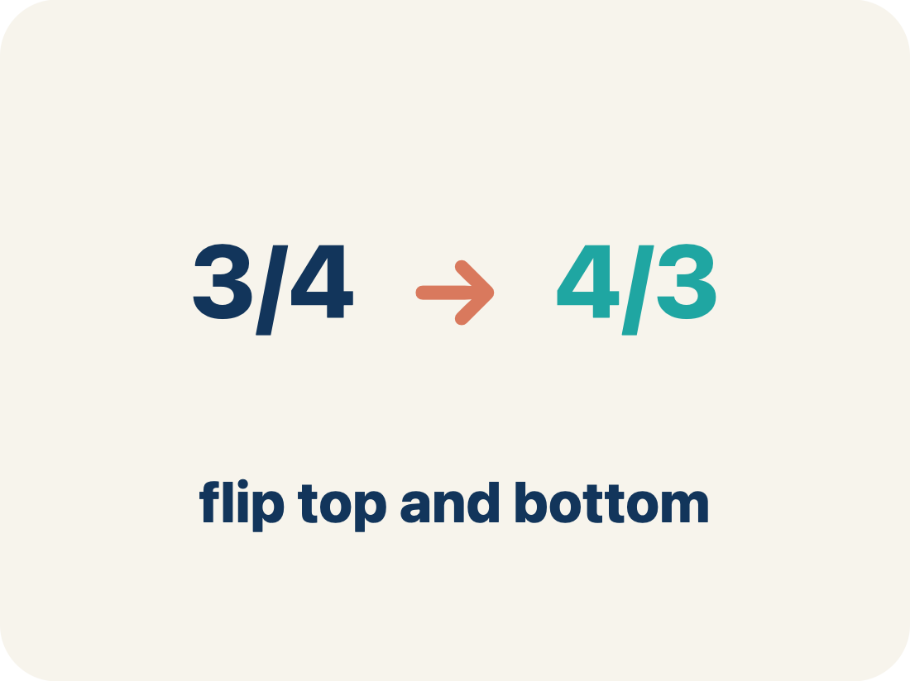
Vocabulary 4 of 8
Lesson 6-2 · Division Expressions with Fractions and Mixed Numbers
Reciprocal
10 / 35
A fraction turned upside down.
EXAMPLE · EXPLAIN WHY IT FITS
The reciprocal of 2/3 is 3/2. To divide by 2/3, multiply by 3/2.
Use “Reciprocal” to explain the example. Point to evidence.
eduwonderlab.com · Neft Teacher
Notes:
TEACH IN PRACTICE | Embedded facilitation | Lesson 6.2, slide 11 | VOCAB
Focus on the existing task: Vocabulary 4 of 8 Reciprocal A…
ASK (T1/3/5): Where does “Reciprocal” appear in the example? Explain the meaning without reading the definition. Partner: restate the idea and ask a clarifying question.
LOOK FOR: A correct connection between the word and a feature of the example. If the student only repeats the definition, invite pointing, sketching or oral rehearsal, then ask for another explanation of this same example.
PARTICIPATION (T5/6/7): Think time before volunteers; accept a written, drawn or rehearsed entry. Students ask for evidence respectfully. Recognize a specific contribution or revision and check that both partners participate.
Source: BCPS Updated Instructional Framework Rubric (June 2020), TEACH 1–7.

Slide 13
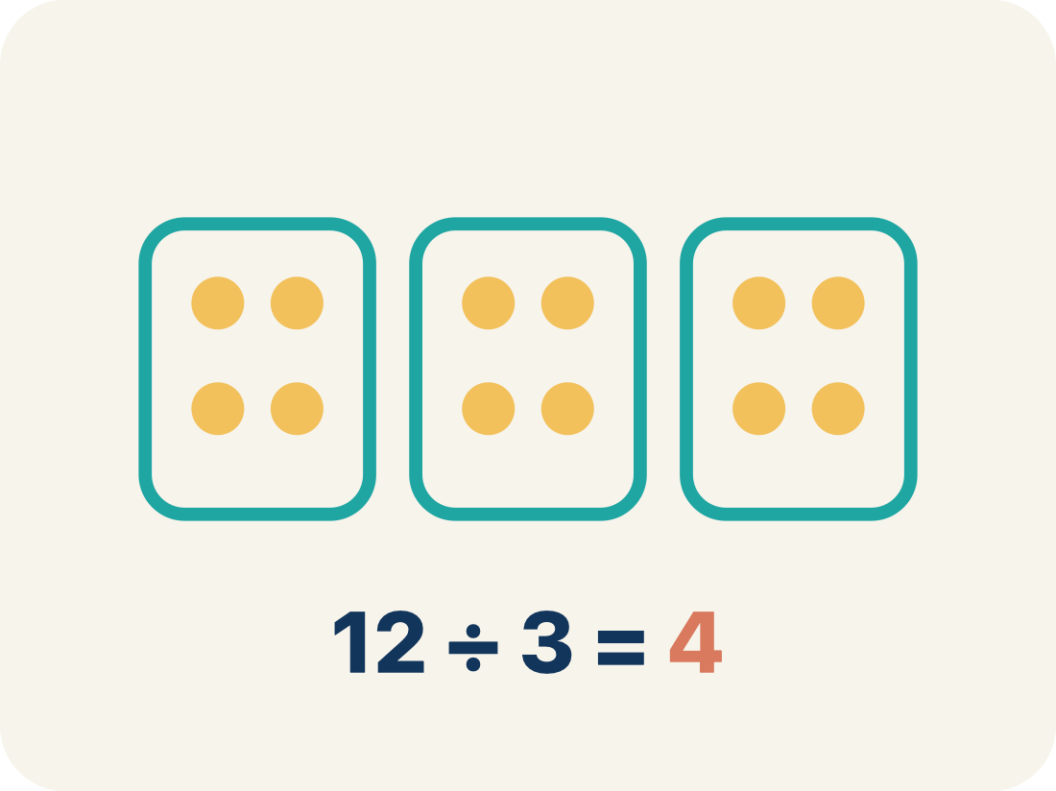
Vocabulary 5 of 8
Lesson 6-2 · Division Expressions with Fractions and Mixed Numbers
Quotient
11 / 35
The answer when you divide.
EXAMPLE · EXPLAIN WHY IT FITS
In 3/4 ÷ 1/4 = 3, the quotient is 3 — three 1/4-size pieces fit into 3/4
Use “Quotient” to explain the example. Point to evidence.
eduwonderlab.com · Neft Teacher
Notes:
TEACH IN PRACTICE | Embedded facilitation | Lesson 6.2, slide 12 | VOCAB
Focus on the existing task: Vocabulary 5 of 8 Quotient The…
ASK (T1/3/5): Where does “Quotient” appear in the example? Explain the meaning without reading the definition. Partner: restate the idea and ask a clarifying question.
LOOK FOR: A correct connection between the word and a feature of the example. If the student only repeats the definition, invite pointing, sketching or oral rehearsal, then ask for another explanation of this same example.
PARTICIPATION (T5/6/7): Think time before volunteers; accept a written, drawn or rehearsed entry. Students ask for evidence respectfully. Recognize a specific contribution or revision and check that both partners participate.
Source: BCPS Updated Instructional Framework Rubric (June 2020), TEACH 1–7.

Slide 14
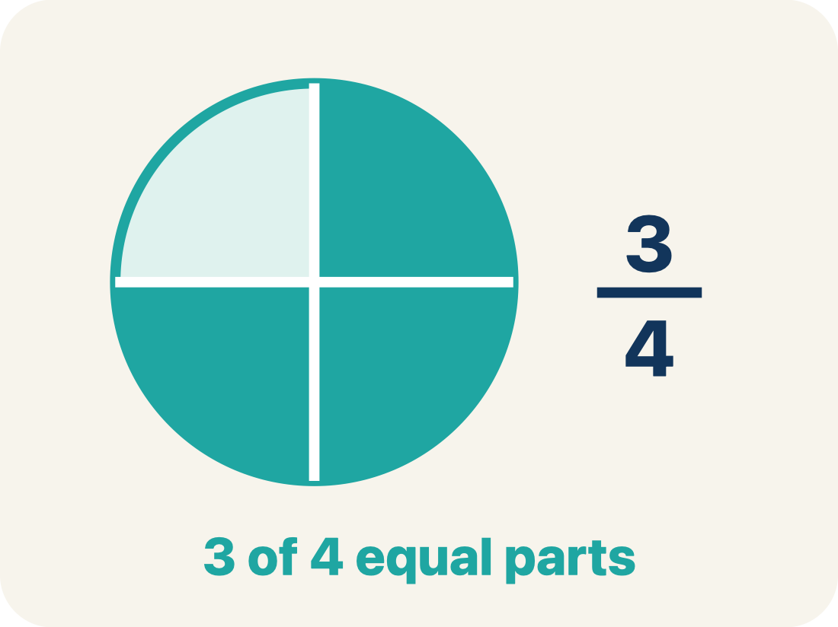
Vocabulary 6 of 8
Lesson 6-2 · Division Expressions with Fractions and Mixed Numbers
Simplify
12 / 35
To write a fraction with smaller numbers that names the same amount, like 2/4 = 1/2.
EXAMPLE · EXPLAIN WHY IT FITS
8/12 → GCF is 4 → 8÷4 / 12÷4 = 2/3
Use “Simplify” to explain the example. Point to evidence.
eduwonderlab.com · Neft Teacher
Notes:
TEACH IN PRACTICE | Embedded facilitation | Lesson 6.2, slide 13 | VOCAB
Focus on the existing task: Vocabulary 6 of 8 Simplify To write…
ASK (T1/3/5): Where does “Simplify” appear in the example? Explain the meaning without reading the definition. Partner: restate the idea and ask a clarifying question.
LOOK FOR: A correct connection between the word and a feature of the example. If the student only repeats the definition, invite pointing, sketching or oral rehearsal, then ask for another explanation of this same example.
PARTICIPATION (T5/6/7): Think time before volunteers; accept a written, drawn or rehearsed entry. Students ask for evidence respectfully. Recognize a specific contribution or revision and check that both partners participate.
Source: BCPS Updated Instructional Framework Rubric (June 2020), TEACH 1–7.

Slide 15
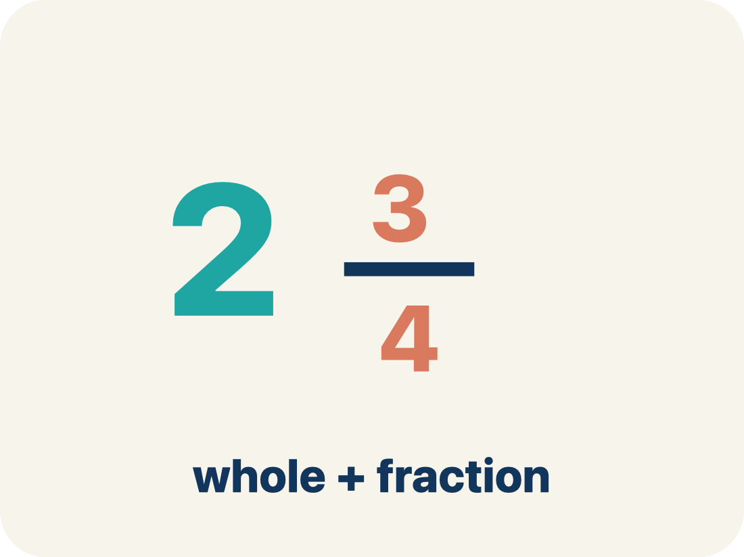
Vocabulary 7 of 8
Lesson 6-2 · Division Expressions with Fractions and Mixed Numbers
Mixed number
13 / 35
A whole number and a fraction written together, like 2 1/2. It must be rewritten as an improper fraction before dividing.
EXAMPLE · EXPLAIN WHY IT FITS
2 1/2 = 5/2
Use “Mixed number” to explain
the example. Point to evidence.
eduwonderlab.com · Neft Teacher
Notes:
TEACH IN PRACTICE | Embedded facilitation | Lesson 6.2, slide 14 | VOCAB
Focus on the existing task: Vocabulary 7 of 8 Mixed number A…
ASK (T1/3/5): Where does “Mixed number” appear in the example? Explain the meaning without reading the definition. Partner: restate the idea and ask a clarifying question.
LOOK FOR: A correct connection between the word and a feature of the example. If the student only repeats the definition, invite pointing, sketching or oral rehearsal, then ask for another explanation of this same example.
PARTICIPATION (T5/6/7): Think time before volunteers; accept a written, drawn or rehearsed entry. Students ask for evidence respectfully. Recognize a specific contribution or revision and check that both partners participate.
Source: BCPS Updated Instructional Framework Rubric (June 2020), TEACH 1–7.

Slide 16
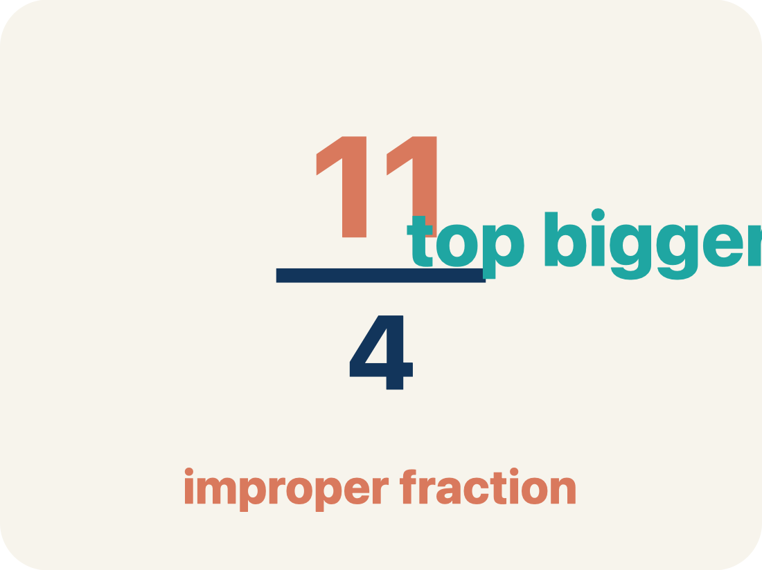
Vocabulary 8 of 8
Lesson 6-2 · Division Expressions with Fractions and Mixed Numbers
Improper fraction
14 / 35
A fraction whose numerator is greater than or equal to its denominator, like 5/2.
EXAMPLE · EXPLAIN WHY IT FITS
5/2 is the same amount as 2 1/2
Use “Improper fraction” to explain the example. Point to
evidence.
eduwonderlab.com · Neft Teacher
Notes:
TEACH IN PRACTICE | Embedded facilitation | Lesson 6.2, slide 15 | VOCAB
Focus on the existing task: Vocabulary 8 of 8 Improper fraction…
ASK (T1/3/5): Where does “Improper fraction” appear in the example? Explain the meaning without reading the definition. Partner: restate the idea and ask a clarifying question.
LOOK FOR: A correct connection between the word and a feature of the example. If the student only repeats the definition, invite pointing, sketching or oral rehearsal, then ask for another explanation of this same example.
PARTICIPATION (T5/6/7): Think time before volunteers; accept a written, drawn or rehearsed entry. Students ask for evidence respectfully. Recognize a specific contribution or revision and check that both partners participate.
Source: BCPS Updated Instructional Framework Rubric (June 2020), TEACH 1–7.

Slide 17
Vocabulary
Lesson 6-2 · Division Expressions with Fractions and Mixed Numbers
USE THE MATH WORDS · Use today’s math words in your explanation — not “it” and “that thing.”
Today’s Math Words
We learn every word — what it means and what it looks like — before we use it.
Divide Fractions
Dividend
Multiply the first fraction by the reciprocal of the second fraction
The total number being divided into equal groups (the number inside the division bracket)
Divisor
Reciprocal
The number of equal groups you are dividing into (the number outside the division bracket)
A fraction turned upside down
Quotient
Simplify
The answer when you divide
To write a fraction with smaller numbers that names the same amount, like 2/4 = 1/2
Mixed number
Improper fraction
A whole number and a fraction written together, like 2 1/2
A fraction whose numerator is greater than or equal to its denominator, like 5/2
eduwonderlab.com · Neft Teacher
17 / 42
Notes:
TEACH IN PRACTICE | Embedded facilitation | Lesson 6.2, slide 16 | VOCAB
Focus on the existing task: Vocabulary Today’s Math Words We…
ASK (T1/3/5): Where does “the displayed term” appear in the example? Explain the meaning without reading the definition. Partner: restate the idea and ask a clarifying question.
LOOK FOR: A correct connection between the word and a feature of the example. If the student only repeats the definition, invite pointing, sketching or oral rehearsal, then ask for another explanation of this same example.
PARTICIPATION (T5/6/7): Think time before volunteers; accept a written, drawn or rehearsed entry. Students ask for evidence respectfully. Recognize a specific contribution or revision and check that both partners participate.
Source: BCPS Updated Instructional Framework Rubric (June 2020), TEACH 1–7. Earlier notes and answer keys are retained below.
EARLIER NOTES / EXISTING ANSWER KEY
Choral-read each word, its meaning, and what it looks like.
Students should use these words out loud today — listen for them in partner talk and revoice student ideas with the academic term.
UIFR: TEACH 1 · TEACH 5.

Slide 18

Be Curious
What’s the question?
Eduardo is making bows for cancer awareness. He has a certain amount of ribbon and uses the same length for each bow.
Think first. Share a notice and a question;
build on a classmate’s idea.
Mindset
What helps you get started on a math activity?
18 / 42
Notes:
TEACH IN PRACTICE | Embedded facilitation | Lesson 6.2, slide 17 | CURIOUS
Focus on the existing task: What’s the question?
LAUNCH (T2/3/5): Allow quiet observation first. Separate a notice from an inference, invite students’ own questions, and follow the existing launch before teaching a procedure.
LOOK FOR (T4): Where this task addresses it, students can represent mixed numbers accurately. Ask which feature of their work supports the claim.
RESPOND: If this task shows the lesson misconception—inverting the dividend or failing to convert a mixed number—mark equal-size fractional units in the given quantities before writing the equivalent division. Have the student revise and explain the change. Use this support only where the concept occurs in the current task; otherwise respond to the displayed question.
RECHECK: If a gap is shared, revisit the existing representation together. If it is limited, give targeted support while others compare valid methods on the same task. Check the revision before moving on.
PARTICIPATION (T5/6/7): Think time before volunteers; accept a written, drawn or rehearsed entry. Students ask for evidence respectfully. Recognize a specific contribution or revision and check that both partners participate.
Source: BCPS Updated Instructional Framework Rubric (June 2020), TEACH 1–7. Earlier notes and answer keys are retained below.
EARLIER NOTES / EXISTING ANSWER KEY
Accept all noticings and wonderings — there are no wrong answers here.
Give 20–30 seconds of quiet think time before taking responses; mix cold and warm calls so it is not always the same voices.
Read the mindset question aloud and let two students respond.
UIFR: TEACH 3 · TEACH 7.

Slide 19
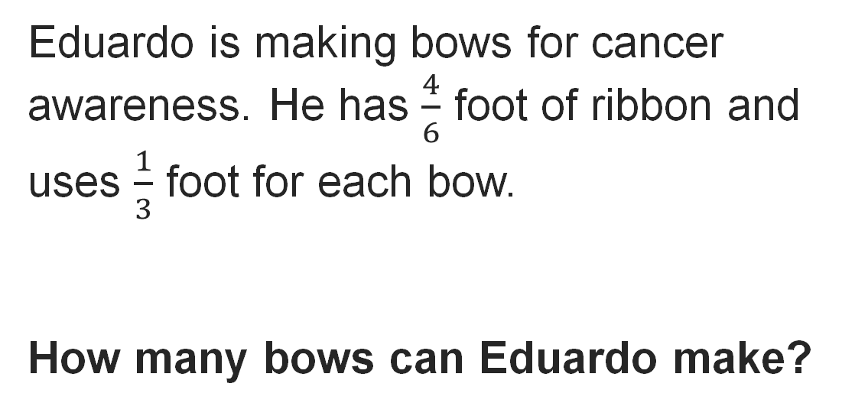

Making Bows
Explain how the information shown supports your reasoning.
19 / 42
Notes:
TEACH IN PRACTICE | Embedded facilitation | Lesson 6.2, slide 18 | WORKED
Focus on the existing task: Making Bows
LAUNCH (T2/3/5): Ask students to explain the displayed idea or example and point to evidence. When a calculation step is shown, ask why it is valid. Have a partner restate the explanation; copying is not the check.
LOOK FOR (T4): Where this task addresses it, students can represent mixed numbers accurately. Ask which feature of their work supports the claim.
RESPOND: If this task shows the lesson misconception—inverting the dividend or failing to convert a mixed number—mark equal-size fractional units in the given quantities before writing the equivalent division. Have the student revise and explain the change. Use this support only where the concept occurs in the current task; otherwise respond to the displayed question.
RECHECK: If a gap is shared, revisit the existing representation together. If it is limited, give targeted support while others compare valid methods on the same task. Check the revision before moving on.
PARTICIPATION (T5/6/7): Think time before volunteers; accept a written, drawn or rehearsed entry. Students ask for evidence respectfully. Recognize a specific contribution or revision and check that both partners participate.
Source: BCPS Updated Instructional Framework Rubric (June 2020), TEACH 1–7. Earlier notes and answer keys are retained below.
EARLIER NOTES / EXISTING ANSWER KEY
Model briefly, then hand the thinking back: ask “Why does this step work?” before showing the next one.
Quick check before moving on — thumbs or whiteboards from everyone, not volunteers.
UIFR: TEACH 2 · TEACH 3 · TEACH 4.

Slide 20
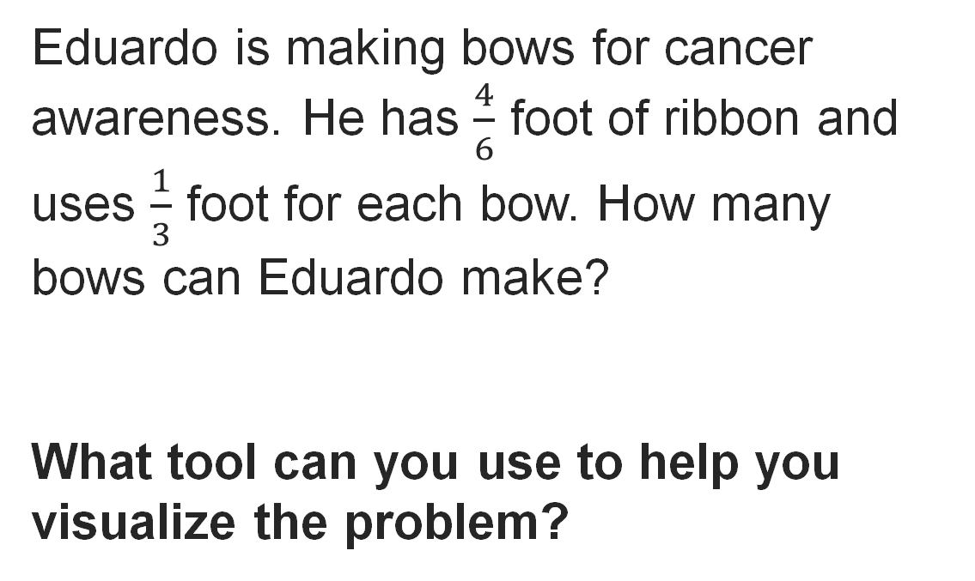
Making Bows
Reveal:
One tool is a tape diagram.
Record your reasoning before the
reveal. Compare, then explain
any revision.
20 / 42
Notes:
TEACH IN PRACTICE | Embedded facilitation | Lesson 6.2, slide 19 | REVEAL
Focus on the existing task: Reveal: One tool is a tape diagram. Making Bows
LAUNCH (T2/3/5): If an existing answer cover is present, gather an attempt before revealing. If the explanation is already visible, ask students to reconstruct and justify it. Compare reasoning and explain a revision; preserve the reveal sequence.
LOOK FOR (T4): Where this task addresses it, students can represent mixed numbers accurately. Ask which feature of their work supports the claim.
RESPOND: If this task shows the lesson misconception—inverting the dividend or failing to convert a mixed number—mark equal-size fractional units in the given quantities before writing the equivalent division. Have the student revise and explain the change. Use this support only where the concept occurs in the current task; otherwise respond to the displayed question.
RECHECK: If a gap is shared, revisit the existing representation together. If it is limited, give targeted support while others compare valid methods on the same task. Check the revision before moving on.
PARTICIPATION (T5/6/7): Think time before volunteers; accept a written, drawn or rehearsed entry. Students ask for evidence respectfully. Recognize a specific contribution or revision and check that both partners participate.
Source: BCPS Updated Instructional Framework Rubric (June 2020), TEACH 1–7. Earlier notes and answer keys are retained below.
EARLIER NOTES / EXISTING ANSWER KEY
Do not click yet: collect 2–3 student answers with reasons first.
Then click to remove the cover and have students compare their thinking to the reveal — “Is this what we said? Where is it different?”
Behind the cover: One tool is a tape diagram.
UIFR: TEACH 3 · TEACH 4.

Slide 21
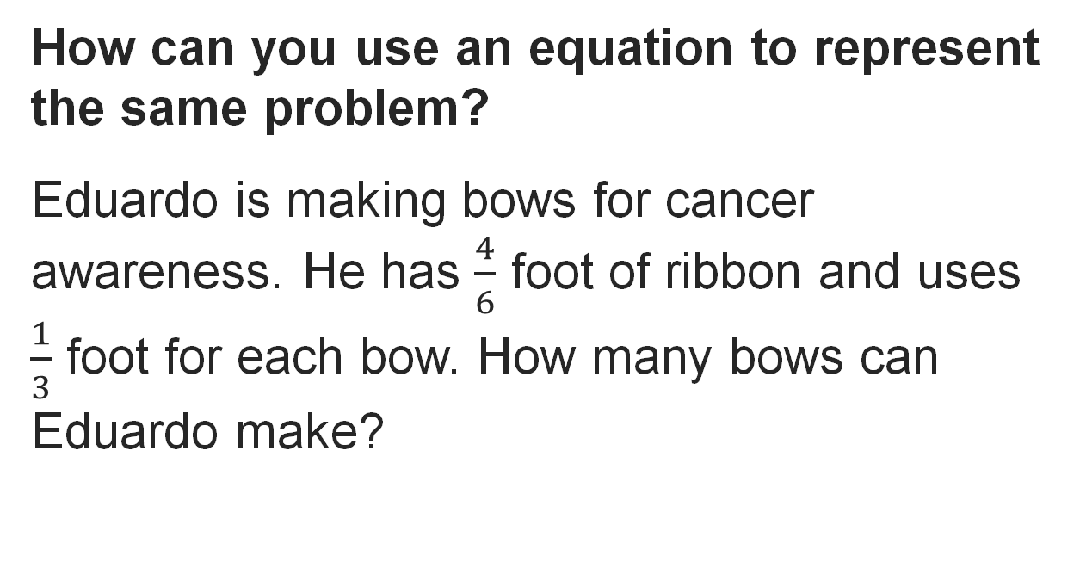
Making Bows
Reveal:
We can write a division equation.
Record your reasoning before the
reveal. Compare, then explain
any revision.
21 / 42
Notes:
TEACH IN PRACTICE | Embedded facilitation | Lesson 6.2, slide 20 | REVEAL
Focus on the existing task: Reveal: We can write a division equation. Making Bows
LAUNCH (T2/3/5): If an existing answer cover is present, gather an attempt before revealing. If the explanation is already visible, ask students to reconstruct and justify it. Compare reasoning and explain a revision; preserve the reveal sequence.
LOOK FOR (T4): Where this task addresses it, students can connect fraction division to a model and reciprocal. Ask which feature of their work supports the claim.
RESPOND: If this task shows the lesson misconception—inverting the dividend or failing to convert a mixed number—mark equal-size fractional units in the given quantities before writing the equivalent division. Have the student revise and explain the change. Use this support only where the concept occurs in the current task; otherwise respond to the displayed question.
RECHECK: If a gap is shared, revisit the existing representation together. If it is limited, give targeted support while others compare valid methods on the same task. Check the revision before moving on.
PARTICIPATION (T5/6/7): Think time before volunteers; accept a written, drawn or rehearsed entry. Students ask for evidence respectfully. Recognize a specific contribution or revision and check that both partners participate.
Source: BCPS Updated Instructional Framework Rubric (June 2020), TEACH 1–7. Earlier notes and answer keys are retained below.
EARLIER NOTES / EXISTING ANSWER KEY
Do not click yet: collect 2–3 student answers with reasons first.
Then click to remove the cover and have students compare their thinking to the reveal — “Is this what we said? Where is it different?”
Behind the cover: We can write a division equation.
UIFR: TEACH 3 · TEACH 4.

Slide 22
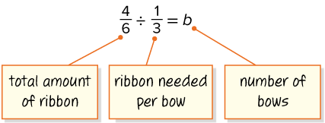
Making Bows
Let’s represent the problem with a division equation.
How can you use multiplication to find the unknown?
HOW DO YOU KNOW? · Ask your partner “How do you know?” Answer by pointing to your own work.
Reveal:
We can write an equivalent multiplication expression using the reciprocal of the divisor.
22 / 42
Notes:
TEACH IN PRACTICE | Embedded facilitation | Lesson 6.2, slide 21 | REVEAL
Focus on the existing task: Let’s represent the problem with a division equation. How can you use multiplication to find the unknown?
LAUNCH (T2/3/5): If an existing answer cover is present, gather an attempt before revealing. If the explanation is already visible, ask students to reconstruct and justify it. Compare reasoning and explain a revision; preserve the reveal sequence.
LOOK FOR (T4): Where this task addresses it, students can connect fraction division to a model and reciprocal. Ask which feature of their work supports the claim.
RESPOND: If this task shows the lesson misconception—inverting the dividend or failing to convert a mixed number—mark equal-size fractional units in the given quantities before writing the equivalent division. Have the student revise and explain the change. Use this support only where the concept occurs in the current task; otherwise respond to the displayed question.
RECHECK: If a gap is shared, revisit the existing representation together. If it is limited, give targeted support while others compare valid methods on the same task. Check the revision before moving on.
PARTICIPATION (T5/6/7): Think time before volunteers; accept a written, drawn or rehearsed entry. Students ask for evidence respectfully. Recognize a specific contribution or revision and check that both partners participate.
Source: BCPS Updated Instructional Framework Rubric (June 2020), TEACH 1–7. Earlier notes and answer keys are retained below.
EARLIER NOTES / EXISTING ANSWER KEY
Do not click yet: collect 2–3 student answers with reasons first.
Then click to remove the cover and have students compare their thinking to the reveal — “Is this what we said? Where is it different?”
Behind the cover: We can write an equivalent multiplication expression using the reciprocal of the divisor.
UIFR: TEACH 3 · TEACH 4.
UIFR FULL | Lesson-specific facilitation
TEACH 2-3 | Session 1 task launch (UIFR PDF pp. 9-10).
Use the problem exactly as displayed. Give individual thinking time before discussion or advancing to the explanation. If the answer is already visible, ask students to reconstruct and justify it. Invite a choice of suitable representations and have students explain why their choice helps.
At the point where this concept appears, ask: “How does the model justify the quotient, and which multiplication checks it?” Wait for evidence, invite another pathway, and have a student ask a follow-up question. Do not replace students’ reasoning with a sequence of leading steps.

Slide 23
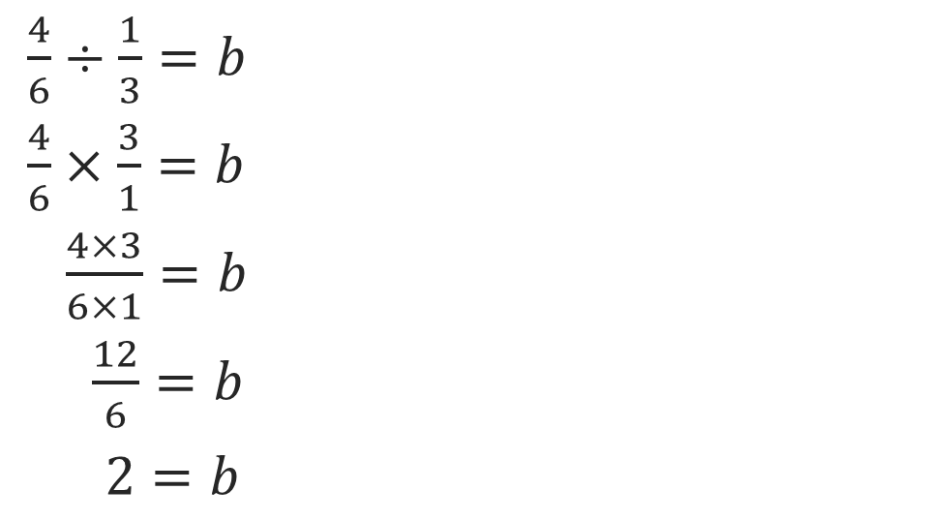
Making Bows
Let’s write and solve an equivalent multiplication equation using the multiplicative inverse, or reciprocal of the divisor to solve.
How can you interpret the product?
Reveal:
The product tells us the number of bows Eduardo can make.
23 / 42
Notes:
TEACH IN PRACTICE | Embedded facilitation | Lesson 6.2, slide 22 | REVEAL
Focus on the existing task: Let’s write and solve an equivalent multiplication equation using the multiplicative inverse, or reciprocal of the divisor to solve. How can you interpret the product?
LAUNCH (T2/3/5): If an existing answer cover is present, gather an attempt before revealing. If the explanation is already visible, ask students to reconstruct and justify it. Compare reasoning and explain a revision; preserve the reveal sequence.
LOOK FOR (T4): Where this task addresses it, students can connect fraction division to a model and reciprocal. Ask which feature of their work supports the claim.
RESPOND: If this task shows the lesson misconception—inverting the dividend or failing to convert a mixed number—mark equal-size fractional units in the given quantities before writing the equivalent division. Have the student revise and explain the change. Use this support only where the concept occurs in the current task; otherwise respond to the displayed question.
RECHECK: If a gap is shared, revisit the existing representation together. If it is limited, give targeted support while others compare valid methods on the same task. Check the revision before moving on.
PARTICIPATION (T5/6/7): Think time before volunteers; accept a written, drawn or rehearsed entry. Students ask for evidence respectfully. Recognize a specific contribution or revision and check that both partners participate.
Source: BCPS Updated Instructional Framework Rubric (June 2020), TEACH 1–7. Earlier notes and answer keys are retained below.
EARLIER NOTES / EXISTING ANSWER KEY
Do not click yet: collect 2–3 student answers with reasons first.
Then click to remove the cover and have students compare their thinking to the reveal — “Is this what we said? Where is it different?”
Behind the cover: The product tells us the number of bows Eduardo can make.
UIFR: TEACH 3 · TEACH 4.

Slide 24
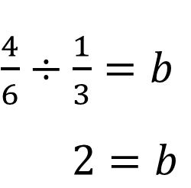
Let’s Explore More
What do you notice about the quotient when dividing two fractions?
Workspace
24 / 42
Notes:
TEACH IN PRACTICE | Embedded facilitation | Lesson 6.2, slide 23 | PRACTICE
Focus on the existing task: Workspace What do you notice about the quotient when dividing two fractions?
LAUNCH (T2/3/5): Use the displayed question. Give private thinking time; then A explains while B asks for evidence. Switch roles. Each student records their own reasoning.
LOOK FOR (T4): Where this task addresses it, students can represent mixed numbers accurately. Ask which feature of their work supports the claim.
RESPOND: If this task shows the lesson misconception—inverting the dividend or failing to convert a mixed number—mark equal-size fractional units in the given quantities before writing the equivalent division. Have the student revise and explain the change. Use this support only where the concept occurs in the current task; otherwise respond to the displayed question.
RECHECK: If a gap is shared, revisit the existing representation together. If it is limited, give targeted support while others compare valid methods on the same task. Check the revision before moving on.
PARTICIPATION (T5/6/7): Think time before volunteers; accept a written, drawn or rehearsed entry. Students ask for evidence respectfully. Recognize a specific contribution or revision and check that both partners participate.
Source: BCPS Updated Instructional Framework Rubric (June 2020), TEACH 1–7. Earlier notes and answer keys are retained below.
EARLIER NOTES / EXISTING ANSWER KEY
Extension for partners or table groups — students choose their approach and use the workspace to show thinking.
Push with “Convince me,” and have two groups with different approaches share.
This is where students stretch past the worked example.
UIFR: TEACH 2 · TEACH 5.
UIFR FULL | Lesson-specific facilitation
TEACH 4-5 | Session 1 discussion and checkpoint (UIFR PDF pp. 11-12).
Collect a brief response from every student to the existing prompt before hearing volunteers. Partners take turns explaining and asking for evidence: “I understand ___; what supports ___?” Offer rehearsal or an annotated model for students who need language support. Each student records their own reasoning.
Look specifically for: inverting the dividend or failing to convert a mixed number. If it appears, mark equal-size fractional units in the given quantities before writing the equivalent division; then ask the student to revise the same response and explain the change. If evidence is secure, have students compare a second valid pathway or state why their approach works. Choose the next step from the responses, not a preset pace.

Slide 25
STUDENT MOVES
Lesson 6-2
Your moves
TWO MINUTES SOLO · Two minutes on your own, then compare. Bring one thing you tried, even if it did not work.
ASK THE CLASS · Write one question about this that you could ask the class.
25 / 42

Slide 26
LESSON 6.2 / DISCUSS THE TASK
Explain and compare
Use the task you just explored.
TAKE TURNS
How does the model justify the quotient, and which multiplication checks it?
Explain
“I know this because…”
Ask
“Where does your work show that?”
Point to evidence in your work.
Then compare your approach with a partner’s.
JUSTIFY IT · Say it like this: “I know ______ because ______.”
Listen to understand. Ask for evidence. Make room for every voice.
Notes:
TEACH IN PRACTICE | Embedded facilitation | Lesson 6.2, slide 24 | PRIOR_INSERT
Focus on the existing task: Point to evidence in your work. Then compare your approach with a partner’s. TAKE TURNS Explain “I know this because…” Ask “Where does your work show that?
CONNECT (T1/4): Ask students to restate the displayed goal or key idea and connect it to earlier work. Relevant lesson evidence: represent mixed numbers accurately; connect fraction division to a model and reciprocal; check the result. Use only the criterion that matches the current session.
SHOW PROGRESS: Students point to their own existing work, explain what improved after feedback, and name a next step. Pair confidence ratings with actual evidence.
PARTICIPATION (T5/6/7): Think time before volunteers; accept a written, drawn or rehearsed entry. Students ask for evidence respectfully. Recognize a specific contribution or revision and check that both partners participate.
Source: BCPS Updated Instructional Framework Rubric (June 2020), TEACH 1–7.

Slide 27
Making Bows
Let’s represent the problem with a division equation.
How can you use multiplication to find the unknown?
23 / 35
ADD ON · Add on: “I agree because ______.” or “I see it differently because ______.”
Reveal:
We can write an equivalent multiplication expression using the reciprocal of the divisor.
Notes:
TEACH IN PRACTICE | Embedded facilitation | Lesson 6.2, slide 25 | REVEAL
Focus on the existing task: Let’s represent the problem with a division equation. How can you use multiplication to find the unknown?
LAUNCH (T2/3/5): If an existing answer cover is present, gather an attempt before revealing. If the explanation is already visible, ask students to reconstruct and justify it. Compare reasoning and explain a revision; preserve the reveal sequence.
LOOK FOR (T4): Where this task addresses it, students can connect fraction division to a model and reciprocal. Ask which feature of their work supports the claim.
RESPOND: If this task shows the lesson misconception—inverting the dividend or failing to convert a mixed number—mark equal-size fractional units in the given quantities before writing the equivalent division. Have the student revise and explain the change. Use this support only where the concept occurs in the current task; otherwise respond to the displayed question.
RECHECK: If a gap is shared, revisit the existing representation together. If it is limited, give targeted support while others compare valid methods on the same task. Check the revision before moving on.
PARTICIPATION (T5/6/7): Think time before volunteers; accept a written, drawn or rehearsed entry. Students ask for evidence respectfully. Recognize a specific contribution or revision and check that both partners participate.
Source: BCPS Updated Instructional Framework Rubric (June 2020), TEACH 1–7.

Slide 28
Warm-Up
Lesson 6-2 · Division Expressions with Fractions and Mixed Numbers
Session 2 Warm-Up
Try alone. Explain one. Then revise.
1
What is the first step when dividing mixed numbers?
2
What is 1 ½ written as an improper fraction?
A
Add whole parts
A
24 / 35
B
Convert mixed numbers to improper fractions
B
24 / 35
C
Cross multiply
C
24 / 35
D
Divide numerators
D
24 / 35
3
What is 3/4 ÷ 1/2?
4
When dividing fractions a/b ÷ c/d, calculate:
A
24 / 35
A
(a × c) / (b × d)
B
6/4 or 1 ½
B
(a × d) / (b × c)
C
24 / 35
C
(a + d) / (b + c)
D
24 / 35
D
(a − c) / (b − d)
eduwonderlab.com · Neft Teacher
28 / 42
Notes:
TEACH IN PRACTICE | Embedded facilitation | Lesson 6.2, slide 26 | WARMUP
Focus on the existing task: A Add whole parts B Convert mixed numbers to improper fractions C Cross multiply D Divide numerators 2 What is 1 ½ written as an improper fraction?
GATHER EVIDENCE (T4/6): Keep the original items. Students try independently, mark an uncertain item, and explain one method before checking. Use the existing key when present.
RESPOND: Distinguish a calculation slip from a reasoning gap. Give one next step on the same item; have students revise in a second color. Use the responses to choose flexible support for today’s lesson.
PARTICIPATION (T5/6/7): Think time before volunteers; accept a written, drawn or rehearsed entry. Students ask for evidence respectfully. Recognize a specific contribution or revision and check that both partners participate.
Source: BCPS Updated Instructional Framework Rubric (June 2020), TEACH 1–7. Earlier notes and answer keys are retained below.
EARLIER NOTES / EXISTING ANSWER KEY
Warm-up routine: students start silently on entry; keep it to about 4 minutes.
Circulate and note who is stuck — use what you see to choose who you check on first today.
Go over answers quickly; ask one student to explain a step, not just say the answer.
UIFR: TEACH 4 · TEACH 6.

Slide 29
STUDENT MOVES
Lesson 6-2
Your move
YOU KNOW THE ROUTINE · Read → plan → solve → check. Do all four, in that order.
29 / 42

Slide 30
Review Notes — Session 2
Lesson 6-2 · Division Expressions with Fractions and Mixed Numbers
Session 2: Review Notes
Copy. Explain. Check.
SHOW YOUR THINKING · Show what you know — write it, draw it, or build it. A picture counts as an explanation.
Improper Fraction Conversion
1
Always convert mixed numbers to improper fractions before applying multiplication rules.
Invert and Multiply
2
Keep the first fraction, change division to multiplication, and flip the second fraction.
Simplification
3
Simplify common factors between numerators and denominators before multiplying.
eduwonderlab.com · Neft Teacher
30 / 42
Notes:
TEACH IN PRACTICE | Embedded facilitation | Lesson 6.2, slide 27 | NOTES
Focus on the existing task: Review Notes — Session 2 Session 2…
ROUTINE (T1/2/4): Read or copy the original notes, cover one line, and explain it using the displayed example. Reopen and correct. Copying alone is not evidence of understanding.
LOOK FOR: A link between a symbol, quantity or feature and the explanation. If missing, point back to that feature and have the student try again; fade the prompt once they can explain.
PARTICIPATION (T5/6/7): Think time before volunteers; accept a written, drawn or rehearsed entry. Students ask for evidence respectfully. Recognize a specific contribution or revision and check that both partners participate.
Source: BCPS Updated Instructional Framework Rubric (June 2020), TEACH 1–7. Earlier notes and answer keys are retained below.
EARLIER NOTES / EXISTING ANSWER KEY
Copy routine: read one line at a time; students copy, then explain that line to a partner.
Keep it brisk — the understanding work happens in the examples, not the copying.
UIFR: TEACH 1 · TEACH 6.

Slide 31
Session 2
Division Expressions with Fractions and
Mixed Numbers
SELF-CHECK · Mark it: ✓ got it · ~ almost · ? stuck. Then fix one thing before we move on.
31 / 42
Notes:
TEACH IN PRACTICE | Embedded facilitation | Lesson 6.2, slide 28 | DIVIDER
Focus on the existing task: Division Expressions with Fractions and Mixed Numbers Session 2
TRANSITION (T6/7): Students confirm materials, roles, how to request help, and the next response routine. Ask a student to restate it. Keep teacher-only slides hidden.
PARTICIPATION (T5/6/7): Think time before volunteers; accept a written, drawn or rehearsed entry. Students ask for evidence respectfully. Recognize a specific contribution or revision and check that both partners participate.
Source: BCPS Updated Instructional Framework Rubric (June 2020), TEACH 1–7. Earlier notes and answer keys are retained below.
EARLIER NOTES / EXISTING ANSWER KEY
Transition cue: state what materials are out and what success looks like this session.
Keep the changeover under a minute.
UIFR: TEACH 6.

Slide 32
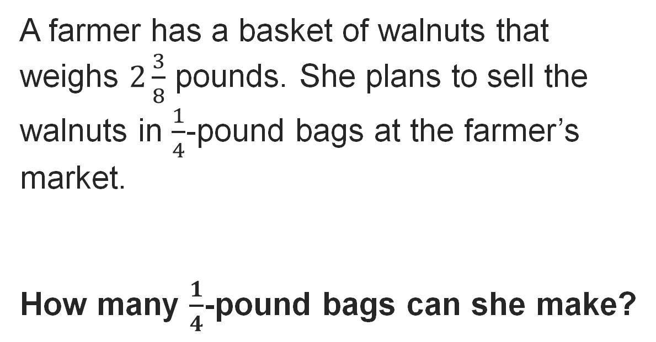
Farmers’ Market
Explain how the information shown supports your reasoning.
32 / 42
Notes:
TEACH IN PRACTICE | Embedded facilitation | Lesson 6.2, slide 29 | WORKED
Focus on the existing task: Farmers’ Market
LAUNCH (T2/3/5): Ask students to explain the displayed idea or example and point to evidence. When a calculation step is shown, ask why it is valid. Have a partner restate the explanation; copying is not the check.
LOOK FOR (T4): Where this task addresses it, students can represent mixed numbers accurately. Ask which feature of their work supports the claim.
RESPOND: If this task shows the lesson misconception—inverting the dividend or failing to convert a mixed number—mark equal-size fractional units in the given quantities before writing the equivalent division. Have the student revise and explain the change. Use this support only where the concept occurs in the current task; otherwise respond to the displayed question.
RECHECK: If a gap is shared, revisit the existing representation together. If it is limited, give targeted support while others compare valid methods on the same task. Check the revision before moving on.
PARTICIPATION (T5/6/7): Think time before volunteers; accept a written, drawn or rehearsed entry. Students ask for evidence respectfully. Recognize a specific contribution or revision and check that both partners participate.
Source: BCPS Updated Instructional Framework Rubric (June 2020), TEACH 1–7. Earlier notes and answer keys are retained below.
EARLIER NOTES / EXISTING ANSWER KEY
Model briefly, then hand the thinking back: ask “Why does this step work?” before showing the next one.
Quick check before moving on — thumbs or whiteboards from everyone, not volunteers.
UIFR: TEACH 2 · TEACH 3 · TEACH 4.

Slide 33
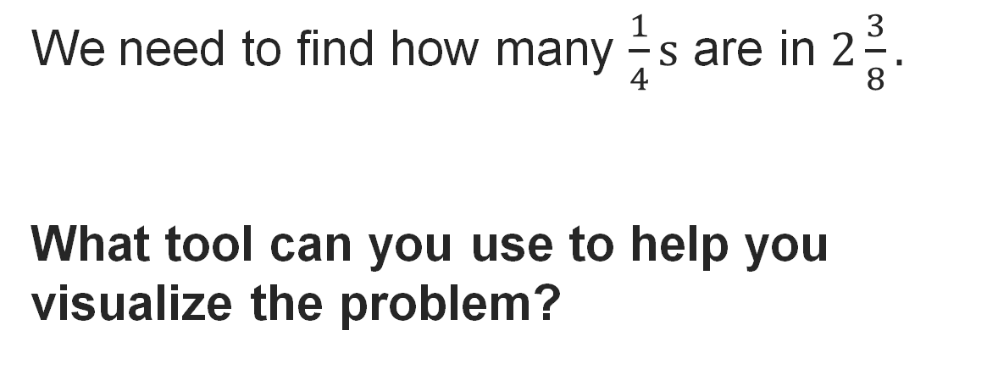
Farmers’ Market
Record your reasoning before the reveal. Compare, then explain any revision.
Reveal:
One tool is a tape diagram.
33 / 42
Notes:
TEACH IN PRACTICE | Embedded facilitation | Lesson 6.2, slide 30 | REVEAL
Focus on the existing task: Reveal: One tool is a tape diagram. Farmers’ Market
LAUNCH (T2/3/5): If an existing answer cover is present, gather an attempt before revealing. If the explanation is already visible, ask students to reconstruct and justify it. Compare reasoning and explain a revision; preserve the reveal sequence.
LOOK FOR (T4): Where this task addresses it, students can represent mixed numbers accurately. Ask which feature of their work supports the claim.
RESPOND: If this task shows the lesson misconception—inverting the dividend or failing to convert a mixed number—mark equal-size fractional units in the given quantities before writing the equivalent division. Have the student revise and explain the change. Use this support only where the concept occurs in the current task; otherwise respond to the displayed question.
RECHECK: If a gap is shared, revisit the existing representation together. If it is limited, give targeted support while others compare valid methods on the same task. Check the revision before moving on.
PARTICIPATION (T5/6/7): Think time before volunteers; accept a written, drawn or rehearsed entry. Students ask for evidence respectfully. Recognize a specific contribution or revision and check that both partners participate.
Source: BCPS Updated Instructional Framework Rubric (June 2020), TEACH 1–7. Earlier notes and answer keys are retained below.
EARLIER NOTES / EXISTING ANSWER KEY
Do not click yet: collect 2–3 student answers with reasons first.
Then click to remove the cover and have students compare their thinking to the reveal — “Is this what we said? Where is it different?”
Behind the cover: One tool is a tape diagram.
UIFR: TEACH 3 · TEACH 4.

Slide 34
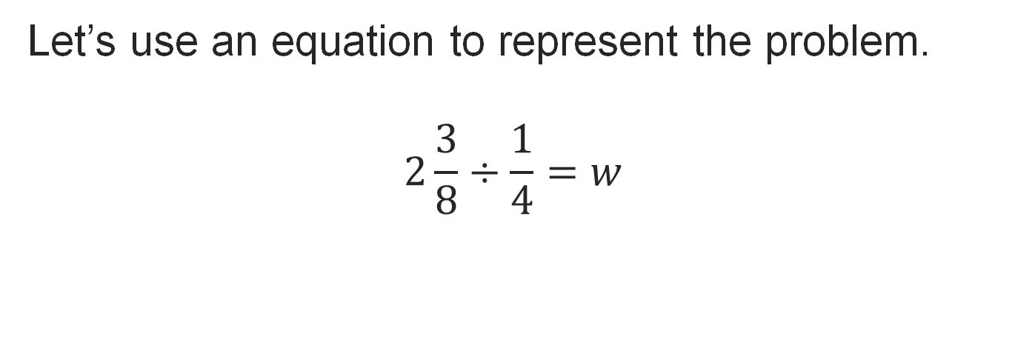
Farmers’ Market
Think About It:
Do you need to find common denominators when dividing fractions?
Think and record first. Which part of your work supports your answer?
34 / 42
Notes:
TEACH IN PRACTICE | Embedded facilitation | Lesson 6.2, slide 31 | TASK
Focus on the existing task: Think About It: Do you need to find common denominators when dividing fractions?
LAUNCH (T2/3/5): Use the displayed question. Give private thinking time; then A explains while B asks for evidence. Switch roles. Each student records their own reasoning.
LOOK FOR (T4): Where this task addresses it, students can represent mixed numbers accurately. Ask which feature of their work supports the claim.
RESPOND: If this task shows the lesson misconception—inverting the dividend or failing to convert a mixed number—mark equal-size fractional units in the given quantities before writing the equivalent division. Have the student revise and explain the change. Use this support only where the concept occurs in the current task; otherwise respond to the displayed question.
RECHECK: If a gap is shared, revisit the existing representation together. If it is limited, give targeted support while others compare valid methods on the same task. Check the revision before moving on.
PARTICIPATION (T5/6/7): Think time before volunteers; accept a written, drawn or rehearsed entry. Students ask for evidence respectfully. Recognize a specific contribution or revision and check that both partners participate.
Source: BCPS Updated Instructional Framework Rubric (June 2020), TEACH 1–7. Earlier notes and answer keys are retained below.
EARLIER NOTES / EXISTING ANSWER KEY
Ask the question, then hold the silence — students think or jot before anyone answers.
Take two or three responses and press with “Why?” or “How do you know?” before moving on.
UIFR: TEACH 3.

Slide 35
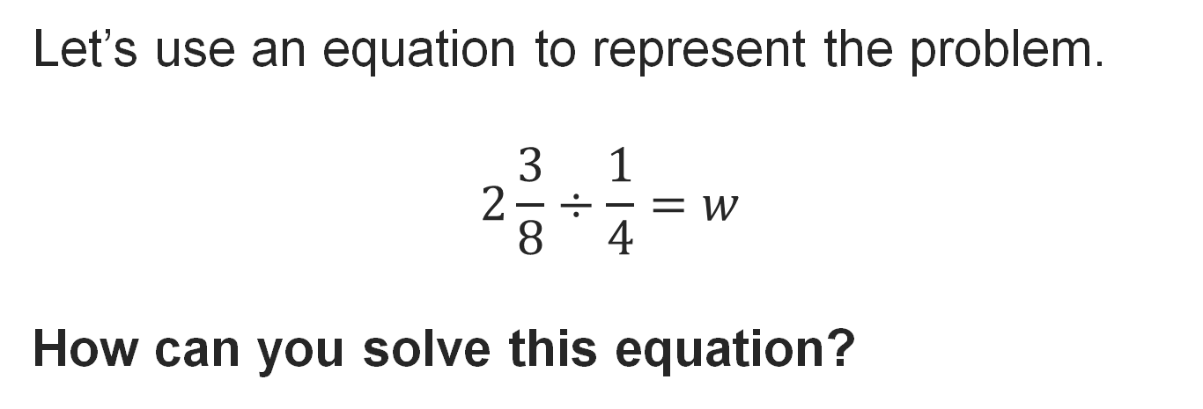
Farmers’ Market
Reveal:
We can write an equivalent multiplication equation using the reciprocal of the divisor.
PICK YOUR STRATEGY · Choose your path — picture, table, number line, or equation — and be ready to say why you chose it.
35 / 42
Notes:
TEACH IN PRACTICE | Embedded facilitation | Lesson 6.2, slide 32 | REVEAL
Focus on the existing task: Reveal: We can write an equivalent multiplication equation using the reciprocal of the divisor. Farmers’ Market
LAUNCH (T2/3/5): If an existing answer cover is present, gather an attempt before revealing. If the explanation is already visible, ask students to reconstruct and justify it. Compare reasoning and explain a revision; preserve the reveal sequence.
LOOK FOR (T4): Where this task addresses it, students can connect fraction division to a model and reciprocal. Ask which feature of their work supports the claim.
RESPOND: If this task shows the lesson misconception—inverting the dividend or failing to convert a mixed number—mark equal-size fractional units in the given quantities before writing the equivalent division. Have the student revise and explain the change. Use this support only where the concept occurs in the current task; otherwise respond to the displayed question.
RECHECK: If a gap is shared, revisit the existing representation together. If it is limited, give targeted support while others compare valid methods on the same task. Check the revision before moving on.
PARTICIPATION (T5/6/7): Think time before volunteers; accept a written, drawn or rehearsed entry. Students ask for evidence respectfully. Recognize a specific contribution or revision and check that both partners participate.
Source: BCPS Updated Instructional Framework Rubric (June 2020), TEACH 1–7. Earlier notes and answer keys are retained below.
EARLIER NOTES / EXISTING ANSWER KEY
Do not click yet: collect 2–3 student answers with reasons first.
Then click to remove the cover and have students compare their thinking to the reveal — “Is this what we said? Where is it different?”
Behind the cover: We can write an equivalent multiplication equation using the reciprocal of the divisor.
UIFR: TEACH 3 · TEACH 4.

Slide 36
Let’s Explore More
When dividing two mixed numbers, why can it be useful to convert the mixed numbers to fractions?
Why can it also be useful to convert a whole number to a fraction when dividing whole numbers and fractions?
STRUGGLE FIRST · Work on your own first. Stuck is allowed — try a second strategy before you ask.
36 / 42
Notes:
TEACH IN PRACTICE | Embedded facilitation | Lesson 6.2, slide 33 | PRACTICE
Focus on the existing task: Let’s Explore More When dividing two mixed numbers, why can it be useful to convert the mixed numbers to fractions?
LAUNCH (T2/3/5): Use the displayed question. Give private thinking time; then A explains while B asks for evidence. Switch roles. Each student records their own reasoning.
LOOK FOR (T4): Where this task addresses it, students can represent mixed numbers accurately. Ask which feature of their work supports the claim.
RESPOND: If this task shows the lesson misconception—inverting the dividend or failing to convert a mixed number—mark equal-size fractional units in the given quantities before writing the equivalent division. Have the student revise and explain the change. Use this support only where the concept occurs in the current task; otherwise respond to the displayed question.
RECHECK: If a gap is shared, revisit the existing representation together. If it is limited, give targeted support while others compare valid methods on the same task. Check the revision before moving on.
PARTICIPATION (T5/6/7): Think time before volunteers; accept a written, drawn or rehearsed entry. Students ask for evidence respectfully. Recognize a specific contribution or revision and check that both partners participate.
Source: BCPS Updated Instructional Framework Rubric (June 2020), TEACH 1–7. Earlier notes and answer keys are retained below.
EARLIER NOTES / EXISTING ANSWER KEY
Extension for partners or table groups — students choose their approach and use the workspace to show thinking.
Push with “Convince me,” and have two groups with different approaches share.
This is where students stretch past the worked example.
UIFR: TEACH 2 · TEACH 5.

Slide 37
LESSON 6.2 / CHECK YOUR WORK
Pause. Check. Improve.
CHECK
A mistake to watch for: inverting the dividend or failing to convert a mixed number.
TRY
Mark equal-size fractional units in the given quantities before writing the equivalent division.
REVISE
Use that check on the task you just completed. Correct or strengthen one part, and explain why.
REVISE NOW · Change one answer and write why you changed it. A revision is evidence of learning.
Listen to understand. Ask for evidence. Make room for every voice.
Notes:
TEACH IN PRACTICE | Embedded facilitation | Lesson 6.2, slide 34 | PRIOR_INSERT
Focus on the existing task: LESSON 6.2 / CHECK YOUR WORK Pause. Check. Improve. Listen to understand. Ask for evidence. Make room for every voice. CHECK A mistake…
CONNECT (T1/4): Ask students to restate the displayed goal or key idea and connect it to earlier work. Relevant lesson evidence: represent mixed numbers accurately; connect fraction division to a model and reciprocal; check the result. Use only the criterion that matches the current session.
SHOW PROGRESS: Students point to their own existing work, explain what improved after feedback, and name a next step. Pair confidence ratings with actual evidence.
PARTICIPATION (T5/6/7): Think time before volunteers; accept a written, drawn or rehearsed entry. Students ask for evidence respectfully. Recognize a specific contribution or revision and check that both partners participate.
Source: BCPS Updated Instructional Framework Rubric (June 2020), TEACH 1–7.

Slide 38
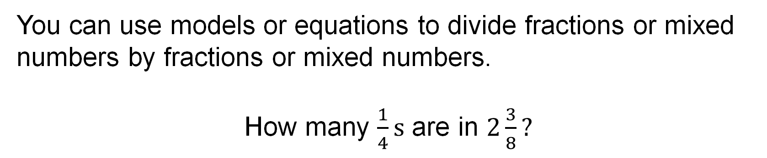
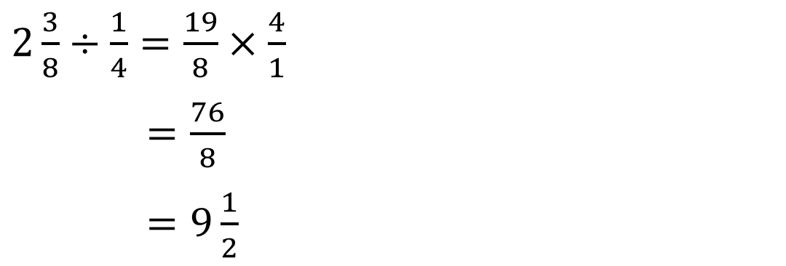
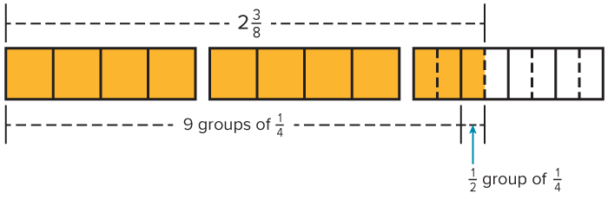
SUMMARIZE · SAY IT IN YOUR OWN WORDS
Summarize: Divide Fractions and Mixed Numbers
ANOTHER PATHWAY · Did anyone get there a different way? Put both pathways side by side and compare.
38 / 42
Notes:
TEACH IN PRACTICE | Embedded facilitation | Lesson 6.2, slide 35 | SUMMARIZE
Focus on the existing task: Summarize: Divide Fractions and Mixed Numbers SUMMARIZE · SAY IT IN YOUR OWN WORDS
CONNECT (T1/4): Ask students to restate the displayed goal or key idea and connect it to earlier work. Relevant lesson evidence: represent mixed numbers accurately; connect fraction division to a model and reciprocal; check the result. Use only the criterion that matches the current session.
SHOW PROGRESS: Students point to their own existing work, explain what improved after feedback, and name a next step. Pair confidence ratings with actual evidence.
PARTICIPATION (T5/6/7): Think time before volunteers; accept a written, drawn or rehearsed entry. Students ask for evidence respectfully. Recognize a specific contribution or revision and check that both partners participate.
Source: BCPS Updated Instructional Framework Rubric (June 2020), TEACH 1–7. Earlier notes and answer keys are retained below.
EARLIER NOTES / EXISTING ANSWER KEY
Routine: SUMMARIZE · SAY IT IN YOUR OWN WORDS

Slide 39
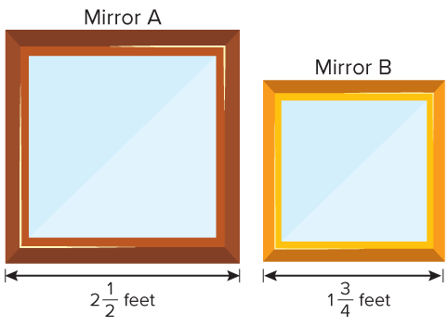
APPLY · PLAN IT • SOLVE IT • PROVE IT
Apply: Square Mirrors
The side lengths of two mirrors are shown.
Question: About how many times greater is the area of mirror A than the area of mirror B?
USE YOUR TOOLS · Reach for your notes, a model, or a manipulative before you reach for an answer.
39 / 42
Notes:
TEACH IN PRACTICE | Embedded facilitation | Lesson 6.2, slide 36 | APPLY
Focus on the existing task: The side lengths of two mirrors are shown. Question: About how many times greater is the area of mirror A than the area of mirror B?
LAUNCH (T2/3/5): Use the exact application task independently first. Ask students to justify their choice of method. Collect evidence before a partner discussion or correction.
LOOK FOR (T4): Where this task addresses it, students can represent mixed numbers accurately. Ask which feature of their work supports the claim.
RESPOND: If this task shows the lesson misconception—inverting the dividend or failing to convert a mixed number—mark equal-size fractional units in the given quantities before writing the equivalent division. Have the student revise and explain the change. Use this support only where the concept occurs in the current task; otherwise respond to the displayed question.
RECHECK: If a gap is shared, revisit the existing representation together. If it is limited, give targeted support while others compare valid methods on the same task. Check the revision before moving on.
PARTICIPATION (T5/6/7): Think time before volunteers; accept a written, drawn or rehearsed entry. Students ask for evidence respectfully. Recognize a specific contribution or revision and check that both partners participate.
Source: BCPS Updated Instructional Framework Rubric (June 2020), TEACH 1–7. Earlier notes and answer keys are retained below.
EARLIER NOTES / EXISTING ANSWER KEY
Routine: APPLY · PLAN IT • SOLVE IT • PROVE IT
UIFR FULL | Lesson-specific facilitation
TEACH 4 | Independent evidence and revision (UIFR PDF p. 11).
Use the existing application/exit problem as the independent check. If this is a learning-target slide, have students point to and explain their work on the preceding task. Separate initial independent evidence from the revision after feedback.
Check the relevant criteria: represent mixed numbers accurately; connect fraction division to a model and reciprocal; check the result. Respond with one specific next step tied to the work. Students revise and annotate what changed, then identify a criterion they can now demonstrate and one they still need to practice.

Slide 40
Learning Targets
I can divide fractions by using fraction models or equations.
I can divide mixed numbers and fractions by using fraction models or equations.
I can attend to precision to divide fractions and mixed numbers.
WHY IT MATTERS · Finish this: “This is worth knowing because ______.”
40 / 42
Notes:
TEACH IN PRACTICE | Embedded facilitation | Lesson 6.2, slide 37 | REFLECTION
Focus on the existing task: I can divide fractions by using fraction models or equations. I can divide mixed numbers and fractions by using fraction models or…
CONNECT (T1/4): Ask students to restate the displayed goal or key idea and connect it to earlier work. Relevant lesson evidence: represent mixed numbers accurately; connect fraction division to a model and reciprocal; check the result. Use only the criterion that matches the current session.
SHOW PROGRESS: Students point to their own existing work, explain what improved after feedback, and name a next step. Pair confidence ratings with actual evidence.
PARTICIPATION (T5/6/7): Think time before volunteers; accept a written, drawn or rehearsed entry. Students ask for evidence respectfully. Recognize a specific contribution or revision and check that both partners participate.
Source: BCPS Updated Instructional Framework Rubric (June 2020), TEACH 1–7. Earlier notes and answer keys are retained below.
EARLIER NOTES / EXISTING ANSWER KEY
Read each target; students self-rate with fist-to-five or thumbs.
Tie back to the goal from the start of class: did we get there?
Note any target that rates low — revisit it tomorrow.
UIFR: TEACH 1 · TEACH 4.

Slide 41
Be Curious
What do you notice?
What do you wonder?
35 / 35
Think first. Share a notice and a question; build on a classmate’s idea.
Mindset
What is helping you get started on a math activity?
Notes:
TEACH IN PRACTICE | Embedded facilitation | Lesson 6.2, slide 38 | CURIOUS
Focus on the existing task: What do you notice?
LAUNCH (T2/3/5): Allow quiet observation first. Separate a notice from an inference, invite students’ own questions, and follow the existing launch before teaching a procedure.
LOOK FOR (T4): Where this task addresses it, students can represent mixed numbers accurately. Ask which feature of their work supports the claim.
RESPOND: If this task shows the lesson misconception—inverting the dividend or failing to convert a mixed number—mark equal-size fractional units in the given quantities before writing the equivalent division. Have the student revise and explain the change. Use this support only where the concept occurs in the current task; otherwise respond to the displayed question.
RECHECK: If a gap is shared, revisit the existing representation together. If it is limited, give targeted support while others compare valid methods on the same task. Check the revision before moving on.
PARTICIPATION (T5/6/7): Think time before volunteers; accept a written, drawn or rehearsed entry. Students ask for evidence respectfully. Recognize a specific contribution or revision and check that both partners participate.
Source: BCPS Updated Instructional Framework Rubric (June 2020), TEACH 1–7. Earlier notes and answer keys are retained below.
EARLIER NOTES / EXISTING ANSWER KEY
UIFR FULL | Lesson-specific facilitation
REFLECT & ADJUST 1-2 | After the lesson (UIFR PDF pp. 15-16).
Sort the existing work by demonstrated reasoning, partial understanding, and the specific misconception: inverting the dividend or failing to convert a mixed number. Compare the initial response with the revision. Record which teaching move plausibly helped, which did not, and whose participation or access needs a different approach; do not record sensitive student details in this shared deck.
Plan the next lesson from that evidence: if the misconception persists, mark equal-size fractional units in the given quantities before writing the equivalent division using the current example before returning to the next grade-level task; if understanding is secure, use an existing extension or ask for a general explanation. Check the targeted idea again at the next warm-up.
Ask students what supported their thinking and what would help next time. Identify one change to try and one successful practice to retain. Seek colleague feedback on anonymized work when useful; these prompts support reflection and do not establish an evaluation rating. Source: Baltimore City Public Schools, Updated Instructional Framework Rubric, June 2020 (UIFR_Full.pdf).

Slide 42
LESSON 6.2 / REFLECT ON YOUR LEARNING
Show your progress
1 SHOW EVIDENCE
2 CHOOSE A NEXT STEP
Choose one response. Point to the part that shows your reasoning.
Name a change you made after feedback—or a question you still have.
“My work shows ___ because ___.”
“Next time, I will ___ to help me ___.”
Today’s focus: Represent mixed numbers accurately.
CREDIT A CLASSMATE · Name one classmate whose idea helped you today, and say what they said.
Listen to understand. Ask for evidence. Make room for every voice.
Notes:
TEACH IN PRACTICE | Embedded facilitation | Lesson 6.2, slide 39 | PRIOR_INSERT
Focus on the existing task: LESSON 6.2 / REFLECT ON YOUR LEARNING Show your progress Listen to understand. Ask for evidence. Make room for every voice. 1 SHOW…
CONNECT (T1/4): Ask students to restate the displayed goal or key idea and connect it to earlier work. Relevant lesson evidence: represent mixed numbers accurately; connect fraction division to a model and reciprocal; check the result. Use only the criterion that matches the current session.
SHOW PROGRESS: Students point to their own existing work, explain what improved after feedback, and name a next step. Pair confidence ratings with actual evidence.
PARTICIPATION (T5/6/7): Think time before volunteers; accept a written, drawn or rehearsed entry. Students ask for evidence respectfully. Recognize a specific contribution or revision and check that both partners participate.
Source: BCPS Updated Instructional Framework Rubric (June 2020), TEACH 1–7.

