Slide 1
WARM-UP · THINK • TRY • CHECK
Turn and talk: compare strategies, then defend one.
Warm-Up
Lesson 6-3 · Explore Numerical Expressions with Exponents | Warm-Up · about 4 minutes
Try each on your own. Mark an unsure answer; explain and revise when we check.
QUESTION 1
QUESTION 2
2 × 2 × 2 = ______
6 × 6 = ______
QUESTION 3
QUESTION 4
10 × 10 × 10 = ______
In 7 × 7 × 7 × 7, the factor 7 is written ______ times
TALK IT OVER: “I got ______ because ______.” • Compare with a partner before we check as a class.
1 / 46
Notes:
TEACH IN PRACTICE | Embedded facilitation | Lesson 6.3, slide 1 | WARMUP
Focus on the existing task: Warm-Up WARM-UP · THINK • TRY • CHECK Do…
GATHER EVIDENCE (T4/6): Keep the original items. Students try independently, mark an uncertain item, and explain one method before checking. Use the existing key when present.
RESPOND: Distinguish a calculation slip from a reasoning gap. Give one next step on the same item; have students revise in a second color. Use the responses to choose flexible support for today’s lesson.
PARTICIPATION (T5/6/7): Think time before volunteers; accept a written, drawn or rehearsed entry. Students ask for evidence respectfully. Recognize a specific contribution or revision and check that both partners participate.
Source: BCPS Updated Instructional Framework Rubric (June 2020), TEACH 1–7. Earlier notes and answer keys are retained below.
EARLIER NOTES / EXISTING ANSWER KEY
Warm-Up answers (teacher only): 1) 8 2) 36 3) 1,000 4) 4
UIFR FULL | Lesson-specific facilitation
PREPARE 1-2 | Before teaching (UIFR PDF pp. 6-7).
Plan to gather evidence that students can distinguish base and exponent; expand repeated factors; evaluate the power. Review recent work and today’s warm-up to choose flexible groups and access supports; do not infer needs from identity or perceived ability. Use the existing lesson tasks and stated standards.
Anticipate: multiplying the base by the exponent. If observed, expand the original power as repeated multiplication before calculating. Offer oral rehearsal, drawing, pointing, or home-language processing as needed; retain the original mathematical demand. Ask students which support helps and fade it as evidence improves.
TEACH 6-7 | Before the first transition, agree on materials, partner roles, and how to request help. Invite students to restate the routine. Normalize revising an idea, recognize a specific contribution, and check privately when frustration blocks participation. Source: UIFR PDF pp. 13-14.

Slide 2
Today’s Math Notes
Lesson 6-3 · Explore Numerical Expressions with Exponents
Section 1: Math Words
Copy. Explain. Check.
SAY THE GOAL · Say today’s goal in your own words, then name one place this shows up outside math class.
Powers and Exponents
1
A power uses a base and an exponent to show repeated
Exponent
2
A small number
Base
3
The number that gets multiplied by itself
eduwonderlab.com · Neft Teacher
2 / 46
Notes:
TEACH IN PRACTICE | Embedded facilitation | Lesson 6.3, slide 2 | NOTES
Focus on the existing task: Today’s Math Notes Section 1: Math Words Copy…
ROUTINE (T1/2/4): Read or copy the original notes, cover one line, and explain it using the displayed example. Reopen and correct. Copying alone is not evidence of understanding.
LOOK FOR: A link between a symbol, quantity or feature and the explanation. If missing, point back to that feature and have the student try again; fade the prompt once they can explain.
PARTICIPATION (T5/6/7): Think time before volunteers; accept a written, drawn or rehearsed entry. Students ask for evidence respectfully. Recognize a specific contribution or revision and check that both partners participate.
Source: BCPS Updated Instructional Framework Rubric (June 2020), TEACH 1–7. Earlier notes and answer keys are retained below.
EARLIER NOTES / EXISTING ANSWER KEY
Copy routine: read one line at a time; students copy, then explain that line to a partner.
Keep it brisk — the understanding work happens in the examples, not the copying.
UIFR: TEACH 1 · TEACH 6.

Slide 3
Today’s Math Notes
Lesson 6-3 · Explore Numerical Expressions with Exponents
Section 2: Today’s Math
Copy. Explain. Check.
Powers & Exponents
Base^Exponent (b^n = b · b · … · b n times)
Read, cover, explain. Reopen your notes to
check and improve your explanation.
1
Base is the factor being multiplied repeatedly
2
Exponent tells how many times to multiply the base by itself
3
Evaluate: 2³ = 2 × 2 × 2 = 8 (not 2 × 3 = 6)
eduwonderlab.com · Neft Teacher
3 / 46
Notes:
TEACH IN PRACTICE | Embedded facilitation | Lesson 6.3, slide 3 | NOTES
Focus on the existing task: Today’s Math Notes Section 2: Today’s Math…
ROUTINE (T1/2/4): Read or copy the original notes, cover one line, and explain it using the displayed example. Reopen and correct. Copying alone is not evidence of understanding.
LOOK FOR: A link between a symbol, quantity or feature and the explanation. If missing, point back to that feature and have the student try again; fade the prompt once they can explain.
PARTICIPATION (T5/6/7): Think time before volunteers; accept a written, drawn or rehearsed entry. Students ask for evidence respectfully. Recognize a specific contribution or revision and check that both partners participate.
Source: BCPS Updated Instructional Framework Rubric (June 2020), TEACH 1–7. Earlier notes and answer keys are retained below.
EARLIER NOTES / EXISTING ANSWER KEY
Copy routine: read one line at a time; students copy, then explain that line to a partner.
Keep it brisk — the understanding work happens in the examples, not the copying.
UIFR: TEACH 1 · TEACH 6.

Slide 4
Session 1
Explore Numerical Expressions with Exponents
PICK YOUR STRATEGY · Choose your path — picture, table, number line, or equation — and be ready to say why you chose it.
4 / 46
Notes:
TEACH IN PRACTICE | Embedded facilitation | Lesson 6.3, slide 4 | DIVIDER
Focus on the existing task: Explore Numerical Expressions with Exponents Session 1
TRANSITION (T6/7): Students confirm materials, roles, how to request help, and the next response routine. Ask a student to restate it. Keep teacher-only slides hidden.
PARTICIPATION (T5/6/7): Think time before volunteers; accept a written, drawn or rehearsed entry. Students ask for evidence respectfully. Recognize a specific contribution or revision and check that both partners participate.
Source: BCPS Updated Instructional Framework Rubric (June 2020), TEACH 1–7. Earlier notes and answer keys are retained below.
EARLIER NOTES / EXISTING ANSWER KEY
Transition cue: state what materials are out and what success looks like this session.
Keep the changeover under a minute.
UIFR: TEACH 6.

Slide 5
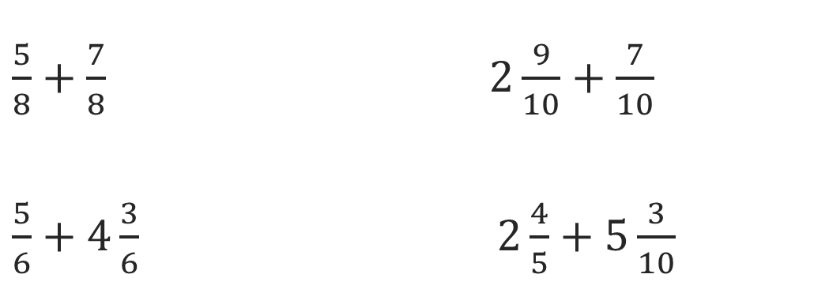
Or You Could
Explain how the information shown supports your reasoning.
5 / 46
Notes:
TEACH IN PRACTICE | Embedded facilitation | Lesson 6.3, slide 5 | WORKED
Focus on the existing task: Or You Could
LAUNCH (T2/3/5): Ask students to explain the displayed idea or example and point to evidence. When a calculation step is shown, ask why it is valid. Have a partner restate the explanation; copying is not the check.
LOOK FOR (T4): Where this task addresses it, students can distinguish base and exponent. Ask which feature of their work supports the claim.
RESPOND: If this task shows the lesson misconception—multiplying the base by the exponent—expand the original power as repeated multiplication before calculating. Have the student revise and explain the change. Use this support only where the concept occurs in the current task; otherwise respond to the displayed question.
RECHECK: If a gap is shared, revisit the existing representation together. If it is limited, give targeted support while others compare valid methods on the same task. Check the revision before moving on.
PARTICIPATION (T5/6/7): Think time before volunteers; accept a written, drawn or rehearsed entry. Students ask for evidence respectfully. Recognize a specific contribution or revision and check that both partners participate.
Source: BCPS Updated Instructional Framework Rubric (June 2020), TEACH 1–7. Earlier notes and answer keys are retained below.
EARLIER NOTES / EXISTING ANSWER KEY
Model briefly, then hand the thinking back: ask “Why does this step work?” before showing the next one.
Quick check before moving on — thumbs or whiteboards from everyone, not volunteers.
UIFR: TEACH 2 · TEACH 3 · TEACH 4.

Slide 6
Today’s Objectives
Lesson 6-3 · Explore Numerical Expressions with Exponents
Explore Numerical Expressions with Exponents
Maryland Standard 6.AT.5
CONNECT IT · What earlier lesson does this build on? Tell a partner in one sentence.
CONTENT OBJECTIVE
LANGUAGE OBJECTIVE
Restate the goal in your words
Use these words to explain why
I can write and evaluate numbers in exponent form using a base and a power.
I can explain my work using the words exponent, base, power, and evaluate.
eduwonderlab.com · Neft Teacher
6 / 46
Notes:
TEACH IN PRACTICE | Embedded facilitation | Lesson 6.3, slide 6 | GOAL
Focus on the existing task: Today’s Objectives Explore Numerical…
CONNECT (T1/4): Ask students to restate the displayed goal or key idea and connect it to earlier work. Relevant lesson evidence: distinguish base and exponent; expand repeated factors; evaluate the power. Use only the criterion that matches the current session.
SHOW PROGRESS: Students point to their own existing work, explain what improved after feedback, and name a next step. Pair confidence ratings with actual evidence.
PARTICIPATION (T5/6/7): Think time before volunteers; accept a written, drawn or rehearsed entry. Students ask for evidence respectfully. Recognize a specific contribution or revision and check that both partners participate.
Source: BCPS Updated Instructional Framework Rubric (June 2020), TEACH 1–7. Earlier notes and answer keys are retained below.
EARLIER NOTES / EXISTING ANSWER KEY
Read the objective together, then have one or two students restate today’s goal in their own words.
Connect it to what the class learned last lesson.
Return to this goal at the end of class to check it was met.
UIFR: TEACH 1.
UIFR FULL | Lesson-specific facilitation
TEACH 1 | Session 1 purpose and evidence (UIFR PDF p. 8).
Have students restate the displayed session goal in their own words and connect it to the existing context or a familiar experience they choose to share. Use the current session goal to select from these lesson-wide evidence criteria; do not frontload a later-session procedure.
Look for: distinguish base and exponent; expand repeated factors; evaluate the power. Ask: “Which part of your work would show this?” Revisit that evidence after the task; a confidence rating alone is not evidence of understanding.

Slide 7
LESSON 6.3 / OUR LEARNING
What will show your learning?
1
Distinguish base and exponent.
2
Expand repeated factors.
3
Evaluate the power.
Tell a partner: Which skill connects to something you already know?
SHOW YOUR THINKING · Show what you know — write it, draw it, or build it. A picture counts as an explanation.
Listen to understand. Ask for evidence. Make room for every voice.
Notes:
TEACH IN PRACTICE | Embedded facilitation | Lesson 6.3, slide 7 | PRIOR_INSERT
Focus on the existing task: LESSON 6.3 / OUR LEARNING What will show your learning?
CONNECT (T1/4): Ask students to restate the displayed goal or key idea and connect it to earlier work. Relevant lesson evidence: distinguish base and exponent; expand repeated factors; evaluate the power. Use only the criterion that matches the current session.
SHOW PROGRESS: Students point to their own existing work, explain what improved after feedback, and name a next step. Pair confidence ratings with actual evidence.
PARTICIPATION (T5/6/7): Think time before volunteers; accept a written, drawn or rehearsed entry. Students ask for evidence respectfully. Recognize a specific contribution or revision and check that both partners participate.
Source: BCPS Updated Instructional Framework Rubric (June 2020), TEACH 1–7.

Slide 8
Vocabulary 1 of 5
Lesson 6-3 · Explore Numerical Expressions with Exponents
Powers and Exponents
A power uses a base and an exponent to show repeated multiplication.
EXAMPLE · EXPLAIN WHY IT FITS
2⁴ = 2 × 2 × 2 × 2 = 16
Use “Powers and Exponents” to explain the example. Point
to evidence.
eduwonderlab.com · Neft Teacher
8 / 46
Notes:
TEACH IN PRACTICE | Embedded facilitation | Lesson 6.3, slide 8 | VOCAB
Focus on the existing task: Vocabulary 1 of 5 Powers and Exponents A…
ASK (T1/3/5): Where does “Powers and Exponents” appear in the example? Explain the meaning without reading the definition. Partner: restate the idea and ask a clarifying question.
LOOK FOR: A correct connection between the word and a feature of the example. If the student only repeats the definition, invite pointing, sketching or oral rehearsal, then ask for another explanation of this same example.
PARTICIPATION (T5/6/7): Think time before volunteers; accept a written, drawn or rehearsed entry. Students ask for evidence respectfully. Recognize a specific contribution or revision and check that both partners participate.
Source: BCPS Updated Instructional Framework Rubric (June 2020), TEACH 1–7.

Slide 9
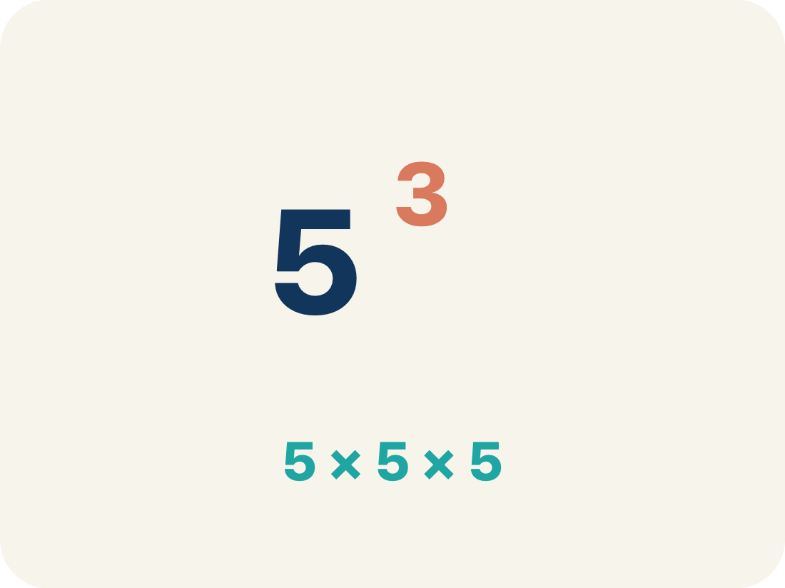
Vocabulary 2 of 5
Lesson 6-3 · Explore Numerical Expressions with Exponents
Exponent
A small number that tells how many times to multiply a number by itself.
EXAMPLE · EXPLAIN WHY IT FITS
In 2³, the small 3 means multiply 2 by itself 3 times: 2 × 2 × 2 = 8
Use “Exponent” to explain the example. Point to evidence.
eduwonderlab.com · Neft Teacher
9 / 46
Notes:
TEACH IN PRACTICE | Embedded facilitation | Lesson 6.3, slide 9 | VOCAB
Focus on the existing task: Vocabulary 2 of 5 Exponent A small number…
ASK (T1/3/5): Where does “Exponent” appear in the example? Explain the meaning without reading the definition. Partner: restate the idea and ask a clarifying question.
LOOK FOR: A correct connection between the word and a feature of the example. If the student only repeats the definition, invite pointing, sketching or oral rehearsal, then ask for another explanation of this same example.
PARTICIPATION (T5/6/7): Think time before volunteers; accept a written, drawn or rehearsed entry. Students ask for evidence respectfully. Recognize a specific contribution or revision and check that both partners participate.
Source: BCPS Updated Instructional Framework Rubric (June 2020), TEACH 1–7.

Slide 10
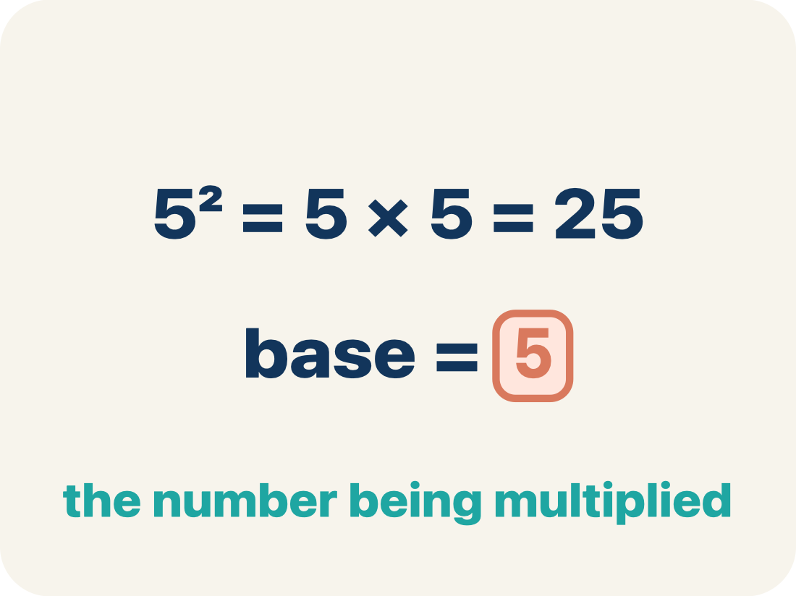
Vocabulary 3 of 5
Lesson 6-3 · Explore Numerical Expressions with Exponents
Base
The number that gets multiplied by itself.
EXAMPLE · EXPLAIN WHY IT FITS
In 5², the base is 5 — it is the number being multiplied: 5 × 5 = 25
Use “Base” to explain the example. Point to evidence.
eduwonderlab.com · Neft Teacher
10 / 46
Notes:
TEACH IN PRACTICE | Embedded facilitation | Lesson 6.3, slide 10 | VOCAB
Focus on the existing task: Vocabulary 3 of 5 Base The number that gets…
ASK (T1/3/5): Where does “Base” appear in the example? Explain the meaning without reading the definition. Partner: restate the idea and ask a clarifying question.
LOOK FOR: A correct connection between the word and a feature of the example. If the student only repeats the definition, invite pointing, sketching or oral rehearsal, then ask for another explanation of this same example.
PARTICIPATION (T5/6/7): Think time before volunteers; accept a written, drawn or rehearsed entry. Students ask for evidence respectfully. Recognize a specific contribution or revision and check that both partners participate.
Source: BCPS Updated Instructional Framework Rubric (June 2020), TEACH 1–7.

Slide 11
Vocabulary 4 of 5
Lesson 6-3 · Explore Numerical Expressions with Exponents
Power
A number written with a base and an exponent, like 2³.
EXAMPLE · EXPLAIN WHY IT FITS
10³ = 10 × 10 × 10 = 1,000 — read as ‘10 to the third power’ or ‘10 cubed’
Use “Power” to explain the example. Point to evidence.
eduwonderlab.com · Neft Teacher
11 / 46
Notes:
TEACH IN PRACTICE | Embedded facilitation | Lesson 6.3, slide 11 | VOCAB
Focus on the existing task: Vocabulary 4 of 5 Power A number written with…
ASK (T1/3/5): Where does “Power” appear in the example? Explain the meaning without reading the definition. Partner: restate the idea and ask a clarifying question.
LOOK FOR: A correct connection between the word and a feature of the example. If the student only repeats the definition, invite pointing, sketching or oral rehearsal, then ask for another explanation of this same example.
PARTICIPATION (T5/6/7): Think time before volunteers; accept a written, drawn or rehearsed entry. Students ask for evidence respectfully. Recognize a specific contribution or revision and check that both partners participate.
Source: BCPS Updated Instructional Framework Rubric (June 2020), TEACH 1–7.

Slide 12
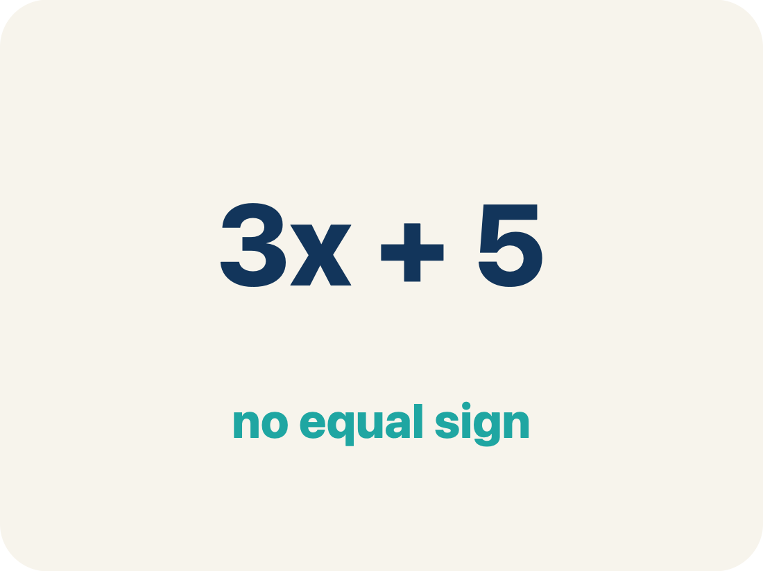
Vocabulary 5 of 5
Lesson 6-3 · Explore Numerical Expressions with Exponents
Evaluate
To find the value by putting numbers in for the letters.
EXAMPLE · EXPLAIN WHY IT FITS
Evaluate 3⁴: write 3 × 3 × 3 × 3, then multiply step by step: 9 × 9 = 81
Use “Evaluate” to explain the example. Point to evidence.
eduwonderlab.com · Neft Teacher
12 / 46
Notes:
TEACH IN PRACTICE | Embedded facilitation | Lesson 6.3, slide 12 | VOCAB
Focus on the existing task: Vocabulary 5 of 5 Evaluate To find the value…
ASK (T1/3/5): Where does “Evaluate” appear in the example? Explain the meaning without reading the definition. Partner: restate the idea and ask a clarifying question.
LOOK FOR: A correct connection between the word and a feature of the example. If the student only repeats the definition, invite pointing, sketching or oral rehearsal, then ask for another explanation of this same example.
PARTICIPATION (T5/6/7): Think time before volunteers; accept a written, drawn or rehearsed entry. Students ask for evidence respectfully. Recognize a specific contribution or revision and check that both partners participate.
Source: BCPS Updated Instructional Framework Rubric (June 2020), TEACH 1–7.

Slide 13
Vocabulary
Lesson 6-3 · Explore Numerical Expressions with Exponents
Today’s Math Words
We learn every word — what it means and what it looks like — before we use it.
Powers and Exponents
Exponent
A power uses a base and an exponent to show repeated multiplication
A small number that tells how many times to multiply a number by itself
Base
Power
The number that gets multiplied by itself
A number written with a base and an exponent, like 2³
Evaluate
To find the value by putting numbers in for the letters
Explain one math word using the example.
Partner: point to evidence.
eduwonderlab.com · Neft Teacher
13 / 46
Notes:
TEACH IN PRACTICE | Embedded facilitation | Lesson 6.3, slide 13 | VOCAB
Focus on the existing task: Vocabulary Today’s Math Words We learn every…
ASK (T1/3/5): Where does “the displayed term” appear in the example? Explain the meaning without reading the definition. Partner: restate the idea and ask a clarifying question.
LOOK FOR: A correct connection between the word and a feature of the example. If the student only repeats the definition, invite pointing, sketching or oral rehearsal, then ask for another explanation of this same example.
PARTICIPATION (T5/6/7): Think time before volunteers; accept a written, drawn or rehearsed entry. Students ask for evidence respectfully. Recognize a specific contribution or revision and check that both partners participate.
Source: BCPS Updated Instructional Framework Rubric (June 2020), TEACH 1–7. Earlier notes and answer keys are retained below.
EARLIER NOTES / EXISTING ANSWER KEY
Choral-read each word, its meaning, and what it looks like.
Students should use these words out loud today — listen for them in partner talk and revoice student ideas with the academic term.
UIFR: TEACH 1 · TEACH 5.

Slide 14
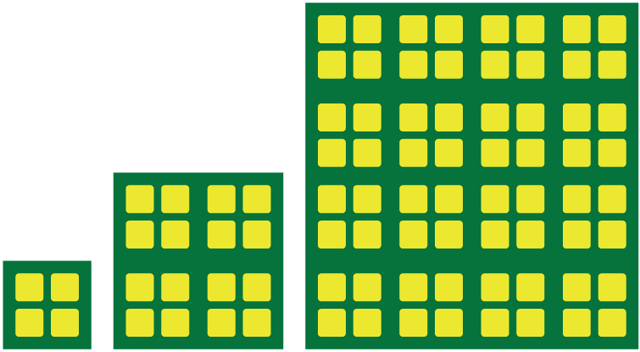

Be Curious
What do you notice?
What do you notice?
Think first. Share a notice and a question;
build on a classmate’s idea.
Mindset
How can you show others that you respect their ideas about math?
14 / 46
Notes:
TEACH IN PRACTICE | Embedded facilitation | Lesson 6.3, slide 14 | CURIOUS
Focus on the existing task: What do you notice?
LAUNCH (T2/3/5): Allow quiet observation first. Separate a notice from an inference, invite students’ own questions, and follow the existing launch before teaching a procedure.
LOOK FOR (T4): Where this task addresses it, students can distinguish base and exponent. Ask which feature of their work supports the claim.
RESPOND: If this task shows the lesson misconception—multiplying the base by the exponent—expand the original power as repeated multiplication before calculating. Have the student revise and explain the change. Use this support only where the concept occurs in the current task; otherwise respond to the displayed question.
RECHECK: If a gap is shared, revisit the existing representation together. If it is limited, give targeted support while others compare valid methods on the same task. Check the revision before moving on.
PARTICIPATION (T5/6/7): Think time before volunteers; accept a written, drawn or rehearsed entry. Students ask for evidence respectfully. Recognize a specific contribution or revision and check that both partners participate.
Source: BCPS Updated Instructional Framework Rubric (June 2020), TEACH 1–7. Earlier notes and answer keys are retained below.
EARLIER NOTES / EXISTING ANSWER KEY
Accept all noticings and wonderings — there are no wrong answers here.
Give 20–30 seconds of quiet think time before taking responses; mix cold and warm calls so it is not always the same voices.
Read the mindset question aloud and let two students respond.
UIFR: TEACH 3 · TEACH 7.

Slide 15
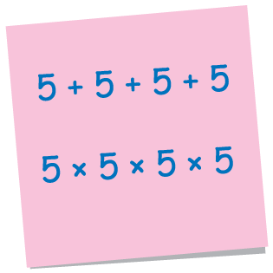
Compare Expressions
How are these two expressions different?
How can the expressions be written in different ways?
What is the same about each expression? different?
Compare your reasoning with the explanation. Explain any
revision you make.
Reveal:
15 / 46
Notes:
TEACH IN PRACTICE | Embedded facilitation | Lesson 6.3, slide 15 | REVEAL
Focus on the existing task: How are these two expressions different?
LAUNCH (T2/3/5): If an existing answer cover is present, gather an attempt before revealing. If the explanation is already visible, ask students to reconstruct and justify it. Compare reasoning and explain a revision; preserve the reveal sequence.
LOOK FOR (T4): Where this task addresses it, students can distinguish base and exponent. Ask which feature of their work supports the claim.
RESPOND: If this task shows the lesson misconception—multiplying the base by the exponent—expand the original power as repeated multiplication before calculating. Have the student revise and explain the change. Use this support only where the concept occurs in the current task; otherwise respond to the displayed question.
RECHECK: If a gap is shared, revisit the existing representation together. If it is limited, give targeted support while others compare valid methods on the same task. Check the revision before moving on.
PARTICIPATION (T5/6/7): Think time before volunteers; accept a written, drawn or rehearsed entry. Students ask for evidence respectfully. Recognize a specific contribution or revision and check that both partners participate.
Source: BCPS Updated Instructional Framework Rubric (June 2020), TEACH 1–7. Earlier notes and answer keys are retained below.
EARLIER NOTES / EXISTING ANSWER KEY
Students should have shared predictions before this reveal.
Have them compare their thinking to what is shown: “Is this the same as what we said? Where is it different?”
Press one student to explain the reveal in their own words.
UIFR: TEACH 3 · TEACH 4.
UIFR FULL | Lesson-specific facilitation
TEACH 2-3 | Session 1 task launch (UIFR PDF pp. 9-10).
Use the problem exactly as displayed. Give individual thinking time before discussion or advancing to the explanation. If the answer is already visible, ask students to reconstruct and justify it. Invite a choice of suitable representations and have students explain why their choice helps.
At the point where this concept appears, ask: “How many factors does the exponent tell you to write, and what is each factor?” Wait for evidence, invite another pathway, and have a student ask a follow-up question. Do not replace students’ reasoning with a sequence of leading steps.

Slide 16
Compare Expressions
How are these two expressions different?
How can the expressions be written in different ways?
What is the same about each expression? different?
Record your reasoning before the reveal. Compare, then
explain any revision.
Reveal:
There are four 5s in each expression. One expression uses addition, and the other uses multiplication.
16 / 46
Notes:
TEACH IN PRACTICE | Embedded facilitation | Lesson 6.3, slide 16 | REVEAL
Focus on the existing task: How are these two expressions different?
LAUNCH (T2/3/5): If an existing answer cover is present, gather an attempt before revealing. If the explanation is already visible, ask students to reconstruct and justify it. Compare reasoning and explain a revision; preserve the reveal sequence.
LOOK FOR (T4): Where this task addresses it, students can distinguish base and exponent. Ask which feature of their work supports the claim.
RESPOND: If this task shows the lesson misconception—multiplying the base by the exponent—expand the original power as repeated multiplication before calculating. Have the student revise and explain the change. Use this support only where the concept occurs in the current task; otherwise respond to the displayed question.
RECHECK: If a gap is shared, revisit the existing representation together. If it is limited, give targeted support while others compare valid methods on the same task. Check the revision before moving on.
PARTICIPATION (T5/6/7): Think time before volunteers; accept a written, drawn or rehearsed entry. Students ask for evidence respectfully. Recognize a specific contribution or revision and check that both partners participate.
Source: BCPS Updated Instructional Framework Rubric (June 2020), TEACH 1–7. Earlier notes and answer keys are retained below.
EARLIER NOTES / EXISTING ANSWER KEY
Do not click yet: collect 2–3 student answers with reasons first.
Then click to remove the cover and have students compare their thinking to the reveal — “Is this what we said? Where is it different?”
Behind the cover: There are four 5s in each expression. One expression uses addition, and the other uses multiplication.
UIFR: TEACH 3 · TEACH 4.

Slide 17
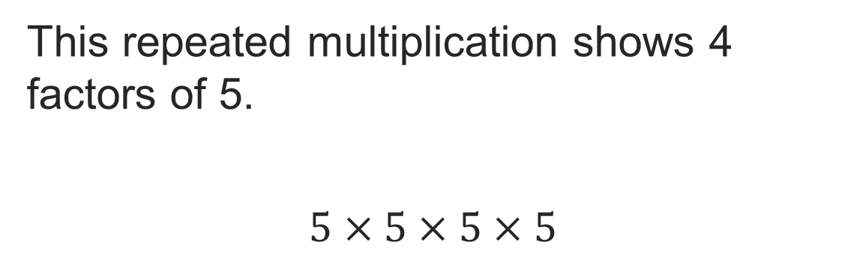
Compare Expressions
Think About It:
Where have you seen repeated multiplication before?
Think and record first. Which part of your work supports your answer?
17 / 46
Notes:
TEACH IN PRACTICE | Embedded facilitation | Lesson 6.3, slide 17 | TASK
Focus on the existing task: Think About It: Where have you seen repeated multiplication before?
LAUNCH (T2/3/5): Use the displayed question. Give private thinking time; then A explains while B asks for evidence. Switch roles. Each student records their own reasoning.
LOOK FOR (T4): Where this task addresses it, students can expand repeated factors. Ask which feature of their work supports the claim.
RESPOND: If this task shows the lesson misconception—multiplying the base by the exponent—expand the original power as repeated multiplication before calculating. Have the student revise and explain the change. Use this support only where the concept occurs in the current task; otherwise respond to the displayed question.
RECHECK: If a gap is shared, revisit the existing representation together. If it is limited, give targeted support while others compare valid methods on the same task. Check the revision before moving on.
PARTICIPATION (T5/6/7): Think time before volunteers; accept a written, drawn or rehearsed entry. Students ask for evidence respectfully. Recognize a specific contribution or revision and check that both partners participate.
Source: BCPS Updated Instructional Framework Rubric (June 2020), TEACH 1–7. Earlier notes and answer keys are retained below.
EARLIER NOTES / EXISTING ANSWER KEY
Ask the question, then hold the silence — students think or jot before anyone answers.
Take two or three responses and press with “Why?” or “How do you know?” before moving on.
UIFR: TEACH 3.

Slide 18
Compare Expressions
Record your reasoning before the reveal. Compare, then explain any revision.
How can you rewrite the repeated multiplication expression?
Reveal:
We can rewrite the expression using an exponent, 5⁴.
18 / 46
Notes:
TEACH IN PRACTICE | Embedded facilitation | Lesson 6.3, slide 18 | REVEAL
Focus on the existing task: How can you rewrite the repeated multiplication expression?
LAUNCH (T2/3/5): If an existing answer cover is present, gather an attempt before revealing. If the explanation is already visible, ask students to reconstruct and justify it. Compare reasoning and explain a revision; preserve the reveal sequence.
LOOK FOR (T4): Where this task addresses it, students can distinguish base and exponent. Ask which feature of their work supports the claim.
RESPOND: If this task shows the lesson misconception—multiplying the base by the exponent—expand the original power as repeated multiplication before calculating. Have the student revise and explain the change. Use this support only where the concept occurs in the current task; otherwise respond to the displayed question.
RECHECK: If a gap is shared, revisit the existing representation together. If it is limited, give targeted support while others compare valid methods on the same task. Check the revision before moving on.
PARTICIPATION (T5/6/7): Think time before volunteers; accept a written, drawn or rehearsed entry. Students ask for evidence respectfully. Recognize a specific contribution or revision and check that both partners participate.
Source: BCPS Updated Instructional Framework Rubric (June 2020), TEACH 1–7. Earlier notes and answer keys are retained below.
EARLIER NOTES / EXISTING ANSWER KEY
Do not click yet: collect 2–3 student answers with reasons first.
Then click to remove the cover and have students compare their thinking to the reveal — “Is this what we said? Where is it different?”
Behind the cover: We can rewrite the expression using an exponent, 5 4 .
UIFR: TEACH 3 · TEACH 4.

Slide 19
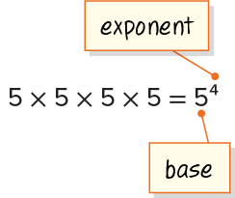
Compare Expressions
A number written with an exponent is a power. This expression is a power of 5. The exponent represents how many times the base is a factor.
Think and record first. Which part of your
work supports your answer?
Listening
How can you be sure you have understood the argument presented?
19 / 46
Notes:
TEACH IN PRACTICE | Embedded facilitation | Lesson 6.3, slide 19 | TASK
Focus on the existing task: How can you be sure you have understood the argument presented?
LAUNCH (T2/3/5): Use the displayed question. Give private thinking time; then A explains while B asks for evidence. Switch roles. Each student records their own reasoning.
LOOK FOR (T4): Where this task addresses it, students can distinguish base and exponent. Ask which feature of their work supports the claim.
RESPOND: If this task shows the lesson misconception—multiplying the base by the exponent—expand the original power as repeated multiplication before calculating. Have the student revise and explain the change. Use this support only where the concept occurs in the current task; otherwise respond to the displayed question.
RECHECK: If a gap is shared, revisit the existing representation together. If it is limited, give targeted support while others compare valid methods on the same task. Check the revision before moving on.
PARTICIPATION (T5/6/7): Think time before volunteers; accept a written, drawn or rehearsed entry. Students ask for evidence respectfully. Recognize a specific contribution or revision and check that both partners participate.
Source: BCPS Updated Instructional Framework Rubric (June 2020), TEACH 1–7. Earlier notes and answer keys are retained below.
EARLIER NOTES / EXISTING ANSWER KEY
Model briefly, then hand the thinking back: ask “Why does this step work?” before showing the next one.
Quick check before moving on — thumbs or whiteboards from everyone, not volunteers.
UIFR: TEACH 2 · TEACH 3 · TEACH 4.

Slide 20

COLLABORATE · TALK IT THROUGH • AGREE ON A MODEL
Collaborate and Connect
What is another power of 5?
How can you write it?
Think first. A explains; B asks for evidence. Switch roles; both revise.
Reveal:
5², 5³, 5⁵, 5⁶, 5⁷, 5⁸, 5⁹
20 / 46
Notes:
TEACH IN PRACTICE | Embedded facilitation | Lesson 6.3, slide 20 | COLLABORATE
Focus on the existing task: What is another power of 5?
LAUNCH (T2/3/5): Use the displayed question. Give private thinking time; then A explains while B asks for evidence. Switch roles. Each student records their own reasoning.
LOOK FOR (T4): Where this task addresses it, students can evaluate the power. Ask which feature of their work supports the claim.
RESPOND: If this task shows the lesson misconception—multiplying the base by the exponent—expand the original power as repeated multiplication before calculating. Have the student revise and explain the change. Use this support only where the concept occurs in the current task; otherwise respond to the displayed question.
RECHECK: If a gap is shared, revisit the existing representation together. If it is limited, give targeted support while others compare valid methods on the same task. Check the revision before moving on.
PARTICIPATION (T5/6/7): Think time before volunteers; accept a written, drawn or rehearsed entry. Students ask for evidence respectfully. Recognize a specific contribution or revision and check that both partners participate.
Source: BCPS Updated Instructional Framework Rubric (June 2020), TEACH 1–7. Earlier notes and answer keys are retained below.
EARLIER NOTES / EXISTING ANSWER KEY
Routine: COLLABORATE · TALK IT THROUGH • AGREE ON A MODEL
UIFR FULL | Lesson-specific facilitation
TEACH 4-5 | Session 1 discussion and checkpoint (UIFR PDF pp. 11-12).
Collect a brief response from every student to the existing prompt before hearing volunteers. Partners take turns explaining and asking for evidence: “I understand ___; what supports ___?” Offer rehearsal or an annotated model for students who need language support. Each student records their own reasoning.
Look specifically for: multiplying the base by the exponent. If it appears, expand the original power as repeated multiplication before calculating; then ask the student to revise the same response and explain the change. If evidence is secure, have students compare a second valid pathway or state why their approach works. Choose the next step from the responses, not a preset pace.

Slide 21
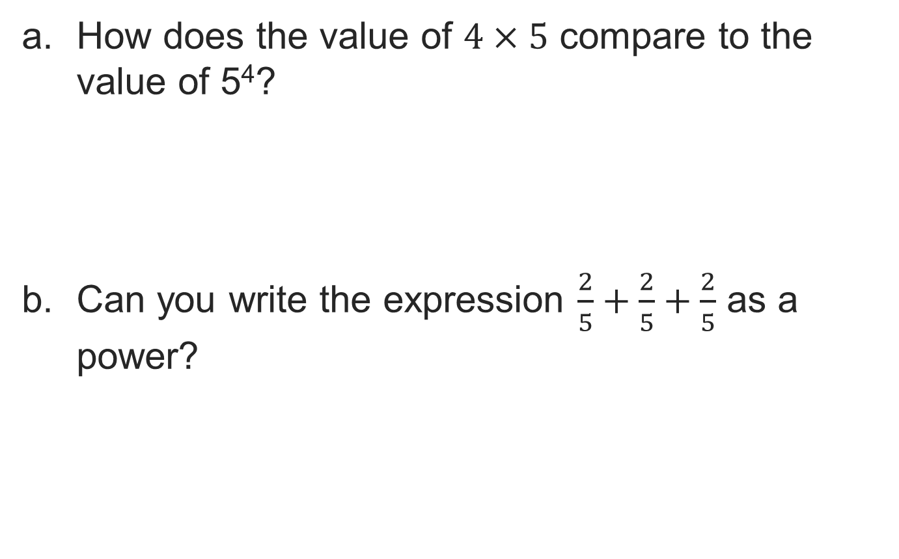
Let’s Explore More
STRUGGLE FIRST · Work on your own first. Stuck is allowed — try a second strategy before you ask.
21 / 46
Notes:
TEACH IN PRACTICE | Embedded facilitation | Lesson 6.3, slide 21 | PRACTICE
Focus on the existing task: Let’s Explore More
LAUNCH (T2/3/5): Use the displayed question. Give private thinking time; then A explains while B asks for evidence. Switch roles. Each student records their own reasoning.
LOOK FOR (T4): Where this task addresses it, students can distinguish base and exponent. Ask which feature of their work supports the claim.
RESPOND: If this task shows the lesson misconception—multiplying the base by the exponent—expand the original power as repeated multiplication before calculating. Have the student revise and explain the change. Use this support only where the concept occurs in the current task; otherwise respond to the displayed question.
RECHECK: If a gap is shared, revisit the existing representation together. If it is limited, give targeted support while others compare valid methods on the same task. Check the revision before moving on.
PARTICIPATION (T5/6/7): Think time before volunteers; accept a written, drawn or rehearsed entry. Students ask for evidence respectfully. Recognize a specific contribution or revision and check that both partners participate.
Source: BCPS Updated Instructional Framework Rubric (June 2020), TEACH 1–7. Earlier notes and answer keys are retained below.
EARLIER NOTES / EXISTING ANSWER KEY
Extension for partners or table groups — students choose their approach and use the workspace to show thinking.
Push with “Convince me,” and have two groups with different approaches share.
This is where students stretch past the worked example.
UIFR: TEACH 2 · TEACH 5.

Slide 22
LESSON 6.3 / DISCUSS THE TASK
Explain and compare
Use the task you just explored.
TAKE TURNS
How many factors does the exponent tell you to write, and what is each factor?
Explain
“I know this because…”
Ask
“Where does your work show that?”
Point to evidence in your work.
Then compare your approach with a partner’s.
HOW DO YOU KNOW? · Ask your partner “How do you know?” Answer by pointing to your own work.
Listen to understand. Ask for evidence. Make room for every voice.
Notes:
TEACH IN PRACTICE | Embedded facilitation | Lesson 6.3, slide 22 | PRIOR_INSERT
Focus on the existing task: Point to evidence in your work. Then compare your approach with a partner’s. TAKE TURNS Explain “I know this because…” Ask “Where does your work show that?
CONNECT (T1/4): Ask students to restate the displayed goal or key idea and connect it to earlier work. Relevant lesson evidence: distinguish base and exponent; expand repeated factors; evaluate the power. Use only the criterion that matches the current session.
SHOW PROGRESS: Students point to their own existing work, explain what improved after feedback, and name a next step. Pair confidence ratings with actual evidence.
PARTICIPATION (T5/6/7): Think time before volunteers; accept a written, drawn or rehearsed entry. Students ask for evidence respectfully. Recognize a specific contribution or revision and check that both partners participate.
Source: BCPS Updated Instructional Framework Rubric (June 2020), TEACH 1–7.

Slide 23
Compare Expressions
Compare your reasoning with the explanation. Explain any revision you make.
How can you rewrite the repeated multiplication expression?
Reveal:
We can rewrite the expression using an exponent, 5⁴.
23 / 46
Notes:
TEACH IN PRACTICE | Embedded facilitation | Lesson 6.3, slide 23 | REVEAL
Focus on the existing task: How can you rewrite the repeated multiplication expression?
LAUNCH (T2/3/5): If an existing answer cover is present, gather an attempt before revealing. If the explanation is already visible, ask students to reconstruct and justify it. Compare reasoning and explain a revision; preserve the reveal sequence.
LOOK FOR (T4): Where this task addresses it, students can distinguish base and exponent. Ask which feature of their work supports the claim.
RESPOND: If this task shows the lesson misconception—multiplying the base by the exponent—expand the original power as repeated multiplication before calculating. Have the student revise and explain the change. Use this support only where the concept occurs in the current task; otherwise respond to the displayed question.
RECHECK: If a gap is shared, revisit the existing representation together. If it is limited, give targeted support while others compare valid methods on the same task. Check the revision before moving on.
PARTICIPATION (T5/6/7): Think time before volunteers; accept a written, drawn or rehearsed entry. Students ask for evidence respectfully. Recognize a specific contribution or revision and check that both partners participate.
Source: BCPS Updated Instructional Framework Rubric (June 2020), TEACH 1–7.

Slide 24
Warm-Up
Lesson 6-3 · Explore Numerical Expressions with Exponents
Session 2 Warm-Up
Try alone. Explain one. Then revise.
1
In 4³, what is the base and what is the exponent?
2
What does 2⁴ mean in expanded form?
A
Base 3, exp 4
A
2 × 4
B
Base 4, exp 3
B
2 × 2 × 2 × 2
C
Both are 4
C
2 + 2 + 2 + 2
D
Both are 3
D
4 × 4
3
What is the value of 3³?
4
Any non-zero number raised to the power 1 equals:
A
9
A
0
B
27
B
1
C
18
C
Itself
D
81
D
10
eduwonderlab.com · Neft Teacher
24 / 46
Notes:
TEACH IN PRACTICE | Embedded facilitation | Lesson 6.3, slide 24 | WARMUP
Focus on the existing task: Warm-Up Session 2 Warm-Up Check what you remember from Session 1 1 In 4³, what is the base and what is the exponent?
GATHER EVIDENCE (T4/6): Keep the original items. Students try independently, mark an uncertain item, and explain one method before checking. Use the existing key when present.
RESPOND: Distinguish a calculation slip from a reasoning gap. Give one next step on the same item; have students revise in a second color. Use the responses to choose flexible support for today’s lesson.
PARTICIPATION (T5/6/7): Think time before volunteers; accept a written, drawn or rehearsed entry. Students ask for evidence respectfully. Recognize a specific contribution or revision and check that both partners participate.
Source: BCPS Updated Instructional Framework Rubric (June 2020), TEACH 1–7. Earlier notes and answer keys are retained below.
EARLIER NOTES / EXISTING ANSWER KEY
Warm-up routine: students start silently on entry; keep it to about 4 minutes.
Circulate and note who is stuck — use what you see to choose who you check on first today.
Go over answers quickly; ask one student to explain a step, not just say the answer.
UIFR: TEACH 4 · TEACH 6.

Slide 25
STUDENT MOVES
Lesson 6-3
Your move
YOU KNOW THE ROUTINE · Read → plan → solve → check. Do all four, in that order.
25 / 46

Slide 26
Review Notes — Session 2
Lesson 6-3 · Explore Numerical Expressions with Exponents
Session 2: Review Notes
Copy. Explain. Check.
WHY IT MATTERS · Finish this: “This is worth knowing because ______.”
Exponential Notation
1
The base is the factor being multiplied; the exponent indicates how many times it repeats.
Expanded vs Evaluated
2
Expanded: 5³ = 5 × 5 × 5. Evaluated numerical value: 125.
Common Misconception
3
An exponent represents repeated multiplication, NEVER base multiplied by exponent (5³ ≠ 15).
eduwonderlab.com · Neft Teacher
26 / 46
Notes:
TEACH IN PRACTICE | Embedded facilitation | Lesson 6.3, slide 25 | NOTES
Focus on the existing task: Review Notes — Session 2 Session 2: Review…
ROUTINE (T1/2/4): Read or copy the original notes, cover one line, and explain it using the displayed example. Reopen and correct. Copying alone is not evidence of understanding.
LOOK FOR: A link between a symbol, quantity or feature and the explanation. If missing, point back to that feature and have the student try again; fade the prompt once they can explain.
PARTICIPATION (T5/6/7): Think time before volunteers; accept a written, drawn or rehearsed entry. Students ask for evidence respectfully. Recognize a specific contribution or revision and check that both partners participate.
Source: BCPS Updated Instructional Framework Rubric (June 2020), TEACH 1–7. Earlier notes and answer keys are retained below.
EARLIER NOTES / EXISTING ANSWER KEY
Copy routine: read one line at a time; students copy, then explain that line to a partner.
Keep it brisk — the understanding work happens in the examples, not the copying.
UIFR: TEACH 1 · TEACH 6.

Slide 27
Session 2
Explore Numerical Expressions with Exponents
USE YOUR TOOLS · Reach for your notes, a model, or a manipulative before you reach for an answer.
27 / 46
Notes:
TEACH IN PRACTICE | Embedded facilitation | Lesson 6.3, slide 26 | DIVIDER
Focus on the existing task: Explore Numerical Expressions with Exponents Session 2
TRANSITION (T6/7): Students confirm materials, roles, how to request help, and the next response routine. Ask a student to restate it. Keep teacher-only slides hidden.
PARTICIPATION (T5/6/7): Think time before volunteers; accept a written, drawn or rehearsed entry. Students ask for evidence respectfully. Recognize a specific contribution or revision and check that both partners participate.
Source: BCPS Updated Instructional Framework Rubric (June 2020), TEACH 1–7. Earlier notes and answer keys are retained below.
EARLIER NOTES / EXISTING ANSWER KEY
Transition cue: state what materials are out and what success looks like this session.
Keep the changeover under a minute.
UIFR: TEACH 6.

Slide 28

How Much Is It?
This expression represents 1.5 to the third power.
What operation is represented by the expression? How do you know?
Reveal:
USE THE MATH WORDS · Use today’s math words in your explanation — not “it” and “that thing.”
28 / 46
Notes:
TEACH IN PRACTICE | Embedded facilitation | Lesson 6.3, slide 27 | REVEAL
Focus on the existing task: This expression represents 1.5 to the third power. What operation is represented by the expression?
LAUNCH (T2/3/5): If an existing answer cover is present, gather an attempt before revealing. If the explanation is already visible, ask students to reconstruct and justify it. Compare reasoning and explain a revision; preserve the reveal sequence.
LOOK FOR (T4): Where this task addresses it, students can evaluate the power. Ask which feature of their work supports the claim.
RESPOND: If this task shows the lesson misconception—multiplying the base by the exponent—expand the original power as repeated multiplication before calculating. Have the student revise and explain the change. Use this support only where the concept occurs in the current task; otherwise respond to the displayed question.
RECHECK: If a gap is shared, revisit the existing representation together. If it is limited, give targeted support while others compare valid methods on the same task. Check the revision before moving on.
PARTICIPATION (T5/6/7): Think time before volunteers; accept a written, drawn or rehearsed entry. Students ask for evidence respectfully. Recognize a specific contribution or revision and check that both partners participate.
Source: BCPS Updated Instructional Framework Rubric (June 2020), TEACH 1–7. Earlier notes and answer keys are retained below.
EARLIER NOTES / EXISTING ANSWER KEY
Students should have shared predictions before this reveal.
Have them compare their thinking to what is shown: “Is this the same as what we said? Where is it different?”
Press one student to explain the reveal in their own words.
UIFR: TEACH 3 · TEACH 4.

Slide 29
How Much Is It?
This expression represents 1.5 to the third power.
What operation is represented by the expression? How do you know?
TRY IT BEFORE YOU’RE SURE · Start even if you are not sure. A revised answer counts as much as a first-try answer.
Reveal:
It represents multiplication because a power represents repeated multiplication.
29 / 46
Notes:
TEACH IN PRACTICE | Embedded facilitation | Lesson 6.3, slide 28 | REVEAL
Focus on the existing task: This expression represents 1.5 to the third power. What operation is represented by the expression?
LAUNCH (T2/3/5): If an existing answer cover is present, gather an attempt before revealing. If the explanation is already visible, ask students to reconstruct and justify it. Compare reasoning and explain a revision; preserve the reveal sequence.
LOOK FOR (T4): Where this task addresses it, students can expand repeated factors. Ask which feature of their work supports the claim.
RESPOND: If this task shows the lesson misconception—multiplying the base by the exponent—expand the original power as repeated multiplication before calculating. Have the student revise and explain the change. Use this support only where the concept occurs in the current task; otherwise respond to the displayed question.
RECHECK: If a gap is shared, revisit the existing representation together. If it is limited, give targeted support while others compare valid methods on the same task. Check the revision before moving on.
PARTICIPATION (T5/6/7): Think time before volunteers; accept a written, drawn or rehearsed entry. Students ask for evidence respectfully. Recognize a specific contribution or revision and check that both partners participate.
Source: BCPS Updated Instructional Framework Rubric (June 2020), TEACH 1–7. Earlier notes and answer keys are retained below.
EARLIER NOTES / EXISTING ANSWER KEY
Do not click yet: collect 2–3 student answers with reasons first.
Then click to remove the cover and have students compare their thinking to the reveal — “Is this what we said? Where is it different?”
Behind the cover: It represents multiplication because a power represents repeated multiplication.
UIFR: TEACH 3 · TEACH 4.

Slide 30
How Much Is It?
Let’s look at another way to find the value of the expression 1.5³.
Powers of 1.5 include 1.5¹, 1.5², 1.5³, etc.
How can you organize the powers of 1.5?
Record your reasoning before the reveal. Compare, then explain any revision.
Reveal:
We can use a table.
30 / 46
Notes:
TEACH IN PRACTICE | Embedded facilitation | Lesson 6.3, slide 29 | REVEAL
Focus on the existing task: Let’s look at another way to find the value of the expression 1.5 3. Powers of 1.5 include 1.5 1, 1.5 2, 1.5 3, etc. How can you organize the powers of 1.5?
LAUNCH (T2/3/5): If an existing answer cover is present, gather an attempt before revealing. If the explanation is already visible, ask students to reconstruct and justify it. Compare reasoning and explain a revision; preserve the reveal sequence.
LOOK FOR (T4): Where this task addresses it, students can distinguish base and exponent. Ask which feature of their work supports the claim.
RESPOND: If this task shows the lesson misconception—multiplying the base by the exponent—expand the original power as repeated multiplication before calculating. Have the student revise and explain the change. Use this support only where the concept occurs in the current task; otherwise respond to the displayed question.
RECHECK: If a gap is shared, revisit the existing representation together. If it is limited, give targeted support while others compare valid methods on the same task. Check the revision before moving on.
PARTICIPATION (T5/6/7): Think time before volunteers; accept a written, drawn or rehearsed entry. Students ask for evidence respectfully. Recognize a specific contribution or revision and check that both partners participate.
Source: BCPS Updated Instructional Framework Rubric (June 2020), TEACH 1–7. Earlier notes and answer keys are retained below.
EARLIER NOTES / EXISTING ANSWER KEY
Do not click yet: collect 2–3 student answers with reasons first.
Then click to remove the cover and have students compare their thinking to the reveal — “Is this what we said? Where is it different?”
Behind the cover: We can use a table.
UIFR: TEACH 3 · TEACH 4.

Slide 31
How Much Is It?
Let’s use a table of values to organize powers of 1.5.
How can you find the value of each power?
Power | 1.5¹ | 1.5² | 1.5³
Value | 1.5
Reveal:
We can multiply the previous value in the table by 1.5 to find the next value in the table.
31 / 46
Notes:
TEACH IN PRACTICE | Embedded facilitation | Lesson 6.3, slide 30 | REVEAL
Focus on the existing task: Let’s use a table of values to organize powers of 1.5. How can you find the value of each power?
LAUNCH (T2/3/5): If an existing answer cover is present, gather an attempt before revealing. If the explanation is already visible, ask students to reconstruct and justify it. Compare reasoning and explain a revision; preserve the reveal sequence.
LOOK FOR (T4): Where this task addresses it, students can evaluate the power. Ask which feature of their work supports the claim.
RESPOND: If this task shows the lesson misconception—multiplying the base by the exponent—expand the original power as repeated multiplication before calculating. Have the student revise and explain the change. Use this support only where the concept occurs in the current task; otherwise respond to the displayed question.
RECHECK: If a gap is shared, revisit the existing representation together. If it is limited, give targeted support while others compare valid methods on the same task. Check the revision before moving on.
PARTICIPATION (T5/6/7): Think time before volunteers; accept a written, drawn or rehearsed entry. Students ask for evidence respectfully. Recognize a specific contribution or revision and check that both partners participate.
Source: BCPS Updated Instructional Framework Rubric (June 2020), TEACH 1–7. Earlier notes and answer keys are retained below.
EARLIER NOTES / EXISTING ANSWER KEY
Do not click yet: collect 2–3 student answers with reasons first.
Then click to remove the cover and have students compare their thinking to the reveal — “Is this what we said? Where is it different?”
Behind the cover: We can multiply the previous value in the table by 1.5 to find the next value in the table.
UIFR: TEACH 3 · TEACH 4.

Slide 32
STUDENT MOVES
Lesson 6-3
Your move
PICK YOUR STRATEGY · Choose your path — picture, table, number line, or equation — and be ready to say why you chose it.
32 / 46

Slide 33
COLLABORATE · TALK IT THROUGH • AGREE ON A MODEL
Collaborate and Connect
How are the values in the table related?
Power | 1.5¹ | 1.5² | 1.5³
Value | 1.5 | 2.25 | 3.375
Think first. A explains; B asks for evidence.
Switch roles; both revise.
Reveal:
The value to the right is 1.5 times greater than the value to its left.
33 / 46
Notes:
TEACH IN PRACTICE | Embedded facilitation | Lesson 6.3, slide 31 | COLLABORATE
Focus on the existing task: Collaborate and Connect Reveal: The value to the right is 1.5 times greater than the value to its left. Power 1.5 1 1.5 2 1.5 3 Value 1.5 2.25 3.375 How are the values in the table related?
LAUNCH (T2/3/5): Use the displayed question. Give private thinking time; then A explains while B asks for evidence. Switch roles. Each student records their own reasoning.
LOOK FOR (T4): Where this task addresses it, students can evaluate the power. Ask which feature of their work supports the claim.
RESPOND: If this task shows the lesson misconception—multiplying the base by the exponent—expand the original power as repeated multiplication before calculating. Have the student revise and explain the change. Use this support only where the concept occurs in the current task; otherwise respond to the displayed question.
RECHECK: If a gap is shared, revisit the existing representation together. If it is limited, give targeted support while others compare valid methods on the same task. Check the revision before moving on.
PARTICIPATION (T5/6/7): Think time before volunteers; accept a written, drawn or rehearsed entry. Students ask for evidence respectfully. Recognize a specific contribution or revision and check that both partners participate.
Source: BCPS Updated Instructional Framework Rubric (June 2020), TEACH 1–7. Earlier notes and answer keys are retained below.
EARLIER NOTES / EXISTING ANSWER KEY
Routine: COLLABORATE · TALK IT THROUGH • AGREE ON A MODEL

Slide 34
How Much Is It?
What is the value of the expression shown?
The value of 1.5³ is 3.375.
Think and record first. Which part of your work supports your
answer?
Justifying
How can you use mathematics to justify your process?
34 / 46
Notes:
TEACH IN PRACTICE | Embedded facilitation | Lesson 6.3, slide 32 | TASK
Focus on the existing task: What is the value of the expression shown?
LAUNCH (T2/3/5): Use the displayed question. Give private thinking time; then A explains while B asks for evidence. Switch roles. Each student records their own reasoning.
LOOK FOR (T4): Where this task addresses it, students can distinguish base and exponent. Ask which feature of their work supports the claim.
RESPOND: If this task shows the lesson misconception—multiplying the base by the exponent—expand the original power as repeated multiplication before calculating. Have the student revise and explain the change. Use this support only where the concept occurs in the current task; otherwise respond to the displayed question.
RECHECK: If a gap is shared, revisit the existing representation together. If it is limited, give targeted support while others compare valid methods on the same task. Check the revision before moving on.
PARTICIPATION (T5/6/7): Think time before volunteers; accept a written, drawn or rehearsed entry. Students ask for evidence respectfully. Recognize a specific contribution or revision and check that both partners participate.
Source: BCPS Updated Instructional Framework Rubric (June 2020), TEACH 1–7. Earlier notes and answer keys are retained below.
EARLIER NOTES / EXISTING ANSWER KEY
Model briefly, then hand the thinking back: ask “Why does this step work?” before showing the next one.
Quick check before moving on — thumbs or whiteboards from everyone, not volunteers.
UIFR: TEACH 2 · TEACH 3 · TEACH 4.

Slide 35
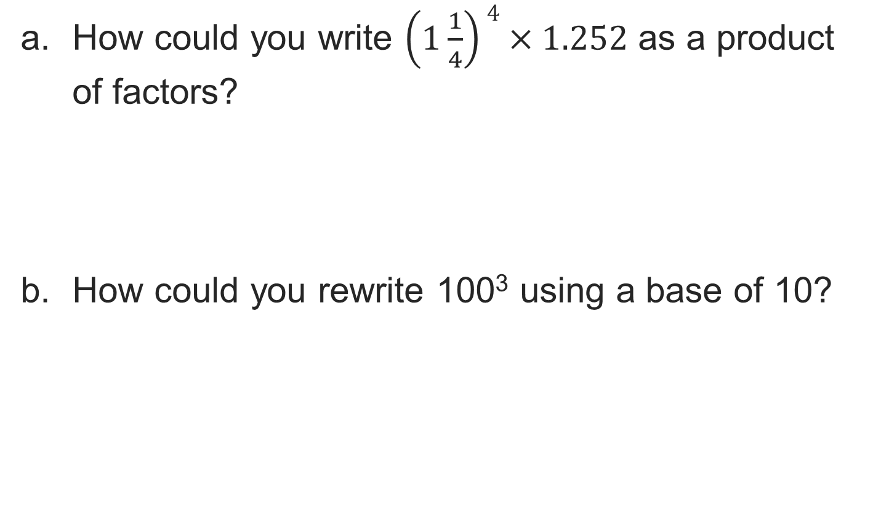
Let’s Explore More
TWO MINUTES SOLO · Two minutes on your own, then compare. Bring one thing you tried, even if it did not work.
35 / 46
Notes:
TEACH IN PRACTICE | Embedded facilitation | Lesson 6.3, slide 33 | PRACTICE
Focus on the existing task: Let’s Explore More
LAUNCH (T2/3/5): Use the displayed question. Give private thinking time; then A explains while B asks for evidence. Switch roles. Each student records their own reasoning.
LOOK FOR (T4): Where this task addresses it, students can distinguish base and exponent. Ask which feature of their work supports the claim.
RESPOND: If this task shows the lesson misconception—multiplying the base by the exponent—expand the original power as repeated multiplication before calculating. Have the student revise and explain the change. Use this support only where the concept occurs in the current task; otherwise respond to the displayed question.
RECHECK: If a gap is shared, revisit the existing representation together. If it is limited, give targeted support while others compare valid methods on the same task. Check the revision before moving on.
PARTICIPATION (T5/6/7): Think time before volunteers; accept a written, drawn or rehearsed entry. Students ask for evidence respectfully. Recognize a specific contribution or revision and check that both partners participate.
Source: BCPS Updated Instructional Framework Rubric (June 2020), TEACH 1–7. Earlier notes and answer keys are retained below.
EARLIER NOTES / EXISTING ANSWER KEY
Extension for partners or table groups — students choose their approach and use the workspace to show thinking.
Push with “Convince me,” and have two groups with different approaches share.
This is where students stretch past the worked example.
UIFR: TEACH 2 · TEACH 5.

Slide 36
LESSON 6.3 / CHECK YOUR WORK
Pause. Check. Improve.
CHECK
A mistake to watch for: multiplying the base by the exponent.
TRY
Expand the given power as repeated multiplication before calculating.
REVISE
Use that check on the task you just completed. Correct or strengthen one part, and explain why.
SELF-CHECK · Mark it: ✓ got it · ~ almost · ? stuck. Then fix one thing before we move on.
Listen to understand. Ask for evidence. Make room for every voice.
Notes:
TEACH IN PRACTICE | Embedded facilitation | Lesson 6.3, slide 34 | PRIOR_INSERT
Focus on the existing task: LESSON 6.3 / CHECK YOUR WORK Pause. Check. Improve. Listen to understand. Ask for evidence. Make room for every voice. CHECK A mistake…
CONNECT (T1/4): Ask students to restate the displayed goal or key idea and connect it to earlier work. Relevant lesson evidence: distinguish base and exponent; expand repeated factors; evaluate the power. Use only the criterion that matches the current session.
SHOW PROGRESS: Students point to their own existing work, explain what improved after feedback, and name a next step. Pair confidence ratings with actual evidence.
PARTICIPATION (T5/6/7): Think time before volunteers; accept a written, drawn or rehearsed entry. Students ask for evidence respectfully. Recognize a specific contribution or revision and check that both partners participate.
Source: BCPS Updated Instructional Framework Rubric (June 2020), TEACH 1–7.

Slide 37
How Much Is It?
How can you describe the expression as a power?
Compare your reasoning with the explanation. Explain any revision you make.
Reveal:
This shows 1.5 to the third power.​
37 / 46
Notes:
TEACH IN PRACTICE | Embedded facilitation | Lesson 6.3, slide 35 | REVEAL
Focus on the existing task: How can you describe the expression as a power?
LAUNCH (T2/3/5): If an existing answer cover is present, gather an attempt before revealing. If the explanation is already visible, ask students to reconstruct and justify it. Compare reasoning and explain a revision; preserve the reveal sequence.
LOOK FOR (T4): Where this task addresses it, students can evaluate the power. Ask which feature of their work supports the claim.
RESPOND: If this task shows the lesson misconception—multiplying the base by the exponent—expand the original power as repeated multiplication before calculating. Have the student revise and explain the change. Use this support only where the concept occurs in the current task; otherwise respond to the displayed question.
RECHECK: If a gap is shared, revisit the existing representation together. If it is limited, give targeted support while others compare valid methods on the same task. Check the revision before moving on.
PARTICIPATION (T5/6/7): Think time before volunteers; accept a written, drawn or rehearsed entry. Students ask for evidence respectfully. Recognize a specific contribution or revision and check that both partners participate.
Source: BCPS Updated Instructional Framework Rubric (June 2020), TEACH 1–7.

Slide 38
How Much Is It?
This expression represents multiplication.
A power represents repeated multiplication.
What number will be used as the factor in the related multiplication expression?
Reveal:
the base, 1.5
38 / 46
Notes:
TEACH IN PRACTICE | Embedded facilitation | Lesson 6.3, slide 36 | REVEAL
Focus on the existing task: This expression represents multiplication. A power represents repeated multiplication. What number will be used as the factor in the related multiplication expression?
LAUNCH (T2/3/5): If an existing answer cover is present, gather an attempt before revealing. If the explanation is already visible, ask students to reconstruct and justify it. Compare reasoning and explain a revision; preserve the reveal sequence.
LOOK FOR (T4): Where this task addresses it, students can distinguish base and exponent. Ask which feature of their work supports the claim.
RESPOND: If this task shows the lesson misconception—multiplying the base by the exponent—expand the original power as repeated multiplication before calculating. Have the student revise and explain the change. Use this support only where the concept occurs in the current task; otherwise respond to the displayed question.
RECHECK: If a gap is shared, revisit the existing representation together. If it is limited, give targeted support while others compare valid methods on the same task. Check the revision before moving on.
PARTICIPATION (T5/6/7): Think time before volunteers; accept a written, drawn or rehearsed entry. Students ask for evidence respectfully. Recognize a specific contribution or revision and check that both partners participate.
Source: BCPS Updated Instructional Framework Rubric (June 2020), TEACH 1–7.

Slide 39
How Much Is It?
Let’s use a table of values to organize powers of 1.5.
How can you find the value of each power?
Power | 1.5¹ | 1.5² | 1.5³
Value | 1.5
Reveal:
We can multiply the previous value in the table by 1.5 to find the next value in the table.
39 / 46
Notes:
TEACH IN PRACTICE | Embedded facilitation | Lesson 6.3, slide 37 | REVEAL
Focus on the existing task: Let’s use a table of values to organize powers of 1.5. How can you find the value of each power?
LAUNCH (T2/3/5): If an existing answer cover is present, gather an attempt before revealing. If the explanation is already visible, ask students to reconstruct and justify it. Compare reasoning and explain a revision; preserve the reveal sequence.
LOOK FOR (T4): Where this task addresses it, students can evaluate the power. Ask which feature of their work supports the claim.
RESPOND: If this task shows the lesson misconception—multiplying the base by the exponent—expand the original power as repeated multiplication before calculating. Have the student revise and explain the change. Use this support only where the concept occurs in the current task; otherwise respond to the displayed question.
RECHECK: If a gap is shared, revisit the existing representation together. If it is limited, give targeted support while others compare valid methods on the same task. Check the revision before moving on.
PARTICIPATION (T5/6/7): Think time before volunteers; accept a written, drawn or rehearsed entry. Students ask for evidence respectfully. Recognize a specific contribution or revision and check that both partners participate.
Source: BCPS Updated Instructional Framework Rubric (June 2020), TEACH 1–7.

Slide 40
STUDENT MOVES
Lesson 6-3
Your moves
JUSTIFY IT · Say it like this: “I know ______ because ______.”
ADD ON · Add on: “I agree because ______.” or “I see it differently because ______.”
40 / 46

Slide 41
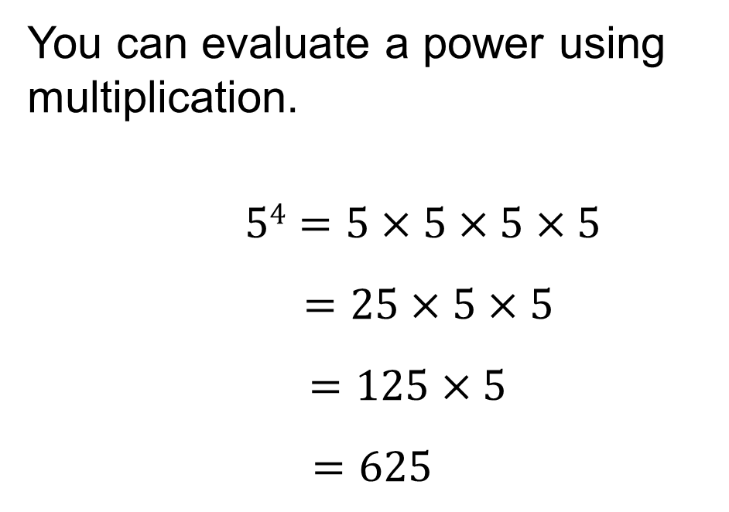
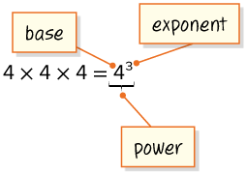
SUMMARIZE · SAY IT IN YOUR OWN WORDS
Summarize: Explore Numerical Expressions with Exponents
You can use exponents to represent a repeated multiplication expression. An expression written with an exponent is a power.
YOUR CHOICE · You choose how to show this — numbers, words, or a diagram. Make your reasoning visible.
41 / 46
Notes:
TEACH IN PRACTICE | Embedded facilitation | Lesson 6.3, slide 38 | SUMMARIZE
Focus on the existing task: Summarize: Explore Numerical Expressions with Exponents You can use exponents to represent a repeated multiplication expression. An…
CONNECT (T1/4): Ask students to restate the displayed goal or key idea and connect it to earlier work. Relevant lesson evidence: distinguish base and exponent; expand repeated factors; evaluate the power. Use only the criterion that matches the current session.
SHOW PROGRESS: Students point to their own existing work, explain what improved after feedback, and name a next step. Pair confidence ratings with actual evidence.
PARTICIPATION (T5/6/7): Think time before volunteers; accept a written, drawn or rehearsed entry. Students ask for evidence respectfully. Recognize a specific contribution or revision and check that both partners participate.
Source: BCPS Updated Instructional Framework Rubric (June 2020), TEACH 1–7. Earlier notes and answer keys are retained below.
EARLIER NOTES / EXISTING ANSWER KEY
Routine: SUMMARIZE · SAY IT IN YOUR OWN WORDS

Slide 42
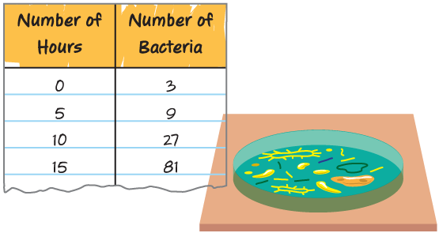
APPLY · PLAN IT • SOLVE IT • PROVE IT
Apply: Biology
James is studying the growth rate of a specific type of bacteria. He places three cells in a Petri dish and records the number of bacteria every five hours. The table shows his results.
Choose a question to answer.
Question 1: What power represents the number of bacteria recorded every 5 hours?
Question 2: What power would represent the number of bacteria after 25 hours?
42 / 46
Notes:
TEACH IN PRACTICE | Embedded facilitation | Lesson 6.3, slide 39 | APPLY
Focus on the existing task: Question 2: What power would represent the number of bacteria after 25 hours?
LAUNCH (T2/3/5): Use the exact application task independently first. Ask students to justify their choice of method. Collect evidence before a partner discussion or correction.
LOOK FOR (T4): Where this task addresses it, students can evaluate the power. Ask which feature of their work supports the claim.
RESPOND: If this task shows the lesson misconception—multiplying the base by the exponent—expand the original power as repeated multiplication before calculating. Have the student revise and explain the change. Use this support only where the concept occurs in the current task; otherwise respond to the displayed question.
RECHECK: If a gap is shared, revisit the existing representation together. If it is limited, give targeted support while others compare valid methods on the same task. Check the revision before moving on.
PARTICIPATION (T5/6/7): Think time before volunteers; accept a written, drawn or rehearsed entry. Students ask for evidence respectfully. Recognize a specific contribution or revision and check that both partners participate.
Source: BCPS Updated Instructional Framework Rubric (June 2020), TEACH 1–7. Earlier notes and answer keys are retained below.
EARLIER NOTES / EXISTING ANSWER KEY
Routine: APPLY · PLAN IT • SOLVE IT • PROVE IT
UIFR FULL | Lesson-specific facilitation
TEACH 4 | Independent evidence and revision (UIFR PDF p. 11).
Use the existing application/exit problem as the independent check. If this is a learning-target slide, have students point to and explain their work on the preceding task. Separate initial independent evidence from the revision after feedback.
Check the relevant criteria: distinguish base and exponent; expand repeated factors; evaluate the power. Respond with one specific next step tied to the work. Students revise and annotate what changed, then identify a criterion they can now demonstrate and one they still need to practice.

Slide 43
STUDENT MOVES
Lesson 6-3
Your move
REVISE NOW · Change one answer and write why you changed it. A revision is evidence of learning.
43 / 46

Slide 44
Learning Targets
I can make use of structure to write a product of whole numbers, fractions, and decimals as a power.
I can write a power as a product of factors to find its value.
NAME THE MATH · Point to the part of this that is new today, and say what it changes.
44 / 46
Notes:
TEACH IN PRACTICE | Embedded facilitation | Lesson 6.3, slide 40 | REFLECTION
Focus on the existing task: I can make use of structure to write a product of whole numbers, fractions, and decimals as a power. I can write a power as a product of…
CONNECT (T1/4): Ask students to restate the displayed goal or key idea and connect it to earlier work. Relevant lesson evidence: distinguish base and exponent; expand repeated factors; evaluate the power. Use only the criterion that matches the current session.
SHOW PROGRESS: Students point to their own existing work, explain what improved after feedback, and name a next step. Pair confidence ratings with actual evidence.
PARTICIPATION (T5/6/7): Think time before volunteers; accept a written, drawn or rehearsed entry. Students ask for evidence respectfully. Recognize a specific contribution or revision and check that both partners participate.
Source: BCPS Updated Instructional Framework Rubric (June 2020), TEACH 1–7. Earlier notes and answer keys are retained below.
EARLIER NOTES / EXISTING ANSWER KEY
Read each target; students self-rate with fist-to-five or thumbs.
Tie back to the goal from the start of class: did we get there?
Note any target that rates low — revisit it tomorrow.
UIFR: TEACH 1 · TEACH 4.

Slide 45
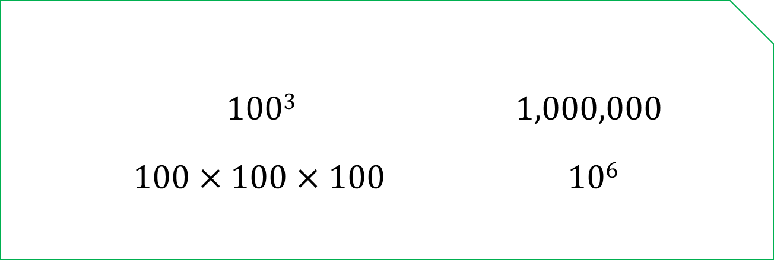
Be Curious
Which doesn’t belong?
Think first. Share a notice and a question;
build on a classmate’s idea.
Mindset
How are you showing others that you respect their ideas about math?
45 / 46
Notes:
TEACH IN PRACTICE | Embedded facilitation | Lesson 6.3, slide 41 | CURIOUS
Focus on the existing task: Which doesn’t belong?
LAUNCH (T2/3/5): Allow quiet observation first. Separate a notice from an inference, invite students’ own questions, and follow the existing launch before teaching a procedure.
LOOK FOR (T4): Where this task addresses it, students can distinguish base and exponent. Ask which feature of their work supports the claim.
RESPOND: If this task shows the lesson misconception—multiplying the base by the exponent—expand the original power as repeated multiplication before calculating. Have the student revise and explain the change. Use this support only where the concept occurs in the current task; otherwise respond to the displayed question.
RECHECK: If a gap is shared, revisit the existing representation together. If it is limited, give targeted support while others compare valid methods on the same task. Check the revision before moving on.
PARTICIPATION (T5/6/7): Think time before volunteers; accept a written, drawn or rehearsed entry. Students ask for evidence respectfully. Recognize a specific contribution or revision and check that both partners participate.
Source: BCPS Updated Instructional Framework Rubric (June 2020), TEACH 1–7. Earlier notes and answer keys are retained below.
EARLIER NOTES / EXISTING ANSWER KEY
UIFR FULL | Lesson-specific facilitation
REFLECT & ADJUST 1-2 | After the lesson (UIFR PDF pp. 15-16).
Sort the existing work by demonstrated reasoning, partial understanding, and the specific misconception: multiplying the base by the exponent. Compare the initial response with the revision. Record which teaching move plausibly helped, which did not, and whose participation or access needs a different approach; do not record sensitive student details in this shared deck.
Plan the next lesson from that evidence: if the misconception persists, expand the original power as repeated multiplication before calculating using the current example before returning to the next grade-level task; if understanding is secure, use an existing extension or ask for a general explanation. Check the targeted idea again at the next warm-up.
Ask students what supported their thinking and what would help next time. Identify one change to try and one successful practice to retain. Seek colleague feedback on anonymized work when useful; these prompts support reflection and do not establish an evaluation rating. Source: Baltimore City Public Schools, Updated Instructional Framework Rubric, June 2020 (UIFR_Full.pdf).

Slide 46
LESSON 6.3 / REFLECT ON YOUR LEARNING
Show your progress
1 SHOW EVIDENCE
2 CHOOSE A NEXT STEP
Choose one response. Point to the part that shows your reasoning.
Name a change you made after feedback—or a question you still have.
“My work shows ___ because ___.”
“Next time, I will ___ to help me ___.”
Today’s focus: Distinguish base and exponent.
CREDIT A CLASSMATE · Name one classmate whose idea helped you today, and say what they said.
Listen to understand. Ask for evidence. Make room for every voice.
Notes:
TEACH IN PRACTICE | Embedded facilitation | Lesson 6.3, slide 42 | PRIOR_INSERT
Focus on the existing task: LESSON 6.3 / REFLECT ON YOUR LEARNING Show your progress Listen to understand. Ask for evidence. Make room for every voice. 1 SHOW…
CONNECT (T1/4): Ask students to restate the displayed goal or key idea and connect it to earlier work. Relevant lesson evidence: distinguish base and exponent; expand repeated factors; evaluate the power. Use only the criterion that matches the current session.
SHOW PROGRESS: Students point to their own existing work, explain what improved after feedback, and name a next step. Pair confidence ratings with actual evidence.
PARTICIPATION (T5/6/7): Think time before volunteers; accept a written, drawn or rehearsed entry. Students ask for evidence respectfully. Recognize a specific contribution or revision and check that both partners participate.
Source: BCPS Updated Instructional Framework Rubric (June 2020), TEACH 1–7.

