Slide 1
WARM-UP · THINK • TRY • CHECK
Turn and talk: compare strategies, then defend one.
Warm-Up
Lesson 6-4 · Write and Evaluate Numerical Expressions with Exponents | Warm-Up · about 4 minutes
Try each on your own. Mark an unsure answer; explain and revise when we check.
QUESTION 1
QUESTION 2
3² = ______
3 + 2² × 5 = ______
QUESTION 3
QUESTION 4
24/(4 + 2) = ______
Write “the product of 4 and 7” in symbols: ______
TALK IT OVER: “I got ______ because ______.” • Compare with a partner before we check as a class.
1 / 44
Notes:
TEACH IN PRACTICE | Embedded facilitation | Lesson 6.4, slide 1 | WARMUP
Focus on the existing task: Warm-Up WARM-UP · THINK • TRY •…
GATHER EVIDENCE (T4/6): Keep the original items. Students try independently, mark an uncertain item, and explain one method before checking. Use the existing key when present.
RESPOND: Distinguish a calculation slip from a reasoning gap. Give one next step on the same item; have students revise in a second color. Use the responses to choose flexible support for today’s lesson.
PARTICIPATION (T5/6/7): Think time before volunteers; accept a written, drawn or rehearsed entry. Students ask for evidence respectfully. Recognize a specific contribution or revision and check that both partners participate.
Source: BCPS Updated Instructional Framework Rubric (June 2020), TEACH 1–7. Earlier notes and answer keys are retained below.
EARLIER NOTES / EXISTING ANSWER KEY
Warm-Up answers (teacher only): 1) 9 2) 23 3) 4 4) 4 × 7
UIFR FULL | Lesson-specific facilitation
PREPARE 1-2 | Before teaching (UIFR PDF pp. 6-7).
Plan to gather evidence that students can translate the situation; respect grouping and exponents; justify operation order. Review recent work and today’s warm-up to choose flexible groups and access supports; do not infer needs from identity or perceived ability. Use the existing lesson tasks and stated standards.
Anticipate: applying operations strictly left to right regardless of grouping. If observed, annotate grouping and powers in the original expression before evaluating one stage at a time. Offer oral rehearsal, drawing, pointing, or home-language processing as needed; retain the original mathematical demand. Ask students which support helps and fade it as evidence improves.
TEACH 6-7 | Before the first transition, agree on materials, partner roles, and how to request help. Invite students to restate the routine. Normalize revising an idea, recognize a specific contribution, and check privately when frustration blocks participation. Source: UIFR PDF pp. 13-14.

Slide 2
Today’s Math Notes
Lesson 6-4 · Write and Evaluate Numerical Expressions with Exponents
Section 1: Math Words
Copy. Explain. Check.
SAY THE GOAL · Say today’s goal in your own words, then name one place this shows up outside math class.
Write and Evaluate Numerical Expressions with Exponents
1
Turning a situation into a number sentence without an equal sign
Numerical expression
2
A math phrase built from numbers and operations
Evaluate
3
To find the single value an expression is worth by carrying
eduwonderlab.com · Neft Teacher
2 / 44
Notes:
TEACH IN PRACTICE | Embedded facilitation | Lesson 6.4, slide 2 | NOTES
Focus on the existing task: Today’s Math Notes Section 1: Math…
ROUTINE (T1/2/4): Read or copy the original notes, cover one line, and explain it using the displayed example. Reopen and correct. Copying alone is not evidence of understanding.
LOOK FOR: A link between a symbol, quantity or feature and the explanation. If missing, point back to that feature and have the student try again; fade the prompt once they can explain.
PARTICIPATION (T5/6/7): Think time before volunteers; accept a written, drawn or rehearsed entry. Students ask for evidence respectfully. Recognize a specific contribution or revision and check that both partners participate.
Source: BCPS Updated Instructional Framework Rubric (June 2020), TEACH 1–7. Earlier notes and answer keys are retained below.
EARLIER NOTES / EXISTING ANSWER KEY
Copy routine: read one line at a time; students copy, then explain that line to a partner.
Keep it brisk — the understanding work happens in the examples, not the copying.
UIFR: TEACH 1 · TEACH 6.

Slide 3
Today’s Math Notes
Lesson 6-4 · Write and Evaluate Numerical Expressions with Exponents
Section 2: Today’s Math
Copy. Explain. Check.
Order of Operations (PEMDAS)
Grouping Symbols: Parentheses, brackets, fraction bars inner to outer
1
Exponents: Evaluate all powers
2
CONNECT IT · What earlier lesson does this build on? Tell a partner in one sentence.
Multiply & Divide left to right; Add & Subtract left to right
3
eduwonderlab.com · Neft Teacher
3 / 44
Notes:
TEACH IN PRACTICE | Embedded facilitation | Lesson 6.4, slide 3 | NOTES
Focus on the existing task: Today’s Math Notes Section 2…
ROUTINE (T1/2/4): Read or copy the original notes, cover one line, and explain it using the displayed example. Reopen and correct. Copying alone is not evidence of understanding.
LOOK FOR: A link between a symbol, quantity or feature and the explanation. If missing, point back to that feature and have the student try again; fade the prompt once they can explain.
PARTICIPATION (T5/6/7): Think time before volunteers; accept a written, drawn or rehearsed entry. Students ask for evidence respectfully. Recognize a specific contribution or revision and check that both partners participate.
Source: BCPS Updated Instructional Framework Rubric (June 2020), TEACH 1–7. Earlier notes and answer keys are retained below.
EARLIER NOTES / EXISTING ANSWER KEY
Copy routine: read one line at a time; students copy, then explain that line to a partner.
Keep it brisk — the understanding work happens in the examples, not the copying.
UIFR: TEACH 1 · TEACH 6.

Slide 4
Session 1
Write and Evaluate Numerical Expressions with Exponents
TRY IT BEFORE YOU’RE SURE · Start even if you are not sure. A revised answer counts as much as a first-try answer.
4 / 44
Notes:
TEACH IN PRACTICE | Embedded facilitation | Lesson 6.4, slide 4 | DIVIDER
Focus on the existing task: Write and Evaluate Numerical Expressions with Exponents Session 1
TRANSITION (T6/7): Students confirm materials, roles, how to request help, and the next response routine. Ask a student to restate it. Keep teacher-only slides hidden.
PARTICIPATION (T5/6/7): Think time before volunteers; accept a written, drawn or rehearsed entry. Students ask for evidence respectfully. Recognize a specific contribution or revision and check that both partners participate.
Source: BCPS Updated Instructional Framework Rubric (June 2020), TEACH 1–7. Earlier notes and answer keys are retained below.
EARLIER NOTES / EXISTING ANSWER KEY
Transition cue: state what materials are out and what success looks like this session.
Keep the changeover under a minute.
UIFR: TEACH 6.

Slide 5
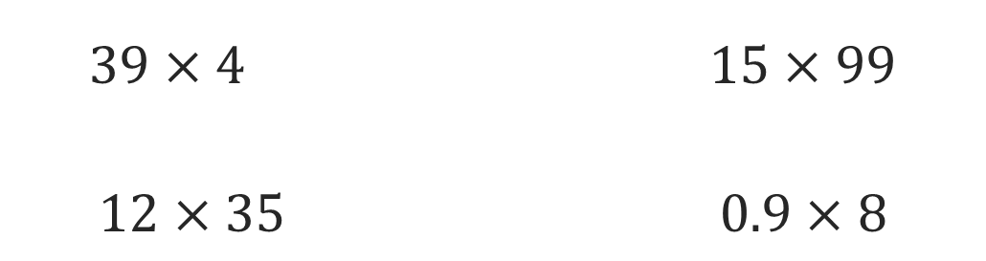
Or You Could
Explain how the information shown supports your reasoning.
5 / 44
Notes:
TEACH IN PRACTICE | Embedded facilitation | Lesson 6.4, slide 5 | WORKED
Focus on the existing task: Or You Could
LAUNCH (T2/3/5): Ask students to explain the displayed idea or example and point to evidence. When a calculation step is shown, ask why it is valid. Have a partner restate the explanation; copying is not the check.
LOOK FOR (T4): Where this task addresses it, students can translate the situation. Ask which feature of their work supports the claim.
RESPOND: If this task shows the lesson misconception—applying operations strictly left to right regardless of grouping—annotate grouping and powers in the original expression before evaluating one stage at a time. Have the student revise and explain the change. Use this support only where the concept occurs in the current task; otherwise respond to the displayed question.
RECHECK: If a gap is shared, revisit the existing representation together. If it is limited, give targeted support while others compare valid methods on the same task. Check the revision before moving on.
PARTICIPATION (T5/6/7): Think time before volunteers; accept a written, drawn or rehearsed entry. Students ask for evidence respectfully. Recognize a specific contribution or revision and check that both partners participate.
Source: BCPS Updated Instructional Framework Rubric (June 2020), TEACH 1–7. Earlier notes and answer keys are retained below.
EARLIER NOTES / EXISTING ANSWER KEY
Model briefly, then hand the thinking back: ask “Why does this step work?” before showing the next one.
Quick check before moving on — thumbs or whiteboards from everyone, not volunteers.
UIFR: TEACH 2 · TEACH 3 · TEACH 4.

Slide 6
Today’s Objectives
Lesson 6-4 · Write and Evaluate Numerical Expressions with Exponents
Write and Evaluate Numerical Expressions with Exponents
Maryland Standard 6.AT.6c
CONTENT OBJECTIVE
LANGUAGE OBJECTIVE
Restate the goal in your words
Use these words to explain why
I can write numerical expressions from a real situation and evaluate them using the order of operations, including powers.
I can explain my steps using the words expression, evaluate, order of operations, base, and exponent.
eduwonderlab.com · Neft Teacher
6 / 44
Notes:
TEACH IN PRACTICE | Embedded facilitation | Lesson 6.4, slide 6 | GOAL
Focus on the existing task: Today’s Objectives Write and…
CONNECT (T1/4): Ask students to restate the displayed goal or key idea and connect it to earlier work. Relevant lesson evidence: translate the situation; respect grouping and exponents; justify operation order. Use only the criterion that matches the current session.
SHOW PROGRESS: Students point to their own existing work, explain what improved after feedback, and name a next step. Pair confidence ratings with actual evidence.
PARTICIPATION (T5/6/7): Think time before volunteers; accept a written, drawn or rehearsed entry. Students ask for evidence respectfully. Recognize a specific contribution or revision and check that both partners participate.
Source: BCPS Updated Instructional Framework Rubric (June 2020), TEACH 1–7. Earlier notes and answer keys are retained below.
EARLIER NOTES / EXISTING ANSWER KEY
Read the objective together, then have one or two students restate today’s goal in their own words.
Connect it to what the class learned last lesson.
Return to this goal at the end of class to check it was met.
UIFR: TEACH 1.
UIFR FULL | Lesson-specific facilitation
TEACH 1 | Session 1 purpose and evidence (UIFR PDF p. 8).
Have students restate the displayed session goal in their own words and connect it to the existing context or a familiar experience they choose to share. Use the current session goal to select from these lesson-wide evidence criteria; do not frontload a later-session procedure.
Look for: translate the situation; respect grouping and exponents; justify operation order. Ask: “Which part of your work would show this?” Revisit that evidence after the task; a confidence rating alone is not evidence of understanding.

Slide 7
STUDENT MOVES
Lesson 6-4
Your move
SAY THE GOAL · Say today’s goal in your own words, then name one place this shows up outside math class.
7 / 44

Slide 8
LESSON 6.4 / OUR LEARNING
What will show your learning?
1
Translate the situation.
2
Respect grouping and exponents.
3
Justify operation order.
Tell a partner: Which skill connects to something you already know?
SHOW YOUR THINKING · Show what you know — write it, draw it, or build it. A picture counts as an explanation.
Listen to understand. Ask for evidence. Make room for every voice.
Notes:
TEACH IN PRACTICE | Embedded facilitation | Lesson 6.4, slide 7 | PRIOR_INSERT
Focus on the existing task: LESSON 6.4 / OUR LEARNING What will show your learning?
CONNECT (T1/4): Ask students to restate the displayed goal or key idea and connect it to earlier work. Relevant lesson evidence: translate the situation; respect grouping and exponents; justify operation order. Use only the criterion that matches the current session.
SHOW PROGRESS: Students point to their own existing work, explain what improved after feedback, and name a next step. Pair confidence ratings with actual evidence.
PARTICIPATION (T5/6/7): Think time before volunteers; accept a written, drawn or rehearsed entry. Students ask for evidence respectfully. Recognize a specific contribution or revision and check that both partners participate.
Source: BCPS Updated Instructional Framework Rubric (June 2020), TEACH 1–7.

Slide 9
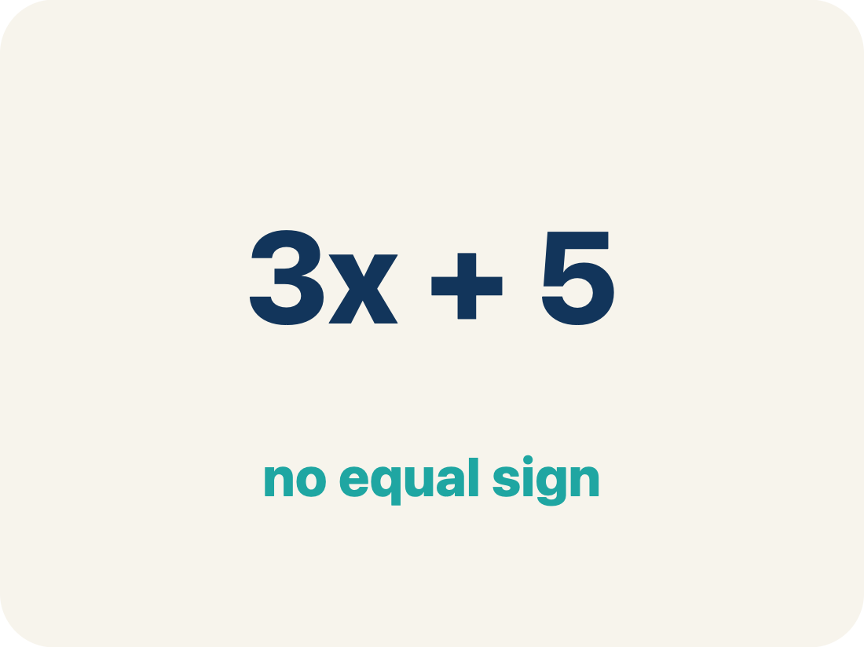
Vocabulary 1 of 7
Lesson 6-4 · Write and Evaluate Numerical Expressions with Exponents
Write and Evaluate Numerical Expressions with Exponents
Turning a situation into a number sentence without an equal sign, then finding its value in the correct order.
EXAMPLE · EXPLAIN WHY IT FITS
2 × 15 + 4 × 20 + 8 × 2³ = 174
USE THE MATH WORDS · Use today’s math words in your explanation — not “it” and “that thing.”
eduwonderlab.com · Neft Teacher
9 / 44
Notes:
TEACH IN PRACTICE | Embedded facilitation | Lesson 6.4, slide 8 | VOCAB
Focus on the existing task: Vocabulary 1 of 7 Write and…
ASK (T1/3/5): Where does “Write and Evaluate Numerical Expressions with Exponents” appear in the example? Explain the meaning without reading the definition. Partner: restate the idea and ask a clarifying question.
LOOK FOR: A correct connection between the word and a feature of the example. If the student only repeats the definition, invite pointing, sketching or oral rehearsal, then ask for another explanation of this same example.
PARTICIPATION (T5/6/7): Think time before volunteers; accept a written, drawn or rehearsed entry. Students ask for evidence respectfully. Recognize a specific contribution or revision and check that both partners participate.
Source: BCPS Updated Instructional Framework Rubric (June 2020), TEACH 1–7.

Slide 10
Vocabulary 2 of 7
Lesson 6-4 · Write and Evaluate Numerical Expressions with Exponents
Numerical expression
A math phrase built from numbers and operations, with no equal sign and no variable.
EXAMPLE · EXPLAIN WHY IT FITS
4 × 20 is an expression; 4 × 20 = 80 is an equation
Use “Numerical expression” to explain the example. Point to
evidence.
eduwonderlab.com · Neft Teacher
10 / 44
Notes:
TEACH IN PRACTICE | Embedded facilitation | Lesson 6.4, slide 9 | VOCAB
Focus on the existing task: Vocabulary 2 of 7 Numerical…
ASK (T1/3/5): Where does “Numerical expression” appear in the example? Explain the meaning without reading the definition. Partner: restate the idea and ask a clarifying question.
LOOK FOR: A correct connection between the word and a feature of the example. If the student only repeats the definition, invite pointing, sketching or oral rehearsal, then ask for another explanation of this same example.
PARTICIPATION (T5/6/7): Think time before volunteers; accept a written, drawn or rehearsed entry. Students ask for evidence respectfully. Recognize a specific contribution or revision and check that both partners participate.
Source: BCPS Updated Instructional Framework Rubric (June 2020), TEACH 1–7.

Slide 11
Vocabulary 3 of 7
Lesson 6-4 · Write and Evaluate Numerical Expressions with Exponents
Evaluate
To find the single value an expression is worth by carrying out its operations in order.
EXAMPLE · EXPLAIN WHY IT FITS
Evaluate 3 + 2 × 4 → 3 + 8 = 11
Use “Evaluate” to explain the example. Point to evidence.
eduwonderlab.com · Neft Teacher
11 / 44
Notes:
TEACH IN PRACTICE | Embedded facilitation | Lesson 6.4, slide 10 | VOCAB
Focus on the existing task: Vocabulary 3 of 7 Evaluate To find…
ASK (T1/3/5): Where does “Evaluate” appear in the example? Explain the meaning without reading the definition. Partner: restate the idea and ask a clarifying question.
LOOK FOR: A correct connection between the word and a feature of the example. If the student only repeats the definition, invite pointing, sketching or oral rehearsal, then ask for another explanation of this same example.
PARTICIPATION (T5/6/7): Think time before volunteers; accept a written, drawn or rehearsed entry. Students ask for evidence respectfully. Recognize a specific contribution or revision and check that both partners participate.
Source: BCPS Updated Instructional Framework Rubric (June 2020), TEACH 1–7.

Slide 12
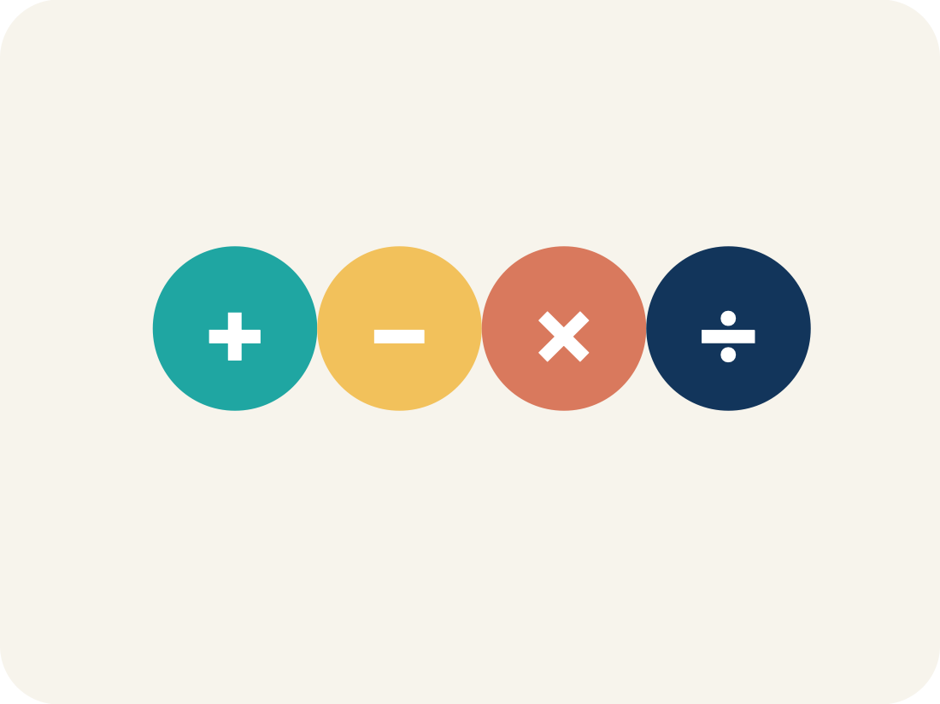
Vocabulary 4 of 7
Lesson 6-4 · Write and Evaluate Numerical Expressions with Exponents
Order of operations
The agreed order for evaluating: grouping symbols, then exponents, then multiply and divide left to right, then add and subtract left to right.
EXAMPLE · EXPLAIN WHY IT FITS
3 + 4 × 2² → 3 + 4 × 4 → 3 + 16 = 19
ADD ON · Add on: “I agree because ______.” or “I see it differently because ______.”
eduwonderlab.com · Neft Teacher
12 / 44
Notes:
TEACH IN PRACTICE | Embedded facilitation | Lesson 6.4, slide 11 | VOCAB
Focus on the existing task: Vocabulary 4 of 7 Order of…
ASK (T1/3/5): Where does “Order of operations” appear in the example? Explain the meaning without reading the definition. Partner: restate the idea and ask a clarifying question.
LOOK FOR: A correct connection between the word and a feature of the example. If the student only repeats the definition, invite pointing, sketching or oral rehearsal, then ask for another explanation of this same example.
PARTICIPATION (T5/6/7): Think time before volunteers; accept a written, drawn or rehearsed entry. Students ask for evidence respectfully. Recognize a specific contribution or revision and check that both partners participate.
Source: BCPS Updated Instructional Framework Rubric (June 2020), TEACH 1–7.

Slide 13
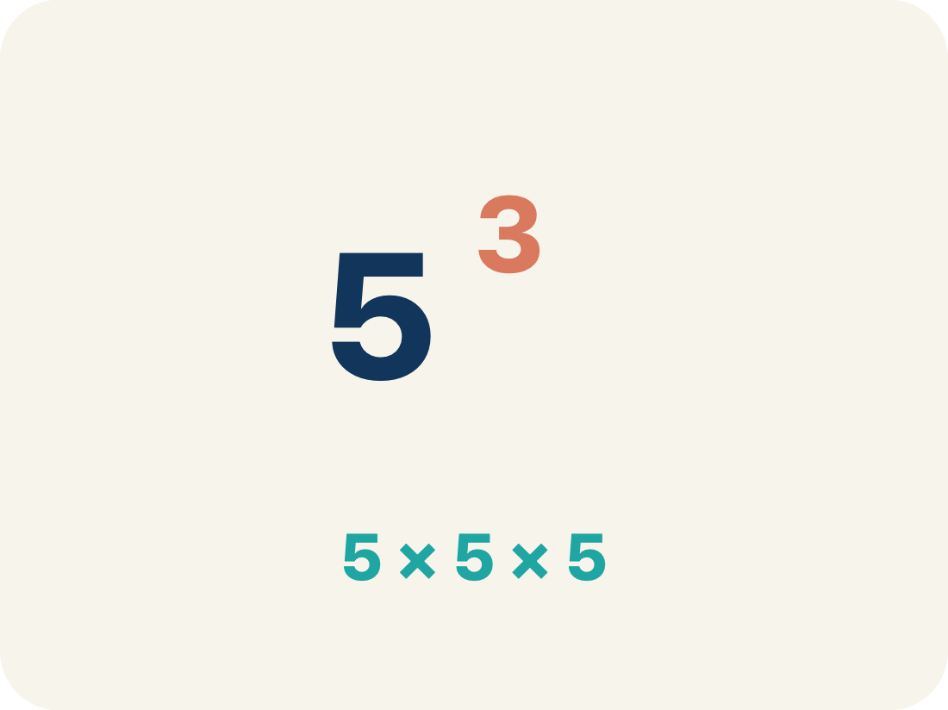
Vocabulary 5 of 7
Lesson 6-4 · Write and Evaluate Numerical Expressions with Exponents
Power
A short way to write repeated multiplication of the same factor, such as 2³ for 2 × 2 × 2.
EXAMPLE · EXPLAIN WHY IT FITS
2³ = 2 × 2 × 2 = 8
Use “Power” to explain the example. Point to evidence.
eduwonderlab.com · Neft Teacher
13 / 44
Notes:
TEACH IN PRACTICE | Embedded facilitation | Lesson 6.4, slide 12 | VOCAB
Focus on the existing task: Vocabulary 5 of 7 Power A short…
ASK (T1/3/5): Where does “Power” appear in the example? Explain the meaning without reading the definition. Partner: restate the idea and ask a clarifying question.
LOOK FOR: A correct connection between the word and a feature of the example. If the student only repeats the definition, invite pointing, sketching or oral rehearsal, then ask for another explanation of this same example.
PARTICIPATION (T5/6/7): Think time before volunteers; accept a written, drawn or rehearsed entry. Students ask for evidence respectfully. Recognize a specific contribution or revision and check that both partners participate.
Source: BCPS Updated Instructional Framework Rubric (June 2020), TEACH 1–7.

Slide 14
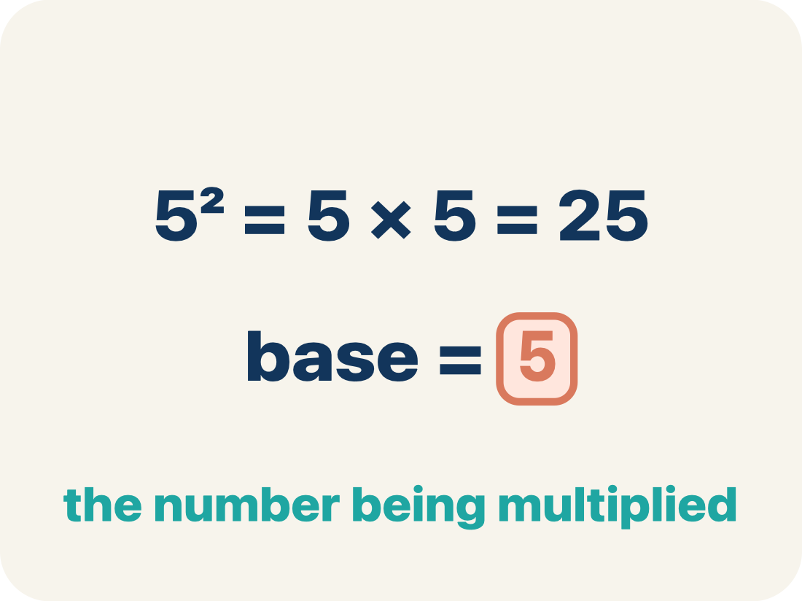
Vocabulary 6 of 7
Lesson 6-4 · Write and Evaluate Numerical Expressions with Exponents
Base
In a power, the number being multiplied by itself. In 2³ the base is 2.
EXAMPLE · EXPLAIN WHY IT FITS
2³ — the 2 is the base
Use “Base” to explain the example. Point to evidence.
eduwonderlab.com · Neft Teacher
14 / 44
Notes:
TEACH IN PRACTICE | Embedded facilitation | Lesson 6.4, slide 13 | VOCAB
Focus on the existing task: Vocabulary 6 of 7 Base In a power…
ASK (T1/3/5): Where does “Base” appear in the example? Explain the meaning without reading the definition. Partner: restate the idea and ask a clarifying question.
LOOK FOR: A correct connection between the word and a feature of the example. If the student only repeats the definition, invite pointing, sketching or oral rehearsal, then ask for another explanation of this same example.
PARTICIPATION (T5/6/7): Think time before volunteers; accept a written, drawn or rehearsed entry. Students ask for evidence respectfully. Recognize a specific contribution or revision and check that both partners participate.
Source: BCPS Updated Instructional Framework Rubric (June 2020), TEACH 1–7.

Slide 15
Vocabulary 7 of 7
Lesson 6-4 · Write and Evaluate Numerical Expressions with Exponents
Exponent
In a power, the small raised number that says how many times the base is used as a factor.
EXAMPLE · EXPLAIN WHY IT FITS
2³ — the 3 is the exponent
Use “Exponent” to explain the example. Point to evidence.
eduwonderlab.com · Neft Teacher
15 / 44
Notes:
TEACH IN PRACTICE | Embedded facilitation | Lesson 6.4, slide 14 | VOCAB
Focus on the existing task: Vocabulary 7 of 7 Exponent In a…
ASK (T1/3/5): Where does “Exponent” appear in the example? Explain the meaning without reading the definition. Partner: restate the idea and ask a clarifying question.
LOOK FOR: A correct connection between the word and a feature of the example. If the student only repeats the definition, invite pointing, sketching or oral rehearsal, then ask for another explanation of this same example.
PARTICIPATION (T5/6/7): Think time before volunteers; accept a written, drawn or rehearsed entry. Students ask for evidence respectfully. Recognize a specific contribution or revision and check that both partners participate.
Source: BCPS Updated Instructional Framework Rubric (June 2020), TEACH 1–7.

Slide 16
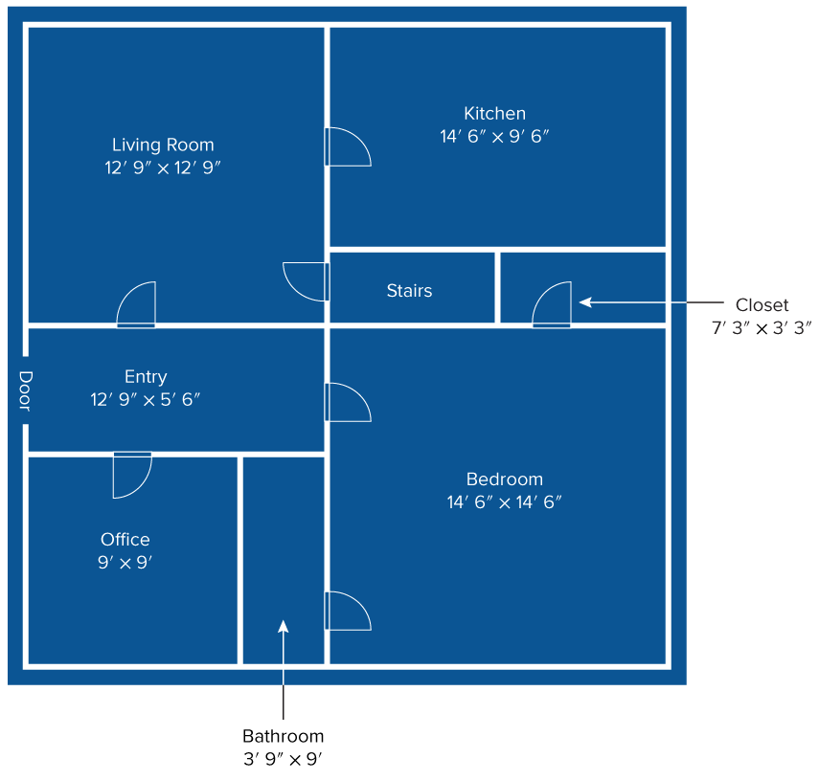

Be Curious
What do you notice?
What do you wonder?
Think first. Share a notice and a question;
build on a classmate’s idea.
Mindset
Why is it important to explain your thinking clearly and concisely?
16 / 44
Notes:
TEACH IN PRACTICE | Embedded facilitation | Lesson 6.4, slide 15 | CURIOUS
Focus on the existing task: Be Curious Mindset Why is it important to explain your thinking clearly and concisely?
LAUNCH (T2/3/5): Allow quiet observation first. Separate a notice from an inference, invite students’ own questions, and follow the existing launch before teaching a procedure.
LOOK FOR (T4): Where this task addresses it, students can translate the situation. Ask which feature of their work supports the claim.
RESPOND: If this task shows the lesson misconception—applying operations strictly left to right regardless of grouping—annotate grouping and powers in the original expression before evaluating one stage at a time. Have the student revise and explain the change. Use this support only where the concept occurs in the current task; otherwise respond to the displayed question.
RECHECK: If a gap is shared, revisit the existing representation together. If it is limited, give targeted support while others compare valid methods on the same task. Check the revision before moving on.
PARTICIPATION (T5/6/7): Think time before volunteers; accept a written, drawn or rehearsed entry. Students ask for evidence respectfully. Recognize a specific contribution or revision and check that both partners participate.
Source: BCPS Updated Instructional Framework Rubric (June 2020), TEACH 1–7.

Slide 17
Vocabulary
Lesson 6-4 · Write and Evaluate Numerical Expressions with Exponents
Today’s Math Words
We learn every word — what it means and what it looks like — before we use it.
Write and Evaluate Numerical Expressions with Exponents
Numerical expression
Turning a situation into a number sentence without an equal sign, then finding its value in the correct order
A math phrase built from numbers and operations, with no equal sign and no variable
Evaluate
Order of operations
To find the single value an expression is worth by carrying out its operations in order
The agreed order for evaluating: grouping symbols, then exponents, then multiply and divide left to right, then add and subtract left to right
Power
Base
A short way to write repeated multiplication of the same factor, such as 2³ for 2 × 2 × 2
In a power, the number being multiplied by itself
Exponent
Explain one math word using the example.
Partner: point to evidence.
In a power, the small raised number that says how many times the base is used as a factor
eduwonderlab.com · Neft Teacher
17 / 44
Notes:
TEACH IN PRACTICE | Embedded facilitation | Lesson 6.4, slide 16 | VOCAB
Focus on the existing task: Vocabulary Today’s Math Words We…
ASK (T1/3/5): Where does “the displayed term” appear in the example? Explain the meaning without reading the definition. Partner: restate the idea and ask a clarifying question.
LOOK FOR: A correct connection between the word and a feature of the example. If the student only repeats the definition, invite pointing, sketching or oral rehearsal, then ask for another explanation of this same example.
PARTICIPATION (T5/6/7): Think time before volunteers; accept a written, drawn or rehearsed entry. Students ask for evidence respectfully. Recognize a specific contribution or revision and check that both partners participate.
Source: BCPS Updated Instructional Framework Rubric (June 2020), TEACH 1–7. Earlier notes and answer keys are retained below.
EARLIER NOTES / EXISTING ANSWER KEY
Choral-read each word, its meaning, and what it looks like.
Students should use these words out loud today — listen for them in partner talk and revoice student ideas with the academic term.
UIFR: TEACH 1 · TEACH 5.

Slide 18

Theater Ticket Prices​
Sofia is buying tickets for two members, four non-members, and eight students. What expression could Sofia use to find the cost of the tickets?
How can you represent the cost for each of the ticket types?
Reveal:
HOW DO YOU KNOW? · Ask your partner “How do you know?” Answer by pointing to your own work.
18 / 44
Notes:
TEACH IN PRACTICE | Embedded facilitation | Lesson 6.4, slide 17 | REVEAL
Focus on the existing task: Sofia is buying tickets for two members, four non-members, and eight students. What expression could Sofia use to find the cost of the tickets?
LAUNCH (T2/3/5): If an existing answer cover is present, gather an attempt before revealing. If the explanation is already visible, ask students to reconstruct and justify it. Compare reasoning and explain a revision; preserve the reveal sequence.
LOOK FOR (T4): Where this task addresses it, students can translate the situation. Ask which feature of their work supports the claim.
RESPOND: If this task shows the lesson misconception—applying operations strictly left to right regardless of grouping—annotate grouping and powers in the original expression before evaluating one stage at a time. Have the student revise and explain the change. Use this support only where the concept occurs in the current task; otherwise respond to the displayed question.
RECHECK: If a gap is shared, revisit the existing representation together. If it is limited, give targeted support while others compare valid methods on the same task. Check the revision before moving on.
PARTICIPATION (T5/6/7): Think time before volunteers; accept a written, drawn or rehearsed entry. Students ask for evidence respectfully. Recognize a specific contribution or revision and check that both partners participate.
Source: BCPS Updated Instructional Framework Rubric (June 2020), TEACH 1–7. Earlier notes and answer keys are retained below.
EARLIER NOTES / EXISTING ANSWER KEY
Students should have shared predictions before this reveal.
Have them compare their thinking to what is shown: “Is this the same as what we said? Where is it different?”
Press one student to explain the reveal in their own words.
UIFR: TEACH 3 · TEACH 4.
UIFR FULL | Lesson-specific facilitation
TEACH 2-3 | Session 1 task launch (UIFR PDF pp. 9-10).
Use the problem exactly as displayed. Give individual thinking time before discussion or advancing to the explanation. If the answer is already visible, ask students to reconstruct and justify it. Invite a choice of suitable representations and have students explain why their choice helps.
At the point where this concept appears, ask: “Which structure tells you what to evaluate first, and how would parentheses change the meaning?” Wait for evidence, invite another pathway, and have a student ask a follow-up question. Do not replace students’ reasoning with a sequence of leading steps.

Slide 19
Theater Ticket Prices​
Sofia is buying tickets for two members, four non-members, and eight students. What expression could Sofia use to find the cost of the tickets?
How can you represent the cost for each of the ticket types?
TAKE TURNS · One explains, one asks a question. Then switch, so both of you talk.
Reveal:
We can write a numerical expression for each of the ticket types.
19 / 44
Notes:
TEACH IN PRACTICE | Embedded facilitation | Lesson 6.4, slide 18 | REVEAL
Focus on the existing task: How can you represent the cost for each of the ticket types?
LAUNCH (T2/3/5): If an existing answer cover is present, gather an attempt before revealing. If the explanation is already visible, ask students to reconstruct and justify it. Compare reasoning and explain a revision; preserve the reveal sequence.
LOOK FOR (T4): Where this task addresses it, students can translate the situation. Ask which feature of their work supports the claim.
RESPOND: If this task shows the lesson misconception—applying operations strictly left to right regardless of grouping—annotate grouping and powers in the original expression before evaluating one stage at a time. Have the student revise and explain the change. Use this support only where the concept occurs in the current task; otherwise respond to the displayed question.
RECHECK: If a gap is shared, revisit the existing representation together. If it is limited, give targeted support while others compare valid methods on the same task. Check the revision before moving on.
PARTICIPATION (T5/6/7): Think time before volunteers; accept a written, drawn or rehearsed entry. Students ask for evidence respectfully. Recognize a specific contribution or revision and check that both partners participate.
Source: BCPS Updated Instructional Framework Rubric (June 2020), TEACH 1–7. Earlier notes and answer keys are retained below.
EARLIER NOTES / EXISTING ANSWER KEY
Do not click yet: collect 2–3 student answers with reasons first.
Then click to remove the cover and have students compare their thinking to the reveal — “Is this what we said? Where is it different?”
Behind the cover: We can write a numerical expression for each of the ticket types.
UIFR: TEACH 3 · TEACH 4.

Slide 20

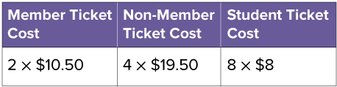
COLLABORATE · TALK IT THROUGH • AGREE ON A MODEL
Collaborate and Connect
How can you represent the total cost of the tickets?
Think first. A explains; B asks for
evidence. Switch roles; both
revise.
Reveal:
We can add the expressions for the costs of the three different ticket types.
20 / 44
Notes:
TEACH IN PRACTICE | Embedded facilitation | Lesson 6.4, slide 19 | COLLABORATE
Focus on the existing task: Collaborate and Connect Reveal: We can add the expressions for the costs of the three different ticket types. How can you represent the total cost of the tickets?
LAUNCH (T2/3/5): Use the displayed question. Give private thinking time; then A explains while B asks for evidence. Switch roles. Each student records their own reasoning.
LOOK FOR (T4): Where this task addresses it, students can translate the situation. Ask which feature of their work supports the claim.
RESPOND: If this task shows the lesson misconception—applying operations strictly left to right regardless of grouping—annotate grouping and powers in the original expression before evaluating one stage at a time. Have the student revise and explain the change. Use this support only where the concept occurs in the current task; otherwise respond to the displayed question.
RECHECK: If a gap is shared, revisit the existing representation together. If it is limited, give targeted support while others compare valid methods on the same task. Check the revision before moving on.
PARTICIPATION (T5/6/7): Think time before volunteers; accept a written, drawn or rehearsed entry. Students ask for evidence respectfully. Recognize a specific contribution or revision and check that both partners participate.
Source: BCPS Updated Instructional Framework Rubric (June 2020), TEACH 1–7. Earlier notes and answer keys are retained below.
EARLIER NOTES / EXISTING ANSWER KEY
Routine: COLLABORATE · TALK IT THROUGH • AGREE ON A MODEL
UIFR FULL | Lesson-specific facilitation
TEACH 4-5 | Session 1 discussion and checkpoint (UIFR PDF pp. 11-12).
Collect a brief response from every student to the existing prompt before hearing volunteers. Partners take turns explaining and asking for evidence: “I understand ___; what supports ___?” Offer rehearsal or an annotated model for students who need language support. Each student records their own reasoning.
Look specifically for: applying operations strictly left to right regardless of grouping. If it appears, annotate grouping and powers in the original expression before evaluating one stage at a time; then ask the student to revise the same response and explain the change. If evidence is secure, have students compare a second valid pathway or state why their approach works. Choose the next step from the responses, not a preset pace.

Slide 21
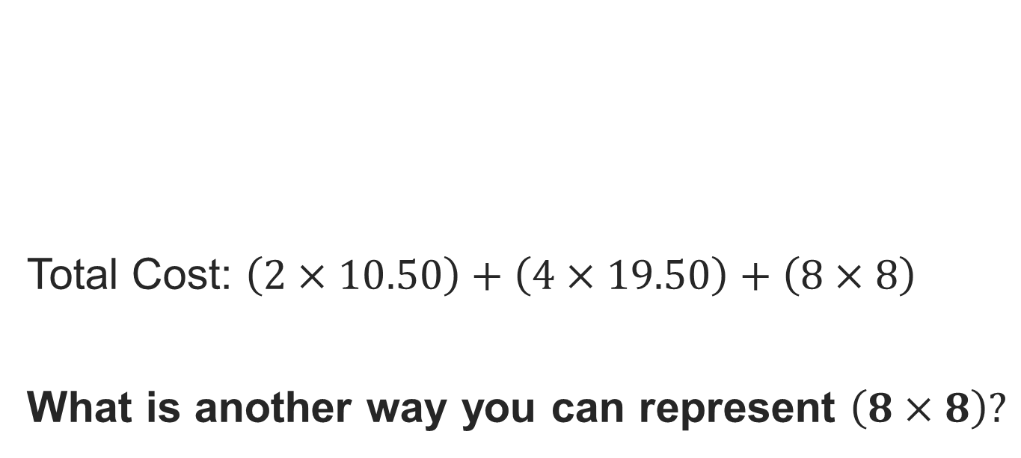
Theater Ticket Prices​
Record your reasoning before the reveal. Compare, then explain any revision.
Reveal:
We can write it as a power.
21 / 44
Notes:
TEACH IN PRACTICE | Embedded facilitation | Lesson 6.4, slide 20 | REVEAL
Focus on the existing task: Reveal: We can write it as a power. Theater Ticket Prices
LAUNCH (T2/3/5): If an existing answer cover is present, gather an attempt before revealing. If the explanation is already visible, ask students to reconstruct and justify it. Compare reasoning and explain a revision; preserve the reveal sequence.
LOOK FOR (T4): Where this task addresses it, students can translate the situation. Ask which feature of their work supports the claim.
RESPOND: If this task shows the lesson misconception—applying operations strictly left to right regardless of grouping—annotate grouping and powers in the original expression before evaluating one stage at a time. Have the student revise and explain the change. Use this support only where the concept occurs in the current task; otherwise respond to the displayed question.
RECHECK: If a gap is shared, revisit the existing representation together. If it is limited, give targeted support while others compare valid methods on the same task. Check the revision before moving on.
PARTICIPATION (T5/6/7): Think time before volunteers; accept a written, drawn or rehearsed entry. Students ask for evidence respectfully. Recognize a specific contribution or revision and check that both partners participate.
Source: BCPS Updated Instructional Framework Rubric (June 2020), TEACH 1–7. Earlier notes and answer keys are retained below.
EARLIER NOTES / EXISTING ANSWER KEY
Do not click yet: collect 2–3 student answers with reasons first.
Then click to remove the cover and have students compare their thinking to the reveal — “Is this what we said? Where is it different?”
Behind the cover: We can write it as a power.
UIFR: TEACH 3 · TEACH 4.

Slide 22
Theater Ticket Prices​
Sofia is buying tickets for two members, four non-members, and eight students.
What expression could Sofia use to find the cost of the tickets?
Think and record first. Which part of your work supports your answer?
22 / 44
Notes:
TEACH IN PRACTICE | Embedded facilitation | Lesson 6.4, slide 21 | TASK
Focus on the existing task: Sofia is buying tickets for two members, four non-members, and eight students. What expression could Sofia use to find the cost of the tickets?
LAUNCH (T2/3/5): Use the displayed question. Give private thinking time; then A explains while B asks for evidence. Switch roles. Each student records their own reasoning.
LOOK FOR (T4): Where this task addresses it, students can translate the situation. Ask which feature of their work supports the claim.
RESPOND: If this task shows the lesson misconception—applying operations strictly left to right regardless of grouping—annotate grouping and powers in the original expression before evaluating one stage at a time. Have the student revise and explain the change. Use this support only where the concept occurs in the current task; otherwise respond to the displayed question.
RECHECK: If a gap is shared, revisit the existing representation together. If it is limited, give targeted support while others compare valid methods on the same task. Check the revision before moving on.
PARTICIPATION (T5/6/7): Think time before volunteers; accept a written, drawn or rehearsed entry. Students ask for evidence respectfully. Recognize a specific contribution or revision and check that both partners participate.
Source: BCPS Updated Instructional Framework Rubric (June 2020), TEACH 1–7. Earlier notes and answer keys are retained below.
EARLIER NOTES / EXISTING ANSWER KEY
Model briefly, then hand the thinking back: ask “Why does this step work?” before showing the next one.
Quick check before moving on — thumbs or whiteboards from everyone, not volunteers.
UIFR: TEACH 2 · TEACH 3 · TEACH 4.

Slide 23
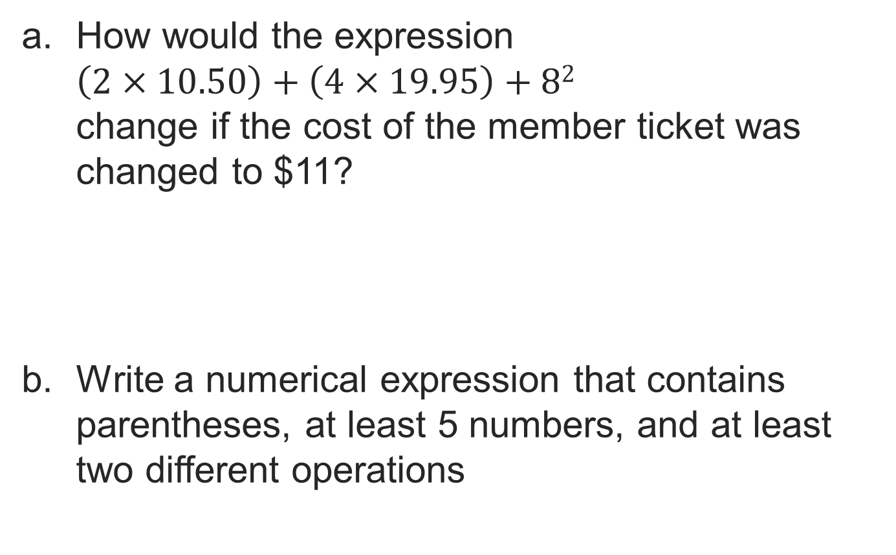
Let’s Explore More
PICK YOUR STRATEGY · Choose your path — picture, table, number line, or equation — and be ready to say why you chose it.
23 / 44
Notes:
TEACH IN PRACTICE | Embedded facilitation | Lesson 6.4, slide 22 | PRACTICE
Focus on the existing task: Let’s Explore More
LAUNCH (T2/3/5): Use the displayed question. Give private thinking time; then A explains while B asks for evidence. Switch roles. Each student records their own reasoning.
LOOK FOR (T4): Where this task addresses it, students can translate the situation. Ask which feature of their work supports the claim.
RESPOND: If this task shows the lesson misconception—applying operations strictly left to right regardless of grouping—annotate grouping and powers in the original expression before evaluating one stage at a time. Have the student revise and explain the change. Use this support only where the concept occurs in the current task; otherwise respond to the displayed question.
RECHECK: If a gap is shared, revisit the existing representation together. If it is limited, give targeted support while others compare valid methods on the same task. Check the revision before moving on.
PARTICIPATION (T5/6/7): Think time before volunteers; accept a written, drawn or rehearsed entry. Students ask for evidence respectfully. Recognize a specific contribution or revision and check that both partners participate.
Source: BCPS Updated Instructional Framework Rubric (June 2020), TEACH 1–7. Earlier notes and answer keys are retained below.
EARLIER NOTES / EXISTING ANSWER KEY
Extension for partners or table groups — students choose their approach and use the workspace to show thinking.
Push with “Convince me,” and have two groups with different approaches share.
This is where students stretch past the worked example.
UIFR: TEACH 2 · TEACH 5.

Slide 24
LESSON 6.4 / DISCUSS THE TASK
Explain and compare
Use the task you just explored.
TAKE TURNS
Which structure tells you what to evaluate first, and how would parentheses change the meaning?
Explain
“I know this because…”
Ask
“Where does your work show that?”
Point to evidence in your work.
Then compare your approach with a partner’s.
JUSTIFY IT · Say it like this: “I know ______ because ______.”
Listen to understand. Ask for evidence. Make room for every voice.
Notes:
TEACH IN PRACTICE | Embedded facilitation | Lesson 6.4, slide 23 | PRIOR_INSERT
Focus on the existing task: Point to evidence in your work. Then compare your approach with a partner’s. TAKE TURNS Explain “I know this because…” Ask “Where does your work show that?
CONNECT (T1/4): Ask students to restate the displayed goal or key idea and connect it to earlier work. Relevant lesson evidence: translate the situation; respect grouping and exponents; justify operation order. Use only the criterion that matches the current session.
SHOW PROGRESS: Students point to their own existing work, explain what improved after feedback, and name a next step. Pair confidence ratings with actual evidence.
PARTICIPATION (T5/6/7): Think time before volunteers; accept a written, drawn or rehearsed entry. Students ask for evidence respectfully. Recognize a specific contribution or revision and check that both partners participate.
Source: BCPS Updated Instructional Framework Rubric (June 2020), TEACH 1–7.

Slide 25
Collaborate and Connect
How can you represent the total cost of the tickets?
Think first. A explains; B asks for
evidence. Switch roles; both
revise.
Reveal:
We can add the expressions for the costs of the three different ticket types.
25 / 44
Notes:
TEACH IN PRACTICE | Embedded facilitation | Lesson 6.4, slide 24 | COLLABORATE
Focus on the existing task: Collaborate and Connect Reveal: We can add the expressions for the costs of the three different ticket types. How can you represent the total cost of the tickets?
LAUNCH (T2/3/5): Use the displayed question. Give private thinking time; then A explains while B asks for evidence. Switch roles. Each student records their own reasoning.
LOOK FOR (T4): Where this task addresses it, students can translate the situation. Ask which feature of their work supports the claim.
RESPOND: If this task shows the lesson misconception—applying operations strictly left to right regardless of grouping—annotate grouping and powers in the original expression before evaluating one stage at a time. Have the student revise and explain the change. Use this support only where the concept occurs in the current task; otherwise respond to the displayed question.
RECHECK: If a gap is shared, revisit the existing representation together. If it is limited, give targeted support while others compare valid methods on the same task. Check the revision before moving on.
PARTICIPATION (T5/6/7): Think time before volunteers; accept a written, drawn or rehearsed entry. Students ask for evidence respectfully. Recognize a specific contribution or revision and check that both partners participate.
Source: BCPS Updated Instructional Framework Rubric (June 2020), TEACH 1–7.

Slide 26
Warm-Up
Lesson 6-4 · Write and Evaluate Numerical Expressions with Exponents
Session 2 Warm-Up
Try alone. Explain one. Then revise.
1
Which operation is performed first in order of operations?
2
What is the value of 2 + 3 × 4?
A
Addition
A
20
B
Parentheses / Grouping
B
14
C
Multiplication
C
24
D
Exponents
D
18
3
What is the value of (2 + 3)²?
4
Multiplication and division are evaluated:
A
13
A
Multiplication first always
B
25
B
Left to right as they appear
C
10
C
Division first always
D
50
D
At the very end
eduwonderlab.com · Neft Teacher
26 / 44
Notes:
TEACH IN PRACTICE | Embedded facilitation | Lesson 6.4, slide 25 | WARMUP
Focus on the existing task: A Addition B Parentheses / Grouping C Multiplication D Exponents 2 What is the value of 2 + 3 × 4?
GATHER EVIDENCE (T4/6): Keep the original items. Students try independently, mark an uncertain item, and explain one method before checking. Use the existing key when present.
RESPOND: Distinguish a calculation slip from a reasoning gap. Give one next step on the same item; have students revise in a second color. Use the responses to choose flexible support for today’s lesson.
PARTICIPATION (T5/6/7): Think time before volunteers; accept a written, drawn or rehearsed entry. Students ask for evidence respectfully. Recognize a specific contribution or revision and check that both partners participate.
Source: BCPS Updated Instructional Framework Rubric (June 2020), TEACH 1–7. Earlier notes and answer keys are retained below.
EARLIER NOTES / EXISTING ANSWER KEY
Warm-up routine: students start silently on entry; keep it to about 4 minutes.
Circulate and note who is stuck — use what you see to choose who you check on first today.
Go over answers quickly; ask one student to explain a step, not just say the answer.
UIFR: TEACH 4 · TEACH 6.

Slide 27
STUDENT MOVES
Lesson 6-4
Your move
YOU KNOW THE ROUTINE · Read → plan → solve → check. Do all four, in that order.
27 / 44

Slide 28
Review Notes — Session 2
Lesson 6-4 · Write and Evaluate Numerical Expressions with Exponents
Session 2: Review Notes
Copy. Explain. Check.
WHY IT MATTERS · Finish this: “This is worth knowing because ______.”
Order of Operations
1
1. Grouping symbols (parentheses, brackets). 2. Exponents. 3. Multiply/Divide left-to-right. 4. Add/Subtract left-to-right.
Left-to-Right Precedence
2
Multiplication does NOT come before division; evaluate whichever appears first from left to right.
Nested Operations
3
Evaluate innermost parentheses completely before applying exponents or outside operations.
eduwonderlab.com · Neft Teacher
28 / 44
Notes:
TEACH IN PRACTICE | Embedded facilitation | Lesson 6.4, slide 26 | NOTES
Focus on the existing task: Review Notes — Session 2 Session 2…
ROUTINE (T1/2/4): Read or copy the original notes, cover one line, and explain it using the displayed example. Reopen and correct. Copying alone is not evidence of understanding.
LOOK FOR: A link between a symbol, quantity or feature and the explanation. If missing, point back to that feature and have the student try again; fade the prompt once they can explain.
PARTICIPATION (T5/6/7): Think time before volunteers; accept a written, drawn or rehearsed entry. Students ask for evidence respectfully. Recognize a specific contribution or revision and check that both partners participate.
Source: BCPS Updated Instructional Framework Rubric (June 2020), TEACH 1–7. Earlier notes and answer keys are retained below.
EARLIER NOTES / EXISTING ANSWER KEY
Copy routine: read one line at a time; students copy, then explain that line to a partner.
Keep it brisk — the understanding work happens in the examples, not the copying.
UIFR: TEACH 1 · TEACH 6.

Slide 29
Session 2
Write and Evaluate Numerical Expressions with Exponents
SELF-CHECK · Mark it: ✓ got it · ~ almost · ? stuck. Then fix one thing before we move on.
29 / 44
Notes:
TEACH IN PRACTICE | Embedded facilitation | Lesson 6.4, slide 27 | DIVIDER
Focus on the existing task: Write and Evaluate Numerical Expressions with Exponents Session 2
TRANSITION (T6/7): Students confirm materials, roles, how to request help, and the next response routine. Ask a student to restate it. Keep teacher-only slides hidden.
PARTICIPATION (T5/6/7): Think time before volunteers; accept a written, drawn or rehearsed entry. Students ask for evidence respectfully. Recognize a specific contribution or revision and check that both partners participate.
Source: BCPS Updated Instructional Framework Rubric (June 2020), TEACH 1–7. Earlier notes and answer keys are retained below.
EARLIER NOTES / EXISTING ANSWER KEY
Transition cue: state what materials are out and what success looks like this session.
Keep the changeover under a minute.
UIFR: TEACH 6.

Slide 30
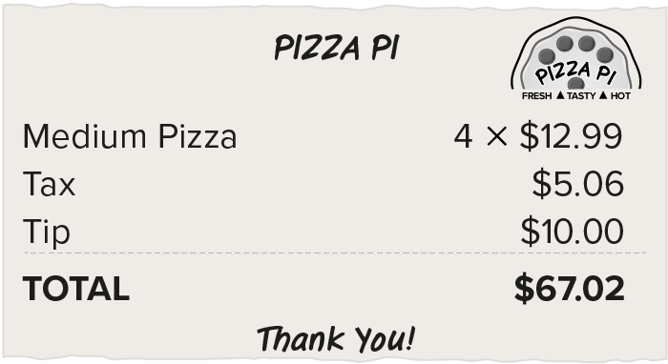
Be Curious
What do you notice?
What do you wonder?
Seven friends are splitting the bill after a pizza party.
Think first. Share a notice and a
question; build on a classmate’s
idea.
Mindset
Why has it been important to explain your thinking clearly and concisely?
30 / 44
Notes:
TEACH IN PRACTICE | Embedded facilitation | Lesson 6.4, slide 28 | CURIOUS
Focus on the existing task: Be Curious Mindset Why has it been important to explain your thinking clearly and concisely?
LAUNCH (T2/3/5): Allow quiet observation first. Separate a notice from an inference, invite students’ own questions, and follow the existing launch before teaching a procedure.
LOOK FOR (T4): Where this task addresses it, students can translate the situation. Ask which feature of their work supports the claim.
RESPOND: If this task shows the lesson misconception—applying operations strictly left to right regardless of grouping—annotate grouping and powers in the original expression before evaluating one stage at a time. Have the student revise and explain the change. Use this support only where the concept occurs in the current task; otherwise respond to the displayed question.
RECHECK: If a gap is shared, revisit the existing representation together. If it is limited, give targeted support while others compare valid methods on the same task. Check the revision before moving on.
PARTICIPATION (T5/6/7): Think time before volunteers; accept a written, drawn or rehearsed entry. Students ask for evidence respectfully. Recognize a specific contribution or revision and check that both partners participate.
Source: BCPS Updated Instructional Framework Rubric (June 2020), TEACH 1–7. Earlier notes and answer keys are retained below.
EARLIER NOTES / EXISTING ANSWER KEY
Accept all noticings and wonderings — there are no wrong answers here.
Give 20–30 seconds of quiet think time before taking responses; mix cold and warm calls so it is not always the same voices.
Read the mindset question aloud and let two students respond.
UIFR: TEACH 3 · TEACH 7.

Slide 31
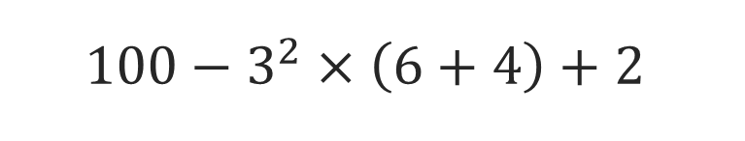
COLLABORATE · TALK IT THROUGH • AGREE ON A MODEL
Collaborate and Connect
Let’s evaluate the expression and compare it to Miguel’s and Margaret’s work.
How can you determine which operation to perform first when evaluating an expression?
Think first. A explains; B asks for evidence. Switch roles; both revise.
Reveal:
31 / 44
Notes:
TEACH IN PRACTICE | Embedded facilitation | Lesson 6.4, slide 29 | COLLABORATE
Focus on the existing task: Let’s evaluate the expression and compare it to Miguel’s and Margaret’s work. How can you determine which operation to perform first when evaluating an expression?
LAUNCH (T2/3/5): Use the displayed question. Give private thinking time; then A explains while B asks for evidence. Switch roles. Each student records their own reasoning.
LOOK FOR (T4): Where this task addresses it, students can justify operation order. Ask which feature of their work supports the claim.
RESPOND: If this task shows the lesson misconception—applying operations strictly left to right regardless of grouping—annotate grouping and powers in the original expression before evaluating one stage at a time. Have the student revise and explain the change. Use this support only where the concept occurs in the current task; otherwise respond to the displayed question.
RECHECK: If a gap is shared, revisit the existing representation together. If it is limited, give targeted support while others compare valid methods on the same task. Check the revision before moving on.
PARTICIPATION (T5/6/7): Think time before volunteers; accept a written, drawn or rehearsed entry. Students ask for evidence respectfully. Recognize a specific contribution or revision and check that both partners participate.
Source: BCPS Updated Instructional Framework Rubric (June 2020), TEACH 1–7. Earlier notes and answer keys are retained below.
EARLIER NOTES / EXISTING ANSWER KEY
Routine: COLLABORATE · TALK IT THROUGH • AGREE ON A MODEL

Slide 32
COLLABORATE · TALK IT THROUGH • AGREE ON A MODEL
Collaborate and Connect
Let’s evaluate the expression and compare it to Miguel’s and Margaret’s work.
How can you determine which operation to perform first when evaluating an expression?
RESTATE FIRST · Restate your partner’s idea in your own words before you give yours.
Reveal:
We can use the order of operations.
32 / 44
Notes:
TEACH IN PRACTICE | Embedded facilitation | Lesson 6.4, slide 30 | COLLABORATE
Focus on the existing task: Collaborate and Connect Reveal: We can use the order of operations. Let’s evaluate the expression and compare it to Miguel’s and…
LAUNCH (T2/3/5): Use the displayed question. Give private thinking time; then A explains while B asks for evidence. Switch roles. Each student records their own reasoning.
LOOK FOR (T4): Where this task addresses it, students can justify operation order. Ask which feature of their work supports the claim.
RESPOND: If this task shows the lesson misconception—applying operations strictly left to right regardless of grouping—annotate grouping and powers in the original expression before evaluating one stage at a time. Have the student revise and explain the change. Use this support only where the concept occurs in the current task; otherwise respond to the displayed question.
RECHECK: If a gap is shared, revisit the existing representation together. If it is limited, give targeted support while others compare valid methods on the same task. Check the revision before moving on.
PARTICIPATION (T5/6/7): Think time before volunteers; accept a written, drawn or rehearsed entry. Students ask for evidence respectfully. Recognize a specific contribution or revision and check that both partners participate.
Source: BCPS Updated Instructional Framework Rubric (June 2020), TEACH 1–7. Earlier notes and answer keys are retained below.
EARLIER NOTES / EXISTING ANSWER KEY
Routine: COLLABORATE · TALK IT THROUGH • AGREE ON A MODEL

Slide 33
Which Way To Go?
When evaluating an expression, there is an order to the operations.
Carry out operations in parentheses or brackets.
Evaluate powers.
Multiply or divide from left to right.
Add or subtract from left to right.
Which of the operations listed do you see in the expression?
Reveal:
There are parentheses, a power, multiplication, addition, and subtraction.
33 / 44
Notes:
TEACH IN PRACTICE | Embedded facilitation | Lesson 6.4, slide 31 | REVEAL
Focus on the existing task: Reveal: There are parentheses, a power, multiplication, addition, and subtraction. Which Way To Go?
LAUNCH (T2/3/5): If an existing answer cover is present, gather an attempt before revealing. If the explanation is already visible, ask students to reconstruct and justify it. Compare reasoning and explain a revision; preserve the reveal sequence.
LOOK FOR (T4): Where this task addresses it, students can justify operation order. Ask which feature of their work supports the claim.
RESPOND: If this task shows the lesson misconception—applying operations strictly left to right regardless of grouping—annotate grouping and powers in the original expression before evaluating one stage at a time. Have the student revise and explain the change. Use this support only where the concept occurs in the current task; otherwise respond to the displayed question.
RECHECK: If a gap is shared, revisit the existing representation together. If it is limited, give targeted support while others compare valid methods on the same task. Check the revision before moving on.
PARTICIPATION (T5/6/7): Think time before volunteers; accept a written, drawn or rehearsed entry. Students ask for evidence respectfully. Recognize a specific contribution or revision and check that both partners participate.
Source: BCPS Updated Instructional Framework Rubric (June 2020), TEACH 1–7. Earlier notes and answer keys are retained below.
EARLIER NOTES / EXISTING ANSWER KEY
Do not click yet: collect 2–3 student answers with reasons first.
Then click to remove the cover and have students compare their thinking to the reveal — “Is this what we said? Where is it different?”
Behind the cover: There are parentheses, a power, multiplication, addition, and subtraction.
UIFR: TEACH 3 · TEACH 4.

Slide 34
STUDENT MOVES
Lesson 6-4
Your move
YOUR CHOICE · You choose how to show this — numbers, words, or a diagram. Make your reasoning visible.
34 / 44

Slide 35
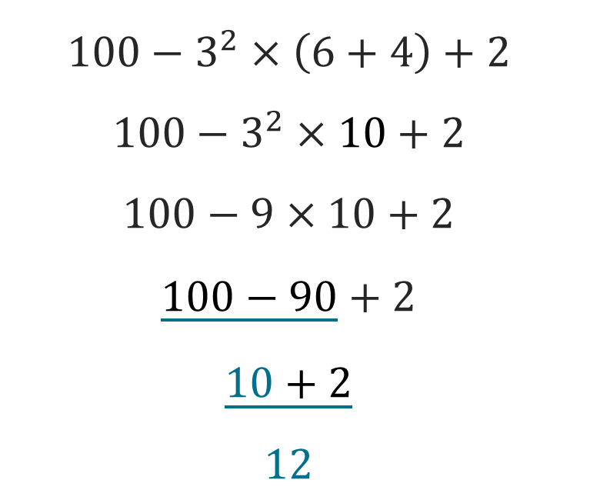
Which Way To Go?
Let’s use the order of operations to evaluate the expression.
Order of Operations:​
Carry out operations in parentheses or brackets.​
Evaluate powers.​
Multiply or divide from left to right.
Add or subtract from left to right.
What is the value of the expression?
Reveal:
STRUGGLE FIRST · Work on your own first. Stuck is allowed — try a second strategy before you ask.
35 / 44
Notes:
TEACH IN PRACTICE | Embedded facilitation | Lesson 6.4, slide 32 | REVEAL
Focus on the existing task: Which Way To Go?
LAUNCH (T2/3/5): If an existing answer cover is present, gather an attempt before revealing. If the explanation is already visible, ask students to reconstruct and justify it. Compare reasoning and explain a revision; preserve the reveal sequence.
LOOK FOR (T4): Where this task addresses it, students can justify operation order. Ask which feature of their work supports the claim.
RESPOND: If this task shows the lesson misconception—applying operations strictly left to right regardless of grouping—annotate grouping and powers in the original expression before evaluating one stage at a time. Have the student revise and explain the change. Use this support only where the concept occurs in the current task; otherwise respond to the displayed question.
RECHECK: If a gap is shared, revisit the existing representation together. If it is limited, give targeted support while others compare valid methods on the same task. Check the revision before moving on.
PARTICIPATION (T5/6/7): Think time before volunteers; accept a written, drawn or rehearsed entry. Students ask for evidence respectfully. Recognize a specific contribution or revision and check that both partners participate.
Source: BCPS Updated Instructional Framework Rubric (June 2020), TEACH 1–7. Earlier notes and answer keys are retained below.
EARLIER NOTES / EXISTING ANSWER KEY
Students should have shared predictions before this reveal.
Have them compare their thinking to what is shown: “Is this the same as what we said? Where is it different?”
Press one student to explain the reveal in their own words.
UIFR: TEACH 3 · TEACH 4.

Slide 36
Which Way To Go?
Let’s use the order of operations to evaluate the expression.
Order of Operations:​
Carry out operations in parentheses or brackets.​
Evaluate powers.​
Multiply or divide from left to right.
Add or subtract from left to right.
What is the value of the expression?
Reveal: 12
ANOTHER PATHWAY · Did anyone get there a different way? Put both pathways side by side and compare.
36 / 44
Notes:
TEACH IN PRACTICE | Embedded facilitation | Lesson 6.4, slide 33 | REVEAL
Focus on the existing task: Which Way To Go?
LAUNCH (T2/3/5): If an existing answer cover is present, gather an attempt before revealing. If the explanation is already visible, ask students to reconstruct and justify it. Compare reasoning and explain a revision; preserve the reveal sequence.
LOOK FOR (T4): Where this task addresses it, students can justify operation order. Ask which feature of their work supports the claim.
RESPOND: If this task shows the lesson misconception—applying operations strictly left to right regardless of grouping—annotate grouping and powers in the original expression before evaluating one stage at a time. Have the student revise and explain the change. Use this support only where the concept occurs in the current task; otherwise respond to the displayed question.
RECHECK: If a gap is shared, revisit the existing representation together. If it is limited, give targeted support while others compare valid methods on the same task. Check the revision before moving on.
PARTICIPATION (T5/6/7): Think time before volunteers; accept a written, drawn or rehearsed entry. Students ask for evidence respectfully. Recognize a specific contribution or revision and check that both partners participate.
Source: BCPS Updated Instructional Framework Rubric (June 2020), TEACH 1–7. Earlier notes and answer keys are retained below.
EARLIER NOTES / EXISTING ANSWER KEY
Model briefly, then hand the thinking back: ask “Why does this step work?” before showing the next one.
Quick check before moving on — thumbs or whiteboards from everyone, not volunteers.
UIFR: TEACH 2 · TEACH 3 · TEACH 4.

Slide 37
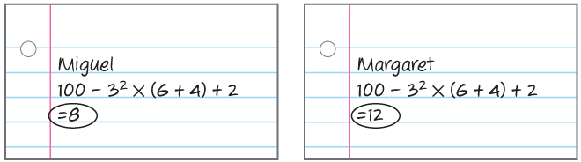

Which Way To Go?
Miguel and Margaret each evaluated the same expression, but got two different solutions.
Who evaluated the expression correctly?
USE YOUR TOOLS · Reach for your notes, a model, or a manipulative before you reach for an answer.
The value of the expression is 12.
Margaret evaluated the expression correctly.
Making Connections
How is this problem like something you have done before?​
37 / 44
Notes:
TEACH IN PRACTICE | Embedded facilitation | Lesson 6.4, slide 34 | TASK
Focus on the existing task: How is this problem like something you have done before?
LAUNCH (T2/3/5): Use the displayed question. Give private thinking time; then A explains while B asks for evidence. Switch roles. Each student records their own reasoning.
LOOK FOR (T4): Where this task addresses it, students can translate the situation. Ask which feature of their work supports the claim.
RESPOND: If this task shows the lesson misconception—applying operations strictly left to right regardless of grouping—annotate grouping and powers in the original expression before evaluating one stage at a time. Have the student revise and explain the change. Use this support only where the concept occurs in the current task; otherwise respond to the displayed question.
RECHECK: If a gap is shared, revisit the existing representation together. If it is limited, give targeted support while others compare valid methods on the same task. Check the revision before moving on.
PARTICIPATION (T5/6/7): Think time before volunteers; accept a written, drawn or rehearsed entry. Students ask for evidence respectfully. Recognize a specific contribution or revision and check that both partners participate.
Source: BCPS Updated Instructional Framework Rubric (June 2020), TEACH 1–7. Earlier notes and answer keys are retained below.
EARLIER NOTES / EXISTING ANSWER KEY
Model briefly, then hand the thinking back: ask “Why does this step work?” before showing the next one.
Quick check before moving on — thumbs or whiteboards from everyone, not volunteers.
UIFR: TEACH 2 · TEACH 3 · TEACH 4.

Slide 38
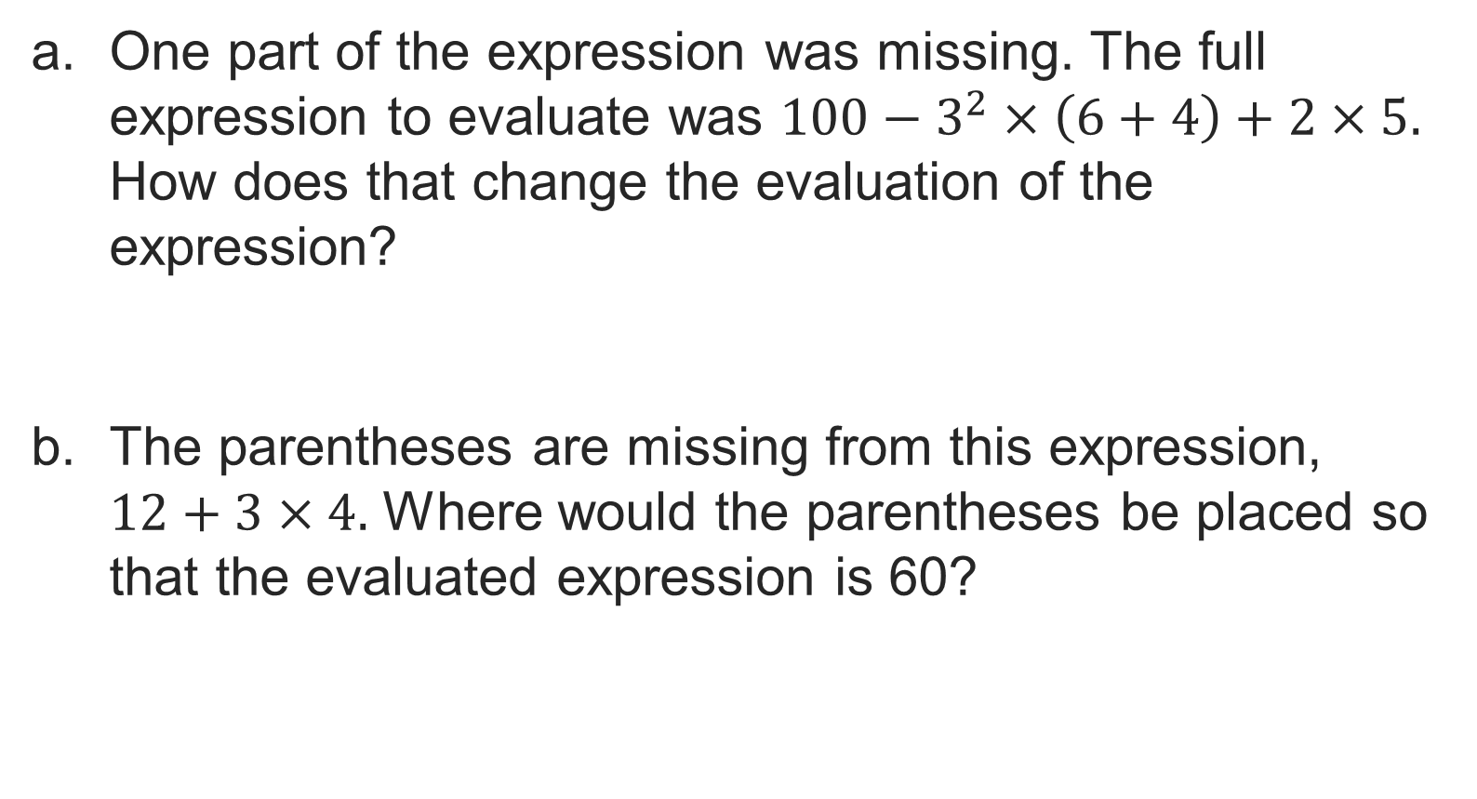
Let’s Explore More
TWO MINUTES SOLO · Two minutes on your own, then compare. Bring one thing you tried, even if it did not work.
38 / 44
Notes:
TEACH IN PRACTICE | Embedded facilitation | Lesson 6.4, slide 35 | PRACTICE
Focus on the existing task: Let’s Explore More
LAUNCH (T2/3/5): Use the displayed question. Give private thinking time; then A explains while B asks for evidence. Switch roles. Each student records their own reasoning.
LOOK FOR (T4): Where this task addresses it, students can translate the situation. Ask which feature of their work supports the claim.
RESPOND: If this task shows the lesson misconception—applying operations strictly left to right regardless of grouping—annotate grouping and powers in the original expression before evaluating one stage at a time. Have the student revise and explain the change. Use this support only where the concept occurs in the current task; otherwise respond to the displayed question.
RECHECK: If a gap is shared, revisit the existing representation together. If it is limited, give targeted support while others compare valid methods on the same task. Check the revision before moving on.
PARTICIPATION (T5/6/7): Think time before volunteers; accept a written, drawn or rehearsed entry. Students ask for evidence respectfully. Recognize a specific contribution or revision and check that both partners participate.
Source: BCPS Updated Instructional Framework Rubric (June 2020), TEACH 1–7. Earlier notes and answer keys are retained below.
EARLIER NOTES / EXISTING ANSWER KEY
Extension for partners or table groups — students choose their approach and use the workspace to show thinking.
Push with “Convince me,” and have two groups with different approaches share.
This is where students stretch past the worked example.
UIFR: TEACH 2 · TEACH 5.

Slide 39
LESSON 6.4 / CHECK YOUR WORK
Pause. Check. Improve.
CHECK
A mistake to watch for: applying operations strictly left to right regardless of grouping.
TRY
Annotate grouping and powers in the given expression before evaluating one stage at a time.
REVISE
Use that check on the task you just completed. Correct or strengthen one part, and explain why.
REVISE NOW · Change one answer and write why you changed it. A revision is evidence of learning.
Listen to understand. Ask for evidence. Make room for every voice.
Notes:
TEACH IN PRACTICE | Embedded facilitation | Lesson 6.4, slide 36 | PRIOR_INSERT
Focus on the existing task: LESSON 6.4 / CHECK YOUR WORK Pause. Check. Improve. Listen to understand. Ask for evidence. Make room for every voice. CHECK A mistake…
CONNECT (T1/4): Ask students to restate the displayed goal or key idea and connect it to earlier work. Relevant lesson evidence: translate the situation; respect grouping and exponents; justify operation order. Use only the criterion that matches the current session.
SHOW PROGRESS: Students point to their own existing work, explain what improved after feedback, and name a next step. Pair confidence ratings with actual evidence.
PARTICIPATION (T5/6/7): Think time before volunteers; accept a written, drawn or rehearsed entry. Students ask for evidence respectfully. Recognize a specific contribution or revision and check that both partners participate.
Source: BCPS Updated Instructional Framework Rubric (June 2020), TEACH 1–7.

Slide 40
Collaborate and Connect
Let’s evaluate the expression and compare it to Miguel’s and Margaret’s work.
How can you determine which operation to perform first when evaluating an expression?
Think first. A explains; B asks for evidence. Switch roles; both revise.
Reveal:
We can use the order of operations.
40 / 44
Notes:
TEACH IN PRACTICE | Embedded facilitation | Lesson 6.4, slide 37 | COLLABORATE
Focus on the existing task: Collaborate and Connect Reveal: We can use the order of operations. Let’s evaluate the expression and compare it to Miguel’s and…
LAUNCH (T2/3/5): Use the displayed question. Give private thinking time; then A explains while B asks for evidence. Switch roles. Each student records their own reasoning.
LOOK FOR (T4): Where this task addresses it, students can justify operation order. Ask which feature of their work supports the claim.
RESPOND: If this task shows the lesson misconception—applying operations strictly left to right regardless of grouping—annotate grouping and powers in the original expression before evaluating one stage at a time. Have the student revise and explain the change. Use this support only where the concept occurs in the current task; otherwise respond to the displayed question.
RECHECK: If a gap is shared, revisit the existing representation together. If it is limited, give targeted support while others compare valid methods on the same task. Check the revision before moving on.
PARTICIPATION (T5/6/7): Think time before volunteers; accept a written, drawn or rehearsed entry. Students ask for evidence respectfully. Recognize a specific contribution or revision and check that both partners participate.
Source: BCPS Updated Instructional Framework Rubric (June 2020), TEACH 1–7.

Slide 41
SUMMARIZE · SAY IT IN YOUR OWN WORDS
Summarize: Write and Evaluate Numerical Expressions with Exponents
ASK THE CLASS · Write one question about this that you could ask the class.
The order of operations are rules that tell which operation to perform first when more than one operation is found in an expression. This guarantees that the same value of a numerical expression is found each time the expression is evaluated.
Order of Operations
Carry out operations in parentheses or brackets.
Evaluate powers.
Multiply or divide from left to right.
Add or subtract from left to right.
41 / 44
Notes:
TEACH IN PRACTICE | Embedded facilitation | Lesson 6.4, slide 38 | SUMMARIZE
Focus on the existing task: Summarize: Write and Evaluate Numerical Expressions with Exponents The order of operations are rules that tell which operation to perform…
CONNECT (T1/4): Ask students to restate the displayed goal or key idea and connect it to earlier work. Relevant lesson evidence: translate the situation; respect grouping and exponents; justify operation order. Use only the criterion that matches the current session.
SHOW PROGRESS: Students point to their own existing work, explain what improved after feedback, and name a next step. Pair confidence ratings with actual evidence.
PARTICIPATION (T5/6/7): Think time before volunteers; accept a written, drawn or rehearsed entry. Students ask for evidence respectfully. Recognize a specific contribution or revision and check that both partners participate.
Source: BCPS Updated Instructional Framework Rubric (June 2020), TEACH 1–7. Earlier notes and answer keys are retained below.
EARLIER NOTES / EXISTING ANSWER KEY
Routine: SUMMARIZE · SAY IT IN YOUR OWN WORDS

Slide 42
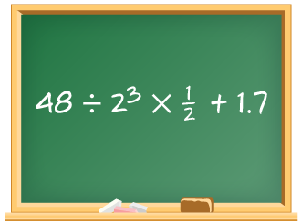
APPLY · PLAN IT • SOLVE IT • PROVE IT
Apply: Missing Parentheses?
Akela has been given a challenge by his math teacher to see how many different values the expression shown can have depending on where one set of parentheses is placed.
Question: How many different values can you come up with?
TEACH A PARTNER · Teach this to someone who missed it. If you can teach it, you know it.
42 / 44
Notes:
TEACH IN PRACTICE | Embedded facilitation | Lesson 6.4, slide 39 | APPLY
Focus on the existing task: Apply: Missing Parentheses?
LAUNCH (T2/3/5): Use the exact application task independently first. Ask students to justify their choice of method. Collect evidence before a partner discussion or correction.
LOOK FOR (T4): Where this task addresses it, students can translate the situation. Ask which feature of their work supports the claim.
RESPOND: If this task shows the lesson misconception—applying operations strictly left to right regardless of grouping—annotate grouping and powers in the original expression before evaluating one stage at a time. Have the student revise and explain the change. Use this support only where the concept occurs in the current task; otherwise respond to the displayed question.
RECHECK: If a gap is shared, revisit the existing representation together. If it is limited, give targeted support while others compare valid methods on the same task. Check the revision before moving on.
PARTICIPATION (T5/6/7): Think time before volunteers; accept a written, drawn or rehearsed entry. Students ask for evidence respectfully. Recognize a specific contribution or revision and check that both partners participate.
Source: BCPS Updated Instructional Framework Rubric (June 2020), TEACH 1–7. Earlier notes and answer keys are retained below.
EARLIER NOTES / EXISTING ANSWER KEY
Routine: APPLY · PLAN IT • SOLVE IT • PROVE IT
UIFR FULL | Lesson-specific facilitation
TEACH 4 | Independent evidence and revision (UIFR PDF p. 11).
Use the existing application/exit problem as the independent check. If this is a learning-target slide, have students point to and explain their work on the preceding task. Separate initial independent evidence from the revision after feedback.
Check the relevant criteria: translate the situation; respect grouping and exponents; justify operation order. Respond with one specific next step tied to the work. Students revise and annotate what changed, then identify a criterion they can now demonstrate and one they still need to practice.

Slide 43
Learning Targets
I can evaluate numerical expressions using the correct order of operations.
I can make sense of problems to write numerical expressions.
NAME THE MATH · Point to the part of this that is new today, and say what it changes.
43 / 44
Notes:
TEACH IN PRACTICE | Embedded facilitation | Lesson 6.4, slide 40 | REFLECTION
Focus on the existing task: I can evaluate numerical expressions using the correct order of operations. I can make sense of problems to write numerical expressions.…
CONNECT (T1/4): Ask students to restate the displayed goal or key idea and connect it to earlier work. Relevant lesson evidence: translate the situation; respect grouping and exponents; justify operation order. Use only the criterion that matches the current session.
SHOW PROGRESS: Students point to their own existing work, explain what improved after feedback, and name a next step. Pair confidence ratings with actual evidence.
PARTICIPATION (T5/6/7): Think time before volunteers; accept a written, drawn or rehearsed entry. Students ask for evidence respectfully. Recognize a specific contribution or revision and check that both partners participate.
Source: BCPS Updated Instructional Framework Rubric (June 2020), TEACH 1–7. Earlier notes and answer keys are retained below.
EARLIER NOTES / EXISTING ANSWER KEY
Read each target; students self-rate with fist-to-five or thumbs.
Tie back to the goal from the start of class: did we get there?
Note any target that rates low — revisit it tomorrow.
UIFR: TEACH 1 · TEACH 4.
UIFR FULL | Lesson-specific facilitation
REFLECT & ADJUST 1-2 | After the lesson (UIFR PDF pp. 15-16).
Sort the existing work by demonstrated reasoning, partial understanding, and the specific misconception: applying operations strictly left to right regardless of grouping. Compare the initial response with the revision. Record which teaching move plausibly helped, which did not, and whose participation or access needs a different approach; do not record sensitive student details in this shared deck.
Plan the next lesson from that evidence: if the misconception persists, annotate grouping and powers in the original expression before evaluating one stage at a time using the current example before returning to the next grade-level task; if understanding is secure, use an existing extension or ask for a general explanation. Check the targeted idea again at the next warm-up.
Ask students what supported their thinking and what would help next time. Identify one change to try and one successful practice to retain. Seek colleague feedback on anonymized work when useful; these prompts support reflection and do not establish an evaluation rating. Source: Baltimore City Public Schools, Updated Instructional Framework Rubric, June 2020 (UIFR_Full.pdf).

Slide 44
LESSON 6.4 / REFLECT ON YOUR LEARNING
Show your progress
1 SHOW EVIDENCE
2 CHOOSE A NEXT STEP
Choose one response. Point to the part that shows your reasoning.
Name a change you made after feedback—or a question you still have.
“My work shows ___ because ___.”
“Next time, I will ___ to help me ___.”
Today’s focus: Translate the situation.
CREDIT A CLASSMATE · Name one classmate whose idea helped you today, and say what they said.
Listen to understand. Ask for evidence. Make room for every voice.
Notes:
TEACH IN PRACTICE | Embedded facilitation | Lesson 6.4, slide 41 | PRIOR_INSERT
Focus on the existing task: LESSON 6.4 / REFLECT ON YOUR LEARNING Show your progress Listen to understand. Ask for evidence. Make room for every voice. 1 SHOW…
CONNECT (T1/4): Ask students to restate the displayed goal or key idea and connect it to earlier work. Relevant lesson evidence: translate the situation; respect grouping and exponents; justify operation order. Use only the criterion that matches the current session.
SHOW PROGRESS: Students point to their own existing work, explain what improved after feedback, and name a next step. Pair confidence ratings with actual evidence.
PARTICIPATION (T5/6/7): Think time before volunteers; accept a written, drawn or rehearsed entry. Students ask for evidence respectfully. Recognize a specific contribution or revision and check that both partners participate.
Source: BCPS Updated Instructional Framework Rubric (June 2020), TEACH 1–7.

