Slide 1
WARM-UP · THINK • TRY • CHECK
Turn and talk: compare strategies, then defend one.
Warm-Up
Lesson 6-5 · Write and Evaluate Algebraic Expressions | Warm-Up · about 4 minutes
Try each on your own. Mark an unsure answer; explain and revise when we check.
QUESTION 1
QUESTION 2
Evaluate n + 8 when n = 6. ______
Evaluate 4n + 3 when n = 5. ______
QUESTION 3
QUESTION 4
4n means 4 × ______
Write an expression for 7 more than a number n: ______
TALK IT OVER: “I got ______ because ______.” • Compare with a partner before we check as a class.
1 / 48
Notes:
TEACH IN PRACTICE | Embedded facilitation | Lesson 6.5, slide 1 | WARMUP
Focus on the existing task: Warm-Up WARM-UP · THINK • TRY • CHECK Do these…
GATHER EVIDENCE (T4/6): Keep the original items. Students try independently, mark an uncertain item, and explain one method before checking. Use the existing key when present.
RESPOND: Distinguish a calculation slip from a reasoning gap. Give one next step on the same item; have students revise in a second color. Use the responses to choose flexible support for today’s lesson.
PARTICIPATION (T5/6/7): Think time before volunteers; accept a written, drawn or rehearsed entry. Students ask for evidence respectfully. Recognize a specific contribution or revision and check that both partners participate.
Source: BCPS Updated Instructional Framework Rubric (June 2020), TEACH 1–7. Earlier notes and answer keys are retained below.
EARLIER NOTES / EXISTING ANSWER KEY
Warm-Up answers (teacher only): 1) 14 2) 23 3) n 4) n + 7
UIFR FULL | Lesson-specific facilitation
PREPARE 1-2 | Before teaching (UIFR PDF pp. 6-7).
Plan to gather evidence that students can define the variable; translate operations in order; substitute and evaluate accurately. Review recent work and today’s warm-up to choose flexible groups and access supports; do not infer needs from identity or perceived ability. Use the existing lesson tasks and stated standards.
Anticipate: reversing subtraction or omitting implied multiplication. If observed, label the quantity represented by each part of the original expression. Offer oral rehearsal, drawing, pointing, or home-language processing as needed; retain the original mathematical demand. Ask students which support helps and fade it as evidence improves.
TEACH 6-7 | Before the first transition, agree on materials, partner roles, and how to request help. Invite students to restate the routine. Normalize revising an idea, recognize a specific contribution, and check privately when frustration blocks participation. Source: UIFR PDF pp. 13-14.

Slide 2
Today’s Math Notes
Lesson 6-5 · Write and Evaluate Algebraic Expressions
Section 1: Math Words
Copy. Explain. Check.
SAY THE GOAL · Say today’s goal in your own words, then name one place this shows up outside math class.
Write Algebraic Expressions
1
Translate words or a situation into numbers, variables, and operation symbols
Variable
2
A letter that stands for a number
Algebraic Expression
3
A math phrase that has at least one letter
eduwonderlab.com · Neft Teacher
2 / 48
Notes:
TEACH IN PRACTICE | Embedded facilitation | Lesson 6.5, slide 2 | NOTES
Focus on the existing task: Today’s Math Notes Section 1: Math Words Copy into…
ROUTINE (T1/2/4): Read or copy the original notes, cover one line, and explain it using the displayed example. Reopen and correct. Copying alone is not evidence of understanding.
LOOK FOR: A link between a symbol, quantity or feature and the explanation. If missing, point back to that feature and have the student try again; fade the prompt once they can explain.
PARTICIPATION (T5/6/7): Think time before volunteers; accept a written, drawn or rehearsed entry. Students ask for evidence respectfully. Recognize a specific contribution or revision and check that both partners participate.
Source: BCPS Updated Instructional Framework Rubric (June 2020), TEACH 1–7. Earlier notes and answer keys are retained below.
EARLIER NOTES / EXISTING ANSWER KEY
Copy routine: read one line at a time; students copy, then explain that line to a partner.
Keep it brisk — the understanding work happens in the examples, not the copying.
UIFR: TEACH 1 · TEACH 6.

Slide 3
Today’s Math Notes
Lesson 6-5 · Write and Evaluate Algebraic Expressions
Section 2: Today’s Math
Copy. Explain. Check.
Writing & Evaluating Algebraic Expressions
Define the variable to represent the unknown quantity
1
Translate mathematical phrases into operations, coefficients, and constants
2
CONNECT IT · What earlier lesson does this build on? Tell a partner in one sentence.
Evaluate by substituting given numerical values for the variable
3
eduwonderlab.com · Neft Teacher
3 / 48
Notes:
TEACH IN PRACTICE | Embedded facilitation | Lesson 6.5, slide 3 | NOTES
Focus on the existing task: Today’s Math Notes Section 2: Today’s Math Copy…
ROUTINE (T1/2/4): Read or copy the original notes, cover one line, and explain it using the displayed example. Reopen and correct. Copying alone is not evidence of understanding.
LOOK FOR: A link between a symbol, quantity or feature and the explanation. If missing, point back to that feature and have the student try again; fade the prompt once they can explain.
PARTICIPATION (T5/6/7): Think time before volunteers; accept a written, drawn or rehearsed entry. Students ask for evidence respectfully. Recognize a specific contribution or revision and check that both partners participate.
Source: BCPS Updated Instructional Framework Rubric (June 2020), TEACH 1–7. Earlier notes and answer keys are retained below.
EARLIER NOTES / EXISTING ANSWER KEY
Copy routine: read one line at a time; students copy, then explain that line to a partner.
Keep it brisk — the understanding work happens in the examples, not the copying.
UIFR: TEACH 1 · TEACH 6.

Slide 4
Session 1
Write and Evaluate Algebraic Expressions
TRY IT BEFORE YOU’RE SURE · Start even if you are not sure. A revised answer counts as much as a first-try answer.
4 / 48
Notes:
TEACH IN PRACTICE | Embedded facilitation | Lesson 6.5, slide 4 | DIVIDER
Focus on the existing task: Write and Evaluate Algebraic Expressions Session 1
TRANSITION (T6/7): Students confirm materials, roles, how to request help, and the next response routine. Ask a student to restate it. Keep teacher-only slides hidden.
PARTICIPATION (T5/6/7): Think time before volunteers; accept a written, drawn or rehearsed entry. Students ask for evidence respectfully. Recognize a specific contribution or revision and check that both partners participate.
Source: BCPS Updated Instructional Framework Rubric (June 2020), TEACH 1–7. Earlier notes and answer keys are retained below.
EARLIER NOTES / EXISTING ANSWER KEY
Transition cue: state what materials are out and what success looks like this session.
Keep the changeover under a minute.
UIFR: TEACH 6.

Slide 5
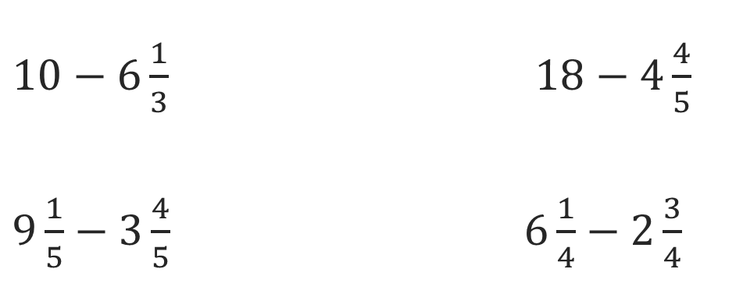
Or You Could
Explain how the information shown supports your reasoning.
5 / 48
Notes:
TEACH IN PRACTICE | Embedded facilitation | Lesson 6.5, slide 5 | WORKED
Focus on the existing task: Or You Could
LAUNCH (T2/3/5): Ask students to explain the displayed idea or example and point to evidence. When a calculation step is shown, ask why it is valid. Have a partner restate the explanation; copying is not the check.
LOOK FOR (T4): Where this task addresses it, students can define the variable. Ask which feature of their work supports the claim.
RESPOND: If this task shows the lesson misconception—reversing subtraction or omitting implied multiplication—label the quantity represented by each part of the original expression. Have the student revise and explain the change. Use this support only where the concept occurs in the current task; otherwise respond to the displayed question.
RECHECK: If a gap is shared, revisit the existing representation together. If it is limited, give targeted support while others compare valid methods on the same task. Check the revision before moving on.
PARTICIPATION (T5/6/7): Think time before volunteers; accept a written, drawn or rehearsed entry. Students ask for evidence respectfully. Recognize a specific contribution or revision and check that both partners participate.
Source: BCPS Updated Instructional Framework Rubric (June 2020), TEACH 1–7. Earlier notes and answer keys are retained below.
EARLIER NOTES / EXISTING ANSWER KEY
Model briefly, then hand the thinking back: ask “Why does this step work?” before showing the next one.
Quick check before moving on — thumbs or whiteboards from everyone, not volunteers.
UIFR: TEACH 2 · TEACH 3 · TEACH 4.

Slide 6
Today’s Objectives
Lesson 6-5 · Write and Evaluate Algebraic Expressions
Write and Evaluate Algebraic Expressions
Maryland Standard 6.AT.6a
SHOW YOUR THINKING · Show what you know — write it, draw it, or build it. A picture counts as an explanation.
CONTENT OBJECTIVE
LANGUAGE OBJECTIVE
Restate the goal in your words
Use these words to explain why
I can write an algebraic expression for a real situation and evaluate it for a given value of the variable.
I can explain my expression using the words variable, term, coefficient, constant, substitute, and evaluate.
eduwonderlab.com · Neft Teacher
6 / 48
Notes:
TEACH IN PRACTICE | Embedded facilitation | Lesson 6.5, slide 6 | GOAL
Focus on the existing task: Today’s Objectives Write and Evaluate Algebraic…
CONNECT (T1/4): Ask students to restate the displayed goal or key idea and connect it to earlier work. Relevant lesson evidence: define the variable; translate operations in order; substitute and evaluate accurately. Use only the criterion that matches the current session.
SHOW PROGRESS: Students point to their own existing work, explain what improved after feedback, and name a next step. Pair confidence ratings with actual evidence.
PARTICIPATION (T5/6/7): Think time before volunteers; accept a written, drawn or rehearsed entry. Students ask for evidence respectfully. Recognize a specific contribution or revision and check that both partners participate.
Source: BCPS Updated Instructional Framework Rubric (June 2020), TEACH 1–7. Earlier notes and answer keys are retained below.
EARLIER NOTES / EXISTING ANSWER KEY
Read the objective together, then have one or two students restate today’s goal in their own words.
Connect it to what the class learned last lesson.
Return to this goal at the end of class to check it was met.
UIFR: TEACH 1.
UIFR FULL | Lesson-specific facilitation
TEACH 1 | Session 1 purpose and evidence (UIFR PDF p. 8).
Have students restate the displayed session goal in their own words and connect it to the existing context or a familiar experience they choose to share. Use the current session goal to select from these lesson-wide evidence criteria; do not frontload a later-session procedure.
Look for: define the variable; translate operations in order; substitute and evaluate accurately. Ask: “Which part of your work would show this?” Revisit that evidence after the task; a confidence rating alone is not evidence of understanding.

Slide 7
LESSON 6.5 / OUR LEARNING
What will show your learning?
1
Define the variable.
2
Translate operations in order.
3
Substitute and evaluate accurately.
Tell a partner: Which skill connects to something you already know?
WHY IT MATTERS · Finish this: “This is worth knowing because ______.”
Listen to understand. Ask for evidence. Make room for every voice.
Notes:
TEACH IN PRACTICE | Embedded facilitation | Lesson 6.5, slide 7 | PRIOR_INSERT
Focus on the existing task: LESSON 6.5 / OUR LEARNING What will show your learning?
CONNECT (T1/4): Ask students to restate the displayed goal or key idea and connect it to earlier work. Relevant lesson evidence: define the variable; translate operations in order; substitute and evaluate accurately. Use only the criterion that matches the current session.
SHOW PROGRESS: Students point to their own existing work, explain what improved after feedback, and name a next step. Pair confidence ratings with actual evidence.
PARTICIPATION (T5/6/7): Think time before volunteers; accept a written, drawn or rehearsed entry. Students ask for evidence respectfully. Recognize a specific contribution or revision and check that both partners participate.
Source: BCPS Updated Instructional Framework Rubric (June 2020), TEACH 1–7.

Slide 8
Vocabulary 1 of 8
Lesson 6-5 · Write and Evaluate Algebraic Expressions
Write Algebraic Expressions
Translate words or a situation into numbers, variables, and operation symbols.
EXAMPLE · EXPLAIN WHY IT FITS
Five more than n becomes n + 5.
USE THE MATH WORDS · Use today’s math words in your explanation — not “it” and “that thing.”
eduwonderlab.com · Neft Teacher
8 / 48
Notes:
TEACH IN PRACTICE | Embedded facilitation | Lesson 6.5, slide 8 | VOCAB
Focus on the existing task: Vocabulary 1 of 8 Write Algebraic Expressions…
ASK (T1/3/5): Where does “Write Algebraic Expressions” appear in the example? Explain the meaning without reading the definition. Partner: restate the idea and ask a clarifying question.
LOOK FOR: A correct connection between the word and a feature of the example. If the student only repeats the definition, invite pointing, sketching or oral rehearsal, then ask for another explanation of this same example.
PARTICIPATION (T5/6/7): Think time before volunteers; accept a written, drawn or rehearsed entry. Students ask for evidence respectfully. Recognize a specific contribution or revision and check that both partners participate.
Source: BCPS Updated Instructional Framework Rubric (June 2020), TEACH 1–7.

Slide 9
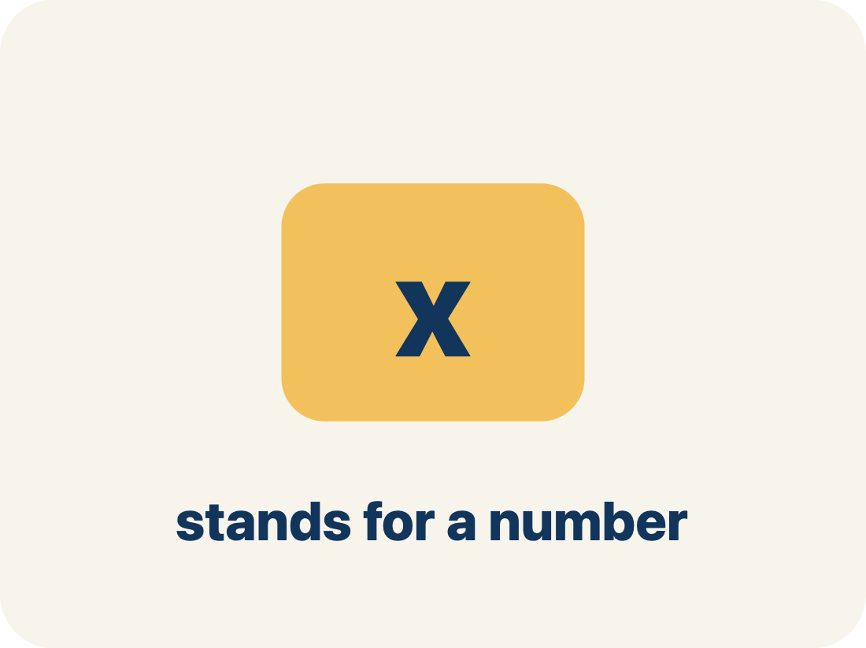
Vocabulary 2 of 8
Lesson 6-5 · Write and Evaluate Algebraic Expressions
Variable
A letter that stands for a number that is unknown or can change.
EXAMPLE · EXPLAIN WHY IT FITS
In 5t + 20, t could be hours worked — if t = 3, the expression equals 35; if t = 8, it equals 60
Use “Variable” to explain the example. Point to evidence.
eduwonderlab.com · Neft Teacher
9 / 48
Notes:
TEACH IN PRACTICE | Embedded facilitation | Lesson 6.5, slide 9 | VOCAB
Focus on the existing task: Vocabulary 2 of 8 Variable A letter that stands…
ASK (T1/3/5): Where does “Variable” appear in the example? Explain the meaning without reading the definition. Partner: restate the idea and ask a clarifying question.
LOOK FOR: A correct connection between the word and a feature of the example. If the student only repeats the definition, invite pointing, sketching or oral rehearsal, then ask for another explanation of this same example.
PARTICIPATION (T5/6/7): Think time before volunteers; accept a written, drawn or rehearsed entry. Students ask for evidence respectfully. Recognize a specific contribution or revision and check that both partners participate.
Source: BCPS Updated Instructional Framework Rubric (June 2020), TEACH 1–7.

Slide 10
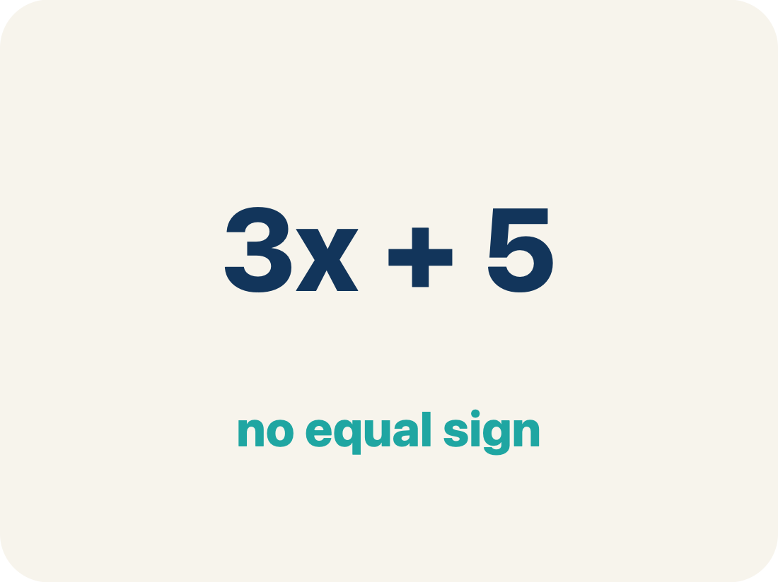
Vocabulary 3 of 8
Lesson 6-5 · Write and Evaluate Algebraic Expressions
Algebraic Expression
A math phrase that has at least one letter.
EXAMPLE · EXPLAIN WHY IT FITS
3n + 7 means ‘triple a number, then add 7’ — it has a variable (n), a coefficient (3), and a constant (7)
Use “Algebraic Expression” to explain the example. Point to
evidence.
eduwonderlab.com · Neft Teacher
10 / 48
Notes:
TEACH IN PRACTICE | Embedded facilitation | Lesson 6.5, slide 10 | VOCAB
Focus on the existing task: Vocabulary 3 of 8 Algebraic Expression A math…
ASK (T1/3/5): Where does “Algebraic Expression” appear in the example? Explain the meaning without reading the definition. Partner: restate the idea and ask a clarifying question.
LOOK FOR: A correct connection between the word and a feature of the example. If the student only repeats the definition, invite pointing, sketching or oral rehearsal, then ask for another explanation of this same example.
PARTICIPATION (T5/6/7): Think time before volunteers; accept a written, drawn or rehearsed entry. Students ask for evidence respectfully. Recognize a specific contribution or revision and check that both partners participate.
Source: BCPS Updated Instructional Framework Rubric (June 2020), TEACH 1–7.

Slide 11
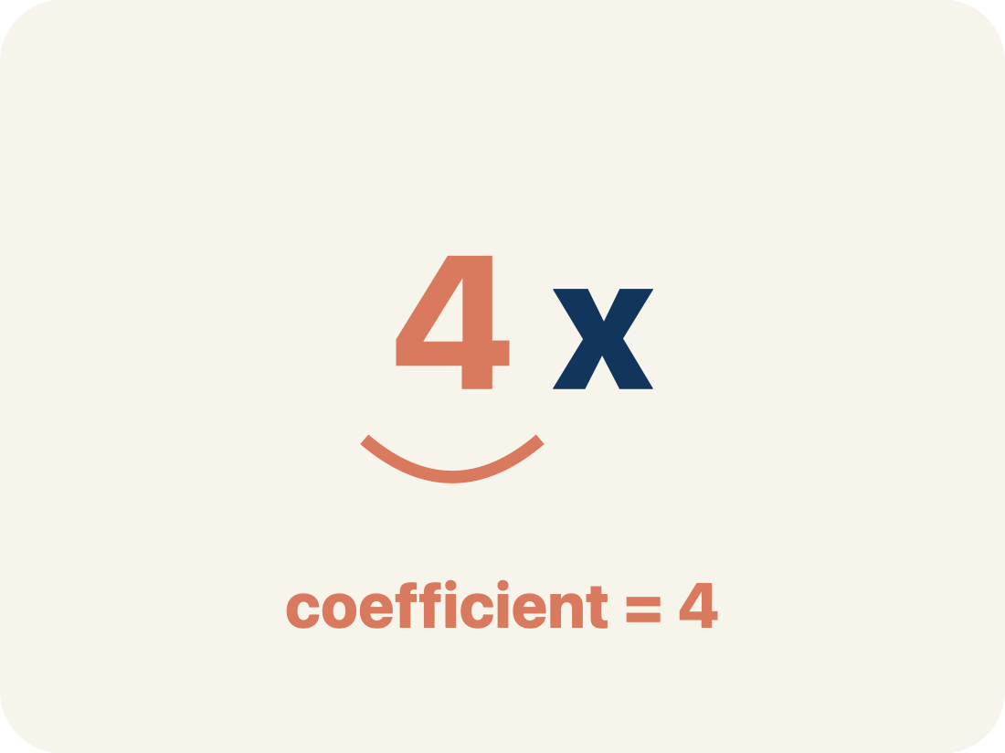
Vocabulary 4 of 8
Lesson 6-5 · Write and Evaluate Algebraic Expressions
Coefficient
The number in front of a letter, like the 3 in 3x.
EXAMPLE · EXPLAIN WHY IT FITS
In 8x, the coefficient 8 means ‘8 groups of x’ — if x = 3, then 8x = 8 × 3 = 24
Use “Coefficient” to explain the example. Point to evidence.
eduwonderlab.com · Neft Teacher
11 / 48
Notes:
TEACH IN PRACTICE | Embedded facilitation | Lesson 6.5, slide 11 | VOCAB
Focus on the existing task: Vocabulary 4 of 8 Coefficient The number in front…
ASK (T1/3/5): Where does “Coefficient” appear in the example? Explain the meaning without reading the definition. Partner: restate the idea and ask a clarifying question.
LOOK FOR: A correct connection between the word and a feature of the example. If the student only repeats the definition, invite pointing, sketching or oral rehearsal, then ask for another explanation of this same example.
PARTICIPATION (T5/6/7): Think time before volunteers; accept a written, drawn or rehearsed entry. Students ask for evidence respectfully. Recognize a specific contribution or revision and check that both partners participate.
Source: BCPS Updated Instructional Framework Rubric (June 2020), TEACH 1–7.

Slide 12
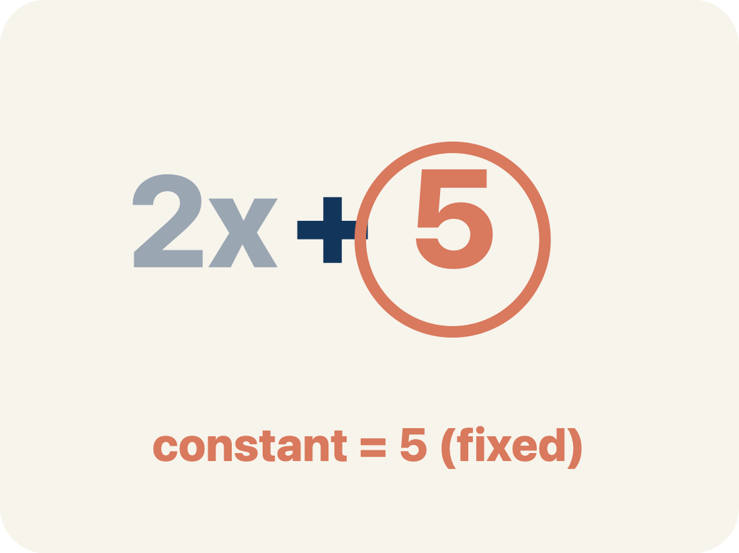
Vocabulary 5 of 8
Lesson 6-5 · Write and Evaluate Algebraic Expressions
Constant
A fixed number in an expression or equation that does not change.
EXAMPLE · EXPLAIN WHY IT FITS
In 3n + 7, the 7 never changes no matter what n is — like a flat fee that stays the same
Use “Constant” to explain the example. Point to evidence.
eduwonderlab.com · Neft Teacher
12 / 48
Notes:
TEACH IN PRACTICE | Embedded facilitation | Lesson 6.5, slide 12 | VOCAB
Focus on the existing task: Vocabulary 5 of 8 Constant A fixed number in an…
ASK (T1/3/5): Where does “Constant” appear in the example? Explain the meaning without reading the definition. Partner: restate the idea and ask a clarifying question.
LOOK FOR: A correct connection between the word and a feature of the example. If the student only repeats the definition, invite pointing, sketching or oral rehearsal, then ask for another explanation of this same example.
PARTICIPATION (T5/6/7): Think time before volunteers; accept a written, drawn or rehearsed entry. Students ask for evidence respectfully. Recognize a specific contribution or revision and check that both partners participate.
Source: BCPS Updated Instructional Framework Rubric (June 2020), TEACH 1–7.

Slide 13
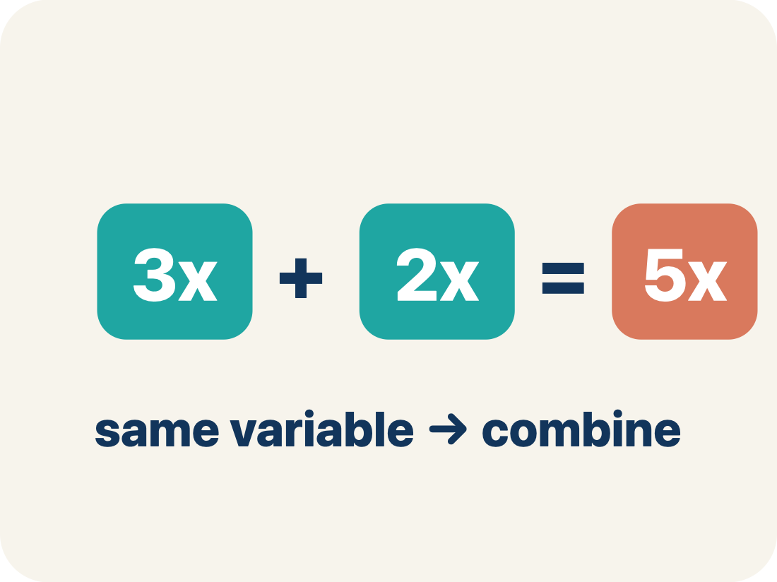
Vocabulary 6 of 8
Lesson 6-5 · Write and Evaluate Algebraic Expressions
Like terms
Terms with the same letter raised to the same power, like 2x and 5x.
EXAMPLE · EXPLAIN WHY IT FITS
4x + 2x = 6x (like terms, same variable); but 4x + 2y cannot be combined (different variables)
Use “Like terms” to explain the example. Point to evidence.
eduwonderlab.com · Neft Teacher
13 / 48
Notes:
TEACH IN PRACTICE | Embedded facilitation | Lesson 6.5, slide 13 | VOCAB
Focus on the existing task: Vocabulary 6 of 8 Like terms Terms with the same…
ASK (T1/3/5): Where does “Like terms” appear in the example? Explain the meaning without reading the definition. Partner: restate the idea and ask a clarifying question.
LOOK FOR: A correct connection between the word and a feature of the example. If the student only repeats the definition, invite pointing, sketching or oral rehearsal, then ask for another explanation of this same example.
PARTICIPATION (T5/6/7): Think time before volunteers; accept a written, drawn or rehearsed entry. Students ask for evidence respectfully. Recognize a specific contribution or revision and check that both partners participate.
Source: BCPS Updated Instructional Framework Rubric (June 2020), TEACH 1–7.

Slide 14
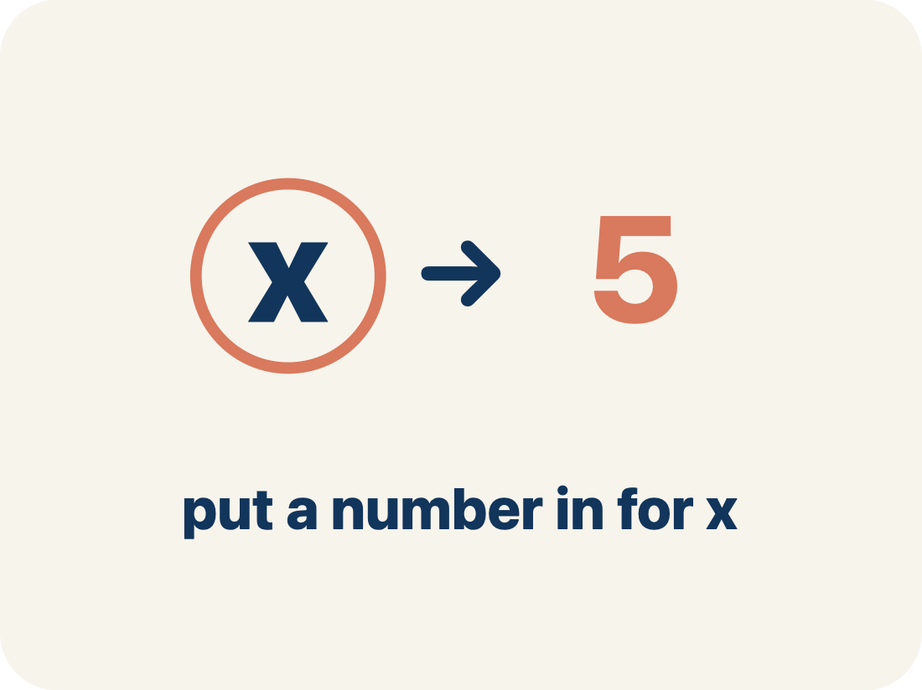
Vocabulary 7 of 8
Lesson 6-5 · Write and Evaluate Algebraic Expressions
Substitute
To replace a variable with a given number before working out the value.
EXAMPLE · EXPLAIN WHY IT FITS
For s = 30: 4.25s + 23.50 → 4.25 × 30 + 23.50
Use “Substitute” to explain the example. Point to evidence.
eduwonderlab.com · Neft Teacher
14 / 48
Notes:
TEACH IN PRACTICE | Embedded facilitation | Lesson 6.5, slide 14 | VOCAB
Focus on the existing task: Vocabulary 7 of 8 Substitute To replace a…
ASK (T1/3/5): Where does “Substitute” appear in the example? Explain the meaning without reading the definition. Partner: restate the idea and ask a clarifying question.
LOOK FOR: A correct connection between the word and a feature of the example. If the student only repeats the definition, invite pointing, sketching or oral rehearsal, then ask for another explanation of this same example.
PARTICIPATION (T5/6/7): Think time before volunteers; accept a written, drawn or rehearsed entry. Students ask for evidence respectfully. Recognize a specific contribution or revision and check that both partners participate.
Source: BCPS Updated Instructional Framework Rubric (June 2020), TEACH 1–7.

Slide 15
Vocabulary 8 of 8
Lesson 6-5 · Write and Evaluate Algebraic Expressions
Evaluate
To find what an expression is worth once every variable has a number, following the order of operations.
EXAMPLE · EXPLAIN WHY IT FITS
4.25 × 30 + 23.50 = 151
Use “Evaluate” to explain the example. Point to evidence.
eduwonderlab.com · Neft Teacher
15 / 48
Notes:
TEACH IN PRACTICE | Embedded facilitation | Lesson 6.5, slide 15 | VOCAB
Focus on the existing task: Vocabulary 8 of 8 Evaluate To find what an…
ASK (T1/3/5): Where does “Evaluate” appear in the example? Explain the meaning without reading the definition. Partner: restate the idea and ask a clarifying question.
LOOK FOR: A correct connection between the word and a feature of the example. If the student only repeats the definition, invite pointing, sketching or oral rehearsal, then ask for another explanation of this same example.
PARTICIPATION (T5/6/7): Think time before volunteers; accept a written, drawn or rehearsed entry. Students ask for evidence respectfully. Recognize a specific contribution or revision and check that both partners participate.
Source: BCPS Updated Instructional Framework Rubric (June 2020), TEACH 1–7.

Slide 16
Vocabulary
Lesson 6-5 · Write and Evaluate Algebraic Expressions
ADD ON · Add on: “I agree because ______.” or “I see it differently because ______.”
Today’s Math Words
We learn every word — what it means and what it looks like — before we use it.
Write Algebraic Expressions
Variable
Translate words or a situation into numbers, variables, and operation symbols
A letter that stands for a number that is unknown or can change
Algebraic Expression
Coefficient
A math phrase that has at least one letter
The number in front of a letter, like the 3 in 3x
Constant
Like terms
A fixed number in an expression or equation that does not change
Terms with the same letter raised to the same power, like 2x and 5x
Substitute
Evaluate
To replace a variable with a given number before working out the value
To find what an expression is worth once every variable has a number, following the order of operations
eduwonderlab.com · Neft Teacher
16 / 48
Notes:
TEACH IN PRACTICE | Embedded facilitation | Lesson 6.5, slide 16 | VOCAB
Focus on the existing task: Vocabulary Today’s Math Words We learn every word…
ASK (T1/3/5): Where does “the displayed term” appear in the example? Explain the meaning without reading the definition. Partner: restate the idea and ask a clarifying question.
LOOK FOR: A correct connection between the word and a feature of the example. If the student only repeats the definition, invite pointing, sketching or oral rehearsal, then ask for another explanation of this same example.
PARTICIPATION (T5/6/7): Think time before volunteers; accept a written, drawn or rehearsed entry. Students ask for evidence respectfully. Recognize a specific contribution or revision and check that both partners participate.
Source: BCPS Updated Instructional Framework Rubric (June 2020), TEACH 1–7. Earlier notes and answer keys are retained below.
EARLIER NOTES / EXISTING ANSWER KEY
Choral-read each word, its meaning, and what it looks like.
Students should use these words out loud today — listen for them in partner talk and revoice student ideas with the academic term.
UIFR: TEACH 1 · TEACH 5.

Slide 17

Be Curious
What’s the question?
In a soccer tournament, a team is awarded some number of points per win, another number of points per tie, and no points per loss.
Think first. Share a notice and a question;
build on a classmate’s idea.
Mindset
How helpful is it for you to have a plan to solve a math or non-math problem?
17 / 48
Notes:
TEACH IN PRACTICE | Embedded facilitation | Lesson 6.5, slide 17 | CURIOUS
Focus on the existing task: Be Curious How helpful is it for you to have a plan to solve a math or non-math problem?
LAUNCH (T2/3/5): Allow quiet observation first. Separate a notice from an inference, invite students’ own questions, and follow the existing launch before teaching a procedure.
LOOK FOR (T4): Where this task addresses it, students can define the variable. Ask which feature of their work supports the claim.
RESPOND: If this task shows the lesson misconception—reversing subtraction or omitting implied multiplication—label the quantity represented by each part of the original expression. Have the student revise and explain the change. Use this support only where the concept occurs in the current task; otherwise respond to the displayed question.
RECHECK: If a gap is shared, revisit the existing representation together. If it is limited, give targeted support while others compare valid methods on the same task. Check the revision before moving on.
PARTICIPATION (T5/6/7): Think time before volunteers; accept a written, drawn or rehearsed entry. Students ask for evidence respectfully. Recognize a specific contribution or revision and check that both partners participate.
Source: BCPS Updated Instructional Framework Rubric (June 2020), TEACH 1–7. Earlier notes and answer keys are retained below.
EARLIER NOTES / EXISTING ANSWER KEY
Accept all noticings and wonderings — there are no wrong answers here.
Give 20–30 seconds of quiet think time before taking responses; mix cold and warm calls so it is not always the same voices.
Read the mindset question aloud and let two students respond.
UIFR: TEACH 3 · TEACH 7.

Slide 18
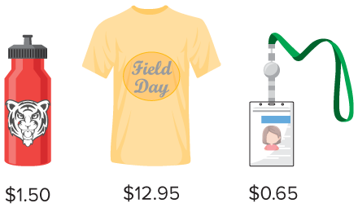
Class Field Day
Evelyn is helping to plan the sixth-grade field day. The committee will order the items shown for each student participating in field day. They do not yet know how many students will be participating in field day. The shipping cost for all items is a one-time cost of $23.50. What expression can Evelyn use to determine how much the committee will need to purchase the items?
What information do you need to find?
Reveal:
HOW DO YOU KNOW? · Ask your partner “How do you know?” Answer by pointing to your own work.
18 / 48
Notes:
TEACH IN PRACTICE | Embedded facilitation | Lesson 6.5, slide 18 | REVEAL
Focus on the existing task: What information do you need to find?
LAUNCH (T2/3/5): If an existing answer cover is present, gather an attempt before revealing. If the explanation is already visible, ask students to reconstruct and justify it. Compare reasoning and explain a revision; preserve the reveal sequence.
LOOK FOR (T4): Where this task addresses it, students can translate operations in order. Ask which feature of their work supports the claim.
RESPOND: If this task shows the lesson misconception—reversing subtraction or omitting implied multiplication—label the quantity represented by each part of the original expression. Have the student revise and explain the change. Use this support only where the concept occurs in the current task; otherwise respond to the displayed question.
RECHECK: If a gap is shared, revisit the existing representation together. If it is limited, give targeted support while others compare valid methods on the same task. Check the revision before moving on.
PARTICIPATION (T5/6/7): Think time before volunteers; accept a written, drawn or rehearsed entry. Students ask for evidence respectfully. Recognize a specific contribution or revision and check that both partners participate.
Source: BCPS Updated Instructional Framework Rubric (June 2020), TEACH 1–7. Earlier notes and answer keys are retained below.
EARLIER NOTES / EXISTING ANSWER KEY
Students should have shared predictions before this reveal.
Have them compare their thinking to what is shown: “Is this the same as what we said? Where is it different?”
Press one student to explain the reveal in their own words.
UIFR: TEACH 3 · TEACH 4.
UIFR FULL | Lesson-specific facilitation
TEACH 2-3 | Session 1 task launch (UIFR PDF pp. 9-10).
Use the problem exactly as displayed. Give individual thinking time before discussion or advancing to the explanation. If the answer is already visible, ask students to reconstruct and justify it. Invite a choice of suitable representations and have students explain why their choice helps.
At the point where this concept appears, ask: “What does each term represent in the situation, and how does substitution preserve that meaning?” Wait for evidence, invite another pathway, and have a student ask a follow-up question. Do not replace students’ reasoning with a sequence of leading steps.

Slide 19
Class Field Day
Evelyn is helping to plan the sixth-grade field day. The committee will order the items shown for each student participating in field day. They do not yet know how many students will be participating in field day. The shipping cost for all items is a one-time cost of $23.50. What expression can Evelyn use to determine how much the committee will need to purchase the items?
What information do you need to find?
TAKE TURNS · One explains, one asks a question. Then switch, so both of you talk.
Reveal:
We need to find an expression that can be used to determine how much the field day items will cost.
19 / 48
Notes:
TEACH IN PRACTICE | Embedded facilitation | Lesson 6.5, slide 19 | REVEAL
Focus on the existing task: What information do you need to find?
LAUNCH (T2/3/5): If an existing answer cover is present, gather an attempt before revealing. If the explanation is already visible, ask students to reconstruct and justify it. Compare reasoning and explain a revision; preserve the reveal sequence.
LOOK FOR (T4): Where this task addresses it, students can translate operations in order. Ask which feature of their work supports the claim.
RESPOND: If this task shows the lesson misconception—reversing subtraction or omitting implied multiplication—label the quantity represented by each part of the original expression. Have the student revise and explain the change. Use this support only where the concept occurs in the current task; otherwise respond to the displayed question.
RECHECK: If a gap is shared, revisit the existing representation together. If it is limited, give targeted support while others compare valid methods on the same task. Check the revision before moving on.
PARTICIPATION (T5/6/7): Think time before volunteers; accept a written, drawn or rehearsed entry. Students ask for evidence respectfully. Recognize a specific contribution or revision and check that both partners participate.
Source: BCPS Updated Instructional Framework Rubric (June 2020), TEACH 1–7. Earlier notes and answer keys are retained below.
EARLIER NOTES / EXISTING ANSWER KEY
Do not click yet: collect 2–3 student answers with reasons first.
Then click to remove the cover and have students compare their thinking to the reveal — “Is this what we said? Where is it different?”
Behind the cover: We need to find an expression that can be used to determine how much the field day items will cost.
UIFR: TEACH 3 · TEACH 4.

Slide 20
Class Field Day
Evelyn is helping to plan the sixth-grade field day. The committee will order the items shown for each student participating in field day. They do not yet know how many students will be participating in field day. The shipping cost for all items is a one-time cost of $23.50. What expression can Evelyn use to determine how much the committee will need to purchase the items?
How can you represent the unknown number of students?
Reveal:
SELF-CHECK · Mark it: ✓ got it · ~ almost · ? stuck. Then fix one thing before we move on.
20 / 48
Notes:
TEACH IN PRACTICE | Embedded facilitation | Lesson 6.5, slide 20 | REVEAL
Focus on the existing task: How can you represent the unknown number of students?
LAUNCH (T2/3/5): If an existing answer cover is present, gather an attempt before revealing. If the explanation is already visible, ask students to reconstruct and justify it. Compare reasoning and explain a revision; preserve the reveal sequence.
LOOK FOR (T4): Where this task addresses it, students can translate operations in order. Ask which feature of their work supports the claim.
RESPOND: If this task shows the lesson misconception—reversing subtraction or omitting implied multiplication—label the quantity represented by each part of the original expression. Have the student revise and explain the change. Use this support only where the concept occurs in the current task; otherwise respond to the displayed question.
RECHECK: If a gap is shared, revisit the existing representation together. If it is limited, give targeted support while others compare valid methods on the same task. Check the revision before moving on.
PARTICIPATION (T5/6/7): Think time before volunteers; accept a written, drawn or rehearsed entry. Students ask for evidence respectfully. Recognize a specific contribution or revision and check that both partners participate.
Source: BCPS Updated Instructional Framework Rubric (June 2020), TEACH 1–7. Earlier notes and answer keys are retained below.
EARLIER NOTES / EXISTING ANSWER KEY
Students should have shared predictions before this reveal.
Have them compare their thinking to what is shown: “Is this the same as what we said? Where is it different?”
Press one student to explain the reveal in their own words.
UIFR: TEACH 3 · TEACH 4.

Slide 21
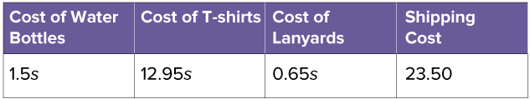
Class Field Day
Each student will receive one item shown and the one-time shipping cost is $23.50.
Why doesn’t the expression for the shipping cost contain a variable?
Reveal:
The shipping cost is not related to the number of students. It is a one-time fee.
21 / 48
Notes:
TEACH IN PRACTICE | Embedded facilitation | Lesson 6.5, slide 21 | REVEAL
Focus on the existing task: Each student will receive one item shown and the one-time shipping cost is $23.50. Why doesn’t the expression for the shipping cost contain a variable?
LAUNCH (T2/3/5): If an existing answer cover is present, gather an attempt before revealing. If the explanation is already visible, ask students to reconstruct and justify it. Compare reasoning and explain a revision; preserve the reveal sequence.
LOOK FOR (T4): Where this task addresses it, students can define the variable. Ask which feature of their work supports the claim.
RESPOND: If this task shows the lesson misconception—reversing subtraction or omitting implied multiplication—label the quantity represented by each part of the original expression. Have the student revise and explain the change. Use this support only where the concept occurs in the current task; otherwise respond to the displayed question.
RECHECK: If a gap is shared, revisit the existing representation together. If it is limited, give targeted support while others compare valid methods on the same task. Check the revision before moving on.
PARTICIPATION (T5/6/7): Think time before volunteers; accept a written, drawn or rehearsed entry. Students ask for evidence respectfully. Recognize a specific contribution or revision and check that both partners participate.
Source: BCPS Updated Instructional Framework Rubric (June 2020), TEACH 1–7. Earlier notes and answer keys are retained below.
EARLIER NOTES / EXISTING ANSWER KEY
Do not click yet: collect 2–3 student answers with reasons first.
Then click to remove the cover and have students compare their thinking to the reveal — “Is this what we said? Where is it different?”
Behind the cover: The shipping cost is not related to the number of students. It is a one-time fee.
UIFR: TEACH 3 · TEACH 4.

Slide 22
Class Field Day
JUSTIFY IT · Say it like this: “I know ______ because ______.”
To determine the total cost, what operation can you use between each expression?
Reveal:
We can use addition.
22 / 48
Notes:
TEACH IN PRACTICE | Embedded facilitation | Lesson 6.5, slide 22 | REVEAL
Focus on the existing task: To determine the total cost, what operation can you use between each expression?
LAUNCH (T2/3/5): If an existing answer cover is present, gather an attempt before revealing. If the explanation is already visible, ask students to reconstruct and justify it. Compare reasoning and explain a revision; preserve the reveal sequence.
LOOK FOR (T4): Where this task addresses it, students can define the variable. Ask which feature of their work supports the claim.
RESPOND: If this task shows the lesson misconception—reversing subtraction or omitting implied multiplication—label the quantity represented by each part of the original expression. Have the student revise and explain the change. Use this support only where the concept occurs in the current task; otherwise respond to the displayed question.
RECHECK: If a gap is shared, revisit the existing representation together. If it is limited, give targeted support while others compare valid methods on the same task. Check the revision before moving on.
PARTICIPATION (T5/6/7): Think time before volunteers; accept a written, drawn or rehearsed entry. Students ask for evidence respectfully. Recognize a specific contribution or revision and check that both partners participate.
Source: BCPS Updated Instructional Framework Rubric (June 2020), TEACH 1–7. Earlier notes and answer keys are retained below.
EARLIER NOTES / EXISTING ANSWER KEY
Do not click yet: collect 2–3 student answers with reasons first.
Then click to remove the cover and have students compare their thinking to the reveal — “Is this what we said? Where is it different?”
Behind the cover: We can use addition.
UIFR: TEACH 3 · TEACH 4.

Slide 23
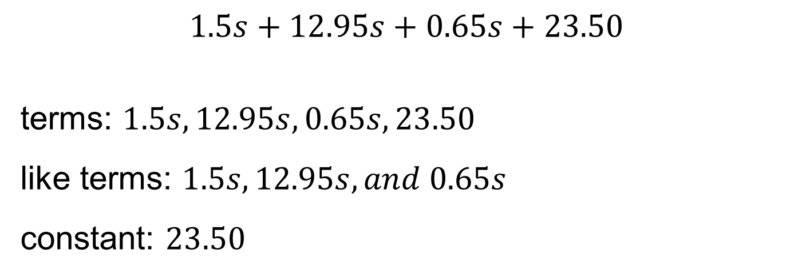
Class Field Day
Think and record first. Which part of your work supports your answer?
Think About It:
Do you think any of the terms can be combined and rewritten as a single term?
23 / 48
Notes:
TEACH IN PRACTICE | Embedded facilitation | Lesson 6.5, slide 23 | TASK
Focus on the existing task: Think About It: Do you think any of the terms can be combined and rewritten as a single term?
LAUNCH (T2/3/5): Use the displayed question. Give private thinking time; then A explains while B asks for evidence. Switch roles. Each student records their own reasoning.
LOOK FOR (T4): Where this task addresses it, students can define the variable. Ask which feature of their work supports the claim.
RESPOND: If this task shows the lesson misconception—reversing subtraction or omitting implied multiplication—label the quantity represented by each part of the original expression. Have the student revise and explain the change. Use this support only where the concept occurs in the current task; otherwise respond to the displayed question.
RECHECK: If a gap is shared, revisit the existing representation together. If it is limited, give targeted support while others compare valid methods on the same task. Check the revision before moving on.
PARTICIPATION (T5/6/7): Think time before volunteers; accept a written, drawn or rehearsed entry. Students ask for evidence respectfully. Recognize a specific contribution or revision and check that both partners participate.
Source: BCPS Updated Instructional Framework Rubric (June 2020), TEACH 1–7. Earlier notes and answer keys are retained below.
EARLIER NOTES / EXISTING ANSWER KEY
Ask the question, then hold the silence — students think or jot before anyone answers.
Take two or three responses and press with “Why?” or “How do you know?” before moving on.
UIFR: TEACH 3.

Slide 24
Class Field Day
Evelyn is helping to plan the sixth-grade field day. The committee will order the items shown for each student participating in field day. They do not yet know how many students will be participating in field day. The shipping cost for all items is a one-time cost of $23.50.
What expression can Evelyn use to determine how much the committee will need to purchase the items?
24 / 48
Notes:
TEACH IN PRACTICE | Embedded facilitation | Lesson 6.5, slide 24 | TASK
Focus on the existing task: Evelyn is helping to plan the sixth-grade field day. The committee will order the items shown for each student participating in field day.…
LAUNCH (T2/3/5): Use the displayed question. Give private thinking time; then A explains while B asks for evidence. Switch roles. Each student records their own reasoning.
LOOK FOR (T4): Where this task addresses it, students can translate operations in order. Ask which feature of their work supports the claim.
RESPOND: If this task shows the lesson misconception—reversing subtraction or omitting implied multiplication—label the quantity represented by each part of the original expression. Have the student revise and explain the change. Use this support only where the concept occurs in the current task; otherwise respond to the displayed question.
RECHECK: If a gap is shared, revisit the existing representation together. If it is limited, give targeted support while others compare valid methods on the same task. Check the revision before moving on.
PARTICIPATION (T5/6/7): Think time before volunteers; accept a written, drawn or rehearsed entry. Students ask for evidence respectfully. Recognize a specific contribution or revision and check that both partners participate.
Source: BCPS Updated Instructional Framework Rubric (June 2020), TEACH 1–7. Earlier notes and answer keys are retained below.
EARLIER NOTES / EXISTING ANSWER KEY
Read the context aloud (or have a student read it).
Before any math, students restate the situation and what is being asked in their own words.
Ask: What expression can Evelyn use to determine how much the committee will need to purchase the items?
UIFR: TEACH 1 · TEACH 3.

Slide 25
STUDENT MOVES
Lesson 6-5
Your move
PICK YOUR STRATEGY · Choose your path — picture, table, number line, or equation — and be ready to say why you chose it.
25 / 48

Slide 26
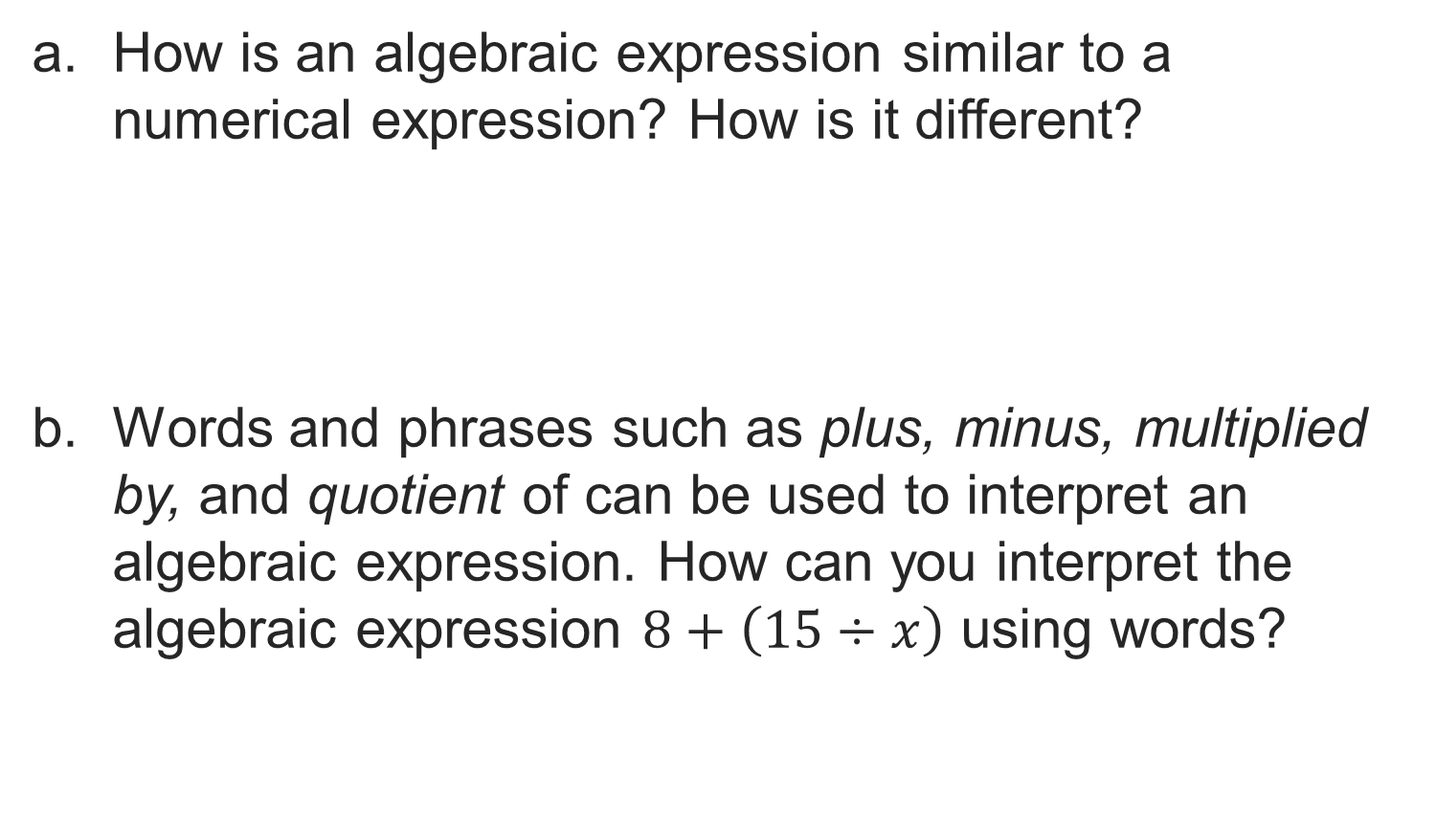
Let’s Explore More
STRUGGLE FIRST · Work on your own first. Stuck is allowed — try a second strategy before you ask.
26 / 48
Notes:
TEACH IN PRACTICE | Embedded facilitation | Lesson 6.5, slide 25 | PRACTICE
Focus on the existing task: Let’s Explore More
LAUNCH (T2/3/5): Use the displayed question. Give private thinking time; then A explains while B asks for evidence. Switch roles. Each student records their own reasoning.
LOOK FOR (T4): Where this task addresses it, students can define the variable. Ask which feature of their work supports the claim.
RESPOND: If this task shows the lesson misconception—reversing subtraction or omitting implied multiplication—label the quantity represented by each part of the original expression. Have the student revise and explain the change. Use this support only where the concept occurs in the current task; otherwise respond to the displayed question.
RECHECK: If a gap is shared, revisit the existing representation together. If it is limited, give targeted support while others compare valid methods on the same task. Check the revision before moving on.
PARTICIPATION (T5/6/7): Think time before volunteers; accept a written, drawn or rehearsed entry. Students ask for evidence respectfully. Recognize a specific contribution or revision and check that both partners participate.
Source: BCPS Updated Instructional Framework Rubric (June 2020), TEACH 1–7. Earlier notes and answer keys are retained below.
EARLIER NOTES / EXISTING ANSWER KEY
Extension for partners or table groups — students choose their approach and use the workspace to show thinking.
Push with “Convince me,” and have two groups with different approaches share.
This is where students stretch past the worked example.
UIFR: TEACH 2 · TEACH 5.
UIFR FULL | Lesson-specific facilitation
TEACH 4-5 | Session 1 discussion and checkpoint (UIFR PDF pp. 11-12).
Collect a brief response from every student to the existing prompt before hearing volunteers. Partners take turns explaining and asking for evidence: “I understand ___; what supports ___?” Offer rehearsal or an annotated model for students who need language support. Each student records their own reasoning.
Look specifically for: reversing subtraction or omitting implied multiplication. If it appears, label the quantity represented by each part of the original expression; then ask the student to revise the same response and explain the change. If evidence is secure, have students compare a second valid pathway or state why their approach works. Choose the next step from the responses, not a preset pace.

Slide 27
LESSON 6.5 / DISCUSS THE TASK
Explain and compare
Use the task you just explored.
TAKE TURNS
What does each term represent in the situation, and how does substitution preserve that meaning?
Explain
“I know this because…”
Ask
“Where does your work show that?”
Point to evidence in your work.
Then compare your approach with a partner’s.
ANOTHER PATHWAY · Did anyone get there a different way? Put both pathways side by side and compare.
Listen to understand. Ask for evidence. Make room for every voice.
Notes:
TEACH IN PRACTICE | Embedded facilitation | Lesson 6.5, slide 26 | PRIOR_INSERT
Focus on the existing task: Point to evidence in your work. Then compare your approach with a partner’s. TAKE TURNS Explain “I know this because…” Ask “Where does your work show that?
CONNECT (T1/4): Ask students to restate the displayed goal or key idea and connect it to earlier work. Relevant lesson evidence: define the variable; translate operations in order; substitute and evaluate accurately. Use only the criterion that matches the current session.
SHOW PROGRESS: Students point to their own existing work, explain what improved after feedback, and name a next step. Pair confidence ratings with actual evidence.
PARTICIPATION (T5/6/7): Think time before volunteers; accept a written, drawn or rehearsed entry. Students ask for evidence respectfully. Recognize a specific contribution or revision and check that both partners participate.
Source: BCPS Updated Instructional Framework Rubric (June 2020), TEACH 1–7.

Slide 28
Class Field Day
USE YOUR TOOLS · Reach for your notes, a model, or a manipulative before you reach for an answer.
To determine the total cost, what operation can you use between each expression?
Reveal:
We can use addition.
28 / 48
Notes:
TEACH IN PRACTICE | Embedded facilitation | Lesson 6.5, slide 27 | REVEAL
Focus on the existing task: To determine the total cost, what operation can you use between each expression?
LAUNCH (T2/3/5): If an existing answer cover is present, gather an attempt before revealing. If the explanation is already visible, ask students to reconstruct and justify it. Compare reasoning and explain a revision; preserve the reveal sequence.
LOOK FOR (T4): Where this task addresses it, students can define the variable. Ask which feature of their work supports the claim.
RESPOND: If this task shows the lesson misconception—reversing subtraction or omitting implied multiplication—label the quantity represented by each part of the original expression. Have the student revise and explain the change. Use this support only where the concept occurs in the current task; otherwise respond to the displayed question.
RECHECK: If a gap is shared, revisit the existing representation together. If it is limited, give targeted support while others compare valid methods on the same task. Check the revision before moving on.
PARTICIPATION (T5/6/7): Think time before volunteers; accept a written, drawn or rehearsed entry. Students ask for evidence respectfully. Recognize a specific contribution or revision and check that both partners participate.
Source: BCPS Updated Instructional Framework Rubric (June 2020), TEACH 1–7.

Slide 29
Warm-Up
Lesson 6-5 · Write and Evaluate Algebraic Expressions
Session 2 Warm-Up
Try alone. Explain one. Then revise.
1
A letter used to represent an unknown quantity is a:
2
In the expression 5x + 3, what is 5?
A
Constant
A
Variable
B
Variable
B
Coefficient
C
Coefficient
C
Constant
D
Term
D
Sum
3
Evaluate 3n − 4 when n = 6:
4
“7 less than a number x” is written as:
A
10
A
7 − x
B
14
B
x − 7
C
18
C
7x
D
2
D
x + 7
eduwonderlab.com · Neft Teacher
29 / 48
Notes:
TEACH IN PRACTICE | Embedded facilitation | Lesson 6.5, slide 28 | WARMUP
Focus on the existing task: Warm-Up Session 2 Warm-Up Check what you remember…
GATHER EVIDENCE (T4/6): Keep the original items. Students try independently, mark an uncertain item, and explain one method before checking. Use the existing key when present.
RESPOND: Distinguish a calculation slip from a reasoning gap. Give one next step on the same item; have students revise in a second color. Use the responses to choose flexible support for today’s lesson.
PARTICIPATION (T5/6/7): Think time before volunteers; accept a written, drawn or rehearsed entry. Students ask for evidence respectfully. Recognize a specific contribution or revision and check that both partners participate.
Source: BCPS Updated Instructional Framework Rubric (June 2020), TEACH 1–7. Earlier notes and answer keys are retained below.
EARLIER NOTES / EXISTING ANSWER KEY
Warm-up routine: students start silently on entry; keep it to about 4 minutes.
Circulate and note who is stuck — use what you see to choose who you check on first today.
Go over answers quickly; ask one student to explain a step, not just say the answer.
UIFR: TEACH 4 · TEACH 6.

Slide 30
STUDENT MOVES
Lesson 6-5
Your move
YOU KNOW THE ROUTINE · Read → plan → solve → check. Do all four, in that order.
30 / 48

Slide 31
Review Notes — Session 2
Lesson 6-5 · Write and Evaluate Algebraic Expressions
Session 2: Review Notes
Copy. Explain. Check.
NAME THE MATH · Point to the part of this that is new today, and say what it changes.
Algebraic Vocabulary
1
Variable (unknown letter), Coefficient (factor multiplying variable), Constant (fixed number).
Evaluating Expressions
2
Substitute the given numerical value into the variable and follow the order of operations.
Translating Phrases
3
Watch for reverse phrases: ‘less than’ and ‘subtracted from’ reverse the order (e.g. x − 7).
eduwonderlab.com · Neft Teacher
31 / 48
Notes:
TEACH IN PRACTICE | Embedded facilitation | Lesson 6.5, slide 29 | NOTES
Focus on the existing task: Review Notes — Session 2 Session 2: Review Notes…
ROUTINE (T1/2/4): Read or copy the original notes, cover one line, and explain it using the displayed example. Reopen and correct. Copying alone is not evidence of understanding.
LOOK FOR: A link between a symbol, quantity or feature and the explanation. If missing, point back to that feature and have the student try again; fade the prompt once they can explain.
PARTICIPATION (T5/6/7): Think time before volunteers; accept a written, drawn or rehearsed entry. Students ask for evidence respectfully. Recognize a specific contribution or revision and check that both partners participate.
Source: BCPS Updated Instructional Framework Rubric (June 2020), TEACH 1–7. Earlier notes and answer keys are retained below.
EARLIER NOTES / EXISTING ANSWER KEY
Choral-read each word, its meaning, and what it looks like.
Students should use these words out loud today — listen for them in partner talk and revoice student ideas with the academic term.
UIFR: TEACH 1 · TEACH 5.

Slide 32
Session 2
Write and Evaluate Algebraic Expressions
ASK THE CLASS · Write one question about this that you could ask the class.
32 / 48
Notes:
TEACH IN PRACTICE | Embedded facilitation | Lesson 6.5, slide 30 | DIVIDER
Focus on the existing task: Write and Evaluate Algebraic Expressions Session 2
TRANSITION (T6/7): Students confirm materials, roles, how to request help, and the next response routine. Ask a student to restate it. Keep teacher-only slides hidden.
PARTICIPATION (T5/6/7): Think time before volunteers; accept a written, drawn or rehearsed entry. Students ask for evidence respectfully. Recognize a specific contribution or revision and check that both partners participate.
Source: BCPS Updated Instructional Framework Rubric (June 2020), TEACH 1–7. Earlier notes and answer keys are retained below.
EARLIER NOTES / EXISTING ANSWER KEY
Transition cue: state what materials are out and what success looks like this session.
Keep the changeover under a minute.
UIFR: TEACH 6.

Slide 33

Toy Cars
A toy car factory makes three different colors of a car. For every green car, three yellow cars and two blue cars are made.
What expression can be used to determine the number of green, yellow, and blue cars made on a given day?
How many total cars are made when 125, 200, and 375 green cars are made?
RESTATE FIRST · Restate your partner’s idea in your own words before you give yours.
33 / 48
Notes:
TEACH IN PRACTICE | Embedded facilitation | Lesson 6.5, slide 31 | TASK
Focus on the existing task: How many total cars are made when 125, 200, and 375 green cars are made?
LAUNCH (T2/3/5): Use the displayed question. Give private thinking time; then A explains while B asks for evidence. Switch roles. Each student records their own reasoning.
LOOK FOR (T4): Where this task addresses it, students can define the variable. Ask which feature of their work supports the claim.
RESPOND: If this task shows the lesson misconception—reversing subtraction or omitting implied multiplication—label the quantity represented by each part of the original expression. Have the student revise and explain the change. Use this support only where the concept occurs in the current task; otherwise respond to the displayed question.
RECHECK: If a gap is shared, revisit the existing representation together. If it is limited, give targeted support while others compare valid methods on the same task. Check the revision before moving on.
PARTICIPATION (T5/6/7): Think time before volunteers; accept a written, drawn or rehearsed entry. Students ask for evidence respectfully. Recognize a specific contribution or revision and check that both partners participate.
Source: BCPS Updated Instructional Framework Rubric (June 2020), TEACH 1–7. Earlier notes and answer keys are retained below.
EARLIER NOTES / EXISTING ANSWER KEY
Read the context aloud (or have a student read it).
Before any math, students restate the situation and what is being asked in their own words.
Ask: What expression can be used to determine the number of green, yellow, and blue cars made on a given day?
UIFR: TEACH 1 · TEACH 3.

Slide 34
Toy Cars
A toy car factory makes three different colors of a car. For every green car, three yellow cars and two blue cars are made.
We can use a variable, such as c, to represent the number of green cars made.
How do the number of yellow cars and the number of blue cars relate to the number of green cars?
Reveal:
There are three times as many yellow cars as green cars. There are twice as many blue cars as green cars.
34 / 48
Notes:
TEACH IN PRACTICE | Embedded facilitation | Lesson 6.5, slide 32 | REVEAL
Focus on the existing task: A toy car factory makes three different colors of a car. For every green car, three yellow cars and two blue cars are made. We can use a…
LAUNCH (T2/3/5): If an existing answer cover is present, gather an attempt before revealing. If the explanation is already visible, ask students to reconstruct and justify it. Compare reasoning and explain a revision; preserve the reveal sequence.
LOOK FOR (T4): Where this task addresses it, students can define the variable. Ask which feature of their work supports the claim.
RESPOND: If this task shows the lesson misconception—reversing subtraction or omitting implied multiplication—label the quantity represented by each part of the original expression. Have the student revise and explain the change. Use this support only where the concept occurs in the current task; otherwise respond to the displayed question.
RECHECK: If a gap is shared, revisit the existing representation together. If it is limited, give targeted support while others compare valid methods on the same task. Check the revision before moving on.
PARTICIPATION (T5/6/7): Think time before volunteers; accept a written, drawn or rehearsed entry. Students ask for evidence respectfully. Recognize a specific contribution or revision and check that both partners participate.
Source: BCPS Updated Instructional Framework Rubric (June 2020), TEACH 1–7. Earlier notes and answer keys are retained below.
EARLIER NOTES / EXISTING ANSWER KEY
Do not click yet: collect 2–3 student answers with reasons first.
Then click to remove the cover and have students compare their thinking to the reveal — “Is this what we said? Where is it different?”
Behind the cover: There are three times as many yellow cars as green cars. There are twice as many blue cars as green cars.
UIFR: TEACH 3 · TEACH 4.

Slide 35
STUDENT MOVES
Lesson 6-5
Your move
JUSTIFY IT · Say it like this: “I know ______ because ______.”
35 / 48

Slide 36

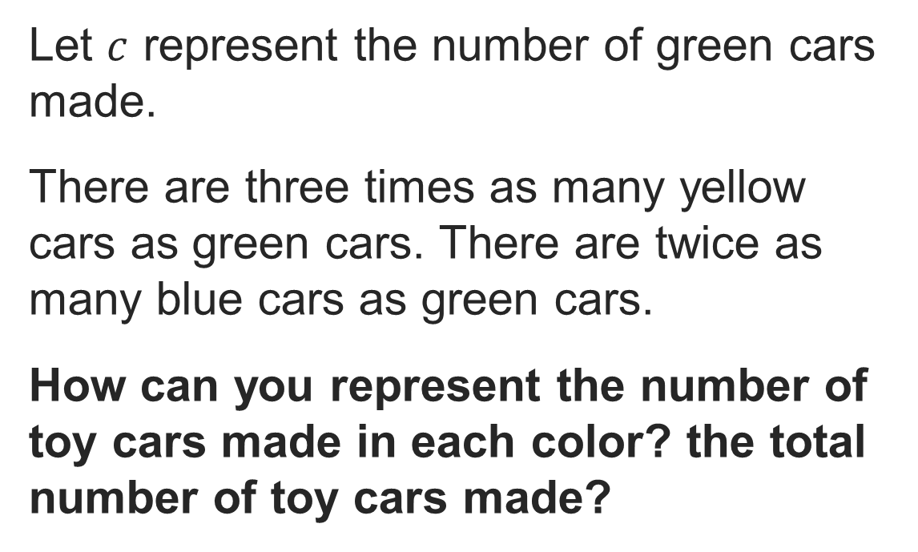
COLLABORATE · TALK IT THROUGH • AGREE ON A MODEL
Collaborate and Connect
Think first. A explains; B asks for
evidence. Switch roles; both
revise.
Reveal:
We can write an algebraic expression for each color and then add them together.
36 / 48
Notes:
TEACH IN PRACTICE | Embedded facilitation | Lesson 6.5, slide 33 | COLLABORATE
Focus on the existing task: Reveal: We can write an algebraic expression for each color and then add them together. Collaborate and Connect COLLABORATE ·
LAUNCH (T2/3/5): Use the displayed question. Give private thinking time; then A explains while B asks for evidence. Switch roles. Each student records their own reasoning.
LOOK FOR (T4): Where this task addresses it, students can define the variable. Ask which feature of their work supports the claim.
RESPOND: If this task shows the lesson misconception—reversing subtraction or omitting implied multiplication—label the quantity represented by each part of the original expression. Have the student revise and explain the change. Use this support only where the concept occurs in the current task; otherwise respond to the displayed question.
RECHECK: If a gap is shared, revisit the existing representation together. If it is limited, give targeted support while others compare valid methods on the same task. Check the revision before moving on.
PARTICIPATION (T5/6/7): Think time before volunteers; accept a written, drawn or rehearsed entry. Students ask for evidence respectfully. Recognize a specific contribution or revision and check that both partners participate.
Source: BCPS Updated Instructional Framework Rubric (June 2020), TEACH 1–7. Earlier notes and answer keys are retained below.
EARLIER NOTES / EXISTING ANSWER KEY
Routine: COLLABORATE · TALK IT THROUGH • AGREE ON A MODEL

Slide 37
Toy Cars
How can you write an expression to represent the number of cars made in one day?
REVISE NOW · Change one answer and write why you changed it. A revision is evidence of learning.
 | There are three times as many yellow cars as green cars.
 | There are twice as many blue cars as green cars.
Reveal:
We can add the individual expressions together.
37 / 48
Notes:
TEACH IN PRACTICE | Embedded facilitation | Lesson 6.5, slide 34 | REVEAL
Focus on the existing task: How can you write an expression to represent the number of cars made in one day?
LAUNCH (T2/3/5): If an existing answer cover is present, gather an attempt before revealing. If the explanation is already visible, ask students to reconstruct and justify it. Compare reasoning and explain a revision; preserve the reveal sequence.
LOOK FOR (T4): Where this task addresses it, students can define the variable. Ask which feature of their work supports the claim.
RESPOND: If this task shows the lesson misconception—reversing subtraction or omitting implied multiplication—label the quantity represented by each part of the original expression. Have the student revise and explain the change. Use this support only where the concept occurs in the current task; otherwise respond to the displayed question.
RECHECK: If a gap is shared, revisit the existing representation together. If it is limited, give targeted support while others compare valid methods on the same task. Check the revision before moving on.
PARTICIPATION (T5/6/7): Think time before volunteers; accept a written, drawn or rehearsed entry. Students ask for evidence respectfully. Recognize a specific contribution or revision and check that both partners participate.
Source: BCPS Updated Instructional Framework Rubric (June 2020), TEACH 1–7. Earlier notes and answer keys are retained below.
EARLIER NOTES / EXISTING ANSWER KEY
Do not click yet: collect 2–3 student answers with reasons first.
Then click to remove the cover and have students compare their thinking to the reveal — “Is this what we said? Where is it different?”
Behind the cover: We can add the individual expressions together.
UIFR: TEACH 3 · TEACH 4.

Slide 38

Toy Cars
A toy car factory makes three different colors of a car. For every green car, three yellow cars and two blue cars are made.
What expression can be used to determine the number of green, yellow, and blue cars made on a given day?
How many total cars are made when 125, 200, and 375 green cars are made?
750, 1,200, and 2,250
TWO MINUTES SOLO · Two minutes on your own, then compare. Bring one thing you tried, even if it did not work.
38 / 48
Notes:
TEACH IN PRACTICE | Embedded facilitation | Lesson 6.5, slide 35 | TASK
Focus on the existing task: What expression can be used to determine the number of green, yellow, and blue cars made on a given day?
LAUNCH (T2/3/5): Use the displayed question. Give private thinking time; then A explains while B asks for evidence. Switch roles. Each student records their own reasoning.
LOOK FOR (T4): Where this task addresses it, students can define the variable. Ask which feature of their work supports the claim.
RESPOND: If this task shows the lesson misconception—reversing subtraction or omitting implied multiplication—label the quantity represented by each part of the original expression. Have the student revise and explain the change. Use this support only where the concept occurs in the current task; otherwise respond to the displayed question.
RECHECK: If a gap is shared, revisit the existing representation together. If it is limited, give targeted support while others compare valid methods on the same task. Check the revision before moving on.
PARTICIPATION (T5/6/7): Think time before volunteers; accept a written, drawn or rehearsed entry. Students ask for evidence respectfully. Recognize a specific contribution or revision and check that both partners participate.
Source: BCPS Updated Instructional Framework Rubric (June 2020), TEACH 1–7. Earlier notes and answer keys are retained below.
EARLIER NOTES / EXISTING ANSWER KEY
Read the context aloud (or have a student read it).
Before any math, students restate the situation and what is being asked in their own words.
Ask: How many total cars are made when 125, 200, and 375 green cars are made?
UIFR: TEACH 1 · TEACH 3.

Slide 39
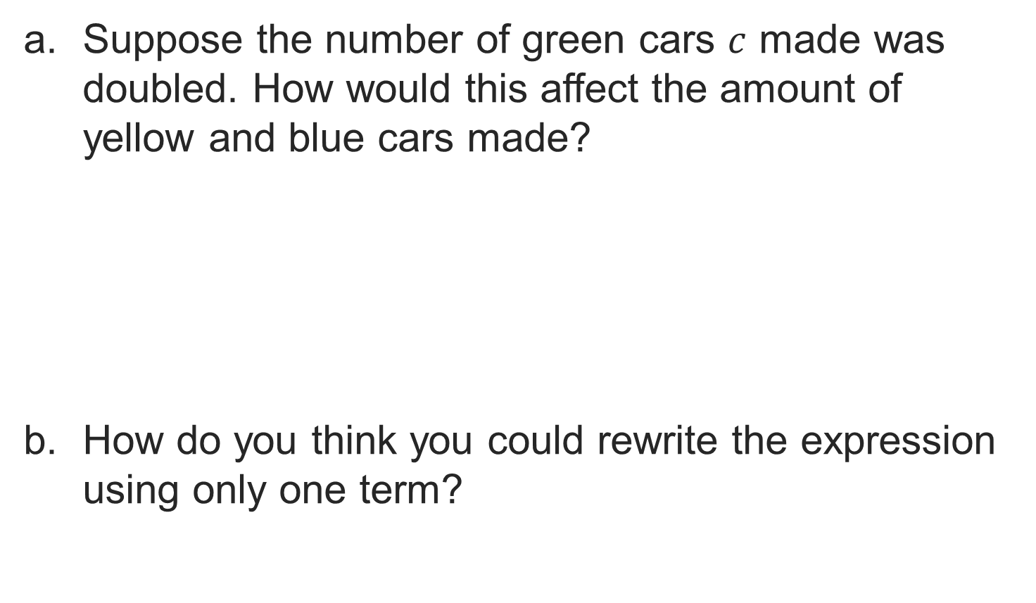
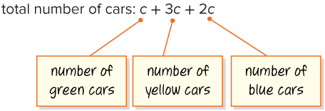

Let’s Explore More
39 / 48
Notes:
TEACH IN PRACTICE | Embedded facilitation | Lesson 6.5, slide 36 | PRACTICE
Focus on the existing task: Let’s Explore More
LAUNCH (T2/3/5): Use the displayed question. Give private thinking time; then A explains while B asks for evidence. Switch roles. Each student records their own reasoning.
LOOK FOR (T4): Where this task addresses it, students can define the variable. Ask which feature of their work supports the claim.
RESPOND: If this task shows the lesson misconception—reversing subtraction or omitting implied multiplication—label the quantity represented by each part of the original expression. Have the student revise and explain the change. Use this support only where the concept occurs in the current task; otherwise respond to the displayed question.
RECHECK: If a gap is shared, revisit the existing representation together. If it is limited, give targeted support while others compare valid methods on the same task. Check the revision before moving on.
PARTICIPATION (T5/6/7): Think time before volunteers; accept a written, drawn or rehearsed entry. Students ask for evidence respectfully. Recognize a specific contribution or revision and check that both partners participate.
Source: BCPS Updated Instructional Framework Rubric (June 2020), TEACH 1–7. Earlier notes and answer keys are retained below.
EARLIER NOTES / EXISTING ANSWER KEY
Extension for partners or table groups — students choose their approach and use the workspace to show thinking.
Push with “Convince me,” and have two groups with different approaches share.
This is where students stretch past the worked example.
UIFR: TEACH 2 · TEACH 5.

Slide 40
STUDENT MOVES
Lesson 6-5
Your move
STRUGGLE FIRST · Work on your own first. Stuck is allowed — try a second strategy before you ask.
40 / 48

Slide 41
LESSON 6.5 / CHECK YOUR WORK
Pause. Check. Improve.
CHECK
A mistake to watch for: reversing subtraction or omitting implied multiplication.
TRY
Label the quantity represented by each part of the given expression.
REVISE
Use that check on the task you just completed. Correct or strengthen one part, and explain why.
SPECIFIC FEEDBACK · Trade work. Give one specific comment: “This part is clear because ______.”
Listen to understand. Ask for evidence. Make room for every voice.
Notes:
TEACH IN PRACTICE | Embedded facilitation | Lesson 6.5, slide 37 | PRIOR_INSERT
Focus on the existing task: LESSON 6.5 / CHECK YOUR WORK Pause. Check. Improve. Listen to understand. Ask for evidence. Make room for every voice. CHECK A mistake…
CONNECT (T1/4): Ask students to restate the displayed goal or key idea and connect it to earlier work. Relevant lesson evidence: define the variable; translate operations in order; substitute and evaluate accurately. Use only the criterion that matches the current session.
SHOW PROGRESS: Students point to their own existing work, explain what improved after feedback, and name a next step. Pair confidence ratings with actual evidence.
PARTICIPATION (T5/6/7): Think time before volunteers; accept a written, drawn or rehearsed entry. Students ask for evidence respectfully. Recognize a specific contribution or revision and check that both partners participate.
Source: BCPS Updated Instructional Framework Rubric (June 2020), TEACH 1–7.

Slide 42
Toy Cars
How can you write an expression to represent the number of cars made in one day?
 | There are three times as many yellow cars as green cars.
 | There are twice as many blue cars as green cars.
PROVE IT · Find the evidence in the problem that makes your answer right — not just the answer.
Reveal:
We can add the individual expressions together.
42 / 48
Notes:
TEACH IN PRACTICE | Embedded facilitation | Lesson 6.5, slide 38 | REVEAL
Focus on the existing task: How can you write an expression to represent the number of cars made in one day?
LAUNCH (T2/3/5): If an existing answer cover is present, gather an attempt before revealing. If the explanation is already visible, ask students to reconstruct and justify it. Compare reasoning and explain a revision; preserve the reveal sequence.
LOOK FOR (T4): Where this task addresses it, students can define the variable. Ask which feature of their work supports the claim.
RESPOND: If this task shows the lesson misconception—reversing subtraction or omitting implied multiplication—label the quantity represented by each part of the original expression. Have the student revise and explain the change. Use this support only where the concept occurs in the current task; otherwise respond to the displayed question.
RECHECK: If a gap is shared, revisit the existing representation together. If it is limited, give targeted support while others compare valid methods on the same task. Check the revision before moving on.
PARTICIPATION (T5/6/7): Think time before volunteers; accept a written, drawn or rehearsed entry. Students ask for evidence respectfully. Recognize a specific contribution or revision and check that both partners participate.
Source: BCPS Updated Instructional Framework Rubric (June 2020), TEACH 1–7.

Slide 43
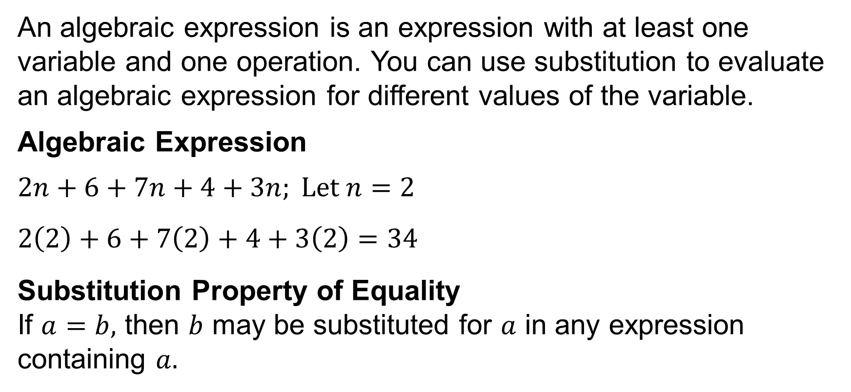
SUMMARIZE · SAY IT IN YOUR OWN WORDS
Summarize: Write and Evaluate Algebraic Expressions
YOUR CHOICE · You choose how to show this — numbers, words, or a diagram. Make your reasoning visible.
43 / 48
Notes:
TEACH IN PRACTICE | Embedded facilitation | Lesson 6.5, slide 39 | SUMMARIZE
Focus on the existing task: Summarize: Write and Evaluate Algebraic Expressions SUMMARIZE · SAY IT IN YOUR OWN WORDS
CONNECT (T1/4): Ask students to restate the displayed goal or key idea and connect it to earlier work. Relevant lesson evidence: define the variable; translate operations in order; substitute and evaluate accurately. Use only the criterion that matches the current session.
SHOW PROGRESS: Students point to their own existing work, explain what improved after feedback, and name a next step. Pair confidence ratings with actual evidence.
PARTICIPATION (T5/6/7): Think time before volunteers; accept a written, drawn or rehearsed entry. Students ask for evidence respectfully. Recognize a specific contribution or revision and check that both partners participate.
Source: BCPS Updated Instructional Framework Rubric (June 2020), TEACH 1–7. Earlier notes and answer keys are retained below.
EARLIER NOTES / EXISTING ANSWER KEY
Routine: SUMMARIZE · SAY IT IN YOUR OWN WORDS

Slide 44
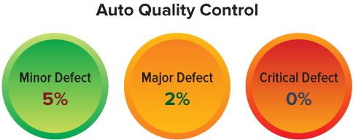
APPLY · PLAN IT • SOLVE IT • PROVE IT
Apply: Acceptable Quality Levels
In manufacturing, inspecting products for defects is essential. The Acceptable Quality Level (AQL) is the maximum number of defective products that is considered acceptable in each batch, or lot. AQL is expressed as a percentage or ratio.
Choose a method. Solve independently, justify your answer, then check the goal.
44 / 48
Notes:
TEACH IN PRACTICE | Embedded facilitation | Lesson 6.5, slide 40 | APPLY
Focus on the existing task: In manufacturing, inspecting products for defects is essential. The Acceptable Quality Level (AQL) is the maximum number of defective…
LAUNCH (T2/3/5): Use the exact application task independently first. Ask students to justify their choice of method. Collect evidence before a partner discussion or correction.
LOOK FOR (T4): Where this task addresses it, students can define the variable. Ask which feature of their work supports the claim.
RESPOND: If this task shows the lesson misconception—reversing subtraction or omitting implied multiplication—label the quantity represented by each part of the original expression. Have the student revise and explain the change. Use this support only where the concept occurs in the current task; otherwise respond to the displayed question.
RECHECK: If a gap is shared, revisit the existing representation together. If it is limited, give targeted support while others compare valid methods on the same task. Check the revision before moving on.
PARTICIPATION (T5/6/7): Think time before volunteers; accept a written, drawn or rehearsed entry. Students ask for evidence respectfully. Recognize a specific contribution or revision and check that both partners participate.
Source: BCPS Updated Instructional Framework Rubric (June 2020), TEACH 1–7. Earlier notes and answer keys are retained below.
EARLIER NOTES / EXISTING ANSWER KEY
Routine: APPLY · PLAN IT • SOLVE IT • PROVE IT

Slide 45
APPLY · PLAN IT • SOLVE IT • PROVE IT
Apply: Acceptable Quality Levels
Some industries set three different levels of defects: critical, major, and minor. The AQLs for an automotive supplier are shown. If any of these defects exceed the acceptable percentage, the factory can pause further production to examine the source of the defects.
A lot of 1,500 sensors had 0 critical defects, 25 major defects, and 143 minor defects.
Choose a method. Solve
independently, justify your
answer, then check the goal.
Question: As the supervisor inspecting the lot, what would you do?
45 / 48
Notes:
TEACH IN PRACTICE | Embedded facilitation | Lesson 6.5, slide 41 | APPLY
Focus on the existing task: Some industries set three different levels of defects: critical, major, and minor. The AQLs for an automotive supplier are shown. If any…
LAUNCH (T2/3/5): Use the exact application task independently first. Ask students to justify their choice of method. Collect evidence before a partner discussion or correction.
LOOK FOR (T4): Where this task addresses it, students can define the variable. Ask which feature of their work supports the claim.
RESPOND: If this task shows the lesson misconception—reversing subtraction or omitting implied multiplication—label the quantity represented by each part of the original expression. Have the student revise and explain the change. Use this support only where the concept occurs in the current task; otherwise respond to the displayed question.
RECHECK: If a gap is shared, revisit the existing representation together. If it is limited, give targeted support while others compare valid methods on the same task. Check the revision before moving on.
PARTICIPATION (T5/6/7): Think time before volunteers; accept a written, drawn or rehearsed entry. Students ask for evidence respectfully. Recognize a specific contribution or revision and check that both partners participate.
Source: BCPS Updated Instructional Framework Rubric (June 2020), TEACH 1–7. Earlier notes and answer keys are retained below.
EARLIER NOTES / EXISTING ANSWER KEY
Routine: APPLY · PLAN IT • SOLVE IT • PROVE IT
UIFR FULL | Lesson-specific facilitation
TEACH 4 | Independent evidence and revision (UIFR PDF p. 11).
Use the existing application/exit problem as the independent check. If this is a learning-target slide, have students point to and explain their work on the preceding task. Separate initial independent evidence from the revision after feedback.
Check the relevant criteria: define the variable; translate operations in order; substitute and evaluate accurately. Respond with one specific next step tied to the work. Students revise and annotate what changed, then identify a criterion they can now demonstrate and one they still need to practice.

Slide 46
Learning Targets
I can reason abstractly and quantitatively to write an algebraic expression, using variables for any unknown quantities.
I can use the order of operations to evaluate a multi-step algebraic expression for the given values.
SAY THE GOAL · Say today’s goal in your own words, then name one place this shows up outside math class.
46 / 48
Notes:
TEACH IN PRACTICE | Embedded facilitation | Lesson 6.5, slide 42 | REFLECTION
Focus on the existing task: I can reason abstractly and quantitatively to write an algebraic expression, using variables for any unknown quantities. I can use the…
CONNECT (T1/4): Ask students to restate the displayed goal or key idea and connect it to earlier work. Relevant lesson evidence: define the variable; translate operations in order; substitute and evaluate accurately. Use only the criterion that matches the current session.
SHOW PROGRESS: Students point to their own existing work, explain what improved after feedback, and name a next step. Pair confidence ratings with actual evidence.
PARTICIPATION (T5/6/7): Think time before volunteers; accept a written, drawn or rehearsed entry. Students ask for evidence respectfully. Recognize a specific contribution or revision and check that both partners participate.
Source: BCPS Updated Instructional Framework Rubric (June 2020), TEACH 1–7. Earlier notes and answer keys are retained below.
EARLIER NOTES / EXISTING ANSWER KEY
Read each target; students self-rate with fist-to-five or thumbs.
Tie back to the goal from the start of class: did we get there?
Note any target that rates low — revisit it tomorrow.
UIFR: TEACH 1 · TEACH 4.

Slide 47
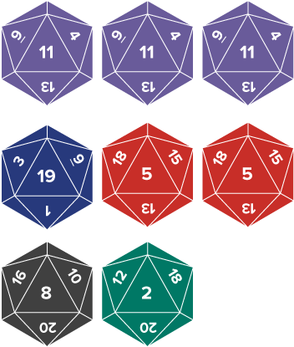
Be Curious
What do you notice?
What do you wonder?
Mindset
HOW DO YOU KNOW? · Ask your partner “How do you know?” Answer by pointing to your own work.
How helpful has it been for you to have a plan to solve a math or non-math problem?
47 / 48
Notes:
TEACH IN PRACTICE | Embedded facilitation | Lesson 6.5, slide 43 | CURIOUS
Focus on the existing task: Be Curious How helpful has it been for you to have a plan to solve a math or non-math problem?
LAUNCH (T2/3/5): Allow quiet observation first. Separate a notice from an inference, invite students’ own questions, and follow the existing launch before teaching a procedure.
LOOK FOR (T4): Where this task addresses it, students can define the variable. Ask which feature of their work supports the claim.
RESPOND: If this task shows the lesson misconception—reversing subtraction or omitting implied multiplication—label the quantity represented by each part of the original expression. Have the student revise and explain the change. Use this support only where the concept occurs in the current task; otherwise respond to the displayed question.
RECHECK: If a gap is shared, revisit the existing representation together. If it is limited, give targeted support while others compare valid methods on the same task. Check the revision before moving on.
PARTICIPATION (T5/6/7): Think time before volunteers; accept a written, drawn or rehearsed entry. Students ask for evidence respectfully. Recognize a specific contribution or revision and check that both partners participate.
Source: BCPS Updated Instructional Framework Rubric (June 2020), TEACH 1–7. Earlier notes and answer keys are retained below.
EARLIER NOTES / EXISTING ANSWER KEY
UIFR FULL | Lesson-specific facilitation
REFLECT & ADJUST 1-2 | After the lesson (UIFR PDF pp. 15-16).
Sort the existing work by demonstrated reasoning, partial understanding, and the specific misconception: reversing subtraction or omitting implied multiplication. Compare the initial response with the revision. Record which teaching move plausibly helped, which did not, and whose participation or access needs a different approach; do not record sensitive student details in this shared deck.
Plan the next lesson from that evidence: if the misconception persists, label the quantity represented by each part of the original expression using the current example before returning to the next grade-level task; if understanding is secure, use an existing extension or ask for a general explanation. Check the targeted idea again at the next warm-up.
Ask students what supported their thinking and what would help next time. Identify one change to try and one successful practice to retain. Seek colleague feedback on anonymized work when useful; these prompts support reflection and do not establish an evaluation rating. Source: Baltimore City Public Schools, Updated Instructional Framework Rubric, June 2020 (UIFR_Full.pdf).

Slide 48
LESSON 6.5 / REFLECT ON YOUR LEARNING
Show your progress
1 SHOW EVIDENCE
2 CHOOSE A NEXT STEP
Choose one response. Point to the part that shows your reasoning.
Name a change you made after feedback—or a question you still have.
“My work shows ___ because ___.”
“Next time, I will ___ to help me ___.”
Today’s focus: Define the variable.
CREDIT A CLASSMATE · Name one classmate whose idea helped you today, and say what they said.
Listen to understand. Ask for evidence. Make room for every voice.
Notes:
TEACH IN PRACTICE | Embedded facilitation | Lesson 6.5, slide 44 | PRIOR_INSERT
Focus on the existing task: LESSON 6.5 / REFLECT ON YOUR LEARNING Show your progress Listen to understand. Ask for evidence. Make room for every voice. 1 SHOW…
CONNECT (T1/4): Ask students to restate the displayed goal or key idea and connect it to earlier work. Relevant lesson evidence: define the variable; translate operations in order; substitute and evaluate accurately. Use only the criterion that matches the current session.
SHOW PROGRESS: Students point to their own existing work, explain what improved after feedback, and name a next step. Pair confidence ratings with actual evidence.
PARTICIPATION (T5/6/7): Think time before volunteers; accept a written, drawn or rehearsed entry. Students ask for evidence respectfully. Recognize a specific contribution or revision and check that both partners participate.
Source: BCPS Updated Instructional Framework Rubric (June 2020), TEACH 1–7.

