Slide 1
WARM-UP · THINK • TRY • CHECK
Turn and talk: compare strategies, then defend one.
Warm-Up
Lesson 6-6 · Identify Equivalent Algebraic Expressions | Warm-Up · about 4 minutes
Try each on your own. Mark an unsure answer; explain and revise when we check.
QUESTION 1
QUESTION 2
5x + 2x = ______
Evaluate 2x + 6 when x = 4. ______
QUESTION 3
QUESTION 4
3(4 + 5) = ______
Is 2(4 + 3) equal to 2 × 4 + 2 × 3? ______
TALK IT OVER: “I got ______ because ______.” • Compare with a partner before we check as a class.
1 / 43
Notes:
TEACH IN PRACTICE | Embedded facilitation | Lesson 6.6, slide 1 | WARMUP
Focus on the existing task: Warm-Up WARM-UP · THINK • TRY • CHECK Do these…
GATHER EVIDENCE (T4/6): Keep the original items. Students try independently, mark an uncertain item, and explain one method before checking. Use the existing key when present.
RESPOND: Distinguish a calculation slip from a reasoning gap. Give one next step on the same item; have students revise in a second color. Use the responses to choose flexible support for today’s lesson.
PARTICIPATION (T5/6/7): Think time before volunteers; accept a written, drawn or rehearsed entry. Students ask for evidence respectfully. Recognize a specific contribution or revision and check that both partners participate.
Source: BCPS Updated Instructional Framework Rubric (June 2020), TEACH 1–7. Earlier notes and answer keys are retained below.
EARLIER NOTES / EXISTING ANSWER KEY
Warm-Up answers (teacher only): 1) 7x 2) 14 3) 27 4) yes, both are 14
UIFR FULL | Lesson-specific facilitation
PREPARE 1-2 | Before teaching (UIFR PDF pp. 6-7).
Plan to gather evidence that students can use properties and like terms to justify equivalence; distinguish evidence from proof. Review recent work and today’s warm-up to choose flexible groups and access supports; do not infer needs from identity or perceived ability. Use the existing lesson tasks and stated standards.
Anticipate: claiming expressions are equivalent because one tested value matches. If observed, mark like terms and name the property used for each rewrite. Offer oral rehearsal, drawing, pointing, or home-language processing as needed; retain the original mathematical demand. Ask students which support helps and fade it as evidence improves.
TEACH 6-7 | Before the first transition, agree on materials, partner roles, and how to request help. Invite students to restate the routine. Normalize revising an idea, recognize a specific contribution, and check privately when frustration blocks participation. Source: UIFR PDF pp. 13-14.

Slide 2
Today’s Math Notes
Lesson 6-6 · Identify Equivalent Algebraic Expressions
Section 1: Math Words
Copy. Explain. Check.
SAY THE GOAL · Say today’s goal in your own words, then name one place this shows up outside math class.
Equivalent Expressions
1
Expressions
Equivalent
2
Expressions that always have the same value
Simplify
3
To rewrite an expression in a shorter form
eduwonderlab.com · Neft Teacher
2 / 43
Notes:
TEACH IN PRACTICE | Embedded facilitation | Lesson 6.6, slide 2 | NOTES
Focus on the existing task: Today’s Math Notes Section 1: Math Words Copy…
ROUTINE (T1/2/4): Read or copy the original notes, cover one line, and explain it using the displayed example. Reopen and correct. Copying alone is not evidence of understanding.
LOOK FOR: A link between a symbol, quantity or feature and the explanation. If missing, point back to that feature and have the student try again; fade the prompt once they can explain.
PARTICIPATION (T5/6/7): Think time before volunteers; accept a written, drawn or rehearsed entry. Students ask for evidence respectfully. Recognize a specific contribution or revision and check that both partners participate.
Source: BCPS Updated Instructional Framework Rubric (June 2020), TEACH 1–7. Earlier notes and answer keys are retained below.
EARLIER NOTES / EXISTING ANSWER KEY
Copy routine: read one line at a time; students copy, then explain that line to a partner.
Keep it brisk — the understanding work happens in the examples, not the copying.
UIFR: TEACH 1 · TEACH 6.

Slide 3
Today’s Math Notes
Lesson 6-6 · Identify Equivalent Algebraic Expressions
Section 2: Today’s Math
Copy. Explain. Check.
Equivalent Algebraic Expressions
Equivalent expressions produce the same value for any substitution of the variable
1
Simplify expressions using algebraic properties (Distributive, Commutative, Associative)
2
CONNECT IT · What earlier lesson does this build on? Tell a partner in one sentence.
Test equivalence by substituting two different test numbers
3
eduwonderlab.com · Neft Teacher
3 / 43
Notes:
TEACH IN PRACTICE | Embedded facilitation | Lesson 6.6, slide 3 | NOTES
Focus on the existing task: Today’s Math Notes Section 2: Today’s Math Copy…
ROUTINE (T1/2/4): Read or copy the original notes, cover one line, and explain it using the displayed example. Reopen and correct. Copying alone is not evidence of understanding.
LOOK FOR: A link between a symbol, quantity or feature and the explanation. If missing, point back to that feature and have the student try again; fade the prompt once they can explain.
PARTICIPATION (T5/6/7): Think time before volunteers; accept a written, drawn or rehearsed entry. Students ask for evidence respectfully. Recognize a specific contribution or revision and check that both partners participate.
Source: BCPS Updated Instructional Framework Rubric (June 2020), TEACH 1–7. Earlier notes and answer keys are retained below.
EARLIER NOTES / EXISTING ANSWER KEY
Copy routine: read one line at a time; students copy, then explain that line to a partner.
Keep it brisk — the understanding work happens in the examples, not the copying.
UIFR: TEACH 1 · TEACH 6.

Slide 4
Session 1
Identify Equivalent Algebraic Expressions
PICK YOUR STRATEGY · Choose your path — picture, table, number line, or equation — and be ready to say why you chose it.
4 / 43
Notes:
TEACH IN PRACTICE | Embedded facilitation | Lesson 6.6, slide 4 | DIVIDER
Focus on the existing task: Session 1 Identify Equivalent Algebraic Expressions
TRANSITION (T6/7): Students confirm materials, roles, how to request help, and the next response routine. Ask a student to restate it. Keep teacher-only slides hidden.
PARTICIPATION (T5/6/7): Think time before volunteers; accept a written, drawn or rehearsed entry. Students ask for evidence respectfully. Recognize a specific contribution or revision and check that both partners participate.
Source: BCPS Updated Instructional Framework Rubric (June 2020), TEACH 1–7. Earlier notes and answer keys are retained below.
EARLIER NOTES / EXISTING ANSWER KEY
Transition cue: state what materials are out and what success looks like this session.
Keep the changeover under a minute.
UIFR: TEACH 6.

Slide 5
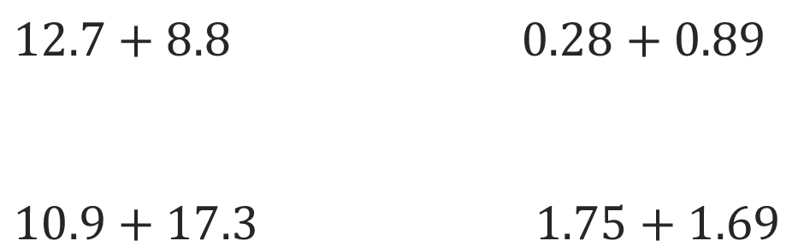
On You Could
Explain how the information shown supports your reasoning.
5 / 43
Notes:
TEACH IN PRACTICE | Embedded facilitation | Lesson 6.6, slide 5 | WORKED
Focus on the existing task: On You Could
LAUNCH (T2/3/5): Ask students to explain the displayed idea or example and point to evidence. When a calculation step is shown, ask why it is valid. Have a partner restate the explanation; copying is not the check.
LOOK FOR (T4): Where this task addresses it, students can use properties and like terms to justify equivalence. Ask which feature of their work supports the claim.
RESPOND: If this task shows the lesson misconception—claiming expressions are equivalent because one tested value matches—mark like terms and name the property used for each rewrite. Have the student revise and explain the change. Use this support only where the concept occurs in the current task; otherwise respond to the displayed question.
RECHECK: If a gap is shared, revisit the existing representation together. If it is limited, give targeted support while others compare valid methods on the same task. Check the revision before moving on.
PARTICIPATION (T5/6/7): Think time before volunteers; accept a written, drawn or rehearsed entry. Students ask for evidence respectfully. Recognize a specific contribution or revision and check that both partners participate.
Source: BCPS Updated Instructional Framework Rubric (June 2020), TEACH 1–7. Earlier notes and answer keys are retained below.
EARLIER NOTES / EXISTING ANSWER KEY
Model briefly, then hand the thinking back: ask “Why does this step work?” before showing the next one.
Quick check before moving on — thumbs or whiteboards from everyone, not volunteers.
UIFR: TEACH 2 · TEACH 3 · TEACH 4.

Slide 6
Today’s Objectives
Lesson 6-6 · Identify Equivalent Algebraic Expressions
Identify Equivalent Algebraic Expressions
Maryland Standard 6.AT.7
SHOW YOUR THINKING · Show what you know — write it, draw it, or build it. A picture counts as an explanation.
CONTENT OBJECTIVE
LANGUAGE OBJECTIVE
Restate the goal in your words
Use these words to explain why
I can show that two expressions are equivalent by simplifying and combining like terms.
I can explain my work using the words equivalent, simplify, like terms, and combine.
eduwonderlab.com · Neft Teacher
6 / 43
Notes:
TEACH IN PRACTICE | Embedded facilitation | Lesson 6.6, slide 6 | GOAL
Focus on the existing task: Today’s Objectives Identify Equivalent Algebraic…
CONNECT (T1/4): Ask students to restate the displayed goal or key idea and connect it to earlier work. Relevant lesson evidence: use properties and like terms to justify equivalence; distinguish evidence from proof. Use only the criterion that matches the current session.
SHOW PROGRESS: Students point to their own existing work, explain what improved after feedback, and name a next step. Pair confidence ratings with actual evidence.
PARTICIPATION (T5/6/7): Think time before volunteers; accept a written, drawn or rehearsed entry. Students ask for evidence respectfully. Recognize a specific contribution or revision and check that both partners participate.
Source: BCPS Updated Instructional Framework Rubric (June 2020), TEACH 1–7. Earlier notes and answer keys are retained below.
EARLIER NOTES / EXISTING ANSWER KEY
Read the objective together, then have one or two students restate today’s goal in their own words.
Connect it to what the class learned last lesson.
Return to this goal at the end of class to check it was met.
UIFR: TEACH 1.
UIFR FULL | Lesson-specific facilitation
TEACH 1 | Session 1 purpose and evidence (UIFR PDF p. 8).
Have students restate the displayed session goal in their own words and connect it to the existing context or a familiar experience they choose to share. Use the current session goal to select from these lesson-wide evidence criteria; do not frontload a later-session procedure.
Look for: use properties and like terms to justify equivalence; distinguish evidence from proof. Ask: “Which part of your work would show this?” Revisit that evidence after the task; a confidence rating alone is not evidence of understanding.

Slide 7
LESSON 6.6 / OUR LEARNING
What will show your learning?
1
Use properties and like terms to justify equivalence.
2
Distinguish evidence from proof.
Tell a partner: Which skill connects to something you already know?
WHY IT MATTERS · Finish this: “This is worth knowing because ______.”
Listen to understand. Ask for evidence. Make room for every voice.
Notes:
TEACH IN PRACTICE | Embedded facilitation | Lesson 6.6, slide 7 | PRIOR_INSERT
Focus on the existing task: LESSON 6.6 / OUR LEARNING What will show your learning?
CONNECT (T1/4): Ask students to restate the displayed goal or key idea and connect it to earlier work. Relevant lesson evidence: use properties and like terms to justify equivalence; distinguish evidence from proof. Use only the criterion that matches the current session.
SHOW PROGRESS: Students point to their own existing work, explain what improved after feedback, and name a next step. Pair confidence ratings with actual evidence.
PARTICIPATION (T5/6/7): Think time before volunteers; accept a written, drawn or rehearsed entry. Students ask for evidence respectfully. Recognize a specific contribution or revision and check that both partners participate.
Source: BCPS Updated Instructional Framework Rubric (June 2020), TEACH 1–7.

Slide 8
Vocabulary 1 of 6
Lesson 6-6 · Identify Equivalent Algebraic Expressions
Equivalent Expressions
Expressions that look different but have the same value for every allowed variable value.
EXAMPLE · EXPLAIN WHY IT FITS
2(x + 3) and 2x + 6 are equivalent.
USE THE MATH WORDS · Use today’s math words in your explanation — not “it” and “that thing.”
eduwonderlab.com · Neft Teacher
8 / 43
Notes:
TEACH IN PRACTICE | Embedded facilitation | Lesson 6.6, slide 8 | VOCAB
Focus on the existing task: Vocabulary 1 of 6 Equivalent Expressions…
ASK (T1/3/5): Where does “Equivalent Expressions” appear in the example? Explain the meaning without reading the definition. Partner: restate the idea and ask a clarifying question.
LOOK FOR: A correct connection between the word and a feature of the example. If the student only repeats the definition, invite pointing, sketching or oral rehearsal, then ask for another explanation of this same example.
PARTICIPATION (T5/6/7): Think time before volunteers; accept a written, drawn or rehearsed entry. Students ask for evidence respectfully. Recognize a specific contribution or revision and check that both partners participate.
Source: BCPS Updated Instructional Framework Rubric (June 2020), TEACH 1–7.

Slide 9
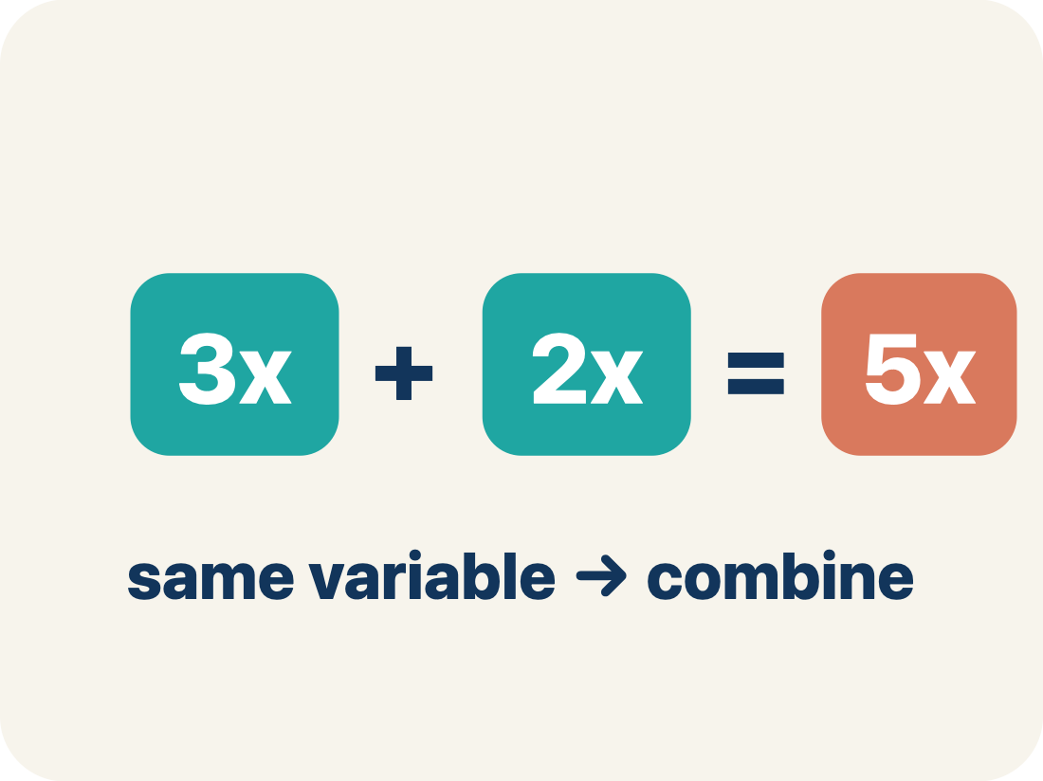
Vocabulary 2 of 6
Lesson 6-6 · Identify Equivalent Algebraic Expressions
Equivalent
Expressions that always have the same value.
EXAMPLE · EXPLAIN WHY IT FITS
2x + 4 and 2(x + 2): when x = 3, both = 10; when x = 7, both = 18 — always the same
Use “Equivalent” to explain the example. Point to evidence.
eduwonderlab.com · Neft Teacher
9 / 43
Notes:
TEACH IN PRACTICE | Embedded facilitation | Lesson 6.6, slide 9 | VOCAB
Focus on the existing task: Vocabulary 2 of 6 Equivalent Expressions that…
ASK (T1/3/5): Where does “Equivalent” appear in the example? Explain the meaning without reading the definition. Partner: restate the idea and ask a clarifying question.
LOOK FOR: A correct connection between the word and a feature of the example. If the student only repeats the definition, invite pointing, sketching or oral rehearsal, then ask for another explanation of this same example.
PARTICIPATION (T5/6/7): Think time before volunteers; accept a written, drawn or rehearsed entry. Students ask for evidence respectfully. Recognize a specific contribution or revision and check that both partners participate.
Source: BCPS Updated Instructional Framework Rubric (June 2020), TEACH 1–7.

Slide 10
Vocabulary 3 of 6
Lesson 6-6 · Identify Equivalent Algebraic Expressions
Simplify
To rewrite an expression in a shorter form that is still equal to the original.
EXAMPLE · EXPLAIN WHY IT FITS
3x + 2x + 5 simplifies to 5x + 5 — fewer terms, same value
Use “Simplify” to explain the example. Point to evidence.
eduwonderlab.com · Neft Teacher
10 / 43
Notes:
TEACH IN PRACTICE | Embedded facilitation | Lesson 6.6, slide 10 | VOCAB
Focus on the existing task: Vocabulary 3 of 6 Simplify To rewrite an…
ASK (T1/3/5): Where does “Simplify” appear in the example? Explain the meaning without reading the definition. Partner: restate the idea and ask a clarifying question.
LOOK FOR: A correct connection between the word and a feature of the example. If the student only repeats the definition, invite pointing, sketching or oral rehearsal, then ask for another explanation of this same example.
PARTICIPATION (T5/6/7): Think time before volunteers; accept a written, drawn or rehearsed entry. Students ask for evidence respectfully. Recognize a specific contribution or revision and check that both partners participate.
Source: BCPS Updated Instructional Framework Rubric (June 2020), TEACH 1–7.

Slide 11
Vocabulary 4 of 6
Lesson 6-6 · Identify Equivalent Algebraic Expressions
Like Terms
Terms with the same letter raised to the same power, like 2x and 5x.
EXAMPLE · EXPLAIN WHY IT FITS
3x and 7x are like terms (both x); 3x and 3y are NOT (x vs y); 3x and 3x² are NOT (x vs x²)
Use “Like Terms” to explain the example. Point to evidence.
eduwonderlab.com · Neft Teacher
11 / 43
Notes:
TEACH IN PRACTICE | Embedded facilitation | Lesson 6.6, slide 11 | VOCAB
Focus on the existing task: Vocabulary 4 of 6 Like Terms Terms with the same…
ASK (T1/3/5): Where does “Like Terms” appear in the example? Explain the meaning without reading the definition. Partner: restate the idea and ask a clarifying question.
LOOK FOR: A correct connection between the word and a feature of the example. If the student only repeats the definition, invite pointing, sketching or oral rehearsal, then ask for another explanation of this same example.
PARTICIPATION (T5/6/7): Think time before volunteers; accept a written, drawn or rehearsed entry. Students ask for evidence respectfully. Recognize a specific contribution or revision and check that both partners participate.
Source: BCPS Updated Instructional Framework Rubric (June 2020), TEACH 1–7.

Slide 12
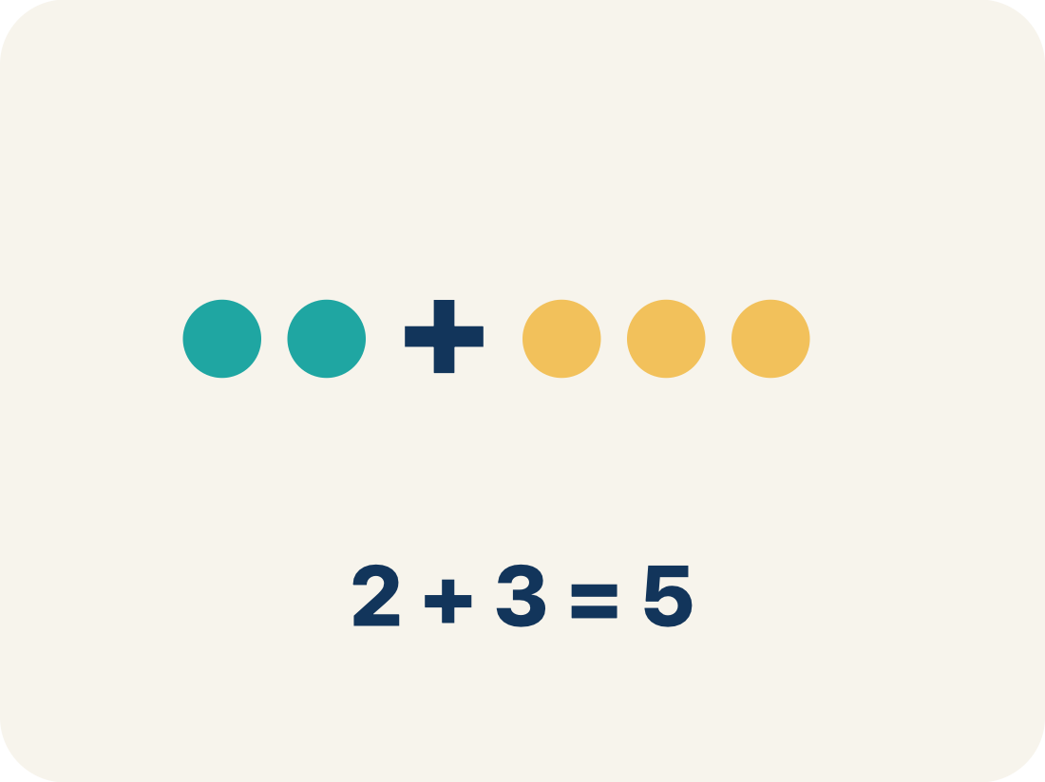
Vocabulary 5 of 6
Lesson 6-6 · Identify Equivalent Algebraic Expressions
Combine
To add or subtract terms with the same letter into one.
EXAMPLE · EXPLAIN WHY IT FITS
4n + 3n = 7n — add the coefficients (4 + 3 = 7) and keep the variable (n)
Use “Combine” to explain the example. Point to evidence.
eduwonderlab.com · Neft Teacher
12 / 43
Notes:
TEACH IN PRACTICE | Embedded facilitation | Lesson 6.6, slide 12 | VOCAB
Focus on the existing task: Vocabulary 5 of 6 Combine To add or subtract…
ASK (T1/3/5): Where does “Combine” appear in the example? Explain the meaning without reading the definition. Partner: restate the idea and ask a clarifying question.
LOOK FOR: A correct connection between the word and a feature of the example. If the student only repeats the definition, invite pointing, sketching or oral rehearsal, then ask for another explanation of this same example.
PARTICIPATION (T5/6/7): Think time before volunteers; accept a written, drawn or rehearsed entry. Students ask for evidence respectfully. Recognize a specific contribution or revision and check that both partners participate.
Source: BCPS Updated Instructional Framework Rubric (June 2020), TEACH 1–7.

Slide 13
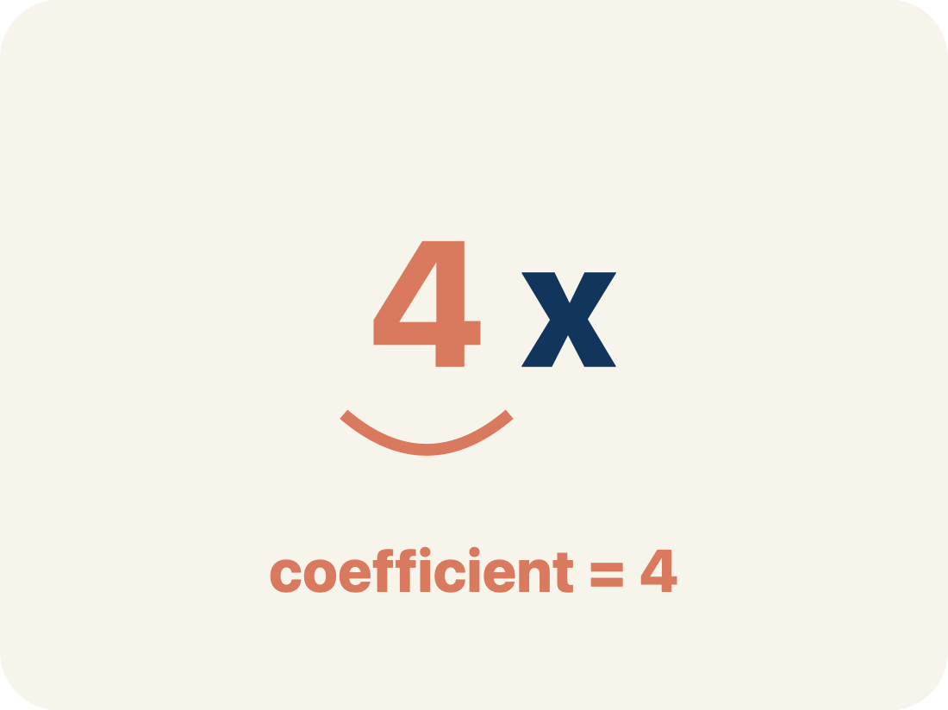
Vocabulary 6 of 6
Lesson 6-6 · Identify Equivalent Algebraic Expressions
Coefficient
The number in front of a letter, like the 3 in 3x.
EXAMPLE · EXPLAIN WHY IT FITS
In 5x + 3, the coefficient of x is 5 — when x = 2, the 5x part equals 10
Use “Coefficient” to explain the example. Point to evidence.
eduwonderlab.com · Neft Teacher
13 / 43
Notes:
TEACH IN PRACTICE | Embedded facilitation | Lesson 6.6, slide 13 | VOCAB
Focus on the existing task: Vocabulary 6 of 6 Coefficient The number in…
ASK (T1/3/5): Where does “Coefficient” appear in the example? Explain the meaning without reading the definition. Partner: restate the idea and ask a clarifying question.
LOOK FOR: A correct connection between the word and a feature of the example. If the student only repeats the definition, invite pointing, sketching or oral rehearsal, then ask for another explanation of this same example.
PARTICIPATION (T5/6/7): Think time before volunteers; accept a written, drawn or rehearsed entry. Students ask for evidence respectfully. Recognize a specific contribution or revision and check that both partners participate.
Source: BCPS Updated Instructional Framework Rubric (June 2020), TEACH 1–7.

Slide 14
Vocabulary
Lesson 6-6 · Identify Equivalent Algebraic Expressions
Today’s Math Words
We learn every word — what it means and what it looks like — before we use it.
Equivalent Expressions
Equivalent
Expressions that look different but have the same value for every allowed variable value
Expressions that always have the same value
Simplify
Like Terms
To rewrite an expression in a shorter form that is still equal to the original
Terms with the same letter raised to the same power, like 2x and 5x
Combine
Coefficient
To add or subtract terms with the same letter into one
The number in front of a letter, like the 3 in 3x
ADD ON · Add on: “I agree because ______.” or “I see it differently because ______.”
eduwonderlab.com · Neft Teacher
14 / 43
Notes:
TEACH IN PRACTICE | Embedded facilitation | Lesson 6.6, slide 14 | VOCAB
Focus on the existing task: Vocabulary Today’s Math Words We learn every word…
ASK (T1/3/5): Where does “the displayed term” appear in the example? Explain the meaning without reading the definition. Partner: restate the idea and ask a clarifying question.
LOOK FOR: A correct connection between the word and a feature of the example. If the student only repeats the definition, invite pointing, sketching or oral rehearsal, then ask for another explanation of this same example.
PARTICIPATION (T5/6/7): Think time before volunteers; accept a written, drawn or rehearsed entry. Students ask for evidence respectfully. Recognize a specific contribution or revision and check that both partners participate.
Source: BCPS Updated Instructional Framework Rubric (June 2020), TEACH 1–7. Earlier notes and answer keys are retained below.
EARLIER NOTES / EXISTING ANSWER KEY
Choral-read each word, its meaning, and what it looks like.
Students should use these words out loud today — listen for them in partner talk and revoice student ideas with the academic term.
UIFR: TEACH 1 · TEACH 5.

Slide 15


Be Curious
How are they the same?
How are they different?
Think first. Share a notice and a
question; build on a classmate’s
idea.
Mindset
How do you know when you are frustrated in math class?
15 / 43
Notes:
TEACH IN PRACTICE | Embedded facilitation | Lesson 6.6, slide 15 | CURIOUS
Focus on the existing task: How are they the same?
LAUNCH (T2/3/5): Allow quiet observation first. Separate a notice from an inference, invite students’ own questions, and follow the existing launch before teaching a procedure.
LOOK FOR (T4): Where this task addresses it, students can use properties and like terms to justify equivalence. Ask which feature of their work supports the claim.
RESPOND: If this task shows the lesson misconception—claiming expressions are equivalent because one tested value matches—mark like terms and name the property used for each rewrite. Have the student revise and explain the change. Use this support only where the concept occurs in the current task; otherwise respond to the displayed question.
RECHECK: If a gap is shared, revisit the existing representation together. If it is limited, give targeted support while others compare valid methods on the same task. Check the revision before moving on.
PARTICIPATION (T5/6/7): Think time before volunteers; accept a written, drawn or rehearsed entry. Students ask for evidence respectfully. Recognize a specific contribution or revision and check that both partners participate.
Source: BCPS Updated Instructional Framework Rubric (June 2020), TEACH 1–7. Earlier notes and answer keys are retained below.
EARLIER NOTES / EXISTING ANSWER KEY
Accept all noticings and wonderings — there are no wrong answers here.
Give 20–30 seconds of quiet think time before taking responses; mix cold and warm calls so it is not always the same voices.
Read the mindset question aloud and let two students respond.
UIFR: TEACH 3 · TEACH 7.

Slide 16
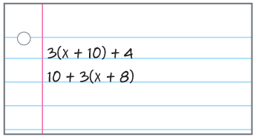
Are They the Same?
We can generate equivalent expressions by simplifying. If the two expressions are equal once they are simplified, then they are equivalent expressions.
What tools or strategies have you used to rewrite or simplify expressions in the past?
Reveal:
TRY IT BEFORE YOU’RE SURE · Start even if you are not sure. A revised answer counts as much as a first-try answer.
16 / 43
Notes:
TEACH IN PRACTICE | Embedded facilitation | Lesson 6.6, slide 16 | REVEAL
Focus on the existing task: Reveal: Are They the Same?
LAUNCH (T2/3/5): If an existing answer cover is present, gather an attempt before revealing. If the explanation is already visible, ask students to reconstruct and justify it. Compare reasoning and explain a revision; preserve the reveal sequence.
LOOK FOR (T4): Where this task addresses it, students can use properties and like terms to justify equivalence. Ask which feature of their work supports the claim.
RESPOND: If this task shows the lesson misconception—claiming expressions are equivalent because one tested value matches—mark like terms and name the property used for each rewrite. Have the student revise and explain the change. Use this support only where the concept occurs in the current task; otherwise respond to the displayed question.
RECHECK: If a gap is shared, revisit the existing representation together. If it is limited, give targeted support while others compare valid methods on the same task. Check the revision before moving on.
PARTICIPATION (T5/6/7): Think time before volunteers; accept a written, drawn or rehearsed entry. Students ask for evidence respectfully. Recognize a specific contribution or revision and check that both partners participate.
Source: BCPS Updated Instructional Framework Rubric (June 2020), TEACH 1–7. Earlier notes and answer keys are retained below.
EARLIER NOTES / EXISTING ANSWER KEY
Students should have shared predictions before this reveal.
Have them compare their thinking to what is shown: “Is this the same as what we said? Where is it different?”
Press one student to explain the reveal in their own words.
UIFR: TEACH 3 · TEACH 4.
UIFR FULL | Lesson-specific facilitation
TEACH 2-3 | Session 1 task launch (UIFR PDF pp. 9-10).
Use the problem exactly as displayed. Give individual thinking time before discussion or advancing to the explanation. If the answer is already visible, ask students to reconstruct and justify it. Invite a choice of suitable representations and have students explain why their choice helps.
At the point where this concept appears, ask: “Why should these expressions agree for every allowed value, rather than only the value you tried?” Wait for evidence, invite another pathway, and have a student ask a follow-up question. Do not replace students’ reasoning with a sequence of leading steps.

Slide 17
Are They the Same?
To determine if these expressions are equivalent, we can simplify the expressions using properties of operations and draw a conclusion.
Let’s look at the first expression.
What do you notice about the operations in the expression?
Reveal:
HOW DO YOU KNOW? · Ask your partner “How do you know?” Answer by pointing to your own work.
17 / 43
Notes:
TEACH IN PRACTICE | Embedded facilitation | Lesson 6.6, slide 17 | REVEAL
Focus on the existing task: Reveal: Are They the Same?
LAUNCH (T2/3/5): If an existing answer cover is present, gather an attempt before revealing. If the explanation is already visible, ask students to reconstruct and justify it. Compare reasoning and explain a revision; preserve the reveal sequence.
LOOK FOR (T4): Where this task addresses it, students can use properties and like terms to justify equivalence. Ask which feature of their work supports the claim.
RESPOND: If this task shows the lesson misconception—claiming expressions are equivalent because one tested value matches—mark like terms and name the property used for each rewrite. Have the student revise and explain the change. Use this support only where the concept occurs in the current task; otherwise respond to the displayed question.
RECHECK: If a gap is shared, revisit the existing representation together. If it is limited, give targeted support while others compare valid methods on the same task. Check the revision before moving on.
PARTICIPATION (T5/6/7): Think time before volunteers; accept a written, drawn or rehearsed entry. Students ask for evidence respectfully. Recognize a specific contribution or revision and check that both partners participate.
Source: BCPS Updated Instructional Framework Rubric (June 2020), TEACH 1–7. Earlier notes and answer keys are retained below.
EARLIER NOTES / EXISTING ANSWER KEY
Students should have shared predictions before this reveal.
Have them compare their thinking to what is shown: “Is this the same as what we said? Where is it different?”
Press one student to explain the reveal in their own words.
UIFR: TEACH 3 · TEACH 4.

Slide 18
Are They the Same?
To determine if these expressions are equivalent, we can simplify the expressions using properties of operations and draw a conclusion.
Let’s look at the first expression.
What do you notice about the operations in the expression?
Reveal:
There is multiplication and addition.
18 / 43
Notes:
TEACH IN PRACTICE | Embedded facilitation | Lesson 6.6, slide 18 | REVEAL
Focus on the existing task: Are They the Same?
LAUNCH (T2/3/5): If an existing answer cover is present, gather an attempt before revealing. If the explanation is already visible, ask students to reconstruct and justify it. Compare reasoning and explain a revision; preserve the reveal sequence.
LOOK FOR (T4): Where this task addresses it, students can use properties and like terms to justify equivalence. Ask which feature of their work supports the claim.
RESPOND: If this task shows the lesson misconception—claiming expressions are equivalent because one tested value matches—mark like terms and name the property used for each rewrite. Have the student revise and explain the change. Use this support only where the concept occurs in the current task; otherwise respond to the displayed question.
RECHECK: If a gap is shared, revisit the existing representation together. If it is limited, give targeted support while others compare valid methods on the same task. Check the revision before moving on.
PARTICIPATION (T5/6/7): Think time before volunteers; accept a written, drawn or rehearsed entry. Students ask for evidence respectfully. Recognize a specific contribution or revision and check that both partners participate.
Source: BCPS Updated Instructional Framework Rubric (June 2020), TEACH 1–7. Earlier notes and answer keys are retained below.
EARLIER NOTES / EXISTING ANSWER KEY
Do not click yet: collect 2–3 student answers with reasons first.
Then click to remove the cover and have students compare their thinking to the reveal — “Is this what we said? Where is it different?”
Behind the cover: There is multiplication and addition.
UIFR: TEACH 3 · TEACH 4.

Slide 19
STUDENT MOVES
Lesson 6-6
Your move
ASK THE CLASS · Write one question about this that you could ask the class.
19 / 43

Slide 20
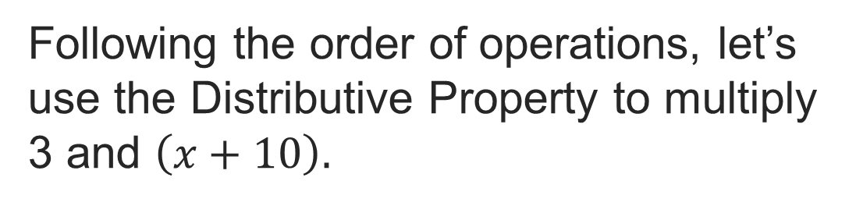

Are They the Same?
Record your reasoning before the reveal.
Compare, then explain any revision.
Are there any like terms in the expression? If so, how can you combine them?
Reveal:
We can add 30 and 4 together because they are both constants.
20 / 43
Notes:
TEACH IN PRACTICE | Embedded facilitation | Lesson 6.6, slide 19 | REVEAL
Focus on the existing task: Reveal: We can add 30 and 4 together because they are both constants. Are there any like terms in the expression?
LAUNCH (T2/3/5): If an existing answer cover is present, gather an attempt before revealing. If the explanation is already visible, ask students to reconstruct and justify it. Compare reasoning and explain a revision; preserve the reveal sequence.
LOOK FOR (T4): Where this task addresses it, students can use properties and like terms to justify equivalence. Ask which feature of their work supports the claim.
RESPOND: If this task shows the lesson misconception—claiming expressions are equivalent because one tested value matches—mark like terms and name the property used for each rewrite. Have the student revise and explain the change. Use this support only where the concept occurs in the current task; otherwise respond to the displayed question.
RECHECK: If a gap is shared, revisit the existing representation together. If it is limited, give targeted support while others compare valid methods on the same task. Check the revision before moving on.
PARTICIPATION (T5/6/7): Think time before volunteers; accept a written, drawn or rehearsed entry. Students ask for evidence respectfully. Recognize a specific contribution or revision and check that both partners participate.
Source: BCPS Updated Instructional Framework Rubric (June 2020), TEACH 1–7. Earlier notes and answer keys are retained below.
EARLIER NOTES / EXISTING ANSWER KEY
Do not click yet: collect 2–3 student answers with reasons first.
Then click to remove the cover and have students compare their thinking to the reveal — “Is this what we said? Where is it different?”
Behind the cover: We can add 30 and 4 together because they are both constants.
UIFR: TEACH 3 · TEACH 4.

Slide 21
Are They the Same?
Let’s compare the simplified expressions.
Record your reasoning before the reveal. Compare, then
explain any revision.
Are the original expressions equivalent? Explain how you know.
Reveal:
Yes, when the expressions are simplified, they are the same expression.
21 / 43
Notes:
TEACH IN PRACTICE | Embedded facilitation | Lesson 6.6, slide 20 | REVEAL
Focus on the existing task: Let’s compare the simplified expressions. Are the original expressions equivalent?
LAUNCH (T2/3/5): If an existing answer cover is present, gather an attempt before revealing. If the explanation is already visible, ask students to reconstruct and justify it. Compare reasoning and explain a revision; preserve the reveal sequence.
LOOK FOR (T4): Where this task addresses it, students can use properties and like terms to justify equivalence. Ask which feature of their work supports the claim.
RESPOND: If this task shows the lesson misconception—claiming expressions are equivalent because one tested value matches—mark like terms and name the property used for each rewrite. Have the student revise and explain the change. Use this support only where the concept occurs in the current task; otherwise respond to the displayed question.
RECHECK: If a gap is shared, revisit the existing representation together. If it is limited, give targeted support while others compare valid methods on the same task. Check the revision before moving on.
PARTICIPATION (T5/6/7): Think time before volunteers; accept a written, drawn or rehearsed entry. Students ask for evidence respectfully. Recognize a specific contribution or revision and check that both partners participate.
Source: BCPS Updated Instructional Framework Rubric (June 2020), TEACH 1–7. Earlier notes and answer keys are retained below.
EARLIER NOTES / EXISTING ANSWER KEY
Do not click yet: collect 2–3 student answers with reasons first.
Then click to remove the cover and have students compare their thinking to the reveal — “Is this what we said? Where is it different?”
Behind the cover: Yes, when the expressions are simplified, they are the same expression.
UIFR: TEACH 3 · TEACH 4.

Slide 22
Are They the Same?
Are the expressions shown equivalent?
When simplified, the two expressions are equivalent.
Think and record first. Which part of your work supports your answer?
Persevering
How could you check your answer?
22 / 43
Notes:
TEACH IN PRACTICE | Embedded facilitation | Lesson 6.6, slide 21 | TASK
Focus on the existing task: Persevering How could you check your answer?
LAUNCH (T2/3/5): Use the displayed question. Give private thinking time; then A explains while B asks for evidence. Switch roles. Each student records their own reasoning.
LOOK FOR (T4): Where this task addresses it, students can use properties and like terms to justify equivalence. Ask which feature of their work supports the claim.
RESPOND: If this task shows the lesson misconception—claiming expressions are equivalent because one tested value matches—mark like terms and name the property used for each rewrite. Have the student revise and explain the change. Use this support only where the concept occurs in the current task; otherwise respond to the displayed question.
RECHECK: If a gap is shared, revisit the existing representation together. If it is limited, give targeted support while others compare valid methods on the same task. Check the revision before moving on.
PARTICIPATION (T5/6/7): Think time before volunteers; accept a written, drawn or rehearsed entry. Students ask for evidence respectfully. Recognize a specific contribution or revision and check that both partners participate.
Source: BCPS Updated Instructional Framework Rubric (June 2020), TEACH 1–7. Earlier notes and answer keys are retained below.
EARLIER NOTES / EXISTING ANSWER KEY
Model briefly, then hand the thinking back: ask “Why does this step work?” before showing the next one.
Quick check before moving on — thumbs or whiteboards from everyone, not volunteers.
UIFR: TEACH 2 · TEACH 3 · TEACH 4.

Slide 23
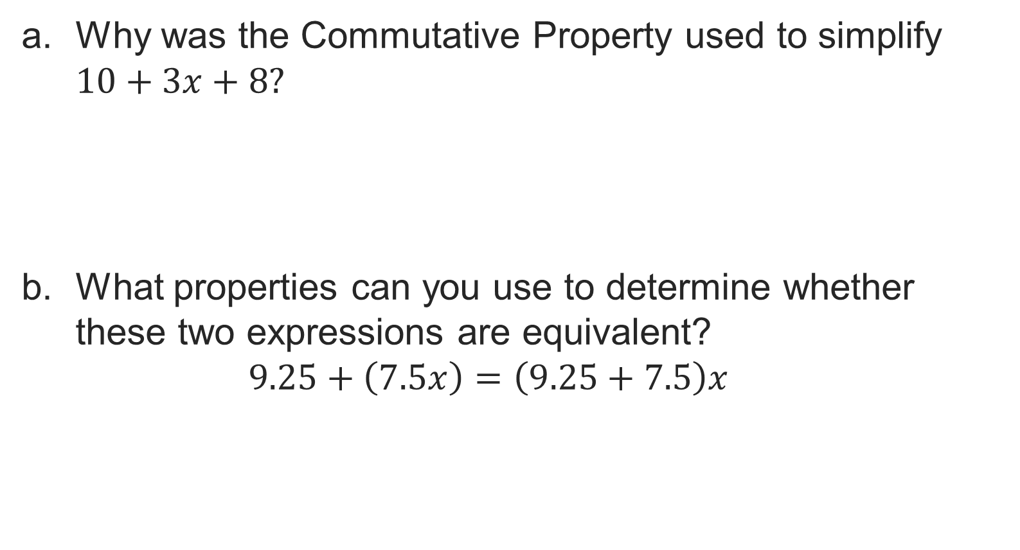
Let’s Explore More
STRUGGLE FIRST · Work on your own first. Stuck is allowed — try a second strategy before you ask.
23 / 43
Notes:
TEACH IN PRACTICE | Embedded facilitation | Lesson 6.6, slide 22 | PRACTICE
Focus on the existing task: Let’s Explore More
LAUNCH (T2/3/5): Use the displayed question. Give private thinking time; then A explains while B asks for evidence. Switch roles. Each student records their own reasoning.
LOOK FOR (T4): Where this task addresses it, students can use properties and like terms to justify equivalence. Ask which feature of their work supports the claim.
RESPOND: If this task shows the lesson misconception—claiming expressions are equivalent because one tested value matches—mark like terms and name the property used for each rewrite. Have the student revise and explain the change. Use this support only where the concept occurs in the current task; otherwise respond to the displayed question.
RECHECK: If a gap is shared, revisit the existing representation together. If it is limited, give targeted support while others compare valid methods on the same task. Check the revision before moving on.
PARTICIPATION (T5/6/7): Think time before volunteers; accept a written, drawn or rehearsed entry. Students ask for evidence respectfully. Recognize a specific contribution or revision and check that both partners participate.
Source: BCPS Updated Instructional Framework Rubric (June 2020), TEACH 1–7. Earlier notes and answer keys are retained below.
EARLIER NOTES / EXISTING ANSWER KEY
Extension for partners or table groups — students choose their approach and use the workspace to show thinking.
Push with “Convince me,” and have two groups with different approaches share.
This is where students stretch past the worked example.
UIFR: TEACH 2 · TEACH 5.
UIFR FULL | Lesson-specific facilitation
TEACH 4-5 | Session 1 discussion and checkpoint (UIFR PDF pp. 11-12).
Collect a brief response from every student to the existing prompt before hearing volunteers. Partners take turns explaining and asking for evidence: “I understand ___; what supports ___?” Offer rehearsal or an annotated model for students who need language support. Each student records their own reasoning.
Look specifically for: claiming expressions are equivalent because one tested value matches. If it appears, mark like terms and name the property used for each rewrite; then ask the student to revise the same response and explain the change. If evidence is secure, have students compare a second valid pathway or state why their approach works. Choose the next step from the responses, not a preset pace.

Slide 24
LESSON 6.6 / DISCUSS THE TASK
Explain and compare
Use the task you just explored.
TAKE TURNS
Why should these expressions agree for every allowed value, rather than only the value you tried?
Explain
“I know this because…”
Ask
“Where does your work show that?”
Point to evidence in your work.
Then compare your approach with a partner’s.
JUSTIFY IT · Say it like this: “I know ______ because ______.”
Listen to understand. Ask for evidence. Make room for every voice.
Notes:
TEACH IN PRACTICE | Embedded facilitation | Lesson 6.6, slide 23 | PRIOR_INSERT
Focus on the existing task: Point to evidence in your work. Then compare your approach with a partner’s. TAKE TURNS Explain “I know this because…” Ask “Where does your work show that?
CONNECT (T1/4): Ask students to restate the displayed goal or key idea and connect it to earlier work. Relevant lesson evidence: use properties and like terms to justify equivalence; distinguish evidence from proof. Use only the criterion that matches the current session.
SHOW PROGRESS: Students point to their own existing work, explain what improved after feedback, and name a next step. Pair confidence ratings with actual evidence.
PARTICIPATION (T5/6/7): Think time before volunteers; accept a written, drawn or rehearsed entry. Students ask for evidence respectfully. Recognize a specific contribution or revision and check that both partners participate.
Source: BCPS Updated Instructional Framework Rubric (June 2020), TEACH 1–7.

Slide 25
Are They the Same?
Are the expressions shown equivalent?
What do you notice about the expressions?
Compare your reasoning with the explanation. Explain any revision you make.
Reveal:
They are both are algebraic expressions. The expressions contain some common numbers, operations, and variables, but are grouped or ordered differently.
25 / 43
Notes:
TEACH IN PRACTICE | Embedded facilitation | Lesson 6.6, slide 24 | REVEAL
Focus on the existing task: Reveal: They are both are algebraic expressions. The expressions contain some common numbers, operations, and variables, but are grouped or ordered differently. Are the expressions shown equivalent?
LAUNCH (T2/3/5): If an existing answer cover is present, gather an attempt before revealing. If the explanation is already visible, ask students to reconstruct and justify it. Compare reasoning and explain a revision; preserve the reveal sequence.
LOOK FOR (T4): Where this task addresses it, students can use properties and like terms to justify equivalence. Ask which feature of their work supports the claim.
RESPOND: If this task shows the lesson misconception—claiming expressions are equivalent because one tested value matches—mark like terms and name the property used for each rewrite. Have the student revise and explain the change. Use this support only where the concept occurs in the current task; otherwise respond to the displayed question.
RECHECK: If a gap is shared, revisit the existing representation together. If it is limited, give targeted support while others compare valid methods on the same task. Check the revision before moving on.
PARTICIPATION (T5/6/7): Think time before volunteers; accept a written, drawn or rehearsed entry. Students ask for evidence respectfully. Recognize a specific contribution or revision and check that both partners participate.
Source: BCPS Updated Instructional Framework Rubric (June 2020), TEACH 1–7.

Slide 26
Are They the Same?
Let’s compare the simplified expressions.
TAKE TURNS · One explains, one asks a question. Then switch, so both of you talk.
Are the original expressions equivalent? Explain how you know.
Reveal:
Yes, when the expressions are simplified, they are the same expression.
26 / 43
Notes:
TEACH IN PRACTICE | Embedded facilitation | Lesson 6.6, slide 25 | REVEAL
Focus on the existing task: Let’s compare the simplified expressions. Are the original expressions equivalent?
LAUNCH (T2/3/5): If an existing answer cover is present, gather an attempt before revealing. If the explanation is already visible, ask students to reconstruct and justify it. Compare reasoning and explain a revision; preserve the reveal sequence.
LOOK FOR (T4): Where this task addresses it, students can use properties and like terms to justify equivalence. Ask which feature of their work supports the claim.
RESPOND: If this task shows the lesson misconception—claiming expressions are equivalent because one tested value matches—mark like terms and name the property used for each rewrite. Have the student revise and explain the change. Use this support only where the concept occurs in the current task; otherwise respond to the displayed question.
RECHECK: If a gap is shared, revisit the existing representation together. If it is limited, give targeted support while others compare valid methods on the same task. Check the revision before moving on.
PARTICIPATION (T5/6/7): Think time before volunteers; accept a written, drawn or rehearsed entry. Students ask for evidence respectfully. Recognize a specific contribution or revision and check that both partners participate.
Source: BCPS Updated Instructional Framework Rubric (June 2020), TEACH 1–7.

Slide 27
Warm-Up
Lesson 6-6 · Identify Equivalent Algebraic Expressions
Session 2 Warm-Up
Try alone. Explain one. Then revise.
1
Expressions that have the same value for any variable input are:
2
Which expression is equivalent to x + x + x?
A
Opposites
A
x³
B
Equivalent expressions
B
3x
C
Inequalities
C
x + 3
D
Constants
D
3 + x
3
Which property states that a + b = b + a?
4
Test equivalence of 2(x + 3) and 2x + 6 using x = 4:
A
Associative
A
Only the first equals 14
B
Commutative Property
B
Both equal 14
C
Distributive
C
They are different
D
Identity
D
Both equal 20
eduwonderlab.com · Neft Teacher
27 / 43
Notes:
TEACH IN PRACTICE | Embedded facilitation | Lesson 6.6, slide 26 | WARMUP
Focus on the existing task: A x³ B 3x C x + 3 D 3 + x 3 Which property states that a + b = b + a?
GATHER EVIDENCE (T4/6): Keep the original items. Students try independently, mark an uncertain item, and explain one method before checking. Use the existing key when present.
RESPOND: Distinguish a calculation slip from a reasoning gap. Give one next step on the same item; have students revise in a second color. Use the responses to choose flexible support for today’s lesson.
PARTICIPATION (T5/6/7): Think time before volunteers; accept a written, drawn or rehearsed entry. Students ask for evidence respectfully. Recognize a specific contribution or revision and check that both partners participate.
Source: BCPS Updated Instructional Framework Rubric (June 2020), TEACH 1–7. Earlier notes and answer keys are retained below.
EARLIER NOTES / EXISTING ANSWER KEY
Warm-up routine: students start silently on entry; keep it to about 4 minutes.
Circulate and note who is stuck — use what you see to choose who you check on first today.
Go over answers quickly; ask one student to explain a step, not just say the answer.
UIFR: TEACH 4 · TEACH 6.

Slide 28
STUDENT MOVES
Lesson 6-6
Your move
YOU KNOW THE ROUTINE · Read → plan → solve → check. Do all four, in that order.
28 / 43

Slide 29
Review Notes — Session 2
Lesson 6-6 · Identify Equivalent Algebraic Expressions
Session 2: Review Notes
Copy. Explain. Check.
NAME THE MATH · Point to the part of this that is new today, and say what it changes.
Equivalent Expressions
1
Two expressions are equivalent if they yield the exact same output for every substitution.
Commutative & Associative
2
Order (commutative) and grouping (associative) can change for addition and multiplication.
Testing Equivalence
3
Substitute several test values into both expressions to verify that outputs remain equal.
eduwonderlab.com · Neft Teacher
29 / 43
Notes:
TEACH IN PRACTICE | Embedded facilitation | Lesson 6.6, slide 27 | NOTES
Focus on the existing task: Review Notes — Session 2 Session 2: Review Notes…
ROUTINE (T1/2/4): Read or copy the original notes, cover one line, and explain it using the displayed example. Reopen and correct. Copying alone is not evidence of understanding.
LOOK FOR: A link between a symbol, quantity or feature and the explanation. If missing, point back to that feature and have the student try again; fade the prompt once they can explain.
PARTICIPATION (T5/6/7): Think time before volunteers; accept a written, drawn or rehearsed entry. Students ask for evidence respectfully. Recognize a specific contribution or revision and check that both partners participate.
Source: BCPS Updated Instructional Framework Rubric (June 2020), TEACH 1–7. Earlier notes and answer keys are retained below.
EARLIER NOTES / EXISTING ANSWER KEY
Copy routine: read one line at a time; students copy, then explain that line to a partner.
Keep it brisk — the understanding work happens in the examples, not the copying.
UIFR: TEACH 1 · TEACH 6.

Slide 30
Session 2
Identify Equivalent Algebraic Expressions
SELF-CHECK · Mark it: ✓ got it · ~ almost · ? stuck. Then fix one thing before we move on.
30 / 43
Notes:
TEACH IN PRACTICE | Embedded facilitation | Lesson 6.6, slide 28 | DIVIDER
Focus on the existing task: Session 2 Identify Equivalent Algebraic Expressions
TRANSITION (T6/7): Students confirm materials, roles, how to request help, and the next response routine. Ask a student to restate it. Keep teacher-only slides hidden.
PARTICIPATION (T5/6/7): Think time before volunteers; accept a written, drawn or rehearsed entry. Students ask for evidence respectfully. Recognize a specific contribution or revision and check that both partners participate.
Source: BCPS Updated Instructional Framework Rubric (June 2020), TEACH 1–7. Earlier notes and answer keys are retained below.
EARLIER NOTES / EXISTING ANSWER KEY
Transition cue: state what materials are out and what success looks like this session.
Keep the changeover under a minute.
UIFR: TEACH 6.

Slide 31
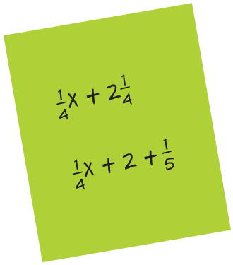
Another Way
Are the two expressions shown equivalent?
What do you notice about the two expressions?
Compare your reasoning with the
explanation. Explain any revision you make.
Reveal:
31 / 43
Notes:
TEACH IN PRACTICE | Embedded facilitation | Lesson 6.6, slide 29 | REVEAL
Focus on the existing task: Are the two expressions shown equivalent?
LAUNCH (T2/3/5): If an existing answer cover is present, gather an attempt before revealing. If the explanation is already visible, ask students to reconstruct and justify it. Compare reasoning and explain a revision; preserve the reveal sequence.
LOOK FOR (T4): Where this task addresses it, students can use properties and like terms to justify equivalence. Ask which feature of their work supports the claim.
RESPOND: If this task shows the lesson misconception—claiming expressions are equivalent because one tested value matches—mark like terms and name the property used for each rewrite. Have the student revise and explain the change. Use this support only where the concept occurs in the current task; otherwise respond to the displayed question.
RECHECK: If a gap is shared, revisit the existing representation together. If it is limited, give targeted support while others compare valid methods on the same task. Check the revision before moving on.
PARTICIPATION (T5/6/7): Think time before volunteers; accept a written, drawn or rehearsed entry. Students ask for evidence respectfully. Recognize a specific contribution or revision and check that both partners participate.
Source: BCPS Updated Instructional Framework Rubric (June 2020), TEACH 1–7. Earlier notes and answer keys are retained below.
EARLIER NOTES / EXISTING ANSWER KEY
Students should have shared predictions before this reveal.
Have them compare their thinking to what is shown: “Is this the same as what we said? Where is it different?”
Press one student to explain the reveal in their own words.
UIFR: TEACH 3 · TEACH 4.

Slide 32
Another Way
How can you evaluate the expressions for a given value of the variable?
Record your reasoning before the reveal.
Compare, then explain any revision.
Reveal:
We can use the Substitution Property of Equality.
32 / 43
Notes:
TEACH IN PRACTICE | Embedded facilitation | Lesson 6.6, slide 30 | REVEAL
Focus on the existing task: Reveal: We can use the Substitution Property of Equality. How can you evaluate the expressions for a given value of the variable?
LAUNCH (T2/3/5): If an existing answer cover is present, gather an attempt before revealing. If the explanation is already visible, ask students to reconstruct and justify it. Compare reasoning and explain a revision; preserve the reveal sequence.
LOOK FOR (T4): Where this task addresses it, students can use properties and like terms to justify equivalence. Ask which feature of their work supports the claim.
RESPOND: If this task shows the lesson misconception—claiming expressions are equivalent because one tested value matches—mark like terms and name the property used for each rewrite. Have the student revise and explain the change. Use this support only where the concept occurs in the current task; otherwise respond to the displayed question.
RECHECK: If a gap is shared, revisit the existing representation together. If it is limited, give targeted support while others compare valid methods on the same task. Check the revision before moving on.
PARTICIPATION (T5/6/7): Think time before volunteers; accept a written, drawn or rehearsed entry. Students ask for evidence respectfully. Recognize a specific contribution or revision and check that both partners participate.
Source: BCPS Updated Instructional Framework Rubric (June 2020), TEACH 1–7. Earlier notes and answer keys are retained below.
EARLIER NOTES / EXISTING ANSWER KEY
Do not click yet: collect 2–3 student answers with reasons first.
Then click to remove the cover and have students compare their thinking to the reveal — “Is this what we said? Where is it different?”
Behind the cover: We can use the Substitution Property of Equality.
UIFR: TEACH 3 · TEACH 4.

Slide 33
Another Way
When the expressions are evaluated for a given value of the variable, what must be true about the values of the simplified expressions if they are equivalent?
Compare your reasoning with the
explanation. Explain any revision you make.
Reveal:
33 / 43
Notes:
TEACH IN PRACTICE | Embedded facilitation | Lesson 6.6, slide 31 | REVEAL
Focus on the existing task: When the expressions are evaluated for a given value of the variable, what must be true about the values of the simplified expressions if they are equivalent?
LAUNCH (T2/3/5): If an existing answer cover is present, gather an attempt before revealing. If the explanation is already visible, ask students to reconstruct and justify it. Compare reasoning and explain a revision; preserve the reveal sequence.
LOOK FOR (T4): Where this task addresses it, students can use properties and like terms to justify equivalence. Ask which feature of their work supports the claim.
RESPOND: If this task shows the lesson misconception—claiming expressions are equivalent because one tested value matches—mark like terms and name the property used for each rewrite. Have the student revise and explain the change. Use this support only where the concept occurs in the current task; otherwise respond to the displayed question.
RECHECK: If a gap is shared, revisit the existing representation together. If it is limited, give targeted support while others compare valid methods on the same task. Check the revision before moving on.
PARTICIPATION (T5/6/7): Think time before volunteers; accept a written, drawn or rehearsed entry. Students ask for evidence respectfully. Recognize a specific contribution or revision and check that both partners participate.
Source: BCPS Updated Instructional Framework Rubric (June 2020), TEACH 1–7. Earlier notes and answer keys are retained below.
EARLIER NOTES / EXISTING ANSWER KEY
Students should have shared predictions before this reveal.
Have them compare their thinking to what is shown: “Is this the same as what we said? Where is it different?”
Press one student to explain the reveal in their own words.
UIFR: TEACH 3 · TEACH 4.

Slide 34
Another Way
When the expressions are evaluated for a given value of the variable, what must be true about the values of the simplified expressions if they are equivalent?
Record your reasoning before the reveal.
Compare, then explain any revision.
Reveal:
The values of the simplified expressions should be the same.
34 / 43
Notes:
TEACH IN PRACTICE | Embedded facilitation | Lesson 6.6, slide 32 | REVEAL
Focus on the existing task: Reveal: The values of the simplified expressions should be the same. When the expressions are evaluated for a given value of the…
LAUNCH (T2/3/5): If an existing answer cover is present, gather an attempt before revealing. If the explanation is already visible, ask students to reconstruct and justify it. Compare reasoning and explain a revision; preserve the reveal sequence.
LOOK FOR (T4): Where this task addresses it, students can use properties and like terms to justify equivalence. Ask which feature of their work supports the claim.
RESPOND: If this task shows the lesson misconception—claiming expressions are equivalent because one tested value matches—mark like terms and name the property used for each rewrite. Have the student revise and explain the change. Use this support only where the concept occurs in the current task; otherwise respond to the displayed question.
RECHECK: If a gap is shared, revisit the existing representation together. If it is limited, give targeted support while others compare valid methods on the same task. Check the revision before moving on.
PARTICIPATION (T5/6/7): Think time before volunteers; accept a written, drawn or rehearsed entry. Students ask for evidence respectfully. Recognize a specific contribution or revision and check that both partners participate.
Source: BCPS Updated Instructional Framework Rubric (June 2020), TEACH 1–7. Earlier notes and answer keys are retained below.
EARLIER NOTES / EXISTING ANSWER KEY
Do not click yet: collect 2–3 student answers with reasons first.
Then click to remove the cover and have students compare their thinking to the reveal — “Is this what we said? Where is it different?”
Behind the cover: The values of the simplified expressions should be the same.
UIFR: TEACH 3 · TEACH 4.

Slide 35
Another Way
Are the two expressions shown equivalent?
The two expressions are not equivalent.
Think and record first. Which part of your
work supports your answer?
Planning
What is another approach to solving this problem?
35 / 43
Notes:
TEACH IN PRACTICE | Embedded facilitation | Lesson 6.6, slide 33 | TASK
Focus on the existing task: The two expressions are not equivalent. Planning What is another approach to solving this problem?
LAUNCH (T2/3/5): Use the displayed question. Give private thinking time; then A explains while B asks for evidence. Switch roles. Each student records their own reasoning.
LOOK FOR (T4): Where this task addresses it, students can use properties and like terms to justify equivalence. Ask which feature of their work supports the claim.
RESPOND: If this task shows the lesson misconception—claiming expressions are equivalent because one tested value matches—mark like terms and name the property used for each rewrite. Have the student revise and explain the change. Use this support only where the concept occurs in the current task; otherwise respond to the displayed question.
RECHECK: If a gap is shared, revisit the existing representation together. If it is limited, give targeted support while others compare valid methods on the same task. Check the revision before moving on.
PARTICIPATION (T5/6/7): Think time before volunteers; accept a written, drawn or rehearsed entry. Students ask for evidence respectfully. Recognize a specific contribution or revision and check that both partners participate.
Source: BCPS Updated Instructional Framework Rubric (June 2020), TEACH 1–7. Earlier notes and answer keys are retained below.
EARLIER NOTES / EXISTING ANSWER KEY
Model briefly, then hand the thinking back: ask “Why does this step work?” before showing the next one.
Quick check before moving on — thumbs or whiteboards from everyone, not volunteers.
UIFR: TEACH 2 · TEACH 3 · TEACH 4.

Slide 36
Let’s Explore More
Try substituting 3 more values for the variable x in each expression. What do you notice?
Why is it not necessary to substitute more than one value into an expression if the first try is not equivalent?
ANOTHER PATHWAY · Did anyone get there a different way? Put both pathways side by side and compare.
36 / 43
Notes:
TEACH IN PRACTICE | Embedded facilitation | Lesson 6.6, slide 34 | PRACTICE
Focus on the existing task: Let’s Explore More Try substituting 3 more values for the variable x in each expression. What do you notice?
LAUNCH (T2/3/5): Use the displayed question. Give private thinking time; then A explains while B asks for evidence. Switch roles. Each student records their own reasoning.
LOOK FOR (T4): Where this task addresses it, students can use properties and like terms to justify equivalence. Ask which feature of their work supports the claim.
RESPOND: If this task shows the lesson misconception—claiming expressions are equivalent because one tested value matches—mark like terms and name the property used for each rewrite. Have the student revise and explain the change. Use this support only where the concept occurs in the current task; otherwise respond to the displayed question.
RECHECK: If a gap is shared, revisit the existing representation together. If it is limited, give targeted support while others compare valid methods on the same task. Check the revision before moving on.
PARTICIPATION (T5/6/7): Think time before volunteers; accept a written, drawn or rehearsed entry. Students ask for evidence respectfully. Recognize a specific contribution or revision and check that both partners participate.
Source: BCPS Updated Instructional Framework Rubric (June 2020), TEACH 1–7. Earlier notes and answer keys are retained below.
EARLIER NOTES / EXISTING ANSWER KEY
Extension for partners or table groups — students choose their approach and use the workspace to show thinking.
Push with “Convince me,” and have two groups with different approaches share.
This is where students stretch past the worked example.
UIFR: TEACH 2 · TEACH 5.

Slide 37
LESSON 6.6 / CHECK YOUR WORK
Pause. Check. Improve.
CHECK
A mistake to watch for: claiming expressions are equivalent because one tested value matches.
TRY
Mark like terms and name the property used for each rewrite.
REVISE
Use that check on the task you just completed. Correct or strengthen one part, and explain why.
REVISE NOW · Change one answer and write why you changed it. A revision is evidence of learning.
Listen to understand. Ask for evidence. Make room for every voice.
Notes:
TEACH IN PRACTICE | Embedded facilitation | Lesson 6.6, slide 35 | PRIOR_INSERT
Focus on the existing task: LESSON 6.6 / CHECK YOUR WORK Pause. Check. Improve. Listen to understand. Ask for evidence. Make room for every voice. CHECK A mistake…
CONNECT (T1/4): Ask students to restate the displayed goal or key idea and connect it to earlier work. Relevant lesson evidence: use properties and like terms to justify equivalence; distinguish evidence from proof. Use only the criterion that matches the current session.
SHOW PROGRESS: Students point to their own existing work, explain what improved after feedback, and name a next step. Pair confidence ratings with actual evidence.
PARTICIPATION (T5/6/7): Think time before volunteers; accept a written, drawn or rehearsed entry. Students ask for evidence respectfully. Recognize a specific contribution or revision and check that both partners participate.
Source: BCPS Updated Instructional Framework Rubric (June 2020), TEACH 1–7.

Slide 38
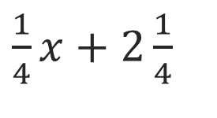
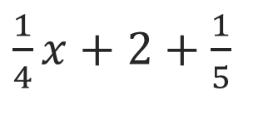
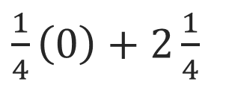
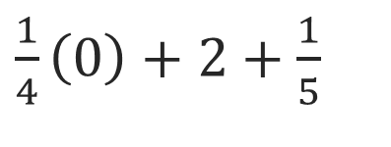




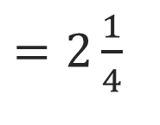
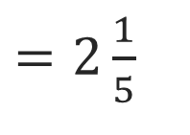
SUMMARIZE · SAY IT IN YOUR OWN WORDS
Summarize
You can use different strategies to determine whether two algebraic expressions are equivalent.
Simplify each expression using properties of operations. An expression is simplified when it has no like terms or parentheses.
Evaluate each expression for the same value.
These expressions are equivalent.
These expressions are not equivalent.
USE YOUR TOOLS · Reach for your notes, a model, or a manipulative before you reach for an answer.
38 / 43
Notes:
TEACH IN PRACTICE | Embedded facilitation | Lesson 6.6, slide 36 | SUMMARIZE
Focus on the existing task: You can use different strategies to determine whether two algebraic expressions are equivalent. Summarize These expressions are…
CONNECT (T1/4): Ask students to restate the displayed goal or key idea and connect it to earlier work. Relevant lesson evidence: use properties and like terms to justify equivalence; distinguish evidence from proof. Use only the criterion that matches the current session.
SHOW PROGRESS: Students point to their own existing work, explain what improved after feedback, and name a next step. Pair confidence ratings with actual evidence.
PARTICIPATION (T5/6/7): Think time before volunteers; accept a written, drawn or rehearsed entry. Students ask for evidence respectfully. Recognize a specific contribution or revision and check that both partners participate.
Source: BCPS Updated Instructional Framework Rubric (June 2020), TEACH 1–7. Earlier notes and answer keys are retained below.
EARLIER NOTES / EXISTING ANSWER KEY
Routine: SUMMARIZE · SAY IT IN YOUR OWN WORDS

Slide 39
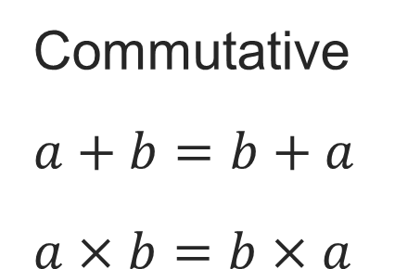
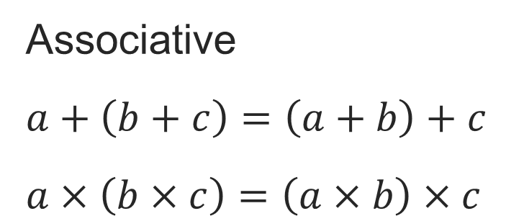
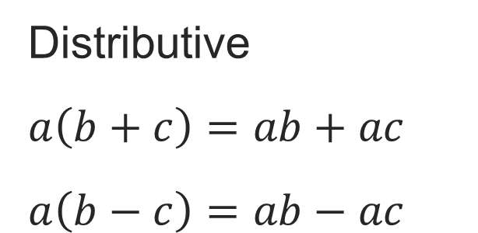
SUMMARIZE · SAY IT IN YOUR OWN WORDS
Summarize
Properties of Operations
Explain the key idea without reading. Use today’s example as evidence.
39 / 43
Notes:
TEACH IN PRACTICE | Embedded facilitation | Lesson 6.6, slide 37 | SUMMARIZE
Focus on the existing task: Summarize Properties of Operations SUMMARIZE · SAY IT IN YOUR OWN WORDS
CONNECT (T1/4): Ask students to restate the displayed goal or key idea and connect it to earlier work. Relevant lesson evidence: use properties and like terms to justify equivalence; distinguish evidence from proof. Use only the criterion that matches the current session.
SHOW PROGRESS: Students point to their own existing work, explain what improved after feedback, and name a next step. Pair confidence ratings with actual evidence.
PARTICIPATION (T5/6/7): Think time before volunteers; accept a written, drawn or rehearsed entry. Students ask for evidence respectfully. Recognize a specific contribution or revision and check that both partners participate.
Source: BCPS Updated Instructional Framework Rubric (June 2020), TEACH 1–7. Earlier notes and answer keys are retained below.
EARLIER NOTES / EXISTING ANSWER KEY
Routine: SUMMARIZE · SAY IT IN YOUR OWN WORDS

Slide 40
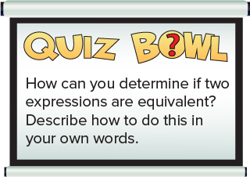
APPLY · PLAN IT • SOLVE IT • PROVE IT
Apply: Bonus Points
Anwar’s quiz bowl team must correctly answer the question shown to earn ten bonus points in their match.
Question: How should Anwar’s team respond if they want to earn the ten bonus points?
Choose a method. Solve
independently, justify your
answer, then check the goal.
40 / 43
Notes:
TEACH IN PRACTICE | Embedded facilitation | Lesson 6.6, slide 38 | APPLY
Focus on the existing task: Anwar’s quiz bowl team must correctly answer the question shown to earn ten bonus points in their match. Question: How should Anwar’s team respond if they want to earn the ten bonus points?
LAUNCH (T2/3/5): Use the exact application task independently first. Ask students to justify their choice of method. Collect evidence before a partner discussion or correction.
LOOK FOR (T4): Where this task addresses it, students can use properties and like terms to justify equivalence. Ask which feature of their work supports the claim.
RESPOND: If this task shows the lesson misconception—claiming expressions are equivalent because one tested value matches—mark like terms and name the property used for each rewrite. Have the student revise and explain the change. Use this support only where the concept occurs in the current task; otherwise respond to the displayed question.
RECHECK: If a gap is shared, revisit the existing representation together. If it is limited, give targeted support while others compare valid methods on the same task. Check the revision before moving on.
PARTICIPATION (T5/6/7): Think time before volunteers; accept a written, drawn or rehearsed entry. Students ask for evidence respectfully. Recognize a specific contribution or revision and check that both partners participate.
Source: BCPS Updated Instructional Framework Rubric (June 2020), TEACH 1–7. Earlier notes and answer keys are retained below.
EARLIER NOTES / EXISTING ANSWER KEY
Routine: APPLY · PLAN IT • SOLVE IT • PROVE IT
UIFR FULL | Lesson-specific facilitation
TEACH 4 | Independent evidence and revision (UIFR PDF p. 11).
Use the existing application/exit problem as the independent check. If this is a learning-target slide, have students point to and explain their work on the preceding task. Separate initial independent evidence from the revision after feedback.
Check the relevant criteria: use properties and like terms to justify equivalence; distinguish evidence from proof. Respond with one specific next step tied to the work. Students revise and annotate what changed, then identify a criterion they can now demonstrate and one they still need to practice.

Slide 41
Learning Targets
I can attend to precision to identify whether two expressions are equivalent.
SAY THE GOAL · Say today’s goal in your own words, then name one place this shows up outside math class.
41 / 43
Notes:
TEACH IN PRACTICE | Embedded facilitation | Lesson 6.6, slide 39 | REFLECTION
Focus on the existing task: I can attend to precision to identify whether two expressions are equivalent. Learning Targets
CONNECT (T1/4): Ask students to restate the displayed goal or key idea and connect it to earlier work. Relevant lesson evidence: use properties and like terms to justify equivalence; distinguish evidence from proof. Use only the criterion that matches the current session.
SHOW PROGRESS: Students point to their own existing work, explain what improved after feedback, and name a next step. Pair confidence ratings with actual evidence.
PARTICIPATION (T5/6/7): Think time before volunteers; accept a written, drawn or rehearsed entry. Students ask for evidence respectfully. Recognize a specific contribution or revision and check that both partners participate.
Source: BCPS Updated Instructional Framework Rubric (June 2020), TEACH 1–7. Earlier notes and answer keys are retained below.
EARLIER NOTES / EXISTING ANSWER KEY
Read each target; students self-rate with fist-to-five or thumbs.
Tie back to the goal from the start of class: did we get there?
Note any target that rates low — revisit it tomorrow.
UIFR: TEACH 1 · TEACH 4.

Slide 42

Be Curious
What do you notice?
What do you wonder?
Think first. Share a notice and a question;
build on a classmate’s idea.
Mindset
How do you know when you are frustrated in math class?
42 / 43
Notes:
TEACH IN PRACTICE | Embedded facilitation | Lesson 6.6, slide 40 | CURIOUS
Focus on the existing task: What do you notice?
LAUNCH (T2/3/5): Allow quiet observation first. Separate a notice from an inference, invite students’ own questions, and follow the existing launch before teaching a procedure.
LOOK FOR (T4): Where this task addresses it, students can use properties and like terms to justify equivalence. Ask which feature of their work supports the claim.
RESPOND: If this task shows the lesson misconception—claiming expressions are equivalent because one tested value matches—mark like terms and name the property used for each rewrite. Have the student revise and explain the change. Use this support only where the concept occurs in the current task; otherwise respond to the displayed question.
RECHECK: If a gap is shared, revisit the existing representation together. If it is limited, give targeted support while others compare valid methods on the same task. Check the revision before moving on.
PARTICIPATION (T5/6/7): Think time before volunteers; accept a written, drawn or rehearsed entry. Students ask for evidence respectfully. Recognize a specific contribution or revision and check that both partners participate.
Source: BCPS Updated Instructional Framework Rubric (June 2020), TEACH 1–7. Earlier notes and answer keys are retained below.
EARLIER NOTES / EXISTING ANSWER KEY
UIFR FULL | Lesson-specific facilitation
REFLECT & ADJUST 1-2 | After the lesson (UIFR PDF pp. 15-16).
Sort the existing work by demonstrated reasoning, partial understanding, and the specific misconception: claiming expressions are equivalent because one tested value matches. Compare the initial response with the revision. Record which teaching move plausibly helped, which did not, and whose participation or access needs a different approach; do not record sensitive student details in this shared deck.
Plan the next lesson from that evidence: if the misconception persists, mark like terms and name the property used for each rewrite using the current example before returning to the next grade-level task; if understanding is secure, use an existing extension or ask for a general explanation. Check the targeted idea again at the next warm-up.
Ask students what supported their thinking and what would help next time. Identify one change to try and one successful practice to retain. Seek colleague feedback on anonymized work when useful; these prompts support reflection and do not establish an evaluation rating. Source: Baltimore City Public Schools, Updated Instructional Framework Rubric, June 2020 (UIFR_Full.pdf).

Slide 43
LESSON 6.6 / REFLECT ON YOUR LEARNING
Show your progress
1 SHOW EVIDENCE
2 CHOOSE A NEXT STEP
Choose one response. Point to the part that shows your reasoning.
Name a change you made after feedback—or a question you still have.
“My work shows ___ because ___.”
“Next time, I will ___ to help me ___.”
Today’s focus: Use properties and like terms to justify equivalence.
CREDIT A CLASSMATE · Name one classmate whose idea helped you today, and say what they said.
Listen to understand. Ask for evidence. Make room for every voice.
Notes:
TEACH IN PRACTICE | Embedded facilitation | Lesson 6.6, slide 41 | PRIOR_INSERT
Focus on the existing task: LESSON 6.6 / REFLECT ON YOUR LEARNING Show your progress Listen to understand. Ask for evidence. Make room for every voice. 1 SHOW…
CONNECT (T1/4): Ask students to restate the displayed goal or key idea and connect it to earlier work. Relevant lesson evidence: use properties and like terms to justify equivalence; distinguish evidence from proof. Use only the criterion that matches the current session.
SHOW PROGRESS: Students point to their own existing work, explain what improved after feedback, and name a next step. Pair confidence ratings with actual evidence.
PARTICIPATION (T5/6/7): Think time before volunteers; accept a written, drawn or rehearsed entry. Students ask for evidence respectfully. Recognize a specific contribution or revision and check that both partners participate.
Source: BCPS Updated Instructional Framework Rubric (June 2020), TEACH 1–7.

