Slide 1
WARM-UP · THINK • TRY • CHECK
Turn and talk: compare strategies, then defend one.
Warm-Up
Lesson 6-7 · Find Factors and Multiples | Warm-Up · about 4 minutes
Try each on your own. Mark an unsure answer; explain and revise when we check.
QUESTION 1
QUESTION 2
7 × 8 = ______
List all the factors of 18: ______
QUESTION 3
QUESTION 4
First five multiples of 6: ______
Is 45 divisible by 9? ______
TALK IT OVER: “I got ______ because ______.” • Compare with a partner before we check as a class.
1 / 51
Notes:
TEACH IN PRACTICE | Embedded facilitation | Lesson 6.7, slide 1 | WARMUP
Focus on the existing task: Warm-Up WARM-UP · THINK • TRY • CHECK Do these four on your own.
GATHER EVIDENCE (T4/6): Keep the original items. Students try independently, mark an uncertain item, and explain one method before checking. Use the existing key when present.
RESPOND: Distinguish a calculation slip from a reasoning gap. Give one next step on the same item; have students revise in a second color. Use the responses to choose flexible support for today’s lesson.
PARTICIPATION (T5/6/7): Think time before volunteers; accept a written, drawn or rehearsed entry. Students ask for evidence respectfully. Recognize a specific contribution or revision and check that both partners participate.
Source: BCPS Updated Instructional Framework Rubric (June 2020), TEACH 1–7. Earlier notes and answer keys are retained below.
EARLIER NOTES / EXISTING ANSWER KEY
Warm-Up answers (teacher only): 1) 56 2) 1, 2, 3, 6, 9, 18 3) 6, 12, 18, 24, 30 4) yes
UIFR FULL | Lesson-specific facilitation
PREPARE 1-2 | Before teaching (UIFR PDF pp. 6-7).
Plan to gather evidence that students can distinguish common factors from common multiples; choose GCF or LCM from context. Review recent work and today’s warm-up to choose flexible groups and access supports; do not infer needs from identity or perceived ability. Use the existing lesson tasks and stated standards.
Anticipate: using the greatest common factor for a repeating-cycle problem. If observed, organize factor lists or multiple lists for the original numbers and connect them to the context. Offer oral rehearsal, drawing, pointing, or home-language processing as needed; retain the original mathematical demand. Ask students which support helps and fade it as evidence improves.
TEACH 6-7 | Before the first transition, agree on materials, partner roles, and how to request help. Invite students to restate the routine. Normalize revising an idea, recognize a specific contribution, and check privately when frustration blocks participation. Source: UIFR PDF pp. 13-14.

Slide 2
Today’s Math Notes
Lesson 6-7 · Find Factors and Multiples
Section 1: Math Words
Copy. Explain. Check.
SAY THE GOAL · Say today’s goal in your own words, then name one place this shows up outside math class.
Find Factors and Multiples
1
Listing what divides a number evenly (its factors) and what it
Factor
2
A whole number that divides another number evenly, with no remainder
Multiple
3
The result of multiplying a number by 1
eduwonderlab.com · Neft Teacher
2 / 51
Notes:
TEACH IN PRACTICE | Embedded facilitation | Lesson 6.7, slide 2 | NOTES
Focus on the existing task: Today’s Math Notes Section 1: Math Words Copy into your…
ROUTINE (T1/2/4): Read or copy the original notes, cover one line, and explain it using the displayed example. Reopen and correct. Copying alone is not evidence of understanding.
LOOK FOR: A link between a symbol, quantity or feature and the explanation. If missing, point back to that feature and have the student try again; fade the prompt once they can explain.
PARTICIPATION (T5/6/7): Think time before volunteers; accept a written, drawn or rehearsed entry. Students ask for evidence respectfully. Recognize a specific contribution or revision and check that both partners participate.
Source: BCPS Updated Instructional Framework Rubric (June 2020), TEACH 1–7. Earlier notes and answer keys are retained below.
EARLIER NOTES / EXISTING ANSWER KEY
Copy routine: read one line at a time; students copy, then explain that line to a partner.
Keep it brisk — the understanding work happens in the examples, not the copying.
UIFR: TEACH 1 · TEACH 6.

Slide 3
Today’s Math Notes
Lesson 6-7 · Find Factors and Multiples
Section 2: Today’s Math
Copy. Explain. Check.
Greatest Common Factor (GCF) & Least Common Multiple (LCM)
GCF: Largest factor shared by two numbers — used to simplify fractions or divide into equal groups
1
LCM: Smallest shared multiple — used to find common denominators
2
CONNECT IT · What earlier lesson does this build on? Tell a partner in one sentence.
Use prime factor trees or list method to find common factors/multiples
3
eduwonderlab.com · Neft Teacher
3 / 51
Notes:
TEACH IN PRACTICE | Embedded facilitation | Lesson 6.7, slide 3 | NOTES
Focus on the existing task: Today’s Math Notes Section 2: Today’s Math Copy into your…
ROUTINE (T1/2/4): Read or copy the original notes, cover one line, and explain it using the displayed example. Reopen and correct. Copying alone is not evidence of understanding.
LOOK FOR: A link between a symbol, quantity or feature and the explanation. If missing, point back to that feature and have the student try again; fade the prompt once they can explain.
PARTICIPATION (T5/6/7): Think time before volunteers; accept a written, drawn or rehearsed entry. Students ask for evidence respectfully. Recognize a specific contribution or revision and check that both partners participate.
Source: BCPS Updated Instructional Framework Rubric (June 2020), TEACH 1–7. Earlier notes and answer keys are retained below.
EARLIER NOTES / EXISTING ANSWER KEY
Copy routine: read one line at a time; students copy, then explain that line to a partner.
Keep it brisk — the understanding work happens in the examples, not the copying.
UIFR: TEACH 1 · TEACH 6.

Slide 4
Session 1
Find Factors and Multiples
PICK YOUR STRATEGY · Choose your path — picture, table, number line, or equation — and be ready to say why you chose it.
4 / 51
Notes:
TEACH IN PRACTICE | Embedded facilitation | Lesson 6.7, slide 4 | DIVIDER
Focus on the existing task: Find Factors and Multiples Session 1
TRANSITION (T6/7): Students confirm materials, roles, how to request help, and the next response routine. Ask a student to restate it. Keep teacher-only slides hidden.
PARTICIPATION (T5/6/7): Think time before volunteers; accept a written, drawn or rehearsed entry. Students ask for evidence respectfully. Recognize a specific contribution or revision and check that both partners participate.
Source: BCPS Updated Instructional Framework Rubric (June 2020), TEACH 1–7. Earlier notes and answer keys are retained below.
EARLIER NOTES / EXISTING ANSWER KEY
Transition cue: state what materials are out and what success looks like this session.
Keep the changeover under a minute.
UIFR: TEACH 6.

Slide 5
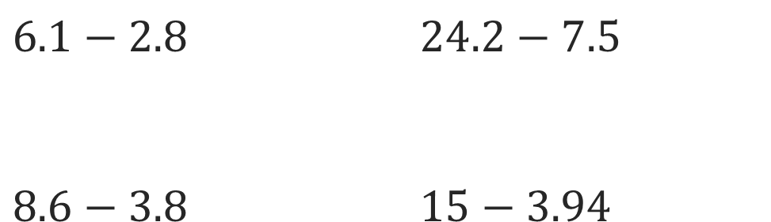
On You Could
Explain how the information shown supports your reasoning.
5 / 51
Notes:
TEACH IN PRACTICE | Embedded facilitation | Lesson 6.7, slide 5 | WORKED
Focus on the existing task: On You Could
LAUNCH (T2/3/5): Ask students to explain the displayed idea or example and point to evidence. When a calculation step is shown, ask why it is valid. Have a partner restate the explanation; copying is not the check.
LOOK FOR (T4): Where this task addresses it, students can distinguish common factors from common multiples. Ask which feature of their work supports the claim.
RESPOND: If this task shows the lesson misconception—using the greatest common factor for a repeating-cycle problem—organize factor lists or multiple lists for the original numbers and connect them to the context. Have the student revise and explain the change. Use this support only where the concept occurs in the current task; otherwise respond to the displayed question.
RECHECK: If a gap is shared, revisit the existing representation together. If it is limited, give targeted support while others compare valid methods on the same task. Check the revision before moving on.
PARTICIPATION (T5/6/7): Think time before volunteers; accept a written, drawn or rehearsed entry. Students ask for evidence respectfully. Recognize a specific contribution or revision and check that both partners participate.
Source: BCPS Updated Instructional Framework Rubric (June 2020), TEACH 1–7. Earlier notes and answer keys are retained below.
EARLIER NOTES / EXISTING ANSWER KEY
Model briefly, then hand the thinking back: ask “Why does this step work?” before showing the next one.
Quick check before moving on — thumbs or whiteboards from everyone, not volunteers.
UIFR: TEACH 2 · TEACH 3 · TEACH 4.

Slide 6
Today’s Objectives
Lesson 6-7 · Find Factors and Multiples
Find Factors and Multiples
Maryland Standard 6.NOS.4
SHOW YOUR THINKING · Show what you know — write it, draw it, or build it. A picture counts as an explanation.
CONTENT OBJECTIVE
LANGUAGE OBJECTIVE
Restate the goal in your words
Use these words to explain why
I can find the greatest common factor and the least common multiple of two numbers, and use each to solve a real problem.
I can explain my choice using the words factor, multiple, common, greatest, and least.
eduwonderlab.com · Neft Teacher
6 / 51
Notes:
TEACH IN PRACTICE | Embedded facilitation | Lesson 6.7, slide 6 | GOAL
Focus on the existing task: Today’s Objectives Find Factors and Multiples Maryland Standard 6.
CONNECT (T1/4): Ask students to restate the displayed goal or key idea and connect it to earlier work. Relevant lesson evidence: distinguish common factors from common multiples; choose GCF or LCM from context. Use only the criterion that matches the current session.
SHOW PROGRESS: Students point to their own existing work, explain what improved after feedback, and name a next step. Pair confidence ratings with actual evidence.
PARTICIPATION (T5/6/7): Think time before volunteers; accept a written, drawn or rehearsed entry. Students ask for evidence respectfully. Recognize a specific contribution or revision and check that both partners participate.
Source: BCPS Updated Instructional Framework Rubric (June 2020), TEACH 1–7. Earlier notes and answer keys are retained below.
EARLIER NOTES / EXISTING ANSWER KEY
Read the objective together, then have one or two students restate today’s goal in their own words.
Connect it to what the class learned last lesson.
Return to this goal at the end of class to check it was met.
UIFR: TEACH 1.
UIFR FULL | Lesson-specific facilitation
TEACH 1 | Session 1 purpose and evidence (UIFR PDF p. 8).
Have students restate the displayed session goal in their own words and connect it to the existing context or a familiar experience they choose to share. Use the current session goal to select from these lesson-wide evidence criteria; do not frontload a later-session procedure.
Look for: distinguish common factors from common multiples; choose GCF or LCM from context. Ask: “Which part of your work would show this?” Revisit that evidence after the task; a confidence rating alone is not evidence of understanding.

Slide 7
LESSON 6.7 / OUR LEARNING
What will show your learning?
1
Distinguish common factors from common multiples.
2
Choose GCF or LCM from context.
Tell a partner: Which skill connects to something you already know?
WHY IT MATTERS · Finish this: “This is worth knowing because ______.”
Listen to understand. Ask for evidence. Make room for every voice.
Notes:
TEACH IN PRACTICE | Embedded facilitation | Lesson 6.7, slide 7 | PRIOR_INSERT
Focus on the existing task: LESSON 6.7 / OUR LEARNING What will show your learning?
CONNECT (T1/4): Ask students to restate the displayed goal or key idea and connect it to earlier work. Relevant lesson evidence: distinguish common factors from common multiples; choose GCF or LCM from context. Use only the criterion that matches the current session.
SHOW PROGRESS: Students point to their own existing work, explain what improved after feedback, and name a next step. Pair confidence ratings with actual evidence.
PARTICIPATION (T5/6/7): Think time before volunteers; accept a written, drawn or rehearsed entry. Students ask for evidence respectfully. Recognize a specific contribution or revision and check that both partners participate.
Source: BCPS Updated Instructional Framework Rubric (June 2020), TEACH 1–7.

Slide 8
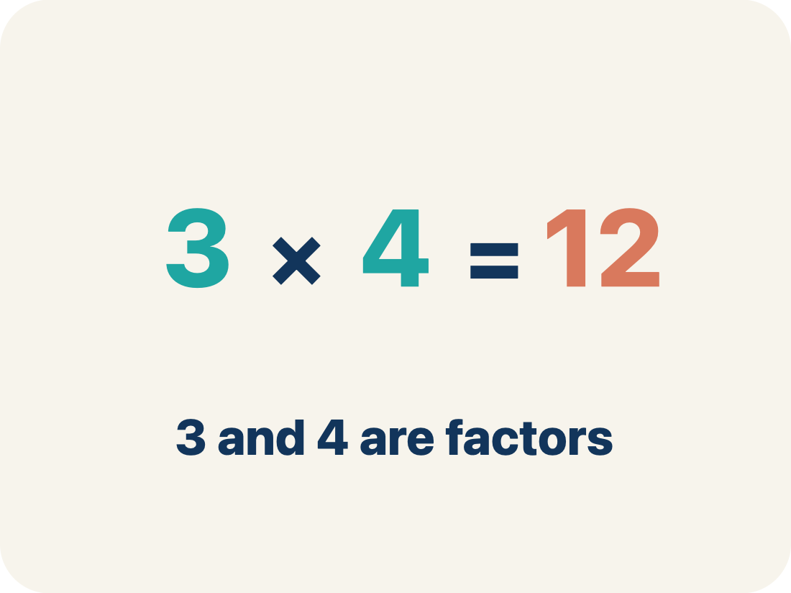
Vocabulary 1 of 7
Lesson 6-7 · Find Factors and Multiples
USE THE MATH WORDS · Use today’s math words in your explanation — not “it” and “that thing.”
Find Factors and Multiples
Listing what divides a number evenly (its factors) and what it divides into evenly (its multiples), then finding what two numbers share.
EXAMPLE · EXPLAIN WHY IT FITS
GCF of 48 and 36 is 12 · LCM of 6 and 8 is 24
eduwonderlab.com · Neft Teacher
8 / 51
Notes:
TEACH IN PRACTICE | Embedded facilitation | Lesson 6.7, slide 8 | VOCAB
Focus on the existing task: Vocabulary 1 of 7 Find Factors and Multiples Listing what…
ASK (T1/3/5): Where does “Find Factors and Multiples” appear in the example? Explain the meaning without reading the definition. Partner: restate the idea and ask a clarifying question.
LOOK FOR: A correct connection between the word and a feature of the example. If the student only repeats the definition, invite pointing, sketching or oral rehearsal, then ask for another explanation of this same example.
PARTICIPATION (T5/6/7): Think time before volunteers; accept a written, drawn or rehearsed entry. Students ask for evidence respectfully. Recognize a specific contribution or revision and check that both partners participate.
Source: BCPS Updated Instructional Framework Rubric (June 2020), TEACH 1–7.

Slide 9
Vocabulary 2 of 7
Lesson 6-7 · Find Factors and Multiples
Factor
A whole number that divides another number evenly, with no remainder.
EXAMPLE · EXPLAIN WHY IT FITS
Factors of 36: 1, 2, 3, 4, 6, 9, 12, 18, 36
Use “Factor” to explain the example. Point to evidence.
eduwonderlab.com · Neft Teacher
9 / 51
Notes:
TEACH IN PRACTICE | Embedded facilitation | Lesson 6.7, slide 9 | VOCAB
Focus on the existing task: Vocabulary 2 of 7 Factor A whole number that divides another…
ASK (T1/3/5): Where does “Factor” appear in the example? Explain the meaning without reading the definition. Partner: restate the idea and ask a clarifying question.
LOOK FOR: A correct connection between the word and a feature of the example. If the student only repeats the definition, invite pointing, sketching or oral rehearsal, then ask for another explanation of this same example.
PARTICIPATION (T5/6/7): Think time before volunteers; accept a written, drawn or rehearsed entry. Students ask for evidence respectfully. Recognize a specific contribution or revision and check that both partners participate.
Source: BCPS Updated Instructional Framework Rubric (June 2020), TEACH 1–7.

Slide 10
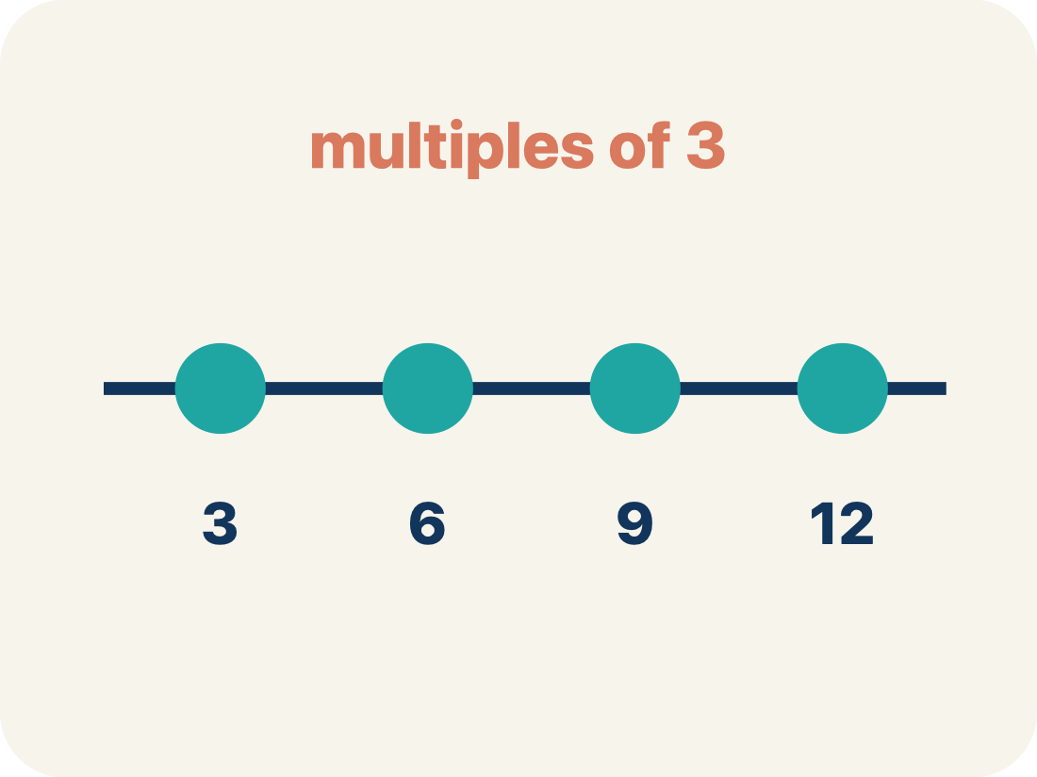
Vocabulary 3 of 7
Lesson 6-7 · Find Factors and Multiples
Multiple
The result of multiplying a number by 1, 2, 3, and so on — where you land when you skip-count by it.
EXAMPLE · EXPLAIN WHY IT FITS
Multiples of 8: 8, 16, 24, 32, 40 …
Use “Multiple” to explain the example. Point to evidence.
eduwonderlab.com · Neft Teacher
10 / 51
Notes:
TEACH IN PRACTICE | Embedded facilitation | Lesson 6.7, slide 10 | VOCAB
Focus on the existing task: Vocabulary 3 of 7 Multiple The result of multiplying a number…
ASK (T1/3/5): Where does “Multiple” appear in the example? Explain the meaning without reading the definition. Partner: restate the idea and ask a clarifying question.
LOOK FOR: A correct connection between the word and a feature of the example. If the student only repeats the definition, invite pointing, sketching or oral rehearsal, then ask for another explanation of this same example.
PARTICIPATION (T5/6/7): Think time before volunteers; accept a written, drawn or rehearsed entry. Students ask for evidence respectfully. Recognize a specific contribution or revision and check that both partners participate.
Source: BCPS Updated Instructional Framework Rubric (June 2020), TEACH 1–7.

Slide 11
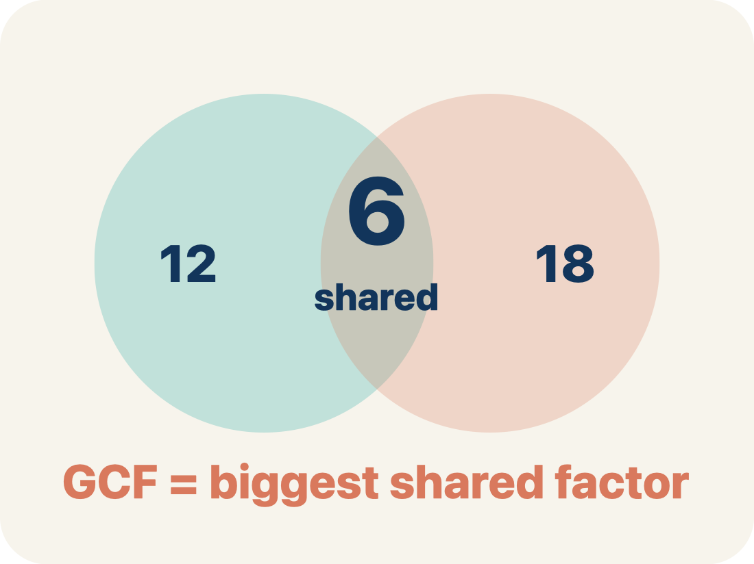
Vocabulary 4 of 7
Lesson 6-7 · Find Factors and Multiples
Greatest common factor (GCF)
The largest number that is a factor of two or more numbers. It answers “how many equal groups can I make?”
EXAMPLE · EXPLAIN WHY IT FITS
48 and 36 share 1, 2, 3, 4, 6, 12 → GCF = 12
ADD ON · Add on: “I agree because ______.” or “I see it differently because ______.”
eduwonderlab.com · Neft Teacher
11 / 51
Notes:
TEACH IN PRACTICE | Embedded facilitation | Lesson 6.7, slide 11 | VOCAB
Focus on the existing task: Vocabulary 4 of 7 Greatest common factor (GCF) The largest…
ASK (T1/3/5): Where does “Greatest common factor (GCF)” appear in the example? Explain the meaning without reading the definition. Partner: restate the idea and ask a clarifying question.
LOOK FOR: A correct connection between the word and a feature of the example. If the student only repeats the definition, invite pointing, sketching or oral rehearsal, then ask for another explanation of this same example.
PARTICIPATION (T5/6/7): Think time before volunteers; accept a written, drawn or rehearsed entry. Students ask for evidence respectfully. Recognize a specific contribution or revision and check that both partners participate.
Source: BCPS Updated Instructional Framework Rubric (June 2020), TEACH 1–7.

Slide 12
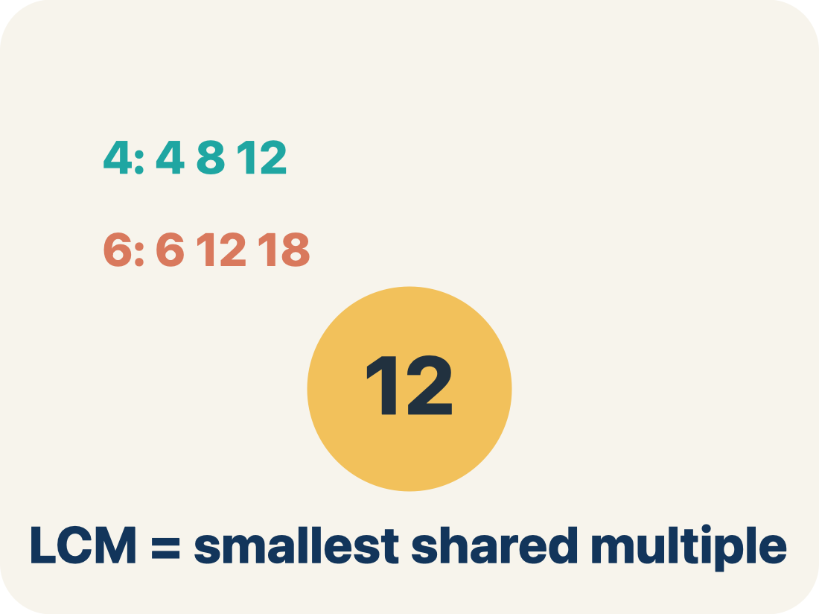
Vocabulary 5 of 7
Lesson 6-7 · Find Factors and Multiples
Least common multiple (LCM)
The smallest number that is a multiple of two or more numbers. It answers “when will these line up again?”
EXAMPLE · EXPLAIN WHY IT FITS
6, 12, 18, 24 and 8, 16, 24 → LCM = 24
TAKE TURNS · One explains, one asks a question. Then switch, so both of you talk.
eduwonderlab.com · Neft Teacher
12 / 51
Notes:
TEACH IN PRACTICE | Embedded facilitation | Lesson 6.7, slide 12 | VOCAB
Focus on the existing task: Vocabulary 5 of 7 Least common multiple (LCM) The smallest…
ASK (T1/3/5): Where does “Least common multiple (LCM)” appear in the example? Explain the meaning without reading the definition. Partner: restate the idea and ask a clarifying question.
LOOK FOR: A correct connection between the word and a feature of the example. If the student only repeats the definition, invite pointing, sketching or oral rehearsal, then ask for another explanation of this same example.
PARTICIPATION (T5/6/7): Think time before volunteers; accept a written, drawn or rehearsed entry. Students ask for evidence respectfully. Recognize a specific contribution or revision and check that both partners participate.
Source: BCPS Updated Instructional Framework Rubric (June 2020), TEACH 1–7.

Slide 13
Vocabulary 6 of 7
Lesson 6-7 · Find Factors and Multiples
Factor pair
Two factors that multiply to make a number. In a word problem, one is the number of groups and the other is the size of each group.
EXAMPLE · EXPLAIN WHY IT FITS
48 = 2 × 24, so 2 packs of 24 pencils
Use “Factor pair” to explain the example. Point to evidence.
eduwonderlab.com · Neft Teacher
13 / 51
Notes:
TEACH IN PRACTICE | Embedded facilitation | Lesson 6.7, slide 13 | VOCAB
Focus on the existing task: Vocabulary 6 of 7 Factor pair Two factors that multiply to make…
ASK (T1/3/5): Where does “Factor pair” appear in the example? Explain the meaning without reading the definition. Partner: restate the idea and ask a clarifying question.
LOOK FOR: A correct connection between the word and a feature of the example. If the student only repeats the definition, invite pointing, sketching or oral rehearsal, then ask for another explanation of this same example.
PARTICIPATION (T5/6/7): Think time before volunteers; accept a written, drawn or rehearsed entry. Students ask for evidence respectfully. Recognize a specific contribution or revision and check that both partners participate.
Source: BCPS Updated Instructional Framework Rubric (June 2020), TEACH 1–7.

Slide 14
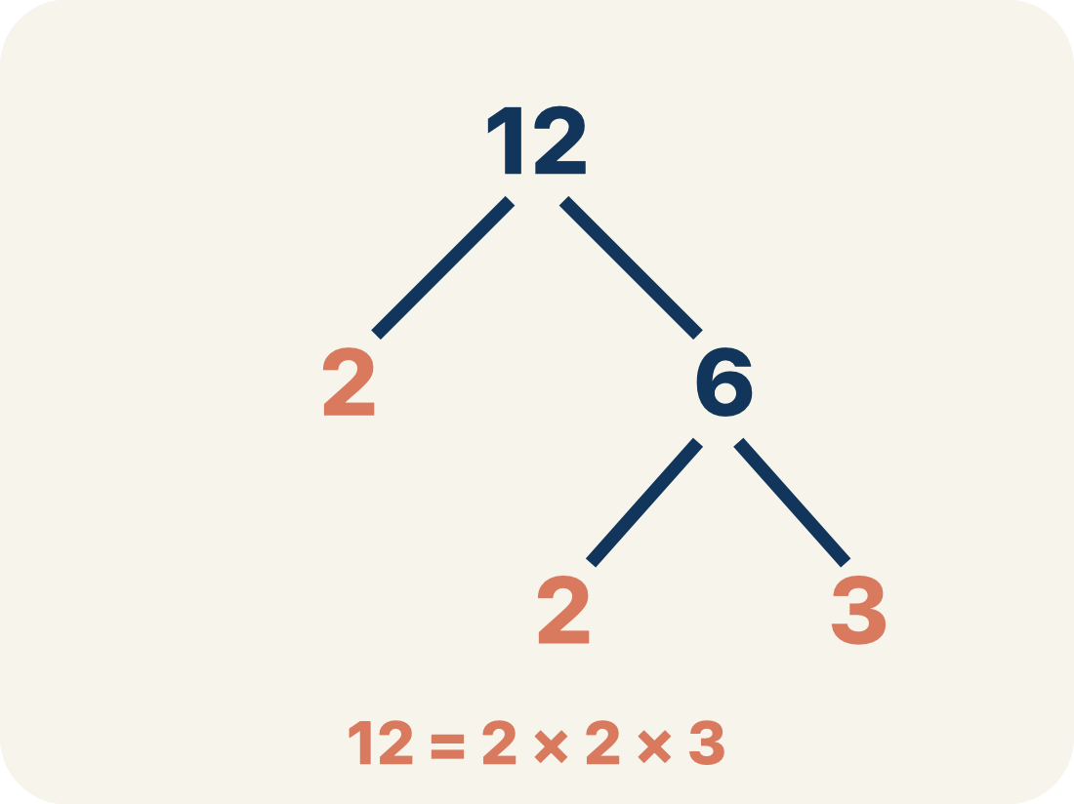
Vocabulary 7 of 7
Lesson 6-7 · Find Factors and Multiples
Prime factorization
Writing a number as a product of prime numbers, usually with a factor tree. Multiplying the primes two numbers share also gives the GCF.
EXAMPLE · EXPLAIN WHY IT FITS
48 = 2×2×2×2×3, 36 = 2×2×3×3 → shared 2×2×3 = 12
RESTATE FIRST · Restate your partner’s idea in your own words before you give yours.
eduwonderlab.com · Neft Teacher
14 / 51
Notes:
TEACH IN PRACTICE | Embedded facilitation | Lesson 6.7, slide 14 | VOCAB
Focus on the existing task: Vocabulary 7 of 7 Prime factorization Writing a number as a…
ASK (T1/3/5): Where does “Prime factorization” appear in the example? Explain the meaning without reading the definition. Partner: restate the idea and ask a clarifying question.
LOOK FOR: A correct connection between the word and a feature of the example. If the student only repeats the definition, invite pointing, sketching or oral rehearsal, then ask for another explanation of this same example.
PARTICIPATION (T5/6/7): Think time before volunteers; accept a written, drawn or rehearsed entry. Students ask for evidence respectfully. Recognize a specific contribution or revision and check that both partners participate.
Source: BCPS Updated Instructional Framework Rubric (June 2020), TEACH 1–7.

Slide 15
Vocabulary
Lesson 6-7 · Find Factors and Multiples
Today’s Math Words
We learn every word — what it means and what it looks like — before we use it.
Find Factors and Multiples
Factor
Listing what divides a number evenly (its factors) and what it divides into evenly (its multiples), then finding what two numbers share
A whole number that divides another number evenly, with no remainder
Multiple
Greatest common factor (GCF)
The result of multiplying a number by 1, 2, 3, and so on — where you land when you skip-count by it
The largest number that is a factor of two or more numbers
Least common multiple (LCM)
Factor pair
The smallest number that is a multiple of two or more numbers
Two factors that multiply to make a number
Prime factorization
Explain one math word using the example.
Partner: point to evidence.
Writing a number as a product of prime numbers, usually with a factor tree
eduwonderlab.com · Neft Teacher
15 / 51
Notes:
TEACH IN PRACTICE | Embedded facilitation | Lesson 6.7, slide 15 | VOCAB
Focus on the existing task: Vocabulary Today’s Math Words We learn every word — what it…
ASK (T1/3/5): Where does “the displayed term” appear in the example? Explain the meaning without reading the definition. Partner: restate the idea and ask a clarifying question.
LOOK FOR: A correct connection between the word and a feature of the example. If the student only repeats the definition, invite pointing, sketching or oral rehearsal, then ask for another explanation of this same example.
PARTICIPATION (T5/6/7): Think time before volunteers; accept a written, drawn or rehearsed entry. Students ask for evidence respectfully. Recognize a specific contribution or revision and check that both partners participate.
Source: BCPS Updated Instructional Framework Rubric (June 2020), TEACH 1–7. Earlier notes and answer keys are retained below.
EARLIER NOTES / EXISTING ANSWER KEY
Choral-read each word, its meaning, and what it looks like.
Students should use these words out loud today — listen for them in partner talk and revoice student ideas with the academic term.
UIFR: TEACH 1 · TEACH 5.

Slide 16
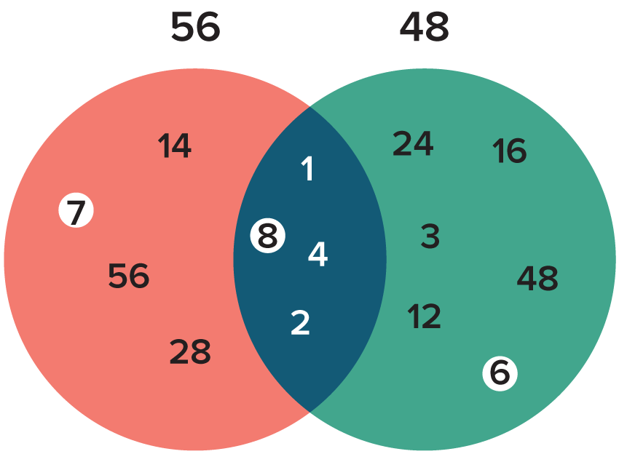

Be Curious
What do you notice?
What do you wonder?
Think first. Share a notice and a question;
build on a classmate’s idea.
Mindset
What strategies could help you work more efficiently?
16 / 51
Notes:
TEACH IN PRACTICE | Embedded facilitation | Lesson 6.7, slide 16 | CURIOUS
Focus on the existing task: What do you notice?
LAUNCH (T2/3/5): Allow quiet observation first. Separate a notice from an inference, invite students’ own questions, and follow the existing launch before teaching a procedure.
LOOK FOR (T4): Where this task addresses it, students can distinguish common factors from common multiples. Ask which feature of their work supports the claim.
RESPOND: If this task shows the lesson misconception—using the greatest common factor for a repeating-cycle problem—organize factor lists or multiple lists for the original numbers and connect them to the context. Have the student revise and explain the change. Use this support only where the concept occurs in the current task; otherwise respond to the displayed question.
RECHECK: If a gap is shared, revisit the existing representation together. If it is limited, give targeted support while others compare valid methods on the same task. Check the revision before moving on.
PARTICIPATION (T5/6/7): Think time before volunteers; accept a written, drawn or rehearsed entry. Students ask for evidence respectfully. Recognize a specific contribution or revision and check that both partners participate.
Source: BCPS Updated Instructional Framework Rubric (June 2020), TEACH 1–7. Earlier notes and answer keys are retained below.
EARLIER NOTES / EXISTING ANSWER KEY
Accept all noticings and wonderings — there are no wrong answers here.
Give 20–30 seconds of quiet think time before taking responses; mix cold and warm calls so it is not always the same voices.
Read the mindset question aloud and let two students respond.
UIFR: TEACH 3 · TEACH 7.

Slide 17
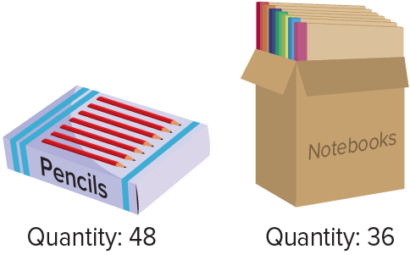
School Store
The school store manager plans to sell a combo pack as a back-to-school item. Each combo pack will have an equal number of pencils and an equal number of notebooks.
Consider the factor pairs 2 and 24 for the pencils and 2 and 18 for the notebooks. What does each factor in a pair represent in this situation?
Reveal:
HOW DO YOU KNOW? · Ask your partner “How do you know?” Answer by pointing to your own work.
17 / 51
Notes:
TEACH IN PRACTICE | Embedded facilitation | Lesson 6.7, slide 17 | REVEAL
Focus on the existing task: Reveal: The school store manager plans to sell a combo pack as a back-to-school item. Each combo pack will have an equal number of…
LAUNCH (T2/3/5): If an existing answer cover is present, gather an attempt before revealing. If the explanation is already visible, ask students to reconstruct and justify it. Compare reasoning and explain a revision; preserve the reveal sequence.
LOOK FOR (T4): Where this task addresses it, students can distinguish common factors from common multiples. Ask which feature of their work supports the claim.
RESPOND: If this task shows the lesson misconception—using the greatest common factor for a repeating-cycle problem—organize factor lists or multiple lists for the original numbers and connect them to the context. Have the student revise and explain the change. Use this support only where the concept occurs in the current task; otherwise respond to the displayed question.
RECHECK: If a gap is shared, revisit the existing representation together. If it is limited, give targeted support while others compare valid methods on the same task. Check the revision before moving on.
PARTICIPATION (T5/6/7): Think time before volunteers; accept a written, drawn or rehearsed entry. Students ask for evidence respectfully. Recognize a specific contribution or revision and check that both partners participate.
Source: BCPS Updated Instructional Framework Rubric (June 2020), TEACH 1–7. Earlier notes and answer keys are retained below.
EARLIER NOTES / EXISTING ANSWER KEY
Students should have shared predictions before this reveal.
Have them compare their thinking to what is shown: “Is this the same as what we said? Where is it different?”
Press one student to explain the reveal in their own words.
UIFR: TEACH 3 · TEACH 4.
UIFR FULL | Lesson-specific facilitation
TEACH 2-3 | Session 1 task launch (UIFR PDF pp. 9-10).
Use the problem exactly as displayed. Give individual thinking time before discussion or advancing to the explanation. If the answer is already visible, ask students to reconstruct and justify it. Invite a choice of suitable representations and have students explain why their choice helps.
At the point where this concept appears, ask: “Does this problem ask for equal groups or a shared repeat, and why does that call for a factor or multiple?” Wait for evidence, invite another pathway, and have a student ask a follow-up question. Do not replace students’ reasoning with a sequence of leading steps.

Slide 18
School Store
Consider the factor pairs for the item quantities. One factor in each pair represents the number of combo packs and the other represents the number of items in each combo pack.
Item | Quantity | Factor Pair
Pencils | 48 | 2, 24
Notebooks | 36 | 2, 18
What do you notice about the factor pairs? What does this tell you about the number of combo packs that can be made?
Reveal:
Each factor pair has a common factor of 2. This means that it is possible to make 2 combo packs with 24 pencils and 18 notebooks in each.
18 / 51
Notes:
TEACH IN PRACTICE | Embedded facilitation | Lesson 6.7, slide 18 | REVEAL
Focus on the existing task: What does this tell you about the number of combo packs that can be made?
LAUNCH (T2/3/5): If an existing answer cover is present, gather an attempt before revealing. If the explanation is already visible, ask students to reconstruct and justify it. Compare reasoning and explain a revision; preserve the reveal sequence.
LOOK FOR (T4): Where this task addresses it, students can distinguish common factors from common multiples. Ask which feature of their work supports the claim.
RESPOND: If this task shows the lesson misconception—using the greatest common factor for a repeating-cycle problem—organize factor lists or multiple lists for the original numbers and connect them to the context. Have the student revise and explain the change. Use this support only where the concept occurs in the current task; otherwise respond to the displayed question.
RECHECK: If a gap is shared, revisit the existing representation together. If it is limited, give targeted support while others compare valid methods on the same task. Check the revision before moving on.
PARTICIPATION (T5/6/7): Think time before volunteers; accept a written, drawn or rehearsed entry. Students ask for evidence respectfully. Recognize a specific contribution or revision and check that both partners participate.
Source: BCPS Updated Instructional Framework Rubric (June 2020), TEACH 1–7. Earlier notes and answer keys are retained below.
EARLIER NOTES / EXISTING ANSWER KEY
Do not click yet: collect 2–3 student answers with reasons first.
Then click to remove the cover and have students compare their thinking to the reveal — “Is this what we said? Where is it different?”
Behind the cover: Each factor pair has a common factor of 2. This means that it is possible to make 2 combo packs with 24 pencils and 18 notebooks in each.
UIFR: TEACH 3 · TEACH 4.

Slide 19
STUDENT MOVES
Lesson 6-7
Your move
PROVE IT · Find the evidence in the problem that makes your answer right — not just the answer.
19 / 51

Slide 20
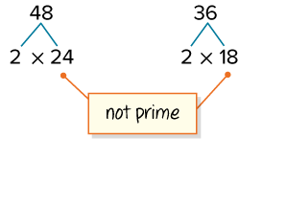
School Store
To find a prime factor, we can find a factor pair that includes a prime number.
Not all the factors are prime. How might you find another prime factor of each number?
TRY IT BEFORE YOU’RE SURE · Start even if you are not sure. A revised answer counts as much as a first-try answer.
Reveal:
For each non-prime factor, we can repeat the process of finding a factor pair that includes a prime number.
20 / 51
Notes:
TEACH IN PRACTICE | Embedded facilitation | Lesson 6.7, slide 19 | REVEAL
Focus on the existing task: Reveal: For each non-prime factor, we can repeat the process of finding a factor pair that includes a prime number. To find a prime…
LAUNCH (T2/3/5): If an existing answer cover is present, gather an attempt before revealing. If the explanation is already visible, ask students to reconstruct and justify it. Compare reasoning and explain a revision; preserve the reveal sequence.
LOOK FOR (T4): Where this task addresses it, students can distinguish common factors from common multiples. Ask which feature of their work supports the claim.
RESPOND: If this task shows the lesson misconception—using the greatest common factor for a repeating-cycle problem—organize factor lists or multiple lists for the original numbers and connect them to the context. Have the student revise and explain the change. Use this support only where the concept occurs in the current task; otherwise respond to the displayed question.
RECHECK: If a gap is shared, revisit the existing representation together. If it is limited, give targeted support while others compare valid methods on the same task. Check the revision before moving on.
PARTICIPATION (T5/6/7): Think time before volunteers; accept a written, drawn or rehearsed entry. Students ask for evidence respectfully. Recognize a specific contribution or revision and check that both partners participate.
Source: BCPS Updated Instructional Framework Rubric (June 2020), TEACH 1–7. Earlier notes and answer keys are retained below.
EARLIER NOTES / EXISTING ANSWER KEY
Do not click yet: collect 2–3 student answers with reasons first.
Then click to remove the cover and have students compare their thinking to the reveal — “Is this what we said? Where is it different?”
Behind the cover: For each non-prime factor, we can repeat the process of finding a factor pair that includes a prime number.
UIFR: TEACH 3 · TEACH 4.

Slide 21
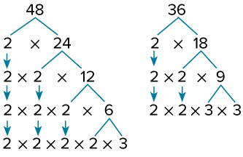
School Store
Let’s repeat the process of finding factor pairs that include prime numbers.
The factor tree is complete when all the factors are prime.
SELF-CHECK · Mark it: ✓ got it · ~ almost · ? stuck. Then fix one thing before we move on.
How do the prime factors relate to the original numbers?
Reveal:
The product of the prime factors is the original number.
21 / 51
Notes:
TEACH IN PRACTICE | Embedded facilitation | Lesson 6.7, slide 20 | REVEAL
Focus on the existing task: Reveal: The product of the prime factors is the original number. Let’s repeat the process of finding factor pairs that include prime…
LAUNCH (T2/3/5): If an existing answer cover is present, gather an attempt before revealing. If the explanation is already visible, ask students to reconstruct and justify it. Compare reasoning and explain a revision; preserve the reveal sequence.
LOOK FOR (T4): Where this task addresses it, students can distinguish common factors from common multiples. Ask which feature of their work supports the claim.
RESPOND: If this task shows the lesson misconception—using the greatest common factor for a repeating-cycle problem—organize factor lists or multiple lists for the original numbers and connect them to the context. Have the student revise and explain the change. Use this support only where the concept occurs in the current task; otherwise respond to the displayed question.
RECHECK: If a gap is shared, revisit the existing representation together. If it is limited, give targeted support while others compare valid methods on the same task. Check the revision before moving on.
PARTICIPATION (T5/6/7): Think time before volunteers; accept a written, drawn or rehearsed entry. Students ask for evidence respectfully. Recognize a specific contribution or revision and check that both partners participate.
Source: BCPS Updated Instructional Framework Rubric (June 2020), TEACH 1–7. Earlier notes and answer keys are retained below.
EARLIER NOTES / EXISTING ANSWER KEY
Do not click yet: collect 2–3 student answers with reasons first.
Then click to remove the cover and have students compare their thinking to the reveal — “Is this what we said? Where is it different?”
Behind the cover: The product of the prime factors is the original number.
UIFR: TEACH 3 · TEACH 4.

Slide 22
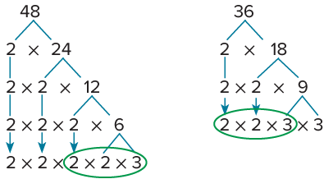
School Store
How do the prime factors of the two quantities compare?
Record your reasoning before the reveal.
Compare, then explain any revision.
Reveal:
The numbers share some prime factors.
22 / 51
Notes:
TEACH IN PRACTICE | Embedded facilitation | Lesson 6.7, slide 21 | REVEAL
Focus on the existing task: Reveal: The numbers share some prime factors. How do the prime factors of the two quantities compare?
LAUNCH (T2/3/5): If an existing answer cover is present, gather an attempt before revealing. If the explanation is already visible, ask students to reconstruct and justify it. Compare reasoning and explain a revision; preserve the reveal sequence.
LOOK FOR (T4): Where this task addresses it, students can distinguish common factors from common multiples. Ask which feature of their work supports the claim.
RESPOND: If this task shows the lesson misconception—using the greatest common factor for a repeating-cycle problem—organize factor lists or multiple lists for the original numbers and connect them to the context. Have the student revise and explain the change. Use this support only where the concept occurs in the current task; otherwise respond to the displayed question.
RECHECK: If a gap is shared, revisit the existing representation together. If it is limited, give targeted support while others compare valid methods on the same task. Check the revision before moving on.
PARTICIPATION (T5/6/7): Think time before volunteers; accept a written, drawn or rehearsed entry. Students ask for evidence respectfully. Recognize a specific contribution or revision and check that both partners participate.
Source: BCPS Updated Instructional Framework Rubric (June 2020), TEACH 1–7. Earlier notes and answer keys are retained below.
EARLIER NOTES / EXISTING ANSWER KEY
Do not click yet: collect 2–3 student answers with reasons first.
Then click to remove the cover and have students compare their thinking to the reveal — “Is this what we said? Where is it different?”
Behind the cover: The numbers share some prime factors.
UIFR: TEACH 3 · TEACH 4.

Slide 23
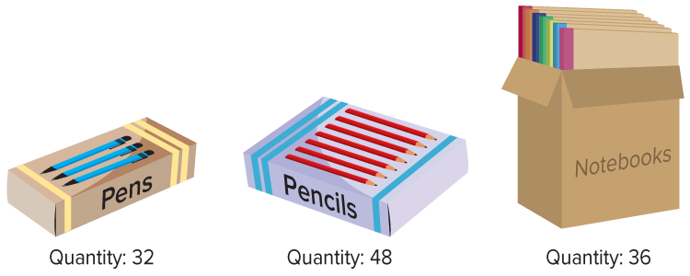
School Store
The school store manager plans to sell a combo pack as a back-to-school item. Each combo pack will have an equal number of pencils and an equal number of notebooks.
What is the greatest number of combo packs that he can make using all the pencils and notebooks?
The manager can make 12 combo packs from the stock of pencils and notebooks.
23 / 51
Notes:
TEACH IN PRACTICE | Embedded facilitation | Lesson 6.7, slide 22 | TASK
Focus on the existing task: The school store manager plans to sell a combo pack as a back-to-school item. Each combo pack will have an equal number of pencils and an…
LAUNCH (T2/3/5): Use the displayed question. Give private thinking time; then A explains while B asks for evidence. Switch roles. Each student records their own reasoning.
LOOK FOR (T4): Where this task addresses it, students can distinguish common factors from common multiples. Ask which feature of their work supports the claim.
RESPOND: If this task shows the lesson misconception—using the greatest common factor for a repeating-cycle problem—organize factor lists or multiple lists for the original numbers and connect them to the context. Have the student revise and explain the change. Use this support only where the concept occurs in the current task; otherwise respond to the displayed question.
RECHECK: If a gap is shared, revisit the existing representation together. If it is limited, give targeted support while others compare valid methods on the same task. Check the revision before moving on.
PARTICIPATION (T5/6/7): Think time before volunteers; accept a written, drawn or rehearsed entry. Students ask for evidence respectfully. Recognize a specific contribution or revision and check that both partners participate.
Source: BCPS Updated Instructional Framework Rubric (June 2020), TEACH 1–7. Earlier notes and answer keys are retained below.
EARLIER NOTES / EXISTING ANSWER KEY
Read the context aloud (or have a student read it).
Before any math, students restate the situation and what is being asked in their own words.
Ask: What is the greatest number of combo packs that he can make using all the pencils and notebooks?
UIFR: TEACH 1 · TEACH 3.

Slide 24
STUDENT MOVES
Lesson 6-7
Your move
PICK YOUR STRATEGY · Choose your path — picture, table, number line, or equation — and be ready to say why you chose it.
24 / 51

Slide 25
Let’s Explore More
How many pencils and how many notebooks will be in each of the 12 combo packs? Explain.
The school store manager is considering adding pens to the combo pack. How many combo packs could she make with the current stock of pencils, pens, and notebooks?
25 / 51
Notes:
TEACH IN PRACTICE | Embedded facilitation | Lesson 6.7, slide 23 | PRACTICE
Focus on the existing task: How many pencils and how many notebooks will be in each of the 12 combo packs?
LAUNCH (T2/3/5): Use the displayed question. Give private thinking time; then A explains while B asks for evidence. Switch roles. Each student records their own reasoning.
LOOK FOR (T4): Where this task addresses it, students can distinguish common factors from common multiples. Ask which feature of their work supports the claim.
RESPOND: If this task shows the lesson misconception—using the greatest common factor for a repeating-cycle problem—organize factor lists or multiple lists for the original numbers and connect them to the context. Have the student revise and explain the change. Use this support only where the concept occurs in the current task; otherwise respond to the displayed question.
RECHECK: If a gap is shared, revisit the existing representation together. If it is limited, give targeted support while others compare valid methods on the same task. Check the revision before moving on.
PARTICIPATION (T5/6/7): Think time before volunteers; accept a written, drawn or rehearsed entry. Students ask for evidence respectfully. Recognize a specific contribution or revision and check that both partners participate.
Source: BCPS Updated Instructional Framework Rubric (June 2020), TEACH 1–7. Earlier notes and answer keys are retained below.
EARLIER NOTES / EXISTING ANSWER KEY
Extension for partners or table groups — students choose their approach and use the workspace to show thinking.
Push with “Convince me,” and have two groups with different approaches share.
This is where students stretch past the worked example.
UIFR: TEACH 2 · TEACH 5.
UIFR FULL | Lesson-specific facilitation
TEACH 4-5 | Session 1 discussion and checkpoint (UIFR PDF pp. 11-12).
Collect a brief response from every student to the existing prompt before hearing volunteers. Partners take turns explaining and asking for evidence: “I understand ___; what supports ___?” Offer rehearsal or an annotated model for students who need language support. Each student records their own reasoning.
Look specifically for: using the greatest common factor for a repeating-cycle problem. If it appears, organize factor lists or multiple lists for the original numbers and connect them to the context; then ask the student to revise the same response and explain the change. If evidence is secure, have students compare a second valid pathway or state why their approach works. Choose the next step from the responses, not a preset pace.

Slide 26
LESSON 6.7 / DISCUSS THE TASK
Explain and compare
Use the task you just explored.
TAKE TURNS
Does this problem ask for equal groups or a shared repeat, and why does that call for a factor or multiple?
Explain
“I know this because…”
Ask
“Where does your work show that?”
Point to evidence in your work.
Then compare your approach with a partner’s.
JUSTIFY IT · Say it like this: “I know ______ because ______.”
Listen to understand. Ask for evidence. Make room for every voice.
Notes:
TEACH IN PRACTICE | Embedded facilitation | Lesson 6.7, slide 24 | PRIOR_INSERT
Focus on the existing task: Point to evidence in your work. Then compare your approach with a partner’s. TAKE TURNS Explain “I know this because…” Ask “Where does your work show that?
CONNECT (T1/4): Ask students to restate the displayed goal or key idea and connect it to earlier work. Relevant lesson evidence: distinguish common factors from common multiples; choose GCF or LCM from context. Use only the criterion that matches the current session.
SHOW PROGRESS: Students point to their own existing work, explain what improved after feedback, and name a next step. Pair confidence ratings with actual evidence.
PARTICIPATION (T5/6/7): Think time before volunteers; accept a written, drawn or rehearsed entry. Students ask for evidence respectfully. Recognize a specific contribution or revision and check that both partners participate.
Source: BCPS Updated Instructional Framework Rubric (June 2020), TEACH 1–7.

Slide 27

Collaborate and Connect
Let’s look for factors that the quantities of pencils and notebooks have in common.
List the factors for each quantity. Which factors do the quantities have in common?
Item | Quantity | Factor Pair
Pencils | 48
Notebooks | 36
TEACH A PARTNER · Teach this to someone who missed it. If you can teach it, you know it.
Reveal:
The common factors are 1, 2, 3, 4, 6, and 12. The store manager should make 12 combo packs.
27 / 51
Notes:
TEACH IN PRACTICE | Embedded facilitation | Lesson 6.7, slide 25 | COLLABORATE
Focus on the existing task: Collaborate and Connect Let’s look for factors that the quantities of pencils and notebooks have in common. List the factors for each quantity. Which factors do the quantities have in common?
LAUNCH (T2/3/5): Use the displayed question. Give private thinking time; then A explains while B asks for evidence. Switch roles. Each student records their own reasoning.
LOOK FOR (T4): Where this task addresses it, students can distinguish common factors from common multiples. Ask which feature of their work supports the claim.
RESPOND: If this task shows the lesson misconception—using the greatest common factor for a repeating-cycle problem—organize factor lists or multiple lists for the original numbers and connect them to the context. Have the student revise and explain the change. Use this support only where the concept occurs in the current task; otherwise respond to the displayed question.
RECHECK: If a gap is shared, revisit the existing representation together. If it is limited, give targeted support while others compare valid methods on the same task. Check the revision before moving on.
PARTICIPATION (T5/6/7): Think time before volunteers; accept a written, drawn or rehearsed entry. Students ask for evidence respectfully. Recognize a specific contribution or revision and check that both partners participate.
Source: BCPS Updated Instructional Framework Rubric (June 2020), TEACH 1–7.

Slide 28
School Store
The common factors are 1, 2, 3, 4, 6, and 12.
Item | Quantity | Factor Pair
Pencils | 48 | 1, 2, 3, 4, 6, 8, 12, 16, 24, 48
Notebooks | 36 | 1, 2, 3, 4, 6, 9, 12, 18, 36
How can you identify the greatest factor the item quantities share?
USE YOUR TOOLS · Reach for your notes, a model, or a manipulative before you reach for an answer.
Reveal:
We can compare the two lists of factors and look for the greatest number they have in common.
28 / 51
Notes:
TEACH IN PRACTICE | Embedded facilitation | Lesson 6.7, slide 26 | REVEAL
Focus on the existing task: Reveal: We can compare the two lists of factors and look for the greatest number they have in common. How can you identify the greatest factor the item quantities share?
LAUNCH (T2/3/5): If an existing answer cover is present, gather an attempt before revealing. If the explanation is already visible, ask students to reconstruct and justify it. Compare reasoning and explain a revision; preserve the reveal sequence.
LOOK FOR (T4): Where this task addresses it, students can distinguish common factors from common multiples. Ask which feature of their work supports the claim.
RESPOND: If this task shows the lesson misconception—using the greatest common factor for a repeating-cycle problem—organize factor lists or multiple lists for the original numbers and connect them to the context. Have the student revise and explain the change. Use this support only where the concept occurs in the current task; otherwise respond to the displayed question.
RECHECK: If a gap is shared, revisit the existing representation together. If it is limited, give targeted support while others compare valid methods on the same task. Check the revision before moving on.
PARTICIPATION (T5/6/7): Think time before volunteers; accept a written, drawn or rehearsed entry. Students ask for evidence respectfully. Recognize a specific contribution or revision and check that both partners participate.
Source: BCPS Updated Instructional Framework Rubric (June 2020), TEACH 1–7.

Slide 29
School Store
Let’s look at another way to find the greatest common factor of 48 and 36.
A factor tree breaks a number down into its prime factors.
Recall that a prime number is a number that has exactly one factor pair.
How might you find one prime factor of a given number?
Reveal:
We can find a factor pair that includes a prime number.
29 / 51
Notes:
TEACH IN PRACTICE | Embedded facilitation | Lesson 6.7, slide 27 | REVEAL
Focus on the existing task: Reveal: We can find a factor pair that includes a prime number. Let’s look at another way to find the greatest common factor of 48 and…
LAUNCH (T2/3/5): If an existing answer cover is present, gather an attempt before revealing. If the explanation is already visible, ask students to reconstruct and justify it. Compare reasoning and explain a revision; preserve the reveal sequence.
LOOK FOR (T4): Where this task addresses it, students can distinguish common factors from common multiples. Ask which feature of their work supports the claim.
RESPOND: If this task shows the lesson misconception—using the greatest common factor for a repeating-cycle problem—organize factor lists or multiple lists for the original numbers and connect them to the context. Have the student revise and explain the change. Use this support only where the concept occurs in the current task; otherwise respond to the displayed question.
RECHECK: If a gap is shared, revisit the existing representation together. If it is limited, give targeted support while others compare valid methods on the same task. Check the revision before moving on.
PARTICIPATION (T5/6/7): Think time before volunteers; accept a written, drawn or rehearsed entry. Students ask for evidence respectfully. Recognize a specific contribution or revision and check that both partners participate.
Source: BCPS Updated Instructional Framework Rubric (June 2020), TEACH 1–7.

Slide 30
Warm-Up
Lesson 6-7 · Find Factors and Multiples
Session 2 Warm-Up
Try alone. Explain one. Then revise.
1
What does GCF stand for?
2
What is the GCF of 12 and 18?
A
General Common Fraction
A
2
B
Greatest Common Factor
B
6
C
Graphing Center Form
C
36
D
Grouped Common Function
D
3
3
What is the Least Common Multiple (LCM) of 4 and 6?
4
Multiples of a number are found by:
A
2
A
Dividing the number
B
12
B
Multiplying by counting numbers
C
24
C
Finding its square root
D
10
D
Subtracting 1
eduwonderlab.com · Neft Teacher
30 / 51
Notes:
TEACH IN PRACTICE | Embedded facilitation | Lesson 6.7, slide 28 | WARMUP
Focus on the existing task: Warm-Up Session 2 Warm-Up Check what you remember from Session 1 1 What does GCF stand for?
GATHER EVIDENCE (T4/6): Keep the original items. Students try independently, mark an uncertain item, and explain one method before checking. Use the existing key when present.
RESPOND: Distinguish a calculation slip from a reasoning gap. Give one next step on the same item; have students revise in a second color. Use the responses to choose flexible support for today’s lesson.
PARTICIPATION (T5/6/7): Think time before volunteers; accept a written, drawn or rehearsed entry. Students ask for evidence respectfully. Recognize a specific contribution or revision and check that both partners participate.
Source: BCPS Updated Instructional Framework Rubric (June 2020), TEACH 1–7. Earlier notes and answer keys are retained below.
EARLIER NOTES / EXISTING ANSWER KEY
Warm-up routine: students start silently on entry; keep it to about 4 minutes.
Circulate and note who is stuck — use what you see to choose who you check on first today.
Go over answers quickly; ask one student to explain a step, not just say the answer.
UIFR: TEACH 4 · TEACH 6.

Slide 31
STUDENT MOVES
Lesson 6-7
Your moves
HOW DO YOU KNOW? · Ask your partner “How do you know?” Answer by pointing to your own work.
YOU KNOW THE ROUTINE · Read → plan → solve → check. Do all four, in that order.
31 / 51

Slide 32
Review Notes — Session 2
Lesson 6-7 · Find Factors and Multiples
Session 2: Review Notes
Copy. Explain. Check.
NAME THE MATH · Point to the part of this that is new today, and say what it changes.
Greatest Common Factor (GCF)
1
The largest whole number that divides evenly into both numbers without remainder.
Least Common Multiple (LCM)
2
The smallest positive multiple shared by both numbers; used to find common denominators.
Prime Factorization
3
Factor trees reveal common prime factors: multiply shared primes to find GCF.
eduwonderlab.com · Neft Teacher
32 / 51
Notes:
TEACH IN PRACTICE | Embedded facilitation | Lesson 6.7, slide 29 | NOTES
Focus on the existing task: Review Notes — Session 2 Session 2: Review Notes Copy into your…
ROUTINE (T1/2/4): Read or copy the original notes, cover one line, and explain it using the displayed example. Reopen and correct. Copying alone is not evidence of understanding.
LOOK FOR: A link between a symbol, quantity or feature and the explanation. If missing, point back to that feature and have the student try again; fade the prompt once they can explain.
PARTICIPATION (T5/6/7): Think time before volunteers; accept a written, drawn or rehearsed entry. Students ask for evidence respectfully. Recognize a specific contribution or revision and check that both partners participate.
Source: BCPS Updated Instructional Framework Rubric (June 2020), TEACH 1–7. Earlier notes and answer keys are retained below.
EARLIER NOTES / EXISTING ANSWER KEY
Copy routine: read one line at a time; students copy, then explain that line to a partner.
Keep it brisk — the understanding work happens in the examples, not the copying.
UIFR: TEACH 1 · TEACH 6.

Slide 33
Session 2
Find Factors and Multiples
ANOTHER PATHWAY · Did anyone get there a different way? Put both pathways side by side and compare.
33 / 51
Notes:
TEACH IN PRACTICE | Embedded facilitation | Lesson 6.7, slide 30 | DIVIDER
Focus on the existing task: Find Factors and Multiples Session 2
TRANSITION (T6/7): Students confirm materials, roles, how to request help, and the next response routine. Ask a student to restate it. Keep teacher-only slides hidden.
PARTICIPATION (T5/6/7): Think time before volunteers; accept a written, drawn or rehearsed entry. Students ask for evidence respectfully. Recognize a specific contribution or revision and check that both partners participate.
Source: BCPS Updated Instructional Framework Rubric (June 2020), TEACH 1–7. Earlier notes and answer keys are retained below.
EARLIER NOTES / EXISTING ANSWER KEY
Transition cue: state what materials are out and what success looks like this session.
Keep the changeover under a minute.
UIFR: TEACH 6.

Slide 34
Community Center Classes
Painting class happens every 8 weeks, so we can find multiples of 8 to find when she will have painting class again.
Pottery class happens every 6 weeks, so we can find multiples of 6 to find when she will have pottery class again.
How can you find when she will have both classes in the same week?
Reveal:
TWO MINUTES SOLO · Two minutes on your own, then compare. Bring one thing you tried, even if it did not work.
34 / 51
Notes:
TEACH IN PRACTICE | Embedded facilitation | Lesson 6.7, slide 31 | REVEAL
Focus on the existing task: Reveal: Painting class happens every 8 weeks, so we can find multiples of 8 to find when she will have painting class again. Pottery…
LAUNCH (T2/3/5): If an existing answer cover is present, gather an attempt before revealing. If the explanation is already visible, ask students to reconstruct and justify it. Compare reasoning and explain a revision; preserve the reveal sequence.
LOOK FOR (T4): Where this task addresses it, students can distinguish common factors from common multiples. Ask which feature of their work supports the claim.
RESPOND: If this task shows the lesson misconception—using the greatest common factor for a repeating-cycle problem—organize factor lists or multiple lists for the original numbers and connect them to the context. Have the student revise and explain the change. Use this support only where the concept occurs in the current task; otherwise respond to the displayed question.
RECHECK: If a gap is shared, revisit the existing representation together. If it is limited, give targeted support while others compare valid methods on the same task. Check the revision before moving on.
PARTICIPATION (T5/6/7): Think time before volunteers; accept a written, drawn or rehearsed entry. Students ask for evidence respectfully. Recognize a specific contribution or revision and check that both partners participate.
Source: BCPS Updated Instructional Framework Rubric (June 2020), TEACH 1–7. Earlier notes and answer keys are retained below.
EARLIER NOTES / EXISTING ANSWER KEY
Students should have shared predictions before this reveal.
Have them compare their thinking to what is shown: “Is this the same as what we said? Where is it different?”
Press one student to explain the reveal in their own words.
UIFR: TEACH 3 · TEACH 4.

Slide 35
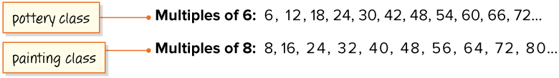
Community Center Classes
What is the least multiple that the classes have in common?
Record your reasoning before the reveal. Compare, then explain any revision.
Reveal:
24
35 / 51
Notes:
TEACH IN PRACTICE | Embedded facilitation | Lesson 6.7, slide 32 | REVEAL
Focus on the existing task: What is the least multiple that the classes have in common?
LAUNCH (T2/3/5): If an existing answer cover is present, gather an attempt before revealing. If the explanation is already visible, ask students to reconstruct and justify it. Compare reasoning and explain a revision; preserve the reveal sequence.
LOOK FOR (T4): Where this task addresses it, students can distinguish common factors from common multiples. Ask which feature of their work supports the claim.
RESPOND: If this task shows the lesson misconception—using the greatest common factor for a repeating-cycle problem—organize factor lists or multiple lists for the original numbers and connect them to the context. Have the student revise and explain the change. Use this support only where the concept occurs in the current task; otherwise respond to the displayed question.
RECHECK: If a gap is shared, revisit the existing representation together. If it is limited, give targeted support while others compare valid methods on the same task. Check the revision before moving on.
PARTICIPATION (T5/6/7): Think time before volunteers; accept a written, drawn or rehearsed entry. Students ask for evidence respectfully. Recognize a specific contribution or revision and check that both partners participate.
Source: BCPS Updated Instructional Framework Rubric (June 2020), TEACH 1–7. Earlier notes and answer keys are retained below.
EARLIER NOTES / EXISTING ANSWER KEY
Do not click yet: collect 2–3 student answers with reasons first.
Then click to remove the cover and have students compare their thinking to the reveal — “Is this what we said? Where is it different?”
Behind the cover: 24
UIFR: TEACH 3 · TEACH 4.

Slide 36
Community Center Classes
The least common multiple of 6 and 8 is 24.
Think and record first. Which part of your work supports your answer?
Think About It:
Why is 48 not the least multiple that the classes have in common?
36 / 51
Notes:
TEACH IN PRACTICE | Embedded facilitation | Lesson 6.7, slide 33 | TASK
Focus on the existing task: Think About It: Why is 48 not the least multiple that the classes have in common?
LAUNCH (T2/3/5): Use the displayed question. Give private thinking time; then A explains while B asks for evidence. Switch roles. Each student records their own reasoning.
LOOK FOR (T4): Where this task addresses it, students can distinguish common factors from common multiples. Ask which feature of their work supports the claim.
RESPOND: If this task shows the lesson misconception—using the greatest common factor for a repeating-cycle problem—organize factor lists or multiple lists for the original numbers and connect them to the context. Have the student revise and explain the change. Use this support only where the concept occurs in the current task; otherwise respond to the displayed question.
RECHECK: If a gap is shared, revisit the existing representation together. If it is limited, give targeted support while others compare valid methods on the same task. Check the revision before moving on.
PARTICIPATION (T5/6/7): Think time before volunteers; accept a written, drawn or rehearsed entry. Students ask for evidence respectfully. Recognize a specific contribution or revision and check that both partners participate.
Source: BCPS Updated Instructional Framework Rubric (June 2020), TEACH 1–7. Earlier notes and answer keys are retained below.
EARLIER NOTES / EXISTING ANSWER KEY
Ask the question, then hold the silence — students think or jot before anyone answers.
Take two or three responses and press with “Why?” or “How do you know?” before moving on.
UIFR: TEACH 3.

Slide 37
Community Center Classes
The least common multiple of 6 and 8 is 24. The least common multiple (LCM) is the multiple shared by two or more numbers with the least value.
Think About It:
When finding the LCM of two numbers, you can stop listing multiples when you reach the product of the two numbers. Why do you think this is?
37 / 51
Notes:
TEACH IN PRACTICE | Embedded facilitation | Lesson 6.7, slide 34 | TASK
Focus on the existing task: Think About It: When finding the LCM of two numbers, you can stop listing multiples when you reach the product of the two numbers. Why do you think this is?
LAUNCH (T2/3/5): Use the displayed question. Give private thinking time; then A explains while B asks for evidence. Switch roles. Each student records their own reasoning.
LOOK FOR (T4): Where this task addresses it, students can distinguish common factors from common multiples. Ask which feature of their work supports the claim.
RESPOND: If this task shows the lesson misconception—using the greatest common factor for a repeating-cycle problem—organize factor lists or multiple lists for the original numbers and connect them to the context. Have the student revise and explain the change. Use this support only where the concept occurs in the current task; otherwise respond to the displayed question.
RECHECK: If a gap is shared, revisit the existing representation together. If it is limited, give targeted support while others compare valid methods on the same task. Check the revision before moving on.
PARTICIPATION (T5/6/7): Think time before volunteers; accept a written, drawn or rehearsed entry. Students ask for evidence respectfully. Recognize a specific contribution or revision and check that both partners participate.
Source: BCPS Updated Instructional Framework Rubric (June 2020), TEACH 1–7. Earlier notes and answer keys are retained below.
EARLIER NOTES / EXISTING ANSWER KEY
Ask the question, then hold the silence — students think or jot before anyone answers.
Take two or three responses and press with “Why?” or “How do you know?” before moving on.
UIFR: TEACH 3.

Slide 38
STUDENT MOVES
Lesson 6-7
Your move
USE THE MATH WORDS · Use today’s math words in your explanation — not “it” and “that thing.”
38 / 51

Slide 39
Community Center Classes
The least common multiple of 6 and 8 is 24. The least common multiple (LCM) is the multiple shared by two or more numbers with the least value.
Think and record first. Which part of your
work supports your answer?
Generalizing
How can this problem be solved more efficiently?
39 / 51
Notes:
TEACH IN PRACTICE | Embedded facilitation | Lesson 6.7, slide 35 | TASK
Focus on the existing task: Generalizing How can this problem be solved more efficiently?
LAUNCH (T2/3/5): Use the displayed question. Give private thinking time; then A explains while B asks for evidence. Switch roles. Each student records their own reasoning.
LOOK FOR (T4): Where this task addresses it, students can distinguish common factors from common multiples. Ask which feature of their work supports the claim.
RESPOND: If this task shows the lesson misconception—using the greatest common factor for a repeating-cycle problem—organize factor lists or multiple lists for the original numbers and connect them to the context. Have the student revise and explain the change. Use this support only where the concept occurs in the current task; otherwise respond to the displayed question.
RECHECK: If a gap is shared, revisit the existing representation together. If it is limited, give targeted support while others compare valid methods on the same task. Check the revision before moving on.
PARTICIPATION (T5/6/7): Think time before volunteers; accept a written, drawn or rehearsed entry. Students ask for evidence respectfully. Recognize a specific contribution or revision and check that both partners participate.
Source: BCPS Updated Instructional Framework Rubric (June 2020), TEACH 1–7. Earlier notes and answer keys are retained below.
EARLIER NOTES / EXISTING ANSWER KEY
Model briefly, then hand the thinking back: ask “Why does this step work?” before showing the next one.
Quick check before moving on — thumbs or whiteboards from everyone, not volunteers.
UIFR: TEACH 2 · TEACH 3 · TEACH 4.

Slide 40
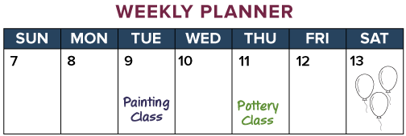
Community Center Classes
Ayasha is at the community center every 8 weeks for her painting class and every 6 weeks for her pottery class. Her schedule for the week is shown.
When will she have both classes in the same week again?
Ayasha will have both classes in the same week again in 24 weeks.
Think and record first. Which part
of your work supports your
answer?
40 / 51
Notes:
TEACH IN PRACTICE | Embedded facilitation | Lesson 6.7, slide 36 | TASK
Focus on the existing task: Ayasha is at the community center every 8 weeks for her painting class and every 6 weeks for her pottery class. Her schedule for the week is shown. When will she have both classes in the same week again?
LAUNCH (T2/3/5): Use the displayed question. Give private thinking time; then A explains while B asks for evidence. Switch roles. Each student records their own reasoning.
LOOK FOR (T4): Where this task addresses it, students can distinguish common factors from common multiples. Ask which feature of their work supports the claim.
RESPOND: If this task shows the lesson misconception—using the greatest common factor for a repeating-cycle problem—organize factor lists or multiple lists for the original numbers and connect them to the context. Have the student revise and explain the change. Use this support only where the concept occurs in the current task; otherwise respond to the displayed question.
RECHECK: If a gap is shared, revisit the existing representation together. If it is limited, give targeted support while others compare valid methods on the same task. Check the revision before moving on.
PARTICIPATION (T5/6/7): Think time before volunteers; accept a written, drawn or rehearsed entry. Students ask for evidence respectfully. Recognize a specific contribution or revision and check that both partners participate.
Source: BCPS Updated Instructional Framework Rubric (June 2020), TEACH 1–7. Earlier notes and answer keys are retained below.
EARLIER NOTES / EXISTING ANSWER KEY
Read the context aloud (or have a student read it).
Before any math, students restate the situation and what is being asked in their own words.
Ask: When will she have both classes in the same week again?
UIFR: TEACH 1 · TEACH 3.

Slide 41
Let’s Explore More
When would the least common multiple of two numbers be the product of the numbers? Give an example.
Can the least common multiple of two numbers ever be one of the given numbers? If so, give an example.
YOUR CHOICE · You choose how to show this — numbers, words, or a diagram. Make your reasoning visible.
41 / 51
Notes:
TEACH IN PRACTICE | Embedded facilitation | Lesson 6.7, slide 37 | PRACTICE
Focus on the existing task: Let’s Explore More When would the least common multiple of two numbers be the product of the numbers?
LAUNCH (T2/3/5): Use the displayed question. Give private thinking time; then A explains while B asks for evidence. Switch roles. Each student records their own reasoning.
LOOK FOR (T4): Where this task addresses it, students can distinguish common factors from common multiples. Ask which feature of their work supports the claim.
RESPOND: If this task shows the lesson misconception—using the greatest common factor for a repeating-cycle problem—organize factor lists or multiple lists for the original numbers and connect them to the context. Have the student revise and explain the change. Use this support only where the concept occurs in the current task; otherwise respond to the displayed question.
RECHECK: If a gap is shared, revisit the existing representation together. If it is limited, give targeted support while others compare valid methods on the same task. Check the revision before moving on.
PARTICIPATION (T5/6/7): Think time before volunteers; accept a written, drawn or rehearsed entry. Students ask for evidence respectfully. Recognize a specific contribution or revision and check that both partners participate.
Source: BCPS Updated Instructional Framework Rubric (June 2020), TEACH 1–7. Earlier notes and answer keys are retained below.
EARLIER NOTES / EXISTING ANSWER KEY
Extension for partners or table groups — students choose their approach and use the workspace to show thinking.
Push with “Convince me,” and have two groups with different approaches share.
This is where students stretch past the worked example.
UIFR: TEACH 2 · TEACH 5.

Slide 42
LESSON 6.7 / CHECK YOUR WORK
Pause. Check. Improve.
CHECK
A mistake to watch for: using the greatest common factor for a repeating-cycle problem.
TRY
Organize factor lists or multiple lists for the given numbers and connect them to the context.
REVISE
Use that check on the task you just completed. Correct or strengthen one part, and explain why.
REVISE NOW · Change one answer and write why you changed it. A revision is evidence of learning.
Listen to understand. Ask for evidence. Make room for every voice.
Notes:
TEACH IN PRACTICE | Embedded facilitation | Lesson 6.7, slide 38 | PRIOR_INSERT
Focus on the existing task: LESSON 6.7 / CHECK YOUR WORK Pause. Check. Improve. Listen to understand. Ask for evidence. Make room for every voice. CHECK A mistake…
CONNECT (T1/4): Ask students to restate the displayed goal or key idea and connect it to earlier work. Relevant lesson evidence: distinguish common factors from common multiples; choose GCF or LCM from context. Use only the criterion that matches the current session.
SHOW PROGRESS: Students point to their own existing work, explain what improved after feedback, and name a next step. Pair confidence ratings with actual evidence.
PARTICIPATION (T5/6/7): Think time before volunteers; accept a written, drawn or rehearsed entry. Students ask for evidence respectfully. Recognize a specific contribution or revision and check that both partners participate.
Source: BCPS Updated Instructional Framework Rubric (June 2020), TEACH 1–7.

Slide 43
Community Center Classes
Ayasha has both classes this week. Painting class occurs every 8 weeks. Pottery class occurs every 6 weeks.
How can you find when she will have painting class again? pottery class?
Compare your reasoning with the explanation. Explain any revision you make.
Reveal:
Painting class occurs every 8 weeks, so we can find multiples of 8. Pottery class happens every 6 weeks, so we can find multiples of 6.
43 / 51
Notes:
TEACH IN PRACTICE | Embedded facilitation | Lesson 6.7, slide 39 | REVEAL
Focus on the existing task: pottery class?
LAUNCH (T2/3/5): If an existing answer cover is present, gather an attempt before revealing. If the explanation is already visible, ask students to reconstruct and justify it. Compare reasoning and explain a revision; preserve the reveal sequence.
LOOK FOR (T4): Where this task addresses it, students can distinguish common factors from common multiples. Ask which feature of their work supports the claim.
RESPOND: If this task shows the lesson misconception—using the greatest common factor for a repeating-cycle problem—organize factor lists or multiple lists for the original numbers and connect them to the context. Have the student revise and explain the change. Use this support only where the concept occurs in the current task; otherwise respond to the displayed question.
RECHECK: If a gap is shared, revisit the existing representation together. If it is limited, give targeted support while others compare valid methods on the same task. Check the revision before moving on.
PARTICIPATION (T5/6/7): Think time before volunteers; accept a written, drawn or rehearsed entry. Students ask for evidence respectfully. Recognize a specific contribution or revision and check that both partners participate.
Source: BCPS Updated Instructional Framework Rubric (June 2020), TEACH 1–7.

Slide 44
Community Center Classes
What is the least multiple that the classes have in common?
Compare your reasoning with the explanation. Explain any revision you make.
Reveal:
24
44 / 51
Notes:
TEACH IN PRACTICE | Embedded facilitation | Lesson 6.7, slide 40 | REVEAL
Focus on the existing task: What is the least multiple that the classes have in common?
LAUNCH (T2/3/5): If an existing answer cover is present, gather an attempt before revealing. If the explanation is already visible, ask students to reconstruct and justify it. Compare reasoning and explain a revision; preserve the reveal sequence.
LOOK FOR (T4): Where this task addresses it, students can distinguish common factors from common multiples. Ask which feature of their work supports the claim.
RESPOND: If this task shows the lesson misconception—using the greatest common factor for a repeating-cycle problem—organize factor lists or multiple lists for the original numbers and connect them to the context. Have the student revise and explain the change. Use this support only where the concept occurs in the current task; otherwise respond to the displayed question.
RECHECK: If a gap is shared, revisit the existing representation together. If it is limited, give targeted support while others compare valid methods on the same task. Check the revision before moving on.
PARTICIPATION (T5/6/7): Think time before volunteers; accept a written, drawn or rehearsed entry. Students ask for evidence respectfully. Recognize a specific contribution or revision and check that both partners participate.
Source: BCPS Updated Instructional Framework Rubric (June 2020), TEACH 1–7.

Slide 45
SUMMARIZE · SAY IT IN YOUR OWN WORDS
Summarize: Find Factors and Multiples
The greatest common factor (GCF) is the factor shared by two or more numbers with the greatest value.
Factors of 48: 1, 2, 3, 4, 6, 8, 12, 16, 24, 48
Factors of 36: 1, 2, 3, 4, 6, 9, 12, 18, 36
The GCF is 12.
Explain the key idea without reading. Use today’s example as evidence.
45 / 51
Notes:
TEACH IN PRACTICE | Embedded facilitation | Lesson 6.7, slide 41 | SUMMARIZE
Focus on the existing task: The greatest common factor (GCF) is the factor shared by two or more numbers with the greatest value. Factors of 48: 1, 2, 3, 4, 6, 8…
CONNECT (T1/4): Ask students to restate the displayed goal or key idea and connect it to earlier work. Relevant lesson evidence: distinguish common factors from common multiples; choose GCF or LCM from context. Use only the criterion that matches the current session.
SHOW PROGRESS: Students point to their own existing work, explain what improved after feedback, and name a next step. Pair confidence ratings with actual evidence.
PARTICIPATION (T5/6/7): Think time before volunteers; accept a written, drawn or rehearsed entry. Students ask for evidence respectfully. Recognize a specific contribution or revision and check that both partners participate.
Source: BCPS Updated Instructional Framework Rubric (June 2020), TEACH 1–7. Earlier notes and answer keys are retained below.
EARLIER NOTES / EXISTING ANSWER KEY
Routine: SUMMARIZE · SAY IT IN YOUR OWN WORDS

Slide 46
SUMMARIZE · SAY IT IN YOUR OWN WORDS
Summarize: Find Factors and Multiples
The least common multiple (LCM) is the multiple shared by two or more numbers with the least value.
Multiples of 15: 15, 30, 45…
Multiples of 30: 30, 60, 90…
The LCM is 30.
Explain the key idea without reading. Use today’s example as evidence.
46 / 51
Notes:
TEACH IN PRACTICE | Embedded facilitation | Lesson 6.7, slide 42 | SUMMARIZE
Focus on the existing task: The least common multiple (LCM) is the multiple shared by two or more numbers with the least value. Multiples of 15: 15, 30, 45……
CONNECT (T1/4): Ask students to restate the displayed goal or key idea and connect it to earlier work. Relevant lesson evidence: distinguish common factors from common multiples; choose GCF or LCM from context. Use only the criterion that matches the current session.
SHOW PROGRESS: Students point to their own existing work, explain what improved after feedback, and name a next step. Pair confidence ratings with actual evidence.
PARTICIPATION (T5/6/7): Think time before volunteers; accept a written, drawn or rehearsed entry. Students ask for evidence respectfully. Recognize a specific contribution or revision and check that both partners participate.
Source: BCPS Updated Instructional Framework Rubric (June 2020), TEACH 1–7. Earlier notes and answer keys are retained below.
EARLIER NOTES / EXISTING ANSWER KEY
Routine: SUMMARIZE · SAY IT IN YOUR OWN WORDS

Slide 47
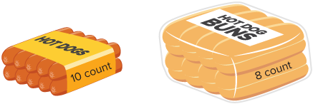
APPLY · PLAN IT • SOLVE IT • PROVE IT
Apply: Party Plans
Reginald is having hot dogs at his party and 24 people are coming. His mom wants to have the same number of buns and hot dogs. Hot dogs and buns come in the packs shown.
Question: How many packs of each do you recommend that she buy? Explain your reasoning.
47 / 51
Notes:
TEACH IN PRACTICE | Embedded facilitation | Lesson 6.7, slide 43 | APPLY
Focus on the existing task: Reginald is having hot dogs at his party and 24 people are coming. His mom wants to have the same number of buns and hot dogs. Hot dogs…
LAUNCH (T2/3/5): Use the exact application task independently first. Ask students to justify their choice of method. Collect evidence before a partner discussion or correction.
LOOK FOR (T4): Where this task addresses it, students can distinguish common factors from common multiples. Ask which feature of their work supports the claim.
RESPOND: If this task shows the lesson misconception—using the greatest common factor for a repeating-cycle problem—organize factor lists or multiple lists for the original numbers and connect them to the context. Have the student revise and explain the change. Use this support only where the concept occurs in the current task; otherwise respond to the displayed question.
RECHECK: If a gap is shared, revisit the existing representation together. If it is limited, give targeted support while others compare valid methods on the same task. Check the revision before moving on.
PARTICIPATION (T5/6/7): Think time before volunteers; accept a written, drawn or rehearsed entry. Students ask for evidence respectfully. Recognize a specific contribution or revision and check that both partners participate.
Source: BCPS Updated Instructional Framework Rubric (June 2020), TEACH 1–7. Earlier notes and answer keys are retained below.
EARLIER NOTES / EXISTING ANSWER KEY
Routine: APPLY · PLAN IT • SOLVE IT • PROVE IT
UIFR FULL | Lesson-specific facilitation
TEACH 4 | Independent evidence and revision (UIFR PDF p. 11).
Use the existing application/exit problem as the independent check. If this is a learning-target slide, have students point to and explain their work on the preceding task. Separate initial independent evidence from the revision after feedback.
Check the relevant criteria: distinguish common factors from common multiples; choose GCF or LCM from context. Respond with one specific next step tied to the work. Students revise and annotate what changed, then identify a criterion they can now demonstrate and one they still need to practice.

Slide 48
STUDENT MOVES
Lesson 6-7
Your move
SPECIFIC FEEDBACK · Trade work. Give one specific comment: “This part is clear because ______.”
48 / 51

Slide 49
Learning Targets
I can find the greatest common factor of two whole numbers.
I can find the least common multiple of two whole numbers.
I can make sense of problems to find the greatest common factor or least common multiple of two whole numbers.
SAY THE GOAL · Say today’s goal in your own words, then name one place this shows up outside math class.
49 / 51
Notes:
TEACH IN PRACTICE | Embedded facilitation | Lesson 6.7, slide 44 | REFLECTION
Focus on the existing task: I can find the greatest common factor of two whole numbers. I can find the least common multiple of two whole numbers. I can make sense of…
CONNECT (T1/4): Ask students to restate the displayed goal or key idea and connect it to earlier work. Relevant lesson evidence: distinguish common factors from common multiples; choose GCF or LCM from context. Use only the criterion that matches the current session.
SHOW PROGRESS: Students point to their own existing work, explain what improved after feedback, and name a next step. Pair confidence ratings with actual evidence.
PARTICIPATION (T5/6/7): Think time before volunteers; accept a written, drawn or rehearsed entry. Students ask for evidence respectfully. Recognize a specific contribution or revision and check that both partners participate.
Source: BCPS Updated Instructional Framework Rubric (June 2020), TEACH 1–7. Earlier notes and answer keys are retained below.
EARLIER NOTES / EXISTING ANSWER KEY
Read each target; students self-rate with fist-to-five or thumbs.
Tie back to the goal from the start of class: did we get there?
Note any target that rates low — revisit it tomorrow.
UIFR: TEACH 1 · TEACH 4.

Slide 50
Be Curious
Which doesn’t belong?
ASK THE CLASS · Write one question about this that you could ask the class.
5 | 15
20 | 47
Mindset
What strategies are helping you work more efficiently?
50 / 51
Notes:
TEACH IN PRACTICE | Embedded facilitation | Lesson 6.7, slide 45 | CURIOUS
Focus on the existing task: Which doesn’t belong?
LAUNCH (T2/3/5): Allow quiet observation first. Separate a notice from an inference, invite students’ own questions, and follow the existing launch before teaching a procedure.
LOOK FOR (T4): Where this task addresses it, students can distinguish common factors from common multiples. Ask which feature of their work supports the claim.
RESPOND: If this task shows the lesson misconception—using the greatest common factor for a repeating-cycle problem—organize factor lists or multiple lists for the original numbers and connect them to the context. Have the student revise and explain the change. Use this support only where the concept occurs in the current task; otherwise respond to the displayed question.
RECHECK: If a gap is shared, revisit the existing representation together. If it is limited, give targeted support while others compare valid methods on the same task. Check the revision before moving on.
PARTICIPATION (T5/6/7): Think time before volunteers; accept a written, drawn or rehearsed entry. Students ask for evidence respectfully. Recognize a specific contribution or revision and check that both partners participate.
Source: BCPS Updated Instructional Framework Rubric (June 2020), TEACH 1–7. Earlier notes and answer keys are retained below.
EARLIER NOTES / EXISTING ANSWER KEY
UIFR FULL | Lesson-specific facilitation
REFLECT & ADJUST 1-2 | After the lesson (UIFR PDF pp. 15-16).
Sort the existing work by demonstrated reasoning, partial understanding, and the specific misconception: using the greatest common factor for a repeating-cycle problem. Compare the initial response with the revision. Record which teaching move plausibly helped, which did not, and whose participation or access needs a different approach; do not record sensitive student details in this shared deck.
Plan the next lesson from that evidence: if the misconception persists, organize factor lists or multiple lists for the original numbers and connect them to the context using the current example before returning to the next grade-level task; if understanding is secure, use an existing extension or ask for a general explanation. Check the targeted idea again at the next warm-up.
Ask students what supported their thinking and what would help next time. Identify one change to try and one successful practice to retain. Seek colleague feedback on anonymized work when useful; these prompts support reflection and do not establish an evaluation rating. Source: Baltimore City Public Schools, Updated Instructional Framework Rubric, June 2020 (UIFR_Full.pdf).

Slide 51
LESSON 6.7 / REFLECT ON YOUR LEARNING
Show your progress
1 SHOW EVIDENCE
2 CHOOSE A NEXT STEP
Choose one response. Point to the part that shows your reasoning.
Name a change you made after feedback—or a question you still have.
“My work shows ___ because ___.”
“Next time, I will ___ to help me ___.”
Today’s focus: Distinguish common factors from common multiples.
CREDIT A CLASSMATE · Name one classmate whose idea helped you today, and say what they said.
Listen to understand. Ask for evidence. Make room for every voice.
Notes:
TEACH IN PRACTICE | Embedded facilitation | Lesson 6.7, slide 46 | PRIOR_INSERT
Focus on the existing task: LESSON 6.7 / REFLECT ON YOUR LEARNING Show your progress Listen to understand. Ask for evidence. Make room for every voice. 1 SHOW…
CONNECT (T1/4): Ask students to restate the displayed goal or key idea and connect it to earlier work. Relevant lesson evidence: distinguish common factors from common multiples; choose GCF or LCM from context. Use only the criterion that matches the current session.
SHOW PROGRESS: Students point to their own existing work, explain what improved after feedback, and name a next step. Pair confidence ratings with actual evidence.
PARTICIPATION (T5/6/7): Think time before volunteers; accept a written, drawn or rehearsed entry. Students ask for evidence respectfully. Recognize a specific contribution or revision and check that both partners participate.
Source: BCPS Updated Instructional Framework Rubric (June 2020), TEACH 1–7.

