Slide 1
WARM-UP · THINK • TRY • CHECK
Turn and talk: compare strategies, then defend one.
Warm-Up
Lesson 6-8 · Generate Equivalent Expressions | Warm-Up · about 4 minutes
Try each on your own. Mark an unsure answer; explain and revise when we check.
QUESTION 1
QUESTION 2
The GCF of 18 and 24 is ______
3(x + 5) = ______
QUESTION 3
QUESTION 4
5x + 2x = ______
6(4 + 3) = ______
TALK IT OVER: “I got ______ because ______.” • Compare with a partner before we check as a class.
1 / 41
Notes:
TEACH IN PRACTICE | Embedded facilitation | Lesson 6.8, slide 1 | WARMUP
Focus on the existing task: Warm-Up WARM-UP · THINK • TRY • CHECK Do these four on…
GATHER EVIDENCE (T4/6): Keep the original items. Students try independently, mark an uncertain item, and explain one method before checking. Use the existing key when present.
RESPOND: Distinguish a calculation slip from a reasoning gap. Give one next step on the same item; have students revise in a second color. Use the responses to choose flexible support for today’s lesson.
PARTICIPATION (T5/6/7): Think time before volunteers; accept a written, drawn or rehearsed entry. Students ask for evidence respectfully. Recognize a specific contribution or revision and check that both partners participate.
Source: BCPS Updated Instructional Framework Rubric (June 2020), TEACH 1–7. Earlier notes and answer keys are retained below.
EARLIER NOTES / EXISTING ANSWER KEY
Warm-Up answers (teacher only): 1) 6 2) 3x + 15 3) 7x 4) 42
UIFR FULL | Lesson-specific facilitation
PREPARE 1-2 | Before teaching (UIFR PDF pp. 6-7).
Plan to gather evidence that students can rewrite using valid properties; preserve value; explain the property at each step. Review recent work and today’s warm-up to choose flexible groups and access supports; do not infer needs from identity or perceived ability. Use the existing lesson tasks and stated standards.
Anticipate: applying commutative reasoning to subtraction or division. If observed, mark what changed in the original expression: order, grouping, or an identity element. Offer oral rehearsal, drawing, pointing, or home-language processing as needed; retain the original mathematical demand. Ask students which support helps and fade it as evidence improves.
TEACH 6-7 | Before the first transition, agree on materials, partner roles, and how to request help. Invite students to restate the routine. Normalize revising an idea, recognize a specific contribution, and check privately when frustration blocks participation. Source: UIFR PDF pp. 13-14.

Slide 2
Today’s Math Notes
Lesson 6-8 · Generate Equivalent Expressions
Section 1: Math Words
Copy. Explain. Check.
SAY THE GOAL · Say today’s goal in your own words, then name one place this shows up outside math class.
Properties of Operations
1
Rules
Commutative Property
2
You can change the order and get the same answer
Associative Property
3
You can change the grouping and get the same answer
eduwonderlab.com · Neft Teacher
2 / 41
Notes:
TEACH IN PRACTICE | Embedded facilitation | Lesson 6.8, slide 2 | NOTES
Focus on the existing task: Today’s Math Notes Section 1: Math Words Copy into your…
ROUTINE (T1/2/4): Read or copy the original notes, cover one line, and explain it using the displayed example. Reopen and correct. Copying alone is not evidence of understanding.
LOOK FOR: A link between a symbol, quantity or feature and the explanation. If missing, point back to that feature and have the student try again; fade the prompt once they can explain.
PARTICIPATION (T5/6/7): Think time before volunteers; accept a written, drawn or rehearsed entry. Students ask for evidence respectfully. Recognize a specific contribution or revision and check that both partners participate.
Source: BCPS Updated Instructional Framework Rubric (June 2020), TEACH 1–7. Earlier notes and answer keys are retained below.
EARLIER NOTES / EXISTING ANSWER KEY
Copy routine: read one line at a time; students copy, then explain that line to a partner.
Keep it brisk — the understanding work happens in the examples, not the copying.
UIFR: TEACH 1 · TEACH 6.

Slide 3
Today’s Math Notes
Lesson 6-8 · Generate Equivalent Expressions
Section 2: Today’s Math
Copy. Explain. Check.
CONNECT IT · What earlier lesson does this build on? Tell a partner in one sentence.
Properties of Operations
Commutative: a + b = b + a
Associative: (a + b) + c = a + (b + c)
1
Commutative Property: Order does not change sum or product
2
Associative Property: Grouping does not change sum or product
3
Identity Property: a + 0 = a; a · 1 = a
eduwonderlab.com · Neft Teacher
3 / 41
Notes:
TEACH IN PRACTICE | Embedded facilitation | Lesson 6.8, slide 3 | NOTES
Focus on the existing task: Today’s Math Notes Section 2: Today’s Math Copy into your…
ROUTINE (T1/2/4): Read or copy the original notes, cover one line, and explain it using the displayed example. Reopen and correct. Copying alone is not evidence of understanding.
LOOK FOR: A link between a symbol, quantity or feature and the explanation. If missing, point back to that feature and have the student try again; fade the prompt once they can explain.
PARTICIPATION (T5/6/7): Think time before volunteers; accept a written, drawn or rehearsed entry. Students ask for evidence respectfully. Recognize a specific contribution or revision and check that both partners participate.
Source: BCPS Updated Instructional Framework Rubric (June 2020), TEACH 1–7. Earlier notes and answer keys are retained below.
EARLIER NOTES / EXISTING ANSWER KEY
Copy routine: read one line at a time; students copy, then explain that line to a partner.
Keep it brisk — the understanding work happens in the examples, not the copying.
UIFR: TEACH 1 · TEACH 6.

Slide 4
Session 1
Generate Equivalent Expressions
TRY IT BEFORE YOU’RE SURE · Start even if you are not sure. A revised answer counts as much as a first-try answer.
4 / 41
Notes:
TEACH IN PRACTICE | Embedded facilitation | Lesson 6.8, slide 4 | DIVIDER
Focus on the existing task: Generate Equivalent Expressions Session 1
TRANSITION (T6/7): Students confirm materials, roles, how to request help, and the next response routine. Ask a student to restate it. Keep teacher-only slides hidden.
PARTICIPATION (T5/6/7): Think time before volunteers; accept a written, drawn or rehearsed entry. Students ask for evidence respectfully. Recognize a specific contribution or revision and check that both partners participate.
Source: BCPS Updated Instructional Framework Rubric (June 2020), TEACH 1–7. Earlier notes and answer keys are retained below.
EARLIER NOTES / EXISTING ANSWER KEY
Transition cue: state what materials are out and what success looks like this session.
Keep the changeover under a minute.
UIFR: TEACH 6.

Slide 5
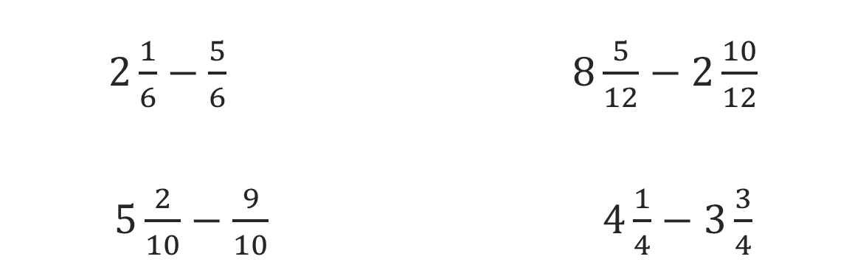
Or You Could
Explain how the information shown supports your reasoning.
5 / 41
Notes:
TEACH IN PRACTICE | Embedded facilitation | Lesson 6.8, slide 5 | WORKED
Focus on the existing task: Or You Could
LAUNCH (T2/3/5): Ask students to explain the displayed idea or example and point to evidence. When a calculation step is shown, ask why it is valid. Have a partner restate the explanation; copying is not the check.
LOOK FOR (T4): Where this task addresses it, students can rewrite using valid properties. Ask which feature of their work supports the claim.
RESPOND: If this task shows the lesson misconception—applying commutative reasoning to subtraction or division—mark what changed in the original expression: order, grouping, or an identity element. Have the student revise and explain the change. Use this support only where the concept occurs in the current task; otherwise respond to the displayed question.
RECHECK: If a gap is shared, revisit the existing representation together. If it is limited, give targeted support while others compare valid methods on the same task. Check the revision before moving on.
PARTICIPATION (T5/6/7): Think time before volunteers; accept a written, drawn or rehearsed entry. Students ask for evidence respectfully. Recognize a specific contribution or revision and check that both partners participate.
Source: BCPS Updated Instructional Framework Rubric (June 2020), TEACH 1–7. Earlier notes and answer keys are retained below.
EARLIER NOTES / EXISTING ANSWER KEY
Model briefly, then hand the thinking back: ask “Why does this step work?” before showing the next one.
Quick check before moving on — thumbs or whiteboards from everyone, not volunteers.
UIFR: TEACH 2 · TEACH 3 · TEACH 4.

Slide 6
Today’s Objectives
Lesson 6-8 · Generate Equivalent Expressions
Generate Equivalent Expressions
Maryland Standard 6.AT.7
SHOW YOUR THINKING · Show what you know — write it, draw it, or build it. A picture counts as an explanation.
CONTENT OBJECTIVE
LANGUAGE OBJECTIVE
Restate the goal in your words
Use these words to explain why
I can use the commutative, associative, and identity properties to rewrite expressions.
I can explain my reasoning using the words commutative property, associative property, and identity property.
eduwonderlab.com · Neft Teacher
6 / 41
Notes:
TEACH IN PRACTICE | Embedded facilitation | Lesson 6.8, slide 6 | GOAL
Focus on the existing task: Today’s Objectives Generate Equivalent Expressions Maryland…
CONNECT (T1/4): Ask students to restate the displayed goal or key idea and connect it to earlier work. Relevant lesson evidence: rewrite using valid properties; preserve value; explain the property at each step. Use only the criterion that matches the current session.
SHOW PROGRESS: Students point to their own existing work, explain what improved after feedback, and name a next step. Pair confidence ratings with actual evidence.
PARTICIPATION (T5/6/7): Think time before volunteers; accept a written, drawn or rehearsed entry. Students ask for evidence respectfully. Recognize a specific contribution or revision and check that both partners participate.
Source: BCPS Updated Instructional Framework Rubric (June 2020), TEACH 1–7. Earlier notes and answer keys are retained below.
EARLIER NOTES / EXISTING ANSWER KEY
Read the objective together, then have one or two students restate today’s goal in their own words.
Connect it to what the class learned last lesson.
Return to this goal at the end of class to check it was met.
UIFR: TEACH 1.
UIFR FULL | Lesson-specific facilitation
TEACH 1 | Session 1 purpose and evidence (UIFR PDF p. 8).
Have students restate the displayed session goal in their own words and connect it to the existing context or a familiar experience they choose to share. Use the current session goal to select from these lesson-wide evidence criteria; do not frontload a later-session procedure.
Look for: rewrite using valid properties; preserve value; explain the property at each step. Ask: “Which part of your work would show this?” Revisit that evidence after the task; a confidence rating alone is not evidence of understanding.

Slide 7
LESSON 6.8 / OUR LEARNING
What will show your learning?
1
Rewrite using valid properties.
2
Preserve value.
3
Explain the property at each step.
Tell a partner: Which skill connects to something you already know?
WHY IT MATTERS · Finish this: “This is worth knowing because ______.”
Listen to understand. Ask for evidence. Make room for every voice.
Notes:
TEACH IN PRACTICE | Embedded facilitation | Lesson 6.8, slide 7 | PRIOR_INSERT
Focus on the existing task: LESSON 6.8 / OUR LEARNING What will show your learning?
CONNECT (T1/4): Ask students to restate the displayed goal or key idea and connect it to earlier work. Relevant lesson evidence: rewrite using valid properties; preserve value; explain the property at each step. Use only the criterion that matches the current session.
SHOW PROGRESS: Students point to their own existing work, explain what improved after feedback, and name a next step. Pair confidence ratings with actual evidence.
PARTICIPATION (T5/6/7): Think time before volunteers; accept a written, drawn or rehearsed entry. Students ask for evidence respectfully. Recognize a specific contribution or revision and check that both partners participate.
Source: BCPS Updated Instructional Framework Rubric (June 2020), TEACH 1–7.

Slide 8
Vocabulary 1 of 6
Lesson 6-8 · Generate Equivalent Expressions
Properties of Operations
Rules that let you reorder or regroup numbers without changing an expression’s value.
EXAMPLE · EXPLAIN WHY IT FITS
3 + 5 = 5 + 3 (commutative property).
USE THE MATH WORDS · Use today’s math words in your explanation — not “it” and “that thing.”
eduwonderlab.com · Neft Teacher
8 / 41
Notes:
TEACH IN PRACTICE | Embedded facilitation | Lesson 6.8, slide 8 | VOCAB
Focus on the existing task: Vocabulary 1 of 6 Properties of Operations Rules that let…
ASK (T1/3/5): Where does “Properties of Operations” appear in the example? Explain the meaning without reading the definition. Partner: restate the idea and ask a clarifying question.
LOOK FOR: A correct connection between the word and a feature of the example. If the student only repeats the definition, invite pointing, sketching or oral rehearsal, then ask for another explanation of this same example.
PARTICIPATION (T5/6/7): Think time before volunteers; accept a written, drawn or rehearsed entry. Students ask for evidence respectfully. Recognize a specific contribution or revision and check that both partners participate.
Source: BCPS Updated Instructional Framework Rubric (June 2020), TEACH 1–7.

Slide 9
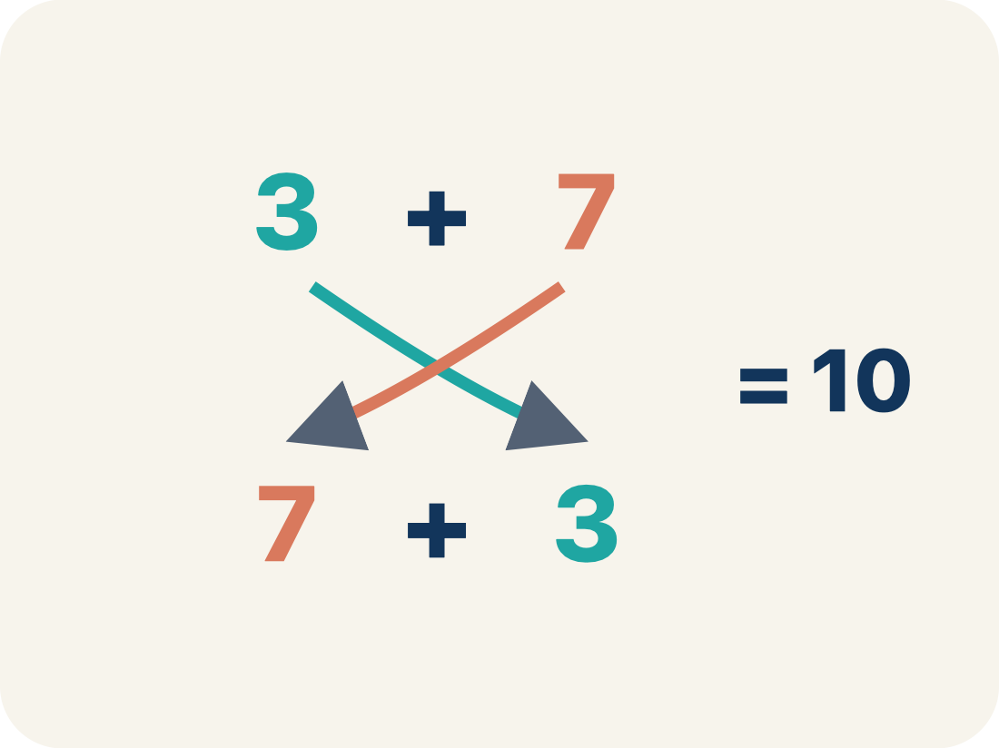
Vocabulary 2 of 6
Lesson 6-8 · Generate Equivalent Expressions
Commutative Property
You can change the order and get the same answer.
EXAMPLE · EXPLAIN WHY IT FITS
3 + 7 = 7 + 3 = 10 both ways; 4 × 5 = 5 × 4 = 20 both ways — order does not matter
Use “Commutative Property” to explain the example. Point to
evidence.
eduwonderlab.com · Neft Teacher
9 / 41
Notes:
TEACH IN PRACTICE | Embedded facilitation | Lesson 6.8, slide 9 | VOCAB
Focus on the existing task: Vocabulary 2 of 6 Commutative Property You can change the…
ASK (T1/3/5): Where does “Commutative Property” appear in the example? Explain the meaning without reading the definition. Partner: restate the idea and ask a clarifying question.
LOOK FOR: A correct connection between the word and a feature of the example. If the student only repeats the definition, invite pointing, sketching or oral rehearsal, then ask for another explanation of this same example.
PARTICIPATION (T5/6/7): Think time before volunteers; accept a written, drawn or rehearsed entry. Students ask for evidence respectfully. Recognize a specific contribution or revision and check that both partners participate.
Source: BCPS Updated Instructional Framework Rubric (June 2020), TEACH 1–7.

Slide 10
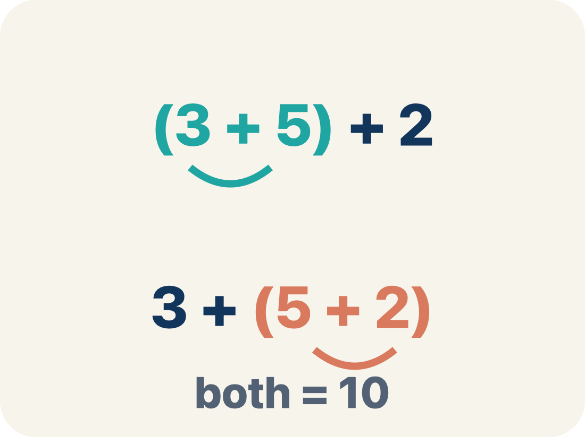
Vocabulary 3 of 6
Lesson 6-8 · Generate Equivalent Expressions
Associative Property
You can change the grouping and get the same answer.
EXAMPLE · EXPLAIN WHY IT FITS
(2 + 3) + 4 = 5 + 4 = 9 and 2 + (3 + 4) = 2 + 7 = 9 — same answer, different grouping
Use “Associative Property” to explain the example. Point to
evidence.
eduwonderlab.com · Neft Teacher
10 / 41
Notes:
TEACH IN PRACTICE | Embedded facilitation | Lesson 6.8, slide 10 | VOCAB
Focus on the existing task: Vocabulary 3 of 6 Associative Property You can change the…
ASK (T1/3/5): Where does “Associative Property” appear in the example? Explain the meaning without reading the definition. Partner: restate the idea and ask a clarifying question.
LOOK FOR: A correct connection between the word and a feature of the example. If the student only repeats the definition, invite pointing, sketching or oral rehearsal, then ask for another explanation of this same example.
PARTICIPATION (T5/6/7): Think time before volunteers; accept a written, drawn or rehearsed entry. Students ask for evidence respectfully. Recognize a specific contribution or revision and check that both partners participate.
Source: BCPS Updated Instructional Framework Rubric (June 2020), TEACH 1–7.

Slide 11
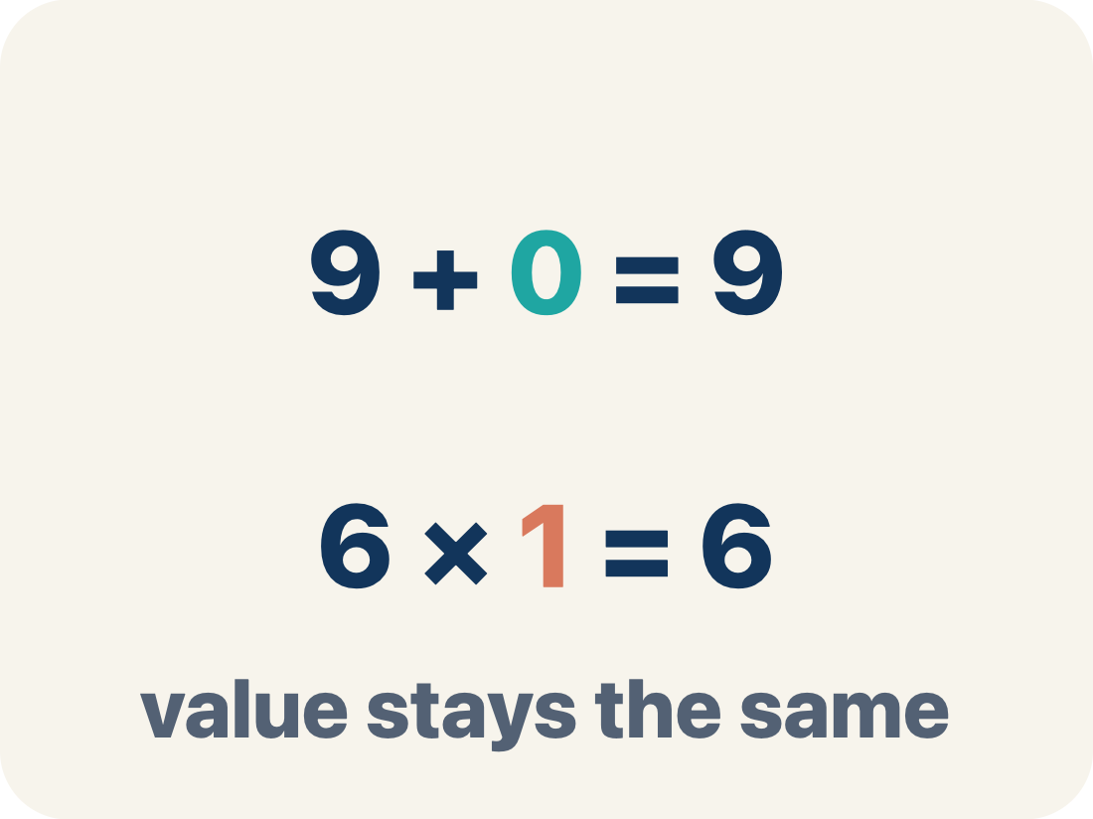
Vocabulary 4 of 6
Lesson 6-8 · Generate Equivalent Expressions
Identity Property
Adding 0 or multiplying by 1 keeps the same value.
EXAMPLE · EXPLAIN WHY IT FITS
9 + 0 = 9 (zero is the identity for addition); 6 × 1 = 6 (one is the identity for multiplication)
Use “Identity Property” to explain the example. Point to
evidence.
eduwonderlab.com · Neft Teacher
11 / 41
Notes:
TEACH IN PRACTICE | Embedded facilitation | Lesson 6.8, slide 11 | VOCAB
Focus on the existing task: Vocabulary 4 of 6 Identity Property Adding 0 or…
ASK (T1/3/5): Where does “Identity Property” appear in the example? Explain the meaning without reading the definition. Partner: restate the idea and ask a clarifying question.
LOOK FOR: A correct connection between the word and a feature of the example. If the student only repeats the definition, invite pointing, sketching or oral rehearsal, then ask for another explanation of this same example.
PARTICIPATION (T5/6/7): Think time before volunteers; accept a written, drawn or rehearsed entry. Students ask for evidence respectfully. Recognize a specific contribution or revision and check that both partners participate.
Source: BCPS Updated Instructional Framework Rubric (June 2020), TEACH 1–7.

Slide 12
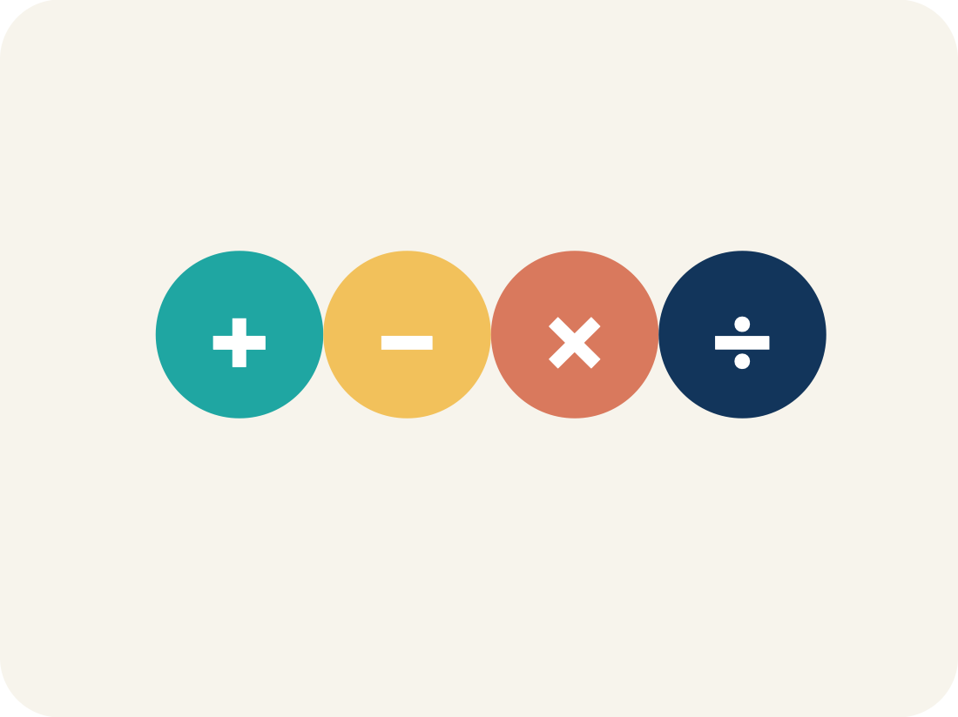
Vocabulary 5 of 6
Lesson 6-8 · Generate Equivalent Expressions
Property
A rule that is always true in math.
EXAMPLE · EXPLAIN WHY IT FITS
Commutative works for + and ×, but NOT for − or ÷ (since 5 − 3 = 2 but 3 − 5 = −2)
Use “Property” to explain the example. Point to evidence.
eduwonderlab.com · Neft Teacher
12 / 41
Notes:
TEACH IN PRACTICE | Embedded facilitation | Lesson 6.8, slide 12 | VOCAB
Focus on the existing task: Vocabulary 5 of 6 Property A rule that is always true in…
ASK (T1/3/5): Where does “Property” appear in the example? Explain the meaning without reading the definition. Partner: restate the idea and ask a clarifying question.
LOOK FOR: A correct connection between the word and a feature of the example. If the student only repeats the definition, invite pointing, sketching or oral rehearsal, then ask for another explanation of this same example.
PARTICIPATION (T5/6/7): Think time before volunteers; accept a written, drawn or rehearsed entry. Students ask for evidence respectfully. Recognize a specific contribution or revision and check that both partners participate.
Source: BCPS Updated Instructional Framework Rubric (June 2020), TEACH 1–7.

Slide 13
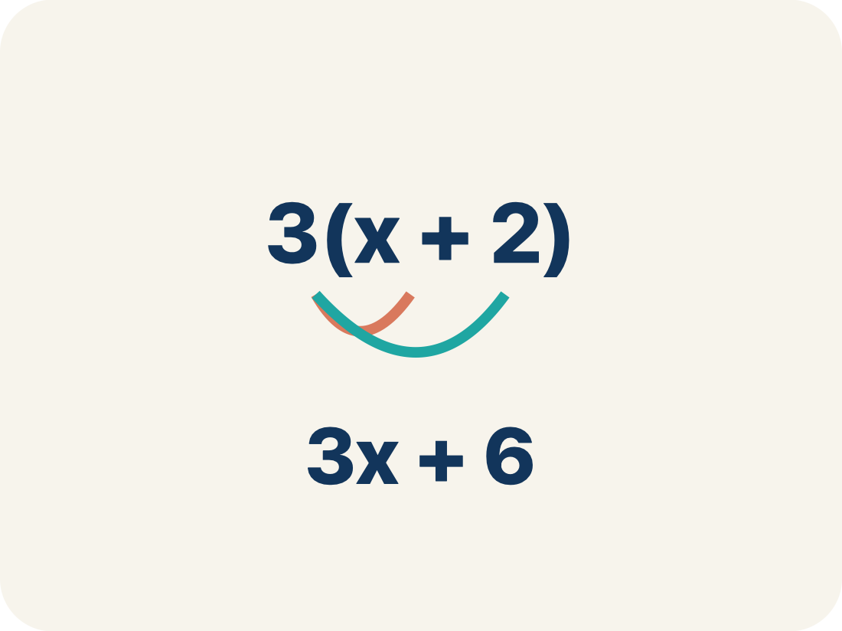
Vocabulary 6 of 6
Lesson 6-8 · Generate Equivalent Expressions
Distributive Property
Multiplying a number by everything inside the parentheses: a(b + c) = ab + ac.
EXAMPLE · EXPLAIN WHY IT FITS
5(7 + 2) = 5 × 7 + 5 × 2 = 35 + 10 = 45; and 5 × 9 = 45 — same answer either way
Use “Distributive Property” to explain the example. Point to
evidence.
eduwonderlab.com · Neft Teacher
13 / 41
Notes:
TEACH IN PRACTICE | Embedded facilitation | Lesson 6.8, slide 13 | VOCAB
Focus on the existing task: Vocabulary 6 of 6 Distributive Property Multiplying a…
ASK (T1/3/5): Where does “Distributive Property” appear in the example? Explain the meaning without reading the definition. Partner: restate the idea and ask a clarifying question.
LOOK FOR: A correct connection between the word and a feature of the example. If the student only repeats the definition, invite pointing, sketching or oral rehearsal, then ask for another explanation of this same example.
PARTICIPATION (T5/6/7): Think time before volunteers; accept a written, drawn or rehearsed entry. Students ask for evidence respectfully. Recognize a specific contribution or revision and check that both partners participate.
Source: BCPS Updated Instructional Framework Rubric (June 2020), TEACH 1–7.

Slide 14
Vocabulary
Lesson 6-8 · Generate Equivalent Expressions
Today’s Math Words
We learn every word — what it means and what it looks like — before we use it.
Properties of Operations
Commutative Property
Rules that let you reorder or regroup numbers without changing an expression’s value
You can change the order and get the same answer
Associative Property
Identity Property
You can change the grouping and get the same answer
Adding 0 or multiplying by 1 keeps the same value
Property
Distributive Property
A rule that is always true in math
Multiplying a number by everything inside the parentheses: a(b + c) = ab + ac
ADD ON · Add on: “I agree because ______.” or “I see it differently because ______.”
eduwonderlab.com · Neft Teacher
14 / 41
Notes:
TEACH IN PRACTICE | Embedded facilitation | Lesson 6.8, slide 14 | VOCAB
Focus on the existing task: Vocabulary Today’s Math Words We learn every word — what it…
ASK (T1/3/5): Where does “the displayed term” appear in the example? Explain the meaning without reading the definition. Partner: restate the idea and ask a clarifying question.
LOOK FOR: A correct connection between the word and a feature of the example. If the student only repeats the definition, invite pointing, sketching or oral rehearsal, then ask for another explanation of this same example.
PARTICIPATION (T5/6/7): Think time before volunteers; accept a written, drawn or rehearsed entry. Students ask for evidence respectfully. Recognize a specific contribution or revision and check that both partners participate.
Source: BCPS Updated Instructional Framework Rubric (June 2020), TEACH 1–7. Earlier notes and answer keys are retained below.
EARLIER NOTES / EXISTING ANSWER KEY
Choral-read each word, its meaning, and what it looks like.
Students should use these words out loud today — listen for them in partner talk and revoice student ideas with the academic term.
UIFR: TEACH 1 · TEACH 5.

Slide 15


Be Curious
What do you notice?
What do you wonder?​
Think first. Share a notice and a question;
build on a classmate’s idea.
Mindset
What questions can you ask to help you understand someone else’s ideas about math?
15 / 41
Notes:
TEACH IN PRACTICE | Embedded facilitation | Lesson 6.8, slide 15 | CURIOUS
Focus on the existing task: Be Curious What questions can you ask to help you understand someone else’s ideas about math?
LAUNCH (T2/3/5): Allow quiet observation first. Separate a notice from an inference, invite students’ own questions, and follow the existing launch before teaching a procedure.
LOOK FOR (T4): Where this task addresses it, students can rewrite using valid properties. Ask which feature of their work supports the claim.
RESPOND: If this task shows the lesson misconception—applying commutative reasoning to subtraction or division—mark what changed in the original expression: order, grouping, or an identity element. Have the student revise and explain the change. Use this support only where the concept occurs in the current task; otherwise respond to the displayed question.
RECHECK: If a gap is shared, revisit the existing representation together. If it is limited, give targeted support while others compare valid methods on the same task. Check the revision before moving on.
PARTICIPATION (T5/6/7): Think time before volunteers; accept a written, drawn or rehearsed entry. Students ask for evidence respectfully. Recognize a specific contribution or revision and check that both partners participate.
Source: BCPS Updated Instructional Framework Rubric (June 2020), TEACH 1–7. Earlier notes and answer keys are retained below.
EARLIER NOTES / EXISTING ANSWER KEY
Accept all noticings and wonderings — there are no wrong answers here.
Give 20–30 seconds of quiet think time before taking responses; mix cold and warm calls so it is not always the same voices.
Read the mindset question aloud and let two students respond.
UIFR: TEACH 3 · TEACH 7.

Slide 16
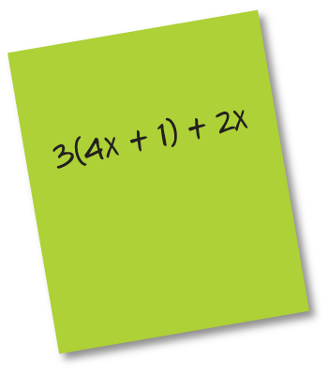

Find Another
What other expressions are equivalent to the one shown?
Think and record first. Which part of your work supports your
answer?
Looking for Structure
How can you change the form to make the expression easier to work with?
16 / 41
Notes:
TEACH IN PRACTICE | Embedded facilitation | Lesson 6.8, slide 16 | TASK
Focus on the existing task: What other expressions are equivalent to the one shown?
LAUNCH (T2/3/5): Use the displayed question. Give private thinking time; then A explains while B asks for evidence. Switch roles. Each student records their own reasoning.
LOOK FOR (T4): Where this task addresses it, students can rewrite using valid properties. Ask which feature of their work supports the claim.
RESPOND: If this task shows the lesson misconception—applying commutative reasoning to subtraction or division—mark what changed in the original expression: order, grouping, or an identity element. Have the student revise and explain the change. Use this support only where the concept occurs in the current task; otherwise respond to the displayed question.
RECHECK: If a gap is shared, revisit the existing representation together. If it is limited, give targeted support while others compare valid methods on the same task. Check the revision before moving on.
PARTICIPATION (T5/6/7): Think time before volunteers; accept a written, drawn or rehearsed entry. Students ask for evidence respectfully. Recognize a specific contribution or revision and check that both partners participate.
Source: BCPS Updated Instructional Framework Rubric (June 2020), TEACH 1–7. Earlier notes and answer keys are retained below.
EARLIER NOTES / EXISTING ANSWER KEY
Model briefly, then hand the thinking back: ask “Why does this step work?” before showing the next one.
Quick check before moving on — thumbs or whiteboards from everyone, not volunteers.
UIFR: TEACH 2 · TEACH 3 · TEACH 4.
UIFR FULL | Lesson-specific facilitation
TEACH 2-3 | Session 1 task launch (UIFR PDF pp. 9-10).
Use the problem exactly as displayed. Give individual thinking time before discussion or advancing to the explanation. If the answer is already visible, ask students to reconstruct and justify it. Invite a choice of suitable representations and have students explain why their choice helps.
At the point where this concept appears, ask: “What property permits this change, and why does it preserve the value for every allowed input?” Wait for evidence, invite another pathway, and have a student ask a follow-up question. Do not replace students’ reasoning with a sequence of leading steps.

Slide 17
Find Another
What other expressions are equivalent to the one shown?
When have you found equivalent expressions before?
HOW DO YOU KNOW? · Ask your partner “How do you know?” Answer by pointing to your own work.
Reveal:
We have found equivalent expressions when simplifying expressions using properties of operations.
17 / 41
Notes:
TEACH IN PRACTICE | Embedded facilitation | Lesson 6.8, slide 17 | REVEAL
Focus on the existing task: What other expressions are equivalent to the one shown?
LAUNCH (T2/3/5): If an existing answer cover is present, gather an attempt before revealing. If the explanation is already visible, ask students to reconstruct and justify it. Compare reasoning and explain a revision; preserve the reveal sequence.
LOOK FOR (T4): Where this task addresses it, students can rewrite using valid properties. Ask which feature of their work supports the claim.
RESPOND: If this task shows the lesson misconception—applying commutative reasoning to subtraction or division—mark what changed in the original expression: order, grouping, or an identity element. Have the student revise and explain the change. Use this support only where the concept occurs in the current task; otherwise respond to the displayed question.
RECHECK: If a gap is shared, revisit the existing representation together. If it is limited, give targeted support while others compare valid methods on the same task. Check the revision before moving on.
PARTICIPATION (T5/6/7): Think time before volunteers; accept a written, drawn or rehearsed entry. Students ask for evidence respectfully. Recognize a specific contribution or revision and check that both partners participate.
Source: BCPS Updated Instructional Framework Rubric (June 2020), TEACH 1–7. Earlier notes and answer keys are retained below.
EARLIER NOTES / EXISTING ANSWER KEY
Do not click yet: collect 2–3 student answers with reasons first.
Then click to remove the cover and have students compare their thinking to the reveal — “Is this what we said? Where is it different?”
Behind the cover: We have found equivalent expressions when simplifying expressions using properties of operations.
UIFR: TEACH 3 · TEACH 4.

Slide 18

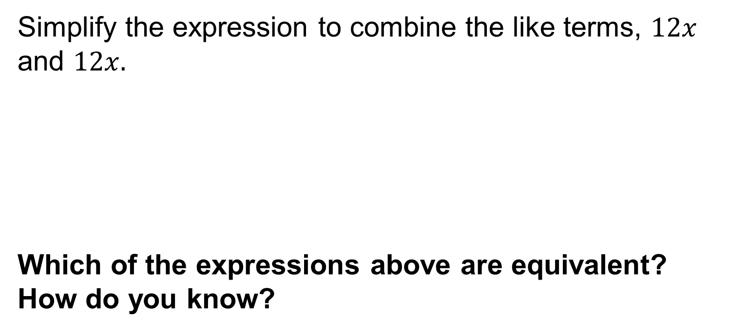
COLLABORATE · TALK IT THROUGH • AGREE ON A MODEL
Collaborate and Connect
 | Distribute 3 to each term in parentheses.
 | Reorder so like terms are together.​
 | Combine like terms.​
Reveal:
All the expressions are equivalent. Rewriting an expression using properties of operations does not change the value of an expression.
18 / 41
Notes:
TEACH IN PRACTICE | Embedded facilitation | Lesson 6.8, slide 18 | COLLABORATE
Focus on the existing task: Collaborate and Connect Reveal: All the expressions are equivalent. Rewriting an expression using properties of operations does not…
LAUNCH (T2/3/5): Use the displayed question. Give private thinking time; then A explains while B asks for evidence. Switch roles. Each student records their own reasoning.
LOOK FOR (T4): Where this task addresses it, students can rewrite using valid properties. Ask which feature of their work supports the claim.
RESPOND: If this task shows the lesson misconception—applying commutative reasoning to subtraction or division—mark what changed in the original expression: order, grouping, or an identity element. Have the student revise and explain the change. Use this support only where the concept occurs in the current task; otherwise respond to the displayed question.
RECHECK: If a gap is shared, revisit the existing representation together. If it is limited, give targeted support while others compare valid methods on the same task. Check the revision before moving on.
PARTICIPATION (T5/6/7): Think time before volunteers; accept a written, drawn or rehearsed entry. Students ask for evidence respectfully. Recognize a specific contribution or revision and check that both partners participate.
Source: BCPS Updated Instructional Framework Rubric (June 2020), TEACH 1–7. Earlier notes and answer keys are retained below.
EARLIER NOTES / EXISTING ANSWER KEY
Routine: COLLABORATE · TALK IT THROUGH • AGREE ON A MODEL
UIFR FULL | Lesson-specific facilitation
TEACH 4-5 | Session 1 discussion and checkpoint (UIFR PDF pp. 11-12).
Collect a brief response from every student to the existing prompt before hearing volunteers. Partners take turns explaining and asking for evidence: “I understand ___; what supports ___?” Offer rehearsal or an annotated model for students who need language support. Each student records their own reasoning.
Look specifically for: applying commutative reasoning to subtraction or division. If it appears, mark what changed in the original expression: order, grouping, or an identity element; then ask the student to revise the same response and explain the change. If evidence is secure, have students compare a second valid pathway or state why their approach works. Choose the next step from the responses, not a preset pace.

Slide 19
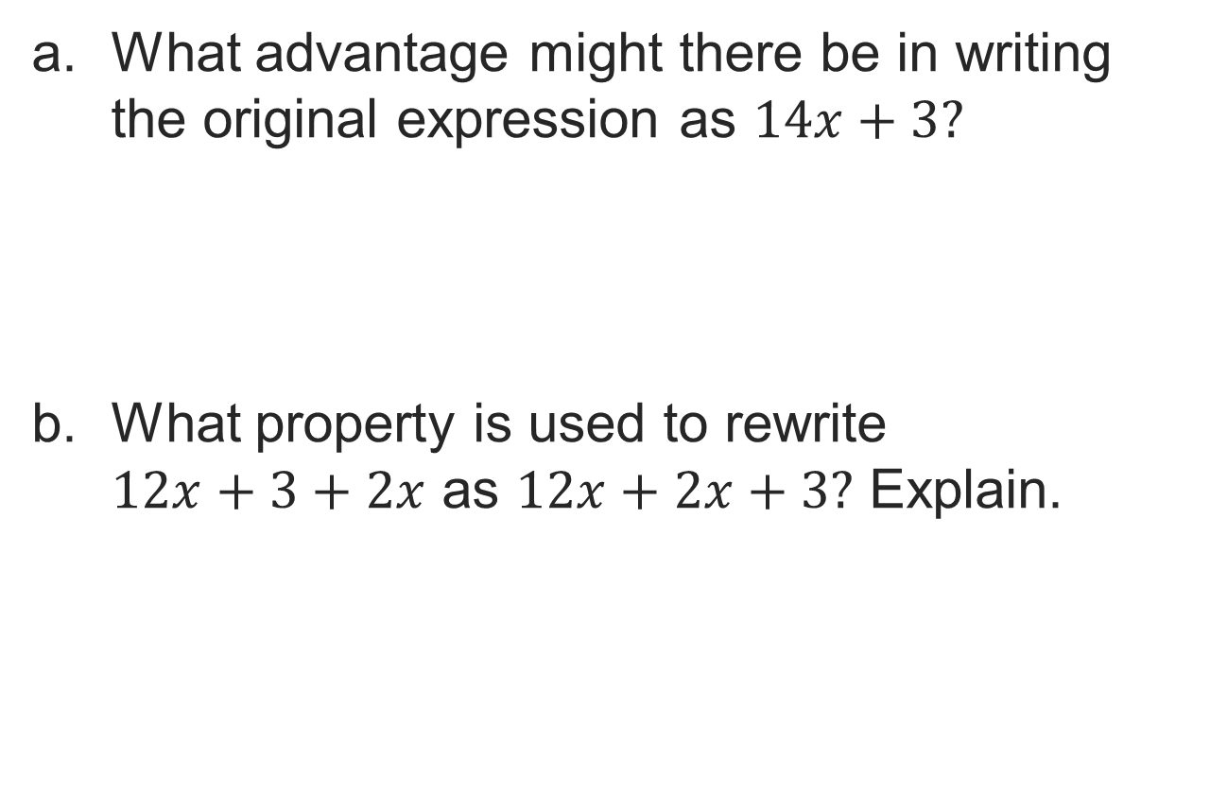
Let’s Explore More
19 / 41
Notes:
TEACH IN PRACTICE | Embedded facilitation | Lesson 6.8, slide 19 | PRACTICE
Focus on the existing task: Let’s Explore More
LAUNCH (T2/3/5): Use the displayed question. Give private thinking time; then A explains while B asks for evidence. Switch roles. Each student records their own reasoning.
LOOK FOR (T4): Where this task addresses it, students can rewrite using valid properties. Ask which feature of their work supports the claim.
RESPOND: If this task shows the lesson misconception—applying commutative reasoning to subtraction or division—mark what changed in the original expression: order, grouping, or an identity element. Have the student revise and explain the change. Use this support only where the concept occurs in the current task; otherwise respond to the displayed question.
RECHECK: If a gap is shared, revisit the existing representation together. If it is limited, give targeted support while others compare valid methods on the same task. Check the revision before moving on.
PARTICIPATION (T5/6/7): Think time before volunteers; accept a written, drawn or rehearsed entry. Students ask for evidence respectfully. Recognize a specific contribution or revision and check that both partners participate.
Source: BCPS Updated Instructional Framework Rubric (June 2020), TEACH 1–7. Earlier notes and answer keys are retained below.
EARLIER NOTES / EXISTING ANSWER KEY
Extension for partners or table groups — students choose their approach and use the workspace to show thinking.
Push with “Convince me,” and have two groups with different approaches share.
This is where students stretch past the worked example.
UIFR: TEACH 2 · TEACH 5.

Slide 20
STUDENT MOVES
Lesson 6-8
Your moves
RESTATE FIRST · Restate your partner’s idea in your own words before you give yours.
TWO MINUTES SOLO · Two minutes on your own, then compare. Bring one thing you tried, even if it did not work.
20 / 41

Slide 21
LESSON 6.8 / DISCUSS THE TASK
Explain and compare
Use the task you just explored.
TAKE TURNS
What property permits this change, and why does it preserve the value for every allowed input?
Explain
“I know this because…”
Ask
“Where does your work show that?”
Point to evidence in your work.
Then compare your approach with a partner’s.
JUSTIFY IT · Say it like this: “I know ______ because ______.”
Listen to understand. Ask for evidence. Make room for every voice.
Notes:
TEACH IN PRACTICE | Embedded facilitation | Lesson 6.8, slide 20 | PRIOR_INSERT
Focus on the existing task: Point to evidence in your work. Then compare your approach with a partner’s. TAKE TURNS Explain “I know this because…” Ask “Where does your work show that?
CONNECT (T1/4): Ask students to restate the displayed goal or key idea and connect it to earlier work. Relevant lesson evidence: rewrite using valid properties; preserve value; explain the property at each step. Use only the criterion that matches the current session.
SHOW PROGRESS: Students point to their own existing work, explain what improved after feedback, and name a next step. Pair confidence ratings with actual evidence.
PARTICIPATION (T5/6/7): Think time before volunteers; accept a written, drawn or rehearsed entry. Students ask for evidence respectfully. Recognize a specific contribution or revision and check that both partners participate.
Source: BCPS Updated Instructional Framework Rubric (June 2020), TEACH 1–7.

Slide 22
Find Another
What other expressions are equivalent to the one shown?
When have you found equivalent expressions before?
TAKE TURNS · One explains, one asks a question. Then switch, so both of you talk.
Reveal:
We have found equivalent expressions when simplifying expressions using properties of operations.
22 / 41
Notes:
TEACH IN PRACTICE | Embedded facilitation | Lesson 6.8, slide 21 | REVEAL
Focus on the existing task: What other expressions are equivalent to the one shown?
LAUNCH (T2/3/5): If an existing answer cover is present, gather an attempt before revealing. If the explanation is already visible, ask students to reconstruct and justify it. Compare reasoning and explain a revision; preserve the reveal sequence.
LOOK FOR (T4): Where this task addresses it, students can rewrite using valid properties. Ask which feature of their work supports the claim.
RESPOND: If this task shows the lesson misconception—applying commutative reasoning to subtraction or division—mark what changed in the original expression: order, grouping, or an identity element. Have the student revise and explain the change. Use this support only where the concept occurs in the current task; otherwise respond to the displayed question.
RECHECK: If a gap is shared, revisit the existing representation together. If it is limited, give targeted support while others compare valid methods on the same task. Check the revision before moving on.
PARTICIPATION (T5/6/7): Think time before volunteers; accept a written, drawn or rehearsed entry. Students ask for evidence respectfully. Recognize a specific contribution or revision and check that both partners participate.
Source: BCPS Updated Instructional Framework Rubric (June 2020), TEACH 1–7.

Slide 23
Warm-Up
Lesson 6-8 · Generate Equivalent Expressions
Session 2 Warm-Up
Try alone. Explain one. Then revise.
1
Which property states a(b + c) = ab + ac?
2
Expand 4(x + 5):
A
Commutative
A
4x + 5
B
Distributive Property
B
4x + 20
C
Identity
C
20x
D
Associative
D
x + 20
3
Factor 18x + 12 using the GCF 6:
4
Combine like terms in 5x + 3 + 2x:
A
6(3x + 2)
A
10x
B
3(6x + 4)
B
7x + 3
C
6(12x + 6)
C
7x + 2
D
2(9x + 6)
D
5x + 5
eduwonderlab.com · Neft Teacher
23 / 41
Notes:
TEACH IN PRACTICE | Embedded facilitation | Lesson 6.8, slide 22 | WARMUP
Focus on the existing task: Warm-Up Session 2 Warm-Up Check what you remember from Session 1 1 Which property states a(b + c) = ab + ac?
GATHER EVIDENCE (T4/6): Keep the original items. Students try independently, mark an uncertain item, and explain one method before checking. Use the existing key when present.
RESPOND: Distinguish a calculation slip from a reasoning gap. Give one next step on the same item; have students revise in a second color. Use the responses to choose flexible support for today’s lesson.
PARTICIPATION (T5/6/7): Think time before volunteers; accept a written, drawn or rehearsed entry. Students ask for evidence respectfully. Recognize a specific contribution or revision and check that both partners participate.
Source: BCPS Updated Instructional Framework Rubric (June 2020), TEACH 1–7. Earlier notes and answer keys are retained below.
EARLIER NOTES / EXISTING ANSWER KEY
Warm-up routine: students start silently on entry; keep it to about 4 minutes.
Circulate and note who is stuck — use what you see to choose who you check on first today.
Go over answers quickly; ask one student to explain a step, not just say the answer.
UIFR: TEACH 4 · TEACH 6.

Slide 24
STUDENT MOVES
Lesson 6-8
Your move
YOU KNOW THE ROUTINE · Read → plan → solve → check. Do all four, in that order.
24 / 41

Slide 25
Review Notes — Session 2
Lesson 6-8 · Generate Equivalent Expressions
Session 2: Review Notes
Copy. Explain. Check.
NAME THE MATH · Point to the part of this that is new today, and say what it changes.
Distributive Property
1
Multiply the term outside the parentheses by every term inside: a(b + c) = ab + ac.
Factoring Expressions
2
Identify the GCF of the terms, factor it outside parentheses, and write quotients inside.
Combining Like Terms
3
Terms sharing identical variable parts can be combined by adding their coefficients.
eduwonderlab.com · Neft Teacher
25 / 41
Notes:
TEACH IN PRACTICE | Embedded facilitation | Lesson 6.8, slide 23 | NOTES
Focus on the existing task: Review Notes — Session 2 Session 2: Review Notes Copy into…
ROUTINE (T1/2/4): Read or copy the original notes, cover one line, and explain it using the displayed example. Reopen and correct. Copying alone is not evidence of understanding.
LOOK FOR: A link between a symbol, quantity or feature and the explanation. If missing, point back to that feature and have the student try again; fade the prompt once they can explain.
PARTICIPATION (T5/6/7): Think time before volunteers; accept a written, drawn or rehearsed entry. Students ask for evidence respectfully. Recognize a specific contribution or revision and check that both partners participate.
Source: BCPS Updated Instructional Framework Rubric (June 2020), TEACH 1–7. Earlier notes and answer keys are retained below.
EARLIER NOTES / EXISTING ANSWER KEY
Copy routine: read one line at a time; students copy, then explain that line to a partner.
Keep it brisk — the understanding work happens in the examples, not the copying.
UIFR: TEACH 1 · TEACH 6.

Slide 26
Session 2
Generate Equivalent Expressions
SELF-CHECK · Mark it: ✓ got it · ~ almost · ? stuck. Then fix one thing before we move on.
26 / 41
Notes:
TEACH IN PRACTICE | Embedded facilitation | Lesson 6.8, slide 24 | DIVIDER
Focus on the existing task: Generate Equivalent Expressions Session 2
TRANSITION (T6/7): Students confirm materials, roles, how to request help, and the next response routine. Ask a student to restate it. Keep teacher-only slides hidden.
PARTICIPATION (T5/6/7): Think time before volunteers; accept a written, drawn or rehearsed entry. Students ask for evidence respectfully. Recognize a specific contribution or revision and check that both partners participate.
Source: BCPS Updated Instructional Framework Rubric (June 2020), TEACH 1–7. Earlier notes and answer keys are retained below.
EARLIER NOTES / EXISTING ANSWER KEY
Transition cue: state what materials are out and what success looks like this session.
Keep the changeover under a minute.
UIFR: TEACH 6.

Slide 27
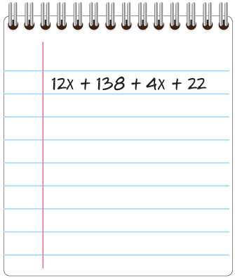
How Many Can You Find?
Let’s use the properties of operations to find an equivalent expression another way.
You have learned how to use a common factor to use the Distributive Property in reverse.
How can you determine whether all four terms have a common factor?
Reveal:
PICK YOUR STRATEGY · Choose your path — picture, table, number line, or equation — and be ready to say why you chose it.
27 / 41
Notes:
TEACH IN PRACTICE | Embedded facilitation | Lesson 6.8, slide 25 | REVEAL
Focus on the existing task: Reveal: How Many Can You Find?
LAUNCH (T2/3/5): If an existing answer cover is present, gather an attempt before revealing. If the explanation is already visible, ask students to reconstruct and justify it. Compare reasoning and explain a revision; preserve the reveal sequence.
LOOK FOR (T4): Where this task addresses it, students can rewrite using valid properties. Ask which feature of their work supports the claim.
RESPOND: If this task shows the lesson misconception—applying commutative reasoning to subtraction or division—mark what changed in the original expression: order, grouping, or an identity element. Have the student revise and explain the change. Use this support only where the concept occurs in the current task; otherwise respond to the displayed question.
RECHECK: If a gap is shared, revisit the existing representation together. If it is limited, give targeted support while others compare valid methods on the same task. Check the revision before moving on.
PARTICIPATION (T5/6/7): Think time before volunteers; accept a written, drawn or rehearsed entry. Students ask for evidence respectfully. Recognize a specific contribution or revision and check that both partners participate.
Source: BCPS Updated Instructional Framework Rubric (June 2020), TEACH 1–7. Earlier notes and answer keys are retained below.
EARLIER NOTES / EXISTING ANSWER KEY
Students should have shared predictions before this reveal.
Have them compare their thinking to what is shown: “Is this the same as what we said? Where is it different?”
Press one student to explain the reveal in their own words.
UIFR: TEACH 3 · TEACH 4.

Slide 28
How Many Can You Find?
The greatest common factor of the four terms is 2.
How can you use the GCF to rewrite the expression in a different way?
ANOTHER PATHWAY · Did anyone get there a different way? Put both pathways side by side and compare.
Reveal:
We can divide each term by the GCF to find the other factor for each term. Then we can use the Distributive Property to write the expression as the product of the GCF and the sum of the other factors.
28 / 41
Notes:
TEACH IN PRACTICE | Embedded facilitation | Lesson 6.8, slide 26 | REVEAL
Focus on the existing task: The greatest common factor of the four terms is 2. How can you use the GCF to rewrite the expression in a different way?
LAUNCH (T2/3/5): If an existing answer cover is present, gather an attempt before revealing. If the explanation is already visible, ask students to reconstruct and justify it. Compare reasoning and explain a revision; preserve the reveal sequence.
LOOK FOR (T4): Where this task addresses it, students can explain the property at each step. Ask which feature of their work supports the claim.
RESPOND: If this task shows the lesson misconception—applying commutative reasoning to subtraction or division—mark what changed in the original expression: order, grouping, or an identity element. Have the student revise and explain the change. Use this support only where the concept occurs in the current task; otherwise respond to the displayed question.
RECHECK: If a gap is shared, revisit the existing representation together. If it is limited, give targeted support while others compare valid methods on the same task. Check the revision before moving on.
PARTICIPATION (T5/6/7): Think time before volunteers; accept a written, drawn or rehearsed entry. Students ask for evidence respectfully. Recognize a specific contribution or revision and check that both partners participate.
Source: BCPS Updated Instructional Framework Rubric (June 2020), TEACH 1–7. Earlier notes and answer keys are retained below.
EARLIER NOTES / EXISTING ANSWER KEY
Do not click yet: collect 2–3 student answers with reasons first.
Then click to remove the cover and have students compare their thinking to the reveal — “Is this what we said? Where is it different?”
Behind the cover: We can divide each term by the GCF to find the other factor for each term. Then we can use the Distributive Property to write the expression as the product of the GCF and the sum of the other factors.
UIFR: TEACH 3 · TEACH 4.

Slide 29
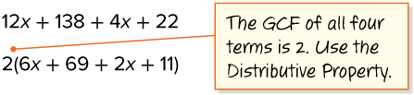
How Many Can You Find?
Let’s use the Distributive Property to rewrite the expression.
Can the expression be further simplified? If so, how?
Reveal:
yes; We can combine the like terms.
Record your reasoning before the
reveal. Compare, then explain
any revision.
29 / 41
Notes:
TEACH IN PRACTICE | Embedded facilitation | Lesson 6.8, slide 27 | REVEAL
Focus on the existing task: Let’s use the Distributive Property to rewrite the expression. Can the expression be further simplified?
LAUNCH (T2/3/5): If an existing answer cover is present, gather an attempt before revealing. If the explanation is already visible, ask students to reconstruct and justify it. Compare reasoning and explain a revision; preserve the reveal sequence.
LOOK FOR (T4): Where this task addresses it, students can rewrite using valid properties. Ask which feature of their work supports the claim.
RESPOND: If this task shows the lesson misconception—applying commutative reasoning to subtraction or division—mark what changed in the original expression: order, grouping, or an identity element. Have the student revise and explain the change. Use this support only where the concept occurs in the current task; otherwise respond to the displayed question.
RECHECK: If a gap is shared, revisit the existing representation together. If it is limited, give targeted support while others compare valid methods on the same task. Check the revision before moving on.
PARTICIPATION (T5/6/7): Think time before volunteers; accept a written, drawn or rehearsed entry. Students ask for evidence respectfully. Recognize a specific contribution or revision and check that both partners participate.
Source: BCPS Updated Instructional Framework Rubric (June 2020), TEACH 1–7. Earlier notes and answer keys are retained below.
EARLIER NOTES / EXISTING ANSWER KEY
Do not click yet: collect 2–3 student answers with reasons first.
Then click to remove the cover and have students compare their thinking to the reveal — “Is this what we said? Where is it different?”
Behind the cover: yes; We can combine the like terms.
UIFR: TEACH 3 · TEACH 4.

Slide 30
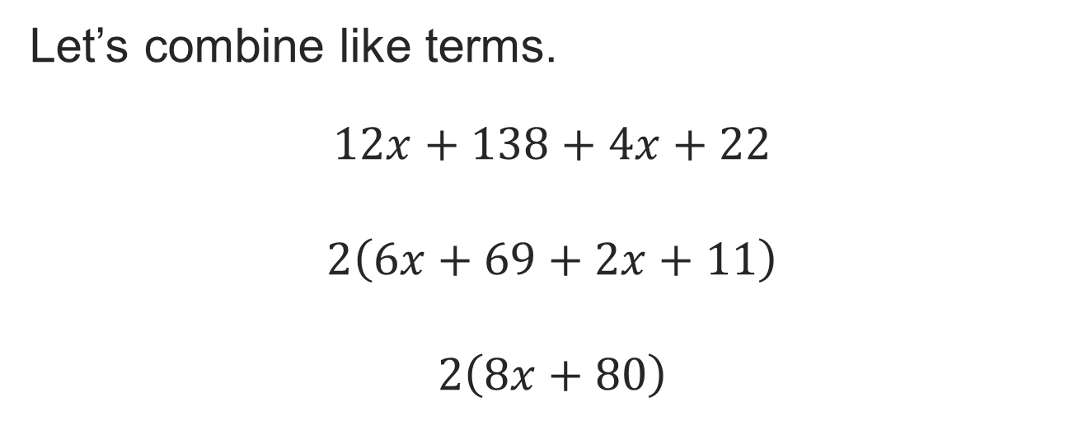
How Many Can You Find?
Think and record first. Which part of your work supports your answer?
Think About It:
How can you check that all the expressions are equivalent?
30 / 41
Notes:
TEACH IN PRACTICE | Embedded facilitation | Lesson 6.8, slide 28 | TASK
Focus on the existing task: Think About It: How can you check that all the expressions are equivalent?
LAUNCH (T2/3/5): Use the displayed question. Give private thinking time; then A explains while B asks for evidence. Switch roles. Each student records their own reasoning.
LOOK FOR (T4): Where this task addresses it, students can rewrite using valid properties. Ask which feature of their work supports the claim.
RESPOND: If this task shows the lesson misconception—applying commutative reasoning to subtraction or division—mark what changed in the original expression: order, grouping, or an identity element. Have the student revise and explain the change. Use this support only where the concept occurs in the current task; otherwise respond to the displayed question.
RECHECK: If a gap is shared, revisit the existing representation together. If it is limited, give targeted support while others compare valid methods on the same task. Check the revision before moving on.
PARTICIPATION (T5/6/7): Think time before volunteers; accept a written, drawn or rehearsed entry. Students ask for evidence respectfully. Recognize a specific contribution or revision and check that both partners participate.
Source: BCPS Updated Instructional Framework Rubric (June 2020), TEACH 1–7. Earlier notes and answer keys are retained below.
EARLIER NOTES / EXISTING ANSWER KEY
Ask the question, then hold the silence — students think or jot before anyone answers.
Take two or three responses and press with “Why?” or “How do you know?” before moving on.
UIFR: TEACH 3.

Slide 31
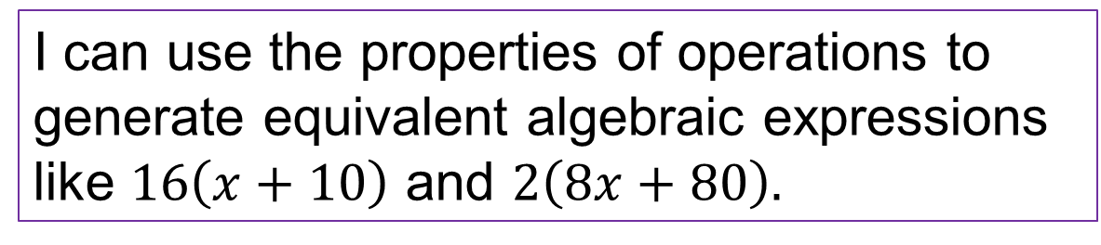
How Many Can You Find?
How many equivalent expressions can you generate for the expression shown?
Think and record first. Which part of your work supports your
answer?
Looking for Structure
How can you use mathematical properties to uncover structure?
31 / 41
Notes:
TEACH IN PRACTICE | Embedded facilitation | Lesson 6.8, slide 29 | TASK
Focus on the existing task: How many equivalent expressions can you generate for the expression shown?
LAUNCH (T2/3/5): Use the displayed question. Give private thinking time; then A explains while B asks for evidence. Switch roles. Each student records their own reasoning.
LOOK FOR (T4): Where this task addresses it, students can rewrite using valid properties. Ask which feature of their work supports the claim.
RESPOND: If this task shows the lesson misconception—applying commutative reasoning to subtraction or division—mark what changed in the original expression: order, grouping, or an identity element. Have the student revise and explain the change. Use this support only where the concept occurs in the current task; otherwise respond to the displayed question.
RECHECK: If a gap is shared, revisit the existing representation together. If it is limited, give targeted support while others compare valid methods on the same task. Check the revision before moving on.
PARTICIPATION (T5/6/7): Think time before volunteers; accept a written, drawn or rehearsed entry. Students ask for evidence respectfully. Recognize a specific contribution or revision and check that both partners participate.
Source: BCPS Updated Instructional Framework Rubric (June 2020), TEACH 1–7. Earlier notes and answer keys are retained below.
EARLIER NOTES / EXISTING ANSWER KEY
Model briefly, then hand the thinking back: ask “Why does this step work?” before showing the next one.
Quick check before moving on — thumbs or whiteboards from everyone, not volunteers.
UIFR: TEACH 2 · TEACH 3 · TEACH 4.

Slide 32
Let’s Explore More
How does finding the greatest common factor help to generate an equivalent expression?
Are there other equivalent expressions not represented in the problem? Explain.
STRUGGLE FIRST · Work on your own first. Stuck is allowed — try a second strategy before you ask.
32 / 41
Notes:
TEACH IN PRACTICE | Embedded facilitation | Lesson 6.8, slide 30 | PRACTICE
Focus on the existing task: Let’s Explore More How does finding the greatest common factor help to generate an equivalent expression?
LAUNCH (T2/3/5): Use the displayed question. Give private thinking time; then A explains while B asks for evidence. Switch roles. Each student records their own reasoning.
LOOK FOR (T4): Where this task addresses it, students can explain the property at each step. Ask which feature of their work supports the claim.
RESPOND: If this task shows the lesson misconception—applying commutative reasoning to subtraction or division—mark what changed in the original expression: order, grouping, or an identity element. Have the student revise and explain the change. Use this support only where the concept occurs in the current task; otherwise respond to the displayed question.
RECHECK: If a gap is shared, revisit the existing representation together. If it is limited, give targeted support while others compare valid methods on the same task. Check the revision before moving on.
PARTICIPATION (T5/6/7): Think time before volunteers; accept a written, drawn or rehearsed entry. Students ask for evidence respectfully. Recognize a specific contribution or revision and check that both partners participate.
Source: BCPS Updated Instructional Framework Rubric (June 2020), TEACH 1–7. Earlier notes and answer keys are retained below.
EARLIER NOTES / EXISTING ANSWER KEY
Extension for partners or table groups — students choose their approach and use the workspace to show thinking.
Push with “Convince me,” and have two groups with different approaches share.
This is where students stretch past the worked example.
UIFR: TEACH 2 · TEACH 5.

Slide 33
LESSON 6.8 / CHECK YOUR WORK
Pause. Check. Improve.
CHECK
A mistake to watch for: applying commutative reasoning to subtraction or division.
TRY
Mark what changed in the given expression: order, grouping, or an identity element.
REVISE
Use that check on the task you just completed. Correct or strengthen one part, and explain why.
REVISE NOW · Change one answer and write why you changed it. A revision is evidence of learning.
Listen to understand. Ask for evidence. Make room for every voice.
Notes:
TEACH IN PRACTICE | Embedded facilitation | Lesson 6.8, slide 31 | PRIOR_INSERT
Focus on the existing task: LESSON 6.8 / CHECK YOUR WORK Pause. Check. Improve. Listen to understand. Ask for evidence. Make room for every voice. CHECK A mistake…
CONNECT (T1/4): Ask students to restate the displayed goal or key idea and connect it to earlier work. Relevant lesson evidence: rewrite using valid properties; preserve value; explain the property at each step. Use only the criterion that matches the current session.
SHOW PROGRESS: Students point to their own existing work, explain what improved after feedback, and name a next step. Pair confidence ratings with actual evidence.
PARTICIPATION (T5/6/7): Think time before volunteers; accept a written, drawn or rehearsed entry. Students ask for evidence respectfully. Recognize a specific contribution or revision and check that both partners participate.
Source: BCPS Updated Instructional Framework Rubric (June 2020), TEACH 1–7.

Slide 34
How Many Can You Find?
The greatest common factor of the four terms is 2.
How can you use the GCF to rewrite the expression in a different way?
USE YOUR TOOLS · Reach for your notes, a model, or a manipulative before you reach for an answer.
Reveal:
We can divide each term by the GCF to find the other factor for each term. Then we can use the Distributive Property to write the expression as the product of the GCF and the sum of the other factors.
34 / 41
Notes:
TEACH IN PRACTICE | Embedded facilitation | Lesson 6.8, slide 32 | REVEAL
Focus on the existing task: The greatest common factor of the four terms is 2. How can you use the GCF to rewrite the expression in a different way?
LAUNCH (T2/3/5): If an existing answer cover is present, gather an attempt before revealing. If the explanation is already visible, ask students to reconstruct and justify it. Compare reasoning and explain a revision; preserve the reveal sequence.
LOOK FOR (T4): Where this task addresses it, students can explain the property at each step. Ask which feature of their work supports the claim.
RESPOND: If this task shows the lesson misconception—applying commutative reasoning to subtraction or division—mark what changed in the original expression: order, grouping, or an identity element. Have the student revise and explain the change. Use this support only where the concept occurs in the current task; otherwise respond to the displayed question.
RECHECK: If a gap is shared, revisit the existing representation together. If it is limited, give targeted support while others compare valid methods on the same task. Check the revision before moving on.
PARTICIPATION (T5/6/7): Think time before volunteers; accept a written, drawn or rehearsed entry. Students ask for evidence respectfully. Recognize a specific contribution or revision and check that both partners participate.
Source: BCPS Updated Instructional Framework Rubric (June 2020), TEACH 1–7.

Slide 35
How Many Can You Find?
Let’s use the Distributive Property to rewrite the expression.
Can the expression be further simplified? If so, how?
Reveal:
yes; We can combine the like terms.
Compare your reasoning with the
explanation. Explain any revision
you make.
35 / 41
Notes:
TEACH IN PRACTICE | Embedded facilitation | Lesson 6.8, slide 33 | REVEAL
Focus on the existing task: Let’s use the Distributive Property to rewrite the expression. Can the expression be further simplified?
LAUNCH (T2/3/5): If an existing answer cover is present, gather an attempt before revealing. If the explanation is already visible, ask students to reconstruct and justify it. Compare reasoning and explain a revision; preserve the reveal sequence.
LOOK FOR (T4): Where this task addresses it, students can rewrite using valid properties. Ask which feature of their work supports the claim.
RESPOND: If this task shows the lesson misconception—applying commutative reasoning to subtraction or division—mark what changed in the original expression: order, grouping, or an identity element. Have the student revise and explain the change. Use this support only where the concept occurs in the current task; otherwise respond to the displayed question.
RECHECK: If a gap is shared, revisit the existing representation together. If it is limited, give targeted support while others compare valid methods on the same task. Check the revision before moving on.
PARTICIPATION (T5/6/7): Think time before volunteers; accept a written, drawn or rehearsed entry. Students ask for evidence respectfully. Recognize a specific contribution or revision and check that both partners participate.
Source: BCPS Updated Instructional Framework Rubric (June 2020), TEACH 1–7.

Slide 36
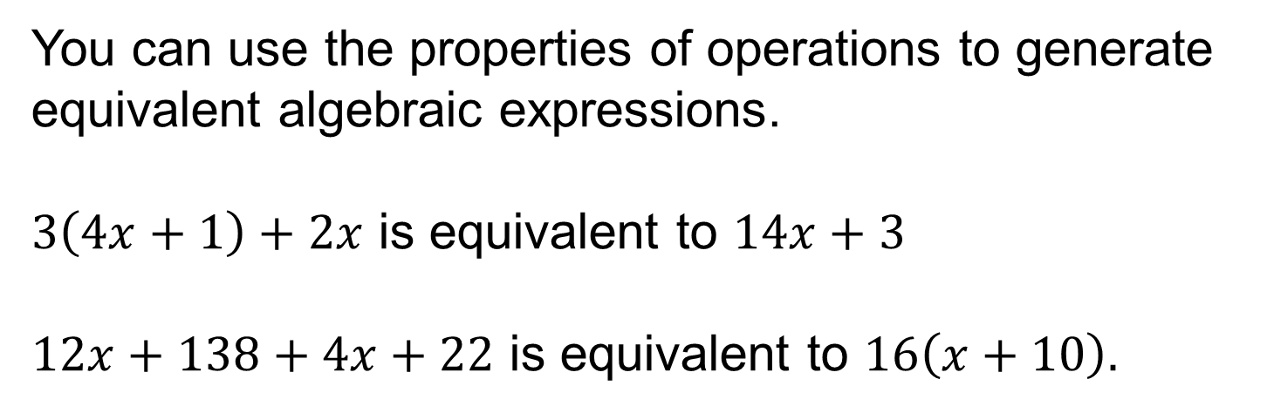
SUMMARIZE · SAY IT IN YOUR OWN WORDS
Summarize: Generate Equivalent Expressions
Explain the key idea without reading. Use today’s example as evidence.
36 / 41
Notes:
TEACH IN PRACTICE | Embedded facilitation | Lesson 6.8, slide 34 | SUMMARIZE
Focus on the existing task: Summarize: Generate Equivalent Expressions SUMMARIZE · SAY IT IN YOUR OWN WORDS
CONNECT (T1/4): Ask students to restate the displayed goal or key idea and connect it to earlier work. Relevant lesson evidence: rewrite using valid properties; preserve value; explain the property at each step. Use only the criterion that matches the current session.
SHOW PROGRESS: Students point to their own existing work, explain what improved after feedback, and name a next step. Pair confidence ratings with actual evidence.
PARTICIPATION (T5/6/7): Think time before volunteers; accept a written, drawn or rehearsed entry. Students ask for evidence respectfully. Recognize a specific contribution or revision and check that both partners participate.
Source: BCPS Updated Instructional Framework Rubric (June 2020), TEACH 1–7. Earlier notes and answer keys are retained below.
EARLIER NOTES / EXISTING ANSWER KEY
Routine: SUMMARIZE · SAY IT IN YOUR OWN WORDS

Slide 37
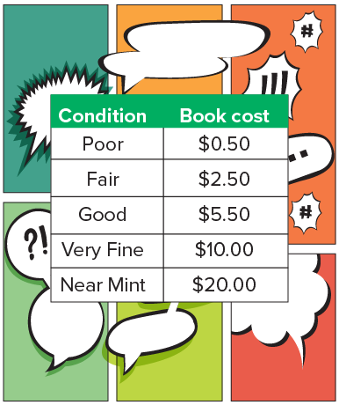
APPLY · PLAN IT • SOLVE IT • PROVE IT
Apply: Vintage Comic Books
Diamond wants to buy some vintage comic books from an online retailer. The price of a comic book is based on its condition, as shown. Diamond plans to buy some comic books that are in good and near mint condition and protective covers for $0.50 for each comic book. The retailer charges $9.99 for shipping.
Question: How could Diamond use an algebraic expression to find and compare the costs of different amounts of good and near mint condition comic books? Which combination of comic books would you recommend Diamond buy?
three near mint and two good comic books
two near mint and six good comic books
one near mint and ten good comic books
37 / 41
Notes:
TEACH IN PRACTICE | Embedded facilitation | Lesson 6.8, slide 35 | APPLY
Focus on the existing task: Which combination of comic books would you recommend Diamond buy?
LAUNCH (T2/3/5): Use the exact application task independently first. Ask students to justify their choice of method. Collect evidence before a partner discussion or correction.
LOOK FOR (T4): Where this task addresses it, students can explain the property at each step. Ask which feature of their work supports the claim.
RESPOND: If this task shows the lesson misconception—applying commutative reasoning to subtraction or division—mark what changed in the original expression: order, grouping, or an identity element. Have the student revise and explain the change. Use this support only where the concept occurs in the current task; otherwise respond to the displayed question.
RECHECK: If a gap is shared, revisit the existing representation together. If it is limited, give targeted support while others compare valid methods on the same task. Check the revision before moving on.
PARTICIPATION (T5/6/7): Think time before volunteers; accept a written, drawn or rehearsed entry. Students ask for evidence respectfully. Recognize a specific contribution or revision and check that both partners participate.
Source: BCPS Updated Instructional Framework Rubric (June 2020), TEACH 1–7. Earlier notes and answer keys are retained below.
EARLIER NOTES / EXISTING ANSWER KEY
Routine: APPLY · PLAN IT • SOLVE IT • PROVE IT
UIFR FULL | Lesson-specific facilitation
TEACH 4 | Independent evidence and revision (UIFR PDF p. 11).
Use the existing application/exit problem as the independent check. If this is a learning-target slide, have students point to and explain their work on the preceding task. Separate initial independent evidence from the revision after feedback.
Check the relevant criteria: rewrite using valid properties; preserve value; explain the property at each step. Respond with one specific next step tied to the work. Students revise and annotate what changed, then identify a criterion they can now demonstrate and one they still need to practice.

Slide 38
STUDENT MOVES
Lesson 6-8
Your move
YOUR CHOICE · You choose how to show this — numbers, words, or a diagram. Make your reasoning visible.
38 / 41

Slide 39
Learning Targets
I can use repeated reasoning and the properties of operations to generate equivalent expressions.
SAY THE GOAL · Say today’s goal in your own words, then name one place this shows up outside math class.
39 / 41
Notes:
TEACH IN PRACTICE | Embedded facilitation | Lesson 6.8, slide 36 | REFLECTION
Focus on the existing task: I can use repeated reasoning and the properties of operations to generate equivalent expressions. Learning Targets
CONNECT (T1/4): Ask students to restate the displayed goal or key idea and connect it to earlier work. Relevant lesson evidence: rewrite using valid properties; preserve value; explain the property at each step. Use only the criterion that matches the current session.
SHOW PROGRESS: Students point to their own existing work, explain what improved after feedback, and name a next step. Pair confidence ratings with actual evidence.
PARTICIPATION (T5/6/7): Think time before volunteers; accept a written, drawn or rehearsed entry. Students ask for evidence respectfully. Recognize a specific contribution or revision and check that both partners participate.
Source: BCPS Updated Instructional Framework Rubric (June 2020), TEACH 1–7. Earlier notes and answer keys are retained below.
EARLIER NOTES / EXISTING ANSWER KEY
Read each target; students self-rate with fist-to-five or thumbs.
Tie back to the goal from the start of class: did we get there?
Note any target that rates low — revisit it tomorrow.
UIFR: TEACH 1 · TEACH 4.

Slide 40
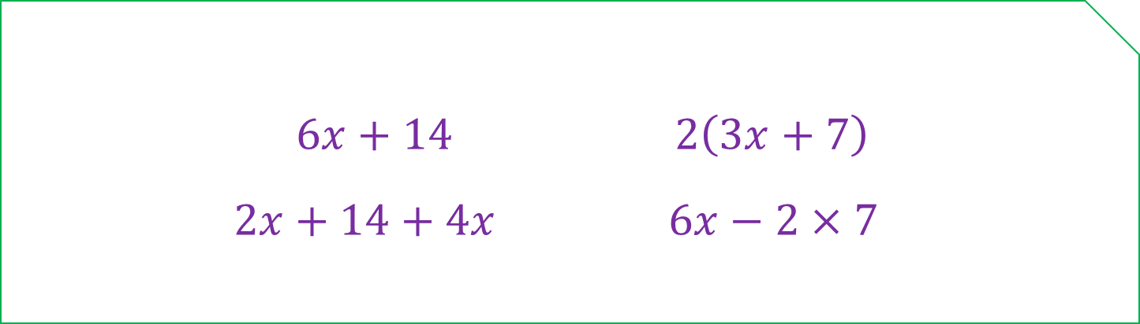
Be Curious
Which doesn’t belong?
Think first. Share a notice and a question;
build on a classmate’s idea.
Mindset
What questions are you asking to help you understand someone else’s ideas about math?
40 / 41
Notes:
TEACH IN PRACTICE | Embedded facilitation | Lesson 6.8, slide 37 | CURIOUS
Focus on the existing task: Be Curious What questions are you asking to help you understand someone else’s ideas about math?
LAUNCH (T2/3/5): Allow quiet observation first. Separate a notice from an inference, invite students’ own questions, and follow the existing launch before teaching a procedure.
LOOK FOR (T4): Where this task addresses it, students can rewrite using valid properties. Ask which feature of their work supports the claim.
RESPOND: If this task shows the lesson misconception—applying commutative reasoning to subtraction or division—mark what changed in the original expression: order, grouping, or an identity element. Have the student revise and explain the change. Use this support only where the concept occurs in the current task; otherwise respond to the displayed question.
RECHECK: If a gap is shared, revisit the existing representation together. If it is limited, give targeted support while others compare valid methods on the same task. Check the revision before moving on.
PARTICIPATION (T5/6/7): Think time before volunteers; accept a written, drawn or rehearsed entry. Students ask for evidence respectfully. Recognize a specific contribution or revision and check that both partners participate.
Source: BCPS Updated Instructional Framework Rubric (June 2020), TEACH 1–7. Earlier notes and answer keys are retained below.
EARLIER NOTES / EXISTING ANSWER KEY
UIFR FULL | Lesson-specific facilitation
REFLECT & ADJUST 1-2 | After the lesson (UIFR PDF pp. 15-16).
Sort the existing work by demonstrated reasoning, partial understanding, and the specific misconception: applying commutative reasoning to subtraction or division. Compare the initial response with the revision. Record which teaching move plausibly helped, which did not, and whose participation or access needs a different approach; do not record sensitive student details in this shared deck.
Plan the next lesson from that evidence: if the misconception persists, mark what changed in the original expression: order, grouping, or an identity element using the current example before returning to the next grade-level task; if understanding is secure, use an existing extension or ask for a general explanation. Check the targeted idea again at the next warm-up.
Ask students what supported their thinking and what would help next time. Identify one change to try and one successful practice to retain. Seek colleague feedback on anonymized work when useful; these prompts support reflection and do not establish an evaluation rating. Source: Baltimore City Public Schools, Updated Instructional Framework Rubric, June 2020 (UIFR_Full.pdf).

Slide 41
LESSON 6.8 / REFLECT ON YOUR LEARNING
Show your progress
1 SHOW EVIDENCE
2 CHOOSE A NEXT STEP
Choose one response. Point to the part that shows your reasoning.
Name a change you made after feedback—or a question you still have.
“My work shows ___ because ___.”
“Next time, I will ___ to help me ___.”
Today’s focus: Rewrite using valid properties.
CREDIT A CLASSMATE · Name one classmate whose idea helped you today, and say what they said.
Listen to understand. Ask for evidence. Make room for every voice.
Notes:
TEACH IN PRACTICE | Embedded facilitation | Lesson 6.8, slide 38 | PRIOR_INSERT
Focus on the existing task: LESSON 6.8 / REFLECT ON YOUR LEARNING Show your progress Listen to understand. Ask for evidence. Make room for every voice. 1 SHOW…
CONNECT (T1/4): Ask students to restate the displayed goal or key idea and connect it to earlier work. Relevant lesson evidence: rewrite using valid properties; preserve value; explain the property at each step. Use only the criterion that matches the current session.
SHOW PROGRESS: Students point to their own existing work, explain what improved after feedback, and name a next step. Pair confidence ratings with actual evidence.
PARTICIPATION (T5/6/7): Think time before volunteers; accept a written, drawn or rehearsed entry. Students ask for evidence respectfully. Recognize a specific contribution or revision and check that both partners participate.
Source: BCPS Updated Instructional Framework Rubric (June 2020), TEACH 1–7.

