Slide 1
WARM-UP · THINK • TRY • CHECK
Turn and talk: compare strategies, then defend one.
Warm-Up
Lesson 7-1 · Explore Integers and Their Opposites | Warm-Up · about 4 minutes
Try each on your own. Mark an unsure answer; explain and revise when we check.
QUESTION 1
QUESTION 2
Which is farther right on a number line: 8 or 3? ______
Count back from 2: 2, 1, 0, ______, ______
QUESTION 3
QUESTION 4
The opposite of −6 is ______
3x + 5x = ______
TALK IT OVER: “I got ______ because ______.” • Compare with a partner before we check as a class.
1 / 51
Notes:
TEACH IN PRACTICE | Embedded facilitation | Lesson 7.1, slide 1 | WARMUP
Focus on the existing task: Warm-Up WARM-UP · THINK • TRY • CHECK Do these four…
GATHER EVIDENCE (T4/6): Keep the original items. Students try independently, mark an uncertain item, and explain one method before checking. Use the existing key when present.
RESPOND: Distinguish a calculation slip from a reasoning gap. Give one next step on the same item; have students revise in a second color. Use the responses to choose flexible support for today’s lesson.
PARTICIPATION (T5/6/7): Think time before volunteers; accept a written, drawn or rehearsed entry. Students ask for evidence respectfully. Recognize a specific contribution or revision and check that both partners participate.
Source: BCPS Updated Instructional Framework Rubric (June 2020), TEACH 1–7. Earlier notes and answer keys are retained below.
EARLIER NOTES / EXISTING ANSWER KEY
Warm-Up answers (teacher only): 1) 8 2) −1, −2 3) 6 4) 8x
UIFR FULL | Lesson-specific facilitation
PREPARE 1-2 | Before teaching (UIFR PDF pp. 6-7).
Plan to gather evidence that students can interpret positive, negative and zero in context; locate opposites equally far from zero. Review recent work and today’s warm-up to choose flexible groups and access supports; do not infer needs from identity or perceived ability. Use the existing lesson tasks and stated standards.
Anticipate: treating zero as positive or confusing an opposite with an absolute value. If observed, label the reference point and directions on the existing number line. Offer oral rehearsal, drawing, pointing, or home-language processing as needed; retain the original mathematical demand. Ask students which support helps and fade it as evidence improves.
TEACH 6-7 | Before the first transition, agree on materials, partner roles, and how to request help. Invite students to restate the routine. Normalize revising an idea, recognize a specific contribution, and check privately when frustration blocks participation. Source: UIFR PDF pp. 13-14.

Slide 2
Today’s Math Notes
Lesson 7-1 · Explore Integers and Their Opposites
Section 1: Math Words
Copy. Explain. Check.
SAY THE GOAL · Say today’s goal in your own words, then name one place this shows up outside math class.
Integer
1
The counting numbers, their opposites, and 0
Opposite
2
A number
Negative number
3
A number less than 0, written with a − sign
eduwonderlab.com · Neft Teacher
2 / 51
Notes:
TEACH IN PRACTICE | Embedded facilitation | Lesson 7.1, slide 2 | NOTES
Focus on the existing task: Today’s Math Notes Section 1: Math Words Copy into…
ROUTINE (T1/2/4): Read or copy the original notes, cover one line, and explain it using the displayed example. Reopen and correct. Copying alone is not evidence of understanding.
LOOK FOR: A link between a symbol, quantity or feature and the explanation. If missing, point back to that feature and have the student try again; fade the prompt once they can explain.
PARTICIPATION (T5/6/7): Think time before volunteers; accept a written, drawn or rehearsed entry. Students ask for evidence respectfully. Recognize a specific contribution or revision and check that both partners participate.
Source: BCPS Updated Instructional Framework Rubric (June 2020), TEACH 1–7. Earlier notes and answer keys are retained below.
EARLIER NOTES / EXISTING ANSWER KEY
Copy routine: read one line at a time; students copy, then explain that line to a partner.
Keep it brisk — the understanding work happens in the examples, not the copying.
UIFR: TEACH 1 · TEACH 6.

Slide 3
Today’s Math Notes
Lesson 7-1 · Explore Integers and Their Opposites
Section 2: Today’s Math
Copy. Explain. Check.
Integers & Opposites
Integers: Positive whole numbers, negative whole numbers, and zero (…, −2, −1, 0, 1, 2, …)
1
Opposites: Numbers that are the same distance from 0 in opposite directions (e.g. −5 and 5)
2
CONNECT IT · What earlier lesson does this build on? Tell a partner in one sentence.
The opposite of the opposite of a number is the number itself: -(-a) = a
3
eduwonderlab.com · Neft Teacher
3 / 51
Notes:
TEACH IN PRACTICE | Embedded facilitation | Lesson 7.1, slide 3 | NOTES
Focus on the existing task: Today’s Math Notes Section 2: Today’s Math Copy into…
ROUTINE (T1/2/4): Read or copy the original notes, cover one line, and explain it using the displayed example. Reopen and correct. Copying alone is not evidence of understanding.
LOOK FOR: A link between a symbol, quantity or feature and the explanation. If missing, point back to that feature and have the student try again; fade the prompt once they can explain.
PARTICIPATION (T5/6/7): Think time before volunteers; accept a written, drawn or rehearsed entry. Students ask for evidence respectfully. Recognize a specific contribution or revision and check that both partners participate.
Source: BCPS Updated Instructional Framework Rubric (June 2020), TEACH 1–7. Earlier notes and answer keys are retained below.
EARLIER NOTES / EXISTING ANSWER KEY
Copy routine: read one line at a time; students copy, then explain that line to a partner.
Keep it brisk — the understanding work happens in the examples, not the copying.
UIFR: TEACH 1 · TEACH 6.

Slide 4
Session 1
Explore Integers and Their Opposites
PICK YOUR STRATEGY · Choose your path — picture, table, number line, or equation — and be ready to say why you chose it.
4 / 51
Notes:
TEACH IN PRACTICE | Embedded facilitation | Lesson 7.1, slide 4 | DIVIDER
Focus on the existing task: Explore Integers and Their Opposites Session 1
TRANSITION (T6/7): Students confirm materials, roles, how to request help, and the next response routine. Ask a student to restate it. Keep teacher-only slides hidden.
PARTICIPATION (T5/6/7): Think time before volunteers; accept a written, drawn or rehearsed entry. Students ask for evidence respectfully. Recognize a specific contribution or revision and check that both partners participate.
Source: BCPS Updated Instructional Framework Rubric (June 2020), TEACH 1–7. Earlier notes and answer keys are retained below.
EARLIER NOTES / EXISTING ANSWER KEY
Transition cue: state what materials are out and what success looks like this session.
Keep the changeover under a minute.
UIFR: TEACH 6.

Slide 5
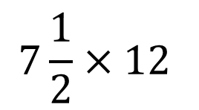
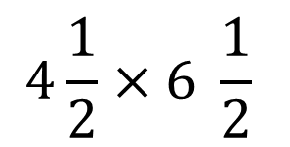
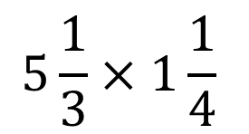
About, Between, or Exact
It is about ___.
It is between ___ and ____.
It is exactly ___.
Explain how the information shown supports your reasoning.
5 / 51
Notes:
TEACH IN PRACTICE | Embedded facilitation | Lesson 7.1, slide 5 | WORKED
Focus on the existing task: About, Between, or Exact It is about ___. It is between ___ and ____. It is exactly ___.
LAUNCH (T2/3/5): Ask students to explain the displayed idea or example and point to evidence. When a calculation step is shown, ask why it is valid. Have a partner restate the explanation; copying is not the check.
LOOK FOR (T4): Where this task addresses it, students can interpret positive, negative and zero in context. Ask which feature of their work supports the claim.
RESPOND: If this task shows the lesson misconception—treating zero as positive or confusing an opposite with an absolute value—label the reference point and directions on the existing number line. Have the student revise and explain the change. Use this support only where the concept occurs in the current task; otherwise respond to the displayed question.
RECHECK: If a gap is shared, revisit the existing representation together. If it is limited, give targeted support while others compare valid methods on the same task. Check the revision before moving on.
PARTICIPATION (T5/6/7): Think time before volunteers; accept a written, drawn or rehearsed entry. Students ask for evidence respectfully. Recognize a specific contribution or revision and check that both partners participate.
Source: BCPS Updated Instructional Framework Rubric (June 2020), TEACH 1–7. Earlier notes and answer keys are retained below.
EARLIER NOTES / EXISTING ANSWER KEY
Number-sense routine — every voice in. Give quiet think time, then hear from at least three students.
Always follow with “How do you know?” — the reasoning is the point, not the answer.
There is more than one path; name and celebrate different strategies.
UIFR: TEACH 3 · TEACH 5 · TEACH 6.

Slide 6
Today’s Objectives
Lesson 7-1 · Explore Integers and Their Opposites
Explore Integers and Their Opposites
Maryland Standard 6.NOS.6
SHOW YOUR THINKING · Show what you know — write it, draw it, or build it. A picture counts as an explanation.
CONTENT OBJECTIVE
LANGUAGE OBJECTIVE
Restate the goal in your words
Use these words to explain why
I can use integers to represent quantities in everyday life, explain what 0 means in each situation, and name the opposite of an integer on the number line.
I can explain my reasoning using the words integer, opposite, negative, positive, and number line.
eduwonderlab.com · Neft Teacher
6 / 51
Notes:
TEACH IN PRACTICE | Embedded facilitation | Lesson 7.1, slide 6 | GOAL
Focus on the existing task: Today’s Objectives Explore Integers and Their…
CONNECT (T1/4): Ask students to restate the displayed goal or key idea and connect it to earlier work. Relevant lesson evidence: interpret positive, negative and zero in context; locate opposites equally far from zero. Use only the criterion that matches the current session.
SHOW PROGRESS: Students point to their own existing work, explain what improved after feedback, and name a next step. Pair confidence ratings with actual evidence.
PARTICIPATION (T5/6/7): Think time before volunteers; accept a written, drawn or rehearsed entry. Students ask for evidence respectfully. Recognize a specific contribution or revision and check that both partners participate.
Source: BCPS Updated Instructional Framework Rubric (June 2020), TEACH 1–7. Earlier notes and answer keys are retained below.
EARLIER NOTES / EXISTING ANSWER KEY
Read the objective together, then have one or two students restate today’s goal in their own words.
Connect it to what the class learned last lesson.
Return to this goal at the end of class to check it was met.
UIFR: TEACH 1.
UIFR FULL | Lesson-specific facilitation
TEACH 1 | Session 1 purpose and evidence (UIFR PDF p. 8).
Have students restate the displayed session goal in their own words and connect it to the existing context or a familiar experience they choose to share. Use the current session goal to select from these lesson-wide evidence criteria; do not frontload a later-session procedure.
Look for: interpret positive, negative and zero in context; locate opposites equally far from zero. Ask: “Which part of your work would show this?” Revisit that evidence after the task; a confidence rating alone is not evidence of understanding.

Slide 7
LESSON 7.1 / OUR LEARNING
What will show your learning?
1
Interpret positive, negative and zero in context.
2
Locate opposites equally far from zero.
Tell a partner: Which skill connects to something you already know?
WHY IT MATTERS · Finish this: “This is worth knowing because ______.”
Listen to understand. Ask for evidence. Make room for every voice.
Notes:
TEACH IN PRACTICE | Embedded facilitation | Lesson 7.1, slide 7 | PRIOR_INSERT
Focus on the existing task: LESSON 7.1 / OUR LEARNING What will show your learning?
CONNECT (T1/4): Ask students to restate the displayed goal or key idea and connect it to earlier work. Relevant lesson evidence: interpret positive, negative and zero in context; locate opposites equally far from zero. Use only the criterion that matches the current session.
SHOW PROGRESS: Students point to their own existing work, explain what improved after feedback, and name a next step. Pair confidence ratings with actual evidence.
PARTICIPATION (T5/6/7): Think time before volunteers; accept a written, drawn or rehearsed entry. Students ask for evidence respectfully. Recognize a specific contribution or revision and check that both partners participate.
Source: BCPS Updated Instructional Framework Rubric (June 2020), TEACH 1–7.

Slide 8
Vocabulary 1 of 5
Lesson 7-1 · Explore Integers and Their Opposites
Integer
The counting numbers, their opposites, and 0.
EXAMPLE · EXPLAIN WHY IT FITS
…, −3, −2, −1, 0, 1, 2, 3, …
Use “Integer” to explain the example. Point to evidence.
eduwonderlab.com · Neft Teacher
8 / 51
Notes:
TEACH IN PRACTICE | Embedded facilitation | Lesson 7.1, slide 8 | VOCAB
Focus on the existing task: Vocabulary 1 of 5 Integer The counting numbers, their…
ASK (T1/3/5): Where does “Integer” appear in the example? Explain the meaning without reading the definition. Partner: restate the idea and ask a clarifying question.
LOOK FOR: A correct connection between the word and a feature of the example. If the student only repeats the definition, invite pointing, sketching or oral rehearsal, then ask for another explanation of this same example.
PARTICIPATION (T5/6/7): Think time before volunteers; accept a written, drawn or rehearsed entry. Students ask for evidence respectfully. Recognize a specific contribution or revision and check that both partners participate.
Source: BCPS Updated Instructional Framework Rubric (June 2020), TEACH 1–7.

Slide 9
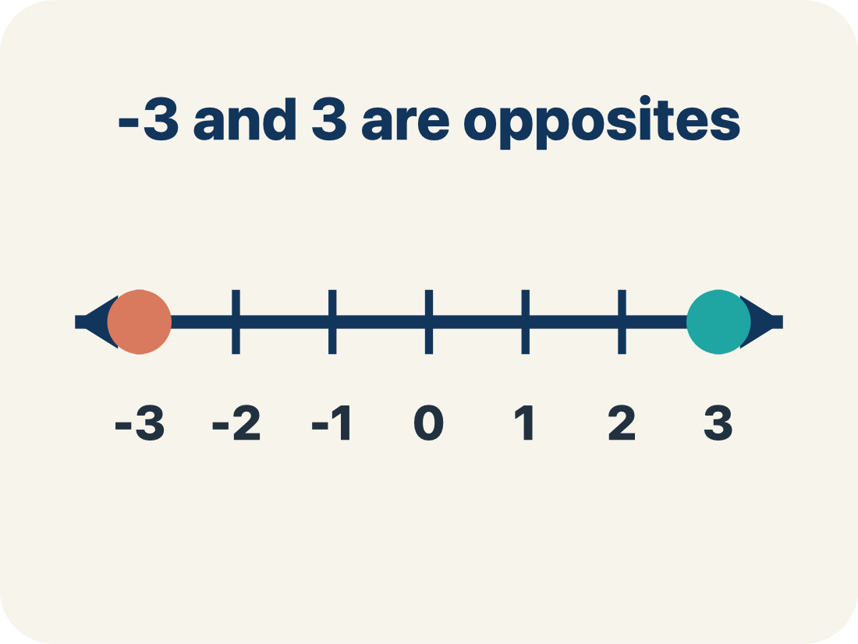
Vocabulary 2 of 5
Lesson 7-1 · Explore Integers and Their Opposites
Opposite
A number that is the same distance from 0 as another number, but on the other side of 0.
EXAMPLE · EXPLAIN WHY IT FITS
86 and −86 are both 86 units from 0, on opposite sides
Use “Opposite” to explain the example. Point to evidence.
eduwonderlab.com · Neft Teacher
9 / 51
Notes:
TEACH IN PRACTICE | Embedded facilitation | Lesson 7.1, slide 9 | VOCAB
Focus on the existing task: Vocabulary 2 of 5 Opposite A number that is the same…
ASK (T1/3/5): Where does “Opposite” appear in the example? Explain the meaning without reading the definition. Partner: restate the idea and ask a clarifying question.
LOOK FOR: A correct connection between the word and a feature of the example. If the student only repeats the definition, invite pointing, sketching or oral rehearsal, then ask for another explanation of this same example.
PARTICIPATION (T5/6/7): Think time before volunteers; accept a written, drawn or rehearsed entry. Students ask for evidence respectfully. Recognize a specific contribution or revision and check that both partners participate.
Source: BCPS Updated Instructional Framework Rubric (June 2020), TEACH 1–7.

Slide 10
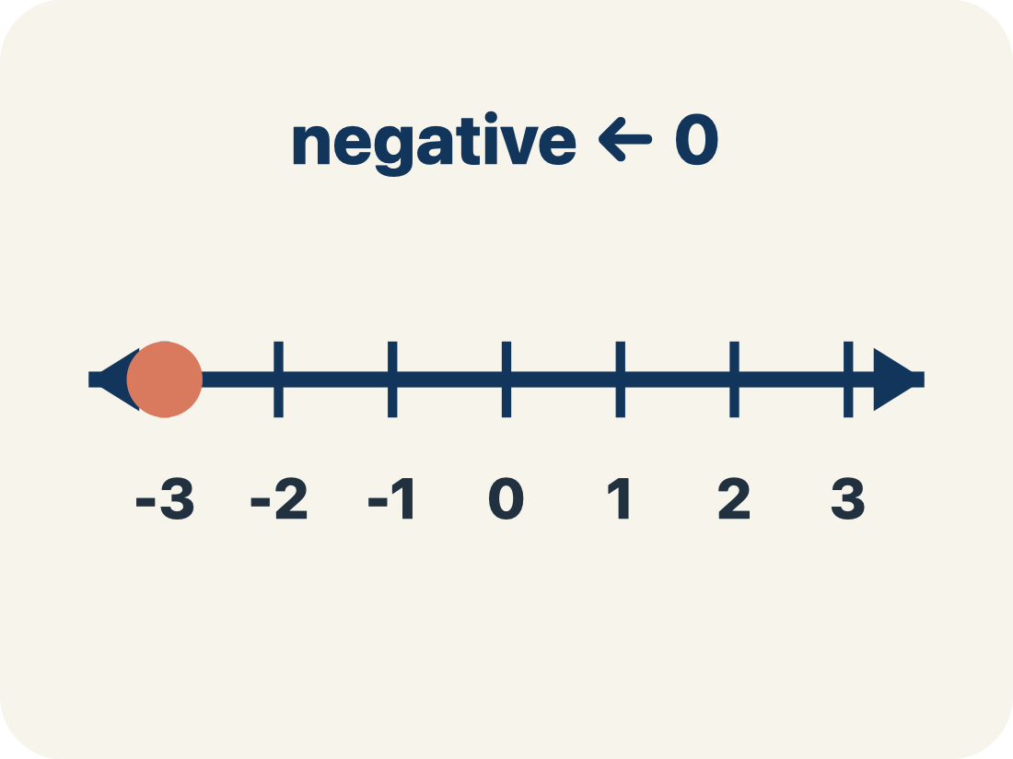
Vocabulary 3 of 5
Lesson 7-1 · Explore Integers and Their Opposites
Negative number
A number less than 0, written with a − sign. On a number line it sits to the left of 0.
EXAMPLE · EXPLAIN WHY IT FITS
−86 meters means 86 meters BELOW sea level
Use “Negative number” to explain the example. Point to
evidence.
eduwonderlab.com · Neft Teacher
10 / 51
Notes:
TEACH IN PRACTICE | Embedded facilitation | Lesson 7.1, slide 10 | VOCAB
Focus on the existing task: Vocabulary 3 of 5 Negative number A number less than…
ASK (T1/3/5): Where does “Negative number” appear in the example? Explain the meaning without reading the definition. Partner: restate the idea and ask a clarifying question.
LOOK FOR: A correct connection between the word and a feature of the example. If the student only repeats the definition, invite pointing, sketching or oral rehearsal, then ask for another explanation of this same example.
PARTICIPATION (T5/6/7): Think time before volunteers; accept a written, drawn or rehearsed entry. Students ask for evidence respectfully. Recognize a specific contribution or revision and check that both partners participate.
Source: BCPS Updated Instructional Framework Rubric (June 2020), TEACH 1–7.

Slide 11
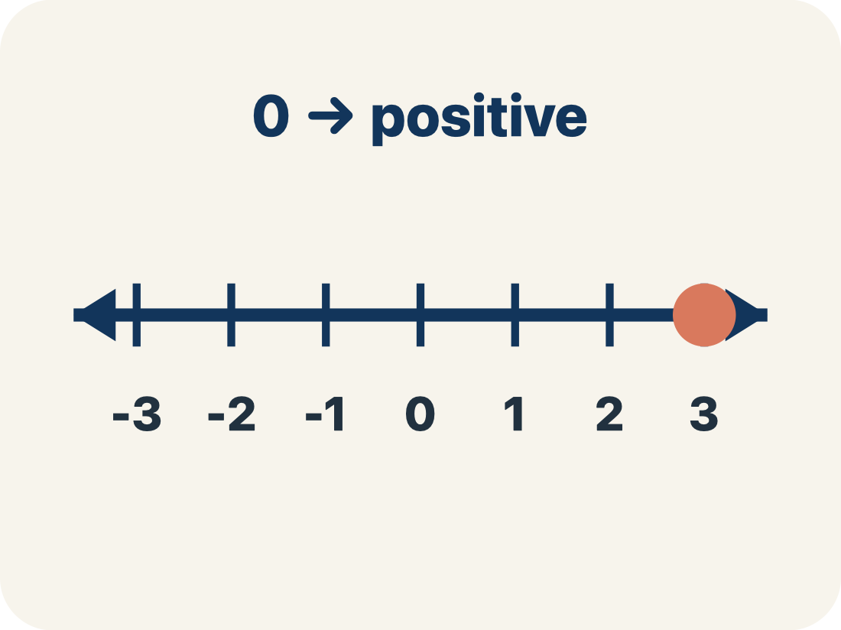
Vocabulary 4 of 5
Lesson 7-1 · Explore Integers and Their Opposites
Positive number
A number greater than 0. On a number line it sits to the right of 0.
EXAMPLE · EXPLAIN WHY IT FITS
9°C is 9 degrees ABOVE zero
Use “Positive number” to explain the example. Point to
evidence.
eduwonderlab.com · Neft Teacher
11 / 51
Notes:
TEACH IN PRACTICE | Embedded facilitation | Lesson 7.1, slide 11 | VOCAB
Focus on the existing task: Vocabulary 4 of 5 Positive number A number greater…
ASK (T1/3/5): Where does “Positive number” appear in the example? Explain the meaning without reading the definition. Partner: restate the idea and ask a clarifying question.
LOOK FOR: A correct connection between the word and a feature of the example. If the student only repeats the definition, invite pointing, sketching or oral rehearsal, then ask for another explanation of this same example.
PARTICIPATION (T5/6/7): Think time before volunteers; accept a written, drawn or rehearsed entry. Students ask for evidence respectfully. Recognize a specific contribution or revision and check that both partners participate.
Source: BCPS Updated Instructional Framework Rubric (June 2020), TEACH 1–7.

Slide 12
Vocabulary 5 of 5
Lesson 7-1 · Explore Integers and Their Opposites
Number line
A straight line where numbers are placed in order. It extends to the left of 0 to show values less than 0.
EXAMPLE · EXPLAIN WHY IT FITS
−3, −2, −1, 0, 1, 2, 3 marked in order from left to right
Use “Number line” to explain the example. Point to evidence.
eduwonderlab.com · Neft Teacher
12 / 51
Notes:
TEACH IN PRACTICE | Embedded facilitation | Lesson 7.1, slide 12 | VOCAB
Focus on the existing task: Vocabulary 5 of 5 Number line A straight line where…
ASK (T1/3/5): Where does “Number line” appear in the example? Explain the meaning without reading the definition. Partner: restate the idea and ask a clarifying question.
LOOK FOR: A correct connection between the word and a feature of the example. If the student only repeats the definition, invite pointing, sketching or oral rehearsal, then ask for another explanation of this same example.
PARTICIPATION (T5/6/7): Think time before volunteers; accept a written, drawn or rehearsed entry. Students ask for evidence respectfully. Recognize a specific contribution or revision and check that both partners participate.
Source: BCPS Updated Instructional Framework Rubric (June 2020), TEACH 1–7.

Slide 13
Vocabulary
Lesson 7-1 · Explore Integers and Their Opposites
Today’s Math Words
We learn every word — what it means and what it looks like — before we use it.
Integer
Opposite
The counting numbers, their opposites, and 0
A number that is the same distance from 0 as another number, but on the other side of 0
Negative number
Positive number
A number less than 0, written with a − sign
A number greater than 0
Number line
A straight line where numbers are placed in order
Explain one math word using the example.
Partner: point to evidence.
eduwonderlab.com · Neft Teacher
13 / 51
Notes:
TEACH IN PRACTICE | Embedded facilitation | Lesson 7.1, slide 13 | VOCAB
Focus on the existing task: Vocabulary Today’s Math Words We learn every word…
ASK (T1/3/5): Where does “the displayed term” appear in the example? Explain the meaning without reading the definition. Partner: restate the idea and ask a clarifying question.
LOOK FOR: A correct connection between the word and a feature of the example. If the student only repeats the definition, invite pointing, sketching or oral rehearsal, then ask for another explanation of this same example.
PARTICIPATION (T5/6/7): Think time before volunteers; accept a written, drawn or rehearsed entry. Students ask for evidence respectfully. Recognize a specific contribution or revision and check that both partners participate.
Source: BCPS Updated Instructional Framework Rubric (June 2020), TEACH 1–7. Earlier notes and answer keys are retained below.
EARLIER NOTES / EXISTING ANSWER KEY
Choral-read each word, its meaning, and what it looks like.
Students should use these words out loud today — listen for them in partner talk and revoice student ideas with the academic term.
UIFR: TEACH 1 · TEACH 5.

Slide 14
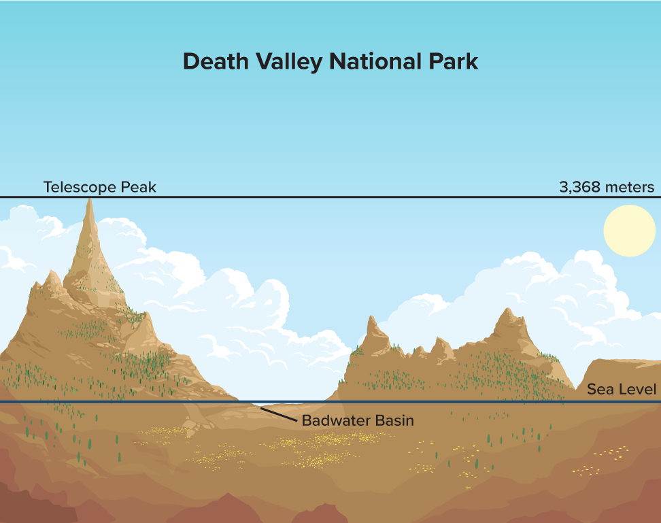

Be Curious
What do you notice?
What do you wonder?
Think first. Share a notice and a question;
build on a classmate’s idea.
Mindset
How do you give positive feedback to your classmates today?
14 / 51
Notes:
TEACH IN PRACTICE | Embedded facilitation | Lesson 7.1, slide 14 | CURIOUS
Focus on the existing task: Be Curious What do you notice?
LAUNCH (T2/3/5): Allow quiet observation first. Separate a notice from an inference, invite students’ own questions, and follow the existing launch before teaching a procedure.
LOOK FOR (T4): Where this task addresses it, students can interpret positive, negative and zero in context. Ask which feature of their work supports the claim.
RESPOND: If this task shows the lesson misconception—treating zero as positive or confusing an opposite with an absolute value—label the reference point and directions on the existing number line. Have the student revise and explain the change. Use this support only where the concept occurs in the current task; otherwise respond to the displayed question.
RECHECK: If a gap is shared, revisit the existing representation together. If it is limited, give targeted support while others compare valid methods on the same task. Check the revision before moving on.
PARTICIPATION (T5/6/7): Think time before volunteers; accept a written, drawn or rehearsed entry. Students ask for evidence respectfully. Recognize a specific contribution or revision and check that both partners participate.
Source: BCPS Updated Instructional Framework Rubric (June 2020), TEACH 1–7. Earlier notes and answer keys are retained below.
EARLIER NOTES / EXISTING ANSWER KEY
Accept all noticings and wonderings — there are no wrong answers here.
Give 20–30 seconds of quiet think time before taking responses; mix cold and warm calls so it is not always the same voices.
Read the mindset question aloud and let two students respond.
UIFR: TEACH 3 · TEACH 7.

Slide 15
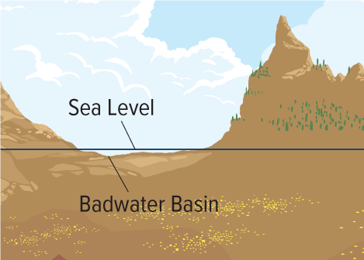

The Lowest Elevation
The lowest elevation in North America is Badwater Basin in Death Valley, which is 86 meters below sea level.
TRY IT BEFORE YOU’RE SURE · Start even if you are not sure. A revised answer counts as much as a first-try answer.
How can you represent this elevation?
Using Representations
How can you use a picture to solve this problem?
15 / 51
Notes:
TEACH IN PRACTICE | Embedded facilitation | Lesson 7.1, slide 15 | TASK
Focus on the existing task: The Lowest Elevation The lowest elevation in North America is Badwater Basin in Death Valley, which is 86 meters below sea level. How can you represent this elevation?
LAUNCH (T2/3/5): Use the displayed question. Give private thinking time; then A explains while B asks for evidence. Switch roles. Each student records their own reasoning.
LOOK FOR (T4): Where this task addresses it, students can interpret positive, negative and zero in context. Ask which feature of their work supports the claim.
RESPOND: If this task shows the lesson misconception—treating zero as positive or confusing an opposite with an absolute value—label the reference point and directions on the existing number line. Have the student revise and explain the change. Use this support only where the concept occurs in the current task; otherwise respond to the displayed question.
RECHECK: If a gap is shared, revisit the existing representation together. If it is limited, give targeted support while others compare valid methods on the same task. Check the revision before moving on.
PARTICIPATION (T5/6/7): Think time before volunteers; accept a written, drawn or rehearsed entry. Students ask for evidence respectfully. Recognize a specific contribution or revision and check that both partners participate.
Source: BCPS Updated Instructional Framework Rubric (June 2020), TEACH 1–7. Earlier notes and answer keys are retained below.
EARLIER NOTES / EXISTING ANSWER KEY
Model briefly, then hand the thinking back: ask “Why does this step work?” before showing the next one.
Quick check before moving on — thumbs or whiteboards from everyone, not volunteers.
UIFR: TEACH 2 · TEACH 3 · TEACH 4.
UIFR FULL | Lesson-specific facilitation
TEACH 2-3 | Session 1 task launch (UIFR PDF pp. 9-10).
Use the problem exactly as displayed. Give individual thinking time before discussion or advancing to the explanation. If the answer is already visible, ask students to reconstruct and justify it. Invite a choice of suitable representations and have students explain why their choice helps.
At the point where this concept appears, ask: “What does zero mean here, and how does the opposite describe a related quantity?” Wait for evidence, invite another pathway, and have a student ask a follow-up question. Do not replace students’ reasoning with a sequence of leading steps.

Slide 16
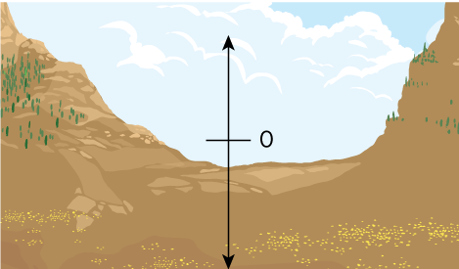
The Lowest Elevation
Let’s make a diagram to represent the situation.
When measuring elevation, sea level is defined as 0.
Badwater Basin is 86 meters below sea level.
Will Badwater Basin be above or below 0 on the diagram? Explain.
Reveal:
It will be below 0 because the elevation is 86 meters below sea level.
16 / 51
Notes:
TEACH IN PRACTICE | Embedded facilitation | Lesson 7.1, slide 16 | REVEAL
Focus on the existing task: Let’s make a diagram to represent the situation. When measuring elevation, sea level is defined as 0. Badwater Basin is 86 meters below sea level. Will Badwater Basin be above or below 0 on the diagram?
LAUNCH (T2/3/5): If an existing answer cover is present, gather an attempt before revealing. If the explanation is already visible, ask students to reconstruct and justify it. Compare reasoning and explain a revision; preserve the reveal sequence.
LOOK FOR (T4): Where this task addresses it, students can interpret positive, negative and zero in context. Ask which feature of their work supports the claim.
RESPOND: If this task shows the lesson misconception—treating zero as positive or confusing an opposite with an absolute value—label the reference point and directions on the existing number line. Have the student revise and explain the change. Use this support only where the concept occurs in the current task; otherwise respond to the displayed question.
RECHECK: If a gap is shared, revisit the existing representation together. If it is limited, give targeted support while others compare valid methods on the same task. Check the revision before moving on.
PARTICIPATION (T5/6/7): Think time before volunteers; accept a written, drawn or rehearsed entry. Students ask for evidence respectfully. Recognize a specific contribution or revision and check that both partners participate.
Source: BCPS Updated Instructional Framework Rubric (June 2020), TEACH 1–7. Earlier notes and answer keys are retained below.
EARLIER NOTES / EXISTING ANSWER KEY
Do not click yet: collect 2–3 student answers with reasons first.
Then click to remove the cover and have students compare their thinking to the reveal — “Is this what we said? Where is it different?”
Behind the cover: It will be below 0 because the elevation is 86 meters below sea level.
UIFR: TEACH 3 · TEACH 4.

Slide 17
STUDENT MOVES
Lesson 7-1
Your move
TWO MINUTES SOLO · Two minutes on your own, then compare. Bring one thing you tried, even if it did not work.
17 / 51

Slide 18
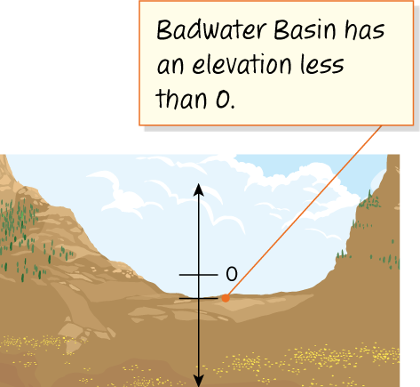
The Lowest Elevation
Badwater Basin is below sea level, that is, below 0.
Think and record first. Which part of your
work supports your answer?
Think About It:
Where have you heard the phrase “below zero” before?
18 / 51
Notes:
TEACH IN PRACTICE | Embedded facilitation | Lesson 7.1, slide 17 | TASK
Focus on the existing task: Badwater Basin is below sea level, that is, below 0. Think About It: Where have you heard the phrase “below zero” before?
LAUNCH (T2/3/5): Use the displayed question. Give private thinking time; then A explains while B asks for evidence. Switch roles. Each student records their own reasoning.
LOOK FOR (T4): Where this task addresses it, students can interpret positive, negative and zero in context. Ask which feature of their work supports the claim.
RESPOND: If this task shows the lesson misconception—treating zero as positive or confusing an opposite with an absolute value—label the reference point and directions on the existing number line. Have the student revise and explain the change. Use this support only where the concept occurs in the current task; otherwise respond to the displayed question.
RECHECK: If a gap is shared, revisit the existing representation together. If it is limited, give targeted support while others compare valid methods on the same task. Check the revision before moving on.
PARTICIPATION (T5/6/7): Think time before volunteers; accept a written, drawn or rehearsed entry. Students ask for evidence respectfully. Recognize a specific contribution or revision and check that both partners participate.
Source: BCPS Updated Instructional Framework Rubric (June 2020), TEACH 1–7. Earlier notes and answer keys are retained below.
EARLIER NOTES / EXISTING ANSWER KEY
Ask the question, then hold the silence — students think or jot before anyone answers.
Take two or three responses and press with “Why?” or “How do you know?” before moving on.
UIFR: TEACH 3.

Slide 19
The Lowest Elevation
Badwater Basin is 86 meters below sea level, that is, below 0.
Numbers less than zero are negative numbers and are written with a − (negative) sign.
How might you write the number that represents the elevation of Badwater Basin?
Reveal:
−86
HOW DO YOU KNOW? · Ask your partner “How do you know?” Answer by pointing to your own work.
19 / 51
Notes:
TEACH IN PRACTICE | Embedded facilitation | Lesson 7.1, slide 18 | REVEAL
Focus on the existing task: Badwater Basin is 86 meters below sea level, that is, below 0. Numbers less than zero are negative numbers and are written with a −…
LAUNCH (T2/3/5): If an existing answer cover is present, gather an attempt before revealing. If the explanation is already visible, ask students to reconstruct and justify it. Compare reasoning and explain a revision; preserve the reveal sequence.
LOOK FOR (T4): Where this task addresses it, students can interpret positive, negative and zero in context. Ask which feature of their work supports the claim.
RESPOND: If this task shows the lesson misconception—treating zero as positive or confusing an opposite with an absolute value—label the reference point and directions on the existing number line. Have the student revise and explain the change. Use this support only where the concept occurs in the current task; otherwise respond to the displayed question.
RECHECK: If a gap is shared, revisit the existing representation together. If it is limited, give targeted support while others compare valid methods on the same task. Check the revision before moving on.
PARTICIPATION (T5/6/7): Think time before volunteers; accept a written, drawn or rehearsed entry. Students ask for evidence respectfully. Recognize a specific contribution or revision and check that both partners participate.
Source: BCPS Updated Instructional Framework Rubric (June 2020), TEACH 1–7. Earlier notes and answer keys are retained below.
EARLIER NOTES / EXISTING ANSWER KEY
Do not click yet: collect 2–3 student answers with reasons first.
Then click to remove the cover and have students compare their thinking to the reveal — “Is this what we said? Where is it different?”
Behind the cover: −86
UIFR: TEACH 3 · TEACH 4.

Slide 20

The Lowest Elevation
The elevation of Badwater Basin is −86 (negative 86) meters.
Record your reasoning before the reveal.
Compare, then explain any revision.
What other tool can you use to represent numbers?
Reveal:
One tool is a number line.
20 / 51
Notes:
TEACH IN PRACTICE | Embedded facilitation | Lesson 7.1, slide 19 | REVEAL
Focus on the existing task: The elevation of Badwater Basin is −86 (negative 86) meters. What other tool can you use to represent numbers?
LAUNCH (T2/3/5): If an existing answer cover is present, gather an attempt before revealing. If the explanation is already visible, ask students to reconstruct and justify it. Compare reasoning and explain a revision; preserve the reveal sequence.
LOOK FOR (T4): Where this task addresses it, students can interpret positive, negative and zero in context. Ask which feature of their work supports the claim.
RESPOND: If this task shows the lesson misconception—treating zero as positive or confusing an opposite with an absolute value—label the reference point and directions on the existing number line. Have the student revise and explain the change. Use this support only where the concept occurs in the current task; otherwise respond to the displayed question.
RECHECK: If a gap is shared, revisit the existing representation together. If it is limited, give targeted support while others compare valid methods on the same task. Check the revision before moving on.
PARTICIPATION (T5/6/7): Think time before volunteers; accept a written, drawn or rehearsed entry. Students ask for evidence respectfully. Recognize a specific contribution or revision and check that both partners participate.
Source: BCPS Updated Instructional Framework Rubric (June 2020), TEACH 1–7. Earlier notes and answer keys are retained below.
EARLIER NOTES / EXISTING ANSWER KEY
Do not click yet: collect 2–3 student answers with reasons first.
Then click to remove the cover and have students compare their thinking to the reveal — “Is this what we said? Where is it different?”
Behind the cover: One tool is a number line.
UIFR: TEACH 3 · TEACH 4.

Slide 21
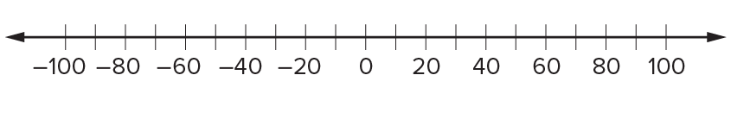
The Lowest Elevation
You can extend a horizontal number line to the left of 0 to represent values less than 0. The numbers to the left of 0 are negative numbers.
How can you represent the elevation of Badwater Basin, −86 (negative 86) meters, on the number line? Explain.
Reveal:
The elevation can be represented by a point that is 86 units to the left of 0 because it is a negative number.
21 / 51
Notes:
TEACH IN PRACTICE | Embedded facilitation | Lesson 7.1, slide 20 | REVEAL
Focus on the existing task: You can extend a horizontal number line to the left of 0 to represent values less than 0. The numbers to the left of 0 are negative numbers.
LAUNCH (T2/3/5): If an existing answer cover is present, gather an attempt before revealing. If the explanation is already visible, ask students to reconstruct and justify it. Compare reasoning and explain a revision; preserve the reveal sequence.
LOOK FOR (T4): Where this task addresses it, students can interpret positive, negative and zero in context. Ask which feature of their work supports the claim.
RESPOND: If this task shows the lesson misconception—treating zero as positive or confusing an opposite with an absolute value—label the reference point and directions on the existing number line. Have the student revise and explain the change. Use this support only where the concept occurs in the current task; otherwise respond to the displayed question.
RECHECK: If a gap is shared, revisit the existing representation together. If it is limited, give targeted support while others compare valid methods on the same task. Check the revision before moving on.
PARTICIPATION (T5/6/7): Think time before volunteers; accept a written, drawn or rehearsed entry. Students ask for evidence respectfully. Recognize a specific contribution or revision and check that both partners participate.
Source: BCPS Updated Instructional Framework Rubric (June 2020), TEACH 1–7. Earlier notes and answer keys are retained below.
EARLIER NOTES / EXISTING ANSWER KEY
Do not click yet: collect 2–3 student answers with reasons first.
Then click to remove the cover and have students compare their thinking to the reveal — “Is this what we said? Where is it different?”
Behind the cover: The elevation can be represented by a point that is 86 units to the left of 0 because it is a negative number.
UIFR: TEACH 3 · TEACH 4.

Slide 22
STUDENT MOVES
Lesson 7-1
Your move
PROVE IT · Find the evidence in the problem that makes your answer right — not just the answer.
22 / 51

Slide 23
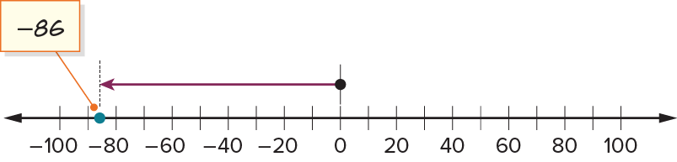
The Lowest Elevation
Let’s represent the elevation of Badwater Basin, −86 (negative 86) meters, on the number line.
The elevation is represented by a point that is 86 units to the left of 0 because it is a negative number.
USE THE MATH WORDS · Use today’s math words in your explanation — not “it” and “that thing.”
23 / 51
Notes:
TEACH IN PRACTICE | Embedded facilitation | Lesson 7.1, slide 21 | WORKED
Focus on the existing task: Let’s represent the elevation of Badwater Basin, −86 (negative 86) meters, on the number line. The elevation is represented by a point…
LAUNCH (T2/3/5): Ask students to explain the displayed idea or example and point to evidence. When a calculation step is shown, ask why it is valid. Have a partner restate the explanation; copying is not the check.
LOOK FOR (T4): Where this task addresses it, students can interpret positive, negative and zero in context. Ask which feature of their work supports the claim.
RESPOND: If this task shows the lesson misconception—treating zero as positive or confusing an opposite with an absolute value—label the reference point and directions on the existing number line. Have the student revise and explain the change. Use this support only where the concept occurs in the current task; otherwise respond to the displayed question.
RECHECK: If a gap is shared, revisit the existing representation together. If it is limited, give targeted support while others compare valid methods on the same task. Check the revision before moving on.
PARTICIPATION (T5/6/7): Think time before volunteers; accept a written, drawn or rehearsed entry. Students ask for evidence respectfully. Recognize a specific contribution or revision and check that both partners participate.
Source: BCPS Updated Instructional Framework Rubric (June 2020), TEACH 1–7. Earlier notes and answer keys are retained below.
EARLIER NOTES / EXISTING ANSWER KEY
Model briefly, then hand the thinking back: ask “Why does this step work?” before showing the next one.
Quick check before moving on — thumbs or whiteboards from everyone, not volunteers.
UIFR: TEACH 2 · TEACH 3 · TEACH 4.

Slide 24
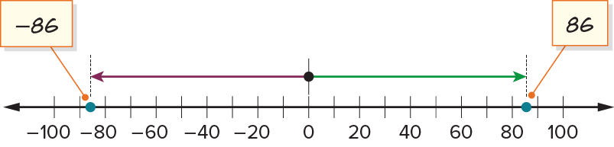
The Lowest Elevation
−86 is the opposite of 86.
JUSTIFY IT · Say it like this: “I know ______ because ______.”
What do you notice about the two opposite numbers?
Reveal:
They are both 86 units from 0, but on different sides of 0 on the number line.
24 / 51
Notes:
TEACH IN PRACTICE | Embedded facilitation | Lesson 7.1, slide 22 | REVEAL
Focus on the existing task: −86 is the opposite of 86. What do you notice about the two opposite numbers?
LAUNCH (T2/3/5): If an existing answer cover is present, gather an attempt before revealing. If the explanation is already visible, ask students to reconstruct and justify it. Compare reasoning and explain a revision; preserve the reveal sequence.
LOOK FOR (T4): Where this task addresses it, students can locate opposites equally far from zero. Ask which feature of their work supports the claim.
RESPOND: If this task shows the lesson misconception—treating zero as positive or confusing an opposite with an absolute value—label the reference point and directions on the existing number line. Have the student revise and explain the change. Use this support only where the concept occurs in the current task; otherwise respond to the displayed question.
RECHECK: If a gap is shared, revisit the existing representation together. If it is limited, give targeted support while others compare valid methods on the same task. Check the revision before moving on.
PARTICIPATION (T5/6/7): Think time before volunteers; accept a written, drawn or rehearsed entry. Students ask for evidence respectfully. Recognize a specific contribution or revision and check that both partners participate.
Source: BCPS Updated Instructional Framework Rubric (June 2020), TEACH 1–7. Earlier notes and answer keys are retained below.
EARLIER NOTES / EXISTING ANSWER KEY
Do not click yet: collect 2–3 student answers with reasons first.
Then click to remove the cover and have students compare their thinking to the reveal — “Is this what we said? Where is it different?”
Behind the cover: They are both 86 units from 0, but on different sides of 0 on the number line.
UIFR: TEACH 3 · TEACH 4.

Slide 25

COLLABORATE · TALK IT THROUGH • AGREE ON A MODEL
Collaborate and Connect
−86 is the opposite of 86.
ADD ON · Add on: “I agree because ______.” or “I see it differently because ______.”
Counting numbers, their opposites, and 0 are integers. Opposites are the same distance from 0 but on the opposite side of the number line.
What are 5 different numbers you can write that are integers?
Reveal:
Some integers we can write are 2, 5, −9, −14, and 230.
25 / 51
Notes:
TEACH IN PRACTICE | Embedded facilitation | Lesson 7.1, slide 23 | COLLABORATE
Focus on the existing task: Collaborate and Connect Reveal: Some integers we can write are 2, 5, −9, −14, and 230. −86 is the opposite of 86. Counting numbers…
LAUNCH (T2/3/5): Use the displayed question. Give private thinking time; then A explains while B asks for evidence. Switch roles. Each student records their own reasoning.
LOOK FOR (T4): Where this task addresses it, students can locate opposites equally far from zero. Ask which feature of their work supports the claim.
RESPOND: If this task shows the lesson misconception—treating zero as positive or confusing an opposite with an absolute value—label the reference point and directions on the existing number line. Have the student revise and explain the change. Use this support only where the concept occurs in the current task; otherwise respond to the displayed question.
RECHECK: If a gap is shared, revisit the existing representation together. If it is limited, give targeted support while others compare valid methods on the same task. Check the revision before moving on.
PARTICIPATION (T5/6/7): Think time before volunteers; accept a written, drawn or rehearsed entry. Students ask for evidence respectfully. Recognize a specific contribution or revision and check that both partners participate.
Source: BCPS Updated Instructional Framework Rubric (June 2020), TEACH 1–7. Earlier notes and answer keys are retained below.
EARLIER NOTES / EXISTING ANSWER KEY
Routine: COLLABORATE · TALK IT THROUGH • AGREE ON A MODEL
UIFR FULL | Lesson-specific facilitation
TEACH 4-5 | Session 1 discussion and checkpoint (UIFR PDF pp. 11-12).
Collect a brief response from every student to the existing prompt before hearing volunteers. Partners take turns explaining and asking for evidence: “I understand ___; what supports ___?” Offer rehearsal or an annotated model for students who need language support. Each student records their own reasoning.
Look specifically for: treating zero as positive or confusing an opposite with an absolute value. If it appears, label the reference point and directions on the existing number line; then ask the student to revise the same response and explain the change. If evidence is secure, have students compare a second valid pathway or state why their approach works. Choose the next step from the responses, not a preset pace.

Slide 26
Let’s Explore More
Why does 0 represent sea level?
How do you think negative values and subtraction are related?
Workspace
STRUGGLE FIRST · Work on your own first. Stuck is allowed — try a second strategy before you ask.
Workspace
26 / 51
Notes:
TEACH IN PRACTICE | Embedded facilitation | Lesson 7.1, slide 24 | PRACTICE
Focus on the existing task: Why does 0 represent sea level?
LAUNCH (T2/3/5): Use the displayed question. Give private thinking time; then A explains while B asks for evidence. Switch roles. Each student records their own reasoning.
LOOK FOR (T4): Where this task addresses it, students can interpret positive, negative and zero in context. Ask which feature of their work supports the claim.
RESPOND: If this task shows the lesson misconception—treating zero as positive or confusing an opposite with an absolute value—label the reference point and directions on the existing number line. Have the student revise and explain the change. Use this support only where the concept occurs in the current task; otherwise respond to the displayed question.
RECHECK: If a gap is shared, revisit the existing representation together. If it is limited, give targeted support while others compare valid methods on the same task. Check the revision before moving on.
PARTICIPATION (T5/6/7): Think time before volunteers; accept a written, drawn or rehearsed entry. Students ask for evidence respectfully. Recognize a specific contribution or revision and check that both partners participate.
Source: BCPS Updated Instructional Framework Rubric (June 2020), TEACH 1–7. Earlier notes and answer keys are retained below.
EARLIER NOTES / EXISTING ANSWER KEY
Extension for partners or table groups — students choose their approach and use the workspace to show thinking.
Push with “Convince me,” and have two groups with different approaches share.
This is where students stretch past the worked example.
UIFR: TEACH 2 · TEACH 5.

Slide 27
LESSON 7.1 / DISCUSS THE TASK
Explain and compare
Use the task you just explored.
TAKE TURNS
What does zero mean here, and how does the opposite describe a related quantity?
Explain
“I know this because…”
Ask
“Where does your work show that?”
Point to evidence in your work.
Then compare your approach with a partner’s.
ANOTHER PATHWAY · Did anyone get there a different way? Put both pathways side by side and compare.
Listen to understand. Ask for evidence. Make room for every voice.
Notes:
TEACH IN PRACTICE | Embedded facilitation | Lesson 7.1, slide 25 | PRIOR_INSERT
Focus on the existing task: Point to evidence in your work. Then compare your approach with a partner’s. TAKE TURNS Explain “I know this because…” Ask “Where does your work show that?
CONNECT (T1/4): Ask students to restate the displayed goal or key idea and connect it to earlier work. Relevant lesson evidence: interpret positive, negative and zero in context; locate opposites equally far from zero. Use only the criterion that matches the current session.
SHOW PROGRESS: Students point to their own existing work, explain what improved after feedback, and name a next step. Pair confidence ratings with actual evidence.
PARTICIPATION (T5/6/7): Think time before volunteers; accept a written, drawn or rehearsed entry. Students ask for evidence respectfully. Recognize a specific contribution or revision and check that both partners participate.
Source: BCPS Updated Instructional Framework Rubric (June 2020), TEACH 1–7.

Slide 28
The Lowest Elevation
The elevation of Badwater Basin is −86 (negative 86) meters.
Compare your reasoning with the
explanation. Explain any revision you make.
What other tool can you use to represent numbers?
Reveal:
One tool is a number line.
28 / 51
Notes:
TEACH IN PRACTICE | Embedded facilitation | Lesson 7.1, slide 26 | REVEAL
Focus on the existing task: The elevation of Badwater Basin is −86 (negative 86) meters. What other tool can you use to represent numbers?
LAUNCH (T2/3/5): If an existing answer cover is present, gather an attempt before revealing. If the explanation is already visible, ask students to reconstruct and justify it. Compare reasoning and explain a revision; preserve the reveal sequence.
LOOK FOR (T4): Where this task addresses it, students can interpret positive, negative and zero in context. Ask which feature of their work supports the claim.
RESPOND: If this task shows the lesson misconception—treating zero as positive or confusing an opposite with an absolute value—label the reference point and directions on the existing number line. Have the student revise and explain the change. Use this support only where the concept occurs in the current task; otherwise respond to the displayed question.
RECHECK: If a gap is shared, revisit the existing representation together. If it is limited, give targeted support while others compare valid methods on the same task. Check the revision before moving on.
PARTICIPATION (T5/6/7): Think time before volunteers; accept a written, drawn or rehearsed entry. Students ask for evidence respectfully. Recognize a specific contribution or revision and check that both partners participate.
Source: BCPS Updated Instructional Framework Rubric (June 2020), TEACH 1–7.

Slide 29
The Lowest Elevation
−86 is the opposite of 86.
ASK THE CLASS · Write one question about this that you could ask the class.
What do you notice about the two opposite numbers?
Reveal:
They are both 86 units from 0, but on different sides of 0 on the number line.
29 / 51
Notes:
TEACH IN PRACTICE | Embedded facilitation | Lesson 7.1, slide 27 | REVEAL
Focus on the existing task: −86 is the opposite of 86. What do you notice about the two opposite numbers?
LAUNCH (T2/3/5): If an existing answer cover is present, gather an attempt before revealing. If the explanation is already visible, ask students to reconstruct and justify it. Compare reasoning and explain a revision; preserve the reveal sequence.
LOOK FOR (T4): Where this task addresses it, students can locate opposites equally far from zero. Ask which feature of their work supports the claim.
RESPOND: If this task shows the lesson misconception—treating zero as positive or confusing an opposite with an absolute value—label the reference point and directions on the existing number line. Have the student revise and explain the change. Use this support only where the concept occurs in the current task; otherwise respond to the displayed question.
RECHECK: If a gap is shared, revisit the existing representation together. If it is limited, give targeted support while others compare valid methods on the same task. Check the revision before moving on.
PARTICIPATION (T5/6/7): Think time before volunteers; accept a written, drawn or rehearsed entry. Students ask for evidence respectfully. Recognize a specific contribution or revision and check that both partners participate.
Source: BCPS Updated Instructional Framework Rubric (June 2020), TEACH 1–7.

Slide 30
Collaborate and Connect
−86 is the opposite of 86.
TAKE TURNS · One explains, one asks a question. Then switch, so both of you talk.
Counting numbers, their opposites, and 0 are integers. Opposites are the same distance from 0 but on the opposite side of the number line.
What are 5 different numbers you can write that are integers?
Reveal:
Some integers we can write are 2, 5, −9, −14, and 230.
30 / 51
Notes:
TEACH IN PRACTICE | Embedded facilitation | Lesson 7.1, slide 28 | COLLABORATE
Focus on the existing task: Collaborate and Connect Reveal: Some integers we can write are 2, 5, −9, −14, and 230. −86 is the opposite of 86. Counting numbers…
LAUNCH (T2/3/5): Use the displayed question. Give private thinking time; then A explains while B asks for evidence. Switch roles. Each student records their own reasoning.
LOOK FOR (T4): Where this task addresses it, students can locate opposites equally far from zero. Ask which feature of their work supports the claim.
RESPOND: If this task shows the lesson misconception—treating zero as positive or confusing an opposite with an absolute value—label the reference point and directions on the existing number line. Have the student revise and explain the change. Use this support only where the concept occurs in the current task; otherwise respond to the displayed question.
RECHECK: If a gap is shared, revisit the existing representation together. If it is limited, give targeted support while others compare valid methods on the same task. Check the revision before moving on.
PARTICIPATION (T5/6/7): Think time before volunteers; accept a written, drawn or rehearsed entry. Students ask for evidence respectfully. Recognize a specific contribution or revision and check that both partners participate.
Source: BCPS Updated Instructional Framework Rubric (June 2020), TEACH 1–7.

Slide 31
Session 2 Warm-Up
Lesson 7-1 · Explore Integers and Their Opposites
Session 2 Warm-Up
Check what you remember from Session 1 · about 4 minutes
1
What is the opposite of −8?
2
On a horizontal number line, negative numbers sit:
A
−8
A
To the right of 0
B
8
B
To the left of 0
C
0
C
Above 0
D
27 / 41
D
Only at 0
3
A bank withdrawal of $50 is represented by:
4
The sum of a number and its opposite is always:
A
+$50
A
1
B
−$50
B
0
C
$0
C
Negative
D
$500
D
Double
eduwonderlab.com · Neft Teacher
31 / 51
Notes:
TEACH IN PRACTICE | Embedded facilitation | Lesson 7.1, slide 29 | WARMUP
Focus on the existing task: Session 2 Warm-Up Session 2 Warm-Up Check what you remember from Session 1 · about 4 minutes 1 What is the opposite of −8?
GATHER EVIDENCE (T4/6): Keep the original items. Students try independently, mark an uncertain item, and explain one method before checking. Use the existing key when present.
RESPOND: Distinguish a calculation slip from a reasoning gap. Give one next step on the same item; have students revise in a second color. Use the responses to choose flexible support for today’s lesson.
PARTICIPATION (T5/6/7): Think time before volunteers; accept a written, drawn or rehearsed entry. Students ask for evidence respectfully. Recognize a specific contribution or revision and check that both partners participate.
Source: BCPS Updated Instructional Framework Rubric (June 2020), TEACH 1–7. Earlier notes and answer keys are retained below.
EARLIER NOTES / EXISTING ANSWER KEY
Warm-up routine: students start silently on entry; keep it to about 4 minutes.
Circulate and note who is stuck — use what you see to choose who you check on first today.
Go over answers quickly; ask one student to explain a step, not just say the answer.
UIFR: TEACH 4 · TEACH 6.
UIFR FULL | Lesson-specific facilitation
TEACH 1 | Session 2 purpose and evidence (UIFR PDF p. 8).
Have students restate the displayed session goal in their own words and connect it to the existing context or a familiar experience they choose to share. Use the current session goal to select from these lesson-wide evidence criteria; do not frontload a later-session procedure.
Look for: interpret positive, negative and zero in context; locate opposites equally far from zero. Ask: “Which part of your work would show this?” Revisit that evidence after the task; a confidence rating alone is not evidence of understanding.

Slide 32
STUDENT MOVES
Lesson 7-1
Your move
YOU KNOW THE ROUTINE · Read → plan → solve → check. Do all four, in that order.
32 / 51

Slide 33
Today’s Math Notes
Lesson 7-1 · Explore Integers and Their Opposites
Review Notes — Session 2
Copy. Explain. Check.
NAME THE MATH · Point to the part of this that is new today, and say what it changes.
Integers Definition
1
The set of whole numbers, their opposites, and zero: {…, −3, −2, −1, 0, 1, 2, 3, …}.
Opposites on Number Line
2
Two numbers that sit equal distances from zero in opposite directions.
Real-World Contexts
3
Positive: elevation, gains, deposits. Negative: below sea level, losses, withdrawals.
eduwonderlab.com · Neft Teacher
33 / 51
Notes:
TEACH IN PRACTICE | Embedded facilitation | Lesson 7.1, slide 30 | NOTES
Focus on the existing task: Today’s Math Notes Review Notes — Session 2 Copy into…
ROUTINE (T1/2/4): Read or copy the original notes, cover one line, and explain it using the displayed example. Reopen and correct. Copying alone is not evidence of understanding.
LOOK FOR: A link between a symbol, quantity or feature and the explanation. If missing, point back to that feature and have the student try again; fade the prompt once they can explain.
PARTICIPATION (T5/6/7): Think time before volunteers; accept a written, drawn or rehearsed entry. Students ask for evidence respectfully. Recognize a specific contribution or revision and check that both partners participate.
Source: BCPS Updated Instructional Framework Rubric (June 2020), TEACH 1–7. Earlier notes and answer keys are retained below.
EARLIER NOTES / EXISTING ANSWER KEY
Copy routine: read one line at a time; students copy, then explain that line to a partner.
Keep it brisk — the understanding work happens in the examples, not the copying.
UIFR: TEACH 1 · TEACH 6.

Slide 34
Session 2
Explore Integers and Their Opposites
USE YOUR TOOLS · Reach for your notes, a model, or a manipulative before you reach for an answer.
34 / 51
Notes:
TEACH IN PRACTICE | Embedded facilitation | Lesson 7.1, slide 31 | DIVIDER
Focus on the existing task: Explore Integers and Their Opposites Session 2
TRANSITION (T6/7): Students confirm materials, roles, how to request help, and the next response routine. Ask a student to restate it. Keep teacher-only slides hidden.
PARTICIPATION (T5/6/7): Think time before volunteers; accept a written, drawn or rehearsed entry. Students ask for evidence respectfully. Recognize a specific contribution or revision and check that both partners participate.
Source: BCPS Updated Instructional Framework Rubric (June 2020), TEACH 1–7. Earlier notes and answer keys are retained below.
EARLIER NOTES / EXISTING ANSWER KEY
Transition cue: state what materials are out and what success looks like this session.
Keep the changeover under a minute.
UIFR: TEACH 6.

Slide 35
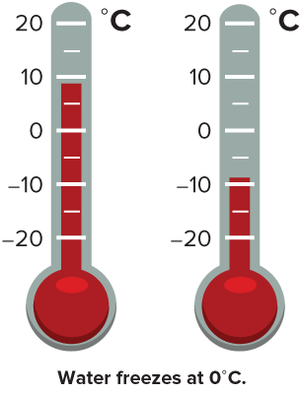
Comparing Temperatures
Brian lives in Toronto, Canada and his cousin lives in Reykjavik, Iceland. One day in January, the temperature in Toronto was 9°C and the temperature in Reykjavik was −9°C. How do the two temperatures relate?
What tool can you use to represent the temperatures?
Applying
How can you apply mathematics to model the context?
35 / 51
Notes:
TEACH IN PRACTICE | Embedded facilitation | Lesson 7.1, slide 32 | TASK
Focus on the existing task: Brian lives in Toronto, Canada and his cousin lives in Reykjavik, Iceland. One day in January, the temperature in Toronto was 9°C and the temperature in Reykjavik was −9°C. How do the two temperatures relate?
LAUNCH (T2/3/5): Use the displayed question. Give private thinking time; then A explains while B asks for evidence. Switch roles. Each student records their own reasoning.
LOOK FOR (T4): Where this task addresses it, students can interpret positive, negative and zero in context. Ask which feature of their work supports the claim.
RESPOND: If this task shows the lesson misconception—treating zero as positive or confusing an opposite with an absolute value—label the reference point and directions on the existing number line. Have the student revise and explain the change. Use this support only where the concept occurs in the current task; otherwise respond to the displayed question.
RECHECK: If a gap is shared, revisit the existing representation together. If it is limited, give targeted support while others compare valid methods on the same task. Check the revision before moving on.
PARTICIPATION (T5/6/7): Think time before volunteers; accept a written, drawn or rehearsed entry. Students ask for evidence respectfully. Recognize a specific contribution or revision and check that both partners participate.
Source: BCPS Updated Instructional Framework Rubric (June 2020), TEACH 1–7. Earlier notes and answer keys are retained below.
EARLIER NOTES / EXISTING ANSWER KEY
Read the context aloud (or have a student read it).
Before any math, students restate the situation and what is being asked in their own words.
Ask: What tool can you use to represent the temperatures?
UIFR: TEACH 1 · TEACH 3.
UIFR FULL | Lesson-specific facilitation
TEACH 2-3 | Session 2 task launch (UIFR PDF pp. 9-10).
Use the problem exactly as displayed. Give individual thinking time before discussion or advancing to the explanation. If the answer is already visible, ask students to reconstruct and justify it. Invite a choice of suitable representations and have students explain why their choice helps.
At the point where this concept appears, ask: “What does zero mean here, and how does the opposite describe a related quantity?” Wait for evidence, invite another pathway, and have a student ask a follow-up question. Do not replace students’ reasoning with a sequence of leading steps.

Slide 36
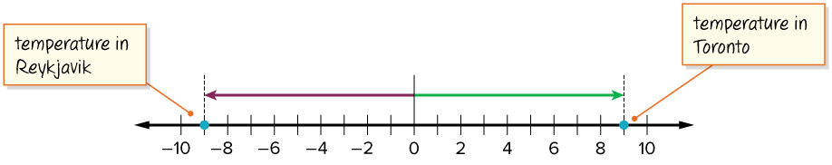
COLLABORATE · TALK IT THROUGH • AGREE ON A MODEL
Collaborate and Connect
How can the signs of the numbers help you graph them?
Reveal:
We know that a negative sign (−) means the number is less than zero, so −9 will be to the left of zero on the number line. A positive integer is greater than zero, so 9 will be to the right of zero on the number line.
36 / 51
Notes:
TEACH IN PRACTICE | Embedded facilitation | Lesson 7.1, slide 33 | COLLABORATE
Focus on the existing task: Reveal: We know that a negative sign (−) means the number is less than zero, so −9 will be to the left of zero on the number line. A…
LAUNCH (T2/3/5): Use the displayed question. Give private thinking time; then A explains while B asks for evidence. Switch roles. Each student records their own reasoning.
LOOK FOR (T4): Where this task addresses it, students can interpret positive, negative and zero in context. Ask which feature of their work supports the claim.
RESPOND: If this task shows the lesson misconception—treating zero as positive or confusing an opposite with an absolute value—label the reference point and directions on the existing number line. Have the student revise and explain the change. Use this support only where the concept occurs in the current task; otherwise respond to the displayed question.
RECHECK: If a gap is shared, revisit the existing representation together. If it is limited, give targeted support while others compare valid methods on the same task. Check the revision before moving on.
PARTICIPATION (T5/6/7): Think time before volunteers; accept a written, drawn or rehearsed entry. Students ask for evidence respectfully. Recognize a specific contribution or revision and check that both partners participate.
Source: BCPS Updated Instructional Framework Rubric (June 2020), TEACH 1–7. Earlier notes and answer keys are retained below.
EARLIER NOTES / EXISTING ANSWER KEY
Routine: COLLABORATE · TALK IT THROUGH • AGREE ON A MODEL
UIFR FULL | Lesson-specific facilitation
TEACH 4-5 | Session 2 discussion and checkpoint (UIFR PDF pp. 11-12).
Collect a brief response from every student to the existing prompt before hearing volunteers. Partners take turns explaining and asking for evidence: “I understand ___; what supports ___?” Offer rehearsal or an annotated model for students who need language support. Each student records their own reasoning.
Look specifically for: treating zero as positive or confusing an opposite with an absolute value. If it appears, label the reference point and directions on the existing number line; then ask the student to revise the same response and explain the change. If evidence is secure, have students compare a second valid pathway or state why their approach works. Choose the next step from the responses, not a preset pace.

Slide 37
STUDENT MOVES
Lesson 7-1
Your moves
RESTATE FIRST · Restate your partner’s idea in your own words before you give yours.
TEACH A PARTNER · Teach this to someone who missed it. If you can teach it, you know it.
37 / 51

Slide 38
Comparing Temperatures
The opposite signs of the integers tell us that 9 and −9 are located on opposite sides of zero on the number line.
How many units away from zero is 9? −9?
Reveal:
They are both 9 units away from zero.
Record your reasoning before the
reveal. Compare, then explain
any revision.
38 / 51
Notes:
TEACH IN PRACTICE | Embedded facilitation | Lesson 7.1, slide 34 | REVEAL
Focus on the existing task: Reveal: They are both 9 units away from zero. The opposite signs of the integers tell us that 9 and −9 are located on opposite sides of zero on the number line. How many units away from zero is 9?
LAUNCH (T2/3/5): If an existing answer cover is present, gather an attempt before revealing. If the explanation is already visible, ask students to reconstruct and justify it. Compare reasoning and explain a revision; preserve the reveal sequence.
LOOK FOR (T4): Where this task addresses it, students can locate opposites equally far from zero. Ask which feature of their work supports the claim.
RESPOND: If this task shows the lesson misconception—treating zero as positive or confusing an opposite with an absolute value—label the reference point and directions on the existing number line. Have the student revise and explain the change. Use this support only where the concept occurs in the current task; otherwise respond to the displayed question.
RECHECK: If a gap is shared, revisit the existing representation together. If it is limited, give targeted support while others compare valid methods on the same task. Check the revision before moving on.
PARTICIPATION (T5/6/7): Think time before volunteers; accept a written, drawn or rehearsed entry. Students ask for evidence respectfully. Recognize a specific contribution or revision and check that both partners participate.
Source: BCPS Updated Instructional Framework Rubric (June 2020), TEACH 1–7. Earlier notes and answer keys are retained below.
EARLIER NOTES / EXISTING ANSWER KEY
Do not click yet: collect 2–3 student answers with reasons first.
Then click to remove the cover and have students compare their thinking to the reveal — “Is this what we said? Where is it different?”
Behind the cover: They are both 9 units away from zero.
UIFR: TEACH 3 · TEACH 4.

Slide 39
Comparing Temperatures
The temperature in Toronto, 9°C, is 9 units away from zero.
The temperature in Reykjavik, −9°C, is 9 units away from zero.
What is the relationship between the two integers? Explain.
Reveal:
They are opposites because they are the same distance away from zero on the number line.
39 / 51
Notes:
TEACH IN PRACTICE | Embedded facilitation | Lesson 7.1, slide 35 | REVEAL
Focus on the existing task: The temperature in Toronto, 9°C, is 9 units away from zero. Reveal: They are opposites because they are the same distance away from…
LAUNCH (T2/3/5): If an existing answer cover is present, gather an attempt before revealing. If the explanation is already visible, ask students to reconstruct and justify it. Compare reasoning and explain a revision; preserve the reveal sequence.
LOOK FOR (T4): Where this task addresses it, students can locate opposites equally far from zero. Ask which feature of their work supports the claim.
RESPOND: If this task shows the lesson misconception—treating zero as positive or confusing an opposite with an absolute value—label the reference point and directions on the existing number line. Have the student revise and explain the change. Use this support only where the concept occurs in the current task; otherwise respond to the displayed question.
RECHECK: If a gap is shared, revisit the existing representation together. If it is limited, give targeted support while others compare valid methods on the same task. Check the revision before moving on.
PARTICIPATION (T5/6/7): Think time before volunteers; accept a written, drawn or rehearsed entry. Students ask for evidence respectfully. Recognize a specific contribution or revision and check that both partners participate.
Source: BCPS Updated Instructional Framework Rubric (June 2020), TEACH 1–7. Earlier notes and answer keys are retained below.
EARLIER NOTES / EXISTING ANSWER KEY
Do not click yet: collect 2–3 student answers with reasons first.
Then click to remove the cover and have students compare their thinking to the reveal — “Is this what we said? Where is it different?”
Behind the cover: They are opposites because they are the same distance away from zero on the number line.
UIFR: TEACH 3 · TEACH 4.

Slide 40
Comparing Temperatures
Brian lives in Toronto, Canada and his cousin lives in Reykjavik, Iceland. One day in January, the temperature in Toronto was 9°C and the temperature in Reykjavik was −9°C.
How do the two temperatures relate?
The temperatures are equal distances from 0. They are opposites.
40 / 51
Notes:
TEACH IN PRACTICE | Embedded facilitation | Lesson 7.1, slide 36 | TASK
Focus on the existing task: Brian lives in Toronto, Canada and his cousin lives in Reykjavik, Iceland. One day in January, the temperature in Toronto was 9°C and the…
LAUNCH (T2/3/5): Use the displayed question. Give private thinking time; then A explains while B asks for evidence. Switch roles. Each student records their own reasoning.
LOOK FOR (T4): Where this task addresses it, students can locate opposites equally far from zero. Ask which feature of their work supports the claim.
RESPOND: If this task shows the lesson misconception—treating zero as positive or confusing an opposite with an absolute value—label the reference point and directions on the existing number line. Have the student revise and explain the change. Use this support only where the concept occurs in the current task; otherwise respond to the displayed question.
RECHECK: If a gap is shared, revisit the existing representation together. If it is limited, give targeted support while others compare valid methods on the same task. Check the revision before moving on.
PARTICIPATION (T5/6/7): Think time before volunteers; accept a written, drawn or rehearsed entry. Students ask for evidence respectfully. Recognize a specific contribution or revision and check that both partners participate.
Source: BCPS Updated Instructional Framework Rubric (June 2020), TEACH 1–7. Earlier notes and answer keys are retained below.
EARLIER NOTES / EXISTING ANSWER KEY
Read the context aloud (or have a student read it).
Before any math, students restate the situation and what is being asked in their own words.
Ask: How do the two temperatures relate?
UIFR: TEACH 1 · TEACH 3.

Slide 41
Let’s Explore More
What is the opposite of 0?
Workspace
At 6 a.m. in Reykjavik the temperature was −12°C. At 2 p.m. it was the opposite temperature than 6 a.m. At 11 p.m. it was the opposite temperature than it was at 2 p.m. What were the temperatures at 2 p.m. and 11 p.m.?
Workspace
41 / 51
Notes:
TEACH IN PRACTICE | Embedded facilitation | Lesson 7.1, slide 37 | PRACTICE
Focus on the existing task: Let’s Explore More What is the opposite of 0?
LAUNCH (T2/3/5): Use the displayed question. Give private thinking time; then A explains while B asks for evidence. Switch roles. Each student records their own reasoning.
LOOK FOR (T4): Where this task addresses it, students can interpret positive, negative and zero in context. Ask which feature of their work supports the claim.
RESPOND: If this task shows the lesson misconception—treating zero as positive or confusing an opposite with an absolute value—label the reference point and directions on the existing number line. Have the student revise and explain the change. Use this support only where the concept occurs in the current task; otherwise respond to the displayed question.
RECHECK: If a gap is shared, revisit the existing representation together. If it is limited, give targeted support while others compare valid methods on the same task. Check the revision before moving on.
PARTICIPATION (T5/6/7): Think time before volunteers; accept a written, drawn or rehearsed entry. Students ask for evidence respectfully. Recognize a specific contribution or revision and check that both partners participate.
Source: BCPS Updated Instructional Framework Rubric (June 2020), TEACH 1–7. Earlier notes and answer keys are retained below.
EARLIER NOTES / EXISTING ANSWER KEY
Extension for partners or table groups — students choose their approach and use the workspace to show thinking.
Push with “Convince me,” and have two groups with different approaches share.
This is where students stretch past the worked example.
UIFR: TEACH 2 · TEACH 5.

Slide 42
STUDENT MOVES
Lesson 7-1
Your moves
SPECIFIC FEEDBACK · Trade work. Give one specific comment: “This part is clear because ______.”
YOUR CHOICE · You choose how to show this — numbers, words, or a diagram. Make your reasoning visible.
PICK YOUR STRATEGY · Choose your path — picture, table, number line, or equation — and be ready to say why you chose it.
42 / 51

Slide 43
LESSON 7.1 / CHECK YOUR WORK
Pause. Check. Improve.
CHECK
A mistake to watch for: treating zero as positive or confusing an opposite with an absolute value.
TRY
Label the reference point and directions on the given number line.
REVISE
Use that check on the task you just completed. Correct or strengthen one part, and explain why.
SELF-CHECK · Mark it: ✓ got it · ~ almost · ? stuck. Then fix one thing before we move on.
Listen to understand. Ask for evidence. Make room for every voice.
Notes:
TEACH IN PRACTICE | Embedded facilitation | Lesson 7.1, slide 38 | PRIOR_INSERT
Focus on the existing task: LESSON 7.1 / CHECK YOUR WORK Pause. Check. Improve. Listen to understand. Ask for evidence. Make room for every voice. CHECK A mistake…
CONNECT (T1/4): Ask students to restate the displayed goal or key idea and connect it to earlier work. Relevant lesson evidence: interpret positive, negative and zero in context; locate opposites equally far from zero. Use only the criterion that matches the current session.
SHOW PROGRESS: Students point to their own existing work, explain what improved after feedback, and name a next step. Pair confidence ratings with actual evidence.
PARTICIPATION (T5/6/7): Think time before volunteers; accept a written, drawn or rehearsed entry. Students ask for evidence respectfully. Recognize a specific contribution or revision and check that both partners participate.
Source: BCPS Updated Instructional Framework Rubric (June 2020), TEACH 1–7.

Slide 44
Comparing Temperatures
The temperature in Toronto, 9°C, is 9 units away from zero.
The temperature in Reykjavik, −9°C, is 9 units away from zero.
What is the relationship between the two integers? Explain.
Reveal:
They are opposites because they are the same distance away from zero on the number line.
44 / 51
Notes:
TEACH IN PRACTICE | Embedded facilitation | Lesson 7.1, slide 39 | REVEAL
Focus on the existing task: The temperature in Toronto, 9°C, is 9 units away from zero. Reveal: They are opposites because they are the same distance away from…
LAUNCH (T2/3/5): If an existing answer cover is present, gather an attempt before revealing. If the explanation is already visible, ask students to reconstruct and justify it. Compare reasoning and explain a revision; preserve the reveal sequence.
LOOK FOR (T4): Where this task addresses it, students can locate opposites equally far from zero. Ask which feature of their work supports the claim.
RESPOND: If this task shows the lesson misconception—treating zero as positive or confusing an opposite with an absolute value—label the reference point and directions on the existing number line. Have the student revise and explain the change. Use this support only where the concept occurs in the current task; otherwise respond to the displayed question.
RECHECK: If a gap is shared, revisit the existing representation together. If it is limited, give targeted support while others compare valid methods on the same task. Check the revision before moving on.
PARTICIPATION (T5/6/7): Think time before volunteers; accept a written, drawn or rehearsed entry. Students ask for evidence respectfully. Recognize a specific contribution or revision and check that both partners participate.
Source: BCPS Updated Instructional Framework Rubric (June 2020), TEACH 1–7.

Slide 45
STUDENT MOVES
Lesson 7-1
Your move
HOW DO YOU KNOW? · Ask your partner “How do you know?” Answer by pointing to your own work.
45 / 51

Slide 46
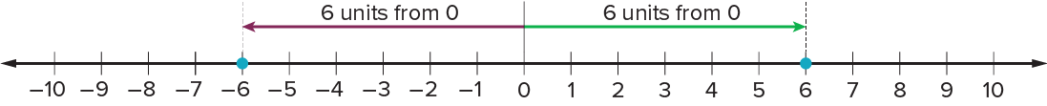
SUMMARIZE · SAY IT IN YOUR OWN WORDS
Summarize: Integers
A negative integer is an integer less than zero and is written with a − sign. Integers include the counting numbers, 0 (zero), and the opposites, or negatives, of the counting numbers. ​
The opposite of a number is the same distance from 0 on the opposite side of the number line.
6 and −6 are opposites.
REVISE NOW · Change one answer and write why you changed it. A revision is evidence of learning.
46 / 51
Notes:
TEACH IN PRACTICE | Embedded facilitation | Lesson 7.1, slide 40 | SUMMARIZE
Focus on the existing task: Summarize: Integers A negative integer is an integer less than zero and is written with a − sign. Integers include the counting numbers…
CONNECT (T1/4): Ask students to restate the displayed goal or key idea and connect it to earlier work. Relevant lesson evidence: interpret positive, negative and zero in context; locate opposites equally far from zero. Use only the criterion that matches the current session.
SHOW PROGRESS: Students point to their own existing work, explain what improved after feedback, and name a next step. Pair confidence ratings with actual evidence.
PARTICIPATION (T5/6/7): Think time before volunteers; accept a written, drawn or rehearsed entry. Students ask for evidence respectfully. Recognize a specific contribution or revision and check that both partners participate.
Source: BCPS Updated Instructional Framework Rubric (June 2020), TEACH 1–7. Earlier notes and answer keys are retained below.
EARLIER NOTES / EXISTING ANSWER KEY
Routine: SUMMARIZE · SAY IT IN YOUR OWN WORDS

Slide 47
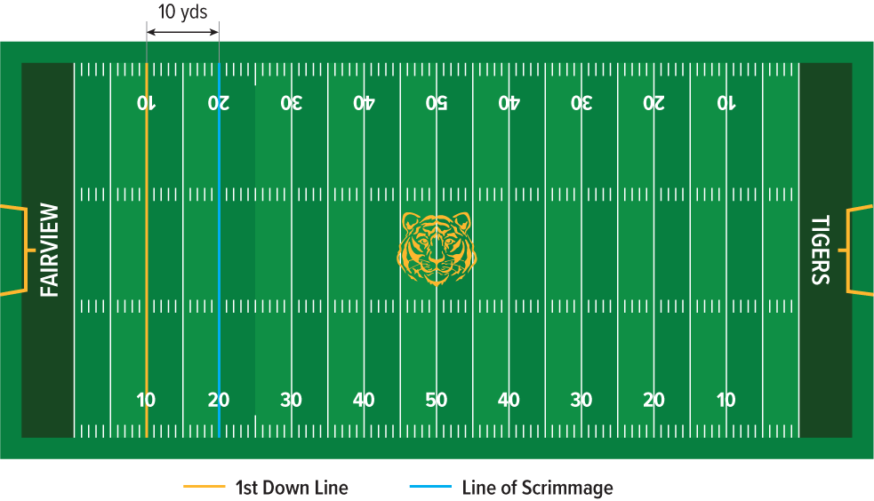
APPLY · PLAN IT • SOLVE IT • PROVE IT
Apply: Football Plays
To make a first down, a football team must make at least a 10-yard gain from where they originally started, called the line of scrimmage. During a series of plays, a football team had a 10-yard loss, a 4-yard gain, a 3-yard loss, and a 21-yard gain.
Question : Did the football team make a first down? How far are they from the line of scrimmage?
Choose a method. Solve
independently, justify your
answer, then check the goal.
47 / 51
Notes:
TEACH IN PRACTICE | Embedded facilitation | Lesson 7.1, slide 41 | APPLY
Focus on the existing task: How far are they from the line of scrimmage?
LAUNCH (T2/3/5): Use the exact application task independently first. Ask students to justify their choice of method. Collect evidence before a partner discussion or correction.
LOOK FOR (T4): Where this task addresses it, students can locate opposites equally far from zero. Ask which feature of their work supports the claim.
RESPOND: If this task shows the lesson misconception—treating zero as positive or confusing an opposite with an absolute value—label the reference point and directions on the existing number line. Have the student revise and explain the change. Use this support only where the concept occurs in the current task; otherwise respond to the displayed question.
RECHECK: If a gap is shared, revisit the existing representation together. If it is limited, give targeted support while others compare valid methods on the same task. Check the revision before moving on.
PARTICIPATION (T5/6/7): Think time before volunteers; accept a written, drawn or rehearsed entry. Students ask for evidence respectfully. Recognize a specific contribution or revision and check that both partners participate.
Source: BCPS Updated Instructional Framework Rubric (June 2020), TEACH 1–7. Earlier notes and answer keys are retained below.
EARLIER NOTES / EXISTING ANSWER KEY
Routine: APPLY · PLAN IT • SOLVE IT • PROVE IT
UIFR FULL | Lesson-specific facilitation
TEACH 4 | Independent evidence and revision (UIFR PDF p. 11).
Use the existing application/exit problem as the independent check. If this is a learning-target slide, have students point to and explain their work on the preceding task. Separate initial independent evidence from the revision after feedback.
Check the relevant criteria: interpret positive, negative and zero in context; locate opposites equally far from zero. Respond with one specific next step tied to the work. Students revise and annotate what changed, then identify a criterion they can now demonstrate and one they still need to practice.

Slide 48
Learning Targets
I can use integers to represent quantities in everyday life and explain the meaning of zero within each real-world context.
I can reason abstractly and quantitatively to represent integers and their opposites on a number line.
Point to evidence in your work. Name what improved and your next step.
48 / 51
Notes:
TEACH IN PRACTICE | Embedded facilitation | Lesson 7.1, slide 42 | REFLECTION
Focus on the existing task: Learning Targets I can use integers to represent quantities in everyday life and explain the meaning of zero within each real-world context.
CONNECT (T1/4): Ask students to restate the displayed goal or key idea and connect it to earlier work. Relevant lesson evidence: interpret positive, negative and zero in context; locate opposites equally far from zero. Use only the criterion that matches the current session.
SHOW PROGRESS: Students point to their own existing work, explain what improved after feedback, and name a next step. Pair confidence ratings with actual evidence.
PARTICIPATION (T5/6/7): Think time before volunteers; accept a written, drawn or rehearsed entry. Students ask for evidence respectfully. Recognize a specific contribution or revision and check that both partners participate.
Source: BCPS Updated Instructional Framework Rubric (June 2020), TEACH 1–7. Earlier notes and answer keys are retained below.
EARLIER NOTES / EXISTING ANSWER KEY
Read each target; students self-rate with fist-to-five or thumbs.
Tie back to the goal from the start of class: did we get there?
Note any target that rates low — revisit it tomorrow.
UIFR: TEACH 1 · TEACH 4.

Slide 49
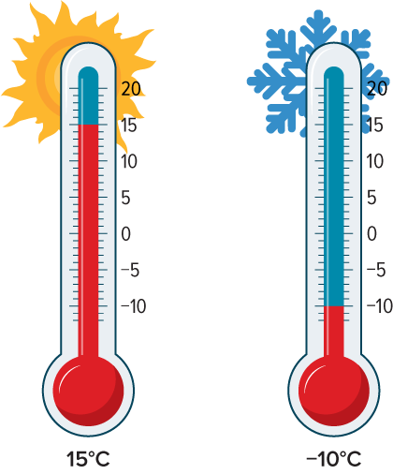
Be Curious
Be Curious
What do you notice?
What do you wonder?
Think first. Share a notice and a question;
build on a classmate’s idea.
Mindset
How have you given positive feedback to your classmates?
49 / 51
Notes:
TEACH IN PRACTICE | Embedded facilitation | Lesson 7.1, slide 43 | CURIOUS
Focus on the existing task: Be Curious Be Curious Mindset How have you given positive feedback to your classmates?
LAUNCH (T2/3/5): Allow quiet observation first. Separate a notice from an inference, invite students’ own questions, and follow the existing launch before teaching a procedure.
LOOK FOR (T4): Where this task addresses it, students can interpret positive, negative and zero in context. Ask which feature of their work supports the claim.
RESPOND: If this task shows the lesson misconception—treating zero as positive or confusing an opposite with an absolute value—label the reference point and directions on the existing number line. Have the student revise and explain the change. Use this support only where the concept occurs in the current task; otherwise respond to the displayed question.
RECHECK: If a gap is shared, revisit the existing representation together. If it is limited, give targeted support while others compare valid methods on the same task. Check the revision before moving on.
PARTICIPATION (T5/6/7): Think time before volunteers; accept a written, drawn or rehearsed entry. Students ask for evidence respectfully. Recognize a specific contribution or revision and check that both partners participate.
Source: BCPS Updated Instructional Framework Rubric (June 2020), TEACH 1–7.

Slide 50
Learning Targets
I can use integers to represent quantities in everyday life and explain the meaning of zero within each real-world context.
I can reason abstractly and quantitatively to represent integers and their opposites on a number line.
Point to evidence in your work. Name what improved and your next step.
50 / 51
Notes:
TEACH IN PRACTICE | Embedded facilitation | Lesson 7.1, slide 44 | REFLECTION
Focus on the existing task: Learning Targets I can use integers to represent quantities in everyday life and explain the meaning of zero within each real-world context.
CONNECT (T1/4): Ask students to restate the displayed goal or key idea and connect it to earlier work. Relevant lesson evidence: interpret positive, negative and zero in context; locate opposites equally far from zero. Use only the criterion that matches the current session.
SHOW PROGRESS: Students point to their own existing work, explain what improved after feedback, and name a next step. Pair confidence ratings with actual evidence.
PARTICIPATION (T5/6/7): Think time before volunteers; accept a written, drawn or rehearsed entry. Students ask for evidence respectfully. Recognize a specific contribution or revision and check that both partners participate.
Source: BCPS Updated Instructional Framework Rubric (June 2020), TEACH 1–7. Earlier notes and answer keys are retained below.
EARLIER NOTES / EXISTING ANSWER KEY
UIFR FULL | Lesson-specific facilitation
REFLECT & ADJUST 1-2 | After the lesson (UIFR PDF pp. 15-16).
Sort the existing work by demonstrated reasoning, partial understanding, and the specific misconception: treating zero as positive or confusing an opposite with an absolute value. Compare the initial response with the revision. Record which teaching move plausibly helped, which did not, and whose participation or access needs a different approach; do not record sensitive student details in this shared deck.
Plan the next lesson from that evidence: if the misconception persists, label the reference point and directions on the existing number line using the current example before returning to the next grade-level task; if understanding is secure, use an existing extension or ask for a general explanation. Check the targeted idea again at the next warm-up.
Ask students what supported their thinking and what would help next time. Identify one change to try and one successful practice to retain. Seek colleague feedback on anonymized work when useful; these prompts support reflection and do not establish an evaluation rating. Source: Baltimore City Public Schools, Updated Instructional Framework Rubric, June 2020 (UIFR_Full.pdf).

Slide 51
LESSON 7.1 / REFLECT ON YOUR LEARNING
Show your progress
1 SHOW EVIDENCE
2 CHOOSE A NEXT STEP
Choose one response. Point to the part that shows your reasoning.
Name a change you made after feedback—or a question you still have.
“My work shows ___ because ___.”
“Next time, I will ___ to help me ___.”
Today’s focus: Interpret positive, negative and zero in context.
CREDIT A CLASSMATE · Name one classmate whose idea helped you today, and say what they said.
Listen to understand. Ask for evidence. Make room for every voice.
Notes:
TEACH IN PRACTICE | Embedded facilitation | Lesson 7.1, slide 45 | PRIOR_INSERT
Focus on the existing task: LESSON 7.1 / REFLECT ON YOUR LEARNING Show your progress Listen to understand. Ask for evidence. Make room for every voice. 1 SHOW…
CONNECT (T1/4): Ask students to restate the displayed goal or key idea and connect it to earlier work. Relevant lesson evidence: interpret positive, negative and zero in context; locate opposites equally far from zero. Use only the criterion that matches the current session.
SHOW PROGRESS: Students point to their own existing work, explain what improved after feedback, and name a next step. Pair confidence ratings with actual evidence.
PARTICIPATION (T5/6/7): Think time before volunteers; accept a written, drawn or rehearsed entry. Students ask for evidence respectfully. Recognize a specific contribution or revision and check that both partners participate.
Source: BCPS Updated Instructional Framework Rubric (June 2020), TEACH 1–7.

