Slide 1
WARM-UP · THINK • TRY • CHECK
Turn and talk: compare strategies, then defend one.
Warm-Up
Lesson 7-2 · Represent Rational Numbers and Their Opposites on the Number Line | Warm-Up · about 4 minutes
Try each on your own. Mark an unsure answer; explain and revise when we check.
QUESTION 1
QUESTION 2
Is 3.4 closer to 3 or to 4? ______
2.7 is between ______ and ______
QUESTION 3
QUESTION 4
Write 11/2 as a decimal: ______
A number line from 0 to 1 is split into 4 equal parts. Each part is ______
TALK IT OVER: “I got ______ because ______.” • Compare with a partner before we check as a class.
1 / 47
Notes:
TEACH IN PRACTICE | Embedded facilitation | Lesson 7.2, slide 1 | WARMUP
Focus on the existing task: Warm-Up WARM-UP · THINK…
GATHER EVIDENCE (T4/6): Keep the original items. Students try independently, mark an uncertain item, and explain one method before checking. Use the existing key when present.
RESPOND: Distinguish a calculation slip from a reasoning gap. Give one next step on the same item; have students revise in a second color. Use the responses to choose flexible support for today’s lesson.
PARTICIPATION (T5/6/7): Think time before volunteers; accept a written, drawn or rehearsed entry. Students ask for evidence respectfully. Recognize a specific contribution or revision and check that both partners participate.
Source: BCPS Updated Instructional Framework Rubric (June 2020), TEACH 1–7. Earlier notes and answer keys are retained below.
EARLIER NOTES / EXISTING ANSWER KEY
Warm-Up answers (teacher only): 1) 3 2) 2 and 3 3) 5.5 4) 1/4
UIFR FULL | Lesson-specific facilitation
PREPARE 1-2 | Before teaching (UIFR PDF pp. 6-7).
Plan to gather evidence that students can use equal intervals to locate rational numbers and opposites; respect the negative side. Review recent work and today’s warm-up to choose flexible groups and access supports; do not infer needs from identity or perceived ability. Use the existing lesson tasks and stated standards.
Anticipate: counting negative fractional intervals in the wrong direction. If observed, mark zero and the unit interval before subdividing the original number line. Offer oral rehearsal, drawing, pointing, or home-language processing as needed; retain the original mathematical demand. Ask students which support helps and fade it as evidence improves.
TEACH 6-7 | Before the first transition, agree on materials, partner roles, and how to request help. Invite students to restate the routine. Normalize revising an idea, recognize a specific contribution, and check privately when frustration blocks participation. Source: UIFR PDF pp. 13-14.

Slide 2
Today’s Math Notes
Lesson 7-2 · Represent Rational Numbers and Their Opposites on the Number Line
Section 1: Math Words
Copy. Explain. Check.
SAY THE GOAL · Say today’s goal in your own words, then name one place this shows up outside math class.
Rational Numbers on the Number Line
1
Every rational number has one exact spot on the number line
Rational number
2
A number
Fraction
3
A number that shows part of a whole, like 3/4
eduwonderlab.com · Neft Teacher
2 / 47
Notes:
TEACH IN PRACTICE | Embedded facilitation | Lesson 7.2, slide 2 | NOTES
Focus on the existing task: Today’s Math Notes…
ROUTINE (T1/2/4): Read or copy the original notes, cover one line, and explain it using the displayed example. Reopen and correct. Copying alone is not evidence of understanding.
LOOK FOR: A link between a symbol, quantity or feature and the explanation. If missing, point back to that feature and have the student try again; fade the prompt once they can explain.
PARTICIPATION (T5/6/7): Think time before volunteers; accept a written, drawn or rehearsed entry. Students ask for evidence respectfully. Recognize a specific contribution or revision and check that both partners participate.
Source: BCPS Updated Instructional Framework Rubric (June 2020), TEACH 1–7. Earlier notes and answer keys are retained below.
EARLIER NOTES / EXISTING ANSWER KEY
Copy routine: read one line at a time; students copy, then explain that line to a partner.
Keep it brisk — the understanding work happens in the examples, not the copying.
UIFR: TEACH 1 · TEACH 6.

Slide 3
Today’s Math Notes
Lesson 7-2 · Represent Rational Numbers and Their Opposites on the Number Line
Section 2: Today’s Math
Copy. Explain. Check.
Rational Numbers on the Number Line
Find the two consecutive integers the rational number falls between
1
Divide the segment between integers into equal parts matching the denominator
2
CONNECT IT · What earlier lesson does this build on? Tell a partner in one sentence.
Negative numbers move to the left of zero; positive numbers move to the right
3
eduwonderlab.com · Neft Teacher
3 / 47
Notes:
TEACH IN PRACTICE | Embedded facilitation | Lesson 7.2, slide 3 | NOTES
Focus on the existing task: Today’s Math Notes…
ROUTINE (T1/2/4): Read or copy the original notes, cover one line, and explain it using the displayed example. Reopen and correct. Copying alone is not evidence of understanding.
LOOK FOR: A link between a symbol, quantity or feature and the explanation. If missing, point back to that feature and have the student try again; fade the prompt once they can explain.
PARTICIPATION (T5/6/7): Think time before volunteers; accept a written, drawn or rehearsed entry. Students ask for evidence respectfully. Recognize a specific contribution or revision and check that both partners participate.
Source: BCPS Updated Instructional Framework Rubric (June 2020), TEACH 1–7. Earlier notes and answer keys are retained below.
EARLIER NOTES / EXISTING ANSWER KEY
Copy routine: read one line at a time; students copy, then explain that line to a partner.
Keep it brisk — the understanding work happens in the examples, not the copying.
UIFR: TEACH 1 · TEACH 6.

Slide 4
Session 1
Represent Rational Numbers and Their Opposites on the Number Line
PICK YOUR STRATEGY · Choose your path — picture, table, number line, or equation — and be ready to say why you chose it.
4 / 47
Notes:
TEACH IN PRACTICE | Embedded facilitation | Lesson 7.2, slide 4 | DIVIDER
Focus on the existing task: Represent Rational Numbers and Their Opposites on the Number Line Session 1
TRANSITION (T6/7): Students confirm materials, roles, how to request help, and the next response routine. Ask a student to restate it. Keep teacher-only slides hidden.
PARTICIPATION (T5/6/7): Think time before volunteers; accept a written, drawn or rehearsed entry. Students ask for evidence respectfully. Recognize a specific contribution or revision and check that both partners participate.
Source: BCPS Updated Instructional Framework Rubric (June 2020), TEACH 1–7. Earlier notes and answer keys are retained below.
EARLIER NOTES / EXISTING ANSWER KEY
Transition cue: state what materials are out and what success looks like this session.
Keep the changeover under a minute.
UIFR: TEACH 6.

Slide 5



About, Between, or Exact
It is about ___.
It is between ___ and ____.
It is exactly ___.
Explain how the information shown supports your reasoning.
5 / 47
Notes:
TEACH IN PRACTICE | Embedded facilitation | Lesson 7.2, slide 5 | WORKED
Focus on the existing task: About, Between, or Exact It is about ___. It is between ___ and ____. It is exactly ___.
LAUNCH (T2/3/5): Ask students to explain the displayed idea or example and point to evidence. When a calculation step is shown, ask why it is valid. Have a partner restate the explanation; copying is not the check.
LOOK FOR (T4): Where this task addresses it, students can use equal intervals to locate rational numbers and opposites. Ask which feature of their work supports the claim.
RESPOND: If this task shows the lesson misconception—counting negative fractional intervals in the wrong direction—mark zero and the unit interval before subdividing the original number line. Have the student revise and explain the change. Use this support only where the concept occurs in the current task; otherwise respond to the displayed question.
RECHECK: If a gap is shared, revisit the existing representation together. If it is limited, give targeted support while others compare valid methods on the same task. Check the revision before moving on.
PARTICIPATION (T5/6/7): Think time before volunteers; accept a written, drawn or rehearsed entry. Students ask for evidence respectfully. Recognize a specific contribution or revision and check that both partners participate.
Source: BCPS Updated Instructional Framework Rubric (June 2020), TEACH 1–7. Earlier notes and answer keys are retained below.
EARLIER NOTES / EXISTING ANSWER KEY
Number-sense routine — every voice in. Give quiet think time, then hear from at least three students.
Always follow with “How do you know?” — the reasoning is the point, not the answer.
There is more than one path; name and celebrate different strategies.
UIFR: TEACH 3 · TEACH 5 · TEACH 6.

Slide 6
Today’s Objectives
Lesson 7-2 · Represent Rational Numbers and Their Opposites on the Number Line
Represent Rational Numbers and Their Opposites on the Number Line
Maryland Standard 6.NOS.6
CONTENT OBJECTIVE
LANGUAGE OBJECTIVE
Restate the goal in your words
Use these words to explain why
I can place rational numbers, including fractions and decimals, on a number line.
I can explain my reasoning using the words rational number, fraction, decimal, and number line.
eduwonderlab.com · Neft Teacher
6 / 47
Notes:
TEACH IN PRACTICE | Embedded facilitation | Lesson 7.2, slide 6 | GOAL
Focus on the existing task: Today’s Objectives…
CONNECT (T1/4): Ask students to restate the displayed goal or key idea and connect it to earlier work. Relevant lesson evidence: use equal intervals to locate rational numbers and opposites; respect the negative side. Use only the criterion that matches the current session.
SHOW PROGRESS: Students point to their own existing work, explain what improved after feedback, and name a next step. Pair confidence ratings with actual evidence.
PARTICIPATION (T5/6/7): Think time before volunteers; accept a written, drawn or rehearsed entry. Students ask for evidence respectfully. Recognize a specific contribution or revision and check that both partners participate.
Source: BCPS Updated Instructional Framework Rubric (June 2020), TEACH 1–7. Earlier notes and answer keys are retained below.
EARLIER NOTES / EXISTING ANSWER KEY
Read the objective together, then have one or two students restate today’s goal in their own words.
Connect it to what the class learned last lesson.
Return to this goal at the end of class to check it was met.
UIFR: TEACH 1.
UIFR FULL | Lesson-specific facilitation
TEACH 1 | Session 1 purpose and evidence (UIFR PDF p. 8).
Have students restate the displayed session goal in their own words and connect it to the existing context or a familiar experience they choose to share. Use the current session goal to select from these lesson-wide evidence criteria; do not frontload a later-session procedure.
Look for: use equal intervals to locate rational numbers and opposites; respect the negative side. Ask: “Which part of your work would show this?” Revisit that evidence after the task; a confidence rating alone is not evidence of understanding.

Slide 7
STUDENT MOVES
Lesson 7-2
Your move
NAME THE MATH · Point to the part of this that is new today, and say what it changes.
7 / 47

Slide 8
LESSON 7.2 / OUR LEARNING
What will show your learning?
1
Use equal intervals to locate rational numbers and opposites.
2
Respect the negative side.
Tell a partner: Which skill connects to something you already know?
SHOW YOUR THINKING · Show what you know — write it, draw it, or build it. A picture counts as an explanation.
Listen to understand. Ask for evidence. Make room for every voice.
Notes:
TEACH IN PRACTICE | Embedded facilitation | Lesson 7.2, slide 7 | PRIOR_INSERT
Focus on the existing task: LESSON 7.2 / OUR LEARNING What will show your learning?
CONNECT (T1/4): Ask students to restate the displayed goal or key idea and connect it to earlier work. Relevant lesson evidence: use equal intervals to locate rational numbers and opposites; respect the negative side. Use only the criterion that matches the current session.
SHOW PROGRESS: Students point to their own existing work, explain what improved after feedback, and name a next step. Pair confidence ratings with actual evidence.
PARTICIPATION (T5/6/7): Think time before volunteers; accept a written, drawn or rehearsed entry. Students ask for evidence respectfully. Recognize a specific contribution or revision and check that both partners participate.
Source: BCPS Updated Instructional Framework Rubric (June 2020), TEACH 1–7.

Slide 9
Vocabulary 1 of 7
Lesson 7-2 · Represent Rational Numbers and Their Opposites on the Number Line
Rational Numbers on the Number Line
Every rational number has one exact spot on the number line. Writing it as a fraction, a decimal, or an integer does not change where it sits.
EXAMPLE · EXPLAIN WHY IT FITS
−3/2 = −1.5 and 1/2 = 0.5 each sit at one exact point.
Use “Rational Numbers on the Number Line” to explain the
example. Point to evidence.
eduwonderlab.com · Neft Teacher
9 / 47
Notes:
TEACH IN PRACTICE | Embedded facilitation | Lesson 7.2, slide 8 | VOCAB
Focus on the existing task: Vocabulary 1 of 7…
ASK (T1/3/5): Where does “Rational Numbers on the Number Line” appear in the example? Explain the meaning without reading the definition. Partner: restate the idea and ask a clarifying question.
LOOK FOR: A correct connection between the word and a feature of the example. If the student only repeats the definition, invite pointing, sketching or oral rehearsal, then ask for another explanation of this same example.
PARTICIPATION (T5/6/7): Think time before volunteers; accept a written, drawn or rehearsed entry. Students ask for evidence respectfully. Recognize a specific contribution or revision and check that both partners participate.
Source: BCPS Updated Instructional Framework Rubric (June 2020), TEACH 1–7.

Slide 10
Vocabulary 2 of 7
Lesson 7-2 · Represent Rational Numbers and Their Opposites on the Number Line
Rational number
A number that can be written as a fraction of two integers, with a bottom number that is not zero.
EXAMPLE · EXPLAIN WHY IT FITS
−1/2, 0 and 5/4 each sit at one exact point.
USE THE MATH WORDS · Use today’s math words in your explanation — not “it” and “that thing.”
eduwonderlab.com · Neft Teacher
10 / 47
Notes:
TEACH IN PRACTICE | Embedded facilitation | Lesson 7.2, slide 9 | VOCAB
Focus on the existing task: Vocabulary 2 of 7…
ASK (T1/3/5): Where does “Rational number” appear in the example? Explain the meaning without reading the definition. Partner: restate the idea and ask a clarifying question.
LOOK FOR: A correct connection between the word and a feature of the example. If the student only repeats the definition, invite pointing, sketching or oral rehearsal, then ask for another explanation of this same example.
PARTICIPATION (T5/6/7): Think time before volunteers; accept a written, drawn or rehearsed entry. Students ask for evidence respectfully. Recognize a specific contribution or revision and check that both partners participate.
Source: BCPS Updated Instructional Framework Rubric (June 2020), TEACH 1–7.

Slide 11
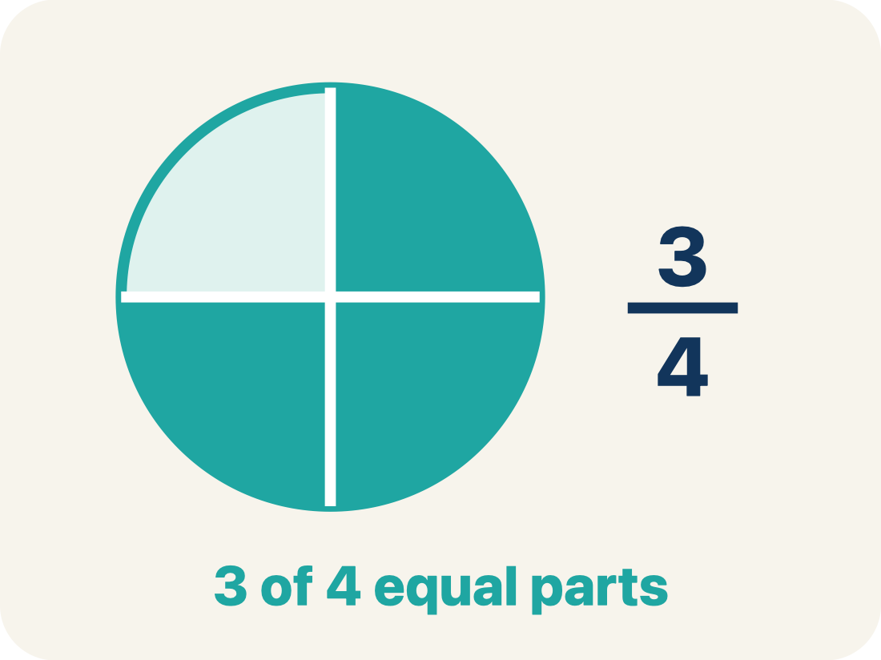
Vocabulary 3 of 7
Lesson 7-2 · Represent Rational Numbers and Their Opposites on the Number Line
Fraction
A number that shows part of a whole, like 3/4.
EXAMPLE · EXPLAIN WHY IT FITS
3/4 means 3 out of 4 equal parts — like 3 slices of a pizza cut into 4
Use “Fraction” to explain the example. Point to evidence.
eduwonderlab.com · Neft Teacher
11 / 47
Notes:
TEACH IN PRACTICE | Embedded facilitation | Lesson 7.2, slide 10 | VOCAB
Focus on the existing task: Vocabulary 3 of 7…
ASK (T1/3/5): Where does “Fraction” appear in the example? Explain the meaning without reading the definition. Partner: restate the idea and ask a clarifying question.
LOOK FOR: A correct connection between the word and a feature of the example. If the student only repeats the definition, invite pointing, sketching or oral rehearsal, then ask for another explanation of this same example.
PARTICIPATION (T5/6/7): Think time before volunteers; accept a written, drawn or rehearsed entry. Students ask for evidence respectfully. Recognize a specific contribution or revision and check that both partners participate.
Source: BCPS Updated Instructional Framework Rubric (June 2020), TEACH 1–7.

Slide 12
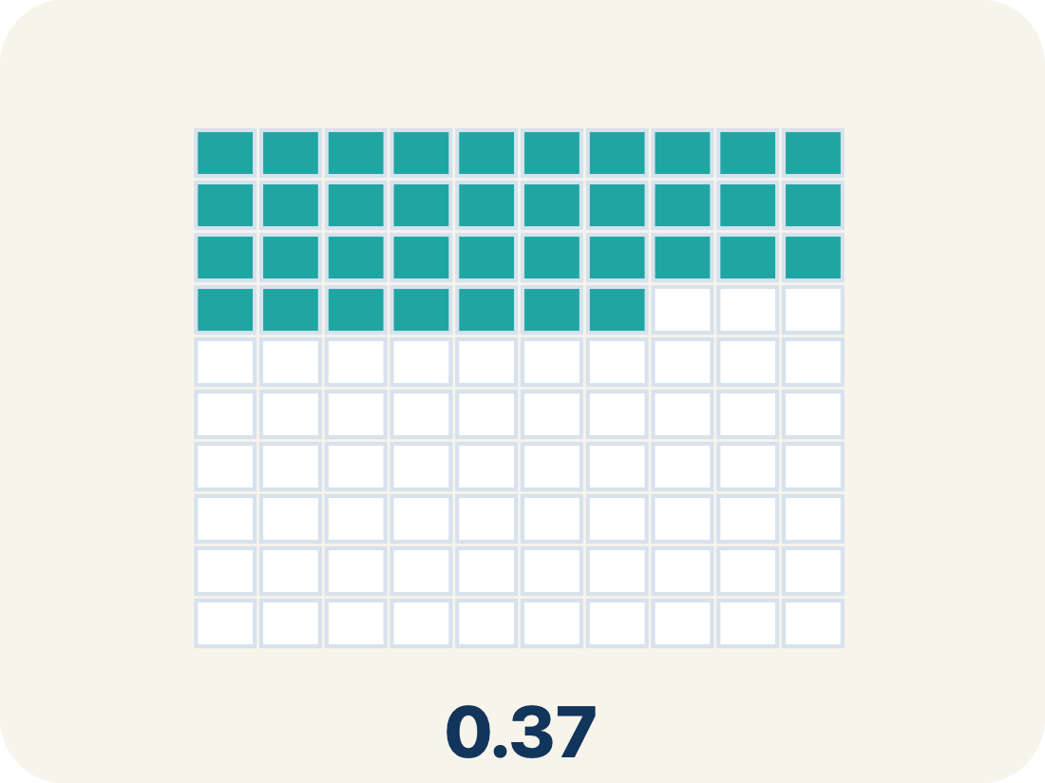
Vocabulary 4 of 7
Lesson 7-2 · Represent Rational Numbers and Their Opposites on the Number Line
Decimal
A number with a dot, like 0.5, that shows a part less than one.
EXAMPLE · EXPLAIN WHY IT FITS
0.5 = 1/2 (halfway between 0 and 1 on the number line)
Use “Decimal” to explain the example. Point to evidence.
eduwonderlab.com · Neft Teacher
12 / 47
Notes:
TEACH IN PRACTICE | Embedded facilitation | Lesson 7.2, slide 11 | VOCAB
Focus on the existing task: Vocabulary 4 of 7…
ASK (T1/3/5): Where does “Decimal” appear in the example? Explain the meaning without reading the definition. Partner: restate the idea and ask a clarifying question.
LOOK FOR: A correct connection between the word and a feature of the example. If the student only repeats the definition, invite pointing, sketching or oral rehearsal, then ask for another explanation of this same example.
PARTICIPATION (T5/6/7): Think time before volunteers; accept a written, drawn or rehearsed entry. Students ask for evidence respectfully. Recognize a specific contribution or revision and check that both partners participate.
Source: BCPS Updated Instructional Framework Rubric (June 2020), TEACH 1–7.

Slide 13

Vocabulary 5 of 7
Lesson 7-2 · Represent Rational Numbers and Their Opposites on the Number Line
Number line
A straight line where numbers are placed in order; numbers get smaller to the left and larger to the right.
EXAMPLE · EXPLAIN WHY IT FITS
A line with marks at −2, −1.5, −1, −0.5, 0, 0.5, 1, 1.5, 2
Use “Number line” to explain the example. Point to evidence.
eduwonderlab.com · Neft Teacher
13 / 47
Notes:
TEACH IN PRACTICE | Embedded facilitation | Lesson 7.2, slide 12 | VOCAB
Focus on the existing task: Vocabulary 5 of 7 Number…
ASK (T1/3/5): Where does “Number line” appear in the example? Explain the meaning without reading the definition. Partner: restate the idea and ask a clarifying question.
LOOK FOR: A correct connection between the word and a feature of the example. If the student only repeats the definition, invite pointing, sketching or oral rehearsal, then ask for another explanation of this same example.
PARTICIPATION (T5/6/7): Think time before volunteers; accept a written, drawn or rehearsed entry. Students ask for evidence respectfully. Recognize a specific contribution or revision and check that both partners participate.
Source: BCPS Updated Instructional Framework Rubric (June 2020), TEACH 1–7.

Slide 14
Vocabulary 6 of 7
Lesson 7-2 · Represent Rational Numbers and Their Opposites on the Number Line
Equivalent
Having the same value, just written a different way.
EXAMPLE · EXPLAIN WHY IT FITS
1/2 = 0.5 = 2/4 — all name the same point on the number line
Use “Equivalent” to explain the example. Point to evidence.
eduwonderlab.com · Neft Teacher
14 / 47
Notes:
TEACH IN PRACTICE | Embedded facilitation | Lesson 7.2, slide 13 | VOCAB
Focus on the existing task: Vocabulary 6 of 7…
ASK (T1/3/5): Where does “Equivalent” appear in the example? Explain the meaning without reading the definition. Partner: restate the idea and ask a clarifying question.
LOOK FOR: A correct connection between the word and a feature of the example. If the student only repeats the definition, invite pointing, sketching or oral rehearsal, then ask for another explanation of this same example.
PARTICIPATION (T5/6/7): Think time before volunteers; accept a written, drawn or rehearsed entry. Students ask for evidence respectfully. Recognize a specific contribution or revision and check that both partners participate.
Source: BCPS Updated Instructional Framework Rubric (June 2020), TEACH 1–7.

Slide 15
Vocabulary 7 of 7
Lesson 7-2 · Represent Rational Numbers and Their Opposites on the Number Line
Integer
Whole numbers and their opposites, like −2, −1, 0, 1, 2.
EXAMPLE · EXPLAIN WHY IT FITS
…, −3, −2, −1, 0, 1, 2, 3, …
Use “Integer” to explain the example. Point to evidence.
eduwonderlab.com · Neft Teacher
15 / 47
Notes:
TEACH IN PRACTICE | Embedded facilitation | Lesson 7.2, slide 14 | VOCAB
Focus on the existing task: Vocabulary 7 of 7…
ASK (T1/3/5): Where does “Integer” appear in the example? Explain the meaning without reading the definition. Partner: restate the idea and ask a clarifying question.
LOOK FOR: A correct connection between the word and a feature of the example. If the student only repeats the definition, invite pointing, sketching or oral rehearsal, then ask for another explanation of this same example.
PARTICIPATION (T5/6/7): Think time before volunteers; accept a written, drawn or rehearsed entry. Students ask for evidence respectfully. Recognize a specific contribution or revision and check that both partners participate.
Source: BCPS Updated Instructional Framework Rubric (June 2020), TEACH 1–7.

Slide 16
Vocabulary
Lesson 7-2 · Represent Rational Numbers and Their Opposites on the Number Line
Today’s Math Words
We learn every word — what it means and what it looks like — before we use it.
Rational Numbers on the Number Line
Rational number
Every rational number has one exact spot on the number line
A number that can be written as a fraction of two integers, with a bottom number that is not zero
Fraction
Decimal
A number that shows part of a whole, like 3/4
A number with a dot, like 0.5, that shows a part less than one
Number line
Equivalent
A straight line where numbers are placed in order; numbers get smaller to the left and larger to the right
Having the same value, just written a different way
Integer
Explain one math word using the example.
Partner: point to evidence.
Whole numbers and their opposites, like −2, −1, 0, 1, 2
eduwonderlab.com · Neft Teacher
16 / 47
Notes:
TEACH IN PRACTICE | Embedded facilitation | Lesson 7.2, slide 15 | VOCAB
Focus on the existing task: Vocabulary Today’s Math…
ASK (T1/3/5): Where does “the displayed term” appear in the example? Explain the meaning without reading the definition. Partner: restate the idea and ask a clarifying question.
LOOK FOR: A correct connection between the word and a feature of the example. If the student only repeats the definition, invite pointing, sketching or oral rehearsal, then ask for another explanation of this same example.
PARTICIPATION (T5/6/7): Think time before volunteers; accept a written, drawn or rehearsed entry. Students ask for evidence respectfully. Recognize a specific contribution or revision and check that both partners participate.
Source: BCPS Updated Instructional Framework Rubric (June 2020), TEACH 1–7. Earlier notes and answer keys are retained below.
EARLIER NOTES / EXISTING ANSWER KEY
Choral-read each word, its meaning, and what it looks like.
Students should use these words out loud today — listen for them in partner talk and revoice student ideas with the academic term.
UIFR: TEACH 1 · TEACH 5.

Slide 17


Be Curious
What do you notice?
What do you wonder?
Think first. Share a notice and a question;
build on a classmate’s idea.
Mindset
What helps you think logically when working on a math or non-math problem?
17 / 47
Notes:
TEACH IN PRACTICE | Embedded facilitation | Lesson 7.2, slide 16 | CURIOUS
Focus on the existing task: Be Curious Mindset What helps you think logically when working on a math or non-math problem?
LAUNCH (T2/3/5): Allow quiet observation first. Separate a notice from an inference, invite students’ own questions, and follow the existing launch before teaching a procedure.
LOOK FOR (T4): Where this task addresses it, students can use equal intervals to locate rational numbers and opposites. Ask which feature of their work supports the claim.
RESPOND: If this task shows the lesson misconception—counting negative fractional intervals in the wrong direction—mark zero and the unit interval before subdividing the original number line. Have the student revise and explain the change. Use this support only where the concept occurs in the current task; otherwise respond to the displayed question.
RECHECK: If a gap is shared, revisit the existing representation together. If it is limited, give targeted support while others compare valid methods on the same task. Check the revision before moving on.
PARTICIPATION (T5/6/7): Think time before volunteers; accept a written, drawn or rehearsed entry. Students ask for evidence respectfully. Recognize a specific contribution or revision and check that both partners participate.
Source: BCPS Updated Instructional Framework Rubric (June 2020), TEACH 1–7. Earlier notes and answer keys are retained below.
EARLIER NOTES / EXISTING ANSWER KEY
Accept all noticings and wonderings — there are no wrong answers here.
Give 20–30 seconds of quiet think time before taking responses; mix cold and warm calls so it is not always the same voices.
Read the mindset question aloud and let two students respond.
UIFR: TEACH 3 · TEACH 7.

Slide 18
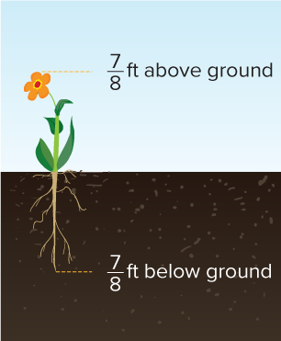
Arihi’s Plant
Arihi planted a flower. The height and depth of the plant are shown. How do the height of the plant and the depth of the roots compare?
What tool can we use to represent the height of the plant and the depth of the roots?
Reveal:
One tool is a number line.
TRY IT BEFORE YOU’RE SURE · Start even if you are not sure. A revised answer counts as much as a first-try answer.
18 / 47
Notes:
TEACH IN PRACTICE | Embedded facilitation | Lesson 7.2, slide 17 | REVEAL
Focus on the existing task: Arihi planted a flower. The height and depth of the plant are shown. How do the height of the plant and the depth of the roots compare?
LAUNCH (T2/3/5): If an existing answer cover is present, gather an attempt before revealing. If the explanation is already visible, ask students to reconstruct and justify it. Compare reasoning and explain a revision; preserve the reveal sequence.
LOOK FOR (T4): Where this task addresses it, students can use equal intervals to locate rational numbers and opposites. Ask which feature of their work supports the claim.
RESPOND: If this task shows the lesson misconception—counting negative fractional intervals in the wrong direction—mark zero and the unit interval before subdividing the original number line. Have the student revise and explain the change. Use this support only where the concept occurs in the current task; otherwise respond to the displayed question.
RECHECK: If a gap is shared, revisit the existing representation together. If it is limited, give targeted support while others compare valid methods on the same task. Check the revision before moving on.
PARTICIPATION (T5/6/7): Think time before volunteers; accept a written, drawn or rehearsed entry. Students ask for evidence respectfully. Recognize a specific contribution or revision and check that both partners participate.
Source: BCPS Updated Instructional Framework Rubric (June 2020), TEACH 1–7. Earlier notes and answer keys are retained below.
EARLIER NOTES / EXISTING ANSWER KEY
Do not click yet: collect 2–3 student answers with reasons first.
Then click to remove the cover and have students compare their thinking to the reveal — “Is this what we said? Where is it different?”
Behind the cover: One tool is a number line.
UIFR: TEACH 3 · TEACH 4.
UIFR FULL | Lesson-specific facilitation
TEACH 2-3 | Session 1 task launch (UIFR PDF pp. 9-10).
Use the problem exactly as displayed. Give individual thinking time before discussion or advancing to the explanation. If the answer is already visible, ask students to reconstruct and justify it. Invite a choice of suitable representations and have students explain why their choice helps.
At the point where this concept appears, ask: “How does the scale determine this location, and where is its opposite?” Wait for evidence, invite another pathway, and have a student ask a follow-up question. Do not replace students’ reasoning with a sequence of leading steps.

Slide 19
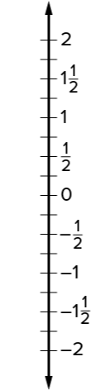
Arihi’s Plant
Let’s use a vertical number line to represent the height of the plant and the depth of the roots.
What do you notice about the location of positive and negative numbers on a vertical number line?
HOW DO YOU KNOW? · Ask your partner “How do you know?” Answer by pointing to your own work.
Reveal:
Positive numbers are above 0 and negative numbers are below 0.
19 / 47
Notes:
TEACH IN PRACTICE | Embedded facilitation | Lesson 7.2, slide 18 | REVEAL
Focus on the existing task: Let’s use a vertical number line to represent the height of the plant and the depth of the roots. What do you notice about the location of positive and negative numbers on a vertical number line?
LAUNCH (T2/3/5): If an existing answer cover is present, gather an attempt before revealing. If the explanation is already visible, ask students to reconstruct and justify it. Compare reasoning and explain a revision; preserve the reveal sequence.
LOOK FOR (T4): Where this task addresses it, students can use equal intervals to locate rational numbers and opposites. Ask which feature of their work supports the claim.
RESPOND: If this task shows the lesson misconception—counting negative fractional intervals in the wrong direction—mark zero and the unit interval before subdividing the original number line. Have the student revise and explain the change. Use this support only where the concept occurs in the current task; otherwise respond to the displayed question.
RECHECK: If a gap is shared, revisit the existing representation together. If it is limited, give targeted support while others compare valid methods on the same task. Check the revision before moving on.
PARTICIPATION (T5/6/7): Think time before volunteers; accept a written, drawn or rehearsed entry. Students ask for evidence respectfully. Recognize a specific contribution or revision and check that both partners participate.
Source: BCPS Updated Instructional Framework Rubric (June 2020), TEACH 1–7. Earlier notes and answer keys are retained below.
EARLIER NOTES / EXISTING ANSWER KEY
Do not click yet: collect 2–3 student answers with reasons first.
Then click to remove the cover and have students compare their thinking to the reveal — “Is this what we said? Where is it different?”
Behind the cover: Positive numbers are above 0 and negative numbers are below 0.
UIFR: TEACH 3 · TEACH 4.

Slide 20
Arihi’s Plant
On a vertical number line, positive numbers are above 0 and negative numbers are below 0.
What number represents ground level? Explain.
Try first. Use the scale and positions on the
number line to justify your answer.
Critiquing
What connections do you see between your thinking and that of a classmate?
20 / 47
Notes:
TEACH IN PRACTICE | Embedded facilitation | Lesson 7.2, slide 19 | TASK
Focus on the existing task: On a vertical number line, positive numbers are above 0 and negative numbers are below 0. What number represents ground level?
LAUNCH (T2/3/5): Use the displayed question. Give private thinking time; then A explains while B asks for evidence. Switch roles. Each student records their own reasoning.
LOOK FOR (T4): Where this task addresses it, students can use equal intervals to locate rational numbers and opposites. Ask which feature of their work supports the claim.
RESPOND: If this task shows the lesson misconception—counting negative fractional intervals in the wrong direction—mark zero and the unit interval before subdividing the original number line. Have the student revise and explain the change. Use this support only where the concept occurs in the current task; otherwise respond to the displayed question.
RECHECK: If a gap is shared, revisit the existing representation together. If it is limited, give targeted support while others compare valid methods on the same task. Check the revision before moving on.
PARTICIPATION (T5/6/7): Think time before volunteers; accept a written, drawn or rehearsed entry. Students ask for evidence respectfully. Recognize a specific contribution or revision and check that both partners participate.
Source: BCPS Updated Instructional Framework Rubric (June 2020), TEACH 1–7. Earlier notes and answer keys are retained below.
EARLIER NOTES / EXISTING ANSWER KEY
Model briefly, then hand the thinking back: ask “Why does this step work?” before showing the next one.
Quick check before moving on — thumbs or whiteboards from everyone, not volunteers.
UIFR: TEACH 2 · TEACH 3 · TEACH 4.

Slide 21
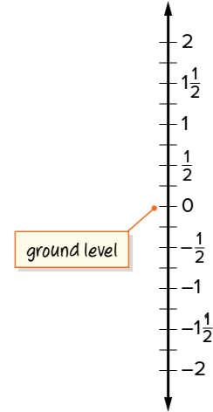
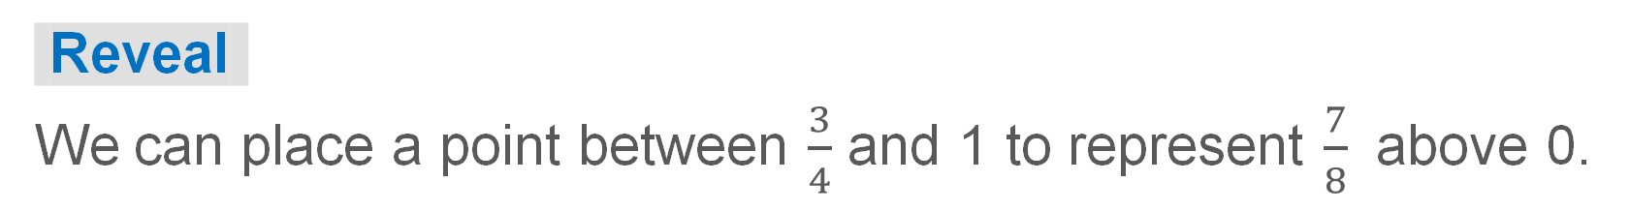
Arihi’s Plant
Ground level is represented by 0 because it is the starting point from where the flower and roots grow.
How can you represent the height of the plant?
Think and record first. Which part of your
work supports your answer?
21 / 47
Notes:
TEACH IN PRACTICE | Embedded facilitation | Lesson 7.2, slide 20 | TASK
Focus on the existing task: Ground level is represented by 0 because it is the starting point from where the flower and roots grow. How can you represent the height of the plant?
LAUNCH (T2/3/5): Use the displayed question. Give private thinking time; then A explains while B asks for evidence. Switch roles. Each student records their own reasoning.
LOOK FOR (T4): Where this task addresses it, students can use equal intervals to locate rational numbers and opposites. Ask which feature of their work supports the claim.
RESPOND: If this task shows the lesson misconception—counting negative fractional intervals in the wrong direction—mark zero and the unit interval before subdividing the original number line. Have the student revise and explain the change. Use this support only where the concept occurs in the current task; otherwise respond to the displayed question.
RECHECK: If a gap is shared, revisit the existing representation together. If it is limited, give targeted support while others compare valid methods on the same task. Check the revision before moving on.
PARTICIPATION (T5/6/7): Think time before volunteers; accept a written, drawn or rehearsed entry. Students ask for evidence respectfully. Recognize a specific contribution or revision and check that both partners participate.
Source: BCPS Updated Instructional Framework Rubric (June 2020), TEACH 1–7. Earlier notes and answer keys are retained below.
EARLIER NOTES / EXISTING ANSWER KEY
Model briefly, then hand the thinking back: ask “Why does this step work?” before showing the next one.
Quick check before moving on — thumbs or whiteboards from everyone, not volunteers.
UIFR: TEACH 2 · TEACH 3 · TEACH 4.

Slide 22

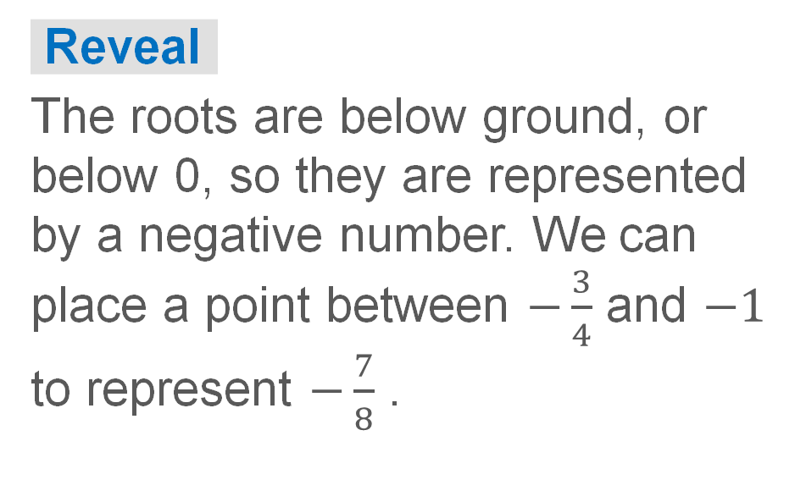
COLLABORATE · TALK IT THROUGH • AGREE ON A MODEL
Collaborate and Connect
How can you represent the depth of the roots?
ADD ON · Add on: “I agree because ______.” or “I see it differently because ______.”
22 / 47
Notes:
TEACH IN PRACTICE | Embedded facilitation | Lesson 7.2, slide 21 | COLLABORATE
Focus on the existing task: Collaborate and Connect How can you represent the depth of the roots?
LAUNCH (T2/3/5): Use the displayed question. Give private thinking time; then A explains while B asks for evidence. Switch roles. Each student records their own reasoning.
LOOK FOR (T4): Where this task addresses it, students can use equal intervals to locate rational numbers and opposites. Ask which feature of their work supports the claim.
RESPOND: If this task shows the lesson misconception—counting negative fractional intervals in the wrong direction—mark zero and the unit interval before subdividing the original number line. Have the student revise and explain the change. Use this support only where the concept occurs in the current task; otherwise respond to the displayed question.
RECHECK: If a gap is shared, revisit the existing representation together. If it is limited, give targeted support while others compare valid methods on the same task. Check the revision before moving on.
PARTICIPATION (T5/6/7): Think time before volunteers; accept a written, drawn or rehearsed entry. Students ask for evidence respectfully. Recognize a specific contribution or revision and check that both partners participate.
Source: BCPS Updated Instructional Framework Rubric (June 2020), TEACH 1–7. Earlier notes and answer keys are retained below.
EARLIER NOTES / EXISTING ANSWER KEY
Routine: COLLABORATE · TALK IT THROUGH • AGREE ON A MODEL
UIFR FULL | Lesson-specific facilitation
TEACH 4-5 | Session 1 discussion and checkpoint (UIFR PDF pp. 11-12).
Collect a brief response from every student to the existing prompt before hearing volunteers. Partners take turns explaining and asking for evidence: “I understand ___; what supports ___?” Offer rehearsal or an annotated model for students who need language support. Each student records their own reasoning.
Look specifically for: counting negative fractional intervals in the wrong direction. If it appears, mark zero and the unit interval before subdividing the original number line; then ask the student to revise the same response and explain the change. If evidence is secure, have students compare a second valid pathway or state why their approach works. Choose the next step from the responses, not a preset pace.

Slide 23
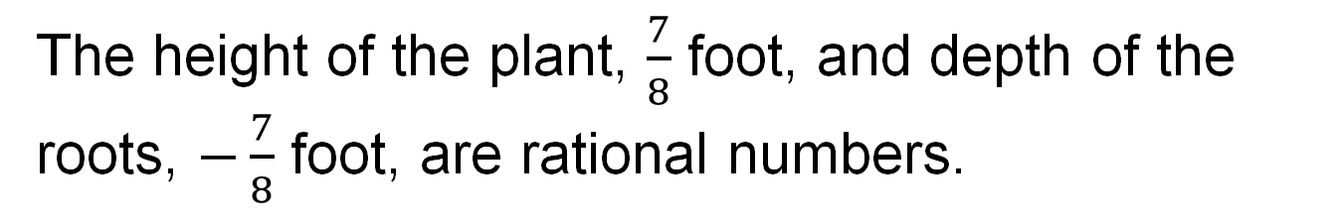
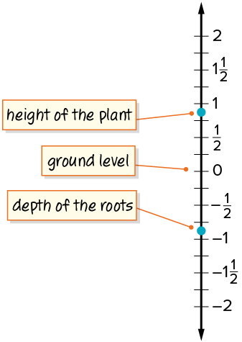
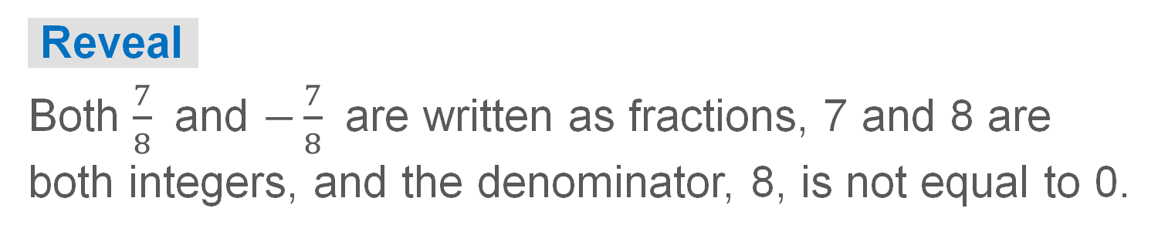
Arihi’s Plant
A rational number is any number that can be written as a fraction, where the numerator and denominator are integers, and the denominator is not 0.
Explain why the height of the plant and the depth of the roots are rational numbers.
23 / 47
Notes:
TEACH IN PRACTICE | Embedded facilitation | Lesson 7.2, slide 22 | TASK
Focus on the existing task: A rational number is any number that can be written as a fraction, where the numerator and denominator are integers, and the denominator…
LAUNCH (T2/3/5): Use the displayed question. Give private thinking time; then A explains while B asks for evidence. Switch roles. Each student records their own reasoning.
LOOK FOR (T4): Where this task addresses it, students can use equal intervals to locate rational numbers and opposites. Ask which feature of their work supports the claim.
RESPOND: If this task shows the lesson misconception—counting negative fractional intervals in the wrong direction—mark zero and the unit interval before subdividing the original number line. Have the student revise and explain the change. Use this support only where the concept occurs in the current task; otherwise respond to the displayed question.
RECHECK: If a gap is shared, revisit the existing representation together. If it is limited, give targeted support while others compare valid methods on the same task. Check the revision before moving on.
PARTICIPATION (T5/6/7): Think time before volunteers; accept a written, drawn or rehearsed entry. Students ask for evidence respectfully. Recognize a specific contribution or revision and check that both partners participate.
Source: BCPS Updated Instructional Framework Rubric (June 2020), TEACH 1–7. Earlier notes and answer keys are retained below.
EARLIER NOTES / EXISTING ANSWER KEY
Model briefly, then hand the thinking back: ask “Why does this step work?” before showing the next one.
Quick check before moving on — thumbs or whiteboards from everyone, not volunteers.
UIFR: TEACH 2 · TEACH 3 · TEACH 4.

Slide 24
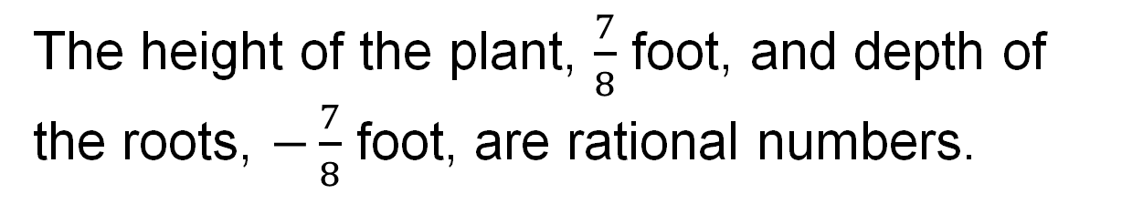
Arihi’s Plant
What do you notice about the height of the plant and the depth of the roots as represented on the number line?
Reveal:
The point representing the depth of the roots is the same distance away from zero as the point representing the height of the plant, so the numbers are opposites.
24 / 47
Notes:
TEACH IN PRACTICE | Embedded facilitation | Lesson 7.2, slide 23 | REVEAL
Focus on the existing task: Reveal: The point representing the depth of the roots is the same distance away from zero as the point representing the height of the…
LAUNCH (T2/3/5): If an existing answer cover is present, gather an attempt before revealing. If the explanation is already visible, ask students to reconstruct and justify it. Compare reasoning and explain a revision; preserve the reveal sequence.
LOOK FOR (T4): Where this task addresses it, students can use equal intervals to locate rational numbers and opposites. Ask which feature of their work supports the claim.
RESPOND: If this task shows the lesson misconception—counting negative fractional intervals in the wrong direction—mark zero and the unit interval before subdividing the original number line. Have the student revise and explain the change. Use this support only where the concept occurs in the current task; otherwise respond to the displayed question.
RECHECK: If a gap is shared, revisit the existing representation together. If it is limited, give targeted support while others compare valid methods on the same task. Check the revision before moving on.
PARTICIPATION (T5/6/7): Think time before volunteers; accept a written, drawn or rehearsed entry. Students ask for evidence respectfully. Recognize a specific contribution or revision and check that both partners participate.
Source: BCPS Updated Instructional Framework Rubric (June 2020), TEACH 1–7. Earlier notes and answer keys are retained below.
EARLIER NOTES / EXISTING ANSWER KEY
Do not click yet: collect 2–3 student answers with reasons first.
Then click to remove the cover and have students compare their thinking to the reveal — “Is this what we said? Where is it different?”
Behind the cover: The point representing the depth of the roots is the same distance away from zero as the point representing the height of the plant, so the numbers are opposites.
UIFR: TEACH 3 · TEACH 4.

Slide 25
STUDENT MOVES
Lesson 7-2
Your moves
TWO MINUTES SOLO · Two minutes on your own, then compare. Bring one thing you tried, even if it did not work.
ASK THE CLASS · Write one question about this that you could ask the class.
25 / 47

Slide 26
Arihi’s Plant
Arihi planted a flower. The height and depth of the plant are shown.
How do the height of the plant and the depth of the roots compare?
The depth of the roots is the opposite of the height of the plant.
Think and record first. Which part of your work supports your answer?
26 / 47
Notes:
TEACH IN PRACTICE | Embedded facilitation | Lesson 7.2, slide 24 | TASK
Focus on the existing task: Arihi planted a flower. The height and depth of the plant are shown. How do the height of the plant and the depth of the roots compare?
LAUNCH (T2/3/5): Use the displayed question. Give private thinking time; then A explains while B asks for evidence. Switch roles. Each student records their own reasoning.
LOOK FOR (T4): Where this task addresses it, students can use equal intervals to locate rational numbers and opposites. Ask which feature of their work supports the claim.
RESPOND: If this task shows the lesson misconception—counting negative fractional intervals in the wrong direction—mark zero and the unit interval before subdividing the original number line. Have the student revise and explain the change. Use this support only where the concept occurs in the current task; otherwise respond to the displayed question.
RECHECK: If a gap is shared, revisit the existing representation together. If it is limited, give targeted support while others compare valid methods on the same task. Check the revision before moving on.
PARTICIPATION (T5/6/7): Think time before volunteers; accept a written, drawn or rehearsed entry. Students ask for evidence respectfully. Recognize a specific contribution or revision and check that both partners participate.
Source: BCPS Updated Instructional Framework Rubric (June 2020), TEACH 1–7. Earlier notes and answer keys are retained below.
EARLIER NOTES / EXISTING ANSWER KEY
Model briefly, then hand the thinking back: ask “Why does this step work?” before showing the next one.
Quick check before moving on — thumbs or whiteboards from everyone, not volunteers.
UIFR: TEACH 2 · TEACH 3 · TEACH 4.

Slide 27
Let’s Explore More
Give another example of when using a vertical number line is useful. Explain your reasoning.
Why is −2.5 the opposite of 2.5?
Workspace
Workspace
STRUGGLE FIRST · Work on your own first. Stuck is allowed — try a second strategy before you ask.
27 / 47
Notes:
TEACH IN PRACTICE | Embedded facilitation | Lesson 7.2, slide 25 | PRACTICE
Focus on the existing task: Let’s Explore More Give another example of when using a vertical number line is useful. Explain your reasoning. Why is −2.5 the opposite of 2.5?
LAUNCH (T2/3/5): Use the displayed question. Give private thinking time; then A explains while B asks for evidence. Switch roles. Each student records their own reasoning.
LOOK FOR (T4): Where this task addresses it, students can use equal intervals to locate rational numbers and opposites. Ask which feature of their work supports the claim.
RESPOND: If this task shows the lesson misconception—counting negative fractional intervals in the wrong direction—mark zero and the unit interval before subdividing the original number line. Have the student revise and explain the change. Use this support only where the concept occurs in the current task; otherwise respond to the displayed question.
RECHECK: If a gap is shared, revisit the existing representation together. If it is limited, give targeted support while others compare valid methods on the same task. Check the revision before moving on.
PARTICIPATION (T5/6/7): Think time before volunteers; accept a written, drawn or rehearsed entry. Students ask for evidence respectfully. Recognize a specific contribution or revision and check that both partners participate.
Source: BCPS Updated Instructional Framework Rubric (June 2020), TEACH 1–7. Earlier notes and answer keys are retained below.
EARLIER NOTES / EXISTING ANSWER KEY
Extension for partners or table groups — students choose their approach and use the workspace to show thinking.
Push with “Convince me,” and have two groups with different approaches share.
This is where students stretch past the worked example.
UIFR: TEACH 2 · TEACH 5.

Slide 28
LESSON 7.2 / DISCUSS THE TASK
Explain and compare
Use the task you just explored.
TAKE TURNS
How does the scale determine this location, and where is its opposite?
Explain
“I know this because…”
Ask
“Where does your work show that?”
Point to evidence in your work.
Then compare your approach with a partner’s.
JUSTIFY IT · Say it like this: “I know ______ because ______.”
Listen to understand. Ask for evidence. Make room for every voice.
Notes:
TEACH IN PRACTICE | Embedded facilitation | Lesson 7.2, slide 26 | PRIOR_INSERT
Focus on the existing task: Point to evidence in your work. Then compare your approach with a partner’s. TAKE TURNS Explain “I know this because…” Ask “Where does your work show that?
CONNECT (T1/4): Ask students to restate the displayed goal or key idea and connect it to earlier work. Relevant lesson evidence: use equal intervals to locate rational numbers and opposites; respect the negative side. Use only the criterion that matches the current session.
SHOW PROGRESS: Students point to their own existing work, explain what improved after feedback, and name a next step. Pair confidence ratings with actual evidence.
PARTICIPATION (T5/6/7): Think time before volunteers; accept a written, drawn or rehearsed entry. Students ask for evidence respectfully. Recognize a specific contribution or revision and check that both partners participate.
Source: BCPS Updated Instructional Framework Rubric (June 2020), TEACH 1–7.

Slide 29
Arihi’s Plant
What do you notice about the height of the plant and the depth of the roots as represented on the number line?
What do you notice about the height of the plant and the depth of the roots as represented on the number line?
Reveal:
The point representing the depth of the roots is the same distance away from zero as the point representing the height of the plant, so the numbers are opposites.
29 / 47
Notes:
TEACH IN PRACTICE | Embedded facilitation | Lesson 7.2, slide 27 | REVEAL
Focus on the existing task: What do you notice about the height of the plant and the depth of the roots as represented on the number line?
LAUNCH (T2/3/5): If an existing answer cover is present, gather an attempt before revealing. If the explanation is already visible, ask students to reconstruct and justify it. Compare reasoning and explain a revision; preserve the reveal sequence.
LOOK FOR (T4): Where this task addresses it, students can use equal intervals to locate rational numbers and opposites. Ask which feature of their work supports the claim.
RESPOND: If this task shows the lesson misconception—counting negative fractional intervals in the wrong direction—mark zero and the unit interval before subdividing the original number line. Have the student revise and explain the change. Use this support only where the concept occurs in the current task; otherwise respond to the displayed question.
RECHECK: If a gap is shared, revisit the existing representation together. If it is limited, give targeted support while others compare valid methods on the same task. Check the revision before moving on.
PARTICIPATION (T5/6/7): Think time before volunteers; accept a written, drawn or rehearsed entry. Students ask for evidence respectfully. Recognize a specific contribution or revision and check that both partners participate.
Source: BCPS Updated Instructional Framework Rubric (June 2020), TEACH 1–7.

Slide 30
Session 2 Warm-Up
Lesson 7-2 · Represent Rational Numbers and Their Opposites on the Number Line
Session 2 Warm-Up
Check what you remember from Session 1 · about 4 minutes
1
A rational number is any number that can be written as:
2
Which number is between −1 and 0?
A
Only whole numbers
A
−1.5
B
A fraction a/b where b ≠ 0
B
−0.5
C
An imaginary sign
C
0.5
D
A square root only
D
1.0
3
What is the opposite of 2.75?
4
On a number line, numbers become greater as you move:
A
2.75
A
Left
B
−2.75
B
Right
C
0.275
C
Down
D
7.25
D
Toward zero
eduwonderlab.com · Neft Teacher
30 / 47
Notes:
TEACH IN PRACTICE | Embedded facilitation | Lesson 7.2, slide 28 | WARMUP
Focus on the existing task: A −1.5 B −0.5 C 0.5 D 1.0 3 What is the opposite of 2.75?
GATHER EVIDENCE (T4/6): Keep the original items. Students try independently, mark an uncertain item, and explain one method before checking. Use the existing key when present.
RESPOND: Distinguish a calculation slip from a reasoning gap. Give one next step on the same item; have students revise in a second color. Use the responses to choose flexible support for today’s lesson.
PARTICIPATION (T5/6/7): Think time before volunteers; accept a written, drawn or rehearsed entry. Students ask for evidence respectfully. Recognize a specific contribution or revision and check that both partners participate.
Source: BCPS Updated Instructional Framework Rubric (June 2020), TEACH 1–7. Earlier notes and answer keys are retained below.
EARLIER NOTES / EXISTING ANSWER KEY
Warm-up routine: students start silently on entry; keep it to about 4 minutes.
Circulate and note who is stuck — use what you see to choose who you check on first today.
Go over answers quickly; ask one student to explain a step, not just say the answer.
UIFR: TEACH 4 · TEACH 6.
UIFR FULL | Lesson-specific facilitation
TEACH 1 | Session 2 purpose and evidence (UIFR PDF p. 8).
Have students restate the displayed session goal in their own words and connect it to the existing context or a familiar experience they choose to share. Use the current session goal to select from these lesson-wide evidence criteria; do not frontload a later-session procedure.
Look for: use equal intervals to locate rational numbers and opposites; respect the negative side. Ask: “Which part of your work would show this?” Revisit that evidence after the task; a confidence rating alone is not evidence of understanding.

Slide 31
STUDENT MOVES
Lesson 7-2
Your moves
PROVE IT · Find the evidence in the problem that makes your answer right — not just the answer.
YOU KNOW THE ROUTINE · Read → plan → solve → check. Do all four, in that order.
31 / 47

Slide 32
Today’s Math Notes
Lesson 7-2 · Represent Rational Numbers and Their Opposites on the Number Line
Review Notes — Session 2
Copy. Explain. Check.
WHY IT MATTERS · Finish this: “This is worth knowing because ______.”
Rational Numbers
1
Any number that can be expressed as a ratio of two integers (fractions, terminating/repeating decimals).
Ordering Negatives
2
Numbers farther to the right are always greater: −0.5 is greater than −1.5.
Plotting Rational Points
3
Partition intervals into equal parts matching fraction denominators or decimal tenths.
eduwonderlab.com · Neft Teacher
32 / 47
Notes:
TEACH IN PRACTICE | Embedded facilitation | Lesson 7.2, slide 29 | NOTES
Focus on the existing task: Today’s Math Notes Review…
ROUTINE (T1/2/4): Read or copy the original notes, cover one line, and explain it using the displayed example. Reopen and correct. Copying alone is not evidence of understanding.
LOOK FOR: A link between a symbol, quantity or feature and the explanation. If missing, point back to that feature and have the student try again; fade the prompt once they can explain.
PARTICIPATION (T5/6/7): Think time before volunteers; accept a written, drawn or rehearsed entry. Students ask for evidence respectfully. Recognize a specific contribution or revision and check that both partners participate.
Source: BCPS Updated Instructional Framework Rubric (June 2020), TEACH 1–7. Earlier notes and answer keys are retained below.
EARLIER NOTES / EXISTING ANSWER KEY
Copy routine: read one line at a time; students copy, then explain that line to a partner.
Keep it brisk — the understanding work happens in the examples, not the copying.
UIFR: TEACH 1 · TEACH 6.

Slide 33
Session 2
Represent Rational Numbers and Their Opposites on the Number Line
TAKE TURNS · One explains, one asks a question. Then switch, so both of you talk.
33 / 47
Notes:
TEACH IN PRACTICE | Embedded facilitation | Lesson 7.2, slide 30 | DIVIDER
Focus on the existing task: Represent Rational Numbers and Their Opposites on the Number Line Session 2
TRANSITION (T6/7): Students confirm materials, roles, how to request help, and the next response routine. Ask a student to restate it. Keep teacher-only slides hidden.
PARTICIPATION (T5/6/7): Think time before volunteers; accept a written, drawn or rehearsed entry. Students ask for evidence respectfully. Recognize a specific contribution or revision and check that both partners participate.
Source: BCPS Updated Instructional Framework Rubric (June 2020), TEACH 1–7. Earlier notes and answer keys are retained below.
EARLIER NOTES / EXISTING ANSWER KEY
Transition cue: state what materials are out and what success looks like this session.
Keep the changeover under a minute.
UIFR: TEACH 6.

Slide 34
Opposite Numbers
What number is the opposite of the opposite of −4.34?
Think and record first. Which part of your work supports your answer?
Think About It:
What does opposite mean?
34 / 47
Notes:
TEACH IN PRACTICE | Embedded facilitation | Lesson 7.2, slide 31 | TASK
Focus on the existing task: Opposite Numbers What number is the opposite of the opposite of −4.34?
LAUNCH (T2/3/5): Use the displayed question. Give private thinking time; then A explains while B asks for evidence. Switch roles. Each student records their own reasoning.
LOOK FOR (T4): Where this task addresses it, students can use equal intervals to locate rational numbers and opposites. Ask which feature of their work supports the claim.
RESPOND: If this task shows the lesson misconception—counting negative fractional intervals in the wrong direction—mark zero and the unit interval before subdividing the original number line. Have the student revise and explain the change. Use this support only where the concept occurs in the current task; otherwise respond to the displayed question.
RECHECK: If a gap is shared, revisit the existing representation together. If it is limited, give targeted support while others compare valid methods on the same task. Check the revision before moving on.
PARTICIPATION (T5/6/7): Think time before volunteers; accept a written, drawn or rehearsed entry. Students ask for evidence respectfully. Recognize a specific contribution or revision and check that both partners participate.
Source: BCPS Updated Instructional Framework Rubric (June 2020), TEACH 1–7. Earlier notes and answer keys are retained below.
EARLIER NOTES / EXISTING ANSWER KEY
Ask the question, then hold the silence — students think or jot before anyone answers.
Take two or three responses and press with “Why?” or “How do you know?” before moving on.
UIFR: TEACH 3.
UIFR FULL | Lesson-specific facilitation
TEACH 2-3 | Session 2 task launch (UIFR PDF pp. 9-10).
Use the problem exactly as displayed. Give individual thinking time before discussion or advancing to the explanation. If the answer is already visible, ask students to reconstruct and justify it. Invite a choice of suitable representations and have students explain why their choice helps.
At the point where this concept appears, ask: “How does the scale determine this location, and where is its opposite?” Wait for evidence, invite another pathway, and have a student ask a follow-up question. Do not replace students’ reasoning with a sequence of leading steps.

Slide 35
Opposite Numbers
We can use a number line to represent the problem.
The number line shows −4.34.
SELF-CHECK · Mark it: ✓ got it · ~ almost · ? stuck. Then fix one thing before we move on.
How can you determine the opposite of a number?
Reveal:
We can identify a number on the opposite side of the number line that is the same distance from 0.
35 / 47
Notes:
TEACH IN PRACTICE | Embedded facilitation | Lesson 7.2, slide 32 | REVEAL
Focus on the existing task: Reveal: We can identify a number on the opposite side of the number line that is the same distance from 0. We can use a number line to…
LAUNCH (T2/3/5): If an existing answer cover is present, gather an attempt before revealing. If the explanation is already visible, ask students to reconstruct and justify it. Compare reasoning and explain a revision; preserve the reveal sequence.
LOOK FOR (T4): Where this task addresses it, students can use equal intervals to locate rational numbers and opposites. Ask which feature of their work supports the claim.
RESPOND: If this task shows the lesson misconception—counting negative fractional intervals in the wrong direction—mark zero and the unit interval before subdividing the original number line. Have the student revise and explain the change. Use this support only where the concept occurs in the current task; otherwise respond to the displayed question.
RECHECK: If a gap is shared, revisit the existing representation together. If it is limited, give targeted support while others compare valid methods on the same task. Check the revision before moving on.
PARTICIPATION (T5/6/7): Think time before volunteers; accept a written, drawn or rehearsed entry. Students ask for evidence respectfully. Recognize a specific contribution or revision and check that both partners participate.
Source: BCPS Updated Instructional Framework Rubric (June 2020), TEACH 1–7. Earlier notes and answer keys are retained below.
EARLIER NOTES / EXISTING ANSWER KEY
Do not click yet: collect 2–3 student answers with reasons first.
Then click to remove the cover and have students compare their thinking to the reveal — “Is this what we said? Where is it different?”
Behind the cover: We can identify a number on the opposite side of the number line that is the same distance from 0.
UIFR: TEACH 3 · TEACH 4.

Slide 36
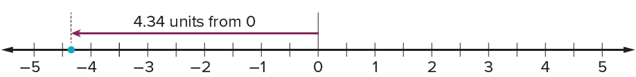
Opposite Numbers
Let’s use a number line to solve the problem.
Determine the distance from 0 to −4.34.
Try first. Use the scale and positions on the number line to justify your answer.
36 / 47
Notes:
TEACH IN PRACTICE | Embedded facilitation | Lesson 7.2, slide 33 | TASK
Focus on the existing task: Let’s use a number line to solve the problem. Opposite Numbers Determine the distance from 0 to −4.34.
LAUNCH (T2/3/5): Use the displayed question. Give private thinking time; then A explains while B asks for evidence. Switch roles. Each student records their own reasoning.
LOOK FOR (T4): Where this task addresses it, students can use equal intervals to locate rational numbers and opposites. Ask which feature of their work supports the claim.
RESPOND: If this task shows the lesson misconception—counting negative fractional intervals in the wrong direction—mark zero and the unit interval before subdividing the original number line. Have the student revise and explain the change. Use this support only where the concept occurs in the current task; otherwise respond to the displayed question.
RECHECK: If a gap is shared, revisit the existing representation together. If it is limited, give targeted support while others compare valid methods on the same task. Check the revision before moving on.
PARTICIPATION (T5/6/7): Think time before volunteers; accept a written, drawn or rehearsed entry. Students ask for evidence respectfully. Recognize a specific contribution or revision and check that both partners participate.
Source: BCPS Updated Instructional Framework Rubric (June 2020), TEACH 1–7. Earlier notes and answer keys are retained below.
EARLIER NOTES / EXISTING ANSWER KEY
Model briefly, then hand the thinking back: ask “Why does this step work?” before showing the next one.
Quick check before moving on — thumbs or whiteboards from everyone, not volunteers.
UIFR: TEACH 2 · TEACH 3 · TEACH 4.

Slide 37
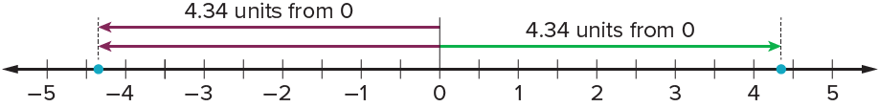
Opposite Numbers
Let’s use a number line to solve the problem.
To find the opposite of the opposite of −4.34, we can determine the opposite of 4.34.
The opposite of 4.34 will be 4.34 units from 0, but on the other side of the number line.
Use the scale and positions on the number line to justify your answer.
37 / 47
Notes:
TEACH IN PRACTICE | Embedded facilitation | Lesson 7.2, slide 34 | WORKED
Focus on the existing task: Let’s use a number line to solve the problem. Opposite Numbers To find the opposite of the opposite of −4.34, we can determine the…
LAUNCH (T2/3/5): Ask students to explain the displayed idea or example and point to evidence. When a calculation step is shown, ask why it is valid. Have a partner restate the explanation; copying is not the check.
LOOK FOR (T4): Where this task addresses it, students can use equal intervals to locate rational numbers and opposites. Ask which feature of their work supports the claim.
RESPOND: If this task shows the lesson misconception—counting negative fractional intervals in the wrong direction—mark zero and the unit interval before subdividing the original number line. Have the student revise and explain the change. Use this support only where the concept occurs in the current task; otherwise respond to the displayed question.
RECHECK: If a gap is shared, revisit the existing representation together. If it is limited, give targeted support while others compare valid methods on the same task. Check the revision before moving on.
PARTICIPATION (T5/6/7): Think time before volunteers; accept a written, drawn or rehearsed entry. Students ask for evidence respectfully. Recognize a specific contribution or revision and check that both partners participate.
Source: BCPS Updated Instructional Framework Rubric (June 2020), TEACH 1–7. Earlier notes and answer keys are retained below.
EARLIER NOTES / EXISTING ANSWER KEY
Model briefly, then hand the thinking back: ask “Why does this step work?” before showing the next one.
Quick check before moving on — thumbs or whiteboards from everyone, not volunteers.
UIFR: TEACH 2 · TEACH 3 · TEACH 4.

Slide 38
Opposite Numbers
What number is the opposite of the opposite of −4.34?
The opposite of the opposite of −4.34 is −4.34.
Clarifying
What questions can you ask to clarify your own thinking?
Think and record first. Which part of your work supports your answer?
38 / 47
Notes:
TEACH IN PRACTICE | Embedded facilitation | Lesson 7.2, slide 35 | TASK
Focus on the existing task: Clarifying What questions can you ask to clarify your own thinking?
LAUNCH (T2/3/5): Use the displayed question. Give private thinking time; then A explains while B asks for evidence. Switch roles. Each student records their own reasoning.
LOOK FOR (T4): Where this task addresses it, students can use equal intervals to locate rational numbers and opposites. Ask which feature of their work supports the claim.
RESPOND: If this task shows the lesson misconception—counting negative fractional intervals in the wrong direction—mark zero and the unit interval before subdividing the original number line. Have the student revise and explain the change. Use this support only where the concept occurs in the current task; otherwise respond to the displayed question.
RECHECK: If a gap is shared, revisit the existing representation together. If it is limited, give targeted support while others compare valid methods on the same task. Check the revision before moving on.
PARTICIPATION (T5/6/7): Think time before volunteers; accept a written, drawn or rehearsed entry. Students ask for evidence respectfully. Recognize a specific contribution or revision and check that both partners participate.
Source: BCPS Updated Instructional Framework Rubric (June 2020), TEACH 1–7. Earlier notes and answer keys are retained below.
EARLIER NOTES / EXISTING ANSWER KEY
Model briefly, then hand the thinking back: ask “Why does this step work?” before showing the next one.
Quick check before moving on — thumbs or whiteboards from everyone, not volunteers.
UIFR: TEACH 2 · TEACH 3 · TEACH 4.

Slide 39
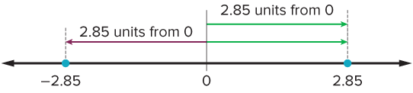
COLLABORATE · TALK IT THROUGH • AGREE ON A MODEL
Collaborate and Connect
Let’s try a similar problem.
What number is the opposite of the opposite of 2.85? Use a number line to show your reasoning.
Reveal:
2.85
RESTATE FIRST · Restate your partner’s idea in your own words before you give yours.
39 / 47
Notes:
TEACH IN PRACTICE | Embedded facilitation | Lesson 7.2, slide 36 | COLLABORATE
Focus on the existing task: Collaborate and Connect Let’s try a similar problem. What number is the opposite of the opposite of 2.85?
LAUNCH (T2/3/5): Use the displayed question. Give private thinking time; then A explains while B asks for evidence. Switch roles. Each student records their own reasoning.
LOOK FOR (T4): Where this task addresses it, students can use equal intervals to locate rational numbers and opposites. Ask which feature of their work supports the claim.
RESPOND: If this task shows the lesson misconception—counting negative fractional intervals in the wrong direction—mark zero and the unit interval before subdividing the original number line. Have the student revise and explain the change. Use this support only where the concept occurs in the current task; otherwise respond to the displayed question.
RECHECK: If a gap is shared, revisit the existing representation together. If it is limited, give targeted support while others compare valid methods on the same task. Check the revision before moving on.
PARTICIPATION (T5/6/7): Think time before volunteers; accept a written, drawn or rehearsed entry. Students ask for evidence respectfully. Recognize a specific contribution or revision and check that both partners participate.
Source: BCPS Updated Instructional Framework Rubric (June 2020), TEACH 1–7. Earlier notes and answer keys are retained below.
EARLIER NOTES / EXISTING ANSWER KEY
Routine: COLLABORATE · TALK IT THROUGH • AGREE ON A MODEL
UIFR FULL | Lesson-specific facilitation
TEACH 4-5 | Session 2 discussion and checkpoint (UIFR PDF pp. 11-12).
Collect a brief response from every student to the existing prompt before hearing volunteers. Partners take turns explaining and asking for evidence: “I understand ___; what supports ___?” Offer rehearsal or an annotated model for students who need language support. Each student records their own reasoning.
Look specifically for: counting negative fractional intervals in the wrong direction. If it appears, mark zero and the unit interval before subdividing the original number line; then ask the student to revise the same response and explain the change. If evidence is secure, have students compare a second valid pathway or state why their approach works. Choose the next step from the responses, not a preset pace.

Slide 40
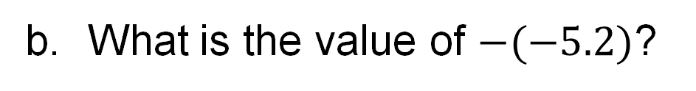
Let’s Explore More
What do you notice about the opposite of the opposite of −4.34? Explain your thinking.
Workspace
ANOTHER PATHWAY · Did anyone get there a different way? Put both pathways side by side and compare.
Workspace
40 / 47
Notes:
TEACH IN PRACTICE | Embedded facilitation | Lesson 7.2, slide 37 | PRACTICE
Focus on the existing task: Let’s Explore More What do you notice about the opposite of the opposite of −4.34?
LAUNCH (T2/3/5): Use the displayed question. Give private thinking time; then A explains while B asks for evidence. Switch roles. Each student records their own reasoning.
LOOK FOR (T4): Where this task addresses it, students can use equal intervals to locate rational numbers and opposites. Ask which feature of their work supports the claim.
RESPOND: If this task shows the lesson misconception—counting negative fractional intervals in the wrong direction—mark zero and the unit interval before subdividing the original number line. Have the student revise and explain the change. Use this support only where the concept occurs in the current task; otherwise respond to the displayed question.
RECHECK: If a gap is shared, revisit the existing representation together. If it is limited, give targeted support while others compare valid methods on the same task. Check the revision before moving on.
PARTICIPATION (T5/6/7): Think time before volunteers; accept a written, drawn or rehearsed entry. Students ask for evidence respectfully. Recognize a specific contribution or revision and check that both partners participate.
Source: BCPS Updated Instructional Framework Rubric (June 2020), TEACH 1–7. Earlier notes and answer keys are retained below.
EARLIER NOTES / EXISTING ANSWER KEY
Extension for partners or table groups — students choose their approach and use the workspace to show thinking.
Push with “Convince me,” and have two groups with different approaches share.
This is where students stretch past the worked example.
UIFR: TEACH 2 · TEACH 5.

Slide 41
LESSON 7.2 / CHECK YOUR WORK
Pause. Check. Improve.
CHECK
A mistake to watch for: counting negative fractional intervals in the wrong direction.
TRY
Mark zero and the unit interval before subdividing the given number line.
REVISE
Use that check on the task you just completed. Correct or strengthen one part, and explain why.
REVISE NOW · Change one answer and write why you changed it. A revision is evidence of learning.
Listen to understand. Ask for evidence. Make room for every voice.
Notes:
TEACH IN PRACTICE | Embedded facilitation | Lesson 7.2, slide 38 | PRIOR_INSERT
Focus on the existing task: LESSON 7.2 / CHECK YOUR WORK Pause. Check. Improve. Listen to understand. Ask for evidence. Make room for every voice. CHECK A mistake…
CONNECT (T1/4): Ask students to restate the displayed goal or key idea and connect it to earlier work. Relevant lesson evidence: use equal intervals to locate rational numbers and opposites; respect the negative side. Use only the criterion that matches the current session.
SHOW PROGRESS: Students point to their own existing work, explain what improved after feedback, and name a next step. Pair confidence ratings with actual evidence.
PARTICIPATION (T5/6/7): Think time before volunteers; accept a written, drawn or rehearsed entry. Students ask for evidence respectfully. Recognize a specific contribution or revision and check that both partners participate.
Source: BCPS Updated Instructional Framework Rubric (June 2020), TEACH 1–7.

Slide 42
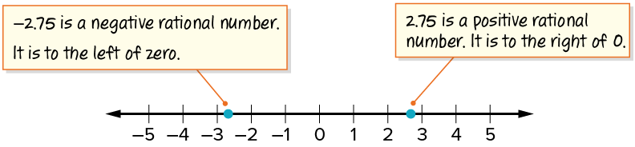
SUMMARIZE · SAY IT IN YOUR OWN WORDS
Summarize: Represent Rational Numbers
USE YOUR TOOLS · Reach for your notes, a model, or a manipulative before you reach for an answer.
A rational number is any number that can be written as a fraction, where the numerator and denominator are integers, and the denominator is not 0. It can also be written as a decimal. Rational numbers and their opposites can be represented on number lines.
42 / 47
Notes:
TEACH IN PRACTICE | Embedded facilitation | Lesson 7.2, slide 39 | SUMMARIZE
Focus on the existing task: Summarize: Represent Rational Numbers A rational number is any number that can be written as a fraction, where the numerator and…
CONNECT (T1/4): Ask students to restate the displayed goal or key idea and connect it to earlier work. Relevant lesson evidence: use equal intervals to locate rational numbers and opposites; respect the negative side. Use only the criterion that matches the current session.
SHOW PROGRESS: Students point to their own existing work, explain what improved after feedback, and name a next step. Pair confidence ratings with actual evidence.
PARTICIPATION (T5/6/7): Think time before volunteers; accept a written, drawn or rehearsed entry. Students ask for evidence respectfully. Recognize a specific contribution or revision and check that both partners participate.
Source: BCPS Updated Instructional Framework Rubric (June 2020), TEACH 1–7. Earlier notes and answer keys are retained below.
EARLIER NOTES / EXISTING ANSWER KEY
Routine: SUMMARIZE · SAY IT IN YOUR OWN WORDS

Slide 43
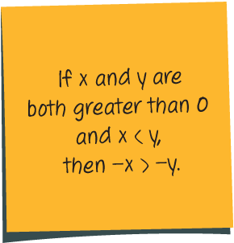
APPLY · PLAN IT • SOLVE IT • PROVE IT
Apply: Andrew’s Reasoning about Opposites
Andrew made the following generalization about opposite numbers.
Choose a method. Solve
independently, justify your
answer, then check the goal.
Question : Do you agree with Andrew’s statement? Explain your reasoning.
43 / 47
Notes:
TEACH IN PRACTICE | Embedded facilitation | Lesson 7.2, slide 40 | APPLY
Focus on the existing task: Apply: Andrew’s Reasoning about Opposites Andrew made the following generalization about opposite numbers. Question: Do you agree with Andrew’s statement?
LAUNCH (T2/3/5): Use the exact application task independently first. Ask students to justify their choice of method. Collect evidence before a partner discussion or correction.
LOOK FOR (T4): Where this task addresses it, students can use equal intervals to locate rational numbers and opposites. Ask which feature of their work supports the claim.
RESPOND: If this task shows the lesson misconception—counting negative fractional intervals in the wrong direction—mark zero and the unit interval before subdividing the original number line. Have the student revise and explain the change. Use this support only where the concept occurs in the current task; otherwise respond to the displayed question.
RECHECK: If a gap is shared, revisit the existing representation together. If it is limited, give targeted support while others compare valid methods on the same task. Check the revision before moving on.
PARTICIPATION (T5/6/7): Think time before volunteers; accept a written, drawn or rehearsed entry. Students ask for evidence respectfully. Recognize a specific contribution or revision and check that both partners participate.
Source: BCPS Updated Instructional Framework Rubric (June 2020), TEACH 1–7. Earlier notes and answer keys are retained below.
EARLIER NOTES / EXISTING ANSWER KEY
Routine: APPLY · PLAN IT • SOLVE IT • PROVE IT
UIFR FULL | Lesson-specific facilitation
TEACH 4 | Independent evidence and revision (UIFR PDF p. 11).
Use the existing application/exit problem as the independent check. If this is a learning-target slide, have students point to and explain their work on the preceding task. Separate initial independent evidence from the revision after feedback.
Check the relevant criteria: use equal intervals to locate rational numbers and opposites; respect the negative side. Respond with one specific next step tied to the work. Students revise and annotate what changed, then identify a criterion they can now demonstrate and one they still need to practice.

Slide 44
Learning Targets
I can graph rational numbers and their opposites on vertical and horizontal number lines.
I can look for and make use of structure to locate the opposite of a number on a number line.
Point to evidence in your work. Name what improved and your next step.
44 / 47
Notes:
TEACH IN PRACTICE | Embedded facilitation | Lesson 7.2, slide 41 | REFLECTION
Focus on the existing task: Learning Targets I can graph rational numbers and their opposites on vertical and horizontal number lines. I can look for and make use of…
CONNECT (T1/4): Ask students to restate the displayed goal or key idea and connect it to earlier work. Relevant lesson evidence: use equal intervals to locate rational numbers and opposites; respect the negative side. Use only the criterion that matches the current session.
SHOW PROGRESS: Students point to their own existing work, explain what improved after feedback, and name a next step. Pair confidence ratings with actual evidence.
PARTICIPATION (T5/6/7): Think time before volunteers; accept a written, drawn or rehearsed entry. Students ask for evidence respectfully. Recognize a specific contribution or revision and check that both partners participate.
Source: BCPS Updated Instructional Framework Rubric (June 2020), TEACH 1–7. Earlier notes and answer keys are retained below.
EARLIER NOTES / EXISTING ANSWER KEY
Read each target; students self-rate with fist-to-five or thumbs.
Tie back to the goal from the start of class: did we get there?
Note any target that rates low — revisit it tomorrow.
UIFR: TEACH 1 · TEACH 4.

Slide 45

Be Curious
Be Curious
What could the question be?
Think first. Share a notice and a question;
build on a classmate’s idea.
Mindset
What helped you think logically when working on a math or non-math problem?
45 / 47
Notes:
TEACH IN PRACTICE | Embedded facilitation | Lesson 7.2, slide 42 | CURIOUS
Focus on the existing task: Be Curious Be Curious What could the question be?
LAUNCH (T2/3/5): Allow quiet observation first. Separate a notice from an inference, invite students’ own questions, and follow the existing launch before teaching a procedure.
LOOK FOR (T4): Where this task addresses it, students can use equal intervals to locate rational numbers and opposites. Ask which feature of their work supports the claim.
RESPOND: If this task shows the lesson misconception—counting negative fractional intervals in the wrong direction—mark zero and the unit interval before subdividing the original number line. Have the student revise and explain the change. Use this support only where the concept occurs in the current task; otherwise respond to the displayed question.
RECHECK: If a gap is shared, revisit the existing representation together. If it is limited, give targeted support while others compare valid methods on the same task. Check the revision before moving on.
PARTICIPATION (T5/6/7): Think time before volunteers; accept a written, drawn or rehearsed entry. Students ask for evidence respectfully. Recognize a specific contribution or revision and check that both partners participate.
Source: BCPS Updated Instructional Framework Rubric (June 2020), TEACH 1–7.

Slide 46
Learning Targets
I can graph rational numbers and their opposites on vertical and horizontal number lines.
I can look for and make use of structure to locate the opposite of a number on a number line.
Point to evidence in your work. Name what improved and your next step.
46 / 47
Notes:
TEACH IN PRACTICE | Embedded facilitation | Lesson 7.2, slide 43 | REFLECTION
Focus on the existing task: Learning Targets I can graph rational numbers and their opposites on vertical and horizontal number lines. I can look for and make use of…
CONNECT (T1/4): Ask students to restate the displayed goal or key idea and connect it to earlier work. Relevant lesson evidence: use equal intervals to locate rational numbers and opposites; respect the negative side. Use only the criterion that matches the current session.
SHOW PROGRESS: Students point to their own existing work, explain what improved after feedback, and name a next step. Pair confidence ratings with actual evidence.
PARTICIPATION (T5/6/7): Think time before volunteers; accept a written, drawn or rehearsed entry. Students ask for evidence respectfully. Recognize a specific contribution or revision and check that both partners participate.
Source: BCPS Updated Instructional Framework Rubric (June 2020), TEACH 1–7. Earlier notes and answer keys are retained below.
EARLIER NOTES / EXISTING ANSWER KEY
UIFR FULL | Lesson-specific facilitation
REFLECT & ADJUST 1-2 | After the lesson (UIFR PDF pp. 15-16).
Sort the existing work by demonstrated reasoning, partial understanding, and the specific misconception: counting negative fractional intervals in the wrong direction. Compare the initial response with the revision. Record which teaching move plausibly helped, which did not, and whose participation or access needs a different approach; do not record sensitive student details in this shared deck.
Plan the next lesson from that evidence: if the misconception persists, mark zero and the unit interval before subdividing the original number line using the current example before returning to the next grade-level task; if understanding is secure, use an existing extension or ask for a general explanation. Check the targeted idea again at the next warm-up.
Ask students what supported their thinking and what would help next time. Identify one change to try and one successful practice to retain. Seek colleague feedback on anonymized work when useful; these prompts support reflection and do not establish an evaluation rating. Source: Baltimore City Public Schools, Updated Instructional Framework Rubric, June 2020 (UIFR_Full.pdf).

Slide 47
LESSON 7.2 / REFLECT ON YOUR LEARNING
Show your progress
1 SHOW EVIDENCE
2 CHOOSE A NEXT STEP
Choose one response. Point to the part that shows your reasoning.
Name a change you made after feedback—or a question you still have.
“My work shows ___ because ___.”
“Next time, I will ___ to help me ___.”
CREDIT A CLASSMATE · Name one classmate whose idea helped you today, and say what they said.
Today’s focus: Use equal intervals to locate rational numbers and opposites.
Listen to understand. Ask for evidence. Make room for every voice.
Notes:
TEACH IN PRACTICE | Embedded facilitation | Lesson 7.2, slide 44 | PRIOR_INSERT
Focus on the existing task: LESSON 7.2 / REFLECT ON YOUR LEARNING Show your progress Listen to understand. Ask for evidence. Make room for every voice. 1 SHOW…
CONNECT (T1/4): Ask students to restate the displayed goal or key idea and connect it to earlier work. Relevant lesson evidence: use equal intervals to locate rational numbers and opposites; respect the negative side. Use only the criterion that matches the current session.
SHOW PROGRESS: Students point to their own existing work, explain what improved after feedback, and name a next step. Pair confidence ratings with actual evidence.
PARTICIPATION (T5/6/7): Think time before volunteers; accept a written, drawn or rehearsed entry. Students ask for evidence respectfully. Recognize a specific contribution or revision and check that both partners participate.
Source: BCPS Updated Instructional Framework Rubric (June 2020), TEACH 1–7.

