Slide 1
WARM-UP · THINK • TRY • CHECK
Turn and talk: compare strategies, then defend one.
Warm-Up
Lesson 7-3 · Understand Absolute Value of Rational Numbers | Warm-Up · about 4 minutes
Try each on your own. Mark an unsure answer; explain and revise when we check.
QUESTION 1
QUESTION 2
From 2 to 6 on a number line is ______ units.
The opposite of 9 is ______
QUESTION 3
QUESTION 4
|−7| = ______
From −4 to 0 is 4 units. From 0 to 3 is 3 units. Total: ______ units.
TALK IT OVER: “I got ______ because ______.” • Compare with a partner before we check as a class.
1 / 53
Notes:
TEACH IN PRACTICE | Embedded facilitation | Lesson 7.3, slide 1 | WARMUP
Focus on the existing task: Warm-Up WARM-UP · THINK • TRY • CHECK Do…
GATHER EVIDENCE (T4/6): Keep the original items. Students try independently, mark an uncertain item, and explain one method before checking. Use the existing key when present.
RESPOND: Distinguish a calculation slip from a reasoning gap. Give one next step on the same item; have students revise in a second color. Use the responses to choose flexible support for today’s lesson.
PARTICIPATION (T5/6/7): Think time before volunteers; accept a written, drawn or rehearsed entry. Students ask for evidence respectfully. Recognize a specific contribution or revision and check that both partners participate.
Source: BCPS Updated Instructional Framework Rubric (June 2020), TEACH 1–7. Earlier notes and answer keys are retained below.
EARLIER NOTES / EXISTING ANSWER KEY
Warm-Up answers (teacher only): 1) 4 units 2) −9 3) 7 4) 7 units
UIFR FULL | Lesson-specific facilitation
PREPARE 1-2 | Before teaching (UIFR PDF pp. 6-7).
Plan to gather evidence that students can interpret absolute value as nonnegative distance; distinguish magnitude from direction. Review recent work and today’s warm-up to choose flexible groups and access supports; do not infer needs from identity or perceived ability. Use the existing lesson tasks and stated standards.
Anticipate: assigning a negative absolute value to a negative number. If observed, trace distance from zero on the original number line and label position separately. Offer oral rehearsal, drawing, pointing, or home-language processing as needed; retain the original mathematical demand. Ask students which support helps and fade it as evidence improves.
TEACH 6-7 | Before the first transition, agree on materials, partner roles, and how to request help. Invite students to restate the routine. Normalize revising an idea, recognize a specific contribution, and check privately when frustration blocks participation. Source: UIFR PDF pp. 13-14.

Slide 2
Today’s Math Notes
Lesson 7-3 · Understand Absolute Value of Rational Numbers
Section 1: Math Words
Copy. Explain. Check.
SAY THE GOAL · Say today’s goal in your own words, then name one place this shows up outside math class.
Integers and Absolute Value
1
Integers are whole numbers and their opposites
Integer
2
Whole numbers and their opposites, like −2, −1, 0, 1, 2
Positive
3
A number bigger than zero
eduwonderlab.com · Neft Teacher
2 / 53
Notes:
TEACH IN PRACTICE | Embedded facilitation | Lesson 7.3, slide 2 | NOTES
Focus on the existing task: Today’s Math Notes Section 1: Math Words Copy…
ROUTINE (T1/2/4): Read or copy the original notes, cover one line, and explain it using the displayed example. Reopen and correct. Copying alone is not evidence of understanding.
LOOK FOR: A link between a symbol, quantity or feature and the explanation. If missing, point back to that feature and have the student try again; fade the prompt once they can explain.
PARTICIPATION (T5/6/7): Think time before volunteers; accept a written, drawn or rehearsed entry. Students ask for evidence respectfully. Recognize a specific contribution or revision and check that both partners participate.
Source: BCPS Updated Instructional Framework Rubric (June 2020), TEACH 1–7. Earlier notes and answer keys are retained below.
EARLIER NOTES / EXISTING ANSWER KEY
Copy routine: read one line at a time; students copy, then explain that line to a partner.
Keep it brisk — the understanding work happens in the examples, not the copying.
UIFR: TEACH 1 · TEACH 6.

Slide 3
Today’s Math Notes
Lesson 7-3 · Understand Absolute Value of Rational Numbers
Section 2: Today’s Math
Copy. Explain. Check.
Absolute Value
|a| = Distance of a from 0 (always ≥ 0)
Read, cover, explain. Reopen your notes to
check and improve your explanation.
1
Absolute value represents distance on a number line, never direction
2
Distance is always positive or zero: |-7| = 7 and |7| = 7
3
Context: Magnitude of temperature, debt, elevation regardless of sign
eduwonderlab.com · Neft Teacher
3 / 53
Notes:
TEACH IN PRACTICE | Embedded facilitation | Lesson 7.3, slide 3 | NOTES
Focus on the existing task: Today’s Math Notes Section 2: Today’s Math…
ROUTINE (T1/2/4): Read or copy the original notes, cover one line, and explain it using the displayed example. Reopen and correct. Copying alone is not evidence of understanding.
LOOK FOR: A link between a symbol, quantity or feature and the explanation. If missing, point back to that feature and have the student try again; fade the prompt once they can explain.
PARTICIPATION (T5/6/7): Think time before volunteers; accept a written, drawn or rehearsed entry. Students ask for evidence respectfully. Recognize a specific contribution or revision and check that both partners participate.
Source: BCPS Updated Instructional Framework Rubric (June 2020), TEACH 1–7. Earlier notes and answer keys are retained below.
EARLIER NOTES / EXISTING ANSWER KEY
Copy routine: read one line at a time; students copy, then explain that line to a partner.
Keep it brisk — the understanding work happens in the examples, not the copying.
UIFR: TEACH 1 · TEACH 6.

Slide 4
Session 1
Understand Absolute Values of
Rational Numbers
PICK YOUR STRATEGY · Choose your path — picture, table, number line, or equation — and be ready to say why you chose it.
4 / 53
Notes:
TEACH IN PRACTICE | Embedded facilitation | Lesson 7.3, slide 4 | DIVIDER
Focus on the existing task: Understand Absolute Values of Rational Numbers Session 1
TRANSITION (T6/7): Students confirm materials, roles, how to request help, and the next response routine. Ask a student to restate it. Keep teacher-only slides hidden.
PARTICIPATION (T5/6/7): Think time before volunteers; accept a written, drawn or rehearsed entry. Students ask for evidence respectfully. Recognize a specific contribution or revision and check that both partners participate.
Source: BCPS Updated Instructional Framework Rubric (June 2020), TEACH 1–7. Earlier notes and answer keys are retained below.
EARLIER NOTES / EXISTING ANSWER KEY
Transition cue: state what materials are out and what success looks like this session.
Keep the changeover under a minute.
UIFR: TEACH 6.

Slide 5
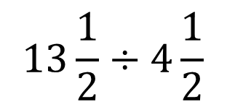
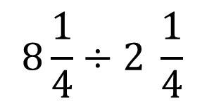
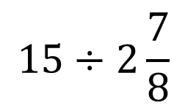
About, Between, or Exact
It is about ___.
It is between ___ and ____.
It is exactly ___.
Explain how the information shown supports your reasoning.
5 / 53
Notes:
TEACH IN PRACTICE | Embedded facilitation | Lesson 7.3, slide 5 | WORKED
Focus on the existing task: About, Between, or Exact It is about ___. It is between ___ and ____. It is exactly ___.
LAUNCH (T2/3/5): Ask students to explain the displayed idea or example and point to evidence. When a calculation step is shown, ask why it is valid. Have a partner restate the explanation; copying is not the check.
LOOK FOR (T4): Where this task addresses it, students can interpret absolute value as nonnegative distance. Ask which feature of their work supports the claim.
RESPOND: If this task shows the lesson misconception—assigning a negative absolute value to a negative number—trace distance from zero on the original number line and label position separately. Have the student revise and explain the change. Use this support only where the concept occurs in the current task; otherwise respond to the displayed question.
RECHECK: If a gap is shared, revisit the existing representation together. If it is limited, give targeted support while others compare valid methods on the same task. Check the revision before moving on.
PARTICIPATION (T5/6/7): Think time before volunteers; accept a written, drawn or rehearsed entry. Students ask for evidence respectfully. Recognize a specific contribution or revision and check that both partners participate.
Source: BCPS Updated Instructional Framework Rubric (June 2020), TEACH 1–7. Earlier notes and answer keys are retained below.
EARLIER NOTES / EXISTING ANSWER KEY
Number-sense routine — every voice in. Give quiet think time, then hear from at least three students.
Always follow with “How do you know?” — the reasoning is the point, not the answer.
There is more than one path; name and celebrate different strategies.
UIFR: TEACH 3 · TEACH 5 · TEACH 6.

Slide 6
Today’s Objectives
Lesson 7-3 · Understand Absolute Value of Rational Numbers
Understand Absolute Value of Rational Numbers
Maryland Standard 6.NOS.8
CONNECT IT · What earlier lesson does this build on? Tell a partner in one sentence.
CONTENT OBJECTIVE
LANGUAGE OBJECTIVE
Restate the goal in your words
Use these words to explain why
I can find the absolute value of a rational number — an integer, fraction, or decimal — as its distance from zero.
I can explain absolute value using the words distance, zero, opposite, and rational number.
eduwonderlab.com · Neft Teacher
6 / 53
Notes:
TEACH IN PRACTICE | Embedded facilitation | Lesson 7.3, slide 6 | GOAL
Focus on the existing task: Today’s Objectives Understand Absolute Value…
CONNECT (T1/4): Ask students to restate the displayed goal or key idea and connect it to earlier work. Relevant lesson evidence: interpret absolute value as nonnegative distance; distinguish magnitude from direction. Use only the criterion that matches the current session.
SHOW PROGRESS: Students point to their own existing work, explain what improved after feedback, and name a next step. Pair confidence ratings with actual evidence.
PARTICIPATION (T5/6/7): Think time before volunteers; accept a written, drawn or rehearsed entry. Students ask for evidence respectfully. Recognize a specific contribution or revision and check that both partners participate.
Source: BCPS Updated Instructional Framework Rubric (June 2020), TEACH 1–7. Earlier notes and answer keys are retained below.
EARLIER NOTES / EXISTING ANSWER KEY
Read the objective together, then have one or two students restate today’s goal in their own words.
Connect it to what the class learned last lesson.
Return to this goal at the end of class to check it was met.
UIFR: TEACH 1.
UIFR FULL | Lesson-specific facilitation
TEACH 1 | Session 1 purpose and evidence (UIFR PDF p. 8).
Have students restate the displayed session goal in their own words and connect it to the existing context or a familiar experience they choose to share. Use the current session goal to select from these lesson-wide evidence criteria; do not frontload a later-session procedure.
Look for: interpret absolute value as nonnegative distance; distinguish magnitude from direction. Ask: “Which part of your work would show this?” Revisit that evidence after the task; a confidence rating alone is not evidence of understanding.

Slide 7
LESSON 7.3 / OUR LEARNING
What will show your learning?
1
Interpret absolute value as nonnegative distance.
2
Distinguish magnitude from direction.
Tell a partner: Which skill connects to something you already know?
SHOW YOUR THINKING · Show what you know — write it, draw it, or build it. A picture counts as an explanation.
Listen to understand. Ask for evidence. Make room for every voice.
Notes:
TEACH IN PRACTICE | Embedded facilitation | Lesson 7.3, slide 7 | PRIOR_INSERT
Focus on the existing task: LESSON 7.3 / OUR LEARNING What will show your learning?
CONNECT (T1/4): Ask students to restate the displayed goal or key idea and connect it to earlier work. Relevant lesson evidence: interpret absolute value as nonnegative distance; distinguish magnitude from direction. Use only the criterion that matches the current session.
SHOW PROGRESS: Students point to their own existing work, explain what improved after feedback, and name a next step. Pair confidence ratings with actual evidence.
PARTICIPATION (T5/6/7): Think time before volunteers; accept a written, drawn or rehearsed entry. Students ask for evidence respectfully. Recognize a specific contribution or revision and check that both partners participate.
Source: BCPS Updated Instructional Framework Rubric (June 2020), TEACH 1–7.

Slide 8
Vocabulary 1 of 7
Lesson 7-3 · Understand Absolute Value of Rational Numbers
Integers and Absolute Value
7 / 43
Integers are whole numbers and their opposites; absolute value is their distance from zero.
EXAMPLE · EXPLAIN WHY IT FITS
|−6| = 6 because −6 is 6 units from zero.
USE THE MATH WORDS · Use today’s math words in your explanation — not “it” and “that thing.”
eduwonderlab.com · Neft Teacher
Notes:
TEACH IN PRACTICE | Embedded facilitation | Lesson 7.3, slide 8 | VOCAB
Focus on the existing task: Vocabulary 1 of 7 Integers and Absolute…
ASK (T1/3/5): Where does “Integers and Absolute Value” appear in the example? Explain the meaning without reading the definition. Partner: restate the idea and ask a clarifying question.
LOOK FOR: A correct connection between the word and a feature of the example. If the student only repeats the definition, invite pointing, sketching or oral rehearsal, then ask for another explanation of this same example.
PARTICIPATION (T5/6/7): Think time before volunteers; accept a written, drawn or rehearsed entry. Students ask for evidence respectfully. Recognize a specific contribution or revision and check that both partners participate.
Source: BCPS Updated Instructional Framework Rubric (June 2020), TEACH 1–7.

Slide 9
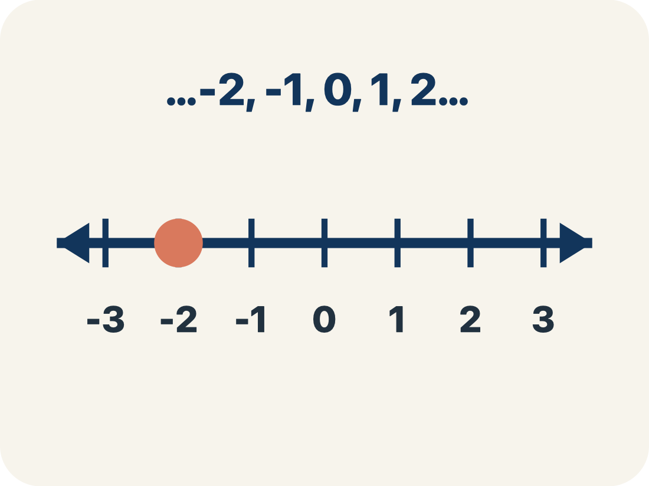
Vocabulary 2 of 7
Lesson 7-3 · Understand Absolute Value of Rational Numbers
Integer
8 / 43
Whole numbers and their opposites, like −2, −1, 0, 1, 2.
EXAMPLE · EXPLAIN WHY IT FITS
… −3, −2, −1, 0, 1, 2, 3 … shown on a number line with 0 in the center
Use “Integer” to explain the example. Point to evidence.
eduwonderlab.com · Neft Teacher
Notes:
TEACH IN PRACTICE | Embedded facilitation | Lesson 7.3, slide 9 | VOCAB
Focus on the existing task: Vocabulary 2 of 7 Integer Whole numbers and…
ASK (T1/3/5): Where does “Integer” appear in the example? Explain the meaning without reading the definition. Partner: restate the idea and ask a clarifying question.
LOOK FOR: A correct connection between the word and a feature of the example. If the student only repeats the definition, invite pointing, sketching or oral rehearsal, then ask for another explanation of this same example.
PARTICIPATION (T5/6/7): Think time before volunteers; accept a written, drawn or rehearsed entry. Students ask for evidence respectfully. Recognize a specific contribution or revision and check that both partners participate.
Source: BCPS Updated Instructional Framework Rubric (June 2020), TEACH 1–7.

Slide 10
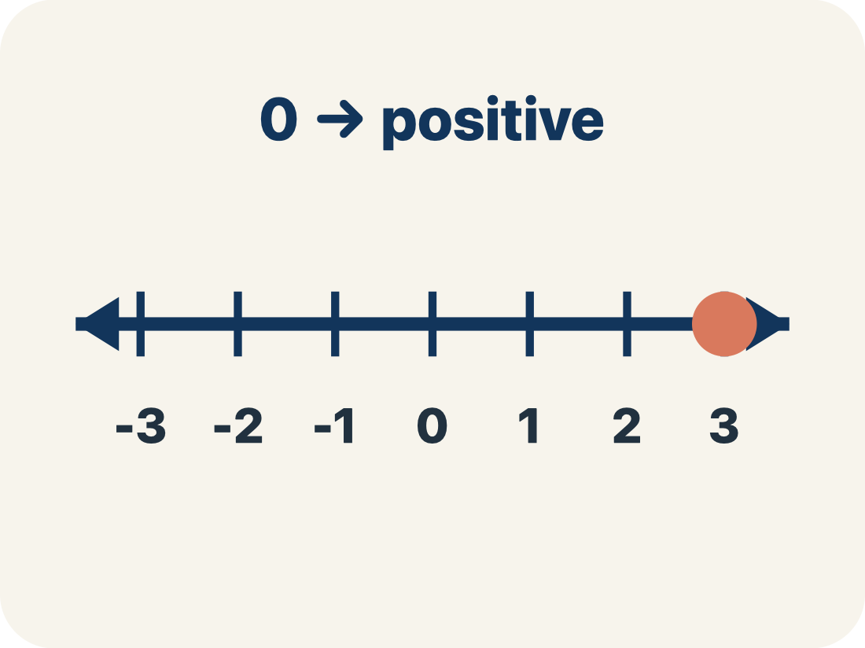
Vocabulary 3 of 7
Lesson 7-3 · Understand Absolute Value of Rational Numbers
Positive
9 / 43
A number bigger than zero, to the right of zero on a number line.
EXAMPLE · EXPLAIN WHY IT FITS
+5 means 5 above zero, like 5 floors above ground level
Use “Positive” to explain the example. Point to evidence.
eduwonderlab.com · Neft Teacher
Notes:
TEACH IN PRACTICE | Embedded facilitation | Lesson 7.3, slide 10 | VOCAB
Focus on the existing task: Vocabulary 3 of 7 Positive A number bigger…
ASK (T1/3/5): Where does “Positive” appear in the example? Explain the meaning without reading the definition. Partner: restate the idea and ask a clarifying question.
LOOK FOR: A correct connection between the word and a feature of the example. If the student only repeats the definition, invite pointing, sketching or oral rehearsal, then ask for another explanation of this same example.
PARTICIPATION (T5/6/7): Think time before volunteers; accept a written, drawn or rehearsed entry. Students ask for evidence respectfully. Recognize a specific contribution or revision and check that both partners participate.
Source: BCPS Updated Instructional Framework Rubric (June 2020), TEACH 1–7.

Slide 11
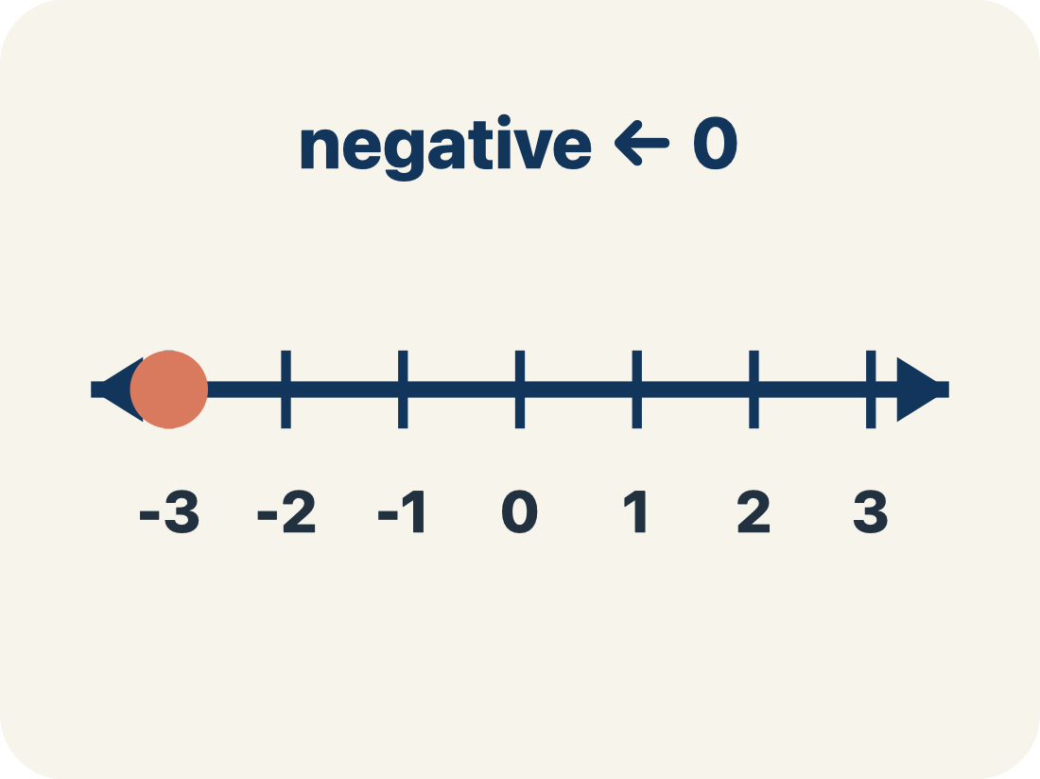
Vocabulary 4 of 7
Lesson 7-3 · Understand Absolute Value of Rational Numbers
Negative
10 / 43
A number smaller than zero, to the left of zero on a number line.
EXAMPLE · EXPLAIN WHY IT FITS
−3 means 3 below zero, like 3 floors underground
Use “Negative” to explain the example. Point to evidence.
eduwonderlab.com · Neft Teacher
Notes:
TEACH IN PRACTICE | Embedded facilitation | Lesson 7.3, slide 11 | VOCAB
Focus on the existing task: Vocabulary 4 of 7 Negative A number smaller…
ASK (T1/3/5): Where does “Negative” appear in the example? Explain the meaning without reading the definition. Partner: restate the idea and ask a clarifying question.
LOOK FOR: A correct connection between the word and a feature of the example. If the student only repeats the definition, invite pointing, sketching or oral rehearsal, then ask for another explanation of this same example.
PARTICIPATION (T5/6/7): Think time before volunteers; accept a written, drawn or rehearsed entry. Students ask for evidence respectfully. Recognize a specific contribution or revision and check that both partners participate.
Source: BCPS Updated Instructional Framework Rubric (June 2020), TEACH 1–7.

Slide 12
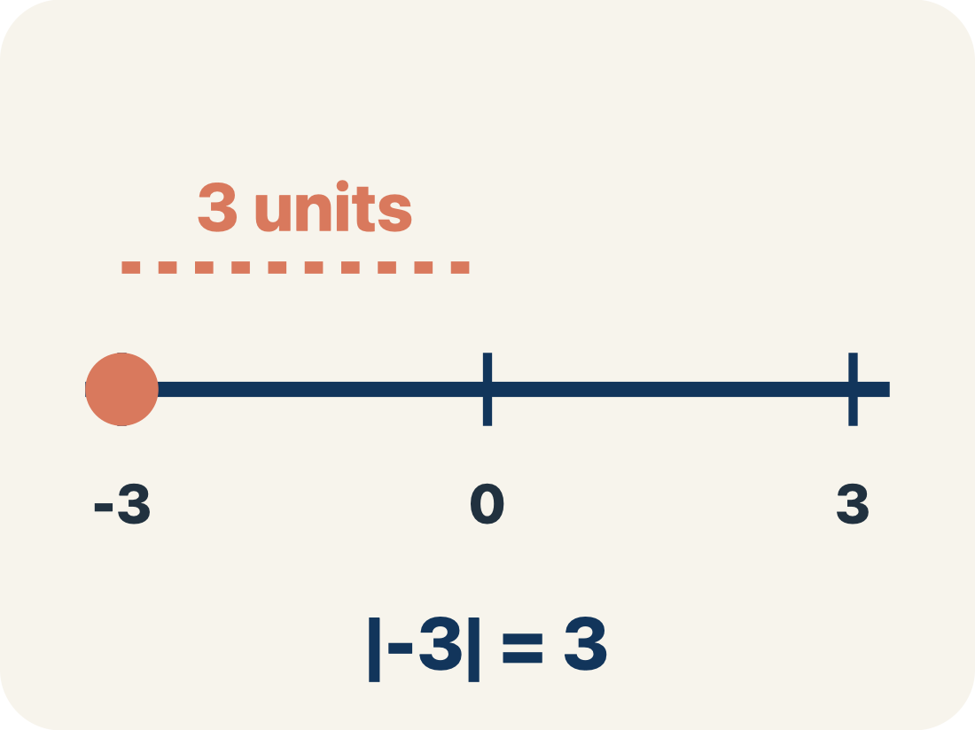
Vocabulary 5 of 7
Lesson 7-3 · Understand Absolute Value of Rational Numbers
Absolute value
11 / 43
How far a number is from zero. It is never negative.
EXAMPLE · EXPLAIN WHY IT FITS
|-5| = 5 and |5| = 5 — both are 5 units from 0
Use “Absolute value” to explain the example. Point to
evidence.
eduwonderlab.com · Neft Teacher
Notes:
TEACH IN PRACTICE | Embedded facilitation | Lesson 7.3, slide 12 | VOCAB
Focus on the existing task: Vocabulary 5 of 7 Absolute value How far a…
ASK (T1/3/5): Where does “Absolute value” appear in the example? Explain the meaning without reading the definition. Partner: restate the idea and ask a clarifying question.
LOOK FOR: A correct connection between the word and a feature of the example. If the student only repeats the definition, invite pointing, sketching or oral rehearsal, then ask for another explanation of this same example.
PARTICIPATION (T5/6/7): Think time before volunteers; accept a written, drawn or rehearsed entry. Students ask for evidence respectfully. Recognize a specific contribution or revision and check that both partners participate.
Source: BCPS Updated Instructional Framework Rubric (June 2020), TEACH 1–7.

Slide 13
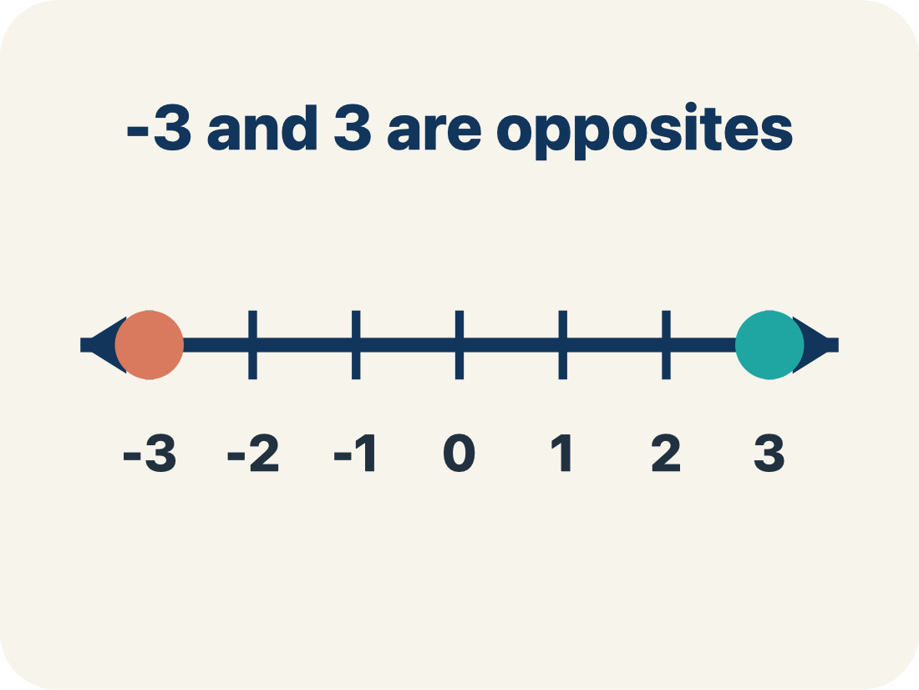
Vocabulary 6 of 7
Lesson 7-3 · Understand Absolute Value of Rational Numbers
Opposite
12 / 43
Two numbers the same distance from zero, on opposite sides, like 3 and −3.
EXAMPLE · EXPLAIN WHY IT FITS
3 and −3 are opposites — both are 3 units from 0
Use “Opposite” to explain the example. Point to evidence.
eduwonderlab.com · Neft Teacher
Notes:
TEACH IN PRACTICE | Embedded facilitation | Lesson 7.3, slide 13 | VOCAB
Focus on the existing task: Vocabulary 6 of 7 Opposite Two numbers the…
ASK (T1/3/5): Where does “Opposite” appear in the example? Explain the meaning without reading the definition. Partner: restate the idea and ask a clarifying question.
LOOK FOR: A correct connection between the word and a feature of the example. If the student only repeats the definition, invite pointing, sketching or oral rehearsal, then ask for another explanation of this same example.
PARTICIPATION (T5/6/7): Think time before volunteers; accept a written, drawn or rehearsed entry. Students ask for evidence respectfully. Recognize a specific contribution or revision and check that both partners participate.
Source: BCPS Updated Instructional Framework Rubric (June 2020), TEACH 1–7.

Slide 14

Vocabulary 7 of 7
Lesson 7-3 · Understand Absolute Value of Rational Numbers
Rational number
13 / 43
A number that can be written as a fraction of two integers, with a bottom number that is not zero.
EXAMPLE · EXPLAIN WHY IT FITS
−1/2, 0 and 5/4 each sit at one exact point.
Use “Rational number” to explain
the example. Point to evidence.
eduwonderlab.com · Neft Teacher
Notes:
TEACH IN PRACTICE | Embedded facilitation | Lesson 7.3, slide 14 | VOCAB
Focus on the existing task: Vocabulary 7 of 7 Rational number A number…
ASK (T1/3/5): Where does “Rational number” appear in the example? Explain the meaning without reading the definition. Partner: restate the idea and ask a clarifying question.
LOOK FOR: A correct connection between the word and a feature of the example. If the student only repeats the definition, invite pointing, sketching or oral rehearsal, then ask for another explanation of this same example.
PARTICIPATION (T5/6/7): Think time before volunteers; accept a written, drawn or rehearsed entry. Students ask for evidence respectfully. Recognize a specific contribution or revision and check that both partners participate.
Source: BCPS Updated Instructional Framework Rubric (June 2020), TEACH 1–7.

Slide 15
Vocabulary
Lesson 7-3 · Understand Absolute Value of Rational Numbers
Today’s Math Words
We learn every word — what it means and what it looks like — before we use it.
Integers and Absolute Value
Integer
Integers are whole numbers and their opposites; absolute value is their distance from zero
Whole numbers and their opposites, like −2, −1, 0, 1, 2
Positive
Negative
A number bigger than zero, to the right of zero on a number line
A number smaller than zero, to the left of zero on a number line
Absolute value
Opposite
How far a number is from zero
Two numbers the same distance from zero, on opposite sides, like 3 and −3
Rational number
Explain one math word using the example.
Partner: point to evidence.
A number that can be written as a fraction of two integers, with a bottom number that is not zero
eduwonderlab.com · Neft Teacher
15 / 53
Notes:
TEACH IN PRACTICE | Embedded facilitation | Lesson 7.3, slide 15 | VOCAB
Focus on the existing task: Vocabulary Today’s Math Words We learn every…
ASK (T1/3/5): Where does “the displayed term” appear in the example? Explain the meaning without reading the definition. Partner: restate the idea and ask a clarifying question.
LOOK FOR: A correct connection between the word and a feature of the example. If the student only repeats the definition, invite pointing, sketching or oral rehearsal, then ask for another explanation of this same example.
PARTICIPATION (T5/6/7): Think time before volunteers; accept a written, drawn or rehearsed entry. Students ask for evidence respectfully. Recognize a specific contribution or revision and check that both partners participate.
Source: BCPS Updated Instructional Framework Rubric (June 2020), TEACH 1–7. Earlier notes and answer keys are retained below.
EARLIER NOTES / EXISTING ANSWER KEY
Choral-read each word, its meaning, and what it looks like.
Students should use these words out loud today — listen for them in partner talk and revoice student ideas with the academic term.
UIFR: TEACH 1 · TEACH 5.

Slide 16


Be Curious
What do you notice?
What do you wonder?
Think first. Share a notice and a
question; build on a classmate’s
idea.
Mindset
What can you do to stay productive when you are frustrated with math?
16 / 53
Notes:
TEACH IN PRACTICE | Embedded facilitation | Lesson 7.3, slide 16 | CURIOUS
Focus on the existing task: Be Curious Mindset What can you do to stay productive when you are frustrated with math?
LAUNCH (T2/3/5): Allow quiet observation first. Separate a notice from an inference, invite students’ own questions, and follow the existing launch before teaching a procedure.
LOOK FOR (T4): Where this task addresses it, students can interpret absolute value as nonnegative distance. Ask which feature of their work supports the claim.
RESPOND: If this task shows the lesson misconception—assigning a negative absolute value to a negative number—trace distance from zero on the original number line and label position separately. Have the student revise and explain the change. Use this support only where the concept occurs in the current task; otherwise respond to the displayed question.
RECHECK: If a gap is shared, revisit the existing representation together. If it is limited, give targeted support while others compare valid methods on the same task. Check the revision before moving on.
PARTICIPATION (T5/6/7): Think time before volunteers; accept a written, drawn or rehearsed entry. Students ask for evidence respectfully. Recognize a specific contribution or revision and check that both partners participate.
Source: BCPS Updated Instructional Framework Rubric (June 2020), TEACH 1–7. Earlier notes and answer keys are retained below.
EARLIER NOTES / EXISTING ANSWER KEY
Accept all noticings and wonderings — there are no wrong answers here.
Give 20–30 seconds of quiet think time before taking responses; mix cold and warm calls so it is not always the same voices.
Read the mindset question aloud and let two students respond.
UIFR: TEACH 3 · TEACH 7.

Slide 17
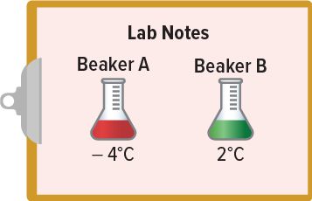
Beaker Temperatures
Claire is performing a science experiment with two liquids. The temperatures of the two liquids in Celsius are shown. She needs to use the beaker with the temperature that is closer to 0°C. Which beaker should Claire use?
What information do you know? What information do you need to find?
Reveal:
The liquid in Beaker A is −4°C, and the liquid in Beaker B is 2°C. We need to find which temperature is closer to 0°C.
17 / 53
Notes:
TEACH IN PRACTICE | Embedded facilitation | Lesson 7.3, slide 17 | REVEAL
Focus on the existing task: What information do you know?
LAUNCH (T2/3/5): If an existing answer cover is present, gather an attempt before revealing. If the explanation is already visible, ask students to reconstruct and justify it. Compare reasoning and explain a revision; preserve the reveal sequence.
LOOK FOR (T4): Where this task addresses it, students can interpret absolute value as nonnegative distance. Ask which feature of their work supports the claim.
RESPOND: If this task shows the lesson misconception—assigning a negative absolute value to a negative number—trace distance from zero on the original number line and label position separately. Have the student revise and explain the change. Use this support only where the concept occurs in the current task; otherwise respond to the displayed question.
RECHECK: If a gap is shared, revisit the existing representation together. If it is limited, give targeted support while others compare valid methods on the same task. Check the revision before moving on.
PARTICIPATION (T5/6/7): Think time before volunteers; accept a written, drawn or rehearsed entry. Students ask for evidence respectfully. Recognize a specific contribution or revision and check that both partners participate.
Source: BCPS Updated Instructional Framework Rubric (June 2020), TEACH 1–7. Earlier notes and answer keys are retained below.
EARLIER NOTES / EXISTING ANSWER KEY
Do not click yet: collect 2–3 student answers with reasons first.
Then click to remove the cover and have students compare their thinking to the reveal — “Is this what we said? Where is it different?”
Behind the cover: The liquid in Beaker A is −4°C, and the liquid in Beaker B is 2°C. We need to find which temperature is closer to 0°C.
UIFR: TEACH 3 · TEACH 4.
UIFR FULL | Lesson-specific facilitation
TEACH 2-3 | Session 1 task launch (UIFR PDF pp. 9-10).
Use the problem exactly as displayed. Give individual thinking time before discussion or advancing to the explanation. If the answer is already visible, ask students to reconstruct and justify it. Invite a choice of suitable representations and have students explain why their choice helps.
At the point where this concept appears, ask: “How can opposite numbers have equal absolute values while representing different positions?” Wait for evidence, invite another pathway, and have a student ask a follow-up question. Do not replace students’ reasoning with a sequence of leading steps.

Slide 18
STUDENT MOVES
Lesson 7-3
Your move
USE YOUR TOOLS · Reach for your notes, a model, or a manipulative before you reach for an answer.
18 / 53

Slide 19
Beaker Temperatures
The liquid in Beaker A is −4°C, and the liquid in Beaker B is 2°C. We need to find which temperature is closer to 0°C.
What tool can you use to compare numbers?
Record your reasoning before the reveal. Compare, then
explain any revision.
Reveal:
One tool is a number line.
19 / 53
Notes:
TEACH IN PRACTICE | Embedded facilitation | Lesson 7.3, slide 18 | REVEAL
Focus on the existing task: Reveal: One tool is a number line. Beaker Temperatures The liquid in Beaker A is −4°C, and the liquid in Beaker B is 2°C. We need to…
LAUNCH (T2/3/5): If an existing answer cover is present, gather an attempt before revealing. If the explanation is already visible, ask students to reconstruct and justify it. Compare reasoning and explain a revision; preserve the reveal sequence.
LOOK FOR (T4): Where this task addresses it, students can interpret absolute value as nonnegative distance. Ask which feature of their work supports the claim.
RESPOND: If this task shows the lesson misconception—assigning a negative absolute value to a negative number—trace distance from zero on the original number line and label position separately. Have the student revise and explain the change. Use this support only where the concept occurs in the current task; otherwise respond to the displayed question.
RECHECK: If a gap is shared, revisit the existing representation together. If it is limited, give targeted support while others compare valid methods on the same task. Check the revision before moving on.
PARTICIPATION (T5/6/7): Think time before volunteers; accept a written, drawn or rehearsed entry. Students ask for evidence respectfully. Recognize a specific contribution or revision and check that both partners participate.
Source: BCPS Updated Instructional Framework Rubric (June 2020), TEACH 1–7. Earlier notes and answer keys are retained below.
EARLIER NOTES / EXISTING ANSWER KEY
Do not click yet: collect 2–3 student answers with reasons first.
Then click to remove the cover and have students compare their thinking to the reveal — “Is this what we said? Where is it different?”
Behind the cover: One tool is a number line.
UIFR: TEACH 3 · TEACH 4.

Slide 20

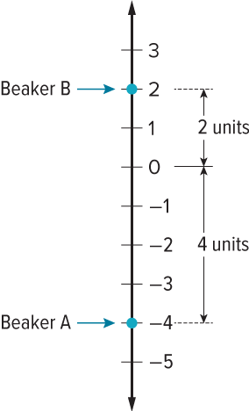
COLLABORATE · TALK IT THROUGH • AGREE ON A MODEL
Collaborate and Connect
Let’s graph the temperatures on a number line.
We need to find which temperature is closer to 0°C.
How far is each value from 0? Explain your reasoning.
Using Tools
ADD ON · Add on: “I agree because ______.” or “I see it differently because ______.”
How does this tool help solve the problem?
20 / 53
Notes:
TEACH IN PRACTICE | Embedded facilitation | Lesson 7.3, slide 19 | COLLABORATE
Focus on the existing task: Collaborate and Connect Using Tools How does this tool help solve the problem?
LAUNCH (T2/3/5): Use the displayed question. Give private thinking time; then A explains while B asks for evidence. Switch roles. Each student records their own reasoning.
LOOK FOR (T4): Where this task addresses it, students can interpret absolute value as nonnegative distance. Ask which feature of their work supports the claim.
RESPOND: If this task shows the lesson misconception—assigning a negative absolute value to a negative number—trace distance from zero on the original number line and label position separately. Have the student revise and explain the change. Use this support only where the concept occurs in the current task; otherwise respond to the displayed question.
RECHECK: If a gap is shared, revisit the existing representation together. If it is limited, give targeted support while others compare valid methods on the same task. Check the revision before moving on.
PARTICIPATION (T5/6/7): Think time before volunteers; accept a written, drawn or rehearsed entry. Students ask for evidence respectfully. Recognize a specific contribution or revision and check that both partners participate.
Source: BCPS Updated Instructional Framework Rubric (June 2020), TEACH 1–7. Earlier notes and answer keys are retained below.
EARLIER NOTES / EXISTING ANSWER KEY
Routine: COLLABORATE · TALK IT THROUGH • AGREE ON A MODEL
UIFR FULL | Lesson-specific facilitation
TEACH 4-5 | Session 1 discussion and checkpoint (UIFR PDF pp. 11-12).
Collect a brief response from every student to the existing prompt before hearing volunteers. Partners take turns explaining and asking for evidence: “I understand ___; what supports ___?” Offer rehearsal or an annotated model for students who need language support. Each student records their own reasoning.
Look specifically for: assigning a negative absolute value to a negative number. If it appears, trace distance from zero on the original number line and label position separately; then ask the student to revise the same response and explain the change. If evidence is secure, have students compare a second valid pathway or state why their approach works. Choose the next step from the responses, not a preset pace.

Slide 21
Beaker Temperatures
The distance of a number from 0 on the number line is the absolute value, or magnitude, of the number.
Distance is always represented by a positive number.
Use the scale and positions on the number line to justify your
answer.
21 / 53
Notes:
TEACH IN PRACTICE | Embedded facilitation | Lesson 7.3, slide 20 | WORKED
Focus on the existing task: The distance of a number from 0 on the number line is the absolute value, or magnitude, of the number. Distance is always represented by…
LAUNCH (T2/3/5): Ask students to explain the displayed idea or example and point to evidence. When a calculation step is shown, ask why it is valid. Have a partner restate the explanation; copying is not the check.
LOOK FOR (T4): Where this task addresses it, students can interpret absolute value as nonnegative distance. Ask which feature of their work supports the claim.
RESPOND: If this task shows the lesson misconception—assigning a negative absolute value to a negative number—trace distance from zero on the original number line and label position separately. Have the student revise and explain the change. Use this support only where the concept occurs in the current task; otherwise respond to the displayed question.
RECHECK: If a gap is shared, revisit the existing representation together. If it is limited, give targeted support while others compare valid methods on the same task. Check the revision before moving on.
PARTICIPATION (T5/6/7): Think time before volunteers; accept a written, drawn or rehearsed entry. Students ask for evidence respectfully. Recognize a specific contribution or revision and check that both partners participate.
Source: BCPS Updated Instructional Framework Rubric (June 2020), TEACH 1–7. Earlier notes and answer keys are retained below.
EARLIER NOTES / EXISTING ANSWER KEY
Model briefly, then hand the thinking back: ask “Why does this step work?” before showing the next one.
Quick check before moving on — thumbs or whiteboards from everyone, not volunteers.
UIFR: TEACH 2 · TEACH 3 · TEACH 4.

Slide 22
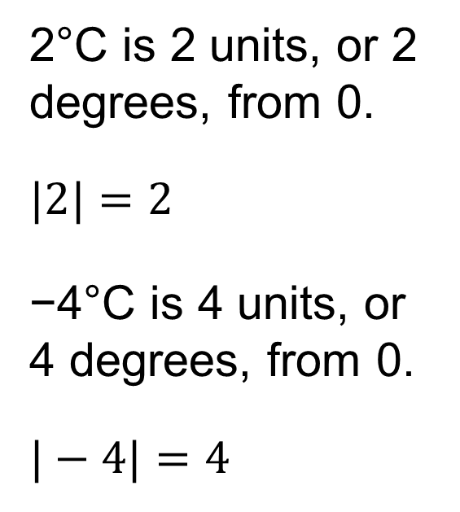
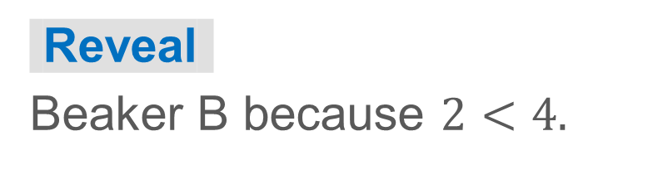
Beaker Temperatures
Let’s use absolute value to determine which value is closer to 0.
Which beaker has a temperature closer to 0? How do you know?
Think and record first. Which part
of your work supports your
answer?
22 / 53
Notes:
TEACH IN PRACTICE | Embedded facilitation | Lesson 7.3, slide 21 | TASK
Focus on the existing task: Let’s use absolute value to determine which value is closer to 0. Which beaker has a temperature closer to 0?
LAUNCH (T2/3/5): Use the displayed question. Give private thinking time; then A explains while B asks for evidence. Switch roles. Each student records their own reasoning.
LOOK FOR (T4): Where this task addresses it, students can interpret absolute value as nonnegative distance. Ask which feature of their work supports the claim.
RESPOND: If this task shows the lesson misconception—assigning a negative absolute value to a negative number—trace distance from zero on the original number line and label position separately. Have the student revise and explain the change. Use this support only where the concept occurs in the current task; otherwise respond to the displayed question.
RECHECK: If a gap is shared, revisit the existing representation together. If it is limited, give targeted support while others compare valid methods on the same task. Check the revision before moving on.
PARTICIPATION (T5/6/7): Think time before volunteers; accept a written, drawn or rehearsed entry. Students ask for evidence respectfully. Recognize a specific contribution or revision and check that both partners participate.
Source: BCPS Updated Instructional Framework Rubric (June 2020), TEACH 1–7. Earlier notes and answer keys are retained below.
EARLIER NOTES / EXISTING ANSWER KEY
Model briefly, then hand the thinking back: ask “Why does this step work?” before showing the next one.
Quick check before moving on — thumbs or whiteboards from everyone, not volunteers.
UIFR: TEACH 2 · TEACH 3 · TEACH 4.

Slide 23
Let’s Explore More
In another experiment, Claire had two liquids that started at 0 degrees Celsius. She warmed one liquid and cooled the other. After a certain amount of time, one liquid was recorded as 4 degrees Celsius, and one liquid was recorded as −9 degrees Celsius. Which temperature is warmer? Which has the greater absolute value?
Workspace
23 / 53
Notes:
TEACH IN PRACTICE | Embedded facilitation | Lesson 7.3, slide 22 | PRACTICE
Focus on the existing task: Which has the greater absolute value?
LAUNCH (T2/3/5): Use the displayed question. Give private thinking time; then A explains while B asks for evidence. Switch roles. Each student records their own reasoning.
LOOK FOR (T4): Where this task addresses it, students can interpret absolute value as nonnegative distance. Ask which feature of their work supports the claim.
RESPOND: If this task shows the lesson misconception—assigning a negative absolute value to a negative number—trace distance from zero on the original number line and label position separately. Have the student revise and explain the change. Use this support only where the concept occurs in the current task; otherwise respond to the displayed question.
RECHECK: If a gap is shared, revisit the existing representation together. If it is limited, give targeted support while others compare valid methods on the same task. Check the revision before moving on.
PARTICIPATION (T5/6/7): Think time before volunteers; accept a written, drawn or rehearsed entry. Students ask for evidence respectfully. Recognize a specific contribution or revision and check that both partners participate.
Source: BCPS Updated Instructional Framework Rubric (June 2020), TEACH 1–7. Earlier notes and answer keys are retained below.
EARLIER NOTES / EXISTING ANSWER KEY
Extension for partners or table groups — students choose their approach and use the workspace to show thinking.
Push with “Convince me,” and have two groups with different approaches share.
This is where students stretch past the worked example.
UIFR: TEACH 2 · TEACH 5.

Slide 24
STUDENT MOVES
Lesson 7-3
Your move
TWO MINUTES SOLO · Two minutes on your own, then compare. Bring one thing you tried, even if it did not work.
24 / 53

Slide 25
LESSON 7.3 / DISCUSS THE TASK
Explain and compare
Use the task you just explored.
TAKE TURNS
How can opposite numbers have equal absolute values while representing different positions?
Explain
“I know this because…”
Ask
“Where does your work show that?”
Point to evidence in your work.
Then compare your approach with a partner’s.
HOW DO YOU KNOW? · Ask your partner “How do you know?” Answer by pointing to your own work.
Listen to understand. Ask for evidence. Make room for every voice.
Notes:
TEACH IN PRACTICE | Embedded facilitation | Lesson 7.3, slide 23 | PRIOR_INSERT
Focus on the existing task: Point to evidence in your work. Then compare your approach with a partner’s. TAKE TURNS Explain “I know this because…” Ask “Where does your work show that?
CONNECT (T1/4): Ask students to restate the displayed goal or key idea and connect it to earlier work. Relevant lesson evidence: interpret absolute value as nonnegative distance; distinguish magnitude from direction. Use only the criterion that matches the current session.
SHOW PROGRESS: Students point to their own existing work, explain what improved after feedback, and name a next step. Pair confidence ratings with actual evidence.
PARTICIPATION (T5/6/7): Think time before volunteers; accept a written, drawn or rehearsed entry. Students ask for evidence respectfully. Recognize a specific contribution or revision and check that both partners participate.
Source: BCPS Updated Instructional Framework Rubric (June 2020), TEACH 1–7.

Slide 26
Collaborate and Connect
Let’s graph the temperatures on a number line.
We need to find which temperature is closer to 0°C.
How far is each value from 0? Explain your reasoning.
22 / 43
Reveal:
We can count the units from 0 to each integer. The point at 2 is 2 units from 0. The point at −4 is 4 units from 0.
Notes:
TEACH IN PRACTICE | Embedded facilitation | Lesson 7.3, slide 24 | COLLABORATE
Focus on the existing task: Collaborate and Connect Let’s graph the temperatures on a number line. We need to find which temperature is closer to 0°C. How far is each value from 0?
LAUNCH (T2/3/5): Use the displayed question. Give private thinking time; then A explains while B asks for evidence. Switch roles. Each student records their own reasoning.
LOOK FOR (T4): Where this task addresses it, students can interpret absolute value as nonnegative distance. Ask which feature of their work supports the claim.
RESPOND: If this task shows the lesson misconception—assigning a negative absolute value to a negative number—trace distance from zero on the original number line and label position separately. Have the student revise and explain the change. Use this support only where the concept occurs in the current task; otherwise respond to the displayed question.
RECHECK: If a gap is shared, revisit the existing representation together. If it is limited, give targeted support while others compare valid methods on the same task. Check the revision before moving on.
PARTICIPATION (T5/6/7): Think time before volunteers; accept a written, drawn or rehearsed entry. Students ask for evidence respectfully. Recognize a specific contribution or revision and check that both partners participate.
Source: BCPS Updated Instructional Framework Rubric (June 2020), TEACH 1–7.

Slide 27
Session 2 Warm-Up
Lesson 7-3 · Understand Absolute Value of Rational Numbers
Session 2 Warm-Up
Check what you remember from Session 1 · about 4 minutes
1
The absolute value of a number represents its:
2
What is |−15|?
A
Opposite value
A
−15
B
Distance from zero on a number line
B
15
C
Reciprocal
C
0
D
Negative sign
D
23 / 43
3
Can an absolute value ever be negative?
4
Which has a greater absolute value: −20 or 15?
A
Yes, always
A
15
B
No, distance is never negative
B
−20 (distance is 20)
C
Only for fractions
C
Both are equal
D
Only in winter
D
Zero
eduwonderlab.com · Neft Teacher
27 / 53
Notes:
TEACH IN PRACTICE | Embedded facilitation | Lesson 7.3, slide 25 | WARMUP
Focus on the existing task: A −15 B 15 C 0 D 3 Can an absolute value ever be negative?
GATHER EVIDENCE (T4/6): Keep the original items. Students try independently, mark an uncertain item, and explain one method before checking. Use the existing key when present.
RESPOND: Distinguish a calculation slip from a reasoning gap. Give one next step on the same item; have students revise in a second color. Use the responses to choose flexible support for today’s lesson.
PARTICIPATION (T5/6/7): Think time before volunteers; accept a written, drawn or rehearsed entry. Students ask for evidence respectfully. Recognize a specific contribution or revision and check that both partners participate.
Source: BCPS Updated Instructional Framework Rubric (June 2020), TEACH 1–7. Earlier notes and answer keys are retained below.
EARLIER NOTES / EXISTING ANSWER KEY
Warm-up routine: students start silently on entry; keep it to about 4 minutes.
Circulate and note who is stuck — use what you see to choose who you check on first today.
Go over answers quickly; ask one student to explain a step, not just say the answer.
UIFR: TEACH 4 · TEACH 6.
UIFR FULL | Lesson-specific facilitation
TEACH 1 | Session 2 purpose and evidence (UIFR PDF p. 8).
Have students restate the displayed session goal in their own words and connect it to the existing context or a familiar experience they choose to share. Use the current session goal to select from these lesson-wide evidence criteria; do not frontload a later-session procedure.
Look for: interpret absolute value as nonnegative distance; distinguish magnitude from direction. Ask: “Which part of your work would show this?” Revisit that evidence after the task; a confidence rating alone is not evidence of understanding.

Slide 28
STUDENT MOVES
Lesson 7-3
Your moves
RESTATE FIRST · Restate your partner’s idea in your own words before you give yours.
YOU KNOW THE ROUTINE · Read → plan → solve → check. Do all four, in that order.
28 / 53

Slide 29
Today’s Math Notes
Lesson 7-3 · Understand Absolute Value of Rational Numbers
Review Notes — Session 2
Copy. Explain. Check.
WHY IT MATTERS · Finish this: “This is worth knowing because ______.”
Absolute Value Definition
1
The distance of a number from zero on a number line, denoted |x|. Distance is always ≥ 0.
Magnitude vs Position
2
Magnitude measures magnitude/size (|−50| = 50), while position describes location on a scale.
Real-World Distance
3
Used to describe depth, debt amount, or temperature variation without direction.
eduwonderlab.com · Neft Teacher
29 / 53
Notes:
TEACH IN PRACTICE | Embedded facilitation | Lesson 7.3, slide 26 | NOTES
Focus on the existing task: Today’s Math Notes Review Notes — Session 2…
ROUTINE (T1/2/4): Read or copy the original notes, cover one line, and explain it using the displayed example. Reopen and correct. Copying alone is not evidence of understanding.
LOOK FOR: A link between a symbol, quantity or feature and the explanation. If missing, point back to that feature and have the student try again; fade the prompt once they can explain.
PARTICIPATION (T5/6/7): Think time before volunteers; accept a written, drawn or rehearsed entry. Students ask for evidence respectfully. Recognize a specific contribution or revision and check that both partners participate.
Source: BCPS Updated Instructional Framework Rubric (June 2020), TEACH 1–7. Earlier notes and answer keys are retained below.
EARLIER NOTES / EXISTING ANSWER KEY
Copy routine: read one line at a time; students copy, then explain that line to a partner.
Keep it brisk — the understanding work happens in the examples, not the copying.
UIFR: TEACH 1 · TEACH 6.

Slide 30
Session 2
Understand Absolute Values of
Rational Numbers
TRY IT BEFORE YOU’RE SURE · Start even if you are not sure. A revised answer counts as much as a first-try answer.
30 / 53
Notes:
TEACH IN PRACTICE | Embedded facilitation | Lesson 7.3, slide 27 | DIVIDER
Focus on the existing task: Understand Absolute Values of Rational Numbers Session 2
TRANSITION (T6/7): Students confirm materials, roles, how to request help, and the next response routine. Ask a student to restate it. Keep teacher-only slides hidden.
PARTICIPATION (T5/6/7): Think time before volunteers; accept a written, drawn or rehearsed entry. Students ask for evidence respectfully. Recognize a specific contribution or revision and check that both partners participate.
Source: BCPS Updated Instructional Framework Rubric (June 2020), TEACH 1–7. Earlier notes and answer keys are retained below.
EARLIER NOTES / EXISTING ANSWER KEY
Transition cue: state what materials are out and what success looks like this session.
Keep the changeover under a minute.
UIFR: TEACH 6.

Slide 31
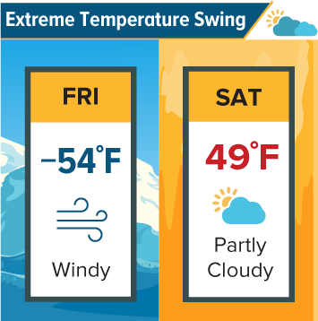
Record Temperatures
The greatest temperature swing in a 24-hour period happened in Loma, Montana in 1972.
How great was the temperature swing?
Think and record first. Which part of your
work supports your answer?
Think About It:
What do you think temperature swing means?
31 / 53
Notes:
TEACH IN PRACTICE | Embedded facilitation | Lesson 7.3, slide 28 | TASK
Focus on the existing task: Record Temperatures The greatest temperature swing in a 24-hour period happened in Loma, Montana in 1972. How great was the temperature swing?
LAUNCH (T2/3/5): Use the displayed question. Give private thinking time; then A explains while B asks for evidence. Switch roles. Each student records their own reasoning.
LOOK FOR (T4): Where this task addresses it, students can interpret absolute value as nonnegative distance. Ask which feature of their work supports the claim.
RESPOND: If this task shows the lesson misconception—assigning a negative absolute value to a negative number—trace distance from zero on the original number line and label position separately. Have the student revise and explain the change. Use this support only where the concept occurs in the current task; otherwise respond to the displayed question.
RECHECK: If a gap is shared, revisit the existing representation together. If it is limited, give targeted support while others compare valid methods on the same task. Check the revision before moving on.
PARTICIPATION (T5/6/7): Think time before volunteers; accept a written, drawn or rehearsed entry. Students ask for evidence respectfully. Recognize a specific contribution or revision and check that both partners participate.
Source: BCPS Updated Instructional Framework Rubric (June 2020), TEACH 1–7. Earlier notes and answer keys are retained below.
EARLIER NOTES / EXISTING ANSWER KEY
Ask the question, then hold the silence — students think or jot before anyone answers.
Take two or three responses and press with “Why?” or “How do you know?” before moving on.
UIFR: TEACH 3.
UIFR FULL | Lesson-specific facilitation
TEACH 2-3 | Session 2 task launch (UIFR PDF pp. 9-10).
Use the problem exactly as displayed. Give individual thinking time before discussion or advancing to the explanation. If the answer is already visible, ask students to reconstruct and justify it. Invite a choice of suitable representations and have students explain why their choice helps.
At the point where this concept appears, ask: “How can opposite numbers have equal absolute values while representing different positions?” Wait for evidence, invite another pathway, and have a student ask a follow-up question. Do not replace students’ reasoning with a sequence of leading steps.

Slide 32
Record Temperatures
The greatest temperature swing in a 24-hour period happened in Loma, Montana in 1972. How great was the temperature swing?
What information do you need to find?
Think and record first. Which part of your
work supports your answer?
Choosing Tools
What tool can help you represent this problem situation?
32 / 53
Notes:
TEACH IN PRACTICE | Embedded facilitation | Lesson 7.3, slide 29 | TASK
Focus on the existing task: The greatest temperature swing in a 24-hour period happened in Loma, Montana in 1972. How great was the temperature swing?
LAUNCH (T2/3/5): Use the displayed question. Give private thinking time; then A explains while B asks for evidence. Switch roles. Each student records their own reasoning.
LOOK FOR (T4): Where this task addresses it, students can interpret absolute value as nonnegative distance. Ask which feature of their work supports the claim.
RESPOND: If this task shows the lesson misconception—assigning a negative absolute value to a negative number—trace distance from zero on the original number line and label position separately. Have the student revise and explain the change. Use this support only where the concept occurs in the current task; otherwise respond to the displayed question.
RECHECK: If a gap is shared, revisit the existing representation together. If it is limited, give targeted support while others compare valid methods on the same task. Check the revision before moving on.
PARTICIPATION (T5/6/7): Think time before volunteers; accept a written, drawn or rehearsed entry. Students ask for evidence respectfully. Recognize a specific contribution or revision and check that both partners participate.
Source: BCPS Updated Instructional Framework Rubric (June 2020), TEACH 1–7. Earlier notes and answer keys are retained below.
EARLIER NOTES / EXISTING ANSWER KEY
Read the context aloud (or have a student read it).
Before any math, students restate the situation and what is being asked in their own words.
Ask: The greatest temperature swing in a 24-hour period happened in Loma, Montana in 1972. How great was the temperature swing?
UIFR: TEACH 1 · TEACH 3.

Slide 33
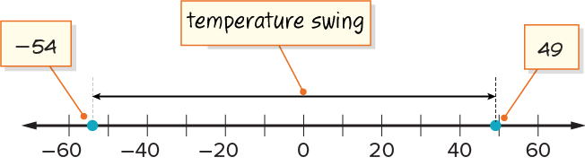
Record Temperatures
We can use a number line to represent the problem.
We need to find how far apart the two temperatures were.
What do you notice about the locations of the two numbers?
Reveal:
One number is to the left of 0 and the other is to the right of 0.
33 / 53
Notes:
TEACH IN PRACTICE | Embedded facilitation | Lesson 7.3, slide 30 | REVEAL
Focus on the existing task: We can use a number line to represent the problem. We need to find how far apart the two temperatures were. What do you notice about the locations of the two numbers?
LAUNCH (T2/3/5): If an existing answer cover is present, gather an attempt before revealing. If the explanation is already visible, ask students to reconstruct and justify it. Compare reasoning and explain a revision; preserve the reveal sequence.
LOOK FOR (T4): Where this task addresses it, students can interpret absolute value as nonnegative distance. Ask which feature of their work supports the claim.
RESPOND: If this task shows the lesson misconception—assigning a negative absolute value to a negative number—trace distance from zero on the original number line and label position separately. Have the student revise and explain the change. Use this support only where the concept occurs in the current task; otherwise respond to the displayed question.
RECHECK: If a gap is shared, revisit the existing representation together. If it is limited, give targeted support while others compare valid methods on the same task. Check the revision before moving on.
PARTICIPATION (T5/6/7): Think time before volunteers; accept a written, drawn or rehearsed entry. Students ask for evidence respectfully. Recognize a specific contribution or revision and check that both partners participate.
Source: BCPS Updated Instructional Framework Rubric (June 2020), TEACH 1–7. Earlier notes and answer keys are retained below.
EARLIER NOTES / EXISTING ANSWER KEY
Do not click yet: collect 2–3 student answers with reasons first.
Then click to remove the cover and have students compare their thinking to the reveal — “Is this what we said? Where is it different?”
Behind the cover: One number is to the left of 0 and the other is to the right of 0.
UIFR: TEACH 3 · TEACH 4.

Slide 34
Record Temperatures
−54 is to the left of 0 and 49 is to the right of 0.
How does the distance of each number from 0 relate to the temperature swing?
Reveal:
The temperature swing is the sum of the distance from −54 to 0 and the distance from 0 to 49.
34 / 53
Notes:
TEACH IN PRACTICE | Embedded facilitation | Lesson 7.3, slide 31 | REVEAL
Focus on the existing task: −54 is to the left of 0 and 49 is to the right of 0. Reveal: The temperature swing is the sum of the distance from −54 to 0 and the…
LAUNCH (T2/3/5): If an existing answer cover is present, gather an attempt before revealing. If the explanation is already visible, ask students to reconstruct and justify it. Compare reasoning and explain a revision; preserve the reveal sequence.
LOOK FOR (T4): Where this task addresses it, students can interpret absolute value as nonnegative distance. Ask which feature of their work supports the claim.
RESPOND: If this task shows the lesson misconception—assigning a negative absolute value to a negative number—trace distance from zero on the original number line and label position separately. Have the student revise and explain the change. Use this support only where the concept occurs in the current task; otherwise respond to the displayed question.
RECHECK: If a gap is shared, revisit the existing representation together. If it is limited, give targeted support while others compare valid methods on the same task. Check the revision before moving on.
PARTICIPATION (T5/6/7): Think time before volunteers; accept a written, drawn or rehearsed entry. Students ask for evidence respectfully. Recognize a specific contribution or revision and check that both partners participate.
Source: BCPS Updated Instructional Framework Rubric (June 2020), TEACH 1–7. Earlier notes and answer keys are retained below.
EARLIER NOTES / EXISTING ANSWER KEY
Do not click yet: collect 2–3 student answers with reasons first.
Then click to remove the cover and have students compare their thinking to the reveal — “Is this what we said? Where is it different?”
Behind the cover: The temperature swing is the sum of the distance from −54 to 0 and the distance from 0 to 49.
UIFR: TEACH 3 · TEACH 4.

Slide 35
STUDENT MOVES
Lesson 7-3
Your moves
ASK THE CLASS · Write one question about this that you could ask the class.
PROVE IT · Find the evidence in the problem that makes your answer right — not just the answer.
35 / 53

Slide 36
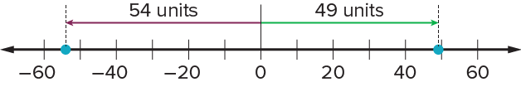
Record Temperatures
The temperature swing is the sum of each number’s distance from 0.
Let’s determine the distance of each number from 0.
Record your reasoning before the
reveal. Compare, then explain
any revision.
How do the distances relate to the absolute value of each number?
Reveal:
The absolute value of each number is the same as the distance we found from 0.
36 / 53
Notes:
TEACH IN PRACTICE | Embedded facilitation | Lesson 7.3, slide 32 | REVEAL
Focus on the existing task: The temperature swing is the sum of each number’s distance from 0. Let’s determine the distance of each number from 0. How do the distances relate to the absolute value of each number?
LAUNCH (T2/3/5): If an existing answer cover is present, gather an attempt before revealing. If the explanation is already visible, ask students to reconstruct and justify it. Compare reasoning and explain a revision; preserve the reveal sequence.
LOOK FOR (T4): Where this task addresses it, students can interpret absolute value as nonnegative distance. Ask which feature of their work supports the claim.
RESPOND: If this task shows the lesson misconception—assigning a negative absolute value to a negative number—trace distance from zero on the original number line and label position separately. Have the student revise and explain the change. Use this support only where the concept occurs in the current task; otherwise respond to the displayed question.
RECHECK: If a gap is shared, revisit the existing representation together. If it is limited, give targeted support while others compare valid methods on the same task. Check the revision before moving on.
PARTICIPATION (T5/6/7): Think time before volunteers; accept a written, drawn or rehearsed entry. Students ask for evidence respectfully. Recognize a specific contribution or revision and check that both partners participate.
Source: BCPS Updated Instructional Framework Rubric (June 2020), TEACH 1–7. Earlier notes and answer keys are retained below.
EARLIER NOTES / EXISTING ANSWER KEY
Do not click yet: collect 2–3 student answers with reasons first.
Then click to remove the cover and have students compare their thinking to the reveal — “Is this what we said? Where is it different?”
Behind the cover: The absolute value of each number is the same as the distance we found from 0.
UIFR: TEACH 3 · TEACH 4.

Slide 37


Record Temperatures
TAKE TURNS · One explains, one asks a question. Then switch, so both of you talk.
How can you use the absolute values to determine the total distance between the two numbers?
Reveal:
We can add the absolute values of the numbers.
37 / 53
Notes:
TEACH IN PRACTICE | Embedded facilitation | Lesson 7.3, slide 33 | REVEAL
Focus on the existing task: Reveal: We can add the absolute values of the numbers. How can you use the absolute values to determine the total distance between the two numbers?
LAUNCH (T2/3/5): If an existing answer cover is present, gather an attempt before revealing. If the explanation is already visible, ask students to reconstruct and justify it. Compare reasoning and explain a revision; preserve the reveal sequence.
LOOK FOR (T4): Where this task addresses it, students can interpret absolute value as nonnegative distance. Ask which feature of their work supports the claim.
RESPOND: If this task shows the lesson misconception—assigning a negative absolute value to a negative number—trace distance from zero on the original number line and label position separately. Have the student revise and explain the change. Use this support only where the concept occurs in the current task; otherwise respond to the displayed question.
RECHECK: If a gap is shared, revisit the existing representation together. If it is limited, give targeted support while others compare valid methods on the same task. Check the revision before moving on.
PARTICIPATION (T5/6/7): Think time before volunteers; accept a written, drawn or rehearsed entry. Students ask for evidence respectfully. Recognize a specific contribution or revision and check that both partners participate.
Source: BCPS Updated Instructional Framework Rubric (June 2020), TEACH 1–7. Earlier notes and answer keys are retained below.
EARLIER NOTES / EXISTING ANSWER KEY
Do not click yet: collect 2–3 student answers with reasons first.
Then click to remove the cover and have students compare their thinking to the reveal — “Is this what we said? Where is it different?”
Behind the cover: We can add the absolute values of the numbers.
UIFR: TEACH 3 · TEACH 4.

Slide 38


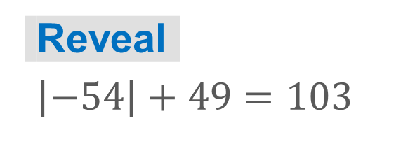
COLLABORATE · TALK IT THROUGH • AGREE ON A MODEL
Collaborate and Connect
We can add the absolute values to determine the total distance between the two numbers.
What is the sum of the absolute values?
Think first. A explains; B asks for evidence. Switch roles;
both revise.
38 / 53
Notes:
TEACH IN PRACTICE | Embedded facilitation | Lesson 7.3, slide 34 | COLLABORATE
Focus on the existing task: Collaborate and Connect We can add the absolute values to determine the total distance between the two numbers. What is the sum of the absolute values?
LAUNCH (T2/3/5): Use the displayed question. Give private thinking time; then A explains while B asks for evidence. Switch roles. Each student records their own reasoning.
LOOK FOR (T4): Where this task addresses it, students can interpret absolute value as nonnegative distance. Ask which feature of their work supports the claim.
RESPOND: If this task shows the lesson misconception—assigning a negative absolute value to a negative number—trace distance from zero on the original number line and label position separately. Have the student revise and explain the change. Use this support only where the concept occurs in the current task; otherwise respond to the displayed question.
RECHECK: If a gap is shared, revisit the existing representation together. If it is limited, give targeted support while others compare valid methods on the same task. Check the revision before moving on.
PARTICIPATION (T5/6/7): Think time before volunteers; accept a written, drawn or rehearsed entry. Students ask for evidence respectfully. Recognize a specific contribution or revision and check that both partners participate.
Source: BCPS Updated Instructional Framework Rubric (June 2020), TEACH 1–7. Earlier notes and answer keys are retained below.
EARLIER NOTES / EXISTING ANSWER KEY
Routine: COLLABORATE · TALK IT THROUGH • AGREE ON A MODEL
UIFR FULL | Lesson-specific facilitation
TEACH 4-5 | Session 2 discussion and checkpoint (UIFR PDF pp. 11-12).
Collect a brief response from every student to the existing prompt before hearing volunteers. Partners take turns explaining and asking for evidence: “I understand ___; what supports ___?” Offer rehearsal or an annotated model for students who need language support. Each student records their own reasoning.
Look specifically for: assigning a negative absolute value to a negative number. If it appears, trace distance from zero on the original number line and label position separately; then ask the student to revise the same response and explain the change. If evidence is secure, have students compare a second valid pathway or state why their approach works. Choose the next step from the responses, not a preset pace.

Slide 39



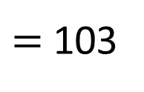
Record Temperatures
What should be the unit of measure given the context of the situation?
Think About It:
SELF-CHECK · Mark it: ✓ got it · ~ almost · ? stuck. Then fix one thing before we move on.
39 / 53
Notes:
TEACH IN PRACTICE | Embedded facilitation | Lesson 7.3, slide 35 | TASK
Focus on the existing task: Think About It: Record Temperatures What should be the unit of measure given the context of the situation?
LAUNCH (T2/3/5): Use the displayed question. Give private thinking time; then A explains while B asks for evidence. Switch roles. Each student records their own reasoning.
LOOK FOR (T4): Where this task addresses it, students can interpret absolute value as nonnegative distance. Ask which feature of their work supports the claim.
RESPOND: If this task shows the lesson misconception—assigning a negative absolute value to a negative number—trace distance from zero on the original number line and label position separately. Have the student revise and explain the change. Use this support only where the concept occurs in the current task; otherwise respond to the displayed question.
RECHECK: If a gap is shared, revisit the existing representation together. If it is limited, give targeted support while others compare valid methods on the same task. Check the revision before moving on.
PARTICIPATION (T5/6/7): Think time before volunteers; accept a written, drawn or rehearsed entry. Students ask for evidence respectfully. Recognize a specific contribution or revision and check that both partners participate.
Source: BCPS Updated Instructional Framework Rubric (June 2020), TEACH 1–7. Earlier notes and answer keys are retained below.
EARLIER NOTES / EXISTING ANSWER KEY
Ask the question, then hold the silence — students think or jot before anyone answers.
Take two or three responses and press with “Why?” or “How do you know?” before moving on.
UIFR: TEACH 3.

Slide 40
Record Temperatures
STRUGGLE FIRST · Work on your own first. Stuck is allowed — try a second strategy before you ask.
What should be the unit of measure given the context of the situation?
Think About It:
How is finding the distance between a negative number and a positive number different than finding the distance between two positive numbers?
40 / 53
Notes:
TEACH IN PRACTICE | Embedded facilitation | Lesson 7.3, slide 36 | TASK
Focus on the existing task: What should be the unit of measure given the context of the situation?
LAUNCH (T2/3/5): Use the displayed question. Give private thinking time; then A explains while B asks for evidence. Switch roles. Each student records their own reasoning.
LOOK FOR (T4): Where this task addresses it, students can interpret absolute value as nonnegative distance. Ask which feature of their work supports the claim.
RESPOND: If this task shows the lesson misconception—assigning a negative absolute value to a negative number—trace distance from zero on the original number line and label position separately. Have the student revise and explain the change. Use this support only where the concept occurs in the current task; otherwise respond to the displayed question.
RECHECK: If a gap is shared, revisit the existing representation together. If it is limited, give targeted support while others compare valid methods on the same task. Check the revision before moving on.
PARTICIPATION (T5/6/7): Think time before volunteers; accept a written, drawn or rehearsed entry. Students ask for evidence respectfully. Recognize a specific contribution or revision and check that both partners participate.
Source: BCPS Updated Instructional Framework Rubric (June 2020), TEACH 1–7. Earlier notes and answer keys are retained below.
EARLIER NOTES / EXISTING ANSWER KEY
Ask the question, then hold the silence — students think or jot before anyone answers.
Take two or three responses and press with “Why?” or “How do you know?” before moving on.
UIFR: TEACH 3.

Slide 41
Record Temperatures
What should be the unit of measure given the context of the situation?
Reveal:
degrees Fahrenheit
Record your reasoning before the
reveal. Compare, then explain
any revision.
41 / 53
Notes:
TEACH IN PRACTICE | Embedded facilitation | Lesson 7.3, slide 37 | REVEAL
Focus on the existing task: Record Temperatures Reveal: degrees Fahrenheit What should be the unit of measure given the context of the situation?
LAUNCH (T2/3/5): If an existing answer cover is present, gather an attempt before revealing. If the explanation is already visible, ask students to reconstruct and justify it. Compare reasoning and explain a revision; preserve the reveal sequence.
LOOK FOR (T4): Where this task addresses it, students can interpret absolute value as nonnegative distance. Ask which feature of their work supports the claim.
RESPOND: If this task shows the lesson misconception—assigning a negative absolute value to a negative number—trace distance from zero on the original number line and label position separately. Have the student revise and explain the change. Use this support only where the concept occurs in the current task; otherwise respond to the displayed question.
RECHECK: If a gap is shared, revisit the existing representation together. If it is limited, give targeted support while others compare valid methods on the same task. Check the revision before moving on.
PARTICIPATION (T5/6/7): Think time before volunteers; accept a written, drawn or rehearsed entry. Students ask for evidence respectfully. Recognize a specific contribution or revision and check that both partners participate.
Source: BCPS Updated Instructional Framework Rubric (June 2020), TEACH 1–7. Earlier notes and answer keys are retained below.
EARLIER NOTES / EXISTING ANSWER KEY
Do not click yet: collect 2–3 student answers with reasons first.
Then click to remove the cover and have students compare their thinking to the reveal — “Is this what we said? Where is it different?”
Behind the cover: degrees Fahrenheit
UIFR: TEACH 3 · TEACH 4.

Slide 42
Record Temperatures
The greatest temperature swing in a 24-hour period happened in Loma, Montana in 1972.
How great was the temperature swing?
The temperature swing was 103°F.
Think and record first. Which part of your work supports your answer?
42 / 53
Notes:
TEACH IN PRACTICE | Embedded facilitation | Lesson 7.3, slide 38 | TASK
Focus on the existing task: The greatest temperature swing in a 24-hour period happened in Loma, Montana in 1972. The temperature swing was 103°F. How great was the temperature swing?
LAUNCH (T2/3/5): Use the displayed question. Give private thinking time; then A explains while B asks for evidence. Switch roles. Each student records their own reasoning.
LOOK FOR (T4): Where this task addresses it, students can interpret absolute value as nonnegative distance. Ask which feature of their work supports the claim.
RESPOND: If this task shows the lesson misconception—assigning a negative absolute value to a negative number—trace distance from zero on the original number line and label position separately. Have the student revise and explain the change. Use this support only where the concept occurs in the current task; otherwise respond to the displayed question.
RECHECK: If a gap is shared, revisit the existing representation together. If it is limited, give targeted support while others compare valid methods on the same task. Check the revision before moving on.
PARTICIPATION (T5/6/7): Think time before volunteers; accept a written, drawn or rehearsed entry. Students ask for evidence respectfully. Recognize a specific contribution or revision and check that both partners participate.
Source: BCPS Updated Instructional Framework Rubric (June 2020), TEACH 1–7. Earlier notes and answer keys are retained below.
EARLIER NOTES / EXISTING ANSWER KEY
Model briefly, then hand the thinking back: ask “Why does this step work?” before showing the next one.
Quick check before moving on — thumbs or whiteboards from everyone, not volunteers.
UIFR: TEACH 2 · TEACH 3 · TEACH 4.

Slide 43
Let’s Explore More
What other temperature has the same magnitude as −54°F? Explain your reasoning.
Workspace
Why is the absolute value of a number never negative?
Workspace
43 / 53
Notes:
TEACH IN PRACTICE | Embedded facilitation | Lesson 7.3, slide 39 | PRACTICE
Focus on the existing task: Let’s Explore More What other temperature has the same magnitude as −54°F?
LAUNCH (T2/3/5): Use the displayed question. Give private thinking time; then A explains while B asks for evidence. Switch roles. Each student records their own reasoning.
LOOK FOR (T4): Where this task addresses it, students can interpret absolute value as nonnegative distance. Ask which feature of their work supports the claim.
RESPOND: If this task shows the lesson misconception—assigning a negative absolute value to a negative number—trace distance from zero on the original number line and label position separately. Have the student revise and explain the change. Use this support only where the concept occurs in the current task; otherwise respond to the displayed question.
RECHECK: If a gap is shared, revisit the existing representation together. If it is limited, give targeted support while others compare valid methods on the same task. Check the revision before moving on.
PARTICIPATION (T5/6/7): Think time before volunteers; accept a written, drawn or rehearsed entry. Students ask for evidence respectfully. Recognize a specific contribution or revision and check that both partners participate.
Source: BCPS Updated Instructional Framework Rubric (June 2020), TEACH 1–7. Earlier notes and answer keys are retained below.
EARLIER NOTES / EXISTING ANSWER KEY
Extension for partners or table groups — students choose their approach and use the workspace to show thinking.
Push with “Convince me,” and have two groups with different approaches share.
This is where students stretch past the worked example.
UIFR: TEACH 2 · TEACH 5.

Slide 44
STUDENT MOVES
Lesson 7-3
Your move
YOUR CHOICE · You choose how to show this — numbers, words, or a diagram. Make your reasoning visible.
44 / 53

Slide 45
LESSON 7.3 / CHECK YOUR WORK
Pause. Check. Improve.
CHECK
A mistake to watch for: assigning a negative absolute value to a negative number.
TRY
Trace distance from zero on the given number line and label position separately.
REVISE
Use that check on the task you just completed. Correct or strengthen one part, and explain why.
REVISE NOW · Change one answer and write why you changed it. A revision is evidence of learning.
Listen to understand. Ask for evidence. Make room for every voice.
Notes:
TEACH IN PRACTICE | Embedded facilitation | Lesson 7.3, slide 40 | PRIOR_INSERT
Focus on the existing task: LESSON 7.3 / CHECK YOUR WORK Pause. Check. Improve. Listen to understand. Ask for evidence. Make room for every voice. CHECK A mistake…
CONNECT (T1/4): Ask students to restate the displayed goal or key idea and connect it to earlier work. Relevant lesson evidence: interpret absolute value as nonnegative distance; distinguish magnitude from direction. Use only the criterion that matches the current session.
SHOW PROGRESS: Students point to their own existing work, explain what improved after feedback, and name a next step. Pair confidence ratings with actual evidence.
PARTICIPATION (T5/6/7): Think time before volunteers; accept a written, drawn or rehearsed entry. Students ask for evidence respectfully. Recognize a specific contribution or revision and check that both partners participate.
Source: BCPS Updated Instructional Framework Rubric (June 2020), TEACH 1–7.

Slide 46
Record Temperatures
−54 is to the left of 0 and 49 is to the right of 0.
38 / 43
How does the distance of each number from 0 relate to the temperature swing?
Reveal:
The temperature swing is the sum of the distance from −54 to 0 and the distance from 0 to 49.
Notes:
TEACH IN PRACTICE | Embedded facilitation | Lesson 7.3, slide 41 | REVEAL
Focus on the existing task: −54 is to the left of 0 and 49 is to the right of 0. Reveal: The temperature swing is the sum of the distance from −54 to 0 and the…
LAUNCH (T2/3/5): If an existing answer cover is present, gather an attempt before revealing. If the explanation is already visible, ask students to reconstruct and justify it. Compare reasoning and explain a revision; preserve the reveal sequence.
LOOK FOR (T4): Where this task addresses it, students can interpret absolute value as nonnegative distance. Ask which feature of their work supports the claim.
RESPOND: If this task shows the lesson misconception—assigning a negative absolute value to a negative number—trace distance from zero on the original number line and label position separately. Have the student revise and explain the change. Use this support only where the concept occurs in the current task; otherwise respond to the displayed question.
RECHECK: If a gap is shared, revisit the existing representation together. If it is limited, give targeted support while others compare valid methods on the same task. Check the revision before moving on.
PARTICIPATION (T5/6/7): Think time before volunteers; accept a written, drawn or rehearsed entry. Students ask for evidence respectfully. Recognize a specific contribution or revision and check that both partners participate.
Source: BCPS Updated Instructional Framework Rubric (June 2020), TEACH 1–7.

Slide 47
STUDENT MOVES
Lesson 7-3
Your move
TEACH A PARTNER · Teach this to someone who missed it. If you can teach it, you know it.
47 / 53

Slide 48
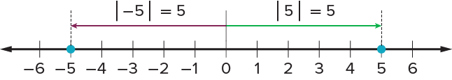
SUMMARIZE · SAY IT IN YOUR OWN WORDS
Summarize: Understand Absolute Values of Numbers
The absolute value of a number is its distance from 0 on the number line. The distance is always expressed as a positive number. In real-world situations, absolute value is sometimes referred to as the magnitude of a number.
JUSTIFY IT · Say it like this: “I know ______ because ______.”
48 / 53
Notes:
TEACH IN PRACTICE | Embedded facilitation | Lesson 7.3, slide 42 | SUMMARIZE
Focus on the existing task: Summarize: Understand Absolute Values of Numbers The absolute value of a number is its distance from 0 on the number line. The distance…
CONNECT (T1/4): Ask students to restate the displayed goal or key idea and connect it to earlier work. Relevant lesson evidence: interpret absolute value as nonnegative distance; distinguish magnitude from direction. Use only the criterion that matches the current session.
SHOW PROGRESS: Students point to their own existing work, explain what improved after feedback, and name a next step. Pair confidence ratings with actual evidence.
PARTICIPATION (T5/6/7): Think time before volunteers; accept a written, drawn or rehearsed entry. Students ask for evidence respectfully. Recognize a specific contribution or revision and check that both partners participate.
Source: BCPS Updated Instructional Framework Rubric (June 2020), TEACH 1–7. Earlier notes and answer keys are retained below.
EARLIER NOTES / EXISTING ANSWER KEY
Routine: SUMMARIZE · SAY IT IN YOUR OWN WORDS

Slide 49
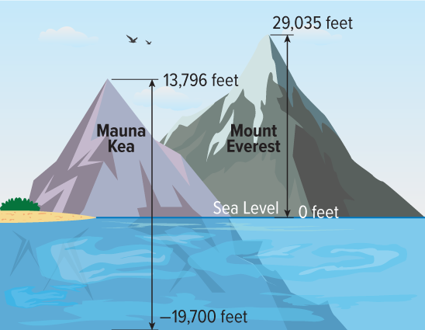
APPLY · PLAN IT • SOLVE IT • PROVE IT
Apply: Comparing Heights
Two of the tallest formations on Earth are Mount Everest and Mauna Kea. Mount Everest is a mountain in South Asia. Mauna Kea is a dormant volcano on the island of Hawaii.
Question : Which formation is taller? Explain how you know.
Choose a method. Solve independently, justify your answer, then check the goal.
49 / 53
Notes:
TEACH IN PRACTICE | Embedded facilitation | Lesson 7.3, slide 43 | APPLY
Focus on the existing task: Apply: Comparing Heights Two of the tallest formations on Earth are Mount Everest and Mauna Kea. Mount Everest is a mountain in South Asia.
LAUNCH (T2/3/5): Use the exact application task independently first. Ask students to justify their choice of method. Collect evidence before a partner discussion or correction.
LOOK FOR (T4): Where this task addresses it, students can interpret absolute value as nonnegative distance. Ask which feature of their work supports the claim.
RESPOND: If this task shows the lesson misconception—assigning a negative absolute value to a negative number—trace distance from zero on the original number line and label position separately. Have the student revise and explain the change. Use this support only where the concept occurs in the current task; otherwise respond to the displayed question.
RECHECK: If a gap is shared, revisit the existing representation together. If it is limited, give targeted support while others compare valid methods on the same task. Check the revision before moving on.
PARTICIPATION (T5/6/7): Think time before volunteers; accept a written, drawn or rehearsed entry. Students ask for evidence respectfully. Recognize a specific contribution or revision and check that both partners participate.
Source: BCPS Updated Instructional Framework Rubric (June 2020), TEACH 1–7. Earlier notes and answer keys are retained below.
EARLIER NOTES / EXISTING ANSWER KEY
Routine: APPLY · PLAN IT • SOLVE IT • PROVE IT
UIFR FULL | Lesson-specific facilitation
TEACH 4 | Independent evidence and revision (UIFR PDF p. 11).
Use the existing application/exit problem as the independent check. If this is a learning-target slide, have students point to and explain their work on the preceding task. Separate initial independent evidence from the revision after feedback.
Check the relevant criteria: interpret absolute value as nonnegative distance; distinguish magnitude from direction. Respond with one specific next step tied to the work. Students revise and annotate what changed, then identify a criterion they can now demonstrate and one they still need to practice.

Slide 50
Learning Targets
I can explain that the absolute value of a number is the distance between the number and zero on a number line.
I can use repeated reasoning to find the absolute value of a number.
Point to evidence in your work. Name what improved and your next step.
50 / 53
Notes:
TEACH IN PRACTICE | Embedded facilitation | Lesson 7.3, slide 44 | REFLECTION
Focus on the existing task: Learning Targets I can explain that the absolute value of a number is the distance between the number and zero on a number line. I can use…
CONNECT (T1/4): Ask students to restate the displayed goal or key idea and connect it to earlier work. Relevant lesson evidence: interpret absolute value as nonnegative distance; distinguish magnitude from direction. Use only the criterion that matches the current session.
SHOW PROGRESS: Students point to their own existing work, explain what improved after feedback, and name a next step. Pair confidence ratings with actual evidence.
PARTICIPATION (T5/6/7): Think time before volunteers; accept a written, drawn or rehearsed entry. Students ask for evidence respectfully. Recognize a specific contribution or revision and check that both partners participate.
Source: BCPS Updated Instructional Framework Rubric (June 2020), TEACH 1–7. Earlier notes and answer keys are retained below.
EARLIER NOTES / EXISTING ANSWER KEY
Read each target; students self-rate with fist-to-five or thumbs.
Tie back to the goal from the start of class: did we get there?
Note any target that rates low — revisit it tomorrow.
UIFR: TEACH 1 · TEACH 4.

Slide 51
Be Curious
Be Curious
What’s the question?
The greatest The greatest temperature swing in a 24-hour period happened in Loma, Montana in 1972. The lowest recorded temperature was a negative temperature and the greatest recorded temperature was a positive
The greatest temperature swing in a 24-hour period happened in Loma, Montana in 1972. The lowest recorded temperature was a negative temperature and the greatest recorded temperature was a positive temperature.
42 / 43
Mindset
ANOTHER PATHWAY · Did anyone get there a different way? Put both pathways side by side and compare.
What are you doing to stay productive when you are frustrated with math?
Notes:
TEACH IN PRACTICE | Embedded facilitation | Lesson 7.3, slide 45 | CURIOUS
Focus on the existing task: Be Curious Be Curious What’s the question?
LAUNCH (T2/3/5): Allow quiet observation first. Separate a notice from an inference, invite students’ own questions, and follow the existing launch before teaching a procedure.
LOOK FOR (T4): Where this task addresses it, students can interpret absolute value as nonnegative distance. Ask which feature of their work supports the claim.
RESPOND: If this task shows the lesson misconception—assigning a negative absolute value to a negative number—trace distance from zero on the original number line and label position separately. Have the student revise and explain the change. Use this support only where the concept occurs in the current task; otherwise respond to the displayed question.
RECHECK: If a gap is shared, revisit the existing representation together. If it is limited, give targeted support while others compare valid methods on the same task. Check the revision before moving on.
PARTICIPATION (T5/6/7): Think time before volunteers; accept a written, drawn or rehearsed entry. Students ask for evidence respectfully. Recognize a specific contribution or revision and check that both partners participate.
Source: BCPS Updated Instructional Framework Rubric (June 2020), TEACH 1–7.

Slide 52
Learning Targets
I can explain that the absolute value of a number is the distance between the number and zero on a number line.
I can use repeated reasoning to find the absolute value of a number.
43 / 43
Point to evidence in your work. Name what improved and your next step.
Notes:
TEACH IN PRACTICE | Embedded facilitation | Lesson 7.3, slide 46 | REFLECTION
Focus on the existing task: Learning Targets I can explain that the absolute value of a number is the distance between the number and zero on a number line. I can use…
CONNECT (T1/4): Ask students to restate the displayed goal or key idea and connect it to earlier work. Relevant lesson evidence: interpret absolute value as nonnegative distance; distinguish magnitude from direction. Use only the criterion that matches the current session.
SHOW PROGRESS: Students point to their own existing work, explain what improved after feedback, and name a next step. Pair confidence ratings with actual evidence.
PARTICIPATION (T5/6/7): Think time before volunteers; accept a written, drawn or rehearsed entry. Students ask for evidence respectfully. Recognize a specific contribution or revision and check that both partners participate.
Source: BCPS Updated Instructional Framework Rubric (June 2020), TEACH 1–7. Earlier notes and answer keys are retained below.
EARLIER NOTES / EXISTING ANSWER KEY
UIFR FULL | Lesson-specific facilitation
REFLECT & ADJUST 1-2 | After the lesson (UIFR PDF pp. 15-16).
Sort the existing work by demonstrated reasoning, partial understanding, and the specific misconception: assigning a negative absolute value to a negative number. Compare the initial response with the revision. Record which teaching move plausibly helped, which did not, and whose participation or access needs a different approach; do not record sensitive student details in this shared deck.
Plan the next lesson from that evidence: if the misconception persists, trace distance from zero on the original number line and label position separately using the current example before returning to the next grade-level task; if understanding is secure, use an existing extension or ask for a general explanation. Check the targeted idea again at the next warm-up.
Ask students what supported their thinking and what would help next time. Identify one change to try and one successful practice to retain. Seek colleague feedback on anonymized work when useful; these prompts support reflection and do not establish an evaluation rating. Source: Baltimore City Public Schools, Updated Instructional Framework Rubric, June 2020 (UIFR_Full.pdf).

Slide 53
LESSON 7.3 / REFLECT ON YOUR LEARNING
Show your progress
1 SHOW EVIDENCE
2 CHOOSE A NEXT STEP
Choose one response. Point to the part that shows your reasoning.
Name a change you made after feedback—or a question you still have.
“My work shows ___ because ___.”
“Next time, I will ___ to help me ___.”
Today’s focus: Interpret absolute value as nonnegative distance.
CREDIT A CLASSMATE · Name one classmate whose idea helped you today, and say what they said.
Listen to understand. Ask for evidence. Make room for every voice.
Notes:
TEACH IN PRACTICE | Embedded facilitation | Lesson 7.3, slide 47 | PRIOR_INSERT
Focus on the existing task: LESSON 7.3 / REFLECT ON YOUR LEARNING Show your progress Listen to understand. Ask for evidence. Make room for every voice. 1 SHOW…
CONNECT (T1/4): Ask students to restate the displayed goal or key idea and connect it to earlier work. Relevant lesson evidence: interpret absolute value as nonnegative distance; distinguish magnitude from direction. Use only the criterion that matches the current session.
SHOW PROGRESS: Students point to their own existing work, explain what improved after feedback, and name a next step. Pair confidence ratings with actual evidence.
PARTICIPATION (T5/6/7): Think time before volunteers; accept a written, drawn or rehearsed entry. Students ask for evidence respectfully. Recognize a specific contribution or revision and check that both partners participate.
Source: BCPS Updated Instructional Framework Rubric (June 2020), TEACH 1–7.

