Slide 1
WARM-UP · THINK • TRY • CHECK
Turn and talk: compare strategies, then defend one.
Warm-Up
Lesson 7-4 · Compare and Order Integers and Rational Numbers | Warm-Up · about 4 minutes
Try each on your own. Mark an unsure answer; explain and revise when we check.
QUESTION 1
QUESTION 2
Write < or >: 8 ______ 3
Which is farther left on a number line: −6 or −2? ______
QUESTION 3
QUESTION 4
Write < or >: 0.5 ______ 1/4
Write < or >: −6 ______ −2
TALK IT OVER: “I got ______ because ______.” • Compare with a partner before we check as a class.
1 / 55
Notes:
TEACH IN PRACTICE | Embedded facilitation | Lesson 7.4, slide 1 | WARMUP
Focus on the existing task: Warm-Up WARM-UP · THINK • TRY • CHECK Do…
GATHER EVIDENCE (T4/6): Keep the original items. Students try independently, mark an uncertain item, and explain one method before checking. Use the existing key when present.
RESPOND: Distinguish a calculation slip from a reasoning gap. Give one next step on the same item; have students revise in a second color. Use the responses to choose flexible support for today’s lesson.
PARTICIPATION (T5/6/7): Think time before volunteers; accept a written, drawn or rehearsed entry. Students ask for evidence respectfully. Recognize a specific contribution or revision and check that both partners participate.
Source: BCPS Updated Instructional Framework Rubric (June 2020), TEACH 1–7. Earlier notes and answer keys are retained below.
EARLIER NOTES / EXISTING ANSWER KEY
Warm-Up answers (teacher only): 1) > 2) −6 3) > 4) <
UIFR FULL | Lesson-specific facilitation
PREPARE 1-2 | Before teaching (UIFR PDF pp. 6-7).
Plan to gather evidence that students can compare rational numbers by position; use inequality signs correctly; distinguish value from magnitude. Review recent work and today’s warm-up to choose flexible groups and access supports; do not infer needs from identity or perceived ability. Use the existing lesson tasks and stated standards.
Anticipate: assuming a negative number with larger absolute value is greater. If observed, plot the original values on one consistently scaled number line. Offer oral rehearsal, drawing, pointing, or home-language processing as needed; retain the original mathematical demand. Ask students which support helps and fade it as evidence improves.
TEACH 6-7 | Before the first transition, agree on materials, partner roles, and how to request help. Invite students to restate the routine. Normalize revising an idea, recognize a specific contribution, and check privately when frustration blocks participation. Source: UIFR PDF pp. 13-14.

Slide 2
Today’s Math Notes
Lesson 7-4 · Compare and Order Integers and Rational Numbers
Section 1: Math Words
Copy. Explain. Check.
SAY THE GOAL · Say today’s goal in your own words, then name one place this shows up outside math class.
Compare and Order Integers
1
Use a number line to decide
Number line
2
A straight line where numbers are placed in order
Compare
3
To see if a number is bigger
eduwonderlab.com · Neft Teacher
2 / 55
Notes:
TEACH IN PRACTICE | Embedded facilitation | Lesson 7.4, slide 2 | NOTES
Focus on the existing task: Today’s Math Notes Section 1: Math Words…
ROUTINE (T1/2/4): Read or copy the original notes, cover one line, and explain it using the displayed example. Reopen and correct. Copying alone is not evidence of understanding.
LOOK FOR: A link between a symbol, quantity or feature and the explanation. If missing, point back to that feature and have the student try again; fade the prompt once they can explain.
PARTICIPATION (T5/6/7): Think time before volunteers; accept a written, drawn or rehearsed entry. Students ask for evidence respectfully. Recognize a specific contribution or revision and check that both partners participate.
Source: BCPS Updated Instructional Framework Rubric (June 2020), TEACH 1–7. Earlier notes and answer keys are retained below.
EARLIER NOTES / EXISTING ANSWER KEY
Copy routine: read one line at a time; students copy, then explain that line to a partner.
Keep it brisk — the understanding work happens in the examples, not the copying.
UIFR: TEACH 1 · TEACH 6.

Slide 3
Today’s Math Notes
Lesson 7-4 · Compare and Order Integers and Rational Numbers
Section 2: Today’s Math
Copy. Explain. Check.
CONNECT IT · What earlier lesson does this build on? Tell a partner in one sentence.
Comparing & Ordering Rational Numbers
Left is Less (<)
Right is Greater (>)
1
Plot or visualize numbers on a horizontal number line
2
Numbers further to the left are always less than numbers to the right
3
For negatives: A negative number with a larger absolute value is smaller (−10 < −2)
eduwonderlab.com · Neft Teacher
3 / 55
Notes:
TEACH IN PRACTICE | Embedded facilitation | Lesson 7.4, slide 3 | NOTES
Focus on the existing task: Today’s Math Notes Section 2: Today’s Math…
ROUTINE (T1/2/4): Read or copy the original notes, cover one line, and explain it using the displayed example. Reopen and correct. Copying alone is not evidence of understanding.
LOOK FOR: A link between a symbol, quantity or feature and the explanation. If missing, point back to that feature and have the student try again; fade the prompt once they can explain.
PARTICIPATION (T5/6/7): Think time before volunteers; accept a written, drawn or rehearsed entry. Students ask for evidence respectfully. Recognize a specific contribution or revision and check that both partners participate.
Source: BCPS Updated Instructional Framework Rubric (June 2020), TEACH 1–7. Earlier notes and answer keys are retained below.
EARLIER NOTES / EXISTING ANSWER KEY
Copy routine: read one line at a time; students copy, then explain that line to a partner.
Keep it brisk — the understanding work happens in the examples, not the copying.
UIFR: TEACH 1 · TEACH 6.

Slide 4
Session 1
Compare and Order Integers and Rational Numbers
PICK YOUR STRATEGY · Choose your path — picture, table, number line, or equation — and be ready to say why you chose it.
4 / 55
Notes:
TEACH IN PRACTICE | Embedded facilitation | Lesson 7.4, slide 4 | DIVIDER
Focus on the existing task: Compare and Order Integers and Rational Numbers Session 1
TRANSITION (T6/7): Students confirm materials, roles, how to request help, and the next response routine. Ask a student to restate it. Keep teacher-only slides hidden.
PARTICIPATION (T5/6/7): Think time before volunteers; accept a written, drawn or rehearsed entry. Students ask for evidence respectfully. Recognize a specific contribution or revision and check that both partners participate.
Source: BCPS Updated Instructional Framework Rubric (June 2020), TEACH 1–7. Earlier notes and answer keys are retained below.
EARLIER NOTES / EXISTING ANSWER KEY
Transition cue: state what materials are out and what success looks like this session.
Keep the changeover under a minute.
UIFR: TEACH 6.

Slide 5



About, Between, or Exact
It is about ___.
It is between ___ and ____.
It is exactly ___.
Explain how the information shown supports your reasoning.
5 / 55
Notes:
TEACH IN PRACTICE | Embedded facilitation | Lesson 7.4, slide 5 | WORKED
Focus on the existing task: About, Between, or Exact It is about ___. It is between ___ and ____. It is exactly ___.
LAUNCH (T2/3/5): Ask students to explain the displayed idea or example and point to evidence. When a calculation step is shown, ask why it is valid. Have a partner restate the explanation; copying is not the check.
LOOK FOR (T4): Where this task addresses it, students can compare rational numbers by position. Ask which feature of their work supports the claim.
RESPOND: If this task shows the lesson misconception—assuming a negative number with larger absolute value is greater—plot the original values on one consistently scaled number line. Have the student revise and explain the change. Use this support only where the concept occurs in the current task; otherwise respond to the displayed question.
RECHECK: If a gap is shared, revisit the existing representation together. If it is limited, give targeted support while others compare valid methods on the same task. Check the revision before moving on.
PARTICIPATION (T5/6/7): Think time before volunteers; accept a written, drawn or rehearsed entry. Students ask for evidence respectfully. Recognize a specific contribution or revision and check that both partners participate.
Source: BCPS Updated Instructional Framework Rubric (June 2020), TEACH 1–7. Earlier notes and answer keys are retained below.
EARLIER NOTES / EXISTING ANSWER KEY
Number-sense routine — every voice in. Give quiet think time, then hear from at least three students.
Always follow with “How do you know?” — the reasoning is the point, not the answer.
There is more than one path; name and celebrate different strategies.
UIFR: TEACH 3 · TEACH 5 · TEACH 6.

Slide 6
Today’s Objectives
Lesson 7-4 · Compare and Order Integers and Rational Numbers
Compare and Order Integers and Rational Numbers
Maryland Standard 6.NOS.8
SHOW YOUR THINKING · Show what you know — write it, draw it, or build it. A picture counts as an explanation.
CONTENT OBJECTIVE
LANGUAGE OBJECTIVE
Restate the goal in your words
Use these words to explain why
I can compare and order integers using a number line.
I can explain my reasoning using the words compare, order, greater than, and less than.
eduwonderlab.com · Neft Teacher
6 / 55
Notes:
TEACH IN PRACTICE | Embedded facilitation | Lesson 7.4, slide 6 | GOAL
Focus on the existing task: Today’s Objectives Compare and Order…
CONNECT (T1/4): Ask students to restate the displayed goal or key idea and connect it to earlier work. Relevant lesson evidence: compare rational numbers by position; use inequality signs correctly; distinguish value from magnitude. Use only the criterion that matches the current session.
SHOW PROGRESS: Students point to their own existing work, explain what improved after feedback, and name a next step. Pair confidence ratings with actual evidence.
PARTICIPATION (T5/6/7): Think time before volunteers; accept a written, drawn or rehearsed entry. Students ask for evidence respectfully. Recognize a specific contribution or revision and check that both partners participate.
Source: BCPS Updated Instructional Framework Rubric (June 2020), TEACH 1–7. Earlier notes and answer keys are retained below.
EARLIER NOTES / EXISTING ANSWER KEY
Read the objective together, then have one or two students restate today’s goal in their own words.
Connect it to what the class learned last lesson.
Return to this goal at the end of class to check it was met.
UIFR: TEACH 1.
UIFR FULL | Lesson-specific facilitation
TEACH 1 | Session 1 purpose and evidence (UIFR PDF p. 8).
Have students restate the displayed session goal in their own words and connect it to the existing context or a familiar experience they choose to share. Use the current session goal to select from these lesson-wide evidence criteria; do not frontload a later-session procedure.
Look for: compare rational numbers by position; use inequality signs correctly; distinguish value from magnitude. Ask: “Which part of your work would show this?” Revisit that evidence after the task; a confidence rating alone is not evidence of understanding.

Slide 7
LESSON 7.4 / OUR LEARNING
What will show your learning?
1
Compare rational numbers by position.
2
Use inequality signs correctly.
3
Distinguish value from magnitude.
Tell a partner: Which skill connects to something you already know?
WHY IT MATTERS · Finish this: “This is worth knowing because ______.”
Listen to understand. Ask for evidence. Make room for every voice.
Notes:
TEACH IN PRACTICE | Embedded facilitation | Lesson 7.4, slide 7 | PRIOR_INSERT
Focus on the existing task: LESSON 7.4 / OUR LEARNING What will show your learning?
CONNECT (T1/4): Ask students to restate the displayed goal or key idea and connect it to earlier work. Relevant lesson evidence: compare rational numbers by position; use inequality signs correctly; distinguish value from magnitude. Use only the criterion that matches the current session.
SHOW PROGRESS: Students point to their own existing work, explain what improved after feedback, and name a next step. Pair confidence ratings with actual evidence.
PARTICIPATION (T5/6/7): Think time before volunteers; accept a written, drawn or rehearsed entry. Students ask for evidence respectfully. Recognize a specific contribution or revision and check that both partners participate.
Source: BCPS Updated Instructional Framework Rubric (June 2020), TEACH 1–7.

Slide 8
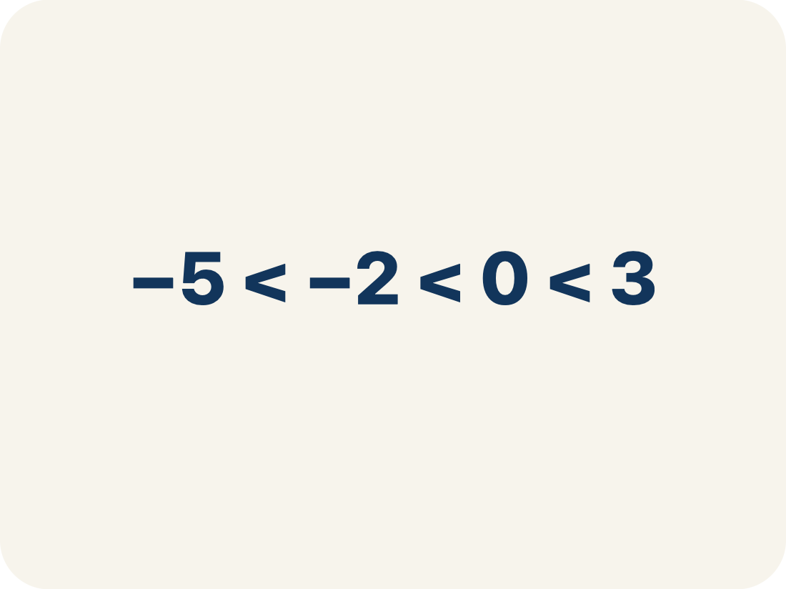
Vocabulary 1 of 8
Lesson 7-4 · Compare and Order Integers and Rational Numbers
Compare and Order Integers
Use a number line to decide which integers are greater or less and place them in order.
EXAMPLE · EXPLAIN WHY IT FITS
−5 < −2 < 0 < 3
USE THE MATH WORDS · Use today’s math words in your explanation — not “it” and “that thing.”
eduwonderlab.com · Neft Teacher
8 / 55
Notes:
TEACH IN PRACTICE | Embedded facilitation | Lesson 7.4, slide 8 | VOCAB
Focus on the existing task: Vocabulary 1 of 8 Compare and Order…
ASK (T1/3/5): Where does “Compare and Order Integers” appear in the example? Explain the meaning without reading the definition. Partner: restate the idea and ask a clarifying question.
LOOK FOR: A correct connection between the word and a feature of the example. If the student only repeats the definition, invite pointing, sketching or oral rehearsal, then ask for another explanation of this same example.
PARTICIPATION (T5/6/7): Think time before volunteers; accept a written, drawn or rehearsed entry. Students ask for evidence respectfully. Recognize a specific contribution or revision and check that both partners participate.
Source: BCPS Updated Instructional Framework Rubric (June 2020), TEACH 1–7.

Slide 9
Vocabulary 2 of 8
Lesson 7-4 · Compare and Order Integers and Rational Numbers
Number line
A straight line where numbers are placed in order; numbers get smaller to the left and larger to the right.
EXAMPLE · EXPLAIN WHY IT FITS
← −3 −2 −1 0 1 2 3 →
Use “Number line” to explain the example. Point to evidence.
eduwonderlab.com · Neft Teacher
9 / 55
Notes:
TEACH IN PRACTICE | Embedded facilitation | Lesson 7.4, slide 9 | VOCAB
Focus on the existing task: Vocabulary 2 of 8 Number line A straight…
ASK (T1/3/5): Where does “Number line” appear in the example? Explain the meaning without reading the definition. Partner: restate the idea and ask a clarifying question.
LOOK FOR: A correct connection between the word and a feature of the example. If the student only repeats the definition, invite pointing, sketching or oral rehearsal, then ask for another explanation of this same example.
PARTICIPATION (T5/6/7): Think time before volunteers; accept a written, drawn or rehearsed entry. Students ask for evidence respectfully. Recognize a specific contribution or revision and check that both partners participate.
Source: BCPS Updated Instructional Framework Rubric (June 2020), TEACH 1–7.

Slide 10
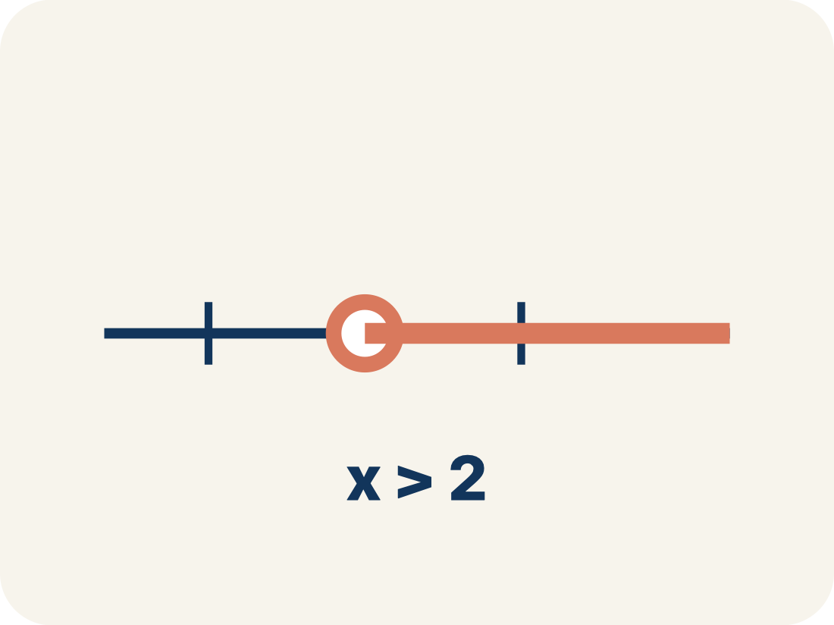
Vocabulary 3 of 8
Lesson 7-4 · Compare and Order Integers and Rational Numbers
Compare
To see if a number is bigger, smaller, or equal to another.
EXAMPLE · EXPLAIN WHY IT FITS
−3 < 2 because −3 is farther left on the number line than 2
Use “Compare” to explain the example. Point to evidence.
eduwonderlab.com · Neft Teacher
10 / 55
Notes:
TEACH IN PRACTICE | Embedded facilitation | Lesson 7.4, slide 10 | VOCAB
Focus on the existing task: Vocabulary 3 of 8 Compare To see if a…
ASK (T1/3/5): Where does “Compare” appear in the example? Explain the meaning without reading the definition. Partner: restate the idea and ask a clarifying question.
LOOK FOR: A correct connection between the word and a feature of the example. If the student only repeats the definition, invite pointing, sketching or oral rehearsal, then ask for another explanation of this same example.
PARTICIPATION (T5/6/7): Think time before volunteers; accept a written, drawn or rehearsed entry. Students ask for evidence respectfully. Recognize a specific contribution or revision and check that both partners participate.
Source: BCPS Updated Instructional Framework Rubric (June 2020), TEACH 1–7.

Slide 11

Vocabulary 4 of 8
Lesson 7-4 · Compare and Order Integers and Rational Numbers
Order
To arrange numbers by size, from least to greatest or greatest to least.
EXAMPLE · EXPLAIN WHY IT FITS
Least to greatest: −5, −2, 0, 3, 7 (left to right on the number line)
Use “Order” to explain the example. Point to evidence.
eduwonderlab.com · Neft Teacher
11 / 55
Notes:
TEACH IN PRACTICE | Embedded facilitation | Lesson 7.4, slide 11 | VOCAB
Focus on the existing task: Vocabulary 4 of 8 Order To arrange numbers…
ASK (T1/3/5): Where does “Order” appear in the example? Explain the meaning without reading the definition. Partner: restate the idea and ask a clarifying question.
LOOK FOR: A correct connection between the word and a feature of the example. If the student only repeats the definition, invite pointing, sketching or oral rehearsal, then ask for another explanation of this same example.
PARTICIPATION (T5/6/7): Think time before volunteers; accept a written, drawn or rehearsed entry. Students ask for evidence respectfully. Recognize a specific contribution or revision and check that both partners participate.
Source: BCPS Updated Instructional Framework Rubric (June 2020), TEACH 1–7.

Slide 12
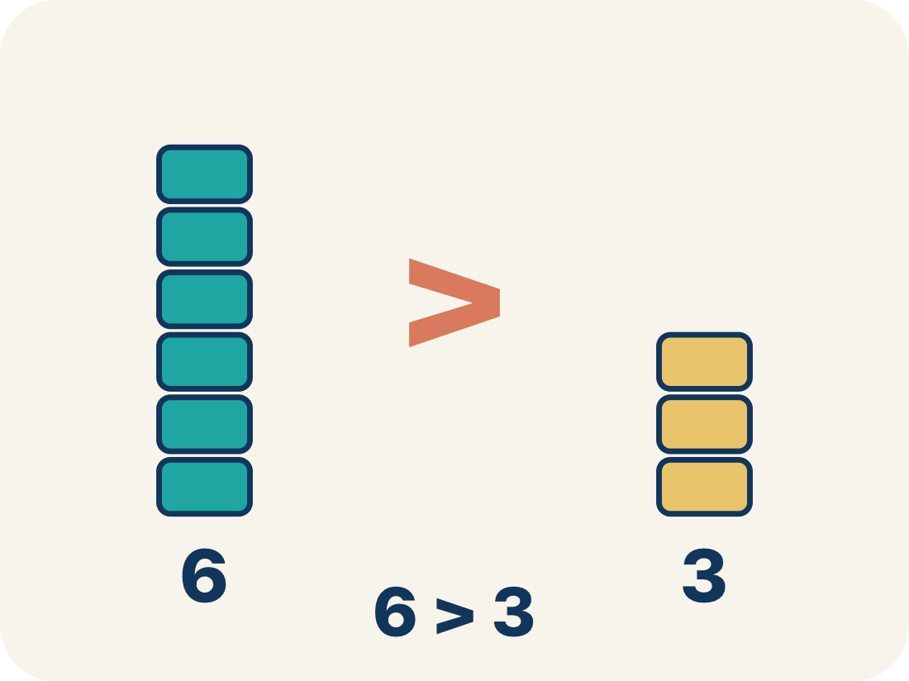
Vocabulary 5 of 8
Lesson 7-4 · Compare and Order Integers and Rational Numbers
Greater than
The > sign, showing one number is bigger.
EXAMPLE · EXPLAIN WHY IT FITS
4 > −1 because 4 is to the right of −1 on the number line
Use “Greater than” to explain the example. Point to evidence.
eduwonderlab.com · Neft Teacher
12 / 55
Notes:
TEACH IN PRACTICE | Embedded facilitation | Lesson 7.4, slide 12 | VOCAB
Focus on the existing task: Vocabulary 5 of 8 Greater than The > sign…
ASK (T1/3/5): Where does “Greater than” appear in the example? Explain the meaning without reading the definition. Partner: restate the idea and ask a clarifying question.
LOOK FOR: A correct connection between the word and a feature of the example. If the student only repeats the definition, invite pointing, sketching or oral rehearsal, then ask for another explanation of this same example.
PARTICIPATION (T5/6/7): Think time before volunteers; accept a written, drawn or rehearsed entry. Students ask for evidence respectfully. Recognize a specific contribution or revision and check that both partners participate.
Source: BCPS Updated Instructional Framework Rubric (June 2020), TEACH 1–7.

Slide 13
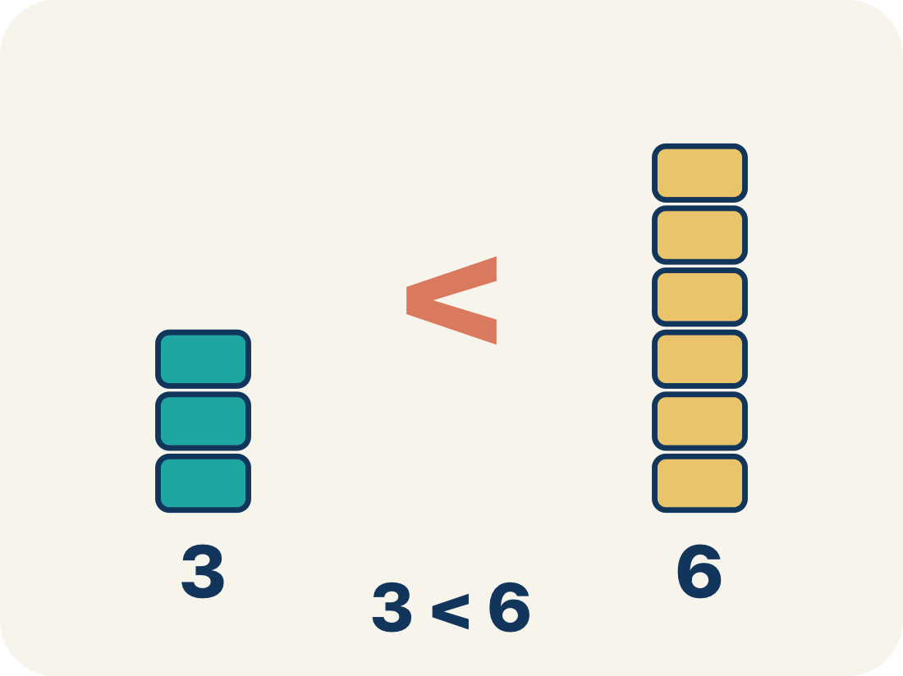
Vocabulary 6 of 8
Lesson 7-4 · Compare and Order Integers and Rational Numbers
Less than
The < sign, showing one number is smaller.
EXAMPLE · EXPLAIN WHY IT FITS
−6 < −2 because −6 is farther left — it is farther from zero
Use “Less than” to explain the example. Point to evidence.
eduwonderlab.com · Neft Teacher
13 / 55
Notes:
TEACH IN PRACTICE | Embedded facilitation | Lesson 7.4, slide 13 | VOCAB
Focus on the existing task: Vocabulary 6 of 8 Less than The < sign…
ASK (T1/3/5): Where does “Less than” appear in the example? Explain the meaning without reading the definition. Partner: restate the idea and ask a clarifying question.
LOOK FOR: A correct connection between the word and a feature of the example. If the student only repeats the definition, invite pointing, sketching or oral rehearsal, then ask for another explanation of this same example.
PARTICIPATION (T5/6/7): Think time before volunteers; accept a written, drawn or rehearsed entry. Students ask for evidence respectfully. Recognize a specific contribution or revision and check that both partners participate.
Source: BCPS Updated Instructional Framework Rubric (June 2020), TEACH 1–7.

Slide 14
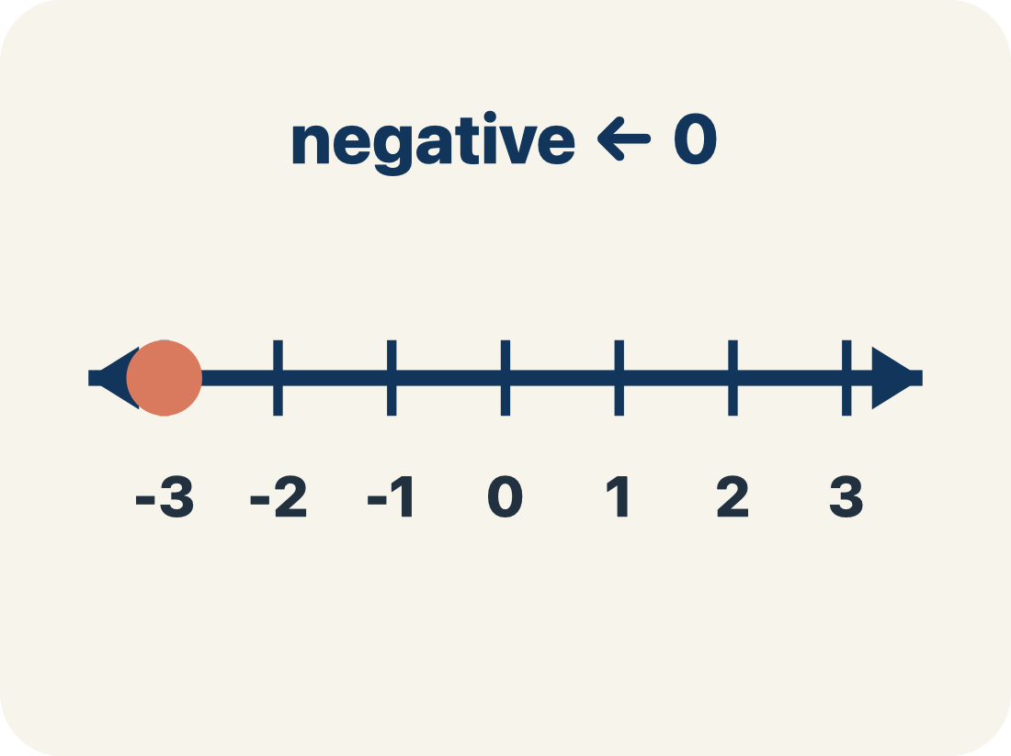
Vocabulary 7 of 8
Lesson 7-4 · Compare and Order Integers and Rational Numbers
Negative integer
A whole number smaller than zero, like −5.
EXAMPLE · EXPLAIN WHY IT FITS
−4 is 4 units to the LEFT of zero on the number line
Use “Negative integer” to explain the example. Point to
evidence.
eduwonderlab.com · Neft Teacher
14 / 55
Notes:
TEACH IN PRACTICE | Embedded facilitation | Lesson 7.4, slide 14 | VOCAB
Focus on the existing task: Vocabulary 7 of 8 Negative integer A whole…
ASK (T1/3/5): Where does “Negative integer” appear in the example? Explain the meaning without reading the definition. Partner: restate the idea and ask a clarifying question.
LOOK FOR: A correct connection between the word and a feature of the example. If the student only repeats the definition, invite pointing, sketching or oral rehearsal, then ask for another explanation of this same example.
PARTICIPATION (T5/6/7): Think time before volunteers; accept a written, drawn or rehearsed entry. Students ask for evidence respectfully. Recognize a specific contribution or revision and check that both partners participate.
Source: BCPS Updated Instructional Framework Rubric (June 2020), TEACH 1–7.

Slide 15
Vocabulary 8 of 8
Lesson 7-4 · Compare and Order Integers and Rational Numbers
Integer
Whole numbers and their opposites, like −2, −1, 0, 1, 2.
EXAMPLE · EXPLAIN WHY IT FITS
…, −3, −2, −1, 0, 1, 2, 3, …
Use “Integer” to explain the example. Point to evidence.
eduwonderlab.com · Neft Teacher
15 / 55
Notes:
TEACH IN PRACTICE | Embedded facilitation | Lesson 7.4, slide 15 | VOCAB
Focus on the existing task: Vocabulary 8 of 8 Integer Whole numbers…
ASK (T1/3/5): Where does “Integer” appear in the example? Explain the meaning without reading the definition. Partner: restate the idea and ask a clarifying question.
LOOK FOR: A correct connection between the word and a feature of the example. If the student only repeats the definition, invite pointing, sketching or oral rehearsal, then ask for another explanation of this same example.
PARTICIPATION (T5/6/7): Think time before volunteers; accept a written, drawn or rehearsed entry. Students ask for evidence respectfully. Recognize a specific contribution or revision and check that both partners participate.
Source: BCPS Updated Instructional Framework Rubric (June 2020), TEACH 1–7.

Slide 16
Vocabulary
Lesson 7-4 · Compare and Order Integers and Rational Numbers
ADD ON · Add on: “I agree because ______.” or “I see it differently because ______.”
Today’s Math Words
We learn every word — what it means and what it looks like — before we use it.
Compare and Order Integers
Number line
Use a number line to decide which integers are greater or less and place them in order
A straight line where numbers are placed in order; numbers get smaller to the left and larger to the right
Compare
Order
To see if a number is bigger, smaller, or equal to another
To arrange numbers by size, from least to greatest or greatest to least
Greater than
Less than
The > sign, showing one number is bigger
The < sign, showing one number is smaller
Negative integer
Integer
A whole number smaller than zero, like −5
Whole numbers and their opposites, like −2, −1, 0, 1, 2
eduwonderlab.com · Neft Teacher
16 / 55
Notes:
TEACH IN PRACTICE | Embedded facilitation | Lesson 7.4, slide 16 | VOCAB
Focus on the existing task: Vocabulary Today’s Math Words We learn…
ASK (T1/3/5): Where does “the displayed term” appear in the example? Explain the meaning without reading the definition. Partner: restate the idea and ask a clarifying question.
LOOK FOR: A correct connection between the word and a feature of the example. If the student only repeats the definition, invite pointing, sketching or oral rehearsal, then ask for another explanation of this same example.
PARTICIPATION (T5/6/7): Think time before volunteers; accept a written, drawn or rehearsed entry. Students ask for evidence respectfully. Recognize a specific contribution or revision and check that both partners participate.
Source: BCPS Updated Instructional Framework Rubric (June 2020), TEACH 1–7. Earlier notes and answer keys are retained below.
EARLIER NOTES / EXISTING ANSWER KEY
Choral-read each word, its meaning, and what it looks like.
Students should use these words out loud today — listen for them in partner talk and revoice student ideas with the academic term.
UIFR: TEACH 1 · TEACH 5.

Slide 17
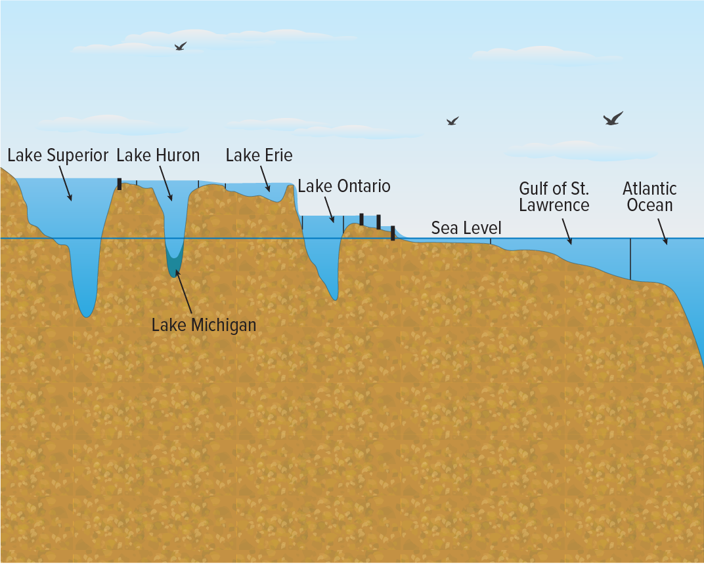

Be Curious
How are they the same?
How are they different?
Think first. Share a notice and a
question; build on a classmate’s
idea.
Mindset
What motivates you to engage with math?
17 / 55
Notes:
TEACH IN PRACTICE | Embedded facilitation | Lesson 7.4, slide 17 | CURIOUS
Focus on the existing task: Be Curious How are they the same?
LAUNCH (T2/3/5): Allow quiet observation first. Separate a notice from an inference, invite students’ own questions, and follow the existing launch before teaching a procedure.
LOOK FOR (T4): Where this task addresses it, students can compare rational numbers by position. Ask which feature of their work supports the claim.
RESPOND: If this task shows the lesson misconception—assuming a negative number with larger absolute value is greater—plot the original values on one consistently scaled number line. Have the student revise and explain the change. Use this support only where the concept occurs in the current task; otherwise respond to the displayed question.
RECHECK: If a gap is shared, revisit the existing representation together. If it is limited, give targeted support while others compare valid methods on the same task. Check the revision before moving on.
PARTICIPATION (T5/6/7): Think time before volunteers; accept a written, drawn or rehearsed entry. Students ask for evidence respectfully. Recognize a specific contribution or revision and check that both partners participate.
Source: BCPS Updated Instructional Framework Rubric (June 2020), TEACH 1–7. Earlier notes and answer keys are retained below.
EARLIER NOTES / EXISTING ANSWER KEY
Accept all noticings and wonderings — there are no wrong answers here.
Give 20–30 seconds of quiet think time before taking responses; mix cold and warm calls so it is not always the same voices.
Read the mindset question aloud and let two students respond.
UIFR: TEACH 3 · TEACH 7.

Slide 18
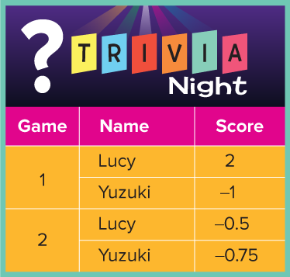
Trivia Game
Lucy and Yuzuki are playing a trivia game with these rules: If a player answers a question correctly, they receive 1 point. If they answer incorrectly, they lose 0.25 point. The player with the greatest score wins the game. The final scores for two games are shown in the table. Who is the winner of each game?
How can you compare the data for Game 1?
Reveal:
We can plot each score on a number line.
18 / 55
Notes:
TEACH IN PRACTICE | Embedded facilitation | Lesson 7.4, slide 18 | REVEAL
Focus on the existing task: How can you compare the data for Game 1?
LAUNCH (T2/3/5): If an existing answer cover is present, gather an attempt before revealing. If the explanation is already visible, ask students to reconstruct and justify it. Compare reasoning and explain a revision; preserve the reveal sequence.
LOOK FOR (T4): Where this task addresses it, students can compare rational numbers by position. Ask which feature of their work supports the claim.
RESPOND: If this task shows the lesson misconception—assuming a negative number with larger absolute value is greater—plot the original values on one consistently scaled number line. Have the student revise and explain the change. Use this support only where the concept occurs in the current task; otherwise respond to the displayed question.
RECHECK: If a gap is shared, revisit the existing representation together. If it is limited, give targeted support while others compare valid methods on the same task. Check the revision before moving on.
PARTICIPATION (T5/6/7): Think time before volunteers; accept a written, drawn or rehearsed entry. Students ask for evidence respectfully. Recognize a specific contribution or revision and check that both partners participate.
Source: BCPS Updated Instructional Framework Rubric (June 2020), TEACH 1–7. Earlier notes and answer keys are retained below.
EARLIER NOTES / EXISTING ANSWER KEY
Do not click yet: collect 2–3 student answers with reasons first.
Then click to remove the cover and have students compare their thinking to the reveal — “Is this what we said? Where is it different?”
Behind the cover: We can plot each score on a number line.
UIFR: TEACH 3 · TEACH 4.
UIFR FULL | Lesson-specific facilitation
TEACH 2-3 | Session 1 task launch (UIFR PDF pp. 9-10).
Use the problem exactly as displayed. Give individual thinking time before discussion or advancing to the explanation. If the answer is already visible, ask students to reconstruct and justify it. Invite a choice of suitable representations and have students explain why their choice helps.
At the point where this concept appears, ask: “Which number lies farther right, and how is that different from being farther from zero?” Wait for evidence, invite another pathway, and have a student ask a follow-up question. Do not replace students’ reasoning with a sequence of leading steps.

Slide 19
STUDENT MOVES
Lesson 7-4
Your move
USE YOUR TOOLS · Reach for your notes, a model, or a manipulative before you reach for an answer.
19 / 55

Slide 20

Trivia Game
Game 1
Use a number line to compare the values.
Record your reasoning before the
reveal. Compare, then explain
any revision.
How can you use the number line to determine the greater value?
Reveal:
We can compare the location of the values on the number line. The number on the right has a greater value.
20 / 55
Notes:
TEACH IN PRACTICE | Embedded facilitation | Lesson 7.4, slide 19 | REVEAL
Focus on the existing task: Game 1 How can you use the number line to determine the greater value?
LAUNCH (T2/3/5): If an existing answer cover is present, gather an attempt before revealing. If the explanation is already visible, ask students to reconstruct and justify it. Compare reasoning and explain a revision; preserve the reveal sequence.
LOOK FOR (T4): Where this task addresses it, students can compare rational numbers by position. Ask which feature of their work supports the claim.
RESPOND: If this task shows the lesson misconception—assuming a negative number with larger absolute value is greater—plot the original values on one consistently scaled number line. Have the student revise and explain the change. Use this support only where the concept occurs in the current task; otherwise respond to the displayed question.
RECHECK: If a gap is shared, revisit the existing representation together. If it is limited, give targeted support while others compare valid methods on the same task. Check the revision before moving on.
PARTICIPATION (T5/6/7): Think time before volunteers; accept a written, drawn or rehearsed entry. Students ask for evidence respectfully. Recognize a specific contribution or revision and check that both partners participate.
Source: BCPS Updated Instructional Framework Rubric (June 2020), TEACH 1–7. Earlier notes and answer keys are retained below.
EARLIER NOTES / EXISTING ANSWER KEY
Do not click yet: collect 2–3 student answers with reasons first.
Then click to remove the cover and have students compare their thinking to the reveal — “Is this what we said? Where is it different?”
Behind the cover: We can compare the location of the values on the number line. The number on the right has a greater value.
UIFR: TEACH 3 · TEACH 4.

Slide 21

Trivia Game
Game 1
2 is to the right of −1 on the number line.
Lucy’s score was greater.
Use the scale and positions on the number line to justify your answer.
21 / 55
Notes:
TEACH IN PRACTICE | Embedded facilitation | Lesson 7.4, slide 20 | WORKED
Focus on the existing task: Game 1 2 is to the right of −1 on the number line. Lucy’s score was greater. Trivia Game
LAUNCH (T2/3/5): Ask students to explain the displayed idea or example and point to evidence. When a calculation step is shown, ask why it is valid. Have a partner restate the explanation; copying is not the check.
LOOK FOR (T4): Where this task addresses it, students can compare rational numbers by position. Ask which feature of their work supports the claim.
RESPOND: If this task shows the lesson misconception—assuming a negative number with larger absolute value is greater—plot the original values on one consistently scaled number line. Have the student revise and explain the change. Use this support only where the concept occurs in the current task; otherwise respond to the displayed question.
RECHECK: If a gap is shared, revisit the existing representation together. If it is limited, give targeted support while others compare valid methods on the same task. Check the revision before moving on.
PARTICIPATION (T5/6/7): Think time before volunteers; accept a written, drawn or rehearsed entry. Students ask for evidence respectfully. Recognize a specific contribution or revision and check that both partners participate.
Source: BCPS Updated Instructional Framework Rubric (June 2020), TEACH 1–7. Earlier notes and answer keys are retained below.
EARLIER NOTES / EXISTING ANSWER KEY
Model briefly, then hand the thinking back: ask “Why does this step work?” before showing the next one.
Quick check before moving on — thumbs or whiteboards from everyone, not volunteers.
UIFR: TEACH 2 · TEACH 3 · TEACH 4.

Slide 22



COLLABORATE · TALK IT THROUGH • AGREE ON A MODEL
Collaborate and Connect
Game 2
Use a number line to compare the values.
Who had the greater score in Game 2? Use a number line to justify your answer.
Reveal:
Lucy had the greater score in Game 2.
TAKE TURNS · One explains, one asks a question. Then switch, so both of you talk.
22 / 55
Notes:
TEACH IN PRACTICE | Embedded facilitation | Lesson 7.4, slide 21 | COLLABORATE
Focus on the existing task: Collaborate and Connect Reveal: Lucy had the greater score in Game 2. Game 2 Use a number line to compare the values. Who had the greater score in Game 2?
LAUNCH (T2/3/5): Use the displayed question. Give private thinking time; then A explains while B asks for evidence. Switch roles. Each student records their own reasoning.
LOOK FOR (T4): Where this task addresses it, students can compare rational numbers by position. Ask which feature of their work supports the claim.
RESPOND: If this task shows the lesson misconception—assuming a negative number with larger absolute value is greater—plot the original values on one consistently scaled number line. Have the student revise and explain the change. Use this support only where the concept occurs in the current task; otherwise respond to the displayed question.
RECHECK: If a gap is shared, revisit the existing representation together. If it is limited, give targeted support while others compare valid methods on the same task. Check the revision before moving on.
PARTICIPATION (T5/6/7): Think time before volunteers; accept a written, drawn or rehearsed entry. Students ask for evidence respectfully. Recognize a specific contribution or revision and check that both partners participate.
Source: BCPS Updated Instructional Framework Rubric (June 2020), TEACH 1–7. Earlier notes and answer keys are retained below.
EARLIER NOTES / EXISTING ANSWER KEY
Routine: COLLABORATE · TALK IT THROUGH • AGREE ON A MODEL
UIFR FULL | Lesson-specific facilitation
TEACH 4-5 | Session 1 discussion and checkpoint (UIFR PDF pp. 11-12).
Collect a brief response from every student to the existing prompt before hearing volunteers. Partners take turns explaining and asking for evidence: “I understand ___; what supports ___?” Offer rehearsal or an annotated model for students who need language support. Each student records their own reasoning.
Look specifically for: assuming a negative number with larger absolute value is greater. If it appears, plot the original values on one consistently scaled number line; then ask the student to revise the same response and explain the change. If evidence is secure, have students compare a second valid pathway or state why their approach works. Choose the next step from the responses, not a preset pace.

Slide 23


Trivia Game
Game 2
−0.5 is to the right of −0.75 on the number line.
Lucy’s score was greater.
Use the scale and positions on the number line to justify your answer.
23 / 55
Notes:
TEACH IN PRACTICE | Embedded facilitation | Lesson 7.4, slide 22 | WORKED
Focus on the existing task: Game 2 −0.5 is to the right of −0.75 on the number line. Lucy’s score was greater. Trivia Game
LAUNCH (T2/3/5): Ask students to explain the displayed idea or example and point to evidence. When a calculation step is shown, ask why it is valid. Have a partner restate the explanation; copying is not the check.
LOOK FOR (T4): Where this task addresses it, students can compare rational numbers by position. Ask which feature of their work supports the claim.
RESPOND: If this task shows the lesson misconception—assuming a negative number with larger absolute value is greater—plot the original values on one consistently scaled number line. Have the student revise and explain the change. Use this support only where the concept occurs in the current task; otherwise respond to the displayed question.
RECHECK: If a gap is shared, revisit the existing representation together. If it is limited, give targeted support while others compare valid methods on the same task. Check the revision before moving on.
PARTICIPATION (T5/6/7): Think time before volunteers; accept a written, drawn or rehearsed entry. Students ask for evidence respectfully. Recognize a specific contribution or revision and check that both partners participate.
Source: BCPS Updated Instructional Framework Rubric (June 2020), TEACH 1–7. Earlier notes and answer keys are retained below.
EARLIER NOTES / EXISTING ANSWER KEY
Model briefly, then hand the thinking back: ask “Why does this step work?” before showing the next one.
Quick check before moving on — thumbs or whiteboards from everyone, not volunteers.
UIFR: TEACH 2 · TEACH 3 · TEACH 4.

Slide 24
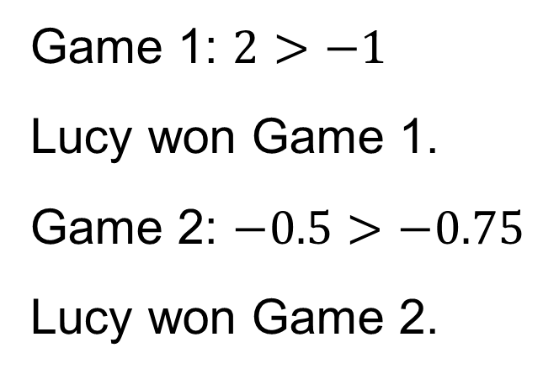
Trivia Game
Who is the winner of each game?
Representing
How can you represent the relationships between quantities?
24 / 55
Notes:
TEACH IN PRACTICE | Embedded facilitation | Lesson 7.4, slide 23 | TASK
Focus on the existing task: How can you represent the relationships between quantities?
LAUNCH (T2/3/5): Use the displayed question. Give private thinking time; then A explains while B asks for evidence. Switch roles. Each student records their own reasoning.
LOOK FOR (T4): Where this task addresses it, students can compare rational numbers by position. Ask which feature of their work supports the claim.
RESPOND: If this task shows the lesson misconception—assuming a negative number with larger absolute value is greater—plot the original values on one consistently scaled number line. Have the student revise and explain the change. Use this support only where the concept occurs in the current task; otherwise respond to the displayed question.
RECHECK: If a gap is shared, revisit the existing representation together. If it is limited, give targeted support while others compare valid methods on the same task. Check the revision before moving on.
PARTICIPATION (T5/6/7): Think time before volunteers; accept a written, drawn or rehearsed entry. Students ask for evidence respectfully. Recognize a specific contribution or revision and check that both partners participate.
Source: BCPS Updated Instructional Framework Rubric (June 2020), TEACH 1–7. Earlier notes and answer keys are retained below.
EARLIER NOTES / EXISTING ANSWER KEY
Model briefly, then hand the thinking back: ask “Why does this step work?” before showing the next one.
Quick check before moving on — thumbs or whiteboards from everyone, not volunteers.
UIFR: TEACH 2 · TEACH 3 · TEACH 4.

Slide 25
Let’s Explore More
What is another way to write inequalities to compare the scores of each game?
Workspace
When comparing a positive number to a negative number, which number is always greater?
Workspace
25 / 55
Notes:
TEACH IN PRACTICE | Embedded facilitation | Lesson 7.4, slide 24 | PRACTICE
Focus on the existing task: Let’s Explore More What is another way to write inequalities to compare the scores of each game?
LAUNCH (T2/3/5): Use the displayed question. Give private thinking time; then A explains while B asks for evidence. Switch roles. Each student records their own reasoning.
LOOK FOR (T4): Where this task addresses it, students can compare rational numbers by position. Ask which feature of their work supports the claim.
RESPOND: If this task shows the lesson misconception—assuming a negative number with larger absolute value is greater—plot the original values on one consistently scaled number line. Have the student revise and explain the change. Use this support only where the concept occurs in the current task; otherwise respond to the displayed question.
RECHECK: If a gap is shared, revisit the existing representation together. If it is limited, give targeted support while others compare valid methods on the same task. Check the revision before moving on.
PARTICIPATION (T5/6/7): Think time before volunteers; accept a written, drawn or rehearsed entry. Students ask for evidence respectfully. Recognize a specific contribution or revision and check that both partners participate.
Source: BCPS Updated Instructional Framework Rubric (June 2020), TEACH 1–7. Earlier notes and answer keys are retained below.
EARLIER NOTES / EXISTING ANSWER KEY
Extension for partners or table groups — students choose their approach and use the workspace to show thinking.
Push with “Convince me,” and have two groups with different approaches share.
This is where students stretch past the worked example.
UIFR: TEACH 2 · TEACH 5.

Slide 26
STUDENT MOVES
Lesson 7-4
Your moves
ANOTHER PATHWAY · Did anyone get there a different way? Put both pathways side by side and compare.
TWO MINUTES SOLO · Two minutes on your own, then compare. Bring one thing you tried, even if it did not work.
26 / 55

Slide 27
LESSON 7.4 / DISCUSS THE TASK
Explain and compare
Use the task you just explored.
TAKE TURNS
Which number lies farther right, and how is that different from being farther from zero?
Explain
“I know this because…”
Ask
“Where does your work show that?”
Point to evidence in your work.
Then compare your approach with a partner’s.
HOW DO YOU KNOW? · Ask your partner “How do you know?” Answer by pointing to your own work.
Listen to understand. Ask for evidence. Make room for every voice.
Notes:
TEACH IN PRACTICE | Embedded facilitation | Lesson 7.4, slide 25 | PRIOR_INSERT
Focus on the existing task: Point to evidence in your work. Then compare your approach with a partner’s. TAKE TURNS Explain “I know this because…” Ask “Where does your work show that?
CONNECT (T1/4): Ask students to restate the displayed goal or key idea and connect it to earlier work. Relevant lesson evidence: compare rational numbers by position; use inequality signs correctly; distinguish value from magnitude. Use only the criterion that matches the current session.
SHOW PROGRESS: Students point to their own existing work, explain what improved after feedback, and name a next step. Pair confidence ratings with actual evidence.
PARTICIPATION (T5/6/7): Think time before volunteers; accept a written, drawn or rehearsed entry. Students ask for evidence respectfully. Recognize a specific contribution or revision and check that both partners participate.
Source: BCPS Updated Instructional Framework Rubric (June 2020), TEACH 1–7.

Slide 28
Trivia Game
Game 1
Use a number line to compare the values.
Compare your reasoning with the
explanation. Explain any revision you make.
How can you use the number line to determine the greater value?
Reveal:
We can compare the location of the values on the number line. The number on the right has a greater value.
28 / 55
Notes:
TEACH IN PRACTICE | Embedded facilitation | Lesson 7.4, slide 26 | REVEAL
Focus on the existing task: Game 1 How can you use the number line to determine the greater value?
LAUNCH (T2/3/5): If an existing answer cover is present, gather an attempt before revealing. If the explanation is already visible, ask students to reconstruct and justify it. Compare reasoning and explain a revision; preserve the reveal sequence.
LOOK FOR (T4): Where this task addresses it, students can compare rational numbers by position. Ask which feature of their work supports the claim.
RESPOND: If this task shows the lesson misconception—assuming a negative number with larger absolute value is greater—plot the original values on one consistently scaled number line. Have the student revise and explain the change. Use this support only where the concept occurs in the current task; otherwise respond to the displayed question.
RECHECK: If a gap is shared, revisit the existing representation together. If it is limited, give targeted support while others compare valid methods on the same task. Check the revision before moving on.
PARTICIPATION (T5/6/7): Think time before volunteers; accept a written, drawn or rehearsed entry. Students ask for evidence respectfully. Recognize a specific contribution or revision and check that both partners participate.
Source: BCPS Updated Instructional Framework Rubric (June 2020), TEACH 1–7.

Slide 29
Collaborate and Connect
Game 2
Use a number line to compare the values.
Who had the greater score in Game 2? Use a number line to justify your answer.
Reveal:
Lucy had the greater score in Game 2.
RESTATE FIRST · Restate your partner’s idea in your own words before you give yours.
29 / 55
Notes:
TEACH IN PRACTICE | Embedded facilitation | Lesson 7.4, slide 27 | COLLABORATE
Focus on the existing task: Collaborate and Connect Reveal: Lucy had the greater score in Game 2. Game 2 Use a number line to compare the values. Who had the greater score in Game 2?
LAUNCH (T2/3/5): Use the displayed question. Give private thinking time; then A explains while B asks for evidence. Switch roles. Each student records their own reasoning.
LOOK FOR (T4): Where this task addresses it, students can compare rational numbers by position. Ask which feature of their work supports the claim.
RESPOND: If this task shows the lesson misconception—assuming a negative number with larger absolute value is greater—plot the original values on one consistently scaled number line. Have the student revise and explain the change. Use this support only where the concept occurs in the current task; otherwise respond to the displayed question.
RECHECK: If a gap is shared, revisit the existing representation together. If it is limited, give targeted support while others compare valid methods on the same task. Check the revision before moving on.
PARTICIPATION (T5/6/7): Think time before volunteers; accept a written, drawn or rehearsed entry. Students ask for evidence respectfully. Recognize a specific contribution or revision and check that both partners participate.
Source: BCPS Updated Instructional Framework Rubric (June 2020), TEACH 1–7.

Slide 30
Session 2 Warm-Up
Lesson 7-4 · Compare and Order Integers and Rational Numbers
Session 2 Warm-Up
Check what you remember from Session 1 · about 4 minutes
1
Which inequality statement is true?
2
Order from least to greatest: −5, 2, −1, 0:
A
−7 > −3
A
2, 0, −1, −5
B
−7 < −3
B
−5, −1, 0, 2
C
−3 < −7
C
0, −1, 2, −5
D
−7 = 7
D
−1, −5, 0, 2
3
Which temperature is coldest?
4
On a horizontal number line, if a < b, then a lies:
A
−2°F
A
To the right of b
B
−12°F
B
To the left of b
C
0°F
C
Directly on b
D
5°F
D
At zero
eduwonderlab.com · Neft Teacher
30 / 55
Notes:
TEACH IN PRACTICE | Embedded facilitation | Lesson 7.4, slide 28 | WARMUP
Focus on the existing task: A −7 > −3 B −7 < −3 C −3 < −7 D −7 = 7 2 Order from least to greatest: −5, 2, −1, 0: A 2, 0, −1, −5 B −5, −1, 0, 2 C 0, −1, 2, −5 D −1, −5, 0, 2 3 Which temperature is coldest?
GATHER EVIDENCE (T4/6): Keep the original items. Students try independently, mark an uncertain item, and explain one method before checking. Use the existing key when present.
RESPOND: Distinguish a calculation slip from a reasoning gap. Give one next step on the same item; have students revise in a second color. Use the responses to choose flexible support for today’s lesson.
PARTICIPATION (T5/6/7): Think time before volunteers; accept a written, drawn or rehearsed entry. Students ask for evidence respectfully. Recognize a specific contribution or revision and check that both partners participate.
Source: BCPS Updated Instructional Framework Rubric (June 2020), TEACH 1–7. Earlier notes and answer keys are retained below.
EARLIER NOTES / EXISTING ANSWER KEY
Warm-up routine: students start silently on entry; keep it to about 4 minutes.
Circulate and note who is stuck — use what you see to choose who you check on first today.
Go over answers quickly; ask one student to explain a step, not just say the answer.
UIFR: TEACH 4 · TEACH 6.
UIFR FULL | Lesson-specific facilitation
TEACH 1 | Session 2 purpose and evidence (UIFR PDF p. 8).
Have students restate the displayed session goal in their own words and connect it to the existing context or a familiar experience they choose to share. Use the current session goal to select from these lesson-wide evidence criteria; do not frontload a later-session procedure.
Look for: compare rational numbers by position; use inequality signs correctly; distinguish value from magnitude. Ask: “Which part of your work would show this?” Revisit that evidence after the task; a confidence rating alone is not evidence of understanding.

Slide 31
STUDENT MOVES
Lesson 7-4
Your move
YOU KNOW THE ROUTINE · Read → plan → solve → check. Do all four, in that order.
31 / 55

Slide 32
Today’s Math Notes
Lesson 7-4 · Compare and Order Integers and Rational Numbers
Review Notes — Session 2
Copy. Explain. Check.
NAME THE MATH · Point to the part of this that is new today, and say what it changes.
Comparing Negative Numbers
1
A value with greater magnitude is farther left on a number line, meaning it is smaller (−10 < −2).
Inequality Notation
2
< means ‘is less than’, > means ‘is greater than’. Point open mouth toward greater value.
Ordering Strategy
3
Separate into negatives and positives; place negatives in reverse order of absolute value.
eduwonderlab.com · Neft Teacher
32 / 55
Notes:
TEACH IN PRACTICE | Embedded facilitation | Lesson 7.4, slide 29 | NOTES
Focus on the existing task: Today’s Math Notes Review Notes — Session 2…
ROUTINE (T1/2/4): Read or copy the original notes, cover one line, and explain it using the displayed example. Reopen and correct. Copying alone is not evidence of understanding.
LOOK FOR: A link between a symbol, quantity or feature and the explanation. If missing, point back to that feature and have the student try again; fade the prompt once they can explain.
PARTICIPATION (T5/6/7): Think time before volunteers; accept a written, drawn or rehearsed entry. Students ask for evidence respectfully. Recognize a specific contribution or revision and check that both partners participate.
Source: BCPS Updated Instructional Framework Rubric (June 2020), TEACH 1–7. Earlier notes and answer keys are retained below.
EARLIER NOTES / EXISTING ANSWER KEY
Copy routine: read one line at a time; students copy, then explain that line to a partner.
Keep it brisk — the understanding work happens in the examples, not the copying.
UIFR: TEACH 1 · TEACH 6.

Slide 33
Session 2
Compare and Order Integers and Rational Numbers
JUSTIFY IT · Say it like this: “I know ______ because ______.”
33 / 55
Notes:
TEACH IN PRACTICE | Embedded facilitation | Lesson 7.4, slide 30 | DIVIDER
Focus on the existing task: Compare and Order Integers and Rational Numbers Session 2
TRANSITION (T6/7): Students confirm materials, roles, how to request help, and the next response routine. Ask a student to restate it. Keep teacher-only slides hidden.
PARTICIPATION (T5/6/7): Think time before volunteers; accept a written, drawn or rehearsed entry. Students ask for evidence respectfully. Recognize a specific contribution or revision and check that both partners participate.
Source: BCPS Updated Instructional Framework Rubric (June 2020), TEACH 1–7. Earlier notes and answer keys are retained below.
EARLIER NOTES / EXISTING ANSWER KEY
Transition cue: state what materials are out and what success looks like this session.
Keep the changeover under a minute.
UIFR: TEACH 6.

Slide 34
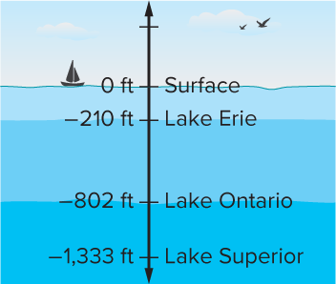
Lake Depths
The diagram shows the depths of three Great Lakes. What statements can you make about the relationship among the three lakes?
What do you notice about the depths?
Reveal:
The depths are all represented by negative values because they are all below the surface.
34 / 55
Notes:
TEACH IN PRACTICE | Embedded facilitation | Lesson 7.4, slide 31 | REVEAL
Focus on the existing task: The diagram shows the depths of three Great Lakes. What statements can you make about the relationship among the three lakes?
LAUNCH (T2/3/5): If an existing answer cover is present, gather an attempt before revealing. If the explanation is already visible, ask students to reconstruct and justify it. Compare reasoning and explain a revision; preserve the reveal sequence.
LOOK FOR (T4): Where this task addresses it, students can compare rational numbers by position. Ask which feature of their work supports the claim.
RESPOND: If this task shows the lesson misconception—assuming a negative number with larger absolute value is greater—plot the original values on one consistently scaled number line. Have the student revise and explain the change. Use this support only where the concept occurs in the current task; otherwise respond to the displayed question.
RECHECK: If a gap is shared, revisit the existing representation together. If it is limited, give targeted support while others compare valid methods on the same task. Check the revision before moving on.
PARTICIPATION (T5/6/7): Think time before volunteers; accept a written, drawn or rehearsed entry. Students ask for evidence respectfully. Recognize a specific contribution or revision and check that both partners participate.
Source: BCPS Updated Instructional Framework Rubric (June 2020), TEACH 1–7. Earlier notes and answer keys are retained below.
EARLIER NOTES / EXISTING ANSWER KEY
Do not click yet: collect 2–3 student answers with reasons first.
Then click to remove the cover and have students compare their thinking to the reveal — “Is this what we said? Where is it different?”
Behind the cover: The depths are all represented by negative values because they are all below the surface.
UIFR: TEACH 3 · TEACH 4.
UIFR FULL | Lesson-specific facilitation
TEACH 2-3 | Session 2 task launch (UIFR PDF pp. 9-10).
Use the problem exactly as displayed. Give individual thinking time before discussion or advancing to the explanation. If the answer is already visible, ask students to reconstruct and justify it. Invite a choice of suitable representations and have students explain why their choice helps.
At the point where this concept appears, ask: “Which number lies farther right, and how is that different from being farther from zero?” Wait for evidence, invite another pathway, and have a student ask a follow-up question. Do not replace students’ reasoning with a sequence of leading steps.

Slide 35
STUDENT MOVES
Lesson 7-4
Your move
ASK THE CLASS · Write one question about this that you could ask the class.
35 / 55

Slide 36
Lake Depths
The diagram shows the depths of three Great Lakes. What statements can you make about the relationship among the three lakes?
What tool can you use to compare the values?
Reveal:
One tool is a number line.
Record your reasoning before the
reveal. Compare, then explain
any revision.
36 / 55
Notes:
TEACH IN PRACTICE | Embedded facilitation | Lesson 7.4, slide 32 | REVEAL
Focus on the existing task: The diagram shows the depths of three Great Lakes. What statements can you make about the relationship among the three lakes?
LAUNCH (T2/3/5): If an existing answer cover is present, gather an attempt before revealing. If the explanation is already visible, ask students to reconstruct and justify it. Compare reasoning and explain a revision; preserve the reveal sequence.
LOOK FOR (T4): Where this task addresses it, students can compare rational numbers by position. Ask which feature of their work supports the claim.
RESPOND: If this task shows the lesson misconception—assuming a negative number with larger absolute value is greater—plot the original values on one consistently scaled number line. Have the student revise and explain the change. Use this support only where the concept occurs in the current task; otherwise respond to the displayed question.
RECHECK: If a gap is shared, revisit the existing representation together. If it is limited, give targeted support while others compare valid methods on the same task. Check the revision before moving on.
PARTICIPATION (T5/6/7): Think time before volunteers; accept a written, drawn or rehearsed entry. Students ask for evidence respectfully. Recognize a specific contribution or revision and check that both partners participate.
Source: BCPS Updated Instructional Framework Rubric (June 2020), TEACH 1–7. Earlier notes and answer keys are retained below.
EARLIER NOTES / EXISTING ANSWER KEY
Do not click yet: collect 2–3 student answers with reasons first.
Then click to remove the cover and have students compare their thinking to the reveal — “Is this what we said? Where is it different?”
Behind the cover: One tool is a number line.
UIFR: TEACH 3 · TEACH 4.

Slide 37
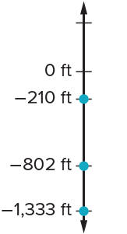
Lake Depths
We can compare the numbers on a number line.
What happens to the values as you move farther down on a vertical number line?
Try first. Use the scale and positions on the number line to
justify your answer.
Think About It:
How would the values appear on a horizontal number line?
37 / 55
Notes:
TEACH IN PRACTICE | Embedded facilitation | Lesson 7.4, slide 33 | TASK
Focus on the existing task: We can compare the numbers on a number line. What happens to the values as you move farther down on a vertical number line?
LAUNCH (T2/3/5): Use the displayed question. Give private thinking time; then A explains while B asks for evidence. Switch roles. Each student records their own reasoning.
LOOK FOR (T4): Where this task addresses it, students can compare rational numbers by position. Ask which feature of their work supports the claim.
RESPOND: If this task shows the lesson misconception—assuming a negative number with larger absolute value is greater—plot the original values on one consistently scaled number line. Have the student revise and explain the change. Use this support only where the concept occurs in the current task; otherwise respond to the displayed question.
RECHECK: If a gap is shared, revisit the existing representation together. If it is limited, give targeted support while others compare valid methods on the same task. Check the revision before moving on.
PARTICIPATION (T5/6/7): Think time before volunteers; accept a written, drawn or rehearsed entry. Students ask for evidence respectfully. Recognize a specific contribution or revision and check that both partners participate.
Source: BCPS Updated Instructional Framework Rubric (June 2020), TEACH 1–7. Earlier notes and answer keys are retained below.
EARLIER NOTES / EXISTING ANSWER KEY
Ask the question, then hold the silence — students think or jot before anyone answers.
Take two or three responses and press with “Why?” or “How do you know?” before moving on.
UIFR: TEACH 3.

Slide 38
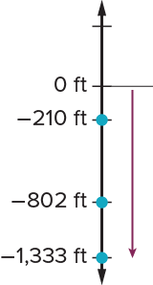
Lake Depths
The values get lesser and lesser as you move farther down on a vertical number line.
−1,333 is the farthest down on the number line.
It is the least of the three numbers.
−210 is the farthest up on the number line.
It is the greatest of the three numbers.
−802 is in between the other two number.
It is less than −210, but greater than −1,333.
TRY IT BEFORE YOU’RE SURE · Start even if you are not sure. A revised answer counts as much as a first-try answer.
38 / 55
Notes:
TEACH IN PRACTICE | Embedded facilitation | Lesson 7.4, slide 34 | WORKED
Focus on the existing task: The values get lesser and lesser as you move farther down on a vertical number line. −1,333 is the farthest down on the number line. It is…
LAUNCH (T2/3/5): Ask students to explain the displayed idea or example and point to evidence. When a calculation step is shown, ask why it is valid. Have a partner restate the explanation; copying is not the check.
LOOK FOR (T4): Where this task addresses it, students can compare rational numbers by position. Ask which feature of their work supports the claim.
RESPOND: If this task shows the lesson misconception—assuming a negative number with larger absolute value is greater—plot the original values on one consistently scaled number line. Have the student revise and explain the change. Use this support only where the concept occurs in the current task; otherwise respond to the displayed question.
RECHECK: If a gap is shared, revisit the existing representation together. If it is limited, give targeted support while others compare valid methods on the same task. Check the revision before moving on.
PARTICIPATION (T5/6/7): Think time before volunteers; accept a written, drawn or rehearsed entry. Students ask for evidence respectfully. Recognize a specific contribution or revision and check that both partners participate.
Source: BCPS Updated Instructional Framework Rubric (June 2020), TEACH 1–7. Earlier notes and answer keys are retained below.
EARLIER NOTES / EXISTING ANSWER KEY
Model briefly, then hand the thinking back: ask “Why does this step work?” before showing the next one.
Quick check before moving on — thumbs or whiteboards from everyone, not volunteers.
UIFR: TEACH 2 · TEACH 3 · TEACH 4.

Slide 39
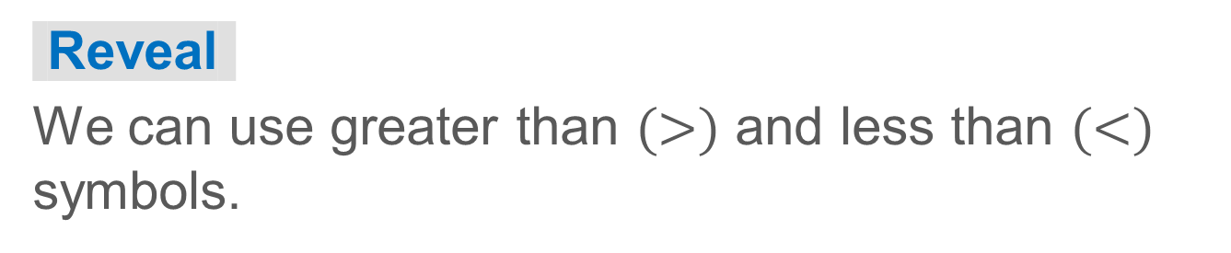
Lake Depths
How can you write mathematical statements to compare the values?
Think and record first. Which part of your work supports your
answer?
39 / 55
Notes:
TEACH IN PRACTICE | Embedded facilitation | Lesson 7.4, slide 35 | TASK
Focus on the existing task: How can you write mathematical statements to compare the values?
LAUNCH (T2/3/5): Use the displayed question. Give private thinking time; then A explains while B asks for evidence. Switch roles. Each student records their own reasoning.
LOOK FOR (T4): Where this task addresses it, students can compare rational numbers by position. Ask which feature of their work supports the claim.
RESPOND: If this task shows the lesson misconception—assuming a negative number with larger absolute value is greater—plot the original values on one consistently scaled number line. Have the student revise and explain the change. Use this support only where the concept occurs in the current task; otherwise respond to the displayed question.
RECHECK: If a gap is shared, revisit the existing representation together. If it is limited, give targeted support while others compare valid methods on the same task. Check the revision before moving on.
PARTICIPATION (T5/6/7): Think time before volunteers; accept a written, drawn or rehearsed entry. Students ask for evidence respectfully. Recognize a specific contribution or revision and check that both partners participate.
Source: BCPS Updated Instructional Framework Rubric (June 2020), TEACH 1–7. Earlier notes and answer keys are retained below.
EARLIER NOTES / EXISTING ANSWER KEY
Model briefly, then hand the thinking back: ask “Why does this step work?” before showing the next one.
Quick check before moving on — thumbs or whiteboards from everyone, not volunteers.
UIFR: TEACH 2 · TEACH 3 · TEACH 4.

Slide 40
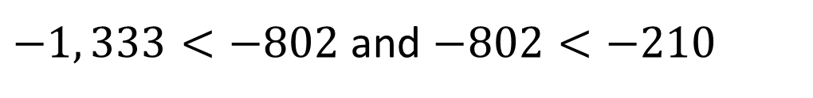
Lake Depths
Let’s write mathematical statements to compare the numbers.
−1,333 is the least of the three numbers.
−210 is the greatest of the three numbers.
−802 is less than −210, but greater than −1,333.
Explain how the information shown supports your reasoning.
40 / 55
Notes:
TEACH IN PRACTICE | Embedded facilitation | Lesson 7.4, slide 36 | WORKED
Focus on the existing task: Let’s write mathematical statements to compare the numbers. −1,333 is the least of the three numbers. −210 is the greatest of the three…
LAUNCH (T2/3/5): Ask students to explain the displayed idea or example and point to evidence. When a calculation step is shown, ask why it is valid. Have a partner restate the explanation; copying is not the check.
LOOK FOR (T4): Where this task addresses it, students can compare rational numbers by position. Ask which feature of their work supports the claim.
RESPOND: If this task shows the lesson misconception—assuming a negative number with larger absolute value is greater—plot the original values on one consistently scaled number line. Have the student revise and explain the change. Use this support only where the concept occurs in the current task; otherwise respond to the displayed question.
RECHECK: If a gap is shared, revisit the existing representation together. If it is limited, give targeted support while others compare valid methods on the same task. Check the revision before moving on.
PARTICIPATION (T5/6/7): Think time before volunteers; accept a written, drawn or rehearsed entry. Students ask for evidence respectfully. Recognize a specific contribution or revision and check that both partners participate.
Source: BCPS Updated Instructional Framework Rubric (June 2020), TEACH 1–7. Earlier notes and answer keys are retained below.
EARLIER NOTES / EXISTING ANSWER KEY
Model briefly, then hand the thinking back: ask “Why does this step work?” before showing the next one.
Quick check before moving on — thumbs or whiteboards from everyone, not volunteers.
UIFR: TEACH 2 · TEACH 3 · TEACH 4.

Slide 41
Lake Depths
Let’s look at another way to compare the numbers.
As the negative numbers decrease in value, what do you notice about their distances from 0? How does this relate to absolute value?
Reveal:
As the negative numbers decrease in value, they get farther and farther away from 0. This means that as the value of the negative numbers decreases, the absolute value increases.
41 / 55
Notes:
TEACH IN PRACTICE | Embedded facilitation | Lesson 7.4, slide 37 | REVEAL
Focus on the existing task: Let’s look at another way to compare the numbers. As the negative numbers decrease in value, what do you notice about their distances from 0?
LAUNCH (T2/3/5): If an existing answer cover is present, gather an attempt before revealing. If the explanation is already visible, ask students to reconstruct and justify it. Compare reasoning and explain a revision; preserve the reveal sequence.
LOOK FOR (T4): Where this task addresses it, students can compare rational numbers by position. Ask which feature of their work supports the claim.
RESPOND: If this task shows the lesson misconception—assuming a negative number with larger absolute value is greater—plot the original values on one consistently scaled number line. Have the student revise and explain the change. Use this support only where the concept occurs in the current task; otherwise respond to the displayed question.
RECHECK: If a gap is shared, revisit the existing representation together. If it is limited, give targeted support while others compare valid methods on the same task. Check the revision before moving on.
PARTICIPATION (T5/6/7): Think time before volunteers; accept a written, drawn or rehearsed entry. Students ask for evidence respectfully. Recognize a specific contribution or revision and check that both partners participate.
Source: BCPS Updated Instructional Framework Rubric (June 2020), TEACH 1–7. Earlier notes and answer keys are retained below.
EARLIER NOTES / EXISTING ANSWER KEY
Do not click yet: collect 2–3 student answers with reasons first.
Then click to remove the cover and have students compare their thinking to the reveal — “Is this what we said? Where is it different?”
Behind the cover: As the negative numbers decrease in value, they get farther and farther away from 0. This means that as the value of the negative numbers decreases, the absolute value increases.
UIFR: TEACH 3 · TEACH 4.

Slide 42
STUDENT MOVES
Lesson 7-4
Your move
PROVE IT · Find the evidence in the problem that makes your answer right — not just the answer.
42 / 55

Slide 43
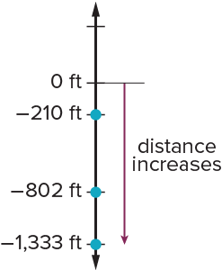
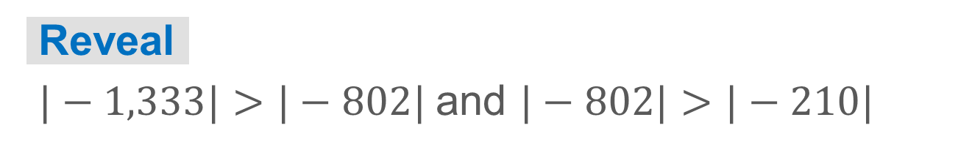
COLLABORATE · TALK IT THROUGH • AGREE ON A MODEL
Collaborate and Connect
As the value of the negative numbers decreases, the absolute value of the negative numbers increases.
How do the absolute values of the numbers compare?
TEACH A PARTNER · Teach this to someone who missed it. If you can teach it, you know it.
43 / 55
Notes:
TEACH IN PRACTICE | Embedded facilitation | Lesson 7.4, slide 38 | COLLABORATE
Focus on the existing task: Collaborate and Connect As the value of the negative numbers decreases, the absolute value of the negative numbers increases. How do the absolute values of the numbers compare?
LAUNCH (T2/3/5): Use the displayed question. Give private thinking time; then A explains while B asks for evidence. Switch roles. Each student records their own reasoning.
LOOK FOR (T4): Where this task addresses it, students can compare rational numbers by position. Ask which feature of their work supports the claim.
RESPOND: If this task shows the lesson misconception—assuming a negative number with larger absolute value is greater—plot the original values on one consistently scaled number line. Have the student revise and explain the change. Use this support only where the concept occurs in the current task; otherwise respond to the displayed question.
RECHECK: If a gap is shared, revisit the existing representation together. If it is limited, give targeted support while others compare valid methods on the same task. Check the revision before moving on.
PARTICIPATION (T5/6/7): Think time before volunteers; accept a written, drawn or rehearsed entry. Students ask for evidence respectfully. Recognize a specific contribution or revision and check that both partners participate.
Source: BCPS Updated Instructional Framework Rubric (June 2020), TEACH 1–7. Earlier notes and answer keys are retained below.
EARLIER NOTES / EXISTING ANSWER KEY
Routine: COLLABORATE · TALK IT THROUGH • AGREE ON A MODEL
UIFR FULL | Lesson-specific facilitation
TEACH 4-5 | Session 2 discussion and checkpoint (UIFR PDF pp. 11-12).
Collect a brief response from every student to the existing prompt before hearing volunteers. Partners take turns explaining and asking for evidence: “I understand ___; what supports ___?” Offer rehearsal or an annotated model for students who need language support. Each student records their own reasoning.
Look specifically for: assuming a negative number with larger absolute value is greater. If it appears, plot the original values on one consistently scaled number line; then ask the student to revise the same response and explain the change. If evidence is secure, have students compare a second valid pathway or state why their approach works. Choose the next step from the responses, not a preset pace.

Slide 44



Lake Depths
We can compare the absolute values of the numbers.
−1,333 is the greatest distance from 0.
It has the greatest absolute value of the three numbers.
Using Symbols
SELF-CHECK · Mark it: ✓ got it · ~ almost · ? stuck. Then fix one thing before we move on.
What do the absolute value symbols tell you to do?
44 / 55
Notes:
TEACH IN PRACTICE | Embedded facilitation | Lesson 7.4, slide 39 | TASK
Focus on the existing task: We can compare the absolute values of the numbers. −1,333 is the greatest distance from 0. It has the greatest absolute value of the…
LAUNCH (T2/3/5): Use the displayed question. Give private thinking time; then A explains while B asks for evidence. Switch roles. Each student records their own reasoning.
LOOK FOR (T4): Where this task addresses it, students can compare rational numbers by position. Ask which feature of their work supports the claim.
RESPOND: If this task shows the lesson misconception—assuming a negative number with larger absolute value is greater—plot the original values on one consistently scaled number line. Have the student revise and explain the change. Use this support only where the concept occurs in the current task; otherwise respond to the displayed question.
RECHECK: If a gap is shared, revisit the existing representation together. If it is limited, give targeted support while others compare valid methods on the same task. Check the revision before moving on.
PARTICIPATION (T5/6/7): Think time before volunteers; accept a written, drawn or rehearsed entry. Students ask for evidence respectfully. Recognize a specific contribution or revision and check that both partners participate.
Source: BCPS Updated Instructional Framework Rubric (June 2020), TEACH 1–7. Earlier notes and answer keys are retained below.
EARLIER NOTES / EXISTING ANSWER KEY
Model briefly, then hand the thinking back: ask “Why does this step work?” before showing the next one.
Quick check before moving on — thumbs or whiteboards from everyone, not volunteers.
UIFR: TEACH 2 · TEACH 3 · TEACH 4.

Slide 45
Lake Depths
We can compare the numbers or their absolute values.
How can you use the comparisons to make statements about the relationship among the depths of the three lakes?
Reveal:
We can state the order of the lakes from deepest to shallowest.
45 / 55
Notes:
TEACH IN PRACTICE | Embedded facilitation | Lesson 7.4, slide 40 | REVEAL
Focus on the existing task: We can compare the numbers or their absolute values. How can you use the comparisons to make statements about the relationship among the depths of the three lakes?
LAUNCH (T2/3/5): If an existing answer cover is present, gather an attempt before revealing. If the explanation is already visible, ask students to reconstruct and justify it. Compare reasoning and explain a revision; preserve the reveal sequence.
LOOK FOR (T4): Where this task addresses it, students can compare rational numbers by position. Ask which feature of their work supports the claim.
RESPOND: If this task shows the lesson misconception—assuming a negative number with larger absolute value is greater—plot the original values on one consistently scaled number line. Have the student revise and explain the change. Use this support only where the concept occurs in the current task; otherwise respond to the displayed question.
RECHECK: If a gap is shared, revisit the existing representation together. If it is limited, give targeted support while others compare valid methods on the same task. Check the revision before moving on.
PARTICIPATION (T5/6/7): Think time before volunteers; accept a written, drawn or rehearsed entry. Students ask for evidence respectfully. Recognize a specific contribution or revision and check that both partners participate.
Source: BCPS Updated Instructional Framework Rubric (June 2020), TEACH 1–7. Earlier notes and answer keys are retained below.
EARLIER NOTES / EXISTING ANSWER KEY
Do not click yet: collect 2–3 student answers with reasons first.
Then click to remove the cover and have students compare their thinking to the reveal — “Is this what we said? Where is it different?”
Behind the cover: We can state the order of the lakes from deepest to shallowest.
UIFR: TEACH 3 · TEACH 4.

Slide 46
Lake Depths
The diagram shows the depths of three Great Lakes.
What statements can you make about the relationship among the three lakes?
Of the three lakes, Lake Superior is the deepest, Lake Ontario is the second deepest, and Lake Erie is the shallowest.
46 / 55
Notes:
TEACH IN PRACTICE | Embedded facilitation | Lesson 7.4, slide 41 | TASK
Focus on the existing task: The diagram shows the depths of three Great Lakes. What statements can you make about the relationship among the three lakes?
LAUNCH (T2/3/5): Use the displayed question. Give private thinking time; then A explains while B asks for evidence. Switch roles. Each student records their own reasoning.
LOOK FOR (T4): Where this task addresses it, students can compare rational numbers by position. Ask which feature of their work supports the claim.
RESPOND: If this task shows the lesson misconception—assuming a negative number with larger absolute value is greater—plot the original values on one consistently scaled number line. Have the student revise and explain the change. Use this support only where the concept occurs in the current task; otherwise respond to the displayed question.
RECHECK: If a gap is shared, revisit the existing representation together. If it is limited, give targeted support while others compare valid methods on the same task. Check the revision before moving on.
PARTICIPATION (T5/6/7): Think time before volunteers; accept a written, drawn or rehearsed entry. Students ask for evidence respectfully. Recognize a specific contribution or revision and check that both partners participate.
Source: BCPS Updated Instructional Framework Rubric (June 2020), TEACH 1–7. Earlier notes and answer keys are retained below.
EARLIER NOTES / EXISTING ANSWER KEY
Model briefly, then hand the thinking back: ask “Why does this step work?” before showing the next one.
Quick check before moving on — thumbs or whiteboards from everyone, not volunteers.
UIFR: TEACH 2 · TEACH 3 · TEACH 4.

Slide 47
Let’s Explore More
Some words, like depth, imply a negative value. What other words imply the sign of the number?
Workspace
How does a number line help to organize a set of rational numbers?
Workspace
47 / 55
Notes:
TEACH IN PRACTICE | Embedded facilitation | Lesson 7.4, slide 42 | PRACTICE
Focus on the existing task: Let’s Explore More Some words, like depth, imply a negative value. What other words imply the sign of the number?
LAUNCH (T2/3/5): Use the displayed question. Give private thinking time; then A explains while B asks for evidence. Switch roles. Each student records their own reasoning.
LOOK FOR (T4): Where this task addresses it, students can compare rational numbers by position. Ask which feature of their work supports the claim.
RESPOND: If this task shows the lesson misconception—assuming a negative number with larger absolute value is greater—plot the original values on one consistently scaled number line. Have the student revise and explain the change. Use this support only where the concept occurs in the current task; otherwise respond to the displayed question.
RECHECK: If a gap is shared, revisit the existing representation together. If it is limited, give targeted support while others compare valid methods on the same task. Check the revision before moving on.
PARTICIPATION (T5/6/7): Think time before volunteers; accept a written, drawn or rehearsed entry. Students ask for evidence respectfully. Recognize a specific contribution or revision and check that both partners participate.
Source: BCPS Updated Instructional Framework Rubric (June 2020), TEACH 1–7. Earlier notes and answer keys are retained below.
EARLIER NOTES / EXISTING ANSWER KEY
Extension for partners or table groups — students choose their approach and use the workspace to show thinking.
Push with “Convince me,” and have two groups with different approaches share.
This is where students stretch past the worked example.
UIFR: TEACH 2 · TEACH 5.

Slide 48
STUDENT MOVES
Lesson 7-4
Your moves
USE THE MATH WORDS · Use today’s math words in your explanation — not “it” and “that thing.”
SPECIFIC FEEDBACK · Trade work. Give one specific comment: “This part is clear because ______.”
YOUR CHOICE · You choose how to show this — numbers, words, or a diagram. Make your reasoning visible.
48 / 55

Slide 49
LESSON 7.4 / CHECK YOUR WORK
Pause. Check. Improve.
CHECK
A mistake to watch for: assuming a negative number with larger absolute value is greater.
TRY
Plot the given values on one consistently scaled number line.
REVISE
Use that check on the task you just completed. Correct or strengthen one part, and explain why.
REVISE NOW · Change one answer and write why you changed it. A revision is evidence of learning.
Listen to understand. Ask for evidence. Make room for every voice.
Notes:
TEACH IN PRACTICE | Embedded facilitation | Lesson 7.4, slide 43 | PRIOR_INSERT
Focus on the existing task: LESSON 7.4 / CHECK YOUR WORK Pause. Check. Improve. Listen to understand. Ask for evidence. Make room for every voice. CHECK A mistake…
CONNECT (T1/4): Ask students to restate the displayed goal or key idea and connect it to earlier work. Relevant lesson evidence: compare rational numbers by position; use inequality signs correctly; distinguish value from magnitude. Use only the criterion that matches the current session.
SHOW PROGRESS: Students point to their own existing work, explain what improved after feedback, and name a next step. Pair confidence ratings with actual evidence.
PARTICIPATION (T5/6/7): Think time before volunteers; accept a written, drawn or rehearsed entry. Students ask for evidence respectfully. Recognize a specific contribution or revision and check that both partners participate.
Source: BCPS Updated Instructional Framework Rubric (June 2020), TEACH 1–7.

Slide 50
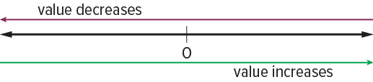

SUMMARIZE · SAY IT IN YOUR OWN WORDS
Summarize: Compare and Order Integers and Rational Numbers
STRUGGLE FIRST · Work on your own first. Stuck is allowed — try a second strategy before you ask.
You can use number lines to compare and order integers and rational numbers. Numbers farther to the left on the number line are always less than numbers that are farther to the right.
When you compare the absolute value of numbers, you are comparing the distance of the number from 0. The farther from 0, the greater the absolute value of the number.
50 / 55
Notes:
TEACH IN PRACTICE | Embedded facilitation | Lesson 7.4, slide 44 | SUMMARIZE
Focus on the existing task: Summarize: Compare and Order Integers and Rational Numbers You can use number lines to compare and order integers and rational numbers.…
CONNECT (T1/4): Ask students to restate the displayed goal or key idea and connect it to earlier work. Relevant lesson evidence: compare rational numbers by position; use inequality signs correctly; distinguish value from magnitude. Use only the criterion that matches the current session.
SHOW PROGRESS: Students point to their own existing work, explain what improved after feedback, and name a next step. Pair confidence ratings with actual evidence.
PARTICIPATION (T5/6/7): Think time before volunteers; accept a written, drawn or rehearsed entry. Students ask for evidence respectfully. Recognize a specific contribution or revision and check that both partners participate.
Source: BCPS Updated Instructional Framework Rubric (June 2020), TEACH 1–7. Earlier notes and answer keys are retained below.
EARLIER NOTES / EXISTING ANSWER KEY
Routine: SUMMARIZE · SAY IT IN YOUR OWN WORDS

Slide 51
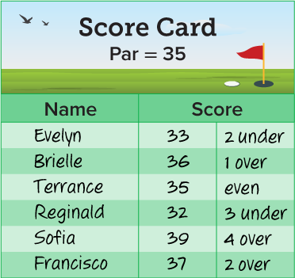
APPLY · PLAN IT • SOLVE IT • PROVE IT
Apply: A Game of Golf
Golf Scores are measured as over or under par. Par is the number of golf strokes considered necessary to get the golf ball in the hole. The winner is the player with the least score. The table shows the golf scores of six players after seven holes. They are playing a total of 9 holes.
Question : Do you think it is possible for Sofia to win the 9-hole round?
Choose a method. Solve independently, justify your answer, then check the goal.
51 / 55
Notes:
TEACH IN PRACTICE | Embedded facilitation | Lesson 7.4, slide 45 | APPLY
Focus on the existing task: Apply: A Game of Golf Golf Scores are measured as over or under par. Par is the number of golf strokes considered necessary to get the…
LAUNCH (T2/3/5): Use the exact application task independently first. Ask students to justify their choice of method. Collect evidence before a partner discussion or correction.
LOOK FOR (T4): Where this task addresses it, students can compare rational numbers by position. Ask which feature of their work supports the claim.
RESPOND: If this task shows the lesson misconception—assuming a negative number with larger absolute value is greater—plot the original values on one consistently scaled number line. Have the student revise and explain the change. Use this support only where the concept occurs in the current task; otherwise respond to the displayed question.
RECHECK: If a gap is shared, revisit the existing representation together. If it is limited, give targeted support while others compare valid methods on the same task. Check the revision before moving on.
PARTICIPATION (T5/6/7): Think time before volunteers; accept a written, drawn or rehearsed entry. Students ask for evidence respectfully. Recognize a specific contribution or revision and check that both partners participate.
Source: BCPS Updated Instructional Framework Rubric (June 2020), TEACH 1–7. Earlier notes and answer keys are retained below.
EARLIER NOTES / EXISTING ANSWER KEY
Routine: APPLY · PLAN IT • SOLVE IT • PROVE IT
UIFR FULL | Lesson-specific facilitation
TEACH 4 | Independent evidence and revision (UIFR PDF p. 11).
Use the existing application/exit problem as the independent check. If this is a learning-target slide, have students point to and explain their work on the preceding task. Separate initial independent evidence from the revision after feedback.
Check the relevant criteria: compare rational numbers by position; use inequality signs correctly; distinguish value from magnitude. Respond with one specific next step tied to the work. Students revise and annotate what changed, then identify a criterion they can now demonstrate and one they still need to practice.

Slide 52
Learning Targets
I can use number lines to interpret statements of inequality of two rational numbers.
I can attend to precision to write, interpret, and explain statements of order for rational numbers and distinguish between comparisons of absolute value from statements about order.
Point to evidence in your work. Name what improved and your next step.
52 / 55
Notes:
TEACH IN PRACTICE | Embedded facilitation | Lesson 7.4, slide 46 | REFLECTION
Focus on the existing task: Learning Targets I can use number lines to interpret statements of inequality of two rational numbers. I can attend to precision to write…
CONNECT (T1/4): Ask students to restate the displayed goal or key idea and connect it to earlier work. Relevant lesson evidence: compare rational numbers by position; use inequality signs correctly; distinguish value from magnitude. Use only the criterion that matches the current session.
SHOW PROGRESS: Students point to their own existing work, explain what improved after feedback, and name a next step. Pair confidence ratings with actual evidence.
PARTICIPATION (T5/6/7): Think time before volunteers; accept a written, drawn or rehearsed entry. Students ask for evidence respectfully. Recognize a specific contribution or revision and check that both partners participate.
Source: BCPS Updated Instructional Framework Rubric (June 2020), TEACH 1–7. Earlier notes and answer keys are retained below.
EARLIER NOTES / EXISTING ANSWER KEY
Read each target; students self-rate with fist-to-five or thumbs.
Tie back to the goal from the start of class: did we get there?
Note any target that rates low — revisit it tomorrow.
UIFR: TEACH 1 · TEACH 4.

Slide 53
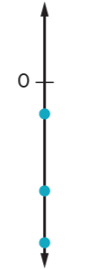
Be Curious
Be Curious
What could the question be?
Think first. Share a notice and a question; build on a
classmate’s idea.
Mindset
What is motivating you to engage with math?
53 / 55
Notes:
TEACH IN PRACTICE | Embedded facilitation | Lesson 7.4, slide 47 | CURIOUS
Focus on the existing task: Be Curious Be Curious What could the question be?
LAUNCH (T2/3/5): Allow quiet observation first. Separate a notice from an inference, invite students’ own questions, and follow the existing launch before teaching a procedure.
LOOK FOR (T4): Where this task addresses it, students can compare rational numbers by position. Ask which feature of their work supports the claim.
RESPOND: If this task shows the lesson misconception—assuming a negative number with larger absolute value is greater—plot the original values on one consistently scaled number line. Have the student revise and explain the change. Use this support only where the concept occurs in the current task; otherwise respond to the displayed question.
RECHECK: If a gap is shared, revisit the existing representation together. If it is limited, give targeted support while others compare valid methods on the same task. Check the revision before moving on.
PARTICIPATION (T5/6/7): Think time before volunteers; accept a written, drawn or rehearsed entry. Students ask for evidence respectfully. Recognize a specific contribution or revision and check that both partners participate.
Source: BCPS Updated Instructional Framework Rubric (June 2020), TEACH 1–7.

Slide 54
Learning Targets
I can use number lines to interpret statements of inequality of two rational numbers.
I can attend to precision to write, interpret, and explain statements of order for rational numbers and distinguish between comparisons of absolute value from statements about order.
Point to evidence in your work. Name what improved and your next step.
54 / 55
Notes:
TEACH IN PRACTICE | Embedded facilitation | Lesson 7.4, slide 48 | REFLECTION
Focus on the existing task: Learning Targets I can use number lines to interpret statements of inequality of two rational numbers. I can attend to precision to write…
CONNECT (T1/4): Ask students to restate the displayed goal or key idea and connect it to earlier work. Relevant lesson evidence: compare rational numbers by position; use inequality signs correctly; distinguish value from magnitude. Use only the criterion that matches the current session.
SHOW PROGRESS: Students point to their own existing work, explain what improved after feedback, and name a next step. Pair confidence ratings with actual evidence.
PARTICIPATION (T5/6/7): Think time before volunteers; accept a written, drawn or rehearsed entry. Students ask for evidence respectfully. Recognize a specific contribution or revision and check that both partners participate.
Source: BCPS Updated Instructional Framework Rubric (June 2020), TEACH 1–7. Earlier notes and answer keys are retained below.
EARLIER NOTES / EXISTING ANSWER KEY
UIFR FULL | Lesson-specific facilitation
REFLECT & ADJUST 1-2 | After the lesson (UIFR PDF pp. 15-16).
Sort the existing work by demonstrated reasoning, partial understanding, and the specific misconception: assuming a negative number with larger absolute value is greater. Compare the initial response with the revision. Record which teaching move plausibly helped, which did not, and whose participation or access needs a different approach; do not record sensitive student details in this shared deck.
Plan the next lesson from that evidence: if the misconception persists, plot the original values on one consistently scaled number line using the current example before returning to the next grade-level task; if understanding is secure, use an existing extension or ask for a general explanation. Check the targeted idea again at the next warm-up.
Ask students what supported their thinking and what would help next time. Identify one change to try and one successful practice to retain. Seek colleague feedback on anonymized work when useful; these prompts support reflection and do not establish an evaluation rating. Source: Baltimore City Public Schools, Updated Instructional Framework Rubric, June 2020 (UIFR_Full.pdf).

Slide 55
LESSON 7.4 / REFLECT ON YOUR LEARNING
Show your progress
1 SHOW EVIDENCE
2 CHOOSE A NEXT STEP
Choose one response. Point to the part that shows your reasoning.
Name a change you made after feedback—or a question you still have.
“My work shows ___ because ___.”
“Next time, I will ___ to help me ___.”
Today’s focus: Compare rational numbers by position.
CREDIT A CLASSMATE · Name one classmate whose idea helped you today, and say what they said.
Listen to understand. Ask for evidence. Make room for every voice.
Notes:
TEACH IN PRACTICE | Embedded facilitation | Lesson 7.4, slide 49 | PRIOR_INSERT
Focus on the existing task: LESSON 7.4 / REFLECT ON YOUR LEARNING Show your progress Listen to understand. Ask for evidence. Make room for every voice. 1 SHOW…
CONNECT (T1/4): Ask students to restate the displayed goal or key idea and connect it to earlier work. Relevant lesson evidence: compare rational numbers by position; use inequality signs correctly; distinguish value from magnitude. Use only the criterion that matches the current session.
SHOW PROGRESS: Students point to their own existing work, explain what improved after feedback, and name a next step. Pair confidence ratings with actual evidence.
PARTICIPATION (T5/6/7): Think time before volunteers; accept a written, drawn or rehearsed entry. Students ask for evidence respectfully. Recognize a specific contribution or revision and check that both partners participate.
Source: BCPS Updated Instructional Framework Rubric (June 2020), TEACH 1–7.

