Slide 1
WARM-UP · THINK • TRY • CHECK
Turn and talk: compare strategies, then defend one.
Warm-Up
Lesson 7-5 · Represent Rational Numbers on the Coordinate Plane | Warm-Up · about 4 minutes
Try each on your own. Mark an unsure answer; explain and revise when we check.
QUESTION 1
QUESTION 2
From the origin, (4, 3) is 4 right and ______ up.
Which quadrant holds (−4, 5)? ______
QUESTION 3
QUESTION 4
To plot (3, −2): move 3 right, then ______
Each tick on an axis is 2 units. The 3rd tick right of 0 is at ______
TALK IT OVER: “I got ______ because ______.” • Compare with a partner before we check as a class.
1 / 51
Notes:
TEACH IN PRACTICE | Embedded facilitation | Lesson 7.5, slide 1 | WARMUP
Focus on the existing task: Warm-Up WARM-UP · THINK • TRY • CHECK…
GATHER EVIDENCE (T4/6): Keep the original items. Students try independently, mark an uncertain item, and explain one method before checking. Use the existing key when present.
RESPOND: Distinguish a calculation slip from a reasoning gap. Give one next step on the same item; have students revise in a second color. Use the responses to choose flexible support for today’s lesson.
PARTICIPATION (T5/6/7): Think time before volunteers; accept a written, drawn or rehearsed entry. Students ask for evidence respectfully. Recognize a specific contribution or revision and check that both partners participate.
Source: BCPS Updated Instructional Framework Rubric (June 2020), TEACH 1–7. Earlier notes and answer keys are retained below.
EARLIER NOTES / EXISTING ANSWER KEY
Warm-Up answers (teacher only): 1) 3 up 2) Quadrant II 3) 2 down 4) 6
UIFR FULL | Lesson-specific facilitation
PREPARE 1-2 | Before teaching (UIFR PDF pp. 6-7).
Plan to gather evidence that students can interpret ordered pairs as horizontal then vertical; use signs to select directions. Review recent work and today’s warm-up to choose flexible groups and access supports; do not infer needs from identity or perceived ability. Use the existing lesson tasks and stated standards.
Anticipate: interchanging x and y or reversing a negative direction. If observed, trace horizontal then vertical movement on the original coordinate plane. Offer oral rehearsal, drawing, pointing, or home-language processing as needed; retain the original mathematical demand. Ask students which support helps and fade it as evidence improves.
TEACH 6-7 | Before the first transition, agree on materials, partner roles, and how to request help. Invite students to restate the routine. Normalize revising an idea, recognize a specific contribution, and check privately when frustration blocks participation. Source: UIFR PDF pp. 13-14.

Slide 2
Today’s Math Notes
Lesson 7-5 · Represent Rational Numbers on the Coordinate Plane
Section 1: Math Words
Copy. Explain. Check.
SAY THE GOAL · Say today’s goal in your own words, then name one place this shows up outside math class.
Graph on the Coordinate Plane
1
Plot a point by moving horizontally to its x-coordinate and vertically
Coordinate plane
2
A grid with a line going across and a line going
Ordered pair
3
Two numbers (x, y)
eduwonderlab.com · Neft Teacher
2 / 51
Notes:
TEACH IN PRACTICE | Embedded facilitation | Lesson 7.5, slide 2 | NOTES
Focus on the existing task: Today’s Math Notes Section 1: Math Words…
ROUTINE (T1/2/4): Read or copy the original notes, cover one line, and explain it using the displayed example. Reopen and correct. Copying alone is not evidence of understanding.
LOOK FOR: A link between a symbol, quantity or feature and the explanation. If missing, point back to that feature and have the student try again; fade the prompt once they can explain.
PARTICIPATION (T5/6/7): Think time before volunteers; accept a written, drawn or rehearsed entry. Students ask for evidence respectfully. Recognize a specific contribution or revision and check that both partners participate.
Source: BCPS Updated Instructional Framework Rubric (June 2020), TEACH 1–7. Earlier notes and answer keys are retained below.
EARLIER NOTES / EXISTING ANSWER KEY
Copy routine: read one line at a time; students copy, then explain that line to a partner.
Keep it brisk — the understanding work happens in the examples, not the copying.
UIFR: TEACH 1 · TEACH 6.

Slide 3
Today’s Math Notes
Lesson 7-5 · Represent Rational Numbers on the Coordinate Plane
Section 2: Today’s Math
Copy. Explain. Check.
Coordinate Plane: Plotting Points
Ordered Pair: (x, y) = (Horizontal, Vertical)
Read, cover, explain. Reopen your notes to
check and improve your explanation.
1
Always start at the Origin (0, 0)
2
x-coordinate: Move right for positive (+), left for negative (-)
3
y-coordinate: Move up for positive (+), down for negative (-)
eduwonderlab.com · Neft Teacher
3 / 51
Notes:
TEACH IN PRACTICE | Embedded facilitation | Lesson 7.5, slide 3 | NOTES
Focus on the existing task: Today’s Math Notes Section 2: Today’s…
ROUTINE (T1/2/4): Read or copy the original notes, cover one line, and explain it using the displayed example. Reopen and correct. Copying alone is not evidence of understanding.
LOOK FOR: A link between a symbol, quantity or feature and the explanation. If missing, point back to that feature and have the student try again; fade the prompt once they can explain.
PARTICIPATION (T5/6/7): Think time before volunteers; accept a written, drawn or rehearsed entry. Students ask for evidence respectfully. Recognize a specific contribution or revision and check that both partners participate.
Source: BCPS Updated Instructional Framework Rubric (June 2020), TEACH 1–7. Earlier notes and answer keys are retained below.
EARLIER NOTES / EXISTING ANSWER KEY
Copy routine: read one line at a time; students copy, then explain that line to a partner.
Keep it brisk — the understanding work happens in the examples, not the copying.
UIFR: TEACH 1 · TEACH 6.

Slide 4
Session 1
Represent Rational Numbers on the Coordinate Plane
PICK YOUR STRATEGY · Choose your path — picture, table, number line, or equation — and be ready to say why you chose it.
4 / 51
Notes:
TEACH IN PRACTICE | Embedded facilitation | Lesson 7.5, slide 4 | DIVIDER
Focus on the existing task: Represent Rational Numbers on the Coordinate Plane Session 1
TRANSITION (T6/7): Students confirm materials, roles, how to request help, and the next response routine. Ask a student to restate it. Keep teacher-only slides hidden.
PARTICIPATION (T5/6/7): Think time before volunteers; accept a written, drawn or rehearsed entry. Students ask for evidence respectfully. Recognize a specific contribution or revision and check that both partners participate.
Source: BCPS Updated Instructional Framework Rubric (June 2020), TEACH 1–7. Earlier notes and answer keys are retained below.
EARLIER NOTES / EXISTING ANSWER KEY
Transition cue: state what materials are out and what success looks like this session.
Keep the changeover under a minute.
UIFR: TEACH 6.

Slide 5

It’s About
What percent is shaded? How do you know?
Think and record first. Which part of your work supports your answer?
5 / 51
Notes:
TEACH IN PRACTICE | Embedded facilitation | Lesson 7.5, slide 5 | TASK
Focus on the existing task: It’s About What percent is shaded?
LAUNCH (T2/3/5): Use the displayed question. Give private thinking time; then A explains while B asks for evidence. Switch roles. Each student records their own reasoning.
LOOK FOR (T4): Where this task addresses it, students can interpret ordered pairs as horizontal then vertical. Ask which feature of their work supports the claim.
RESPOND: If this task shows the lesson misconception—interchanging x and y or reversing a negative direction—trace horizontal then vertical movement on the original coordinate plane. Have the student revise and explain the change. Use this support only where the concept occurs in the current task; otherwise respond to the displayed question.
RECHECK: If a gap is shared, revisit the existing representation together. If it is limited, give targeted support while others compare valid methods on the same task. Check the revision before moving on.
PARTICIPATION (T5/6/7): Think time before volunteers; accept a written, drawn or rehearsed entry. Students ask for evidence respectfully. Recognize a specific contribution or revision and check that both partners participate.
Source: BCPS Updated Instructional Framework Rubric (June 2020), TEACH 1–7. Earlier notes and answer keys are retained below.
EARLIER NOTES / EXISTING ANSWER KEY
Model briefly, then hand the thinking back: ask “Why does this step work?” before showing the next one.
Quick check before moving on — thumbs or whiteboards from everyone, not volunteers.
UIFR: TEACH 2 · TEACH 3 · TEACH 4.

Slide 6
Today’s Objectives
Lesson 7-5 · Represent Rational Numbers on the Coordinate Plane
Represent Rational Numbers on the Coordinate Plane
Maryland Standard 6.NOS.6
CONNECT IT · What earlier lesson does this build on? Tell a partner in one sentence.
CONTENT OBJECTIVE
LANGUAGE OBJECTIVE
Restate the goal in your words
Use these words to explain why
I can plot and identify points on the coordinate plane using ordered pairs.
I can explain my work using the words coordinate plane, ordered pair, origin, and quadrant.
eduwonderlab.com · Neft Teacher
6 / 51
Notes:
TEACH IN PRACTICE | Embedded facilitation | Lesson 7.5, slide 6 | GOAL
Focus on the existing task: Today’s Objectives Represent Rational…
CONNECT (T1/4): Ask students to restate the displayed goal or key idea and connect it to earlier work. Relevant lesson evidence: interpret ordered pairs as horizontal then vertical; use signs to select directions. Use only the criterion that matches the current session.
SHOW PROGRESS: Students point to their own existing work, explain what improved after feedback, and name a next step. Pair confidence ratings with actual evidence.
PARTICIPATION (T5/6/7): Think time before volunteers; accept a written, drawn or rehearsed entry. Students ask for evidence respectfully. Recognize a specific contribution or revision and check that both partners participate.
Source: BCPS Updated Instructional Framework Rubric (June 2020), TEACH 1–7. Earlier notes and answer keys are retained below.
EARLIER NOTES / EXISTING ANSWER KEY
Read the objective together, then have one or two students restate today’s goal in their own words.
Connect it to what the class learned last lesson.
Return to this goal at the end of class to check it was met.
UIFR: TEACH 1.
UIFR FULL | Lesson-specific facilitation
TEACH 1 | Session 1 purpose and evidence (UIFR PDF p. 8).
Have students restate the displayed session goal in their own words and connect it to the existing context or a familiar experience they choose to share. Use the current session goal to select from these lesson-wide evidence criteria; do not frontload a later-session procedure.
Look for: interpret ordered pairs as horizontal then vertical; use signs to select directions. Ask: “Which part of your work would show this?” Revisit that evidence after the task; a confidence rating alone is not evidence of understanding.

Slide 7
LESSON 7.5 / OUR LEARNING
What will show your learning?
1
Interpret ordered pairs as horizontal then vertical.
2
Use signs to select directions.
Tell a partner: Which skill connects to something you already know?
SHOW YOUR THINKING · Show what you know — write it, draw it, or build it. A picture counts as an explanation.
Listen to understand. Ask for evidence. Make room for every voice.
Notes:
TEACH IN PRACTICE | Embedded facilitation | Lesson 7.5, slide 7 | PRIOR_INSERT
Focus on the existing task: LESSON 7.5 / OUR LEARNING What will show your learning?
CONNECT (T1/4): Ask students to restate the displayed goal or key idea and connect it to earlier work. Relevant lesson evidence: interpret ordered pairs as horizontal then vertical; use signs to select directions. Use only the criterion that matches the current session.
SHOW PROGRESS: Students point to their own existing work, explain what improved after feedback, and name a next step. Pair confidence ratings with actual evidence.
PARTICIPATION (T5/6/7): Think time before volunteers; accept a written, drawn or rehearsed entry. Students ask for evidence respectfully. Recognize a specific contribution or revision and check that both partners participate.
Source: BCPS Updated Instructional Framework Rubric (June 2020), TEACH 1–7.

Slide 8
Vocabulary 1 of 7
Lesson 7-5 · Represent Rational Numbers on the Coordinate Plane
Graph on the Coordinate Plane
Plot a point by moving horizontally to its x-coordinate and vertically to its y-coordinate.
EXAMPLE · EXPLAIN WHY IT FITS
For (3, −2), move right 3 and down 2.
USE THE MATH WORDS · Use today’s math words in your explanation — not “it” and “that thing.”
eduwonderlab.com · Neft Teacher
8 / 51
Notes:
TEACH IN PRACTICE | Embedded facilitation | Lesson 7.5, slide 8 | VOCAB
Focus on the existing task: Vocabulary 1 of 7 Graph on the…
ASK (T1/3/5): Where does “Graph on the Coordinate Plane” appear in the example? Explain the meaning without reading the definition. Partner: restate the idea and ask a clarifying question.
LOOK FOR: A correct connection between the word and a feature of the example. If the student only repeats the definition, invite pointing, sketching or oral rehearsal, then ask for another explanation of this same example.
PARTICIPATION (T5/6/7): Think time before volunteers; accept a written, drawn or rehearsed entry. Students ask for evidence respectfully. Recognize a specific contribution or revision and check that both partners participate.
Source: BCPS Updated Instructional Framework Rubric (June 2020), TEACH 1–7.

Slide 9
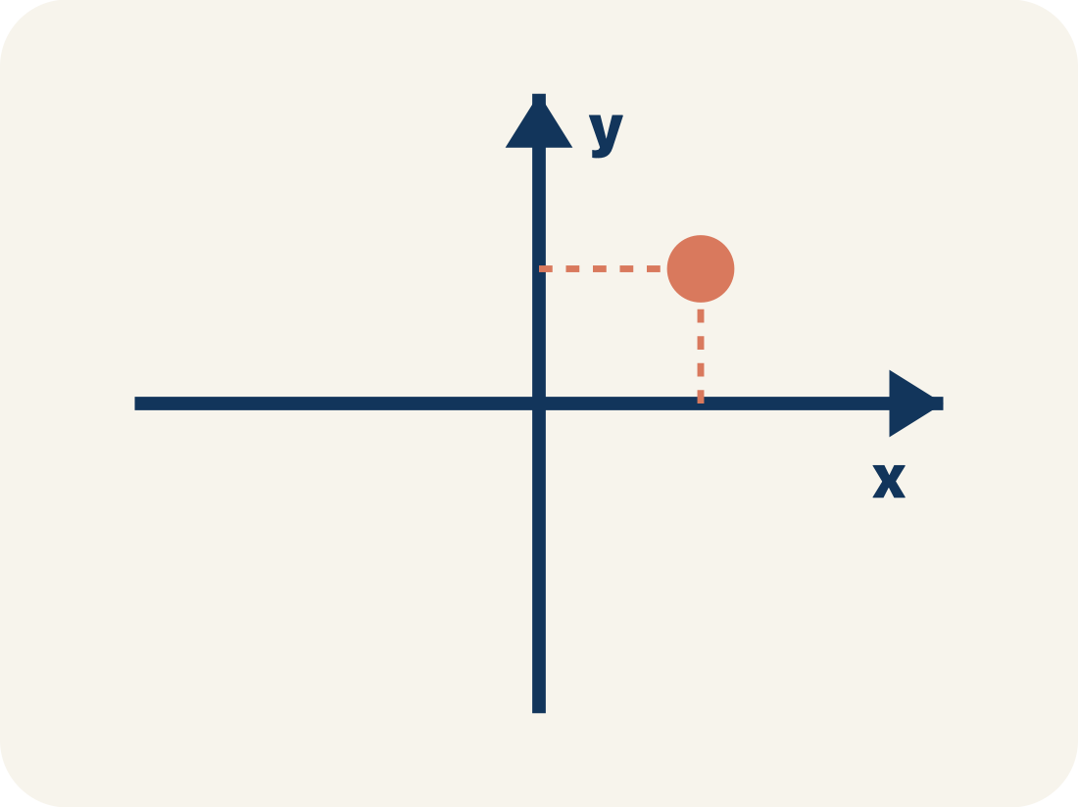
Vocabulary 2 of 7
Lesson 7-5 · Represent Rational Numbers on the Coordinate Plane
Coordinate plane
A grid with a line going across and a line going up to plot points.
EXAMPLE · EXPLAIN WHY IT FITS
A grid with a horizontal line (x-axis) crossing a vertical line (y-axis), making four sections
Use “Coordinate plane” to explain the example. Point to
evidence.
eduwonderlab.com · Neft Teacher
9 / 51
Notes:
TEACH IN PRACTICE | Embedded facilitation | Lesson 7.5, slide 9 | VOCAB
Focus on the existing task: Vocabulary 2 of 7 Coordinate plane A…
ASK (T1/3/5): Where does “Coordinate plane” appear in the example? Explain the meaning without reading the definition. Partner: restate the idea and ask a clarifying question.
LOOK FOR: A correct connection between the word and a feature of the example. If the student only repeats the definition, invite pointing, sketching or oral rehearsal, then ask for another explanation of this same example.
PARTICIPATION (T5/6/7): Think time before volunteers; accept a written, drawn or rehearsed entry. Students ask for evidence respectfully. Recognize a specific contribution or revision and check that both partners participate.
Source: BCPS Updated Instructional Framework Rubric (June 2020), TEACH 1–7.

Slide 10
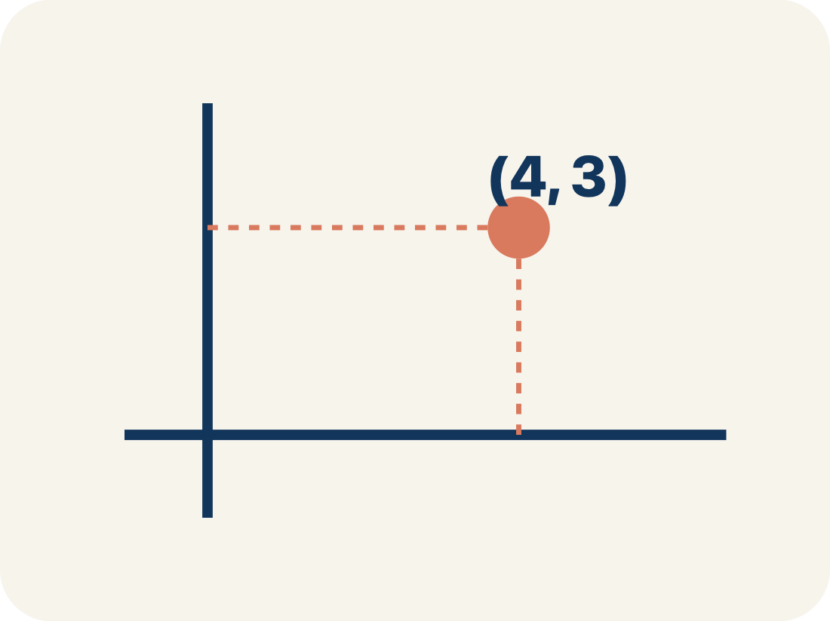
Vocabulary 3 of 7
Lesson 7-5 · Represent Rational Numbers on the Coordinate Plane
Ordered pair
Two numbers (x, y) that tell where a point is on a grid.
EXAMPLE · EXPLAIN WHY IT FITS
(3, 5) means move right 3 from the origin, then up 5
Use “Ordered pair” to explain the example. Point to evidence.
eduwonderlab.com · Neft Teacher
10 / 51
Notes:
TEACH IN PRACTICE | Embedded facilitation | Lesson 7.5, slide 10 | VOCAB
Focus on the existing task: Vocabulary 3 of 7 Ordered pair Two…
ASK (T1/3/5): Where does “Ordered pair” appear in the example? Explain the meaning without reading the definition. Partner: restate the idea and ask a clarifying question.
LOOK FOR: A correct connection between the word and a feature of the example. If the student only repeats the definition, invite pointing, sketching or oral rehearsal, then ask for another explanation of this same example.
PARTICIPATION (T5/6/7): Think time before volunteers; accept a written, drawn or rehearsed entry. Students ask for evidence respectfully. Recognize a specific contribution or revision and check that both partners participate.
Source: BCPS Updated Instructional Framework Rubric (June 2020), TEACH 1–7.

Slide 11
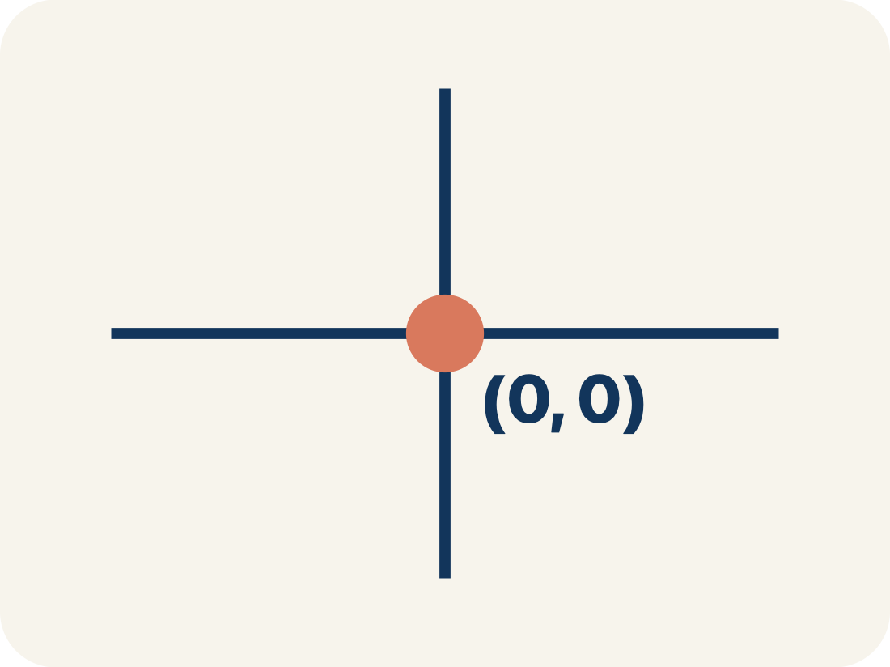
Vocabulary 4 of 7
Lesson 7-5 · Represent Rational Numbers on the Coordinate Plane
Origin
The point (0, 0) where the two grid lines cross.
EXAMPLE · EXPLAIN WHY IT FITS
The starting point at the center where both axes cross — (0, 0)
Use “Origin” to explain the example. Point to evidence.
eduwonderlab.com · Neft Teacher
11 / 51
Notes:
TEACH IN PRACTICE | Embedded facilitation | Lesson 7.5, slide 11 | VOCAB
Focus on the existing task: Vocabulary 4 of 7 Origin The point (0, 0)
ASK (T1/3/5): Where does “Origin” appear in the example? Explain the meaning without reading the definition. Partner: restate the idea and ask a clarifying question.
LOOK FOR: A correct connection between the word and a feature of the example. If the student only repeats the definition, invite pointing, sketching or oral rehearsal, then ask for another explanation of this same example.
PARTICIPATION (T5/6/7): Think time before volunteers; accept a written, drawn or rehearsed entry. Students ask for evidence respectfully. Recognize a specific contribution or revision and check that both partners participate.
Source: BCPS Updated Instructional Framework Rubric (June 2020), TEACH 1–7.

Slide 12
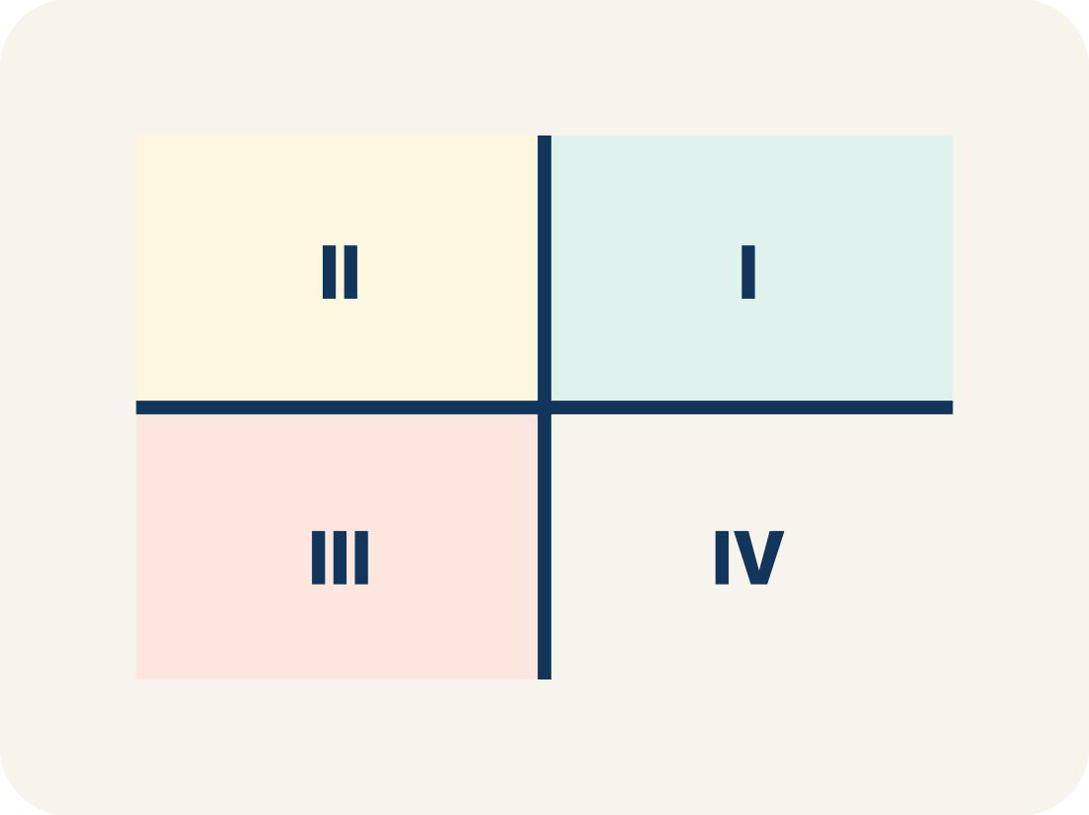
Vocabulary 5 of 7
Lesson 7-5 · Represent Rational Numbers on the Coordinate Plane
Quadrant
One of the four parts of a coordinate grid, numbered I to IV.
EXAMPLE · EXPLAIN WHY IT FITS
I (+,+) top-right, II (-,+) top-left, III (-,-) bottom-left, IV (+,-) bottom-right
Use “Quadrant” to explain the example. Point to evidence.
eduwonderlab.com · Neft Teacher
12 / 51
Notes:
TEACH IN PRACTICE | Embedded facilitation | Lesson 7.5, slide 12 | VOCAB
Focus on the existing task: Vocabulary 5 of 7 Quadrant One of the…
ASK (T1/3/5): Where does “Quadrant” appear in the example? Explain the meaning without reading the definition. Partner: restate the idea and ask a clarifying question.
LOOK FOR: A correct connection between the word and a feature of the example. If the student only repeats the definition, invite pointing, sketching or oral rehearsal, then ask for another explanation of this same example.
PARTICIPATION (T5/6/7): Think time before volunteers; accept a written, drawn or rehearsed entry. Students ask for evidence respectfully. Recognize a specific contribution or revision and check that both partners participate.
Source: BCPS Updated Instructional Framework Rubric (June 2020), TEACH 1–7.

Slide 13
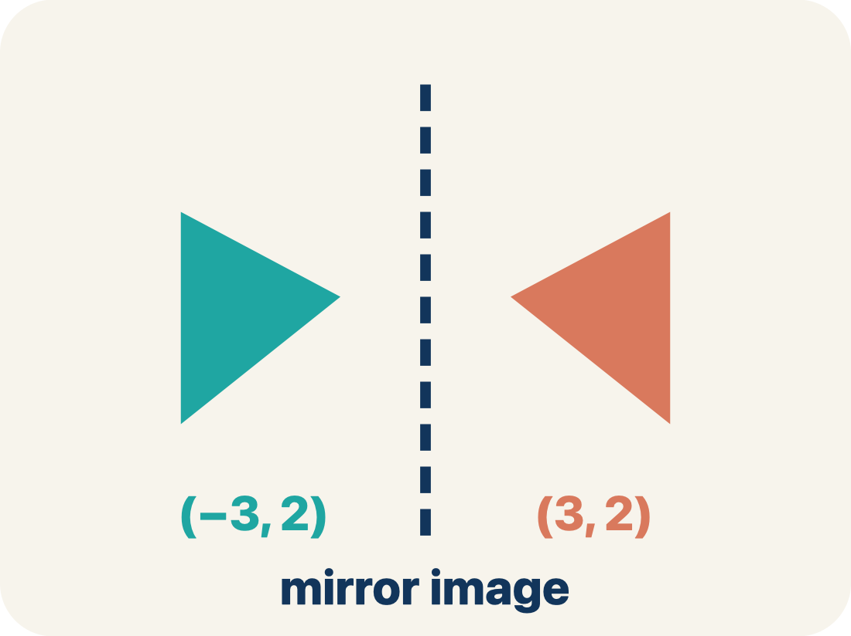
Vocabulary 6 of 7
Lesson 7-5 · Represent Rational Numbers on the Coordinate Plane
Reflection
A flipped, mirror image across a line.
EXAMPLE · EXPLAIN WHY IT FITS
(3, 2) reflected over the x-axis becomes (3, −2) — same x, opposite y
Use “Reflection” to explain the example. Point to evidence.
eduwonderlab.com · Neft Teacher
13 / 51
Notes:
TEACH IN PRACTICE | Embedded facilitation | Lesson 7.5, slide 13 | VOCAB
Focus on the existing task: Vocabulary 6 of 7 Reflection A flipped…
ASK (T1/3/5): Where does “Reflection” appear in the example? Explain the meaning without reading the definition. Partner: restate the idea and ask a clarifying question.
LOOK FOR: A correct connection between the word and a feature of the example. If the student only repeats the definition, invite pointing, sketching or oral rehearsal, then ask for another explanation of this same example.
PARTICIPATION (T5/6/7): Think time before volunteers; accept a written, drawn or rehearsed entry. Students ask for evidence respectfully. Recognize a specific contribution or revision and check that both partners participate.
Source: BCPS Updated Instructional Framework Rubric (June 2020), TEACH 1–7.

Slide 14
Vocabulary 7 of 7
Lesson 7-5 · Represent Rational Numbers on the Coordinate Plane
Integer
Whole numbers and their opposites, like −2, −1, 0, 1, 2.
EXAMPLE · EXPLAIN WHY IT FITS
…, −3, −2, −1, 0, 1, 2, 3, …
Use “Integer” to explain the example. Point to evidence.
eduwonderlab.com · Neft Teacher
14 / 51
Notes:
TEACH IN PRACTICE | Embedded facilitation | Lesson 7.5, slide 14 | VOCAB
Focus on the existing task: Vocabulary 7 of 7 Integer Whole numbers…
ASK (T1/3/5): Where does “Integer” appear in the example? Explain the meaning without reading the definition. Partner: restate the idea and ask a clarifying question.
LOOK FOR: A correct connection between the word and a feature of the example. If the student only repeats the definition, invite pointing, sketching or oral rehearsal, then ask for another explanation of this same example.
PARTICIPATION (T5/6/7): Think time before volunteers; accept a written, drawn or rehearsed entry. Students ask for evidence respectfully. Recognize a specific contribution or revision and check that both partners participate.
Source: BCPS Updated Instructional Framework Rubric (June 2020), TEACH 1–7.

Slide 15
Vocabulary
Lesson 7-5 · Represent Rational Numbers on the Coordinate Plane
Today’s Math Words
We learn every word — what it means and what it looks like — before we use it.
Graph on the Coordinate Plane
Coordinate plane
Plot a point by moving horizontally to its x-coordinate and vertically to its y-coordinate
A grid with a line going across and a line going up to plot points
Ordered pair
Origin
Two numbers (x, y) that tell where a point is on a grid
The point (0, 0) where the two grid lines cross
Quadrant
Reflection
One of the four parts of a coordinate grid, numbered I to IV
A flipped, mirror image across a line
Integer
Explain one math word using the example.
Partner: point to evidence.
Whole numbers and their opposites, like −2, −1, 0, 1, 2
eduwonderlab.com · Neft Teacher
15 / 51
Notes:
TEACH IN PRACTICE | Embedded facilitation | Lesson 7.5, slide 15 | VOCAB
Focus on the existing task: Vocabulary Today’s Math Words We learn…
ASK (T1/3/5): Where does “the displayed term” appear in the example? Explain the meaning without reading the definition. Partner: restate the idea and ask a clarifying question.
LOOK FOR: A correct connection between the word and a feature of the example. If the student only repeats the definition, invite pointing, sketching or oral rehearsal, then ask for another explanation of this same example.
PARTICIPATION (T5/6/7): Think time before volunteers; accept a written, drawn or rehearsed entry. Students ask for evidence respectfully. Recognize a specific contribution or revision and check that both partners participate.
Source: BCPS Updated Instructional Framework Rubric (June 2020), TEACH 1–7. Earlier notes and answer keys are retained below.
EARLIER NOTES / EXISTING ANSWER KEY
Choral-read each word, its meaning, and what it looks like.
Students should use these words out loud today — listen for them in partner talk and revoice student ideas with the academic term.
UIFR: TEACH 1 · TEACH 5.

Slide 16
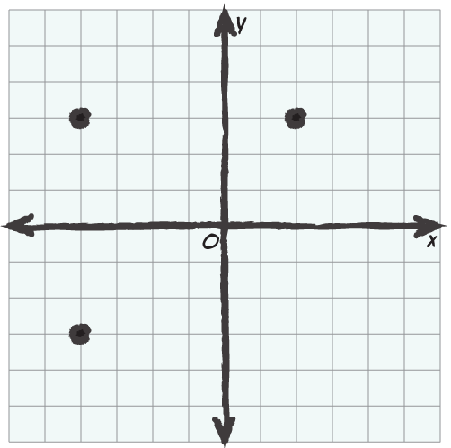

Be Curious
What do you notice?
What do you wonder?
Think first. Share a notice and a question;
build on a classmate’s idea.
Mindset
In what ways can understanding different reasoning strategies help you in math?
16 / 51
Notes:
TEACH IN PRACTICE | Embedded facilitation | Lesson 7.5, slide 16 | CURIOUS
Focus on the existing task: Be Curious Mindset What do you notice?
LAUNCH (T2/3/5): Allow quiet observation first. Separate a notice from an inference, invite students’ own questions, and follow the existing launch before teaching a procedure.
LOOK FOR (T4): Where this task addresses it, students can interpret ordered pairs as horizontal then vertical. Ask which feature of their work supports the claim.
RESPOND: If this task shows the lesson misconception—interchanging x and y or reversing a negative direction—trace horizontal then vertical movement on the original coordinate plane. Have the student revise and explain the change. Use this support only where the concept occurs in the current task; otherwise respond to the displayed question.
RECHECK: If a gap is shared, revisit the existing representation together. If it is limited, give targeted support while others compare valid methods on the same task. Check the revision before moving on.
PARTICIPATION (T5/6/7): Think time before volunteers; accept a written, drawn or rehearsed entry. Students ask for evidence respectfully. Recognize a specific contribution or revision and check that both partners participate.
Source: BCPS Updated Instructional Framework Rubric (June 2020), TEACH 1–7. Earlier notes and answer keys are retained below.
EARLIER NOTES / EXISTING ANSWER KEY
Accept all noticings and wonderings — there are no wrong answers here.
Give 20–30 seconds of quiet think time before taking responses; mix cold and warm calls so it is not always the same voices.
Read the mindset question aloud and let two students respond.
UIFR: TEACH 3 · TEACH 7.

Slide 17
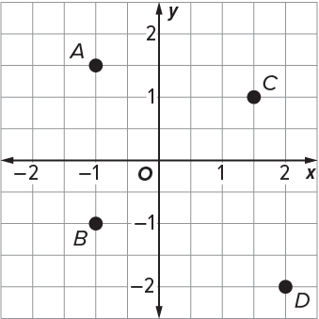
The Coordinate Plane
The coordinate plane shows points A, B, C, and D.
What are the coordinates of the four points?
Think and record first. Which part of your work supports your answer?
17 / 51
Notes:
TEACH IN PRACTICE | Embedded facilitation | Lesson 7.5, slide 17 | TASK
Focus on the existing task: The Coordinate Plane The coordinate plane shows points A, B, C, and D. What are the coordinates of the four points?
LAUNCH (T2/3/5): Use the displayed question. Give private thinking time; then A explains while B asks for evidence. Switch roles. Each student records their own reasoning.
LOOK FOR (T4): Where this task addresses it, students can interpret ordered pairs as horizontal then vertical. Ask which feature of their work supports the claim.
RESPOND: If this task shows the lesson misconception—interchanging x and y or reversing a negative direction—trace horizontal then vertical movement on the original coordinate plane. Have the student revise and explain the change. Use this support only where the concept occurs in the current task; otherwise respond to the displayed question.
RECHECK: If a gap is shared, revisit the existing representation together. If it is limited, give targeted support while others compare valid methods on the same task. Check the revision before moving on.
PARTICIPATION (T5/6/7): Think time before volunteers; accept a written, drawn or rehearsed entry. Students ask for evidence respectfully. Recognize a specific contribution or revision and check that both partners participate.
Source: BCPS Updated Instructional Framework Rubric (June 2020), TEACH 1–7. Earlier notes and answer keys are retained below.
EARLIER NOTES / EXISTING ANSWER KEY
Model briefly, then hand the thinking back: ask “Why does this step work?” before showing the next one.
Quick check before moving on — thumbs or whiteboards from everyone, not volunteers.
UIFR: TEACH 2 · TEACH 3 · TEACH 4.
UIFR FULL | Lesson-specific facilitation
TEACH 2-3 | Session 1 task launch (UIFR PDF pp. 9-10).
Use the problem exactly as displayed. Give individual thinking time before discussion or advancing to the explanation. If the answer is already visible, ask students to reconstruct and justify it. Invite a choice of suitable representations and have students explain why their choice helps.
At the point where this concept appears, ask: “How does each coordinate control one movement from the origin?” Wait for evidence, invite another pathway, and have a student ask a follow-up question. Do not replace students’ reasoning with a sequence of leading steps.

Slide 18
The Coordinate Plane
The coordinate plane shows points A, B, C, and D.
What do you notice about the coordinate plane and the points?
HOW DO YOU KNOW? · Ask your partner “How do you know?” Answer by pointing to your own work.
Reveal:
The coordinate plane is separated into 4 sections. Each point is in a different section of the coordinate plane.
18 / 51
Notes:
TEACH IN PRACTICE | Embedded facilitation | Lesson 7.5, slide 18 | REVEAL
Focus on the existing task: The coordinate plane shows points A, B, C, and D. What do you notice about the coordinate plane and the points?
LAUNCH (T2/3/5): If an existing answer cover is present, gather an attempt before revealing. If the explanation is already visible, ask students to reconstruct and justify it. Compare reasoning and explain a revision; preserve the reveal sequence.
LOOK FOR (T4): Where this task addresses it, students can interpret ordered pairs as horizontal then vertical. Ask which feature of their work supports the claim.
RESPOND: If this task shows the lesson misconception—interchanging x and y or reversing a negative direction—trace horizontal then vertical movement on the original coordinate plane. Have the student revise and explain the change. Use this support only where the concept occurs in the current task; otherwise respond to the displayed question.
RECHECK: If a gap is shared, revisit the existing representation together. If it is limited, give targeted support while others compare valid methods on the same task. Check the revision before moving on.
PARTICIPATION (T5/6/7): Think time before volunteers; accept a written, drawn or rehearsed entry. Students ask for evidence respectfully. Recognize a specific contribution or revision and check that both partners participate.
Source: BCPS Updated Instructional Framework Rubric (June 2020), TEACH 1–7. Earlier notes and answer keys are retained below.
EARLIER NOTES / EXISTING ANSWER KEY
Do not click yet: collect 2–3 student answers with reasons first.
Then click to remove the cover and have students compare their thinking to the reveal — “Is this what we said? Where is it different?”
Behind the cover: The coordinate plane is separated into 4 sections. Each point is in a different section of the coordinate plane.
UIFR: TEACH 3 · TEACH 4.

Slide 19
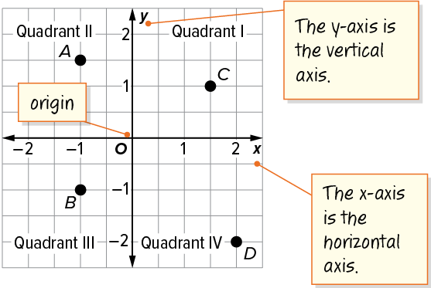
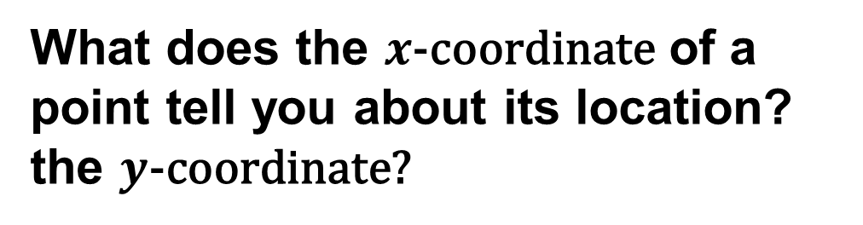
The Coordinate Plane
This coordinate plane has 4 sections or quadrants. The coordinates of a point may indicate in which quadrant the point is located.
TRY IT BEFORE YOU’RE SURE · Start even if you are not sure. A revised answer counts as much as a first-try answer.
Think About It:
How does what you know about quarters relate to quadrants?
19 / 51
Notes:
TEACH IN PRACTICE | Embedded facilitation | Lesson 7.5, slide 19 | TASK
Focus on the existing task: The Coordinate Plane Think About It: How does what you know about quarters relate to quadrants?
LAUNCH (T2/3/5): Use the displayed question. Give private thinking time; then A explains while B asks for evidence. Switch roles. Each student records their own reasoning.
LOOK FOR (T4): Where this task addresses it, students can interpret ordered pairs as horizontal then vertical. Ask which feature of their work supports the claim.
RESPOND: If this task shows the lesson misconception—interchanging x and y or reversing a negative direction—trace horizontal then vertical movement on the original coordinate plane. Have the student revise and explain the change. Use this support only where the concept occurs in the current task; otherwise respond to the displayed question.
RECHECK: If a gap is shared, revisit the existing representation together. If it is limited, give targeted support while others compare valid methods on the same task. Check the revision before moving on.
PARTICIPATION (T5/6/7): Think time before volunteers; accept a written, drawn or rehearsed entry. Students ask for evidence respectfully. Recognize a specific contribution or revision and check that both partners participate.
Source: BCPS Updated Instructional Framework Rubric (June 2020), TEACH 1–7. Earlier notes and answer keys are retained below.
EARLIER NOTES / EXISTING ANSWER KEY
Ask the question, then hold the silence — students think or jot before anyone answers.
Take two or three responses and press with “Why?” or “How do you know?” before moving on.
UIFR: TEACH 3.

Slide 20
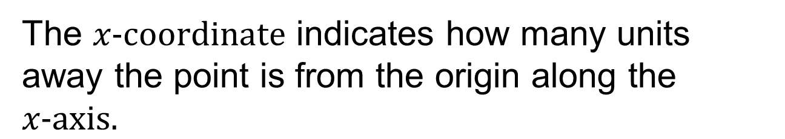
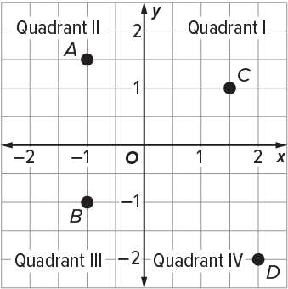
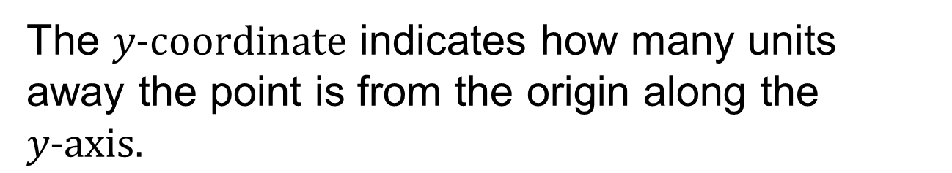
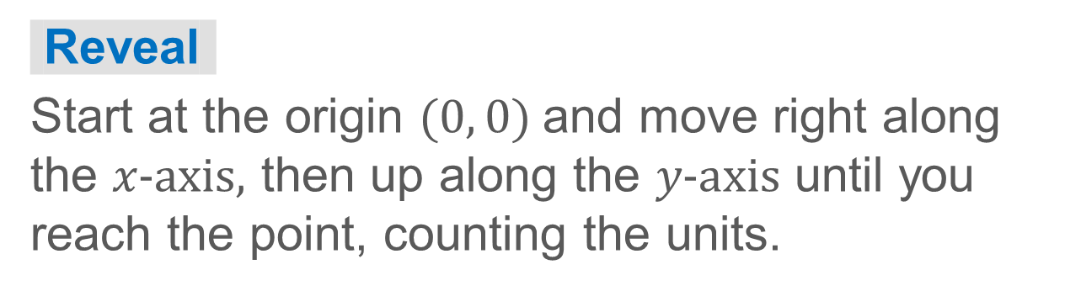
The Coordinate Plane
How can you find the coordinates of a point in Quadrant I?
20 / 51
Notes:
TEACH IN PRACTICE | Embedded facilitation | Lesson 7.5, slide 20 | TASK
Focus on the existing task: How can you find the coordinates of a point in Quadrant I?
LAUNCH (T2/3/5): Use the displayed question. Give private thinking time; then A explains while B asks for evidence. Switch roles. Each student records their own reasoning.
LOOK FOR (T4): Where this task addresses it, students can interpret ordered pairs as horizontal then vertical. Ask which feature of their work supports the claim.
RESPOND: If this task shows the lesson misconception—interchanging x and y or reversing a negative direction—trace horizontal then vertical movement on the original coordinate plane. Have the student revise and explain the change. Use this support only where the concept occurs in the current task; otherwise respond to the displayed question.
RECHECK: If a gap is shared, revisit the existing representation together. If it is limited, give targeted support while others compare valid methods on the same task. Check the revision before moving on.
PARTICIPATION (T5/6/7): Think time before volunteers; accept a written, drawn or rehearsed entry. Students ask for evidence respectfully. Recognize a specific contribution or revision and check that both partners participate.
Source: BCPS Updated Instructional Framework Rubric (June 2020), TEACH 1–7. Earlier notes and answer keys are retained below.
EARLIER NOTES / EXISTING ANSWER KEY
Model briefly, then hand the thinking back: ask “Why does this step work?” before showing the next one.
Quick check before moving on — thumbs or whiteboards from everyone, not volunteers.
UIFR: TEACH 2 · TEACH 3 · TEACH 4.

Slide 21
STUDENT MOVES
Lesson 7-5
Your move
USE YOUR TOOLS · Reach for your notes, a model, or a manipulative before you reach for an answer.
21 / 51

Slide 22
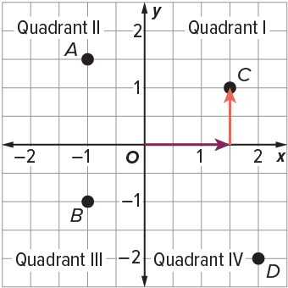
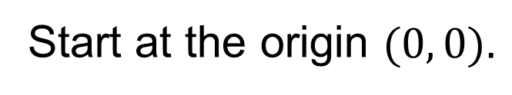
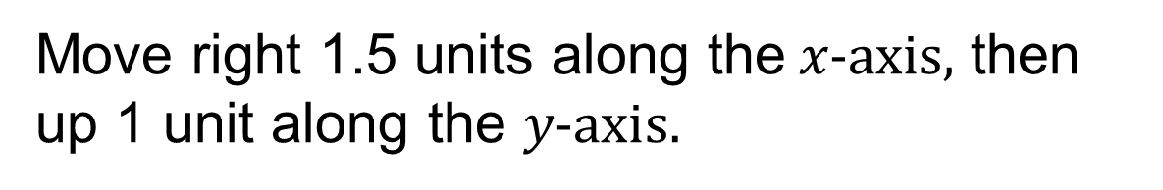
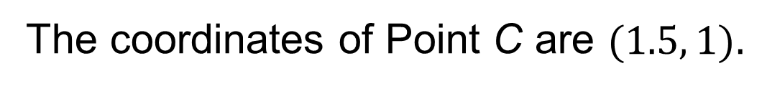
The Coordinate Plane
Let’s find the coordinates of Point C in Quadrant I.
Explain how the information shown supports your reasoning.
22 / 51
Notes:
TEACH IN PRACTICE | Embedded facilitation | Lesson 7.5, slide 21 | WORKED
Focus on the existing task: Let’s find the coordinates of Point C in Quadrant I. The Coordinate Plane
LAUNCH (T2/3/5): Ask students to explain the displayed idea or example and point to evidence. When a calculation step is shown, ask why it is valid. Have a partner restate the explanation; copying is not the check.
LOOK FOR (T4): Where this task addresses it, students can interpret ordered pairs as horizontal then vertical. Ask which feature of their work supports the claim.
RESPOND: If this task shows the lesson misconception—interchanging x and y or reversing a negative direction—trace horizontal then vertical movement on the original coordinate plane. Have the student revise and explain the change. Use this support only where the concept occurs in the current task; otherwise respond to the displayed question.
RECHECK: If a gap is shared, revisit the existing representation together. If it is limited, give targeted support while others compare valid methods on the same task. Check the revision before moving on.
PARTICIPATION (T5/6/7): Think time before volunteers; accept a written, drawn or rehearsed entry. Students ask for evidence respectfully. Recognize a specific contribution or revision and check that both partners participate.
Source: BCPS Updated Instructional Framework Rubric (June 2020), TEACH 1–7. Earlier notes and answer keys are retained below.
EARLIER NOTES / EXISTING ANSWER KEY
Model briefly, then hand the thinking back: ask “Why does this step work?” before showing the next one.
Quick check before moving on — thumbs or whiteboards from everyone, not volunteers.
UIFR: TEACH 2 · TEACH 3 · TEACH 4.

Slide 23
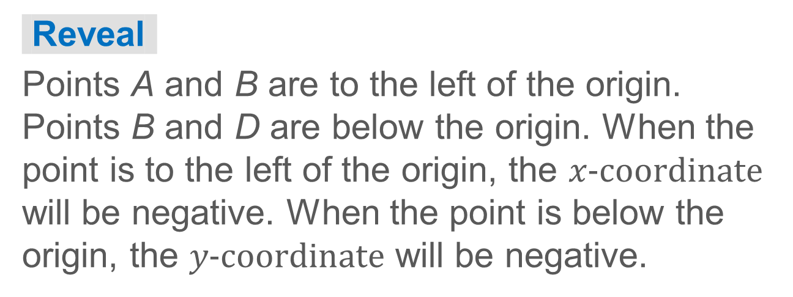
The Coordinate Plane
How do the locations of points A, B, and D compare to the origin? How might this affect the coordinates of the points?
ADD ON · Add on: “I agree because ______.” or “I see it differently because ______.”
23 / 51
Notes:
TEACH IN PRACTICE | Embedded facilitation | Lesson 7.5, slide 22 | TASK
Focus on the existing task: How do the locations of points A, B, and D compare to the origin?
LAUNCH (T2/3/5): Use the displayed question. Give private thinking time; then A explains while B asks for evidence. Switch roles. Each student records their own reasoning.
LOOK FOR (T4): Where this task addresses it, students can interpret ordered pairs as horizontal then vertical. Ask which feature of their work supports the claim.
RESPOND: If this task shows the lesson misconception—interchanging x and y or reversing a negative direction—trace horizontal then vertical movement on the original coordinate plane. Have the student revise and explain the change. Use this support only where the concept occurs in the current task; otherwise respond to the displayed question.
RECHECK: If a gap is shared, revisit the existing representation together. If it is limited, give targeted support while others compare valid methods on the same task. Check the revision before moving on.
PARTICIPATION (T5/6/7): Think time before volunteers; accept a written, drawn or rehearsed entry. Students ask for evidence respectfully. Recognize a specific contribution or revision and check that both partners participate.
Source: BCPS Updated Instructional Framework Rubric (June 2020), TEACH 1–7. Earlier notes and answer keys are retained below.
EARLIER NOTES / EXISTING ANSWER KEY
Model briefly, then hand the thinking back: ask “Why does this step work?” before showing the next one.
Quick check before moving on — thumbs or whiteboards from everyone, not volunteers.
UIFR: TEACH 2 · TEACH 3 · TEACH 4.

Slide 24
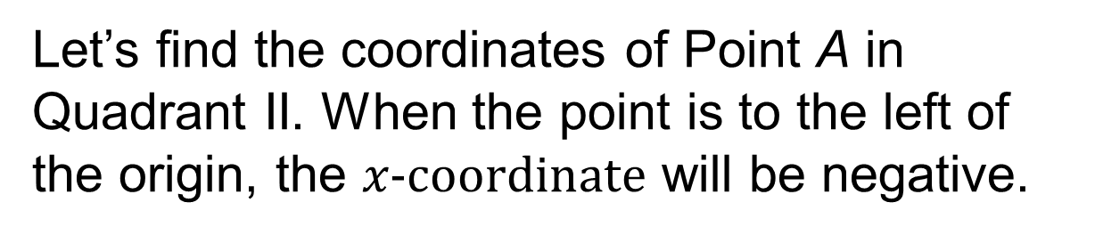
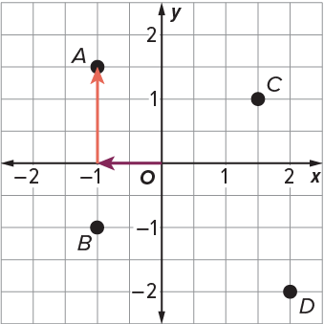
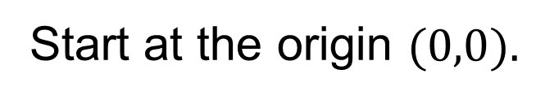
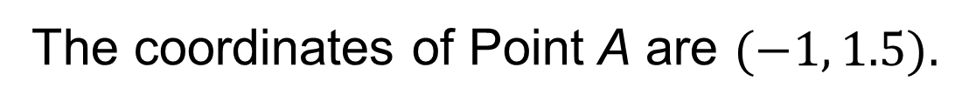
The Coordinate Plane
Move left 1 unit along the x-axis, then up 1.5 units along the y-axis.
Explain how the information shown supports your reasoning.
24 / 51
Notes:
TEACH IN PRACTICE | Embedded facilitation | Lesson 7.5, slide 23 | WORKED
Focus on the existing task: Move left 1 unit along the x -axis, then up 1.5 units along the y -axis. The Coordinate Plane
LAUNCH (T2/3/5): Ask students to explain the displayed idea or example and point to evidence. When a calculation step is shown, ask why it is valid. Have a partner restate the explanation; copying is not the check.
LOOK FOR (T4): Where this task addresses it, students can interpret ordered pairs as horizontal then vertical. Ask which feature of their work supports the claim.
RESPOND: If this task shows the lesson misconception—interchanging x and y or reversing a negative direction—trace horizontal then vertical movement on the original coordinate plane. Have the student revise and explain the change. Use this support only where the concept occurs in the current task; otherwise respond to the displayed question.
RECHECK: If a gap is shared, revisit the existing representation together. If it is limited, give targeted support while others compare valid methods on the same task. Check the revision before moving on.
PARTICIPATION (T5/6/7): Think time before volunteers; accept a written, drawn or rehearsed entry. Students ask for evidence respectfully. Recognize a specific contribution or revision and check that both partners participate.
Source: BCPS Updated Instructional Framework Rubric (June 2020), TEACH 1–7. Earlier notes and answer keys are retained below.
EARLIER NOTES / EXISTING ANSWER KEY
Model briefly, then hand the thinking back: ask “Why does this step work?” before showing the next one.
Quick check before moving on — thumbs or whiteboards from everyone, not volunteers.
UIFR: TEACH 2 · TEACH 3 · TEACH 4.

Slide 25

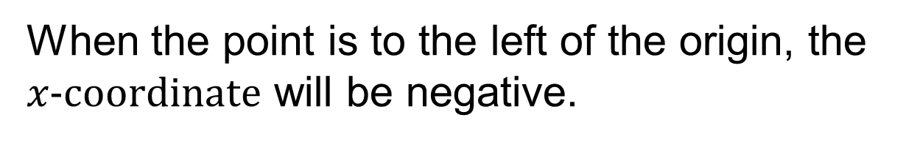
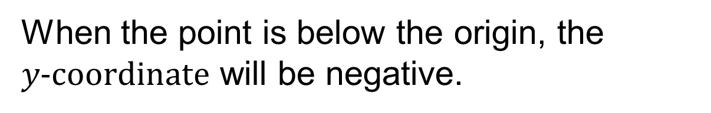
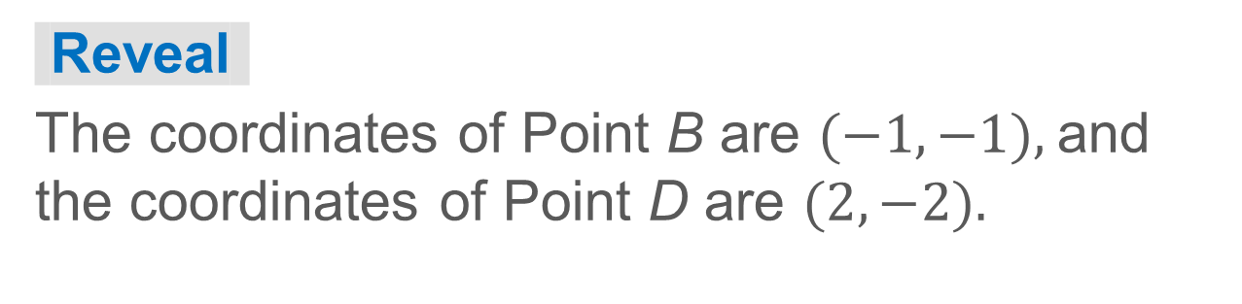
COLLABORATE · TALK IT THROUGH • AGREE ON A MODEL
Collaborate and Connect
Find the coordinates of points B and D.
25 / 51
Notes:
TEACH IN PRACTICE | Embedded facilitation | Lesson 7.5, slide 24 | COLLABORATE
Focus on the existing task: Find the coordinates of points B and D. Collaborate and Connect COLLABORATE · TALK IT THROUGH • AGREE ON A MODEL
LAUNCH (T2/3/5): Use the displayed question. Give private thinking time; then A explains while B asks for evidence. Switch roles. Each student records their own reasoning.
LOOK FOR (T4): Where this task addresses it, students can interpret ordered pairs as horizontal then vertical. Ask which feature of their work supports the claim.
RESPOND: If this task shows the lesson misconception—interchanging x and y or reversing a negative direction—trace horizontal then vertical movement on the original coordinate plane. Have the student revise and explain the change. Use this support only where the concept occurs in the current task; otherwise respond to the displayed question.
RECHECK: If a gap is shared, revisit the existing representation together. If it is limited, give targeted support while others compare valid methods on the same task. Check the revision before moving on.
PARTICIPATION (T5/6/7): Think time before volunteers; accept a written, drawn or rehearsed entry. Students ask for evidence respectfully. Recognize a specific contribution or revision and check that both partners participate.
Source: BCPS Updated Instructional Framework Rubric (June 2020), TEACH 1–7. Earlier notes and answer keys are retained below.
EARLIER NOTES / EXISTING ANSWER KEY
Routine: COLLABORATE · TALK IT THROUGH • AGREE ON A MODEL
UIFR FULL | Lesson-specific facilitation
TEACH 4-5 | Session 1 discussion and checkpoint (UIFR PDF pp. 11-12).
Collect a brief response from every student to the existing prompt before hearing volunteers. Partners take turns explaining and asking for evidence: “I understand ___; what supports ___?” Offer rehearsal or an annotated model for students who need language support. Each student records their own reasoning.
Look specifically for: interchanging x and y or reversing a negative direction. If it appears, trace horizontal then vertical movement on the original coordinate plane; then ask the student to revise the same response and explain the change. If evidence is secure, have students compare a second valid pathway or state why their approach works. Choose the next step from the responses, not a preset pace.

Slide 26
STUDENT MOVES
Lesson 7-5
Your move
RESTATE FIRST · Restate your partner’s idea in your own words before you give yours.
26 / 51

Slide 27
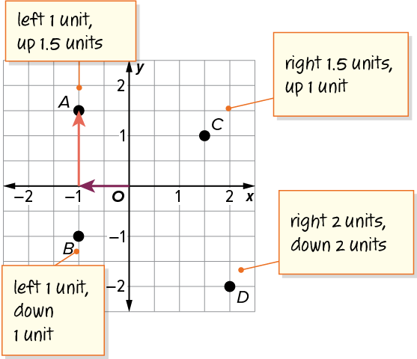
The Coordinate Plane
What do you notice about the signs of the coordinates of the points in each quadrant?
Think and record first. Which part of your work supports your
answer?
Using Structure
How can generalizing be helpful in solving this problem?
27 / 51
Notes:
TEACH IN PRACTICE | Embedded facilitation | Lesson 7.5, slide 25 | TASK
Focus on the existing task: What do you notice about the signs of the coordinates of the points in each quadrant?
LAUNCH (T2/3/5): Use the displayed question. Give private thinking time; then A explains while B asks for evidence. Switch roles. Each student records their own reasoning.
LOOK FOR (T4): Where this task addresses it, students can use signs to select directions. Ask which feature of their work supports the claim.
RESPOND: If this task shows the lesson misconception—interchanging x and y or reversing a negative direction—trace horizontal then vertical movement on the original coordinate plane. Have the student revise and explain the change. Use this support only where the concept occurs in the current task; otherwise respond to the displayed question.
RECHECK: If a gap is shared, revisit the existing representation together. If it is limited, give targeted support while others compare valid methods on the same task. Check the revision before moving on.
PARTICIPATION (T5/6/7): Think time before volunteers; accept a written, drawn or rehearsed entry. Students ask for evidence respectfully. Recognize a specific contribution or revision and check that both partners participate.
Source: BCPS Updated Instructional Framework Rubric (June 2020), TEACH 1–7. Earlier notes and answer keys are retained below.
EARLIER NOTES / EXISTING ANSWER KEY
Model briefly, then hand the thinking back: ask “Why does this step work?” before showing the next one.
Quick check before moving on — thumbs or whiteboards from everyone, not volunteers.
UIFR: TEACH 2 · TEACH 3 · TEACH 4.

Slide 28
Let’s Explore More
What statement can you make about the coordinates for points in Quadrant III? In Quadrant IV?
Workspace
How are the coordinates for points in Quadrant I different from the coordinates for points in Quadrant II?
Workspace
28 / 51
Notes:
TEACH IN PRACTICE | Embedded facilitation | Lesson 7.5, slide 26 | PRACTICE
Focus on the existing task: Let’s Explore More What statement can you make about the coordinates for points in Quadrant III?
LAUNCH (T2/3/5): Use the displayed question. Give private thinking time; then A explains while B asks for evidence. Switch roles. Each student records their own reasoning.
LOOK FOR (T4): Where this task addresses it, students can interpret ordered pairs as horizontal then vertical. Ask which feature of their work supports the claim.
RESPOND: If this task shows the lesson misconception—interchanging x and y or reversing a negative direction—trace horizontal then vertical movement on the original coordinate plane. Have the student revise and explain the change. Use this support only where the concept occurs in the current task; otherwise respond to the displayed question.
RECHECK: If a gap is shared, revisit the existing representation together. If it is limited, give targeted support while others compare valid methods on the same task. Check the revision before moving on.
PARTICIPATION (T5/6/7): Think time before volunteers; accept a written, drawn or rehearsed entry. Students ask for evidence respectfully. Recognize a specific contribution or revision and check that both partners participate.
Source: BCPS Updated Instructional Framework Rubric (June 2020), TEACH 1–7. Earlier notes and answer keys are retained below.
EARLIER NOTES / EXISTING ANSWER KEY
Extension for partners or table groups — students choose their approach and use the workspace to show thinking.
Push with “Convince me,” and have two groups with different approaches share.
This is where students stretch past the worked example.
UIFR: TEACH 2 · TEACH 5.

Slide 29
STUDENT MOVES
Lesson 7-5
Your move
TWO MINUTES SOLO · Two minutes on your own, then compare. Bring one thing you tried, even if it did not work.
29 / 51

Slide 30
LESSON 7.5 / DISCUSS THE TASK
Explain and compare
Use the task you just explored.
TAKE TURNS
How does each coordinate control one movement from the origin?
Explain
“I know this because…”
Ask
“Where does your work show that?”
Point to evidence in your work.
Then compare your approach with a partner’s.
JUSTIFY IT · Say it like this: “I know ______ because ______.”
Listen to understand. Ask for evidence. Make room for every voice.
Notes:
TEACH IN PRACTICE | Embedded facilitation | Lesson 7.5, slide 27 | PRIOR_INSERT
Focus on the existing task: Point to evidence in your work. Then compare your approach with a partner’s. TAKE TURNS Explain “I know this because…” Ask “Where does your work show that?
CONNECT (T1/4): Ask students to restate the displayed goal or key idea and connect it to earlier work. Relevant lesson evidence: interpret ordered pairs as horizontal then vertical; use signs to select directions. Use only the criterion that matches the current session.
SHOW PROGRESS: Students point to their own existing work, explain what improved after feedback, and name a next step. Pair confidence ratings with actual evidence.
PARTICIPATION (T5/6/7): Think time before volunteers; accept a written, drawn or rehearsed entry. Students ask for evidence respectfully. Recognize a specific contribution or revision and check that both partners participate.
Source: BCPS Updated Instructional Framework Rubric (June 2020), TEACH 1–7.

Slide 31
The Coordinate Plane
The coordinate plane shows points A, B, C, and D.
What do you notice about the coordinate plane and the points?
Compare your reasoning with the explanation. Explain any
revision you make.
Reveal:
The coordinate plane is separated into 4 sections. Each point is in a different section of the coordinate plane.
31 / 51
Notes:
TEACH IN PRACTICE | Embedded facilitation | Lesson 7.5, slide 28 | REVEAL
Focus on the existing task: The coordinate plane shows points A, B, C, and D. What do you notice about the coordinate plane and the points?
LAUNCH (T2/3/5): If an existing answer cover is present, gather an attempt before revealing. If the explanation is already visible, ask students to reconstruct and justify it. Compare reasoning and explain a revision; preserve the reveal sequence.
LOOK FOR (T4): Where this task addresses it, students can interpret ordered pairs as horizontal then vertical. Ask which feature of their work supports the claim.
RESPOND: If this task shows the lesson misconception—interchanging x and y or reversing a negative direction—trace horizontal then vertical movement on the original coordinate plane. Have the student revise and explain the change. Use this support only where the concept occurs in the current task; otherwise respond to the displayed question.
RECHECK: If a gap is shared, revisit the existing representation together. If it is limited, give targeted support while others compare valid methods on the same task. Check the revision before moving on.
PARTICIPATION (T5/6/7): Think time before volunteers; accept a written, drawn or rehearsed entry. Students ask for evidence respectfully. Recognize a specific contribution or revision and check that both partners participate.
Source: BCPS Updated Instructional Framework Rubric (June 2020), TEACH 1–7.

Slide 32
Session 2 Warm-Up
Lesson 7-5 · Represent Rational Numbers on the Coordinate Plane
Session 2 Warm-Up
Check what you remember from Session 1 · about 4 minutes
1
In an ordered pair (x, y), x represents:
2
The point where the x-axis and y-axis intersect is:
A
Vertical move
A
Apex
B
Horizontal move along x-axis
B
Origin (0, 0)
C
Angle size
C
Quadrant I
D
Quadrant number
D
Infinity
3
Which quadrant contains the point (−3, 4)?
4
Point (−5, −2) is located in:
A
Quadrant I
A
Quadrant I
B
Quadrant II
B
Quadrant II
C
Quadrant III
C
Quadrant III
D
Quadrant IV
D
Quadrant IV
eduwonderlab.com · Neft Teacher
32 / 51
Notes:
TEACH IN PRACTICE | Embedded facilitation | Lesson 7.5, slide 29 | WARMUP
Focus on the existing task: Session 2 Warm-Up Session 2 Warm-Up…
GATHER EVIDENCE (T4/6): Keep the original items. Students try independently, mark an uncertain item, and explain one method before checking. Use the existing key when present.
RESPOND: Distinguish a calculation slip from a reasoning gap. Give one next step on the same item; have students revise in a second color. Use the responses to choose flexible support for today’s lesson.
PARTICIPATION (T5/6/7): Think time before volunteers; accept a written, drawn or rehearsed entry. Students ask for evidence respectfully. Recognize a specific contribution or revision and check that both partners participate.
Source: BCPS Updated Instructional Framework Rubric (June 2020), TEACH 1–7. Earlier notes and answer keys are retained below.
EARLIER NOTES / EXISTING ANSWER KEY
Warm-up routine: students start silently on entry; keep it to about 4 minutes.
Circulate and note who is stuck — use what you see to choose who you check on first today.
Go over answers quickly; ask one student to explain a step, not just say the answer.
UIFR: TEACH 4 · TEACH 6.
UIFR FULL | Lesson-specific facilitation
TEACH 1 | Session 2 purpose and evidence (UIFR PDF p. 8).
Have students restate the displayed session goal in their own words and connect it to the existing context or a familiar experience they choose to share. Use the current session goal to select from these lesson-wide evidence criteria; do not frontload a later-session procedure.
Look for: interpret ordered pairs as horizontal then vertical; use signs to select directions. Ask: “Which part of your work would show this?” Revisit that evidence after the task; a confidence rating alone is not evidence of understanding.

Slide 33
STUDENT MOVES
Lesson 7-5
Your move
YOU KNOW THE ROUTINE · Read → plan → solve → check. Do all four, in that order.
33 / 51

Slide 34
Today’s Math Notes
Lesson 7-5 · Represent Rational Numbers on the Coordinate Plane
Review Notes — Session 2
Copy. Explain. Check.
WHY IT MATTERS · Finish this: “This is worth knowing because ______.”
Coordinate Plane Quadrants
1
Quad I (+, +), Quad II (−, +), Quad III (−, −), Quad IV (+, −), intersecting at Origin (0,0).
Ordered Pairs (x, y)
2
Move x units horizontally (right +, left −), then y units vertically (up +, down −).
Axis Points
3
Points with y = 0 sit on the x-axis; points with x = 0 sit on the y-axis.
eduwonderlab.com · Neft Teacher
34 / 51
Notes:
TEACH IN PRACTICE | Embedded facilitation | Lesson 7.5, slide 30 | NOTES
Focus on the existing task: Today’s Math Notes Review Notes…
ROUTINE (T1/2/4): Read or copy the original notes, cover one line, and explain it using the displayed example. Reopen and correct. Copying alone is not evidence of understanding.
LOOK FOR: A link between a symbol, quantity or feature and the explanation. If missing, point back to that feature and have the student try again; fade the prompt once they can explain.
PARTICIPATION (T5/6/7): Think time before volunteers; accept a written, drawn or rehearsed entry. Students ask for evidence respectfully. Recognize a specific contribution or revision and check that both partners participate.
Source: BCPS Updated Instructional Framework Rubric (June 2020), TEACH 1–7. Earlier notes and answer keys are retained below.
EARLIER NOTES / EXISTING ANSWER KEY
Copy routine: read one line at a time; students copy, then explain that line to a partner.
Keep it brisk — the understanding work happens in the examples, not the copying.
UIFR: TEACH 1 · TEACH 6.

Slide 35
Session 2
Represent Rational Numbers on the Coordinate Plane
SELF-CHECK · Mark it: ✓ got it · ~ almost · ? stuck. Then fix one thing before we move on.
35 / 51
Notes:
TEACH IN PRACTICE | Embedded facilitation | Lesson 7.5, slide 31 | DIVIDER
Focus on the existing task: Represent Rational Numbers on the Coordinate Plane Session 2
TRANSITION (T6/7): Students confirm materials, roles, how to request help, and the next response routine. Ask a student to restate it. Keep teacher-only slides hidden.
PARTICIPATION (T5/6/7): Think time before volunteers; accept a written, drawn or rehearsed entry. Students ask for evidence respectfully. Recognize a specific contribution or revision and check that both partners participate.
Source: BCPS Updated Instructional Framework Rubric (June 2020), TEACH 1–7. Earlier notes and answer keys are retained below.
EARLIER NOTES / EXISTING ANSWER KEY
Transition cue: state what materials are out and what success looks like this session.
Keep the changeover under a minute.
UIFR: TEACH 6.

Slide 36
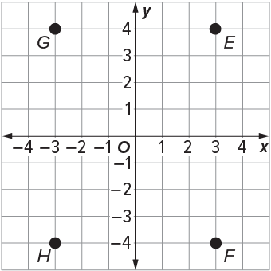
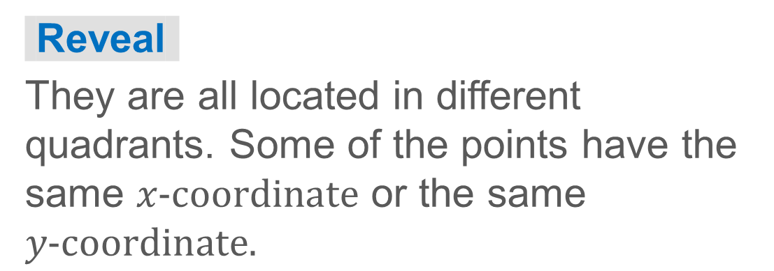
Point Relationships
How do points E, F, and G relate?
What do you notice about the points?
Think and record first. Which part of your
work supports your answer?
36 / 51
Notes:
TEACH IN PRACTICE | Embedded facilitation | Lesson 7.5, slide 32 | TASK
Focus on the existing task: Point Relationships How do points E, F, and G relate?
LAUNCH (T2/3/5): Use the displayed question. Give private thinking time; then A explains while B asks for evidence. Switch roles. Each student records their own reasoning.
LOOK FOR (T4): Where this task addresses it, students can interpret ordered pairs as horizontal then vertical. Ask which feature of their work supports the claim.
RESPOND: If this task shows the lesson misconception—interchanging x and y or reversing a negative direction—trace horizontal then vertical movement on the original coordinate plane. Have the student revise and explain the change. Use this support only where the concept occurs in the current task; otherwise respond to the displayed question.
RECHECK: If a gap is shared, revisit the existing representation together. If it is limited, give targeted support while others compare valid methods on the same task. Check the revision before moving on.
PARTICIPATION (T5/6/7): Think time before volunteers; accept a written, drawn or rehearsed entry. Students ask for evidence respectfully. Recognize a specific contribution or revision and check that both partners participate.
Source: BCPS Updated Instructional Framework Rubric (June 2020), TEACH 1–7. Earlier notes and answer keys are retained below.
EARLIER NOTES / EXISTING ANSWER KEY
Model briefly, then hand the thinking back: ask “Why does this step work?” before showing the next one.
Quick check before moving on — thumbs or whiteboards from everyone, not volunteers.
UIFR: TEACH 2 · TEACH 3 · TEACH 4.
UIFR FULL | Lesson-specific facilitation
TEACH 2-3 | Session 2 task launch (UIFR PDF pp. 9-10).
Use the problem exactly as displayed. Give individual thinking time before discussion or advancing to the explanation. If the answer is already visible, ask students to reconstruct and justify it. Invite a choice of suitable representations and have students explain why their choice helps.
At the point where this concept appears, ask: “How does each coordinate control one movement from the origin?” Wait for evidence, invite another pathway, and have a student ask a follow-up question. Do not replace students’ reasoning with a sequence of leading steps.

Slide 37
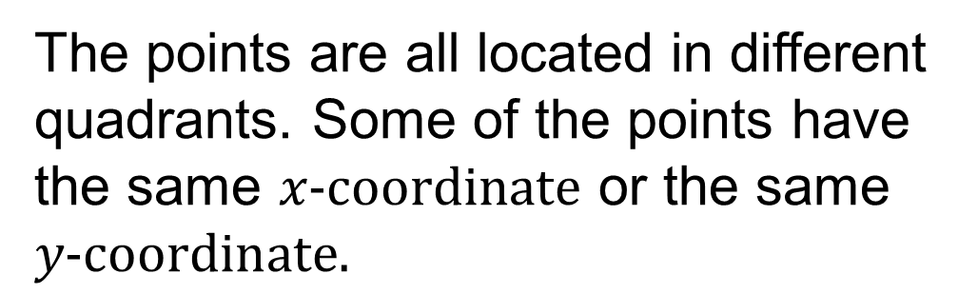
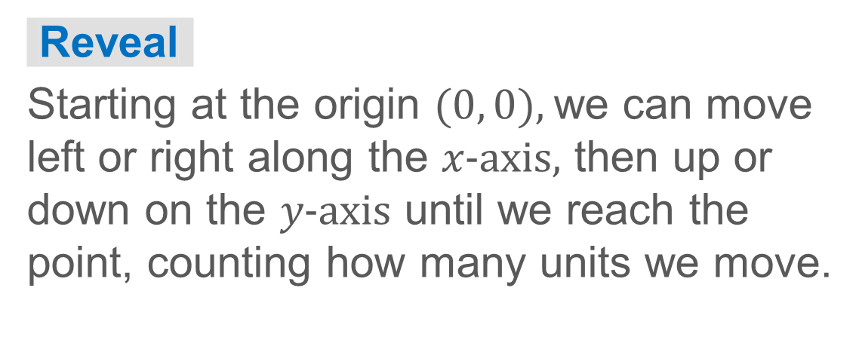
Point Relationships
How can you find the coordinates of each point?
37 / 51
Notes:
TEACH IN PRACTICE | Embedded facilitation | Lesson 7.5, slide 33 | TASK
Focus on the existing task: Point Relationships How can you find the coordinates of each point?
LAUNCH (T2/3/5): Use the displayed question. Give private thinking time; then A explains while B asks for evidence. Switch roles. Each student records their own reasoning.
LOOK FOR (T4): Where this task addresses it, students can interpret ordered pairs as horizontal then vertical. Ask which feature of their work supports the claim.
RESPOND: If this task shows the lesson misconception—interchanging x and y or reversing a negative direction—trace horizontal then vertical movement on the original coordinate plane. Have the student revise and explain the change. Use this support only where the concept occurs in the current task; otherwise respond to the displayed question.
RECHECK: If a gap is shared, revisit the existing representation together. If it is limited, give targeted support while others compare valid methods on the same task. Check the revision before moving on.
PARTICIPATION (T5/6/7): Think time before volunteers; accept a written, drawn or rehearsed entry. Students ask for evidence respectfully. Recognize a specific contribution or revision and check that both partners participate.
Source: BCPS Updated Instructional Framework Rubric (June 2020), TEACH 1–7. Earlier notes and answer keys are retained below.
EARLIER NOTES / EXISTING ANSWER KEY
Model briefly, then hand the thinking back: ask “Why does this step work?” before showing the next one.
Quick check before moving on — thumbs or whiteboards from everyone, not volunteers.
UIFR: TEACH 2 · TEACH 3 · TEACH 4.

Slide 38

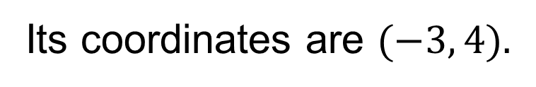
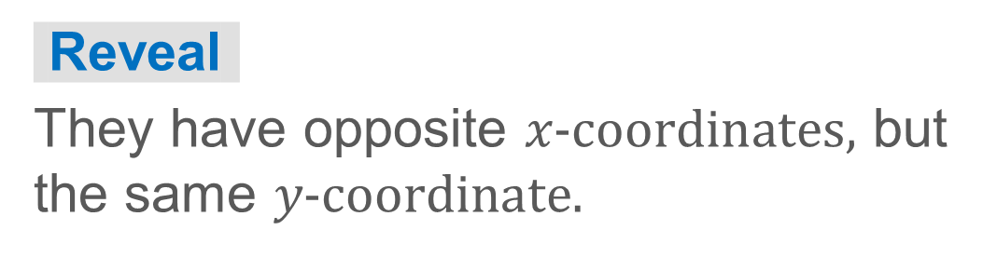
Point Relationships
Let’s find the coordinates of points E and G.
Point E is in Quadrant I.
Point G is in Quadrant II.
What do you notice about the coordinates for points E and G?
38 / 51
Notes:
TEACH IN PRACTICE | Embedded facilitation | Lesson 7.5, slide 34 | TASK
Focus on the existing task: Point Relationships Let’s find the coordinates of points E and G. Point E is in Quadrant I. Point G is in Quadrant II. What do you notice about the coordinates for points E and G?
LAUNCH (T2/3/5): Use the displayed question. Give private thinking time; then A explains while B asks for evidence. Switch roles. Each student records their own reasoning.
LOOK FOR (T4): Where this task addresses it, students can interpret ordered pairs as horizontal then vertical. Ask which feature of their work supports the claim.
RESPOND: If this task shows the lesson misconception—interchanging x and y or reversing a negative direction—trace horizontal then vertical movement on the original coordinate plane. Have the student revise and explain the change. Use this support only where the concept occurs in the current task; otherwise respond to the displayed question.
RECHECK: If a gap is shared, revisit the existing representation together. If it is limited, give targeted support while others compare valid methods on the same task. Check the revision before moving on.
PARTICIPATION (T5/6/7): Think time before volunteers; accept a written, drawn or rehearsed entry. Students ask for evidence respectfully. Recognize a specific contribution or revision and check that both partners participate.
Source: BCPS Updated Instructional Framework Rubric (June 2020), TEACH 1–7. Earlier notes and answer keys are retained below.
EARLIER NOTES / EXISTING ANSWER KEY
Model briefly, then hand the thinking back: ask “Why does this step work?” before showing the next one.
Quick check before moving on — thumbs or whiteboards from everyone, not volunteers.
UIFR: TEACH 2 · TEACH 3 · TEACH 4.

Slide 39
STUDENT MOVES
Lesson 7-5
Your moves
ANOTHER PATHWAY · Did anyone get there a different way? Put both pathways side by side and compare.
TEACH A PARTNER · Teach this to someone who missed it. If you can teach it, you know it.
39 / 51

Slide 40
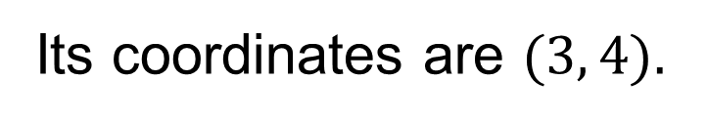
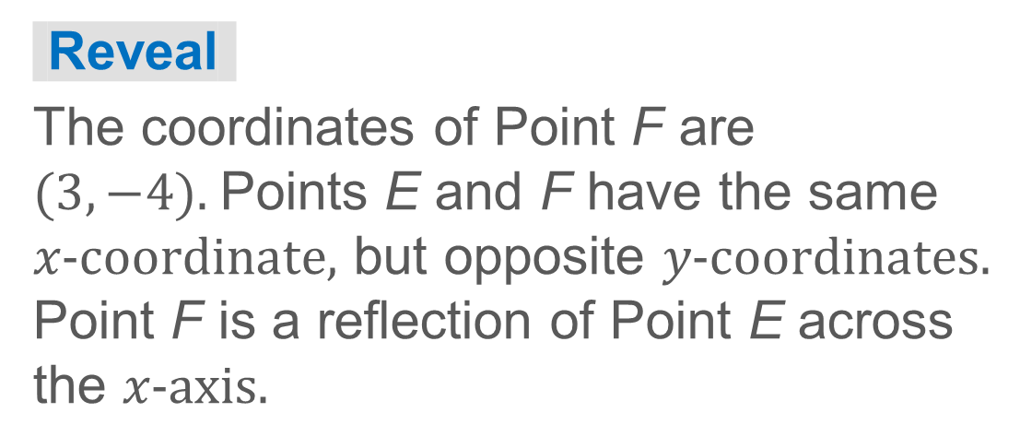
COLLABORATE · TALK IT THROUGH • AGREE ON A MODEL
Collaborate and Connect
Point E is in Quadrant I.
TAKE TURNS · One explains, one asks a question. Then switch, so both of you talk.
Compare the coordinates of points E and F. How could you describe the relationship between the points?
40 / 51
Notes:
TEACH IN PRACTICE | Embedded facilitation | Lesson 7.5, slide 35 | COLLABORATE
Focus on the existing task: Point E is in Quadrant I. Collaborate and Connect Compare the coordinates of points E and F. How could you describe the relationship between the points?
LAUNCH (T2/3/5): Use the displayed question. Give private thinking time; then A explains while B asks for evidence. Switch roles. Each student records their own reasoning.
LOOK FOR (T4): Where this task addresses it, students can interpret ordered pairs as horizontal then vertical. Ask which feature of their work supports the claim.
RESPOND: If this task shows the lesson misconception—interchanging x and y or reversing a negative direction—trace horizontal then vertical movement on the original coordinate plane. Have the student revise and explain the change. Use this support only where the concept occurs in the current task; otherwise respond to the displayed question.
RECHECK: If a gap is shared, revisit the existing representation together. If it is limited, give targeted support while others compare valid methods on the same task. Check the revision before moving on.
PARTICIPATION (T5/6/7): Think time before volunteers; accept a written, drawn or rehearsed entry. Students ask for evidence respectfully. Recognize a specific contribution or revision and check that both partners participate.
Source: BCPS Updated Instructional Framework Rubric (June 2020), TEACH 1–7. Earlier notes and answer keys are retained below.
EARLIER NOTES / EXISTING ANSWER KEY
Routine: COLLABORATE · TALK IT THROUGH • AGREE ON A MODEL
UIFR FULL | Lesson-specific facilitation
TEACH 4-5 | Session 2 discussion and checkpoint (UIFR PDF pp. 11-12).
Collect a brief response from every student to the existing prompt before hearing volunteers. Partners take turns explaining and asking for evidence: “I understand ___; what supports ___?” Offer rehearsal or an annotated model for students who need language support. Each student records their own reasoning.
Look specifically for: interchanging x and y or reversing a negative direction. If it appears, trace horizontal then vertical movement on the original coordinate plane; then ask the student to revise the same response and explain the change. If evidence is secure, have students compare a second valid pathway or state why their approach works. Choose the next step from the responses, not a preset pace.

Slide 41
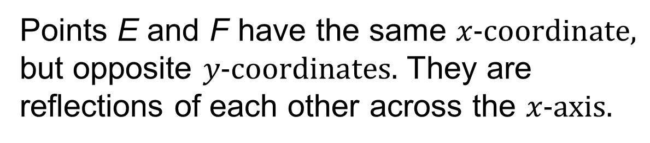
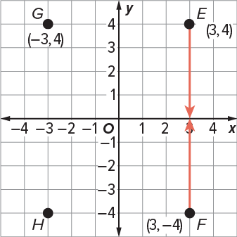
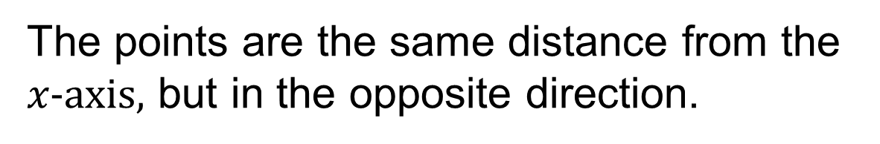
Point Relationships
Think and record first. Which part of your
work supports your answer?
Think About It:
How does a reflection on the coordinate plane relate to a reflection in the mirror?
41 / 51
Notes:
TEACH IN PRACTICE | Embedded facilitation | Lesson 7.5, slide 36 | TASK
Focus on the existing task: Point Relationships Think About It: How does a reflection on the coordinate plane relate to a reflection in the mirror?
LAUNCH (T2/3/5): Use the displayed question. Give private thinking time; then A explains while B asks for evidence. Switch roles. Each student records their own reasoning.
LOOK FOR (T4): Where this task addresses it, students can interpret ordered pairs as horizontal then vertical. Ask which feature of their work supports the claim.
RESPOND: If this task shows the lesson misconception—interchanging x and y or reversing a negative direction—trace horizontal then vertical movement on the original coordinate plane. Have the student revise and explain the change. Use this support only where the concept occurs in the current task; otherwise respond to the displayed question.
RECHECK: If a gap is shared, revisit the existing representation together. If it is limited, give targeted support while others compare valid methods on the same task. Check the revision before moving on.
PARTICIPATION (T5/6/7): Think time before volunteers; accept a written, drawn or rehearsed entry. Students ask for evidence respectfully. Recognize a specific contribution or revision and check that both partners participate.
Source: BCPS Updated Instructional Framework Rubric (June 2020), TEACH 1–7. Earlier notes and answer keys are retained below.
EARLIER NOTES / EXISTING ANSWER KEY
Ask the question, then hold the silence — students think or jot before anyone answers.
Take two or three responses and press with “Why?” or “How do you know?” before moving on.
UIFR: TEACH 3.

Slide 42
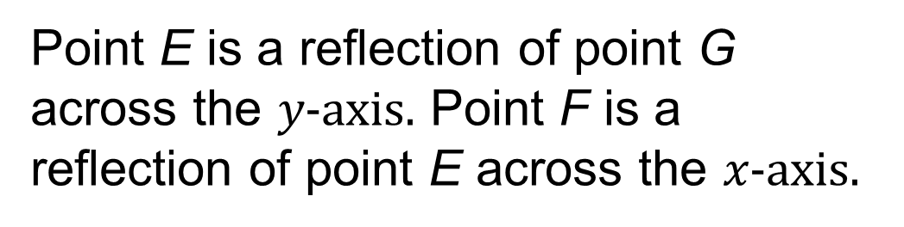

Point Relationships
How do points E, F, and G relate?
Think and record first. Which part of your
work supports your answer?
Looking for Structure
How can exploring patterns be helpful in solving this problem?
42 / 51
Notes:
TEACH IN PRACTICE | Embedded facilitation | Lesson 7.5, slide 37 | TASK
Focus on the existing task: Point Relationships Looking for Structure How can exploring patterns be helpful in solving this problem?
LAUNCH (T2/3/5): Use the displayed question. Give private thinking time; then A explains while B asks for evidence. Switch roles. Each student records their own reasoning.
LOOK FOR (T4): Where this task addresses it, students can interpret ordered pairs as horizontal then vertical. Ask which feature of their work supports the claim.
RESPOND: If this task shows the lesson misconception—interchanging x and y or reversing a negative direction—trace horizontal then vertical movement on the original coordinate plane. Have the student revise and explain the change. Use this support only where the concept occurs in the current task; otherwise respond to the displayed question.
RECHECK: If a gap is shared, revisit the existing representation together. If it is limited, give targeted support while others compare valid methods on the same task. Check the revision before moving on.
PARTICIPATION (T5/6/7): Think time before volunteers; accept a written, drawn or rehearsed entry. Students ask for evidence respectfully. Recognize a specific contribution or revision and check that both partners participate.
Source: BCPS Updated Instructional Framework Rubric (June 2020), TEACH 1–7. Earlier notes and answer keys are retained below.
EARLIER NOTES / EXISTING ANSWER KEY
Model briefly, then hand the thinking back: ask “Why does this step work?” before showing the next one.
Quick check before moving on — thumbs or whiteboards from everyone, not volunteers.
UIFR: TEACH 2 · TEACH 3 · TEACH 4.

Slide 43
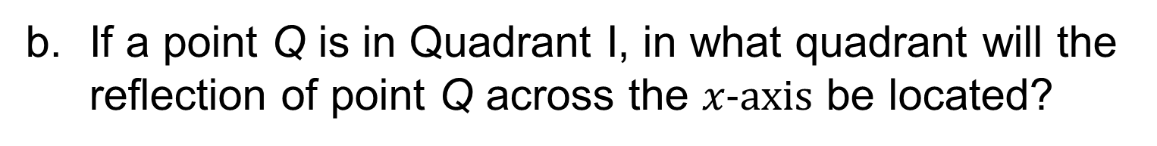
Let’s Explore More
How does point H relate to point F? to point G?
Workspace
Workspace
STRUGGLE FIRST · Work on your own first. Stuck is allowed — try a second strategy before you ask.
43 / 51
Notes:
TEACH IN PRACTICE | Embedded facilitation | Lesson 7.5, slide 38 | PRACTICE
Focus on the existing task: Let’s Explore More How does point H relate to point F?
LAUNCH (T2/3/5): Use the displayed question. Give private thinking time; then A explains while B asks for evidence. Switch roles. Each student records their own reasoning.
LOOK FOR (T4): Where this task addresses it, students can interpret ordered pairs as horizontal then vertical. Ask which feature of their work supports the claim.
RESPOND: If this task shows the lesson misconception—interchanging x and y or reversing a negative direction—trace horizontal then vertical movement on the original coordinate plane. Have the student revise and explain the change. Use this support only where the concept occurs in the current task; otherwise respond to the displayed question.
RECHECK: If a gap is shared, revisit the existing representation together. If it is limited, give targeted support while others compare valid methods on the same task. Check the revision before moving on.
PARTICIPATION (T5/6/7): Think time before volunteers; accept a written, drawn or rehearsed entry. Students ask for evidence respectfully. Recognize a specific contribution or revision and check that both partners participate.
Source: BCPS Updated Instructional Framework Rubric (June 2020), TEACH 1–7. Earlier notes and answer keys are retained below.
EARLIER NOTES / EXISTING ANSWER KEY
Extension for partners or table groups — students choose their approach and use the workspace to show thinking.
Push with “Convince me,” and have two groups with different approaches share.
This is where students stretch past the worked example.
UIFR: TEACH 2 · TEACH 5.

Slide 44
LESSON 7.5 / CHECK YOUR WORK
Pause. Check. Improve.
CHECK
A mistake to watch for: interchanging x and y or reversing a negative direction.
TRY
Trace horizontal then vertical movement on the given coordinate plane.
REVISE
Use that check on the task you just completed. Correct or strengthen one part, and explain why.
REVISE NOW · Change one answer and write why you changed it. A revision is evidence of learning.
Listen to understand. Ask for evidence. Make room for every voice.
Notes:
TEACH IN PRACTICE | Embedded facilitation | Lesson 7.5, slide 39 | PRIOR_INSERT
Focus on the existing task: LESSON 7.5 / CHECK YOUR WORK Pause. Check. Improve. Listen to understand. Ask for evidence. Make room for every voice. CHECK A mistake…
CONNECT (T1/4): Ask students to restate the displayed goal or key idea and connect it to earlier work. Relevant lesson evidence: interpret ordered pairs as horizontal then vertical; use signs to select directions. Use only the criterion that matches the current session.
SHOW PROGRESS: Students point to their own existing work, explain what improved after feedback, and name a next step. Pair confidence ratings with actual evidence.
PARTICIPATION (T5/6/7): Think time before volunteers; accept a written, drawn or rehearsed entry. Students ask for evidence respectfully. Recognize a specific contribution or revision and check that both partners participate.
Source: BCPS Updated Instructional Framework Rubric (June 2020), TEACH 1–7.

Slide 45
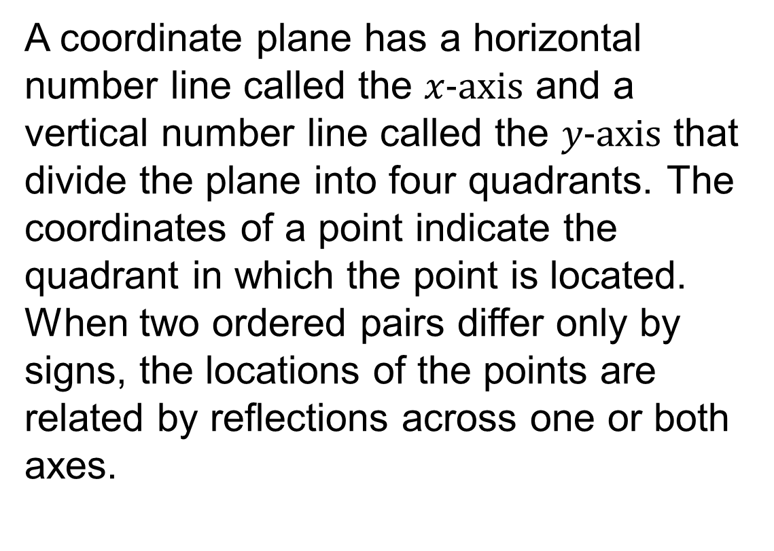
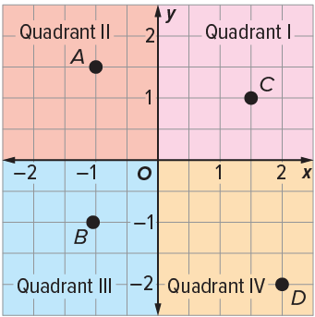
SUMMARIZE · SAY IT IN YOUR OWN WORDS
Summarize: Represent Rational Numbers on the Coordinate Plane
45 / 51
Notes:
TEACH IN PRACTICE | Embedded facilitation | Lesson 7.5, slide 40 | SUMMARIZE
Focus on the existing task: Summarize: Represent Rational Numbers on the Coordinate Plane SUMMARIZE · SAY IT IN YOUR OWN WORDS
CONNECT (T1/4): Ask students to restate the displayed goal or key idea and connect it to earlier work. Relevant lesson evidence: interpret ordered pairs as horizontal then vertical; use signs to select directions. Use only the criterion that matches the current session.
SHOW PROGRESS: Students point to their own existing work, explain what improved after feedback, and name a next step. Pair confidence ratings with actual evidence.
PARTICIPATION (T5/6/7): Think time before volunteers; accept a written, drawn or rehearsed entry. Students ask for evidence respectfully. Recognize a specific contribution or revision and check that both partners participate.
Source: BCPS Updated Instructional Framework Rubric (June 2020), TEACH 1–7. Earlier notes and answer keys are retained below.
EARLIER NOTES / EXISTING ANSWER KEY
Routine: SUMMARIZE · SAY IT IN YOUR OWN WORDS

Slide 46
STUDENT MOVES
Lesson 7-5
Your move
SPECIFIC FEEDBACK · Trade work. Give one specific comment: “This part is clear because ______.”
46 / 51

Slide 47
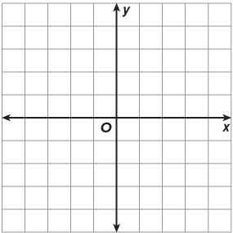
APPLY · PLAN IT • SOLVE IT • PROVE IT
Apply: Let’s Draw Shapes
Question: What shape can you create on the coordinate plane that will have all of its vertices be reflections of each other? What are the coordinates of each vertex?
Choose a method. Solve independently, justify your answer, then check the goal.
47 / 51
Notes:
TEACH IN PRACTICE | Embedded facilitation | Lesson 7.5, slide 41 | APPLY
Focus on the existing task: Apply: Let’s Draw Shapes Question: What shape can you create on the coordinate plane that will have all of its vertices be reflections of each other?
LAUNCH (T2/3/5): Use the exact application task independently first. Ask students to justify their choice of method. Collect evidence before a partner discussion or correction.
LOOK FOR (T4): Where this task addresses it, students can interpret ordered pairs as horizontal then vertical. Ask which feature of their work supports the claim.
RESPOND: If this task shows the lesson misconception—interchanging x and y or reversing a negative direction—trace horizontal then vertical movement on the original coordinate plane. Have the student revise and explain the change. Use this support only where the concept occurs in the current task; otherwise respond to the displayed question.
RECHECK: If a gap is shared, revisit the existing representation together. If it is limited, give targeted support while others compare valid methods on the same task. Check the revision before moving on.
PARTICIPATION (T5/6/7): Think time before volunteers; accept a written, drawn or rehearsed entry. Students ask for evidence respectfully. Recognize a specific contribution or revision and check that both partners participate.
Source: BCPS Updated Instructional Framework Rubric (June 2020), TEACH 1–7. Earlier notes and answer keys are retained below.
EARLIER NOTES / EXISTING ANSWER KEY
Routine: APPLY · PLAN IT • SOLVE IT • PROVE IT
UIFR FULL | Lesson-specific facilitation
TEACH 4 | Independent evidence and revision (UIFR PDF p. 11).
Use the existing application/exit problem as the independent check. If this is a learning-target slide, have students point to and explain their work on the preceding task. Separate initial independent evidence from the revision after feedback.
Check the relevant criteria: interpret ordered pairs as horizontal then vertical; use signs to select directions. Respond with one specific next step tied to the work. Students revise and annotate what changed, then identify a criterion they can now demonstrate and one they still need to practice.

Slide 48
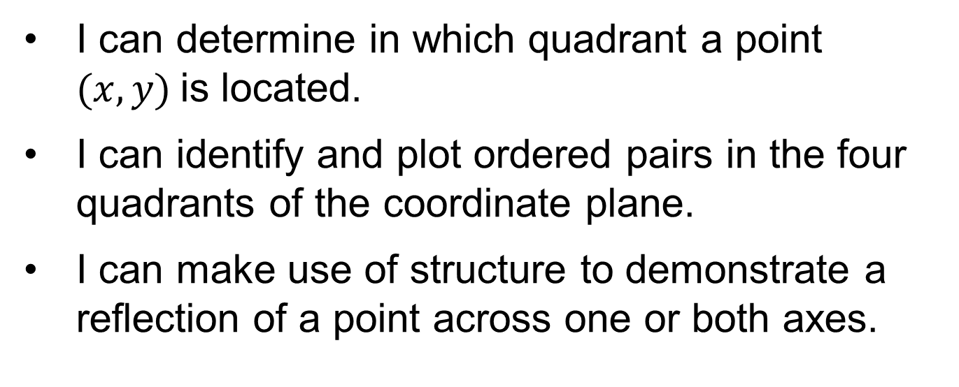
Learning Targets
Point to evidence in your work. Name what improved and your next step.
48 / 51
Notes:
TEACH IN PRACTICE | Embedded facilitation | Lesson 7.5, slide 42 | REFLECTION
Focus on the existing task: Learning Targets
CONNECT (T1/4): Ask students to restate the displayed goal or key idea and connect it to earlier work. Relevant lesson evidence: interpret ordered pairs as horizontal then vertical; use signs to select directions. Use only the criterion that matches the current session.
SHOW PROGRESS: Students point to their own existing work, explain what improved after feedback, and name a next step. Pair confidence ratings with actual evidence.
PARTICIPATION (T5/6/7): Think time before volunteers; accept a written, drawn or rehearsed entry. Students ask for evidence respectfully. Recognize a specific contribution or revision and check that both partners participate.
Source: BCPS Updated Instructional Framework Rubric (June 2020), TEACH 1–7. Earlier notes and answer keys are retained below.
EARLIER NOTES / EXISTING ANSWER KEY
Read each target; students self-rate with fist-to-five or thumbs.
Tie back to the goal from the start of class: did we get there?
Note any target that rates low — revisit it tomorrow.
UIFR: TEACH 1 · TEACH 4.

Slide 49
Be Curious
Be Curious
How are they the same?
How are they the same?
Think first. Share a notice and a question;
build on a classmate’s idea.
Mindset
In what ways is understanding different reasoning strategies helping you in math?
49 / 51
Notes:
TEACH IN PRACTICE | Embedded facilitation | Lesson 7.5, slide 43 | CURIOUS
Focus on the existing task: Be Curious How are they the same?
LAUNCH (T2/3/5): Allow quiet observation first. Separate a notice from an inference, invite students’ own questions, and follow the existing launch before teaching a procedure.
LOOK FOR (T4): Where this task addresses it, students can interpret ordered pairs as horizontal then vertical. Ask which feature of their work supports the claim.
RESPOND: If this task shows the lesson misconception—interchanging x and y or reversing a negative direction—trace horizontal then vertical movement on the original coordinate plane. Have the student revise and explain the change. Use this support only where the concept occurs in the current task; otherwise respond to the displayed question.
RECHECK: If a gap is shared, revisit the existing representation together. If it is limited, give targeted support while others compare valid methods on the same task. Check the revision before moving on.
PARTICIPATION (T5/6/7): Think time before volunteers; accept a written, drawn or rehearsed entry. Students ask for evidence respectfully. Recognize a specific contribution or revision and check that both partners participate.
Source: BCPS Updated Instructional Framework Rubric (June 2020), TEACH 1–7.

Slide 50
Learning Targets
Point to evidence in your work. Name what improved and your next step.
50 / 51
Notes:
TEACH IN PRACTICE | Embedded facilitation | Lesson 7.5, slide 44 | REFLECTION
Focus on the existing task: Learning Targets
CONNECT (T1/4): Ask students to restate the displayed goal or key idea and connect it to earlier work. Relevant lesson evidence: interpret ordered pairs as horizontal then vertical; use signs to select directions. Use only the criterion that matches the current session.
SHOW PROGRESS: Students point to their own existing work, explain what improved after feedback, and name a next step. Pair confidence ratings with actual evidence.
PARTICIPATION (T5/6/7): Think time before volunteers; accept a written, drawn or rehearsed entry. Students ask for evidence respectfully. Recognize a specific contribution or revision and check that both partners participate.
Source: BCPS Updated Instructional Framework Rubric (June 2020), TEACH 1–7. Earlier notes and answer keys are retained below.
EARLIER NOTES / EXISTING ANSWER KEY
UIFR FULL | Lesson-specific facilitation
REFLECT & ADJUST 1-2 | After the lesson (UIFR PDF pp. 15-16).
Sort the existing work by demonstrated reasoning, partial understanding, and the specific misconception: interchanging x and y or reversing a negative direction. Compare the initial response with the revision. Record which teaching move plausibly helped, which did not, and whose participation or access needs a different approach; do not record sensitive student details in this shared deck.
Plan the next lesson from that evidence: if the misconception persists, trace horizontal then vertical movement on the original coordinate plane using the current example before returning to the next grade-level task; if understanding is secure, use an existing extension or ask for a general explanation. Check the targeted idea again at the next warm-up.
Ask students what supported their thinking and what would help next time. Identify one change to try and one successful practice to retain. Seek colleague feedback on anonymized work when useful; these prompts support reflection and do not establish an evaluation rating. Source: Baltimore City Public Schools, Updated Instructional Framework Rubric, June 2020 (UIFR_Full.pdf).

Slide 51
LESSON 7.5 / REFLECT ON YOUR LEARNING
Show your progress
1 SHOW EVIDENCE
2 CHOOSE A NEXT STEP
Choose one response. Point to the part that shows your reasoning.
Name a change you made after feedback—or a question you still have.
“My work shows ___ because ___.”
“Next time, I will ___ to help me ___.”
Today’s focus: Interpret ordered pairs as horizontal then vertical.
CREDIT A CLASSMATE · Name one classmate whose idea helped you today, and say what they said.
Listen to understand. Ask for evidence. Make room for every voice.
Notes:
TEACH IN PRACTICE | Embedded facilitation | Lesson 7.5, slide 45 | PRIOR_INSERT
Focus on the existing task: LESSON 7.5 / REFLECT ON YOUR LEARNING Show your progress Listen to understand. Ask for evidence. Make room for every voice. 1 SHOW…
CONNECT (T1/4): Ask students to restate the displayed goal or key idea and connect it to earlier work. Relevant lesson evidence: interpret ordered pairs as horizontal then vertical; use signs to select directions. Use only the criterion that matches the current session.
SHOW PROGRESS: Students point to their own existing work, explain what improved after feedback, and name a next step. Pair confidence ratings with actual evidence.
PARTICIPATION (T5/6/7): Think time before volunteers; accept a written, drawn or rehearsed entry. Students ask for evidence respectfully. Recognize a specific contribution or revision and check that both partners participate.
Source: BCPS Updated Instructional Framework Rubric (June 2020), TEACH 1–7.

