Slide 1
WARM-UP · THINK • TRY • CHECK
Turn and talk: compare strategies, then defend one.
Warm-Up
Lesson 7-6 · Determine Distance on the Coordinate Plane | Warm-Up · about 4 minutes
Try each on your own. Mark an unsure answer; explain and revise when we check.
QUESTION 1
QUESTION 2
−5 − 3 = ______
|−8| = ______
QUESTION 3
QUESTION 4
7 units right of the origin and 2 units down is the point ______
From −5 to 0 is 5 units. From 0 to 3 is 3 units. Total: ______ units.
TALK IT OVER: “I got ______ because ______.” • Compare with a partner before we check as a class.
1 / 55
Notes:
TEACH IN PRACTICE | Embedded facilitation | Lesson 7.6, slide 1 | WARMUP
Focus on the existing task: Warm-Up WARM-UP · THINK • TRY • CHECK Do these…
GATHER EVIDENCE (T4/6): Keep the original items. Students try independently, mark an uncertain item, and explain one method before checking. Use the existing key when present.
RESPOND: Distinguish a calculation slip from a reasoning gap. Give one next step on the same item; have students revise in a second color. Use the responses to choose flexible support for today’s lesson.
PARTICIPATION (T5/6/7): Think time before volunteers; accept a written, drawn or rehearsed entry. Students ask for evidence respectfully. Recognize a specific contribution or revision and check that both partners participate.
Source: BCPS Updated Instructional Framework Rubric (June 2020), TEACH 1–7. Earlier notes and answer keys are retained below.
EARLIER NOTES / EXISTING ANSWER KEY
Warm-Up answers (teacher only): 1) −8 2) 8 3) (7, −2) 4) 8 units
UIFR FULL | Lesson-specific facilitation
PREPARE 1-2 | Before teaching (UIFR PDF pp. 6-7).
Plan to gather evidence that students can identify a shared coordinate; find horizontal or vertical distance; justify nonnegative length. Review recent work and today’s warm-up to choose flexible groups and access supports; do not infer needs from identity or perceived ability. Use the existing lesson tasks and stated standards.
Anticipate: adding absolute values for every pair regardless of location. If observed, mark the shared coordinate and trace the axis-aligned segment through the original points. Offer oral rehearsal, drawing, pointing, or home-language processing as needed; retain the original mathematical demand. Ask students which support helps and fade it as evidence improves.
TEACH 6-7 | Before the first transition, agree on materials, partner roles, and how to request help. Invite students to restate the routine. Normalize revising an idea, recognize a specific contribution, and check privately when frustration blocks participation. Source: UIFR PDF pp. 13-14.

Slide 2
Today’s Math Notes
Lesson 7-6 · Determine Distance on the Coordinate Plane
Section 1: Math Words
Copy. Explain. Check.
SAY THE GOAL · Say today’s goal in your own words, then name one place this shows up outside math class.
Distance on the Coordinate Plane
1
The positive space between points
Distance
2
How far apart two points
Absolute value
3
How far a number is from zero
eduwonderlab.com · Neft Teacher
2 / 55
Notes:
TEACH IN PRACTICE | Embedded facilitation | Lesson 7.6, slide 2 | NOTES
Focus on the existing task: Today’s Math Notes Section 1: Math Words Copy…
ROUTINE (T1/2/4): Read or copy the original notes, cover one line, and explain it using the displayed example. Reopen and correct. Copying alone is not evidence of understanding.
LOOK FOR: A link between a symbol, quantity or feature and the explanation. If missing, point back to that feature and have the student try again; fade the prompt once they can explain.
PARTICIPATION (T5/6/7): Think time before volunteers; accept a written, drawn or rehearsed entry. Students ask for evidence respectfully. Recognize a specific contribution or revision and check that both partners participate.
Source: BCPS Updated Instructional Framework Rubric (June 2020), TEACH 1–7. Earlier notes and answer keys are retained below.
EARLIER NOTES / EXISTING ANSWER KEY
Copy routine: read one line at a time; students copy, then explain that line to a partner.
Keep it brisk — the understanding work happens in the examples, not the copying.
UIFR: TEACH 1 · TEACH 6.

Slide 3
Today’s Math Notes
Lesson 7-6 · Determine Distance on the Coordinate Plane
Section 2: Today’s Math
Copy. Explain. Check.
Distance on the Coordinate Plane
Distance = |x1 − x2| (horizontal) or |y1 − y2| (vertical)
Read, cover, explain. Reopen your notes to
check and improve your explanation.
1
Same quadrant / Same sign: Subtract absolute values of differing coordinates
2
Different quadrants / Opposite signs: Add absolute values of differing coordinates
3
Distance represents length, so it is always positive
eduwonderlab.com · Neft Teacher
3 / 55
Notes:
TEACH IN PRACTICE | Embedded facilitation | Lesson 7.6, slide 3 | NOTES
Focus on the existing task: Today’s Math Notes Section 2: Today’s Math Copy…
ROUTINE (T1/2/4): Read or copy the original notes, cover one line, and explain it using the displayed example. Reopen and correct. Copying alone is not evidence of understanding.
LOOK FOR: A link between a symbol, quantity or feature and the explanation. If missing, point back to that feature and have the student try again; fade the prompt once they can explain.
PARTICIPATION (T5/6/7): Think time before volunteers; accept a written, drawn or rehearsed entry. Students ask for evidence respectfully. Recognize a specific contribution or revision and check that both partners participate.
Source: BCPS Updated Instructional Framework Rubric (June 2020), TEACH 1–7. Earlier notes and answer keys are retained below.
EARLIER NOTES / EXISTING ANSWER KEY
Copy routine: read one line at a time; students copy, then explain that line to a partner.
Keep it brisk — the understanding work happens in the examples, not the copying.
UIFR: TEACH 1 · TEACH 6.

Slide 4
Session 1
Determine Distance on the
Coordinate Plane
PICK YOUR STRATEGY · Choose your path — picture, table, number line, or equation — and be ready to say why you chose it.
4 / 55
Notes:
TEACH IN PRACTICE | Embedded facilitation | Lesson 7.6, slide 4 | DIVIDER
Focus on the existing task: Determine Distance on the Coordinate Plane Session 1
TRANSITION (T6/7): Students confirm materials, roles, how to request help, and the next response routine. Ask a student to restate it. Keep teacher-only slides hidden.
PARTICIPATION (T5/6/7): Think time before volunteers; accept a written, drawn or rehearsed entry. Students ask for evidence respectfully. Recognize a specific contribution or revision and check that both partners participate.
Source: BCPS Updated Instructional Framework Rubric (June 2020), TEACH 1–7. Earlier notes and answer keys are retained below.
EARLIER NOTES / EXISTING ANSWER KEY
Transition cue: state what materials are out and what success looks like this session.
Keep the changeover under a minute.
UIFR: TEACH 6.

Slide 5

It’s About
What percent is shaded? How do you know?
Think and record first. Which part of your work supports your answer?
5 / 55
Notes:
TEACH IN PRACTICE | Embedded facilitation | Lesson 7.6, slide 5 | TASK
Focus on the existing task: It’s About What percent is shaded?
LAUNCH (T2/3/5): Use the displayed question. Give private thinking time; then A explains while B asks for evidence. Switch roles. Each student records their own reasoning.
LOOK FOR (T4): Where this task addresses it, students can identify a shared coordinate. Ask which feature of their work supports the claim.
RESPOND: If this task shows the lesson misconception—adding absolute values for every pair regardless of location—mark the shared coordinate and trace the axis-aligned segment through the original points. Have the student revise and explain the change. Use this support only where the concept occurs in the current task; otherwise respond to the displayed question.
RECHECK: If a gap is shared, revisit the existing representation together. If it is limited, give targeted support while others compare valid methods on the same task. Check the revision before moving on.
PARTICIPATION (T5/6/7): Think time before volunteers; accept a written, drawn or rehearsed entry. Students ask for evidence respectfully. Recognize a specific contribution or revision and check that both partners participate.
Source: BCPS Updated Instructional Framework Rubric (June 2020), TEACH 1–7. Earlier notes and answer keys are retained below.
EARLIER NOTES / EXISTING ANSWER KEY
Model briefly, then hand the thinking back: ask “Why does this step work?” before showing the next one.
Quick check before moving on — thumbs or whiteboards from everyone, not volunteers.
UIFR: TEACH 2 · TEACH 3 · TEACH 4.

Slide 6
Today’s Objectives
Lesson 7-6 · Determine Distance on the Coordinate Plane
Determine Distance on the Coordinate Plane
Maryland Standard 6.NOS.9
CONNECT IT · What earlier lesson does this build on? Tell a partner in one sentence.
CONTENT OBJECTIVE
LANGUAGE OBJECTIVE
Restate the goal in your words
Use these words to explain why
I can find the distance between two points on the coordinate plane using absolute value.
I can explain my work using the words distance, absolute value, horizontal distance, and vertical distance.
eduwonderlab.com · Neft Teacher
6 / 55
Notes:
TEACH IN PRACTICE | Embedded facilitation | Lesson 7.6, slide 6 | GOAL
Focus on the existing task: Today’s Objectives Determine Distance on the…
CONNECT (T1/4): Ask students to restate the displayed goal or key idea and connect it to earlier work. Relevant lesson evidence: identify a shared coordinate; find horizontal or vertical distance; justify nonnegative length. Use only the criterion that matches the current session.
SHOW PROGRESS: Students point to their own existing work, explain what improved after feedback, and name a next step. Pair confidence ratings with actual evidence.
PARTICIPATION (T5/6/7): Think time before volunteers; accept a written, drawn or rehearsed entry. Students ask for evidence respectfully. Recognize a specific contribution or revision and check that both partners participate.
Source: BCPS Updated Instructional Framework Rubric (June 2020), TEACH 1–7. Earlier notes and answer keys are retained below.
EARLIER NOTES / EXISTING ANSWER KEY
Read the objective together, then have one or two students restate today’s goal in their own words.
Connect it to what the class learned last lesson.
Return to this goal at the end of class to check it was met.
UIFR: TEACH 1.
UIFR FULL | Lesson-specific facilitation
TEACH 1 | Session 1 purpose and evidence (UIFR PDF p. 8).
Have students restate the displayed session goal in their own words and connect it to the existing context or a familiar experience they choose to share. Use the current session goal to select from these lesson-wide evidence criteria; do not frontload a later-session procedure.
Look for: identify a shared coordinate; find horizontal or vertical distance; justify nonnegative length. Ask: “Which part of your work would show this?” Revisit that evidence after the task; a confidence rating alone is not evidence of understanding.

Slide 7
LESSON 7.6 / OUR LEARNING
What will show your learning?
1
Identify a shared coordinate.
2
Find horizontal or vertical distance.
3
Justify nonnegative length.
Tell a partner: Which skill connects to something you already know?
SHOW YOUR THINKING · Show what you know — write it, draw it, or build it. A picture counts as an explanation.
Listen to understand. Ask for evidence. Make room for every voice.
Notes:
TEACH IN PRACTICE | Embedded facilitation | Lesson 7.6, slide 7 | PRIOR_INSERT
Focus on the existing task: LESSON 7.6 / OUR LEARNING What will show your learning?
CONNECT (T1/4): Ask students to restate the displayed goal or key idea and connect it to earlier work. Relevant lesson evidence: identify a shared coordinate; find horizontal or vertical distance; justify nonnegative length. Use only the criterion that matches the current session.
SHOW PROGRESS: Students point to their own existing work, explain what improved after feedback, and name a next step. Pair confidence ratings with actual evidence.
PARTICIPATION (T5/6/7): Think time before volunteers; accept a written, drawn or rehearsed entry. Students ask for evidence respectfully. Recognize a specific contribution or revision and check that both partners participate.
Source: BCPS Updated Instructional Framework Rubric (June 2020), TEACH 1–7.

Slide 8
Vocabulary 1 of 7
Lesson 7-6 · Determine Distance on the Coordinate Plane
Distance on the Coordinate Plane
The positive space between points, found from the absolute difference of coordinates on a horizontal or vertical line.
EXAMPLE · EXPLAIN WHY IT FITS
From (−2, 3) to (5, 3): |5 − (−2)| = 7 units.
USE THE MATH WORDS · Use today’s math words in your explanation — not “it” and “that thing.”
eduwonderlab.com · Neft Teacher
8 / 55
Notes:
TEACH IN PRACTICE | Embedded facilitation | Lesson 7.6, slide 8 | VOCAB
Focus on the existing task: Vocabulary 1 of 7 Distance on the Coordinate…
ASK (T1/3/5): Where does “Distance on the Coordinate Plane” appear in the example? Explain the meaning without reading the definition. Partner: restate the idea and ask a clarifying question.
LOOK FOR: A correct connection between the word and a feature of the example. If the student only repeats the definition, invite pointing, sketching or oral rehearsal, then ask for another explanation of this same example.
PARTICIPATION (T5/6/7): Think time before volunteers; accept a written, drawn or rehearsed entry. Students ask for evidence respectfully. Recognize a specific contribution or revision and check that both partners participate.
Source: BCPS Updated Instructional Framework Rubric (June 2020), TEACH 1–7.

Slide 9
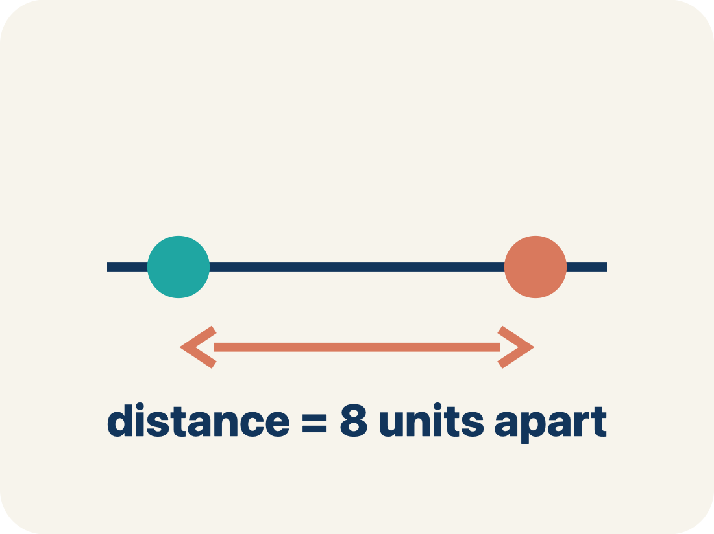
Vocabulary 2 of 7
Lesson 7-6 · Determine Distance on the Coordinate Plane
Distance
How far apart two points are. It is never negative.
EXAMPLE · EXPLAIN WHY IT FITS
The distance from −3 to 4 on a number line is |-3| + |4| = 3 + 4 = 7 units
Use “Distance” to explain the example. Point to evidence.
eduwonderlab.com · Neft Teacher
9 / 55
Notes:
TEACH IN PRACTICE | Embedded facilitation | Lesson 7.6, slide 9 | VOCAB
Focus on the existing task: Vocabulary 2 of 7 Distance How far apart two…
ASK (T1/3/5): Where does “Distance” appear in the example? Explain the meaning without reading the definition. Partner: restate the idea and ask a clarifying question.
LOOK FOR: A correct connection between the word and a feature of the example. If the student only repeats the definition, invite pointing, sketching or oral rehearsal, then ask for another explanation of this same example.
PARTICIPATION (T5/6/7): Think time before volunteers; accept a written, drawn or rehearsed entry. Students ask for evidence respectfully. Recognize a specific contribution or revision and check that both partners participate.
Source: BCPS Updated Instructional Framework Rubric (June 2020), TEACH 1–7.

Slide 10
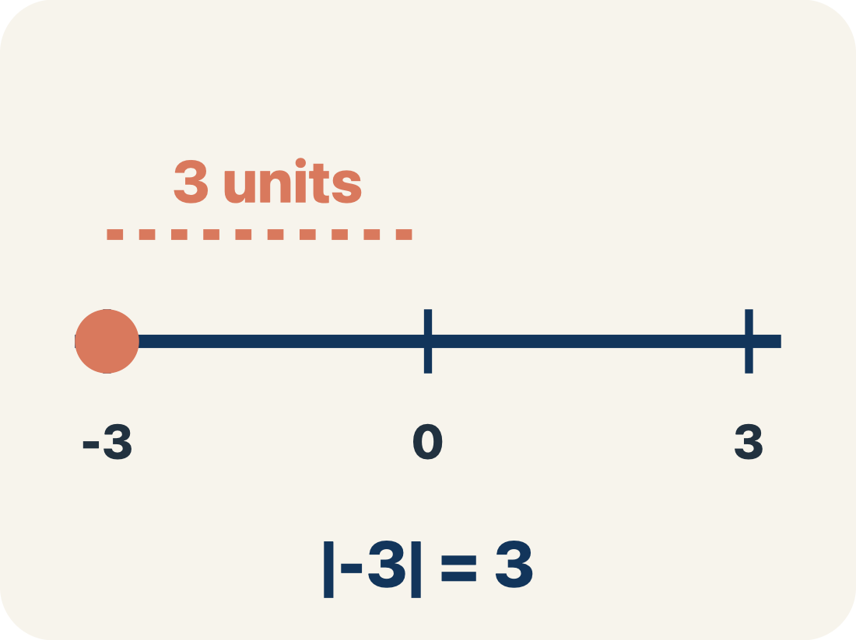
Vocabulary 3 of 7
Lesson 7-6 · Determine Distance on the Coordinate Plane
Absolute value
How far a number is from zero. It is never negative.
EXAMPLE · EXPLAIN WHY IT FITS
|-3| = 3 and |4| = 4; to find distance: |4 − (−3)| = 7
Use “Absolute value” to explain the example. Point to
evidence.
eduwonderlab.com · Neft Teacher
10 / 55
Notes:
TEACH IN PRACTICE | Embedded facilitation | Lesson 7.6, slide 10 | VOCAB
Focus on the existing task: Vocabulary 3 of 7 Absolute value How far a…
ASK (T1/3/5): Where does “Absolute value” appear in the example? Explain the meaning without reading the definition. Partner: restate the idea and ask a clarifying question.
LOOK FOR: A correct connection between the word and a feature of the example. If the student only repeats the definition, invite pointing, sketching or oral rehearsal, then ask for another explanation of this same example.
PARTICIPATION (T5/6/7): Think time before volunteers; accept a written, drawn or rehearsed entry. Students ask for evidence respectfully. Recognize a specific contribution or revision and check that both partners participate.
Source: BCPS Updated Instructional Framework Rubric (June 2020), TEACH 1–7.

Slide 11
Vocabulary 4 of 7
Lesson 7-6 · Determine Distance on the Coordinate Plane
Horizontal distance
How far apart two points are going left or right.
EXAMPLE · EXPLAIN WHY IT FITS
From (−2, 3) to (5, 3): count from −2 to 5 = 7 units across
Use “Horizontal distance” to explain the example. Point to
evidence.
eduwonderlab.com · Neft Teacher
11 / 55
Notes:
TEACH IN PRACTICE | Embedded facilitation | Lesson 7.6, slide 11 | VOCAB
Focus on the existing task: Vocabulary 4 of 7 Horizontal distance How far…
ASK (T1/3/5): Where does “Horizontal distance” appear in the example? Explain the meaning without reading the definition. Partner: restate the idea and ask a clarifying question.
LOOK FOR: A correct connection between the word and a feature of the example. If the student only repeats the definition, invite pointing, sketching or oral rehearsal, then ask for another explanation of this same example.
PARTICIPATION (T5/6/7): Think time before volunteers; accept a written, drawn or rehearsed entry. Students ask for evidence respectfully. Recognize a specific contribution or revision and check that both partners participate.
Source: BCPS Updated Instructional Framework Rubric (June 2020), TEACH 1–7.

Slide 12
Vocabulary 5 of 7
Lesson 7-6 · Determine Distance on the Coordinate Plane
Vertical distance
How far apart two points are going up or down.
EXAMPLE · EXPLAIN WHY IT FITS
From (4, −1) to (4, 6): count from −1 to 6 = 7 units up
Use “Vertical distance” to explain the example. Point to
evidence.
eduwonderlab.com · Neft Teacher
12 / 55
Notes:
TEACH IN PRACTICE | Embedded facilitation | Lesson 7.6, slide 12 | VOCAB
Focus on the existing task: Vocabulary 5 of 7 Vertical distance How far…
ASK (T1/3/5): Where does “Vertical distance” appear in the example? Explain the meaning without reading the definition. Partner: restate the idea and ask a clarifying question.
LOOK FOR: A correct connection between the word and a feature of the example. If the student only repeats the definition, invite pointing, sketching or oral rehearsal, then ask for another explanation of this same example.
PARTICIPATION (T5/6/7): Think time before volunteers; accept a written, drawn or rehearsed entry. Students ask for evidence respectfully. Recognize a specific contribution or revision and check that both partners participate.
Source: BCPS Updated Instructional Framework Rubric (June 2020), TEACH 1–7.

Slide 13
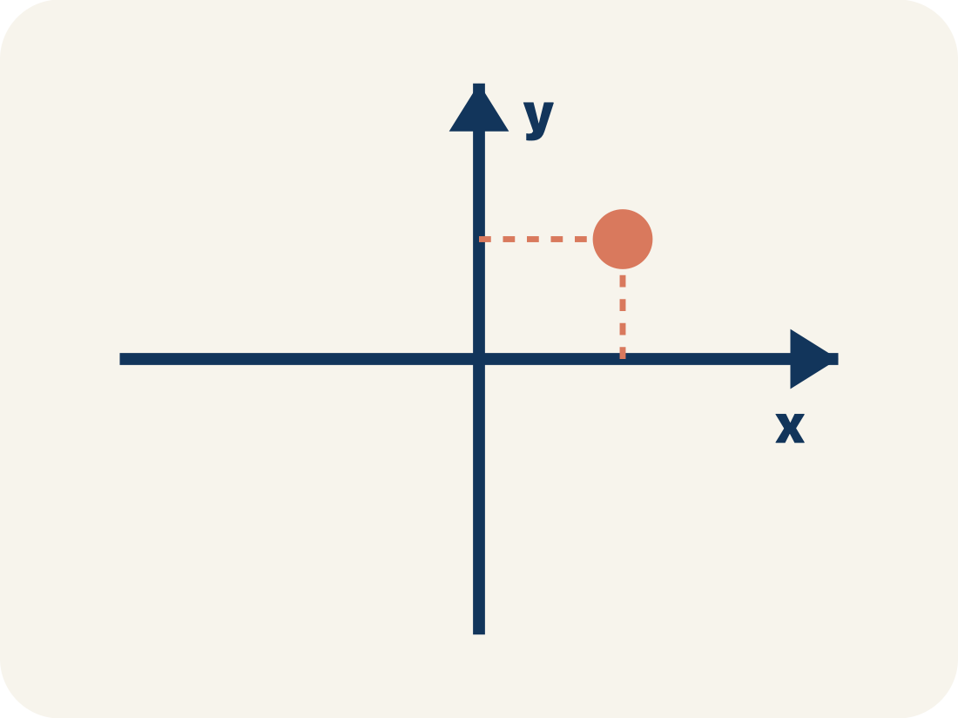
Vocabulary 6 of 7
Lesson 7-6 · Determine Distance on the Coordinate Plane
Coordinate plane
A grid with a line going across and a line going up to plot points.
EXAMPLE · EXPLAIN WHY IT FITS
Two number lines crossing at (0, 0), creating four quadrants
Use “Coordinate plane” to explain the example. Point to
evidence.
eduwonderlab.com · Neft Teacher
13 / 55
Notes:
TEACH IN PRACTICE | Embedded facilitation | Lesson 7.6, slide 13 | VOCAB
Focus on the existing task: Vocabulary 6 of 7 Coordinate plane A grid with…
ASK (T1/3/5): Where does “Coordinate plane” appear in the example? Explain the meaning without reading the definition. Partner: restate the idea and ask a clarifying question.
LOOK FOR: A correct connection between the word and a feature of the example. If the student only repeats the definition, invite pointing, sketching or oral rehearsal, then ask for another explanation of this same example.
PARTICIPATION (T5/6/7): Think time before volunteers; accept a written, drawn or rehearsed entry. Students ask for evidence respectfully. Recognize a specific contribution or revision and check that both partners participate.
Source: BCPS Updated Instructional Framework Rubric (June 2020), TEACH 1–7.

Slide 14
Vocabulary 7 of 7
Lesson 7-6 · Determine Distance on the Coordinate Plane
Integer
Whole numbers and their opposites, like −2, −1, 0, 1, 2.
EXAMPLE · EXPLAIN WHY IT FITS
…, −3, −2, −1, 0, 1, 2, 3, …
Use “Integer” to explain the example. Point to evidence.
eduwonderlab.com · Neft Teacher
14 / 55
Notes:
TEACH IN PRACTICE | Embedded facilitation | Lesson 7.6, slide 14 | VOCAB
Focus on the existing task: Vocabulary 7 of 7 Integer Whole numbers and…
ASK (T1/3/5): Where does “Integer” appear in the example? Explain the meaning without reading the definition. Partner: restate the idea and ask a clarifying question.
LOOK FOR: A correct connection between the word and a feature of the example. If the student only repeats the definition, invite pointing, sketching or oral rehearsal, then ask for another explanation of this same example.
PARTICIPATION (T5/6/7): Think time before volunteers; accept a written, drawn or rehearsed entry. Students ask for evidence respectfully. Recognize a specific contribution or revision and check that both partners participate.
Source: BCPS Updated Instructional Framework Rubric (June 2020), TEACH 1–7.

Slide 15
Vocabulary
Lesson 7-6 · Determine Distance on the Coordinate Plane
Today’s Math Words
We learn every word — what it means and what it looks like — before we use it.
Distance on the Coordinate Plane
Distance
The positive space between points, found from the absolute difference of coordinates on a horizontal or vertical line
How far apart two points are
Absolute value
Horizontal distance
How far a number is from zero
How far apart two points are going left or right
Vertical distance
Coordinate plane
How far apart two points are going up or down
A grid with a line going across and a line going up to plot points
Integer
Explain one math word using the example.
Partner: point to evidence.
Whole numbers and their opposites, like −2, −1, 0, 1, 2
eduwonderlab.com · Neft Teacher
15 / 55
Notes:
TEACH IN PRACTICE | Embedded facilitation | Lesson 7.6, slide 15 | VOCAB
Focus on the existing task: Vocabulary Today’s Math Words We learn every…
ASK (T1/3/5): Where does “the displayed term” appear in the example? Explain the meaning without reading the definition. Partner: restate the idea and ask a clarifying question.
LOOK FOR: A correct connection between the word and a feature of the example. If the student only repeats the definition, invite pointing, sketching or oral rehearsal, then ask for another explanation of this same example.
PARTICIPATION (T5/6/7): Think time before volunteers; accept a written, drawn or rehearsed entry. Students ask for evidence respectfully. Recognize a specific contribution or revision and check that both partners participate.
Source: BCPS Updated Instructional Framework Rubric (June 2020), TEACH 1–7. Earlier notes and answer keys are retained below.
EARLIER NOTES / EXISTING ANSWER KEY
Choral-read each word, its meaning, and what it looks like.
Students should use these words out loud today — listen for them in partner talk and revoice student ideas with the academic term.
UIFR: TEACH 1 · TEACH 5.

Slide 16
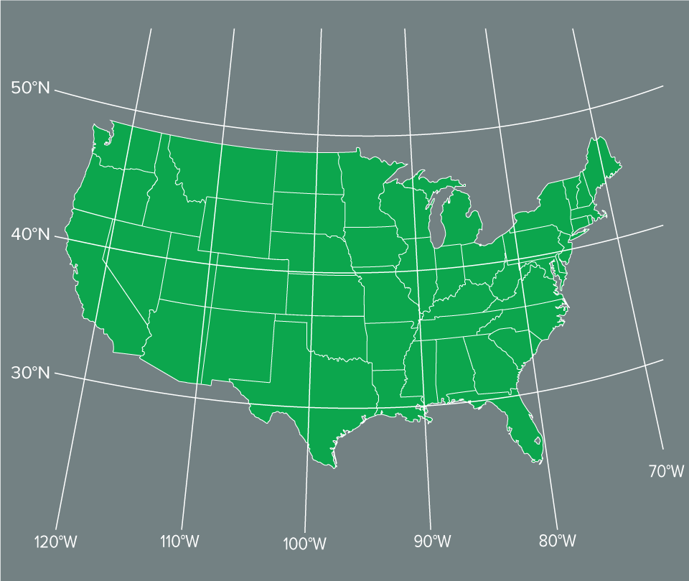

Be Curious
What do you notice?
What do you wonder?
Think first. Share a notice and a
question; build on a classmate’s
idea.
Mindset
How can you work productively with a classmate even when you might have different solutions to a math problem?
16 / 55
Notes:
TEACH IN PRACTICE | Embedded facilitation | Lesson 7.6, slide 16 | CURIOUS
Focus on the existing task: Be Curious Mindset What do you notice?
LAUNCH (T2/3/5): Allow quiet observation first. Separate a notice from an inference, invite students’ own questions, and follow the existing launch before teaching a procedure.
LOOK FOR (T4): Where this task addresses it, students can identify a shared coordinate. Ask which feature of their work supports the claim.
RESPOND: If this task shows the lesson misconception—adding absolute values for every pair regardless of location—mark the shared coordinate and trace the axis-aligned segment through the original points. Have the student revise and explain the change. Use this support only where the concept occurs in the current task; otherwise respond to the displayed question.
RECHECK: If a gap is shared, revisit the existing representation together. If it is limited, give targeted support while others compare valid methods on the same task. Check the revision before moving on.
PARTICIPATION (T5/6/7): Think time before volunteers; accept a written, drawn or rehearsed entry. Students ask for evidence respectfully. Recognize a specific contribution or revision and check that both partners participate.
Source: BCPS Updated Instructional Framework Rubric (June 2020), TEACH 1–7. Earlier notes and answer keys are retained below.
EARLIER NOTES / EXISTING ANSWER KEY
Accept all noticings and wonderings — there are no wrong answers here.
Give 20–30 seconds of quiet think time before taking responses; mix cold and warm calls so it is not always the same voices.
Read the mindset question aloud and let two students respond.
UIFR: TEACH 3 · TEACH 7.

Slide 17
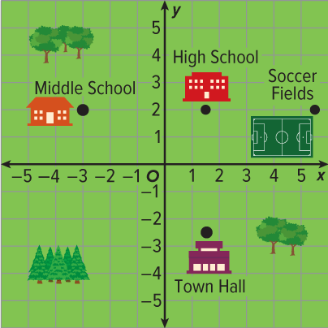
How Far?
Tahira will walk from the middle school to the high school. The grid shows a map of the town, where each unit labeled on the grid represents one kilometer. How far will Tahira walk?
What information do you need to find?
TRY IT BEFORE YOU’RE SURE · Start even if you are not sure. A revised answer counts as much as a first-try answer.
Reveal:
We need to find the distance from the middle school to the high school.
17 / 55
Notes:
TEACH IN PRACTICE | Embedded facilitation | Lesson 7.6, slide 17 | REVEAL
Focus on the existing task: How Far?
LAUNCH (T2/3/5): If an existing answer cover is present, gather an attempt before revealing. If the explanation is already visible, ask students to reconstruct and justify it. Compare reasoning and explain a revision; preserve the reveal sequence.
LOOK FOR (T4): Where this task addresses it, students can find horizontal or vertical distance. Ask which feature of their work supports the claim.
RESPOND: If this task shows the lesson misconception—adding absolute values for every pair regardless of location—mark the shared coordinate and trace the axis-aligned segment through the original points. Have the student revise and explain the change. Use this support only where the concept occurs in the current task; otherwise respond to the displayed question.
RECHECK: If a gap is shared, revisit the existing representation together. If it is limited, give targeted support while others compare valid methods on the same task. Check the revision before moving on.
PARTICIPATION (T5/6/7): Think time before volunteers; accept a written, drawn or rehearsed entry. Students ask for evidence respectfully. Recognize a specific contribution or revision and check that both partners participate.
Source: BCPS Updated Instructional Framework Rubric (June 2020), TEACH 1–7. Earlier notes and answer keys are retained below.
EARLIER NOTES / EXISTING ANSWER KEY
Do not click yet: collect 2–3 student answers with reasons first.
Then click to remove the cover and have students compare their thinking to the reveal — “Is this what we said? Where is it different?”
Behind the cover: We need to find the distance from the middle school to the high school.
UIFR: TEACH 3 · TEACH 4.
UIFR FULL | Lesson-specific facilitation
TEACH 2-3 | Session 1 task launch (UIFR PDF pp. 9-10).
Use the problem exactly as displayed. Give individual thinking time before discussion or advancing to the explanation. If the answer is already visible, ask students to reconstruct and justify it. Invite a choice of suitable representations and have students explain why their choice helps.
At the point where this concept appears, ask: “Do the points lie on the same side of zero or opposite sides, and how does that affect the distance?” Wait for evidence, invite another pathway, and have a student ask a follow-up question. Do not replace students’ reasoning with a sequence of leading steps.

Slide 18
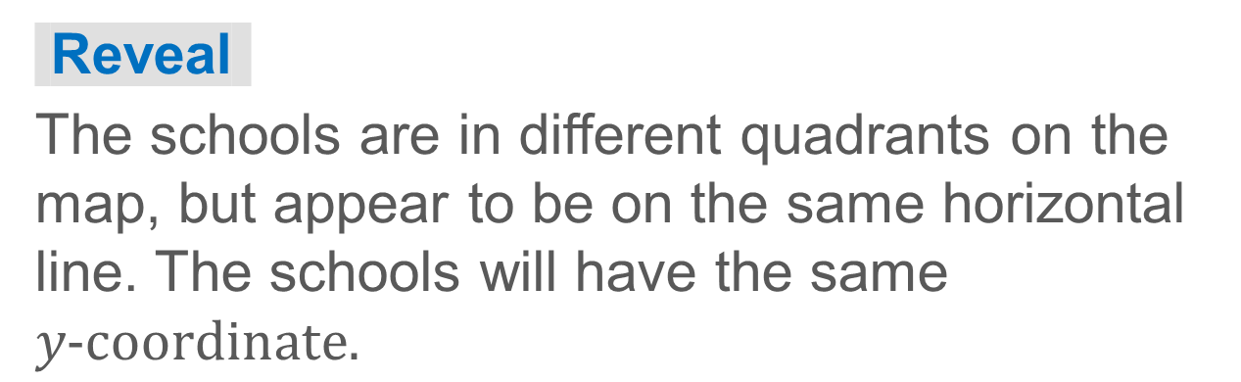
How Far?
We need to find the distance from the middle school to the high school.
What do you notice about the locations of the middle school and the high school? What does this tell you about the coordinates of the schools?
18 / 55
Notes:
TEACH IN PRACTICE | Embedded facilitation | Lesson 7.6, slide 18 | TASK
Focus on the existing task: How Far?
LAUNCH (T2/3/5): Use the displayed question. Give private thinking time; then A explains while B asks for evidence. Switch roles. Each student records their own reasoning.
LOOK FOR (T4): Where this task addresses it, students can find horizontal or vertical distance. Ask which feature of their work supports the claim.
RESPOND: If this task shows the lesson misconception—adding absolute values for every pair regardless of location—mark the shared coordinate and trace the axis-aligned segment through the original points. Have the student revise and explain the change. Use this support only where the concept occurs in the current task; otherwise respond to the displayed question.
RECHECK: If a gap is shared, revisit the existing representation together. If it is limited, give targeted support while others compare valid methods on the same task. Check the revision before moving on.
PARTICIPATION (T5/6/7): Think time before volunteers; accept a written, drawn or rehearsed entry. Students ask for evidence respectfully. Recognize a specific contribution or revision and check that both partners participate.
Source: BCPS Updated Instructional Framework Rubric (June 2020), TEACH 1–7. Earlier notes and answer keys are retained below.
EARLIER NOTES / EXISTING ANSWER KEY
Model briefly, then hand the thinking back: ask “Why does this step work?” before showing the next one.
Quick check before moving on — thumbs or whiteboards from everyone, not volunteers.
UIFR: TEACH 2 · TEACH 3 · TEACH 4.

Slide 19

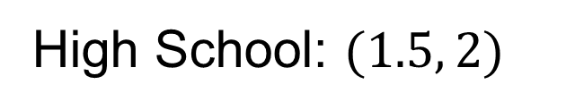
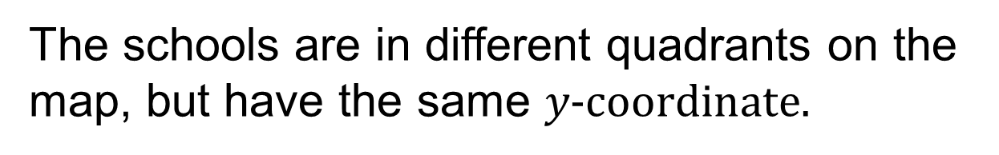
How Far?
Let’s find the coordinates of the middle school and the high school.
How can you use the coordinate plane to find the distance between the two schools?
Reveal:
One way is to count the units on the coordinate plane.
19 / 55
Notes:
TEACH IN PRACTICE | Embedded facilitation | Lesson 7.6, slide 19 | REVEAL
Focus on the existing task: How Far?
LAUNCH (T2/3/5): If an existing answer cover is present, gather an attempt before revealing. If the explanation is already visible, ask students to reconstruct and justify it. Compare reasoning and explain a revision; preserve the reveal sequence.
LOOK FOR (T4): Where this task addresses it, students can find horizontal or vertical distance. Ask which feature of their work supports the claim.
RESPOND: If this task shows the lesson misconception—adding absolute values for every pair regardless of location—mark the shared coordinate and trace the axis-aligned segment through the original points. Have the student revise and explain the change. Use this support only where the concept occurs in the current task; otherwise respond to the displayed question.
RECHECK: If a gap is shared, revisit the existing representation together. If it is limited, give targeted support while others compare valid methods on the same task. Check the revision before moving on.
PARTICIPATION (T5/6/7): Think time before volunteers; accept a written, drawn or rehearsed entry. Students ask for evidence respectfully. Recognize a specific contribution or revision and check that both partners participate.
Source: BCPS Updated Instructional Framework Rubric (June 2020), TEACH 1–7. Earlier notes and answer keys are retained below.
EARLIER NOTES / EXISTING ANSWER KEY
Do not click yet: collect 2–3 student answers with reasons first.
Then click to remove the cover and have students compare their thinking to the reveal — “Is this what we said? Where is it different?”
Behind the cover: One way is to count the units on the coordinate plane.
UIFR: TEACH 3 · TEACH 4.

Slide 20
STUDENT MOVES
Lesson 7-6
Your moves
ANOTHER PATHWAY · Did anyone get there a different way? Put both pathways side by side and compare.
USE YOUR TOOLS · Reach for your notes, a model, or a manipulative before you reach for an answer.
20 / 55

Slide 21
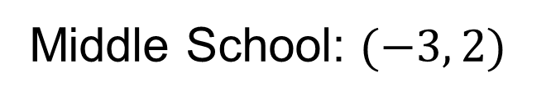
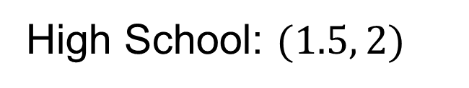
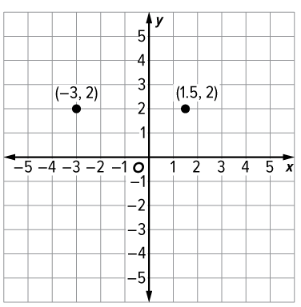
How Far?
Let’s count the units between the points representing the schools.
Think and record first. Which part
of your work supports your
answer?
21 / 55
Notes:
TEACH IN PRACTICE | Embedded facilitation | Lesson 7.6, slide 20 | TASK
Focus on the existing task: How Far?
LAUNCH (T2/3/5): Use the displayed question. Give private thinking time; then A explains while B asks for evidence. Switch roles. Each student records their own reasoning.
LOOK FOR (T4): Where this task addresses it, students can identify a shared coordinate. Ask which feature of their work supports the claim.
RESPOND: If this task shows the lesson misconception—adding absolute values for every pair regardless of location—mark the shared coordinate and trace the axis-aligned segment through the original points. Have the student revise and explain the change. Use this support only where the concept occurs in the current task; otherwise respond to the displayed question.
RECHECK: If a gap is shared, revisit the existing representation together. If it is limited, give targeted support while others compare valid methods on the same task. Check the revision before moving on.
PARTICIPATION (T5/6/7): Think time before volunteers; accept a written, drawn or rehearsed entry. Students ask for evidence respectfully. Recognize a specific contribution or revision and check that both partners participate.
Source: BCPS Updated Instructional Framework Rubric (June 2020), TEACH 1–7. Earlier notes and answer keys are retained below.
EARLIER NOTES / EXISTING ANSWER KEY
Model briefly, then hand the thinking back: ask “Why does this step work?” before showing the next one.
Quick check before moving on — thumbs or whiteboards from everyone, not volunteers.
UIFR: TEACH 2 · TEACH 3 · TEACH 4.

Slide 22

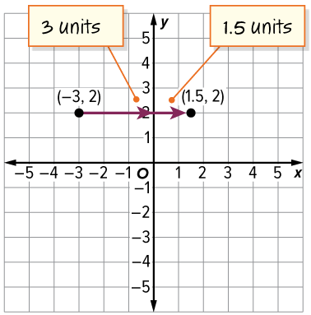
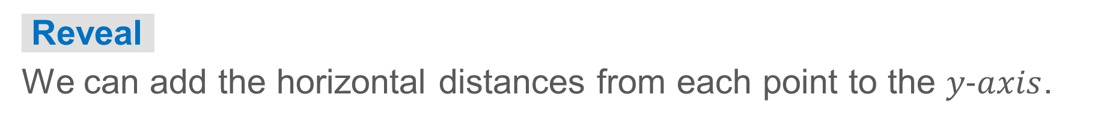
How Far?
Think and record first. Which part
of your work supports your
answer?
How can you find the total distance between the two points?
22 / 55
Notes:
TEACH IN PRACTICE | Embedded facilitation | Lesson 7.6, slide 21 | TASK
Focus on the existing task: How Far?
LAUNCH (T2/3/5): Use the displayed question. Give private thinking time; then A explains while B asks for evidence. Switch roles. Each student records their own reasoning.
LOOK FOR (T4): Where this task addresses it, students can find horizontal or vertical distance. Ask which feature of their work supports the claim.
RESPOND: If this task shows the lesson misconception—adding absolute values for every pair regardless of location—mark the shared coordinate and trace the axis-aligned segment through the original points. Have the student revise and explain the change. Use this support only where the concept occurs in the current task; otherwise respond to the displayed question.
RECHECK: If a gap is shared, revisit the existing representation together. If it is limited, give targeted support while others compare valid methods on the same task. Check the revision before moving on.
PARTICIPATION (T5/6/7): Think time before volunteers; accept a written, drawn or rehearsed entry. Students ask for evidence respectfully. Recognize a specific contribution or revision and check that both partners participate.
Source: BCPS Updated Instructional Framework Rubric (June 2020), TEACH 1–7. Earlier notes and answer keys are retained below.
EARLIER NOTES / EXISTING ANSWER KEY
Model briefly, then hand the thinking back: ask “Why does this step work?” before showing the next one.
Quick check before moving on — thumbs or whiteboards from everyone, not volunteers.
UIFR: TEACH 2 · TEACH 3 · TEACH 4.

Slide 23

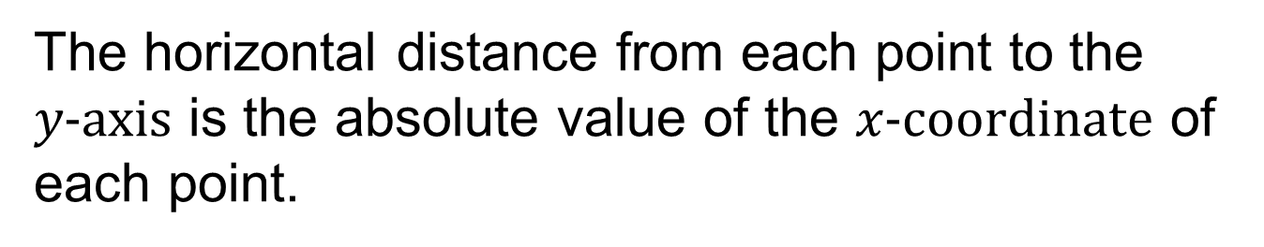


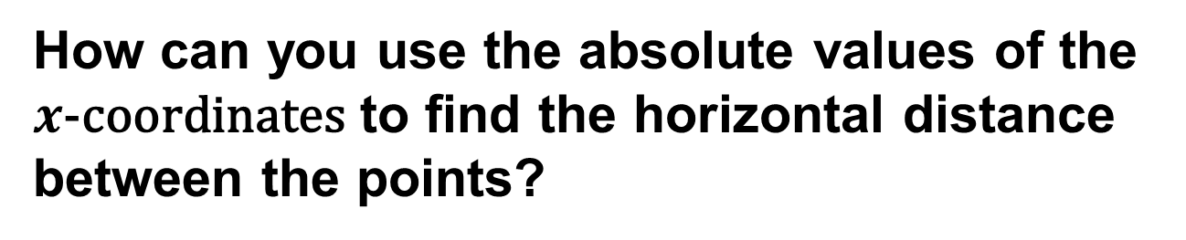
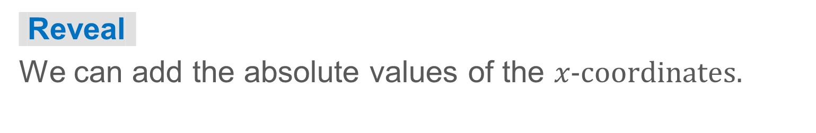

COLLABORATE · TALK IT THROUGH • AGREE ON A MODEL
Collaborate and Connect
Let’s look at another way to find the distance.
23 / 55
Notes:
TEACH IN PRACTICE | Embedded facilitation | Lesson 7.6, slide 22 | COLLABORATE
Focus on the existing task: Collaborate and Connect Let’s look at another way to find the distance. COLLABORATE · TALK IT THROUGH • AGREE ON A…
LAUNCH (T2/3/5): Use the displayed question. Give private thinking time; then A explains while B asks for evidence. Switch roles. Each student records their own reasoning.
LOOK FOR (T4): Where this task addresses it, students can find horizontal or vertical distance. Ask which feature of their work supports the claim.
RESPOND: If this task shows the lesson misconception—adding absolute values for every pair regardless of location—mark the shared coordinate and trace the axis-aligned segment through the original points. Have the student revise and explain the change. Use this support only where the concept occurs in the current task; otherwise respond to the displayed question.
RECHECK: If a gap is shared, revisit the existing representation together. If it is limited, give targeted support while others compare valid methods on the same task. Check the revision before moving on.
PARTICIPATION (T5/6/7): Think time before volunteers; accept a written, drawn or rehearsed entry. Students ask for evidence respectfully. Recognize a specific contribution or revision and check that both partners participate.
Source: BCPS Updated Instructional Framework Rubric (June 2020), TEACH 1–7. Earlier notes and answer keys are retained below.
EARLIER NOTES / EXISTING ANSWER KEY
Routine: COLLABORATE · TALK IT THROUGH • AGREE ON A MODEL
UIFR FULL | Lesson-specific facilitation
TEACH 4-5 | Session 1 discussion and checkpoint (UIFR PDF pp. 11-12).
Collect a brief response from every student to the existing prompt before hearing volunteers. Partners take turns explaining and asking for evidence: “I understand ___; what supports ___?” Offer rehearsal or an annotated model for students who need language support. Each student records their own reasoning.
Look specifically for: adding absolute values for every pair regardless of location. If it appears, mark the shared coordinate and trace the axis-aligned segment through the original points; then ask the student to revise the same response and explain the change. If evidence is secure, have students compare a second valid pathway or state why their approach works. Choose the next step from the responses, not a preset pace.

Slide 24
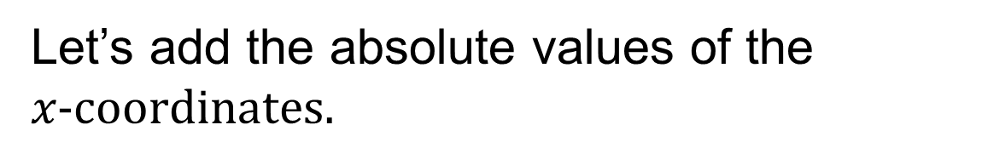
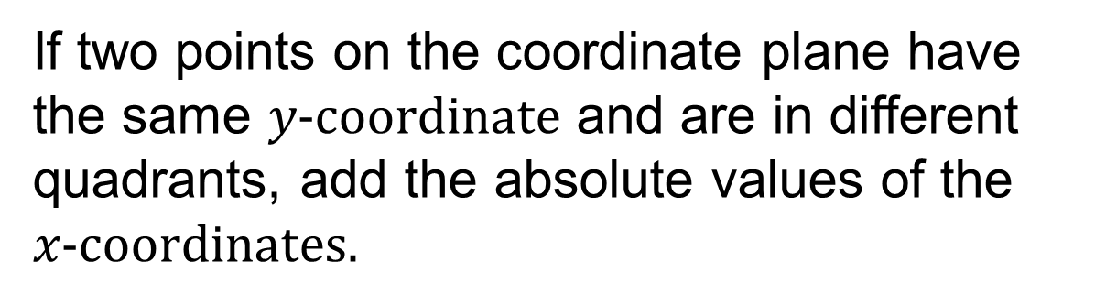

How Far?
Think About It:
What operation would you use if the points were located in the same quadrant?
24 / 55
Notes:
TEACH IN PRACTICE | Embedded facilitation | Lesson 7.6, slide 23 | TASK
Focus on the existing task: How Far?
LAUNCH (T2/3/5): Use the displayed question. Give private thinking time; then A explains while B asks for evidence. Switch roles. Each student records their own reasoning.
LOOK FOR (T4): Where this task addresses it, students can identify a shared coordinate. Ask which feature of their work supports the claim.
RESPOND: If this task shows the lesson misconception—adding absolute values for every pair regardless of location—mark the shared coordinate and trace the axis-aligned segment through the original points. Have the student revise and explain the change. Use this support only where the concept occurs in the current task; otherwise respond to the displayed question.
RECHECK: If a gap is shared, revisit the existing representation together. If it is limited, give targeted support while others compare valid methods on the same task. Check the revision before moving on.
PARTICIPATION (T5/6/7): Think time before volunteers; accept a written, drawn or rehearsed entry. Students ask for evidence respectfully. Recognize a specific contribution or revision and check that both partners participate.
Source: BCPS Updated Instructional Framework Rubric (June 2020), TEACH 1–7. Earlier notes and answer keys are retained below.
EARLIER NOTES / EXISTING ANSWER KEY
Ask the question, then hold the silence — students think or jot before anyone answers.
Take two or three responses and press with “Why?” or “How do you know?” before moving on.
UIFR: TEACH 3.

Slide 25
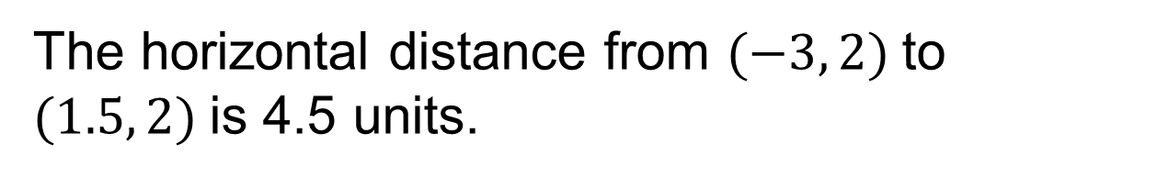
How Far?
Tahira will walk from the middle school to the high school. The grid shows a map of the town, where each unit labeled on the grid represents one kilometer.
What does 4.5 units mean in the context of the problem?
Reveal:
The distance between the middle school to the high school is 4.5 kilometers.
25 / 55
Notes:
TEACH IN PRACTICE | Embedded facilitation | Lesson 7.6, slide 24 | REVEAL
Focus on the existing task: How Far?
LAUNCH (T2/3/5): If an existing answer cover is present, gather an attempt before revealing. If the explanation is already visible, ask students to reconstruct and justify it. Compare reasoning and explain a revision; preserve the reveal sequence.
LOOK FOR (T4): Where this task addresses it, students can find horizontal or vertical distance. Ask which feature of their work supports the claim.
RESPOND: If this task shows the lesson misconception—adding absolute values for every pair regardless of location—mark the shared coordinate and trace the axis-aligned segment through the original points. Have the student revise and explain the change. Use this support only where the concept occurs in the current task; otherwise respond to the displayed question.
RECHECK: If a gap is shared, revisit the existing representation together. If it is limited, give targeted support while others compare valid methods on the same task. Check the revision before moving on.
PARTICIPATION (T5/6/7): Think time before volunteers; accept a written, drawn or rehearsed entry. Students ask for evidence respectfully. Recognize a specific contribution or revision and check that both partners participate.
Source: BCPS Updated Instructional Framework Rubric (June 2020), TEACH 1–7. Earlier notes and answer keys are retained below.
EARLIER NOTES / EXISTING ANSWER KEY
Do not click yet: collect 2–3 student answers with reasons first.
Then click to remove the cover and have students compare their thinking to the reveal — “Is this what we said? Where is it different?”
Behind the cover: The distance between the middle school to the high school is 4.5 kilometers.
UIFR: TEACH 3 · TEACH 4.

Slide 26
STUDENT MOVES
Lesson 7-6
Your moves
TAKE TURNS · One explains, one asks a question. Then switch, so both of you talk.
ASK THE CLASS · Write one question about this that you could ask the class.
RESTATE FIRST · Restate your partner’s idea in your own words before you give yours.
26 / 55

Slide 27

How Far?
Tahira will walk from the middle school to the high school. The grid shows a map of the town, where each unit labeled on the grid represents one kilometer.
How far will Tahira walk?
Tahira will walk 4.5 kilometers.
ADD ON · Add on: “I agree because ______.” or “I see it differently because ______.”
Using Symbols Appropriately
What unit of measure is needed to be precise?
27 / 55
Notes:
TEACH IN PRACTICE | Embedded facilitation | Lesson 7.6, slide 25 | TASK
Focus on the existing task: How Far?
LAUNCH (T2/3/5): Use the displayed question. Give private thinking time; then A explains while B asks for evidence. Switch roles. Each student records their own reasoning.
LOOK FOR (T4): Where this task addresses it, students can identify a shared coordinate. Ask which feature of their work supports the claim.
RESPOND: If this task shows the lesson misconception—adding absolute values for every pair regardless of location—mark the shared coordinate and trace the axis-aligned segment through the original points. Have the student revise and explain the change. Use this support only where the concept occurs in the current task; otherwise respond to the displayed question.
RECHECK: If a gap is shared, revisit the existing representation together. If it is limited, give targeted support while others compare valid methods on the same task. Check the revision before moving on.
PARTICIPATION (T5/6/7): Think time before volunteers; accept a written, drawn or rehearsed entry. Students ask for evidence respectfully. Recognize a specific contribution or revision and check that both partners participate.
Source: BCPS Updated Instructional Framework Rubric (June 2020), TEACH 1–7. Earlier notes and answer keys are retained below.
EARLIER NOTES / EXISTING ANSWER KEY
Read the context aloud (or have a student read it).
Before any math, students restate the situation and what is being asked in their own words.
Ask: How far will Tahira walk?
UIFR: TEACH 1 · TEACH 3.

Slide 28
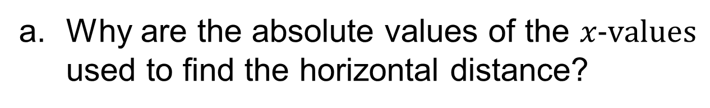

Let’s Explore More
Workspace
Which coordinate would you use to determine the vertical distance between two points on the coordinate plane?
Workspace
28 / 55
Notes:
TEACH IN PRACTICE | Embedded facilitation | Lesson 7.6, slide 26 | PRACTICE
Focus on the existing task: Let’s Explore More Workspace Workspace Which coordinate would you use to determine the vertical distance between two points on the coordinate plane?
LAUNCH (T2/3/5): Use the displayed question. Give private thinking time; then A explains while B asks for evidence. Switch roles. Each student records their own reasoning.
LOOK FOR (T4): Where this task addresses it, students can find horizontal or vertical distance. Ask which feature of their work supports the claim.
RESPOND: If this task shows the lesson misconception—adding absolute values for every pair regardless of location—mark the shared coordinate and trace the axis-aligned segment through the original points. Have the student revise and explain the change. Use this support only where the concept occurs in the current task; otherwise respond to the displayed question.
RECHECK: If a gap is shared, revisit the existing representation together. If it is limited, give targeted support while others compare valid methods on the same task. Check the revision before moving on.
PARTICIPATION (T5/6/7): Think time before volunteers; accept a written, drawn or rehearsed entry. Students ask for evidence respectfully. Recognize a specific contribution or revision and check that both partners participate.
Source: BCPS Updated Instructional Framework Rubric (June 2020), TEACH 1–7. Earlier notes and answer keys are retained below.
EARLIER NOTES / EXISTING ANSWER KEY
Extension for partners or table groups — students choose their approach and use the workspace to show thinking.
Push with “Convince me,” and have two groups with different approaches share.
This is where students stretch past the worked example.
UIFR: TEACH 2 · TEACH 5.

Slide 29
STUDENT MOVES
Lesson 7-6
Your move
TWO MINUTES SOLO · Two minutes on your own, then compare. Bring one thing you tried, even if it did not work.
29 / 55

Slide 30
LESSON 7.6 / DISCUSS THE TASK
Explain and compare
Use the task you just explored.
TAKE TURNS
Do the points lie on the same side of zero or opposite sides, and how does that affect the distance?
Explain
“I know this because…”
Ask
“Where does your work show that?”
Point to evidence in your work.
Then compare your approach with a partner’s.
HOW DO YOU KNOW? · Ask your partner “How do you know?” Answer by pointing to your own work.
Listen to understand. Ask for evidence. Make room for every voice.
Notes:
TEACH IN PRACTICE | Embedded facilitation | Lesson 7.6, slide 27 | PRIOR_INSERT
Focus on the existing task: Point to evidence in your work. Then compare your approach with a partner’s. TAKE TURNS Explain “I know this because…” Ask “Where does your work show that?
CONNECT (T1/4): Ask students to restate the displayed goal or key idea and connect it to earlier work. Relevant lesson evidence: identify a shared coordinate; find horizontal or vertical distance; justify nonnegative length. Use only the criterion that matches the current session.
SHOW PROGRESS: Students point to their own existing work, explain what improved after feedback, and name a next step. Pair confidence ratings with actual evidence.
PARTICIPATION (T5/6/7): Think time before volunteers; accept a written, drawn or rehearsed entry. Students ask for evidence respectfully. Recognize a specific contribution or revision and check that both partners participate.
Source: BCPS Updated Instructional Framework Rubric (June 2020), TEACH 1–7.

Slide 31
How Far?
Let’s find the coordinates of the middle school and the high school.
How can you use the coordinate plane to find the distance between the two schools?
Reveal:
One way is to count the units on the coordinate plane.
31 / 55
Notes:
TEACH IN PRACTICE | Embedded facilitation | Lesson 7.6, slide 28 | REVEAL
Focus on the existing task: How Far?
LAUNCH (T2/3/5): If an existing answer cover is present, gather an attempt before revealing. If the explanation is already visible, ask students to reconstruct and justify it. Compare reasoning and explain a revision; preserve the reveal sequence.
LOOK FOR (T4): Where this task addresses it, students can find horizontal or vertical distance. Ask which feature of their work supports the claim.
RESPOND: If this task shows the lesson misconception—adding absolute values for every pair regardless of location—mark the shared coordinate and trace the axis-aligned segment through the original points. Have the student revise and explain the change. Use this support only where the concept occurs in the current task; otherwise respond to the displayed question.
RECHECK: If a gap is shared, revisit the existing representation together. If it is limited, give targeted support while others compare valid methods on the same task. Check the revision before moving on.
PARTICIPATION (T5/6/7): Think time before volunteers; accept a written, drawn or rehearsed entry. Students ask for evidence respectfully. Recognize a specific contribution or revision and check that both partners participate.
Source: BCPS Updated Instructional Framework Rubric (June 2020), TEACH 1–7.

Slide 32
Session 2 Warm-Up
Lesson 7-6 · Determine Distance on the Coordinate Plane
Session 2 Warm-Up
Check what you remember from Session 1 · about 4 minutes
1
To find distance between (2, 5) and (2, −3), look at:
2
What is the distance between (2, 5) and (2, −3)?
A
x-coordinates
A
2
B
y-coordinates (vertical distance)
B
8 units
C
Sum of all coordinates
C
−8 units
D
Quadrant names
D
15 units
3
What is horizontal distance between (−4, 3) and (6, 3)?
4
When points lie in different quadrants across an axis:
A
2
A
Subtract absolute values
B
10 units
B
Add their absolute values
C
−10 units
C
Multiply coordinates
D
24 units
D
Distance is 0
eduwonderlab.com · Neft Teacher
32 / 55
Notes:
TEACH IN PRACTICE | Embedded facilitation | Lesson 7.6, slide 29 | WARMUP
Focus on the existing task: A 2 B 8 units C −8 units D 15 units 3 What is horizontal distance between (−4, 3) and (6, 3)?
GATHER EVIDENCE (T4/6): Keep the original items. Students try independently, mark an uncertain item, and explain one method before checking. Use the existing key when present.
RESPOND: Distinguish a calculation slip from a reasoning gap. Give one next step on the same item; have students revise in a second color. Use the responses to choose flexible support for today’s lesson.
PARTICIPATION (T5/6/7): Think time before volunteers; accept a written, drawn or rehearsed entry. Students ask for evidence respectfully. Recognize a specific contribution or revision and check that both partners participate.
Source: BCPS Updated Instructional Framework Rubric (June 2020), TEACH 1–7. Earlier notes and answer keys are retained below.
EARLIER NOTES / EXISTING ANSWER KEY
Warm-up routine: students start silently on entry; keep it to about 4 minutes.
Circulate and note who is stuck — use what you see to choose who you check on first today.
Go over answers quickly; ask one student to explain a step, not just say the answer.
UIFR: TEACH 4 · TEACH 6.
UIFR FULL | Lesson-specific facilitation
TEACH 1 | Session 2 purpose and evidence (UIFR PDF p. 8).
Have students restate the displayed session goal in their own words and connect it to the existing context or a familiar experience they choose to share. Use the current session goal to select from these lesson-wide evidence criteria; do not frontload a later-session procedure.
Look for: identify a shared coordinate; find horizontal or vertical distance; justify nonnegative length. Ask: “Which part of your work would show this?” Revisit that evidence after the task; a confidence rating alone is not evidence of understanding.

Slide 33
STUDENT MOVES
Lesson 7-6
Your moves
SPECIFIC FEEDBACK · Trade work. Give one specific comment: “This part is clear because ______.”
YOU KNOW THE ROUTINE · Read → plan → solve → check. Do all four, in that order.
33 / 55

Slide 34
Today’s Math Notes
Lesson 7-6 · Determine Distance on the Coordinate Plane
Review Notes — Session 2
Copy. Explain. Check.
WHY IT MATTERS · Finish this: “This is worth knowing because ______.”
Same Quadrant Distance
1
When coordinates have the same sign, subtract absolute values: |coord1| − |coord2|.
Different Quadrant Distance
2
When points cross an axis (different signs), add absolute values: |coord1| + |coord2|.
Orientation
3
Same x-coordinates indicate vertical lines; same y-coordinates indicate horizontal lines.
eduwonderlab.com · Neft Teacher
34 / 55
Notes:
TEACH IN PRACTICE | Embedded facilitation | Lesson 7.6, slide 30 | NOTES
Focus on the existing task: Today’s Math Notes Review Notes — Session 2 Copy…
ROUTINE (T1/2/4): Read or copy the original notes, cover one line, and explain it using the displayed example. Reopen and correct. Copying alone is not evidence of understanding.
LOOK FOR: A link between a symbol, quantity or feature and the explanation. If missing, point back to that feature and have the student try again; fade the prompt once they can explain.
PARTICIPATION (T5/6/7): Think time before volunteers; accept a written, drawn or rehearsed entry. Students ask for evidence respectfully. Recognize a specific contribution or revision and check that both partners participate.
Source: BCPS Updated Instructional Framework Rubric (June 2020), TEACH 1–7. Earlier notes and answer keys are retained below.
EARLIER NOTES / EXISTING ANSWER KEY
Copy routine: read one line at a time; students copy, then explain that line to a partner.
Keep it brisk — the understanding work happens in the examples, not the copying.
UIFR: TEACH 1 · TEACH 6.

Slide 35
Session 2
Determine Distance on the
Coordinate Plane
SELF-CHECK · Mark it: ✓ got it · ~ almost · ? stuck. Then fix one thing before we move on.
35 / 55
Notes:
TEACH IN PRACTICE | Embedded facilitation | Lesson 7.6, slide 31 | DIVIDER
Focus on the existing task: Determine Distance on the Coordinate Plane Session 2
TRANSITION (T6/7): Students confirm materials, roles, how to request help, and the next response routine. Ask a student to restate it. Keep teacher-only slides hidden.
PARTICIPATION (T5/6/7): Think time before volunteers; accept a written, drawn or rehearsed entry. Students ask for evidence respectfully. Recognize a specific contribution or revision and check that both partners participate.
Source: BCPS Updated Instructional Framework Rubric (June 2020), TEACH 1–7. Earlier notes and answer keys are retained below.
EARLIER NOTES / EXISTING ANSWER KEY
Transition cue: state what materials are out and what success looks like this session.
Keep the changeover under a minute.
UIFR: TEACH 6.

Slide 36
Who Walks Farther?
Miguel will walk from the high school to the town hall. Shanice will walk from the high school to the soccer fields. The grid shows a map of the town, where each unit labeled on the grid represents one kilometer.
Who will walk farther?
Precision
STRUGGLE FIRST · Work on your own first. Stuck is allowed — try a second strategy before you ask.
What level of precision does this problem require?
36 / 55
Notes:
TEACH IN PRACTICE | Embedded facilitation | Lesson 7.6, slide 32 | TASK
Focus on the existing task: Who Walks Farther?
LAUNCH (T2/3/5): Use the displayed question. Give private thinking time; then A explains while B asks for evidence. Switch roles. Each student records their own reasoning.
LOOK FOR (T4): Where this task addresses it, students can identify a shared coordinate. Ask which feature of their work supports the claim.
RESPOND: If this task shows the lesson misconception—adding absolute values for every pair regardless of location—mark the shared coordinate and trace the axis-aligned segment through the original points. Have the student revise and explain the change. Use this support only where the concept occurs in the current task; otherwise respond to the displayed question.
RECHECK: If a gap is shared, revisit the existing representation together. If it is limited, give targeted support while others compare valid methods on the same task. Check the revision before moving on.
PARTICIPATION (T5/6/7): Think time before volunteers; accept a written, drawn or rehearsed entry. Students ask for evidence respectfully. Recognize a specific contribution or revision and check that both partners participate.
Source: BCPS Updated Instructional Framework Rubric (June 2020), TEACH 1–7. Earlier notes and answer keys are retained below.
EARLIER NOTES / EXISTING ANSWER KEY
Read the context aloud (or have a student read it).
Before any math, students restate the situation and what is being asked in their own words.
Ask: Who Walks Farther?
UIFR: TEACH 1 · TEACH 3.
UIFR FULL | Lesson-specific facilitation
TEACH 2-3 | Session 2 task launch (UIFR PDF pp. 9-10).
Use the problem exactly as displayed. Give individual thinking time before discussion or advancing to the explanation. If the answer is already visible, ask students to reconstruct and justify it. Invite a choice of suitable representations and have students explain why their choice helps.
At the point where this concept appears, ask: “Do the points lie on the same side of zero or opposite sides, and how does that affect the distance?” Wait for evidence, invite another pathway, and have a student ask a follow-up question. Do not replace students’ reasoning with a sequence of leading steps.

Slide 37
Who Walks Farther?
Miguel will walk from the high school to the town hall. Shanice will walk from the high school to the soccer fields. The grid shows a map of the town, where each unit labeled on the grid represents one kilometer. Who will walk farther?
What do you need to know to determine who will walk farther?
Reveal:
We need to know the distance each person will walk.
37 / 55
Notes:
TEACH IN PRACTICE | Embedded facilitation | Lesson 7.6, slide 33 | REVEAL
Focus on the existing task: Who Walks Farther?
LAUNCH (T2/3/5): If an existing answer cover is present, gather an attempt before revealing. If the explanation is already visible, ask students to reconstruct and justify it. Compare reasoning and explain a revision; preserve the reveal sequence.
LOOK FOR (T4): Where this task addresses it, students can find horizontal or vertical distance. Ask which feature of their work supports the claim.
RESPOND: If this task shows the lesson misconception—adding absolute values for every pair regardless of location—mark the shared coordinate and trace the axis-aligned segment through the original points. Have the student revise and explain the change. Use this support only where the concept occurs in the current task; otherwise respond to the displayed question.
RECHECK: If a gap is shared, revisit the existing representation together. If it is limited, give targeted support while others compare valid methods on the same task. Check the revision before moving on.
PARTICIPATION (T5/6/7): Think time before volunteers; accept a written, drawn or rehearsed entry. Students ask for evidence respectfully. Recognize a specific contribution or revision and check that both partners participate.
Source: BCPS Updated Instructional Framework Rubric (June 2020), TEACH 1–7. Earlier notes and answer keys are retained below.
EARLIER NOTES / EXISTING ANSWER KEY
Do not click yet: collect 2–3 student answers with reasons first.
Then click to remove the cover and have students compare their thinking to the reveal — “Is this what we said? Where is it different?”
Behind the cover: We need to know the distance each person will walk.
UIFR: TEACH 3 · TEACH 4.

Slide 38
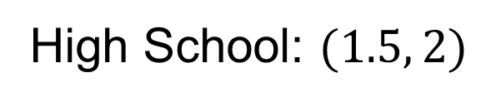
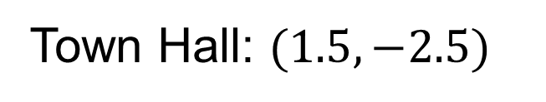
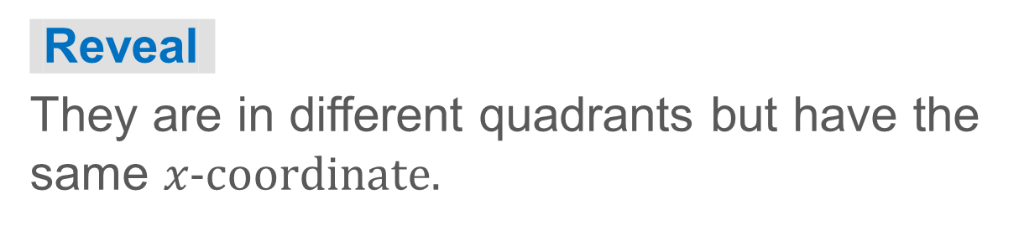
Who Walks Farther?
Let’s determine how far Miguel will walk.
Miguel will walk from the high school to the town hall.
What do you notice about the locations of the high school and the town hall?
38 / 55
Notes:
TEACH IN PRACTICE | Embedded facilitation | Lesson 7.6, slide 34 | TASK
Focus on the existing task: Who Walks Farther?
LAUNCH (T2/3/5): Use the displayed question. Give private thinking time; then A explains while B asks for evidence. Switch roles. Each student records their own reasoning.
LOOK FOR (T4): Where this task addresses it, students can identify a shared coordinate. Ask which feature of their work supports the claim.
RESPOND: If this task shows the lesson misconception—adding absolute values for every pair regardless of location—mark the shared coordinate and trace the axis-aligned segment through the original points. Have the student revise and explain the change. Use this support only where the concept occurs in the current task; otherwise respond to the displayed question.
RECHECK: If a gap is shared, revisit the existing representation together. If it is limited, give targeted support while others compare valid methods on the same task. Check the revision before moving on.
PARTICIPATION (T5/6/7): Think time before volunteers; accept a written, drawn or rehearsed entry. Students ask for evidence respectfully. Recognize a specific contribution or revision and check that both partners participate.
Source: BCPS Updated Instructional Framework Rubric (June 2020), TEACH 1–7. Earlier notes and answer keys are retained below.
EARLIER NOTES / EXISTING ANSWER KEY
Model briefly, then hand the thinking back: ask “Why does this step work?” before showing the next one.
Quick check before moving on — thumbs or whiteboards from everyone, not volunteers.
UIFR: TEACH 2 · TEACH 3 · TEACH 4.

Slide 39
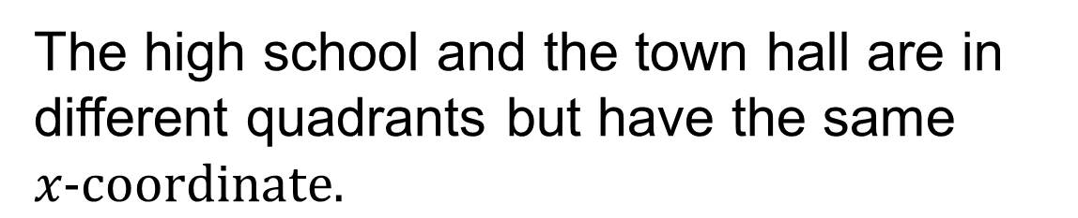
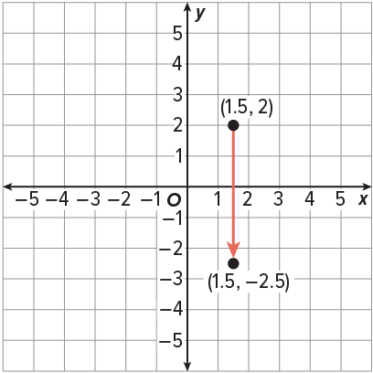
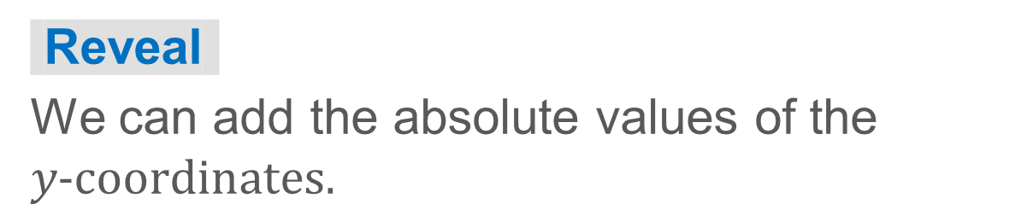
Who Walks Farther?
How can you use the coordinates to find the distance between the two points?
39 / 55
Notes:
TEACH IN PRACTICE | Embedded facilitation | Lesson 7.6, slide 35 | TASK
Focus on the existing task: Who Walks Farther?
LAUNCH (T2/3/5): Use the displayed question. Give private thinking time; then A explains while B asks for evidence. Switch roles. Each student records their own reasoning.
LOOK FOR (T4): Where this task addresses it, students can find horizontal or vertical distance. Ask which feature of their work supports the claim.
RESPOND: If this task shows the lesson misconception—adding absolute values for every pair regardless of location—mark the shared coordinate and trace the axis-aligned segment through the original points. Have the student revise and explain the change. Use this support only where the concept occurs in the current task; otherwise respond to the displayed question.
RECHECK: If a gap is shared, revisit the existing representation together. If it is limited, give targeted support while others compare valid methods on the same task. Check the revision before moving on.
PARTICIPATION (T5/6/7): Think time before volunteers; accept a written, drawn or rehearsed entry. Students ask for evidence respectfully. Recognize a specific contribution or revision and check that both partners participate.
Source: BCPS Updated Instructional Framework Rubric (June 2020), TEACH 1–7. Earlier notes and answer keys are retained below.
EARLIER NOTES / EXISTING ANSWER KEY
Model briefly, then hand the thinking back: ask “Why does this step work?” before showing the next one.
Quick check before moving on — thumbs or whiteboards from everyone, not volunteers.
UIFR: TEACH 2 · TEACH 3 · TEACH 4.

Slide 40
STUDENT MOVES
Lesson 7-6
Your moves
YOUR CHOICE · You choose how to show this — numbers, words, or a diagram. Make your reasoning visible.
PROVE IT · Find the evidence in the problem that makes your answer right — not just the answer.
HOW DO YOU KNOW? · Ask your partner “How do you know?” Answer by pointing to your own work.
40 / 55

Slide 41

Who Walks Farther?
Let’s add the absolute values of the y-coordinates.
Miguel will walk 4.5 kilometers.
Think About It:
JUSTIFY IT · Say it like this: “I know ______ because ______.”
41 / 55
Notes:
TEACH IN PRACTICE | Embedded facilitation | Lesson 7.6, slide 36 | TASK
Focus on the existing task: Who Walks Farther?
LAUNCH (T2/3/5): Use the displayed question. Give private thinking time; then A explains while B asks for evidence. Switch roles. Each student records their own reasoning.
LOOK FOR (T4): Where this task addresses it, students can identify a shared coordinate. Ask which feature of their work supports the claim.
RESPOND: If this task shows the lesson misconception—adding absolute values for every pair regardless of location—mark the shared coordinate and trace the axis-aligned segment through the original points. Have the student revise and explain the change. Use this support only where the concept occurs in the current task; otherwise respond to the displayed question.
RECHECK: If a gap is shared, revisit the existing representation together. If it is limited, give targeted support while others compare valid methods on the same task. Check the revision before moving on.
PARTICIPATION (T5/6/7): Think time before volunteers; accept a written, drawn or rehearsed entry. Students ask for evidence respectfully. Recognize a specific contribution or revision and check that both partners participate.
Source: BCPS Updated Instructional Framework Rubric (June 2020), TEACH 1–7. Earlier notes and answer keys are retained below.
EARLIER NOTES / EXISTING ANSWER KEY
Ask the question, then hold the silence — students think or jot before anyone answers.
Take two or three responses and press with “Why?” or “How do you know?” before moving on.
UIFR: TEACH 3.

Slide 42
Who Walks Farther?
Let’s add the absolute values of the y-coordinates.
Miguel will walk 4.5 kilometers.
Think About It:
What generalization can you make about which coordinates to add or subtract when finding the distance between two points?
42 / 55
Notes:
TEACH IN PRACTICE | Embedded facilitation | Lesson 7.6, slide 37 | TASK
Focus on the existing task: Who Walks Farther?
LAUNCH (T2/3/5): Use the displayed question. Give private thinking time; then A explains while B asks for evidence. Switch roles. Each student records their own reasoning.
LOOK FOR (T4): Where this task addresses it, students can find horizontal or vertical distance. Ask which feature of their work supports the claim.
RESPOND: If this task shows the lesson misconception—adding absolute values for every pair regardless of location—mark the shared coordinate and trace the axis-aligned segment through the original points. Have the student revise and explain the change. Use this support only where the concept occurs in the current task; otherwise respond to the displayed question.
RECHECK: If a gap is shared, revisit the existing representation together. If it is limited, give targeted support while others compare valid methods on the same task. Check the revision before moving on.
PARTICIPATION (T5/6/7): Think time before volunteers; accept a written, drawn or rehearsed entry. Students ask for evidence respectfully. Recognize a specific contribution or revision and check that both partners participate.
Source: BCPS Updated Instructional Framework Rubric (June 2020), TEACH 1–7. Earlier notes and answer keys are retained below.
EARLIER NOTES / EXISTING ANSWER KEY
Ask the question, then hold the silence — students think or jot before anyone answers.
Take two or three responses and press with “Why?” or “How do you know?” before moving on.
UIFR: TEACH 3.

Slide 43
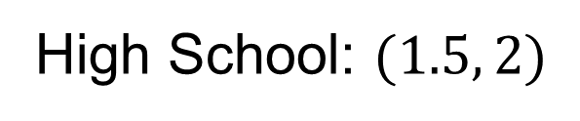
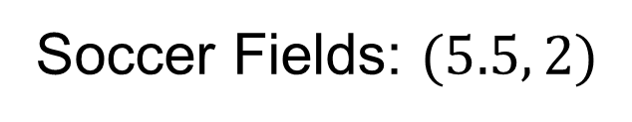
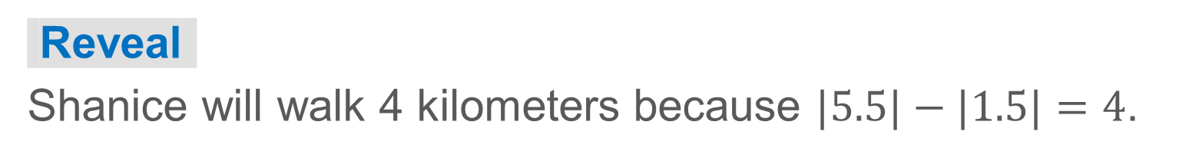
COLLABORATE · TALK IT THROUGH • AGREE ON A MODEL
Collaborate and Connect
Shanice will walk from the high school to the soccer fields. Each unit labeled on the grid represents one kilometer.
How far did Shanice walk? Explain your reasoning.
43 / 55
Notes:
TEACH IN PRACTICE | Embedded facilitation | Lesson 7.6, slide 38 | COLLABORATE
Focus on the existing task: Shanice will walk from the high school to the soccer fields. Each unit labeled on the grid represents one kilometer. Collaborate and Connect How far did Shanice walk?
LAUNCH (T2/3/5): Use the displayed question. Give private thinking time; then A explains while B asks for evidence. Switch roles. Each student records their own reasoning.
LOOK FOR (T4): Where this task addresses it, students can identify a shared coordinate. Ask which feature of their work supports the claim.
RESPOND: If this task shows the lesson misconception—adding absolute values for every pair regardless of location—mark the shared coordinate and trace the axis-aligned segment through the original points. Have the student revise and explain the change. Use this support only where the concept occurs in the current task; otherwise respond to the displayed question.
RECHECK: If a gap is shared, revisit the existing representation together. If it is limited, give targeted support while others compare valid methods on the same task. Check the revision before moving on.
PARTICIPATION (T5/6/7): Think time before volunteers; accept a written, drawn or rehearsed entry. Students ask for evidence respectfully. Recognize a specific contribution or revision and check that both partners participate.
Source: BCPS Updated Instructional Framework Rubric (June 2020), TEACH 1–7. Earlier notes and answer keys are retained below.
EARLIER NOTES / EXISTING ANSWER KEY
Routine: COLLABORATE · TALK IT THROUGH • AGREE ON A MODEL
UIFR FULL | Lesson-specific facilitation
TEACH 4-5 | Session 2 discussion and checkpoint (UIFR PDF pp. 11-12).
Collect a brief response from every student to the existing prompt before hearing volunteers. Partners take turns explaining and asking for evidence: “I understand ___; what supports ___?” Offer rehearsal or an annotated model for students who need language support. Each student records their own reasoning.
Look specifically for: adding absolute values for every pair regardless of location. If it appears, mark the shared coordinate and trace the axis-aligned segment through the original points; then ask the student to revise the same response and explain the change. If evidence is secure, have students compare a second valid pathway or state why their approach works. Choose the next step from the responses, not a preset pace.

Slide 44
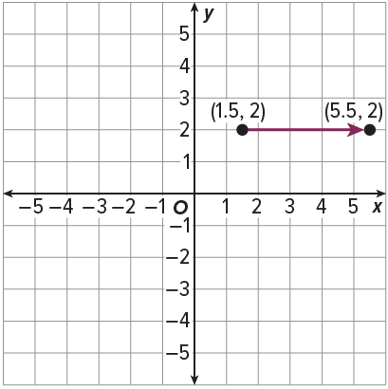

Who Walks Farther?
Let’s find how far Shanice will walk.
We can subtract the absolute values of the x-coordinates because the points are in the same quadrant.
Think About It:
Why is it necessary to use the absolute value of coordinates when finding distance?
44 / 55
Notes:
TEACH IN PRACTICE | Embedded facilitation | Lesson 7.6, slide 39 | TASK
Focus on the existing task: Let’s find how far Shanice will walk. Who Walks Farther?
LAUNCH (T2/3/5): Use the displayed question. Give private thinking time; then A explains while B asks for evidence. Switch roles. Each student records their own reasoning.
LOOK FOR (T4): Where this task addresses it, students can find horizontal or vertical distance. Ask which feature of their work supports the claim.
RESPOND: If this task shows the lesson misconception—adding absolute values for every pair regardless of location—mark the shared coordinate and trace the axis-aligned segment through the original points. Have the student revise and explain the change. Use this support only where the concept occurs in the current task; otherwise respond to the displayed question.
RECHECK: If a gap is shared, revisit the existing representation together. If it is limited, give targeted support while others compare valid methods on the same task. Check the revision before moving on.
PARTICIPATION (T5/6/7): Think time before volunteers; accept a written, drawn or rehearsed entry. Students ask for evidence respectfully. Recognize a specific contribution or revision and check that both partners participate.
Source: BCPS Updated Instructional Framework Rubric (June 2020), TEACH 1–7. Earlier notes and answer keys are retained below.
EARLIER NOTES / EXISTING ANSWER KEY
Ask the question, then hold the silence — students think or jot before anyone answers.
Take two or three responses and press with “Why?” or “How do you know?” before moving on.
UIFR: TEACH 3.

Slide 45
STUDENT MOVES
Lesson 7-6
Your moves
PICK YOUR STRATEGY · Choose your path — picture, table, number line, or equation — and be ready to say why you chose it.
TEACH A PARTNER · Teach this to someone who missed it. If you can teach it, you know it.
JUSTIFY IT · Say it like this: “I know ______ because ______.”
45 / 55

Slide 46
Who Walks Farther?
Miguel will walk 4.5 kilometers. Shanice will walk 4 kilometers.
How can you determine who will walk farther?
Reveal:
We can compare the distances they will walk.
Record your reasoning before the reveal. Compare, then explain any revision.
46 / 55
Notes:
TEACH IN PRACTICE | Embedded facilitation | Lesson 7.6, slide 40 | REVEAL
Focus on the existing task: Miguel will walk 4.5 kilometers. Shanice will walk 4 kilometers. Who Walks Farther?
LAUNCH (T2/3/5): If an existing answer cover is present, gather an attempt before revealing. If the explanation is already visible, ask students to reconstruct and justify it. Compare reasoning and explain a revision; preserve the reveal sequence.
LOOK FOR (T4): Where this task addresses it, students can identify a shared coordinate. Ask which feature of their work supports the claim.
RESPOND: If this task shows the lesson misconception—adding absolute values for every pair regardless of location—mark the shared coordinate and trace the axis-aligned segment through the original points. Have the student revise and explain the change. Use this support only where the concept occurs in the current task; otherwise respond to the displayed question.
RECHECK: If a gap is shared, revisit the existing representation together. If it is limited, give targeted support while others compare valid methods on the same task. Check the revision before moving on.
PARTICIPATION (T5/6/7): Think time before volunteers; accept a written, drawn or rehearsed entry. Students ask for evidence respectfully. Recognize a specific contribution or revision and check that both partners participate.
Source: BCPS Updated Instructional Framework Rubric (June 2020), TEACH 1–7. Earlier notes and answer keys are retained below.
EARLIER NOTES / EXISTING ANSWER KEY
Do not click yet: collect 2–3 student answers with reasons first.
Then click to remove the cover and have students compare their thinking to the reveal — “Is this what we said? Where is it different?”
Behind the cover: We can compare the distances they will walk.
UIFR: TEACH 3 · TEACH 4.

Slide 47
Let’s Explore More
Why did you add to find Miguel’s distance from the high school to the town hall and subtract to find Shanice’s distance from the high school to the soccer fields?
Workspace
Try it yourself. Compare your work with a partner; explain one choice and revise.
47 / 55
Notes:
TEACH IN PRACTICE | Embedded facilitation | Lesson 7.6, slide 41 | PRACTICE
Focus on the existing task: Let’s Explore More Why did you add to find Miguel’s distance from the high school to the town hall and subtract to find Shanice’s distance from the high school to the soccer fields?
LAUNCH (T2/3/5): Use the displayed question. Give private thinking time; then A explains while B asks for evidence. Switch roles. Each student records their own reasoning.
LOOK FOR (T4): Where this task addresses it, students can find horizontal or vertical distance. Ask which feature of their work supports the claim.
RESPOND: If this task shows the lesson misconception—adding absolute values for every pair regardless of location—mark the shared coordinate and trace the axis-aligned segment through the original points. Have the student revise and explain the change. Use this support only where the concept occurs in the current task; otherwise respond to the displayed question.
RECHECK: If a gap is shared, revisit the existing representation together. If it is limited, give targeted support while others compare valid methods on the same task. Check the revision before moving on.
PARTICIPATION (T5/6/7): Think time before volunteers; accept a written, drawn or rehearsed entry. Students ask for evidence respectfully. Recognize a specific contribution or revision and check that both partners participate.
Source: BCPS Updated Instructional Framework Rubric (June 2020), TEACH 1–7. Earlier notes and answer keys are retained below.
EARLIER NOTES / EXISTING ANSWER KEY
Extension for partners or table groups — students choose their approach and use the workspace to show thinking.
Push with “Convince me,” and have two groups with different approaches share.
This is where students stretch past the worked example.
UIFR: TEACH 2 · TEACH 5.

Slide 48
LESSON 7.6 / CHECK YOUR WORK
Pause. Check. Improve.
CHECK
A mistake to watch for: adding absolute values for every pair regardless of location.
TRY
Mark the shared coordinate and trace the axis-aligned segment through the given points.
REVISE
Use that check on the task you just completed. Correct or strengthen one part, and explain why.
REVISE NOW · Change one answer and write why you changed it. A revision is evidence of learning.
Listen to understand. Ask for evidence. Make room for every voice.
Notes:
TEACH IN PRACTICE | Embedded facilitation | Lesson 7.6, slide 42 | PRIOR_INSERT
Focus on the existing task: LESSON 7.6 / CHECK YOUR WORK Pause. Check. Improve. Listen to understand. Ask for evidence. Make room for every voice. CHECK A mistake…
CONNECT (T1/4): Ask students to restate the displayed goal or key idea and connect it to earlier work. Relevant lesson evidence: identify a shared coordinate; find horizontal or vertical distance; justify nonnegative length. Use only the criterion that matches the current session.
SHOW PROGRESS: Students point to their own existing work, explain what improved after feedback, and name a next step. Pair confidence ratings with actual evidence.
PARTICIPATION (T5/6/7): Think time before volunteers; accept a written, drawn or rehearsed entry. Students ask for evidence respectfully. Recognize a specific contribution or revision and check that both partners participate.
Source: BCPS Updated Instructional Framework Rubric (June 2020), TEACH 1–7.

Slide 49
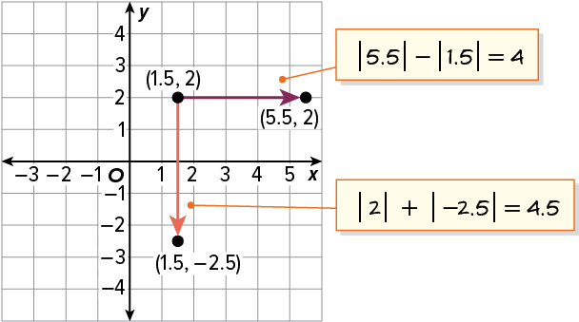
SUMMARIZE · SAY IT IN YOUR OWN WORDS
Summarize: Find Distance on the Coordinate Plane
You can use the coordinates and absolute value to find distances between points with the same first coordinate or the same second coordinate.
When two points are in the same quadrant, subtract the absolute values of the coordinates to determine the distance.
When the points are in different quadrants, add the absolute values of the coordinates to determine the distance.
49 / 55
Notes:
TEACH IN PRACTICE | Embedded facilitation | Lesson 7.6, slide 43 | SUMMARIZE
Focus on the existing task: Summarize: Find Distance on the Coordinate Plane You can use the coordinates and absolute value to find distances between points with the…
CONNECT (T1/4): Ask students to restate the displayed goal or key idea and connect it to earlier work. Relevant lesson evidence: identify a shared coordinate; find horizontal or vertical distance; justify nonnegative length. Use only the criterion that matches the current session.
SHOW PROGRESS: Students point to their own existing work, explain what improved after feedback, and name a next step. Pair confidence ratings with actual evidence.
PARTICIPATION (T5/6/7): Think time before volunteers; accept a written, drawn or rehearsed entry. Students ask for evidence respectfully. Recognize a specific contribution or revision and check that both partners participate.
Source: BCPS Updated Instructional Framework Rubric (June 2020), TEACH 1–7. Earlier notes and answer keys are retained below.
EARLIER NOTES / EXISTING ANSWER KEY
Routine: SUMMARIZE · SAY IT IN YOUR OWN WORDS

Slide 50
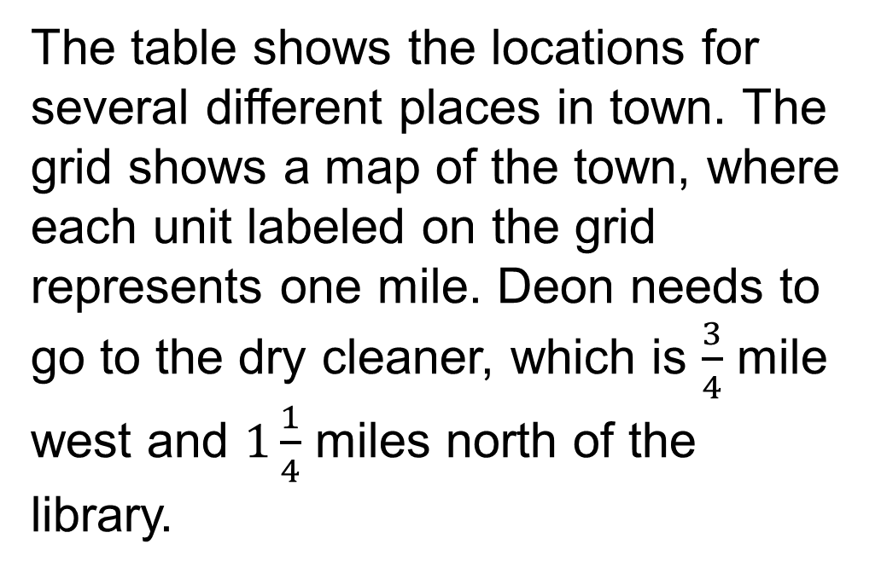
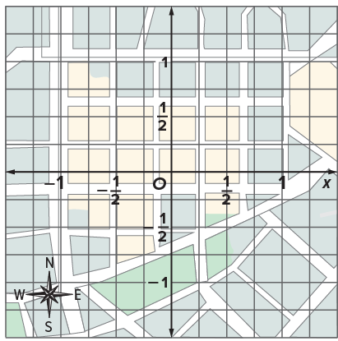
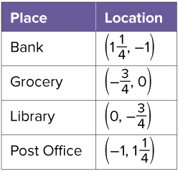
APPLY · PLAN IT • SOLVE IT • PROVE IT
Apply: Deon’s Errands
Question: What are the coordinates of the dry cleaner?
50 / 55
Notes:
TEACH IN PRACTICE | Embedded facilitation | Lesson 7.6, slide 44 | APPLY
Focus on the existing task: Apply: Deon’s Errands Question: What are the coordinates of the dry cleaner?
LAUNCH (T2/3/5): Use the exact application task independently first. Ask students to justify their choice of method. Collect evidence before a partner discussion or correction.
LOOK FOR (T4): Where this task addresses it, students can identify a shared coordinate. Ask which feature of their work supports the claim.
RESPOND: If this task shows the lesson misconception—adding absolute values for every pair regardless of location—mark the shared coordinate and trace the axis-aligned segment through the original points. Have the student revise and explain the change. Use this support only where the concept occurs in the current task; otherwise respond to the displayed question.
RECHECK: If a gap is shared, revisit the existing representation together. If it is limited, give targeted support while others compare valid methods on the same task. Check the revision before moving on.
PARTICIPATION (T5/6/7): Think time before volunteers; accept a written, drawn or rehearsed entry. Students ask for evidence respectfully. Recognize a specific contribution or revision and check that both partners participate.
Source: BCPS Updated Instructional Framework Rubric (June 2020), TEACH 1–7. Earlier notes and answer keys are retained below.
EARLIER NOTES / EXISTING ANSWER KEY
Routine: APPLY · PLAN IT • SOLVE IT • PROVE IT
UIFR FULL | Lesson-specific facilitation
TEACH 4 | Independent evidence and revision (UIFR PDF p. 11).
Use the existing application/exit problem as the independent check. If this is a learning-target slide, have students point to and explain their work on the preceding task. Separate initial independent evidence from the revision after feedback.
Check the relevant criteria: identify a shared coordinate; find horizontal or vertical distance; justify nonnegative length. Respond with one specific next step tied to the work. Students revise and annotate what changed, then identify a criterion they can now demonstrate and one they still need to practice.

Slide 51
STUDENT MOVES
Lesson 7-6
Your moves
USE THE MATH WORDS · Use today’s math words in your explanation — not “it” and “that thing.”
SHOW THE EVIDENCE · Circle the part of your work that proves you met today’s goal.
51 / 55

Slide 52
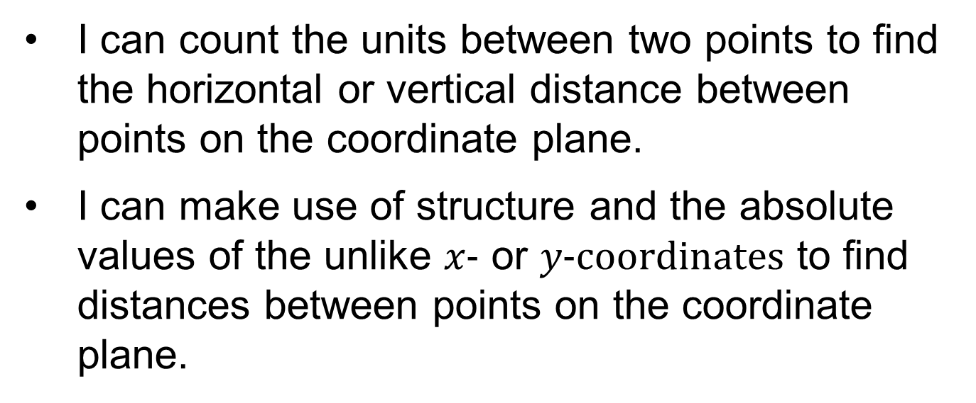
Learning Targets
Point to evidence in your work. Name what improved and your next step.
52 / 55
Notes:
TEACH IN PRACTICE | Embedded facilitation | Lesson 7.6, slide 45 | REFLECTION
Focus on the existing task: Learning Targets
CONNECT (T1/4): Ask students to restate the displayed goal or key idea and connect it to earlier work. Relevant lesson evidence: identify a shared coordinate; find horizontal or vertical distance; justify nonnegative length. Use only the criterion that matches the current session.
SHOW PROGRESS: Students point to their own existing work, explain what improved after feedback, and name a next step. Pair confidence ratings with actual evidence.
PARTICIPATION (T5/6/7): Think time before volunteers; accept a written, drawn or rehearsed entry. Students ask for evidence respectfully. Recognize a specific contribution or revision and check that both partners participate.
Source: BCPS Updated Instructional Framework Rubric (June 2020), TEACH 1–7. Earlier notes and answer keys are retained below.
EARLIER NOTES / EXISTING ANSWER KEY
Read each target; students self-rate with fist-to-five or thumbs.
Tie back to the goal from the start of class: did we get there?
Note any target that rates low — revisit it tomorrow.
UIFR: TEACH 1 · TEACH 4.

Slide 53
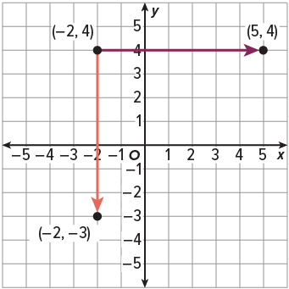
Be Curious
Be Curious
How are they the same?
How are they different?
Think first. Share a notice and a question;
build on a classmate’s idea.
Mindset
How are you working productively with a classmate even when you might have different solutions to a math problem?
53 / 55
Notes:
TEACH IN PRACTICE | Embedded facilitation | Lesson 7.6, slide 46 | CURIOUS
Focus on the existing task: Be Curious How are they the same?
LAUNCH (T2/3/5): Allow quiet observation first. Separate a notice from an inference, invite students’ own questions, and follow the existing launch before teaching a procedure.
LOOK FOR (T4): Where this task addresses it, students can identify a shared coordinate. Ask which feature of their work supports the claim.
RESPOND: If this task shows the lesson misconception—adding absolute values for every pair regardless of location—mark the shared coordinate and trace the axis-aligned segment through the original points. Have the student revise and explain the change. Use this support only where the concept occurs in the current task; otherwise respond to the displayed question.
RECHECK: If a gap is shared, revisit the existing representation together. If it is limited, give targeted support while others compare valid methods on the same task. Check the revision before moving on.
PARTICIPATION (T5/6/7): Think time before volunteers; accept a written, drawn or rehearsed entry. Students ask for evidence respectfully. Recognize a specific contribution or revision and check that both partners participate.
Source: BCPS Updated Instructional Framework Rubric (June 2020), TEACH 1–7.

Slide 54
Learning Targets
Point to evidence in your work. Name what improved and your next step.
54 / 55
Notes:
TEACH IN PRACTICE | Embedded facilitation | Lesson 7.6, slide 47 | REFLECTION
Focus on the existing task: Learning Targets
CONNECT (T1/4): Ask students to restate the displayed goal or key idea and connect it to earlier work. Relevant lesson evidence: identify a shared coordinate; find horizontal or vertical distance; justify nonnegative length. Use only the criterion that matches the current session.
SHOW PROGRESS: Students point to their own existing work, explain what improved after feedback, and name a next step. Pair confidence ratings with actual evidence.
PARTICIPATION (T5/6/7): Think time before volunteers; accept a written, drawn or rehearsed entry. Students ask for evidence respectfully. Recognize a specific contribution or revision and check that both partners participate.
Source: BCPS Updated Instructional Framework Rubric (June 2020), TEACH 1–7. Earlier notes and answer keys are retained below.
EARLIER NOTES / EXISTING ANSWER KEY
UIFR FULL | Lesson-specific facilitation
REFLECT & ADJUST 1-2 | After the lesson (UIFR PDF pp. 15-16).
Sort the existing work by demonstrated reasoning, partial understanding, and the specific misconception: adding absolute values for every pair regardless of location. Compare the initial response with the revision. Record which teaching move plausibly helped, which did not, and whose participation or access needs a different approach; do not record sensitive student details in this shared deck.
Plan the next lesson from that evidence: if the misconception persists, mark the shared coordinate and trace the axis-aligned segment through the original points using the current example before returning to the next grade-level task; if understanding is secure, use an existing extension or ask for a general explanation. Check the targeted idea again at the next warm-up.
Ask students what supported their thinking and what would help next time. Identify one change to try and one successful practice to retain. Seek colleague feedback on anonymized work when useful; these prompts support reflection and do not establish an evaluation rating. Source: Baltimore City Public Schools, Updated Instructional Framework Rubric, June 2020 (UIFR_Full.pdf).

Slide 55
LESSON 7.6 / REFLECT ON YOUR LEARNING
Show your progress
1 SHOW EVIDENCE
2 CHOOSE A NEXT STEP
Choose one response. Point to the part that shows your reasoning.
Name a change you made after feedback—or a question you still have.
“My work shows ___ because ___.”
“Next time, I will ___ to help me ___.”
Today’s focus: Identify a shared coordinate.
CREDIT A CLASSMATE · Name one classmate whose idea helped you today, and say what they said.
Listen to understand. Ask for evidence. Make room for every voice.
Notes:
TEACH IN PRACTICE | Embedded facilitation | Lesson 7.6, slide 48 | PRIOR_INSERT
Focus on the existing task: LESSON 7.6 / REFLECT ON YOUR LEARNING Show your progress Listen to understand. Ask for evidence. Make room for every voice. 1 SHOW…
CONNECT (T1/4): Ask students to restate the displayed goal or key idea and connect it to earlier work. Relevant lesson evidence: identify a shared coordinate; find horizontal or vertical distance; justify nonnegative length. Use only the criterion that matches the current session.
SHOW PROGRESS: Students point to their own existing work, explain what improved after feedback, and name a next step. Pair confidence ratings with actual evidence.
PARTICIPATION (T5/6/7): Think time before volunteers; accept a written, drawn or rehearsed entry. Students ask for evidence respectfully. Recognize a specific contribution or revision and check that both partners participate.
Source: BCPS Updated Instructional Framework Rubric (June 2020), TEACH 1–7.

