Slide 1
WARM-UP · THINK • TRY • CHECK
Turn and talk: compare strategies, then defend one.
Warm-Up
Lesson 7-7 · Represent Polygons on the Coordinate Plane | Warm-Up · about 4 minutes
Try each on your own. Mark an unsure answer; explain and revise when we check.
QUESTION 1
QUESTION 2
Connect (1, 1), (5, 1), (5, 4), (1, 4) in order. The shape is a ______
From (1, 1) to (5, 1) is ______ units.
QUESTION 3
QUESTION 4
A rectangle has sides 4, 3, 4, and 3. Perimeter = ______ units.
Area of a rectangle 4 units by 3 units = ______ square units.
TALK IT OVER: “I got ______ because ______.” • Compare with a partner before we check as a class.
1 / 51
Notes:
TEACH IN PRACTICE | Embedded facilitation | Lesson 7.7, slide 1 | WARMUP
Focus on the existing task: Warm-Up WARM-UP · THINK • TRY • CHECK Do these…
GATHER EVIDENCE (T4/6): Keep the original items. Students try independently, mark an uncertain item, and explain one method before checking. Use the existing key when present.
RESPOND: Distinguish a calculation slip from a reasoning gap. Give one next step on the same item; have students revise in a second color. Use the responses to choose flexible support for today’s lesson.
PARTICIPATION (T5/6/7): Think time before volunteers; accept a written, drawn or rehearsed entry. Students ask for evidence respectfully. Recognize a specific contribution or revision and check that both partners participate.
Source: BCPS Updated Instructional Framework Rubric (June 2020), TEACH 1–7. Earlier notes and answer keys are retained below.
EARLIER NOTES / EXISTING ANSWER KEY
Warm-Up answers (teacher only): 1) rectangle 2) 4 units 3) 14 units 4) 12 square units
UIFR FULL | Lesson-specific facilitation
PREPARE 1-2 | Before teaching (UIFR PDF pp. 6-7).
Plan to gather evidence that students can plot vertices in order; determine applicable side lengths; connect coordinates to perimeter or area. Review recent work and today’s warm-up to choose flexible groups and access supports; do not infer needs from identity or perceived ability. Use the existing lesson tasks and stated standards.
Anticipate: confusing a coordinate with a side length or applying an axis-distance rule to a slanted edge. If observed, label the vertices and axis-aligned side lengths on the original polygon. Offer oral rehearsal, drawing, pointing, or home-language processing as needed; retain the original mathematical demand. Ask students which support helps and fade it as evidence improves.
TEACH 6-7 | Before the first transition, agree on materials, partner roles, and how to request help. Invite students to restate the routine. Normalize revising an idea, recognize a specific contribution, and check privately when frustration blocks participation. Source: UIFR PDF pp. 13-14.

Slide 2
Today’s Math Notes
Lesson 7-7 · Represent Polygons on the Coordinate Plane
Section 1: Math Words
Copy. Explain. Check.
SAY THE GOAL · Say today’s goal in your own words, then name one place this shows up outside math class.
vertex
1
A corner point of a polygon
polygon
2
A closed figure made of line segments
perimeter
3
The total distance around a polygon
eduwonderlab.com · Neft Teacher
2 / 51
Notes:
TEACH IN PRACTICE | Embedded facilitation | Lesson 7.7, slide 2 | NOTES
Focus on the existing task: Today’s Math Notes Section 1: Math Words Copy…
ROUTINE (T1/2/4): Read or copy the original notes, cover one line, and explain it using the displayed example. Reopen and correct. Copying alone is not evidence of understanding.
LOOK FOR: A link between a symbol, quantity or feature and the explanation. If missing, point back to that feature and have the student try again; fade the prompt once they can explain.
PARTICIPATION (T5/6/7): Think time before volunteers; accept a written, drawn or rehearsed entry. Students ask for evidence respectfully. Recognize a specific contribution or revision and check that both partners participate.
Source: BCPS Updated Instructional Framework Rubric (June 2020), TEACH 1–7. Earlier notes and answer keys are retained below.
EARLIER NOTES / EXISTING ANSWER KEY
Copy routine: read one line at a time; students copy, then explain that line to a partner.
Keep it brisk — the understanding work happens in the examples, not the copying.
UIFR: TEACH 1 · TEACH 6.

Slide 3
Today’s Math Notes
Lesson 7-7 · Represent Polygons on the Coordinate Plane
Section 2: Today’s Math
Copy. Explain. Check.
Polygons on the Coordinate Plane
Plot all given vertices and connect them in order to form the polygon
1
Find side lengths by counting grid units or using coordinate distance formulas
2
CONNECT IT · What earlier lesson does this build on? Tell a partner in one sentence.
Perimeter = Sum of all side lengths; Area = Use standard polygon formulas
3
eduwonderlab.com · Neft Teacher
3 / 51
Notes:
TEACH IN PRACTICE | Embedded facilitation | Lesson 7.7, slide 3 | NOTES
Focus on the existing task: Today’s Math Notes Section 2: Today’s Math Copy…
ROUTINE (T1/2/4): Read or copy the original notes, cover one line, and explain it using the displayed example. Reopen and correct. Copying alone is not evidence of understanding.
LOOK FOR: A link between a symbol, quantity or feature and the explanation. If missing, point back to that feature and have the student try again; fade the prompt once they can explain.
PARTICIPATION (T5/6/7): Think time before volunteers; accept a written, drawn or rehearsed entry. Students ask for evidence respectfully. Recognize a specific contribution or revision and check that both partners participate.
Source: BCPS Updated Instructional Framework Rubric (June 2020), TEACH 1–7. Earlier notes and answer keys are retained below.
EARLIER NOTES / EXISTING ANSWER KEY
Copy routine: read one line at a time; students copy, then explain that line to a partner.
Keep it brisk — the understanding work happens in the examples, not the copying.
UIFR: TEACH 1 · TEACH 6.

Slide 4
Session 1
Represent Polygons on the
Coordinate Plane
PICK YOUR STRATEGY · Choose your path — picture, table, number line, or equation — and be ready to say why you chose it.
4 / 51
Notes:
TEACH IN PRACTICE | Embedded facilitation | Lesson 7.7, slide 4 | DIVIDER
Focus on the existing task: Represent Polygons on the Coordinate Plane Session 1
TRANSITION (T6/7): Students confirm materials, roles, how to request help, and the next response routine. Ask a student to restate it. Keep teacher-only slides hidden.
PARTICIPATION (T5/6/7): Think time before volunteers; accept a written, drawn or rehearsed entry. Students ask for evidence respectfully. Recognize a specific contribution or revision and check that both partners participate.
Source: BCPS Updated Instructional Framework Rubric (June 2020), TEACH 1–7. Earlier notes and answer keys are retained below.
EARLIER NOTES / EXISTING ANSWER KEY
Transition cue: state what materials are out and what success looks like this session.
Keep the changeover under a minute.
UIFR: TEACH 6.

Slide 5



About, Between, or Exact
It is about ______.
It is between ______ and ______.
It is exactly ______.
Explain how the information shown supports your reasoning.
5 / 51
Notes:
TEACH IN PRACTICE | Embedded facilitation | Lesson 7.7, slide 5 | WORKED
Focus on the existing task: About, Between, or Exact It is about ______. It is between ______ and ______. It is exactly ______.
LAUNCH (T2/3/5): Ask students to explain the displayed idea or example and point to evidence. When a calculation step is shown, ask why it is valid. Have a partner restate the explanation; copying is not the check.
LOOK FOR (T4): Where this task addresses it, students can plot vertices in order. Ask which feature of their work supports the claim.
RESPOND: If this task shows the lesson misconception—confusing a coordinate with a side length or applying an axis-distance rule to a slanted edge—label the vertices and axis-aligned side lengths on the original polygon. Have the student revise and explain the change. Use this support only where the concept occurs in the current task; otherwise respond to the displayed question.
RECHECK: If a gap is shared, revisit the existing representation together. If it is limited, give targeted support while others compare valid methods on the same task. Check the revision before moving on.
PARTICIPATION (T5/6/7): Think time before volunteers; accept a written, drawn or rehearsed entry. Students ask for evidence respectfully. Recognize a specific contribution or revision and check that both partners participate.
Source: BCPS Updated Instructional Framework Rubric (June 2020), TEACH 1–7. Earlier notes and answer keys are retained below.
EARLIER NOTES / EXISTING ANSWER KEY
Number-sense routine — every voice in. Give quiet think time, then hear from at least three students.
Always follow with “How do you know?” — the reasoning is the point, not the answer.
There is more than one path; name and celebrate different strategies.
UIFR: TEACH 3 · TEACH 5 · TEACH 6.

Slide 6
Today’s Objectives
Lesson 7-7 · Represent Polygons on the Coordinate Plane
Represent Polygons on the Coordinate Plane
Maryland Standard 6.NOS.9
SHOW YOUR THINKING · Show what you know — write it, draw it, or build it. A picture counts as an explanation.
CONTENT OBJECTIVE
LANGUAGE OBJECTIVE
Restate the goal in your words
Use these words to explain why
I can draw polygons from their vertex coordinates on the coordinate plane, and use coordinates to find side lengths and solve perimeter and area problems.
I can explain how I found a distance using the words vertices, coordinates, and absolute value.
eduwonderlab.com · Neft Teacher
6 / 51
Notes:
TEACH IN PRACTICE | Embedded facilitation | Lesson 7.7, slide 6 | GOAL
Focus on the existing task: Today’s Objectives Represent Polygons on the…
CONNECT (T1/4): Ask students to restate the displayed goal or key idea and connect it to earlier work. Relevant lesson evidence: plot vertices in order; determine applicable side lengths; connect coordinates to perimeter or area. Use only the criterion that matches the current session.
SHOW PROGRESS: Students point to their own existing work, explain what improved after feedback, and name a next step. Pair confidence ratings with actual evidence.
PARTICIPATION (T5/6/7): Think time before volunteers; accept a written, drawn or rehearsed entry. Students ask for evidence respectfully. Recognize a specific contribution or revision and check that both partners participate.
Source: BCPS Updated Instructional Framework Rubric (June 2020), TEACH 1–7. Earlier notes and answer keys are retained below.
EARLIER NOTES / EXISTING ANSWER KEY
Read the objective together, then have one or two students restate today’s goal in their own words.
Connect it to what the class learned last lesson.
Return to this goal at the end of class to check it was met.
UIFR: TEACH 1.
UIFR FULL | Lesson-specific facilitation
TEACH 1 | Session 1 purpose and evidence (UIFR PDF p. 8).
Have students restate the displayed session goal in their own words and connect it to the existing context or a familiar experience they choose to share. Use the current session goal to select from these lesson-wide evidence criteria; do not frontload a later-session procedure.
Look for: plot vertices in order; determine applicable side lengths; connect coordinates to perimeter or area. Ask: “Which part of your work would show this?” Revisit that evidence after the task; a confidence rating alone is not evidence of understanding.

Slide 7
LESSON 7.7 / OUR LEARNING
What will show your learning?
1
Plot vertices in order.
2
Determine applicable side lengths.
3
Connect coordinates to perimeter or area.
Tell a partner: Which skill connects to something you already know?
WHY IT MATTERS · Finish this: “This is worth knowing because ______.”
Listen to understand. Ask for evidence. Make room for every voice.
Notes:
TEACH IN PRACTICE | Embedded facilitation | Lesson 7.7, slide 7 | PRIOR_INSERT
Focus on the existing task: LESSON 7.7 / OUR LEARNING What will show your learning?
CONNECT (T1/4): Ask students to restate the displayed goal or key idea and connect it to earlier work. Relevant lesson evidence: plot vertices in order; determine applicable side lengths; connect coordinates to perimeter or area. Use only the criterion that matches the current session.
SHOW PROGRESS: Students point to their own existing work, explain what improved after feedback, and name a next step. Pair confidence ratings with actual evidence.
PARTICIPATION (T5/6/7): Think time before volunteers; accept a written, drawn or rehearsed entry. Students ask for evidence respectfully. Recognize a specific contribution or revision and check that both partners participate.
Source: BCPS Updated Instructional Framework Rubric (June 2020), TEACH 1–7.

Slide 8
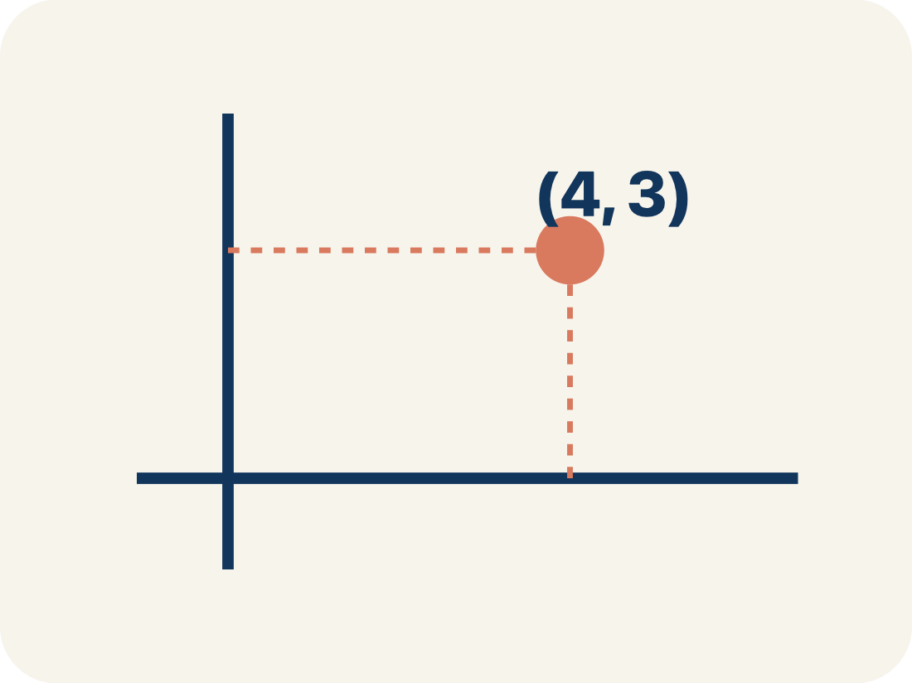
Vocabulary 1 of 5
Lesson 7-7 · Represent Polygons on the Coordinate Plane
vertex
A corner point of a polygon, named by an ordered pair on the coordinate plane.
EXAMPLE · EXPLAIN WHY IT FITS
The park’s corner at (2, 4) — one corner, named by an ordered pair.
Use “vertex” to explain the example. Point to evidence.
eduwonderlab.com · Neft Teacher
8 / 51
Notes:
TEACH IN PRACTICE | Embedded facilitation | Lesson 7.7, slide 8 | VOCAB
Focus on the existing task: Vocabulary 1 of 5 vertex A corner point of a…
ASK (T1/3/5): Where does “vertex” appear in the example? Explain the meaning without reading the definition. Partner: restate the idea and ask a clarifying question.
LOOK FOR: A correct connection between the word and a feature of the example. If the student only repeats the definition, invite pointing, sketching or oral rehearsal, then ask for another explanation of this same example.
PARTICIPATION (T5/6/7): Think time before volunteers; accept a written, drawn or rehearsed entry. Students ask for evidence respectfully. Recognize a specific contribution or revision and check that both partners participate.
Source: BCPS Updated Instructional Framework Rubric (June 2020), TEACH 1–7.

Slide 9
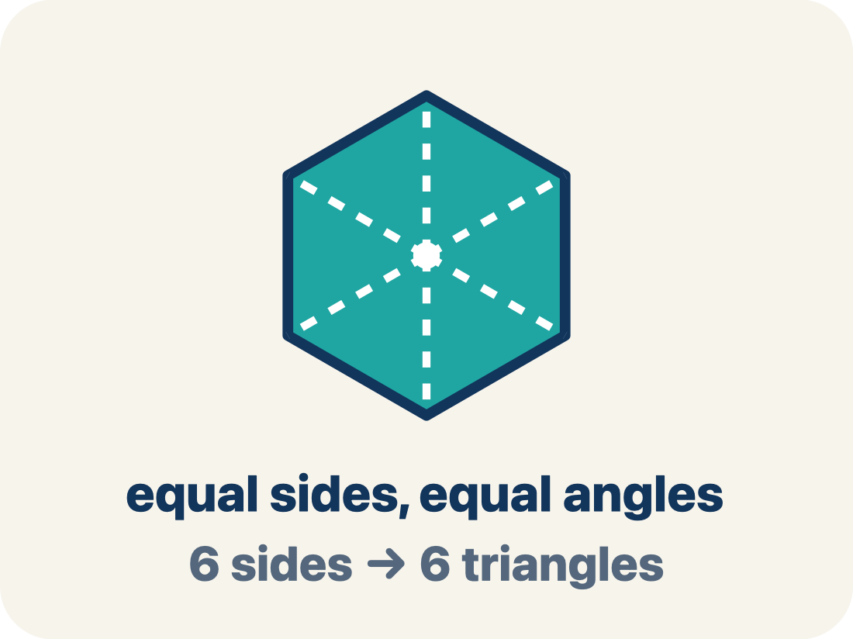
Vocabulary 2 of 5
Lesson 7-7 · Represent Polygons on the Coordinate Plane
polygon
A closed figure made of line segments; on the plane you draw it by plotting the vertices and connecting them in order.
EXAMPLE · EXPLAIN WHY IT FITS
Plot (2, 4), (5, 4), (5, −4), (2, −4) and join them — a rectangle appears.
Use “polygon” to explain the example. Point to evidence.
eduwonderlab.com · Neft Teacher
9 / 51
Notes:
TEACH IN PRACTICE | Embedded facilitation | Lesson 7.7, slide 9 | VOCAB
Focus on the existing task: Vocabulary 2 of 5 polygon A closed figure made…
ASK (T1/3/5): Where does “polygon” appear in the example? Explain the meaning without reading the definition. Partner: restate the idea and ask a clarifying question.
LOOK FOR: A correct connection between the word and a feature of the example. If the student only repeats the definition, invite pointing, sketching or oral rehearsal, then ask for another explanation of this same example.
PARTICIPATION (T5/6/7): Think time before volunteers; accept a written, drawn or rehearsed entry. Students ask for evidence respectfully. Recognize a specific contribution or revision and check that both partners participate.
Source: BCPS Updated Instructional Framework Rubric (June 2020), TEACH 1–7.

Slide 10
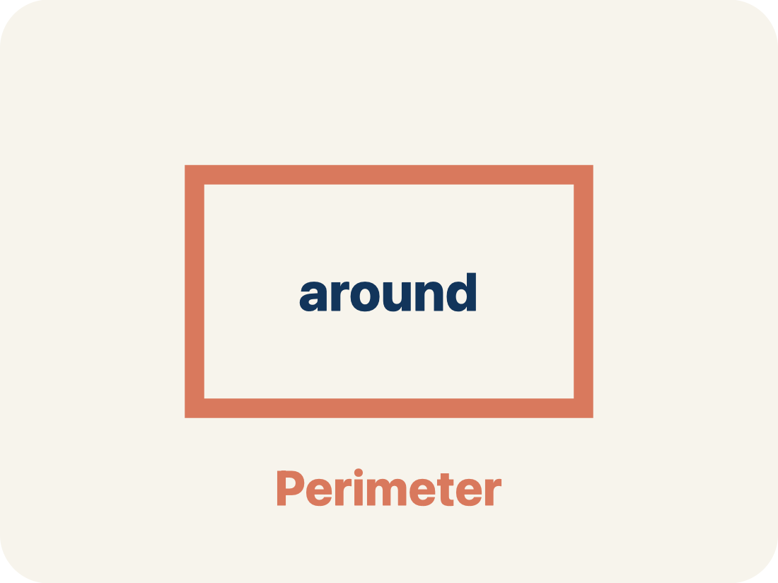
Vocabulary 3 of 5
Lesson 7-7 · Represent Polygons on the Coordinate Plane
perimeter
The total distance around a polygon — the sum of all its side lengths.
EXAMPLE · EXPLAIN WHY IT FITS
2(9.5) + 2(6.75) = 32.5 units around the deck.
Use “perimeter” to explain the example. Point to evidence.
eduwonderlab.com · Neft Teacher
10 / 51
Notes:
TEACH IN PRACTICE | Embedded facilitation | Lesson 7.7, slide 10 | VOCAB
Focus on the existing task: Vocabulary 3 of 5 perimeter The total distance…
ASK (T1/3/5): Where does “perimeter” appear in the example? Explain the meaning without reading the definition. Partner: restate the idea and ask a clarifying question.
LOOK FOR: A correct connection between the word and a feature of the example. If the student only repeats the definition, invite pointing, sketching or oral rehearsal, then ask for another explanation of this same example.
PARTICIPATION (T5/6/7): Think time before volunteers; accept a written, drawn or rehearsed entry. Students ask for evidence respectfully. Recognize a specific contribution or revision and check that both partners participate.
Source: BCPS Updated Instructional Framework Rubric (June 2020), TEACH 1–7.

Slide 11
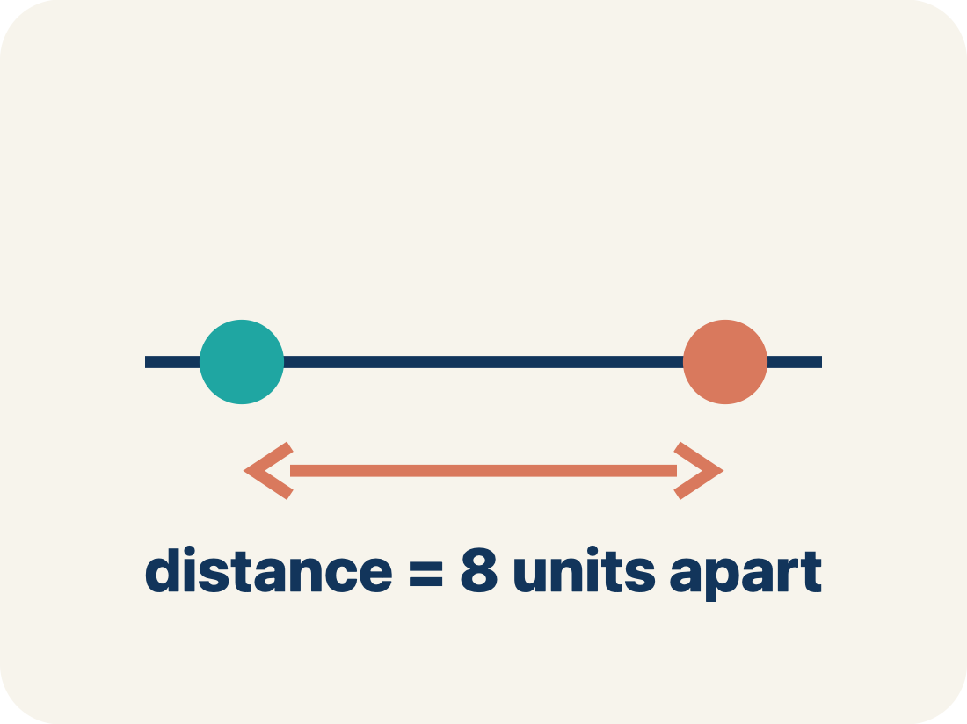
Vocabulary 4 of 5
Lesson 7-7 · Represent Polygons on the Coordinate Plane
distance between vertices
When two vertices share an x- or y-coordinate, the distance between them is the absolute difference of the other coordinates.
EXAMPLE · EXPLAIN WHY IT FITS
(2, 4) and (5, 4) share y, so the side is |5 − 2| = 3 units.
USE THE MATH WORDS · Use today’s math words in your explanation — not “it” and “that thing.”
eduwonderlab.com · Neft Teacher
11 / 51
Notes:
TEACH IN PRACTICE | Embedded facilitation | Lesson 7.7, slide 11 | VOCAB
Focus on the existing task: Vocabulary 4 of 5 distance between vertices…
ASK (T1/3/5): Where does “distance between vertices” appear in the example? Explain the meaning without reading the definition. Partner: restate the idea and ask a clarifying question.
LOOK FOR: A correct connection between the word and a feature of the example. If the student only repeats the definition, invite pointing, sketching or oral rehearsal, then ask for another explanation of this same example.
PARTICIPATION (T5/6/7): Think time before volunteers; accept a written, drawn or rehearsed entry. Students ask for evidence respectfully. Recognize a specific contribution or revision and check that both partners participate.
Source: BCPS Updated Instructional Framework Rubric (June 2020), TEACH 1–7.

Slide 12
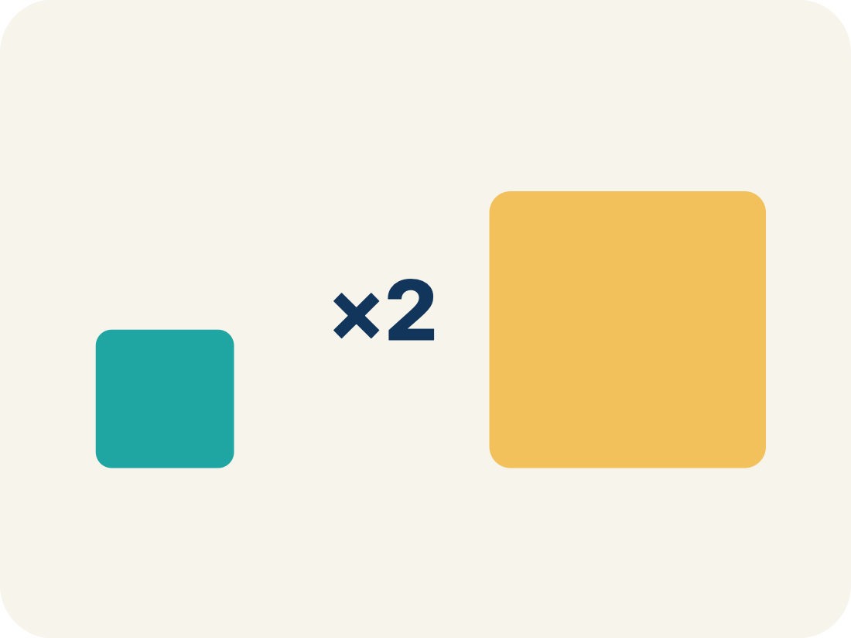
Vocabulary 5 of 5
Lesson 7-7 · Represent Polygons on the Coordinate Plane
scale
What one grid unit stands for in the real situation.
EXAMPLE · EXPLAIN WHY IT FITS
Each grid unit = 100 feet, so 8 units of map is 800 real feet.
Use “scale” to explain the example. Point to evidence.
eduwonderlab.com · Neft Teacher
12 / 51
Notes:
TEACH IN PRACTICE | Embedded facilitation | Lesson 7.7, slide 12 | VOCAB
Focus on the existing task: Vocabulary 5 of 5 scale What one grid unit…
ASK (T1/3/5): Where does “scale” appear in the example? Explain the meaning without reading the definition. Partner: restate the idea and ask a clarifying question.
LOOK FOR: A correct connection between the word and a feature of the example. If the student only repeats the definition, invite pointing, sketching or oral rehearsal, then ask for another explanation of this same example.
PARTICIPATION (T5/6/7): Think time before volunteers; accept a written, drawn or rehearsed entry. Students ask for evidence respectfully. Recognize a specific contribution or revision and check that both partners participate.
Source: BCPS Updated Instructional Framework Rubric (June 2020), TEACH 1–7.

Slide 13
Vocabulary
Lesson 7-7 · Represent Polygons on the Coordinate Plane
Today’s Math Words
We learn every word — what it means and what it looks like — before we use it.
vertex
polygon
A corner point of a polygon, named by an ordered pair on the coordinate plane
A closed figure made of line segments; on the plane you draw it by plotting the vertices and connecting them in order
perimeter
distance between vertices
The total distance around a polygon — the sum of all its side lengths
When two vertices share an x- or y-coordinate, the distance between them is the absolute difference of the other coordinates
scale
What one grid unit stands for in the real situation
Explain one math word using the example.
Partner: point to evidence.
eduwonderlab.com · Neft Teacher
13 / 51
Notes:
TEACH IN PRACTICE | Embedded facilitation | Lesson 7.7, slide 13 | VOCAB
Focus on the existing task: Vocabulary Today’s Math Words We learn every…
ASK (T1/3/5): Where does “the displayed term” appear in the example? Explain the meaning without reading the definition. Partner: restate the idea and ask a clarifying question.
LOOK FOR: A correct connection between the word and a feature of the example. If the student only repeats the definition, invite pointing, sketching or oral rehearsal, then ask for another explanation of this same example.
PARTICIPATION (T5/6/7): Think time before volunteers; accept a written, drawn or rehearsed entry. Students ask for evidence respectfully. Recognize a specific contribution or revision and check that both partners participate.
Source: BCPS Updated Instructional Framework Rubric (June 2020), TEACH 1–7. Earlier notes and answer keys are retained below.
EARLIER NOTES / EXISTING ANSWER KEY
Choral-read each word, its meaning, and what it looks like.
Students should use these words out loud today — listen for them in partner talk and revoice student ideas with the academic term.
UIFR: TEACH 1 · TEACH 5.

Slide 14
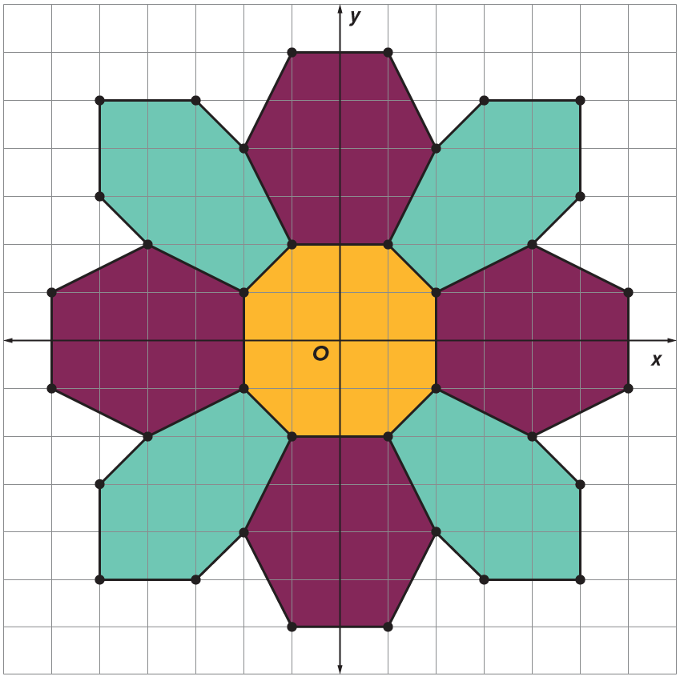

Be Curious
What do you notice?
What do you wonder?
Think first. Share a notice and a question;
build on a classmate’s idea.
Mindset
How does identifying a problem help in analyzing and solving the problem?
14 / 51
Notes:
TEACH IN PRACTICE | Embedded facilitation | Lesson 7.7, slide 14 | CURIOUS
Focus on the existing task: Be Curious Mindset What do you notice?
LAUNCH (T2/3/5): Allow quiet observation first. Separate a notice from an inference, invite students’ own questions, and follow the existing launch before teaching a procedure.
LOOK FOR (T4): Where this task addresses it, students can plot vertices in order. Ask which feature of their work supports the claim.
RESPOND: If this task shows the lesson misconception—confusing a coordinate with a side length or applying an axis-distance rule to a slanted edge—label the vertices and axis-aligned side lengths on the original polygon. Have the student revise and explain the change. Use this support only where the concept occurs in the current task; otherwise respond to the displayed question.
RECHECK: If a gap is shared, revisit the existing representation together. If it is limited, give targeted support while others compare valid methods on the same task. Check the revision before moving on.
PARTICIPATION (T5/6/7): Think time before volunteers; accept a written, drawn or rehearsed entry. Students ask for evidence respectfully. Recognize a specific contribution or revision and check that both partners participate.
Source: BCPS Updated Instructional Framework Rubric (June 2020), TEACH 1–7. Earlier notes and answer keys are retained below.
EARLIER NOTES / EXISTING ANSWER KEY
Accept all noticings and wonderings — there are no wrong answers here.
Give 20–30 seconds of quiet think time before taking responses; mix cold and warm calls so it is not always the same voices.
Read the mindset question aloud and let two students respond.
UIFR: TEACH 3 · TEACH 7.

Slide 15
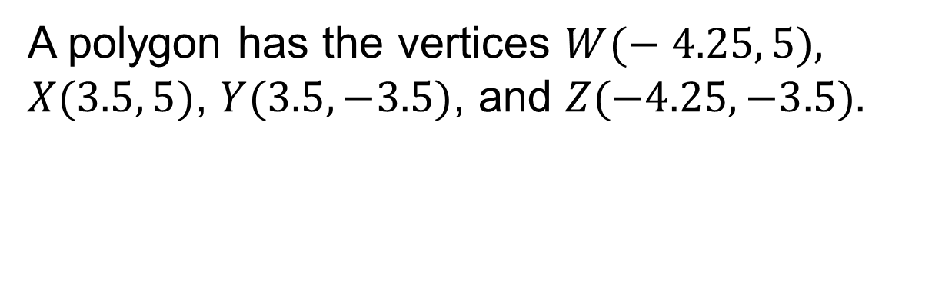
Polygons on the Coordinate Plane
What is the perimeter of the polygon?
Think and record first. Which part of your work supports your answer?
15 / 51
Notes:
TEACH IN PRACTICE | Embedded facilitation | Lesson 7.7, slide 15 | TASK
Focus on the existing task: Polygons on the Coordinate Plane What is the perimeter of the polygon?
LAUNCH (T2/3/5): Use the displayed question. Give private thinking time; then A explains while B asks for evidence. Switch roles. Each student records their own reasoning.
LOOK FOR (T4): Where this task addresses it, students can connect coordinates to perimeter or area. Ask which feature of their work supports the claim.
RESPOND: If this task shows the lesson misconception—confusing a coordinate with a side length or applying an axis-distance rule to a slanted edge—label the vertices and axis-aligned side lengths on the original polygon. Have the student revise and explain the change. Use this support only where the concept occurs in the current task; otherwise respond to the displayed question.
RECHECK: If a gap is shared, revisit the existing representation together. If it is limited, give targeted support while others compare valid methods on the same task. Check the revision before moving on.
PARTICIPATION (T5/6/7): Think time before volunteers; accept a written, drawn or rehearsed entry. Students ask for evidence respectfully. Recognize a specific contribution or revision and check that both partners participate.
Source: BCPS Updated Instructional Framework Rubric (June 2020), TEACH 1–7. Earlier notes and answer keys are retained below.
EARLIER NOTES / EXISTING ANSWER KEY
Model briefly, then hand the thinking back: ask “Why does this step work?” before showing the next one.
Quick check before moving on — thumbs or whiteboards from everyone, not volunteers.
UIFR: TEACH 2 · TEACH 3 · TEACH 4.
UIFR FULL | Lesson-specific facilitation
TEACH 2-3 | Session 1 task launch (UIFR PDF pp. 9-10).
Use the problem exactly as displayed. Give individual thinking time before discussion or advancing to the explanation. If the answer is already visible, ask students to reconstruct and justify it. Invite a choice of suitable representations and have students explain why their choice helps.
At the point where this concept appears, ask: “Which coordinates determine this side length, and how does that length enter the required measure?” Wait for evidence, invite another pathway, and have a student ask a follow-up question. Do not replace students’ reasoning with a sequence of leading steps.

Slide 16

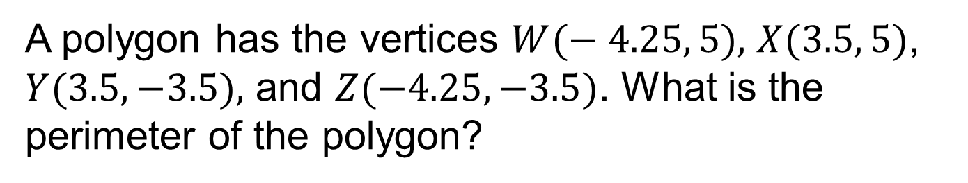
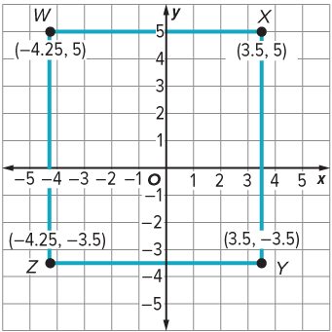
COLLABORATE · TALK IT THROUGH • AGREE ON A MODEL
Collaborate and Connect
How can you draw the polygon described?
Reveal:
We can graph the points
on a coordinate plane
and connect them to
form the polygon.
16 / 51
Notes:
TEACH IN PRACTICE | Embedded facilitation | Lesson 7.7, slide 16 | COLLABORATE
Focus on the existing task: Collaborate and Connect How can you draw the polygon described?
LAUNCH (T2/3/5): Use the displayed question. Give private thinking time; then A explains while B asks for evidence. Switch roles. Each student records their own reasoning.
LOOK FOR (T4): Where this task addresses it, students can connect coordinates to perimeter or area. Ask which feature of their work supports the claim.
RESPOND: If this task shows the lesson misconception—confusing a coordinate with a side length or applying an axis-distance rule to a slanted edge—label the vertices and axis-aligned side lengths on the original polygon. Have the student revise and explain the change. Use this support only where the concept occurs in the current task; otherwise respond to the displayed question.
RECHECK: If a gap is shared, revisit the existing representation together. If it is limited, give targeted support while others compare valid methods on the same task. Check the revision before moving on.
PARTICIPATION (T5/6/7): Think time before volunteers; accept a written, drawn or rehearsed entry. Students ask for evidence respectfully. Recognize a specific contribution or revision and check that both partners participate.
Source: BCPS Updated Instructional Framework Rubric (June 2020), TEACH 1–7. Earlier notes and answer keys are retained below.
EARLIER NOTES / EXISTING ANSWER KEY
Routine: COLLABORATE · TALK IT THROUGH • AGREE ON A MODEL
UIFR FULL | Lesson-specific facilitation
TEACH 4-5 | Session 1 discussion and checkpoint (UIFR PDF pp. 11-12).
Collect a brief response from every student to the existing prompt before hearing volunteers. Partners take turns explaining and asking for evidence: “I understand ___; what supports ___?” Offer rehearsal or an annotated model for students who need language support. Each student records their own reasoning.
Look specifically for: confusing a coordinate with a side length or applying an axis-distance rule to a slanted edge. If it appears, label the vertices and axis-aligned side lengths on the original polygon; then ask the student to revise the same response and explain the change. If evidence is secure, have students compare a second valid pathway or state why their approach works. Choose the next step from the responses, not a preset pace.

Slide 17
STUDENT MOVES
Lesson 7-7
Your move
RESTATE FIRST · Restate your partner’s idea in your own words before you give yours.
17 / 51

Slide 18
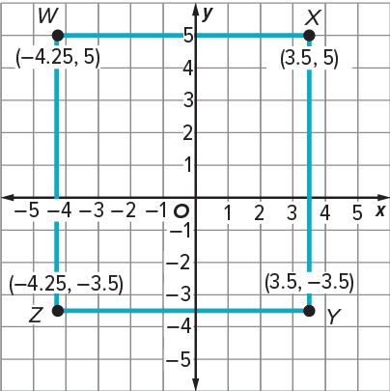
Polygons on the Coordinate Plane
We can graph the points on a coordinate plane and connect them with line segments to form the polygon.
What do you need to know to find the perimeter of a polygon?
TRY IT BEFORE YOU’RE SURE · Start even if you are not sure. A revised answer counts as much as a first-try answer.
Reveal:
We need to know the side lengths.
18 / 51
Notes:
TEACH IN PRACTICE | Embedded facilitation | Lesson 7.7, slide 17 | REVEAL
Focus on the existing task: Reveal: We need to know the side lengths. Polygons on the Coordinate Plane We can graph the points on a coordinate plane and connect them…
LAUNCH (T2/3/5): If an existing answer cover is present, gather an attempt before revealing. If the explanation is already visible, ask students to reconstruct and justify it. Compare reasoning and explain a revision; preserve the reveal sequence.
LOOK FOR (T4): Where this task addresses it, students can determine applicable side lengths. Ask which feature of their work supports the claim.
RESPOND: If this task shows the lesson misconception—confusing a coordinate with a side length or applying an axis-distance rule to a slanted edge—label the vertices and axis-aligned side lengths on the original polygon. Have the student revise and explain the change. Use this support only where the concept occurs in the current task; otherwise respond to the displayed question.
RECHECK: If a gap is shared, revisit the existing representation together. If it is limited, give targeted support while others compare valid methods on the same task. Check the revision before moving on.
PARTICIPATION (T5/6/7): Think time before volunteers; accept a written, drawn or rehearsed entry. Students ask for evidence respectfully. Recognize a specific contribution or revision and check that both partners participate.
Source: BCPS Updated Instructional Framework Rubric (June 2020), TEACH 1–7. Earlier notes and answer keys are retained below.
EARLIER NOTES / EXISTING ANSWER KEY
Do not click yet: collect 2–3 student answers with reasons first.
Then click to remove the cover and have students compare their thinking to the reveal — “Is this what we said? Where is it different?”
Behind the cover: We need to know the side lengths.
UIFR: TEACH 3 · TEACH 4.

Slide 19
Polygons on the Coordinate Plane
ADD ON · Add on: “I agree because ______.” or “I see it differently because ______.”
We can find the sum of the side lengths to determine the perimeter of the polygon.
How can you find the side lengths of the rectangle?
Reveal:
We can use the coordinates to find the distance between each pair of vertices that make up a side of the polygon.
19 / 51
Notes:
TEACH IN PRACTICE | Embedded facilitation | Lesson 7.7, slide 18 | REVEAL
Focus on the existing task: Reveal: We can use the coordinates to find the distance between each pair of vertices that make up a side of the polygon. We can find the…
LAUNCH (T2/3/5): If an existing answer cover is present, gather an attempt before revealing. If the explanation is already visible, ask students to reconstruct and justify it. Compare reasoning and explain a revision; preserve the reveal sequence.
LOOK FOR (T4): Where this task addresses it, students can determine applicable side lengths. Ask which feature of their work supports the claim.
RESPOND: If this task shows the lesson misconception—confusing a coordinate with a side length or applying an axis-distance rule to a slanted edge—label the vertices and axis-aligned side lengths on the original polygon. Have the student revise and explain the change. Use this support only where the concept occurs in the current task; otherwise respond to the displayed question.
RECHECK: If a gap is shared, revisit the existing representation together. If it is limited, give targeted support while others compare valid methods on the same task. Check the revision before moving on.
PARTICIPATION (T5/6/7): Think time before volunteers; accept a written, drawn or rehearsed entry. Students ask for evidence respectfully. Recognize a specific contribution or revision and check that both partners participate.
Source: BCPS Updated Instructional Framework Rubric (June 2020), TEACH 1–7. Earlier notes and answer keys are retained below.
EARLIER NOTES / EXISTING ANSWER KEY
Do not click yet: collect 2–3 student answers with reasons first.
Then click to remove the cover and have students compare their thinking to the reveal — “Is this what we said? Where is it different?”
Behind the cover: We can use the coordinates to find the distance between each pair of vertices that make up a side of the polygon.
UIFR: TEACH 3 · TEACH 4.

Slide 20
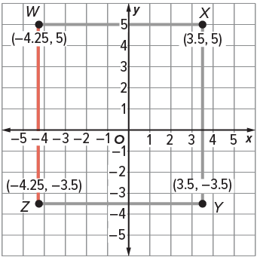
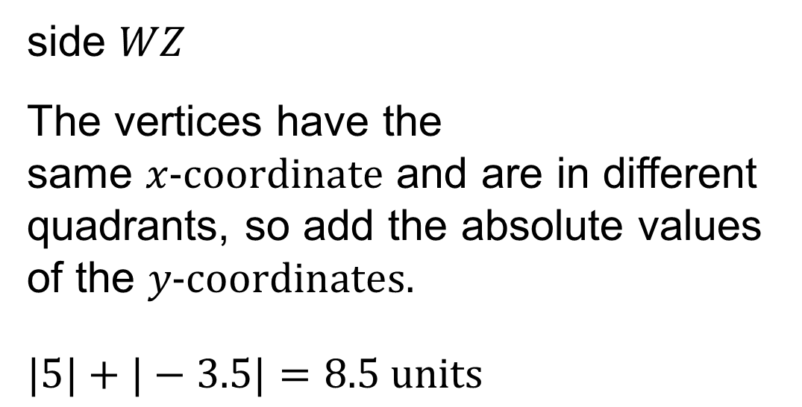
Polygons on the Coordinate Plane
SELF-CHECK · Mark it: ✓ got it · ~ almost · ? stuck. Then fix one thing before we move on.
Let’s find the distance between each pair of vertices that make up a side of the polygon.
20 / 51
Notes:
TEACH IN PRACTICE | Embedded facilitation | Lesson 7.7, slide 19 | WORKED
Focus on the existing task: Let’s find the distance between each pair of vertices that make up a side of the polygon. Polygons on the Coordinate Plane
LAUNCH (T2/3/5): Ask students to explain the displayed idea or example and point to evidence. When a calculation step is shown, ask why it is valid. Have a partner restate the explanation; copying is not the check.
LOOK FOR (T4): Where this task addresses it, students can plot vertices in order. Ask which feature of their work supports the claim.
RESPOND: If this task shows the lesson misconception—confusing a coordinate with a side length or applying an axis-distance rule to a slanted edge—label the vertices and axis-aligned side lengths on the original polygon. Have the student revise and explain the change. Use this support only where the concept occurs in the current task; otherwise respond to the displayed question.
RECHECK: If a gap is shared, revisit the existing representation together. If it is limited, give targeted support while others compare valid methods on the same task. Check the revision before moving on.
PARTICIPATION (T5/6/7): Think time before volunteers; accept a written, drawn or rehearsed entry. Students ask for evidence respectfully. Recognize a specific contribution or revision and check that both partners participate.
Source: BCPS Updated Instructional Framework Rubric (June 2020), TEACH 1–7. Earlier notes and answer keys are retained below.
EARLIER NOTES / EXISTING ANSWER KEY
Model briefly, then hand the thinking back: ask “Why does this step work?” before showing the next one.
Quick check before moving on — thumbs or whiteboards from everyone, not volunteers.
UIFR: TEACH 2 · TEACH 3 · TEACH 4.

Slide 21
Polygons on the Coordinate Plane
How can you find the perimeter of the polygon?
Reveal:
We can add the side lengths.
STRUGGLE FIRST · Work on your own first. Stuck is allowed — try a second strategy before you ask.
21 / 51
Notes:
TEACH IN PRACTICE | Embedded facilitation | Lesson 7.7, slide 20 | REVEAL
Focus on the existing task: Reveal: We can add the side lengths. How can you find the perimeter of the polygon?
LAUNCH (T2/3/5): If an existing answer cover is present, gather an attempt before revealing. If the explanation is already visible, ask students to reconstruct and justify it. Compare reasoning and explain a revision; preserve the reveal sequence.
LOOK FOR (T4): Where this task addresses it, students can determine applicable side lengths. Ask which feature of their work supports the claim.
RESPOND: If this task shows the lesson misconception—confusing a coordinate with a side length or applying an axis-distance rule to a slanted edge—label the vertices and axis-aligned side lengths on the original polygon. Have the student revise and explain the change. Use this support only where the concept occurs in the current task; otherwise respond to the displayed question.
RECHECK: If a gap is shared, revisit the existing representation together. If it is limited, give targeted support while others compare valid methods on the same task. Check the revision before moving on.
PARTICIPATION (T5/6/7): Think time before volunteers; accept a written, drawn or rehearsed entry. Students ask for evidence respectfully. Recognize a specific contribution or revision and check that both partners participate.
Source: BCPS Updated Instructional Framework Rubric (June 2020), TEACH 1–7. Earlier notes and answer keys are retained below.
EARLIER NOTES / EXISTING ANSWER KEY
Do not click yet: collect 2–3 student answers with reasons first.
Then click to remove the cover and have students compare their thinking to the reveal — “Is this what we said? Where is it different?”
Behind the cover: We can add the side lengths.
UIFR: TEACH 3 · TEACH 4.

Slide 22




Polygons on the Coordinate Plane
HOW DO YOU KNOW? · Ask your partner “How do you know?” Answer by pointing to your own work.
Think About It:
Why are two of the terms multiplied by 2?
22 / 51
Notes:
TEACH IN PRACTICE | Embedded facilitation | Lesson 7.7, slide 21 | TASK
Focus on the existing task: Think About It: Why are two of the terms multiplied by 2?
LAUNCH (T2/3/5): Use the displayed question. Give private thinking time; then A explains while B asks for evidence. Switch roles. Each student records their own reasoning.
LOOK FOR (T4): Where this task addresses it, students can plot vertices in order. Ask which feature of their work supports the claim.
RESPOND: If this task shows the lesson misconception—confusing a coordinate with a side length or applying an axis-distance rule to a slanted edge—label the vertices and axis-aligned side lengths on the original polygon. Have the student revise and explain the change. Use this support only where the concept occurs in the current task; otherwise respond to the displayed question.
RECHECK: If a gap is shared, revisit the existing representation together. If it is limited, give targeted support while others compare valid methods on the same task. Check the revision before moving on.
PARTICIPATION (T5/6/7): Think time before volunteers; accept a written, drawn or rehearsed entry. Students ask for evidence respectfully. Recognize a specific contribution or revision and check that both partners participate.
Source: BCPS Updated Instructional Framework Rubric (June 2020), TEACH 1–7. Earlier notes and answer keys are retained below.
EARLIER NOTES / EXISTING ANSWER KEY
Ask the question, then hold the silence — students think or jot before anyone answers.
Take two or three responses and press with “Why?” or “How do you know?” before moving on.
UIFR: TEACH 3.

Slide 23
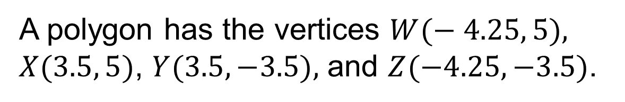
Polygons on the Coordinate Plane
What is the perimeter of the polygon?
The perimeter of the polygon is 32.5 units.
Persevering
How could you check your answer?
Think and record first. Which part of your
work supports your answer?
23 / 51
Notes:
TEACH IN PRACTICE | Embedded facilitation | Lesson 7.7, slide 22 | TASK
Focus on the existing task: Persevering How could you check your answer?
LAUNCH (T2/3/5): Use the displayed question. Give private thinking time; then A explains while B asks for evidence. Switch roles. Each student records their own reasoning.
LOOK FOR (T4): Where this task addresses it, students can connect coordinates to perimeter or area. Ask which feature of their work supports the claim.
RESPOND: If this task shows the lesson misconception—confusing a coordinate with a side length or applying an axis-distance rule to a slanted edge—label the vertices and axis-aligned side lengths on the original polygon. Have the student revise and explain the change. Use this support only where the concept occurs in the current task; otherwise respond to the displayed question.
RECHECK: If a gap is shared, revisit the existing representation together. If it is limited, give targeted support while others compare valid methods on the same task. Check the revision before moving on.
PARTICIPATION (T5/6/7): Think time before volunteers; accept a written, drawn or rehearsed entry. Students ask for evidence respectfully. Recognize a specific contribution or revision and check that both partners participate.
Source: BCPS Updated Instructional Framework Rubric (June 2020), TEACH 1–7. Earlier notes and answer keys are retained below.
EARLIER NOTES / EXISTING ANSWER KEY
Model briefly, then hand the thinking back: ask “Why does this step work?” before showing the next one.
Quick check before moving on — thumbs or whiteboards from everyone, not volunteers.
UIFR: TEACH 2 · TEACH 3 · TEACH 4.

Slide 24
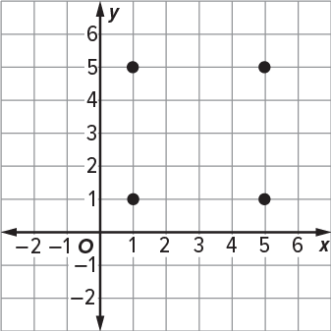
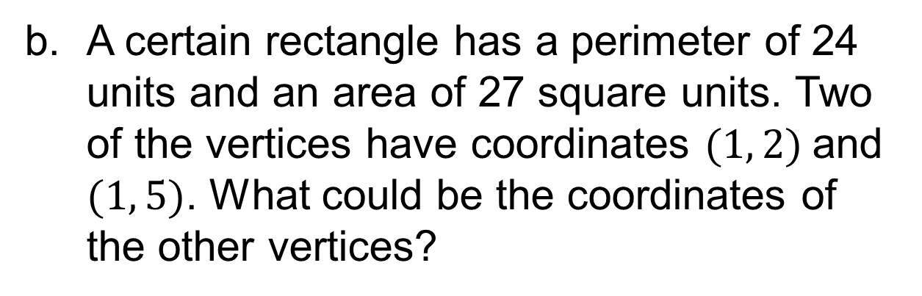
Let’s Explore More
What operation would you use to determine the side lengths of a square with the vertices shown?
Workspace
Workspace
24 / 51
Notes:
TEACH IN PRACTICE | Embedded facilitation | Lesson 7.7, slide 23 | PRACTICE
Focus on the existing task: Let’s Explore More What operation would you use to determine the side lengths of a square with the vertices shown?
LAUNCH (T2/3/5): Use the displayed question. Give private thinking time; then A explains while B asks for evidence. Switch roles. Each student records their own reasoning.
LOOK FOR (T4): Where this task addresses it, students can determine applicable side lengths. Ask which feature of their work supports the claim.
RESPOND: If this task shows the lesson misconception—confusing a coordinate with a side length or applying an axis-distance rule to a slanted edge—label the vertices and axis-aligned side lengths on the original polygon. Have the student revise and explain the change. Use this support only where the concept occurs in the current task; otherwise respond to the displayed question.
RECHECK: If a gap is shared, revisit the existing representation together. If it is limited, give targeted support while others compare valid methods on the same task. Check the revision before moving on.
PARTICIPATION (T5/6/7): Think time before volunteers; accept a written, drawn or rehearsed entry. Students ask for evidence respectfully. Recognize a specific contribution or revision and check that both partners participate.
Source: BCPS Updated Instructional Framework Rubric (June 2020), TEACH 1–7. Earlier notes and answer keys are retained below.
EARLIER NOTES / EXISTING ANSWER KEY
Extension for partners or table groups — students choose their approach and use the workspace to show thinking.
Push with “Convince me,” and have two groups with different approaches share.
This is where students stretch past the worked example.
UIFR: TEACH 2 · TEACH 5.

Slide 25
STUDENT MOVES
Lesson 7-7
Your move
YOUR CHOICE · You choose how to show this — numbers, words, or a diagram. Make your reasoning visible.
25 / 51

Slide 26
LESSON 7.7 / DISCUSS THE TASK
Explain and compare
Use the task you just explored.
TAKE TURNS
Which coordinates determine this side length, and how does that length enter the required measure?
Explain
“I know this because…”
Ask
“Where does your work show that?”
Point to evidence in your work.
Then compare your approach with a partner’s.
JUSTIFY IT · Say it like this: “I know ______ because ______.”
Listen to understand. Ask for evidence. Make room for every voice.
Notes:
TEACH IN PRACTICE | Embedded facilitation | Lesson 7.7, slide 24 | PRIOR_INSERT
Focus on the existing task: Point to evidence in your work. Then compare your approach with a partner’s. TAKE TURNS Explain “I know this because…” Ask “Where does your work show that?
CONNECT (T1/4): Ask students to restate the displayed goal or key idea and connect it to earlier work. Relevant lesson evidence: plot vertices in order; determine applicable side lengths; connect coordinates to perimeter or area. Use only the criterion that matches the current session.
SHOW PROGRESS: Students point to their own existing work, explain what improved after feedback, and name a next step. Pair confidence ratings with actual evidence.
PARTICIPATION (T5/6/7): Think time before volunteers; accept a written, drawn or rehearsed entry. Students ask for evidence respectfully. Recognize a specific contribution or revision and check that both partners participate.
Source: BCPS Updated Instructional Framework Rubric (June 2020), TEACH 1–7.

Slide 27
Session 2 Warm-Up
Lesson 7-7 · Represent Polygons on the Coordinate Plane
Session 2 Warm-Up
Check what you remember from Session 1 · about 4 minutes
1
A polygon on a coordinate plane has vertices at (1,1), (1,4), (5,1). Shape is:
2
A rectangle has vertices (0,0), (6,0), (6,4), (0,4). Its perimeter is:
A
Square
A
10
B
Right Triangle
B
20 units
C
Hexagon
C
24 units
D
Trapezoid
D
12 units
3
What is the area of this rectangle (length 6, height 4)?
4
Side lengths of polygons on a grid are found by:
A
10
A
Estimating diagonals
B
24 square units
B
Calculating distances between adjacent vertices
C
20 square units
C
Counting total dots
D
12 square units
D
Adding all coordinates
eduwonderlab.com · Neft Teacher
27 / 51
Notes:
TEACH IN PRACTICE | Embedded facilitation | Lesson 7.7, slide 25 | WARMUP
Focus on the existing task: Session 2 Warm-Up Session 2 Warm-Up Check what…
GATHER EVIDENCE (T4/6): Keep the original items. Students try independently, mark an uncertain item, and explain one method before checking. Use the existing key when present.
RESPOND: Distinguish a calculation slip from a reasoning gap. Give one next step on the same item; have students revise in a second color. Use the responses to choose flexible support for today’s lesson.
PARTICIPATION (T5/6/7): Think time before volunteers; accept a written, drawn or rehearsed entry. Students ask for evidence respectfully. Recognize a specific contribution or revision and check that both partners participate.
Source: BCPS Updated Instructional Framework Rubric (June 2020), TEACH 1–7. Earlier notes and answer keys are retained below.
EARLIER NOTES / EXISTING ANSWER KEY
Warm-up routine: students start silently on entry; keep it to about 4 minutes.
Circulate and note who is stuck — use what you see to choose who you check on first today.
Go over answers quickly; ask one student to explain a step, not just say the answer.
UIFR: TEACH 4 · TEACH 6.
UIFR FULL | Lesson-specific facilitation
TEACH 1 | Session 2 purpose and evidence (UIFR PDF p. 8).
Have students restate the displayed session goal in their own words and connect it to the existing context or a familiar experience they choose to share. Use the current session goal to select from these lesson-wide evidence criteria; do not frontload a later-session procedure.
Look for: plot vertices in order; determine applicable side lengths; connect coordinates to perimeter or area. Ask: “Which part of your work would show this?” Revisit that evidence after the task; a confidence rating alone is not evidence of understanding.

Slide 28
STUDENT MOVES
Lesson 7-7
Your move
YOU KNOW THE ROUTINE · Read → plan → solve → check. Do all four, in that order.
28 / 51

Slide 29
Today’s Math Notes
Lesson 7-7 · Represent Polygons on the Coordinate Plane
Review Notes — Session 2
Copy. Explain. Check.
NAME THE MATH · Point to the part of this that is new today, and say what it changes.
Plotting Vertices
1
Plot coordinates and connect consecutive points with straight segments to form polygon sides.
Side Lengths
2
Use horizontal and vertical distance formulas between vertices sharing an axis value.
Perimeter & Area
3
Perimeter is sum of side lengths; Area is calculated using geometric formulas (bh, ½bh).
eduwonderlab.com · Neft Teacher
29 / 51
Notes:
TEACH IN PRACTICE | Embedded facilitation | Lesson 7.7, slide 26 | NOTES
Focus on the existing task: Today’s Math Notes Review Notes — Session 2 Copy…
ROUTINE (T1/2/4): Read or copy the original notes, cover one line, and explain it using the displayed example. Reopen and correct. Copying alone is not evidence of understanding.
LOOK FOR: A link between a symbol, quantity or feature and the explanation. If missing, point back to that feature and have the student try again; fade the prompt once they can explain.
PARTICIPATION (T5/6/7): Think time before volunteers; accept a written, drawn or rehearsed entry. Students ask for evidence respectfully. Recognize a specific contribution or revision and check that both partners participate.
Source: BCPS Updated Instructional Framework Rubric (June 2020), TEACH 1–7. Earlier notes and answer keys are retained below.
EARLIER NOTES / EXISTING ANSWER KEY
Copy routine: read one line at a time; students copy, then explain that line to a partner.
Keep it brisk — the understanding work happens in the examples, not the copying.
UIFR: TEACH 1 · TEACH 6.

Slide 30
Session 2
Represent Polygons on the
Coordinate Plane
USE YOUR TOOLS · Reach for your notes, a model, or a manipulative before you reach for an answer.
30 / 51
Notes:
TEACH IN PRACTICE | Embedded facilitation | Lesson 7.7, slide 27 | DIVIDER
Focus on the existing task: Represent Polygons on the Coordinate Plane Session 2
TRANSITION (T6/7): Students confirm materials, roles, how to request help, and the next response routine. Ask a student to restate it. Keep teacher-only slides hidden.
PARTICIPATION (T5/6/7): Think time before volunteers; accept a written, drawn or rehearsed entry. Students ask for evidence respectfully. Recognize a specific contribution or revision and check that both partners participate.
Source: BCPS Updated Instructional Framework Rubric (June 2020), TEACH 1–7. Earlier notes and answer keys are retained below.
EARLIER NOTES / EXISTING ANSWER KEY
Transition cue: state what materials are out and what success looks like this session.
Keep the changeover under a minute.
UIFR: TEACH 6.

Slide 31
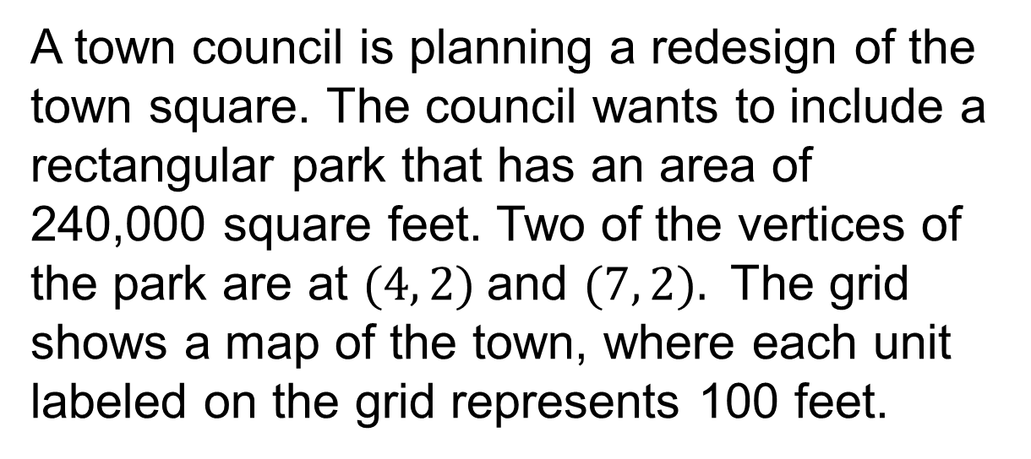
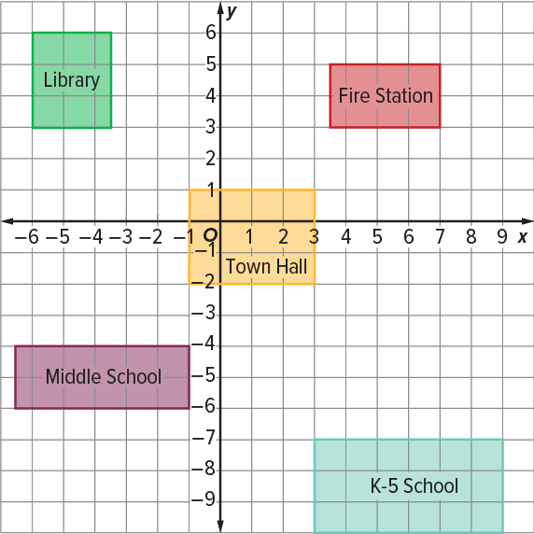
Designing the Town Square
What will be the coordinates of the other two vertices of the park?
Planning
ANOTHER PATHWAY · Did anyone get there a different way? Put both pathways side by side and compare.
What information do you know? What information do you need?
31 / 51
Notes:
TEACH IN PRACTICE | Embedded facilitation | Lesson 7.7, slide 28 | TASK
Focus on the existing task: Designing the Town Square Planning What information do you know?
LAUNCH (T2/3/5): Use the displayed question. Give private thinking time; then A explains while B asks for evidence. Switch roles. Each student records their own reasoning.
LOOK FOR (T4): Where this task addresses it, students can plot vertices in order. Ask which feature of their work supports the claim.
RESPOND: If this task shows the lesson misconception—confusing a coordinate with a side length or applying an axis-distance rule to a slanted edge—label the vertices and axis-aligned side lengths on the original polygon. Have the student revise and explain the change. Use this support only where the concept occurs in the current task; otherwise respond to the displayed question.
RECHECK: If a gap is shared, revisit the existing representation together. If it is limited, give targeted support while others compare valid methods on the same task. Check the revision before moving on.
PARTICIPATION (T5/6/7): Think time before volunteers; accept a written, drawn or rehearsed entry. Students ask for evidence respectfully. Recognize a specific contribution or revision and check that both partners participate.
Source: BCPS Updated Instructional Framework Rubric (June 2020), TEACH 1–7. Earlier notes and answer keys are retained below.
EARLIER NOTES / EXISTING ANSWER KEY
Model briefly, then hand the thinking back: ask “Why does this step work?” before showing the next one.
Quick check before moving on — thumbs or whiteboards from everyone, not volunteers.
UIFR: TEACH 2 · TEACH 3 · TEACH 4.
UIFR FULL | Lesson-specific facilitation
TEACH 2-3 | Session 2 task launch (UIFR PDF pp. 9-10).
Use the problem exactly as displayed. Give individual thinking time before discussion or advancing to the explanation. If the answer is already visible, ask students to reconstruct and justify it. Invite a choice of suitable representations and have students explain why their choice helps.
At the point where this concept appears, ask: “Which coordinates determine this side length, and how does that length enter the required measure?” Wait for evidence, invite another pathway, and have a student ask a follow-up question. Do not replace students’ reasoning with a sequence of leading steps.

Slide 32
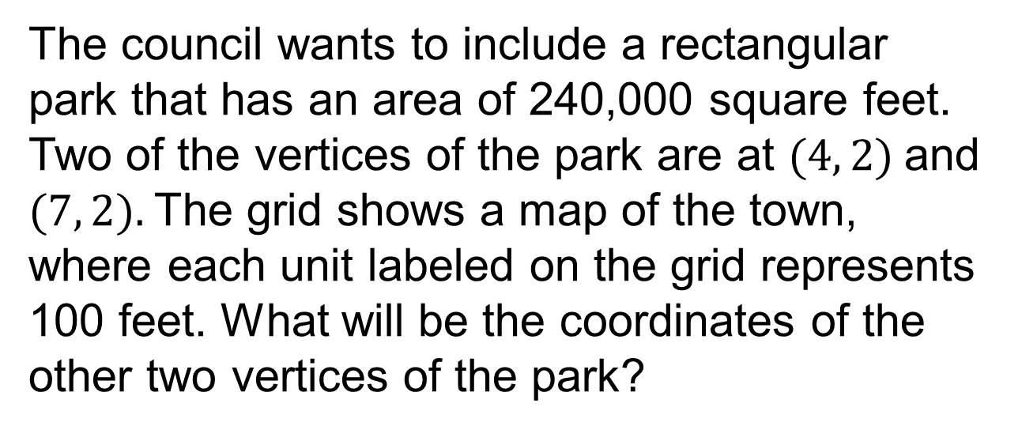
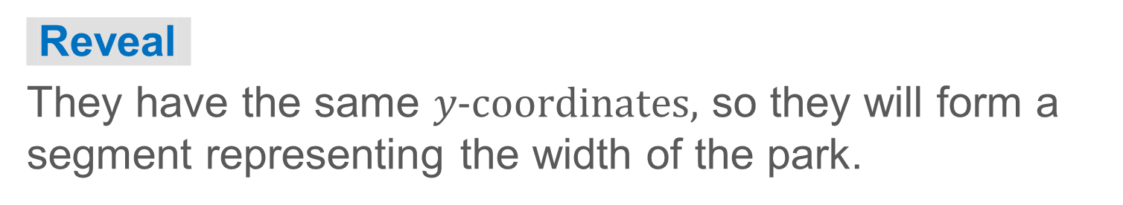
Designing the Town Square
What do you notice about the given vertices?
32 / 51
Notes:
TEACH IN PRACTICE | Embedded facilitation | Lesson 7.7, slide 29 | TASK
Focus on the existing task: Designing the Town Square What do you notice about the given vertices?
LAUNCH (T2/3/5): Use the displayed question. Give private thinking time; then A explains while B asks for evidence. Switch roles. Each student records their own reasoning.
LOOK FOR (T4): Where this task addresses it, students can plot vertices in order. Ask which feature of their work supports the claim.
RESPOND: If this task shows the lesson misconception—confusing a coordinate with a side length or applying an axis-distance rule to a slanted edge—label the vertices and axis-aligned side lengths on the original polygon. Have the student revise and explain the change. Use this support only where the concept occurs in the current task; otherwise respond to the displayed question.
RECHECK: If a gap is shared, revisit the existing representation together. If it is limited, give targeted support while others compare valid methods on the same task. Check the revision before moving on.
PARTICIPATION (T5/6/7): Think time before volunteers; accept a written, drawn or rehearsed entry. Students ask for evidence respectfully. Recognize a specific contribution or revision and check that both partners participate.
Source: BCPS Updated Instructional Framework Rubric (June 2020), TEACH 1–7. Earlier notes and answer keys are retained below.
EARLIER NOTES / EXISTING ANSWER KEY
Model briefly, then hand the thinking back: ask “Why does this step work?” before showing the next one.
Quick check before moving on — thumbs or whiteboards from everyone, not volunteers.
UIFR: TEACH 2 · TEACH 3 · TEACH 4.

Slide 33
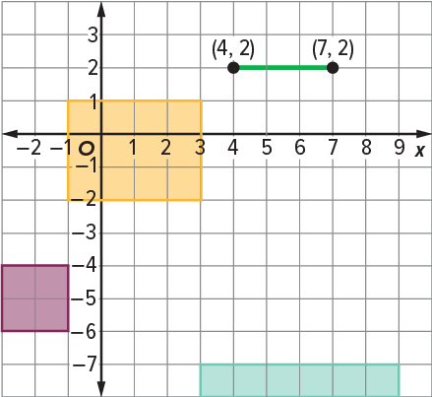
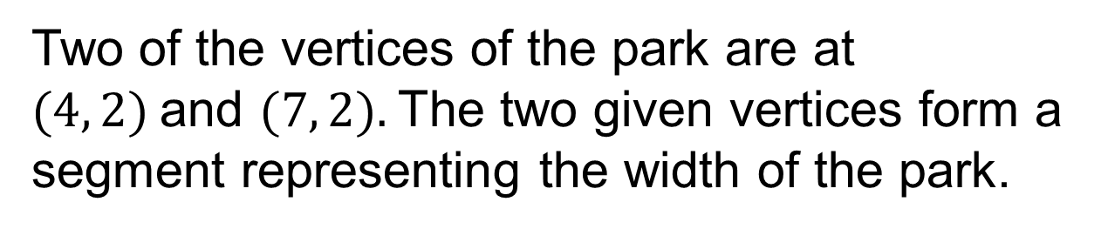
Designing the Town Square
A rectangular park will have an area of 240,000 square feet. Each unit labeled on the grid represents 100 feet.
How can you use the given vertices to find the dimensions of the park?
Reveal:
We can find the distance between the given vertices to find the width. Then we can divide the area by the width to find the length of the park.
33 / 51
Notes:
TEACH IN PRACTICE | Embedded facilitation | Lesson 7.7, slide 30 | REVEAL
Focus on the existing task: Reveal: We can find the distance between the given vertices to find the width. Then we can divide the area by the width to find the…
LAUNCH (T2/3/5): If an existing answer cover is present, gather an attempt before revealing. If the explanation is already visible, ask students to reconstruct and justify it. Compare reasoning and explain a revision; preserve the reveal sequence.
LOOK FOR (T4): Where this task addresses it, students can plot vertices in order. Ask which feature of their work supports the claim.
RESPOND: If this task shows the lesson misconception—confusing a coordinate with a side length or applying an axis-distance rule to a slanted edge—label the vertices and axis-aligned side lengths on the original polygon. Have the student revise and explain the change. Use this support only where the concept occurs in the current task; otherwise respond to the displayed question.
RECHECK: If a gap is shared, revisit the existing representation together. If it is limited, give targeted support while others compare valid methods on the same task. Check the revision before moving on.
PARTICIPATION (T5/6/7): Think time before volunteers; accept a written, drawn or rehearsed entry. Students ask for evidence respectfully. Recognize a specific contribution or revision and check that both partners participate.
Source: BCPS Updated Instructional Framework Rubric (June 2020), TEACH 1–7. Earlier notes and answer keys are retained below.
EARLIER NOTES / EXISTING ANSWER KEY
Do not click yet: collect 2–3 student answers with reasons first.
Then click to remove the cover and have students compare their thinking to the reveal — “Is this what we said? Where is it different?”
Behind the cover: We can find the distance between the given vertices to find the width. Then we can divide the area by the width to find the length of the park.
UIFR: TEACH 3 · TEACH 4.

Slide 34
STUDENT MOVES
Lesson 7-7
Your moves
PROVE IT · Find the evidence in the problem that makes your answer right — not just the answer.
PICK YOUR STRATEGY · Choose your path — picture, table, number line, or equation — and be ready to say why you chose it.
34 / 51

Slide 35
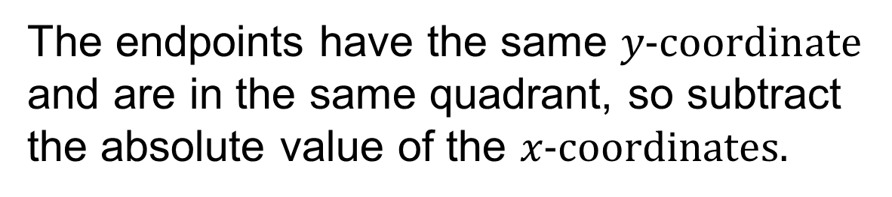

Designing the Town Square
Let’s use the given vertices to determine the dimensions of the park.
Find the distance between the given vertices. Each unit labeled on the grid represents 100 feet.
Think and record first. Which part of your work supports your
answer?
35 / 51
Notes:
TEACH IN PRACTICE | Embedded facilitation | Lesson 7.7, slide 31 | TASK
Focus on the existing task: Designing the Town Square Let’s use the given vertices to determine the dimensions of the park. Find the distance between the given…
LAUNCH (T2/3/5): Use the displayed question. Give private thinking time; then A explains while B asks for evidence. Switch roles. Each student records their own reasoning.
LOOK FOR (T4): Where this task addresses it, students can plot vertices in order. Ask which feature of their work supports the claim.
RESPOND: If this task shows the lesson misconception—confusing a coordinate with a side length or applying an axis-distance rule to a slanted edge—label the vertices and axis-aligned side lengths on the original polygon. Have the student revise and explain the change. Use this support only where the concept occurs in the current task; otherwise respond to the displayed question.
RECHECK: If a gap is shared, revisit the existing representation together. If it is limited, give targeted support while others compare valid methods on the same task. Check the revision before moving on.
PARTICIPATION (T5/6/7): Think time before volunteers; accept a written, drawn or rehearsed entry. Students ask for evidence respectfully. Recognize a specific contribution or revision and check that both partners participate.
Source: BCPS Updated Instructional Framework Rubric (June 2020), TEACH 1–7. Earlier notes and answer keys are retained below.
EARLIER NOTES / EXISTING ANSWER KEY
Model briefly, then hand the thinking back: ask “Why does this step work?” before showing the next one.
Quick check before moving on — thumbs or whiteboards from everyone, not volunteers.
UIFR: TEACH 2 · TEACH 3 · TEACH 4.

Slide 36
Designing the Town Square
On the coordinate plane, the distance between the given vertices is 3 units.
Each unit represents 100 feet, so the width will be 300 feet.
Explain how the information shown supports your reasoning.
36 / 51
Notes:
TEACH IN PRACTICE | Embedded facilitation | Lesson 7.7, slide 32 | WORKED
Focus on the existing task: Designing the Town Square On the coordinate plane, the distance between the given vertices is 3 units. Each unit represents 100 feet, so…
LAUNCH (T2/3/5): Ask students to explain the displayed idea or example and point to evidence. When a calculation step is shown, ask why it is valid. Have a partner restate the explanation; copying is not the check.
LOOK FOR (T4): Where this task addresses it, students can plot vertices in order. Ask which feature of their work supports the claim.
RESPOND: If this task shows the lesson misconception—confusing a coordinate with a side length or applying an axis-distance rule to a slanted edge—label the vertices and axis-aligned side lengths on the original polygon. Have the student revise and explain the change. Use this support only where the concept occurs in the current task; otherwise respond to the displayed question.
RECHECK: If a gap is shared, revisit the existing representation together. If it is limited, give targeted support while others compare valid methods on the same task. Check the revision before moving on.
PARTICIPATION (T5/6/7): Think time before volunteers; accept a written, drawn or rehearsed entry. Students ask for evidence respectfully. Recognize a specific contribution or revision and check that both partners participate.
Source: BCPS Updated Instructional Framework Rubric (June 2020), TEACH 1–7. Earlier notes and answer keys are retained below.
EARLIER NOTES / EXISTING ANSWER KEY
Model briefly, then hand the thinking back: ask “Why does this step work?” before showing the next one.
Quick check before moving on — thumbs or whiteboards from everyone, not volunteers.
UIFR: TEACH 2 · TEACH 3 · TEACH 4.

Slide 37




Designing the Town Square
The park will have an area of 240,000 square feet and a width of 300 feet.
Each unit labeled on the grid represents 100 feet.
TAKE TURNS · One explains, one asks a question. Then switch, so both of you talk.
To have the desired area, the length will need to be 800 feet.
37 / 51
Notes:
TEACH IN PRACTICE | Embedded facilitation | Lesson 7.7, slide 33 | WORKED
Focus on the existing task: Designing the Town Square The park will have an area of 240,000 square feet and a width of 300 feet. Each unit labeled on the grid…
LAUNCH (T2/3/5): Ask students to explain the displayed idea or example and point to evidence. When a calculation step is shown, ask why it is valid. Have a partner restate the explanation; copying is not the check.
LOOK FOR (T4): Where this task addresses it, students can connect coordinates to perimeter or area. Ask which feature of their work supports the claim.
RESPOND: If this task shows the lesson misconception—confusing a coordinate with a side length or applying an axis-distance rule to a slanted edge—label the vertices and axis-aligned side lengths on the original polygon. Have the student revise and explain the change. Use this support only where the concept occurs in the current task; otherwise respond to the displayed question.
RECHECK: If a gap is shared, revisit the existing representation together. If it is limited, give targeted support while others compare valid methods on the same task. Check the revision before moving on.
PARTICIPATION (T5/6/7): Think time before volunteers; accept a written, drawn or rehearsed entry. Students ask for evidence respectfully. Recognize a specific contribution or revision and check that both partners participate.
Source: BCPS Updated Instructional Framework Rubric (June 2020), TEACH 1–7. Earlier notes and answer keys are retained below.
EARLIER NOTES / EXISTING ANSWER KEY
Model briefly, then hand the thinking back: ask “Why does this step work?” before showing the next one.
Quick check before moving on — thumbs or whiteboards from everyone, not volunteers.
UIFR: TEACH 2 · TEACH 3 · TEACH 4.

Slide 38
Designing the Town Square
How can you determine the number of units that will represent the length of the park on the map?
Record your reasoning before the reveal.
Compare, then explain any revision.
Reveal:
We can divide the length by 100 because each unit represents 100 feet.
38 / 51
Notes:
TEACH IN PRACTICE | Embedded facilitation | Lesson 7.7, slide 34 | REVEAL
Focus on the existing task: Designing the Town Square How can you determine the number of units that will represent the length of the park on the map?
LAUNCH (T2/3/5): If an existing answer cover is present, gather an attempt before revealing. If the explanation is already visible, ask students to reconstruct and justify it. Compare reasoning and explain a revision; preserve the reveal sequence.
LOOK FOR (T4): Where this task addresses it, students can determine applicable side lengths. Ask which feature of their work supports the claim.
RESPOND: If this task shows the lesson misconception—confusing a coordinate with a side length or applying an axis-distance rule to a slanted edge—label the vertices and axis-aligned side lengths on the original polygon. Have the student revise and explain the change. Use this support only where the concept occurs in the current task; otherwise respond to the displayed question.
RECHECK: If a gap is shared, revisit the existing representation together. If it is limited, give targeted support while others compare valid methods on the same task. Check the revision before moving on.
PARTICIPATION (T5/6/7): Think time before volunteers; accept a written, drawn or rehearsed entry. Students ask for evidence respectfully. Recognize a specific contribution or revision and check that both partners participate.
Source: BCPS Updated Instructional Framework Rubric (June 2020), TEACH 1–7. Earlier notes and answer keys are retained below.
EARLIER NOTES / EXISTING ANSWER KEY
Do not click yet: collect 2–3 student answers with reasons first.
Then click to remove the cover and have students compare their thinking to the reveal — “Is this what we said? Where is it different?”
Behind the cover: We can divide the length by 100 because each unit represents 100 feet.
UIFR: TEACH 3 · TEACH 4.

Slide 39
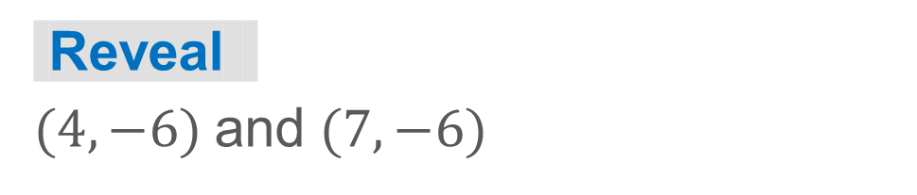
COLLABORATE · TALK IT THROUGH • AGREE ON A MODEL
Collaborate and Connect
The width will be 300 feet, represented by 3 units on the map.
Each unit labeled on the grid represents 100 feet.
The length will be 800 feet, represented by 8 units on the map.
Find the coordinates of the other two vertices.
39 / 51
Notes:
TEACH IN PRACTICE | Embedded facilitation | Lesson 7.7, slide 35 | COLLABORATE
Focus on the existing task: Collaborate and Connect The width will be 300 feet, represented by 3 units on the map. Each unit labeled on the grid represents 100 feet.
LAUNCH (T2/3/5): Use the displayed question. Give private thinking time; then A explains while B asks for evidence. Switch roles. Each student records their own reasoning.
LOOK FOR (T4): Where this task addresses it, students can connect coordinates to perimeter or area. Ask which feature of their work supports the claim.
RESPOND: If this task shows the lesson misconception—confusing a coordinate with a side length or applying an axis-distance rule to a slanted edge—label the vertices and axis-aligned side lengths on the original polygon. Have the student revise and explain the change. Use this support only where the concept occurs in the current task; otherwise respond to the displayed question.
RECHECK: If a gap is shared, revisit the existing representation together. If it is limited, give targeted support while others compare valid methods on the same task. Check the revision before moving on.
PARTICIPATION (T5/6/7): Think time before volunteers; accept a written, drawn or rehearsed entry. Students ask for evidence respectfully. Recognize a specific contribution or revision and check that both partners participate.
Source: BCPS Updated Instructional Framework Rubric (June 2020), TEACH 1–7. Earlier notes and answer keys are retained below.
EARLIER NOTES / EXISTING ANSWER KEY
Routine: COLLABORATE · TALK IT THROUGH • AGREE ON A MODEL
UIFR FULL | Lesson-specific facilitation
TEACH 4-5 | Session 2 discussion and checkpoint (UIFR PDF pp. 11-12).
Collect a brief response from every student to the existing prompt before hearing volunteers. Partners take turns explaining and asking for evidence: “I understand ___; what supports ___?” Offer rehearsal or an annotated model for students who need language support. Each student records their own reasoning.
Look specifically for: confusing a coordinate with a side length or applying an axis-distance rule to a slanted edge. If it appears, label the vertices and axis-aligned side lengths on the original polygon; then ask the student to revise the same response and explain the change. If evidence is secure, have students compare a second valid pathway or state why their approach works. Choose the next step from the responses, not a preset pace.

Slide 40
STUDENT MOVES
Lesson 7-7
Your move
TEACH A PARTNER · Teach this to someone who missed it. If you can teach it, you know it.
40 / 51

Slide 41
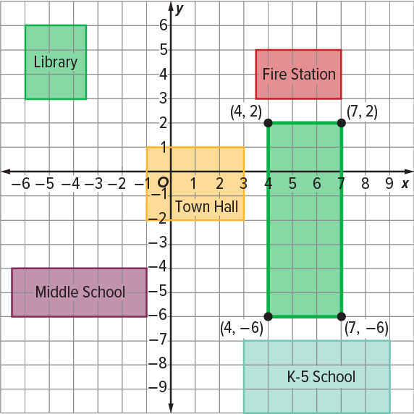
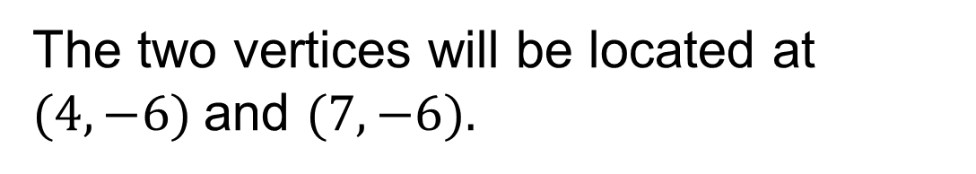
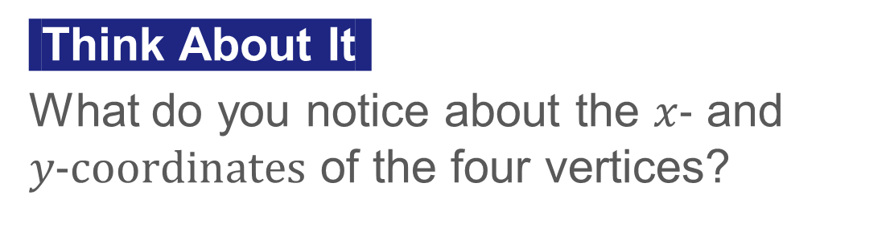
Designing the Town Square
The other two vertices need to be 8 units below the known vertices because the length of the rectangle is 800 feet, or 8 units.
Explain how the information
shown supports your reasoning.
41 / 51
Notes:
TEACH IN PRACTICE | Embedded facilitation | Lesson 7.7, slide 36 | WORKED
Focus on the existing task: The other two vertices need to be 8 units below the known vertices because the length of the rectangle is 800 feet, or 8 units. Designing…
LAUNCH (T2/3/5): Ask students to explain the displayed idea or example and point to evidence. When a calculation step is shown, ask why it is valid. Have a partner restate the explanation; copying is not the check.
LOOK FOR (T4): Where this task addresses it, students can plot vertices in order. Ask which feature of their work supports the claim.
RESPOND: If this task shows the lesson misconception—confusing a coordinate with a side length or applying an axis-distance rule to a slanted edge—label the vertices and axis-aligned side lengths on the original polygon. Have the student revise and explain the change. Use this support only where the concept occurs in the current task; otherwise respond to the displayed question.
RECHECK: If a gap is shared, revisit the existing representation together. If it is limited, give targeted support while others compare valid methods on the same task. Check the revision before moving on.
PARTICIPATION (T5/6/7): Think time before volunteers; accept a written, drawn or rehearsed entry. Students ask for evidence respectfully. Recognize a specific contribution or revision and check that both partners participate.
Source: BCPS Updated Instructional Framework Rubric (June 2020), TEACH 1–7. Earlier notes and answer keys are retained below.
EARLIER NOTES / EXISTING ANSWER KEY
Model briefly, then hand the thinking back: ask “Why does this step work?” before showing the next one.
Quick check before moving on — thumbs or whiteboards from everyone, not volunteers.
UIFR: TEACH 2 · TEACH 3 · TEACH 4.

Slide 42
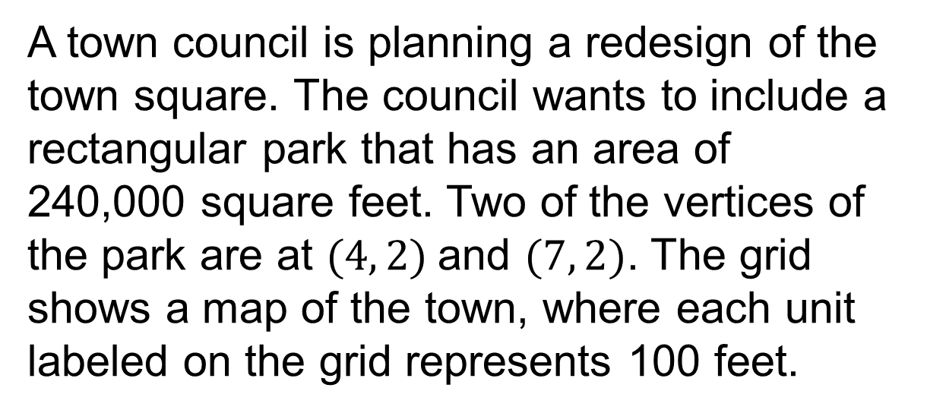
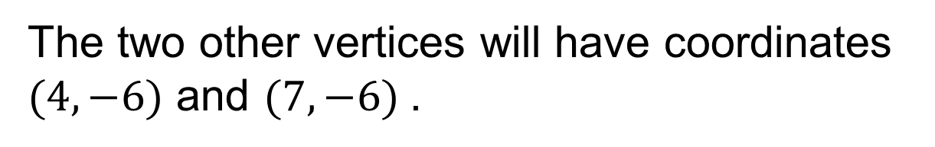
Designing the Town Square
REVISE NOW · Change one answer and write why you changed it. A revision is evidence of learning.
What will be the coordinates of the other two vertices of the park?
42 / 51
Notes:
TEACH IN PRACTICE | Embedded facilitation | Lesson 7.7, slide 37 | TASK
Focus on the existing task: What will be the coordinates of the other two vertices of the park?
LAUNCH (T2/3/5): Use the displayed question. Give private thinking time; then A explains while B asks for evidence. Switch roles. Each student records their own reasoning.
LOOK FOR (T4): Where this task addresses it, students can plot vertices in order. Ask which feature of their work supports the claim.
RESPOND: If this task shows the lesson misconception—confusing a coordinate with a side length or applying an axis-distance rule to a slanted edge—label the vertices and axis-aligned side lengths on the original polygon. Have the student revise and explain the change. Use this support only where the concept occurs in the current task; otherwise respond to the displayed question.
RECHECK: If a gap is shared, revisit the existing representation together. If it is limited, give targeted support while others compare valid methods on the same task. Check the revision before moving on.
PARTICIPATION (T5/6/7): Think time before volunteers; accept a written, drawn or rehearsed entry. Students ask for evidence respectfully. Recognize a specific contribution or revision and check that both partners participate.
Source: BCPS Updated Instructional Framework Rubric (June 2020), TEACH 1–7. Earlier notes and answer keys are retained below.
EARLIER NOTES / EXISTING ANSWER KEY
Model briefly, then hand the thinking back: ask “Why does this step work?” before showing the next one.
Quick check before moving on — thumbs or whiteboards from everyone, not volunteers.
UIFR: TEACH 2 · TEACH 3 · TEACH 4.

Slide 43
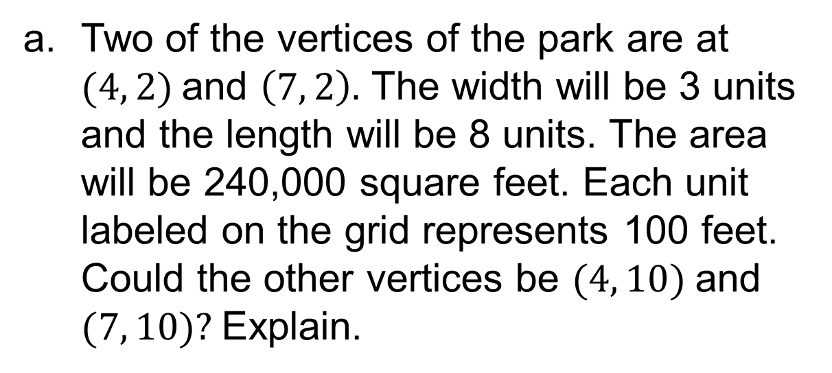
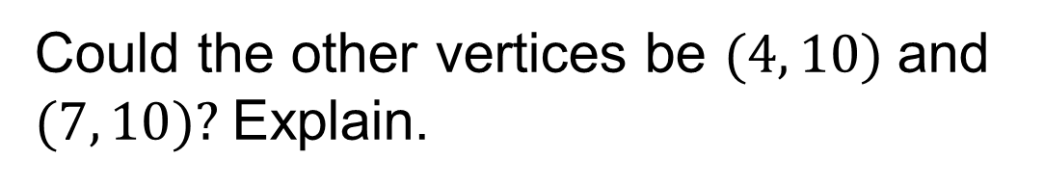
Let’s Explore More
Workspace
43 / 51
Notes:
TEACH IN PRACTICE | Embedded facilitation | Lesson 7.7, slide 38 | PRACTICE
Focus on the existing task: Let’s Explore More Workspace
LAUNCH (T2/3/5): Use the displayed question. Give private thinking time; then A explains while B asks for evidence. Switch roles. Each student records their own reasoning.
LOOK FOR (T4): Where this task addresses it, students can plot vertices in order. Ask which feature of their work supports the claim.
RESPOND: If this task shows the lesson misconception—confusing a coordinate with a side length or applying an axis-distance rule to a slanted edge—label the vertices and axis-aligned side lengths on the original polygon. Have the student revise and explain the change. Use this support only where the concept occurs in the current task; otherwise respond to the displayed question.
RECHECK: If a gap is shared, revisit the existing representation together. If it is limited, give targeted support while others compare valid methods on the same task. Check the revision before moving on.
PARTICIPATION (T5/6/7): Think time before volunteers; accept a written, drawn or rehearsed entry. Students ask for evidence respectfully. Recognize a specific contribution or revision and check that both partners participate.
Source: BCPS Updated Instructional Framework Rubric (June 2020), TEACH 1–7. Earlier notes and answer keys are retained below.
EARLIER NOTES / EXISTING ANSWER KEY
Extension for partners or table groups — students choose their approach and use the workspace to show thinking.
Push with “Convince me,” and have two groups with different approaches share.
This is where students stretch past the worked example.
UIFR: TEACH 2 · TEACH 5.

Slide 44
STUDENT MOVES
Lesson 7-7
Your move
STRUGGLE FIRST · Work on your own first. Stuck is allowed — try a second strategy before you ask.
44 / 51

Slide 45
LESSON 7.7 / CHECK YOUR WORK
Pause. Check. Improve.
CHECK
A mistake to watch for: confusing a coordinate with a side length or applying an axis-distance rule to a slanted edge.
TRY
Label the vertices and axis-aligned side lengths on the given polygon.
REVISE
Use that check on the task you just completed. Correct or strengthen one part, and explain why.
SPECIFIC FEEDBACK · Trade work. Give one specific comment: “This part is clear because ______.”
Listen to understand. Ask for evidence. Make room for every voice.
Notes:
TEACH IN PRACTICE | Embedded facilitation | Lesson 7.7, slide 39 | PRIOR_INSERT
Focus on the existing task: LESSON 7.7 / CHECK YOUR WORK Pause. Check. Improve. Listen to understand. Ask for evidence. Make room for every voice. CHECK A mistake…
CONNECT (T1/4): Ask students to restate the displayed goal or key idea and connect it to earlier work. Relevant lesson evidence: plot vertices in order; determine applicable side lengths; connect coordinates to perimeter or area. Use only the criterion that matches the current session.
SHOW PROGRESS: Students point to their own existing work, explain what improved after feedback, and name a next step. Pair confidence ratings with actual evidence.
PARTICIPATION (T5/6/7): Think time before volunteers; accept a written, drawn or rehearsed entry. Students ask for evidence respectfully. Recognize a specific contribution or revision and check that both partners participate.
Source: BCPS Updated Instructional Framework Rubric (June 2020), TEACH 1–7.

Slide 46
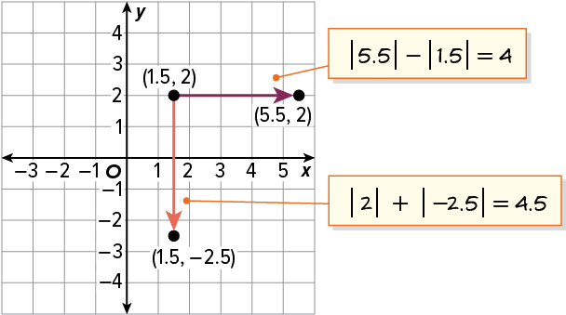

SUMMARIZE · SAY IT IN YOUR OWN WORDS
Summarize: Polygons on the Coordinate Plane
You can draw or represent polygons on the coordinate plane and can solve problems involving distances between coordinates.
Explain the key idea without reading. Use today’s example as evidence.
46 / 51
Notes:
TEACH IN PRACTICE | Embedded facilitation | Lesson 7.7, slide 40 | SUMMARIZE
Focus on the existing task: Summarize: Polygons on the Coordinate Plane You can draw or represent polygons on the coordinate plane and can solve problems involving…
CONNECT (T1/4): Ask students to restate the displayed goal or key idea and connect it to earlier work. Relevant lesson evidence: plot vertices in order; determine applicable side lengths; connect coordinates to perimeter or area. Use only the criterion that matches the current session.
SHOW PROGRESS: Students point to their own existing work, explain what improved after feedback, and name a next step. Pair confidence ratings with actual evidence.
PARTICIPATION (T5/6/7): Think time before volunteers; accept a written, drawn or rehearsed entry. Students ask for evidence respectfully. Recognize a specific contribution or revision and check that both partners participate.
Source: BCPS Updated Instructional Framework Rubric (June 2020), TEACH 1–7. Earlier notes and answer keys are retained below.
EARLIER NOTES / EXISTING ANSWER KEY
Routine: SUMMARIZE · SAY IT IN YOUR OWN WORDS

Slide 47
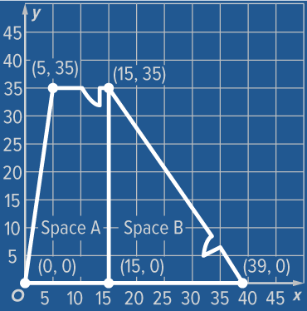
APPLY · PLAN IT • SOLVE IT • PROVE IT
Apply: Maria’s Craft Store
Maria, a craft store owner, plans to rent a location in a shopping center and is considering the two spaces shown. Each unit represents one foot, so each line on the grid represents 5 feet. Space A has a monthly rental cost of $13.89 per square foot. Space B has a monthly rental cost of $13.49 per square foot. Maria wants to pay the lower total monthly rental price.​
Question: Which location would you recommend that she rent? ​
TWO MINUTES SOLO · Two minutes on your own, then compare. Bring one thing you tried, even if it did not work.
47 / 51
Notes:
TEACH IN PRACTICE | Embedded facilitation | Lesson 7.7, slide 41 | APPLY
Focus on the existing task: Apply: Maria’s Craft Store Maria, a craft store owner, plans to rent a location in a shopping center and is considering the two spaces…
LAUNCH (T2/3/5): Use the exact application task independently first. Ask students to justify their choice of method. Collect evidence before a partner discussion or correction.
LOOK FOR (T4): Where this task addresses it, students can plot vertices in order. Ask which feature of their work supports the claim.
RESPOND: If this task shows the lesson misconception—confusing a coordinate with a side length or applying an axis-distance rule to a slanted edge—label the vertices and axis-aligned side lengths on the original polygon. Have the student revise and explain the change. Use this support only where the concept occurs in the current task; otherwise respond to the displayed question.
RECHECK: If a gap is shared, revisit the existing representation together. If it is limited, give targeted support while others compare valid methods on the same task. Check the revision before moving on.
PARTICIPATION (T5/6/7): Think time before volunteers; accept a written, drawn or rehearsed entry. Students ask for evidence respectfully. Recognize a specific contribution or revision and check that both partners participate.
Source: BCPS Updated Instructional Framework Rubric (June 2020), TEACH 1–7. Earlier notes and answer keys are retained below.
EARLIER NOTES / EXISTING ANSWER KEY
Routine: APPLY · PLAN IT • SOLVE IT • PROVE IT
UIFR FULL | Lesson-specific facilitation
TEACH 4 | Independent evidence and revision (UIFR PDF p. 11).
Use the existing application/exit problem as the independent check. If this is a learning-target slide, have students point to and explain their work on the preceding task. Separate initial independent evidence from the revision after feedback.
Check the relevant criteria: plot vertices in order; determine applicable side lengths; connect coordinates to perimeter or area. Respond with one specific next step tied to the work. Students revise and annotate what changed, then identify a criterion they can now demonstrate and one they still need to practice.

Slide 48
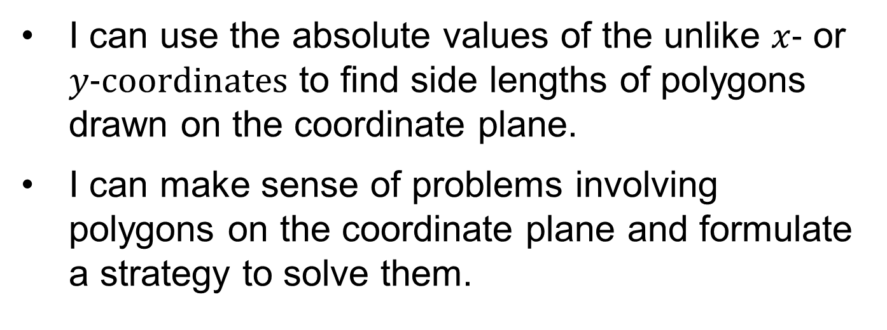
Learning Targets
Point to evidence in your work. Name what improved and your next step.
48 / 51
Notes:
TEACH IN PRACTICE | Embedded facilitation | Lesson 7.7, slide 42 | REFLECTION
Focus on the existing task: Learning Targets
CONNECT (T1/4): Ask students to restate the displayed goal or key idea and connect it to earlier work. Relevant lesson evidence: plot vertices in order; determine applicable side lengths; connect coordinates to perimeter or area. Use only the criterion that matches the current session.
SHOW PROGRESS: Students point to their own existing work, explain what improved after feedback, and name a next step. Pair confidence ratings with actual evidence.
PARTICIPATION (T5/6/7): Think time before volunteers; accept a written, drawn or rehearsed entry. Students ask for evidence respectfully. Recognize a specific contribution or revision and check that both partners participate.
Source: BCPS Updated Instructional Framework Rubric (June 2020), TEACH 1–7. Earlier notes and answer keys are retained below.
EARLIER NOTES / EXISTING ANSWER KEY
Read each target; students self-rate with fist-to-five or thumbs.
Tie back to the goal from the start of class: did we get there?
Note any target that rates low — revisit it tomorrow.
UIFR: TEACH 1 · TEACH 4.

Slide 49
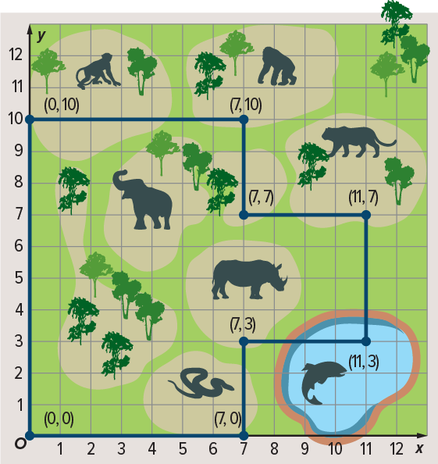
Be Curious
Be Curious
What’s the question?
Sheng is planning a visit to the zoo using the map shown. He plans to visit each exhibit.
ASK THE CLASS · Write one question about this that you could ask the class.
Mindset
How is identifying a problem helping in analyzing and solving the problem?
49 / 51
Notes:
TEACH IN PRACTICE | Embedded facilitation | Lesson 7.7, slide 43 | CURIOUS
Focus on the existing task: Be Curious Be Curious How is identifying a problem helping in analyzing and solving the problem?
LAUNCH (T2/3/5): Allow quiet observation first. Separate a notice from an inference, invite students’ own questions, and follow the existing launch before teaching a procedure.
LOOK FOR (T4): Where this task addresses it, students can plot vertices in order. Ask which feature of their work supports the claim.
RESPOND: If this task shows the lesson misconception—confusing a coordinate with a side length or applying an axis-distance rule to a slanted edge—label the vertices and axis-aligned side lengths on the original polygon. Have the student revise and explain the change. Use this support only where the concept occurs in the current task; otherwise respond to the displayed question.
RECHECK: If a gap is shared, revisit the existing representation together. If it is limited, give targeted support while others compare valid methods on the same task. Check the revision before moving on.
PARTICIPATION (T5/6/7): Think time before volunteers; accept a written, drawn or rehearsed entry. Students ask for evidence respectfully. Recognize a specific contribution or revision and check that both partners participate.
Source: BCPS Updated Instructional Framework Rubric (June 2020), TEACH 1–7.

Slide 50
Learning Targets
Point to evidence in your work. Name what improved and your next step.
50 / 51
Notes:
TEACH IN PRACTICE | Embedded facilitation | Lesson 7.7, slide 44 | REFLECTION
Focus on the existing task: Learning Targets
CONNECT (T1/4): Ask students to restate the displayed goal or key idea and connect it to earlier work. Relevant lesson evidence: plot vertices in order; determine applicable side lengths; connect coordinates to perimeter or area. Use only the criterion that matches the current session.
SHOW PROGRESS: Students point to their own existing work, explain what improved after feedback, and name a next step. Pair confidence ratings with actual evidence.
PARTICIPATION (T5/6/7): Think time before volunteers; accept a written, drawn or rehearsed entry. Students ask for evidence respectfully. Recognize a specific contribution or revision and check that both partners participate.
Source: BCPS Updated Instructional Framework Rubric (June 2020), TEACH 1–7. Earlier notes and answer keys are retained below.
EARLIER NOTES / EXISTING ANSWER KEY
UIFR FULL | Lesson-specific facilitation
REFLECT & ADJUST 1-2 | After the lesson (UIFR PDF pp. 15-16).
Sort the existing work by demonstrated reasoning, partial understanding, and the specific misconception: confusing a coordinate with a side length or applying an axis-distance rule to a slanted edge. Compare the initial response with the revision. Record which teaching move plausibly helped, which did not, and whose participation or access needs a different approach; do not record sensitive student details in this shared deck.
Plan the next lesson from that evidence: if the misconception persists, label the vertices and axis-aligned side lengths on the original polygon using the current example before returning to the next grade-level task; if understanding is secure, use an existing extension or ask for a general explanation. Check the targeted idea again at the next warm-up.
Ask students what supported their thinking and what would help next time. Identify one change to try and one successful practice to retain. Seek colleague feedback on anonymized work when useful; these prompts support reflection and do not establish an evaluation rating. Source: Baltimore City Public Schools, Updated Instructional Framework Rubric, June 2020 (UIFR_Full.pdf).

Slide 51
LESSON 7.7 / REFLECT ON YOUR LEARNING
Show your progress
1 SHOW EVIDENCE
2 CHOOSE A NEXT STEP
Choose one response. Point to the part that shows your reasoning.
Name a change you made after feedback—or a question you still have.
“My work shows ___ because ___.”
“Next time, I will ___ to help me ___.”
Today’s focus: Plot vertices in order.
CREDIT A CLASSMATE · Name one classmate whose idea helped you today, and say what they said.
Listen to understand. Ask for evidence. Make room for every voice.
Notes:
TEACH IN PRACTICE | Embedded facilitation | Lesson 7.7, slide 45 | PRIOR_INSERT
Focus on the existing task: LESSON 7.7 / REFLECT ON YOUR LEARNING Show your progress Listen to understand. Ask for evidence. Make room for every voice. 1 SHOW…
CONNECT (T1/4): Ask students to restate the displayed goal or key idea and connect it to earlier work. Relevant lesson evidence: plot vertices in order; determine applicable side lengths; connect coordinates to perimeter or area. Use only the criterion that matches the current session.
SHOW PROGRESS: Students point to their own existing work, explain what improved after feedback, and name a next step. Pair confidence ratings with actual evidence.
PARTICIPATION (T5/6/7): Think time before volunteers; accept a written, drawn or rehearsed entry. Students ask for evidence respectfully. Recognize a specific contribution or revision and check that both partners participate.
Source: BCPS Updated Instructional Framework Rubric (June 2020), TEACH 1–7.

