Slide 1
WARM-UP · THINK • TRY • CHECK
Turn and talk: compare strategies, then defend one.
Warm-Up
Lesson 8-1 · Understand Equations and Their Solutions | Warm-Up · about 4 minutes
Try each on your own. Mark an unsure answer; explain and revise when we check.
QUESTION 1
QUESTION 2
If n = 5, then 4n = ______
7 + 5 = ______ + 3
QUESTION 3
QUESTION 4
A number n times 4 is 20.
Write the equation: ______
One side is 5 × 4. The other side is 18.
Do the two sides match? ______
TALK IT OVER: “I got ______ because ______.” • Compare with a partner before we check as a class.
1 / 55
Notes:
TEACH IN PRACTICE | Embedded facilitation | Lesson 8.1, slide 1 | WARMUP
Focus on the existing task: Warm-Up WARM-UP · THINK • TRY • CHECK Do these…
GATHER EVIDENCE (T4/6): Keep the original items. Students try independently, mark an uncertain item, and explain one method before checking. Use the existing key when present.
RESPOND: Distinguish a calculation slip from a reasoning gap. Give one next step on the same item; have students revise in a second color. Use the responses to choose flexible support for today’s lesson.
PARTICIPATION (T5/6/7): Think time before volunteers; accept a written, drawn or rehearsed entry. Students ask for evidence respectfully. Recognize a specific contribution or revision and check that both partners participate.
Source: BCPS Updated Instructional Framework Rubric (June 2020), TEACH 1–7. Earlier notes and answer keys are retained below.
EARLIER NOTES / EXISTING ANSWER KEY
Warm-Up answers (teacher only): 1) 20 2) 9 3) 4n = 20 4) no
UIFR FULL | Lesson-specific facilitation
PREPARE 1-2 | Before teaching (UIFR PDF pp. 6-7).
Plan to gather evidence that students can translate the relationship into an equation; substitute a proposed value; compare both sides. Review recent work and today’s warm-up to choose flexible groups and access supports; do not infer needs from identity or perceived ability. Use the existing lesson tasks and stated standards.
Anticipate: assuming the equals sign means to calculate only the left side. If observed, evaluate the two sides of the original equation separately after substitution. Offer oral rehearsal, drawing, pointing, or home-language processing as needed; retain the original mathematical demand. Ask students which support helps and fade it as evidence improves.
TEACH 6-7 | Before the first transition, agree on materials, partner roles, and how to request help. Invite students to restate the routine. Normalize revising an idea, recognize a specific contribution, and check privately when frustration blocks participation. Source: UIFR PDF pp. 13-14.

Slide 2
Today’s Math Notes
Lesson 8-1 · Understand Equations and Their Solutions
Section 1: Math Words
Copy. Explain. Check.
SAY THE GOAL · Say today’s goal in your own words, then name one place this shows up outside math class.
Write Equations
1
Represent a relationship with expressions joined by an equal sign
Equation
2
A math sentence with an equal sign showing both sides
Variable
3
A letter that stands for a number
eduwonderlab.com · Neft Teacher
2 / 55
Notes:
TEACH IN PRACTICE | Embedded facilitation | Lesson 8.1, slide 2 | NOTES
Focus on the existing task: Today’s Math Notes Section 1: Math Words Copy into…
ROUTINE (T1/2/4): Read or copy the original notes, cover one line, and explain it using the displayed example. Reopen and correct. Copying alone is not evidence of understanding.
LOOK FOR: A link between a symbol, quantity or feature and the explanation. If missing, point back to that feature and have the student try again; fade the prompt once they can explain.
PARTICIPATION (T5/6/7): Think time before volunteers; accept a written, drawn or rehearsed entry. Students ask for evidence respectfully. Recognize a specific contribution or revision and check that both partners participate.
Source: BCPS Updated Instructional Framework Rubric (June 2020), TEACH 1–7. Earlier notes and answer keys are retained below.
EARLIER NOTES / EXISTING ANSWER KEY
Copy routine: read one line at a time; students copy, then explain that line to a partner.
Keep it brisk — the understanding work happens in the examples, not the copying.
UIFR: TEACH 1 · TEACH 6.

Slide 3
Today’s Math Notes
Lesson 8-1 · Understand Equations and Their Solutions
Section 2: Today’s Math
Copy. Explain. Check.
Equations & Solutions
Left Expression = Right Expression
Read, cover, explain. Reopen your notes to
check and improve your explanation.
1
An equation is a mathematical sentence stating two expressions are equal
2
A solution is a value for the variable that makes the equation true
3
Check: Substitute the value into the equation and verify that both sides balance
eduwonderlab.com · Neft Teacher
3 / 55
Notes:
TEACH IN PRACTICE | Embedded facilitation | Lesson 8.1, slide 3 | NOTES
Focus on the existing task: Today’s Math Notes Section 2: Today’s Math Copy…
ROUTINE (T1/2/4): Read or copy the original notes, cover one line, and explain it using the displayed example. Reopen and correct. Copying alone is not evidence of understanding.
LOOK FOR: A link between a symbol, quantity or feature and the explanation. If missing, point back to that feature and have the student try again; fade the prompt once they can explain.
PARTICIPATION (T5/6/7): Think time before volunteers; accept a written, drawn or rehearsed entry. Students ask for evidence respectfully. Recognize a specific contribution or revision and check that both partners participate.
Source: BCPS Updated Instructional Framework Rubric (June 2020), TEACH 1–7. Earlier notes and answer keys are retained below.
EARLIER NOTES / EXISTING ANSWER KEY
Copy routine: read one line at a time; students copy, then explain that line to a partner.
Keep it brisk — the understanding work happens in the examples, not the copying.
UIFR: TEACH 1 · TEACH 6.

Slide 4
Session 1
Understand Equations and
Their Solutions
TRY IT BEFORE YOU’RE SURE · Start even if you are not sure. A revised answer counts as much as a first-try answer.
4 / 55
Notes:
TEACH IN PRACTICE | Embedded facilitation | Lesson 8.1, slide 4 | DIVIDER
Focus on the existing task: Understand Equations and Their Solutions Session 1
TRANSITION (T6/7): Students confirm materials, roles, how to request help, and the next response routine. Ask a student to restate it. Keep teacher-only slides hidden.
PARTICIPATION (T5/6/7): Think time before volunteers; accept a written, drawn or rehearsed entry. Students ask for evidence respectfully. Recognize a specific contribution or revision and check that both partners participate.
Source: BCPS Updated Instructional Framework Rubric (June 2020), TEACH 1–7. Earlier notes and answer keys are retained below.
EARLIER NOTES / EXISTING ANSWER KEY
Transition cue: state what materials are out and what success looks like this session.
Keep the changeover under a minute.
UIFR: TEACH 6.

Slide 5
Today’s Objectives
Lesson 8-1 · Understand Equations and Their Solutions
Understand Equations and Their Solutions
Maryland Standard 6.AT.8
CONNECT IT · What earlier lesson does this build on? Tell a partner in one sentence.
CONTENT OBJECTIVE
LANGUAGE OBJECTIVE
Restate the goal in your words
Use these words to explain why
I can write an equation for a real situation and check whether a given value is a solution by substituting it.
I can explain a solution using the words substitute, solution, true, and equal sign.
eduwonderlab.com · Neft Teacher
5 / 55
Notes:
TEACH IN PRACTICE | Embedded facilitation | Lesson 8.1, slide 5 | GOAL
Focus on the existing task: Today’s Objectives Understand Equations and Their…
CONNECT (T1/4): Ask students to restate the displayed goal or key idea and connect it to earlier work. Relevant lesson evidence: translate the relationship into an equation; substitute a proposed value; compare both sides. Use only the criterion that matches the current session.
SHOW PROGRESS: Students point to their own existing work, explain what improved after feedback, and name a next step. Pair confidence ratings with actual evidence.
PARTICIPATION (T5/6/7): Think time before volunteers; accept a written, drawn or rehearsed entry. Students ask for evidence respectfully. Recognize a specific contribution or revision and check that both partners participate.
Source: BCPS Updated Instructional Framework Rubric (June 2020), TEACH 1–7. Earlier notes and answer keys are retained below.
EARLIER NOTES / EXISTING ANSWER KEY
Read the objective together, then have one or two students restate today’s goal in their own words.
Connect it to what the class learned last lesson.
Return to this goal at the end of class to check it was met.
UIFR: TEACH 1.
UIFR FULL | Lesson-specific facilitation
TEACH 1 | Session 1 purpose and evidence (UIFR PDF p. 8).
Have students restate the displayed session goal in their own words and connect it to the existing context or a familiar experience they choose to share. Use the current session goal to select from these lesson-wide evidence criteria; do not frontload a later-session procedure.
Look for: translate the relationship into an equation; substitute a proposed value; compare both sides. Ask: “Which part of your work would show this?” Revisit that evidence after the task; a confidence rating alone is not evidence of understanding.

Slide 6
LESSON 8.1 / OUR LEARNING
What will show your learning?
1
Translate the relationship into an equation.
2
Substitute a proposed value.
3
Compare both sides.
Tell a partner: Which skill connects to something you already know?
SHOW YOUR THINKING · Show what you know — write it, draw it, or build it. A picture counts as an explanation.
Listen to understand. Ask for evidence. Make room for every voice.
Notes:
TEACH IN PRACTICE | Embedded facilitation | Lesson 8.1, slide 6 | PRIOR_INSERT
Focus on the existing task: LESSON 8.1 / OUR LEARNING What will show your learning?
CONNECT (T1/4): Ask students to restate the displayed goal or key idea and connect it to earlier work. Relevant lesson evidence: translate the relationship into an equation; substitute a proposed value; compare both sides. Use only the criterion that matches the current session.
SHOW PROGRESS: Students point to their own existing work, explain what improved after feedback, and name a next step. Pair confidence ratings with actual evidence.
PARTICIPATION (T5/6/7): Think time before volunteers; accept a written, drawn or rehearsed entry. Students ask for evidence respectfully. Recognize a specific contribution or revision and check that both partners participate.
Source: BCPS Updated Instructional Framework Rubric (June 2020), TEACH 1–7.

Slide 7
Vocabulary 1 of 9
Lesson 8-1 · Understand Equations and Their Solutions
Write Equations
Represent a relationship with expressions joined by an equal sign.
EXAMPLE · EXPLAIN WHY IT FITS
A $5 fee plus $3 per game for g games: 5 + 3g = total.
Use “Write Equations” to explain the example. Point to
evidence.
eduwonderlab.com · Neft Teacher
7 / 55
Notes:
TEACH IN PRACTICE | Embedded facilitation | Lesson 8.1, slide 7 | VOCAB
Focus on the existing task: Vocabulary 1 of 9 Write Equations Represent a…
ASK (T1/3/5): Where does “Write Equations” appear in the example? Explain the meaning without reading the definition. Partner: restate the idea and ask a clarifying question.
LOOK FOR: A correct connection between the word and a feature of the example. If the student only repeats the definition, invite pointing, sketching or oral rehearsal, then ask for another explanation of this same example.
PARTICIPATION (T5/6/7): Think time before volunteers; accept a written, drawn or rehearsed entry. Students ask for evidence respectfully. Recognize a specific contribution or revision and check that both partners participate.
Source: BCPS Updated Instructional Framework Rubric (June 2020), TEACH 1–7.

Slide 8
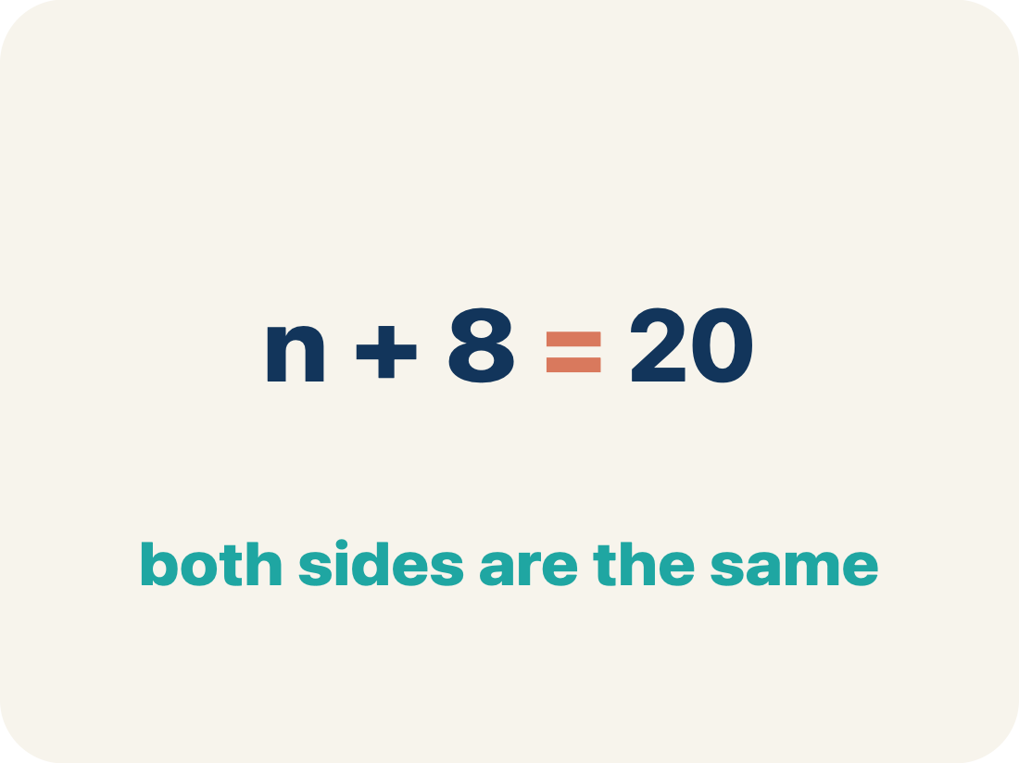
Vocabulary 2 of 9
Lesson 8-1 · Understand Equations and Their Solutions
Equation
A math sentence with an equal sign showing both sides are the same.
EXAMPLE · EXPLAIN WHY IT FITS
n + 8 = 20 means ‘some number plus 8 equals 20’
Use “Equation” to explain the example. Point to evidence.
eduwonderlab.com · Neft Teacher
8 / 55
Notes:
TEACH IN PRACTICE | Embedded facilitation | Lesson 8.1, slide 8 | VOCAB
Focus on the existing task: Vocabulary 2 of 9 Equation A math sentence with…
ASK (T1/3/5): Where does “Equation” appear in the example? Explain the meaning without reading the definition. Partner: restate the idea and ask a clarifying question.
LOOK FOR: A correct connection between the word and a feature of the example. If the student only repeats the definition, invite pointing, sketching or oral rehearsal, then ask for another explanation of this same example.
PARTICIPATION (T5/6/7): Think time before volunteers; accept a written, drawn or rehearsed entry. Students ask for evidence respectfully. Recognize a specific contribution or revision and check that both partners participate.
Source: BCPS Updated Instructional Framework Rubric (June 2020), TEACH 1–7.

Slide 9
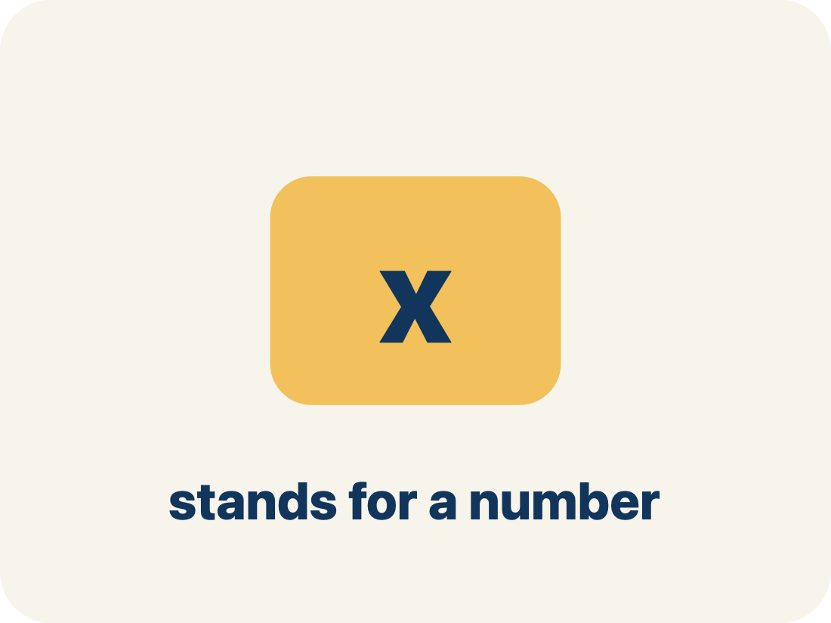
Vocabulary 3 of 9
Lesson 8-1 · Understand Equations and Their Solutions
Variable
A letter that stands for a number that is unknown or can change.
EXAMPLE · EXPLAIN WHY IT FITS
In n + 3 = 10, the letter n stands for the unknown number (n = 7)
Use “Variable” to explain the example. Point to evidence.
eduwonderlab.com · Neft Teacher
9 / 55
Notes:
TEACH IN PRACTICE | Embedded facilitation | Lesson 8.1, slide 9 | VOCAB
Focus on the existing task: Vocabulary 3 of 9 Variable A letter that stands…
ASK (T1/3/5): Where does “Variable” appear in the example? Explain the meaning without reading the definition. Partner: restate the idea and ask a clarifying question.
LOOK FOR: A correct connection between the word and a feature of the example. If the student only repeats the definition, invite pointing, sketching or oral rehearsal, then ask for another explanation of this same example.
PARTICIPATION (T5/6/7): Think time before volunteers; accept a written, drawn or rehearsed entry. Students ask for evidence respectfully. Recognize a specific contribution or revision and check that both partners participate.
Source: BCPS Updated Instructional Framework Rubric (June 2020), TEACH 1–7.

Slide 10
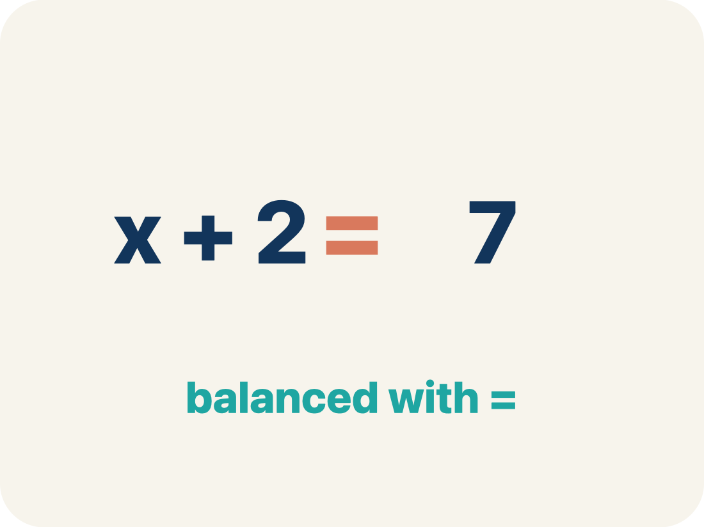
Vocabulary 4 of 9
Lesson 8-1 · Understand Equations and Their Solutions
Equal sign
The = sign, showing both sides are the same.
EXAMPLE · EXPLAIN WHY IT FITS
7 + 3 = 10 — both sides equal 10
Use “Equal sign” to explain the example. Point to evidence.
eduwonderlab.com · Neft Teacher
10 / 55
Notes:
TEACH IN PRACTICE | Embedded facilitation | Lesson 8.1, slide 10 | VOCAB
Focus on the existing task: Vocabulary 4 of 9 Equal sign The = sign, showing…
ASK (T1/3/5): Where does “Equal sign” appear in the example? Explain the meaning without reading the definition. Partner: restate the idea and ask a clarifying question.
LOOK FOR: A correct connection between the word and a feature of the example. If the student only repeats the definition, invite pointing, sketching or oral rehearsal, then ask for another explanation of this same example.
PARTICIPATION (T5/6/7): Think time before volunteers; accept a written, drawn or rehearsed entry. Students ask for evidence respectfully. Recognize a specific contribution or revision and check that both partners participate.
Source: BCPS Updated Instructional Framework Rubric (June 2020), TEACH 1–7.

Slide 11
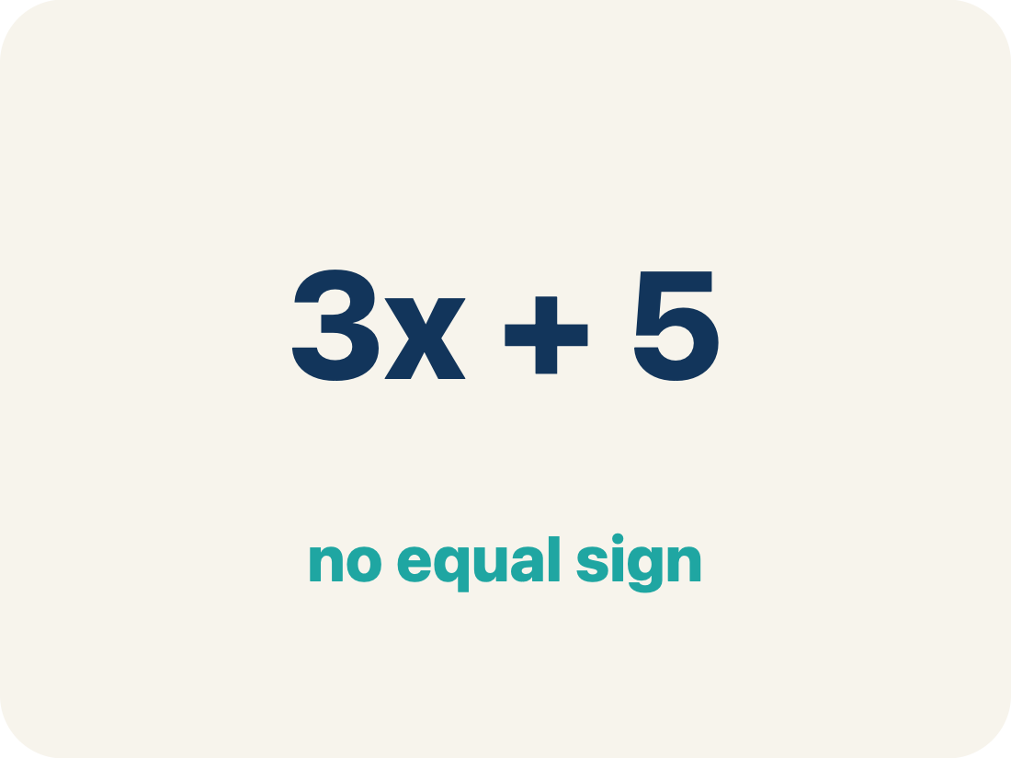
Vocabulary 5 of 9
Lesson 8-1 · Understand Equations and Their Solutions
Expression
A math phrase with numbers and letters, but no equal sign.
EXAMPLE · EXPLAIN WHY IT FITS
2x + 5 is an expression; it becomes an equation when you write 2x + 5 = 15
Use “Expression” to explain the example. Point to evidence.
eduwonderlab.com · Neft Teacher
11 / 55
Notes:
TEACH IN PRACTICE | Embedded facilitation | Lesson 8.1, slide 11 | VOCAB
Focus on the existing task: Vocabulary 5 of 9 Expression A math phrase with…
ASK (T1/3/5): Where does “Expression” appear in the example? Explain the meaning without reading the definition. Partner: restate the idea and ask a clarifying question.
LOOK FOR: A correct connection between the word and a feature of the example. If the student only repeats the definition, invite pointing, sketching or oral rehearsal, then ask for another explanation of this same example.
PARTICIPATION (T5/6/7): Think time before volunteers; accept a written, drawn or rehearsed entry. Students ask for evidence respectfully. Recognize a specific contribution or revision and check that both partners participate.
Source: BCPS Updated Instructional Framework Rubric (June 2020), TEACH 1–7.

Slide 12
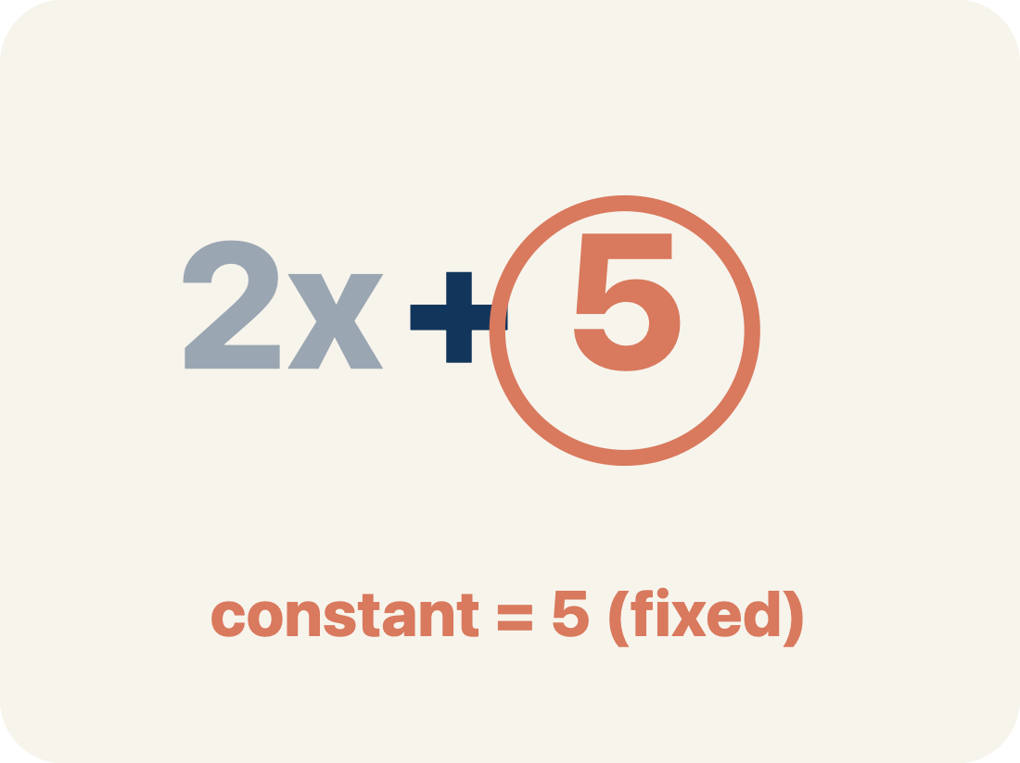
Vocabulary 6 of 9
Lesson 8-1 · Understand Equations and Their Solutions
Constant
A fixed number in an expression or equation that does not change.
EXAMPLE · EXPLAIN WHY IT FITS
In x + 7 = 12, the numbers 7 and 12 are constants; only x can change.
Use “Constant” to explain the example. Point to evidence.
eduwonderlab.com · Neft Teacher
12 / 55
Notes:
TEACH IN PRACTICE | Embedded facilitation | Lesson 8.1, slide 12 | VOCAB
Focus on the existing task: Vocabulary 6 of 9 Constant A fixed number in an…
ASK (T1/3/5): Where does “Constant” appear in the example? Explain the meaning without reading the definition. Partner: restate the idea and ask a clarifying question.
LOOK FOR: A correct connection between the word and a feature of the example. If the student only repeats the definition, invite pointing, sketching or oral rehearsal, then ask for another explanation of this same example.
PARTICIPATION (T5/6/7): Think time before volunteers; accept a written, drawn or rehearsed entry. Students ask for evidence respectfully. Recognize a specific contribution or revision and check that both partners participate.
Source: BCPS Updated Instructional Framework Rubric (June 2020), TEACH 1–7.

Slide 13
Vocabulary 7 of 9
Lesson 8-1 · Understand Equations and Their Solutions
Unknown
The value you are trying to find, usually shown with a variable.
EXAMPLE · EXPLAIN WHY IT FITS
In n + 5 = 12, n is the unknown; you solve to find n = 7.
Use “Unknown” to explain the example. Point to evidence.
eduwonderlab.com · Neft Teacher
13 / 55
Notes:
TEACH IN PRACTICE | Embedded facilitation | Lesson 8.1, slide 13 | VOCAB
Focus on the existing task: Vocabulary 7 of 9 Unknown The value you are…
ASK (T1/3/5): Where does “Unknown” appear in the example? Explain the meaning without reading the definition. Partner: restate the idea and ask a clarifying question.
LOOK FOR: A correct connection between the word and a feature of the example. If the student only repeats the definition, invite pointing, sketching or oral rehearsal, then ask for another explanation of this same example.
PARTICIPATION (T5/6/7): Think time before volunteers; accept a written, drawn or rehearsed entry. Students ask for evidence respectfully. Recognize a specific contribution or revision and check that both partners participate.
Source: BCPS Updated Instructional Framework Rubric (June 2020), TEACH 1–7.

Slide 14
Vocabulary 8 of 9
Lesson 8-1 · Understand Equations and Their Solutions
Solution
A value that makes an equation true when it is substituted for the variable.
EXAMPLE · EXPLAIN WHY IT FITS
n = 4 is the solution of n + 5 = 9
Use “Solution” to explain the example. Point to evidence.
eduwonderlab.com · Neft Teacher
14 / 55
Notes:
TEACH IN PRACTICE | Embedded facilitation | Lesson 8.1, slide 14 | VOCAB
Focus on the existing task: Vocabulary 8 of 9 Solution A value that makes an…
ASK (T1/3/5): Where does “Solution” appear in the example? Explain the meaning without reading the definition. Partner: restate the idea and ask a clarifying question.
LOOK FOR: A correct connection between the word and a feature of the example. If the student only repeats the definition, invite pointing, sketching or oral rehearsal, then ask for another explanation of this same example.
PARTICIPATION (T5/6/7): Think time before volunteers; accept a written, drawn or rehearsed entry. Students ask for evidence respectfully. Recognize a specific contribution or revision and check that both partners participate.
Source: BCPS Updated Instructional Framework Rubric (June 2020), TEACH 1–7.

Slide 15
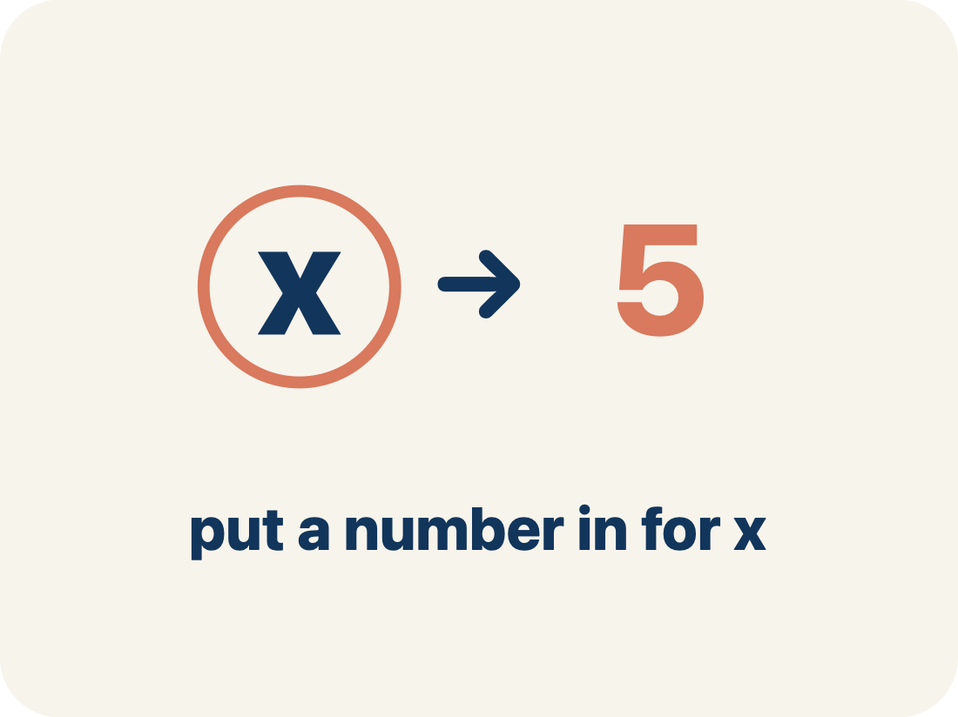
Vocabulary 9 of 9
Lesson 8-1 · Understand Equations and Their Solutions
Substitute
To replace a variable with a number so the equation can be checked.
EXAMPLE · EXPLAIN WHY IT FITS
n + 5 = 9 with n = 4 → 4 + 5 = 9 ✓
Use “Substitute” to explain the example. Point to evidence.
eduwonderlab.com · Neft Teacher
15 / 55
Notes:
TEACH IN PRACTICE | Embedded facilitation | Lesson 8.1, slide 15 | VOCAB
Focus on the existing task: Vocabulary 9 of 9 Substitute To replace a…
ASK (T1/3/5): Where does “Substitute” appear in the example? Explain the meaning without reading the definition. Partner: restate the idea and ask a clarifying question.
LOOK FOR: A correct connection between the word and a feature of the example. If the student only repeats the definition, invite pointing, sketching or oral rehearsal, then ask for another explanation of this same example.
PARTICIPATION (T5/6/7): Think time before volunteers; accept a written, drawn or rehearsed entry. Students ask for evidence respectfully. Recognize a specific contribution or revision and check that both partners participate.
Source: BCPS Updated Instructional Framework Rubric (June 2020), TEACH 1–7.

Slide 16
Vocabulary
Lesson 8-1 · Understand Equations and Their Solutions
Today’s Math Words
We learn every word — what it means and what it looks like — before we use it.
Write Equations
Equation
Variable
Represent a relationship with expressions joined by an equal sign
A math sentence with an equal sign showing both sides are the same
A letter that stands for a number that is unknown or can change
Equal sign
Expression
Constant
The = sign, showing both sides are the same
A math phrase with numbers and letters, but no equal sign
A fixed number in an expression or equation that does not change
Unknown
Solution
Substitute
The value you are trying to find, usually shown with a variable
A value that makes an equation true when it is substituted for the variable
To replace a variable with a number so the equation can be checked
USE THE MATH WORDS · Use today’s math words in your explanation — not “it” and “that thing.”
eduwonderlab.com · Neft Teacher
16 / 55
Notes:
TEACH IN PRACTICE | Embedded facilitation | Lesson 8.1, slide 16 | VOCAB
Focus on the existing task: Vocabulary Today’s Math Words We learn every word…
ASK (T1/3/5): Where does “the displayed term” appear in the example? Explain the meaning without reading the definition. Partner: restate the idea and ask a clarifying question.
LOOK FOR: A correct connection between the word and a feature of the example. If the student only repeats the definition, invite pointing, sketching or oral rehearsal, then ask for another explanation of this same example.
PARTICIPATION (T5/6/7): Think time before volunteers; accept a written, drawn or rehearsed entry. Students ask for evidence respectfully. Recognize a specific contribution or revision and check that both partners participate.
Source: BCPS Updated Instructional Framework Rubric (June 2020), TEACH 1–7. Earlier notes and answer keys are retained below.
EARLIER NOTES / EXISTING ANSWER KEY
Choral-read each word, its meaning, and what it looks like.
Students should use these words out loud today — listen for them in partner talk and revoice student ideas with the academic term.
UIFR: TEACH 1 · TEACH 5.

Slide 17







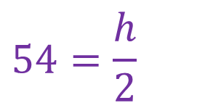

Be Curious
How are they the same?
How are they different?​
Think first. Share a notice and a
question; build on a classmate’s
idea.
Mindset
What helps you be flexible in your mathematical thinking?​
17 / 55
Notes:
TEACH IN PRACTICE | Embedded facilitation | Lesson 8.1, slide 17 | CURIOUS
Focus on the existing task: Be Curious Mindset What helps you be flexible in your mathematical thinking?
LAUNCH (T2/3/5): Allow quiet observation first. Separate a notice from an inference, invite students’ own questions, and follow the existing launch before teaching a procedure.
LOOK FOR (T4): Where this task addresses it, students can translate the relationship into an equation. Ask which feature of their work supports the claim.
RESPOND: If this task shows the lesson misconception—assuming the equals sign means to calculate only the left side—evaluate the two sides of the original equation separately after substitution. Have the student revise and explain the change. Use this support only where the concept occurs in the current task; otherwise respond to the displayed question.
RECHECK: If a gap is shared, revisit the existing representation together. If it is limited, give targeted support while others compare valid methods on the same task. Check the revision before moving on.
PARTICIPATION (T5/6/7): Think time before volunteers; accept a written, drawn or rehearsed entry. Students ask for evidence respectfully. Recognize a specific contribution or revision and check that both partners participate.
Source: BCPS Updated Instructional Framework Rubric (June 2020), TEACH 1–7. Earlier notes and answer keys are retained below.
EARLIER NOTES / EXISTING ANSWER KEY
Accept all noticings and wonderings — there are no wrong answers here.
Give 20–30 seconds of quiet think time before taking responses; mix cold and warm calls so it is not always the same voices.
Read the mindset question aloud and let two students respond.
UIFR: TEACH 3 · TEACH 7.

Slide 18
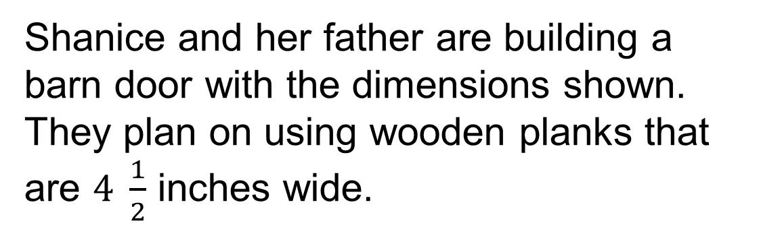
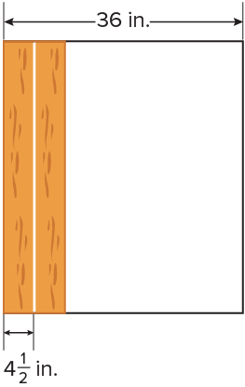

Building a Door
How can Shanice determine the number of planks needed?
Making Connections
How can you connect the problem to math that you already know?
18 / 55
Notes:
TEACH IN PRACTICE | Embedded facilitation | Lesson 8.1, slide 18 | TASK
Focus on the existing task: Building a Door How can you connect the problem to math that you already know?
LAUNCH (T2/3/5): Use the displayed question. Give private thinking time; then A explains while B asks for evidence. Switch roles. Each student records their own reasoning.
LOOK FOR (T4): Where this task addresses it, students can translate the relationship into an equation. Ask which feature of their work supports the claim.
RESPOND: If this task shows the lesson misconception—assuming the equals sign means to calculate only the left side—evaluate the two sides of the original equation separately after substitution. Have the student revise and explain the change. Use this support only where the concept occurs in the current task; otherwise respond to the displayed question.
RECHECK: If a gap is shared, revisit the existing representation together. If it is limited, give targeted support while others compare valid methods on the same task. Check the revision before moving on.
PARTICIPATION (T5/6/7): Think time before volunteers; accept a written, drawn or rehearsed entry. Students ask for evidence respectfully. Recognize a specific contribution or revision and check that both partners participate.
Source: BCPS Updated Instructional Framework Rubric (June 2020), TEACH 1–7. Earlier notes and answer keys are retained below.
EARLIER NOTES / EXISTING ANSWER KEY
Model briefly, then hand the thinking back: ask “Why does this step work?” before showing the next one.
Quick check before moving on — thumbs or whiteboards from everyone, not volunteers.
UIFR: TEACH 2 · TEACH 3 · TEACH 4.
UIFR FULL | Lesson-specific facilitation
TEACH 2-3 | Session 1 task launch (UIFR PDF pp. 9-10).
Use the problem exactly as displayed. Give individual thinking time before discussion or advancing to the explanation. If the answer is already visible, ask students to reconstruct and justify it. Invite a choice of suitable representations and have students explain why their choice helps.
At the point where this concept appears, ask: “What does equality assert here, and what evidence makes this value a solution?” Wait for evidence, invite another pathway, and have a student ask a follow-up question. Do not replace students’ reasoning with a sequence of leading steps.

Slide 19
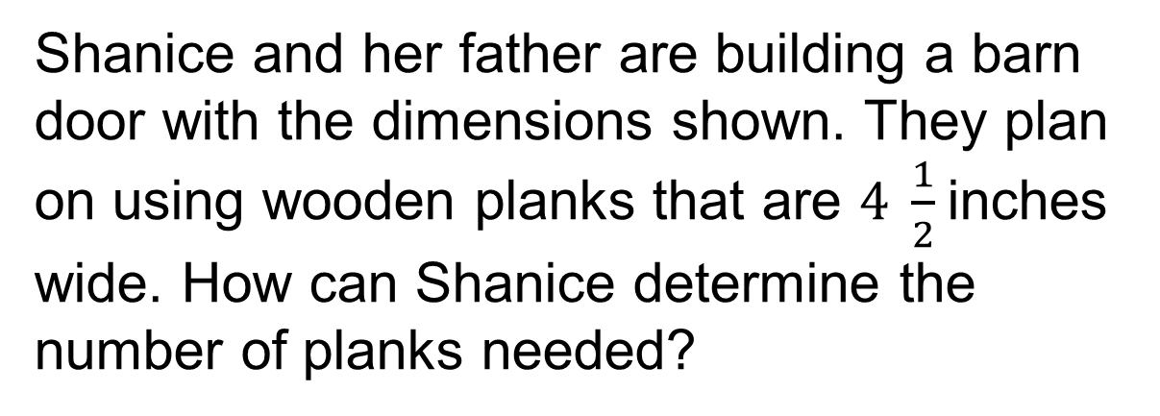
Building a Door
What tool can you use to represent and compare the widths of the door and the planks?
Reveal:
One tool is a tape diagram.
19 / 55
Notes:
TEACH IN PRACTICE | Embedded facilitation | Lesson 8.1, slide 19 | REVEAL
Focus on the existing task: Building a Door Reveal: One tool is a tape diagram. What tool can you use to represent and compare the widths of the door and the planks?
LAUNCH (T2/3/5): If an existing answer cover is present, gather an attempt before revealing. If the explanation is already visible, ask students to reconstruct and justify it. Compare reasoning and explain a revision; preserve the reveal sequence.
LOOK FOR (T4): Where this task addresses it, students can compare both sides. Ask which feature of their work supports the claim.
RESPOND: If this task shows the lesson misconception—assuming the equals sign means to calculate only the left side—evaluate the two sides of the original equation separately after substitution. Have the student revise and explain the change. Use this support only where the concept occurs in the current task; otherwise respond to the displayed question.
RECHECK: If a gap is shared, revisit the existing representation together. If it is limited, give targeted support while others compare valid methods on the same task. Check the revision before moving on.
PARTICIPATION (T5/6/7): Think time before volunteers; accept a written, drawn or rehearsed entry. Students ask for evidence respectfully. Recognize a specific contribution or revision and check that both partners participate.
Source: BCPS Updated Instructional Framework Rubric (June 2020), TEACH 1–7. Earlier notes and answer keys are retained below.
EARLIER NOTES / EXISTING ANSWER KEY
Do not click yet: collect 2–3 student answers with reasons first.
Then click to remove the cover and have students compare their thinking to the reveal — “Is this what we said? Where is it different?”
Behind the cover: One tool is a tape diagram.
UIFR: TEACH 3 · TEACH 4.

Slide 20
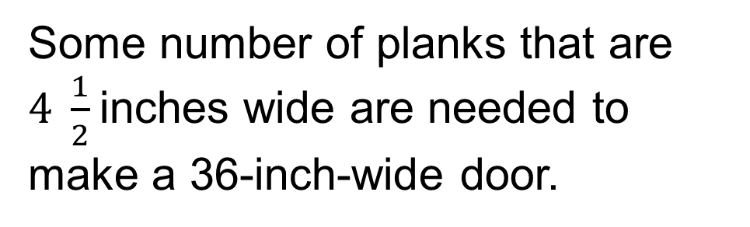
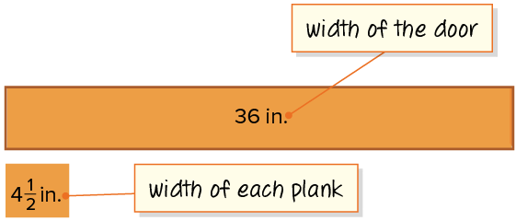
Building a Door
We can use a tape diagram to represent and make sense of the quantities in the problem.
How can you represent the total width of a given number of planks algebraically?
Reveal:
We can use an algebraic expression.
20 / 55
Notes:
TEACH IN PRACTICE | Embedded facilitation | Lesson 8.1, slide 20 | REVEAL
Focus on the existing task: Building a Door Reveal: We can use an algebraic expression. We can use a tape diagram to represent and make sense of the quantities in…
LAUNCH (T2/3/5): If an existing answer cover is present, gather an attempt before revealing. If the explanation is already visible, ask students to reconstruct and justify it. Compare reasoning and explain a revision; preserve the reveal sequence.
LOOK FOR (T4): Where this task addresses it, students can translate the relationship into an equation. Ask which feature of their work supports the claim.
RESPOND: If this task shows the lesson misconception—assuming the equals sign means to calculate only the left side—evaluate the two sides of the original equation separately after substitution. Have the student revise and explain the change. Use this support only where the concept occurs in the current task; otherwise respond to the displayed question.
RECHECK: If a gap is shared, revisit the existing representation together. If it is limited, give targeted support while others compare valid methods on the same task. Check the revision before moving on.
PARTICIPATION (T5/6/7): Think time before volunteers; accept a written, drawn or rehearsed entry. Students ask for evidence respectfully. Recognize a specific contribution or revision and check that both partners participate.
Source: BCPS Updated Instructional Framework Rubric (June 2020), TEACH 1–7. Earlier notes and answer keys are retained below.
EARLIER NOTES / EXISTING ANSWER KEY
Do not click yet: collect 2–3 student answers with reasons first.
Then click to remove the cover and have students compare their thinking to the reveal — “Is this what we said? Where is it different?”
Behind the cover: We can use an algebraic expression.
UIFR: TEACH 3 · TEACH 4.

Slide 21
STUDENT MOVES
Lesson 8-1
Your moves
YOUR CHOICE · You choose how to show this — numbers, words, or a diagram. Make your reasoning visible.
HOW DO YOU KNOW? · Ask your partner “How do you know?” Answer by pointing to your own work.
RESTATE FIRST · Restate your partner’s idea in your own words before you give yours.
21 / 55

Slide 22
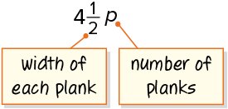
Building a Door
Let’s write an algebraic expression to represent the total width of some number of planks.
What do you know about the total width of the planks needed to build the door?
Record your reasoning before the reveal.
Compare, then explain any revision.
Reveal:
The total width of the planks needs to be 36 inches.
22 / 55
Notes:
TEACH IN PRACTICE | Embedded facilitation | Lesson 8.1, slide 21 | REVEAL
Focus on the existing task: Building a Door Reveal: The total width of the planks needs to be 36 inches. Let’s write an algebraic expression to represent the total…
LAUNCH (T2/3/5): If an existing answer cover is present, gather an attempt before revealing. If the explanation is already visible, ask students to reconstruct and justify it. Compare reasoning and explain a revision; preserve the reveal sequence.
LOOK FOR (T4): Where this task addresses it, students can translate the relationship into an equation. Ask which feature of their work supports the claim.
RESPOND: If this task shows the lesson misconception—assuming the equals sign means to calculate only the left side—evaluate the two sides of the original equation separately after substitution. Have the student revise and explain the change. Use this support only where the concept occurs in the current task; otherwise respond to the displayed question.
RECHECK: If a gap is shared, revisit the existing representation together. If it is limited, give targeted support while others compare valid methods on the same task. Check the revision before moving on.
PARTICIPATION (T5/6/7): Think time before volunteers; accept a written, drawn or rehearsed entry. Students ask for evidence respectfully. Recognize a specific contribution or revision and check that both partners participate.
Source: BCPS Updated Instructional Framework Rubric (June 2020), TEACH 1–7. Earlier notes and answer keys are retained below.
EARLIER NOTES / EXISTING ANSWER KEY
Do not click yet: collect 2–3 student answers with reasons first.
Then click to remove the cover and have students compare their thinking to the reveal — “Is this what we said? Where is it different?”
Behind the cover: The total width of the planks needs to be 36 inches.
UIFR: TEACH 3 · TEACH 4.

Slide 23
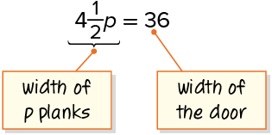
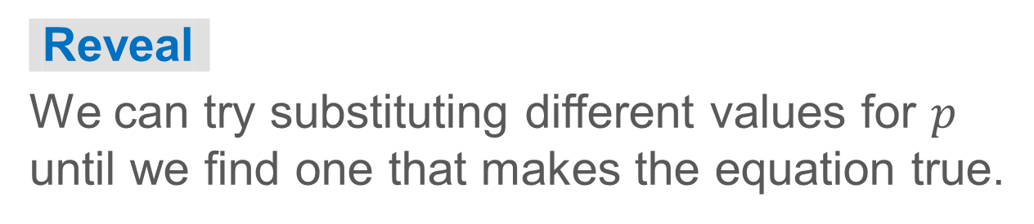
Building a Door
The total width of the planks needs to be 36 inches.
How can you determine the value of the unknown?
HOW DO YOU KNOW? · Ask your partner “How do you know?” Answer by pointing to your own work.
23 / 55
Notes:
TEACH IN PRACTICE | Embedded facilitation | Lesson 8.1, slide 22 | TASK
Focus on the existing task: Building a Door The total width of the planks needs to be 36 inches. How can you determine the value of the unknown?
LAUNCH (T2/3/5): Use the displayed question. Give private thinking time; then A explains while B asks for evidence. Switch roles. Each student records their own reasoning.
LOOK FOR (T4): Where this task addresses it, students can substitute a proposed value. Ask which feature of their work supports the claim.
RESPOND: If this task shows the lesson misconception—assuming the equals sign means to calculate only the left side—evaluate the two sides of the original equation separately after substitution. Have the student revise and explain the change. Use this support only where the concept occurs in the current task; otherwise respond to the displayed question.
RECHECK: If a gap is shared, revisit the existing representation together. If it is limited, give targeted support while others compare valid methods on the same task. Check the revision before moving on.
PARTICIPATION (T5/6/7): Think time before volunteers; accept a written, drawn or rehearsed entry. Students ask for evidence respectfully. Recognize a specific contribution or revision and check that both partners participate.
Source: BCPS Updated Instructional Framework Rubric (June 2020), TEACH 1–7. Earlier notes and answer keys are retained below.
EARLIER NOTES / EXISTING ANSWER KEY
Model briefly, then hand the thinking back: ask “Why does this step work?” before showing the next one.
Quick check before moving on — thumbs or whiteboards from everyone, not volunteers.
UIFR: TEACH 2 · TEACH 3 · TEACH 4.

Slide 24
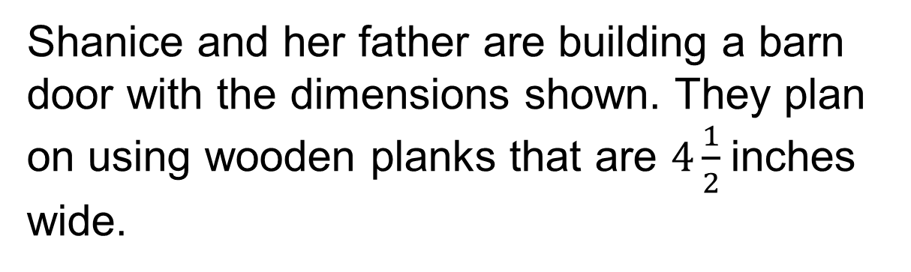
Building a Door
How can Shanice determine the number of planks needed?
Shanice can use an equation to determine the number of planks, 8, she needs to build the door.
ADD ON · Add on: “I agree because ______.” or “I see it differently because ______.”
24 / 55
Notes:
TEACH IN PRACTICE | Embedded facilitation | Lesson 8.1, slide 23 | TASK
Focus on the existing task: Building a Door How can Shanice determine the number of planks needed?
LAUNCH (T2/3/5): Use the displayed question. Give private thinking time; then A explains while B asks for evidence. Switch roles. Each student records their own reasoning.
LOOK FOR (T4): Where this task addresses it, students can translate the relationship into an equation. Ask which feature of their work supports the claim.
RESPOND: If this task shows the lesson misconception—assuming the equals sign means to calculate only the left side—evaluate the two sides of the original equation separately after substitution. Have the student revise and explain the change. Use this support only where the concept occurs in the current task; otherwise respond to the displayed question.
RECHECK: If a gap is shared, revisit the existing representation together. If it is limited, give targeted support while others compare valid methods on the same task. Check the revision before moving on.
PARTICIPATION (T5/6/7): Think time before volunteers; accept a written, drawn or rehearsed entry. Students ask for evidence respectfully. Recognize a specific contribution or revision and check that both partners participate.
Source: BCPS Updated Instructional Framework Rubric (June 2020), TEACH 1–7. Earlier notes and answer keys are retained below.
EARLIER NOTES / EXISTING ANSWER KEY
Model briefly, then hand the thinking back: ask “Why does this step work?” before showing the next one.
Quick check before moving on — thumbs or whiteboards from everyone, not volunteers.
UIFR: TEACH 2 · TEACH 3 · TEACH 4.

Slide 25
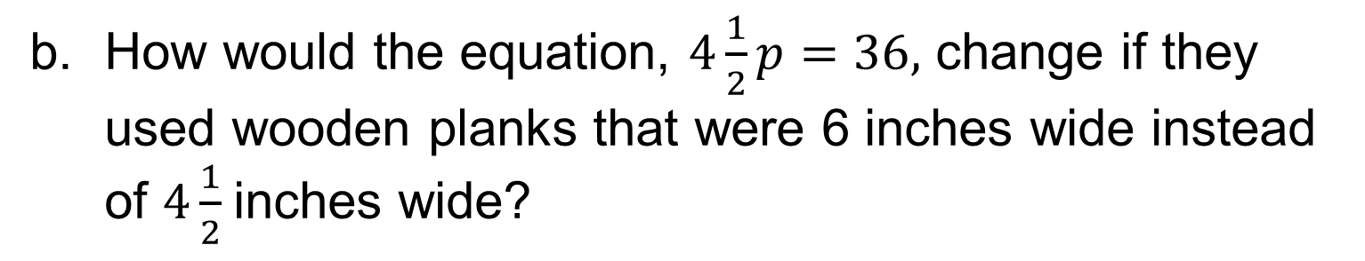
Let’s Explore More
PICK YOUR STRATEGY · Choose your path — picture, table, number line, or equation — and be ready to say why you chose it.
How would the equation, 4 1 2 p = 36 , change if they used wooden planks that were 6 inches wide instead of 4 1 2 inches wide?
Workspace
Workspace
25 / 55
Notes:
TEACH IN PRACTICE | Embedded facilitation | Lesson 8.1, slide 24 | PRACTICE
Focus on the existing task: Let’s Explore More How would the equation, 4 1 2 p = 36, change if they used wooden planks that were 6 inches wide instead of 4 1 2 inches wide?
LAUNCH (T2/3/5): Use the displayed question. Give private thinking time; then A explains while B asks for evidence. Switch roles. Each student records their own reasoning.
LOOK FOR (T4): Where this task addresses it, students can translate the relationship into an equation. Ask which feature of their work supports the claim.
RESPOND: If this task shows the lesson misconception—assuming the equals sign means to calculate only the left side—evaluate the two sides of the original equation separately after substitution. Have the student revise and explain the change. Use this support only where the concept occurs in the current task; otherwise respond to the displayed question.
RECHECK: If a gap is shared, revisit the existing representation together. If it is limited, give targeted support while others compare valid methods on the same task. Check the revision before moving on.
PARTICIPATION (T5/6/7): Think time before volunteers; accept a written, drawn or rehearsed entry. Students ask for evidence respectfully. Recognize a specific contribution or revision and check that both partners participate.
Source: BCPS Updated Instructional Framework Rubric (June 2020), TEACH 1–7. Earlier notes and answer keys are retained below.
EARLIER NOTES / EXISTING ANSWER KEY
Extension for partners or table groups — students choose their approach and use the workspace to show thinking.
Push with “Convince me,” and have two groups with different approaches share.
This is where students stretch past the worked example.
UIFR: TEACH 2 · TEACH 5.
UIFR FULL | Lesson-specific facilitation
TEACH 4-5 | Session 1 discussion and checkpoint (UIFR PDF pp. 11-12).
Collect a brief response from every student to the existing prompt before hearing volunteers. Partners take turns explaining and asking for evidence: “I understand ___; what supports ___?” Offer rehearsal or an annotated model for students who need language support. Each student records their own reasoning.
Look specifically for: assuming the equals sign means to calculate only the left side. If it appears, evaluate the two sides of the original equation separately after substitution; then ask the student to revise the same response and explain the change. If evidence is secure, have students compare a second valid pathway or state why their approach works. Choose the next step from the responses, not a preset pace.

Slide 26
LESSON 8.1 / DISCUSS THE TASK
Explain and compare
Use the task you just explored.
TAKE TURNS
What does equality assert here, and what evidence makes this value a solution?
Explain
“I know this because…”
Ask
“Where does your work show that?”
Point to evidence in your work.
Then compare your approach with a partner’s.
JUSTIFY IT · Say it like this: “I know ______ because ______.”
Listen to understand. Ask for evidence. Make room for every voice.
Notes:
TEACH IN PRACTICE | Embedded facilitation | Lesson 8.1, slide 25 | PRIOR_INSERT
Focus on the existing task: Point to evidence in your work. Then compare your approach with a partner’s. TAKE TURNS Explain “I know this because…” Ask “Where does your work show that?
CONNECT (T1/4): Ask students to restate the displayed goal or key idea and connect it to earlier work. Relevant lesson evidence: translate the relationship into an equation; substitute a proposed value; compare both sides. Use only the criterion that matches the current session.
SHOW PROGRESS: Students point to their own existing work, explain what improved after feedback, and name a next step. Pair confidence ratings with actual evidence.
PARTICIPATION (T5/6/7): Think time before volunteers; accept a written, drawn or rehearsed entry. Students ask for evidence respectfully. Recognize a specific contribution or revision and check that both partners participate.
Source: BCPS Updated Instructional Framework Rubric (June 2020), TEACH 1–7.

Slide 27
Building a Door
What tool can you use to represent and compare the widths of the door and the planks?
Reveal:
One tool is a tape diagram.
SELF-CHECK · Mark it: ✓ got it · ~ almost · ? stuck. Then fix one thing before we move on.
27 / 55
Notes:
TEACH IN PRACTICE | Embedded facilitation | Lesson 8.1, slide 26 | REVEAL
Focus on the existing task: Building a Door Reveal: One tool is a tape diagram. What tool can you use to represent and compare the widths of the door and the planks?
LAUNCH (T2/3/5): If an existing answer cover is present, gather an attempt before revealing. If the explanation is already visible, ask students to reconstruct and justify it. Compare reasoning and explain a revision; preserve the reveal sequence.
LOOK FOR (T4): Where this task addresses it, students can compare both sides. Ask which feature of their work supports the claim.
RESPOND: If this task shows the lesson misconception—assuming the equals sign means to calculate only the left side—evaluate the two sides of the original equation separately after substitution. Have the student revise and explain the change. Use this support only where the concept occurs in the current task; otherwise respond to the displayed question.
RECHECK: If a gap is shared, revisit the existing representation together. If it is limited, give targeted support while others compare valid methods on the same task. Check the revision before moving on.
PARTICIPATION (T5/6/7): Think time before volunteers; accept a written, drawn or rehearsed entry. Students ask for evidence respectfully. Recognize a specific contribution or revision and check that both partners participate.
Source: BCPS Updated Instructional Framework Rubric (June 2020), TEACH 1–7.

Slide 28
Building a Door
We can use a tape diagram to represent and make sense of the quantities in the problem.
How can you represent the total width of a given number of planks algebraically?
Reveal:
We can use an algebraic expression.
28 / 55
Notes:
TEACH IN PRACTICE | Embedded facilitation | Lesson 8.1, slide 27 | REVEAL
Focus on the existing task: Building a Door Reveal: We can use an algebraic expression. We can use a tape diagram to represent and make sense of the quantities in…
LAUNCH (T2/3/5): If an existing answer cover is present, gather an attempt before revealing. If the explanation is already visible, ask students to reconstruct and justify it. Compare reasoning and explain a revision; preserve the reveal sequence.
LOOK FOR (T4): Where this task addresses it, students can translate the relationship into an equation. Ask which feature of their work supports the claim.
RESPOND: If this task shows the lesson misconception—assuming the equals sign means to calculate only the left side—evaluate the two sides of the original equation separately after substitution. Have the student revise and explain the change. Use this support only where the concept occurs in the current task; otherwise respond to the displayed question.
RECHECK: If a gap is shared, revisit the existing representation together. If it is limited, give targeted support while others compare valid methods on the same task. Check the revision before moving on.
PARTICIPATION (T5/6/7): Think time before volunteers; accept a written, drawn or rehearsed entry. Students ask for evidence respectfully. Recognize a specific contribution or revision and check that both partners participate.
Source: BCPS Updated Instructional Framework Rubric (June 2020), TEACH 1–7.

Slide 29
STUDENT MOVES
Lesson 8-1
Your move
SHOW THE EVIDENCE · Circle the part of your work that proves you met today’s goal.
29 / 55

Slide 30
Building a Door
Let’s write an algebraic expression to represent the total width of some number of planks.
What do you know about the total width of the planks needed to build the door?
Compare your reasoning with the
explanation. Explain any revision you make.
Reveal:
The total width of the planks needs to be 36 inches.
30 / 55
Notes:
TEACH IN PRACTICE | Embedded facilitation | Lesson 8.1, slide 28 | REVEAL
Focus on the existing task: Building a Door Reveal: The total width of the planks needs to be 36 inches. Let’s write an algebraic expression to represent the total…
LAUNCH (T2/3/5): If an existing answer cover is present, gather an attempt before revealing. If the explanation is already visible, ask students to reconstruct and justify it. Compare reasoning and explain a revision; preserve the reveal sequence.
LOOK FOR (T4): Where this task addresses it, students can translate the relationship into an equation. Ask which feature of their work supports the claim.
RESPOND: If this task shows the lesson misconception—assuming the equals sign means to calculate only the left side—evaluate the two sides of the original equation separately after substitution. Have the student revise and explain the change. Use this support only where the concept occurs in the current task; otherwise respond to the displayed question.
RECHECK: If a gap is shared, revisit the existing representation together. If it is limited, give targeted support while others compare valid methods on the same task. Check the revision before moving on.
PARTICIPATION (T5/6/7): Think time before volunteers; accept a written, drawn or rehearsed entry. Students ask for evidence respectfully. Recognize a specific contribution or revision and check that both partners participate.
Source: BCPS Updated Instructional Framework Rubric (June 2020), TEACH 1–7.

Slide 31
Session 2 Warm-Up
Lesson 8-1 · Understand Equations and Their Solutions
Session 2 Warm-Up
Check what you remember from Session 1 · about 4 minutes
1
An equation states that two expressions are:
2
A solution to an equation is a value that makes it:
A
Opposites
A
Equal to zero
B
Equal to each other
B
True
C
Inequalities
C
Undefined
D
Fractions
D
Negative
3
Is x = 5 a solution to x + 7 = 12?
4
Is y = 4 a solution to 3y = 15?
A
No
A
Yes
B
Yes (5 + 7 = 12)
B
No (3 × 4 = 12 ≠ 15)
C
Only if x is 0
C
Always
D
Cannot tell
D
Only in fractions
eduwonderlab.com · Neft Teacher
31 / 55
Notes:
TEACH IN PRACTICE | Embedded facilitation | Lesson 8.1, slide 29 | WARMUP
Focus on the existing task: A No B Yes (5 + 7 = 12) C Only if x is 0 D Cannot tell 4 Is y = 4 a solution to 3y = 15?
GATHER EVIDENCE (T4/6): Keep the original items. Students try independently, mark an uncertain item, and explain one method before checking. Use the existing key when present.
RESPOND: Distinguish a calculation slip from a reasoning gap. Give one next step on the same item; have students revise in a second color. Use the responses to choose flexible support for today’s lesson.
PARTICIPATION (T5/6/7): Think time before volunteers; accept a written, drawn or rehearsed entry. Students ask for evidence respectfully. Recognize a specific contribution or revision and check that both partners participate.
Source: BCPS Updated Instructional Framework Rubric (June 2020), TEACH 1–7. Earlier notes and answer keys are retained below.
EARLIER NOTES / EXISTING ANSWER KEY
Warm-up routine: students start silently on entry; keep it to about 4 minutes.
Circulate and note who is stuck — use what you see to choose who you check on first today.
Go over answers quickly; ask one student to explain a step, not just say the answer.
UIFR: TEACH 4 · TEACH 6.
UIFR FULL | Lesson-specific facilitation
TEACH 1 | Session 2 purpose and evidence (UIFR PDF p. 8).
Have students restate the displayed session goal in their own words and connect it to the existing context or a familiar experience they choose to share. Use the current session goal to select from these lesson-wide evidence criteria; do not frontload a later-session procedure.
Look for: translate the relationship into an equation; substitute a proposed value; compare both sides. Ask: “Which part of your work would show this?” Revisit that evidence after the task; a confidence rating alone is not evidence of understanding.

Slide 32
STUDENT MOVES
Lesson 8-1
Your move
YOU KNOW THE ROUTINE · Read → plan → solve → check. Do all four, in that order.
32 / 55

Slide 33
Today’s Math Notes
Lesson 8-1 · Understand Equations and Their Solutions
Review Notes — Session 2
Copy. Explain. Check.
WHY IT MATTERS · Finish this: “This is worth knowing because ______.”
Equation Definition
1
A mathematical statement asserting that two expressions have equal value, linked by =.
Solution of an Equation
2
Any numerical value for the variable that makes the equation a true statement.
Substitution Check
3
Verify solutions by replacing variable with candidate value and checking if Left Side = Right Side.
eduwonderlab.com · Neft Teacher
33 / 55
Notes:
TEACH IN PRACTICE | Embedded facilitation | Lesson 8.1, slide 30 | NOTES
Focus on the existing task: Today’s Math Notes Review Notes — Session 2 Copy…
ROUTINE (T1/2/4): Read or copy the original notes, cover one line, and explain it using the displayed example. Reopen and correct. Copying alone is not evidence of understanding.
LOOK FOR: A link between a symbol, quantity or feature and the explanation. If missing, point back to that feature and have the student try again; fade the prompt once they can explain.
PARTICIPATION (T5/6/7): Think time before volunteers; accept a written, drawn or rehearsed entry. Students ask for evidence respectfully. Recognize a specific contribution or revision and check that both partners participate.
Source: BCPS Updated Instructional Framework Rubric (June 2020), TEACH 1–7. Earlier notes and answer keys are retained below.
EARLIER NOTES / EXISTING ANSWER KEY
Copy routine: read one line at a time; students copy, then explain that line to a partner.
Keep it brisk — the understanding work happens in the examples, not the copying.
UIFR: TEACH 1 · TEACH 6.

Slide 34
Session 2
Understand Equations and
Their Solutions
STRUGGLE FIRST · Work on your own first. Stuck is allowed — try a second strategy before you ask.
34 / 55
Notes:
TEACH IN PRACTICE | Embedded facilitation | Lesson 8.1, slide 31 | DIVIDER
Focus on the existing task: Understand Equations and Their Solutions Session 2
TRANSITION (T6/7): Students confirm materials, roles, how to request help, and the next response routine. Ask a student to restate it. Keep teacher-only slides hidden.
PARTICIPATION (T5/6/7): Think time before volunteers; accept a written, drawn or rehearsed entry. Students ask for evidence respectfully. Recognize a specific contribution or revision and check that both partners participate.
Source: BCPS Updated Instructional Framework Rubric (June 2020), TEACH 1–7. Earlier notes and answer keys are retained below.
EARLIER NOTES / EXISTING ANSWER KEY
Transition cue: state what materials are out and what success looks like this session.
Keep the changeover under a minute.
UIFR: TEACH 6.

Slide 35
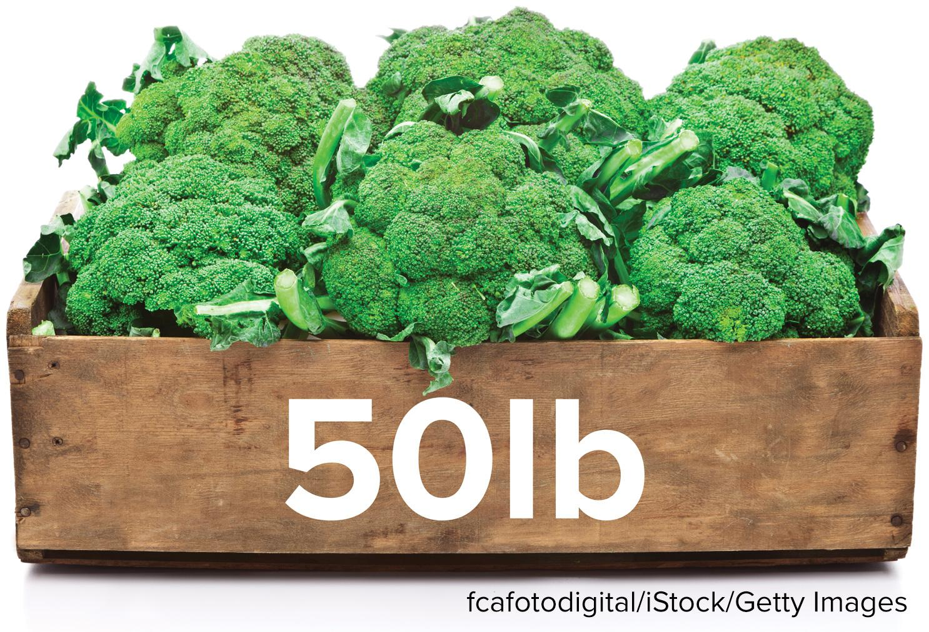
School Broccoli
The workers in a middle school cafeteria cooked 50 pounds of broccoli. A certain amount of broccoli was consumed at lunch and at the end of the school day, there were 19 pounds of broccoli remaining. How can you determine the amount of broccoli that was consumed at lunch?
What are the quantities in the problem? Which of the quantities is unknown?
Think and record first. Which part of your work supports your answer?
35 / 55
Notes:
TEACH IN PRACTICE | Embedded facilitation | Lesson 8.1, slide 32 | TASK
Focus on the existing task: What are the quantities in the problem?
LAUNCH (T2/3/5): Use the displayed question. Give private thinking time; then A explains while B asks for evidence. Switch roles. Each student records their own reasoning.
LOOK FOR (T4): Where this task addresses it, students can translate the relationship into an equation. Ask which feature of their work supports the claim.
RESPOND: If this task shows the lesson misconception—assuming the equals sign means to calculate only the left side—evaluate the two sides of the original equation separately after substitution. Have the student revise and explain the change. Use this support only where the concept occurs in the current task; otherwise respond to the displayed question.
RECHECK: If a gap is shared, revisit the existing representation together. If it is limited, give targeted support while others compare valid methods on the same task. Check the revision before moving on.
PARTICIPATION (T5/6/7): Think time before volunteers; accept a written, drawn or rehearsed entry. Students ask for evidence respectfully. Recognize a specific contribution or revision and check that both partners participate.
Source: BCPS Updated Instructional Framework Rubric (June 2020), TEACH 1–7. Earlier notes and answer keys are retained below.
EARLIER NOTES / EXISTING ANSWER KEY
Read the context aloud (or have a student read it).
Before any math, students restate the situation and what is being asked in their own words.
Ask: What are the quantities in the problem? Which of the quantities is unknown?
UIFR: TEACH 1 · TEACH 3.
UIFR FULL | Lesson-specific facilitation
TEACH 2-3 | Session 2 task launch (UIFR PDF pp. 9-10).
Use the problem exactly as displayed. Give individual thinking time before discussion or advancing to the explanation. If the answer is already visible, ask students to reconstruct and justify it. Invite a choice of suitable representations and have students explain why their choice helps.
At the point where this concept appears, ask: “What does equality assert here, and what evidence makes this value a solution?” Wait for evidence, invite another pathway, and have a student ask a follow-up question. Do not replace students’ reasoning with a sequence of leading steps.

Slide 36
School Broccoli
What are the quantities in the problem? Which of the quantities is unknown?
ANOTHER PATHWAY · Did anyone get there a different way? Put both pathways side by side and compare.
Reveal:
The quantities are the amount of broccoli that was cooked at the start of the day, the amount of broccoli that was consumed, and the amount of broccoli remaining at the end of the day. The amount of broccoli consumed is unknown.
36 / 55
Notes:
TEACH IN PRACTICE | Embedded facilitation | Lesson 8.1, slide 33 | REVEAL
Focus on the existing task: School Broccoli What are the quantities in the problem?
LAUNCH (T2/3/5): If an existing answer cover is present, gather an attempt before revealing. If the explanation is already visible, ask students to reconstruct and justify it. Compare reasoning and explain a revision; preserve the reveal sequence.
LOOK FOR (T4): Where this task addresses it, students can translate the relationship into an equation. Ask which feature of their work supports the claim.
RESPOND: If this task shows the lesson misconception—assuming the equals sign means to calculate only the left side—evaluate the two sides of the original equation separately after substitution. Have the student revise and explain the change. Use this support only where the concept occurs in the current task; otherwise respond to the displayed question.
RECHECK: If a gap is shared, revisit the existing representation together. If it is limited, give targeted support while others compare valid methods on the same task. Check the revision before moving on.
PARTICIPATION (T5/6/7): Think time before volunteers; accept a written, drawn or rehearsed entry. Students ask for evidence respectfully. Recognize a specific contribution or revision and check that both partners participate.
Source: BCPS Updated Instructional Framework Rubric (June 2020), TEACH 1–7. Earlier notes and answer keys are retained below.
EARLIER NOTES / EXISTING ANSWER KEY
Do not click yet: collect 2–3 student answers with reasons first.
Then click to remove the cover and have students compare their thinking to the reveal — “Is this what we said? Where is it different?”
Behind the cover: The quantities are the amount of broccoli that was cooked at the start of the day, the amount of broccoli that was consumed, and the amount of broccoli remaining at the end of the day. The amount of broccoli consumed …
UIFR: TEACH 3 · TEACH 4.

Slide 37
School Broccoli
The quantities in the problem are:
the amount of broccoli that was consumed
the amount of broccoli that was cooked at the start of the day, 50 pounds
the amount of broccoli remaining at the end of the day, 19 pounds
The amount of broccoli consumed is unknown.
How can you represent the relationship between the quantities algebraically?
Reveal:
We can write an equation.
37 / 55
Notes:
TEACH IN PRACTICE | Embedded facilitation | Lesson 8.1, slide 34 | REVEAL
Focus on the existing task: School Broccoli The quantities in the problem are: How can you represent the relationship between the quantities algebraically?
LAUNCH (T2/3/5): If an existing answer cover is present, gather an attempt before revealing. If the explanation is already visible, ask students to reconstruct and justify it. Compare reasoning and explain a revision; preserve the reveal sequence.
LOOK FOR (T4): Where this task addresses it, students can translate the relationship into an equation. Ask which feature of their work supports the claim.
RESPOND: If this task shows the lesson misconception—assuming the equals sign means to calculate only the left side—evaluate the two sides of the original equation separately after substitution. Have the student revise and explain the change. Use this support only where the concept occurs in the current task; otherwise respond to the displayed question.
RECHECK: If a gap is shared, revisit the existing representation together. If it is limited, give targeted support while others compare valid methods on the same task. Check the revision before moving on.
PARTICIPATION (T5/6/7): Think time before volunteers; accept a written, drawn or rehearsed entry. Students ask for evidence respectfully. Recognize a specific contribution or revision and check that both partners participate.
Source: BCPS Updated Instructional Framework Rubric (June 2020), TEACH 1–7. Earlier notes and answer keys are retained below.
EARLIER NOTES / EXISTING ANSWER KEY
Do not click yet: collect 2–3 student answers with reasons first.
Then click to remove the cover and have students compare their thinking to the reveal — “Is this what we said? Where is it different?”
Behind the cover: We can write an equation.
UIFR: TEACH 3 · TEACH 4.

Slide 38

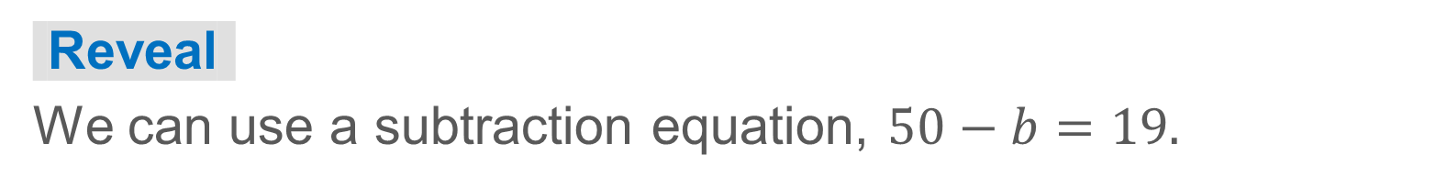
COLLABORATE · TALK IT THROUGH • AGREE ON A MODEL
Collaborate and Connect
The quantities in the problem are:
the amount of broccoli that was consumed
the amount of broccoli remaining at the end of the day, 19 pounds
the amount of broccoli that was cooked at the start of the day, 50 pounds
The amount of broccoli consumed is unknown.
What equation represents the relationship between the quantities? Be sure to define any variables you use.
38 / 55
Notes:
TEACH IN PRACTICE | Embedded facilitation | Lesson 8.1, slide 35 | COLLABORATE
Focus on the existing task: The quantities in the problem are: Collaborate and Connect What equation represents the relationship between the quantities?
LAUNCH (T2/3/5): Use the displayed question. Give private thinking time; then A explains while B asks for evidence. Switch roles. Each student records their own reasoning.
LOOK FOR (T4): Where this task addresses it, students can translate the relationship into an equation. Ask which feature of their work supports the claim.
RESPOND: If this task shows the lesson misconception—assuming the equals sign means to calculate only the left side—evaluate the two sides of the original equation separately after substitution. Have the student revise and explain the change. Use this support only where the concept occurs in the current task; otherwise respond to the displayed question.
RECHECK: If a gap is shared, revisit the existing representation together. If it is limited, give targeted support while others compare valid methods on the same task. Check the revision before moving on.
PARTICIPATION (T5/6/7): Think time before volunteers; accept a written, drawn or rehearsed entry. Students ask for evidence respectfully. Recognize a specific contribution or revision and check that both partners participate.
Source: BCPS Updated Instructional Framework Rubric (June 2020), TEACH 1–7. Earlier notes and answer keys are retained below.
EARLIER NOTES / EXISTING ANSWER KEY
Routine: COLLABORATE · TALK IT THROUGH • AGREE ON A MODEL
UIFR FULL | Lesson-specific facilitation
TEACH 4-5 | Session 2 discussion and checkpoint (UIFR PDF pp. 11-12).
Collect a brief response from every student to the existing prompt before hearing volunteers. Partners take turns explaining and asking for evidence: “I understand ___; what supports ___?” Offer rehearsal or an annotated model for students who need language support. Each student records their own reasoning.
Look specifically for: assuming the equals sign means to calculate only the left side. If it appears, evaluate the two sides of the original equation separately after substitution; then ask the student to revise the same response and explain the change. If evidence is secure, have students compare a second valid pathway or state why their approach works. Choose the next step from the responses, not a preset pace.

Slide 39
STUDENT MOVES
Lesson 8-1
Your moves
PICK YOUR STRATEGY · Choose your path — picture, table, number line, or equation — and be ready to say why you chose it.
TEACH A PARTNER · Teach this to someone who missed it. If you can teach it, you know it.
39 / 55

Slide 40
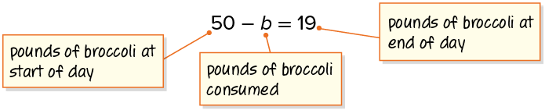
School Broccoli
How can you determine the value of the unknown?
Try first. Explain how your equation represents the situation. Check the result.
Think About It:
How can estimating help you solve an equation?
40 / 55
Notes:
TEACH IN PRACTICE | Embedded facilitation | Lesson 8.1, slide 36 | TASK
Focus on the existing task: School Broccoli Think About It: How can estimating help you solve an equation?
LAUNCH (T2/3/5): Use the displayed question. Give private thinking time; then A explains while B asks for evidence. Switch roles. Each student records their own reasoning.
LOOK FOR (T4): Where this task addresses it, students can translate the relationship into an equation. Ask which feature of their work supports the claim.
RESPOND: If this task shows the lesson misconception—assuming the equals sign means to calculate only the left side—evaluate the two sides of the original equation separately after substitution. Have the student revise and explain the change. Use this support only where the concept occurs in the current task; otherwise respond to the displayed question.
RECHECK: If a gap is shared, revisit the existing representation together. If it is limited, give targeted support while others compare valid methods on the same task. Check the revision before moving on.
PARTICIPATION (T5/6/7): Think time before volunteers; accept a written, drawn or rehearsed entry. Students ask for evidence respectfully. Recognize a specific contribution or revision and check that both partners participate.
Source: BCPS Updated Instructional Framework Rubric (June 2020), TEACH 1–7. Earlier notes and answer keys are retained below.
EARLIER NOTES / EXISTING ANSWER KEY
Ask the question, then hold the silence — students think or jot before anyone answers.
Take two or three responses and press with “Why?” or “How do you know?” before moving on.
UIFR: TEACH 3.

Slide 41
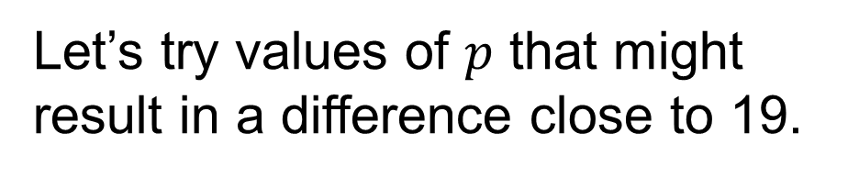

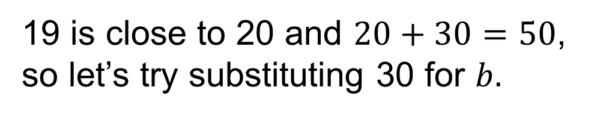


School Broccoli
USE YOUR TOOLS · Reach for your notes, a model, or a manipulative before you reach for an answer.
How can you determine another number to try?
30 does not make the equation true.
Reveal:
We can try 31, because we need to take 1 more away from 50 to get to 19.
41 / 55
Notes:
TEACH IN PRACTICE | Embedded facilitation | Lesson 8.1, slide 37 | REVEAL
Focus on the existing task: School Broccoli How can you determine another number to try?
LAUNCH (T2/3/5): If an existing answer cover is present, gather an attempt before revealing. If the explanation is already visible, ask students to reconstruct and justify it. Compare reasoning and explain a revision; preserve the reveal sequence.
LOOK FOR (T4): Where this task addresses it, students can translate the relationship into an equation. Ask which feature of their work supports the claim.
RESPOND: If this task shows the lesson misconception—assuming the equals sign means to calculate only the left side—evaluate the two sides of the original equation separately after substitution. Have the student revise and explain the change. Use this support only where the concept occurs in the current task; otherwise respond to the displayed question.
RECHECK: If a gap is shared, revisit the existing representation together. If it is limited, give targeted support while others compare valid methods on the same task. Check the revision before moving on.
PARTICIPATION (T5/6/7): Think time before volunteers; accept a written, drawn or rehearsed entry. Students ask for evidence respectfully. Recognize a specific contribution or revision and check that both partners participate.
Source: BCPS Updated Instructional Framework Rubric (June 2020), TEACH 1–7. Earlier notes and answer keys are retained below.
EARLIER NOTES / EXISTING ANSWER KEY
Do not click yet: collect 2–3 student answers with reasons first.
Then click to remove the cover and have students compare their thinking to the reveal — “Is this what we said? Where is it different?”
Behind the cover: We can try 31, because we need to take 1 more away from 50 to get to 19.
UIFR: TEACH 3 · TEACH 4.

Slide 42
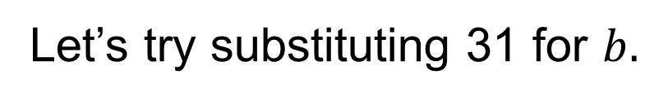



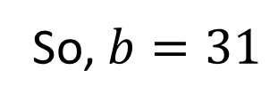
School Broccoli
ASK THE CLASS · Write one question about this that you could ask the class.
What does the solution mean in the context of the situation?
Reveal:
31 pounds of broccoli were consumed.
42 / 55
Notes:
TEACH IN PRACTICE | Embedded facilitation | Lesson 8.1, slide 38 | REVEAL
Focus on the existing task: School Broccoli Reveal: 31 pounds of broccoli were consumed. What does the solution mean in the context of the situation?
LAUNCH (T2/3/5): If an existing answer cover is present, gather an attempt before revealing. If the explanation is already visible, ask students to reconstruct and justify it. Compare reasoning and explain a revision; preserve the reveal sequence.
LOOK FOR (T4): Where this task addresses it, students can translate the relationship into an equation. Ask which feature of their work supports the claim.
RESPOND: If this task shows the lesson misconception—assuming the equals sign means to calculate only the left side—evaluate the two sides of the original equation separately after substitution. Have the student revise and explain the change. Use this support only where the concept occurs in the current task; otherwise respond to the displayed question.
RECHECK: If a gap is shared, revisit the existing representation together. If it is limited, give targeted support while others compare valid methods on the same task. Check the revision before moving on.
PARTICIPATION (T5/6/7): Think time before volunteers; accept a written, drawn or rehearsed entry. Students ask for evidence respectfully. Recognize a specific contribution or revision and check that both partners participate.
Source: BCPS Updated Instructional Framework Rubric (June 2020), TEACH 1–7. Earlier notes and answer keys are retained below.
EARLIER NOTES / EXISTING ANSWER KEY
Do not click yet: collect 2–3 student answers with reasons first.
Then click to remove the cover and have students compare their thinking to the reveal — “Is this what we said? Where is it different?”
Behind the cover: 31 pounds of broccoli were consumed.
UIFR: TEACH 3 · TEACH 4.

Slide 43
School Broccoli
The workers in a middle school cafeteria cooked 50 pounds of broccoli. A certain amount of broccoli was consumed at lunch and at the end of the school day, there were 19 pounds of broccoli remaining.
How can you determine the amount of broccoli that was consumed at lunch?
I can use a subtraction equation to determine that 31 pounds of broccoli were consumed at lunch.
43 / 55
Notes:
TEACH IN PRACTICE | Embedded facilitation | Lesson 8.1, slide 39 | TASK
Focus on the existing task: School Broccoli The workers in a middle school cafeteria cooked 50 pounds of broccoli. A certain amount of broccoli was consumed at lunch…
LAUNCH (T2/3/5): Use the displayed question. Give private thinking time; then A explains while B asks for evidence. Switch roles. Each student records their own reasoning.
LOOK FOR (T4): Where this task addresses it, students can translate the relationship into an equation. Ask which feature of their work supports the claim.
RESPOND: If this task shows the lesson misconception—assuming the equals sign means to calculate only the left side—evaluate the two sides of the original equation separately after substitution. Have the student revise and explain the change. Use this support only where the concept occurs in the current task; otherwise respond to the displayed question.
RECHECK: If a gap is shared, revisit the existing representation together. If it is limited, give targeted support while others compare valid methods on the same task. Check the revision before moving on.
PARTICIPATION (T5/6/7): Think time before volunteers; accept a written, drawn or rehearsed entry. Students ask for evidence respectfully. Recognize a specific contribution or revision and check that both partners participate.
Source: BCPS Updated Instructional Framework Rubric (June 2020), TEACH 1–7. Earlier notes and answer keys are retained below.
EARLIER NOTES / EXISTING ANSWER KEY
Read the context aloud (or have a student read it).
Before any math, students restate the situation and what is being asked in their own words.
Ask: How can you determine the amount of broccoli that was consumed at lunch?
UIFR: TEACH 1 · TEACH 3.

Slide 44
STUDENT MOVES
Lesson 8-1
Your move
JUSTIFY IT · Say it like this: “I know ______ because ______.”
44 / 55

Slide 45
Let’s Explore More
The equation shown was used to solve the following problem:
How can you determine the amount of broccoli that was consumed at lunch?
Try first. Explain how your equation represents the situation. Check the result.
45 / 55
Notes:
TEACH IN PRACTICE | Embedded facilitation | Lesson 8.1, slide 40 | PRACTICE
Focus on the existing task: Let’s Explore More The equation shown was used to solve the following problem: How can you determine the amount of broccoli that was consumed at lunch?
LAUNCH (T2/3/5): Use the displayed question. Give private thinking time; then A explains while B asks for evidence. Switch roles. Each student records their own reasoning.
LOOK FOR (T4): Where this task addresses it, students can translate the relationship into an equation. Ask which feature of their work supports the claim.
RESPOND: If this task shows the lesson misconception—assuming the equals sign means to calculate only the left side—evaluate the two sides of the original equation separately after substitution. Have the student revise and explain the change. Use this support only where the concept occurs in the current task; otherwise respond to the displayed question.
RECHECK: If a gap is shared, revisit the existing representation together. If it is limited, give targeted support while others compare valid methods on the same task. Check the revision before moving on.
PARTICIPATION (T5/6/7): Think time before volunteers; accept a written, drawn or rehearsed entry. Students ask for evidence respectfully. Recognize a specific contribution or revision and check that both partners participate.
Source: BCPS Updated Instructional Framework Rubric (June 2020), TEACH 1–7. Earlier notes and answer keys are retained below.
EARLIER NOTES / EXISTING ANSWER KEY
Extension for partners or table groups — students choose their approach and use the workspace to show thinking.
Push with “Convince me,” and have two groups with different approaches share.
This is where students stretch past the worked example.
UIFR: TEACH 2 · TEACH 5.

Slide 46
Let’s Explore More
What is a different way to write a subtraction equation to represent the problem?
Workspace
How can you represent the problem using an addition equation?
Workspace
TWO MINUTES SOLO · Two minutes on your own, then compare. Bring one thing you tried, even if it did not work.
46 / 55
Notes:
TEACH IN PRACTICE | Embedded facilitation | Lesson 8.1, slide 41 | PRACTICE
Focus on the existing task: Let’s Explore More What is a different way to write a subtraction equation to represent the problem?
LAUNCH (T2/3/5): Use the displayed question. Give private thinking time; then A explains while B asks for evidence. Switch roles. Each student records their own reasoning.
LOOK FOR (T4): Where this task addresses it, students can translate the relationship into an equation. Ask which feature of their work supports the claim.
RESPOND: If this task shows the lesson misconception—assuming the equals sign means to calculate only the left side—evaluate the two sides of the original equation separately after substitution. Have the student revise and explain the change. Use this support only where the concept occurs in the current task; otherwise respond to the displayed question.
RECHECK: If a gap is shared, revisit the existing representation together. If it is limited, give targeted support while others compare valid methods on the same task. Check the revision before moving on.
PARTICIPATION (T5/6/7): Think time before volunteers; accept a written, drawn or rehearsed entry. Students ask for evidence respectfully. Recognize a specific contribution or revision and check that both partners participate.
Source: BCPS Updated Instructional Framework Rubric (June 2020), TEACH 1–7. Earlier notes and answer keys are retained below.
EARLIER NOTES / EXISTING ANSWER KEY
Extension for partners or table groups — students choose their approach and use the workspace to show thinking.
Push with “Convince me,” and have two groups with different approaches share.
This is where students stretch past the worked example.
UIFR: TEACH 2 · TEACH 5.

Slide 47
LESSON 8.1 / CHECK YOUR WORK
Pause. Check. Improve.
CHECK
A mistake to watch for: assuming the equals sign means to calculate only the left side.
TRY
Evaluate the two sides of the given equation separately after substitution.
REVISE
Use that check on the task you just completed. Correct or strengthen one part, and explain why.
REVISE NOW · Change one answer and write why you changed it. A revision is evidence of learning.
Listen to understand. Ask for evidence. Make room for every voice.
Notes:
TEACH IN PRACTICE | Embedded facilitation | Lesson 8.1, slide 42 | PRIOR_INSERT
Focus on the existing task: LESSON 8.1 / CHECK YOUR WORK Pause. Check. Improve. Listen to understand. Ask for evidence. Make room for every voice. CHECK A mistake…
CONNECT (T1/4): Ask students to restate the displayed goal or key idea and connect it to earlier work. Relevant lesson evidence: translate the relationship into an equation; substitute a proposed value; compare both sides. Use only the criterion that matches the current session.
SHOW PROGRESS: Students point to their own existing work, explain what improved after feedback, and name a next step. Pair confidence ratings with actual evidence.
PARTICIPATION (T5/6/7): Think time before volunteers; accept a written, drawn or rehearsed entry. Students ask for evidence respectfully. Recognize a specific contribution or revision and check that both partners participate.
Source: BCPS Updated Instructional Framework Rubric (June 2020), TEACH 1–7.

Slide 48
School Broccoli
TAKE TURNS · One explains, one asks a question. Then switch, so both of you talk.
How can you determine another number to try?
30 does not make the equation true.
Reveal:
We can try 31, because we need to take 1 more away from 50 to get to 19.
48 / 55
Notes:
TEACH IN PRACTICE | Embedded facilitation | Lesson 8.1, slide 43 | REVEAL
Focus on the existing task: School Broccoli How can you determine another number to try?
LAUNCH (T2/3/5): If an existing answer cover is present, gather an attempt before revealing. If the explanation is already visible, ask students to reconstruct and justify it. Compare reasoning and explain a revision; preserve the reveal sequence.
LOOK FOR (T4): Where this task addresses it, students can translate the relationship into an equation. Ask which feature of their work supports the claim.
RESPOND: If this task shows the lesson misconception—assuming the equals sign means to calculate only the left side—evaluate the two sides of the original equation separately after substitution. Have the student revise and explain the change. Use this support only where the concept occurs in the current task; otherwise respond to the displayed question.
RECHECK: If a gap is shared, revisit the existing representation together. If it is limited, give targeted support while others compare valid methods on the same task. Check the revision before moving on.
PARTICIPATION (T5/6/7): Think time before volunteers; accept a written, drawn or rehearsed entry. Students ask for evidence respectfully. Recognize a specific contribution or revision and check that both partners participate.
Source: BCPS Updated Instructional Framework Rubric (June 2020), TEACH 1–7.

Slide 49
School Broccoli
SPECIFIC FEEDBACK · Trade work. Give one specific comment: “This part is clear because ______.”
What does the solution mean in the context of the situation?
Reveal:
31 pounds of broccoli were consumed.
49 / 55
Notes:
TEACH IN PRACTICE | Embedded facilitation | Lesson 8.1, slide 44 | REVEAL
Focus on the existing task: School Broccoli Reveal: 31 pounds of broccoli were consumed. What does the solution mean in the context of the situation?
LAUNCH (T2/3/5): If an existing answer cover is present, gather an attempt before revealing. If the explanation is already visible, ask students to reconstruct and justify it. Compare reasoning and explain a revision; preserve the reveal sequence.
LOOK FOR (T4): Where this task addresses it, students can translate the relationship into an equation. Ask which feature of their work supports the claim.
RESPOND: If this task shows the lesson misconception—assuming the equals sign means to calculate only the left side—evaluate the two sides of the original equation separately after substitution. Have the student revise and explain the change. Use this support only where the concept occurs in the current task; otherwise respond to the displayed question.
RECHECK: If a gap is shared, revisit the existing representation together. If it is limited, give targeted support while others compare valid methods on the same task. Check the revision before moving on.
PARTICIPATION (T5/6/7): Think time before volunteers; accept a written, drawn or rehearsed entry. Students ask for evidence respectfully. Recognize a specific contribution or revision and check that both partners participate.
Source: BCPS Updated Instructional Framework Rubric (June 2020), TEACH 1–7.

Slide 50




SUMMARIZE · SAY IT IN YOUR OWN WORDS
Summarize: Understand Equations and Their Solutions
A solution to an equation is a value that makes the equation true. One way to determine a solution to an equation is to use substitution. To use substitution, determine a reasonable estimate for the unknown and check whether it makes the equation true.
Explain the key idea without reading. Use today’s example as
evidence.
50 / 55
Notes:
TEACH IN PRACTICE | Embedded facilitation | Lesson 8.1, slide 45 | SUMMARIZE
Focus on the existing task: Summarize: Understand Equations and Their Solutions A solution to an equation is a value that makes the equation true. One way to…
CONNECT (T1/4): Ask students to restate the displayed goal or key idea and connect it to earlier work. Relevant lesson evidence: translate the relationship into an equation; substitute a proposed value; compare both sides. Use only the criterion that matches the current session.
SHOW PROGRESS: Students point to their own existing work, explain what improved after feedback, and name a next step. Pair confidence ratings with actual evidence.
PARTICIPATION (T5/6/7): Think time before volunteers; accept a written, drawn or rehearsed entry. Students ask for evidence respectfully. Recognize a specific contribution or revision and check that both partners participate.
Source: BCPS Updated Instructional Framework Rubric (June 2020), TEACH 1–7. Earlier notes and answer keys are retained below.
EARLIER NOTES / EXISTING ANSWER KEY
Routine: SUMMARIZE · SAY IT IN YOUR OWN WORDS

Slide 51
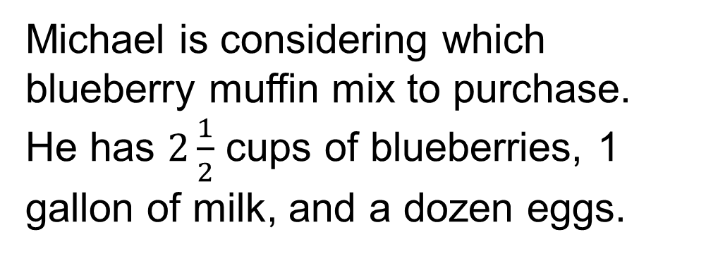
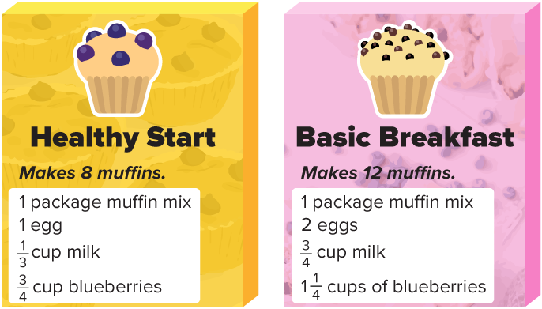
APPLY · PLAN IT • SOLVE IT • PROVE IT
Apply: Blueberry Muffins
Question: If Michael wants to have 24 blueberry muffins, which muffin mix and how many boxes of each mix would you recommend he purchase? Explain.
Choose a method. Solve
independently, justify your
answer, then check the goal.
51 / 55
Notes:
TEACH IN PRACTICE | Embedded facilitation | Lesson 8.1, slide 46 | APPLY
Focus on the existing task: Apply: Blueberry Muffins Question: If Michael wants to have 24 blueberry muffins, which muffin mix and how many boxes of each mix would you recommend he purchase?
LAUNCH (T2/3/5): Use the exact application task independently first. Ask students to justify their choice of method. Collect evidence before a partner discussion or correction.
LOOK FOR (T4): Where this task addresses it, students can translate the relationship into an equation. Ask which feature of their work supports the claim.
RESPOND: If this task shows the lesson misconception—assuming the equals sign means to calculate only the left side—evaluate the two sides of the original equation separately after substitution. Have the student revise and explain the change. Use this support only where the concept occurs in the current task; otherwise respond to the displayed question.
RECHECK: If a gap is shared, revisit the existing representation together. If it is limited, give targeted support while others compare valid methods on the same task. Check the revision before moving on.
PARTICIPATION (T5/6/7): Think time before volunteers; accept a written, drawn or rehearsed entry. Students ask for evidence respectfully. Recognize a specific contribution or revision and check that both partners participate.
Source: BCPS Updated Instructional Framework Rubric (June 2020), TEACH 1–7. Earlier notes and answer keys are retained below.
EARLIER NOTES / EXISTING ANSWER KEY
Routine: APPLY · PLAN IT • SOLVE IT • PROVE IT
UIFR FULL | Lesson-specific facilitation
TEACH 4 | Independent evidence and revision (UIFR PDF p. 11).
Use the existing application/exit problem as the independent check. If this is a learning-target slide, have students point to and explain their work on the preceding task. Separate initial independent evidence from the revision after feedback.
Check the relevant criteria: translate the relationship into an equation; substitute a proposed value; compare both sides. Respond with one specific next step tied to the work. Students revise and annotate what changed, then identify a criterion they can now demonstrate and one they still need to practice.

Slide 52
Learning Targets
I can make sense of one-step equations in order to solve them using substitution.
I can solve one-step equations using the guess, check, and revise strategy.
Point to evidence in your work. Name what improved and your next step.
52 / 55
Notes:
TEACH IN PRACTICE | Embedded facilitation | Lesson 8.1, slide 47 | REFLECTION
Focus on the existing task: Learning Targets I can make sense of one-step equations in order to solve them using substitution. I can solve one-step equations using…
CONNECT (T1/4): Ask students to restate the displayed goal or key idea and connect it to earlier work. Relevant lesson evidence: translate the relationship into an equation; substitute a proposed value; compare both sides. Use only the criterion that matches the current session.
SHOW PROGRESS: Students point to their own existing work, explain what improved after feedback, and name a next step. Pair confidence ratings with actual evidence.
PARTICIPATION (T5/6/7): Think time before volunteers; accept a written, drawn or rehearsed entry. Students ask for evidence respectfully. Recognize a specific contribution or revision and check that both partners participate.
Source: BCPS Updated Instructional Framework Rubric (June 2020), TEACH 1–7. Earlier notes and answer keys are retained below.
EARLIER NOTES / EXISTING ANSWER KEY
Read each target; students self-rate with fist-to-five or thumbs.
Tie back to the goal from the start of class: did we get there?
Note any target that rates low — revisit it tomorrow.
UIFR: TEACH 1 · TEACH 4.

Slide 53
Be Curious
Be Curious
What’s the question?
The workers in a middle school cafeteria cooked a certain amount of broccoli. Some broccoli was consumed at lunch. At the end of the school day, there was some broccoli left over.
Mindset
PROVE IT · Find the evidence in the problem that makes your answer right — not just the answer.
What is helping you be flexible in your mathematical thinking?
53 / 55
Notes:
TEACH IN PRACTICE | Embedded facilitation | Lesson 8.1, slide 48 | CURIOUS
Focus on the existing task: Be Curious What’s the question?
LAUNCH (T2/3/5): Allow quiet observation first. Separate a notice from an inference, invite students’ own questions, and follow the existing launch before teaching a procedure.
LOOK FOR (T4): Where this task addresses it, students can translate the relationship into an equation. Ask which feature of their work supports the claim.
RESPOND: If this task shows the lesson misconception—assuming the equals sign means to calculate only the left side—evaluate the two sides of the original equation separately after substitution. Have the student revise and explain the change. Use this support only where the concept occurs in the current task; otherwise respond to the displayed question.
RECHECK: If a gap is shared, revisit the existing representation together. If it is limited, give targeted support while others compare valid methods on the same task. Check the revision before moving on.
PARTICIPATION (T5/6/7): Think time before volunteers; accept a written, drawn or rehearsed entry. Students ask for evidence respectfully. Recognize a specific contribution or revision and check that both partners participate.
Source: BCPS Updated Instructional Framework Rubric (June 2020), TEACH 1–7.

Slide 54
Learning Targets
I can make sense of one-step equations in order to solve them using substitution.
I can solve one-step equations using the guess, check, and revise strategy.
Point to evidence in your work. Name what improved and your next step.
54 / 55
Notes:
TEACH IN PRACTICE | Embedded facilitation | Lesson 8.1, slide 49 | REFLECTION
Focus on the existing task: Learning Targets I can make sense of one-step equations in order to solve them using substitution. I can solve one-step equations using…
CONNECT (T1/4): Ask students to restate the displayed goal or key idea and connect it to earlier work. Relevant lesson evidence: translate the relationship into an equation; substitute a proposed value; compare both sides. Use only the criterion that matches the current session.
SHOW PROGRESS: Students point to their own existing work, explain what improved after feedback, and name a next step. Pair confidence ratings with actual evidence.
PARTICIPATION (T5/6/7): Think time before volunteers; accept a written, drawn or rehearsed entry. Students ask for evidence respectfully. Recognize a specific contribution or revision and check that both partners participate.
Source: BCPS Updated Instructional Framework Rubric (June 2020), TEACH 1–7. Earlier notes and answer keys are retained below.
EARLIER NOTES / EXISTING ANSWER KEY
UIFR FULL | Lesson-specific facilitation
REFLECT & ADJUST 1-2 | After the lesson (UIFR PDF pp. 15-16).
Sort the existing work by demonstrated reasoning, partial understanding, and the specific misconception: assuming the equals sign means to calculate only the left side. Compare the initial response with the revision. Record which teaching move plausibly helped, which did not, and whose participation or access needs a different approach; do not record sensitive student details in this shared deck.
Plan the next lesson from that evidence: if the misconception persists, evaluate the two sides of the original equation separately after substitution using the current example before returning to the next grade-level task; if understanding is secure, use an existing extension or ask for a general explanation. Check the targeted idea again at the next warm-up.
Ask students what supported their thinking and what would help next time. Identify one change to try and one successful practice to retain. Seek colleague feedback on anonymized work when useful; these prompts support reflection and do not establish an evaluation rating. Source: Baltimore City Public Schools, Updated Instructional Framework Rubric, June 2020 (UIFR_Full.pdf).

Slide 55
LESSON 8.1 / REFLECT ON YOUR LEARNING
Show your progress
1 SHOW EVIDENCE
2 CHOOSE A NEXT STEP
Choose one response. Point to the part that shows your reasoning.
Name a change you made after feedback—or a question you still have.
“My work shows ___ because ___.”
“Next time, I will ___ to help me ___.”
Today’s focus: Translate the relationship into an equation.
CREDIT A CLASSMATE · Name one classmate whose idea helped you today, and say what they said.
Listen to understand. Ask for evidence. Make room for every voice.
Notes:
TEACH IN PRACTICE | Embedded facilitation | Lesson 8.1, slide 50 | PRIOR_INSERT
Focus on the existing task: LESSON 8.1 / REFLECT ON YOUR LEARNING Show your progress Listen to understand. Ask for evidence. Make room for every voice. 1 SHOW…
CONNECT (T1/4): Ask students to restate the displayed goal or key idea and connect it to earlier work. Relevant lesson evidence: translate the relationship into an equation; substitute a proposed value; compare both sides. Use only the criterion that matches the current session.
SHOW PROGRESS: Students point to their own existing work, explain what improved after feedback, and name a next step. Pair confidence ratings with actual evidence.
PARTICIPATION (T5/6/7): Think time before volunteers; accept a written, drawn or rehearsed entry. Students ask for evidence respectfully. Recognize a specific contribution or revision and check that both partners participate.
Source: BCPS Updated Instructional Framework Rubric (June 2020), TEACH 1–7.

