Slide 1
WARM-UP · THINK • TRY • CHECK
Turn and talk: compare strategies, then defend one.
Warm-Up
Lesson 8-2 · Write and Solve Equations Using Addition or Subtraction | Warm-Up · about 4 minutes
Try each on your own. Mark an unsure answer; explain and revise when we check.
QUESTION 1
QUESTION 2
8 + ______ = 13
4.5 + 2.7 = ______
QUESTION 3
QUESTION 4
What undoes adding 8? ______
If m = 36, then m − 11 = ______
TALK IT OVER: “I got ______ because ______.” • Compare with a partner before we check as a class.
1 / 54
Notes:
TEACH IN PRACTICE | Embedded facilitation | Lesson 8.2, slide 1 | WARMUP
Focus on the existing task: Warm-Up WARM-UP · THINK • TRY •…
GATHER EVIDENCE (T4/6): Keep the original items. Students try independently, mark an uncertain item, and explain one method before checking. Use the existing key when present.
RESPOND: Distinguish a calculation slip from a reasoning gap. Give one next step on the same item; have students revise in a second color. Use the responses to choose flexible support for today’s lesson.
PARTICIPATION (T5/6/7): Think time before volunteers; accept a written, drawn or rehearsed entry. Students ask for evidence respectfully. Recognize a specific contribution or revision and check that both partners participate.
Source: BCPS Updated Instructional Framework Rubric (June 2020), TEACH 1–7. Earlier notes and answer keys are retained below.
EARLIER NOTES / EXISTING ANSWER KEY
Warm-Up answers (teacher only): 1) 5 2) 7.2 3) subtracting 8 4) 25
UIFR FULL | Lesson-specific facilitation
PREPARE 1-2 | Before teaching (UIFR PDF pp. 6-7).
Plan to gather evidence that students can use an inverse operation on both sides; isolate the variable; check in the original equation. Review recent work and today’s warm-up to choose flexible groups and access supports; do not infer needs from identity or perceived ability. Use the existing lesson tasks and stated standards.
Anticipate: changing only one side or using the same operation instead of its inverse. If observed, show the same operation under both sides of the original equation. Offer oral rehearsal, drawing, pointing, or home-language processing as needed; retain the original mathematical demand. Ask students which support helps and fade it as evidence improves.
TEACH 6-7 | Before the first transition, agree on materials, partner roles, and how to request help. Invite students to restate the routine. Normalize revising an idea, recognize a specific contribution, and check privately when frustration blocks participation. Source: UIFR PDF pp. 13-14.

Slide 2
Today’s Math Notes
Lesson 8-2 · Write and Solve Equations Using Addition or Subtraction
Section 1: Math Words
Copy. Explain. Check.
SAY THE GOAL · Say today’s goal in your own words, then name one place this shows up outside math class.
Solve One-Step Addition and Subtraction Equations
1
Use one inverse addition or subtraction operation to isolate the variable
Equation
2
A math sentence with an equal sign showing both sides
Inverse operation
3
Two math actions that undo each other, like × and ÷
eduwonderlab.com · Neft Teacher
2 / 54
Notes:
TEACH IN PRACTICE | Embedded facilitation | Lesson 8.2, slide 2 | NOTES
Focus on the existing task: Today’s Math Notes Section 1: Math…
ROUTINE (T1/2/4): Read or copy the original notes, cover one line, and explain it using the displayed example. Reopen and correct. Copying alone is not evidence of understanding.
LOOK FOR: A link between a symbol, quantity or feature and the explanation. If missing, point back to that feature and have the student try again; fade the prompt once they can explain.
PARTICIPATION (T5/6/7): Think time before volunteers; accept a written, drawn or rehearsed entry. Students ask for evidence respectfully. Recognize a specific contribution or revision and check that both partners participate.
Source: BCPS Updated Instructional Framework Rubric (June 2020), TEACH 1–7. Earlier notes and answer keys are retained below.
EARLIER NOTES / EXISTING ANSWER KEY
Copy routine: read one line at a time; students copy, then explain that line to a partner.
Keep it brisk — the understanding work happens in the examples, not the copying.
UIFR: TEACH 1 · TEACH 6.

Slide 3
Today’s Math Notes
Lesson 8-2 · Write and Solve Equations Using Addition or Subtraction
Section 2: Today’s Math
Copy. Explain. Check.
CONNECT IT · What earlier lesson does this build on? Tell a partner in one sentence.
Solving Addition & Subtraction Equations
x + a = b → x = b − a
x − a = b → x = b + a
1
Identify operation on variable
2
Use inverse operation: subtract to undo addition; add to undo subtraction
3
Property of Equality: do same operation to both sides
eduwonderlab.com · Neft Teacher
3 / 54
Notes:
TEACH IN PRACTICE | Embedded facilitation | Lesson 8.2, slide 3 | NOTES
Focus on the existing task: Today’s Math Notes Section 2…
ROUTINE (T1/2/4): Read or copy the original notes, cover one line, and explain it using the displayed example. Reopen and correct. Copying alone is not evidence of understanding.
LOOK FOR: A link between a symbol, quantity or feature and the explanation. If missing, point back to that feature and have the student try again; fade the prompt once they can explain.
PARTICIPATION (T5/6/7): Think time before volunteers; accept a written, drawn or rehearsed entry. Students ask for evidence respectfully. Recognize a specific contribution or revision and check that both partners participate.
Source: BCPS Updated Instructional Framework Rubric (June 2020), TEACH 1–7. Earlier notes and answer keys are retained below.
EARLIER NOTES / EXISTING ANSWER KEY
Copy routine: read one line at a time; students copy, then explain that line to a partner.
Keep it brisk — the understanding work happens in the examples, not the copying.
UIFR: TEACH 1 · TEACH 6.

Slide 4
Session 1
Write and Solve Equations Using Addition or Subtraction
TRY IT BEFORE YOU’RE SURE · Start even if you are not sure. A revised answer counts as much as a first-try answer.
4 / 54
Notes:
TEACH IN PRACTICE | Embedded facilitation | Lesson 8.2, slide 4 | DIVIDER
Focus on the existing task: Write and Solve Equations Using Addition or Subtraction Session 1
TRANSITION (T6/7): Students confirm materials, roles, how to request help, and the next response routine. Ask a student to restate it. Keep teacher-only slides hidden.
PARTICIPATION (T5/6/7): Think time before volunteers; accept a written, drawn or rehearsed entry. Students ask for evidence respectfully. Recognize a specific contribution or revision and check that both partners participate.
Source: BCPS Updated Instructional Framework Rubric (June 2020), TEACH 1–7. Earlier notes and answer keys are retained below.
EARLIER NOTES / EXISTING ANSWER KEY
Transition cue: state what materials are out and what success looks like this session.
Keep the changeover under a minute.
UIFR: TEACH 6.

Slide 5
This or That?
Would you rather have THIS or THAT of your favorite cookies?
THIS or THAT
THIS | THAT
Think and record first. Which part of your work supports your answer?
5 / 54
Notes:
TEACH IN PRACTICE | Embedded facilitation | Lesson 8.2, slide 5 | TASK
Focus on the existing task: This or That?
LAUNCH (T2/3/5): Use the displayed question. Give private thinking time; then A explains while B asks for evidence. Switch roles. Each student records their own reasoning.
LOOK FOR (T4): Where this task addresses it, students can use an inverse operation on both sides. Ask which feature of their work supports the claim.
RESPOND: If this task shows the lesson misconception—changing only one side or using the same operation instead of its inverse—show the same operation under both sides of the original equation. Have the student revise and explain the change. Use this support only where the concept occurs in the current task; otherwise respond to the displayed question.
RECHECK: If a gap is shared, revisit the existing representation together. If it is limited, give targeted support while others compare valid methods on the same task. Check the revision before moving on.
PARTICIPATION (T5/6/7): Think time before volunteers; accept a written, drawn or rehearsed entry. Students ask for evidence respectfully. Recognize a specific contribution or revision and check that both partners participate.
Source: BCPS Updated Instructional Framework Rubric (June 2020), TEACH 1–7. Earlier notes and answer keys are retained below.
EARLIER NOTES / EXISTING ANSWER KEY
Number-sense routine — every voice in. Give quiet think time, then hear from at least three students.
Always follow with “How do you know?” — the reasoning is the point, not the answer.
There is more than one path; name and celebrate different strategies.
UIFR: TEACH 3 · TEACH 5 · TEACH 6.

Slide 6
Today’s Objectives
Lesson 8-2 · Write and Solve Equations Using Addition or Subtraction
Write and Solve Equations Using Addition or Subtraction
Maryland Standard 6.AT.8
CONTENT OBJECTIVE
LANGUAGE OBJECTIVE
Restate the goal in your words
Use these words to explain why
I can solve one-step addition and subtraction equations using inverse operations.
I can explain my steps using the words equation, inverse operation, isolate, and solution.
eduwonderlab.com · Neft Teacher
6 / 54
Notes:
TEACH IN PRACTICE | Embedded facilitation | Lesson 8.2, slide 6 | GOAL
Focus on the existing task: Today’s Objectives Write and Solve…
CONNECT (T1/4): Ask students to restate the displayed goal or key idea and connect it to earlier work. Relevant lesson evidence: use an inverse operation on both sides; isolate the variable; check in the original equation. Use only the criterion that matches the current session.
SHOW PROGRESS: Students point to their own existing work, explain what improved after feedback, and name a next step. Pair confidence ratings with actual evidence.
PARTICIPATION (T5/6/7): Think time before volunteers; accept a written, drawn or rehearsed entry. Students ask for evidence respectfully. Recognize a specific contribution or revision and check that both partners participate.
Source: BCPS Updated Instructional Framework Rubric (June 2020), TEACH 1–7. Earlier notes and answer keys are retained below.
EARLIER NOTES / EXISTING ANSWER KEY
Read the objective together, then have one or two students restate today’s goal in their own words.
Connect it to what the class learned last lesson.
Return to this goal at the end of class to check it was met.
UIFR: TEACH 1.
UIFR FULL | Lesson-specific facilitation
TEACH 1 | Session 1 purpose and evidence (UIFR PDF p. 8).
Have students restate the displayed session goal in their own words and connect it to the existing context or a familiar experience they choose to share. Use the current session goal to select from these lesson-wide evidence criteria; do not frontload a later-session procedure.
Look for: use an inverse operation on both sides; isolate the variable; check in the original equation. Ask: “Which part of your work would show this?” Revisit that evidence after the task; a confidence rating alone is not evidence of understanding.

Slide 7
STUDENT MOVES
Lesson 8-2
Your move
NAME THE MATH · Point to the part of this that is new today, and say what it changes.
7 / 54

Slide 8
LESSON 8.2 / OUR LEARNING
What will show your learning?
1
Use an inverse operation on both sides.
2
Isolate the variable.
3
Check in the original equation.
Tell a partner: Which skill connects to something you already know?
SHOW YOUR THINKING · Show what you know — write it, draw it, or build it. A picture counts as an explanation.
Listen to understand. Ask for evidence. Make room for every voice.
Notes:
TEACH IN PRACTICE | Embedded facilitation | Lesson 8.2, slide 7 | PRIOR_INSERT
Focus on the existing task: LESSON 8.2 / OUR LEARNING What will show your learning?
CONNECT (T1/4): Ask students to restate the displayed goal or key idea and connect it to earlier work. Relevant lesson evidence: use an inverse operation on both sides; isolate the variable; check in the original equation. Use only the criterion that matches the current session.
SHOW PROGRESS: Students point to their own existing work, explain what improved after feedback, and name a next step. Pair confidence ratings with actual evidence.
PARTICIPATION (T5/6/7): Think time before volunteers; accept a written, drawn or rehearsed entry. Students ask for evidence respectfully. Recognize a specific contribution or revision and check that both partners participate.
Source: BCPS Updated Instructional Framework Rubric (June 2020), TEACH 1–7.

Slide 9
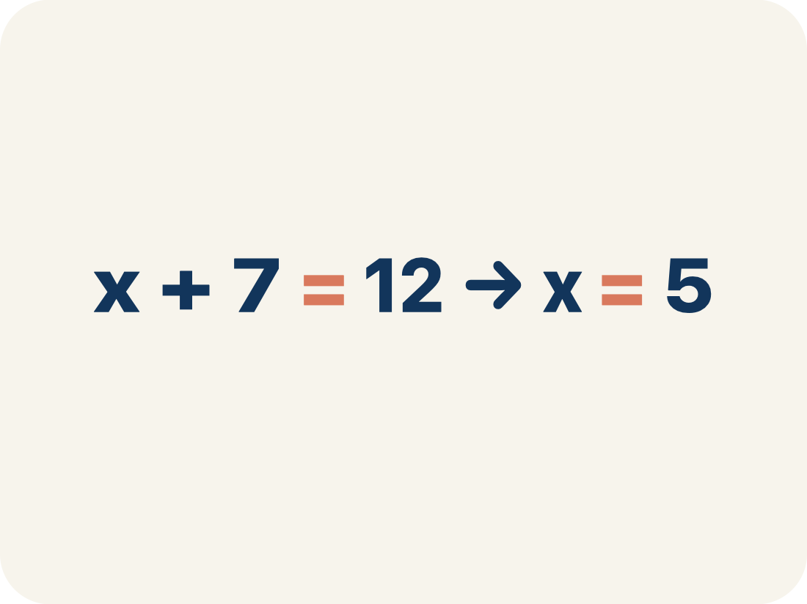
Vocabulary 1 of 7
Lesson 8-2 · Write and Solve Equations Using Addition or Subtraction
Solve One-Step Addition and Subtraction Equations
Use one inverse addition or subtraction operation to isolate the variable.
EXAMPLE · EXPLAIN WHY IT FITS
x + 7 = 12 → x = 5
USE THE MATH WORDS · Use today’s math words in your explanation — not “it” and “that thing.”
eduwonderlab.com · Neft Teacher
9 / 54
Notes:
TEACH IN PRACTICE | Embedded facilitation | Lesson 8.2, slide 8 | VOCAB
Focus on the existing task: Vocabulary 1 of 7 Solve One-Step…
ASK (T1/3/5): Where does “Solve One-Step Addition and Subtraction Equations” appear in the example? Explain the meaning without reading the definition. Partner: restate the idea and ask a clarifying question.
LOOK FOR: A correct connection between the word and a feature of the example. If the student only repeats the definition, invite pointing, sketching or oral rehearsal, then ask for another explanation of this same example.
PARTICIPATION (T5/6/7): Think time before volunteers; accept a written, drawn or rehearsed entry. Students ask for evidence respectfully. Recognize a specific contribution or revision and check that both partners participate.
Source: BCPS Updated Instructional Framework Rubric (June 2020), TEACH 1–7.

Slide 10
Vocabulary 2 of 7
Lesson 8-2 · Write and Solve Equations Using Addition or Subtraction
Equation
A math sentence with an equal sign showing both sides are the same.
EXAMPLE · EXPLAIN WHY IT FITS
x + 25 = 60 — both sides equal 60 when x = 35
Use “Equation” to explain the example. Point to evidence.
eduwonderlab.com · Neft Teacher
10 / 54
Notes:
TEACH IN PRACTICE | Embedded facilitation | Lesson 8.2, slide 9 | VOCAB
Focus on the existing task: Vocabulary 2 of 7 Equation A math…
ASK (T1/3/5): Where does “Equation” appear in the example? Explain the meaning without reading the definition. Partner: restate the idea and ask a clarifying question.
LOOK FOR: A correct connection between the word and a feature of the example. If the student only repeats the definition, invite pointing, sketching or oral rehearsal, then ask for another explanation of this same example.
PARTICIPATION (T5/6/7): Think time before volunteers; accept a written, drawn or rehearsed entry. Students ask for evidence respectfully. Recognize a specific contribution or revision and check that both partners participate.
Source: BCPS Updated Instructional Framework Rubric (June 2020), TEACH 1–7.

Slide 11
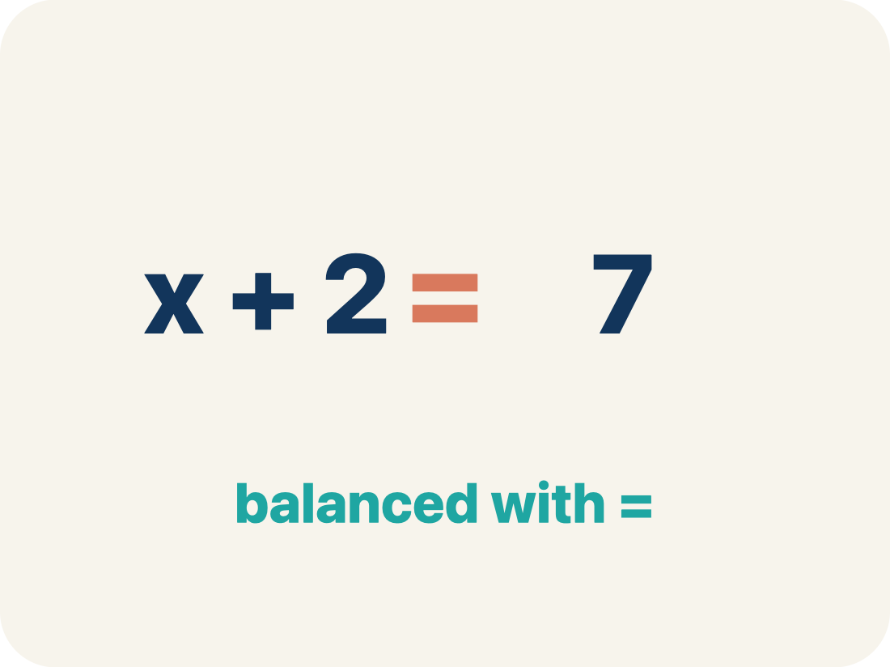
Vocabulary 3 of 7
Lesson 8-2 · Write and Solve Equations Using Addition or Subtraction
Inverse operation
Two math actions that undo each other, like × and ÷.
EXAMPLE · EXPLAIN WHY IT FITS
Addition undoes subtraction: if x − 3 = 10, add 3 to get x = 13
Use “Inverse operation” to explain the example. Point to
evidence.
eduwonderlab.com · Neft Teacher
11 / 54
Notes:
TEACH IN PRACTICE | Embedded facilitation | Lesson 8.2, slide 10 | VOCAB
Focus on the existing task: Vocabulary 3 of 7 Inverse…
ASK (T1/3/5): Where does “Inverse operation” appear in the example? Explain the meaning without reading the definition. Partner: restate the idea and ask a clarifying question.
LOOK FOR: A correct connection between the word and a feature of the example. If the student only repeats the definition, invite pointing, sketching or oral rehearsal, then ask for another explanation of this same example.
PARTICIPATION (T5/6/7): Think time before volunteers; accept a written, drawn or rehearsed entry. Students ask for evidence respectfully. Recognize a specific contribution or revision and check that both partners participate.
Source: BCPS Updated Instructional Framework Rubric (June 2020), TEACH 1–7.

Slide 12
Vocabulary 4 of 7
Lesson 8-2 · Write and Solve Equations Using Addition or Subtraction
Isolate
To get the letter by itself on one side.
EXAMPLE · EXPLAIN WHY IT FITS
x + 5 = 12 → subtract 5 from both sides → x = 7 (x is isolated)
Use “Isolate” to explain the example. Point to evidence.
eduwonderlab.com · Neft Teacher
12 / 54
Notes:
TEACH IN PRACTICE | Embedded facilitation | Lesson 8.2, slide 11 | VOCAB
Focus on the existing task: Vocabulary 4 of 7 Isolate To get…
ASK (T1/3/5): Where does “Isolate” appear in the example? Explain the meaning without reading the definition. Partner: restate the idea and ask a clarifying question.
LOOK FOR: A correct connection between the word and a feature of the example. If the student only repeats the definition, invite pointing, sketching or oral rehearsal, then ask for another explanation of this same example.
PARTICIPATION (T5/6/7): Think time before volunteers; accept a written, drawn or rehearsed entry. Students ask for evidence respectfully. Recognize a specific contribution or revision and check that both partners participate.
Source: BCPS Updated Instructional Framework Rubric (June 2020), TEACH 1–7.

Slide 13
Vocabulary 5 of 7
Lesson 8-2 · Write and Solve Equations Using Addition or Subtraction
Solution
A number that makes the equation or inequality true.
EXAMPLE · EXPLAIN WHY IT FITS
x = 7 is the solution to x + 5 = 12 because 7 + 5 = 12 ✓
Use “Solution” to explain the example. Point to evidence.
eduwonderlab.com · Neft Teacher
13 / 54
Notes:
TEACH IN PRACTICE | Embedded facilitation | Lesson 8.2, slide 12 | VOCAB
Focus on the existing task: Vocabulary 5 of 7 Solution A…
ASK (T1/3/5): Where does “Solution” appear in the example? Explain the meaning without reading the definition. Partner: restate the idea and ask a clarifying question.
LOOK FOR: A correct connection between the word and a feature of the example. If the student only repeats the definition, invite pointing, sketching or oral rehearsal, then ask for another explanation of this same example.
PARTICIPATION (T5/6/7): Think time before volunteers; accept a written, drawn or rehearsed entry. Students ask for evidence respectfully. Recognize a specific contribution or revision and check that both partners participate.
Source: BCPS Updated Instructional Framework Rubric (June 2020), TEACH 1–7.

Slide 14
Vocabulary 6 of 7
Lesson 8-2 · Write and Solve Equations Using Addition or Subtraction
One-step equation
An equation you can solve in a single step using one inverse operation.
EXAMPLE · EXPLAIN WHY IT FITS
x + 4 = 9 is solved in one step: subtract 4 from both sides, so x = 5.
Use “One-step equation” to explain the example. Point to
evidence.
eduwonderlab.com · Neft Teacher
14 / 54
Notes:
TEACH IN PRACTICE | Embedded facilitation | Lesson 8.2, slide 13 | VOCAB
Focus on the existing task: Vocabulary 6 of 7 One-step…
ASK (T1/3/5): Where does “One-step equation” appear in the example? Explain the meaning without reading the definition. Partner: restate the idea and ask a clarifying question.
LOOK FOR: A correct connection between the word and a feature of the example. If the student only repeats the definition, invite pointing, sketching or oral rehearsal, then ask for another explanation of this same example.
PARTICIPATION (T5/6/7): Think time before volunteers; accept a written, drawn or rehearsed entry. Students ask for evidence respectfully. Recognize a specific contribution or revision and check that both partners participate.
Source: BCPS Updated Instructional Framework Rubric (June 2020), TEACH 1–7.

Slide 15
Vocabulary 7 of 7
Lesson 8-2 · Write and Solve Equations Using Addition or Subtraction
Balance
Keeping both sides of an equation equal by doing the same thing to each side.
EXAMPLE · EXPLAIN WHY IT FITS
If you subtract 4 from the left side, you must subtract 4 from the right to keep balance.
Use “Balance” to explain the example. Point to evidence.
eduwonderlab.com · Neft Teacher
15 / 54
Notes:
TEACH IN PRACTICE | Embedded facilitation | Lesson 8.2, slide 14 | VOCAB
Focus on the existing task: Vocabulary 7 of 7 Balance Keeping…
ASK (T1/3/5): Where does “Balance” appear in the example? Explain the meaning without reading the definition. Partner: restate the idea and ask a clarifying question.
LOOK FOR: A correct connection between the word and a feature of the example. If the student only repeats the definition, invite pointing, sketching or oral rehearsal, then ask for another explanation of this same example.
PARTICIPATION (T5/6/7): Think time before volunteers; accept a written, drawn or rehearsed entry. Students ask for evidence respectfully. Recognize a specific contribution or revision and check that both partners participate.
Source: BCPS Updated Instructional Framework Rubric (June 2020), TEACH 1–7.

Slide 16
Vocabulary
Lesson 8-2 · Write and Solve Equations Using Addition or Subtraction
Today’s Math Words
We learn every word — what it means and what it looks like — before we use it.
Solve One-Step Addition and Subtraction Equations
Equation
Use one inverse addition or subtraction operation to isolate the variable
A math sentence with an equal sign showing both sides are the same
Inverse operation
Isolate
Two math actions that undo each other, like × and ÷
To get the letter by itself on one side
Solution
One-step equation
A number that makes the equation or inequality true
An equation you can solve in a single step using one inverse operation
Balance
Explain one math word using the example.
Partner: point to evidence.
Keeping both sides of an equation equal by doing the same thing to each side
eduwonderlab.com · Neft Teacher
16 / 54
Notes:
TEACH IN PRACTICE | Embedded facilitation | Lesson 8.2, slide 15 | VOCAB
Focus on the existing task: Vocabulary Today’s Math Words We…
ASK (T1/3/5): Where does “the displayed term” appear in the example? Explain the meaning without reading the definition. Partner: restate the idea and ask a clarifying question.
LOOK FOR: A correct connection between the word and a feature of the example. If the student only repeats the definition, invite pointing, sketching or oral rehearsal, then ask for another explanation of this same example.
PARTICIPATION (T5/6/7): Think time before volunteers; accept a written, drawn or rehearsed entry. Students ask for evidence respectfully. Recognize a specific contribution or revision and check that both partners participate.
Source: BCPS Updated Instructional Framework Rubric (June 2020), TEACH 1–7. Earlier notes and answer keys are retained below.
EARLIER NOTES / EXISTING ANSWER KEY
Choral-read each word, its meaning, and what it looks like.
Students should use these words out loud today — listen for them in partner talk and revoice student ideas with the academic term.
UIFR: TEACH 1 · TEACH 5.

Slide 17
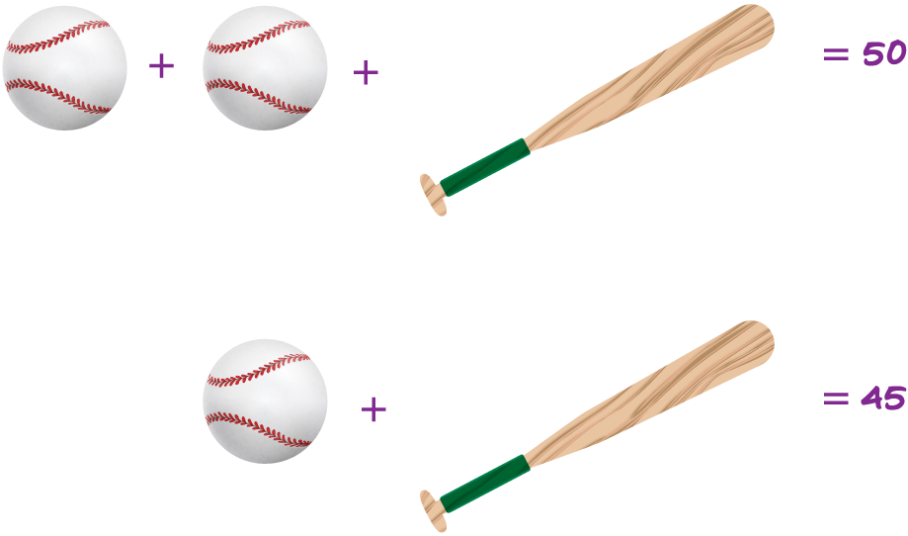

Be Curious
What do you notice?
What do you notice?
Think first. Share a notice and a
question; build on a classmate’s
idea.
Mindset
What helps you stay motivated to learn math?
17 / 54
Notes:
TEACH IN PRACTICE | Embedded facilitation | Lesson 8.2, slide 16 | CURIOUS
Focus on the existing task: Be Curious What do you notice?
LAUNCH (T2/3/5): Allow quiet observation first. Separate a notice from an inference, invite students’ own questions, and follow the existing launch before teaching a procedure.
LOOK FOR (T4): Where this task addresses it, students can use an inverse operation on both sides. Ask which feature of their work supports the claim.
RESPOND: If this task shows the lesson misconception—changing only one side or using the same operation instead of its inverse—show the same operation under both sides of the original equation. Have the student revise and explain the change. Use this support only where the concept occurs in the current task; otherwise respond to the displayed question.
RECHECK: If a gap is shared, revisit the existing representation together. If it is limited, give targeted support while others compare valid methods on the same task. Check the revision before moving on.
PARTICIPATION (T5/6/7): Think time before volunteers; accept a written, drawn or rehearsed entry. Students ask for evidence respectfully. Recognize a specific contribution or revision and check that both partners participate.
Source: BCPS Updated Instructional Framework Rubric (June 2020), TEACH 1–7. Earlier notes and answer keys are retained below.
EARLIER NOTES / EXISTING ANSWER KEY
Accept all noticings and wonderings — there are no wrong answers here.
Give 20–30 seconds of quiet think time before taking responses; mix cold and warm calls so it is not always the same voices.
Read the mindset question aloud and let two students respond.
UIFR: TEACH 3 · TEACH 7.

Slide 18
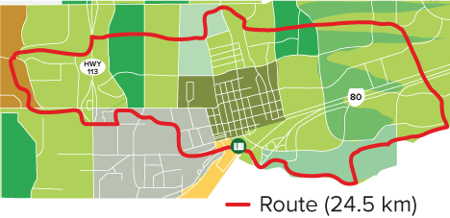
Eduardo’s Biking Adventures
On Sunday, Eduardo biked the route shown. This was 6.6 more kilometers than he biked on Saturday. How many kilometers did Eduardo bike on Saturday?
What information do you know? What information is unknown?
Reveal:
Eduardo biked some distance on Saturday. He biked 24.5 kilometers on Sunday. He biked 6.6 kilometers more on Sunday than he did on Saturday. The number of kilometers Eduardo biked on Saturday is unknown.
18 / 54
Notes:
TEACH IN PRACTICE | Embedded facilitation | Lesson 8.2, slide 17 | REVEAL
Focus on the existing task: Eduardo’s Biking Adventures On Sunday, Eduardo biked the route shown. This was 6.6 more kilometers than he biked on Saturday. How many kilometers did Eduardo bike on Saturday?
LAUNCH (T2/3/5): If an existing answer cover is present, gather an attempt before revealing. If the explanation is already visible, ask students to reconstruct and justify it. Compare reasoning and explain a revision; preserve the reveal sequence.
LOOK FOR (T4): Where this task addresses it, students can use an inverse operation on both sides. Ask which feature of their work supports the claim.
RESPOND: If this task shows the lesson misconception—changing only one side or using the same operation instead of its inverse—show the same operation under both sides of the original equation. Have the student revise and explain the change. Use this support only where the concept occurs in the current task; otherwise respond to the displayed question.
RECHECK: If a gap is shared, revisit the existing representation together. If it is limited, give targeted support while others compare valid methods on the same task. Check the revision before moving on.
PARTICIPATION (T5/6/7): Think time before volunteers; accept a written, drawn or rehearsed entry. Students ask for evidence respectfully. Recognize a specific contribution or revision and check that both partners participate.
Source: BCPS Updated Instructional Framework Rubric (June 2020), TEACH 1–7. Earlier notes and answer keys are retained below.
EARLIER NOTES / EXISTING ANSWER KEY
Do not click yet: collect 2–3 student answers with reasons first.
Then click to remove the cover and have students compare their thinking to the reveal — “Is this what we said? Where is it different?”
Behind the cover: Eduardo biked some distance on Saturday. He biked 24.5 kilometers on Sunday. He biked 6.6 kilometers more on Sunday than he did on Saturday. The number of kilometers Eduardo biked on Saturday is unknown.
UIFR: TEACH 3 · TEACH 4.
UIFR FULL | Lesson-specific facilitation
TEACH 2-3 | Session 1 task launch (UIFR PDF pp. 9-10).
Use the problem exactly as displayed. Give individual thinking time before discussion or advancing to the explanation. If the answer is already visible, ask students to reconstruct and justify it. Invite a choice of suitable representations and have students explain why their choice helps.
At the point where this concept appears, ask: “Why does this operation preserve equality, and how will you check the solution?” Wait for evidence, invite another pathway, and have a student ask a follow-up question. Do not replace students’ reasoning with a sequence of leading steps.

Slide 19
Eduardo’s Biking Adventures
One approach to solving the problem is to make sense of quantities and their relationships.
Eduardo biked 6.6 kilometers more on Sunday than he did on Saturday.
He biked 24.5 kilometers on Sunday.
The number of kilometers Eduardo biked on Saturday is unknown
This situation is looking for a part given the whole.
19 / 54
Notes:
TEACH IN PRACTICE | Embedded facilitation | Lesson 8.2, slide 18 | WORKED
Focus on the existing task: Eduardo’s Biking Adventures One approach to solving the problem is to make sense of quantities and their relationships. Eduardo biked 6.6…
LAUNCH (T2/3/5): Ask students to explain the displayed idea or example and point to evidence. When a calculation step is shown, ask why it is valid. Have a partner restate the explanation; copying is not the check.
LOOK FOR (T4): Where this task addresses it, students can use an inverse operation on both sides. Ask which feature of their work supports the claim.
RESPOND: If this task shows the lesson misconception—changing only one side or using the same operation instead of its inverse—show the same operation under both sides of the original equation. Have the student revise and explain the change. Use this support only where the concept occurs in the current task; otherwise respond to the displayed question.
RECHECK: If a gap is shared, revisit the existing representation together. If it is limited, give targeted support while others compare valid methods on the same task. Check the revision before moving on.
PARTICIPATION (T5/6/7): Think time before volunteers; accept a written, drawn or rehearsed entry. Students ask for evidence respectfully. Recognize a specific contribution or revision and check that both partners participate.
Source: BCPS Updated Instructional Framework Rubric (June 2020), TEACH 1–7. Earlier notes and answer keys are retained below.
EARLIER NOTES / EXISTING ANSWER KEY
Model briefly, then hand the thinking back: ask “Why does this step work?” before showing the next one.
Quick check before moving on — thumbs or whiteboards from everyone, not volunteers.
UIFR: TEACH 2 · TEACH 3 · TEACH 4.

Slide 20
STUDENT MOVES
Lesson 8-2
Your moves
USE YOUR TOOLS · Reach for your notes, a model, or a manipulative before you reach for an answer.
ASK THE CLASS · Write one question about this that you could ask the class.
20 / 54

Slide 21
Eduardo’s Biking Adventures
What are some tools, both visual and algebraic, you can use to show the relationship between the quantities?
Reveal:
Some tools include a tape diagram and an equation.
Record your reasoning before the reveal. Compare, then explain any revision.
21 / 54
Notes:
TEACH IN PRACTICE | Embedded facilitation | Lesson 8.2, slide 19 | REVEAL
Focus on the existing task: Eduardo’s Biking Adventures What are some tools, both visual and algebraic, you can use to show the relationship between the quantities?
LAUNCH (T2/3/5): If an existing answer cover is present, gather an attempt before revealing. If the explanation is already visible, ask students to reconstruct and justify it. Compare reasoning and explain a revision; preserve the reveal sequence.
LOOK FOR (T4): Where this task addresses it, students can use an inverse operation on both sides. Ask which feature of their work supports the claim.
RESPOND: If this task shows the lesson misconception—changing only one side or using the same operation instead of its inverse—show the same operation under both sides of the original equation. Have the student revise and explain the change. Use this support only where the concept occurs in the current task; otherwise respond to the displayed question.
RECHECK: If a gap is shared, revisit the existing representation together. If it is limited, give targeted support while others compare valid methods on the same task. Check the revision before moving on.
PARTICIPATION (T5/6/7): Think time before volunteers; accept a written, drawn or rehearsed entry. Students ask for evidence respectfully. Recognize a specific contribution or revision and check that both partners participate.
Source: BCPS Updated Instructional Framework Rubric (June 2020), TEACH 1–7. Earlier notes and answer keys are retained below.
EARLIER NOTES / EXISTING ANSWER KEY
Do not click yet: collect 2–3 student answers with reasons first.
Then click to remove the cover and have students compare their thinking to the reveal — “Is this what we said? Where is it different?”
Behind the cover: Some tools include a tape diagram and an equation.
UIFR: TEACH 3 · TEACH 4.

Slide 22

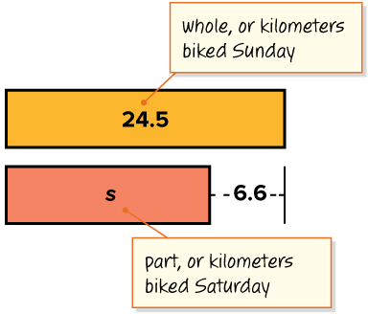
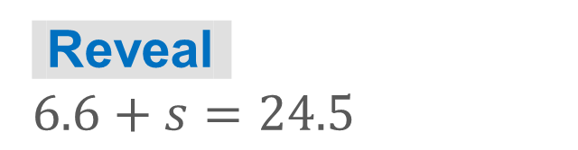
COLLABORATE · TALK IT THROUGH • AGREE ON A MODEL
Collaborate and Connect
We can use a tape diagram and an equation to show the relationship between the quantities.
Eduardo biked 24.5 kilometers on Sunday.
Eduardo biked 6.6 kilometers more on Sunday than he did on Saturday.
What equation represents this relationship?
Think first. A explains; B asks for evidence.
Switch roles; both revise.
22 / 54
Notes:
TEACH IN PRACTICE | Embedded facilitation | Lesson 8.2, slide 20 | COLLABORATE
Focus on the existing task: Collaborate and Connect We can use a tape diagram and an equation to show the relationship between the quantities. Eduardo biked 24.5…
LAUNCH (T2/3/5): Use the displayed question. Give private thinking time; then A explains while B asks for evidence. Switch roles. Each student records their own reasoning.
LOOK FOR (T4): Where this task addresses it, students can check in the original equation. Ask which feature of their work supports the claim.
RESPOND: If this task shows the lesson misconception—changing only one side or using the same operation instead of its inverse—show the same operation under both sides of the original equation. Have the student revise and explain the change. Use this support only where the concept occurs in the current task; otherwise respond to the displayed question.
RECHECK: If a gap is shared, revisit the existing representation together. If it is limited, give targeted support while others compare valid methods on the same task. Check the revision before moving on.
PARTICIPATION (T5/6/7): Think time before volunteers; accept a written, drawn or rehearsed entry. Students ask for evidence respectfully. Recognize a specific contribution or revision and check that both partners participate.
Source: BCPS Updated Instructional Framework Rubric (June 2020), TEACH 1–7. Earlier notes and answer keys are retained below.
EARLIER NOTES / EXISTING ANSWER KEY
Routine: COLLABORATE · TALK IT THROUGH • AGREE ON A MODEL
UIFR FULL | Lesson-specific facilitation
TEACH 4-5 | Session 1 discussion and checkpoint (UIFR PDF pp. 11-12).
Collect a brief response from every student to the existing prompt before hearing volunteers. Partners take turns explaining and asking for evidence: “I understand ___; what supports ___?” Offer rehearsal or an annotated model for students who need language support. Each student records their own reasoning.
Look specifically for: changing only one side or using the same operation instead of its inverse. If it appears, show the same operation under both sides of the original equation; then ask the student to revise the same response and explain the change. If evidence is secure, have students compare a second valid pathway or state why their approach works. Choose the next step from the responses, not a preset pace.

Slide 23
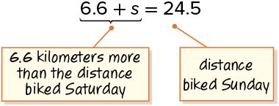
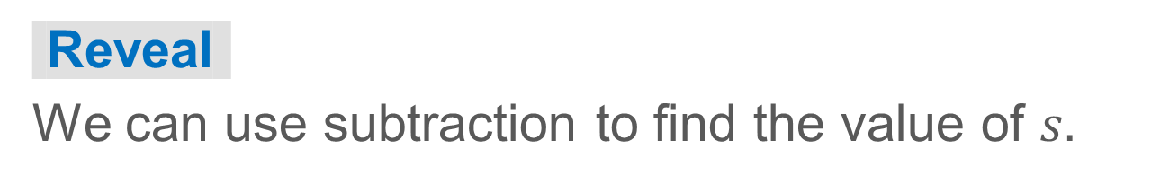
Eduardo’s Biking Adventures
We can use an addition equation to represent the relationship.
Try first. Explain how your
equation represents the situation.
Check the result.
How can you use a related operation to find the value of the unknown?
23 / 54
Notes:
TEACH IN PRACTICE | Embedded facilitation | Lesson 8.2, slide 21 | TASK
Focus on the existing task: Eduardo’s Biking Adventures We can use an addition equation to represent the relationship. How can you use a related operation to find the value of the unknown?
LAUNCH (T2/3/5): Use the displayed question. Give private thinking time; then A explains while B asks for evidence. Switch roles. Each student records their own reasoning.
LOOK FOR (T4): Where this task addresses it, students can use an inverse operation on both sides. Ask which feature of their work supports the claim.
RESPOND: If this task shows the lesson misconception—changing only one side or using the same operation instead of its inverse—show the same operation under both sides of the original equation. Have the student revise and explain the change. Use this support only where the concept occurs in the current task; otherwise respond to the displayed question.
RECHECK: If a gap is shared, revisit the existing representation together. If it is limited, give targeted support while others compare valid methods on the same task. Check the revision before moving on.
PARTICIPATION (T5/6/7): Think time before volunteers; accept a written, drawn or rehearsed entry. Students ask for evidence respectfully. Recognize a specific contribution or revision and check that both partners participate.
Source: BCPS Updated Instructional Framework Rubric (June 2020), TEACH 1–7. Earlier notes and answer keys are retained below.
EARLIER NOTES / EXISTING ANSWER KEY
Model briefly, then hand the thinking back: ask “Why does this step work?” before showing the next one.
Quick check before moving on — thumbs or whiteboards from everyone, not volunteers.
UIFR: TEACH 2 · TEACH 3 · TEACH 4.

Slide 24
Eduardo’s Biking Adventures
Let’s use the Subtraction Property of Equality to solve the equation.
 | Subtraction Property of Equality
 | Subtract.
Persevering
How could you check your answer?
HOW DO YOU KNOW? · Ask your partner “How do you know?” Answer by pointing to your own work.
24 / 54
Notes:
TEACH IN PRACTICE | Embedded facilitation | Lesson 8.2, slide 22 | TASK
Focus on the existing task: Eduardo’s Biking Adventures Persevering How could you check your answer?
LAUNCH (T2/3/5): Use the displayed question. Give private thinking time; then A explains while B asks for evidence. Switch roles. Each student records their own reasoning.
LOOK FOR (T4): Where this task addresses it, students can check in the original equation. Ask which feature of their work supports the claim.
RESPOND: If this task shows the lesson misconception—changing only one side or using the same operation instead of its inverse—show the same operation under both sides of the original equation. Have the student revise and explain the change. Use this support only where the concept occurs in the current task; otherwise respond to the displayed question.
RECHECK: If a gap is shared, revisit the existing representation together. If it is limited, give targeted support while others compare valid methods on the same task. Check the revision before moving on.
PARTICIPATION (T5/6/7): Think time before volunteers; accept a written, drawn or rehearsed entry. Students ask for evidence respectfully. Recognize a specific contribution or revision and check that both partners participate.
Source: BCPS Updated Instructional Framework Rubric (June 2020), TEACH 1–7. Earlier notes and answer keys are retained below.
EARLIER NOTES / EXISTING ANSWER KEY
Model briefly, then hand the thinking back: ask “Why does this step work?” before showing the next one.
Quick check before moving on — thumbs or whiteboards from everyone, not volunteers.
UIFR: TEACH 2 · TEACH 3 · TEACH 4.

Slide 25
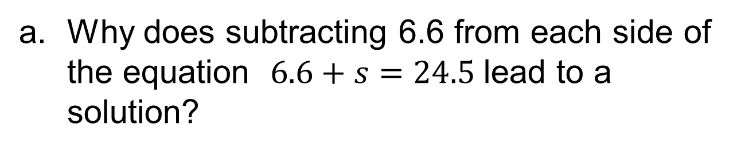
Let’s Explore More
How would the equation, 4 1 2 p = 36 , change if they used wooden planks that were 6 inches wide instead of 4 1 2 inches wide?
Workspace
Why do addition and subtraction have an inverse relationship?
Workspace
25 / 54
Notes:
TEACH IN PRACTICE | Embedded facilitation | Lesson 8.2, slide 23 | PRACTICE
Focus on the existing task: Let’s Explore More How would the equation, 4 1 2 p = 36, change if they used wooden planks that were 6 inches wide instead of 4 1 2 inches wide?
LAUNCH (T2/3/5): Use the displayed question. Give private thinking time; then A explains while B asks for evidence. Switch roles. Each student records their own reasoning.
LOOK FOR (T4): Where this task addresses it, students can use an inverse operation on both sides. Ask which feature of their work supports the claim.
RESPOND: If this task shows the lesson misconception—changing only one side or using the same operation instead of its inverse—show the same operation under both sides of the original equation. Have the student revise and explain the change. Use this support only where the concept occurs in the current task; otherwise respond to the displayed question.
RECHECK: If a gap is shared, revisit the existing representation together. If it is limited, give targeted support while others compare valid methods on the same task. Check the revision before moving on.
PARTICIPATION (T5/6/7): Think time before volunteers; accept a written, drawn or rehearsed entry. Students ask for evidence respectfully. Recognize a specific contribution or revision and check that both partners participate.
Source: BCPS Updated Instructional Framework Rubric (June 2020), TEACH 1–7. Earlier notes and answer keys are retained below.
EARLIER NOTES / EXISTING ANSWER KEY
Extension for partners or table groups — students choose their approach and use the workspace to show thinking.
Push with “Convince me,” and have two groups with different approaches share.
This is where students stretch past the worked example.
UIFR: TEACH 2 · TEACH 5.

Slide 26
STUDENT MOVES
Lesson 8-2
Your move
TWO MINUTES SOLO · Two minutes on your own, then compare. Bring one thing you tried, even if it did not work.
26 / 54

Slide 27
LESSON 8.2 / DISCUSS THE TASK
Explain and compare
Use the task you just explored.
TAKE TURNS
Why does this operation preserve equality, and how will you check the solution?
Explain
“I know this because…”
Ask
“Where does your work show that?”
Point to evidence in your work.
Then compare your approach with a partner’s.
JUSTIFY IT · Say it like this: “I know ______ because ______.”
Listen to understand. Ask for evidence. Make room for every voice.
Notes:
TEACH IN PRACTICE | Embedded facilitation | Lesson 8.2, slide 24 | PRIOR_INSERT
Focus on the existing task: Point to evidence in your work. Then compare your approach with a partner’s. TAKE TURNS Explain “I know this because…” Ask “Where does your work show that?
CONNECT (T1/4): Ask students to restate the displayed goal or key idea and connect it to earlier work. Relevant lesson evidence: use an inverse operation on both sides; isolate the variable; check in the original equation. Use only the criterion that matches the current session.
SHOW PROGRESS: Students point to their own existing work, explain what improved after feedback, and name a next step. Pair confidence ratings with actual evidence.
PARTICIPATION (T5/6/7): Think time before volunteers; accept a written, drawn or rehearsed entry. Students ask for evidence respectfully. Recognize a specific contribution or revision and check that both partners participate.
Source: BCPS Updated Instructional Framework Rubric (June 2020), TEACH 1–7.

Slide 28
Session 2 Warm-Up
Lesson 8-2 · Write and Solve Equations Using Addition or Subtraction
Session 2 Warm-Up
Check what you remember from Session 1 · about 4 minutes
1
What is the inverse operation of addition?
2
To solve x + 8 = 15, which operation isolates x?
A
Multiplication
A
Add 8 to both sides
B
Subtraction
B
Subtract 8 from both sides
C
Division
C
Multiply by 8
D
Exponents
D
Divide by 8
3
Solve y − 6 = 14:
4
The golden rule of equations is: whatever you do to one side:
A
y = 8
A
Do the opposite to the other
B
y = 20
B
Do the exact same to the other side
C
y = 24
C
Leave the other side alone
D
y = 10
D
Multiply by zero
eduwonderlab.com · Neft Teacher
28 / 54
Notes:
TEACH IN PRACTICE | Embedded facilitation | Lesson 8.2, slide 25 | WARMUP
Focus on the existing task: A Multiplication B Subtraction C Division D Exponents 2 To solve x + 8 = 15, which operation isolates x?
GATHER EVIDENCE (T4/6): Keep the original items. Students try independently, mark an uncertain item, and explain one method before checking. Use the existing key when present.
RESPOND: Distinguish a calculation slip from a reasoning gap. Give one next step on the same item; have students revise in a second color. Use the responses to choose flexible support for today’s lesson.
PARTICIPATION (T5/6/7): Think time before volunteers; accept a written, drawn or rehearsed entry. Students ask for evidence respectfully. Recognize a specific contribution or revision and check that both partners participate.
Source: BCPS Updated Instructional Framework Rubric (June 2020), TEACH 1–7. Earlier notes and answer keys are retained below.
EARLIER NOTES / EXISTING ANSWER KEY
Warm-up routine: students start silently on entry; keep it to about 4 minutes.
Circulate and note who is stuck — use what you see to choose who you check on first today.
Go over answers quickly; ask one student to explain a step, not just say the answer.
UIFR: TEACH 4 · TEACH 6.
UIFR FULL | Lesson-specific facilitation
TEACH 1 | Session 2 purpose and evidence (UIFR PDF p. 8).
Have students restate the displayed session goal in their own words and connect it to the existing context or a familiar experience they choose to share. Use the current session goal to select from these lesson-wide evidence criteria; do not frontload a later-session procedure.
Look for: use an inverse operation on both sides; isolate the variable; check in the original equation. Ask: “Which part of your work would show this?” Revisit that evidence after the task; a confidence rating alone is not evidence of understanding.

Slide 29
STUDENT MOVES
Lesson 8-2
Your move
YOU KNOW THE ROUTINE · Read → plan → solve → check. Do all four, in that order.
29 / 54

Slide 30
Today’s Math Notes
Lesson 8-2 · Write and Solve Equations Using Addition or Subtraction
Review Notes — Session 2
Copy. Explain. Check.
WHY IT MATTERS · Finish this: “This is worth knowing because ______.”
Inverse Operations
1
Addition and subtraction are inverse operations that undo each other.
Balance Principle
2
Maintain equality by performing the identical operation on both sides of the equals sign.
Isolating the Variable
3
Eliminate constants on the variable’s side to find the unknown quantity.
eduwonderlab.com · Neft Teacher
30 / 54
Notes:
TEACH IN PRACTICE | Embedded facilitation | Lesson 8.2, slide 26 | NOTES
Focus on the existing task: Today’s Math Notes Review Notes…
ROUTINE (T1/2/4): Read or copy the original notes, cover one line, and explain it using the displayed example. Reopen and correct. Copying alone is not evidence of understanding.
LOOK FOR: A link between a symbol, quantity or feature and the explanation. If missing, point back to that feature and have the student try again; fade the prompt once they can explain.
PARTICIPATION (T5/6/7): Think time before volunteers; accept a written, drawn or rehearsed entry. Students ask for evidence respectfully. Recognize a specific contribution or revision and check that both partners participate.
Source: BCPS Updated Instructional Framework Rubric (June 2020), TEACH 1–7. Earlier notes and answer keys are retained below.
EARLIER NOTES / EXISTING ANSWER KEY
Copy routine: read one line at a time; students copy, then explain that line to a partner.
Keep it brisk — the understanding work happens in the examples, not the copying.
UIFR: TEACH 1 · TEACH 6.

Slide 31
Session 2
Write and Solve Equations Using Addition or Subtraction
ADD ON · Add on: “I agree because ______.” or “I see it differently because ______.”
31 / 54
Notes:
TEACH IN PRACTICE | Embedded facilitation | Lesson 8.2, slide 27 | DIVIDER
Focus on the existing task: Write and Solve Equations Using Addition or Subtraction Session 2
TRANSITION (T6/7): Students confirm materials, roles, how to request help, and the next response routine. Ask a student to restate it. Keep teacher-only slides hidden.
PARTICIPATION (T5/6/7): Think time before volunteers; accept a written, drawn or rehearsed entry. Students ask for evidence respectfully. Recognize a specific contribution or revision and check that both partners participate.
Source: BCPS Updated Instructional Framework Rubric (June 2020), TEACH 1–7. Earlier notes and answer keys are retained below.
EARLIER NOTES / EXISTING ANSWER KEY
Transition cue: state what materials are out and what success looks like this session.
Keep the changeover under a minute.
UIFR: TEACH 6.

Slide 32
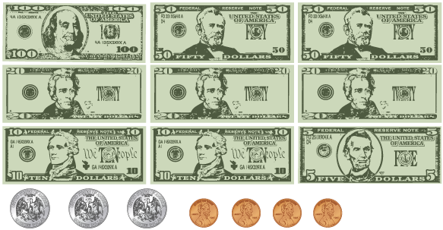
Tracking Sales
The students at a local middle school collected money from a walk-a-thon fundraiser. They donated $168.50 to the local food pantry and now have the remaining money shown from the fundraiser.
How much money did the students raise at the walk-a-thon?
Think and record first. Which part of your
work supports your answer?
Making Sense
Have you seen problems like this before?
32 / 54
Notes:
TEACH IN PRACTICE | Embedded facilitation | Lesson 8.2, slide 28 | TASK
Focus on the existing task: Tracking Sales Have you seen problems like this before?
LAUNCH (T2/3/5): Use the displayed question. Give private thinking time; then A explains while B asks for evidence. Switch roles. Each student records their own reasoning.
LOOK FOR (T4): Where this task addresses it, students can use an inverse operation on both sides. Ask which feature of their work supports the claim.
RESPOND: If this task shows the lesson misconception—changing only one side or using the same operation instead of its inverse—show the same operation under both sides of the original equation. Have the student revise and explain the change. Use this support only where the concept occurs in the current task; otherwise respond to the displayed question.
RECHECK: If a gap is shared, revisit the existing representation together. If it is limited, give targeted support while others compare valid methods on the same task. Check the revision before moving on.
PARTICIPATION (T5/6/7): Think time before volunteers; accept a written, drawn or rehearsed entry. Students ask for evidence respectfully. Recognize a specific contribution or revision and check that both partners participate.
Source: BCPS Updated Instructional Framework Rubric (June 2020), TEACH 1–7. Earlier notes and answer keys are retained below.
EARLIER NOTES / EXISTING ANSWER KEY
Read the context aloud (or have a student read it).
Before any math, students restate the situation and what is being asked in their own words.
Ask: Have you seen problems like this before?
UIFR: TEACH 1 · TEACH 3.
UIFR FULL | Lesson-specific facilitation
TEACH 2-3 | Session 2 task launch (UIFR PDF pp. 9-10).
Use the problem exactly as displayed. Give individual thinking time before discussion or advancing to the explanation. If the answer is already visible, ask students to reconstruct and justify it. Invite a choice of suitable representations and have students explain why their choice helps.
At the point where this concept appears, ask: “Why does this operation preserve equality, and how will you check the solution?” Wait for evidence, invite another pathway, and have a student ask a follow-up question. Do not replace students’ reasoning with a sequence of leading steps.

Slide 33
Tracking Sales
The students at a local middle school collected money from a walk-a-thon fundraiser. They donated $168.50 to the local food pantry and now have the remaining money shown from the fundraiser. How much money did the students raise at the walk-a-thon?
What are the quantities in the problem?
Think and record first. Which part of your work supports your answer?
33 / 54
Notes:
TEACH IN PRACTICE | Embedded facilitation | Lesson 8.2, slide 29 | TASK
Focus on the existing task: What are the quantities in the problem?
LAUNCH (T2/3/5): Use the displayed question. Give private thinking time; then A explains while B asks for evidence. Switch roles. Each student records their own reasoning.
LOOK FOR (T4): Where this task addresses it, students can use an inverse operation on both sides. Ask which feature of their work supports the claim.
RESPOND: If this task shows the lesson misconception—changing only one side or using the same operation instead of its inverse—show the same operation under both sides of the original equation. Have the student revise and explain the change. Use this support only where the concept occurs in the current task; otherwise respond to the displayed question.
RECHECK: If a gap is shared, revisit the existing representation together. If it is limited, give targeted support while others compare valid methods on the same task. Check the revision before moving on.
PARTICIPATION (T5/6/7): Think time before volunteers; accept a written, drawn or rehearsed entry. Students ask for evidence respectfully. Recognize a specific contribution or revision and check that both partners participate.
Source: BCPS Updated Instructional Framework Rubric (June 2020), TEACH 1–7. Earlier notes and answer keys are retained below.
EARLIER NOTES / EXISTING ANSWER KEY
Read the context aloud (or have a student read it).
Before any math, students restate the situation and what is being asked in their own words.
Ask: What are the quantities in the problem?
UIFR: TEACH 1 · TEACH 3.

Slide 34
Tracking Sales
What are the quantities in the problem?
Record your reasoning before the reveal.
Compare, then explain any revision.
Reveal:
The quantities are:
the total amount raised at the walk-a-thon
the amount donated to the food pantry
and the amount remaining after donating to the food pantry
34 / 54
Notes:
TEACH IN PRACTICE | Embedded facilitation | Lesson 8.2, slide 30 | REVEAL
Focus on the existing task: Tracking Sales What are the quantities in the problem?
LAUNCH (T2/3/5): If an existing answer cover is present, gather an attempt before revealing. If the explanation is already visible, ask students to reconstruct and justify it. Compare reasoning and explain a revision; preserve the reveal sequence.
LOOK FOR (T4): Where this task addresses it, students can use an inverse operation on both sides. Ask which feature of their work supports the claim.
RESPOND: If this task shows the lesson misconception—changing only one side or using the same operation instead of its inverse—show the same operation under both sides of the original equation. Have the student revise and explain the change. Use this support only where the concept occurs in the current task; otherwise respond to the displayed question.
RECHECK: If a gap is shared, revisit the existing representation together. If it is limited, give targeted support while others compare valid methods on the same task. Check the revision before moving on.
PARTICIPATION (T5/6/7): Think time before volunteers; accept a written, drawn or rehearsed entry. Students ask for evidence respectfully. Recognize a specific contribution or revision and check that both partners participate.
Source: BCPS Updated Instructional Framework Rubric (June 2020), TEACH 1–7. Earlier notes and answer keys are retained below.
EARLIER NOTES / EXISTING ANSWER KEY
Do not click yet: collect 2–3 student answers with reasons first.
Then click to remove the cover and have students compare their thinking to the reveal — “Is this what we said? Where is it different?”
Behind the cover: The quantities are: the total amount raised at the walk-a-thon the amount donated to the food pantry and the amount remaining after donating to the food pantry
UIFR: TEACH 3 · TEACH 4.

Slide 35
Tracking Sales
The quantities are:
the total amount raised at the walk-a-thon
the amount donated to the food pantry
the amount remaining after donating to the food pantry
How can you represent the relationship algebraically?
SELF-CHECK · Mark it: ✓ got it · ~ almost · ? stuck. Then fix one thing before we move on.
Reveal:
We can use the known values and a variable to write an equation.
35 / 54
Notes:
TEACH IN PRACTICE | Embedded facilitation | Lesson 8.2, slide 31 | REVEAL
Focus on the existing task: Tracking Sales How can you represent the relationship algebraically?
LAUNCH (T2/3/5): If an existing answer cover is present, gather an attempt before revealing. If the explanation is already visible, ask students to reconstruct and justify it. Compare reasoning and explain a revision; preserve the reveal sequence.
LOOK FOR (T4): Where this task addresses it, students can isolate the variable. Ask which feature of their work supports the claim.
RESPOND: If this task shows the lesson misconception—changing only one side or using the same operation instead of its inverse—show the same operation under both sides of the original equation. Have the student revise and explain the change. Use this support only where the concept occurs in the current task; otherwise respond to the displayed question.
RECHECK: If a gap is shared, revisit the existing representation together. If it is limited, give targeted support while others compare valid methods on the same task. Check the revision before moving on.
PARTICIPATION (T5/6/7): Think time before volunteers; accept a written, drawn or rehearsed entry. Students ask for evidence respectfully. Recognize a specific contribution or revision and check that both partners participate.
Source: BCPS Updated Instructional Framework Rubric (June 2020), TEACH 1–7. Earlier notes and answer keys are retained below.
EARLIER NOTES / EXISTING ANSWER KEY
Do not click yet: collect 2–3 student answers with reasons first.
Then click to remove the cover and have students compare their thinking to the reveal — “Is this what we said? Where is it different?”
Behind the cover: We can use the known values and a variable to write an equation.
UIFR: TEACH 3 · TEACH 4.

Slide 36
Tracking Sales
The students donated $168.50 to the local food pantry and now have the remaining money shown from the fundraiser.
The difference between the total amount raised and the amount donated is equal to the amount remaining.
total raised − amount donated = amount remaining
How can you represent the relationship algebraically?
Reveal:
We can use the known values and a variable to write an equation.
36 / 54
Notes:
TEACH IN PRACTICE | Embedded facilitation | Lesson 8.2, slide 32 | REVEAL
Focus on the existing task: Tracking Sales The students donated $168.50 to the local food pantry and now have the remaining money shown from the fundraiser. total…
LAUNCH (T2/3/5): If an existing answer cover is present, gather an attempt before revealing. If the explanation is already visible, ask students to reconstruct and justify it. Compare reasoning and explain a revision; preserve the reveal sequence.
LOOK FOR (T4): Where this task addresses it, students can isolate the variable. Ask which feature of their work supports the claim.
RESPOND: If this task shows the lesson misconception—changing only one side or using the same operation instead of its inverse—show the same operation under both sides of the original equation. Have the student revise and explain the change. Use this support only where the concept occurs in the current task; otherwise respond to the displayed question.
RECHECK: If a gap is shared, revisit the existing representation together. If it is limited, give targeted support while others compare valid methods on the same task. Check the revision before moving on.
PARTICIPATION (T5/6/7): Think time before volunteers; accept a written, drawn or rehearsed entry. Students ask for evidence respectfully. Recognize a specific contribution or revision and check that both partners participate.
Source: BCPS Updated Instructional Framework Rubric (June 2020), TEACH 1–7. Earlier notes and answer keys are retained below.
EARLIER NOTES / EXISTING ANSWER KEY
Do not click yet: collect 2–3 student answers with reasons first.
Then click to remove the cover and have students compare their thinking to the reveal — “Is this what we said? Where is it different?”
Behind the cover: We can use the known values and a variable to write an equation.
UIFR: TEACH 3 · TEACH 4.

Slide 37
STUDENT MOVES
Lesson 8-2
Your move
TAKE TURNS · One explains, one asks a question. Then switch, so both of you talk.
37 / 54

Slide 38
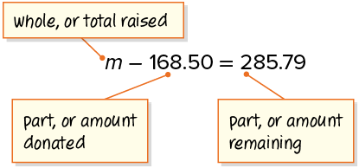
COLLABORATE · TALK IT THROUGH • AGREE ON A MODEL
Collaborate and Connect
We can represent the problem using a subtraction equation.
This situation is looking for the whole given two parts.
Think first. A explains; B asks for
evidence. Switch roles; both
revise.
How can you find the unknown in the equation?
Reveal:
We can use the inverse operation of subtraction, which is addition.
38 / 54
Notes:
TEACH IN PRACTICE | Embedded facilitation | Lesson 8.2, slide 33 | COLLABORATE
Focus on the existing task: Collaborate and Connect Reveal: We can use the inverse operation of subtraction, which is addition. We can represent the problem using a subtraction equation. How can you find the unknown in the equation?
LAUNCH (T2/3/5): Use the displayed question. Give private thinking time; then A explains while B asks for evidence. Switch roles. Each student records their own reasoning.
LOOK FOR (T4): Where this task addresses it, students can use an inverse operation on both sides. Ask which feature of their work supports the claim.
RESPOND: If this task shows the lesson misconception—changing only one side or using the same operation instead of its inverse—show the same operation under both sides of the original equation. Have the student revise and explain the change. Use this support only where the concept occurs in the current task; otherwise respond to the displayed question.
RECHECK: If a gap is shared, revisit the existing representation together. If it is limited, give targeted support while others compare valid methods on the same task. Check the revision before moving on.
PARTICIPATION (T5/6/7): Think time before volunteers; accept a written, drawn or rehearsed entry. Students ask for evidence respectfully. Recognize a specific contribution or revision and check that both partners participate.
Source: BCPS Updated Instructional Framework Rubric (June 2020), TEACH 1–7. Earlier notes and answer keys are retained below.
EARLIER NOTES / EXISTING ANSWER KEY
Routine: COLLABORATE · TALK IT THROUGH • AGREE ON A MODEL
UIFR FULL | Lesson-specific facilitation
TEACH 4-5 | Session 2 discussion and checkpoint (UIFR PDF pp. 11-12).
Collect a brief response from every student to the existing prompt before hearing volunteers. Partners take turns explaining and asking for evidence: “I understand ___; what supports ___?” Offer rehearsal or an annotated model for students who need language support. Each student records their own reasoning.
Look specifically for: changing only one side or using the same operation instead of its inverse. If it appears, show the same operation under both sides of the original equation; then ask the student to revise the same response and explain the change. If evidence is secure, have students compare a second valid pathway or state why their approach works. Choose the next step from the responses, not a preset pace.

Slide 39
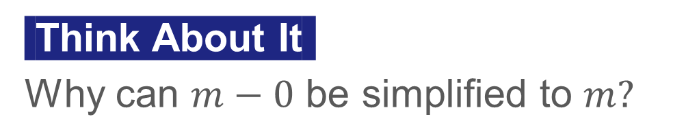
Tracking Sales
To solve a subtraction equation, you can use the inverse operation, addition.
The Addition Property of Equality states that you can add the same value to each side of the equation and maintain the equality.
 | Addition Property of Equality
 | Add.
 | Simplify.
PICK YOUR STRATEGY · Choose your path — picture, table, number line, or equation — and be ready to say why you chose it.
39 / 54
Notes:
TEACH IN PRACTICE | Embedded facilitation | Lesson 8.2, slide 34 | WORKED
Focus on the existing task: Tracking Sales To solve a subtraction equation, you can use the inverse operation, addition. The Addition Property of Equality states…
LAUNCH (T2/3/5): Ask students to explain the displayed idea or example and point to evidence. When a calculation step is shown, ask why it is valid. Have a partner restate the explanation; copying is not the check.
LOOK FOR (T4): Where this task addresses it, students can use an inverse operation on both sides. Ask which feature of their work supports the claim.
RESPOND: If this task shows the lesson misconception—changing only one side or using the same operation instead of its inverse—show the same operation under both sides of the original equation. Have the student revise and explain the change. Use this support only where the concept occurs in the current task; otherwise respond to the displayed question.
RECHECK: If a gap is shared, revisit the existing representation together. If it is limited, give targeted support while others compare valid methods on the same task. Check the revision before moving on.
PARTICIPATION (T5/6/7): Think time before volunteers; accept a written, drawn or rehearsed entry. Students ask for evidence respectfully. Recognize a specific contribution or revision and check that both partners participate.
Source: BCPS Updated Instructional Framework Rubric (June 2020), TEACH 1–7. Earlier notes and answer keys are retained below.
EARLIER NOTES / EXISTING ANSWER KEY
Model briefly, then hand the thinking back: ask “Why does this step work?” before showing the next one.
Quick check before moving on — thumbs or whiteboards from everyone, not volunteers.
UIFR: TEACH 2 · TEACH 3 · TEACH 4.

Slide 40
School Broccoli
The students at a local middle school collected money from a walk-a-thon fundraiser. They donated $168.50 to the local food pantry and now have the remaining money shown from the fundraiser.
How much money did the students raise at the walk-a-thon?
The students raised $454.29 at the walk-a-thon.
Think and record first. Which part
of your work supports your
answer?
40 / 54
Notes:
TEACH IN PRACTICE | Embedded facilitation | Lesson 8.2, slide 35 | TASK
Focus on the existing task: School Broccoli The students at a local middle school collected money from a walk-a-thon fundraiser. They donated $168.50 to the local…
LAUNCH (T2/3/5): Use the displayed question. Give private thinking time; then A explains while B asks for evidence. Switch roles. Each student records their own reasoning.
LOOK FOR (T4): Where this task addresses it, students can use an inverse operation on both sides. Ask which feature of their work supports the claim.
RESPOND: If this task shows the lesson misconception—changing only one side or using the same operation instead of its inverse—show the same operation under both sides of the original equation. Have the student revise and explain the change. Use this support only where the concept occurs in the current task; otherwise respond to the displayed question.
RECHECK: If a gap is shared, revisit the existing representation together. If it is limited, give targeted support while others compare valid methods on the same task. Check the revision before moving on.
PARTICIPATION (T5/6/7): Think time before volunteers; accept a written, drawn or rehearsed entry. Students ask for evidence respectfully. Recognize a specific contribution or revision and check that both partners participate.
Source: BCPS Updated Instructional Framework Rubric (June 2020), TEACH 1–7. Earlier notes and answer keys are retained below.
EARLIER NOTES / EXISTING ANSWER KEY
Read the context aloud (or have a student read it).
Before any math, students restate the situation and what is being asked in their own words.
Ask: How much money did the students raise at the walk-a-thon?
UIFR: TEACH 1 · TEACH 3.

Slide 41
Let’s Explore More
The equation shown was used to the represent and solve the following problem: How much money did the students raise at the walk-a-thon?
STRUGGLE FIRST · Work on your own first. Stuck is allowed — try a second strategy before you ask.
41 / 54
Notes:
TEACH IN PRACTICE | Embedded facilitation | Lesson 8.2, slide 36 | PRACTICE
Focus on the existing task: Let’s Explore More The equation shown was used to the represent and solve the following problem: How much money did the students raise at the walk-a-thon?
LAUNCH (T2/3/5): Use the displayed question. Give private thinking time; then A explains while B asks for evidence. Switch roles. Each student records their own reasoning.
LOOK FOR (T4): Where this task addresses it, students can check in the original equation. Ask which feature of their work supports the claim.
RESPOND: If this task shows the lesson misconception—changing only one side or using the same operation instead of its inverse—show the same operation under both sides of the original equation. Have the student revise and explain the change. Use this support only where the concept occurs in the current task; otherwise respond to the displayed question.
RECHECK: If a gap is shared, revisit the existing representation together. If it is limited, give targeted support while others compare valid methods on the same task. Check the revision before moving on.
PARTICIPATION (T5/6/7): Think time before volunteers; accept a written, drawn or rehearsed entry. Students ask for evidence respectfully. Recognize a specific contribution or revision and check that both partners participate.
Source: BCPS Updated Instructional Framework Rubric (June 2020), TEACH 1–7. Earlier notes and answer keys are retained below.
EARLIER NOTES / EXISTING ANSWER KEY
Extension for partners or table groups — students choose their approach and use the workspace to show thinking.
Push with “Convince me,” and have two groups with different approaches share.
This is where students stretch past the worked example.
UIFR: TEACH 2 · TEACH 5.

Slide 42
Let’s Explore More
What other equation can represent the problem?
Workspace
What is similar and different in the processes of solving addition equations and subtraction equations?
Workspace
42 / 54
Notes:
TEACH IN PRACTICE | Embedded facilitation | Lesson 8.2, slide 37 | PRACTICE
Focus on the existing task: Let’s Explore More Workspace What other equation can represent the problem?
LAUNCH (T2/3/5): Use the displayed question. Give private thinking time; then A explains while B asks for evidence. Switch roles. Each student records their own reasoning.
LOOK FOR (T4): Where this task addresses it, students can check in the original equation. Ask which feature of their work supports the claim.
RESPOND: If this task shows the lesson misconception—changing only one side or using the same operation instead of its inverse—show the same operation under both sides of the original equation. Have the student revise and explain the change. Use this support only where the concept occurs in the current task; otherwise respond to the displayed question.
RECHECK: If a gap is shared, revisit the existing representation together. If it is limited, give targeted support while others compare valid methods on the same task. Check the revision before moving on.
PARTICIPATION (T5/6/7): Think time before volunteers; accept a written, drawn or rehearsed entry. Students ask for evidence respectfully. Recognize a specific contribution or revision and check that both partners participate.
Source: BCPS Updated Instructional Framework Rubric (June 2020), TEACH 1–7. Earlier notes and answer keys are retained below.
EARLIER NOTES / EXISTING ANSWER KEY
Extension for partners or table groups — students choose their approach and use the workspace to show thinking.
Push with “Convince me,” and have two groups with different approaches share.
This is where students stretch past the worked example.
UIFR: TEACH 2 · TEACH 5.

Slide 43
STUDENT MOVES
Lesson 8-2
Your move
YOUR CHOICE · You choose how to show this — numbers, words, or a diagram. Make your reasoning visible.
43 / 54

Slide 44
LESSON 8.2 / CHECK YOUR WORK
Pause. Check. Improve.
CHECK
A mistake to watch for: changing only one side or using the same operation instead of its inverse.
TRY
Show the same operation under both sides of the given equation.
REVISE
Use that check on the task you just completed. Correct or strengthen one part, and explain why.
REVISE NOW · Change one answer and write why you changed it. A revision is evidence of learning.
Listen to understand. Ask for evidence. Make room for every voice.
Notes:
TEACH IN PRACTICE | Embedded facilitation | Lesson 8.2, slide 38 | PRIOR_INSERT
Focus on the existing task: LESSON 8.2 / CHECK YOUR WORK Pause. Check. Improve. Listen to understand. Ask for evidence. Make room for every voice. CHECK A mistake…
CONNECT (T1/4): Ask students to restate the displayed goal or key idea and connect it to earlier work. Relevant lesson evidence: use an inverse operation on both sides; isolate the variable; check in the original equation. Use only the criterion that matches the current session.
SHOW PROGRESS: Students point to their own existing work, explain what improved after feedback, and name a next step. Pair confidence ratings with actual evidence.
PARTICIPATION (T5/6/7): Think time before volunteers; accept a written, drawn or rehearsed entry. Students ask for evidence respectfully. Recognize a specific contribution or revision and check that both partners participate.
Source: BCPS Updated Instructional Framework Rubric (June 2020), TEACH 1–7.

Slide 45
Tracking Sales
The quantities are:
the total amount raised at the walk-a-thon
the amount donated to the food pantry
the amount remaining after donating to the food pantry
How can you represent the relationship algebraically?
ANOTHER PATHWAY · Did anyone get there a different way? Put both pathways side by side and compare.
Reveal:
We can use the known values and a variable to write an equation.
45 / 54
Notes:
TEACH IN PRACTICE | Embedded facilitation | Lesson 8.2, slide 39 | REVEAL
Focus on the existing task: Tracking Sales How can you represent the relationship algebraically?
LAUNCH (T2/3/5): If an existing answer cover is present, gather an attempt before revealing. If the explanation is already visible, ask students to reconstruct and justify it. Compare reasoning and explain a revision; preserve the reveal sequence.
LOOK FOR (T4): Where this task addresses it, students can isolate the variable. Ask which feature of their work supports the claim.
RESPOND: If this task shows the lesson misconception—changing only one side or using the same operation instead of its inverse—show the same operation under both sides of the original equation. Have the student revise and explain the change. Use this support only where the concept occurs in the current task; otherwise respond to the displayed question.
RECHECK: If a gap is shared, revisit the existing representation together. If it is limited, give targeted support while others compare valid methods on the same task. Check the revision before moving on.
PARTICIPATION (T5/6/7): Think time before volunteers; accept a written, drawn or rehearsed entry. Students ask for evidence respectfully. Recognize a specific contribution or revision and check that both partners participate.
Source: BCPS Updated Instructional Framework Rubric (June 2020), TEACH 1–7.

Slide 46
Collaborate and Connect
We can represent the problem using a subtraction equation.
This situation is looking for the whole given two parts.
Think first. A explains; B asks for
evidence. Switch roles; both
revise.
How can you find the unknown in the equation?
Reveal:
We can use the inverse operation of subtraction, which is addition.
46 / 54
Notes:
TEACH IN PRACTICE | Embedded facilitation | Lesson 8.2, slide 40 | COLLABORATE
Focus on the existing task: Collaborate and Connect Reveal: We can use the inverse operation of subtraction, which is addition. We can represent the problem using a subtraction equation. How can you find the unknown in the equation?
LAUNCH (T2/3/5): Use the displayed question. Give private thinking time; then A explains while B asks for evidence. Switch roles. Each student records their own reasoning.
LOOK FOR (T4): Where this task addresses it, students can use an inverse operation on both sides. Ask which feature of their work supports the claim.
RESPOND: If this task shows the lesson misconception—changing only one side or using the same operation instead of its inverse—show the same operation under both sides of the original equation. Have the student revise and explain the change. Use this support only where the concept occurs in the current task; otherwise respond to the displayed question.
RECHECK: If a gap is shared, revisit the existing representation together. If it is limited, give targeted support while others compare valid methods on the same task. Check the revision before moving on.
PARTICIPATION (T5/6/7): Think time before volunteers; accept a written, drawn or rehearsed entry. Students ask for evidence respectfully. Recognize a specific contribution or revision and check that both partners participate.
Source: BCPS Updated Instructional Framework Rubric (June 2020), TEACH 1–7.

Slide 47
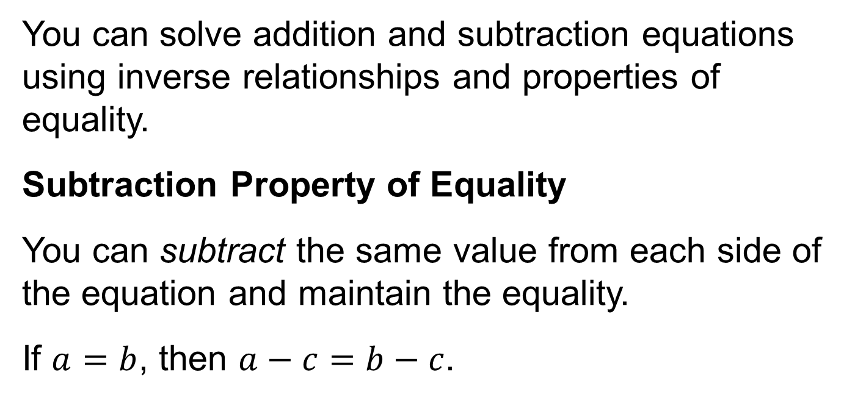
SUMMARIZE · SAY IT IN YOUR OWN WORDS
Summarize: Write and Solve Equations Using Addition or Subtraction
Explain the key idea without reading. Use today’s example as evidence.
47 / 54
Notes:
TEACH IN PRACTICE | Embedded facilitation | Lesson 8.2, slide 41 | SUMMARIZE
Focus on the existing task: Summarize: Write and Solve Equations Using Addition or Subtraction SUMMARIZE · SAY IT IN YOUR OWN WORDS
CONNECT (T1/4): Ask students to restate the displayed goal or key idea and connect it to earlier work. Relevant lesson evidence: use an inverse operation on both sides; isolate the variable; check in the original equation. Use only the criterion that matches the current session.
SHOW PROGRESS: Students point to their own existing work, explain what improved after feedback, and name a next step. Pair confidence ratings with actual evidence.
PARTICIPATION (T5/6/7): Think time before volunteers; accept a written, drawn or rehearsed entry. Students ask for evidence respectfully. Recognize a specific contribution or revision and check that both partners participate.
Source: BCPS Updated Instructional Framework Rubric (June 2020), TEACH 1–7. Earlier notes and answer keys are retained below.
EARLIER NOTES / EXISTING ANSWER KEY
Routine: SUMMARIZE · SAY IT IN YOUR OWN WORDS

Slide 48
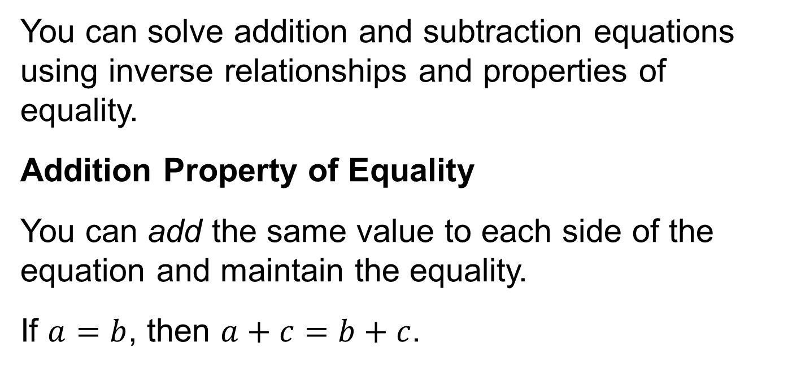
SUMMARIZE · SAY IT IN YOUR OWN WORDS
Summarize: Write and Solve Equations Using Addition or Subtraction
Explain the key idea without reading. Use today’s example as evidence.
48 / 54
Notes:
TEACH IN PRACTICE | Embedded facilitation | Lesson 8.2, slide 42 | SUMMARIZE
Focus on the existing task: Summarize: Write and Solve Equations Using Addition or Subtraction SUMMARIZE · SAY IT IN YOUR OWN WORDS
CONNECT (T1/4): Ask students to restate the displayed goal or key idea and connect it to earlier work. Relevant lesson evidence: use an inverse operation on both sides; isolate the variable; check in the original equation. Use only the criterion that matches the current session.
SHOW PROGRESS: Students point to their own existing work, explain what improved after feedback, and name a next step. Pair confidence ratings with actual evidence.
PARTICIPATION (T5/6/7): Think time before volunteers; accept a written, drawn or rehearsed entry. Students ask for evidence respectfully. Recognize a specific contribution or revision and check that both partners participate.
Source: BCPS Updated Instructional Framework Rubric (June 2020), TEACH 1–7. Earlier notes and answer keys are retained below.
EARLIER NOTES / EXISTING ANSWER KEY
Routine: SUMMARIZE · SAY IT IN YOUR OWN WORDS

Slide 49

APPLY · PLAN IT • SOLVE IT • PROVE IT
Apply: Margaret’s New Pet
Margaret is researching different dog breeds to adopt. The image and list below give information about the weights of the different dog breeds she is considering.
Pugs weigh 32 pounds less than bulldogs.
Irish Setters weigh 20 pounds more than bulldogs.
Irish Terriers weigh 43 pounds less than Irish Setters.
Shiba Inu weigh 5 pounds more than pugs.
Question: If Margaret’s apartment building only allows dogs up to 30 pounds, which breed(s) would you recommend she adopt?
49 / 54
Notes:
TEACH IN PRACTICE | Embedded facilitation | Lesson 8.2, slide 43 | APPLY
Focus on the existing task: Apply: Margaret’s New Pet Margaret is researching different dog breeds to adopt. The image and list below give information about the…
LAUNCH (T2/3/5): Use the exact application task independently first. Ask students to justify their choice of method. Collect evidence before a partner discussion or correction.
LOOK FOR (T4): Where this task addresses it, students can use an inverse operation on both sides. Ask which feature of their work supports the claim.
RESPOND: If this task shows the lesson misconception—changing only one side or using the same operation instead of its inverse—show the same operation under both sides of the original equation. Have the student revise and explain the change. Use this support only where the concept occurs in the current task; otherwise respond to the displayed question.
RECHECK: If a gap is shared, revisit the existing representation together. If it is limited, give targeted support while others compare valid methods on the same task. Check the revision before moving on.
PARTICIPATION (T5/6/7): Think time before volunteers; accept a written, drawn or rehearsed entry. Students ask for evidence respectfully. Recognize a specific contribution or revision and check that both partners participate.
Source: BCPS Updated Instructional Framework Rubric (June 2020), TEACH 1–7. Earlier notes and answer keys are retained below.
EARLIER NOTES / EXISTING ANSWER KEY
Routine: APPLY · PLAN IT • SOLVE IT • PROVE IT
UIFR FULL | Lesson-specific facilitation
TEACH 4 | Independent evidence and revision (UIFR PDF p. 11).
Use the existing application/exit problem as the independent check. If this is a learning-target slide, have students point to and explain their work on the preceding task. Separate initial independent evidence from the revision after feedback.
Check the relevant criteria: use an inverse operation on both sides; isolate the variable; check in the original equation. Respond with one specific next step tied to the work. Students revise and annotate what changed, then identify a criterion they can now demonstrate and one they still need to practice.

Slide 50
STUDENT MOVES
Lesson 8-2
Your move
SPECIFIC FEEDBACK · Trade work. Give one specific comment: “This part is clear because ______.”
50 / 54

Slide 51
Learning Targets
I can write and solve one-step addition equations using models and the Subtraction Property of Equality.
I can write and solve one-step subtraction equations using models and the Addition Property of Equality.
I can make sense of quantities to write and solve one-step equations.
Point to evidence in your work. Name what improved and your next step.
51 / 54
Notes:
TEACH IN PRACTICE | Embedded facilitation | Lesson 8.2, slide 44 | REFLECTION
Focus on the existing task: Learning Targets I can write and solve one-step addition equations using models and the Subtraction Property of Equality. I can write and…
CONNECT (T1/4): Ask students to restate the displayed goal or key idea and connect it to earlier work. Relevant lesson evidence: use an inverse operation on both sides; isolate the variable; check in the original equation. Use only the criterion that matches the current session.
SHOW PROGRESS: Students point to their own existing work, explain what improved after feedback, and name a next step. Pair confidence ratings with actual evidence.
PARTICIPATION (T5/6/7): Think time before volunteers; accept a written, drawn or rehearsed entry. Students ask for evidence respectfully. Recognize a specific contribution or revision and check that both partners participate.
Source: BCPS Updated Instructional Framework Rubric (June 2020), TEACH 1–7. Earlier notes and answer keys are retained below.
EARLIER NOTES / EXISTING ANSWER KEY
Read each target; students self-rate with fist-to-five or thumbs.
Tie back to the goal from the start of class: did we get there?
Note any target that rates low — revisit it tomorrow.
UIFR: TEACH 1 · TEACH 4.

Slide 52
Be Curious
Be Curious
What math do you see in this problem?
Brielle is considering buying a bike that is on sale for some amount off the original price. What was the original price of the bike?
Think first. Share a notice and a question; build on a classmate’s idea.
Mindset
What is helping you stay motivated to learn math?
52 / 54
Notes:
TEACH IN PRACTICE | Embedded facilitation | Lesson 8.2, slide 45 | CURIOUS
Focus on the existing task: Be Curious Mindset Be Curious What is helping you stay motivated to learn math?
LAUNCH (T2/3/5): Allow quiet observation first. Separate a notice from an inference, invite students’ own questions, and follow the existing launch before teaching a procedure.
LOOK FOR (T4): Where this task addresses it, students can check in the original equation. Ask which feature of their work supports the claim.
RESPOND: If this task shows the lesson misconception—changing only one side or using the same operation instead of its inverse—show the same operation under both sides of the original equation. Have the student revise and explain the change. Use this support only where the concept occurs in the current task; otherwise respond to the displayed question.
RECHECK: If a gap is shared, revisit the existing representation together. If it is limited, give targeted support while others compare valid methods on the same task. Check the revision before moving on.
PARTICIPATION (T5/6/7): Think time before volunteers; accept a written, drawn or rehearsed entry. Students ask for evidence respectfully. Recognize a specific contribution or revision and check that both partners participate.
Source: BCPS Updated Instructional Framework Rubric (June 2020), TEACH 1–7.

Slide 53
Learning Targets
I can write and solve one-step addition equations using models and the Subtraction Property of Equality.
I can write and solve one-step subtraction equations using models and the Addition Property of Equality.
I can make sense of quantities to write and solve one-step equations.
Point to evidence in your work. Name what improved and your next step.
53 / 54
Notes:
TEACH IN PRACTICE | Embedded facilitation | Lesson 8.2, slide 46 | REFLECTION
Focus on the existing task: Learning Targets I can write and solve one-step addition equations using models and the Subtraction Property of Equality. I can write and…
CONNECT (T1/4): Ask students to restate the displayed goal or key idea and connect it to earlier work. Relevant lesson evidence: use an inverse operation on both sides; isolate the variable; check in the original equation. Use only the criterion that matches the current session.
SHOW PROGRESS: Students point to their own existing work, explain what improved after feedback, and name a next step. Pair confidence ratings with actual evidence.
PARTICIPATION (T5/6/7): Think time before volunteers; accept a written, drawn or rehearsed entry. Students ask for evidence respectfully. Recognize a specific contribution or revision and check that both partners participate.
Source: BCPS Updated Instructional Framework Rubric (June 2020), TEACH 1–7. Earlier notes and answer keys are retained below.
EARLIER NOTES / EXISTING ANSWER KEY
UIFR FULL | Lesson-specific facilitation
REFLECT & ADJUST 1-2 | After the lesson (UIFR PDF pp. 15-16).
Sort the existing work by demonstrated reasoning, partial understanding, and the specific misconception: changing only one side or using the same operation instead of its inverse. Compare the initial response with the revision. Record which teaching move plausibly helped, which did not, and whose participation or access needs a different approach; do not record sensitive student details in this shared deck.
Plan the next lesson from that evidence: if the misconception persists, show the same operation under both sides of the original equation using the current example before returning to the next grade-level task; if understanding is secure, use an existing extension or ask for a general explanation. Check the targeted idea again at the next warm-up.
Ask students what supported their thinking and what would help next time. Identify one change to try and one successful practice to retain. Seek colleague feedback on anonymized work when useful; these prompts support reflection and do not establish an evaluation rating. Source: Baltimore City Public Schools, Updated Instructional Framework Rubric, June 2020 (UIFR_Full.pdf).

Slide 54
LESSON 8.2 / REFLECT ON YOUR LEARNING
Show your progress
1 SHOW EVIDENCE
2 CHOOSE A NEXT STEP
Choose one response. Point to the part that shows your reasoning.
Name a change you made after feedback—or a question you still have.
“My work shows ___ because ___.”
“Next time, I will ___ to help me ___.”
Today’s focus: Use an inverse operation on both sides.
CREDIT A CLASSMATE · Name one classmate whose idea helped you today, and say what they said.
Listen to understand. Ask for evidence. Make room for every voice.
Notes:
TEACH IN PRACTICE | Embedded facilitation | Lesson 8.2, slide 47 | PRIOR_INSERT
Focus on the existing task: LESSON 8.2 / REFLECT ON YOUR LEARNING Show your progress Listen to understand. Ask for evidence. Make room for every voice. 1 SHOW…
CONNECT (T1/4): Ask students to restate the displayed goal or key idea and connect it to earlier work. Relevant lesson evidence: use an inverse operation on both sides; isolate the variable; check in the original equation. Use only the criterion that matches the current session.
SHOW PROGRESS: Students point to their own existing work, explain what improved after feedback, and name a next step. Pair confidence ratings with actual evidence.
PARTICIPATION (T5/6/7): Think time before volunteers; accept a written, drawn or rehearsed entry. Students ask for evidence respectfully. Recognize a specific contribution or revision and check that both partners participate.
Source: BCPS Updated Instructional Framework Rubric (June 2020), TEACH 1–7.

