Slide 1
WARM-UP · THINK • TRY • CHECK
Turn and talk: compare strategies, then defend one.
Warm-Up
Lesson 8-3 · Write and Solve Equations Using Multiplication or Division | Warm-Up · about 4 minutes
Try each on your own. Mark an unsure answer; explain and revise when we check.
QUESTION 1
QUESTION 2
7 × 8 = ______
7.2 ÷ 6 = ______
QUESTION 3
QUESTION 4
What undoes multiplying by 4? ______
1/2 × ______ = 10
TALK IT OVER: “I got ______ because ______.” • Compare with a partner before we check as a class.
1 / 56
Notes:
TEACH IN PRACTICE | Embedded facilitation | Lesson 8.3, slide 1 | WARMUP
Focus on the existing task: Warm-Up WARM-UP · THINK • TRY •…
GATHER EVIDENCE (T4/6): Keep the original items. Students try independently, mark an uncertain item, and explain one method before checking. Use the existing key when present.
RESPOND: Distinguish a calculation slip from a reasoning gap. Give one next step on the same item; have students revise in a second color. Use the responses to choose flexible support for today’s lesson.
PARTICIPATION (T5/6/7): Think time before volunteers; accept a written, drawn or rehearsed entry. Students ask for evidence respectfully. Recognize a specific contribution or revision and check that both partners participate.
Source: BCPS Updated Instructional Framework Rubric (June 2020), TEACH 1–7. Earlier notes and answer keys are retained below.
EARLIER NOTES / EXISTING ANSWER KEY
Warm-Up answers (teacher only): 1) 56 2) 1.2 3) dividing by 4 4) 20
UIFR FULL | Lesson-specific facilitation
PREPARE 1-2 | Before teaching (UIFR PDF pp. 6-7).
Plan to gather evidence that students can undo multiplication or division on both sides; preserve equality; check the result. Review recent work and today’s warm-up to choose flexible groups and access supports; do not infer needs from identity or perceived ability. Use the existing lesson tasks and stated standards.
Anticipate: using the reciprocal operation on only one side. If observed, label the operation attached to the variable and show its inverse on both sides. Offer oral rehearsal, drawing, pointing, or home-language processing as needed; retain the original mathematical demand. Ask students which support helps and fade it as evidence improves.
TEACH 6-7 | Before the first transition, agree on materials, partner roles, and how to request help. Invite students to restate the routine. Normalize revising an idea, recognize a specific contribution, and check privately when frustration blocks participation. Source: UIFR PDF pp. 13-14.

Slide 2
Today’s Math Notes
Lesson 8-3 · Write and Solve Equations Using Multiplication or Division
Section 1: Math Words
Copy. Explain. Check.
SAY THE GOAL · Say today’s goal in your own words, then name one place this shows up outside math class.
Solve Multiplication and Division Equations
1
Use inverse multiplication or division to isolate the variable
Inverse operation
2
Two math actions that undo each other, like × and ÷
Multiply
3
To add equal groups again and again
eduwonderlab.com · Neft Teacher
2 / 56
Notes:
TEACH IN PRACTICE | Embedded facilitation | Lesson 8.3, slide 2 | NOTES
Focus on the existing task: Today’s Math Notes Section 1…
ROUTINE (T1/2/4): Read or copy the original notes, cover one line, and explain it using the displayed example. Reopen and correct. Copying alone is not evidence of understanding.
LOOK FOR: A link between a symbol, quantity or feature and the explanation. If missing, point back to that feature and have the student try again; fade the prompt once they can explain.
PARTICIPATION (T5/6/7): Think time before volunteers; accept a written, drawn or rehearsed entry. Students ask for evidence respectfully. Recognize a specific contribution or revision and check that both partners participate.
Source: BCPS Updated Instructional Framework Rubric (June 2020), TEACH 1–7. Earlier notes and answer keys are retained below.
EARLIER NOTES / EXISTING ANSWER KEY
Copy routine: read one line at a time; students copy, then explain that line to a partner.
Keep it brisk — the understanding work happens in the examples, not the copying.
UIFR: TEACH 1 · TEACH 6.

Slide 3
Today’s Math Notes
Lesson 8-3 · Write and Solve Equations Using Multiplication or Division
Section 2: Today’s Math
Copy. Explain. Check.
CONNECT IT · What earlier lesson does this build on? Tell a partner in one sentence.
Solving Multiplication & Division Equations
ax = b → x = b/a
x/a = b → x = a · b
1
Identify the operation applied to the variable
2
Use the inverse operation: Divide to undo multiplication; multiply to undo division
3
Balance: Apply the inverse operation to both sides to isolate the variable
eduwonderlab.com · Neft Teacher
3 / 56
Notes:
TEACH IN PRACTICE | Embedded facilitation | Lesson 8.3, slide 3 | NOTES
Focus on the existing task: Today’s Math Notes Section 2…
ROUTINE (T1/2/4): Read or copy the original notes, cover one line, and explain it using the displayed example. Reopen and correct. Copying alone is not evidence of understanding.
LOOK FOR: A link between a symbol, quantity or feature and the explanation. If missing, point back to that feature and have the student try again; fade the prompt once they can explain.
PARTICIPATION (T5/6/7): Think time before volunteers; accept a written, drawn or rehearsed entry. Students ask for evidence respectfully. Recognize a specific contribution or revision and check that both partners participate.
Source: BCPS Updated Instructional Framework Rubric (June 2020), TEACH 1–7. Earlier notes and answer keys are retained below.
EARLIER NOTES / EXISTING ANSWER KEY
Copy routine: read one line at a time; students copy, then explain that line to a partner.
Keep it brisk — the understanding work happens in the examples, not the copying.
UIFR: TEACH 1 · TEACH 6.

Slide 4
Session 1
Write and Solve Equations Using Multiplication or Division
TRY IT BEFORE YOU’RE SURE · Start even if you are not sure. A revised answer counts as much as a first-try answer.
4 / 56
Notes:
TEACH IN PRACTICE | Embedded facilitation | Lesson 8.3, slide 4 | DIVIDER
Focus on the existing task: Write and Solve Equations Using Multiplication or Division Session 1
TRANSITION (T6/7): Students confirm materials, roles, how to request help, and the next response routine. Ask a student to restate it. Keep teacher-only slides hidden.
PARTICIPATION (T5/6/7): Think time before volunteers; accept a written, drawn or rehearsed entry. Students ask for evidence respectfully. Recognize a specific contribution or revision and check that both partners participate.
Source: BCPS Updated Instructional Framework Rubric (June 2020), TEACH 1–7. Earlier notes and answer keys are retained below.
EARLIER NOTES / EXISTING ANSWER KEY
Transition cue: state what materials are out and what success looks like this session.
Keep the changeover under a minute.
UIFR: TEACH 6.

Slide 5
This or That?
Would you rather have THIS or THAT many ounces of gold?
THIS or THAT
THIS | THAT
Think and record first. Which part of your work supports your answer?
5 / 56
Notes:
TEACH IN PRACTICE | Embedded facilitation | Lesson 8.3, slide 5 | TASK
Focus on the existing task: This or That?
LAUNCH (T2/3/5): Use the displayed question. Give private thinking time; then A explains while B asks for evidence. Switch roles. Each student records their own reasoning.
LOOK FOR (T4): Where this task addresses it, students can undo multiplication or division on both sides. Ask which feature of their work supports the claim.
RESPOND: If this task shows the lesson misconception—using the reciprocal operation on only one side—label the operation attached to the variable and show its inverse on both sides. Have the student revise and explain the change. Use this support only where the concept occurs in the current task; otherwise respond to the displayed question.
RECHECK: If a gap is shared, revisit the existing representation together. If it is limited, give targeted support while others compare valid methods on the same task. Check the revision before moving on.
PARTICIPATION (T5/6/7): Think time before volunteers; accept a written, drawn or rehearsed entry. Students ask for evidence respectfully. Recognize a specific contribution or revision and check that both partners participate.
Source: BCPS Updated Instructional Framework Rubric (June 2020), TEACH 1–7. Earlier notes and answer keys are retained below.
EARLIER NOTES / EXISTING ANSWER KEY
Number-sense routine — every voice in. Give quiet think time, then hear from at least three students.
Always follow with “How do you know?” — the reasoning is the point, not the answer.
There is more than one path; name and celebrate different strategies.
UIFR: TEACH 3 · TEACH 5 · TEACH 6.

Slide 6
Today’s Objectives
Lesson 8-3 · Write and Solve Equations Using Multiplication or Division
Write and Solve Equations Using Multiplication or Division
Maryland Standard 6.AT.8
CONTENT OBJECTIVE
LANGUAGE OBJECTIVE
Restate the goal in your words
Use these words to explain why
I can solve one-step multiplication and division equations using inverse operations.
I can explain my steps using the words inverse operation, multiply, divide, and isolate.
eduwonderlab.com · Neft Teacher
6 / 56
Notes:
TEACH IN PRACTICE | Embedded facilitation | Lesson 8.3, slide 6 | GOAL
Focus on the existing task: Today’s Objectives Write and…
CONNECT (T1/4): Ask students to restate the displayed goal or key idea and connect it to earlier work. Relevant lesson evidence: undo multiplication or division on both sides; preserve equality; check the result. Use only the criterion that matches the current session.
SHOW PROGRESS: Students point to their own existing work, explain what improved after feedback, and name a next step. Pair confidence ratings with actual evidence.
PARTICIPATION (T5/6/7): Think time before volunteers; accept a written, drawn or rehearsed entry. Students ask for evidence respectfully. Recognize a specific contribution or revision and check that both partners participate.
Source: BCPS Updated Instructional Framework Rubric (June 2020), TEACH 1–7. Earlier notes and answer keys are retained below.
EARLIER NOTES / EXISTING ANSWER KEY
Read the objective together, then have one or two students restate today’s goal in their own words.
Connect it to what the class learned last lesson.
Return to this goal at the end of class to check it was met.
UIFR: TEACH 1.
UIFR FULL | Lesson-specific facilitation
TEACH 1 | Session 1 purpose and evidence (UIFR PDF p. 8).
Have students restate the displayed session goal in their own words and connect it to the existing context or a familiar experience they choose to share. Use the current session goal to select from these lesson-wide evidence criteria; do not frontload a later-session procedure.
Look for: undo multiplication or division on both sides; preserve equality; check the result. Ask: “Which part of your work would show this?” Revisit that evidence after the task; a confidence rating alone is not evidence of understanding.

Slide 7
STUDENT MOVES
Lesson 8-3
Your move
NAME THE MATH · Point to the part of this that is new today, and say what it changes.
7 / 56

Slide 8
LESSON 8.3 / OUR LEARNING
What will show your learning?
1
Undo multiplication or division on both sides.
2
Preserve equality.
3
Check the result.
Tell a partner: Which skill connects to something you already know?
SHOW YOUR THINKING · Show what you know — write it, draw it, or build it. A picture counts as an explanation.
Listen to understand. Ask for evidence. Make room for every voice.
Notes:
TEACH IN PRACTICE | Embedded facilitation | Lesson 8.3, slide 7 | PRIOR_INSERT
Focus on the existing task: LESSON 8.3 / OUR LEARNING What will show your learning?
CONNECT (T1/4): Ask students to restate the displayed goal or key idea and connect it to earlier work. Relevant lesson evidence: undo multiplication or division on both sides; preserve equality; check the result. Use only the criterion that matches the current session.
SHOW PROGRESS: Students point to their own existing work, explain what improved after feedback, and name a next step. Pair confidence ratings with actual evidence.
PARTICIPATION (T5/6/7): Think time before volunteers; accept a written, drawn or rehearsed entry. Students ask for evidence respectfully. Recognize a specific contribution or revision and check that both partners participate.
Source: BCPS Updated Instructional Framework Rubric (June 2020), TEACH 1–7.

Slide 9
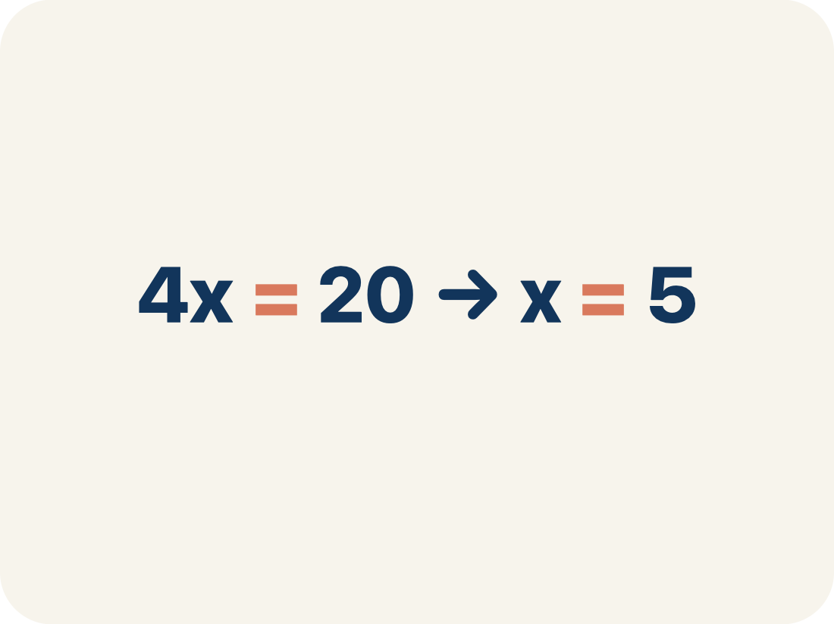
Vocabulary 1 of 7
Lesson 8-3 · Write and Solve Equations Using Multiplication or Division
Solve Multiplication and Division Equations
Use inverse multiplication or division to isolate the variable.
EXAMPLE · EXPLAIN WHY IT FITS
4x = 20 → x = 5
USE THE MATH WORDS · Use today’s math words in your explanation — not “it” and “that thing.”
eduwonderlab.com · Neft Teacher
9 / 56
Notes:
TEACH IN PRACTICE | Embedded facilitation | Lesson 8.3, slide 8 | VOCAB
Focus on the existing task: Vocabulary 1 of 7 Solve…
ASK (T1/3/5): Where does “Solve Multiplication and Division Equations” appear in the example? Explain the meaning without reading the definition. Partner: restate the idea and ask a clarifying question.
LOOK FOR: A correct connection between the word and a feature of the example. If the student only repeats the definition, invite pointing, sketching or oral rehearsal, then ask for another explanation of this same example.
PARTICIPATION (T5/6/7): Think time before volunteers; accept a written, drawn or rehearsed entry. Students ask for evidence respectfully. Recognize a specific contribution or revision and check that both partners participate.
Source: BCPS Updated Instructional Framework Rubric (June 2020), TEACH 1–7.

Slide 10
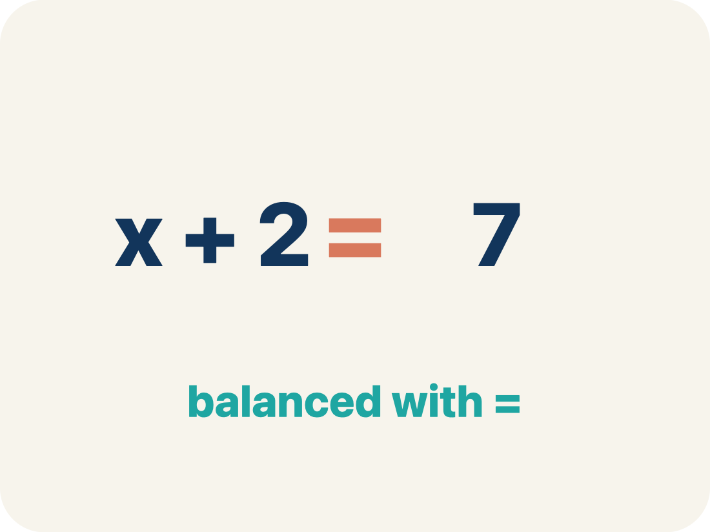
Vocabulary 2 of 7
Lesson 8-3 · Write and Solve Equations Using Multiplication or Division
Inverse operation
Two math actions that undo each other, like × and ÷.
EXAMPLE · EXPLAIN WHY IT FITS
Multiplication and division are inverses: 3 × 7 = 21, so 21 ÷ 3 = 7
Use “Inverse operation” to explain the example. Point to
evidence.
eduwonderlab.com · Neft Teacher
10 / 56
Notes:
TEACH IN PRACTICE | Embedded facilitation | Lesson 8.3, slide 9 | VOCAB
Focus on the existing task: Vocabulary 2 of 7 Inverse…
ASK (T1/3/5): Where does “Inverse operation” appear in the example? Explain the meaning without reading the definition. Partner: restate the idea and ask a clarifying question.
LOOK FOR: A correct connection between the word and a feature of the example. If the student only repeats the definition, invite pointing, sketching or oral rehearsal, then ask for another explanation of this same example.
PARTICIPATION (T5/6/7): Think time before volunteers; accept a written, drawn or rehearsed entry. Students ask for evidence respectfully. Recognize a specific contribution or revision and check that both partners participate.
Source: BCPS Updated Instructional Framework Rubric (June 2020), TEACH 1–7.

Slide 11
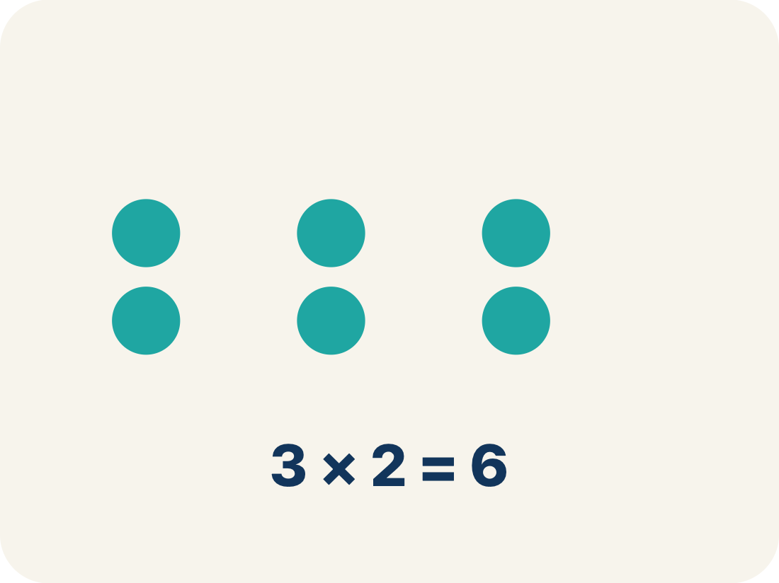
Vocabulary 3 of 7
Lesson 8-3 · Write and Solve Equations Using Multiplication or Division
Multiply
To add equal groups again and again.
EXAMPLE · EXPLAIN WHY IT FITS
3 × 7 = 21 means 3 groups of 7 equals 21
Use “Multiply” to explain the example. Point to evidence.
eduwonderlab.com · Neft Teacher
11 / 56
Notes:
TEACH IN PRACTICE | Embedded facilitation | Lesson 8.3, slide 10 | VOCAB
Focus on the existing task: Vocabulary 3 of 7 Multiply To…
ASK (T1/3/5): Where does “Multiply” appear in the example? Explain the meaning without reading the definition. Partner: restate the idea and ask a clarifying question.
LOOK FOR: A correct connection between the word and a feature of the example. If the student only repeats the definition, invite pointing, sketching or oral rehearsal, then ask for another explanation of this same example.
PARTICIPATION (T5/6/7): Think time before volunteers; accept a written, drawn or rehearsed entry. Students ask for evidence respectfully. Recognize a specific contribution or revision and check that both partners participate.
Source: BCPS Updated Instructional Framework Rubric (June 2020), TEACH 1–7.

Slide 12
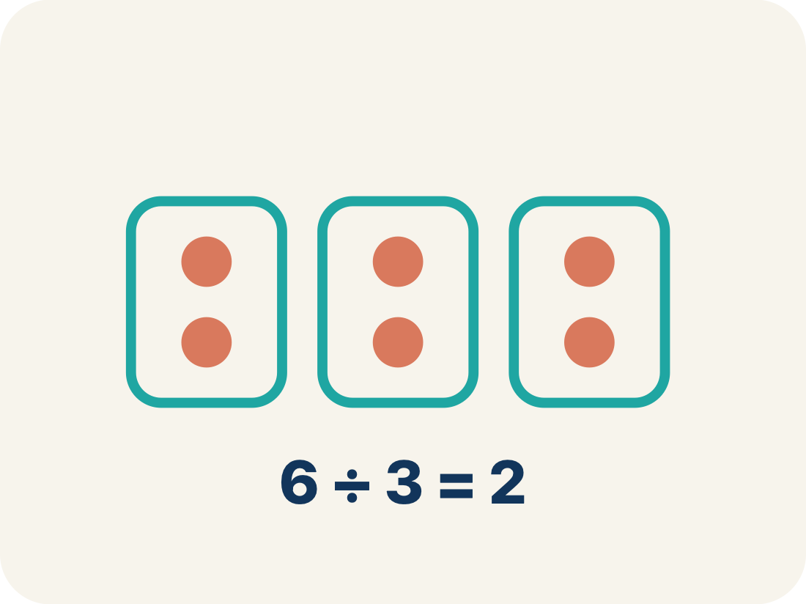
Vocabulary 4 of 7
Lesson 8-3 · Write and Solve Equations Using Multiplication or Division
Divide
To split into equal groups.
EXAMPLE · EXPLAIN WHY IT FITS
36 ÷ 4 = 9 means 36 split into 4 equal groups gives 9 per group
Use “Divide” to explain the example. Point to evidence.
eduwonderlab.com · Neft Teacher
12 / 56
Notes:
TEACH IN PRACTICE | Embedded facilitation | Lesson 8.3, slide 11 | VOCAB
Focus on the existing task: Vocabulary 4 of 7 Divide To…
ASK (T1/3/5): Where does “Divide” appear in the example? Explain the meaning without reading the definition. Partner: restate the idea and ask a clarifying question.
LOOK FOR: A correct connection between the word and a feature of the example. If the student only repeats the definition, invite pointing, sketching or oral rehearsal, then ask for another explanation of this same example.
PARTICIPATION (T5/6/7): Think time before volunteers; accept a written, drawn or rehearsed entry. Students ask for evidence respectfully. Recognize a specific contribution or revision and check that both partners participate.
Source: BCPS Updated Instructional Framework Rubric (June 2020), TEACH 1–7.

Slide 13
Vocabulary 5 of 7
Lesson 8-3 · Write and Solve Equations Using Multiplication or Division
Isolate
To get the letter by itself on one side.
EXAMPLE · EXPLAIN WHY IT FITS
3x = 21 → divide both sides by 3 → x = 7 (x is alone)
Use “Isolate” to explain the example. Point to evidence.
eduwonderlab.com · Neft Teacher
13 / 56
Notes:
TEACH IN PRACTICE | Embedded facilitation | Lesson 8.3, slide 12 | VOCAB
Focus on the existing task: Vocabulary 5 of 7 Isolate To…
ASK (T1/3/5): Where does “Isolate” appear in the example? Explain the meaning without reading the definition. Partner: restate the idea and ask a clarifying question.
LOOK FOR: A correct connection between the word and a feature of the example. If the student only repeats the definition, invite pointing, sketching or oral rehearsal, then ask for another explanation of this same example.
PARTICIPATION (T5/6/7): Think time before volunteers; accept a written, drawn or rehearsed entry. Students ask for evidence respectfully. Recognize a specific contribution or revision and check that both partners participate.
Source: BCPS Updated Instructional Framework Rubric (June 2020), TEACH 1–7.

Slide 14
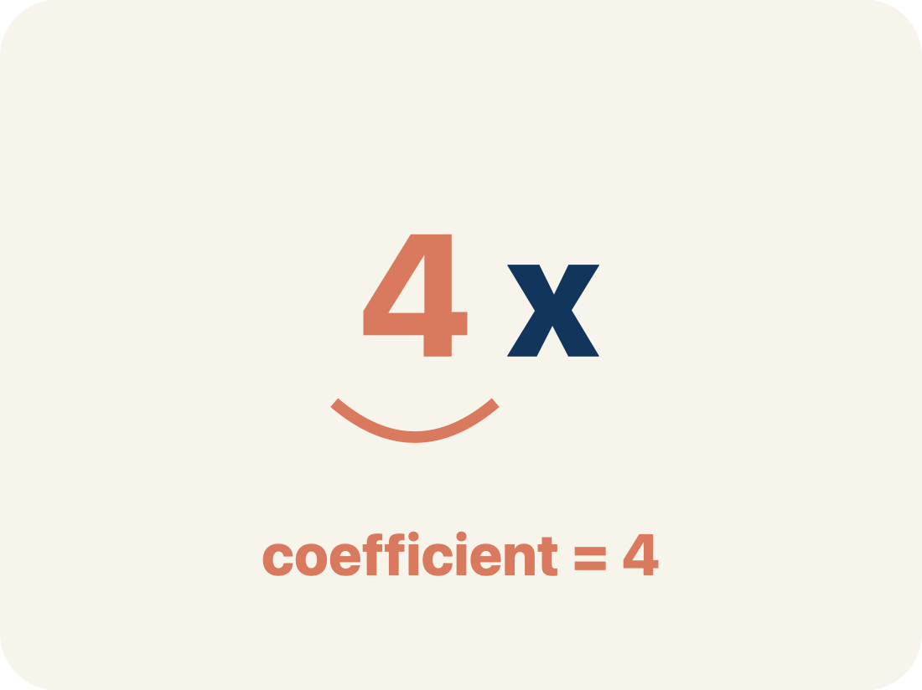
Vocabulary 6 of 7
Lesson 8-3 · Write and Solve Equations Using Multiplication or Division
Coefficient
The number in front of a letter, like the 3 in 3x.
EXAMPLE · EXPLAIN WHY IT FITS
In 6x = 18, the coefficient is 6; divide both sides by 6 to get x = 3.
Use “Coefficient” to explain the example. Point to evidence.
eduwonderlab.com · Neft Teacher
14 / 56
Notes:
TEACH IN PRACTICE | Embedded facilitation | Lesson 8.3, slide 13 | VOCAB
Focus on the existing task: Vocabulary 6 of 7 Coefficient…
ASK (T1/3/5): Where does “Coefficient” appear in the example? Explain the meaning without reading the definition. Partner: restate the idea and ask a clarifying question.
LOOK FOR: A correct connection between the word and a feature of the example. If the student only repeats the definition, invite pointing, sketching or oral rehearsal, then ask for another explanation of this same example.
PARTICIPATION (T5/6/7): Think time before volunteers; accept a written, drawn or rehearsed entry. Students ask for evidence respectfully. Recognize a specific contribution or revision and check that both partners participate.
Source: BCPS Updated Instructional Framework Rubric (June 2020), TEACH 1–7.

Slide 15
Vocabulary 7 of 7
Lesson 8-3 · Write and Solve Equations Using Multiplication or Division
Solution
A number that makes the equation or inequality true.
EXAMPLE · EXPLAIN WHY IT FITS
x = 3 is the solution of 6x = 18 because 6 × 3 = 18.
Use “Solution” to explain the example. Point to evidence.
eduwonderlab.com · Neft Teacher
15 / 56
Notes:
TEACH IN PRACTICE | Embedded facilitation | Lesson 8.3, slide 14 | VOCAB
Focus on the existing task: Vocabulary 7 of 7 Solution A…
ASK (T1/3/5): Where does “Solution” appear in the example? Explain the meaning without reading the definition. Partner: restate the idea and ask a clarifying question.
LOOK FOR: A correct connection between the word and a feature of the example. If the student only repeats the definition, invite pointing, sketching or oral rehearsal, then ask for another explanation of this same example.
PARTICIPATION (T5/6/7): Think time before volunteers; accept a written, drawn or rehearsed entry. Students ask for evidence respectfully. Recognize a specific contribution or revision and check that both partners participate.
Source: BCPS Updated Instructional Framework Rubric (June 2020), TEACH 1–7.

Slide 16
Vocabulary
Lesson 8-3 · Write and Solve Equations Using Multiplication or Division
Today’s Math Words
We learn every word — what it means and what it looks like — before we use it.
Solve Multiplication and Division Equations
Inverse operation
Use inverse multiplication or division to isolate the variable
Two math actions that undo each other, like × and ÷
Multiply
Divide
To add equal groups again and again
To split into equal groups
Isolate
Coefficient
To get the letter by itself on one side
The number in front of a letter, like the 3 in 3x
Solution
Explain one math word using the example.
Partner: point to evidence.
A number that makes the equation or inequality true
eduwonderlab.com · Neft Teacher
16 / 56
Notes:
TEACH IN PRACTICE | Embedded facilitation | Lesson 8.3, slide 15 | VOCAB
Focus on the existing task: Vocabulary Today’s Math Words We…
ASK (T1/3/5): Where does “the displayed term” appear in the example? Explain the meaning without reading the definition. Partner: restate the idea and ask a clarifying question.
LOOK FOR: A correct connection between the word and a feature of the example. If the student only repeats the definition, invite pointing, sketching or oral rehearsal, then ask for another explanation of this same example.
PARTICIPATION (T5/6/7): Think time before volunteers; accept a written, drawn or rehearsed entry. Students ask for evidence respectfully. Recognize a specific contribution or revision and check that both partners participate.
Source: BCPS Updated Instructional Framework Rubric (June 2020), TEACH 1–7. Earlier notes and answer keys are retained below.
EARLIER NOTES / EXISTING ANSWER KEY
Choral-read each word, its meaning, and what it looks like.
Students should use these words out loud today — listen for them in partner talk and revoice student ideas with the academic term.
UIFR: TEACH 1 · TEACH 5.

Slide 17
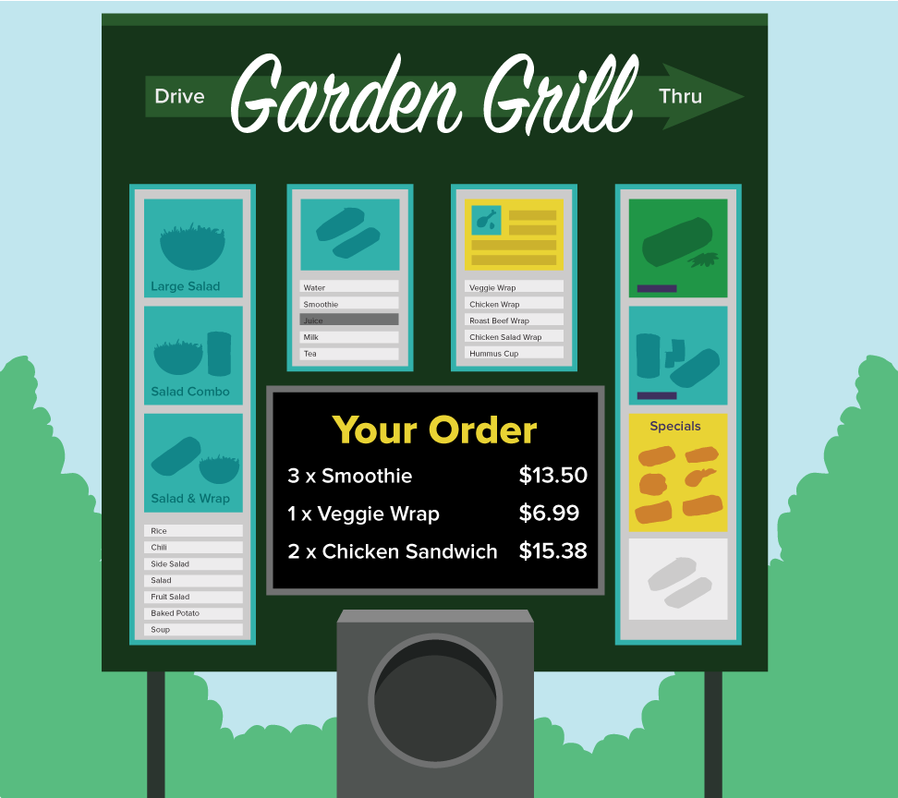

Be Curious
What could the question be?
Think first. Share a notice and a
question; build on a classmate’s
idea.
Mindset
How can you be respectful of others even if you disagree with their reasoning?
17 / 56
Notes:
TEACH IN PRACTICE | Embedded facilitation | Lesson 8.3, slide 16 | CURIOUS
Focus on the existing task: Be Curious Mindset What could the question be?
LAUNCH (T2/3/5): Allow quiet observation first. Separate a notice from an inference, invite students’ own questions, and follow the existing launch before teaching a procedure.
LOOK FOR (T4): Where this task addresses it, students can undo multiplication or division on both sides. Ask which feature of their work supports the claim.
RESPOND: If this task shows the lesson misconception—using the reciprocal operation on only one side—label the operation attached to the variable and show its inverse on both sides. Have the student revise and explain the change. Use this support only where the concept occurs in the current task; otherwise respond to the displayed question.
RECHECK: If a gap is shared, revisit the existing representation together. If it is limited, give targeted support while others compare valid methods on the same task. Check the revision before moving on.
PARTICIPATION (T5/6/7): Think time before volunteers; accept a written, drawn or rehearsed entry. Students ask for evidence respectfully. Recognize a specific contribution or revision and check that both partners participate.
Source: BCPS Updated Instructional Framework Rubric (June 2020), TEACH 1–7. Earlier notes and answer keys are retained below.
EARLIER NOTES / EXISTING ANSWER KEY
Accept all noticings and wonderings — there are no wrong answers here.
Give 20–30 seconds of quiet think time before taking responses; mix cold and warm calls so it is not always the same voices.
Read the mindset question aloud and let two students respond.
UIFR: TEACH 3 · TEACH 7.

Slide 18
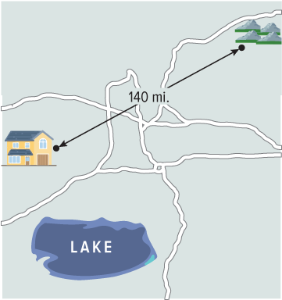
Ayasha’s House
The distance from Ayasha’s house to the mountains is shown. The distance from her house to the mountains is four times as far as the distance from her house to the lake.
What is the distance from Ayasha’s house to the lake?
Applying
HOW DO YOU KNOW? · Ask your partner “How do you know?” Answer by pointing to your own work.
How can you apply mathematics to model the context?
18 / 56
Notes:
TEACH IN PRACTICE | Embedded facilitation | Lesson 8.3, slide 17 | TASK
Focus on the existing task: Ayasha’s House What is the distance from Ayasha’s house to the lake?
LAUNCH (T2/3/5): Use the displayed question. Give private thinking time; then A explains while B asks for evidence. Switch roles. Each student records their own reasoning.
LOOK FOR (T4): Where this task addresses it, students can undo multiplication or division on both sides. Ask which feature of their work supports the claim.
RESPOND: If this task shows the lesson misconception—using the reciprocal operation on only one side—label the operation attached to the variable and show its inverse on both sides. Have the student revise and explain the change. Use this support only where the concept occurs in the current task; otherwise respond to the displayed question.
RECHECK: If a gap is shared, revisit the existing representation together. If it is limited, give targeted support while others compare valid methods on the same task. Check the revision before moving on.
PARTICIPATION (T5/6/7): Think time before volunteers; accept a written, drawn or rehearsed entry. Students ask for evidence respectfully. Recognize a specific contribution or revision and check that both partners participate.
Source: BCPS Updated Instructional Framework Rubric (June 2020), TEACH 1–7. Earlier notes and answer keys are retained below.
EARLIER NOTES / EXISTING ANSWER KEY
Read the context aloud (or have a student read it).
Before any math, students restate the situation and what is being asked in their own words.
Ask: What is the distance from Ayasha’s house to the lake?
UIFR: TEACH 1 · TEACH 3.
UIFR FULL | Lesson-specific facilitation
TEACH 2-3 | Session 1 task launch (UIFR PDF pp. 9-10).
Use the problem exactly as displayed. Give individual thinking time before discussion or advancing to the explanation. If the answer is already visible, ask students to reconstruct and justify it. Invite a choice of suitable representations and have students explain why their choice helps.
At the point where this concept appears, ask: “How does the inverse operation undo the change to the variable while keeping both sides equal?” Wait for evidence, invite another pathway, and have a student ask a follow-up question. Do not replace students’ reasoning with a sequence of leading steps.

Slide 19
Ayasha’s House
Let’s take a closer look at the relationship between the two distances.
The distance from the house to the mountains is four times as far as the distance from the house to the lake.
What other information do you know about the two distances?
Reveal:
The distance from the house to the mountains is 140 miles, while the distance from the house to the lake is unknown.
19 / 56
Notes:
TEACH IN PRACTICE | Embedded facilitation | Lesson 8.3, slide 18 | REVEAL
Focus on the existing task: Ayasha’s House Reveal: The distance from the house to the mountains is 140 miles, while the distance from the house to the lake is…
LAUNCH (T2/3/5): If an existing answer cover is present, gather an attempt before revealing. If the explanation is already visible, ask students to reconstruct and justify it. Compare reasoning and explain a revision; preserve the reveal sequence.
LOOK FOR (T4): Where this task addresses it, students can undo multiplication or division on both sides. Ask which feature of their work supports the claim.
RESPOND: If this task shows the lesson misconception—using the reciprocal operation on only one side—label the operation attached to the variable and show its inverse on both sides. Have the student revise and explain the change. Use this support only where the concept occurs in the current task; otherwise respond to the displayed question.
RECHECK: If a gap is shared, revisit the existing representation together. If it is limited, give targeted support while others compare valid methods on the same task. Check the revision before moving on.
PARTICIPATION (T5/6/7): Think time before volunteers; accept a written, drawn or rehearsed entry. Students ask for evidence respectfully. Recognize a specific contribution or revision and check that both partners participate.
Source: BCPS Updated Instructional Framework Rubric (June 2020), TEACH 1–7. Earlier notes and answer keys are retained below.
EARLIER NOTES / EXISTING ANSWER KEY
Do not click yet: collect 2–3 student answers with reasons first.
Then click to remove the cover and have students compare their thinking to the reveal — “Is this what we said? Where is it different?”
Behind the cover: The distance from the house to the mountains is 140 miles, while the distance from the house to the lake is unknown.
UIFR: TEACH 3 · TEACH 4.

Slide 20
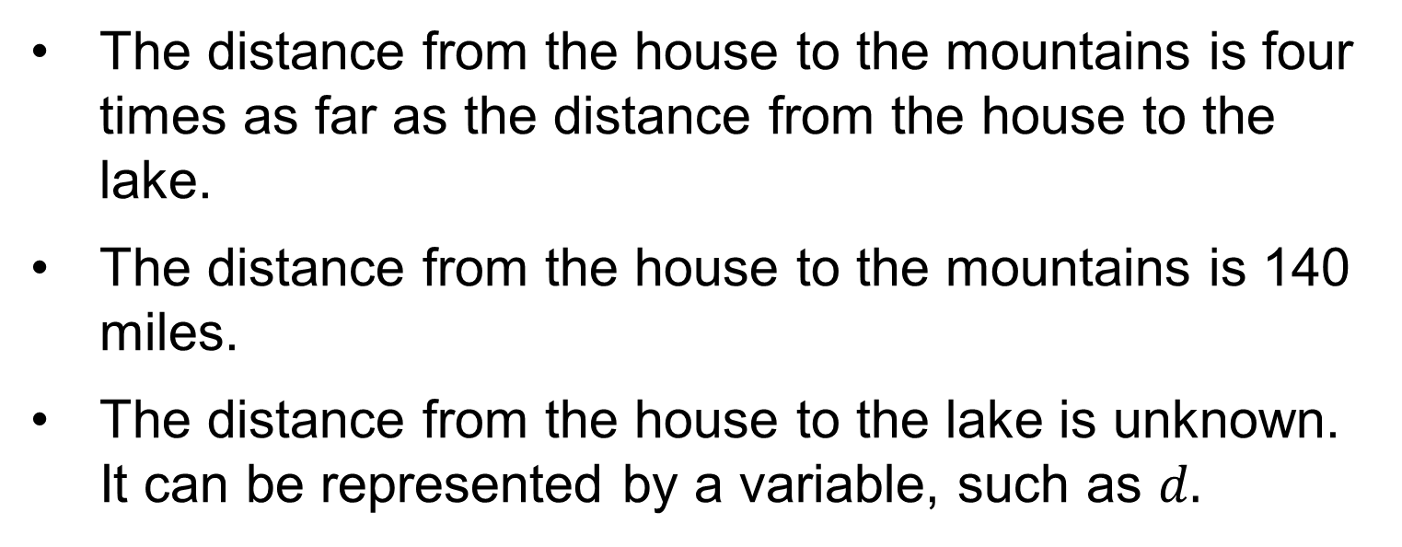
Ayasha’s House
How can you represent the relationship between the two distances algebraically?
Reveal:
We can use an equation with a variable for the distance to the lake.
20 / 56
Notes:
TEACH IN PRACTICE | Embedded facilitation | Lesson 8.3, slide 19 | REVEAL
Focus on the existing task: Ayasha’s House How can you represent the relationship between the two distances algebraically?
LAUNCH (T2/3/5): If an existing answer cover is present, gather an attempt before revealing. If the explanation is already visible, ask students to reconstruct and justify it. Compare reasoning and explain a revision; preserve the reveal sequence.
LOOK FOR (T4): Where this task addresses it, students can undo multiplication or division on both sides. Ask which feature of their work supports the claim.
RESPOND: If this task shows the lesson misconception—using the reciprocal operation on only one side—label the operation attached to the variable and show its inverse on both sides. Have the student revise and explain the change. Use this support only where the concept occurs in the current task; otherwise respond to the displayed question.
RECHECK: If a gap is shared, revisit the existing representation together. If it is limited, give targeted support while others compare valid methods on the same task. Check the revision before moving on.
PARTICIPATION (T5/6/7): Think time before volunteers; accept a written, drawn or rehearsed entry. Students ask for evidence respectfully. Recognize a specific contribution or revision and check that both partners participate.
Source: BCPS Updated Instructional Framework Rubric (June 2020), TEACH 1–7. Earlier notes and answer keys are retained below.
EARLIER NOTES / EXISTING ANSWER KEY
Do not click yet: collect 2–3 student answers with reasons first.
Then click to remove the cover and have students compare their thinking to the reveal — “Is this what we said? Where is it different?”
Behind the cover: We can use an equation with a variable for the distance to the lake.
UIFR: TEACH 3 · TEACH 4.

Slide 21
STUDENT MOVES
Lesson 8-3
Your moves
STRUGGLE FIRST · Work on your own first. Stuck is allowed — try a second strategy before you ask.
ANOTHER PATHWAY · Did anyone get there a different way? Put both pathways side by side and compare.
21 / 56

Slide 22

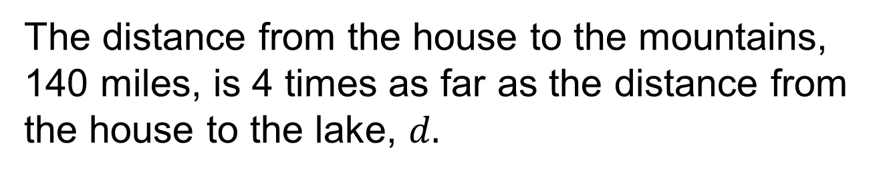
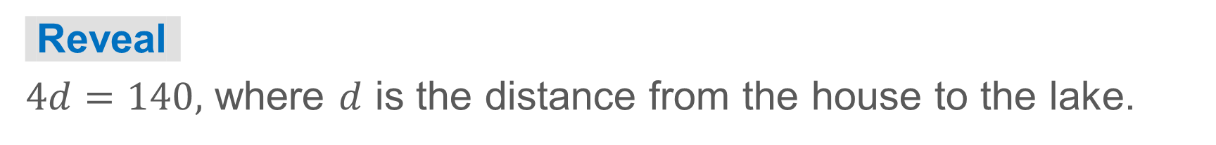
COLLABORATE · TALK IT THROUGH • AGREE ON A MODEL
Collaborate and Connect
Write an equation that represents the relationship between the distances. Be sure to define any variables you use.
Think first. A explains; B asks for evidence. Switch roles; both revise.
22 / 56
Notes:
TEACH IN PRACTICE | Embedded facilitation | Lesson 8.3, slide 20 | COLLABORATE
Focus on the existing task: Collaborate and Connect Write an equation that represents the relationship between the distances. Be sure to define any variables you…
LAUNCH (T2/3/5): Use the displayed question. Give private thinking time; then A explains while B asks for evidence. Switch roles. Each student records their own reasoning.
LOOK FOR (T4): Where this task addresses it, students can undo multiplication or division on both sides. Ask which feature of their work supports the claim.
RESPOND: If this task shows the lesson misconception—using the reciprocal operation on only one side—label the operation attached to the variable and show its inverse on both sides. Have the student revise and explain the change. Use this support only where the concept occurs in the current task; otherwise respond to the displayed question.
RECHECK: If a gap is shared, revisit the existing representation together. If it is limited, give targeted support while others compare valid methods on the same task. Check the revision before moving on.
PARTICIPATION (T5/6/7): Think time before volunteers; accept a written, drawn or rehearsed entry. Students ask for evidence respectfully. Recognize a specific contribution or revision and check that both partners participate.
Source: BCPS Updated Instructional Framework Rubric (June 2020), TEACH 1–7. Earlier notes and answer keys are retained below.
EARLIER NOTES / EXISTING ANSWER KEY
Routine: COLLABORATE · TALK IT THROUGH • AGREE ON A MODEL
UIFR FULL | Lesson-specific facilitation
TEACH 4-5 | Session 1 discussion and checkpoint (UIFR PDF pp. 11-12).
Collect a brief response from every student to the existing prompt before hearing volunteers. Partners take turns explaining and asking for evidence: “I understand ___; what supports ___?” Offer rehearsal or an annotated model for students who need language support. Each student records their own reasoning.
Look specifically for: using the reciprocal operation on only one side. If it appears, label the operation attached to the variable and show its inverse on both sides; then ask the student to revise the same response and explain the change. If evidence is secure, have students compare a second valid pathway or state why their approach works. Choose the next step from the responses, not a preset pace.

Slide 23
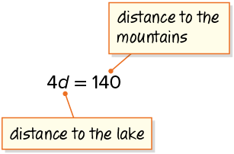
Ayasha’s House
We can use an equation to represent the problem.
Record your reasoning before the reveal.
Compare, then explain any revision.
How can you solve the equation?
Reveal:
We can use an inverse relationship.
23 / 56
Notes:
TEACH IN PRACTICE | Embedded facilitation | Lesson 8.3, slide 21 | REVEAL
Focus on the existing task: Ayasha’s House Reveal: We can use an inverse relationship. How can you solve the equation?
LAUNCH (T2/3/5): If an existing answer cover is present, gather an attempt before revealing. If the explanation is already visible, ask students to reconstruct and justify it. Compare reasoning and explain a revision; preserve the reveal sequence.
LOOK FOR (T4): Where this task addresses it, students can undo multiplication or division on both sides. Ask which feature of their work supports the claim.
RESPOND: If this task shows the lesson misconception—using the reciprocal operation on only one side—label the operation attached to the variable and show its inverse on both sides. Have the student revise and explain the change. Use this support only where the concept occurs in the current task; otherwise respond to the displayed question.
RECHECK: If a gap is shared, revisit the existing representation together. If it is limited, give targeted support while others compare valid methods on the same task. Check the revision before moving on.
PARTICIPATION (T5/6/7): Think time before volunteers; accept a written, drawn or rehearsed entry. Students ask for evidence respectfully. Recognize a specific contribution or revision and check that both partners participate.
Source: BCPS Updated Instructional Framework Rubric (June 2020), TEACH 1–7. Earlier notes and answer keys are retained below.
EARLIER NOTES / EXISTING ANSWER KEY
Do not click yet: collect 2–3 student answers with reasons first.
Then click to remove the cover and have students compare their thinking to the reveal — “Is this what we said? Where is it different?”
Behind the cover: We can use an inverse relationship.
UIFR: TEACH 3 · TEACH 4.

Slide 24

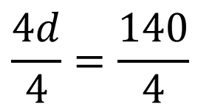


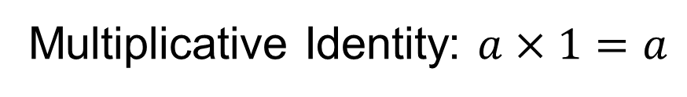
Ayasha’s House
To solve a multiplication equation, you can use the inverse operation, division.
The Division Property of Equality states that you can divide each side of the equation by the same nonzero value and maintain equality.
Division Property of Equality
Divide.
ADD ON · Add on: “I agree because ______.” or “I see it differently because ______.”
24 / 56
Notes:
TEACH IN PRACTICE | Embedded facilitation | Lesson 8.3, slide 22 | WORKED
Focus on the existing task: Ayasha’s House To solve a multiplication equation, you can use the inverse operation, division. The Division Property of Equality states…
LAUNCH (T2/3/5): Ask students to explain the displayed idea or example and point to evidence. When a calculation step is shown, ask why it is valid. Have a partner restate the explanation; copying is not the check.
LOOK FOR (T4): Where this task addresses it, students can undo multiplication or division on both sides. Ask which feature of their work supports the claim.
RESPOND: If this task shows the lesson misconception—using the reciprocal operation on only one side—label the operation attached to the variable and show its inverse on both sides. Have the student revise and explain the change. Use this support only where the concept occurs in the current task; otherwise respond to the displayed question.
RECHECK: If a gap is shared, revisit the existing representation together. If it is limited, give targeted support while others compare valid methods on the same task. Check the revision before moving on.
PARTICIPATION (T5/6/7): Think time before volunteers; accept a written, drawn or rehearsed entry. Students ask for evidence respectfully. Recognize a specific contribution or revision and check that both partners participate.
Source: BCPS Updated Instructional Framework Rubric (June 2020), TEACH 1–7. Earlier notes and answer keys are retained below.
EARLIER NOTES / EXISTING ANSWER KEY
Model briefly, then hand the thinking back: ask “Why does this step work?” before showing the next one.
Quick check before moving on — thumbs or whiteboards from everyone, not volunteers.
UIFR: TEACH 2 · TEACH 3 · TEACH 4.

Slide 25
Ayasha’s House
The distance from Ayasha’s house to the mountains is shown. The distance from her house to the mountains is four times as far as the distance from her house to the lake.
What is the distance from Ayasha’s house to the lake?
The distance from Ayasha’s house to the lake is 35 miles.
SELF-CHECK · Mark it: ✓ got it · ~ almost · ? stuck. Then fix one thing before we move on.
25 / 56
Notes:
TEACH IN PRACTICE | Embedded facilitation | Lesson 8.3, slide 23 | TASK
Focus on the existing task: Ayasha’s House The distance from Ayasha’s house to the mountains is shown. The distance from her house to the mountains is four times as…
LAUNCH (T2/3/5): Use the displayed question. Give private thinking time; then A explains while B asks for evidence. Switch roles. Each student records their own reasoning.
LOOK FOR (T4): Where this task addresses it, students can undo multiplication or division on both sides. Ask which feature of their work supports the claim.
RESPOND: If this task shows the lesson misconception—using the reciprocal operation on only one side—label the operation attached to the variable and show its inverse on both sides. Have the student revise and explain the change. Use this support only where the concept occurs in the current task; otherwise respond to the displayed question.
RECHECK: If a gap is shared, revisit the existing representation together. If it is limited, give targeted support while others compare valid methods on the same task. Check the revision before moving on.
PARTICIPATION (T5/6/7): Think time before volunteers; accept a written, drawn or rehearsed entry. Students ask for evidence respectfully. Recognize a specific contribution or revision and check that both partners participate.
Source: BCPS Updated Instructional Framework Rubric (June 2020), TEACH 1–7. Earlier notes and answer keys are retained below.
EARLIER NOTES / EXISTING ANSWER KEY
Read the context aloud (or have a student read it).
Before any math, students restate the situation and what is being asked in their own words.
Ask: What is the distance from Ayasha’s house to the lake?
UIFR: TEACH 1 · TEACH 3.

Slide 26
Let’s Explore More
Why can you use division when solving a multiplication equation?
Workspace
Why is it important to divide each side by the coefficient in a one-step multiplication equation?
Workspace
26 / 56
Notes:
TEACH IN PRACTICE | Embedded facilitation | Lesson 8.3, slide 24 | PRACTICE
Focus on the existing task: Let’s Explore More Why can you use division when solving a multiplication equation?
LAUNCH (T2/3/5): Use the displayed question. Give private thinking time; then A explains while B asks for evidence. Switch roles. Each student records their own reasoning.
LOOK FOR (T4): Where this task addresses it, students can undo multiplication or division on both sides. Ask which feature of their work supports the claim.
RESPOND: If this task shows the lesson misconception—using the reciprocal operation on only one side—label the operation attached to the variable and show its inverse on both sides. Have the student revise and explain the change. Use this support only where the concept occurs in the current task; otherwise respond to the displayed question.
RECHECK: If a gap is shared, revisit the existing representation together. If it is limited, give targeted support while others compare valid methods on the same task. Check the revision before moving on.
PARTICIPATION (T5/6/7): Think time before volunteers; accept a written, drawn or rehearsed entry. Students ask for evidence respectfully. Recognize a specific contribution or revision and check that both partners participate.
Source: BCPS Updated Instructional Framework Rubric (June 2020), TEACH 1–7. Earlier notes and answer keys are retained below.
EARLIER NOTES / EXISTING ANSWER KEY
Extension for partners or table groups — students choose their approach and use the workspace to show thinking.
Push with “Convince me,” and have two groups with different approaches share.
This is where students stretch past the worked example.
UIFR: TEACH 2 · TEACH 5.

Slide 27
STUDENT MOVES
Lesson 8-3
Your move
USE YOUR TOOLS · Reach for your notes, a model, or a manipulative before you reach for an answer.
27 / 56

Slide 28
LESSON 8.3 / DISCUSS THE TASK
Explain and compare
Use the task you just explored.
TAKE TURNS
How does the inverse operation undo the change to the variable while keeping both sides equal?
Explain
“I know this because…”
Ask
“Where does your work show that?”
Point to evidence in your work.
Then compare your approach with a partner’s.
JUSTIFY IT · Say it like this: “I know ______ because ______.”
Listen to understand. Ask for evidence. Make room for every voice.
Notes:
TEACH IN PRACTICE | Embedded facilitation | Lesson 8.3, slide 25 | PRIOR_INSERT
Focus on the existing task: Point to evidence in your work. Then compare your approach with a partner’s. TAKE TURNS Explain “I know this because…” Ask “Where does your work show that?
CONNECT (T1/4): Ask students to restate the displayed goal or key idea and connect it to earlier work. Relevant lesson evidence: undo multiplication or division on both sides; preserve equality; check the result. Use only the criterion that matches the current session.
SHOW PROGRESS: Students point to their own existing work, explain what improved after feedback, and name a next step. Pair confidence ratings with actual evidence.
PARTICIPATION (T5/6/7): Think time before volunteers; accept a written, drawn or rehearsed entry. Students ask for evidence respectfully. Recognize a specific contribution or revision and check that both partners participate.
Source: BCPS Updated Instructional Framework Rubric (June 2020), TEACH 1–7.

Slide 29
Ayasha’s House
Let’s take a closer look at the relationship between the two distances.
The distance from the house to the mountains is four times as far as the distance from the house to the lake.
What other information do you know about the two distances?
Reveal:
The distance from the house to the mountains is 140 miles, while the distance from the house to the lake is unknown.
29 / 56
Notes:
TEACH IN PRACTICE | Embedded facilitation | Lesson 8.3, slide 26 | REVEAL
Focus on the existing task: Ayasha’s House Reveal: The distance from the house to the mountains is 140 miles, while the distance from the house to the lake is…
LAUNCH (T2/3/5): If an existing answer cover is present, gather an attempt before revealing. If the explanation is already visible, ask students to reconstruct and justify it. Compare reasoning and explain a revision; preserve the reveal sequence.
LOOK FOR (T4): Where this task addresses it, students can undo multiplication or division on both sides. Ask which feature of their work supports the claim.
RESPOND: If this task shows the lesson misconception—using the reciprocal operation on only one side—label the operation attached to the variable and show its inverse on both sides. Have the student revise and explain the change. Use this support only where the concept occurs in the current task; otherwise respond to the displayed question.
RECHECK: If a gap is shared, revisit the existing representation together. If it is limited, give targeted support while others compare valid methods on the same task. Check the revision before moving on.
PARTICIPATION (T5/6/7): Think time before volunteers; accept a written, drawn or rehearsed entry. Students ask for evidence respectfully. Recognize a specific contribution or revision and check that both partners participate.
Source: BCPS Updated Instructional Framework Rubric (June 2020), TEACH 1–7.

Slide 30
STUDENT MOVES
Lesson 8-3
Your move
TAKE TURNS · One explains, one asks a question. Then switch, so both of you talk.
30 / 56

Slide 31
Ayasha’s House
We can use an equation to represent the problem.
Compare your reasoning with the
explanation. Explain any revision you make.
How can you solve the equation?
Reveal:
We can use an inverse relationship.
31 / 56
Notes:
TEACH IN PRACTICE | Embedded facilitation | Lesson 8.3, slide 27 | REVEAL
Focus on the existing task: Ayasha’s House Reveal: We can use an inverse relationship. How can you solve the equation?
LAUNCH (T2/3/5): If an existing answer cover is present, gather an attempt before revealing. If the explanation is already visible, ask students to reconstruct and justify it. Compare reasoning and explain a revision; preserve the reveal sequence.
LOOK FOR (T4): Where this task addresses it, students can undo multiplication or division on both sides. Ask which feature of their work supports the claim.
RESPOND: If this task shows the lesson misconception—using the reciprocal operation on only one side—label the operation attached to the variable and show its inverse on both sides. Have the student revise and explain the change. Use this support only where the concept occurs in the current task; otherwise respond to the displayed question.
RECHECK: If a gap is shared, revisit the existing representation together. If it is limited, give targeted support while others compare valid methods on the same task. Check the revision before moving on.
PARTICIPATION (T5/6/7): Think time before volunteers; accept a written, drawn or rehearsed entry. Students ask for evidence respectfully. Recognize a specific contribution or revision and check that both partners participate.
Source: BCPS Updated Instructional Framework Rubric (June 2020), TEACH 1–7.

Slide 32
Session 2 Warm-Up
Lesson 8-3 · Write and Solve Equations Using Multiplication or Division
Session 2 Warm-Up
Check what you remember from Session 1 · about 4 minutes
1
What is the inverse operation of multiplication?
2
To solve 4x = 28, which operation isolates x?
A
Addition
A
Multiply both sides by 4
B
Division
B
Divide both sides by 4
C
Subtraction
C
Subtract 4
D
Squaring
D
Add 28
3
Solve 4x = 28:
4
Solve m ÷ 5 = 6:
A
x = 4
A
m = 1
B
x = 7
B
m = 30
C
x = 24
C
m = 11
D
x = 112
D
m = 25
eduwonderlab.com · Neft Teacher
32 / 56
Notes:
TEACH IN PRACTICE | Embedded facilitation | Lesson 8.3, slide 28 | WARMUP
Focus on the existing task: A Addition B Division C Subtraction D Squaring 2 To solve 4x = 28, which operation isolates x?
GATHER EVIDENCE (T4/6): Keep the original items. Students try independently, mark an uncertain item, and explain one method before checking. Use the existing key when present.
RESPOND: Distinguish a calculation slip from a reasoning gap. Give one next step on the same item; have students revise in a second color. Use the responses to choose flexible support for today’s lesson.
PARTICIPATION (T5/6/7): Think time before volunteers; accept a written, drawn or rehearsed entry. Students ask for evidence respectfully. Recognize a specific contribution or revision and check that both partners participate.
Source: BCPS Updated Instructional Framework Rubric (June 2020), TEACH 1–7. Earlier notes and answer keys are retained below.
EARLIER NOTES / EXISTING ANSWER KEY
Warm-up routine: students start silently on entry; keep it to about 4 minutes.
Circulate and note who is stuck — use what you see to choose who you check on first today.
Go over answers quickly; ask one student to explain a step, not just say the answer.
UIFR: TEACH 4 · TEACH 6.
UIFR FULL | Lesson-specific facilitation
TEACH 1 | Session 2 purpose and evidence (UIFR PDF p. 8).
Have students restate the displayed session goal in their own words and connect it to the existing context or a familiar experience they choose to share. Use the current session goal to select from these lesson-wide evidence criteria; do not frontload a later-session procedure.
Look for: undo multiplication or division on both sides; preserve equality; check the result. Ask: “Which part of your work would show this?” Revisit that evidence after the task; a confidence rating alone is not evidence of understanding.

Slide 33
STUDENT MOVES
Lesson 8-3
Your move
YOU KNOW THE ROUTINE · Read → plan → solve → check. Do all four, in that order.
33 / 56

Slide 34
Today’s Math Notes
Lesson 8-3 · Write and Solve Equations Using Multiplication or Division
Review Notes — Session 2
Copy. Explain. Check.
WHY IT MATTERS · Finish this: “This is worth knowing because ______.”
Multiplication & Division Inverses
1
Multiply to undo division; divide to undo multiplication.
Isolating Coefficients
2
Divide both sides by the variable’s coefficient: ax = b implies x = b / a.
Checking Solutions
3
Substitute answer back into original equation to confirm equality.
eduwonderlab.com · Neft Teacher
34 / 56
Notes:
TEACH IN PRACTICE | Embedded facilitation | Lesson 8.3, slide 29 | NOTES
Focus on the existing task: Today’s Math Notes Review Notes…
ROUTINE (T1/2/4): Read or copy the original notes, cover one line, and explain it using the displayed example. Reopen and correct. Copying alone is not evidence of understanding.
LOOK FOR: A link between a symbol, quantity or feature and the explanation. If missing, point back to that feature and have the student try again; fade the prompt once they can explain.
PARTICIPATION (T5/6/7): Think time before volunteers; accept a written, drawn or rehearsed entry. Students ask for evidence respectfully. Recognize a specific contribution or revision and check that both partners participate.
Source: BCPS Updated Instructional Framework Rubric (June 2020), TEACH 1–7. Earlier notes and answer keys are retained below.
EARLIER NOTES / EXISTING ANSWER KEY
Copy routine: read one line at a time; students copy, then explain that line to a partner.
Keep it brisk — the understanding work happens in the examples, not the copying.
UIFR: TEACH 1 · TEACH 6.

Slide 35
Session 2
Write and Solve Equations Using Multiplication or Division
PICK YOUR STRATEGY · Choose your path — picture, table, number line, or equation — and be ready to say why you chose it.
35 / 56
Notes:
TEACH IN PRACTICE | Embedded facilitation | Lesson 8.3, slide 30 | DIVIDER
Focus on the existing task: Write and Solve Equations Using Multiplication or Division Session 2
TRANSITION (T6/7): Students confirm materials, roles, how to request help, and the next response routine. Ask a student to restate it. Keep teacher-only slides hidden.
PARTICIPATION (T5/6/7): Think time before volunteers; accept a written, drawn or rehearsed entry. Students ask for evidence respectfully. Recognize a specific contribution or revision and check that both partners participate.
Source: BCPS Updated Instructional Framework Rubric (June 2020), TEACH 1–7. Earlier notes and answer keys are retained below.
EARLIER NOTES / EXISTING ANSWER KEY
Transition cue: state what materials are out and what success looks like this session.
Keep the changeover under a minute.
UIFR: TEACH 6.

Slide 36

Free Books
The local library has some books to give away. The librarian will divide the books into 21 packets resulting with the number of books shown in each packet. How many books does the library have to give away?
What information is given? What information is unknown?
Reveal:
The books can be divided into 21 packets.
There will be 6 books in each packet.
The number of books the library has to give away is unknown.
36 / 56
Notes:
TEACH IN PRACTICE | Embedded facilitation | Lesson 8.3, slide 31 | REVEAL
Focus on the existing task: What information is given?
LAUNCH (T2/3/5): If an existing answer cover is present, gather an attempt before revealing. If the explanation is already visible, ask students to reconstruct and justify it. Compare reasoning and explain a revision; preserve the reveal sequence.
LOOK FOR (T4): Where this task addresses it, students can undo multiplication or division on both sides. Ask which feature of their work supports the claim.
RESPOND: If this task shows the lesson misconception—using the reciprocal operation on only one side—label the operation attached to the variable and show its inverse on both sides. Have the student revise and explain the change. Use this support only where the concept occurs in the current task; otherwise respond to the displayed question.
RECHECK: If a gap is shared, revisit the existing representation together. If it is limited, give targeted support while others compare valid methods on the same task. Check the revision before moving on.
PARTICIPATION (T5/6/7): Think time before volunteers; accept a written, drawn or rehearsed entry. Students ask for evidence respectfully. Recognize a specific contribution or revision and check that both partners participate.
Source: BCPS Updated Instructional Framework Rubric (June 2020), TEACH 1–7. Earlier notes and answer keys are retained below.
EARLIER NOTES / EXISTING ANSWER KEY
Do not click yet: collect 2–3 student answers with reasons first.
Then click to remove the cover and have students compare their thinking to the reveal — “Is this what we said? Where is it different?”
Behind the cover: The books can be divided into 21 packets. There will be 6 books in each packet. The number of books the library has to give away is unknown.
UIFR: TEACH 3 · TEACH 4.
UIFR FULL | Lesson-specific facilitation
TEACH 2-3 | Session 2 task launch (UIFR PDF pp. 9-10).
Use the problem exactly as displayed. Give individual thinking time before discussion or advancing to the explanation. If the answer is already visible, ask students to reconstruct and justify it. Invite a choice of suitable representations and have students explain why their choice helps.
At the point where this concept appears, ask: “How does the inverse operation undo the change to the variable while keeping both sides equal?” Wait for evidence, invite another pathway, and have a student ask a follow-up question. Do not replace students’ reasoning with a sequence of leading steps.

Slide 37
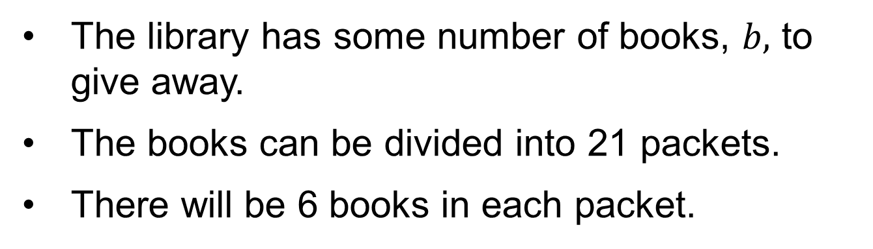

Free Books
Describe, in words, the relationship between the total number of books, the number of packets, and the number of books in each packet.
Using Representations
How can you use a picture to model the problem?
37 / 56
Notes:
TEACH IN PRACTICE | Embedded facilitation | Lesson 8.3, slide 32 | TASK
Focus on the existing task: Free Books Using Representations How can you use a picture to model the problem?
LAUNCH (T2/3/5): Use the displayed question. Give private thinking time; then A explains while B asks for evidence. Switch roles. Each student records their own reasoning.
LOOK FOR (T4): Where this task addresses it, students can undo multiplication or division on both sides. Ask which feature of their work supports the claim.
RESPOND: If this task shows the lesson misconception—using the reciprocal operation on only one side—label the operation attached to the variable and show its inverse on both sides. Have the student revise and explain the change. Use this support only where the concept occurs in the current task; otherwise respond to the displayed question.
RECHECK: If a gap is shared, revisit the existing representation together. If it is limited, give targeted support while others compare valid methods on the same task. Check the revision before moving on.
PARTICIPATION (T5/6/7): Think time before volunteers; accept a written, drawn or rehearsed entry. Students ask for evidence respectfully. Recognize a specific contribution or revision and check that both partners participate.
Source: BCPS Updated Instructional Framework Rubric (June 2020), TEACH 1–7. Earlier notes and answer keys are retained below.
EARLIER NOTES / EXISTING ANSWER KEY
Read the context aloud (or have a student read it).
Before any math, students restate the situation and what is being asked in their own words.
Ask: How can you use a picture to model the problem?
UIFR: TEACH 1 · TEACH 3.

Slide 38
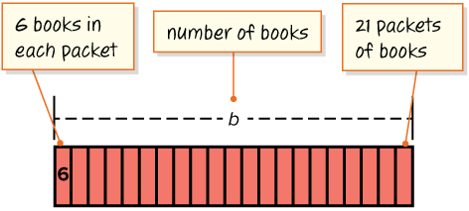
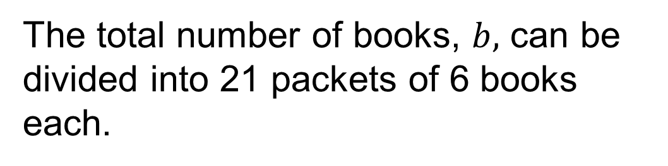
Free Books
Let’s use a tape diagram to think about the structure of the relationship.
The situation is looking for the whole given two parts.
How can you represent the relationship algebraically?
Reveal:
We can use a division equation.
38 / 56
Notes:
TEACH IN PRACTICE | Embedded facilitation | Lesson 8.3, slide 33 | REVEAL
Focus on the existing task: Free Books Reveal: We can use a division equation. Let’s use a tape diagram to think about the structure of the relationship. How can you represent the relationship algebraically?
LAUNCH (T2/3/5): If an existing answer cover is present, gather an attempt before revealing. If the explanation is already visible, ask students to reconstruct and justify it. Compare reasoning and explain a revision; preserve the reveal sequence.
LOOK FOR (T4): Where this task addresses it, students can undo multiplication or division on both sides. Ask which feature of their work supports the claim.
RESPOND: If this task shows the lesson misconception—using the reciprocal operation on only one side—label the operation attached to the variable and show its inverse on both sides. Have the student revise and explain the change. Use this support only where the concept occurs in the current task; otherwise respond to the displayed question.
RECHECK: If a gap is shared, revisit the existing representation together. If it is limited, give targeted support while others compare valid methods on the same task. Check the revision before moving on.
PARTICIPATION (T5/6/7): Think time before volunteers; accept a written, drawn or rehearsed entry. Students ask for evidence respectfully. Recognize a specific contribution or revision and check that both partners participate.
Source: BCPS Updated Instructional Framework Rubric (June 2020), TEACH 1–7. Earlier notes and answer keys are retained below.
EARLIER NOTES / EXISTING ANSWER KEY
Do not click yet: collect 2–3 student answers with reasons first.
Then click to remove the cover and have students compare their thinking to the reveal — “Is this what we said? Where is it different?”
Behind the cover: We can use a division equation.
UIFR: TEACH 3 · TEACH 4.

Slide 39
STUDENT MOVES
Lesson 8-3
Your moves
SPECIFIC FEEDBACK · Trade work. Give one specific comment: “This part is clear because ______.”
TWO MINUTES SOLO · Two minutes on your own, then compare. Bring one thing you tried, even if it did not work.
ASK THE CLASS · Write one question about this that you could ask the class.
39 / 56

Slide 40
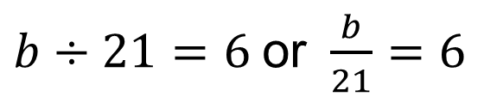
Free Books
We can use a division equation to represent the problem.
Record your reasoning before the
reveal. Compare, then explain
any revision.
How can you use an inverse operation to solve the equation?
Reveal:
We can use the opposite of division, multiplication.
40 / 56
Notes:
TEACH IN PRACTICE | Embedded facilitation | Lesson 8.3, slide 34 | REVEAL
Focus on the existing task: Free Books How can you use an inverse operation to solve the equation?
LAUNCH (T2/3/5): If an existing answer cover is present, gather an attempt before revealing. If the explanation is already visible, ask students to reconstruct and justify it. Compare reasoning and explain a revision; preserve the reveal sequence.
LOOK FOR (T4): Where this task addresses it, students can undo multiplication or division on both sides. Ask which feature of their work supports the claim.
RESPOND: If this task shows the lesson misconception—using the reciprocal operation on only one side—label the operation attached to the variable and show its inverse on both sides. Have the student revise and explain the change. Use this support only where the concept occurs in the current task; otherwise respond to the displayed question.
RECHECK: If a gap is shared, revisit the existing representation together. If it is limited, give targeted support while others compare valid methods on the same task. Check the revision before moving on.
PARTICIPATION (T5/6/7): Think time before volunteers; accept a written, drawn or rehearsed entry. Students ask for evidence respectfully. Recognize a specific contribution or revision and check that both partners participate.
Source: BCPS Updated Instructional Framework Rubric (June 2020), TEACH 1–7. Earlier notes and answer keys are retained below.
EARLIER NOTES / EXISTING ANSWER KEY
Do not click yet: collect 2–3 student answers with reasons first.
Then click to remove the cover and have students compare their thinking to the reveal — “Is this what we said? Where is it different?”
Behind the cover: We can use the opposite of division, multiplication.
UIFR: TEACH 3 · TEACH 4.

Slide 41
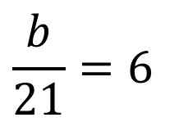
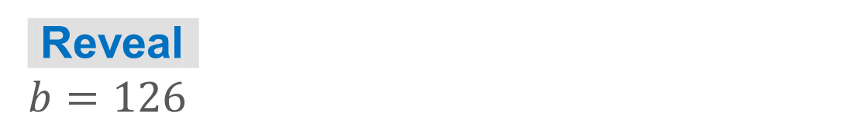
COLLABORATE · TALK IT THROUGH • AGREE ON A MODEL
Collaborate and Connect
To solve a division equation, you can use the inverse operation, multiplication.
The Multiplication Property of Equality states that you can multiply each side of the equation by the same nonzero value and maintain equality.
Think first. A explains; B asks for evidence. Switch roles;
both revise.
Use the Multiplication Property of Equality to solve the equation. Show your work.
41 / 56
Notes:
TEACH IN PRACTICE | Embedded facilitation | Lesson 8.3, slide 35 | COLLABORATE
Focus on the existing task: To solve a division equation, you can use the inverse operation, multiplication. Collaborate and Connect Use the Multiplication Property…
LAUNCH (T2/3/5): Use the displayed question. Give private thinking time; then A explains while B asks for evidence. Switch roles. Each student records their own reasoning.
LOOK FOR (T4): Where this task addresses it, students can undo multiplication or division on both sides. Ask which feature of their work supports the claim.
RESPOND: If this task shows the lesson misconception—using the reciprocal operation on only one side—label the operation attached to the variable and show its inverse on both sides. Have the student revise and explain the change. Use this support only where the concept occurs in the current task; otherwise respond to the displayed question.
RECHECK: If a gap is shared, revisit the existing representation together. If it is limited, give targeted support while others compare valid methods on the same task. Check the revision before moving on.
PARTICIPATION (T5/6/7): Think time before volunteers; accept a written, drawn or rehearsed entry. Students ask for evidence respectfully. Recognize a specific contribution or revision and check that both partners participate.
Source: BCPS Updated Instructional Framework Rubric (June 2020), TEACH 1–7. Earlier notes and answer keys are retained below.
EARLIER NOTES / EXISTING ANSWER KEY
Routine: COLLABORATE · TALK IT THROUGH • AGREE ON A MODEL
UIFR FULL | Lesson-specific facilitation
TEACH 4-5 | Session 2 discussion and checkpoint (UIFR PDF pp. 11-12).
Collect a brief response from every student to the existing prompt before hearing volunteers. Partners take turns explaining and asking for evidence: “I understand ___; what supports ___?” Offer rehearsal or an annotated model for students who need language support. Each student records their own reasoning.
Look specifically for: using the reciprocal operation on only one side. If it appears, label the operation attached to the variable and show its inverse on both sides; then ask the student to revise the same response and explain the change. If evidence is secure, have students compare a second valid pathway or state why their approach works. Choose the next step from the responses, not a preset pace.

Slide 42
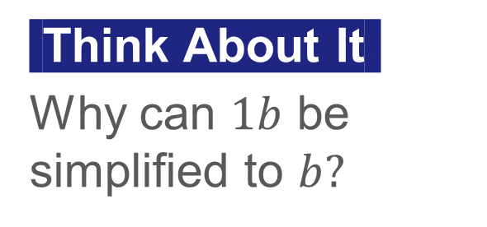
Free Books
Let’s use the Multiplication Property of Equality to solve the equation.
 | Multiplication Property of Equality
 | Multiply.
Explain how your equation represents the situation. Check
the result.
42 / 56
Notes:
TEACH IN PRACTICE | Embedded facilitation | Lesson 8.3, slide 36 | WORKED
Focus on the existing task: Let’s use the Multiplication Property of Equality to solve the equation. Free Books Multiplication Property of Equality Multiply.
LAUNCH (T2/3/5): Ask students to explain the displayed idea or example and point to evidence. When a calculation step is shown, ask why it is valid. Have a partner restate the explanation; copying is not the check.
LOOK FOR (T4): Where this task addresses it, students can undo multiplication or division on both sides. Ask which feature of their work supports the claim.
RESPOND: If this task shows the lesson misconception—using the reciprocal operation on only one side—label the operation attached to the variable and show its inverse on both sides. Have the student revise and explain the change. Use this support only where the concept occurs in the current task; otherwise respond to the displayed question.
RECHECK: If a gap is shared, revisit the existing representation together. If it is limited, give targeted support while others compare valid methods on the same task. Check the revision before moving on.
PARTICIPATION (T5/6/7): Think time before volunteers; accept a written, drawn or rehearsed entry. Students ask for evidence respectfully. Recognize a specific contribution or revision and check that both partners participate.
Source: BCPS Updated Instructional Framework Rubric (June 2020), TEACH 1–7. Earlier notes and answer keys are retained below.
EARLIER NOTES / EXISTING ANSWER KEY
Model briefly, then hand the thinking back: ask “Why does this step work?” before showing the next one.
Quick check before moving on — thumbs or whiteboards from everyone, not volunteers.
UIFR: TEACH 2 · TEACH 3 · TEACH 4.

Slide 43
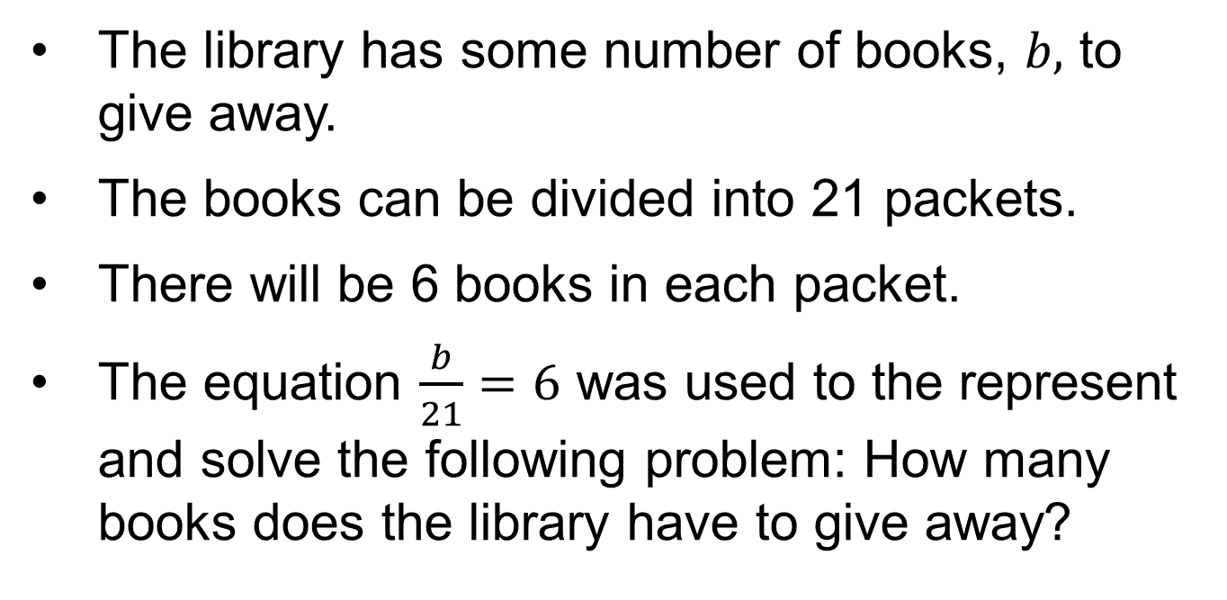
Let’s Explore More
Try it yourself. Compare your work with a partner; explain one choice and revise.
43 / 56
Notes:
TEACH IN PRACTICE | Embedded facilitation | Lesson 8.3, slide 37 | PRACTICE
Focus on the existing task: Let’s Explore More
LAUNCH (T2/3/5): Use the displayed question. Give private thinking time; then A explains while B asks for evidence. Switch roles. Each student records their own reasoning.
LOOK FOR (T4): Where this task addresses it, students can undo multiplication or division on both sides. Ask which feature of their work supports the claim.
RESPOND: If this task shows the lesson misconception—using the reciprocal operation on only one side—label the operation attached to the variable and show its inverse on both sides. Have the student revise and explain the change. Use this support only where the concept occurs in the current task; otherwise respond to the displayed question.
RECHECK: If a gap is shared, revisit the existing representation together. If it is limited, give targeted support while others compare valid methods on the same task. Check the revision before moving on.
PARTICIPATION (T5/6/7): Think time before volunteers; accept a written, drawn or rehearsed entry. Students ask for evidence respectfully. Recognize a specific contribution or revision and check that both partners participate.
Source: BCPS Updated Instructional Framework Rubric (June 2020), TEACH 1–7. Earlier notes and answer keys are retained below.
EARLIER NOTES / EXISTING ANSWER KEY
Extension for partners or table groups — students choose their approach and use the workspace to show thinking.
Push with “Convince me,” and have two groups with different approaches share.
This is where students stretch past the worked example.
UIFR: TEACH 2 · TEACH 5.

Slide 44
Let’s Explore More
What is another equation that represents the problem? Explain your reasoning.
Workspace
Why is it important to multiply each side by the divisor in a one-step division equation?
Workspace
44 / 56
Notes:
TEACH IN PRACTICE | Embedded facilitation | Lesson 8.3, slide 38 | PRACTICE
Focus on the existing task: Let’s Explore More What is another equation that represents the problem?
LAUNCH (T2/3/5): Use the displayed question. Give private thinking time; then A explains while B asks for evidence. Switch roles. Each student records their own reasoning.
LOOK FOR (T4): Where this task addresses it, students can undo multiplication or division on both sides. Ask which feature of their work supports the claim.
RESPOND: If this task shows the lesson misconception—using the reciprocal operation on only one side—label the operation attached to the variable and show its inverse on both sides. Have the student revise and explain the change. Use this support only where the concept occurs in the current task; otherwise respond to the displayed question.
RECHECK: If a gap is shared, revisit the existing representation together. If it is limited, give targeted support while others compare valid methods on the same task. Check the revision before moving on.
PARTICIPATION (T5/6/7): Think time before volunteers; accept a written, drawn or rehearsed entry. Students ask for evidence respectfully. Recognize a specific contribution or revision and check that both partners participate.
Source: BCPS Updated Instructional Framework Rubric (June 2020), TEACH 1–7. Earlier notes and answer keys are retained below.
EARLIER NOTES / EXISTING ANSWER KEY
Extension for partners or table groups — students choose their approach and use the workspace to show thinking.
Push with “Convince me,” and have two groups with different approaches share.
This is where students stretch past the worked example.
UIFR: TEACH 2 · TEACH 5.

Slide 45
STUDENT MOVES
Lesson 8-3
Your move
YOUR CHOICE · You choose how to show this — numbers, words, or a diagram. Make your reasoning visible.
45 / 56

Slide 46
LESSON 8.3 / CHECK YOUR WORK
Pause. Check. Improve.
CHECK
A mistake to watch for: using the reciprocal operation on only one side.
TRY
Label the operation attached to the variable and show its inverse on both sides.
REVISE
Use that check on the task you just completed. Correct or strengthen one part, and explain why.
REVISE NOW · Change one answer and write why you changed it. A revision is evidence of learning.
Listen to understand. Ask for evidence. Make room for every voice.
Notes:
TEACH IN PRACTICE | Embedded facilitation | Lesson 8.3, slide 39 | PRIOR_INSERT
Focus on the existing task: LESSON 8.3 / CHECK YOUR WORK Pause. Check. Improve. Listen to understand. Ask for evidence. Make room for every voice. CHECK A mistake…
CONNECT (T1/4): Ask students to restate the displayed goal or key idea and connect it to earlier work. Relevant lesson evidence: undo multiplication or division on both sides; preserve equality; check the result. Use only the criterion that matches the current session.
SHOW PROGRESS: Students point to their own existing work, explain what improved after feedback, and name a next step. Pair confidence ratings with actual evidence.
PARTICIPATION (T5/6/7): Think time before volunteers; accept a written, drawn or rehearsed entry. Students ask for evidence respectfully. Recognize a specific contribution or revision and check that both partners participate.
Source: BCPS Updated Instructional Framework Rubric (June 2020), TEACH 1–7.

Slide 47
Free Books
Let’s use a tape diagram to think about the structure of the relationship.
The situation is looking for the whole given two parts.
How can you represent the relationship algebraically?
Reveal:
We can use a division equation.
47 / 56
Notes:
TEACH IN PRACTICE | Embedded facilitation | Lesson 8.3, slide 40 | REVEAL
Focus on the existing task: Free Books Reveal: We can use a division equation. Let’s use a tape diagram to think about the structure of the relationship. How can you represent the relationship algebraically?
LAUNCH (T2/3/5): If an existing answer cover is present, gather an attempt before revealing. If the explanation is already visible, ask students to reconstruct and justify it. Compare reasoning and explain a revision; preserve the reveal sequence.
LOOK FOR (T4): Where this task addresses it, students can undo multiplication or division on both sides. Ask which feature of their work supports the claim.
RESPOND: If this task shows the lesson misconception—using the reciprocal operation on only one side—label the operation attached to the variable and show its inverse on both sides. Have the student revise and explain the change. Use this support only where the concept occurs in the current task; otherwise respond to the displayed question.
RECHECK: If a gap is shared, revisit the existing representation together. If it is limited, give targeted support while others compare valid methods on the same task. Check the revision before moving on.
PARTICIPATION (T5/6/7): Think time before volunteers; accept a written, drawn or rehearsed entry. Students ask for evidence respectfully. Recognize a specific contribution or revision and check that both partners participate.
Source: BCPS Updated Instructional Framework Rubric (June 2020), TEACH 1–7.

Slide 48
STUDENT MOVES
Lesson 8-3
Your move
PICK YOUR STRATEGY · Choose your path — picture, table, number line, or equation — and be ready to say why you chose it.
48 / 56

Slide 49
Free Books
We can use a division equation to represent the problem.
Compare your reasoning with the
explanation. Explain any revision
you make.
How can you use an inverse operation to solve the equation?
Reveal:
We can use the opposite of division, multiplication.
49 / 56
Notes:
TEACH IN PRACTICE | Embedded facilitation | Lesson 8.3, slide 41 | REVEAL
Focus on the existing task: Free Books How can you use an inverse operation to solve the equation?
LAUNCH (T2/3/5): If an existing answer cover is present, gather an attempt before revealing. If the explanation is already visible, ask students to reconstruct and justify it. Compare reasoning and explain a revision; preserve the reveal sequence.
LOOK FOR (T4): Where this task addresses it, students can undo multiplication or division on both sides. Ask which feature of their work supports the claim.
RESPOND: If this task shows the lesson misconception—using the reciprocal operation on only one side—label the operation attached to the variable and show its inverse on both sides. Have the student revise and explain the change. Use this support only where the concept occurs in the current task; otherwise respond to the displayed question.
RECHECK: If a gap is shared, revisit the existing representation together. If it is limited, give targeted support while others compare valid methods on the same task. Check the revision before moving on.
PARTICIPATION (T5/6/7): Think time before volunteers; accept a written, drawn or rehearsed entry. Students ask for evidence respectfully. Recognize a specific contribution or revision and check that both partners participate.
Source: BCPS Updated Instructional Framework Rubric (June 2020), TEACH 1–7.

Slide 50
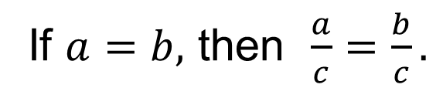
SUMMARIZE · SAY IT IN YOUR OWN WORDS
Summarize: Write and Solve Equations Using Multiplication or Division
You can solve multiplication and division equations using inverse relationships and properties of equality.
Division Property of Equality
You can divide each side of the equation by the same nonzero value and maintain the equality.
Explain the key idea without reading. Use today’s example as evidence.
50 / 56
Notes:
TEACH IN PRACTICE | Embedded facilitation | Lesson 8.3, slide 42 | SUMMARIZE
Focus on the existing task: Summarize: Write and Solve Equations Using Multiplication or Division You can solve multiplication and division equations using inverse…
CONNECT (T1/4): Ask students to restate the displayed goal or key idea and connect it to earlier work. Relevant lesson evidence: undo multiplication or division on both sides; preserve equality; check the result. Use only the criterion that matches the current session.
SHOW PROGRESS: Students point to their own existing work, explain what improved after feedback, and name a next step. Pair confidence ratings with actual evidence.
PARTICIPATION (T5/6/7): Think time before volunteers; accept a written, drawn or rehearsed entry. Students ask for evidence respectfully. Recognize a specific contribution or revision and check that both partners participate.
Source: BCPS Updated Instructional Framework Rubric (June 2020), TEACH 1–7. Earlier notes and answer keys are retained below.
EARLIER NOTES / EXISTING ANSWER KEY
Routine: SUMMARIZE · SAY IT IN YOUR OWN WORDS

Slide 51
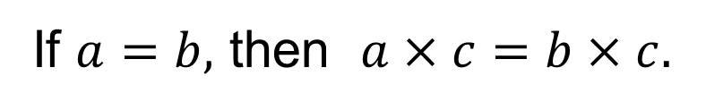
SUMMARIZE · SAY IT IN YOUR OWN WORDS
Summarize: Write and Solve Equations Using Multiplication or Division
You can solve multiplication and division equations using inverse relationships and properties of equality.
Multiplication Property of Equality
You can multiply each side of the equation by the same nonzero value and maintain the equality.
Explain the key idea without reading. Use today’s example as evidence.
51 / 56
Notes:
TEACH IN PRACTICE | Embedded facilitation | Lesson 8.3, slide 43 | SUMMARIZE
Focus on the existing task: Summarize: Write and Solve Equations Using Multiplication or Division You can solve multiplication and division equations using inverse…
CONNECT (T1/4): Ask students to restate the displayed goal or key idea and connect it to earlier work. Relevant lesson evidence: undo multiplication or division on both sides; preserve equality; check the result. Use only the criterion that matches the current session.
SHOW PROGRESS: Students point to their own existing work, explain what improved after feedback, and name a next step. Pair confidence ratings with actual evidence.
PARTICIPATION (T5/6/7): Think time before volunteers; accept a written, drawn or rehearsed entry. Students ask for evidence respectfully. Recognize a specific contribution or revision and check that both partners participate.
Source: BCPS Updated Instructional Framework Rubric (June 2020), TEACH 1–7. Earlier notes and answer keys are retained below.
EARLIER NOTES / EXISTING ANSWER KEY
Routine: SUMMARIZE · SAY IT IN YOUR OWN WORDS

Slide 52
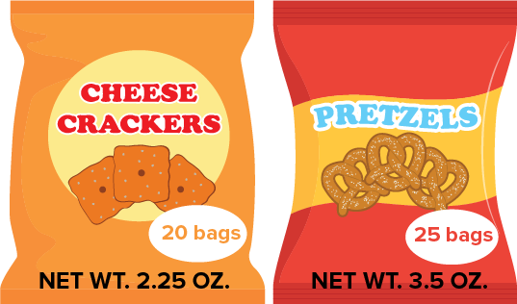
APPLY · PLAN IT • SOLVE IT • PROVE IT
Apply: Snack Bags
The student council buys snacks in bulk to sell during lunch. One box of snacks contains the types and quantities of snacks shown below. The first month, the student council sold 115 bags of snacks, including 50 bags of cheese crackers.
Question: How many boxes of snacks would you recommend the student council order for next month?
Choose a method. Solve
independently, justify your
answer, then check the goal.
52 / 56
Notes:
TEACH IN PRACTICE | Embedded facilitation | Lesson 8.3, slide 44 | APPLY
Focus on the existing task: Apply: Snack Bags The student council buys snacks in bulk to sell during lunch. One box of snacks contains the types and quantities of…
LAUNCH (T2/3/5): Use the exact application task independently first. Ask students to justify their choice of method. Collect evidence before a partner discussion or correction.
LOOK FOR (T4): Where this task addresses it, students can undo multiplication or division on both sides. Ask which feature of their work supports the claim.
RESPOND: If this task shows the lesson misconception—using the reciprocal operation on only one side—label the operation attached to the variable and show its inverse on both sides. Have the student revise and explain the change. Use this support only where the concept occurs in the current task; otherwise respond to the displayed question.
RECHECK: If a gap is shared, revisit the existing representation together. If it is limited, give targeted support while others compare valid methods on the same task. Check the revision before moving on.
PARTICIPATION (T5/6/7): Think time before volunteers; accept a written, drawn or rehearsed entry. Students ask for evidence respectfully. Recognize a specific contribution or revision and check that both partners participate.
Source: BCPS Updated Instructional Framework Rubric (June 2020), TEACH 1–7. Earlier notes and answer keys are retained below.
EARLIER NOTES / EXISTING ANSWER KEY
Routine: APPLY · PLAN IT • SOLVE IT • PROVE IT
UIFR FULL | Lesson-specific facilitation
TEACH 4 | Independent evidence and revision (UIFR PDF p. 11).
Use the existing application/exit problem as the independent check. If this is a learning-target slide, have students point to and explain their work on the preceding task. Separate initial independent evidence from the revision after feedback.
Check the relevant criteria: undo multiplication or division on both sides; preserve equality; check the result. Respond with one specific next step tied to the work. Students revise and annotate what changed, then identify a criterion they can now demonstrate and one they still need to practice.

Slide 53
Learning Targets
I can write and solve one-step multiplication equations using the Division Property of Equality.
I can write and solve one-step division equations using the Multiplication Property of Equality.
I can make sense of quantities to write and solve one-step equations.
Point to evidence in your work. Name what improved and your next step.
53 / 56
Notes:
TEACH IN PRACTICE | Embedded facilitation | Lesson 8.3, slide 45 | REFLECTION
Focus on the existing task: Learning Targets I can write and solve one-step multiplication equations using the Division Property of Equality. I can write and solve…
CONNECT (T1/4): Ask students to restate the displayed goal or key idea and connect it to earlier work. Relevant lesson evidence: undo multiplication or division on both sides; preserve equality; check the result. Use only the criterion that matches the current session.
SHOW PROGRESS: Students point to their own existing work, explain what improved after feedback, and name a next step. Pair confidence ratings with actual evidence.
PARTICIPATION (T5/6/7): Think time before volunteers; accept a written, drawn or rehearsed entry. Students ask for evidence respectfully. Recognize a specific contribution or revision and check that both partners participate.
Source: BCPS Updated Instructional Framework Rubric (June 2020), TEACH 1–7. Earlier notes and answer keys are retained below.
EARLIER NOTES / EXISTING ANSWER KEY
Read each target; students self-rate with fist-to-five or thumbs.
Tie back to the goal from the start of class: did we get there?
Note any target that rates low — revisit it tomorrow.
UIFR: TEACH 1 · TEACH 4.

Slide 54
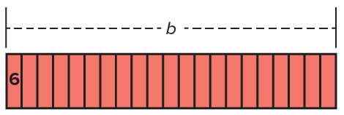
Be Curious
Be Curious
What do you notice?
What do you wonder?
Think first. Share a notice and a question;
build on a classmate’s idea.
Mindset
How is being respectful of others, even if you disagree with their reasoning, helpful in math class?
54 / 56
Notes:
TEACH IN PRACTICE | Embedded facilitation | Lesson 8.3, slide 46 | CURIOUS
Focus on the existing task: Be Curious What do you notice?
LAUNCH (T2/3/5): Allow quiet observation first. Separate a notice from an inference, invite students’ own questions, and follow the existing launch before teaching a procedure.
LOOK FOR (T4): Where this task addresses it, students can undo multiplication or division on both sides. Ask which feature of their work supports the claim.
RESPOND: If this task shows the lesson misconception—using the reciprocal operation on only one side—label the operation attached to the variable and show its inverse on both sides. Have the student revise and explain the change. Use this support only where the concept occurs in the current task; otherwise respond to the displayed question.
RECHECK: If a gap is shared, revisit the existing representation together. If it is limited, give targeted support while others compare valid methods on the same task. Check the revision before moving on.
PARTICIPATION (T5/6/7): Think time before volunteers; accept a written, drawn or rehearsed entry. Students ask for evidence respectfully. Recognize a specific contribution or revision and check that both partners participate.
Source: BCPS Updated Instructional Framework Rubric (June 2020), TEACH 1–7.

Slide 55
Learning Targets
I can write and solve one-step multiplication equations using the Division Property of Equality.
I can write and solve one-step division equations using the Multiplication Property of Equality.
I can make sense of quantities to write and solve one-step equations.
Point to evidence in your work. Name what improved and your next step.
55 / 56
Notes:
TEACH IN PRACTICE | Embedded facilitation | Lesson 8.3, slide 47 | REFLECTION
Focus on the existing task: Learning Targets I can write and solve one-step multiplication equations using the Division Property of Equality. I can write and solve…
CONNECT (T1/4): Ask students to restate the displayed goal or key idea and connect it to earlier work. Relevant lesson evidence: undo multiplication or division on both sides; preserve equality; check the result. Use only the criterion that matches the current session.
SHOW PROGRESS: Students point to their own existing work, explain what improved after feedback, and name a next step. Pair confidence ratings with actual evidence.
PARTICIPATION (T5/6/7): Think time before volunteers; accept a written, drawn or rehearsed entry. Students ask for evidence respectfully. Recognize a specific contribution or revision and check that both partners participate.
Source: BCPS Updated Instructional Framework Rubric (June 2020), TEACH 1–7. Earlier notes and answer keys are retained below.
EARLIER NOTES / EXISTING ANSWER KEY
UIFR FULL | Lesson-specific facilitation
REFLECT & ADJUST 1-2 | After the lesson (UIFR PDF pp. 15-16).
Sort the existing work by demonstrated reasoning, partial understanding, and the specific misconception: using the reciprocal operation on only one side. Compare the initial response with the revision. Record which teaching move plausibly helped, which did not, and whose participation or access needs a different approach; do not record sensitive student details in this shared deck.
Plan the next lesson from that evidence: if the misconception persists, label the operation attached to the variable and show its inverse on both sides using the current example before returning to the next grade-level task; if understanding is secure, use an existing extension or ask for a general explanation. Check the targeted idea again at the next warm-up.
Ask students what supported their thinking and what would help next time. Identify one change to try and one successful practice to retain. Seek colleague feedback on anonymized work when useful; these prompts support reflection and do not establish an evaluation rating. Source: Baltimore City Public Schools, Updated Instructional Framework Rubric, June 2020 (UIFR_Full.pdf).

Slide 56
LESSON 8.3 / REFLECT ON YOUR LEARNING
Show your progress
1 SHOW EVIDENCE
2 CHOOSE A NEXT STEP
Choose one response. Point to the part that shows your reasoning.
Name a change you made after feedback—or a question you still have.
“My work shows ___ because ___.”
“Next time, I will ___ to help me ___.”
Today’s focus: Undo multiplication or division on both sides.
CREDIT A CLASSMATE · Name one classmate whose idea helped you today, and say what they said.
Listen to understand. Ask for evidence. Make room for every voice.
Notes:
TEACH IN PRACTICE | Embedded facilitation | Lesson 8.3, slide 48 | PRIOR_INSERT
Focus on the existing task: LESSON 8.3 / REFLECT ON YOUR LEARNING Show your progress Listen to understand. Ask for evidence. Make room for every voice. 1 SHOW…
CONNECT (T1/4): Ask students to restate the displayed goal or key idea and connect it to earlier work. Relevant lesson evidence: undo multiplication or division on both sides; preserve equality; check the result. Use only the criterion that matches the current session.
SHOW PROGRESS: Students point to their own existing work, explain what improved after feedback, and name a next step. Pair confidence ratings with actual evidence.
PARTICIPATION (T5/6/7): Think time before volunteers; accept a written, drawn or rehearsed entry. Students ask for evidence respectfully. Recognize a specific contribution or revision and check that both partners participate.
Source: BCPS Updated Instructional Framework Rubric (June 2020), TEACH 1–7.

