Slide 1
WARM-UP · THINK • TRY • CHECK
Turn and talk: compare strategies, then defend one.
Warm-Up
Lesson 8-4 · Write and Represent Inequalities | Warm-Up · about 4 minutes
Try each on your own. Mark an unsure answer; explain and revise when we check.
QUESTION 1
QUESTION 2
Write < or > : 7 ______ 12
At least 48 inches tall means
h ______ 48
QUESTION 3
QUESTION 4
Which is farther right on a number line:
−3 or 2? ______
Is 9 a solution of x > 9? ______
TALK IT OVER: “I got ______ because ______.” • Compare with a partner before we check as a class.
1 / 49
Notes:
TEACH IN PRACTICE | Embedded facilitation | Lesson 8.4, slide 1 | WARMUP
Focus on the existing task: ______ QUESTION 4 Is 9 a solution of x > 9?
GATHER EVIDENCE (T4/6): Keep the original items. Students try independently, mark an uncertain item, and explain one method before checking. Use the existing key when present.
RESPOND: Distinguish a calculation slip from a reasoning gap. Give one next step on the same item; have students revise in a second color. Use the responses to choose flexible support for today’s lesson.
PARTICIPATION (T5/6/7): Think time before volunteers; accept a written, drawn or rehearsed entry. Students ask for evidence respectfully. Recognize a specific contribution or revision and check that both partners participate.
Source: BCPS Updated Instructional Framework Rubric (June 2020), TEACH 1–7. Earlier notes and answer keys are retained below.
EARLIER NOTES / EXISTING ANSWER KEY
Warm-Up answers (teacher only): 1) < 2) ≥ 3) 2 4) no
UIFR FULL | Lesson-specific facilitation
PREPARE 1-2 | Before teaching (UIFR PDF pp. 6-7).
Plan to gather evidence that students can translate a constraint; distinguish strict from inclusive bounds; explain multiple solutions. Review recent work and today’s warm-up to choose flexible groups and access supports; do not infer needs from identity or perceived ability. Use the existing lesson tasks and stated standards.
Anticipate: confusing at least with greater than or reversing the comparison. If observed, test the boundary against the original words before selecting the symbol. Offer oral rehearsal, drawing, pointing, or home-language processing as needed; retain the original mathematical demand. Ask students which support helps and fade it as evidence improves.
TEACH 6-7 | Before the first transition, agree on materials, partner roles, and how to request help. Invite students to restate the routine. Normalize revising an idea, recognize a specific contribution, and check privately when frustration blocks participation. Source: UIFR PDF pp. 13-14.

Slide 2
Today’s Math Notes
Lesson 8-4 · Write and Represent Inequalities
Section 1: Math Words
Copy. Explain. Check.
SAY THE GOAL · Say today’s goal in your own words, then name one place this shows up outside math class.
Write Inequalities
1
Represent a range of possible values with <
Inequality
2
A math sentence that compares two sides with <
Greater than
3
The > sign, showing one number is bigger
eduwonderlab.com · Neft Teacher
2 / 49
Notes:
TEACH IN PRACTICE | Embedded facilitation | Lesson 8.4, slide 2 | NOTES
Focus on the existing task: Today’s Math Notes Section 1: Math Words Copy into your…
ROUTINE (T1/2/4): Read or copy the original notes, cover one line, and explain it using the displayed example. Reopen and correct. Copying alone is not evidence of understanding.
LOOK FOR: A link between a symbol, quantity or feature and the explanation. If missing, point back to that feature and have the student try again; fade the prompt once they can explain.
PARTICIPATION (T5/6/7): Think time before volunteers; accept a written, drawn or rehearsed entry. Students ask for evidence respectfully. Recognize a specific contribution or revision and check that both partners participate.
Source: BCPS Updated Instructional Framework Rubric (June 2020), TEACH 1–7. Earlier notes and answer keys are retained below.
EARLIER NOTES / EXISTING ANSWER KEY
Copy routine: read one line at a time; students copy, then explain that line to a partner.
Keep it brisk — the understanding work happens in the examples, not the copying.
UIFR: TEACH 1 · TEACH 6.

Slide 3
Today’s Math Notes
Lesson 8-4 · Write and Represent Inequalities
Section 2: Today’s Math
Copy. Explain. Check.
CONNECT IT · What earlier lesson does this build on? Tell a partner in one sentence.
Writing & Representing Inequalities
< (less)
> (greater)
≤ (at most / ≤)
≥ (at least / ≥)
1
‘At least’, ‘minimum’, ‘no less than’ translate to ≥ (greater than or equal to)
2
‘At most’, ‘maximum’, ‘no more than’ translate to ≤ (less than or equal to)
3
‘More than’ is >; ‘Fewer than’ / ‘Less than’ is <
eduwonderlab.com · Neft Teacher
3 / 49
Notes:
TEACH IN PRACTICE | Embedded facilitation | Lesson 8.4, slide 3 | NOTES
Focus on the existing task: Today’s Math Notes Section 2: Today’s Math Copy into your…
ROUTINE (T1/2/4): Read or copy the original notes, cover one line, and explain it using the displayed example. Reopen and correct. Copying alone is not evidence of understanding.
LOOK FOR: A link between a symbol, quantity or feature and the explanation. If missing, point back to that feature and have the student try again; fade the prompt once they can explain.
PARTICIPATION (T5/6/7): Think time before volunteers; accept a written, drawn or rehearsed entry. Students ask for evidence respectfully. Recognize a specific contribution or revision and check that both partners participate.
Source: BCPS Updated Instructional Framework Rubric (June 2020), TEACH 1–7. Earlier notes and answer keys are retained below.
EARLIER NOTES / EXISTING ANSWER KEY
Copy routine: read one line at a time; students copy, then explain that line to a partner.
Keep it brisk — the understanding work happens in the examples, not the copying.
UIFR: TEACH 1 · TEACH 6.

Slide 4
Session 1
Write and Represent Inequalities
PICK YOUR STRATEGY · Choose your path — picture, table, number line, or equation — and be ready to say why you chose it.
4 / 49
Notes:
TEACH IN PRACTICE | Embedded facilitation | Lesson 8.4, slide 4 | DIVIDER
Focus on the existing task: Write and Represent Inequalities Session 1
TRANSITION (T6/7): Students confirm materials, roles, how to request help, and the next response routine. Ask a student to restate it. Keep teacher-only slides hidden.
PARTICIPATION (T5/6/7): Think time before volunteers; accept a written, drawn or rehearsed entry. Students ask for evidence respectfully. Recognize a specific contribution or revision and check that both partners participate.
Source: BCPS Updated Instructional Framework Rubric (June 2020), TEACH 1–7. Earlier notes and answer keys are retained below.
EARLIER NOTES / EXISTING ANSWER KEY
Transition cue: state what materials are out and what success looks like this session.
Keep the changeover under a minute.
UIFR: TEACH 6.

Slide 5
This or That?
Would you rather have THIS or THAT hours of free time?
THIS or THAT
THIS | THAT
Think and record first. Which part of your work supports your answer?
5 / 49
Notes:
TEACH IN PRACTICE | Embedded facilitation | Lesson 8.4, slide 5 | TASK
Focus on the existing task: This or That?
LAUNCH (T2/3/5): Use the displayed question. Give private thinking time; then A explains while B asks for evidence. Switch roles. Each student records their own reasoning.
LOOK FOR (T4): Where this task addresses it, students can translate a constraint. Ask which feature of their work supports the claim.
RESPOND: If this task shows the lesson misconception—confusing at least with greater than or reversing the comparison—test the boundary against the original words before selecting the symbol. Have the student revise and explain the change. Use this support only where the concept occurs in the current task; otherwise respond to the displayed question.
RECHECK: If a gap is shared, revisit the existing representation together. If it is limited, give targeted support while others compare valid methods on the same task. Check the revision before moving on.
PARTICIPATION (T5/6/7): Think time before volunteers; accept a written, drawn or rehearsed entry. Students ask for evidence respectfully. Recognize a specific contribution or revision and check that both partners participate.
Source: BCPS Updated Instructional Framework Rubric (June 2020), TEACH 1–7. Earlier notes and answer keys are retained below.
EARLIER NOTES / EXISTING ANSWER KEY
Number-sense routine — every voice in. Give quiet think time, then hear from at least three students.
Always follow with “How do you know?” — the reasoning is the point, not the answer.
There is more than one path; name and celebrate different strategies.
UIFR: TEACH 3 · TEACH 5 · TEACH 6.

Slide 6
Today’s Objectives
Lesson 8-4 · Write and Represent Inequalities
Write and Represent Inequalities
Maryland Standard 6.AT.9
SHOW YOUR THINKING · Show what you know — write it, draw it, or build it. A picture counts as an explanation.
CONTENT OBJECTIVE
LANGUAGE OBJECTIVE
Restate the goal in your words
Use these words to explain why
I can write inequalities to represent real-world situations.
I can explain my inequality using the words inequality, greater than, less than, and at least / at most.
eduwonderlab.com · Neft Teacher
6 / 49
Notes:
TEACH IN PRACTICE | Embedded facilitation | Lesson 8.4, slide 6 | GOAL
Focus on the existing task: Today’s Objectives Write and Represent Inequalities…
CONNECT (T1/4): Ask students to restate the displayed goal or key idea and connect it to earlier work. Relevant lesson evidence: translate a constraint; distinguish strict from inclusive bounds; explain multiple solutions. Use only the criterion that matches the current session.
SHOW PROGRESS: Students point to their own existing work, explain what improved after feedback, and name a next step. Pair confidence ratings with actual evidence.
PARTICIPATION (T5/6/7): Think time before volunteers; accept a written, drawn or rehearsed entry. Students ask for evidence respectfully. Recognize a specific contribution or revision and check that both partners participate.
Source: BCPS Updated Instructional Framework Rubric (June 2020), TEACH 1–7. Earlier notes and answer keys are retained below.
EARLIER NOTES / EXISTING ANSWER KEY
Read the objective together, then have one or two students restate today’s goal in their own words.
Connect it to what the class learned last lesson.
Return to this goal at the end of class to check it was met.
UIFR: TEACH 1.
UIFR FULL | Lesson-specific facilitation
TEACH 1 | Session 1 purpose and evidence (UIFR PDF p. 8).
Have students restate the displayed session goal in their own words and connect it to the existing context or a familiar experience they choose to share. Use the current session goal to select from these lesson-wide evidence criteria; do not frontload a later-session procedure.
Look for: translate a constraint; distinguish strict from inclusive bounds; explain multiple solutions. Ask: “Which part of your work would show this?” Revisit that evidence after the task; a confidence rating alone is not evidence of understanding.

Slide 7
LESSON 8.4 / OUR LEARNING
What will show your learning?
1
Translate a constraint.
2
Distinguish strict from inclusive bounds.
3
Explain multiple solutions.
Tell a partner: Which skill connects to something you already know?
WHY IT MATTERS · Finish this: “This is worth knowing because ______.”
Listen to understand. Ask for evidence. Make room for every voice.
Notes:
TEACH IN PRACTICE | Embedded facilitation | Lesson 8.4, slide 7 | PRIOR_INSERT
Focus on the existing task: LESSON 8.4 / OUR LEARNING What will show your learning?
CONNECT (T1/4): Ask students to restate the displayed goal or key idea and connect it to earlier work. Relevant lesson evidence: translate a constraint; distinguish strict from inclusive bounds; explain multiple solutions. Use only the criterion that matches the current session.
SHOW PROGRESS: Students point to their own existing work, explain what improved after feedback, and name a next step. Pair confidence ratings with actual evidence.
PARTICIPATION (T5/6/7): Think time before volunteers; accept a written, drawn or rehearsed entry. Students ask for evidence respectfully. Recognize a specific contribution or revision and check that both partners participate.
Source: BCPS Updated Instructional Framework Rubric (June 2020), TEACH 1–7.

Slide 8
Vocabulary 1 of 7
Lesson 8-4 · Write and Represent Inequalities
Write Inequalities
Represent a range of possible values with <, >, ≤, or ≥.
EXAMPLE · EXPLAIN WHY IT FITS
You must be at least 12 years old: a ≥ 12.
Use “Write Inequalities” to explain the example. Point to
evidence.
eduwonderlab.com · Neft Teacher
8 / 49
Notes:
TEACH IN PRACTICE | Embedded facilitation | Lesson 8.4, slide 8 | VOCAB
Focus on the existing task: Vocabulary 1 of 7 Write Inequalities Represent a range of…
ASK (T1/3/5): Where does “Write Inequalities” appear in the example? Explain the meaning without reading the definition. Partner: restate the idea and ask a clarifying question.
LOOK FOR: A correct connection between the word and a feature of the example. If the student only repeats the definition, invite pointing, sketching or oral rehearsal, then ask for another explanation of this same example.
PARTICIPATION (T5/6/7): Think time before volunteers; accept a written, drawn or rehearsed entry. Students ask for evidence respectfully. Recognize a specific contribution or revision and check that both partners participate.
Source: BCPS Updated Instructional Framework Rubric (June 2020), TEACH 1–7.

Slide 9
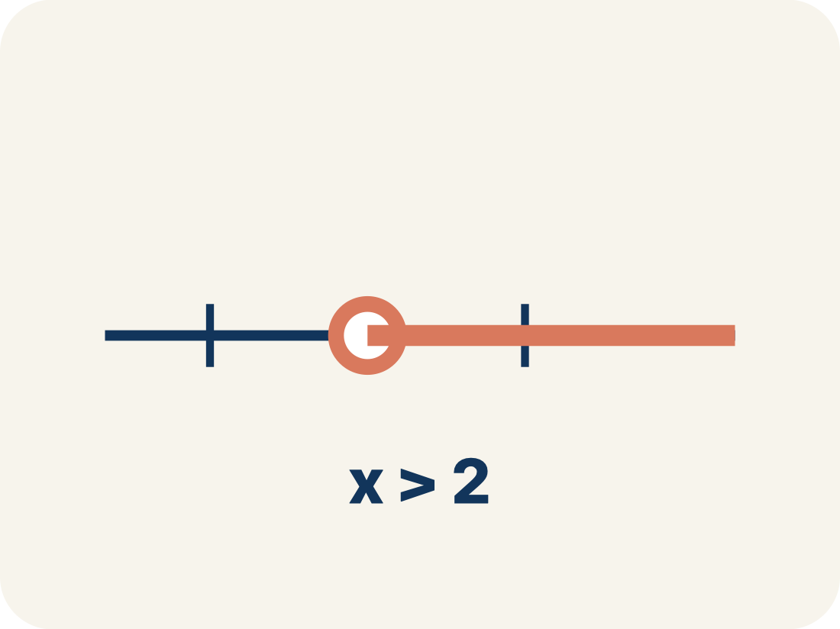
Vocabulary 2 of 7
Lesson 8-4 · Write and Represent Inequalities
Inequality
A math sentence that compares two sides with <, >, ≤, or ≥.
EXAMPLE · EXPLAIN WHY IT FITS
x > 5 means x can be 6, 7, 8, … — any number greater than 5
Use “Inequality” to explain the example. Point to evidence.
eduwonderlab.com · Neft Teacher
9 / 49
Notes:
TEACH IN PRACTICE | Embedded facilitation | Lesson 8.4, slide 9 | VOCAB
Focus on the existing task: Vocabulary 2 of 7 Inequality A math sentence that…
ASK (T1/3/5): Where does “Inequality” appear in the example? Explain the meaning without reading the definition. Partner: restate the idea and ask a clarifying question.
LOOK FOR: A correct connection between the word and a feature of the example. If the student only repeats the definition, invite pointing, sketching or oral rehearsal, then ask for another explanation of this same example.
PARTICIPATION (T5/6/7): Think time before volunteers; accept a written, drawn or rehearsed entry. Students ask for evidence respectfully. Recognize a specific contribution or revision and check that both partners participate.
Source: BCPS Updated Instructional Framework Rubric (June 2020), TEACH 1–7.

Slide 10
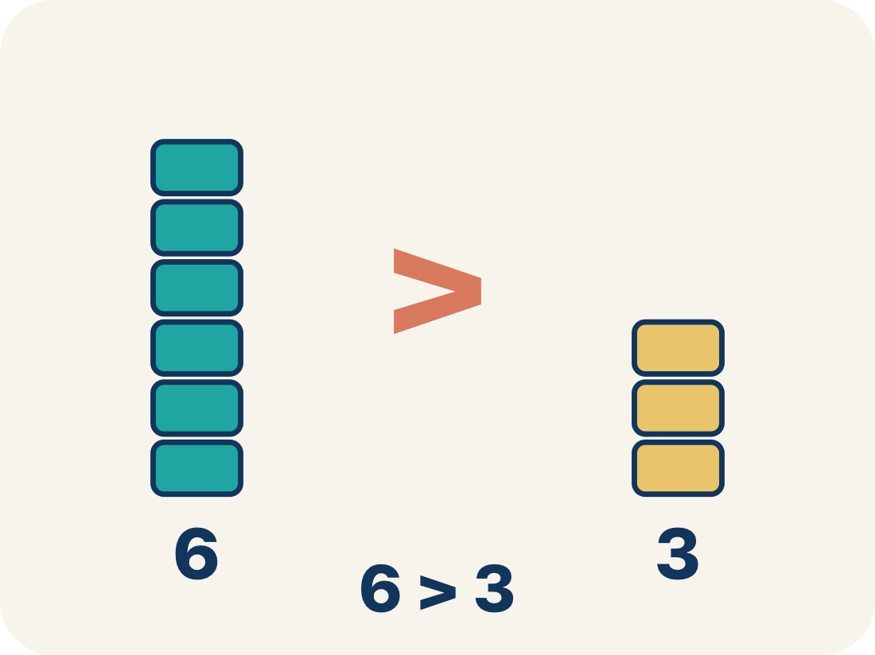
Vocabulary 3 of 7
Lesson 8-4 · Write and Represent Inequalities
Greater than
The > sign, showing one number is bigger.
EXAMPLE · EXPLAIN WHY IT FITS
8 > 3 — eight is larger than three
Use “Greater than” to explain the example. Point to evidence.
eduwonderlab.com · Neft Teacher
10 / 49
Notes:
TEACH IN PRACTICE | Embedded facilitation | Lesson 8.4, slide 10 | VOCAB
Focus on the existing task: Vocabulary 3 of 7 Greater than The > sign, showing one…
ASK (T1/3/5): Where does “Greater than” appear in the example? Explain the meaning without reading the definition. Partner: restate the idea and ask a clarifying question.
LOOK FOR: A correct connection between the word and a feature of the example. If the student only repeats the definition, invite pointing, sketching or oral rehearsal, then ask for another explanation of this same example.
PARTICIPATION (T5/6/7): Think time before volunteers; accept a written, drawn or rehearsed entry. Students ask for evidence respectfully. Recognize a specific contribution or revision and check that both partners participate.
Source: BCPS Updated Instructional Framework Rubric (June 2020), TEACH 1–7.

Slide 11
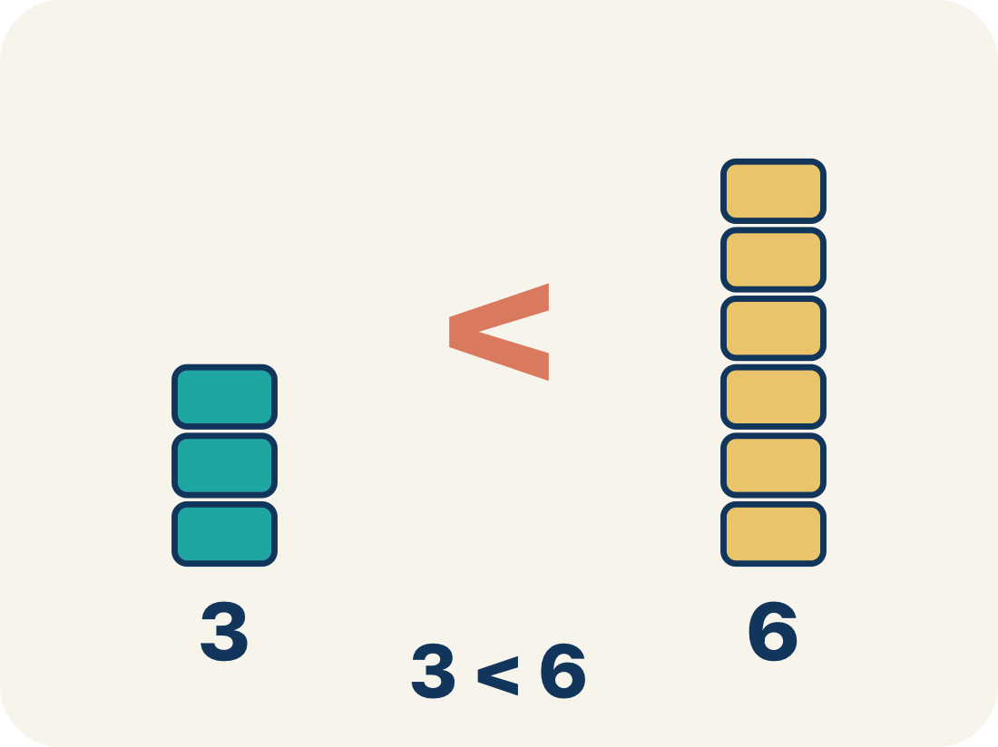
Vocabulary 4 of 7
Lesson 8-4 · Write and Represent Inequalities
Less than
The < sign, showing one number is smaller.
EXAMPLE · EXPLAIN WHY IT FITS
2 < 7 — two is smaller than seven
Use “Less than” to explain the example. Point to evidence.
eduwonderlab.com · Neft Teacher
11 / 49
Notes:
TEACH IN PRACTICE | Embedded facilitation | Lesson 8.4, slide 11 | VOCAB
Focus on the existing task: Vocabulary 4 of 7 Less than The < sign, showing one…
ASK (T1/3/5): Where does “Less than” appear in the example? Explain the meaning without reading the definition. Partner: restate the idea and ask a clarifying question.
LOOK FOR: A correct connection between the word and a feature of the example. If the student only repeats the definition, invite pointing, sketching or oral rehearsal, then ask for another explanation of this same example.
PARTICIPATION (T5/6/7): Think time before volunteers; accept a written, drawn or rehearsed entry. Students ask for evidence respectfully. Recognize a specific contribution or revision and check that both partners participate.
Source: BCPS Updated Instructional Framework Rubric (June 2020), TEACH 1–7.

Slide 12
Vocabulary 5 of 7
Lesson 8-4 · Write and Represent Inequalities
At least / At most
‘At least’ means ≥. ‘At most’ means ≤.
EXAMPLE · EXPLAIN WHY IT FITS
‘At least 10 players’ → p ≥ 10 (could be 10, 11, 12, …); ‘At most 5 tries’ → t ≤ 5 (could be 5, 4, 3, …)
Use “At least / At most” to explain the example. Point to
evidence.
eduwonderlab.com · Neft Teacher
12 / 49
Notes:
TEACH IN PRACTICE | Embedded facilitation | Lesson 8.4, slide 12 | VOCAB
Focus on the existing task: Vocabulary 5 of 7 At least / At most ‘At least’ means ≥.…
ASK (T1/3/5): Where does “At least / At most” appear in the example? Explain the meaning without reading the definition. Partner: restate the idea and ask a clarifying question.
LOOK FOR: A correct connection between the word and a feature of the example. If the student only repeats the definition, invite pointing, sketching or oral rehearsal, then ask for another explanation of this same example.
PARTICIPATION (T5/6/7): Think time before volunteers; accept a written, drawn or rehearsed entry. Students ask for evidence respectfully. Recognize a specific contribution or revision and check that both partners participate.
Source: BCPS Updated Instructional Framework Rubric (June 2020), TEACH 1–7.

Slide 13
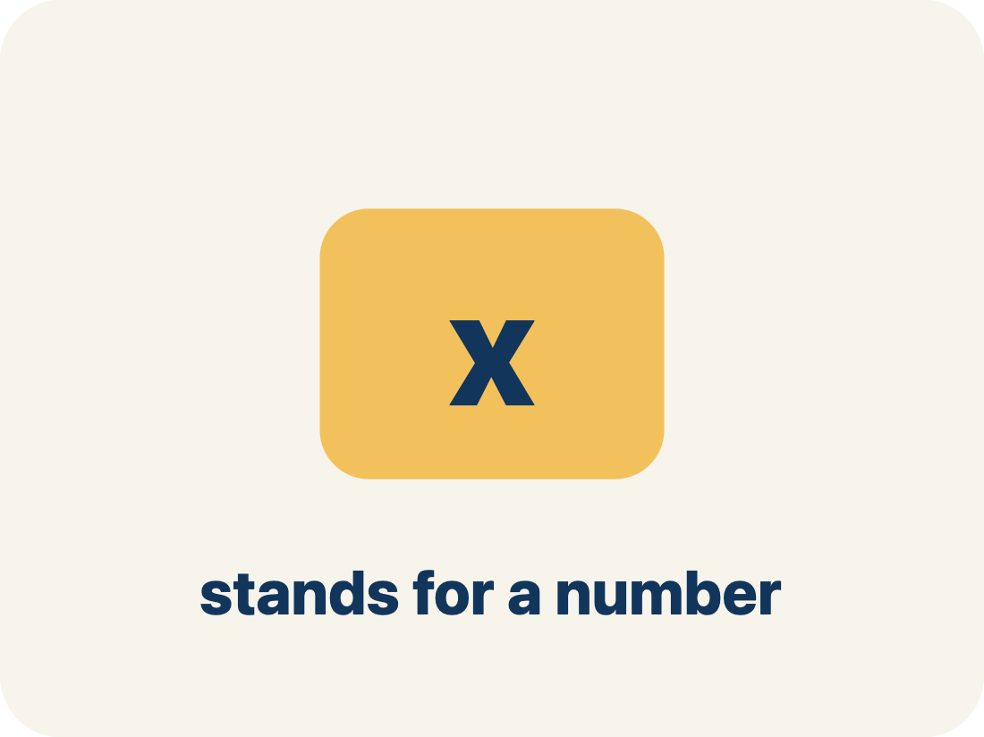
Vocabulary 6 of 7
Lesson 8-4 · Write and Represent Inequalities
Variable
A letter that stands for a number that is unknown or can change.
EXAMPLE · EXPLAIN WHY IT FITS
In x > 5, the letter x stands for any number greater than 5.
Use “Variable” to explain the example. Point to evidence.
eduwonderlab.com · Neft Teacher
13 / 49
Notes:
TEACH IN PRACTICE | Embedded facilitation | Lesson 8.4, slide 13 | VOCAB
Focus on the existing task: Vocabulary 6 of 7 Variable A letter that stands for a…
ASK (T1/3/5): Where does “Variable” appear in the example? Explain the meaning without reading the definition. Partner: restate the idea and ask a clarifying question.
LOOK FOR: A correct connection between the word and a feature of the example. If the student only repeats the definition, invite pointing, sketching or oral rehearsal, then ask for another explanation of this same example.
PARTICIPATION (T5/6/7): Think time before volunteers; accept a written, drawn or rehearsed entry. Students ask for evidence respectfully. Recognize a specific contribution or revision and check that both partners participate.
Source: BCPS Updated Instructional Framework Rubric (June 2020), TEACH 1–7.

Slide 14
Vocabulary 7 of 7
Lesson 8-4 · Write and Represent Inequalities
No more than
A phrase meaning less than or equal to (≤).
EXAMPLE · EXPLAIN WHY IT FITS
“No more than 8 people” means people ≤ 8.
Use “No more than” to explain the example. Point to
evidence.
eduwonderlab.com · Neft Teacher
14 / 49
Notes:
TEACH IN PRACTICE | Embedded facilitation | Lesson 8.4, slide 14 | VOCAB
Focus on the existing task: Vocabulary 7 of 7 No more than A phrase meaning less than…
ASK (T1/3/5): Where does “No more than” appear in the example? Explain the meaning without reading the definition. Partner: restate the idea and ask a clarifying question.
LOOK FOR: A correct connection between the word and a feature of the example. If the student only repeats the definition, invite pointing, sketching or oral rehearsal, then ask for another explanation of this same example.
PARTICIPATION (T5/6/7): Think time before volunteers; accept a written, drawn or rehearsed entry. Students ask for evidence respectfully. Recognize a specific contribution or revision and check that both partners participate.
Source: BCPS Updated Instructional Framework Rubric (June 2020), TEACH 1–7.

Slide 15
Vocabulary
Lesson 8-4 · Write and Represent Inequalities
Today’s Math Words
We learn every word — what it means and what it looks like — before we use it.
Write Inequalities
Inequality
Represent a range of possible values with <, >, ≤, or ≥
A math sentence that compares two sides with <, >, ≤, or ≥
Greater than
Less than
The > sign, showing one number is bigger
The < sign, showing one number is smaller
At least / At most
Variable
‘At least’ means ≥
A letter that stands for a number that is unknown or can change
No more than
Explain one math word using the example.
Partner: point to evidence.
A phrase meaning less than or equal to (≤)
eduwonderlab.com · Neft Teacher
15 / 49
Notes:
TEACH IN PRACTICE | Embedded facilitation | Lesson 8.4, slide 15 | VOCAB
Focus on the existing task: Vocabulary Today’s Math Words We learn every word — what…
ASK (T1/3/5): Where does “the displayed term” appear in the example? Explain the meaning without reading the definition. Partner: restate the idea and ask a clarifying question.
LOOK FOR: A correct connection between the word and a feature of the example. If the student only repeats the definition, invite pointing, sketching or oral rehearsal, then ask for another explanation of this same example.
PARTICIPATION (T5/6/7): Think time before volunteers; accept a written, drawn or rehearsed entry. Students ask for evidence respectfully. Recognize a specific contribution or revision and check that both partners participate.
Source: BCPS Updated Instructional Framework Rubric (June 2020), TEACH 1–7. Earlier notes and answer keys are retained below.
EARLIER NOTES / EXISTING ANSWER KEY
Choral-read each word, its meaning, and what it looks like.
Students should use these words out loud today — listen for them in partner talk and revoice student ideas with the academic term.
UIFR: TEACH 1 · TEACH 5.

Slide 16
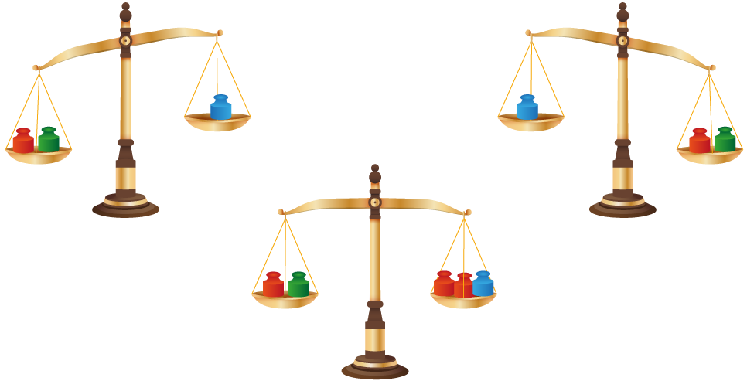

Be Curious
What do you notice?
What do you wonder?
Mindset
HOW DO YOU KNOW? · Ask your partner “How do you know?” Answer by pointing to your own work.
What are some ways to resolve disagreements in math class?
16 / 49
Notes:
TEACH IN PRACTICE | Embedded facilitation | Lesson 8.4, slide 16 | CURIOUS
Focus on the existing task: Be Curious Mindset What are some ways to resolve disagreements in math class?
LAUNCH (T2/3/5): Allow quiet observation first. Separate a notice from an inference, invite students’ own questions, and follow the existing launch before teaching a procedure.
LOOK FOR (T4): Where this task addresses it, students can translate a constraint. Ask which feature of their work supports the claim.
RESPOND: If this task shows the lesson misconception—confusing at least with greater than or reversing the comparison—test the boundary against the original words before selecting the symbol. Have the student revise and explain the change. Use this support only where the concept occurs in the current task; otherwise respond to the displayed question.
RECHECK: If a gap is shared, revisit the existing representation together. If it is limited, give targeted support while others compare valid methods on the same task. Check the revision before moving on.
PARTICIPATION (T5/6/7): Think time before volunteers; accept a written, drawn or rehearsed entry. Students ask for evidence respectfully. Recognize a specific contribution or revision and check that both partners participate.
Source: BCPS Updated Instructional Framework Rubric (June 2020), TEACH 1–7. Earlier notes and answer keys are retained below.
EARLIER NOTES / EXISTING ANSWER KEY
Accept all noticings and wonderings — there are no wrong answers here.
Give 20–30 seconds of quiet think time before taking responses; mix cold and warm calls so it is not always the same voices.
Read the mindset question aloud and let two students respond.
UIFR: TEACH 3 · TEACH 7.

Slide 17
Voting Age
In the United States, a person must be at least 18 years old to vote. How can you represent the age of a voter in the United States?
What tool can you use to compare other ages to the voting age requirement?
Reveal:
We can use a number line.
Record your reasoning before the reveal.
Compare, then explain any revision.
17 / 49
Notes:
TEACH IN PRACTICE | Embedded facilitation | Lesson 8.4, slide 17 | REVEAL
Focus on the existing task: Voting Age In the United States, a person must be at least 18 years old to vote. How can you represent the age of a voter in the United States?
LAUNCH (T2/3/5): If an existing answer cover is present, gather an attempt before revealing. If the explanation is already visible, ask students to reconstruct and justify it. Compare reasoning and explain a revision; preserve the reveal sequence.
LOOK FOR (T4): Where this task addresses it, students can translate a constraint. Ask which feature of their work supports the claim.
RESPOND: If this task shows the lesson misconception—confusing at least with greater than or reversing the comparison—test the boundary against the original words before selecting the symbol. Have the student revise and explain the change. Use this support only where the concept occurs in the current task; otherwise respond to the displayed question.
RECHECK: If a gap is shared, revisit the existing representation together. If it is limited, give targeted support while others compare valid methods on the same task. Check the revision before moving on.
PARTICIPATION (T5/6/7): Think time before volunteers; accept a written, drawn or rehearsed entry. Students ask for evidence respectfully. Recognize a specific contribution or revision and check that both partners participate.
Source: BCPS Updated Instructional Framework Rubric (June 2020), TEACH 1–7. Earlier notes and answer keys are retained below.
EARLIER NOTES / EXISTING ANSWER KEY
Do not click yet: collect 2–3 student answers with reasons first.
Then click to remove the cover and have students compare their thinking to the reveal — “Is this what we said? Where is it different?”
Behind the cover: We can use a number line.
UIFR: TEACH 3 · TEACH 4.
UIFR FULL | Lesson-specific facilitation
TEACH 2-3 | Session 1 task launch (UIFR PDF pp. 9-10).
Use the problem exactly as displayed. Give individual thinking time before discussion or advancing to the explanation. If the answer is already visible, ask students to reconstruct and justify it. Invite a choice of suitable representations and have students explain why their choice helps.
At the point where this concept appears, ask: “Is the boundary value allowed in the stated situation, and how does the symbol communicate that?” Wait for evidence, invite another pathway, and have a student ask a follow-up question. Do not replace students’ reasoning with a sequence of leading steps.

Slide 18


Voting Age
In the United States, a person must be at least 18 years old to vote.
Let’s reason about the problem using a number line. We can plot several possible ages of individuals who are able to vote on a number line.
TRY IT BEFORE YOU’RE SURE · Start even if you are not sure. A revised answer counts as much as a first-try answer.
Recognizing Repetition
What about the process is repeating?
18 / 49
Notes:
TEACH IN PRACTICE | Embedded facilitation | Lesson 8.4, slide 18 | TASK
Focus on the existing task: Voting Age Recognizing Repetition What about the process is repeating?
LAUNCH (T2/3/5): Use the displayed question. Give private thinking time; then A explains while B asks for evidence. Switch roles. Each student records their own reasoning.
LOOK FOR (T4): Where this task addresses it, students can translate a constraint. Ask which feature of their work supports the claim.
RESPOND: If this task shows the lesson misconception—confusing at least with greater than or reversing the comparison—test the boundary against the original words before selecting the symbol. Have the student revise and explain the change. Use this support only where the concept occurs in the current task; otherwise respond to the displayed question.
RECHECK: If a gap is shared, revisit the existing representation together. If it is limited, give targeted support while others compare valid methods on the same task. Check the revision before moving on.
PARTICIPATION (T5/6/7): Think time before volunteers; accept a written, drawn or rehearsed entry. Students ask for evidence respectfully. Recognize a specific contribution or revision and check that both partners participate.
Source: BCPS Updated Instructional Framework Rubric (June 2020), TEACH 1–7. Earlier notes and answer keys are retained below.
EARLIER NOTES / EXISTING ANSWER KEY
Read the context aloud (or have a student read it).
Before any math, students restate the situation and what is being asked in their own words.
Ask: What about the process is repeating?
UIFR: TEACH 1 · TEACH 3.

Slide 19
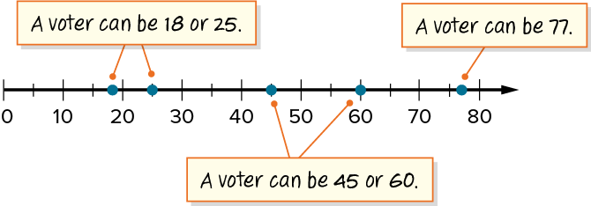
Voting Age
In the United States, a person must be at least 18 years old to vote.
The voting age requirement is a constraint or a condition that a solution must satisfy.
What do you notice about the number of ages that satisfy the constraint?
Reveal:
There are several ages that satisfy the constraint.
19 / 49
Notes:
TEACH IN PRACTICE | Embedded facilitation | Lesson 8.4, slide 19 | REVEAL
Focus on the existing task: Voting Age Reveal: There are several ages that satisfy the constraint. In the United States, a person must be at least 18 years old to…
LAUNCH (T2/3/5): If an existing answer cover is present, gather an attempt before revealing. If the explanation is already visible, ask students to reconstruct and justify it. Compare reasoning and explain a revision; preserve the reveal sequence.
LOOK FOR (T4): Where this task addresses it, students can translate a constraint. Ask which feature of their work supports the claim.
RESPOND: If this task shows the lesson misconception—confusing at least with greater than or reversing the comparison—test the boundary against the original words before selecting the symbol. Have the student revise and explain the change. Use this support only where the concept occurs in the current task; otherwise respond to the displayed question.
RECHECK: If a gap is shared, revisit the existing representation together. If it is limited, give targeted support while others compare valid methods on the same task. Check the revision before moving on.
PARTICIPATION (T5/6/7): Think time before volunteers; accept a written, drawn or rehearsed entry. Students ask for evidence respectfully. Recognize a specific contribution or revision and check that both partners participate.
Source: BCPS Updated Instructional Framework Rubric (June 2020), TEACH 1–7. Earlier notes and answer keys are retained below.
EARLIER NOTES / EXISTING ANSWER KEY
Do not click yet: collect 2–3 student answers with reasons first.
Then click to remove the cover and have students compare their thinking to the reveal — “Is this what we said? Where is it different?”
Behind the cover: There are several ages that satisfy the constraint.
UIFR: TEACH 3 · TEACH 4.

Slide 20

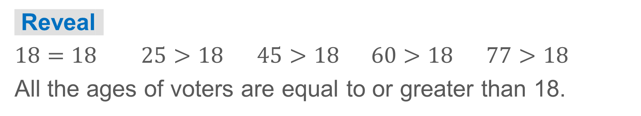
COLLABORATE · TALK IT THROUGH • AGREE ON A MODEL
Collaborate and Connect
In the United States, a person must be at least 18 years old to vote.
There are several possible ages of voters.
Compare each of the ages plotted to the age requirement of 18 using <, >, or =. What do you notice about the ages that satisfy the constraint?
20 / 49
Notes:
TEACH IN PRACTICE | Embedded facilitation | Lesson 8.4, slide 20 | COLLABORATE
Focus on the existing task: In the United States, a person must be at least 18 years old to vote. Collaborate and Connect Compare each of the ages plotted to the age…
LAUNCH (T2/3/5): Use the displayed question. Give private thinking time; then A explains while B asks for evidence. Switch roles. Each student records their own reasoning.
LOOK FOR (T4): Where this task addresses it, students can translate a constraint. Ask which feature of their work supports the claim.
RESPOND: If this task shows the lesson misconception—confusing at least with greater than or reversing the comparison—test the boundary against the original words before selecting the symbol. Have the student revise and explain the change. Use this support only where the concept occurs in the current task; otherwise respond to the displayed question.
RECHECK: If a gap is shared, revisit the existing representation together. If it is limited, give targeted support while others compare valid methods on the same task. Check the revision before moving on.
PARTICIPATION (T5/6/7): Think time before volunteers; accept a written, drawn or rehearsed entry. Students ask for evidence respectfully. Recognize a specific contribution or revision and check that both partners participate.
Source: BCPS Updated Instructional Framework Rubric (June 2020), TEACH 1–7. Earlier notes and answer keys are retained below.
EARLIER NOTES / EXISTING ANSWER KEY
Routine: COLLABORATE · TALK IT THROUGH • AGREE ON A MODEL
UIFR FULL | Lesson-specific facilitation
TEACH 4-5 | Session 1 discussion and checkpoint (UIFR PDF pp. 11-12).
Collect a brief response from every student to the existing prompt before hearing volunteers. Partners take turns explaining and asking for evidence: “I understand ___; what supports ___?” Offer rehearsal or an annotated model for students who need language support. Each student records their own reasoning.
Look specifically for: confusing at least with greater than or reversing the comparison. If it appears, test the boundary against the original words before selecting the symbol; then ask the student to revise the same response and explain the change. If evidence is secure, have students compare a second valid pathway or state why their approach works. Choose the next step from the responses, not a preset pace.

Slide 21
STUDENT MOVES
Lesson 8-4
Your moves
PROVE IT · Find the evidence in the problem that makes your answer right — not just the answer.
HOW DO YOU KNOW? · Ask your partner “How do you know?” Answer by pointing to your own work.
21 / 49

Slide 22
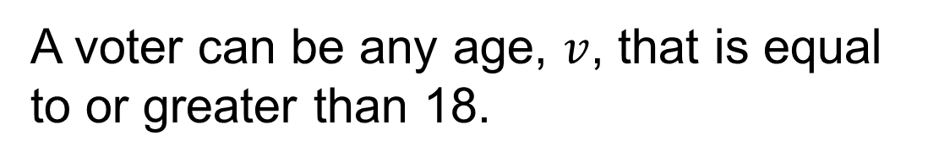
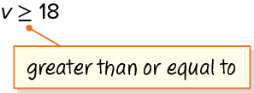
Voting Age
The solution is a range of values, so an inequality represents the problem. An inequality is a mathematical statement that compares quantities using inequality symbols.
Think and record first. Which part of your work supports your answer?
Think About It:
How is the inequality symbol ≥ similar to symbols you have seen before?
22 / 49
Notes:
TEACH IN PRACTICE | Embedded facilitation | Lesson 8.4, slide 21 | TASK
Focus on the existing task: Voting Age Think About It: How is the inequality symbol ≥ similar to symbols you have seen before?
LAUNCH (T2/3/5): Use the displayed question. Give private thinking time; then A explains while B asks for evidence. Switch roles. Each student records their own reasoning.
LOOK FOR (T4): Where this task addresses it, students can translate a constraint. Ask which feature of their work supports the claim.
RESPOND: If this task shows the lesson misconception—confusing at least with greater than or reversing the comparison—test the boundary against the original words before selecting the symbol. Have the student revise and explain the change. Use this support only where the concept occurs in the current task; otherwise respond to the displayed question.
RECHECK: If a gap is shared, revisit the existing representation together. If it is limited, give targeted support while others compare valid methods on the same task. Check the revision before moving on.
PARTICIPATION (T5/6/7): Think time before volunteers; accept a written, drawn or rehearsed entry. Students ask for evidence respectfully. Recognize a specific contribution or revision and check that both partners participate.
Source: BCPS Updated Instructional Framework Rubric (June 2020), TEACH 1–7. Earlier notes and answer keys are retained below.
EARLIER NOTES / EXISTING ANSWER KEY
Ask the question, then hold the silence — students think or jot before anyone answers.
Take two or three responses and press with “Why?” or “How do you know?” before moving on.
UIFR: TEACH 3.

Slide 23
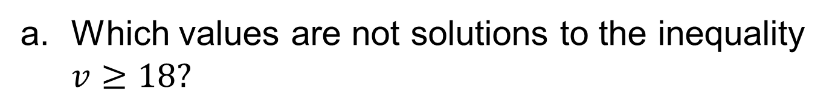
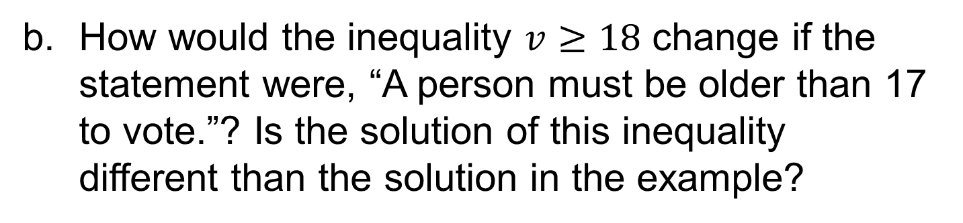
Let’s Explore More
Workspace
Workspace
23 / 49
Notes:
TEACH IN PRACTICE | Embedded facilitation | Lesson 8.4, slide 22 | PRACTICE
Focus on the existing task: Let’s Explore More Workspace Workspace
LAUNCH (T2/3/5): Use the displayed question. Give private thinking time; then A explains while B asks for evidence. Switch roles. Each student records their own reasoning.
LOOK FOR (T4): Where this task addresses it, students can translate a constraint. Ask which feature of their work supports the claim.
RESPOND: If this task shows the lesson misconception—confusing at least with greater than or reversing the comparison—test the boundary against the original words before selecting the symbol. Have the student revise and explain the change. Use this support only where the concept occurs in the current task; otherwise respond to the displayed question.
RECHECK: If a gap is shared, revisit the existing representation together. If it is limited, give targeted support while others compare valid methods on the same task. Check the revision before moving on.
PARTICIPATION (T5/6/7): Think time before volunteers; accept a written, drawn or rehearsed entry. Students ask for evidence respectfully. Recognize a specific contribution or revision and check that both partners participate.
Source: BCPS Updated Instructional Framework Rubric (June 2020), TEACH 1–7. Earlier notes and answer keys are retained below.
EARLIER NOTES / EXISTING ANSWER KEY
Extension for partners or table groups — students choose their approach and use the workspace to show thinking.
Push with “Convince me,” and have two groups with different approaches share.
This is where students stretch past the worked example.
UIFR: TEACH 2 · TEACH 5.

Slide 24
STUDENT MOVES
Lesson 8-4
Your move
TWO MINUTES SOLO · Two minutes on your own, then compare. Bring one thing you tried, even if it did not work.
24 / 49

Slide 25
LESSON 8.4 / DISCUSS THE TASK
Explain and compare
Use the task you just explored.
TAKE TURNS
Is the boundary value allowed in the stated situation, and how does the symbol communicate that?
Explain
“I know this because…”
Ask
“Where does your work show that?”
Point to evidence in your work.
Then compare your approach with a partner’s.
JUSTIFY IT · Say it like this: “I know ______ because ______.”
Listen to understand. Ask for evidence. Make room for every voice.
Notes:
TEACH IN PRACTICE | Embedded facilitation | Lesson 8.4, slide 23 | PRIOR_INSERT
Focus on the existing task: Point to evidence in your work. Then compare your approach with a partner’s. TAKE TURNS Explain “I know this because…” Ask “Where does your work show that?
CONNECT (T1/4): Ask students to restate the displayed goal or key idea and connect it to earlier work. Relevant lesson evidence: translate a constraint; distinguish strict from inclusive bounds; explain multiple solutions. Use only the criterion that matches the current session.
SHOW PROGRESS: Students point to their own existing work, explain what improved after feedback, and name a next step. Pair confidence ratings with actual evidence.
PARTICIPATION (T5/6/7): Think time before volunteers; accept a written, drawn or rehearsed entry. Students ask for evidence respectfully. Recognize a specific contribution or revision and check that both partners participate.
Source: BCPS Updated Instructional Framework Rubric (June 2020), TEACH 1–7.

Slide 26
Voting Age
In the United States, a person must be at least 18 years old to vote.
The voting age requirement is a constraint or a condition that a solution must satisfy.
What do you notice about the number of ages that satisfy the constraint?
Reveal:
There are several ages that satisfy the constraint.
26 / 49
Notes:
TEACH IN PRACTICE | Embedded facilitation | Lesson 8.4, slide 24 | REVEAL
Focus on the existing task: Voting Age Reveal: There are several ages that satisfy the constraint. In the United States, a person must be at least 18 years old to…
LAUNCH (T2/3/5): If an existing answer cover is present, gather an attempt before revealing. If the explanation is already visible, ask students to reconstruct and justify it. Compare reasoning and explain a revision; preserve the reveal sequence.
LOOK FOR (T4): Where this task addresses it, students can translate a constraint. Ask which feature of their work supports the claim.
RESPOND: If this task shows the lesson misconception—confusing at least with greater than or reversing the comparison—test the boundary against the original words before selecting the symbol. Have the student revise and explain the change. Use this support only where the concept occurs in the current task; otherwise respond to the displayed question.
RECHECK: If a gap is shared, revisit the existing representation together. If it is limited, give targeted support while others compare valid methods on the same task. Check the revision before moving on.
PARTICIPATION (T5/6/7): Think time before volunteers; accept a written, drawn or rehearsed entry. Students ask for evidence respectfully. Recognize a specific contribution or revision and check that both partners participate.
Source: BCPS Updated Instructional Framework Rubric (June 2020), TEACH 1–7.

Slide 27
Session 2 Warm-Up
Lesson 8-4 · Write and Represent Inequalities
Session 2 Warm-Up
Check what you remember from Session 1 · about 4 minutes
1
An inequality compares quantities that are:
2
Which symbol represents “less than or equal to”?
A
Strictly equal
A
<
B
Not necessarily equal (<, >, ≤, ≥)
B
≤
C
Only fractions
C
>
D
Identical
D
≥
3
“A speed limit of 45 mph or less” is written:
4
Unlike equations, inequalities typically have:
A
s > 45
A
No answers
B
s ≤ 45
B
Infinitely many solutions
C
s = 45
C
Only one answer
D
s < 45
D
Zero solutions
eduwonderlab.com · Neft Teacher
27 / 49
Notes:
TEACH IN PRACTICE | Embedded facilitation | Lesson 8.4, slide 25 | WARMUP
Focus on the existing task: Session 2 Warm-Up Session 2 Warm-Up Check what you…
GATHER EVIDENCE (T4/6): Keep the original items. Students try independently, mark an uncertain item, and explain one method before checking. Use the existing key when present.
RESPOND: Distinguish a calculation slip from a reasoning gap. Give one next step on the same item; have students revise in a second color. Use the responses to choose flexible support for today’s lesson.
PARTICIPATION (T5/6/7): Think time before volunteers; accept a written, drawn or rehearsed entry. Students ask for evidence respectfully. Recognize a specific contribution or revision and check that both partners participate.
Source: BCPS Updated Instructional Framework Rubric (June 2020), TEACH 1–7. Earlier notes and answer keys are retained below.
EARLIER NOTES / EXISTING ANSWER KEY
Warm-up routine: students start silently on entry; keep it to about 4 minutes.
Circulate and note who is stuck — use what you see to choose who you check on first today.
Go over answers quickly; ask one student to explain a step, not just say the answer.
UIFR: TEACH 4 · TEACH 6.
UIFR FULL | Lesson-specific facilitation
TEACH 1 | Session 2 purpose and evidence (UIFR PDF p. 8).
Have students restate the displayed session goal in their own words and connect it to the existing context or a familiar experience they choose to share. Use the current session goal to select from these lesson-wide evidence criteria; do not frontload a later-session procedure.
Look for: translate a constraint; distinguish strict from inclusive bounds; explain multiple solutions. Ask: “Which part of your work would show this?” Revisit that evidence after the task; a confidence rating alone is not evidence of understanding.

Slide 28
STUDENT MOVES
Lesson 8-4
Your moves
JUSTIFY IT · Say it like this: “I know ______ because ______.”
YOU KNOW THE ROUTINE · Read → plan → solve → check. Do all four, in that order.
28 / 49

Slide 29
Today’s Math Notes
Lesson 8-4 · Write and Represent Inequalities
Review Notes — Session 2
Copy. Explain. Check.
NAME THE MATH · Point to the part of this that is new today, and say what it changes.
Inequality Symbols
1
< (less than), > (greater than), ≤ (less than or equal to), ≥ (greater than or equal to).
Solution Sets
2
Inequalities describe an entire set or range of values that satisfy the condition.
Key Phrases
3
‘At least’ means ≥; ‘at most’ means ≤; ‘exceeds’ means >; ‘fewer than’ means <.
eduwonderlab.com · Neft Teacher
29 / 49
Notes:
TEACH IN PRACTICE | Embedded facilitation | Lesson 8.4, slide 26 | NOTES
Focus on the existing task: Today’s Math Notes Review Notes — Session 2 Copy into your…
ROUTINE (T1/2/4): Read or copy the original notes, cover one line, and explain it using the displayed example. Reopen and correct. Copying alone is not evidence of understanding.
LOOK FOR: A link between a symbol, quantity or feature and the explanation. If missing, point back to that feature and have the student try again; fade the prompt once they can explain.
PARTICIPATION (T5/6/7): Think time before volunteers; accept a written, drawn or rehearsed entry. Students ask for evidence respectfully. Recognize a specific contribution or revision and check that both partners participate.
Source: BCPS Updated Instructional Framework Rubric (June 2020), TEACH 1–7. Earlier notes and answer keys are retained below.
EARLIER NOTES / EXISTING ANSWER KEY
Copy routine: read one line at a time; students copy, then explain that line to a partner.
Keep it brisk — the understanding work happens in the examples, not the copying.
UIFR: TEACH 1 · TEACH 6.

Slide 30
Session 2
Write and Represent Inequalities
USE THE MATH WORDS · Use today’s math words in your explanation — not “it” and “that thing.”
30 / 49
Notes:
TEACH IN PRACTICE | Embedded facilitation | Lesson 8.4, slide 27 | DIVIDER
Focus on the existing task: Write and Represent Inequalities Session 2
TRANSITION (T6/7): Students confirm materials, roles, how to request help, and the next response routine. Ask a student to restate it. Keep teacher-only slides hidden.
PARTICIPATION (T5/6/7): Think time before volunteers; accept a written, drawn or rehearsed entry. Students ask for evidence respectfully. Recognize a specific contribution or revision and check that both partners participate.
Source: BCPS Updated Instructional Framework Rubric (June 2020), TEACH 1–7. Earlier notes and answer keys are retained below.
EARLIER NOTES / EXISTING ANSWER KEY
Transition cue: state what materials are out and what success looks like this session.
Keep the changeover under a minute.
UIFR: TEACH 6.

Slide 31
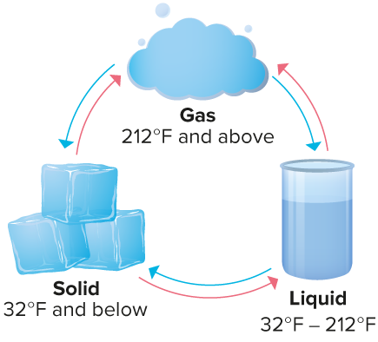
Freezing Point
The diagram shows the three states of matter for water and the temperatures at which each state occurs. How can you represent the temperatures at which water is a solid?
SELF-CHECK · Mark it: ✓ got it · ~ almost · ? stuck. Then fix one thing before we move on.
What do you know about the temperature(s) at which water is a solid?
Think About It:
At what temperature(s) is water not a solid?
31 / 49
Notes:
TEACH IN PRACTICE | Embedded facilitation | Lesson 8.4, slide 28 | TASK
Focus on the existing task: Freezing Point The diagram shows the three states of matter for water and the temperatures at which each state occurs. How can you represent the temperatures at which water is a solid?
LAUNCH (T2/3/5): Use the displayed question. Give private thinking time; then A explains while B asks for evidence. Switch roles. Each student records their own reasoning.
LOOK FOR (T4): Where this task addresses it, students can translate a constraint. Ask which feature of their work supports the claim.
RESPOND: If this task shows the lesson misconception—confusing at least with greater than or reversing the comparison—test the boundary against the original words before selecting the symbol. Have the student revise and explain the change. Use this support only where the concept occurs in the current task; otherwise respond to the displayed question.
RECHECK: If a gap is shared, revisit the existing representation together. If it is limited, give targeted support while others compare valid methods on the same task. Check the revision before moving on.
PARTICIPATION (T5/6/7): Think time before volunteers; accept a written, drawn or rehearsed entry. Students ask for evidence respectfully. Recognize a specific contribution or revision and check that both partners participate.
Source: BCPS Updated Instructional Framework Rubric (June 2020), TEACH 1–7. Earlier notes and answer keys are retained below.
EARLIER NOTES / EXISTING ANSWER KEY
Ask the question, then hold the silence — students think or jot before anyone answers.
Take two or three responses and press with “Why?” or “How do you know?” before moving on.
UIFR: TEACH 3.
UIFR FULL | Lesson-specific facilitation
TEACH 2-3 | Session 2 task launch (UIFR PDF pp. 9-10).
Use the problem exactly as displayed. Give individual thinking time before discussion or advancing to the explanation. If the answer is already visible, ask students to reconstruct and justify it. Invite a choice of suitable representations and have students explain why their choice helps.
At the point where this concept appears, ask: “Is the boundary value allowed in the stated situation, and how does the symbol communicate that?” Wait for evidence, invite another pathway, and have a student ask a follow-up question. Do not replace students’ reasoning with a sequence of leading steps.

Slide 32
Freezing Point
Let’s think about the structure of the problem.
Water is a solid for all temperatures that are 32°F or below.
How many temperatures result in a solid? How can you show the possible temperatures the result in a solid?
Reveal:
There are many temperatures at which water is a solid. We can use a number line to plot several points that represent the temperatures.
32 / 49
Notes:
TEACH IN PRACTICE | Embedded facilitation | Lesson 8.4, slide 29 | REVEAL
Focus on the existing task: Freezing Point Let’s think about the structure of the problem. How many temperatures result in a solid?
LAUNCH (T2/3/5): If an existing answer cover is present, gather an attempt before revealing. If the explanation is already visible, ask students to reconstruct and justify it. Compare reasoning and explain a revision; preserve the reveal sequence.
LOOK FOR (T4): Where this task addresses it, students can translate a constraint. Ask which feature of their work supports the claim.
RESPOND: If this task shows the lesson misconception—confusing at least with greater than or reversing the comparison—test the boundary against the original words before selecting the symbol. Have the student revise and explain the change. Use this support only where the concept occurs in the current task; otherwise respond to the displayed question.
RECHECK: If a gap is shared, revisit the existing representation together. If it is limited, give targeted support while others compare valid methods on the same task. Check the revision before moving on.
PARTICIPATION (T5/6/7): Think time before volunteers; accept a written, drawn or rehearsed entry. Students ask for evidence respectfully. Recognize a specific contribution or revision and check that both partners participate.
Source: BCPS Updated Instructional Framework Rubric (June 2020), TEACH 1–7. Earlier notes and answer keys are retained below.
EARLIER NOTES / EXISTING ANSWER KEY
Do not click yet: collect 2–3 student answers with reasons first.
Then click to remove the cover and have students compare their thinking to the reveal — “Is this what we said? Where is it different?”
Behind the cover: There are many temperatures at which water is a solid. We can use a number line to plot several points that represent the temperatures.
UIFR: TEACH 3 · TEACH 4.

Slide 33
STUDENT MOVES
Lesson 8-4
Your move
YOUR CHOICE · You choose how to show this — numbers, words, or a diagram. Make your reasoning visible.
33 / 49

Slide 34

Freezing Point
Water is a solid for all temperatures that are 32°F or below.
Let’s plot several possible temperatures at which water is a solid on a number line.
Use the scale and positions on the number line to justify your answer.
34 / 49
Notes:
TEACH IN PRACTICE | Embedded facilitation | Lesson 8.4, slide 30 | WORKED
Focus on the existing task: Freezing Point Water is a solid for all temperatures that are 32°F or below. Let’s plot several possible temperatures at which water is…
LAUNCH (T2/3/5): Ask students to explain the displayed idea or example and point to evidence. When a calculation step is shown, ask why it is valid. Have a partner restate the explanation; copying is not the check.
LOOK FOR (T4): Where this task addresses it, students can translate a constraint. Ask which feature of their work supports the claim.
RESPOND: If this task shows the lesson misconception—confusing at least with greater than or reversing the comparison—test the boundary against the original words before selecting the symbol. Have the student revise and explain the change. Use this support only where the concept occurs in the current task; otherwise respond to the displayed question.
RECHECK: If a gap is shared, revisit the existing representation together. If it is limited, give targeted support while others compare valid methods on the same task. Check the revision before moving on.
PARTICIPATION (T5/6/7): Think time before volunteers; accept a written, drawn or rehearsed entry. Students ask for evidence respectfully. Recognize a specific contribution or revision and check that both partners participate.
Source: BCPS Updated Instructional Framework Rubric (June 2020), TEACH 1–7. Earlier notes and answer keys are retained below.
EARLIER NOTES / EXISTING ANSWER KEY
Model briefly, then hand the thinking back: ask “Why does this step work?” before showing the next one.
Quick check before moving on — thumbs or whiteboards from everyone, not volunteers.
UIFR: TEACH 2 · TEACH 3 · TEACH 4.

Slide 35
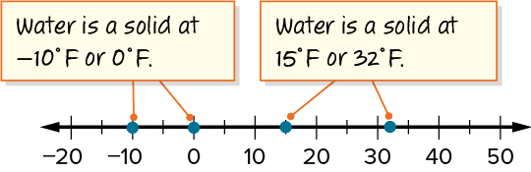
Freezing Point
Water is a solid for all temperatures that are 32°F or below.
What do you notice about the temperatures at which water is a solid?
Looking for Patterns
How can arriving at a generalization be helpful in approaching this problem?
STRUGGLE FIRST · Work on your own first. Stuck is allowed — try a second strategy before you ask.
35 / 49
Notes:
TEACH IN PRACTICE | Embedded facilitation | Lesson 8.4, slide 31 | TASK
Focus on the existing task: Freezing Point Looking for Patterns How can arriving at a generalization be helpful in approaching this problem?
LAUNCH (T2/3/5): Use the displayed question. Give private thinking time; then A explains while B asks for evidence. Switch roles. Each student records their own reasoning.
LOOK FOR (T4): Where this task addresses it, students can translate a constraint. Ask which feature of their work supports the claim.
RESPOND: If this task shows the lesson misconception—confusing at least with greater than or reversing the comparison—test the boundary against the original words before selecting the symbol. Have the student revise and explain the change. Use this support only where the concept occurs in the current task; otherwise respond to the displayed question.
RECHECK: If a gap is shared, revisit the existing representation together. If it is limited, give targeted support while others compare valid methods on the same task. Check the revision before moving on.
PARTICIPATION (T5/6/7): Think time before volunteers; accept a written, drawn or rehearsed entry. Students ask for evidence respectfully. Recognize a specific contribution or revision and check that both partners participate.
Source: BCPS Updated Instructional Framework Rubric (June 2020), TEACH 1–7. Earlier notes and answer keys are retained below.
EARLIER NOTES / EXISTING ANSWER KEY
Model briefly, then hand the thinking back: ask “Why does this step work?” before showing the next one.
Quick check before moving on — thumbs or whiteboards from everyone, not volunteers.
UIFR: TEACH 2 · TEACH 3 · TEACH 4.

Slide 36
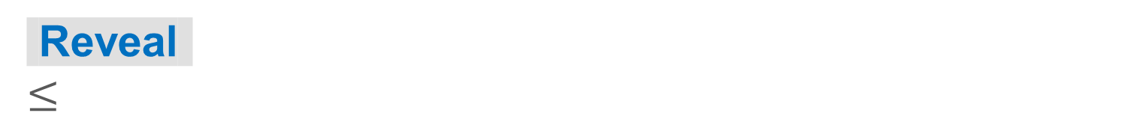
COLLABORATE · TALK IT THROUGH • AGREE ON A MODEL
Collaborate and Connect
Water is a solid for all temperatures less than or equal to 32°F.
What symbol do you think you can use to show less than or equal to?
Think first. A explains; B asks for evidence. Switch roles; both revise.
36 / 49
Notes:
TEACH IN PRACTICE | Embedded facilitation | Lesson 8.4, slide 32 | COLLABORATE
Focus on the existing task: Collaborate and Connect Water is a solid for all temperatures less than or equal to 32°F. What symbol do you think you can use to show less than or equal to?
LAUNCH (T2/3/5): Use the displayed question. Give private thinking time; then A explains while B asks for evidence. Switch roles. Each student records their own reasoning.
LOOK FOR (T4): Where this task addresses it, students can translate a constraint. Ask which feature of their work supports the claim.
RESPOND: If this task shows the lesson misconception—confusing at least with greater than or reversing the comparison—test the boundary against the original words before selecting the symbol. Have the student revise and explain the change. Use this support only where the concept occurs in the current task; otherwise respond to the displayed question.
RECHECK: If a gap is shared, revisit the existing representation together. If it is limited, give targeted support while others compare valid methods on the same task. Check the revision before moving on.
PARTICIPATION (T5/6/7): Think time before volunteers; accept a written, drawn or rehearsed entry. Students ask for evidence respectfully. Recognize a specific contribution or revision and check that both partners participate.
Source: BCPS Updated Instructional Framework Rubric (June 2020), TEACH 1–7. Earlier notes and answer keys are retained below.
EARLIER NOTES / EXISTING ANSWER KEY
Routine: COLLABORATE · TALK IT THROUGH • AGREE ON A MODEL
UIFR FULL | Lesson-specific facilitation
TEACH 4-5 | Session 2 discussion and checkpoint (UIFR PDF pp. 11-12).
Collect a brief response from every student to the existing prompt before hearing volunteers. Partners take turns explaining and asking for evidence: “I understand ___; what supports ___?” Offer rehearsal or an annotated model for students who need language support. Each student records their own reasoning.
Look specifically for: confusing at least with greater than or reversing the comparison. If it appears, test the boundary against the original words before selecting the symbol; then ask the student to revise the same response and explain the change. If evidence is secure, have students compare a second valid pathway or state why their approach works. Choose the next step from the responses, not a preset pace.

Slide 37
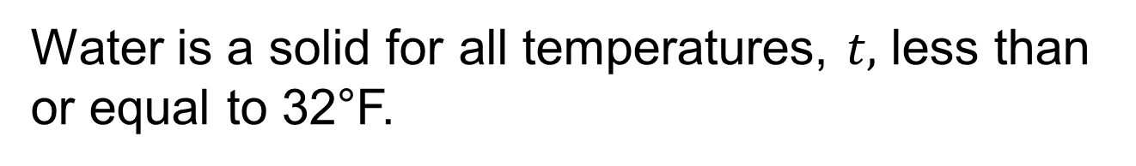
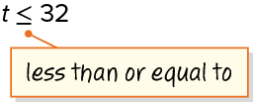
Freezing Point
The solution is a range of values, so an inequality represents the problem.
Explain how the information
shown supports your reasoning.
37 / 49
Notes:
TEACH IN PRACTICE | Embedded facilitation | Lesson 8.4, slide 33 | WORKED
Focus on the existing task: Freezing Point The solution is a range of values, so an inequality represents the problem.
LAUNCH (T2/3/5): Ask students to explain the displayed idea or example and point to evidence. When a calculation step is shown, ask why it is valid. Have a partner restate the explanation; copying is not the check.
LOOK FOR (T4): Where this task addresses it, students can translate a constraint. Ask which feature of their work supports the claim.
RESPOND: If this task shows the lesson misconception—confusing at least with greater than or reversing the comparison—test the boundary against the original words before selecting the symbol. Have the student revise and explain the change. Use this support only where the concept occurs in the current task; otherwise respond to the displayed question.
RECHECK: If a gap is shared, revisit the existing representation together. If it is limited, give targeted support while others compare valid methods on the same task. Check the revision before moving on.
PARTICIPATION (T5/6/7): Think time before volunteers; accept a written, drawn or rehearsed entry. Students ask for evidence respectfully. Recognize a specific contribution or revision and check that both partners participate.
Source: BCPS Updated Instructional Framework Rubric (June 2020), TEACH 1–7. Earlier notes and answer keys are retained below.
EARLIER NOTES / EXISTING ANSWER KEY
Model briefly, then hand the thinking back: ask “Why does this step work?” before showing the next one.
Quick check before moving on — thumbs or whiteboards from everyone, not volunteers.
UIFR: TEACH 2 · TEACH 3 · TEACH 4.

Slide 38
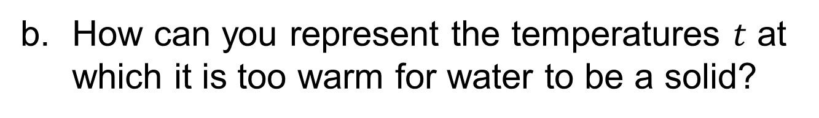
Let’s Explore More
How is an inequality different from an equation?
Workspace
Workspace
38 / 49
Notes:
TEACH IN PRACTICE | Embedded facilitation | Lesson 8.4, slide 34 | PRACTICE
Focus on the existing task: Let’s Explore More How is an inequality different from an equation?
LAUNCH (T2/3/5): Use the displayed question. Give private thinking time; then A explains while B asks for evidence. Switch roles. Each student records their own reasoning.
LOOK FOR (T4): Where this task addresses it, students can distinguish strict from inclusive bounds. Ask which feature of their work supports the claim.
RESPOND: If this task shows the lesson misconception—confusing at least with greater than or reversing the comparison—test the boundary against the original words before selecting the symbol. Have the student revise and explain the change. Use this support only where the concept occurs in the current task; otherwise respond to the displayed question.
RECHECK: If a gap is shared, revisit the existing representation together. If it is limited, give targeted support while others compare valid methods on the same task. Check the revision before moving on.
PARTICIPATION (T5/6/7): Think time before volunteers; accept a written, drawn or rehearsed entry. Students ask for evidence respectfully. Recognize a specific contribution or revision and check that both partners participate.
Source: BCPS Updated Instructional Framework Rubric (June 2020), TEACH 1–7. Earlier notes and answer keys are retained below.
EARLIER NOTES / EXISTING ANSWER KEY
Extension for partners or table groups — students choose their approach and use the workspace to show thinking.
Push with “Convince me,” and have two groups with different approaches share.
This is where students stretch past the worked example.
UIFR: TEACH 2 · TEACH 5.

Slide 39
STUDENT MOVES
Lesson 8-4
Your move
PICK YOUR STRATEGY · Choose your path — picture, table, number line, or equation — and be ready to say why you chose it.
39 / 49

Slide 40
LESSON 8.4 / CHECK YOUR WORK
Pause. Check. Improve.
CHECK
A mistake to watch for: confusing at least with greater than or reversing the comparison.
TRY
Test the boundary against the given words before selecting the symbol.
REVISE
Use that check on the task you just completed. Correct or strengthen one part, and explain why.
REVISE NOW · Change one answer and write why you changed it. A revision is evidence of learning.
Listen to understand. Ask for evidence. Make room for every voice.
Notes:
TEACH IN PRACTICE | Embedded facilitation | Lesson 8.4, slide 35 | PRIOR_INSERT
Focus on the existing task: LESSON 8.4 / CHECK YOUR WORK Pause. Check. Improve. Listen to understand. Ask for evidence. Make room for every voice. CHECK A mistake…
CONNECT (T1/4): Ask students to restate the displayed goal or key idea and connect it to earlier work. Relevant lesson evidence: translate a constraint; distinguish strict from inclusive bounds; explain multiple solutions. Use only the criterion that matches the current session.
SHOW PROGRESS: Students point to their own existing work, explain what improved after feedback, and name a next step. Pair confidence ratings with actual evidence.
PARTICIPATION (T5/6/7): Think time before volunteers; accept a written, drawn or rehearsed entry. Students ask for evidence respectfully. Recognize a specific contribution or revision and check that both partners participate.
Source: BCPS Updated Instructional Framework Rubric (June 2020), TEACH 1–7.

Slide 41
Free Books
Let’s think about the structure of the problem.
Water is a solid for all temperatures that are 32°F or below.
How many temperatures result in a solid? How can you show the possible temperatures the result in a solid?
Reveal:
There are many temperatures at which water is a solid. We can use a number line to plot several points that represent the temperatures.
41 / 49
Notes:
TEACH IN PRACTICE | Embedded facilitation | Lesson 8.4, slide 36 | REVEAL
Focus on the existing task: Free Books Let’s think about the structure of the problem. How many temperatures result in a solid?
LAUNCH (T2/3/5): If an existing answer cover is present, gather an attempt before revealing. If the explanation is already visible, ask students to reconstruct and justify it. Compare reasoning and explain a revision; preserve the reveal sequence.
LOOK FOR (T4): Where this task addresses it, students can translate a constraint. Ask which feature of their work supports the claim.
RESPOND: If this task shows the lesson misconception—confusing at least with greater than or reversing the comparison—test the boundary against the original words before selecting the symbol. Have the student revise and explain the change. Use this support only where the concept occurs in the current task; otherwise respond to the displayed question.
RECHECK: If a gap is shared, revisit the existing representation together. If it is limited, give targeted support while others compare valid methods on the same task. Check the revision before moving on.
PARTICIPATION (T5/6/7): Think time before volunteers; accept a written, drawn or rehearsed entry. Students ask for evidence respectfully. Recognize a specific contribution or revision and check that both partners participate.
Source: BCPS Updated Instructional Framework Rubric (June 2020), TEACH 1–7.

Slide 42
STUDENT MOVES
Lesson 8-4
Your move
ANOTHER PATHWAY · Did anyone get there a different way? Put both pathways side by side and compare.
42 / 49

Slide 43
Freezing Point
Water is a solid for all temperatures that are 32°F or below.
What do you notice about the temperatures at which water is a solid?
Reveal:
All the temperatures at which water is a solid are less than or equal to 32°F.
ANOTHER PATHWAY · Did anyone get there a different way? Put both pathways side by side and compare.
43 / 49
Notes:
TEACH IN PRACTICE | Embedded facilitation | Lesson 8.4, slide 37 | REVEAL
Focus on the existing task: Freezing Point Water is a solid for all temperatures that are 32°F or below. What do you notice about the temperatures at which water is a solid?
LAUNCH (T2/3/5): If an existing answer cover is present, gather an attempt before revealing. If the explanation is already visible, ask students to reconstruct and justify it. Compare reasoning and explain a revision; preserve the reveal sequence.
LOOK FOR (T4): Where this task addresses it, students can translate a constraint. Ask which feature of their work supports the claim.
RESPOND: If this task shows the lesson misconception—confusing at least with greater than or reversing the comparison—test the boundary against the original words before selecting the symbol. Have the student revise and explain the change. Use this support only where the concept occurs in the current task; otherwise respond to the displayed question.
RECHECK: If a gap is shared, revisit the existing representation together. If it is limited, give targeted support while others compare valid methods on the same task. Check the revision before moving on.
PARTICIPATION (T5/6/7): Think time before volunteers; accept a written, drawn or rehearsed entry. Students ask for evidence respectfully. Recognize a specific contribution or revision and check that both partners participate.
Source: BCPS Updated Instructional Framework Rubric (June 2020), TEACH 1–7.

Slide 44
SUMMARIZE · SAY IT IN YOUR OWN WORDS
Summarize: Write and Represent Inequalities
An inequality is a mathematical sentence that compares quantities. It uses an inequality symbol.
A solution of an inequality with an unknown value is any value that makes the inequality a true statement.
< | less than
≤ | less than or equal to
> | greater than
≥ | greater than or equal to
ASK THE CLASS · Write one question about this that you could ask the class.
44 / 49
Notes:
TEACH IN PRACTICE | Embedded facilitation | Lesson 8.4, slide 38 | SUMMARIZE
Focus on the existing task: Summarize: Write and Represent Inequalities An inequality is a mathematical sentence that compares quantities. It uses an inequality…
CONNECT (T1/4): Ask students to restate the displayed goal or key idea and connect it to earlier work. Relevant lesson evidence: translate a constraint; distinguish strict from inclusive bounds; explain multiple solutions. Use only the criterion that matches the current session.
SHOW PROGRESS: Students point to their own existing work, explain what improved after feedback, and name a next step. Pair confidence ratings with actual evidence.
PARTICIPATION (T5/6/7): Think time before volunteers; accept a written, drawn or rehearsed entry. Students ask for evidence respectfully. Recognize a specific contribution or revision and check that both partners participate.
Source: BCPS Updated Instructional Framework Rubric (June 2020), TEACH 1–7. Earlier notes and answer keys are retained below.
EARLIER NOTES / EXISTING ANSWER KEY
Routine: SUMMARIZE · SAY IT IN YOUR OWN WORDS

Slide 45

APPLY · PLAN IT • SOLVE IT • PROVE IT
Apply: Festival Tickets
Four friends are doing yard work around town to earn money to attend the upcoming festival advertised in the flyer. They are charging $15 per hour for yard work. The four friends will combine their earnings.
Question: How many hours do the four friends need to work to earn enough money to buy four tickets? Propose a breakdown of the number of hours each friend might work.
USE YOUR TOOLS · Reach for your notes, a model, or a manipulative before you reach for an answer.
45 / 49
Notes:
TEACH IN PRACTICE | Embedded facilitation | Lesson 8.4, slide 39 | APPLY
Focus on the existing task: Apply: Festival Tickets Four friends are doing yard work around town to earn money to attend the upcoming festival advertised in the flyer.
LAUNCH (T2/3/5): Use the exact application task independently first. Ask students to justify their choice of method. Collect evidence before a partner discussion or correction.
LOOK FOR (T4): Where this task addresses it, students can translate a constraint. Ask which feature of their work supports the claim.
RESPOND: If this task shows the lesson misconception—confusing at least with greater than or reversing the comparison—test the boundary against the original words before selecting the symbol. Have the student revise and explain the change. Use this support only where the concept occurs in the current task; otherwise respond to the displayed question.
RECHECK: If a gap is shared, revisit the existing representation together. If it is limited, give targeted support while others compare valid methods on the same task. Check the revision before moving on.
PARTICIPATION (T5/6/7): Think time before volunteers; accept a written, drawn or rehearsed entry. Students ask for evidence respectfully. Recognize a specific contribution or revision and check that both partners participate.
Source: BCPS Updated Instructional Framework Rubric (June 2020), TEACH 1–7. Earlier notes and answer keys are retained below.
EARLIER NOTES / EXISTING ANSWER KEY
Routine: APPLY · PLAN IT • SOLVE IT • PROVE IT
UIFR FULL | Lesson-specific facilitation
TEACH 4 | Independent evidence and revision (UIFR PDF p. 11).
Use the existing application/exit problem as the independent check. If this is a learning-target slide, have students point to and explain their work on the preceding task. Separate initial independent evidence from the revision after feedback.
Check the relevant criteria: translate a constraint; distinguish strict from inclusive bounds; explain multiple solutions. Respond with one specific next step tied to the work. Students revise and annotate what changed, then identify a criterion they can now demonstrate and one they still need to practice.

Slide 46
Learning Targets
I can write inequalities to represent a real-world or mathematical problem.
I can use repeated reasoning to understand ways that problems can be represented by inequalities.
Point to evidence in your work. Name what improved and your next step.
46 / 49
Notes:
TEACH IN PRACTICE | Embedded facilitation | Lesson 8.4, slide 40 | REFLECTION
Focus on the existing task: Learning Targets I can write inequalities to represent a real-world or mathematical problem. I can use repeated reasoning to understand…
CONNECT (T1/4): Ask students to restate the displayed goal or key idea and connect it to earlier work. Relevant lesson evidence: translate a constraint; distinguish strict from inclusive bounds; explain multiple solutions. Use only the criterion that matches the current session.
SHOW PROGRESS: Students point to their own existing work, explain what improved after feedback, and name a next step. Pair confidence ratings with actual evidence.
PARTICIPATION (T5/6/7): Think time before volunteers; accept a written, drawn or rehearsed entry. Students ask for evidence respectfully. Recognize a specific contribution or revision and check that both partners participate.
Source: BCPS Updated Instructional Framework Rubric (June 2020), TEACH 1–7. Earlier notes and answer keys are retained below.
EARLIER NOTES / EXISTING ANSWER KEY
Read each target; students self-rate with fist-to-five or thumbs.
Tie back to the goal from the start of class: did we get there?
Note any target that rates low — revisit it tomorrow.
UIFR: TEACH 1 · TEACH 4.

Slide 47
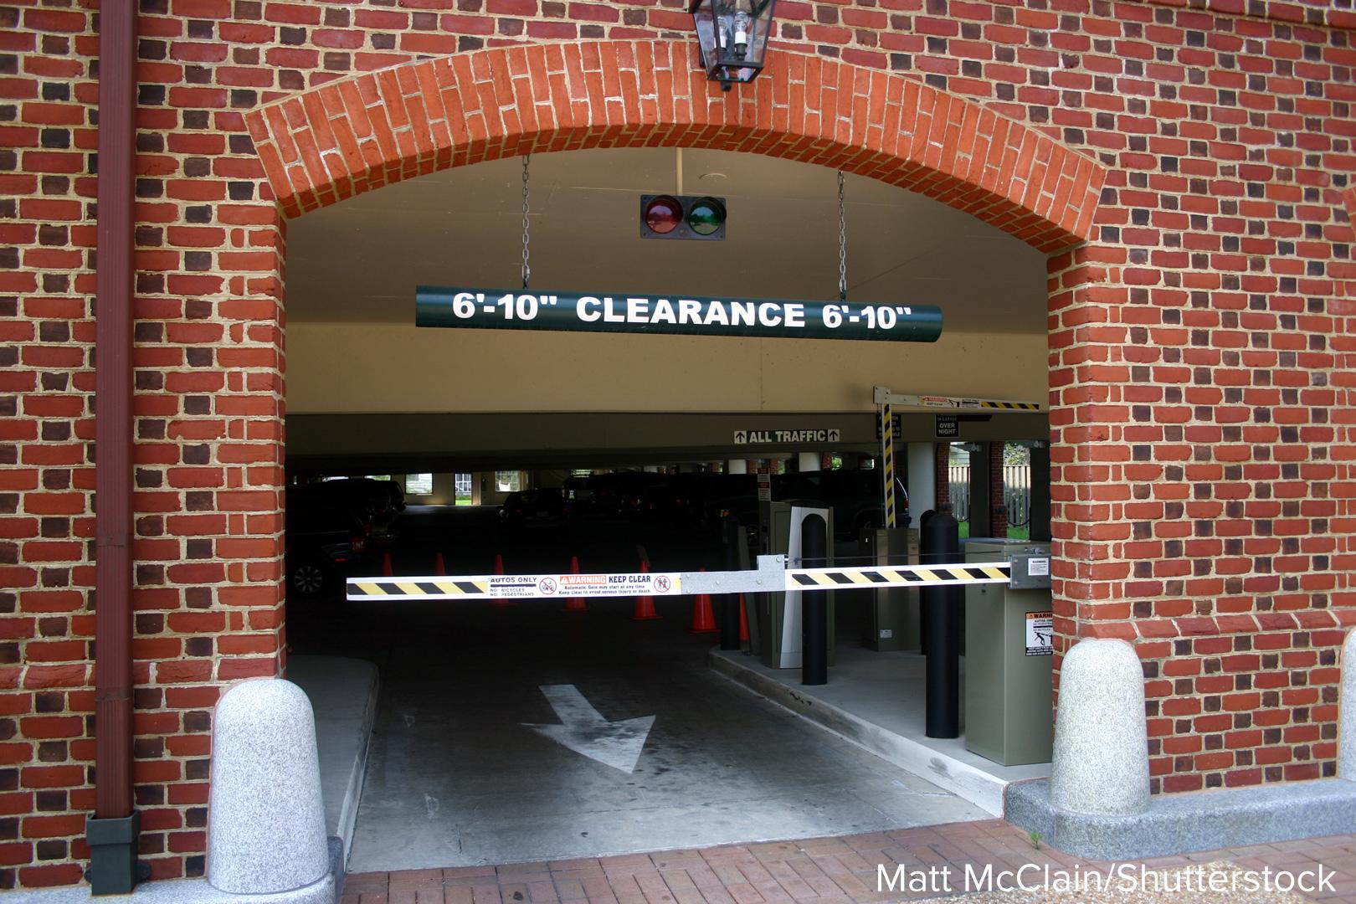
Be Curious
Be Curious
What could the question be?
Think first. Share a notice and a
question; build on a classmate’s
idea.
Mindset
How have you resolved a disagreement in math class?
47 / 49
Notes:
TEACH IN PRACTICE | Embedded facilitation | Lesson 8.4, slide 41 | CURIOUS
Focus on the existing task: Be Curious What could the question be?
LAUNCH (T2/3/5): Allow quiet observation first. Separate a notice from an inference, invite students’ own questions, and follow the existing launch before teaching a procedure.
LOOK FOR (T4): Where this task addresses it, students can translate a constraint. Ask which feature of their work supports the claim.
RESPOND: If this task shows the lesson misconception—confusing at least with greater than or reversing the comparison—test the boundary against the original words before selecting the symbol. Have the student revise and explain the change. Use this support only where the concept occurs in the current task; otherwise respond to the displayed question.
RECHECK: If a gap is shared, revisit the existing representation together. If it is limited, give targeted support while others compare valid methods on the same task. Check the revision before moving on.
PARTICIPATION (T5/6/7): Think time before volunteers; accept a written, drawn or rehearsed entry. Students ask for evidence respectfully. Recognize a specific contribution or revision and check that both partners participate.
Source: BCPS Updated Instructional Framework Rubric (June 2020), TEACH 1–7.

Slide 48
Learning Targets
I can write inequalities to represent a real-world or mathematical problem.
I can use repeated reasoning to understand ways that problems can be represented by inequalities.
Point to evidence in your work. Name what improved and your next step.
48 / 49
Notes:
TEACH IN PRACTICE | Embedded facilitation | Lesson 8.4, slide 42 | REFLECTION
Focus on the existing task: Learning Targets I can write inequalities to represent a real-world or mathematical problem. I can use repeated reasoning to understand…
CONNECT (T1/4): Ask students to restate the displayed goal or key idea and connect it to earlier work. Relevant lesson evidence: translate a constraint; distinguish strict from inclusive bounds; explain multiple solutions. Use only the criterion that matches the current session.
SHOW PROGRESS: Students point to their own existing work, explain what improved after feedback, and name a next step. Pair confidence ratings with actual evidence.
PARTICIPATION (T5/6/7): Think time before volunteers; accept a written, drawn or rehearsed entry. Students ask for evidence respectfully. Recognize a specific contribution or revision and check that both partners participate.
Source: BCPS Updated Instructional Framework Rubric (June 2020), TEACH 1–7. Earlier notes and answer keys are retained below.
EARLIER NOTES / EXISTING ANSWER KEY
UIFR FULL | Lesson-specific facilitation
REFLECT & ADJUST 1-2 | After the lesson (UIFR PDF pp. 15-16).
Sort the existing work by demonstrated reasoning, partial understanding, and the specific misconception: confusing at least with greater than or reversing the comparison. Compare the initial response with the revision. Record which teaching move plausibly helped, which did not, and whose participation or access needs a different approach; do not record sensitive student details in this shared deck.
Plan the next lesson from that evidence: if the misconception persists, test the boundary against the original words before selecting the symbol using the current example before returning to the next grade-level task; if understanding is secure, use an existing extension or ask for a general explanation. Check the targeted idea again at the next warm-up.
Ask students what supported their thinking and what would help next time. Identify one change to try and one successful practice to retain. Seek colleague feedback on anonymized work when useful; these prompts support reflection and do not establish an evaluation rating. Source: Baltimore City Public Schools, Updated Instructional Framework Rubric, June 2020 (UIFR_Full.pdf).

Slide 49
LESSON 8.4 / REFLECT ON YOUR LEARNING
Show your progress
1 SHOW EVIDENCE
2 CHOOSE A NEXT STEP
Choose one response. Point to the part that shows your reasoning.
Name a change you made after feedback—or a question you still have.
“My work shows ___ because ___.”
“Next time, I will ___ to help me ___.”
Today’s focus: Translate a constraint.
CREDIT A CLASSMATE · Name one classmate whose idea helped you today, and say what they said.
Listen to understand. Ask for evidence. Make room for every voice.
Notes:
TEACH IN PRACTICE | Embedded facilitation | Lesson 8.4, slide 43 | PRIOR_INSERT
Focus on the existing task: LESSON 8.4 / REFLECT ON YOUR LEARNING Show your progress Listen to understand. Ask for evidence. Make room for every voice. 1 SHOW…
CONNECT (T1/4): Ask students to restate the displayed goal or key idea and connect it to earlier work. Relevant lesson evidence: translate a constraint; distinguish strict from inclusive bounds; explain multiple solutions. Use only the criterion that matches the current session.
SHOW PROGRESS: Students point to their own existing work, explain what improved after feedback, and name a next step. Pair confidence ratings with actual evidence.
PARTICIPATION (T5/6/7): Think time before volunteers; accept a written, drawn or rehearsed entry. Students ask for evidence respectfully. Recognize a specific contribution or revision and check that both partners participate.
Source: BCPS Updated Instructional Framework Rubric (June 2020), TEACH 1–7.

