Slide 1
WARM-UP · THINK • TRY • CHECK
Turn and talk: compare strategies, then defend one.
Warm-Up
Lesson 8-5 · Understand Inequalities and Their Solutions | Warm-Up · about 4 minutes
Try each on your own. Mark an unsure answer; explain and revise when we check.
QUESTION 1
QUESTION 2
x < 6. Do you shade left or right? ______
x ≥ 3. Open circle or closed circle? ______
QUESTION 3
QUESTION 4
Is 2 a solution of x > 2? ______
x ≤ 10. What is the largest number
that works? ______
TALK IT OVER: “I got ______ because ______.” • Compare with a partner before we check as a class.
1 / 58
Notes:
TEACH IN PRACTICE | Embedded facilitation | Lesson 8.5, slide 1 | WARMUP
Focus on the existing task: ______ QUESTION 2 x ≥ 3. Open circle or closed circle?
GATHER EVIDENCE (T4/6): Keep the original items. Students try independently, mark an uncertain item, and explain one method before checking. Use the existing key when present.
RESPOND: Distinguish a calculation slip from a reasoning gap. Give one next step on the same item; have students revise in a second color. Use the responses to choose flexible support for today’s lesson.
PARTICIPATION (T5/6/7): Think time before volunteers; accept a written, drawn or rehearsed entry. Students ask for evidence respectfully. Recognize a specific contribution or revision and check that both partners participate.
Source: BCPS Updated Instructional Framework Rubric (June 2020), TEACH 1–7. Earlier notes and answer keys are retained below.
EARLIER NOTES / EXISTING ANSWER KEY
Warm-Up answers (teacher only): 1) left 2) closed 3) no 4) 10
UIFR FULL | Lesson-specific facilitation
PREPARE 1-2 | Before teaching (UIFR PDF pp. 6-7).
Plan to gather evidence that students can choose an open or closed endpoint; shade the correct direction; test boundary and other values. Review recent work and today’s warm-up to choose flexible groups and access supports; do not infer needs from identity or perceived ability. Use the existing lesson tasks and stated standards.
Anticipate: including a strict boundary or shading toward nonsolutions. If observed, substitute the original boundary and a value on each side before graphing. Offer oral rehearsal, drawing, pointing, or home-language processing as needed; retain the original mathematical demand. Ask students which support helps and fade it as evidence improves.
TEACH 6-7 | Before the first transition, agree on materials, partner roles, and how to request help. Invite students to restate the routine. Normalize revising an idea, recognize a specific contribution, and check privately when frustration blocks participation. Source: UIFR PDF pp. 13-14.

Slide 2
Today’s Math Notes
Lesson 8-5 · Understand Inequalities and Their Solutions
Section 1: Math Words
Copy. Explain. Check.
SAY THE GOAL · Say today’s goal in your own words, then name one place this shows up outside math class.
Graph Inequalities
1
Show every solution to an inequality on a number line
Number line
2
A straight line where numbers are placed in order
Open circle
3
An empty circle showing a number is NOT included
eduwonderlab.com · Neft Teacher
2 / 58
Notes:
TEACH IN PRACTICE | Embedded facilitation | Lesson 8.5, slide 2 | NOTES
Focus on the existing task: Today’s Math Notes Section 1: Math Words Copy…
ROUTINE (T1/2/4): Read or copy the original notes, cover one line, and explain it using the displayed example. Reopen and correct. Copying alone is not evidence of understanding.
LOOK FOR: A link between a symbol, quantity or feature and the explanation. If missing, point back to that feature and have the student try again; fade the prompt once they can explain.
PARTICIPATION (T5/6/7): Think time before volunteers; accept a written, drawn or rehearsed entry. Students ask for evidence respectfully. Recognize a specific contribution or revision and check that both partners participate.
Source: BCPS Updated Instructional Framework Rubric (June 2020), TEACH 1–7. Earlier notes and answer keys are retained below.
EARLIER NOTES / EXISTING ANSWER KEY
Copy routine: read one line at a time; students copy, then explain that line to a partner.
Keep it brisk — the understanding work happens in the examples, not the copying.
UIFR: TEACH 1 · TEACH 6.

Slide 3
Today’s Math Notes
Lesson 8-5 · Understand Inequalities and Their Solutions
Section 2: Today’s Math
Copy. Explain. Check.
Graphing Inequalities on the Number Line
Draw the boundary circle at the given constant number
1
Open Circle (○) for < or > (boundary value is not included in solution set)
2
CONNECT IT · What earlier lesson does this build on? Tell a partner in one sentence.
Closed Circle (●) for ≤ or ≥ (boundary value is included). Shade right for >, left for <
3
eduwonderlab.com · Neft Teacher
3 / 58
Notes:
TEACH IN PRACTICE | Embedded facilitation | Lesson 8.5, slide 3 | NOTES
Focus on the existing task: Today’s Math Notes Section 2: Today’s Math Copy…
ROUTINE (T1/2/4): Read or copy the original notes, cover one line, and explain it using the displayed example. Reopen and correct. Copying alone is not evidence of understanding.
LOOK FOR: A link between a symbol, quantity or feature and the explanation. If missing, point back to that feature and have the student try again; fade the prompt once they can explain.
PARTICIPATION (T5/6/7): Think time before volunteers; accept a written, drawn or rehearsed entry. Students ask for evidence respectfully. Recognize a specific contribution or revision and check that both partners participate.
Source: BCPS Updated Instructional Framework Rubric (June 2020), TEACH 1–7. Earlier notes and answer keys are retained below.
EARLIER NOTES / EXISTING ANSWER KEY
Copy routine: read one line at a time; students copy, then explain that line to a partner.
Keep it brisk — the understanding work happens in the examples, not the copying.
UIFR: TEACH 1 · TEACH 6.

Slide 4
Session 1
Understand Inequalities and Their Solutions
TRY IT BEFORE YOU’RE SURE · Start even if you are not sure. A revised answer counts as much as a first-try answer.
4 / 58
Notes:
TEACH IN PRACTICE | Embedded facilitation | Lesson 8.5, slide 4 | DIVIDER
Focus on the existing task: Understand Inequalities and Their Solutions Session 1
TRANSITION (T6/7): Students confirm materials, roles, how to request help, and the next response routine. Ask a student to restate it. Keep teacher-only slides hidden.
PARTICIPATION (T5/6/7): Think time before volunteers; accept a written, drawn or rehearsed entry. Students ask for evidence respectfully. Recognize a specific contribution or revision and check that both partners participate.
Source: BCPS Updated Instructional Framework Rubric (June 2020), TEACH 1–7. Earlier notes and answer keys are retained below.
EARLIER NOTES / EXISTING ANSWER KEY
Transition cue: state what materials are out and what success looks like this session.
Keep the changeover under a minute.
UIFR: TEACH 6.

Slide 5
This or That
Would you rather have THIS or THAT hours of chores?
THIS or THAT2
THIS | THAT
Think and record first. Which part of your work supports your answer?
5 / 58
Notes:
TEACH IN PRACTICE | Embedded facilitation | Lesson 8.5, slide 5 | TASK
Focus on the existing task: This or That Would you rather have THIS or THAT hours of chores?
LAUNCH (T2/3/5): Use the displayed question. Give private thinking time; then A explains while B asks for evidence. Switch roles. Each student records their own reasoning.
LOOK FOR (T4): Where this task addresses it, students can choose an open or closed endpoint. Ask which feature of their work supports the claim.
RESPOND: If this task shows the lesson misconception—including a strict boundary or shading toward nonsolutions—substitute the original boundary and a value on each side before graphing. Have the student revise and explain the change. Use this support only where the concept occurs in the current task; otherwise respond to the displayed question.
RECHECK: If a gap is shared, revisit the existing representation together. If it is limited, give targeted support while others compare valid methods on the same task. Check the revision before moving on.
PARTICIPATION (T5/6/7): Think time before volunteers; accept a written, drawn or rehearsed entry. Students ask for evidence respectfully. Recognize a specific contribution or revision and check that both partners participate.
Source: BCPS Updated Instructional Framework Rubric (June 2020), TEACH 1–7. Earlier notes and answer keys are retained below.
EARLIER NOTES / EXISTING ANSWER KEY
Number-sense routine — every voice in. Give quiet think time, then hear from at least three students.
Always follow with “How do you know?” — the reasoning is the point, not the answer.
There is more than one path; name and celebrate different strategies.
UIFR: TEACH 3 · TEACH 5 · TEACH 6.

Slide 6
Today’s Objectives
Lesson 8-5 · Understand Inequalities and Their Solutions
Understand Inequalities and Their Solutions
Maryland Standard 6.AT.9
SHOW YOUR THINKING · Show what you know — write it, draw it, or build it. A picture counts as an explanation.
CONTENT OBJECTIVE
LANGUAGE OBJECTIVE
Restate the goal in your words
Use these words to explain why
I can graph the solutions of an inequality on a number line.
I can explain my graph using the words number line, open circle, closed circle, and solution set.
eduwonderlab.com · Neft Teacher
6 / 58
Notes:
TEACH IN PRACTICE | Embedded facilitation | Lesson 8.5, slide 6 | GOAL
Focus on the existing task: Today’s Objectives Understand Inequalities and…
CONNECT (T1/4): Ask students to restate the displayed goal or key idea and connect it to earlier work. Relevant lesson evidence: choose an open or closed endpoint; shade the correct direction; test boundary and other values. Use only the criterion that matches the current session.
SHOW PROGRESS: Students point to their own existing work, explain what improved after feedback, and name a next step. Pair confidence ratings with actual evidence.
PARTICIPATION (T5/6/7): Think time before volunteers; accept a written, drawn or rehearsed entry. Students ask for evidence respectfully. Recognize a specific contribution or revision and check that both partners participate.
Source: BCPS Updated Instructional Framework Rubric (June 2020), TEACH 1–7. Earlier notes and answer keys are retained below.
EARLIER NOTES / EXISTING ANSWER KEY
Read the objective together, then have one or two students restate today’s goal in their own words.
Connect it to what the class learned last lesson.
Return to this goal at the end of class to check it was met.
UIFR: TEACH 1.
UIFR FULL | Lesson-specific facilitation
TEACH 1 | Session 1 purpose and evidence (UIFR PDF p. 8).
Have students restate the displayed session goal in their own words and connect it to the existing context or a familiar experience they choose to share. Use the current session goal to select from these lesson-wide evidence criteria; do not frontload a later-session procedure.
Look for: choose an open or closed endpoint; shade the correct direction; test boundary and other values. Ask: “Which part of your work would show this?” Revisit that evidence after the task; a confidence rating alone is not evidence of understanding.

Slide 7
LESSON 8.5 / OUR LEARNING
What will show your learning?
1
Choose an open or closed endpoint.
2
Shade the correct direction.
3
Test boundary and other values.
Tell a partner: Which skill connects to something you already know?
WHY IT MATTERS · Finish this: “This is worth knowing because ______.”
Listen to understand. Ask for evidence. Make room for every voice.
Notes:
TEACH IN PRACTICE | Embedded facilitation | Lesson 8.5, slide 7 | PRIOR_INSERT
Focus on the existing task: LESSON 8.5 / OUR LEARNING What will show your learning?
CONNECT (T1/4): Ask students to restate the displayed goal or key idea and connect it to earlier work. Relevant lesson evidence: choose an open or closed endpoint; shade the correct direction; test boundary and other values. Use only the criterion that matches the current session.
SHOW PROGRESS: Students point to their own existing work, explain what improved after feedback, and name a next step. Pair confidence ratings with actual evidence.
PARTICIPATION (T5/6/7): Think time before volunteers; accept a written, drawn or rehearsed entry. Students ask for evidence respectfully. Recognize a specific contribution or revision and check that both partners participate.
Source: BCPS Updated Instructional Framework Rubric (June 2020), TEACH 1–7.

Slide 8
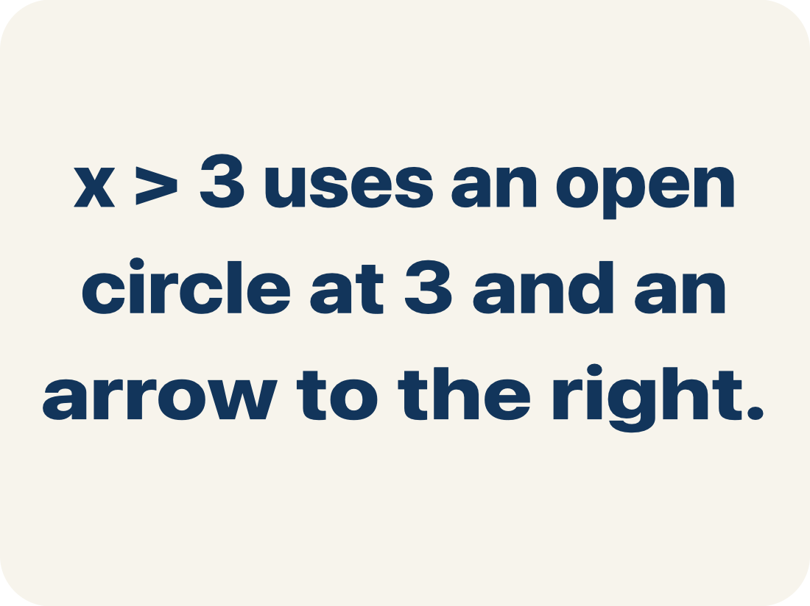
Vocabulary 1 of 7
Lesson 8-5 · Understand Inequalities and Their Solutions
Graph Inequalities
Show every solution to an inequality on a number line with a boundary point and an arrow.
EXAMPLE · EXPLAIN WHY IT FITS
x > 3 uses an open circle at 3 and an arrow to the right.
USE THE MATH WORDS · Use today’s math words in your explanation — not “it” and “that thing.”
eduwonderlab.com · Neft Teacher
8 / 58
Notes:
TEACH IN PRACTICE | Embedded facilitation | Lesson 8.5, slide 8 | VOCAB
Focus on the existing task: Vocabulary 1 of 7 Graph Inequalities Show…
ASK (T1/3/5): Where does “Graph Inequalities” appear in the example? Explain the meaning without reading the definition. Partner: restate the idea and ask a clarifying question.
LOOK FOR: A correct connection between the word and a feature of the example. If the student only repeats the definition, invite pointing, sketching or oral rehearsal, then ask for another explanation of this same example.
PARTICIPATION (T5/6/7): Think time before volunteers; accept a written, drawn or rehearsed entry. Students ask for evidence respectfully. Recognize a specific contribution or revision and check that both partners participate.
Source: BCPS Updated Instructional Framework Rubric (June 2020), TEACH 1–7.

Slide 9

Vocabulary 2 of 7
Lesson 8-5 · Understand Inequalities and Their Solutions
Number line
A straight line where numbers are placed in order; numbers get smaller to the left and larger to the right.
EXAMPLE · EXPLAIN WHY IT FITS
A horizontal line with marks at 0, 1, 2, 3, … showing where values fall
Use “Number line” to explain the example. Point to evidence.
eduwonderlab.com · Neft Teacher
9 / 58
Notes:
TEACH IN PRACTICE | Embedded facilitation | Lesson 8.5, slide 9 | VOCAB
Focus on the existing task: Vocabulary 2 of 7 Number line A straight line…
ASK (T1/3/5): Where does “Number line” appear in the example? Explain the meaning without reading the definition. Partner: restate the idea and ask a clarifying question.
LOOK FOR: A correct connection between the word and a feature of the example. If the student only repeats the definition, invite pointing, sketching or oral rehearsal, then ask for another explanation of this same example.
PARTICIPATION (T5/6/7): Think time before volunteers; accept a written, drawn or rehearsed entry. Students ask for evidence respectfully. Recognize a specific contribution or revision and check that both partners participate.
Source: BCPS Updated Instructional Framework Rubric (June 2020), TEACH 1–7.

Slide 10
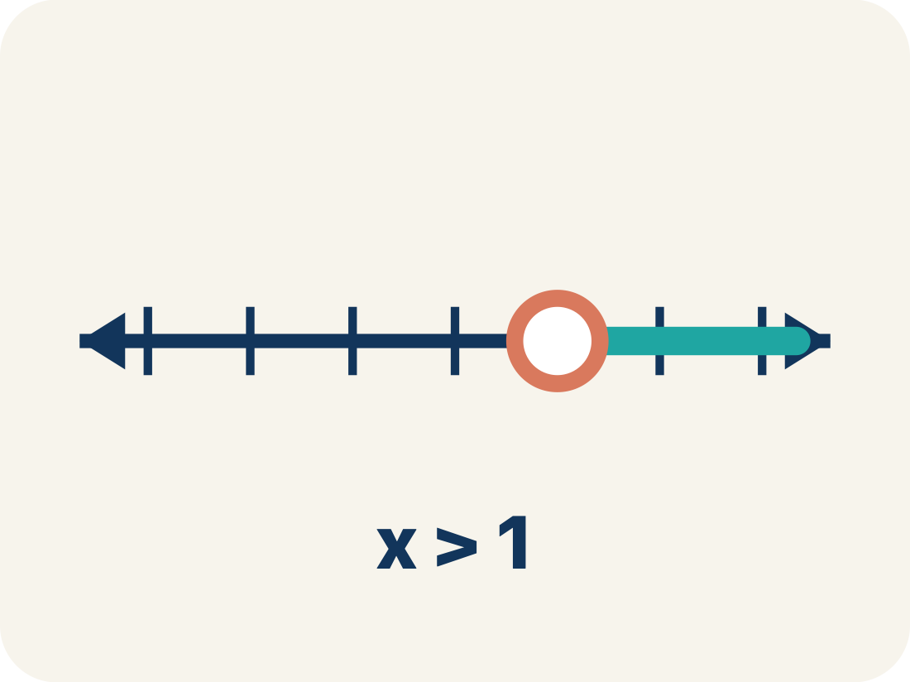
Vocabulary 3 of 7
Lesson 8-5 · Understand Inequalities and Their Solutions
Open circle
An empty circle showing a number is NOT included.
EXAMPLE · EXPLAIN WHY IT FITS
x > 5: open circle at 5 means 5 itself is NOT a solution, but 5.1, 6, 7, … are
Use “Open circle” to explain the example. Point to evidence.
eduwonderlab.com · Neft Teacher
10 / 58
Notes:
TEACH IN PRACTICE | Embedded facilitation | Lesson 8.5, slide 10 | VOCAB
Focus on the existing task: Vocabulary 3 of 7 Open circle An empty circle…
ASK (T1/3/5): Where does “Open circle” appear in the example? Explain the meaning without reading the definition. Partner: restate the idea and ask a clarifying question.
LOOK FOR: A correct connection between the word and a feature of the example. If the student only repeats the definition, invite pointing, sketching or oral rehearsal, then ask for another explanation of this same example.
PARTICIPATION (T5/6/7): Think time before volunteers; accept a written, drawn or rehearsed entry. Students ask for evidence respectfully. Recognize a specific contribution or revision and check that both partners participate.
Source: BCPS Updated Instructional Framework Rubric (June 2020), TEACH 1–7.

Slide 11
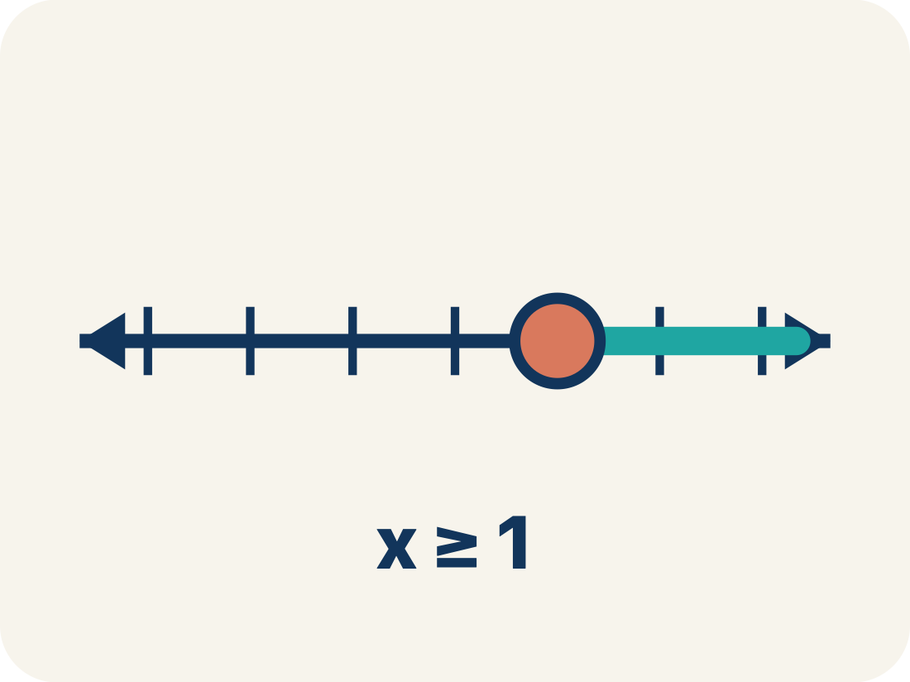
Vocabulary 4 of 7
Lesson 8-5 · Understand Inequalities and Their Solutions
Closed circle
A filled-in circle showing a number IS included.
EXAMPLE · EXPLAIN WHY IT FITS
x ≥ 5: closed circle at 5 means 5 IS a solution, and so are 6, 7, 8, …
Use “Closed circle” to explain the example. Point to
evidence.
eduwonderlab.com · Neft Teacher
11 / 58
Notes:
TEACH IN PRACTICE | Embedded facilitation | Lesson 8.5, slide 11 | VOCAB
Focus on the existing task: Vocabulary 4 of 7 Closed circle A filled-in…
ASK (T1/3/5): Where does “Closed circle” appear in the example? Explain the meaning without reading the definition. Partner: restate the idea and ask a clarifying question.
LOOK FOR: A correct connection between the word and a feature of the example. If the student only repeats the definition, invite pointing, sketching or oral rehearsal, then ask for another explanation of this same example.
PARTICIPATION (T5/6/7): Think time before volunteers; accept a written, drawn or rehearsed entry. Students ask for evidence respectfully. Recognize a specific contribution or revision and check that both partners participate.
Source: BCPS Updated Instructional Framework Rubric (June 2020), TEACH 1–7.

Slide 12
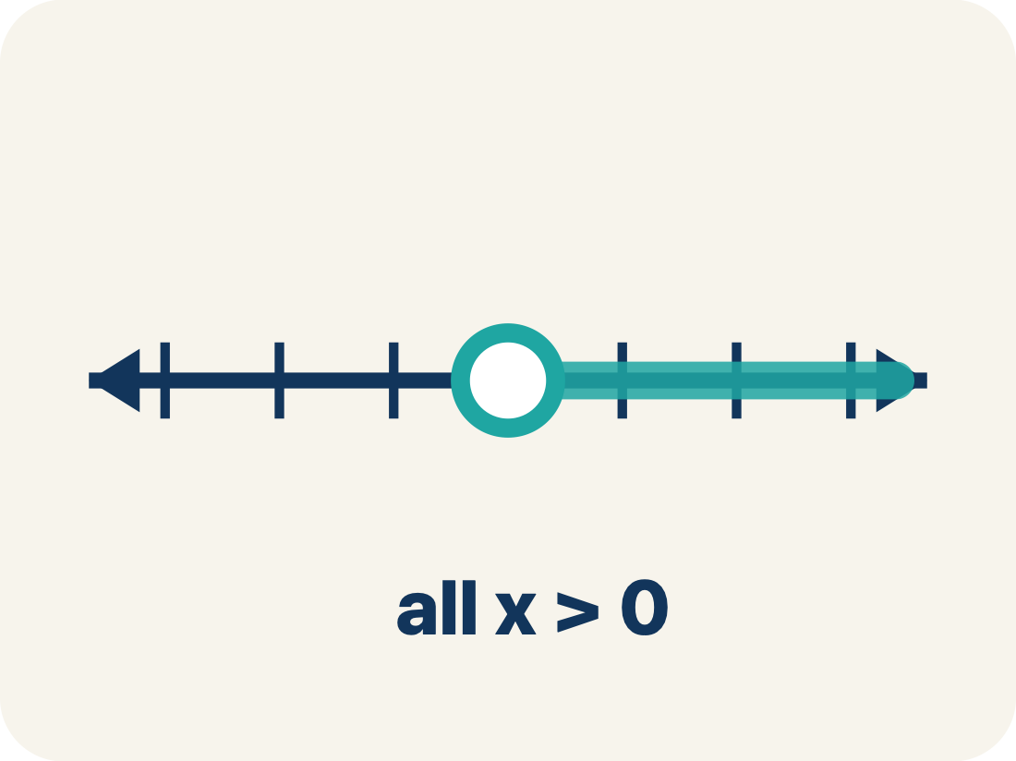
Vocabulary 5 of 7
Lesson 8-5 · Understand Inequalities and Their Solutions
Solution set
All the numbers that make the inequality true.
EXAMPLE · EXPLAIN WHY IT FITS
For x > 3, the solution set includes 3.1, 4, 5, 10, 100 — any number greater than 3
Use “Solution set” to explain the example. Point to evidence.
eduwonderlab.com · Neft Teacher
12 / 58
Notes:
TEACH IN PRACTICE | Embedded facilitation | Lesson 8.5, slide 12 | VOCAB
Focus on the existing task: Vocabulary 5 of 7 Solution set All the numbers…
ASK (T1/3/5): Where does “Solution set” appear in the example? Explain the meaning without reading the definition. Partner: restate the idea and ask a clarifying question.
LOOK FOR: A correct connection between the word and a feature of the example. If the student only repeats the definition, invite pointing, sketching or oral rehearsal, then ask for another explanation of this same example.
PARTICIPATION (T5/6/7): Think time before volunteers; accept a written, drawn or rehearsed entry. Students ask for evidence respectfully. Recognize a specific contribution or revision and check that both partners participate.
Source: BCPS Updated Instructional Framework Rubric (June 2020), TEACH 1–7.

Slide 13
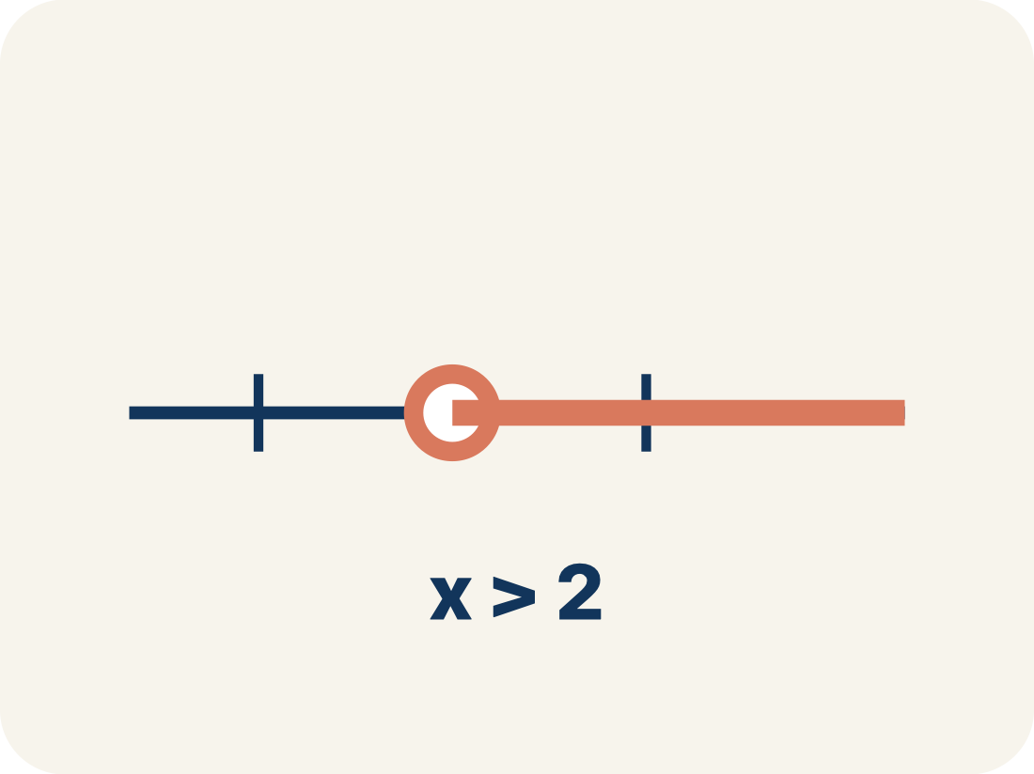
Vocabulary 6 of 7
Lesson 8-5 · Understand Inequalities and Their Solutions
Inequality
A math sentence that compares two sides with <, >, ≤, or ≥.
EXAMPLE · EXPLAIN WHY IT FITS
x ≥ 3 is an inequality; it is graphed as a closed circle on 3 with an arrow to the right.
Use “Inequality” to explain the example. Point to evidence.
eduwonderlab.com · Neft Teacher
13 / 58
Notes:
TEACH IN PRACTICE | Embedded facilitation | Lesson 8.5, slide 13 | VOCAB
Focus on the existing task: Vocabulary 6 of 7 Inequality A math sentence…
ASK (T1/3/5): Where does “Inequality” appear in the example? Explain the meaning without reading the definition. Partner: restate the idea and ask a clarifying question.
LOOK FOR: A correct connection between the word and a feature of the example. If the student only repeats the definition, invite pointing, sketching or oral rehearsal, then ask for another explanation of this same example.
PARTICIPATION (T5/6/7): Think time before volunteers; accept a written, drawn or rehearsed entry. Students ask for evidence respectfully. Recognize a specific contribution or revision and check that both partners participate.
Source: BCPS Updated Instructional Framework Rubric (June 2020), TEACH 1–7.

Slide 14
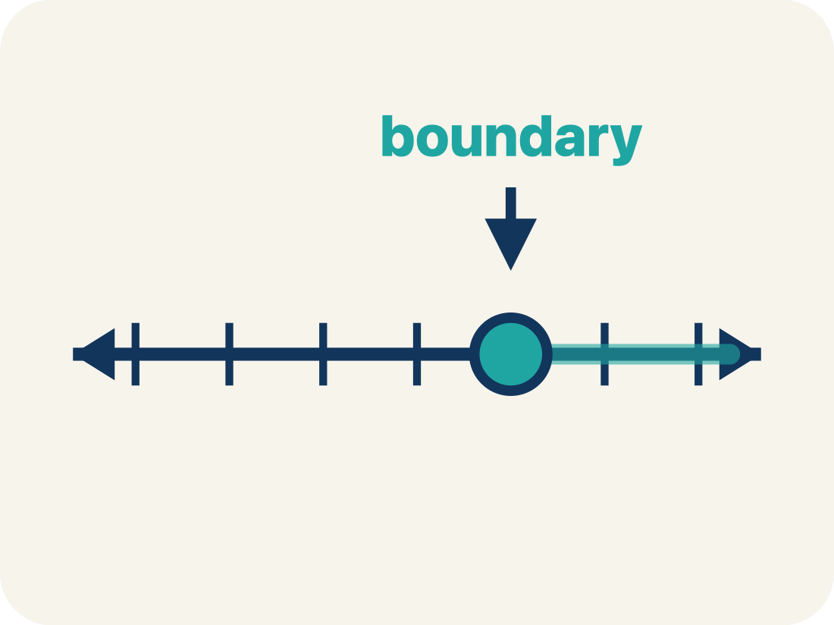
Vocabulary 7 of 7
Lesson 8-5 · Understand Inequalities and Their Solutions
Boundary point
The number on the number line where the solution set starts.
EXAMPLE · EXPLAIN WHY IT FITS
For x > 5, the boundary point is 5, shown with an open circle.
Use “Boundary point” to explain the example. Point to
evidence.
eduwonderlab.com · Neft Teacher
14 / 58
Notes:
TEACH IN PRACTICE | Embedded facilitation | Lesson 8.5, slide 14 | VOCAB
Focus on the existing task: Vocabulary 7 of 7 Boundary point The number on…
ASK (T1/3/5): Where does “Boundary point” appear in the example? Explain the meaning without reading the definition. Partner: restate the idea and ask a clarifying question.
LOOK FOR: A correct connection between the word and a feature of the example. If the student only repeats the definition, invite pointing, sketching or oral rehearsal, then ask for another explanation of this same example.
PARTICIPATION (T5/6/7): Think time before volunteers; accept a written, drawn or rehearsed entry. Students ask for evidence respectfully. Recognize a specific contribution or revision and check that both partners participate.
Source: BCPS Updated Instructional Framework Rubric (June 2020), TEACH 1–7.

Slide 15
Vocabulary
Lesson 8-5 · Understand Inequalities and Their Solutions
Today’s Math Words
We learn every word — what it means and what it looks like — before we use it.
Graph Inequalities
Number line
Show every solution to an inequality on a number line with a boundary point and an arrow
A straight line where numbers are placed in order; numbers get smaller to the left and larger to the right
Open circle
Closed circle
An empty circle showing a number is NOT included
A filled-in circle showing a number IS included
Solution set
Inequality
All the numbers that make the inequality true
A math sentence that compares two sides with <, >, ≤, or ≥
Boundary point
Explain one math word using the example.
Partner: point to evidence.
The number on the number line where the solution set starts
eduwonderlab.com · Neft Teacher
15 / 58
Notes:
TEACH IN PRACTICE | Embedded facilitation | Lesson 8.5, slide 15 | VOCAB
Focus on the existing task: Vocabulary Today’s Math Words We learn every…
ASK (T1/3/5): Where does “the displayed term” appear in the example? Explain the meaning without reading the definition. Partner: restate the idea and ask a clarifying question.
LOOK FOR: A correct connection between the word and a feature of the example. If the student only repeats the definition, invite pointing, sketching or oral rehearsal, then ask for another explanation of this same example.
PARTICIPATION (T5/6/7): Think time before volunteers; accept a written, drawn or rehearsed entry. Students ask for evidence respectfully. Recognize a specific contribution or revision and check that both partners participate.
Source: BCPS Updated Instructional Framework Rubric (June 2020), TEACH 1–7. Earlier notes and answer keys are retained below.
EARLIER NOTES / EXISTING ANSWER KEY
Choral-read each word, its meaning, and what it looks like.
Students should use these words out loud today — listen for them in partner talk and revoice student ideas with the academic term.
UIFR: TEACH 1 · TEACH 5.

Slide 16
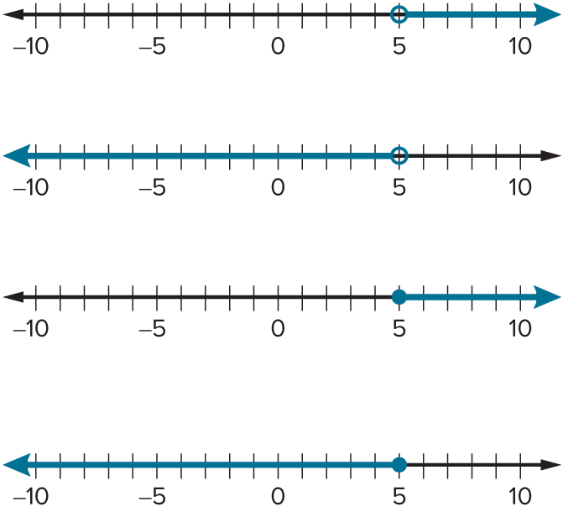

Be Curious
What do you notice?
What do you wonder?
Think first. Share a notice and a question;
build on a classmate’s idea.
Mindset
How can understanding the context of a problem or situation help in solving a math or non-math problem?
16 / 58
Notes:
TEACH IN PRACTICE | Embedded facilitation | Lesson 8.5, slide 16 | CURIOUS
Focus on the existing task: Be Curious What do you notice?
LAUNCH (T2/3/5): Allow quiet observation first. Separate a notice from an inference, invite students’ own questions, and follow the existing launch before teaching a procedure.
LOOK FOR (T4): Where this task addresses it, students can choose an open or closed endpoint. Ask which feature of their work supports the claim.
RESPOND: If this task shows the lesson misconception—including a strict boundary or shading toward nonsolutions—substitute the original boundary and a value on each side before graphing. Have the student revise and explain the change. Use this support only where the concept occurs in the current task; otherwise respond to the displayed question.
RECHECK: If a gap is shared, revisit the existing representation together. If it is limited, give targeted support while others compare valid methods on the same task. Check the revision before moving on.
PARTICIPATION (T5/6/7): Think time before volunteers; accept a written, drawn or rehearsed entry. Students ask for evidence respectfully. Recognize a specific contribution or revision and check that both partners participate.
Source: BCPS Updated Instructional Framework Rubric (June 2020), TEACH 1–7. Earlier notes and answer keys are retained below.
EARLIER NOTES / EXISTING ANSWER KEY
Accept all noticings and wonderings — there are no wrong answers here.
Give 20–30 seconds of quiet think time before taking responses; mix cold and warm calls so it is not always the same voices.
Read the mindset question aloud and let two students respond.
UIFR: TEACH 3 · TEACH 7.

Slide 17
Elevation
At an elevation of 8,849 meters above sea level, the peak of Mount Everest is the highest point of elevation on Earth. How can you represent the possible elevations of landforms on Earth?
What constraint exists on the elevations of landforms on Earth?
Reveal:
All landforms have an elevation of 8,849 meters or less.
17 / 58
Notes:
TEACH IN PRACTICE | Embedded facilitation | Lesson 8.5, slide 17 | REVEAL
Focus on the existing task: What constraint exists on the elevations of landforms on Earth?
LAUNCH (T2/3/5): If an existing answer cover is present, gather an attempt before revealing. If the explanation is already visible, ask students to reconstruct and justify it. Compare reasoning and explain a revision; preserve the reveal sequence.
LOOK FOR (T4): Where this task addresses it, students can choose an open or closed endpoint. Ask which feature of their work supports the claim.
RESPOND: If this task shows the lesson misconception—including a strict boundary or shading toward nonsolutions—substitute the original boundary and a value on each side before graphing. Have the student revise and explain the change. Use this support only where the concept occurs in the current task; otherwise respond to the displayed question.
RECHECK: If a gap is shared, revisit the existing representation together. If it is limited, give targeted support while others compare valid methods on the same task. Check the revision before moving on.
PARTICIPATION (T5/6/7): Think time before volunteers; accept a written, drawn or rehearsed entry. Students ask for evidence respectfully. Recognize a specific contribution or revision and check that both partners participate.
Source: BCPS Updated Instructional Framework Rubric (June 2020), TEACH 1–7. Earlier notes and answer keys are retained below.
EARLIER NOTES / EXISTING ANSWER KEY
Do not click yet: collect 2–3 student answers with reasons first.
Then click to remove the cover and have students compare their thinking to the reveal — “Is this what we said? Where is it different?”
Behind the cover: All landforms have an elevation of 8,849 meters or less.
UIFR: TEACH 3 · TEACH 4.
UIFR FULL | Lesson-specific facilitation
TEACH 2-3 | Session 1 task launch (UIFR PDF pp. 9-10).
Use the problem exactly as displayed. Give individual thinking time before discussion or advancing to the explanation. If the answer is already visible, ask students to reconstruct and justify it. Invite a choice of suitable representations and have students explain why their choice helps.
At the point where this concept appears, ask: “Which test values verify the endpoint and shaded direction of your graph?” Wait for evidence, invite another pathway, and have a student ask a follow-up question. Do not replace students’ reasoning with a sequence of leading steps.

Slide 18
STUDENT MOVES
Lesson 8-5
Your move
TWO MINUTES SOLO · Two minutes on your own, then compare. Bring one thing you tried, even if it did not work.
18 / 58

Slide 19
Elevation
All landforms have an elevation of 8,849 meters or less.
How can you use a number line to think about the structure of the problem?
Record your reasoning before the reveal. Compare, then explain any revision.
Reveal:
I can plot possible elevations of landforms to analyze what elevations satisfy the constraint.
19 / 58
Notes:
TEACH IN PRACTICE | Embedded facilitation | Lesson 8.5, slide 18 | REVEAL
Focus on the existing task: Reveal: I can plot possible elevations of landforms to analyze what elevations satisfy the constraint. Elevation All landforms have an…
LAUNCH (T2/3/5): If an existing answer cover is present, gather an attempt before revealing. If the explanation is already visible, ask students to reconstruct and justify it. Compare reasoning and explain a revision; preserve the reveal sequence.
LOOK FOR (T4): Where this task addresses it, students can choose an open or closed endpoint. Ask which feature of their work supports the claim.
RESPOND: If this task shows the lesson misconception—including a strict boundary or shading toward nonsolutions—substitute the original boundary and a value on each side before graphing. Have the student revise and explain the change. Use this support only where the concept occurs in the current task; otherwise respond to the displayed question.
RECHECK: If a gap is shared, revisit the existing representation together. If it is limited, give targeted support while others compare valid methods on the same task. Check the revision before moving on.
PARTICIPATION (T5/6/7): Think time before volunteers; accept a written, drawn or rehearsed entry. Students ask for evidence respectfully. Recognize a specific contribution or revision and check that both partners participate.
Source: BCPS Updated Instructional Framework Rubric (June 2020), TEACH 1–7. Earlier notes and answer keys are retained below.
EARLIER NOTES / EXISTING ANSWER KEY
Do not click yet: collect 2–3 student answers with reasons first.
Then click to remove the cover and have students compare their thinking to the reveal — “Is this what we said? Where is it different?”
Behind the cover: I can plot possible elevations of landforms to analyze what elevations satisfy the constraint.
UIFR: TEACH 3 · TEACH 4.

Slide 20

COLLABORATE · TALK IT THROUGH • AGREE ON A MODEL
Collaborate and Connect
All landforms have an elevation of 8,849 meters or less.
How can you use the number line to plot possible elevations of landforms?
Think first. A explains; B asks for evidence. Switch roles; both revise.
20 / 58
Notes:
TEACH IN PRACTICE | Embedded facilitation | Lesson 8.5, slide 19 | COLLABORATE
Focus on the existing task: Collaborate and Connect All landforms have an elevation of 8,849 meters or less. How can you use the number line to plot possible elevations of landforms?
LAUNCH (T2/3/5): Use the displayed question. Give private thinking time; then A explains while B asks for evidence. Switch roles. Each student records their own reasoning.
LOOK FOR (T4): Where this task addresses it, students can choose an open or closed endpoint. Ask which feature of their work supports the claim.
RESPOND: If this task shows the lesson misconception—including a strict boundary or shading toward nonsolutions—substitute the original boundary and a value on each side before graphing. Have the student revise and explain the change. Use this support only where the concept occurs in the current task; otherwise respond to the displayed question.
RECHECK: If a gap is shared, revisit the existing representation together. If it is limited, give targeted support while others compare valid methods on the same task. Check the revision before moving on.
PARTICIPATION (T5/6/7): Think time before volunteers; accept a written, drawn or rehearsed entry. Students ask for evidence respectfully. Recognize a specific contribution or revision and check that both partners participate.
Source: BCPS Updated Instructional Framework Rubric (June 2020), TEACH 1–7. Earlier notes and answer keys are retained below.
EARLIER NOTES / EXISTING ANSWER KEY
Routine: COLLABORATE · TALK IT THROUGH • AGREE ON A MODEL
UIFR FULL | Lesson-specific facilitation
TEACH 4-5 | Session 1 discussion and checkpoint (UIFR PDF pp. 11-12).
Collect a brief response from every student to the existing prompt before hearing volunteers. Partners take turns explaining and asking for evidence: “I understand ___; what supports ___?” Offer rehearsal or an annotated model for students who need language support. Each student records their own reasoning.
Look specifically for: including a strict boundary or shading toward nonsolutions. If it appears, substitute the original boundary and a value on each side before graphing; then ask the student to revise the same response and explain the change. If evidence is secure, have students compare a second valid pathway or state why their approach works. Choose the next step from the responses, not a preset pace.

Slide 21
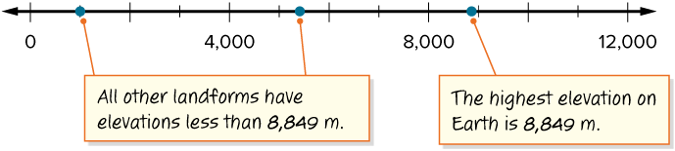
Elevation
All landforms have an elevation of 8,849 meters or less.
The number line shows possible elevations of landforms.
Record your reasoning before the reveal.
Compare, then explain any revision.
How can you represent all possible elevations of landforms on Earth algebraically?
Reveal:
We can write an inequality to represent the elevations.
21 / 58
Notes:
TEACH IN PRACTICE | Embedded facilitation | Lesson 8.5, slide 20 | REVEAL
Focus on the existing task: Reveal: We can write an inequality to represent the elevations. Elevation All landforms have an elevation of 8,849 meters or less. The…
LAUNCH (T2/3/5): If an existing answer cover is present, gather an attempt before revealing. If the explanation is already visible, ask students to reconstruct and justify it. Compare reasoning and explain a revision; preserve the reveal sequence.
LOOK FOR (T4): Where this task addresses it, students can choose an open or closed endpoint. Ask which feature of their work supports the claim.
RESPOND: If this task shows the lesson misconception—including a strict boundary or shading toward nonsolutions—substitute the original boundary and a value on each side before graphing. Have the student revise and explain the change. Use this support only where the concept occurs in the current task; otherwise respond to the displayed question.
RECHECK: If a gap is shared, revisit the existing representation together. If it is limited, give targeted support while others compare valid methods on the same task. Check the revision before moving on.
PARTICIPATION (T5/6/7): Think time before volunteers; accept a written, drawn or rehearsed entry. Students ask for evidence respectfully. Recognize a specific contribution or revision and check that both partners participate.
Source: BCPS Updated Instructional Framework Rubric (June 2020), TEACH 1–7. Earlier notes and answer keys are retained below.
EARLIER NOTES / EXISTING ANSWER KEY
Do not click yet: collect 2–3 student answers with reasons first.
Then click to remove the cover and have students compare their thinking to the reveal — “Is this what we said? Where is it different?”
Behind the cover: We can write an inequality to represent the elevations.
UIFR: TEACH 3 · TEACH 4.

Slide 22
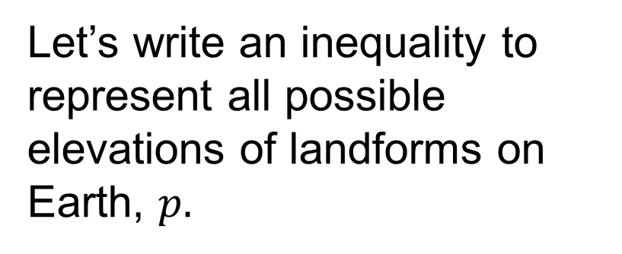

Elevation
HOW DO YOU KNOW? · Ask your partner “How do you know?” Answer by pointing to your own work.
Does the highest elevation on Earth, the peak of Mount Everest, satisfy the constraint represented by the inequality? Explain.
Reveal:
Yes, because the inequality symbol represents less than or equal to, and the highest elevation is equal to 8,849.
22 / 58
Notes:
TEACH IN PRACTICE | Embedded facilitation | Lesson 8.5, slide 21 | REVEAL
Focus on the existing task: Reveal: Yes, because the inequality symbol represents less than or equal to, and the highest elevation is equal to 8,849. Elevation…
LAUNCH (T2/3/5): If an existing answer cover is present, gather an attempt before revealing. If the explanation is already visible, ask students to reconstruct and justify it. Compare reasoning and explain a revision; preserve the reveal sequence.
LOOK FOR (T4): Where this task addresses it, students can choose an open or closed endpoint. Ask which feature of their work supports the claim.
RESPOND: If this task shows the lesson misconception—including a strict boundary or shading toward nonsolutions—substitute the original boundary and a value on each side before graphing. Have the student revise and explain the change. Use this support only where the concept occurs in the current task; otherwise respond to the displayed question.
RECHECK: If a gap is shared, revisit the existing representation together. If it is limited, give targeted support while others compare valid methods on the same task. Check the revision before moving on.
PARTICIPATION (T5/6/7): Think time before volunteers; accept a written, drawn or rehearsed entry. Students ask for evidence respectfully. Recognize a specific contribution or revision and check that both partners participate.
Source: BCPS Updated Instructional Framework Rubric (June 2020), TEACH 1–7. Earlier notes and answer keys are retained below.
EARLIER NOTES / EXISTING ANSWER KEY
Do not click yet: collect 2–3 student answers with reasons first.
Then click to remove the cover and have students compare their thinking to the reveal — “Is this what we said? Where is it different?”
Behind the cover: Yes, because the inequality symbol represents less than or equal to, and the highest elevation is equal to 8,849.
UIFR: TEACH 3 · TEACH 4.

Slide 23

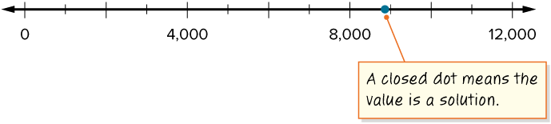
Elevation
Because the inequality symbol represents less than or equal to, the elevation of the peak of Mount Everest, 8,849 meters, satisfies the constraint.
We can plot the highest, or maximum, elevation on the number line.
ADD ON · Add on: “I agree because ______.” or “I see it differently because ______.”
23 / 58
Notes:
TEACH IN PRACTICE | Embedded facilitation | Lesson 8.5, slide 22 | WORKED
Focus on the existing task: Elevation Because the inequality symbol represents less than or equal to, the elevation of the peak of Mount Everest, 8,849 meters…
LAUNCH (T2/3/5): Ask students to explain the displayed idea or example and point to evidence. When a calculation step is shown, ask why it is valid. Have a partner restate the explanation; copying is not the check.
LOOK FOR (T4): Where this task addresses it, students can choose an open or closed endpoint. Ask which feature of their work supports the claim.
RESPOND: If this task shows the lesson misconception—including a strict boundary or shading toward nonsolutions—substitute the original boundary and a value on each side before graphing. Have the student revise and explain the change. Use this support only where the concept occurs in the current task; otherwise respond to the displayed question.
RECHECK: If a gap is shared, revisit the existing representation together. If it is limited, give targeted support while others compare valid methods on the same task. Check the revision before moving on.
PARTICIPATION (T5/6/7): Think time before volunteers; accept a written, drawn or rehearsed entry. Students ask for evidence respectfully. Recognize a specific contribution or revision and check that both partners participate.
Source: BCPS Updated Instructional Framework Rubric (June 2020), TEACH 1–7. Earlier notes and answer keys are retained below.
EARLIER NOTES / EXISTING ANSWER KEY
Model briefly, then hand the thinking back: ask “Why does this step work?” before showing the next one.
Quick check before moving on — thumbs or whiteboards from everyone, not volunteers.
UIFR: TEACH 2 · TEACH 3 · TEACH 4.

Slide 24
Elevation
What points would you need to plot to represent every other possible elevation?
Record your reasoning before the reveal. Compare, then explain any revision.
Reveal:
We would need to plot a point at every value that is less than, or to the left of, 8,849.
24 / 58
Notes:
TEACH IN PRACTICE | Embedded facilitation | Lesson 8.5, slide 23 | REVEAL
Focus on the existing task: Elevation Reveal: We would need to plot a point at every value that is less than, or to the left of, 8,849. What points would you need to plot to represent every other possible elevation?
LAUNCH (T2/3/5): If an existing answer cover is present, gather an attempt before revealing. If the explanation is already visible, ask students to reconstruct and justify it. Compare reasoning and explain a revision; preserve the reveal sequence.
LOOK FOR (T4): Where this task addresses it, students can test boundary and other values. Ask which feature of their work supports the claim.
RESPOND: If this task shows the lesson misconception—including a strict boundary or shading toward nonsolutions—substitute the original boundary and a value on each side before graphing. Have the student revise and explain the change. Use this support only where the concept occurs in the current task; otherwise respond to the displayed question.
RECHECK: If a gap is shared, revisit the existing representation together. If it is limited, give targeted support while others compare valid methods on the same task. Check the revision before moving on.
PARTICIPATION (T5/6/7): Think time before volunteers; accept a written, drawn or rehearsed entry. Students ask for evidence respectfully. Recognize a specific contribution or revision and check that both partners participate.
Source: BCPS Updated Instructional Framework Rubric (June 2020), TEACH 1–7. Earlier notes and answer keys are retained below.
EARLIER NOTES / EXISTING ANSWER KEY
Do not click yet: collect 2–3 student answers with reasons first.
Then click to remove the cover and have students compare their thinking to the reveal — “Is this what we said? Where is it different?”
Behind the cover: We would need to plot a point at every value that is less than, or to the left of, 8,849.
UIFR: TEACH 3 · TEACH 4.

Slide 25
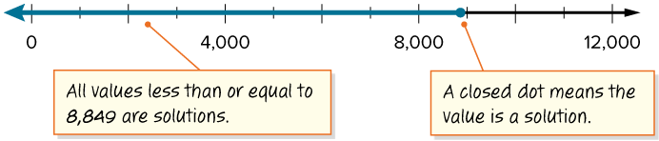
Elevation
Every value less than 8,849 is a solution of the inequality.
Rather than plotting a point for every possible solution, we can use an arrow. Every value covered by the arrow is included in the solution.
SELF-CHECK · Mark it: ✓ got it · ~ almost · ? stuck. Then fix one thing before we move on.
25 / 58
Notes:
TEACH IN PRACTICE | Embedded facilitation | Lesson 8.5, slide 24 | WORKED
Focus on the existing task: Elevation Every value less than 8,849 is a solution of the inequality. Rather than plotting a point for every possible solution, we can…
LAUNCH (T2/3/5): Ask students to explain the displayed idea or example and point to evidence. When a calculation step is shown, ask why it is valid. Have a partner restate the explanation; copying is not the check.
LOOK FOR (T4): Where this task addresses it, students can choose an open or closed endpoint. Ask which feature of their work supports the claim.
RESPOND: If this task shows the lesson misconception—including a strict boundary or shading toward nonsolutions—substitute the original boundary and a value on each side before graphing. Have the student revise and explain the change. Use this support only where the concept occurs in the current task; otherwise respond to the displayed question.
RECHECK: If a gap is shared, revisit the existing representation together. If it is limited, give targeted support while others compare valid methods on the same task. Check the revision before moving on.
PARTICIPATION (T5/6/7): Think time before volunteers; accept a written, drawn or rehearsed entry. Students ask for evidence respectfully. Recognize a specific contribution or revision and check that both partners participate.
Source: BCPS Updated Instructional Framework Rubric (June 2020), TEACH 1–7. Earlier notes and answer keys are retained below.
EARLIER NOTES / EXISTING ANSWER KEY
Model briefly, then hand the thinking back: ask “Why does this step work?” before showing the next one.
Quick check before moving on — thumbs or whiteboards from everyone, not volunteers.
UIFR: TEACH 2 · TEACH 3 · TEACH 4.

Slide 26
Elevation
What points would you need to plot to represent every other possible elevation?
Think and record first. Which part of your work supports your answer?
Justifying
How can you use mathematics to justify your strategy?
26 / 58
Notes:
TEACH IN PRACTICE | Embedded facilitation | Lesson 8.5, slide 25 | TASK
Focus on the existing task: Elevation Justifying How can you use mathematics to justify your strategy?
LAUNCH (T2/3/5): Use the displayed question. Give private thinking time; then A explains while B asks for evidence. Switch roles. Each student records their own reasoning.
LOOK FOR (T4): Where this task addresses it, students can test boundary and other values. Ask which feature of their work supports the claim.
RESPOND: If this task shows the lesson misconception—including a strict boundary or shading toward nonsolutions—substitute the original boundary and a value on each side before graphing. Have the student revise and explain the change. Use this support only where the concept occurs in the current task; otherwise respond to the displayed question.
RECHECK: If a gap is shared, revisit the existing representation together. If it is limited, give targeted support while others compare valid methods on the same task. Check the revision before moving on.
PARTICIPATION (T5/6/7): Think time before volunteers; accept a written, drawn or rehearsed entry. Students ask for evidence respectfully. Recognize a specific contribution or revision and check that both partners participate.
Source: BCPS Updated Instructional Framework Rubric (June 2020), TEACH 1–7. Earlier notes and answer keys are retained below.
EARLIER NOTES / EXISTING ANSWER KEY
Model briefly, then hand the thinking back: ask “Why does this step work?” before showing the next one.
Quick check before moving on — thumbs or whiteboards from everyone, not volunteers.
UIFR: TEACH 2 · TEACH 3 · TEACH 4.

Slide 27
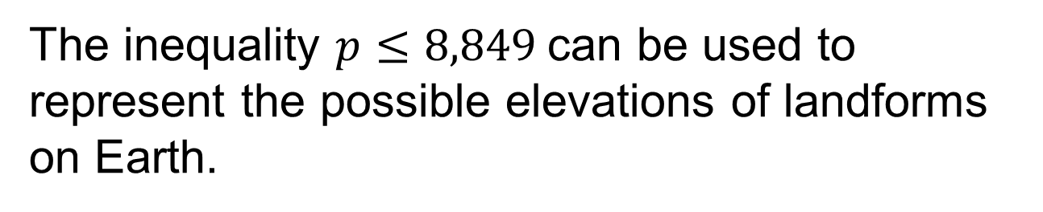
Let’s Explore More
Is it possible for a landform to have an elevation of 8,850 meters? Explain your reasoning.
Workspace
27 / 58
Notes:
TEACH IN PRACTICE | Embedded facilitation | Lesson 8.5, slide 26 | PRACTICE
Focus on the existing task: Let’s Explore More Is it possible for a landform to have an elevation of 8,850 meters?
LAUNCH (T2/3/5): Use the displayed question. Give private thinking time; then A explains while B asks for evidence. Switch roles. Each student records their own reasoning.
LOOK FOR (T4): Where this task addresses it, students can choose an open or closed endpoint. Ask which feature of their work supports the claim.
RESPOND: If this task shows the lesson misconception—including a strict boundary or shading toward nonsolutions—substitute the original boundary and a value on each side before graphing. Have the student revise and explain the change. Use this support only where the concept occurs in the current task; otherwise respond to the displayed question.
RECHECK: If a gap is shared, revisit the existing representation together. If it is limited, give targeted support while others compare valid methods on the same task. Check the revision before moving on.
PARTICIPATION (T5/6/7): Think time before volunteers; accept a written, drawn or rehearsed entry. Students ask for evidence respectfully. Recognize a specific contribution or revision and check that both partners participate.
Source: BCPS Updated Instructional Framework Rubric (June 2020), TEACH 1–7. Earlier notes and answer keys are retained below.
EARLIER NOTES / EXISTING ANSWER KEY
Extension for partners or table groups — students choose their approach and use the workspace to show thinking.
Push with “Convince me,” and have two groups with different approaches share.
This is where students stretch past the worked example.
UIFR: TEACH 2 · TEACH 5.

Slide 28
STUDENT MOVES
Lesson 8-5
Your move
YOUR CHOICE · You choose how to show this — numbers, words, or a diagram. Make your reasoning visible.
28 / 58

Slide 29
LESSON 8.5 / DISCUSS THE TASK
Explain and compare
Use the task you just explored.
TAKE TURNS
Which test values verify the endpoint and shaded direction of your graph?
Explain
“I know this because…”
Ask
“Where does your work show that?”
Point to evidence in your work.
Then compare your approach with a partner’s.
JUSTIFY IT · Say it like this: “I know ______ because ______.”
Listen to understand. Ask for evidence. Make room for every voice.
Notes:
TEACH IN PRACTICE | Embedded facilitation | Lesson 8.5, slide 27 | PRIOR_INSERT
Focus on the existing task: Point to evidence in your work. Then compare your approach with a partner’s. TAKE TURNS Explain “I know this because…” Ask “Where does your work show that?
CONNECT (T1/4): Ask students to restate the displayed goal or key idea and connect it to earlier work. Relevant lesson evidence: choose an open or closed endpoint; shade the correct direction; test boundary and other values. Use only the criterion that matches the current session.
SHOW PROGRESS: Students point to their own existing work, explain what improved after feedback, and name a next step. Pair confidence ratings with actual evidence.
PARTICIPATION (T5/6/7): Think time before volunteers; accept a written, drawn or rehearsed entry. Students ask for evidence respectfully. Recognize a specific contribution or revision and check that both partners participate.
Source: BCPS Updated Instructional Framework Rubric (June 2020), TEACH 1–7.

Slide 30
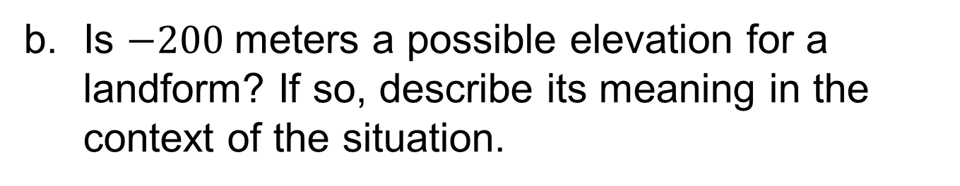
Let’s Explore More
Workspace
Try it yourself. Compare your work with a partner; explain one choice and revise.
30 / 58
Notes:
TEACH IN PRACTICE | Embedded facilitation | Lesson 8.5, slide 28 | PRACTICE
Focus on the existing task: Let’s Explore More Workspace
LAUNCH (T2/3/5): Use the displayed question. Give private thinking time; then A explains while B asks for evidence. Switch roles. Each student records their own reasoning.
LOOK FOR (T4): Where this task addresses it, students can choose an open or closed endpoint. Ask which feature of their work supports the claim.
RESPOND: If this task shows the lesson misconception—including a strict boundary or shading toward nonsolutions—substitute the original boundary and a value on each side before graphing. Have the student revise and explain the change. Use this support only where the concept occurs in the current task; otherwise respond to the displayed question.
RECHECK: If a gap is shared, revisit the existing representation together. If it is limited, give targeted support while others compare valid methods on the same task. Check the revision before moving on.
PARTICIPATION (T5/6/7): Think time before volunteers; accept a written, drawn or rehearsed entry. Students ask for evidence respectfully. Recognize a specific contribution or revision and check that both partners participate.
Source: BCPS Updated Instructional Framework Rubric (June 2020), TEACH 1–7. Earlier notes and answer keys are retained below.
EARLIER NOTES / EXISTING ANSWER KEY
Extension for partners or table groups — students choose their approach and use the workspace to show thinking.
Push with “Convince me,” and have two groups with different approaches share.
This is where students stretch past the worked example.
UIFR: TEACH 2 · TEACH 5.

Slide 31
Elevation
At an elevation of 8,849 meters above sea level, the peak of Mount Everest is the highest point of elevation on Earth. How can you represent the possible elevations of landforms on Earth?
What constraint exists on the elevations of landforms on Earth?
Reveal:
All landforms have an elevation of 8,849 meters or less.
31 / 58
Notes:
TEACH IN PRACTICE | Embedded facilitation | Lesson 8.5, slide 29 | REVEAL
Focus on the existing task: What constraint exists on the elevations of landforms on Earth?
LAUNCH (T2/3/5): If an existing answer cover is present, gather an attempt before revealing. If the explanation is already visible, ask students to reconstruct and justify it. Compare reasoning and explain a revision; preserve the reveal sequence.
LOOK FOR (T4): Where this task addresses it, students can choose an open or closed endpoint. Ask which feature of their work supports the claim.
RESPOND: If this task shows the lesson misconception—including a strict boundary or shading toward nonsolutions—substitute the original boundary and a value on each side before graphing. Have the student revise and explain the change. Use this support only where the concept occurs in the current task; otherwise respond to the displayed question.
RECHECK: If a gap is shared, revisit the existing representation together. If it is limited, give targeted support while others compare valid methods on the same task. Check the revision before moving on.
PARTICIPATION (T5/6/7): Think time before volunteers; accept a written, drawn or rehearsed entry. Students ask for evidence respectfully. Recognize a specific contribution or revision and check that both partners participate.
Source: BCPS Updated Instructional Framework Rubric (June 2020), TEACH 1–7.

Slide 32
STUDENT MOVES
Lesson 8-5
Your move
PROVE IT · Find the evidence in the problem that makes your answer right — not just the answer.
32 / 58

Slide 33
Elevation
What points would you need to plot to represent every other possible elevation?
Compare your reasoning with the explanation. Explain any revision you make.
Reveal:
The arrow points left, and a value being to the left of 8,849 on a number line indicates that the value is less than 8,849.
33 / 58
Notes:
TEACH IN PRACTICE | Embedded facilitation | Lesson 8.5, slide 30 | REVEAL
Focus on the existing task: Elevation Reveal: The arrow points left, and a value being to the left of 8,849 on a number line indicates that the value is less…
LAUNCH (T2/3/5): If an existing answer cover is present, gather an attempt before revealing. If the explanation is already visible, ask students to reconstruct and justify it. Compare reasoning and explain a revision; preserve the reveal sequence.
LOOK FOR (T4): Where this task addresses it, students can test boundary and other values. Ask which feature of their work supports the claim.
RESPOND: If this task shows the lesson misconception—including a strict boundary or shading toward nonsolutions—substitute the original boundary and a value on each side before graphing. Have the student revise and explain the change. Use this support only where the concept occurs in the current task; otherwise respond to the displayed question.
RECHECK: If a gap is shared, revisit the existing representation together. If it is limited, give targeted support while others compare valid methods on the same task. Check the revision before moving on.
PARTICIPATION (T5/6/7): Think time before volunteers; accept a written, drawn or rehearsed entry. Students ask for evidence respectfully. Recognize a specific contribution or revision and check that both partners participate.
Source: BCPS Updated Instructional Framework Rubric (June 2020), TEACH 1–7.

Slide 34
Session 2 Warm-Up
Lesson 8-5 · Understand Inequalities and Their Solutions
Session 2 Warm-Up
Check what you remember from Session 1 · about 4 minutes
1
On a number line, an OPEN circle is used for:
2
On a number line, a CLOSED (solid) circle is used for:
A
≤ and ≥
A
< and >
B
< and >
B
≤ and ≥
C
Equal to
C
Fractions only
D
Zero only
D
No values
3
To graph x > 3, draw an open circle at 3 and shade:
4
Is 4 a solution to x ≥ 4?
A
To the left
A
No
B
To the right (greater values)
B
Yes (4 is equal to 4)
C
Only at 3
C
Only if negative
D
Both directions
D
Cannot tell
eduwonderlab.com · Neft Teacher
34 / 58
Notes:
TEACH IN PRACTICE | Embedded facilitation | Lesson 8.5, slide 31 | WARMUP
Focus on the existing task: Session 2 Warm-Up Session 2 Warm-Up Check what…
GATHER EVIDENCE (T4/6): Keep the original items. Students try independently, mark an uncertain item, and explain one method before checking. Use the existing key when present.
RESPOND: Distinguish a calculation slip from a reasoning gap. Give one next step on the same item; have students revise in a second color. Use the responses to choose flexible support for today’s lesson.
PARTICIPATION (T5/6/7): Think time before volunteers; accept a written, drawn or rehearsed entry. Students ask for evidence respectfully. Recognize a specific contribution or revision and check that both partners participate.
Source: BCPS Updated Instructional Framework Rubric (June 2020), TEACH 1–7. Earlier notes and answer keys are retained below.
EARLIER NOTES / EXISTING ANSWER KEY
Warm-up routine: students start silently on entry; keep it to about 4 minutes.
Circulate and note who is stuck — use what you see to choose who you check on first today.
Go over answers quickly; ask one student to explain a step, not just say the answer.
UIFR: TEACH 4 · TEACH 6.
UIFR FULL | Lesson-specific facilitation
TEACH 1 | Session 2 purpose and evidence (UIFR PDF p. 8).
Have students restate the displayed session goal in their own words and connect it to the existing context or a familiar experience they choose to share. Use the current session goal to select from these lesson-wide evidence criteria; do not frontload a later-session procedure.
Look for: choose an open or closed endpoint; shade the correct direction; test boundary and other values. Ask: “Which part of your work would show this?” Revisit that evidence after the task; a confidence rating alone is not evidence of understanding.

Slide 35
STUDENT MOVES
Lesson 8-5
Your move
YOU KNOW THE ROUTINE · Read → plan → solve → check. Do all four, in that order.
35 / 58

Slide 36
Today’s Math Notes
Lesson 8-5 · Understand Inequalities and Their Solutions
Review Notes — Session 2
Copy. Explain. Check.
NAME THE MATH · Point to the part of this that is new today, and say what it changes.
Graphing Boundaries
1
Open circle: boundary is NOT included (< or >). Closed circle: boundary IS included (≤ or ≥).
Shading Direction
2
Shade right for greater numbers (> or ≥); shade left for lesser numbers (< or ≤).
Testing Solutions
3
Pick a test point in the shaded region and confirm it satisfies the inequality.
eduwonderlab.com · Neft Teacher
36 / 58
Notes:
TEACH IN PRACTICE | Embedded facilitation | Lesson 8.5, slide 32 | NOTES
Focus on the existing task: Today’s Math Notes Review Notes — Session 2…
ROUTINE (T1/2/4): Read or copy the original notes, cover one line, and explain it using the displayed example. Reopen and correct. Copying alone is not evidence of understanding.
LOOK FOR: A link between a symbol, quantity or feature and the explanation. If missing, point back to that feature and have the student try again; fade the prompt once they can explain.
PARTICIPATION (T5/6/7): Think time before volunteers; accept a written, drawn or rehearsed entry. Students ask for evidence respectfully. Recognize a specific contribution or revision and check that both partners participate.
Source: BCPS Updated Instructional Framework Rubric (June 2020), TEACH 1–7. Earlier notes and answer keys are retained below.
EARLIER NOTES / EXISTING ANSWER KEY
Copy routine: read one line at a time; students copy, then explain that line to a partner.
Keep it brisk — the understanding work happens in the examples, not the copying.
UIFR: TEACH 1 · TEACH 6.

Slide 37
Session 2
Understand Inequalities and Their Solutions
PICK YOUR STRATEGY · Choose your path — picture, table, number line, or equation — and be ready to say why you chose it.
37 / 58
Notes:
TEACH IN PRACTICE | Embedded facilitation | Lesson 8.5, slide 33 | DIVIDER
Focus on the existing task: Understand Inequalities and Their Solutions Session 2
TRANSITION (T6/7): Students confirm materials, roles, how to request help, and the next response routine. Ask a student to restate it. Keep teacher-only slides hidden.
PARTICIPATION (T5/6/7): Think time before volunteers; accept a written, drawn or rehearsed entry. Students ask for evidence respectfully. Recognize a specific contribution or revision and check that both partners participate.
Source: BCPS Updated Instructional Framework Rubric (June 2020), TEACH 1–7. Earlier notes and answer keys are retained below.
EARLIER NOTES / EXISTING ANSWER KEY
Transition cue: state what materials are out and what success looks like this session.
Keep the changeover under a minute.
UIFR: TEACH 6.

Slide 38
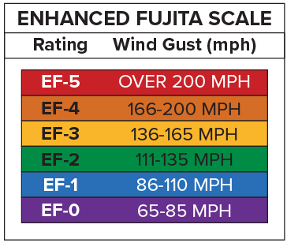
Tornado Intensity
The Enhanced Fujita Scale, or EF scale, is used to assign a tornado intensity based on estimated wind gusts and related damage. The most severe category is an EF-5. How can you represent wind gusts that would result in an EF-5 rating?
What constraint, or limitation, exists in the problem? How can you represent the constraint?
Reveal:
Wind gusts must be over 200 miles per hour to be classified as an EF-5 tornado. We can represent this with an inequality.
38 / 58
Notes:
TEACH IN PRACTICE | Embedded facilitation | Lesson 8.5, slide 34 | REVEAL
Focus on the existing task: What constraint, or limitation, exists in the problem?
LAUNCH (T2/3/5): If an existing answer cover is present, gather an attempt before revealing. If the explanation is already visible, ask students to reconstruct and justify it. Compare reasoning and explain a revision; preserve the reveal sequence.
LOOK FOR (T4): Where this task addresses it, students can choose an open or closed endpoint. Ask which feature of their work supports the claim.
RESPOND: If this task shows the lesson misconception—including a strict boundary or shading toward nonsolutions—substitute the original boundary and a value on each side before graphing. Have the student revise and explain the change. Use this support only where the concept occurs in the current task; otherwise respond to the displayed question.
RECHECK: If a gap is shared, revisit the existing representation together. If it is limited, give targeted support while others compare valid methods on the same task. Check the revision before moving on.
PARTICIPATION (T5/6/7): Think time before volunteers; accept a written, drawn or rehearsed entry. Students ask for evidence respectfully. Recognize a specific contribution or revision and check that both partners participate.
Source: BCPS Updated Instructional Framework Rubric (June 2020), TEACH 1–7. Earlier notes and answer keys are retained below.
EARLIER NOTES / EXISTING ANSWER KEY
Do not click yet: collect 2–3 student answers with reasons first.
Then click to remove the cover and have students compare their thinking to the reveal — “Is this what we said? Where is it different?”
Behind the cover: Wind gusts must be over 200 miles per hour to be classified as an EF-5 tornado. We can represent this with an inequality.
UIFR: TEACH 3 · TEACH 4.
UIFR FULL | Lesson-specific facilitation
TEACH 2-3 | Session 2 task launch (UIFR PDF pp. 9-10).
Use the problem exactly as displayed. Give individual thinking time before discussion or advancing to the explanation. If the answer is already visible, ask students to reconstruct and justify it. Invite a choice of suitable representations and have students explain why their choice helps.
At the point where this concept appears, ask: “Which test values verify the endpoint and shaded direction of your graph?” Wait for evidence, invite another pathway, and have a student ask a follow-up question. Do not replace students’ reasoning with a sequence of leading steps.

Slide 39

Tornado Intensity
To be classified as an EF-5 tornado, wind gusts must be greater than 200 miles per hour.
Let’s write an inequality to represent the constraint.
How do you know whether a value is a solution of the inequality?
Reveal:
If the value satisfies the inequality, then it is a solution.
39 / 58
Notes:
TEACH IN PRACTICE | Embedded facilitation | Lesson 8.5, slide 35 | REVEAL
Focus on the existing task: Tornado Intensity Reveal: If the value satisfies the inequality, then it is a solution. How do you know whether a value is a solution of the inequality?
LAUNCH (T2/3/5): If an existing answer cover is present, gather an attempt before revealing. If the explanation is already visible, ask students to reconstruct and justify it. Compare reasoning and explain a revision; preserve the reveal sequence.
LOOK FOR (T4): Where this task addresses it, students can choose an open or closed endpoint. Ask which feature of their work supports the claim.
RESPOND: If this task shows the lesson misconception—including a strict boundary or shading toward nonsolutions—substitute the original boundary and a value on each side before graphing. Have the student revise and explain the change. Use this support only where the concept occurs in the current task; otherwise respond to the displayed question.
RECHECK: If a gap is shared, revisit the existing representation together. If it is limited, give targeted support while others compare valid methods on the same task. Check the revision before moving on.
PARTICIPATION (T5/6/7): Think time before volunteers; accept a written, drawn or rehearsed entry. Students ask for evidence respectfully. Recognize a specific contribution or revision and check that both partners participate.
Source: BCPS Updated Instructional Framework Rubric (June 2020), TEACH 1–7. Earlier notes and answer keys are retained below.
EARLIER NOTES / EXISTING ANSWER KEY
Do not click yet: collect 2–3 student answers with reasons first.
Then click to remove the cover and have students compare their thinking to the reveal — “Is this what we said? Where is it different?”
Behind the cover: If the value satisfies the inequality, then it is a solution.
UIFR: TEACH 3 · TEACH 4.

Slide 40
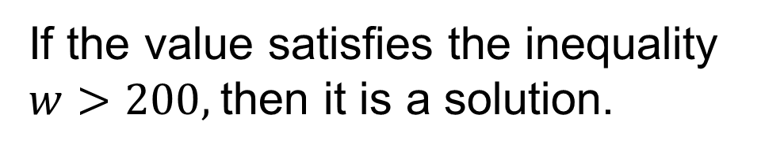
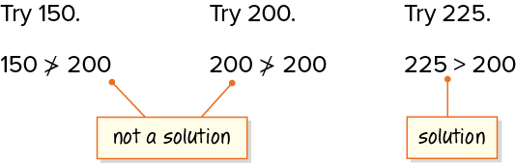
Tornado Intensity
Let’s test some values using substitution.
What can you say about values less than 200? equal to 200? greater than 200?
Reveal:
Values less than or equal to 200 are not solutions of the inequality. Values greater than 200 are solutions.
40 / 58
Notes:
TEACH IN PRACTICE | Embedded facilitation | Lesson 8.5, slide 36 | REVEAL
Focus on the existing task: Tornado Intensity Reveal: Values less than or equal to 200 are not solutions of the inequality. Values greater than 200 are solutions. What can you say about values less than 200?
LAUNCH (T2/3/5): If an existing answer cover is present, gather an attempt before revealing. If the explanation is already visible, ask students to reconstruct and justify it. Compare reasoning and explain a revision; preserve the reveal sequence.
LOOK FOR (T4): Where this task addresses it, students can test boundary and other values. Ask which feature of their work supports the claim.
RESPOND: If this task shows the lesson misconception—including a strict boundary or shading toward nonsolutions—substitute the original boundary and a value on each side before graphing. Have the student revise and explain the change. Use this support only where the concept occurs in the current task; otherwise respond to the displayed question.
RECHECK: If a gap is shared, revisit the existing representation together. If it is limited, give targeted support while others compare valid methods on the same task. Check the revision before moving on.
PARTICIPATION (T5/6/7): Think time before volunteers; accept a written, drawn or rehearsed entry. Students ask for evidence respectfully. Recognize a specific contribution or revision and check that both partners participate.
Source: BCPS Updated Instructional Framework Rubric (June 2020), TEACH 1–7. Earlier notes and answer keys are retained below.
EARLIER NOTES / EXISTING ANSWER KEY
Do not click yet: collect 2–3 student answers with reasons first.
Then click to remove the cover and have students compare their thinking to the reveal — “Is this what we said? Where is it different?”
Behind the cover: Values less than or equal to 200 are not solutions of the inequality. Values greater than 200 are solutions.
UIFR: TEACH 3 · TEACH 4.

Slide 41
STUDENT MOVES
Lesson 8-5
Your moves
RESTATE FIRST · Restate your partner’s idea in your own words before you give yours.
SPECIFIC FEEDBACK · Trade work. Give one specific comment: “This part is clear because ______.”
PICK YOUR STRATEGY · Choose your path — picture, table, number line, or equation — and be ready to say why you chose it.
41 / 58

Slide 42

Tornado Intensity
Values less than or equal to 200 are not solutions of the inequality. Values greater than 200 are solutions.
How can you visually represent the solutions of the inequality?
Reveal:
We can use a number line to represent the inequality.
ANOTHER PATHWAY · Did anyone get there a different way? Put both pathways side by side and compare.
42 / 58
Notes:
TEACH IN PRACTICE | Embedded facilitation | Lesson 8.5, slide 37 | REVEAL
Focus on the existing task: Reveal: We can use a number line to represent the inequality. Tornado Intensity How can you visually represent the solutions of the inequality?
LAUNCH (T2/3/5): If an existing answer cover is present, gather an attempt before revealing. If the explanation is already visible, ask students to reconstruct and justify it. Compare reasoning and explain a revision; preserve the reveal sequence.
LOOK FOR (T4): Where this task addresses it, students can test boundary and other values. Ask which feature of their work supports the claim.
RESPOND: If this task shows the lesson misconception—including a strict boundary or shading toward nonsolutions—substitute the original boundary and a value on each side before graphing. Have the student revise and explain the change. Use this support only where the concept occurs in the current task; otherwise respond to the displayed question.
RECHECK: If a gap is shared, revisit the existing representation together. If it is limited, give targeted support while others compare valid methods on the same task. Check the revision before moving on.
PARTICIPATION (T5/6/7): Think time before volunteers; accept a written, drawn or rehearsed entry. Students ask for evidence respectfully. Recognize a specific contribution or revision and check that both partners participate.
Source: BCPS Updated Instructional Framework Rubric (June 2020), TEACH 1–7. Earlier notes and answer keys are retained below.
EARLIER NOTES / EXISTING ANSWER KEY
Do not click yet: collect 2–3 student answers with reasons first.
Then click to remove the cover and have students compare their thinking to the reveal — “Is this what we said? Where is it different?”
Behind the cover: We can use a number line to represent the inequality.
UIFR: TEACH 3 · TEACH 4.

Slide 43
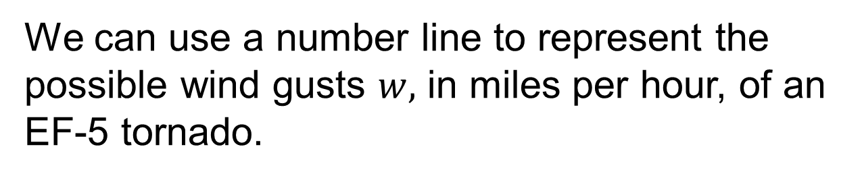

COLLABORATE · TALK IT THROUGH • AGREE ON A MODEL
Collaborate and Connect
TAKE TURNS · One explains, one asks a question. Then switch, so both of you talk.
Represent the inequality on a number line.
Think About It:
Should 200 be represented with a closed dot?
43 / 58
Notes:
TEACH IN PRACTICE | Embedded facilitation | Lesson 8.5, slide 38 | COLLABORATE
Focus on the existing task: Collaborate and Connect Think About It: Should 200 be represented with a closed dot?
LAUNCH (T2/3/5): Use the displayed question. Give private thinking time; then A explains while B asks for evidence. Switch roles. Each student records their own reasoning.
LOOK FOR (T4): Where this task addresses it, students can choose an open or closed endpoint. Ask which feature of their work supports the claim.
RESPOND: If this task shows the lesson misconception—including a strict boundary or shading toward nonsolutions—substitute the original boundary and a value on each side before graphing. Have the student revise and explain the change. Use this support only where the concept occurs in the current task; otherwise respond to the displayed question.
RECHECK: If a gap is shared, revisit the existing representation together. If it is limited, give targeted support while others compare valid methods on the same task. Check the revision before moving on.
PARTICIPATION (T5/6/7): Think time before volunteers; accept a written, drawn or rehearsed entry. Students ask for evidence respectfully. Recognize a specific contribution or revision and check that both partners participate.
Source: BCPS Updated Instructional Framework Rubric (June 2020), TEACH 1–7. Earlier notes and answer keys are retained below.
EARLIER NOTES / EXISTING ANSWER KEY
Routine: COLLABORATE · TALK IT THROUGH • AGREE ON A MODEL
UIFR FULL | Lesson-specific facilitation
TEACH 4-5 | Session 2 discussion and checkpoint (UIFR PDF pp. 11-12).
Collect a brief response from every student to the existing prompt before hearing volunteers. Partners take turns explaining and asking for evidence: “I understand ___; what supports ___?” Offer rehearsal or an annotated model for students who need language support. Each student records their own reasoning.
Look specifically for: including a strict boundary or shading toward nonsolutions. If it appears, substitute the original boundary and a value on each side before graphing; then ask the student to revise the same response and explain the change. If evidence is secure, have students compare a second valid pathway or state why their approach works. Choose the next step from the responses, not a preset pace.

Slide 44

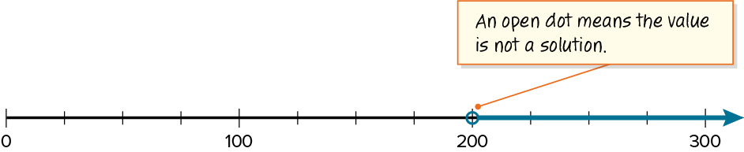
Tornado Intensity
We can represent the inequality on a number line.
Because 200 is the lower limit, but is not a solution, use an open dot at 200.
STRUGGLE FIRST · Work on your own first. Stuck is allowed — try a second strategy before you ask.
44 / 58
Notes:
TEACH IN PRACTICE | Embedded facilitation | Lesson 8.5, slide 39 | WORKED
Focus on the existing task: Tornado Intensity We can represent the inequality on a number line. Because 200 is the lower limit, but is not a solution, use an open…
LAUNCH (T2/3/5): Ask students to explain the displayed idea or example and point to evidence. When a calculation step is shown, ask why it is valid. Have a partner restate the explanation; copying is not the check.
LOOK FOR (T4): Where this task addresses it, students can choose an open or closed endpoint. Ask which feature of their work supports the claim.
RESPOND: If this task shows the lesson misconception—including a strict boundary or shading toward nonsolutions—substitute the original boundary and a value on each side before graphing. Have the student revise and explain the change. Use this support only where the concept occurs in the current task; otherwise respond to the displayed question.
RECHECK: If a gap is shared, revisit the existing representation together. If it is limited, give targeted support while others compare valid methods on the same task. Check the revision before moving on.
PARTICIPATION (T5/6/7): Think time before volunteers; accept a written, drawn or rehearsed entry. Students ask for evidence respectfully. Recognize a specific contribution or revision and check that both partners participate.
Source: BCPS Updated Instructional Framework Rubric (June 2020), TEACH 1–7. Earlier notes and answer keys are retained below.
EARLIER NOTES / EXISTING ANSWER KEY
Model briefly, then hand the thinking back: ask “Why does this step work?” before showing the next one.
Quick check before moving on — thumbs or whiteboards from everyone, not volunteers.
UIFR: TEACH 2 · TEACH 3 · TEACH 4.

Slide 45
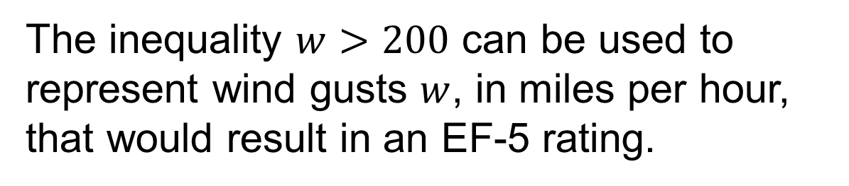
Tornado Intensity
The Enhanced Fujita Scale, or EF scale, is used to assign a tornado intensity based on estimated wind gusts and related damage. The most severe category is an EF-5.
How can you represent wind gusts that would result in an EF-5 rating?
Listening
ASK THE CLASS · Write one question about this that you could ask the class.
How can you be sure you have understood the argument presented?
45 / 58
Notes:
TEACH IN PRACTICE | Embedded facilitation | Lesson 8.5, slide 40 | TASK
Focus on the existing task: How can you be sure you have understood the argument presented?
LAUNCH (T2/3/5): Use the displayed question. Give private thinking time; then A explains while B asks for evidence. Switch roles. Each student records their own reasoning.
LOOK FOR (T4): Where this task addresses it, students can choose an open or closed endpoint. Ask which feature of their work supports the claim.
RESPOND: If this task shows the lesson misconception—including a strict boundary or shading toward nonsolutions—substitute the original boundary and a value on each side before graphing. Have the student revise and explain the change. Use this support only where the concept occurs in the current task; otherwise respond to the displayed question.
RECHECK: If a gap is shared, revisit the existing representation together. If it is limited, give targeted support while others compare valid methods on the same task. Check the revision before moving on.
PARTICIPATION (T5/6/7): Think time before volunteers; accept a written, drawn or rehearsed entry. Students ask for evidence respectfully. Recognize a specific contribution or revision and check that both partners participate.
Source: BCPS Updated Instructional Framework Rubric (June 2020), TEACH 1–7. Earlier notes and answer keys are retained below.
EARLIER NOTES / EXISTING ANSWER KEY
Read the context aloud (or have a student read it).
Before any math, students restate the situation and what is being asked in their own words.
Ask: How can you be sure you have understood the argument presented?
UIFR: TEACH 1 · TEACH 3.

Slide 46



Let’s Explore More
Does the number line make sense given what you know about wind gusts of 150 miles per hour, 200 miles per hour, and 225 miles per hour? Explain.
Workspace
46 / 58
Notes:
TEACH IN PRACTICE | Embedded facilitation | Lesson 8.5, slide 41 | PRACTICE
Focus on the existing task: Let’s Explore More Does the number line make sense given what you know about wind gusts of 150 miles per hour, 200 miles per hour, and 225 miles per hour?
LAUNCH (T2/3/5): Use the displayed question. Give private thinking time; then A explains while B asks for evidence. Switch roles. Each student records their own reasoning.
LOOK FOR (T4): Where this task addresses it, students can choose an open or closed endpoint. Ask which feature of their work supports the claim.
RESPOND: If this task shows the lesson misconception—including a strict boundary or shading toward nonsolutions—substitute the original boundary and a value on each side before graphing. Have the student revise and explain the change. Use this support only where the concept occurs in the current task; otherwise respond to the displayed question.
RECHECK: If a gap is shared, revisit the existing representation together. If it is limited, give targeted support while others compare valid methods on the same task. Check the revision before moving on.
PARTICIPATION (T5/6/7): Think time before volunteers; accept a written, drawn or rehearsed entry. Students ask for evidence respectfully. Recognize a specific contribution or revision and check that both partners participate.
Source: BCPS Updated Instructional Framework Rubric (June 2020), TEACH 1–7. Earlier notes and answer keys are retained below.
EARLIER NOTES / EXISTING ANSWER KEY
Extension for partners or table groups — students choose their approach and use the workspace to show thinking.
Push with “Convince me,” and have two groups with different approaches share.
This is where students stretch past the worked example.
UIFR: TEACH 2 · TEACH 5.

Slide 47
STUDENT MOVES
Lesson 8-5
Your move
STRUGGLE FIRST · Work on your own first. Stuck is allowed — try a second strategy before you ask.
47 / 58

Slide 48
Let’s Explore More
Why do you think an open dot indicates the value is not a solution?
Workspace
USE YOUR TOOLS · Reach for your notes, a model, or a manipulative before you reach for an answer.
48 / 58
Notes:
TEACH IN PRACTICE | Embedded facilitation | Lesson 8.5, slide 42 | PRACTICE
Focus on the existing task: Let’s Explore More Why do you think an open dot indicates the value is not a solution?
LAUNCH (T2/3/5): Use the displayed question. Give private thinking time; then A explains while B asks for evidence. Switch roles. Each student records their own reasoning.
LOOK FOR (T4): Where this task addresses it, students can choose an open or closed endpoint. Ask which feature of their work supports the claim.
RESPOND: If this task shows the lesson misconception—including a strict boundary or shading toward nonsolutions—substitute the original boundary and a value on each side before graphing. Have the student revise and explain the change. Use this support only where the concept occurs in the current task; otherwise respond to the displayed question.
RECHECK: If a gap is shared, revisit the existing representation together. If it is limited, give targeted support while others compare valid methods on the same task. Check the revision before moving on.
PARTICIPATION (T5/6/7): Think time before volunteers; accept a written, drawn or rehearsed entry. Students ask for evidence respectfully. Recognize a specific contribution or revision and check that both partners participate.
Source: BCPS Updated Instructional Framework Rubric (June 2020), TEACH 1–7. Earlier notes and answer keys are retained below.
EARLIER NOTES / EXISTING ANSWER KEY
Extension for partners or table groups — students choose their approach and use the workspace to show thinking.
Push with “Convince me,” and have two groups with different approaches share.
This is where students stretch past the worked example.
UIFR: TEACH 2 · TEACH 5.

Slide 49
LESSON 8.5 / CHECK YOUR WORK
Pause. Check. Improve.
CHECK
A mistake to watch for: including a strict boundary or shading toward nonsolutions.
TRY
Substitute the given boundary and a value on each side before graphing.
REVISE
Use that check on the task you just completed. Correct or strengthen one part, and explain why.
REVISE NOW · Change one answer and write why you changed it. A revision is evidence of learning.
Listen to understand. Ask for evidence. Make room for every voice.
Notes:
TEACH IN PRACTICE | Embedded facilitation | Lesson 8.5, slide 43 | PRIOR_INSERT
Focus on the existing task: LESSON 8.5 / CHECK YOUR WORK Pause. Check. Improve. Listen to understand. Ask for evidence. Make room for every voice. CHECK A mistake…
CONNECT (T1/4): Ask students to restate the displayed goal or key idea and connect it to earlier work. Relevant lesson evidence: choose an open or closed endpoint; shade the correct direction; test boundary and other values. Use only the criterion that matches the current session.
SHOW PROGRESS: Students point to their own existing work, explain what improved after feedback, and name a next step. Pair confidence ratings with actual evidence.
PARTICIPATION (T5/6/7): Think time before volunteers; accept a written, drawn or rehearsed entry. Students ask for evidence respectfully. Recognize a specific contribution or revision and check that both partners participate.
Source: BCPS Updated Instructional Framework Rubric (June 2020), TEACH 1–7.

Slide 50
Tornado Intensity
To be classified as an EF-5 tornado, wind gusts must be greater than 200 miles per hour.
Let’s write an inequality to represent the constraint.
Compare your reasoning with the
explanation. Explain any revision
you make.
How do you know whether a value is a solution of the inequality?
Reveal:
If the value satisfies the inequality, then it is a solution.
50 / 58
Notes:
TEACH IN PRACTICE | Embedded facilitation | Lesson 8.5, slide 44 | REVEAL
Focus on the existing task: Tornado Intensity Reveal: If the value satisfies the inequality, then it is a solution. How do you know whether a value is a solution of the inequality?
LAUNCH (T2/3/5): If an existing answer cover is present, gather an attempt before revealing. If the explanation is already visible, ask students to reconstruct and justify it. Compare reasoning and explain a revision; preserve the reveal sequence.
LOOK FOR (T4): Where this task addresses it, students can choose an open or closed endpoint. Ask which feature of their work supports the claim.
RESPOND: If this task shows the lesson misconception—including a strict boundary or shading toward nonsolutions—substitute the original boundary and a value on each side before graphing. Have the student revise and explain the change. Use this support only where the concept occurs in the current task; otherwise respond to the displayed question.
RECHECK: If a gap is shared, revisit the existing representation together. If it is limited, give targeted support while others compare valid methods on the same task. Check the revision before moving on.
PARTICIPATION (T5/6/7): Think time before volunteers; accept a written, drawn or rehearsed entry. Students ask for evidence respectfully. Recognize a specific contribution or revision and check that both partners participate.
Source: BCPS Updated Instructional Framework Rubric (June 2020), TEACH 1–7.

Slide 51
Tornado Intensity
Let’s test some values using substitution.
What can you say about values less than 200? equal to 200? greater than 200?
Reveal:
Values less than or equal to 200 are not solutions of the inequality. Values greater than 200 are solutions.
51 / 58
Notes:
TEACH IN PRACTICE | Embedded facilitation | Lesson 8.5, slide 45 | REVEAL
Focus on the existing task: Tornado Intensity Reveal: Values less than or equal to 200 are not solutions of the inequality. Values greater than 200 are solutions. What can you say about values less than 200?
LAUNCH (T2/3/5): If an existing answer cover is present, gather an attempt before revealing. If the explanation is already visible, ask students to reconstruct and justify it. Compare reasoning and explain a revision; preserve the reveal sequence.
LOOK FOR (T4): Where this task addresses it, students can test boundary and other values. Ask which feature of their work supports the claim.
RESPOND: If this task shows the lesson misconception—including a strict boundary or shading toward nonsolutions—substitute the original boundary and a value on each side before graphing. Have the student revise and explain the change. Use this support only where the concept occurs in the current task; otherwise respond to the displayed question.
RECHECK: If a gap is shared, revisit the existing representation together. If it is limited, give targeted support while others compare valid methods on the same task. Check the revision before moving on.
PARTICIPATION (T5/6/7): Think time before volunteers; accept a written, drawn or rehearsed entry. Students ask for evidence respectfully. Recognize a specific contribution or revision and check that both partners participate.
Source: BCPS Updated Instructional Framework Rubric (June 2020), TEACH 1–7.

Slide 52
STUDENT MOVES
Lesson 8-5
Your move
HOW DO YOU KNOW? · Ask your partner “How do you know?” Answer by pointing to your own work.
52 / 58

Slide 53


SUMMARIZE · SAY IT IN YOUR OWN WORDS
Summarize: Understand Inequalities and Their Solutions
You can represent an inequality on a number line or with a mathematical statement using inequality symbols. On a number line, a closed dot means the number is a solution, and an open dot means the number is not a solution.
Explain the key idea without reading. Use today’s example as
evidence.
53 / 58
Notes:
TEACH IN PRACTICE | Embedded facilitation | Lesson 8.5, slide 46 | SUMMARIZE
Focus on the existing task: Summarize: Understand Inequalities and Their Solutions You can represent an inequality on a number line or with a mathematical statement…
CONNECT (T1/4): Ask students to restate the displayed goal or key idea and connect it to earlier work. Relevant lesson evidence: choose an open or closed endpoint; shade the correct direction; test boundary and other values. Use only the criterion that matches the current session.
SHOW PROGRESS: Students point to their own existing work, explain what improved after feedback, and name a next step. Pair confidence ratings with actual evidence.
PARTICIPATION (T5/6/7): Think time before volunteers; accept a written, drawn or rehearsed entry. Students ask for evidence respectfully. Recognize a specific contribution or revision and check that both partners participate.
Source: BCPS Updated Instructional Framework Rubric (June 2020), TEACH 1–7. Earlier notes and answer keys are retained below.
EARLIER NOTES / EXISTING ANSWER KEY
Routine: SUMMARIZE · SAY IT IN YOUR OWN WORDS

Slide 54
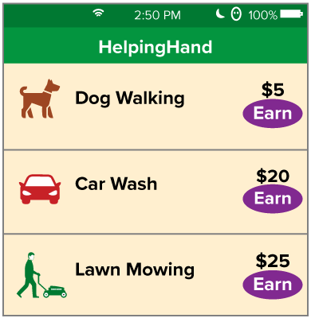
APPLY · PLAN IT • SOLVE IT • PROVE IT
Apply: Earning Money
Yuzuki wants to earn enough money to go on a class trip that costs $750. The image shows different ways she can earn money.
Question : What are some ways that Yuzuki can earn at least $750?
Choose a method. Solve independently,
justify your answer, then check the goal.
54 / 58
Notes:
TEACH IN PRACTICE | Embedded facilitation | Lesson 8.5, slide 47 | APPLY
Focus on the existing task: Apply: Earning Money Yuzuki wants to earn enough money to go on a class trip that costs $750. The image shows different ways she can earn…
LAUNCH (T2/3/5): Use the exact application task independently first. Ask students to justify their choice of method. Collect evidence before a partner discussion or correction.
LOOK FOR (T4): Where this task addresses it, students can choose an open or closed endpoint. Ask which feature of their work supports the claim.
RESPOND: If this task shows the lesson misconception—including a strict boundary or shading toward nonsolutions—substitute the original boundary and a value on each side before graphing. Have the student revise and explain the change. Use this support only where the concept occurs in the current task; otherwise respond to the displayed question.
RECHECK: If a gap is shared, revisit the existing representation together. If it is limited, give targeted support while others compare valid methods on the same task. Check the revision before moving on.
PARTICIPATION (T5/6/7): Think time before volunteers; accept a written, drawn or rehearsed entry. Students ask for evidence respectfully. Recognize a specific contribution or revision and check that both partners participate.
Source: BCPS Updated Instructional Framework Rubric (June 2020), TEACH 1–7. Earlier notes and answer keys are retained below.
EARLIER NOTES / EXISTING ANSWER KEY
Routine: APPLY · PLAN IT • SOLVE IT • PROVE IT
UIFR FULL | Lesson-specific facilitation
TEACH 4 | Independent evidence and revision (UIFR PDF p. 11).
Use the existing application/exit problem as the independent check. If this is a learning-target slide, have students point to and explain their work on the preceding task. Separate initial independent evidence from the revision after feedback.
Check the relevant criteria: choose an open or closed endpoint; shade the correct direction; test boundary and other values. Respond with one specific next step tied to the work. Students revise and annotate what changed, then identify a criterion they can now demonstrate and one they still need to practice.

Slide 55
Learning Targets
I can represent an inequality with an inequality statement or on a number line.
I can find solutions of inequalities using substitution.
I can make use of structure to graph solutions of inequalities on a number line.
Point to evidence in your work. Name what improved and your next step.
55 / 58
Notes:
TEACH IN PRACTICE | Embedded facilitation | Lesson 8.5, slide 48 | REFLECTION
Focus on the existing task: Learning Targets I can represent an inequality with an inequality statement or on a number line. I can find solutions of inequalities…
CONNECT (T1/4): Ask students to restate the displayed goal or key idea and connect it to earlier work. Relevant lesson evidence: choose an open or closed endpoint; shade the correct direction; test boundary and other values. Use only the criterion that matches the current session.
SHOW PROGRESS: Students point to their own existing work, explain what improved after feedback, and name a next step. Pair confidence ratings with actual evidence.
PARTICIPATION (T5/6/7): Think time before volunteers; accept a written, drawn or rehearsed entry. Students ask for evidence respectfully. Recognize a specific contribution or revision and check that both partners participate.
Source: BCPS Updated Instructional Framework Rubric (June 2020), TEACH 1–7. Earlier notes and answer keys are retained below.
EARLIER NOTES / EXISTING ANSWER KEY
Read each target; students self-rate with fist-to-five or thumbs.
Tie back to the goal from the start of class: did we get there?
Note any target that rates low — revisit it tomorrow.
UIFR: TEACH 1 · TEACH 4.

Slide 56
Be Curious
Be Curious
What’s the question?​
To make a profit, a production company wants their new movie to earn a certain amount of money from ticket sales.
Think first. Share a notice and a
question; build on a classmate’s
idea.
Mindset
How is understanding the context of a problem or situation helping to solve a math or non-math problem?
56 / 58
Notes:
TEACH IN PRACTICE | Embedded facilitation | Lesson 8.5, slide 49 | CURIOUS
Focus on the existing task: Be Curious Be Curious What’s the question?
LAUNCH (T2/3/5): Allow quiet observation first. Separate a notice from an inference, invite students’ own questions, and follow the existing launch before teaching a procedure.
LOOK FOR (T4): Where this task addresses it, students can choose an open or closed endpoint. Ask which feature of their work supports the claim.
RESPOND: If this task shows the lesson misconception—including a strict boundary or shading toward nonsolutions—substitute the original boundary and a value on each side before graphing. Have the student revise and explain the change. Use this support only where the concept occurs in the current task; otherwise respond to the displayed question.
RECHECK: If a gap is shared, revisit the existing representation together. If it is limited, give targeted support while others compare valid methods on the same task. Check the revision before moving on.
PARTICIPATION (T5/6/7): Think time before volunteers; accept a written, drawn or rehearsed entry. Students ask for evidence respectfully. Recognize a specific contribution or revision and check that both partners participate.
Source: BCPS Updated Instructional Framework Rubric (June 2020), TEACH 1–7.

Slide 57
Learning Targets
I can represent an inequality with an inequality statement or on a number line.
I can find solutions of inequalities using substitution.
I can make use of structure to graph solutions of inequalities on a number line.
Point to evidence in your work. Name what improved and your next step.
57 / 58
Notes:
TEACH IN PRACTICE | Embedded facilitation | Lesson 8.5, slide 50 | REFLECTION
Focus on the existing task: Learning Targets I can represent an inequality with an inequality statement or on a number line. I can find solutions of inequalities…
CONNECT (T1/4): Ask students to restate the displayed goal or key idea and connect it to earlier work. Relevant lesson evidence: choose an open or closed endpoint; shade the correct direction; test boundary and other values. Use only the criterion that matches the current session.
SHOW PROGRESS: Students point to their own existing work, explain what improved after feedback, and name a next step. Pair confidence ratings with actual evidence.
PARTICIPATION (T5/6/7): Think time before volunteers; accept a written, drawn or rehearsed entry. Students ask for evidence respectfully. Recognize a specific contribution or revision and check that both partners participate.
Source: BCPS Updated Instructional Framework Rubric (June 2020), TEACH 1–7. Earlier notes and answer keys are retained below.
EARLIER NOTES / EXISTING ANSWER KEY
UIFR FULL | Lesson-specific facilitation
REFLECT & ADJUST 1-2 | After the lesson (UIFR PDF pp. 15-16).
Sort the existing work by demonstrated reasoning, partial understanding, and the specific misconception: including a strict boundary or shading toward nonsolutions. Compare the initial response with the revision. Record which teaching move plausibly helped, which did not, and whose participation or access needs a different approach; do not record sensitive student details in this shared deck.
Plan the next lesson from that evidence: if the misconception persists, substitute the original boundary and a value on each side before graphing using the current example before returning to the next grade-level task; if understanding is secure, use an existing extension or ask for a general explanation. Check the targeted idea again at the next warm-up.
Ask students what supported their thinking and what would help next time. Identify one change to try and one successful practice to retain. Seek colleague feedback on anonymized work when useful; these prompts support reflection and do not establish an evaluation rating. Source: Baltimore City Public Schools, Updated Instructional Framework Rubric, June 2020 (UIFR_Full.pdf).

Slide 58
LESSON 8.5 / REFLECT ON YOUR LEARNING
Show your progress
1 SHOW EVIDENCE
2 CHOOSE A NEXT STEP
Choose one response. Point to the part that shows your reasoning.
Name a change you made after feedback—or a question you still have.
“My work shows ___ because ___.”
“Next time, I will ___ to help me ___.”
Today’s focus: Choose an open or closed endpoint.
CREDIT A CLASSMATE · Name one classmate whose idea helped you today, and say what they said.
Listen to understand. Ask for evidence. Make room for every voice.
Notes:
TEACH IN PRACTICE | Embedded facilitation | Lesson 8.5, slide 51 | PRIOR_INSERT
Focus on the existing task: LESSON 8.5 / REFLECT ON YOUR LEARNING Show your progress Listen to understand. Ask for evidence. Make room for every voice. 1 SHOW…
CONNECT (T1/4): Ask students to restate the displayed goal or key idea and connect it to earlier work. Relevant lesson evidence: choose an open or closed endpoint; shade the correct direction; test boundary and other values. Use only the criterion that matches the current session.
SHOW PROGRESS: Students point to their own existing work, explain what improved after feedback, and name a next step. Pair confidence ratings with actual evidence.
PARTICIPATION (T5/6/7): Think time before volunteers; accept a written, drawn or rehearsed entry. Students ask for evidence respectfully. Recognize a specific contribution or revision and check that both partners participate.
Source: BCPS Updated Instructional Framework Rubric (June 2020), TEACH 1–7.

