Slide 1
WARM-UP · THINK • TRY • CHECK
Turn and talk: compare strategies, then defend one.
Warm-Up
Lesson 9-1 · Explore Relationships Between Two Variables | Warm-Up · about 4 minutes
Try each on your own. Mark an unsure answer; explain and revise when we check.
QUESTION 1
QUESTION 2
y = 3x. When x = 5, y = ______
y = x + 7. Find y for x = 1, 2, 3: ______, ______, ______
QUESTION 3
QUESTION 4
Pencils cost $2 each. 7 pencils cost $______
Hours worked, pay earned. Which one do you choose? ______
TALK IT OVER: “I got ______ because ______.” • Compare with a partner before we check as a class.
1 / 50
Notes:
TEACH IN PRACTICE | Embedded facilitation | Lesson 9.1, slide 1 | WARMUP
Focus on the existing task: Warm-Up WARM-UP · THINK • TRY • CHECK Do these…
GATHER EVIDENCE (T4/6): Keep the original items. Students try independently, mark an uncertain item, and explain one method before checking. Use the existing key when present.
RESPOND: Distinguish a calculation slip from a reasoning gap. Give one next step on the same item; have students revise in a second color. Use the responses to choose flexible support for today’s lesson.
PARTICIPATION (T5/6/7): Think time before volunteers; accept a written, drawn or rehearsed entry. Students ask for evidence respectfully. Recognize a specific contribution or revision and check that both partners participate.
Source: BCPS Updated Instructional Framework Rubric (June 2020), TEACH 1–7. Earlier notes and answer keys are retained below.
EARLIER NOTES / EXISTING ANSWER KEY
Warm-Up answers (teacher only): 1) 15 2) 8, 9, 10 3) $14 4) hours worked
UIFR FULL | Lesson-specific facilitation
PREPARE 1-2 | Before teaching (UIFR PDF pp. 6-7).
Plan to gather evidence that students can identify related quantities; justify which depends on the other; interpret values in context. Review recent work and today’s warm-up to choose flexible groups and access supports; do not infer needs from identity or perceived ability. Use the existing lesson tasks and stated standards.
Anticipate: assigning independence from the variable letter rather than the situation. If observed, label each original quantity and explain the dependency in a sentence. Offer oral rehearsal, drawing, pointing, or home-language processing as needed; retain the original mathematical demand. Ask students which support helps and fade it as evidence improves.
TEACH 6-7 | Before the first transition, agree on materials, partner roles, and how to request help. Invite students to restate the routine. Normalize revising an idea, recognize a specific contribution, and check privately when frustration blocks participation. Source: UIFR PDF pp. 13-14.

Slide 2
Today’s Math Notes
Lesson 9-1 · Explore Relationships Between Two Variables
Section 1: Math Words
Copy. Explain. Check.
TRY IT BEFORE YOU’RE SURE · Start even if you are not sure. A revised answer counts as much as a first-try answer.
independent variable
1
The quantity that is subject to choice
dependent variable
2
The quantity that changes in response to the independent variable
depends on
3
One quantity depends on another when changing the first causes
eduwonderlab.com · Neft Teacher
2 / 50
Notes:
TEACH IN PRACTICE | Embedded facilitation | Lesson 9.1, slide 2 | NOTES
Focus on the existing task: Today’s Math Notes Section 1: Math Words Copy…
ROUTINE (T1/2/4): Read or copy the original notes, cover one line, and explain it using the displayed example. Reopen and correct. Copying alone is not evidence of understanding.
LOOK FOR: A link between a symbol, quantity or feature and the explanation. If missing, point back to that feature and have the student try again; fade the prompt once they can explain.
PARTICIPATION (T5/6/7): Think time before volunteers; accept a written, drawn or rehearsed entry. Students ask for evidence respectfully. Recognize a specific contribution or revision and check that both partners participate.
Source: BCPS Updated Instructional Framework Rubric (June 2020), TEACH 1–7. Earlier notes and answer keys are retained below.
EARLIER NOTES / EXISTING ANSWER KEY
Copy routine: read one line at a time; students copy, then explain that line to a partner.
Keep it brisk — the understanding work happens in the examples, not the copying.
UIFR: TEACH 1 · TEACH 6.

Slide 3
Today’s Math Notes
Lesson 9-1 · Explore Relationships Between Two Variables
Section 2: Today’s Math
Copy. Explain. Check.
Independent & Dependent Variables
Independent Variable (x): The input / cause that is chosen or changes freely
1
Dependent Variable (y): The output / effect that depends on the independent variable
2
SAY THE GOAL · Say today’s goal in your own words, then name one place this shows up outside math class.
Sentence check: ‘The (dependent) depends on the (independent)’
3
eduwonderlab.com · Neft Teacher
3 / 50
Notes:
TEACH IN PRACTICE | Embedded facilitation | Lesson 9.1, slide 3 | NOTES
Focus on the existing task: Today’s Math Notes Section 2: Today’s Math Copy…
ROUTINE (T1/2/4): Read or copy the original notes, cover one line, and explain it using the displayed example. Reopen and correct. Copying alone is not evidence of understanding.
LOOK FOR: A link between a symbol, quantity or feature and the explanation. If missing, point back to that feature and have the student try again; fade the prompt once they can explain.
PARTICIPATION (T5/6/7): Think time before volunteers; accept a written, drawn or rehearsed entry. Students ask for evidence respectfully. Recognize a specific contribution or revision and check that both partners participate.
Source: BCPS Updated Instructional Framework Rubric (June 2020), TEACH 1–7. Earlier notes and answer keys are retained below.
EARLIER NOTES / EXISTING ANSWER KEY
Copy routine: read one line at a time; students copy, then explain that line to a partner.
Keep it brisk — the understanding work happens in the examples, not the copying.
UIFR: TEACH 1 · TEACH 6.

Slide 4
Session 1
Explore Relationships Between
Two Variables
PICK YOUR STRATEGY · Choose your path — picture, table, number line, or equation — and be ready to say why you chose it.
4 / 50
Notes:
TEACH IN PRACTICE | Embedded facilitation | Lesson 9.1, slide 4 | DIVIDER
Focus on the existing task: Explore Relationships Between Two Variables Session 1
TRANSITION (T6/7): Students confirm materials, roles, how to request help, and the next response routine. Ask a student to restate it. Keep teacher-only slides hidden.
PARTICIPATION (T5/6/7): Think time before volunteers; accept a written, drawn or rehearsed entry. Students ask for evidence respectfully. Recognize a specific contribution or revision and check that both partners participate.
Source: BCPS Updated Instructional Framework Rubric (June 2020), TEACH 1–7. Earlier notes and answer keys are retained below.
EARLIER NOTES / EXISTING ANSWER KEY
Transition cue: state what materials are out and what success looks like this session.
Keep the changeover under a minute.
UIFR: TEACH 6.

Slide 5



More or Less Than…
More or Less Than 50
Explain how the information shown supports your reasoning.
5 / 50
Notes:
TEACH IN PRACTICE | Embedded facilitation | Lesson 9.1, slide 5 | WORKED
Focus on the existing task: More or Less Than… More or Less Than 50
LAUNCH (T2/3/5): Ask students to explain the displayed idea or example and point to evidence. When a calculation step is shown, ask why it is valid. Have a partner restate the explanation; copying is not the check.
LOOK FOR (T4): Where this task addresses it, students can identify related quantities. Ask which feature of their work supports the claim.
RESPOND: If this task shows the lesson misconception—assigning independence from the variable letter rather than the situation—label each original quantity and explain the dependency in a sentence. Have the student revise and explain the change. Use this support only where the concept occurs in the current task; otherwise respond to the displayed question.
RECHECK: If a gap is shared, revisit the existing representation together. If it is limited, give targeted support while others compare valid methods on the same task. Check the revision before moving on.
PARTICIPATION (T5/6/7): Think time before volunteers; accept a written, drawn or rehearsed entry. Students ask for evidence respectfully. Recognize a specific contribution or revision and check that both partners participate.
Source: BCPS Updated Instructional Framework Rubric (June 2020), TEACH 1–7. Earlier notes and answer keys are retained below.
EARLIER NOTES / EXISTING ANSWER KEY
Number-sense routine — every voice in. Give quiet think time, then hear from at least three students.
Always follow with “How do you know?” — the reasoning is the point, not the answer.
There is more than one path; name and celebrate different strategies.
UIFR: TEACH 3 · TEACH 5 · TEACH 6.

Slide 6
Today’s Objectives
Lesson 9-1 · Explore Relationships Between Two Variables
Explore Relationships Between Two Variables
Maryland Standard 6.AT.11
CONNECT IT · What earlier lesson does this build on? Tell a partner in one sentence.
CONTENT OBJECTIVE
LANGUAGE OBJECTIVE
Restate the goal in your words
Use these words to explain why
I can recognize when two quantities change together, and identify which one is the independent variable and which is the dependent variable.
I can explain which quantity depends on the other using the words independent variable, dependent variable, and depends on.
eduwonderlab.com · Neft Teacher
6 / 50
Notes:
TEACH IN PRACTICE | Embedded facilitation | Lesson 9.1, slide 6 | GOAL
Focus on the existing task: Today’s Objectives Explore Relationships…
CONNECT (T1/4): Ask students to restate the displayed goal or key idea and connect it to earlier work. Relevant lesson evidence: identify related quantities; justify which depends on the other; interpret values in context. Use only the criterion that matches the current session.
SHOW PROGRESS: Students point to their own existing work, explain what improved after feedback, and name a next step. Pair confidence ratings with actual evidence.
PARTICIPATION (T5/6/7): Think time before volunteers; accept a written, drawn or rehearsed entry. Students ask for evidence respectfully. Recognize a specific contribution or revision and check that both partners participate.
Source: BCPS Updated Instructional Framework Rubric (June 2020), TEACH 1–7. Earlier notes and answer keys are retained below.
EARLIER NOTES / EXISTING ANSWER KEY
Read the objective together, then have one or two students restate today’s goal in their own words.
Connect it to what the class learned last lesson.
Return to this goal at the end of class to check it was met.
UIFR: TEACH 1.
UIFR FULL | Lesson-specific facilitation
TEACH 1 | Session 1 purpose and evidence (UIFR PDF p. 8).
Have students restate the displayed session goal in their own words and connect it to the existing context or a familiar experience they choose to share. Use the current session goal to select from these lesson-wide evidence criteria; do not frontload a later-session procedure.
Look for: identify related quantities; justify which depends on the other; interpret values in context. Ask: “Which part of your work would show this?” Revisit that evidence after the task; a confidence rating alone is not evidence of understanding.

Slide 7
LESSON 9.1 / OUR LEARNING
What will show your learning?
1
Identify related quantities.
2
Justify which depends on the other.
3
Interpret values in context.
Tell a partner: Which skill connects to something you already know?
SHOW YOUR THINKING · Show what you know — write it, draw it, or build it. A picture counts as an explanation.
Listen to understand. Ask for evidence. Make room for every voice.
Notes:
TEACH IN PRACTICE | Embedded facilitation | Lesson 9.1, slide 7 | PRIOR_INSERT
Focus on the existing task: LESSON 9.1 / OUR LEARNING What will show your learning?
CONNECT (T1/4): Ask students to restate the displayed goal or key idea and connect it to earlier work. Relevant lesson evidence: identify related quantities; justify which depends on the other; interpret values in context. Use only the criterion that matches the current session.
SHOW PROGRESS: Students point to their own existing work, explain what improved after feedback, and name a next step. Pair confidence ratings with actual evidence.
PARTICIPATION (T5/6/7): Think time before volunteers; accept a written, drawn or rehearsed entry. Students ask for evidence respectfully. Recognize a specific contribution or revision and check that both partners participate.
Source: BCPS Updated Instructional Framework Rubric (June 2020), TEACH 1–7.

Slide 8
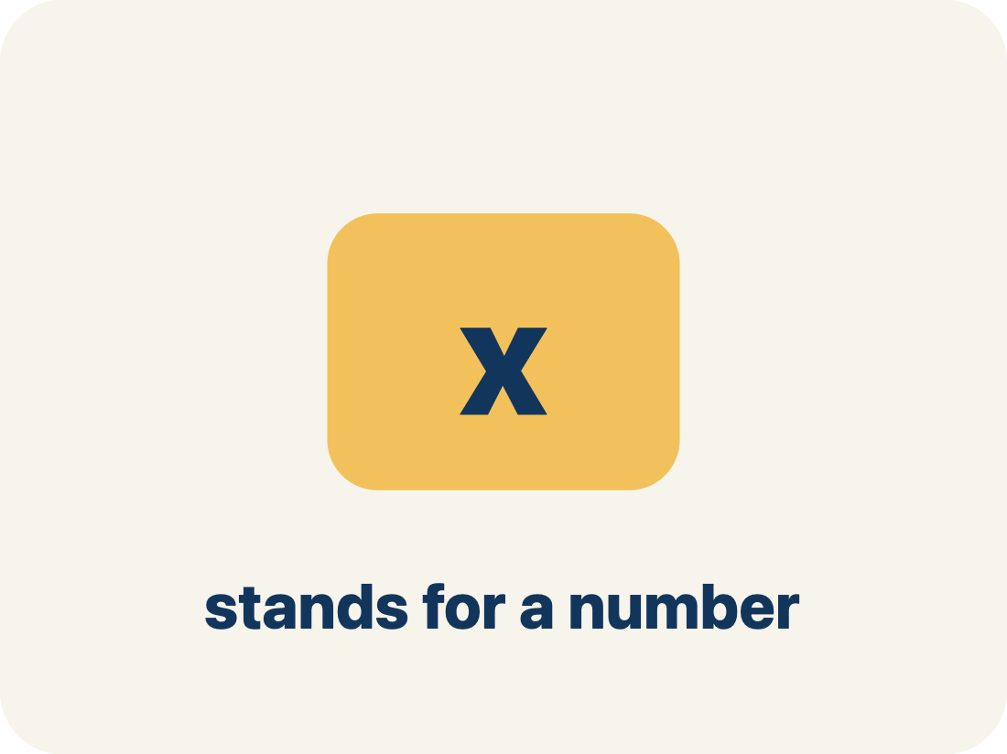
Vocabulary 1 of 5
Lesson 9-1 · Explore Relationships Between Two Variables
independent variable
The quantity that is subject to choice. It does not depend on the other quantity.
EXAMPLE · EXPLAIN WHY IT FITS
Miguel picks the number of MONTHS — nothing else decides it for him.
Use “independent variable” to explain the example. Point to
evidence.
eduwonderlab.com · Neft Teacher
8 / 50
Notes:
TEACH IN PRACTICE | Embedded facilitation | Lesson 9.1, slide 8 | VOCAB
Focus on the existing task: Vocabulary 1 of 5 independent variable The…
ASK (T1/3/5): Where does “independent variable” appear in the example? Explain the meaning without reading the definition. Partner: restate the idea and ask a clarifying question.
LOOK FOR: A correct connection between the word and a feature of the example. If the student only repeats the definition, invite pointing, sketching or oral rehearsal, then ask for another explanation of this same example.
PARTICIPATION (T5/6/7): Think time before volunteers; accept a written, drawn or rehearsed entry. Students ask for evidence respectfully. Recognize a specific contribution or revision and check that both partners participate.
Source: BCPS Updated Instructional Framework Rubric (June 2020), TEACH 1–7.

Slide 9
Vocabulary 2 of 5
Lesson 9-1 · Explore Relationships Between Two Variables
dependent variable
The quantity that changes in response to the independent variable.
EXAMPLE · EXPLAIN WHY IT FITS
Total cost = $24.95 × months — the cost RESPONDS to the months.
Use “dependent variable” to explain the example. Point to
evidence.
eduwonderlab.com · Neft Teacher
9 / 50
Notes:
TEACH IN PRACTICE | Embedded facilitation | Lesson 9.1, slide 9 | VOCAB
Focus on the existing task: Vocabulary 2 of 5 dependent variable The…
ASK (T1/3/5): Where does “dependent variable” appear in the example? Explain the meaning without reading the definition. Partner: restate the idea and ask a clarifying question.
LOOK FOR: A correct connection between the word and a feature of the example. If the student only repeats the definition, invite pointing, sketching or oral rehearsal, then ask for another explanation of this same example.
PARTICIPATION (T5/6/7): Think time before volunteers; accept a written, drawn or rehearsed entry. Students ask for evidence respectfully. Recognize a specific contribution or revision and check that both partners participate.
Source: BCPS Updated Instructional Framework Rubric (June 2020), TEACH 1–7.

Slide 10
Vocabulary 3 of 5
Lesson 9-1 · Explore Relationships Between Two Variables
depends on
One quantity depends on another when changing the first causes the second to change.
EXAMPLE · EXPLAIN WHY IT FITS
“Total cost depends on the number of months.” Responder first, chooser last.
Use “depends on” to explain the example. Point to evidence.
eduwonderlab.com · Neft Teacher
10 / 50
Notes:
TEACH IN PRACTICE | Embedded facilitation | Lesson 9.1, slide 10 | VOCAB
Focus on the existing task: Vocabulary 3 of 5 depends on One quantity…
ASK (T1/3/5): Where does “depends on” appear in the example? Explain the meaning without reading the definition. Partner: restate the idea and ask a clarifying question.
LOOK FOR: A correct connection between the word and a feature of the example. If the student only repeats the definition, invite pointing, sketching or oral rehearsal, then ask for another explanation of this same example.
PARTICIPATION (T5/6/7): Think time before volunteers; accept a written, drawn or rehearsed entry. Students ask for evidence respectfully. Recognize a specific contribution or revision and check that both partners participate.
Source: BCPS Updated Instructional Framework Rubric (June 2020), TEACH 1–7.

Slide 11
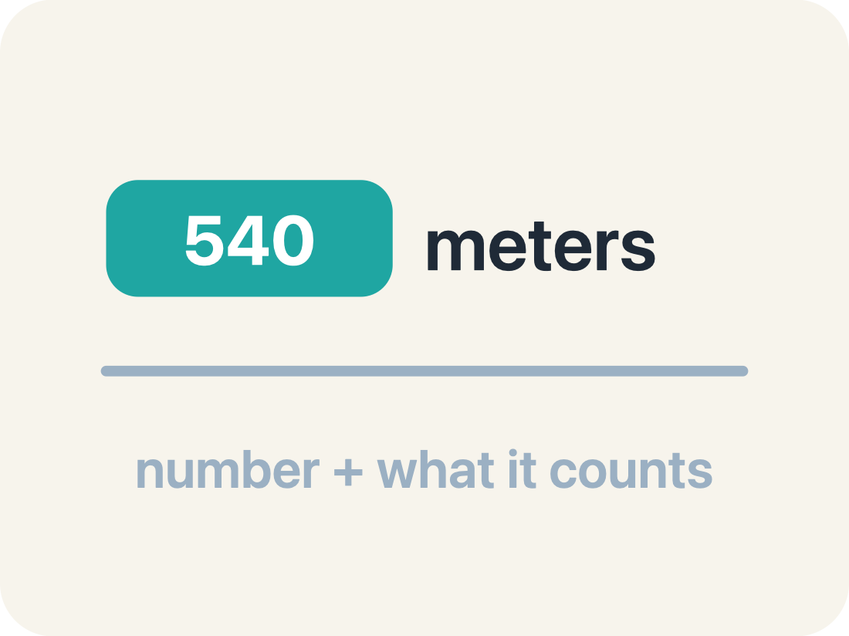
Vocabulary 4 of 5
Lesson 9-1 · Explore Relationships Between Two Variables
quantity
Something that can be counted or measured.
EXAMPLE · EXPLAIN WHY IT FITS
24.95 dollars per month, 12 months — each is a number with a meaning.
Use “quantity” to explain the example. Point to evidence.
eduwonderlab.com · Neft Teacher
11 / 50
Notes:
TEACH IN PRACTICE | Embedded facilitation | Lesson 9.1, slide 11 | VOCAB
Focus on the existing task: Vocabulary 4 of 5 quantity Something that can…
ASK (T1/3/5): Where does “quantity” appear in the example? Explain the meaning without reading the definition. Partner: restate the idea and ask a clarifying question.
LOOK FOR: A correct connection between the word and a feature of the example. If the student only repeats the definition, invite pointing, sketching or oral rehearsal, then ask for another explanation of this same example.
PARTICIPATION (T5/6/7): Think time before volunteers; accept a written, drawn or rehearsed entry. Students ask for evidence respectfully. Recognize a specific contribution or revision and check that both partners participate.
Source: BCPS Updated Instructional Framework Rubric (June 2020), TEACH 1–7.

Slide 12
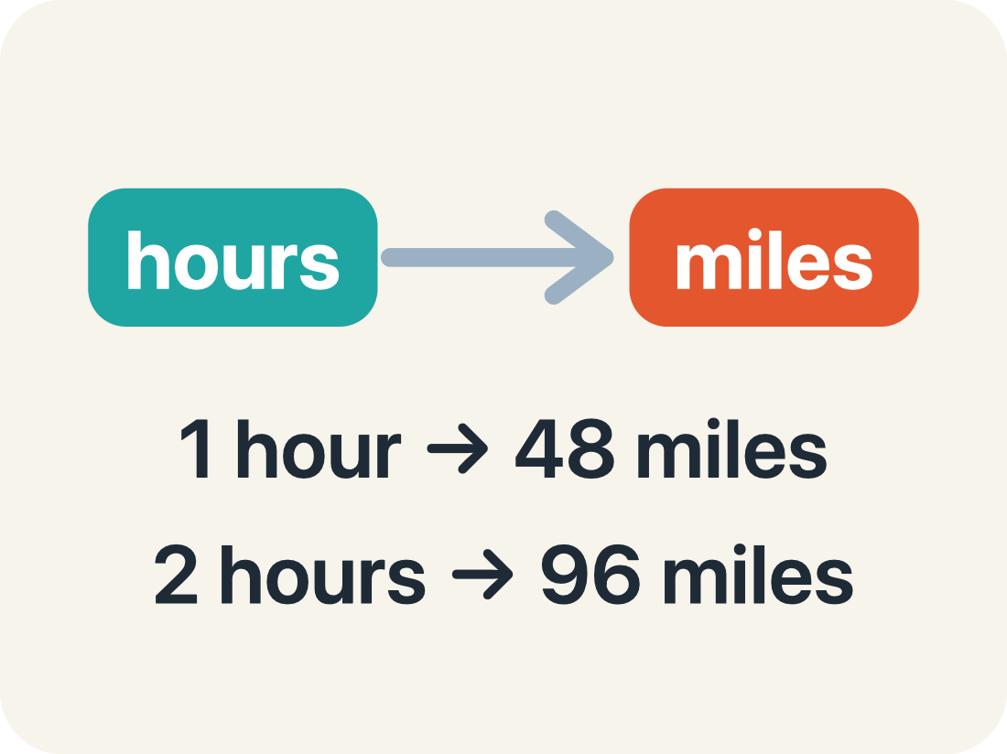
Vocabulary 5 of 5
Lesson 9-1 · Explore Relationships Between Two Variables
relationship
How two quantities change together.
EXAMPLE · EXPLAIN WHY IT FITS
1 month → $24.95, 2 months → $49.90: the two quantities move together.
Use “relationship” to explain the example. Point to evidence.
eduwonderlab.com · Neft Teacher
12 / 50
Notes:
TEACH IN PRACTICE | Embedded facilitation | Lesson 9.1, slide 12 | VOCAB
Focus on the existing task: Vocabulary 5 of 5 relationship How two…
ASK (T1/3/5): Where does “relationship” appear in the example? Explain the meaning without reading the definition. Partner: restate the idea and ask a clarifying question.
LOOK FOR: A correct connection between the word and a feature of the example. If the student only repeats the definition, invite pointing, sketching or oral rehearsal, then ask for another explanation of this same example.
PARTICIPATION (T5/6/7): Think time before volunteers; accept a written, drawn or rehearsed entry. Students ask for evidence respectfully. Recognize a specific contribution or revision and check that both partners participate.
Source: BCPS Updated Instructional Framework Rubric (June 2020), TEACH 1–7.

Slide 13
Vocabulary
Lesson 9-1 · Explore Relationships Between Two Variables
Today’s Math Words
We learn every word — what it means and what it looks like — before we use it.
independent variable
dependent variable
The quantity that is subject to choice
The quantity that changes in response to the independent variable
depends on
quantity
One quantity depends on another when changing the first causes the second to change
Something that can be counted or measured
relationship
How two quantities change together
Explain one math word using the example.
Partner: point to evidence.
eduwonderlab.com · Neft Teacher
13 / 50
Notes:
TEACH IN PRACTICE | Embedded facilitation | Lesson 9.1, slide 13 | VOCAB
Focus on the existing task: Vocabulary Today’s Math Words We learn every…
ASK (T1/3/5): Where does “the displayed term” appear in the example? Explain the meaning without reading the definition. Partner: restate the idea and ask a clarifying question.
LOOK FOR: A correct connection between the word and a feature of the example. If the student only repeats the definition, invite pointing, sketching or oral rehearsal, then ask for another explanation of this same example.
PARTICIPATION (T5/6/7): Think time before volunteers; accept a written, drawn or rehearsed entry. Students ask for evidence respectfully. Recognize a specific contribution or revision and check that both partners participate.
Source: BCPS Updated Instructional Framework Rubric (June 2020), TEACH 1–7. Earlier notes and answer keys are retained below.
EARLIER NOTES / EXISTING ANSWER KEY
Choral-read each word, its meaning, and what it looks like.
Students should use these words out loud today — listen for them in partner talk and revoice student ideas with the academic term.
UIFR: TEACH 1 · TEACH 5.

Slide 14
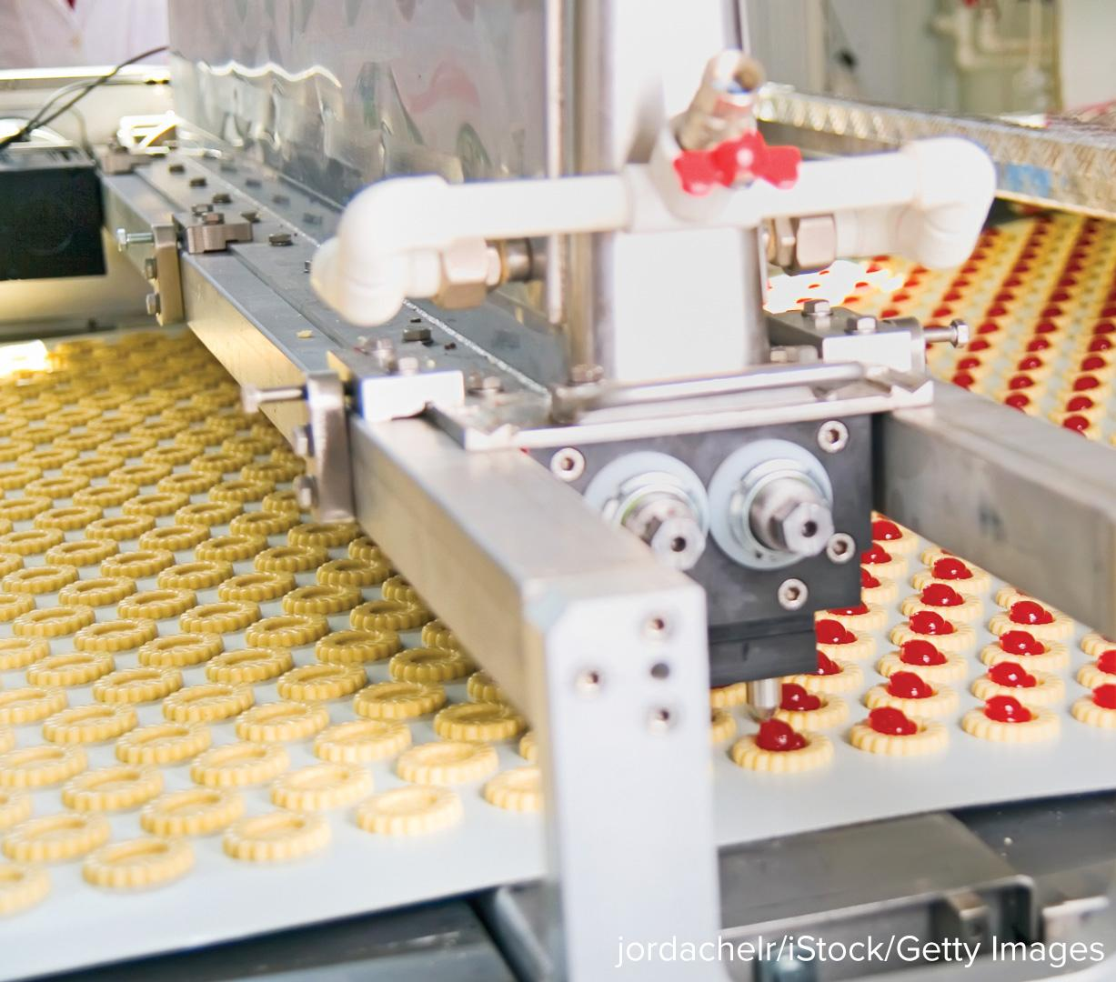

Be Curious
What do you notice?
What do you wonder?
Think first. Share a notice and a question;
build on a classmate’s idea.
Mindset
Why is flexible thinking useful when engaging with math?
14 / 50
Notes:
TEACH IN PRACTICE | Embedded facilitation | Lesson 9.1, slide 14 | CURIOUS
Focus on the existing task: Be Curious What do you notice?
LAUNCH (T2/3/5): Allow quiet observation first. Separate a notice from an inference, invite students’ own questions, and follow the existing launch before teaching a procedure.
LOOK FOR (T4): Where this task addresses it, students can identify related quantities. Ask which feature of their work supports the claim.
RESPOND: If this task shows the lesson misconception—assigning independence from the variable letter rather than the situation—label each original quantity and explain the dependency in a sentence. Have the student revise and explain the change. Use this support only where the concept occurs in the current task; otherwise respond to the displayed question.
RECHECK: If a gap is shared, revisit the existing representation together. If it is limited, give targeted support while others compare valid methods on the same task. Check the revision before moving on.
PARTICIPATION (T5/6/7): Think time before volunteers; accept a written, drawn or rehearsed entry. Students ask for evidence respectfully. Recognize a specific contribution or revision and check that both partners participate.
Source: BCPS Updated Instructional Framework Rubric (June 2020), TEACH 1–7. Earlier notes and answer keys are retained below.
EARLIER NOTES / EXISTING ANSWER KEY
Accept all noticings and wonderings — there are no wrong answers here.
Give 20–30 seconds of quiet think time before taking responses; mix cold and warm calls so it is not always the same voices.
Read the mindset question aloud and let two students respond.
UIFR: TEACH 3 · TEACH 7.

Slide 15
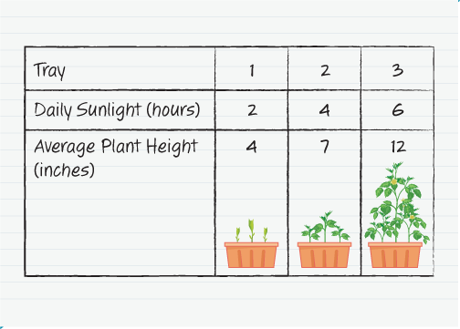
Growing Plants
Akela planted three trays of bean seeds for a science experiment. She records the daily amount of sunlight each tray of seeds receives and average plant height for each tray after 3 weeks of growth.
What can Akela say about the relationship between sunlight and plant growth?
Think and record first. Which part of your work supports your answer?
15 / 50
Notes:
TEACH IN PRACTICE | Embedded facilitation | Lesson 9.1, slide 15 | TASK
Focus on the existing task: Growing Plants Akela planted three trays of bean seeds for a science experiment. She records the daily amount of sunlight each tray of…
LAUNCH (T2/3/5): Use the displayed question. Give private thinking time; then A explains while B asks for evidence. Switch roles. Each student records their own reasoning.
LOOK FOR (T4): Where this task addresses it, students can identify related quantities. Ask which feature of their work supports the claim.
RESPOND: If this task shows the lesson misconception—assigning independence from the variable letter rather than the situation—label each original quantity and explain the dependency in a sentence. Have the student revise and explain the change. Use this support only where the concept occurs in the current task; otherwise respond to the displayed question.
RECHECK: If a gap is shared, revisit the existing representation together. If it is limited, give targeted support while others compare valid methods on the same task. Check the revision before moving on.
PARTICIPATION (T5/6/7): Think time before volunteers; accept a written, drawn or rehearsed entry. Students ask for evidence respectfully. Recognize a specific contribution or revision and check that both partners participate.
Source: BCPS Updated Instructional Framework Rubric (June 2020), TEACH 1–7. Earlier notes and answer keys are retained below.
EARLIER NOTES / EXISTING ANSWER KEY
Read the context aloud (or have a student read it).
Before any math, students restate the situation and what is being asked in their own words.
Ask: What can Akela say about the relationship between sunlight and plant growth?
UIFR: TEACH 1 · TEACH 3.
UIFR FULL | Lesson-specific facilitation
TEACH 2-3 | Session 1 task launch (UIFR PDF pp. 9-10).
Use the problem exactly as displayed. Give individual thinking time before discussion or advancing to the explanation. If the answer is already visible, ask students to reconstruct and justify it. Invite a choice of suitable representations and have students explain why their choice helps.
At the point where this concept appears, ask: “Which quantity is chosen or varied, and how does the other respond in this situation?” Wait for evidence, invite another pathway, and have a student ask a follow-up question. Do not replace students’ reasoning with a sequence of leading steps.

Slide 16
Growing Plants
Akela planted three trays of bean seeds for a science experiment. She records the daily amount of sunlight each tray of seeds receives and average plant height for each tray after 3 weeks of growth. What can Akela say about the relationship between sunlight and plant growth?
What quantities are represented in the problem?
Reveal:
The quantities are the amount of sunlight the seeds were exposed to each day and the height of the bean plants after 3 weeks.
16 / 50
Notes:
TEACH IN PRACTICE | Embedded facilitation | Lesson 9.1, slide 16 | REVEAL
Focus on the existing task: Growing Plants What quantities are represented in the problem?
LAUNCH (T2/3/5): If an existing answer cover is present, gather an attempt before revealing. If the explanation is already visible, ask students to reconstruct and justify it. Compare reasoning and explain a revision; preserve the reveal sequence.
LOOK FOR (T4): Where this task addresses it, students can identify related quantities. Ask which feature of their work supports the claim.
RESPOND: If this task shows the lesson misconception—assigning independence from the variable letter rather than the situation—label each original quantity and explain the dependency in a sentence. Have the student revise and explain the change. Use this support only where the concept occurs in the current task; otherwise respond to the displayed question.
RECHECK: If a gap is shared, revisit the existing representation together. If it is limited, give targeted support while others compare valid methods on the same task. Check the revision before moving on.
PARTICIPATION (T5/6/7): Think time before volunteers; accept a written, drawn or rehearsed entry. Students ask for evidence respectfully. Recognize a specific contribution or revision and check that both partners participate.
Source: BCPS Updated Instructional Framework Rubric (June 2020), TEACH 1–7. Earlier notes and answer keys are retained below.
EARLIER NOTES / EXISTING ANSWER KEY
Do not click yet: collect 2–3 student answers with reasons first.
Then click to remove the cover and have students compare their thinking to the reveal — “Is this what we said? Where is it different?”
Behind the cover: The quantities are the amount of sunlight the seeds were exposed to each day and the height of the bean plants after 3 weeks.
UIFR: TEACH 3 · TEACH 4.

Slide 17
STUDENT MOVES
Lesson 9-1
Your move
USE YOUR TOOLS · Reach for your notes, a model, or a manipulative before you reach for an answer.
17 / 50

Slide 18
Growing Plants
What do you notice about the shortest average plant height? the tallest average plant height?
HOW DO YOU KNOW? · Ask your partner “How do you know?” Answer by pointing to your own work.
Reveal:
The shortest average plant height is the tray that received the least amount of sunlight, while the tallest average plant height is the tray that received the most sunlight.
18 / 50
Notes:
TEACH IN PRACTICE | Embedded facilitation | Lesson 9.1, slide 17 | REVEAL
Focus on the existing task: the tallest average plant height?
LAUNCH (T2/3/5): If an existing answer cover is present, gather an attempt before revealing. If the explanation is already visible, ask students to reconstruct and justify it. Compare reasoning and explain a revision; preserve the reveal sequence.
LOOK FOR (T4): Where this task addresses it, students can identify related quantities. Ask which feature of their work supports the claim.
RESPOND: If this task shows the lesson misconception—assigning independence from the variable letter rather than the situation—label each original quantity and explain the dependency in a sentence. Have the student revise and explain the change. Use this support only where the concept occurs in the current task; otherwise respond to the displayed question.
RECHECK: If a gap is shared, revisit the existing representation together. If it is limited, give targeted support while others compare valid methods on the same task. Check the revision before moving on.
PARTICIPATION (T5/6/7): Think time before volunteers; accept a written, drawn or rehearsed entry. Students ask for evidence respectfully. Recognize a specific contribution or revision and check that both partners participate.
Source: BCPS Updated Instructional Framework Rubric (June 2020), TEACH 1–7. Earlier notes and answer keys are retained below.
EARLIER NOTES / EXISTING ANSWER KEY
Do not click yet: collect 2–3 student answers with reasons first.
Then click to remove the cover and have students compare their thinking to the reveal — “Is this what we said? Where is it different?”
Behind the cover: The shortest average plant height is the tray that received the least amount of sunlight, while the tallest average plant height is the tray that received the most sunlight.
UIFR: TEACH 3 · TEACH 4.

Slide 19
Growing Plants
An independent variable does not depend upon the other quantity.
A dependent variable changes in response to the input for the independent variable.
Explain how the information shown supports
your reasoning.
Think About It:
19 / 50
Notes:
TEACH IN PRACTICE | Embedded facilitation | Lesson 9.1, slide 18 | WORKED
Focus on the existing task: Growing Plants An independent variable does not depend upon the other quantity. A dependent variable changes in response to the input…
LAUNCH (T2/3/5): Ask students to explain the displayed idea or example and point to evidence. When a calculation step is shown, ask why it is valid. Have a partner restate the explanation; copying is not the check.
LOOK FOR (T4): Where this task addresses it, students can justify which depends on the other. Ask which feature of their work supports the claim.
RESPOND: If this task shows the lesson misconception—assigning independence from the variable letter rather than the situation—label each original quantity and explain the dependency in a sentence. Have the student revise and explain the change. Use this support only where the concept occurs in the current task; otherwise respond to the displayed question.
RECHECK: If a gap is shared, revisit the existing representation together. If it is limited, give targeted support while others compare valid methods on the same task. Check the revision before moving on.
PARTICIPATION (T5/6/7): Think time before volunteers; accept a written, drawn or rehearsed entry. Students ask for evidence respectfully. Recognize a specific contribution or revision and check that both partners participate.
Source: BCPS Updated Instructional Framework Rubric (June 2020), TEACH 1–7. Earlier notes and answer keys are retained below.
EARLIER NOTES / EXISTING ANSWER KEY
Ask the question, then hold the silence — students think or jot before anyone answers.
Take two or three responses and press with “Why?” or “How do you know?” before moving on.
UIFR: TEACH 3.

Slide 20

COLLABORATE · TALK IT THROUGH • AGREE ON A MODEL
Collaborate and Connect
The average height of the plants depends on the amount of sunlight they receive.
Which quantity is the independent variable, and which is the dependent variable?
USE THE MATH WORDS · Use today’s math words in your explanation — not “it” and “that thing.”
Reveal:
The height of the plant is the dependent variable.
The amount of sunlight is the independent variable.
20 / 50
Notes:
TEACH IN PRACTICE | Embedded facilitation | Lesson 9.1, slide 19 | COLLABORATE
Focus on the existing task: Collaborate and Connect Reveal: The height of the plant is the dependent variable. The amount of sunlight is the independent variable.…
LAUNCH (T2/3/5): Use the displayed question. Give private thinking time; then A explains while B asks for evidence. Switch roles. Each student records their own reasoning.
LOOK FOR (T4): Where this task addresses it, students can justify which depends on the other. Ask which feature of their work supports the claim.
RESPOND: If this task shows the lesson misconception—assigning independence from the variable letter rather than the situation—label each original quantity and explain the dependency in a sentence. Have the student revise and explain the change. Use this support only where the concept occurs in the current task; otherwise respond to the displayed question.
RECHECK: If a gap is shared, revisit the existing representation together. If it is limited, give targeted support while others compare valid methods on the same task. Check the revision before moving on.
PARTICIPATION (T5/6/7): Think time before volunteers; accept a written, drawn or rehearsed entry. Students ask for evidence respectfully. Recognize a specific contribution or revision and check that both partners participate.
Source: BCPS Updated Instructional Framework Rubric (June 2020), TEACH 1–7. Earlier notes and answer keys are retained below.
EARLIER NOTES / EXISTING ANSWER KEY
Routine: COLLABORATE · TALK IT THROUGH • AGREE ON A MODEL
UIFR FULL | Lesson-specific facilitation
TEACH 4-5 | Session 1 discussion and checkpoint (UIFR PDF pp. 11-12).
Collect a brief response from every student to the existing prompt before hearing volunteers. Partners take turns explaining and asking for evidence: “I understand ___; what supports ___?” Offer rehearsal or an annotated model for students who need language support. Each student records their own reasoning.
Look specifically for: assigning independence from the variable letter rather than the situation. If it appears, label each original quantity and explain the dependency in a sentence; then ask the student to revise the same response and explain the change. If evidence is secure, have students compare a second valid pathway or state why their approach works. Choose the next step from the responses, not a preset pace.

Slide 21
Let’s Explore More
Why do you think the variables that represent the quantities are called independent and dependent variables?
Workspace
Why is the amount of sunlight the independent variable?
Workspace
21 / 50
Notes:
TEACH IN PRACTICE | Embedded facilitation | Lesson 9.1, slide 20 | PRACTICE
Focus on the existing task: Let’s Explore More Why do you think the variables that represent the quantities are called independent and dependent variables?
LAUNCH (T2/3/5): Use the displayed question. Give private thinking time; then A explains while B asks for evidence. Switch roles. Each student records their own reasoning.
LOOK FOR (T4): Where this task addresses it, students can identify related quantities. Ask which feature of their work supports the claim.
RESPOND: If this task shows the lesson misconception—assigning independence from the variable letter rather than the situation—label each original quantity and explain the dependency in a sentence. Have the student revise and explain the change. Use this support only where the concept occurs in the current task; otherwise respond to the displayed question.
RECHECK: If a gap is shared, revisit the existing representation together. If it is limited, give targeted support while others compare valid methods on the same task. Check the revision before moving on.
PARTICIPATION (T5/6/7): Think time before volunteers; accept a written, drawn or rehearsed entry. Students ask for evidence respectfully. Recognize a specific contribution or revision and check that both partners participate.
Source: BCPS Updated Instructional Framework Rubric (June 2020), TEACH 1–7. Earlier notes and answer keys are retained below.
EARLIER NOTES / EXISTING ANSWER KEY
Extension for partners or table groups — students choose their approach and use the workspace to show thinking.
Push with “Convince me,” and have two groups with different approaches share.
This is where students stretch past the worked example.
UIFR: TEACH 2 · TEACH 5.

Slide 22
STUDENT MOVES
Lesson 9-1
Your move
TWO MINUTES SOLO · Two minutes on your own, then compare. Bring one thing you tried, even if it did not work.
22 / 50

Slide 23
LESSON 9.1 / DISCUSS THE TASK
Explain and compare
Use the task you just explored.
TAKE TURNS
Which quantity is chosen or varied, and how does the other respond in this situation?
Explain
“I know this because…”
Ask
“Where does your work show that?”
Point to evidence in your work.
Then compare your approach with a partner’s.
JUSTIFY IT · Say it like this: “I know ______ because ______.”
Listen to understand. Ask for evidence. Make room for every voice.
Notes:
TEACH IN PRACTICE | Embedded facilitation | Lesson 9.1, slide 21 | PRIOR_INSERT
Focus on the existing task: Point to evidence in your work. Then compare your approach with a partner’s. TAKE TURNS Explain “I know this because…” Ask “Where does your work show that?
CONNECT (T1/4): Ask students to restate the displayed goal or key idea and connect it to earlier work. Relevant lesson evidence: identify related quantities; justify which depends on the other; interpret values in context. Use only the criterion that matches the current session.
SHOW PROGRESS: Students point to their own existing work, explain what improved after feedback, and name a next step. Pair confidence ratings with actual evidence.
PARTICIPATION (T5/6/7): Think time before volunteers; accept a written, drawn or rehearsed entry. Students ask for evidence respectfully. Recognize a specific contribution or revision and check that both partners participate.
Source: BCPS Updated Instructional Framework Rubric (June 2020), TEACH 1–7.

Slide 24
Growing Plants
Akela planted three trays of bean seeds for a science experiment. She records the daily amount of sunlight each tray of seeds receives and average plant height for each tray after 3 weeks of growth. What can Akela say about the relationship between sunlight and plant growth?
What quantities are represented in the problem?
Reveal:
The quantities are the amount of sunlight the seeds were exposed to each day and the height of the bean plants after 3 weeks.
24 / 50
Notes:
TEACH IN PRACTICE | Embedded facilitation | Lesson 9.1, slide 22 | REVEAL
Focus on the existing task: Growing Plants What quantities are represented in the problem?
LAUNCH (T2/3/5): If an existing answer cover is present, gather an attempt before revealing. If the explanation is already visible, ask students to reconstruct and justify it. Compare reasoning and explain a revision; preserve the reveal sequence.
LOOK FOR (T4): Where this task addresses it, students can identify related quantities. Ask which feature of their work supports the claim.
RESPOND: If this task shows the lesson misconception—assigning independence from the variable letter rather than the situation—label each original quantity and explain the dependency in a sentence. Have the student revise and explain the change. Use this support only where the concept occurs in the current task; otherwise respond to the displayed question.
RECHECK: If a gap is shared, revisit the existing representation together. If it is limited, give targeted support while others compare valid methods on the same task. Check the revision before moving on.
PARTICIPATION (T5/6/7): Think time before volunteers; accept a written, drawn or rehearsed entry. Students ask for evidence respectfully. Recognize a specific contribution or revision and check that both partners participate.
Source: BCPS Updated Instructional Framework Rubric (June 2020), TEACH 1–7.

Slide 25
STUDENT MOVES
Lesson 9-1
Your move
ANOTHER PATHWAY · Did anyone get there a different way? Put both pathways side by side and compare.
25 / 50

Slide 26
Growing Plants
What do you notice about the shortest average plant height? the tallest average plant height?
Compare your reasoning with the
explanation. Explain any revision you make.
Reveal:
The shortest average plant height is the tray that received the least amount of sunlight, while the tallest average plant height is the tray that received the most sunlight.
26 / 50
Notes:
TEACH IN PRACTICE | Embedded facilitation | Lesson 9.1, slide 23 | REVEAL
Focus on the existing task: the tallest average plant height?
LAUNCH (T2/3/5): If an existing answer cover is present, gather an attempt before revealing. If the explanation is already visible, ask students to reconstruct and justify it. Compare reasoning and explain a revision; preserve the reveal sequence.
LOOK FOR (T4): Where this task addresses it, students can identify related quantities. Ask which feature of their work supports the claim.
RESPOND: If this task shows the lesson misconception—assigning independence from the variable letter rather than the situation—label each original quantity and explain the dependency in a sentence. Have the student revise and explain the change. Use this support only where the concept occurs in the current task; otherwise respond to the displayed question.
RECHECK: If a gap is shared, revisit the existing representation together. If it is limited, give targeted support while others compare valid methods on the same task. Check the revision before moving on.
PARTICIPATION (T5/6/7): Think time before volunteers; accept a written, drawn or rehearsed entry. Students ask for evidence respectfully. Recognize a specific contribution or revision and check that both partners participate.
Source: BCPS Updated Instructional Framework Rubric (June 2020), TEACH 1–7.

Slide 27
Collaborate and Connect
The average height of the plants depends on the amount of sunlight they receive.
Which quantity is the independent variable, and which is the dependent variable?
ADD ON · Add on: “I agree because ______.” or “I see it differently because ______.”
Reveal:
The height of the plant is the dependent variable.
The amount of sunlight is the independent variable.
27 / 50
Notes:
TEACH IN PRACTICE | Embedded facilitation | Lesson 9.1, slide 24 | COLLABORATE
Focus on the existing task: Collaborate and Connect Reveal: The height of the plant is the dependent variable. The amount of sunlight is the independent variable.…
LAUNCH (T2/3/5): Use the displayed question. Give private thinking time; then A explains while B asks for evidence. Switch roles. Each student records their own reasoning.
LOOK FOR (T4): Where this task addresses it, students can justify which depends on the other. Ask which feature of their work supports the claim.
RESPOND: If this task shows the lesson misconception—assigning independence from the variable letter rather than the situation—label each original quantity and explain the dependency in a sentence. Have the student revise and explain the change. Use this support only where the concept occurs in the current task; otherwise respond to the displayed question.
RECHECK: If a gap is shared, revisit the existing representation together. If it is limited, give targeted support while others compare valid methods on the same task. Check the revision before moving on.
PARTICIPATION (T5/6/7): Think time before volunteers; accept a written, drawn or rehearsed entry. Students ask for evidence respectfully. Recognize a specific contribution or revision and check that both partners participate.
Source: BCPS Updated Instructional Framework Rubric (June 2020), TEACH 1–7.

Slide 28
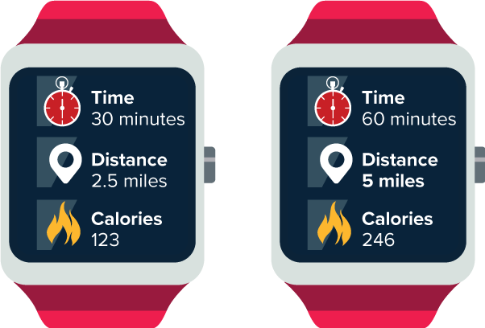
Be Curious
Be Curious
What do you notice?
What do you wonder?
Think first. Share a notice and a question;
build on a classmate’s idea.
Mindset
How is flexible thinking helping you engage with math?
28 / 50
Notes:
TEACH IN PRACTICE | Embedded facilitation | Lesson 9.1, slide 25 | CURIOUS
Focus on the existing task: Be Curious Be Curious What do you notice?
LAUNCH (T2/3/5): Allow quiet observation first. Separate a notice from an inference, invite students’ own questions, and follow the existing launch before teaching a procedure.
LOOK FOR (T4): Where this task addresses it, students can identify related quantities. Ask which feature of their work supports the claim.
RESPOND: If this task shows the lesson misconception—assigning independence from the variable letter rather than the situation—label each original quantity and explain the dependency in a sentence. Have the student revise and explain the change. Use this support only where the concept occurs in the current task; otherwise respond to the displayed question.
RECHECK: If a gap is shared, revisit the existing representation together. If it is limited, give targeted support while others compare valid methods on the same task. Check the revision before moving on.
PARTICIPATION (T5/6/7): Think time before volunteers; accept a written, drawn or rehearsed entry. Students ask for evidence respectfully. Recognize a specific contribution or revision and check that both partners participate.
Source: BCPS Updated Instructional Framework Rubric (June 2020), TEACH 1–7.

Slide 29
Session 2 Warm-Up
Lesson 9-1 · Explore Relationships Between Two Variables
Session 2 Warm-Up
Check what you remember from Session 1 · about 4 minutes
1
The variable whose value determines the other variable is the:
2
In hours worked (h) and pay earned (p), which is dependent?
A
Dependent variable
A
Hours worked (h)
B
Independent variable
B
Pay earned (p)
C
Constant
C
Both are independent
D
Coefficient
D
Neither
3
On a graph, the independent variable is plotted on the:
4
The dependent variable is plotted on the:
A
Vertical y-axis
A
Horizontal x-axis
B
Horizontal x-axis
B
Vertical y-axis
C
Diagonal line
C
Origin only
D
Quadrant III
D
Z-axis
eduwonderlab.com · Neft Teacher
29 / 50
Notes:
TEACH IN PRACTICE | Embedded facilitation | Lesson 9.1, slide 26 | WARMUP
Focus on the existing task: Session 2 Warm-Up Session 2 Warm-Up Check what…
GATHER EVIDENCE (T4/6): Keep the original items. Students try independently, mark an uncertain item, and explain one method before checking. Use the existing key when present.
RESPOND: Distinguish a calculation slip from a reasoning gap. Give one next step on the same item; have students revise in a second color. Use the responses to choose flexible support for today’s lesson.
PARTICIPATION (T5/6/7): Think time before volunteers; accept a written, drawn or rehearsed entry. Students ask for evidence respectfully. Recognize a specific contribution or revision and check that both partners participate.
Source: BCPS Updated Instructional Framework Rubric (June 2020), TEACH 1–7. Earlier notes and answer keys are retained below.
EARLIER NOTES / EXISTING ANSWER KEY
Warm-up routine: students start silently on entry; keep it to about 4 minutes.
Circulate and note who is stuck — use what you see to choose who you check on first today.
Go over answers quickly; ask one student to explain a step, not just say the answer.
UIFR: TEACH 4 · TEACH 6.
UIFR FULL | Lesson-specific facilitation
TEACH 1 | Session 2 purpose and evidence (UIFR PDF p. 8).
Have students restate the displayed session goal in their own words and connect it to the existing context or a familiar experience they choose to share. Use the current session goal to select from these lesson-wide evidence criteria; do not frontload a later-session procedure.
Look for: identify related quantities; justify which depends on the other; interpret values in context. Ask: “Which part of your work would show this?” Revisit that evidence after the task; a confidence rating alone is not evidence of understanding.

Slide 30
STUDENT MOVES
Lesson 9-1
Your move
YOU KNOW THE ROUTINE · Read → plan → solve → check. Do all four, in that order.
30 / 50

Slide 31
Today’s Math Notes
Lesson 9-1 · Explore Relationships Between Two Variables
Review Notes — Session 2
Copy. Explain. Check.
WHY IT MATTERS · Finish this: “This is worth knowing because ______.”
Independent Variable (x)
1
The input value that causes change; plotted along the horizontal axis.
Dependent Variable (y)
2
The output value that depends on or responds to x; plotted along the vertical axis.
Function Thinking
3
Sentence test: ‘[Dependent variable] depends on [Independent variable]’.
eduwonderlab.com · Neft Teacher
31 / 50
Notes:
TEACH IN PRACTICE | Embedded facilitation | Lesson 9.1, slide 27 | NOTES
Focus on the existing task: Today’s Math Notes Review Notes — Session 2…
ROUTINE (T1/2/4): Read or copy the original notes, cover one line, and explain it using the displayed example. Reopen and correct. Copying alone is not evidence of understanding.
LOOK FOR: A link between a symbol, quantity or feature and the explanation. If missing, point back to that feature and have the student try again; fade the prompt once they can explain.
PARTICIPATION (T5/6/7): Think time before volunteers; accept a written, drawn or rehearsed entry. Students ask for evidence respectfully. Recognize a specific contribution or revision and check that both partners participate.
Source: BCPS Updated Instructional Framework Rubric (June 2020), TEACH 1–7. Earlier notes and answer keys are retained below.
EARLIER NOTES / EXISTING ANSWER KEY
Copy routine: read one line at a time; students copy, then explain that line to a partner.
Keep it brisk — the understanding work happens in the examples, not the copying.
UIFR: TEACH 1 · TEACH 6.

Slide 32
Session 2
Explore Relationships Between
Two Variables
STRUGGLE FIRST · Work on your own first. Stuck is allowed — try a second strategy before you ask.
32 / 50
Notes:
TEACH IN PRACTICE | Embedded facilitation | Lesson 9.1, slide 28 | DIVIDER
Focus on the existing task: Explore Relationships Between Two Variables Session 2
TRANSITION (T6/7): Students confirm materials, roles, how to request help, and the next response routine. Ask a student to restate it. Keep teacher-only slides hidden.
PARTICIPATION (T5/6/7): Think time before volunteers; accept a written, drawn or rehearsed entry. Students ask for evidence respectfully. Recognize a specific contribution or revision and check that both partners participate.
Source: BCPS Updated Instructional Framework Rubric (June 2020), TEACH 1–7. Earlier notes and answer keys are retained below.
EARLIER NOTES / EXISTING ANSWER KEY
Transition cue: state what materials are out and what success looks like this session.
Keep the changeover under a minute.
UIFR: TEACH 6.

Slide 33
Tracking Calories
Claire has a new fitness tracker to track the number of Calories she burns each time she jogs. The data for a 30-minute jog and a 60-minute jog are shown.
How does the number of Calories burned relate to the amount of time Claire spends jogging?
Reasoning
Think and record first. Which part of your
work supports your answer?
33 / 50
Notes:
TEACH IN PRACTICE | Embedded facilitation | Lesson 9.1, slide 29 | TASK
Focus on the existing task: Tracking Calories Claire has a new fitness tracker to track the number of Calories she burns each time she jogs. The data for a 30-minute…
LAUNCH (T2/3/5): Use the displayed question. Give private thinking time; then A explains while B asks for evidence. Switch roles. Each student records their own reasoning.
LOOK FOR (T4): Where this task addresses it, students can identify related quantities. Ask which feature of their work supports the claim.
RESPOND: If this task shows the lesson misconception—assigning independence from the variable letter rather than the situation—label each original quantity and explain the dependency in a sentence. Have the student revise and explain the change. Use this support only where the concept occurs in the current task; otherwise respond to the displayed question.
RECHECK: If a gap is shared, revisit the existing representation together. If it is limited, give targeted support while others compare valid methods on the same task. Check the revision before moving on.
PARTICIPATION (T5/6/7): Think time before volunteers; accept a written, drawn or rehearsed entry. Students ask for evidence respectfully. Recognize a specific contribution or revision and check that both partners participate.
Source: BCPS Updated Instructional Framework Rubric (June 2020), TEACH 1–7. Earlier notes and answer keys are retained below.
EARLIER NOTES / EXISTING ANSWER KEY
Read the context aloud (or have a student read it).
Before any math, students restate the situation and what is being asked in their own words.
Ask: How does the number of Calories burned relate to the amount of time Claire spends jogging?
UIFR: TEACH 1 · TEACH 3.
UIFR FULL | Lesson-specific facilitation
TEACH 2-3 | Session 2 task launch (UIFR PDF pp. 9-10).
Use the problem exactly as displayed. Give individual thinking time before discussion or advancing to the explanation. If the answer is already visible, ask students to reconstruct and justify it. Invite a choice of suitable representations and have students explain why their choice helps.
At the point where this concept appears, ask: “Which quantity is chosen or varied, and how does the other respond in this situation?” Wait for evidence, invite another pathway, and have a student ask a follow-up question. Do not replace students’ reasoning with a sequence of leading steps.

Slide 34
Tracking Calories
Claire has a new fitness tracker to track the number of Calories she burns each time she jogs. The data for a 30-minute jog and a 60-minute jog are shown. How does the number of Calories burned relate to the amount of time Claire spends jogging?
What information do you know?
Reveal:
Claire burned 123 Calories during a 30-minute jog and 246 Calories during a 60-minute jog.
34 / 50
Notes:
TEACH IN PRACTICE | Embedded facilitation | Lesson 9.1, slide 30 | REVEAL
Focus on the existing task: Tracking Calories What information do you know?
LAUNCH (T2/3/5): If an existing answer cover is present, gather an attempt before revealing. If the explanation is already visible, ask students to reconstruct and justify it. Compare reasoning and explain a revision; preserve the reveal sequence.
LOOK FOR (T4): Where this task addresses it, students can identify related quantities. Ask which feature of their work supports the claim.
RESPOND: If this task shows the lesson misconception—assigning independence from the variable letter rather than the situation—label each original quantity and explain the dependency in a sentence. Have the student revise and explain the change. Use this support only where the concept occurs in the current task; otherwise respond to the displayed question.
RECHECK: If a gap is shared, revisit the existing representation together. If it is limited, give targeted support while others compare valid methods on the same task. Check the revision before moving on.
PARTICIPATION (T5/6/7): Think time before volunteers; accept a written, drawn or rehearsed entry. Students ask for evidence respectfully. Recognize a specific contribution or revision and check that both partners participate.
Source: BCPS Updated Instructional Framework Rubric (June 2020), TEACH 1–7. Earlier notes and answer keys are retained below.
EARLIER NOTES / EXISTING ANSWER KEY
Do not click yet: collect 2–3 student answers with reasons first.
Then click to remove the cover and have students compare their thinking to the reveal — “Is this what we said? Where is it different?”
Behind the cover: Claire burned 123 Calories during a 30-minute jog and 246 Calories during a 60-minute jog.
UIFR: TEACH 3 · TEACH 4.

Slide 35
STUDENT MOVES
Lesson 9-1
Your move
TAKE TURNS · One explains, one asks a question. Then switch, so both of you talk.
35 / 50

Slide 36
Tracking Calories
Which quantity is the independent variable? the dependent variable? How do you know?
Reveal:
The time spent jogging is the independent variable because it is subject to choice. The number of Calories burned is the dependent variable because it changes in response to the time spent jogging.
Record your reasoning before the
reveal. Compare, then explain
any revision.
36 / 50
Notes:
TEACH IN PRACTICE | Embedded facilitation | Lesson 9.1, slide 31 | REVEAL
Focus on the existing task: Which quantity is the independent variable?
LAUNCH (T2/3/5): If an existing answer cover is present, gather an attempt before revealing. If the explanation is already visible, ask students to reconstruct and justify it. Compare reasoning and explain a revision; preserve the reveal sequence.
LOOK FOR (T4): Where this task addresses it, students can justify which depends on the other. Ask which feature of their work supports the claim.
RESPOND: If this task shows the lesson misconception—assigning independence from the variable letter rather than the situation—label each original quantity and explain the dependency in a sentence. Have the student revise and explain the change. Use this support only where the concept occurs in the current task; otherwise respond to the displayed question.
RECHECK: If a gap is shared, revisit the existing representation together. If it is limited, give targeted support while others compare valid methods on the same task. Check the revision before moving on.
PARTICIPATION (T5/6/7): Think time before volunteers; accept a written, drawn or rehearsed entry. Students ask for evidence respectfully. Recognize a specific contribution or revision and check that both partners participate.
Source: BCPS Updated Instructional Framework Rubric (June 2020), TEACH 1–7. Earlier notes and answer keys are retained below.
EARLIER NOTES / EXISTING ANSWER KEY
Do not click yet: collect 2–3 student answers with reasons first.
Then click to remove the cover and have students compare their thinking to the reveal — “Is this what we said? Where is it different?”
Behind the cover: The time spent jogging is the independent variable because it is subject to choice. The number of Calories burned is the dependent variable because it changes in response to the time spent jogging.
UIFR: TEACH 3 · TEACH 4.

Slide 37
Tracking Calories
Let’s use a table of values to represent the relationship between the amount of time spent jogging and Calories burned.
Tracking Calories
Time Spent Jagging (min) | Calories Burned
Explain what a row or column represents. Use it as evidence
for your answer.
37 / 50
Notes:
TEACH IN PRACTICE | Embedded facilitation | Lesson 9.1, slide 32 | WORKED
Focus on the existing task: Let’s use a table of values to represent the relationship between the amount of time spent jogging and Calories burned. Tracking Calories…
LAUNCH (T2/3/5): Ask students to explain the displayed idea or example and point to evidence. When a calculation step is shown, ask why it is valid. Have a partner restate the explanation; copying is not the check.
LOOK FOR (T4): Where this task addresses it, students can interpret values in context. Ask which feature of their work supports the claim.
RESPOND: If this task shows the lesson misconception—assigning independence from the variable letter rather than the situation—label each original quantity and explain the dependency in a sentence. Have the student revise and explain the change. Use this support only where the concept occurs in the current task; otherwise respond to the displayed question.
RECHECK: If a gap is shared, revisit the existing representation together. If it is limited, give targeted support while others compare valid methods on the same task. Check the revision before moving on.
PARTICIPATION (T5/6/7): Think time before volunteers; accept a written, drawn or rehearsed entry. Students ask for evidence respectfully. Recognize a specific contribution or revision and check that both partners participate.
Source: BCPS Updated Instructional Framework Rubric (June 2020), TEACH 1–7. Earlier notes and answer keys are retained below.
EARLIER NOTES / EXISTING ANSWER KEY
Model briefly, then hand the thinking back: ask “Why does this step work?” before showing the next one.
Quick check before moving on — thumbs or whiteboards from everyone, not volunteers.
UIFR: TEACH 2 · TEACH 3 · TEACH 4.

Slide 38
Tracking Calories
How does the table illustrate the relationship between the quantities?
Record your reasoning before the reveal.
Compare, then explain any revision.
Reveal:
The table shows how the dependent variable, Calories burned, changes in response to the independent variable, time spent jogging.
38 / 50
Notes:
TEACH IN PRACTICE | Embedded facilitation | Lesson 9.1, slide 33 | REVEAL
Focus on the existing task: Reveal: The table shows how the dependent variable, Calories burned, changes in response to the independent variable, time spent jogging.
LAUNCH (T2/3/5): If an existing answer cover is present, gather an attempt before revealing. If the explanation is already visible, ask students to reconstruct and justify it. Compare reasoning and explain a revision; preserve the reveal sequence.
LOOK FOR (T4): Where this task addresses it, students can identify related quantities. Ask which feature of their work supports the claim.
RESPOND: If this task shows the lesson misconception—assigning independence from the variable letter rather than the situation—label each original quantity and explain the dependency in a sentence. Have the student revise and explain the change. Use this support only where the concept occurs in the current task; otherwise respond to the displayed question.
RECHECK: If a gap is shared, revisit the existing representation together. If it is limited, give targeted support while others compare valid methods on the same task. Check the revision before moving on.
PARTICIPATION (T5/6/7): Think time before volunteers; accept a written, drawn or rehearsed entry. Students ask for evidence respectfully. Recognize a specific contribution or revision and check that both partners participate.
Source: BCPS Updated Instructional Framework Rubric (June 2020), TEACH 1–7. Earlier notes and answer keys are retained below.
EARLIER NOTES / EXISTING ANSWER KEY
Do not click yet: collect 2–3 student answers with reasons first.
Then click to remove the cover and have students compare their thinking to the reveal — “Is this what we said? Where is it different?”
Behind the cover: The table shows how the dependent variable, Calories burned, changes in response to the independent variable, time spent jogging.
UIFR: TEACH 3 · TEACH 4.

Slide 39
Let’s Explore More
a. How do you think the number of Calories burned would change if Claire switched from jogging to walking?
Workspace
b. If Claire jogs for 3 miles and records the time it takes, what is the independent variable and what is the dependent variable? Explain.
Workspace
39 / 50
Notes:
TEACH IN PRACTICE | Embedded facilitation | Lesson 9.1, slide 34 | PRACTICE
Focus on the existing task: Let’s Explore More a. How do you think the number of Calories burned would change if Claire switched from jogging to walking?
LAUNCH (T2/3/5): Use the displayed question. Give private thinking time; then A explains while B asks for evidence. Switch roles. Each student records their own reasoning.
LOOK FOR (T4): Where this task addresses it, students can identify related quantities. Ask which feature of their work supports the claim.
RESPOND: If this task shows the lesson misconception—assigning independence from the variable letter rather than the situation—label each original quantity and explain the dependency in a sentence. Have the student revise and explain the change. Use this support only where the concept occurs in the current task; otherwise respond to the displayed question.
RECHECK: If a gap is shared, revisit the existing representation together. If it is limited, give targeted support while others compare valid methods on the same task. Check the revision before moving on.
PARTICIPATION (T5/6/7): Think time before volunteers; accept a written, drawn or rehearsed entry. Students ask for evidence respectfully. Recognize a specific contribution or revision and check that both partners participate.
Source: BCPS Updated Instructional Framework Rubric (June 2020), TEACH 1–7. Earlier notes and answer keys are retained below.
EARLIER NOTES / EXISTING ANSWER KEY
Extension for partners or table groups — students choose their approach and use the workspace to show thinking.
Push with “Convince me,” and have two groups with different approaches share.
This is where students stretch past the worked example.
UIFR: TEACH 2 · TEACH 5.
UIFR FULL | Lesson-specific facilitation
TEACH 4-5 | Session 2 discussion and checkpoint (UIFR PDF pp. 11-12).
Collect a brief response from every student to the existing prompt before hearing volunteers. Partners take turns explaining and asking for evidence: “I understand ___; what supports ___?” Offer rehearsal or an annotated model for students who need language support. Each student records their own reasoning.
Look specifically for: assigning independence from the variable letter rather than the situation. If it appears, label each original quantity and explain the dependency in a sentence; then ask the student to revise the same response and explain the change. If evidence is secure, have students compare a second valid pathway or state why their approach works. Choose the next step from the responses, not a preset pace.

Slide 40
STUDENT MOVES
Lesson 9-1
Your move
YOUR CHOICE · You choose how to show this — numbers, words, or a diagram. Make your reasoning visible.
40 / 50

Slide 41
LESSON 9.1 / CHECK YOUR WORK
Pause. Check. Improve.
CHECK
A mistake to watch for: assigning independence from the variable letter rather than the situation.
TRY
Label each given quantity and explain the dependency in a sentence.
REVISE
Use that check on the task you just completed. Correct or strengthen one part, and explain why.
SELF-CHECK · Mark it: ✓ got it · ~ almost · ? stuck. Then fix one thing before we move on.
Listen to understand. Ask for evidence. Make room for every voice.
Notes:
TEACH IN PRACTICE | Embedded facilitation | Lesson 9.1, slide 35 | PRIOR_INSERT
Focus on the existing task: LESSON 9.1 / CHECK YOUR WORK Pause. Check. Improve. Listen to understand. Ask for evidence. Make room for every voice. CHECK A mistake…
CONNECT (T1/4): Ask students to restate the displayed goal or key idea and connect it to earlier work. Relevant lesson evidence: identify related quantities; justify which depends on the other; interpret values in context. Use only the criterion that matches the current session.
SHOW PROGRESS: Students point to their own existing work, explain what improved after feedback, and name a next step. Pair confidence ratings with actual evidence.
PARTICIPATION (T5/6/7): Think time before volunteers; accept a written, drawn or rehearsed entry. Students ask for evidence respectfully. Recognize a specific contribution or revision and check that both partners participate.
Source: BCPS Updated Instructional Framework Rubric (June 2020), TEACH 1–7.

Slide 42
Tracking Calories
Claire has a new fitness tracker to track the number of Calories she burns each time she jogs. The data for a 30-minute jog and a 60-minute jog are shown. How does the number of Calories burned relate to the amount of time Claire spends jogging?
What information do you know?
Reveal:
Claire burned 123 Calories during a 30-minute jog and 246 Calories during a 60-minute jog.
42 / 50
Notes:
TEACH IN PRACTICE | Embedded facilitation | Lesson 9.1, slide 36 | REVEAL
Focus on the existing task: Tracking Calories What information do you know?
LAUNCH (T2/3/5): If an existing answer cover is present, gather an attempt before revealing. If the explanation is already visible, ask students to reconstruct and justify it. Compare reasoning and explain a revision; preserve the reveal sequence.
LOOK FOR (T4): Where this task addresses it, students can identify related quantities. Ask which feature of their work supports the claim.
RESPOND: If this task shows the lesson misconception—assigning independence from the variable letter rather than the situation—label each original quantity and explain the dependency in a sentence. Have the student revise and explain the change. Use this support only where the concept occurs in the current task; otherwise respond to the displayed question.
RECHECK: If a gap is shared, revisit the existing representation together. If it is limited, give targeted support while others compare valid methods on the same task. Check the revision before moving on.
PARTICIPATION (T5/6/7): Think time before volunteers; accept a written, drawn or rehearsed entry. Students ask for evidence respectfully. Recognize a specific contribution or revision and check that both partners participate.
Source: BCPS Updated Instructional Framework Rubric (June 2020), TEACH 1–7.

Slide 43
STUDENT MOVES
Lesson 9-1
Your move
REVISE NOW · Change one answer and write why you changed it. A revision is evidence of learning.
43 / 50

Slide 44
Tracking Calories
Claire burned 123 Calories during a 30-minute jog and 246 Calories during a 60-minute jog.
What quantities are represented in the problem?
Compare your reasoning with the
explanation. Explain any revision you make.
Reveal:
The quantities are the number of minutes Claire spent jogging and the number of Calories she burned.
44 / 50
Notes:
TEACH IN PRACTICE | Embedded facilitation | Lesson 9.1, slide 37 | REVEAL
Focus on the existing task: Tracking Calories Claire burned 123 Calories during a 30-minute jog and 246 Calories during a 60-minute jog. What quantities are represented in the problem?
LAUNCH (T2/3/5): If an existing answer cover is present, gather an attempt before revealing. If the explanation is already visible, ask students to reconstruct and justify it. Compare reasoning and explain a revision; preserve the reveal sequence.
LOOK FOR (T4): Where this task addresses it, students can identify related quantities. Ask which feature of their work supports the claim.
RESPOND: If this task shows the lesson misconception—assigning independence from the variable letter rather than the situation—label each original quantity and explain the dependency in a sentence. Have the student revise and explain the change. Use this support only where the concept occurs in the current task; otherwise respond to the displayed question.
RECHECK: If a gap is shared, revisit the existing representation together. If it is limited, give targeted support while others compare valid methods on the same task. Check the revision before moving on.
PARTICIPATION (T5/6/7): Think time before volunteers; accept a written, drawn or rehearsed entry. Students ask for evidence respectfully. Recognize a specific contribution or revision and check that both partners participate.
Source: BCPS Updated Instructional Framework Rubric (June 2020), TEACH 1–7.

Slide 45
Tracking Calories
Which quantity is the independent variable? the dependent variable? How do you know?
Reveal:
The time spent jogging is the independent variable because it is subject to choice. The number of Calories burned is the dependent variable because it changes in response to the time spent jogging.
Compare your reasoning with the
explanation. Explain any revision
you make.
45 / 50
Notes:
TEACH IN PRACTICE | Embedded facilitation | Lesson 9.1, slide 38 | REVEAL
Focus on the existing task: Which quantity is the independent variable?
LAUNCH (T2/3/5): If an existing answer cover is present, gather an attempt before revealing. If the explanation is already visible, ask students to reconstruct and justify it. Compare reasoning and explain a revision; preserve the reveal sequence.
LOOK FOR (T4): Where this task addresses it, students can justify which depends on the other. Ask which feature of their work supports the claim.
RESPOND: If this task shows the lesson misconception—assigning independence from the variable letter rather than the situation—label each original quantity and explain the dependency in a sentence. Have the student revise and explain the change. Use this support only where the concept occurs in the current task; otherwise respond to the displayed question.
RECHECK: If a gap is shared, revisit the existing representation together. If it is limited, give targeted support while others compare valid methods on the same task. Check the revision before moving on.
PARTICIPATION (T5/6/7): Think time before volunteers; accept a written, drawn or rehearsed entry. Students ask for evidence respectfully. Recognize a specific contribution or revision and check that both partners participate.
Source: BCPS Updated Instructional Framework Rubric (June 2020), TEACH 1–7.

Slide 46
SUMMARIZE · SAY IT IN YOUR OWN WORDS
Summarize: Explore Relationships Between Two Quantities
When two quantities are related, one quantity is represented by an independent variable and the other by a dependent variable. The independent variable does not depend upon the other quantity. It is subject to choice. The dependent variable changes in response to changes of the independent variable.
Explain the key idea without reading. Use today’s example as evidence.
46 / 50
Notes:
TEACH IN PRACTICE | Embedded facilitation | Lesson 9.1, slide 39 | SUMMARIZE
Focus on the existing task: Summarize: Explore Relationships Between Two Quantities When two quantities are related, one quantity is represented by an independent…
CONNECT (T1/4): Ask students to restate the displayed goal or key idea and connect it to earlier work. Relevant lesson evidence: identify related quantities; justify which depends on the other; interpret values in context. Use only the criterion that matches the current session.
SHOW PROGRESS: Students point to their own existing work, explain what improved after feedback, and name a next step. Pair confidence ratings with actual evidence.
PARTICIPATION (T5/6/7): Think time before volunteers; accept a written, drawn or rehearsed entry. Students ask for evidence respectfully. Recognize a specific contribution or revision and check that both partners participate.
Source: BCPS Updated Instructional Framework Rubric (June 2020), TEACH 1–7. Earlier notes and answer keys are retained below.
EARLIER NOTES / EXISTING ANSWER KEY
Routine: SUMMARIZE · SAY IT IN YOUR OWN WORDS

Slide 47

APPLY · PLAN IT • SOLVE IT • PROVE IT
Apply: Selling Pizzas
At a local pizza shop, a customer can order up to three different toppings on a large pizza. The pizza shop has a total of 6 employees. The shop spends $1.15 on cheese and $1.95 on sauce for each pizza.
Question: How can you describe the relationship between the number of large pizzas sold and each of the following:
the hours the shop is open
the number of employees who work in the shop
the cost of cheese each week
the cost of sauce each week
47 / 50
Notes:
TEACH IN PRACTICE | Embedded facilitation | Lesson 9.1, slide 40 | APPLY
Focus on the existing task: Apply: Selling Pizzas At a local pizza shop, a customer can order up to three different toppings on a large pizza. The pizza shop has a…
LAUNCH (T2/3/5): Use the exact application task independently first. Ask students to justify their choice of method. Collect evidence before a partner discussion or correction.
LOOK FOR (T4): Where this task addresses it, students can identify related quantities. Ask which feature of their work supports the claim.
RESPOND: If this task shows the lesson misconception—assigning independence from the variable letter rather than the situation—label each original quantity and explain the dependency in a sentence. Have the student revise and explain the change. Use this support only where the concept occurs in the current task; otherwise respond to the displayed question.
RECHECK: If a gap is shared, revisit the existing representation together. If it is limited, give targeted support while others compare valid methods on the same task. Check the revision before moving on.
PARTICIPATION (T5/6/7): Think time before volunteers; accept a written, drawn or rehearsed entry. Students ask for evidence respectfully. Recognize a specific contribution or revision and check that both partners participate.
Source: BCPS Updated Instructional Framework Rubric (June 2020), TEACH 1–7. Earlier notes and answer keys are retained below.
EARLIER NOTES / EXISTING ANSWER KEY
Routine: APPLY · PLAN IT • SOLVE IT • PROVE IT
UIFR FULL | Lesson-specific facilitation
TEACH 4 | Independent evidence and revision (UIFR PDF p. 11).
Use the existing application/exit problem as the independent check. If this is a learning-target slide, have students point to and explain their work on the preceding task. Separate initial independent evidence from the revision after feedback.
Check the relevant criteria: identify related quantities; justify which depends on the other; interpret values in context. Respond with one specific next step tied to the work. Students revise and annotate what changed, then identify a criterion they can now demonstrate and one they still need to practice.

Slide 48
STUDENT MOVES
Lesson 9-1
Your move
PICK YOUR STRATEGY · Choose your path — picture, table, number line, or equation — and be ready to say why you chose it.
48 / 50

Slide 49
Learning Targets
I can recognize when two quantities relate to each other, i.e., as one quantity changes independently, the other quantity changes in a related way.
I can make sense of quantities to identify the independent variable and dependent variable and determine the value of the dependent variable given the relationship between two quantities.
Point to evidence in your work. Name what improved and your next step.
49 / 50
Notes:
TEACH IN PRACTICE | Embedded facilitation | Lesson 9.1, slide 41 | REFLECTION
Focus on the existing task: Learning Targets I can recognize when two quantities relate to each other, i.e., as one quantity changes independently, the other quantity…
CONNECT (T1/4): Ask students to restate the displayed goal or key idea and connect it to earlier work. Relevant lesson evidence: identify related quantities; justify which depends on the other; interpret values in context. Use only the criterion that matches the current session.
SHOW PROGRESS: Students point to their own existing work, explain what improved after feedback, and name a next step. Pair confidence ratings with actual evidence.
PARTICIPATION (T5/6/7): Think time before volunteers; accept a written, drawn or rehearsed entry. Students ask for evidence respectfully. Recognize a specific contribution or revision and check that both partners participate.
Source: BCPS Updated Instructional Framework Rubric (June 2020), TEACH 1–7. Earlier notes and answer keys are retained below.
EARLIER NOTES / EXISTING ANSWER KEY
UIFR FULL | Lesson-specific facilitation
REFLECT & ADJUST 1-2 | After the lesson (UIFR PDF pp. 15-16).
Sort the existing work by demonstrated reasoning, partial understanding, and the specific misconception: assigning independence from the variable letter rather than the situation. Compare the initial response with the revision. Record which teaching move plausibly helped, which did not, and whose participation or access needs a different approach; do not record sensitive student details in this shared deck.
Plan the next lesson from that evidence: if the misconception persists, label each original quantity and explain the dependency in a sentence using the current example before returning to the next grade-level task; if understanding is secure, use an existing extension or ask for a general explanation. Check the targeted idea again at the next warm-up.
Ask students what supported their thinking and what would help next time. Identify one change to try and one successful practice to retain. Seek colleague feedback on anonymized work when useful; these prompts support reflection and do not establish an evaluation rating. Source: Baltimore City Public Schools, Updated Instructional Framework Rubric, June 2020 (UIFR_Full.pdf).

Slide 50
LESSON 9.1 / REFLECT ON YOUR LEARNING
Show your progress
1 SHOW EVIDENCE
2 CHOOSE A NEXT STEP
Choose one response. Point to the part that shows your reasoning.
Name a change you made after feedback—or a question you still have.
“My work shows ___ because ___.”
“Next time, I will ___ to help me ___.”
Today’s focus: Identify related quantities.
CREDIT A CLASSMATE · Name one classmate whose idea helped you today, and say what they said.
Listen to understand. Ask for evidence. Make room for every voice.
Notes:
TEACH IN PRACTICE | Embedded facilitation | Lesson 9.1, slide 42 | PRIOR_INSERT
Focus on the existing task: LESSON 9.1 / REFLECT ON YOUR LEARNING Show your progress Listen to understand. Ask for evidence. Make room for every voice. 1 SHOW…
CONNECT (T1/4): Ask students to restate the displayed goal or key idea and connect it to earlier work. Relevant lesson evidence: identify related quantities; justify which depends on the other; interpret values in context. Use only the criterion that matches the current session.
SHOW PROGRESS: Students point to their own existing work, explain what improved after feedback, and name a next step. Pair confidence ratings with actual evidence.
PARTICIPATION (T5/6/7): Think time before volunteers; accept a written, drawn or rehearsed entry. Students ask for evidence respectfully. Recognize a specific contribution or revision and check that both partners participate.
Source: BCPS Updated Instructional Framework Rubric (June 2020), TEACH 1–7.

