Slide 1
WARM-UP · THINK • TRY • CHECK
Turn and talk: compare strategies, then defend one.
Warm-Up
Lesson 9-2 · Analyze Graphs of Relationships Between Two Variables | Warm-Up · about 4 minutes
Try each on your own. Mark an unsure answer; explain and revise when we check.
QUESTION 1
QUESTION 2
Table row: x = 3, y = 8. Ordered pair: ______
A point is 5 across and 2 up. Write it: ______
QUESTION 3
QUESTION 4
An axis is marked 0, 10, 20, 30. One step is ______
(1, 4), (2, 8), (3, 12), then ______
TALK IT OVER: “I got ______ because ______.” • Compare with a partner before we check as a class.
1 / 47
Notes:
TEACH IN PRACTICE | Embedded facilitation | Lesson 9.2, slide 1 | WARMUP
Focus on the existing task: Warm-Up WARM-UP · THINK • TRY •…
GATHER EVIDENCE (T4/6): Keep the original items. Students try independently, mark an uncertain item, and explain one method before checking. Use the existing key when present.
RESPOND: Distinguish a calculation slip from a reasoning gap. Give one next step on the same item; have students revise in a second color. Use the responses to choose flexible support for today’s lesson.
PARTICIPATION (T5/6/7): Think time before volunteers; accept a written, drawn or rehearsed entry. Students ask for evidence respectfully. Recognize a specific contribution or revision and check that both partners participate.
Source: BCPS Updated Instructional Framework Rubric (June 2020), TEACH 1–7. Earlier notes and answer keys are retained below.
EARLIER NOTES / EXISTING ANSWER KEY
Warm-Up answers (teacher only): 1) (3, 8) 2) (5, 2) 3) 10 4) (4, 16)
UIFR FULL | Lesson-specific facilitation
PREPARE 1-2 | Before teaching (UIFR PDF pp. 6-7).
Plan to gather evidence that students can connect table rows to graph points; interpret axes and scale; describe the relationship. Review recent work and today’s warm-up to choose flexible groups and access supports; do not infer needs from identity or perceived ability. Use the existing lesson tasks and stated standards.
Anticipate: misreading the axis scale or assuming every relationship starts at zero. If observed, trace one original table row to its graph point and label both units. Offer oral rehearsal, drawing, pointing, or home-language processing as needed; retain the original mathematical demand. Ask students which support helps and fade it as evidence improves.
TEACH 6-7 | Before the first transition, agree on materials, partner roles, and how to request help. Invite students to restate the routine. Normalize revising an idea, recognize a specific contribution, and check privately when frustration blocks participation. Source: UIFR PDF pp. 13-14.

Slide 2
Today’s Math Notes
Lesson 9-2 · Analyze Graphs of Relationships Between Two Variables
Section 1: Math Words
Copy. Explain. Check.
SAY THE GOAL · Say today’s goal in your own words, then name one place this shows up outside math class.
graph
1
A picture on a coordinate plane
table of values
2
A list of matched pairs of values
ordered pair
3
Two numbers written
eduwonderlab.com · Neft Teacher
2 / 47
Notes:
TEACH IN PRACTICE | Embedded facilitation | Lesson 9.2, slide 2 | NOTES
Focus on the existing task: Today’s Math Notes Section 1: Math…
ROUTINE (T1/2/4): Read or copy the original notes, cover one line, and explain it using the displayed example. Reopen and correct. Copying alone is not evidence of understanding.
LOOK FOR: A link between a symbol, quantity or feature and the explanation. If missing, point back to that feature and have the student try again; fade the prompt once they can explain.
PARTICIPATION (T5/6/7): Think time before volunteers; accept a written, drawn or rehearsed entry. Students ask for evidence respectfully. Recognize a specific contribution or revision and check that both partners participate.
Source: BCPS Updated Instructional Framework Rubric (June 2020), TEACH 1–7. Earlier notes and answer keys are retained below.
EARLIER NOTES / EXISTING ANSWER KEY
Copy routine: read one line at a time; students copy, then explain that line to a partner.
Keep it brisk — the understanding work happens in the examples, not the copying.
UIFR: TEACH 1 · TEACH 6.

Slide 3
Today’s Math Notes
Lesson 9-2 · Analyze Graphs of Relationships Between Two Variables
Section 2: Today’s Math
Copy. Explain. Check.
Representing Two-Variable Relationships with Tables & Graphs
Table (x, y) → Graph Point (x, y)
CONNECT IT · What earlier lesson does this build on? Tell a partner in one sentence.
1
Construct table: Put independent variable in column 1 (x) and dependent in column 2 (y)
2
Identify the rate of change or rule connecting x to y
3
Plot the ordered pairs on the coordinate plane with x on horizontal axis and y on vertical
eduwonderlab.com · Neft Teacher
3 / 47
Notes:
TEACH IN PRACTICE | Embedded facilitation | Lesson 9.2, slide 3 | NOTES
Focus on the existing task: Today’s Math Notes Section 2: Today’s…
ROUTINE (T1/2/4): Read or copy the original notes, cover one line, and explain it using the displayed example. Reopen and correct. Copying alone is not evidence of understanding.
LOOK FOR: A link between a symbol, quantity or feature and the explanation. If missing, point back to that feature and have the student try again; fade the prompt once they can explain.
PARTICIPATION (T5/6/7): Think time before volunteers; accept a written, drawn or rehearsed entry. Students ask for evidence respectfully. Recognize a specific contribution or revision and check that both partners participate.
Source: BCPS Updated Instructional Framework Rubric (June 2020), TEACH 1–7. Earlier notes and answer keys are retained below.
EARLIER NOTES / EXISTING ANSWER KEY
Copy routine: read one line at a time; students copy, then explain that line to a partner.
Keep it brisk — the understanding work happens in the examples, not the copying.
UIFR: TEACH 1 · TEACH 6.

Slide 4
Session 1
Analyze Graphs of Relationships Between Two Variables
TRY IT BEFORE YOU’RE SURE · Start even if you are not sure. A revised answer counts as much as a first-try answer.
4 / 47
Notes:
TEACH IN PRACTICE | Embedded facilitation | Lesson 9.2, slide 4 | DIVIDER
Focus on the existing task: Analyze Graphs of Relationships Between Two Variables Session 1
TRANSITION (T6/7): Students confirm materials, roles, how to request help, and the next response routine. Ask a student to restate it. Keep teacher-only slides hidden.
PARTICIPATION (T5/6/7): Think time before volunteers; accept a written, drawn or rehearsed entry. Students ask for evidence respectfully. Recognize a specific contribution or revision and check that both partners participate.
Source: BCPS Updated Instructional Framework Rubric (June 2020), TEACH 1–7. Earlier notes and answer keys are retained below.
EARLIER NOTES / EXISTING ANSWER KEY
Transition cue: state what materials are out and what success looks like this session.
Keep the changeover under a minute.
UIFR: TEACH 6.

Slide 5
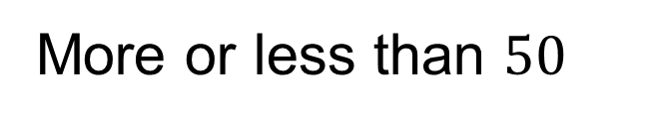



More or Less Than
Explain how the information shown supports your reasoning.
5 / 47
Notes:
TEACH IN PRACTICE | Embedded facilitation | Lesson 9.2, slide 5 | WORKED
Focus on the existing task: More or Less Than
LAUNCH (T2/3/5): Ask students to explain the displayed idea or example and point to evidence. When a calculation step is shown, ask why it is valid. Have a partner restate the explanation; copying is not the check.
LOOK FOR (T4): Where this task addresses it, students can connect table rows to graph points. Ask which feature of their work supports the claim.
RESPOND: If this task shows the lesson misconception—misreading the axis scale or assuming every relationship starts at zero—trace one original table row to its graph point and label both units. Have the student revise and explain the change. Use this support only where the concept occurs in the current task; otherwise respond to the displayed question.
RECHECK: If a gap is shared, revisit the existing representation together. If it is limited, give targeted support while others compare valid methods on the same task. Check the revision before moving on.
PARTICIPATION (T5/6/7): Think time before volunteers; accept a written, drawn or rehearsed entry. Students ask for evidence respectfully. Recognize a specific contribution or revision and check that both partners participate.
Source: BCPS Updated Instructional Framework Rubric (June 2020), TEACH 1–7. Earlier notes and answer keys are retained below.
EARLIER NOTES / EXISTING ANSWER KEY
Number-sense routine — every voice in. Give quiet think time, then hear from at least three students.
Always follow with “How do you know?” — the reasoning is the point, not the answer.
There is more than one path; name and celebrate different strategies.
UIFR: TEACH 3 · TEACH 5 · TEACH 6.

Slide 6
Today’s Objectives
Lesson 9-2 · Analyze Graphs of Relationships Between Two Variables
Analyze Graphs of Relationships Between Two Variables
Maryland Standard 6.AT.11
CONTENT OBJECTIVE
LANGUAGE OBJECTIVE
Restate the goal in your words
Use these words to explain why
I can use a table and a graph to determine and analyze the relationship between two variable quantities.
I can describe what a point on a graph represents using the words ordered pair, axis, and coordinates.
eduwonderlab.com · Neft Teacher
6 / 47
Notes:
TEACH IN PRACTICE | Embedded facilitation | Lesson 9.2, slide 6 | GOAL
Focus on the existing task: Today’s Objectives Analyze Graphs of…
CONNECT (T1/4): Ask students to restate the displayed goal or key idea and connect it to earlier work. Relevant lesson evidence: connect table rows to graph points; interpret axes and scale; describe the relationship. Use only the criterion that matches the current session.
SHOW PROGRESS: Students point to their own existing work, explain what improved after feedback, and name a next step. Pair confidence ratings with actual evidence.
PARTICIPATION (T5/6/7): Think time before volunteers; accept a written, drawn or rehearsed entry. Students ask for evidence respectfully. Recognize a specific contribution or revision and check that both partners participate.
Source: BCPS Updated Instructional Framework Rubric (June 2020), TEACH 1–7. Earlier notes and answer keys are retained below.
EARLIER NOTES / EXISTING ANSWER KEY
Read the objective together, then have one or two students restate today’s goal in their own words.
Connect it to what the class learned last lesson.
Return to this goal at the end of class to check it was met.
UIFR: TEACH 1.
UIFR FULL | Lesson-specific facilitation
TEACH 1 | Session 1 purpose and evidence (UIFR PDF p. 8).
Have students restate the displayed session goal in their own words and connect it to the existing context or a familiar experience they choose to share. Use the current session goal to select from these lesson-wide evidence criteria; do not frontload a later-session procedure.
Look for: connect table rows to graph points; interpret axes and scale; describe the relationship. Ask: “Which part of your work would show this?” Revisit that evidence after the task; a confidence rating alone is not evidence of understanding.

Slide 7
STUDENT MOVES
Lesson 9-2
Your move
NAME THE MATH · Point to the part of this that is new today, and say what it changes.
7 / 47

Slide 8
LESSON 9.2 / OUR LEARNING
What will show your learning?
1
Connect table rows to graph points.
2
Interpret axes and scale.
3
Describe the relationship.
Tell a partner: Which skill connects to something you already know?
SHOW YOUR THINKING · Show what you know — write it, draw it, or build it. A picture counts as an explanation.
Listen to understand. Ask for evidence. Make room for every voice.
Notes:
TEACH IN PRACTICE | Embedded facilitation | Lesson 9.2, slide 7 | PRIOR_INSERT
Focus on the existing task: LESSON 9.2 / OUR LEARNING What will show your learning?
CONNECT (T1/4): Ask students to restate the displayed goal or key idea and connect it to earlier work. Relevant lesson evidence: connect table rows to graph points; interpret axes and scale; describe the relationship. Use only the criterion that matches the current session.
SHOW PROGRESS: Students point to their own existing work, explain what improved after feedback, and name a next step. Pair confidence ratings with actual evidence.
PARTICIPATION (T5/6/7): Think time before volunteers; accept a written, drawn or rehearsed entry. Students ask for evidence respectfully. Recognize a specific contribution or revision and check that both partners participate.
Source: BCPS Updated Instructional Framework Rubric (June 2020), TEACH 1–7.

Slide 9
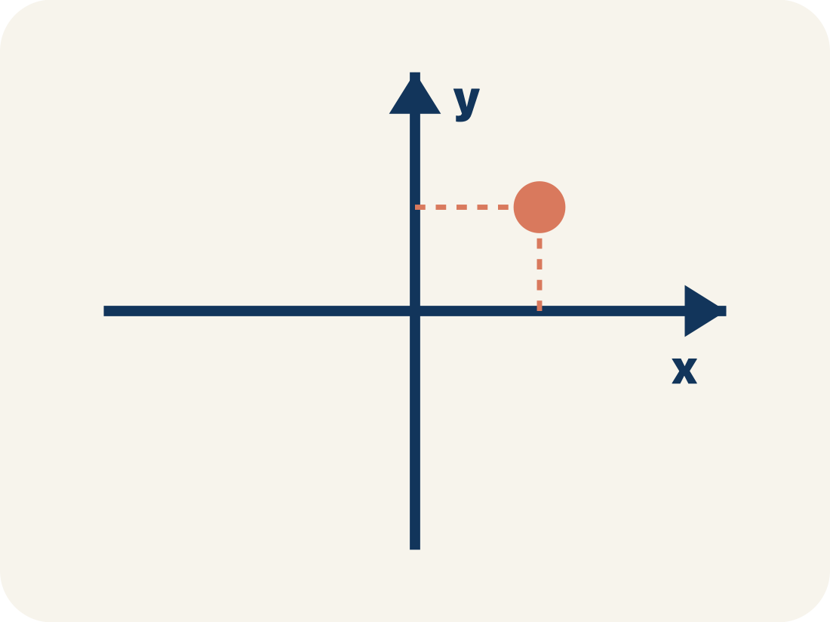
Vocabulary 1 of 5
Lesson 9-2 · Analyze Graphs of Relationships Between Two Variables
graph
A picture on a coordinate plane that shows how two quantities are related.
EXAMPLE · EXPLAIN WHY IT FITS
Points (1, 45), (2, 90), (3, 135) climbing left to right — cost by tickets.
Use “graph” to explain the example. Point to evidence.
eduwonderlab.com · Neft Teacher
9 / 47
Notes:
TEACH IN PRACTICE | Embedded facilitation | Lesson 9.2, slide 8 | VOCAB
Focus on the existing task: Vocabulary 1 of 5 graph A picture on…
ASK (T1/3/5): Where does “graph” appear in the example? Explain the meaning without reading the definition. Partner: restate the idea and ask a clarifying question.
LOOK FOR: A correct connection between the word and a feature of the example. If the student only repeats the definition, invite pointing, sketching or oral rehearsal, then ask for another explanation of this same example.
PARTICIPATION (T5/6/7): Think time before volunteers; accept a written, drawn or rehearsed entry. Students ask for evidence respectfully. Recognize a specific contribution or revision and check that both partners participate.
Source: BCPS Updated Instructional Framework Rubric (June 2020), TEACH 1–7.

Slide 10
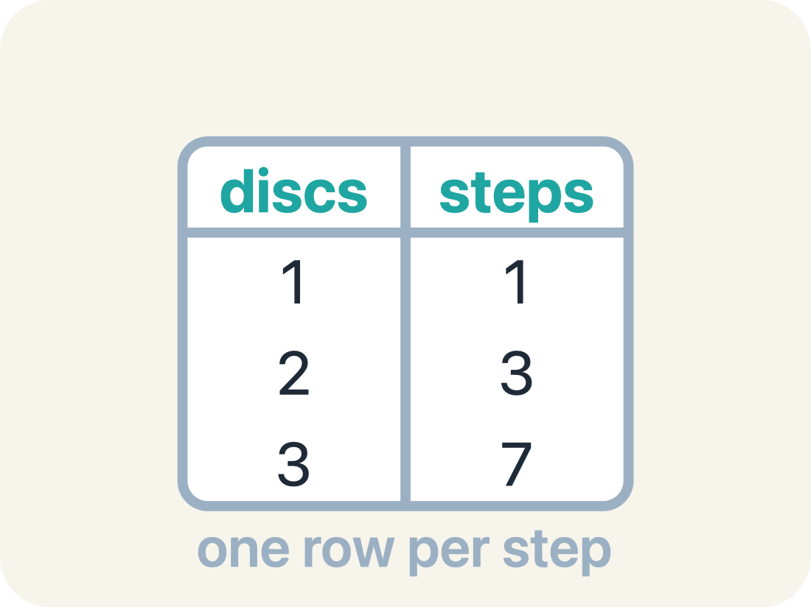
Vocabulary 2 of 5
Lesson 9-2 · Analyze Graphs of Relationships Between Two Variables
table of values
A list of matched pairs of values that shows a relationship using numbers.
EXAMPLE · EXPLAIN WHY IT FITS
months 1, 2, 4 beside cost 24.95, 49.90, 99.80 — one row per pair.
Use “table of values” to explain the example. Point to
evidence.
eduwonderlab.com · Neft Teacher
10 / 47
Notes:
TEACH IN PRACTICE | Embedded facilitation | Lesson 9.2, slide 9 | VOCAB
Focus on the existing task: Vocabulary 2 of 5 table of values A…
ASK (T1/3/5): Where does “table of values” appear in the example? Explain the meaning without reading the definition. Partner: restate the idea and ask a clarifying question.
LOOK FOR: A correct connection between the word and a feature of the example. If the student only repeats the definition, invite pointing, sketching or oral rehearsal, then ask for another explanation of this same example.
PARTICIPATION (T5/6/7): Think time before volunteers; accept a written, drawn or rehearsed entry. Students ask for evidence respectfully. Recognize a specific contribution or revision and check that both partners participate.
Source: BCPS Updated Instructional Framework Rubric (June 2020), TEACH 1–7.

Slide 11
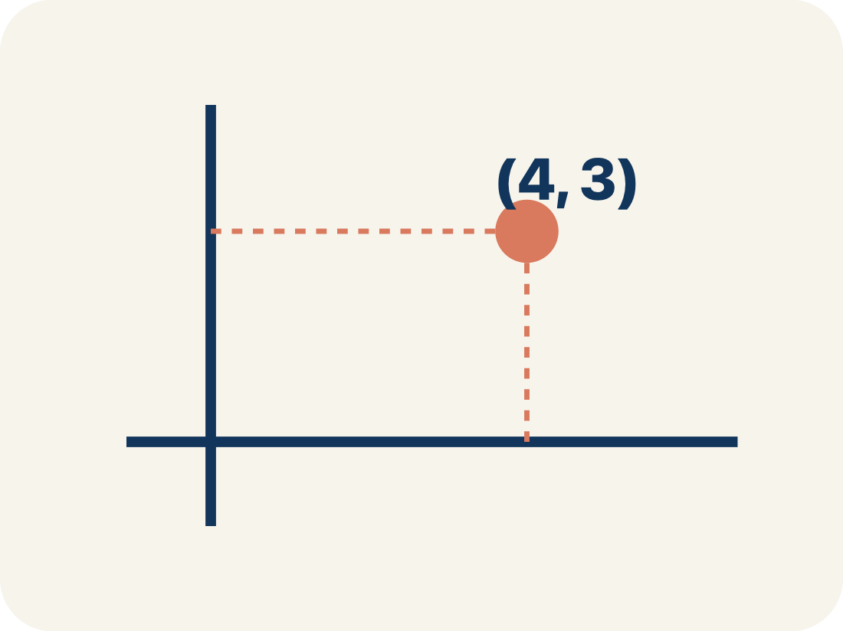
Vocabulary 3 of 5
Lesson 9-2 · Analyze Graphs of Relationships Between Two Variables
ordered pair
Two numbers written as (x, y) that name one point on a graph. The independent variable comes first.
EXAMPLE · EXPLAIN WHY IT FITS
(3, 135): 3 tickets cost $135 — the independent quantity comes first.
Use “ordered pair” to explain the example. Point to evidence.
eduwonderlab.com · Neft Teacher
11 / 47
Notes:
TEACH IN PRACTICE | Embedded facilitation | Lesson 9.2, slide 10 | VOCAB
Focus on the existing task: Vocabulary 3 of 5 ordered pair Two…
ASK (T1/3/5): Where does “ordered pair” appear in the example? Explain the meaning without reading the definition. Partner: restate the idea and ask a clarifying question.
LOOK FOR: A correct connection between the word and a feature of the example. If the student only repeats the definition, invite pointing, sketching or oral rehearsal, then ask for another explanation of this same example.
PARTICIPATION (T5/6/7): Think time before volunteers; accept a written, drawn or rehearsed entry. Students ask for evidence respectfully. Recognize a specific contribution or revision and check that both partners participate.
Source: BCPS Updated Instructional Framework Rubric (June 2020), TEACH 1–7.

Slide 12
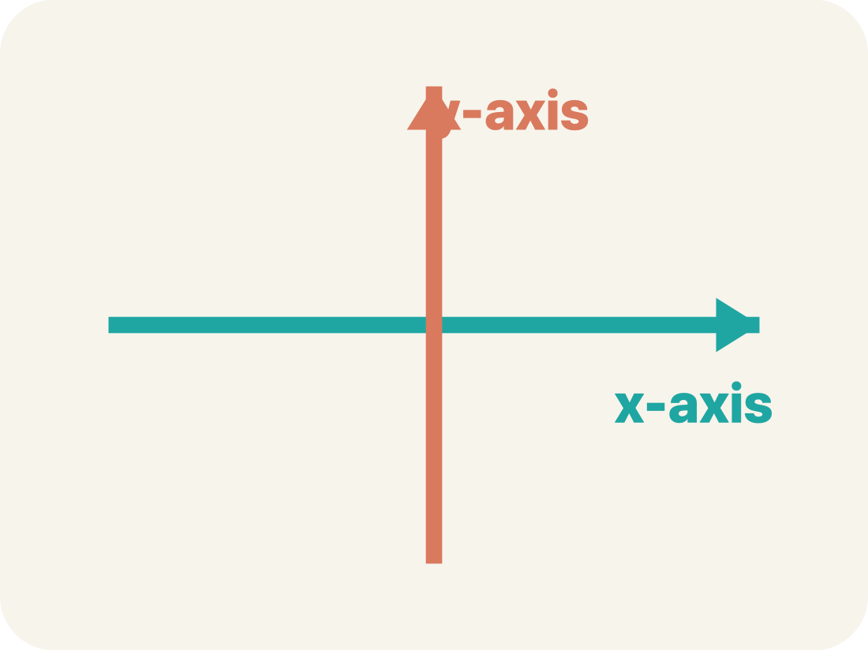
Vocabulary 4 of 5
Lesson 9-2 · Analyze Graphs of Relationships Between Two Variables
axis
One of the two number lines that frame a graph. Each axis is labeled with a quantity from the problem.
EXAMPLE · EXPLAIN WHY IT FITS
Horizontal axis: months. Vertical axis: total cost.
Use “axis” to explain the example. Point to evidence.
eduwonderlab.com · Neft Teacher
12 / 47
Notes:
TEACH IN PRACTICE | Embedded facilitation | Lesson 9.2, slide 11 | VOCAB
Focus on the existing task: Vocabulary 4 of 5 axis One of the…
ASK (T1/3/5): Where does “axis” appear in the example? Explain the meaning without reading the definition. Partner: restate the idea and ask a clarifying question.
LOOK FOR: A correct connection between the word and a feature of the example. If the student only repeats the definition, invite pointing, sketching or oral rehearsal, then ask for another explanation of this same example.
PARTICIPATION (T5/6/7): Think time before volunteers; accept a written, drawn or rehearsed entry. Students ask for evidence respectfully. Recognize a specific contribution or revision and check that both partners participate.
Source: BCPS Updated Instructional Framework Rubric (June 2020), TEACH 1–7.

Slide 13
Vocabulary 5 of 5
Lesson 9-2 · Analyze Graphs of Relationships Between Two Variables
coordinates
The numbers in an ordered pair that tell how far to move along each axis to reach a point.
EXAMPLE · EXPLAIN WHY IT FITS
In (4, 105), 4 says how far across and 105 how far up.
Use “coordinates” to explain the example. Point to evidence.
eduwonderlab.com · Neft Teacher
13 / 47
Notes:
TEACH IN PRACTICE | Embedded facilitation | Lesson 9.2, slide 12 | VOCAB
Focus on the existing task: Vocabulary 5 of 5 coordinates The…
ASK (T1/3/5): Where does “coordinates” appear in the example? Explain the meaning without reading the definition. Partner: restate the idea and ask a clarifying question.
LOOK FOR: A correct connection between the word and a feature of the example. If the student only repeats the definition, invite pointing, sketching or oral rehearsal, then ask for another explanation of this same example.
PARTICIPATION (T5/6/7): Think time before volunteers; accept a written, drawn or rehearsed entry. Students ask for evidence respectfully. Recognize a specific contribution or revision and check that both partners participate.
Source: BCPS Updated Instructional Framework Rubric (June 2020), TEACH 1–7.

Slide 14
Vocabulary
Lesson 9-2 · Analyze Graphs of Relationships Between Two Variables
Today’s Math Words
We learn every word — what it means and what it looks like — before we use it.
graph
table of values
A picture on a coordinate plane that shows how two quantities are related
A list of matched pairs of values that shows a relationship using numbers
ordered pair
axis
Two numbers written as (x, y) that name one point on a graph
One of the two number lines that frame a graph
coordinates
The numbers in an ordered pair that tell how far to move along each axis to reach a point
Explain one math word using the example.
Partner: point to evidence.
eduwonderlab.com · Neft Teacher
14 / 47
Notes:
TEACH IN PRACTICE | Embedded facilitation | Lesson 9.2, slide 13 | VOCAB
Focus on the existing task: Vocabulary Today’s Math Words We…
ASK (T1/3/5): Where does “the displayed term” appear in the example? Explain the meaning without reading the definition. Partner: restate the idea and ask a clarifying question.
LOOK FOR: A correct connection between the word and a feature of the example. If the student only repeats the definition, invite pointing, sketching or oral rehearsal, then ask for another explanation of this same example.
PARTICIPATION (T5/6/7): Think time before volunteers; accept a written, drawn or rehearsed entry. Students ask for evidence respectfully. Recognize a specific contribution or revision and check that both partners participate.
Source: BCPS Updated Instructional Framework Rubric (June 2020), TEACH 1–7. Earlier notes and answer keys are retained below.
EARLIER NOTES / EXISTING ANSWER KEY
Choral-read each word, its meaning, and what it looks like.
Students should use these words out loud today — listen for them in partner talk and revoice student ideas with the academic term.
UIFR: TEACH 1 · TEACH 5.

Slide 15
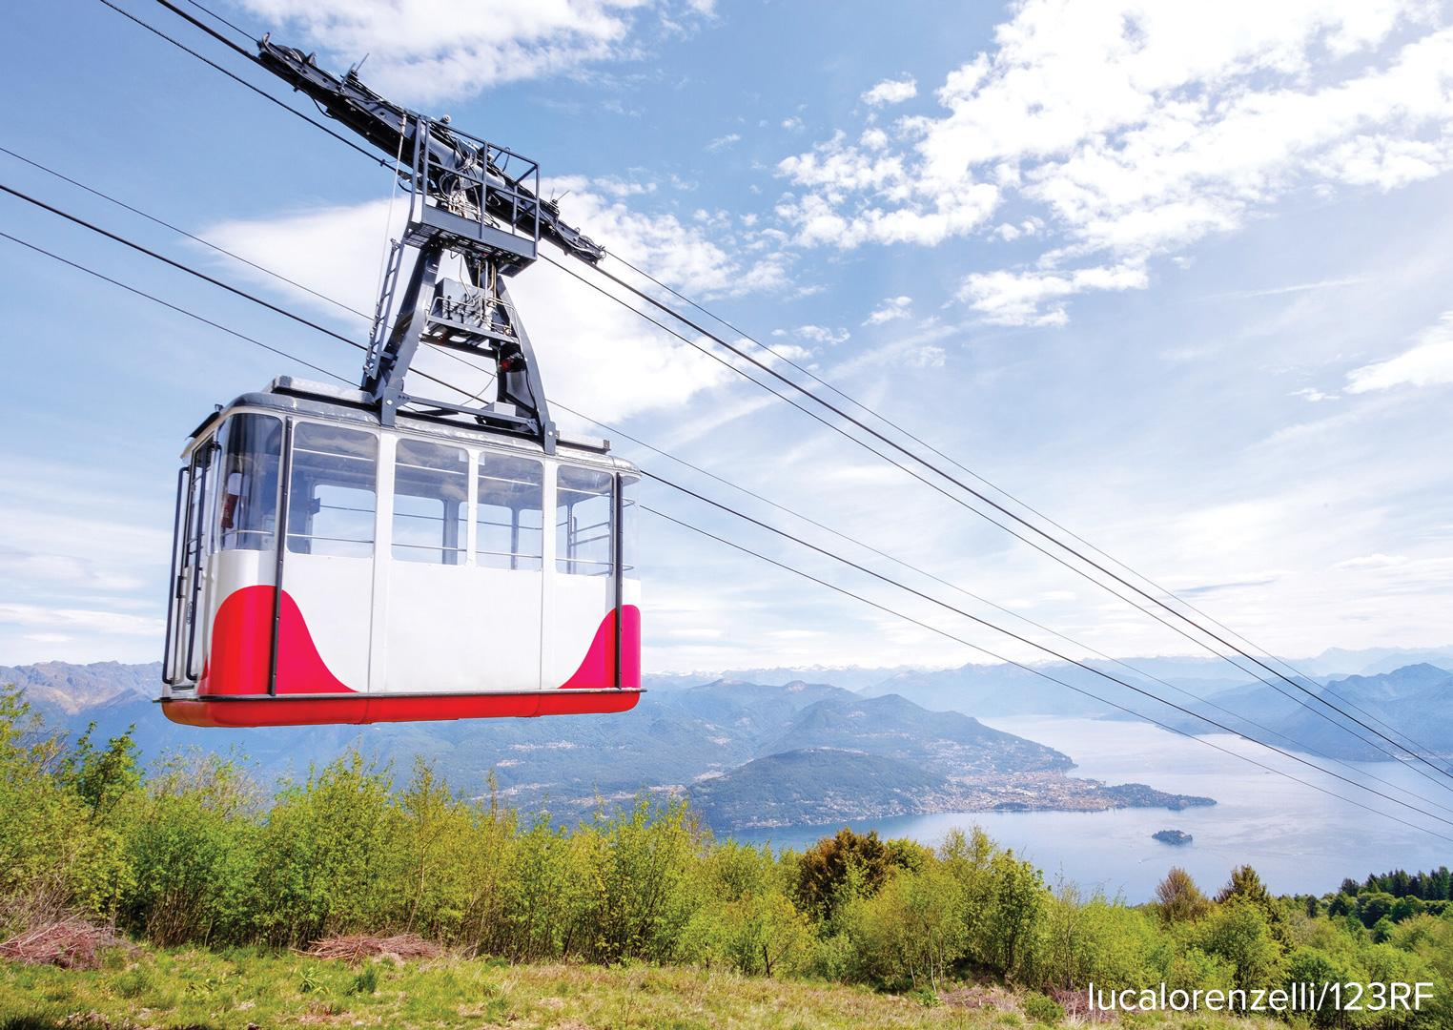

Be Curious
What do you notice?
What do you wonder?
Think first. Share a notice and a
question; build on a classmate’s
idea.
Mindset
What goal will you set for today’s math class?
15 / 47
Notes:
TEACH IN PRACTICE | Embedded facilitation | Lesson 9.2, slide 14 | CURIOUS
Focus on the existing task: Be Curious What do you notice?
LAUNCH (T2/3/5): Allow quiet observation first. Separate a notice from an inference, invite students’ own questions, and follow the existing launch before teaching a procedure.
LOOK FOR (T4): Where this task addresses it, students can connect table rows to graph points. Ask which feature of their work supports the claim.
RESPOND: If this task shows the lesson misconception—misreading the axis scale or assuming every relationship starts at zero—trace one original table row to its graph point and label both units. Have the student revise and explain the change. Use this support only where the concept occurs in the current task; otherwise respond to the displayed question.
RECHECK: If a gap is shared, revisit the existing representation together. If it is limited, give targeted support while others compare valid methods on the same task. Check the revision before moving on.
PARTICIPATION (T5/6/7): Think time before volunteers; accept a written, drawn or rehearsed entry. Students ask for evidence respectfully. Recognize a specific contribution or revision and check that both partners participate.
Source: BCPS Updated Instructional Framework Rubric (June 2020), TEACH 1–7. Earlier notes and answer keys are retained below.
EARLIER NOTES / EXISTING ANSWER KEY
Accept all noticings and wonderings — there are no wrong answers here.
Give 20–30 seconds of quiet think time before taking responses; mix cold and warm calls so it is not always the same voices.
Read the mindset question aloud and let two students respond.
UIFR: TEACH 3 · TEACH 7.

Slide 16

Football Game Tickets
The ticket shows the cost to attend a college football game.
How does the total cost of tickets relate to the number of tickets purchased?
Think About It:
HOW DO YOU KNOW? · Ask your partner “How do you know?” Answer by pointing to your own work.
16 / 47
Notes:
TEACH IN PRACTICE | Embedded facilitation | Lesson 9.2, slide 15 | TASK
Focus on the existing task: Football Game Tickets The ticket shows the cost to attend a college football game. How does the total cost of tickets relate to the number of tickets purchased?
LAUNCH (T2/3/5): Use the displayed question. Give private thinking time; then A explains while B asks for evidence. Switch roles. Each student records their own reasoning.
LOOK FOR (T4): Where this task addresses it, students can connect table rows to graph points. Ask which feature of their work supports the claim.
RESPOND: If this task shows the lesson misconception—misreading the axis scale or assuming every relationship starts at zero—trace one original table row to its graph point and label both units. Have the student revise and explain the change. Use this support only where the concept occurs in the current task; otherwise respond to the displayed question.
RECHECK: If a gap is shared, revisit the existing representation together. If it is limited, give targeted support while others compare valid methods on the same task. Check the revision before moving on.
PARTICIPATION (T5/6/7): Think time before volunteers; accept a written, drawn or rehearsed entry. Students ask for evidence respectfully. Recognize a specific contribution or revision and check that both partners participate.
Source: BCPS Updated Instructional Framework Rubric (June 2020), TEACH 1–7. Earlier notes and answer keys are retained below.
EARLIER NOTES / EXISTING ANSWER KEY
Ask the question, then hold the silence — students think or jot before anyone answers.
Take two or three responses and press with “Why?” or “How do you know?” before moving on.
UIFR: TEACH 3.
UIFR FULL | Lesson-specific facilitation
TEACH 2-3 | Session 1 task launch (UIFR PDF pp. 9-10).
Use the problem exactly as displayed. Give individual thinking time before discussion or advancing to the explanation. If the answer is already visible, ask students to reconstruct and justify it. Invite a choice of suitable representations and have students explain why their choice helps.
At the point where this concept appears, ask: “What does this point mean in the situation, and what does the graph show when the input is zero?” Wait for evidence, invite another pathway, and have a student ask a follow-up question. Do not replace students’ reasoning with a sequence of leading steps.

Slide 17

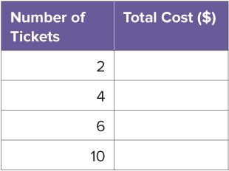
COLLABORATE · TALK IT THROUGH • AGREE ON A MODEL
Collaborate and Connect
We can use a table to represent the relationship between two variables.
How can you complete the table of values to relate the cost of tickets to the number of tickets purchased? Explain your reasoning.
17 / 47
Notes:
TEACH IN PRACTICE | Embedded facilitation | Lesson 9.2, slide 16 | COLLABORATE
Focus on the existing task: We can use a table to represent the relationship between two variables. Collaborate and Connect How can you complete the table of values to relate the cost of tickets to the number of tickets purchased?
LAUNCH (T2/3/5): Use the displayed question. Give private thinking time; then A explains while B asks for evidence. Switch roles. Each student records their own reasoning.
LOOK FOR (T4): Where this task addresses it, students can connect table rows to graph points. Ask which feature of their work supports the claim.
RESPOND: If this task shows the lesson misconception—misreading the axis scale or assuming every relationship starts at zero—trace one original table row to its graph point and label both units. Have the student revise and explain the change. Use this support only where the concept occurs in the current task; otherwise respond to the displayed question.
RECHECK: If a gap is shared, revisit the existing representation together. If it is limited, give targeted support while others compare valid methods on the same task. Check the revision before moving on.
PARTICIPATION (T5/6/7): Think time before volunteers; accept a written, drawn or rehearsed entry. Students ask for evidence respectfully. Recognize a specific contribution or revision and check that both partners participate.
Source: BCPS Updated Instructional Framework Rubric (June 2020), TEACH 1–7. Earlier notes and answer keys are retained below.
EARLIER NOTES / EXISTING ANSWER KEY
Routine: COLLABORATE · TALK IT THROUGH • AGREE ON A MODEL
UIFR FULL | Lesson-specific facilitation
TEACH 4-5 | Session 1 discussion and checkpoint (UIFR PDF pp. 11-12).
Collect a brief response from every student to the existing prompt before hearing volunteers. Partners take turns explaining and asking for evidence: “I understand ___; what supports ___?” Offer rehearsal or an annotated model for students who need language support. Each student records their own reasoning.
Look specifically for: misreading the axis scale or assuming every relationship starts at zero. If it appears, trace one original table row to its graph point and label both units; then ask the student to revise the same response and explain the change. If evidence is secure, have students compare a second valid pathway or state why their approach works. Choose the next step from the responses, not a preset pace.

Slide 18
STUDENT MOVES
Lesson 9-2
Your move
ADD ON · Add on: “I agree because ______.” or “I see it differently because ______.”
18 / 47

Slide 19
Football Game Tickets
We can multiply the cost of one ticket by the number of tickets purchased.
Tickets
Number of Tickets | Total Cost ($)
10 | 450
What relationships do you notice in the table?
Reveal:
As the number of tickets increases, the total cost increases. The total cost is 45 times the number of tickets.
Record your reasoning before the
reveal. Compare, then explain
any revision.
19 / 47
Notes:
TEACH IN PRACTICE | Embedded facilitation | Lesson 9.2, slide 17 | REVEAL
Focus on the existing task: Reveal: As the number of tickets increases, the total cost increases. The total cost is 45 times the number of tickets. We can multiply…
LAUNCH (T2/3/5): If an existing answer cover is present, gather an attempt before revealing. If the explanation is already visible, ask students to reconstruct and justify it. Compare reasoning and explain a revision; preserve the reveal sequence.
LOOK FOR (T4): Where this task addresses it, students can connect table rows to graph points. Ask which feature of their work supports the claim.
RESPOND: If this task shows the lesson misconception—misreading the axis scale or assuming every relationship starts at zero—trace one original table row to its graph point and label both units. Have the student revise and explain the change. Use this support only where the concept occurs in the current task; otherwise respond to the displayed question.
RECHECK: If a gap is shared, revisit the existing representation together. If it is limited, give targeted support while others compare valid methods on the same task. Check the revision before moving on.
PARTICIPATION (T5/6/7): Think time before volunteers; accept a written, drawn or rehearsed entry. Students ask for evidence respectfully. Recognize a specific contribution or revision and check that both partners participate.
Source: BCPS Updated Instructional Framework Rubric (June 2020), TEACH 1–7. Earlier notes and answer keys are retained below.
EARLIER NOTES / EXISTING ANSWER KEY
Do not click yet: collect 2–3 student answers with reasons first.
Then click to remove the cover and have students compare their thinking to the reveal — “Is this what we said? Where is it different?”
Behind the cover: As the number of tickets increases, the total cost increases. The total cost is 45 times the number of tickets.
UIFR: TEACH 3 · TEACH 4.

Slide 20
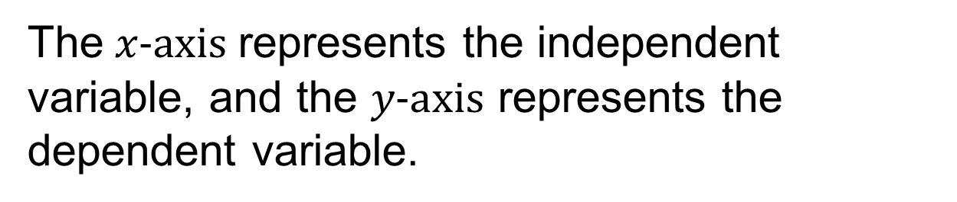
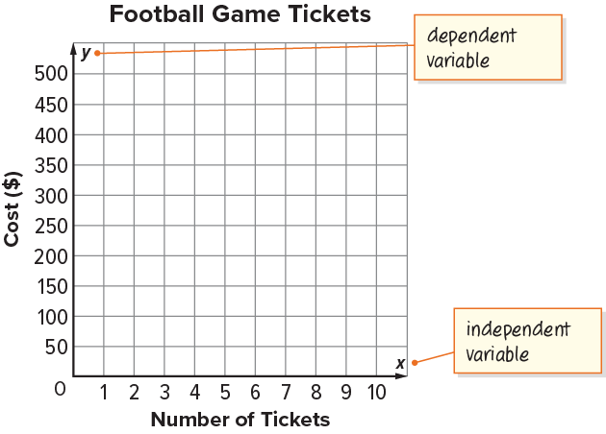
Football Game Tickets
Tickets
Number of Tickets | Total Cost ($)
10 | 450
20 / 47
Notes:
TEACH IN PRACTICE | Embedded facilitation | Lesson 9.2, slide 18 | WORKED
Focus on the existing task: Football Game Tickets Tickets Number of Tickets Total Cost ($) 10 450
LAUNCH (T2/3/5): Ask students to explain the displayed idea or example and point to evidence. When a calculation step is shown, ask why it is valid. Have a partner restate the explanation; copying is not the check.
LOOK FOR (T4): Where this task addresses it, students can connect table rows to graph points. Ask which feature of their work supports the claim.
RESPOND: If this task shows the lesson misconception—misreading the axis scale or assuming every relationship starts at zero—trace one original table row to its graph point and label both units. Have the student revise and explain the change. Use this support only where the concept occurs in the current task; otherwise respond to the displayed question.
RECHECK: If a gap is shared, revisit the existing representation together. If it is limited, give targeted support while others compare valid methods on the same task. Check the revision before moving on.
PARTICIPATION (T5/6/7): Think time before volunteers; accept a written, drawn or rehearsed entry. Students ask for evidence respectfully. Recognize a specific contribution or revision and check that both partners participate.
Source: BCPS Updated Instructional Framework Rubric (June 2020), TEACH 1–7. Earlier notes and answer keys are retained below.
EARLIER NOTES / EXISTING ANSWER KEY
Model briefly, then hand the thinking back: ask “Why does this step work?” before showing the next one.
Quick check before moving on — thumbs or whiteboards from everyone, not volunteers.
UIFR: TEACH 2 · TEACH 3 · TEACH 4.

Slide 21
STUDENT MOVES
Lesson 9-2
Your move
YOUR CHOICE · You choose how to show this — numbers, words, or a diagram. Make your reasoning visible.
21 / 47

Slide 22
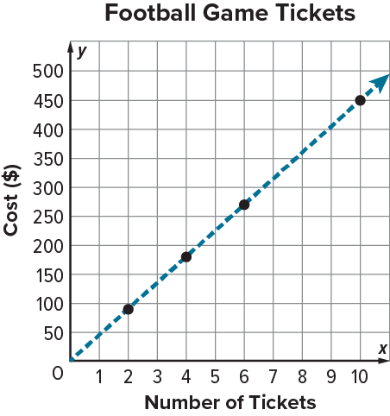
Football Game Tickets
Tickets
Number of Tickets | Total Cost ($)
10 | 450
What do you notice about the two representations?
JUSTIFY IT · Say it like this: “I know ______ because ______.”
22 / 47
Notes:
TEACH IN PRACTICE | Embedded facilitation | Lesson 9.2, slide 19 | TASK
Focus on the existing task: Tickets Number of Tickets Total Cost ($) 10 450 What do you notice about the two representations?
LAUNCH (T2/3/5): Use the displayed question. Give private thinking time; then A explains while B asks for evidence. Switch roles. Each student records their own reasoning.
LOOK FOR (T4): Where this task addresses it, students can connect table rows to graph points. Ask which feature of their work supports the claim.
RESPOND: If this task shows the lesson misconception—misreading the axis scale or assuming every relationship starts at zero—trace one original table row to its graph point and label both units. Have the student revise and explain the change. Use this support only where the concept occurs in the current task; otherwise respond to the displayed question.
RECHECK: If a gap is shared, revisit the existing representation together. If it is limited, give targeted support while others compare valid methods on the same task. Check the revision before moving on.
PARTICIPATION (T5/6/7): Think time before volunteers; accept a written, drawn or rehearsed entry. Students ask for evidence respectfully. Recognize a specific contribution or revision and check that both partners participate.
Source: BCPS Updated Instructional Framework Rubric (June 2020), TEACH 1–7. Earlier notes and answer keys are retained below.
EARLIER NOTES / EXISTING ANSWER KEY
Model briefly, then hand the thinking back: ask “Why does this step work?” before showing the next one.
Quick check before moving on — thumbs or whiteboards from everyone, not volunteers.
UIFR: TEACH 2 · TEACH 3 · TEACH 4.

Slide 23
Football Game Tickets
What do you notice about the two representations?
Record your reasoning before the reveal. Compare, then explain any revision.
Reveal:
Both representations show the same relationship. The table shows the relationship using numerical values, while the graph shows the relationship in a more visual way.
23 / 47
Notes:
TEACH IN PRACTICE | Embedded facilitation | Lesson 9.2, slide 20 | REVEAL
Focus on the existing task: What do you notice about the two representations?
LAUNCH (T2/3/5): If an existing answer cover is present, gather an attempt before revealing. If the explanation is already visible, ask students to reconstruct and justify it. Compare reasoning and explain a revision; preserve the reveal sequence.
LOOK FOR (T4): Where this task addresses it, students can connect table rows to graph points. Ask which feature of their work supports the claim.
RESPOND: If this task shows the lesson misconception—misreading the axis scale or assuming every relationship starts at zero—trace one original table row to its graph point and label both units. Have the student revise and explain the change. Use this support only where the concept occurs in the current task; otherwise respond to the displayed question.
RECHECK: If a gap is shared, revisit the existing representation together. If it is limited, give targeted support while others compare valid methods on the same task. Check the revision before moving on.
PARTICIPATION (T5/6/7): Think time before volunteers; accept a written, drawn or rehearsed entry. Students ask for evidence respectfully. Recognize a specific contribution or revision and check that both partners participate.
Source: BCPS Updated Instructional Framework Rubric (June 2020), TEACH 1–7. Earlier notes and answer keys are retained below.
EARLIER NOTES / EXISTING ANSWER KEY
Do not click yet: collect 2–3 student answers with reasons first.
Then click to remove the cover and have students compare their thinking to the reveal — “Is this what we said? Where is it different?”
Behind the cover: Both representations show the same relationship. The table shows the relationship using numerical values, while the graph shows the relationship in a more visual way.
UIFR: TEACH 3 · TEACH 4.

Slide 24
Let’s Explore More
Tickets to a college football game cost $45 each.
Ticket Cost
Number of Tickets | Total Cost ($)
10 | 450
PICK YOUR STRATEGY · Choose your path — picture, table, number line, or equation — and be ready to say why you chose it.
24 / 47
Notes:
TEACH IN PRACTICE | Embedded facilitation | Lesson 9.2, slide 21 | PRACTICE
Focus on the existing task: Let’s Explore More Tickets to a college football game cost $45 each. Ticket Cost Number of Tickets Total Cost ($) 10 450
LAUNCH (T2/3/5): Use the displayed question. Give private thinking time; then A explains while B asks for evidence. Switch roles. Each student records their own reasoning.
LOOK FOR (T4): Where this task addresses it, students can connect table rows to graph points. Ask which feature of their work supports the claim.
RESPOND: If this task shows the lesson misconception—misreading the axis scale or assuming every relationship starts at zero—trace one original table row to its graph point and label both units. Have the student revise and explain the change. Use this support only where the concept occurs in the current task; otherwise respond to the displayed question.
RECHECK: If a gap is shared, revisit the existing representation together. If it is limited, give targeted support while others compare valid methods on the same task. Check the revision before moving on.
PARTICIPATION (T5/6/7): Think time before volunteers; accept a written, drawn or rehearsed entry. Students ask for evidence respectfully. Recognize a specific contribution or revision and check that both partners participate.
Source: BCPS Updated Instructional Framework Rubric (June 2020), TEACH 1–7. Earlier notes and answer keys are retained below.
EARLIER NOTES / EXISTING ANSWER KEY
Extension for partners or table groups — students choose their approach and use the workspace to show thinking.
Push with “Convince me,” and have two groups with different approaches share.
This is where students stretch past the worked example.
UIFR: TEACH 2 · TEACH 5.

Slide 25
LESSON 9.2 / DISCUSS THE TASK
Explain and compare
Use the task you just explored.
TAKE TURNS
What does this point mean in the situation, and what does the graph show when the input is zero?
Explain
“I know this because…”
Ask
“Where does your work show that?”
Point to evidence in your work.
Then compare your approach with a partner’s.
ANOTHER PATHWAY · Did anyone get there a different way? Put both pathways side by side and compare.
Listen to understand. Ask for evidence. Make room for every voice.
Notes:
TEACH IN PRACTICE | Embedded facilitation | Lesson 9.2, slide 22 | PRIOR_INSERT
Focus on the existing task: Point to evidence in your work. Then compare your approach with a partner’s. TAKE TURNS Explain “I know this because…” Ask “Where does your work show that?
CONNECT (T1/4): Ask students to restate the displayed goal or key idea and connect it to earlier work. Relevant lesson evidence: connect table rows to graph points; interpret axes and scale; describe the relationship. Use only the criterion that matches the current session.
SHOW PROGRESS: Students point to their own existing work, explain what improved after feedback, and name a next step. Pair confidence ratings with actual evidence.
PARTICIPATION (T5/6/7): Think time before volunteers; accept a written, drawn or rehearsed entry. Students ask for evidence respectfully. Recognize a specific contribution or revision and check that both partners participate.
Source: BCPS Updated Instructional Framework Rubric (June 2020), TEACH 1–7.

Slide 26
Football Game Tickets
As the number of tickets increases, the total cost increases.
Tickets
Number of Tickets | Total Cost ($)
10 | 450
The number of tickets is the independent variable, and the total cost is the dependent variable.
How can you use the table to help create a graph of the relationship?
Reveal:
We can plot points that represent the different combinations of tickets and costs shown in the table.
26 / 47
Notes:
TEACH IN PRACTICE | Embedded facilitation | Lesson 9.2, slide 23 | REVEAL
Focus on the existing task: Reveal: We can plot points that represent the different combinations of tickets and costs shown in the table. As the number of tickets…
LAUNCH (T2/3/5): If an existing answer cover is present, gather an attempt before revealing. If the explanation is already visible, ask students to reconstruct and justify it. Compare reasoning and explain a revision; preserve the reveal sequence.
LOOK FOR (T4): Where this task addresses it, students can connect table rows to graph points. Ask which feature of their work supports the claim.
RESPOND: If this task shows the lesson misconception—misreading the axis scale or assuming every relationship starts at zero—trace one original table row to its graph point and label both units. Have the student revise and explain the change. Use this support only where the concept occurs in the current task; otherwise respond to the displayed question.
RECHECK: If a gap is shared, revisit the existing representation together. If it is limited, give targeted support while others compare valid methods on the same task. Check the revision before moving on.
PARTICIPATION (T5/6/7): Think time before volunteers; accept a written, drawn or rehearsed entry. Students ask for evidence respectfully. Recognize a specific contribution or revision and check that both partners participate.
Source: BCPS Updated Instructional Framework Rubric (June 2020), TEACH 1–7.

Slide 27
STUDENT MOVES
Lesson 9-2
Your move
PICK YOUR STRATEGY · Choose your path — picture, table, number line, or equation — and be ready to say why you chose it.
27 / 47

Slide 28
Football Game Tickets
What can you conclude about how the cost changes in relation to the number of tickets purchased?
Reveal:
The cost increases as more tickets are purchased.
Compare your reasoning with the explanation. Explain any revision you make.
28 / 47
Notes:
TEACH IN PRACTICE | Embedded facilitation | Lesson 9.2, slide 24 | REVEAL
Focus on the existing task: Reveal: The cost increases as more tickets are purchased. What can you conclude about how the cost changes in relation to the number of tickets purchased?
LAUNCH (T2/3/5): If an existing answer cover is present, gather an attempt before revealing. If the explanation is already visible, ask students to reconstruct and justify it. Compare reasoning and explain a revision; preserve the reveal sequence.
LOOK FOR (T4): Where this task addresses it, students can connect table rows to graph points. Ask which feature of their work supports the claim.
RESPOND: If this task shows the lesson misconception—misreading the axis scale or assuming every relationship starts at zero—trace one original table row to its graph point and label both units. Have the student revise and explain the change. Use this support only where the concept occurs in the current task; otherwise respond to the displayed question.
RECHECK: If a gap is shared, revisit the existing representation together. If it is limited, give targeted support while others compare valid methods on the same task. Check the revision before moving on.
PARTICIPATION (T5/6/7): Think time before volunteers; accept a written, drawn or rehearsed entry. Students ask for evidence respectfully. Recognize a specific contribution or revision and check that both partners participate.
Source: BCPS Updated Instructional Framework Rubric (June 2020), TEACH 1–7.

Slide 29
Be Curious
What do you notice?
What do you wonder?
Number of Kilometers | Number of Hours
0 | 0
48 | 1
96 | 2
240 | 5
Mindset
ASK THE CLASS · Write one question about this that you could ask the class.
What are you doing to meet the goal you set for today’s math class?
29 / 47
Notes:
TEACH IN PRACTICE | Embedded facilitation | Lesson 9.2, slide 25 | CURIOUS
Focus on the existing task: Be Curious What do you notice?
LAUNCH (T2/3/5): Allow quiet observation first. Separate a notice from an inference, invite students’ own questions, and follow the existing launch before teaching a procedure.
LOOK FOR (T4): Where this task addresses it, students can connect table rows to graph points. Ask which feature of their work supports the claim.
RESPOND: If this task shows the lesson misconception—misreading the axis scale or assuming every relationship starts at zero—trace one original table row to its graph point and label both units. Have the student revise and explain the change. Use this support only where the concept occurs in the current task; otherwise respond to the displayed question.
RECHECK: If a gap is shared, revisit the existing representation together. If it is limited, give targeted support while others compare valid methods on the same task. Check the revision before moving on.
PARTICIPATION (T5/6/7): Think time before volunteers; accept a written, drawn or rehearsed entry. Students ask for evidence respectfully. Recognize a specific contribution or revision and check that both partners participate.
Source: BCPS Updated Instructional Framework Rubric (June 2020), TEACH 1–7.

Slide 30
Session 2 Warm-Up
Lesson 9-2 · Analyze Graphs of Relationships Between Two Variables
Session 2 Warm-Up
Check what you remember from Session 1 · about 4 minutes
1
A line graph showing cost per ticket that starts at (0,0) and rises shows a:
2
If 1 ticket costs $5, 2 cost $10, 3 cost $15, the unit rate is:
A
Decreasing relationship
A
$3
B
Constant rate of change
B
$5 per ticket
C
Negative slope
C
$15
D
Random scatter
D
$10
3
To read the value of y when x = 4 on a graph:
4
Points on a line representing two variables can be recorded in:
A
Look at x=0
A
A frequency histogram
B
Find 4 on x-axis and trace vertically to the line
B
An input-output table
C
Multiply by 4
C
A box plot
D
Count the axes
D
A pie chart
eduwonderlab.com · Neft Teacher
30 / 47
Notes:
TEACH IN PRACTICE | Embedded facilitation | Lesson 9.2, slide 26 | WARMUP
Focus on the existing task: Session 2 Warm-Up Session 2 Warm-Up…
GATHER EVIDENCE (T4/6): Keep the original items. Students try independently, mark an uncertain item, and explain one method before checking. Use the existing key when present.
RESPOND: Distinguish a calculation slip from a reasoning gap. Give one next step on the same item; have students revise in a second color. Use the responses to choose flexible support for today’s lesson.
PARTICIPATION (T5/6/7): Think time before volunteers; accept a written, drawn or rehearsed entry. Students ask for evidence respectfully. Recognize a specific contribution or revision and check that both partners participate.
Source: BCPS Updated Instructional Framework Rubric (June 2020), TEACH 1–7. Earlier notes and answer keys are retained below.
EARLIER NOTES / EXISTING ANSWER KEY
Warm-up routine: students start silently on entry; keep it to about 4 minutes.
Circulate and note who is stuck — use what you see to choose who you check on first today.
Go over answers quickly; ask one student to explain a step, not just say the answer.
UIFR: TEACH 4 · TEACH 6.
UIFR FULL | Lesson-specific facilitation
TEACH 1 | Session 2 purpose and evidence (UIFR PDF p. 8).
Have students restate the displayed session goal in their own words and connect it to the existing context or a familiar experience they choose to share. Use the current session goal to select from these lesson-wide evidence criteria; do not frontload a later-session procedure.
Look for: connect table rows to graph points; interpret axes and scale; describe the relationship. Ask: “Which part of your work would show this?” Revisit that evidence after the task; a confidence rating alone is not evidence of understanding.

Slide 31
STUDENT MOVES
Lesson 9-2
Your move
YOU KNOW THE ROUTINE · Read → plan → solve → check. Do all four, in that order.
31 / 47

Slide 32
Today’s Math Notes
Lesson 9-2 · Analyze Graphs of Relationships Between Two Variables
Review Notes — Session 2
Copy. Explain. Check.
WHY IT MATTERS · Finish this: “This is worth knowing because ______.”
Graphing Coordinates
1
Each point (x, y) on the line represents a pair of related values from the situation.
Rate of Change
2
The steepness of the linear path reflects the unit rate between the two quantities.
Connecting Representations
3
Move fluidly between situations, data tables, graphs, and algebraic equations.
eduwonderlab.com · Neft Teacher
32 / 47
Notes:
TEACH IN PRACTICE | Embedded facilitation | Lesson 9.2, slide 27 | NOTES
Focus on the existing task: Today’s Math Notes Review Notes…
ROUTINE (T1/2/4): Read or copy the original notes, cover one line, and explain it using the displayed example. Reopen and correct. Copying alone is not evidence of understanding.
LOOK FOR: A link between a symbol, quantity or feature and the explanation. If missing, point back to that feature and have the student try again; fade the prompt once they can explain.
PARTICIPATION (T5/6/7): Think time before volunteers; accept a written, drawn or rehearsed entry. Students ask for evidence respectfully. Recognize a specific contribution or revision and check that both partners participate.
Source: BCPS Updated Instructional Framework Rubric (June 2020), TEACH 1–7. Earlier notes and answer keys are retained below.
EARLIER NOTES / EXISTING ANSWER KEY
Copy routine: read one line at a time; students copy, then explain that line to a partner.
Keep it brisk — the understanding work happens in the examples, not the copying.
UIFR: TEACH 1 · TEACH 6.

Slide 33
Session 2
Analyze Graphs of Relationships Between Two Variables
USE THE MATH WORDS · Use today’s math words in your explanation — not “it” and “that thing.”
33 / 47
Notes:
TEACH IN PRACTICE | Embedded facilitation | Lesson 9.2, slide 28 | DIVIDER
Focus on the existing task: Analyze Graphs of Relationships Between Two Variables Session 2
TRANSITION (T6/7): Students confirm materials, roles, how to request help, and the next response routine. Ask a student to restate it. Keep teacher-only slides hidden.
PARTICIPATION (T5/6/7): Think time before volunteers; accept a written, drawn or rehearsed entry. Students ask for evidence respectfully. Recognize a specific contribution or revision and check that both partners participate.
Source: BCPS Updated Instructional Framework Rubric (June 2020), TEACH 1–7. Earlier notes and answer keys are retained below.
EARLIER NOTES / EXISTING ANSWER KEY
Transition cue: state what materials are out and what success looks like this session.
Keep the changeover under a minute.
UIFR: TEACH 6.

Slide 34
Riding the Tramway
The Sandia Peak tram travels a distance of 1,200 feet each minute to take visitors from the base in Albuquerque, New Mexico to the top of Sandia Peak. The ascent takes 15 minutes.
How can you describe the relationship between the distance the tram has traveled and the time it has traveled?
Think and record first. Which part of your work supports your answer?
34 / 47
Notes:
TEACH IN PRACTICE | Embedded facilitation | Lesson 9.2, slide 29 | TASK
Focus on the existing task: Riding the Tramway The Sandia Peak tram travels a distance of 1,200 feet each minute to take visitors from the base in Albuquerque, New…
LAUNCH (T2/3/5): Use the displayed question. Give private thinking time; then A explains while B asks for evidence. Switch roles. Each student records their own reasoning.
LOOK FOR (T4): Where this task addresses it, students can describe the relationship. Ask which feature of their work supports the claim.
RESPOND: If this task shows the lesson misconception—misreading the axis scale or assuming every relationship starts at zero—trace one original table row to its graph point and label both units. Have the student revise and explain the change. Use this support only where the concept occurs in the current task; otherwise respond to the displayed question.
RECHECK: If a gap is shared, revisit the existing representation together. If it is limited, give targeted support while others compare valid methods on the same task. Check the revision before moving on.
PARTICIPATION (T5/6/7): Think time before volunteers; accept a written, drawn or rehearsed entry. Students ask for evidence respectfully. Recognize a specific contribution or revision and check that both partners participate.
Source: BCPS Updated Instructional Framework Rubric (June 2020), TEACH 1–7. Earlier notes and answer keys are retained below.
EARLIER NOTES / EXISTING ANSWER KEY
Read the context aloud (or have a student read it).
Before any math, students restate the situation and what is being asked in their own words.
Ask: How can you describe the relationship between the distance the tram has traveled and the time it has traveled?
UIFR: TEACH 1 · TEACH 3.
UIFR FULL | Lesson-specific facilitation
TEACH 2-3 | Session 2 task launch (UIFR PDF pp. 9-10).
Use the problem exactly as displayed. Give individual thinking time before discussion or advancing to the explanation. If the answer is already visible, ask students to reconstruct and justify it. Invite a choice of suitable representations and have students explain why their choice helps.
At the point where this concept appears, ask: “What does this point mean in the situation, and what does the graph show when the input is zero?” Wait for evidence, invite another pathway, and have a student ask a follow-up question. Do not replace students’ reasoning with a sequence of leading steps.

Slide 35
Riding the Tramway
The Sandia Peak tram travels a distance of 1,200 feet each minute to take visitors from the base in Albuquerque, New Mexico to the top of Sandia Peak. The ascent takes 15 minutes.
How can you describe the relationship between the distance the tram has traveled and the time it has traveled?
What information do you know?
Reveal:
The tram travels 1,200 feet every minute, and it takes 15 minutes for the tram to travel from the base to the top of Sandia Peak.
35 / 47
Notes:
TEACH IN PRACTICE | Embedded facilitation | Lesson 9.2, slide 30 | REVEAL
Focus on the existing task: What information do you know?
LAUNCH (T2/3/5): If an existing answer cover is present, gather an attempt before revealing. If the explanation is already visible, ask students to reconstruct and justify it. Compare reasoning and explain a revision; preserve the reveal sequence.
LOOK FOR (T4): Where this task addresses it, students can describe the relationship. Ask which feature of their work supports the claim.
RESPOND: If this task shows the lesson misconception—misreading the axis scale or assuming every relationship starts at zero—trace one original table row to its graph point and label both units. Have the student revise and explain the change. Use this support only where the concept occurs in the current task; otherwise respond to the displayed question.
RECHECK: If a gap is shared, revisit the existing representation together. If it is limited, give targeted support while others compare valid methods on the same task. Check the revision before moving on.
PARTICIPATION (T5/6/7): Think time before volunteers; accept a written, drawn or rehearsed entry. Students ask for evidence respectfully. Recognize a specific contribution or revision and check that both partners participate.
Source: BCPS Updated Instructional Framework Rubric (June 2020), TEACH 1–7. Earlier notes and answer keys are retained below.
EARLIER NOTES / EXISTING ANSWER KEY
Do not click yet: collect 2–3 student answers with reasons first.
Then click to remove the cover and have students compare their thinking to the reveal — “Is this what we said? Where is it different?”
Behind the cover: The tram travels 1,200 feet every minute, and it takes 15 minutes for the tram to travel from the base to the top of Sandia Peak.
UIFR: TEACH 3 · TEACH 4.

Slide 36
STUDENT MOVES
Lesson 9-2
Your move
PROVE IT · Find the evidence in the problem that makes your answer right — not just the answer.
36 / 47

Slide 37
Riding the Tramway
Every minute, the tram travels 1,200 feet.
It takes 15 minutes for the tram to travel from the base to the top of Sandia Peak.
What are the quantities in the situation? Which quantity is the independent variable, and which is the dependent variable?
Reveal:
The quantities are time and distance. Time is the independent variable, and distance is the dependent variable.
STRUGGLE FIRST · Work on your own first. Stuck is allowed — try a second strategy before you ask.
37 / 47
Notes:
TEACH IN PRACTICE | Embedded facilitation | Lesson 9.2, slide 31 | REVEAL
Focus on the existing task: Which quantity is the independent variable, and which is the dependent variable?
LAUNCH (T2/3/5): If an existing answer cover is present, gather an attempt before revealing. If the explanation is already visible, ask students to reconstruct and justify it. Compare reasoning and explain a revision; preserve the reveal sequence.
LOOK FOR (T4): Where this task addresses it, students can connect table rows to graph points. Ask which feature of their work supports the claim.
RESPOND: If this task shows the lesson misconception—misreading the axis scale or assuming every relationship starts at zero—trace one original table row to its graph point and label both units. Have the student revise and explain the change. Use this support only where the concept occurs in the current task; otherwise respond to the displayed question.
RECHECK: If a gap is shared, revisit the existing representation together. If it is limited, give targeted support while others compare valid methods on the same task. Check the revision before moving on.
PARTICIPATION (T5/6/7): Think time before volunteers; accept a written, drawn or rehearsed entry. Students ask for evidence respectfully. Recognize a specific contribution or revision and check that both partners participate.
Source: BCPS Updated Instructional Framework Rubric (June 2020), TEACH 1–7. Earlier notes and answer keys are retained below.
EARLIER NOTES / EXISTING ANSWER KEY
Do not click yet: collect 2–3 student answers with reasons first.
Then click to remove the cover and have students compare their thinking to the reveal — “Is this what we said? Where is it different?”
Behind the cover: The quantities are time and distance. Time is the independent variable, and distance is the dependent variable.
UIFR: TEACH 3 · TEACH 4.

Slide 38
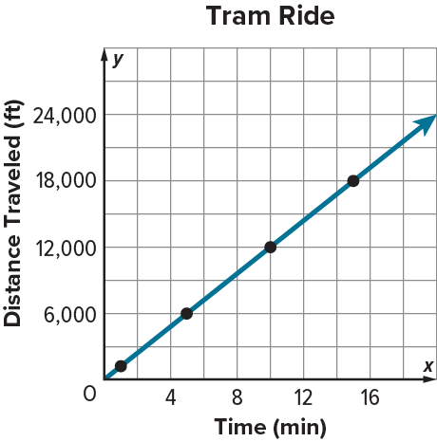
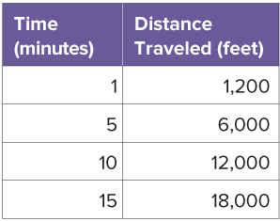
COLLABORATE · TALK IT THROUGH • AGREE ON A MODEL
Collaborate and Connect
We can use a table of values to create a graph that shows the relationship between time and distance.
Every minute, the tram travels 1,200 feet.
How can you complete the table and create a graph that represents the relationship?
38 / 47
Notes:
TEACH IN PRACTICE | Embedded facilitation | Lesson 9.2, slide 32 | COLLABORATE
Focus on the existing task: We can use a table of values to create a graph that shows the relationship between time and distance. Every minute, the tram travels 1,200…
LAUNCH (T2/3/5): Use the displayed question. Give private thinking time; then A explains while B asks for evidence. Switch roles. Each student records their own reasoning.
LOOK FOR (T4): Where this task addresses it, students can connect table rows to graph points. Ask which feature of their work supports the claim.
RESPOND: If this task shows the lesson misconception—misreading the axis scale or assuming every relationship starts at zero—trace one original table row to its graph point and label both units. Have the student revise and explain the change. Use this support only where the concept occurs in the current task; otherwise respond to the displayed question.
RECHECK: If a gap is shared, revisit the existing representation together. If it is limited, give targeted support while others compare valid methods on the same task. Check the revision before moving on.
PARTICIPATION (T5/6/7): Think time before volunteers; accept a written, drawn or rehearsed entry. Students ask for evidence respectfully. Recognize a specific contribution or revision and check that both partners participate.
Source: BCPS Updated Instructional Framework Rubric (June 2020), TEACH 1–7. Earlier notes and answer keys are retained below.
EARLIER NOTES / EXISTING ANSWER KEY
Routine: COLLABORATE · TALK IT THROUGH • AGREE ON A MODEL
UIFR FULL | Lesson-specific facilitation
TEACH 4-5 | Session 2 discussion and checkpoint (UIFR PDF pp. 11-12).
Collect a brief response from every student to the existing prompt before hearing volunteers. Partners take turns explaining and asking for evidence: “I understand ___; what supports ___?” Offer rehearsal or an annotated model for students who need language support. Each student records their own reasoning.
Look specifically for: misreading the axis scale or assuming every relationship starts at zero. If it appears, trace one original table row to its graph point and label both units; then ask the student to revise the same response and explain the change. If evidence is secure, have students compare a second valid pathway or state why their approach works. Choose the next step from the responses, not a preset pace.

Slide 39
STUDENT MOVES
Lesson 9-2
Your move
TAKE TURNS · One explains, one asks a question. Then switch, so both of you talk.
39 / 47

Slide 40
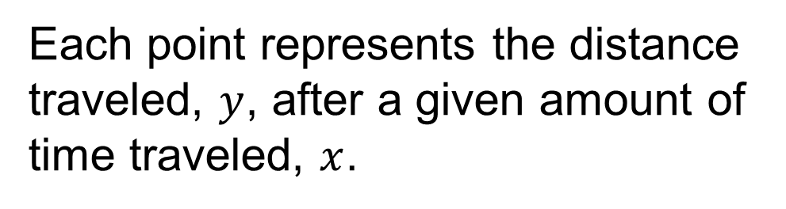
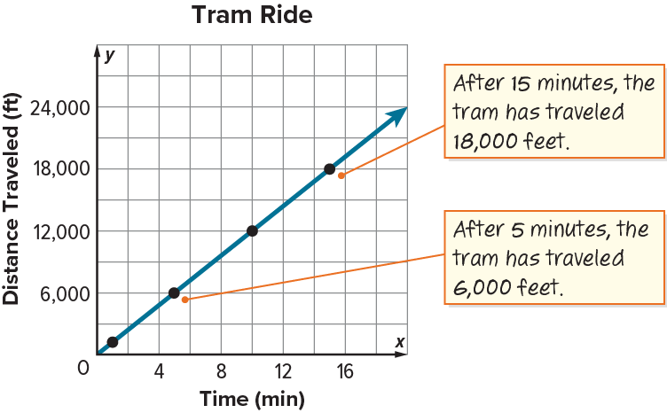
Riding the Tramway
How can you describe the relationship between the distance the tram has traveled and the time it has traveled?
SELF-CHECK · Mark it: ✓ got it · ~ almost · ? stuck. Then fix one thing before we move on.
Reveal:
The greater the time of travel, the farther the tram has traveled.
40 / 47
Notes:
TEACH IN PRACTICE | Embedded facilitation | Lesson 9.2, slide 33 | REVEAL
Focus on the existing task: Reveal: The greater the time of travel, the farther the tram has traveled. Riding the Tramway How can you describe the relationship between the distance the tram has traveled and the time it has traveled?
LAUNCH (T2/3/5): If an existing answer cover is present, gather an attempt before revealing. If the explanation is already visible, ask students to reconstruct and justify it. Compare reasoning and explain a revision; preserve the reveal sequence.
LOOK FOR (T4): Where this task addresses it, students can describe the relationship. Ask which feature of their work supports the claim.
RESPOND: If this task shows the lesson misconception—misreading the axis scale or assuming every relationship starts at zero—trace one original table row to its graph point and label both units. Have the student revise and explain the change. Use this support only where the concept occurs in the current task; otherwise respond to the displayed question.
RECHECK: If a gap is shared, revisit the existing representation together. If it is limited, give targeted support while others compare valid methods on the same task. Check the revision before moving on.
PARTICIPATION (T5/6/7): Think time before volunteers; accept a written, drawn or rehearsed entry. Students ask for evidence respectfully. Recognize a specific contribution or revision and check that both partners participate.
Source: BCPS Updated Instructional Framework Rubric (June 2020), TEACH 1–7. Earlier notes and answer keys are retained below.
EARLIER NOTES / EXISTING ANSWER KEY
Do not click yet: collect 2–3 student answers with reasons first.
Then click to remove the cover and have students compare their thinking to the reveal — “Is this what we said? Where is it different?”
Behind the cover: The greater the time of travel, the farther the tram has traveled.
UIFR: TEACH 3 · TEACH 4.

Slide 41
Let’s Explore More
It takes 15 minutes for the Sandia Peak tram to travel from the base to the top of Sandia Peak.
Which quantity is the independent variable? Explain how you know.
Workspace
USE YOUR TOOLS · Reach for your notes, a model, or a manipulative before you reach for an answer.
41 / 47
Notes:
TEACH IN PRACTICE | Embedded facilitation | Lesson 9.2, slide 34 | PRACTICE
Focus on the existing task: Let’s Explore More It takes 15 minutes for the Sandia Peak tram to travel from the base to the top of Sandia Peak. Which quantity is the independent variable?
LAUNCH (T2/3/5): Use the displayed question. Give private thinking time; then A explains while B asks for evidence. Switch roles. Each student records their own reasoning.
LOOK FOR (T4): Where this task addresses it, students can connect table rows to graph points. Ask which feature of their work supports the claim.
RESPOND: If this task shows the lesson misconception—misreading the axis scale or assuming every relationship starts at zero—trace one original table row to its graph point and label both units. Have the student revise and explain the change. Use this support only where the concept occurs in the current task; otherwise respond to the displayed question.
RECHECK: If a gap is shared, revisit the existing representation together. If it is limited, give targeted support while others compare valid methods on the same task. Check the revision before moving on.
PARTICIPATION (T5/6/7): Think time before volunteers; accept a written, drawn or rehearsed entry. Students ask for evidence respectfully. Recognize a specific contribution or revision and check that both partners participate.
Source: BCPS Updated Instructional Framework Rubric (June 2020), TEACH 1–7. Earlier notes and answer keys are retained below.
EARLIER NOTES / EXISTING ANSWER KEY
Extension for partners or table groups — students choose their approach and use the workspace to show thinking.
Push with “Convince me,” and have two groups with different approaches share.
This is where students stretch past the worked example.
UIFR: TEACH 2 · TEACH 5.

Slide 42
LESSON 9.2 / CHECK YOUR WORK
Pause. Check. Improve.
CHECK
A mistake to watch for: misreading the axis scale or assuming every relationship starts at zero.
TRY
Trace one given table row to its graph point and label both units.
REVISE
Use that check on the task you just completed. Correct or strengthen one part, and explain why.
REVISE NOW · Change one answer and write why you changed it. A revision is evidence of learning.
Listen to understand. Ask for evidence. Make room for every voice.
Notes:
TEACH IN PRACTICE | Embedded facilitation | Lesson 9.2, slide 35 | PRIOR_INSERT
Focus on the existing task: LESSON 9.2 / CHECK YOUR WORK Pause. Check. Improve. Listen to understand. Ask for evidence. Make room for every voice. CHECK A mistake…
CONNECT (T1/4): Ask students to restate the displayed goal or key idea and connect it to earlier work. Relevant lesson evidence: connect table rows to graph points; interpret axes and scale; describe the relationship. Use only the criterion that matches the current session.
SHOW PROGRESS: Students point to their own existing work, explain what improved after feedback, and name a next step. Pair confidence ratings with actual evidence.
PARTICIPATION (T5/6/7): Think time before volunteers; accept a written, drawn or rehearsed entry. Students ask for evidence respectfully. Recognize a specific contribution or revision and check that both partners participate.
Source: BCPS Updated Instructional Framework Rubric (June 2020), TEACH 1–7.

Slide 43
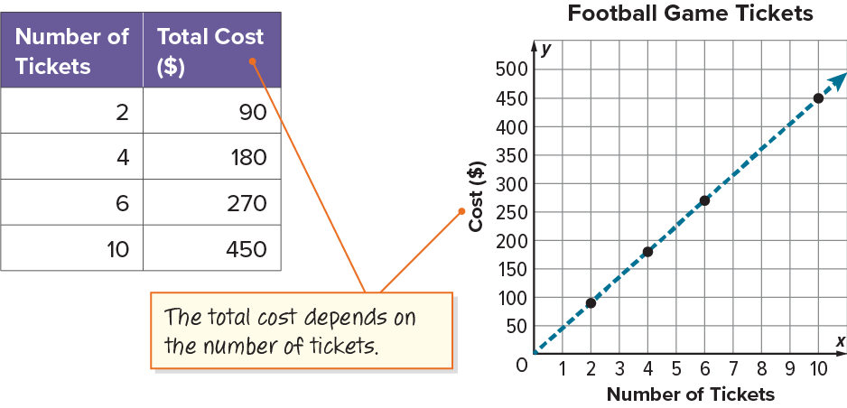
SUMMARIZE · SAY IT IN YOUR OWN WORDS
Summarize: Analyze Relationships Between Two Quantities
You can use graphs or tables to analyze the relationship between the quantities of a given situation.
43 / 47
Notes:
TEACH IN PRACTICE | Embedded facilitation | Lesson 9.2, slide 36 | SUMMARIZE
Focus on the existing task: Summarize: Analyze Relationships Between Two Quantities You can use graphs or tables to analyze the relationship between the quantities of…
CONNECT (T1/4): Ask students to restate the displayed goal or key idea and connect it to earlier work. Relevant lesson evidence: connect table rows to graph points; interpret axes and scale; describe the relationship. Use only the criterion that matches the current session.
SHOW PROGRESS: Students point to their own existing work, explain what improved after feedback, and name a next step. Pair confidence ratings with actual evidence.
PARTICIPATION (T5/6/7): Think time before volunteers; accept a written, drawn or rehearsed entry. Students ask for evidence respectfully. Recognize a specific contribution or revision and check that both partners participate.
Source: BCPS Updated Instructional Framework Rubric (June 2020), TEACH 1–7. Earlier notes and answer keys are retained below.
EARLIER NOTES / EXISTING ANSWER KEY
Routine: SUMMARIZE · SAY IT IN YOUR OWN WORDS

Slide 44
STUDENT MOVES
Lesson 9-2
Your move
RESTATE FIRST · Restate your partner’s idea in your own words before you give yours.
44 / 47

Slide 45
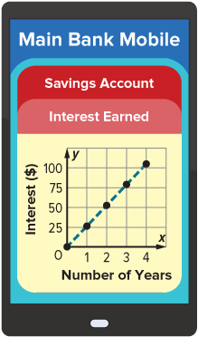
APPLY · PLAN IT • SOLVE IT • PROVE IT
Apply: Nakai’s Savings Account
TWO MINUTES SOLO · Two minutes on your own, then compare. Bring one thing you tried, even if it did not work.
Nakai opened a savings account with an initial deposit, or principal, of $750. The account earns 3.5% simple interest each year. Interest is the amount paid or earned for the use of the principal. Interest is called simple interest when it is calculated using the principal amount. The graph shows the interest Nakai has earned over a period of time.
Question: What observations can you make about the data using the graph?
45 / 47
Notes:
TEACH IN PRACTICE | Embedded facilitation | Lesson 9.2, slide 37 | APPLY
Focus on the existing task: Apply: Nakai’s Savings Account Question: What observations can you make about the data using the graph?
LAUNCH (T2/3/5): Use the exact application task independently first. Ask students to justify their choice of method. Collect evidence before a partner discussion or correction.
LOOK FOR (T4): Where this task addresses it, students can connect table rows to graph points. Ask which feature of their work supports the claim.
RESPOND: If this task shows the lesson misconception—misreading the axis scale or assuming every relationship starts at zero—trace one original table row to its graph point and label both units. Have the student revise and explain the change. Use this support only where the concept occurs in the current task; otherwise respond to the displayed question.
RECHECK: If a gap is shared, revisit the existing representation together. If it is limited, give targeted support while others compare valid methods on the same task. Check the revision before moving on.
PARTICIPATION (T5/6/7): Think time before volunteers; accept a written, drawn or rehearsed entry. Students ask for evidence respectfully. Recognize a specific contribution or revision and check that both partners participate.
Source: BCPS Updated Instructional Framework Rubric (June 2020), TEACH 1–7. Earlier notes and answer keys are retained below.
EARLIER NOTES / EXISTING ANSWER KEY
Routine: APPLY · PLAN IT • SOLVE IT • PROVE IT
UIFR FULL | Lesson-specific facilitation
TEACH 4 | Independent evidence and revision (UIFR PDF p. 11).
Use the existing application/exit problem as the independent check. If this is a learning-target slide, have students point to and explain their work on the preceding task. Separate initial independent evidence from the revision after feedback.
Check the relevant criteria: connect table rows to graph points; interpret axes and scale; describe the relationship. Respond with one specific next step tied to the work. Students revise and annotate what changed, then identify a criterion they can now demonstrate and one they still need to practice.

Slide 46
Learning Targets
I can use a table and a graph to determine the relationship between two variable quantities.
I can use a graph as a tool to analyze the relationship between two variable quantities.
Point to evidence in your work. Name what improved and your next step.
46 / 47
Notes:
TEACH IN PRACTICE | Embedded facilitation | Lesson 9.2, slide 38 | REFLECTION
Focus on the existing task: Learning Targets I can use a table and a graph to determine the relationship between two variable quantities. I can use a graph as a tool…
CONNECT (T1/4): Ask students to restate the displayed goal or key idea and connect it to earlier work. Relevant lesson evidence: connect table rows to graph points; interpret axes and scale; describe the relationship. Use only the criterion that matches the current session.
SHOW PROGRESS: Students point to their own existing work, explain what improved after feedback, and name a next step. Pair confidence ratings with actual evidence.
PARTICIPATION (T5/6/7): Think time before volunteers; accept a written, drawn or rehearsed entry. Students ask for evidence respectfully. Recognize a specific contribution or revision and check that both partners participate.
Source: BCPS Updated Instructional Framework Rubric (June 2020), TEACH 1–7. Earlier notes and answer keys are retained below.
EARLIER NOTES / EXISTING ANSWER KEY
UIFR FULL | Lesson-specific facilitation
REFLECT & ADJUST 1-2 | After the lesson (UIFR PDF pp. 15-16).
Sort the existing work by demonstrated reasoning, partial understanding, and the specific misconception: misreading the axis scale or assuming every relationship starts at zero. Compare the initial response with the revision. Record which teaching move plausibly helped, which did not, and whose participation or access needs a different approach; do not record sensitive student details in this shared deck.
Plan the next lesson from that evidence: if the misconception persists, trace one original table row to its graph point and label both units using the current example before returning to the next grade-level task; if understanding is secure, use an existing extension or ask for a general explanation. Check the targeted idea again at the next warm-up.
Ask students what supported their thinking and what would help next time. Identify one change to try and one successful practice to retain. Seek colleague feedback on anonymized work when useful; these prompts support reflection and do not establish an evaluation rating. Source: Baltimore City Public Schools, Updated Instructional Framework Rubric, June 2020 (UIFR_Full.pdf).

Slide 47
LESSON 9.2 / REFLECT ON YOUR LEARNING
Show your progress
1 SHOW EVIDENCE
2 CHOOSE A NEXT STEP
Choose one response. Point to the part that shows your reasoning.
Name a change you made after feedback—or a question you still have.
“My work shows ___ because ___.”
“Next time, I will ___ to help me ___.”
Today’s focus: Connect table rows to graph points.
CREDIT A CLASSMATE · Name one classmate whose idea helped you today, and say what they said.
Listen to understand. Ask for evidence. Make room for every voice.
Notes:
TEACH IN PRACTICE | Embedded facilitation | Lesson 9.2, slide 39 | PRIOR_INSERT
Focus on the existing task: LESSON 9.2 / REFLECT ON YOUR LEARNING Show your progress Listen to understand. Ask for evidence. Make room for every voice. 1 SHOW…
CONNECT (T1/4): Ask students to restate the displayed goal or key idea and connect it to earlier work. Relevant lesson evidence: connect table rows to graph points; interpret axes and scale; describe the relationship. Use only the criterion that matches the current session.
SHOW PROGRESS: Students point to their own existing work, explain what improved after feedback, and name a next step. Pair confidence ratings with actual evidence.
PARTICIPATION (T5/6/7): Think time before volunteers; accept a written, drawn or rehearsed entry. Students ask for evidence respectfully. Recognize a specific contribution or revision and check that both partners participate.
Source: BCPS Updated Instructional Framework Rubric (June 2020), TEACH 1–7.

