Slide 1
WARM-UP · THINK • TRY • CHECK
Turn and talk: compare strategies, then defend one.
Warm-Up
Lesson 9-3 · Write Equations to Represent Relationships Between Two Variables | Warm-Up · about 4 minutes
Try each on your own. Mark an unsure answer; explain and revise when we check.
QUESTION 1
QUESTION 2
3 books cost $12. One book costs $______
A table row is x = 4, y = 20. y ÷ x = ______
QUESTION 3
QUESTION 4
5 times a number n is ______
Does x = 3, y = 12 fit y = 4x? ______
TALK IT OVER: “I got ______ because ______.” • Compare with a partner before we check as a class.
1 / 49
Notes:
TEACH IN PRACTICE | Embedded facilitation | Lesson 9.3, slide 1 | WARMUP
Focus on the existing task: Warm-Up WARM-UP · THINK •…
GATHER EVIDENCE (T4/6): Keep the original items. Students try independently, mark an uncertain item, and explain one method before checking. Use the existing key when present.
RESPOND: Distinguish a calculation slip from a reasoning gap. Give one next step on the same item; have students revise in a second color. Use the responses to choose flexible support for today’s lesson.
PARTICIPATION (T5/6/7): Think time before volunteers; accept a written, drawn or rehearsed entry. Students ask for evidence respectfully. Recognize a specific contribution or revision and check that both partners participate.
Source: BCPS Updated Instructional Framework Rubric (June 2020), TEACH 1–7. Earlier notes and answer keys are retained below.
EARLIER NOTES / EXISTING ANSWER KEY
Warm-Up answers (teacher only): 1) $4 2) 5 3) 5n 4) yes
UIFR FULL | Lesson-specific facilitation
PREPARE 1-2 | Before teaching (UIFR PDF pp. 6-7).
Plan to gather evidence that students can define variables; identify rate and any initial amount; write and verify an equation. Review recent work and today’s warm-up to choose flexible groups and access supports; do not infer needs from identity or perceived ability. Use the existing lesson tasks and stated standards.
Anticipate: assuming every relationship has the form y = kx without checking the starting value. If observed, compare successive values and the starting amount in the existing table or graph. Offer oral rehearsal, drawing, pointing, or home-language processing as needed; retain the original mathematical demand. Ask students which support helps and fade it as evidence improves.
TEACH 6-7 | Before the first transition, agree on materials, partner roles, and how to request help. Invite students to restate the routine. Normalize revising an idea, recognize a specific contribution, and check privately when frustration blocks participation. Source: UIFR PDF pp. 13-14.

Slide 2
Today’s Math Notes
Lesson 9-3 · Write Equations to Represent Relationships Between Two Variables
Section 1: Math Words
Copy. Explain. Check.
SAY THE GOAL · Say today’s goal in your own words, then name one place this shows up outside math class.
equation
1
A mathematical sentence with an equals sign
variable
2
A letter that represents a quantity that can change, or vary
rate
3
A fixed amount of one quantity for every one unit
eduwonderlab.com · Neft Teacher
2 / 49
Notes:
TEACH IN PRACTICE | Embedded facilitation | Lesson 9.3, slide 2 | NOTES
Focus on the existing task: Today’s Math Notes Section…
ROUTINE (T1/2/4): Read or copy the original notes, cover one line, and explain it using the displayed example. Reopen and correct. Copying alone is not evidence of understanding.
LOOK FOR: A link between a symbol, quantity or feature and the explanation. If missing, point back to that feature and have the student try again; fade the prompt once they can explain.
PARTICIPATION (T5/6/7): Think time before volunteers; accept a written, drawn or rehearsed entry. Students ask for evidence respectfully. Recognize a specific contribution or revision and check that both partners participate.
Source: BCPS Updated Instructional Framework Rubric (June 2020), TEACH 1–7. Earlier notes and answer keys are retained below.
EARLIER NOTES / EXISTING ANSWER KEY
Copy routine: read one line at a time; students copy, then explain that line to a partner.
Keep it brisk — the understanding work happens in the examples, not the copying.
UIFR: TEACH 1 · TEACH 6.

Slide 3
Today’s Math Notes
Lesson 9-3 · Write Equations to Represent Relationships Between Two Variables
Section 2: Today’s Math
Copy. Explain. Check.
CONNECT IT · What earlier lesson does this build on? Tell a partner in one sentence.
Writing Two-Variable Equations
y = kx
Dependent = (Unit Rate) × Independent
1
Identify the independent variable (x) and dependent variable (y)
2
Find the constant unit rate (k = y ÷ x)
3
Write the equation relating the two variables: y = kx (or y = x + c)
eduwonderlab.com · Neft Teacher
3 / 49
Notes:
TEACH IN PRACTICE | Embedded facilitation | Lesson 9.3, slide 3 | NOTES
Focus on the existing task: Today’s Math Notes Section…
ROUTINE (T1/2/4): Read or copy the original notes, cover one line, and explain it using the displayed example. Reopen and correct. Copying alone is not evidence of understanding.
LOOK FOR: A link between a symbol, quantity or feature and the explanation. If missing, point back to that feature and have the student try again; fade the prompt once they can explain.
PARTICIPATION (T5/6/7): Think time before volunteers; accept a written, drawn or rehearsed entry. Students ask for evidence respectfully. Recognize a specific contribution or revision and check that both partners participate.
Source: BCPS Updated Instructional Framework Rubric (June 2020), TEACH 1–7. Earlier notes and answer keys are retained below.
EARLIER NOTES / EXISTING ANSWER KEY
Copy routine: read one line at a time; students copy, then explain that line to a partner.
Keep it brisk — the understanding work happens in the examples, not the copying.
UIFR: TEACH 1 · TEACH 6.

Slide 4
Session 1
Write Equations to Represent Relationships Between Two Variables
PICK YOUR STRATEGY · Choose your path — picture, table, number line, or equation — and be ready to say why you chose it.
4 / 49
Notes:
TEACH IN PRACTICE | Embedded facilitation | Lesson 9.3, slide 4 | DIVIDER
Focus on the existing task: Write Equations to Represent Relationships Between Two Variables Session 1
TRANSITION (T6/7): Students confirm materials, roles, how to request help, and the next response routine. Ask a student to restate it. Keep teacher-only slides hidden.
PARTICIPATION (T5/6/7): Think time before volunteers; accept a written, drawn or rehearsed entry. Students ask for evidence respectfully. Recognize a specific contribution or revision and check that both partners participate.
Source: BCPS Updated Instructional Framework Rubric (June 2020), TEACH 1–7. Earlier notes and answer keys are retained below.
EARLIER NOTES / EXISTING ANSWER KEY
Transition cue: state what materials are out and what success looks like this session.
Keep the changeover under a minute.
UIFR: TEACH 6.

Slide 5



More or Less Than…
More or Less Than 5
Explain how the information shown supports your reasoning.
5 / 49
Notes:
TEACH IN PRACTICE | Embedded facilitation | Lesson 9.3, slide 5 | WORKED
Focus on the existing task: More or Less Than… More or Less Than 5
LAUNCH (T2/3/5): Ask students to explain the displayed idea or example and point to evidence. When a calculation step is shown, ask why it is valid. Have a partner restate the explanation; copying is not the check.
LOOK FOR (T4): Where this task addresses it, students can define variables. Ask which feature of their work supports the claim.
RESPOND: If this task shows the lesson misconception—assuming every relationship has the form y = kx without checking the starting value—compare successive values and the starting amount in the existing table or graph. Have the student revise and explain the change. Use this support only where the concept occurs in the current task; otherwise respond to the displayed question.
RECHECK: If a gap is shared, revisit the existing representation together. If it is limited, give targeted support while others compare valid methods on the same task. Check the revision before moving on.
PARTICIPATION (T5/6/7): Think time before volunteers; accept a written, drawn or rehearsed entry. Students ask for evidence respectfully. Recognize a specific contribution or revision and check that both partners participate.
Source: BCPS Updated Instructional Framework Rubric (June 2020), TEACH 1–7. Earlier notes and answer keys are retained below.
EARLIER NOTES / EXISTING ANSWER KEY
Number-sense routine — every voice in. Give quiet think time, then hear from at least three students.
Always follow with “How do you know?” — the reasoning is the point, not the answer.
There is more than one path; name and celebrate different strategies.
UIFR: TEACH 3 · TEACH 5 · TEACH 6.

Slide 6
Today’s Objectives
Lesson 9-3 · Write Equations to Represent Relationships Between Two Variables
Write Equations to Represent Relationships Between Two Variables
Maryland Standard 6.AT.11
CONTENT OBJECTIVE
LANGUAGE OBJECTIVE
Restate the goal in your words
Use these words to explain why
I can write an equation from a table or a graph to model the relationship between the dependent and independent variables.
I can define the variables in my equation and explain what each part represents using the words equation, variable, and rate.
eduwonderlab.com · Neft Teacher
6 / 49
Notes:
TEACH IN PRACTICE | Embedded facilitation | Lesson 9.3, slide 6 | GOAL
Focus on the existing task: Today’s Objectives Write…
CONNECT (T1/4): Ask students to restate the displayed goal or key idea and connect it to earlier work. Relevant lesson evidence: define variables; identify rate and any initial amount; write and verify an equation. Use only the criterion that matches the current session.
SHOW PROGRESS: Students point to their own existing work, explain what improved after feedback, and name a next step. Pair confidence ratings with actual evidence.
PARTICIPATION (T5/6/7): Think time before volunteers; accept a written, drawn or rehearsed entry. Students ask for evidence respectfully. Recognize a specific contribution or revision and check that both partners participate.
Source: BCPS Updated Instructional Framework Rubric (June 2020), TEACH 1–7. Earlier notes and answer keys are retained below.
EARLIER NOTES / EXISTING ANSWER KEY
Read the objective together, then have one or two students restate today’s goal in their own words.
Connect it to what the class learned last lesson.
Return to this goal at the end of class to check it was met.
UIFR: TEACH 1.
UIFR FULL | Lesson-specific facilitation
TEACH 1 | Session 1 purpose and evidence (UIFR PDF p. 8).
Have students restate the displayed session goal in their own words and connect it to the existing context or a familiar experience they choose to share. Use the current session goal to select from these lesson-wide evidence criteria; do not frontload a later-session procedure.
Look for: define variables; identify rate and any initial amount; write and verify an equation. Ask: “Which part of your work would show this?” Revisit that evidence after the task; a confidence rating alone is not evidence of understanding.

Slide 7
STUDENT MOVES
Lesson 9-3
Your move
NAME THE MATH · Point to the part of this that is new today, and say what it changes.
7 / 49

Slide 8
LESSON 9.3 / OUR LEARNING
What will show your learning?
1
Define variables.
2
Identify rate and any initial amount.
3
Write and verify an equation.
Tell a partner: Which skill connects to something you already know?
SHOW YOUR THINKING · Show what you know — write it, draw it, or build it. A picture counts as an explanation.
Listen to understand. Ask for evidence. Make room for every voice.
Notes:
TEACH IN PRACTICE | Embedded facilitation | Lesson 9.3, slide 7 | PRIOR_INSERT
Focus on the existing task: LESSON 9.3 / OUR LEARNING What will show your learning?
CONNECT (T1/4): Ask students to restate the displayed goal or key idea and connect it to earlier work. Relevant lesson evidence: define variables; identify rate and any initial amount; write and verify an equation. Use only the criterion that matches the current session.
SHOW PROGRESS: Students point to their own existing work, explain what improved after feedback, and name a next step. Pair confidence ratings with actual evidence.
PARTICIPATION (T5/6/7): Think time before volunteers; accept a written, drawn or rehearsed entry. Students ask for evidence respectfully. Recognize a specific contribution or revision and check that both partners participate.
Source: BCPS Updated Instructional Framework Rubric (June 2020), TEACH 1–7.

Slide 9
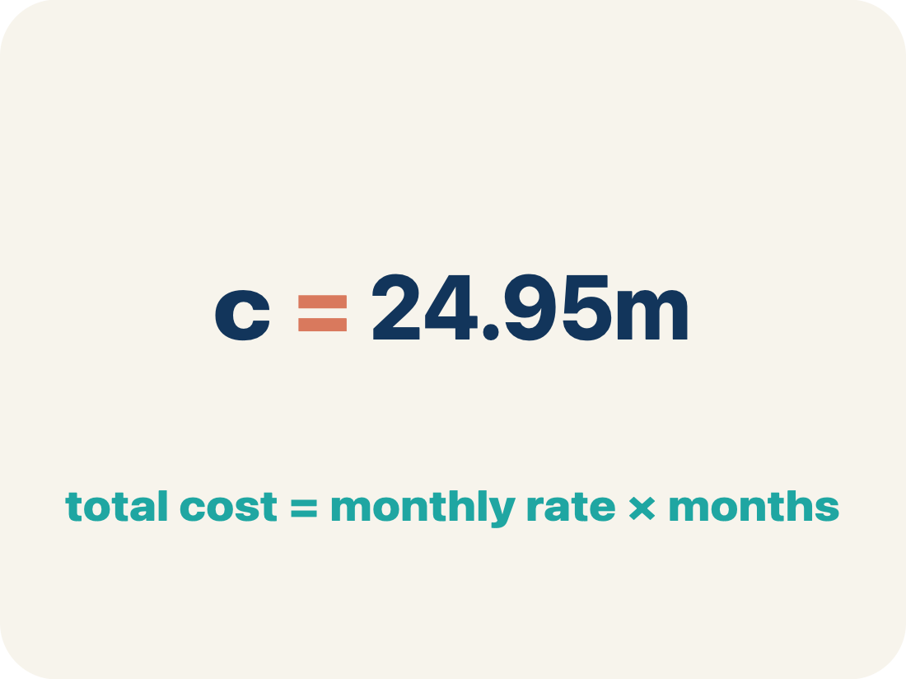
Vocabulary 1 of 5
Lesson 9-3 · Write Equations to Represent Relationships Between Two Variables
equation
A mathematical sentence with an equals sign that shows two amounts are the same.
EXAMPLE · EXPLAIN WHY IT FITS
c = 24.95m means the total cost equals $24.95 times the number of months
Use “equation” to explain the example. Point to evidence.
eduwonderlab.com · Neft Teacher
9 / 49
Notes:
TEACH IN PRACTICE | Embedded facilitation | Lesson 9.3, slide 8 | VOCAB
Focus on the existing task: Vocabulary 1 of 5…
ASK (T1/3/5): Where does “equation” appear in the example? Explain the meaning without reading the definition. Partner: restate the idea and ask a clarifying question.
LOOK FOR: A correct connection between the word and a feature of the example. If the student only repeats the definition, invite pointing, sketching or oral rehearsal, then ask for another explanation of this same example.
PARTICIPATION (T5/6/7): Think time before volunteers; accept a written, drawn or rehearsed entry. Students ask for evidence respectfully. Recognize a specific contribution or revision and check that both partners participate.
Source: BCPS Updated Instructional Framework Rubric (June 2020), TEACH 1–7.

Slide 10
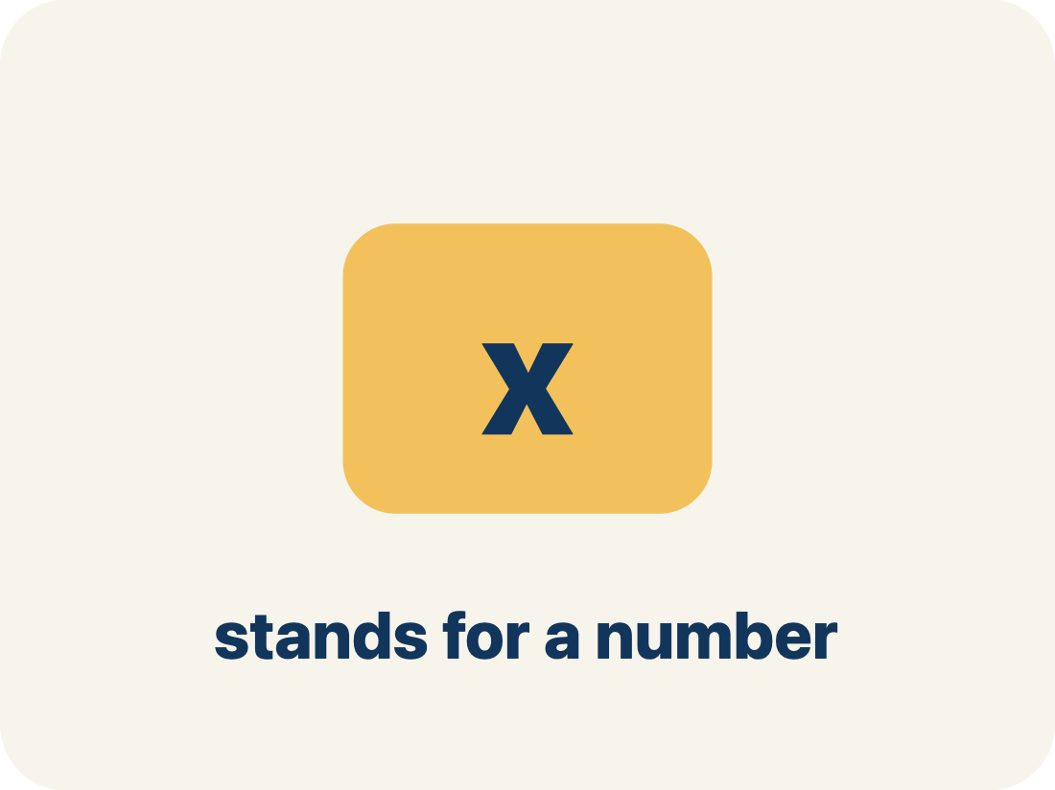
Vocabulary 2 of 5
Lesson 9-3 · Write Equations to Represent Relationships Between Two Variables
variable
A letter that represents a quantity that can change, or vary.
EXAMPLE · EXPLAIN WHY IT FITS
In c = 24.95m, the m can be 1, 2, or 12 — it varies.
Use “variable” to explain the example. Point to evidence.
eduwonderlab.com · Neft Teacher
10 / 49
Notes:
TEACH IN PRACTICE | Embedded facilitation | Lesson 9.3, slide 9 | VOCAB
Focus on the existing task: Vocabulary 2 of 5…
ASK (T1/3/5): Where does “variable” appear in the example? Explain the meaning without reading the definition. Partner: restate the idea and ask a clarifying question.
LOOK FOR: A correct connection between the word and a feature of the example. If the student only repeats the definition, invite pointing, sketching or oral rehearsal, then ask for another explanation of this same example.
PARTICIPATION (T5/6/7): Think time before volunteers; accept a written, drawn or rehearsed entry. Students ask for evidence respectfully. Recognize a specific contribution or revision and check that both partners participate.
Source: BCPS Updated Instructional Framework Rubric (June 2020), TEACH 1–7.

Slide 11
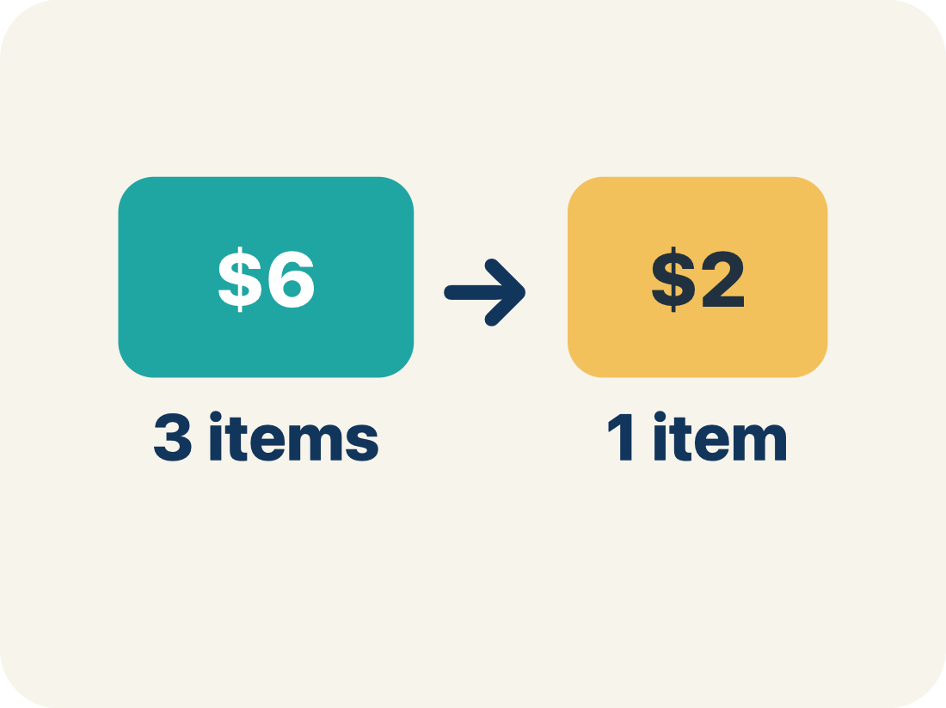
Vocabulary 3 of 5
Lesson 9-3 · Write Equations to Represent Relationships Between Two Variables
rate
A fixed amount of one quantity for every one unit of the other quantity.
EXAMPLE · EXPLAIN WHY IT FITS
$24.95 for every 1 month — the amount attached to one unit.
Use “rate” to explain the example. Point to evidence.
eduwonderlab.com · Neft Teacher
11 / 49
Notes:
TEACH IN PRACTICE | Embedded facilitation | Lesson 9.3, slide 10 | VOCAB
Focus on the existing task: Vocabulary 3 of 5 rate A…
ASK (T1/3/5): Where does “rate” appear in the example? Explain the meaning without reading the definition. Partner: restate the idea and ask a clarifying question.
LOOK FOR: A correct connection between the word and a feature of the example. If the student only repeats the definition, invite pointing, sketching or oral rehearsal, then ask for another explanation of this same example.
PARTICIPATION (T5/6/7): Think time before volunteers; accept a written, drawn or rehearsed entry. Students ask for evidence respectfully. Recognize a specific contribution or revision and check that both partners participate.
Source: BCPS Updated Instructional Framework Rubric (June 2020), TEACH 1–7.

Slide 12
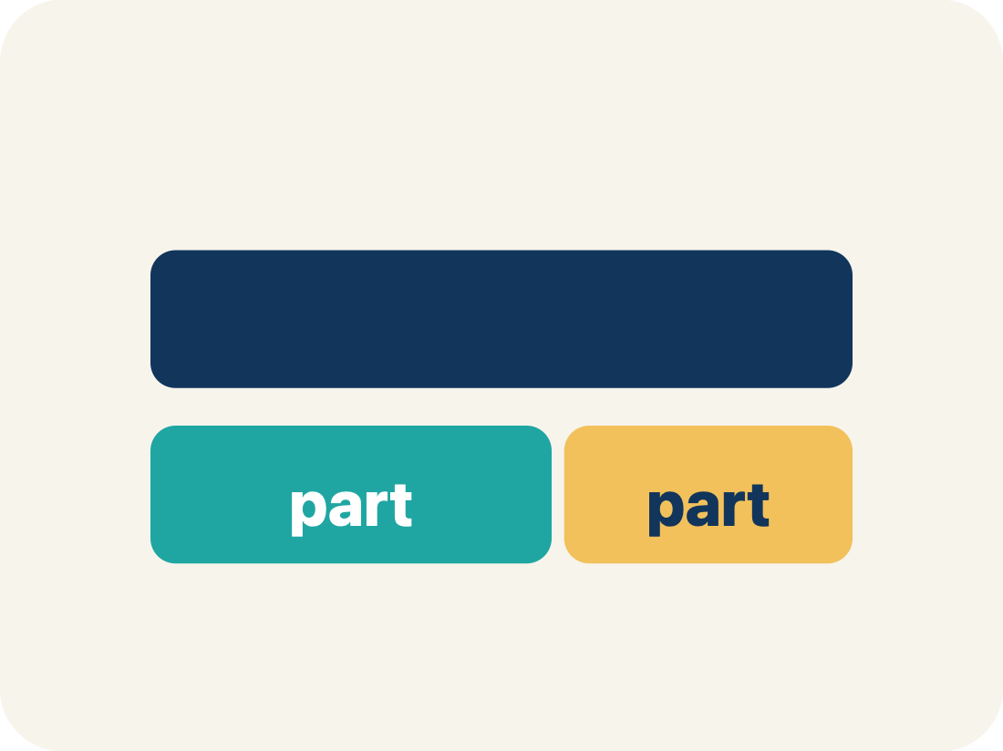
Vocabulary 4 of 5
Lesson 9-3 · Write Equations to Represent Relationships Between Two Variables
represent
To show a relationship using a tool such as a table, a graph, or an equation.
EXAMPLE · EXPLAIN WHY IT FITS
The same membership shown as a table, a graph, AND c = 24.95m.
Use “represent” to explain the example. Point to evidence.
eduwonderlab.com · Neft Teacher
12 / 49
Notes:
TEACH IN PRACTICE | Embedded facilitation | Lesson 9.3, slide 11 | VOCAB
Focus on the existing task: Vocabulary 4 of 5…
ASK (T1/3/5): Where does “represent” appear in the example? Explain the meaning without reading the definition. Partner: restate the idea and ask a clarifying question.
LOOK FOR: A correct connection between the word and a feature of the example. If the student only repeats the definition, invite pointing, sketching or oral rehearsal, then ask for another explanation of this same example.
PARTICIPATION (T5/6/7): Think time before volunteers; accept a written, drawn or rehearsed entry. Students ask for evidence respectfully. Recognize a specific contribution or revision and check that both partners participate.
Source: BCPS Updated Instructional Framework Rubric (June 2020), TEACH 1–7.

Slide 13
Vocabulary 5 of 5
Lesson 9-3 · Write Equations to Represent Relationships Between Two Variables
define the variables
To state exactly what quantity each letter in an equation stands for.
EXAMPLE · EXPLAIN WHY IT FITS
“Let m = months and c = total cost” — written before you solve.
Use “define the variables” to explain the example. Point to
evidence.
eduwonderlab.com · Neft Teacher
13 / 49
Notes:
TEACH IN PRACTICE | Embedded facilitation | Lesson 9.3, slide 12 | VOCAB
Focus on the existing task: Vocabulary 5 of 5 define…
ASK (T1/3/5): Where does “define the variables” appear in the example? Explain the meaning without reading the definition. Partner: restate the idea and ask a clarifying question.
LOOK FOR: A correct connection between the word and a feature of the example. If the student only repeats the definition, invite pointing, sketching or oral rehearsal, then ask for another explanation of this same example.
PARTICIPATION (T5/6/7): Think time before volunteers; accept a written, drawn or rehearsed entry. Students ask for evidence respectfully. Recognize a specific contribution or revision and check that both partners participate.
Source: BCPS Updated Instructional Framework Rubric (June 2020), TEACH 1–7.

Slide 14
Vocabulary
Lesson 9-3 · Write Equations to Represent Relationships Between Two Variables
Today’s Math Words
We learn every word — what it means and what it looks like — before we use it.
equation
variable
A mathematical sentence with an equals sign that shows two amounts are the same
A letter that represents a quantity that can change, or vary
rate
represent
A fixed amount of one quantity for every one unit of the other quantity
To show a relationship using a tool such as a table, a graph, or an equation
define the variables
To state exactly what quantity each letter in an equation stands for
Explain one math word using the example.
Partner: point to evidence.
eduwonderlab.com · Neft Teacher
14 / 49
Notes:
TEACH IN PRACTICE | Embedded facilitation | Lesson 9.3, slide 13 | VOCAB
Focus on the existing task: Vocabulary Today’s Math…
ASK (T1/3/5): Where does “the displayed term” appear in the example? Explain the meaning without reading the definition. Partner: restate the idea and ask a clarifying question.
LOOK FOR: A correct connection between the word and a feature of the example. If the student only repeats the definition, invite pointing, sketching or oral rehearsal, then ask for another explanation of this same example.
PARTICIPATION (T5/6/7): Think time before volunteers; accept a written, drawn or rehearsed entry. Students ask for evidence respectfully. Recognize a specific contribution or revision and check that both partners participate.
Source: BCPS Updated Instructional Framework Rubric (June 2020), TEACH 1–7. Earlier notes and answer keys are retained below.
EARLIER NOTES / EXISTING ANSWER KEY
Choral-read each word, its meaning, and what it looks like.
Students should use these words out loud today — listen for them in partner talk and revoice student ideas with the academic term.
UIFR: TEACH 1 · TEACH 5.

Slide 15
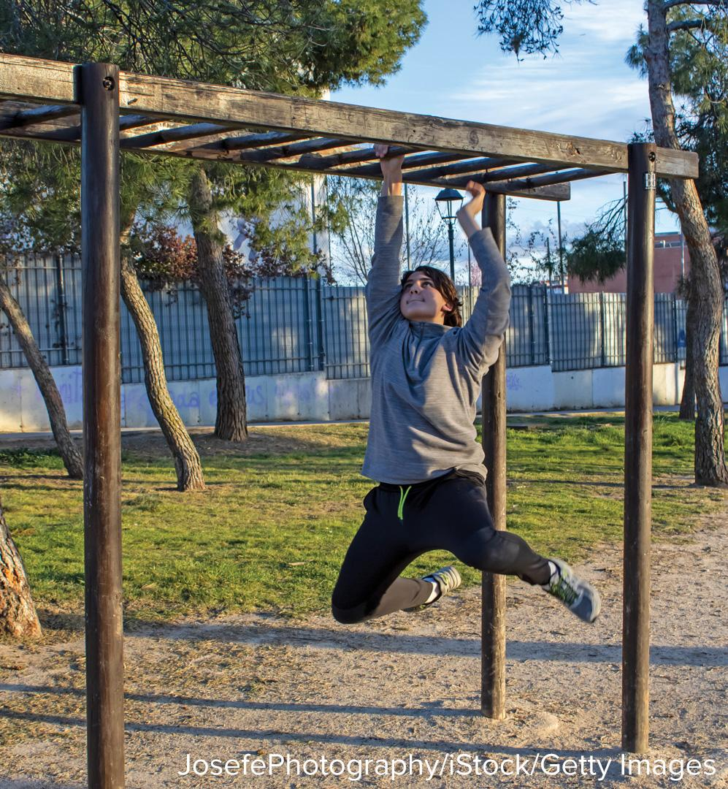
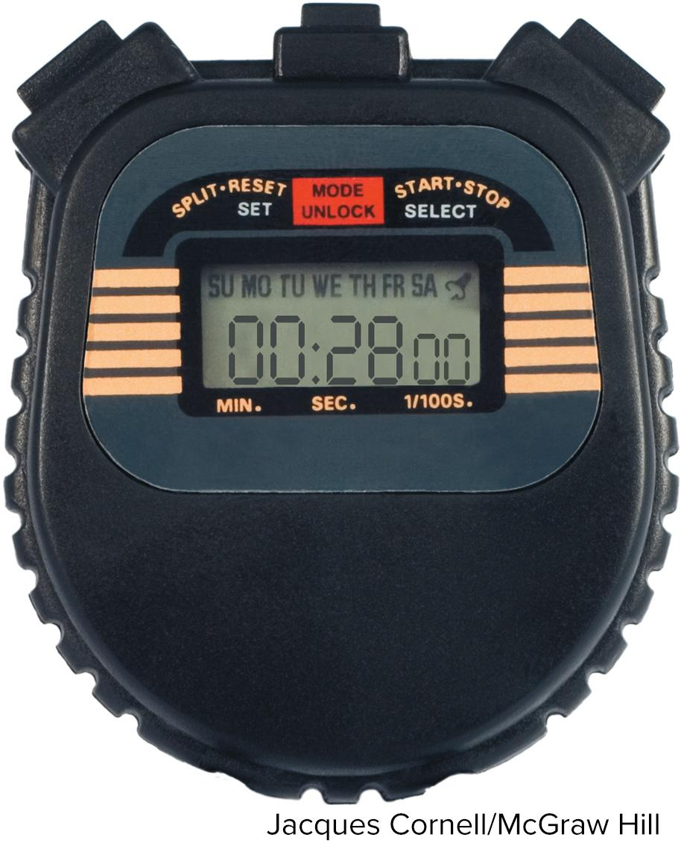

Be Curious
What do you notice?
What do you wonder?
Mindset
HOW DO YOU KNOW? · Ask your partner “How do you know?” Answer by pointing to your own work.
How can you show others that you respect their ideas about math?
15 / 49
Notes:
TEACH IN PRACTICE | Embedded facilitation | Lesson 9.3, slide 14 | CURIOUS
Focus on the existing task: Be Curious What do you notice?
LAUNCH (T2/3/5): Allow quiet observation first. Separate a notice from an inference, invite students’ own questions, and follow the existing launch before teaching a procedure.
LOOK FOR (T4): Where this task addresses it, students can define variables. Ask which feature of their work supports the claim.
RESPOND: If this task shows the lesson misconception—assuming every relationship has the form y = kx without checking the starting value—compare successive values and the starting amount in the existing table or graph. Have the student revise and explain the change. Use this support only where the concept occurs in the current task; otherwise respond to the displayed question.
RECHECK: If a gap is shared, revisit the existing representation together. If it is limited, give targeted support while others compare valid methods on the same task. Check the revision before moving on.
PARTICIPATION (T5/6/7): Think time before volunteers; accept a written, drawn or rehearsed entry. Students ask for evidence respectfully. Recognize a specific contribution or revision and check that both partners participate.
Source: BCPS Updated Instructional Framework Rubric (June 2020), TEACH 1–7. Earlier notes and answer keys are retained below.
EARLIER NOTES / EXISTING ANSWER KEY
Accept all noticings and wonderings — there are no wrong answers here.
Give 20–30 seconds of quiet think time before taking responses; mix cold and warm calls so it is not always the same voices.
Read the mindset question aloud and let two students respond.
UIFR: TEACH 3 · TEACH 7.

Slide 16
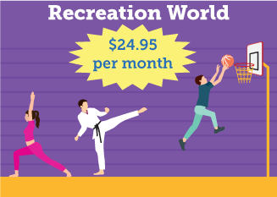
The Cost of Fitness
Miguel is interested in joining a recreation center. Recreation World charges the monthly fee shown on the flyer.
How can Miguel determine the cost of being a member of Recreation World for any number of months?
Think and record first. Which part of your work supports your answer?
16 / 49
Notes:
TEACH IN PRACTICE | Embedded facilitation | Lesson 9.3, slide 15 | TASK
Focus on the existing task: The Cost of Fitness Miguel is interested in joining a recreation center. Recreation World charges the monthly fee shown on the flyer. How…
LAUNCH (T2/3/5): Use the displayed question. Give private thinking time; then A explains while B asks for evidence. Switch roles. Each student records their own reasoning.
LOOK FOR (T4): Where this task addresses it, students can define variables. Ask which feature of their work supports the claim.
RESPOND: If this task shows the lesson misconception—assuming every relationship has the form y = kx without checking the starting value—compare successive values and the starting amount in the existing table or graph. Have the student revise and explain the change. Use this support only where the concept occurs in the current task; otherwise respond to the displayed question.
RECHECK: If a gap is shared, revisit the existing representation together. If it is limited, give targeted support while others compare valid methods on the same task. Check the revision before moving on.
PARTICIPATION (T5/6/7): Think time before volunteers; accept a written, drawn or rehearsed entry. Students ask for evidence respectfully. Recognize a specific contribution or revision and check that both partners participate.
Source: BCPS Updated Instructional Framework Rubric (June 2020), TEACH 1–7. Earlier notes and answer keys are retained below.
EARLIER NOTES / EXISTING ANSWER KEY
Model briefly, then hand the thinking back: ask “Why does this step work?” before showing the next one.
Quick check before moving on — thumbs or whiteboards from everyone, not volunteers.
UIFR: TEACH 2 · TEACH 3 · TEACH 4.
UIFR FULL | Lesson-specific facilitation
TEACH 2-3 | Session 1 task launch (UIFR PDF pp. 9-10).
Use the problem exactly as displayed. Give individual thinking time before discussion or advancing to the explanation. If the answer is already visible, ask students to reconstruct and justify it. Invite a choice of suitable representations and have students explain why their choice helps.
At the point where this concept appears, ask: “How do the rate and any starting amount appear in both the representation and the equation?” Wait for evidence, invite another pathway, and have a student ask a follow-up question. Do not replace students’ reasoning with a sequence of leading steps.

Slide 17
The Cost of Fitness
Miguel is interested in joining a recreation center. Recreation World charges the monthly fee shown on the flyer.
How can Miguel determine the cost of being a member of Recreation World for any number of months?
What are the quantities in the problem?
Does one quantity depend on the other? Explain.
Reveal:
The quantities are the number of months of membership and the total cost. The total cost depends on the number of months of membership.
17 / 49
Notes:
TEACH IN PRACTICE | Embedded facilitation | Lesson 9.3, slide 16 | REVEAL
Focus on the existing task: Reveal: The quantities are the number of months of membership and the total cost. The total cost depends on the number of months of membership. What are the quantities in the problem?
LAUNCH (T2/3/5): If an existing answer cover is present, gather an attempt before revealing. If the explanation is already visible, ask students to reconstruct and justify it. Compare reasoning and explain a revision; preserve the reveal sequence.
LOOK FOR (T4): Where this task addresses it, students can define variables. Ask which feature of their work supports the claim.
RESPOND: If this task shows the lesson misconception—assuming every relationship has the form y = kx without checking the starting value—compare successive values and the starting amount in the existing table or graph. Have the student revise and explain the change. Use this support only where the concept occurs in the current task; otherwise respond to the displayed question.
RECHECK: If a gap is shared, revisit the existing representation together. If it is limited, give targeted support while others compare valid methods on the same task. Check the revision before moving on.
PARTICIPATION (T5/6/7): Think time before volunteers; accept a written, drawn or rehearsed entry. Students ask for evidence respectfully. Recognize a specific contribution or revision and check that both partners participate.
Source: BCPS Updated Instructional Framework Rubric (June 2020), TEACH 1–7. Earlier notes and answer keys are retained below.
EARLIER NOTES / EXISTING ANSWER KEY
Do not click yet: collect 2–3 student answers with reasons first.
Then click to remove the cover and have students compare their thinking to the reveal — “Is this what we said? Where is it different?”
Behind the cover: The quantities are the number of months of membership and the total cost. The total cost depends on the number of months of membership.
UIFR: TEACH 3 · TEACH 4.

Slide 18
STUDENT MOVES
Lesson 9-3
Your move
USE YOUR TOOLS · Reach for your notes, a model, or a manipulative before you reach for an answer.
18 / 49

Slide 19
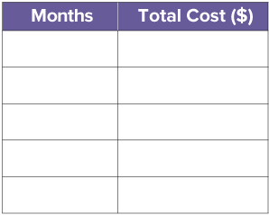
The Cost of Fitness
The total cost depends on the number of months of membership.
We can use a table of values to show the total cost for various numbers of months.
How can you complete the table to show the total cost of being a member for different numbers of months?
TRY IT BEFORE YOU’RE SURE · Start even if you are not sure. A revised answer counts as much as a first-try answer.
19 / 49
Notes:
TEACH IN PRACTICE | Embedded facilitation | Lesson 9.3, slide 17 | TASK
Focus on the existing task: The total cost depends on the number of months of membership. We can use a table of values to show the total cost for various numbers of…
LAUNCH (T2/3/5): Use the displayed question. Give private thinking time; then A explains while B asks for evidence. Switch roles. Each student records their own reasoning.
LOOK FOR (T4): Where this task addresses it, students can define variables. Ask which feature of their work supports the claim.
RESPOND: If this task shows the lesson misconception—assuming every relationship has the form y = kx without checking the starting value—compare successive values and the starting amount in the existing table or graph. Have the student revise and explain the change. Use this support only where the concept occurs in the current task; otherwise respond to the displayed question.
RECHECK: If a gap is shared, revisit the existing representation together. If it is limited, give targeted support while others compare valid methods on the same task. Check the revision before moving on.
PARTICIPATION (T5/6/7): Think time before volunteers; accept a written, drawn or rehearsed entry. Students ask for evidence respectfully. Recognize a specific contribution or revision and check that both partners participate.
Source: BCPS Updated Instructional Framework Rubric (June 2020), TEACH 1–7. Earlier notes and answer keys are retained below.
EARLIER NOTES / EXISTING ANSWER KEY
Model briefly, then hand the thinking back: ask “Why does this step work?” before showing the next one.
Quick check before moving on — thumbs or whiteboards from everyone, not volunteers.
UIFR: TEACH 2 · TEACH 3 · TEACH 4.

Slide 20
The Cost of Fitness
The total cost depends on the number of months of membership.
Membership Cost
Months | Total Cost($)
1 | 24.95
2 | 49.90
3 | 74.85
4 | 99.80
10 | 249.50
JUSTIFY IT · Say it like this: “I know ______ because ______.”
What do you notice about the total cost?
Reveal:
It increases by $24.95 each month.
20 / 49
Notes:
TEACH IN PRACTICE | Embedded facilitation | Lesson 9.3, slide 18 | REVEAL
Focus on the existing task: The total cost depends on the number of months of membership. Reveal: It increases by $24.95 each month. What do you notice about the total cost?
LAUNCH (T2/3/5): If an existing answer cover is present, gather an attempt before revealing. If the explanation is already visible, ask students to reconstruct and justify it. Compare reasoning and explain a revision; preserve the reveal sequence.
LOOK FOR (T4): Where this task addresses it, students can define variables. Ask which feature of their work supports the claim.
RESPOND: If this task shows the lesson misconception—assuming every relationship has the form y = kx without checking the starting value—compare successive values and the starting amount in the existing table or graph. Have the student revise and explain the change. Use this support only where the concept occurs in the current task; otherwise respond to the displayed question.
RECHECK: If a gap is shared, revisit the existing representation together. If it is limited, give targeted support while others compare valid methods on the same task. Check the revision before moving on.
PARTICIPATION (T5/6/7): Think time before volunteers; accept a written, drawn or rehearsed entry. Students ask for evidence respectfully. Recognize a specific contribution or revision and check that both partners participate.
Source: BCPS Updated Instructional Framework Rubric (June 2020), TEACH 1–7. Earlier notes and answer keys are retained below.
EARLIER NOTES / EXISTING ANSWER KEY
Do not click yet: collect 2–3 student answers with reasons first.
Then click to remove the cover and have students compare their thinking to the reveal — “Is this what we said? Where is it different?”
Behind the cover: It increases by $24.95 each month.
UIFR: TEACH 3 · TEACH 4.

Slide 21
The Cost of Fitness
The total cost is the cost per month multiplied by the number of months.
How can you represent the relationship algebraically?
Record your reasoning before the reveal. Compare, then
explain any revision.
Reveal:
We can use an equation.
21 / 49
Notes:
TEACH IN PRACTICE | Embedded facilitation | Lesson 9.3, slide 19 | REVEAL
Focus on the existing task: Reveal: We can use an equation. The total cost is the cost per month multiplied by the number of months. How can you represent the relationship algebraically?
LAUNCH (T2/3/5): If an existing answer cover is present, gather an attempt before revealing. If the explanation is already visible, ask students to reconstruct and justify it. Compare reasoning and explain a revision; preserve the reveal sequence.
LOOK FOR (T4): Where this task addresses it, students can write and verify an equation. Ask which feature of their work supports the claim.
RESPOND: If this task shows the lesson misconception—assuming every relationship has the form y = kx without checking the starting value—compare successive values and the starting amount in the existing table or graph. Have the student revise and explain the change. Use this support only where the concept occurs in the current task; otherwise respond to the displayed question.
RECHECK: If a gap is shared, revisit the existing representation together. If it is limited, give targeted support while others compare valid methods on the same task. Check the revision before moving on.
PARTICIPATION (T5/6/7): Think time before volunteers; accept a written, drawn or rehearsed entry. Students ask for evidence respectfully. Recognize a specific contribution or revision and check that both partners participate.
Source: BCPS Updated Instructional Framework Rubric (June 2020), TEACH 1–7. Earlier notes and answer keys are retained below.
EARLIER NOTES / EXISTING ANSWER KEY
Do not click yet: collect 2–3 student answers with reasons first.
Then click to remove the cover and have students compare their thinking to the reveal — “Is this what we said? Where is it different?”
Behind the cover: We can use an equation.
UIFR: TEACH 3 · TEACH 4.

Slide 22
The Cost of Fitness
We can write an equation to represent the relationship between the quantities.
The total cost is the cost per month times the number of months.
What quantities can change, or vary? How can you represent these quantities?
Reveal:
The number of months and the total cost can change. We can represent them with variables.
22 / 49
Notes:
TEACH IN PRACTICE | Embedded facilitation | Lesson 9.3, slide 20 | REVEAL
Focus on the existing task: How can you represent these quantities?
LAUNCH (T2/3/5): If an existing answer cover is present, gather an attempt before revealing. If the explanation is already visible, ask students to reconstruct and justify it. Compare reasoning and explain a revision; preserve the reveal sequence.
LOOK FOR (T4): Where this task addresses it, students can write and verify an equation. Ask which feature of their work supports the claim.
RESPOND: If this task shows the lesson misconception—assuming every relationship has the form y = kx without checking the starting value—compare successive values and the starting amount in the existing table or graph. Have the student revise and explain the change. Use this support only where the concept occurs in the current task; otherwise respond to the displayed question.
RECHECK: If a gap is shared, revisit the existing representation together. If it is limited, give targeted support while others compare valid methods on the same task. Check the revision before moving on.
PARTICIPATION (T5/6/7): Think time before volunteers; accept a written, drawn or rehearsed entry. Students ask for evidence respectfully. Recognize a specific contribution or revision and check that both partners participate.
Source: BCPS Updated Instructional Framework Rubric (June 2020), TEACH 1–7. Earlier notes and answer keys are retained below.
EARLIER NOTES / EXISTING ANSWER KEY
Do not click yet: collect 2–3 student answers with reasons first.
Then click to remove the cover and have students compare their thinking to the reveal — “Is this what we said? Where is it different?”
Behind the cover: The number of months and the total cost can change. We can represent them with variables.
UIFR: TEACH 3 · TEACH 4.

Slide 23
STUDENT MOVES
Lesson 9-3
Your move
PROVE IT · Find the evidence in the problem that makes your answer right — not just the answer.
23 / 49

Slide 24
Let’s Explore More
What is the benefit of using a table of values or an equation to represent the number of months and total cost?
How would the equation, 4 1 2 p = 36 , change if they used wooden planks that were 6 inches wide instead of 4 1 2 inches wide?
Workspace
What does the total cost Miguel will spend on Recreation World membership depend on?
Workspace
STRUGGLE FIRST · Work on your own first. Stuck is allowed — try a second strategy before you ask.
24 / 49
Notes:
TEACH IN PRACTICE | Embedded facilitation | Lesson 9.3, slide 21 | PRACTICE
Focus on the existing task: Let’s Explore More What is the benefit of using a table of values or an equation to represent the number of months and total cost?
LAUNCH (T2/3/5): Use the displayed question. Give private thinking time; then A explains while B asks for evidence. Switch roles. Each student records their own reasoning.
LOOK FOR (T4): Where this task addresses it, students can write and verify an equation. Ask which feature of their work supports the claim.
RESPOND: If this task shows the lesson misconception—assuming every relationship has the form y = kx without checking the starting value—compare successive values and the starting amount in the existing table or graph. Have the student revise and explain the change. Use this support only where the concept occurs in the current task; otherwise respond to the displayed question.
RECHECK: If a gap is shared, revisit the existing representation together. If it is limited, give targeted support while others compare valid methods on the same task. Check the revision before moving on.
PARTICIPATION (T5/6/7): Think time before volunteers; accept a written, drawn or rehearsed entry. Students ask for evidence respectfully. Recognize a specific contribution or revision and check that both partners participate.
Source: BCPS Updated Instructional Framework Rubric (June 2020), TEACH 1–7. Earlier notes and answer keys are retained below.
EARLIER NOTES / EXISTING ANSWER KEY
Extension for partners or table groups — students choose their approach and use the workspace to show thinking.
Push with “Convince me,” and have two groups with different approaches share.
This is where students stretch past the worked example.
UIFR: TEACH 2 · TEACH 5.
UIFR FULL | Lesson-specific facilitation
TEACH 4-5 | Session 1 discussion and checkpoint (UIFR PDF pp. 11-12).
Collect a brief response from every student to the existing prompt before hearing volunteers. Partners take turns explaining and asking for evidence: “I understand ___; what supports ___?” Offer rehearsal or an annotated model for students who need language support. Each student records their own reasoning.
Look specifically for: assuming every relationship has the form y = kx without checking the starting value. If it appears, compare successive values and the starting amount in the existing table or graph; then ask the student to revise the same response and explain the change. If evidence is secure, have students compare a second valid pathway or state why their approach works. Choose the next step from the responses, not a preset pace.

Slide 25
LESSON 9.3 / DISCUSS THE TASK
Explain and compare
Use the task you just explored.
TAKE TURNS
How do the rate and any starting amount appear in both the representation and the equation?
Explain
“I know this because…”
Ask
“Where does your work show that?”
Point to evidence in your work.
Then compare your approach with a partner’s.
ANOTHER PATHWAY · Did anyone get there a different way? Put both pathways side by side and compare.
Listen to understand. Ask for evidence. Make room for every voice.
Notes:
TEACH IN PRACTICE | Embedded facilitation | Lesson 9.3, slide 22 | PRIOR_INSERT
Focus on the existing task: Point to evidence in your work. Then compare your approach with a partner’s. TAKE TURNS Explain “I know this because…” Ask “Where does your work show that?
CONNECT (T1/4): Ask students to restate the displayed goal or key idea and connect it to earlier work. Relevant lesson evidence: define variables; identify rate and any initial amount; write and verify an equation. Use only the criterion that matches the current session.
SHOW PROGRESS: Students point to their own existing work, explain what improved after feedback, and name a next step. Pair confidence ratings with actual evidence.
PARTICIPATION (T5/6/7): Think time before volunteers; accept a written, drawn or rehearsed entry. Students ask for evidence respectfully. Recognize a specific contribution or revision and check that both partners participate.
Source: BCPS Updated Instructional Framework Rubric (June 2020), TEACH 1–7.

Slide 26
The Cost of Fitness
The total cost depends on the number of months of membership.
Membership Cost
Months | Total Cost($)
1 | 24.95
2 | 49.90
3 | 74.85
4 | 99.80
10 | 249.50
ASK THE CLASS · Write one question about this that you could ask the class.
What do you notice about the total cost?
Reveal:
It increases by $24.95 each month.
26 / 49
Notes:
TEACH IN PRACTICE | Embedded facilitation | Lesson 9.3, slide 23 | REVEAL
Focus on the existing task: The total cost depends on the number of months of membership. Reveal: It increases by $24.95 each month. What do you notice about the total cost?
LAUNCH (T2/3/5): If an existing answer cover is present, gather an attempt before revealing. If the explanation is already visible, ask students to reconstruct and justify it. Compare reasoning and explain a revision; preserve the reveal sequence.
LOOK FOR (T4): Where this task addresses it, students can define variables. Ask which feature of their work supports the claim.
RESPOND: If this task shows the lesson misconception—assuming every relationship has the form y = kx without checking the starting value—compare successive values and the starting amount in the existing table or graph. Have the student revise and explain the change. Use this support only where the concept occurs in the current task; otherwise respond to the displayed question.
RECHECK: If a gap is shared, revisit the existing representation together. If it is limited, give targeted support while others compare valid methods on the same task. Check the revision before moving on.
PARTICIPATION (T5/6/7): Think time before volunteers; accept a written, drawn or rehearsed entry. Students ask for evidence respectfully. Recognize a specific contribution or revision and check that both partners participate.
Source: BCPS Updated Instructional Framework Rubric (June 2020), TEACH 1–7.

Slide 27

Collaborate and Connect
Each month, the total cost increases by $24.95.
Membership Cost
Months | Total Cost($)
1 | 24.95
2 | 49.90
3 | 74.85
4 | 99.80
10 | 249.50
How can you describe the relationship between the total cost and a given number of months?
Reveal:
The total cost is the cost per month, $24.95, times the number of months.
27 / 49
Notes:
TEACH IN PRACTICE | Embedded facilitation | Lesson 9.3, slide 24 | COLLABORATE
Focus on the existing task: Collaborate and Connect Each month, the total cost increases by $24.95. Reveal: The total cost is the cost per month, $24.95, times…
LAUNCH (T2/3/5): Use the displayed question. Give private thinking time; then A explains while B asks for evidence. Switch roles. Each student records their own reasoning.
LOOK FOR (T4): Where this task addresses it, students can define variables. Ask which feature of their work supports the claim.
RESPOND: If this task shows the lesson misconception—assuming every relationship has the form y = kx without checking the starting value—compare successive values and the starting amount in the existing table or graph. Have the student revise and explain the change. Use this support only where the concept occurs in the current task; otherwise respond to the displayed question.
RECHECK: If a gap is shared, revisit the existing representation together. If it is limited, give targeted support while others compare valid methods on the same task. Check the revision before moving on.
PARTICIPATION (T5/6/7): Think time before volunteers; accept a written, drawn or rehearsed entry. Students ask for evidence respectfully. Recognize a specific contribution or revision and check that both partners participate.
Source: BCPS Updated Instructional Framework Rubric (June 2020), TEACH 1–7.

Slide 28
The Cost of Fitness
We can write an equation to represent the relationship between the quantities.
The total cost is the cost per month times the number of months.
What quantities can change, or vary? How can you represent these quantities?
Reveal:
The number of months and the total cost can change. We can represent them with variables.
28 / 49
Notes:
TEACH IN PRACTICE | Embedded facilitation | Lesson 9.3, slide 25 | REVEAL
Focus on the existing task: How can you represent these quantities?
LAUNCH (T2/3/5): If an existing answer cover is present, gather an attempt before revealing. If the explanation is already visible, ask students to reconstruct and justify it. Compare reasoning and explain a revision; preserve the reveal sequence.
LOOK FOR (T4): Where this task addresses it, students can write and verify an equation. Ask which feature of their work supports the claim.
RESPOND: If this task shows the lesson misconception—assuming every relationship has the form y = kx without checking the starting value—compare successive values and the starting amount in the existing table or graph. Have the student revise and explain the change. Use this support only where the concept occurs in the current task; otherwise respond to the displayed question.
RECHECK: If a gap is shared, revisit the existing representation together. If it is limited, give targeted support while others compare valid methods on the same task. Check the revision before moving on.
PARTICIPATION (T5/6/7): Think time before volunteers; accept a written, drawn or rehearsed entry. Students ask for evidence respectfully. Recognize a specific contribution or revision and check that both partners participate.
Source: BCPS Updated Instructional Framework Rubric (June 2020), TEACH 1–7.

Slide 29
STUDENT MOVES
Lesson 9-3
Your moves
ADD ON · Add on: “I agree because ______.” or “I see it differently because ______.”
TAKE TURNS · One explains, one asks a question. Then switch, so both of you talk.
29 / 49

Slide 30
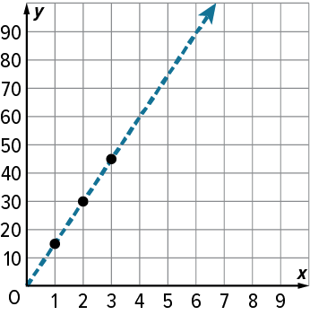
Be Curious
What do you notice?
What do you wonder?
Think first. Share a notice and a question;
build on a classmate’s idea.
Mindset
How are you showing others that you respect their ideas about math?​
30 / 49
Notes:
TEACH IN PRACTICE | Embedded facilitation | Lesson 9.3, slide 26 | CURIOUS
Focus on the existing task: Be Curious What do you notice?
LAUNCH (T2/3/5): Allow quiet observation first. Separate a notice from an inference, invite students’ own questions, and follow the existing launch before teaching a procedure.
LOOK FOR (T4): Where this task addresses it, students can define variables. Ask which feature of their work supports the claim.
RESPOND: If this task shows the lesson misconception—assuming every relationship has the form y = kx without checking the starting value—compare successive values and the starting amount in the existing table or graph. Have the student revise and explain the change. Use this support only where the concept occurs in the current task; otherwise respond to the displayed question.
RECHECK: If a gap is shared, revisit the existing representation together. If it is limited, give targeted support while others compare valid methods on the same task. Check the revision before moving on.
PARTICIPATION (T5/6/7): Think time before volunteers; accept a written, drawn or rehearsed entry. Students ask for evidence respectfully. Recognize a specific contribution or revision and check that both partners participate.
Source: BCPS Updated Instructional Framework Rubric (June 2020), TEACH 1–7.

Slide 31
Session 2 Warm-Up
Lesson 9-3 · Write Equations to Represent Relationships Between Two Variables
Session 2 Warm-Up
Check what you remember from Session 1 · about 4 minutes
1
If y is 4 times x, which equation represents the relationship?
2
In the equation d = 50t, what is the speed (unit rate)?
A
y = x + 4
A
t
B
y = 4x
B
50
C
x = 4y
C
d
D
y = x ÷ 4
D
500
3
If distance d = 50t, how far do you travel in t = 3 hours?
4
Equations relating two variables are typically written as:
A
53 miles
A
x = y + 0
B
150 miles
B
y = (rule involving x)
C
100 miles
C
x × y = 0
D
17 miles
D
Constants only
eduwonderlab.com · Neft Teacher
31 / 49
Notes:
TEACH IN PRACTICE | Embedded facilitation | Lesson 9.3, slide 27 | WARMUP
Focus on the existing task: A y = x + 4 B y = 4x C x = 4y D y = x ÷ 4 2 In the equation d = 50t, what is the speed (unit rate)?
GATHER EVIDENCE (T4/6): Keep the original items. Students try independently, mark an uncertain item, and explain one method before checking. Use the existing key when present.
RESPOND: Distinguish a calculation slip from a reasoning gap. Give one next step on the same item; have students revise in a second color. Use the responses to choose flexible support for today’s lesson.
PARTICIPATION (T5/6/7): Think time before volunteers; accept a written, drawn or rehearsed entry. Students ask for evidence respectfully. Recognize a specific contribution or revision and check that both partners participate.
Source: BCPS Updated Instructional Framework Rubric (June 2020), TEACH 1–7. Earlier notes and answer keys are retained below.
EARLIER NOTES / EXISTING ANSWER KEY
Warm-up routine: students start silently on entry; keep it to about 4 minutes.
Circulate and note who is stuck — use what you see to choose who you check on first today.
Go over answers quickly; ask one student to explain a step, not just say the answer.
UIFR: TEACH 4 · TEACH 6.
UIFR FULL | Lesson-specific facilitation
TEACH 1 | Session 2 purpose and evidence (UIFR PDF p. 8).
Have students restate the displayed session goal in their own words and connect it to the existing context or a familiar experience they choose to share. Use the current session goal to select from these lesson-wide evidence criteria; do not frontload a later-session procedure.
Look for: define variables; identify rate and any initial amount; write and verify an equation. Ask: “Which part of your work would show this?” Revisit that evidence after the task; a confidence rating alone is not evidence of understanding.

Slide 32
STUDENT MOVES
Lesson 9-3
Your move
YOU KNOW THE ROUTINE · Read → plan → solve → check. Do all four, in that order.
32 / 49

Slide 33
Today’s Math Notes
Lesson 9-3 · Write Equations to Represent Relationships Between Two Variables
Review Notes — Session 2
Copy. Explain. Check.
WHY IT MATTERS · Finish this: “This is worth knowing because ______.”
Writing Equations
1
Express the dependent variable in terms of the independent variable: y = kx or y = x + c.
Multiplicative Rules
2
When y is formed by multiplying x by a constant rate k: y = kx.
Additive Rules
3
When y is formed by adding a starting value or offset c to x: y = x + c.
eduwonderlab.com · Neft Teacher
33 / 49
Notes:
TEACH IN PRACTICE | Embedded facilitation | Lesson 9.3, slide 28 | NOTES
Focus on the existing task: Today’s Math Notes Review…
ROUTINE (T1/2/4): Read or copy the original notes, cover one line, and explain it using the displayed example. Reopen and correct. Copying alone is not evidence of understanding.
LOOK FOR: A link between a symbol, quantity or feature and the explanation. If missing, point back to that feature and have the student try again; fade the prompt once they can explain.
PARTICIPATION (T5/6/7): Think time before volunteers; accept a written, drawn or rehearsed entry. Students ask for evidence respectfully. Recognize a specific contribution or revision and check that both partners participate.
Source: BCPS Updated Instructional Framework Rubric (June 2020), TEACH 1–7. Earlier notes and answer keys are retained below.
EARLIER NOTES / EXISTING ANSWER KEY
Copy routine: read one line at a time; students copy, then explain that line to a partner.
Keep it brisk — the understanding work happens in the examples, not the copying.
UIFR: TEACH 1 · TEACH 6.

Slide 34
Session 2
Write Equations to Represent Relationships Between Two Variables
USE THE MATH WORDS · Use today’s math words in your explanation — not “it” and “that thing.”
34 / 49
Notes:
TEACH IN PRACTICE | Embedded facilitation | Lesson 9.3, slide 29 | DIVIDER
Focus on the existing task: Write Equations to Represent Relationships Between Two Variables Session 2
TRANSITION (T6/7): Students confirm materials, roles, how to request help, and the next response routine. Ask a student to restate it. Keep teacher-only slides hidden.
PARTICIPATION (T5/6/7): Think time before volunteers; accept a written, drawn or rehearsed entry. Students ask for evidence respectfully. Recognize a specific contribution or revision and check that both partners participate.
Source: BCPS Updated Instructional Framework Rubric (June 2020), TEACH 1–7. Earlier notes and answer keys are retained below.
EARLIER NOTES / EXISTING ANSWER KEY
Transition cue: state what materials are out and what success looks like this session.
Keep the changeover under a minute.
UIFR: TEACH 6.

Slide 35

Canoe Rental
Some friends want to rent a canoe for a few hours. The sign shows the rental cost.
How can the friends determine how much money they need to rent a canoe for any number of hours?
Think and record first. Which part of your work supports your answer?
Applying
35 / 49
Notes:
TEACH IN PRACTICE | Embedded facilitation | Lesson 9.3, slide 30 | TASK
Focus on the existing task: Canoe Rental Some friends want to rent a canoe for a few hours. The sign shows the rental cost. How can the friends determine how much money they need to rent a canoe for any number of hours?
LAUNCH (T2/3/5): Use the displayed question. Give private thinking time; then A explains while B asks for evidence. Switch roles. Each student records their own reasoning.
LOOK FOR (T4): Where this task addresses it, students can define variables. Ask which feature of their work supports the claim.
RESPOND: If this task shows the lesson misconception—assuming every relationship has the form y = kx without checking the starting value—compare successive values and the starting amount in the existing table or graph. Have the student revise and explain the change. Use this support only where the concept occurs in the current task; otherwise respond to the displayed question.
RECHECK: If a gap is shared, revisit the existing representation together. If it is limited, give targeted support while others compare valid methods on the same task. Check the revision before moving on.
PARTICIPATION (T5/6/7): Think time before volunteers; accept a written, drawn or rehearsed entry. Students ask for evidence respectfully. Recognize a specific contribution or revision and check that both partners participate.
Source: BCPS Updated Instructional Framework Rubric (June 2020), TEACH 1–7. Earlier notes and answer keys are retained below.
EARLIER NOTES / EXISTING ANSWER KEY
Model briefly, then hand the thinking back: ask “Why does this step work?” before showing the next one.
Quick check before moving on — thumbs or whiteboards from everyone, not volunteers.
UIFR: TEACH 2 · TEACH 3 · TEACH 4.
UIFR FULL | Lesson-specific facilitation
TEACH 2-3 | Session 2 task launch (UIFR PDF pp. 9-10).
Use the problem exactly as displayed. Give individual thinking time before discussion or advancing to the explanation. If the answer is already visible, ask students to reconstruct and justify it. Invite a choice of suitable representations and have students explain why their choice helps.
At the point where this concept appears, ask: “How do the rate and any starting amount appear in both the representation and the equation?” Wait for evidence, invite another pathway, and have a student ask a follow-up question. Do not replace students’ reasoning with a sequence of leading steps.

Slide 36
Canoe Rental
Some friends want to rent a canoe for a few hours. The sign shows the rental costs. How can the friends determine how much money they need to rent a canoe for any number of hours?
What are the quantities in the situation? Which quantity is the independent variable, and which is the dependent variable?
Reveal:
The quantities are the time of the canoe rental, the independent variable, and the total cost of the rental, the dependent variable.
36 / 49
Notes:
TEACH IN PRACTICE | Embedded facilitation | Lesson 9.3, slide 31 | REVEAL
Focus on the existing task: Canoe Rental Some friends want to rent a canoe for a few hours. The sign shows the rental costs. How can the friends determine how much money they need to rent a canoe for any number of hours?
LAUNCH (T2/3/5): If an existing answer cover is present, gather an attempt before revealing. If the explanation is already visible, ask students to reconstruct and justify it. Compare reasoning and explain a revision; preserve the reveal sequence.
LOOK FOR (T4): Where this task addresses it, students can define variables. Ask which feature of their work supports the claim.
RESPOND: If this task shows the lesson misconception—assuming every relationship has the form y = kx without checking the starting value—compare successive values and the starting amount in the existing table or graph. Have the student revise and explain the change. Use this support only where the concept occurs in the current task; otherwise respond to the displayed question.
RECHECK: If a gap is shared, revisit the existing representation together. If it is limited, give targeted support while others compare valid methods on the same task. Check the revision before moving on.
PARTICIPATION (T5/6/7): Think time before volunteers; accept a written, drawn or rehearsed entry. Students ask for evidence respectfully. Recognize a specific contribution or revision and check that both partners participate.
Source: BCPS Updated Instructional Framework Rubric (June 2020), TEACH 1–7. Earlier notes and answer keys are retained below.
EARLIER NOTES / EXISTING ANSWER KEY
Do not click yet: collect 2–3 student answers with reasons first.
Then click to remove the cover and have students compare their thinking to the reveal — “Is this what we said? Where is it different?”
Behind the cover: The quantities are the time of the canoe rental, the independent variable, and the total cost of the rental, the dependent variable.
UIFR: TEACH 3 · TEACH 4.

Slide 37
STUDENT MOVES
Lesson 9-3
Your move
TWO MINUTES SOLO · Two minutes on your own, then compare. Bring one thing you tried, even if it did not work.
37 / 49

Slide 38
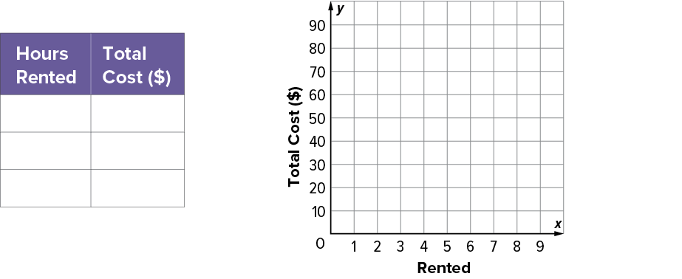
Canoe Rental
Let’s graph the relationship between the two quantities.
independent variable: hours of canoe rental
dependent variable: total cost of canoe rental
Read the labels and scale. Use a
point or feature to justify your
answer.
38 / 49
Notes:
TEACH IN PRACTICE | Embedded facilitation | Lesson 9.3, slide 32 | WORKED
Focus on the existing task: Canoe Rental Let’s graph the relationship between the two quantities. independent variable: hours of canoe rental dependent variable…
LAUNCH (T2/3/5): Ask students to explain the displayed idea or example and point to evidence. When a calculation step is shown, ask why it is valid. Have a partner restate the explanation; copying is not the check.
LOOK FOR (T4): Where this task addresses it, students can define variables. Ask which feature of their work supports the claim.
RESPOND: If this task shows the lesson misconception—assuming every relationship has the form y = kx without checking the starting value—compare successive values and the starting amount in the existing table or graph. Have the student revise and explain the change. Use this support only where the concept occurs in the current task; otherwise respond to the displayed question.
RECHECK: If a gap is shared, revisit the existing representation together. If it is limited, give targeted support while others compare valid methods on the same task. Check the revision before moving on.
PARTICIPATION (T5/6/7): Think time before volunteers; accept a written, drawn or rehearsed entry. Students ask for evidence respectfully. Recognize a specific contribution or revision and check that both partners participate.
Source: BCPS Updated Instructional Framework Rubric (June 2020), TEACH 1–7. Earlier notes and answer keys are retained below.
EARLIER NOTES / EXISTING ANSWER KEY
Model briefly, then hand the thinking back: ask “Why does this step work?” before showing the next one.
Quick check before moving on — thumbs or whiteboards from everyone, not volunteers.
UIFR: TEACH 2 · TEACH 3 · TEACH 4.

Slide 39
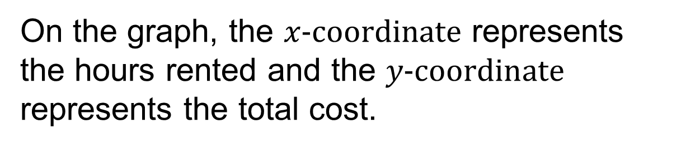
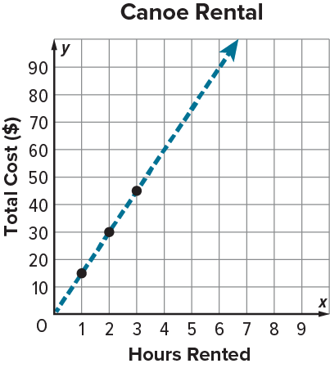
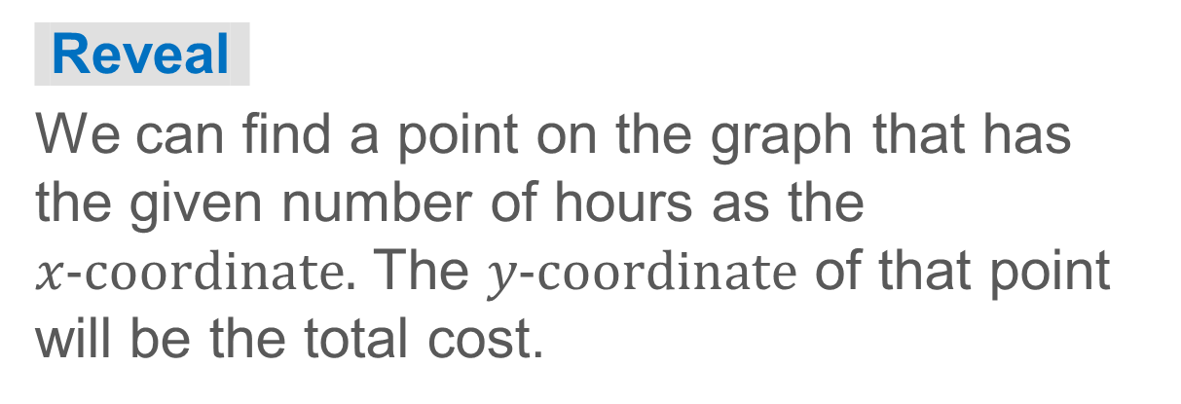
Canoe Rental
How can you use the graph to determine the total cost for a given number of hours?
39 / 49
Notes:
TEACH IN PRACTICE | Embedded facilitation | Lesson 9.3, slide 33 | TASK
Focus on the existing task: Canoe Rental How can you use the graph to determine the total cost for a given number of hours?
LAUNCH (T2/3/5): Use the displayed question. Give private thinking time; then A explains while B asks for evidence. Switch roles. Each student records their own reasoning.
LOOK FOR (T4): Where this task addresses it, students can define variables. Ask which feature of their work supports the claim.
RESPOND: If this task shows the lesson misconception—assuming every relationship has the form y = kx without checking the starting value—compare successive values and the starting amount in the existing table or graph. Have the student revise and explain the change. Use this support only where the concept occurs in the current task; otherwise respond to the displayed question.
RECHECK: If a gap is shared, revisit the existing representation together. If it is limited, give targeted support while others compare valid methods on the same task. Check the revision before moving on.
PARTICIPATION (T5/6/7): Think time before volunteers; accept a written, drawn or rehearsed entry. Students ask for evidence respectfully. Recognize a specific contribution or revision and check that both partners participate.
Source: BCPS Updated Instructional Framework Rubric (June 2020), TEACH 1–7. Earlier notes and answer keys are retained below.
EARLIER NOTES / EXISTING ANSWER KEY
Model briefly, then hand the thinking back: ask “Why does this step work?” before showing the next one.
Quick check before moving on — thumbs or whiteboards from everyone, not volunteers.
UIFR: TEACH 2 · TEACH 3 · TEACH 4.

Slide 40
Canoe Rental
We can also use an equation to represent the relationship between hours rented and total cost.
independent variable: hours of canoe rental
dependent variable: total cost of canoe rental
How can you describe in words how to find the total cost for any number of hours of canoe rental?
Reveal:
The total cost equals the hourly rental cost, $15, times the number of hours of canoe rental.
40 / 49
Notes:
TEACH IN PRACTICE | Embedded facilitation | Lesson 9.3, slide 34 | REVEAL
Focus on the existing task: Canoe Rental We can also use an equation to represent the relationship between hours rented and total cost. Reveal: The total cost…
LAUNCH (T2/3/5): If an existing answer cover is present, gather an attempt before revealing. If the explanation is already visible, ask students to reconstruct and justify it. Compare reasoning and explain a revision; preserve the reveal sequence.
LOOK FOR (T4): Where this task addresses it, students can write and verify an equation. Ask which feature of their work supports the claim.
RESPOND: If this task shows the lesson misconception—assuming every relationship has the form y = kx without checking the starting value—compare successive values and the starting amount in the existing table or graph. Have the student revise and explain the change. Use this support only where the concept occurs in the current task; otherwise respond to the displayed question.
RECHECK: If a gap is shared, revisit the existing representation together. If it is limited, give targeted support while others compare valid methods on the same task. Check the revision before moving on.
PARTICIPATION (T5/6/7): Think time before volunteers; accept a written, drawn or rehearsed entry. Students ask for evidence respectfully. Recognize a specific contribution or revision and check that both partners participate.
Source: BCPS Updated Instructional Framework Rubric (June 2020), TEACH 1–7. Earlier notes and answer keys are retained below.
EARLIER NOTES / EXISTING ANSWER KEY
Do not click yet: collect 2–3 student answers with reasons first.
Then click to remove the cover and have students compare their thinking to the reveal — “Is this what we said? Where is it different?”
Behind the cover: The total cost equals the hourly rental cost, $15, times the number of hours of canoe rental.
UIFR: TEACH 3 · TEACH 4.

Slide 41

Let’s Explore More
Which representation do you find most helpful when representing the relationship between two variables: a table, a graph, or an equation?
Workspace
How are the graph and equation related?
Workspace
41 / 49
Notes:
TEACH IN PRACTICE | Embedded facilitation | Lesson 9.3, slide 35 | PRACTICE
Focus on the existing task: Let’s Explore More Which representation do you find most helpful when representing the relationship between two variables: a table, a graph, or an equation?
LAUNCH (T2/3/5): Use the displayed question. Give private thinking time; then A explains while B asks for evidence. Switch roles. Each student records their own reasoning.
LOOK FOR (T4): Where this task addresses it, students can define variables. Ask which feature of their work supports the claim.
RESPOND: If this task shows the lesson misconception—assuming every relationship has the form y = kx without checking the starting value—compare successive values and the starting amount in the existing table or graph. Have the student revise and explain the change. Use this support only where the concept occurs in the current task; otherwise respond to the displayed question.
RECHECK: If a gap is shared, revisit the existing representation together. If it is limited, give targeted support while others compare valid methods on the same task. Check the revision before moving on.
PARTICIPATION (T5/6/7): Think time before volunteers; accept a written, drawn or rehearsed entry. Students ask for evidence respectfully. Recognize a specific contribution or revision and check that both partners participate.
Source: BCPS Updated Instructional Framework Rubric (June 2020), TEACH 1–7. Earlier notes and answer keys are retained below.
EARLIER NOTES / EXISTING ANSWER KEY
Extension for partners or table groups — students choose their approach and use the workspace to show thinking.
Push with “Convince me,” and have two groups with different approaches share.
This is where students stretch past the worked example.
UIFR: TEACH 2 · TEACH 5.
UIFR FULL | Lesson-specific facilitation
TEACH 4-5 | Session 2 discussion and checkpoint (UIFR PDF pp. 11-12).
Collect a brief response from every student to the existing prompt before hearing volunteers. Partners take turns explaining and asking for evidence: “I understand ___; what supports ___?” Offer rehearsal or an annotated model for students who need language support. Each student records their own reasoning.
Look specifically for: assuming every relationship has the form y = kx without checking the starting value. If it appears, compare successive values and the starting amount in the existing table or graph; then ask the student to revise the same response and explain the change. If evidence is secure, have students compare a second valid pathway or state why their approach works. Choose the next step from the responses, not a preset pace.

Slide 42
STUDENT MOVES
Lesson 9-3
Your moves
REVISE NOW · Change one answer and write why you changed it. A revision is evidence of learning.
YOUR CHOICE · You choose how to show this — numbers, words, or a diagram. Make your reasoning visible.
PICK YOUR STRATEGY · Choose your path — picture, table, number line, or equation — and be ready to say why you chose it.
42 / 49

Slide 43
LESSON 9.3 / CHECK YOUR WORK
Pause. Check. Improve.
CHECK
A mistake to watch for: assuming every relationship has the form y = kx without checking the starting value.
TRY
Compare successive values and the starting amount in the given table or graph.
REVISE
Use that check on the task you just completed. Correct or strengthen one part, and explain why.
SELF-CHECK · Mark it: ✓ got it · ~ almost · ? stuck. Then fix one thing before we move on.
Listen to understand. Ask for evidence. Make room for every voice.
Notes:
TEACH IN PRACTICE | Embedded facilitation | Lesson 9.3, slide 36 | PRIOR_INSERT
Focus on the existing task: LESSON 9.3 / CHECK YOUR WORK Pause. Check. Improve. Listen to understand. Ask for evidence. Make room for every voice. CHECK A mistake…
CONNECT (T1/4): Ask students to restate the displayed goal or key idea and connect it to earlier work. Relevant lesson evidence: define variables; identify rate and any initial amount; write and verify an equation. Use only the criterion that matches the current session.
SHOW PROGRESS: Students point to their own existing work, explain what improved after feedback, and name a next step. Pair confidence ratings with actual evidence.
PARTICIPATION (T5/6/7): Think time before volunteers; accept a written, drawn or rehearsed entry. Students ask for evidence respectfully. Recognize a specific contribution or revision and check that both partners participate.
Source: BCPS Updated Instructional Framework Rubric (June 2020), TEACH 1–7.

Slide 44
Canoe Rental
We can also use an equation to represent the relationship between hours rented and total cost.
independent variable: hours of canoe rental
dependent variable: total cost of canoe rental
How can you describe in words how to find the total cost for any number of hours of canoe rental?
Reveal:
The total cost equals the hourly rental cost, $15, times the number of hours of canoe rental.
44 / 49
Notes:
TEACH IN PRACTICE | Embedded facilitation | Lesson 9.3, slide 37 | REVEAL
Focus on the existing task: Canoe Rental We can also use an equation to represent the relationship between hours rented and total cost. Reveal: The total cost…
LAUNCH (T2/3/5): If an existing answer cover is present, gather an attempt before revealing. If the explanation is already visible, ask students to reconstruct and justify it. Compare reasoning and explain a revision; preserve the reveal sequence.
LOOK FOR (T4): Where this task addresses it, students can write and verify an equation. Ask which feature of their work supports the claim.
RESPOND: If this task shows the lesson misconception—assuming every relationship has the form y = kx without checking the starting value—compare successive values and the starting amount in the existing table or graph. Have the student revise and explain the change. Use this support only where the concept occurs in the current task; otherwise respond to the displayed question.
RECHECK: If a gap is shared, revisit the existing representation together. If it is limited, give targeted support while others compare valid methods on the same task. Check the revision before moving on.
PARTICIPATION (T5/6/7): Think time before volunteers; accept a written, drawn or rehearsed entry. Students ask for evidence respectfully. Recognize a specific contribution or revision and check that both partners participate.
Source: BCPS Updated Instructional Framework Rubric (June 2020), TEACH 1–7.

Slide 45
STUDENT MOVES
Lesson 9-3
Your move
STRUGGLE FIRST · Work on your own first. Stuck is allowed — try a second strategy before you ask.
45 / 49

Slide 46
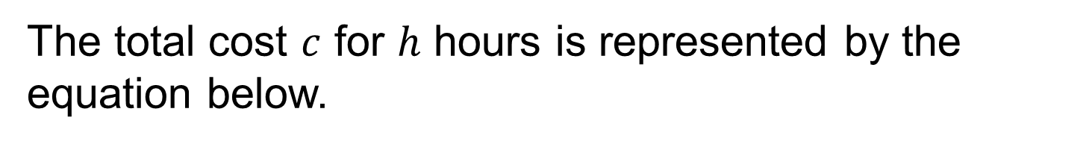
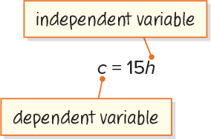
SUMMARIZE · SAY IT IN YOUR OWN WORDS
Summarize: Write Equations to Represent Relationships Between Two Quantities
You can write an equation to express the relationship between two quantities.
Explain the key idea without
reading. Use today’s example as
evidence.
46 / 49
Notes:
TEACH IN PRACTICE | Embedded facilitation | Lesson 9.3, slide 38 | SUMMARIZE
Focus on the existing task: Summarize: Write Equations to Represent Relationships Between Two Quantities You can write an equation to express the relationship…
CONNECT (T1/4): Ask students to restate the displayed goal or key idea and connect it to earlier work. Relevant lesson evidence: define variables; identify rate and any initial amount; write and verify an equation. Use only the criterion that matches the current session.
SHOW PROGRESS: Students point to their own existing work, explain what improved after feedback, and name a next step. Pair confidence ratings with actual evidence.
PARTICIPATION (T5/6/7): Think time before volunteers; accept a written, drawn or rehearsed entry. Students ask for evidence respectfully. Recognize a specific contribution or revision and check that both partners participate.
Source: BCPS Updated Instructional Framework Rubric (June 2020), TEACH 1–7. Earlier notes and answer keys are retained below.
EARLIER NOTES / EXISTING ANSWER KEY
Routine: SUMMARIZE · SAY IT IN YOUR OWN WORDS

Slide 47

APPLY · PLAN IT • SOLVE IT • PROVE IT
Apply: Music Downloads
Diamond is considering using the online music service shown to purchase or stream songs.
Question: Would you recommend that Diamond purchase or stream songs from the online music service?
Choose a method. Solve independently,
justify your answer, then check the goal.
47 / 49
Notes:
TEACH IN PRACTICE | Embedded facilitation | Lesson 9.3, slide 39 | APPLY
Focus on the existing task: Apply: Music Downloads Diamond is considering using the online music service shown to purchase or stream songs. Question: Would you…
LAUNCH (T2/3/5): Use the exact application task independently first. Ask students to justify their choice of method. Collect evidence before a partner discussion or correction.
LOOK FOR (T4): Where this task addresses it, students can define variables. Ask which feature of their work supports the claim.
RESPOND: If this task shows the lesson misconception—assuming every relationship has the form y = kx without checking the starting value—compare successive values and the starting amount in the existing table or graph. Have the student revise and explain the change. Use this support only where the concept occurs in the current task; otherwise respond to the displayed question.
RECHECK: If a gap is shared, revisit the existing representation together. If it is limited, give targeted support while others compare valid methods on the same task. Check the revision before moving on.
PARTICIPATION (T5/6/7): Think time before volunteers; accept a written, drawn or rehearsed entry. Students ask for evidence respectfully. Recognize a specific contribution or revision and check that both partners participate.
Source: BCPS Updated Instructional Framework Rubric (June 2020), TEACH 1–7. Earlier notes and answer keys are retained below.
EARLIER NOTES / EXISTING ANSWER KEY
Routine: APPLY · PLAN IT • SOLVE IT • PROVE IT
UIFR FULL | Lesson-specific facilitation
TEACH 4 | Independent evidence and revision (UIFR PDF p. 11).
Use the existing application/exit problem as the independent check. If this is a learning-target slide, have students point to and explain their work on the preceding task. Separate initial independent evidence from the revision after feedback.
Check the relevant criteria: define variables; identify rate and any initial amount; write and verify an equation. Respond with one specific next step tied to the work. Students revise and annotate what changed, then identify a criterion they can now demonstrate and one they still need to practice.

Slide 48
Learning Targets
I can write an equation from a table to model the relationship between the dependent and independent variables.
I can write an equation from a graph to model the relationship between the dependent and independent variables.
Point to evidence in your work. Name what improved and your next step.
48 / 49
Notes:
TEACH IN PRACTICE | Embedded facilitation | Lesson 9.3, slide 40 | REFLECTION
Focus on the existing task: Learning Targets I can write an equation from a table to model the relationship between the dependent and independent variables. I can…
CONNECT (T1/4): Ask students to restate the displayed goal or key idea and connect it to earlier work. Relevant lesson evidence: define variables; identify rate and any initial amount; write and verify an equation. Use only the criterion that matches the current session.
SHOW PROGRESS: Students point to their own existing work, explain what improved after feedback, and name a next step. Pair confidence ratings with actual evidence.
PARTICIPATION (T5/6/7): Think time before volunteers; accept a written, drawn or rehearsed entry. Students ask for evidence respectfully. Recognize a specific contribution or revision and check that both partners participate.
Source: BCPS Updated Instructional Framework Rubric (June 2020), TEACH 1–7. Earlier notes and answer keys are retained below.
EARLIER NOTES / EXISTING ANSWER KEY
UIFR FULL | Lesson-specific facilitation
REFLECT & ADJUST 1-2 | After the lesson (UIFR PDF pp. 15-16).
Sort the existing work by demonstrated reasoning, partial understanding, and the specific misconception: assuming every relationship has the form y = kx without checking the starting value. Compare the initial response with the revision. Record which teaching move plausibly helped, which did not, and whose participation or access needs a different approach; do not record sensitive student details in this shared deck.
Plan the next lesson from that evidence: if the misconception persists, compare successive values and the starting amount in the existing table or graph using the current example before returning to the next grade-level task; if understanding is secure, use an existing extension or ask for a general explanation. Check the targeted idea again at the next warm-up.
Ask students what supported their thinking and what would help next time. Identify one change to try and one successful practice to retain. Seek colleague feedback on anonymized work when useful; these prompts support reflection and do not establish an evaluation rating. Source: Baltimore City Public Schools, Updated Instructional Framework Rubric, June 2020 (UIFR_Full.pdf).

Slide 49
LESSON 9.3 / REFLECT ON YOUR LEARNING
Show your progress
1 SHOW EVIDENCE
2 CHOOSE A NEXT STEP
Choose one response. Point to the part that shows your reasoning.
Name a change you made after feedback—or a question you still have.
“My work shows ___ because ___.”
“Next time, I will ___ to help me ___.”
Today’s focus: Define variables.
CREDIT A CLASSMATE · Name one classmate whose idea helped you today, and say what they said.
Listen to understand. Ask for evidence. Make room for every voice.
Notes:
TEACH IN PRACTICE | Embedded facilitation | Lesson 9.3, slide 41 | PRIOR_INSERT
Focus on the existing task: LESSON 9.3 / REFLECT ON YOUR LEARNING Show your progress Listen to understand. Ask for evidence. Make room for every voice. 1 SHOW…
CONNECT (T1/4): Ask students to restate the displayed goal or key idea and connect it to earlier work. Relevant lesson evidence: define variables; identify rate and any initial amount; write and verify an equation. Use only the criterion that matches the current session.
SHOW PROGRESS: Students point to their own existing work, explain what improved after feedback, and name a next step. Pair confidence ratings with actual evidence.
PARTICIPATION (T5/6/7): Think time before volunteers; accept a written, drawn or rehearsed entry. Students ask for evidence respectfully. Recognize a specific contribution or revision and check that both partners participate.
Source: BCPS Updated Instructional Framework Rubric (June 2020), TEACH 1–7.

