Slide 1
WARM-UP · THINK • TRY • CHECK
Turn and talk: compare strategies, then defend one.
Warm-Up
Lesson 9-4 · Apply Two-Variable Relationships to Solve Problems | Warm-Up · about 4 minutes
Try each on your own. Mark an unsure answer; explain and revise when we check.
QUESTION 1
QUESTION 2
y = 4x. When x = 6, y = ______
5x = 45, so x = ______
QUESTION 3
QUESTION 4
1.5 × 6 = ______
Muffins cost $3 each. 8 muffins cost $______
TALK IT OVER: “I got ______ because ______.” • Compare with a partner before we check as a class.
1 / 40
Notes:
TEACH IN PRACTICE | Embedded facilitation | Lesson 9.4, slide 1 | WARMUP
Focus on the existing task: Warm-Up WARM-UP · THINK • TRY • CHECK…
GATHER EVIDENCE (T4/6): Keep the original items. Students try independently, mark an uncertain item, and explain one method before checking. Use the existing key when present.
RESPOND: Distinguish a calculation slip from a reasoning gap. Give one next step on the same item; have students revise in a second color. Use the responses to choose flexible support for today’s lesson.
PARTICIPATION (T5/6/7): Think time before volunteers; accept a written, drawn or rehearsed entry. Students ask for evidence respectfully. Recognize a specific contribution or revision and check that both partners participate.
Source: BCPS Updated Instructional Framework Rubric (June 2020), TEACH 1–7. Earlier notes and answer keys are retained below.
EARLIER NOTES / EXISTING ANSWER KEY
Warm-Up answers (teacher only): 1) 24 2) 9 3) 9 4) $24
UIFR FULL | Lesson-specific facilitation
PREPARE 1-2 | Before teaching (UIFR PDF pp. 6-7).
Plan to gather evidence that students can model the two quantities; solve for the requested value; interpret units and contextual constraints. Review recent work and today’s warm-up to choose flexible groups and access supports; do not infer needs from identity or perceived ability. Use the existing lesson tasks and stated standards.
Anticipate: rounding a required count down so that a stated goal is not met. If observed, substitute the proposed result back into the original relationship and check the requirement. Offer oral rehearsal, drawing, pointing, or home-language processing as needed; retain the original mathematical demand. Ask students which support helps and fade it as evidence improves.
TEACH 6-7 | Before the first transition, agree on materials, partner roles, and how to request help. Invite students to restate the routine. Normalize revising an idea, recognize a specific contribution, and check privately when frustration blocks participation. Source: UIFR PDF pp. 13-14.

Slide 2
Today’s Math Notes
Lesson 9-4 · Apply Two-Variable Relationships to Solve Problems
Section 1: Math Words
Copy. Explain. Check.
SAY THE GOAL · Say today’s goal in your own words, then name one place this shows up outside math class.
equation
1
A mathematical sentence with an equals sign
substitute
2
To replace a variable with a value you know
solution
3
The value that makes the equation true
eduwonderlab.com · Neft Teacher
2 / 40
Notes:
TEACH IN PRACTICE | Embedded facilitation | Lesson 9.4, slide 2 | NOTES
Focus on the existing task: Today’s Math Notes Section 1: Math Words…
ROUTINE (T1/2/4): Read or copy the original notes, cover one line, and explain it using the displayed example. Reopen and correct. Copying alone is not evidence of understanding.
LOOK FOR: A link between a symbol, quantity or feature and the explanation. If missing, point back to that feature and have the student try again; fade the prompt once they can explain.
PARTICIPATION (T5/6/7): Think time before volunteers; accept a written, drawn or rehearsed entry. Students ask for evidence respectfully. Recognize a specific contribution or revision and check that both partners participate.
Source: BCPS Updated Instructional Framework Rubric (June 2020), TEACH 1–7. Earlier notes and answer keys are retained below.
EARLIER NOTES / EXISTING ANSWER KEY
Copy routine: read one line at a time; students copy, then explain that line to a partner.
Keep it brisk — the understanding work happens in the examples, not the copying.
UIFR: TEACH 1 · TEACH 6.

Slide 3
Today’s Math Notes
Lesson 9-4 · Apply Two-Variable Relationships to Solve Problems
Section 2: Today’s Math
Copy. Explain. Check.
CONNECT IT · What earlier lesson does this build on? Tell a partner in one sentence.
Solving Problems with Two Variables
y = kx
Substitute what you know → solve for what you don’t
1
Define the variables and write the equation
2
Substitute the value you already know
3
Solve for the unknown, then check it against the situation: does the answer make sense?
eduwonderlab.com · Neft Teacher
3 / 40
Notes:
TEACH IN PRACTICE | Embedded facilitation | Lesson 9.4, slide 3 | NOTES
Focus on the existing task: Today’s Math Notes Section 2: Today’s…
ROUTINE (T1/2/4): Read or copy the original notes, cover one line, and explain it using the displayed example. Reopen and correct. Copying alone is not evidence of understanding.
LOOK FOR: A link between a symbol, quantity or feature and the explanation. If missing, point back to that feature and have the student try again; fade the prompt once they can explain.
PARTICIPATION (T5/6/7): Think time before volunteers; accept a written, drawn or rehearsed entry. Students ask for evidence respectfully. Recognize a specific contribution or revision and check that both partners participate.
Source: BCPS Updated Instructional Framework Rubric (June 2020), TEACH 1–7. Earlier notes and answer keys are retained below.
EARLIER NOTES / EXISTING ANSWER KEY
Copy routine: read one line at a time; students copy, then explain that line to a partner.
Keep it brisk — the understanding work happens in the examples, not the copying.
UIFR: TEACH 1 · TEACH 6.

Slide 4
Session 1
Apply Two-Variable Relationships to Solve Problems
TRY IT BEFORE YOU’RE SURE · Start even if you are not sure. A revised answer counts as much as a first-try answer.
4 / 40
Notes:
TEACH IN PRACTICE | Embedded facilitation | Lesson 9.4, slide 4 | DIVIDER
Focus on the existing task: Apply Two-Variable Relationships to Solve Problems Session 1
TRANSITION (T6/7): Students confirm materials, roles, how to request help, and the next response routine. Ask a student to restate it. Keep teacher-only slides hidden.
PARTICIPATION (T5/6/7): Think time before volunteers; accept a written, drawn or rehearsed entry. Students ask for evidence respectfully. Recognize a specific contribution or revision and check that both partners participate.
Source: BCPS Updated Instructional Framework Rubric (June 2020), TEACH 1–7. Earlier notes and answer keys are retained below.
EARLIER NOTES / EXISTING ANSWER KEY
Transition cue: state what materials are out and what success looks like this session.
Keep the changeover under a minute.
UIFR: TEACH 6.

Slide 5
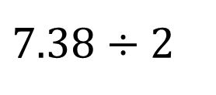
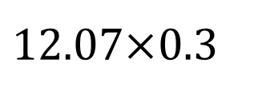
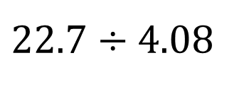
More or Less Than…
More or Less Than 5
$$\text{7.}\text{3}\text{8}÷\text{2}$$
$$12\text{.}\text{07}\text{×}\text{0.3}$$
$$\text{2}\text{2}\text{.7}÷\text{4.0}\text{8}$$
Explain how the information shown supports your reasoning.
5 / 40
Notes:
TEACH IN PRACTICE | Embedded facilitation | Lesson 9.4, slide 5 | WORKED
Focus on the existing task: More or Less Than… More or Less Than 5
LAUNCH (T2/3/5): Ask students to explain the displayed idea or example and point to evidence. When a calculation step is shown, ask why it is valid. Have a partner restate the explanation; copying is not the check.
LOOK FOR (T4): Where this task addresses it, students can model the two quantities. Ask which feature of their work supports the claim.
RESPOND: If this task shows the lesson misconception—rounding a required count down so that a stated goal is not met—substitute the proposed result back into the original relationship and check the requirement. Have the student revise and explain the change. Use this support only where the concept occurs in the current task; otherwise respond to the displayed question.
RECHECK: If a gap is shared, revisit the existing representation together. If it is limited, give targeted support while others compare valid methods on the same task. Check the revision before moving on.
PARTICIPATION (T5/6/7): Think time before volunteers; accept a written, drawn or rehearsed entry. Students ask for evidence respectfully. Recognize a specific contribution or revision and check that both partners participate.
Source: BCPS Updated Instructional Framework Rubric (June 2020), TEACH 1–7. Earlier notes and answer keys are retained below.
EARLIER NOTES / EXISTING ANSWER KEY
Number-sense routine — every voice in. Give quiet think time, then hear from at least three students.
Always follow with “How do you know?” — the reasoning is the point, not the answer.
There is more than one path; name and celebrate different strategies.
UIFR: TEACH 3 · TEACH 5 · TEACH 6.

Slide 6
Today’s Objectives
Lesson 9-4 · Apply Two-Variable Relationships to Solve Problems
Apply Two-Variable Relationships to Solve Problems
Maryland Standard 6.AT.11
CONTENT OBJECTIVE
LANGUAGE OBJECTIVE
Restate the goal in your words
Use these words to explain why
I can write an equation to represent the relationship between two quantities and use it to solve a problem.
I can define my variables and justify my answer using the words equation, variable, substitute, and solution.
eduwonderlab.com · Neft Teacher
6 / 40
Notes:
TEACH IN PRACTICE | Embedded facilitation | Lesson 9.4, slide 6 | GOAL
Focus on the existing task: Today’s Objectives Apply Two-Variable…
CONNECT (T1/4): Ask students to restate the displayed goal or key idea and connect it to earlier work. Relevant lesson evidence: model the two quantities; solve for the requested value; interpret units and contextual constraints. Use only the criterion that matches the current session.
SHOW PROGRESS: Students point to their own existing work, explain what improved after feedback, and name a next step. Pair confidence ratings with actual evidence.
PARTICIPATION (T5/6/7): Think time before volunteers; accept a written, drawn or rehearsed entry. Students ask for evidence respectfully. Recognize a specific contribution or revision and check that both partners participate.
Source: BCPS Updated Instructional Framework Rubric (June 2020), TEACH 1–7. Earlier notes and answer keys are retained below.
EARLIER NOTES / EXISTING ANSWER KEY
Read the objective together, then have one or two students restate today’s goal in their own words.
Connect it to what the class learned last lesson.
Return to this goal at the end of class to check it was met.
UIFR: TEACH 1.
UIFR FULL | Lesson-specific facilitation
TEACH 1 | Session 1 purpose and evidence (UIFR PDF p. 8).
Have students restate the displayed session goal in their own words and connect it to the existing context or a familiar experience they choose to share. Use the current session goal to select from these lesson-wide evidence criteria; do not frontload a later-session procedure.
Look for: model the two quantities; solve for the requested value; interpret units and contextual constraints. Ask: “Which part of your work would show this?” Revisit that evidence after the task; a confidence rating alone is not evidence of understanding.

Slide 7
STUDENT MOVES
Lesson 9-4
Your move
NAME THE MATH · Point to the part of this that is new today, and say what it changes.
7 / 40

Slide 8
LESSON 9.4 / OUR LEARNING
What will show your learning?
1
Model the two quantities.
2
Solve for the requested value.
3
Interpret units and contextual constraints.
Tell a partner: Which skill connects to something you already know?
SHOW YOUR THINKING · Show what you know — write it, draw it, or build it. A picture counts as an explanation.
Listen to understand. Ask for evidence. Make room for every voice.
Notes:
TEACH IN PRACTICE | Embedded facilitation | Lesson 9.4, slide 7 | PRIOR_INSERT
Focus on the existing task: LESSON 9.4 / OUR LEARNING What will show your learning?
CONNECT (T1/4): Ask students to restate the displayed goal or key idea and connect it to earlier work. Relevant lesson evidence: model the two quantities; solve for the requested value; interpret units and contextual constraints. Use only the criterion that matches the current session.
SHOW PROGRESS: Students point to their own existing work, explain what improved after feedback, and name a next step. Pair confidence ratings with actual evidence.
PARTICIPATION (T5/6/7): Think time before volunteers; accept a written, drawn or rehearsed entry. Students ask for evidence respectfully. Recognize a specific contribution or revision and check that both partners participate.
Source: BCPS Updated Instructional Framework Rubric (June 2020), TEACH 1–7.

Slide 9
Vocabulary
Lesson 9-4 · Apply Two-Variable Relationships to Solve Problems
Today’s Math Words
We learn every word — what it means and what it looks like — before we use it.
equation
variable
A mathematical sentence with an equals sign that shows two amounts are the same
A letter that represents a quantity that can change, or vary
substitute
solution
To replace a variable with a value you already know
The value of the variable that makes the equation true
rate
A fixed amount of one quantity for every one unit of the other quantity
Explain one math word using the example.
Partner: point to evidence.
eduwonderlab.com · Neft Teacher
9 / 40
Notes:
TEACH IN PRACTICE | Embedded facilitation | Lesson 9.4, slide 8 | VOCAB
Focus on the existing task: Vocabulary Today’s Math Words We learn…
ASK (T1/3/5): Where does “the displayed term” appear in the example? Explain the meaning without reading the definition. Partner: restate the idea and ask a clarifying question.
LOOK FOR: A correct connection between the word and a feature of the example. If the student only repeats the definition, invite pointing, sketching or oral rehearsal, then ask for another explanation of this same example.
PARTICIPATION (T5/6/7): Think time before volunteers; accept a written, drawn or rehearsed entry. Students ask for evidence respectfully. Recognize a specific contribution or revision and check that both partners participate.
Source: BCPS Updated Instructional Framework Rubric (June 2020), TEACH 1–7. Earlier notes and answer keys are retained below.
EARLIER NOTES / EXISTING ANSWER KEY
Choral-read each word, its meaning, and what it looks like.
Students should use these words out loud today — listen for them in partner talk and revoice student ideas with the academic term.
UIFR: TEACH 1 · TEACH 5.

Slide 10
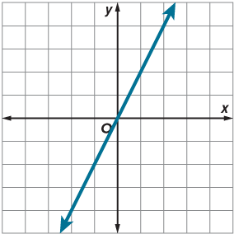


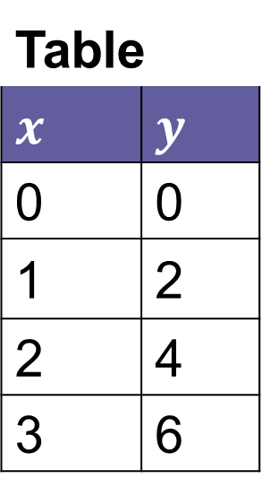
Be Curious
How are they the same?
How are they different?
A
B
C
$$y=2x$$
Table
$$x$$ | $$y$$
0 | 0
1 | 2
2 | 4
3 | 6
Mindset
HOW DO YOU KNOW? · Ask your partner “How do you know?” Answer by pointing to your own work.
What positive feedback can you give a classmate?
10 / 40
Notes:
TEACH IN PRACTICE | Embedded facilitation | Lesson 9.4, slide 9 | CURIOUS
Focus on the existing task: Mindset What positive feedback can you give a classmate?
LAUNCH (T2/3/5): Allow quiet observation first. Separate a notice from an inference, invite students’ own questions, and follow the existing launch before teaching a procedure.
LOOK FOR (T4): Where this task addresses it, students can model the two quantities. Ask which feature of their work supports the claim.
RESPOND: If this task shows the lesson misconception—rounding a required count down so that a stated goal is not met—substitute the proposed result back into the original relationship and check the requirement. Have the student revise and explain the change. Use this support only where the concept occurs in the current task; otherwise respond to the displayed question.
RECHECK: If a gap is shared, revisit the existing representation together. If it is limited, give targeted support while others compare valid methods on the same task. Check the revision before moving on.
PARTICIPATION (T5/6/7): Think time before volunteers; accept a written, drawn or rehearsed entry. Students ask for evidence respectfully. Recognize a specific contribution or revision and check that both partners participate.
Source: BCPS Updated Instructional Framework Rubric (June 2020), TEACH 1–7. Earlier notes and answer keys are retained below.
EARLIER NOTES / EXISTING ANSWER KEY
Accept all noticings and wonderings — there are no wrong answers here.
Give 20–30 seconds of quiet think time before taking responses; mix cold and warm calls so it is not always the same voices.
Read the mindset question aloud and let two students respond.
UIFR: TEACH 3 · TEACH 7.

Slide 11
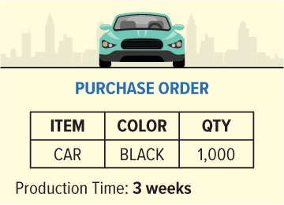
Automobile Manufacturing
An assembly line at an automobile manufacturing plant is run in 8-hour shifts and produces 2.5 cars per hour. The manufacturer has received the order shown.
Should the manufacturer accept the order?
Making Sense
Think and record first. Which part of your work supports your answer?
11 / 40
Notes:
TEACH IN PRACTICE | Embedded facilitation | Lesson 9.4, slide 10 | TASK
Focus on the existing task: Automobile Manufacturing An assembly line at an automobile manufacturing plant is run in 8-hour shifts and produces 2.5 cars per hour. The…
LAUNCH (T2/3/5): Use the displayed question. Give private thinking time; then A explains while B asks for evidence. Switch roles. Each student records their own reasoning.
LOOK FOR (T4): Where this task addresses it, students can model the two quantities. Ask which feature of their work supports the claim.
RESPOND: If this task shows the lesson misconception—rounding a required count down so that a stated goal is not met—substitute the proposed result back into the original relationship and check the requirement. Have the student revise and explain the change. Use this support only where the concept occurs in the current task; otherwise respond to the displayed question.
RECHECK: If a gap is shared, revisit the existing representation together. If it is limited, give targeted support while others compare valid methods on the same task. Check the revision before moving on.
PARTICIPATION (T5/6/7): Think time before volunteers; accept a written, drawn or rehearsed entry. Students ask for evidence respectfully. Recognize a specific contribution or revision and check that both partners participate.
Source: BCPS Updated Instructional Framework Rubric (June 2020), TEACH 1–7. Earlier notes and answer keys are retained below.
EARLIER NOTES / EXISTING ANSWER KEY
Read the context aloud (or have a student read it).
Before any math, students restate the situation and what is being asked in their own words.
Ask: Should the manufacturer accept the order?
UIFR: TEACH 1 · TEACH 3.
UIFR FULL | Lesson-specific facilitation
TEACH 2-3 | Session 1 task launch (UIFR PDF pp. 9-10).
Use the problem exactly as displayed. Give individual thinking time before discussion or advancing to the explanation. If the answer is already visible, ask students to reconstruct and justify it. Invite a choice of suitable representations and have students explain why their choice helps.
At the point where this concept appears, ask: “Does your numerical result satisfy the real-world constraint, and what does a partial unit mean here?” Wait for evidence, invite another pathway, and have a student ask a follow-up question. Do not replace students’ reasoning with a sequence of leading steps.

Slide 12
Automobile Manufacturing
An assembly line at an automobile manufacturing plant is run in 8-hour shifts and produces 2.5 cars per hour. The manufacturer has received the order shown. Should the manufacturer accept the order?
What information do you need to know to determine whether the manufacturer should accept the order?
Reveal:
We need to know whether the plant can produce 1,000 cars in 3 weeks or less.
12 / 40
Notes:
TEACH IN PRACTICE | Embedded facilitation | Lesson 9.4, slide 11 | REVEAL
Focus on the existing task: What information do you need to know to determine whether the manufacturer should accept the order?
LAUNCH (T2/3/5): If an existing answer cover is present, gather an attempt before revealing. If the explanation is already visible, ask students to reconstruct and justify it. Compare reasoning and explain a revision; preserve the reveal sequence.
LOOK FOR (T4): Where this task addresses it, students can model the two quantities. Ask which feature of their work supports the claim.
RESPOND: If this task shows the lesson misconception—rounding a required count down so that a stated goal is not met—substitute the proposed result back into the original relationship and check the requirement. Have the student revise and explain the change. Use this support only where the concept occurs in the current task; otherwise respond to the displayed question.
RECHECK: If a gap is shared, revisit the existing representation together. If it is limited, give targeted support while others compare valid methods on the same task. Check the revision before moving on.
PARTICIPATION (T5/6/7): Think time before volunteers; accept a written, drawn or rehearsed entry. Students ask for evidence respectfully. Recognize a specific contribution or revision and check that both partners participate.
Source: BCPS Updated Instructional Framework Rubric (June 2020), TEACH 1–7. Earlier notes and answer keys are retained below.
EARLIER NOTES / EXISTING ANSWER KEY
Do not click yet: collect 2–3 student answers with reasons first.
Then click to remove the cover and have students compare their thinking to the reveal — “Is this what we said? Where is it different?”
Behind the cover: We need to know whether the plant can produce 1,000 cars in 3 weeks or less.
UIFR: TEACH 3 · TEACH 4.

Slide 13
Automobile Manufacturing
We can analyze the quantities to make sense of the problem.
An assembly line at an automobile manufacturing plant is run in 8-hour shifts and produces 2.5 cars per hour.
How do the quantities in the problem—time, in hours, and the number of cars produced—relate?
Reveal:
The number of cars produced depends on the number of hours of operation. Every hour, the plant produces 2.5 cars.
13 / 40
Notes:
TEACH IN PRACTICE | Embedded facilitation | Lesson 9.4, slide 12 | REVEAL
Focus on the existing task: Automobile Manufacturing Reveal: The number of cars produced depends on the number of hours of operation. Every hour, the plant…
LAUNCH (T2/3/5): If an existing answer cover is present, gather an attempt before revealing. If the explanation is already visible, ask students to reconstruct and justify it. Compare reasoning and explain a revision; preserve the reveal sequence.
LOOK FOR (T4): Where this task addresses it, students can model the two quantities. Ask which feature of their work supports the claim.
RESPOND: If this task shows the lesson misconception—rounding a required count down so that a stated goal is not met—substitute the proposed result back into the original relationship and check the requirement. Have the student revise and explain the change. Use this support only where the concept occurs in the current task; otherwise respond to the displayed question.
RECHECK: If a gap is shared, revisit the existing representation together. If it is limited, give targeted support while others compare valid methods on the same task. Check the revision before moving on.
PARTICIPATION (T5/6/7): Think time before volunteers; accept a written, drawn or rehearsed entry. Students ask for evidence respectfully. Recognize a specific contribution or revision and check that both partners participate.
Source: BCPS Updated Instructional Framework Rubric (June 2020), TEACH 1–7. Earlier notes and answer keys are retained below.
EARLIER NOTES / EXISTING ANSWER KEY
Do not click yet: collect 2–3 student answers with reasons first.
Then click to remove the cover and have students compare their thinking to the reveal — “Is this what we said? Where is it different?”
Behind the cover: The number of cars produced depends on the number of hours of operation. Every hour, the plant produces 2.5 cars.
UIFR: TEACH 3 · TEACH 4.

Slide 14
Automobile Manufacturing
Cars Manufacturing
Number of Hours | Number of Cars Made
1 | 2.5
8 | 20
16 | 40
24 | 60
What can you say about the number of cars that are produced in each 8-hour shift?
Reveal:
The plant produces 20 cars in an 8-hour shift.
14 / 40
Notes:
TEACH IN PRACTICE | Embedded facilitation | Lesson 9.4, slide 13 | REVEAL
Focus on the existing task: Automobile Manufacturing Reveal: The plant produces 20 cars in an 8-hour shift. What can you say about the number of cars that are produced in each 8-hour shift?
LAUNCH (T2/3/5): If an existing answer cover is present, gather an attempt before revealing. If the explanation is already visible, ask students to reconstruct and justify it. Compare reasoning and explain a revision; preserve the reveal sequence.
LOOK FOR (T4): Where this task addresses it, students can model the two quantities. Ask which feature of their work supports the claim.
RESPOND: If this task shows the lesson misconception—rounding a required count down so that a stated goal is not met—substitute the proposed result back into the original relationship and check the requirement. Have the student revise and explain the change. Use this support only where the concept occurs in the current task; otherwise respond to the displayed question.
RECHECK: If a gap is shared, revisit the existing representation together. If it is limited, give targeted support while others compare valid methods on the same task. Check the revision before moving on.
PARTICIPATION (T5/6/7): Think time before volunteers; accept a written, drawn or rehearsed entry. Students ask for evidence respectfully. Recognize a specific contribution or revision and check that both partners participate.
Source: BCPS Updated Instructional Framework Rubric (June 2020), TEACH 1–7. Earlier notes and answer keys are retained below.
EARLIER NOTES / EXISTING ANSWER KEY
Do not click yet: collect 2–3 student answers with reasons first.
Then click to remove the cover and have students compare their thinking to the reveal — “Is this what we said? Where is it different?”
Behind the cover: The plant produces 20 cars in an 8-hour shift.
UIFR: TEACH 3 · TEACH 4.

Slide 15
STUDENT MOVES
Lesson 9-4
Your moves
TWO MINUTES SOLO · Two minutes on your own, then compare. Bring one thing you tried, even if it did not work.
ASK THE CLASS · Write one question about this that you could ask the class.
ADD ON · Add on: “I agree because ______.” or “I see it differently because ______.”
15 / 40

Slide 16
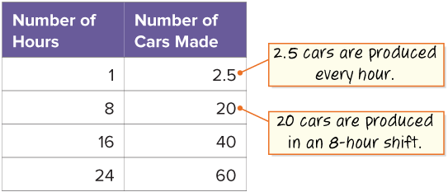
Automobile Manufacturing
We can write an equation to represent the total number of cars produced for any number of hours.
USE THE MATH WORDS · Use today’s math words in your explanation — not “it” and “that thing.”
How can you describe in words how to find the number of cars produced for any number of hours?
Reveal:
The total number of cars produced equals the number of cars produced in an hour, 2.5, times the number of hours.
16 / 40
Notes:
TEACH IN PRACTICE | Embedded facilitation | Lesson 9.4, slide 14 | REVEAL
Focus on the existing task: Automobile Manufacturing Reveal: The total number of cars produced equals the number of cars produced in an hour, 2.5, times the number…
LAUNCH (T2/3/5): If an existing answer cover is present, gather an attempt before revealing. If the explanation is already visible, ask students to reconstruct and justify it. Compare reasoning and explain a revision; preserve the reveal sequence.
LOOK FOR (T4): Where this task addresses it, students can model the two quantities. Ask which feature of their work supports the claim.
RESPOND: If this task shows the lesson misconception—rounding a required count down so that a stated goal is not met—substitute the proposed result back into the original relationship and check the requirement. Have the student revise and explain the change. Use this support only where the concept occurs in the current task; otherwise respond to the displayed question.
RECHECK: If a gap is shared, revisit the existing representation together. If it is limited, give targeted support while others compare valid methods on the same task. Check the revision before moving on.
PARTICIPATION (T5/6/7): Think time before volunteers; accept a written, drawn or rehearsed entry. Students ask for evidence respectfully. Recognize a specific contribution or revision and check that both partners participate.
Source: BCPS Updated Instructional Framework Rubric (June 2020), TEACH 1–7. Earlier notes and answer keys are retained below.
EARLIER NOTES / EXISTING ANSWER KEY
Do not click yet: collect 2–3 student answers with reasons first.
Then click to remove the cover and have students compare their thinking to the reveal — “Is this what we said? Where is it different?”
Behind the cover: The total number of cars produced equals the number of cars produced in an hour, 2.5, times the number of hours.
UIFR: TEACH 3 · TEACH 4.

Slide 17


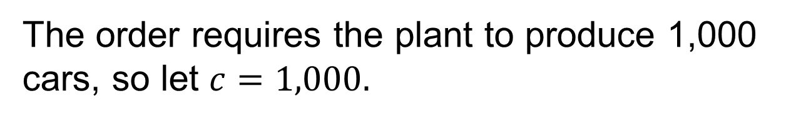

Automobile Manufacturing
The order requires the plant to produce 1,000 cars, so let $c=1,000.$
$$cars produced=2.5×number of hours$$
$$c=2.5h$$
$$1000=2.5h$$
How can you determine how long it will take the plant to produce 1,000 cars?
Reveal:
We can solve the equation for the number of hours, $h$.
Compare your reasoning with the explanation. Explain any revision you make.
17 / 40
Notes:
TEACH IN PRACTICE | Embedded facilitation | Lesson 9.4, slide 15 | REVEAL
Focus on the existing task: Reveal: We can solve the equation for the number of hours,. How can you determine how long it will take the plant to produce 1,000 cars?
LAUNCH (T2/3/5): If an existing answer cover is present, gather an attempt before revealing. If the explanation is already visible, ask students to reconstruct and justify it. Compare reasoning and explain a revision; preserve the reveal sequence.
LOOK FOR (T4): Where this task addresses it, students can solve for the requested value. Ask which feature of their work supports the claim.
RESPOND: If this task shows the lesson misconception—rounding a required count down so that a stated goal is not met—substitute the proposed result back into the original relationship and check the requirement. Have the student revise and explain the change. Use this support only where the concept occurs in the current task; otherwise respond to the displayed question.
RECHECK: If a gap is shared, revisit the existing representation together. If it is limited, give targeted support while others compare valid methods on the same task. Check the revision before moving on.
PARTICIPATION (T5/6/7): Think time before volunteers; accept a written, drawn or rehearsed entry. Students ask for evidence respectfully. Recognize a specific contribution or revision and check that both partners participate.
Source: BCPS Updated Instructional Framework Rubric (June 2020), TEACH 1–7. Earlier notes and answer keys are retained below.
EARLIER NOTES / EXISTING ANSWER KEY
Students should have shared predictions before this reveal.
Have them compare their thinking to what is shown: “Is this the same as what we said? Where is it different?”
Press one student to explain the reveal in their own words.
UIFR: TEACH 3 · TEACH 4.

Slide 18


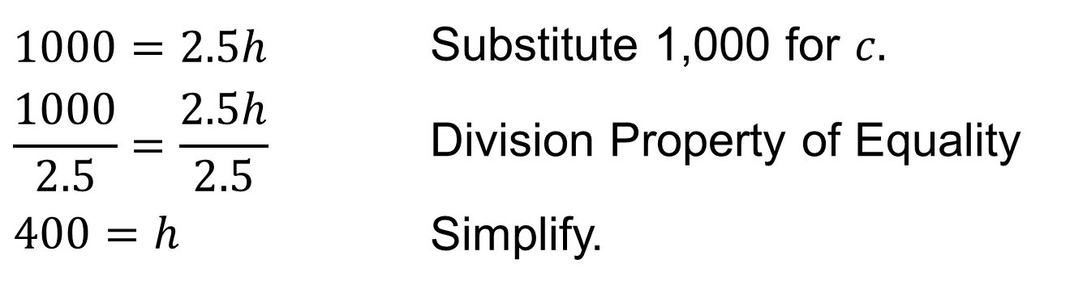
Automobile Manufacturing
Let’s solve the equation of $h.$
$$cars produced=2.5×number of hours$$
$$c=2.5h$$
$$1000=2.5h$$ | Substitute 1,000 for $c.$
$$\frac{1000}{2.5}=\frac{2.5h}{2.5}$$ | Division Property of Equality
$$400=h$$ | Simplify.
SELF-CHECK · Mark it: ✓ got it · ~ almost · ? stuck. Then fix one thing before we move on.
What does the solution mean in the context of the situation?
Reveal:
The plant will need 400 hours to produce 1,000 cars.
18 / 40
Notes:
TEACH IN PRACTICE | Embedded facilitation | Lesson 9.4, slide 16 | REVEAL
Focus on the existing task: Let’s solve the equation of Automobile Manufacturing What does the solution mean in the context of the situation?
LAUNCH (T2/3/5): If an existing answer cover is present, gather an attempt before revealing. If the explanation is already visible, ask students to reconstruct and justify it. Compare reasoning and explain a revision; preserve the reveal sequence.
LOOK FOR (T4): Where this task addresses it, students can solve for the requested value. Ask which feature of their work supports the claim.
RESPOND: If this task shows the lesson misconception—rounding a required count down so that a stated goal is not met—substitute the proposed result back into the original relationship and check the requirement. Have the student revise and explain the change. Use this support only where the concept occurs in the current task; otherwise respond to the displayed question.
RECHECK: If a gap is shared, revisit the existing representation together. If it is limited, give targeted support while others compare valid methods on the same task. Check the revision before moving on.
PARTICIPATION (T5/6/7): Think time before volunteers; accept a written, drawn or rehearsed entry. Students ask for evidence respectfully. Recognize a specific contribution or revision and check that both partners participate.
Source: BCPS Updated Instructional Framework Rubric (June 2020), TEACH 1–7. Earlier notes and answer keys are retained below.
EARLIER NOTES / EXISTING ANSWER KEY
Do not click yet: collect 2–3 student answers with reasons first.
Then click to remove the cover and have students compare their thinking to the reveal — “Is this what we said? Where is it different?”
Behind the cover: The plant will need 400 hours to produce 1,000 cars.
UIFR: TEACH 3 · TEACH 4.

Slide 19
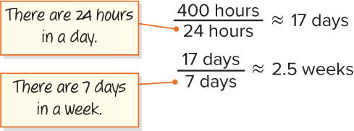
Automobile Manufacturing
Let’s convert 400 hours to days and weeks.
Record your reasoning before the
reveal. Compare, then explain
any revision.
It will take about 17 days, or 2.5 weeks, to produce 1,000 cars.
What must be true about the manufacturing plant’s hours of operation to meet the production timeframe of 3 weeks?
Reveal:
The plant must operate 24 hours a day, 7 days a week.
19 / 40
Notes:
TEACH IN PRACTICE | Embedded facilitation | Lesson 9.4, slide 17 | REVEAL
Focus on the existing task: Reveal: The plant must operate 24 hours a day, 7 days a week. Let’s convert 400 hours to days and weeks. Automobile Manufacturing It will…
LAUNCH (T2/3/5): If an existing answer cover is present, gather an attempt before revealing. If the explanation is already visible, ask students to reconstruct and justify it. Compare reasoning and explain a revision; preserve the reveal sequence.
LOOK FOR (T4): Where this task addresses it, students can model the two quantities. Ask which feature of their work supports the claim.
RESPOND: If this task shows the lesson misconception—rounding a required count down so that a stated goal is not met—substitute the proposed result back into the original relationship and check the requirement. Have the student revise and explain the change. Use this support only where the concept occurs in the current task; otherwise respond to the displayed question.
RECHECK: If a gap is shared, revisit the existing representation together. If it is limited, give targeted support while others compare valid methods on the same task. Check the revision before moving on.
PARTICIPATION (T5/6/7): Think time before volunteers; accept a written, drawn or rehearsed entry. Students ask for evidence respectfully. Recognize a specific contribution or revision and check that both partners participate.
Source: BCPS Updated Instructional Framework Rubric (June 2020), TEACH 1–7. Earlier notes and answer keys are retained below.
EARLIER NOTES / EXISTING ANSWER KEY
Do not click yet: collect 2–3 student answers with reasons first.
Then click to remove the cover and have students compare their thinking to the reveal — “Is this what we said? Where is it different?”
Behind the cover: The plant must operate 24 hours a day, 7 days a week.
UIFR: TEACH 3 · TEACH 4.

Slide 20
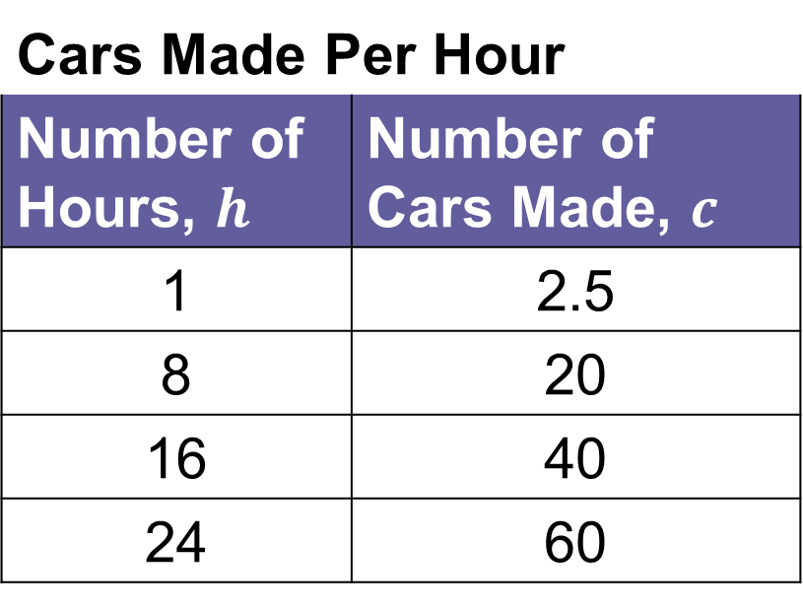

Let’s Explore More
An assembly line at an automobile manufacturing plant is run in 8-hour shifts and produces 2.5 cars per hour. The manufacturer has received the order shown.
Cars Made Per Hour
Number of Hours, $h$ | Number of Cars Made, $c$
1 | 2.5
8 | 20
16 | 40
24 | 60
$$cars produced=2.5×number of hours$$
$$c=2.5h$$
20 / 40
Notes:
TEACH IN PRACTICE | Embedded facilitation | Lesson 9.4, slide 18 | PRACTICE
Focus on the existing task: Let’s Explore More An assembly line at an automobile manufacturing plant is run in 8-hour shifts and produces 2.5 cars per hour. The…
LAUNCH (T2/3/5): Use the displayed question. Give private thinking time; then A explains while B asks for evidence. Switch roles. Each student records their own reasoning.
LOOK FOR (T4): Where this task addresses it, students can model the two quantities. Ask which feature of their work supports the claim.
RESPOND: If this task shows the lesson misconception—rounding a required count down so that a stated goal is not met—substitute the proposed result back into the original relationship and check the requirement. Have the student revise and explain the change. Use this support only where the concept occurs in the current task; otherwise respond to the displayed question.
RECHECK: If a gap is shared, revisit the existing representation together. If it is limited, give targeted support while others compare valid methods on the same task. Check the revision before moving on.
PARTICIPATION (T5/6/7): Think time before volunteers; accept a written, drawn or rehearsed entry. Students ask for evidence respectfully. Recognize a specific contribution or revision and check that both partners participate.
Source: BCPS Updated Instructional Framework Rubric (June 2020), TEACH 1–7. Earlier notes and answer keys are retained below.
EARLIER NOTES / EXISTING ANSWER KEY
Extension for partners or table groups — students choose their approach and use the workspace to show thinking.
Push with “Convince me,” and have two groups with different approaches share.
This is where students stretch past the worked example.
UIFR: TEACH 2 · TEACH 5.
UIFR FULL | Lesson-specific facilitation
TEACH 4-5 | Session 1 discussion and checkpoint (UIFR PDF pp. 11-12).
Collect a brief response from every student to the existing prompt before hearing volunteers. Partners take turns explaining and asking for evidence: “I understand ___; what supports ___?” Offer rehearsal or an annotated model for students who need language support. Each student records their own reasoning.
Look specifically for: rounding a required count down so that a stated goal is not met. If it appears, substitute the proposed result back into the original relationship and check the requirement; then ask the student to revise the same response and explain the change. If evidence is secure, have students compare a second valid pathway or state why their approach works. Choose the next step from the responses, not a preset pace.

Slide 21
LESSON 9.4 / DISCUSS THE TASK
Explain and compare
Use the task you just explored.
TAKE TURNS
Does your numerical result satisfy the real-world constraint, and what does a partial unit mean here?
Explain
“I know this because…”
Ask
“Where does your work show that?”
Point to evidence in your work.
Then compare your approach with a partner’s.
JUSTIFY IT · Say it like this: “I know ______ because ______.”
Listen to understand. Ask for evidence. Make room for every voice.
Notes:
TEACH IN PRACTICE | Embedded facilitation | Lesson 9.4, slide 19 | PRIOR_INSERT
Focus on the existing task: Point to evidence in your work. Then compare your approach with a partner’s. TAKE TURNS Explain “I know this because…” Ask “Where does your work show that?
CONNECT (T1/4): Ask students to restate the displayed goal or key idea and connect it to earlier work. Relevant lesson evidence: model the two quantities; solve for the requested value; interpret units and contextual constraints. Use only the criterion that matches the current session.
SHOW PROGRESS: Students point to their own existing work, explain what improved after feedback, and name a next step. Pair confidence ratings with actual evidence.
PARTICIPATION (T5/6/7): Think time before volunteers; accept a written, drawn or rehearsed entry. Students ask for evidence respectfully. Recognize a specific contribution or revision and check that both partners participate.
Source: BCPS Updated Instructional Framework Rubric (June 2020), TEACH 1–7.

Slide 22
Session 2 Warm-Up
Lesson 9-4 · Apply Two-Variable Relationships to Solve Problems
Session 2 Warm-Up
Check what you remember from Session 1 · about 4 minutes
1
A car factory produces 25 cars per hour (c = 25h). In 8 hours it makes:
2
If c = 25h, how many hours are needed to make 150 cars?
A
33 cars
A
4 hours
B
200 cars
B
6 hours
C
100 cars
C
8 hours
D
250 cars
D
10 hours
3
To solve a word problem with two variables, first identify:
4
An equation allows you to:
A
The largest number
A
Only find past values
B
Which variable is independent and which is dependent
B
Calculate unknown values for any given input
C
The font size
C
Eliminate variables
D
The perimeter
D
Avoid math
eduwonderlab.com · Neft Teacher
22 / 40
Notes:
TEACH IN PRACTICE | Embedded facilitation | Lesson 9.4, slide 20 | WARMUP
Focus on the existing task: Session 2 Warm-Up Session 2 Warm-Up…
GATHER EVIDENCE (T4/6): Keep the original items. Students try independently, mark an uncertain item, and explain one method before checking. Use the existing key when present.
RESPOND: Distinguish a calculation slip from a reasoning gap. Give one next step on the same item; have students revise in a second color. Use the responses to choose flexible support for today’s lesson.
PARTICIPATION (T5/6/7): Think time before volunteers; accept a written, drawn or rehearsed entry. Students ask for evidence respectfully. Recognize a specific contribution or revision and check that both partners participate.
Source: BCPS Updated Instructional Framework Rubric (June 2020), TEACH 1–7. Earlier notes and answer keys are retained below.
EARLIER NOTES / EXISTING ANSWER KEY
Warm-up routine: students start silently on entry; keep it to about 4 minutes.
Circulate and note who is stuck — use what you see to choose who you check on first today.
Go over answers quickly; ask one student to explain a step, not just say the answer.
UIFR: TEACH 4 · TEACH 6.
UIFR FULL | Lesson-specific facilitation
TEACH 1 | Session 2 purpose and evidence (UIFR PDF p. 8).
Have students restate the displayed session goal in their own words and connect it to the existing context or a familiar experience they choose to share. Use the current session goal to select from these lesson-wide evidence criteria; do not frontload a later-session procedure.
Look for: model the two quantities; solve for the requested value; interpret units and contextual constraints. Ask: “Which part of your work would show this?” Revisit that evidence after the task; a confidence rating alone is not evidence of understanding.

Slide 23
STUDENT MOVES
Lesson 9-4
Your move
YOU KNOW THE ROUTINE · Read → plan → solve → check. Do all four, in that order.
23 / 40

Slide 24
Today’s Math Notes
Lesson 9-4 · Apply Two-Variable Relationships to Solve Problems
Review Notes — Session 2
Copy. Explain. Check.
WHY IT MATTERS · Finish this: “This is worth knowing because ______.”
Problem-Solving Framework
1
1. Identify independent (input) and dependent (output) quantities. 2. Write the equation. 3. Substitute to solve.
Forward Calculation
2
Given independent x, multiply or add according to the rule to find dependent y.
Reverse Calculation
3
Given target output y, use inverse operations to determine the required input x.
eduwonderlab.com · Neft Teacher
24 / 40
Notes:
TEACH IN PRACTICE | Embedded facilitation | Lesson 9.4, slide 21 | NOTES
Focus on the existing task: Today’s Math Notes Review Notes…
ROUTINE (T1/2/4): Read or copy the original notes, cover one line, and explain it using the displayed example. Reopen and correct. Copying alone is not evidence of understanding.
LOOK FOR: A link between a symbol, quantity or feature and the explanation. If missing, point back to that feature and have the student try again; fade the prompt once they can explain.
PARTICIPATION (T5/6/7): Think time before volunteers; accept a written, drawn or rehearsed entry. Students ask for evidence respectfully. Recognize a specific contribution or revision and check that both partners participate.
Source: BCPS Updated Instructional Framework Rubric (June 2020), TEACH 1–7. Earlier notes and answer keys are retained below.
EARLIER NOTES / EXISTING ANSWER KEY
Copy routine: read one line at a time; students copy, then explain that line to a partner.
Keep it brisk — the understanding work happens in the examples, not the copying.
UIFR: TEACH 1 · TEACH 6.

Slide 25
Session 2
Apply Two-Variable Relationships to Solve Problems
STRUGGLE FIRST · Work on your own first. Stuck is allowed — try a second strategy before you ask.
25 / 40
Notes:
TEACH IN PRACTICE | Embedded facilitation | Lesson 9.4, slide 22 | DIVIDER
Focus on the existing task: Apply Two-Variable Relationships to Solve Problems Session 2
TRANSITION (T6/7): Students confirm materials, roles, how to request help, and the next response routine. Ask a student to restate it. Keep teacher-only slides hidden.
PARTICIPATION (T5/6/7): Think time before volunteers; accept a written, drawn or rehearsed entry. Students ask for evidence respectfully. Recognize a specific contribution or revision and check that both partners participate.
Source: BCPS Updated Instructional Framework Rubric (June 2020), TEACH 1–7. Earlier notes and answer keys are retained below.
EARLIER NOTES / EXISTING ANSWER KEY
Transition cue: state what materials are out and what success looks like this session.
Keep the changeover under a minute.
UIFR: TEACH 6.

Slide 26

Car Wash Fundraiser
The student council is organizing a fundraiser car wash as shown. At last year’s car wash, they washed 34 cars and raised $408.
How can the student council be sure they will hit their fundraising goal?
Think and record first. Which part of your work supports your answer?
26 / 40
Notes:
TEACH IN PRACTICE | Embedded facilitation | Lesson 9.4, slide 23 | TASK
Focus on the existing task: Car Wash Fundraiser The student council is organizing a fundraiser car wash as shown. At last year’s car wash, they washed 34 cars and…
LAUNCH (T2/3/5): Use the displayed question. Give private thinking time; then A explains while B asks for evidence. Switch roles. Each student records their own reasoning.
LOOK FOR (T4): Where this task addresses it, students can model the two quantities. Ask which feature of their work supports the claim.
RESPOND: If this task shows the lesson misconception—rounding a required count down so that a stated goal is not met—substitute the proposed result back into the original relationship and check the requirement. Have the student revise and explain the change. Use this support only where the concept occurs in the current task; otherwise respond to the displayed question.
RECHECK: If a gap is shared, revisit the existing representation together. If it is limited, give targeted support while others compare valid methods on the same task. Check the revision before moving on.
PARTICIPATION (T5/6/7): Think time before volunteers; accept a written, drawn or rehearsed entry. Students ask for evidence respectfully. Recognize a specific contribution or revision and check that both partners participate.
Source: BCPS Updated Instructional Framework Rubric (June 2020), TEACH 1–7. Earlier notes and answer keys are retained below.
EARLIER NOTES / EXISTING ANSWER KEY
Read the context aloud (or have a student read it).
Before any math, students restate the situation and what is being asked in their own words.
Ask: How can the student council be sure they will hit their fundraising goal?
UIFR: TEACH 1 · TEACH 3.
UIFR FULL | Lesson-specific facilitation
TEACH 2-3 | Session 2 task launch (UIFR PDF pp. 9-10).
Use the problem exactly as displayed. Give individual thinking time before discussion or advancing to the explanation. If the answer is already visible, ask students to reconstruct and justify it. Invite a choice of suitable representations and have students explain why their choice helps.
At the point where this concept appears, ask: “Does your numerical result satisfy the real-world constraint, and what does a partial unit mean here?” Wait for evidence, invite another pathway, and have a student ask a follow-up question. Do not replace students’ reasoning with a sequence of leading steps.

Slide 27
Car Wash Fundraiser
The student council is organizing a fundraiser car wash as shown.
If the student council charges a certain price for each car washed, how can you calculate the total amount that will be raised?
ANOTHER PATHWAY · Did anyone get there a different way? Put both pathways side by side and compare.
Reveal:
The total amount raised will be the product of the price for each car and the number of cars washed.
27 / 40
Notes:
TEACH IN PRACTICE | Embedded facilitation | Lesson 9.4, slide 24 | REVEAL
Focus on the existing task: Reveal: The total amount raised will be the product of the price for each car and the number of cars washed. Car Wash Fundraiser The…
LAUNCH (T2/3/5): If an existing answer cover is present, gather an attempt before revealing. If the explanation is already visible, ask students to reconstruct and justify it. Compare reasoning and explain a revision; preserve the reveal sequence.
LOOK FOR (T4): Where this task addresses it, students can model the two quantities. Ask which feature of their work supports the claim.
RESPOND: If this task shows the lesson misconception—rounding a required count down so that a stated goal is not met—substitute the proposed result back into the original relationship and check the requirement. Have the student revise and explain the change. Use this support only where the concept occurs in the current task; otherwise respond to the displayed question.
RECHECK: If a gap is shared, revisit the existing representation together. If it is limited, give targeted support while others compare valid methods on the same task. Check the revision before moving on.
PARTICIPATION (T5/6/7): Think time before volunteers; accept a written, drawn or rehearsed entry. Students ask for evidence respectfully. Recognize a specific contribution or revision and check that both partners participate.
Source: BCPS Updated Instructional Framework Rubric (June 2020), TEACH 1–7. Earlier notes and answer keys are retained below.
EARLIER NOTES / EXISTING ANSWER KEY
Do not click yet: collect 2–3 student answers with reasons first.
Then click to remove the cover and have students compare their thinking to the reveal — “Is this what we said? Where is it different?”
Behind the cover: The total amount raised will be the product of the price for each car and the number of cars washed.
UIFR: TEACH 3 · TEACH 4.

Slide 28
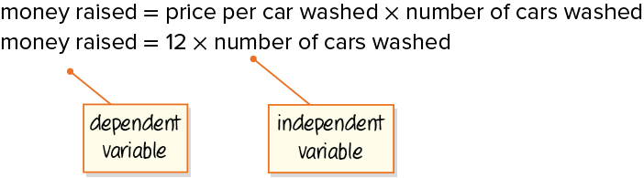
Car Wash Fundraiser
The student council will charge $12 for each car washed.
Record your reasoning before the
reveal. Compare, then explain
any revision.
How can you write an algebraic equation to represent the total amount raised for any number of cars washed?
Reveal:
We can use variables to represent the two quantities, money raised, and the number of cars washed.
28 / 40
Notes:
TEACH IN PRACTICE | Embedded facilitation | Lesson 9.4, slide 25 | REVEAL
Focus on the existing task: The student council will charge $12 for each car washed. Reveal: We can use variables to represent the two quantities, money raised…
LAUNCH (T2/3/5): If an existing answer cover is present, gather an attempt before revealing. If the explanation is already visible, ask students to reconstruct and justify it. Compare reasoning and explain a revision; preserve the reveal sequence.
LOOK FOR (T4): Where this task addresses it, students can model the two quantities. Ask which feature of their work supports the claim.
RESPOND: If this task shows the lesson misconception—rounding a required count down so that a stated goal is not met—substitute the proposed result back into the original relationship and check the requirement. Have the student revise and explain the change. Use this support only where the concept occurs in the current task; otherwise respond to the displayed question.
RECHECK: If a gap is shared, revisit the existing representation together. If it is limited, give targeted support while others compare valid methods on the same task. Check the revision before moving on.
PARTICIPATION (T5/6/7): Think time before volunteers; accept a written, drawn or rehearsed entry. Students ask for evidence respectfully. Recognize a specific contribution or revision and check that both partners participate.
Source: BCPS Updated Instructional Framework Rubric (June 2020), TEACH 1–7. Earlier notes and answer keys are retained below.
EARLIER NOTES / EXISTING ANSWER KEY
Do not click yet: collect 2–3 student answers with reasons first.
Then click to remove the cover and have students compare their thinking to the reveal — “Is this what we said? Where is it different?”
Behind the cover: We can use variables to represent the two quantities, money raised, and the number of cars washed.
UIFR: TEACH 3 · TEACH 4.

Slide 29
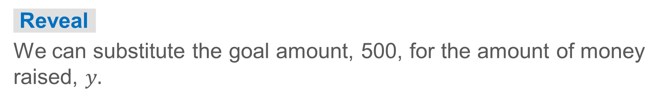
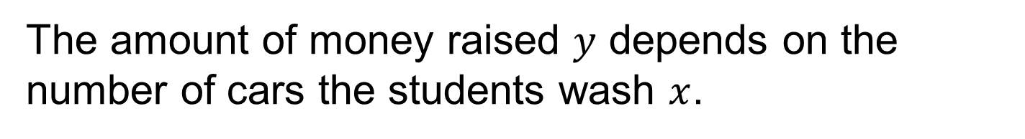

Car Wash Fundraiser
The amount of money raised $y$ depends on the number of cars the students wash $x$.
$$money raised=12×number of car washed$$
$$y=12x$$
The student council wants to raise $500 at this year’s car wash. How can you use the equation to represent the goal?
Reveal:
We can substitute the goal amount, 500, for the amount of money raised, $y.$
Compare your reasoning with the explanation. Explain any revision you make.
29 / 40
Notes:
TEACH IN PRACTICE | Embedded facilitation | Lesson 9.4, slide 26 | REVEAL
Focus on the existing task: Reveal: We can substitute the goal amount, 500, for the amount of money raised, The amount of money raised depends on the number…
LAUNCH (T2/3/5): If an existing answer cover is present, gather an attempt before revealing. If the explanation is already visible, ask students to reconstruct and justify it. Compare reasoning and explain a revision; preserve the reveal sequence.
LOOK FOR (T4): Where this task addresses it, students can model the two quantities. Ask which feature of their work supports the claim.
RESPOND: If this task shows the lesson misconception—rounding a required count down so that a stated goal is not met—substitute the proposed result back into the original relationship and check the requirement. Have the student revise and explain the change. Use this support only where the concept occurs in the current task; otherwise respond to the displayed question.
RECHECK: If a gap is shared, revisit the existing representation together. If it is limited, give targeted support while others compare valid methods on the same task. Check the revision before moving on.
PARTICIPATION (T5/6/7): Think time before volunteers; accept a written, drawn or rehearsed entry. Students ask for evidence respectfully. Recognize a specific contribution or revision and check that both partners participate.
Source: BCPS Updated Instructional Framework Rubric (June 2020), TEACH 1–7. Earlier notes and answer keys are retained below.
EARLIER NOTES / EXISTING ANSWER KEY
Students should have shared predictions before this reveal.
Have them compare their thinking to what is shown: “Is this the same as what we said? Where is it different?”
Press one student to explain the reveal in their own words.
UIFR: TEACH 3 · TEACH 4.

Slide 30
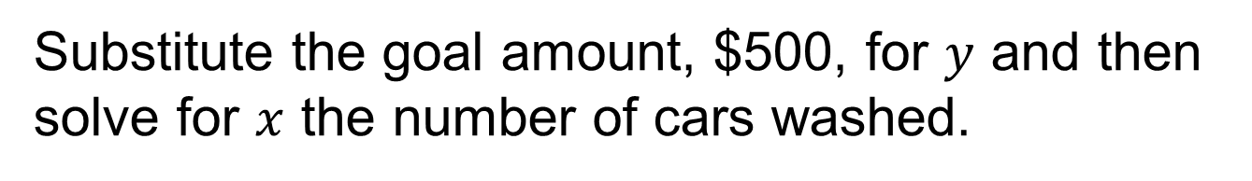


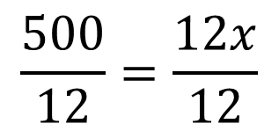

Car Wash Fundraiser
Substitute the goal amount, $500, for $y$ and then solve for $x$ the number of cars washed.
$$money raised=12×number of car washed$$
$$y=12x$$
$$500=12x$$
$$\frac{500}{12}=\frac{12x}{12}$$
Explain how the information shown supports your reasoning.
Think About It:
$$41.7≈x$$
If the student council charges $12 per car, they will need to wash at least 42 cars.
30 / 40
Notes:
TEACH IN PRACTICE | Embedded facilitation | Lesson 9.4, slide 27 | WORKED
Focus on the existing task: Substitute the goal amount, $500, for and then solve for the number of cars washed. Car Wash Fundraiser If the student…
LAUNCH (T2/3/5): Ask students to explain the displayed idea or example and point to evidence. When a calculation step is shown, ask why it is valid. Have a partner restate the explanation; copying is not the check.
LOOK FOR (T4): Where this task addresses it, students can solve for the requested value. Ask which feature of their work supports the claim.
RESPOND: If this task shows the lesson misconception—rounding a required count down so that a stated goal is not met—substitute the proposed result back into the original relationship and check the requirement. Have the student revise and explain the change. Use this support only where the concept occurs in the current task; otherwise respond to the displayed question.
RECHECK: If a gap is shared, revisit the existing representation together. If it is limited, give targeted support while others compare valid methods on the same task. Check the revision before moving on.
PARTICIPATION (T5/6/7): Think time before volunteers; accept a written, drawn or rehearsed entry. Students ask for evidence respectfully. Recognize a specific contribution or revision and check that both partners participate.
Source: BCPS Updated Instructional Framework Rubric (June 2020), TEACH 1–7. Earlier notes and answer keys are retained below.
EARLIER NOTES / EXISTING ANSWER KEY
Ask the question, then hold the silence — students think or jot before anyone answers.
Take two or three responses and press with “Why?” or “How do you know?” before moving on.
UIFR: TEACH 3.

Slide 31
Car Wash Fundraiser
Let’s look at another way the student council can reach their goal.
At last year’s car wash, they washed 34 cars and raised $408.
The student council predicts that they will wash a similar number of cars this year.
What is a reasonable prediction for the number of cars the student council will wash this year?
Reveal:
One reasonable prediction is 35 cars because it is close to the number of cars washed last year.
31 / 40
Notes:
TEACH IN PRACTICE | Embedded facilitation | Lesson 9.4, slide 28 | REVEAL
Focus on the existing task: Reveal: One reasonable prediction is 35 cars because it is close to the number of cars washed last year. Let’s look at another way the…
LAUNCH (T2/3/5): If an existing answer cover is present, gather an attempt before revealing. If the explanation is already visible, ask students to reconstruct and justify it. Compare reasoning and explain a revision; preserve the reveal sequence.
LOOK FOR (T4): Where this task addresses it, students can model the two quantities. Ask which feature of their work supports the claim.
RESPOND: If this task shows the lesson misconception—rounding a required count down so that a stated goal is not met—substitute the proposed result back into the original relationship and check the requirement. Have the student revise and explain the change. Use this support only where the concept occurs in the current task; otherwise respond to the displayed question.
RECHECK: If a gap is shared, revisit the existing representation together. If it is limited, give targeted support while others compare valid methods on the same task. Check the revision before moving on.
PARTICIPATION (T5/6/7): Think time before volunteers; accept a written, drawn or rehearsed entry. Students ask for evidence respectfully. Recognize a specific contribution or revision and check that both partners participate.
Source: BCPS Updated Instructional Framework Rubric (June 2020), TEACH 1–7. Earlier notes and answer keys are retained below.
EARLIER NOTES / EXISTING ANSWER KEY
Do not click yet: collect 2–3 student answers with reasons first.
Then click to remove the cover and have students compare their thinking to the reveal — “Is this what we said? Where is it different?”
Behind the cover: One reasonable prediction is 35 cars because it is close to the number of cars washed last year.
UIFR: TEACH 3 · TEACH 4.

Slide 32
STUDENT MOVES
Lesson 9-4
Your move
SPECIFIC FEEDBACK · Trade work. Give one specific comment: “This part is clear because ______.”
32 / 40

Slide 33
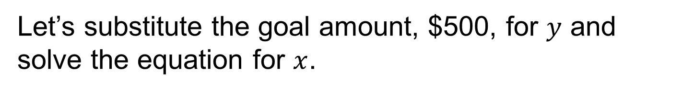


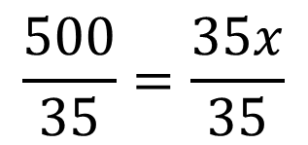

Car Wash Fundraiser
Let’s substitute the goal amount, $500, for $y$ and solve the equation for $x$.
$$money raised=number of car washed×price per car washed$$
$$y=35x$$
$$500=35x$$
Explain how your equation represents the situation. Check the result.
$$\frac{500}{35}=\frac{35x}{35}$$
If the student council expects to wash 35 cars, they will need to charge at least $14.30 per car to hit their fundraising goal.
$$14.3≈x$$
Persevering
33 / 40
Notes:
TEACH IN PRACTICE | Embedded facilitation | Lesson 9.4, slide 29 | WORKED
Focus on the existing task: Let’s substitute the goal amount, $500, for and solve the equation for. Car Wash Fundraiser If the student council expects…
LAUNCH (T2/3/5): Ask students to explain the displayed idea or example and point to evidence. When a calculation step is shown, ask why it is valid. Have a partner restate the explanation; copying is not the check.
LOOK FOR (T4): Where this task addresses it, students can solve for the requested value. Ask which feature of their work supports the claim.
RESPOND: If this task shows the lesson misconception—rounding a required count down so that a stated goal is not met—substitute the proposed result back into the original relationship and check the requirement. Have the student revise and explain the change. Use this support only where the concept occurs in the current task; otherwise respond to the displayed question.
RECHECK: If a gap is shared, revisit the existing representation together. If it is limited, give targeted support while others compare valid methods on the same task. Check the revision before moving on.
PARTICIPATION (T5/6/7): Think time before volunteers; accept a written, drawn or rehearsed entry. Students ask for evidence respectfully. Recognize a specific contribution or revision and check that both partners participate.
Source: BCPS Updated Instructional Framework Rubric (June 2020), TEACH 1–7. Earlier notes and answer keys are retained below.
EARLIER NOTES / EXISTING ANSWER KEY
Model briefly, then hand the thinking back: ask “Why does this step work?” before showing the next one.
Quick check before moving on — thumbs or whiteboards from everyone, not volunteers.
UIFR: TEACH 2 · TEACH 3 · TEACH 4.

Slide 34
Car Wash Fundraiser
How can the student council be sure they will hit their fundraising goal?
The student council can set a price per car to determine how many cars they will need to wash, or they can predict how many cars they will wash to determine how much to charge per car.
The student council will need to charge about $14.30 per car if they wash 35 cars.
The student council will need to wash at least 42 cars when charging $12 per car.
34 / 40
Notes:
TEACH IN PRACTICE | Embedded facilitation | Lesson 9.4, slide 30 | TASK
Focus on the existing task: The student council can set a price per car to determine how many cars they will need to wash, or they can predict how many cars they will…
LAUNCH (T2/3/5): Use the displayed question. Give private thinking time; then A explains while B asks for evidence. Switch roles. Each student records their own reasoning.
LOOK FOR (T4): Where this task addresses it, students can model the two quantities. Ask which feature of their work supports the claim.
RESPOND: If this task shows the lesson misconception—rounding a required count down so that a stated goal is not met—substitute the proposed result back into the original relationship and check the requirement. Have the student revise and explain the change. Use this support only where the concept occurs in the current task; otherwise respond to the displayed question.
RECHECK: If a gap is shared, revisit the existing representation together. If it is limited, give targeted support while others compare valid methods on the same task. Check the revision before moving on.
PARTICIPATION (T5/6/7): Think time before volunteers; accept a written, drawn or rehearsed entry. Students ask for evidence respectfully. Recognize a specific contribution or revision and check that both partners participate.
Source: BCPS Updated Instructional Framework Rubric (June 2020), TEACH 1–7. Earlier notes and answer keys are retained below.
EARLIER NOTES / EXISTING ANSWER KEY
Apply task — students try it independently first, then partners compare answers and reasoning.
Collect a quick pulse (thumbs or whiteboards) before the close; this tells you who needs a second look tomorrow.
UIFR: TEACH 2 · TEACH 4.

Slide 35
Let’s Explore More
Would you recommend that the student council charge $12 or $14.30 per car? Why?
Workspace
Describe the general relationship between the price per car, the number of cars washed, and the total amount of money raised.
Workspace
35 / 40
Notes:
TEACH IN PRACTICE | Embedded facilitation | Lesson 9.4, slide 31 | PRACTICE
Focus on the existing task: Let’s Explore More Would you recommend that the student council charge $12 or $14.30 per car?
LAUNCH (T2/3/5): Use the displayed question. Give private thinking time; then A explains while B asks for evidence. Switch roles. Each student records their own reasoning.
LOOK FOR (T4): Where this task addresses it, students can model the two quantities. Ask which feature of their work supports the claim.
RESPOND: If this task shows the lesson misconception—rounding a required count down so that a stated goal is not met—substitute the proposed result back into the original relationship and check the requirement. Have the student revise and explain the change. Use this support only where the concept occurs in the current task; otherwise respond to the displayed question.
RECHECK: If a gap is shared, revisit the existing representation together. If it is limited, give targeted support while others compare valid methods on the same task. Check the revision before moving on.
PARTICIPATION (T5/6/7): Think time before volunteers; accept a written, drawn or rehearsed entry. Students ask for evidence respectfully. Recognize a specific contribution or revision and check that both partners participate.
Source: BCPS Updated Instructional Framework Rubric (June 2020), TEACH 1–7. Earlier notes and answer keys are retained below.
EARLIER NOTES / EXISTING ANSWER KEY
Extension for partners or table groups — students choose their approach and use the workspace to show thinking.
Push with “Convince me,” and have two groups with different approaches share.
This is where students stretch past the worked example.
UIFR: TEACH 2 · TEACH 5.
UIFR FULL | Lesson-specific facilitation
TEACH 4-5 | Session 2 discussion and checkpoint (UIFR PDF pp. 11-12).
Collect a brief response from every student to the existing prompt before hearing volunteers. Partners take turns explaining and asking for evidence: “I understand ___; what supports ___?” Offer rehearsal or an annotated model for students who need language support. Each student records their own reasoning.
Look specifically for: rounding a required count down so that a stated goal is not met. If it appears, substitute the proposed result back into the original relationship and check the requirement; then ask the student to revise the same response and explain the change. If evidence is secure, have students compare a second valid pathway or state why their approach works. Choose the next step from the responses, not a preset pace.

Slide 36
STUDENT MOVES
Lesson 9-4
Your moves
YOUR CHOICE · You choose how to show this — numbers, words, or a diagram. Make your reasoning visible.
PICK YOUR STRATEGY · Choose your path — picture, table, number line, or equation — and be ready to say why you chose it.
36 / 40

Slide 37
LESSON 9.4 / CHECK YOUR WORK
Pause. Check. Improve.
CHECK
A mistake to watch for: rounding a required count down so that a stated goal is not met.
TRY
Substitute the proposed result back into the given relationship and check the requirement.
REVISE
Use that check on the task you just completed. Correct or strengthen one part, and explain why.
REVISE NOW · Change one answer and write why you changed it. A revision is evidence of learning.
Listen to understand. Ask for evidence. Make room for every voice.
Notes:
TEACH IN PRACTICE | Embedded facilitation | Lesson 9.4, slide 32 | PRIOR_INSERT
Focus on the existing task: LESSON 9.4 / CHECK YOUR WORK Pause. Check. Improve. Listen to understand. Ask for evidence. Make room for every voice. CHECK A mistake…
CONNECT (T1/4): Ask students to restate the displayed goal or key idea and connect it to earlier work. Relevant lesson evidence: model the two quantities; solve for the requested value; interpret units and contextual constraints. Use only the criterion that matches the current session.
SHOW PROGRESS: Students point to their own existing work, explain what improved after feedback, and name a next step. Pair confidence ratings with actual evidence.
PARTICIPATION (T5/6/7): Think time before volunteers; accept a written, drawn or rehearsed entry. Students ask for evidence respectfully. Recognize a specific contribution or revision and check that both partners participate.
Source: BCPS Updated Instructional Framework Rubric (June 2020), TEACH 1–7.

Slide 38
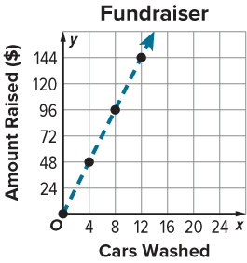
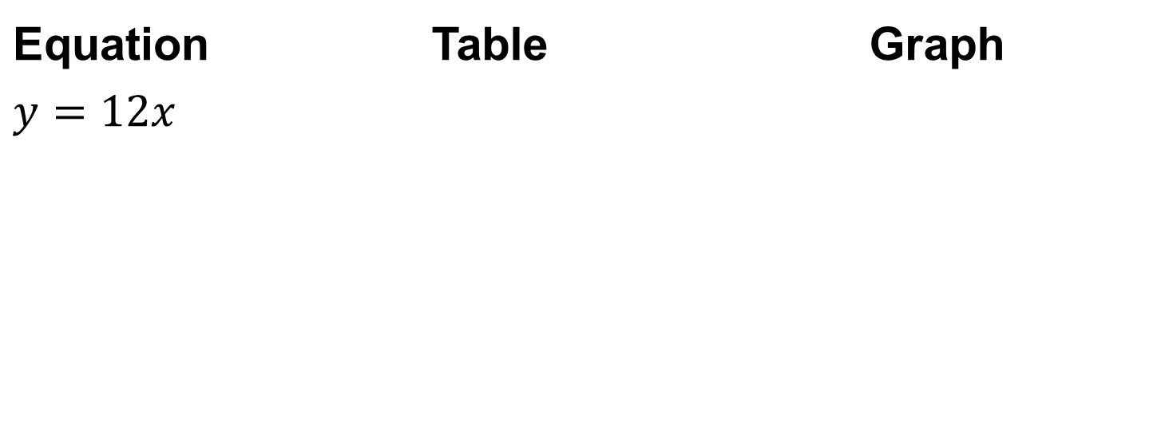
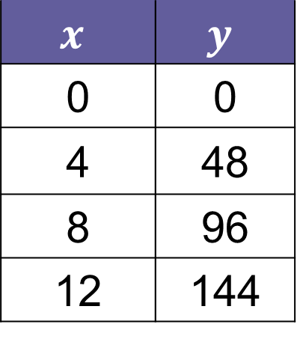
SUMMARIZE · SAY IT IN YOUR OWN WORDS
Summarize: Solve Problems Involving Two Quantities
You can solve problems involving two quantities using equations, tables, or graphs.
A car wash fundraiser earns $y$ dollars for washing $x$ cars.
Equation | Table | Graph
$$y=12x$$
$$x$$ | $$y$$
0 | 0
4 | 48
8 | 96
12 | 144
38 / 40
Notes:
TEACH IN PRACTICE | Embedded facilitation | Lesson 9.4, slide 33 | SUMMARIZE
Focus on the existing task: Equation Table Graph Equation Table Graph Summarize: Solve Problems Involving Two Quantities You can solve problems involving two…
CONNECT (T1/4): Ask students to restate the displayed goal or key idea and connect it to earlier work. Relevant lesson evidence: model the two quantities; solve for the requested value; interpret units and contextual constraints. Use only the criterion that matches the current session.
SHOW PROGRESS: Students point to their own existing work, explain what improved after feedback, and name a next step. Pair confidence ratings with actual evidence.
PARTICIPATION (T5/6/7): Think time before volunteers; accept a written, drawn or rehearsed entry. Students ask for evidence respectfully. Recognize a specific contribution or revision and check that both partners participate.
Source: BCPS Updated Instructional Framework Rubric (June 2020), TEACH 1–7. Earlier notes and answer keys are retained below.
EARLIER NOTES / EXISTING ANSWER KEY
Model briefly, then hand the thinking back: ask “Why does this step work?” before showing the next one.
Quick check before moving on — thumbs or whiteboards from everyone, not volunteers.
UIFR: TEACH 2 · TEACH 3 · TEACH 4.

Slide 39
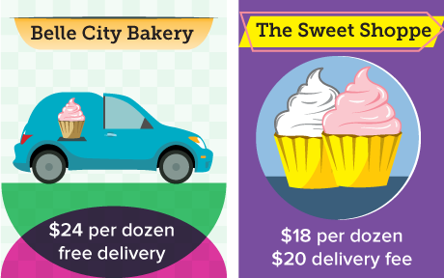
APPLY · PLAN IT • SOLVE IT • PROVE IT
Apply: Choosing Cupcakes
Yelina is comparing the costs of having cupcakes delivered from two different bakeries. Yelina has a budget of $110 to spend.
Question: From which bakery would you recommend Yelina purchase cupcakes? Explain.
Choose a method. Solve independently, justify your answer, then check the goal.
39 / 40
Notes:
TEACH IN PRACTICE | Embedded facilitation | Lesson 9.4, slide 34 | APPLY
Focus on the existing task: Apply: Choosing Cupcakes Yelina is comparing the costs of having cupcakes delivered from two different bakeries. Yelina has a budget…
LAUNCH (T2/3/5): Use the exact application task independently first. Ask students to justify their choice of method. Collect evidence before a partner discussion or correction.
LOOK FOR (T4): Where this task addresses it, students can solve for the requested value. Ask which feature of their work supports the claim.
RESPOND: If this task shows the lesson misconception—rounding a required count down so that a stated goal is not met—substitute the proposed result back into the original relationship and check the requirement. Have the student revise and explain the change. Use this support only where the concept occurs in the current task; otherwise respond to the displayed question.
RECHECK: If a gap is shared, revisit the existing representation together. If it is limited, give targeted support while others compare valid methods on the same task. Check the revision before moving on.
PARTICIPATION (T5/6/7): Think time before volunteers; accept a written, drawn or rehearsed entry. Students ask for evidence respectfully. Recognize a specific contribution or revision and check that both partners participate.
Source: BCPS Updated Instructional Framework Rubric (June 2020), TEACH 1–7. Earlier notes and answer keys are retained below.
EARLIER NOTES / EXISTING ANSWER KEY
Model briefly, then hand the thinking back: ask “Why does this step work?” before showing the next one.
Quick check before moving on — thumbs or whiteboards from everyone, not volunteers.
UIFR: TEACH 2 · TEACH 3 · TEACH 4.
UIFR FULL | Lesson-specific facilitation
TEACH 4 | Independent evidence and revision (UIFR PDF p. 11).
Use the existing application/exit problem as the independent check. If this is a learning-target slide, have students point to and explain their work on the preceding task. Separate initial independent evidence from the revision after feedback.
Check the relevant criteria: model the two quantities; solve for the requested value; interpret units and contextual constraints. Respond with one specific next step tied to the work. Students revise and annotate what changed, then identify a criterion they can now demonstrate and one they still need to practice.
REFLECT & ADJUST 1-2 | After the lesson (UIFR PDF pp. 15-16).
Sort the existing work by demonstrated reasoning, partial understanding, and the specific misconception: rounding a required count down so that a stated goal is not met. Compare the initial response with the revision. Record which teaching move plausibly helped, which did not, and whose participation or access needs a different approach; do not record sensitive student details in this shared deck.
Plan the next lesson from that evidence: if the misconception persists, substitute the proposed result back into the original relationship and check the requirement using the current example before returning to the next grade-level task; if understanding is secure, use an existing extension or ask for a general explanation. Check the targeted idea again at the next warm-up.
Ask students what supported their thinking and what would help next time. Identify one change to try and one successful practice to retain. Seek colleague feedback on anonymized work when useful; these prompts support reflection and do not establish an evaluation rating. Source: Baltimore City Public Schools, Updated Instructional Framework Rubric, June 2020 (UIFR_Full.pdf).

Slide 40
LESSON 9.4 / REFLECT ON YOUR LEARNING
Show your progress
1 SHOW EVIDENCE
2 CHOOSE A NEXT STEP
Choose one response. Point to the part that shows your reasoning.
Name a change you made after feedback—or a question you still have.
“My work shows ___ because ___.”
“Next time, I will ___ to help me ___.”
Today’s focus: Model the two quantities.
CREDIT A CLASSMATE · Name one classmate whose idea helped you today, and say what they said.
Listen to understand. Ask for evidence. Make room for every voice.
Notes:
TEACH IN PRACTICE | Embedded facilitation | Lesson 9.4, slide 35 | PRIOR_INSERT
Focus on the existing task: LESSON 9.4 / REFLECT ON YOUR LEARNING Show your progress Listen to understand. Ask for evidence. Make room for every voice. 1 SHOW…
CONNECT (T1/4): Ask students to restate the displayed goal or key idea and connect it to earlier work. Relevant lesson evidence: model the two quantities; solve for the requested value; interpret units and contextual constraints. Use only the criterion that matches the current session.
SHOW PROGRESS: Students point to their own existing work, explain what improved after feedback, and name a next step. Pair confidence ratings with actual evidence.
PARTICIPATION (T5/6/7): Think time before volunteers; accept a written, drawn or rehearsed entry. Students ask for evidence respectfully. Recognize a specific contribution or revision and check that both partners participate.
Source: BCPS Updated Instructional Framework Rubric (June 2020), TEACH 1–7.

