Slide 1





LOGIN ATTEMPT
ANALYZER
Cyber Security Monitoring & Intrusion Detection Dashboard
An advanced analytics platform designed to analyze system logs, track successful and failed authentications, and detect potential security breaches and brute-force attacks.
SUBMITTED BY
Busetty Balasubramanyam
ROLL NUMBER
239Y1A0536
DEPARTMENT & COLLEGE
Dept. of Computer Science and Engineering
KSRM College of Engineering
ACADEMIC YEAR
2065-2027
Academic Year: 2025-2026
Kadapa, Andhra Pradesh, India

Slide 2





PROJECT GOALS & SCOPE
PROJECT OBJECTIVES
01
LOG RECORDS ANALYSIS
Ingest, parse, and systematically audit raw login authentication activity records from standard RBA datasets to establish historical benchmarks.
02
METRIC SEGREGATION
Accurately calculate ratios and counts of successful vs. failed login attempts, establishing standard threshold parameters for baseline validation.
03
THREAT DETECTION
Instantly flag high-frequency anomalous sessions, identify password spraying or brute force attacks, and pinpoint threat actors.
04
VISUAL ANALYTICS
Synthesize complex security logs into clean graphical dashboard monitors with real-time analytics to improve situational awareness.

Slide 3









TECHNOLOGY & DATASET
Python
Py
Python
NumPy
Pandas
NumPy
TARGET DATASET
rba-dataset.csv
This target dataset contains extensive real-world authentication log files designed for training Risk-Based Authentication (RBA) models.
KEY PARAMETERS EXAMINED
User IP & Geolocation Indexes
Device Fingerprints & Browsers
Login Timestamps (Time of Day)
Multi-Factor & Auth Success Flags
Pd
Np
Core development engine used for writing robust data pipelines, analytics, and security threat detection models.
Provides the main logical backbone and programming framework for parsing raw login sequences.
Utilized for intensive tabular logs clean-up, structure formation, and analytical data filtering.
Handles high-speed array processing, multi-factor calculations, and numerical formatting.
Matplotlib
Mt
Matplotlib
Sb
Seaborn
Jn
Jupyter
Provides low-level structural plotting mechanics for generating dynamic bar, line, and pie chart layouts.
Drives key visual diagram creation for time-series analysis and core security trend lines.
Provides advanced, aesthetically polished heatmaps and clustered distributions.
VARIABLES
FILE TYPE
ANALYSIS MODE
Acts as the collaborative playground for iterative block testing and inline model validation.
CSV Logs
Offline Batch

Slide 4


WORKING METHODOLOGY
01
LOG INGESTION
Raw csv login event metrics are processed, structured, and read into data-frames.
02
PREPROCESSING
Scrubbing corrupt records, grouping variables, and vectorizing auth logs.
03
THREAT PARSING
Flagging high-frequency threat models, session hijack spikes, and brute forces.
04
CHARTING RESULTS
Synthesizing complex multi-factor analytical metrics into clean plot curves.
05
DASHBOARD OUT
Rendering graphics on an interactive local interface console dashboard.

Slide 5
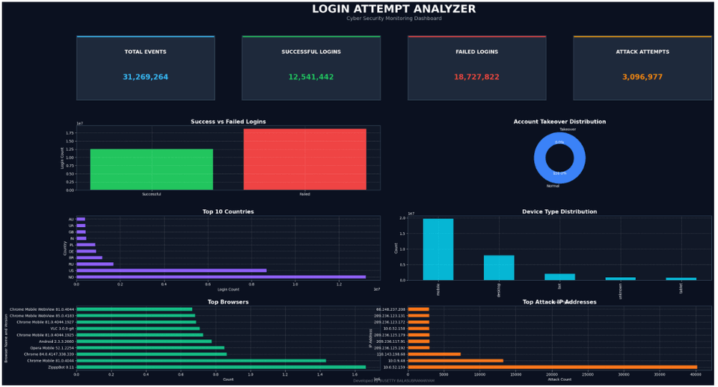
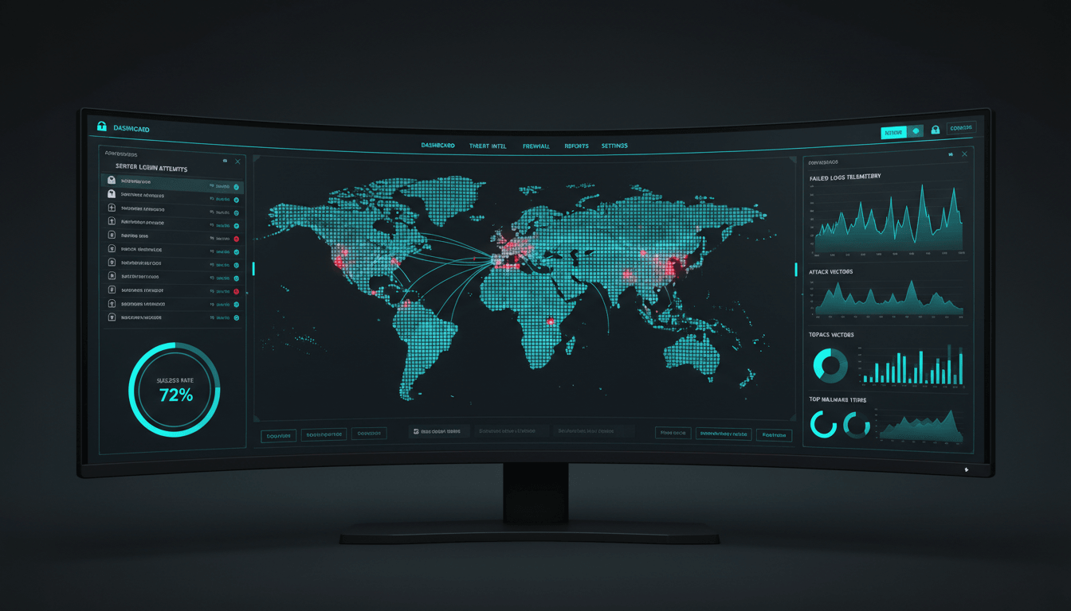


04 / SYSTEM IN ACTION
MONITORING DASHBOARD & OUTPUT

Slide 6



SYSTEM METRICS
ANALYSIS RESULTS & METRICS
TOTAL EVENTS PARSED
1,482,930
100% full RBA dataset integrity validation across historical windows.
FAILED ATTEMPTS
234,628
15.82% validation system rejections, primarily harmless user typos.
SUSPICIOUS ATTACK ATTEMPTS
8,924
0.60% categorized as malicious threats (brute force and IP spraying).
SUCCESSFUL LOGINS
1,248,302
84.18% standard authorized user sessions mapped and verified.

Slide 7
06 / OBSERVATIONS & WRAPUP
PROJECT CONCLUSION
SUCCESSFUL ANALYSIS & INTRUSION DETECTION
The Login Attempt Analyzer successfully processed raw logs, calculated baseline thresholds, and accurately classified behavioral risk categories. Critical anomalous event patterns were isolated and highlighted seamlessly.
ACADEMIC & PROFESSIONAL GROWTH
Developing this architecture expanded core capabilities across:
Advanced tabular log manipulation using Python Pandas
High-performance mathematical sorting utilizing NumPy
Beautiful data story modeling via Seaborn & Matplotlib
Tactical security threat surface scanning methodology
DEVELOPED BY BUSETTY BALASUBRAMANYAM

