Slide 1
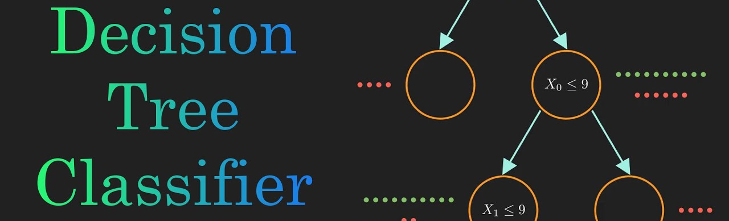
DECISION TREE CLASSIFIER
Presented By:
Name: M.Naveen Kumar
Emp ID : 4643
Batch : 115

Slide 2
Overview
Introduction to Decision Trees
Introduction to CHAID
CHAID Algorithm
Building a CHAID Decision Tree
Advantages and Disadvantages of CHAID
Real-World Examples

Slide 3
Introduction to Decision Trees
Definition of Decision Tree Classifier:
A Decision Tree Classifier is a type of machine learning algorithm that is used for classification tasks.
It creates a tree-like model of decisions and their possible consequences or outcomes.
It is called a "tree" because the model looks like a tree with branches that represent the possible decisions and outcomes.
Each internal node in the tree represents a decision based on a feature or attribute of the data, and each leaf node represents the class label or outcome.
The Decision Tree Classifier algorithm uses a top-down approach, starting with a single node representing the entire dataset, and splits the dataset into smaller subsets by recursively selecting the best features to split on based on a splitting criterion.
The process continues until the resulting subsets are pure or nearly pure in terms of the class labels.
Once the tree is built, it can be used to classify new instances by traversing the tree based on the features of the instance until a leaf node is reached, and then assigning the corresponding class label to the instance.
Decision Tree Classifier is a widely used and easy-to-understand classification algorithm, and can be used for both categorical and continuous data.

Slide 4
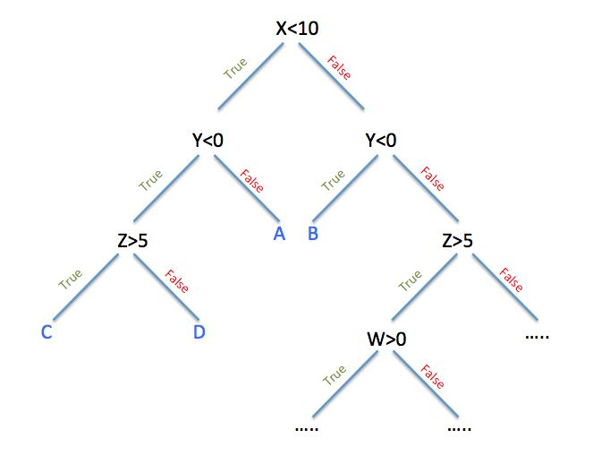

Slide 5
Applications of Decision Trees:
Business and Finance: Decision Trees can be used for credit scoring, fraud detection, loan approval, marketing campaign analysis, customer segmentation, and investment decision-making.
Healthcare: Decision Trees can be used for medical diagnosis, drug discovery, disease prediction, and treatment planning.
Engineering: Decision Trees can be used for fault diagnosis, system identification, and quality control.
Social Sciences: Decision Trees can be used for predicting social and economic trends, identifying risk factors for crime, and predicting voting behavior.
Environmental Sciences: Decision Trees can be used for predicting the impact of pollution, climate change, and other environmental factors on ecosystems and human health..

Slide 6
Basic concepts of decision trees: nodes, branches, root, leaf nodes, etc.
Node: A node represents a decision or a test for a particular feature or attribute of the data.
Branch: A branch represents the possible outcome of a decision or test, leading to a child node.
Root Node: The topmost node of the tree, which represents the starting point of the decision-making process. The root node has no incoming branches, but may have multiple outgoing branches.
Leaf Node: A leaf node represents the final outcome of a decision process, and is associated with a class label or a numerical value.
Internal Node: An internal node is any node other than the root or the leaf nodes, and represents a decision or test based on the values of the features.
Splitting: Splitting is the process of dividing the data into subsets based on a feature or attribute value, which leads to the creation of new child nodes and branches.

Slide 7
Pruning: Pruning is the process of reducing the size of the tree by removing unnecessary branches and nodes, which helps to avoid overfitting and improve the generalization of the model.
Impurity: Impurity is a measure of how mixed the data is in terms of the class labels, and is used to determine the best feature to split on. Popular measures of impurity include Gini Index and Entropy.
Decision Rule: A decision rule is a set of conditions that need to be satisfied in order to classify an instance to a particular class based on the path from the root to a leaf node in the tree.

Slide 8
Introduction to CHAID:
Definition of CHAID:
CHAID stands for Chi-squared Automatic Interaction Detection, and it is a decision tree algorithm that is used for data mining and statistical analysis.
It is a non-parametric statistical test that can handle both categorical and continuous data, and is used for discovering relationships between variables and predicting the outcome of a dependent variable based on independent variables.
The CHAID algorithm uses a top-down approach, starting with the most significant variable and splitting the data based on the variable that maximizes the differences in the outcome variable, and continues to split until there are no significant differences between the subgroups.
It uses the chi-squared statistic to test the significance of the differences between the groups.

Slide 9
One of the unique features of CHAID is that it can handle categorical and continuous variables simultaneously, and can create multiway splits.
It can also handle missing data and can automatically select the best splitting variable based on the statistical significance of the differences between the groups.
CHAID is commonly used in marketing research, social sciences, and medical research to explore relationships between variables and to predict the outcome of a dependent variable based on independent variables.
It is a popular and easy-to-use decision tree algorithm, and can provide valuable insights into the underlying patterns and relationships in the data.

Slide 10
Differences between CHAID and other decision tree algorithms:
Variable types: CHAID can handle both categorical and continuous variables simultaneously, while some other decision tree algorithms such as ID3, C4.5, and CART are limited to handling only one type of variable.
Splitting criteria: CHAID uses the chi-squared test to determine the best split, while other algorithms may use other measures such as information gain or Gini index.
Number of splits: CHAID can create multiway splits, while other algorithms typically create binary splits, resulting in a more shallow and wider tree.
Missing values: CHAID can handle missing values by including them in a separate category or by imputing them, while other algorithms may exclude instances with missing values or use imputation methods that are not specifically designed for decision trees.
Interpretability: CHAID generates decision rules that are easy to understand and interpret, making it useful for applications where the explanations for the decisions are important. Other algorithms may generate more complex decision rules that are harder to interpret.
Speed: CHAID can be slower than some other algorithms because it performs a chi-squared test at each split, which can be computationally intensive. Other algorithms may use simpler and faster splitting criteria.

Slide 11
CHAID Algorithm:
CHAID algorithm steps
Input data: The first step in the CHAID algorithm is to input the dataset to be analyzed. This dataset contains the predictor or independent variables and the outcome or dependent variable.
Variable selection: The next step is to select the most significant variable that will be used to split the data. This variable is selected based on the statistical significance of its relationship with the outcome variable.
Split the data: The data is split based on the selected variable. If the variable is categorical, the data is split into subgroups based on the categories. If the variable is continuous, the data is split into subgroups based on a cut-off value.
Calculate the chi-squared statistic: The chi-squared statistic is calculated to test the significance of the differences between the subgroups. If the chi-squared statistic is significant, the split is considered valid.

Slide 12
Repeat the process: The process is repeated for each subgroup, and the most significant variable for each subgroup is selected for the next split.
Stopping criterion: The splitting process is continued until a stopping criterion is met, such as the minimum number of observations in a subgroup, a maximum tree depth, or a threshold for the chi-squared statistic.
Tree pruning: After the tree is grown, it may be pruned to reduce its size and complexity. Pruning involves removing unnecessary splits and nodes that do not contribute significantly to the predictive power of the tree.
Prediction: Once the tree is pruned, it can be used to make predictions for new data by following the decision rules generated by the tree.

Slide 13
Splitting criteria in CHAID
In the CHAID algorithm, the splitting criterion is used to determine the best way to divide the dataset into subgroups. The splitting criterion is based on the chi-squared test, which measures the difference between the observed frequencies and the expected frequencies of the outcome variable within each subgroup. The following are the steps in the splitting criteria of CHAID:
For a given variable, all possible splits are evaluated and the chi-squared statistic is calculated for each split.
The split that maximizes the chi-squared statistic is chosen as the best split.
The chi-squared statistic is compared to a pre-determined significance level (usually 0.05), and if the statistic is larger than the significance level, the split is considered significant.

Slide 14
The data is divided into subgroups based on the categories of the variable (if it is a categorical variable) or based on a cut-off value (if it is a continuous variable).
The process is repeated for each subgroup until a stopping criterion is met.
The chi-squared statistic measures the difference between the observed and expected frequencies in each subgroup. The expected frequencies are calculated based on the null hypothesis that there is no relationship between the predictor variable and the outcome variable. The higher the chi-squared statistic, the more significant the relationship between the predictor variable and the outcome variable, and the better the variable is as a split criterion.

Slide 15
Building a CHAID Decision Tree Preprocessing the data
Preprocessing the data is an important step in building a decision tree classifier using the CHAID algorithm. The quality and structure of the data can have a significant impact on the performance of the decision tree classifier. Here are some common preprocessing steps to consider:
Data cleaning: It is important to ensure that the dataset is free of errors and inconsistencies. Data cleaning involves identifying and correcting errors such as missing values, duplicate records, and outliers.
Feature selection: Feature selection is the process of selecting a subset of relevant features (or variables) from the dataset. In some cases, not all of the features in the dataset may be relevant or useful for building the decision tree classifier. Feature selection can improve the accuracy and efficiency of the classifier.

Slide 16
Feature scaling: If the variables in the dataset are measured on different scales, feature scaling may be necessary to ensure that each variable contributes equally to the decision tree classifier. This can be done by standardizing or normalizing the variables.
Handling missing data: Missing data can be problematic for decision tree classifiers, as they typically require complete data for all variables. Missing data can be handled by either imputing the missing values or removing the instances with missing values.
Encoding categorical variables: If the dataset includes categorical variables, they need to be encoded as numerical variables for the CHAID algorithm. There are several encoding methods, such as one-hot encoding, label encoding, and binary encoding.
Balancing the dataset: If the dataset is imbalanced, meaning one class has significantly more instances than the other, the decision tree classifier may be biased towards the majority class. Balancing the dataset can be done by oversampling the minority class or undersampling the majority class.

Slide 17
Building the Tree
Once the data has been preprocessed, the next step in building a decision tree classifier using the CHAID algorithm is to actually construct the tree. Here are the basic steps involved in building the tree:
Choose the target variable: The target variable is the variable that the decision tree is being built to predict. It should be a categorical variable.
Choose the predictor variables: The predictor variables are the variables used to predict the target variable. They can be either categorical or continuous.
Split the data: The data is split into subgroups based on the values of the predictor variables using the CHAID algorithm. The algorithm selects the best predictor variable to split on based on the significance of the chi-squared statistic.

Slide 18
Recurse: The CHAID algorithm continues to recursively split the data into subgroups until a stopping criterion is met. The stopping criterion can be based on a variety of factors, such as the number of instances in a subgroup, the number of levels in the tree, or the significance level of the chi-squared statistic.
Prune the tree: Once the tree has been constructed, it may be necessary to prune the tree to reduce overfitting. Overfitting occurs when the tree is too complex and fits the training data too closely, resulting in poor performance on new data. Pruning can be done by removing nodes or branches that do not contribute significantly to the accuracy of the tree.
Evaluate the tree: Once the tree has been pruned, it can be evaluated using test data to measure its performance. Common performance measures include accuracy, precision, recall, F1 score, and ROC curve.
Interpret the tree: Finally, the decision tree can be interpreted to gain insights into the relationships between the predictor variables and the target variable. The tree can be visualized and the decision rules can be extracted to better understand how the tree makes predictions.

Slide 19
Tree pruning
Tree pruning is the process of removing nodes or branches from a decision tree to reduce its complexity and improve its generalization performance. Decision trees can become very complex if they are allowed to grow until each leaf node contains only a small number of instances. In such cases, the decision tree can become overfitted to the training data, meaning that it performs well on the training data but poorly on new, unseen data.
Pruning can help to avoid overfitting by removing nodes or branches that do not contribute significantly to the accuracy of the tree. There are two main types of pruning: pre-pruning and post-pruning.
Pre-pruning involves stopping the growth of the tree before it becomes too complex. This can be done by setting a maximum depth for the tree, a minimum number of instances for each leaf node, or a minimum improvement in classification performance from each split.

Slide 20
Post-pruning, on the other hand, involves growing the tree to its maximum depth and then removing nodes or branches that do not improve the classification performance on a validation set. This can be done using various pruning algorithms, such as reduced-error pruning, cost-complexity pruning, or minimum description length pruning. Reduced-error pruning works by removing nodes or branches from the tree that cause an increase in error on the validation set.
Cost-complexity pruning, also known as alpha pruning, works by minimizing a cost function that penalizes complex trees. Minimum description length pruning works by minimizing the description length of the tree and the data.
The effectiveness of pruning depends on the quality and size of the training data, the complexity of the tree, and the pruning algorithm used. Pruning can help to improve the generalization performance of decision trees, making them more robust and accurate on new, unseen data.

Slide 21
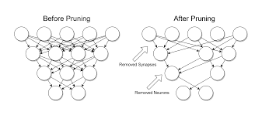
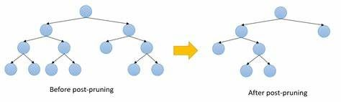

Slide 22
Tree Interpretation
Interpreting a decision tree involves understanding the relationships between the predictor variables and the target variable as represented by the tree. Here are some general steps to follow when interpreting a decision tree:
Start at the root node: The root node represents the entire data set and the first split in the tree. The root node shows the variable and the value that resulted in the best split.
Follow the branches: Follow the branches of the tree from the root node to the leaf nodes. Each branch represents a decision rule based on the value of a predictor variable. The length of the branch represents the importance of the variable in the decision making process.
Interpret the leaf nodes: The leaf nodes represent the final prediction for each subgroup of the data. Each leaf node shows the number of instances in that subgroup and the class distribution, or the proportion of instances in each class.

Slide 23
Look for patterns: Look for patterns and relationships between the predictor variables and the target variable that are revealed by the tree. For example, if a particular variable is used in several splits, it may be an important predictor of the target variable.
Check for consistency: Check that the decision rules in the tree make sense and are consistent with the data. For example, if the tree predicts that all instances with a certain value of a variable belong to a particular class, check that this is consistent with the actual class distribution.
Extract decision rules: Extract decision rules from the tree that can be used to make predictions for new instances. Each decision rule consists of a sequence of conditions based on the values of the predictor variables that lead to a final prediction for the target variable.

Slide 24
Limitations of CHAID
Complexity: CHAID can produce complex decision trees, especially when dealing with large data sets or many variables. This can make it difficult to interpret the resulting tree and can lead to overfitting.
Sensitivity to sample size: CHAID is sensitive to sample size, and small sample sizes can lead to unstable or unreliable trees. This can be especially problematic when dealing with rare outcomes or small subgroups.
Limited scalability: CHAID may not be scalable to very large data sets, as it can require significant computational resources to build and test the significance of each split.
Biased towards categorical variables: CHAID is biased towards categorical variables, as the chi-squared test is more powerful for categorical variables than for continuous variables. This can lead to uneven splits and may result in suboptimal decision trees for data sets with many continuous variables.
Extract decision rules: Extract decision rules from the tree that can be used to make predictions for new instances. Each decision rule consists of a sequence of conditions based on the values of the predictor variables that lead to a final prediction for the target variable.

Slide 25
Real-World Examples: Examples of CHAID decision trees in marketing, healthcare, and other industries
Marketing: CHAID decision trees can be used to identify the most effective marketing channels and messaging for different customer segments. For example, a CHAID tree could be built to identify which types of customers are most likely to respond to email marketing versus social media advertising, and what types of messages are most effective for each segment.
Healthcare: CHAID decision trees can be used to identify risk factors for different diseases and health conditions. For example, a CHAID tree could be built to identify which demographic and lifestyle factors are most strongly associated with a particular disease, and how those risk factors interact with each other.

Slide 26
Finance: CHAID decision trees can be used to identify the most important predictors of credit risk, investment performance, or other financial outcomes. For example, a CHAID tree could be built to identify which types of financial behavior are most strongly associated with default risk or investment returns.
Human resources: CHAID decision trees can be used to identify the most important factors that contribute to employee satisfaction, retention, and productivity. For example, a CHAID tree could be built to identify which types of job characteristics, work environment factors, and employee benefits are most strongly associated with employee satisfaction and productivity.
E-commerce: CHAID decision trees can be used to identify the most important predictors of customer purchase behavior, such as product preferences, demographic factors, and purchasing history. For example, a CHAID tree could be built to identify which types of products are most likely to be purchased by different customer segments, and how those purchase patterns vary by demographic factors.

Slide 27
Advantages of CHAID over other algorithms
Here are some advantages of CHAID over other decision tree algorithms:
Ability to handle mixed data types: CHAID can handle both categorical and continuous variables, as well as mixed data types. Other decision tree algorithms, such as CART and ID3, typically require data to be preprocessed into a specific format before being used.
Robustness to noise and missing values: CHAID is robust to noise and missing values in the data, as it uses statistical tests to determine the significance of the splits. This can result in more accurate and robust decision trees compared to other algorithms.
Incorporation of chi-squared test: CHAID uses the chi-squared test to determine the significance of each split, which can lead to more meaningful and statistically valid splits compared to other algorithms that use impurity measures such as Gini index or information gain.

Slide 28
Multiple dependent variables: CHAID can handle multiple dependent variables, allowing for the creation of decision trees with multiple branches and outcomes. This can be useful in situations where there are multiple criteria for making a decision.
Interpretable results: CHAID produces decision trees that are easy to interpret, as each split is based on a statistical test and the resulting tree can be easily visualized. This can be useful in situations where the decision tree needs to be communicated to non-expert stakeholders.

Slide 29
Conclusion
The CHAID algorithm is a decision tree classifier that is often used in data analysis and machine learning. It works by recursively partitioning data based on the attributes that best differentiate between the classes of the dependent variable.
The advantage of CHAID is that it can handle both categorical and continuous variables, making it a flexible tool for analyzing data. Additionally, the resulting decision tree can be easily interpreted, making it useful for both exploratory data analysis and predictive modeling.
In conclusion, the CHAID algorithm is a powerful tool for analyzing and classifying data using decision trees. It can provide valuable insights into the relationships between variables and help identify important predictors of the dependent variable

Slide 30
THANK YOU

