Slide 1
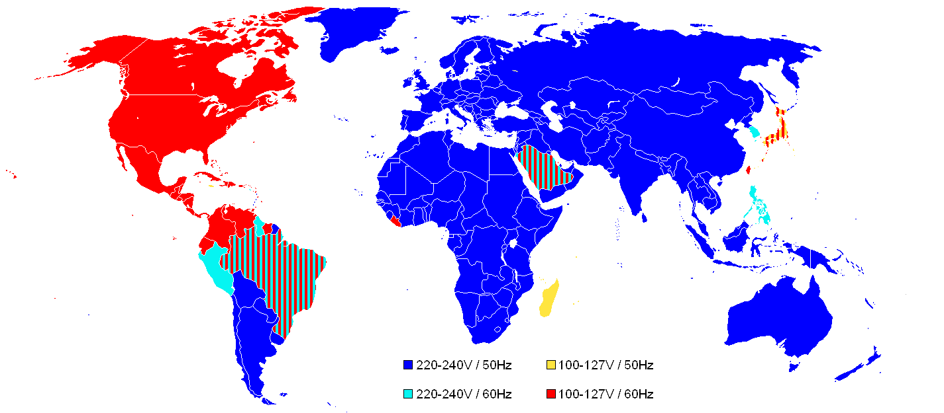
ALTERNATING CURRENT CIRCUITS

Slide 2

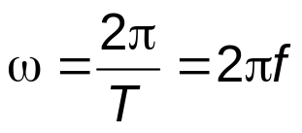
ALTERNATING CURRENT CIRCUITS
SINUSOIDAL QUANTITIES AND COMPLEX REPRESENTATION
Definitions
A sinusoidal or harmonic quantity is a quantity of the form:
with A_{max} > 0, ω > 0 and γ constant quantities, which are called respectively:
the peak value, the angular frequency and the initial phase angle of the sinusoidal quantity
The angle (ωt + γ) is called the phase of the sinusoidal quantity a.
The period T of a sinusoidal quantity is connected to the angular frequency by the relation:
ω T = 2 π
The number of periods per second, expressed by the reciprocal of the period is called frequency: f = 1 / T
Angular frequency can therefore be expressed by:
In the International Unit System, the period is measured in seconds [s], the frequency in Hertz [Hz] and the angular frequency in radians per second [rad/s].
Remark: the quantities of the form: a = A_{max} cos (ωt + α) are also sinusoidal quantities since they can be written as: a = A_{max} sin (ωt + γ) with γ = α + π / 2.

Slide 3
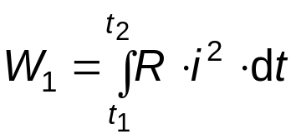

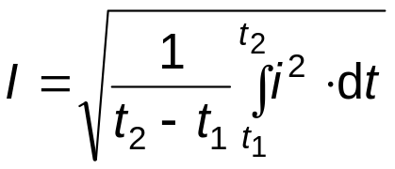
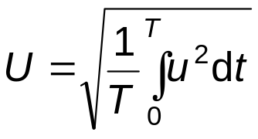
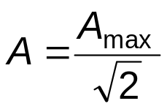
The root-mean-square (r.m.s.) value (effective value) of a variable electric current
Consider a conductor of resistance R carrying a variable current i(t). The energy losses produced by thermal (Joule-Lentz) effect in a period of time t₂ - t₁ is:
Consider the same conductor but carrying a constant direct current I, the same period of time, in this case the energy losses by thermal effect is:
By equating the two above expression, the constant direct current can be obtained as:
The obtained value represents the root-mean-square (r.m.s.) value (effective value) of a variable electric current. Hence, the r.m.s. value of a variable current represents the constant direct current which produces the same result of heating in the same time interval in the same resistor. The r.m.s. value of a variable electric current represents the equivalent constant direct current.
The root-mean-square (r.m.s.) value (effective) of a periodic function u(t) of period T is, by definition:
A sinusoidal quantity: a = A_{max} sin (ωt + γ) has the r.m.s. value:

Slide 4
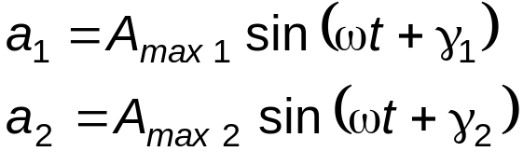

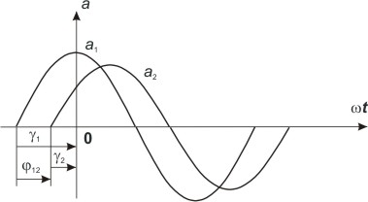
The phase difference of a sinusoidal quantity a₂ which lags behind a sinusoidal quantity a₁ having the same angular frequency:
is by definition:
This phase difference φ₁₂ is an algebraic quantity and is also called the phase difference of quantity a₁ with respect to quantity a₂.
Graphically, the phase difference is an angle which is measured on the abscissa ωt, by the orientated segment in figure below. The quantities having phase differences of 0, π/2, π are respectively referred to as in phase, in quadrature and in opposition.

Slide 5

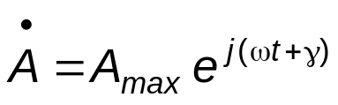





Complex representation of sinusoidal quantities
Given a sinusoidal quantity:
by convention, two complex numbers are associated:
called respectively: the non-simplified complex representation, , and the simplified complex representation, , of the sinusoidal quantity.
In the above relations we use the notation for the imaginary unit:
For the simplified complex representation, also called the complex of a, we also use the notation:
The complex of a has therefore the magnitude equal with the r.m.s. value of the sinusoidal quantity, while its argument γ is the initial phase of the sinusoidal quantity.

Slide 6
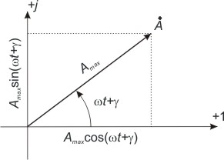
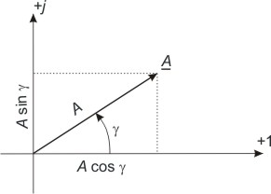




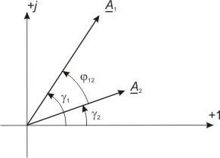


A major advantage of the complex representation of sinusoidal quantities is that it also allows a phasor representation of these sinusoidal quantities:
For each sinusoidal quantity a, the phasor corresponding to its complex or
is associated on the complex plane. These are referred to as representative phasors of the complex quantity.
The phasors are rotating phasors, with the angular velocity ω, while the phasors are fixed phasors.
The projection of the rotating phasor on the imaginary axis is:
while that on the real axis is:
The phase difference φ₁₂ by which the sinusoidal quantity:
lags behind sinusoidal quantity
equal to φ₁₂ = γ₁ – γ₂, is the angle between the representative phasors of these sinusoidal quantities:

Slide 7
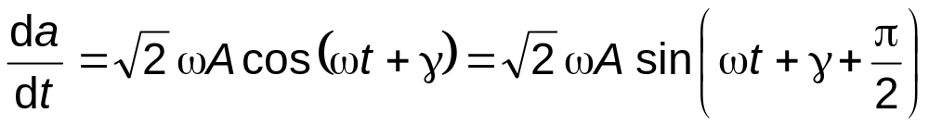
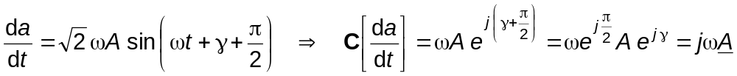
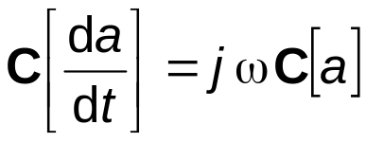
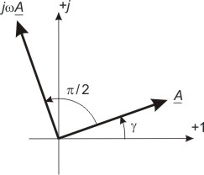

Sinusoidal quantities (time functions) feature the notable property of having a derivative with respect to time which is also a sinusoidal quantity, of the same angular frequency:
By differentiation, the r.m.s. value increases by the factor ω, while the argument is increased with an additional π / 2 angle.
Above relations yields:
The theorem of complex representation of the derivative: the
complex of the derivative is obtained multiplying by jω the complex of the sinusoidal quantity a.
The magnitude of the complex of the derivative is ω times larger than the complex of the quantity, its argument has an additional π/2 compared to the argument of the complex of the quantity.
The theorem of the derivative is represented in the figure:

Slide 8
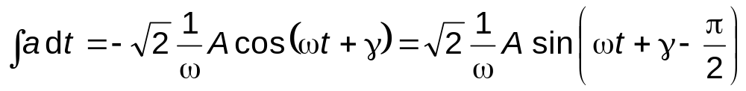
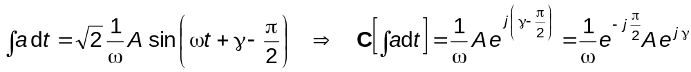
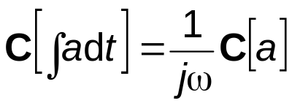
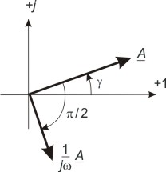

Analogously, we demonstrate the theorem of complex representation of the integral:
By integration, the r.m.s. value decreases by the factor ω, while the argument decreases with the π/2 angle.
The theorem of complex representation of the integral: the complex of the primitive
is the complex of a divided by jω.
The theorem of the integral is represented in figure:

Slide 9
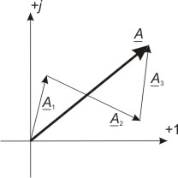

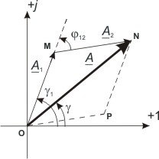
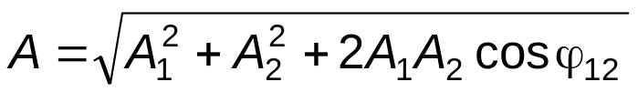
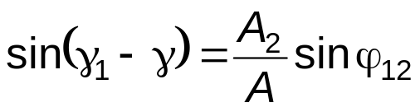
A third, widely used theorem is the theorem of complex representation of the sum: The complex of the sum of several sinusoidal quantities of identical angular frequencies is equal with the sum of the complexes of these sinusoidal quantities:
For simplification, in figure, we assume that n = 3:
In the particular case n = 2, the sum of the phasors leads to the triangle OMN, or to the parallelogram OMNP whose main diagonal is the phasor of the sum :
From the triangle OMN, we have:
which represent the r.m.s. value A and the initial phase γ of the sum a = a₁ + a₂, respectively.

Slide 10
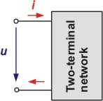
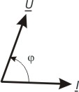





The two – terminal sinusoidal AC network
Circuits having two supply terminals are called two – terminal networks. Two – terminal networks without sources are called passive networks. Such passive networks are, for example, the circuit elements: resistor, coil and capacitor.
An electrical network is referred to as sinusoidal network if all time – varying quantities that characterize the operation of this circuit, are sinusoidal time – varying quantities.
If passive two – terminal networks are characterized by the quantities that will be defined in the following, analysis of sinusoidal AC circuits becomes analogous to the analysis of DC circuits.
The terminal voltage and current of a sinusoidal AC network is expressed in instantaneous values by:
and in complex form by:
The current lags behind the voltage by a phase difference angle:
The meaning of this phase difference results from the phasor diagram shown in the above figure. On this diagram as well as on the subsequent diagrams, axes have been omitted in order to simplify the representation.

Slide 11
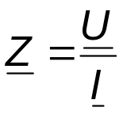

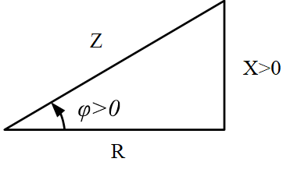
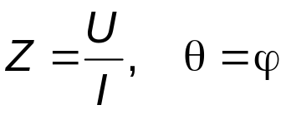
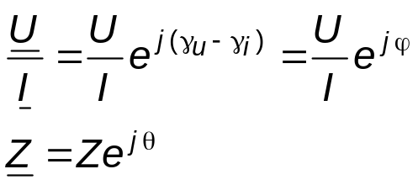


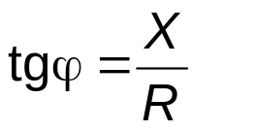



Impedance, resistance and reactance
A passive two – terminal sinusoidal network is characterized (with respect to its terminal behaviour) by the ratio of the complex of the voltage to the complex of the current. This ratio is called complex equivalent impedance of the two – terminal network:
Using the complex impedance, the relation between the voltage complex and the current complex is expressed by:
relation called Ohm’s law in complex form since it is formally analogous to the relation U = R I which expresses Ohm’s law for a DC resistor.
The absolute value of the complex impedance, called impedance and its argument denoted by θ have the values:
which result from:
The real part of the complex (equivalent) impedance is called equivalent resistance and it is denoted by R, while the imaginary part is called reactance and it is denoted by X. There is the impedance triangle.
From the above relations results:
Using Euler’s formula:
also results:
From the above definition relations, we note that the measurement unit of impedance and reactance is the same as for resistance (1 Ohm, denoted [1 Ω]).

Slide 12
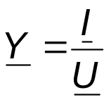
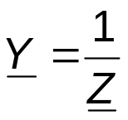
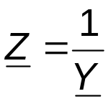
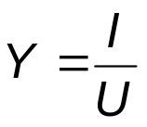
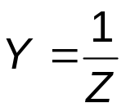




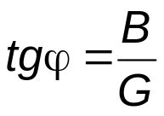

Admittance, conductance and susceptance
A two – terminal network can also be characterized by the ratio of the complex of the current to the complex of the voltage, called complex (equivalent) admittance of the two – terminal network:
we note that the complex admittance is the reciprocal of the complex impedance :
or:
The magnitude of the complex admittance, called admittance, has therefore the expression:
The exponential form of the complex admittance is:
or:
The real part of the complex admittance, denoted by G is called (equivalent) conductance while the imaginary part with changed sign, denoted B, is called susceptance:
From the previous relations we get:
and:
From the above definition relations, we note that both the admittance and the susceptance have the same measurement unit as the conductance (1 Siemens, denoted [1 S]).

Slide 13
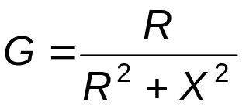
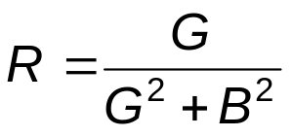
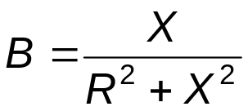
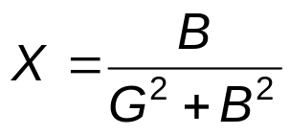


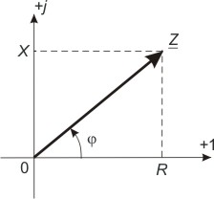
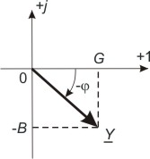
Relations between the quantities characterizing the same two – terminal network:
From the above relations we obtain:
and
By equating the real parts and the imaginary parts in the two members of the relation Y Z = 1, we obtain the relations:
The quantities Z and Y can be represented on the complex plane, by phasors as shown in the figures:

Slide 14

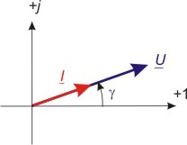
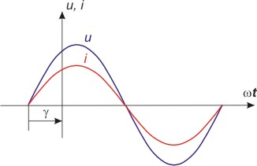
PASSIVE SINUSOIDAL CIRCUIT ELEMENTS
Ideal resistor
Using the relation which expresses the dependence of the terminal voltage from the current in an ideal resistor u = R i we obtain the complex relation: U = R I, which expresses the equality of the complex quantities by means of which the equal sinusoidal quantities in the left and the right member of relation u = R i were represented. This relation corresponds to the phasor diagram in the figure:
(PSpice AC-EX-01)
Comparing relation U = Z I to relation U = R I it results that the complex impedance of the ideal resistor is equal to the resistance of the latter: Z_{R} = R
The argument of this complex impedance (equal to the phase difference by which the current lags behind the voltage) is zero since in an ideal resistor the current is in phase with the voltage. The instantaneous voltage and current values are diagrammed in the figure:
By equating the two members of relation U = R I, the relation between r.m.s. values of the terminal voltage and current results: U = R I
(PSpice AC-EX-01a)

Slide 15

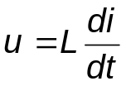
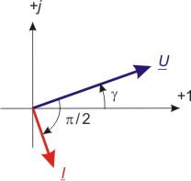
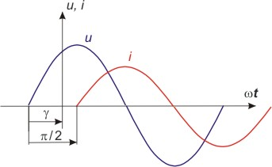
The ideal coil
The dependence between the terminal voltage of an ideal coil and the current flowing through the coil is:
Since the sinusoidal quantities in the two members of the previous relation are equal it follows that their complex representations are also equal: U = j ω L I
The phasor diagram of the current and the terminal voltage is represented in the figure.
The complex impedance of the ideal coil is Z_{L} = j ω L.The absolute value of the impedance of the ideal coil is denoted by X_{L} and is called inductive reactance: X_{L} = Z = ω L. It results that the inductive reactance is directly proportional with the angular frequency ω.
The phase difference by which the current lags behind the terminal voltage is equal with the argument of Z_{L} and its value is φ = π / 2. It follows that, in an ideal coil, the current lags behind the voltage by π / 2 which, in time, corresponds to a phase difference of T / 4, that is, a quarter of period behind. The instantaneous values of voltage and current are presented in the figure.
(PSpice AC-EX-02)
The relationship between the r.m.s terminal voltage value and the r.m.s current in an ideal coil is: U = ω L I or U = X_{L} I
(PSpice AC-EX-02a)

Slide 16
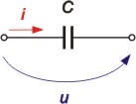
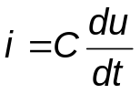




The ideal capacitor
The dependence between the terminal voltage of an ideal capacitor and the current is:
Since the sinusoidal quantities in the two members of the previous relation are equal it follows that their complex representations are also equal: I = j ω C U
The phasor diagram of the current and the terminal voltage is represented in the figure.
The complex impedance of the ideal capacitor is:
The absolute value of the impedance of the ideal capacitor is denoted by X_{C} and it is called capacitive reactance:
The capacitive reactance is inversely proportional with the angular frequency ω. The phase difference by which the current lags behind the terminal voltage is equal with the argument of Z_{C} and its value is φ = - π / 2. It follows that, for an ideal capacitor, the current leads the voltage by π / 2 which, in time, corresponds to a phase difference of T / 4, that is, the current leads the voltage by a quarter of period . The instantaneous values of voltage and current are presented in the figure.
The relationship between the r.m.s terminal voltage value and the r.m.s current in an ideal capacitor is: I = ω C U or U = X_{C} I

Slide 17











Characteristic quantities of passive sinusoidal ac circuit elements
It was shown that, in order to characterize a given two – terminal network, we use either impedance, resistance and reactance or admittance, conductance and susceptance. Table below presents a review of the characteristic quantity values of passive circuit elements, analyzed:
Ideal element |  | R | X |  | G | B
Rezistance | R | R | 0 |  |  | 0
Coil |  | 0 |  |  | 0
Capacitor |  | 0 |  |  | 0

Slide 18


SINUSOIDAL AC CIRCUITS CALCULATION
The method of calculation of sinusoidal AC circuits based on complex representation of sinusoidal voltages and currents is called symbolic calculation method of sinusoidal AC circuits. By the symbolic method, the complex forms of Kirchhoff’s laws are derived; subsequently these theorems are used in writing equations with complex numbers whose solving allows the calculation of the complex values of the unknown sinusoidal quantities, in terms of the complex values of the known sinusoidal quantities and those of the complex impedances.
The complex form of Kirchhoff’s laws. Using instantaneous values, Kirchhoff’s laws can be written in a similar way as for DC as follows:
Kirchhoff’s current law, in instantaneous values, has the expression:
In this „algebraic” sum, a (+) sign is assigned to the currents leaving the node while a (–) sign is assigned to the currents entering the node. The „belonging” sign є is used to specify: branch k belongs to the set of branches meeting at node N, where the law is applied.
Kirchhoff’s voltage law, in instantaneous values, has the expression:
In this „algebraic” sum, a (+) sign is assigned to the terminal voltages whose reference direction coincides with the reference direction of the loop (also called direction of writing the equation) while a (-) sign is assigned to the terminal voltages whose reference direction opposes to that of the loop. The „belonging” sign є is used to specify: branch k belongs to the set of branches forming loop p, where the law is applied.

Slide 19


In accord with the complex representation theorem of a sum of sinusoidal quantities, the complex correspondents for sinusoidal circuits of relations KCL and KVL are:
which are called Kirchhoff’s current and voltage laws in complex form respectively.
Kirchhoff’s current law in complex form: the algebraic sum of complex representations of branch currents meeting at a node is zero. With this statement, conventions on signs are the same as for instantaneous values. If the network has n nodes, Kirchhoff’s current law must be written (n – 1) times.
Kirchhoff’s voltage law in complex form: the algebraic sum of complex representations of terminal voltages of elements around a circuit loop is zero. With this statement, conventions on signs are the same as for instantaneous values. If the network has n nodes and ℓ branches, Kirchhoff’s voltage law must be written (ℓ - n + 1) times.

Slide 20






Expressing in
the complex values of the voltages in terms of complex currents and complex impedances for the passive circuit elements and in form of emfs for the ideal voltage sources, yields the usual complex form of Kirchhoff’s voltage law:
or
If the coils are not magnetically coupled the above expression becomes:
or
where:
is the complex impedance of a branch that belongs to the loop (p).

Slide 21




Relation
is formally analogous with that known from DC circuits and expresses the following: the algebraic sum of complex values of voltage drops (Z I) is equal with the algebraic sum of complex values of emfs (E) around any network loop.
If the coils are magnetically coupled the above expression becomes:
where:
The dot terminal convention:
The positive direction of the coil surface normal is obtained by applying the screw rule for the direction of passing through the coil. The coil terminal from which the positive direction of the coil surface normal goes out is selected as the dot terminal.
The dot terminal convention decides the sign of the mutual inductance between two coils magnetically coupled when the Kirchhoff’s voltage law is written for a loop containing one of the two coils (It is not necessary to specify the winding direction)
Let suppose that the Kirchhoff’s voltage law is written for the loop containing L₁: the mutual inductance L₁₂ is positive if the direction of passing through the loop and the current i₂ simultaneously enter (or go out) from the dot terminals of the two coils magnetically coupled; in the opposite case the mutual inductance L₁₂ is negative.
The loop-current method The node voltage method

Slide 22



POWERS
A passive or active two – terminal circuit receives at its terminals an instantaneous power: p(t) = u(t) i(t)
Assuming a sinusoidal circuit, this instantaneous power is:
The graph of the function p(t) = u(t) i(t) assuming a sinusoidal circuit is diagrammed in the figure:
It can be seen that in sinusoidal circuits the power will be transmitted not just in one direction only and that its direction of transmission may reverse during certain time intervals. More specific, if a power line is supplying a load at a power factor 0 < cos φ < 1, part of the delivered energy will be returned to the source during time intervals when the power delivered to the load is negative.
This change of energy direction of transmission (either in one direction or in the other) reduces the efficiency of energy transport and the efficiency of electric grids, transformers and generators. To avoid this, the supply companies permanently seek to improve the power factor (cos φ ) of industrial loads, that is, to increase it at near – unity values.

Slide 23







The average value P of the instantaneous power p(t) over one period is called active (real; true) power:
In sinusoidal circuits, the active power has the expression:
where: φ = γ_{u} - γ_{i} is the phase difference by which the terminal voltage u leads the current i in the circuit, U – the r.m.s. value of the voltage and I – the r.m.s. value of the current.
The instantaneous power is, by definition, the rate of transmission of energy:
The energy received by the AC sinusoidal circuit over one period is:
Over a time interval t, longer than one period, the energy received by the circuit is therefore:
The reactive power received by the two – terminal circuit is, by definition:
The apparent power of the two – terminal circuit is, by definition:
In the International System of Units these powers are expressed in:
1 [W] (watt) for P;
1 [VAr] (volt-ampere reactive) for Q;
1 [VA] (volt-ampere) for S.

Slide 24







The symbolic method also defines the complex power:
with: U - the complex of voltage,
I - the complex of current,
I* - the complex conjugate of I.
By substituting the values of the above complex quantities, the expression of S becomes:
that is:
Starting from the introduced relations; the following additional relations, used in power calculation, can be derived:

Slide 25


The power factor
Is defined as:
For alternating harmonic circuits
As a cosine function, the maximum values of the power factor is 1.
To improve the power factor we put in parallel with the consumer a capacitor with a computed value to obtain the desired value for the power factor.
Let’s assume circuit having a load of impedance Z = R + j X and power factor cos φ is supplied at voltage U and angular frequency ω via a supply line of resistance r.
We will determine the value of the capacitor which is needed to establish a parallel circuit with a power factor cos φ_{e} > cos φ .
We start the calcullus assuming the the power must be the same after we improve the power factor:

Slide 26






From the phasor diagram of the circuit we obtain the equality:
On multiplying both members by U and considering that P = U I cos φ, we obtain the equality:
Since, I_{e} cos φ_{e} = I cos φ , it results that P = P_{e} and, consequently
assuming that the supply voltage is the same.

Slide 27




Calculation of series passive circuits
Consider the case of a series circuit containing two elements Each element is a two – terminal network characterized by one resistance and one reactance.
By Kirchhoff’s voltage law, the terminal voltage of the network is the sum of terminal voltages of the elements in series. It follows that:
U = U₁ + U₂
On applying Ohm’s law in complex form: U₁ = Z₁ I and U₂ = Z₂ I
we obtain:
U = Z₁ I + Z₂ I = (Z₁ + Z₂) I
Consequently, the series circuit, which also forms a two – terminal network has the equivalent complex impedance: Z_{e} = Z₁ + Z₂
Equating the real and the imaginary parts, the equivalent resistance and equivalent reactance of the series circuit are respectively:
R_{e} = R₁ + R₂
X_{e} = X₁ + X₂
From the above relations we obtain:
with:
The obtained relations can be generalized for any number of series connected elements. Consequently, we can state that: the complex equivalent impedance (resistance, reactance) of a series circuit is equal to the sum of complex impedance (resistances, reactances) of the series connected elements.

Slide 28



The figures below present the phasor diagrams of the voltages of the series circuit and the phasor diagram of the complex impedances of the series circuit respectively:
These diagrams clearly show that: U ≠ U₁ + U₂ and Z ≠ Z₁ + Z₂ the equality being attained only in the special case when the complex quantities which are to be added, have the same argument and therefore the phasors have the same direction (the case when adding sinusoidal quantities having the same phase).
According to the above stated relations, calculation of series circuits is performed as follows:
1. Calculate the equivalent resistance and the equivalent reactance, using the relations:
R_{e} = ∑R_{k} and X_{e} = ∑X_{k};
2. Calculate the complex of current using the relations I = U / Z_{e} and Z_{e} = R_{e} + j X_{e};
3. Determine the instantaneous current i(t), its complex value being given:

Slide 29






The diagram depicts the I_{r} = f(ω_{r}) dependence, where:
I_{r} is the relative value of the current, defined as the ratio of the r.m.s value of the current at angular frequency ω, to the r.m.s value of the current at the resonant frequency ω₀ :
ω_{r} is the relative value of the angular frequency, that is, the ratio of ω to the resonant frequency:
The analytical expression of the dependence I_{r} = f(ω_{r}) , derived from relation:
is:
where:
The quantity Q is called the quality factor of the R-L-C series circuit. The higher the quality factor (or Q - factor), the more pronounced the peak of the resonance curve I_{r} = f(ω_{r}) and the circuit is more selective.
(PSpice AC-EX-04a)

Slide 30




Calculation of parallel passive circuits
Consider the case of a circuit formed of two parallel connected elements. Each element is a two – terminal network characterized by one conductance and one susceptance.
By Kirchhoff’s current law, the current at the terminals of the circuit is the sum of currents through the parallel connected elements. It follows that:
I = I₁ + I₂
On applying Ohm’s law in complex form: I₁ = Y₁ U and I₂ = Y₂ U
we obtain:
I = Y₁ U + Y₂ U = (Y₁ + Y₂) U
It follows that the parallel circuit, which also forms a two – terminal network, has the equivalent complex admittance: Y_{e} = Y₁ + Y₂
Equating the real and the imaginary parts, the equivalent conductance and equivalent susceptance of the parallel circuit are respectively:
G_{e} = G₁ + G₂
B_{e} = B₁ + B₂
From the above relations we obtain:
with:
The obtained relations can be generalized for any number of parallel connected elements. Consequently, it can be stated that: the equivalent complex admittance (conductance, susceptance) of a parallel circuit is equal to the sum of complex admittances (conductances, susceptances) of the parallel connected elements.

Slide 31


The figures below present the phasor diagram of the currents of the parallel circuit and the phasor diagram of the complex admittances of the parallel circuit respectively:
These diagrams clearly show that: I ≠ I₁ + I₂ and Y ≠ Y₁ + Y₂ the equality being attained only in the special case when the complex quantities which are to be added, have the same argument and therefore the phasors have the same direction (the case when adding sinusoidal quantities having the same phase).
According to the above stated relations, calculation of parallel circuits is performed as follows:
1. Calculate the equivalent conductance and the equivalent susceptance, using the relations:
G_{e} = ∑G_{k} and B_{e} = ∑B_{k};
2. Calculate the complex of current using the relations I = Y_{e} U and Y_{e} = G_{e} - j B_{e};
3. Determine the instantaneous current i(t), its complex value being given:

Slide 32





The L - C parallel circuit
An important case of parallel circuit is the L - C parallel circuit consisting of a coil with negligible resistance and a capacitor that can be approximated with an ideal capacitor. The voltage applied to the circuit terminals is:
(PSpice AC-EX-05)
The susceptance and admittance of the circuit are given by:
G_{e} = 0
B_{e} = B_{L} - B_{C}
Consequently, the complex value of the total current is:
I = Y_{e} U = - j (B_{L} - B_{C}) U
The phasor diagram of the currents is given in the figure:
If I_{L} + I_{C} = 0, it is said that current resonance has occurred, therefore the total current in the circuit is zero.
This circuit is an ideal filter which blocks the currents of angular frequency:
for which B_{L} = B_{C}.
At resonant frequency,ω_{r} , the equivalent impedance of this circuit is infinite and the current is zero (I = 0).
(PSpice AC-EX-05a)

