Slide 1

Breeze SPA Template Tour
Ward Bell, v.p. of technology, IdeaBlade

Slide 2
Single Page Application
Rich Client App in HTML/JavaScript

Slide 3
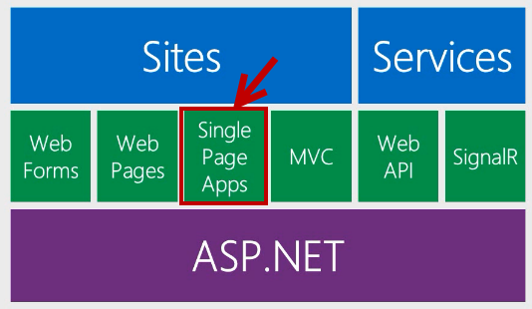
One ASP.NET

Slide 4
Hybrid is the norm
ASP.NET Web Form
ASP.NET
MVC Page
SPA
ASP.Net
MVC Page
No one pattern is the best Evolution, not revolution

Slide 5
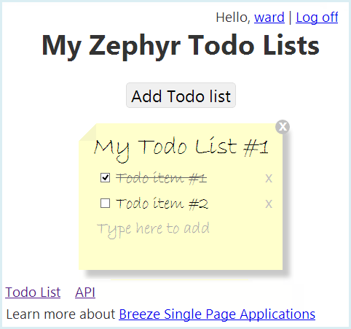

Slide 6
Rich data
Client Queries
Roll Your Own
Caching
Change Tracking
Validation
Batch Save

Slide 7
Free
Open Source (GitHub)
MIT License

Slide 8
Technical Support
Professional Services

Slide 10
learn more at
www.breezejs.com

