Slide 1
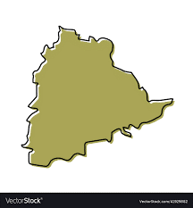
Codebasics Resume Project Challenge - 5
Telangana tourism Analysis

Slide 2
Objectives
1.Explore the available data to understand the current state of tourism in Telangana.
2.Identify patterns and trends in the data that can help to inform recommendations for improving tourism.
3.Conduct additional research to gain a deeper understanding of the factors that impact tourism in Telangana.
4.Use the insights gained from the data analysis and additional research to develop data-informed recommendations for the Telangana government.
Present the findings and recommendations in a clear and concise manner.

Slide 3
Questions
Answers
Analysis
Inferences
Reasons
Suggestions

Slide 4
Facts about Telangana
Youngest state of India formed on 4 June 2014.
Capital city – Hyderabad.
Number of districts - 33
11th largest State (112,077 km² )
12th most populous State (35,003,674 as per 2011 census)

Slide 5
1) List Down the top 10 districts that have the highest number of domestic visitors overall (2016 – 2019)

Slide 7

Heart & Soul of Telangana tourism

Slide 8
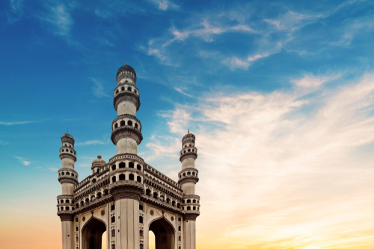
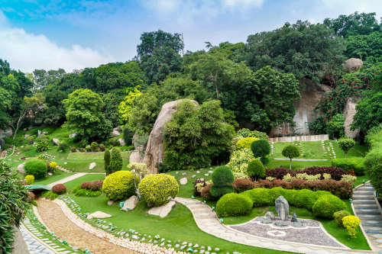
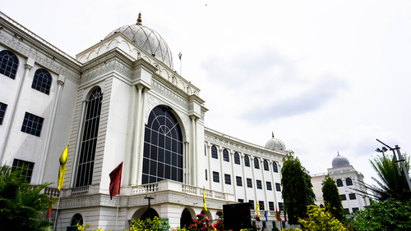
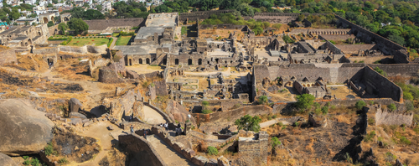
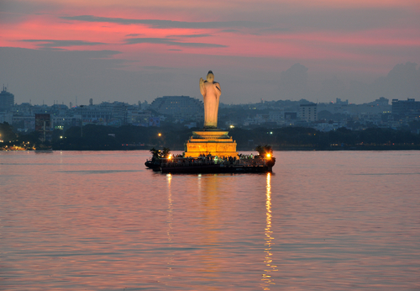
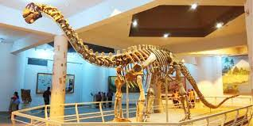
L
Hyderabad
Most visited tourism places in the city
Charminar
Ramoji
Film city
Salar jung museum
Golconda
fort
Hussain
Sagar lake
Birla science museum

Slide 9
L
Hyderabad
Most visited tourism places in the city
Birla science museum
Salar jung museum
Hussain
Sagar lake
Ramoji
Film city
Golconda
fort
Charminar

Slide 10
L
Hyderabad
Most visited tourism places in the city
Birla science museum
Charminar
Hussain
Sagar lake
Salar jung museum
Golconda
fort
Ramoji
Film city

Slide 11
L
Hyderabad
Most visited tourism places in the city
Ramoji
Film city
Birla science museum
Charminar
Hussain
Sagar lake
Golconda
fort
Salar jung museum

Slide 12
L
Hyderabad
Most visited tourism places in the city
Ramoji
Film city
Salar jung museum
Birla science museum
Charminar
Hussain
Sagar lake
Golconda
fort

Slide 13
L
Hyderabad
Most visited tourism places in the city
Ramoji
Film city
Salar jung museum
Golconda
fort
Birla science museum
Charminar
Hussain
Sagar lake

Slide 14
L
Hyderabad
Most visited tourism places in the city
Ramoji
Film city
Salar jung museum
Charminar
Golconda
fort
Hussain
Sagar lake
Birla science museum

Slide 15
L
Hyderabad
Important facts about the city
Pearl City
Diversity in tourism spots
Airport
Capital city of Telangana
Metro
IT Hub
Universities & colleges

Slide 16

L
The Tourist attractions of non – Hyderabad region are mostly temples, forts & recreation spots

Slide 17
L
Hyderabad
Other Tourism hotspots
Ananthagiri Hills, Vikarabad district
Armenian cemetery in Hyderabad
Aza Khane Zehra
Badshahi Ashurkhana
British Residency, Hyderabad
Buddha Statue of Hyderabad
Chilkoor Balaji Temple
Chiraan Fort Palace
Chowmahalla Palace
Dharna Chowk, Hyderaba
Falaknuma Palace
Goshamahal Baradari
Hayat Bakshi Mosque
Himayat Sagar
Hyderabad International Film Festival
Jalagam Vengal Rao Park
Jawahar Deer Park
Kasu Brahmananda Reddy National Park
Khairtabad Mosque
Mahavir Harina Vanasthali National Park

Slide 18
L
Hyderabad
Mahboob Chowk Clock Tower
Manjira Wildlife Sanctuary
Moula Ali hill
Mrugavani National Park
Nampally Sarai
Nanakramguda Temple
Naya Qila
Necklace Road
Nehru Zoological Park
Nizam Museum
Pranahita Wildlife Sanctuary
Purani Haveli
Purani Idgah
Qadir Ali Baig Theatre Festival
Ramoji Film City
Rashtrapati Nilayam
Ravindra Bharathi
Ruhaniyat – The All India Sufi & Mystic Music Festival
Salar Jung Museum
Sardar Mahal
Secunderabad Clock Tower
Shilparamam
Snow World
Sudha Cars Museum
Taramati Baradari
Toli Masjid
Wonderla

Slide 19
2) What are the peak & low season months for Hyderabad from 2016 to 2019

Slide 20
Peak season months year wise
Year | Month
2016 | June
2017 | December
2018 | October
2019 | January
Winter Season

Slide 21
Low season months year wise
Year | Month
2016 | February
2017 | March
2018 | May
2019 | September
Summer Season

Slide 22
Domestic visitors’ trend month wise
- Highest - June
(17 Millions)
- Lowest – February
(5 Millions)
Black line – Average
(7 Millions)

Slide 23
Foreign visitors’ trend month wise
- Highest - December
(120 K)
- Lowest – May
(60 K)
Black line – Average
(87 K)

Slide 24
3) List down the top 3 districts based on Compounded annual growth rate from 2016 – 2019

Slide 26
4) List down the bottom 3 districts based on Compounded annual growth rate from 2016 – 2019

Slide 27
4) List down the bottom 3 districts Compounded annual growth rate from (2016 – 2019)

Slide 28
5) Show the top 3 & bottom 3 districts with high domestic to foreign tourists ratio

Slide 29
Top 3 Districts

Slide 30
99%

Slide 31
Reasons for the dominance of Hyderabad in attracting foreign tourism
Airport
Capital city of Telangana
Pearl City
IT Hub
World famous Destinations
Infrastructure

Slide 32
Bottom 3 Districts

Slide 33
Reasons for the Failure of Other districts in attracting foreign tourism
Far from airport
Poor transportation
Poor accommodation
Poor infrastructure
Not familiar

Slide 34
6) List the top & bottom 5 districts based on “population to tourist footfall ratio”

Slide 35
Top 5 Districts

Slide 36


Bottom 5 Districts
Kamareddy
Medchal
Rangareddy
Suryapet
Vikarabad

Slide 37
Steps that can be taken by the government to increase tourism in these districts
Focus on Popularising ancient temples of these regions.
Renovating Buddhist & Jain monuments in these localities.
Improving transportation facilities.
Improving Accommodation facilities.
Special focus on ananthagiri hills in vikarabad
Coming up with recreation spots like park etc..
Proper usage of media & social media for Popularising tourism these districts.
Publishing articles on the internet about the hidden gems in these districts.

Slide 38
7) What will be the projected number of domestic & Foreign tourists in Hyderabad by 2025

Slide 39
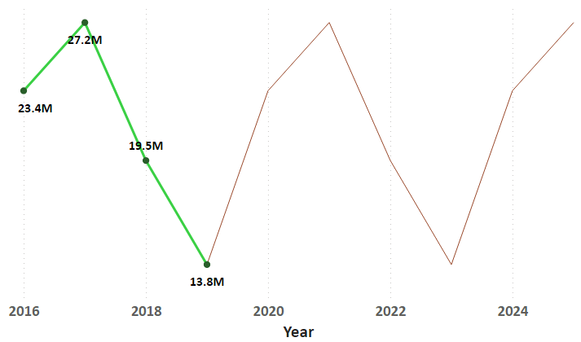
Projected trend of domestic tourists in Hyderabad in 2025
As per the current trend, Projected domestic tourists number by 2025 is 27 Million

Slide 40
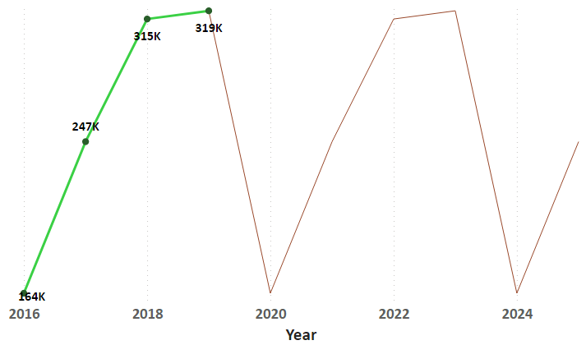
Projected trend of Foreign tourists in Hyderabad in 2025
As per the current trend, Projected domestic tourists number by 2025 is 2.5 Lakhs

Slide 41
8) What will be the projected Revenue from domestic & Foreign tourists in Hyderabad by 2025

Slide 42
Projected Revenue of Domestic tourists in Hyderabad in 2025 (Revenue per tourist – 1200)

Slide 43
Projected Revenue of Foreign tourists in Hyderabad in 2025 (Revenue per tourist – 5600)

Slide 44
Recommendations

Slide 45
Districts with highest potential for tourism growth
Hyderabad
Warangal (Urban)
52%
Yadadri Bhongir
Rajanna Sircilla

Slide 46
Actions to be taken by the government in these districts
Come up with more number of airports.
Increase metro & railway connectivity.
Setup IT parks & recreation parks.
Improve accommodation.
Setup adventure sports & resorts

Slide 47
Corporate & cultural events that can conducted to boost tourism
Event | Month | Districts
Summer camp for students | April, May | Medchal, Rangareddy
Food Festivals | December, January | Any
Sports & Adventure events | October, November | Hyderabad, Warangal
Corporate conferences | January, December | Hyderabad
Heritage walks | Mar, Feb | Any

Slide 48

Can Hyderabad Adopt the Dubai model?
Sustainability
Cost efficiency
Cultural Importance
Technological advancement

Slide 49
Recommendations to boost Telangana tourism (Hyderabad)
Technological Advancement – Ex : Use of AI to recommend places to tourists based on there Interests.
Adoption to native Telangana culture – Ex: Customising tourist places with native culture to attract tourists.
More focus on advertising & branding – Ex: Proper usage of social media
Making changes in academic curriculum – Ex : Teaching Students about the native culture & history can actually encourage them to visit local tourist spots
Tieng up with cinema stars – Ex: Making them promote tourism

Slide 50


Dhaval Patel
Hemanand Vadivel
K T Rama Rao
(IT minister of Telangana)

