Slide 1
EMPLOYEE MANAGEMENT SYSTEM

Slide 2
INTRODUCTION
The Employee Management System (EMS) is a robust, enterprise-grade application designed to streamline human resource operations. Built on the Spring Boot framework, it provides a secure environment for managing employee lifecycles—from recruitment to data maintenance—ensuring data integrity through strict validation and protecting sensitive information with role-based security.

Slide 3
ABSTRAT
The Employee Management System is a secure, cloud-ready backend solution built with Spring Boot to streamline human resource operations. It features a robust Login and Register API secured by JWT (JSON Web Tokens) for stateless authentication and Role-Based Access Control (RBAC) to manage permissions. The system ensures high data quality through strict User Input Validation and provides a resilient user experience via Global Exception Handling. To handle large datasets efficiently, the system implements Pagination and Sorting, all while being fully documented via Swagger for seamless cloud deployment.

Slide 4
What we are going to build: Client Requirement
User Authentication & Security:
Secure Login and Sign-up for all employees.
Role-Based Access Control (RBAC): Only Admins can add/delete employees, while
regular users can only view or edit their own profiles.
Employee Management (CRUD):
Create: Add new employee records with fields like Name, Email, Department, and
Salary.
Read: Search for employees by ID or Name and view a complete list of staff.
Update: Modify existing details (e.g., salary hikes or department changes).
Delete: Remove records of former employees from the active database.
Validation: Automated checks for valid email formats and mandatory fields to prevent
empty or "junk" data.
.

Slide 5
What we are going to build: Some technical terms.
Security & Identity: Implementation of a Proper Login and Register API using JWT-based authentication to ensure secure, stateless communication.
Role-Based Security: APIs are protected with Role-based authentication, ensuring that only authorized users (e.g., Admin vs. Employee) can access specific resources.
Data Optimization: The API supports Pagination and Sorting for employee records, preventing performance bottlenecks during data retrieval.
Code Quality: Includes Proper user input validation to maintain data integrity and Proper exception handling to return standardized error messages.
DevOps & Documentation: All REST APIs are documented (using Swagger/OpenAPI) for easy consumer integration and are prepared for Cloud Platform deployment

Slide 6
What are the technologies and tools we are going use ?
Framework: Spring Boot Java Framework.
  Java 8+
  Maven
  STS
  Spring core, Spring security(jwt) , Spring data JPA(Hibernate) et.c
MySQL Database.
Postman Rest Client
Swagger
Lombok

Slide 7
SYSTEM REQUIREMENTS
Operating System | Windows 10
Java SDK (JDK) | JDK 17
Integrated Development Environment (IDE) | Eclipse
Database Server | MySQL 8.0
Build Tool | Maven 3.6
API Testing | Browser
Documentation | Text File

Slide 8
PROJECT MODULE
Identity & Security Module
Employee Core Module
Validation & Exception Module
AOP Logging & Audit Module
Infrastructure & Documentation Module

Slide 9
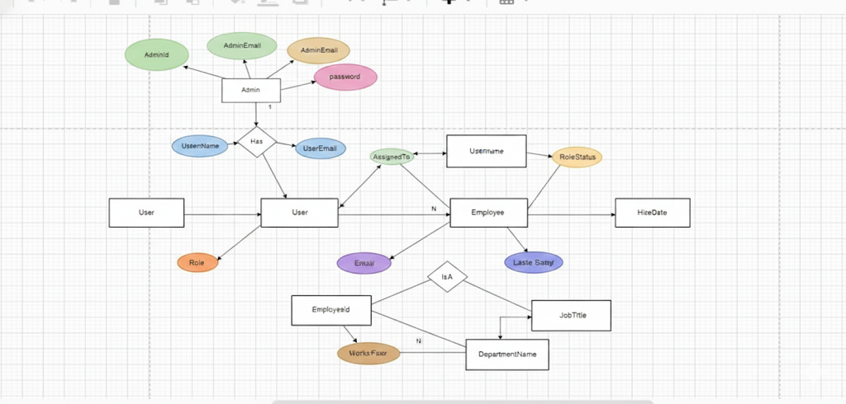
ER DIAGRAM

Slide 10
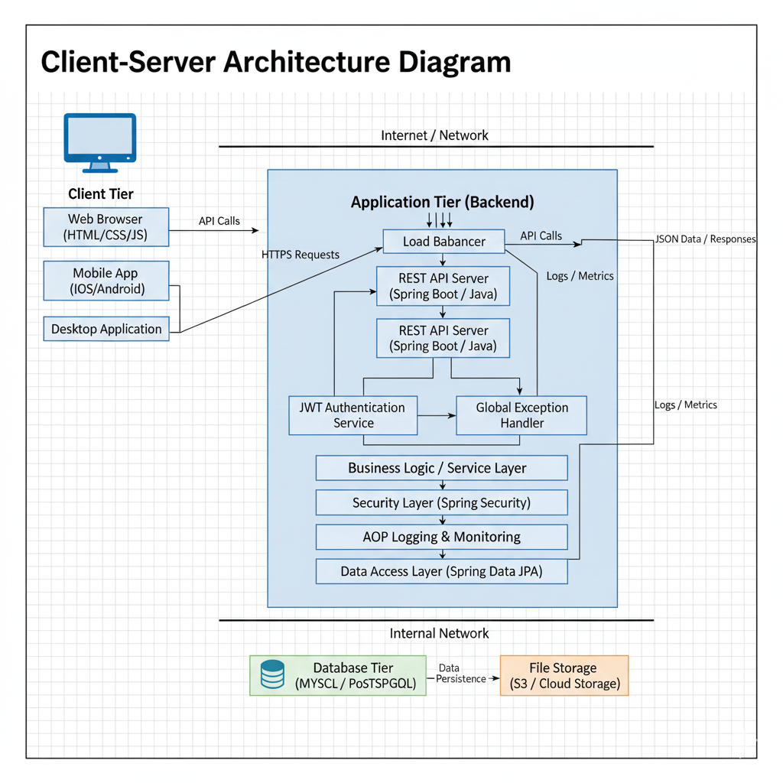
Client – Server Architecture

Slide 11
Dao Layer
API
Layers
Business Logic
Controllers
Services
Repositories
Postma n (Client)
Database
Spring Boot APP

Slide 12
Identity & Security Module
1. Registration: When a new user signs up, the system takes the plain-text password, uses the BCrypt hashing algorithm to encrypt it, and stores the user in the database with a specific role (e.g., ROLE_USER).
2. Login & Authentication: When a user logs in, theAuthenticationManager verifies the credentials
3.Token Issuance: If valid, the system generates a JWT (JSON Web Token).
4. Authorization: For every subsequent request, the user must send this token in the header. Spring Security intercepts the request, validates the token, and checks if the user has the required role (e.g.,@PreAuthorize("hasRole('ADMIN')")) to perform the action

Slide 13
Employee Core Module
  Controller Layer: Receives the HTTP request (like POST /api/employees).
  Service Layer: Contains the "business rules." For example, before adding an employee, it might check if the email already exists.
  Pagination & Sorting: Instead of fetching 10,000 employees at once, the PagingAndSortingRepository allows the client to request "Page 1 with 10 records." This keeps the application fast and reduces memory usage.
  Data Persistence: Uses Spring Data JPA to save or retrieve the Employee entity from the MySQL database without writing manual SQL queries.

Slide 14
Validation & Exception Module
Request Validation: Before the data reaches the Service layer, the Hibernate
Validator checks the annotations
Centralized Error Handling: If something goes wrong (e.g., you try to an
employee with ID 999 which doesn't exist), the code throws a ResourceNotFoun
-dException.
Global Response: The @ControllerAdvice class intercepts this exception and
sends a clean, professional JSON response to the user:{ "error": "Employee not
found", "status": 404 }

Slide 15
AOP Logging & Audit Module
This module uses Aspect-Oriented Programming to observe the system without interfering with the logic.
Aspects & Pointcuts: You define an "Aspect" (a piece of code) and a "Pointcut“
(where that code should run, e.g., "all methods in the Service layer").
Interception: Every time a service method is called, the AOP proxy "wraps" the
call.
Automated Logging: It automatically logs the method name and the time it took
to execute. This is crucial for Production Debugging—if a process is slow, the
AOP logs will show exactly which method is causing the delay.

Slide 16
Infrastructure & Documentation Module
  Swagger/OpenAPI: By adding a few dependencies, Spring Boot scans your controllers and generates a visual webpage (Swagger UI). Developers can use this page to test the API endpoints (like a built-in Postman).
  Database Configuration: Manages the Hikari Connection Pool, which keeps a set of database connections ready to use, significantly speeding up the app.
  Cloud Readiness: This module ensures the app uses application.properties or environment variables, making it easy to deploy on cloud platforms like AWS or Azure.

Slide 17
DATA DICTIONARY

Slide 18
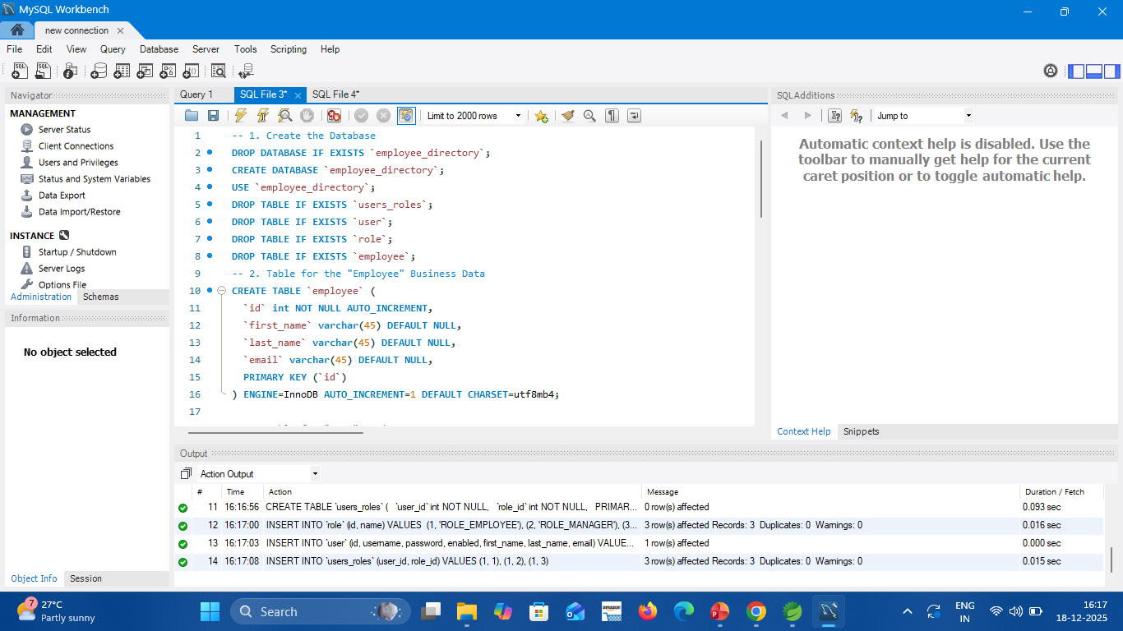
TABLES OF DATABASE

Slide 19
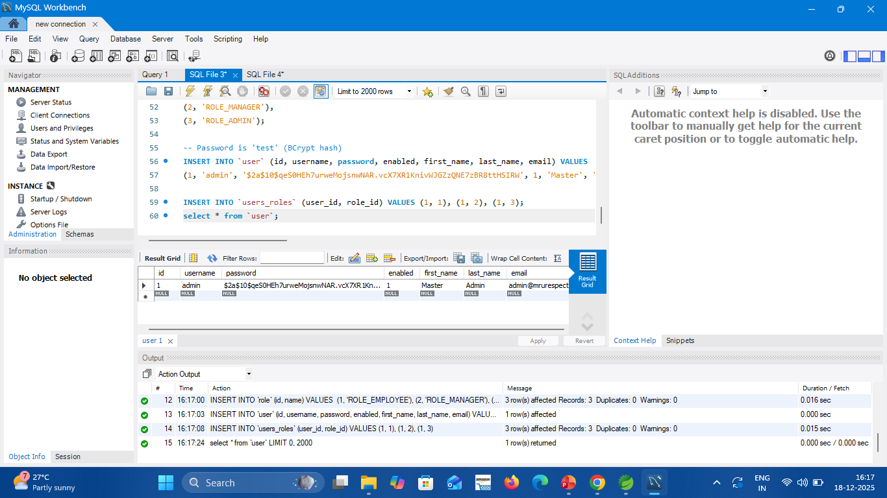
ADMIN DATABASE

Slide 20
DATABASE CODE

Slide 21
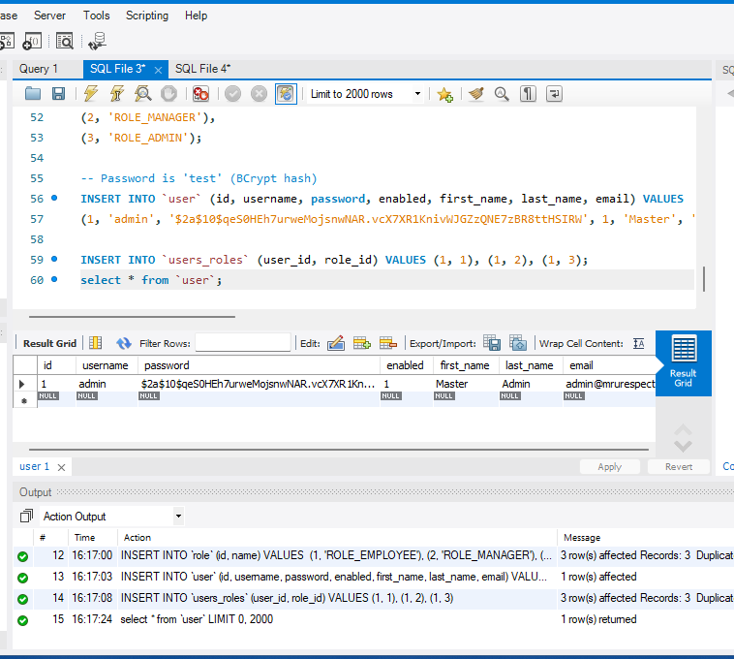
USER DATABASE TABLE

Slide 22
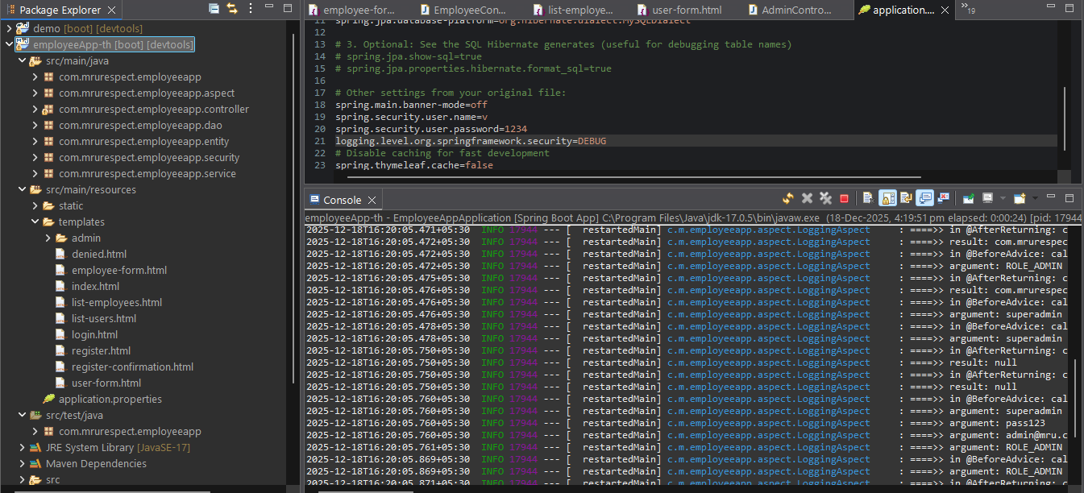
Spring Boot Application Running

Slide 23
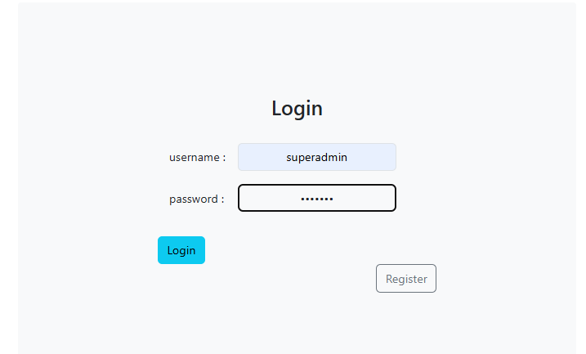
Login Form

Slide 24
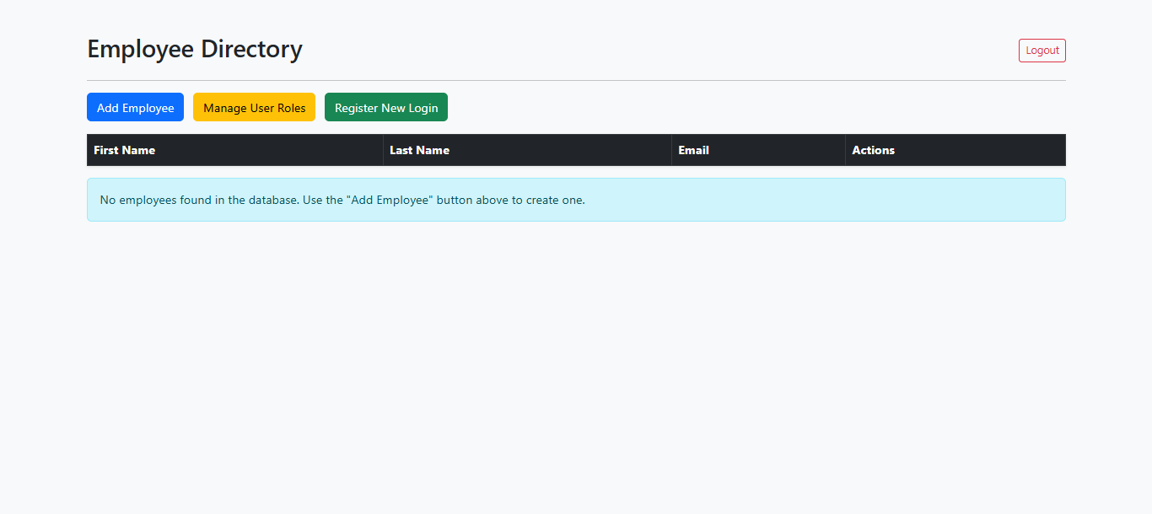
Main Interface

Slide 25
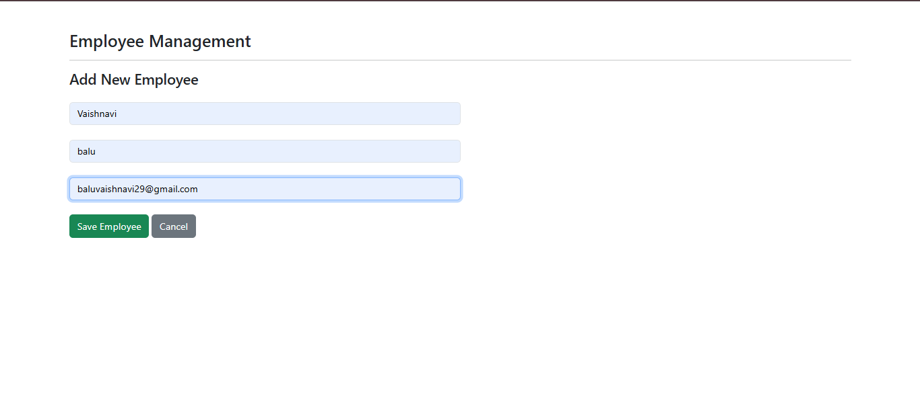
Adding New Employee

Slide 26
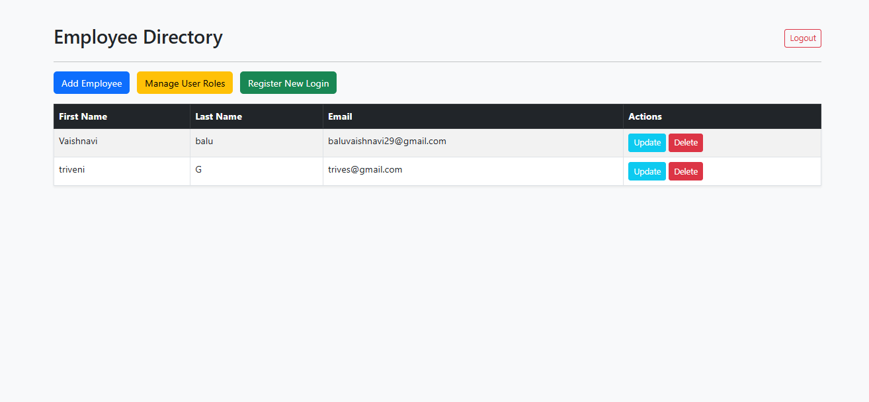
Updated Employee Details

Slide 27
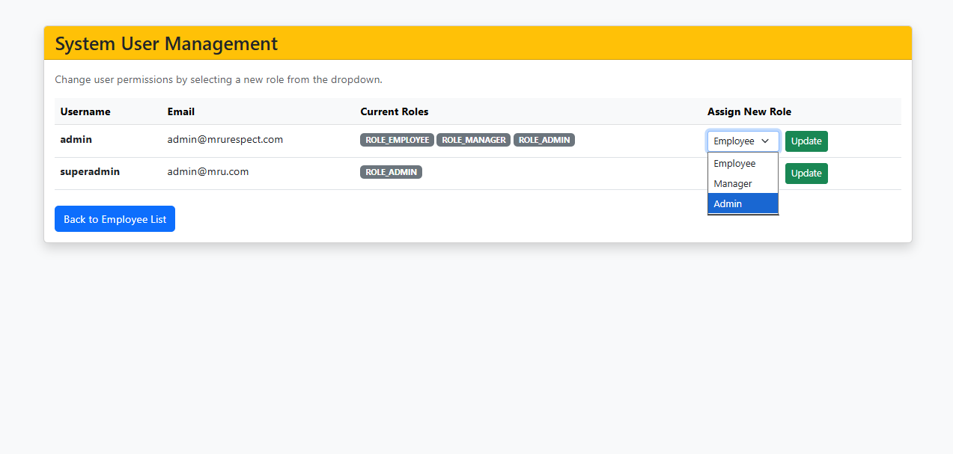
System User Management

Slide 28
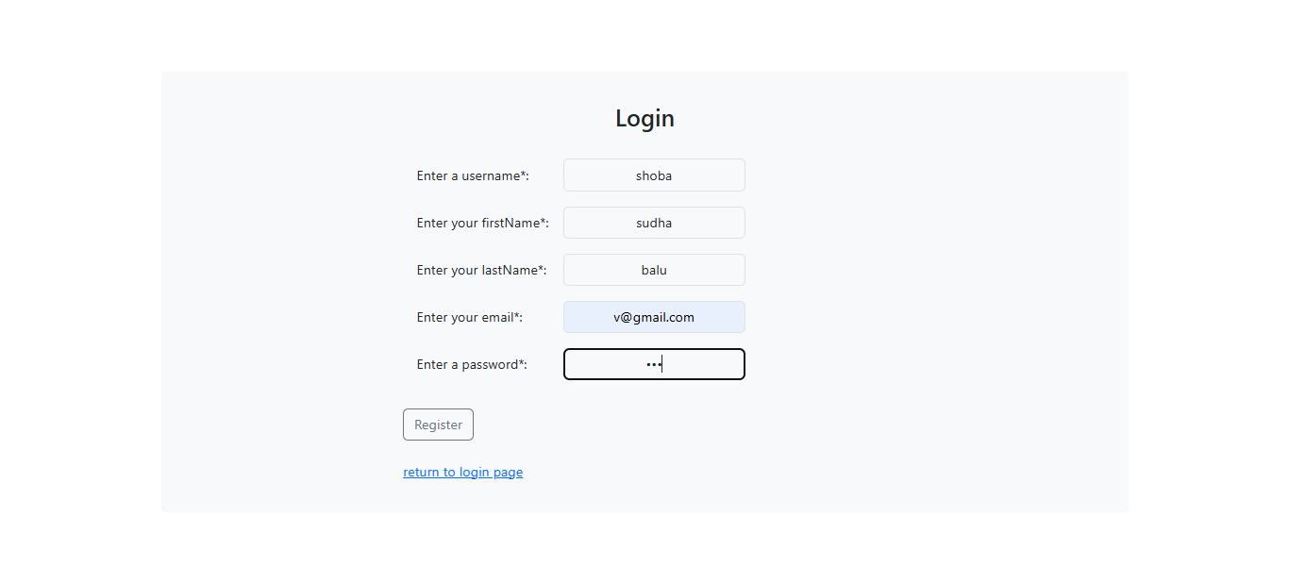
Register New Login

Slide 29
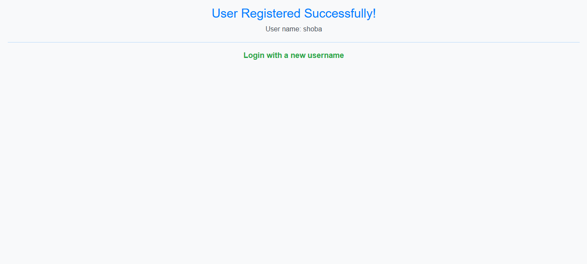
Successful Registration

Slide 30
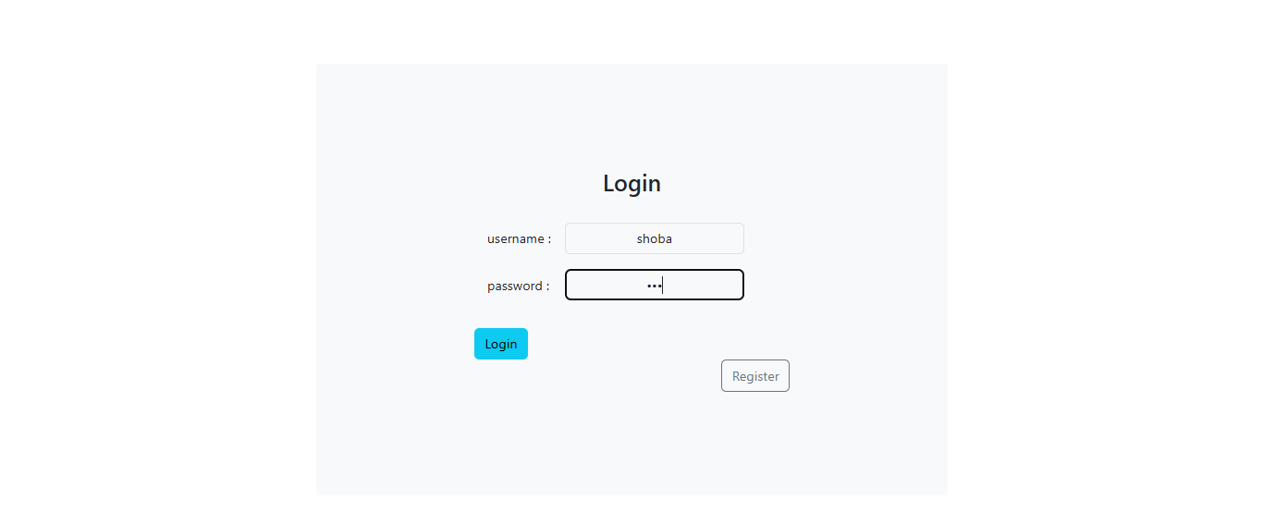
Login New User

Slide 31
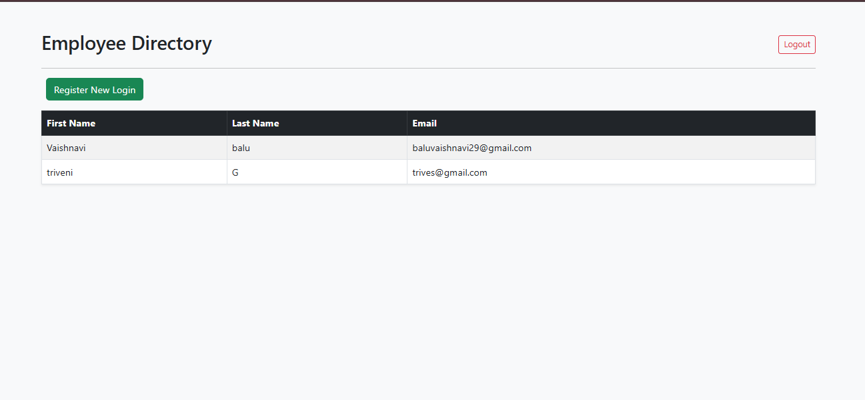
Successful login

Slide 32
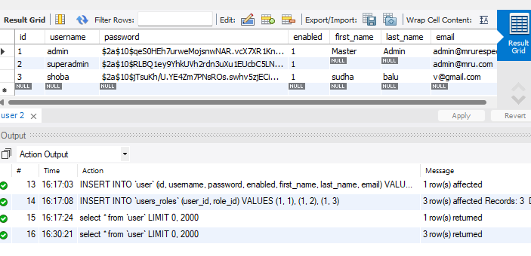
Updated DataBase

