Slide 1


Slide 2


Log into Continental Rewards Program website with user_name and password shared with you. Website URL: http://crd4.thetrinket.in/

Slide 3
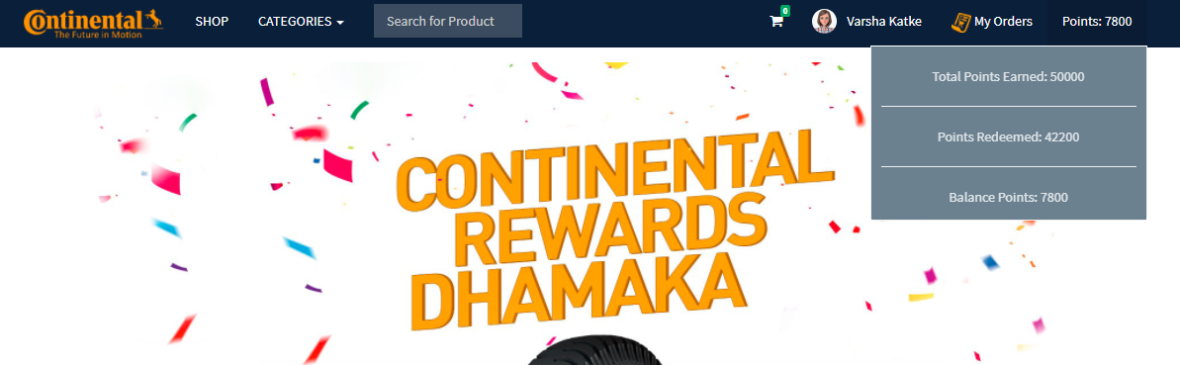
Click on Reward Points to get the points details –Total, Redeemed, Balance.

Slide 4
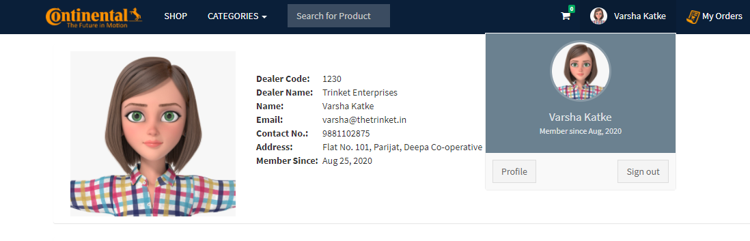
Check your details by clicking on profile option

Slide 5
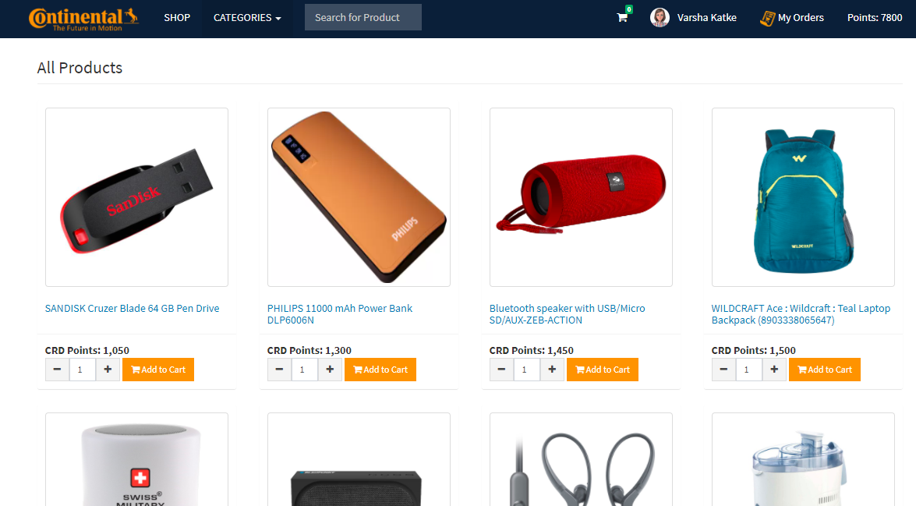
Click on the option ‘Shop’ to select the products available for redemption.

Slide 6
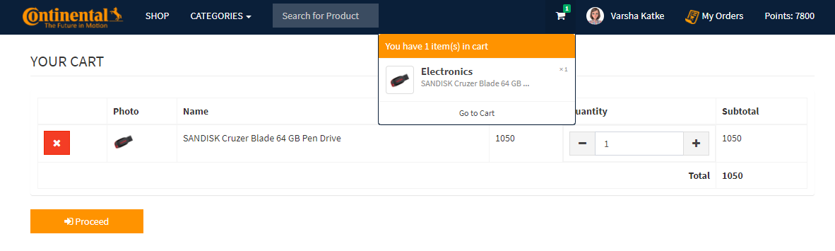
Add selected products to the cart and proceed with redemption request.

Slide 7
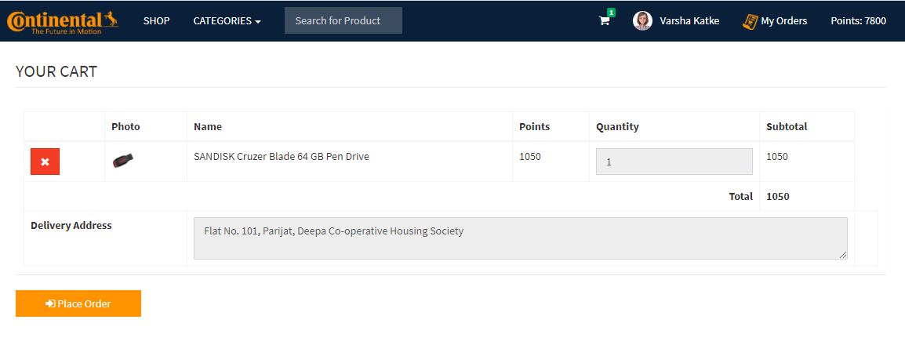
Verify the product added and the shipping address on the confirmation page and place the order

Slide 8
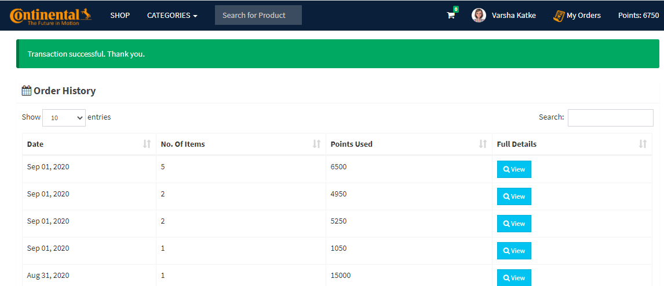
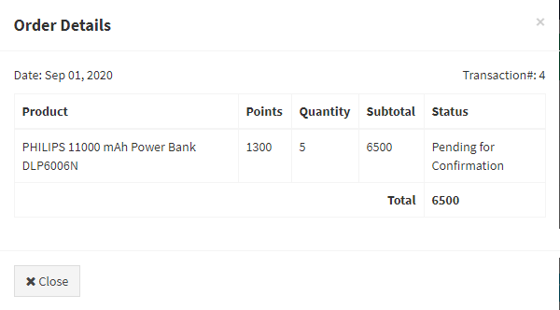
Check the order status under the order history option

Slide 9
Thank You!

