Slide 1
ParallelGumtree
DPHPC project of
Amirreza Bahreini
Christopher Signer
Balz Guenat

Slide 2
Problem: Matching Trees
Given two similar rooted ordered trees, find a matching of nodes.
Find edit operations transforming one tree into the other.
Applications:
  Different versions of source code ASTs
  Compare XML documents

Slide 3
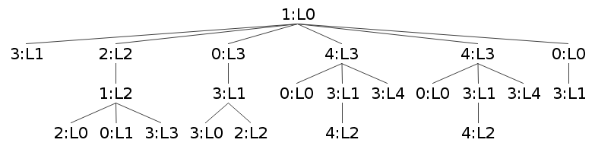
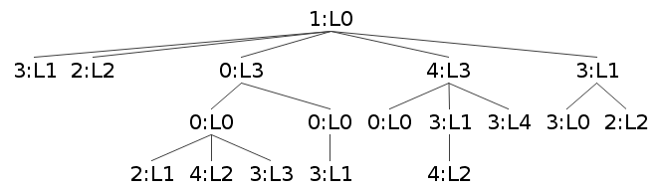
Trees

Slide 4
Trees – Top down
Match identical subtrees

Slide 5
Trees – Bottom up
Match by similarity

Slide 6
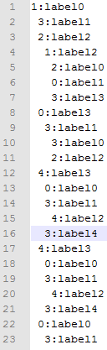
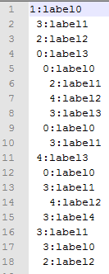
Tree matchings

Slide 7
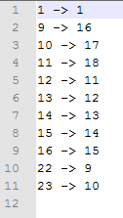
Tree matchings

Slide 8
Approach
Port from single thread Java to C++
Tree parsing, writing
Tree generation using Prüfer sequences
Add parallelizing
Optimizing and evaluating

