Slide 1
ParallelGumtree
DPHPC project of
Amirreza Bahreini
Christopher Signer
Balz Guenat

Slide 2
Problem: Matching Trees
Given two similar rooted ordered trees, find a matching of nodes.
Find edit operations transforming one tree into the other.
Applications:
  Different versions of source code ASTs
  Compare XML documents

Slide 3
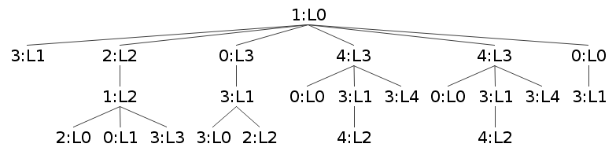
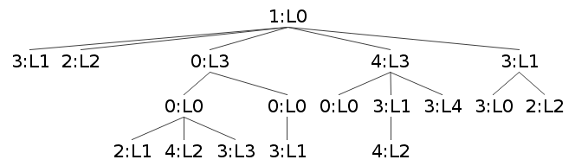
Trees

Slide 4
Trees – Top down
Match identical subtrees

Slide 5
Trees – Bottom up
Match by similarity

Slide 6
Approach
Port from single thread Java to C++
Tree parsing, writing
Generation of pairs of similar trees
Add parallelizing (OpenMP)
Write test tool
Optimizing and evaluating

Slide 7
Challenges
Start off with a large amount of code
Hard to get realistic tree generation
  Should be similar to source code edits
  Hard to validate
gperftools caused freezes :(

Slide 8
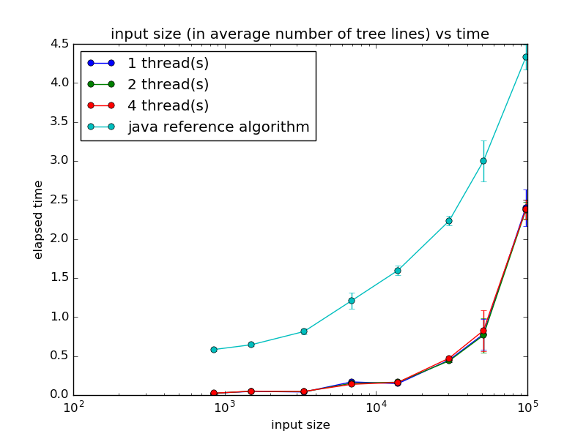
Results
Good news:
Much faster than Java
Lower memory footprint
Bad news:
Basically no speedup
Compiled with GCC 5.2.1, Ubuntu 15.10, Intel Core i7-3520M

Slide 9
The problem:
Size of parallelizable parts depends on problem instance
Found to be generally small
Inherent in algorithm
#pragma omp parallel for reduction(pair_max:maxPair)
for (unsigned i = 0; i < candidatesSize; ++i) {
auto c = candidates[i];
double sim = jaccardSimilarity(t, c);
if (sim > maxPair.first && sim >= SIM_THRESHOLD) {
maxPair = make_pair(sim, c);
}
}

Slide 10
Ideas for improvement
Use additional cores for precomputation
  All-in-all more work but
  Chance that needed values are already available when needed
auto candidates = getDstCandidates(t);
#pragma omp parallel for reduction(pair_max:maxPair)
for (unsigned i = 0; i < candidatesSize; ++i) {
auto c = candidates[i];
double sim = jaccardSimilarity(t, c);
if (sim > maxPair.first && sim >= SIM_THRESHOLD) {
maxPair = make_pair(sim, c);
}
}

Slide 11
Ideas for improvement
Use additional cores for precomputation
  All-in-all more work but
  Chance that needed values are already available when needed
auto candidates = getAllUnmatchedNodes(t);
#pragma omp parallel for reduction(pair_max:maxPair)
for (unsigned i = 0; i < candidatesSize; ++i) {
auto c = candidates[i];
double sim = jaccardSimilarity(t, c);
if (sim > maxPair.first && sim >= SIM_THRESHOLD) {
maxPair = make_pair(sim, c);
}
}

