Slide 1
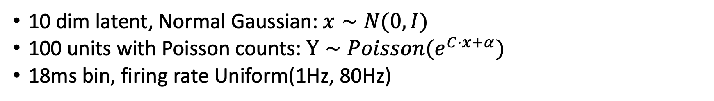
Synthetic data
10 dim latent, Normal Gaussian: $x∼N(0,I)$
100 units with Poisson counts: $Y∼Poisson(e^{C⋅x+α})$
18ms bin, firing rate Uniform(1Hz, 80Hz)
Pre-processing
Square root counts
Smooth with gaussian Kernel (around 100ms)

Slide 2
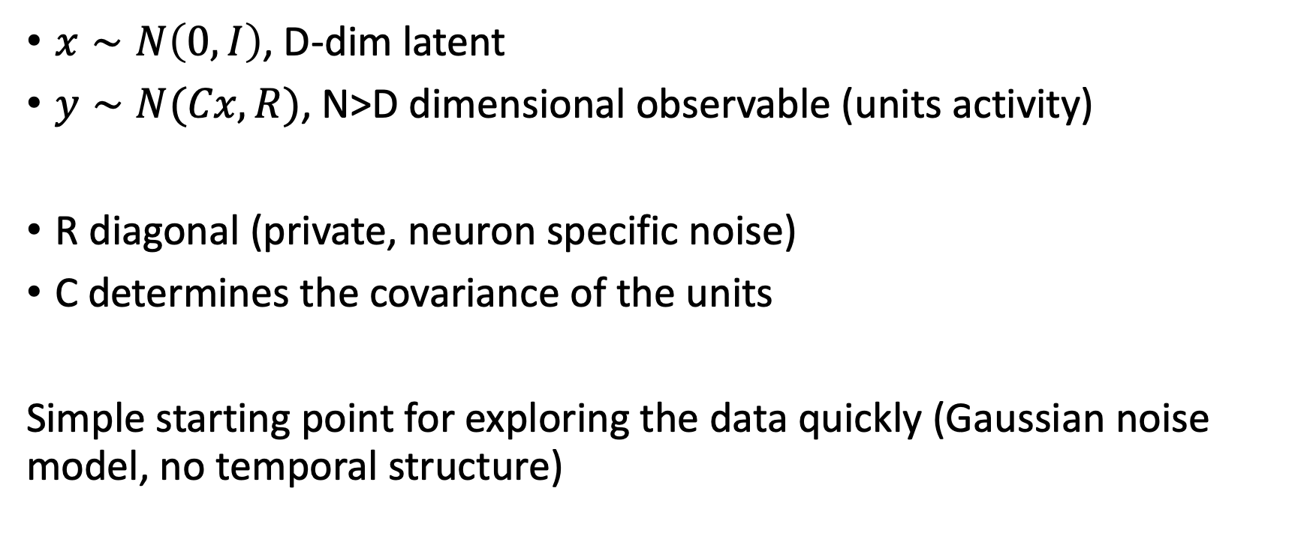
Exploratory Factor Analysis
$x∼N\left(0,I\right)$, D-dim latent
$y∼N(Cx,R)$, N>D dimensional observable (units activity)
R diagonal (private, neuron specific noise)
C determines the covariance of the units
Simple starting point for exploring the data quickly (Gaussian noise model, no temporal structure)

Slide 3
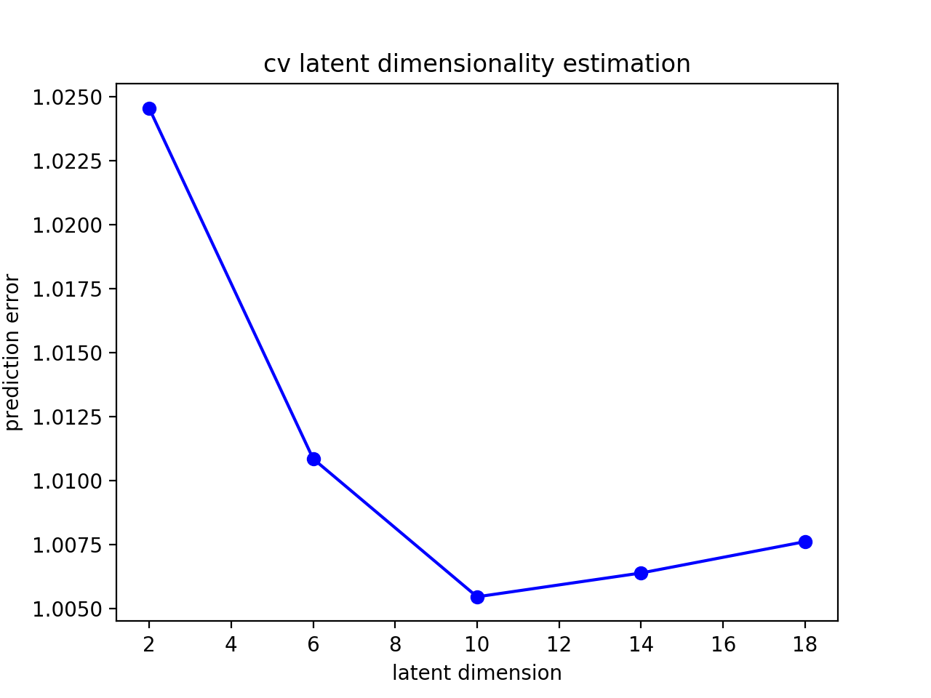
Latent dimension reconstruction
Split data in train/test (90/10 percent)
Fit factor analysis on the train set
Prediction error: (Yu, 2009 – GPFA paper)
Predict the spike counts of unit j given the activity of all the other units
compute the mean squared difference between prediction and square rooted counts
Repeat for all units and average across the population
True dim
Prediction error

Slide 4
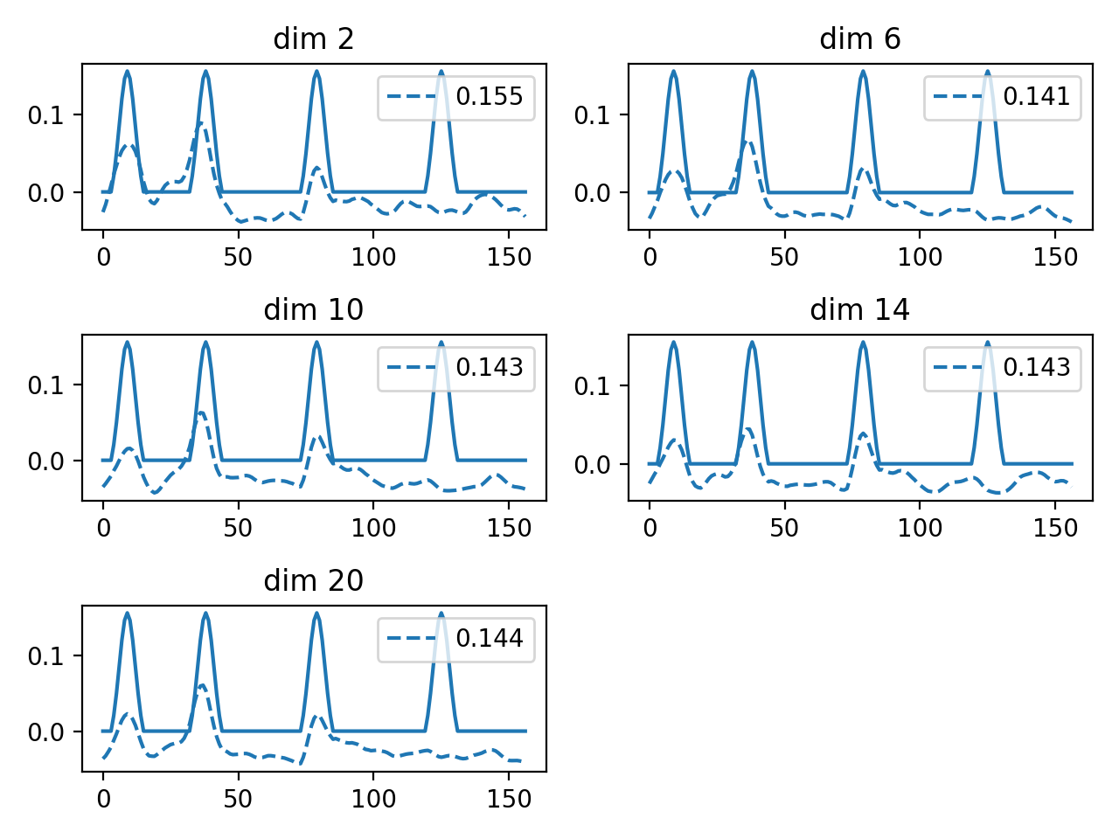
Experimental Data: example reconstructed rate (single trial, test set)
Filtered spike
Reconstructed Rate
Prediction Error
Time points

Slide 5
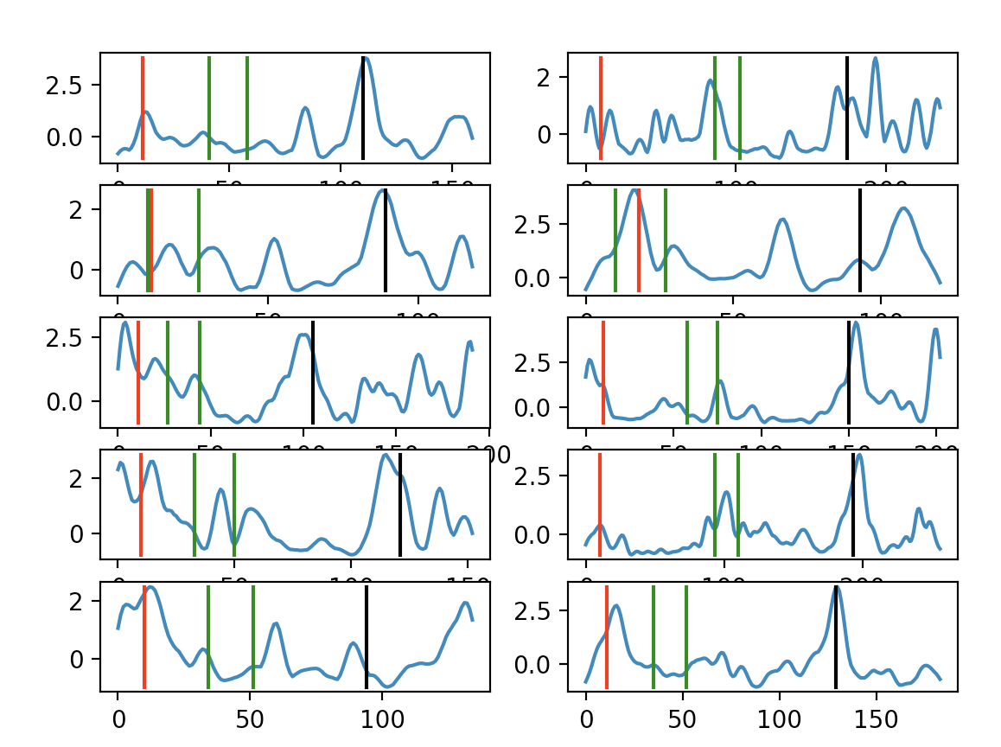
Example latent trajectories for individual trials
Target ON/OFF
Time Move Start
Time Move Stop

