Slide 1
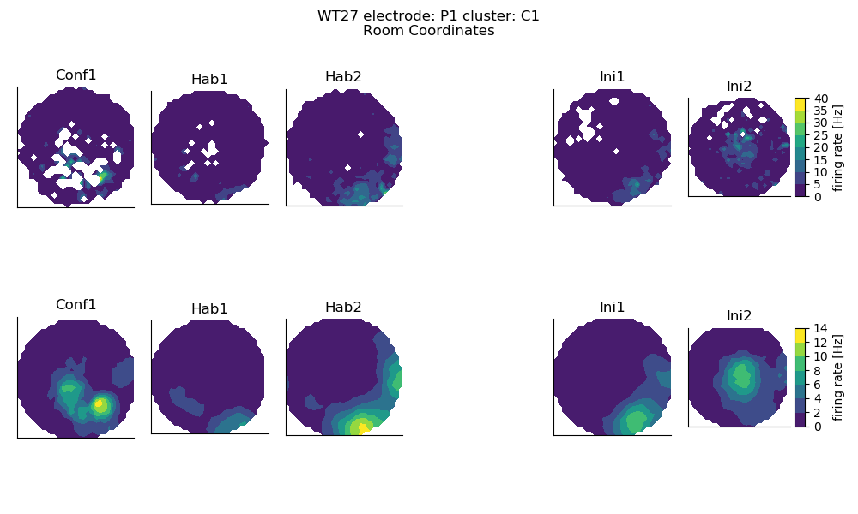
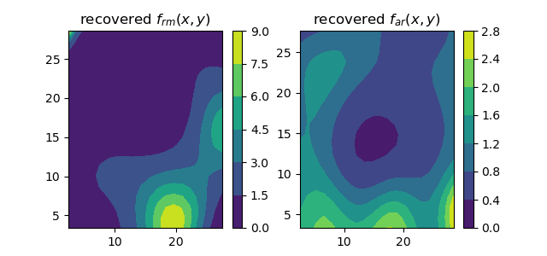
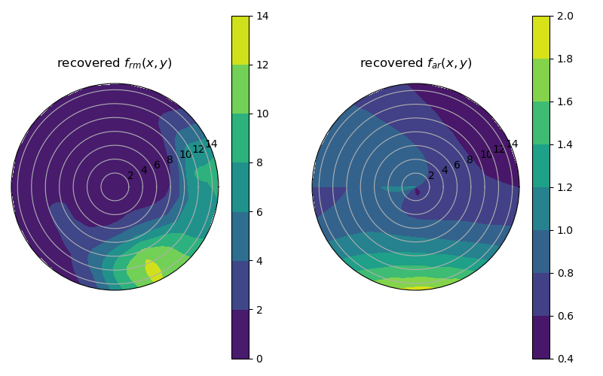
ROOM COORDINATES
Raw rates
spatial smooth rates

Slide 2
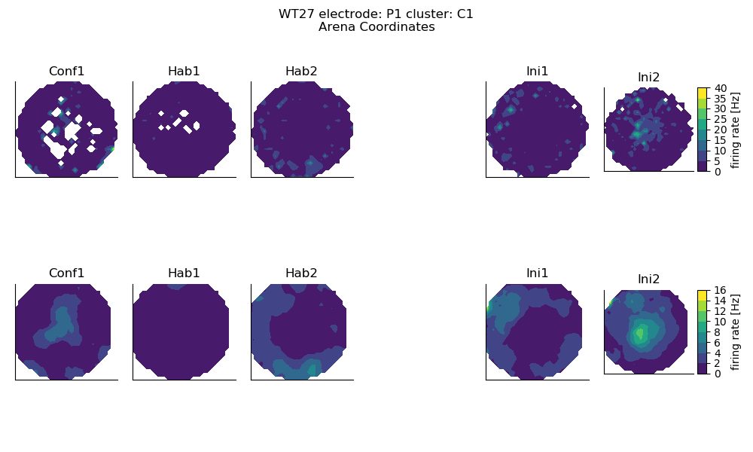
ARENA COORDINATES
Raw
spatial smooth rates

