Slide 1
Residual Estimate

Slide 2
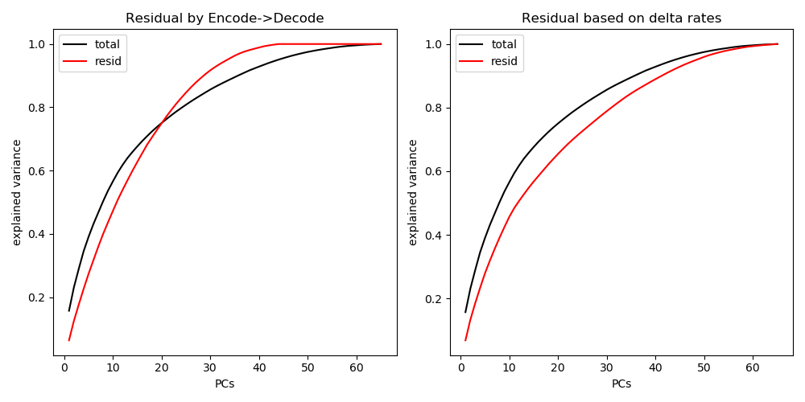
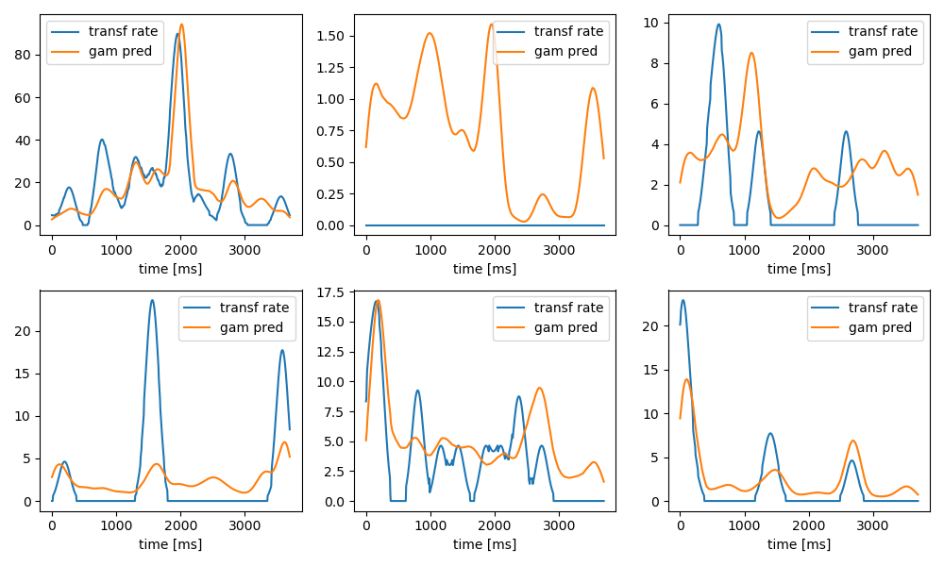
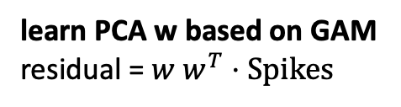
Residual based on difference
learn PCA w based on GAM
residual = $w w^{T}⋅Spikes$
Smoothed Spikes
GAM Prediction
PCA (sm. spikes – prediction)

Slide 3
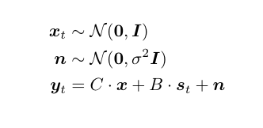
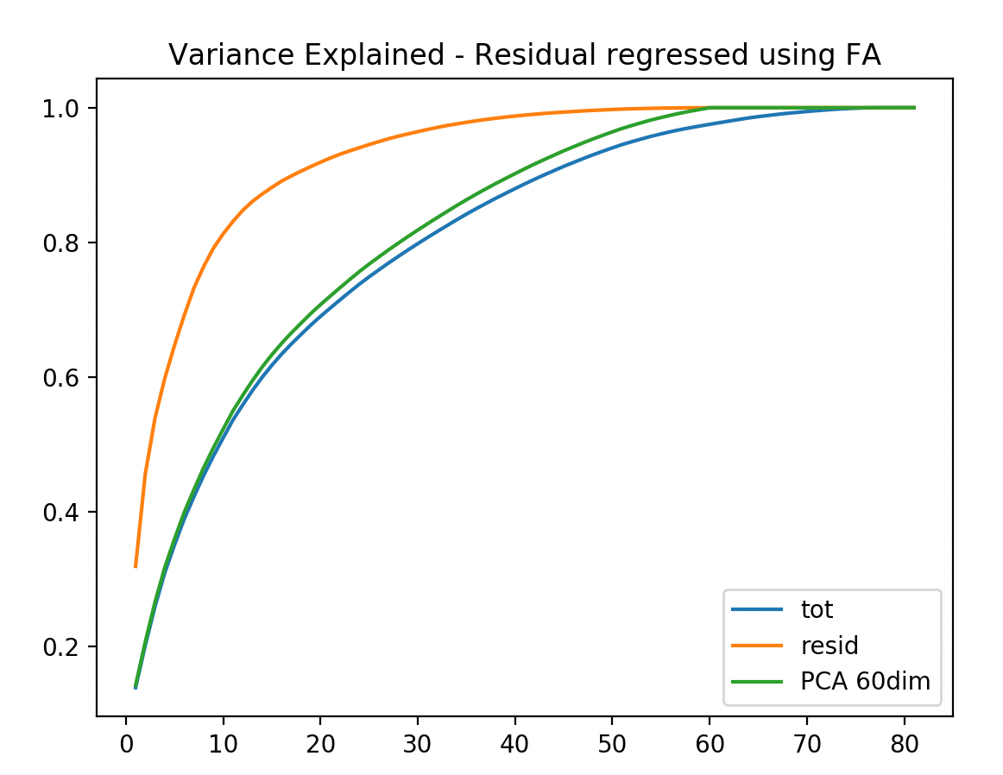

Fit a factor analysis
y smoothed spikes
x latent 60 dim
s stimulus non-linearly transformed using a B-spline
resid = $C⋅E[x|y]$

Slide 4
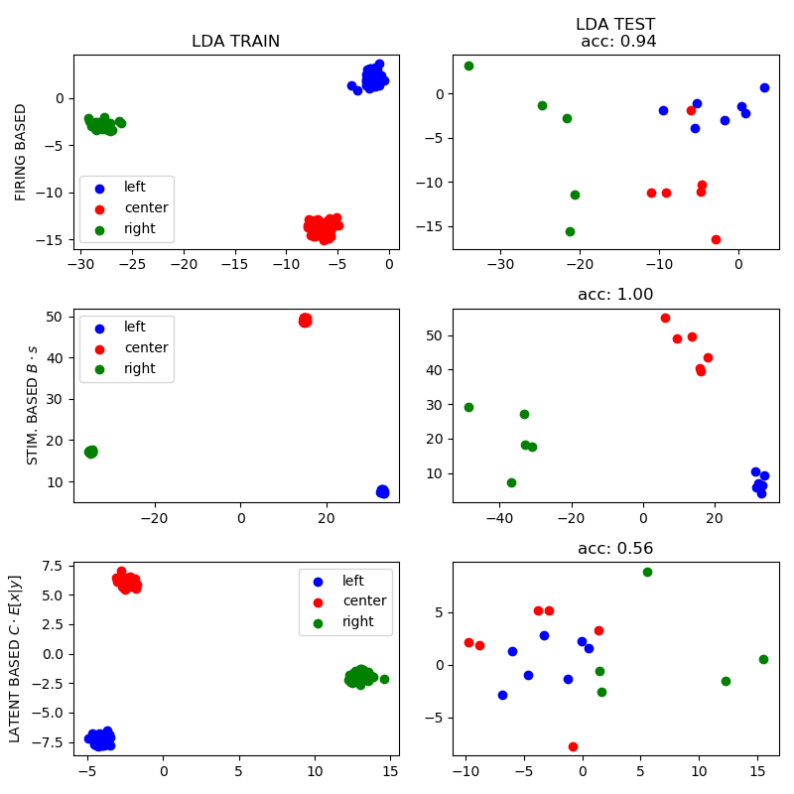
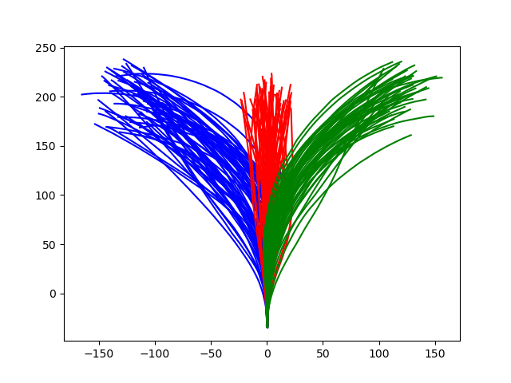
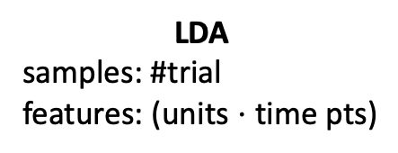
Does the latent contains trial information? (trajectory angle)
LDA
samples: #trial
features: (units $⋅$ time pts)

Slide 5
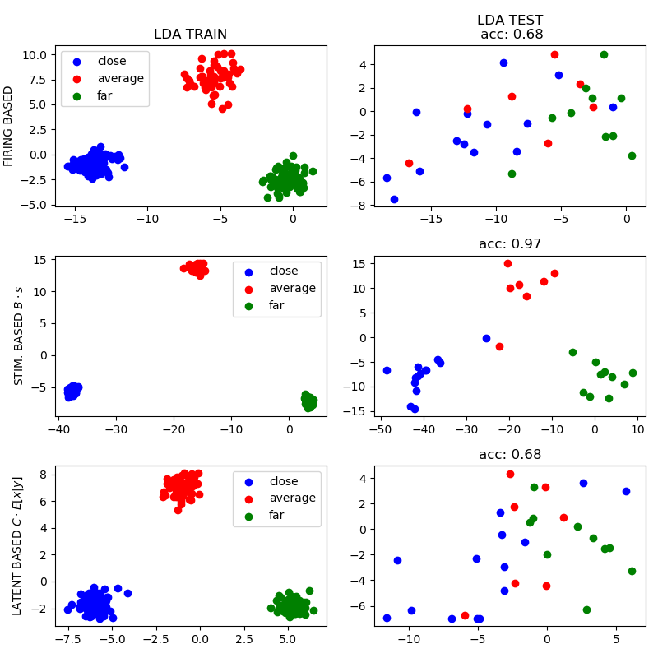
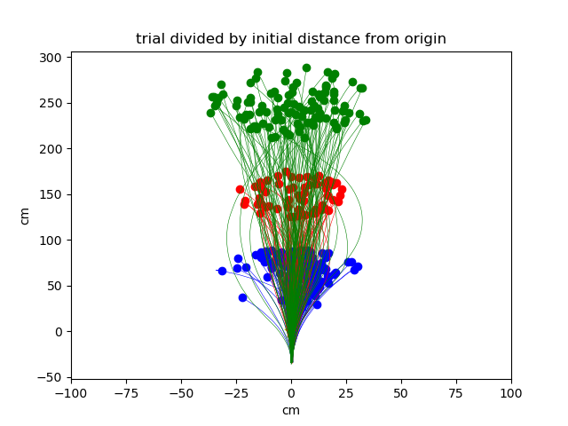
Does the latent contains trial information? (trajectory radial distance)
LDA
samples: #trial
features: (units $⋅$ time pts)

Slide 6
Paper Supplements: rad. distance to target reconstruction
model achieves 100% accuracy in variable selection for simulated data over the tested units
Notes:
100 sim of the spike counts
and then summary stats.

Slide 7
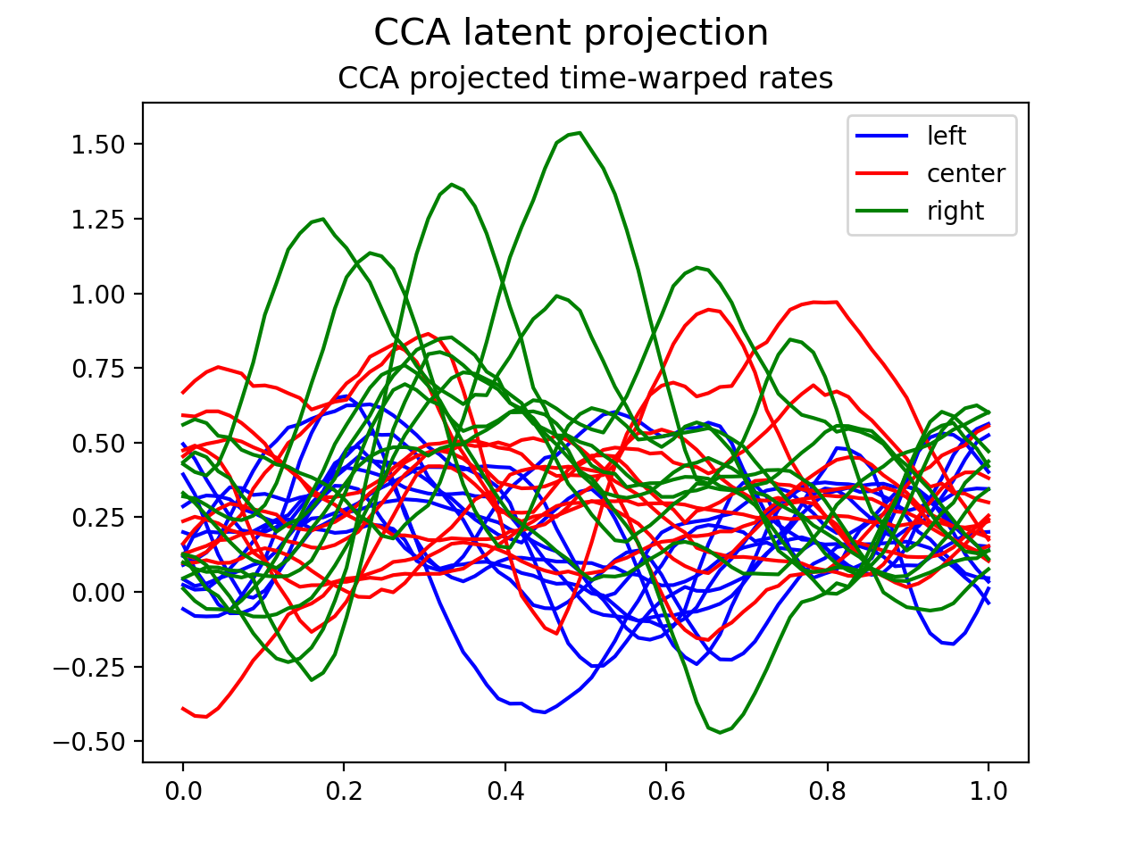
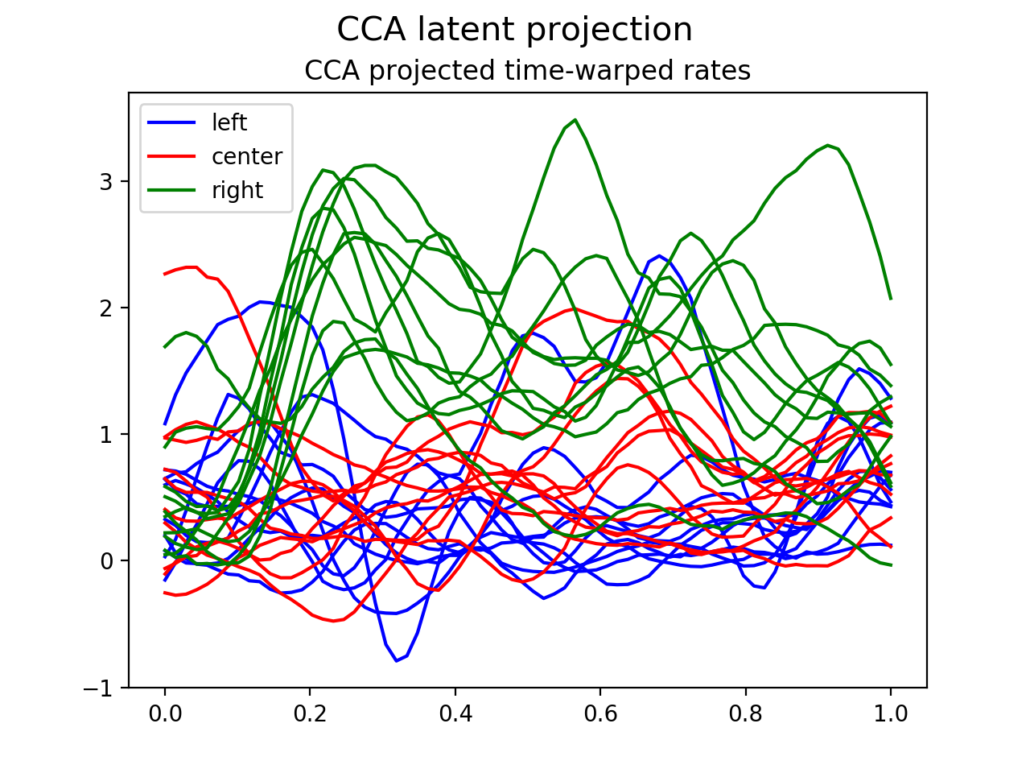
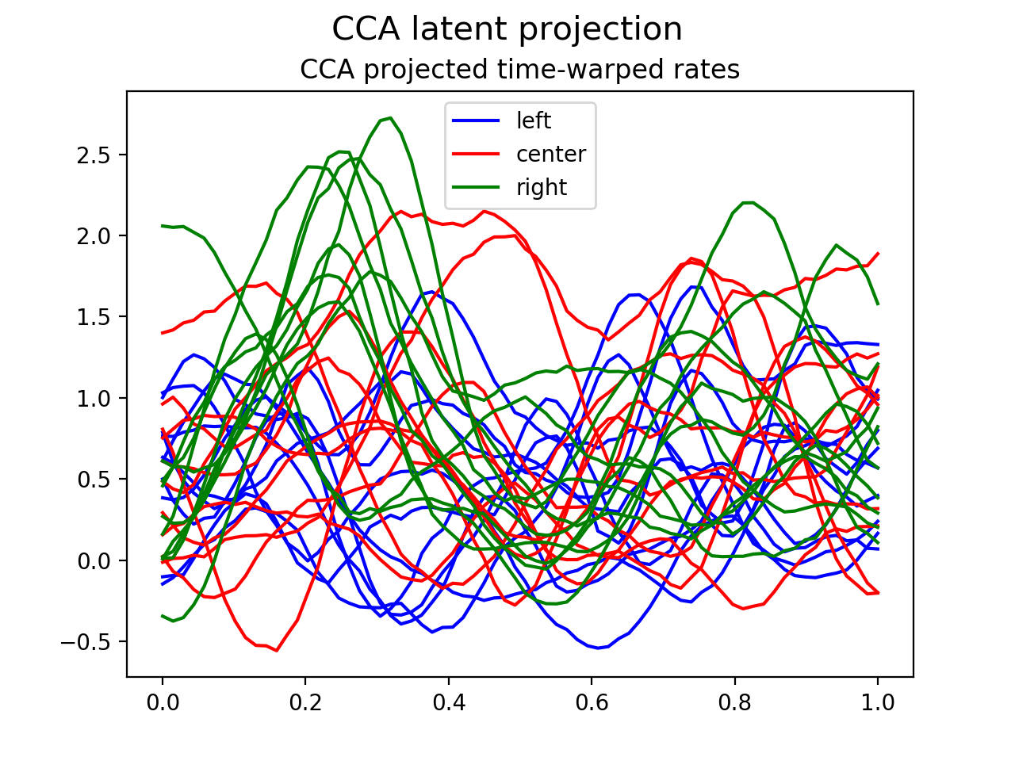
Find stimulus relevant direction
CCA initial stimulus position (depth and lateral displacement)
MST
area 7a
dlPFC

Slide 8
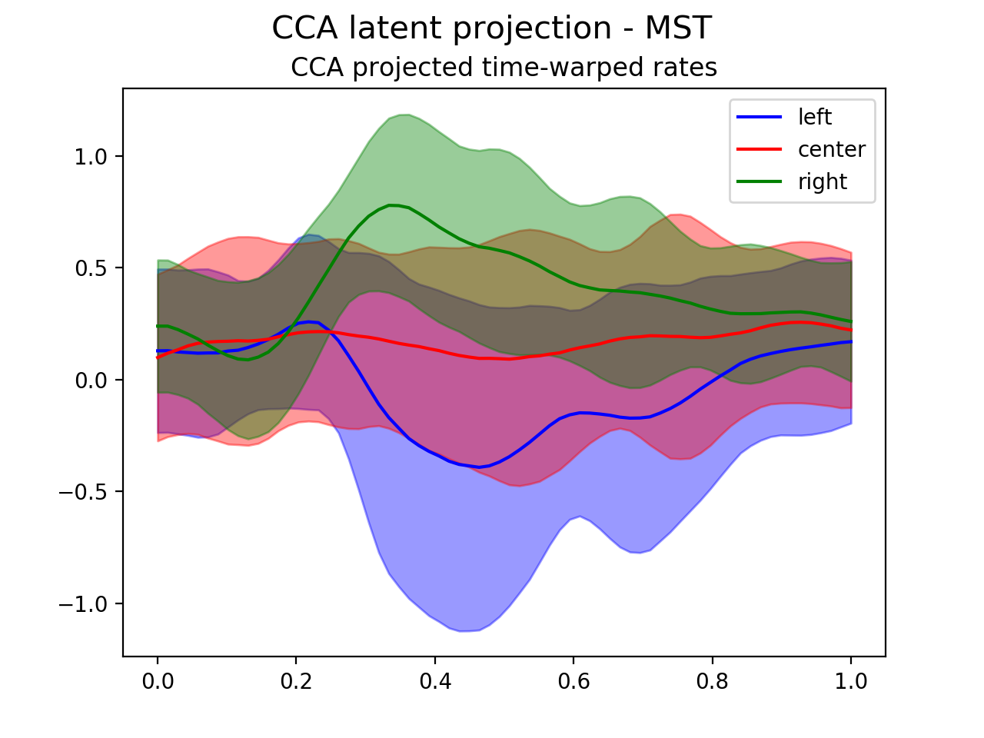
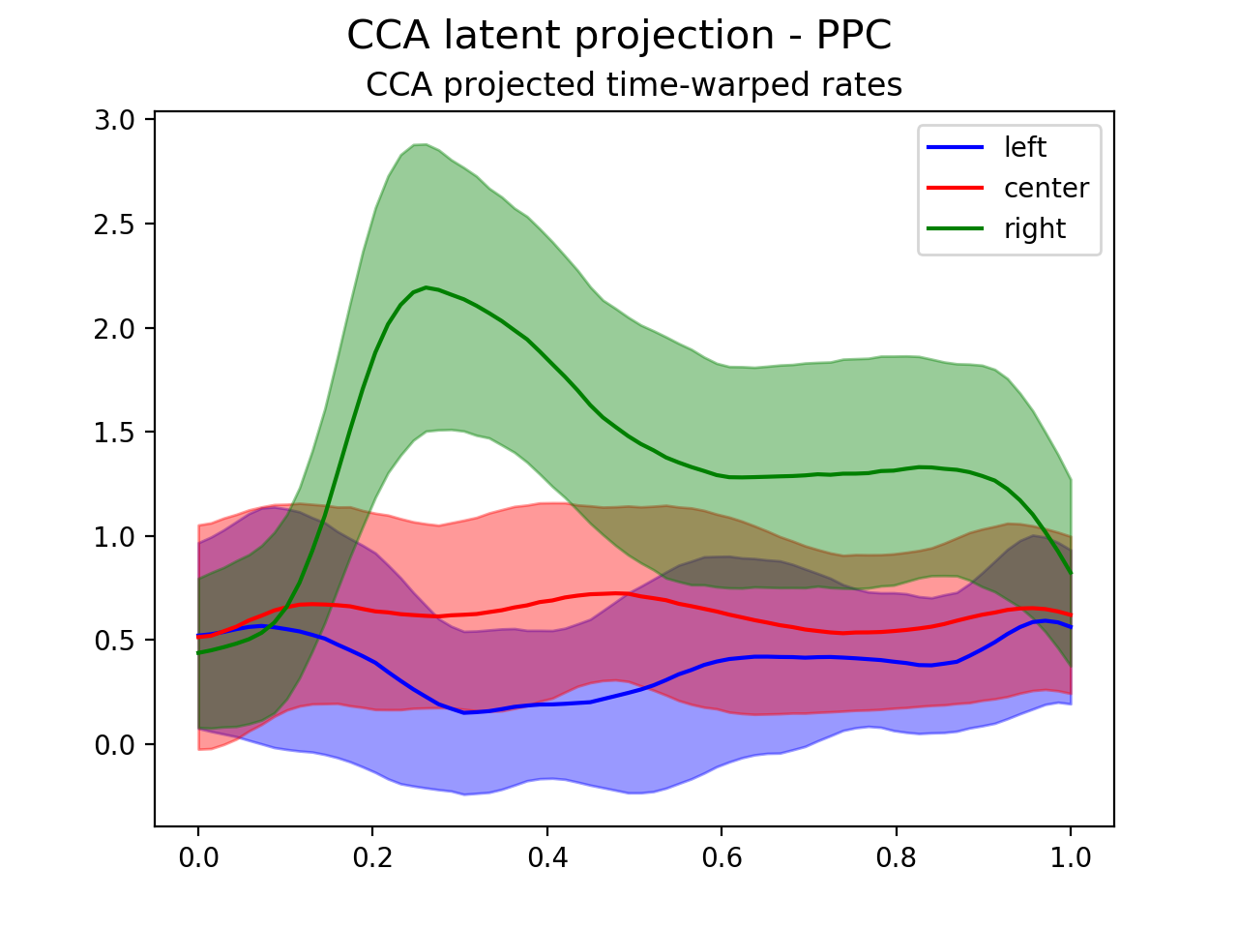
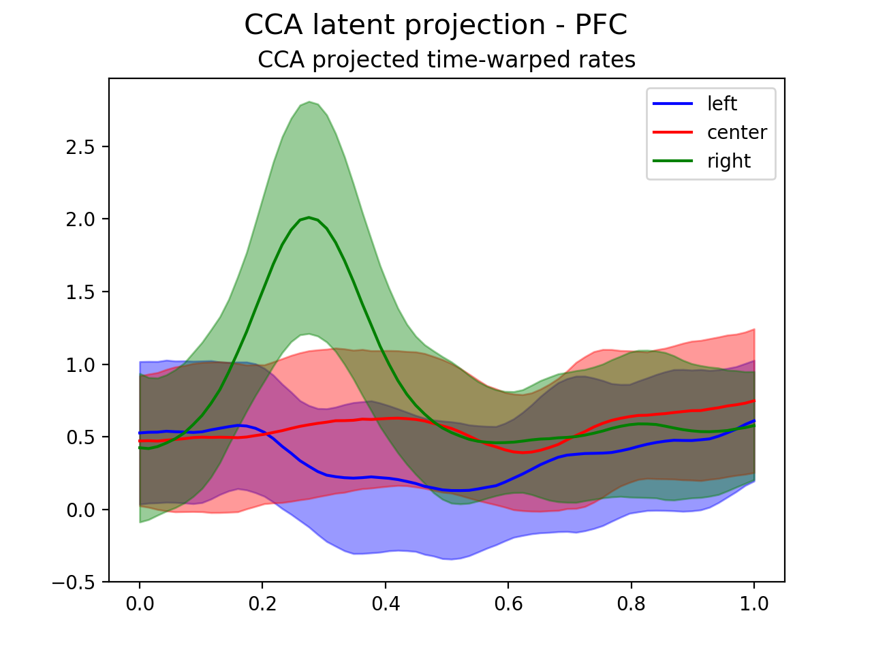
Find stimulus relevant direction
CCA initial stimulus position (depth and lateral displacement)
MST
area 7a
dlPFC

