Slide 1


Slide 2

June Cho Enterprise Mobile App Dev App Innovation | Global Black Belt

Slide 3
Agenda
Time | Topic | Speaker
9:00-9:30am | Welcome Statement | Keith Ballinger
9:30-10:30am | Setup, Build, and Test | Nikhil Keeppanasseril and Sweekriti Satpathy
10:30-10:45am | BREAK
10:45-11:45am | Distribute, Push, Analytics, and Crash | Derek Loar, Trevor Moore, and Dimah Zaidalkilani
11:45-12:45pm | Working Lunch | Chris Reichard
12:45-1:30pm | Machine Learning | Anuj Bhatia
1:30-2:15pm | Cognitive Services | Michael Watson
2:15-2:30pm | BREAK
2:30-4:00pm | Hands-On with Sentiment App | Mahdi Alirezaie
4:00-5:00pm | Closing Statement | Gifts | June Cho and ArcTouch
Dimah Zaidalkilani

Slide 4
Nikhil Keeppanasseril App. Innovation Specialist Global Black Belt

Slide 5
Getting Started
Log in to https://www.visualstudio.com/vs/mobile-center/
Connect directly with Github, your Microsoft login or new sign-up
Add new App → choose OS/platform
Build:
Select a service
Select Branch
Configure and build

Slide 6
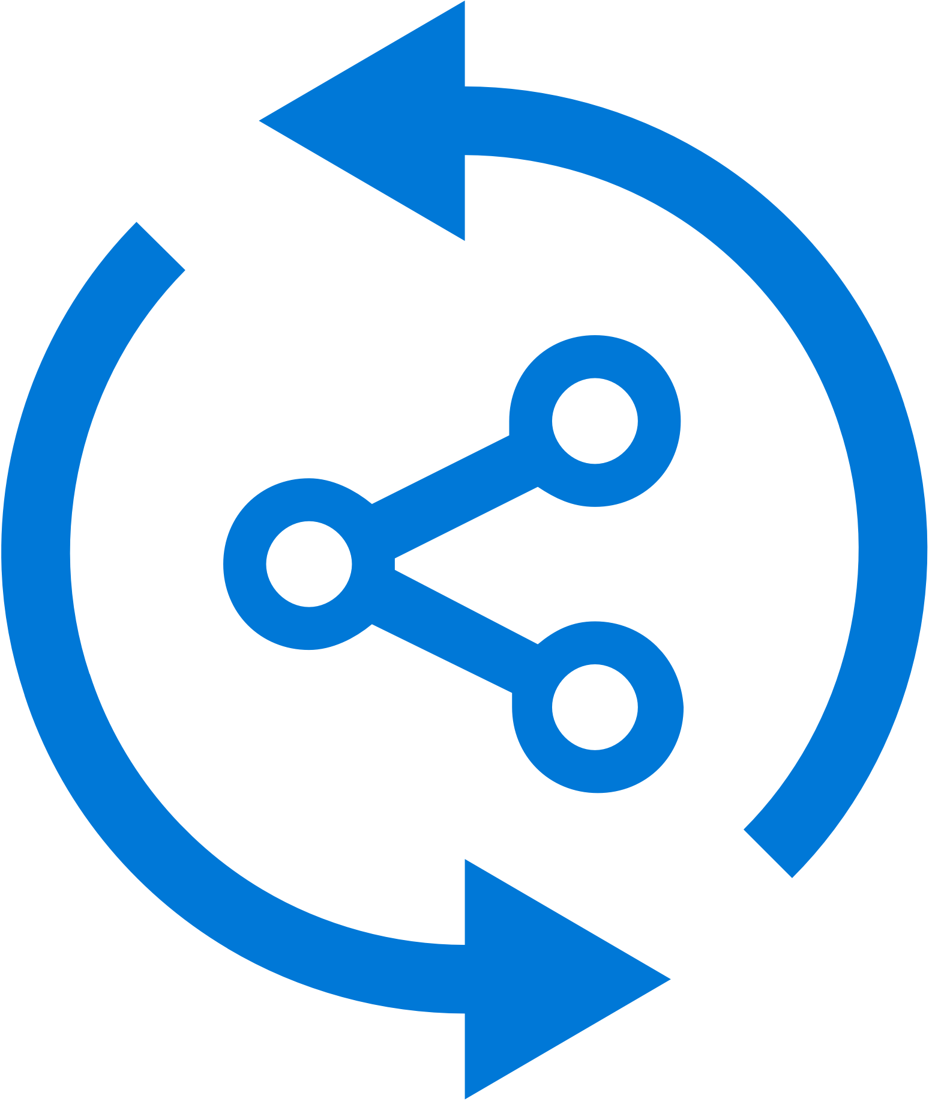


Mobile Center: Build
Build-on-push
With just a few steps automatically build apps with every commit, and generate packages to test and distribute
Work with existing tools
Connect existing repositories in GitHub, Bitbucket, and Visual Studio Team Services with just a few clicks
Build securely in the cloud
Each build is run on a separate, clean virtual machine hosted on our secure cloud servers
Notes:
Each build is run on a separate, clean virtual machine and no other user has access to this virtual machine. Once the build is completed, the virtual machine is discarded and all files removed. The files resulting from the build (log files, application files, symbol files) are stored on Mobile Center servers.

Slide 7
Trevor Moore App. Innovation Specialist Global Black Belt

Slide 8
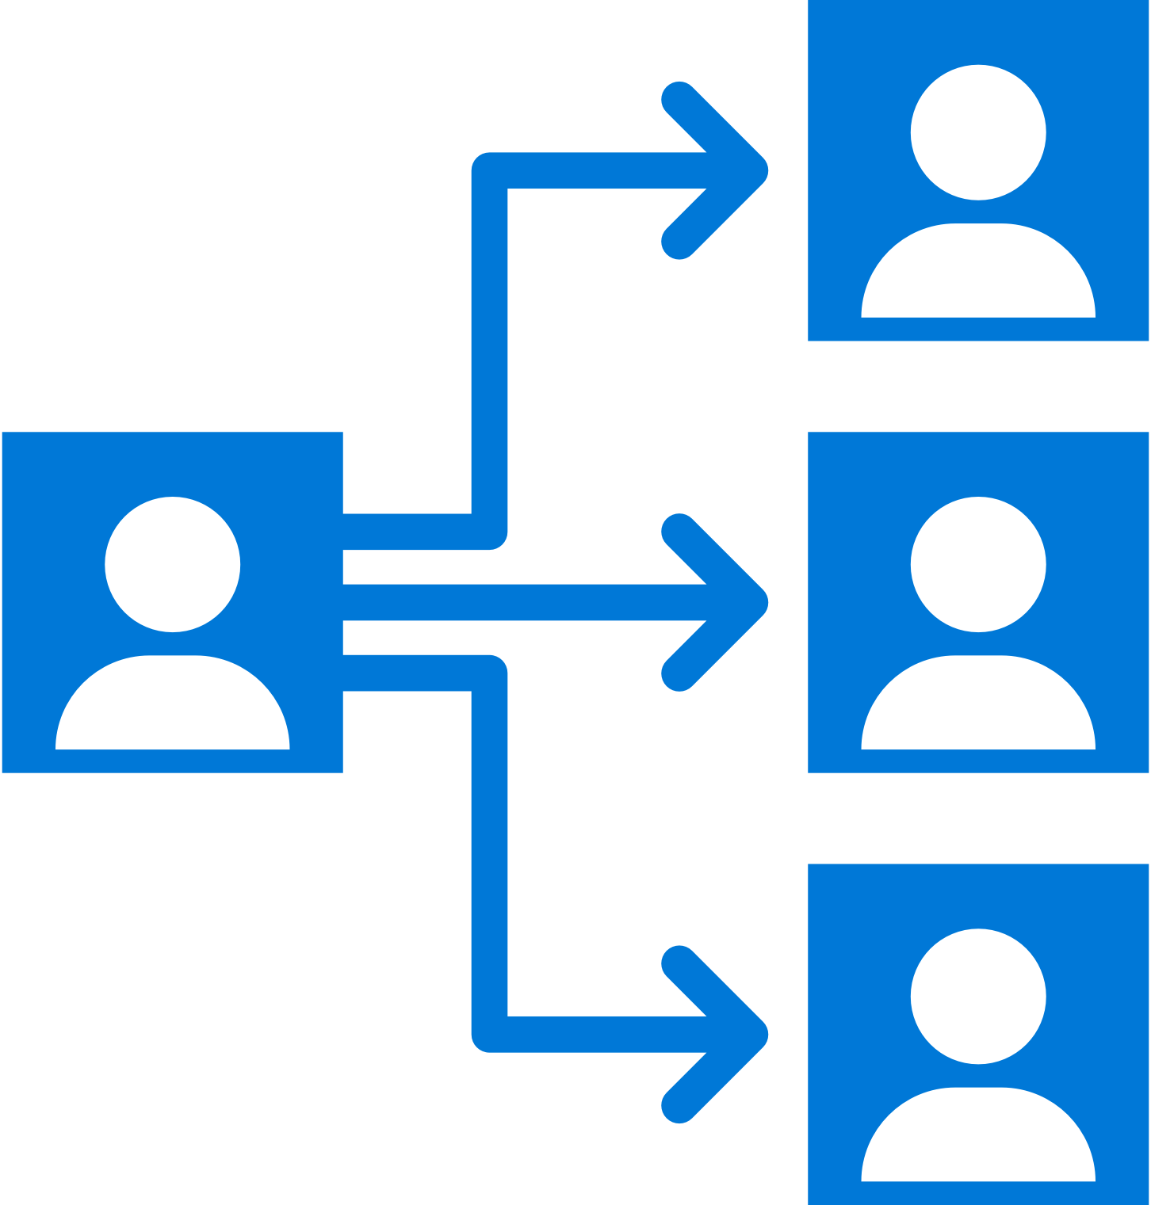

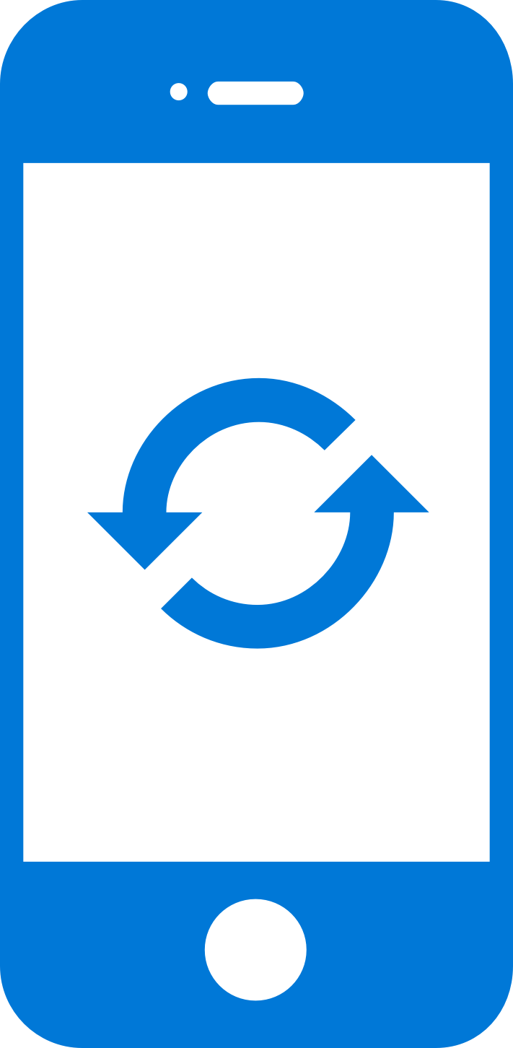
Mobile Center: Distribute
Instantly distribute apps
Quickly get apps in the hands of your beta testers on multiple device platforms
Create targeted distribution groups
With categorized groups of users, send specific builds to specific groups and devices
Send in-app updates
Notify beta testers as soon as a new build is available, right inside the app

Slide 9
Getting Started
Distributing with Mobile Center is easy, and only requires a few steps. No need for an SDK. Just the application binary.
Add users to grant access to all releases.
Create Distribution Groups to manage access.
Upload a new application release.
At the completion of the upload an email will be sent to all users of the app to notify them of the new release.
Install the release onto your device by clicking on the link in the email.
Enable In-App Updates to help your users stay always on the latest release.

Slide 10
Derek Loar App. Innovation Specialist Global Black Belt

Slide 11


Mobile Center: Push Notifications
push
Push notification services
(Apple and Google)
push
push
Notification
Hubs
Visual Studio
Mobile Center
tokens
Notes:
How many of you are involved in mobile app dev?
How many of your apps have push notifications?
Big point of your mobile apps are to engage user and customers. Push notifications helps do that.

Slide 12

Mobile Center: Push Notifications
Fast and easy to setup
Just a few lines of code in your app. No need to specify format for iOS, Android and Windows.
Send to specific audiences
Target push notifications to specific users or devices
Fast and easy to send
Three easy steps: Compose, Target, and Review.
No need for technical skills!
Notes:
Visual Studio Mobile Center Push Notifications is really easy
-Just a few lines of code in your app
-No need to specify format for Android, iOS or Windows
-and I’ll show you how easy it is to target and send notifications to your users
Difference in Push Notifications between Notification Hub and MC

Slide 13
Visual Studio Mobile Center
Sweeky Satpathy
MobCAT Ninja

Slide 14
Importance of Testing
Verify App Integrity
UI loads as expected on different sized screen
App performs as expected on different CPUs
Accessible UI
Features work as per User Flows
Useable Functionality
Testing as part of CI
Reliable Development Cycle

Slide 15



Mobile Center: Test
Release faster
Shrink release times significantly and push new apps out faster
Ship high quality apps Ensure the highest quality user experience that keeps users continuously engaged
Engage a broad audience
Test on a broad range of devices to make sure apps work on your users’ devices
Create new features Spend less time fixing bugs, and more time creating value

Slide 16
Supported Testing Platforms
Xamarin.UITest
Tests written in C#
Supports Xamarin apps, Native (Android, iOS) Apps, React Native Apps, Hybrid Apps
XCUITest
Tests written in Swift
Supports native iOS apps
Espresso
Tests written in Java
Supports native Android apps
Appium
Tests written in Java
Supports native (Android and iOS) apps , Xamarin Apps, React Native Apps, Hybrid Apps

